Slide 1


cs5 black alums ~ re-reunion!
Today!
Tues., Mar. 4 and Tues. Mar. 11, we'll have a reunion of CS5 black: your CS60 will be in Shan 2440.
We'll be there!

Slide 2

Midterm!
Extra: A faster miss?
next time…
I'm aiming to return these post-spring break…

Slide 3

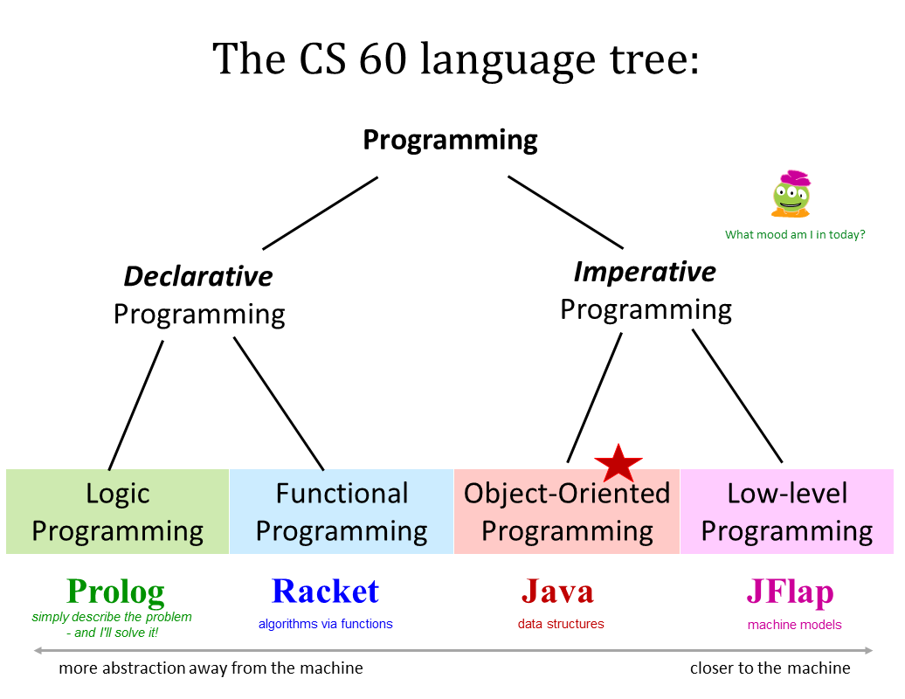
CS 60 today…
Hw #6, due on 3/25!
in Java
Java: the language for data structure(r)s

Slide 4
The assignment operator, =, always does the same thing…
... it copies the VALUE on the right to the LOCATION on the left.
LHS is a LOCATION
p2.x = 42
RHS is a VALUE
that value might be a reference!
Java ~ Data
numbers
42
p2.x
p2 = p1
objects
p2
p1
7
8
x
y

Slide 5
The assignment operator, =, always does the same thing…
... it copies the VALUE on the right to the LOCATION on the left.
LHS is a LOCATION
p2.x = 42
RHS is a VALUE
that value might be a reference!
numbers
42
p2.x
p2 = p1
objects
p2
p1
7
8
x
y

Slide 6
class Point
{
private double x;
private double y;
public Point(double x_in, double y_in)
{
this.x = x_in;
this.y = y_in;
}
public static void main(String[] args)
{
Point p1 = new Point(7, 8);
Point p2 = p1;
p2.x = 42;
System.out.println("p1.x is " + p1.x);
}
p1
STACK
p2
multiple names are possible for the same data ~ aliasing
7
42
8
HEAP
x
y
p1.x is 42

Slide 7
class Point
{
private double x;
private double y;
public Point(double x_in, double y_in)
{
this.x = x_in;
this.y = y_in;
}
public static void main(String[] args)
{
Point p1 = new Point(7, 8);
Point p2 = new Point(7, 8);
if (p1 == p2)
System.out.println("p1 and p2 are equal");
else
System.out.println("p1 and p2 are NOT equal");
System.out.println("p1 is " + p1);
System.out.println("p2 is " + p2);
}
p1
STACK
p2
7
8
x
y
No curlies?
7
8
HEAP
x
y
What will print here?

Slide 8
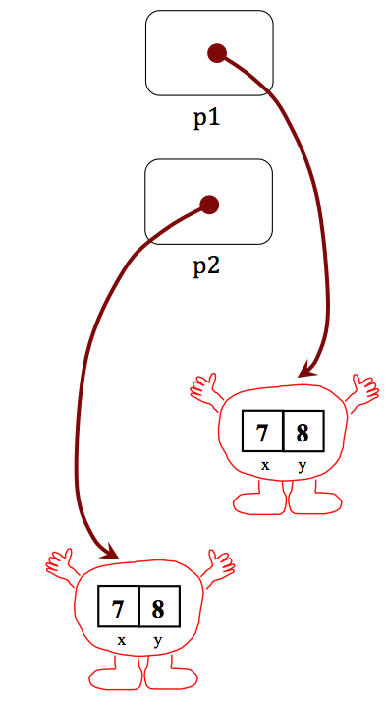
class Point
{
private double x;
private double y;
public Point(double x_in, double y_in)
{
this.x = x_in;
this.y = y_in;
}
public boolean equals( Point p )
{
return (this.x == p.x && this.y == p.y);
}
public String toString()
{
return "(" + x + "," + y + ")";
}
public static void main(String[] args)
{
Point p1 = new Point(7, 8);
Point p2 = new Point(7, 8);
if (p1.equals(p2))
System.out.println("p1 and p2 are equal");
else
System.out.println("p1 and p2 are NOT equal");
System.out.println("p1 is " + p1);
System.out.println("p2 is " + p2);
}
equals
"deep" comparison instead of reference (shallow) comparison
(1) What's this saying?
(3) Does this have anything missing here?
(2) Which Point is p?
here
toString
is called

Slide 9
Destructive vs. Constructive methods in concept
Point P;
P = new Point(84,84);
Point P
P.scaleDest( 0.5 );
// now what's P?
P, before
84
84
x
y

Slide 10
Destructive vs. Constructive methods in concept
Point P;
P = new Point(84,84);
Point Q
Point P
Point Q = P.scale( 0.5 );
// P is unchanged…
// Q is a new Point…
42
42
x
y
P, before and after
84
84
x
y

Slide 11
import static java.lang.Math.*;
class Point
{
private double x;
private double y;
public Point(double x_in, double y_in)
public Point scale( double sf )
{
}
public void scaleDest( double sf )
{
}
public static void main(String[] args)
{
Point p1 = new Point(7, 8);
Point p2 = new Point(4, 4);
Point p3 = p1.scale(2.0); // p3 is the scaled result
p2.scaleDest(10.5); // Where is the result?
// then we might print...
}
}
Destructive vs. Constructive methods in code
Which of these two methods, scale or scaleDest, will need to use the Point constructor?

Slide 12
42
42
x
y
Kool-Aid prefers… ?

Slide 13


Have you noticed that Kool Aid is always SMiley?
Kool-Aid prefers the destructive approach…

Slide 14
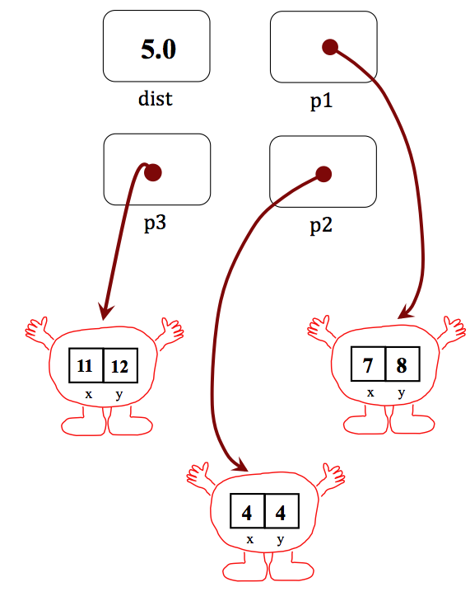
import static java.lang.Math.*;
class Point
{
private double x;
private double y;
public Point add( Point p )
{
}
public void addDest( Point p )
{
}
public double dist( Point p )
{
}
public static void main(String[] args)
{
Point p1 = new Point(7, 8);
Point p2 = new Point(4, 4);
Point p3 = p1.add(p2); // p3 is the sum
double dist = p1.dist(p2); // Euclidean dist.
}
}
Quiz
Name(s) _________________________________
Write 3 Point methods
add, addDest, and dist
Power is pow(b,p); sqrt(x) is also available.
The final picture after main

Slide 15
hw6pr1 (isn't) Complex
Filename:
Complex.java
Data members:
private double real;
private double imag;
Methods:
public Complex( real_in, imag_in )
public Complex( )
public String toString()
public boolean equals(Complex c)
public Complex conjugate()
public void conjugateDest()
public Complex negate()
public void negateDest()
public Complex add(Complex c)
public void addDest(Complex c)
public boolean multiply(Complex c)
This all feels oddly familiar…
public boolean divide(Complex c)

Slide 16
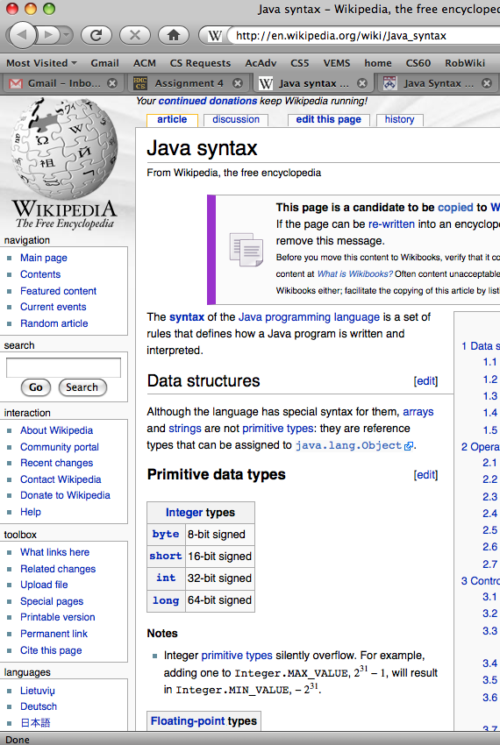
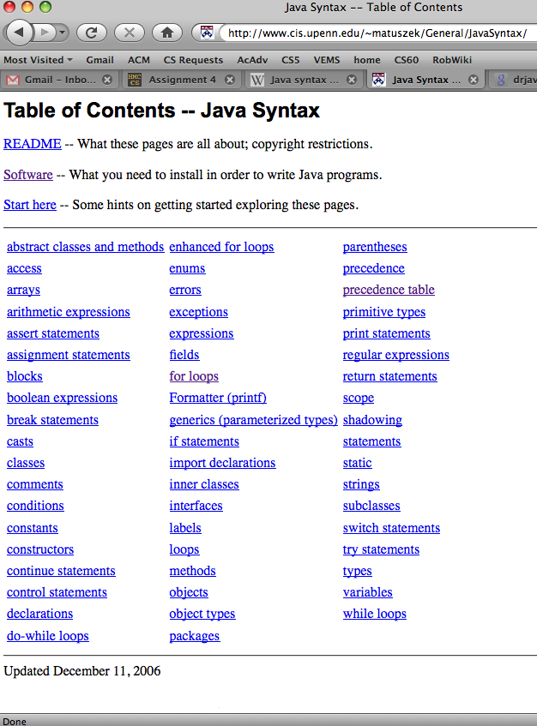
Two good references for looking up Java syntax…
wikipedia, for sure
http://www.cis.upenn.edu/~matuszek/General/JavaSyntax/
for checking out just one thing!

Slide 17
Java structures data
List
ListNode
ListNode
ListNode
"a"
"b"
"c"
null
3
myFirst
myRest
myFirst
myRest
myFirst
myRest
mySize
myHead
List L

Slide 18
Java structures data
List
ListNode
ListNode
ListNode
"a"
"b"
"c"
null
3
myFirst
myRest
myFirst
myRest
myFirst
myRest
mySize
myHead
Singly-linked list data structure
Anything look familiar here?
List L

Slide 19
Java structures data
All objects are handled by reference.
Empty references are null.
List L;
null
List L
I guess this reference is a null space…

Slide 20
Java structures data
List
int
ListNode
0
null
mySize
myHead
List L;
L = new List();
List L

Slide 21
Java structures data
List
ListNode
"c"
null
1
myFirst
myRest
mySize
myHead
List L;
L = new List();
L.addToFront("c");
List L

Slide 22
Java structures data
List
ListNode
ListNode
"b"
"c"
null
2
myFirst
myRest
myFirst
myRest
mySize
myHead
List L;
L = new List();
L.addToFront("c");
List L
L.addToFront("b");

Slide 23
Java structures data
List
ListNode
ListNode
ListNode
"a"
"b"
"c"
null
3
myFirst
myRest
myFirst
myRest
myFirst
myRest
mySize
myHead
List L;
L = new List();
L.addToFront("c");
List L
L.addToFront("b");
L.addToFront("a");

Slide 24
Java structures data
List
ListNode
ListNode
ListNode
"a"
"b"
"c"
null
3
myFirst
myRest
myFirst
myRest
myFirst
myRest
mySize
myHead
Singly-linked list data structure
List L;
L = new List();
List L
L.addToFront("c");
L.addToFront("b");
L.addToFront("a");

Slide 25
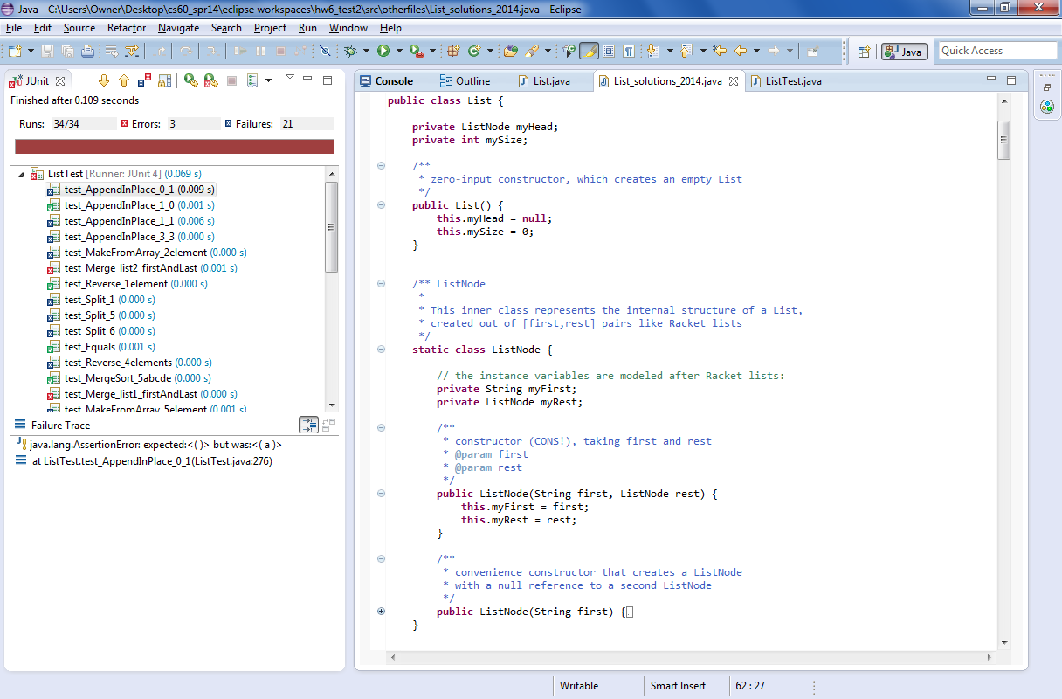
List class
List
ListNode
ListNode
ListNode
"a"
"b"
"c"
int
ListNode
null
3
myFirst
myRest
myFirst
myRest
myFirst
myRest
mySize
myHead

Slide 26
List class
ListNode class
List
ListNode
ListNode
ListNode
"a"
"b"
"c"
null
3
myFirst
myRest
myFirst
myRest
myFirst
myRest
mySize
myHead
!

Slide 27
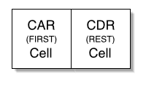
Implementing Racket Lists!
Address part of the Register
Decrement part of the Register
"contents of the address part of the register"
"contents of the decrement part of the register"
Racket/Scheme/Lisp lists are made of cons cells
first
rest
… our ListNode class
originally 15 bits each !
'("c" "s" "60")
two null references
first
rest
first
rest
first
rest
first
rest
car
cdr
car
cdr
car
cdr
car
cdr
"c"
"s"
"60"
are these really Lists at all?
Notes:
I don’t know if this really works...

Slide 28




I'll bet this is car!
Cats car & cdr !
- thanks to Hannah Troisi
Notes:
I don’t know if this really works...

Slide 29
List methods
L.addToFront("a");
List
ListNode
ListNode
"b"
"c"
null
2
myFirst
myRest
myFirst
myRest
before
mySize
myHead
List
ListNode
ListNode
ListNode
"a"
"b"
"c"
null
3
myFirst
myRest
myFirst
myRest
myFirst
myRest
mySize
myHead
after

Slide 30
List methods
L.addToFront("a");
List
ListNode
ListNode
"b"
"c"
null
2
myFirst
myRest
myFirst
myRest
Will addToFront be destructive or constructive for its List object?
before
mySize
myHead
List
ListNode
ListNode
ListNode
"a"
"b"
"c"
null
3
myFirst
myRest
myFirst
myRest
myFirst
myRest
mySize
myHead
after

Slide 31
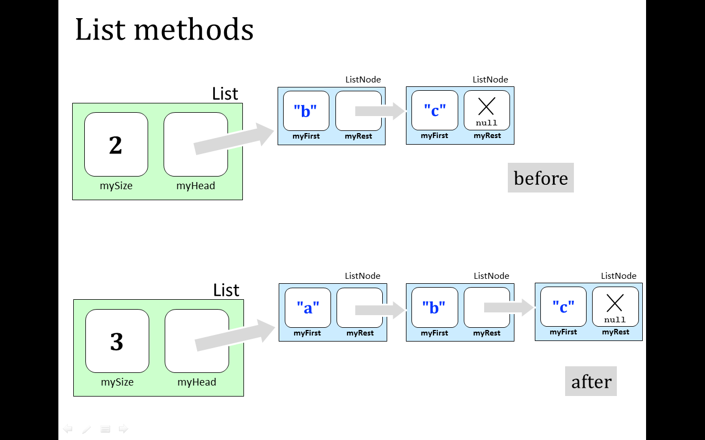
addToFront
L.addToFront("a");
public void addToFront( String str ) {

Slide 32
addToFront
L.addToFront("a");
public void addToFront( String str ) {
ListNode LN = new ListNode( str, null ); // 1
LN.myRest = this.myHead; // 2
this.myHead = LN; // 3
this.mySize += 1; // 4
}
whoa!
public void addToFront( String str ) {
this.myHead = new ListNode( str, myHead ); // 1-3
this.mySize += 1; // 4
same thing:

Slide 33
Overloading…
What might come to mind?

Slide 34

Overloading: HMC
public void addToFront( String str ) {
ListNode LN = new ListNode( str, null ); // 1
LN.myRest = this.myHead; // 2
this.myHead = LN; // 3
this.mySize += 1; // 4
}

Slide 35
Overloading: Java
L.addToFront( LN );
You can have several methods (functions) of the same name as long as they take different types/#s of inputs…
public void addToFront( ListNode LN ) {
order matters here…

Slide 36
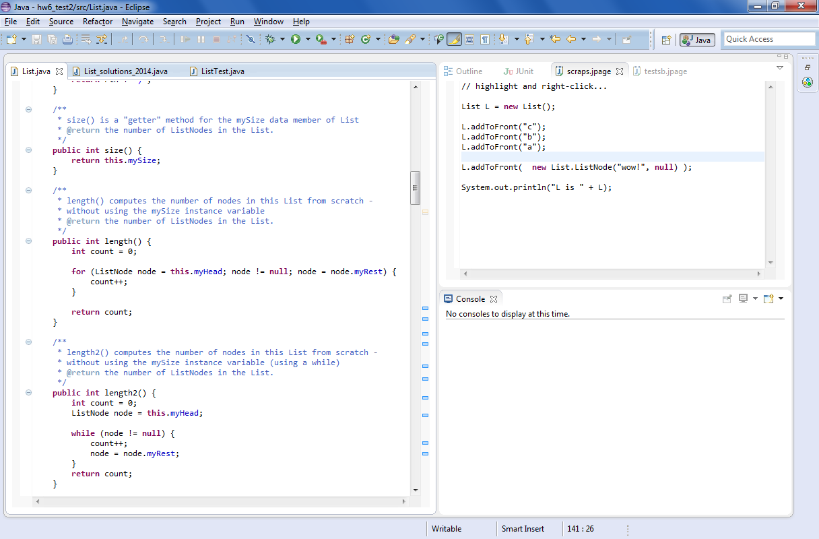
How many?
(3) Loop!!
(4) Update + go back to step 2
(1) Declare + initialize a "runner" variable
(2) Test!
checks the length by actually walking the list

Slide 37
How many?
while loops do the same four things…
(3) Loop!!
(4) Update + go back to step 2
(1) Declare + initialize a "runner" variable
(2) Test!
checks the length by actually walking the list

Slide 38
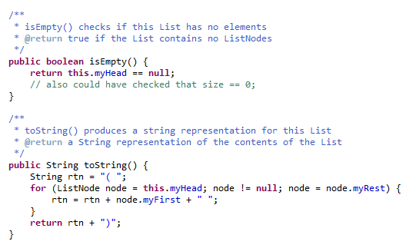
More loops: toString

Slide 39
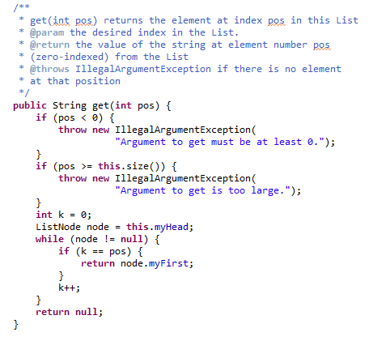
More loops: get
"Big errors" are handled in Java by throwing exceptions
loop until k == pos

Slide 40
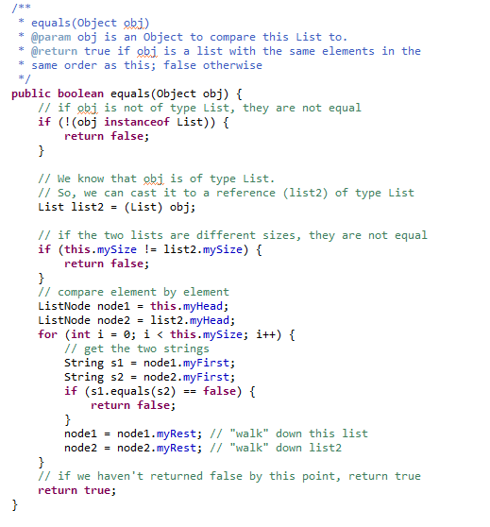
More loops: equals
loop until k == pos

Slide 41
Try it! removeFirst
before
List
ListNode
ListNode
"b"
"c"
null
2
myFirst
myRest
myFirst
myRest
mySize
myHead
L.removeFirst( );
List
ListNode
"c"
1
null
myFirst
myRest
mySize
myHead
after

Slide 42
Try it! removeFirst
public ListNode removeFirst( ) {
(1) Cut the node out and give it a name.
(2) Fix up the List (this object)
(3) Return the node you cut out.
(4) What have we forgotten?!?

Slide 43
Try it! add
before
List
ListNode
ListNode
"b"
"c"
null
2
myFirst
myRest
myFirst
myRest
mySize
myHead
L.add( "d" );
List
ListNode
ListNode
ListNode
"b"
"c"
"d"
null
3
myFirst
myRest
myFirst
myRest
myFirst
myRest
mySize
myHead
after

Slide 44
Try it! add
public void add( String str ) {
(1) handle the empty case
(2) if nonempty, write a loop !
(3) How far should you loop?
(4) What to do at the loop's end?

Slide 45

See you Thursday!
My strategy for making it to Spring Break is Java!

Slide 47
Programming language space
JFLAP
computation
Prolog
Racket
Prolog
Python
Matlab
abstraction axis
Java
C
Java
JFLAP
HWare
Hmmm
task-independent
specificity axis
task-specific
Racket
You'll use at least four programming languages...
the language formerly known as Scheme

Slide 48

All corners of computational space?
Say hello.
Cow
MoO moO MoO mOo MOO OOM MMM moO moO MMM mOo mOo moO MMM mOo MMM moO moO MOO MOo mOo MoO moO moo mOo mOo moo
Fibonacci
Whitespace
Hello world
0 lI'moH A cher
1 lI'moH B cher
A cha' B cha'
18 {
A B boq
latlh
cha'
B "A" cher
"B" cher
} vangqa'
Piet
Var’aq
Fibonacci
Fibonacci
Malbolge
(=<`$9]7<5YXz7wT.3,+O/o'K%$H"'~D|#z@b=`{^Lx8%$Xmrkpohm_Ni;gsedcba`_^]\[ZYXWVUTSRQPONMLKJIHGFEDCBA@?>=<;:9876543s+O<oLm
Hello world
Who are you calling fringe?
Fortunately, CS 60 does NOT goto the fringe of the programming-language universe !

Slide 49
Introducing…
Java
… a data-structuring language
compiled
statically typed
object-oriented
Notes:
I don’t know if this really works...

Slide 50
Objects
"Oh yeah!"
42
42
Data reigns
x
y
a String object…
a Point object…
Java ~ an object-oriented programming language
Classes
input
Methods
Functions
output
Types

Slide 51
Objects
"Oh yeah!"
42
42
Data reigns
x
y
a String object…
a Point object…
In Java, the fundamental activity is designing and creating DATATYPES and DATA (rather than functions)
Classes
input
Methods
Functions
output
Types

Slide 52
Objects
"Oh yeah!"
42
42
Data reigns
x
y
a String object…
a Point object…
In Java, the fundamental activity is designing and creating DATATYPES and DATA (rather than functions)
data are objects
datatypes are classes
Classes
input
Methods
Functions
output
Types

Slide 53
Objects
"Oh yeah!"
42
42
Data reigns
x
y
a Point object…
Let's dive in!
a String object…
In Java, the fundamental activity is designing and creating DATATYPES and DATA (rather than functions)
data are objects
This seems a bit disorganized to be about data organization!
datatypes are classes
Classes
input
Methods
Functions
output
Types

Slide 54
class Point
{
private double x;
private double y;
public Point(double x_in, double y_in)
{
this.x = x_in;
this.y = y_in;
}
public static void main(String[] args)
{
Point p1 = new Point(4, 2);
Point p2 = new Point(0, 42);
System.out.println("Oh yeah!");
}
}
Point p1
Point p2

