Slide 1
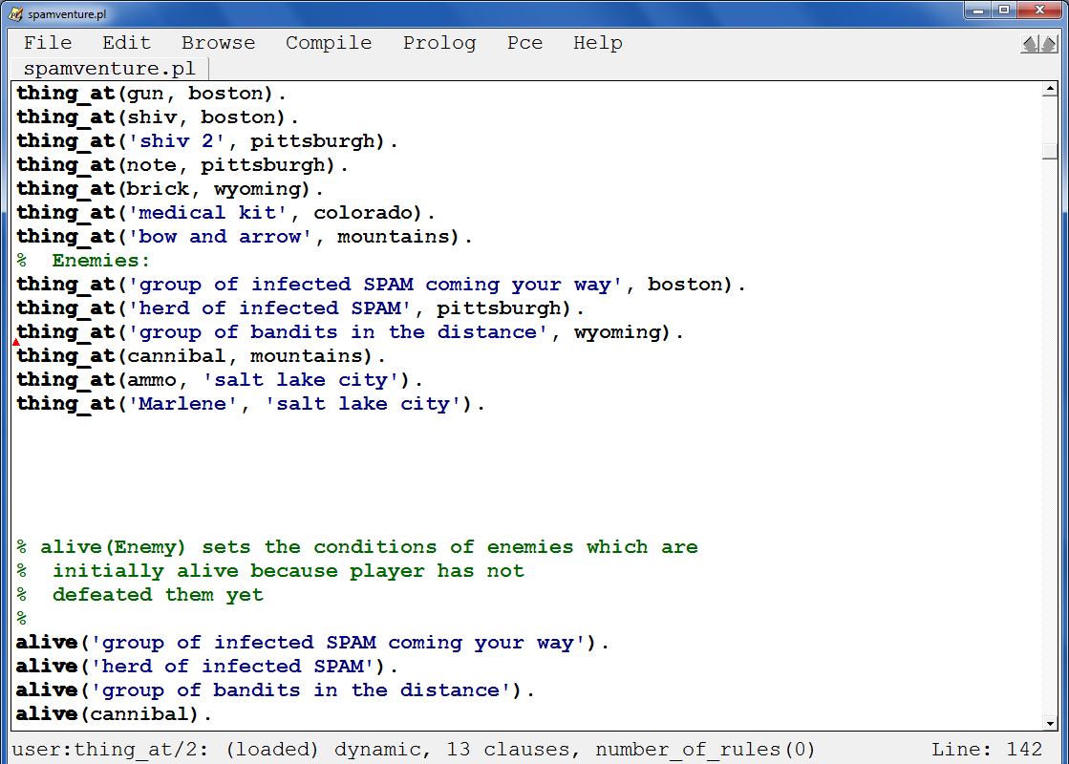


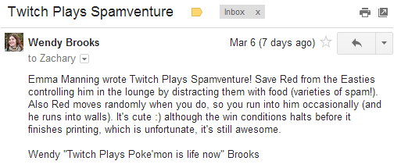
further adventures in cs60 !
mnaval, 859 lines!
msheely, 1432 lines!!
Hw #6 due on 3/25…
Java, from the details to the bigger picture
slam
emanning
after break…
Spamventure! From the details, the big (ASCII) picture

Slide 2
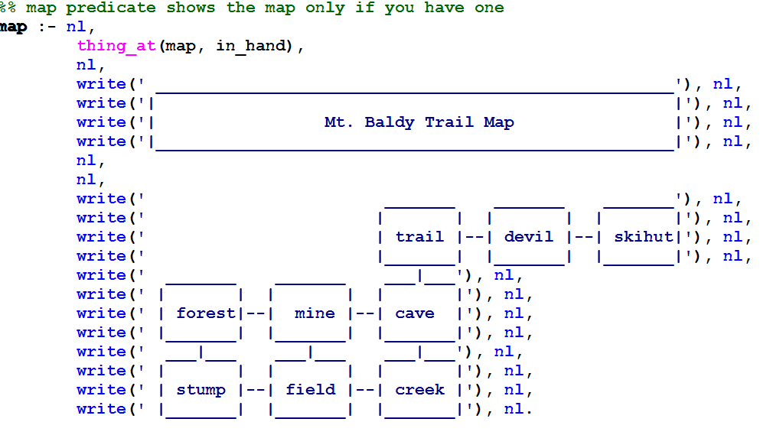
further adventures in cs60 !
mnaval, 859 lines!
msheely, 1432 lines!!
Hw #6 due on 3/25…
Java, from the details to the bigger picture
slam
emanning
after break…

Slide 3

Big Java…

Slide 4
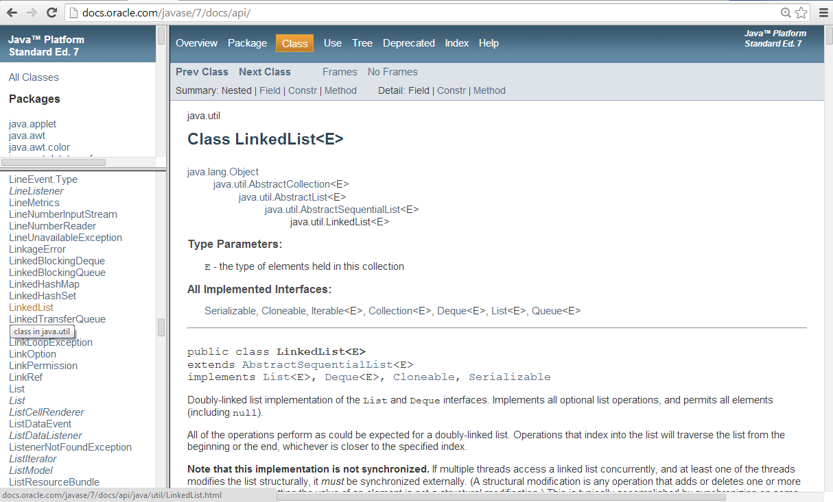
Big Java…
huge libraries of classes (data structures)

Slide 5
Even Math
add Prof. Williams!

Slide 6
Java structures data

Slide 7
Java structures data
List
ListNode
ListNode
ListNode
"a"
"b"
"c"
null
3
myFirst
myRest
myFirst
myRest
myFirst
myRest
mySize
myHead
List L;
L = new List();
L.addToFront("c");
L.addToFront("b");
List L
L.addToFront("a");
Singly-linked list data structure

Slide 8
Java structures data
All objects are handled by reference.
Empty references are null.
List L;
null
List L
I guess this reference is a null space…

Slide 9
Java structures data
List
int
ListNode
0
null
mySize
myHead
List L;
L = new List();
List L

Slide 10
Java structures data
List
ListNode
"c"
null
1
myFirst
myRest
mySize
myHead
List L;
L = new List();
L.addToFront("c");
List L

Slide 11
Java structures data
List
ListNode
ListNode
"b"
"c"
null
2
myFirst
myRest
myFirst
myRest
mySize
myHead
List L;
L = new List();
L.addToFront("c");
List L
L.addToFront("b");

Slide 12
Java structures data
List
ListNode
ListNode
ListNode
"a"
"b"
"c"
null
3
myFirst
myRest
myFirst
myRest
myFirst
myRest
mySize
myHead
List L;
L = new List();
L.addToFront("c");
List L
L.addToFront("b");
L.addToFront("a");

Slide 13
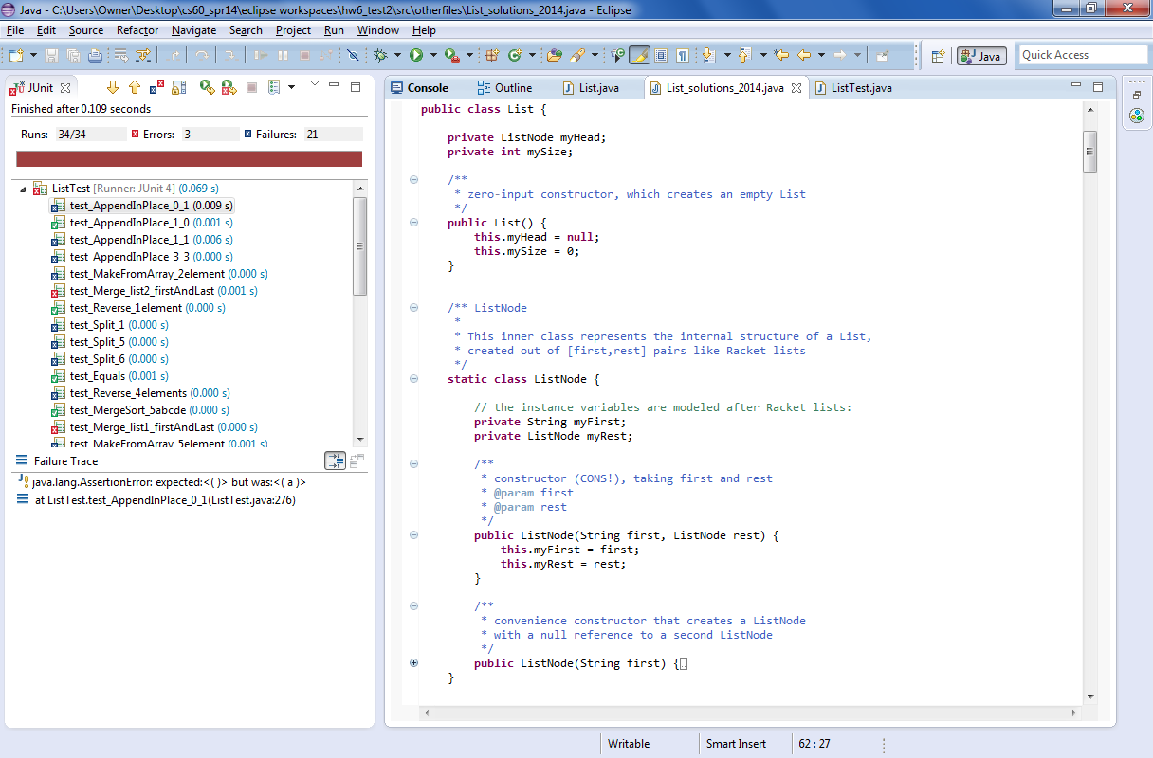
List class
ListNode class
List
ListNode
ListNode
ListNode
"a"
"b"
"c"
null
3
myFirst
myRest
myFirst
myRest
myFirst
myRest
mySize
myHead
!

Slide 14
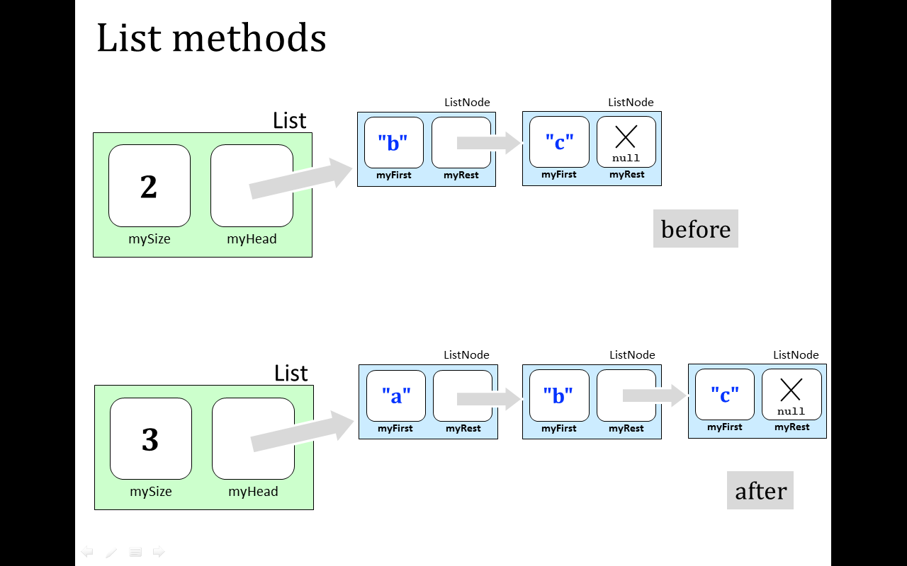
addToFront
L.addToFront("a");
public void addToFront( String str ) {
ListNode LN = new ListNode( str, null ); // 1
LN.myRest = this.myHead; // 2
this.myHead = LN; // 3
this.mySize += 1; // 4
}
whoa!
public void addToFront( String str ) {
this.myHead = new ListNode( str, myHead ); // 1-3
this.mySize += 1; // 4
same thing:

Slide 15
removeFirst
before
List
ListNode
ListNode
List
int
ListNode
"b"
"c"
null
2
myFirst
myRest
myFirst
myRest
L
mySize
myHead
(before)
L.removeFirst( );
after

Slide 16
removeFirst
before
List
ListNode
ListNode
List
int
ListNode
"b"
"c"
null
2
myFirst
myRest
myFirst
myRest
L
mySize
myHead
(before)
L.removeFirst( );
after
List
ListNode
List
int
ListNode
"c"
1
null
myFirst
myRest
L
?
mySize
myHead
(after)
return value:

Slide 17
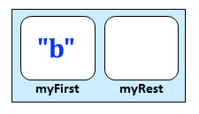
removeFirst
before
List
ListNode
ListNode
List
int
ListNode
"b"
"c"
null
2
myFirst
myRest
myFirst
myRest
L
mySize
myHead
(before)
L.removeFirst( );
after
List
ListNode
List
int
ListNode
"c"
1
null
myFirst
myRest
L
mySize
myHead
(after)
return value:

Slide 18
Quiz
Write the removeFirst method…
Name(s): ________________________
public ListNode removeFirst( ) {
ListNode result =
if
return result; }
(1) What is the result?
(2) We need an if – why?!
(3) Fix the list up …
(4) Return.
Step (3) is one to remember!

Slide 19
Quiz
Write the removeFirst method…
Try this on the back page first…
public ListNode removeFirst( ) {
ListNode result =
return result; }
(1) Cut the node out and give it a name.
(2) "Fix up" the List (this object)
(3) What have we forgotten?!
(…) Return the node you cut out.
Step (3) is one to remember!

Slide 20
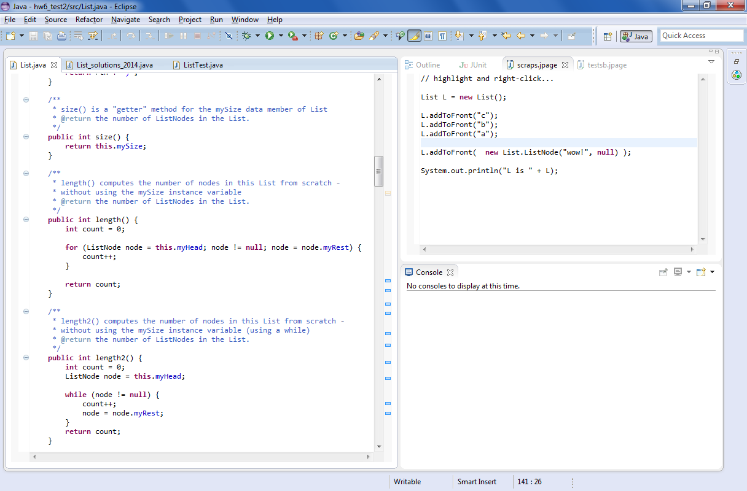
How many?
Why have both the mySize field and a length() method?

Slide 21
How many?
for loop!
(3) Loop body!
(4) Update + go back to step 2
(1) Declare + initialize a "runner" variable
(2) Test!
checks the length by actually walking the list

Slide 22
How many?
while loops do the same four things…
(3) Loop body!
(4) Update + go back to step 2
(1) Declare + initialize a "runner" variable
(2) Test!
checks the length by actually walking the list

Slide 23
List
this
Walking the list…
(1) Declare + initialize a "runner" variable
(2) Test!
(3) Loop body!
(4) Update + go back to step 2

Slide 24
List
this
int
ListNode
0
count
node
(1) Declare + initialize a "runner" variable
(2) Test!
(3) Loop body!
(4) Update + go back to step 2
Heap vs. stack ?
What is node pointing to??

Slide 25
List
this
int
ListNode
0
count
node
(1) Declare + initialize a "runner" variable
(2) Test!
(3) Loop body!
(4) Update + go back to step 2

Slide 26
List
this
int
ListNode
1
count
node
(1) Declare + initialize a "runner" variable
(2) Test!
(3) Loop body!
(4) Update + go back to step 2

Slide 27
List
this
int
ListNode
1
count
node
(1) Declare + initialize a "runner" variable
(2) Test!
(3) Loop body!
(4) Update + go back to step 2
What is node now pointing to??

Slide 28
List
this
int
ListNode
1
count
node
(1) Declare + initialize a "runner" variable
(2) Test!
(3) Loop body!
(4) Update + go back to step 2

Slide 29
List
this
int
ListNode
2
count
node
(1) Declare + initialize a "runner" variable
(2) Test!
(3) Loop body!
(4) Update + go back to step 2

Slide 30
List
this
int
ListNode
2
count
node
(1) Declare + initialize a "runner" variable
(2) Test!
(3) Loop body!
(4) Update + go back to step 2

Slide 31
List
this
int
ListNode
2
count
node
(1) Declare + initialize a "runner" variable
(2) Test!
(3) Loop body!
(4) Update + go back to step 2

Slide 32
List
this
int
ListNode
3
count
node
(1) Declare + initialize a "runner" variable
(2) Test!
(3) Loop body!
(4) Update + go back to step 2

Slide 33
List
this
int
ListNode
3
count
node
What will node now point to??
(1) Declare + initialize a "runner" variable
(2) Test!
(3) Loop body!
(4) Update + go back to step 2

Slide 34
List
this
int
ListNode
3
null
count
node
Nothing!
(1) Declare + initialize a "runner" variable
(2) Test!
(3) Loop body!
(4) Update + go back to step 2
the loop exits, returning count…

Slide 35
List
this
Walking the list…
too slow!
(1) Declare + initialize a "runner" variable
(2) Test!
(3) Loop body!
(4) Update + go back to step 2

Slide 36
List
this
Walking the list…
Sprinting
(1) Declare + initialize a "runner" variable
(2) Test!
(3) Loop body!
(4) Update + go back to step 2

Slide 37
List
this
int
ListNode
0
count
node
(1) Declare + initialize a "runner" variable
(2) Test!
(3) Loop body!
(4) Update + go back to step 2

Slide 38
List
this
int
ListNode
0
count
node
(1) Declare + initialize a "runner" variable
(2) Test!
(3) Loop body!
(4) Update + go back to step 2

Slide 39
List
this
int
ListNode
1
count
node
(1) Declare + initialize a "runner" variable
(2) Test!
(3) Loop body!
(4) Update + go back to step 2

Slide 40
List
this
int
ListNode
1
count
node
(1) Declare + initialize a "runner" variable
(2) Test!
(3) Loop body!
(4) Update + go back to step 2

Slide 41
List
this
int
ListNode
1
count
node
(1) Declare + initialize a "runner" variable
(2) Test!
(3) Loop body!
(4) Update + go back to step 2

Slide 42
List
this
int
ListNode
2
count
node
(1) Declare + initialize a "runner" variable
(2) Test!
(3) Loop body!
(4) Update + go back to step 2

Slide 43
List
this
int
ListNode
2
count
node
(1) Declare + initialize a "runner" variable
(2) Test!
(3) Loop body!
(4) Update + go back to step 2

Slide 44
List
this
int
ListNode
2
count
node
(1) Declare + initialize a "runner" variable
(2) Test!
(3) Loop body!
(4) Update + go back to step 2

Slide 45
List
this
int
ListNode
3
count
node
(1) Declare + initialize a "runner" variable
(2) Test!
(3) Loop body!
(4) Update + go back to step 2

Slide 46
List
this
int
ListNode
3
null
count
node
Done!
(1) Declare + initialize a "runner" variable
(2) Test!
(3) Loop body!
(4) Update + go back to step 2
the loop exits, returning count…

Slide 47
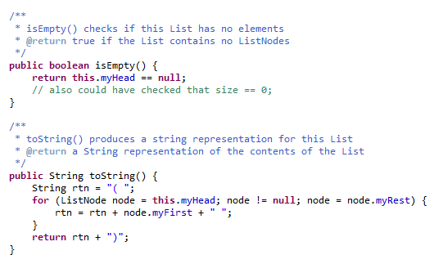
More loops: toString
Racket style!

Slide 48
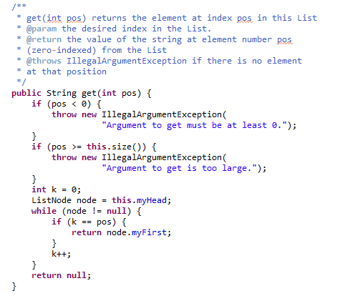
More loops: get
"Big errors" are handled in Java by throwing exceptions
loops until k == pos

Slide 49
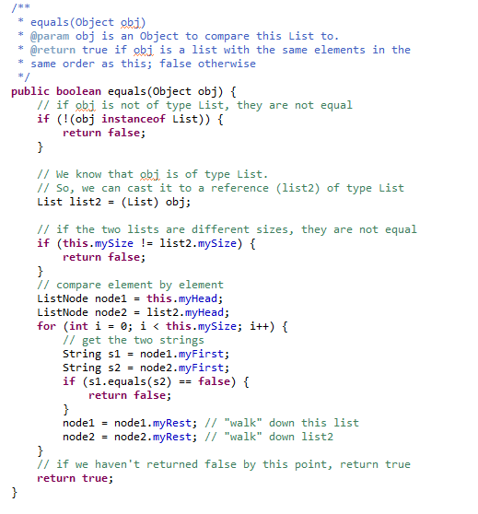
More loops: equals
loops for the full list

Slide 50
add
adds to the end of the List…
before
List
ListNode
ListNode
"b"
"c"
null
2
myFirst
myRest
myFirst
myRest
mySize
myHead
L.add( "d" );

Slide 51
add
adds to the end of the List…
before
List
ListNode
ListNode
"b"
"c"
null
2
myFirst
myRest
myFirst
myRest
mySize
myHead
L.add( "d" );
List
ListNode
ListNode
ListNode
"b"
"c"
"d"
null
3
myFirst
myRest
myFirst
myRest
myFirst
myRest
mySize
myHead
after

Slide 52
Try it! add
public void add( String str ) {
ListNode LN = new ListNode( , );
}
(0) Make a new ListNode
(1) Handle the empty case
(2) If nonempty, write a loop !
(3) How far to loop?
(4) and when the loop ends…?

Slide 53
"Base Case"
List
List
before
0
null
this
mySize
myHead
L.add( "b" );
ListNode
after
List
List
"b"
null
1
myFirst
myRest
this
mySize
myHead

Slide 54
Try it!
Write the add method, which adds a new ListNode at the end.
public void add( String str ) {
ListNode end = new ListNode( , );
if (this.myHead == null) {
} else {
}
(0) Make a new ListNode
(1) Handle the empty case
(2) If nonempty, write a loop !
(3) How far to loop?
(4) and when the loop ends…?

Slide 55
List
this
ListNode
Our example while loop…
node
(1) You need a different test!
(2) What do you need in the loop and after it?

Slide 56
Try it!
Write the add method, which adds a new ListNode at the end.
public void add( String str ) {
ListNode end = new ListNode( str , null );
if (this.myHead == null) {
this.myHead = end;
} else {
ListNode node = this.myHead;
while (node.myRest != null) {
node = node.myRest;
}
node.myRest = end;
}
this.mySize += 1;
}
(0) Make a new ListNode
(1) Handle the empty case
(2) If nonempty, write a loop !
(3) Loop until
node.myRest == null
(4) Add end at end of loop.
(5) Don't forget!

Slide 57
Lists vs. Arrays…
List L
ListNode
ListNode
ListNode
"b"
"c"
"d"
null
3
myFirst
myRest
myFirst
myRest
myFirst
myRest
mySize
myHead
List
L

Slide 58
Lists vs. Arrays…
List L
ListNode
ListNode
ListNode
"b"
"c"
"d"
null
3
myFirst
myRest
myFirst
myRest
myFirst
myRest
mySize
myHead
List
L
Array
String[] A
a single, set length
1 type of element
indexing ~ Python
no built-in slicing
traverse with loops…
3
"b"
"c"
"d"
length
A[0]
A[1]
A[2]
A
We should end with Arrays' upside…

Slide 59
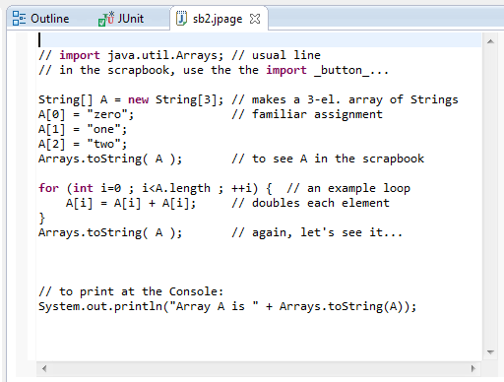
Lists vs. Arrays…
Let's scrapbook it!
I cherish my Java!

Slide 60
other methods in hw6pr2
( "d" "b" "e" "c" "a" )
split
( "d" "b" "e" )
( "c" "a" )
( "b" "d" "e" )
( "a" "c" )
merge
( "a" "b" "c" "d" "e" )

Slide 61
Mergesort!
( "d" "b" "e" "c" "a" )
split
( "d" "b" "e" )
( "c" "a" )
What has to happen within these pink arrows?
( "b" "d" "e" )
( "a" "c" )
merge
( "a" "b" "c" "d" "e" )

Slide 62
Mergesort!
( "d" "b" "e" "c" "a" )
split
( "d" "b" "e" )
( "c" "a" )
mergesort
mergesort
( "b" "d" "e" )
( "a" "c" )
merge
( "a" "b" "c" "d" "e" )

Slide 63
After break?
Java
Data-structuring details
Java
Applications
plus, lots more data-structuring details

Slide 64

Prof Lewis!
The week after spring break…
Pixels!

Slide 65

Have a great spring break!
My plans are for maximum Java!

