Slide 1

Take your midterm today!
Notes:
in the small … in the large!
gathering storm – assignment # 7

Slide 2
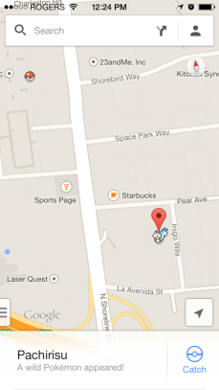
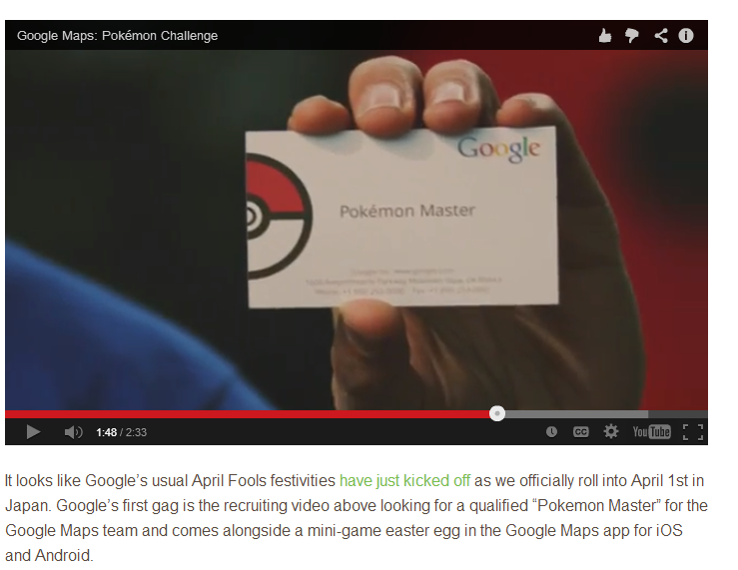
Take your midterm today!
gotta catch 'em all!
Notes:
in the small … in the large!
gathering storm – assignment # 7

Slide 3

Today (and beyond…) in CS 60
Java, Fast
SeamCarving (hw7) due tonight (4/1)
"Algorithmic Engineering"
this week:
BSTNode
fast data structure
memoization
fast alg. design
Dynamic Programming
next week:
fastest-possible algorithms?
homework #8 due next Tuesday night (4/8)
then
fastest-possible computations!
Notes:
in the small … in the large!
gathering storm – assignment # 7

Slide 4
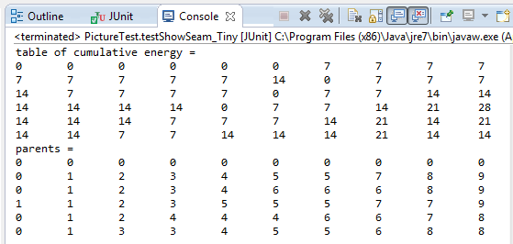
Include these statements in your seam-finding code:
Analyzing seam…
System.out.println("table of cumulative energy = ");
this.printArray( T );
System.out.println("parents = ");
this.printArray( P );
Then, make sure your arrays match these:
Notes:
in the small … in the large!
gathering storm – assignment # 7

Slide 5
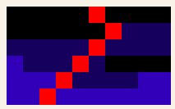
Tiny
Where's the seam ??
Notes:
in the small … in the large!
gathering storm – assignment # 7

Slide 6
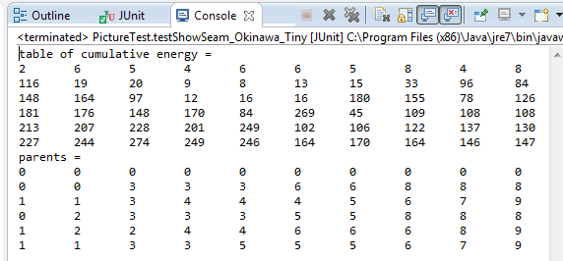
Include these statements in your seam-finding code:
Analyzing seam…
System.out.println("table of cumulative energy = ");
this.printArray( T );
System.out.println("parents = ");
this.printArray( P );
Then, make sure your arrays match these:
Where's the seam ??
Notes:
in the small … in the large!
gathering storm – assignment # 7

Slide 7

Okinawa (tiny)
If these work, they all should…
Notes:
in the small … in the large!
gathering storm – assignment # 7

Slide 8

CS 60 midterm exam…
Do not share these solutions outside of this term's CS 60…
our enforcer…

Slide 9
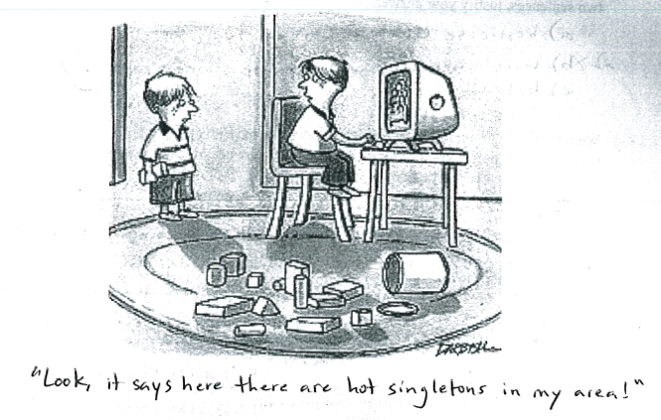
Problem 4: binary search trees in Prolog
findmin( [Rt, [], R], Rt ).
Part (a): singletons!
findmin( [Rt, L, R], M ) :-
findmin( L, MinL ), M = MinL.
Notes:
Zachary Quinto -- Spock

Slide 10
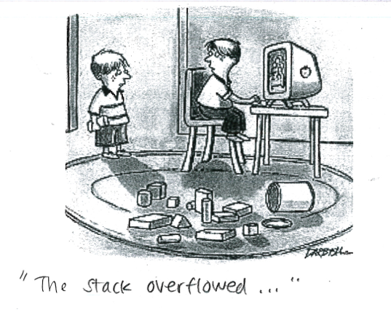
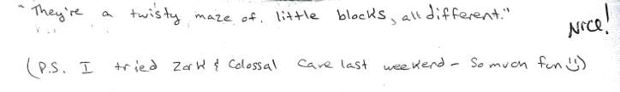
Beyond the exam itself… things get weird
Notes:
Zachary Quinto -- Spock

Slide 11
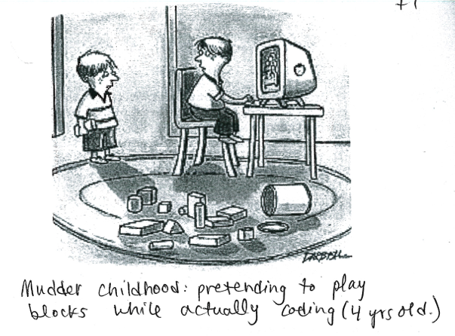
Beyond the exam itself… things get weird
Notes:
Zachary Quinto -- Spock

Slide 12
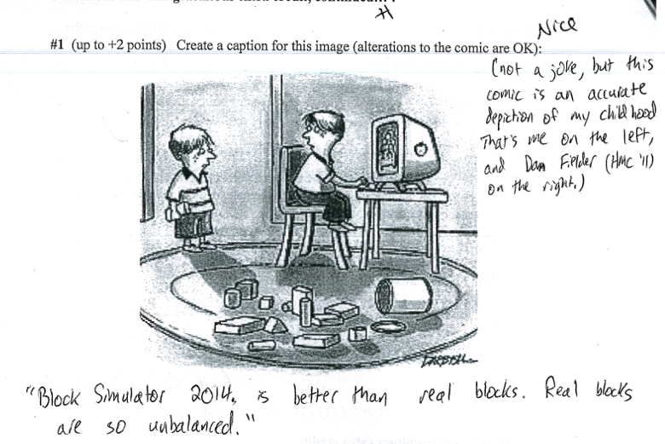
Beyond the exam itself… things get weird
Notes:
Zachary Quinto -- Spock

Slide 13
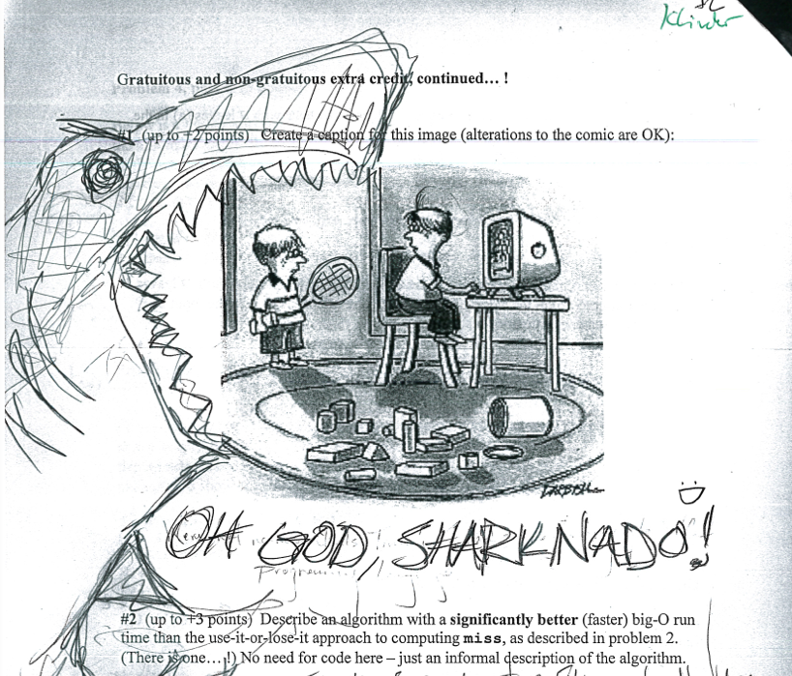
Beyond the exam itself… things get weird
Notes:
Zachary Quinto -- Spock

Slide 14
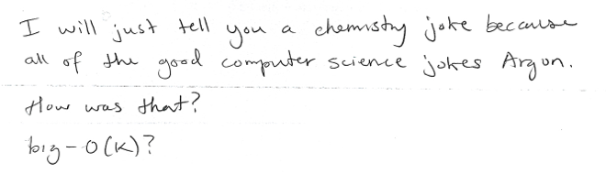
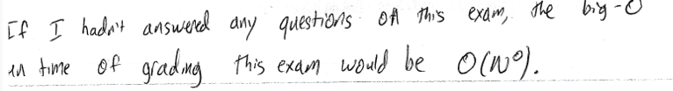
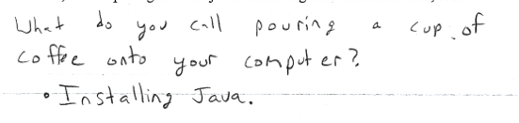
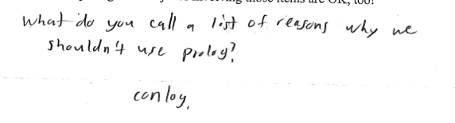
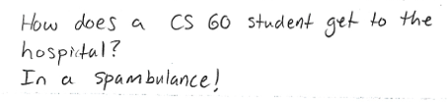
Beyond the exam itself… things get weird
Notes:
Zachary Quinto -- Spock

Slide 15
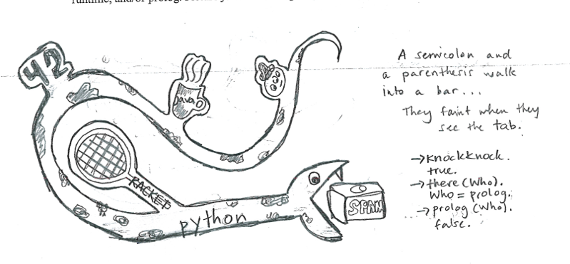
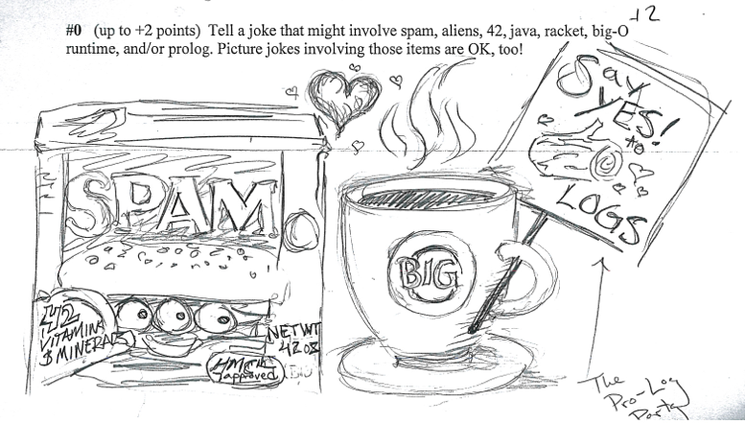
Notes:
Zachary Quinto -- Spock

Slide 16
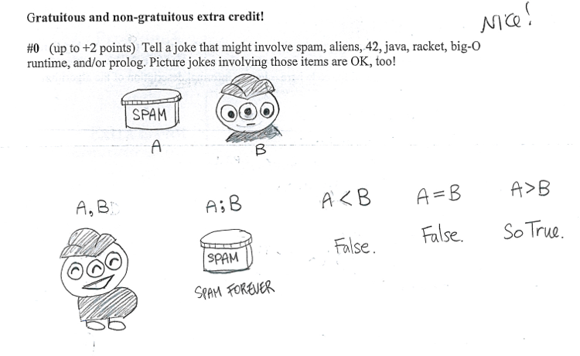
Notes:
Zachary Quinto -- Spock

Slide 17
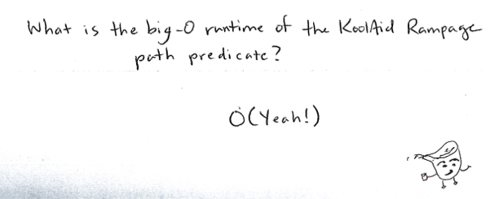
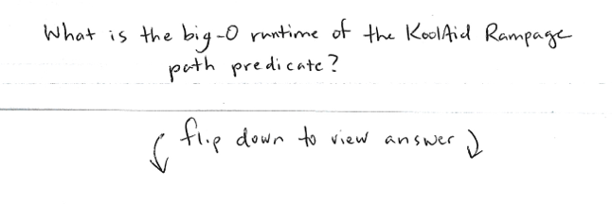
Beyond the exam itself… things get weird
Notes:
Zachary Quinto -- Spock

Slide 18
Beyond the exam itself… things get weird
Notes:
Zachary Quinto -- Spock

Slide 19
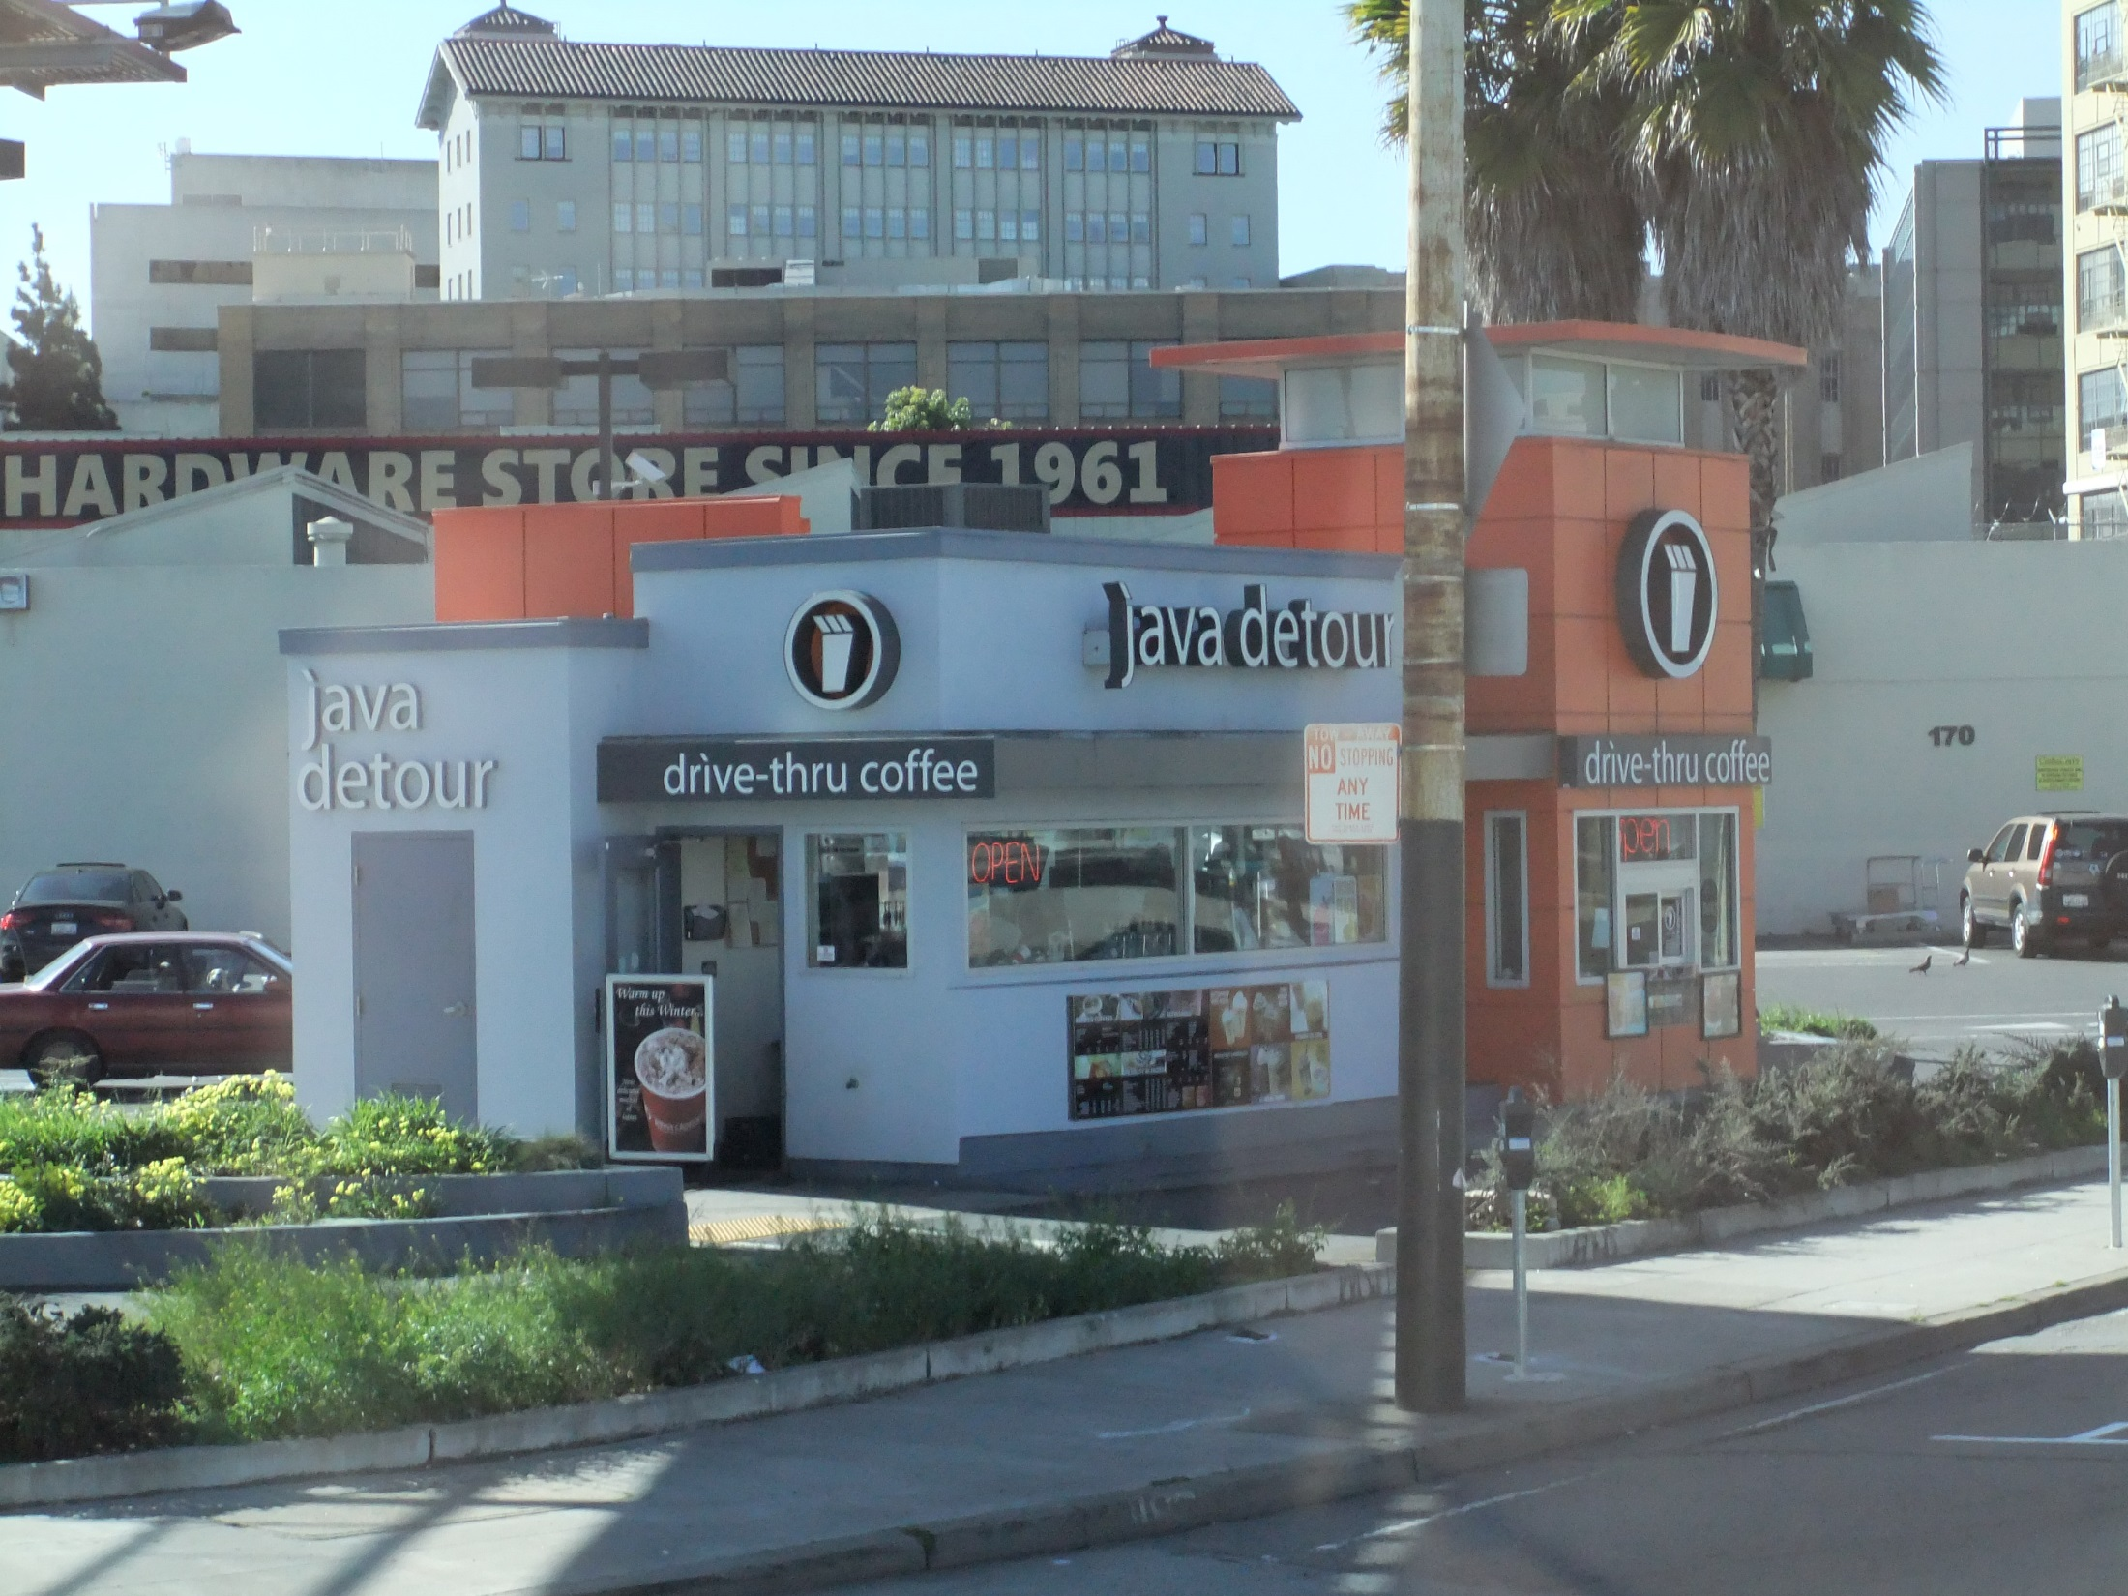
This week's theme: fast Java!
Note that in this context fast and caffeinated can be used interchangeably…
A Java detour! Thanks, Yvonne!
Notes:
Zachary Quinto -- Spock

Slide 20

All Java objects are of type Object!
the instanceof operator can check this…
I object! This is obvious!
Object
and a cast of thousands!
String
List
BSTNode
Picture
Pixel
int
double
char
boolean
Even built-in types are OK with this! There are intermediary classes being used in this case: Integer, Character, Boolean, Double, ...!

Slide 21



Privacy
Access to data and methods is controlled via four options:
public
private
accessible to any class (the outside world)
accessible ONLY in the defining class
a class
typical of methods
typical of data
methods
an object
data
protected
(package)
accessible to any class derived from the defining class
accessible to any class in the package
(same directory)

Slide 22
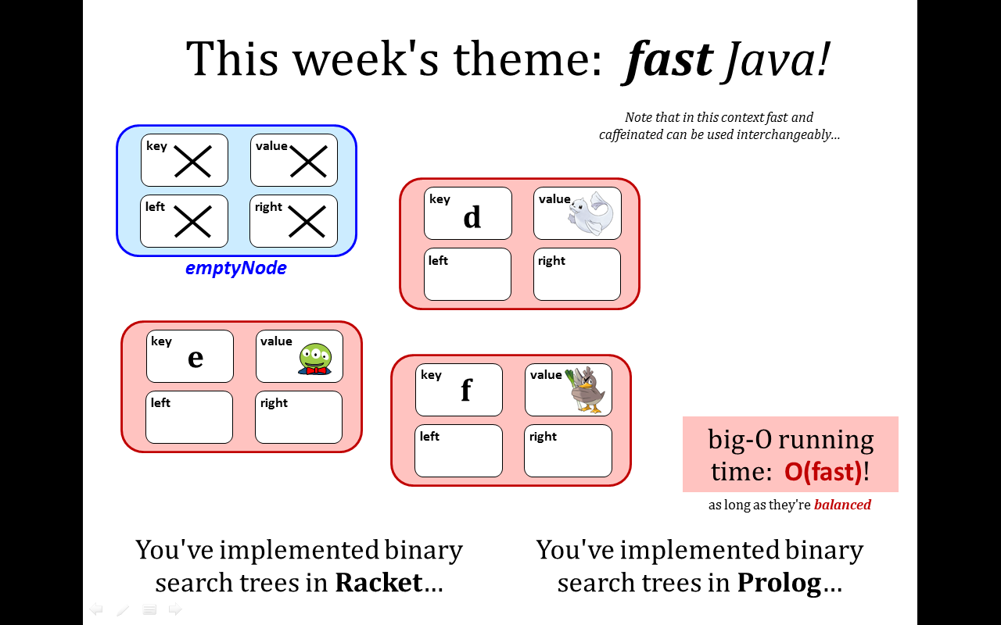
BSTNode, in code + pictures
key
a
value
class BSTNode
{
private String key;
private Object value;
private BSTNode left;
private BSTNode right;
public static BSTNode emptyNode = …
public BSTNode(String k, Object v) {
this.key = k; this.value = v;
}
left
right

Slide 23
BSTNode, in code + pictures
key
a
value
class BSTNode
{
private String key;
private Object value;
private BSTNode left;
private BSTNode right;
public static BSTNode emptyNode = …
public BSTNode(String k, Object v) {
this.key = k; this.value = v;
}
left
right

Slide 24




BSTNode ~ just pictures
key
b
value
How many BSTNodes are contained within this overall BST?
left
right
key
a
value
key
d
value
left
right
left
right
key
c
value
key
f
value
left
right
left
right
See any potential problems with all of these leaf nodes (empty nodes)?!?

Slide 25
BSTNode ~ just code
Lots of examples of object-owned (nonstatic) data. Each object has its own ~ also: instance data
class BSTNode
{
private String key;
private Object value;
private BSTNode left;
private BSTNode right;
public static BSTNode emptyNode =
new BSTNode(null,null);
public BSTNode(String k, Object v) {
…
An example of class-owned (static) data. The class owns one; there is only one.

Slide 26
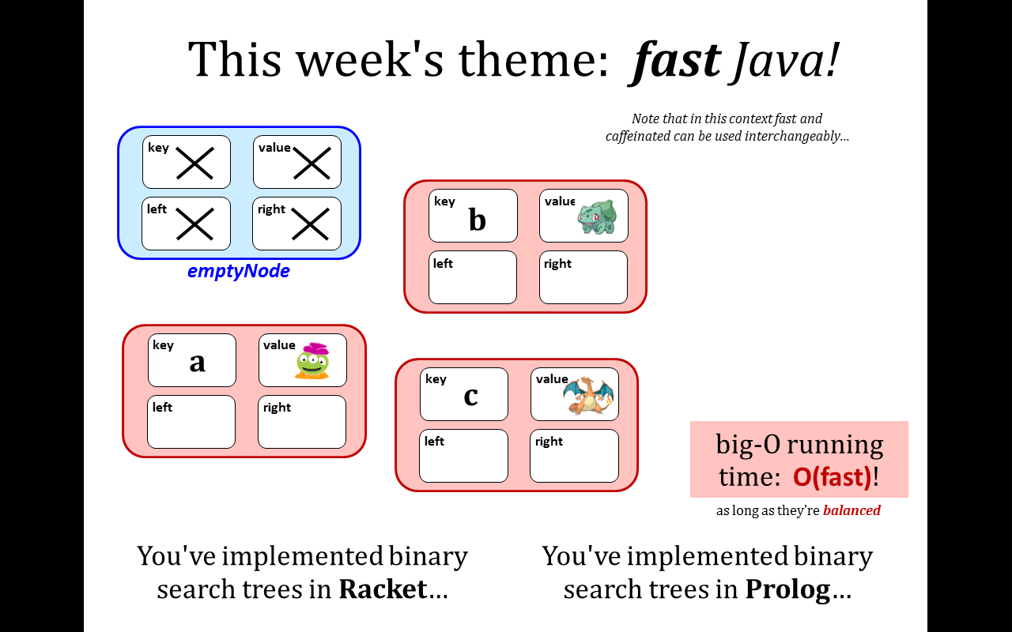
Lots of examples of object-owned (nonstatic) data. Each object has its own ~ also: instance data
class BSTNode
{
private String key;
private Object value;
private BSTNode left;
private BSTNode right;
public static BSTNode emptyNode =
new BSTNode(null,null);
public BSTNode(String k, Object v) {
…
An example of class-owned (static) data. The class owns one; there is only one.

Slide 27
BSTNode ~ conceptually
Each of the references is a memory address.
What would this be if more "memory-accurate"?
key
b
value
left
right
key
a
value
key
d
value
left
right
left
right
key
c
value
key
f
value
left
right
left
right

Slide 28
BSTNode ~ conceptually
Each of the references is a memory address.
What would this be if more "memory-accurate"?
key
b
value
left
right
key
a
value
key
d
value
left
right
left
right
key
c
value
key
f
value
left
right
left
right
They're all the same (identical) object in memory!

Slide 29


Wayne Static of Static-X
danger: static !

Slide 30
static
vs.
(nonstatic)
One copy, owned by the CLASS.
A separate copy for each OBJECT.
The pixels of a Picture
The value PI
The size of a List
The Color pink
The tangent function
The isEmpty function for BSTs
Are these static or nonstatic?

Slide 31
static
vs.
(nonstatic)
One copy, owned by the CLASS.
A separate copy for each OBJECT.
The pixels of a Picture
The value PI
The size of a List
The Color pink
The tangent function
The isEmpty function for BSTs
Are these static or nonstatic?

Slide 32
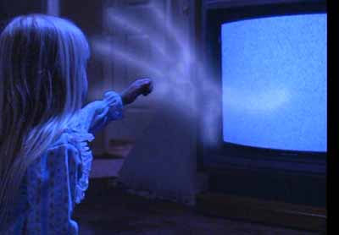
danger: static methods!

Slide 33
static
(nonstatic)
One copy, owned by the CLASS.
A separate copy for each OBJECT.
true for both data members and for methods/functions !
BSTNode N = …
BSTNode N = …
if (BSTNode.isEmpty( N )) {
if (N.isEmpty( )) {
called by the class
called by an object
static methods don't
have a this
they have an extra input instead
nonstatic methods do
have a this object

Slide 34
Static vs. nonstatic methods…
static boolean isEmpty(BSTNode N) {
return N == emptyList;
}
boolean isEmpty( ) {
return this == emptyList;
}

Slide 35
What if you already had the static version?
static boolean isEmpty(BSTNode N) {
return N == emptyList;
}
boolean isEmpty( ) {
}
and you wanted the nonstatic?

Slide 36
What if you already had the nonstatic version?
static boolean isEmpty(BSTNode N) {
}
boolean isEmpty( ) {
return this == emptyList;
}
and you wanted the static?

Slide 37
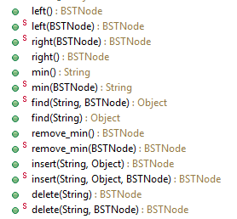
hw8pr1: BSTNode in Java…
one of each of these pairs is needed… and
these four are needed…

Slide 38
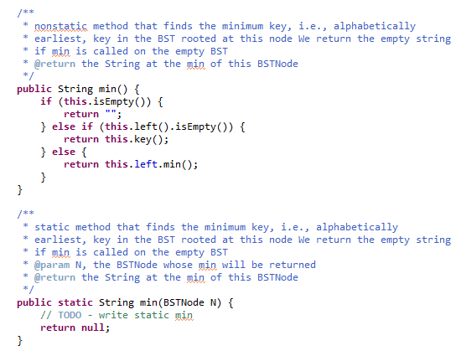
min() is
provided…

Slide 39
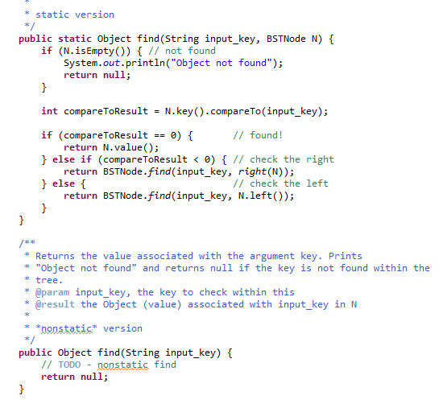
find() is
provided…
?

Slide 40
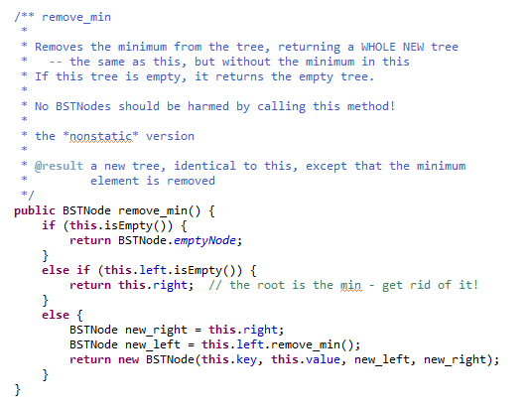
Quiz
Name(s) _____________
Write this version of remove_min
Extra! Which version is this? Can you write the other version – using this one – in the space @ right?
Notes:
in the small … in the large!
gathering storm – assignment # 7

Slide 41
Quiz
Try this on the back first…
Write this version of remove_min
Extra! Which version is this? Can you write the other version – using this one – in the space @ right?
Notes:
in the small … in the large!
gathering storm – assignment # 7

Slide 42
Quiz
Solution (in file)
Write this version of remove_min
Extra! Which version is this? Can you write the other version – using this one – in the space @ right?
Notes:
in the small … in the large!
gathering storm – assignment # 7

Slide 43
Goings-on…
Notes:
in the small … in the large!
gathering storm – assignment # 7

Slide 44
public String min()
{
if (isEmpty(this)) {
} else if (this.left.isEmpty()) {
} else {
}
}
get a copy

Slide 45
This week's theme: fast Java!
Note that in this context fast and caffeinated can be used interchangeably…
key
value
left
right
key
b
value
emptyNode
left
right
key
a
value
key
c
value
left
right
left
right
big-O running time: O(fast)!
as long as they're balanced
You've implemented binary search trees in Racket…
You've implemented binary search trees in Prolog…
Notes:
Zachary Quinto -- Spock

Slide 46
This week's theme: fast Java!
Note that in this context fast and caffeinated can be used interchangeably…
key
value
left
right
key
d
value
emptyNode
left
right
key
e
value
key
f
value
left
right
left
right
You've implemented binary search trees in Racket…
You've implemented binary search trees in Prolog…
Notes:
Zachary Quinto -- Spock

Slide 47
static
(nonstatic)
One copy, owned by the CLASS.
A separate copy for each OBJECT.
definitions of each
static boolean isEmpty( BSTNode N )
{
return N.key ==
}
BSTNode N = …
BSTNode N = …
if (BSTNode.isEmpty( N )) {
if (N.isEmpty( )) {
static methods don't
have a this
they have an extra input instead
nonstatic methods do
have a this object

Slide 48
static
(nonstatic)
One copy, owned by the CLASS.
A separate copy for each OBJECT.
static OpenList emptyList =
new OpenList(null,null);
Object first;
OpenList rest;
nonstatic by default
access is through the class
must access from an object!
first
rest
OpenList.emptyList
L.first
“a”
typical access via class name
L.rest
“4”
“2”
you may omit the class name if you're within the class itself…
Math.PI and Math.E are other examples of static data...
Most data members are nonstatic ~ they define each object

Slide 49
null reference vs. emptyList
What do these two pieces of code do to memory?
OpenList L;
L = emptyList;
OpenList L;

Slide 50
null reference vs. emptyList
What do these two pieces of code do to memory?
OpenList L;
L = emptyList;
OpenList L;
L is a box that could hold a reference to a valid OpenList
now L does hold a reference to a valid but empty OpenList
OpenList
OpenList
It is null by default.
first
An X often represents null.
rest
L
L
emptyList

Slide 51
OpenList
public class OpenList
{
private Object first;
private OpenList rest;
public static OpenList emptyList = new OpenList(null,null);
public OpenList(Object F, OpenList R) {…}
public OpenList cons(Object F) {…}
public static OpenList cons(Object F, OpenList R) {…}
public static void main(String[] arg) {…}
}
Data Members
Constructors
Methods
Main
use the starting code provided!

Slide 52
Construction
Why is Java OK with this?
Object first
OpenList rest
OpenList L = new OpenList("a", emptyList);
the constructor creates an actual object elsewhere in memory (in "the heap") and a reference to that object is returned and stored
The keyword new is always used in front of the constructor.
L
“a”
first
first
rest
rest
( "a" )
L
emptyList
rather, the object L refers to!
Racket's version
L.first?
L.rest?
rightmost x?
Notes:
really, "a" is a reference to a string "a" elsewhere on the heap!
why is Java OK with using the string "a" as an input to an Object??

Slide 53
Constructors
A constructor should set an Object’s nonstatic data members
Object first;
each object's individual "genetic" material
OpenList rest;
two-argument constructor: (cons f R)
public OpenList(Object f, OpenList R)
{
this.first = f;
this.rest = R;
}
Some of this code is already provided…

Slide 54
static
(nonstatic)
methods
methods
OpenList L = emptyList;
OpenList M = cons("1st",L);
OpenList L = emptyList;
OpenList M = L.cons("1st");
The class name is required if you're outside the class itself.
Owned and called by the CLASS.
Owned and called by an OBJECT.
static OpenList cons(Object f,
OpenList R)
{
return new OpenList(f,R);
}
OpenList cons(Object f)
{
return new OpenList(f,this);
}

Slide 55
static
(nonstatic)
methods
methods
OpenList L = emptyList;
OpenList M = cons("a",L);
Object ob = first(M);
OpenList R = rest(M);
OpenList L = emptyList;
OpenList M = L.cons("a");
Object ob = M.first();
OpenList R = M.rest();
Owned and called by the CLASS.
Owned and called by an OBJECT.
static Object first(OpenList L)
{
return L.first;
}
Object first()
{
return this.first;
}
static Object rest(OpenList L)
{
return L.rest;
}
OpenList rest()
{
return this.rest;
}
accessor methods ~ all public
Two more examples

Slide 56
Draw what happens here!
class Point
{
private double x;
private double y;
public Point(double x_in, double y_in)
{
this.x = x_in;
this.y = y_in;
}
public static void main(String[] args)
{
Point p1 = new Point(7, 8);
Point p2 = new Point(p1.x, p1.y);
p2.x = 42.0;
System.out.println("p1.x is " + p1.x);
}
other artistic interpretations of objects are welcome
x
y
x
y
Point p1
Point p2

Slide 57
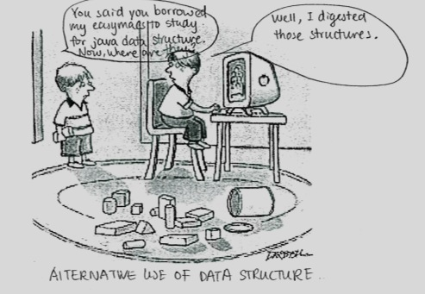
Extra Credit: Captions, jokes and Prolog!
Notes:
Zachary Quinto -- Spock

Slide 58
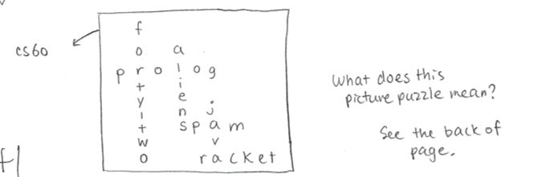
My kind of word search!
Notes:
Zachary Quinto -- Spock

Slide 59

Notes:
Zachary Quinto -- Spock

Slide 60
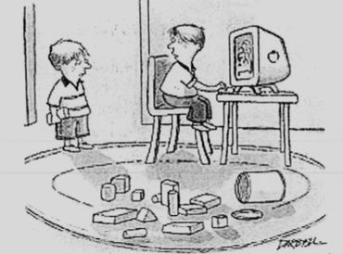


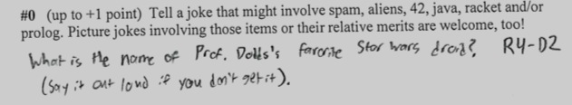
Notes:
Zachary Quinto -- Spock

Slide 61

Extra Credit: Captions, jokes and Prolog!
Notes:
Zachary Quinto -- Spock

Slide 62
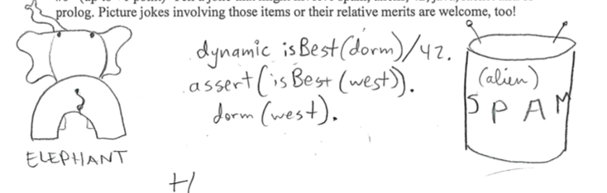
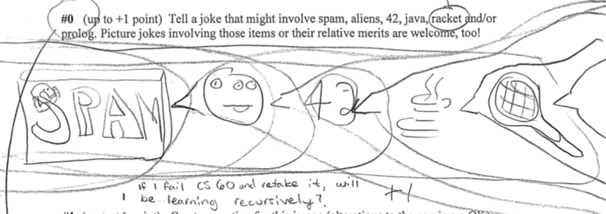
Notes:
Zachary Quinto -- Spock

Slide 63
Notes:
Zachary Quinto -- Spock

Slide 64

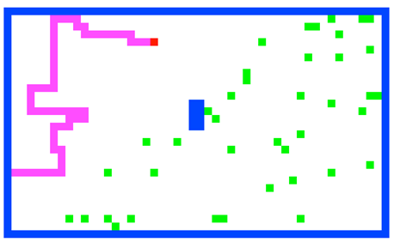
Today (and beyond…) in CS 60
strategies for software reuse
Looking forward
We support Green programming… 1995: Sun/Green/Oak/Java!
Software Engineering
M 12th
W 14th
Inheritance
Graphics/API
hw #9: Searching for SPAM, part 2
M 19th
W 21st
Speed worries
office hours only (no class)
M 26th
W 28th
Better big-O via Memoization
Dynamic Programming
Spampede!
Algorithmic Engineering
Looking back
Notes:
in the small … in the large!
gathering storm – assignment # 7

Slide 65
Software design: Top-down
Getting a clear view of the requirements of the project…
breaking it up into component pieces
visualize
reuse or recurse!
assembling those pieces into a coherent whole…
What can you reuse for Spampede…
+ what will change or be built from scratch?

Slide 66
Software design: Top-down
Getting a clear view of the requirements of the project…
breaking it up into component pieces
visualize
reuse or recurse!
assembling those pieces into a coherent whole…
What can you reuse for Spampede…
Maze + BFS
underlying representation
+ what will change or be built from scratch?
snake, spam++, graphics, events
pre-defined maze (instead of file)

Slide 67
The model is your internal representation.
Model vs. View
30
50
this.maze = new MazeCell[HEIGHT][WIDTH];
for (int r=0 ; r<HEIGHT ; ++r) // for each row
for (int c=0 ; c<WIDTH ; ++c) // for each column
maze[r][c] = new MazeCell(r,c, <appropriate character here> );
What characters is the model, this.maze, using for each of these on-screen colors?
The view is its external rendering.

Slide 68
Initial data:
final initial data?
mazeStrings
static final String[] mazeStrings = {
"**************************************************",
"*PS D *",
"* *",
"* *",
"* *",
"* *",
"* *",
"* *",
"* *",
"* *",
"* *",
"* *",
"* ** *",
"* ** *",
"* ** *",
"* ** *",
"* *",
"* *",
"* *",
"* *",
"* *",
"* *",
"* *",
"* *",
"* *",
"* D *",
"* *",
"* *",
"* *",
"**************************************************"
};
'S' == head of the centipede
This array of Strings holds the starting contents of the maze.
'*' == wall
'P' == body of the centipede
'D' == spam
30 rows
50 columns

Slide 69

Avoid magic !
magic numbers, magic strings, magic stuff in general…
Data constants make code easier to read and modify, e.g.,
even Prof. B. agrees...
public static final char SPAM = 'D';
public static final char START = 'S';
public static final char WALL = '*';
public static final char PEDE = 'P';
these are unchangeable values for use in functions, etc. Preface with class name, if needed…
This BFS looks different to me…
BFS( start, Maze.SPAM );

Slide 70
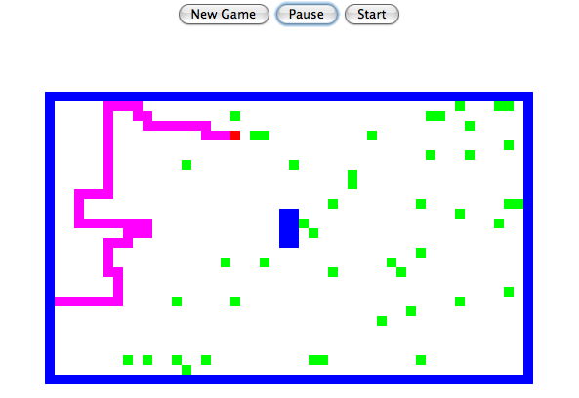
Changes to your Maze class?
the Maze class stores the maze and can find paths within its model of the maze
Key Idea:
Notes:
other differences: the tail of the centipede the PEDE cells are like walls, too
what if: there is no solution!!

Slide 71
Changes to your Maze class?
multiBFS should find the nearest spam without changing the maze!
public MazeCell multiBFS(MazeCell start, char dest)
char makes sense…
but why return a MazeCell?
how it would be called:
multiBFS(start, Maze.SPAM)
testing: ascii demo
Notes:
other differences: the tail of the centipede the PEDE cells are like walls, too
what if: there is no solution!!

Slide 72
Changes to your Maze class?
multiBFS should find the nearest spam without changing the maze!
public MazeCell multiBFS(MazeCell start, char dest)
char makes sense…
but why return a MazeCell?
how it would be called:
multiBFS(start, Maze.SPAM)
testing:
print the maze with the path, then remove the path before returning…
caution!
other differences with respect to the old BFS?
what if… ?
testing: ascii demo
Notes:
other differences: the tail of the centipede the PEDE cells are like walls, too
what if: there is no solution!!

Slide 73
hw9, part 1: New methods in Maze
(1) multiBFS should find the nearest spam without changing the maze!
public MazeCell multiBFS(MazeCell start, char dest)
(2) accessor methods as needed…
(3) a new constructor using mazeStrings:
/* method: constructor
* output: a maze containing a 2d array of MazeCells
*/
protected Maze()
{
sets up this.maze as a 2d array of MazeCells
Software reuse strategy: copy-paste-change

Slide 74
Access Levels
private
no access outside the defining class
protected
derived classes have access
classes in the same package have access
public
anyone can access the data or method
(package)
/* method: constructor
* output: a maze containing a 2d array of MazeCells
*/
protected Maze()
{
sets up this.maze as a 2d array of MazeCells

Slide 75
Reuse by data design: beyond copy-and-paste
Java is an object-oriented programming language:
Classes
Objects
user-defined datatypes
variables of those types
The primary goal of OOP is to create a good data abstraction
- one that models relationships accurately
- without forcing the user to keep track of more than necessary
There are two relationship types that Java can model:
can it handle serious relationships?

Slide 76
Data design #1
There are two basic relationship types that Java models:
(1) Part-of
containment or embedding
a QCell is part of a Queue
a MazeCell is part of a Maze
a char (the contents) is part of a MazeCell
class Queue
implements QueueInterface
{
private QCell front;
private QCell back;
class Maze
{
MazeCell[][] maze;
class MazeCell
{
private int row;
private int col;
private char contents;
private boolean visited;
Notes:
last line is key … it's really extension!

Slide 77
Data design #2
There are two basic relationship types that Java models:
(2) Kind-of
Kind-of
specializations and extensions
a String is a kind of an Object
a MazeCell is a kind of an Object
a SpamMaze is a Maze
"Inheritance"
"is-a"!
class String
extends Object
{
private char[] data;
class MazeCell
extends Object
{
private int row;
private int col;
private char contents;
class SpamMaze
extends Maze
{
Notes:
last line is key … it's really extension!

Slide 78
Data design #2
There are two basic relationship types that Java models:
(2) Kind-of
Kind-of
specializations and extensions
a String is a kind of an Object
a MazeCell is a kind of an Object
Inheritance provides top-level access to all methods and data (non-private data)
a SpamMaze is a Maze
"Inheritance"
"is-a"!
class String
extends Object
{
private char[] data;
class MazeCell
extends Object
{
private int row;
private int col;
private char contents;
class SpamMaze
extends Maze
{
demo
Notes:
last line is key … it's really extension!

Slide 79
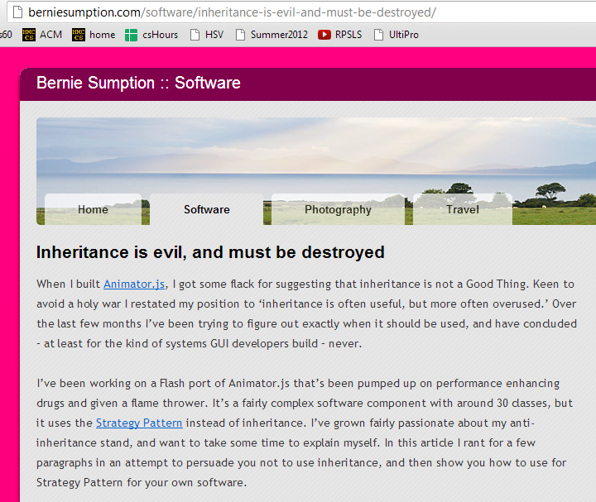
Inheritance opinions…
Java's libraries use it extensively…
It incites passions (and not only in TV Soap Operas)
Worth knowing about…

Slide 80
Inheritance intuition…
inheritance gives top-level access to all capabilities
Which of these relationships is well-modeled by inheritance?
class Car extends Engine
class Rectangle extends Shape
class Square extends Rectangle
class Queue extends OpenList
class Stack extends OpenList
class Mudder extends Person
Good use of inheritance? use a consonant
Poor use of inheritance? use a vowel
What word could these examples spell?
Name(s): _____________________

Slide 81
Why?
Reuse!
Containment
Inheritance
using existing classes as data members
extending classes that are already written
Part-of
Kind-of

Slide 82
Containment vs. Inheritance
What is it?
Data members…
Inheritance !
Models the part-of relationship among classes
Models the kind-of relationship among classes
Why would I want to?
Code reuse
Lets new code call old code
Code reuse
Lets old code call new code
Notes:
this week's new Maze class will use your Queue class from last week
this week's new SpamMaze class will use a linked list that someone else wrote years ago…!
you – or someone – wrote a linked list class… now let's use it as a data member (or two or more)…

Slide 83
class Person
{
protected String name; // data member – protected
public Person( String name ) { this.name = name; }
public boolean isAsleep( int hr ) { return hr > 22 || hr < 7; }
public String toString() { return name; }
public void status( int hr )
{
if ( this.isAsleep( hr ) )
System.out.println( "Now asleep: " + this );
else
System.out.println( "Now awake: " + this );
}
}
Code overview
Person
Base Class
or Super-Class
class Student extends Person
{
protected int units; // additional data member
public Student( String name, int units ) {
super(name);
this.units = units;
}
public boolean isAsleep( int hr ) // override!
{ return 2 < hr && hr < 8; }
public String toString()
{
String result = super.toString();
return result + " units: " + units;
}
}
Student
Derived Class
or Sub-Class
in main:
Student S;
S = new Student("Wally", 18);
Extend the picture…
Notes:
draw a picture

Slide 84
An inheritance hierarchy + code
Base Class
Data
Methods
Person
String name;
boolean isAsleep(int hr)
{
return hr > 22 || hr < 7;
}
Student
Derived Class
Very Derived Class
Mudder
Notes:
military-type definition of time…

Slide 85
An inheritance hierarchy + code
Base Class
Data
Methods
Person
String name;
boolean isAsleep(int hr)
{
return hr > 22 || hr < 7;
}
Student
Derived Class
int units;
boolean isAsleep(int hr)
{
return hr > 2 && hr < 8;
}
overriding the previous method
Very Derived Class
Mudder

Slide 86
An inheritance hierarchy + code
Base Class
Data
Methods
Person
String name;
boolean isAsleep(int hr)
{
return hr > 22 || hr < 7;
}
Student
Derived Class
int units;
boolean isAsleep(int hr)
{
return hr > 2 && hr < 8;
}
Very Derived Class
Mudder
String dorm;
??
(x'y - y'x) / y**2
Now that's derived!

Slide 87
What is this Java hierarchy missing?!
An inheritance hierarchy
Base Class
Data
Methods
Person
String name;
boolean isAsleep(int hr)
{
return hr > 22 || hr < 7;
}
Student
Derived Class
int units;
boolean isAsleep(int hr)
{
return hr > 2 && hr < 8;
}
Very Derived Class
Mudder
boolean isAsleep(int hr)
{
return false;
}
String dorm;
Any further?
Notes:
add Object - the language's overarching base class for ALL user-defined and library-defined classes…
up: human, mammal, …
down: Case-ey; Casite; Casian; Caser; Case-ell, CS60er, Matt, Matt J

Slide 88
class Person
{
protected String name; // data member – protected
public Person( String name ) { this.name = name; }
public boolean isAsleep( int hr ) { return hr > 22 || hr < 7; }
public String toString() { return name; }
public void status( int hr )
{
if ( this.isAsleep( hr ) )
System.out.println( "Now asleep: " + this );
else
System.out.println( "Now awake: " + this );
}
}
Code overview
Person
Base Class
or Super-Class
Student
Derived Class
or Sub-Class
in main:
Student S;
S = new Student("Wally", 18);
Notes:
draw a picture

Slide 89
class Person
{
protected String name; // data member – protected
public Person( String name ) { this.name = name; }
public boolean isAsleep( int hr ) { return hr > 22 || hr < 7; }
public String toString() { return name; }
public void status( int hr )
{
if ( this.isAsleep( hr ) )
System.out.println( "Now asleep: " + this );
else
System.out.println( "Now awake: " + this );
}
}
Code overview
Person
Base Class
or Super-Class
class Student extends Person
{
protected int units; // additional data member
public Student( String name, int units ) {
super(name);
this.units = units;
}
public boolean isAsleep( int hr ) // override!
{ return 2 < hr && hr < 8; }
public String toString()
{
String result = super.toString();
return result + " units: " + units;
}
}
Student
Derived Class
or Sub-Class
in main:
Student S;
S = new Student("Wally", 18);
Extend the picture…
Notes:
draw a picture

Slide 90
class Person
{
protected String name; // data member – protected
public Person( String name ) { this.name = name; }
public boolean isAsleep( int hr ) { return hr > 22 || hr < 7; }
public String toString() { return name; }
public void status( int hr )
{
if ( this.isAsleep( hr ) )
System.out.println( "Now asleep: " + this );
else
System.out.println( "Now awake: " + this );
}
}
Visual overview
Person
Base Class
or Super-Class
class Student extends Person
{
protected int units;
public Student( String name, int units ) {
super(name);
this.units = units;
}
public boolean isAsleep( int hr )
{ return 2 < hr && hr < 8; }
public String toString()
{
String result = super.toString();
return result + " units: " + units;
}
}
Student
Derived Class
or Sub-Class
Derived Class
Student
Person
Base Class
or Sub-Class
or Super-Class
Mathematically speaking, I'd call this SUBoptimal terminology…!

Slide 91
class Mudder extends Student
{
protected String dorm;
public boolean isAsleep( int hr ) { return false; }
public Mudder( String name, int units, String dorm )
{
}
public toString()
{
}
public static void main(String[] args)
{
Student W = new Student( "Wally", 16 );
W.status( 7 ); // status at 7 am
Person P = new Mudder( "Susan", 18, "Sontag" );
P.status( 3 ); // status at 3 am
Student S = P;
S.status( 3 ); // status at 3 am
}
}
Try it!
Write the constructor and toString methods for this Mudder class.
A Mudder should print out as
Wally units: 42 dorm: Olin
What will these three status calls print:
asleep or awake?
Will the Java compiler get upset anywhere here?

Slide 92
Polymorphism
Sometimes an Object's exact type is known at compile-time:
Student S;
S = new Student( "Claremonter", 16 );
then we can use S.units or S.isAsleep …
"Ordinary" code -- exact type known at compile time

Slide 93
Polymorphism
But sometimes it's not known until run-time:
- The compiler will assume the object is of the declared type.
This can be very useful, e.g., imagine a game with many people…
Person[] P = new Person[100];
then, later on…
P[41] = new Student( "Sagehen", 16 );
P[42] = new Mudder( "Wally", 16, "Case" );
P[43] = new Wrecker( "Ralph" );
The constructor determines the "actual" type of the Object.
- At run-time, Java will use the actual type's latest (most-derived) methods.

Slide 94
Object
An inheritance tree
Person
Teacher
Circus Performer
Student
Pomonan?
Pasadena Institute of
Technology Student
Pomonian?
Mudder
Things to keep in mind!
Westie
a Westie is a Person…
"everything" is an Object…
Notes:
Something about Pomoner just doesn't sound right…

Slide 95

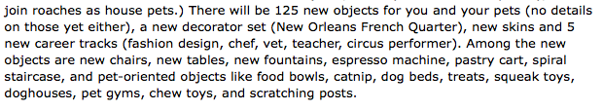
Object
An inheritance tree
Person
Teacher
Circus Performer
Student
Pomonan?
Pasadena Institute of
Technology Student
Pomonian?
Mudder
Things to keep in mind!
Westie
a Westie is a Person…
"everything" is an Object…
Notes:
Something about Pomoner just doesn't sound right…

Slide 96
Hw 9, Part 1: the Maze class
… improving the Maze class
Object
data members
methods
maze
multiBFS
Maze
toString
constructors…
SpamMaze

Slide 97
Hw 9, Part 2: the SpamMaze class
… inheriting from the Maze class
Object
data members
methods
maze
multiBFS
Maze
toString
constructors…
addSpam
spamCells
removeSpam
SpamMaze
advancePede
pedeCells
reversePede
What types should spamCells and pedeCells be?

Slide 98
Visualizing spamCells and pedeCells
*
*
*
*
*
*
*
*
*
*
*
*
*
*
*
*
*
*
*
*
*
*
*
*
*
*
P
P
P
*
P
P
P
*
P
D
P
P
P
P
P
P
P
*
P
P
P
P
D
*
P
S
D
*
P
*
P
*
P
D
D
*
P
*
P
What should their underlying data structures be, i.e., their model ?
Notes:
Java's libraries are comprehensive and huge… [POSTER] – two versions ago
We don't teach them explicitly, actually, but it's always good to keep in mind that they're there…
story about balance (Lenovo's Mr. Challener)

Slide 99
Visualizing spamCells and pedeCells
*
*
*
*
*
*
*
*
*
*
*
*
*
*
*
*
*
*
*
*
*
*
*
*
*
*
P
P
P
*
P
P
P
*
P
D
P
P
P
P
P
P
P
*
P
P
P
P
D
*
P
S
D
*
P
*
P
*
P
D
D
Java's LinkedList is a double-ended queue or deque datatype:
we'll use it for both!
*
P
*
P
What should their underlying data structures be, i.e., their model ?
Notes:
Java's libraries are comprehensive and huge… [POSTER] – two versions ago
We don't teach them explicitly, actually, but it's always good to keep in mind that they're there…
story about balance (Lenovo's Mr. Challener)

Slide 100
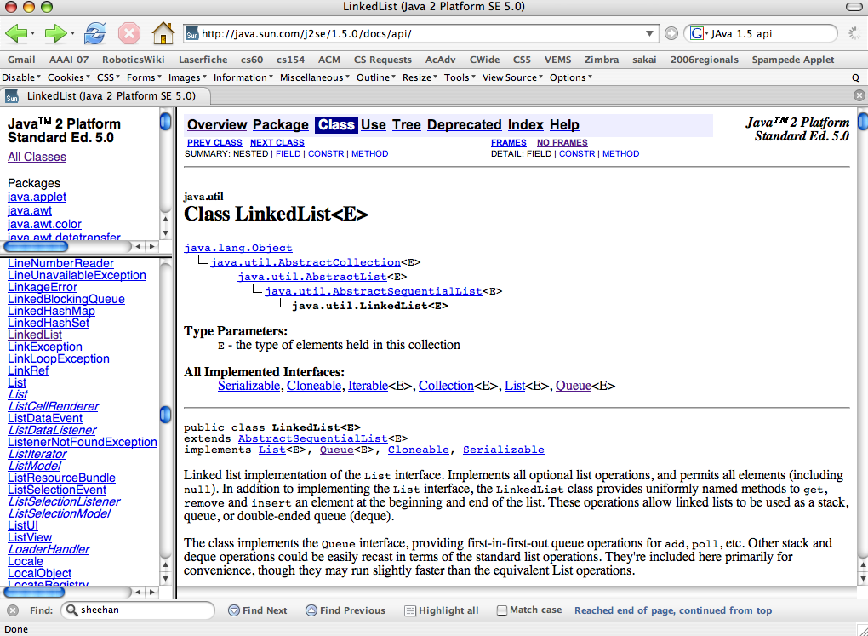
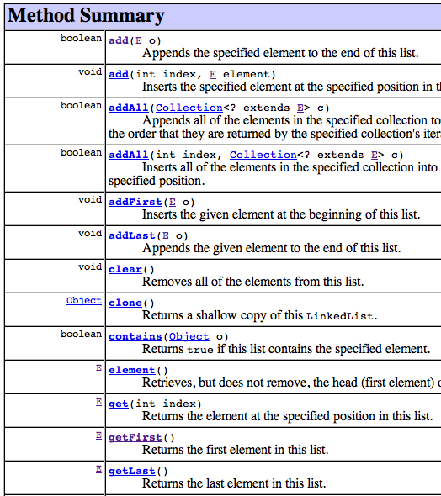
Have someone else write the software!
Reuse: LinkedList
packages
individual classes
inheritance hierarchy
import java.util.LinkedList;
EEEEk! What is going on here?!
methods

Slide 101
<Parameterized> Types
Many languages offer containers that can hold elements of any single type…
Early versions of Java used Objects, polymorphism, and lots of casting so that container classes (OpenList, Queue, etc.) could hold any type of element.
Now, many containers have a type parameter to indicate what it holds:
LinkedList<MazeCell> pedeCells;
angle brackets indicate the type of Object being held in the container
Hooray!!
pedeCells.addFirst(maze[1][2]);
pedeCells.addLast(maze[1][1]);
MazeCell head = pedeCells.getFirst();
I'm casting around for what feels like it's missing here…
Notes:
What's missing is the cast!!! Hooray!
No more classCastExceptions!

Slide 102
Java's LinkedList<E>
LinkedList<MazeCell> spamCells =
new LinkedList<MazeCell>();
what's going on here?
it's a crazy name, but it's a type just like all of Java's others…
what kind of INTERNAL list cells will this data structure have to have?

Slide 103
Wednesday's inheritance tree
Java's GUI classes
Component
Checkbox
Choice
TextComponent
Button
Container
List
TextArea
TextField
Window
Panel
Applet
Frame
Dialog
JApplet
This seemed like the right place for me…
Spampede

Slide 104
Testing! It's easier in ASCII
Wed. ~ we'll look at Java's graphics…

Slide 105
Doubly linked lists
A double-ended queue can add and remove elements from the front OR the back…
LinkedList<MazeCell> spamCells
first
prev
data
next
[12,1]
[11,1]
DCell
last
P P … P
[12,1]
S
D
P
P
D
[15,4]
P
[15,4]
DCell
D
D
[6,4]
[6,4]
What kind of list should spamCells emulate?
[11,1]
Which will be the next spam to disappear?
Implemented via a series of doubly-linked cells (deque cells or DCells)

Slide 106
So I guess pedeCells are just queuedCells?
Moving the centipede
Moving
Eating
Breaking?!
How might a double-ended queue update the centipede, too?
updatePede(char dir)
*
*
*
*
*
*
*
*
*
*
*
*
*
*
*
*
*
*
*
*
*
*
*
*
*
*
P
P
P
*
P
P
P
*
P
D
P
P
P
P
P
P
P
*
P
P
P
P
D
*
P
S
D
*
P
*
P
*
P
D
D
*
P
*
P
LinkedList<MazeCell> pedeCells;

Slide 107
Inheritance Reminders
Models the kind-of or is-a relationship
Uses the keyword extends to indicate a base class
Only add new data members -- the old ones are already there
The keyword super calls the base class’s constructor or methods
Overriding functions have the same signature as in the base class -- only override if a new implementation is needed.
Watch out for casting/compiling issues...

Slide 108
instanceof
Base classes
Object
Person P = new Person(…);
Student S = new Student(…);
Object Ob;
Ob = P;
if (Ob instanceof Person) { print(“GO”); }
if (Ob instanceof Student) { print(“NE”); }
if (Ob instanceof String) { print(“TO”); }
Ob = S;
if (Ob instanceof Person) { print(“OD”); }
if (Ob instanceof Student) { print(“LU”); }
if (Ob instanceof Stack) { print(“WA”); }
if (Ob instanceof Object) { print(“CK”); }
Person
Student
Derived classes

Slide 109
Inheritance
Which of the lines of code below will work as written and which will java complain about (and why?)
Person P = new Person();
Person Q = new Person();
Mudder M = new Mudder();
General G = new General();
Object Ob = new General();
print( M.getName() );
P = M;
print( P.getMajor() );
G = Q;
G = Ob;
print( G.equals(Ob) );
print( G.equals(new General()) );
class Person
{
public String getName() {…}
// no getMajor method defined here
}
class Mudder extends Person
{
// no getName defined here
public String getMajor() {…}
}
class General extends Person
{
// no getName defined here
public String getMajor() {…}
}
static void print(String s)
{
System.out.println(s);
}
1
2
3
4
5
cast
6
7
Extra! Where does equals come from?

Slide 110
Polymorphism
But sometimes an exact type is not known until run-time:
- The compiler will assume the object is of the declared type.
The constructor still determines the actual type of the Object.
- At run-time, Java will use the actual type's latest (most-derived) methods.
Person P = new Student( "Wally", 16 );
System.out.println("P's name is " + P.name);
System.out.println( P.isAsleep( 24 ) );
P.status( 24 );
System.out.println("P is taking " + P.units);
There's a problem here!
Who has the problem?

