Slide 1
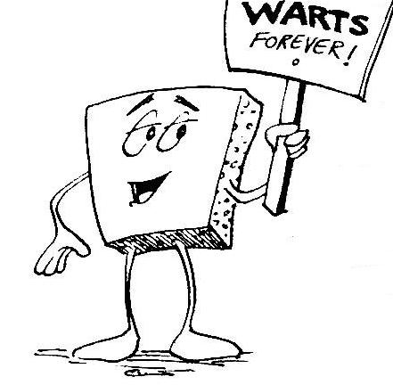
Welcome to CS 60 !
Principles of CS
Wally Wart, protrusive advocate of concrete computing
We don't have words strong enough to describe this class.
- US News and Course Report
Everyone will get out of this course – a lot!
1 handout…
- New York Times Review of Courses
slides & syllabus
We give this course two thumbs…
- Metametacritic
Your hosts…

Slide 2
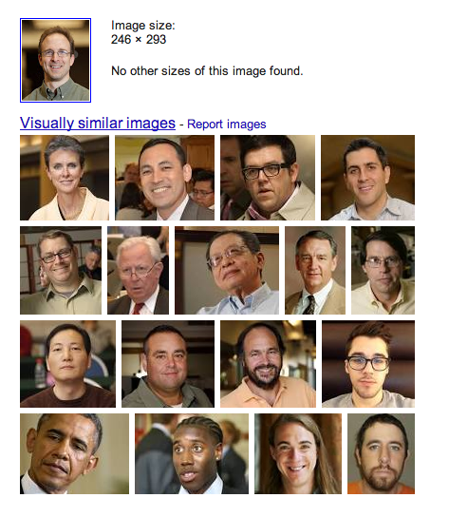
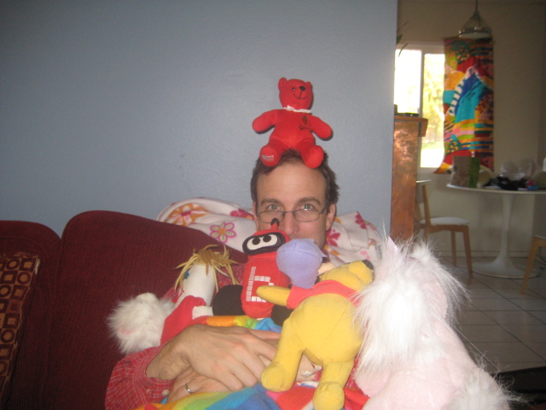
Introductions...
Zach Dodds
Olin B163
dodds@cs.hmc.edu
fan of low-level AI
taker of low-quality pictures
consumer of high-quantity coffee!
and not afraid of stuffed animals!

Slide 3
Introductions...
Zach Dodds
Olin B163
dodds@cs.hmc.edu
fan of low-level AI
taker of low-quality pictures
consumer of high-quantity coffee!
and not afraid of stuffed animals!

Slide 4
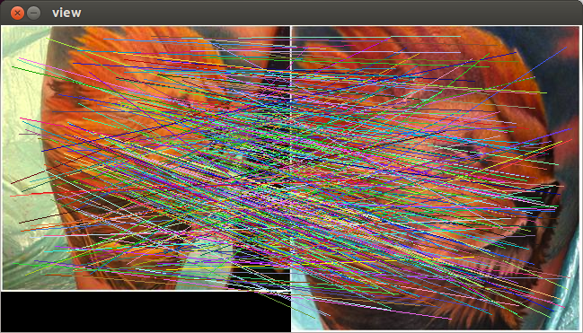
Winter break…
Zach Dodds
Olin B163
dodds@cs.hmc.edu
fan of low-level AI
taker of low-quality pictures
consumer of high-quantity coffee!
and Ethiopian cuisine…
tattoo-matching

Slide 5
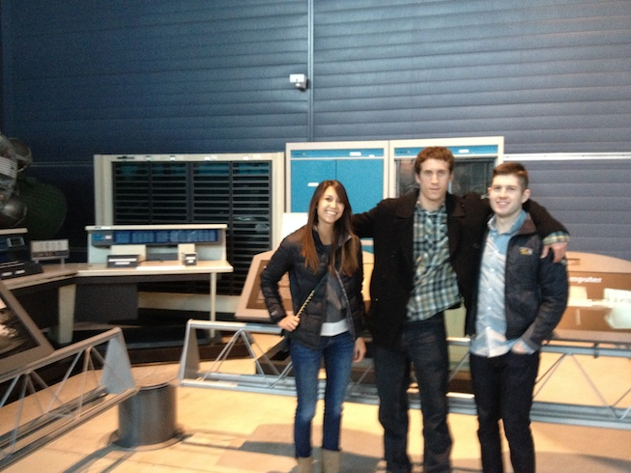
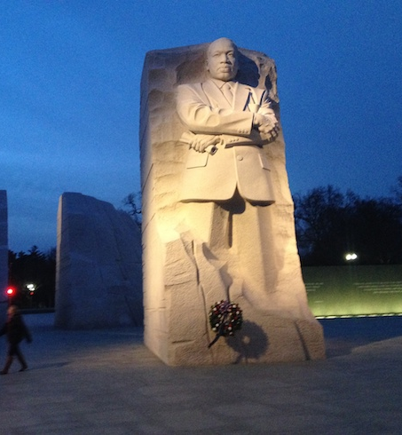
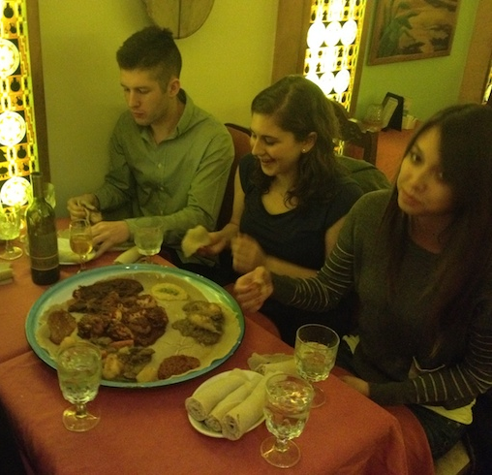
Winter break…
Zach Dodds
Olin B163
dodds@cs.hmc.edu
fan of low-level AI
taker of low-quality pictures
consumer of high-quantity coffee!
and Ethiopian cuisine…
tattoo-matching

Slide 6
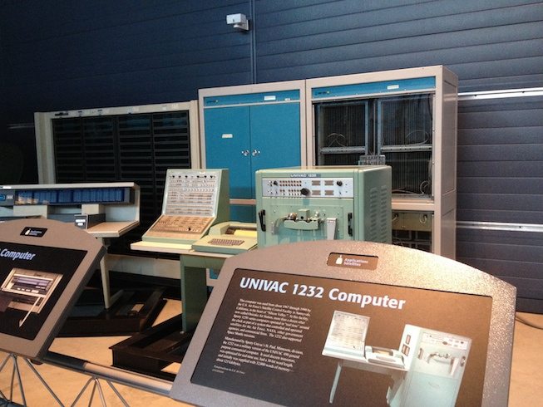

Slide 7
Course Details…

Slide 8
CS 60 vs. CS 5
CS 5's goals
Solving computational problems in one language (Python)
Conveying some of CS's breadth
Labs!
I'm sure it's just a coincidence that CS 60 seems more alien than CS 5.
CS 60's goals
Conveying some of CS's depth
Solving computational problems in several languages!
Understanding - computational problems
- their difficulty and limitations
- solution principles and efficiency

Slide 9
Syllabus, very briefly
laptops not really needed…
Lectures
TTh : 1:15-2:30 pm
Come to Lecture!
Key skills, knowledge, and topics
Insight into the HW ~ what, why, and how
Required: email me if you won’t make it
Site
www.cs.hmc.edu/courses/2014/spring/cs60
Tutors
LOTS! See website; starts this Thursday…
Lots of help available!
Help + Q'ns
copies me and all of the tutors
can ask q'ns publicly or privately
Office Hrs
Fridays , about 2-4pm
come by the LAC computer lab here at HMC…
get started on the week's HW!
Notes:
still before the quiz… (syllabus is in the back of your handout…)

Slide 10
Syllabus, briefly
laptops not really needed…
Lectures
TTh : 1:15-2:30 pm
Key skills, knowledge, and topics
Insight into the HW ~ what, why, and how
Required: email me if you won’t make it
Site
www.cs.hmc.edu/courses/2014/spring/cs60
Tutors
LOTS! See website; starts this Thursday…
Help + Q'ns
copies me and all of the tutors
can ask q'ns publicly or privately
Office Hrs
Fridays , about 2-4pm
come by the LAC computer lab here at HMC…
get started on the week's HW!
Notes:
still before the quiz… (syllabus is in the back of your handout…)

Slide 11
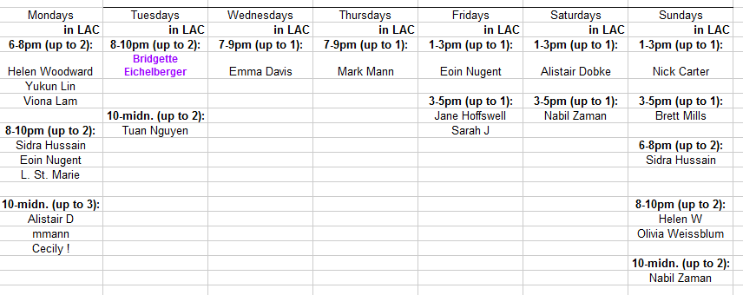
Tutoring hours @ LAC will begin Thursday…
Important for CS 60 happiness:
Tutors
LOTS! See website; starts this Thursday…
Help + Q'ns
copies me and all of the tutors
can ask q'ns publicly or privately
Office Hrs
Fridays , about 2-4pm
come by the LAC computer lab here at HMC…
get started on the week's HW!
Notes:
still before the quiz… (syllabus is in the back of your handout…)

Slide 12
Grades
(define (grade perc)
(if (>= perc 0.95) "A")
(if (>= perc 0.90) "A-")
"and so on…")))
~ 60% Assignments
~ 30% Exams
~ 10% Participation/“quizzes”
Midterm: Thu. 3/6/14
Final: Thu. 5/15/14 @ 2pm
This is a crazy programming Scheme!
Assignments
Due Monday nights: by 11:59 pm
Submit @ the usual place:
your login: first initial + last name
passwd: be sure to change it! For now it's
100 points per week: you have 3 CS 60 Euros to use ~ each is 1 day
Start early - Seek help - Embrace craziness!
Notes:
homework really comprises the key skills I hope that everyone takes away from this class…
weighted accordingly!
if you never submit anything before 11:59pm on Sunday – I have complete sympathy!

Slide 13
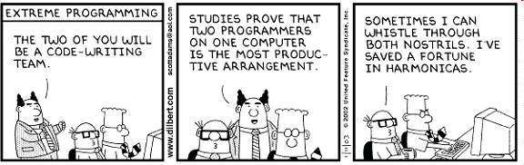
Pairing
On many problems, you may pair program – do!
If you do, you must practice "pair programming"
- both people at the 1 or 2 computer(s) at the same time
if 1, trade off "driver" and "navigator" every 30 minutes
both people contribute equally and fully to the solution
Individual problems must be completed individually
Read the syllabus Collaboration & Honesty Policy!
May your pair-programming be more pleasant!

Slide 14
Honor Code
You're encouraged to discuss problems with other students – or tutors – or any instructors.
You may not share written, electronic or verbal solutions with other students, present or past:
Please do use the internet for language references.
Please do use other's eyes for finding sintax erorrs!
Do not use the internet (or intranet) to (try to) find solutions…
If you work as a pair/partners, these rules apply for the group.
Even with three eyes, I need to borrow others' to find the syntax errors here!
What matters is what you create.

Slide 15
Big Picture

Slide 16
Principles of CS?
Computer Science is no more about computers
than astronomy is about telescopes...
E. Dijkstra

Slide 17
Principles of CS?
Computer Science is no more about computers
than astronomy is about telescopes...
E. Dijkstra
physics
matter ‘n’ energy
the God particle
chem
molecules
RNA; caffeine
cells + organisms
properties and applications of each
biology
revived species!
math
rule-based systems
a³ + b³ != c³
CS
information
algorithms
field
raw material
products

Slide 18
Principles of CS?
Information-based problems…
Algorithms + Programs
Design
Analysis
Which language?
Which data structures?
What algorithm?
How to design programs?
You will use at least four languages in CS60…
Is my algorithm correct?
Is my program correct?
How fast does my algorithm run?
Is the problem solvable at all?

Slide 19
Why four languages?
… to be able to use any language efficiently and effectively
Goal:
Imagine putting together your resume…
C. C. Student
Hobbies:
Di-Unicycling, Coffee Imbibing

Slide 20
Why four languages?
… to be able to use any language efficiently and effectively
Goal:
it's not really about this list
Skills: Python, Prolog, Racket/Scheme/LISP, …
Skills: Comfortable developing, analyzing, and improving software in any language.
Experience: Python, Prolog, Racket/Scheme/LISP, and several domain-specific languages, e.g., JFLAP, Unicalc, and Picobot …
this is CS60's real goal…
but no harm done here!

Slide 21
CS60's languages are widely spread out over "programming-language space" :
Racket
Prolog
computation
Python
Matlab
abstraction axis
Java
C and C++
JFLAP
computer
Hmmm
task-independent
task-specific
specificity axis

Slide 22
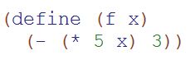

Racket: dive in!
(- 21 16)
(+ 8 (* 4 13))
Find these values:
(- 10 (* (- 8) (/ 8 2)))
What are the results of these function calls?
Here are two racket functions:
(f 5)
(g (f 4))
(g (g 14))
What value of x makes
(f (g x))
42
Extra: how would you write invf, the inverse of f?

Slide 23
Thought for the day:
Racket is an easy language to learn - once you get over your fear of parentheses…
- so, nothing to fear in hw#0!

Slide 24
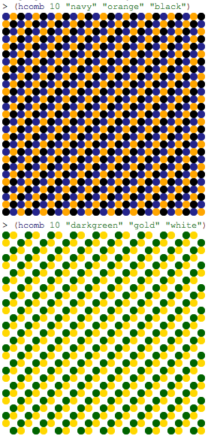
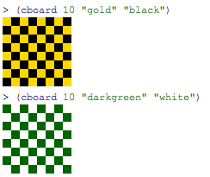
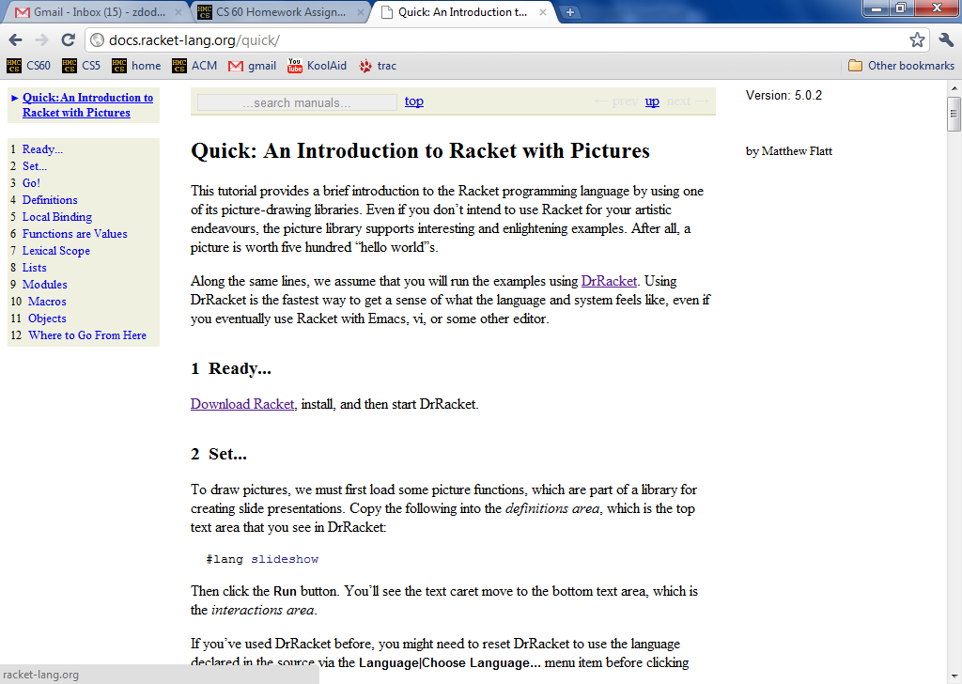
hw0, pr1: Racket functions
Problem 2 must be even MORE fun!

Slide 25
A new programming language does not expand the set of all possible algorithms,
but it does expand the set of algorithms we can efficiently think about, write, and analyze…
big-O analysis

Slide 26
Principles of CS!
Information-based problems…
Algorithms + Programs
Design
Analysis
Which language?
Which data structures?
What algorithm?
How to design my programs?
Is my algorithm correct?
Is my program correct?
How fast does my algorithm run?
Is the problem solvable at all?

Slide 27
Problem
Factorial: Find N!
Big-O analysis
Problem Size
value of input, N
Algorithm
5! is 5*4*3*2*1*1
Python
Racket
def fac(N):
if N == 0:
return 1
return N*fac(N-1)
(define (fac N)
(if (= N 0)
1
(* N (fac (- N 1))) ))
How many steps are run, if the “step” is…
a multiplication
a comparison
a function call
all operators
(fac 5)
(fac N)
Notes:
Answer

Slide 28
Problem
Factorial: Find N!
Big-O analysis
Problem Size
value of input, N
Algorithm
5! is 5*4*3*2*1*1
Python
Racket
def fac(N):
if N == 0:
return 1
return N*fac(N-1)
(define (fac N)
(if (= N 0)
1
(* N (fac (- N 1))) ))
How many steps are run, if the “step” is…
a multiplication
a comparison
a function call
all operators
(fac 5)
(fac N)
Notes:
Answer

Slide 29
Problem
Factorial: Find N!
Big-O analysis
Problem Size
value of input, N
Algorithm
5! is 5*4*3*2*1*1
Python
Racket
def fac(N):
if N == 0:
return 1
return N*fac(N-1)
(define (fac N)
(if (= N 0)
1
(* N (fac (- N 1))) ))
How many steps are run, if the “step” is…
a multiplication
a comparison
a function call
all operators
(fac 5)
5
6
5
16
(fac N)
N
N+1
N
3N+1
Notes:
Answer

Slide 30
Problem
Factorial: Find N!
Big-O analysis
Problem Size
value of input, N
Algorithm
5! is 5*4*3*2*1*1
Python
Racket
def fac(N):
if N == 0:
return 1
return N*fac(N-1)
(define (fac N)
(if (= N 0)
1
(* N (fac (- N 1))) ))
factorial is O(N) or "order N"
How many steps are run, if the “step” is…
a multiplication
a comparison
a function call
all operators
(fac 5)
5
6
5
16
(fac N)
N
N+1
N
3N+1
Notes:
Answer

Slide 31
Big - O
Big-O is CS's way to compare algorithms and problems.
ignore constants/coefficients
ignore all but the biggest term
N - 1
O(N)
is
2N² + 5N
O(N²)
is
2N² + 4N³
O( )
is
big-O is the asymptotic Order of the computational work, abstracting away "insignificant" details, e.g., code + computer!

Slide 32
Big-O analysis
Don't need the code!
Problem
Compute factorial: (fac N)
Problem Size
value of input, N
Algorithm
If N = 5, then compute 5*4*3*2*1*1
If N = 8, then compute 8*7*6*5*4*3*2*1*1
If N = N, then compute N*(N-1)* … *2*1
How many steps are needed in big-O terms ?
let's say that a "step" is a multiplication here… - does it really matter?
Notes:
Answer

Slide 33
Racket Code
Big-O analysis
(define (h-c N)
(if (equals? 1 N)
0
(+ 1 (h-c (quotient N 2)))
Problem
Compute (halve-count N)
Problem Size
value of input, N
Algorithm
If N = 11, then 11 – 5 – 2 – 1
returns 3
If N = 4, then 4 – 2 – 1
returns 2
If N = 42, then 42 – 21 – 10 – 5 – 2 – 1
returns 6
How many steps are needed in big-O terms ?
does it matter what a “step” is here?
Notes:
Answer

Slide 34
Log?
Problem
Compute (halve-count N)
Problem Size
value of input, N
Algorithm
If N = 11, then 11 – 5 – 2 – 1
returns 3
If N = 4, then 4 – 2 – 1
returns 2
If N = 42, then 42 – 21 – 10 – 5 – 2 – 1
returns 6
log(N) is the # of times you can divide N by 2
until you reach 1
we assume base 2 (it really doesn't matter!)
Notes:
Answer

Slide 35
Big-O analysis
Problem
Find the min of an N-element list
Problem Size
length of list, N
Algorithm
Walk the list and track the min
index
0
1
2
3
N-1
element
60
8
1
7
...
42
How many steps are needed in big-O terms ?
a “step” is often one comparison
Notes:
Answer

Slide 36
Big-O analysis
Problem
Sort an N-element list
Problem Size
length of list, N
Algorithm
Keep finding the next min!
original list
60
8
1
7
...
42
sorted list
...
How many steps are needed in big-O terms ?
a “step” is often one comparison
Notes:
Answer

Slide 37
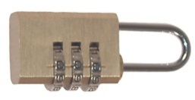
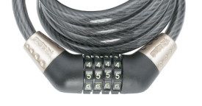
"Quiz"
Names:
Something you have in common:
Estimate the worst-case big-O complexity for these problems:
6
Prob: Find the dot product of two vectors
Size: The vectors are both of length N.
Count: multiplications and additions …
0
Prob: Find the minimum of a list
Size: N = # elements in the list
Count: the number of comparisons...
O( N )
7
Prob: Open a combination lock like these below:
Size: N = # of digits in the combination
Count: the number of guesses required…
1
Prob: Sort a list via repeated min-finding
Size: N = # elements in the list
Count: the number of comparisons...
O( )
Prob: Find the length of a list (by "walking" it)
Size: N = # elements in the list
Count: the number of comparisons...
N = 3
N = 4
2
8
Prob: Multiply two square matrices: ( ) ( ) = ( )
Size: N = one dimension = one matrix side
Count: multiplications and additions...
3
Prob: Find the minimum in a sorted list
Size: N = # elements in the list
Count: the number of comparisons...
Prob: Compute some base to a power: b^{N}
Size: N = the integer exponent
Count: multiplications...
9
Prob: Find the median of a list
Size: N = length of the list
Count: the number of comparisons
4
Prob: Guess and find a hidden integer X, betw. 1 & N
- For each guess G, you’re told G>X or G<X or G=X.
Count: the number of guesses required…
10
Prob: Determine if a program has an infinite loop.
Size: N = # of characters in the program
Count: all operations.
5

Slide 38
The algorithms
Length of a list by "walking" it:
60
8
1
7
15
42
"walking" – touching each element
Guess a # from 1 to N, with "higher/lower" clues…
between 1 and 100
is it 42?
-- no, too low
between 43 and 100
is it 60?
continue until you find it…

Slide 39
The algorithms
( 3, 4, 5, …, 1, 2, 0 )
Dot product of two vectors
*
*
*
*
*
*
( 2, 1, 0, …, 3, 2, 1 )
6
+
4
+
0
+
+
3
+
4
+
0
= 17
Matrix product
These 's make up the result.
*
=
Each is a (potentially) different number.
Each is the result of one dot product!

Slide 40
The algorithms – open for ideas… ?
Median value?
Halting problem?

Slide 41
"Quiz"
Names:
Something you have in common:
Please pass these to the aisles + back…
then turn to the notes.
Estimate the worst-case big-O complexity for these problems:
6
Prob: Find the dot product of two vectors
Size: The vectors are both of length N.
Count: multiplications and additions …
0
Prob: Find the minimum of a list
Size: N = # elements in the list
Count: the number of comparisons...
O( N )
7
Prob: Open a combination lock like these below:
Size: N = # of digits in the combination
Count: the number of guesses required…
1
Prob: Sort a list via repeated min-finding
Size: N = # elements in the list
Count: the number of comparisons...
O( )
Prob: Find the length of a list (by "marching")
Size: N = # elements in the list
Count: the number of comparisons...
N = 3
N = 4
2
8
Prob: Multiply two square matrices: ( ) ( ) = ( )
Size: N = one dimension = one matrix side
Count: multiplications and additions...
3
Prob: Find the minimum in a sorted list
Size: N = # elements in the list
Count: the number of comparisons...
Prob: Compute some base to a power: b^{N}
Size: N = the integer exponent
Count: multiplications...
9
Prob: Find the median of a list
Size: N = length of the list
Count: the number of comparisons
4
Prob: Guess and find a hidden integer X, betw. 1 & N
- For each guess G, you’re told G>X or G<X or G=X.
Count: the number of guesses required…
10
Prob: Determine if a program has an infinite loop.
Size: N = # of characters in the program
Count: all operations.
5

Slide 42
Try these on the back page first…
Estimate the worst-case big-O complexity for these problems:
6
Prob: Find the dot product of two vectors
Size: The vectors are both of length N.
Count: multiplications and additions …
0
Prob: Find the minimum of a list
Size: N = # elements in the list
Count: the number of comparisons...
O( N )
7
Prob: Open a combination lock like these below:
Size: N = # of digits in the combination
Count: the number of guesses required…
1
Prob: Sort a list via repeated min-finding
Size: N = # elements in the list
Count: the number of comparisons...
O( )
Prob: Find the length of a list (by "marching")
Size: N = # elements in the list
Count: the number of comparisons...
N = 3
N = 4
2
8
Prob: Multiply two square matrices: ( ) ( ) = ( )
Size: N = one dimension = one matrix side
Count: multiplications and additions...
3
Prob: Find the minimum in a sorted list
Size: N = # elements in the list
Count: the number of comparisons...
Prob: Compute some base to a power: b^{N}
Size: N = the integer exponent
Count: multiplications...
9
Prob: Find the median of a list
Size: N = length of the list
Count: the number of comparisons
4
Prob: Guess and find a hidden integer X, betw. 1 & N
- For each guess G, you’re told G>X or G<X or G=X.
Count: the number of guesses required…
10
Prob: Determine if a program has an infinite loop.
Size: N = # of characters in the program
Count: all operations.
5

Slide 43

See you on Thursday!
Next time: Giving Racket a try!
You're in good company!

Slide 44
The algorithms
Length of a list by "walking" it:
60
8
1
7
15
42
"walking" – touching each element
Guess a # from 1 to N, with "higher/lower" clues…
between 1 and 100
is it 42?
-- no, too low
between 43 and 100
is it 60?
continue until you find it…

Slide 45
The algorithms
( 3, 4, 5, …, 1, 2, 0 )
Dot product of two vectors
*
*
*
*
*
*
( 2, 1, 0, …, 3, 2, 1 )
6
+
4
+
0
+
+
3
+
4
+
0
= 17
Matrix product
These 's make up the result.
*
=
Each is a (potentially) different number.
Each is the result of one dot product!

Slide 46
The algorithms – open for ideas… ?
Median value?
Halting problem?

Slide 47

All corners of computational space?
Cow
MoO moO MoO mOo MOO OOM MMM moO moO MMM mOo mOo moO MMM mOo MMM moO moO MOO MOo mOo MoO moO moo mOo mOo moo
Fibonacci
Whitespace
Hello world
0 lI'moH A cher
1 lI'moH B cher
A cha' B cha'
18 {
A B boq
latlh
cha'
B "A" cher
"B" cher
} vangqa'
Var'aq
Piet
Fibonacci
Fibonacci
Malbolge
(=<`$9]7<5YXz7wT.3,+O/o'K%$H"'~D|#z@b=`{^Lx8%$Xmrkpohm_Ni;gsedcba`_^]\[ZYXWVUTSRQPONMLKJIHGFEDCBA@?>=<;:9876543s+O<oLm
Hello world
Fortunately, CS 60 does NOT go all the way to the fringe of the programming-language universe !
Who are you calling fringe?

Slide 48
A+ - Dialect of APL used at Morgan-Stanley.
A0 or A-0 - Grace Hopper's team at Remington Rand, 1952, for the UNIVAC I
AACC - Language for building finite state automata.
AADL - Axiomatic Architecture Description Language.
ABC ALGOL - An extension of ALGOL 60 with arbitrary data structures
ACOS – Bulletin-board language for PRODOS 8 on Apple ][.
Ada - named for Ada Lovelace (1811-52), arguably the world's first programmer
... skipping 2,279 languages ...
yacc - Yet Another Compiler Compiler. Language used to build parsers.
YALLL - Yet Another Low Level Language. Patterson et al, UC Berkeley,
Yay - Yet Another Yacc - An extension of Yacc with LALR(2) parsing.
Yerk - named for Yerkes Observatory, where it was used/developed
ZAP - Language for expressing transformational developments.
ZENO - U Rochester 1978. Euclid with asynchronous message-passing.
ZIL - Zork Implementation Language. Language used by Infocom's Interactive
zsh - Sh with list processing and database enhancements.
Zuse - named for Konrad Zuse, the designer of an early binary digital computer
Programming Languages
CS 60's goal: to think computationally ~ i.e., pick up any language easily…

Slide 49
End of slides for 2014…

Slide 50

My "Quiz"
Pittsburgh Hat
Name
Birthday
A place you considered home
Your favorite _____ is _____.
Your least favorite _____ is _____.
Zachary Dodds
1/21/1969
NOT Pittsburgh locale
the perfect balance...
Pittsburgh, PA
tv drama
White Collar
coffee
decaffeinated
What is a something you have in common that you didn’t know before?
Our taste in hats!

Slide 51
big-O in O(N)e slide!
big-O captures the long-term (asymptotic) speed of an algorithm in the worst case
Algorithm/Problem
big-O runtime
Find the minimum of a list of N elements.
Sort an N-el. List by repeated min-finding.
Find the minimum of an N-el. sorted list.
Find the diameter of a set of N points.
Find the dot product of two N-el. vectors.
Find the product of two NxN matrices.
Run halve-count(N)
Find the element closest to 42 in a sorted list.
Find the median of an N-el. list.

Slide 52
Assignment #0 Due 9/?? 11:59pm
Implementing, testing, and analyzing several Racket functions
Using your machine OR the CS labs: B102, B105 or CIS labs
Friday 2-4 and lots of grutor hours in the LAC lab
Macalister
Pryne
Here there be dragons (or engineers!)
B102
B105
Beckman B126
up to Olin
CS labs’ code:
Notes:
CS Lab code: 23-5-4 Building code: 2-3-4-7-8-8-5

Slide 53
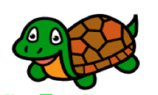
Computer Science Principles
Subsequence
alignment...
AACAGTTACC
TAAGGTCA
What insertions/deletions would best align these two sequences?
“Left-justify algorithm”
“Greed-is-good algorithm”
“Try all pairs algorithm”
AACAGTTACC
-AA---CAGTTACC
AACAGTTACC
TAAGGTCA--
TAAGGTCA------
TA-AGGT-CA
1011001022
20022200222222
1020010201
Error cost: 8
Error cost: 20
Error cost: 7
Design
Analysis
Which language?
Which data structures?
What algorithm?
How to structure my functions?
Does my algorithm solve the problem?
Is my program bug free?
How fast does my algorithm run?
Is the problem solvable at all?
We'll do both of these today & in this week's HW!

Slide 54

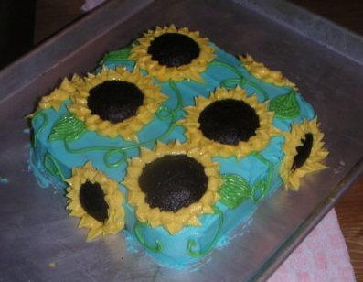
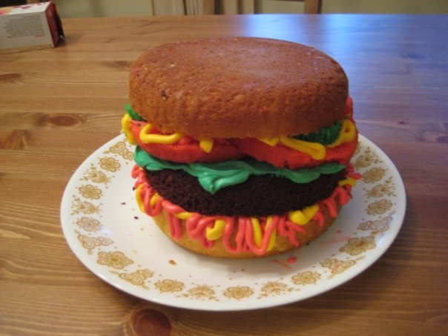
Introductions...
Colleen Lewis
Olin 1241
lewis@cs.hmc.edu
fan of swimming/sleeping
fan of baking

Slide 55
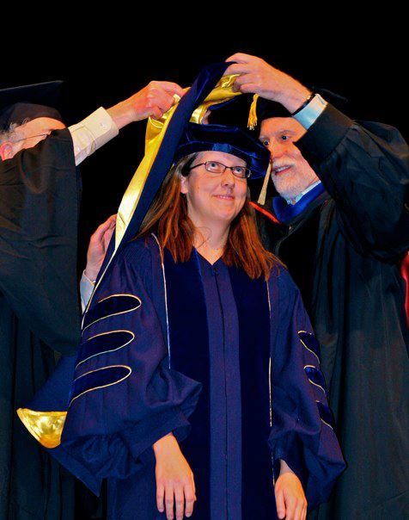

How I spent my summer vacation...
Finishing my PhD at Berkeley...
...teaching 6th graders computer science!

Slide 56
How to use if & cond
(if <predicate>
<true case> <false case> )
(cond
[ <test1> <result> ]
[ <test2> <result> ]
[ else <result> ] )

Slide 57
How to use Let (create new variables in definitions)
(let
( [<variable1> <value1>]
[<variable2> <value2>]
)
<body>
)

Slide 58

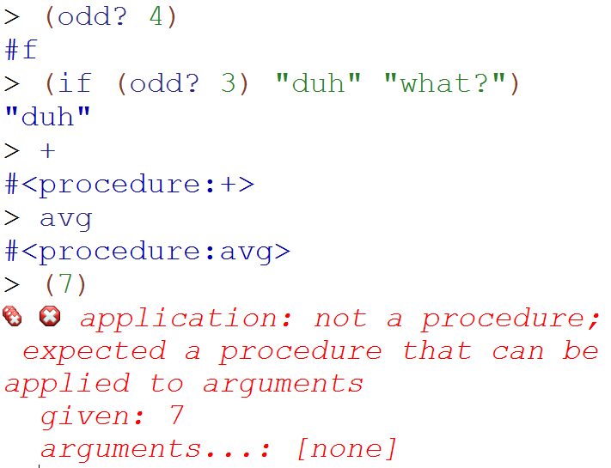
DEMO: procedures/parens
#t and #f are Booleans
Procedures are just things
No extra parens! Racket thinks the thing after a paren is a function

Slide 59
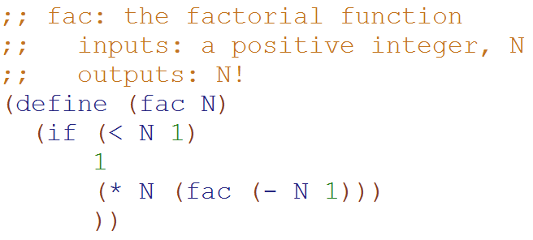
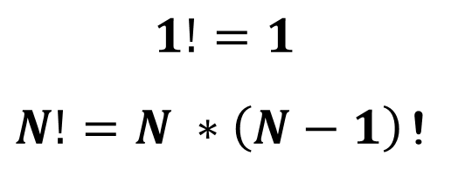
The Factorial function

Slide 61
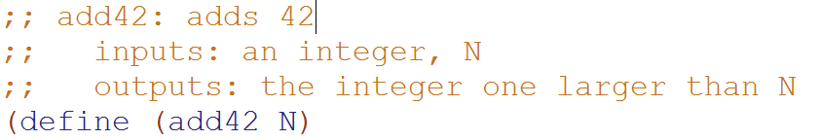
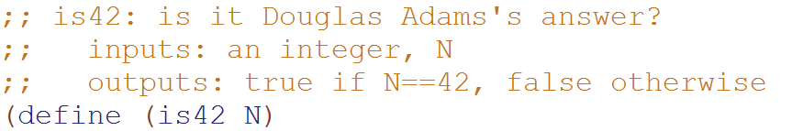
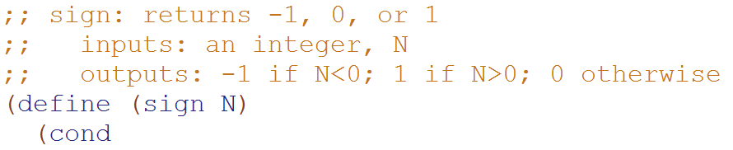
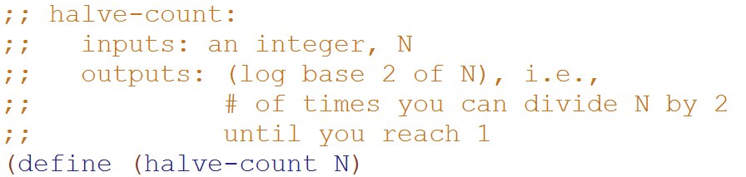
Try these!

Slide 62
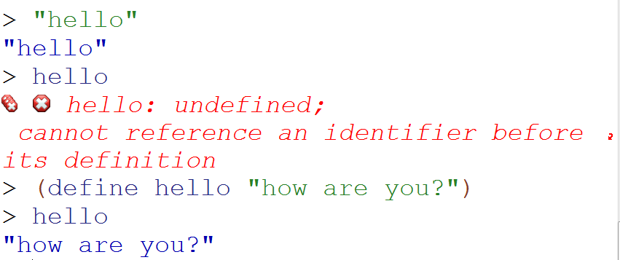
DEMO: Labeling Data
String
Helpful error messages READ THEM
Label data

Slide 63
How to Label Data
(define variable value)
Keyword
An expression
Shouldn’t be an expression

Slide 64
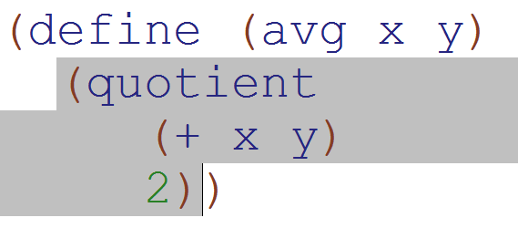

How to label functions
Function Name
Formal parameters
Body
Keyword
Actual argument values

