Slide 1
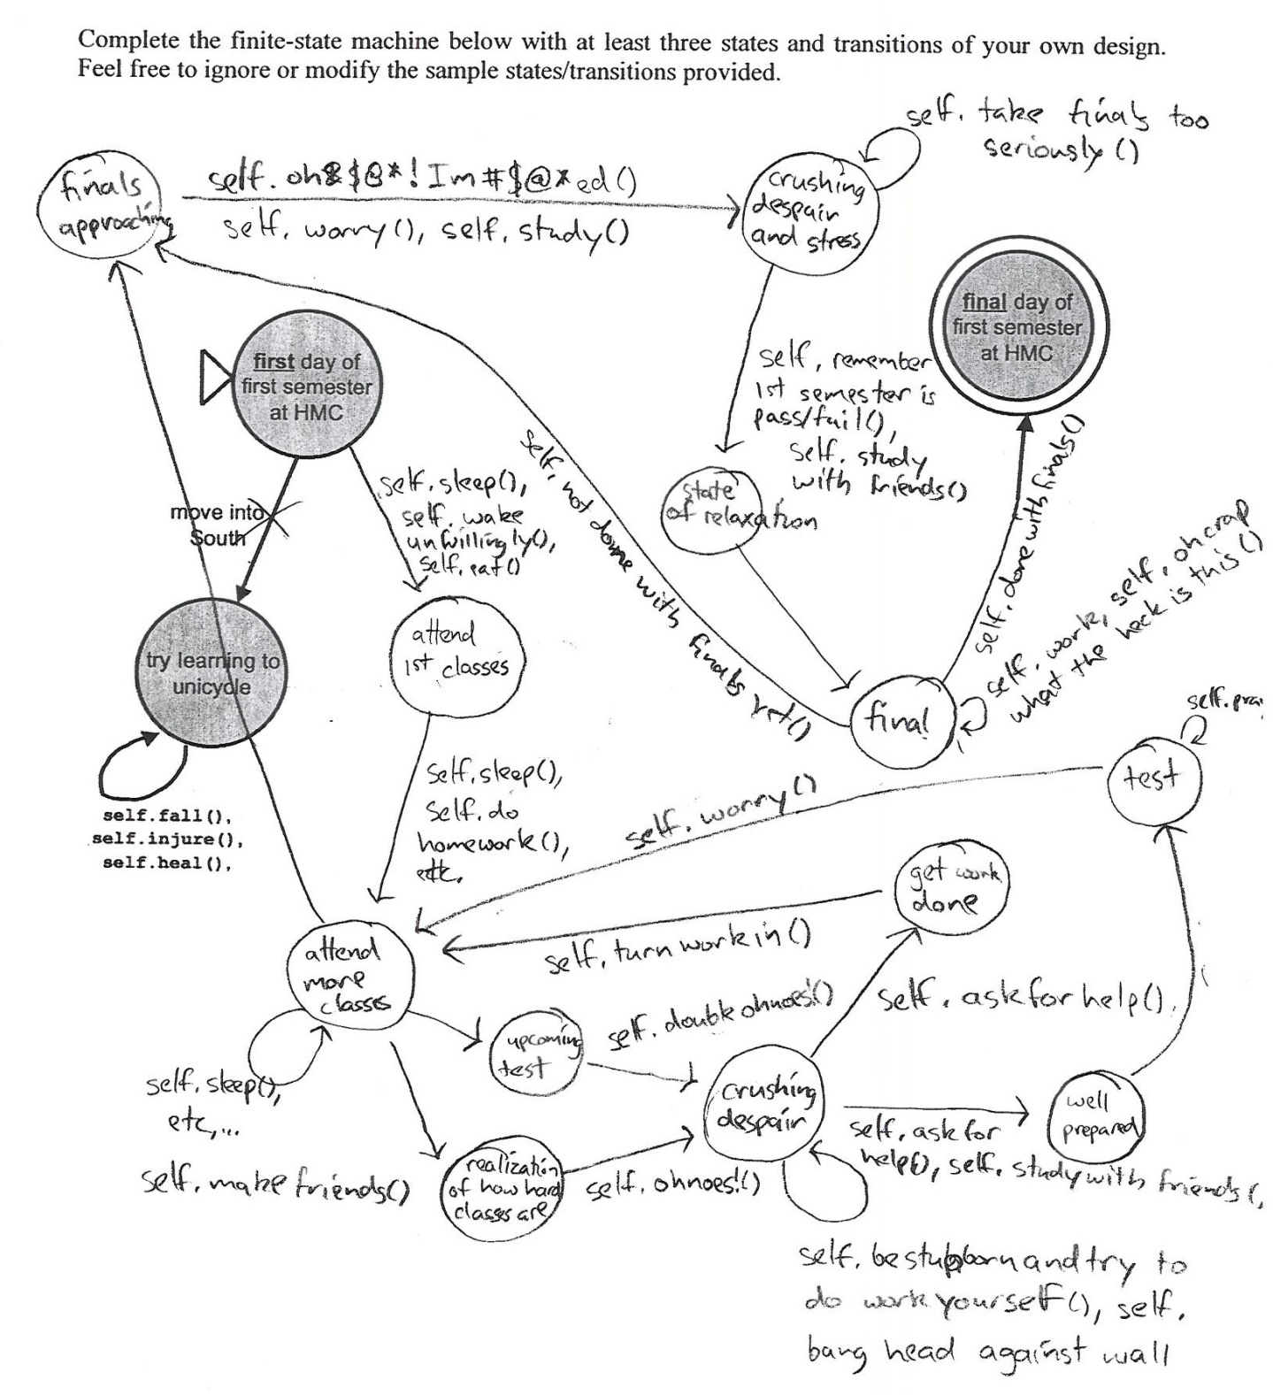
This week in CS 60…
… computation without the computer
What can be computed.
How it can be computed.
Deterministic Finite Automaton
Finite State Machine
"simplest" procedural model of computation…
Minimum-complexity FSMs/DFAs ~ designing and proving them.
This seems like a MAXimum complexity FSM…
hw9 (Sorting) due T, 4/15
hw10 (JFLAP) due T, 4/22
Notes:
regexen?

Slide 2
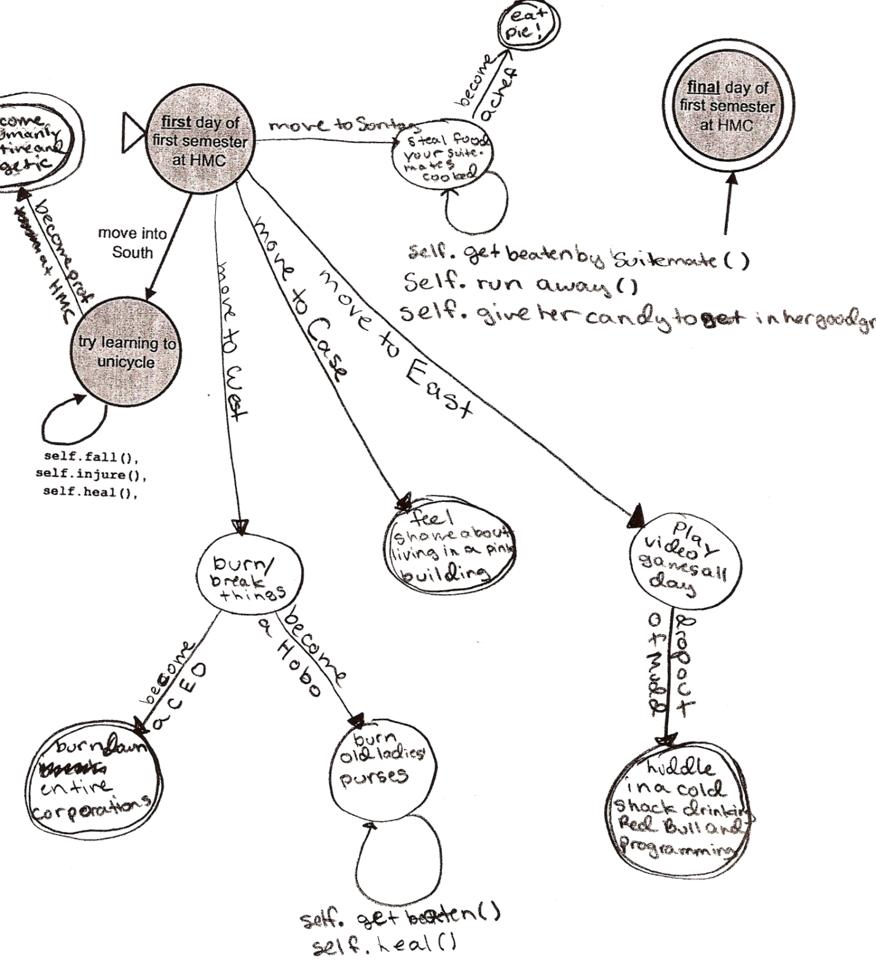
Another HMC DFA

Slide 3
{ 4, 8, 7, 7, 4, 4, 4, 8 }
Bucket sort, revisited…
{ 9, 8, 3, 7, 4, 5, 2, 8 }
Minsort, revisited

Slide 4
In CS, the computer doesn't matter!
this may seem big-O(bvious) recently…
Quantum interactions
with DNA or RNA
Silicon-based switching
Mechanical computation
Using marbles!
We want to capture the fundamental processes of all of these machines...

Slide 5
All computation has...
Input: a string of bits
01
0011
A string is a sequence of legal characters:
000111
characters from some alphabet, such as {0,1}
three input bitstrings
Output: a bit
Is the string is accepted (1) or rejected (0) ?
A Computer: accepts or rejects strings, looking one bit at a time.
Each machine accepts a language, or set of strings
{ 01, 0011, 000111 }
{ w | w contains the substring 01 }
{ w | w is 0^{k} followed by 1^{k} }
This is O^{k} by me!

Slide 6
Our computer: FSMs ~ DFAs
no s needed!
“Finite State Machine”
"Deterministic Finite Automata"
Deterministic
0
Every state has one transition for every possible character.
0
1
q0
q1
1
Finite
start state
transition
final (accepting) state
key resource is number of states
“input funnel”
“where to go”
double circled
00101
Example Inputs:
100011
What is the language this FSM accepts?

Slide 7
What is each state saying?
DFAs or FSMs
Machine 2
0
Accepts…
1
q1
q0
0
1
q2
0,1
Rejects…
L is the language accepted by Machine 2
L =
To be Deterministic, a DFA must
have a 0-edge and a 1-edge from every state
accept all strings in L and reject all strings not in L

Slide 8
Creating DFAs
What DFA accepts L = { w | the # of 1s in w is divisible by 4 } ?
The set of all bit strings containing 0, 4, 8, ... , 1s

Slide 9
Creating DFAs
What DFA accepts L = { w | the # of 1s in w is divisible by 4 } ?
The set of all bit strings containing 0, 4, 8, ... , 1s
Common thoughts...
I understood the last couple of examples, but am not sure where to start here...

Slide 10
Creating DFAs
What DFA accepts L = { w | the # of 1s in w is divisible by 4 } ?
(1) Name a couple of strings accepted by this DFA…
(2) Name a couple of strings rejected by this DFA…
(3) What will the states mean ?
(4) Sketch…
JFLAP !

Slide 11
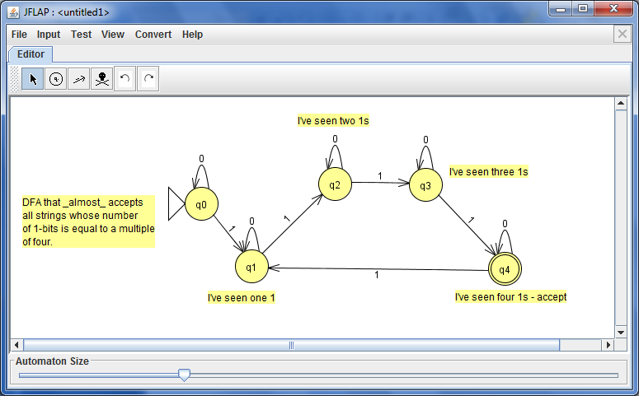

JFLAP !
transitions
states
comments or notes
There's a bug here!
And this can be done in only 4 states!
Plus, this reminds me of the NyanCat...

Slide 12
Quiz
(2) Draw a DFA accepting the language
Try creating some DFA(s)!
L = { w | w is a binary # that's a power of two }
(1) Draw a DFA accepting
initial 0s are OK
0s-only are not OK
L = { w | w is the string 10 }
the empty string λ is not OK
0010
1
10000
…
10
(3) Draw a DFA accepting
(4) Draw a DFA accepting
L = { w | the first and last bit of w are the same }
L = { w | w is a binary # divisible by 4, but not 8 }
the empty string λ is OK
initial 0s are OK
the empty string λ is OK
101
00
0010
0
1
λ
…
0100
0
λ
10100
…
Extra! Find the minimum possible number of states + Can you prove it?

Slide 13
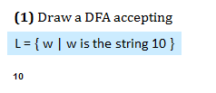

Slide 14
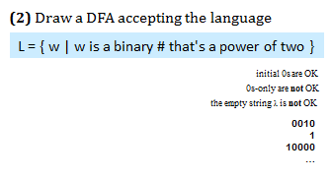

Slide 15
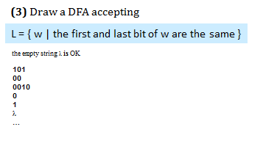

Slide 16
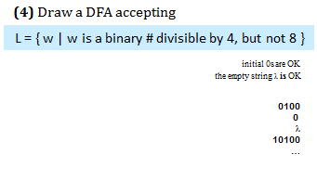

Slide 17
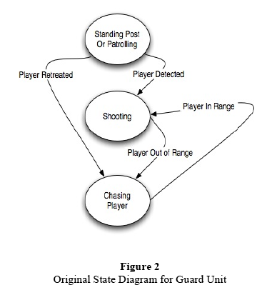
FSM applications…
http://www.gameai.com/statemachines.html
Game AI
Notes:
Ask for the game: Wolfenstein 3d - really the first first-person shooter 1992
by id software: Doom, in 1993, Quake in 1996,
ammo == ammo remaining at the end of the level…

Slide 18
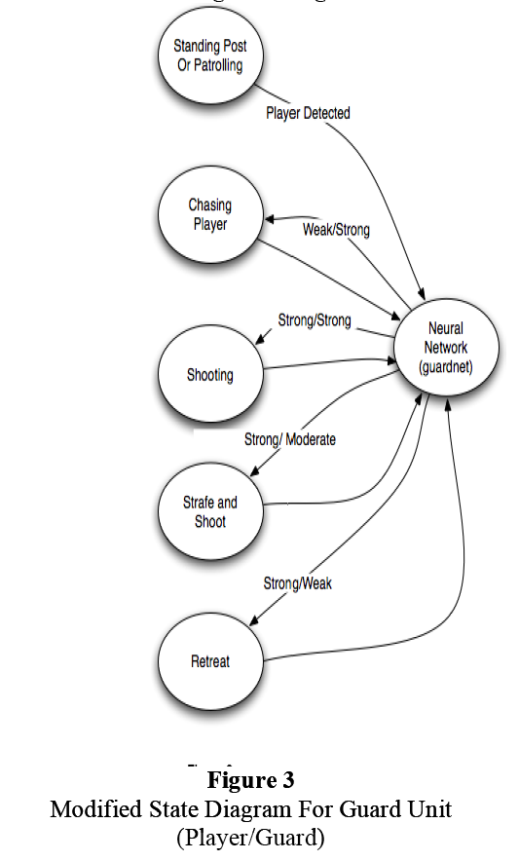
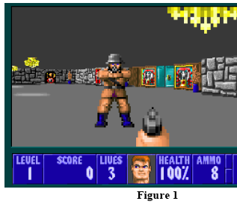
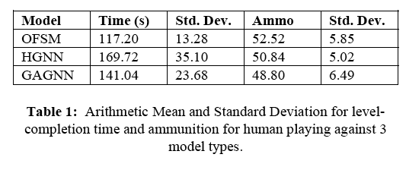
FSM applications…
http://www.gameai.com/statemachines.html
Game AI
Notes:
Ask for the game: Wolfenstein 3d - really the first first-person shooter 1992
by id software: Doom, in 1993, Quake in 1996,
ammo == ammo remaining at the end of the level…

Slide 19
FSM applications…
http://www.gameai.com/statemachines.html
Game AI
original finite state machine
human-guided neural network
genetic-algorithm-guided neural network
Notes:
Ask for the game: Wolfenstein 3d - really the first first-person shooter 1992
by id software: Doom, in 1993, Quake in 1996,
ammo == ammo remaining at the end of the level…

Slide 20
Minimal states
Sounds like Rhode Island…
Start with a language
L = { w | w is a binary number whose value is a power of two }
initial 0s are OK
only 0s are not OK
the empty string λ is not OK
example strings in L
001
1000
1
010000000
examples NOT in L
λ
11
0101010
0000
This DFA needs at least 3 states.
But, how can we prove this… ?

Slide 21
Minimal machines
Basic idea:
State == Fate
when a string lands in a particular state, that state fully determines what will happen to it as additional characters are added
A FSM has more states than needed if strings in two different states have the same fate.
I wonder what other state shares CA's fate ?

Slide 22
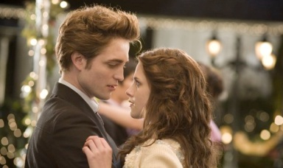
String soulmates ~ share the same fate…
Meet our four string couples for today:
w₁ = λ …
w₁ = 100…
w₁ = 11…
w₁ = 11…
w₂ = 1…
w₂ = 1…
w₂ = 101…
w₂ = 10…
Couple #1
Couple #2
Couple #3
Couple #4
Consider the language
L = { w | w is a binary number whose value is a power of two }
Are the fates of these string-pairs the same or different in L?
both accepted? both rejected? or might they have different outcomes?
indistinguishable
distinguishable
Soulmates? No soul required!
Notes:
from twilight: Bella Swan and Edward Cullen

Slide 23
Distinguishability
Given a language L
they might have different outcomes/fates
Two strings w₁ , w₂ are distinguishable w.r.t. L if
with respect to
∃ z s.t. w₁ z ∈ L and w₂ z ∉ L (or vice versa).
such that
there exists
think of z as a "suffix" or a "future" for w₁ and w₂

Slide 24
Distinguishability
Given a language L
they might have different outcomes/fates
Two strings w₁ , w₂ are distinguishable w.r.t. L if
with respect to
∃ z s.t. w₁ z ∈ L and w₂ z ∉ L (or vice versa).
such that
there exists
think of z as a "suffix" or a "future" for w₁ and w₂
Intuition…
Consider the "power of two in binary" language…
Two strings are distinguishable if they could possibly have different fates.
1
11

Slide 25
Distinguishable Sets
Given a language L
A set of strings { w₁ , w₂ , w₃ } is pairwise distinguishable w.r.t. L if all pairs w_{i} , w_{j} are distinguishable…

Slide 26
Distinguishable Sets
Given a language L
A set of strings { w₁ , w₂ , w₃ } is pairwise distinguishable w.r.t. L if all pairs w_{i} , w_{j} are distinguishable…
Intuition…
Consider the "power of two in binary" language…
0
1
A set is pairwise distinguishable if all possible pairs of strings in the set could have different fates…
0
11
Consider the set { 0, 1, and 11 }
1
11
All possible pairings:

Slide 27
The Distinguishability Theorem
Distinguishable pairs must "live" in different states.
Thus, given a language L, if you can show a pairwise distinguishable set of N strings
then L's DFA must have ≥ N states.
We've just proven that
L = { w | w is a binary number whose value is a power of two }
can be built in 3 states and requires 3 states.

Slide 28
The Distinguishability Theorem
Let's prove that
L = { w | w's first bit == w's last bit }
can be built in 5 states and requires 5 states.
… we need to show a set of five strings, all pairwise distinguishable
Our five strings:
Our P.D. proof:

Slide 29
The Distinguishability Theorem
Name(s) ____________________
Let's prove that
L = { w | w's first bit == w's last bit }
can be built in 5 states and requires 5 states.
… we need to show a set of five strings, all pairwise distinguishable
Our five strings:
Our P.D. proof:

Slide 30
The Distinguishability Theorem
Try this on the back first…
Let's prove that
L = { w | w's first bit == w's last bit }
can be built in 5 states and requires 5 states.
… we need to show a set of five strings, all pairwise distinguishable
Our five strings:
Our P.D. proof:

Slide 31
The Distinguishability Theorem
Distinguishable pairs must reside in different states.
Thus, given a language L, if you can show a pairwise distinguishable set of N strings
then L's DFA must have ≥ N states.
How about L = { w | w is a binary number whose value is a power of two } ?

Slide 32
Regular Languages
A language L is regular if there is a DFA that accepts it.
L = { w | w is a binary number whose value is a power of two }
L = { w | the third and third-to-last digits of w are identical }
L = { w | w is a binary number that’s divisible by 7 }
L = { 0^{k}1^{k} | k ≥ 0}
Are any of these languages too complex for a DFA to accept ?
Everyone O^{k} with these?

Slide 33
What can DFAs do?
Is it possible to build a DFA accepting this language?
L = { w | w is a binary number that’s divisible by 7 }
Accept
Reject
0
111
1110
10101
11100
100011
101010
...
all others
This is problem 6 on this week's HW…

Slide 34
Regular Languages
A language L is regular if there is a DFA that accepts it.
L = { w | w is a binary number whose value is a power of two }
L = { w | the third and third-to-last digits of w are identical }
L = { w | w is a binary number that’s divisible by 7 }
All regular languages ~ a DFA "is enough"
L = { 0^{k}1^{k} | k ≥ 0}
but no DFA accepts this language!
How could we prove this?

Slide 35
Regular Languages
To show no DFA accepts
L = { 0^{k}1^{k} | k ≥ 0}
We need to show it would need infinitely many states…
… that is, there is an infinite pairwise distinguishable set!
What infinite set of strings is pairwise distinguishable w.r.t. L?

Slide 36
Proving a language nonregular
The "double" language:
Show L = { ww | w is a bitstring } nonregular:

Slide 37
Proving a language nonregular
²
Show L = {0^{n} | n >= 0} nonregular:

Slide 38
The nonregular language theorem
Myhill-Nerode theorem
If you can show an infinite pairwise distinguishable set of strings (w.r.t. L), it must be that L is not regular!
No DFA can compute (accept) that language. Next time…
… a computational model that can: Turing Machines.

Slide 39
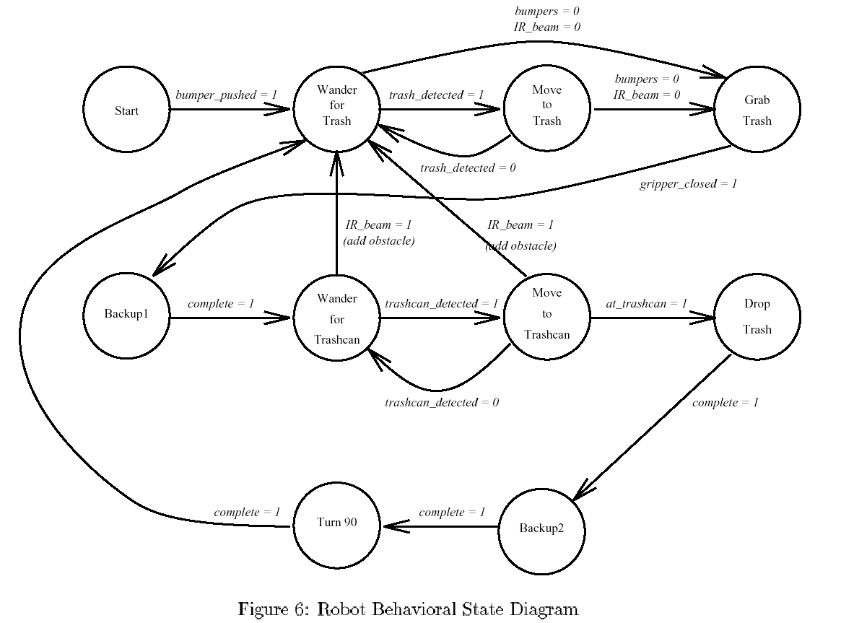
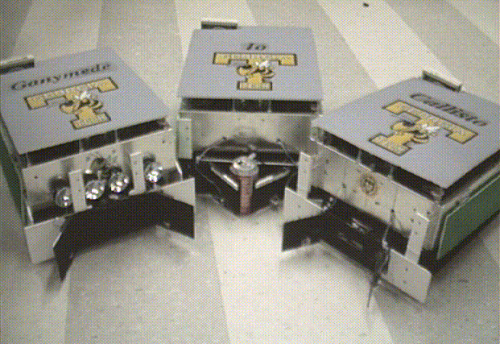
Robots are all FSMs…

Slide 40
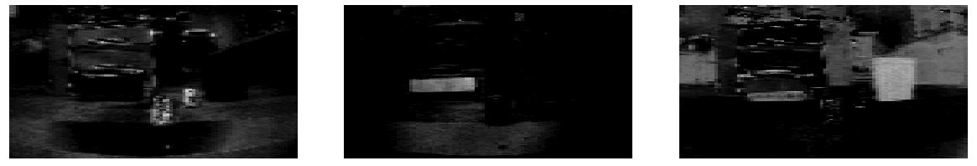
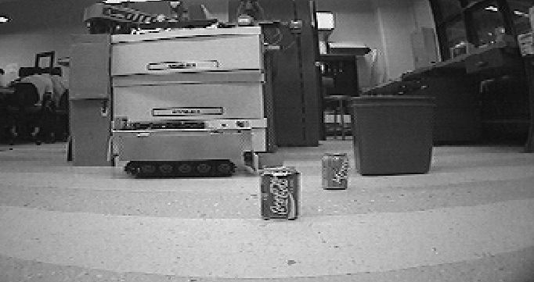
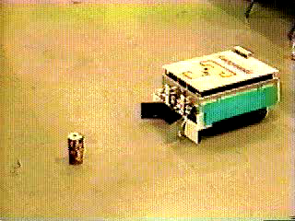
AAAI office-cleaning event
Winner '94: Georgia Tech

Slide 41
you
See
Thu!
Happy sorting !
Notes:
41
http://www.cs.duke.edu/csed/jflap/new/DOCS/gui.regular.EditorPane.html
The Regular Expression EditorThe editor for a regular expression is essentially just a single text field. Operators in a regular expression are the Kleene star (*), the ``or'' operator (+), parentheses are also usable, and concatenation is accomplished by making symbols adjacent.In HaikuTo make expressions for this program to work with, type them in the field.Adjacent symbols imply concatenation. No symbol is used.Many or nothing, Asterisk (*) is the Kleine star. What precedes repeats.Additionally, if you want an "or" symbol the plus (+) should be used.Screaming nothingness, exclamations (!) are special. They act as lambda.Formatting errors will be reported to you when you choose actions. The Regular Expression EditorThe editor for a regular expression is essentially just a single text field. Operators in a regular expression are the Kleene star (*), the ``or'' operator (+), parentheses are also usable, and concatenation is accomplished by making symbols adjacent.In HaikuTo make expressions for this program to work with, type them in the field.Adjacent symbols imply concatenation. No symbol is used.Many or nothing, Asterisk (*) is the Kleine star. What precedes repeats.Additionally, if you want an "or" symbol the plus (+) should be used.Screaming nothingness, exclamations (!) are special. They act as lambda.Formatting errors will be reported to you when you choose actions.

Slide 42
What is each state saying?
DFAs or FSMs
Deterministic
0
Every state has one transition for every possible character.
1
q1
Machine 2
q0
0
1
q2
0,1
L is the language accepted by Machine 2
L =
To be Deterministic, a DFA must
have a 0-edge and a 1-edge from every state
accept all strings in L and reject all strings not in L

Slide 43
Distinguishable Sets
Given a language L
they might have different outcomes/fates
Two strings w₁ , w₂ are distinguishable w.r.t. L if
with respect to
∃ z s.t. w₁ z ∈ L and w₂ z ∉ L (or vice versa).
such that
there exists
think of z as a "suffix" or a "future" for w₁ and w₂

Slide 44
This week's key ideas:
(1) Not every (boolean) function can be computed.
(2) So, what can be computed?
Last time
Answer #1: Regular expressions
Finite-state machines (FSMs)
Answer #2:
This time
Deterministic Finite Automata (DFAs)
Turing machines (TMs)
Next time
Answer #3:
Notes:
regexen?

Slide 45
A Kleene answer: Regular Expressions
a structural description for those sets that are computable …
A regular expression is composed of three operations:
Kleene Star a* “0 or more a’s”
high precedence
concatenation ab “a then b”
union a | b “a or b”
low precedence
where a and b can be any bit strings - or regular expressions
base case
recursively defined !
Notes:
45
http://www.cs.duke.edu/csed/jflap/new/DOCS/gui.regular.EditorPane.html
The Regular Expression EditorThe editor for a regular expression is essentially just a single text field. Operators in a regular expression are the Kleene star (*), the ``or'' operator (+), parentheses are also usable, and concatenation is accomplished by making symbols adjacent.In HaikuTo make expressions for this program to work with, type them in the field.Adjacent symbols imply concatenation. No symbol is used.Many or nothing, Asterisk (*) is the Kleine star. What precedes repeats.Additionally, if you want an "or" symbol the plus (+) should be used.Screaming nothingness, exclamations (!) are special. They act as lambda.Formatting errors will be reported to you when you choose actions. The Regular Expression EditorThe editor for a regular expression is essentially just a single text field. Operators in a regular expression are the Kleene star (*), the ``or'' operator (+), parentheses are also usable, and concatenation is accomplished by making symbols adjacent.In HaikuTo make expressions for this program to work with, type them in the field.Adjacent symbols imply concatenation. No symbol is used.Many or nothing, Asterisk (*) is the Kleine star. What precedes repeats.Additionally, if you want an "or" symbol the plus (+) should be used.Screaming nothingness, exclamations (!) are special. They act as lambda.Formatting errors will be reported to you when you choose actions.

Slide 46
CS 60 programming languages
Programming
Declarative
Programming
Imperative
Programming
Logic Programming
Functional Programming
Object-Oriented
Programming
Low-level Programming
Prolog
Scheme
Java
the (real) machine
JFlap
leveraging one algorithm
creating algorithms
creating data structures
creating computation
more abstraction away from the machine
closer to the machine
No machine at all!

Slide 47
What can DFA's do?
Is it possible to build a DFA accepting this language?
L = { w | w is a binary number that is divisible by 7 }
Accept
Reject
0
111
1110
10101
11100
100011
101010
...
all others
This is problem 6 on this week's HW…
Suppose you're on the accepting state and the next input bit is a 0… ?

Slide 48
Regular Languages
A language L is regular if there is a DFA that accepts it.
L = { w | w is a binary number whose value is a power of two }
All regular
L = { w | the third and third-to-last digits of w are identical }
L = { w | w is a binary number that’s divisible by 7 }
L = { 0^{k}1^{k} | k ≥ 0}
Nonregular !
How could we prove that
L = { 0^{k}1^{k} | k ≥ 0}
is not regular?

Slide 49
Regular Languages
A language L is regular if there is a DFA that accepts it.
L = { w | w is a binary number whose value is a power of two }
All regular
L = { w | the third and third-to-last digits of w are identical }
L = { w | w is a binary number that’s divisible by 7 }
L = { 0^{k}1^{k} | k ≥ 0}
Nonregular !
How could we prove that
L = { 0^{k}1^{k} | k ≥ 0}
is not regular?
If there is an infinite pairwise distinguishable set of strings (w.r.t. L), it must be that L is not regular!
The Nonregular Language Theorem
Myhill-Nerode theorem

Slide 50
Proving a language nonregular
L = { 0^{k}1^{k} | k ≥ 0}
is a non-regular language !
We need to show an infinite set of pairwise distinguishable strings:

Slide 51
Kleene's answer: Regular Expressions
looking for a simple description for those sets that are computable …
Examples:
10
matches the string 10, which is the language
{ 10 }
or
L = { w | w is 10 }
(10)*
1* | 10*
A regular expression is composed of three operations:
Kleene Star a* “0 or more a’s”
high precedence
concatenation ab “a then b”
union a | b “a or b”
low precedence
where a and b can be any bit strings - or regular expressions
base case
recursively defined !
Notes:
51
http://www.cs.duke.edu/csed/jflap/new/DOCS/gui.regular.EditorPane.html
The Regular Expression EditorThe editor for a regular expression is essentially just a single text field. Operators in a regular expression are the Kleene star (*), the ``or'' operator (+), parentheses are also usable, and concatenation is accomplished by making symbols adjacent.In HaikuTo make expressions for this program to work with, type them in the field.Adjacent symbols imply concatenation. No symbol is used.Many or nothing, Asterisk (*) is the Kleine star. What precedes repeats.Additionally, if you want an "or" symbol the plus (+) should be used.Screaming nothingness, exclamations (!) are special. They act as lambda.Formatting errors will be reported to you when you choose actions. The Regular Expression EditorThe editor for a regular expression is essentially just a single text field. Operators in a regular expression are the Kleene star (*), the ``or'' operator (+), parentheses are also usable, and concatenation is accomplished by making symbols adjacent.In HaikuTo make expressions for this program to work with, type them in the field.Adjacent symbols imply concatenation. No symbol is used.Many or nothing, Asterisk (*) is the Kleine star. What precedes repeats.Additionally, if you want an "or" symbol the plus (+) should be used.Screaming nothingness, exclamations (!) are special. They act as lambda.Formatting errors will be reported to you when you choose actions.

Slide 52
Computations-as-sets
example alphabets
Choose an alphabet
(a set of input characters)
ASCII
{a,b,…,z}
{0,1}
Consider all sets of the alphabet's finite-length strings.
∅
1
10
100
1
10
100
1000
…
λ
0
1
00
01
10
11
000
…
101010
{ }
Is there a static, structural description of computation?

Slide 53
Quiz
Regular (?) expressions
Operator Name
Example
Description
Kleene Star a* “0 or more a’s”
concatenation ab “a then b”
union a | b “a or b”
L = { w | w contains a 0 }
L = { w | w’s second-to-last character is a 1 }
L = { w | every 1 in w has a 0 after it }
L = { w | w’s first and last bits are the same }
Description of a formal language
Equivalent regular expression
Is there an equivalent regular expression to this one that avoids the nested * operators?
( 01* | 10 )*
Can every reg. expression avoid nested *'s ?
Notes:
53
http://www.cs.duke.edu/csed/jflap/new/DOCS/gui.regular.EditorPane.html
The Regular Expression EditorThe editor for a regular expression is essentially just a single text field. Operators in a regular expression are the Kleene star (*), the ``or'' operator (+), parentheses are also usable, and concatenation is accomplished by making symbols adjacent.In HaikuTo make expressions for this program to work with, type them in the field.Adjacent symbols imply concatenation. No symbol is used.Many or nothing, Asterisk (*) is the Kleine star. What precedes repeats.Additionally, if you want an "or" symbol the plus (+) should be used.Screaming nothingness, exclamations (!) are special. They act as lambda.Formatting errors will be reported to you when you choose actions. The Regular Expression EditorThe editor for a regular expression is essentially just a single text field. Operators in a regular expression are the Kleene star (*), the ``or'' operator (+), parentheses are also usable, and concatenation is accomplished by making symbols adjacent.In HaikuTo make expressions for this program to work with, type them in the field.Adjacent symbols imply concatenation. No symbol is used.Many or nothing, Asterisk (*) is the Kleine star. What precedes repeats.Additionally, if you want an "or" symbol the plus (+) should be used.Screaming nothingness, exclamations (!) are special. They act as lambda.Formatting errors will be reported to you when you choose actions.

Slide 54
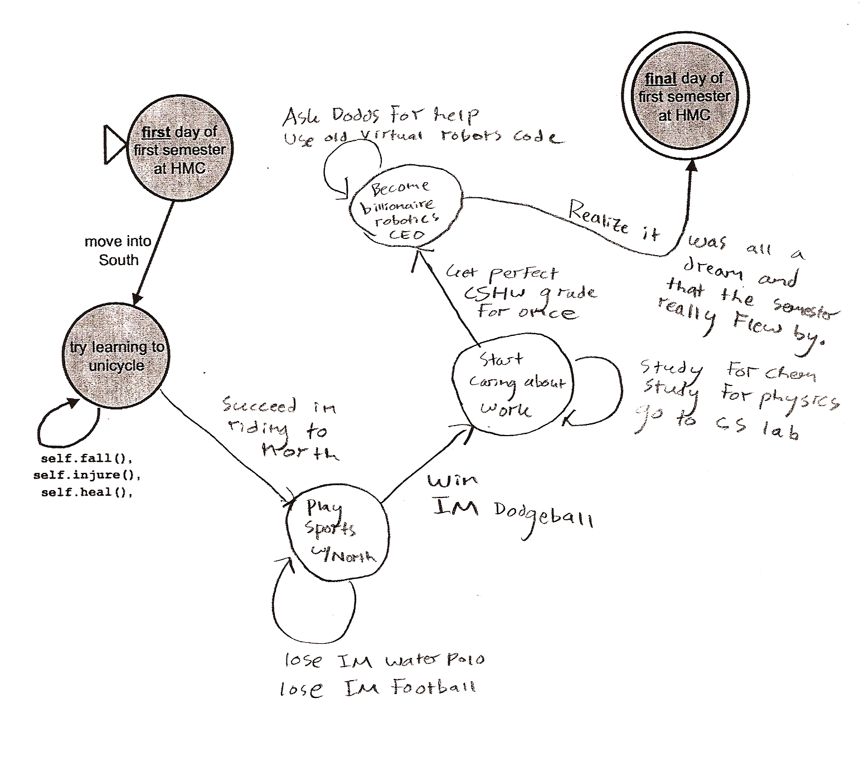
Yet another HMC DFA
I think it was all a dream…

Slide 55
Grammars
Regular grammars
Context-free grammars
S
1A
λ
S
1A
λ
A
0S
A
0S
A
1AA
at most one nonterminal on the right and it must be at the far right end
may have many nonterminals and terminals on the right…
only one nonterminal on the left of each rule
are regular grammars the same as finite state machines?
only one nonterminal on the left of each rule

Slide 56
Real assembly languages are messy…
each of these programs swaps the values of two variables (what are those values?)
main:
pushl %ebp
movl %esp, %ebp
subl $24, %esp
andl $-16, %esp
movl $0, %eax
subl %eax, %esp
movl $42, -4(%ebp)
movl $7, -8(%ebp)
movl -4(%ebp), %eax
movl %eax, -12(%ebp)
movl -8(%ebp), %eax
movl %eax, -4(%ebp)
movl -12(%ebp), %eax
movl %eax, -8(%ebp)
subl $4, %esp
pushl -8(%ebp)
pushl -4(%ebp)
pushl $.LC0
call printf
addl $16, %esp
leave
ret
main:
!#PROLOGUE# 0
save %sp, -128, %sp
!#PROLOGUE# 1
mov 42, %g1
st %g1, [%fp-20]
mov 7, %g1
st %g1, [%fp-24]
ld [%fp-20], %g1
st %g1, [%fp-28]
ld [%fp-24], %g1
st %g1, [%fp-20]
ld [%fp-28], %g1
st %g1, [%fp-24]
sethi %hi(.LLC0), %g1
or %g1, %lo(.LLC0), %o0
ld [%fp-20], %o1
ld [%fp-24], %o2
call printf, 0
nop
mov %g1, %i0
ret
restore
main:
pushl %ebp
movl %esp, %ebp
subl $8, %esp
andl $-16, %esp
movl $0, %eax
subl %eax, %esp
movl $42, -4(%ebp)
movl $7, -8(%ebp)
movl -8(%ebp), %edx
leal -4(%ebp), %eax
xorl %edx, (%eax)
movl -4(%ebp), %edx
leal -8(%ebp), %eax
xorl %edx, (%eax)
movl -8(%ebp), %edx
leal -4(%ebp), %eax
xorl %edx, (%eax)
subl $4, %esp
pushl -8(%ebp)
pushl -4(%ebp)
pushl $.LC0
call printf
addl $16, %esp
leave
ret
main:
!#PROLOGUE# 0
save %sp, -120, %sp
!#PROLOGUE# 1
mov 42, %g1
st %g1, [%fp-20]
mov 7, %g1
st %g1, [%fp-24]
ld [%fp-20], %o5
ld [%fp-24], %g1
xor %o5, %g1, %g1
mov %g1, %o5
st %o5, [%fp-20]
ld [%fp-24], %g1
xor %g1, %o5, %g1
mov %g1, %o5
st %o5, [%fp-24]
ld [%fp-20], %g1
xor %g1, %o5, %g1
st %g1, [%fp-20]
sethi %hi(.LLC0), %g1
or %g1, %lo(.LLC0), %o0
ld [%fp-20], %o1
ld [%fp-24], %o2
call printf, 0
nop
mov %g1, %i0
ret
restore
Intel: PC
Sun UltraSparc
with a temporary variable
Intel: PC
only worry about these details on a need-to-know basis…
using the XOR trick
Sun UltraSparc

Slide 57
Grammars ~ production machines
Regular grammars
Context-free grammars
S
1A
λ
S
1A
λ
more than 1 possibility with each step!
A
0S
A
0S
A
1AA
at most one nonterminal on the right and it must be at the far right end
may have many nonterminals and terminals on the right…
only one nonterminal on the left of each rule
only one nonterminal on the left of each rule

Slide 58
Creating DFAs
What DFA accepts L = { w | the # of 1s in w is divisible by 4 } ?
is defined to be the set of all strings, w, such that the number of 1s in w is divisible by 4.
the language is named L
Remember: we're only worried about strings of 0s and 1s.
(1) Name a couple of strings accepted by this DFA…
(2) Name a couple of strings rejected by this DFA…
(3) What will the states mean ?
(4) Sketch…
JFLAP

Slide 59
Kleene's answer: Regular Expressions
looking for a simple description for those sets that are computable …
Examples:
10
matches the string 10, which is the language
{ 10 }
or
L = { w | w is 10 }
(10)*
1* | 10*
A regular expression is composed of three operations:
Kleene Star a* “0 or more a’s”
high precedence
concatenation ab “a then b”
union a | b “a or b”
low precedence
where a and b can be any bit strings - or regular expressions
base case
recursively defined !
Notes:
59
http://www.cs.duke.edu/csed/jflap/new/DOCS/gui.regular.EditorPane.html
The Regular Expression EditorThe editor for a regular expression is essentially just a single text field. Operators in a regular expression are the Kleene star (*), the ``or'' operator (+), parentheses are also usable, and concatenation is accomplished by making symbols adjacent.In HaikuTo make expressions for this program to work with, type them in the field.Adjacent symbols imply concatenation. No symbol is used.Many or nothing, Asterisk (*) is the Kleine star. What precedes repeats.Additionally, if you want an "or" symbol the plus (+) should be used.Screaming nothingness, exclamations (!) are special. They act as lambda.Formatting errors will be reported to you when you choose actions. The Regular Expression EditorThe editor for a regular expression is essentially just a single text field. Operators in a regular expression are the Kleene star (*), the ``or'' operator (+), parentheses are also usable, and concatenation is accomplished by making symbols adjacent.In HaikuTo make expressions for this program to work with, type them in the field.Adjacent symbols imply concatenation. No symbol is used.Many or nothing, Asterisk (*) is the Kleine star. What precedes repeats.Additionally, if you want an "or" symbol the plus (+) should be used.Screaming nothingness, exclamations (!) are special. They act as lambda.Formatting errors will be reported to you when you choose actions.

Slide 60
Quiz
Regular (?) expressions
Operator Name
Example
Description
Kleene Star a* “0 or more a’s”
concatenation ab “a then b”
union a | b “a or b”
L = { w | w contains a 0 }
L = { w | w’s second-to-last character is a 1 }
L = { w | every 1 in w has a 0 after it }
L = { w | w’s first and last bits are the same }
Description of a formal language
Equivalent regular expression
Is there an equivalent regular expression to this one that avoids the nested * operators?
( 01* | 10 )*
Can every reg. expression avoid nested *'s ?
Other operators can be used with regular expressions, such as
a+
1 or more as
strings not matching a
~a
Write these operators in terms of the original three…
Notes:
60
http://www.cs.duke.edu/csed/jflap/new/DOCS/gui.regular.EditorPane.html
The Regular Expression EditorThe editor for a regular expression is essentially just a single text field. Operators in a regular expression are the Kleene star (*), the ``or'' operator (+), parentheses are also usable, and concatenation is accomplished by making symbols adjacent.In HaikuTo make expressions for this program to work with, type them in the field.Adjacent symbols imply concatenation. No symbol is used.Many or nothing, Asterisk (*) is the Kleine star. What precedes repeats.Additionally, if you want an "or" symbol the plus (+) should be used.Screaming nothingness, exclamations (!) are special. They act as lambda.Formatting errors will be reported to you when you choose actions. The Regular Expression EditorThe editor for a regular expression is essentially just a single text field. Operators in a regular expression are the Kleene star (*), the ``or'' operator (+), parentheses are also usable, and concatenation is accomplished by making symbols adjacent.In HaikuTo make expressions for this program to work with, type them in the field.Adjacent symbols imply concatenation. No symbol is used.Many or nothing, Asterisk (*) is the Kleine star. What precedes repeats.Additionally, if you want an "or" symbol the plus (+) should be used.Screaming nothingness, exclamations (!) are special. They act as lambda.Formatting errors will be reported to you when you choose actions.

Slide 61
Kleene's computer: Regular Expressions
a "simple" description for those sets that are computable …
A regex describes a formal language, a set of (binary) inputs for which a logical function outputs True
regex
10
(10)*
1* | 10*
L = { w | w is zero or more 1's or w is a single 1 followed by zero or more 0's
its language
{ 10 }
{λ, 10, 1010, 101010, … }
Ouch!
A regular expression is composed of three operations:
Kleene Star a* “0 or more a’s”
high precedence
concatenation ab “a then b”
union a | b “a or b”
low precedence
where a and b can be any bit strings - or regular expressions
base case
recursively defined !
Notes:
61
http://www.cs.duke.edu/csed/jflap/new/DOCS/gui.regular.EditorPane.html
The Regular Expression EditorThe editor for a regular expression is essentially just a single text field. Operators in a regular expression are the Kleene star (*), the ``or'' operator (+), parentheses are also usable, and concatenation is accomplished by making symbols adjacent.In HaikuTo make expressions for this program to work with, type them in the field.Adjacent symbols imply concatenation. No symbol is used.Many or nothing, Asterisk (*) is the Kleine star. What precedes repeats.Additionally, if you want an "or" symbol the plus (+) should be used.Screaming nothingness, exclamations (!) are special. They act as lambda.Formatting errors will be reported to you when you choose actions. The Regular Expression EditorThe editor for a regular expression is essentially just a single text field. Operators in a regular expression are the Kleene star (*), the ``or'' operator (+), parentheses are also usable, and concatenation is accomplished by making symbols adjacent.In HaikuTo make expressions for this program to work with, type them in the field.Adjacent symbols imply concatenation. No symbol is used.Many or nothing, Asterisk (*) is the Kleine star. What precedes repeats.Additionally, if you want an "or" symbol the plus (+) should be used.Screaming nothingness, exclamations (!) are special. They act as lambda.Formatting errors will be reported to you when you choose actions.

Slide 62
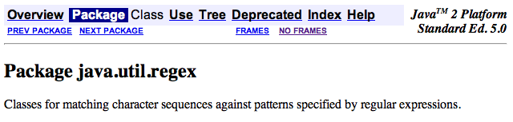
Regexes in practice…
Almost all languages have a regex library…
Unix’s egrep does a line-by-line search for a regex:
egrep 'hh'
egrep 'y.*y'
egrep '(xq|hq)'
egrep '^y.*y$'
/usr/share/dict/words
symbol for start of a line
symbol for end of a line
symbol for any character, a shortcut for (a|b|c|…|z|0|1|…|9|…)
good for crosswords !
VOWEL
U
VOWEL
not always obvious …
egrep '^(0|1(01*0)*1)(0|1(01*0)*1)*$' binStr
Notes:
62

Slide 63

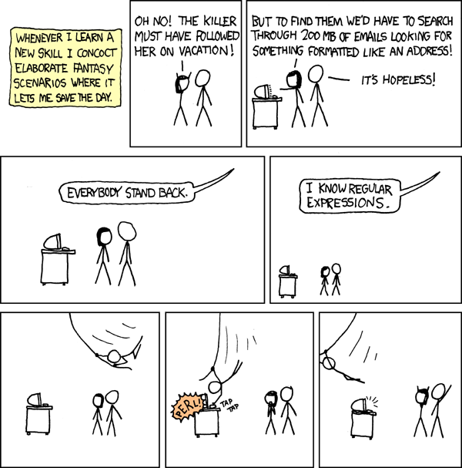
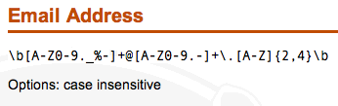
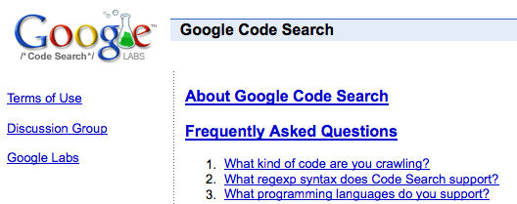
xkcd to the rescue, perhaps?
REs to the rescue!
practical extraction and report language
PERL
www.regular-expressions.info/regexbuddy/email.html
but how does regular expression matching actually work?
Notes:
63
Pimp my Ride from MTV - Corona is where the garage is…
MTV + SciFi -- twilight zone…

Slide 64
See you Wednesday!
You walk west
You are in a dark cave.
There is water dripping from the stalactites.
The only light is from the way you came.
You can just barely make out a sign that says
"Here there be dragons"
You see a dragon
?- look(dragon).
___====-_ _-====___
_--~~~#####// \\#####~~~--_
_-~##########// ( ) \\##########~-_
-############// :\^^/: \\############-
_~############// (@::@) \\############~
~#############(( \\// ))#############~
-###############\\ (^^) //###############-
-#################\\ / "" \ //#################-
-###################\\/ \//###################-
_#/:##########/\######( /\ )######/\##########:\#_
:/ :#/\#/\#/\/ \#/\##\ : : /##/\#/ \/\#/\#/\#: \:
" :/ V V " V \#\: : : :/#/ V " V V \: "
" " " " \ : : : : / " " " "
You are in a hallway with dull grey wallpaper.
There is really not much to describe...
There is a door to the south and to the west.
You see a wibstr_dictionary
Yes
?- look(wibstr_dictionary).
Brought to you by the AAAA, the
American Association Against Acronyms.
You are in a giant pantry, or is it a giant's pantry?
There is a door to the west.
You see a forty_two_cans_of_spam
You see a spork
?- take( spork ).
You now have the spork
?- take( forty_two_cans_of_spam ).
You now have the forty_two_cans_of_spam
?- eat( forty_two_cans_of_spam ).
You greedily shovel all 42 cans of spam down your throat.
Your stomach explodes, but you died happy. You just won THE GAME.
You are in a giant pantry, or is it a giant's pantry?
There is a door to the west.
You see a forty_two_cans_of_spam
You see a spork
?- take( forty_two_cans_of_spam ).
You now have the forty_two_cans_of_spam
?- eat( forty_two_cans_of_spam ).
You eat the spam, cans and all. You choke on the metal and die.
You just lost the game.
Losing.
Winning!
The line between winning and losing can be very thin indeed!

Slide 65
Regexes in practice…
Haiku?
Almost all languages have a regex library…
Unix’s egrep does a line-by-line search for a regex:
egrep 'hh'
egrep 'y.*y'
egrep '(xq|hq)'
egrep '^y.*y$'
/usr/share/dict/words
Haiku
symbol for start of a line
symbol for end of a line
symbol for any character, a shortcut for (a|b|c|…|z|0|1|…|9|…)
good for crosswords !
VOWEL
U
VOWEL
not always obvious …
egrep '^(0|1(01*0)*1)(0|1(01*0)*1)*$' binStr
Notes:
65

Slide 66
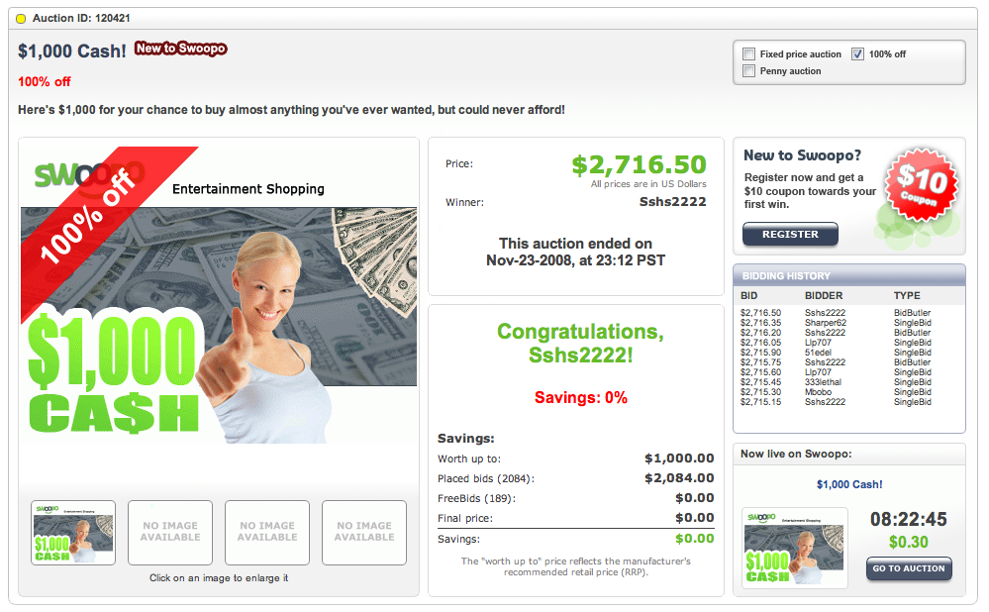
entertainment shopping?

Slide 67
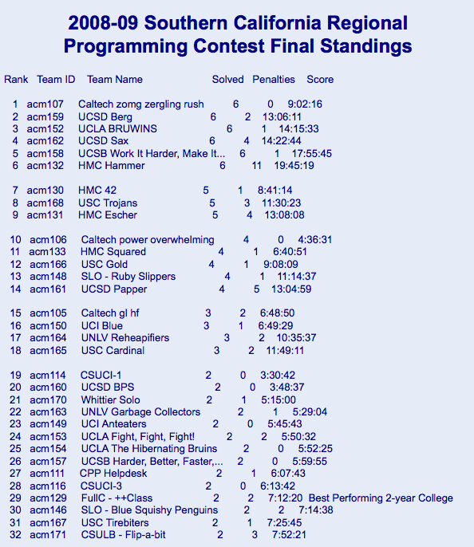
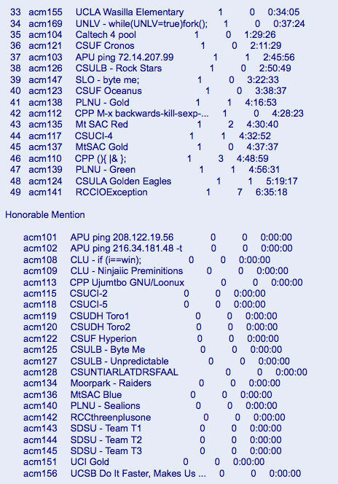
This weekend's ACM regional programming contest
Aaron Pribadi, Stuart Persteiner, and Daniel Lubarov
Anak Yodpinyanee + Jason GarretGlaser
Kevin Oelze, Andrew Hunter, and Kwang Ketcham
Marquis Wang, Josh Ehrlich, and Daniel Fielder
Notes:
67

Slide 68
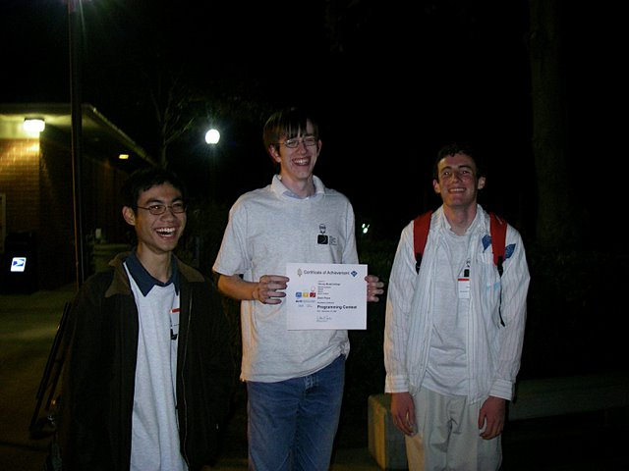
This weekend's ACM regional programming contest
Aaron Pribadi, Stuart Persteiner, and Daniel Lubarov
Anak Yodpinyanee + Jason GarretGlaser
Kevin Oelze, Andrew Hunter, and Kwang Ketcham
Marquis Wang, Josh Ehrlich, and Daniel Fielder
The contest seemed to be channeling CS 60…
Notes:
68

Slide 69
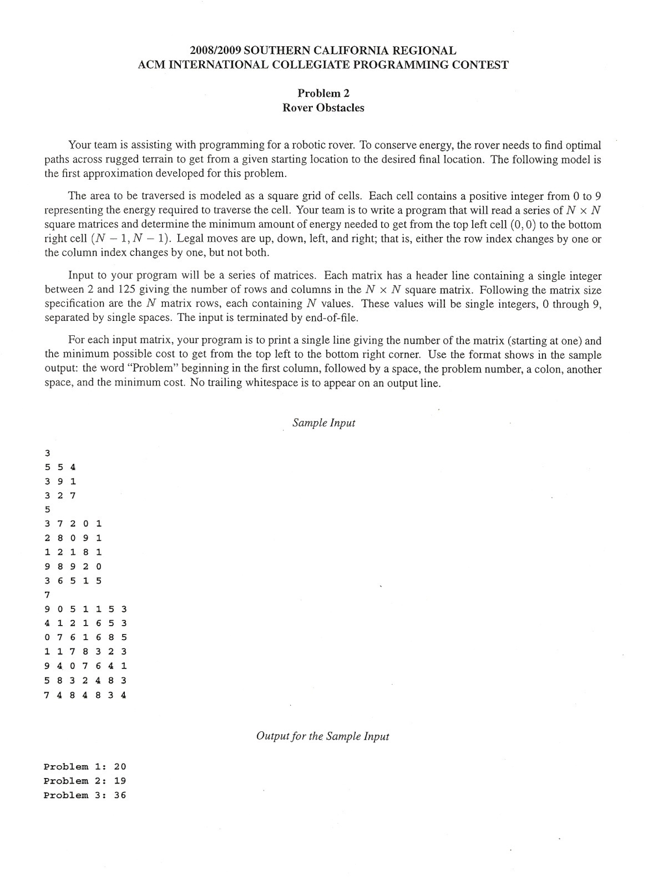

ACM regionals ~ CS 60?
From corner to corner as cheaply as possible…
Notes:
69

Slide 70
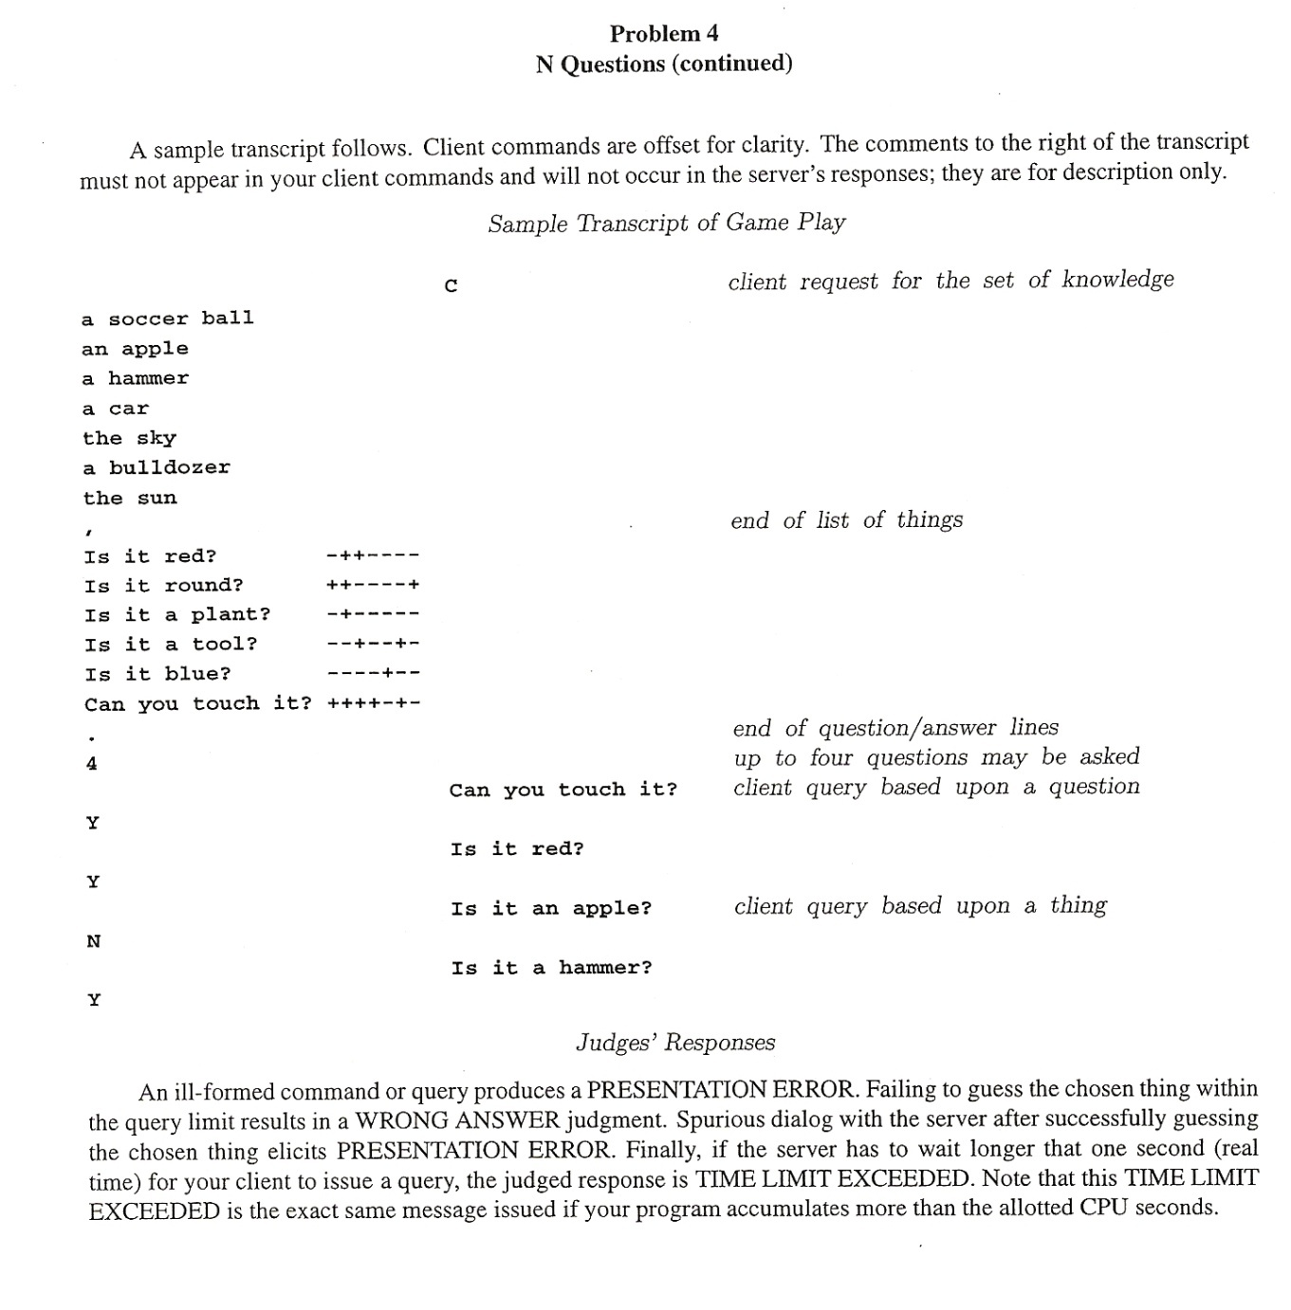
ACM regionals ~ CS 60?
20 questions: given objects, given questions, and given the answers to the questions (!), Identify the object in the specified number of questions…
Notes:
70

Slide 71
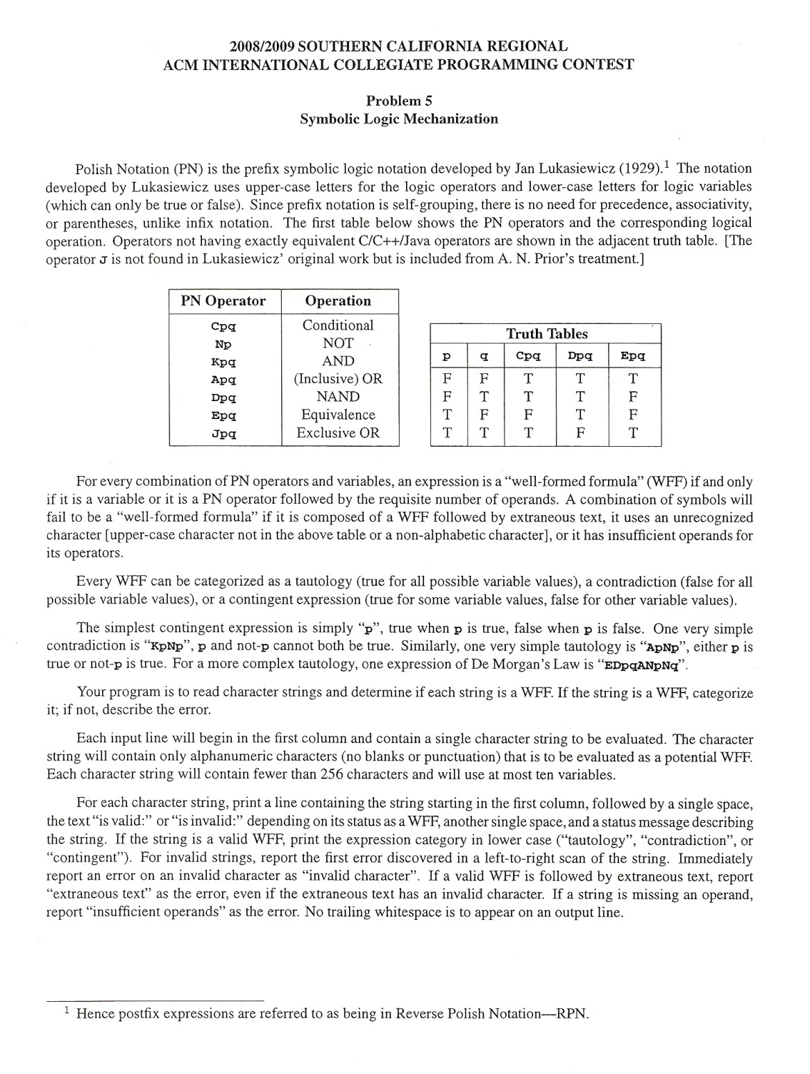
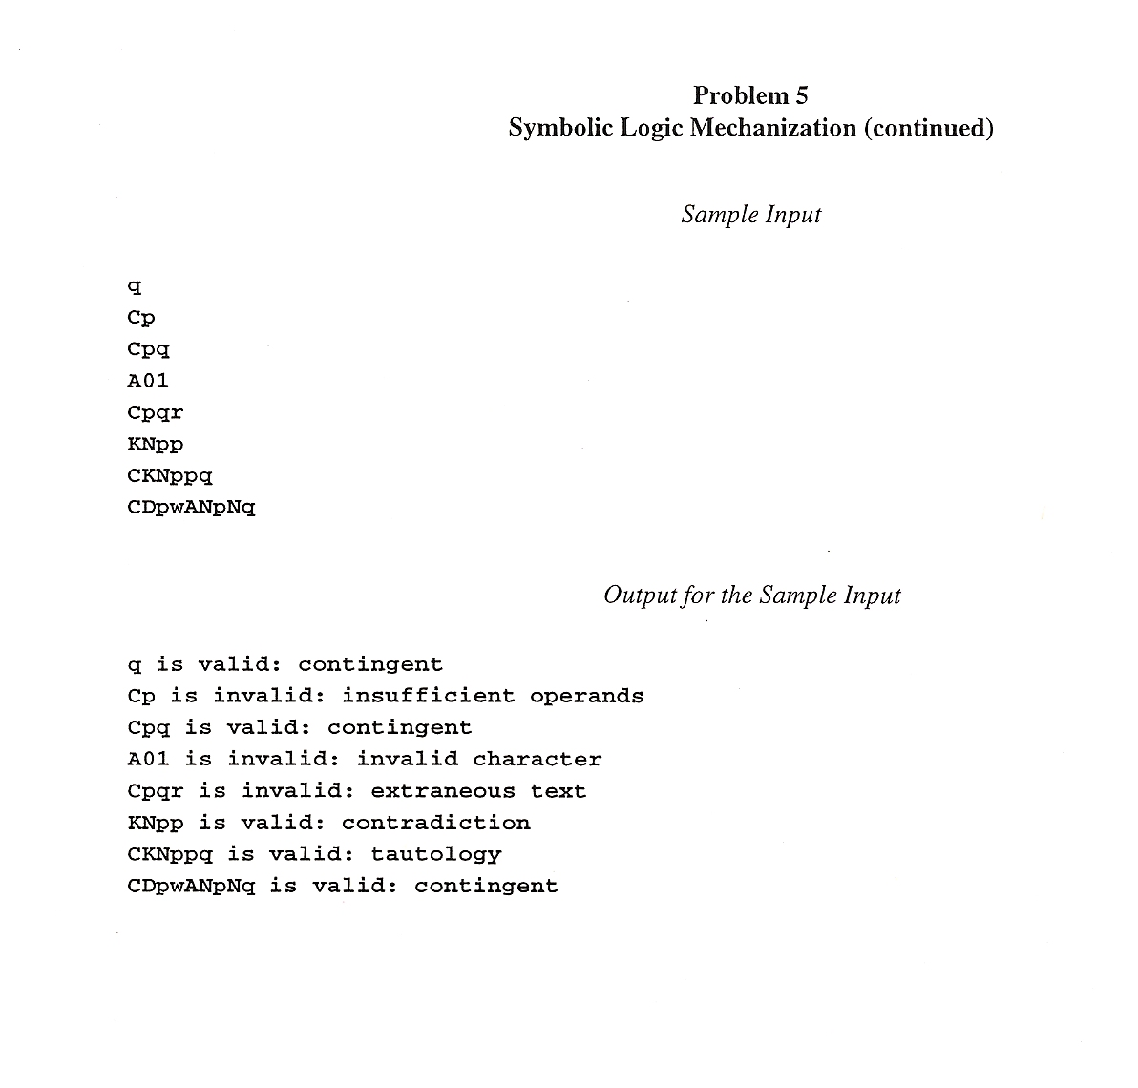
ACM regionals ~ CS 60?
Tautology checking (and parsing!)
( no Prolog permitted )
Notes:
71

Slide 72
See you on Wednesday!
Wednesday, April 16 for some
Wednesday, September 3 for others, perhaps…

Slide 73
There's something irregular about this theorem's name…
The Nonregular Language Theorem
Consider the language
L = { 0^{n}1^{n} | n ≥ 0}
example strings in L
To show it’s not regular…
λ
01
0011
000111
00001111
0000011111
Does the same set work for these languages?
L = palindromes
L = { w | w has the same # of 1s and 0s }

Slide 74
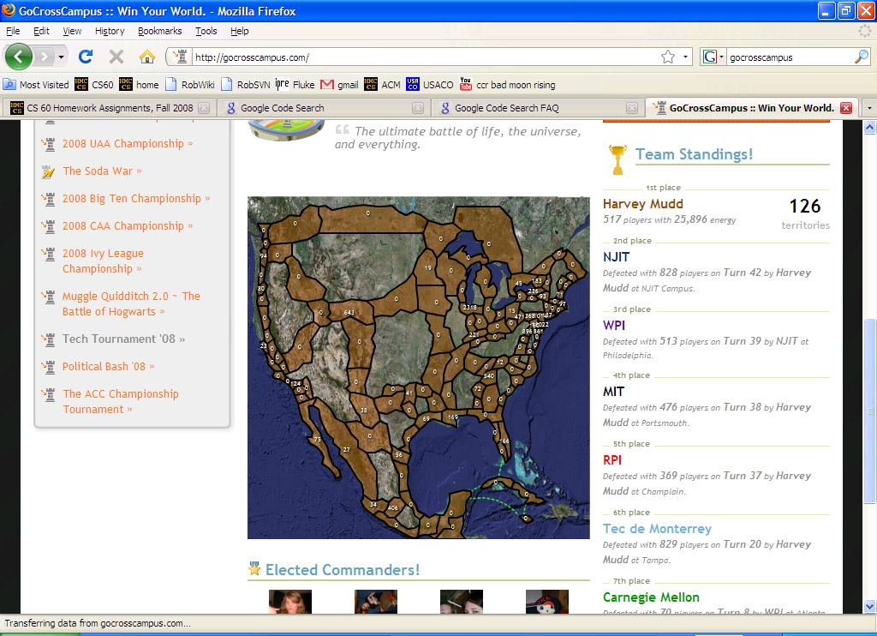
Notes:
regexen?

Slide 75
The question…
How powerful are DFAs ?
Can they emulate normal I/O behavior?
Can they do anything a desktop machine can?
Can they compute anything at all?
computing with parallel universes…
Next Time:

Slide 76
See you on Wednesday!
Wednesday, April 16 for some
Wednesday, September 3 for others, perhaps…

Slide 77
GA Tech’s FSM for trash pick-up

Slide 78
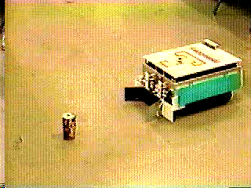
AAAI 1994 champions
Office-cleaning event
Georgia Tech

Slide 79
FSM applications…
http://www.gameai.com/statemachines.html
Game AI
original finite state machine
human-guided neural network
genetic-algorithm-guided neural network
Notes:
Ask for the game: Wolfenstein 3d - really the first first-person shooter 1992
by id software: Doom, in 1993, Quake in 1996,
ammo == ammo remaining at the end of the level…

Slide 80
FSM applications…
http://www.gameai.com/statemachines.html
Game AI
Notes:
Ask for the game: Wolfenstein 3d - really the first first-person shooter 1992
by id software: Doom, in 1993, Quake in 1996,

Slide 81
The question…
How powerful are DFAs ?
Can they emulate normal I/O behavior?
Can they do anything a desktop machine can?
Can they compute anything at all?
computing with parallel universes…
Next Time:
the DFA - DNA connection: string sequencing!

Slide 82
Soulmate strings…
Start with a language
L = { w | w’s third-from-left character is a 1}
example strings in L
example strings NOT in L
001
1010
11100010
011111111
λ
11
0101010
110111011110
Meet our three string couples for today…
Couple #1
Couple #2
Couple #3
w₁ = 011…
w₁ = 011…
w₁ = 01…
w₂ = 111…
w₂ = 110…
w₂ = 10…
Are the fates of these string couples the same or different?
both accepted? both rejected? or might they have different outcomes?
indistinguishable
distinguishable

Slide 83
String matchmaking
Given a language, L,
they might have different outcomes
Two strings w₁ , w₂ are distinguishable (w.r.t. L) if
∃z such that w₁ z ∈ L and w₂ z ∉ L (or vice versa).
A set of strings {w₁,w₂,w₃,…} is pairwise distinguishable if
∀ w_{i} ,w_{j} with i ≠ j , w_{i} and w_{j} are distinguishable, as above.
What if there are 42 of them?

Slide 84
The Distinguishability Theorem
If there is a pairwise distinguishable set of N strings for a language L, then a DFA accepting L must have ≥ N states.

Slide 85
The Distinguishability Theorem
If there is a pairwise distinguishable set of N strings for a language L, then a DFA accepting L must have ≥ N states.
How could we prove that this language's DFA requires 4 states?
L = { w | w is a binary # that’s divisible by 4 }

Slide 86
The question…
How powerful are DFAs ?
Can they emulate normal I/O behavior?
Can they do anything a desktop machine can?
Can they compute anything at all?
computing with parallel universes…
Next Time:
the DFA - DNA connection: string sequencing!

Slide 87
GA Tech’s FSM for trash pick-up

Slide 88
AAAI 1994 champions
Office-cleaning event
Georgia Tech

Slide 89
FSM applications…
http://www.gameai.com/statemachines.html
Game AI
original finite state machine
human-guided neural network
genetic-algorithm-guided neural network
Notes:
Ask for the game: Wolfenstein 3d - really the first first-person shooter 1992
by id software: Doom, in 1993, Quake in 1996,
ammo == ammo remaining at the end of the level…

Slide 90
FSM applications…
http://www.gameai.com/statemachines.html
Game AI
Notes:
Ask for the game: Wolfenstein 3d - really the first first-person shooter 1992
by id software: Doom, in 1993, Quake in 1996,

Slide 91
A really big DFA…
What DFA accepts this language?
L = { 0^{n}1^{n} | n ≥ 0}
example strings
λ
01
0011
000111
00001111
0000011111

Slide 92
Regular Languages
A language L is regular if there is a DFA that accepts it.
L = { w | w’s third character is a 1}
L = { w | w’s third-to-last character (from the right) is a 1}
L = { w | w is a binary # that’s divisible by 3 }
How could we prove that
L = { 0^{n}1^{n} | n ≥ 0}
is not regular?
If there is an infinite pairwise distinguishable set of strings (wrt L), it must be that L is not regular!

Slide 93
The Nonregular Language Theorem
Consider the language
L = { 0^{n}1^{n} | n ≥ 0}
example strings
λ
01
0011
000111
00001111
0000011111

Slide 94
DFA “Quiz”
(1) Draw a DFA that accepts
L = { w | w’s third character is a 1}
Extra Credit: do your solutions use the minimum possible number of states?
(2) (Watch out!) Draw a DFA accepting
L = { w | w’s third-to-last character (from the right) is a 1}

Slide 95
(1) How many states must a DFA for
L = { w | w’s third character is a 1}
have?
Extra Credit: do your solutions use the minimum possible number of states?
(2) How many states must a DFA for this language have?
L = { w | w’s third-to-last character (from the right) is a 1}

Slide 96
DFA “Quiz”
(1) Draw a DFA that accepts
L = { w | w’s third character is a 1}
Extra Credit: do your solutions use the minimum possible number of states?
(2) (Watch out!) Draw a DFA accepting
L = { w | w’s third-to-last character (from the right) is a 1}

Slide 97
q000
q001
q010
q011
q100
q101
q110
q111
0
qλ
1
q0
q1
0
1
0
1
q00
q01
q10
q11
0
1
0
1
0
1
0
1
q000
q001
q010
q011
q100
q101
q110
q111
0
qλ
1
q0
q1
0
1
0
1
q00
q01
q10
q11
0
1
0
1
0
1
0
1
q000
q001
q010
q011
q100
q101
q110
q111
plus a “few” more transitions...

Slide 98
Adding nondeterminism to DFAs
(nondeterministic finite automaton)
NFA
States can have any number of transitions for a single character. (zero, one, more...)
q1
1
1
Is this possible ??
q0
1
q2
0
L = { w | w’s third character from the right is a 1} (revisited)

Slide 99
NFAs vs. DFAs
What NFA accepts L = { w | w ends with 011 or 110} ?

Slide 100
Regular Languages
A regular language is a set of strings defined by three operations:
concatenation ab “a then b”
high precedence
“Kleene Star” a* “0 or more a’s”
union a | b “a or b”
low precedence
A regular expression defines a regular language:
(0|1)(0|1)1(0|1)* all (binary) strings whose third bit is 1
(1|0)*1(0|1)(0|1) all strings whose third-to-last bit is 1
01*0
all strings in which each 1 is followed by a 0

Slide 101
emacs
Perl
vi ...
Regular Expressions
Unix’s grep or egrep
does a line-by-line search for a regexp:
egrep ’hh’ /usr/dict/words
egrep ’y.*y’ /usr/dict/words
egrep ’^y.*y$’ /usr/dict/words
egrep ’(xq|hq)’ /usr/dict/words
good for crosswords
A
T or S
A
not always obvious !
egrep ’^(0|1(01*0)*1)(0|1(01*0)*1)*$’
Regular Expressions = DFAs = NFAs

Slide 102
DFAs to Regular Expressions
What reg. exp. is equivalent to this FA?
Is it deterministic or nondeterministic?
0
0
1
q0
q1
1

Slide 103
DFAs and Regular Expressions
DFA accepting { w | w is a binary number divisible by 3 } :

Slide 104
A slide about λ ...
nothing
S λ
S ( S )
S S S
E T + T
T V * V
V
a
b
c
d
e
…
z
Derivation Tree of ( )(( )) ?
Derivation Tree of n+m∗y

Slide 105
Other Machines
Classifier: maps each state to some category
Why no final states ?
0
0
q0/all 0
1
qs/none
1
q2/mix
0,1
0
q1/all 1
1
outputs a symbol at EACH STATE

Slide 106
Other Machines
Transducer: maps each transition to some output character
input
records the path taken
0/0
output
start
saw 0
0/0
1/0
0/1
1/1
saw 1
1/0
outputs a symbol at EACH TRANSITION

Slide 107
qs
0
0
“none”
acceptor
q0
0
0
q0
1
0,1
qs
qs
q2
“all 0”
acceptor
1
0
qs
1
q1
q1
“mix”
acceptor
1
“all 1”
acceptor
1

Slide 108
0
0
start
qb/0
qB/1
0
1
Equivalent
Classifier
0
1
1
0
1
qc/0
1
qC/1

Slide 109
qs
1
q1
0
1
1
0
0
q0
q2
0
1

Slide 110
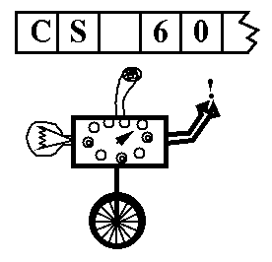
Real Machines don’t just accept their input
Turing machine (TM): a simple model of universal computation.
The tape: an unbounded amount of memory. Consists of cells, each containing exactly one of an alphabet ∑ of characters (e.g. 0, 1, _ (blank))
Read/write head for the tape
The control: a finite amount of memory, the control states. Defines control functions.
The complete state of a TM is determined by:
The control state
The symbol now under the head
The symbols to the right of the head
The symbols to the left of the head
Ability to move left and right

Slide 111
Polyglot Sorting
minsort([],[]).
minsort(U, [F|R] ) :- member(F,U), remove(F,U,N), minsort(N,R), less(F,R).
less(F,[A|R]) :- F =< A, less(F,R). less(F,[ ]).
swapsort2([ ]) => [ ];
swapsort2([ x ]) => [x];
swapsort2([f,s | r]) => f < s ? [ f | swapsort2([ s|r ]) ]: [ s, f | swapsort2( r ) ] ;
mergesort (see one possible solution in /cs/cs60/as/a10)
A true polyglot ...
/***/
class//
hello// /*
{ public static void main(String[] arg) {
System.out.println("\nHello from Java.\n");
// */ /***/ p(0). p(hello-from-prolog). /*
// */ /***/ hello :- p(A), write(A). /*
} } // */ %; hello = "\nHello from Rex.";

Slide 112
AS 11 due Fri. @ midnight
Today
Fall 00 Lec 24
Machines, machines, machines...
DFAs (Deterministic Finite Automata) { = FSMs }
NFAs (Nondeterministic Finite Automata)
Turing Machines = universal computing
other types of computing: DNA Quantum
... and Problems
P
NP
EXP
UNDECIDABLE
NP complete
halting
satisfiability
tiling
searching
knapsack
equivalence of “super” regular expressions
sorting
factoring
theorem proving
graph coloring
traveling salesperson

Slide 113
NFAs vs. DFAs
What NFA accepts L = { w | w ends with 011 or 110} ?
True or False?
For any DFA, there is some NFA that accepts the same language?
For any NFA, there is some DFA that accepts the same language?
Languages accepted by FAs are called regular.

Slide 114
Today
In search of an O(1) sorting algorithm...
CS: The science of difficulty
Assignment 11: Finite State Machines (Due Fri., 12/1)
?
P ≠ NP
also called
DFA: “Deterministic Finite Automata”
Mudd
do HW
skip HW
Summer
HW
HW
skip HW
do HW
The Mudd DFA
Thursday
Tuesday
Thursday
5/14 or 5/17
Turing Machines
Real Machines! (circuits)
Machine Language
Final Exam

Slide 115
Quicksort
Another Divide and Conquer technique
List of length n
Quick Sort
5
3
2
6
4
1
3
7
partition and swap

Slide 116
Quicksort
“Divide and Conquer”
List of length n
Quick Sort
5
3
2
6
4
1
3
7
partition and swap
3
3
2
1
4
6
5
7
3
3
2
1
4
6
5
7
1
2
3
3
4
5
6
7
...
Can we do better than O(n*log(n)) ?

Slide 117
O(n) Sorting
Can we do better than O( n*log(n) ) ?
Yes, but we have to make assumptions about the data...
Counting Sort
List of length n
or
5
3
2
6
4
1
3
7
Bucket Sort
Suppose we know each item is between 1 and 10.

Slide 118
O(n) Sorting
Radix Sort
start with LSD & continue from there...
5
101
3
011
FOR
2
010
BOX
6
110
FOX
4
100
BAR
1
001
FAR
3
011
7
111
Can we do better than O(n)?

Slide 119
Seeking O(1) sorting !
Punchcard sort
radix sort with 1 operation per digit
List of length n
5
101
3
011
2
010
6
110
List of any length!
4
100
Spaghettisort
1
001
...
need a big, flat surface and a lot of pasta
3
011
7
111

Slide 120

Any Comparison Sort is at best O(n log(n))
•
Start with all of the permutations of a list with n elements.
[e1, e2, e3, ... , en]
Key Fact
n
n
( )
2
n
[4,1,5,3,2]
2
< n! <
n
[4,5,3,1,2]
[3,1,4,5,2]
[2,4,1,5,3]
[1,2,3,4,5]
[5,4,3,1,2]
yes
?
no
e1 < e2
[1,2,3,4,5]
[4,1,5,3,2]
[4,5,3,1,2]
[5,4,3,1,2]
[2,4,1,5,3]
[3,1,4,5,2]
“Adversary Argument”
The Adversary

Slide 121



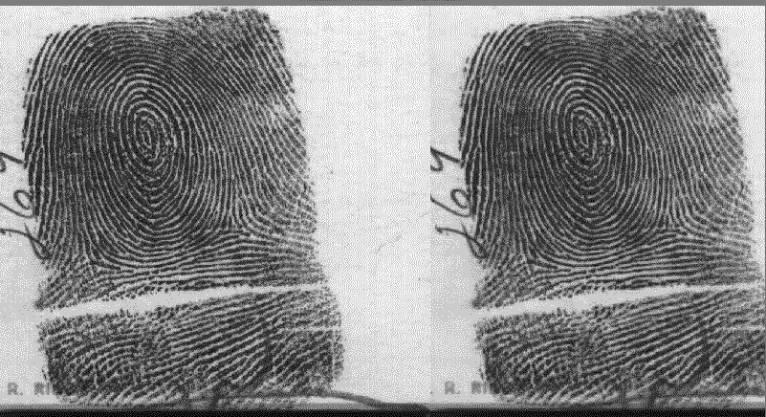
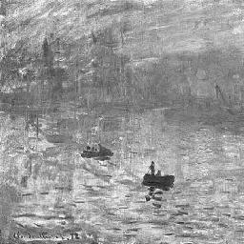

Fast Algorithms Us
Fast fourier transform / MIT’s FFTW
N-body interactions, particle simulations
Image and audio compression

Slide 122
“Big Oh” + Tractable Problems
Order
n
n
n!
Intractable Problems (Exponential)
n
2
3
n
2
n
Tractable Problems (Polynomial)
n log(n)
n
√n
Problem-solving strategy:
log(n)
No Problems!
Push a problem as far down the hierarchy as possible, then worry about constants... .
1

Slide 123
What assumptions are allowed?
Testing for satisfiability (SAT)
(x+y) * (x+y’) * (x’+y’)
Deterministic Algorithm
Nondeterministic Algorithm
Each algorithm step has a specified following step.
An algorithm step may have several choices of following steps.
Deterministic Algorithm:
Nondeterministic Algorithm:
Let x = false (0).
Recurse to determine SAT.
Let x = true (1).
Recurse to determine SAT.
If either was satisfiable,
return 1 else return 0.
Choose x = true and false (1 and 0).
Recurse to determine SAT.
If any choice succeeded,
return 1 else return 0.

Slide 124
Deterministic Computing
“step-by-step”
x = true;
y = true;
z=1
unsatisfiable
z=0
unsatisfiable
y = false;
z=1
unsatisfiable
z=0
unsatisfiable
14 steps...
x = false;
y = true;
z=1
unsatisfiable
z=0
tautology
y = false;
z=1
unsatisfiable
z=0
unsatisfiable

Slide 125
Nondeterminism
parallel-universe computing

Slide 126
This weekend's ACM regional programming contest
Aaron Pribadi, Stuart Persteiner, and Daniel Lubarov
Anak Yodpinyanee + Jason GarretGlaser
Kevin Oelze, Andrew Hunter, and Kwang Ketcham
Marquis Wang, Josh Ehrlich, and Daniel Fielder
Notes:
126

Slide 127
This weekend's ACM regional programming contest
Aaron Pribadi, Stuart Persteiner, and Daniel Lubarov
Anak Yodpinyanee + Jason GarretGlaser
Kevin Oelze, Andrew Hunter, and Kwang Ketcham
Marquis Wang, Josh Ehrlich, and Daniel Fielder
The contest seemed to be channeling CS 60…
Notes:
127

Slide 128
ACM regionals ~ CS 60?
From corner to corner as cheaply as possible…
Notes:
128

Slide 129
ACM regionals ~ CS 60?
20 questions: given objects, given questions, and given the answers to the questions (!), Identify the object in the specified number of questions…
Notes:
129

Slide 130
ACM regionals ~ CS 60?
Tautology checking (and parsing!)
( no Prolog permitted )
Notes:
130

Slide 131
Nondeterminism
“computing with parallel universes”
x = true;
x = false;
y = true;
y = false;
y = true;
y = false;
z=1
z=0
z=1
z=0
z=1
z=0
z=1
z=0
3 steps!
U
U
U
U
U
T
U
U

Slide 132
Extra Credit
P
vs.
NP
Set of problems solvable by deterministic algorithms in polynomial time.
Set of problems solvable by nondeterministic algorithms in polynomial time.
searching
sorting
Fourier Transform
chess, checkers, go, ...
SAT (satisfiability)
Bin Packing
Knapsack problem
factoring
TSP

Slide 133
More efficient?
The results of compiling into two different machine languages…
.LLC0:
.asciz "x is %d and y is %d.\n"
.section ".text"
.align 4
.global main
.type main, #function
.proc 04
main:
!#PROLOGUE# 0
save %sp, -128, %sp
!#PROLOGUE# 1
mov 42, %g1
st %g1, [%fp-20]
mov 7, %g1
st %g1, [%fp-24]
ld [%fp-20], %g1
st %g1, [%fp-28]
ld [%fp-24], %g1
st %g1, [%fp-20]
ld [%fp-28], %g1
st %g1, [%fp-24]
sethi %hi(.LLC0), %g1
or %g1, %lo(.LLC0), %o0
ld [%fp-20], %o1
ld [%fp-24], %o2
call printf, 0
nop
mov %g1, %i0
ret
restore
.LC0:
.string "x is %d and y is %d.\n"
.text
.globl main
.type main,@function
main:
pushl %ebp
movl %esp, %ebp
subl $24, %esp
andl $-16, %esp
movl $0, %eax
subl %eax, %esp
movl $42, -4(%ebp)
movl $7, -8(%ebp)
movl -4(%ebp), %eax
movl %eax, -12(%ebp)
movl -8(%ebp), %eax
movl %eax, -4(%ebp)
movl -12(%ebp), %eax
movl %eax, -8(%ebp)
subl $4, %esp
pushl -8(%ebp)
pushl -4(%ebp)
pushl $.LC0
call printf
addl $16, %esp
leave
ret
main:
!#PROLOGUE# 0
save %sp, -120, %sp
!#PROLOGUE# 1
mov 42, %g1
st %g1, [%fp-20]
mov 7, %g1
st %g1, [%fp-24]
ld [%fp-20], %o5
ld [%fp-24], %g1
xor %o5, %g1, %g1
mov %g1, %o5
st %o5, [%fp-20]
ld [%fp-24], %g1
xor %g1, %o5, %g1
mov %g1, %o5
st %o5, [%fp-24]
ld [%fp-20], %g1
xor %g1, %o5, %g1
st %g1, [%fp-20]
sethi %hi(.LLC0), %g1
or %g1, %lo(.LLC0), %o0
ld [%fp-20], %o1
ld [%fp-24], %o2
call printf, 0
nop
mov %g1, %i0
ret
restore
main:
pushl %ebp
movl %esp, %ebp
subl $8, %esp
andl $-16, %esp
movl $0, %eax
subl %eax, %esp
movl $42, -4(%ebp)
movl $7, -8(%ebp)
movl -8(%ebp), %edx
leal -4(%ebp), %eax
xorl %edx, (%eax)
movl -4(%ebp), %edx
leal -8(%ebp), %eax
xorl %edx, (%eax)
movl -8(%ebp), %edx
leal -4(%ebp), %eax
xorl %edx, (%eax)
subl $4, %esp
pushl -8(%ebp)
pushl -4(%ebp)
pushl $.LC0
call printf
addl $16, %esp
leave
ret
lots of machine-dependent details!

Slide 134
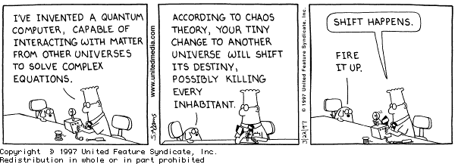
Computation, without the machine!
http://www.cs.caltech.edu/~westside/quantum-intro.html

Slide 135
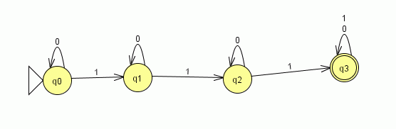
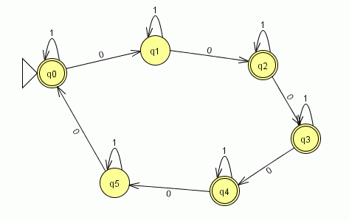
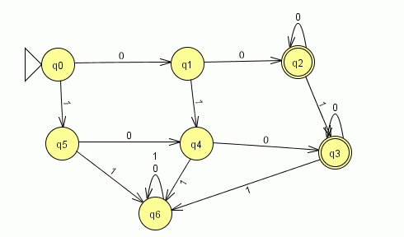
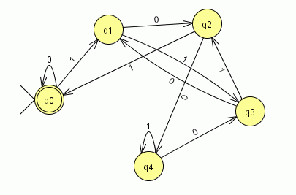
part1
part2
part3
part5

Slide 136
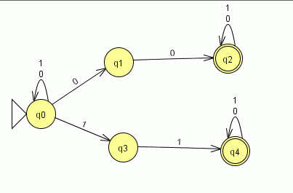
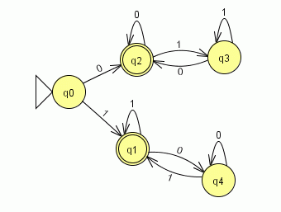
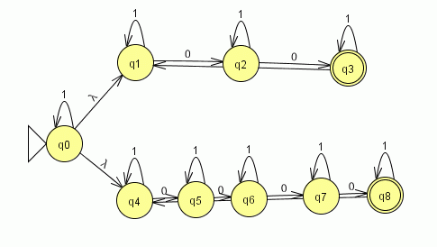
part6
part10
part7

