Slide 1
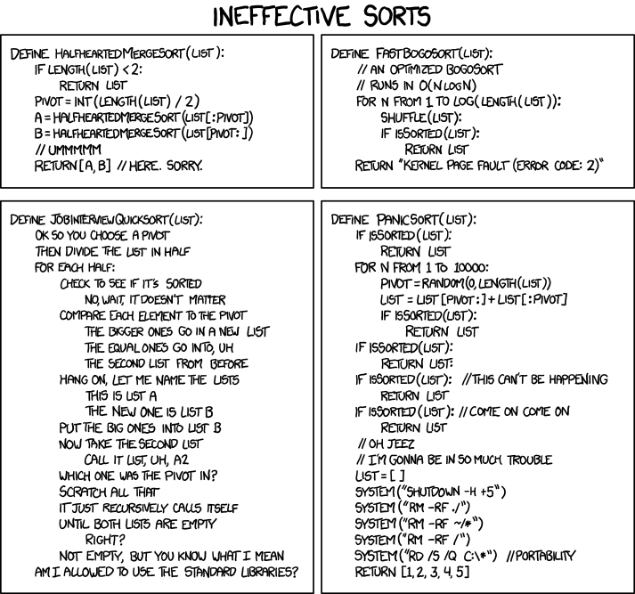
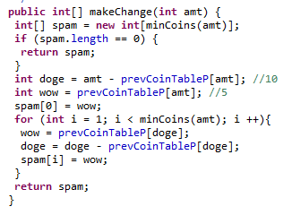
By any other name, this code would not nearly be so sweet!

Slide 2

TIC6
Computability!
acronymically, Today In CS 60!!
Turing Machines
universal! model of computation
Nondeterministic Finite Automata
Acronymania!
somewhere in the middle?
Regular Expressions ?
Deterministic Finite Automata
Finite State Machines
not all-powerful
Assignment #10: JFLAP
due this coming Tuesday evening, 4/22 by 11:59 pm
to do: seven machines and three proofs…
Proofs? Machines? I thought this was CS!!?
Come visit us on Friday in the LAC, 2-4!
Duke's Susan Rodger ~ JFLAP's author

Slide 3
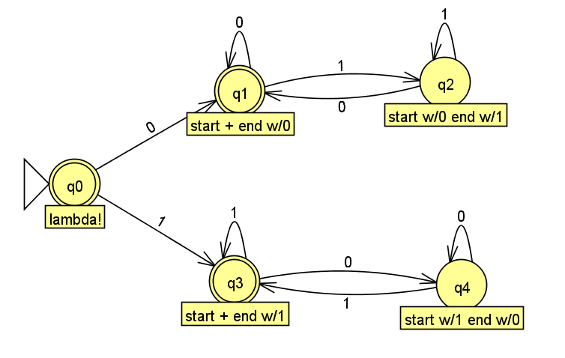
Where were we… ?
We built programmed? several DFAs…
and proved lower-bounds on their state-complexity
We proved that
L = { w | w's first bit == w's last bit }
requires at least 5 states

Slide 4
Where were we… ?
Distinguishable pairs must "live" in different states.
Thus, given a language L, if you can show a pairwise distinguishable set of N strings
then L's DFA must have ≥ N states.
We proved that
L = { w | w's first bit == w's last bit }
requires at least 5 states

Slide 5
The Distinguishability Theorem
To prove that
L = { w | w's first bit == w's last bit }
requires at least 5 states
… we need to show a set of five strings, all pairwise distinguishable
Our five strings:
Our P.D. proof:

Slide 6
Regular Languages
A language L is regular if there is a DFA that accepts it.
L = { w | w is a binary number whose value is a power of two }
L = { w | the third-to-last digit of w is a 1 }
L = { w | w is a binary number that’s divisible by 7 }
L = { w | w has same # of 0's as 1's}
Are any of these languages too complex for a DFA to accept ?

Slide 7
DFAs aren't enough!
L = { w | w is a binary number whose value is a power of two }
L = { w | the third-to-last digit of w is a 1 }
L = { w | w is a binary number that’s divisible by 7 }
L = { w | w has same # of 0's as 1's}
Not everything computable is computable with a DFA…

Slide 8
Regular languages
Is it possible to build a DFA accepting this language?
L = { w | the third-to-last digit of w is a 1 }
Yes, regular!
0
s∅
1
s0
s1
1
0
1
0
s00
s01
s10
s11
0
1
0
1
0
1
0
1
s000
s001
s010
s011
s100
s101
s110
s111
with 16 more transitions among these bottom-layer nodes!

Slide 9
What can DFAs do?
Is it possible to build a DFA accepting this language?
L = { w | w is a binary number that’s divisible by 7 }
Yes, regular!
Accept
Reject
0
111
1110
10101
11100
100011
101010
...
all others
This is problem 6 on this week's HW…
1
10
11
100
101
110
1000
...
Hint?

Slide 10
Regular Languages
A language L is regular if there is a DFA that accepts it.
L = { w | w is a binary number whose value is a power of two }
L = { w | the third and third-to-last digits of w are identical }
L = { w | w is a binary number that’s divisible by 7 }
All regular languages ~ so, a DFA "is enough"
L = { w | w has same # of 0's as 1's}
but no DFA accepts this language!
How could we prove this?

Slide 11
Regular Languages
L = { w | w has same # of 0's as 1's}
To show no DFA accepts
We show that no finite # of states will work …
… by showing an infinite pairwise distinguishable set!
Let's prove it!
What infinite set of strings is pairwise distinguishable w.r.t. L?

Slide 12
Regular Languages
L = { w | w has same # of 0's as 1's}
To show no DFA accepts
We show that no finite # of states will work …
… by showing an infinite pairwise distinguishable set!
Engineer an infinite S.
S = {
Choose ANY 2 elements
two elements from S:
Find a "fate" that sends them to different results
a distinguishing suffix z:

Slide 13
The Nonregular-language theorem
or Myhill-Nerode theorem
If there's an infinite pairwise-distinguishable set of strings wrt L, then L is not regular.
This proves no DFA can compute that language.
"accept"

Slide 14
Quiz
Name(s) __________________
Proving languages nonregular
k 1s then k 0s:
all "doubled" strings
L = { 1^{k}0^{k} | k ≥ 0}
L = { ww | w is any bitstring }
S = {
S = {
two elements from S:
two elements from S:
a distinguishing suffix z:
a distinguishing suffix z:
O^{k} !
For each of these two languages above, find an infinite set of strings, S, that is pairwise distinguishable with respect to that language, then prove it!
Finished? How would you tackle the two nonregular proofs on the hw:
L = { w | w is a palindrome }
L = { w | w contains 2^{k} zeros }

Slide 15
Quiz
Try this on the back first…
Proving languages nonregular
k 1s then k 0s:
all "doubled" strings
L = { 1^{k}0^{k} | k ≥ 0}
L = { ww | w is any bitstring }
S = {
S = {
two elements from S:
two elements from S:
a distinguishing suffix z:
a distinguishing suffix z:
O^{k} !
For each of these two languages above, find an infinite set of strings, S, that is pairwise distinguishable with respect to that language, then prove it!
Finished? How would you tackle the two nonregular proofs on the hw:
L = { w | w is a palindrome }
L = { w | w contains 2^{k} zeros }

Slide 16
State-machines are limited.
DFAs can't count
at least, not arbitrarily high...
We need a more powerful model than DFAs...
so, "we" add memory !
where "we" == Turing

Slide 17
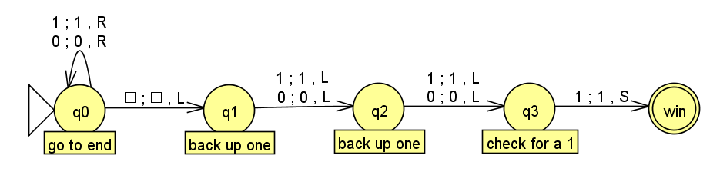
DFAs can't count...
So, let's build a better machine!
Shiny!
Turing Machine
Notes:
metric prefixes…

Slide 18
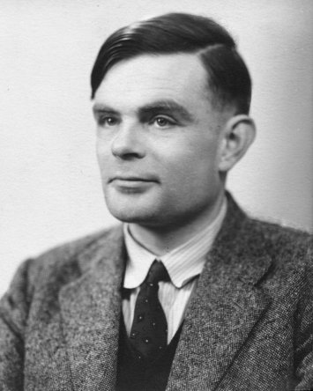
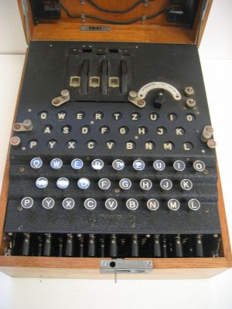
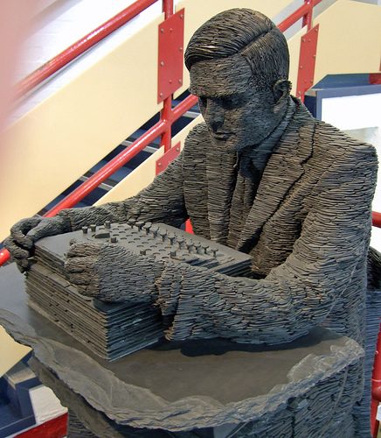
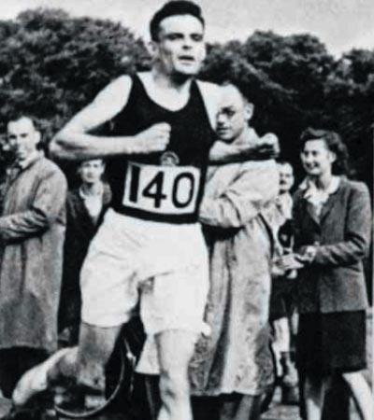
Alan Turing
AI!
1912-1954
WWII
Enigma machine ~ The axis's encryption engine
2007
1946
Bletchley Park

Slide 19
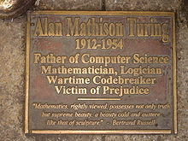
Alan Turing
AI!
1912-1954
WWII
Enigma machine ~ The axis's encryption engine
2007
1946
Bletchley Park

Slide 20
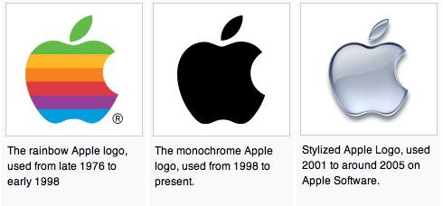
Alan Turing
AI!
1912-1954
WWII
Enigma machine ~ The axis's encryption engine
unfortunately, no…
2007
1946
Bletchley Park

Slide 21
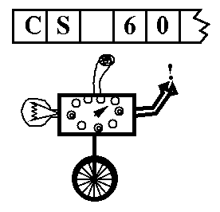
Turing Machine
A simple model of universal computation.
Starts on the leftmost character
The tape: an expandable amount of memory made of cells, each with exactly one character: 0, 1, blank…
Read/write head for the tape
The control: the DFA running things…
Ability to move left and right
The complete working of a Turing Machine is determined by:
The control state of the DFA
The location of the R/W head
The symbols on the tape

Slide 22
the input
0
1
1
0
1
the tape
"blanks" are everywhere else
R/W head
an accepting state always halts -- and then just basks in its success!
if a transition is missing, the input FAILS, i.e., is rejected
0
;
0
,
a Turing Machine rule:
R
READ
WRITE
MOTION
Notes:
metric prefixes…

Slide 23
TM programming !?
How could we build a TM to accept all and only strings with the same # of 0s and 1s?
Strategy: let's go to the tape…
Ideas?
0
1
0
0
1
1
Notes:
metric prefixes…

Slide 24
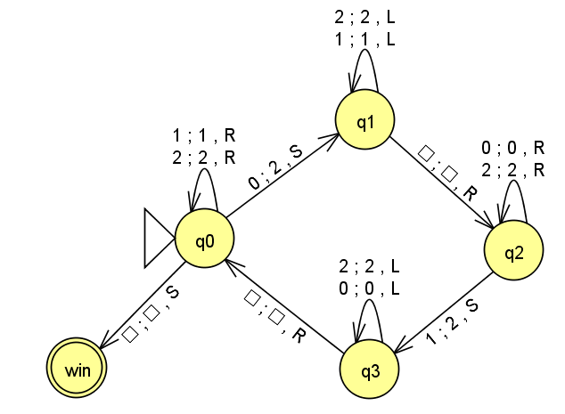
Try this TM…
How does the tape change here?
1
1
0
0
0
1
This machine "wants" to accept all strings with the same # of 0s and 1s:
Does it accept the above input, 110001 ?
What's an input where it doesn't work?
How would you change it so that it did work… ?
(just a thought experiment)
Extra! (hw10pr7) how could you build a TM that accepts all and only those strings with exactly 2^{k} zeros for some k?
Notes:
metric prefixes…

Slide 25
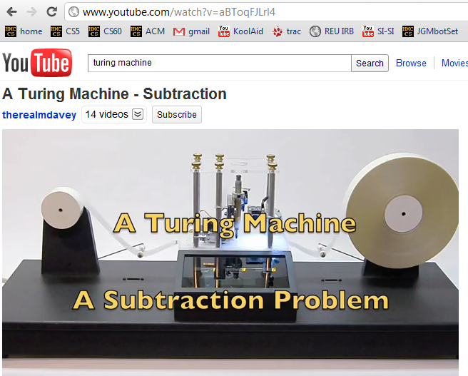
C:\Zach\Robotics\Lec23\Lec23_2008_movies\turingmachine.mpg

Slide 26
hw10 Turing machine
Create a TM that accepts strings of 2^{k} zeros.
You may assume the input is all zeros
start
reject
0
accept
0
0
accept
0
0
0
…
reject
0
0
0
0
0
0
0
0
accept
Extra: in as few states as possible; min is 3; but you may add symbols…

Slide 27
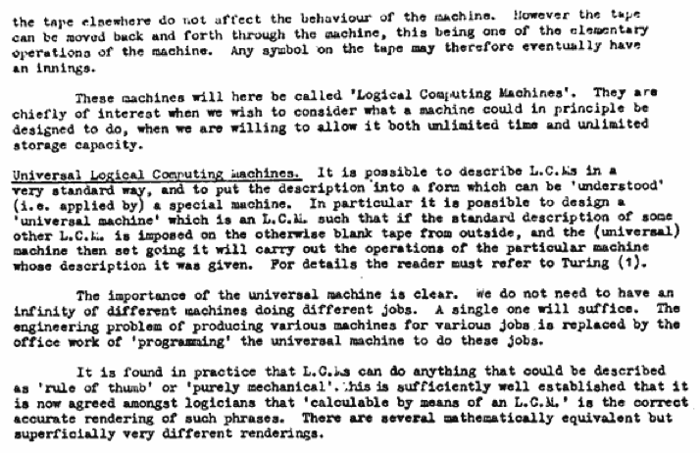
Can TMs compute everything?
Alan Turing says yes...
Turing called them Logical Computing Machines
Turing’s Intelligent Machines, 1948
http://www.alanturing.net/turing_archive/archive/l/l32/L32-005.html

Slide 28
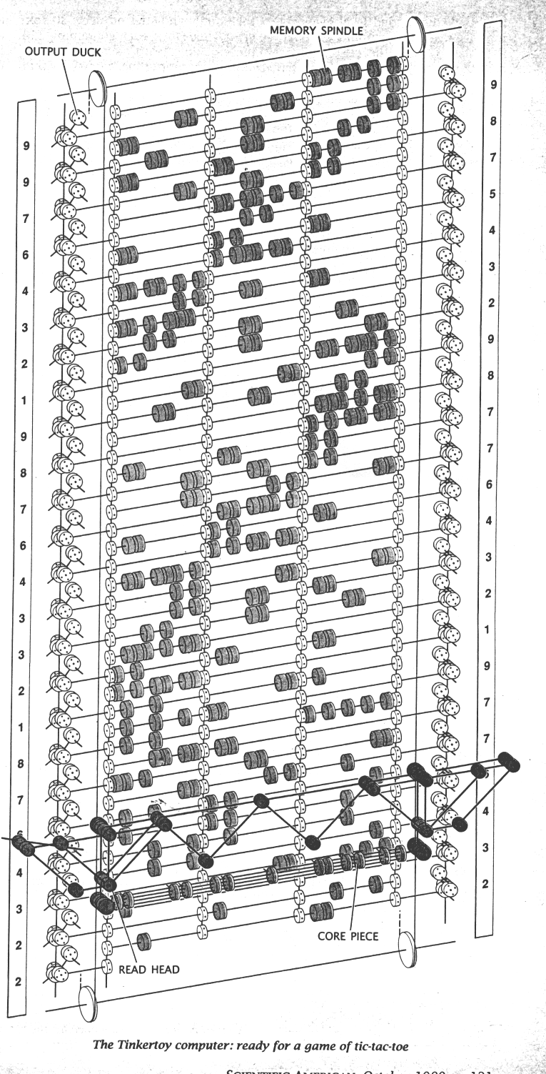

So far, all known computational devices can compute only what Turing Machines can...
some are faster than others…
Quantum computation
http://www.cs.virginia.edu/~robins/The_Limits_of_Quantum_Computers.pdf
Molecular computation
http://www.arstechnica.com/reviews/2q00/dna/dna-1.html
Parallel computers
Integrated circuits
Electromechanical computation
Water-based computation
Tinkertoy computation

Slide 29
Computability
DFAs
???
TMs
computability axis
less power
more power
Computability is the "power" required to solve a particular problem, i.e., accept a particular language.

Slide 30
Adding nondeterminism to DFAs
What's different!?
NFAs
q1
λ
1
nondeterministic finite automata
q0
1
0
q2
0
1
What happens with …
0
11
101
λ
Is L = { all strings beginning with 1 } ?
Notes:
equivalent NFAs?
is this possible?

Slide 31
DFAs vs. NFAs vs. TMs ?
strings not in L
L = { w | w’s third-to-last character (from the right) is a 1}
λ
11
01
01011001
1111111011
strings in L
110
100
0000100
111111111
a DFA requires 8 states
efficiency vs. computability ?!
a TM could use <4 states
Notes:
good to have a lambda here at the start

Slide 32
Computability
NFAs?
DFAs
TMs
computability axis
less power
more power
Computability is the "power" required to solve a particular problem, i.e., accept a particular language.

Slide 33
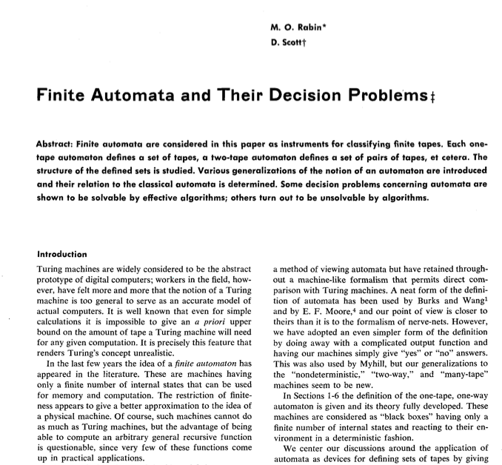
Computability
DFAs
???
TMs
computability axis
less power
more power
Computability is the "power" required to solve a particular problem, i.e., accept a particular language.

Slide 34
NFAs == DFAs !
To show:
every NFA has an == DFA
What DFA states might we need!?
NFA example:
q1
1
λ
q0
1
0
q2
0
λ, 0, or multiple transitions
Notes:
Key property of NFA – multiple states at once….
Key insight was that you could represent this deterministically by considering all different SUBSETS of states that you might be in!

Slide 35
NFAs == DFAs !
"Subset-state Construction"
To show:
every NFA has an == DFA
q0
q1
NFA example:
q2
q1
1
λ
q0,1
q0
1
q0,2
0
q2
0
q1,2
q0,1,2
λ, 0, or multiple transitions
Start State?
Accepting states?
Transitions?
q-∅
graveyard state
Notes:
Key property of NFA – multiple states at once….
Key insight was that you could represent this deterministically by considering all different SUBSETS of states that you might be in!

Slide 36
Computability
DFAs
NFAs can compute exactly what DFAs can, but…
TMs
NFAs
This BUT is the million dollar question!
literally…!
computability axis
less power
more power
Computability is the "power" required to solve a particular problem, i.e., accept a particular language.

Slide 37
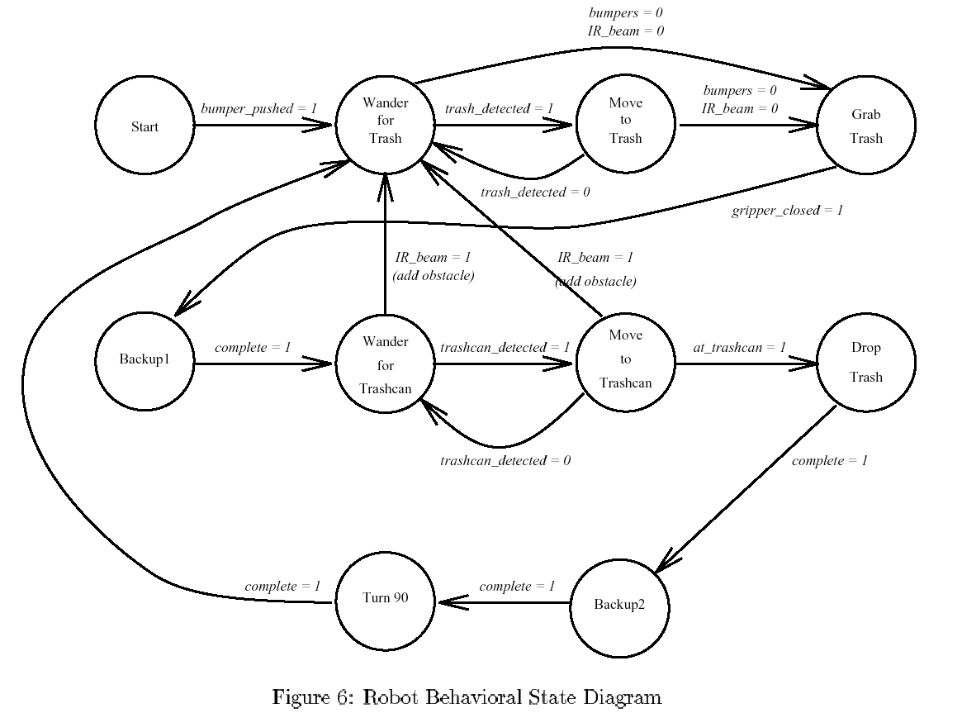
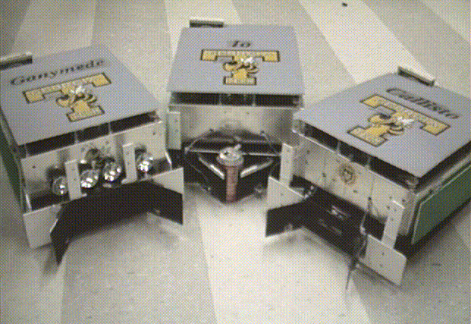
Robots ~ DFA or NFA ?!

Slide 38
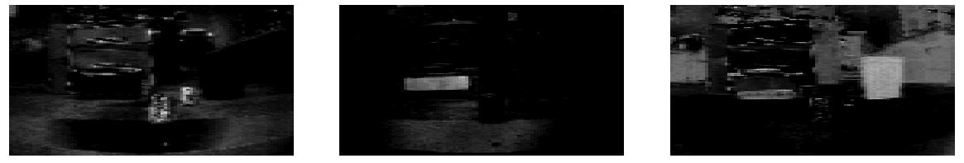
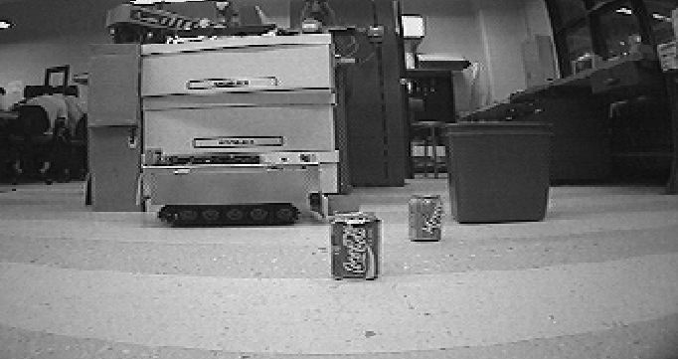
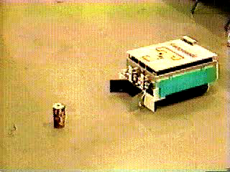
AAAI office-cleaning event
Winner '94: Georgia Tech
bliz.mpeg

Slide 39
Robots ~ DFA or NFA ?!

Slide 40
Robots ~ DFA or NFA ?!
Happy JFLAPping
this weekend!

Slide 41
NFA DFA
To show:
q0
DFAs can represent NFAs
q1
λ, 0, or multiple transitions
q2
q0,1
q1
1
λ
q0
q0,2
1
0
q2
q1,2
0
q0,1,2
"subset-state" construction
Start State?
Accepting states?
Transitions?
q-∅
graveyard state

Slide 42
Adding nondeterminism to DFAs
NFAs
States can have any number of transitions for a single character. (zero, one, more...)
(nondeterministic finite automata)
q1
1
λ
q0
1
0
q2
0
What happens with …
- an input of 1 ?
- an input of 0 ?
- an input of 11 ?
- an input of 101 ?
- an input of λ?
Is L = { all strings beginning with 1 } ?
Notes:
equivalent NFAs?
is this possible?

Slide 43
NFA DFA
To show:
q0
DFAs can represent NFAs
q1
λ, 0, or multiple transitions
q2
q0,1
q1
1
λ
q0
q0,2
1
0
q2
q1,2
0
q0,1,2
"subset-state" construction
Start State?
Accepting states?
Transitions?
q-∅
graveyard state

Slide 44
Proving a language nonregular
Same number of 0s and 1s:
L = { w | w has the same # of 0s and 1s } is not regular
this is an odd name…
What infinite set of strings, S, is pairwise distinguishable w.r.t. this L?

Slide 45
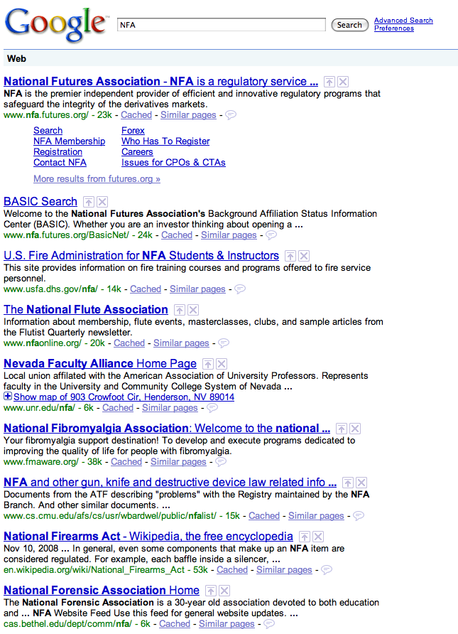
Four models
NFAs ?
DFAs
TMs
"can't count"
TMs count!
FSMs
Turing Machines
can compute regular languages
strictly more powerful than DFAs
?
an alien, a plan, a canal, paneilana!
NFAs
I'd have named it Paneilana.
Nondeterministic
finite automata
Palindromes are computable by TMs, but not by DFAs.
the ability to be in more than one state at once…!
?
?
Where do NFAs go?
Notes:
Pimp my Ride from MTV - Corona is where the garage is…
MTV + SciFi -- twilight zone…

Slide 46
Four models
DFAs
TMs
"can't count"
TMs count!
FSMs
Turing Machines
can compute regular languages
strictly more powerful than DFAs
?
an alien, a plan, a canal, paneilana!
NFAs
I'd have named it Paneilana.
Nondeterministic
finite automata
Palindromes are computable by TMs, but not by DFAs.
the ability to be in more than one state at once…!
?
?
Where do NFAs go?
Notes:
Pimp my Ride from MTV - Corona is where the garage is…
MTV + SciFi -- twilight zone…

Slide 47
Computability
not complexity
DFAs
TMs
"can't count"
TMs count!
FSMs
Turing Machines
can compute regular languages
strictly more powerful than DFAs
!
these all compute the SAME languages !
NFAs
though not necessarily as efficiently…
are computationally equivalent to DFAs!
Prove it!?
plan?
Notes:
plan on board….

Slide 48
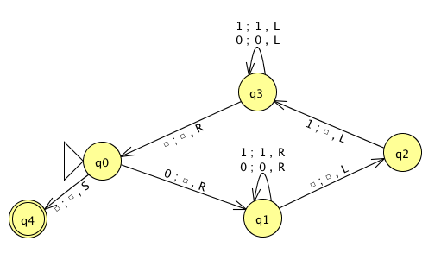
Name(s) __________________________________ Quiz
Run this TM on this input:
0
0
1
1
1
Is this input accepted or rejected?
What inputs are accepted in general? How does it work?
Extra: How could you change this to accept palindromes?
(just a thought experiment)
Notes:
metric prefixes…

Slide 49
Name(s) __________________________________ Quiz
Run this TM on this input:
0
0
1
1
1
Is this input accepted or rejected?
What inputs are accepted in general? How does it work?
Extra: How could you change this to accept palindromes?
(just a thought experiment)
Notes:
metric prefixes…

Slide 50
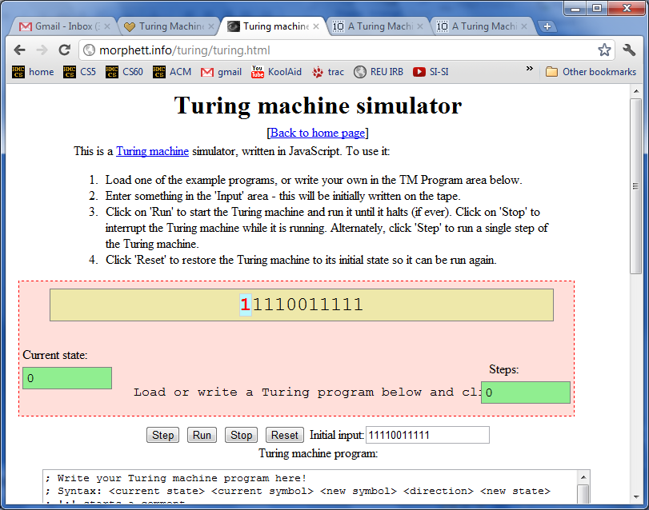
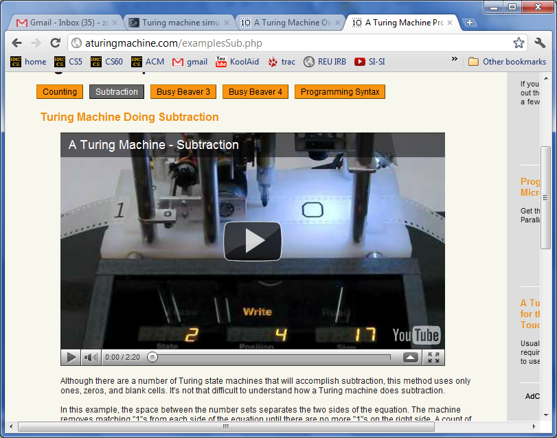
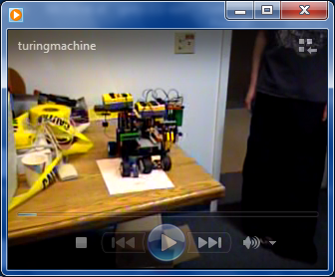
Turing Machine machines!

Slide 51
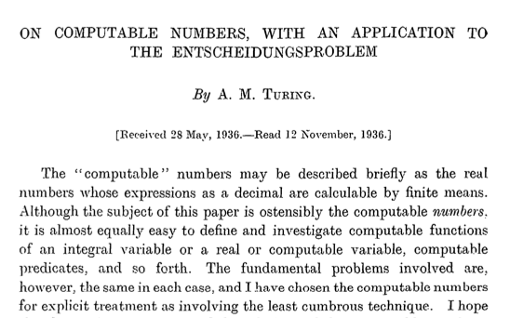
Can TMs compute everything?
Alan Turing says No!
http://www.cs.virginia.edu/~robins/Turing_Paper_1936.pdf

Slide 52
Proving a language nonregular
²
Show L = {0^{n} | n >= 0} nonregular:

Slide 53
Summary…
Given a language L, if you can show a pairwise distinguishable set of N strings
then L's DFA must have ≥ N states.
The Distinguishability Theorem
If there is an infinite pairwise distinguishable set of strings (w.r.t. L), it must be that L is not regular!
The Nonregular Language Theorem
Myhill-Nerode theorem

Slide 54
computability axis
less power
more power
DFAs can compute regular languages
can't compute nonregular languages
L₁ = { w | w is a binary # divisible by 7 }
L₂ = { 0^{k}1^{k} | k ≥ 0}
L₁ is computable by the DFA model.
L₂ is not computable by the DFA model.
FSMs DFAs
"FSMs can't count"
TMs
Regular Expressions
Turing Machines
Alan Turing
Turing machines are a strictly more powerful model of computation than DFAs
http://www.cs.virginia.edu/~robins/Turing_Paper_1936.pdf

Slide 55
Turing Machines…
Alan Turing: “Logical Computing Machines”
A simple model of universal computation.
Starts on the leftmost character
The tape: an unbounded amount of memory. Consists of cells, each containing exactly one character characters (e.g. 0, 1, or  (blank))
Read/write head for the tape
The control: a finite amount of memory, the control states -- some are accepting, some are not.
Ability to move left and right
The control state
The symbol now under the head
The symbols to the right of the head
The symbols to the left of the head
The complete state of a TM is determined by:

Slide 56
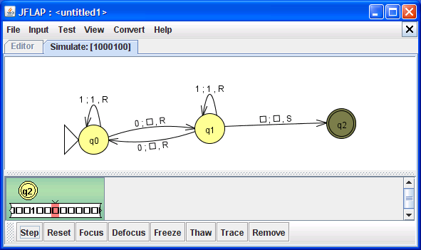
JFLAP's Turing Machines
what language of strings is accepted by this machine?
Let’s try one out…

Slide 57
Turing Machines…
Turing: “Logical Computing Machines”
Problem: Accepting the nonregular language { 0^{k}1^{k} | k >= 0 }
0
0
0
1
1
1
Every Turing machine is/has a program: (see next slide for this one!)
The turing machine's read/write head starts at the left of the input.
Halting convention #1: if a transition is unspecified, then the TM halts in the current state.
Halting convention #2: if a TM goes into an accepting state, it accepts and does no more work.

Slide 58
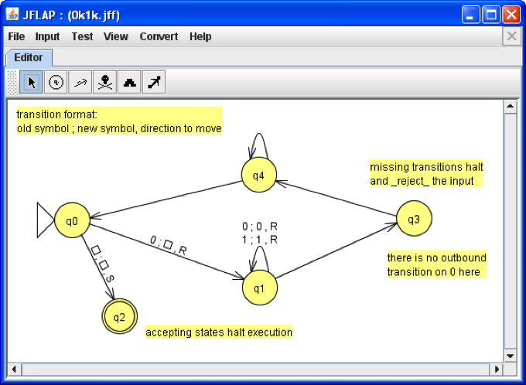
JFLAP's Turing Machines
block set tools – we won't need to use these
Left == char. read on the tape
Middle == char. written to the tape
States control the TM’s execution
Right == direction to move (LRS)
read
write
move
Blank
Accepting states halt computation immediately!

Slide 59
Try it! Fill out the remaining transitions…
read
write
move
Blank
Accepting states halt computation immediately.

Slide 60
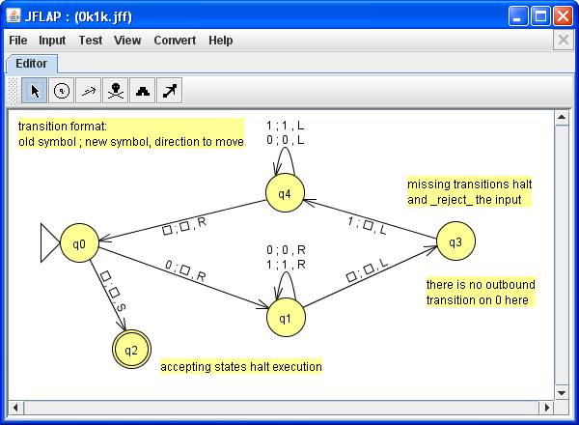
Solution
Blank
Accepting states halt computation immediately.

Slide 61
Computability
TMs
FSMs DFAs
"can't count"
TMs count!
Turing Machines
can compute regular languages
strictly more powerful than DFAs
?
can't compute nonregular languages
What's in the middle of this computability spectrum?
compute some nonregular languages
Notes:
Pimp my Ride from MTV - Corona is where the garage is…
MTV + SciFi -- twilight zone…

Slide 62

Computability
TMs
FSMs DFAs
"can't count"
TMs count!
Turing Machines
can compute regular languages
strictly more powerful than DFAs
?
can't compute nonregular languages
What's in the middle of this computability spectrum?
compute some nonregular languages
We could…
add capabilities to DFAs
more fun!
take away capabilities of TMs
Less tape? Less fun.
Notes:
Pimp my Ride from MTV - Corona is where the garage is…
MTV + SciFi -- twilight zone…

Slide 63
Regular Expressions
Where would you guess this model of computation lives?
DFAs
TMs
"can't count"
TMs count!
FSMs
Turing Machines
can compute regular languages
strictly more powerful than DFAs
NFAs
can compute some nonregular languages

Slide 64
Regex NFA
To show: NFAs can represent any regular expression
Base Case Regexes:
Equivalent NFA:
no expression
Ø
q0
matches no strings
Remember, DFAs are NFAs (but not vice versa)
empty expression
λ
q0
matches the empty string
a single alphabetic character (or bit)
0
matches that one bit
1

Slide 65
Regex NFA
To show: NFAs can represent any regular expression
Base Case Regexes:
Equivalent NFA:
no expression
Ø
q0
matches no strings
Remember, DFAs are NFAs (but not vice versa)
empty expression
λ
q0
matches the empty string
a single alphabetic character (or bit)
0
q0
q1
0
matches that one bit
1
q0
q1
1

Slide 66
Regex NFA
building our machine from available components
Suppose a and b are regular expressions with equivalent NFAs:
a
b
0 or more accepting states…
What NFAs will these composite regular expressions be?
a|b
ab
a*

Slide 67
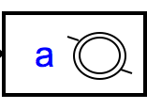
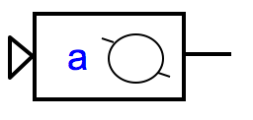
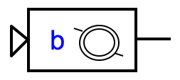
Regex NFA
building our machine from available components
Suppose a and b are regular expressions with equivalent NFAs:
a
b
0 or more accepting states…
What NFAs will these composite regular expressions be?
a|b
ab
a*
λ
λ
q0
λ
λ
sequential machine - watch out for accepting states!
q0
parallel machine: NFA!
Loops!

Slide 68
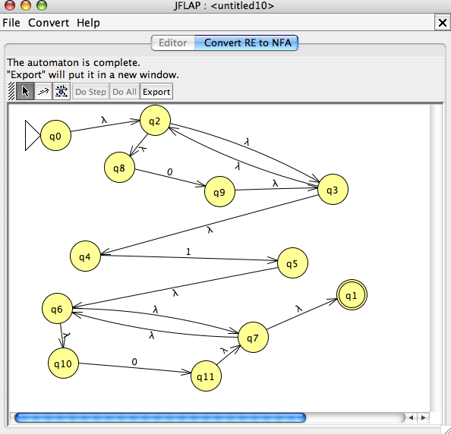
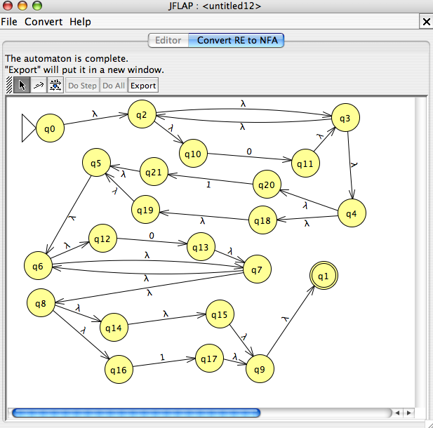
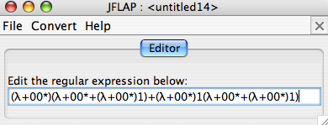
DFAs
≡
NFAs
≡
RegEx's
This conversion is provided by JFLAP…
0*10*
L = { w | w is a binary number whose value is a power of two }
or 0 or a power of two +1
0*(λ|1)0*(λ|1)
Entropy wins again!
this doesn't look right…

Slide 69
DFA RegEx
What regular expression does this DFA produce?
0
1
q1
q0
1
0
0
q2
1
What's this DFA doing?

Slide 70
Regular Languages
A language L is regular if there is a DFA that accepts it.
L = { w | w is a binary number whose value is a power of two }
L = { w | the third and third-to-last digits of w are identical }
L = { w | w is a binary number that’s divisible by 7 }
All regular languages ~ so, a DFA "is enough"
L = { 0^{k}1^{k} | k ≥ 0}
but no DFA accepts this language!
How could we prove this?

Slide 71
Regular Languages
This all O^{k} ?
To show no DFA accepts
L = { 0^{k}1^{k} | k ≥ 0}
We need to show it would need infinitely many states…
… that is, there is an infinite pairwise distinguishable set!
L = { w | w has same # of 0's as 1's}
What infinite set of strings is pairwise distinguishable w.r.t. L?

Slide 72
Reg. Expressions
+
DFAs
TMs
Happy JFLAPping!
"can't count"
TMs count!
FSMs
Turing Machines
can compute regular languages
strictly more powerful than DFAs
NFAs
Hey… where'd everybody go?

Slide 73
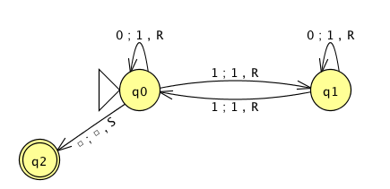
the input
0
1
0
1
0
the tape
R/W head
"blanks" are everywhere else
an accepting state always halts -- then basks in its success!
if a transition is missing, the input FAILS!
0
;
1
,
a Turing Machine rule:
R
READ
WRITE
MOTION
try it in JFLAP...
Notes:
metric prefixes…

Slide 74
See you on Monday!

Slide 75
Regular Languages
A language L is regular if there is a DFA that accepts it.
L = { w | w is a binary number whose value is a power of two }
L = { w | the third-to-last digit of w is a 1 }
L = { w | w is a binary number that’s divisible by 7 }
L = { 0^{k}1^{k} | k ≥ 0}
Are any of these languages too complex for a DFA to accept ?
Everyone O^{k} with these?

Slide 76
NFA DFA
To show:
DFAs can represent NFAs
λ, 0, or multiple transitions
q1
1
λ
q0
1
0
q2
0
What DFA states might we need?
Notes:
Key property of NFA – multiple states at once….
Key insight was that you could represent this deterministically by considering all different SUBSETS of states that you might be in!

Slide 77
NFA DFA
To show:
q0
DFAs can represent NFAs
q1
λ, 0, or multiple transitions
q2
q0,1
q1
1
λ
q0
q0,2
1
0
q2
q1,2
0
q0,1,2
"subset-state" construction
Start State?
Accepting states?
Transitions?
q-∅
graveyard state

Slide 78
Regular grammars ~ DFAs ?
Regular grammars
Context-free grammars
S
1A
λ
S
1A
λ
A
0S
A
0S
A
1AA
at most one nonterminal on the right and it must be at the far right end
may have many nonterminals and terminals on the right…
only one nonterminal on the left of each rule
Do regular grammars compute as much as DFAs? More? Less?
only one nonterminal on the left of each rule

Slide 79
Computability
DFAs
TMs
"can't count"
TMs count!
Turing Machines
can compute regular languages
strictly more powerful than DFAs
!
NFAs
Have we proven
RegEx's
DFAs
≡
NFAs
≡
RegEx's
are computationally equivalent to DFAs!
?
Notes:
we've shown DFAs equiv. to NFAs (both ways!)
…
next only need to show NFAs can be written as regular expressions….

Slide 80
Turing computability
TMs
FSMs DFAs
"can't count"
TMs count!
Turing Machines
can compute regular languages
TMs can compute nonregular languages
but not all of them!
L₁ = { w | w is a binary # divisible by 7 }
L₂ = { 0^{k}1^{k} | k ≥ 0}
L₁ is computable by the DFA model.
L₁ and L₂ are computable by the TM model.
L₂ is not computable by the DFA model.
Turing machines are a strictly more powerful model of computation

Slide 81
Turing computability
FSMs DFAs
TMs
"can't count"
TMs count!
Regular Grammars
Turing Machines
can compute regular languages
TMs can compute nonregular languages
but not all of them!
L₁ = { w | w is a binary # divisible by 7 }
L₂ = { 0^{k}1^{k} | k ≥ 0}
L₁ is computable by the DFA model.
L₁ and L₂ are computable by the TM model.
L₂ is not computable by the DFA model.
Turing machines are a strictly more powerful model of computation
http://www.cs.virginia.edu/~robins/Turing_Paper_1936.pdf

Slide 82
A Kleene answer: Regular Expressions
a simple description of those sets that are computable …
A regular expression is composed of three operations:
Kleene Star a* “0 or more a’s”
high precedence
concatenation ab “a then b”
union a | b “a or b”
low precedence
where a and b can be any bit strings - or regular expressions
base case
recursively defined !
Notes:
82
http://www.cs.duke.edu/csed/jflap/new/DOCS/gui.regular.EditorPane.html
The Regular Expression EditorThe editor for a regular expression is essentially just a single text field. Operators in a regular expression are the Kleene star (*), the ``or'' operator (+), parentheses are also usable, and concatenation is accomplished by making symbols adjacent.In HaikuTo make expressions for this program to work with, type them in the field.Adjacent symbols imply concatenation. No symbol is used.Many or nothing, Asterisk (*) is the Kleine star. What precedes repeats.Additionally, if you want an "or" symbol the plus (+) should be used.Screaming nothingness, exclamations (!) are special. They act as lambda.Formatting errors will be reported to you when you choose actions. The Regular Expression EditorThe editor for a regular expression is essentially just a single text field. Operators in a regular expression are the Kleene star (*), the ``or'' operator (+), parentheses are also usable, and concatenation is accomplished by making symbols adjacent.In HaikuTo make expressions for this program to work with, type them in the field.Adjacent symbols imply concatenation. No symbol is used.Many or nothing, Asterisk (*) is the Kleine star. What precedes repeats.Additionally, if you want an "or" symbol the plus (+) should be used.Screaming nothingness, exclamations (!) are special. They act as lambda.Formatting errors will be reported to you when you choose actions.

Slide 83
Regular Expressions
Examples:
10
matches the string 10, which is the language
{ 10 }
or
L = { w | w is 10 }
(10)*
1* | 10*
A regular expression is composed of three operations:
Kleene Star a* “0 or more a’s”
high precedence
concatenation ab “a then b”
union a | b “a or b”
low precedence
where a and b can be any bit strings - or regular expressions
base case
recursively defined !
Notes:
83
http://www.cs.duke.edu/csed/jflap/new/DOCS/gui.regular.EditorPane.html
The Regular Expression EditorThe editor for a regular expression is essentially just a single text field. Operators in a regular expression are the Kleene star (*), the ``or'' operator (+), parentheses are also usable, and concatenation is accomplished by making symbols adjacent.In HaikuTo make expressions for this program to work with, type them in the field.Adjacent symbols imply concatenation. No symbol is used.Many or nothing, Asterisk (*) is the Kleine star. What precedes repeats.Additionally, if you want an "or" symbol the plus (+) should be used.Screaming nothingness, exclamations (!) are special. They act as lambda.Formatting errors will be reported to you when you choose actions. The Regular Expression EditorThe editor for a regular expression is essentially just a single text field. Operators in a regular expression are the Kleene star (*), the ``or'' operator (+), parentheses are also usable, and concatenation is accomplished by making symbols adjacent.In HaikuTo make expressions for this program to work with, type them in the field.Adjacent symbols imply concatenation. No symbol is used.Many or nothing, Asterisk (*) is the Kleine star. What precedes repeats.Additionally, if you want an "or" symbol the plus (+) should be used.Screaming nothingness, exclamations (!) are special. They act as lambda.Formatting errors will be reported to you when you choose actions.

Slide 84
Operator Name
Example
Description
For each language below, write a regular expression that describes it.
Kleene Star a* “0 or more a’s”
concatenation ab “a then b”
Try it!
union a | b “a or b”
Formal language
Regular Expression
L = { w | w contains a 0 }
L = { w | w’s second-to-last character is a 1 }
L = { w | every 1 in w has a 0 after it }
L = { w | w’s first and last bits are the same }
Is there an equivalent regular expression to this one that avoids the nested * operators?
( 01* | 10 )*
Can every reg. expression avoid nested *'s ?
Notes:
84
http://www.cs.duke.edu/csed/jflap/new/DOCS/gui.regular.EditorPane.html
The Regular Expression EditorThe editor for a regular expression is essentially just a single text field. Operators in a regular expression are the Kleene star (*), the ``or'' operator (+), parentheses are also usable, and concatenation is accomplished by making symbols adjacent.In HaikuTo make expressions for this program to work with, type them in the field.Adjacent symbols imply concatenation. No symbol is used.Many or nothing, Asterisk (*) is the Kleine star. What precedes repeats.Additionally, if you want an "or" symbol the plus (+) should be used.Screaming nothingness, exclamations (!) are special. They act as lambda.Formatting errors will be reported to you when you choose actions. The Regular Expression EditorThe editor for a regular expression is essentially just a single text field. Operators in a regular expression are the Kleene star (*), the ``or'' operator (+), parentheses are also usable, and concatenation is accomplished by making symbols adjacent.In HaikuTo make expressions for this program to work with, type them in the field.Adjacent symbols imply concatenation. No symbol is used.Many or nothing, Asterisk (*) is the Kleine star. What precedes repeats.Additionally, if you want an "or" symbol the plus (+) should be used.Screaming nothingness, exclamations (!) are special. They act as lambda.Formatting errors will be reported to you when you choose actions.

Slide 85
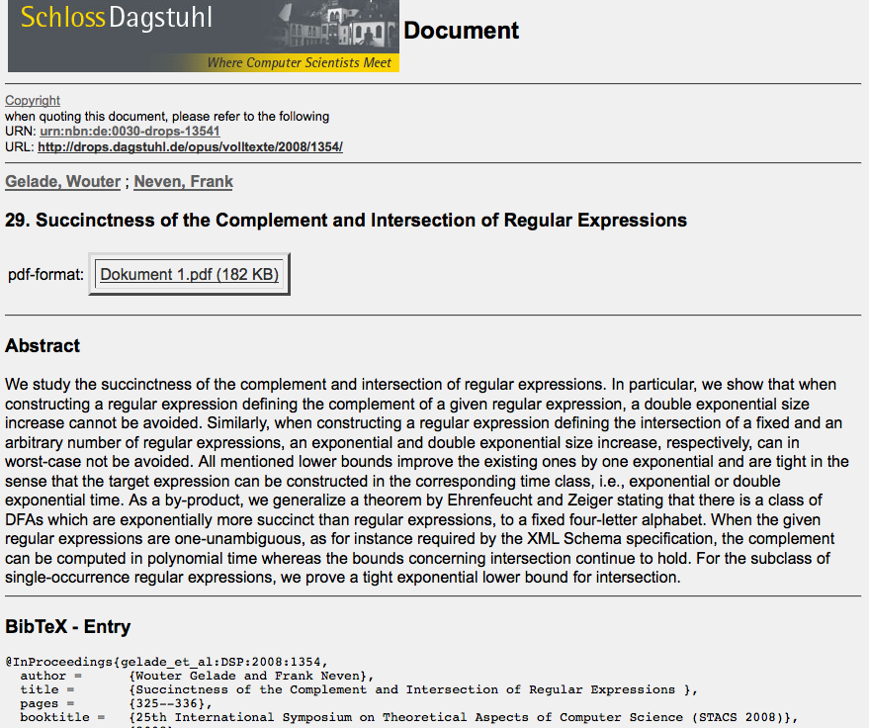
Star-height problem solved in 1963 by Eggers.
Star-height problem with negation still unsolved...

Slide 86
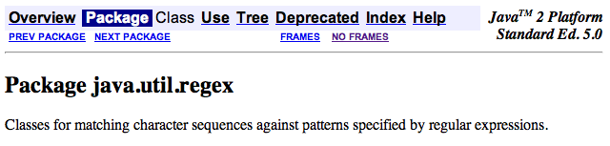
Regexes in practice…
Almost all languages have a regex library…
Unix’s egrep does a line-by-line search for a regex:
egrep 'hh'
egrep 'y.*y'
egrep '(xq|hq)'
egrep '^y.*y$'
/usr/share/dict/words
symbol for start of a line
symbol for end of a line
symbol for any character, a shortcut for (a|b|c|…|z|0|1|…|9|…)
good for crosswords !
VOWEL
U
VOWEL
not always obvious …
egrep '^(0|1(01*0)*1)(0|1(01*0)*1)*$' binStr
Notes:
86

Slide 87
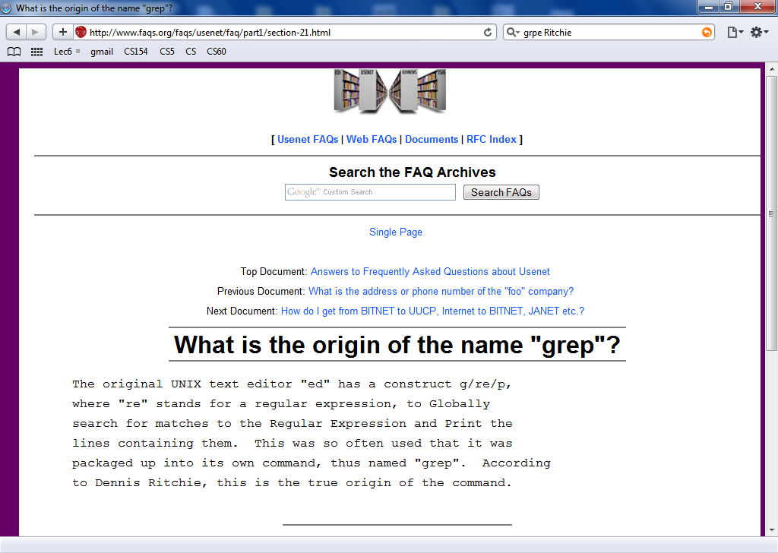
Regexes in practice…
Almost all languages have a regex library…
Unix’s egrep does a line-by-line search for a regex:
egrep 'hh'
egrep 'y.*y'
egrep '(xq|hq)'
egrep '^y.*y$'
/usr/share/dict/words
symbol for start of a line
symbol for end of a line
symbol for any character, a shortcut for (a|b|c|…|z|0|1|…|9|…)
good for crosswords !
VOWEL
U
VOWEL
not always obvious …
egrep '^(0|1(01*0)*1)(0|1(01*0)*1)*$' binStr
Notes:
87

Slide 88
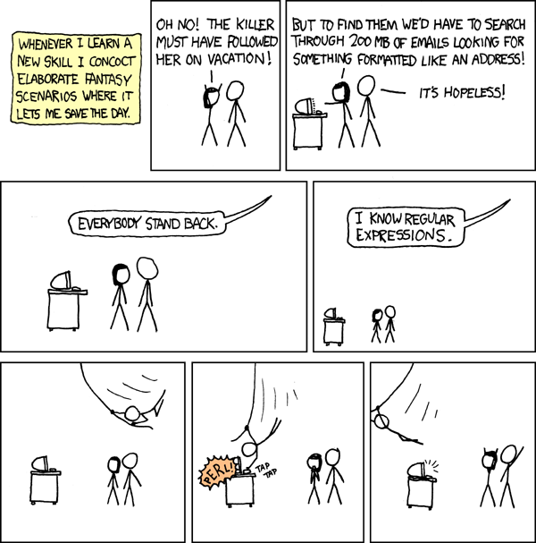
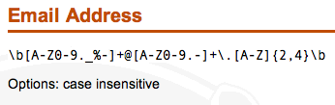
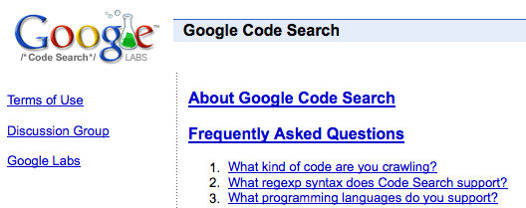
xkcd to the rescue, perhaps?
REs to the REscue!
practical extraction and report language
PERL
www.regular-expressions.info/regexbuddy/email.html
but how does regular expression matching actually work?
Notes:
88
Pimp my Ride from MTV - Corona is where the garage is…
MTV + SciFi -- twilight zone…

Slide 89
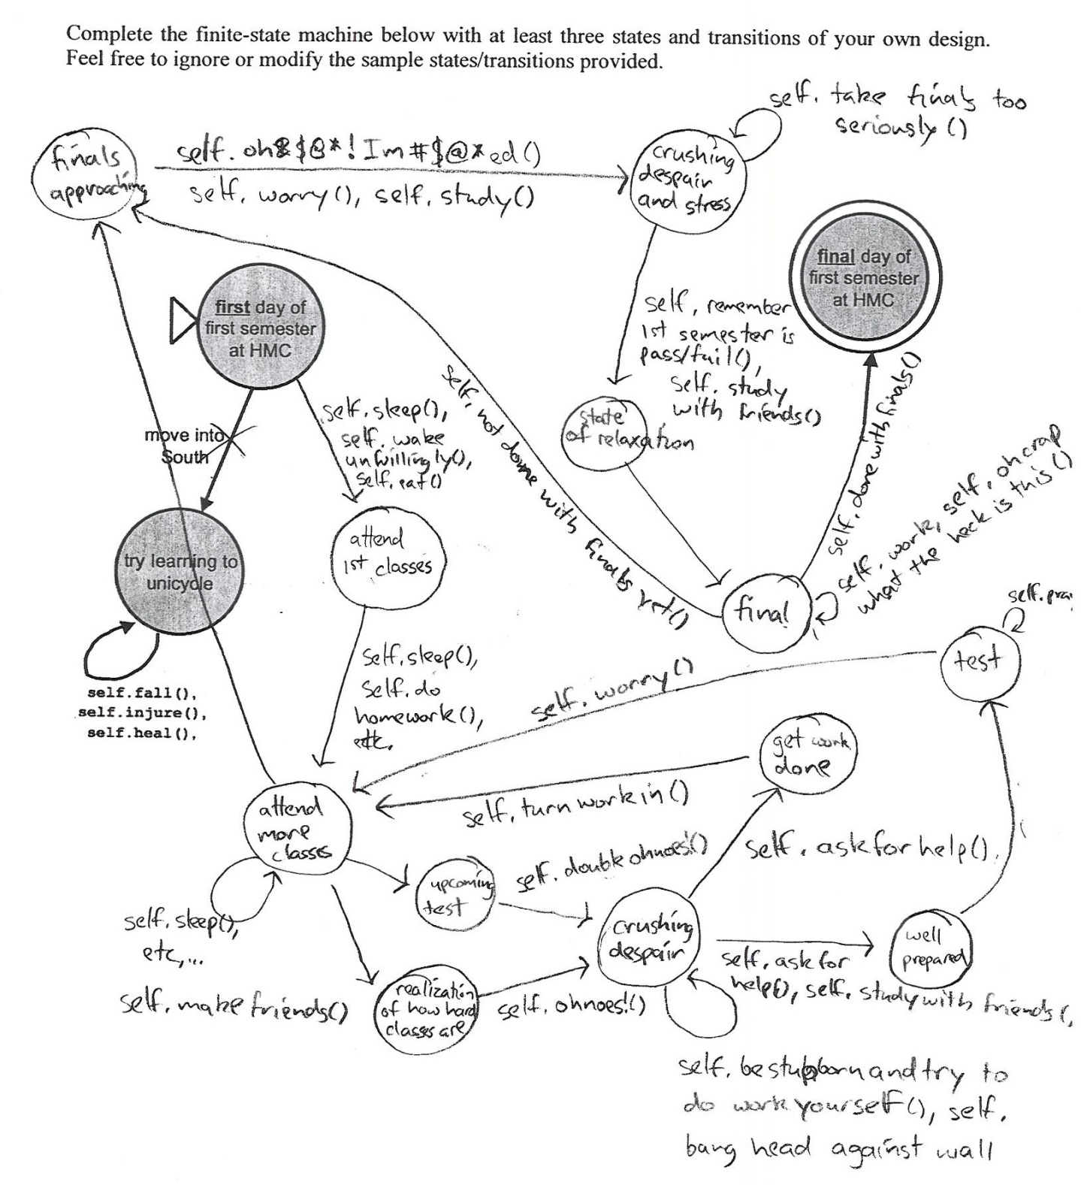
Another HMC DFA
not sure whose this is…

Slide 90
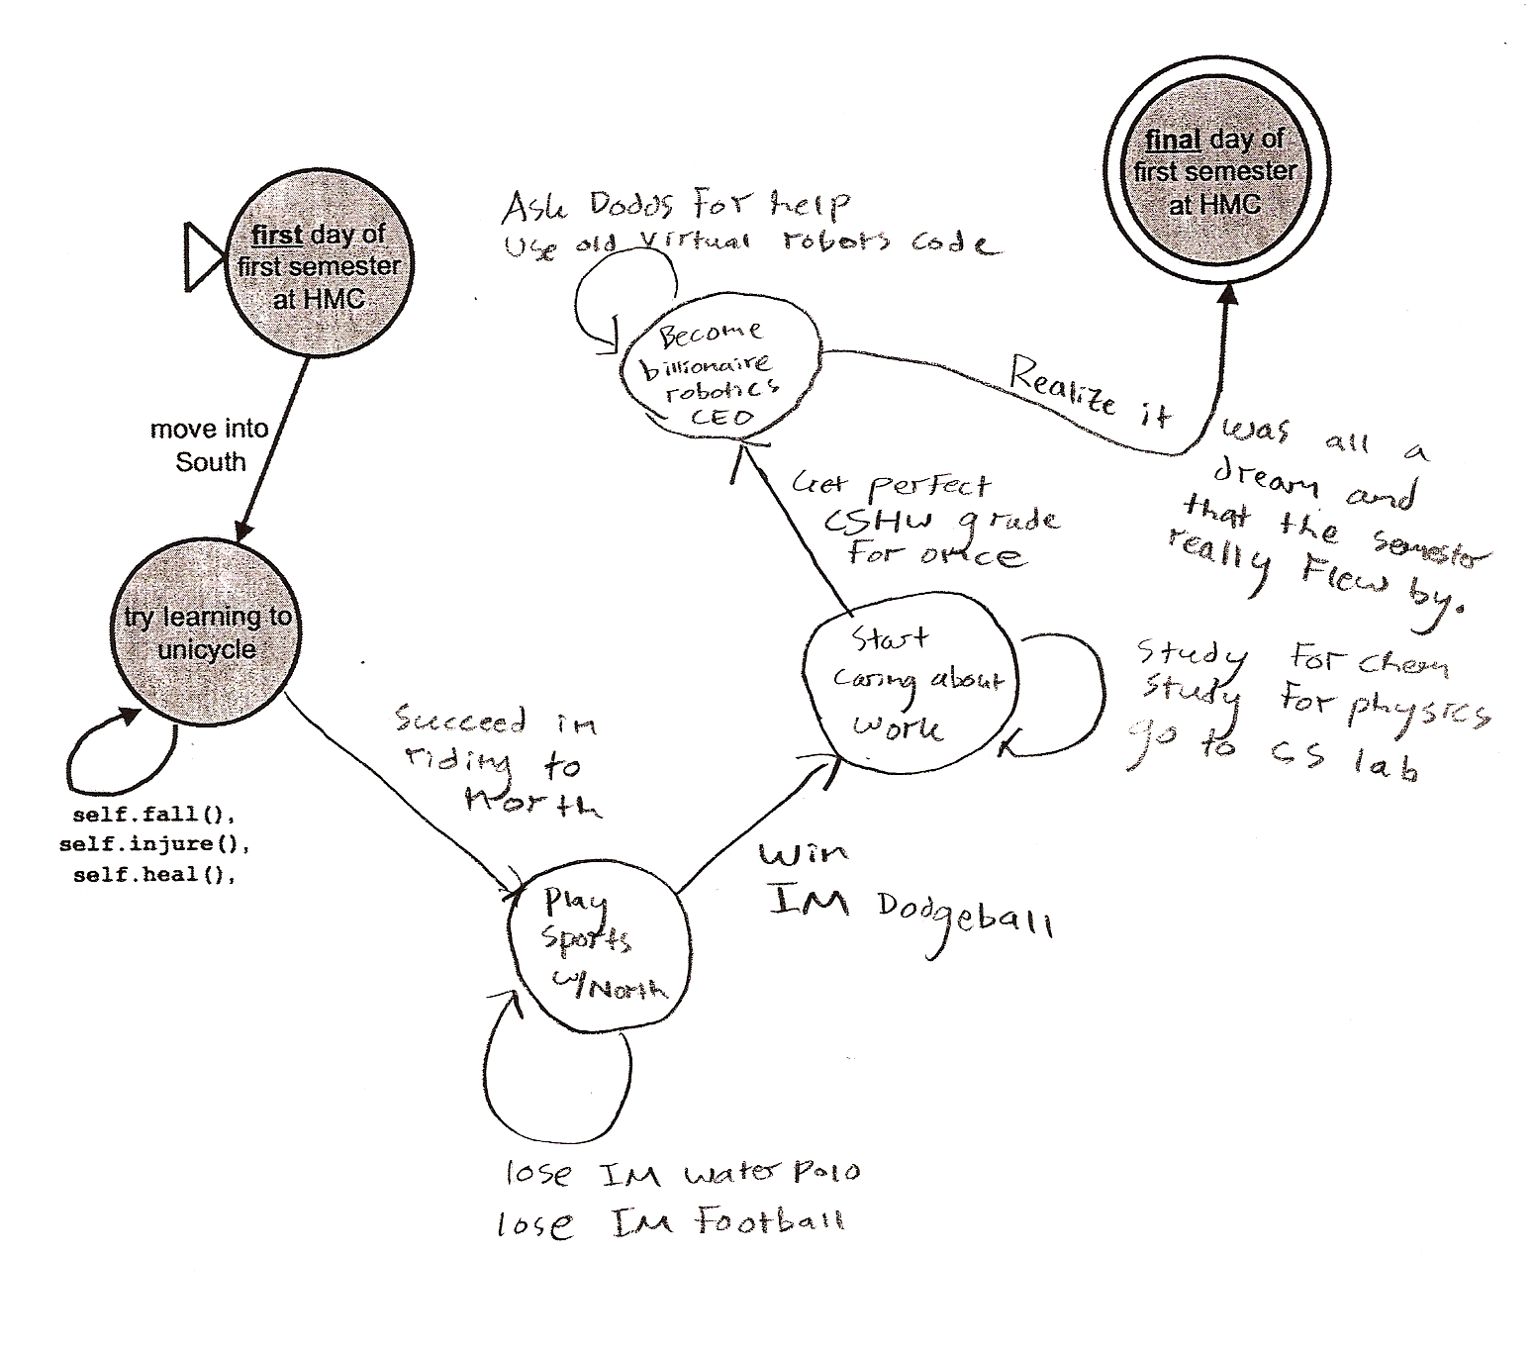
Yet another HMC DFA
I think it was all a dream…

Slide 91
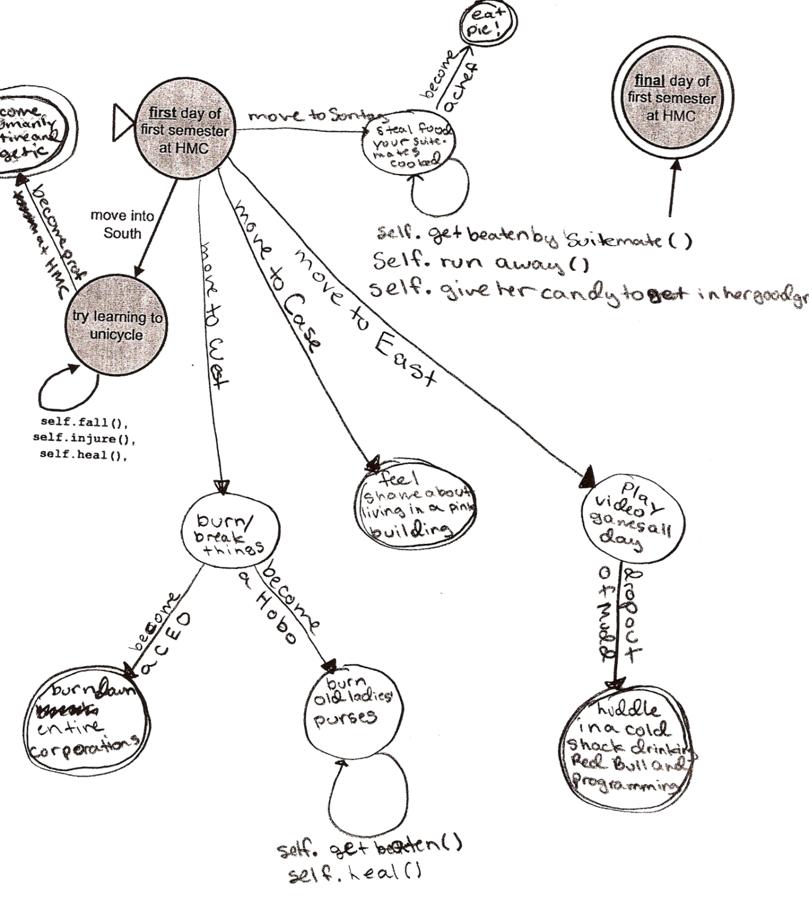
Yet another HMC DFA
don't trust dorm stereotypes…

Slide 92
Regular Languages
A language L is regular if there is a DFA that accepts it.
or NFA
or RegEx
L = { w | w is a binary number whose value is a power of two }
All regular
L = { w | the third and third-to-last digits of w are identical }
L = { w | w is a binary number that’s divisible by 7 }
L = { 0^{k}1^{k} | k ≥ 0}
Nonregular !
How could we prove that
L = { 0^{k}1^{k} | k ≥ 0}
is not regular?
If there is an infinite pairwise distinguishable set of strings (w.r.t. L), it must be that L is not regular!
The Nonregular Language Theorem

Slide 93
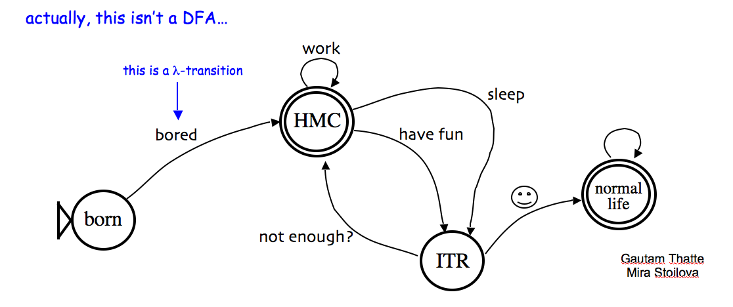
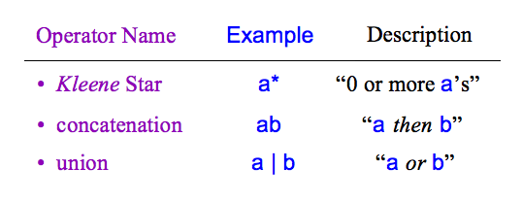
HW 11 due Nov. 25th
Today in CS 60
Weekend adventures?
JFLAP!
Computation without a computer…
Regular Expressions
"simplest" structural model of computation…
(0|1(01*0)*1)(0|1(01*0)*1)*
The % operator in a regex?!
Deterministic Finite Automaton
Finite State Machine
"simplest" procedural models of computation…
What can computers do, after all?
Notes:
regexen?

Slide 94
NFAs vs. DFAs
What NFA accepts L = { w | w is all 1s or (10)^{k} } ?
strings in L
λ is OK
λ
11
01
01010101
1111111111
strings not in L
10
00
0101010
0100101
a DFA requires 8 states
L = { w | w’s third-to-last character (from the right) is a 1}
Notes:
good to have a lambda here at the start

Slide 95
There's something irregular about this theorem's name…
The Nonregular Language Theorem
Consider the language
L = { 0^{n}1^{n} | n ≥ 0}
example strings in L
To show it’s not regular…
λ
01
0011
000111
00001111
0000011111

Slide 96
Maybe add the proof that the Kolmogorov complexity of a number
is not computable, though it's well defined. See the Theory3.ppt lecture in the cs5
directory - example of another proof…
maybe the last day of the semester… ?

Slide 97
(0|101|11(01)*(1|00)1|(100|11(01)*(1|00)0)(1|0(01)*(1|00)0)*0(01)*(1|00)1)*
div-by-5
Today in CS 60
Computability and complexity
possibility for computation
efficiency of computation
Both depend on the computational model used.
^(0|7|(1|8)5*4|(2|9|(1|8)5*6)(3|(2|9)5*6)*(1|8|(2|9)5*4)|(3|(1|8)5*(0|7)|(2|9|(1|8)5*6)(3|(2|9)5*6)*(4|(2|9)5*(0|7)))(1|8|65*(0|7)|(0|7|65*6)(3|(2|9)5*6)*(4|(2|9)5*(0|7)))*(5|65*4|(0|7|65*6)(3|(2|9)5*6)*(1|8|(2|9)5*4))|(4|(1|8)5*(1|8)|(2|9|(1|8)5*6)(3|(2|9)5*6)*(5|(2|9)5*(1|8))|(3|(1|8)5*(0|7)|(2|9|(1|8)5*6)(3|(2|9)5*6)*(4|(2|9)5*(0|7)))(1|8|65*(0|7)|(0|7|65*6)(3|(2|9)5*6)*(4|(2|9)5*(0|7)))*(2|9|65*(1|8)|(0|7|65*6)(3|(2|9)5*6)*(5|(2|9)5*(1|8))))(6|35*(1|8)|(4|35*6)(3|(2|9)5*6)*(5|(2|9)5*(1|8))|(5|35*(0|7)|(4|35*6)(3|(2|9)5*6)*(4|(2|9)5*(0|7)))(1|8|65*(0|7)|(0|7|65*6)(3|(2|9)5*6)*(4|(2|9)5*(0|7)))*(2|9|65*(1|8)|(0|7|65*6)(3|(2|9)5*6)*(5|(2|9)5*(1|8))))*(2|9|35*4|(4|35*6)(3|(2|9)5*6)*(1|8|(2|9)5*4)|(5|35*(0|7)|(4|35*6)(3|(2|9)5*6)*(4|(2|9)5*(0|7)))(1|8|65*(0|7)|(0|7|65*6)(3|(2|9)5*6)*(4|(2|9)5*(0|7)))*(5|65*4|(0|7|65*6)(3|(2|9)5*6)*(1|8|(2|9)5*4)))|(5|(1|8)5*(2|9)|(2|9|(1|8)5*6)(3|(2|9)5*6)*(6|(2|9)5*(2|9))|(3|(1|8)5*(0|7)|(2|9|(1|8)5*6)(3|(2|9)5*6)*(4|(2|9)5*(0|7)))(1|8|65*(0|7)|(0|7|65*6)(3|(2|9)5*6)*(4|(2|9)5*(0|7)))*(3|65*(2|9)|(0|7|65*6)(3|(2|9)5*6)*(6|(2|9)5*(2|9)))|(4|(1|8)5*(1|8)|(2|9|(1|8)5*6)(3|(2|9)5*6)*(5|(2|9)5*(1|8))|(3|(1|8)5*(0|7)|(2|9|(1|8)5*6)(3|(2|9)5*6)*(4|(2|9)5*(0|7)))(1|8|65*(0|7)|(0|7|65*6)(3|(2|9)5*6)*(4|(2|9)5*(0|7)))*(2|9|65*(1|8)|(0|7|65*6)(3|(2|9)5*6)*(5|(2|9)5*(1|8))))(6|35*(1|8)|(4|35*6)(3|(2|9)5*6)*(5|(2|9)5*(1|8))|(5|35*(0|7)|(4|35*6)(3|(2|9)5*6)*(4|(2|9)5*(0|7)))(1|8|65*(0|7)|(0|7|65*6)(3|(2|9)5*6)*(4|(2|9)5*(0|7)))*(2|9|65*(1|8)|(0|7|65*6)(3|(2|9)5*6)*(5|(2|9)5*(1|8))))*(0|7|35*(2|9)|(4|35*6)(3|(2|9)5*6)*(6|(2|9)5*(2|9))|(5|35*(0|7)|(4|35*6)(3|(2|9)5*6)*(4|(2|9)5*(0|7)))(1|8|65*(0|7)|(0|7|65*6)(3|(2|9)5*6)*(4|(2|9)5*(0|7)))*(3|65*(2|9)|(0|7|65*6)(3|(2|9)5*6)*(6|(2|9)5*(2|9)))))(4|(0|7)5*(2|9)|(1|8|(0|7)5*6)(3|(2|9)5*6)*(6|(2|9)5*(2|9))|(2|9|(0|7)5*(0|7)|(1|8|(0|7)5*6)(3|(2|9)5*6)*(4|(2|9)5*(0|7)))(1|8|65*(0|7)|(0|7|65*6)(3|(2|9)5*6)*(4|(2|9)5*(0|7)))*(3|65*(2|9)|(0|7|65*6)(3|(2|9)5*6)*(6|(2|9)5*(2|9)))|(3|(0|7)5*(1|8)|(1|8|(0|7)5*6)(3|(2|9)5*6)*(5|(2|9)5*(1|8))|(2|9|(0|7)5*(0|7)|(1|8|(0|7)5*6)(3|(2|9)5*6)*(4|(2|9)5*(0|7)))(1|8|65*(0|7)|(0|7|65*6)(3|(2|9)5*6)*(4|(2|9)5*(0|7)))*(2|9|65*(1|8)|(0|7|65*6)(3|(2|9)5*6)*(5|(2|9)5*(1|8))))(6|35*(1|8)|(4|35*6)(3|(2|9)5*6)*(5|(2|9)5*(1|8))|(5|35*(0|7)|(4|35*6)(3|(2|9)5*6)*(4|(2|9)5*(0|7)))(1|8|65*(0|7)|(0|7|65*6)(3|(2|9)5*6)*(4|(2|9)5*(0|7)))*(2|9|65*(1|8)|(0|7|65*6)(3|(2|9)5*6)*(5|(2|9)5*(1|8))))*(0|7|35*(2|9)|(4|35*6…
DFAs can't count - but they're great at modular arithmetic!
start of a multiple-of-7 matcher
HW #11 due today
analysis of several algorithms
plus! a Java algorithm challenge (and review)
post-hoc extra credit available!
one problem more than on a typical assignment
due Wednesday, April 30th 11:59 pm (no CS 60 dollar for #4)

Slide 98
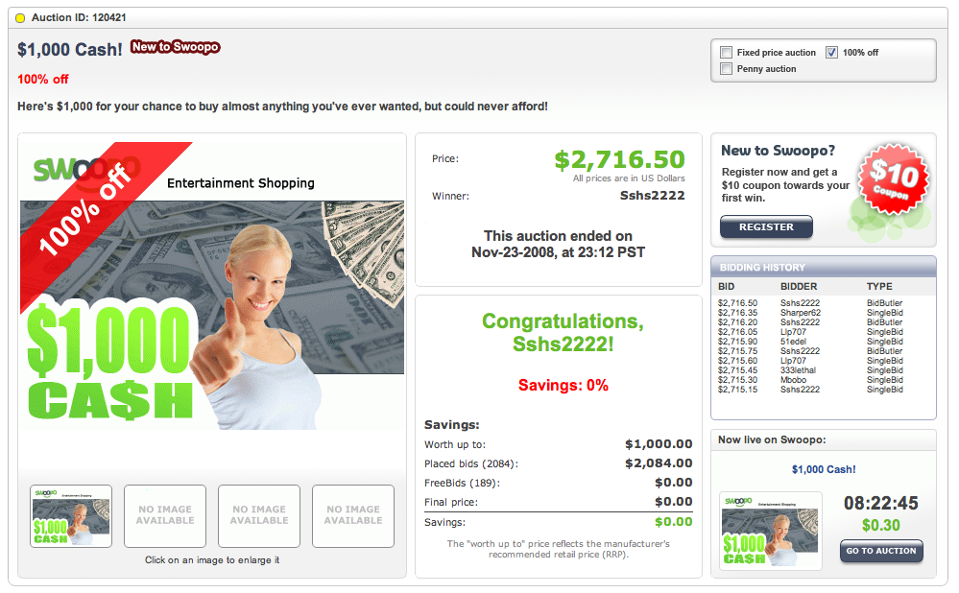
The case for letting machines compute…
Notes:
98

Slide 99
String matchmaking
Given a language, L,
they might have different outcomes
Two strings w₁ , w₂ are distinguishable w.r.t. L if
(with respect to)
∃ z such that w₁ z ∈ L and w₂ z ∉ L (or vice versa).
"there exists"
think of z as a "suffix" for w₁ and w₂
they ALL might have different outcomes
A set of strings {w₁,w₂,w₃,…} is pairwise distinguishable if
∀ w_{i} , w_{j} with i ≠ j , w_{i} and w_{j} are distinguishable.
"for all"
How does this help?

Slide 100
Four models
DFAs
TMs
"can't count"
TMs count!
FSMs
Turing Machines
can compute regular languages
strictly more powerful than DFAs
!
an alien, a plan, a canal, paneilana!
NFAs
I'd have named it Paneilana.
Nondeterministic
finite automata
Palindromes are computable by TMs, but not by DFAs.
RegEx's
the ability to be in more than one state at once…!
are computationally equivalent to DFAs!
Where do NFAs go?
Notes:
Pimp my Ride from MTV - Corona is where the garage is…
MTV + SciFi -- twilight zone…

Slide 101
Four models
DFAs
TMs
"can't count"
TMs count!
FSMs
Turing Machines
can compute regular languages
strictly more powerful than DFAs
?
an alien, a plan, a canal, paneilana!
I'd have named it Paneilana.
Palindromes are computable by TMs, but not by DFAs.
RegEx's
are computationally equivalent to DFAs!
Notes:
Pimp my Ride from MTV - Corona is where the garage is…
MTV + SciFi -- twilight zone…

Slide 102
Today in CS 60
Computability and complexity
possibility of computation
efficiency of computation
Both depend on the computational model used.
DFAs and regular expressions are equivalent computationally but not in complexity!
^(0|7|(1|8)5*4|(2|9|(1|8)5*6)(3|(2|9)5*6)*(1|8|(2|9)5*4)|(3|(1|8)5*(0|7)|(2|9|(1|8)5*6)(3|(2|9)5*6)*(4|(2|9)5*(0|7)))(1|8|65*(0|7)|(0|7|65*6)(3|(2|9)5*6)*(4|(2|9)5*(0|7)))*(5|65*4|(0|7|65*6)(3|(2|9)5*6)*(1|8|(2|9)5*4))|(4|(1|8)5*(1|8)|(2|9|(1|8)5*6)(3|(2|9)5*6)*(5|(2|9)5*(1|8))|(3|(1|8)5*(0|7)|(2|9|(1|8)5*6)(3|(2|9)5*6)*(4|(2|9)5*(0|7)))(1|8|65*(0|7)|(0|7|65*6)(3|(2|9)5*6)*(4|(2|9)5*(0|7)))*(2|9|65*(1|8)|(0|7|65*6)(3|(2|9)5*6)*(5|(2|9)5*(1|8))))(6|35*(1|8)|(4|35*6)(3|(2|9)5*6)*(5|(2|9)5*(1|8))|(5|35*(0|7)|(4|35*6)(3|(2|9)5*6)*(4|(2|9)5*(0|7)))(1|8|65*(0|7)|(0|7|65*6)(3|(2|9)5*6)*(4|(2|9)5*(0|7)))*(2|9|65*(1|8)|(0|7|65*6)(3|(2|9)5*6)*(5|(2|9)5*(1|8))))*(2|9|35*4|(4|35*6)(3|(2|9)5*6)*(1|8|(2|9)5*4)|(5|35*(0|7)|(4|35*6)(3|(2|9)5*6)*(4|(2|9)5*(0|7)))(1|8|65*(0|7)|(0|7|65*6)(3|(2|9)5*6)*(4|(2|9)5*(0|7)))*(5|65*4|(0|7|65*6)(3|(2|9)5*6)*(1|8|(2|9)5*4)))|(5|(1|8)5*(2|9)|(2|9|(1|8)5*6)(3|(2|9)5*6)*(6|(2|9)5*(2|9))|(3|(1|8)5*(0|7)|(2|9|(1|8)5*6)(3|(2|9)5*6)*(4|(2|9)5*(0|7)))(1|8|65*(0|7)|(0|7|65*6)(3|(2|9)5*6)*(4|(2|9)5*(0|7)))*(3|65*(2|9)|(0|7|65*6)(3|(2|9)5*6)*(6|(2|9)5*(2|9)))|(4|(1|8)5*(1|8)|(2|9|(1|8)5*6)(3|(2|9)5*6)*(5|(2|9)5*(1|8))|(3|(1|8)5*(0|7)|(2|9|(1|8)5*6)(3|(2|9)5*6)*(4|(2|9)5*(0|7)))(1|8|65*(0|7)|(0|7|65*6)(3|(2|9)5*6)*(4|(2|9)5*(0|7)))*(2|9|65*(1|8)|(0|7|65*6)(3|(2|9)5*6)*(5|(2|9)5*(1|8))))(6|35*(1|8)|(4|35*6)(3|(2|9)5*6)*(5|(2|9)5*(1|8))|(5|35*(0|7)|(4|35*6)(3|(2|9)5*6)*(4|(2|9)5*(0|7)))(1|8|65*(0|7)|(0|7|65*6)(3|(2|9)5*6)*(4|(2|9)5*(0|7)))*(2|9|65*(1|8)|(0|7|65*6)(3|(2|9)5*6)*(5|(2|9)5*(1|8))))*(0|7|35*(2|9)|(4|35*6)(3|(2|9)5*6)*(6|(2|9)5*(2|9))|(5|35*(0|7)|(4|35*6)(3|(2|9)5*6)*(4|(2|9)5*(0|7)))(1|8|65*(0|7)|(0|7|65*6)(3|(2|9)5*6)*(4|(2|9)5*(0|7)))*(3|65*(2|9)|(0|7|65*6)(3|(2|9)5*6)*(6|(2|9)5*(2|9)))))(4|(0|7)5*(2|9)|(1|8|(0|7)5*6)(3|(2|9)5*6)*(6|(2|9)5*(2|9))|(2|9|(0|7)5*(0|7)|(1|8|(0|7)5*6)(3|(2|9)5*6)*(4|(2|9)5*(0|7)))(1|8|65*(0|7)|(0|7|65*6)(3|(2|9)5*6)*(4|(2|9)5*(0|7)))*(3|65*(2|9)|(0|7|65*6)(3|(2|9)5*6)*(6|(2|9)5*(2|9)))|(3|(0|7)5*(1|8)|(1|8|(0|7)5*6)(3|(2|9)5*6)*(5|(2|9)5*(1|8))|(2|9|(0|7)5*(0|7)|(1|8|(0|7)5*6)(3|(2|9)5*6)*(4|(2|9)5*(0|7)))(1|8|65*(0|7)|(0|7|65*6)(3|(2|9)5*6)*(4|(2|9)5*(0|7)))*(2|9|65*(1|8)|(0|7|65*6)(3|(2|9)5*6)*(5|(2|9)5*(1|8))))(6|35*(1|8)|(4|35*6)(3|(2|9)5*6)*(5|(2|9)5*(1|8))|(5|35*(0|7)|(4|35*6)(3|(2|9)5*6)*(4|(2|9)5*(0|7)))(1|8|65*(0|7)|(0|7|65*6)(3|(2|9)5*6)*(4|(2|9)5*(0|7)))*(2|9|65*(1|8)|(0|7|65*6)(3|(2|9)5*6)*(5|(2|9)5*(1|8))))*(0|7|35*(2|9)|(4|35*6…
just the start…
HW #11 due this evening…
Problem #9:
N
2
Recognizing
0
i.e., strings of zeros whose length is a power of two.

Slide 103
Regex NFA
building our machine from available components
Suppose a and b are regular expressions with equivalent NFAs:
a
b
0 or more accepting states…
What NFAs will these composite regular expressions be?
a|b
ab
a*

Slide 104
NFA DFA
To show:
q0
DFAs can represent NFAs
q1
λ, 0, or multiple transitions
q2
q0,1
q1
1
λ
q0
q0,2
1
0
q2
q1,2
0
q0,1,2
subset-state construction
Start State?
Accepting states?
Transitions?
q-∅
graveyard state

