Slide 1

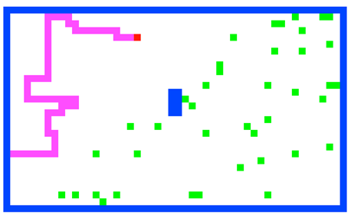
Today in CS60
From theory to practice
strategies for software reuse
from engineering algorithms to engineering software
We support Green programming… 1995: Sun/Green/Oak/Java!
Software Engineering
hw #11: Spampede due Fri. 5/2
Tu 22nd
Th 24th
Inheritance
Graphics + APIs
Tu 29th
Th 1st
AI == BFS?
Finale!
Spampede!
5/5 - 5/9 ~ cs60 doesn't meet
Assignment #10: JFLAP
Notes:
in the small … in the large!
gathering storm – assignment # 7

Slide 2
Final assignments/options
due today: JFLAP!
Fri. 4/25: Claremont Robotics judging!
++fun!
+10 points of ex. cr.
due 5/2: Spampede
due 5/10: Extra-credit assignment…
Parsing! worth up to +50 pts
due 5/15 by 11:59pm: cs60's final exam

Slide 3
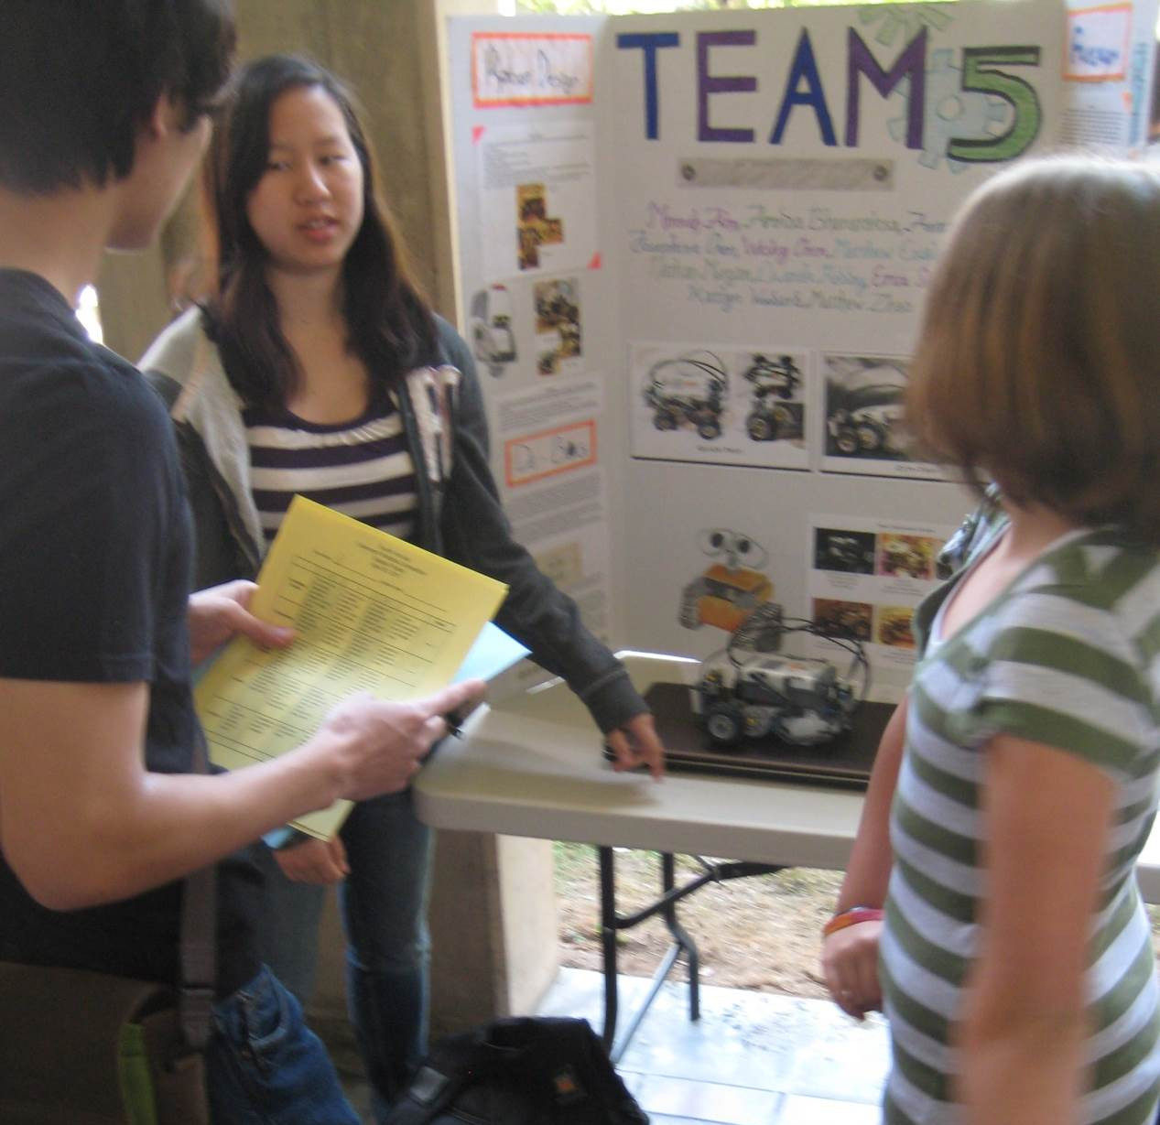
Claremont Robotics ~ judging!
Josephine!
Friday, 4/25 @ 11am
Mixed-age teams
Lego robots
4-5 judges @ the poster session from 11am - noon
Jeff L.

Slide 4

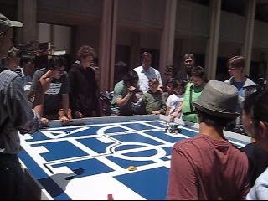
Claremont Robotics ~ judging!
fastest lap competition
city tour competition
4-5 judges @ the contest session from 1pm – 2pm
Join us! ~ email me

Slide 5
Computability
DFAs
???
TMs
computability axis
less power
more power
Computability is the "power" required to solve a particular problem, i.e., accept a particular language.

Slide 6
Adding nondeterminism to DFAs
What's different!?
NFAs
q1
λ
1
λ-transitions
missing transitions
multiple transitions!
nondeterministic finite automata
q0
1
0
q2
0
1
What happens with …
0
11
101
λ
Is L = { all strings beginning with 1 } ?
Notes:
equivalent NFAs?
is this possible?

Slide 7
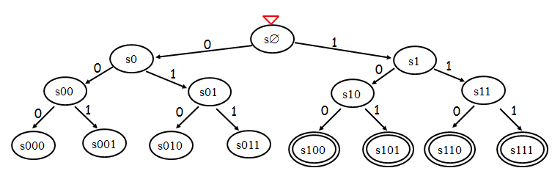
DFAs vs. NFAs vs. TMs ?
strings not in L
L = { w | w’s third-to-last character (from the right) is a 1}
λ
11
01
01011001
1111111011
strings in L
110
100
0000100
111111111
DFA had lots of states (minimum: 8 states)
a DFA requires 8 states
efficiency vs. computability ?!
a TM could use <4 states
Notes:
good to have a lambda here at the start

Slide 8
DFAs vs. NFAs vs. TMs ?
strings not in L
L = { w | w’s third-to-last character (from the right) is a 1}
λ
11
01
01011001
1111111011
strings in L
110
100
0000100
111111111
a DFA requires 8 states
efficiency vs. computability ?!
a TM could use <4 states
Notes:
good to have a lambda here at the start

Slide 9
Computability
NFAs?
DFAs
TMs
computability axis
less power
more power
Computability is the "power" required to solve a particular problem, i.e., accept a particular language.

Slide 10
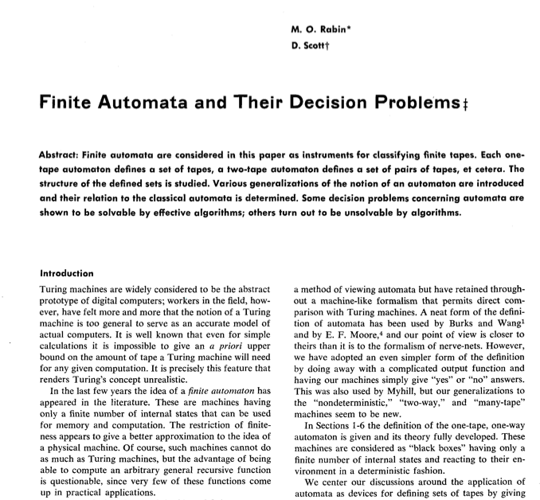
Computability
DFAs
???
TMs
computability axis
less power
more power
Computability is the "power" required to solve a particular problem, i.e., accept a particular language.

Slide 11
NFAs == DFAs !
To show:
every NFA has an == DFA
What DFA states might we need!?
NFA example:
q1
1
λ
q0
1
0
q2
0
λ, 0, or multiple transitions
Notes:
Key property of NFA – multiple states at once….
Key insight was that you could represent this deterministically by considering all different SUBSETS of states that you might be in!

Slide 12
NFAs == DFAs !
"Subset-state Construction"
To show:
every NFA has an == DFA
q0
q1
NFA example:
q2
q1
1
λ
q0,1
q0
1
q0,2
0
q2
0
q1,2
q0,1,2
λ, 0, or multiple transitions
Start State?
Accepting states?
Transitions?
q-∅
graveyard state
Notes:
Key property of NFA – multiple states at once….
Key insight was that you could represent this deterministically by considering all different SUBSETS of states that you might be in!

Slide 13
Computability
DFAs
NFAs can compute exactly what DFAs can, but…
TMs
NFAs
This BUT is the million dollar question!
literally…!
computability axis
less power
more power
Computability is the "power" required to solve a particular problem, i.e., accept a particular language.

Slide 14
Nondeterminism's power…
DFAs
DFAs and NFAs have the same computing power, but DFAs can be exponentially less efficient…
NFAs
Non-deterministic Turing Machines, i.e., algorithms, are also possible.
TMs
In fact there are non-deterministic languages!!
NTMs

Slide 15
Nondeterminism's power…
DFAs
DFAs and NFAs have the same computing power, but DFAs can be exponentially less efficient…
NFAs
Non-deterministic Turing Machines, i.e., algorithms, are also possible.
Are they also exponentially less efficient?
TMs
In fact there are non-deterministic languages!!
NTMs

Slide 16

P
P vs. NP
NP
polynomially checkable
polynomially solvable
$1M Clay prize…

Slide 17
I thought it was non-polynomial
P vs. NP
P
NP
Nondeterministic Polynomial algorithms
Polynomial algorithms
searching
Are these the same set of algorithms?
Tautology checking
sorting
Traveling S.P.
Floyd-Warshall
Use-it-or-lose-it

Slide 18
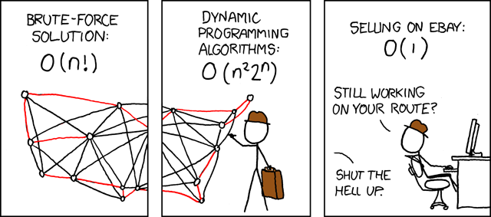
P
P vs. NP
NP
Polynomial algorithms
Nondeterministic Polynomial algorithms
not quite in P…!
Traveling Salesperson Problem

Slide 19
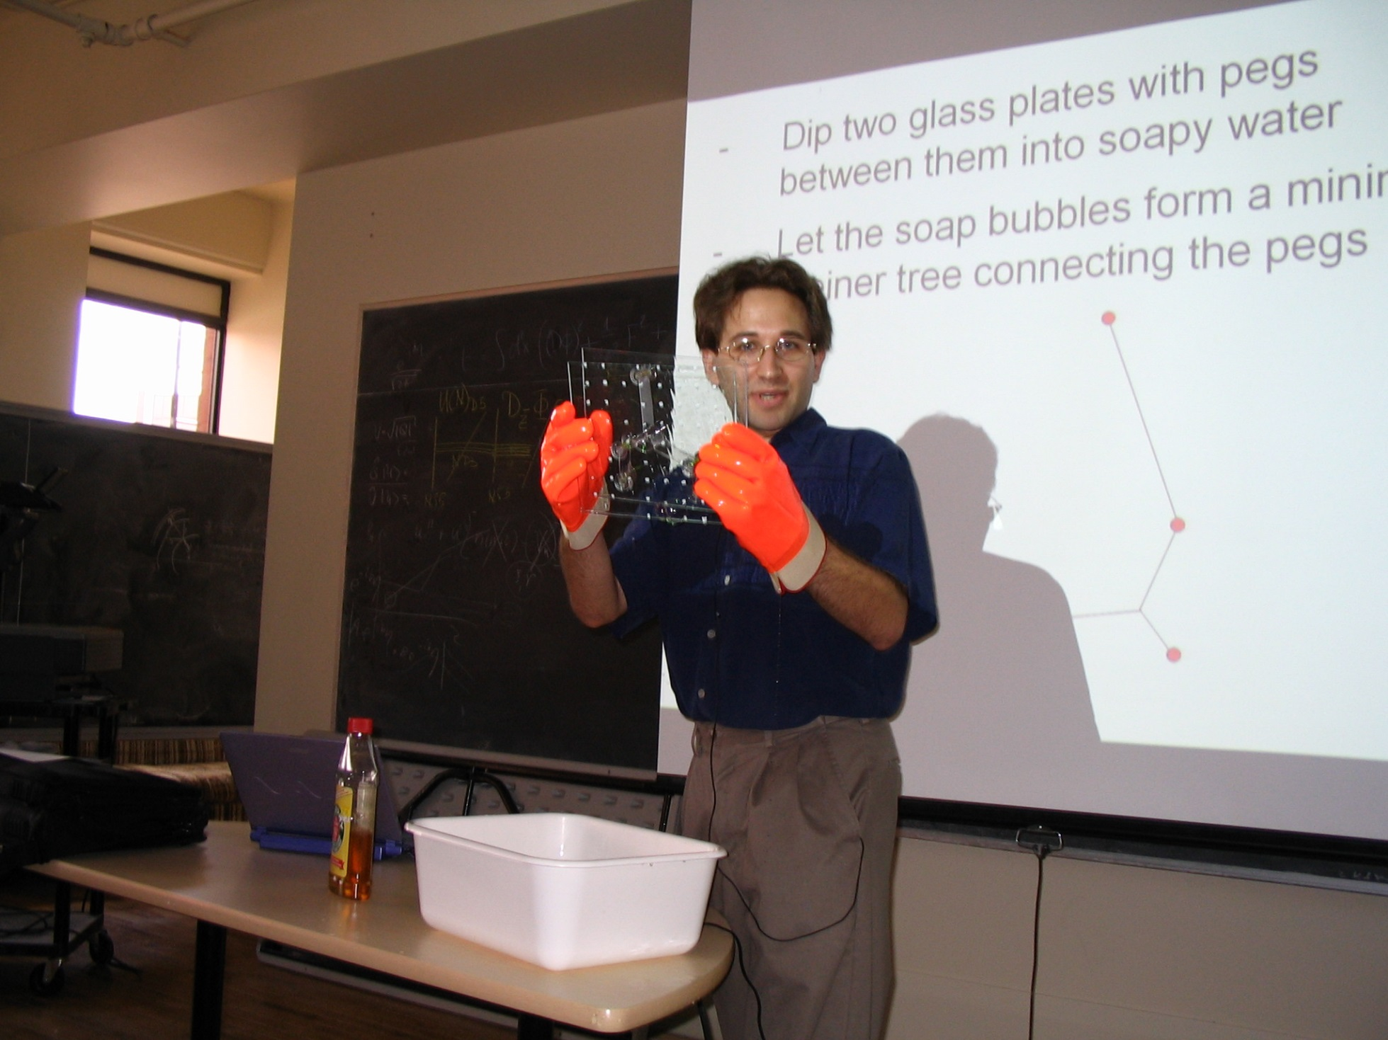
P
P vs. NP
NP
MIT's Scott Aaronson

Slide 20
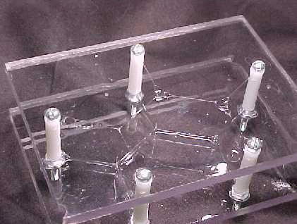
P
P vs. NP
NP
Nature, finding the shortest tree of paths connecting N vertices…

Slide 21
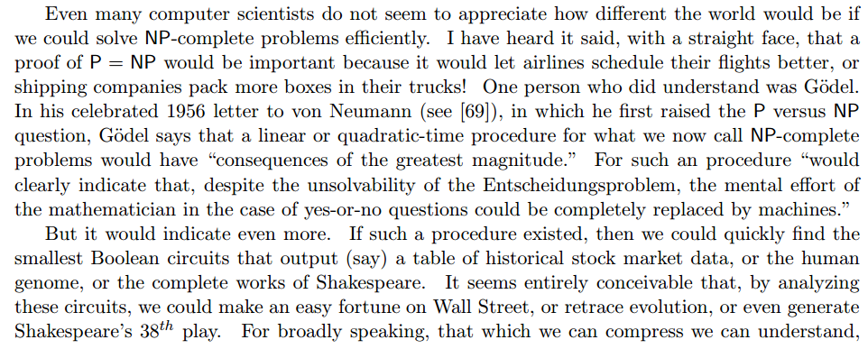
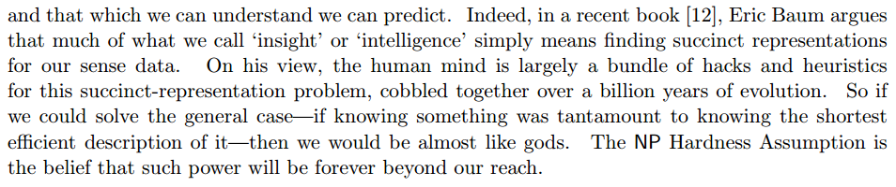
P
P vs. NP
NP
MIT's Scott Aaronson

Slide 22
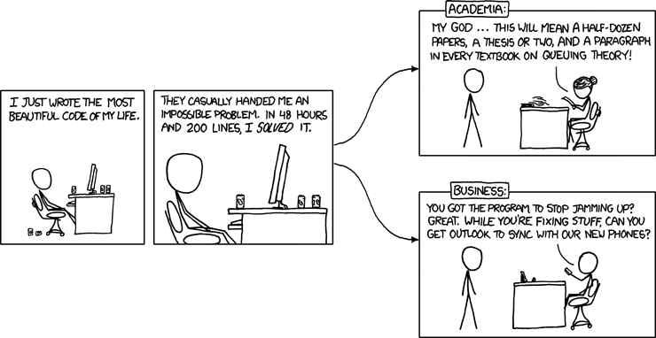
P vs. NP
Write a tautology checker that runs in O(N^{k}) time.
Or prove it can't be done.
on to the business of software!

Slide 23
Software design: Top-down
Getting a clear view of the requirements of the project…
breaking it up into component pieces
visualize!
reuse or recurse!
assembling those pieces into a coherent whole…
What are the pieces of Spampede?
and how can we reuse existing code…
"Maze"

Slide 24
Reuse by data design: beyond copy-and-paste
Java is an object-oriented programming language:
Classes
Objects
user-defined datatypes
variables of those types
The primary goal of OOP is to create a good data abstraction
- one that models relationships accurately
- without forcing the user to keep track of more than necessary
There are two relationship types that Java can model:
can it handle serious relationships?

Slide 25
Data design #1: part-of
There are two basic relationship types that Java models:
(1) the part-of relationship
containment or embedding
a Pixel is part of a Picture
a MazeCell is part of a Maze
a char (the contents) is part of a MazeCell
class Picture
{
private Pixel[][] pix;
class Maze
{
MazeCell[][] maze;
class MazeCell
{
private int row;
private int col;
private char contents;
private boolean visited;
Notes:
last line is key … it's really extension!

Slide 26
Data design #2: kind-of
There are two basic relationship types that Java models:
(1) the kind-of relationship
extensions
Kind-of
a String is a kind of an Object
"Inheritance"
a Maze is an Object
"is-a"!
a Spampede is a JApplet
class String
extends Object
{
private char[] data;
class Maze
extends Object
{
MazeCell[][] maze;
class Spampede
extends JApplet
{
Notes:
last line is key … it's really extension!

Slide 27
Data design #2: kind-of
There are two basic relationship types that Java models:
(1) the kind-of relationship
specializations and extensions
Kind-of
a String is a kind of an Object
"Inheritance"
a Maze is an Object
Inheritance provides top-level access to all methods and data (non-private data)
"is-a"!
a Spampede is a JApplet
class String
extends Object
{
private char[] data;
class Maze
extends Object
{
MazeCell[][] maze;
class Spampede
extends JApplet
{
Notes:
last line is key … it's really extension!

Slide 28
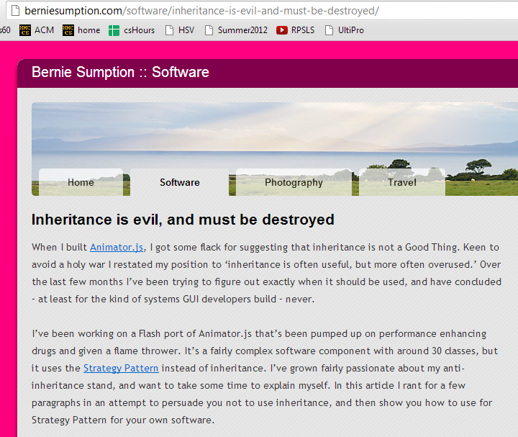
Inheritance opinions…
Java's libraries use it extensively…
It incites passions
At least worth knowing about…
perhaps misused!

Slide 29
Inheritance opinions…
Giraffe "is an" Animal?
Java's libraries use it extensively…
It incites passions
At least worth knowing about…
Application "is a" Window?
GUI "is a" Window?
perhaps misused!
Wheel well "is a" Seat!?!

Slide 30
inheritance gives top-level access to all capabilities
Inheritance intuition…
inheritance models the "kind-of" or "is-a" relationship.
Which of these relationships is well-modeled by inheritance?
class Car extends Engine
class Rectangle extends Shape
class Square extends Rectangle
class Heap extends List
class NFA extends DFA
class Mudder extends Person
Good use of inheritance? use a consonant
Poor use of inheritance? use a vowel
What word could these examples spell?
Name(s): _____________________

Slide 31
inheritance gives top-level access to all capabilities
Inheritance intuition…
inheritance models the "kind-of" or "is-a" relationship.
Which of these relationships is well-modeled by inheritance?
class Car extends Engine
class Rectangle extends Shape
class Square extends Rectangle
class Heap extends List
class NFA extends DFA
class Mudder extends Person
Good use of inheritance? use a consonant
Poor use of inheritance? use a vowel
What word could these examples spell?
Name(s): _____________________

Slide 32
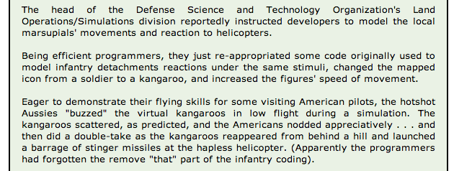
Dangers of Inheritance…
Goal: create a useful & representative data model
A derived class extends all of the capabilities of a base class… !

Slide 33
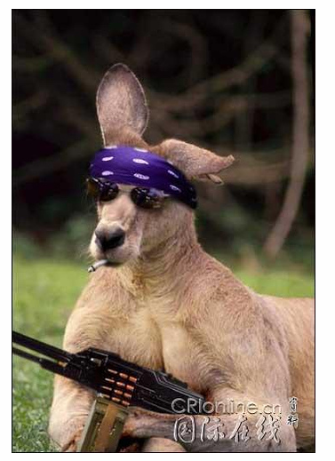

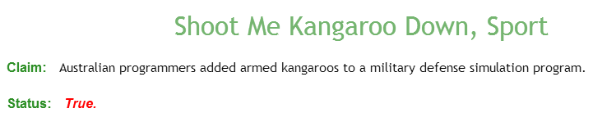
Dangers of Inheritance…
Goal: create a useful & representative data model
A derived class extends all of the capabilities of a base class… !

Slide 34
class Person
{
protected String name; // data member – protected
public Person( String name ) { this.name = name; }
public boolean isAsleep( int hr ) { return hr > 22 || hr < 7; }
public String toString() { return name; }
public void status( int hr )
{
if ( this.isAsleep( hr ) )
System.out.println( "Now asleep: " + this );
else
System.out.println( "Now awake: " + this );
}
}
Code overview
Person
Base Class
or Super-Class
class Student extends Person
{
protected int units; // additional data member
public Student( String name, int units ) {
super(name);
this.units = units;
}
public boolean isAsleep( int hr ) // override!
{ return 2 < hr && hr < 8; }
public String toString()
{
String result = super.toString();
return result + " units: " + units;
}
}
Student
Derived Class
or Sub-Class
in main:
Student S;
S = new Student("Wally", 18);
Extend the picture…
Notes:
draw a picture

Slide 35
An inheritance hierarchy + code
Base Class
Data
Methods
Person
String name;
boolean isAsleep(int hr)
{
return hr > 22
|| hr < 7;
}
Student
Derived Class
Very Derived Class
Mudder
Notes:
military-type definition of time…

Slide 36
An inheritance hierarchy + code
Base Class
Data
Methods
Person
String name;
boolean isAsleep(int hr)
{
return hr > 22
|| hr < 7;
}
Student
Derived Class
int units;
boolean isAsleep(int hr)
{
return hr > 2
&& hr < 8;
}
Very Derived Class
overriding the previous method
Mudder
(x'y - y'x) / y**2
Now that's derived!

Slide 37
An inheritance hierarchy + code
Base Class
Data
Methods
Person
String name;
boolean isAsleep(int hr)
{
return hr > 22
|| hr < 7;
}
Student
Derived Class
int units;
boolean isAsleep(int hr)
{
return hr > 2
&& hr < 8;
}
Very Derived Class
Mudder
String dorm;
??
(x'y - y'x) / y**2
Now that's derived!

Slide 38
What is this Java hierarchy missing?!
An inheritance hierarchy
Base Class
Data
Methods
Person
String name;
boolean isAsleep(int hr)
{
return hr > 22
|| hr < 7;
}
Student
Derived Class
int units;
boolean isAsleep(int hr)
{
return hr > 2
&& hr < 8;
}
Very Derived Class
Mudder
boolean isAsleep(int hr)
{
return false;
}
String dorm;
Notes:
add Object - the language's overarching base class for ALL user-defined and library-defined classes…
up: human, mammal, …
down: Case-ey; Casite; Casian; Caser; Case-ell, CS60er, Matt, Matt J

Slide 39
class Person
{
protected String name; // data member – protected
public Person( String name ) { this.name = name; }
public boolean isAsleep( int hr ) { return hr > 22 || hr < 7; }
public String toString() { return name; }
public void status( int hr )
{
if ( this.isAsleep( hr ) )
System.out.println( "Now asleep: " + this );
else
System.out.println( "Now awake: " + this );
}
}
Code overview
Person
Base Class
or Super-Class
Student
Derived Class
or Sub-Class
in main:
Person P;
P = new Person("Wally");
Extend the picture…
Notes:
draw a picture

Slide 40
class Person
{
protected String name; // data member – protected
public Person( String name ) { this.name = name; }
public boolean isAsleep( int hr ) { return hr > 22 || hr < 7; }
public String toString() { return name; }
public void status( int hr )
{
if ( this.isAsleep( hr ) )
System.out.println( "Now asleep: " + this );
else
System.out.println( "Now awake: " + this );
}
}
Code overview
Person
Base Class
or Super-Class
class Student extends Person
{
protected int units; // additional data member
public Student( String name, int units ) {
super(name);
this.units = units;
}
public boolean isAsleep( int hr ) // override!
{ return 2 < hr && hr < 8; }
public String toString()
{
String result = super.toString();
return result + " units: " + units;
}
}
Student
Derived Class
or Sub-Class
in main:
Student S;
S = new Student("Wally", 18);
Extend the picture…
Notes:
draw a picture

Slide 41
class Person
{
protected String name; // data member – protected
public Person( String name ) { this.name = name; }
public boolean isAsleep( int hr ) { return hr > 22 || hr < 7; }
public String toString() { return name; }
public void status( int hr )
{
if ( this.isAsleep( hr ) )
System.out.println( "Now asleep: " + this );
else
System.out.println( "Now awake: " + this );
}
}
Visual overview
Person
Base Class
or Super-Class
class Student extends Person
{
protected int units;
public Student( String name, int units ) {
super(name);
this.units = units;
}
public boolean isAsleep( int hr )
{ return 2 < hr && hr < 8; }
public String toString()
{
String result = super.toString();
return result + " units: " + units;
}
}
Student
Derived Class
or Sub-Class
Derived Class
Student
Person
Base Class
or Sub-Class
or Super-Class
Mathematically speaking, I'd call this SUBoptimal terminology…!

Slide 42
class Mudder extends Student
{
protected String dorm;
public boolean isAsleep( int hr ) { return false; }
public Mudder( String name, int units, String dorm )
{
}
public toString()
{
}
public static void main(String[] args)
{
Student W = new Student( "Wally", 16 );
W.status( 7 ); // status at 7 am
Person P = new Mudder( "Susan", 18, "Sontag" );
P.status( 3 ); // status at 3 am
Student S = P;
S.status( 3 ); // status at 3 am
}
}
Try it!
Write the constructor and toString methods for this Mudder class.
A Mudder should print out as
Wally units: 42 dorm: Olin
What will these three status calls print:
asleep or awake?
Where will the Java compiler get upset here?

Slide 43
Polymorphism
Sometimes an Object's exact type is known at compile-time:
Student S;
S = new Student( "Athena", 16 );
then we can use S.units or S.isAsleep …
"Ordinary" code -- exact type known at compile time

Slide 44
Polymorphism
But sometimes it's not known until run-time:
- The compiler will assume the object is of the declared type.
This can be very useful, e.g., imagine a game with many people…
Person[] P = new Person[100];
then, later on…
P[41] = new Student( "Sagehen", 16 );
P[42] = new Mudder( "Wally", 16, "Case" );
P[43] = new Person( "Ralph" );
The constructor determines the "actual" type of the Object.
- At run-time, Java will use the actual type's latest (most-derived) methods.

Slide 45
Casting!
If YOU know better than the compiler, you can cast:
Person[] P = new Person[100];
then, later on…
P[41] = new Student( "Sagehen", 16 );
P[42] = new Mudder( "Wally", 16, "Case" );
P[43] = new Person( "Ralph" );
P[42].getDorm(); // OK, but the compiler doesn't know it!
((Mudder)(P[42])).getDorm(); // OK, but Yuck!!
Mudder m = (Mudder)P[42]; m.getDorm(); // happier!
What might happen if you're wrong about the actual type… ?

Slide 46
Object
An inheritance tree
Person
Teacher
Circus Performer
Student
Pomonan?
Pitzer?
Pitzerer?
Pitzerier?
Pomonian?
Mudder
Things to keep in mind!
Westie
a Westie is a Person…
"everything" is an Object…
Notes:
Something about Pomoner just doesn't sound right…

Slide 47

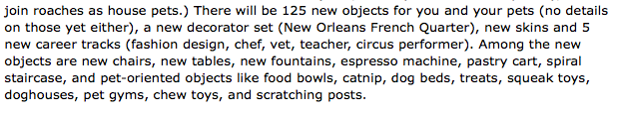
Object
An inheritance tree
Person
Teacher
Circus Performer
Student
Pomonan?
Pasadena Institute of
Technology Student
Pomonian?
Mudder
Things to keep in mind!
Westie
a Westie is a Person…
"everything" is an Object…
Notes:
Something about Pomoner just doesn't sound right…

Slide 48
Object
CS60's inheritance tree!
Subject
More CS!
Other things?
CS
CS101
CS70
CS60
Thursday!
See you on Thursday!
Notes:
Something about Pomoner just doesn't sound right…

Slide 49
Containment vs. Inheritance
What is it?
Data members…
Inheritance !
Models the part-of relationship among classes
Models the kind-of relationship among classes
Why would I want to?
Code reuse
Lets new code call old code
Code reuse
Lets old code call new code
Notes:
this week's new Maze class will use your Queue class from last week
this week's new SpamMaze class will use a linked list that someone else wrote years ago…!
you – or someone – wrote a linked list class… now let's use it as a data member (or two or more)…

Slide 50
class Person {
protected String name; // data member – protected
public Person( String name ) { this.name = name; } // constructor
public boolean isAsleep( int hr ) { return hr > 22 || hr < 7; } // 24hr clock
public String toString() { return name; }
public void status( int hr ) {
if ( this.isAsleep( hr ) ) System.out.println( "Now asleep: " + this );
else System.out.println( "Now awake: " + this );
}
}
Code overview
Person
Base Class
or Super-Class
Student
Derived Class
or Sub-Class
in main:
Person P;
P = new Person("Wally");
Extend the picture…

Slide 51
class Person {
protected String name; // data member – protected
public Person( String name ) { this.name = name; } // constructor
public boolean isAsleep( int hr ) { return hr > 22 || hr < 7; } // 24hr clock
public String toString() { return name; }
public void status( int hr ) {
if ( this.isAsleep( hr ) ) System.out.println( "Now asleep: " + this );
else System.out.println( "Now awake: " + this );
}
}
Code overview
Person
Base Class
or Super-Class
class Student extends Person {
protected int units; // additional data member
public Student( String name, int units ) {
super(name);
this.units = units;
}
public boolean isAsleep( int hr ) { return 2 < hr && hr < 8; }
public String toString() {
String result = super.toString();
return result + " units: " + units;
}
}
Student
Derived Class
or Sub-Class
in main:
Student S;
S = new Student("Wally", 18);
Extend further!

Slide 52
class Mudder extends Student
{
protected String dorm;
public boolean isAsleep( int hr ) { return false; }
public Mudder( String name, int units, String dorm )
{
}
public toString()
{
}
public static void main(String[] args)
{
Student W = new Student( "Wally", 16 );
W.status( 7 ); // status at 7 am
Person P = new Mudder( "Susan", 18, "Sontag" );
P.status( 3 ); // status at 3 am
Student S = P;
S.status( 3 ); // status at 3 am
}
}
Try it!
Write the constructor and toString methods for this Mudder class.
A Mudder should print out as
Wally units: 42 dorm: Olin
What will these three status calls print:
asleep or awake?
Will the Java compiler get upset anywhere here?

Slide 53
Polymorphism
Sometimes an Object's exact type is known at compile-time:
Student S;
S = new Student( "Claremonter", 16 );
then we can use S.units or S.isAsleep …
"Ordinary" code -- exact type known at compile time

Slide 54
Polymorphism
But sometimes it's not known until run-time:
- The compiler will assume the object is of the declared type.
This can be very useful, e.g., imagine a game with many "people" …
Person[] P = new Person[3];
then, later on…
P[0] = new Student( "Sagehen", 16 );
P[1] = new Mudder( "Wally", 16, "Case" );
P[2] = new Person( "JDoe" );
The constructor determines the "actual" type of the Object.
- At run-time, Java will use the actual type's latest (most-derived) methods.

Slide 55
Object
An inheritance tree
Person
Teacher
Circus Performer
Student
Pomonan?
Pitzer?
Pitzerer?
Pitzerier?
Pomonian?
Mudder
Things to keep in mind!
Westie
a Westie is a Person…
"everything" is an Object…
Notes:
Something about Pomoner just doesn't sound right…

Slide 56
Object
An inheritance tree
Person
Teacher
Circus Performer
Student
Pomonan?
Pasadena Institute of
Technology Student
Pomonian?
Mudder
Things to keep in mind!
Westie
a Westie is a Person…
"everything" is an Object…
Notes:
Something about Pomoner just doesn't sound right…

Slide 57
Spampede's inheritance tree
Java's GUI classes
Component
Checkbox
Choice
TextComponent
Button
Container
List
TextArea
TextField
Window
Panel
Applet
Frame
Dialog
JApplet
This seemed like the right place for me…
Spampede

Slide 58
Why these designs?
Reuse!
Containment
Inheritance
using existing classes as data members
extending classes that are already written
Part-of
Kind-of

Slide 59
class Person
{
protected String name; // data member – protected
public Person( String name ) { this.name = name; }
public boolean isAsleep( int hr ) { return hr > 22 || hr < 7; }
public String toString() { return name; }
public void status( int hr )
{
if ( this.isAsleep( hr ) )
System.out.println( "Now asleep: " + this );
else
System.out.println( "Now awake: " + this );
}
}
Code overview
Person
Base Class
or Super-Class
class Student extends Person
{
protected int units; // additional data member
public Student( String name, int units ) {
super(name);
this.units = units;
}
public boolean isAsleep( int hr ) // override!
{ return 2 < hr && hr < 8; }
public String toString()
{
String result = super.toString();
return result + " units: " + units;
}
}
Student
Derived Class
or Sub-Class
in main:
Student S;
S = new Student("Wally", 18);
Extend the picture…
Notes:
draw a picture

Slide 60
Hw 9, Part 1: the Maze class
… improving the Maze class
Object
data members
methods
maze
multiBFS
Maze
toString
constructors…
SpamMaze

Slide 61
Hw 9, Part 2: the SpamMaze class
… inheriting from the Maze class
Object
data members
methods
maze
multiBFS
Maze
toString
constructors…
addSpam
spamCells
removeSpam
SpamMaze
advancePede
pedeCells
reversePede
What types should spamCells and pedeCells be?

Slide 62
Inheritance reminders...
Base classes
Ideas
Models the kind-of/is-a relationship
Factors out common code
Function overriding allows old code to call new code
Keywords
extends, super, protected
Object
Maze
SpamMaze
Derived classes

Slide 63
Visual overviews of inheritance
Capabilities (and memory)
Derived Class
Student
Person
Person
Base Class
or Sub-Class
or Super-Class
Base Class
or Super-Class
A Student is-a Person - and more!
Student
Identity
Derived Class
or Sub-Class
Base Class
or Super-Class
Derived Class
Person
or Sub-Class
Our hierarchy
Student
"Only some Persons are Students"

Slide 64
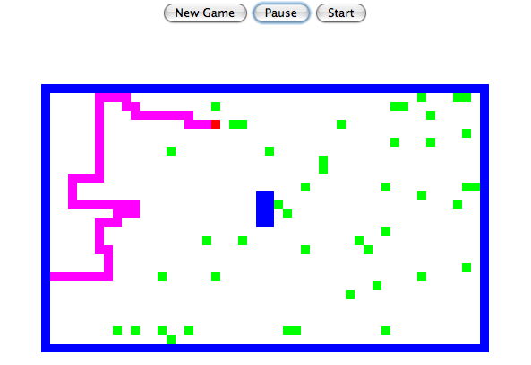
Visualizing spamCells and pedeCells
*
*
*
*
*
*
*
*
*
*
*
*
*
*
*
*
*
*
*
*
*
*
*
*
*
*
P
P
P
*
P
P
P
*
P
D
P
P
P
P
P
P
P
*
P
P
P
P
D
*
P
S
D
*
P
*
P
*
P
D
D
*
P
*
P
What should their underlying data structures be, i.e., their model ?
Notes:
Java's libraries are comprehensive and huge… [POSTER] – two versions ago
We don't teach them explicitly, actually, but it's always good to keep in mind that they're there…
story about balance (Lenovo's Mr. Challener)

Slide 65
Visualizing spamCells and pedeCells
*
*
*
*
*
*
*
*
*
*
*
*
*
*
*
*
*
*
*
*
*
*
*
*
*
*
P
P
P
*
P
P
P
*
P
D
P
P
P
P
P
P
P
*
P
P
P
P
D
*
P
S
D
*
P
*
P
*
P
D
D
Java's LinkedList is a double-ended queue or deque datatype:
we'll use it for both!
*
P
*
P
What should their underlying data structures be, i.e., their model ?
Notes:
Java's libraries are comprehensive and huge… [POSTER] – two versions ago
We don't teach them explicitly, actually, but it's always good to keep in mind that they're there…
story about balance (Lenovo's Mr. Challener)

Slide 66
The model is your internal representation.
Model vs. View
30
50
this.maze = new MazeCell[HEIGHT][WIDTH];
for (int r=0 ; r<HEIGHT ; ++r) // for each row
for (int c=0 ; c<WIDTH ; ++c) // for each column
maze[r][c] = new MazeCell(r,c, <appropriate character here> );
What characters is the model, this.maze, using for each of these on-screen colors?
The view is its external rendering.

Slide 67
Initial data:
final initial data?
mazeStrings
static final String[] mazeStrings = {
"**************************************************",
"*PS D *",
"* *",
"* *",
"* *",
"* *",
"* *",
"* *",
"* *",
"* *",
"* *",
"* *",
"* ** *",
"* ** *",
"* ** *",
"* ** *",
"* *",
"* *",
"* *",
"* *",
"* *",
"* *",
"* *",
"* *",
"* *",
"* D *",
"* *",
"* *",
"* *",
"**************************************************"
};
'S' == head of the centipede
This array of Strings holds the starting contents of the maze.
'*' == wall
'P' == body of the centipede
'D' == spam
30 rows
50 columns

Slide 68

Avoid magic !
magic numbers, magic strings, magic stuff in general…
Data constants make code easier to read and modify, e.g.,
even Prof. B. agrees...
public static final char SPAM = 'D';
public static final char START = 'S';
public static final char WALL = '*';
public static final char PEDE = 'P';
these are unchangeable values for use in functions, etc. Preface with class name, if needed…
This BFS looks different to me…
BFS( start, Maze.SPAM );

Slide 69
Changes to your Maze class?
the Maze class stores the maze and can find paths within its model of the maze
Key Idea:
Notes:
other differences: the tail of the centipede the PEDE cells are like walls, too
what if: there is no solution!!

Slide 70
Changes to your Maze class?
multiBFS should find the nearest spam without changing the maze!
public MazeCell multiBFS(MazeCell start, char dest)
char makes sense…
but why return a MazeCell?
how it would be called:
multiBFS(start, Maze.SPAM)
testing: ascii demo
Notes:
other differences: the tail of the centipede the PEDE cells are like walls, too
what if: there is no solution!!

Slide 71
Changes to your Maze class?
multiBFS should find the nearest spam without changing the maze!
public MazeCell multiBFS(MazeCell start, char dest)
char makes sense…
but why return a MazeCell?
how it would be called:
multiBFS(start, Maze.SPAM)
testing:
print the maze with the path, then remove the path before returning…
caution!
other differences with respect to the old BFS?
what if… ?
testing: ascii demo
Notes:
other differences: the tail of the centipede the PEDE cells are like walls, too
what if: there is no solution!!

Slide 72
hw9, part 1: New methods in Maze
(1) multiBFS should find the nearest spam without changing the maze!
public MazeCell multiBFS(MazeCell start, char dest)
(2) accessor methods as needed…
(3) a new constructor using mazeStrings:
/* method: constructor
* output: a maze containing a 2d array of MazeCells
*/
protected Maze()
{
sets up this.maze as a 2d array of MazeCells
Software reuse strategy: copy-paste-change

Slide 73
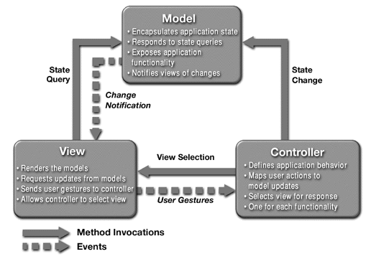
Model - View - Controller (MVC) architecture
SpamMaze.java
Spampede.java
Why? To benefit from a narrower focus in designing, revising, … each piece.

Slide 74
Model - View - Controller (MVC) architecture
SpamMaze.java
Spampede.java
Why? To benefit from a narrower focus in designing, revising, … each piece.

Slide 75
Four models
DFAs
TMs
"can't count"
TMs count!
FSMs
Turing Machines
can compute regular languages
strictly more powerful than DFAs
?
an alien, a plan, a canal, paneilana!
NFAs
I'd have named it Paneilana.
Nondeterministic
finite automata
Palindromes are computable by TMs, but not by DFAs.
the ability to be in more than one state at once…!
?
?
Where do NFAs go?
Notes:
Pimp my Ride from MTV - Corona is where the garage is…
MTV + SciFi -- twilight zone…

Slide 76
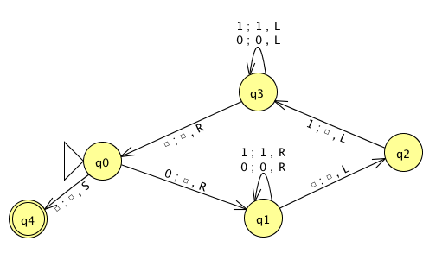
Name(s) __________________________________ Quiz
Run this TM on this input:
0
0
1
1
1
Is this input accepted or rejected?
What inputs are accepted in general? How does it work?
Extra: How could you change this to accept palindromes?
(just a thought experiment)
Notes:
metric prefixes…

Slide 77
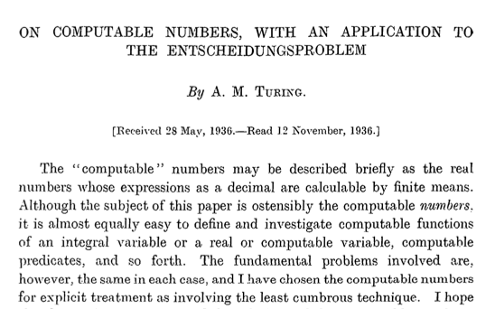
Can TMs compute everything?
Alan Turing says No!
http://www.cs.virginia.edu/~robins/Turing_Paper_1936.pdf

Slide 78
Proving a language nonregular
²
Show L = {0^{n} | n >= 0} nonregular:

Slide 79
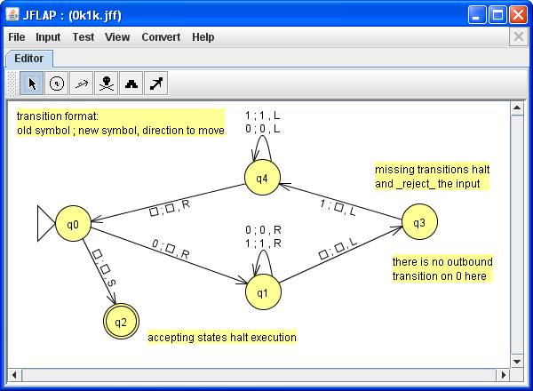
Solution
Blank
Accepting states halt computation immediately.

Slide 80
Computability
TMs
FSMs DFAs
"can't count"
TMs count!
Turing Machines
can compute regular languages
strictly more powerful than DFAs
?
can't compute nonregular languages
What's in the middle of this computability spectrum?
compute some nonregular languages
Notes:
Pimp my Ride from MTV - Corona is where the garage is…
MTV + SciFi -- twilight zone…

Slide 81

Computability
TMs
FSMs DFAs
"can't count"
TMs count!
Turing Machines
can compute regular languages
strictly more powerful than DFAs
?
can't compute nonregular languages
What's in the middle of this computability spectrum?
compute some nonregular languages
We could…
add capabilities to DFAs
more fun!
take away capabilities of TMs
Less tape? Less fun.
Notes:
Pimp my Ride from MTV - Corona is where the garage is…
MTV + SciFi -- twilight zone…

Slide 82
Regular Expressions
Where would you guess this model of computation lives?
DFAs
TMs
"can't count"
TMs count!
FSMs
Turing Machines
can compute regular languages
strictly more powerful than DFAs
NFAs
can compute some nonregular languages

Slide 83
Regex NFA
To show: NFAs can represent any regular expression
Base Case Regexes:
Equivalent NFA:
no expression
Ø
q0
matches no strings
Remember, DFAs are NFAs (but not vice versa)
empty expression
λ
q0
matches the empty string
a single alphabetic character (or bit)
0
matches that one bit
1

Slide 84
Regex NFA
To show: NFAs can represent any regular expression
Base Case Regexes:
Equivalent NFA:
no expression
Ø
q0
matches no strings
Remember, DFAs are NFAs (but not vice versa)
empty expression
λ
q0
matches the empty string
a single alphabetic character (or bit)
0
q0
q1
0
matches that one bit
1
q0
q1
1

Slide 85
Regex NFA
building our machine from available components
Suppose a and b are regular expressions with equivalent NFAs:
a
b
0 or more accepting states…
What NFAs will these composite regular expressions be?
a|b
ab
a*

Slide 86
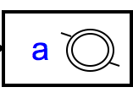
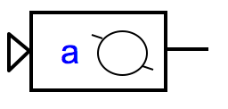
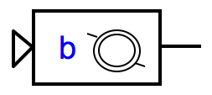
Regex NFA
building our machine from available components
Suppose a and b are regular expressions with equivalent NFAs:
a
b
0 or more accepting states…
What NFAs will these composite regular expressions be?
a|b
ab
a*
λ
λ
q0
λ
λ
sequential machine - watch out for accepting states!
q0
parallel machine: NFA!
Loops!

Slide 87
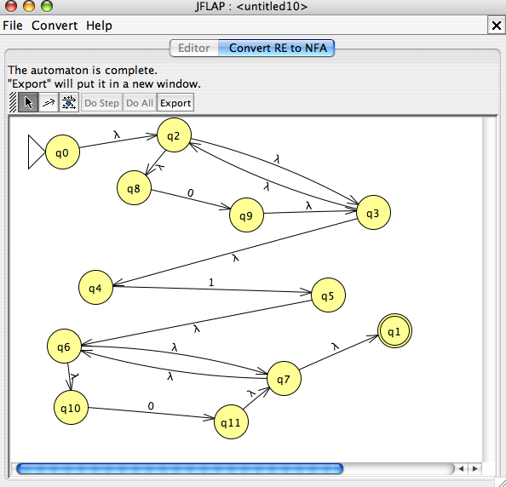
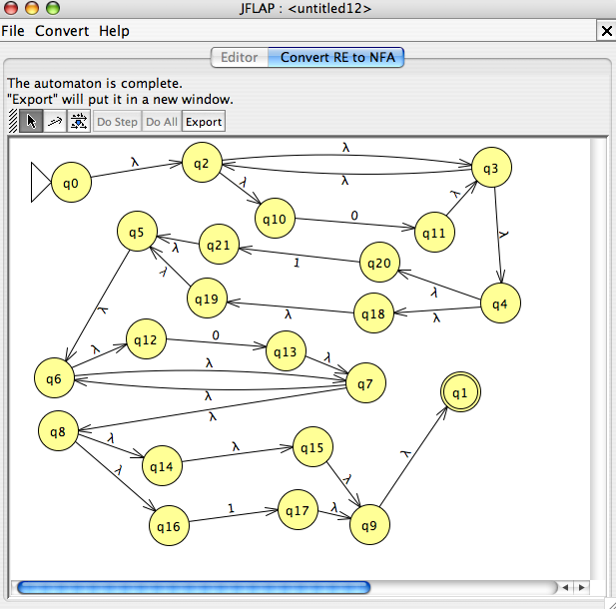
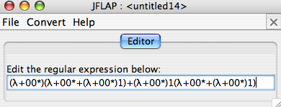
DFAs
≡
NFAs
≡
RegEx's
This conversion is provided by JFLAP…
0*10*
L = { w | w is a binary number whose value is a power of two }
or 0 or a power of two +1
0*(λ|1)0*(λ|1)
Entropy wins again!
this doesn't look right…

Slide 88
DFA RegEx
What regular expression does this DFA produce?
0
1
q1
q0
1
0
0
q2
1
What's this DFA doing?

