Slide 1
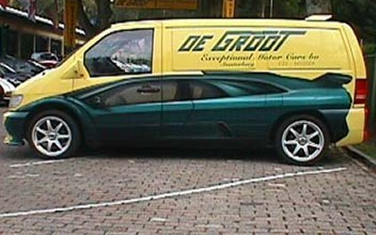
Today in 60: Java's graphics + MVC
Graphics: leveraging a large codebase…
HW11: Spampede (+ AI)
switch schedule
switch (dayOfMay):
{
case 2:
message = "Spampede due"; break;
case 15:
message = "Enjoy summer break";
default:
message = "Time for a coffee"; break;
}
Sporty new keywords!
I wouldn't switch any plans, just in case this code's "message" breaks down…

Slide 2
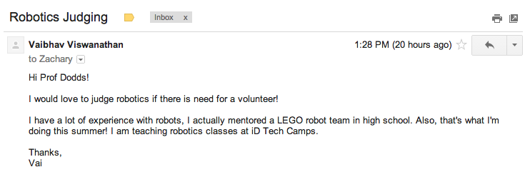
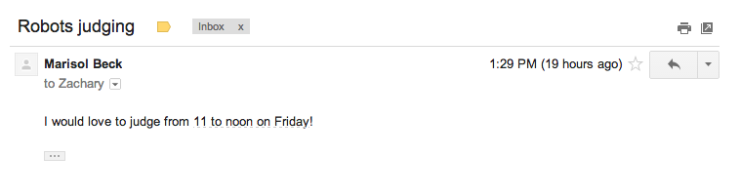
Claremont Robotics ~ thank you!
I think 1:28 might be before even mentioning this?

Slide 3
Three states!?
The insight here is where the insight is, here… .

Slide 4
The Java Language switch
switch (keypress):
{
case 'i': dir = NORTH;
case 'k': dir = SOUTH;
others for other actions…
default: dir = STOP;
}
The direction (or directive) will be the same at the end of this code… regardless of what key was pressed!
Notes:
sibling syndrome: need to have it even though there's no interest is using it (siblings: c, c++)
missing two? true/false??

Slide 5
The Java Language
Which did we introduce last time?
abstract double int strictfp
boolean else interface super
break extends long switch
byte final native synchronized
case finally new this
catch float package throw
char for private throws
class goto* protected transient
const* if public try
continue implements return void
default import short volatile
do instanceof static while
* not used
evidence of Java's "sibling syndrome"
we disagree!
Red: primitive types
Green: flow of control
Blue: declarations
Purple: modifiers
Orange: Object support
Literals: true, false, null
Notes:
sibling syndrome: need to have it even though there's no interest is using it (siblings: c, c++)
missing two? true/false??

Slide 6
Last time: data design strategies
Containment
Inheritance
using existing classes as data members
extending classes that are already written
Part-of
Kind-of

Slide 7
Containment
Inheritance
vs.
What is it?
part-of relationship
kind-of relationship
When to use it?
to contain ("wrap")
to extend capabilities
to constrain capabilities
to specialize capabilities
(tricky here…)
Why would I want to?
Code reuse
Lets new code call old code
Code reuse
Lets old code call new code
Notes:
this week's new Maze class will use your Queue class from last week
this week's new SpamMaze class will use a linked list that someone else wrote years ago…!
you – or someone – wrote a linked list class… now let's use it as a data member (or two or more)…

Slide 8
Visual overviews of inheritance
Capabilities (and memory)
Derived Class
Student
Person
Person
Base Class
or Sub-Class
or Super-Class
Base Class
or Super-Class
A Student is-a Person - and more!
Student
Identity
Derived Class
or Sub-Class
Base Class
or Super-Class
Derived Class
Person
or Sub-Class
Our hierarchy
Student
"Only some Persons are Students"

Slide 9
Today's inheritance tree
Java's GUI classes
Component
Checkbox
Choice
TextComponent
Button
Container
List
TextArea
TextField
Window
Panel
Applet
Frame
Dialog
JApplet
This seemed like the right place for me…
SpampedeBase
Spampede

Slide 10
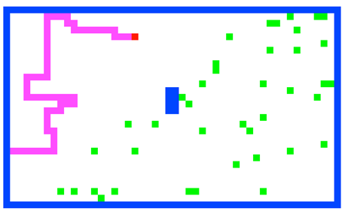
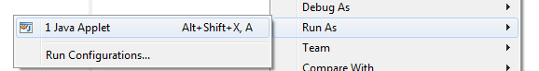
Spampede reminder
Goal: You'll be able to get all of the game working after today – except, perhaps, the AI.
Notes:
Java's libraries are comprehensive and huge… [POSTER] – two versions ago
We don't teach them explicitly, actually, but it's always good to keep in mind that they're there…
story about balance (Lenovo's Mr. Challener)

Slide 11
Next up…
Object-oriented graphics capabilities
This sounds like one of those extra-carmelized Starbucks drinks!
designing programs with a Java GUI...?

Slide 12
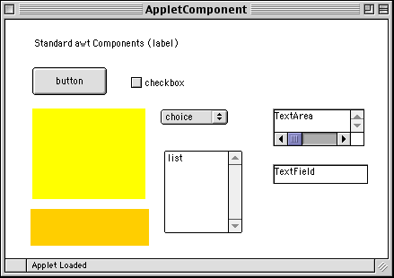

Java's graphics library
applet “is a” panel
Wow! this is image is many light-years old!…
panel "is a" Component and contains other components!
Things have spiraled out since 1995!

Slide 13
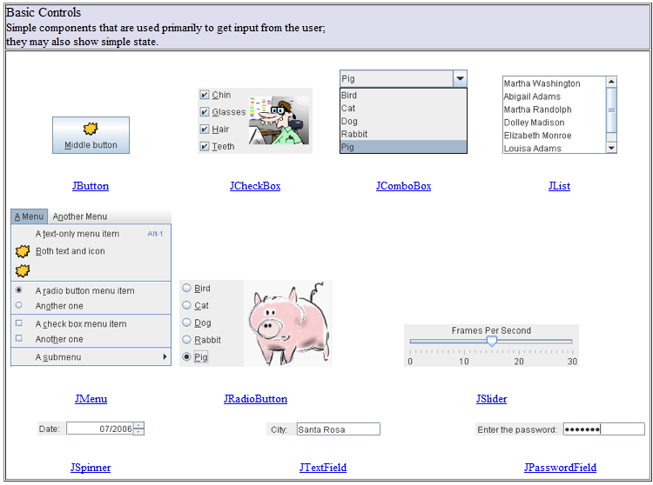
Swing Components!
Lots of examples of these online: Java is well-documented!
Notes:
Show that page!

Slide 14
Object
wait()
Reuse via inheritance
notify()
get reused, too!
public void requestFocus()
Component
reusing base-classes' methods
public void addKeyListener()
public void repaint()
Container
public void paint()
public void add(Component c)
Panel
public void addNotify()
JApplet
public void init()
overriding of base-classes' methods
SpampedeBase
public void init()
Spampede

Slide 15
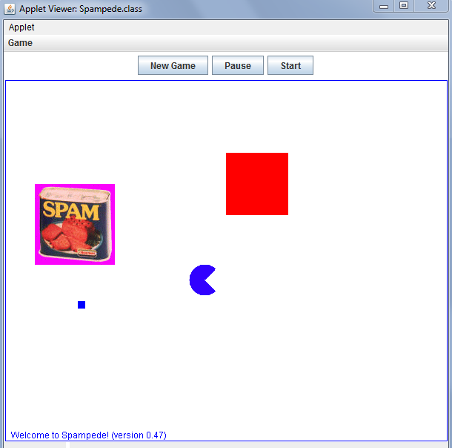
Spampede, as provided...
Menu
Buttons
(42,142)
(100,300)
Arc Man?
message
Panel/drawing canvas

Slide 16
let's take a look at the code...

Slide 17
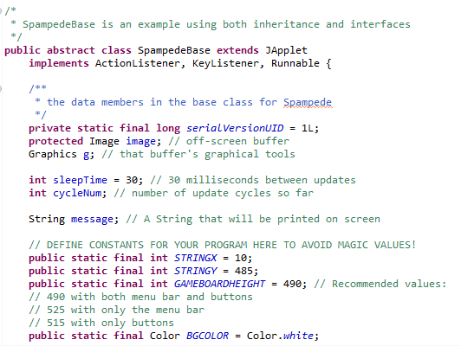
Does anyone see any new Java keywords here… ? (3-4 of them?)

Slide 18
3
2
Does anyone see any new Java keywords here… ? (3-4 of them?)
0
visible to the class and all derived classes!
default is also visible to the class and all derived classes (called package visibility)
1

Slide 19
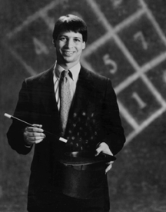
Dursley design: Avoid magic!
magic numbers, magic strings, magic stuff in general…
Data constants make code easier to read and modify, e.g.,
even Prof. B. agrees...

Slide 20

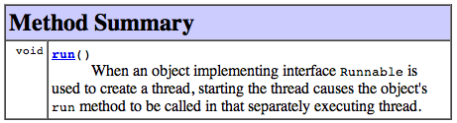
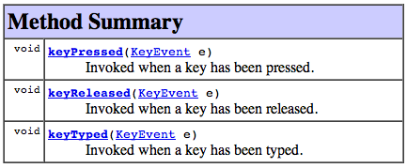
Interfaces enable event handling...
class SpampedeBase extends JApplet implements ActionListener, KeyListener, Runnable
"this object can handle button presses..."
"this object can run in a separate thread"
handles button presses...
"this object can handle key presses..."
A Java interface is a TYPE but not a class. By implementing it, you guarantee that you will include certain methods.
Then, other code - library code or other users' code - can rely on those methods being present!

Slide 21
creates our drawing canvas, image, and create our graphics tools, g
public void init()
{
image = createImage(getSize().width, getSize().height);
g = image.getGraphics();
…
pauseButton = new Button(”Pause");
pauseButton.addActionListener(this);
pauseButton.addKeyListener(this);
add(pauseButton);
try
{
URL url = getCodeBase();
audioCrunch = getAudioClip(url,"crunch.au");
imageSpam = getImage(url,"spam.gif");
System.out.println("successful loading of audio/images!");
}
catch (Exception e)
{
System.out.println("problem loading audio/images!");
audioCrunch = null;
imageSpam = null;
}
}
types?
create a button, register event handlers, and add it to the game
a try … catch block for handling Exceptions
What could go wrong with the sound and image loading…?

Slide 22
create our drawing canvas, image, and create our graphics tools, g
public void init()
{
image = createImage(getSize().width, getSize().height);
g = image.getGraphics();
pauseButton = new Button(”Pause");
pauseButton.addActionListener(this);
pauseButton.addKeyListener(this);
add(pauseButton);
try
{
URL url = getCodeBase();
audioCrunch = getAudioClip(url,"crunch.au");
imageSpam = getImage(url,"spam.gif");
System.out.println("successful loading of audio/images!");
}
catch (Exception e)
{
System.out.println("problem loading audio/images!");
audioCrunch = null;
imageSpam = null;
}
}
create a button, register event handlers, and add it to the form
a try … catch block for handling Exceptions
What could go wrong with the sound and image loading…?

Slide 23
Exceptions
Allow central handling of rare or external events/errors.
try
{
URL url = getCodeBase();
audioCrunch = getAudioClip(url,"crunch.au");
imageSpam = getImage(url,"spam.gif");
System.out.println("success w/ audio/images!");
}
catch (Exception e)
{
System.out.println("problem w/ audio/images!");
audioCrunch = null;
imageSpam = null;
}
getAudioClip
stack frame
valid URL?
stack frame
connect w/ server
stack frame
crunch.au there?
NO!
stack frame
An error try'd anywhere in the following function-call stack will get thrown and passed up the stack until a block of code catches it.

Slide 24

The game's basic cycle
void cycle()
{
updateCentipede(); // update the Spampede
updateSpam(); // update the Spam
drawEnvironment(); // draw off the screen…
displayMessage(); // display messages
repaint(); // draw ON the screen!
cycleNum++; // One cycle just elapsed
}
Maybe this should be called REcycle?
How could we update the spam more slowly than the pede?

Slide 25
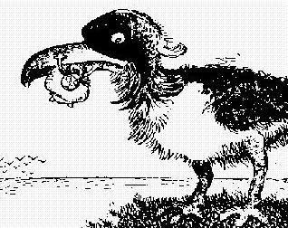
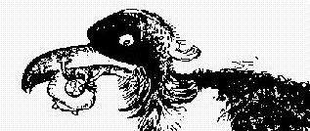
Double Buffering
Create offscreen image
Copy to window!
G. Verbeek
individual Graphics commands
Talk about a double-take !
When you want to refresh, you 'll call repaint()
written in 2014, it transfers your image!
written in 1995, it calls paint()
public void paint(Graphics g)
{
g.drawImage(image, 0, 0, null);
}
repaint()
This is in the SpampedeBasePanel class.
old code calling new code!

Slide 26
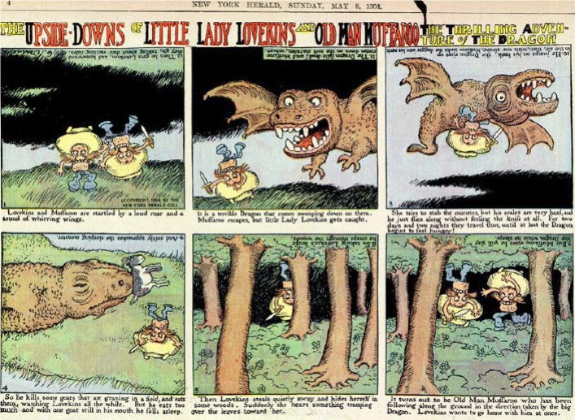
Gustave Verbeek

Slide 27
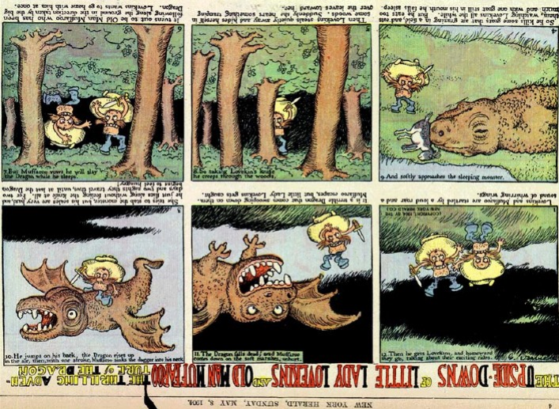

Slide 28
Quiz
Code Treasure Hunt! try your luck; catch the adventure!
Name(s): ___________________
1) Start by looking over Spampede's data members...
1a) What is the NAME of the data member of type SpamMaze?
1b) What is the TYPE of this.dir? By the way, what is the type of this?
1c) Find where currentColor, and dir, get declared and then get assigned…
1d) Find where image, g, and cycleNum, get declared and then get assigned…
2) Find cycle and then find each method that cycle calls
3) Find the code that is drawing the small blue square ...
4) What do you think the four input arguments to fillRect(int,int,int,int) mean?
5) Trickier: do you think the arguments to fillArc(250,250,42,42,45,270) mean?
6) What keypress produces a hearty, spam-consuming crunch sound?
7) What keypress leads to drawing the large square blue? Are there others?
8) EXTRA! What's the longest time it could take for the large square to return to magenta color?
8b) EXTRA! How could you change the inputs to fillArc to create a PacMan-like animation?

Slide 29
Arg! Java has so many classes…
Notes:
Java's libraries are comprehensive and huge… [POSTER] – two versions ago
We don't teach them explicitly, actually, but it's always good to keep in mind that they're there…
story about balance (Lenovo's Mr. Challener)

Slide 30
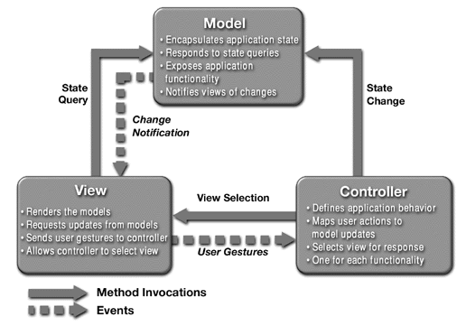
Model - View - Controller (MVC) architecture
Why? To benefit from a narrower focus in designing, revising, … each piece.

Slide 31
Model - View - Controller (MVC) architecture
SpamMaze.java
Maze.java
Spampede.java
Why? To benefit from a narrower focus in designing, revising, … each piece.

Slide 32

Maze and MazeCell classes
Model
The Maze is a 2d array of MazeCells.
View

Slide 33


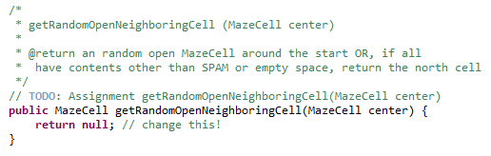
Maze and MazeCell classes
Model
to write…
The Maze is a 2d array of MazeCells.

Slide 34
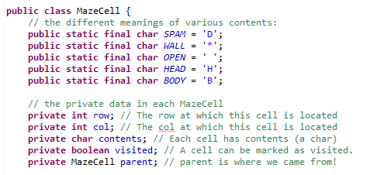


MazeCell
Different characters represent different cell contents
many methods already written:

Slide 35
MazeCell
Different characters represent different cell contents
data for the AI…
many methods already written:

Slide 36
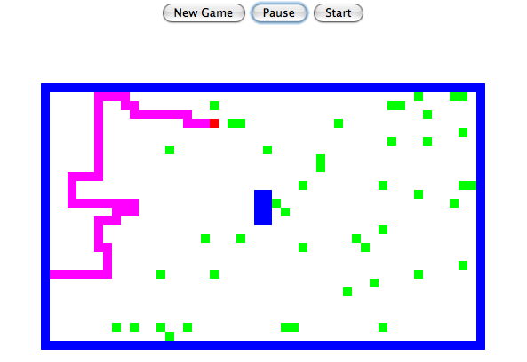
Handling spam and the "pede" …
*
*
*
*
*
*
*
*
*
*
*
*
*
*
*
*
*
*
*
*
*
*
*
*
*
*
P
P
P
*
P
P
P
*
P
D
P
P
P
P
P
P
P
*
P
P
P
P
D
*
P
S
D
*
P
*
P
*
P
D
D
*
P
*
P
What should be the model (data and datatypes) for spamCells and pedeCells?
Notes:
Java's libraries are comprehensive and huge… [POSTER] – two versions ago
We don't teach them explicitly, actually, but it's always good to keep in mind that they're there…
story about balance (Lenovo's Mr. Challener)

Slide 37
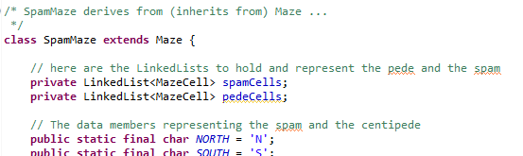
LinkedList<MazeCell> spamCells;
LinkedList<MazeCell> pedeCells;
*
*
*
*
*
*
*
*
*
*
*
*
*
*
*
*
*
*
*
*
*
*
*
*
*
*
P
P
P
*
P
P
P
*
P
D
P
P
P
P
P
P
P
*
P
P
P
P
D
*
P
S
D
*
P
*
P
*
P
D
D
*
P
*
P
Java's LinkedList is the library's "Racket-like" list.
You'll use it for spam + pede!
Notes:
Java's libraries are comprehensive and huge… [POSTER] – two versions ago
We don't teach them explicitly, actually, but it's always good to keep in mind that they're there…
story about balance (Lenovo's Mr. Challener)

Slide 38
Java's LinkedList<E>
LinkedList<MazeCell> spamCells;
spamCells = new LinkedList<MazeCell>();
it's a crazy name, but it's a class just like all of Java's others…
It supports add/remove/peek on either side:
spamCells.addFirst(mc);
spamCells.removeFirst(mc);
spamCells.peekFirst()
spamCells.addLast(mc);
spamCells.removeLast(mc);
spamCells.peekLast()

Slide 39
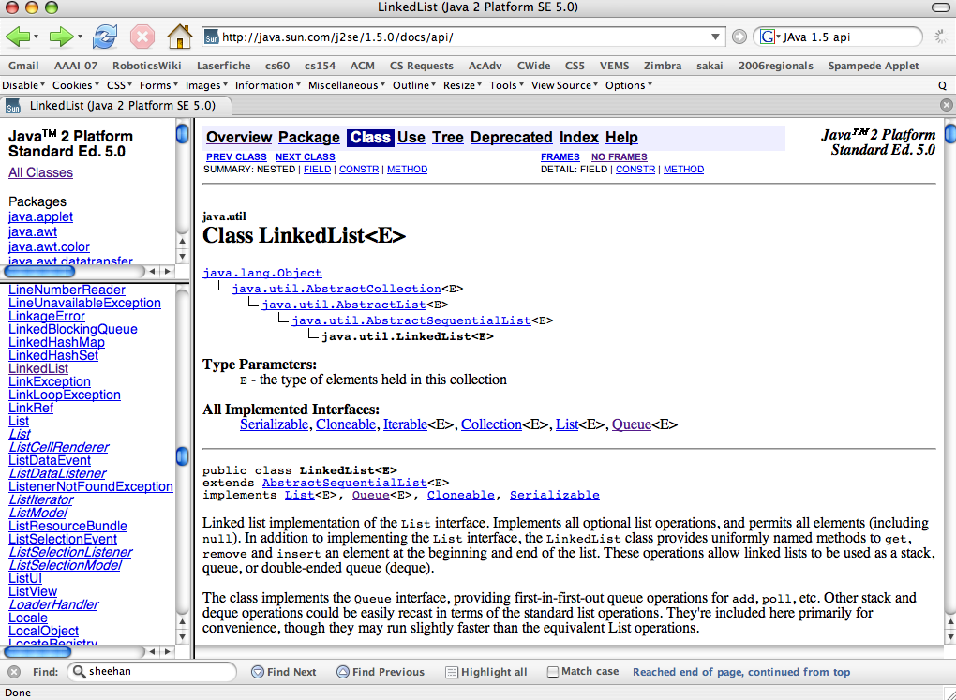
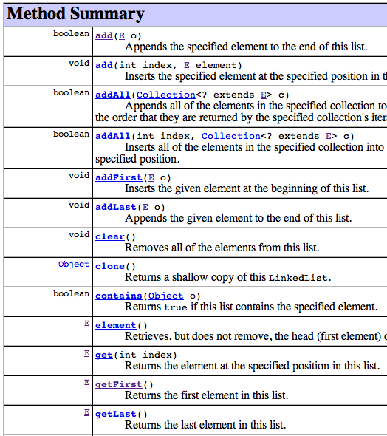
Have someone else write the software!
Reuse: LinkedList
packages
individual classes
inheritance hierarchy
import java.util.LinkedList;
EEEEk! What is going on here?!
methods

Slide 40
LinkedList<MazeCell> spamCells;
LinkedList<MazeCell> pedeCells;
*
*
*
*
*
*
*
*
*
*
*
*
*
*
*
*
*
*
*
*
*
*
*
*
*
*
P
P
P
*
P
P
P
*
P
D
P
P
P
P
P
P
P
*
P
P
P
P
D
*
P
S
D
*
P
*
P
*
P
D
D
*
P
*
P
(1) Get the head from pedeCells.
(2) Pass in dir from Spampede (NEW or S)
(3) Find the next MazeCell in direction dir
(4) Check its contents: IF EMPTY
How could we model the snake with pedeCells?
Change the head to the new cell and add it!
(4b) IF SPAM
How about reverse? AI?
(4c) IF WALL
Notes:
Java's libraries are comprehensive and huge… [POSTER] – two versions ago
We don't teach them explicitly, actually, but it's always good to keep in mind that they're there…
story about balance (Lenovo's Mr. Challener)

Slide 41
Don't wait!
Incremental changes are key!
code
test
code
test
code
test
...
CODE
TEST
closing in on a solution
concentrated despair phase

Slide 42
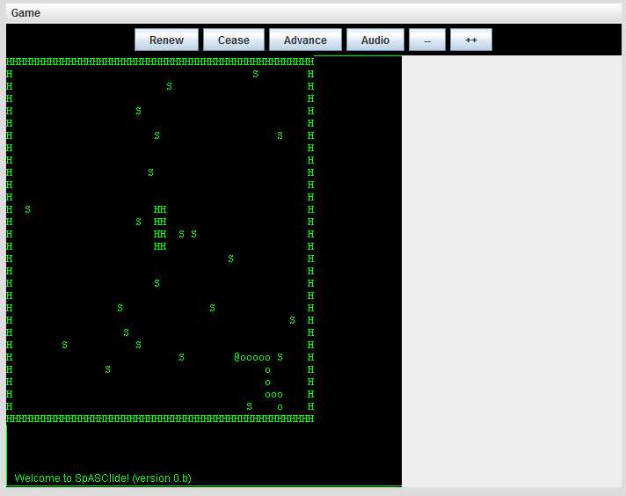
Happy Spampeding!
Notes:
(9) update is being called when the window is made visible, etc…

Slide 43
<Parameterized> Types
Many languages offer containers that can hold elements of any single type…
Early versions of Java used Objects, polymorphism, and lots of casting so that container classes (OpenList, Queue, etc.) could hold any type of element.
Now, many containers have a type parameter to indicate what it holds:
LinkedList<MazeCell> pedeCells;
angle brackets indicate the type of Object being held in the container
Hooray!!
pedeCells.addFirst(maze[1][2]);
pedeCells.addLast(maze[1][1]);
MazeCell head = pedeCells.peekFirst();
I'm casting around for what feels like it's missing here…
Notes:
What's missing is the cast!!! Hooray!
No more classCastExceptions!

Slide 44
Quiz
Code Treasure Hunt! try your luck; catch the adventure!
Name(s): ___________________
1) Start by looking over Spampede's data members...
1a) What is the NAME of the data member of type SpamMaze?
1b) What is the TYPE of this.dir? By the way, what is the type of this?
1c) Find where image and g get declared (they're assigned in init).
2) Find cycle and then find each method that cycle calls
3) Find the code that is drawing the small red square ...
4) What do you think the four arguments to fillRect(int,int,int,int) mean?
4a) FIRST TO-DO ITEM: how could you use fillRect to draw the game's playing field?
5) At what coordinates is the spam image being drawn within the game's window?
6a) What keypress leads to drawing the large square blue?
6b) Which keypress is INCORRECTLY identified in the on-screen message?
7) What event produces a hearty spam-consuming crunch sound?
8) EXTRA! What's the longest time it could take for the large square to return to magenta color?

Slide 45
Avoid my mistakes!
1) Do the Maze and SpamMaze parts of the assignment first…
2) Make sure you can change, compile, and test Spampede.java
use Appletviewer!
> appletviewer Spampede.html
public SpamMaze themaze
3) Get a bird's-eye view of the code…
private char dir
the current direction the snake is heading
4) Write drawEnvironment (and test…)
5) Write updatePede and keyPressed (and test…)
one direction at a time…
6) Build up to reversing and AI (note that AI is almost completely implemented by multiBFS)
this can be tricky, as well…
Notes:
(9) update is being called when the window is made visible, etc…

Slide 46
Avoid my mistakes!
1) Do the Maze and SpamMaze parts of the assignment first…
2) Make sure you can change, compile, and test Spampede.java
It's a bad idea to make the centipede's body contain the same character as the maze's spam!
use Appletviewer!
> appletviewer Spampede.html
public SpamMaze themaze
3) Get a bird's-eye view of the code…
I ended up talking to my stuffed robot to resolve this one…
private char dir
the current direction the snake is heading
4) Write drawEnvironment (and test…)
Where are the stuffed three-eyed aliens?
5) Write updatePede and keyPressed (and test…)
one direction at a time…
6) Build up to reversing and AI (note that AI is almost completely implemented by multiBFS)
this can be tricky, as well…
Notes:
(9) update is being called when the window is made visible, etc…

Slide 47
the main game loop...
The cycle method gets called every so often … in order to allow for the program to progress in the absence of user input.
void cycle()
{
updateCentipede(); // update the Spampede deque
updateSpam(); // update the Spam deque
drawEnvironment(); // draw off the screen…
displayMessage(); // display messages
repaint(); // draw ON the screen!
cycleNum++; // One cycle just elapsed
}
How could we use cycleNum to update the spam more slowly than the centipede?
In fact, there are two threads of execution are running simultaneously ~ what are they?

Slide 48
Threads
Getting two programs for the price of one
Each thread is considered an independent process
They alternate in controlling the applet.
When they alternate is not specified (in general).
Abstraction
event handler (default thread)
centipede and spam updater
Where are the threads in the hw #7 Spampede applet?
Implementation
but be careful how far you look!
event handler (default thread)
centipede and spam updater

Slide 49
Spampede.java
Thread thread; // the thread controlling the updates
boolean threadSuspended; // paused?
boolean running; // null?
public void run()
{
while (running)
{
try
{
if (thread != null)
{
thread.sleep(sleepTime);
synchronized(this)
{
while (threadSuspended)
wait();
}
}
}
catch (InterruptedException e) { ; }
cycle();
}
thread = null;
}
button- and key- handling
spam-handling
// called by the “Start” button
public synchronized void go()
{
if (thread == null)
{
thread = new Thread(this);
running = true;
thread.start();
threadSuspended = false;
}
else
threadSuspended = false;
notify();
}
// called by the “Pause” button
void pause()
{
if (thread != null)
threadSuspended = true;
}
this is the connection with the outside world…

Slide 50
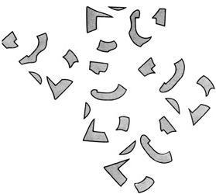
Event-driven execution
Events are things that happen to a graphical application
Button Presses • Text Entries
Key Presses, Key Releases, Key Events
Each object receiving an event notifies its “Listener”
The Listener then handles the event appropriately
// Here's how keyboard events are handled...
public void keyPressed(KeyEvent evt)
{
switch (evt.getKeyChar())
{
case 'k':
message = "Unicycles only!";
this.dir = 'k';
break;
What's 'k'?
context?

Slide 51
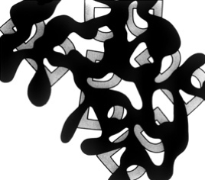
Event-driven execution
Events are things that happen to a graphical application
Button Presses • Text Entries
Key Presses, Key Releases, Key Events
Each object receiving an event notifies its “Listener”
The Listener then handles the event appropriately
// Here's how keyboard events are handled...
public void keyPressed(KeyEvent evt)
{
switch (evt.getKeyChar())
{
case SOUTH:
message = "Unicycles only!";
this.dir = SOUTH;
break;
Avoiding magic values...
context!
Notes:
West!

Slide 52
Inheritance reminders...
Base classes
Ideas
Models the kind-of/is-a relationship
Factors out common code
Function overriding allows old code to call new code
Keywords
extends, super, protected
Object
Maze
SpamMaze
Derived classes

Slide 53
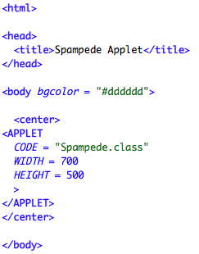
Running via Appletviewer
0) Add appletviewer to your path
C:\Program Files\Java\jdk1.7.0_04\bin
(needed for windows only – see assignment)
1) Open terminal (on Windows: cmd)
2) cd to your code's directory
cd Desktop
cd week9files
3) appletviewer Spampede.html
Spampede.html file
Running it with appletviewer
view source…

Slide 54
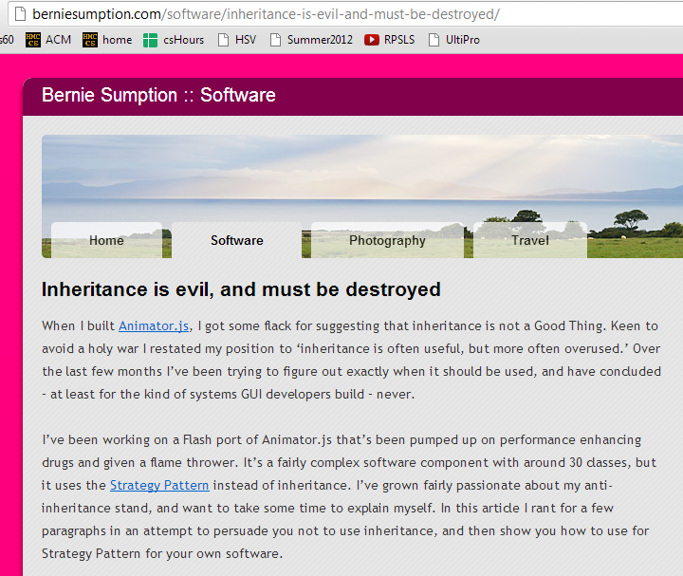
Inheritance opinions…
Giraffe "is an" Animal?
Java's libraries use it extensively…
It incites passions
At least worth knowing about…
Application "is a" Window?
GUI "is a" Window?
perhaps misused!
Wheel well "is a" Seat!?!

Slide 55
inheritance gives top-level access to all capabilities
Inheritance intuition…
inheritance models the "kind-of" or "is-a" relationship.
Which of these relationships is well-modeled by inheritance?
class Car extends Engine
class Rectangle extends Shape
class Square extends Rectangle
class Heap extends List
class NFA extends DFA
class Mudder extends Person
Good use of inheritance? use a consonant
Poor use of inheritance? use a vowel
What word could these examples spell?
Name(s): _____________________

Slide 56
inheritance gives top-level access to all capabilities
Inheritance intuition…
inheritance models the "kind-of" or "is-a" relationship.
Which of these relationships is well-modeled by inheritance?
class Car extends Engine
class Rectangle extends Shape
class Square extends Rectangle
class Heap extends List
class NFA extends DFA
class Mudder extends Person
Good use of inheritance? use a consonant
Poor use of inheritance? use a vowel
What word could these examples spell?
Name(s): _____________________

Slide 57
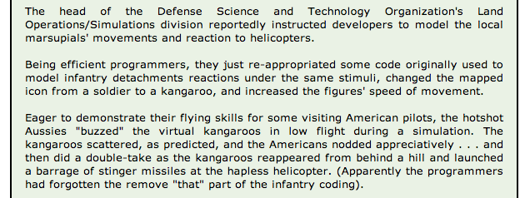
Dangers of Inheritance…
Goal: create a useful & representative data model
A derived class extends all of the capabilities of a base class… !

Slide 58
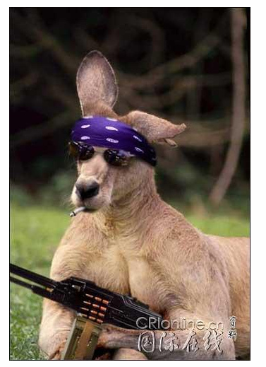

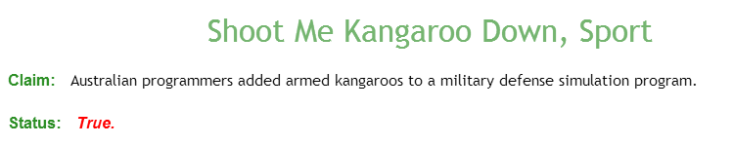
Dangers of Inheritance…
Goal: create a useful & representative data model
A derived class extends all of the capabilities of a base class… !

Slide 59
class Person
{
protected String name; // data member – protected
public Person( String name ) { this.name = name; }
public boolean isAsleep( int hr ) { return hr > 22 || hr < 7; }
public String toString() { return name; }
public void status( int hr )
{
if ( this.isAsleep( hr ) )
System.out.println( "Now asleep: " + this );
else
System.out.println( "Now awake: " + this );
}
}
Code overview
Person
Base Class
or Super-Class
class Student extends Person
{
protected int units; // additional data member
public Student( String name, int units ) {
super(name);
this.units = units;
}
public boolean isAsleep( int hr ) // override!
{ return 2 < hr && hr < 8; }
public String toString()
{
String result = super.toString();
return result + " units: " + units;
}
}
Student
Derived Class
or Sub-Class
in main:
Student S;
S = new Student("Wally", 18);
Extend the picture…
Notes:
draw a picture

Slide 60
An inheritance hierarchy + code
Base Class
Data
Methods
Person
String name;
boolean isAsleep(int hr)
{
return hr > 22
|| hr < 7;
}
Student
Derived Class
Very Derived Class
Mudder
Notes:
military-type definition of time…

Slide 61
An inheritance hierarchy + code
Base Class
Data
Methods
Person
String name;
boolean isAsleep(int hr)
{
return hr > 22
|| hr < 7;
}
Student
Derived Class
int units;
boolean isAsleep(int hr)
{
return hr > 2
&& hr < 8;
}
Very Derived Class
overriding the previous method
Mudder
(x'y - y'x) / y**2
Now that's derived!

Slide 62
An inheritance hierarchy + code
Base Class
Data
Methods
Person
String name;
boolean isAsleep(int hr)
{
return hr > 22
|| hr < 7;
}
Student
Derived Class
int units;
boolean isAsleep(int hr)
{
return hr > 2
&& hr < 8;
}
Very Derived Class
Mudder
String dorm;
??
(x'y - y'x) / y**2
Now that's derived!

Slide 63
What is this Java hierarchy missing?!
An inheritance hierarchy
Base Class
Data
Methods
Person
String name;
boolean isAsleep(int hr)
{
return hr > 22
|| hr < 7;
}
Student
Derived Class
int units;
boolean isAsleep(int hr)
{
return hr > 2
&& hr < 8;
}
Very Derived Class
Mudder
boolean isAsleep(int hr)
{
return false;
}
String dorm;
Notes:
add Object - the language's overarching base class for ALL user-defined and library-defined classes…
up: human, mammal, …
down: Case-ey; Casite; Casian; Caser; Case-ell, CS60er, Matt, Matt J

Slide 64
class Person
{
protected String name; // data member – protected
public Person( String name ) { this.name = name; }
public boolean isAsleep( int hr ) { return hr > 22 || hr < 7; }
public String toString() { return name; }
public void status( int hr )
{
if ( this.isAsleep( hr ) )
System.out.println( "Now asleep: " + this );
else
System.out.println( "Now awake: " + this );
}
}
Code overview
Person
Base Class
or Super-Class
Student
Derived Class
or Sub-Class
in main:
Person P;
P = new Person("Wally");
Extend the picture…
Notes:
draw a picture

Slide 65
class Person
{
protected String name; // data member – protected
public Person( String name ) { this.name = name; }
public boolean isAsleep( int hr ) { return hr > 22 || hr < 7; }
public String toString() { return name; }
public void status( int hr )
{
if ( this.isAsleep( hr ) )
System.out.println( "Now asleep: " + this );
else
System.out.println( "Now awake: " + this );
}
}
Code overview
Person
Base Class
or Super-Class
class Student extends Person
{
protected int units; // additional data member
public Student( String name, int units ) {
super(name);
this.units = units;
}
public boolean isAsleep( int hr ) // override!
{ return 2 < hr && hr < 8; }
public String toString()
{
String result = super.toString();
return result + " units: " + units;
}
}
Student
Derived Class
or Sub-Class
in main:
Student S;
S = new Student("Wally", 18);
Extend the picture…
Notes:
draw a picture

Slide 66
class Person
{
protected String name; // data member – protected
public Person( String name ) { this.name = name; }
public boolean isAsleep( int hr ) { return hr > 22 || hr < 7; }
public String toString() { return name; }
public void status( int hr )
{
if ( this.isAsleep( hr ) )
System.out.println( "Now asleep: " + this );
else
System.out.println( "Now awake: " + this );
}
}
Visual overview
Person
Base Class
or Super-Class
class Student extends Person
{
protected int units;
public Student( String name, int units ) {
super(name);
this.units = units;
}
public boolean isAsleep( int hr )
{ return 2 < hr && hr < 8; }
public String toString()
{
String result = super.toString();
return result + " units: " + units;
}
}
Student
Derived Class
or Sub-Class
Derived Class
Student
Person
Base Class
or Sub-Class
or Super-Class
Mathematically speaking, I'd call this SUBoptimal terminology…!

Slide 67
class Mudder extends Student
{
protected String dorm;
public boolean isAsleep( int hr ) { return false; }
public Mudder( String name, int units, String dorm )
{
}
public toString()
{
}
public static void main(String[] args)
{
Student W = new Student( "Wally", 16 );
W.status( 7 ); // status at 7 am
Person P = new Mudder( "Susan", 18, "Sontag" );
P.status( 3 ); // status at 3 am
Student S = P;
S.status( 3 ); // status at 3 am
}
}
Try it!
Write the constructor and toString methods for this Mudder class.
A Mudder should print out as
Wally units: 42 dorm: Olin
What will these three status calls print:
asleep or awake?
Where will the Java compiler get upset here?

Slide 68
Polymorphism
Sometimes an Object's exact type is known at compile-time:
Student S;
S = new Student( "Athena", 16 );
then we can use S.units or S.isAsleep …
"Ordinary" code -- exact type known at compile time

Slide 69
Polymorphism
But sometimes it's not known until run-time:
- The compiler will assume the object is of the declared type.
This can be very useful, e.g., imagine a game with many people…
Person[] P = new Person[100];
then, later on…
P[41] = new Student( "Sagehen", 16 );
P[42] = new Mudder( "Wally", 16, "Case" );
P[43] = new Person( "Ralph" );
The constructor determines the "actual" type of the Object.
- At run-time, Java will use the actual type's latest (most-derived) methods.

Slide 70
Casting!
If YOU know better than the compiler, you can cast:
Person[] P = new Person[100];
then, later on…
P[41] = new Student( "Sagehen", 16 );
P[42] = new Mudder( "Wally", 16, "Case" );
P[43] = new Person( "Ralph" );
P[42].getDorm(); // OK, but the compiler doesn't know it!
((Mudder)(P[42])).getDorm(); // OK, but Yuck!!
Mudder m = (Mudder)P[42]; m.getDorm(); // happier!
What might happen if you're wrong about the actual type… ?

Slide 71
Object
An inheritance tree
Person
Teacher
Circus Performer
Student
Pomonan?
Pitzer?
Pitzerer?
Pitzerier?
Pomonian?
Mudder
Things to keep in mind!
Westie
a Westie is a Person…
"everything" is an Object…
Notes:
Something about Pomoner just doesn't sound right…

Slide 72

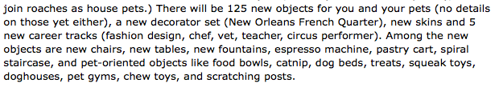
Object
An inheritance tree
Person
Teacher
Circus Performer
Student
Pomonan?
Pasadena Institute of
Technology Student
Pomonian?
Mudder
Things to keep in mind!
Westie
a Westie is a Person…
"everything" is an Object…
Notes:
Something about Pomoner just doesn't sound right…

Slide 73
Object
CS60's inheritance tree!
Subject
More CS!
Other things?
CS
CS101
CS70
CS60
Thursday!
See you on Thursday!
Notes:
Something about Pomoner just doesn't sound right…

Slide 74
Notes:
Something about Pomoner just doesn't sound right…

Slide 75
class Person {
protected String name; // data member – protected
public Person( String name ) { this.name = name; } // constructor
public boolean isAsleep( int hr ) { return hr > 22 || hr < 7; } // 24hr clock
public String toString() { return name; }
public void status( int hr ) {
if ( this.isAsleep( hr ) ) System.out.println( "Now asleep: " + this );
else System.out.println( "Now awake: " + this );
}
}
Code overview
Person
Base Class
or Super-Class
Student
Derived Class
or Sub-Class
in main:
Person P;
P = new Person("Wally");
Extend the picture…

Slide 76
class Person {
protected String name; // data member – protected
public Person( String name ) { this.name = name; } // constructor
public boolean isAsleep( int hr ) { return hr > 22 || hr < 7; } // 24hr clock
public String toString() { return name; }
public void status( int hr ) {
if ( this.isAsleep( hr ) ) System.out.println( "Now asleep: " + this );
else System.out.println( "Now awake: " + this );
}
}
Code overview
Person
Base Class
or Super-Class
class Student extends Person {
protected int units; // additional data member
public Student( String name, int units ) {
super(name);
this.units = units;
}
public boolean isAsleep( int hr ) { return 2 < hr && hr < 8; }
public String toString() {
String result = super.toString();
return result + " units: " + units;
}
}
Student
Derived Class
or Sub-Class
in main:
Student S;
S = new Student("Wally", 18);
Extend further!

Slide 77
class Mudder extends Student
{
protected String dorm;
public boolean isAsleep( int hr ) { return false; }
public Mudder( String name, int units, String dorm )
{
}
public toString()
{
}
public static void main(String[] args)
{
Student W = new Student( "Wally", 16 );
W.status( 7 ); // status at 7 am
Person P = new Mudder( "Susan", 18, "Sontag" );
P.status( 3 ); // status at 3 am
Student S = P;
S.status( 3 ); // status at 3 am
}
}
Try it!
Write the constructor and toString methods for this Mudder class.
A Mudder should print out as
Wally units: 42 dorm: Olin
What will these three status calls print:
asleep or awake?
Will the Java compiler get upset anywhere here?

Slide 78
Polymorphism
Sometimes an Object's exact type is known at compile-time:
Student S;
S = new Student( "Claremonter", 16 );
then we can use S.units or S.isAsleep …
"Ordinary" code -- exact type known at compile time

Slide 79
Polymorphism
But sometimes it's not known until run-time:
- The compiler will assume the object is of the declared type.
This can be very useful, e.g., imagine a game with many "people" …
Person[] P = new Person[3];
then, later on…
P[0] = new Student( "Sagehen", 16 );
P[1] = new Mudder( "Wally", 16, "Case" );
P[2] = new Person( "JDoe" );
The constructor determines the "actual" type of the Object.
- At run-time, Java will use the actual type's latest (most-derived) methods.

Slide 80
Object
An inheritance tree
Person
Teacher
Circus Performer
Student
Pomonan?
Pitzer?
Pitzerer?
Pitzerier?
Pomonian?
Mudder
Things to keep in mind!
Westie
a Westie is a Person…
"everything" is an Object…
Notes:
Something about Pomoner just doesn't sound right…

Slide 81
Object
An inheritance tree
Person
Teacher
Circus Performer
Student
Pomonan?
Pasadena Institute of
Technology Student
Pomonian?
Mudder
Things to keep in mind!
Westie
a Westie is a Person…
"everything" is an Object…
Notes:
Something about Pomoner just doesn't sound right…

Slide 82
Spampede's inheritance tree
Java's GUI classes
Component
Checkbox
Choice
TextComponent
Button
Container
List
TextArea
TextField
Window
Panel
Applet
Frame
Dialog
JApplet
This seemed like the right place for me…
Spampede

Slide 83
class Person
{
protected String name; // data member – protected
public Person( String name ) { this.name = name; }
public boolean isAsleep( int hr ) { return hr > 22 || hr < 7; }
public String toString() { return name; }
public void status( int hr )
{
if ( this.isAsleep( hr ) )
System.out.println( "Now asleep: " + this );
else
System.out.println( "Now awake: " + this );
}
}
Code overview
Person
Base Class
or Super-Class
class Student extends Person
{
protected int units; // additional data member
public Student( String name, int units ) {
super(name);
this.units = units;
}
public boolean isAsleep( int hr ) // override!
{ return 2 < hr && hr < 8; }
public String toString()
{
String result = super.toString();
return result + " units: " + units;
}
}
Student
Derived Class
or Sub-Class
in main:
Student S;
S = new Student("Wally", 18);
Extend the picture…
Notes:
draw a picture

Slide 84
Hw 9, Part 1: the Maze class
… improving the Maze class
Object
data members
methods
maze
multiBFS
Maze
toString
constructors…
SpamMaze

Slide 85
Hw 9, Part 2: the SpamMaze class
… inheriting from the Maze class
Object
data members
methods
maze
multiBFS
Maze
toString
constructors…
addSpam
spamCells
removeSpam
SpamMaze
advancePede
pedeCells
reversePede
What types should spamCells and pedeCells be?

Slide 86
Inheritance reminders...
Base classes
Ideas
Models the kind-of/is-a relationship
Factors out common code
Function overriding allows old code to call new code
Keywords
extends, super, protected
Object
Maze
SpamMaze
Derived classes

Slide 87
Visual overviews of inheritance
Capabilities (and memory)
Derived Class
Student
Person
Person
Base Class
or Sub-Class
or Super-Class
Base Class
or Super-Class
A Student is-a Person - and more!
Student
Identity
Derived Class
or Sub-Class
Base Class
or Super-Class
Derived Class
Person
or Sub-Class
Our hierarchy
Student
"Only some Persons are Students"

Slide 88
Visualizing spamCells and pedeCells
*
*
*
*
*
*
*
*
*
*
*
*
*
*
*
*
*
*
*
*
*
*
*
*
*
*
P
P
P
*
P
P
P
*
P
D
P
P
P
P
P
P
P
*
P
P
P
P
D
*
P
S
D
*
P
*
P
*
P
D
D
*
P
*
P
What should their underlying data structures be, i.e., their model ?
Notes:
Java's libraries are comprehensive and huge… [POSTER] – two versions ago
We don't teach them explicitly, actually, but it's always good to keep in mind that they're there…
story about balance (Lenovo's Mr. Challener)

Slide 89
Visualizing spamCells and pedeCells
*
*
*
*
*
*
*
*
*
*
*
*
*
*
*
*
*
*
*
*
*
*
*
*
*
*
P
P
P
*
P
P
P
*
P
D
P
P
P
P
P
P
P
*
P
P
P
P
D
*
P
S
D
*
P
*
P
*
P
D
D
Java's LinkedList is a double-ended queue or deque datatype:
we'll use it for both!
*
P
*
P
What should their underlying data structures be, i.e., their model ?
Notes:
Java's libraries are comprehensive and huge… [POSTER] – two versions ago
We don't teach them explicitly, actually, but it's always good to keep in mind that they're there…
story about balance (Lenovo's Mr. Challener)

Slide 90
The model is your internal representation.
Model vs. View
30
50
this.maze = new MazeCell[HEIGHT][WIDTH];
for (int r=0 ; r<HEIGHT ; ++r) // for each row
for (int c=0 ; c<WIDTH ; ++c) // for each column
maze[r][c] = new MazeCell(r,c, <appropriate character here> );
What characters is the model, this.maze, using for each of these on-screen colors?
The view is its external rendering.

Slide 91
Initial data:
final initial data?
mazeStrings
static final String[] mazeStrings = {
"**************************************************",
"*PS D *",
"* *",
"* *",
"* *",
"* *",
"* *",
"* *",
"* *",
"* *",
"* *",
"* *",
"* ** *",
"* ** *",
"* ** *",
"* ** *",
"* *",
"* *",
"* *",
"* *",
"* *",
"* *",
"* *",
"* *",
"* *",
"* D *",
"* *",
"* *",
"* *",
"**************************************************"
};
'S' == head of the centipede
This array of Strings holds the starting contents of the maze.
'*' == wall
'P' == body of the centipede
'D' == spam
30 rows
50 columns

Slide 92
Avoid magic !
magic numbers, magic strings, magic stuff in general…
Data constants make code easier to read and modify, e.g.,
even Prof. B. agrees...
public static final char SPAM = 'D';
public static final char START = 'S';
public static final char WALL = '*';
public static final char PEDE = 'P';
these are unchangeable values for use in functions, etc. Preface with class name, if needed…
This BFS looks different to me…
BFS( start, Maze.SPAM );

Slide 93
Changes to your Maze class?
the Maze class stores the maze and can find paths within its model of the maze
Key Idea:
Notes:
other differences: the tail of the centipede the PEDE cells are like walls, too
what if: there is no solution!!

Slide 94
Changes to your Maze class?
multiBFS should find the nearest spam without changing the maze!
public MazeCell multiBFS(MazeCell start, char dest)
char makes sense…
but why return a MazeCell?
how it would be called:
multiBFS(start, Maze.SPAM)
testing: ascii demo
Notes:
other differences: the tail of the centipede the PEDE cells are like walls, too
what if: there is no solution!!

Slide 95
Changes to your Maze class?
multiBFS should find the nearest spam without changing the maze!
public MazeCell multiBFS(MazeCell start, char dest)
char makes sense…
but why return a MazeCell?
how it would be called:
multiBFS(start, Maze.SPAM)
testing:
print the maze with the path, then remove the path before returning…
caution!
other differences with respect to the old BFS?
what if… ?
testing: ascii demo
Notes:
other differences: the tail of the centipede the PEDE cells are like walls, too
what if: there is no solution!!

Slide 96
hw9, part 1: New methods in Maze
(1) multiBFS should find the nearest spam without changing the maze!
public MazeCell multiBFS(MazeCell start, char dest)
(2) accessor methods as needed…
(3) a new constructor using mazeStrings:
/* method: constructor
* output: a maze containing a 2d array of MazeCells
*/
protected Maze()
{
sets up this.maze as a 2d array of MazeCells
Software reuse strategy: copy-paste-change

Slide 97
Model - View - Controller (MVC) architecture
SpamMaze.java
Spampede.java
Why? To benefit from a narrower focus in designing, revising, … each piece.

Slide 98
Model - View - Controller (MVC) architecture
SpamMaze.java
Spampede.java
Why? To benefit from a narrower focus in designing, revising, … each piece.

Slide 99
Four models
DFAs
TMs
"can't count"
TMs count!
FSMs
Turing Machines
can compute regular languages
strictly more powerful than DFAs
?
an alien, a plan, a canal, paneilana!
NFAs
I'd have named it Paneilana.
Nondeterministic
finite automata
Palindromes are computable by TMs, but not by DFAs.
the ability to be in more than one state at once…!
?
?
Where do NFAs go?
Notes:
Pimp my Ride from MTV - Corona is where the garage is…
MTV + SciFi -- twilight zone…

Slide 100
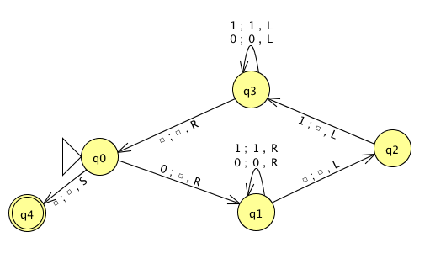
Name(s) __________________________________ Quiz
Run this TM on this input:
0
0
1
1
1
Is this input accepted or rejected?
What inputs are accepted in general? How does it work?
Extra: How could you change this to accept palindromes?
(just a thought experiment)
Notes:
metric prefixes…

Slide 101
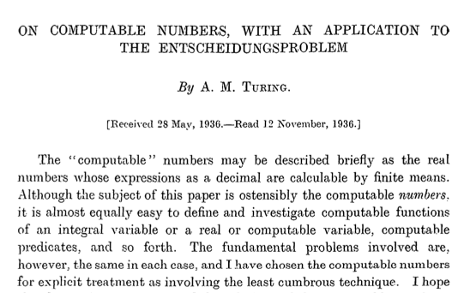
Can TMs compute everything?
Alan Turing says No!
http://www.cs.virginia.edu/~robins/Turing_Paper_1936.pdf

Slide 102
Proving a language nonregular
²
Show L = {0^{n} | n >= 0} nonregular:

Slide 103
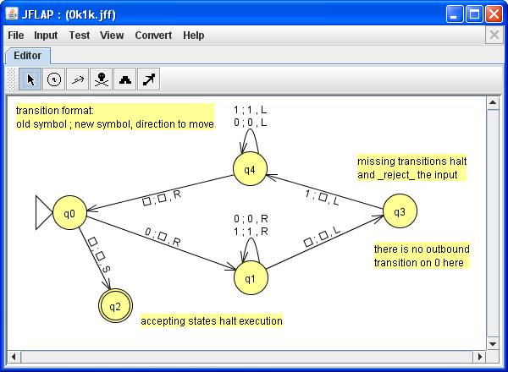
Solution
Blank
Accepting states halt computation immediately.

Slide 104
Computability
TMs
FSMs DFAs
"can't count"
TMs count!
Turing Machines
can compute regular languages
strictly more powerful than DFAs
?
can't compute nonregular languages
What's in the middle of this computability spectrum?
compute some nonregular languages
Notes:
Pimp my Ride from MTV - Corona is where the garage is…
MTV + SciFi -- twilight zone…

Slide 105

Computability
TMs
FSMs DFAs
"can't count"
TMs count!
Turing Machines
can compute regular languages
strictly more powerful than DFAs
?
can't compute nonregular languages
What's in the middle of this computability spectrum?
compute some nonregular languages
We could…
add capabilities to DFAs
more fun!
take away capabilities of TMs
Less tape? Less fun.
Notes:
Pimp my Ride from MTV - Corona is where the garage is…
MTV + SciFi -- twilight zone…

Slide 106
Regular Expressions
Where would you guess this model of computation lives?
DFAs
TMs
"can't count"
TMs count!
FSMs
Turing Machines
can compute regular languages
strictly more powerful than DFAs
NFAs
can compute some nonregular languages

Slide 107
Regex NFA
To show: NFAs can represent any regular expression
Base Case Regexes:
Equivalent NFA:
no expression
Ø
q0
matches no strings
Remember, DFAs are NFAs (but not vice versa)
empty expression
λ
q0
matches the empty string
a single alphabetic character (or bit)
0
matches that one bit
1

Slide 108
Regex NFA
To show: NFAs can represent any regular expression
Base Case Regexes:
Equivalent NFA:
no expression
Ø
q0
matches no strings
Remember, DFAs are NFAs (but not vice versa)
empty expression
λ
q0
matches the empty string
a single alphabetic character (or bit)
0
q0
q1
0
matches that one bit
1
q0
q1
1

Slide 109
Regex NFA
building our machine from available components
Suppose a and b are regular expressions with equivalent NFAs:
a
b
0 or more accepting states…
What NFAs will these composite regular expressions be?
a|b
ab
a*

Slide 110
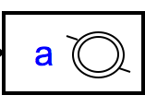
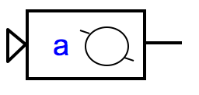
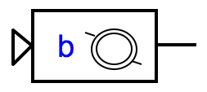
Regex NFA
building our machine from available components
Suppose a and b are regular expressions with equivalent NFAs:
a
b
0 or more accepting states…
What NFAs will these composite regular expressions be?
a|b
ab
a*
λ
λ
q0
λ
λ
sequential machine - watch out for accepting states!
q0
parallel machine: NFA!
Loops!

Slide 111
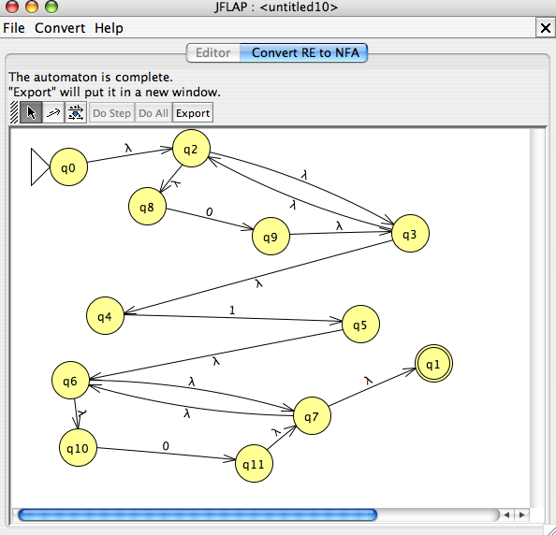
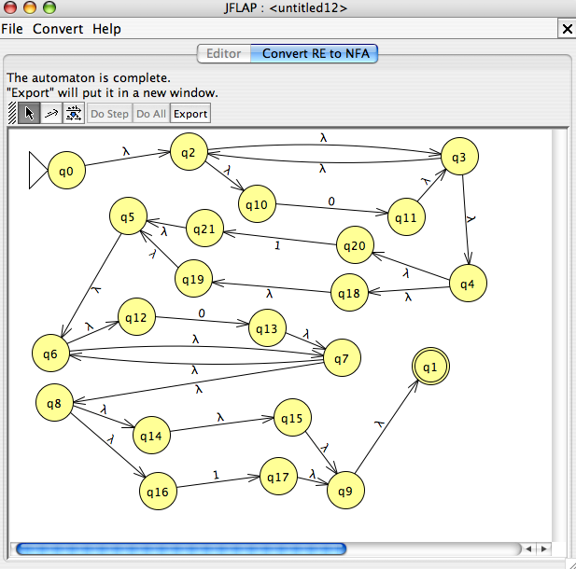
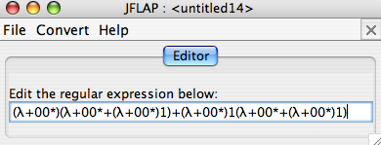
DFAs
≡
NFAs
≡
RegEx's
This conversion is provided by JFLAP…
0*10*
L = { w | w is a binary number whose value is a power of two }
or 0 or a power of two +1
0*(λ|1)0*(λ|1)
Entropy wins again!
this doesn't look right…

Slide 112
DFA RegEx
What regular expression does this DFA produce?
0
1
q1
q0
1
0
0
q2
1
What's this DFA doing?

