Slide 1
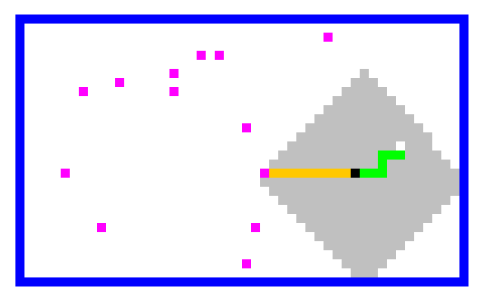
CS60 today + beyond…
Final exam
Final assignment
Topics and practice posted…
the Applet's big-picture view
(and solutions – can check midterm again, too)
HW11: Spampede (+ AI)
Review session ~ Sun 11th 7-8pm
Stack
Queue
Take-home ready on Mon 12th…
Depth-first search
Breadth-first search
…return by Thu 15th by 5pm
(we grade the exams that evening @ 5:30!)
Details:
BFS!
- two two-sided pages of notes OK
- may use an IDE to compose, not run
- worth 2½ assignments
Seniors can opt out…

Slide 2
Three states!?
Yes!
Thanks to Kyle L. for this!

Slide 3
Abstract Data Types
Queue<MazeCell> cellsToVisit =
new LinkedList<MazeCell>();
Mismatched types seem out-of-place in a data-structuring language (Java)
This can happen in two cases…

Slide 4
Abstract Data Types
Queue<MazeCell> cellsToVisit =
new LinkedList<MazeCell>();
Mismatched types seem out-of-place in a data-structuring language (Java)
(1) something inheritance … ?!
This can happen in two cases…
(2) if Queue is an interface!

Slide 5
Abstract Data Types
… provide an interface removed from implementation details
interface Queue<MazeCell> {
}
public boolean isEmpty();
public void add();
public MazeCell remove();
a class without code
No code!? I want to write Java like this!
Java does this through the interface keyword

Slide 6
Abstract Data Types
… provide an interface removed from implementation details
interface Queue<MazeCell> {
}
public boolean isEmpty();
public void add();
public MazeCell remove();
a class without code
No code!? I want to write Java like this!
Java does this through the interface keyword
later, the implementation can be changed …
Queue<MazeCell> cellsToVisit =
new LinkedList<MazeCell>();

Slide 7
Abstract Data Types
… provide an interface removed from implementation details
interface Queue<MazeCell> {
}
public boolean isEmpty();
public void add();
public MazeCell remove();
a class without code
No code!? I want to write Java like this!
Java does this through the interface keyword
later, the implementation can be changed …
Queue<MazeCell> cellsToVisit =
new ArrayList<MazeCell>();

Slide 8
Abstract Data Types
… provide an interface removed from implementation details
interface Queue<MazeCell> {
}
public boolean isEmpty();
public void add();
public MazeCell remove();
a class without code
No code!? I want to write Java like this!
Java does this through the interface keyword
later, the implementation can be changed …
Queue<MazeCell> cellsToVisit =
new Heap<MazeCell>();

Slide 9
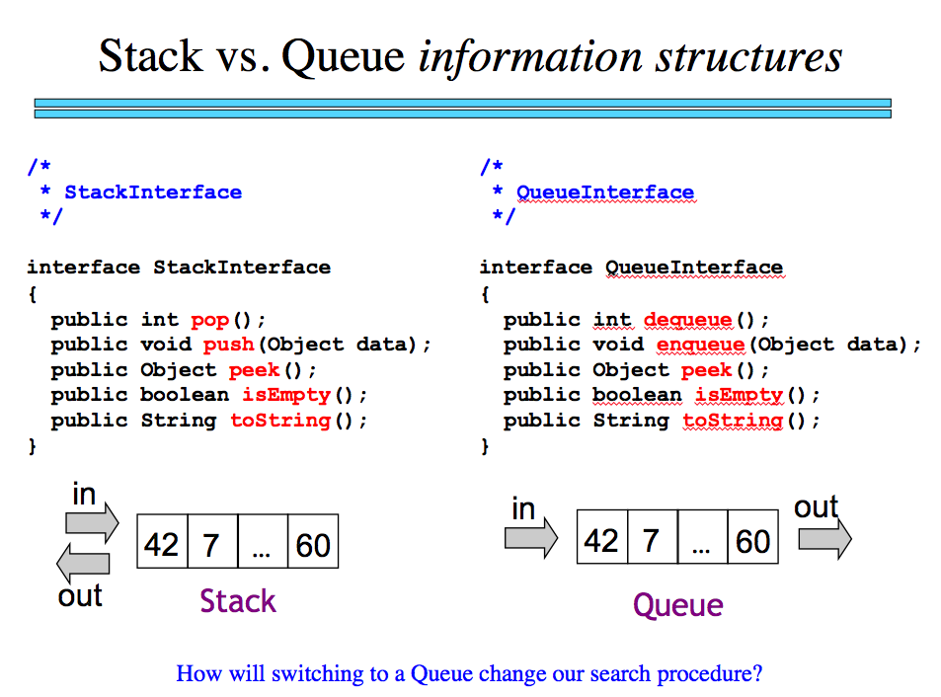
Stack and Queue abstract data types:
Stack
Queue
LIFO
FIFO

Slide 10



Stack, queue, and deque
Stack
Queue
Deque
LIFO
FIFO
WIFO
Which one of the other two would be a better base interface for Deque?
Greg Packer is at the front of the line somewhere…
The deque seems stacked here – and right on queue!

Slide 11
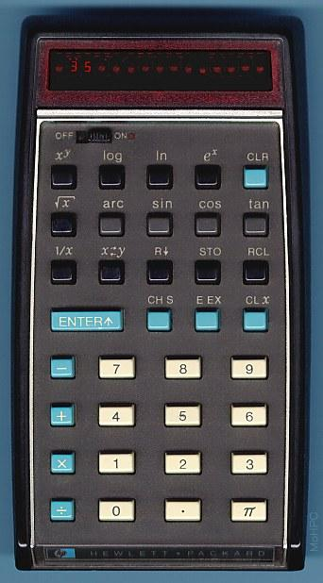
Stack examples...
push - inserts an item at the front
pop - removes the item at the front
HP, Pez, and to do lists!
public static void main(String[] arg)
{
Stack S = new Stack();
S.push(“sleep”);
S.push(“innertube waterpolo”);
S.push(“do CS 60 assignment!”);
System.out.println(S);
Object midnight = S.pop();
System.out.println(S);
}
Do not underestimate the Power of Pez.

Slide 12

Stack examples...
The Pez "Dark Side" collection
Pez!

Slide 13
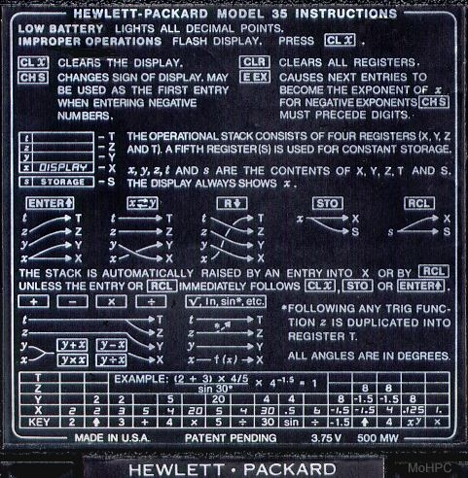
to compute...
4*9+6
you'd have to type...
another Stack interface ?!

Slide 14
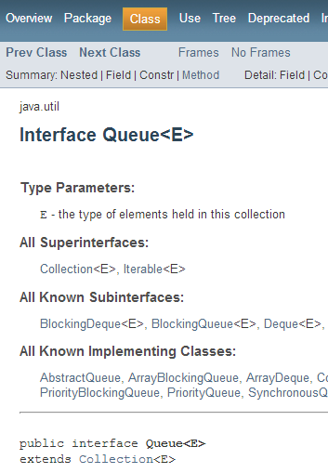
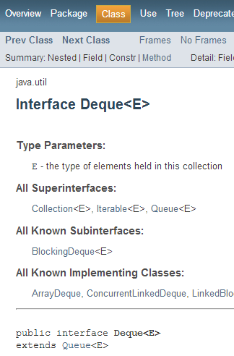
Interfaces for our abstract data types:
Stack
Queue
Deque
LIFO
FIFO
WIFO
pop
push
isEmpty
remove
add
isEmpty
all of these!

Slide 15
Interfaces for our abstract data types:
Stack
Queue
Deque
LIFO
FIFO
WIFO
Java says to use Deque instead!

Slide 16
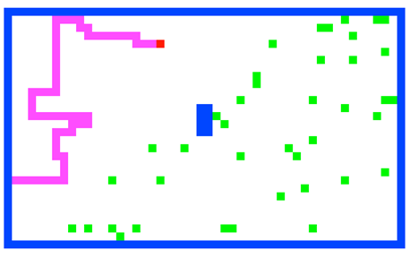
Spampede: overview & AI
Notes:
Java's libraries are comprehensive and huge… [POSTER] – two versions ago
We don't teach them explicitly, actually, but it's always good to keep in mind that they're there…
story about balance (Lenovo's Mr. Challener)

Slide 17
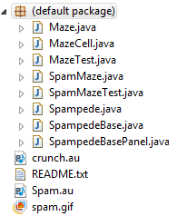
Spampede Files

Slide 18
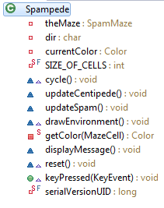
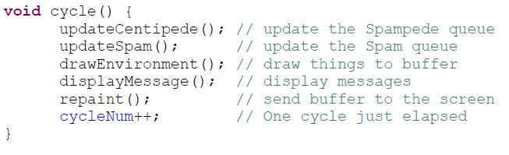
Spampede
Called every frame!
You write this stuff
Called when a key is pressed (update dir)

Slide 19


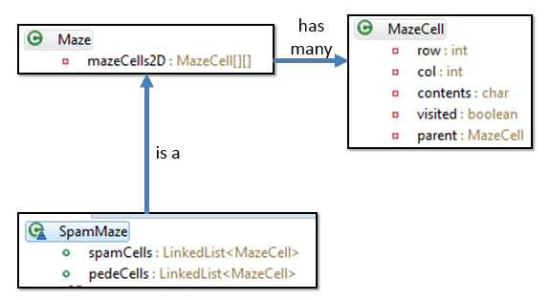
Full class structure
Ok to ignore!
Ok to ignore!
has one
is a
has one

Slide 20
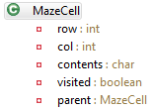
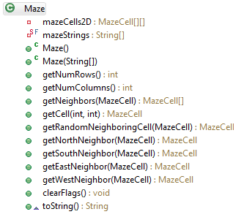
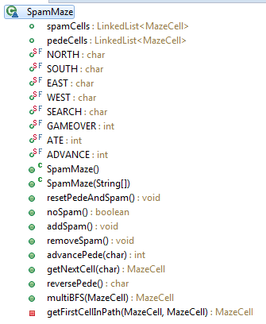
Data Model
has many
is a
class-design diagram
(UML)

Slide 21
Maze has a MazeCell[][]
Nothing too
crazy here…
clearFlags()
Clears visited and parent for all MazeCells after running BFS.

Slide 22
SpamMaze extends Maze
Instance variables
Modes for pede movement
Possible results of movement
Constructors & Initialization
Spam updating
Pede movement

Slide 23
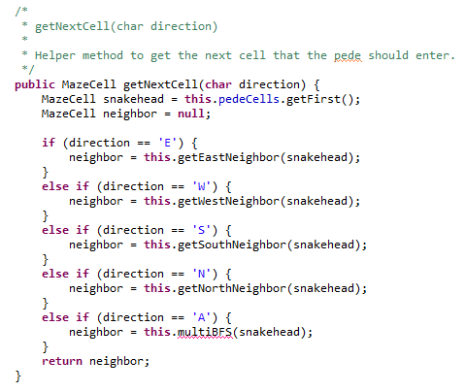
getNextCell
returns the next cell into which to go, depending on the directive from the Applet
Hey – can we use this!?
current direction
leveraging the capabilities of the base class, Maze
this is the AI – its goal is to find the next cell to move!

Slide 24
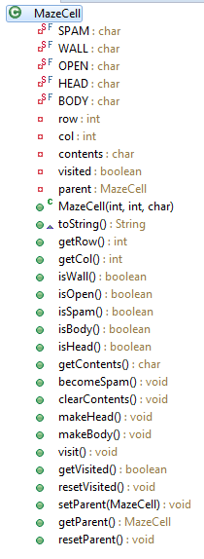
MazeCell
Types of contents
Instance variables
Constructor, toString, access row and column info
Methods to inspect contents
Methods for doing BFS:
visited:
avoid infinite loops parent:
retrace path
Methods to modify contents

Slide 25
Let's zoom in on the Game AI…
' '
'S'
'D'
We need to get from 'S' to 'D'
and then find our way back…
Notes:
Java's libraries are comprehensive and huge… [POSTER] – two versions ago
We don't teach them explicitly, actually, but it's always good to keep in mind that they're there…
story about balance (Lenovo's Mr. Challener)

Slide 26

Spampede's AI is maze-solving
class Maze
class MazeCell
This maze looks kinda easy to me…
How is this is the same as Spampede's AI?
Notes:
I don’t know if this really works...

Slide 27
Search!
(1) Place the start into a data structure of some sort
(2) While the data structure is not empty…
(2a) Remove the next cell
(2b) Check if it's the goal!
(2c) If so, we're done!
(2d) If not, keep going: add its neighbors to the data structure!
Notes:
Java's libraries are comprehensive and huge… [POSTER] – two versions ago
We don't teach them explicitly, actually, but it's always good to keep in mind that they're there…
story about balance (Lenovo's Mr. Challener)

Slide 28
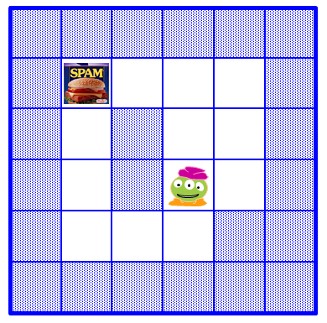
Search!
(1) Place the start into a data structure of some sort
(2) While the data structure is not empty…
(2a) Remove the next cell
(2b) Check if it's the goal!
(2c) If so, we're done!
(2d) If not, keep going: add its neighbors to the data structure!
Notes:
Java's libraries are comprehensive and huge… [POSTER] – two versions ago
We don't teach them explicitly, actually, but it's always good to keep in mind that they're there…
story about balance (Lenovo's Mr. Challener)

Slide 29
Parent and visited!
col
col
col
col
col
col
0
1
2
3
4
5
class MazeCell
{
private int row;
private int col;
private char contents;
private boolean visited;
private MazeCell parent;
MazeCell(int row, int col, char c)
{
this.row = row;
this.col = col;
this.contents = c;
this.visited = false;
this.parent = null;
}
public String toString()
{
return "[" + row + "," +
col + "," +
contents + "]";
}
}
row
0
row
'D'
1
row
2
row
'S'
3
row
' '
4
row
'*'
'*'
5
I was wondering why that was 'S' and 'D'!
'S' = Start Spam Seeking
'*' = Wall!
'D' = Delectible Dinner Destination
' ' = Open Space
Notes:
I don’t know if this really works...

Slide 30
The Stack:
top
Depth-First Search (DFS)…
1
3
2
4
uses a Stack to hold the fringe of cells still to be explored…
NEWS order
D
bottom
C
B
L
E
A
K
S
F
J
3
G
H
I
2
4
1
SWNE order?
Notes:
I don’t know if this really works...

Slide 31
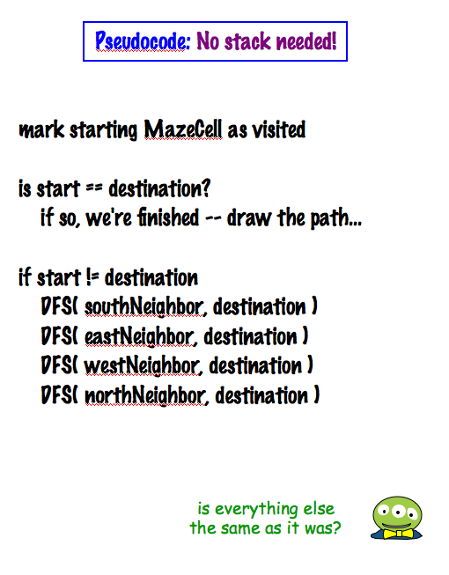
Recursive DFS!
other base cases…
D
S
Is everything the same as before?
‘S’ = Start
‘D’ = Destination
Is there really no stack here?
Notes:
I don’t know if this really works...

Slide 32
Try Breadth-First Search (BFS)…
Name(s) _____________________________
1
3
2
Draw the parents, the visited cells, and the Queue in each step of a breadth-first search from S to D…
4
uses a Queue to hold the fringe, instead of DFS's Stack.
NEWS order
The Queue:
back
front
time
D
C
B
L
E
A
K
S
F
J
G
H
I
Extra: Which is better? DFS or BFS ~ in terms of (a) the path found, (b) memory used, (c) time used
Notes:
I don’t know if this really works...

Slide 33
DFS vs. BFS ?
DFS is search using a Stack to hold the fringe.
BFS is search using a Queue to hold the fringe.
Which search approach is "better" in terms of
i.e., more efficient
(1) the path found
(2) memory use
(by the data structure)
(3) time required
Notes:
Java's libraries are comprehensive and huge… [POSTER] – two versions ago
We don't teach them explicitly, actually, but it's always good to keep in mind that they're there…
story about balance (Lenovo's Mr. Challener)

Slide 34
Search algorithm details…
(0) Be sure all MazeCells are marked unvisited! (clearFlags)
(1) Place the start MazeCell into a data structure of some sort
F
C
B
L
(2) While the data structure is not empty…
E
A
K
(2a) Remove the next MazeCell
D
S
(2b) Check if it's the goal!
J
(2c) If so, find the path back to the start & we're done!
G
H
I
(2d) If not, check all of the neighbors – for each not-yet-visited open neighbor, mark it as visited, set its parent, and add it!
another BFS path result…
Notes:
Java's libraries are comprehensive and huge… [POSTER] – two versions ago
We don't teach them explicitly, actually, but it's always good to keep in mind that they're there…
story about balance (Lenovo's Mr. Challener)

Slide 35
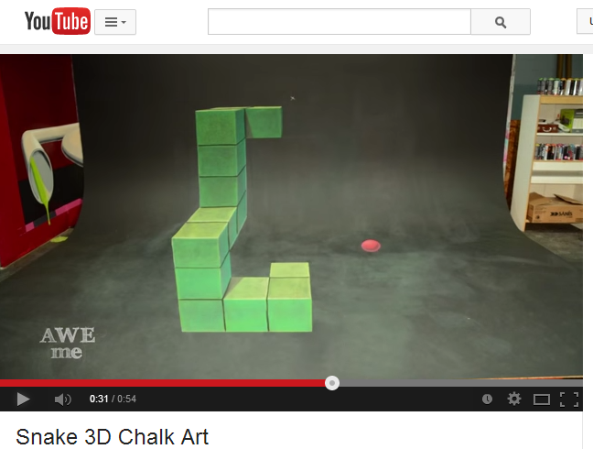
Is this BFS or DFS?!
I can't decide if it's 2d or 3d!
Perhaps it's CFS: chalk-first search?!

Slide 36
Implementation…
{
this.clearFlags();
Queue<MazeCell> cellsToVisit = (provided)
cellsToVisit.add( start );
while …
public MazeCell multiBFS( MazeCell start, char goal )
(0) Be sure all MazeCells are marked unvisited! (clearFlags)
(1) Place the start MazeCell into a data structure of some sort
(2) While the data structure is not empty…
(2a) Remove the next MazeCell
(2b) Check if it's the goal!
(2c) If so, find the path back to the start & we're done!
(2d) If not, check all of the neighbors – for each not-yet-visited open neighbor, mark it as visited, set its parent, and add it!
Notes:
Java's libraries are comprehensive and huge… [POSTER] – two versions ago
We don't teach them explicitly, actually, but it's always good to keep in mind that they're there…
story about balance (Lenovo's Mr. Challener)

Slide 37
Results !
Notes:
Java's libraries are comprehensive and huge… [POSTER] – two versions ago
We don't teach them explicitly, actually, but it's always good to keep in mind that they're there…
story about balance (Lenovo's Mr. Challener)

Slide 38
Computing with Language(s)
DFAs and NFAs
TMs
procedural definitions!
?
structural definition?

Slide 39
Computing with Language(s)
DFAs and NFAs
TMs
procedural definitions!
Regular Expressions
Grammars
structural definition?

Slide 40
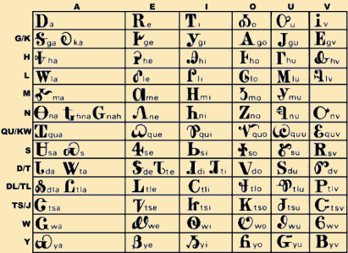
Formal languages
four example alphabets
Choose an alphabet
ASCII
{a,b,…,z}
{0,1}
(a set of input characters)
Consider all sets of the alphabet's finite-length strings.
the bitstrings are all finite, but the sets themselves don't have to be!
∅
1
10
100
101010
{ }
the set of NO bitstrings
a set of one bitstring (42)
a set of three bitstrings

Slide 41
Formal languages
four example alphabets
Choose an alphabet
ASCII
{a,b,…,z}
{0,1}
(a set of input characters)
Consider all sets of the alphabet's finite-length strings.
∅
1
10
100
1
10
100
1000
…
λ
0
1
00
01
10
11
000
…
101010
{ }
Are all formal languages computable by some program?
Choose your data representation…
Choose your algorithm…
Choose your language…
Choose your computer…
Choose your OS…

Slide 42
Formal languages
example alphabets
Choose an alphabet
(a set of input characters)
ASCII
{a,b,…,z}
{0,1}
Consider all sets of the alphabet's finite-length strings.
∅
1
10
100
1
10
100
1000
…
λ
0
1
00
01
10
11
000
…
101010
{ }
Are all formal languages computable by some program?
NO !

Slide 43
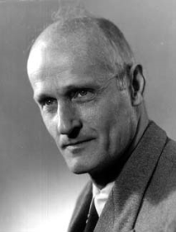
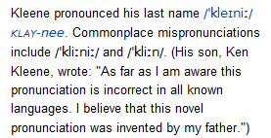
Computable Sets
Computation ~ logical functions
consider only 1 bit of output (combine these to get more)
Computation simply separates its inputs!
Stephen Kleene, 1950's
inputs yielding "true"
inputs yielding "false"
do we need both of these?

Slide 44
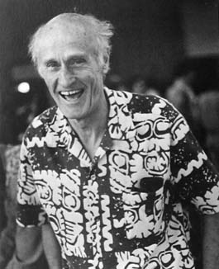
Computable Sets
Computation ~ logical functions
consider only 1 bit of output (combine these to get more)
Computation simply separates its inputs!
inputs yielding "true"
inputs yielding "false"
Not always so formal ...
One of these is enough to describe a particular computation.
a formal language
is a set of inputs selected by a computation
from function to structure…

Slide 45
Kleene's answer: Regular Expressions
looking for a simple description for those sets that are computable …
10
Examples of three regular expressions and overall "regex" syntax.
(10)*
1* | 10*
A regular expression is composed of three operations:
Kleene Star a* “0 or more a’s”
high precedence
concatenation ab “a then b”
union a | b “a or b”
low precedence
where a and b can be any bit strings - or regular expressions
Notes:
http://www.cs.duke.edu/csed/jflap/new/DOCS/gui.regular.EditorPane.html
The Regular Expression EditorThe editor for a regular expression is essentially just a single text field. Operators in a regular expression are the Kleene star (*), the ``or'' operator (+), parentheses are also usable, and concatenation is accomplished by making symbols adjacent.In HaikuTo make expressions for this program to work with, type them in the field.Adjacent symbols imply concatenation. No symbol is used.Many or nothing, Asterisk (*) is the Kleine star. What precedes repeats.Additionally, if you want an "or" symbol the plus (+) should be used.Screaming nothingness, exclamations (!) are special. They act as lambda.Formatting errors will be reported to you when you choose actions. The Regular Expression EditorThe editor for a regular expression is essentially just a single text field. Operators in a regular expression are the Kleene star (*), the ``or'' operator (+), parentheses are also usable, and concatenation is accomplished by making symbols adjacent.In HaikuTo make expressions for this program to work with, type them in the field.Adjacent symbols imply concatenation. No symbol is used.Many or nothing, Asterisk (*) is the Kleine star. What precedes repeats.Additionally, if you want an "or" symbol the plus (+) should be used.Screaming nothingness, exclamations (!) are special. They act as lambda.Formatting errors will be reported to you when you choose actions.

Slide 46
Kleene's answer: Regular Expressions
looking for a simple description for those sets that are computable …
10
matches the string 10, which is the language
{ 10 }
or
L = { w | w is 10 }
(10)*
1* | 10*
A regular expression is composed of three operations:
Kleene Star a* “0 or more a’s”
high precedence
concatenation ab “a then b”
union a | b “a or b”
low precedence
where a and b can be any bit strings - or regular expressions
Notes:
http://www.cs.duke.edu/csed/jflap/new/DOCS/gui.regular.EditorPane.html
The Regular Expression EditorThe editor for a regular expression is essentially just a single text field. Operators in a regular expression are the Kleene star (*), the ``or'' operator (+), parentheses are also usable, and concatenation is accomplished by making symbols adjacent.In HaikuTo make expressions for this program to work with, type them in the field.Adjacent symbols imply concatenation. No symbol is used.Many or nothing, Asterisk (*) is the Kleine star. What precedes repeats.Additionally, if you want an "or" symbol the plus (+) should be used.Screaming nothingness, exclamations (!) are special. They act as lambda.Formatting errors will be reported to you when you choose actions. The Regular Expression EditorThe editor for a regular expression is essentially just a single text field. Operators in a regular expression are the Kleene star (*), the ``or'' operator (+), parentheses are also usable, and concatenation is accomplished by making symbols adjacent.In HaikuTo make expressions for this program to work with, type them in the field.Adjacent symbols imply concatenation. No symbol is used.Many or nothing, Asterisk (*) is the Kleine star. What precedes repeats.Additionally, if you want an "or" symbol the plus (+) should be used.Screaming nothingness, exclamations (!) are special. They act as lambda.Formatting errors will be reported to you when you choose actions.

Slide 47
Kleene's answer: Regular Expressions
Here is a pretty complex regular expression:
Strings in/out of this language?
( 01* | 10 )*
A regular expression is composed of three operations:
Kleene Star a* “0 or more a’s”
high precedence
concatenation ab “a then b”
union a | b “a or b”
low precedence
Notes:
http://www.cs.duke.edu/csed/jflap/new/DOCS/gui.regular.EditorPane.html
The Regular Expression EditorThe editor for a regular expression is essentially just a single text field. Operators in a regular expression are the Kleene star (*), the ``or'' operator (+), parentheses are also usable, and concatenation is accomplished by making symbols adjacent.In HaikuTo make expressions for this program to work with, type them in the field.Adjacent symbols imply concatenation. No symbol is used.Many or nothing, Asterisk (*) is the Kleine star. What precedes repeats.Additionally, if you want an "or" symbol the plus (+) should be used.Screaming nothingness, exclamations (!) are special. They act as lambda.Formatting errors will be reported to you when you choose actions. The Regular Expression EditorThe editor for a regular expression is essentially just a single text field. Operators in a regular expression are the Kleene star (*), the ``or'' operator (+), parentheses are also usable, and concatenation is accomplished by making symbols adjacent.In HaikuTo make expressions for this program to work with, type them in the field.Adjacent symbols imply concatenation. No symbol is used.Many or nothing, Asterisk (*) is the Kleine star. What precedes repeats.Additionally, if you want an "or" symbol the plus (+) should be used.Screaming nothingness, exclamations (!) are special. They act as lambda.Formatting errors will be reported to you when you choose actions.

Slide 48
Try it!
Operator Name
Example
Description
Regular expressions
Kleene Star a* “0 or more a’s”
concatenation ab “a then b”
union a | b “a or b”
Description of a formal language
Equivalent RE
L = { w | w contains a 0 }
L = { w | w’s second-to-last character is a 1 }
L = { w | every 1 in w has a 0 after it }
L = { w | w’s first and last bits are the same }
Notes:
http://www.cs.duke.edu/csed/jflap/new/DOCS/gui.regular.EditorPane.html
The Regular Expression EditorThe editor for a regular expression is essentially just a single text field. Operators in a regular expression are the Kleene star (*), the ``or'' operator (+), parentheses are also usable, and concatenation is accomplished by making symbols adjacent.In HaikuTo make expressions for this program to work with, type them in the field.Adjacent symbols imply concatenation. No symbol is used.Many or nothing, Asterisk (*) is the Kleine star. What precedes repeats.Additionally, if you want an "or" symbol the plus (+) should be used.Screaming nothingness, exclamations (!) are special. They act as lambda.Formatting errors will be reported to you when you choose actions. The Regular Expression EditorThe editor for a regular expression is essentially just a single text field. Operators in a regular expression are the Kleene star (*), the ``or'' operator (+), parentheses are also usable, and concatenation is accomplished by making symbols adjacent.In HaikuTo make expressions for this program to work with, type them in the field.Adjacent symbols imply concatenation. No symbol is used.Many or nothing, Asterisk (*) is the Kleine star. What precedes repeats.Additionally, if you want an "or" symbol the plus (+) should be used.Screaming nothingness, exclamations (!) are special. They act as lambda.Formatting errors will be reported to you when you choose actions.

Slide 49
See you Thursday!
Notes:
http://www.cs.duke.edu/csed/jflap/new/DOCS/gui.regular.EditorPane.html
The Regular Expression EditorThe editor for a regular expression is essentially just a single text field. Operators in a regular expression are the Kleene star (*), the ``or'' operator (+), parentheses are also usable, and concatenation is accomplished by making symbols adjacent.In HaikuTo make expressions for this program to work with, type them in the field.Adjacent symbols imply concatenation. No symbol is used.Many or nothing, Asterisk (*) is the Kleine star. What precedes repeats.Additionally, if you want an "or" symbol the plus (+) should be used.Screaming nothingness, exclamations (!) are special. They act as lambda.Formatting errors will be reported to you when you choose actions. The Regular Expression EditorThe editor for a regular expression is essentially just a single text field. Operators in a regular expression are the Kleene star (*), the ``or'' operator (+), parentheses are also usable, and concatenation is accomplished by making symbols adjacent.In HaikuTo make expressions for this program to work with, type them in the field.Adjacent symbols imply concatenation. No symbol is used.Many or nothing, Asterisk (*) is the Kleine star. What precedes repeats.Additionally, if you want an "or" symbol the plus (+) should be used.Screaming nothingness, exclamations (!) are special. They act as lambda.Formatting errors will be reported to you when you choose actions.

Slide 50
Try it!
Operator Name
Example
Description
Regular (?!) expressions
Kleene Star a* “0 or more a’s”
concatenation ab “a then b”
union a | b “a or b”
Description of a formal language
Equivalent RE
L = { w | w contains a 0 }
L = { w | w’s second-to-last character is a 1 }
L = { w | every 1 in w has a 0 after it }
L = { w | w’s first and last bits are the same }
one or more as
a+
How could you implement other operators?
strings not matching 11
~(11)
strings not matching a
~a
Try writing these REs in terms of the original three…
Is there an equivalent RE to this one that avoids the nested * operators?
( 01* | 10 )*
Extra: can every RE avoid nested *'s ?
Notes:
http://www.cs.duke.edu/csed/jflap/new/DOCS/gui.regular.EditorPane.html
The Regular Expression EditorThe editor for a regular expression is essentially just a single text field. Operators in a regular expression are the Kleene star (*), the ``or'' operator (+), parentheses are also usable, and concatenation is accomplished by making symbols adjacent.In HaikuTo make expressions for this program to work with, type them in the field.Adjacent symbols imply concatenation. No symbol is used.Many or nothing, Asterisk (*) is the Kleine star. What precedes repeats.Additionally, if you want an "or" symbol the plus (+) should be used.Screaming nothingness, exclamations (!) are special. They act as lambda.Formatting errors will be reported to you when you choose actions. The Regular Expression EditorThe editor for a regular expression is essentially just a single text field. Operators in a regular expression are the Kleene star (*), the ``or'' operator (+), parentheses are also usable, and concatenation is accomplished by making symbols adjacent.In HaikuTo make expressions for this program to work with, type them in the field.Adjacent symbols imply concatenation. No symbol is used.Many or nothing, Asterisk (*) is the Kleine star. What precedes repeats.Additionally, if you want an "or" symbol the plus (+) should be used.Screaming nothingness, exclamations (!) are special. They act as lambda.Formatting errors will be reported to you when you choose actions.

Slide 51
/* making the most of one's comments…
* - Jim Norwood from cs60 past…
*/
class Queue implements QueueInterface
{
private QCell front;
private QCell back;
// I 1 2 C F D Q S M T
boolean isEmpty() {return front == null;}
// I 1 A v M T Q
public Queue() {
this.front = null;
this.back = null;
}
// other methods in the interface…
add
remove
peek
}
Queue comments?

Slide 52
Results !
Notes:
Java's libraries are comprehensive and huge… [POSTER] – two versions ago
We don't teach them explicitly, actually, but it's always good to keep in mind that they're there…
story about balance (Lenovo's Mr. Challener)

Slide 53


Three views of Qs
John Cleese
Desmond Llewelyn
in main…
Queue = new Queue();
Ball.enqueue("Y");
Ball.enqueue("C");
Ball.enqueue("U");
String s = Ball.dequeue();
back
front
Arg! Why will Java complain here ?!

Slide 54
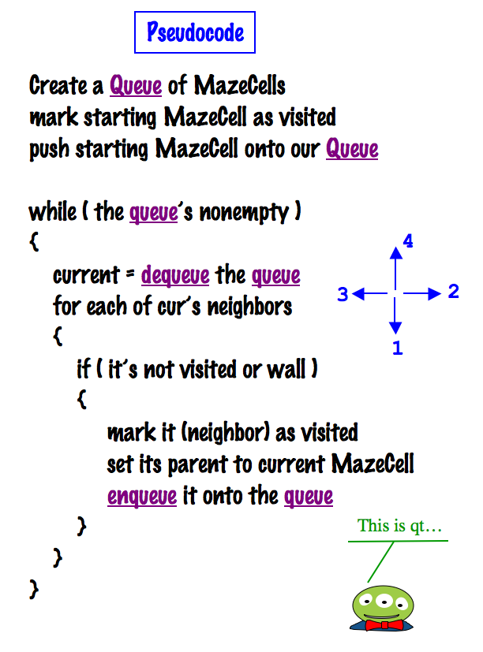
Breadth-first search (BFS)
4
3
2
1
col
col
col
col
col
col
0
1
2
3
4
5
row
0
row
1
F
C
B
L
row
2
E
A
K
row
D
S
3
J
row
4
G
H
I
row
5
'S' = Start Spam Seeking
'D' = Delectible Dinner Destination
Notes:
I don’t know if this really works...

Slide 55
Results
Notes:
Java's libraries are comprehensive and huge… [POSTER] – two versions ago
We don't teach them explicitly, actually, but it's always good to keep in mind that they're there…
story about balance (Lenovo's Mr. Challener)

Slide 56
Our Queue:
back
front
col
col
col
col
col
col
0
1
2
3
4
5
4
row
3
2
0
1
row
SEWN order
1
F
C
B
L
row
2
E
A
K
row
D
S
Breadth-first search (BFS)
3
J
row
4
G
H
I
row
uses a Queue to hold the fringe, instead of a Stack.
5
'S' = Start Spam Seeking
'D' = Delectible Dinner Destination
Notes:
I don’t know if this really works...

