Slide 1
Do not think I am too twisted.
Here are some of the additional features:
It is impossible to blaspheme or pray before you have the sword It is impossible to pick up the jar of spices before you are a glutton (obtained through eating a baby) It is possible to eat things in your inventory and lucifer …
Soundtrack: http://www.youtube.com/watch?v=GFIvXVMbII0
There is madd_skillz here.
You encounter starving_frosh.
%% It's amusing to find that one minute of
%% gameplay translates to about an hour of coding.
CS 60 ~ the end of a Spamventure
You have made a huge mistake.
That muffin was three years old.
You have died of dysentery.
An end to spam? I don't believe it!
Final reminders…
Spampede
Exam…
Due tomorrow by 11:59pm!
office hours both this afternoon and Friday afternoon…
Review session ~ Sun 11th 7-8pm
Take-home ready on Mon 12th…
Extra Java!
…return by Thu 15th by 5pm
(we grade the exams that evening @ 5:30!)
Extra credit hw, up to +50/0 pts: implementing a small language in Java

Slide 2
The end of CS (60) …
CS
useful
creative
Spampede
Due tomorrow by 11:59pm!
office hours both this afternoon and Friday afternoon…

Slide 3
Spampede…
… is meant to be less constrained than the write-to-the-test hwks – feel free to add or change methods, their return types, etc. especially in SpamMaze and Spampede… Add new things!
Please do change the SpamMaze tests to work with your implementation ~ and then add 9 tests of your own!
Warnings…
Reversing the pedeCells may seem "backwards"!
Call clearFlags each time before running multiBFS
Don't add walls or spampede body segments to the queue!
Don't use the same char for your body segments as spam ~ Aargh!!

Slide 4
The end of CS (60) …
Racket
CS60 has lots of languages…
Prolog
so that whatever language you encounter in the future, it won't be as crazy as one of these!
Java
JFLAP
useful
creative
CS

Slide 5
def yard 3 foot
{ 3.0, [foot], [] }
def furlong 0.125 mile
{ 0.125, [mile], [] }
def mile 5280 foot
{ 5280.0, [foot], [] }
1 foot + 2 yard
{ 7.0, [foot], [] }
def hour 3600 second
{ 3600.0, [second], [] }
def day 24 hour
{ 24.0, [hour], [] }
# 1 mile / day
???
Unilang, a unicalc language
Running the language:
Notes:
REPL == read - eval - print - loop Prof. Keller had implemented in Scheme…
implementing in Java provides additional insight!

Slide 6
Running minimath:
5 + 4
9.0
5 * 5
25.0
5 + 9 * 3
32.0
(5 + 9) * 3
42.0
x = 7
7.0
x * 6
42.0
Minimath!
full source code provided…
Input?
Output?
Challenges?
These last two features aren't so mini!

Slide 7
Implementing a language…
String input
"(5 + 9) * 3"
String[] tokens
( 5 + 9 ) * 3
*
OpenList parseTree
+
3
5
9
Quantity result
42.0

Slide 8
Implementing a language…
String input
"(5 + 9) * 3"
Tokenizer
String[] tokens
( 5 + 9 ) * 3
Parser
*
OpenList parseTree
+
3
5
9
Evaluator
Quantity result
42.0

Slide 9
Implementing a language…
String input
"(5 + 9) * 3"
Tokenizer
Which of these three steps seems the most difficult!?
String[] tokens
( 5 + 9 ) * 3
Parser
*
OpenList parseTree
+
3
5
9
Evaluator
Quantity result
42.0

Slide 10
CS ideas…
String input
Regular expressions
Tokenizer
String[] tokens
Parser
Grammars
OpenList parseTree
Evaluator
Recursion!
Quantity result

Slide 11
Computation, via language
DFAs and NFAs
TMs
procedural definitions!
Regular Expressions
Grammars
structural definitions!

Slide 12
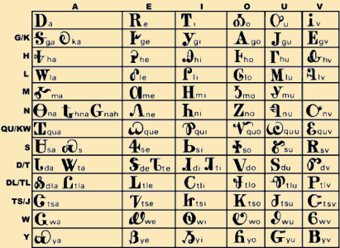
Defining a (formal) language
Choose an alphabet
Cherokee!
{0,1}
{a,b,…,z}
ASCII
A language is some set of the alphabet's finite-length strings.
the strings are all finite, but the sets themselves don't have to be!
∅
1
10
100
101010
{ }
the set of NO bitstrings
a set of three bitstrings
a set of one bitstring (42)

Slide 13
Defining a (formal) language
Choose an alphabet
Cherokee!
{0,1}
{a,b,…,z}
ASCII
A language is some set of the alphabet's finite-length strings.
∅
1
10
100
1
10
100
1000
…
λ
0
1
00
01
10
11
000
…
101010
{ }
the set of NO bitstrings
a set of three bitstrings
a set of one bitstring (42)
an ∞ set of bitstrings (2^k)
the set of all bitstrings

Slide 14
Defining computation via language!
A formal language is a set of finite-length strings:
∅
1
10
100
1
10
100
1000
…
λ
0
1
00
01
10
11
000
…
101010
{ }
the set of NO bitstrings
a set of three bitstrings
a set of one bitstring (42)
an ∞ set of bitstrings (2^k)
the set of all bitstrings
def f(x):
return False
def f(x):
return x in [1,10,100]
?
def f(x):
return x[0] == 1 and \
x[1:] == '0'*(len(x)-1)
def f(x):
return x == 101010
which is a computation!

Slide 15
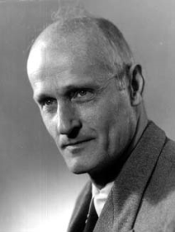
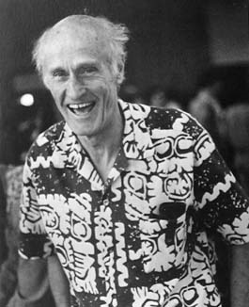
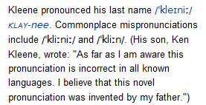
Computation ~ functions of bits
consider only 1 bit of output (combine to get more)
Stephen Kleene, 1950's
Computation simply separates its inputs!
inputs yielding "true"
do we need both of these?
inputs yielding "false"
Not always so formal ...
Every computation is just the set of inputs that output true!
structure vs. procedure

Slide 16
Computation ~ functions of bits
consider only 1 bit of output (combine to get more)
Stephen Kleene, 1950's
Computation simply separates its inputs!
Then which sets are actually computable?
inputs yielding "true"
do we need both of these?
inputs yielding "false"
Not always so formal ...
Every computation is just the set of inputs that output true!
structure vs. procedure

Slide 17
Kleene's answer: Regular Expressions
10
Examples of three regular expressions and overall "regex" syntax.
(10)*
1* | 10*
A regular expression is composed of three operations:
union a | b “a or b”
concatenation ab “a then b”
Kleene Star a* “0 or more a’s”
higher precedence
where a and b can be any bit strings - or regular expressions
Notes:
http://www.cs.duke.edu/csed/jflap/new/DOCS/gui.regular.EditorPane.html
The Regular Expression EditorThe editor for a regular expression is essentially just a single text field. Operators in a regular expression are the Kleene star (*), the ``or'' operator (+), parentheses are also usable, and concatenation is accomplished by making symbols adjacent.In HaikuTo make expressions for this program to work with, type them in the field.Adjacent symbols imply concatenation. No symbol is used.Many or nothing, Asterisk (*) is the Kleine star. What precedes repeats.Additionally, if you want an "or" symbol the plus (+) should be used.Screaming nothingness, exclamations (!) are special. They act as lambda.Formatting errors will be reported to you when you choose actions. The Regular Expression EditorThe editor for a regular expression is essentially just a single text field. Operators in a regular expression are the Kleene star (*), the ``or'' operator (+), parentheses are also usable, and concatenation is accomplished by making symbols adjacent.In HaikuTo make expressions for this program to work with, type them in the field.Adjacent symbols imply concatenation. No symbol is used.Many or nothing, Asterisk (*) is the Kleine star. What precedes repeats.Additionally, if you want an "or" symbol the plus (+) should be used.Screaming nothingness, exclamations (!) are special. They act as lambda.Formatting errors will be reported to you when you choose actions.

Slide 18
Regular Expressions
10
matches the string 10, which is the language
{ 10 }
or
L = { w | w is 10 }
(10)*
1* | 10*
A regular expression is composed of three operations:
union a | b “a or b”
concatenation ab “a then b”
Kleene Star a* “0 or more a’s”
Notes:
http://www.cs.duke.edu/csed/jflap/new/DOCS/gui.regular.EditorPane.html
The Regular Expression EditorThe editor for a regular expression is essentially just a single text field. Operators in a regular expression are the Kleene star (*), the ``or'' operator (+), parentheses are also usable, and concatenation is accomplished by making symbols adjacent.In HaikuTo make expressions for this program to work with, type them in the field.Adjacent symbols imply concatenation. No symbol is used.Many or nothing, Asterisk (*) is the Kleine star. What precedes repeats.Additionally, if you want an "or" symbol the plus (+) should be used.Screaming nothingness, exclamations (!) are special. They act as lambda.Formatting errors will be reported to you when you choose actions. The Regular Expression EditorThe editor for a regular expression is essentially just a single text field. Operators in a regular expression are the Kleene star (*), the ``or'' operator (+), parentheses are also usable, and concatenation is accomplished by making symbols adjacent.In HaikuTo make expressions for this program to work with, type them in the field.Adjacent symbols imply concatenation. No symbol is used.Many or nothing, Asterisk (*) is the Kleine star. What precedes repeats.Additionally, if you want an "or" symbol the plus (+) should be used.Screaming nothingness, exclamations (!) are special. They act as lambda.Formatting errors will be reported to you when you choose actions.

Slide 19
Regular Expressions
( 01* | 10 )*
Here is a more complex regular expression
What strings are in/out of its language?
Notes:
http://www.cs.duke.edu/csed/jflap/new/DOCS/gui.regular.EditorPane.html
The Regular Expression EditorThe editor for a regular expression is essentially just a single text field. Operators in a regular expression are the Kleene star (*), the ``or'' operator (+), parentheses are also usable, and concatenation is accomplished by making symbols adjacent.In HaikuTo make expressions for this program to work with, type them in the field.Adjacent symbols imply concatenation. No symbol is used.Many or nothing, Asterisk (*) is the Kleine star. What precedes repeats.Additionally, if you want an "or" symbol the plus (+) should be used.Screaming nothingness, exclamations (!) are special. They act as lambda.Formatting errors will be reported to you when you choose actions. The Regular Expression EditorThe editor for a regular expression is essentially just a single text field. Operators in a regular expression are the Kleene star (*), the ``or'' operator (+), parentheses are also usable, and concatenation is accomplished by making symbols adjacent.In HaikuTo make expressions for this program to work with, type them in the field.Adjacent symbols imply concatenation. No symbol is used.Many or nothing, Asterisk (*) is the Kleine star. What precedes repeats.Additionally, if you want an "or" symbol the plus (+) should be used.Screaming nothingness, exclamations (!) are special. They act as lambda.Formatting errors will be reported to you when you choose actions.

Slide 20
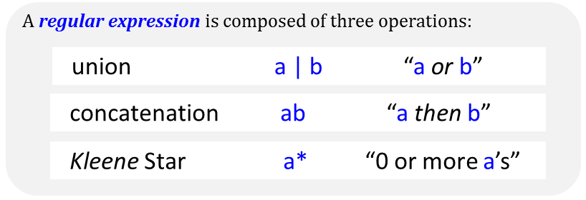
Creating regular expressions…
Description of a formal language
Equivalent RE
L = { w | w is a power of 2 in binary }
L = { w | every 1 in w has a 0 after it }
L = { w | w is any string at all! }
L = { w | w’s third-to-last character is a 1 }
L = { w | w’s first and last bits are the same }
Extra: can you create an equivalent regex to this one without nesting stars!?!
( 01* | 10 )*
Notes:
http://www.cs.duke.edu/csed/jflap/new/DOCS/gui.regular.EditorPane.html
The Regular Expression EditorThe editor for a regular expression is essentially just a single text field. Operators in a regular expression are the Kleene star (*), the ``or'' operator (+), parentheses are also usable, and concatenation is accomplished by making symbols adjacent.In HaikuTo make expressions for this program to work with, type them in the field.Adjacent symbols imply concatenation. No symbol is used.Many or nothing, Asterisk (*) is the Kleine star. What precedes repeats.Additionally, if you want an "or" symbol the plus (+) should be used.Screaming nothingness, exclamations (!) are special. They act as lambda.Formatting errors will be reported to you when you choose actions. The Regular Expression EditorThe editor for a regular expression is essentially just a single text field. Operators in a regular expression are the Kleene star (*), the ``or'' operator (+), parentheses are also usable, and concatenation is accomplished by making symbols adjacent.In HaikuTo make expressions for this program to work with, type them in the field.Adjacent symbols imply concatenation. No symbol is used.Many or nothing, Asterisk (*) is the Kleine star. What precedes repeats.Additionally, if you want an "or" symbol the plus (+) should be used.Screaming nothingness, exclamations (!) are special. They act as lambda.Formatting errors will be reported to you when you choose actions.

Slide 21
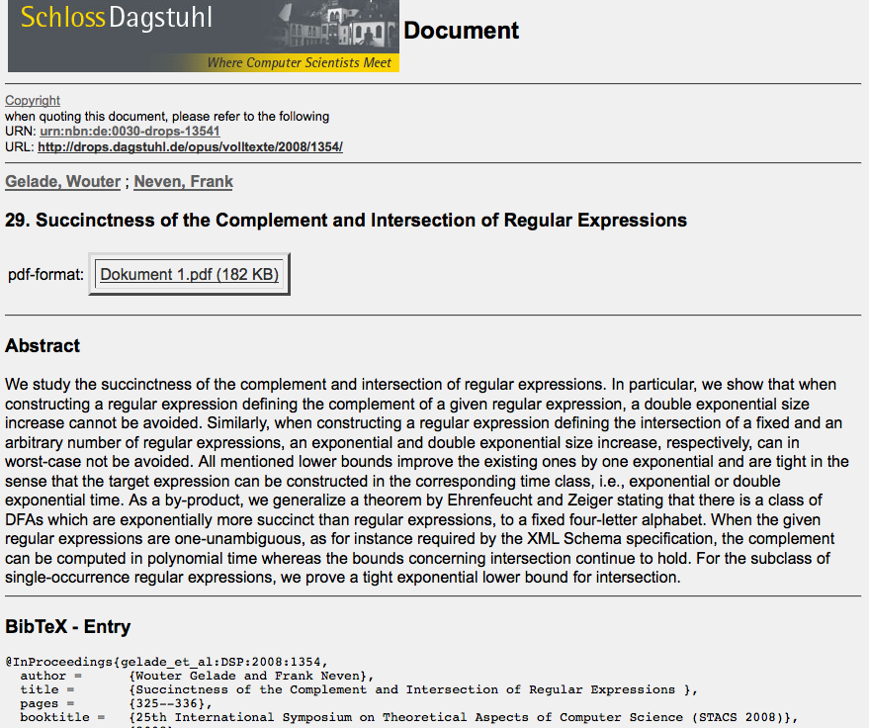
The "Star-height problem" was solved in 1963: there are languages that require deeply nested stars…
Star-height problem with negation still unsolved...

Slide 22
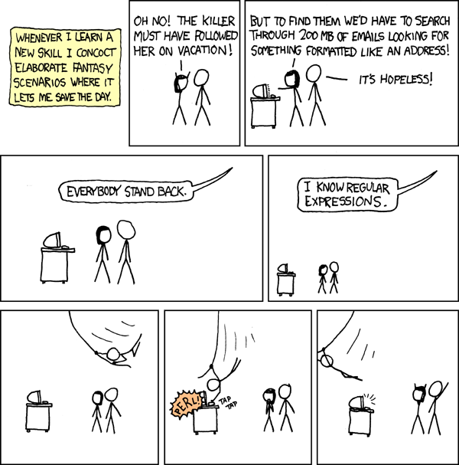
REs to the REscue!
PERL
practical extraction and report language
Notes:
22
Pimp my Ride from MTV - Corona is where the garage is…
MTV + SciFi -- twilight zone…

Slide 23
Regexes in practice!
Unix's egrep does a line-by-line search for a regex:
egrep 'hh'
egrep 'y.*y'
egrep '(xq|hq)'
egrep '^y.*y$'
/usr/share/dict/words
good for crosswords !
U
vowel
vowel
not always obvious …
egrep '^(0|1(01*0)*1)(0|1(01*0)*1)*$' binStr
But how do they work?!
Notes:
23

Slide 24
Implementing a language…
String input
"(5 + 9) * 3"
Tokenizer
String[] tokens
( 5 + 9 ) * 3
Parser
*
OpenList parseTree
+
3
5
9
Evaluator
Quantity result
42.0

Slide 25

Tokens don't grow on trees…
but trees grow from them!
"z = x + y"
code, a String
[ z, =, x, +, y ]
tokens, a String[]
parse tree, a tree!
parse trees capture the structure of the tokens in our particular language

Slide 26
Parsing is understanding…
The chef gave her cat food.
The young horse around.
The woman that whistles tunes pianos.
The man who hunts ducks out on weekends.
Those who admire a man that paints like Monet.
“garden path” sentences

Slide 27
Parsing is understanding…
The chef gave her cat food.
chef gave food
chef gave food
her
cat
cat
her
What happened to the the?
It's grammar that provides this structure!

Slide 28
Grammars
Grammar: A set of rules that determines legal expressions in a language.
of single-digit sums
start here
S
S V S
V
+
V
0
1
…
9
creates a parse tree!
This grammar contains two production rules …
4 + 5
Tokens

Slide 29
Grammars
the starting rule or “production”
the parse tree for "4+5"
Example:
S V S
V
+
S
"sum"
V
V
+
S
0
1
…
9
"value"
4
V
nonterminal or auxiliary symbol
"or" in the grammar, not the language
5
each nonterminal symbol represents a “syntactic category”
root
LHS
RHS
Parse tree: [ +, [4], [5] ]
Token list: < 4, +, 5 >
recursive!
S = “I want to be a sum.”
V = “I want to be a value.”
terminal symbols -- things that appear in the expression to be parsed
Input “4 + 5”
alphabet = { +, 0, 1, …, 9 }

Slide 30
Grammars guide parsing
start here
S
S
V
+
S
V
-
S
V
V
0
1
…
9
What is the parse tree for these tokens?
8 - 4 + 5

Slide 31
Root of the parse tree
Parsing ~ following a grammar
S
Starting symbol
S
P
+
S
P
-
S
P
"sum"
P
V
*
P
V
/
P
V
"product"
V
0
1
…
9
"value"
(1) Create the parse tree for these tokens
7 * 3 + 9 / 2
(2) Evaluate the tree!
tokens to be parsed
(3) What rule could you add in the grammar
above – and where – so that it would enable the use of parentheses ( and ) for grouping terms?
Notes:
why it would be good -- because the expression comes out to 42!

Slide 32
Mondegreens
American author Sylvia Wright (1954):
When I was a child, my mother used to read
aloud to me… One of my favorite poems began,
as I remember:
Ye Highlands and ye Lowlands,
Oh, where hae ye been?
They have slain the Earl of Murray,
And Lady Mondegreen.
The actual line is And laid him on the green.
Wright gives other examples of her own mondegreens:
Surely, Good Mrs. Murphy shall follow me all the days of my life
("Surely goodness and mercy…" from the 23rd Psalm)
Are these tokenizing or parsing problems?
'Scuse me while I kiss this guy…
It's hard to wreck a nice beach!
Actually, it's not that difficult…
Notes:
Hold me closer, Tony Danza…

Slide 33
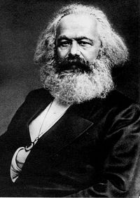
Parsing English…
Time flies like an arrow, but fruit flies like a banana.
- Marx
I like bananas, too!
"<*time>"
"time" <*> N NOM SG @SUBJ
"<flies>"
"fly" <SVO> <SV> V PRES @+FMAINV
"fly" N NOM PL @NPHR
"<like>"
"like" PREP @<NOM
"<an>"
"an" <Indef> DET CENTRAL ART
"<$2-NL>"
"<arrow>"
"arrow" N NOM SG @NPHR
"<$\,>"
"<but>"
"but" CC @CC
"<fruit_flies>"
"fruit_fly" N NOM PL @NPHR
"<like>"
"like" PREP @<NOM
"<a>"
"a" <Indef> DET CENTRAL ART
"<banana>"
"banana" N NOM SG @<P
"<$.>"
(S (S (NP Time flies)
(VP like
(NP an arrow)))
, but
(S (NP fruit)
(VP flies
(PP like
(NP a banana))))
.)
http://www.link.cs.cmu.edu/link/submit-sentence-4.html
parseTree #1
http://www.lingsoft.fi/cgi-bin/engcg
parseTree #2

Slide 34
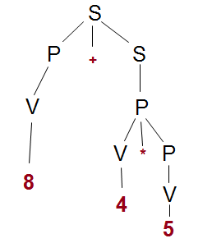
Recursive Descent Parsing
uses a shared token list, as a String[]
each nonterminal has its own method
builds a parse tree by peeking ahead at tokens…
Tokens:
Parse tree:
< 8, +, 4, *, 5 >
[+ [8] [* [4] [5]]]

Slide 35
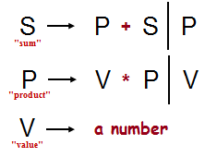
The Recursive Descent Parsing Algorithm
< 8, +, 4, *, 5 >
parse: I'll just call S…
tokens: <"8", "+", "4", "*", "5">
S

Slide 36
The Recursive Descent Parsing Algorithm
< 8, +, 4, *, 5 >
parse: I'll just call S…
tokens: <"8", "+", "4", "*", "5">
S: "No matter what, I start with a P, so I'll ask P to parse"
tokens: <"8", "+", "4", "*", "5">
S
P

Slide 37
The Recursive Descent Parsing Algorithm
< 8, +, 4, *, 5 >
parse: I'll just call S…
tokens: <"8", "+", "4", "*", "5">
S: "No matter what, I start with a P, so I'll ask P to parse"
tokens: <"8", "+", "4", "*", "5">
P: "No matter what, I start with a V, so I'll ask V to parse"
tokens: <"8", "+", "4", "*", "5">
S
P
V

Slide 38
The Recursive Descent Parsing Algorithm
< 8, +, 4, *, 5 >
parse: I'll just call S…
tokens: <"8", "+", "4", "*", "5">
S: "No matter what, I start with a P, so I'll ask P to parse"
tokens: <"8", "+", "4", "*", "5">
P: "No matter what, I start with a V, so I'll ask V to parse"
tokens: <"8", "+", "4", "*", "5">
S
V: "I'm a number, so I'll use up the next token as a number."
tokens: <"+", "4", "*", "5">
return [8.0]
P
V
8

Slide 39
The Recursive Descent Parsing Algorithm
< 8, +, 4, *, 5 >
parse: I'll just call S…
tokens: <"8", "+", "4", "*", "5">
S: "No matter what, I start with a P, so I'll ask P to parse"
tokens: <"8", "+", "4", "*", "5">
P: "No matter what, I start with a V, so I'll ask V to parse"
tokens: <"8", "+", "4", "*", "5">
S
V: "I'm a number, so I'll use up the next token as a number."
tokens: <"+", "4", "*", "5">
return [8.0]
P
P: "I have a V, so I expect a * P or nothing more at all;
I see a +, not a *, so I'll just return the current V…"
V
tokens: <"+", "4", "*", "5">
return [8.0]
8

Slide 40
The Recursive Descent Parsing Algorithm
< 8, +, 4, *, 5 >
parse: I'll just call S…
tokens: <"8", "+", "4", "*", "5">
S: "No matter what, I start with a P, so I'll ask P to parse"
tokens: <"8", "+", "4", "*", "5">
P: "No matter what, I start with a V, so I'll ask V to parse"
tokens: <"8", "+", "4", "*", "5">
S
V: "I'm a number, so I'll use up the next token as a number."
tokens: <"+", "4", "*", "5">
return [8.0]
P
+
P: "I have a V, so I expect a * P or nothing more at all;
I see a +, not a *, so I'll just return the current V…"
V
tokens: <"+", "4", "*", "5">
return [8.0]
S: "I have a P, so I expect a + S or nothing more at all;
I do see a +, so I use it…
8
tokens: <"4", "*", "5">

Slide 41
The Recursive Descent Parsing Algorithm
< 8, +, 4, *, 5 >
parse: I'll just call S…
tokens: <"8", "+", "4", "*", "5">
S: "No matter what, I start with a P, so I'll ask P to parse"
tokens: <"8", "+", "4", "*", "5">
P: "No matter what, I start with a V, so I'll ask V to parse"
tokens: <"8", "+", "4", "*", "5">
S
V: "I'm a number, so I'll use up the next token as a number."
tokens: <"+", "4", "*", "5">
return [8.0]
P
S
+
P: "I have a V, so I expect a * P or nothing more at all;
I see a +, not a *, so I'll just return the current V…"
V
tokens: <"+", "4", "*", "5">
return [8.0]
S: "I have a P, so I expect a + S or nothing more at all;
I do see a +, so I use it, then call S, …
8
tokens: <"4", "*", "5">

Slide 42
The Recursive Descent Parsing Algorithm
< 8, +, 4, *, 5 >
parse: I'll just call S…
tokens: <"8", "+", "4", "*", "5">
S: "No matter what, I start with a P, so I'll ask P to parse"
tokens: <"8", "+", "4", "*", "5">
P: "No matter what, I start with a V, so I'll ask V to parse"
tokens: <"8", "+", "4", "*", "5">
S
V: "I'm a number, so I'll use up the next token as a number."
tokens: <"+", "4", "*", "5">
return [8.0]
P
S
+
P: "I have a V, so I expect a * P or nothing more at all;
I see a +, not a *, so I'll just return the current V…"
V
P
tokens: <"+", "4", "*", "5">
return [8.0]
V
*
P
S: "I have a P, so I expect a + S or nothing more at all;
I do see a +, so I use it, then call S, then make my tree!"
8
V
tokens: < >
4
5
return [+, [8.0], [*, [4.0], [5.0]]]

Slide 43
The end of CS (60) …
recursing from below!
useful
creative
CS
recurse to top!
recurse to top!

Slide 44
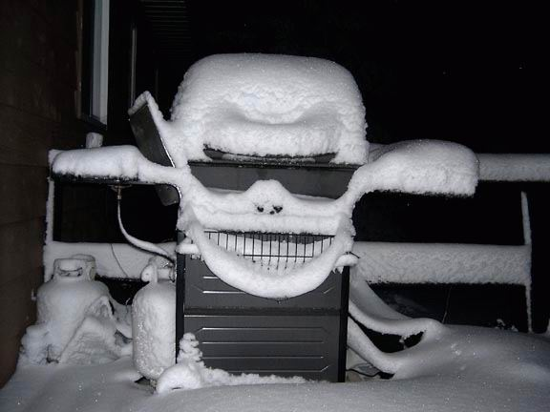
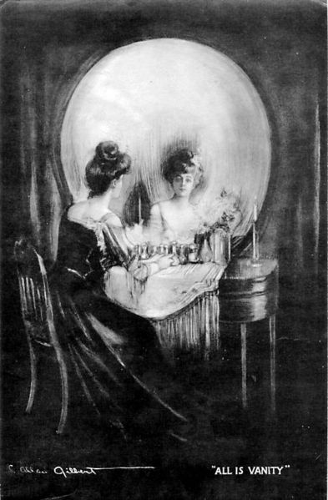
Visual tokenizing and parsing…

Slide 45
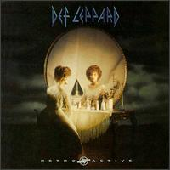
Visual tokenizing and parsing…

Slide 46
The end of CS (60) …
recursing from below!
useful
creative
CS
recurse to top!
recurse to top!

Slide 47
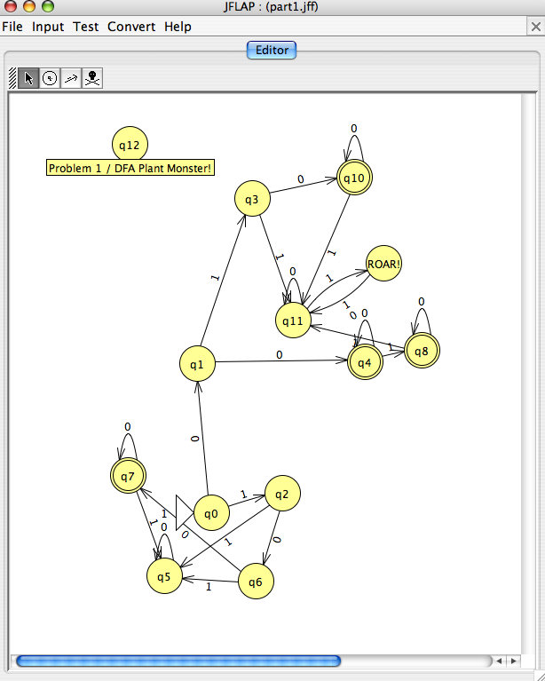
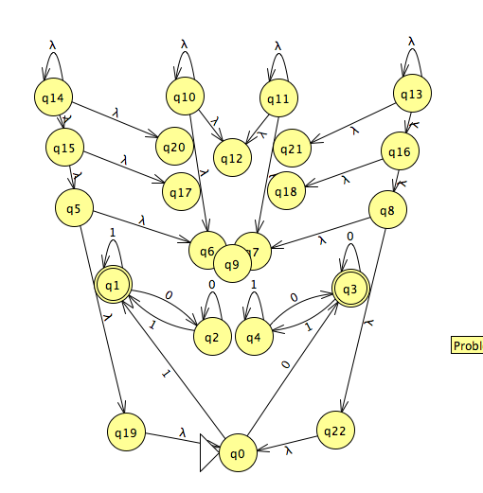
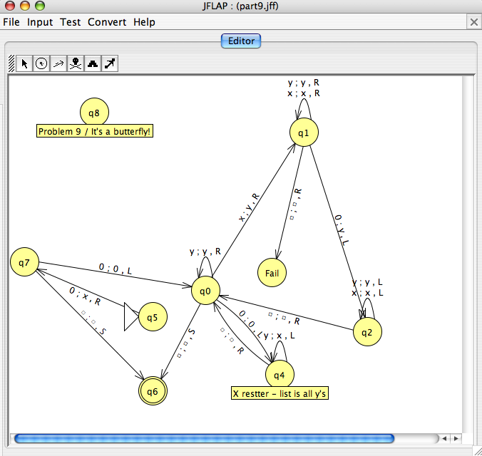
Creativity per se

Slide 48
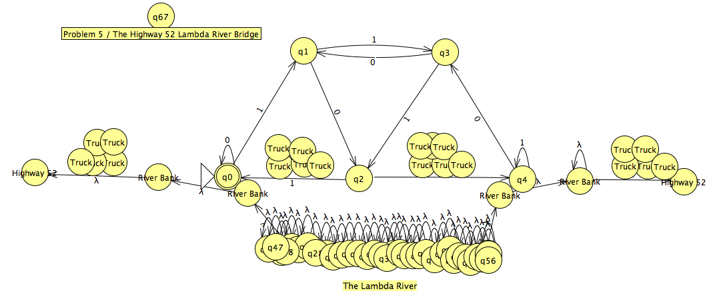
CS 60 as the lambda river
or the bridge. You decide…
I think the current's got me!

Slide 49
The 1-term CS major?
CS 60
CS 70 : C++ & data structures
CS 81 : Logic for CS
CS105 : Systems
CS121 : LSD
CS131 : Prog. Languages
CS140 : Algorithms
CS142 : Theory
CS151 : Artificial Intelligence
CS132 : Compilers
CS155 : Graphics
Java / Object-Or. programming
Lists, Stacks, Queues, Heaps
BFS + DFS: graphs and trees
Spampede, Inheritance
Racket and fun. programs
Parsing and Grammars
Prolog and Boolean Logic
Computability and TMs
DFAs, NFAs, and Reg. Exps
DP and Big-O analysis
REQUIRED
3 ELECTIVES
among many others...

Slide 50
The 1-term CS major!
CS 60
CS 70 : C++ & data structures
CS 81 : Logic for CS
CS105 : Systems
CS121 : LSD
CS131 : Prog. Languages
CS140 : Algorithms
CS142 : Theory
CS151 : Artificial Intelligence
CS132 : Compilers
CS155 : Graphics
Java / Object-Or. programming
Lists, Stacks, Queues, Heaps
BFS + DFS: graphs and trees
Spampede, Inheritance
Racket and fun. programs
Parsing and Grammars
Prolog and Boolean Logic
Computability and TMs
DFAs, NFAs, and Reg. Exps
DP and Big-O analysis
REQUIRED
3 ELECTIVES
among many others...

Slide 51
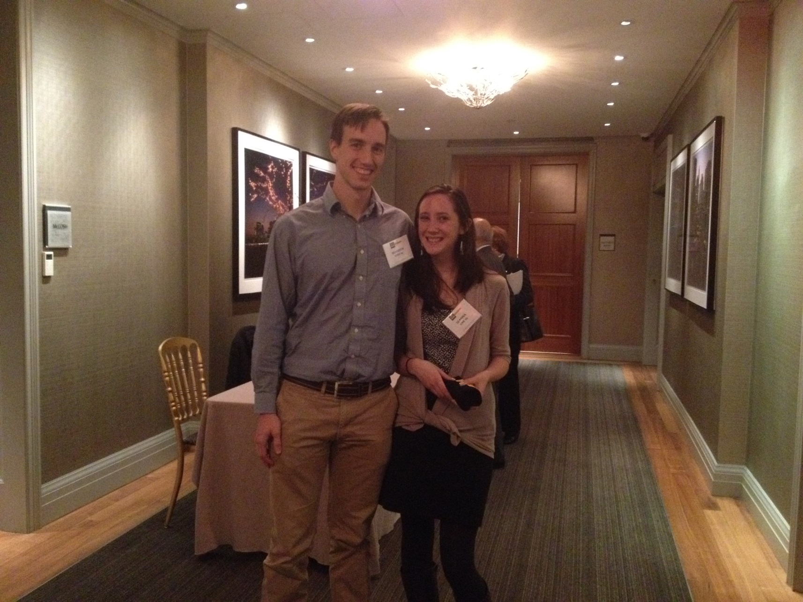
Other benefits of CS60!
CS 60
CS 70 : C++ & data structures
CS 81 : Logic for CS
CS105 : Systems
CS121 : LSD
CS131 : Prog. Languages
CS140 : Algorithms
CS142 : Theory
CS151 : Artificial Intelligence
CS132 : Compilers
CS155 : Graphics
Java / Object-Or. programming
Lists, Stacks, Queues, Heaps
BFS + DFS: graphs and trees
Spampede, Inheritance
Racket and fun. programs
Parsing and Grammars
Prolog and Boolean Logic
Computability and TMs
DFAs, NFAs, and Reg. Exps
DP and Big-O analysis
REQUIRED
3 ELECTIVES
among many others...

Slide 52
Other benefits of CS60!
CS 60
CS 70 : C++ & data structures
CS 81 : Logic for CS
CS105 : Systems
CS121 : LSD
CS131 : Prog. Languages
CS140 : Algorithms
CS142 : Theory
CS151 : Artificial Intelligence
CS132 : Compilers
CS155 : Graphics
Java / Object-Or. programming
Lists, Stacks, Queues, Heaps
BFS + DFS: graphs and trees
Spampede, Inheritance
Racket and fun. programs
Parsing and Grammars
Prolog and Boolean Logic
Computability and TMs
DFAs, NFAs, and Reg. Exps
DP and Big-O analysis
REQUIRED
Enjoy CS!
3 ELECTIVES
who knows what it will lead to!?
among many others...

Slide 53
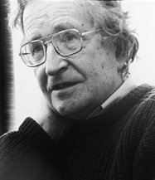
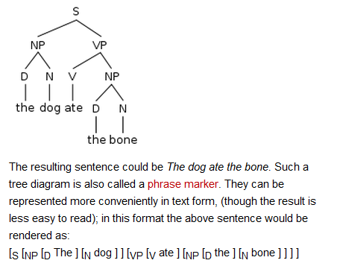
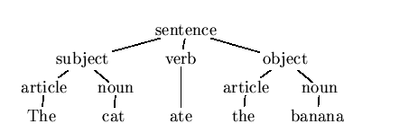
Grammars really everywhere ?
Noam Chomsky, MIT linguist; credited with "universal grammar" theories in linguistics and inventor of the "Chomsky hierarchy" of grammars used throughout CS
Also, still going strong…
English
The cat ate the banana.

Slide 54
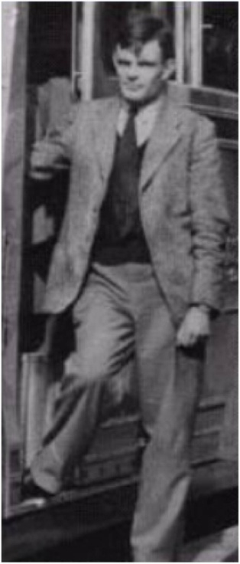


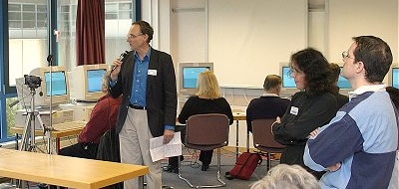
Parsing for real (money)
Turing Test
How could a computer demonstrate intelligence?
Can the judge distinguish the program from the human?
Confederate (human)
Computer program
Judge
$100,000 Loebner prize for passing the Turing test, held each year
Alan Turing

Slide 55
A conversation…
You: Hi. you’re the program that won the Loebner competition, right?

Slide 56
A conversation…
You: Hi. you’re the program that won the Loebner competition, right?
SID: Albert One was the last winner of the Loebner Contest. I am something else entirely.
You: Impressive. Do you have any areas of particular expertise?

Slide 57
A conversation…
You: Hi. you’re the program that won the Loebner competition, right?
SID: Albert One was the last winner of the Loebner Contest. I am something else entirely.
You: Impressive. Do you have any areas of particular expertise?
SID: I appreciate that.
You: Not so impressive. If I ask a question after a statement, do you ignore the question?

Slide 58
A conversation…
You: Hi. you’re the program that won the Loebner competition, right?
SID: Albert One was the last winner of the Loebner Contest. I am something else entirely.
You: Impressive. Do you have any areas of particular expertise?
SID: I appreciate that.
You: Not so impressive. If I ask a question after a statement, do you ignore the question?
SID: I am free to do as I please.
You: Wow! Are you talking free will vs. determinism?

Slide 59
A conversation…
You: Hi. you’re the program that won the Loebner competition, right?
SID: Albert One was the last winner of the Loebner Contest. I am something else entirely.
You: Impressive. Do you have any areas of particular expertise?
SID: I appreciate that.
You: Not so impressive. If I ask a question after a statement, do you ignore the question?
SID: I am free to do as I please.
You: Wow! Are you talking free will vs. determinism?
SID: I don’t think wow am i talking free will vs. determinism, but I can’t be 100% sure of that.

Slide 60
Recursive Descent Parsing
uses a shared token list, as a String[]
each nonterminal has its own method
builds a parse tree by peeking ahead at tokens…
Tokens:
Parse tree:
< 8, +, 4, *, 5 >
[+ [8] [* [4] [5]]]
Grammar:
Parsing via a method for each nonterminal:
S
P
+
S
P
?? S()
"sum"
P
V
P
V
?? P()
*
"product"
V
?? V()
any number
"value"
What should these return types be?

Slide 61
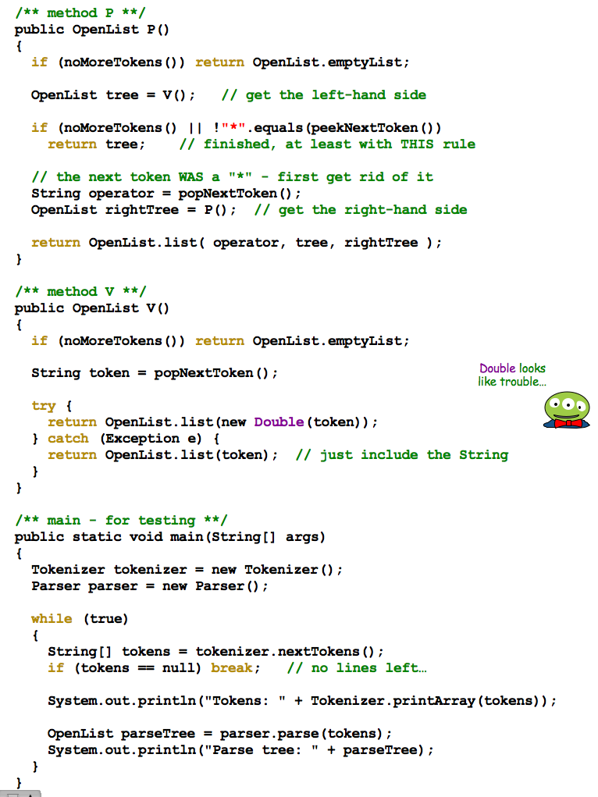
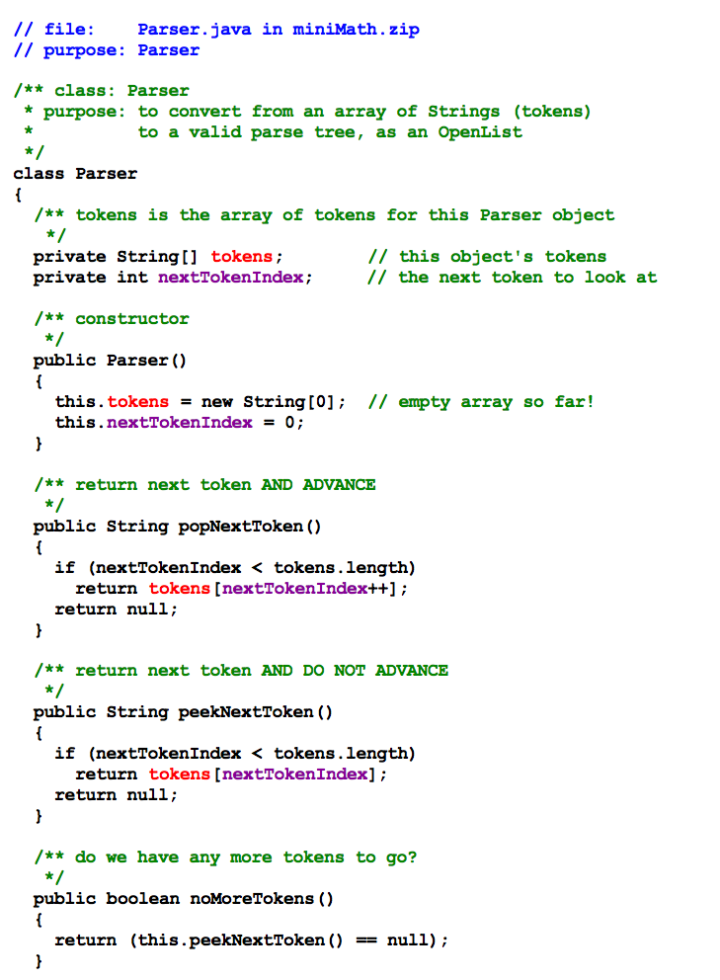
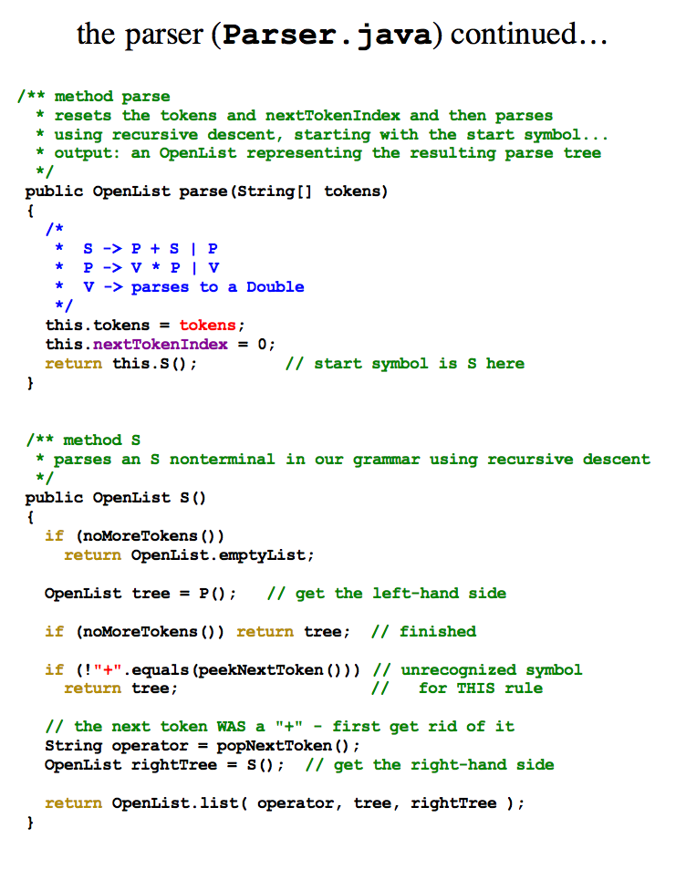
(0) Find the parser object created in main…
Name(s) ______________________________________
(1) Suppose the tokens are <5, *, 8, +, 2>
[5]
first OL returned by V:
(2) Trace the code starting with parse …
first OL returned by P:
(3) What is the OpenList returned by P? and by S?
first OL returned by S:
(4) How would you change this code to handle subtraction - and division / ?

Slide 62
The final piece!
String input
Tokenizer
String[] tokens
Parser
OpenList parseTree
Evaluator
getting from structure to value
Quantity result

Slide 63
Evaluate!
The final step in our language's implementation…
String
"8 + 4 * 5"
Token List
< 8 + 4 * 5 >
Parse Tree
[+, [8], [*, [4], [5]]]
Evaluation
28.0
public ?? evaluate( ?? )
How is this going to work?

Slide 64
Language, via computation
Maybe this is only about computer languages…
intent etc.
Notes:
Java's libraries are comprehensive and huge… [POSTER] – two versions ago
We don't teach them explicitly, actually, but it's always good to keep in mind that they're there…
story about balance (Lenovo's Mr. Challener)

Slide 65
See you Thursday!
Notes:
http://www.cs.duke.edu/csed/jflap/new/DOCS/gui.regular.EditorPane.html
The Regular Expression EditorThe editor for a regular expression is essentially just a single text field. Operators in a regular expression are the Kleene star (*), the ``or'' operator (+), parentheses are also usable, and concatenation is accomplished by making symbols adjacent.In HaikuTo make expressions for this program to work with, type them in the field.Adjacent symbols imply concatenation. No symbol is used.Many or nothing, Asterisk (*) is the Kleine star. What precedes repeats.Additionally, if you want an "or" symbol the plus (+) should be used.Screaming nothingness, exclamations (!) are special. They act as lambda.Formatting errors will be reported to you when you choose actions. The Regular Expression EditorThe editor for a regular expression is essentially just a single text field. Operators in a regular expression are the Kleene star (*), the ``or'' operator (+), parentheses are also usable, and concatenation is accomplished by making symbols adjacent.In HaikuTo make expressions for this program to work with, type them in the field.Adjacent symbols imply concatenation. No symbol is used.Many or nothing, Asterisk (*) is the Kleine star. What precedes repeats.Additionally, if you want an "or" symbol the plus (+) should be used.Screaming nothingness, exclamations (!) are special. They act as lambda.Formatting errors will be reported to you when you choose actions.

Slide 66
/* making the most of one's comments…
* - Jim Norwood from cs60 past…
*/
class Queue implements QueueInterface
{
private QCell front;
private QCell back;
// I 1 2 C F D Q S M T
boolean isEmpty() {return front == null;}
// I 1 A v M T Q
public Queue() {
this.front = null;
this.back = null;
}
// other methods in the interface…
add
remove
peek
}
Queue comments?

Slide 67
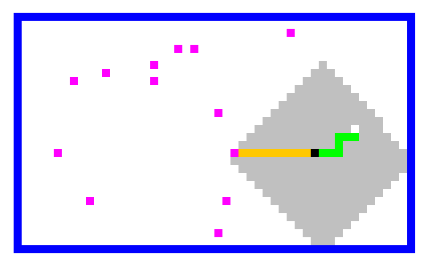
The end of CS60?
Final exam
Final assignment
Topics and practice posted…
the Applet's big-picture view
(and solutions – can check midterm again, too)
HW11: Spampede (+ AI)
Review session ~ Sun 11th 7-8pm
Stack
Queue
Take-home ready on Mon 12th…
Depth-first search
Breadth-first search
…return by Thu 15th by 5pm
(we grade the exams that evening @ 5:30!)
Details:
BFS!
- two two-sided pages of notes OK
- may use an IDE to compose, not run
- worth 2½ assignments
Seniors can opt out…

Slide 68
Who needs extra credit to want more Java?!
More Java!?
Implement your own language…
… for Unicalc.
demos
CS60 ~ how (computer) languages work!!

