Slide 1
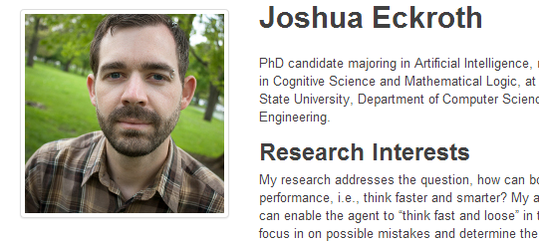
Today in CS 60
Homework #0 due Mon., 1/27 by 11:59 pm
1 month of CS 5 in a single day… (in a new language, too!)
Quick questions?
Piazza!
How Racket thinks: lists and recursion
you are cordially invited to the LAC Lab for…
Friday 2-4
"office" hours!
big-O
Guest lecture next Tues. by Josh Eckroth…

Slide 2
O(N)e-slide big-O
big-O captures the long-term or "asymptotic" speed of an algorithm (in the worst case)
Algorithm/Problem
big-O runtime
Find the minimum of a list of N elements.
O(N)
Sort an N-el. list by repeated min-finding.
O(N²)
Find the minimum of an N-el. sorted list.
O(1)
Run halve-count(N)
O(logN)
Open an N-wheel combination lock
O(10^{N})
Find the dot product of two N-el. vectors.
O(N)
Find the product of two NxN matrices.
O(N³)
Play Connect-Four with N ply lookahead
Find the element closest to 42 in an (un)sorted list.
in hw0pr2
Find the two closest elements in an (un)sorted list.

Slide 3
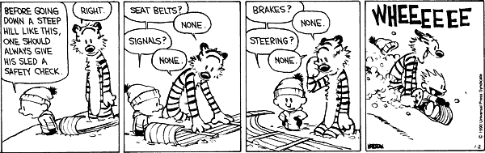
Racket is a small, exceptionally clean language which is fun to use.
(define (add42 N)
(+ 42 N))
(define (is42 N)
(if (equal? N 42)
#t
#f)
Something seems wrong here…
Racket - Scheme - LISP
1960 John McCarthy

Slide 4
Data!
Questions to ask with any new language…
Read - Evaluate - Print
How do you interact?
(define answer 42)
How do you label data?
#f #t
booleans
How do basic data types look?
42
integer
42.0
floating point (also: rational, complex)
#\c
character
"a string"
string
'fac
symbol
What data structures are supported?
100% of the syntax!
'(a b c)
list

Slide 5
Data structures in Racket
string
"tictacs"
familiar!
They say John McCarthy hated commas!
list
'(a b c)
familiar, but…
symbol
'fac
similar to a "variable" or "label" – but it doesn't need a defined value!
char
#\c
the smallest piece of a string…
(string->list "Go cs!")
(string->symbol "fac")
But he seemed to like punctuation!
(list? "cs")

Slide 6
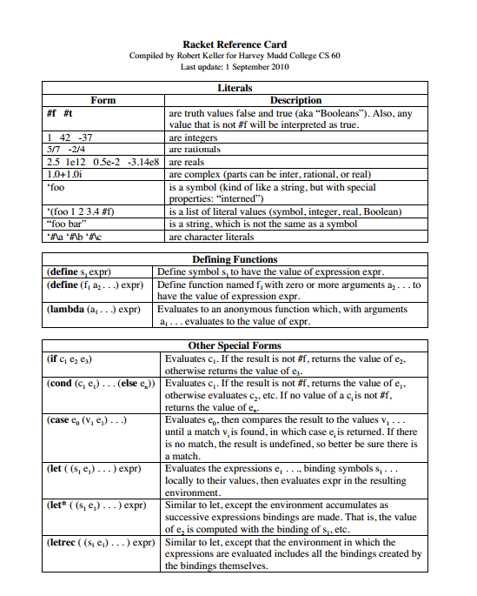
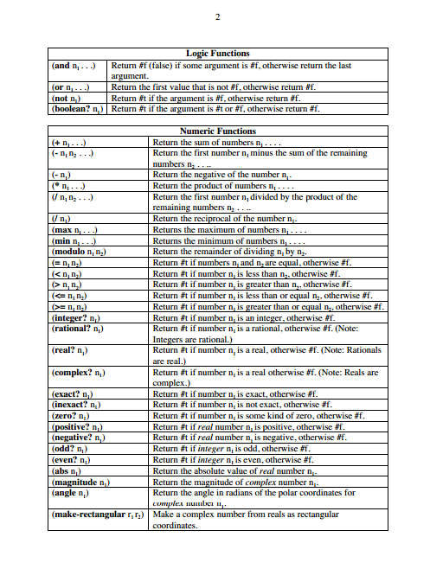
Reference card…

Slide 7
Equality?
Questions to ask with any new language…
How to label data?
(define answer 42)
global names
Python: =
(let* ((answer 42)
(class 60))
(+ answer class))
local names
102
set-equals
test-equals
How to test for equality?
(equal? '(42) (list 42))
equality of structures…
#t
Python ==
(= 42 42.0)
equality of numbers…
#t

Slide 8
Interpreting lists...
(f 60)
This will be the value returned when the function f is run on the single input, 60.
'(f 60)
This is simply a list consisting of two elements… ~ a QUOTED expression
Don't quote me on this, but I thought Racket was exceptionally un-exception-al ?
(quote (f 60))
even ' is a function!
Indeed:
(eval '(f 60))
functions == data

Slide 9
Functions vs. Data?
Better to have 100 functions operate on one data structure than 10 functions on 10 data structures.
- Alan Perlis
Notes:
There’s another quote about judging programming via structures, not control flow... I need to find that one.
Illustrative pictures: 2 sets of 10 nodes completely interconnected vs.
1 set of 100 nodes and a singleton set of 1 node...
same # of connections, so what’s the difference
-- consistency of representation

Slide 10
Racket: a functional language
I prefer NONfunctional languages!
Whose efficiency matters ?!? coding vs. running time
Functions as primary building blocks toolkit approach
Lists are the "only" data structure simplicity!
Racket
Lists
Functions
'(1 2 3)
(fac 5)
In fact, lists are everything - data and f'ns no special cases!
Recursion is the primary control structure no loops!
Notes:
Functional programming is a major paradigm
“Functional” means relating to functions, not “working”
-- a time when AI researchers believed that LISP (an early fp language) could model how humans thought...
-- (note that LISP was mentioned more than once as the least favorite
thing)

Slide 11
Analyzing Lists
(define M '(1 (2 3) 4))
Iterative structure
Recursive structure
(length M)
(null? M)
(first M)
base case
recursion!
(second M)
(first M)
(third M)
(fourth M)
(rest M)

Slide 12
Synthesizing Lists
three fundamental functions
Iterative list-building
Recursive list-building
(list 1 2 3)
(cons 1 '(2 3))
'(1 2 3)
'(1 2 3)
consider cons first (and rest)!
Composite list-building
(append '(1 2) '(3 4))
'(1 2 3 4)

Slide 13
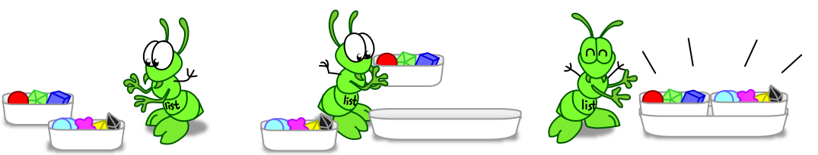
Hey! Who are these ocularly-challenged intruders?!?
Synthesizing Lists
in pictures!
(list '(1 2 3) '(4 5 6))
'((1 2 3) (4 5 6))

Slide 14
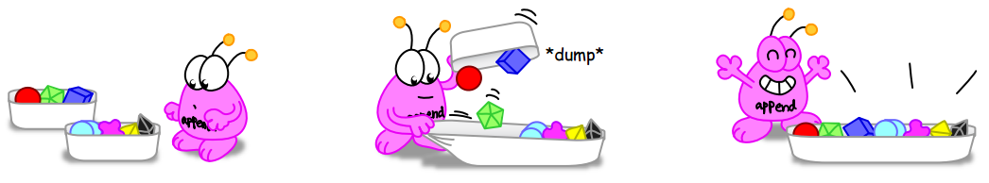
Synthesizing Lists
in pictures!
(append '(1 2 3) '(4 5 6))
'(1 2 3 4 5 6)

Slide 15
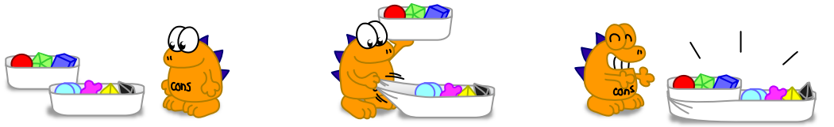
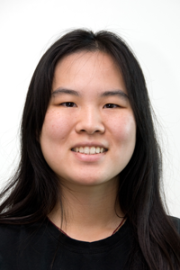
Synthesizing Lists
in pictures!
(cons '(1 2 3) '(4 5 6))
'((1 2 3) 4 5 6)
Ketrina Yim, Cal CS Illustrated

Slide 16
List-building
list
cons
append
reverse
(cons 'a '(b c))
(cons '(a) '(b c))
(list 'a '(b c))
(list '(a) '(b c))
(append 'a '(b c))
(append '(a) '(b c))
( reverse '((a b) c d) )

Slide 17
Quiz
list
cons
Name(s) _______________________
append
reverse
(define L '(h a r))
Use L and M to evaluate (and build) these lists:
(define M '(e v))
(list L L)
(cons L M)
(append L (reverse L))
'(r a v e)
'(h a r v e y)
use 'y here

Slide 18
list
cons
Quiz
DO THESE FIRST ON THE BACK PAGE OF THE NOTES ... (to be handed in...)
append
reverse
(define L '(h a r))
Use L and M to evaluate (and build) these lists:
(define M '(e v))
(list L L)
(cons L M)
(append L (reverse L))
'(r a v e)
'(h a r v e y)
use 'y here

Slide 19
Recursion: strategies!
To understand recursion, you must first understand recursion… .
- a CS60 student who understood recursion
Just pretend that the function you're writing already exists.
- CS60er G. Romer
Notes:
I don’t know if this really works...

Slide 20
Recursion: strategies!
To understand recursion, you must first understand recursion… .
- a CS60 student who understood recursion
Just pretend that the function you're writing already exists.
- CS60er G. Romer
New:
Write it in Python first!
or at least imagine it in Python...
- CS60er M. Lai
Notes:
I don’t know if this really works...

Slide 21
Recursion ~ functional control flow
Specification:
returns the length of the list L
(length L)
Code:
(define (length L)
(if (null? L)
#t branch
#f branch
big-O ?
length is already built-in…

Slide 22
How to if?
Questions to ask of any new language…
these can be parens, too
(define (h2o temp)
(cond [(< temp 32) "ice"]
[(< temp 212) "water"]
[ else "steam"]))
cond
(define (h2o temp)
(if (< temp 32) "ice"
(if (< temp 212) "water"
"steam")))
if
I like this one better…
all branches are mutually exclusive ~ notice the implicit returns!

Slide 23
Spacing doesn't matter!
Do you see the #t and #f branches here?
(define (h2o temp)
(if (< temp 32)
"ice"
(if (< temp 212)
"water"
"steam")))
These are identical to Racket.
(define (h2o temp)
(if (< temp 32) "ice"
(if (< temp 212) "water"
"steam")))
if
I like this one better…

Slide 24
Use one of these , if …
expanded:
(define (h2o temp)
(if (< temp 32)
"ice"
(if (< temp 212)
"water"
"steam")))
compact:
(define (h2o temp)
(if (< temp 32) "ice"
(if (< temp 212) "water"
"steam")))

Slide 25
Re-member-ing recursion…
Specification:
(member e L)
returns #t if e is in L, #f otherwise
Code:
(define (member e L)
(if
(if
best-case?
worst-case?
average-case?
big-O ?
member is also built-in… but it looks a little different

Slide 26
Remove, recursion?
Specification:
returns L without its first e, if it has one
(remove e L)
Code:
(define (remove e L)
(if (null? L)
(if (equal? e (first L))
best-case?
worst-case?
big-O ?
remove is built-in

Slide 27
A better remover?
Insight:
(remove e L)
runs through the whole list even when the element e is not there…
Improvement:
let's check if it's there first!
(define (remove e L)
(if (not (member e L))
L
( … other cases as before …
new!
worst-case?
big-O ?

Slide 28
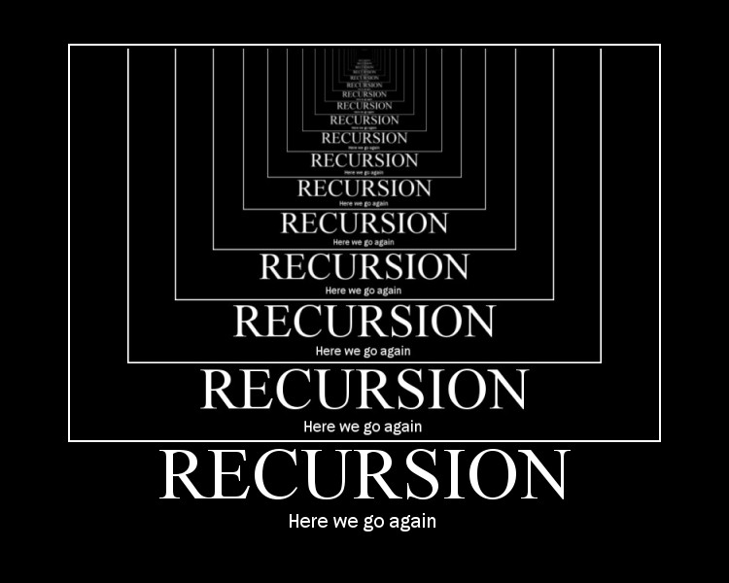

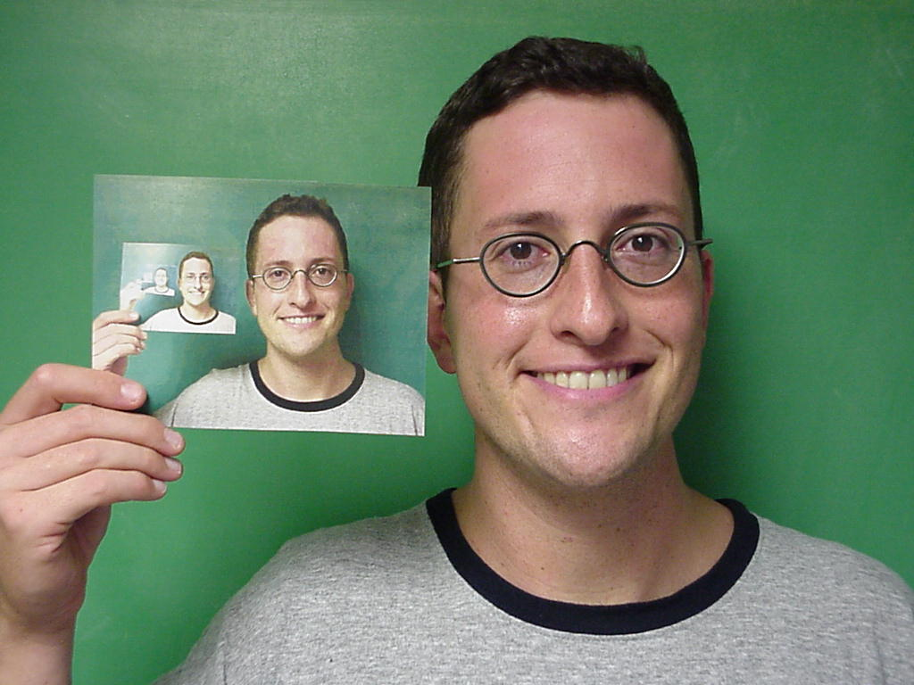
handles arbitrary structural depth – all at once!
Recursion's advantage:
Notes:
I don’t know if this really works...

Slide 29
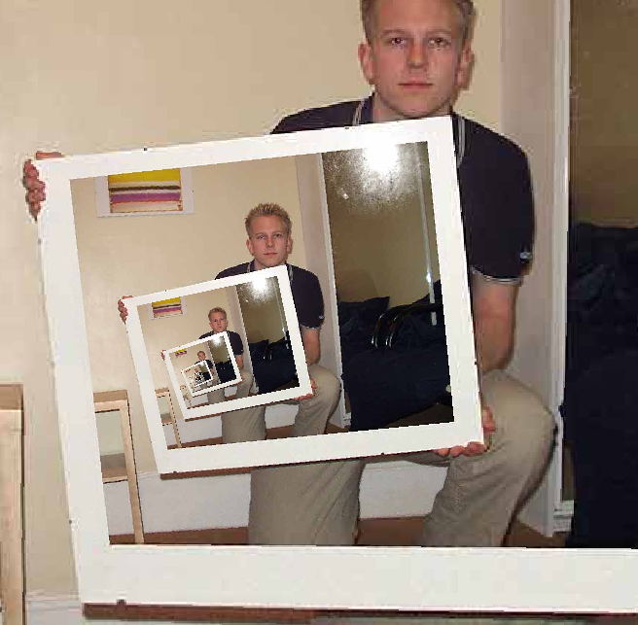
Recursion's disadvantage:
your brain also needs to handle arbitrary structural depth – all at once!
The dizzying dangers of having no base case!
Notes:
I don’t know if this really works...

Slide 30
Going deeper!
Specification:
does e appear at any nesting depth in the list L?
(memAny e L)
Code:
(define (memAny e L)
(cond
( (equal? e L)
( (not (list? L))
( (null? L)
( else
(list? x) returns #t or #f depending on whether x is a list...
big-O ?

Slide 31
Try it!
Write these functions using recursion!
2
(reverse L)
should return a list identical to L, but with its (top-level) elements reversed
1
(append L M)
should return a list identical to what Python would call L+M
E.g.,
( reverse '(1 2 (3 4)) )
'((3 4) 2 1)
(define (reverse L)
(if (null? L)
(define (append L M)
(if (null? L)
(cons
Hint: you only need to finish this thought!
3
(flatten L)
should return a list identical to L, but with all internal nesting flattened!
4
(fib N)
the Nth fibonacci number, from 0
(fib 0)
1
(fib 1)
1
E.g.,
(flatten '(1 (2 3 (4)) (5 6)))
'(1 2 3 4 5 6)
(fib 2)
2
(fib 3)
3
(define (fib N)
(
(fib 4)
5
(define (flatten L)
(
(fib 5)
8
each is the sum of the previous two...
Extra: Estimate the big-O complexity of these four functions...

Slide 32
Recursion:
craziness? insight? both?
Hofstadter's Law:
It always takes longer than you expect,
even when you take Hofstadter's Law into account.
Warning: This tends to apply to CS 60 homework!
Notes:
I don’t know if this really works...

Slide 33
from the Quiz…
2
should return a list identical to L, but with its (top-level) elements reversed
(reverse L)
should return a list identical to what Python would call L+M
E.g.,
( reverse '(1 2 (3 4)) )
'((3 4) 2 1)
1
(append L M)
(define (append L M)
(if (null? L)
M
(cons (first L)
(append (rest L) M))...
(define (reverse L)
(if (null? L)
M
(append (reverse (rest L))
(list (first L))...
Big-O ?
3
(flatten L)
should return a list identical to L, but with all internal nesting flattened!
4
(fib 0)
1
(fib N)
(fib 1)
1
E.g.,
(flatten '(1 (2 3 (4)) (5 6)))
'(1 2 3 4 5 6)
(fib 2)
2
the Nth fibonacci number, from 0
(fib 3)
3
(fib 4)
5
(define (flatten L)
(cond
((null? L) '() ) ; or L
((list? L) (append (flatten (first L))
(flatten (rest L))))
( else (list L) ) ...
(fib 5)
8
each is the sum of the previous two...
(define (fib N)
(if (< N 2)
1
(+ (fib (- N 1))
(fib (- N 2))...

Slide 35
Quiz
Write these functions using recursion!
2
(reverse L)
should return a list identical to L, but with its (top-level) elements reversed
1
(append L M)
should return a list identical to what Python would call L+M
E.g.,
( reverse '(1 2 (3 4)) )
'((3 4) 2 1)
Hint: only recurse on L, not M!
(define (reverse L)
(
Try this idea: '(1 2 3) + '(4 5) == (cons 1 '(2 3) + '(4 5) )
(define (append L M)
(
We'll try these next time… perhaps we'll make it in 2014…
3
(flatten L)
should return a list identical to L, but with all internal nesting flattened!
4
(fib N)
the Nth fibonacci number, from 0
(fib 0)
1
(fib 1)
1
E.g.,
(flatten '(1 (2 3 (4)) (5 6)))
'(1 2 3 4 5 6)
(fib 2)
2
(fib 3)
3
(define (fib N)
(
(fib 4)
5
(define (flatten L)
(
(fib 5)
8
each is the sum of the previous two...
Extra: Estimate the big-O complexity of these four functions...

Slide 36
Slides from past years from this point on…

Slide 37
Last time...
should return a list identical to L, but with its (top-level) elements reversed
2
(reverse L)
1
(append L M)
should return a list identical to what Python would call L+M
(define (reverse L)
(if (null? L)
M
(append (reverse (rest L))
(list (first L))...
(define (append L M)
(if (null? L)
M
(cons (first L)
(append (rest L) M))...
Big-O ?
3
(flatten L)
should return a list identical to L, but with all internal nesting flattened!
4
(fib 0)
1
(fib N)
(fib 1)
1
E.g.,
(flatten '(1 (2 3 (4)) (5 6)))
'(1 2 3 4 5 6)
(fib 2)
2
the Nth fibonacci number, from 0
(fib 3)
3
(fib 4)
5
(define (flatten L)
(cond
((null? L) '() ) ; or L
((list? L) (append (flatten (first L))
(flatten (rest L))))
( else (list L) ) ...
(fib 5)
8
each is the sum of the previous two...
(define (fib N)
(if (< N 2)
1
(+ (fib (- N 1))
(fib (- N 2))...

Slide 38

All corners of computational space?
Cow
MoO moO MoO mOo MOO OOM MMM moO moO MMM mOo mOo moO MMM mOo MMM moO moO MOO MOo mOo MoO moO moo mOo mOo moo
Whitespace
Fibonacci
Hello world
0 lI'moH A cher
1 lI'moH B cher
A cha' B cha'
18 {
A B boq
latlh
cha'
B "A" cher
"B" cher
} vangqa'
Var’aq
Piet
Fibonacci
Fibonacci
Malbolge
(=<`$9]7<5YXz7wT.3,+O/o'K%$H"'~D|#z@b=`{^Lx8%$Xmrkpohm_Ni;gsedcba`_^]\[ZYXWVUTSRQPONMLKJIHGFEDCBA@?>=<;:9876543s+O<oLm
Hello world
Who are you calling fringe?
Fortunately, CS 60 does NOT goto the fringe of the programming-language universe !

Slide 39
Analyzing Lists
(define M '(1 (2 3) 4))
Iterative structure
Recursive structure
(length M)
(null? M)
(first M)
base case
recursion!
(second M)
(first M)
(third M)
(fourth M)
(rest M)

Slide 40
list
cons
DO THESE FIRST ON THE BACK PAGE OF THE NOTES ... (to be handed in...)
Quiz
append
reverse
( define L '(h a r) )
Use L and M to evaluate - or build - these lists:
( define M '(e v) )
(list L L)
(cons L M)
(append L (reverse L))
'(r a v e)
'(h a r v e y)
use 'y

Slide 41
List-building
list
cons
append
reverse
(cons 'a '(b c))
(cons '(a) '(b c))
(list 'a '(b c))
(list '(a) '(b c))
(append 'a '(b c))
(append '(a) '(b c))
( reverse '((a b) c d) )

Slide 42
list
cons
DO THESE FIRST ON THE BACK PAGE OF THE NOTES ... (to be handed in...)
Quiz
append
reverse
( define L '(h a r) )
Use L and M to evaluate - or build - these lists:
( define M '(e v) )
evaluates to
(list L L)
(cons L M)
(append L (reverse L))
'(r a v e)
'(h a r v e y)
use 'y

Slide 43
List-building
list
cons
append
reverse
(cons 'a '(b c))
(cons '(a) '(b c))
(list 'a '(b c))
Big-O ?
(list '(a) '(b c))
(append 'a '(b c))
(append '(a) '(b c))
( reverse '((a b) c d) )

Slide 44
Recursion ~ functional control flow
Specification:
(length L)
returns the length of the list L!
Code:
(define (length L)
(if
big-O ?
length is built-in

Slide 45
Going deeper!
Specification:
does e appear at any nesting depth in the list L?
(memAny e L)
Code:
(define (memAny e L)
(cond
( (equal? e L)
( (not (list? L))
( (null? L)
( else
(list? x) returns #t or #f depending on whether x is a list...
big-O ?

Slide 46
big-O in O(N)e slide!
big-O captures the long-term (asymptotic) speed of an algorithm in the worst case
Algorithm/Problem
big-O runtime
Find the minimum of a list of N elements.
Sort an N-el. List by repeated min-finding.
Find the minimum of an N-el. sorted list.
Find the diameter of a set of N points.
Find the dot product of two N-el. vectors.
Find the product of two NxN matrices.
Run halve-count(N)
Find the element closest to 42 in a sorted list.
Find the median of an N-el. list.

Slide 47
Quiz
Write these functions using recursion!
2
(reverse L)
should return a list identical to L, but with its (top-level) elements reversed
1
(append L M)
should return a list identical to what Python would call L+M
(define (reverse L)
(
Hint: only recurse on L, not M!
Try this idea: '(1 2 3) + '(4 5) == (cons 1 '(2 3) + '(4 5) )
(define (append L M)
(
3
(flatten L)
should return a list identical to L, but with all internal nesting flattened!
4
(fib N)
the Nth fibonacci number, from 0
(fib 0)
1
(fib 1)
1
E.g.,
(flatten '(1 (2 3 (4)) (5 6)))
'(1 2 3 4 5 6)
(fib 2)
2
(fib 3)
3
(define (fib N)
(
(fib 4)
5
(define (flatten L)
(
(fib 5)
8
each is the sum of the previous two...
Extra: Estimate the big-O complexity of these four functions...

Slide 48
list
cons
Quiz
Name(s): __________________________
append
reverse
( define L '(h a r) )
Use L and M to evaluate - or create - these lists:
( define M '(e v) )
evaluates to
(list L L)
(cons L M)
(append L (reverse L))
'(r a v e)
'(h a r v e y)
use 'y

Slide 49
Analyzing Lists
( define M '(1 (2 3) 4) )
Iterative structure
Recursive structure
(length M)
(null? M)
(first M)
(first M)
(second M)
(rest M)
(third M)

Slide 50
list
cons
Quiz
Name(s): __________________________
append
reverse
( define L '(h a r) )
Use L and M to evaluate - or create - these lists:
( define M '(e v) )
evaluates to
(list L L)
(cons L M)
(append L (reverse L))
'(r a v e)
'(h a r v e y)
use 'y

Slide 51
Recursion: trials (and tribulations)
Specification:
(length L)
returns the length of the list L!
Code:
(define (length L)
(if
big-O ?

Slide 52
Remember recursion?
Specification:
(member e L)
returns #t if e is in L, #f otherwise
Code:
(define (member e L)
(cond
( (null? L)
(
pattern?
I'd re-MEMBER this example!
big-O ?

Slide 53
Recursive Remove?
Specification:
returns L without its first e, if it has one
(remove e L)
Code:
(define (remove e L)
(cond
( (null? L)
( (equal? e (first L))
big-O ?
can we do better?

Slide 54
Going deeper!
Specification:
does e appear at any nesting depth in the list L?
(memAny e L)
Code:
(define (memAny e L)
(cond
( (equal? e L)
( (not (list? L))
( (null? L)
( else
(list? x) returns #t or #f depending on whether x is a list...

Slide 56
Programming language space
JFLAP
computation
Prolog
Matlab
abstraction axis
Python
C
Java
HWare
task-independent
specificity axis
task-specific
Racket
In CS 60 you'll use at least four programming languages...
the language formerly known as Scheme

Slide 57
A+ - Dialect of APL used at Morgan-Stanley.
A0 or A-0 - Grace Hopper's team at Remington Rand, 1952, for the UNIVAC I
AACC - Language for building finite state automata.
AADL - Axiomatic Architecture Description Language.
ABC ALGOL - An extension of ALGOL 60 with arbitrary data structures
ACOS – Bulletin-board language for PRODOS 8 on Apple ][.
ACP - Algebra of Communicating Processes.
ACT++ - Concurrent extension of C++ based on actors.
Act1 - An actor language, descendant of Plasma.
Act2 - An actor language. "Issues in the Design of Act2", by D. Theriault
Act3 - High-level actor language, descendant of Act2.
Ada - named for Ada Lovelace (1811-52), arguably the world's first programmer
... skipping 2,279 languages ...
yacc - Yet Another Compiler Compiler. Language used to build parsers.
YALLL - Yet Another Low Level Language. Patterson et al, UC Berkeley,
Yay - Yet Another Yacc - An extension of Yacc with LALR(2) parsing.
Yerk - named for Yerkes Observatory, where it was used/developed
ZAP - Language for expressing transformational developments.
Zed - 1978. Software Portability Group, U Waterloo. Eh, with types added.
ZENO - U Rochester 1978. Euclid with asynchronous message-passing.
ZIL - Zork Implementation Language. Language used by Infocom's Interactive
zsh - Sh with list processing and database enhancements.
Zuse - named for Konrad Zuse, the designer of the first binary digital computer
Programming Languages
CS 60’s goal: to think computationally ~ i.e., pick up any of these languages easily…

Slide 58
list
cons
Quiz
Name(s): __________________________
append
reverse
( define L '(h a r) )
Use L and M to evaluate - or create - these lists:
( define M '(e v) )
evaluates to
(list L L)
(cons L M)
(append L (reverse L))
'(r a v e)
'(h a r v e y)
use 'y

Slide 59
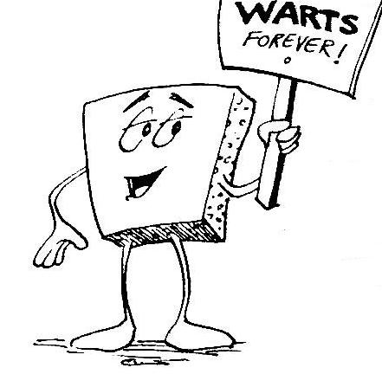

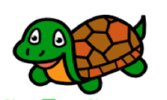
Welcome to CS 60 !
Principles of CS
Principles of CS gets two thumbs.
Of all the classes I took, this was one of them.
When CS 60 was over, I knew it was a good thing.
an advocate of concrete computing
- Megacritic's course reviews
Some of your hosts…
Notes:
Welcome!

Slide 60
Recursion: craziness? insight?
both?
Banach-Tarski Paradox
A solid sphere can be cut into 5 rigid parts... and then rearranged into two spheres identical to the original!
Warning: This also tends to apply to CS 60 homework!
Notes:
I don’t know if this really works...

Slide 61
let* there be local variables!
O( log(N) ) power-:
(define (pow b N) ;; return b**N
(cond
[ (= N 0) 1 ]
[ (odd? N) (* b (pow b N-1)) ]
[ else
(let* ([ halfpow (pow b (/ N 2)) ])
(* halfpow halfpow)) ] ;; end else
))
end of let*
local definition(s)

Slide 62
Putting assoc in it…
An a-list (association list) is a way of associating a data "key" with a value
similar to Python's dictionaries…
(define rome '( (#\I 1) (#\V 5) (#\X 10) (#\L 50) (#\C 100) (#\D 500) (#\M 1000) ))
(assoc #\D rome)
'(#\D 500)
(assoc #\Z rome)
#f
Notes:
I don’t know if this really works...

Slide 63
Recursion "wrappers"
;; find the factorial of
;; the numbers in a list
(define (fac-of-list L)
(if (equal? L '())
'()
(cons (fac (first L))
(rest L))))
;; square all the numbers in a list
(define (squares-of-list L)
(if (equal? L '())
'()
(cons (square (first L))
(rest L))))
;; apply function f to all the
;; elements in a list
(define (map f L)
(if (equal? L '())
'()
(cons (f (first L))
(rest L))))
MAP
rewrite above functions
using map
Note: map is built-in to scheme

Slide 64
foldr
best illustrated by example…
(define (foldr f e L)
foldr
rewrite above functions
using map
Note: foldr is also built-in

Slide 65
mag
Problem:
a function that computes the vector magnitude of L…
(define (mag L)
rewrite above functions
using map
Use map and foldr!

Slide 66
romanize
Problem:
Determining the roman-numeral value of a string
start with just summing the characters!
(define (romanize f e L)
rewrite above functions
using map

Slide 67
Have a great weekend!

Slide 68
Sum of squares
What if we want to use map in a function that finds the sum of the squares in a list?
(sum-of-squares '(1 2 3)) → 14

Slide 69
Avoiding (Hiding) recursion, Again!
foldr to the rescue!
(foldr + 0 '(1 2 3))
→ 6
Definition:
(define (foldr op initial lst)
(if (equal? lst '())
initial
(op (first list) (foldr op initial (rest list)))))

Slide 70
Sum of even squares
What if we wanted to sum only the even squares?

Slide 71
keep and drop
(keep even? '(1 2 3 4 5))
→ '(2 4)
(drop even? '(1 2 3 4 5))
→ '(1 3 5)
Finish the definitions:
(define (keep pred? lst)
(if (equal? lst '())
'()
(if
(define (drop pred? lst)
(if (equal? lst '())
'()
(if
Then show the definition of sum-of-even-squares

Slide 72
Association lists (a-lists)
An a-list is a way of associating a data key with a value:
  e.g., names and hometowns
(define rome '( (#\I 1) (#\V 5) (#\X 10) (#\L 50) (#\C 100) (#\D 500) (#\M 1000) ))
Go back to Dr Scheme

Slide 73
Map
A / \ o
/</ \/|>
/ \ /\
__/___\______\ \____
http://www.asciimation.co.nz
Suppose log2(x) is the log-base-2 function, then map( log2, [8,1024,1,2]); returns [3,10,0,1]
Suppose f(x) = x%4; (“x mod 4”) then map( f, [7,8,9,10,11,12]); returns [3,0,1,2,3,0]
map( sort, [[8,6,7],[5,3,0]]); returns[[6,7,8],[0,3,5]]
1
2
3
map(f,L)
Notes:
I don’t know if this really works...

Slide 74
Foldr
1
(foldr + 0 '(1 2 3 4]) 10
Suppose max(x,y) = x > y ? x : y; then
(foldr max -Infinity, [5, -5, 14, 10]); returns 14
2
reduce(f,e,L)
Notes:
I don’t know if this really works...

Slide 75
Example
Specification:
prod(L) returns the product of the elements of a list L
Examples:
prod([4, 5, 6]) ; prod(range(1,10)); 120 3628800
Code:
fac ?
Notes:
I don’t know if this really works...

Slide 76
closestToTheAnswer?
Specification:
closestTo42(L) returns the element of L which is closest to 42
Examples:
closestTo42([4, 16, -17]); closestTo42(range(1.7,50.7)); 16 41.7
Code:
too many solutions ?!?
Notes:
I don’t know if this really works...

Slide 77
Functions are first-class objects
Anything that data can do, we can do better!
can be arguments of functions
can be the return value from a function
variables (names) can be bound to functions
… but need not be !
- functions
But why ?
Notes:
I don’t know if this really works...

Slide 78
See you on Thursday!

Slide 79
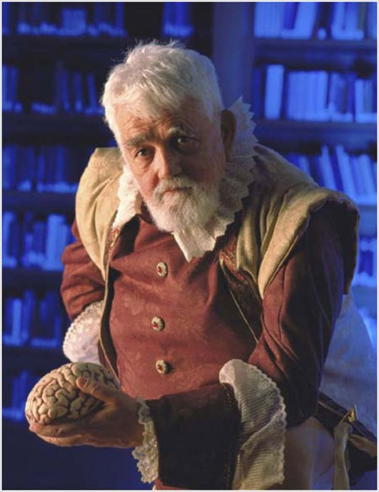
Scheme !
History: John McCarthy and LISP (1960)
Stanford University
coined Artificial Intelligence
'56 Dartmouth Conf.
Scheme grew as a very "clean" version of LISP, a functional programming language…
I wonder what a non-functional language looks like?
Part of most AI researchers' geneology…

Slide 80
Scheme data ~ Lists
Lists
List Access
List Access
S-expression syntax
List!

Slide 81
Scheme functions ~ also lists!
Lists
List Access
List Access
Stanford University
coined Artificial Intelligence
'56 Dartmouth Conf.
Scheme grew as a very "clean" version of LISP, a functional programming language…
List!
Part of most AI researchers' geneology…

Slide 82
Scheme !
Stanford University
coined Artificial Intelligence
'56 Dartmouth Conf.
Scheme grew as a very "clean" version of LISP, a functional programming language…
I wonder what a non-functional language looks like?
Part of most AI researchers' geneology…

Slide 83
Scheme !
History: John McCarthy and LISP (1960)
Next time…
No internet or other copying of files except those provided by the course material.
No transcribing of programs from paper, whiteboards, blackboards, or other media.

Slide 84
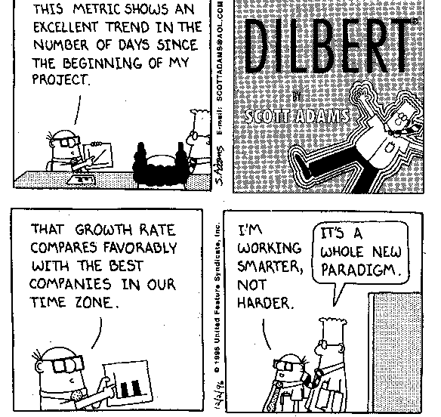
Choosing a path
Programming
What
How
Declarative
Imperative
What mood am I in today?
Logic Programming
Functional Programming
Object-Oriented
Programming
Low-level Programming
Prolog
Scheme
Java
JFLAP
algorithms via functions
more abstraction away from the machine
closer to the machine

Slide 85
Programming paradigms
Imperative programming
Declarative programming
NAME
moving & changing data
defining functions
IDEA
sequences of commands
composing functions
Assignment statement
Function definition
CODE
int x = 0;
x = x + 42;
(define (add42 x)
(+ x 42))

Slide 86
Scheme's strategy: Recursion
Factorial!
(define (fac N) ;; return the factorial of N
(cond
Power
(define (pow b N) ;; return b**N -- as fast as possible!
(cond

Slide 87
Scheme's strategy: Recursion
Unfactorial
;; return the largest N
(define (unfac F)
;; such that N! <= F

Slide 88
Lists
Universal?
( define M '((e y) v r) )
( define L '(h a) )
( define M '((e y) v r) )
Iterative structure
Recursive structure
(length M)
(null? M)
(first M)
(first M)
(second M)
(rest M)
…
that's it!

Slide 89
Building lists
( define L '(H a) )
(list 1 )
(cons 'a L)
(cons 'a '(H a))
(append L L L)

Slide 90
Paradigms, unmasked

Slide 91
Good news/Bad news
Recursion is very common in scheme…
… but you can often avoid it completely!
Consider these functions:
;; square all the numbers in a list
(define (squares-of-list L)
(if (equal? L '())
'()
(cons (square (first L))
(rest L))))
;; find the factorial of the numbers in a list
(define (fac-of-list L)
(if (equal? L '())
'()
(cons (fac (first L))
(rest L))))

Slide 92
Map: The recursion "alternative"
;; find the factorial of
;; the numbers in a list
(define (fac-of-list L)
(if (equal? L '())
'()
(cons (fac (first L))
(rest L))))
;; square all the numbers in a list
(define (squares-of-list L)
(if (equal? L '())
'()
(cons (square (first L))
(rest L))))
;; apply function f to all the
;; elements in a list
(define (map f L)
(if (equal? L '())
'()
(cons (f (first L))
(rest L))))
rewrite above functions
using map
Note: map is built-in to scheme

Slide 93
Sum of squares
What if we want to use map in a function that finds the sum of the squares in a list?
(sum-of-squares '(1 2 3)) → 14

Slide 94
Avoiding (Hiding) recursion, Again!
foldr to the rescue!
(foldr + 0 '(1 2 3))
→ 6
Definition:
(define (foldr op initial lst)
(if (equal? lst '())
initial
(op (first list) (foldr op initial (rest list)))))

Slide 95
Sum of even squares
What if we wanted to sum only the even squares?

Slide 96
keep and drop
(keep even? '(1 2 3 4 5))
→ '(2 4)
(drop even? '(1 2 3 4 5))
→ '(1 3 5)
Finish the definitions:
(define (keep pred? lst)
(if (equal? lst '())
'()
(if
(define (drop pred? lst)
(if (equal? lst '())
'()
(if
Then show the definition of sum-of-even-squares

Slide 97
Scheme control: Recursion
(define (pow b N) ;; return b**N
(cond
[ (= N 0) 1 ]
[ (odd? N) (* b (pow b N-1)) ]
[ else (* (pow b (/ N 2))
(pow b (/ N 2))) ]
))
A powerful strategy
base case
recursive cases
list?
number?

Slide 98
Scheming: Functions
Questions to ask of any new language…
(> 60 answer)
How do you call functions?
(+ 60 (- 18))
and or not
boolean operators
And what are common functions called?
+ - * /
modulo quotient
arithmetic
max min expt sqrt sin cos …
mathematical functions
(define (f N)
(* N (+ N 1)))
and define functions?

Slide 99
Scheming, hands-on
Questions to ask of any new language…
(if b
true-branch
false-branch)
How do you make choices?
(cond
[ test result ]
[ test result ]
[ else result ]
)
This one seems like the unconditionally obvious choice to me !
TRY IT OUT!!

Slide 100
Scheme control: Recursion
Taking the power b^{N}
(define (pow b N) ;; return b**N
(cond
[
[
))
base case
recursive case
A powerful strategy!
I think we can do better!

Slide 101
Power: less is more
Can we reuse computation?
(define (pow b N) ;; return b**N
(cond
[ (= N 0) 1 ]
[ (odd? N) (* b (pow b N-1)) ]
[ else (* (pow b (/ N 2))
(pow b (/ N 2))) ]
))
base case
recursive cases
list?
number?
How did we do?

Slide 102
Power: let less be more!
Let allows you to name values inside a procedure:
(define (f x)
(let ((y 3)
(z 10))
(+ y (* z x))))
(f 2) → 23
Note: let binds values in parallel, so the following does not work:
(define (f x)
(let ((y 3)
(z (* 2 y)))
(+ y (* z x))))
problem!
use let* instead !

Slide 103
Scheme?
John McCarthy hated commas!
John McCarthy contemplating minds…
Scheme is a small, exceptionally clean language which is fun to use.
www.engin.umd.umich.edu/CIS/course.des/cis400/scheme/scheme.html
Stanford University
coined Artificial Intelligence
'56 Dartmouth Conf.
inventor of LISP
Part of most AI researchers' geneology…

Slide 104
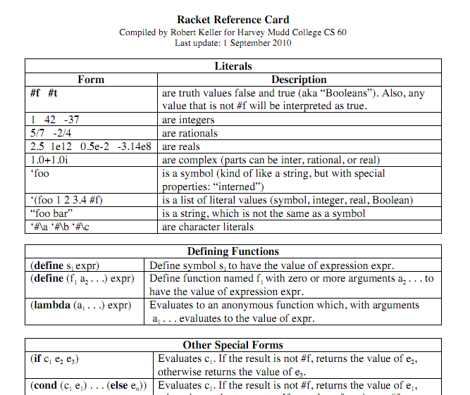
Reference card!
on the CS 60 site...

Slide 105
List-building
list
cons
append
reverse
(cons 'a '(b c))
(cons '(a) '(b c))
(list 'a '(b c))
(list '(a) '(b c))
(append 'a '(b c))
(append '(a) '(b c))
( reverse '((a b) c d) )

