Slide 1
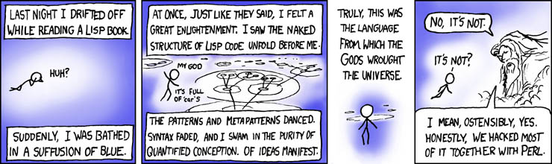
Lisp == Racket
Today in CS 60
This time:
Higher-order functions!
Last time:
Tail recursion…
Homework #1 due Monday, 2/3 by 11:59 pm
Thanks to Josh E.!
Notes:
Randall Munroe == XKCD's author

Slide 2
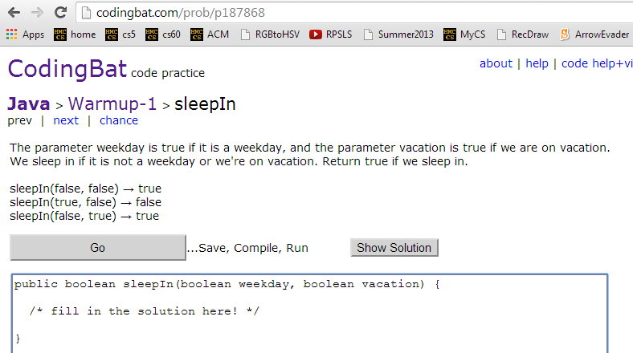
another language already!
homework 1
(1) the problem
(2) examples
(5) break glass in emergency…
(4) try it!
(3) code
The final part involves writing a bit of Java code…
Notes:
Randall Munroe == XKCD's author

Slide 3
another language already!
Racket + Java == Clojure
"new" language ~ 2008
syntax
execution
Here's factorial written in clojure…
(defn fact[x]
(if (<= x 1) 1
(* x (fact (- x 1)))))
Notes:
Randall Munroe == XKCD's author

Slide 4
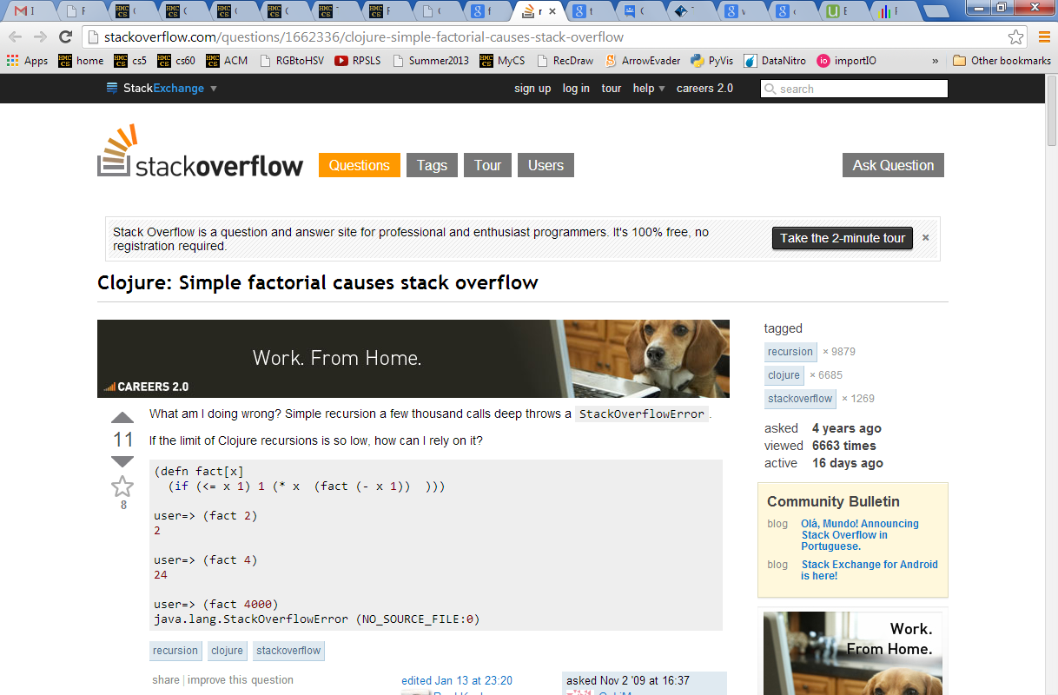
Racket + Java == Clojure
Any suggestions as to how we might get around this?
Notes:
Randall Munroe == XKCD's author

Slide 5
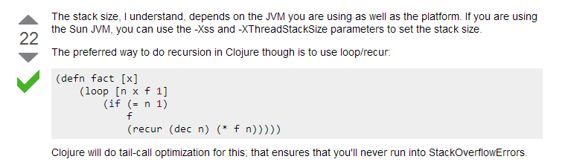
Racket + Java == Clojure
Use tail-recursion!
Notes:
Randall Munroe == XKCD's author

Slide 6
Running recursion
(define (len L)
(if (null? L)
0
(+ 1 (len (rest L)))))
actually, any function call
L =
'(a b c)
( len '(a b c) )
result
the "stack"
L =
'(b c)
its "frames"
( len '(b c) )
result
L =
'(c)
( len '(c) )
result
L =
'()
( len '() )
What goes on the stack, doesn't stay on the stack!
result

Slide 7
Running recursion
(define (len L)
(if (null? L)
0
(+ 1 (len (rest L)))))
actually, any function call
L =
'(a b c)
( len '(a b c) )
result
3
the "stack"
L =
'(b c)
+1
its "frames"
( len '(b c) )
result
2
L =
'(c)
+1
( len '(c) )
result
1
L =
'()
+1
( len '() )
What goes on the stack, doesn't stay on the stack!
result
0

Slide 8
Tail recursion
(define (len L)
(len-tr L 0))
The TR version is usually a helper function…
…because it needs an accumulator
(define (len-tr L Acc)
(if (null? L)
Acc
(len-tr (rest L) (+ 1 Acc))))
Acc accumulates the result …
… then the stack isn't needed!
if the recursion is the final call (in "tail" position)…
Don't need it? Don't use it!

Slide 9
Running tail-recursion
stack
(len-tr '(a b c) 0)
1 stack frame
L =
'(a b c)
'(b c)
'(c)
'()
Acc
0
1
All in 1 stack frame – reused as needed!
Time
(define (len-tr L Acc)
(if (null? L)
Acc
(len-tr (rest L) (+ 1 Acc))))
But does this really save us anything?

Slide 10
TRy a couple more…
(define (fac-tr N Acc)
(if
No accumulator needed for assoc!
(define (assoc e AL)
(if

Slide 11

An association list is a list-of-lists.
Each is considered a key/value pair.
assoc
This is Racket's dictionary structure.
assoc uses a key to look up a key/value pair
or two...
(define AL1 '((1 "jan") (2 "feb") (3 "mar")))
(define AL2 '((#\a 1) (#\b 3) (#\c 3) (#\d 2)))
(assoc 2 AL1)
'(2 "feb")
(assoc #\c AL2)
(assoc #\z AL2)

Slide 12
TRy a couple more…
(define (fac-tr N Acc)
(if
No accumulator needed for assoc!
(define (assoc e L)
(if

Slide 13
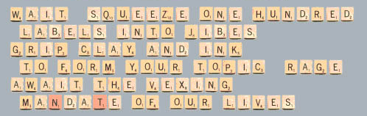
hw1 challenge: best-word
This is stanza three of a recursive Scrabble-tile poem
www.cadaeic.net/scrpoem.htm
Don't leave too little time for this one!
You'll use assoc to look up the tiles' scores…
Notes:
I don’t know if this really works...

Slide 14
Can every recursive function be tail-recursivized?
Did you just verb that adjective?

Slide 15
Can every recursive function be tail-recursivized?
No!
(define (flatten L)
(if (null? L) '()
(if (list? L) (append (flatten (first L))
(flatten (rest L)))
(list L))))
Why can't flatten be flattened?

Slide 16
LISP
Scheme
Racket
Clojure
ML
Haskell
Functional programming…
Building blocks ~ functions

Slide 17
LISP
Scheme
Racket
Clojure
ML
Haskell
Functional programming…
functions are first-class objects, just as data is
Building blocks ~ functions

Slide 18
Higher-order functions
map
input or output other functions.
(define (treble x) (* x 3))
a one-input function
a list of inputs
a list of outputs
(map treble '(13 14 15))
'(39 42 45)
That triple's been trebled!
What does the HOF (map f L) do?

Slide 19
foldr
foldr is called reduce in many languages
a two-input function
an accumulator!
a list of inputs
a single value
(foldr + 0 '(3 4 5 6 7 8 9))
42
What does the HOF (foldr f e L) do?

Slide 20
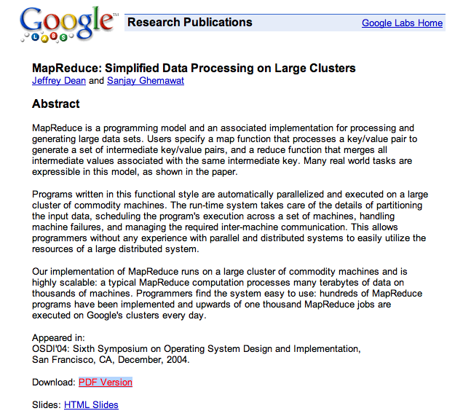
map distributes work
foldr combines work
Google's map-reduce is a system for large-scale parallel processing.

Slide 21
Two more HOFs…
A predicate is a function that outputs a boolean: #t or #f.
sort works as expected…
sort requires a two-input predicate
(sort '(3 1 4 1 5 9) <)
'(1 1 3 4 5 9)
What does filter do?
(filter even? '(2 3 4 5 6 8))
'(2 4 6 8)
filter requires a one-input predicate
You'll definitely appreciate filter…

Slide 22
Functions ~ data
42
Data does not have to have a label:
"forty-two"
#\f

Slide 23
Functions ~ data
42
Data does not have to have a label:
"forty-two"
#\f
So, functions don't have to have labels, either!
(lambda (x) (+ x 1))

Slide 24
Functions anywhere!
No need for a name!
What's this? It looks gross !
((lambda (x) (* x x)) 12)
Since functions can be anonymous, they can be returned:
(define (wrap x)
(lambda (wrapee) (list x wrapee x)))
What will happen, then, if we call
((wrap 'w) 'o)
Agreed!
Try it!

Slide 25
Quiz
Name(s): ______________________________
Higher-order functions…
((lambda (L) (cons 42 L)) '(is the answer))
(map (lambda (x) (* x 7)) '(4 5 6))
(map - (range -43 -41))
Evaluate these function calls:
(foldr * 1 '(6 101 7))
(filter (lambda (x) (= (modulo x 9) 6)) (range 15 45))
(sort '("works!" "wow" "this") string<?)
(sort '("works!" "wow" "this")
(lambda (s1 s2) (< (string-length s1)
(string-length s2))) )
Finished? Head to page 2, which won't be handed in…

Slide 26
Quiz, page 2…
Use HOFs to write these functions!
smush should concatenate all of the elements of L: all of L's elements will be lists. An example:
addk should add k to each element of L: all of L's elements will be numbers, e.g.,
( smush '((t h i) (s i s) (s o c o) (o l) )
'( t h i s i s s o c o o l )
( addk 60 '( -18 101 7940 ) )
'( 42 161 8000 )
(define (smush L)
(
(define (addk k L)
(
It's only one line!
Use lambda…
Write (matches T W) which should compute the # of elements T and W have in common.
3
(matches ' (3 40 50 51 52) '(1 3 41 51 52))
(define (matches T W)
(
Which HOFs might help?

Slide 27
Quiz
Try these on the back page first!
Higher-order functions…
((lambda (L) (cons 42 L)) '(is the answer))
(map (lambda (x) (* x 7)) '(4 5 6))
(map - (range -43 -41))
Evaluate these function calls:
(foldr * 1 '(6 101 7))
(filter (lambda (x) (= (modulo x 9) 6)) (range 15 45))
(sort '("works!" "wow" "this") string<?)
(sort '("works!" "wow" "this")
(lambda (s1 s2) (< (string-length s1)
(string-length s2))) )
Finished? Head to page 2, which won't be handed in…

Slide 28
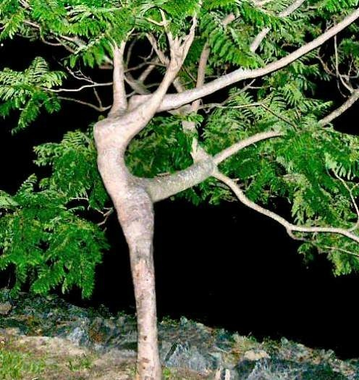
Next time: trees!
Lists aren't the only recursive data structure in town!
'()
'( 5 () () )
'( 42 (5 () ()) () )
Your data will be dancing!
'( 60 (42 (5 () ()) (49 () ()))
(100 () (171 () (202 () ())) )

Slide 29

Did someone say sugar?
Syntactic Sugar
This:
(define (f x)
(+ x 1))
is simply a convenient shortcut for expressing a binding:
syntactic sugar
(define f
(lambda (x) (+ x 1))
λ
Functions are first-class objects in Racket - or any functional language.
Like data, they need not have names. So, what is…
This really looks gross!
((lambda (x) (* x x)) 12)
Maybe it does need sugar!

Slide 30
Did someone say sugar?
Syntactic Sugar
This:
(define (f x)
(+ x 1))
is simply a convenient shortcut for expressing a binding:
syntactic sugar
(define f
(lambda (x) (+ x 1))
λ
Functions are first-class objects in Racket - or any functional language.
Like data, they need not have names. So, what is…
This really looks gross!
((lambda (x) (* x x)) 12)
Maybe it does need sugar!

Slide 31
Functions anywhere!
Since functions can be anonymous,
they can be returned:
(define (wrap x)
(lambda (wrapee) (list x wrapee x)))
What will happen, then, if we call
((wrap 'w) 'o)
Agreed!
Try this at the interpreter!

Slide 32
Functions ~ data
Binding:
puts a name (label) onto otherwise anonymous data
(define answer 41)
41
unlabeled data, 41
(define answer
(lambda (x) (+ x 1)))
(lambda (x) (+ x 1))
answer
A label can be used for any kind of data!

Slide 33
I've heard recursion is totally stacked against you!
Using map and foldr
'( (a) (b) ((c d)) (e) )
(nest '(a b (c d) e))
'( (-1) (-2) )
Write nest and best-num without raw recursion:
(nest '( -1 -2 ))
(define (nest L)
(
(best-num '(32 38 44 50 56))
44
(best-num '(0 10 100 1000))
10
(define (best-num L)
(
(define (help x y)
(if (< (abs (- x 42))
(abs (- y 42)))
x
y ))
looking for help ?
Also, +inf.0 is ∞.

Slide 34
I've heard recursion is totally stacked against you!
Using map and foldr
'( (a) (b) ((c d)) (e) )
(nest '(a b (c d) e))
'( (-1) (-2) )
Write nest and best-num without raw recursion:
(nest '( -1 -2 ))
I'd change this slide to four "what do these do?" questions, followed by these two as "extra"!
This (or the next slide) would be the end!
(define (nest L)
(
(best-num '(32 38 44 50 56))
44
(best-num '(0 10 100 1000))
10
(define (best-num L)
(
(define (help x y)
(if (< (abs (- x 42))
(abs (- y 42)))
x
y ))
looking for help ?
Also, +inf.0 is ∞.

Slide 35
Today in CS 60
Last time:
First-class Scheming
Cool! An upgrade…
((lambda (L) (rest (rest L))) '(a r c s) )
(foldr * 0.5 '(1 2 3 4 5))
Hw#1?
Homework #2 due Monday, 9/19 by 11:59 pm
tutors will be around all week & weekend
office hours: Friday 2-4pm, in lab
This time!
Lists might be everything…
Wood someone tell me what's at the root of all this?
T
42
but they're not the only thing!
30
77
(define T '(42 (30 () ()) (77 () ())))

Slide 36
map and foldr
These are higher-order functions...
... because they use functions as input or output.
any two-input function
accumu-lator!
a list
(foldr + 0 '(3 4 5))
12
(foldr f Acc L) accumulates a single-value result by applying f pairwise through L starting with Acc.
(map odd? '(3 4 5))
'(#t #f #t)
(map f L) applies f to each top-level element of L.

Slide 37
filter sort
What does the higher-order function filter do?
(filter even? '(1 2 3 4 5 6 8))
'(2 4 6 8)
You will definitely appreciate filter!
a function that returns #t or #f is called a predicate

Slide 38
filter sort
What does the higher-order function filter do?
(filter even? '(1 2 3 4 5 6 8))
'(2 4 6 8)
You will definitely appreciate filter!
sort does what you expect,
but it requires a two-argument function as a third input
(sort '(77 30 42) <)
'(30 42 77)

Slide 39
Try it!
Write (drop-above k L), which returns the list L without any elements > k.
(drop-above 60 '(55 60 65 101 133))
'(55 60)
(define (drop-above k L)
(
What does this output?
for alphabetical order:
string<?
(sort '("works!" "wow" "this")
(lambda (s1 s2) (< (string-length s1)
(string-length s2))) )

Slide 40
Quiz!
Use only higher-order functions, not raw recursion, to write these :
1
smush should concatenate all of the elements of L, which you should assume are lists
2
addk should add k to each element of L (all will be numberic)
( smush '((t h i) (s i s) (s o c o) (o l) )
'( t h i s i s s o c o o l )
( addk 60 '( -18 101 7940 ) )
'( 42 161 8000 )
(define (smush L)
(foldr append '() L) )
(define (addk k L)
(map (lambda (x)
(+ x k)) L))
Already done last time...
this one too!
3
Lotto-winner takes a list of tickets: '( (name n1 n2 n3 n4 n5) (name n1 n2 n3 n4 n5) ... ) and a list of winning numbers W as input. Then, lotto should return a list of the name of the winner (most matches with W) and the number of matches made.
( lotto-winner '( (Amy 2 3 41 42 50) (Bea 3 40 50 51 52) ) '( 1 3 41 51 52 ) )
'( Bea 3 )
Here, write a helper function: (matches T W) returns the number of elements T and W have in common.
( matches ' (Bea 3 40 50 51 52) '( 1 3 41 51 52 ) )
3
(define (matches T W)
(
Hint: use filter + member...
What more do you need for lotto-winner ? It's hw2 #3!

Slide 41
Assignment vs. binding
Assignment:
puts data into a named location
in Java, C, C++, ...
answer = 41
41
Next: answer = 42
answer
the location named answer
Binding:
puts a name (label) onto otherwise anonymous data
in Racket, Python, ML, …
41
(define answer 41)
answer
the label, answer, placed on the data, 41, for now...
Next: (define answer 42)

Slide 42
Assignment vs. binding
Assignment:
puts data into a named location
in Java, C, C++, ...
answer = 41
41
42
Next: answer = 42
answer
the location named answer
Binding:
puts a name (label) onto otherwise anonymous data
in Racket, Python, ML, …
41
(define answer 41)
Next: (define answer 42)
42
the label, answer, now placed on the data, 42
answer
SAFER! Data is never overwritten or destroyed!

Slide 43
Functional programming…
Since functions can be anonymous,
they can be returned:
(define (wrap x)
(lambda (wrapee) (list x wrapee x)))
What will happen, then, if we call
((wrap 'w) 'o)
Agreed!
Try this at the interpreter!

Slide 44
Functions are data, too!
Binding:
puts a name (label) onto otherwise anonymous data
(define answer 41)
41
unlabeled data, 41
(define answer
(lambda (x) (+ x 1)))
(lambda (x) (+ x 1))
answer
A label can be used for any kind of data!

Slide 45
Did someone say sugar?
Syntactic Sugar
This:
(define (f x)
(+ x 1))
is simply a convenient shortcut for expressing a binding:
syntactic sugar
(define f
(lambda (x) (+ x 1))
λ
Functions are first-class objects in Racket - or any functional language.
Like data, they need not have names. So, what is…
This really looks gross!
((lambda (x) (* x x)) 12)
Maybe it does need sugar!

Slide 46
Functions anywhere!
Since functions can be anonymous,
they can be returned:
(define (wrap x)
(lambda (wrapee) (list x wrapee x)))
What will happen, then, if we call
((wrap 'w) 'o)
Agreed!
Try this at the interpreter!

Slide 47
Thought experiments…
(sort '("works" "way" "no" "this")
(lambda (s1 s2) (< (string-length s1)
(string-length s2)))
) ;; end of sort
What does sort return?
(smush '((t h i) (s i s) (s o c o) (o l)))
'(t h i s i s s o c o o l)
Write smush in one line to concatenate all of the elements of L. (L will contain only lists.)
(define (smush L)
(
(addk 60 '(-18 101 8941))
'(42 161 9001)
(define (addk k L)
(
addk should use map add k to each element of L (all are numeric)
(drop-more 60 '(52 60 65 101 133))
'(52 60)
(define (drop-more k L)
(
Write (drop-more k L)to return L without the elements larger than k.

Slide 48
Try it...
Use only higher-order f'ns (not raw recursion) to write these functions:
1
smush should concatenate all of the elements of L, which you should assume are lists
2
addk should add k to each element of L (all will be numberic)
( smush '((t h i) (s i s) (s o c o) (o l) )
'( t h i s i s s o c o o l )
( addk 60 '( -18 101 7940 ) )
'( 42 161 8000 )
(define (smush L)
(
(define (addk k L)
(
3
Lotto takes a list of tickets: '( (name n1 n2 n3 n4 n5) (name n1 n2 n3 n4 n5) ... ) and a list of winning numbers W as input. Then, lotto should return a list of the name of the winner (most matches with W) and the number of matches made.
You should assume that the function (matches L1 L2) already exists. It returns the # of elements in L1 that are in L2.
( lotto '( (Amy 2 3 41 42 50) (Bea 3 40 50 51 52) ) '( 1 3 41 51 52 ) )
'( Bea 3 )
(define (lotto TL W)
Helper functions!

Slide 49
Next time: trees!
Lists are not the only recursive data structure!
'()
'( 5 () () )
'( 42 (5 () ()) () )
Your data will be dancing!
'( 60 (42 (5 () ()) (49 () ()))
(100 () (171 () (202 () ())) )

Slide 51
"Quiz"
Name(s) ________________
Write tail-recursive versions of power, range, and assoc...
1
power will only take nonnegative integers as input
2
lo and hi are integers; range is the list from lo up to but not including hi
E.g.
(power 2 5) 32
(power 0 0) 1
E.g.
(range 2 5) '(2 3 4)
(range 42 42) '( )
(define (power b N)
(tail-power b N 1)
(define (tail-power b N Acc)
(define (range lo hi)
(tail-range lo hi '())
(define (tail-range lo hi Acc)
3
E.g.
assoc is on the previous slide...
(define (assoc e Alist)
(if (null? AList)
(if (equal? e (first (first AList))
(assoc 2 '((1 "jan") (2 "feb")) ) '(2 "feb")
(assoc 7 '((1 "jan") (2 "feb")) ) #f
Extra!
Can every function be tail-recursivized?
Does tail-recursivization improve big-O runtime?
Feature! you don't even need a tail-assoc!!

Slide 52
Tail recursion
starting value of an extra accumulator input
(define (len L)
(tail-len L 0))
Acc accumulates the result as you go!
(define (tail-len L Acc)
(if (null? L)
Acc
(tail-len (rest L) (+ 1 Acc))) ))
no work is being done after the recursion here…
no work? no way!
If no work happens after the recursive call, the stack is not necessary!

Slide 53
"Quiz"
Name(s): __________________
Write tail-recursive versions of power, range, and assoc...
1
power will only take nonnegative integers as input
2
lo and hi are integers; range is the list from lo up to but not including hi
E.g.
(power 2 5) 32
(power 0 0) 1
E.g.
(range 2 5) '(2 3 4)
(range 42 42) '( )
(define (power b N)
(tail-power b N 1)
(define (tail-power b N Acc)
(define (range lo hi)
(tail-range lo hi '())
(define (tail-range lo hi Acc)
assoc is on the previous slide...
Feature! you don't even need a tail-assoc!!
E.g.
3
(define (assoc e Alist)
(assoc 2 '((1 "jan") (2 "feb")) ) '(2 "feb")
(assoc 7 '((1 "jan") (2 "feb")) ) #f
Extra!
Can every function be tail-recursivized?
Does tail-recursivization improve big-O runtime?

Slide 55
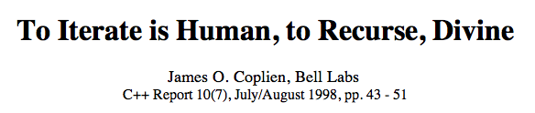
CS quips...
The best thing about a boolean is that, even if you are wrong, you are only off by a bit.
true wisdom!
The art and practice of thinking recursively!
Notes:
Randall Munroe

Slide 56
len
Recursion ~ magic ?
(len '())
0
(len '(5 7 8 9))
4
(len '(((7 8) 9 0) ((1) 2 (3))))
I'm glad Racket has to do this, not me!

Slide 57
Bottom-up recursive mindset
(len '(7 8 9))
3
(len '(5 7 8 9))
(len '(6 8 9))
3
(len '(8 9))
2
(len '(42))
1
(len '(9))
1
(len '())
0
Imagine the table of results so far…
(define (len L)
(if (null? L)
0
(+ 1 (len (rest L)))))
Here is one result.
…and how to build larger results.

Slide 58
Top-down recursive mindset
(len '(5 7 8 9))
Think of this as a function – so, look for its pieces.
(define (len L)
(if (null? L)
0
(+ 1 (len (rest L)))))
Don't think of this as a function – just as the answer!

Slide 59
So, which mindset does the computer use?

Slide 60
Running recursion
(define (len L)
(if (null? L)
0
(+ 1 (len (rest L)))))
actually, any function call
L =
'(a b c)
( len '(a b c) )
result
the "stack"
( len '(b c) )
L =
its "frames"
result
L =
( len )
result
L =
( len )
What goes on the stack, doesn't stay on the stack!
result

Slide 61
Running recursion
(define (len L)
(if (null? L)
0
(+ 1 (len (rest L)))))
actually, any function call
L =
'(a b c)
( len '(a b c) )
result
the "stack"
( len '(b c) )
L =
its "frames"
result
L =
( len )
result
L =
( len )
What goes on the stack, doesn't stay on the stack!
result

Slide 62
Tail recursion
How is this len different ?
(len '(7 8 9))
(define (len L)
(tail-len L 0))
(define (tail-len L Acc)
(if (null? L)
Acc
(tail-len (rest L) (+ 1 Acc)))))

Slide 63
Tail recursion
starting value of an extra accumulator input
(define (len L)
(tail-len L 0))
Acc accumulates the result as it goes…
(define (tail-len L Acc)
(if (null? L)
Acc
(tail-len (rest L) (+ 1 Acc)))))
no work is being done after the recursion here…
no work? no way!
If no work happens after the recursive call, the stack is not necessary!

Slide 64
Running tail-recursion
or any "tail-called" function!
(tail-len '(a b c) 0)
L =
'(a b c)
Acc
0
All in 1 stack frame – reuse as needed! Time
(define (tail-len L Acc)
(if (null? L)
Acc
(tail-len (rest L) (+ 1 Acc))
Go stackless!

Slide 65
Timing tail-recursion
or any tail-called function!
show examples in racket…

Slide 66
Tail-recursive fac
It's a fac that tail-recursion stacks up well against ordinary recursion!
(define (fac N)
(tail-fac ___ ___)
input
initial value of accumulator
(define (tail-fac N Acc)
(if (equal? N 0)
make sure that the recursive call is the last and outermost call!

Slide 67
"Quiz"
Try this first on the slide at the back of the handout!
Write tail-recursive versions of power, range, and assoc...
1
power will only take nonnegative integers as input
2
lo and hi are integers; range is the list from lo up to but not including hi
E.g.
(power 2 5) 32
(power 0 0) 1
E.g.
(range 2 5) '(2 3 4)
(range 42 42) '( )
(define (power b N)
(tail-power b N 1)
(define (tail-power b N Acc)
(define (range lo hi)
(tail-range lo hi '())
(define (tail-range lo hi Acc)
3
E.g.
assoc is on the previous slide...
(define (assoc e Alist)
(if (null? AList)
(if (equal? e (first (first AList))
(assoc 2 '((1 "jan") (2 "feb")) ) '(2 "feb")
(assoc 7 '((1 "jan") (2 "feb")) ) #f
Extra!
Can every function be tail-recursivized?
Does tail-recursivization improve big-O runtime?
Feature! you don't even need a tail-assoc!!

Slide 68
Can every recursive function be tail-recursivized?

Slide 69
flatten
Different recursively?
(flatten '((3 2) 1))
'(3 2 1)
(flatten 42)
'(42)
(flatten '(1 (2 (3 4 ((5) 6))) 7 (8 9)))
'(1 2 3 4 5 6 7 8 9)
seems like a lot of flattening is happening here!?

Slide 70
flatten
(define (flatten L)
(if (null? L) '()
(if (list? L) (append (flatten (first L))
(flatten (rest L)))
(list L))))
(flatten '((1 2) 3))

Slide 71
flatten
what should this input be?
( flatten '( (1 2) 3 ) )
(append
)
( flatten '(1 2) )
(flatten )
How many calls to flatten occur in here?
Whoa! – or woe?
(append
)
'( 1 2 )
'( 1 2 3 )

Slide 72
Recursion's benefits:
Recursion is the root of computation since it trades description for time.
- Alan Perlis
less
more
Another take:
Let recursion do the work for you!
- Prof. Keller
sounds good to me!

Slide 73
Not so flat, after all!
flatten
9 calls in total
( flatten '( (1 2) 3 ) )
(append
)
( flatten '(1 2) )
(flatten '( 3 ) )
( flatten 1) )
( flatten '( 2 ) )
( flatten 3) )
( flatten '() )
( flatten 2 )
( flatten '() )
'( 3 )
'()
'( 2 )
'()
append
'( 1 )
'( 2 )
append
append
(append
)
'( 1 2 )
'( 3 )
append
'( 1 2 3 )
Wooo!

Slide 74
flatten's stack!
linearize/show!

Slide 75
"Quiz"
Try this first on the slide at the back of the handout!
Write tail-recursive versions of power, range, and assoc...
1
power will only take nonnegative integers as input
2
lo and hi are integers; range is the list from lo up to but not including hi
E.g.
(power 2 5) 32
(power 0 0) 1
E.g.
(range 2 5) '(2 3 4)
(range 42 42) '( )
(define (power b N)
(tail-power b N 1)
(define (tail-power b N Acc)
(define (range lo hi)
(tail-range lo hi '())
(define (tail-range lo hi Acc)
assoc is on the previous slide...
3
E.g.
(define (assoc e AList)
(assoc 2 '((1 "jan") (2 "feb")) ) '(2 "feb")
(assoc 7 '((1 "jan") (2 "feb")) ) #f
Extra!
Can every function be tail-recursivized?
Does tail-recursivization improve big-O runtime?

Slide 76
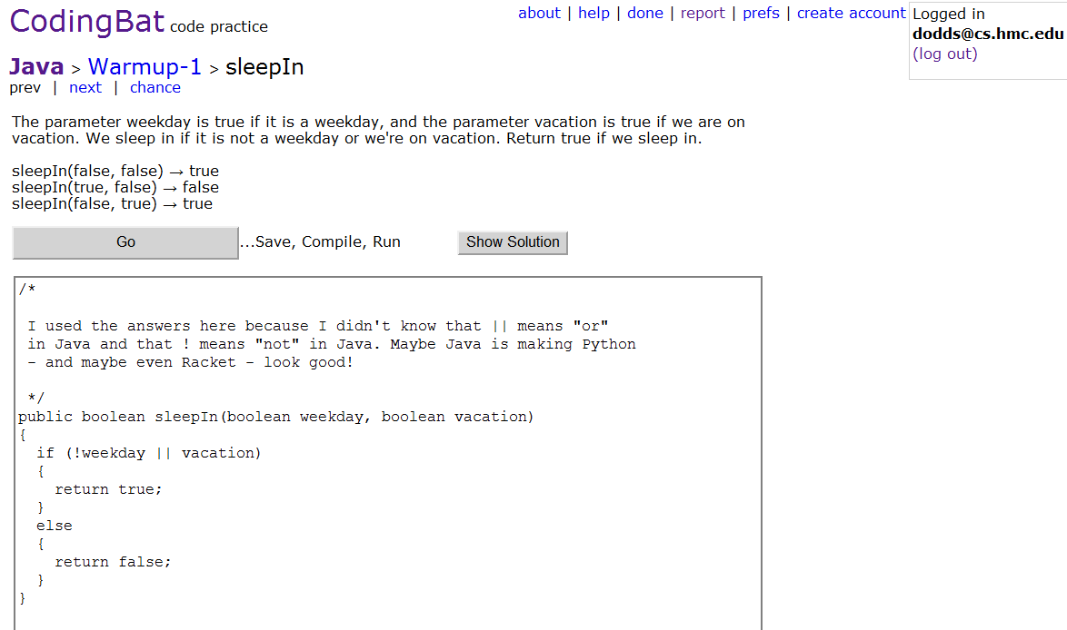
Java!
http://codingbat.com/java
Account
Java!
Solution
This week: solve 8 of these (very) short Java problems… answers provided!
Notes:
Randall Munroe == XKCD's author

Slide 77
Quiz
Write these functions using recursion!
2
(reverse L)
should return a list identical to L, but with its (top-level) elements reversed
1
(append L M)
should return a list identical to what Python would call L+M
E.g.,
( reverse '(1 2 (3 4)) )
'((3 4) 2 1)
Hint: only recurse on L, not M!
(define (reverse L)
(if (null? L)
Try this idea: '(1 2 3) + '(4 5) == (cons 1 '(2 3) + '(4 5) )
(define (append L M)
(if (null? L)
3
(flatten L)
should return a list identical to L, but with all internal nesting flattened!
4
(fib N)
the Nth fibonacci number, from 0
(fib 0)
1
(fib 1)
1
E.g.,
(flatten '(1 (2 3 (4)) (5 6)))
'(1 2 3 4 5 6)
(fib 2)
2
(fib 3)
3
(define (fib N)
(if (< N 2)
(fib 4)
5
(define (flatten L)
(if (null? L)
(fib 5)
8
each is the sum of the previous two...
Extra: Estimate the big-O complexity of these four functions...

Slide 78
from the Quiz…
2
should return a list identical to L, but with its (top-level) elements reversed
(reverse L)
should return a list identical to what Python would call L+M
E.g.,
( reverse '(1 2 (3 4)) )
'((3 4) 2 1)
1
(append L M)
(define (append L M)
(if (null? L)
M
(cons (first L)
(append (rest L) M))...
(define (reverse L)
(if (null? L)
L
(append (reverse (rest L))
(list (first L))...
Big-O ?
3
(flatten L)
should return a list identical to L, but with all internal nesting flattened!
4
(fib 0)
1
(fib N)
(fib 1)
1
E.g.,
(flatten '(1 (2 3 (4)) (5 6)))
'(1 2 3 4 5 6)
(fib 2)
2
the Nth fibonacci number, from 0
(fib 3)
3
(fib 4)
5
(fib 5)
8
(define (flatten L)
(if (null? L)
'() ;; or L
(if (not (list? L))
(list L)
(append (flatten (first L))
(flatten (rest L))) ...
each is the sum of the previous two...
(define (fib N)
(if (< N 2)
1
(+ (fib (- N 1))
(fib (- N 2))...

Slide 79
Assignment vs. binding
Assignment:
41
Java, C, C++, ...
answer = 41
answer
puts data into a named location
the location named answer
Next: answer = 42
Binding:
(define answer 41)
41
answer
puts a name (label) onto otherwise anonymous data
the label, answer, placed on the data, 41, for now...
Racket, Python, ML
but in racket, functions are data...

Slide 80
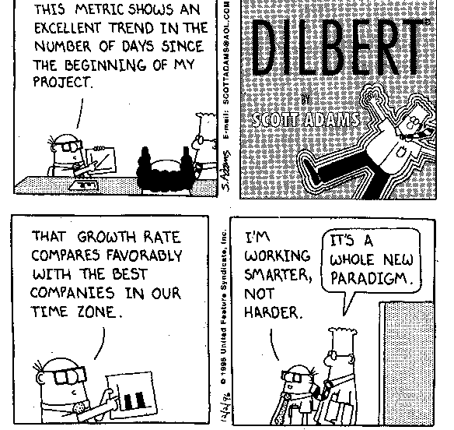
Paradigms, unmasked

Slide 81
Good news/Bad news
Recursion is very common in scheme…
… but you can often avoid it completely!
Consider these functions:
;; square all the numbers in a list
(define (squares-of-list L)
(if (equal? L '())
'()
(cons (square (first L))
(rest L))))
;; find the factorial of the numbers in a list
(define (fac-of-list L)
(if (equal? L '())
'()
(cons (fac (first L))
(rest L))))

Slide 82
Map: The recursion "alternative"
;; find the factorial of
;; the numbers in a list
(define (fac-of-list L)
(if (equal? L '())
'()
(cons (fac (first L))
(rest L))))
;; square all the numbers in a list
(define (squares-of-list L)
(if (equal? L '())
'()
(cons (square (first L))
(rest L))))
;; apply function f to all the
;; elements in a list
(define (map f L)
(if (equal? L '())
'()
(cons (f (first L))
(rest L))))
rewrite above functions
using map
Note: map is built-in to scheme

Slide 83
Sum of squares
What if we want to use map in a function that finds the sum of the squares in a list?
(sum-of-squares '(1 2 3)) → 14

Slide 84
Avoiding (Hiding) recursion, Again!
foldr to the rescue!
(foldr + 0 '(1 2 3))
→ 6
Definition:
(define (foldr op initial lst)
(if (equal? lst '())
initial
(op (first list) (foldr op initial (rest list)))))

Slide 85
keep and drop
(keep even? '(1 2 3 4 5))
→ '(2 4)
(drop even? '(1 2 3 4 5))
→ '(1 3 5)
Finish the definitions:
(define (keep pred? lst)
(if (equal? lst '())
'()
(if
(define (drop pred? lst)
(if (equal? lst '())
'()
(if
Then show the definition of sum-of-even-squares

Slide 86
Scheme control: Recursion
(define (pow b N) ;; return b**N
(cond
[ (= N 0) 1 ]
[ (odd? N) (* b (pow b N-1)) ]
[ else (* (pow b (/ N 2))
(pow b (/ N 2))) ]
))
A powerful strategy
base case
recursive cases
list?
number?

Slide 87
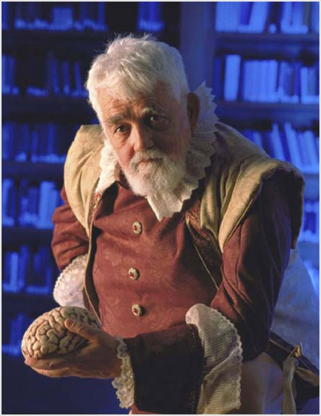
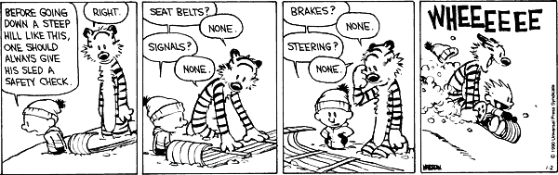
Scheme?
John McCarthy hated commas!
John McCarthy contemplating minds…
Scheme is a small, exceptionally clean language which is fun to use.
www.engin.umd.umich.edu/CIS/course.des/cis400/scheme/scheme.html
Stanford University
coined Artificial Intelligence
'56 Dartmouth Conf.
inventor of LISP
Part of most AI researchers' geneology…

Slide 88
Subtle but Big-O

Slide 89
Today in CS 60
The CS code?
Last time:
Lisp ~ Scheme
How Scheme thinks.
This time!
How Scheme works…
How the universe works…
Tail recursion
Higher-order functions can do it all!
Higher-order functions
favorites ~ matching
for "hiding" recursion
drink
yellow
Homework #1 due Monday, 1/31 by 11:59 pm
color
parsley
vegetable
mint
ice cream
pet shop of horrors
manga
smoothies
Categories
Items
extra if you can tell most/least favorite!
only cheese made it on both sides!

Slide 90
Choosing a path
Programming
What
How
Declarative
Imperative
What mood am I in today?
Logic Programming
Functional Programming
Object-Oriented
Programming
Low-level Programming
Prolog
Scheme
Java
JFLAP
algorithms via functions
more abstraction away from the machine
closer to the machine

Slide 91
Implementing functions
What happens on
a list of stack frames: top
does NOT stay on the stack!
"the stack":
(f 4)
(define (f x)
(g (expt x 3) x))
(define (g x y)
(h (- x y)))
(define (h x)
(* x x)

Slide 92
Tail reverse
Consider reverse:
(define (rev L)
(cond
[ (null? L) () ]
[ else (append (rev (rest L))
(list (first L))) ] ))
What is reverse's big-O complexity?
What is append's big-O complexity?
(append L1 L2)

Slide 93
Recursion reality!
dR is duperreverse
( dR '( (1 2) 3 4 ) )
(append
)
( dR '( 3 4 ) )
(list ( dR '( 1 2 ) ))
( dR '(4) )
( dR 3 )
( dR '(2) )
( dR 1 )
appending…
( dR 2 )
( dR '() )
( dR 4 )
( dR '() )
'(4)
'(3)
'(2)
'(1)
(append
'( ( 2 1 ) )
)
'( 4 3 )
'( 4 3 (2 1) )
Phew!

Slide 94
Try it...
Use only higher-order f'ns (not raw recursion) to write these functions:
1
smush should concatenate all of the elements of L, which you should assume are lists
2
addk should add k to each element of L (all will be numberic)
( smush '((t h i) (s i s) (s o c o) (o l) )
'( t h i s i s s o c o o l )
( addk 60 '( -18 101 7940 ) )
'( 42 161 8000 )
(define (smush L)
(
(define (addk k L)
(
3
Lotto takes a list of tickets: '( (name n1 n2 n3 n4 n5) (name n1 n2 n3 n4 n5) ... ) and a list of winning numbers W as input. Then, lotto should return a list of the name of the winner (most matches with W) and the number of matches made.
You should assume that the function (matches L1 L2) already exists. It returns the # of elements in L1 that are in L2.
( lotto '( (Amy 2 3 41 42 50) (Bea 3 40 50 51 52) ) '( 1 3 41 51 52 ) )
'( Bea 3 )
(define (lotto TL W)
Helper functions!

