Slide 1

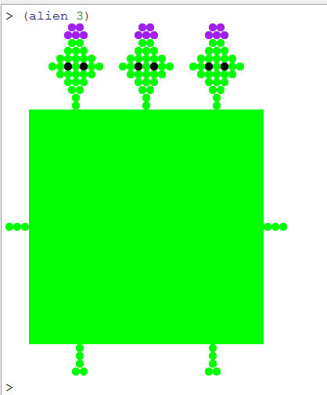
The CS 60 Times New Roman
composite sketch based on eyewitness accounts of one of the CS 60 suspects...
Three-Eyed Aliens Stole My Lecture Notes claims distraught CS professor!
(Claremont AP):
A distraught CS professor at Harvey Mudd College claims that aliens broke in to his office last night and stole the notes that he planned to use in CS 60. “These aliens made quite a Racket! When I came out to evaluate, they cond me into lending them my keys, went into my office, made a list of the contents, and took the first item on that list in an effort to null? my lecture,” said the professor. “Our job is to map the crime,” said a detective on the scene. “These aliens must recognize the cons of altering CS 60 slides. They should know that we will not rest or foldr our investigation until we’ve appended every last culprit.” Evidence at the crime scene included a number of items that could not be define'd, as well as several mismatched parentheses. “We’re filtering through it,” said investigators, "just let* us sort this out." The overextended investigators did pause briefly for a coffee break; as the chief put it, "With a bit of Java, we'll be able to outlast these &&||! aliens for sure…!"
Students agree: CS 60 threatens to overrun their resumes…
CS 60 student, Imin Parens, was shocked to discover that after only three weeks she had already learned two new programming languages, big-O analysis, and the endless "warm hugs" that pairs of parentheses can bring!
"The key so far," she says, "is to start the cs60 hw early - otherwise I run out of time to keep my resume updated!" "Plus, it always seems like more is on the way! I'm planning to go to both Starbucks and the Motley today… ."

Slide 2
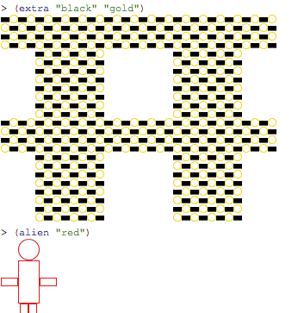
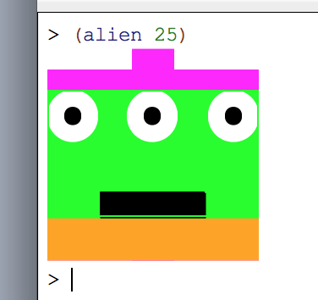
Caleb Eades
hyoungkkiani
tmiddlemas
grade locked ones... ttaborek, trotolo

Slide 3
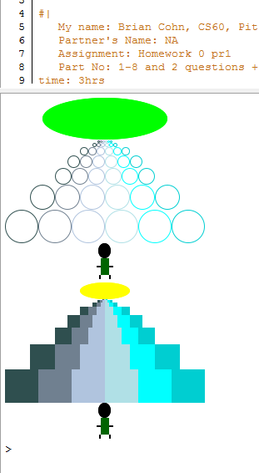

Anthony Davanzo's bees!

Slide 4
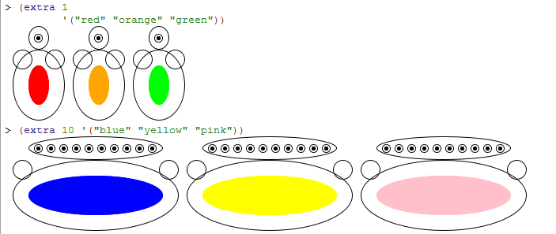


Antoine Billig
Emma Manning

Slide 5
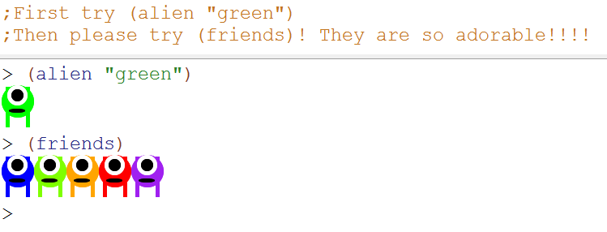

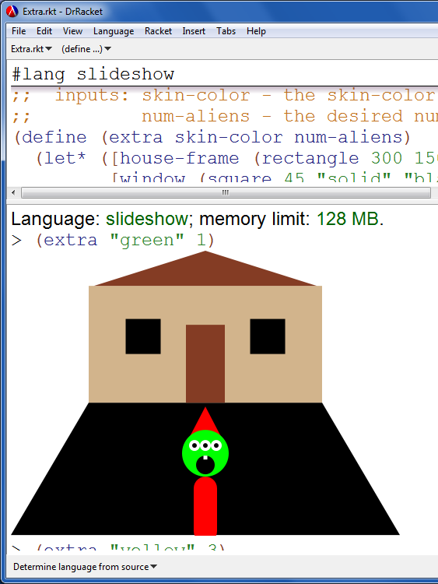
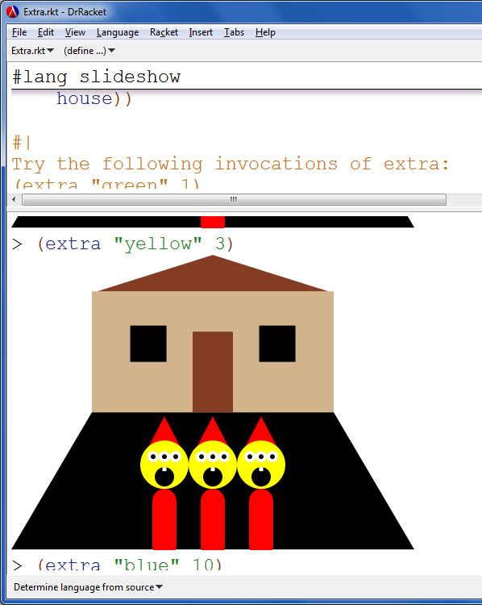
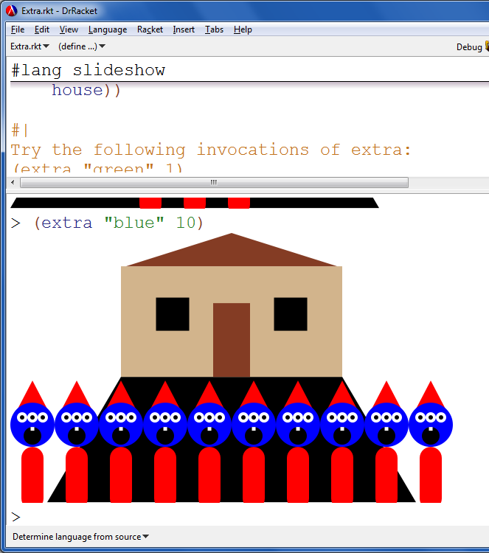
Katherine Shim
Haley Patoski
Steve Ibanez

Slide 6
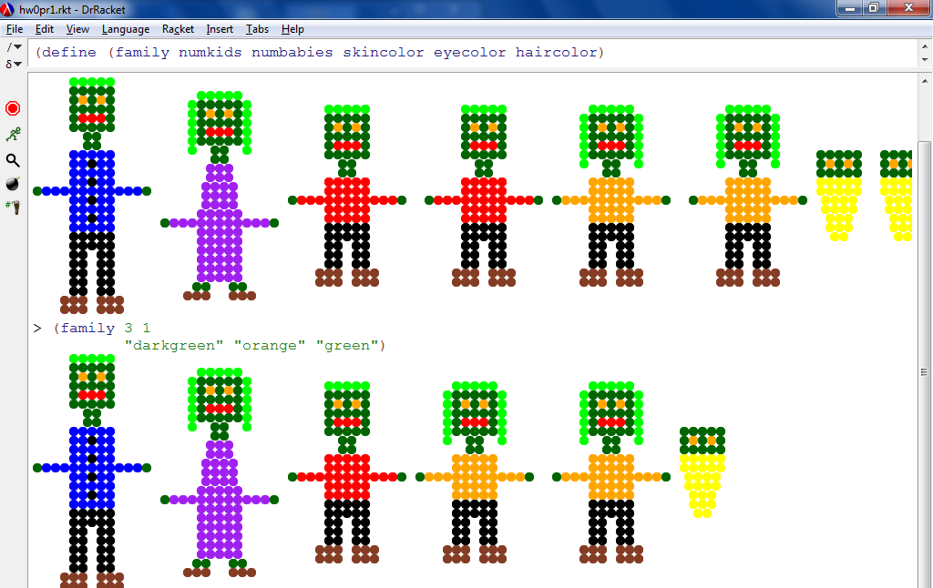
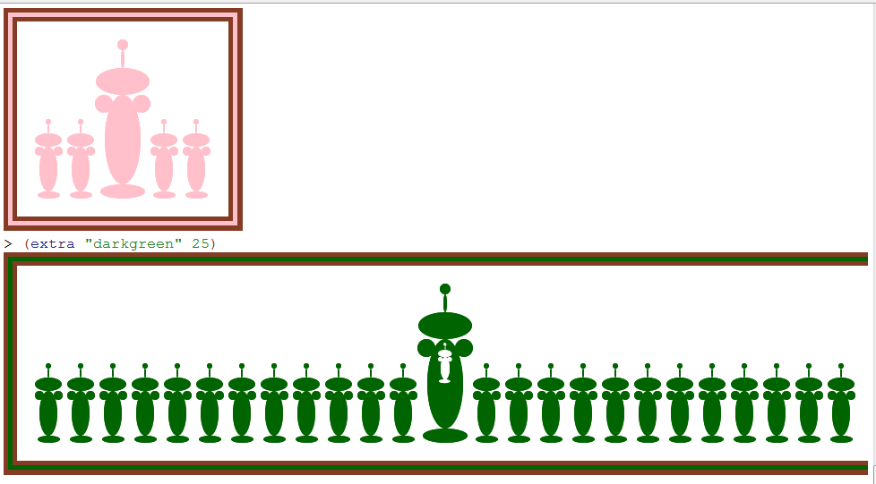

Slide 7






Aliens!

Slide 8

One of the favorites...
Carola P. & Richard S.

Slide 9
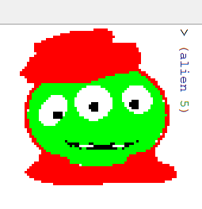
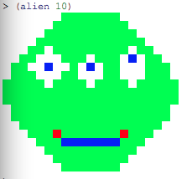
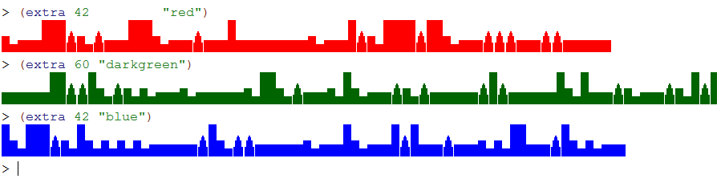

Slide 10
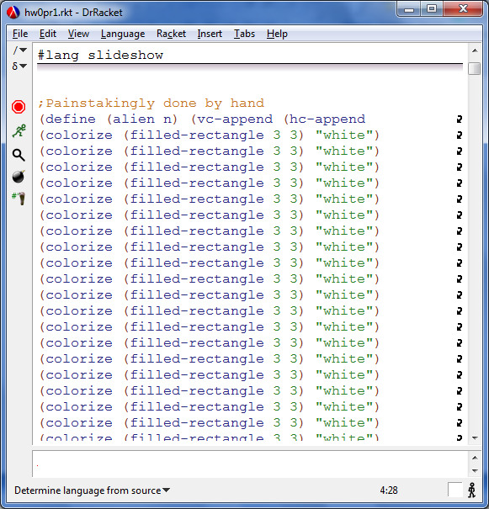
!

Slide 11
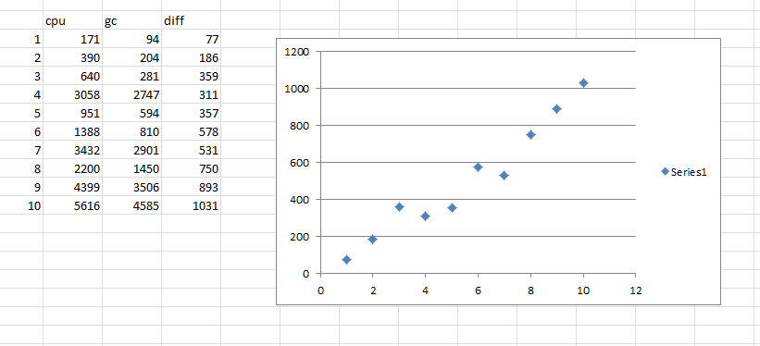
(ordinary) power is big-O(N)
thanks, Sherman!
Notes:
I don’t know if this really works...

Slide 12
let* lets you sequence in Racket
let* allows the use of names defined earlier...
let does not
(define (assoc e AList)
(if (null? AList)
#f
(let* (
( F (first AList) )
( fOfF (first F) )
( R (rest AList) )
)
(if (equal? e fOfF)
F
(assoc e R)) ) ))
defining local variables is a form of sequential execution...
Notes:
I don’t know if this really works...

Slide 13
Last time:
First-class Scheming
Cool! An upgrade to First Class…
((lambda (L) (rest (rest L))) '(a r c s))
(foldr * 0.5 '(1 2 3 4 5))
This time!
Lists might be everything…
but they're not the only thing!
T
42
5
60
(define T '(42 (5 () ()) (60 () ())))
Wood someone tell me what's at the root of all this?

Slide 14
map and foldr
a one-input function
a list
(map odd? '(3 4 5))
'(#t #f #t)
(map f L) applies f to each top-level element of L.
These are higher-order functions...
... because they use functions as input or output.
a two-input function
accum-ulator!
a list
(foldr + 0 '(3 4 5))
12
(foldr f Acc L) accumulates a single-value result by applying f pairwise through L starting with Acc.

Slide 15
sort and filter
a list
(sort
'((9 "cay") (12 "twelve") (2 "aa"))
(lambda (w1 w2) (> (first w1) (first w2))) )
a two-input comparison function
'((12 "twelve") (9 "cay") (2 "aa"))
a one-input predicate
a list
(filter odd? '(3 4 5))
'(3 5)

Slide 16
Functions ~ data
42
Data does not have to have a label:
"forty-two"
#\f
So, functions don't have to have labels, either!
(lambda (x) (+ x 1))
an anonymous function

Slide 17
Practice: higher-order functions and lambda…
smush should concatenate all of the elements of L: all of L's elements will be lists, e.g.,
It's only one line!
( smush '((t h i) (s i s) (s o c o) (o l) )
'( t h i s i s s o c o o l )
(define (smush L)
(foldr
addk should add k to each element of L: all of L's elements will be numbers, e.g.,
Use lambda…
( addk 60 '( -18 101 7940 ) )
'( 42 161 8000 )
(define (addk k L)
(map L))
a one-input function, to be applied to each element of L
Write (matches T W) which should compute the # of elements T and W have in common.
There won't be in-list repeats.
3
(matches ' (3 40 50 51 52) '(1 3 41 51 52))
(define (matches T W)
(length (filter T)))
a one-input function, to be applied to each element of T

Slide 18
Practice with higher-order functions…
smush should concatenate all of the elements of L: all of L's elements will be lists, e.g.,
It's only one line!
( smush '((t h i) (s i s) (s o c o) (o l) )
'( t h i s i s s o c o o l )
(define (smush L)
(foldr append '() L))
addk should add k to each element of L: all of L's elements will be numbers, e.g.,
Use lambda…
( addk 60 '( -18 101 7940 ) )
'( 42 161 8000 )
(define (addk k L)
(map (lambda (x) (+ x k)) L))
a one-input function, to be applied to each element of L
Write (matches T W) which should compute the # of elements T and W have in common.
There won't be in-list repeats.
3
(matches ' (3 40 50 51 52) '(1 3 41 51 52))
(define (matches T W)
(length (filter (lambda (x) (member x W)) T)))
a one-input function, to be applied to each element of T

Slide 19
AAA Aardvark Training
909-555-ANTS
key
value
Allen's Aliens
909-555-XTRA
finding the right business…
Fran’s Foto
909-555-FOTO
Ma’s Mermaids
909-555-SWIM
Pam’s Pretzels
909-555-KNOT
What about higher-order data?
Zyzzyva Zappers
909-555-GONE

Slide 20

Linear search
AAA Aardvark Training
909-555-ANTS
key
value
Allen's Aliens
909-555-XTRA
If we use assoc, this will take O(N) time, where N is the # of list entries.
Fran’s Foto
909-555-FOTO
Ma’s Mermaids
909-555-SWIM
Pam’s Pretzels
909-555-KNOT
Zyzzyva Zappers
909-555-GONE
Want speed? Phone books hold the key
Notes:
I don’t know if this really works...

Slide 21
Idea: use phone-book search to structure our data!
Logarithmic search
How deep will an N-node tree be?
Ma’s Mermaids
909-555-SWIM
key
value
Fran’s Foto
909-555-FOTO
Pam’s Pretzels
909-555-KNOT
AAA Aardvark Training
909-555-ANTS
???
???
Zyzzyva Zappers
909-555-GONE
What businesses might go here?
Notes:
I don’t know if this really works...

Slide 22
Trees!
General search tree or prefix trie
Binary Search Tree
Root!
/
42
bin/
home/
usr/
20
100
passwd
local
12
21
211
dodds/
mike/
35
courses/
bin/
25
39
cs5/
spamc
cs60/
hw2.rkt
each node holds an entire key or key/value pair
each node holds part of a piece of data
Notes:
I don’t know if this really works...

Slide 23
Binary Search Trees or BSTs
BSTs are the BeST!
Every BST either has two subtrees, OR it's empty!
root
Each node has a unique key.
node
42
Nodes might also have other data, e.g., the "value" in a key/value pair, but the key is the key piece of info!
20
100
12
21
211
35
This BST's root has a key of 42.
leaf
25
39
How many nodes does it have?
What's its height?
Racket code
B42 = '(42 (20 (12 () ()) (21 () (35 (25 () ()) (39 () ())))) (100 () (211 () ())))
Notes:
I don’t know if this really works...

Slide 24
Binary Search Trees or BSTs
BSTs are the BeST!
Every BST either has two subtrees, OR it's empty!
root
Each node has a unique key.
42
Nodes might also have other data, e.g., the "value" in a key/value pair, but the key is the key piece of info!
20
100
12
21
211
How does the root's key compare to the right subtree's keys?
35
25
39
How does the root's key compare to the left subtree's keys?
Can you determine the structure here?
Racket code
B42 = '(42 (20 (12 () ()) (21 () (35 (25 () ()) (39 () ())))) (100 () (211 () ())))
Notes:
I don’t know if this really works...

Slide 25
Binary Search Trees
Move over lists -- there's a new data structure in town - and it's even more recursive than you!
'(60 (42 (5 () ()) (49 () ()))
(100 () (171 () (202 () ())) )
'(42 (5 () ()) ())
'(5 () ())
'()
Picture?

Slide 26
Tapping into BSTs
let* me make a suggestion: Name each of the BST's parts…
(define (rev1 BST)
(if (null? BST)
'()
(let* ([rt (first BST)]
[L (second BST)]
[R (third BST)])
(list rt R L)) ))
42
20
100
12
21
211
"ELSE" branch
35
25
What will be the result of (rev1 B42)?
Notes:
I don’t know if this really works...

Slide 27
Tapping into BSTs
let* me make a suggestion: Name each of the BST's parts…
(define (rev1 BST)
(if (null? BST)
'()
(let* ([rt (first BST)]
[L (second BST)]
[R (third BST)])
(list rt R L)) ))
42
20
100
12
21
211
"ELSE" branch
35
25
Did this work?
big-O?
something seems gwron!
Notes:
I don’t know if this really works...

Slide 28
getting the most from a BST
(find-max BST)
the largest of BST's elements
42
(define (find-max BST)
(if (null? BST)
"no max!"
(let* ([rt (first BST)]
[L (second BST)]
[R (third BST)])
(if
20
100
12
21
211
35
25
What are the best-case and worst-case running times here?
What is the worst-case for BALANCED trees?
N = # of nodes
Notes:
I don’t know if this really works...

Slide 29
Finding any element...
similar to member for lists
(find? k BST)
#t if k ∈ BST else #f
42
(define (find? BST)
(if (null? BST)
#f
(let* ([rt (first BST)]
[L (second BST)]
[R (third BST)])
(if
20
100
12
21
211
35
25
What are the best-case and worst-case running times here?
What is the worst-case for BALANCED trees?
N = # of nodes
Notes:
I don’t know if this really works...

Slide 30
hw0 ~ add'l notes…
(define (fast-pow b p)
(cond
((< p 1) 1)
((odd? p) (* (fast-pow b (- p 1)) b))
( else
(* (fast-pow b (/ p 2))
(fast-pow b (/ p 2)))) ))
if odd: proceed as normal
p/2
if even: find b and square it
but this is still O(N) – where N is the value of p, the power
Notes:
I don’t know if this really works...

Slide 31
the call tree is only O(log(N)) levels deep
fast-pow's call tree
(fp b 16)
(fp b 8)
(fp b 8)
(fp b 4)
(fp b 4)
(fp b 4)
(fp b 4)
(fp b 2)
(fp b 2)
(fp b 2)
(fp b 2)
(fp b 2)
(fp b 2)
(fp b 2)
(fp b 2)
(fp b 1)
(fp b 1)
(fp b 1)
(fp b 1)
(fp b 1)
(fp b 1)
(fp b 1)
(fp b 1)
(fp b 1)
(fp b 1)
(fp b 1)
(fp b 1)
(fp b 1)
(fp b 1)
(fp b 1)
(fp b 1)
the total work is O(N) because too much work is repeated!
Notes:
I don’t know if this really works...

Slide 32
let* there be local variables
(define (fast-pow b p)
(cond
((< p 1) 1)
((odd? p) (* (fast-pow b (- p 1)) b))
( else
(let* (
( halfpow (fast-pow b (/ p 2)))
( answer 42 )
)
(* halfpow halfpow)) ) ))
compute once – and give it a name with let!
I had to toss that in there…
now this is O(log(N)) !
Notes:
I don’t know if this really works...

Slide 33
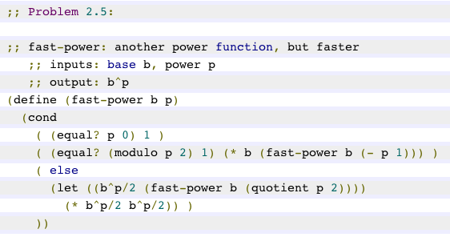
let* there be local variables
compute it once – and give it a name with let!
had to toss that in there...
feel free to choose names that are meaningful to you!...
Notes:
I don’t know if this really works...

Slide 34
the call tree is only O(log(N)) levels deep
fast-pow's call tree
(fp b 16)
(fp b 8)
(fp b 8)
(fp b 4)
(fp b 4)
(fp b 4)
(fp b 4)
(fp b 2)
(fp b 2)
(fp b 2)
(fp b 2)
(fp b 2)
(fp b 2)
(fp b 2)
(fp b 2)
(fp b 1)
(fp b 1)
(fp b 1)
(fp b 1)
(fp b 1)
(fp b 1)
(fp b 1)
(fp b 1)
(fp b 1)
(fp b 1)
(fp b 1)
(fp b 1)
(fp b 1)
(fp b 1)
(fp b 1)
(fp b 1)
Now, only ONE call is being made per level!!
Notes:
I don’t know if this really works...

Slide 35
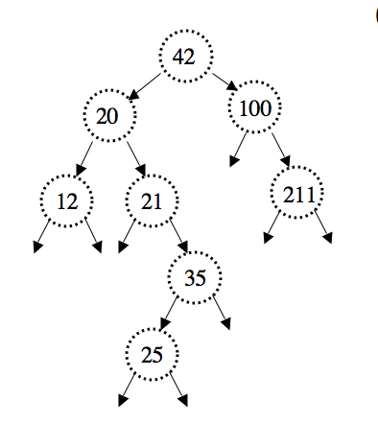
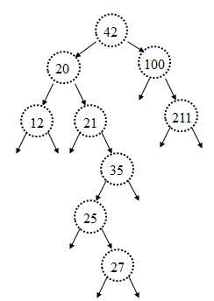
Quiz
(define (nnodes BST)
(if (null? BST)
(let* ([rt (first BST)]
[L (second BST)]
[R (third BST)])
(
Name(s) __________________
(nnodes BST) returns the total # of nodes in the BST
(define (insert k BST)
(if (null? BST)
(let* ([rt (first BST)]
[L (second BST)]
[R (third BST)])
(if/cond
(insert k BST) starts with BST and returns a new binary tree, now with k added. If k was already there, it returns the original BST.
Notes:
I don’t know if this really works...

Slide 36
Traversing trees…
(define (nnodes BST)
(if (null? BST)
(let* ([rt (first BST)]
[L (second BST)]
[R (third BST)])
(
42
20
100
12
21
211
35
25
What are the best-case and worst-case running times here?
What is the worst-case for BALANCED trees?
N = # of nodes
Notes:
I don’t know if this really works...

Slide 37
Trimming BSTs
(define (insert k BST)
(if (null? BST)
(let* ([rt (first BST)]
[L (second BST)]
[R (third BST)])
(if (= k rt)
(if (< k rt)
“trim”
“inflammable”
“fast”
“oversight”
“dust”
“garnish”
“wean”
What's with the words!?
big-O?
Notes:
I don’t know if this really works...

Slide 38
Trimming BSTs
HW 2 problem…
(define (delete k BST)
if 0 children?
“does”
“boss”
“ouch”
if 1 child?
“axes”
“number”
“supply”
“ox”
“sake”
“tarry”
if 2 children?
“wind”
Which three should we delete?
Notes:
I don’t know if this really works...

Slide 39
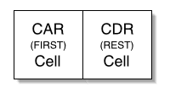
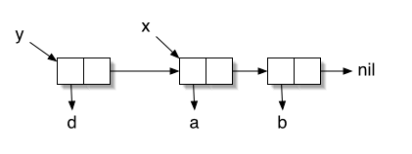
Racket lists aren't!
Address part of the Register
Decrement part of the Register
www.comnet.ca/~pballan/MAJOR.htm
15 bits
15 bits
car
cdr
"contents of the address part of the register"
"contents of the decrement part of the register"
'(a b)
(cddr '(8 6 4 2))
(cdadr '(f (g h i) j k))
These are still in Racket/Scheme today - in any combination!
Notes:
I don’t know if this really works...

Slide 40
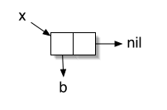
Racket's lists are trees!
'()
a null pointer
'(b)
a cons cell
'(a b)
two cons cells
'((a b) c)
Notes:
I don’t know if this really works...

Slide 41
Racket's lists are trees!
c
'((a b) c)
'(a b c)
Which of these two lists is shown above?
Sketch the other below:
Notes:
I don’t know if this really works...

Slide 42
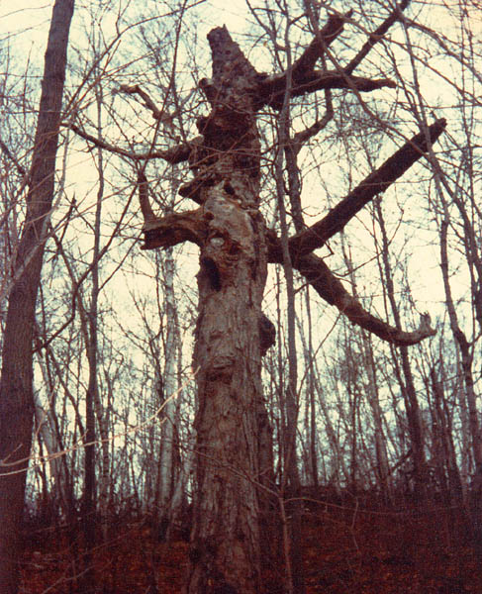
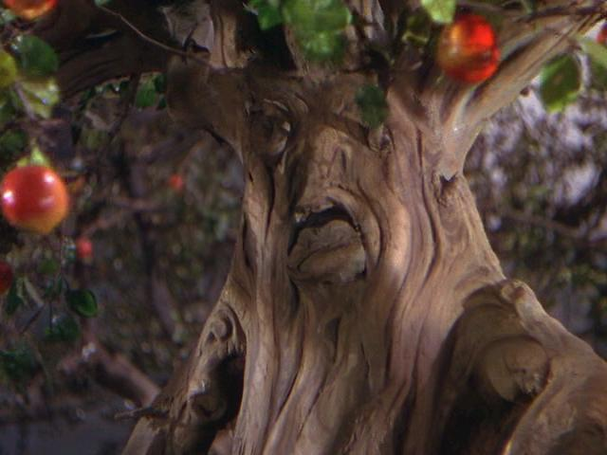
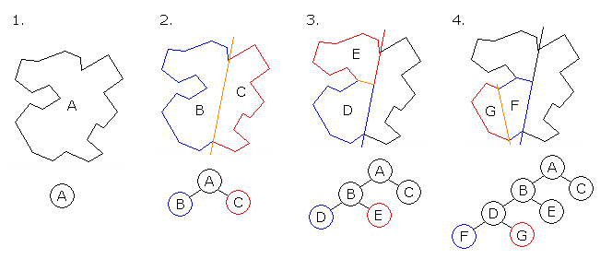


What good are trees?
OZ tree
Not all are good!
"Poltergeist" tree
Binary Space Partition:
Doom, ~1993
improving the "painter's algorithm"
Notes:
I don’t know if this really works...

Slide 43

Hw 2's trees!
The game of 20 Questions
What is the tree here?
Notes:
I don’t know if this really works...

Slide 44

Hw 3's trees!
The game of 20 Questions
What is the tree here?
Is it bigger than a breadbox?
no
yes
Robin Burgener
gelconference.com/07/robin.html
spam
a computer scientist
Notes:
I don’t know if this really works...

Slide 45
See you Thursday!
good luck with hw #2! tonight...
Notes:
I don’t know if this really works...

Slide 46
Quiz!
Use only higher-order functions, not raw recursion, to write these :
Name(s): ____________________
1
smush should concatenate all of the elements of L, which you should assume are lists
2
addk should add k to each element of L (all will be numberic)
( smush '((t h i) (s i s) (s o c o) (o l) )
'( t h i s i s s o c o o l )
( addk 60 '( -18 101 7940 ) )
'( 42 161 8000 )
(define (smush L)
(foldr append '() L) )
(define (addk k L)
(map L))
Already done last time...
What should this be?
3
Lotto-winner takes a list of tickets: '( (name n1 n2 n3 n4 n5) (name n1 n2 n3 n4 n5) ... ) and a list of winning numbers W as input. Then, lotto should return a list of the name of the winner (most matches with W) and the number of matches made.
( lotto-winner '( (Amy 2 3 41 42 50) (Bea 3 40 50 51 52) ) '( 1 3 41 51 52 ) )
'( Bea 3 )
Here, write a helper function: (matches T W) returns the number of elements T and W have in common.
( matches ' (Bea 3 40 50 51 52) '( 1 3 41 51 52 ) )
3
(define (matches T W)
(
Hint: use filter + member...
What more do you need for lotto-winner ? It's hw2 #3!

Slide 47
Anybody claim these aliens?
Kate K.
Carola P. & Richard S.
Garret W. and Lilian H.
Eva G.

Slide 48
One of the favorites...
Kate K.
Carola P. & Richard S.
???
Garret W. and Lilian H.
Eva G.

Slide 49
Try it!
Write (drop-above k L), which returns the list L without any elements > k.
(drop-above 60 '(55 60 65 101 133))
'(55 60)
(define (drop-above k L)
(
What does this output?
(sort '("works!" "wow" "this")
(lambda (s1 s2) (< (string-length s1)
(string-length s2))) )

Slide 50
Binary Search Trees
Move over lists -- there's a new data structure in town - and it's even more recursive than you!
represented by hierarchical lists with empty leaves…
'( 60 (42 (5 () ()) (49 () ()))
(100 () (171 () (202 () ())) )
'( 42 (5 () ()) () )
'( 5 () () )
'()
pictures?

Slide 51
Finding any element...
(find v BT) = (out) #t if v ∈ BT else #f (in) a value and a list representing a BST
N = # of nodes
42
similar to member for lists
20
100
(define (find v BT)
(if (null? BT)
#f
(let* ((root (first BT))
(LEFT (second BT))
(RIGHT (third BT)))
(cond
12
21
211
35
25
What are the best-case and worst-case running times here?
What is the worst-case for BALANCED trees?
Notes:
I don’t know if this really works...

Slide 52
Tapping Trees
(count BT) = (out) total number of non-empty nodes (in) a list representing a BST
42
20
100
(define (count BT)
(if (null? BT)
(let* ((root (first BT))
(LEFT (second BT))
(RIGHT (third BT)))
(
12
21
211
35
25
What are the best-case and worst-case running times here?
What is the worst-case for BALANCED trees?
Notes:
I don’t know if this really works...

Slide 53
Trimming Trees
(insert v BT) = (out) new tree with node v (in) node v and BST T
What's with the words?
“take out”
“inflammable”
(define (insert n BT)
(if (null? BT)
(let* ((root (first BT))
(LEFT (second BT))
(RIGHT (third BT)))
(
base case
“fast”
“oversight”
“dust”
“garnish”
“wean”
Running times?
Notes:
I don’t know if this really works...

Slide 54
Trimming BSTs
HW 2 problem…
(delete v BT) = (out) new tree without v (in) node v and BST BT
“does”
if 0 children?
“boss”
“ouch”
“axes”
“number”
“supply”
if 1 child?
“ox”
“sake”
“tarry”
“wind”
if 2 children?
Which three should we delete?
Notes:
I don’t know if this really works...

Slide 55
Graph’s Anatomy
C
N
C
root
Directed graph
Y
“fan-in”
E
leaves?
L
U
I
cycle
Models any connection relationships
Notes:
I don’t know if this really works...

Slide 56
Undirected Graphs
Brad Pitt
Bill Clinton
Fight
Club
Sleepers
Edward Norton
Kevin Bacon
Novocaine
The Gift
Chelcie Ross
Cate Blanchett
Model relationships in which all connections are two-way.
The “Oracle of Bacon” at www.cs.virginia.edu/oracle
Notes:
I don’t know if this really works...

Slide 57
Trees vs. Graphs
You
Parents
Grandparents
DAG !
Notes:
I don’t know if this really works...

Slide 58

Graphs around the globe
“Chromatic number”
The $100 problem
Notes:
I don’t know if this really works...

Slide 59
Graphs in Rex
E
A
B
C
Representations
Connection Matrix:
[ [0,1,0,0,0], [0,1,1,1,0], [0,0,0,1,0], [0,0,0,0,0], [0,0,1,0,0] ]
D
graph1
Binary Relation: [ [‘A’,‘B’],[‘B’,‘C’],[‘B’,‘B’],[‘B’,‘D’],[‘C’,‘D’],[‘E’,‘C’] ]
Notes:
I don’t know if this really works...

Slide 60
Quiz
Graphical Programming
HW7’s “reachable”
G = [ [‘A’,‘B’],[‘B’,‘C’],[‘B’,‘B’],[‘B’,‘D’],[‘C’,‘D’],[‘E’,‘C’] ]
Problem:
twoStep(x,y,G) = (out) 1, if you can go from x-to-y in exactly two steps, else 0 (in) two nodes (x and y) and a graph G, as a binary relation
Examples:
twoStep(‘A’, ‘C’, G) returns 1
twoStep(‘E’, ‘C’, G) returns 0
Code:
Notes:
I don’t know if this really works...

Slide 61
Quiz
Graphical Programming
HW7’s “biggestFan”
G = [ [‘A’,‘B’],[‘B’,‘C’],[‘B’,‘B’],[‘B’,‘D’],[‘C’,‘D’],[‘E’,‘C’] ]
Problem:
allRoots(G) = (out) a list of the nodes that have 0 parents (in) a graph G as a binary relation
(“roots”)
Example:
allRoots(G) returns [ ‘A’, ‘E’ ]
Code:
Notes:
I don’t know if this really works...

Slide 62
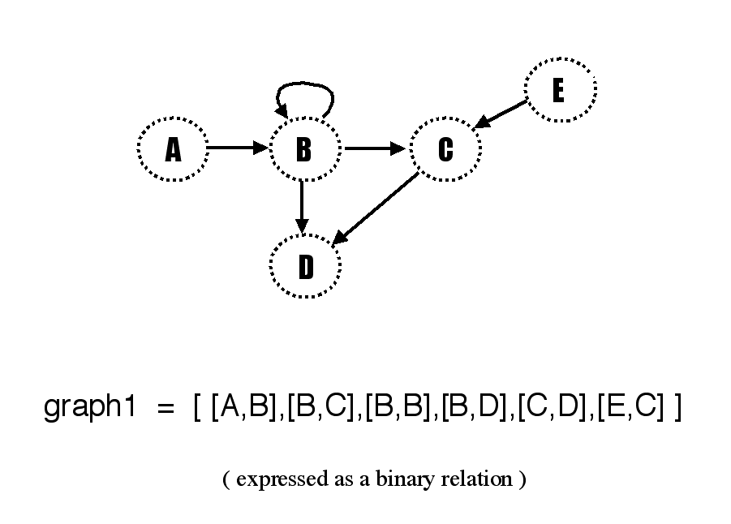
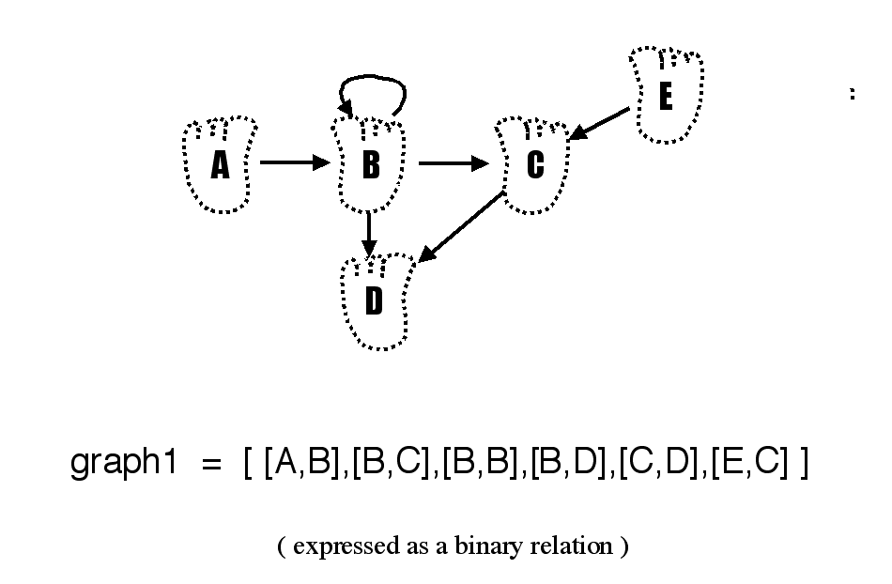
They are p1.gif and p2.gif in CS 60 Lectures/CS 60 Misc S02 !
These images should be put on the big screen to complement going over the prev slide...
Notes:
I don’t know if this really works...

Slide 63
Climbing BSTs
height(T) = (out) integer == the height (in) list representing a BST
42
20
100
21
211
35
25
Notes:
I don’t know if this really works...

Slide 64
Scheme lists are trees!
Not all are good!
Some are…
Doom, ~1993
improving the "painter's algorithm"
Notes:
I don’t know if this really works...

Slide 65
Tapping BSTs
(in) a list representing a non-empty BST
(max BT) = (out) largest element of BT
42
42
20
100
20
100
12
21
211
7
31
60
35
1
8
41
25
Notes:
I don’t know if this really works...

Slide 66
What Scheme would produce…
(define x '(b) )
Sharing!
Notes:
I don’t know if this really works...

Slide 67







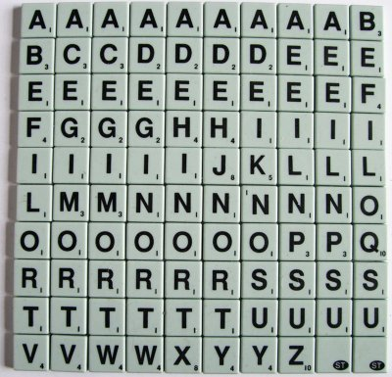
map
foldr
sort
filter
Scrabble
Use only higher-order functions and lambda to compose solutions to
(define (bestWord rack wordList)
'("got"
"dog"
"tax"
"toy")
or the Scrabble dictionary
scrabble-tile-bag
Helper functions help!

Slide 68
define for local variables
(define (fast-pow b p)
(cond
((< p 1) 1)
((odd? p) (* (fast-pow b (- p 1)) b))
( else
(define halfpow (fast-pow b (/ p 2)))
(* halfpow halfpow) ) ))
compute it once – and name it with define!
now this is O(log(N)) !
Notes:
I don’t know if this really works...

Slide 69
map foldr
What does the higher-order function filter do?
(filter even? '(1 2 3 4 5 6 8))
'(2 4 6 8)
You will definitely appreciate filter!

