Slide 1
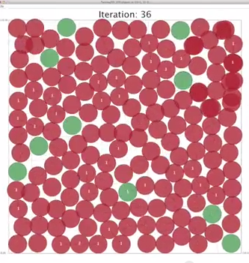
Trees and higher-order functions
Last time
C S
Trees' tangled cousins: Graphs
This time
use-it-or-lose-it algorithm design
6 0
Homework #2 due Monday, 2/10 11:59 pm
starting early is the key to CS 60 happiness for assignment #2…
When isn't it the key?
Or, you could be watching this circle-packing YouTube video?

Slide 2
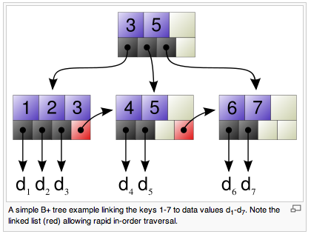

Trees: benefits
fast storage, manipulation + retrieval of data
File systems and databases tend to use trees with higher branching factors and advantageous block sizes. For example, a B+ tree.
wikipedia, B+ trees

Slide 3
Not so fast… ?
Worst balanced case!!
Best-case?
Worst-case?
42
100
find
O(1)
O(N)
20
12
21
211
insert
O(1)
O(N)
35
25
39
delete
O(1)
O(N)
Notes:
I don’t know if this really works...

Slide 4
BST Trimming
HW 2 problem on binary search trees
(define (delete k BST)
if 0 children?
“does”
“boss”
“ouch”
if 1 child?
“axes”
“number”
“supply”
“ox”
“sake”
“tarry”
if 2 children?
“wind”
Which three should we delete?
Notes:
I don’t know if this really works...

Slide 5
Not so fast… ?
Worst balanced case!!
Best-case?
Worst-case?
42
100
find
O(1)
O(log(N))
O(N)
20
12
21
211
insert
O(1)
O(log(N))
O(N)
35
25
39
delete
O(1)
O(log(N))
O(N)
Which side is this column closer to?
?
?
Notes:
I don’t know if this really works...

Slide 6
Not so fast… ?
Worst balanced case!!
Best-case?
Worst-case?
42
100
find
O(1)
O(log(N))
O(N)
20
12
21
211
insert
O(1)
O(log(N))
O(N)
35
logN is constant for all intents and purposes (don't say this in front of computer scientists, however…)
25
39
delete
O(1)
O(log(N))
O(N)
Which side is this column closer to?
x
Notes:
I don’t know if this really works...

Slide 7
First, trees are almost always balanced...
Suppose elements are being inserted into a binary tree.
At each decision point 90% of elements are larger and sort to the right.
let D = # of descendants (including oneself) at each node and let N = total # of nodes in the entire tree
D = N
If the tree has N nodes, how tall is it?
Notes:
I don’t know if this really works...

Slide 8
First, trees are almost always balanced...
Suppose elements are being inserted into a binary tree.
At each decision point 90% of elements are larger and sort to the right.
.9 of all elements are inserted on the right…
let D = # of descendants (including oneself) at each node and let N = total # of nodes in the entire tree
D = N
… and suppose this imbalance holds at every node... !
D = .9N
D = .9²N
D = .9³N
D = 1
If the tree has N nodes, how tall is it?
What about 99.9% ?
Notes:
I don’t know if this really works...

Slide 9
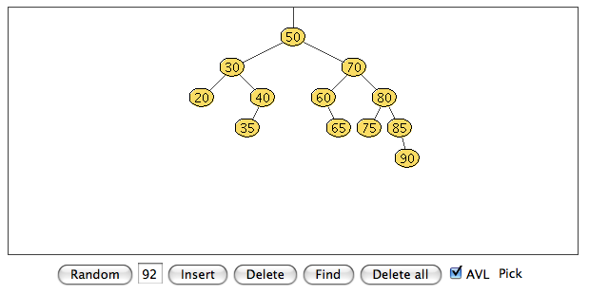
Plus, trees can self-balance…
find
For any constant left/right splitting ratio of the data, all retrieval/upadates on trees are O(logN).
insert
delete
AVL tree
Adelson-Velskii and Landis, An algorithm for the organization of information, 1960
http://www.csi.uottawa.ca/~stan/csi2514/applets/avl/BT.html
And if the data conspire to create an O(N) path...
... self-balance!
Notes:
I don’t know if this really works...

Slide 10
Plus, trees can self-balance…
find
For any constant left/right splitting ratio of the data, all retrieval/upadates on trees are O(logN).
insert
delete
This application was written in Java
AVL tree
Adelson-Velskii and Landis, An algorithm for the organization of information, 1960
http://www.csi.uottawa.ca/~stan/csi2514/applets/avl/BT.html
And if the data conspire to create an O(N) path...
... self-balance!
Notes:
I don’t know if this really works...

Slide 11
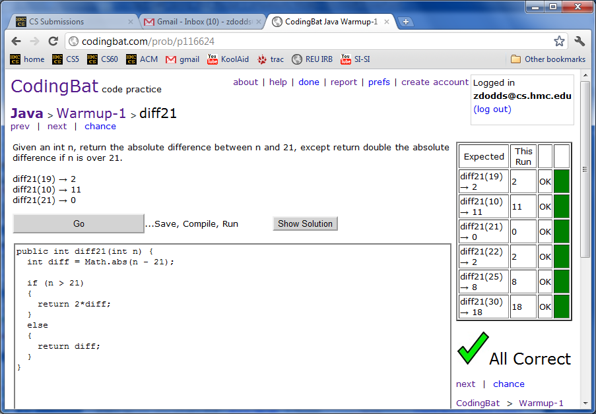
CodingBat…
Java
This language is so alien!

Slide 12
A familiar tree application?
(42-great)-grandparents
... 42 generations ...
grandparents
parents
DAG !
us
Notes:
I don’t know if this really works...

Slide 13
Graphs
A directed graph is a general set of connection relationships.
in Racket…
node
node
node…
C
N
C
(define Gu
'((C1 N) (C1 Y) (N Y)
(C2 N) (C2 Y) (Y E)
(E U) (U I) (I L)
(L E)))
1
2
edge
Y
Graph
edge
Gu
Trees vs. graphs…
E
Roots ?
edge…
Leaves ?
L
U
Children ?
I
Cycles ?
Parents?
I guess I'd call this graph unicyclic…
“fan-in”
Notes:
I don’t know if this really works...

Slide 14
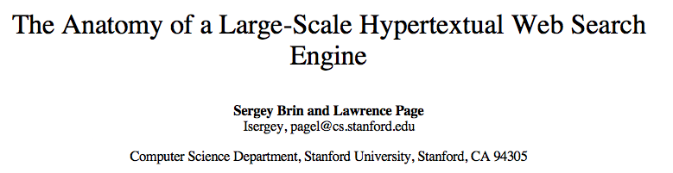
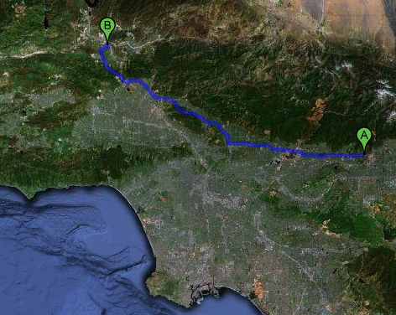
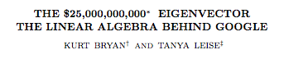

"PageRank" algorithm
Graphs ~ life!
life ~ connectivity ~ graphs
Maps!
Graph theory
Link analysis
Physical graphs ~ shortest paths
lists are graphs...
trees are graphs...
everything's a graph!
Notes:
I don’t know if this really works...

Slide 15
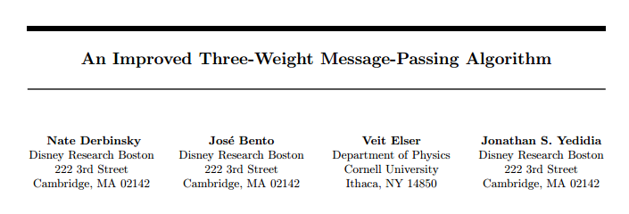
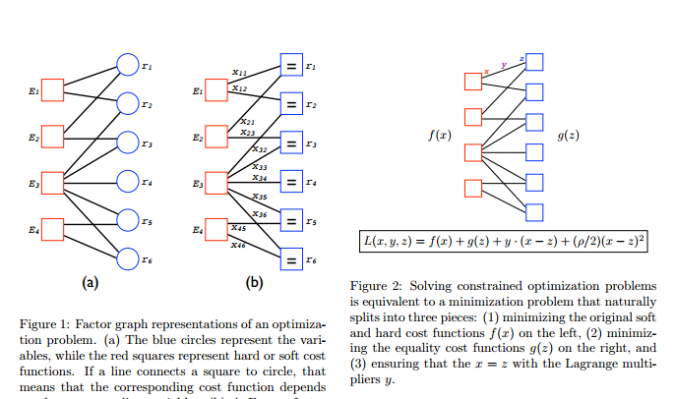
Circle-packing algorithm…
much prose…
Notes:
I don’t know if this really works...

Slide 16
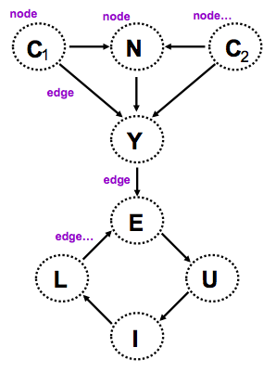
Gu = '((C1 N) (C1 Y) (N Y) (C2 N) (C2 Y)
(Y E) (E U) (U I) (I L) (L E))
(nodes G)
a list of all the nodes of G
(define (nodes G)
Hint: show uniq – how could we use it?
Notes:
big-O: could be edges or nodes!

Slide 17
Gu = '((C1 N) (C1 Y) (N Y) (C2 N) (C2 Y)
(Y E) (E U) (U I) (I L) (L E))
(kids n G)
a list of all the children of n in G
(define (kids n G)
(let* ([
Hint: how might filter help us?
parents?
Notes:
big-O: could be edges or nodes!

Slide 18
Quiz
Graph functions!
Name(s) _________________________
Gu
Feel free to use uniq, nodes, kids, parents, and Racket's usual assortment of functions...
(define (leaf? n G)
(leaf? n G) should return #t if n is a leaf in G and #f otherwise.
(leaf? 'E Gu)
#f
Hint: call (kids n G)
(define (gkids n G)
(gkids n G) should compute the list of grandchildren of n in G: all nodes two edges away.
(gkids 'E Gu)
'( I )
(gkids 'C1 Gu)
'( Y E )
Hint: use kids and map! It's a bit tricky...
(define (reach? a b G)
(reach? a b G) should return #t if there is some path from a to b in G and #f otherwise.
(
there is definitely not enough room here – plus, a solution is a couple slides away. So, this one is just a thought experiment...
(reach? 'E 'N Gu)
#f
(reach? 'N 'E Gu)
#t
Notes:
I don’t know if this really works...

Slide 19
Use it or lose it
A design strategy

Slide 20
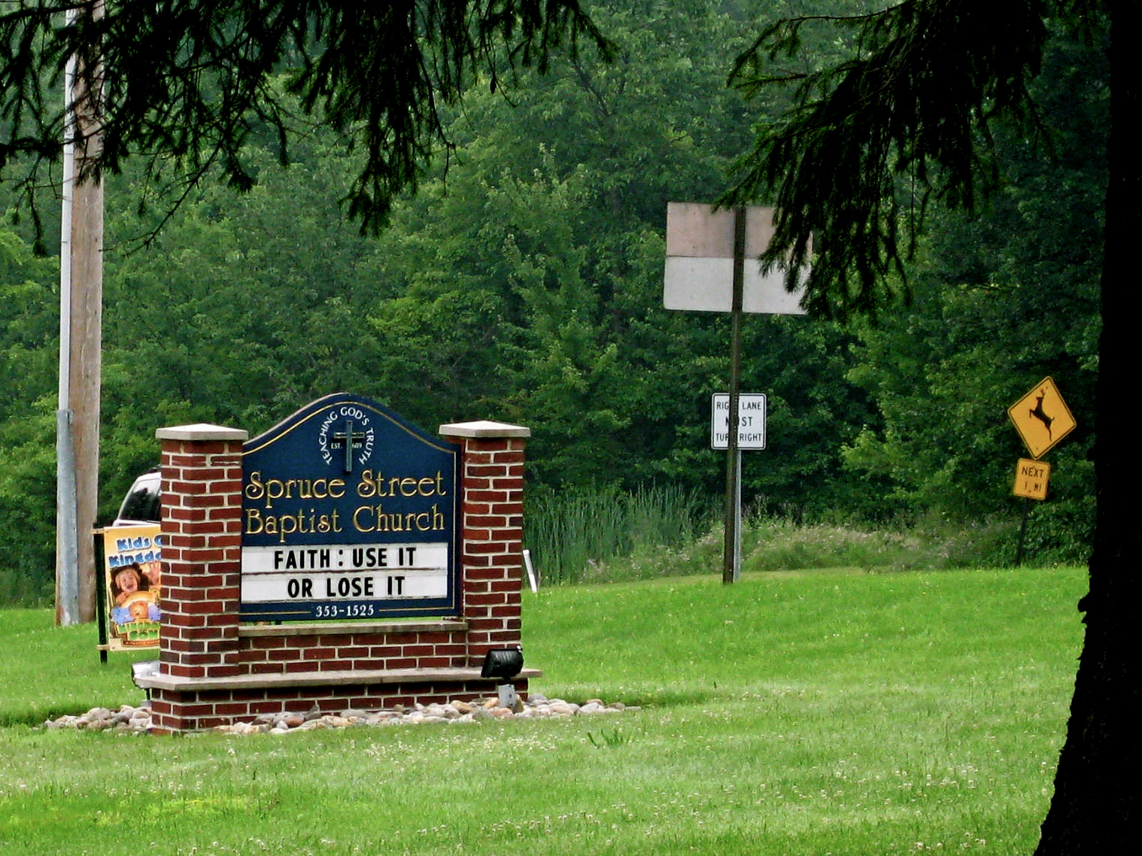
sent by Allie Russell
more recent signs?
Notes:
I don’t know if this really works...

Slide 21

Notes:
I don’t know if this really works...

Slide 22


Racket (Scheme) appears in surprising places...
including robots...
Notes:
I don’t know if this really works...

Slide 23


running Scheme!
Helen Greiner, co-founder and CEO of iRobot (at left in each image!)
Notes:
I don’t know if this really works...

Slide 24
Use it or lose it
A design strategy for algorithms…

Slide 25
Use it or lose it
A design strategy for algorithms…
(1) single "it" out
(2) solve the problem without "it"
(3) solve the problem with "it"
if needed...
(4) Combine!
as appropriate...
Shouldn't this be called use it AND lose it?

Slide 26
Use it or lose it
(uniq '(1 2 1 2 1))
(define (uniq L)
(if (null? L)
'()
(let* ([it (first L) ]
[loseit (uniq (rest L))]
[useit (cons it loseit)])
(
let*'s give a name to the first element: we're going to use it and lose it and combine the results as necessary
solve without "it" + with "it"

Slide 27
Use it or lose it
(uniq '(1 2 1 2 1))
(define (uniq L)
(if (null? L)
'()
(let* ([it (first L) ]
[loseit (uniq (rest L))]
[useit (cons it loseit)])
(if (member it loseit)
loseit
useit
))))
let*'s give a name to the first element: we're going to use it and lose it and combine the results as necessary
solve without "it" + with "it"
Combine and/or check!
return the correct result

Slide 28
Use it or lose it
A design strategy for algorithms…
(1) single "it" out
(2) solve the problem without "it"
(3) solve the problem with "it"
if needed...
(4) Combine!
as appropriate...
Shouldn't this be called use it AND lose it?

Slide 29
Graph-reachability: can you get from A to B?
(reach? a b G)
#t if there is some path from a to b in G, else #f
Gu
(reach? 'Y 'E Gu)
(reach? 'C1 'U Gu)
(reach? Gu)
#f
What's a #f example?
Consider examples first…

Slide 30
Graph-reachability: can you get from A to B?
(reach? a b G)
#t if there is some path from a to b in G, else #f
Welcome to my humble 'a node
'a
'r
't
'z
'm
What is the first element of G?
"it"
'b
'q
Consider the algorithm next…

Slide 31
Graph-reachability: can you get from A to B?
(reach? a b G)
#t if there is some path from a to b in G, else #f
Welcome to my humble 'a node
'a
'r
't
'z
'm
'x
'y
'b
an arbitrary edge in the graph '(x y)
'q
Consider the algorithm next…

Slide 32
Graph-reachability: can you get from A to B?
(define (reach? a b G)
(cond
((equal? a b)
((null? G)
( else (let* ((EDGE (first G))
(R (rest G))
(loseit (reach? s d R))
(x (first EDGE))
(y (second EDGE))
(useit (and (reach? a x R)
(reach? y b R))))
what are the base cases? what are they saying?
solve the problem without "it"
solve the problem with "it"
the punchline?
Consider the code last…
I see why it's called use it or lose it!

Slide 33
Graph-reachability: can you get from A to B?
(define (reach? a b G)
(cond
((equal? a b) #t)
((null? G) #f)
( else (let* ((EDGE (first G))
(R (rest G))
(loseit (reach? s d R))
(x (first EDGE))
(y (second EDGE))
(useit (and (reach? a x R)
(reach? y b R))))
(or useit loseit)…
what are the base cases? what are they saying?
solve the problem without "it"
solve the problem with "it"
I see why it's called use it or lose it!
Consider the code last…

Slide 34
Use it or lose it
(sublists '( a b ))
'(( ) ( b ) ( a ) ( a b ))
returns ALL sublists of elements in L
the order of these sublists in these overall outputs does not matter...
(sublists '( a b c ))
'(( ) ( c ) ( b ) ( b c )
(a) (a c) (a b) (a b c))
(define (sublists L)
(if (null? L)
Base Case! What are all of the sublists of the empty list?
Loseit! What are all of the sublists without it (the first)?
(let* ((it (first L))
(loseit (
(useit (map
Use-it-or-lose-it
Useit! What are all of the sublists that MUST have it?
I think I just lost it!
Combine! What is the complete set of all of the sublists?
on the HW
(make-change Total CoinList)
This should return #t if it's possible to make change for Total using coins in CoinList; otherwise #f
(make-change 42 '(2 5 10 25 50))
#t ;; 42 == 2 + 5 + 10 + 25
(make-change 42 '(3 5 10 25 50))
#f ;; here, 42 can't be made

Slide 35
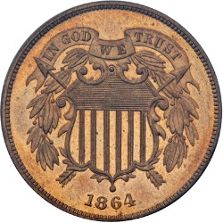
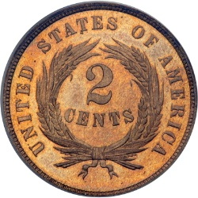
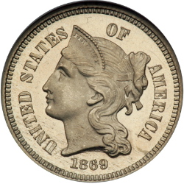
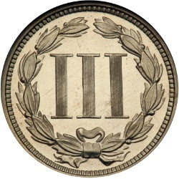
Hw #2
Change!
Can you make the total from the coins available? (odd denominations OK!)
(make-change total CoinList)
(make-change 42 '(2 5 10 25 50))
?
(make-change 42 '(3 5 10 25 50))
?
Examples – Algorithm ideas - Code
I'd be happy with a 3-cent nickel!

Slide 36
(define Gtw '((e b 100) (a b 25) (e a 42)
(a c 7) (a d 13) (a e 15)
(b c 10) (b d 5) (d e 2)
(b e 100) (c d 1) (c e 7)) )
What might these weights represent?
weights
b
This graph looks heavy!
a
e
c
Weighted graphs
d

Slide 37
(define Gtw '((e b 100) (a b 25) (e a 42)
(a c 7) (a d 13) (a e 15)
(b c 10) (b d 5) (d e 2)
(b e 100) (c d 1) (c e 7)) )
weights ~
distances
times (traffic!)
costs
capacities
life!
weights
15
42
25
b
100
This graph looks heavy!
a
10
7
e
100
c
7
5
13
1
2
Weighted graphs
d

Slide 38
(define Gtw '((e b 100) (a b 25) (e a 42)
(a c 7) (a d 13) (a e 15)
(b c 10) (b d 5) (d e 2)
(b e 100) (c d 1) (c e 7)) )
weights ~
distances
times (traffic!)
costs
capacities
life!
weights
15
42
25
(min-dist 'a 'e Gt)
14
b
100
a
10
7
e
100
c
The shortest distance and path from A to B!
7
5
13
1
2
(min-path 'a 'e Gt)
'(14 a c e)
d

Slide 39



Good luck on hw #2!
Extra: the game of 20 Questions
It's a tree!
Is it bigger than a breadbox?
no
yes
spam
a computer scientist
Notes:
I don’t know if this really works...

Slide 40
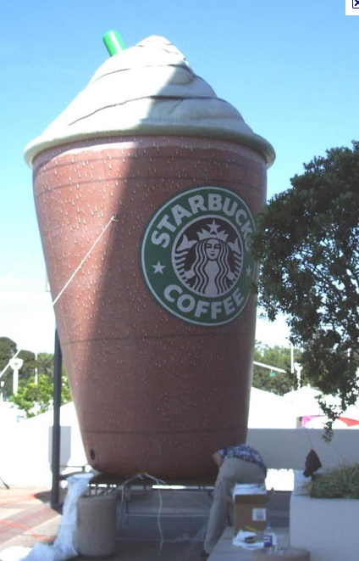
Next week: Java!
Is Java's reputation inflated ?
Decide for yourself...
Good luck with hw #2!
Notes:
I don’t know if this really works...

Slide 41
Graph-reachability: can you get from A to B?
is there some path from a to b in G?
a == start
b == goal destination
(define (reach? a b G)
This space for rent!
Consider the algorithm first, then the code...

Slide 42
Trees are almost always balanced...
Suppose elements are being inserted into a binary tree.
At each decision point 90% of elements are larger and sort to the right.
.9 of all elements are inserted on the right…
let D = # of descendants (including oneself) at each node and let N = total # of nodes in the tree
D = N
… and suppose this imbalance holds at every node... !
D = .9N
D = .9²N
D = .9³N
Desc = 1
If the tree has N nodes, how tall is it?
or even 99.9%
Notes:
I don’t know if this really works...

Slide 43
Use it or lose it
(sublists '( a b ))
'(( ) ( b ) ( a ) ( a b ))
returns ALL sublists of elements in L
the order of these sublists in these overall outputs does not matter...
(define (sublists L)
(if (null? L)
'(( ) ( c ) ( b ) ( b c )
(a) (a c) (a b) (a b c))
(sublists '( a b c ))
Base Case!
(let* ((it (first L))
(loseit (
(useit (
Use-it-or-lose-it
I think I just lost it!
on the HW
(make-change Total CoinList)
This should return #t if it's possible to make change for Total using coins in CoinList; otherwise #f
(make-change 42 '(2 5 10 25 50))
#t ;; 42 == 2 + 5 + 10 + 25
(make-change 42 '(3 5 10 25 50))
#f ;; here, 42 can't be made

Slide 44
Quiz
Feel free to use functions such as uniq, nodes, kids, parents, and higher-order functions...
Gu
Write these functions for directed graphs.
(define (leaf? n G)
(leaf? n G) should return #t if n is a leaf in G and #f otherwise.
(
(leaf? 'e Gu)
#f
Hint: call (kids n G)
(define (gkids n G)
(gkids n G) should compute the list of grandchildren of n in G: all nodes two edges away.
(
(gkids 'e Gu)
'( i )
(gkids 'c1 Gu)
'( y e )
Hint: use kids and map! It's a bit tricky...
(define (reach? a b G)
(reach? a b G) should return #t if there is some path from a to b in G and #f otherwise.
(
there is definitely not enough room here – plus, a solution is a couple slides away: so, this one is just a thought experiment...
(reach? 'e 'n Gu)
#f
(reach? 'n 'e Gu)
#t
Notes:
I don’t know if this really works...

Slide 45
Gu = '((C1 N) (C1 Y) (N Y) (C2 N) (C2 Y)
(Y E) (E U) (U I) (I L) (L E))
(nodes G)
a list of all the nodes of G
(define (nodes G)
(uniq (smush G)))
Hint: show uniq – how could we use it?
big-O?
(kids n G)
a list of all the children of n in G
(define (kids n G)
Hint: could we use filter?
Notes:
big-O: could be edges or nodes!

Slide 46
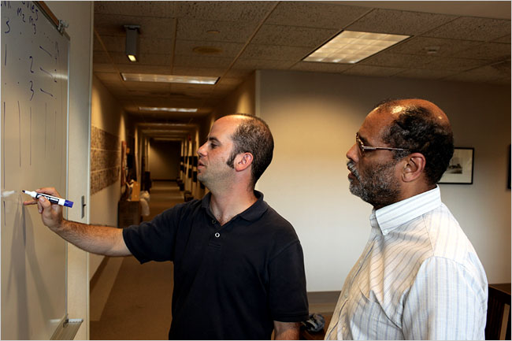
C S 6 0
Trees and higher-order functions
Last time
Trees' tangled cousins: Graphs
This time
use-it-or-lose-it algorithm design
Homework #2 due Monday, 2/10 11:59 pm
Movie graphs!
Bob Bell HMC '72
tutors will be around all weekend
office hours: Friday 2-4pm, in lab
starting early is the key to CS 60 happiness for assignment #2…
When isn't it the key?
we don't know who this guy is...

Slide 47
Use it or lose it
(sublists '( a b ))
'(( ) ( b ) ( a ) ( a b ))
returns ALL sublists of elements in L
the order of these sublists in these overall outputs does not matter...
(define (sublists L)
'(( ) ( c ) ( b ) ( b c )
(a) (a c) (a b) (a b c))
(sublists '( a b c ))
Base Case!
Use-it-or-lose-it
on the HW
(make-change Total CoinList)
This should return #t if it's possible to make change for Total using coins in CoinList; otherwise #f
(make-change 42 '(2 5 10 25 50))
#t ;; 42 == 2 + 5 + 10 + 25
(make-change 42 '(3 5 10 25 50))
#f ;; here, 42 can't be made
I think I lost it!

Slide 48
Quiz
Feel free to use available functions: uniq, nodes, kids, parents, and higher-order functions...
Name(s) ___________________
Gu
Write these functions for directed graphs.
(define (leaf? n G)
(leaf? n G) should return #t if n is a leaf in G and #f otherwise.
(
(leaf? 'e Gu)
#f
Hint: call (kids n G)
(define (gkids n G)
(gkids n G) should compute the list of grandchildren of n in G: all nodes two edges away.
(
(gkids 'e Gu)
'( i )
(gkids 'c1 Gu)
'( y e )
Hint: use kids and map! It's a bit tricky...
(define (reach? a b G)
(reach? a b G) should return #t if there is some path from a to b in G and #f otherwise.
(
there is definitely not enough room here – plus, a solution is a couple slides away: so, this one is just a thought experiment...
(reach? 'e 'n Gu)
#f
(reach? 'n 'e Gu)
#t
Notes:
I don’t know if this really works...

Slide 49
Java
// The "main" method (function) is where it all starts...
public static void main(String[] args)
{
System.out.println("Hello from Java!"); // printing
Scanner inputter = new Scanner( System.in ); // input setup
System.out.print("Type an x-coordinate: ");
double xcoord = inputter.nextDouble();
System.out.print("Type a y-coordinate: ");
double ycoord = inputter.nextDouble();
// create an object, named p1, of type Point:
Point p1 = new Point( xcoord, ycoord );
// do it again for a second object (p2) of type Point
System.out.print("Type another x-coordinate: ");
xcoord = inputter.nextDouble();
System.out.print("Type another y-coordinate: ");
ycoord = inputter.nextDouble();
// our second object, named p2, of type Point:
Point p2 = new Point( xcoord, ycoord );
System.out.println("Point p1 is " + p1.toString());
System.out.println("Point p2 is " + p2.toString());
double mdist = p1.manhattan_distance(p2);
System.out.println("Their manhattan distance is " + mdist);
if ( mdist > 42.0 ) // conclude with an appropriate message...
{
System.out.println("Too far!");
}
else if ( mdist < 42.0 )
{
System.out.println("Too close!");
}
else
{
System.out.println("Perfect!");
}
} // end of the main method
} // end of the Point class
This language is so alien!
execution starts here!
//
// hw2pr2.java
// name:
//
import java.util.Scanner; // input library
/*
* This class, named Point, is a data structure
* representing 2d points :-)
*/
class Point
{
// the data members that make up Points
private double x;
private double y;
// a constructor that creates Points from an
// x-coordinate and a y-coordinate
public Point( double xcoord, double ycoord )
{
this.x = xcoord; // the constructor sets the values
this.y = ycoord; // for the data members, x and y
}
// a method (function) that prints Points
public String toString() // it's always named toString
{
String result = "(" + this.x + "," + this.y + ")";
return result;
}
// a method (function) that returns the Manhattan distance
// between the calling Point (this) and the input Point (p)
public double manhattan_distance(Point p)
{
double x_difference = Math.abs( this.x - p.x );
double y_difference = Math.abs( this.y - p.y );
return x_difference + y_difference;
}
inputter is a software object that provides input functionality
A class is a user-defined data structure.
p1 is a software object of our own type (our own Point class)
All data comes with a pre-defined and unchangeable type!
p2 is also an object of our own Point class
this is Python's self
An object calls its methods with the dot operator.
Java should have a shorter command for printing!
functions that objects can call are named methods
{ curly braces define scope }
// comment characters

Slide 50

Graphs around the globe
“Chromatic number”
The $100 problem
Notes:
I don’t know if this really works...

Slide 51
Lopsided trees?
Suppose elements are being inserted into a binary tree.
At each decision point 90% of elements are larger and sort to the right.
let D = # of descendants (including oneself) at each node and let N = total # of nodes in the tree
D = N
.9 of all elements are inserted on this side
D = .9N
suppose this unbalanced split holds at every node... !
D = .9²N
D = .9³N
D = 1
If the tree has N nodes, how tall is it?
Notes:
I don’t know if this really works...

Slide 52
2⁴⁴ = 17,592,186,044,416
A familiar tree application?
(42-great)-grandparents
... 42 generations ...
grandparents
parents
DAG !
us
Notes:
I don’t know if this really works...

Slide 53
Gu = '((C1 N) (C1 Y) (N Y) (C2 N) (C2 Y)
(Y E) (E U) (U I) (I L) (L E))
(in) a graph as a list of (x,y) edges
nodes( G )
(out) a list of the nodes of G
(define (nodes G)
helper functions: uniq
higher-order functions?
(in) a node and a graph
kids( n, G )
(out) a list of n's children
(define (kids n G)
parents?
big-O( )
Notes:
I don’t know if this really works...

Slide 54
Quiz
Feel free to use available functions: uniq, nodes, kids, parents, and higher-order functions...
Gu
Write these functions for directed graphs.
(define (leaf? n G)
(leaf n G) should return #t if n is a leaf in G and #f otherwise.
(
(leaf? 'e Gu)
#f
Hint: call (kids n G) first
(define (gkids n G)
(gkids n G) should compute the list of grandchildren of n in G: all nodes two edges away.
(
(gkids 'e Gu)
'( i )
(gkids 'c1 Gu)
'( y e )
Hint: call (kids n G) first – then use map!
(define (reach? a b G)
(reach? a b G) should return #t if there is some path from a to b in G and #f otherwise.
(
(reach? 'e 'n Gu)
#f
there is definitely not enough room here – plus, a solution is a couple slides away: so, this one is just a thought experiment...
(reach? 'n 'e Gu)
#t
Notes:
I don’t know if this really works...

Slide 55
Use it or lose it ~ recursive strategizing
let's give a name to the first element: we're going to use it and lose it and combine the results as necessary
(define (uniq L)
(if (null? L)
'()
(let* (( it (first L) )
( loseit (uniq (rest L))))
(if (member it loseit)
loseit
(cons it loseit)
))))
solve the problem without "it"
do/might we need "it" ?
solve the problem with "it"
Shouldn't this be called use it AND lose it?
if needed...

Slide 56
Graph-reachability: can you get from A to B?
is there some path from a to b in G?
(define (reach? a b G)
This space for rent!
Consider the algorithm first, then the code...

Slide 57

Use it or lose it
Try writing (or analyzing) these functions in a use-it-or-lose it style...
(define (sublists L)
This should return ALL sublists of the elements in the list L
(sublists '( a b ))
'(( ) ( b ) ( a ) ( a b ))
the order of these sublists in these overall outputs does not matter...
'(( ) ( c ) ( b ) ( b c )
(a) (a c) (a b) (a b c))
(sublists '( a b c ))
(define (acyclic? G)
This should return #t if graph G has NO cycles; otherwise #f
Look! I'm tricyclic!
there IS a cycle, so it's NOT acyclic...
no cycles in this one...
(acyclic? '((a b) (b a) (a c)))
#f
(acyclic? '((a b) (b c) (a c)))
#t
consider a plan for acyclic?

Slide 58
Graph-reachability: can you get from A to B?
(define (reach? a b G)
(cond
((equal? a b) #t)
((null? G) #f)
( else (let* ((EDGE (first G))
(R (rest G))
(loseit (reach? a b R))
(c (first EDGE))
(d (second EDGE))
(useit (and (reach? a c R)
(reach? d b R))...
(or useit loseit))))...
what are the base cases saying?
solve the problem without "it"
solve the problem with "it"
I see why it's called use it or lose it!
big-O( )

Slide 59
Feel free to use available functions: uniq, nodes, kids, parents, and higher-order functions...
Name(s) ________________
Gu
Write these functions for directed graphs.
(define (leaf? n G)
(leaf n G) should return #t if n is a leaf in G and #f otherwise.
(
(leaf? 'e Gu)
#f
Hint: call (kids n G) first
(define (gkids n G)
(gkids n G) should compute the list of grandchildren of n in G: all nodes two edges away.
(
(gkids 'e Gu)
'( i )
(gkids 'c1 Gu)
'( y e )
Hint: call (kids n G) first – then use map!
(define (reach? a b G)
(reach? a b G) should return #t if there is some path from a to b in G and #f otherwise.
(
(reach? 'e 'n Gu)
#f
there is definitely not enough room here – plus, a solution is a couple slides away: so, this one is just a thought experiment...
(reach? 'n 'e Gu)
#t
Notes:
I don’t know if this really works...

Slide 60
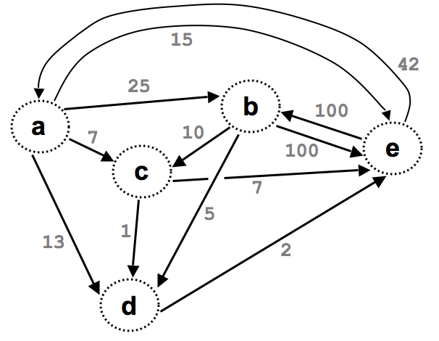
(define Gt '((e b 100) (a b 25) (e a 42)
(a c 7) (a d 13) (a e 15)
(b c 10) (b d 5) (d e 2)
(b e 100) (c d 1) (c e 7)) )
"Quiz"
Try writing these two functions for weighted graphs…
This should return the total of the edge weights coming in to a in G:
Return +inf.0 is there are no such weights.
+inf.0 !?
(define (inflow a G)
This should return the child node closest to n in G:
(define (closest-child n G)
Will this be a useful subroutine for min-path?

Slide 61
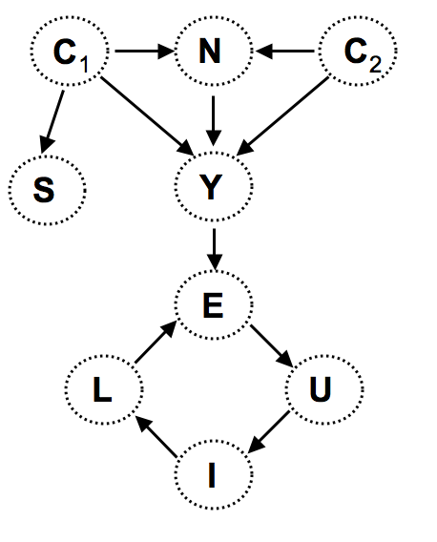
Try it out…
(define Gu '( (c1 n) (c1 y) (n y)
(c2 n) (c2 y) (y e)
(e u) (u i) (i l)
(l e) ) )
This function returns #t if node gp is a grandparent of node gk, else #f.
(define (gkid gp gk G)
This function returns #t if node b can be reached by any path from node a, else #f.
(define (reach a b G)
Thought experiment: How could you determine if a graph contains a cycle or not?
Notes:
I don’t know if this really works...

Slide 62
gkid
(define Gu '( (c1 n) (c1 y) (n y)
(c2 n) (c2 y) (y e)
(e u) (u i) (i l)
(l e) ) )
This function returns #t if node gp is a grandparent of node gk, else #f.
(define (gkid gp gk G)
Notes:
I don’t know if this really works...

Slide 63
reach
(define Gu '( (c1 n) (c1 y) (n y)
(c2 n) (c2 y) (y e)
(e u) (u i) (i l)
(l e) ) )
This function returns #t if node b can be reached by any path from node a, else #f.
(define (reach a b G)
Notes:
I don’t know if this really works...

Slide 64
hasCycle?
(define Gu '( (c1 n) (c1 y) (n y)
(c2 n) (c2 y) (y e)
(e u) (u i) (i l)
(l e) ) )
Thought experiment: How could you determine if a graph contains a cycle or not?
Notes:
I don’t know if this really works...

Slide 65
Graphical programming
(define Gu '( (c1 n) (c1 y) (n y)
(c2 n) (c2 y) (y e)
(e u) (u i) (i l)
(l e) ) )
C
N
C
1
2
Roots ?
Leaves ?
S
Y
Parents
“fan-in”
Children ?
E
Cycles ?
L
U
Representation?
parents
rev
I
grandkids
kids
nodes
descendants!
leaves
Notes:
I don’t know if this really works...

Slide 66
Graphs in Rex
E
A
B
C
Representations
Connection Matrix:
[ [0,1,0,0,0], [0,1,1,1,0], [0,0,0,1,0], [0,0,0,0,0], [0,0,1,0,0] ]
D
graph1
Binary Relation: [ [‘A’,‘B’],[‘B’,‘C’],[‘B’,‘B’],[‘B’,‘D’],[‘C’,‘D’],[‘E’,‘C’] ]
Notes:
I don’t know if this really works...

Slide 67
"Quiz"
Try these two techniques:
handling sorted lists (merge)
Name(s):
use it or lose it: "weirdo analysis"
diff(L,M) should return all the elements in L that are NOT in M. Both lists are already sorted!
Examples:
diff( [1,2,4,5], [0,1,4,7,8] )
[2,5]
We only remove as many examples as appear in the second list!
diff( [1,2,2,2,5], [0,1,2,5] )
[2,2]
diff( [], M ) =>
diff( L, [] ) =>
diff( [f|R], [e|S] ) => f == e ?
: f <= e ?
: ;
sublists( L ) should return all the sublists consisting of elements of L
sublists( [1] )
[ [], [1] ]
Don't worry about their order in the output!
Examples:
sublists( [1,2] )
[ [], [2], [1], [1,2] ]
sublists( [] ) =>
sublists( [f|R] ) =>
Notes:
Really a very recursive idea: recursively handle the Rest, then consider using the first
"Use it or Lose it!"

Slide 68
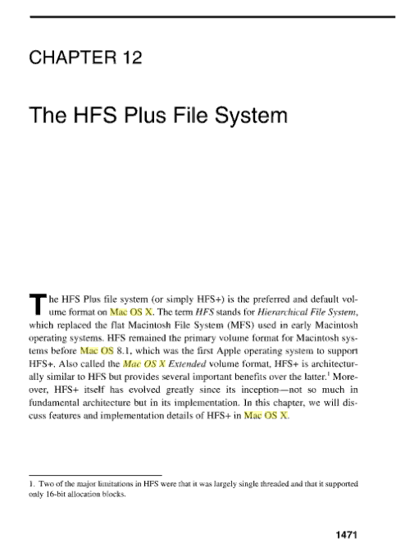
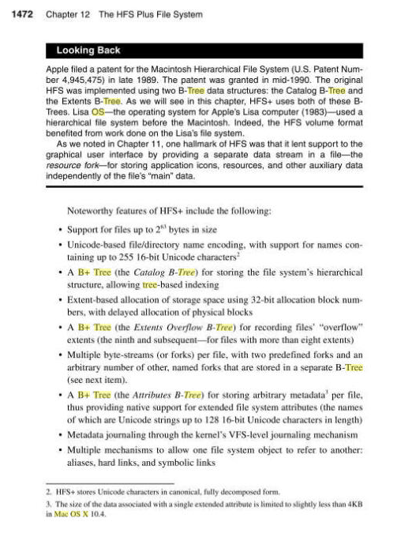
Macs, too

Slide 69
Quiz
Graphical Programming
HW7’s “reachable”
G = [ [‘A’,‘B’],[‘B’,‘C’],[‘B’,‘B’],[‘B’,‘D’],[‘C’,‘D’],[‘E’,‘C’] ]
Problem:
twoStep(x,y,G) = (out) 1, if you can go from x-to-y in exactly two steps, else 0 (in) two nodes (x and y) and a graph G, as a binary relation
Examples:
twoStep(‘A’, ‘C’, G) returns 1
twoStep(‘E’, ‘C’, G) returns 0
Code:
Notes:
I don’t know if this really works...

Slide 70
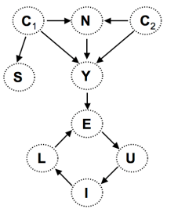
"Quiz"
G1
Write these functions for directed graphs.
G2
gkid(a,b,G) should be a predicate returning 1 if b is a's grandchild in G, else 0.
cyc(G) is a predicate that returns 1 if G has a cycle and 0 if not.
This is really a thought question, not a coding one -- see if you can determine a cycle-checking algorithm!
gkid("N","E",G1)
1
gkid("N","U",G1)
0
(leaf? n G)
cyc( G1 )
1
cyc( G2 )
0
(gkids n G)
(reach? a b G)
This is graphical programming?
Feel free to use nodes, kids, parents, hofs...
Notes:
I don’t know if this really works...

Slide 71
Quiz
Graphical Programming
HW7’s “biggestFan”
G = [ [‘A’,‘B’],[‘B’,‘C’],[‘B’,‘B’],[‘B’,‘D’],[‘C’,‘D’],[‘E’,‘C’] ]
Problem:
allRoots(G) = (out) a list of the nodes that have 0 parents (in) a graph G as a binary relation
(“roots”)
Example:
allRoots(G) returns [ ‘A’, ‘E’ ]
Code:
Notes:
I don’t know if this really works...

Slide 72
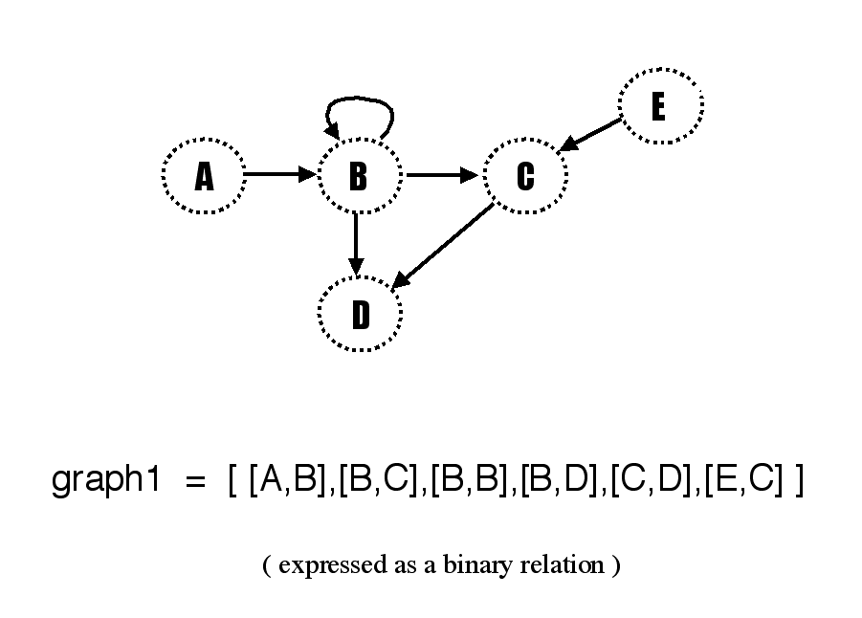
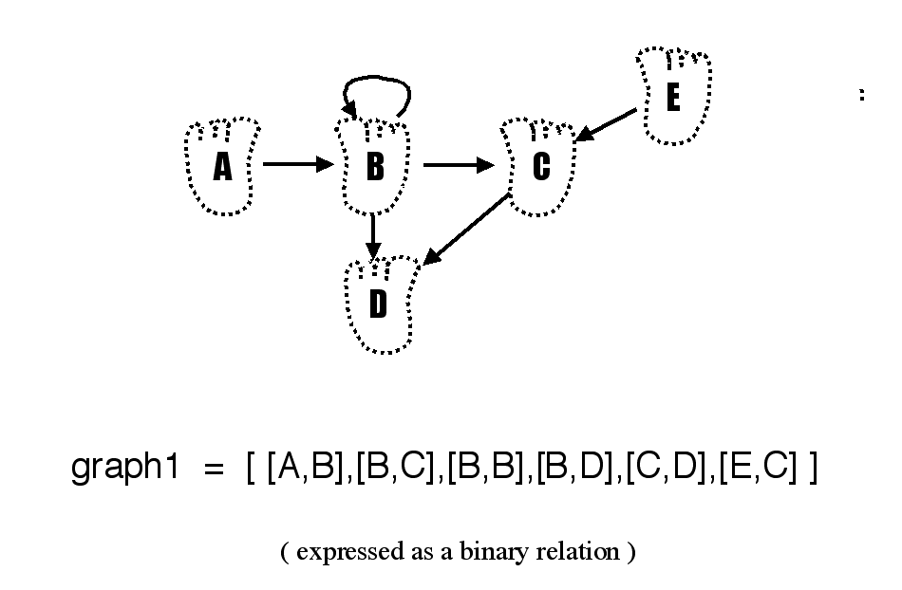
They are p1.gif and p2.gif in CS 60 Lectures/CS 60 Misc S02 !
These images should be put on the big screen to complement going over the prev slide...
Notes:
I don’t know if this really works...

Slide 73
Graphical programming
node
node
(in) a node and an edge-list graph
node…
C
N
C
kids( n, G )
(out) a list of n's children
1
2
recursion
edge
kids(n,[]) =>
Y
edge
kids(n,[ [a,b]|R ]) =>
E
edge…
L
U
I
parents?
Notes:
I don’t know if this really works...

Slide 74
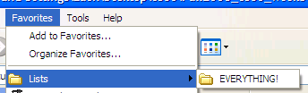
Functional languages do provide a menu of data structure options:
all data structures are lists at heart!
Notes:
Not really feature-rich – but they are structurally rich! (elegant)

Slide 75
Weirdo Analysis ~ recursive problem solving
(define (powerset L)
(if (null? L)
(let* ([ weirdo
[ didRest
Should return a list of all of the different subsets of L.
Assume L contains distinct elements.
base case(s)
choose a "weirdo"
give wdo. a vacation
re-include as necessary

Slide 76
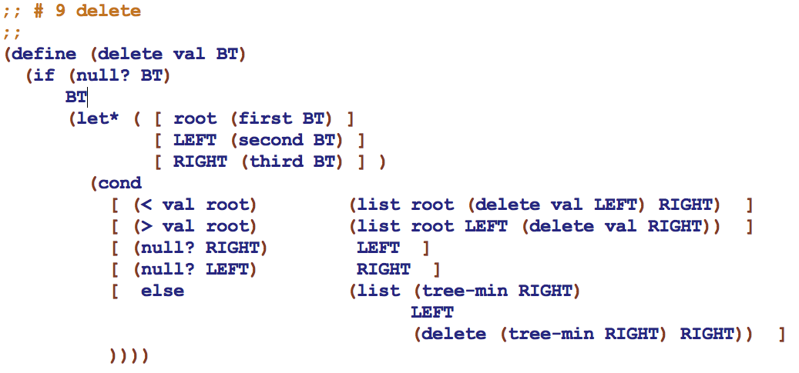
Deleting from a binary tree

Slide 77
Trees are fast
find
For any constant left/right split-ratio of the data, all operations on trees are O(logN).
insert
delete
What if the data conspire against you -- and create an O(N) path?
Notes:
I don’t know if this really works...

Slide 78
Another tree example?
You
Parents
Grandparents
DAG !
Notes:
I don’t know if this really works...

Slide 79
Undirected Graphs
Brad Pitt
Bill Clinton
Fight
Club
Sleepers
Edward Norton
Kevin Bacon
Novocaine
The Gift
Chelcie Ross
Cate Blanchett
Model relationships in which all connections are two-way.
The “Oracle of Bacon” at oracleofbacon.org/
Notes:
I don’t know if this really works...

Slide 80
Graph’s Anatomy
A directed graph models a general set of connection relationships.
node
node
node…
C
N
C
1
2
edge
How might it differ from a tree ?
Roots ?
Y
Leaves ?
edge
Parents
“fan-in”
E
edge…
Children ?
L
U
Cycles ?
Representation?
I
Notes:
I don’t know if this really works...

Slide 81
Graphical programming
(define Gu '( (c1 n) (c1 y) (n y)
(c2 n) (c2 y) (y e)
(e u) (u i) (i l)
(l e) ) )
C
N
C
1
2
S
Y
The representation is edge-based.
How would we gather a list of nodes of graph G?
(define (nodes G)
E
L
U
I
Notes:
I don’t know if this really works...

Slide 82
Graphical programming
(define Gu '( (c1 n) (c1 y) (n y)
(c2 n) (c2 y) (y e)
(e u) (u i) (i l)
(l e) (c1 s) ) )
already written…
How to extract the children of a particular node, n in G?
nodes
(define (kids n G)
Notes:
I don’t know if this really works...

Slide 83
Graphical programming
(define Gu '( (c1 n) (c1 y) (n y)
(c2 n) (c2 y) (y e)
(e u) (u i) (i l)
(l e) (c1 s) ) )
already written…
How about the parents?
nodes
(define (parents n G)
kids
and the roots?
Notes:
I don’t know if this really works...

Slide 84
Lotto!
Use only higher-order functions and lambda to compose a solution to
3
Lotto takes a list of tickets: '( (name n1 n2 n3 n4 n5) (name n1 n2 n3 n4 n5) ) and a list of winning numbers W as input. Then, lotto should return a list of the name of the winner (most matches with W) and the number of matches made.
You should assume that the function (matches L1 L2) already exists. It returns the # of elements in L1 that are in L2.
( lotto '( (Amy 2 3 41 42 50) (Bea 3 40 50 51 52) ) '( 1 3 41 51 52 ) )
'( Bea 3 )
(define (lotto TL W)
Helper functions!

Slide 85







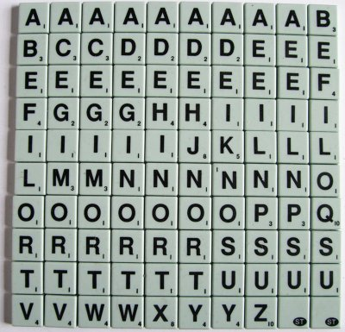
map
foldr
sort
filter
Scrabble
Use only higher-order functions and lambda to compose solutions to
(define (bestWord rack wordList)
'("got"
"dog"
"tax"
"toy")
or the Scrabble dictionary
scrabble-tile-bag
Helper functions help!

Slide 86
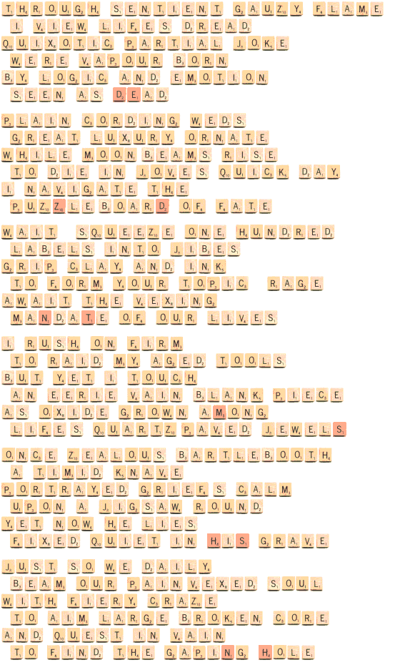
A Scrabble Poem…
- Mike Keith
http://users.aol.com/s6sj7gt/scrpoem.htm
Notes:
I don’t know if this really works...

Slide 87
filter sort
What does the higher-order function filter do?
(filter even? '(1 2 3 4 5 6 8))
'(2 4 6 8)
You will definitely appreciate filter!

Slide 88
filter sort
What does the higher-order function filter do?
(filter even? '(1 2 3 4 5 6 8))
'(2 4 6 8)
You will definitely appreciate filter!
sort does what you expect,
but it requires a two-argument function as its third input
(sort '(42 30 77) <)
'(30 42 77)

Slide 89
Try it!
(sort '("works" "way" "no" "this")
(lambda (s1 s2) (< (string-length s1)
(string-length s2)))
) ;; end of sort
Write (drop-above k L), which returns L without any elements > k.
(drop-more 60 '(55 60 65 101 133))
'(55 60)
(define (drop-above k L)

Slide 90
Scheme Field Guide: Trees
Target Set = all the children of a node
Root
R
"child" node
"parent" node
E
A
U
Height = number of edges on longest path from root to a node
1+
Subtree
D
X
N
G
Representations
Leaf
Binary Relation: ' ( (R E) (R A) (R U) (E D) (E X) (U N) (N G) )
Hierarchical List: '( R (E (D) (X)) (A) (U (N (G))) )
Notes:
I don’t know if this really works...

Slide 91
Tree species
Search Tree / Trie
Binary Search Tree
/
42
usr/
home/
bin/
20
100
local/
pwd
12
21
211
z/
mike/
I am!
35
bin/
courses/
25
39
spamc
cs60/
hw2.scm
each node holds an entire piece of data
each node holds part of a piece of data
What else is special here?
Notes:
I don’t know if this really works...

Slide 92
Binary Search Trees
Move over lists -- there's a new data structure in town - and it's even more recursive than you!
represented by hierarchical lists with empty leaves…
'( 60 (42 (5 () ()) (49 () ()))
(100 () (171 () (202 () ())) )
'( 42 (5 () ()) () )
'( 5 () () )
'()
pictures?

Slide 93
Binary Search Trees
42
Identifying features:
Every node has two subtrees
Each node has a value or “key”
The root value is always greater than all nodes in a left subtree (or empty)
The root value is always less than all nodes in a right subtree (or empty)
Each node has a distinct value
20
100
12
21
211
35
25
39
BT = '( 42 ( 20 (12 () ()) (21 () (35 (25 () ()) (39 () ())) )) (100 () (211 () ()) ) )
All these parens look like leaves!
Notes:
I don’t know if this really works...

Slide 94
Tapping BSTs
Let* me make a suggestion! Name each of the tree's parts…
(define (print-bt BT)
(if (null? BT)
"empty tree!"
(let* ([ root (first BT) ]
[ LEFT (second BT) ]
[ RIGHT (third BT) ])
(begin ;; good for debugging
(display "root: ")
(pretty-print root)
(display "LEFT: ")
(pretty-print LEFT)
(display "RIGHT: ")
(pretty-print RIGHT)
"done!")
)))
42
20
100
12
21
211
This is all "ELSE" code
35
25
Notes:
I don’t know if this really works...

Slide 95
Tapping BSTs
(in) a list representing a non-empty BST
(find-max BT) = (out) the largest of BST's elements
42
100
(define (find-max BT)
(let* ([ root (first BT) ]
[ LEFT (second BT) ]
[ RIGHT (third BT) ])
(
20
12
21
211
35
25
big-O?
Notes:
I don’t know if this really works...

Slide 96
Tapping BSTs
(find v BT) = (out) #t if v ∈ BT else #f (in) a value and a list representing a BST
42
20
100
similar to member for lists
12
21
211
(define (find v BT)
(if (null? BT)
;; base case
(let* ([ root (first BT) ]
[ LEFT (second BT) ]
[ RIGHT (third BT) ])
(
35
25
Notes:
I don’t know if this really works...

Slide 97
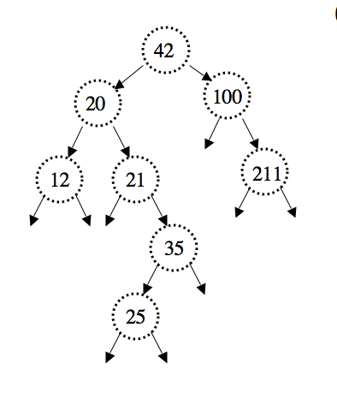
Quiz
BT2
Write these two functions that use binary search trees
count should return the total number of nodes in BT
insert starts with BT and returns a new binary tree, now with v added. If v is already there, return the original.
(count BT)
8
(define (count BT)
(if (null? BT)
(let* ([ root (first BT) ]
[ LEFT (second BT) ]
[ RIGHT (third BT) ])
(
(define (insert v BT)
(if (null? BT)
(let* ([ root (first BT) ]
[ LEFT (second BT) ]
[ RIGHT (third BT) ])
(
base case
base case
Notes:
I don’t know if this really works...

Slide 98
Tapping BSTs
(count BT) = (out) total number of non-empty nodes (in) a list representing a BST
42
20
100
12
21
211
35
25
(define (count BT)
(if (null? BT)
;; what should this be?
(let* ([ root (first BT) ]
[ LEFT (second BT) ]
[ RIGHT (third BT) ])
(
big-O?
Notes:
I don’t know if this really works...

Slide 99
Trimming BSTs
(insert v BT) = (out) new tree with node v (in) node v and BST T
What's with the words?
“take out”
“inflammable”
(define (insert v BT)
(if (null? BT)
(let* ([ root (first BT) ]
[ LEFT (second BT) ]
[ RIGHT (third BT) ])
(cond
“fast”
“out”
base case
“dust”
“garnish”
“wean”
Notes:
I don’t know if this really works...

Slide 100
Trimming BSTs
HW 2 problem…
(delete v BT) = (out) new tree without v (in) node v and BST BT
“does”
“boss”
“ouch”
“axes”
“number”
“supply”
“ox”
“sake”
“tarry”
“wind”
Which three should we delete?
Notes:
I don’t know if this really works...

Slide 101
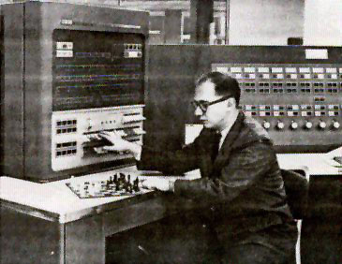
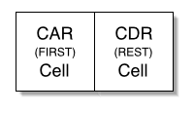
Scheme lists are trees!
Address part of the Register
Decrement part of the Register
www.comnet.ca/~pballan/MAJOR.htm
15 bits
15 bits
car
cdr
"contents of the address part of the register"
"contents of the decrement part of the register"
These are still in Scheme today - in any combination!
Playing Chess with an IBM 704 ~ 1957
talk about a LOW-LEVEL interface!
(cddr '(8 6 4 2))
(cdadr '(f (g h i) j k))
Notes:
I don’t know if this really works...

Slide 102
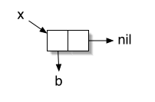
Scheme lists are trees!
()
"a NULL pointer!"
(cons 'b '())
(define x (cons 'b '()) )
Notes:
I don’t know if this really works...

Slide 103
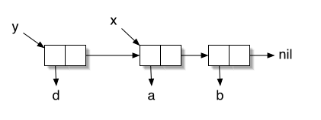
What Scheme would produce…
Sharing!
Notes:
I don’t know if this really works...

Slide 104
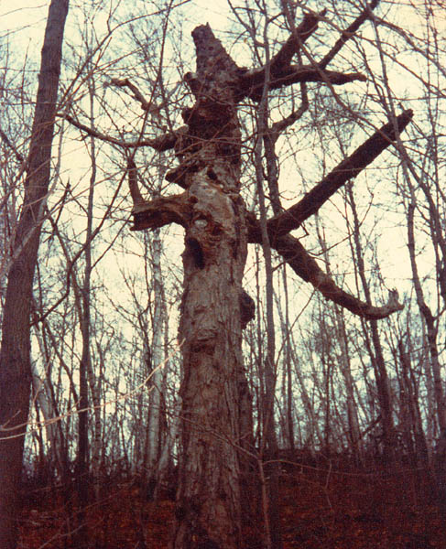
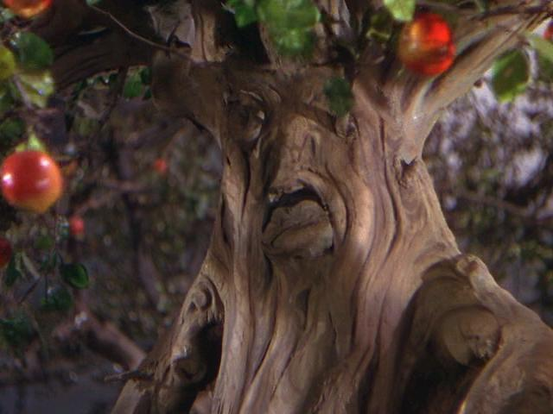
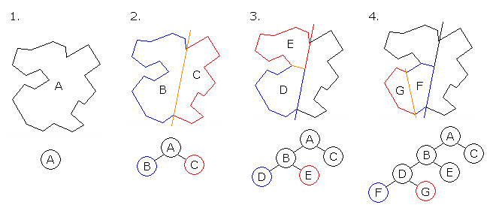
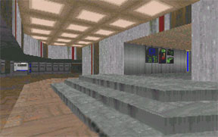

What good are trees?
OZ tree
Not all are good!
"Poltergeist" tree
Binary Space Partition:
Doom, ~1993
improving the "painter's algorithm"
Notes:
I don’t know if this really works...

Slide 105
Graph’s Anatomy
C
N
C
root
Directed graph
Y
“fan-in”
E
leaves?
L
U
I
cycle
Models any connection relationships
Notes:
I don’t know if this really works...

Slide 106
Undirected Graphs
Brad Pitt
Bill Clinton
Fight
Club
Sleepers
Edward Norton
Kevin Bacon
Novocaine
The Gift
Chelcie Ross
Cate Blanchett
Model relationships in which all connections are two-way.
The “Oracle of Bacon” at www.cs.virginia.edu/oracle
Notes:
I don’t know if this really works...

Slide 107
Trees vs. Graphs
You
Parents
Grandparents
DAG !
Notes:
I don’t know if this really works...

Slide 108
Graphs around the globe
“Chromatic number”
The $100 problem
Notes:
I don’t know if this really works...

Slide 109
Graphs in Rex
E
A
B
C
Representations
Connection Matrix:
[ [0,1,0,0,0], [0,1,1,1,0], [0,0,0,1,0], [0,0,0,0,0], [0,0,1,0,0] ]
D
graph1
Binary Relation: [ [‘A’,‘B’],[‘B’,‘C’],[‘B’,‘B’],[‘B’,‘D’],[‘C’,‘D’],[‘E’,‘C’] ]
Notes:
I don’t know if this really works...

Slide 110
Quiz
Graphical Programming
HW7’s “reachable”
G = [ [‘A’,‘B’],[‘B’,‘C’],[‘B’,‘B’],[‘B’,‘D’],[‘C’,‘D’],[‘E’,‘C’] ]
Problem:
twoStep(x,y,G) = (out) 1, if you can go from x-to-y in exactly two steps, else 0 (in) two nodes (x and y) and a graph G, as a binary relation
Examples:
twoStep(‘A’, ‘C’, G) returns 1
twoStep(‘E’, ‘C’, G) returns 0
Code:
Notes:
I don’t know if this really works...

Slide 111
Quiz
Graphical Programming
HW7’s “biggestFan”
G = [ [‘A’,‘B’],[‘B’,‘C’],[‘B’,‘B’],[‘B’,‘D’],[‘C’,‘D’],[‘E’,‘C’] ]
Problem:
allRoots(G) = (out) a list of the nodes that have 0 parents (in) a graph G as a binary relation
(“roots”)
Example:
allRoots(G) returns [ ‘A’, ‘E’ ]
Code:
Notes:
I don’t know if this really works...

Slide 112
They are p1.gif and p2.gif in CS 60 Lectures/CS 60 Misc S02 !
These images should be put on the big screen to complement going over the prev slide...
Notes:
I don’t know if this really works...

Slide 113
Climbing BSTs
height(T) = (out) integer == the height (in) list representing a BST
42
20
100
21
211
35
25
Notes:
I don’t know if this really works...

Slide 114
Scheme lists are trees!
Not all are good!
Some are…
Doom, ~1993
improving the "painter's algorithm"
Notes:
I don’t know if this really works...

Slide 115
Tapping BSTs
(in) a list representing a non-empty BST
(max BT) = (out) largest element of BT
42
42
20
100
20
100
12
21
211
7
31
60
35
1
8
41
25
Notes:
I don’t know if this really works...

Slide 116

C S 6 0
Last week:
Trees and higher-order functions
This week!
Trees' tangled cousins: Graphs
(define (mystery L)
(if (null? L)
()
(let* ([ weirdo (first L) ]
[ didRest (mystery (rest L)) ])
(if (member weirdo didRest)
didRest
(cons weirdo didRest)
))))
Well, this function is certainly unique!
Homework #3 due Sunday, 9/21 by 11:59 pm
tutors will be around all week
office hours: Friday 2-4pm, in lab
starting early is the key to CS 60 happiness for assignment #3…

