Slide 1
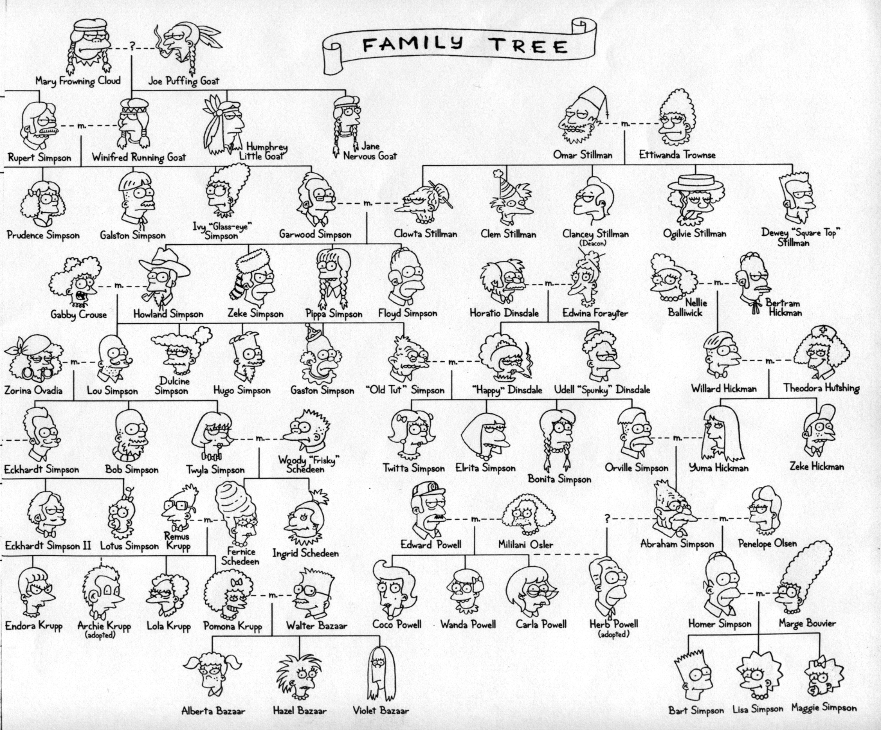

CS 6
Matt Groening's tree?
true!
Hw #3: Prolog
Problem #1: The Simpsons
Problem #2: Racket finale
Problem #3: Java syntax

Slide 2
Use it or lose it
(1) single "it" out
How did this go?
(2) solve the problem without "it"
(3) solve the problem with "it"
if needed...
(4) Combine!
as appropriate...
Shouldn't this be called use it AND lose it?

Slide 3
Aargh!

Slide 4
Aargh!

Slide 5
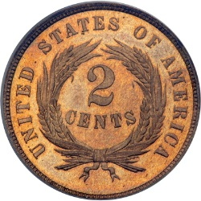
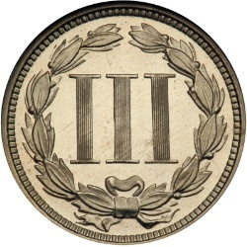
Change!
Can you make the total from the coins available? (odd denominations OK!)
original call
(make-change 42 '(2 5 10 25 50))
it
2
loseit
(make-change 42 '(5 10 25 50))
useit
Examples – Algorithm ideas - Code
If I had change, I'd hate to lose it!

Slide 6
Graph-reachability: can you get from A to B?
(define (reach? a b G)
(cond
((equal? a b) #t)
((null? G) #f)
( else (let* ((EDGE (first G))
(R (rest G))
(loseit (reach? a b R))
(x (first EDGE))
(y (second EDGE))
(useit (and (reach? a x R)
(reach? y b R))))
(or useit loseit)…
what are the base cases? what are they saying?
solve the problem without "it"
solve the problem with "it"
Consider the code last…

Slide 7
(define Gtw '((e b 100) (a b 25) (e a 42)
(a c 7) (a d 13) (a e 15)
(b c 10) (b d 5) (d e 2)
(b e 100) (c d 1) (c e 7)) )
weights ~
"distances"
weights
15
42
25
(min-dist 'a 'e Gt)
14
b
100
a
10
7
e
100
c
The shortest distance and path from A to B!
7
5
13
1
2
(min-path 'a 'e Gt)
'(14 a c e)
d
big-O?

Slide 8
Graph-reachability: can you get from A to B?
(define (reach? a b G) ;; much code omitted
(loseit (reach? a b R))
(useit (and (reach? a x R)
(reach? y b R))))
(or useit loseit)…
First call has N nodes in G
N
big-O?
What about make-change?

Slide 9
Use it or lose it
(sublists '( a b ))
'(( ) ( b ) ( a ) ( a b ))
returns ALL sublists of elements in L
the order of these sublists in these overall outputs does not matter...
(sublists '( a b c ))
'(( ) ( c ) ( b ) ( b c )
(a) (a c) (a b) (a b c))
(define (sublists L)
(if (null? L)
Base Case! What are all of the sublists of the empty list?
Loseit! What are all of the sublists without it (the first)?
(let* ((it (first L))
(loseit (
(useit (map
I think I just lost it!
Combine! What is the complete set of all of the sublists?
Useit! What are all of the sublists that MUST have it?
on hw#3
What do these return?
(most-multiples '(25 33 18 ) )
( 33 18 )
… if they return the longest subsequence whose elements share a common divisor: they're all multiples of a common factor > 1
(most-multiples '(25 33 18 115 5) )
(most-multiples '(25 33 18 115 5 6 81 72) )

Slide 10
Use it? Lose it?? Try it!
Name(s) _______________________________
(define (most-last-digit L)
(if (null? L)
Base Case!
Loseit! Without "it," what's the longest subsequence with similar final digits?
(let* ((it (first L))
(loseit (
(useit (
Useit! Including "it," what's the longest subsequence with similar final digits?
Combine! What is the right answer to the original question?
on hw#3
What do these return?
(most-multiples '(25 33 18 ) )
( 33 18 )
… if they return the longest subsequence whose elements share a common divisor: they're all multiples of a common factor > 1
(most-multiples '(25 33 18 115 5) )
(most-multiples '(25 33 18 115 5 6 81 72) )

Slide 11
Use it? Lose it?? Try it!
Try this on the back first…
(define (most-last-digit L)
(if (null? L)
Base Case!
Loseit! Without "it," what's the longest subsequence with similar final digits?
(let* ((it (first L))
(loseit (
(useit (
Useit! Including "it," what's the longest subsequence with similar final digits?
Combine! What is the right answer to the original question?
on hw#3
What do these return?
(most-multiples '(25 33 18 ) )
( 33 18 )
… if they return the longest subsequence whose elements share a common divisor: they're all multiples of a common factor > 1
(most-multiples '(25 33 18 115 5) )
(most-multiples '(25 33 18 115 5 6 81 72) )

Slide 12
Use it? Lose it?? Try it!
Try this on the back first…
(define (most-last-digit L)
(if (null? L)
Base Case!
Loseit! Without "it," what's the longest subsequence with similar final digits?
(let* ((it (first L))
(loseit (
(useit (
Useit! Including "it," what's the longest subsequence with similar final digits?
Combine! What is the right answer to the original question?

Slide 13
hw3 pr2
What do these return?
… if they should return the longest subsequence whose elements share a common divisor, i.e.,
They're all multiples of a common factor > 1
(most-multiples '(25 33 18 ) )
(most-multiples '(25 33 18 115 5) )
(most-multiples '(25 33 18 115 5 6 81 72) )

Slide 14
Wow!
The use it or lose it strategy
Looks like we've lost most of it!

Slide 15
Wow!
Trees and tree algorithms
higher-order functions (map, filter, sort, foldr)
Graphs and graph algorithms
lambda! (anonymous functions)
Racket /LISP /Scheme syntax!
cons, append, list, …
The use it or lose it strategy
Functional thinking
Looks like we've lost most of it!

Slide 16
The CS 60 language tree:
Programming
What mood am I in today?
Declarative
Programming
Imperative
Programming
Logic Programming
Functional Programming
Object-Oriented
Programming
Low-level Programming
Prolog
Racket
Java
JFlap
simply describe the problem - and I'll solve it!
algorithms via functions
data structures
machine models
more abstraction away from the machine
closer to the machine

Slide 17
The CS 60 language tree:
Programming
What mood am I in today?
Declarative
Programming
Imperative
Programming
Logic Programming
Functional Programming
Object-Oriented
Programming
Low-level Programming
Prolog
Racket
Java
JFlap
simply describe the problem - and I'll solve it!
algorithms via functions
data structures
machine models
more abstraction away from the machine
closer to the machine

Slide 18
The CS 60 language tree:
Programming
even more abstract!
What mood am I in today?
Declarative
Programming
Imperative
Programming
Logic Programming
Functional Programming
Object-Oriented
Programming
Low-level Programming
Prolog
Racket
Java
JFlap
simply describe the problem - and I'll solve it!
algorithms via functions
data structures
machine models
more abstraction away from the machine
closer to the machine

Slide 19
Key to thinking in Prolog
You are not permitted to solve the problem!
So don't try.
Resistance is futile.
but have a nice day :-)
Note Prolog's Gallic sense of friendly inevitability.
What's more, this is almost legal Prolog syntax!

Slide 20
prolog is very definitive!
Prolog: true computing
Data ~ similar to Racket's
X = [3.14,42,spam,a,'hi'].
floating point
symbols
strings
integers
is that Python list syntax I see?!
But -- Prolog has only 1 algorithm!
starbucks.
cs(5).
cs(60).
college(X).
which is to seek truth wherever it may be found!

Slide 21
Prolog: true computing
But -- Prolog has only 1 algorithm!
The idea:
Provide data and relationships to describe the world.
Then ask questions! function evaluation vs. inference…
Racket
Prolog
Caution!

Slide 22
Prolog: true computing
But -- Prolog has only 1 algorithm!
The idea:
Provide data and relationships to describe the world.
Then ask questions! function evaluation vs. inference…
Racket
Prolog
Caution!
There is not now, and never will be, a programming language in which it is the least bit difficult to write bad programs.
- L. Flon

Slide 23
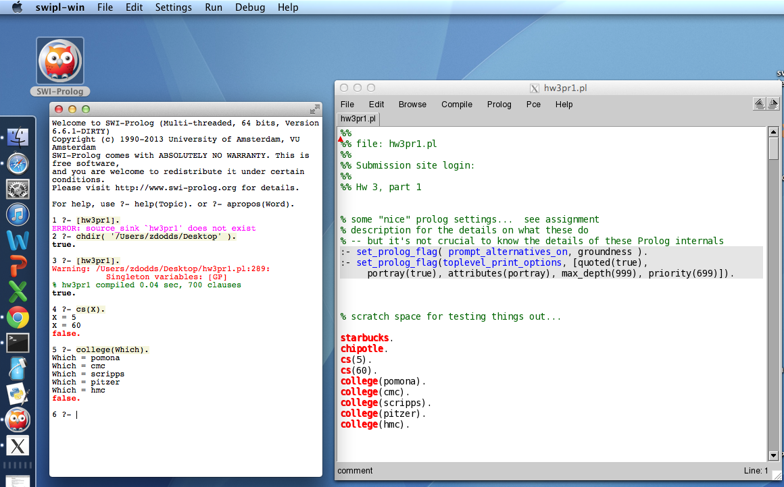
Prolog can seem alien…
This new arrival is a hoot!

Slide 24
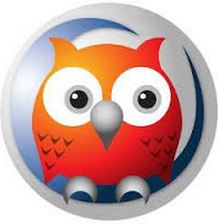
Prolog can seem alien…
Windows and Mac 10.7+ run in an IDE…
MacOS 10.6.x runs at the command-line
/opt/local/bin/swipl
- use any plain-text editor, e.g., TextEdit, Sublime,…
the file hw3pr1.pl
the query environment
parent(homer,bart).
parent(homer,lisa).
parent(marge,bart).
parent(marge,lisa).
child(A,B) :- parent(B,A).
?: parent(homer,lisa).
true
?- parent(P,bart).
P = homer ;
P = marge ;
false
FACTS
TEST
GENERATE
RULES

Slide 25
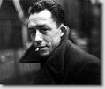
Prolog syntax is stranger
The idea:
Provide data/relationships that describe the world. Then ask questions…
you mean L’Étranger…
Relationships:
variables start with a capital letter
colon-hyphen means “IF”
predicates
mother(X, Y) :- parent(X, Y), female(X).
child(X, Y) :- parent(Y, X).
anc(X, Y) :- parent(X, Y).
anc(X, Y) :- parent(X, Z), anc(Z, Y).
commas mean “AND”
predicates and constants start with a lowercase letter
ancestor
∀∃∃∃∃∃ !
these relationships are predicates not functions. They have a value, but they do not return a value!
recursion welcome!
The existential scream!
multiple rules express “OR”
; also means “OR”

Slide 26

Prolog syntax is stranger
The idea:
Provide data/relationships that describe the world. Then ask questions…
you mean L’Étranger…
Relationships:
variables start with a capital letter
colon-hyphen means “IF”
predicates
mother(X, Y) :- parent(X, Y), female(X).
child(X, Y) :- parent(Y, X).
anc(X, Y) :- parent(X, Y).
anc(X, Y) :- parent(X, Z), anc(Z, Y).
commas mean “AND”
predicates and constants start with a lowercase letter
ancestor
∀∃∃∃∃∃ !
these relationships are predicates not functions. They have a value, but they do not return a value!
recursion welcome!
The existential scream!
multiple rules express “OR”
; also means “OR”

Slide 27
/*
* the parent predicate
*/
parent(olf, skug).
parent(helga, skug).
parent(skug, esmerelda).
parent(skugerina, esmerelda).
parent(esmerelda, klotho).
parent(gemini, klotho).
parent(esmerelda, atropos).
parent(gemini, atropos).
parent(esmerelda, lachesis).
parent(gemini, lachesis).
parent(olf, homericus).
parent(helga, homericus).
parent(ug, matilda).
parent(uggette, matilda).
parent(homericus, homer).
parent(matilda, homer).
parent(homericus, gomer).
parent(matilda, gomer).
parent(homer, bart).
parent(marge, bart).
parent(homer, lisa).
parent(marge, lisa).
parent(homer, maggie).
parent(marge, maggie).
parent(john, marge).
parent(jackie, marge).
parent(john, selma).
parent(jackie, selma).
parent(john, patty).
parent(jackie, patty).
parent(john, glum).
parent(jackie, glum).
parent(glum, millhouse).
parent(cher, millhouse).
parent(glum, terpsichore).
parent(cher, terpsichore).
/*
* the age predicate
*/
age(helga, 97).
age(olf, 99).
age(uggette, 93).
age(ug, 92).
age(matilda, 65).
age(homericus, 76).
age(skugerina, 101).
age(skug, 78).
age(esmerelda, 55).
age(gemini, 54).
age(klotho, 20).
age(atropos, 19).
age(lachesis, 18).
age(marge, 35).
age(homer, 38).
age(lisa, 8).
age(maggie, 1).
age(bart, 10).
age(gomer, 41).
age(john, 62).
age(jackie, 59).
age(patty, 38).
age(selma, 38).
age(glum, 27).
age(cher, 44).
age(millhouse, 8).
age(terpsichore, 8).
The file hw3pr1.pl
/*
* the female predicate
*/
female(helga).
female(esmerelda).
female(skugerina).
female(uggette).
female(matilda).
female(marge).
female(jackie).
female(selma).
female(patty).
female(cher).
female(lisa).
female(maggie).
female(klotho).
female(atropos).
female(lachesis).
female(terpsichore).
/*
* the male predicate
*/
male(olf).
male(skug).
male(homericus).
male(ug).
male(homer).
male(gomer).
male(gemini).
male(john).
male(glum).
male(bart).
male(millhouse).
% PLUS - rules about families!
child(X, Y) :- parent(Y, X).
mother(X, Y) :- female(X), parent(X, Y).
anc(X, Y) :- parent(X, Y).
anc(X, Y) :- parent(Z, Y), anc(X, Z).

Slide 28
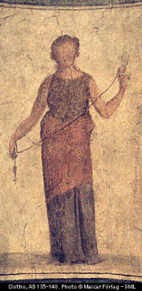
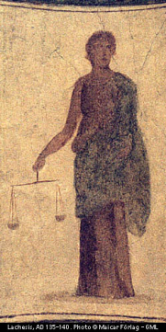
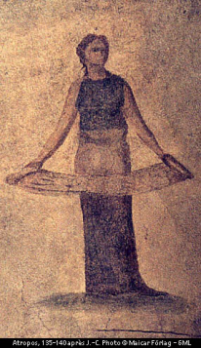
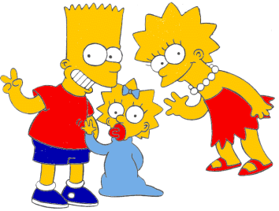

A more intuitive picture ...
age
age
female
male
99
97
92
93
olf
helga
ug
uggette
101
78
76
65
62
59
skugerina
skug
homericus
matilda
john
jackie
54
55
41
38
35
38
38
27
44
gemini
esmerelda
gomer
homer
marge
selma
patty
glum
cher
20
18
19
10
1
8
8
8
klotho
lachesis
atropos
bart
maggie
lisa
millhouse
terpsichore
Oh, brother!

Slide 29
The idea:
Provide data/relationships that describe the world. Then ask questions…
Questions:
Prolog:
Is Lisa a child of Marge?
Who has Marge as a parent?
Is Ug a parent of anyone?
Who are the ancestors of Lisa?
Who are Uggette's descendants?
Who is Maggie's mother?
Who is a person (you know about)?
Who is Bart's age or younger?
child(lisa,marge).
parent(marge,X).
parent(
anc(
anc(
you might see why this makes me sad...

Slide 30
Expressing relationships
The pain's not Prolog, it's younger brothers!
I might say the same about older sisters!
brother(B,X) :-
true if B is X’s brother
sameAge(X,Y) :-
true if X is the same age as Y
Caution: this is tricky.
twoYrsOlder(X,Y) :-
true if X is 2 years older than Y
This is equally tricky.

Slide 31
hw3pr1: prolog as family…
grandparent( GP, GK )
Lines of code?
siblings( S1, S2 )
cousins( C1, C2 )
hasDaughterAndSon( X )
hasOlderSibling( S1 )
hasYS( S )
true iff S has a younger sister…
hasOlderCousin( C, GP )
true iff GP has a grandchild older than C
hasFirstGC( Parent )
true iff Parent has child who is the oldest grandchild of one of Parent's parents!

Slide 32
hw3pr1: prolog as family…
All are ONE line of code...
grandparent( GP, GK )
two predicates
siblings( S1, S2 )
three clauses
cousins( C1, C2 )
four clauses
hasDaughterAndSon( X )
four clauses
hasOlderSibling( S1 )
four clauses
hasYS( S )
five clauses
hasOlderCousin( C, GP )
five clauses
hasFirstGC( Parent )
three clauses
These are the number of clauses we used....

Slide 33
Try it!
Write these four predicates in prolog:
true if X and Y are siblings
half siblings are OK
sibs(X,Y) :-
true if A is N’s aunt
aunt(A,N) :-
true if X and Y are related (by blood)
rel(X,Y) :-
true if N is the factorial of X (for X >= 0)
Extra!
fac(X,N) :-
you need a base case, too – what should it be?

Slide 34
cs60( Day, Topic ).
Day = thursday,
Topic = prolog ;
Day = thursday,
Topic = unicalc
true!
Happy prologging!

Slide 35
“Quiz”
Try these on the back page first...
Write these four predicates in prolog:
true if X and Y are siblings
half siblings are OK
sibs(X,Y) :-
true if A is N’s aunt
aunt(A,N) :-
true if X and Y are related (by blood)
rel(X,Y) :-
true if N is the factorial of X (for X >= 0)
Extra!
fac(X,N) :-
you need a base case, too – what should it be?

Slide 36
Expressing relationships
The pain's not Prolog, it's younger brothers!
I might say the same about older sisters!
brother(B,X) :-
true if B is X’s brother
sameAge(X,Y) :-
true if X is the same age as Y
Caution: this is tricky.
twoYrsOlder(X,Y) :-
true if X is 2 years older than Y
This is equally tricky.

Slide 37
Math in Prolog?
fac(X) :- X * fac(X-1).
(1) No base case
(2) assumes return value (3 times)
This goes wrong in FOUR places (in Prolog)!
! rules!
Prolog: everything is done via side effects, there are no return values!
Racket: no side effects (no assignments to change variables) -- new data is returned
Java: you can choose to use side effects, or return new data as needed
fac(0,1).
base case
fac(X,N) :-
recursive case
new bindings
Notes:
write fac!

Slide 38
Prolog is… DFS!
trace.
Who are Bart’s aunts?
aunt(A,bart)
aunt(A,N) :- parent(P,N), sibling(A,P), female(A).
N = bart
parent(P,N)
What space is Prolog searching through?
is there a parent?
other parents?
parent(homer,bart)
parent(marge,bart)
YES N = bart
YES N = bart
P = homer
P = marge
backtrack!
sibling(A,P)
is there a sibling?
other siblings?
is there a sibling?
other siblings?
sibling(gomer,homer)
NO
sibling(glum, marge)
sibling(selma, marge)
YES N = bart
YES N = bart
YES N = bart
P = homer
P = marge
P = marge
A = gomer
A = glum
A = selma
backtrack!
backtrack!
female(A)
female(gomer) ?
female(glum) ?
female(selma)
NO (fails)
NO
SUCCESS
YES!

Slide 39
Prolog is… DFS!
trace.
Who are Bart’s aunts?
aunt(A,bart)
aunt(A,N) :- parent(P,N), sibling(A,P), female(A).
N = bart
parent(P,N)
The space of possible bindings of values to variables
is there a parent?
other parents?
parent(homer,bart)
parent(marge,bart)
YES N = bart
YES N = bart
P = homer
P = marge
backtrack!
sibling(A,P)
is there a sibling?
other siblings?
is there a sibling?
other siblings?
sibling(gomer,homer)
NO
sibling(glum, marge)
sibling(selma, marge)
YES N = bart
YES N = bart
YES N = bart
P = homer
P = marge
P = marge
A = gomer
A = glum
A = selma
backtrack!
backtrack!
female(A)
female(gomer) ?
female(glum) ?
female(selma)
NO (fails)
NO
SUCCESS
YES!

Slide 40
Prolog Execution
Depth-first search through possible bindings
Given a goal, Prolog tries the each rule of that name...
If a rule has subgoals (a right-hand side),
Subgoals are checked in order, binding variables as needed
Those bindings persist until backtracking backs over them
Watch out for unbound variables… !
If a goal or subgoal fails, Prolog backtracks and tries again with the next available option (another binding or rule).
Be careful with negation!
trace.

Slide 41
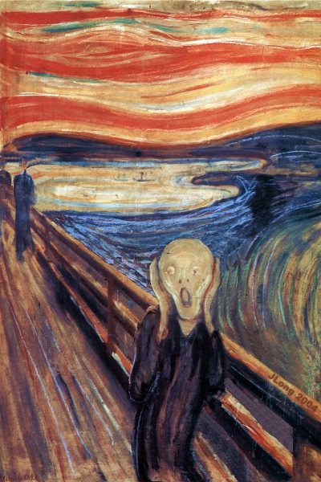
What's wrong here?
sibs(X, Y) :- X \== Y,
parent(P,X),
parent(P,Y).
This works sometimes...
Bound vs. unbound variables!

Slide 42
Negation in Prolog?
Take-home message #1:
Prolog has at least six sorts of (in)equalities.
Not all equals are created equal !
=
==
the two sides are the same structure
\+
not
the two sides can and DO unify
\=
the two sides can't unify (or this fails)
\==
the two sides are different structures
is
the LHS gets the evaluation of the RHS's arithmetic
Take-home message #2:
Negation does not work unless all of the variables are BOUND to values.
Put negative predicates last.
Stay positive!

Slide 43
Stay positive!
Negated predicates need bound variables – defer them until the end!
Here is the "related" predicate:
rel(X,Y) :- anc(A,X), anc(A,Y).
Suppose only non-relatives can marry. How well will this work?
canMarry(X,Y) :- \+rel(X,Y).
That is not not!
Can we generate marriageable pairs?
canMarry(X,Y) :- \+rel(X,Y).

Slide 44
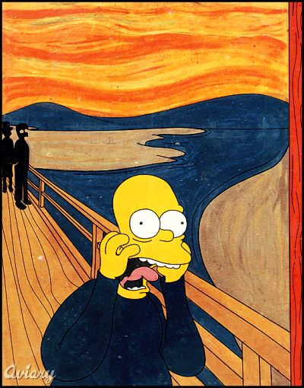
What's wrong here ?
sibs(X, Y) :- parent (P,X), parent (P,Y), X \== Y.
Nothing is wrong…

Slide 45
What's wrong here?
sibs(X, Y) :- parent (P,X), parent (P,Y), X \== Y.
Nothing IS wrong…

Slide 46
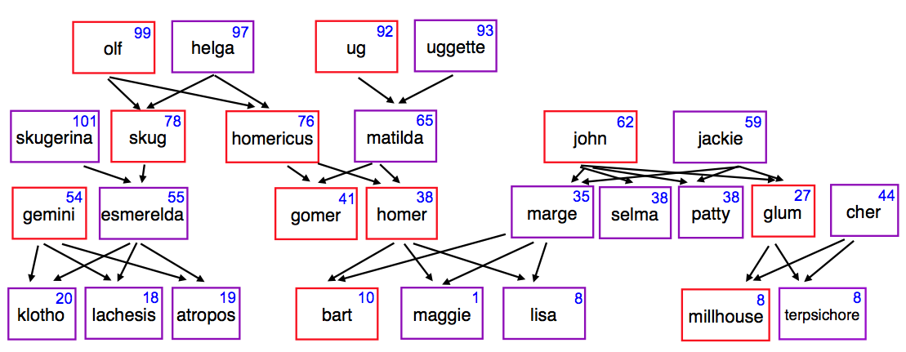
Watch out! oldest
oldest(X) :-
We want oldest(X) to answer skugerina:
101
skugerina

Slide 47
Watch out! oldest
oldest(X) :- AX > AY, age(X,AX), age(Y,AY).
What's wrong with each of these ?
oldest(X) :- age(X,AX), age(Y,AY), AX > AY.
We want oldest(X) to answer skugerina:
101
skugerina

Slide 48
Rescued! Not.
notoldest(X) :- age(X,AX), age(Y,AY), AX < AY.
oldest(X) :- age(X,AX), \+notoldest(X).
Why is this needed?
and why will Prolog complain about it?
Well, I'm feeling negative about Prolog about now...

Slide 49
cs60( Day, Topic ).
Day = thursday
Topic = prolog
Topic = unicalc
true
Happy prologging!

Slide 50
HW 8 (part 1): Prolog as family…
grandparent( GP, GK )
Lines of code?
siblings( S1, S2 )
cousins( C1, C2 )
hasDaughterAndSon( X )
hasOlderSibling( S1 )
hasYS( S )
true iff S has a younger sister…
hasOlderCousin( C, GP )
true iff GP has a grandchild older than C
hasFirstGC( Parent )
true iff Parent has child who is the oldest grandchild of one of Parent's parents!

Slide 51
HW 8 (part 1): Prolog as family…
grandparent( GP, GK )
two predicates
All are ONE line of code...
siblings( S1, S2 )
three clauses
These are the number of clauses we used....
cousins( C1, C2 )
four clauses
hasDaughterAndSon( X )
four clauses
hasOlderSibling( S1 )
how many clauses?
hasYS( S )
five clauses
hasOlderCousin( C, GP )
five clauses
hasFirstGC( Parent )
three clauses

Slide 52
HW 8 (part 2): Old friends
Prologified
Test
Generate
length([a,b,c,d],4).
true
length([1,2,3],N).
N = 3 ;
false
length([a,b,c],4).
false
length(L,0).
L = [] ;
false
both variable?

Slide 53
Expressing if in prolog
L unifies with []
N unifies with 0
"The length of L is N"
if
and
length(L,N) :- L = [], N = 0.
Even simpler:
length([],0).

Slide 54
Expressing if in prolog
"F cons R"
L unifies with [F|R]
F = first of L
"The length of L is N"
R = rest of L
if
L is nonempty!
length(L,N) :- L = [F|R],
and
length(R,M),
and
N is M+1.
Even simpler:
length([F|R],N) :- length(R,M),
N is M+1.

Slide 55
“Quiz”
Write these four predicates in prolog:
Name(s): ________________________
true if X and Y are siblings
half siblings are OK
sibs(X,Y) :-
true if A is N’s aunt
aunt(A,N) :-
true if X and Y are related (by blood)
rel(X,Y) :-
true if N is the factorial of X (for X >= 0)
Extra!
fac(X,N) :-
you need a base case, too – what should it be?

Slide 56
“Quiz”
Write these four predicates in prolog:
Name(s): ________________________
true if X and Y are siblings
half siblings are OK
sibs(X,Y) :-
true if A is N’s aunt
aunt(A,N) :-
true if X and Y are related (by blood)
rel(X,Y) :-
true if N is the factorial of X (for X >= 0)
Extra!
fac(X,N) :-
you need a base case, too – what should it be?

Slide 57
HW 8 (part 2): Old friends
Prologified
Test
Generate
member(3, [1,2,3,4,5]).
Yes
member(E, [1,2,3,4,5]).
E = 1 ;
E = 2 ;
E = 3 ;
E = 4 ;
E = 5 ;
No
member(6, [1,2,3,4,5]).
No
both variable?

Slide 58
Prolog’s key difference...
Unlike Racket and Java, prolog does not have return values!
member( e, L )
in Racket/Java, this returns a boolean
member( E, L )
in prolog, this can be tested (yes/no) OR it can bind values to E or L !
true when E is a member of L and false otherwise
member(E,L) :- L = [E]
Writing the member predicate.

Slide 59
Prolog’s lists...
Prolog has Rex-like pattern-matching in its rules:
Or maybe vice-versa!
hasA1( [1] ).
A reasonable base case.
hasA1( [1|R] ).
R pattern-matches with the rest of the input list!
cons "bar"
does hasA1 now identify all lists with a 1 in them?

Slide 60
Prolog’s lists...
Prolog can pattern-match in its rules:
hasA1( [1] ).
hasA1( [1|R] ).
R pattern-matches with the rest of the input list!
cons "bar"
hasA1( [F|R] ) :-
This says, "a list whose first element is F and rest is R"
the rest, R, has a 1.
has a 1 if
singletons?
I just "don't care"

Slide 61
Don't cares
Prolog let's you say "I don't care!"
How does prolog say "I might think about caring in the indefinite future?"
hasA1( [1] ).
hasA1( [1|_] ).
This says, "a list whose first element is 1 and whose rest is (I don't care)"
hasA1( [_|R] ) :- hasA1(R).
This says, "a list whose first element is (I don't care) and whose rest is R"
has a 1 if
But do we need all three of these rules?

Slide 62
Math in Prolog
Rex: there are no side effects (assignments) new data is created and returned.
Java: you have a choice to use side effects, or return new data as needed
Prolog: everything is done via side effects, there are no return values!
Math without return values ?
factorial rules!
fac(X,N)
! does rule!

Slide 63
This is bound to cause problems…
Binding vs. comparison
Prolog binds values to Variables through unification:
= unification & pattern matching (structural -- no arithmetic!)
\+
is evaluates the right-hand side only
predicate negation
[X,a] = [b,Y]. <-- yes, binds X to b and Y to a
X = [Y]. <-- yes, binds X to [Y]
X = [X]. <-- quite literally hours of fun!
X = 5+2. <-- yes, but X is 5+2, not 7
X is 5+2. <-- yes, now X is 7
X is Y+3. <-- error: Y is unbound
Y = 6, X is Y*7. <-- yes, X is bound to 42
5+2 is X. <-- error: X is unbound
== comparison (structural -- no arithmetic!)
\==
=:= arithmetic comparison with both-sided evaluation
=\=
2 not-equals
3 == 3. <-- yes
1+2 == 1+2. <-- yes
1+2 == 2+1. <-- no
1+2 =:= 2+1. <-- yes
[1,X] == [1,X]. <-- yes
[1,2] == [1,X]. <-- no
[1,2] = [1,X]. <-- yes, X is bound to 2

Slide 64
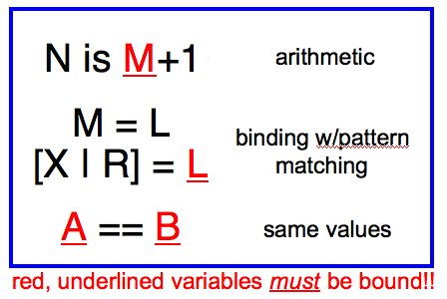
Prologging!
Prolog Equalities
length( L, N )
append( L, M, Both )
Short. Sweet!

Slide 65
Listing with Prolog
%% member is not built in to prolog...
member(X, [X|R]).
member(X, [F|R]) :- member(X, R).
%% length is built-in, so we will write len
%% just to illuistrate how it might be written
len([], 0).
len([_|R], L) :- len(R, L2), L is L2+1.
%% append is built-in, so we will write app
%% again just to see how it might be done
app([], L, L).
app([F|R], L, [F|A]) :- app(R, L, A).
Why might Prolog complain here?
Does order matter here?
I should underscore the importance of this!
See! Prolog is friendly!

Slide 66
yes or no ?
2+2 = 4.
2+2 =:= 4.
4 is 2+2.
2+2 is 4.
X is 2+2.
X =:= 2+2.
X = 2+2, X == 4.
X = 2+2, X == 2+2.
X = 2+2, 3+1 =:= X.
X = 4, X == 2+2.
X == 4, X == 2+2.
These are a test of Prolog’s (and your own) sanity… !
Other operators:
<, >, >=, =< <-- notice the unhappy face! =<
+, -, * <-- add, subtract, multiply
/ <-- floating-point division
// <-- integer division
mod <-- integer remainder

Slide 67
Quiz, p2
Prolog Equalities
Short. Sweet!
true iff X is the last element of L
true iff X is adjacent to Y in L
lastof( X, L )
nextto( X, Y, L )
true iff N is the sum of L
Extra!
true iff S is a sublist of L
sum( L, N )
sublist( S, L )

Slide 68
HW 8: Prolog as family…
removeOne( E, LBefore, LAfter )
remove( 1, [ 3,1,4,4,9 ], [3,4,4,9] ).
find( L, M, N )
find( [1,4], [ 3,1,4,1,4,9 ], 1 ).
(or 3)
occurs( E, L, N )
occurs( 4, [ 3,1,4,1,4,9 ], 2 ).
reverse( L, RL )
reverse( [1,2,3], [3,2,1] ).

Slide 69
Sorting in Prolog? mysort
%% sort is built-in, so we’ll write mysort:
mysort(L,S) :- perm(L,S), sorted(S).
%% sorted checks if a list is sorted...
sorted([]).
sorted([_]).
sorted([F,S|R]) :-
%% perm can generate all permutations of L
%% it does not work in right-to-left, however
This is mysort of programming!
what do we need here?

Slide 70
Sorting in Prolog? mysort
%% sort is built-in, so we’ll write mysort:
mysort(L,S) :- perm(L,S), sorted(S).
%% sorted checks if a list is sorted...
sorted([]).
sorted([_]).
sorted([F,S|R]) :-
%% perm can generate all permutations of L
%% it does not work in right-to-left, however
perm([],[]).
perm(L, [F|R]) :-
app(BeforeF, [F|AfterF], L), %% split L around F
app(BeforeF, AfterF, PermR), %% recombine all except F
perm(PermR, R). %% PermR is bound, so we're OK
This is mysort of programming!
what do we need here?

Slide 71
Good luck with the Spampede assignment!

Slide 72
“Quiz” #2
Mathematics with Prolog
Write a predicate fac that finds factorials…
How many arguments will fac need?
Write a predicate sum that finds the sum of two values…
How many arguments will sum need?
Will your predicates always work?

Slide 73
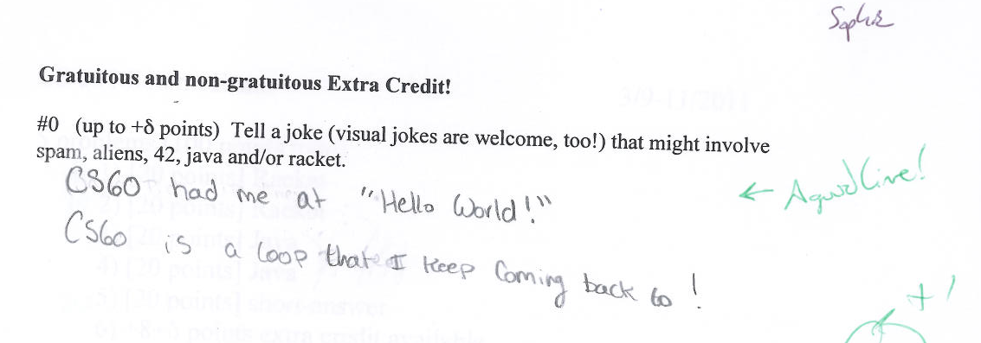
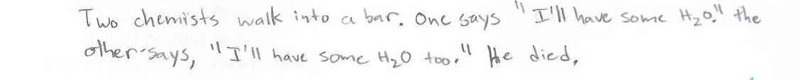
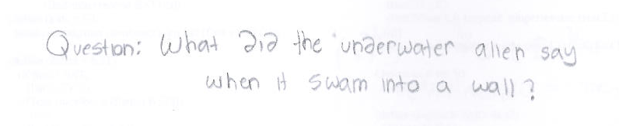

O(funny) jokes..

Slide 74
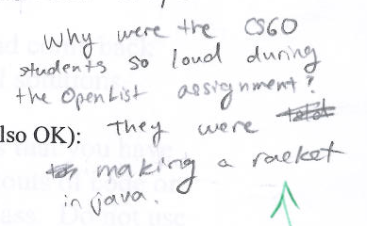
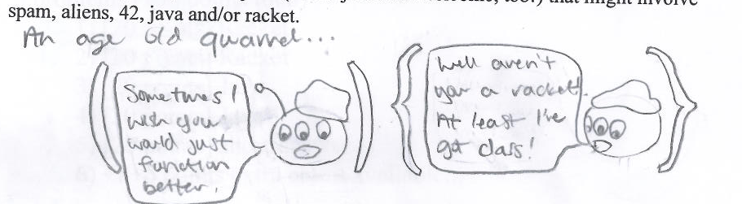
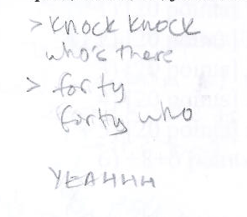
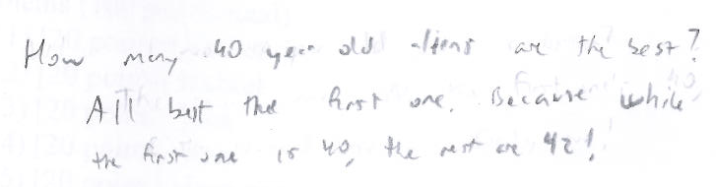
O(funny) jokes..
I didn't get these two. And the top one, I still don't...

Slide 75
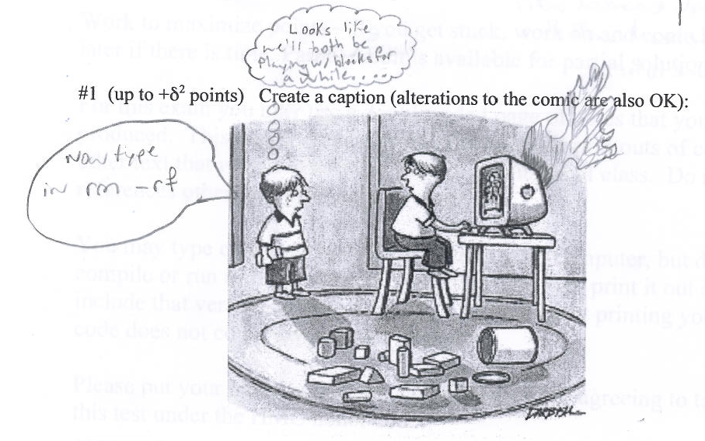
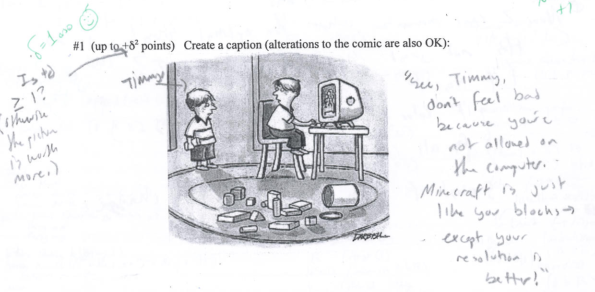

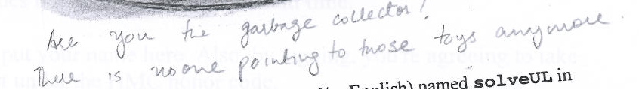


captions
and O(funny) jokes!

Slide 76

captions
and O(funny) jokes!

Slide 77
Unhappy Prolog
len([], 0).
len([_|R], L) :- len(R,L2), L2 is L-1.
When will Prolog not like these definitions?
sum(X, Y, Z) :- Z is X + Y.
any ideas?

Slide 78
More flexible sums…
digits([0,1,2,3,4,5,6,7,8,9]).
sum(X,Y,Z) :-
digits(D),
member(X,D),
member(Y,D),
Z is X+Y.
sum(X,Y,Z) :-
D = [0,1,2,3,4,5,6,7,8,9],
member(X,D),
member(Y,D),
Z is X+Y.
better?

Slide 79
More flexible sums…
sum(X,Y,Z) :-
D = [0,1,2,3,4,5,6,7,8,9],
member(X,D),
member(Y,D),
Z is X+Y.
digits([0,1,2,3,4,5,6,7,8,9]).
sum(X,Y,Z) :-
digits(D),
member(X,D),
member(Y,D),
Z is X+Y.
better solution? Use var, nonvar
sum(X,Y,Z) :- nonvar(Y), nonvar(Z), X is Z-Y.
sum(X,Y,Z) :- nonvar(X), nonvar(Z), Y is Z-X.
sum(X,Y,Z) :- nonvar(X), nonvar(Y), Z is X+Y.
It’s possible to make sum generate ALL integer solutions even when X, Y, and Z are all variables…
How many of these rules will sum(2,2,4) and sum(2,2,5) finish?

Slide 80


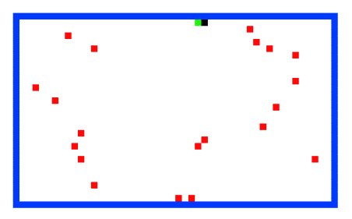

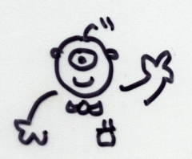
Welcome back to CS 60!
CS 60 Then and Now:
Weeks 1-4: Java
Weeks 5-8: Rex
Weeks 10-15:
Prolog, ISCAL, JFLAP, and more!
Guest-appearing this week …
Keeping the CS 60 ecosystem balanced…
This makes me appreciate my own family reunions…

Slide 81
The idea:
Provide data/relationships that describe the world. Then ask questions.
Questions:
child(lisa,marge).
parent(marge,X).
Is Lisa a child of Marge?
Who has Marge as a parent?
Is Ug a parent of Bart?
Who are the ancestors of Lisa?
Who are uggette's descendants?
Who is who's parent?
Who are John's grandchildren?

Slide 82
Prolog lists…
unifies L with [1, 2, 3]
Prolog has a more Python-like list syntax than Scheme:
L = [ 1, 2, 3 ].
== comparison (structural -- no arithmetic!)
\==
=:= arithmetic comparison with both-sided evaluation
=\=
2 not-equals
3 == 3. <-- yes
1+2 == 1+2. <-- yes
1+2 == 2+1. <-- no
1+2 =:= 2+1. <-- yes
[1,X] == [1,X]. <-- yes
[1,2] == [1,X]. <-- no
[1,2] = [1,X]. <-- yes, X is bound to 2

Slide 83
Math in Prolog
General operators/rules
Example
Notes
comparing for equality: == X == Y
arithmetic assignment: is X is Y+42
pattern matching (lists): = [F|R] = L
inequalities: < > =< >= \==
does not bind X or Y --
they must be bound
binds X ; Y must be bound
binds F and R
L must already be bound
read(X)
write(X)
nl
reads keyboard input into X
writes X to the screen
writes a newline “\n” to the screen
Input / Output

Slide 84
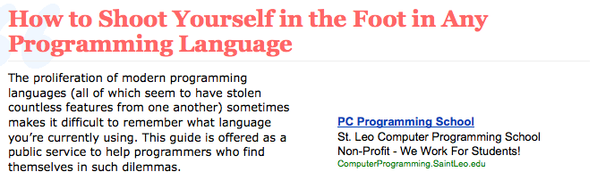
Does it matter?

Slide 85
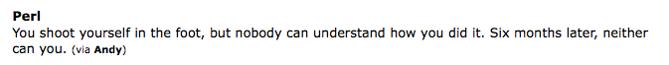
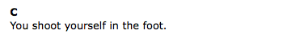
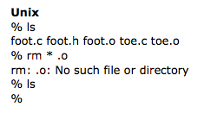
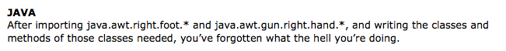
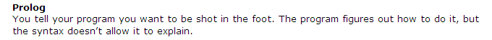

Rex
1 rex > shoot( [f|oot] ) => "ouch!";
shoot
2 rex > shoot( [] );
(failure 1)
Does it matter?

Slide 86
Prolog’s key difference...
Unlike scheme and java, prolog does not have return values!
(member X L)
in scheme/java, this returns a boolean
member( X, L )
in prolog, this can be tested (yes/no) OR it can bind values to X or L !
true when X is a member of L and false otherwise
Writing the member predicate:

Slide 87
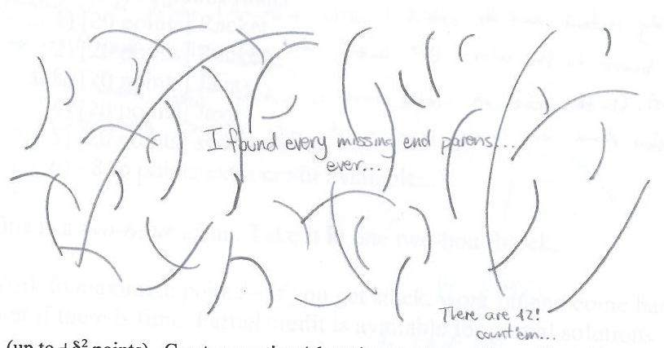
CS 60 captions!
and O(funny) jokes!
Christian Mason

Slide 88
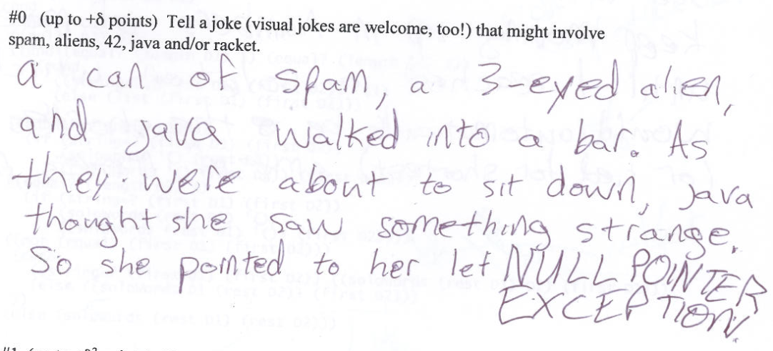
CS 60 captions!
and O(funny) jokes!

Slide 89
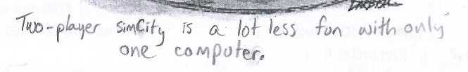
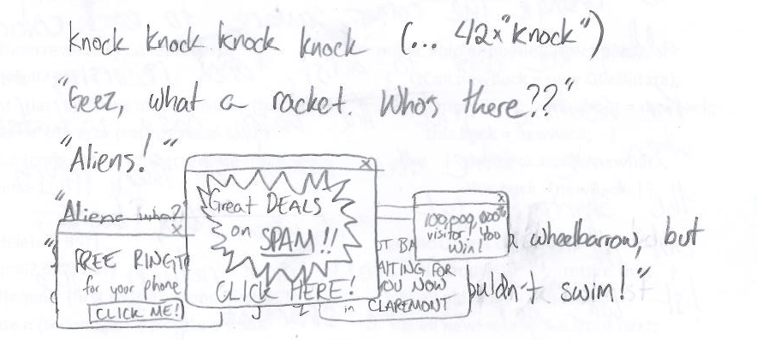
CS 60 captions!
and O(funny) jokes!

Slide 90
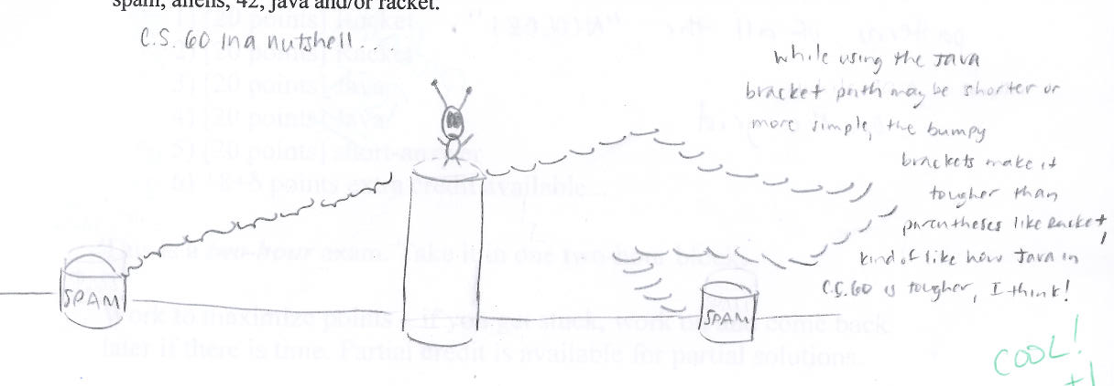
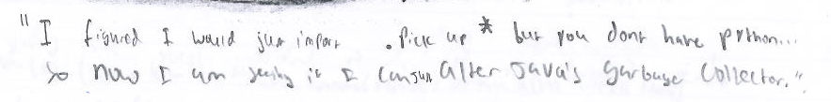
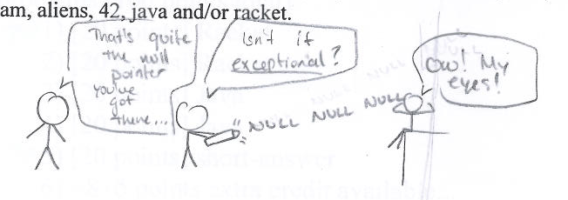
Meg O.

Slide 91
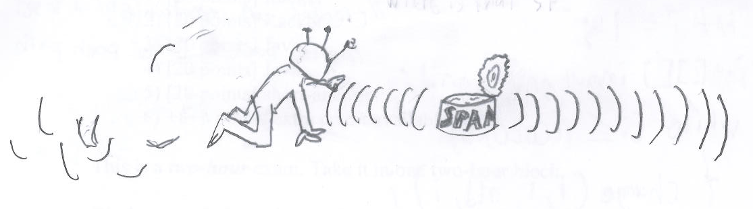
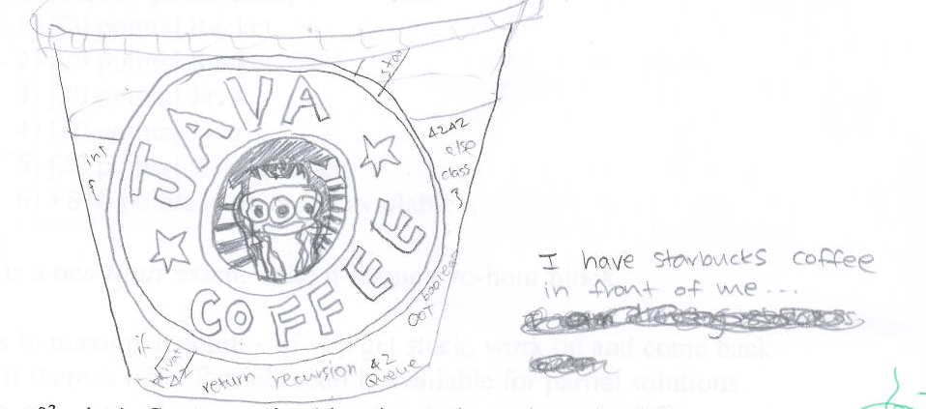
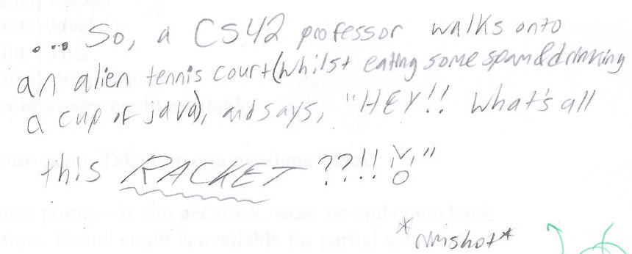

Seo P.

Slide 92
Prolog is… DFS!
trace. notrace.
Who are Bart’s aunts?
aunt(A,bart)
aunt(A,N) :- parent(P,N), sibling(A,P), female(A).
parent(P,N)
sibling(A,P)
female(A)

Slide 93
Prolog is… DFS!
Who are Bart’s aunts?
aunt(A,bart)
aunt(A,N) :- parent(P,N), sibling(A,P), female(A).
N = bart
parent(P,N)
is there a parent?
parent(homer,bart)
YES N = bart
P = homer
sibling(A,P)
female(A)

Slide 94
Prolog is… DFS!
Who are Bart’s aunts?
aunt(A,bart)
aunt(A,N) :- parent(P,N), sibling(A,P), female(A).
N = bart
parent(P,N)
is there a parent?
parent(homer,bart)
YES N = bart
P = homer
sibling(A,P)
is there a sibling?
sibling(gomer,homer)
YES N = bart
P = homer
A = gomer
female(A)

Slide 95
Prolog is… DFS!
Who are Bart’s aunts?
aunt(A,bart)
aunt(A,N) :- parent(P,N), sibling(A,P), female(A).
N = bart
parent(P,N)
is there a parent?
parent(homer,bart)
YES N = bart
P = homer
sibling(A,P)
is there a sibling?
sibling(gomer,homer)
YES N = bart
P = homer
A = gomer
female(A)
female(gomer) ?
NO (fails)

Slide 96
Prolog is… DFS!
Who are Bart’s aunts?
aunt(A,bart)
aunt(A,N) :- parent(P,N), sibling(A,P), female(A).
N = bart
parent(P,N)
is there a parent?
parent(homer,bart)
YES N = bart
P = homer
sibling(A,P)
is there a sibling?
sibling(gomer,homer)
YES N = bart
P = homer
A = gomer
backtrack!
female(A)
female(gomer) ?
NO (fails)

Slide 97
Prolog is… DFS!
Who are Bart’s aunts?
aunt(A,bart)
aunt(A,N) :- parent(P,N), sibling(A,P), female(A).
N = bart
parent(P,N)
is there a parent?
parent(homer,bart)
YES N = bart
P = homer
sibling(A,P)
is there a sibling?
other siblings?
sibling(gomer,homer)
NO
YES N = bart
P = homer
A = gomer
backtrack!
female(A)
female(gomer) ?
NO (fails)

Slide 98
Prolog is… DFS!
Who are Bart’s aunts?
aunt(A,bart)
aunt(A,N) :- parent(P,N), sibling(A,P), female(A).
N = bart
parent(P,N)
is there a parent?
other parents?
parent(homer,bart)
parent(marge,bart)
YES N = bart
YES N = bart
P = homer
P = marge
backtrack!
sibling(A,P)
is there a sibling?
other siblings?
sibling(gomer,homer)
NO
YES N = bart
P = homer
A = gomer
backtrack!
female(A)
female(gomer) ?
NO (fails)

Slide 99
Prolog is… DFS!
Who are Bart’s aunts?
aunt(A,bart)
aunt(A,N) :- parent(P,N), sibling(A,P), female(A).
N = bart
parent(P,N)
is there a parent?
other parents?
parent(homer,bart)
parent(marge,bart)
YES N = bart
YES N = bart
P = homer
P = marge
backtrack!
sibling(A,P)
is there a sibling?
other siblings?
is there a sibling?
sibling(gomer,homer)
NO
sibling(glum, marge)
YES N = bart
YES N = bart
P = homer
P = marge
A = gomer
A = glum
backtrack!
female(A)
female(gomer) ?
NO (fails)

Slide 100
Prolog is… DFS!
Who are Bart’s aunts?
aunt(A,bart)
aunt(A,N) :- parent(P,N), sibling(A,P), female(A).
N = bart
parent(P,N)
is there a parent?
other parents?
parent(homer,bart)
parent(marge,bart)
YES N = bart
YES N = bart
P = homer
P = marge
backtrack!
sibling(A,P)
is there a sibling?
other siblings?
is there a sibling?
sibling(gomer,homer)
NO
sibling(glum, marge)
YES N = bart
YES N = bart
P = homer
P = marge
A = gomer
A = glum
backtrack!
female(A)
female(gomer) ?
female(glum) ?
NO (fails)
NO

Slide 101
Prolog is… DFS!
Who are Bart’s aunts?
aunt(A,bart)
aunt(A,N) :- parent(P,N), sibling(A,P), female(A).
N = bart
parent(P,N)
is there a parent?
other parents?
parent(homer,bart)
parent(marge,bart)
YES N = bart
YES N = bart
P = homer
P = marge
backtrack!
sibling(A,P)
is there a sibling?
other siblings?
is there a sibling?
other siblings?
sibling(gomer,homer)
NO
sibling(glum, marge)
sibling(selma, marge)
YES N = bart
YES N = bart
YES N = bart
P = homer
P = marge
P = marge
A = gomer
A = glum
A = selma
backtrack!
backtrack!
female(A)
female(gomer) ?
female(glum) ?
NO (fails)
NO

Slide 102
Prolog is… DFS!
Who are Bart’s aunts?
aunt(A,bart)
aunt(A,N) :- parent(P,N), sibling(A,P), female(A).
N = bart
parent(P,N)
is there a parent?
other parents?
parent(homer,bart)
parent(marge,bart)
YES N = bart
YES N = bart
P = homer
P = marge
backtrack!
sibling(A,P)
is there a sibling?
other siblings?
is there a sibling?
other siblings?
sibling(gomer,homer)
NO
sibling(glum, marge)
sibling(selma, marge)
YES N = bart
YES N = bart
YES N = bart
P = homer
P = marge
P = marge
A = gomer
A = glum
A = selma
backtrack!
backtrack!
female(A)
female(gomer) ?
female(glum) ?
female(selma)
NO (fails)
NO
SUCCESS
YES!

Slide 103
when in Prolog…
This is bound to cause problems…
Equals Aren't!
positive
negative
Binding
=
\=
2-sided!
the = operator is also called "unification"
the two sides can unify
the two sides can't unify
==
\==
Structure
the two sides are the same structure
the two sides are different structures
Math!
is
no need for this!
the LHS gets the evaluation of the RHS arithmetic
Prolog knows arithmetic, not algebra!

Slide 104
Not all equals are created equal!
[X,a] = [b,Y]. <-- yes, binds X to b and Y to a
X = [Y]. <-- yes, binds X to [Y]
X = [X]. <-- quite literally hours of fun!
X = 5+2. <-- yes, but X is 5+2, not 7
X \= Y. <-- NO, because X CAN unify with Y.
X=3, Y=2, X \= Y. <-- YES, they can not be unified
Binding
1+2 == 1+2. <-- yes, the same structure
1+2 == 2+1. <-- no, NOT the same structure!
[1,X] == [1,X]. <-- yes
[1,2] == [1,X]. <-- no, although OK with =
X \== Y. <-- YES, they have different names!
X=3, Y=2, X \== Y. <-- NO, it uses the values!
Structure
Math
X is 5+2. <-- yes, now X is 7
X is Y+3. <-- error: Y is unbound
Y = 6, X is Y*7. <-- yes, X is bound to 42
1+2 =:= 2+1. <-- yes – this op. evals both sides!!

Slide 105
Negation
Prolog’s NOT
Be careful with negation!
\+
notaunt(A,N) :- \+ aunt(A,N).
?- notaunt(lisa,bart).
?- notaunt(selma,bart).
?- notaunt(A,bart).
How could you write oldest(X) ?
oldest(X) :- age(X, AX),
age(Y, AY),
AX > AY.
Does this work?

Slide 106
setof
?- setof(A,aunt(A,bart),S).
?- setof(N,aunt(marge,N),S).
setof(R, p(R), S)
is true when S is the set (list) of Rs that satisfy predicate p.
?- setof(A,notaunt(A,bart),S).
?- setof(N,notaunt(marge,N),S).
lists!

