Slide 1
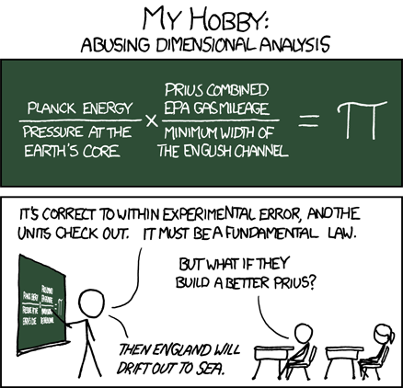
Today in CS 60
HW 3 due Mon, 2/17
Prolog, Java, and Racket: Unicalc
They say that time is money and knowledge is power…
A new take on unit testing: Unicalc…
Notes:
I don’t know if this really works...

Slide 2
Language space…
This is a big stretch…
more in mindset, even than syntax
computation
Prolog
Racket
Programming language space
Python
abstraction axis
Matlab
Java
JFLAP
C
Hmmm
HWare
task-independent
specificity axis
task-specific
I always feel nostalgic when we talk about space…
Notes:
I don’t know if this really works...

Slide 3
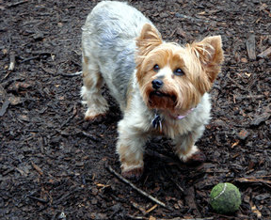
Prolog's mindset
You're not permitted to solve the problem…
So don't try.
… instead, you guide prolog to fetch the solution(s) you want!
Good prolog?
programming-as-training!?

Slide 4

Prolog's mindset
You're not permitted to solve the problem…
So don't try.
… instead, you guide prolog to fetch the solution(s) you want!
Go Prolog!

Slide 5
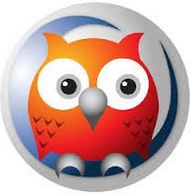
Prolog is alien…
Windows and Mac 10.7+ run in an IDE…
MacOS 10.6.x runs at the command-line
/opt/local/bin/swipl
- use any plain-text editor, e.g., TextEdit, Sublime,…
the file hw3pr1.pl
the query environment
parent(homer,bart).
parent(homer,lisa).
parent(marge,bart).
parent(marge,lisa).
child(A,B) :- parent(B,A).
?: parent(homer,lisa).
true
?- parent(P,bart).
P = homer ;
P = marge ;
false
FACTS
TEST
GENERATE
RULES

Slide 6
/*
* the parent predicate
*/
parent(olf, skug).
parent(helga, skug).
parent(skug, esmerelda).
parent(skugerina, esmerelda).
parent(esmerelda, klotho).
parent(gemini, klotho).
parent(esmerelda, atropos).
parent(gemini, atropos).
parent(esmerelda, lachesis).
parent(gemini, lachesis).
parent(olf, homericus).
parent(helga, homericus).
parent(ug, matilda).
parent(uggette, matilda).
parent(homericus, homer).
parent(matilda, homer).
parent(homericus, gomer).
parent(matilda, gomer).
parent(homer, bart).
parent(marge, bart).
parent(homer, lisa).
parent(marge, lisa).
parent(homer, maggie).
parent(marge, maggie).
parent(john, marge).
parent(jackie, marge).
parent(john, selma).
parent(jackie, selma).
parent(john, patty).
parent(jackie, patty).
parent(john, glum).
parent(jackie, glum).
parent(glum, millhouse).
parent(cher, millhouse).
parent(glum, terpsichore).
parent(cher, terpsichore).
/*
* the age predicate
*/
age(helga, 97).
age(olf, 99).
age(uggette, 93).
age(ug, 92).
age(matilda, 65).
age(homericus, 76).
age(skugerina, 101).
age(skug, 78).
age(esmerelda, 55).
age(gemini, 54).
age(klotho, 20).
age(atropos, 19).
age(lachesis, 18).
age(marge, 35).
age(homer, 38).
age(lisa, 8).
age(maggie, 1).
age(bart, 10).
age(gomer, 41).
age(john, 62).
age(jackie, 59).
age(patty, 38).
age(selma, 38).
age(glum, 27).
age(cher, 44).
age(millhouse, 8).
age(terpsichore, 8).
The file hw3pr1.pl
/*
* the female predicate
*/
female(helga).
female(esmerelda).
female(skugerina).
female(uggette).
female(matilda).
female(marge).
female(jackie).
female(selma).
female(patty).
female(cher).
female(lisa).
female(maggie).
female(klotho).
female(atropos).
female(lachesis).
female(terpsichore).
/*
* the male predicate
*/
male(olf).
male(skug).
male(homericus).
male(ug).
male(homer).
male(gomer).
male(gemini).
male(john).
male(glum).
male(bart).
male(millhouse).
% PLUS - rules about families!
child(X, Y) :- parent(Y, X).
mother(X, Y) :- female(X), parent(X, Y).
anc(X, Y) :- parent(X, Y).
anc(X, Y) :- parent(Z, Y), anc(X, Z).

Slide 7
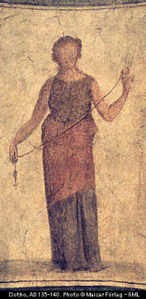
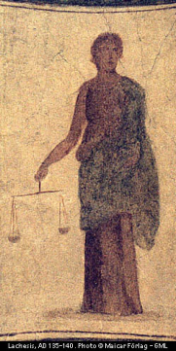
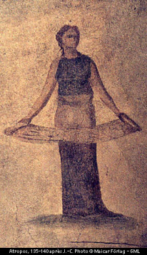
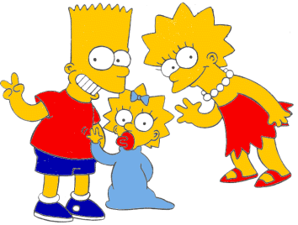

The picture ...
age
age
female
male
99
97
92
93
olf
helga
ug
uggette
101
78
76
65
62
59
skugerina
skug
homericus
matilda
john
jackie
54
55
41
38
35
38
38
27
44
gemini
esmerelda
gomer
homer
marge
selma
patty
glum
cher
20
18
19
10
1
8
8
8
klotho
lachesis
atropos
bart
maggie
lisa
millhouse
terpsichore
Oh, brother!

Slide 8
Prolog, fetch!
Questions:
Prolog queries:
Is Lisa a child of Marge?
Who has Marge as a parent?
Is Ug a parent of anyone?
Who are the ancestors of Lisa?
Who are Uggette's descendants?
Who is Maggie's mother?
Who is a person (you know about)?
Who is Bart's age or younger?
child(lisa,marge).
parent(marge,X).
parent(ug,X).
anc(A,lisa).
anc(ugette,Desc).
anc(ugette,Desc).
person(X).
perhaps you see why this makes me sad...

Slide 9
Expressing relationships
The problem's not Prolog, it's brothers!
I might say the same about older sisters!
true if B is X’s brother
brother(B,X) :-
parent(P,X), parent(P,B), male(B).
this would give back a few too many solutions, in some cases!
this is a predicate, not a function – in prolog, the rules (predicates) never return any value!
So, how does prolog fetch…?

Slide 10
Prolog is… Search
Who are lisa's brothers?
brother(B,X) :- parent(P,X), parent(P,B), male(B)
X = lisa
brother(B,lisa)

Slide 11

Prolog is… Search
Who are lisa's brothers?
brother(B,X) :- parent(P,X), parent(P,B), male(B)
X = lisa
brother(B,lisa)
parent(P,lisa)
P = homer
parent(homer,lisa)
parent(homer,B)
B = maggie
parent(homer,maggie)
male(maggie)
parent(homer,B)
fail!
Backtracking…
B = lisa
parent(homer,lisa)
male(lisa)
parent(homer,B)
fail!
B = bart
parent(homer,bart)
male(bart)
found one!
What's next?

Slide 12
Prolog is… Search
Who are lisa's brothers?
brother(B,X) :- parent(P,X), parent(P,B), male(B)
X = lisa
brother(B,lisa)
parent(P,lisa)
P = homer
parent(homer,lisa)
parent(homer,B)
B = maggie
parent(homer,maggie)
male(maggie)
parent(homer,B)
fail!
Backtracking…
B = lisa
parent(homer,lisa)
male(lisa)
parent(homer,B)
fail!
B = bart
parent(homer,bart)
male(bart)
found one!
What's next?

Slide 13
Prolog is… Search
Who are lisa's brothers?
brother(B,X) :- parent(P,X), parent(P,B), male(B)
X = lisa
brother(B,lisa)
parent(P,lisa)
P = homer
parent(homer,lisa)
parent(homer,B)
B = maggie
parent(homer,maggie)
male(maggie)
parent(homer,B)
fail!
B = lisa
parent(homer,lisa)
male(lisa)
parent(homer,B)
fail!
B = bart
parent(homer,bart)
male(bart)
parent(P,lisa)
parent(homer,B)
found one!
Doh!
P = marge
parent(marge,lisa)
parent(marge,B)
B = maggie
parent(marge,maggie)
male(maggie)
trace.
fail!

Slide 14

Prolog is… Search
Who are lisa's brothers?
brother(B,X) :- parent(P,X), parent(P,B), male(B)
X = lisa
brother(B,lisa)
parent(P,lisa)
P = homer
parent(homer,lisa)
parent(homer,B)
B = maggie
parent(homer,maggie)
male(maggie)
Prolog "just" searches through assignment space
parent(homer,B)
fail!
B = lisa
parent(homer,lisa)
male(lisa)
parent(homer,B)
fail!
B = bart
parent(homer,bart)
male(bart)
parent(P,lisa)
parent(homer,B)
found one!
Doh!
P = marge
parent(marge,lisa)
parent(marge,B)
What do you mean, assignment space?
B = maggie
parent(marge,maggie)
male(maggie)
fail!

Slide 15
Assignment space!
Prolog calls the = operator binding, or unification.
Prolog has at least six sorts of (in)equalities...
=
the two sides can and DO unify
==
the two sides are the same structure
is
the LHS gets the evaluation of the RHS's arithmetic
\=
the two sides can't unify
\==
the two sides are different structures
\+
not
= is called unification. It actively tries to make its two sides equal. It succeeds if it can make them equal. It fails if it can't.
Not all equals are created equal!
Perhaps some equals are more equal than others?

Slide 16
Prolog's unification and negation
X == bart.
== compares structure
X = bart, Y = X.
= creates structure (tries)
X = bart, Y == X.
X = bart, Y = bart, Y == X.
In prolog, math is ONLY right-to-left…
6 = X, Y is 7*X.
Math in prolog
… but binding is bidirectional!
contrast 6 is X…
Y \= X, X = bart, Y = lisa.
Wow! Try to avoid being negative around prolog…
Y \== X, X = bart, Y = bart.

Slide 17
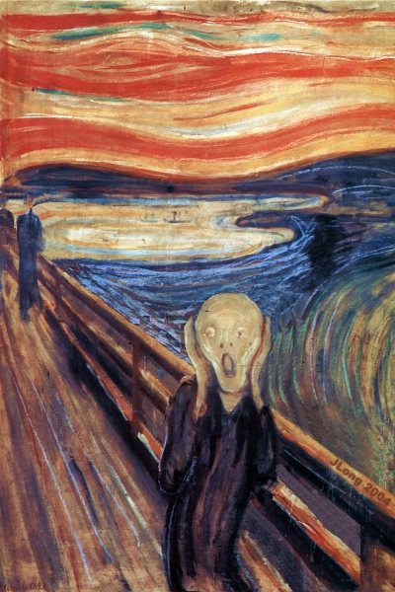
Watch out for not!
sibs(X,Y) :- X \= Y,
parent(P,X),
parent(P,Y).
Why does this fail?

Slide 18
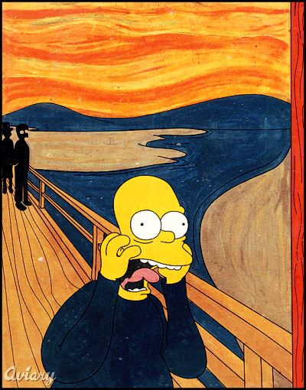
Put negation last…
parent(P,X),
sibs(X,Y) :-
parent(P,Y),
X \= Y.
X \== Y.
is equally OK here.
Stay positive!

Slide 19
Write these six predicates in prolog – the other three are on the facing page…
Try it!
Name(s) _____________________
oldersis(S,X) :-
true if S is the older sister or half-sister of X – use sibs!
aunt(A,N) :-
true if A is N’s aunt – again, use sibs!
twoyrsolder(X,Y) :-
Write this one on the facing page…
true if X is two years older than Y

Slide 20
Write these six predicates in prolog – the other three are on the facing page…
Try it!
Try the first three on the back page…
oldersis(S,X) :-
true if S is the older sister or half-sister of X – use sibs!
aunt(A,N) :-
true if A is N’s aunt – again, use sibs!
twoyrsolder(X,Y) :-
true if X is two years older than Y
oldest(X) :-
true if X is the oldest person (known)…
Extra!
fac(X,N) :-
true if N is the factorial of X (for X >= 0)

Slide 21
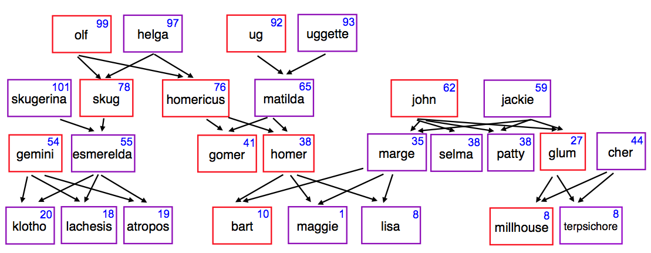
Watch out! oldest
oldest(X) :- AX > AY, age(X,AX), age(Y,AY).
What's wrong with each of these ?
oldest(X) :- age(X,AX), age(Y,AY), AX > AY.
We want oldest(X) to answer skugerina:
101
skugerina

Slide 22
Rescued! Not.
notoldest(X) :- age(X,AX), age(Y,AY), AX < AY.
oldest(X) :- person(X), \+notoldest(X).
Why is this needed?
Well, I'm feeling negative about Prolog about now...

Slide 23
Math in Prolog?
fac(X) :- X * fac(X-1).
(1) No base case
(2) assumes return value (3 times)
This goes wrong in FOUR places (in Prolog)!
! rules!
fac(0,1).
base case
fac(X,N) :-
recursive case
new bindings
Notes:
write fac!

Slide 24
hw3pr1: prolog as family…
grandparent( GP, GK )
Lines of code?
siblings( S1, S2 )
cousins( C1, C2 )
hasDaughterAndSon( X )
hasOlderSibling( S1 )
hasYS( S )
true iff S has a younger sister…
hasOlderCousin( C, GP )
true iff GP has a grandchild older than C
hasFirstGC( Parent )
true iff Parent has child who is the oldest grandchild of one of Parent's parents!

Slide 25
hw3pr1: prolog as family…
All are ONE line of code...
grandparent( GP, GK )
two predicates
siblings( S1, S2 )
three clauses
cousins( C1, C2 )
four clauses
hasDaughterAndSon( X )
four clauses
hasOlderSibling( S1 )
four clauses
hasYS( S )
five clauses
hasOlderCousin( C, GP )
five clauses
hasFirstGC( Parent )
three clauses
These are the number of clauses we used....

Slide 26
UIOLI is not the only approach!
Not even the first approach!!!
Unicalc!
computation
Prolog
Racket
Programming language space
Python
abstraction axis
Matlab
Java
JFLAP
C
Hmmm
HWare
task-independent
specificity axis
task-specific
Notes:
I don’t know if this really works...

Slide 27
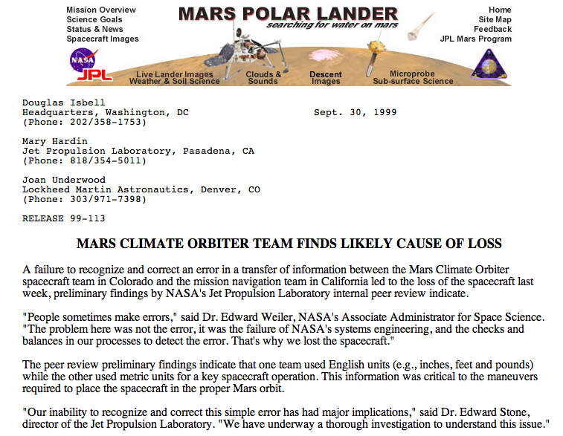
Unicalc: A Universal Unit Calculator
Phew! They almost made it that time!

Slide 28
Unicalc
It computes with Quantity Lists
first
second
third
fourth
(make-QL 24.0 '(hour) '() 0.0))
quantity
numerator
denominator
uncertainty

Slide 29
Unicalc
Quantity List
first
second
third
fourth
(make-QL 24.0 '(hour) '() 0.0))
quantity
numerator
denominator
uncertainty
Calculations ~ with uncertainty propagation
(multiply (make-QL 2.0 '(meter) '(ampere) 0.01)
(make-QL 0.5 '(kg) '(s) 0.01))
'(1.0 (kg meter) (ampere s) 0.0206)
With the units kept sorted!
Conversions ~ with uncertainty propagation
(convert '(1.0 (furlong) (fortnight) 0.1)
'(1.0 (mile) (hour) 0.01))
'(0.000372 () () 3.72e-5)
means
1 furlong
0.000372 miles
=
fortnight
hour

Slide 30
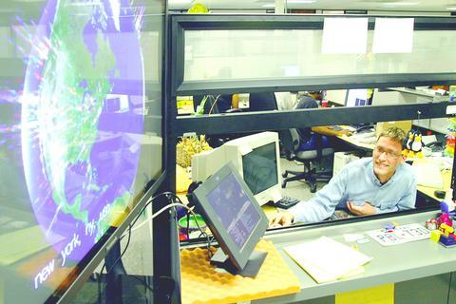
Geo display of Google searches
HMC's first Google employee: Greg Rae

Slide 31
Unit-conversion database…
db is an AList (graph) of conversions
association list
(define db
(list
(list 'hertz (make-QL 1.0 '() '(s) 0.0))
(list 'foot (make-QL 12.0 '(inch) '() 0.0))
(list 'mile (make-QL 5280.0 '(foot) '() 0.0))
(list 'hour (make-QL 60.0 '(minute) '() 0.0))
(list 'minute (make-QL 60.0 '(s) '() 0.0))
(list 'furlong (make-QL 0.125 '(mile) '() 0.0))
(list 'fortnight (make-QL 14.0 '(day) '() 0.0))
(list 'day (make-QL 24.0 '(hour) '() 0.0))
))
first
second
third
fourth
quantity
numerator
denominator
uncertainty
Note that some units don't appear on the left!
"BASIC UNITS"
QL ~ Quantity Lists
num & den will always be sorted

Slide 32

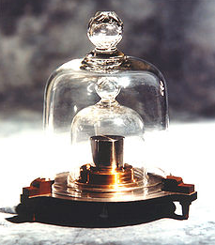
; constructs a quantity list from parts
(define (make-QL quant num den unc)
(list quant (sortsym num) (sortsym den) unc))
; Accessors for our QL information structure
(define get-quant first)
(define get-num second)
(define get-den third)
(define get-unc fourth)
the kg

Slide 33
; constructs a quantity list from parts
(define (make-QL quant num den unc)
(list quant (sortsym num) (sortsym den) unc))
; Accessors for our QL information structure
(define get-quant first)
(define get-num second)
(define get-den third)
(define get-unc fourth)
; Convert from a unit (symbol)
; to a QL using the AList unicalc-db
(define (unit-to-QL unit)
(let* ((lookup (assoc unit db)))
(if lookup
(second lookup) ;; done!
(make-QL 1.0
(list unit)
'()
0.0))))
Example lookups:
(unit-to-QL 'hour)
'(60.0 (minute) () 0.0)
remember this?
our unit dictionary
(unit-to-QL 'second)
'(1.0 (second) () 0.0)
basic units are not in the AList
(define unicalc-db
(list
(list 'hertz (make-QL 1.0 '() '(s) 0.0))
(list 'foot (make-QL 12.0 '(inch) '() 0.0))
(list 'hour (make-QL 60.0 '(minute) '() 0.0))
… ))

Slide 34
Unicalc
Quantity List
first
second
third
fourth
(make-QL 24.0 '(hour) '() 0.0))
quantity
numerator
denominator
uncertainty
Calculations ~ with uncertainty propagation
(multiply (make-QL 2.0 '(meter) '(ampere) 0.01)
(make-QL 0.5 '(kg) '(s) 0.01))
'(1.0 (kg meter) (ampere s) 0.0206)
With the units kept sorted!
What will multiply do with its num + den lists? How?
Conversions ~ with uncertainty propagation
(convert '(1.0 (furlong) (fortnight) 0.1)
'(1.0 (mile) (hour) 0.01))
'(0.000372 () () 3.72e-5)
means
1 furlong
0.000372 miles
=
fortnight
hour

Slide 35
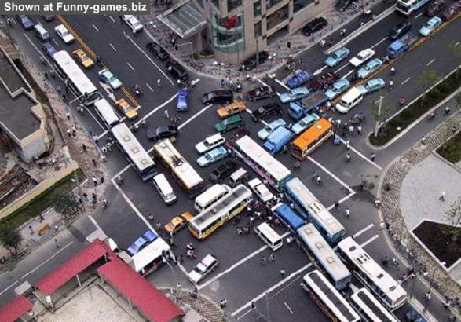
efficient merging?
One way to merge two sorted lists into a single sorted list:
(sort (append num1 num2))
# of comparisons: at least N*log(N)
It'll take a while to SORT this all out…
Notes:
I don’t know if this really works...

Slide 36
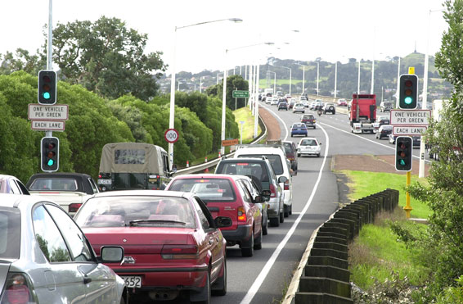
Fast merging!
But because the unit lists are already sorted, you can merge them asymptotically faster:
In LA, merging is really a life-long skill!
merge:
num1
num2
'(b d e g)
'(a c f h)

Slide 37
Implement O(N) merge in Racket. Assume L1 and L2 are sorted...
Example:
(merge '(b d e g) '(a c f h))
'(a b c d e f g h)
(define (merge L1 L2)
(if (null? L1)
(if (null? L2)
(let* ((f1 (first L1)) (R1 (rest L1))
(f2 (first L2)) (R2 (rest L2)))
(if (sym<? f1 f2)
2 base cases!
sym<? is provided…
2 recursive cases!

Slide 38
Cancel that!
In order to reduce fractions, you'll want to be able to cancel units one list from another…
In LA, merging is really a life-long skill!
cancel
list1
list2
'(b d e g)
'(a b c g)

Slide 39
Implement O(N) cancelin Racket. Assume L1 and L2 are sorted...
Example:
(cancel '(b d e g) '(a b c g))
'(d e)
(define (cancel L1 L2)
(if (null? L1)
(if (null? L2)
(let* ((f1 (first L1)) (R1 (rest L1))
(f2 (first L2)) (R2 (rest L2)))
(if (sym<? f1 f2)
2 base cases!
sym<? is provided…
2 recursive cases!

Slide 40
Brainstorming…
multiply
divide
normalize?
adding…

Slide 41
Good luck with Prolog & Unicalc!

Slide 42
Implement multiply for Quantity Lists. Use merge!
(multiply '(2.0 (m) (amp) 0.01) '(0.5 (kg) (s) 0.01) )
'(1.0 (kg meter) (amp s) 0.0206)
Note: the propagated uncertainty is
q1•q2((u1/q1)² + (u2/q2)²)^{.5}
;; multiply
(define (multiply QL1 QL2)
(let* ((q1 (get-quant QL1)) (q2 (get-quant QL2))
(N1 (get-num QL1)) (N2 (get-num QL2))
(D1 (get-den QL1)) (D2 (get-den QL2))
(u1 (get-unc QL1)) (u2 (get-unc QL2))
(newD (merge D1 D2)) ;; use merge!
(newN (merge N1 N2))
(newq (* q1 q2))
;; aargh!
(newu (* newq (sqrt (+ (expt (/ u1 q1) 2)
(expt (/ u2 q2) 2))))))
(simplify (make-QL newq newN newD newu))))
expt is Racket's power…

Slide 43
More UIOLI?
More UIOLI?
(closest-change 42 '(2 5 10 25 50))
original call
it
2
loseit
(make-change 42 '(5 10 25 50))
useit
Examples – Algorithm ideas - Code
If I had change, I'd hate to lose it!

Slide 44
Graph-reachability: can you get from A to B?
(define (reach? a b G) ;; much code omitted
(loseit (reach? a b R))
(useit (and (reach? a x R)
(reach? y b R))))
(or useit loseit)…
First call has N nodes in G
N
big-O?
What about make-change?

Slide 45
Quiz
For each Prolog query on the left…

Slide 46
cs60( Day, Topic ).
Day = thursday,
Topic = prolog ;
Day = thursday,
Topic = unicalc
true!
Happy prologging!

Slide 47
“Quiz”
Try these on the back page first...
Write these four predicates in prolog:
true if X and Y are siblings
half siblings are OK
sibs(X,Y) :-
true if A is N’s aunt
aunt(A,N) :-
true if X and Y are related (by blood)
rel(X,Y) :-
true if N is the factorial of X (for X >= 0)
Extra!
fac(X,N) :-
you need a base case, too – what should it be?

Slide 48
HW 8 (part 1): Prolog as family…
grandparent( GP, GK )
Lines of code?
siblings( S1, S2 )
cousins( C1, C2 )
hasDaughterAndSon( X )
hasOlderSibling( S1 )
hasYS( S )
true iff S has a younger sister…
hasOlderCousin( C, GP )
true iff GP has a grandchild older than C
hasFirstGC( Parent )
true iff Parent has child who is the oldest grandchild of one of Parent's parents!

Slide 49
HW 8 (part 1): Prolog as family…
grandparent( GP, GK )
two predicates
All are ONE line of code...
siblings( S1, S2 )
three clauses
These are the number of clauses we used....
cousins( C1, C2 )
four clauses
hasDaughterAndSon( X )
four clauses
hasOlderSibling( S1 )
how many clauses?
hasYS( S )
five clauses
hasOlderCousin( C, GP )
five clauses
hasFirstGC( Parent )
three clauses

Slide 50
HW 8 (part 2): Old friends
Prologified
Test
Generate
length([a,b,c,d],4).
true
length([1,2,3],N).
N = 3 ;
false
length([a,b,c],4).
false
length(L,0).
L = [] ;
false
both variable?

Slide 51
Expressing if in prolog
L unifies with []
N unifies with 0
"The length of L is N"
if
and
length(L,N) :- L = [], N = 0.
Even simpler:
length([],0).

Slide 52
Expressing if in prolog
"F cons R"
L unifies with [F|R]
F = first of L
"The length of L is N"
R = rest of L
if
L is nonempty!
length(L,N) :- L = [F|R],
and
length(R,M),
and
N is M+1.
Even simpler:
length([F|R],N) :- length(R,M),
N is M+1.

Slide 53
“Quiz”
Write these four predicates in prolog:
Name(s): ________________________
true if X and Y are siblings
half siblings are OK
sibs(X,Y) :-
true if A is N’s aunt
aunt(A,N) :-
true if X and Y are related (by blood)
rel(X,Y) :-
true if N is the factorial of X (for X >= 0)
Extra!
fac(X,N) :-
you need a base case, too – what should it be?

Slide 54
“Quiz”
Write these four predicates in prolog:
Name(s): ________________________
true if X and Y are siblings
half siblings are OK
sibs(X,Y) :-
true if A is N’s aunt
aunt(A,N) :-
true if X and Y are related (by blood)
rel(X,Y) :-
true if N is the factorial of X (for X >= 0)
Extra!
fac(X,N) :-
you need a base case, too – what should it be?

Slide 55
HW 8 (part 2): Old friends
Prologified
Test
Generate
member(3, [1,2,3,4,5]).
Yes
member(E, [1,2,3,4,5]).
E = 1 ;
E = 2 ;
E = 3 ;
E = 4 ;
E = 5 ;
No
member(6, [1,2,3,4,5]).
No
both variable?

Slide 56
Prolog’s key difference...
Unlike Racket and Java, prolog does not have return values!
member( e, L )
in Racket/Java, this returns a boolean
member( E, L )
in prolog, this can be tested (yes/no) OR it can bind values to E or L !
true when E is a member of L and false otherwise
member(E,L) :- L = [E]
Writing the member predicate.

Slide 57
Prolog’s lists...
Prolog has Rex-like pattern-matching in its rules:
Or maybe vice-versa!
hasA1( [1] ).
A reasonable base case.
hasA1( [1|R] ).
R pattern-matches with the rest of the input list!
cons "bar"
does hasA1 now identify all lists with a 1 in them?

Slide 58
Prolog’s lists...
Prolog can pattern-match in its rules:
hasA1( [1] ).
hasA1( [1|R] ).
R pattern-matches with the rest of the input list!
cons "bar"
hasA1( [F|R] ) :-
This says, "a list whose first element is F and rest is R"
the rest, R, has a 1.
has a 1 if
singletons?
I just "don't care"

Slide 59
Don't cares
Prolog let's you say "I don't care!"
How does prolog say "I might think about caring in the indefinite future?"
hasA1( [1] ).
hasA1( [1|_] ).
This says, "a list whose first element is 1 and whose rest is (I don't care)"
hasA1( [_|R] ) :- hasA1(R).
This says, "a list whose first element is (I don't care) and whose rest is R"
has a 1 if
But do we need all three of these rules?

Slide 60
Math in Prolog
Rex: there are no side effects (assignments) new data is created and returned.
Java: you have a choice to use side effects, or return new data as needed
Prolog: everything is done via side effects, there are no return values!
Math without return values ?
factorial rules!
fac(X,N)
! does rule!

Slide 61
This is bound to cause problems…
Binding vs. comparison
Prolog binds values to Variables through unification:
= unification & pattern matching (structural -- no arithmetic!)
\+
is evaluates the right-hand side only
predicate negation
[X,a] = [b,Y]. <-- yes, binds X to b and Y to a
X = [Y]. <-- yes, binds X to [Y]
X = [X]. <-- quite literally hours of fun!
X = 5+2. <-- yes, but X is 5+2, not 7
X is 5+2. <-- yes, now X is 7
X is Y+3. <-- error: Y is unbound
Y = 6, X is Y*7. <-- yes, X is bound to 42
5+2 is X. <-- error: X is unbound
== comparison (structural -- no arithmetic!)
\==
=:= arithmetic comparison with both-sided evaluation
=\=
2 not-equals
3 == 3. <-- yes
1+2 == 1+2. <-- yes
1+2 == 2+1. <-- no
1+2 =:= 2+1. <-- yes
[1,X] == [1,X]. <-- yes
[1,2] == [1,X]. <-- no
[1,2] = [1,X]. <-- yes, X is bound to 2

Slide 62
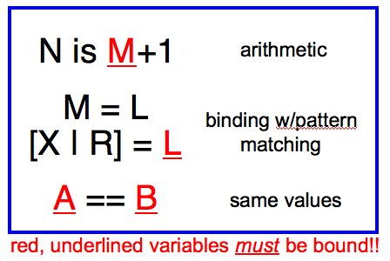
Prologging!
Prolog Equalities
length( L, N )
append( L, M, Both )
Short. Sweet!

Slide 63
Listing with Prolog
%% member is not built in to prolog...
member(X, [X|R]).
member(X, [F|R]) :- member(X, R).
%% length is built-in, so we will write len
%% just to illuistrate how it might be written
len([], 0).
len([_|R], L) :- len(R, L2), L is L2+1.
%% append is built-in, so we will write app
%% again just to see how it might be done
app([], L, L).
app([F|R], L, [F|A]) :- app(R, L, A).
Why might Prolog complain here?
Does order matter here?
I should underscore the importance of this!
See! Prolog is friendly!

Slide 64
yes or no ?
2+2 = 4.
2+2 =:= 4.
4 is 2+2.
2+2 is 4.
X is 2+2.
X =:= 2+2.
X = 2+2, X == 4.
X = 2+2, X == 2+2.
X = 2+2, 3+1 =:= X.
X = 4, X == 2+2.
X == 4, X == 2+2.
These are a test of Prolog’s (and your own) sanity… !
Other operators:
<, >, >=, =< <-- notice the unhappy face! =<
+, -, * <-- add, subtract, multiply
/ <-- floating-point division
// <-- integer division
mod <-- integer remainder

Slide 65
Quiz, p2
Prolog Equalities
Short. Sweet!
true iff X is the last element of L
true iff X is adjacent to Y in L
lastof( X, L )
nextto( X, Y, L )
true iff N is the sum of L
Extra!
true iff S is a sublist of L
sum( L, N )
sublist( S, L )

Slide 66
HW 8: Prolog as family…
removeOne( E, LBefore, LAfter )
remove( 1, [ 3,1,4,4,9 ], [3,4,4,9] ).
find( L, M, N )
find( [1,4], [ 3,1,4,1,4,9 ], 1 ).
(or 3)
occurs( E, L, N )
occurs( 4, [ 3,1,4,1,4,9 ], 2 ).
reverse( L, RL )
reverse( [1,2,3], [3,2,1] ).

Slide 67
Sorting in Prolog? mysort
%% sort is built-in, so we’ll write mysort:
mysort(L,S) :- perm(L,S), sorted(S).
%% sorted checks if a list is sorted...
sorted([]).
sorted([_]).
sorted([F,S|R]) :-
%% perm can generate all permutations of L
%% it does not work in right-to-left, however
This is mysort of programming!
what do we need here?

Slide 68
Sorting in Prolog? mysort
%% sort is built-in, so we’ll write mysort:
mysort(L,S) :- perm(L,S), sorted(S).
%% sorted checks if a list is sorted...
sorted([]).
sorted([_]).
sorted([F,S|R]) :-
%% perm can generate all permutations of L
%% it does not work in right-to-left, however
perm([],[]).
perm(L, [F|R]) :-
app(BeforeF, [F|AfterF], L), %% split L around F
app(BeforeF, AfterF, PermR), %% recombine all except F
perm(PermR, R). %% PermR is bound, so we're OK
This is mysort of programming!
what do we need here?

Slide 69
Good luck with the Spampede assignment!

Slide 70
“Quiz” #2
Mathematics with Prolog
Write a predicate fac that finds factorials…
How many arguments will fac need?
Write a predicate sum that finds the sum of two values…
How many arguments will sum need?
Will your predicates always work?

Slide 71
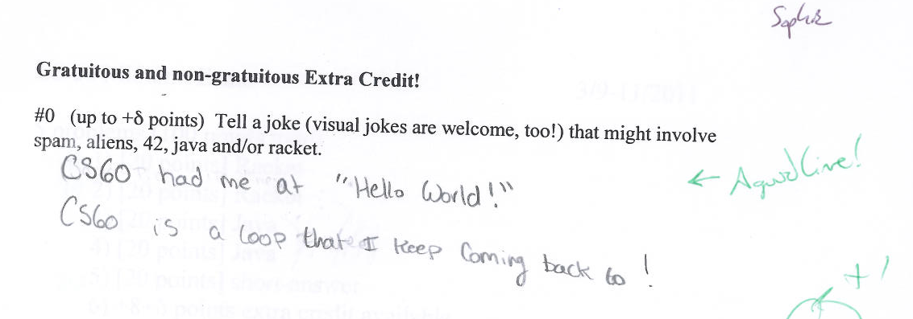
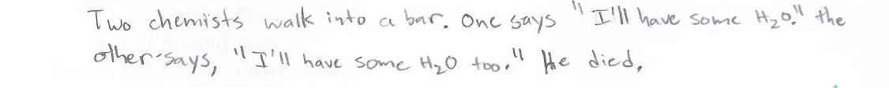
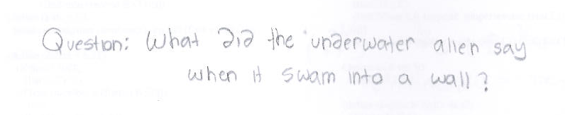

O(funny) jokes..

Slide 72
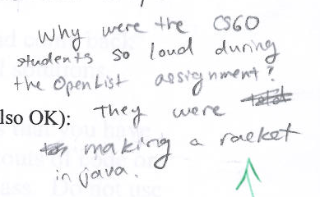
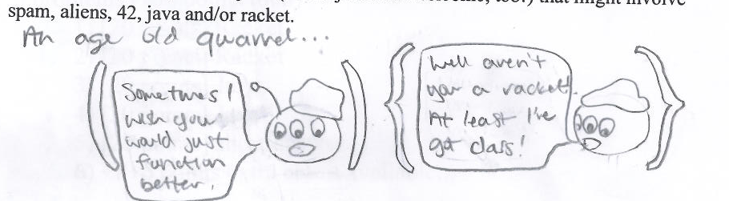
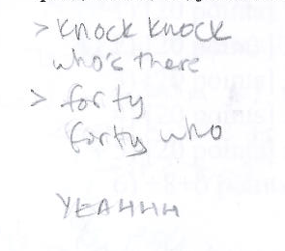
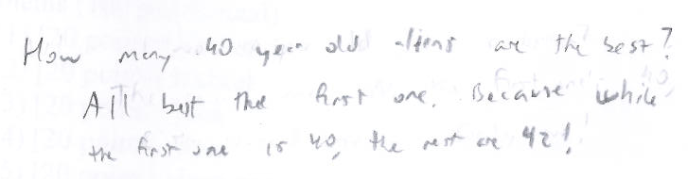
O(funny) jokes..
I didn't get these two. And the top one, I still don't...

Slide 73
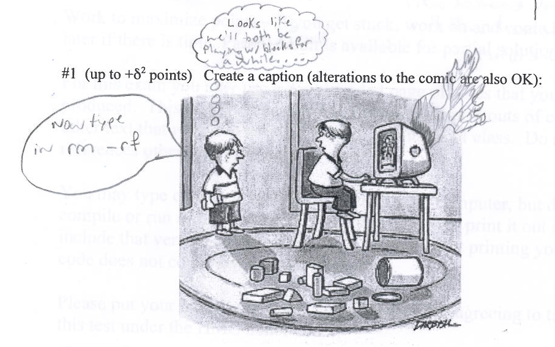
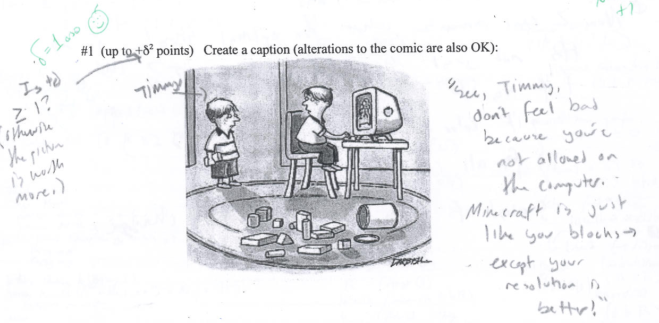

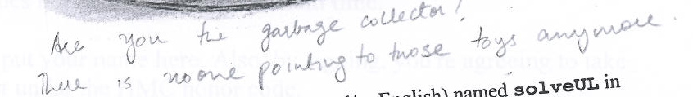


captions
and O(funny) jokes!

Slide 74

captions
and O(funny) jokes!

Slide 75
Unhappy Prolog
len([], 0).
len([_|R], L) :- len(R,L2), L2 is L-1.
When will Prolog not like these definitions?
sum(X, Y, Z) :- Z is X + Y.
any ideas?

Slide 76
More flexible sums…
digits([0,1,2,3,4,5,6,7,8,9]).
sum(X,Y,Z) :-
digits(D),
member(X,D),
member(Y,D),
Z is X+Y.
sum(X,Y,Z) :-
D = [0,1,2,3,4,5,6,7,8,9],
member(X,D),
member(Y,D),
Z is X+Y.
better?

Slide 77
More flexible sums…
sum(X,Y,Z) :-
D = [0,1,2,3,4,5,6,7,8,9],
member(X,D),
member(Y,D),
Z is X+Y.
digits([0,1,2,3,4,5,6,7,8,9]).
sum(X,Y,Z) :-
digits(D),
member(X,D),
member(Y,D),
Z is X+Y.
better solution? Use var, nonvar
sum(X,Y,Z) :- nonvar(Y), nonvar(Z), X is Z-Y.
sum(X,Y,Z) :- nonvar(X), nonvar(Z), Y is Z-X.
sum(X,Y,Z) :- nonvar(X), nonvar(Y), Z is X+Y.
It’s possible to make sum generate ALL integer solutions even when X, Y, and Z are all variables…
How many of these rules will sum(2,2,4) and sum(2,2,5) finish?

Slide 78

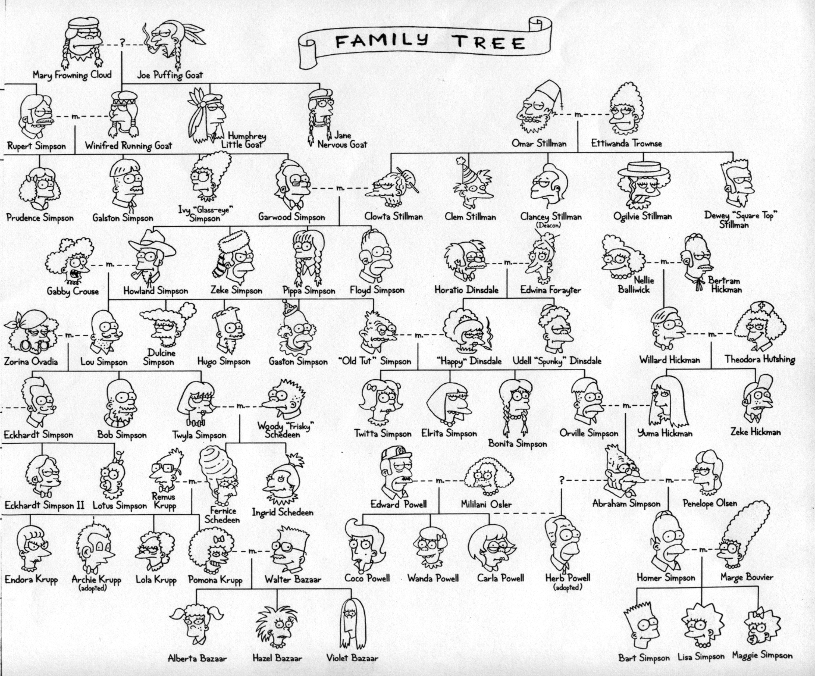

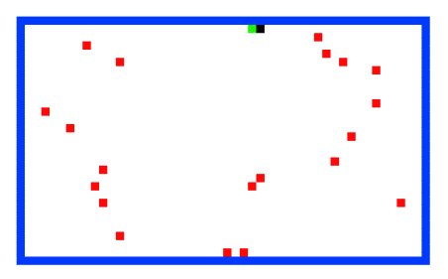

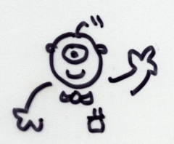
Welcome back to CS 60!
CS 60 Then and Now:
Weeks 1-4: Java
Weeks 5-8: Rex
Weeks 10-15:
Prolog, ISCAL, JFLAP, and more!
Guest-appearing this week …
Keeping the CS 60 ecosystem balanced…
This makes me appreciate my own family reunions…

Slide 79
The idea:
Provide data/relationships that describe the world. Then ask questions.
Questions:
child(lisa,marge).
parent(marge,X).
Is Lisa a child of Marge?
Who has Marge as a parent?
Is Ug a parent of Bart?
Who are the ancestors of Lisa?
Who are uggette's descendants?
Who is who's parent?
Who are John's grandchildren?

Slide 80
Prolog lists…
unifies L with [1, 2, 3]
Prolog has a more Python-like list syntax than Scheme:
L = [ 1, 2, 3 ].
== comparison (structural -- no arithmetic!)
\==
=:= arithmetic comparison with both-sided evaluation
=\=
2 not-equals
3 == 3. <-- yes
1+2 == 1+2. <-- yes
1+2 == 2+1. <-- no
1+2 =:= 2+1. <-- yes
[1,X] == [1,X]. <-- yes
[1,2] == [1,X]. <-- no
[1,2] = [1,X]. <-- yes, X is bound to 2

Slide 81
Math in Prolog
General operators/rules
Example
Notes
comparing for equality: == X == Y
arithmetic assignment: is X is Y+42
pattern matching (lists): = [F|R] = L
inequalities: < > =< >= \==
does not bind X or Y --
they must be bound
binds X ; Y must be bound
binds F and R
L must already be bound
read(X)
write(X)
nl
reads keyboard input into X
writes X to the screen
writes a newline “\n” to the screen
Input / Output

Slide 82
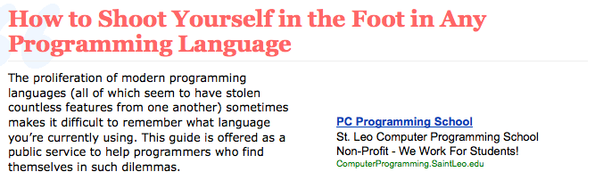
Does it matter?

Slide 83
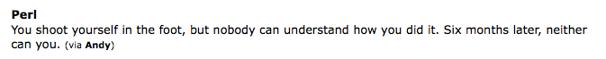
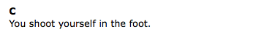
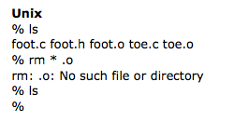
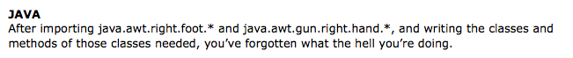
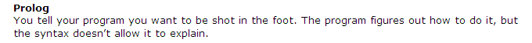

Rex
1 rex > shoot( [f|oot] ) => "ouch!";
shoot
2 rex > shoot( [] );
(failure 1)
Does it matter?

Slide 84
Prolog’s key difference...
Unlike scheme and java, prolog does not have return values!
(member X L)
in scheme/java, this returns a boolean
member( X, L )
in prolog, this can be tested (yes/no) OR it can bind values to X or L !
true when X is a member of L and false otherwise
Writing the member predicate:

Slide 85
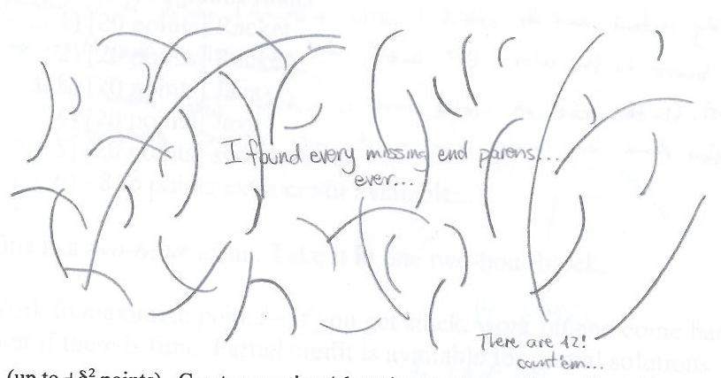
CS 60 captions!
and O(funny) jokes!
Christian Mason

Slide 86
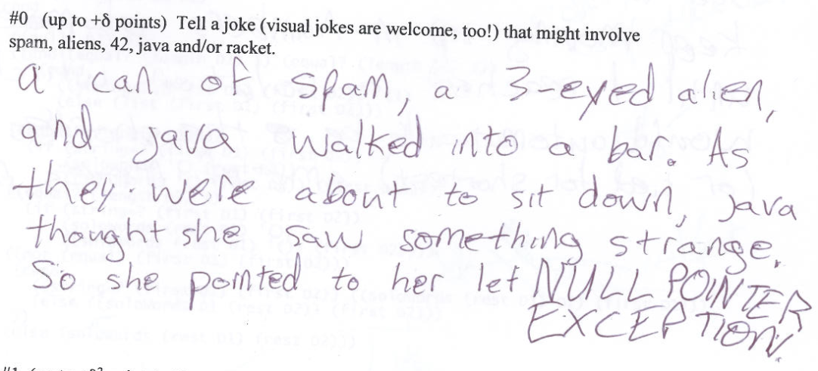
CS 60 captions!
and O(funny) jokes!

Slide 87
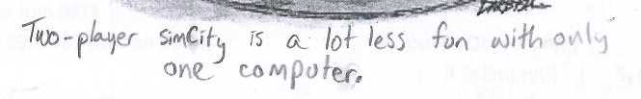
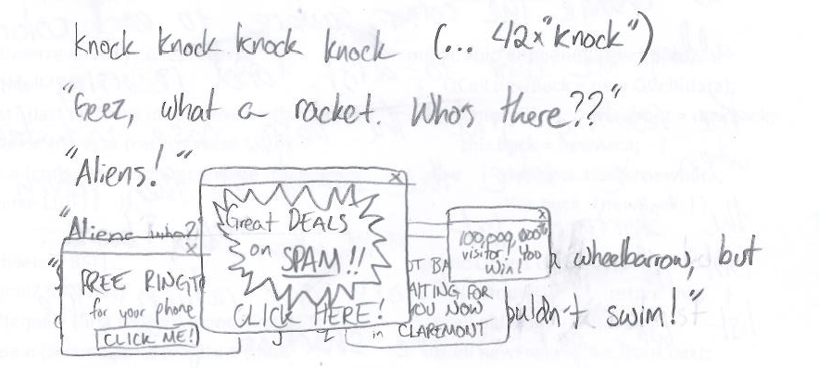
CS 60 captions!
and O(funny) jokes!

Slide 88
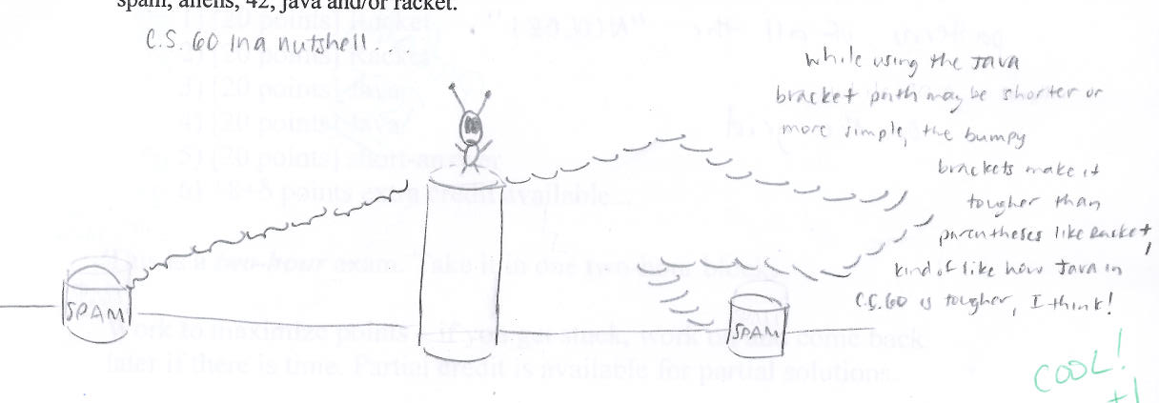
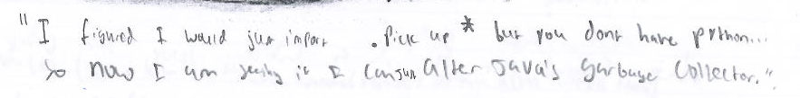
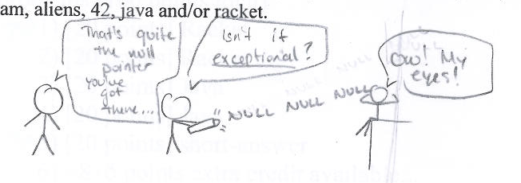
Meg O.

Slide 89
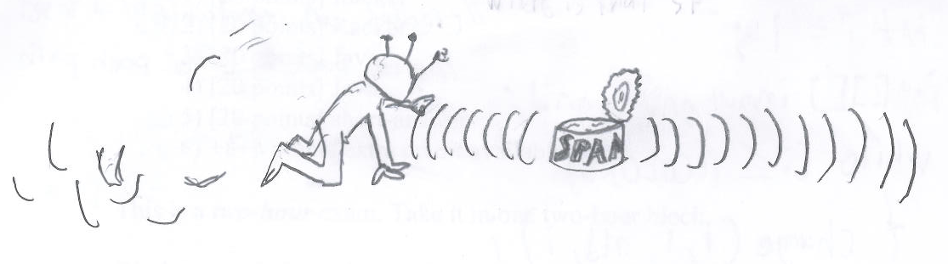
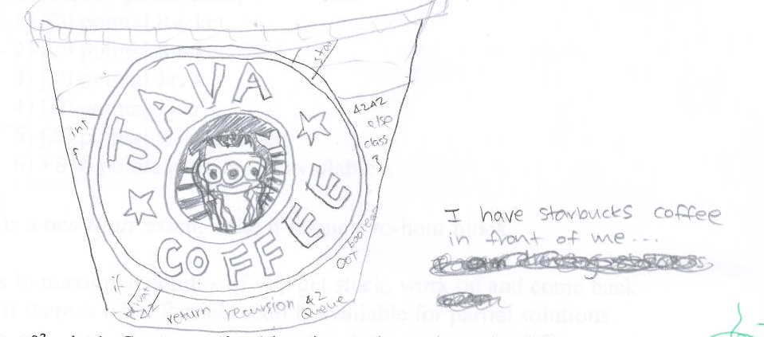
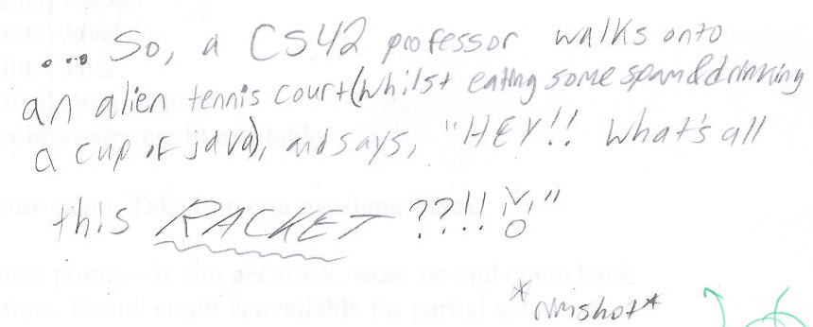

Seo P.

Slide 90
Prolog is… DFS!
trace. notrace.
Who are Bart’s aunts?
aunt(A,bart)
aunt(A,N) :- parent(P,N), sibling(A,P), female(A).
parent(P,N)
sibling(A,P)
female(A)

Slide 91
Prolog is… DFS!
Who are Bart’s aunts?
aunt(A,bart)
aunt(A,N) :- parent(P,N), sibling(A,P), female(A).
N = bart
parent(P,N)
is there a parent?
parent(homer,bart)
YES N = bart
P = homer
sibling(A,P)
female(A)

Slide 92
Prolog is… DFS!
Who are Bart’s aunts?
aunt(A,bart)
aunt(A,N) :- parent(P,N), sibling(A,P), female(A).
N = bart
parent(P,N)
is there a parent?
parent(homer,bart)
YES N = bart
P = homer
sibling(A,P)
is there a sibling?
sibling(gomer,homer)
YES N = bart
P = homer
A = gomer
female(A)

Slide 93
Prolog is… DFS!
Who are Bart’s aunts?
aunt(A,bart)
aunt(A,N) :- parent(P,N), sibling(A,P), female(A).
N = bart
parent(P,N)
is there a parent?
parent(homer,bart)
YES N = bart
P = homer
sibling(A,P)
is there a sibling?
sibling(gomer,homer)
YES N = bart
P = homer
A = gomer
female(A)
female(gomer) ?
NO (fails)

Slide 94
Prolog is… DFS!
Who are Bart’s aunts?
aunt(A,bart)
aunt(A,N) :- parent(P,N), sibling(A,P), female(A).
N = bart
parent(P,N)
is there a parent?
parent(homer,bart)
YES N = bart
P = homer
sibling(A,P)
is there a sibling?
sibling(gomer,homer)
YES N = bart
P = homer
A = gomer
backtrack!
female(A)
female(gomer) ?
NO (fails)

Slide 95
Prolog is… DFS!
Who are Bart’s aunts?
aunt(A,bart)
aunt(A,N) :- parent(P,N), sibling(A,P), female(A).
N = bart
parent(P,N)
is there a parent?
parent(homer,bart)
YES N = bart
P = homer
sibling(A,P)
is there a sibling?
other siblings?
sibling(gomer,homer)
NO
YES N = bart
P = homer
A = gomer
backtrack!
female(A)
female(gomer) ?
NO (fails)

Slide 96
Prolog is… DFS!
Who are Bart’s aunts?
aunt(A,bart)
aunt(A,N) :- parent(P,N), sibling(A,P), female(A).
N = bart
parent(P,N)
is there a parent?
other parents?
parent(homer,bart)
parent(marge,bart)
YES N = bart
YES N = bart
P = homer
P = marge
backtrack!
sibling(A,P)
is there a sibling?
other siblings?
sibling(gomer,homer)
NO
YES N = bart
P = homer
A = gomer
backtrack!
female(A)
female(gomer) ?
NO (fails)

Slide 97
Prolog is… DFS!
Who are Bart’s aunts?
aunt(A,bart)
aunt(A,N) :- parent(P,N), sibling(A,P), female(A).
N = bart
parent(P,N)
is there a parent?
other parents?
parent(homer,bart)
parent(marge,bart)
YES N = bart
YES N = bart
P = homer
P = marge
backtrack!
sibling(A,P)
is there a sibling?
other siblings?
is there a sibling?
sibling(gomer,homer)
NO
sibling(glum, marge)
YES N = bart
YES N = bart
P = homer
P = marge
A = gomer
A = glum
backtrack!
female(A)
female(gomer) ?
NO (fails)

Slide 98
Prolog is… DFS!
Who are Bart’s aunts?
aunt(A,bart)
aunt(A,N) :- parent(P,N), sibling(A,P), female(A).
N = bart
parent(P,N)
is there a parent?
other parents?
parent(homer,bart)
parent(marge,bart)
YES N = bart
YES N = bart
P = homer
P = marge
backtrack!
sibling(A,P)
is there a sibling?
other siblings?
is there a sibling?
sibling(gomer,homer)
NO
sibling(glum, marge)
YES N = bart
YES N = bart
P = homer
P = marge
A = gomer
A = glum
backtrack!
female(A)
female(gomer) ?
female(glum) ?
NO (fails)
NO

Slide 99
Prolog is… DFS!
Who are Bart’s aunts?
aunt(A,bart)
aunt(A,N) :- parent(P,N), sibling(A,P), female(A).
N = bart
parent(P,N)
is there a parent?
other parents?
parent(homer,bart)
parent(marge,bart)
YES N = bart
YES N = bart
P = homer
P = marge
backtrack!
sibling(A,P)
is there a sibling?
other siblings?
is there a sibling?
other siblings?
sibling(gomer,homer)
NO
sibling(glum, marge)
sibling(selma, marge)
YES N = bart
YES N = bart
YES N = bart
P = homer
P = marge
P = marge
A = gomer
A = glum
A = selma
backtrack!
backtrack!
female(A)
female(gomer) ?
female(glum) ?
NO (fails)
NO

Slide 100
Prolog is… DFS!
Who are Bart’s aunts?
aunt(A,bart)
aunt(A,N) :- parent(P,N), sibling(A,P), female(A).
N = bart
parent(P,N)
is there a parent?
other parents?
parent(homer,bart)
parent(marge,bart)
YES N = bart
YES N = bart
P = homer
P = marge
backtrack!
sibling(A,P)
is there a sibling?
other siblings?
is there a sibling?
other siblings?
sibling(gomer,homer)
NO
sibling(glum, marge)
sibling(selma, marge)
YES N = bart
YES N = bart
YES N = bart
P = homer
P = marge
P = marge
A = gomer
A = glum
A = selma
backtrack!
backtrack!
female(A)
female(gomer) ?
female(glum) ?
female(selma)
NO (fails)
NO
SUCCESS
YES!

Slide 101
when in Prolog…
This is bound to cause problems…
Equals Aren't!
positive
negative
Binding
=
\=
2-sided!
the = operator is also called "unification"
the two sides can unify
the two sides can't unify
==
\==
Structure
the two sides are the same structure
the two sides are different structures
Math!
is
no need for this!
the LHS gets the evaluation of the RHS arithmetic
Prolog knows arithmetic, not algebra!

Slide 102
Not all equals are created equal!
[X,a] = [b,Y]. <-- yes, binds X to b and Y to a
X = [Y]. <-- yes, binds X to [Y]
X = [X]. <-- quite literally hours of fun!
X = 5+2. <-- yes, but X is 5+2, not 7
X \= Y. <-- NO, because X CAN unify with Y.
X=3, Y=2, X \= Y. <-- YES, they can not be unified
Binding
1+2 == 1+2. <-- yes, the same structure
1+2 == 2+1. <-- no, NOT the same structure!
[1,X] == [1,X]. <-- yes
[1,2] == [1,X]. <-- no, although OK with =
X \== Y. <-- YES, they have different names!
X=3, Y=2, X \== Y. <-- NO, it uses the values!
Structure
Math
X is 5+2. <-- yes, now X is 7
X is Y+3. <-- error: Y is unbound
Y = 6, X is Y*7. <-- yes, X is bound to 42
1+2 =:= 2+1. <-- yes – this op. evals both sides!!

Slide 103
Negation
Prolog’s NOT
Be careful with negation!
\+
notaunt(A,N) :- \+ aunt(A,N).
?- notaunt(lisa,bart).
?- notaunt(selma,bart).
?- notaunt(A,bart).
How could you write oldest(X) ?
oldest(X) :- age(X, AX),
age(Y, AY),
AX > AY.
Does this work?

Slide 104
setof
?- setof(A,aunt(A,bart),S).
?- setof(N,aunt(marge,N),S).
setof(R, p(R), S)
is true when S is the set (list) of Rs that satisfy predicate p.
?- setof(A,notaunt(A,bart),S).
?- setof(N,notaunt(marge,N),S).
lists!

Slide 105
Expressing relationships
The pain's not Prolog, it's younger brothers!
I might say the same about older sisters!
brother(B,X) :-
true if B is X’s brother
sameAge(X,Y) :-
true if X is the same age as Y
Caution: this is tricky.
twoYrsOlder(X,Y) :-
true if X is 2 years older than Y
This is equally tricky.

Slide 106
Prolog is… Search
Who are lisa's brothers?
brother(B,X) :- parent(P,X), parent(P,B), male(B)
X = lisa
brother(B,lisa)
parent(P,lisa)
parent(homer,lisa)
parent(homer,B)
male(maggie)
P = homer
parent(homer,maggie)
fail!
parent(homer,B)
B = maggie
parent(homer,lisa)
male(lisa)
fail!
fail!
B = lisa
parent(homer,B)
parent(homer,bart)
male(bart)
B = bart
found one!
parent(P,lisa)
parent(homer,B)
fail!
parent(marge,lisa)
trace.
P = marge
parent(homer,B)

Slide 107
Prolog is… Search
Who are lisa's brothers?
brother(B,X) :- parent(P,X), parent(P,B), male(B)
brother(B,lisa)
parent(P,lisa)
X = lisa
parent(homer,lisa)
parent(homer,maggie)
male(maggie)
P = homer
B = maggie
fail!
brother(B,homer)
parent(homer,B)
parent(homer,lisa)
male(lisa)
brother(B,lisa)
B = lisa
fail!
parent(marge,bart)
sibling(marge)
male(B)
parent(P,bart)
trace.
parent(homer,B)

Slide 108
Prolog is… Search!
Who are lisa's brothers?
brother(B,X) :- parent(P,S), parent(P,B), male(B)
brother(B,lisa)
parent(P,lisa)
parent(homer,B)
N = bart
parent(P,bart)
male(B)
parent(homer,bart)
brother(B,homer)
brother(B,lisa)
parent(marge,bart)
brother(B,S) :- parent(P,B), parent(P,S), male(B)
sibling(marge)
trace.

Slide 109
Prolog is… DFS!
trace.
Who are Bart’s aunts?
aunt(A,bart)
aunt(A,N) :- parent(P,N), sibling(A,P), female(A).
N = bart
parent(P,N)
What space is Prolog searching through?
is there a parent?
other parents?
parent(homer,bart)
parent(marge,bart)
YES N = bart
YES N = bart
P = homer
P = marge
backtrack!
sibling(A,P)
is there a sibling?
other siblings?
is there a sibling?
other siblings?
sibling(gomer,homer)
NO
sibling(glum, marge)
sibling(selma, marge)
YES N = bart
YES N = bart
YES N = bart
P = homer
P = marge
P = marge
A = gomer
A = glum
A = selma
backtrack!
backtrack!
female(A)
female(gomer) ?
female(glum) ?
female(selma)
NO (fails)
NO
SUCCESS
YES!

Slide 110
Prolog is… DFS!
trace.
Who are Bart’s aunts?
aunt(A,bart)
aunt(A,N) :- parent(P,N), sibling(A,P), female(A).
N = bart
parent(P,N)
The space of possible bindings of values to variables
is there a parent?
other parents?
parent(homer,bart)
parent(marge,bart)
YES N = bart
YES N = bart
P = homer
P = marge
backtrack!
sibling(A,P)
is there a sibling?
other siblings?
is there a sibling?
other siblings?
sibling(gomer,homer)
NO
sibling(glum, marge)
sibling(selma, marge)
YES N = bart
YES N = bart
YES N = bart
P = homer
P = marge
P = marge
A = gomer
A = glum
A = selma
backtrack!
backtrack!
female(A)
female(gomer) ?
female(glum) ?
female(selma)
NO (fails)
NO
SUCCESS
YES!

Slide 111
Prolog Execution
Depth-first search through possible bindings
  Given a goal, Prolog tries the each rule of that name...
  If a rule has subgoals (a right-hand side),
    Subgoals are checked in order, binding variables as needed
    Those bindings persist until backtracking backs over them
    Watch out for unbound variables… !
  If a goal or subgoal fails, Prolog backtracks and tries again with the next available option (another binding or rule).
Be careful with negation!
trace.

Slide 112
Negation in Prolog?
Take-home message #1:
Prolog has at least six sorts of (in)equalities.
Not all equals are created equal !
=
==
the two sides are the same structure
\+
not
the two sides can and DO unify
\=
the two sides can't unify (or this fails)
\==
the two sides are different structures
is
the LHS gets the evaluation of the RHS's arithmetic
Take-home message #2:
Negation does not work unless all of the variables are BOUND to values.
Put negative predicates last.
Stay positive!

Slide 113
Stay positive!
Negated predicates need bound variables – defer them until the end!
Here is the "related" predicate:
rel(X,Y) :- anc(A,X), anc(A,Y).
Suppose only non-relatives can marry. How well will this work?
canMarry(X,Y) :- \+rel(X,Y).
That is not not!
Can we generate marriageable pairs?
canMarry(X,Y) :- \+rel(X,Y).

Slide 114
UIOLI is not the only approach!
I'd recommend that it NEVER be the first take…
Does your "first-thought" solution work for the task?!
Note: "first-thought" == easy to implement!
Work: "first-thought" == easy to implement!
Phew! They almost made it that time!

