Slide 1
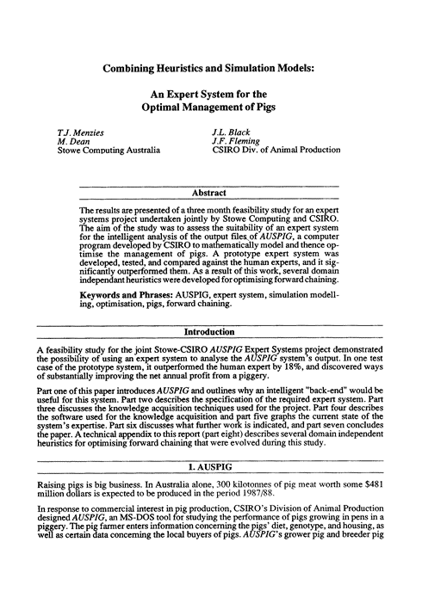
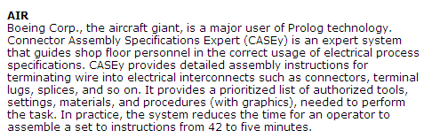
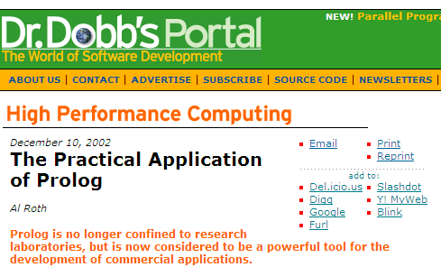
cs(X,When).
X = 60
When = today
Hw #4: Prolog – true!
Problem #1: Lists, Trees, Graphs
Problem #2: Einstein's Zebra puzzle
Problem #3: Java's Arrays
if
and
or
equals and not equals
not
Prolog syntax is galling – or Gallic (or both)…
:-

Slide 2
cs(X,When).
X = 60
When = today
Hw #4: Prolog – true!
Problem #1: Lists, Trees, Graphs
Problem #2: Einstein's Zebra puzzle
Problem #3: Java's Arrays
if
and
or
equals and not equals
not
Prolog syntax is galling – or Gallic (or both)…
= == is
,
;
:-
\= \== \+

Slide 3
cs(X,When).
X = 60
When = today
Hw #4: Prolog – true!
Problem #1: Lists, Trees, Graphs
Problem #2: Einstein's Zebra puzzle
Problem #3: Java's Arrays
if
and
or
equals and not equals
not
Prolog syntax is galling – or Gallic (or both)…
= == is
,
;
:-
\= \== \+

Slide 4
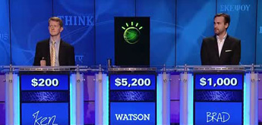
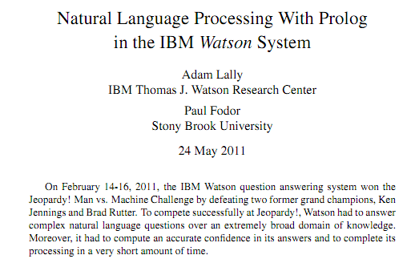
What's Prolog good for?
He was a bank clerk in the Yukon before he published
“Songs of a Sourdough” in 1907
lemma(1, "he").
partOfSpeech(1,pronoun).
lemma(2, "publish").
partOfSpeech(2,verb).
lemma(3, "Songs of a Sourdough").
partOfSpeech(3,noun).
subject(2,1).
object(2,3).
We required a language in which we could conveniently express pattern matching rules... and could execute these rules very efficiently. We found that Prolog was the ideal choice...

Slide 5
What's Prolog good for?
He was a bank clerk in the Yukon before he published
“Songs of a Sourdough” in 1907
lemma(1, "he").
partOfSpeech(1,pronoun).
lemma(2, "publish").
partOfSpeech(2,verb).
lemma(3, "Songs of a Sourdough").
partOfSpeech(3,noun).
subject(2,1).
object(2,3).
We required a language in which we could conveniently express pattern matching rules... and could execute these rules very efficiently. We found that Prolog was the ideal choice...

Slide 6
How Watson use Prolog to handle ambiguity…
"Songs of a Sourdough" by Robert W. Service
authorOf(Author,Composition) :-
composition(Composition),
argument(Composition,Preposition),
lemma(Preposition, "by"),
objectOfPreposition(Preposition,Author),
author(Author).
... when Robert Service wrote "Songs of a Sourdough"
authorOf(Author,Composition) :- createVerb(Verb),
subject(Verb,Author),
author(Author),
object(Verb,Composition),
composition(Composition).
createVerb(Verb) :-
partOfSpeech(Verb,verb),
lemma(Verb,VerbLemma),
member(VerbLemma,
["write",
"publish",
...]).

Slide 7
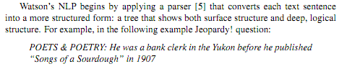
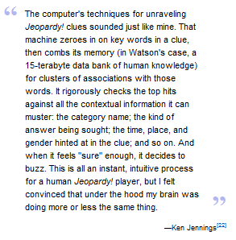
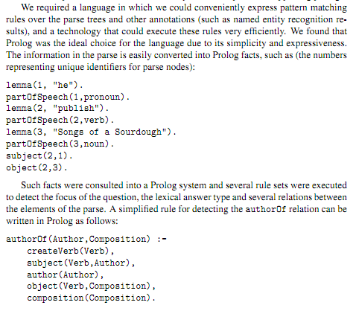
Prolog's structure is close to (language-based) reasoning
www.cs.nmsu.edu/ALP/2011/03/natural-language-processing-with-prolog-in-the-ibm-watson-system/

Slide 8
Racket vs. Prolog
but Prolog would win in an Epic Rap Battle…
(define (min-path s d G)
(if (equal? s d) (list 0 d)
(if (null? G) '(42000000)
(let* (
(it (first G))
(use-it-dist (+ initial-dist middle-dist final-dist))
(use-it-nodes (append (rest initial-path)
(rest final-path)))
(use-it-path (cons use-it-dist use-it-nodes))
(lose-it-path (min-path s d R))
(lose-it-dist (first lose-it-path))
)
(if (> use-it-dist lose-it-dist)
lose-it-path
use-it-path)))))
(a (first it))
(b (second it))
(R (rest G))
(initial-path (min-path s a R))
(initial-dist (first initial-path))
(middle-dist (third it))
(final-path (min-path b d R))
(final-dist (first final-path))
difference in mindsets
Racket has no side effects (no assignment) new data is created with each operation
Notes:
write fac!

Slide 9
Racket vs. Prolog
but Prolog would win in an Epic Rap Battle…
Unicalc?
(define (min-path s d G)
(if (equal? s d) (list 0 d)
(if (null? G) '(42000000)
(let* (
(it (first G))
(use-it-dist (+ initial-dist middle-dist final-dist))
(use-it-nodes (append (rest initial-path)
(rest final-path)))
(use-it-path (cons use-it-dist use-it-nodes))
(lose-it-path (min-path s d R))
(lose-it-dist (first lose-it-path))
)
(if (> use-it-dist lose-it-dist)
lose-it-path
use-it-path)))))
(a (first it))
(b (second it))
(R (rest G))
(initial-path (min-path s a R))
(initial-dist (first initial-path))
(middle-dist (third it))
(final-path (min-path b d R))
(final-dist (first final-path))
everything is function evaluation – everything is a return value!
Racket has no side effects (no assignment) new data is created with each operation
Notes:
write fac!

Slide 10
Racket vs. Prolog
aunt(A,N) :- parent(P,N), sibling(A,P), female(A).
aunt and fac are predicates, not functions!
fac(0,1).
fac(X,N) :- fac(Y,M), X is Y+1, N is X*M.
Prolog: everything is done via side effects (assignments): there are no return values!
Notes:
write fac!

Slide 11
Prolog thinks differently…
fac(X) :- X * fac(X-1).
3 =< places this goes wrong!
Even math is done via search through possible assignments!
Notes:
write fac!

Slide 12
Prolog thinks differently…
fac(X) :- X * fac(X-1).
3 =< places this goes wrong!
(1) There's no base case
(2) Assumes return values (all over!)
No wonder Prolog's making that unhappy face!
Notes:
write fac!

Slide 13
... so how does Prolog think?
(0) base case
fac(0,1).
fac(X,N) :- fac(Y,M), X is Y+1, N is X*M.
(1) then recursion...
(2) new bindings next
(3) negations last
How would these work?
?- fac(0,N).
?- fac(1,N).
?- fac(2,N).
?- fac(3,N).
When in doubt, try this order for your Prolog clauses

Slide 14
Equality vs. Unifies
Prolog has at least six sorts of (in)equalities.
=
==
the two sides are the same structure
\+
not
the two sides can and DO unify
\=
the two sides can't unify (or this fails)
\==
the two sides are different structures
is
the LHS gets the evaluation of the RHS's arithmetic
= is called unification. It actively tries to make its two sides equal. It succeeds if it can make them equal. It fails if it can't.
[F,S] = [41,42]
[Rt,L,R] = [42,[],[]]

Slide 15
Prolog's cons bar
[F|R] is read "F cons R"
F gets the first of the list
R gets the rest of the list
[F|R] = [7,8,9]
F = 7
R = [8,9]
does unify, with bindings

Slide 16
Cons bar & pattern matching
[F|R] = [42]
yields
F =
R =
[F|R] = []
yields
Prolog thinks in terms of variable bindings – i.e., assignments

Slide 17
Quiz
Prolog's patterns
Name(s) ______________________________
What assignments result here, if any?
[F|R] = [s,p,a,m]
F =
R =
RT =
L =
R =
[RT,L,R] = [42,[],[60,[],[]]]
What kind of data structure is this?
[F,S] = [42,[],[60,[],[]]]
F =
S =
[E|R] = [[a,b]]
E =
R =
What kind of data structures are these two?
X =
Y =
R =
[[X,Y]|R] = [[c,d],[a,b]]

Slide 18
Quiz
pattern matching
Try this on the back first…
What assignments result here, if any?
[F|R] = [s,p,a,m]
F = s
R = [p,a,m]
RT = 42
L = []
R = [60,[],[]]
[RT,L,R] = [42,[],[60,[],[]]]
What kind of data structure is this?
[F,S] = [42,[],[60,[],[]]]
F =
S =
[E|R] = [[a,b]]
E =
R =
What kind of data structures are these two?
X =
Y =
R =
[[X,Y]|R] = [[c,d],[a,b]]

Slide 19
hw4, part1: old friends
Lists, Trees, and Graphs, Prologified
Test
Generate
length([a,b,c],3).
true
length([a,b,c],N).
N = 3
length([a,b],4).
false
length(L,0).
L = []
what if BOTH are variable?

Slide 20
Using pattern matching
length(L,N) :- L = [], N = 0.
if
and
"The length of L is N"
L unifies with []
N unifies with 0
length([],0).
Prolog allows pattern-matching within the left-hand side of rules!
Same rule!

Slide 21
Nonempty matching with cons
This matches only the empty list.
length([],0).
This matches any NON-empty list – and names the first F and the rest R!
length([F|R],N) :- length(R,M),
N is M+1.
This is read "F cons R" . It only binds to nonempty lists - and you can then use F and R!

Slide 22
Nonempty matching with cons
This matches only the empty list.
(0) base case
length([],0).
This matches any NON-empty list – and names the first F and the rest R!
(1) then recursion...
length([F|R],N) :- length(R,M),
N is M+1.
This is read "F cons R" . It only binds to nonempty lists - and you can then use F and R!
(2) new bindings next
(3) negations last

Slide 23
Prolog and data…
Inference on structure, instead of a database.
Test
Generate
member(3, [1,2,3,4,5]).
true
member(E, [1,2,3,4,5]).
E = 1 ;
E = 2 ;
E = 3 ;
E = 4 ;
E = 5 ;
false
member(6, [1,2,3,4,5]).
false
both variable?

Slide 24
Thinking with pattern matching
English: "E is a member of a list whose first element is E."
mem( E, ).
English: "E is a member of a list whose first element might not be E, if …"
mem( E, ) :-

Slide 25
"I don't care!"
We never used R in this rule: it's a singleton.
mem( E, [E|R] ).
mem( E, [F|R] ) :- mem(E, R).
Prolog will warn you about singletons!
and we never used F in this rule!
mem( E, [E|_] ).
mem( E, [_|R] ) :- mem(E, R).
Let me underscore that _ has no value!
The underscore _ is Prolog's "I don't care" place holder

Slide 26
Prolog patterns…
Short! Sweet!
length( [ ], 0 ).
base case
length( L, N )
length( [F|R], N ) :- length(R,M), N is M+1.
rec case
mem( E, [E|_] ).
mem( E, L )
[ ] is NOT always the base case!
mem( E, [_|R] ) :- mem( E, R ).
lastof( E, ).
base case
lastof( E, L )
rec case
lastof( E, ) :-
nnodes( ).
nnodes( BST, N )
nnodes( ) :-
for example, BST = [42, [ ], [100,[ ],[ ]] ].

Slide 27
app( [ ], M, ).
base case
app( L, M, A )
app( [F|R], M, ) :-
rec case
true iff A is L and M, appended
rem1( E, [E|R], ) .
rem1( E, L, NewL )
rem1( E, [F|R], ) :-
true iff NewL is L with E removed
should only work if E is in L
treefind( E, ).
treefind( E, BST )
treefind( E, ) :-
true iff E is in BST
for example, BST = [42, [5,[],[]], [100,[ ],[ ]] ].
kid( K, P, G )
add more rules if you want…
kid(
true iff K is a child of P in graph G, a list of edges)
Try it!
for example, G = [ [a,b], [b,c], [c,d], [a,d] ].

Slide 28
hw4pr1: Prolog + friends
< 15 lines
TOTAL!
rev( L, Rev )
Rev is L, reversed
count( E, L, N )
There are exactly N Es in L.
find( Pattern, Target, Index )
The list Pattern is found in the list Target at location Index.
depth( BST, Depth )
The binary tree BST has a depth (or height) of Depth.
insert( E, BST, NewBST )
NewBST is BST with E appropriately inserted.
We've been down this path before!
path( A, B, Graph, Path )
Path is a list of nodes going from A to B in Graph, a list of edges.

Slide 29
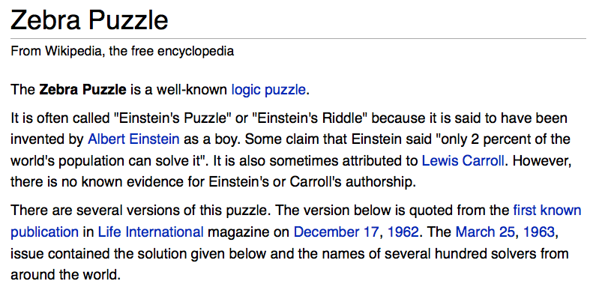
There are five houses:
The nationalities are norwegian, brit, swede, dane, german
The pets are dog, bird, zebra, cat, horse
The cigars are pallmall, winfield, dunhill, rothmans, marlboro
The beverages are tea, coffee, milk, water, beer
The house colors are red, green, yellow, blue, white
We know that
1) The Norwegian lives in the first house.
2) The person living in the center house drinks milk.
3) The Brit lives in a red house.
4) The Swede keeps dogs as pets.
5) The Dane drinks tea.
6) The Green house is next to, and on the left of the White house.
7) The owner of the Green house drinks coffee.
8) The person who smokes Pall Mall rears birds.
9) The owner of the Yellow house smokes Dunhill.
10) The man who smokes Marlboro lives next to the one who keeps cats.
11) The man who keeps horses lives next to the man who smokes Dunhill.
12) The man who smokes Winfields drinks beer.
13) The German smokes Rothmans.
14) The red house is to the right of the blue.
15) The Norwegian doesn't live by the red, white, or green houses
Who owns the zebra?
hw4pr2
Einstein's Zebra puzzle: a set of logical constraints

Slide 30
There are five houses:
The nationalities are norwegian, brit, swede, dane, german
The pets are dog, bird, zebra, cat, horse
The cigars are pallmall, winfield, dunhill, rothmans, marlboro
The beverages are tea, coffee, milk, water, beer
The house colors are red, green, yellow, blue, white
We know 15 things…
1) The Norwegian lives in the first house.
Who owns the zebra?
hw4pr2
Einstein's Zebra puzzle: a set of logical constraints
(plus fourteen more constraints)
The setup
nation, pet, cigar, beverage, house color
nation, pet, cigar, beverage, house color
nation, pet, cigar, beverage, house color
nation, pet, cigar, beverage, house color
nation, pet, cigar, beverage, house color
house colors may not be in this order…

Slide 31
There are five houses:
The nationalities are norwegian, brit, swede, dane, german
The pets are dog, bird, zebra, cat, horse
The cigars are pallmall, winfield, dunhill, rothmans, marlboro
The beverages are tea, coffee, milk, water, beer
The house colors are red, green, yellow, blue, white
We know that
1) The Norwegian lives in the first house.
2) The person living in the center house drinks milk.
3) The Brit lives in a red house.
4) The Swede keeps dogs as pets.
5) The Dane drinks tea.
6) The Green house is next to, and on the left of the White house.
7) The owner of the Green house drinks coffee.
8) The person who smokes Pall Mall rears birds.
9) The owner of the Yellow house smokes Dunhill.
10) The man who smokes Marlboro lives next to the one who keeps cats.
11) The man who keeps horses lives next to the man who smokes Dunhill.
12) The man who smokes Winfields drinks beer.
13) The German smokes Rothmans.
14) The red house is to the right of the blue.
15) The Norwegian doesn't live by the red, white, or green houses
Who owns the zebra?
hw4pr2
Einstein's Zebra puzzle: a set of logical constraints
The full puzzle
What does Prolog care about?

Slide 32
There are five houses:
The nationalities are norwegian, brit, swede, dane, german
The pets are dog, bird, zebra, cat, horse
The cigars are pallmall, winfield, dunhill, rothmans, marlboro
The beverages are tea, coffee, milk, water, beer
The house colors are red, green, yellow, blue, white
We know that
1) The Norwegian lives in the first house.
2) The person living in the center house drinks milk.
3) The Brit lives in a red house.
4) The Swede keeps dogs as pets.
5) The Dane drinks tea.
6) The Green house is next to, and on the left of the White house.
7) The owner of the Green house drinks coffee.
8) The person who smokes Pall Mall rears birds.
9) The owner of the Yellow house smokes Dunhill.
10) The man who smokes Marlboro lives next to the one who keeps cats.
11) The man who keeps horses lives next to the man who smokes Dunhill.
12) The man who smokes Winfields drinks beer.
13) The German smokes Rothmans.
14) The red house is to the right of the blue.
15) The Norwegian doesn't live by the red, white, or green houses
Who owns the zebra?
hw4pr2
Einstein's Zebra puzzle: a set of logical constraints
(0) How do we represent the puzzle state?
Prolog ~ representation!
(1) What relationships do we need?
(2) How do we encode the constraints?

Slide 33
Zebra-puzzle representation
A list H reflects the houses' spatial order
with the five items that each house has…
pet
cigar
beverage
nation
house color
H = [[norwegian, _, _, _, _], _, [_, _, _, milk, _], _, _]
1) The Norwegian lives in the first house.
2) What's this piece of data out here indicating?

Slide 34
Zebra-puzzle representation
A list H reflects the houses' spatial order
with the five items that each house has…
pet
cigar
beverage
nation
house color
H = [[norwegian, _, _, _, _], _, [_, _, _, milk, _], _, _]
House 1
House 3
House 2
Houses 4+5
1) The Norwegian lives in the first house.
2) The person living in the center house drinks milk.

Slide 35
Zebra-puzzle representation
A list H reflects the houses' spatial order
with the five items that each house has…
pet
cigar
beverage
nation
house color
H = [[norwegian, _, _, _, _], _, [_, _, _, milk, _], _, _]
House 1
House 3
House 2
Houses 4+5
Let's try this constraint:
7) The owner of the Green house drinks coffee.
Hint: use member and H

Slide 36
Zebra-puzzle constraints
% What does this say about L and R?
% lr( L, R, HouseList )
lr(L, R, [L, R | _ ]).
lr(L, R, [ _ | Rest]) :- lr(L, R, Rest).
% … and then X and Y?
% mystery( X, Y, HouseList )
mystery(X, Y, HList) :- lr(X, Y, HList).
mystery(X, Y, HList) :- lr(Y, X, HList).
Helpers...
HList will be "big H"

Slide 37
Zebra-puzzle constraints
% left-to-right adjacency
lr(L, R, [L, R | _ ]).
lr(L, R, [ _ | Rest]) :- lr(L, R, Rest).
% adjacency (unordered)
nextTo(X, Y, HList) :- lr(X, Y, HList).
nextTo(X, Y, HList) :- lr(Y, X, HList).
Helpers...
HList will be "big H"
Try this constraint:
15) The Norwegian does not live by the red house.
Hint: use one of the above predicates -- and H
Where should this predicate go?

Slide 38
Got bindings?
houses( [H1, H2, H3, H4, H5 ] ) :-
H1 = [ N1, P1, S1, B1, C1 ],
H2 = [ N2, P2, S2, B2, C2 ],
H3 = [ N3, P3, S3, B3, C3 ],
H4 = [ N4, P4, S4, B4, C4 ],
H5 = [ N5, P5, S5, B5, C5 ],
perm( [N1,N2,N3,N4,N5], [norwegian, brit, swede, dane, german] ),
perm( [P1,P2,P3,P4,P5], [dog, bird, zebra, cat, horse] ),
perm( [S1,S2,S3,S4,S5], [pallmall, winfield, dunhill, rothmans, marlboro] ),
perm( [B1,B2,B3,B4,B5], [tea, coffee, milk, water, beer] ),
perm( [C1,C2,C3,C4,C5], [red, green, yellow, blue, white] ).
Question1: What does this houses predicate do?
Question2: How many binding-possibilities will Prolog try?
perm == permutation
predicate order can dramatically speed up/slow down Prolog's search!

Slide 39
Zebra-puzzle output
solve :-
einstein( [ H1, H2, H3, H4, H5 ] ),
write( ' first house: '), write(H1), nl,
write( 'second house: '), write(H2), nl,
write( ' third house: '), write(H3), nl,
write( 'fourth house: '), write(H4), nl,
write( ' fifth house: '), write(H5), nl.
A zero-argument predicate!
and its output:
?- solve.
first house: [norwegian, cat, dunhill, water, yellow]
second house: [dane, horse, marlboro, tea, blue]
third house: [brit, bird, pallmall, milk, red]
fourth house: [german, zebra, rothmans, coffee, green]
fifth house: [swede, dog, winfield, beer, white]
true

Slide 40
The Mystery of the Spamwarts Express
Five "people" are traveling home in adjacent train seats for break…
Seat 1
Seat 2
Seat 3
Seat 4
Seat 5
Names = [algird, bruno, collette, dino, edwina].
Each has a different name.
Schools = [pomona, pitzer, hmc, cmc, scripps].
Each is from a different Claremont College.
Snacks = [jots, chocolate, donuts, pez, spam].
Each has brought a different snack.
1) Dino and Bruno sat in the end seats.
2) Algird sat next to the student from HMC.
3) Collette sat next to friends with chocolate and donuts.
4) The HMC student brought spam as a snack and sat in the middle seat.
5) Chocolate was immediately to the left of pez.
6) Bruno, Dino, and Algird do not go to Scripps.
7) The Pomona student sat between the one with jots and the one with spam.
8) Dino did not sit next to the person with donuts.
9) The CMC student did not sit next to Edwina.
9 hints are available

Slide 41
Prolog patterns
(1) Base case (usually no constraint clauses at all!)
mem(E, [E|_]).
mem(E, [_|R]) :- mem(E, R).
(2) Recursion first! (when possible)
Key idea: You are describing the constraints that make a relationship - a Prolog predicate - true.
an element
a list
(3) Other bindings and/or arithmetic next (is needs a bound RHS)
len([], 0).
len([_|R], N) :- len(R, M), N is M+1.
list
its length
(4) Negation last (all vars must be bound)
Notes:
secret strategy: randomly reorder things until it works!!

Slide 42
Thinking with pattern matching
English: "E is a member of a list whose first element is E."
member( E, ).
English: "E is a member of a list whose first element might not be E, if …"
member( E, ) :-

Slide 43
Prolog patterns!
Short. Sweet!
length( [ ], 0 ).
base case
length( L, N )
rec case
length( [F|R], N ) :- length(R,M), N is M+1.
mem( E, [E|_] ).
mem( E, L )
[ ] is NOT always the base case!
mem( E, [_|R] ) :- mem( E, R ).
lastof( E, ).
base case
lastof( E, L )
rec case
lastof( E, ) :-
nnodes( ).
nnodes( BST, N )
nnodes( ) :-
for example, BST = [42, [ ], [100,[ ],[ ]] ].

Slide 44
Prolog patterns
(1) Base case (usually no constraint clauses at all!)
mem(E, [E|_]).
mem(E, [_|R]) :- mem(E, R).
(2) Recursion first! (when possible)
an element
a list
(3) Other bindings and/or arithmetic next (is needs a bound RHS)
len([], 0).
len([_|R], N) :- len(R, M), N is M+1.
list
its length
(4) Negation last (all vars must be bound)
Notes:
secret strategy: randomly reorder things until it works!!

Slide 45
Prolog patterns
(1) Base case
app([], M, M).
app([F|R], M, [F|B]) :- app(R, M, B).
left list
right list
final list
(2) Recurse
rev([], []).
rev([F|R], Rev) :- rev(R, RoR),
app(RoR, [F], Rev).
a list
its reverse
reverse of the rest
(3) Other constraints
Notes:
secret strategy: randomly reorder things until it works!!

Slide 46
var and nonvar
both inputs are variables
rev( L, Rev ) :- var(L), var(Rev),
write( 'If you insist…' ), nl,
L = [42], Rev = [42].
rev( L, Rev ) :- var(L), nonvar(Rev),
rev(Rev, L).
first input is a variable
rev([], []).
rev([F|R], Rev) :- rev(R, RoR),
app(RoR, [F], Rev).
second input is a variable
Or, try permuting predicates until it works - which might not work!

Slide 47
Name(s): ___________
Prolog patterns
(1) Base case
(2) Recurse
(3) Other constraints
min( , ).
min( , ) :-
min( , ) :-
Example: min( [6,7,5,42], 5 ).
a list
its min
nonmin( , ):-
a list
a nonmin element
Example: nonmin( [6,7,5,42], 42 ).
rem1(E, [E|R], R).
rem1(
element
list
list w/o el.
Example: rem1( 7, [6,7,5], [6,5] ).
Notes:
secret strategy: randomly reorder things until it works!!

Slide 48

Sorting out Prolog… by sorting in Prolog!
Practice with how prolog thinks...
rem1(E,L,NL)
true if NL is L without one of its Es
E must be present in L!
inorder(L)
true if L's elements are inorder (ascending)
perm(L,P)
true if P is a permutation of L
sort(L,S)
It can be tough to get perm right!
S is L, sorted

Slide 49
Don't hand these in!
rem1(E, [E|R], R).
rem1(E, [F|R], [F|NR]) :-
inorder( ).
inorder( ).
inorder(
Hint: you may want two base cases
Hint: recurse and then use something else on this page
perm([], []).
perm([F|R], P) :-
big-O!
Extra! There are at least TWO ways to write sort... Both use predicates we've just written!
sort(
sort(
Notes:
secret strategy: randomly reorder things until it works!!

Slide 50
Sorting out Prolog… by sorting in Prolog!
Practice with how prolog thinks...
sort(
sort(
Extra! There are at least TWO ways to write sort... What are they?
What are their big-O runtimes?
sort(
sort(
Notes:
secret strategy: randomly reorder things until it works!!

Slide 51
Trees and graphs work, too!
42
tree1( [42,[5,[],[]],[60,[],[]]] )
5
60
bst
# of nodes
nnodes([], 0).
nnodes([Root,L,R], N) :- nnodes(L,NoL),
nnodes(R,NoR),
N is NoL + NoR + 1.
treemin(
treemin(
binary search tree
its minimum element
Notes:
secret strategy: randomly reorder things until it works!!

Slide 52
Trees and graphs work, too!
a
graph1( [[a,b],[b,c],[a,c]] )
b
c
graph as a list of edges
# of edges
numedges([], 0).
numedges(G, N) :- length( G, N ).
kid(P,K,Graph) :-
parent
child (kid)
graph as list of edges
Notes:
secret strategy: randomly reorder things until it works!!

Slide 53
HW 8 (part 1): Prolog & friends…
removeOne( E, L, NewL )
NewL is L with an E removed.
less than 15-20 lines
count( E, L, N )
There are exactly N Es in L.
TOTAL
find( Pattern, Target, Index )
The list Pattern is found in the list Target at location Index.
depth( BST, Depth )
The binary tree BST has a depth (or height) of Depth.
insert( E, BST, NewBST )
NewBST is BST with E appropriately inserted.
I think we've been down this PATH before?!!
path( A, B, Graph, Path )
Path is a path from A to B in Graph, a list of [src,dst] edges.

Slide 54
Use-it-or-lose-it
You're it!
revisited!
"it"
change( 42, [ 2, 20, 21 ] ) … ?
longest common subsequence
LCS( 'taylor', 'yotra' ) … ?
big-O ?

Slide 55
Use-it-or-lose-it
You're it!
"it"
change( 42, [ 2, 20, 21 ] ) … ?
change( 42, [ 20, 21 ] )
"lose it"
OR
change( 40, [ 20, 21 ] )
"use it"
longest common subsequence
"it1"
"it2"
LCS( 'taylor', 'yotra' ) … ?
if it1 and it2 match, return it + recurse
"use it"
R1 = LCS( 'taylor', 'otra' )
"lose it or lose it"
R2 = LCS( 'aylor', 'yotra' )
return longer of R1 and R2
big-O ?

Slide 56
Use-it-or-lose-it
You're it!
path( A, B, G, P ) :- P is a path from A to B in G.
G1
b
c
a
d
x
z
w
setof(P, path(a, z, G1, P), A).
A = [[a,b,w,x,z],[a,b,z]]

Slide 57
Use-it-or-lose-it
You're it!
path( A, B, G, P ) :- P is a path from A to B in G.
How would prolog write a non-empty G?
B
A
X
Y
See Racket's min-path…
big-O ?

Slide 58
var and nonvar
rev( L, Rev ) :- var(L), var(Rev),
write( 'If you insist…' ), nl,
L = [42], Rev = [42].
rev( L, Rev ) :- var(L), nonvar(Rev),
rev(Rev, L).
Alternatively, try randomly permute predicates until something works !
reverse( [], [] ).
and the recursive case from the quiz…
which might not work!

Slide 59
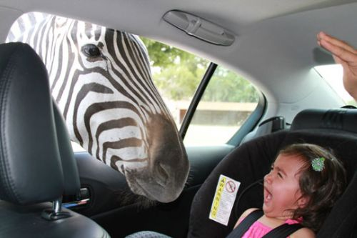

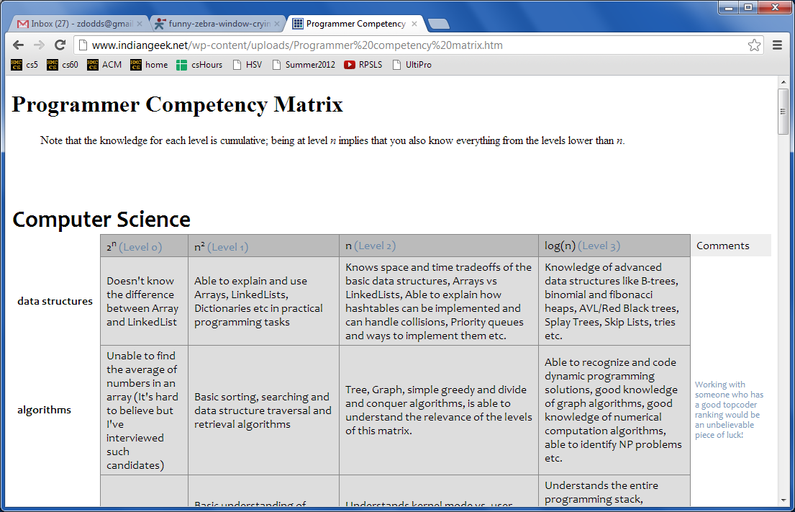
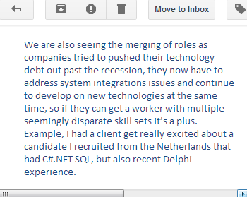
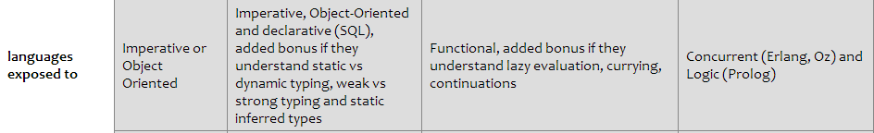
today(CS,60).
Puzzling zebras
&
De-puzzling puzzles!
What prolog is good for!
… and how you might feel about it …
thoughts from Cory…
Sean M. & JPL: 5 languages yesterday!
www.indiangeek.net/wp-content/uploads/Programmer%20competency%20matrix.htm
Notes:
secret strategy: randomly reorder things until it works!!

Slide 60
true or false ?
Name(s): ________________
For each line, determine if Prolog will find it true or false. What bindings will Prolog create?
[F|R] = [42]. <-- true, binds F to 42 and R to []
[F|R] = []. <-- false, [] does not have a first!
[Root,L,R] = [42,[],[100,[],[]]]
[Root,L,R] = [42,[]]
X = 5+2.
X \= Y.
X=3, Y=2, X \= Y.
Binding
=
tries to assign any two structures to one another…
Structure
1+2 == 1+2.
1+2 == 2+1.
[1,X] == [1,X].
[1,2] == [1,X].
X \== Y.
X=3, Y=3, X \== Y.
==
compares any two structures to one another…
Math
X is 5+2.
X is Y+3.
Y = 6, X is Y*7.
1+2 is 2+1.
X = 3, Y < X
is
computes the right-hand side and binds to the left-hand side

Slide 61
Not all equals are created equal!
For each line, determine if Prolog will find it true or false. What bindings will Prolog create?
[F|R] = [42]. <-- true, binds F to 42 and R to []
[F|R] = []. <-- false, [] does not have a first!
[Root,L,R] = [42,[],[100,[],[]]] <-- true, binds Root=42, L=[], R=[100,[],[]]
[Root,L,R] = [42,[]] <-- false, different # of elems.
X = 5+2. <-- true, but X is 5+2, not 7
X \= Y. <-- false, X CAN unify with Y.
X=3, Y=2, X \= Y. <-- true, they can not be unified
Binding
=
tries to assign any two structures to one another…
Structure
1+2 == 1+2. <-- true, the same structure
1+2 == 2+1. <-- false, NOT the same structure!
[1,X] == [1,X]. <-- true
[1,2] == [1,X]. <-- false, no bindings are made
X \== Y. <-- true, they have different names!
X=3, Y=3, X \== Y. <-- false, it uses the values!
==
compares any two structures to one another…
Math
X is 5+2. <-- true, now X is 7
X is Y+3. <-- error: Y is unbound
Y = 6, X is Y*7. <-- true, X is bound to 42
1+2 is 2+1. <-- false: only evals the RHS
X = 3, Y < X <-- error: Y is unbound
is
computes the right-hand side and binds to the left-hand side

Slide 62
Goal is design, not duplication
www.cs.nmsu.edu/ALP/2011/03/natural-language-processing-with-prolog-in-the-ibm-watson-system/

Slide 63
Goal is design, not duplication
He was a bank clerk in the Yukon before he published
“Songs of a Sourdough” in 1907
We required a language in which we could conveniently express pattern matching rules... and could execute these rules very efficiently. We found that Prolog was the ideal choice...
Hw#4 will ask for structure homework (#4) is due next Mon.
lemma(1, "he").
partOfSpeech(1,pronoun).
lemma(2, "publish").
partOfSpeech(2,verb).
lemma(3, "Songs of a Sourdough").
partOfSpeech(3,noun).
subject(2,1).
object(2,3).
6 prolog predicates in ~15 lines of code (instead of 300+)

Slide 64
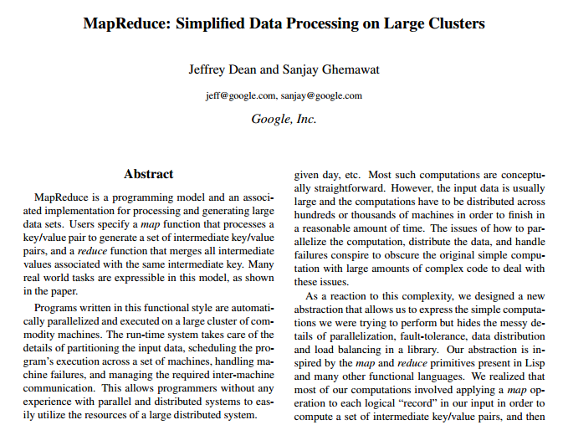
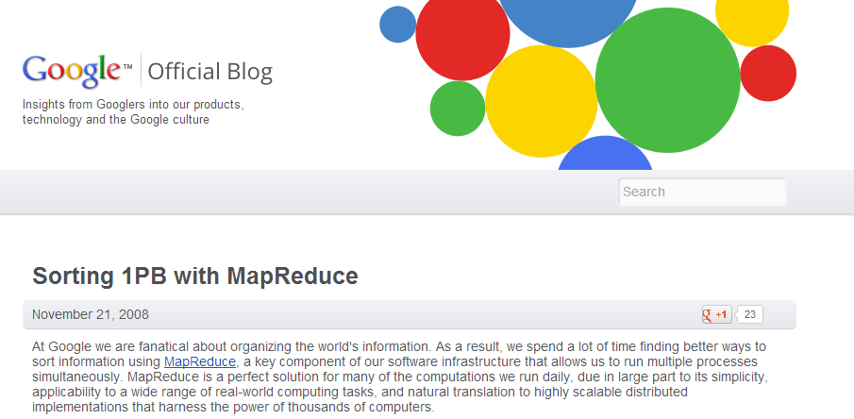
Goal is design, not duplication
OSDI '04: operating systems design and implementation
Notes:
write fac!

Slide 65
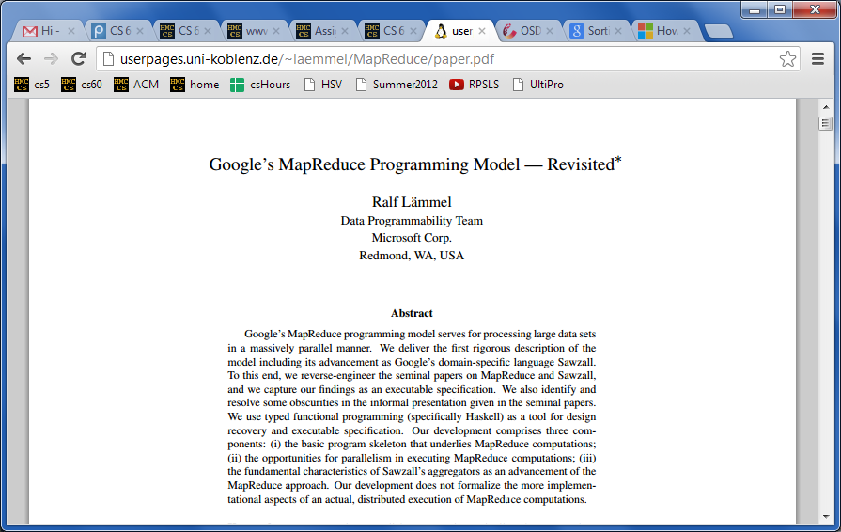
Goal is design, not duplication
OSDI '04: operating systems design and implementation
or, maybe it is duplication…
Notes:
write fac!

Slide 66
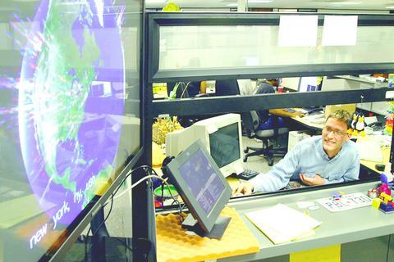
Geo display of Google searches
HMC's first Google employee: Greg Rae
pre-20% time
"drive-through" toys…

Slide 67
The Prolog progression...
Prolog is crazy.
Who would ever invent such a thing?
Week 1:
Week 2:
Week 3:
Notes:
secret strategy: randomly reorder things until it works!!

Slide 68
The Prolog progression...
Prolog is crazy.
Who would ever invent such a thing?
Week 1:
Prolog is crazy.
... though not as bad as before...
Week 2:
Week 3:
Notes:
secret strategy: randomly reorder things until it works!!

Slide 69
The Prolog progression...
Prolog is crazy.
Who would ever invent such a thing?
Week 1:
Prolog is crazy.
... though not as bad as before...
Week 2:
Prolog is crazy.
... and now so am I
Week 3:
but what if you started off that way?
because it makes sense to me!
Notes:
secret strategy: randomly reorder things until it works!!

Slide 70
Prolog patterns
(1) Base case (usually no constraint clauses at all!)
mem(E, [E|_]).
mem(E, [_|R]) :- mem(E, R).
(2) Recursion first! (when possible)
Key idea: You are describing the constraints that make a relationship - a Prolog predicate - true.
an element
a list
(3) Other bindings and/or arithmetic next (is needs a bound RHS)
len([], 0).
len([_|R], N) :- len(R, M), N is M+1.
list
its length
(4) Negation last (all vars must be bound)
Notes:
secret strategy: randomly reorder things until it works!!

Slide 71
Prolog patterns
(1) Base case (usually no constraint clauses at all!)
mem(E, [E|_]).
mem(E, [_|R]) :- mem(E, R).
(2) Recursion first! (when possible)
an element
a list
(3) Other bindings and/or arithmetic next (is needs a bound RHS)
len([], 0).
len([_|R], N) :- len(R, M), N is M+1.
list
its length
(4) Negation last (all vars must be bound)
Notes:
secret strategy: randomly reorder things until it works!!

Slide 72
Prolog patterns
(1) Base case
app([], M, M).
app([F|R], M, [F|B]) :- app(R, M, B).
left list
right list
final list
(2) Recurse
rev([], []).
rev([F|R], Rev) :- rev(R, RoR),
app(RoR, [F], Rev).
a list
its reverse
reverse of the rest
(3) Other constraints
Notes:
secret strategy: randomly reorder things until it works!!

Slide 73
var and nonvar
both inputs are variables
rev( L, Rev ) :- var(L), var(Rev),
write( 'If you insist…' ), nl,
L = [42], Rev = [42].
rev( L, Rev ) :- var(L), nonvar(Rev),
rev(Rev, L).
first input is a variable
rev([], []).
rev([F|R], Rev) :- rev(R, RoR),
app(RoR, [F], Rev).
second input is a variable
Or, try permuting predicates until it works - which might not work!

Slide 74
Name(s): ___________
Prolog patterns
(1) Base case
(2) Recurse
(3) Other constraints
min( , ).
min( , ) :-
min( , ) :-
Example: min( [6,7,5,42], 5 ).
a list
its min
nonmin( , ):-
a list
a nonmin element
Example: nonmin( [6,7,5,42], 42 ).
rem1(E, [E|R], R).
rem1(
element
list
list w/o el.
Example: rem1( 7, [6,7,5], [6,5] ).
Notes:
secret strategy: randomly reorder things until it works!!

Slide 75
Sorting out Prolog… by sorting in Prolog!
Practice with how prolog thinks...
rem1(E,L,NL)
true if NL is L without one of its Es
E must be present in L!
inorder(L)
true if L's elements are inorder (ascending)
perm(L,P)
true if P is a permutation of L
sort(L,S)
It can be tough to get perm right!
S is L, sorted

Slide 76
Don't hand these in!
rem1(E, [E|R], R).
rem1(E, [F|R], [F|NR]) :-
inorder( ).
inorder( ).
inorder(
Hint: you may want two base cases
Hint: recurse and then use something else on this page
perm([], []).
perm([F|R], P) :-
big-O!
Extra! There are at least TWO ways to write sort... Both use predicates we've just written!
sort(
sort(
Notes:
secret strategy: randomly reorder things until it works!!

Slide 77
Sorting out Prolog… by sorting in Prolog!
Practice with how prolog thinks...
sort(
sort(
Extra! There are at least TWO ways to write sort... What are they?
What are their big-O runtimes?
sort(
sort(
Notes:
secret strategy: randomly reorder things until it works!!

Slide 78
Trees and graphs work, too!
42
tree1( [42,[5,[],[]],[60,[],[]]] )
5
60
bst
# of nodes
nnodes([], 0).
nnodes([Root,L,R], N) :- nnodes(L,NoL),
nnodes(R,NoR),
N is NoL + NoR + 1.
treemin(
treemin(
binary search tree
its minimum element
Notes:
secret strategy: randomly reorder things until it works!!

Slide 79
Trees and graphs work, too!
a
graph1( [[a,b],[b,c],[a,c]] )
b
c
graph as a list of edges
# of edges
numedges([], 0).
numedges(G, N) :- length( G, N ).
kid(P,K,Graph) :-
parent
child (kid)
graph as list of edges
Notes:
secret strategy: randomly reorder things until it works!!

Slide 80
HW 8 (part 1): Prolog & friends…
removeOne( E, L, NewL )
NewL is L with an E removed.
less than 15-20 lines
count( E, L, N )
There are exactly N Es in L.
TOTAL
find( Pattern, Target, Index )
The list Pattern is found in the list Target at location Index.
depth( BST, Depth )
The binary tree BST has a depth (or height) of Depth.
insert( E, BST, NewBST )
NewBST is BST with E appropriately inserted.
I think we've been down this PATH before?!!
path( A, B, Graph, Path )
Path is a path from A to B in Graph, a list of [src,dst] edges.

Slide 81
Use-it-or-lose-it
You're it!
revisited!
"it"
change( 42, [ 2, 20, 21 ] ) … ?
longest common subsequence
LCS( 'taylor', 'yotra' ) … ?
big-O ?

Slide 82
Use-it-or-lose-it
You're it!
"it"
change( 42, [ 2, 20, 21 ] ) … ?
change( 42, [ 20, 21 ] )
"lose it"
OR
change( 40, [ 20, 21 ] )
"use it"
longest common subsequence
"it1"
"it2"
LCS( 'taylor', 'yotra' ) … ?
if it1 and it2 match, return it + recurse
"use it"
R1 = LCS( 'taylor', 'otra' )
"lose it or lose it"
R2 = LCS( 'aylor', 'yotra' )
return longer of R1 and R2
big-O ?

Slide 83
Use-it-or-lose-it
You're it!
path( A, B, G, P ) :- P is a path from A to B in G.
G1
b
c
a
d
x
z
w
setof(P, path(a, z, G1, P), A).
A = [[a,b,w,x,z],[a,b,z]]

Slide 84
Use-it-or-lose-it
You're it!
path( A, B, G, P ) :- P is a path from A to B in G.
How would prolog write a non-empty G?
B
A
X
Y
See Racket's min-path…
big-O ?

Slide 85
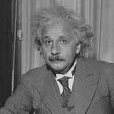
There are five houses:
The nationalities are norwegian, brit, swede, dane, german
The pets are dog, bird, zebra, cat, horse
The cigars are pallmall, winfield, dunhill, rothmans, marlboro
The beverages are tea, coffee, milk, water, beer
The house colors are red, green, yellow, blue, white
We know that
1) The Norwegian lives in the first house.
2) The person living in the center house drinks milk.
3) The Brit lives in a red house.
4) The Swede keeps dogs as pets.
5) The Dane drinks tea.
6) The Green house is next to, and on the left of the White house.
7) The owner of the Green house drinks coffee.
8) The person who smokes Pall Mall rears birds.
9) The owner of the Yellow house smokes Dunhill.
10) The man who smokes Marlboro lives next to the one who keeps cats.
11) The man who keeps horses lives next to the man who smokes Dunhill.
12) The man who smokes Winfields drinks beer.
13) The German smokes Rothmans.
14) The red house is to the right of the blue.
15) The Norwegian doesn't live by the red, white, or green houses
Who owns the zebra?
Prolog ~ representation!
Einstein's Zebra puzzle: a logic challenge

Slide 86
There are five houses:
The nationalities are norwegian, brit, swede, dane, german
The pets are dog, bird, zebra, cat, horse
The cigars are pallmall, winfield, dunhill, rothmans, marlboro
The beverages are tea, coffee, milk, water, beer
The house colors are red, green, yellow, blue, white
We know 15 things…
1) The Norwegian lives in the first house.
Who owns the zebra?
Einstein's Zebra puzzle: a logic challenge
~ 1900
(plus fourteen more constraints)
The setup
nation, pet, cigar, beverage, house color
nation, pet, cigar, beverage, house color
nation, pet, cigar, beverage, house color
nation, pet, cigar, beverage, house color
nation, pet, cigar, beverage, house color

Slide 87
There are five houses:
The nationalities are norwegian, brit, swede, dane, german
The pets are dog, bird, zebra, cat, horse
The cigars are pallmall, winfield, dunhill, rothmans, marlboro
The beverages are tea, coffee, milk, water, beer
The house colors are red, green, yellow, blue, white
We know that
1) The Norwegian lives in the first house.
2) The person living in the center house drinks milk.
3) The Brit lives in a red house.
4) The Swede keeps dogs as pets.
5) The Dane drinks tea.
6) The Green house is next to, and on the left of the White house.
7) The owner of the Green house drinks coffee.
8) The person who smokes Pall Mall rears birds.
9) The owner of the Yellow house smokes Dunhill.
10) The man who smokes Marlboro lives next to the one who keeps cats.
11) The man who keeps horses lives next to the man who smokes Dunhill.
12) The man who smokes Winfields drinks beer.
13) The German smokes Rothmans.
14) The red house is to the right of the blue.
15) The Norwegian doesn't live by the red, white, or green houses
Who owns the zebra?
Einstein's Zebra puzzle: a logic challenge
The full puzzle

Slide 88
There are five houses:
The nationalities are norwegian, brit, swede, dane, german
The pets are dog, bird, zebra, cat, horse
The cigars are pallmall, winfield, dunhill, rothmans, marlboro
The beverages are tea, coffee, milk, water, beer
The house colors are red, green, yellow, blue, white
We know that
1) The Norwegian lives in the first house.
2) The person living in the center house drinks milk.
3) The Brit lives in a red house.
4) The Swede keeps dogs as pets.
5) The Dane drinks tea.
6) The Green house is next to, and on the left of the White house.
7) The owner of the Green house drinks coffee.
8) The person who smokes Pall Mall rears birds.
9) The owner of the Yellow house smokes Dunhill.
10) The man who smokes Marlboro lives next to the one who keeps cats.
11) The man who keeps horses lives next to the man who smokes Dunhill.
12) The man who smokes Winfields drinks beer.
13) The German smokes Rothmans.
14) The red house is to the right of the blue.
15) The Norwegian doesn't live by the red, white, or green houses
Who owns the zebra?
Einstein's Zebra puzzle: a logic challenge
(0) How do we represent the puzzle state?
(1) What relationships do we need?
(2) How do we encode the constraints?

Slide 89
Zebra-puzzle representation
A list H reflects the houses' spatial order
with the five items that each house has…
pet
cigar
beverage
nation
house color
H = [[norwegian, _, _, _, _], _, [_, _, _, milk, _], _, _]
House 1
House 3
House 2
Houses 4+5
1) The Norwegian lives in the first house.
2) The person living in the center house drinks milk.

Slide 90
Zebra-puzzle representation
A list H reflecting the houses' spatial order
with the five items that each house has…
pet
cigar
beverage
nation
house color
H = [[norwegian, _, _, _, _], _, [_, _, _, milk, _], _, _]
House 1
House 3
House 2
Houses 4+5
Let's try this constraint:
7) The owner of the Green house drinks coffee.
Hint: use member and H

Slide 91
Zebra-puzzle constraints
% What does this say about L and R?
% lr( L, R, HouseList )
lr(L, R, [L, R | _ ]).
lr(L, R, [ _ | Rest]) :- lr(L, R, Rest).
% … and then X and Y?
% mystery( X, Y, HouseList )
mystery(X, Y, HList) :- lr(X, Y, HList).
mystery(X, Y, HList) :- lr(Y, X, HList).
Helpers...
HList will be "big H"

Slide 92
Zebra-puzzle constraints
% left-to-right adjacency
lr(L, R, [L, R | _ ]).
lr(L, R, [ _ | Rest]) :- lr(L, R, Rest).
% adjacency (unordered)
nextTo(X, Y, HList) :- lr(X, Y, HList).
nextTo(X, Y, HList) :- lr(Y, X, HList).
Helpers...
HList will be "big H"
Try this constraint:
15) The Norwegian does not live by the red house.
Hint: use one of the above predicates -- and H
Where should this predicate go?

Slide 93
Got bindings?
houses( [H1, H2, H3, H4, H5 ] ) :-
H1 = [ N1, P1, S1, B1, C1 ],
H2 = [ N2, P2, S2, B2, C2 ],
H3 = [ N3, P3, S3, B3, C3 ],
H4 = [ N4, P4, S4, B4, C4 ],
H5 = [ N5, P5, S5, B5, C5 ],
perm( [N1,N2,N3,N4,N5], [norwegian, brit, swede, dane, german] ),
perm( [P1,P2,P3,P4,P5], [dog, bird, zebra, cat, horse] ),
perm( [S1,S2,S3,S4,S5], [pallmall, winfield, dunhill, rothmans, marlboro] ),
perm( [B1,B2,B3,B4,B5], [tea, coffee, milk, water, beer] ),
perm( [C1,C2,C3,C4,C5], [red, green, yellow, blue, white] ).
Question1: What does this houses predicate do?
Question2: How many binding-possibilities will Prolog try?
perm == permutation
predicate order can dramatically speed up/slow down Prolog's search!

Slide 94
Zebra-puzzle output
solve :-
einstein( [ H1, H2, H3, H4, H5 ] ),
write( ' first house: '), write(H1), nl,
write( 'second house: '), write(H2), nl,
write( ' third house: '), write(H3), nl,
write( 'fourth house: '), write(H4), nl,
write( ' fifth house: '), write(H5), nl.
A zero-argument predicate!
and its output:
?- solve.
first house: [norwegian, cat, dunhill, water, yellow]
second house: [dane, horse, marlboro, tea, blue]
third house: [brit, bird, pallmall, milk, red]
fourth house: [german, zebra, rothmans, coffee, green]
fifth house: [swede, dog, winfield, beer, white]
true

Slide 95
The Mystery of the Spamwarts Express
Five "people" are traveling home in adjacent train seats for break…
Seat 1
Seat 2
Seat 3
Seat 4
Seat 5
Names = [algird, bruno, collette, dino, edwina].
Each has a different name.
Schools = [pomona, pitzer, hmc, cmc, scripps].
Each is from a different Claremont College.
Snacks = [jots, chocolate, donuts, pez, spam].
Each has brought a different snack.
1) Dino and Bruno sat in the end seats.
2) Algird sat next to the student from HMC.
3) Collette sat next to friends with chocolate and donuts.
4) The HMC student brought spam as a snack and sat in the middle seat.
5) Chocolate was immediately to the left of pez.
6) Bruno, Dino, and Algird do not go to Scripps.
7) The Pomona student sat between the one with jots and the one with spam.
8) Dino did not sit next to the person with donuts.
9) The CMC student did not sit next to Edwina.
9 hints are available

Slide 96

24 (Problem #2)
4
7
4
7
Can you combine these numbers into 24 with the operations + - * ÷ ?
2
1
Each operation may be used any number of times.
2
1
A two-dot card from the "official" 24 game: 24game.com

Slide 97
24 (Problem #2)
4
7
4
7
Can you combine these numbers into 24 with the operations + - * ÷ ?
2
1
Each operation may be used any number of times.
2
1
solve( [‘+’,‘-’,‘*’,‘/’], [1,2,4,7], 24, Tree ).
operators available: (use any number of times)
values:
(use each exactly once)
arithmetic tree
final answer
Tree = [*, [+, 1, [-,7,2]], 4]

Slide 98
Searching to the end…
be sure there is an end!
setof( Tree, solve( [‘+’,‘-’,‘*’,‘/’], [1,2,4,7], 24, Tree ) , S).
variable whose values you want to collect into a set
the set
predicate that you would like to satisfy…
setof( Tree, solve( [‘+’,‘-’,‘*’,‘/’], [5,1,155,11], 24, Tree ) , S).
a much smaller example…
notice the splitting!
[2,8,22,424] ~ 42
[4,4,4,4] ~ 42
setof( N, T^solve( [‘+’,‘-’,‘*’,‘/’], [4,4,4,4], N, T ) , S).
a surprisingly well-studied problem!
T^ ~ there exists a T

Slide 99
solve( [‘+’,‘-’,‘*’,‘/’], [1,2,4,7], 24, Tree ).
Each operation may be used any number of times.
operators available: (use any number of times)
values:
(use each exactly once)
arithmetic tree
final answer
Tree = [*,[+,1,[-,7,2]],4]
solve
What is the base case?
solve(
What is the recursive case?
solve( Ops, Values, Ans, Tree ) :-
Set up: Ops and Values will have values; Tree may not (5pts); or Ans (5pts); …
How to create Left and Right here?
What about Op ?
What helper predicates will be needed?
Tree = [ Op, Left, Right ].
Leave until the end.

Slide 100
eval
Provided tree-evaluation code :
Note the base case!
eval(R, R) :- number(R).
eval(['+', A, B], R) :- eval(A, AR), eval(B, BR), R is AR + BR.
eval(['*', A, B], R) :- eval(A, AR), eval(B, BR), R is AR * BR.
eval(['-', A, B], R) :- eval(A, AR), eval(B, BR), R is AR - BR.
eval(['/', A, B], R) :- eval(A, AR), eval(B, BR), BR\==0, R is AR // BR.
the tree
also checks nonvar(A) and nonvar(B)
resulting value
Really?
This eval can both test and generate resulting values, R.

Slide 101
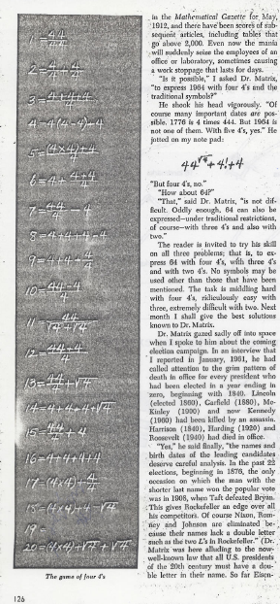
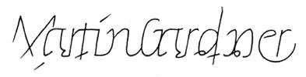
For four 4’s ...
0 = 4 + 4 - 4 - 4
1 = 44 / 44
2 = 4
...
8 = sqrt( .4 ) * ( 4 + 4 + 4 )
...
19 = ???
20 = 4! + 4 - 4 - 4
4/(4+4)
Ask around…

Slide 102
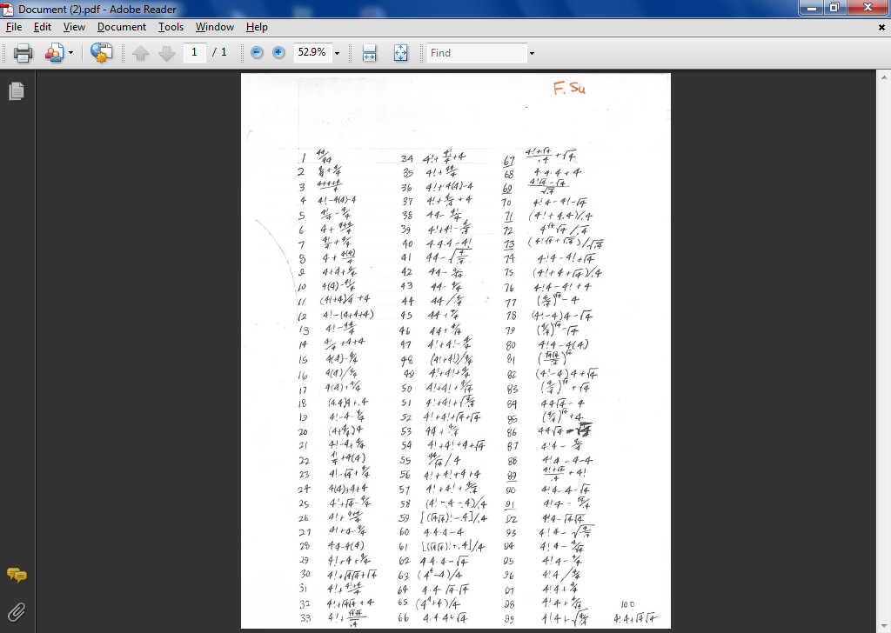

Slide 104
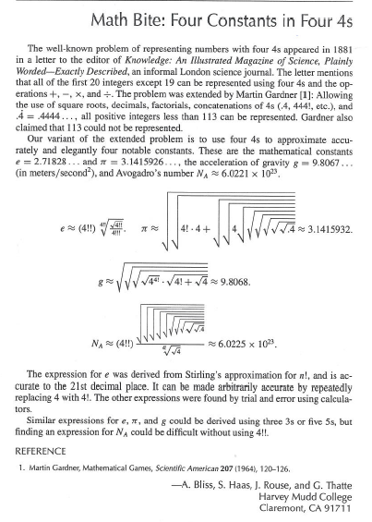
Using Prolog initially written in CS 60!

Slide 105
Next week ~
… more puzzling w/Prolog …
designing-your-own
Good luck with Prologging this week(end)...

Slide 106
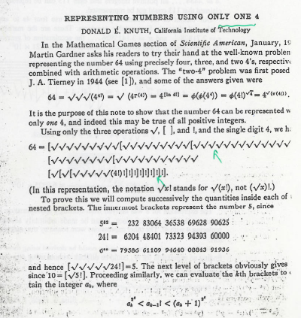

Slide 107
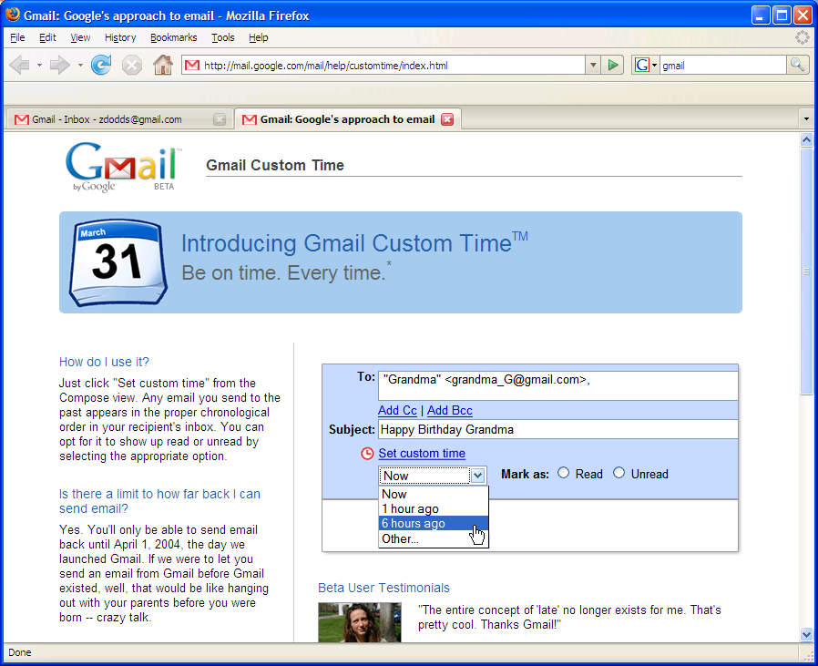
More puzzles next time!
in honor of Apr. 1, I'll be disguised as Jack Ma on Friday…

Slide 108
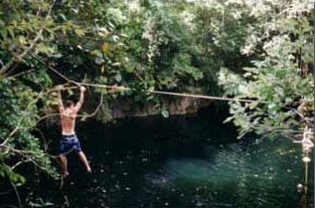
Where we're headed…
Week 9: Mar 28…
Prolog puzzles...
Week 10: Apr 4…
Prolog adventure!
Week 11: Apr 11…
"Theocomp" ~ formal models of computation
DFA, NFA, Regexes,
Week 12: Apr 18…
More on DFA, NFA, Regular expressions, also Turing Machines, reduction-style uncomputability, algorithm analysis
Week 14: Apr 25…
algorithm analysis: unwinding recurrences, loop-counting, sorting, big-O, algorithm speed challenge…
Not to mention some very cool computer science constructs with suggestively cool (maybe?) names, like quantum computing, NP-completeness, linear median finding, and sub-cubic matrix multiplication!
Oxford comma

Slide 109
Don't hand these in!
rem1(E, [E|R], R).
rem1(E, [F|R], [F|NR]) :-
inorder( ).
inorder( ).
inorder(
Hint: you may want two base cases
Hint: recurse and then use something else on this page
perm([], []).
perm([F|R], P) :-
big-O!
Extra! There are at least TWO ways to write sort... Both use predicates we've just written!
sort(
sort(
Notes:
secret strategy: randomly reorder things until it works!!

Slide 110
Sorting out Prolog… by sorting in Prolog!
Practice with how prolog thinks...
sort(
sort(
Extra! There are at least TWO ways to write sort... What are they?
What are their big-O runtimes?
sort(
sort(
Notes:
secret strategy: randomly reorder things until it works!!

Slide 111
Trees and graphs work, too!
42
tree1( [42,[5,[],[]],[60,[],[]]] )
5
60
bst
# of nodes
nnodes([], 0).
nnodes([Root,L,R], N) :- nnodes(L,NoL),
nnodes(R,NoR),
N is NoL + NoR + 1.
treemin(
treemin(
binary search tree
its minimum element
Notes:
secret strategy: randomly reorder things until it works!!

Slide 112
Trees and graphs work, too!
a
graph1( [[a,b],[b,c],[a,c]] )
b
c
graph as a list of edges
# of edges
numedges([], 0).
numedges(G, N) :- length( G, N ).
kid(P,K,Graph) :-
parent
child (kid)
graph as list of edges
Notes:
secret strategy: randomly reorder things until it works!!

Slide 113
removeOne( 42, L, [5,6,7])
removeOne( E, L, NewL )
removeOne(E,[E|R],R).
E must be present
removeOne(E,[F|R],[F|R2]) :- removeOne(E,R,R2).
removeAll( 42, L, [5,6,7])
removeAll( E, L, NewL )
removeAll(E,[],[]).
E need not be present...
removeAll(E,[E|R],X) :-
removeAll(E,[F|R],[F|X]) :-
uniq( [7,6,5,6,7,7,5], UList)
uniq( List, UList )
uniq([],[]).
uniq([F|R],[F|X]) :-

Slide 114
sorted( L )
Define sorted(L). Assume L contains only integers.
Quiz
You'll want 2 base cases and one recursive case…
Don't hand this in...
sorted(
sorted(
Prolog pandemonium!
sorted(
perm( L, P )
Write perm(L,P) to generate permutations P of a list L.
Hint: Use recursion and removeOne
perm( [ ], [ ] ).
perm( [F|R], P ) :-
sort( L, S )
Write sort(L,S), which "sorts" L into S.
Hint: Use the previous two predicates – in only one rule!
What is the big-O running time for this sorting algorithm?
sort( L, S ) :-
split( L, S1, S2 )
Write split(L,S1,S2) that splits a list L into all possible subsets S1 and S2.
so that L = S1 ∪ S2.
union, not concatenation
split( L, S1, S2 ) :-
Hint: Only 1 rule needed! You'll want to use a built-in helper predicate and something on this page...
speaking of split…

Slide 115

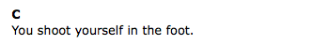

Slide 116
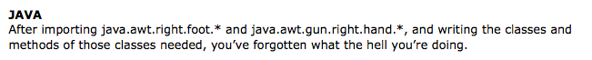
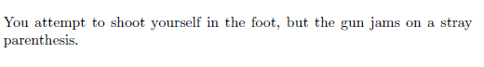
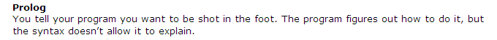
LISP/Scheme/Racket

Slide 117

LISP/Scheme/Racket

Slide 118
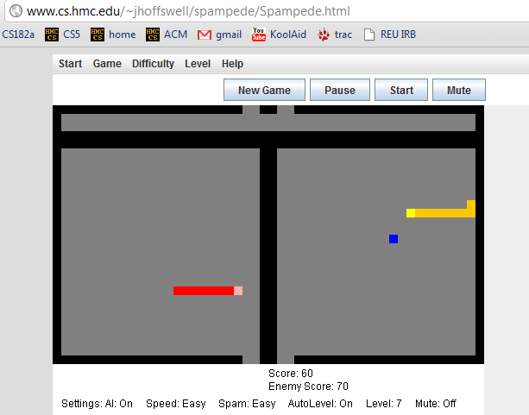
Applet examples
- Jane H.

Slide 119
lastof( E, L )
Take-home messages
lastof( E, )
Many times [] is not the base case!
lastof( E, )
reverse( L, Rev )
true if Rev is the reverse of the list L
reverse( , ).
test vs. generate: var and nonvar
reverse( [F|R], Rev ) :-
treefind( E, BST )
true if E is a node found in BST (a bin. search tree)
trees and graphs are OK, too!
Extra!
kid( P, Graph, K )
true if K is a child of P in graph Graph (list of edges)
kid( a, [ [a,b], [b,c], [a,c] ], K ).
K = b ;
K = c ;
No
No kidding!

Slide 120
var and nonvar
reverse( L, Rev ) :- var(L), var(Rev),
write( 'If you insist…' ), nl,
L = [42], Rev = [42].
reverse( L, Rev ) :- var(L), nonvar(Rev),
reverse(Rev, L).
Alternatively, try randomly permute predicates until something works !
reverse( [], [] ).
and the recursive case from the quiz…
which might not work!

Slide 121
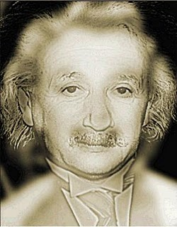
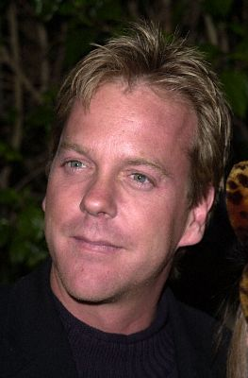
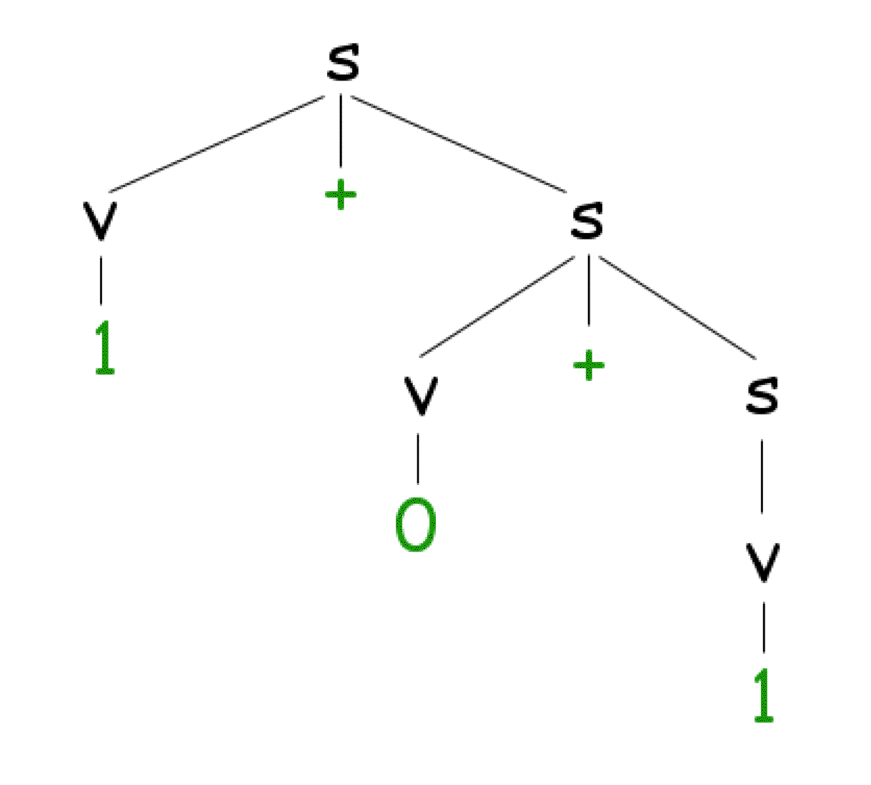
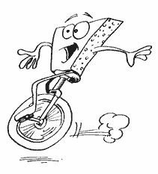
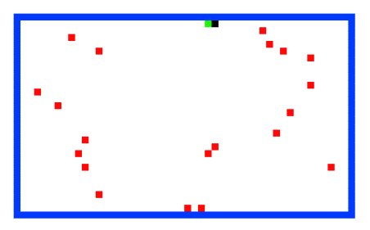

CS 60 Today
Problem #1: an Einsteinian logic puzzle...
Applet grading...!
Hw 9:
prolog puzzles, parsing, paths less traveled…
These two look fairly puzzling to me!
Prolog comma
~ due Mon. April 4
Tutors will be available W, Th, F, S, Sun.
X.
Office hours ~ Sun. afternoon, 2-4 @ LAC
the answer?
Line count:
~30 lines
~15 clauses
~15 lines
~8 clauses
seems like a good trend!
#1
#2
#3
#4
more rules
more structure
Problem #2: 24
Problem #3: The rivercrossing puzzle…
Problem #4: parsing ANY grammar…
Mudder
Alien
Spampede
Spam
parse([s],[1,+,0,+,1]).

Slide 122
Lists and trees, prolog style…
(length and append are built-in, but we'll write them here, too)
length( L, N )
length( [], 0 ).
length( [F|R], N ) :- length(R,M), N is M+1.
append( L, M, Both )
base case
append(
rec case
append(
BST = [ 42, [10,[],[]], [60,[],[]] ], for example
Short. Sweet!
nnodes( BST, N )
base case
nnodes(
rec case
nnodes( [Root,L,R], N ) :-

Slide 123
lastof( E, L )
Try it…
true if Eis the last element of the list L
lastof( E, )
lastof( E, )
reverse( L, Rev )
true if Rev is the reverse of the list L
reverse( , ).
reverse( [F|R], Rev ) :-
Hint: use reverse (recursively) and append.
treefind( E, BST )
true if E is a node found in BST (a bin. search tree) otherwise, false
Extra!
kid( Par, Graph, K )
true if K is a child of Par in graph Graph (list of edges)
kid( a, [ [a,b], [b,c], [a,c] ], K ).
K = b ;
K = c ;
No
No kidding!

Slide 124
Midterm feedback…
Don't put your name
We'd love to know any thoughts you have about CS60 thus far in the term… in particular, how you feel about the time and effort you find CS60 requires:
Where we've been...…
On average how much time per week do you spend on CS60 – outside of class time?
How does CS60's workload compare to other classes you're taking this term?
How would you judge the pace of CS60?
much lighter
about the same
much heavier
much too slow
about right
much too fast
What is something you'd keep about CS60 …?
& something you'd change about / get rid of / add to CS60 …?
Racket/Scheme
Java
Prolog
Rank each language we've used from 0 (disliked it) to 10 (loved it):
Other thoughts are optional, but 142% welcome.
Would you like the class to use clickers?
Possibilities:
Would you like exams to be actual coding?
Other concerns?

Slide 125
Prolog is uniq !
uniq( List, UList )
uniq([],[])
uniq([F|R],[F|X])
removeAll( E, L, NewL )
will
rA( _ ,
rA( E ,[E|R],
rA( E ,[F|R],
removeOne( E, L, NewL )
removeOne(E,[E|R],R).
removeOne(E,[F|R],[F|R2]) :- removeOne(E,R,R2).

Slide 126
Zebra-puzzle representation
A list H reflecting the houses' spatial order
containing the five items that each house has…
pet
cigar
beverage
nation
house color
H = [[norwegian, _, _, _, _], _, [_, _, _, milk, _], _, _]
House 1
House 3
House 2
Houses 4+5
Try this constraint:
7) The owner of the Green house drinks coffee.
Hint: use member and H

Slide 127
sorted( L )
Define sorted(L). Assume L contains only integers.
Quiz
You'll want 2 base cases and one recursive case…
Prolog pandemonium!
perm( L, P )
Write perm(L,P) to generate permutations P of a list L.
Use removeOne(E,L,NewL)
perm( [ ], [ ] ).
perm( [F|R], P ) :-
sort( L, S )
Write sort(L,S), which "sorts" L into S.
What is the big-O running time for this sorting algorithm?
Hint: Use the previous two predicates!
split( L, S1, S2 )
Write split(L,S1,S2) that splits a list L into subsets S1 and S2.
so that L = S1 ∪ S2.
not concatenation
speaking of split…

Slide 128
Zebra-puzzle constraints
% left-to-right adjacency
lr(L, R, [L, R | _ ]).
lr(L, R, [ _ | Rest]) :- lr(L, R, Rest).
% adjacency (unordered)
nextTo(X, Y, List) :- lr(X, Y, List).
nextTo(X, Y, List) :- lr(Y, X, List).
Creating some helpers:
List will be H
Try this constraint:
15) The Norwegian does not live by the red house.
Where should this predicate go?

Slide 129
Applet #1

Slide 130
24 (Problem #2)
4
7
4
7
Can you combine these numbers into 24 with the operations + - * ÷ ?
2
1
Each operation may be used any number of times.
2
1
A two-dot card from the "official" 24 game: 24game.com

Slide 131
24 (Problem #2)
4
7
4
7
Can you combine these numbers into 24 with the operations + - * ÷ ?
2
1
Each operation may be used any number of times.
2
1
solve( [‘+’,‘-’,‘*’,‘/’], [1,2,4,7], 24, Tree ).
operators available: (use any number of times)
values:
(use each exactly once)
arithmetic tree
final answer
Tree = [*, [+, 1, [-,7,2]], 4]

Slide 132
24 (Problem #2)
4
7
4
7
Can you combine these numbers into 24 with the operations + - * ÷ ?
2
1
Each operation may be used any number of times.
2
1
solve( [‘+’,‘-’,‘*’,‘/’], [1,2,4,7], 24, Tree ).
operators available: (use any number of times)
values:
(use each exactly once)
arithmetic tree
final answer
Tree = [*,[+,1,[-,7,2]],4]
Suggestion on solve -- use the following as a rough template:
solve(base case).
solve( Ops, Values, Sol, Tree ) :-
… , % don’t start with Tree = [ Op, Left, Right ] (why?)
predicates that create an appropriate Tree,
… ,
Tree = [ Op, Left, Right ]. % may also have more predicates after…

Slide 133
Searching to the end…
be sure there is an end!
setof( Tree, solve( [‘+’,‘-’,‘*’,‘/’], [1,2,4,7], 24, Tree ) , S).
variable whose values you want to collect into a set
the set
predicate that you would like to satisfy…
setof( Tree, solve( [‘+’,‘-’,‘*’,‘/’], [5,1,155,11], 24, Tree ) , S).
a much smaller example…
[2,8,22,424] ~ 42
[4,4,4,4] ~ 42
setof( N, T^solve( [‘+’,‘-’,‘*’,‘/’], [4,4,4,4], N, T ) , S).
a surprisingly well-studied problem!
T^ ~ there exists a T

Slide 134

For four 4’s ...
0 = 4 + 4 - 4 - 4
1 = 44 / 44
2 = 4
...
8 = sqrt( .4 ) * ( 4 + 4 + 4 )
...
19 = ???
20 = 4! + 4 - 4 - 4
Allowed Operations
4/(4+4)
+
-
*
/
sqrt
.
!
concat
power
A problem surprisingly well-studied…

Slide 135
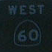
The alien, the spampede, and the spam!
Goal: Get back to the dorms with the spam, the spampede, and the three-eyed alien.
Constraints: Can’t carry more than one thing and can’t leave two things alone if one would eat the other…
Heading to the polls…!
Mudder
West
East

Slide 136
Towers of Hanoi
Goal: Get all of the disks from Peg 1 to Peg 3.
Constraints: You may not place a smaller disk onto a larger one.
Peg 1
Peg 2
Peg 3
solve( [[1,2,3,4],[],[]], M ).
This could get Hanoi’ing!
Use spam.pl as a starting point…

Slide 137
Parsing in Prolog
I refuse to write more than one parser!
%% file: g0.pl
%% A grammar must specify variables, terminals, and rules.
variable(s). %% grammar variables, NOT prolog variables!
variable(v).
terminal(0). %% grammar terminals, NOT prolog constants…
terminal(1).
terminal(+). %% actually, all of these are prolog constants
%% Here are the rules for this grammar: [LHS, RHS]
%% s -> v + s | v
%% v -> 0 | 1
rule(s, [v, +, s]).
rule(s, [v]).
rule(v, [0]).
rule(v, [1]).
A grammar expressed in prolog.
this is the file g0.pl
you’ll write the file part5.pl
parse([s], [1,+,0,+,1]).
yes
Your parse predicate should work for any reasonable grammar!
parse([s], [1,0,+,1]).
no
and we will ONLY test with fully-instantiated lists…

Slide 138
Parsing in Prolog
A derivation tree…
Sentential Forms
s
s
v
+
s
v + s
1 + s
1
+
v
s
1 + v + s
0
v
1 + 0 + s
1
1 + 0 + v
1 + 0 + 1

Slide 139
And I thought parse was just a good jotto word!
Parsing in Prolog
An example of how prolog might think about this…
parse([s], [1,+,0,+,1]).
parse([v,+,s], [1,+,0,+,1]).
parse([1,+,s], [1,+,0,+,1]).
parse([+,s], [+,0,+,1]).
parse([s], [0,+,1]).
parse([v,+,s], [0,+,1]).
parse([0,+,s], [0,+,1]).
parse([+,s], [+,1]).
parse([s], [1]).
parse([v], [1]).
parse([1], [1]).
parse([], []).
yes
What are the key decisions being made here?

Slide 140
And I thought parse was just a good jotto word!
Parse ~ Jotto?

Slide 141
Towers of Hanoi, briefly
The Towers of Hanoi puzzle was first published in 1883 by French mathematician Edouard Lucas.
class hanoi
{
public static void main(String[] args)
{
int n = Integer.parseInt(args[0]); // # of disks
int x = 0; // move number
int to = 0; // peg to move to
int from = 0; // peg to move from
for (x=1 ; x < (1<<n) ; ++x)
System.out.println("Move " + x +
": from peg " + ((x&x-1)%3) +
" to peg " + (((x|x-1)+1)%3));
}
}
Can be done recursively AND without recursion.

Slide 142
Math in Prolog
Rex: there are no side effects (assignments) new data is created and returned.
Java: you have a choice to use side effects, or return new data as needed
Prolog: everything is done via side effects, there are no return values!
Math without return values ?
factorial rules!
fac(X,N)
! does rule!

Slide 143
Sorting in Prolog? mysort
%% sort is built-in, so we’ll write mysort:
mysort(L,S) :- perm(L,S), sorted(S).
%% sorted checks if a list is sorted...
sorted([]).
sorted([_]).
sorted([F,S|R]) :-
%% perm can generate all permutations of L
%% it does not work in right-to-left, however
This is mysort of programming!
what do we need here?

Slide 144
Sorting in Prolog? mysort
%% sort is built-in, so we’ll write mysort:
mysort(L,S) :- perm(L,S), sorted(S).
%% sorted checks if a list is sorted...
sorted([]).
sorted([_]).
sorted([F,S|R]) :-
%% perm can generate all permutations of L
%% it does not work in right-to-left, however
perm([],[]).
perm(L, [F|R]) :-
app(BeforeF, [F|AfterF], L), %% split L around F
app(BeforeF, AfterF, PermR), %% recombine all except F
perm(PermR, R). %% PermR is bound, so we're OK
This is mysort of programming!
what do we need here?

Slide 145
Listing with Prolog
%% member is not built in to prolog...
member(X, [X|R]).
member(X, [F|R]) :- member(X, R).
%% length is built-in, so we will write len
%% just to illuistrate how it might be written
len([], 0).
len([_|R], L) :- len(R, L2), L is L2+1.
%% append is built-in, so we will write app
%% again just to see how it might be done
app([], L, L).
app([F|R], L, [F|A]) :- app(R, L, A).
Why might Prolog complain here?
Does order matter here?
I should underscore the importance of this!
See! Prolog is friendly!

Slide 146
“Quiz” #2
Mathematics with Prolog
Write a predicate fac that finds factorials…
How many arguments will fac need?
Write a predicate sum that finds the sum of two values…
How many arguments will sum need?
Will your predicates always work?

Slide 147
Unhappy Prolog
len([], 0).
len([_|R], L) :- len(R,L2), L2 is L-1.
When will Prolog not like these definitions?
sum(X, Y, Z) :- Z is X + Y.
any ideas?

Slide 148
More flexible sums…
digits([0,1,2,3,4,5,6,7,8,9]).
sum(X,Y,Z) :-
digits(D),
member(X,D),
member(Y,D),
Z is X+Y.
sum(X,Y,Z) :-
D = [0,1,2,3,4,5,6,7,8,9],
member(X,D),
member(Y,D),
Z is X+Y.
better?

Slide 149
More flexible sums…
sum(X,Y,Z) :-
D = [0,1,2,3,4,5,6,7,8,9],
member(X,D),
member(Y,D),
Z is X+Y.
digits([0,1,2,3,4,5,6,7,8,9]).
sum(X,Y,Z) :-
digits(D),
member(X,D),
member(Y,D),
Z is X+Y.
better solution? Use var, nonvar
sum(X,Y,Z) :- nonvar(Y), nonvar(Z), X is Z-Y.
sum(X,Y,Z) :- nonvar(X), nonvar(Z), Y is Z-X.
sum(X,Y,Z) :- nonvar(X), nonvar(Y), Z is X+Y.
It’s possible to make sum generate ALL integer solutions even when X, Y, and Z are all variables…
How many of these rules will sum(2,2,4) and sum(2,2,5) finish?

Slide 150
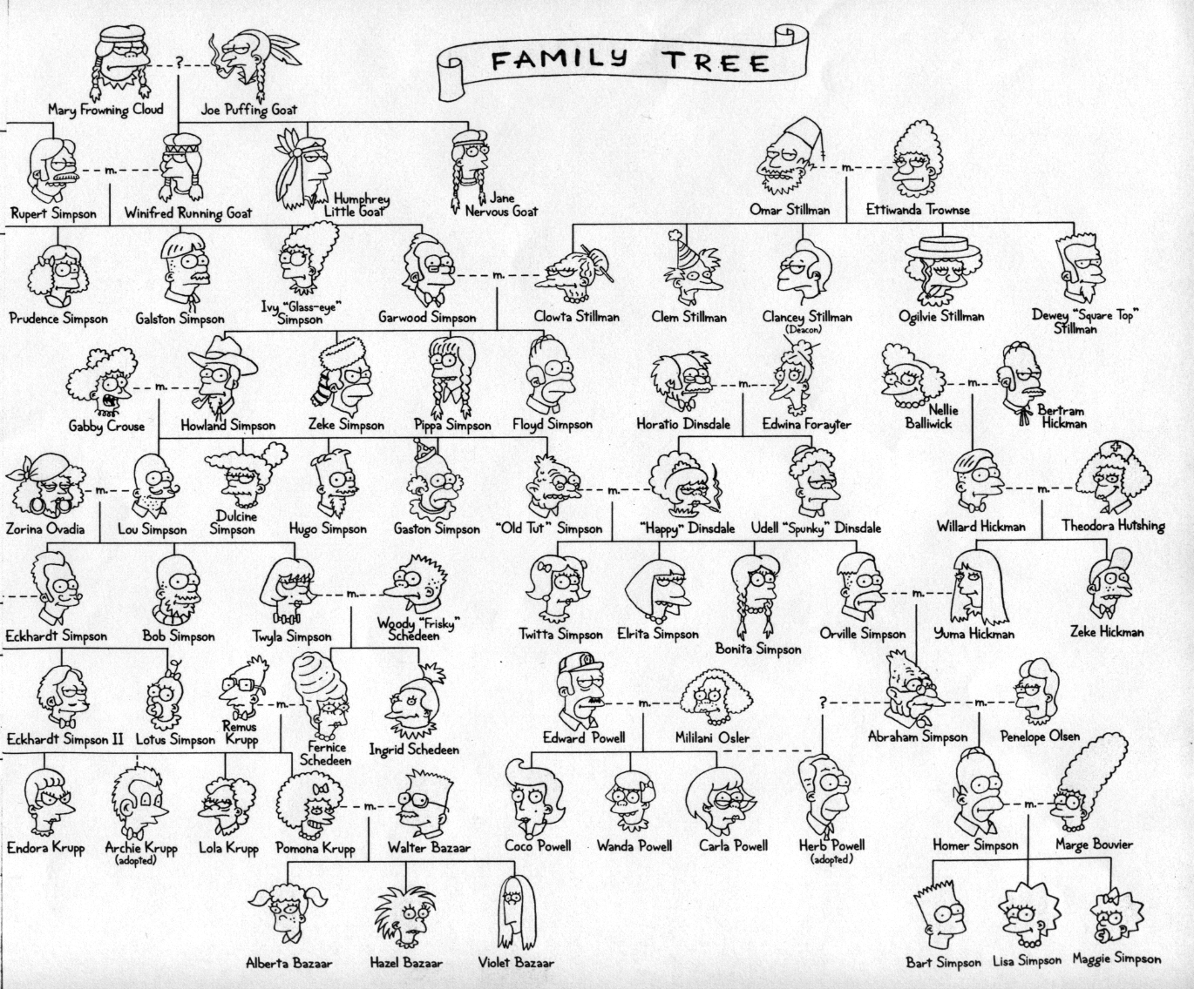
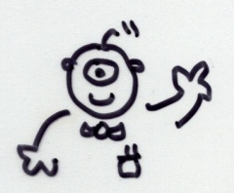
Welcome back to CS 60!
CS 60 Then and Now:
Weeks 1-4: Java
Weeks 5-8: Rex
Weeks 10-15:
Prolog, ISCAL, JFLAP, and more!
Guest-appearing this week …
Keeping the CS 60 ecosystem balanced…
This makes me appreciate my own family reunions…

Slide 151
The idea:
Provide data/relationships that describe the world. Then ask questions.
Questions:
child(lisa,marge).
parent(marge,X).
Is Lisa a child of Marge?
Who has Marge as a parent?
Is Ug a parent of Bart?
Who are the ancestors of Lisa?
Who are uggette's descendants?
Who is who's parent?
Who are John's grandchildren?

Slide 152
Prolog lists…
unifies L with [1, 2, 3]
Prolog has a more Python-like list syntax than Scheme:
L = [ 1, 2, 3 ].
== comparison (structural -- no arithmetic!)
\==
=:= arithmetic comparison with both-sided evaluation
=\=
2 not-equals
3 == 3. <-- yes
1+2 == 1+2. <-- yes
1+2 == 2+1. <-- no
1+2 =:= 2+1. <-- yes
[1,X] == [1,X]. <-- yes
[1,2] == [1,X]. <-- no
[1,2] = [1,X]. <-- yes, X is bound to 2

Slide 153
Math in Prolog
General operators/rules
Example
Notes
comparing for equality: == X == Y
arithmetic assignment: is X is Y+42
pattern matching (lists): = [F|R] = L
inequalities: < > =< >= \==
does not bind X or Y --
they must be bound
binds X ; Y must be bound
binds F and R
L must already be bound
read(X)
write(X)
nl
reads keyboard input into X
writes X to the screen
writes a newline “\n” to the screen
Input / Output

Slide 154
Towers of Hanoi
Goal: Get all of the disks from Peg 1 to Peg 3.
Constraints: You may not place a smaller disk onto a larger one.
Peg 1
Peg 2
Peg 3

Slide 155
Einstein's Zebra puzzle…
length( L, N )
append( L, M, Both )
Short. Sweet!

Slide 156
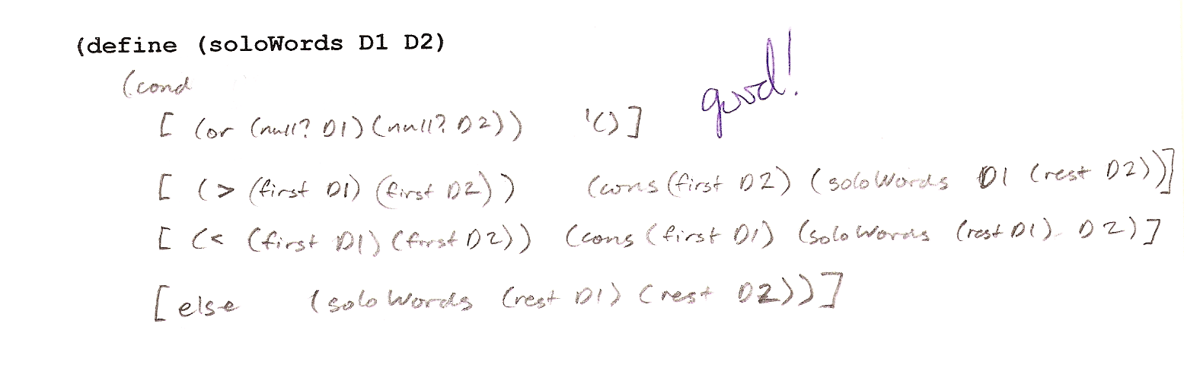
Exam notes, p. 1
worth 1 hw
av. ~81
Problem #1
(define (soloWords D1 D2)
CJ

Slide 157
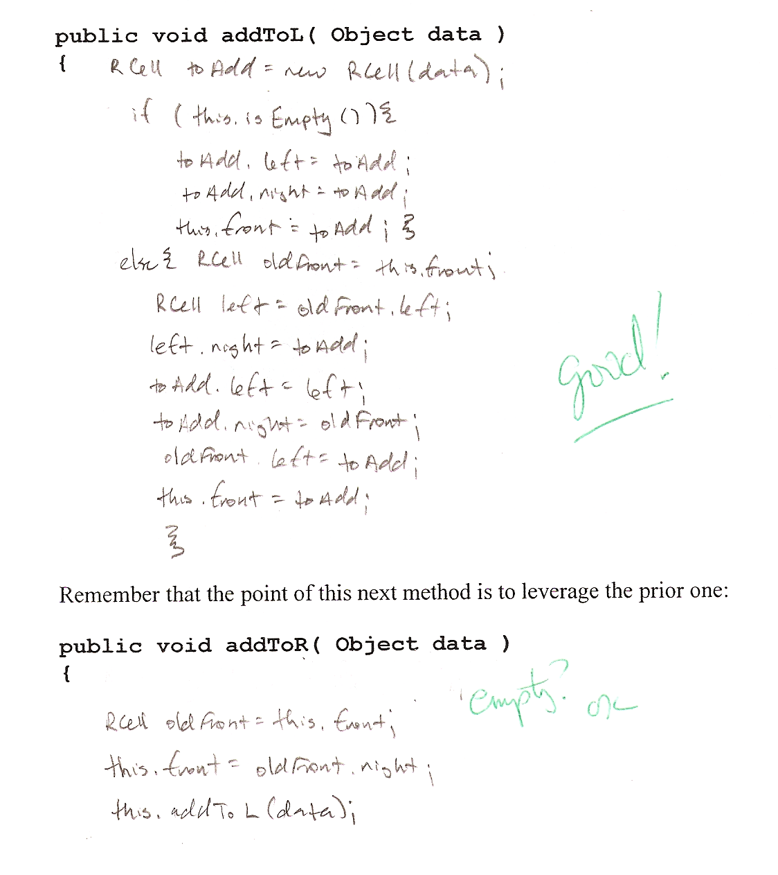
Exam notes, p. 2
Problem #2
void addToL(Object data)
EF

Slide 158
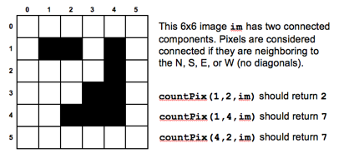
Exam notes, p. 3
Problem #3
countPix
public int countPix(int r, int c, int[][] image)
{
if (image[r][c] != 1) return 0; // no pixels here!
image[r][c] = 0; // make sure we don't count it again
return 1 + countPix(r+1,c,image) // count it, plus S neighbor, etc.
+ countPix(r-1,c,image) // plus N neighbor, etc.
+ countPix(r,c+1,image) // plus E neighbor, etc.
+ countPix(r,c-1,image); // and W neighbor, etc.
}

Slide 159
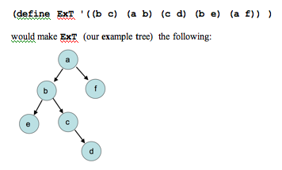
Exam notes, p. 4
(define (root T)
(soloWords (map second T)
(uniq (flatten T))))
Problem #4
(lists should be sorted)
coolest solution!
it's the root!
no kids?
(define (find r n T)
(if (equal? r n) #t
(if (null? (kids r T)) #f
(foldr OR #f (map (lambda (r2) (find r2 n T))
(kids r T))))))
check each child

Slide 160
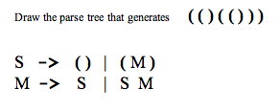
Exam notes, p. 5
S
Parse trees
(
M
)
S
M
( )
S
(
M
)
S
( )
( ( ) ( ( ) ) )

Slide 161
Exam notes, pr. 5
A function is tail recursive if it does no computational work after the recursive call.
Tail recursive functions can be implemented as loops and thus save the time of building the function-call stack.
def fac(N):
if N < 2: return 1
else: return N * fac(N-1)
No tail recursion
def fac(N): return facTail(N,1)
def facTail(N,A):
if N < 2: return A
else: return facTail(N-1,N*A)
With tail recursion

Slide 162
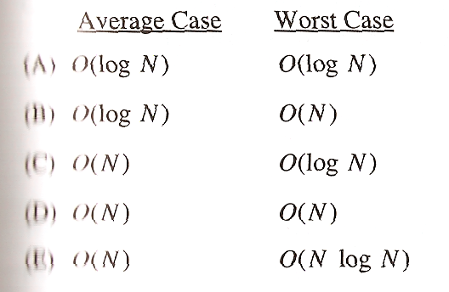
Exam notes, ex. cr.
There once was an alien named Sam
who ate 42 punds of spam
it was all during lunch
and it made quite a crunch
next time please do not eat the can!
Emily
Limericks?
Multiple-choice problem:
most difficult problem on the AP computer science exam!
< 10% of students answered it correctly…

Slide 163
Poetic programming
There once was an alien named Sam
who ate 42 punds of spam
it was all during lunch
and it made quite a crunch
next time please do not eat the can!
Emily
Alex Y
There once was an elf who loved spam
He devised a scheme to cook it in a pan.
At the age of 42
he made java for me and you
And never once said, Oh Damn!
An Alien named 42-PAM
desired a quick train trip for spam
said alien, "Let's go!"
but prolog said No
So the alien rode alone on the tram.
Camille

Slide 164
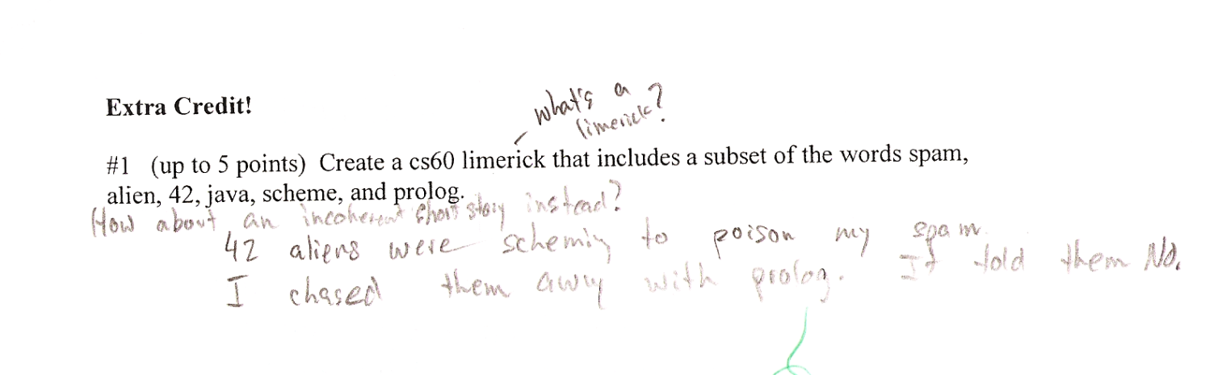
Poetic programming
There once was an alien named Sam
who ate 42 punds of spam
it was all during lunch
and it made quite a crunch
next time please do not eat the can!
Emily
Alex Y
There once was an elf who loved spam
He devised a scheme to cook it in a pan.
At the age of 42
he made java for me and you
And never once said, Oh Damn!
An Alien named 42-PAM
desired a quick train trip for spam
said alien, "Let's go!"
but prolog said No
So the alien rode alone on the tram.
Camille
Andrew X.

Slide 165
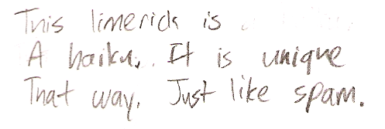
Poetic programming
There once was an alien named Sam
who ate 42 punds of spam
it was all during lunch
and it made quite a crunch
next time please do not eat the can!
Emily
Skye B.
Alex Y
There once was an elf who loved spam
He devised a scheme to cook it in a pan.
At the age of 42
he made java for me and you
And never once said, Oh Damn!
An Alien named 42-PAM
desired a quick train trip for spam
said alien, "Let's go!"
but prolog said No
So the alien rode alone on the tram.
Camille
Andrew X.

Slide 166
Where we're headed…
Week 9: Nov 4…
Prolog puzzles.
Week 10: Nov 11…
Prolog adventure!
Week 11: Nov 18…
"Theocomp" ~ formal models of computation
Week 12: Nov 25…
DFA, NFA, Regular Expressions, indistinguishability and minimum # of states
Week 13: Dec 2…
Implementing DFAs via sequential logic, Turing Machines, uncomputability, algorithm analysis
Week 14: Dec 9…
algorithm analysis: unwinding recurrences, loop-counting, sorting, big-O, algorithm speed challenge…
Not to mention some very cool computer science constructs with suggestively cool (maybe?) names, like quantum computing, NP-completeness, linear median finding, and sub-cubic matrix multiplication!
Oxford comma

Slide 167
The Mystery of the Spamwarts Express
Five people are traveling home in adjacent train seats for Thanksgiving break…
Seat 1
Seat 2
Seat 3
Seat 4
Seat 5
Names = [algird, bruno, collette, dino, edwina].
Each has a different name.
Schools = [pomona, pitzer, hmc, cmc, scripps].
Each is from a different Claremont College.
Snacks = [jots, chocolate, donuts, pez, spam].
Each has brought a different snack.
Dino and Bruno sat in the end seats (that is, seats 1 and 5, but which student sat in which of these seats is still unknown).
2) Algird sat next to the student from HMC.
3) Collette sat next to friends with chocolate and donuts.
4) The HMC student brought spam as a snack and sat in the middle seat.
5) Chocolate was immediately to the left of pez.
6) Bruno, Dino, and Algird do not go to Scripps.
7) The Pomona student sat between the person with jots and spam.
8) Dino did not sit next to the person with donuts.
9) The CMC student did not sit next to Edwina.
9 hints are available

Slide 168
There are five houses:
The nationalities are norwegian, brit, swede, dane, german
The pets are dog, bird, zebra, cat, horse
The cigars are pallmall, winfield, dunhill, rothmans, marlboro
The beverages are tea, coffee, milk, water, beer
The house colors are red, green, yellow, blue, white
We know that
1) The Norwegian lives in the first house.
2) The person living in the center house drinks milk.
3) The Brit lives in a red house.
4) The Swede keeps dogs as pets.
5) The Dane drinks tea.
6) The Green house is next to, and on the left of the White house.
7) The owner of the Green house drinks coffee.
8) The person who smokes Pall Mall rears birds.
9) The owner of the Yellow house smokes Dunhill.
10) The man who smokes Marlboro lives next to the one who keeps cats.
11) The man who keeps horses lives next to the man who smokes Dunhill.
12) The man who smokes Winfields drinks beer.
13) The German smokes Rothmans.
14) The red house is to the right of the blue.
15) The Norwegian doesn't live by the red, white, or green houses
Who owns the zebra?
Einstein's Zebra puzzle: a logic challenge
(0) How do we represent the puzzle state?
(1) What relationships do we need?
(2) How do we encode the constraints?

