Slide 1
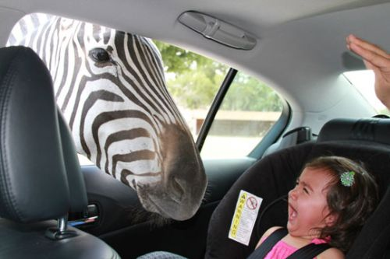
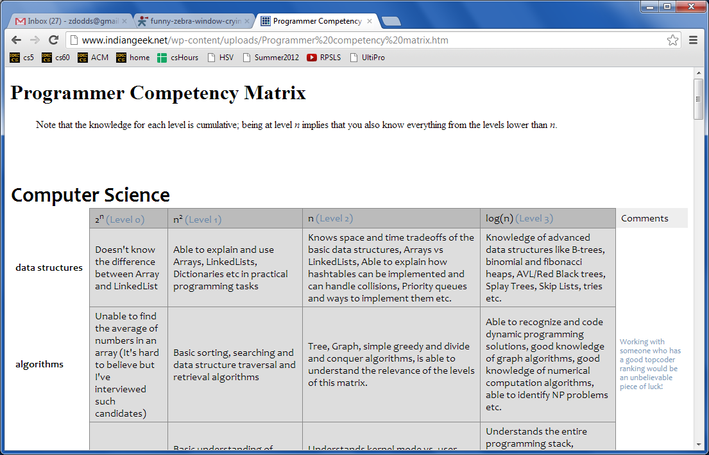

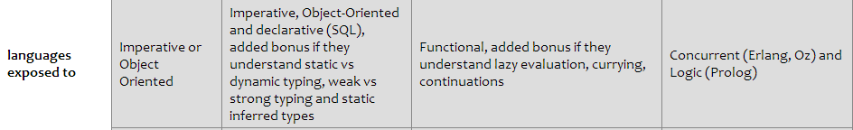
today(CS,60).
Reminders
Puzzling zebras
&
De-puzzling puzzles!
Hw#4 due Mon. 2/24
No class Tue. 2/25
You'll be ready for Hw #5…
What prolog is good for...
thoughts from Cory…
www.indiangeek.net/wp-content/uploads/Programmer%20competency%20matrix.htm
Notes:
secret strategy: randomly reorder things until it works!!

Slide 2
today(CS,60).
Reminders
Hw#4 due Mon. 2/24
No class Tue. 2/25
You'll be ready for Hw #5…
What prolog is good for... … and how it might seem!
thoughts from Cory…
www.indiangeek.net/wp-content/uploads/Programmer%20competency%20matrix.htm
Notes:
secret strategy: randomly reorder things until it works!!

Slide 3
The Prolog progression...
Prolog is crazy.
Who would ever invent such a thing?
Week 1:
Week 2:
Week 3:
Notes:
secret strategy: randomly reorder things until it works!!

Slide 4
The Prolog progression...
Prolog is crazy.
Who would ever invent such a thing?
Week 1:
Prolog is crazy.
... though not as bad as before...
Week 2:
Week 3:
Notes:
secret strategy: randomly reorder things until it works!!

Slide 5
The Prolog progression...
Prolog is crazy.
Who would ever invent such a thing?
Week 1:
Prolog is crazy.
... though not as bad as before...
Week 2:
Prolog is crazy.
... and now so am I
Week 3:
because it makes sense!
but what if you started off that way?
Notes:
secret strategy: randomly reorder things until it works!!

Slide 6
hw4pr1: Prolog + friends
Amount of code?
rev( L, Rev )
Rev is L, reversed
count( E, L, N )
There are exactly N Es in L.
find( Pattern, Target, Index )
The list Pattern is found in the list Target at location Index.
depth( BST, Depth )
The binary tree BST has a depth (or height) of Depth.
insert( E, BST, NewBST )
NewBST is BST with E appropriately inserted.
We've been down this path before!
path( A, B, Graph, Path )
Path is a list of nodes going from A to B in Graph, a list of edges.

Slide 7
hw4pr1: Prolog + friends
< 15 lines
TOTAL!
rev( L, Rev )
Rev is L, reversed
count( E, L, N )
There are exactly N Es in L.
find( Pattern, Target, Index )
The list Pattern is found in the list Target at location Index.
depth( BST, Depth )
The binary tree BST has a depth (or height) of Depth.
insert( E, BST, NewBST )
NewBST is BST with E appropriately inserted.
We've been down this path before!
path( A, B, Graph, Path )
Path is a list of nodes going from A to B in Graph, a list of edges.

Slide 8
Pattern-matching guide…
"The result of removing one E from [E|R] is R."
(1) Write the base cases first!
(3) Add other constraints - put negatives last -- or at least as late as possible!
rem1(E,[E|R],R).
rem1(E,[F|R],[F|S]) :- rem1(E,R,S).
(2) Recurse next…
"Removing an E from [F|R] is [F|S], as long as S is what you get when you remove an E from R."
"E is the min of [E]"
min(E,[E]).
min(E,[E|R]) :-
min(E,[B|R]) :-
"E is the min of [E|R], as long as… "
"E is the min of [B|R], as long as… "

Slide 9
Name(s) _______________________________
Quiz
Algorithms in Prolog: a true paradox
rem1(E,[E|R],R).
rem1(E,[F|R],[F|S]) :- rem1(E,R,S).
provided…
Write inorder(L) to be true if L's elements are in order.
What two base cases are needed here?
inorder( ).
inorder( ).
inorder([F,S|R]) :-
Write perm(L,P) to be true if P is a permutation of L's elements…
Hint: recurse first… then use something else on this page!
perm([], []).
perm([F|R], P) :-
Write sort(L,S) to be true if S has L's elements in sorted order.
sort(
sort(
What is the big-O run-time of your Prolog sort?
Notes:
secret strategy: randomly reorder things until it works!!

Slide 10
Quiz
Algorithms in Prolog: a true paradox
rem1(E,[E|R],R).
rem1(E,[F|R],[F|S]) :- rem1(E,R,S).
provided…
Write inorder(L) to be true if L's elements are in order.
What two base cases are needed here?
inorder( ).
inorder( ).
inorder([F,S|R]) :-
Write perm(L,P) to be true if P is a permutation of L's elements…
Hint: recurse first… then use something else on this page!
perm([], []).
perm([F|R], P) :-
Notes:
secret strategy: randomly reorder things until it works!!

Slide 11
Sort!
Algorithms in Prolog: a true paradox
Write sort(L,S) to be true if S has L's elements in sorted order.
sort(
sort(
What is the big-O run-time of your Prolog sort?
sort(
sort(
Seems like we're sorting out Prolog by sorting in Prolog!
Notes:
secret strategy: randomly reorder things until it works!!

Slide 12
Algorithms in Prolog: a true paradox
Try this on the back first…
Quiz
rem1(E,[E|R],R).
rem1(E,[F|R],[F|S]) :- rem1(E,R,S).
Write inorder(L) to be true if L's elements are in order.
What two base cases are needed here?
inorder( ).
inorder( ).
inorder([F,S|R]) :-
Write perm(L,P) to be true if P is a permutation of L's elements…
Hint: recurse first… then use something else on this page!
perm([], []).
perm([F|R], P) :-
Write sort(L,S) to be true if S has L's elements in sorted order.
sort(
sort(
What is the big-O run-time of your Prolog sort?
Notes:
secret strategy: randomly reorder things until it works!!

Slide 13
Prolog's natural applications?

Slide 14
Prolog's natural applications?
Constraint-based puzzles/games!
An example of a completely unconstrained puzzle/game…

Slide 15
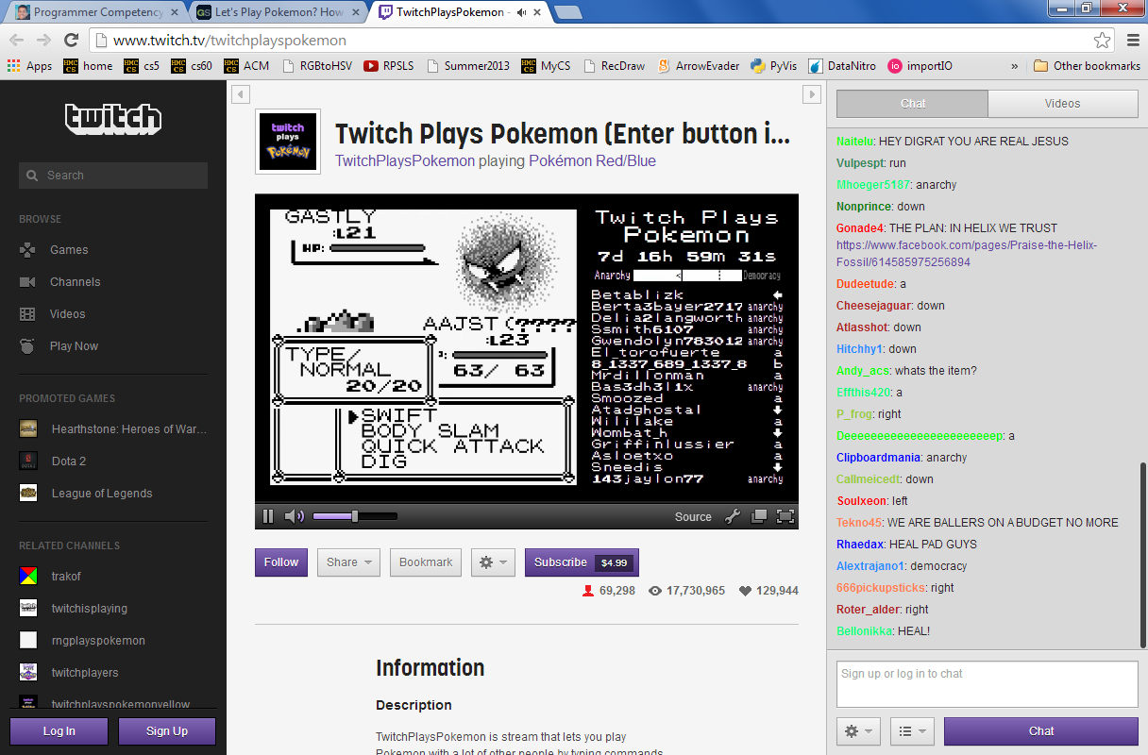
Prolog's natural applications?
Constraint-based puzzles/games!
This is an example of a completely unconstrained puzzle/game…
I'm voting for anarchy!

Slide 16
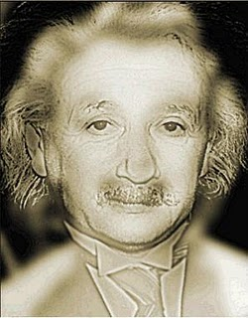
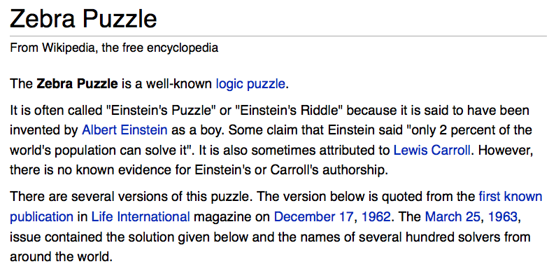
There are five houses:
The nationalities are norwegian, brit, swede, dane, german
The pets are dog, bird, zebra, cat, horse
The cigars are pallmall, winfield, dunhill, rothmans, marlboro
The beverages are tea, coffee, milk, water, beer
The house colors are red, green, yellow, blue, white
We know that
1) The Norwegian lives in the first house.
2) The person living in the center house drinks milk.
3) The Brit lives in a red house.
4) The Swede keeps dogs as pets.
5) The Dane drinks tea.
6) The Green house is next to, and on the left of the White house.
7) The owner of the Green house drinks coffee.
8) The person who smokes Pall Mall rears birds.
9) The owner of the Yellow house smokes Dunhill.
10) The man who smokes Marlboro lives next to the one who keeps cats.
11) The man who keeps horses lives next to the man who smokes Dunhill.
12) The man who smokes Winfields drinks beer.
13) The German smokes Rothmans.
14) The red house is to the right of the blue.
15) The Norwegian doesn't live by the red, white, or green houses
Who owns the zebra?
hw4pr2
Einstein's Zebra puzzle: a set of logical constraints

Slide 17
There are five houses:
The nationalities are norwegian, brit, swede, dane, german
The pets are dog, bird, zebra, cat, horse
The cigars are pallmall, winfield, dunhill, rothmans, marlboro
The beverages are tea, coffee, milk, water, beer
The house colors are red, green, yellow, blue, white
We know 15 things…
1) The Norwegian lives in the first house.
Who owns the zebra?
hw4pr2
Einstein's Zebra puzzle: a set of logical constraints
(plus fourteen more constraints)
The setup
nation, pet, cigar, beverage, house color
nation, pet, cigar, beverage, house color
nation, pet, cigar, beverage, house color
nation, pet, cigar, beverage, house color
nation, pet, cigar, beverage, house color
house colors may not be in this order…

Slide 18
There are five houses:
The nationalities are norwegian, brit, swede, dane, german
The pets are dog, bird, zebra, cat, horse
The cigars are pallmall, winfield, dunhill, rothmans, marlboro
The beverages are tea, coffee, milk, water, beer
The house colors are red, green, yellow, blue, white
We know that
1) The Norwegian lives in the first house.
2) The person living in the center house drinks milk.
3) The Brit lives in a red house.
4) The Swede keeps dogs as pets.
5) The Dane drinks tea.
6) The Green house is next to, and on the left of the White house.
7) The owner of the Green house drinks coffee.
8) The person who smokes Pall Mall rears birds.
9) The owner of the Yellow house smokes Dunhill.
10) The man who smokes Marlboro lives next to the one who keeps cats.
11) The man who keeps horses lives next to the man who smokes Dunhill.
12) The man who smokes Winfields drinks beer.
13) The German smokes Rothmans.
14) The red house is to the right of the blue.
15) The Norwegian doesn't live by the red, white, or green houses
Who owns the zebra?
hw4pr2
Einstein's Zebra puzzle: a set of logical constraints
The full puzzle
What does Prolog care about?

Slide 19
There are five houses:
The nationalities are norwegian, brit, swede, dane, german
The pets are dog, bird, zebra, cat, horse
The cigars are pallmall, winfield, dunhill, rothmans, marlboro
The beverages are tea, coffee, milk, water, beer
The house colors are red, green, yellow, blue, white
We know that
1) The Norwegian lives in the first house.
2) The person living in the center house drinks milk.
3) The Brit lives in a red house.
4) The Swede keeps dogs as pets.
5) The Dane drinks tea.
6) The Green house is next to, and on the left of the White house.
7) The owner of the Green house drinks coffee.
8) The person who smokes Pall Mall rears birds.
9) The owner of the Yellow house smokes Dunhill.
10) The man who smokes Marlboro lives next to the one who keeps cats.
11) The man who keeps horses lives next to the man who smokes Dunhill.
12) The man who smokes Winfields drinks beer.
13) The German smokes Rothmans.
14) The red house is to the right of the blue.
15) The Norwegian doesn't live by the red, white, or green houses
Who owns the zebra?
hw4pr2
Einstein's Zebra puzzle: a set of logical constraints
(0) How do we represent the puzzle state?
Prolog ~ representation!
(1) What relationships do we need?
(2) How do we encode the constraints?

Slide 20
Zebra-puzzle representation
A list H reflects the houses' spatial order
with the five items that each house has…
a partial constraint…
H = [[norwegian, _, _, _, _], _, [_, _, _, milk, _], _, _]
… using the don't care __
1) The Norwegian lives in the first house.

Slide 21
Zebra-puzzle representation
A list H reflects the houses' spatial order
with the five items that each house has…
pet
cigar
beverage
nation
house color
H = [[norwegian, _, _, _, _], _, [_, _, _, milk, _], _, _]
House 1
House 2?
1) The Norwegian lives in the first house.
2) What's this piece of data (milk) indicating?

Slide 22
Zebra-puzzle representation
A list H reflects the houses' spatial order
with the five items that each house has…
pet
cigar
beverage
nation
house color
H = [[norwegian, _, _, _, _], _, [_, _, _, milk, _], _, _]
House 1
House 3
House 2
Houses 4+5
1) The Norwegian lives in the first house.
2) The person living in the center house drinks milk.

Slide 23
Zebra-puzzle representation
A list H reflects the houses' spatial order
with the five items that each house has…
pet
cigar
beverage
nation
house color
H = [[norwegian, _, _, _, _], _, [_, _, _, milk, _], _, _]
House 1
House 3
House 2
Houses 4+5
Let's try this constraint:
7) The owner of the Green house drinks coffee.
Hint: use member and H

Slide 24
Zebra-puzzle helper predicates
% What does this lr predicate say about L and R?
% lr(L,R,H)
lr(L, R, [L,R|_]).
lr(L, R, [_|Rest]) :- lr(L, R, Rest).
This input is "big H"

Slide 25
Zebra-puzzle helper predicates
% What does this lr predicate say about L and R?
% lr(L,R,H)
lr(L, R, [L,R|_]).
lr(L, R, [_|Rest]) :- lr(L, R, Rest).
% … and then what does mystery check?
% mystery(X,Y,H)
mystery(X, Y, H) :- lr(X, Y, H).
mystery(X, Y, H) :- lr(Y, X, H).
This input is "big H"

Slide 26
Zebra-puzzle constraints
% left-to-right adjacency
lr(L, R, [L, R | _ ]).
lr(L, R, [ _ | Rest]) :- lr(L, R, Rest).
% _unordered_ adjacency ("nextTo")
nextTo(X, Y, H) :- lr(X, Y, H).
nextTo(X, Y, H) :- lr(Y, X, H).
Try this constraint:
15) The Norwegian does not live by the red house.
Hint: use one of the above predicates -- and H
Where should this predicate go?

Slide 27
Zebra-puzzle, completed!
A zero-input predicate, solve:
solve :-
einstein( [ H1, H2, H3, H4, H5 ] ),
write( ' first house: '), write(H1), nl,
write( 'second house: '), write(H2), nl,
write( ' third house: '), write(H3), nl,
write( 'fourth house: '), write(H4), nl,
write( ' fifth house: '), write(H5), nl.
Its output:
?- solve.
first house: [norwegian, cat, dunhill, water, yellow]
second house: [dane, horse, marlboro, tea, blue]
third house: [brit, bird, pallmall, milk, red]
fourth house: [german, zebra, rothmans, coffee, green]
fifth house: [swede, dog, winfield, beer, white]
see einstein.pl for the full Prolog solution…

Slide 28
Remember: Prolog is searching…
houses( [H1, H2, H3, H4, H5 ] ) :-
H1 = [ N1, P1, S1, B1, C1 ],
H2 = [ N2, P2, S2, B2, C2 ],
H3 = [ N3, P3, S3, B3, C3 ],
H4 = [ N4, P4, S4, B4, C4 ],
H5 = [ N5, P5, S5, B5, C5 ],
perm( [N1,N2,N3,N4,N5], [norwegian, brit, swede, dane, german] ),
perm( [P1,P2,P3,P4,P5], [dog, bird, zebra, cat, horse] ),
perm( [S1,S2,S3,S4,S5], [pallmall, winfield, dunhill, rothmans, marlboro] ),
perm( [B1,B2,B3,B4,B5], [tea, coffee, milk, water, beer] ),
perm( [C1,C2,C3,C4,C5], [red, green, yellow, blue, white] ).
Question1: What does this houses predicate do?
Question2: How many binding-possibilities will Prolog try?
predicate order can dramatically speed up/slow down Prolog's search!
perm == permutation

Slide 29
hw4pr2: the Spamwarts Express…
Five "people" are traveling home in adjacent train seats for break…
Seat 1
Seat 2
Seat 3
Seat 4
Seat 5
Names = [algird, bruno, collette, dino, edwina].
Each has a different name.
Schools = [pomona, pitzer, hmc, cmc, scripps].
Each is from a different Claremont College.
Snacks = [jots, chocolate, donuts, pez, spam].
Each has brought a different snack.

Slide 30
hw4pr2: the Spamwarts Express…
Five "people" are traveling home in adjacent train seats for break…
Seat 1
Seat 2
Seat 3
Seat 4
Seat 5
Names = [algird, bruno, collette, dino, edwina].
Each has a different name.
Schools = [pomona, pitzer, hmc, cmc, scripps].
Each is from a different Claremont College.
Snacks = [jots, chocolate, donuts, pez, spam].
Each has brought a different snack.
1) Dino and Bruno sat in the end seats.
2) Algird sat next to the student from HMC.
3) Collette sat next to friends with chocolate and donuts.
4) The HMC student brought spam as a snack and sat in the middle seat.
5) Chocolate was immediately to the left of pez.
6) Bruno, Dino, and Algird do not go to Scripps.
7) The Pomona student sat between the one with jots and the one with spam.
8) Dino did not sit next to the person with donuts.
9) The CMC student did not sit next to Edwina.
9 hints are available

Slide 31
hw4pr2: the Spamwarts Express…
Five "people" are traveling home in adjacent train seats for break…
You might try it yourself, but you need to have Prolog solve it, too!
Seat 1
Seat 2
Seat 3
Seat 4
Seat 5
Names = [algird, bruno, collette, dino, edwina].
Each has a different name.
Schools = [pomona, pitzer, hmc, cmc, scripps].
Each is from a different Claremont College.
Snacks = [jots, chocolate, donuts, pez, spam].
Each has brought a different snack.
1) Dino and Bruno sat in the end seats.
2) Algird sat next to the student from HMC.
3) Collette sat next to friends with chocolate and donuts.
4) The HMC student brought spam as a snack and sat in the middle seat.
5) Chocolate was immediately to the left of pez.
6) Bruno, Dino, and Algird do not go to Scripps.
7) The Pomona student sat between the one with jots and the one with spam.
8) Dino did not sit next to the person with donuts.
9) The CMC student did not sit next to Edwina.
9 hints are available

Slide 32
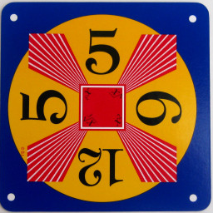

Extra: 24
Can you combine a list numbers into 24 with the operations + - * ÷ ?
Each operation may be used any number of times.
Cards from the "official" 24 game: 24game.com

Slide 33
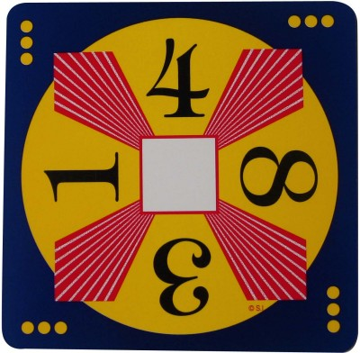
Extra: 24
Can you combine a list numbers into 24 with the operations + - * ÷ ?
Each operation may be used any number of times.
Cards from the "official" 24 game: 24game.com

Slide 34
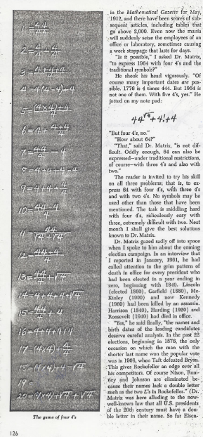
Four 4’s
0 = 4 + 4 - 4 - 4
1 = 44 / 44
2 = 4
...
8 = sqrt( .4 ) * ( 4 + 4 + 4 )
...
19 = ???
20 = 4! + 4 - 4 - 4
4/(4+4)
Martin Gardner's article in Scientific American …
Ask around…

Slide 35
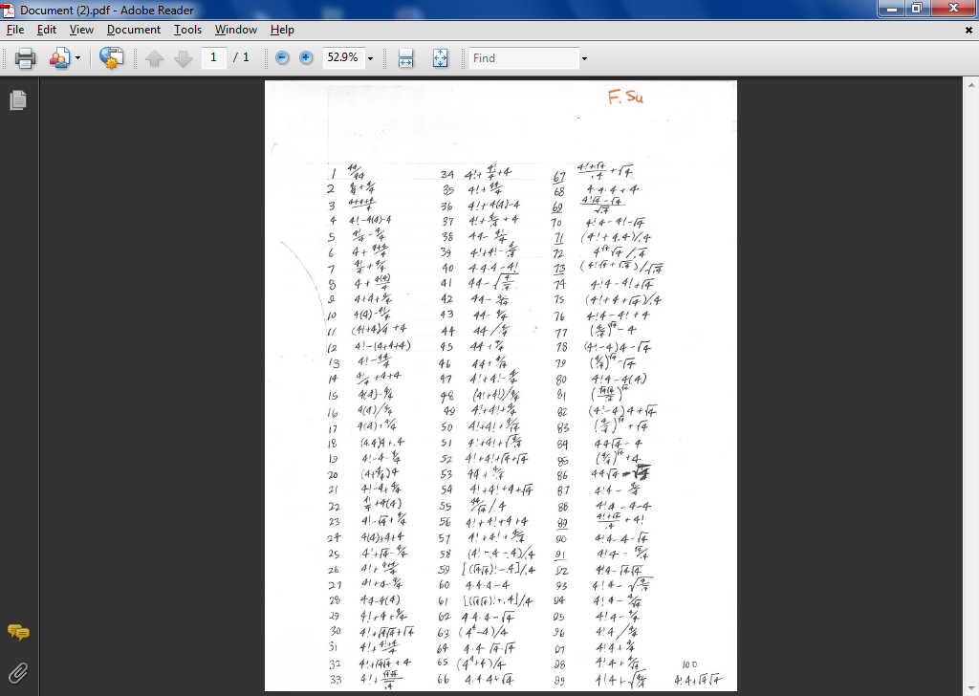

Slide 37
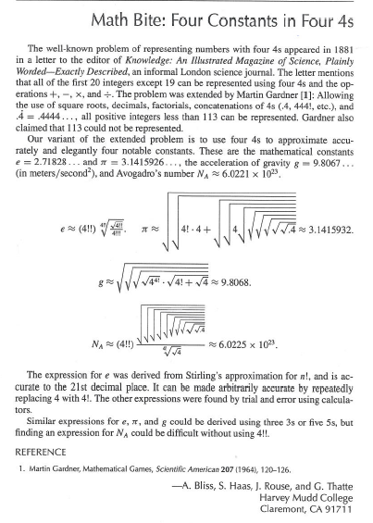
… an extension of CS 60's Four 4's problem!

Slide 38
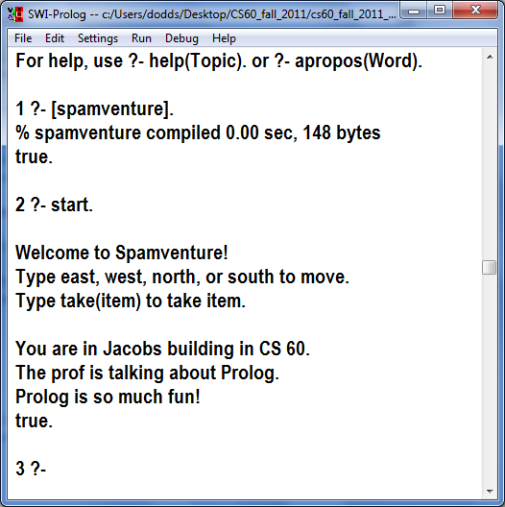
Next week hw5pr1
Spamventure!

Slide 39
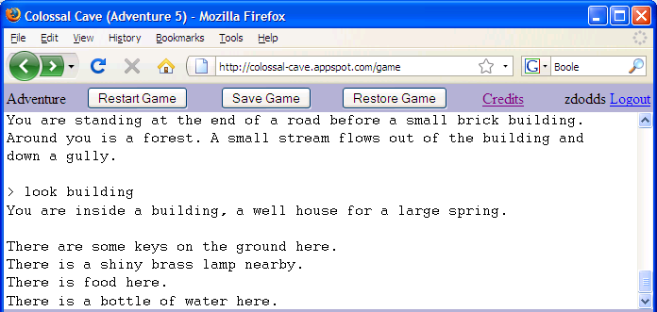
Adventure: the first interactive fiction game
You are in a twisting maze of little passages, all different.
You are in a maze of twisting little passages, all different.
You are in a little maze of twisting passages, all different.
Text Mazes!
You are in a maze of twisty little passages, all alike.
You are in a maze of twisty little passages, all alike.
You are in a maze of twisty little passages, all alike.

Slide 40
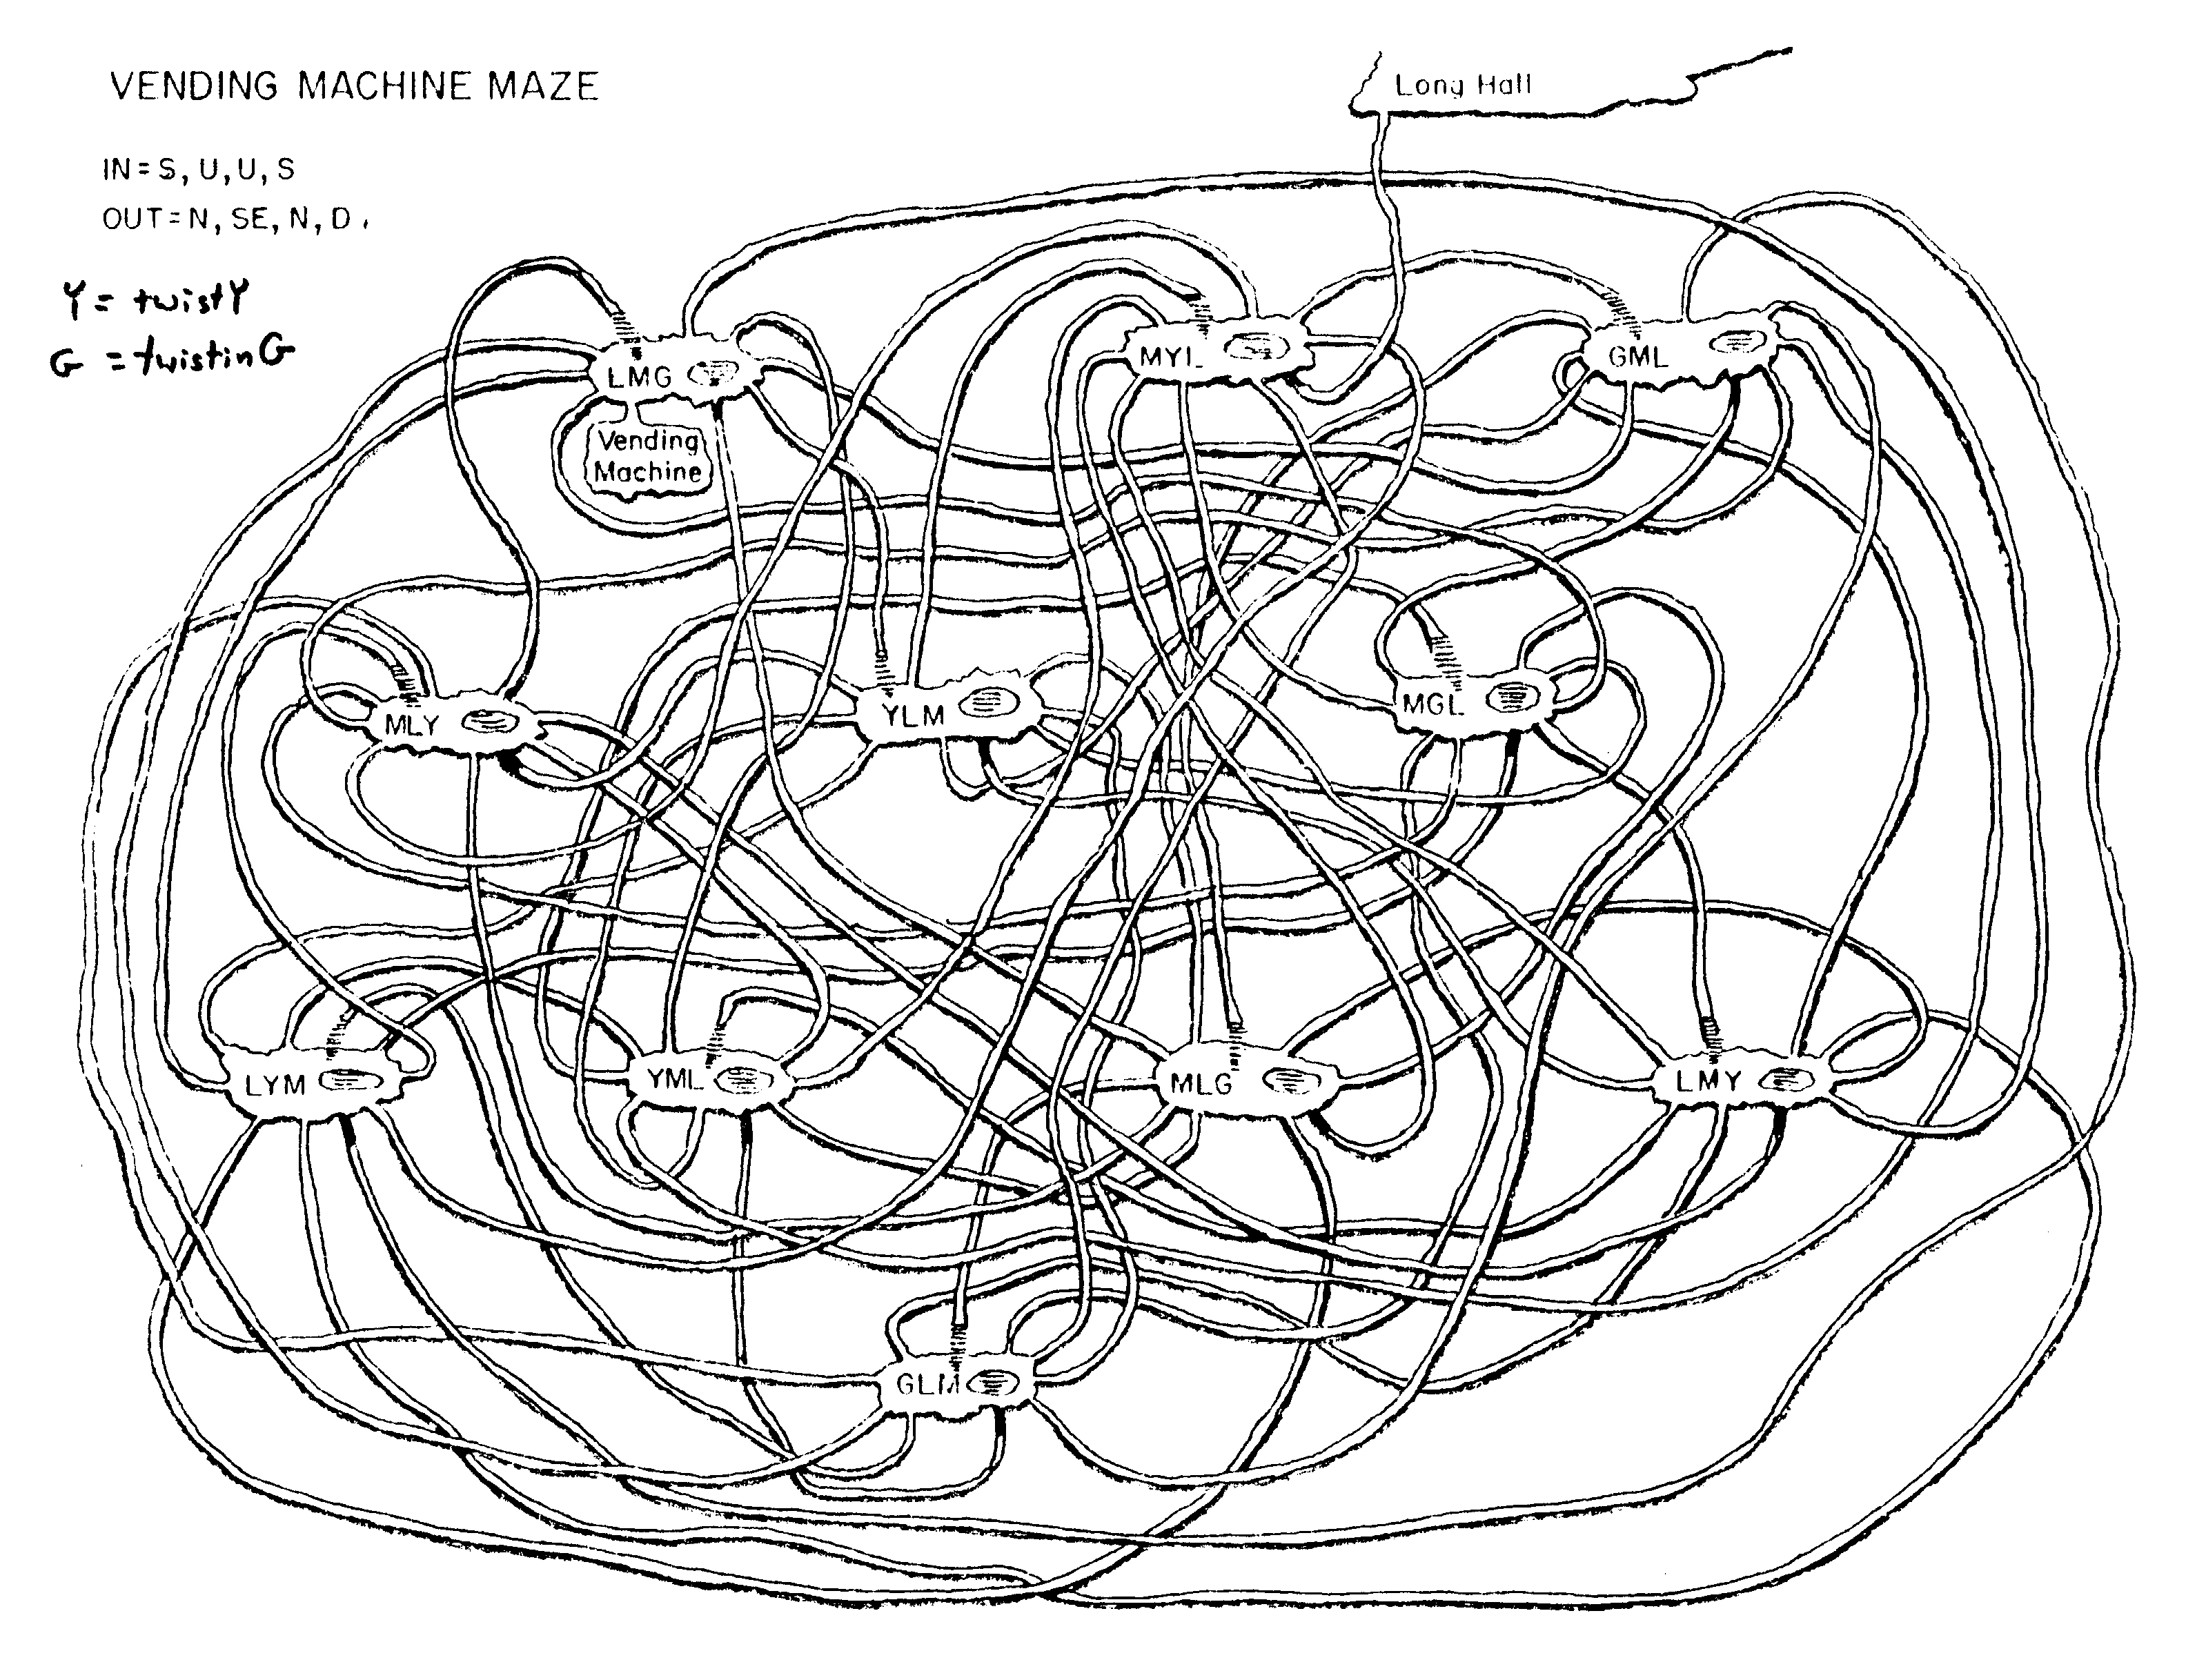
Try ESC-x dunnet within emacs…
At last!

Slide 41
It's a Prolog adventure!
Spamventure!
To be added
a goal + instructions
at least 6 locations
at least 4 items
needing to use an item
fix item descriptions
inventory.
drop (like take)
no more than 2 items in_hand
an additional feature
how to win! (so that we can...)
west
parsons
platt
east
south
north
south
north
key
spam
west
jacobs
east
west_dorm
items
locations

Slide 42
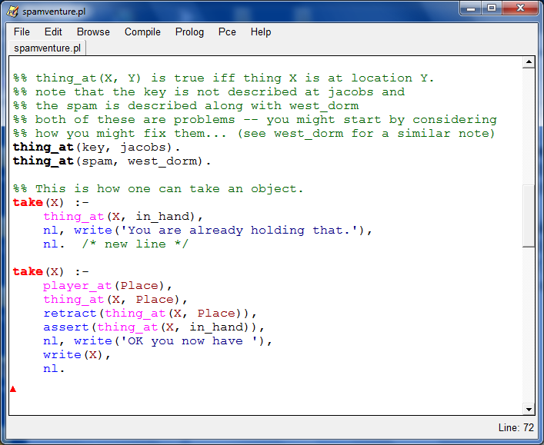
Getting started...
How take(X). works...
How might inventory. work?

Slide 43
How to succeed with fail.
Given the foo facts to the left, what will Prolog output to the two queries to the right? Note that fail forces Prolog to consider that it has failed to meet the overall goal …
% Three foo facts!
foo(chris).
foo(taylor).
foo(dave).
% The 'good' and the 'bad':
bad :-
foo(X), write('foo: '),
write(X), nl.
good :-
foo(X), write('foo: '),
write(X), nl,
fail.
% Two foo queries:
?- bad.
?- good.
1
2
Is there anything we can do to make good better?

Slide 44

Eric warns!
write('Don't do this!').

Slide 45
cs60( class_tuesday ).
false
cs60( hw4_monday ).
true
Good luck with hw#4!
cs60( WhatToWatchWhileDoingPrologHomework ).
WhatToWatchWhileDoingPrologHomework = twitch_plays_pokemon ;
false

Slide 46
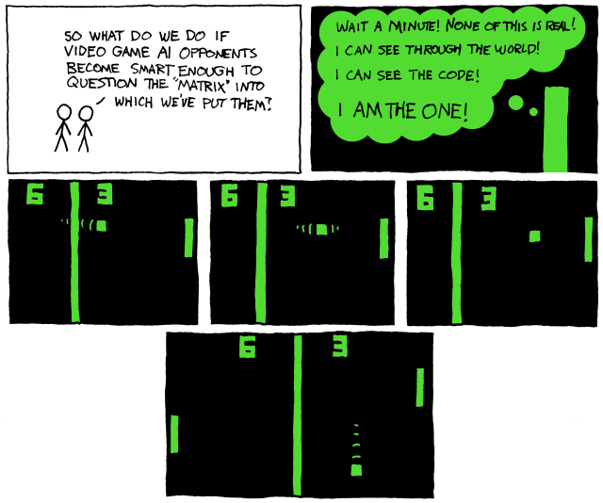
Early computer games?
Pong!

Slide 47
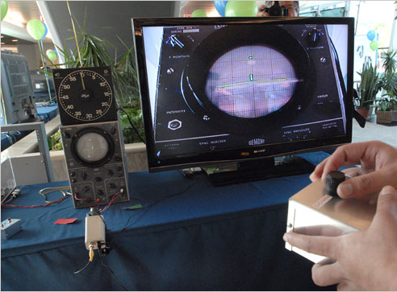
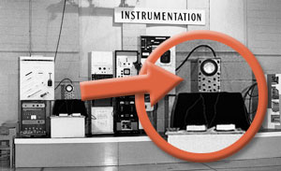
The first video game!
created to liven up lab tours in 1958
the console: an oscilloscope
only known picture of the original game
similar to pong - but with invisible paddles…
It took 4 people 3 working months to recreate the game for its 50th anniversary in 2008
tennis for two @ Brookhaven national labs
http://www.nytimes.com/2008/11/09/nyregion/long-island/09videoli.html
http://www.bnl.gov/bnlweb/history/higinbotham.asp

Slide 48
Hw10, problem 1
Spamventure!

Slide 49
Don't hand these in!
rem1(E, [E|R], R).
rem1(E, [F|R], [F|NR]) :-
inorder( ).
inorder( ).
inorder(
What two base cases are needed here?
Hint: recurse and then use something else on this page
perm([], []).
perm([F|R], P) :-
big-O!
Extra! There are at least TWO ways to write sort... Both use predicates we've just written!
sort(
sort(
Notes:
secret strategy: randomly reorder things until it works!!

Slide 50
Prolog patterns
(1) Base case (usually no constraint clauses at all!)
mem(E, [E|_]).
mem(E, [_|R]) :- mem(E, R).
(2) Recursion first! (when possible)
Key idea: You are describing the constraints that make a relationship - a Prolog predicate - true.
an element
a list
(3) Other bindings and/or arithmetic next (is needs a bound RHS)
len([], 0).
len([_|R], N) :- len(R, M), N is M+1.
list
its length
(4) Negation last (all vars must be bound)
Notes:
secret strategy: randomly reorder things until it works!!

Slide 51
Don't hand these in!
rem1(E, [E|R], R).
rem1(E, [F|R], [F|NR]) :-
inorder( ).
inorder( ).
inorder(
Hint: you may want two base cases
Hint: recurse and then use something else on this page
perm([], []).
perm([F|R], P) :-
big-O!
Extra! There are at least TWO ways to write sort... Both use predicates we've just written!
sort(
sort(
Notes:
secret strategy: randomly reorder things until it works!!

Slide 52
Sorting out Prolog… by sorting in Prolog!
Practice with how prolog thinks...
sort(
sort(
Extra! There are at least TWO ways to write sort... What are they?
What are their big-O runtimes?
sort(
sort(
Notes:
secret strategy: randomly reorder things until it works!!

Slide 53
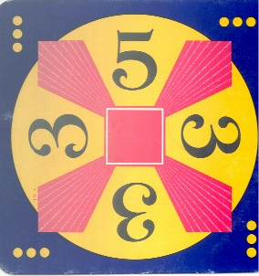
Extra: 24
Can you combine a list numbers into 24 with the operations + - * ÷ ?
Each operation may be used any number of times.
Cards from the "official" 24 game: 24game.com

Slide 54
var and nonvar
rev( L, Rev ) :- var(L), var(Rev),
write( 'If you insist…' ), nl,
L = [42], Rev = [42].
rev( L, Rev ) :- var(L), nonvar(Rev),
rev(Rev, L).
Alternatively, try randomly permute predicates until something works !
reverse( [], [] ).
and the recursive case from the quiz…
which might not work!

Slide 55
Prolog patterns
(1) Base case (usually no constraint clauses at all!)
mem(E, [E|_]).
mem(E, [_|R]) :- mem(E, R).
(2) Recursion first! (when possible)
Key idea: You are describing the constraints that make a relationship - a Prolog predicate - true.
an element
a list
(3) Other bindings and/or arithmetic next (is needs a bound RHS)
len([], 0).
len([_|R], N) :- len(R, M), N is M+1.
list
its length
(4) Negation last (all vars must be bound)
Notes:
secret strategy: randomly reorder things until it works!!

Slide 56
Prolog patterns
(1) Base case (usually no constraint clauses at all!)
mem(E, [E|_]).
mem(E, [_|R]) :- mem(E, R).
(2) Recursion first! (when possible)
an element
a list
(3) Other bindings and/or arithmetic next (is needs a bound RHS)
len([], 0).
len([_|R], N) :- len(R, M), N is M+1.
list
its length
(4) Negation last (all vars must be bound)
Notes:
secret strategy: randomly reorder things until it works!!

Slide 57
Prolog patterns
(1) Base case
app([], M, M).
app([F|R], M, [F|B]) :- app(R, M, B).
left list
right list
final list
(2) Recurse
rev([], []).
rev([F|R], Rev) :- rev(R, RoR),
app(RoR, [F], Rev).
a list
its reverse
reverse of the rest
(3) Other constraints
Notes:
secret strategy: randomly reorder things until it works!!

Slide 58
var and nonvar
both inputs are variables
rev( L, Rev ) :- var(L), var(Rev),
write( 'If you insist…' ), nl,
L = [42], Rev = [42].
rev( L, Rev ) :- var(L), nonvar(Rev),
rev(Rev, L).
first input is a variable
rev([], []).
rev([F|R], Rev) :- rev(R, RoR),
app(RoR, [F], Rev).
second input is a variable
Or, try permuting predicates until it works - which might not work!

Slide 59
Name(s): ___________
Prolog patterns
(1) Base case
(2) Recurse
(3) Other constraints
min( , ).
min( , ) :-
min( , ) :-
Example: min( [6,7,5,42], 5 ).
a list
its min
nonmin( , ):-
a list
a nonmin element
Example: nonmin( [6,7,5,42], 42 ).
rem1(E, [E|R], R).
rem1(
element
list
list w/o el.
Example: rem1( 7, [6,7,5], [6,5] ).
Notes:
secret strategy: randomly reorder things until it works!!

Slide 60

Sorting out Prolog… by sorting in Prolog!
Practice with how prolog thinks...
rem1(E,L,NL)
true if NL is L without one of its Es
E must be present in L!
inorder(L)
true if L's elements are inorder (ascending)
perm(L,P)
true if P is a permutation of L
sort(L,S)
It can be tough to get perm right!
S is L, sorted

Slide 61
Don't hand these in!
rem1(E, [E|R], R).
rem1(E, [F|R], [F|NR]) :-
inorder( ).
inorder( ).
inorder(
Hint: you may want two base cases
Hint: recurse and then use something else on this page
perm([], []).
perm([F|R], P) :-
big-O!
Extra! There are at least TWO ways to write sort... Both use predicates we've just written!
sort(
sort(
Notes:
secret strategy: randomly reorder things until it works!!

Slide 62
Sorting out Prolog… by sorting in Prolog!
Practice with how prolog thinks...
sort(
sort(
Extra! There are at least TWO ways to write sort... What are they?
What are their big-O runtimes?
sort(
sort(
Notes:
secret strategy: randomly reorder things until it works!!

Slide 63
Trees and graphs work, too!
42
tree1( [42,[5,[],[]],[60,[],[]]] )
5
60
bst
# of nodes
nnodes([], 0).
nnodes([Root,L,R], N) :- nnodes(L,NoL),
nnodes(R,NoR),
N is NoL + NoR + 1.
treemin(
treemin(
binary search tree
its minimum element
Notes:
secret strategy: randomly reorder things until it works!!

Slide 64
Trees and graphs work, too!
a
graph1( [[a,b],[b,c],[a,c]] )
b
c
graph as a list of edges
# of edges
numedges([], 0).
numedges(G, N) :- length( G, N ).
kid(P,K,Graph) :-
parent
child (kid)
graph as list of edges
Notes:
secret strategy: randomly reorder things until it works!!

Slide 65
HW 8 (part 1): Prolog & friends…
removeOne( E, L, NewL )
NewL is L with an E removed.
less than 15-20 lines
count( E, L, N )
There are exactly N Es in L.
TOTAL
find( Pattern, Target, Index )
The list Pattern is found in the list Target at location Index.
depth( BST, Depth )
The binary tree BST has a depth (or height) of Depth.
insert( E, BST, NewBST )
NewBST is BST with E appropriately inserted.
I think we've been down this PATH before?!!
path( A, B, Graph, Path )
Path is a path from A to B in Graph, a list of [src,dst] edges.

Slide 66
Use-it-or-lose-it
You're it!
revisited!
"it"
change( 42, [ 2, 20, 21 ] ) … ?
longest common subsequence
LCS( 'taylor', 'yotra' ) … ?
big-O ?

Slide 67
Use-it-or-lose-it
You're it!
"it"
change( 42, [ 2, 20, 21 ] ) … ?
change( 42, [ 20, 21 ] )
"lose it"
OR
change( 40, [ 20, 21 ] )
"use it"
longest common subsequence
"it1"
"it2"
LCS( 'taylor', 'yotra' ) … ?
if it1 and it2 match, return it + recurse
"use it"
R1 = LCS( 'taylor', 'otra' )
"lose it or lose it"
R2 = LCS( 'aylor', 'yotra' )
return longer of R1 and R2
big-O ?

Slide 68
Use-it-or-lose-it
You're it!
path( A, B, G, P ) :- P is a path from A to B in G.
G1
b
c
a
d
x
z
w
setof(P, path(a, z, G1, P), A).
A = [[a,b,w,x,z],[a,b,z]]

Slide 69
Use-it-or-lose-it
You're it!
path( A, B, G, P ) :- P is a path from A to B in G.
How would prolog write a non-empty G?
B
A
X
Y
See Racket's min-path…
big-O ?

Slide 70
Order matters!
(1) Base case
(2) Recurse
(3) Other constraints
min( , ).
min( , ) :-
min( , ) :-
Example: min( [6,7,5,42], 5 ).
a list
its min
nonmin( , ):-
a list
a nonmin element
Example: nonmin( [6,7,5,42], 42 ).
rem1(E, [E|R], R).
rem1(
element
list
list w/o el.
Example: rem1( 7, [6,7,5], [6,5] ).
Notes:
secret strategy: randomly reorder things until it works!!

Slide 71
Sorting out Prolog by sorting in Prolog
rem1(E,L,NL)
true if NL is L without one of its Es
E must be present in L!
inorder(L)
true if L's elements are inorder (ascending)
perm(L,P)
true if P is a permutation of L
sort(L,S)
S is L, sorted

Slide 72
24 (Problem #2)
4
7
4
7
Can you combine these numbers into 24 with the operations + - * ÷ ?
2
1
Each operation may be used any number of times.
2
1
solve( [‘+’,‘-’,‘*’,‘/’], [1,2,4,7], 24, Tree ).
operators available: (use any number of times)
values:
(use each exactly once)
arithmetic tree
final answer
Tree = [*, [+, 1, [-,7,2]], 4]

Slide 73
Searching to the end…
be sure there is an end!
setof( Tree, solve( [‘+’,‘-’,‘*’,‘/’], [1,2,4,7], 24, Tree ) , S).
variable whose values you want to collect into a set
the set
predicate that you would like to satisfy…
setof( Tree, solve( [‘+’,‘-’,‘*’,‘/’], [5,1,155,11], 24, Tree ) , S).
a much smaller example…
notice the splitting!
[2,8,22,424] ~ 42
[4,4,4,4] ~ 42
setof( N, T^solve( [‘+’,‘-’,‘*’,‘/’], [4,4,4,4], N, T ) , S).
a surprisingly well-studied problem!
T^ ~ there exists a T

Slide 74
solve( [‘+’,‘-’,‘*’,‘/’], [1,2,4,7], 24, Tree ).
Each operation may be used any number of times.
operators available: (use any number of times)
values:
(use each exactly once)
arithmetic tree
final answer
Tree = [*,[+,1,[-,7,2]],4]
solve
What is the base case?
solve(
What is the recursive case?
solve( Ops, Values, Ans, Tree ) :-
Set up: Ops and Values will have values; Tree may not (5pts); or Ans (5pts); …
How to create Left and Right here?
What about Op ?
What helper predicates will be needed?
Tree = [ Op, Left, Right ].
Leave until the end.

Slide 75
eval
Provided tree-evaluation code :
Note the base case!
eval(R, R) :- number(R).
eval(['+', A, B], R) :- eval(A, AR), eval(B, BR), R is AR + BR.
eval(['*', A, B], R) :- eval(A, AR), eval(B, BR), R is AR * BR.
eval(['-', A, B], R) :- eval(A, AR), eval(B, BR), R is AR - BR.
eval(['/', A, B], R) :- eval(A, AR), eval(B, BR), BR\==0, R is AR // BR.
the tree
also checks nonvar(A) and nonvar(B)
resulting value
Really?
This eval can both test and generate resulting values, R.

Slide 76
Next week ~
… more puzzling w/Prolog …
designing-your-own
Good luck with Prologging this week(end)...

Slide 77
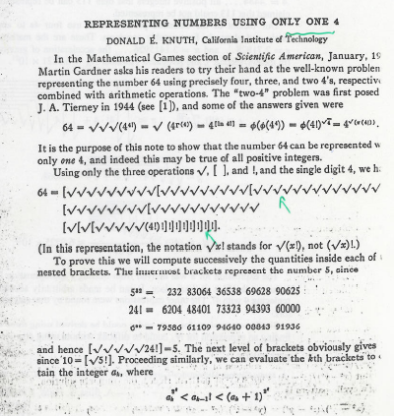

Slide 78
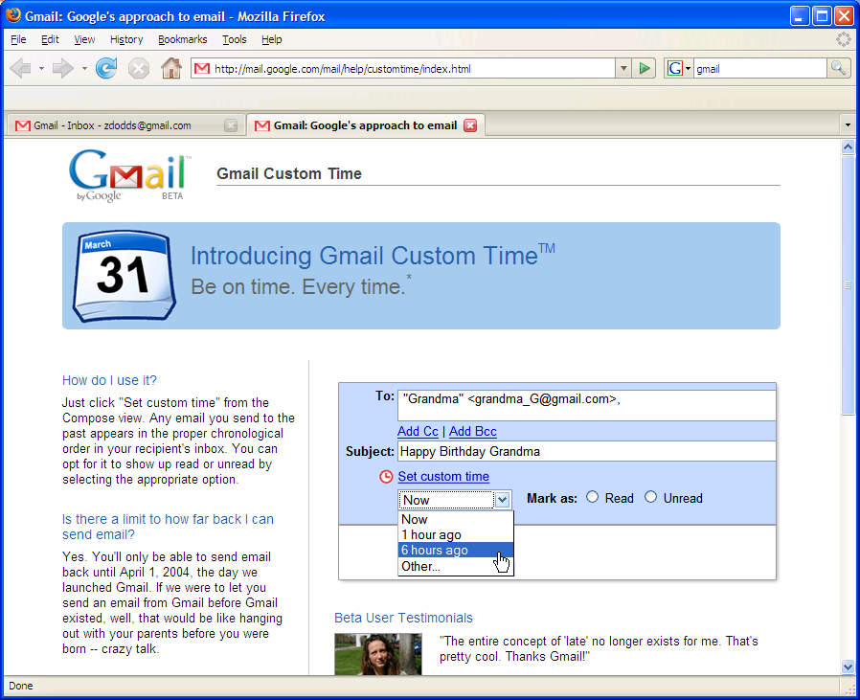
More puzzles next time!
in honor of Apr. 1, I'll be disguised as Jack Ma on Friday…

Slide 79
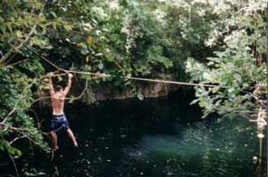
Where we're headed…
Week 9: Mar 28…
Prolog puzzles...
Week 10: Apr 4…
Prolog adventure!
Week 11: Apr 11…
"Theocomp" ~ formal models of computation
DFA, NFA, Regexes,
Week 12: Apr 18…
More on DFA, NFA, Regular expressions, also Turing Machines, reduction-style uncomputability, algorithm analysis
Week 14: Apr 25…
algorithm analysis: unwinding recurrences, loop-counting, sorting, big-O, algorithm speed challenge…
Not to mention some very cool computer science constructs with suggestively cool (maybe?) names, like quantum computing, NP-completeness, linear median finding, and sub-cubic matrix multiplication!
Oxford comma

Slide 80
Don't hand these in!
rem1(E, [E|R], R).
rem1(E, [F|R], [F|NR]) :-
inorder( ).
inorder( ).
inorder(
Hint: you may want two base cases
Hint: recurse and then use something else on this page
perm([], []).
perm([F|R], P) :-
big-O!
Extra! There are at least TWO ways to write sort... Both use predicates we've just written!
sort(
sort(
Notes:
secret strategy: randomly reorder things until it works!!

Slide 81
Sorting out Prolog… by sorting in Prolog!
Practice with how prolog thinks...
sort(
sort(
Extra! There are at least TWO ways to write sort... What are they?
What are their big-O runtimes?
sort(
sort(
Notes:
secret strategy: randomly reorder things until it works!!

Slide 82
Trees and graphs work, too!
42
tree1( [42,[5,[],[]],[60,[],[]]] )
5
60
bst
# of nodes
nnodes([], 0).
nnodes([Root,L,R], N) :- nnodes(L,NoL),
nnodes(R,NoR),
N is NoL + NoR + 1.
treemin(
treemin(
binary search tree
its minimum element
Notes:
secret strategy: randomly reorder things until it works!!

Slide 83
Trees and graphs work, too!
a
graph1( [[a,b],[b,c],[a,c]] )
b
c
graph as a list of edges
# of edges
numedges([], 0).
numedges(G, N) :- length( G, N ).
kid(P,K,Graph) :-
parent
child (kid)
graph as list of edges
Notes:
secret strategy: randomly reorder things until it works!!

Slide 84
removeOne( 42, L, [5,6,7])
removeOne( E, L, NewL )
removeOne(E,[E|R],R).
E must be present
removeOne(E,[F|R],[F|R2]) :- removeOne(E,R,R2).
removeAll( 42, L, [5,6,7])
removeAll( E, L, NewL )
removeAll(E,[],[]).
E need not be present...
removeAll(E,[E|R],X) :-
removeAll(E,[F|R],[F|X]) :-
uniq( [7,6,5,6,7,7,5], UList)
uniq( List, UList )
uniq([],[]).
uniq([F|R],[F|X]) :-

Slide 85
sorted( L )
Define sorted(L). Assume L contains only integers.
Quiz
You'll want 2 base cases and one recursive case…
Don't hand this in...
sorted(
sorted(
Prolog pandemonium!
sorted(
perm( L, P )
Write perm(L,P) to generate permutations P of a list L.
Hint: Use recursion and removeOne
perm( [ ], [ ] ).
perm( [F|R], P ) :-
sort( L, S )
Write sort(L,S), which "sorts" L into S.
Hint: Use the previous two predicates – in only one rule!
What is the big-O running time for this sorting algorithm?
sort( L, S ) :-
split( L, S1, S2 )
Write split(L,S1,S2) that splits a list L into all possible subsets S1 and S2.
so that L = S1 ∪ S2.
union, not concatenation
split( L, S1, S2 ) :-
Hint: Only 1 rule needed! You'll want to use a built-in helper predicate and something on this page...
speaking of split…

Slide 86

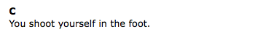

Slide 87
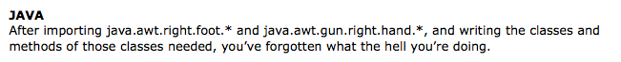
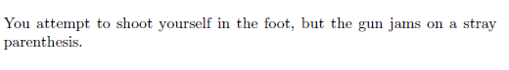
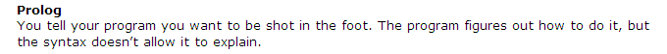
LISP/Scheme/Racket

Slide 88

LISP/Scheme/Racket

Slide 89
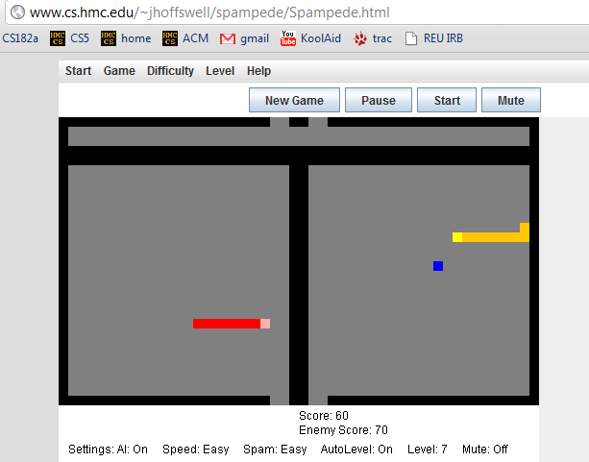
Applet examples
- Jane H.

Slide 90
lastof( E, L )
Take-home messages
lastof( E, )
Many times [] is not the base case!
lastof( E, )
reverse( L, Rev )
true if Rev is the reverse of the list L
reverse( , ).
test vs. generate: var and nonvar
reverse( [F|R], Rev ) :-
treefind( E, BST )
true if E is a node found in BST (a bin. search tree)
trees and graphs are OK, too!
Extra!
kid( P, Graph, K )
true if K is a child of P in graph Graph (list of edges)
kid( a, [ [a,b], [b,c], [a,c] ], K ).
K = b ;
K = c ;
No
No kidding!

Slide 91
var and nonvar
reverse( L, Rev ) :- var(L), var(Rev),
write( 'If you insist…' ), nl,
L = [42], Rev = [42].
reverse( L, Rev ) :- var(L), nonvar(Rev),
reverse(Rev, L).
Alternatively, try randomly permute predicates until something works !
reverse( [], [] ).
and the recursive case from the quiz…
which might not work!

Slide 92
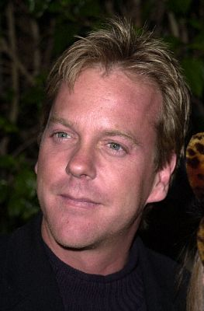
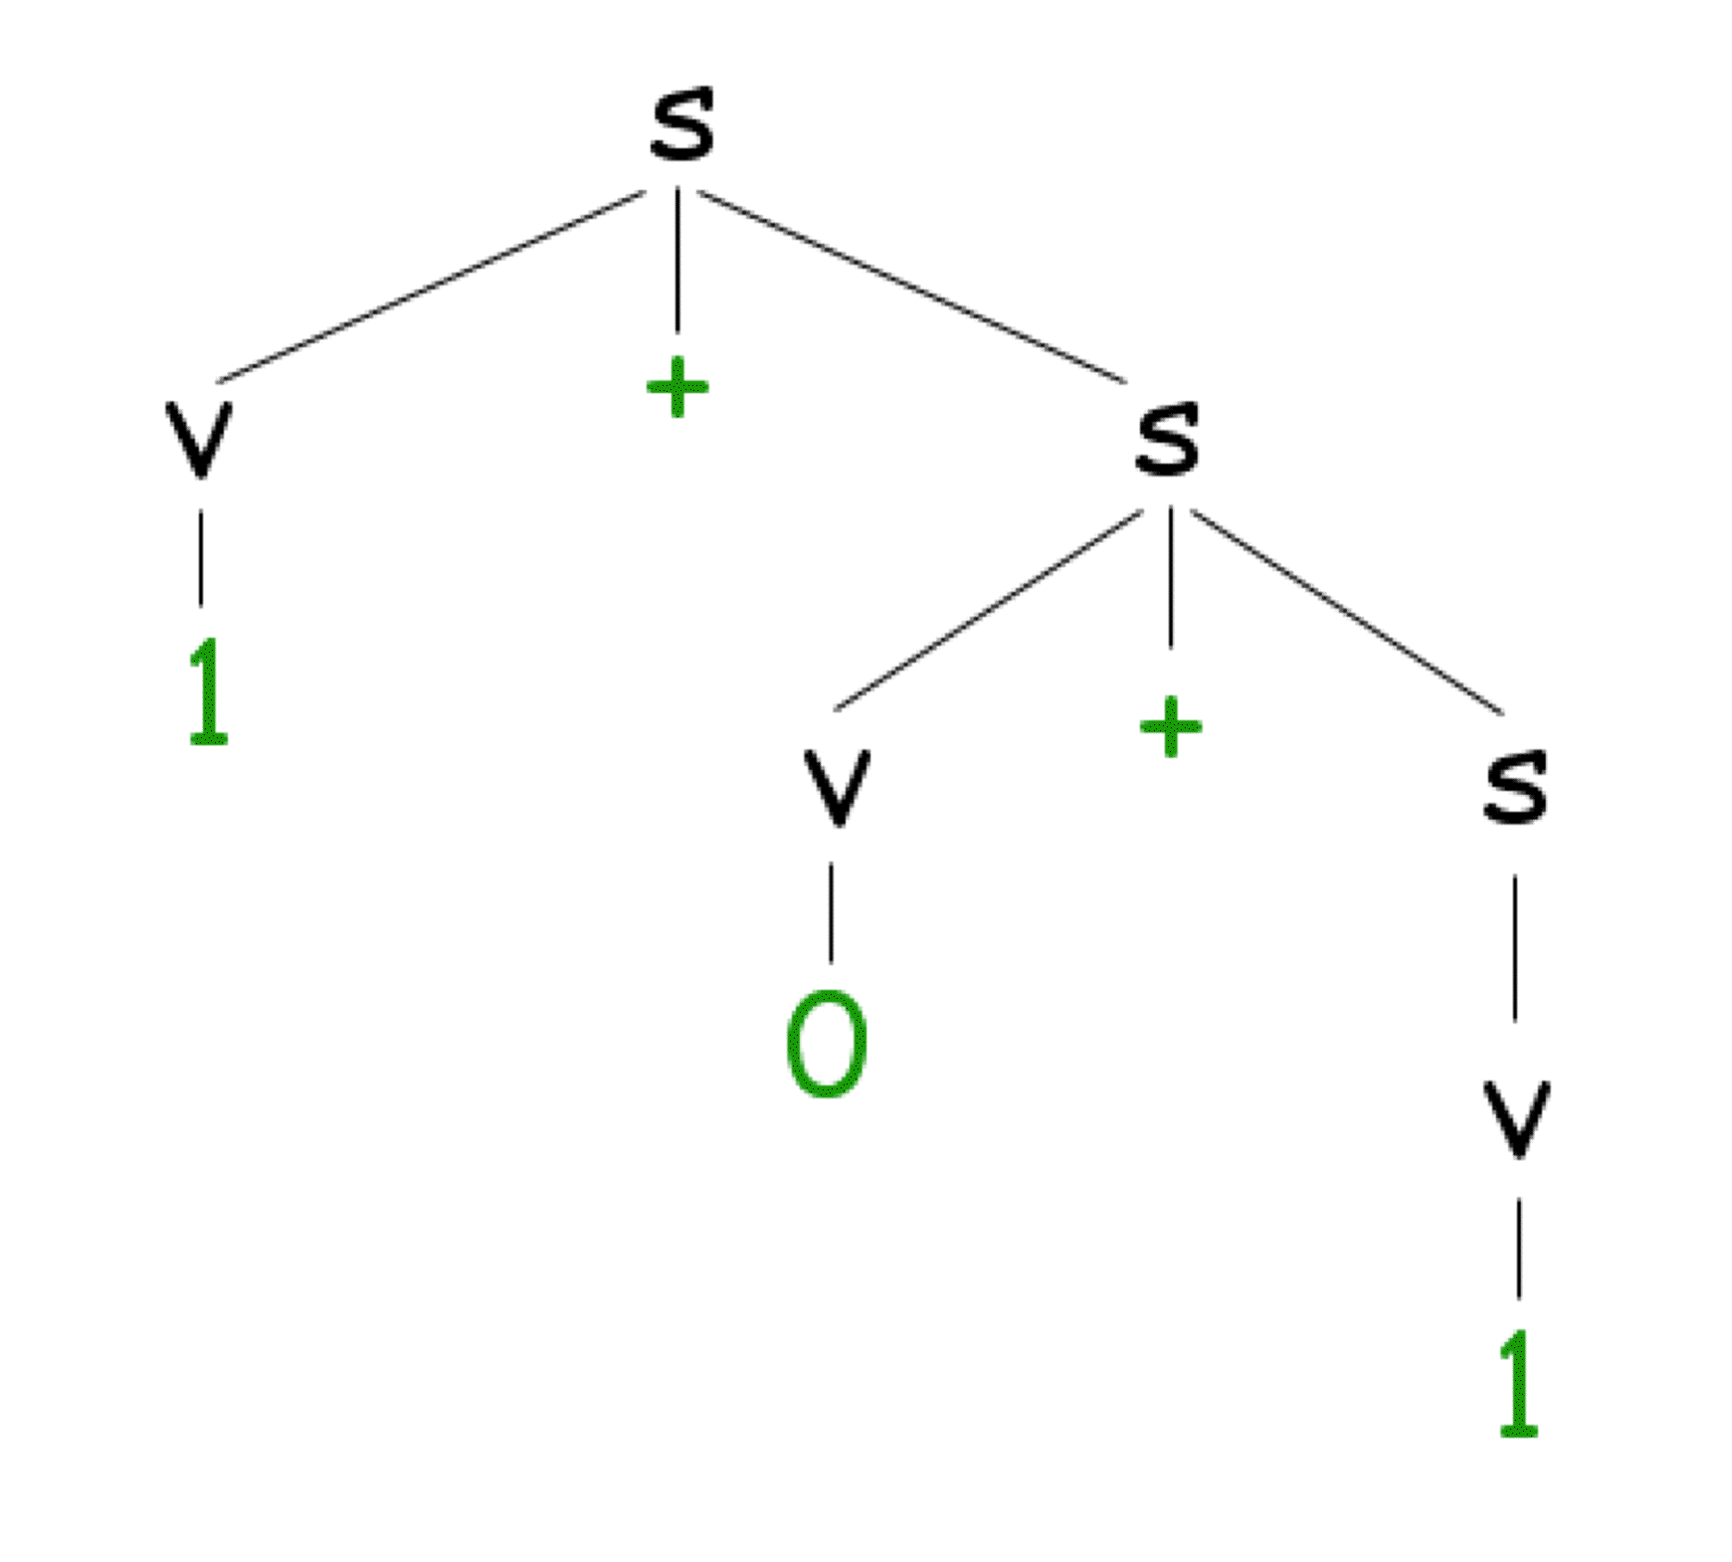

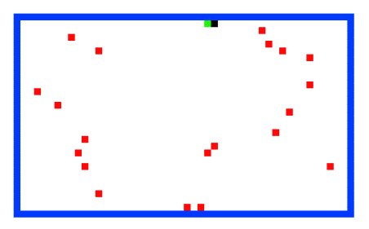
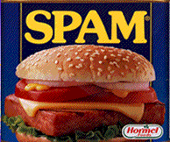
CS 60 Today
Problem #1: an Einsteinian logic puzzle...
Applet grading...!
Hw 9:
prolog puzzles, parsing, paths less traveled…
These two look fairly puzzling to me!
Prolog comma
~ due Mon. April 4
Tutors will be available W, Th, F, S, Sun.
X.
Office hours ~ Sun. afternoon, 2-4 @ LAC
the answer?
Line count:
~30 lines
~15 clauses
~15 lines
~8 clauses
seems like a good trend!
#1
#2
#3
#4
more rules
more structure
Problem #2: 24
Problem #3: The rivercrossing puzzle…
Problem #4: parsing ANY grammar…
Mudder
Alien
Spampede
Spam
parse([s],[1,+,0,+,1]).

Slide 93
Lists and trees, prolog style…
(length and append are built-in, but we'll write them here, too)
length( L, N )
length( [], 0 ).
length( [F|R], N ) :- length(R,M), N is M+1.
append( L, M, Both )
base case
append(
rec case
append(
BST = [ 42, [10,[],[]], [60,[],[]] ], for example
Short. Sweet!
nnodes( BST, N )
base case
nnodes(
rec case
nnodes( [Root,L,R], N ) :-

Slide 94
lastof( E, L )
Try it…
true if Eis the last element of the list L
lastof( E, )
lastof( E, )
reverse( L, Rev )
true if Rev is the reverse of the list L
reverse( , ).
reverse( [F|R], Rev ) :-
Hint: use reverse (recursively) and append.
treefind( E, BST )
true if E is a node found in BST (a bin. search tree) otherwise, false
Extra!
kid( Par, Graph, K )
true if K is a child of Par in graph Graph (list of edges)
kid( a, [ [a,b], [b,c], [a,c] ], K ).
K = b ;
K = c ;
No
No kidding!

Slide 95
Midterm feedback…
Don't put your name
We'd love to know any thoughts you have about CS60 thus far in the term… in particular, how you feel about the time and effort you find CS60 requires:
Where we've been...…
On average how much time per week do you spend on CS60 – outside of class time?
How does CS60's workload compare to other classes you're taking this term?
How would you judge the pace of CS60?
much lighter
about the same
much heavier
much too slow
about right
much too fast
What is something you'd keep about CS60 …?
& something you'd change about / get rid of / add to CS60 …?
Racket/Scheme
Java
Prolog
Rank each language we've used from 0 (disliked it) to 10 (loved it):
Other thoughts are optional, but 142% welcome.
Would you like the class to use clickers?
Possibilities:
Would you like exams to be actual coding?
Other concerns?

Slide 96
Prolog is uniq !
uniq( List, UList )
uniq([],[])
uniq([F|R],[F|X])
removeAll( E, L, NewL )
will
rA( _ ,
rA( E ,[E|R],
rA( E ,[F|R],
removeOne( E, L, NewL )
removeOne(E,[E|R],R).
removeOne(E,[F|R],[F|R2]) :- removeOne(E,R,R2).

Slide 97
Zebra-puzzle representation
A list H reflecting the houses' spatial order
containing the five items that each house has…
pet
cigar
beverage
nation
house color
H = [[norwegian, _, _, _, _], _, [_, _, _, milk, _], _, _]
House 1
House 3
House 2
Houses 4+5
Try this constraint:
7) The owner of the Green house drinks coffee.
Hint: use member and H

Slide 98
sorted( L )
Define sorted(L). Assume L contains only integers.
Quiz
You'll want 2 base cases and one recursive case…
Prolog pandemonium!
perm( L, P )
Write perm(L,P) to generate permutations P of a list L.
Use removeOne(E,L,NewL)
perm( [ ], [ ] ).
perm( [F|R], P ) :-
sort( L, S )
Write sort(L,S), which "sorts" L into S.
What is the big-O running time for this sorting algorithm?
Hint: Use the previous two predicates!
split( L, S1, S2 )
Write split(L,S1,S2) that splits a list L into subsets S1 and S2.
so that L = S1 ∪ S2.
not concatenation
speaking of split…

Slide 99
Zebra-puzzle constraints
% left-to-right adjacency
lr(L, R, [L, R | _ ]).
lr(L, R, [ _ | Rest]) :- lr(L, R, Rest).
% adjacency (unordered)
nextTo(X, Y, List) :- lr(X, Y, List).
nextTo(X, Y, List) :- lr(Y, X, List).
Creating some helpers:
List will be H
Try this constraint:
15) The Norwegian does not live by the red house.
Where should this predicate go?

Slide 100
Applet #1

Slide 101
24 (Problem #2)
4
7
4
7
Can you combine these numbers into 24 with the operations + - * ÷ ?
2
1
Each operation may be used any number of times.
2
1
A two-dot card from the "official" 24 game: 24game.com

Slide 102
24 (Problem #2)
4
7
4
7
Can you combine these numbers into 24 with the operations + - * ÷ ?
2
1
Each operation may be used any number of times.
2
1
solve( [‘+’,‘-’,‘*’,‘/’], [1,2,4,7], 24, Tree ).
operators available: (use any number of times)
values:
(use each exactly once)
arithmetic tree
final answer
Tree = [*, [+, 1, [-,7,2]], 4]

Slide 103
24 (Problem #2)
4
7
4
7
Can you combine these numbers into 24 with the operations + - * ÷ ?
2
1
Each operation may be used any number of times.
2
1
solve( [‘+’,‘-’,‘*’,‘/’], [1,2,4,7], 24, Tree ).
operators available: (use any number of times)
values:
(use each exactly once)
arithmetic tree
final answer
Tree = [*,[+,1,[-,7,2]],4]
Suggestion on solve -- use the following as a rough template:
solve(base case).
solve( Ops, Values, Sol, Tree ) :-
… , % don’t start with Tree = [ Op, Left, Right ] (why?)
predicates that create an appropriate Tree,
… ,
Tree = [ Op, Left, Right ]. % may also have more predicates after…

Slide 104
Searching to the end…
be sure there is an end!
setof( Tree, solve( [‘+’,‘-’,‘*’,‘/’], [1,2,4,7], 24, Tree ) , S).
variable whose values you want to collect into a set
the set
predicate that you would like to satisfy…
setof( Tree, solve( [‘+’,‘-’,‘*’,‘/’], [5,1,155,11], 24, Tree ) , S).
a much smaller example…
[2,8,22,424] ~ 42
[4,4,4,4] ~ 42
setof( N, T^solve( [‘+’,‘-’,‘*’,‘/’], [4,4,4,4], N, T ) , S).
a surprisingly well-studied problem!
T^ ~ there exists a T

Slide 105
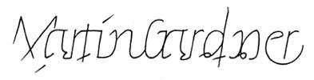

For four 4’s ...
0 = 4 + 4 - 4 - 4
1 = 44 / 44
2 = 4
...
8 = sqrt( .4 ) * ( 4 + 4 + 4 )
...
19 = ???
20 = 4! + 4 - 4 - 4
Allowed Operations
4/(4+4)
+
-
*
/
sqrt
.
!
concat
power
A problem surprisingly well-studied…

Slide 106
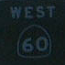
The alien, the spampede, and the spam!
Goal: Get back to the dorms with the spam, the spampede, and the three-eyed alien.
Constraints: Can’t carry more than one thing and can’t leave two things alone if one would eat the other…
Heading to the polls…!
Mudder
West
East

Slide 107
Towers of Hanoi
Goal: Get all of the disks from Peg 1 to Peg 3.
Constraints: You may not place a smaller disk onto a larger one.
Peg 1
Peg 2
Peg 3
solve( [[1,2,3,4],[],[]], M ).
This could get Hanoi’ing!
Use spam.pl as a starting point…

Slide 108
Parsing in Prolog
I refuse to write more than one parser!
%% file: g0.pl
%% A grammar must specify variables, terminals, and rules.
variable(s). %% grammar variables, NOT prolog variables!
variable(v).
terminal(0). %% grammar terminals, NOT prolog constants…
terminal(1).
terminal(+). %% actually, all of these are prolog constants
%% Here are the rules for this grammar: [LHS, RHS]
%% s -> v + s | v
%% v -> 0 | 1
rule(s, [v, +, s]).
rule(s, [v]).
rule(v, [0]).
rule(v, [1]).
A grammar expressed in prolog.
this is the file g0.pl
you’ll write the file part5.pl
parse([s], [1,+,0,+,1]).
yes
Your parse predicate should work for any reasonable grammar!
parse([s], [1,0,+,1]).
no
and we will ONLY test with fully-instantiated lists…

Slide 109
Parsing in Prolog
A derivation tree…
Sentential Forms
s
s
v
+
s
v + s
1 + s
1
+
v
s
1 + v + s
0
v
1 + 0 + s
1
1 + 0 + v
1 + 0 + 1

Slide 110
And I thought parse was just a good jotto word!
Parsing in Prolog
An example of how prolog might think about this…
parse([s], [1,+,0,+,1]).
parse([v,+,s], [1,+,0,+,1]).
parse([1,+,s], [1,+,0,+,1]).
parse([+,s], [+,0,+,1]).
parse([s], [0,+,1]).
parse([v,+,s], [0,+,1]).
parse([0,+,s], [0,+,1]).
parse([+,s], [+,1]).
parse([s], [1]).
parse([v], [1]).
parse([1], [1]).
parse([], []).
yes
What are the key decisions being made here?

Slide 111
And I thought parse was just a good jotto word!
Parse ~ Jotto?

Slide 112
Towers of Hanoi, briefly
The Towers of Hanoi puzzle was first published in 1883 by French mathematician Edouard Lucas.
class hanoi
{
public static void main(String[] args)
{
int n = Integer.parseInt(args[0]); // # of disks
int x = 0; // move number
int to = 0; // peg to move to
int from = 0; // peg to move from
for (x=1 ; x < (1<<n) ; ++x)
System.out.println("Move " + x +
": from peg " + ((x&x-1)%3) +
" to peg " + (((x|x-1)+1)%3));
}
}
Can be done recursively AND without recursion.

Slide 113
Math in Prolog
Rex: there are no side effects (assignments) new data is created and returned.
Java: you have a choice to use side effects, or return new data as needed
Prolog: everything is done via side effects, there are no return values!
Math without return values ?
factorial rules!
fac(X,N)
! does rule!

Slide 114
Sorting in Prolog? mysort
%% sort is built-in, so we’ll write mysort:
mysort(L,S) :- perm(L,S), sorted(S).
%% sorted checks if a list is sorted...
sorted([]).
sorted([_]).
sorted([F,S|R]) :-
%% perm can generate all permutations of L
%% it does not work in right-to-left, however
This is mysort of programming!
what do we need here?

Slide 115
Sorting in Prolog? mysort
%% sort is built-in, so we’ll write mysort:
mysort(L,S) :- perm(L,S), sorted(S).
%% sorted checks if a list is sorted...
sorted([]).
sorted([_]).
sorted([F,S|R]) :-
%% perm can generate all permutations of L
%% it does not work in right-to-left, however
perm([],[]).
perm(L, [F|R]) :-
app(BeforeF, [F|AfterF], L), %% split L around F
app(BeforeF, AfterF, PermR), %% recombine all except F
perm(PermR, R). %% PermR is bound, so we're OK
This is mysort of programming!
what do we need here?

Slide 116
Listing with Prolog
%% member is not built in to prolog...
member(X, [X|R]).
member(X, [F|R]) :- member(X, R).
%% length is built-in, so we will write len
%% just to illuistrate how it might be written
len([], 0).
len([_|R], L) :- len(R, L2), L is L2+1.
%% append is built-in, so we will write app
%% again just to see how it might be done
app([], L, L).
app([F|R], L, [F|A]) :- app(R, L, A).
Why might Prolog complain here?
Does order matter here?
I should underscore the importance of this!
See! Prolog is friendly!

Slide 117
“Quiz” #2
Mathematics with Prolog
Write a predicate fac that finds factorials…
How many arguments will fac need?
Write a predicate sum that finds the sum of two values…
How many arguments will sum need?
Will your predicates always work?

Slide 118
Unhappy Prolog
len([], 0).
len([_|R], L) :- len(R,L2), L2 is L-1.
When will Prolog not like these definitions?
sum(X, Y, Z) :- Z is X + Y.
any ideas?

Slide 119
More flexible sums…
digits([0,1,2,3,4,5,6,7,8,9]).
sum(X,Y,Z) :-
digits(D),
member(X,D),
member(Y,D),
Z is X+Y.
sum(X,Y,Z) :-
D = [0,1,2,3,4,5,6,7,8,9],
member(X,D),
member(Y,D),
Z is X+Y.
better?

Slide 120
More flexible sums…
sum(X,Y,Z) :-
D = [0,1,2,3,4,5,6,7,8,9],
member(X,D),
member(Y,D),
Z is X+Y.
digits([0,1,2,3,4,5,6,7,8,9]).
sum(X,Y,Z) :-
digits(D),
member(X,D),
member(Y,D),
Z is X+Y.
better solution? Use var, nonvar
sum(X,Y,Z) :- nonvar(Y), nonvar(Z), X is Z-Y.
sum(X,Y,Z) :- nonvar(X), nonvar(Z), Y is Z-X.
sum(X,Y,Z) :- nonvar(X), nonvar(Y), Z is X+Y.
It’s possible to make sum generate ALL integer solutions even when X, Y, and Z are all variables…
How many of these rules will sum(2,2,4) and sum(2,2,5) finish?

Slide 121
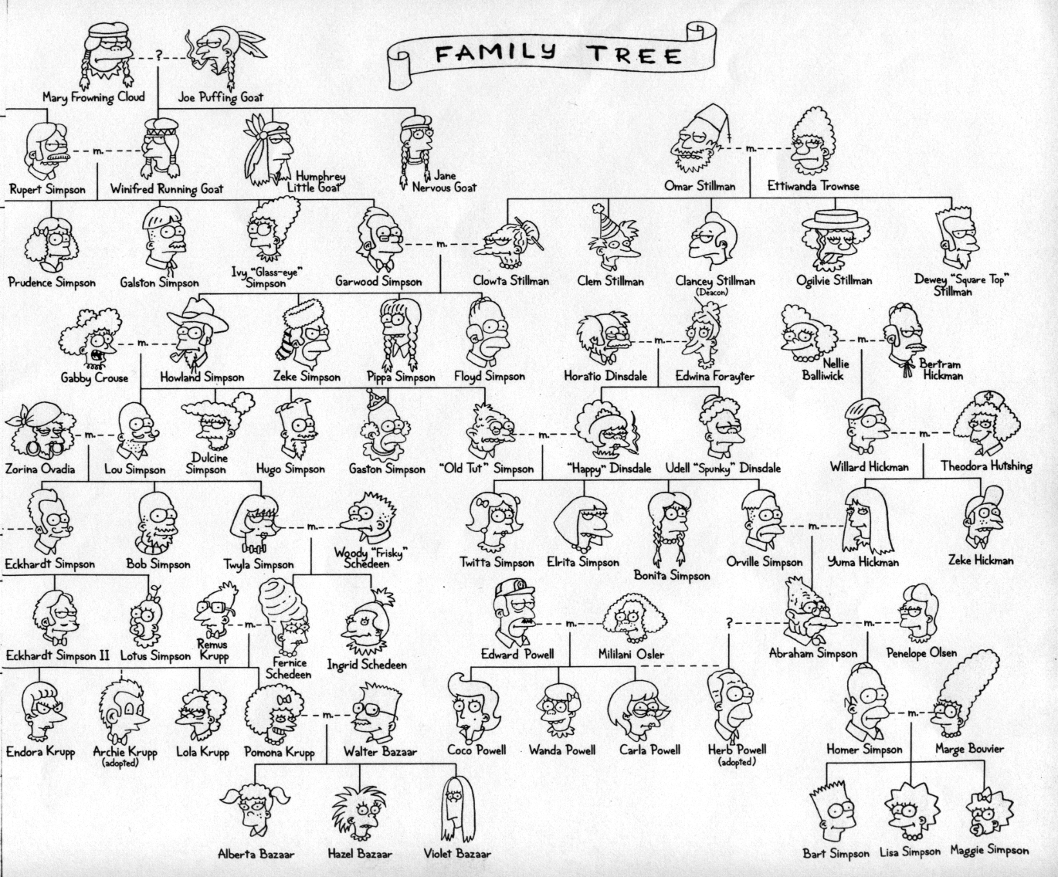
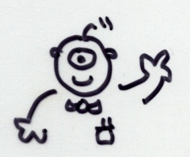
Welcome back to CS 60!
CS 60 Then and Now:
Weeks 1-4: Java
Weeks 5-8: Rex
Weeks 10-15:
Prolog, ISCAL, JFLAP, and more!
Guest-appearing this week …
Keeping the CS 60 ecosystem balanced…
This makes me appreciate my own family reunions…

Slide 122
The idea:
Provide data/relationships that describe the world. Then ask questions.
Questions:
child(lisa,marge).
parent(marge,X).
Is Lisa a child of Marge?
Who has Marge as a parent?
Is Ug a parent of Bart?
Who are the ancestors of Lisa?
Who are uggette's descendants?
Who is who's parent?
Who are John's grandchildren?

Slide 123
Prolog lists…
unifies L with [1, 2, 3]
Prolog has a more Python-like list syntax than Scheme:
L = [ 1, 2, 3 ].
== comparison (structural -- no arithmetic!)
\==
=:= arithmetic comparison with both-sided evaluation
=\=
2 not-equals
3 == 3. <-- yes
1+2 == 1+2. <-- yes
1+2 == 2+1. <-- no
1+2 =:= 2+1. <-- yes
[1,X] == [1,X]. <-- yes
[1,2] == [1,X]. <-- no
[1,2] = [1,X]. <-- yes, X is bound to 2

Slide 124
Math in Prolog
General operators/rules
Example
Notes
comparing for equality: == X == Y
arithmetic assignment: is X is Y+42
pattern matching (lists): = [F|R] = L
inequalities: < > =< >= \==
does not bind X or Y --
they must be bound
binds X ; Y must be bound
binds F and R
L must already be bound
read(X)
write(X)
nl
reads keyboard input into X
writes X to the screen
writes a newline “\n” to the screen
Input / Output

Slide 125
Towers of Hanoi
Goal: Get all of the disks from Peg 1 to Peg 3.
Constraints: You may not place a smaller disk onto a larger one.
Peg 1
Peg 2
Peg 3

Slide 126
Einstein's Zebra puzzle…
length( L, N )
append( L, M, Both )
Short. Sweet!

Slide 127
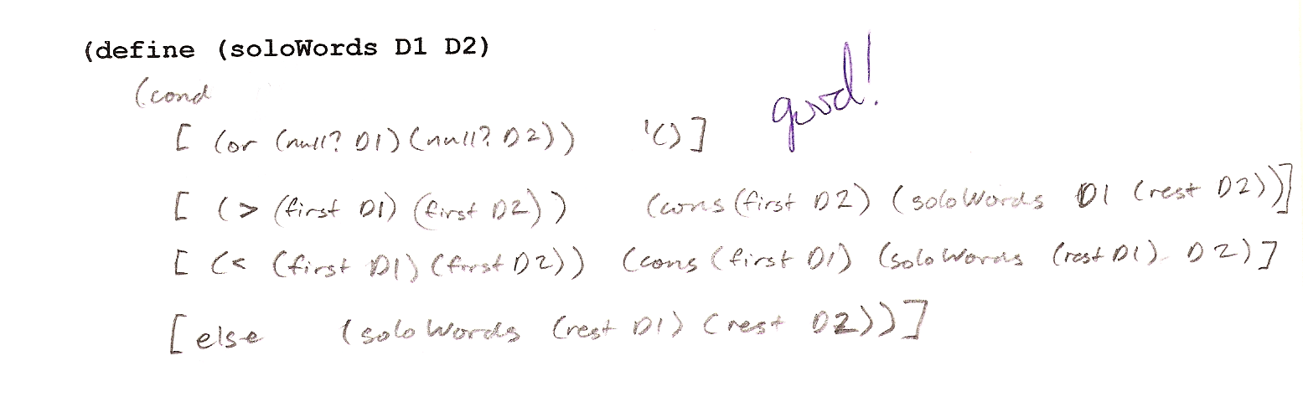
Exam notes, p. 1
worth 1 hw
av. ~81
Problem #1
(define (soloWords D1 D2)
CJ

Slide 128
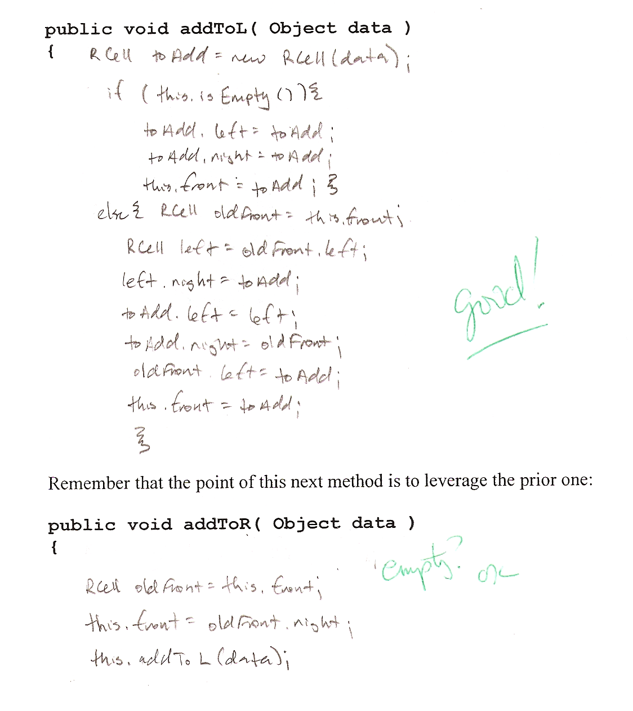
Exam notes, p. 2
Problem #2
void addToL(Object data)
EF

Slide 129
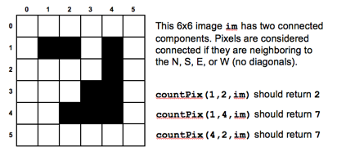
Exam notes, p. 3
Problem #3
countPix
public int countPix(int r, int c, int[][] image)
{
if (image[r][c] != 1) return 0; // no pixels here!
image[r][c] = 0; // make sure we don't count it again
return 1 + countPix(r+1,c,image) // count it, plus S neighbor, etc.
+ countPix(r-1,c,image) // plus N neighbor, etc.
+ countPix(r,c+1,image) // plus E neighbor, etc.
+ countPix(r,c-1,image); // and W neighbor, etc.
}

Slide 130
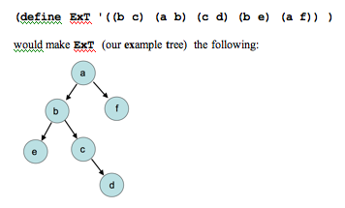
Exam notes, p. 4
(define (root T)
(soloWords (map second T)
(uniq (flatten T))))
Problem #4
(lists should be sorted)
coolest solution!
it's the root!
no kids?
(define (find r n T)
(if (equal? r n) #t
(if (null? (kids r T)) #f
(foldr OR #f (map (lambda (r2) (find r2 n T))
(kids r T))))))
check each child

Slide 131
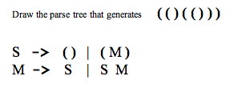
Exam notes, p. 5
S
Parse trees
(
M
)
S
M
( )
S
(
M
)
S
( )
( ( ) ( ( ) ) )

Slide 132
Exam notes, pr. 5
A function is tail recursive if it does no computational work after the recursive call.
Tail recursive functions can be implemented as loops and thus save the time of building the function-call stack.
def fac(N):
if N < 2: return 1
else: return N * fac(N-1)
No tail recursion
def fac(N): return facTail(N,1)
def facTail(N,A):
if N < 2: return A
else: return facTail(N-1,N*A)
With tail recursion

Slide 133
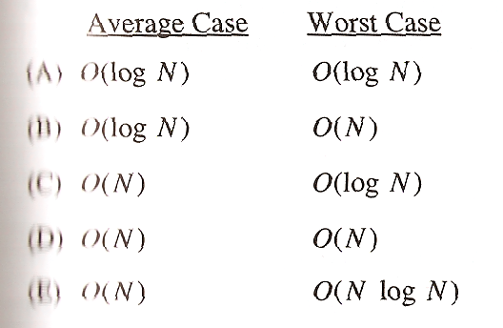
Exam notes, ex. cr.
There once was an alien named Sam
who ate 42 punds of spam
it was all during lunch
and it made quite a crunch
next time please do not eat the can!
Emily
Limericks?
Multiple-choice problem:
most difficult problem on the AP computer science exam!
< 10% of students answered it correctly…

Slide 134
Poetic programming
There once was an alien named Sam
who ate 42 punds of spam
it was all during lunch
and it made quite a crunch
next time please do not eat the can!
Emily
Alex Y
There once was an elf who loved spam
He devised a scheme to cook it in a pan.
At the age of 42
he made java for me and you
And never once said, Oh Damn!
An Alien named 42-PAM
desired a quick train trip for spam
said alien, "Let's go!"
but prolog said No
So the alien rode alone on the tram.
Camille

Slide 135
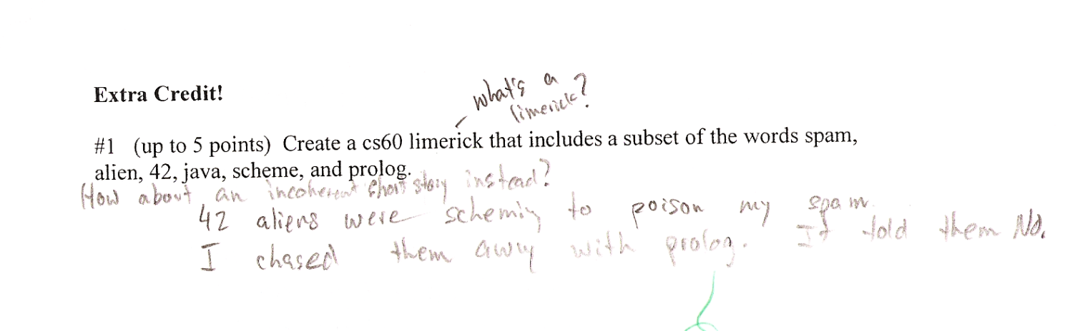
Poetic programming
There once was an alien named Sam
who ate 42 punds of spam
it was all during lunch
and it made quite a crunch
next time please do not eat the can!
Emily
Alex Y
There once was an elf who loved spam
He devised a scheme to cook it in a pan.
At the age of 42
he made java for me and you
And never once said, Oh Damn!
An Alien named 42-PAM
desired a quick train trip for spam
said alien, "Let's go!"
but prolog said No
So the alien rode alone on the tram.
Camille
Andrew X.

Slide 136
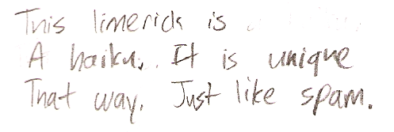
Poetic programming
There once was an alien named Sam
who ate 42 punds of spam
it was all during lunch
and it made quite a crunch
next time please do not eat the can!
Emily
Skye B.
Alex Y
There once was an elf who loved spam
He devised a scheme to cook it in a pan.
At the age of 42
he made java for me and you
And never once said, Oh Damn!
An Alien named 42-PAM
desired a quick train trip for spam
said alien, "Let's go!"
but prolog said No
So the alien rode alone on the tram.
Camille
Andrew X.

Slide 137
Where we're headed…
Week 9: Nov 4…
Prolog puzzles.
Week 10: Nov 11…
Prolog adventure!
Week 11: Nov 18…
"Theocomp" ~ formal models of computation
Week 12: Nov 25…
DFA, NFA, Regular Expressions, indistinguishability and minimum # of states
Week 13: Dec 2…
Implementing DFAs via sequential logic, Turing Machines, uncomputability, algorithm analysis
Week 14: Dec 9…
algorithm analysis: unwinding recurrences, loop-counting, sorting, big-O, algorithm speed challenge…
Not to mention some very cool computer science constructs with suggestively cool (maybe?) names, like quantum computing, NP-completeness, linear median finding, and sub-cubic matrix multiplication!
Oxford comma

Slide 138
The Mystery of the Spamwarts Express
Five people are traveling home in adjacent train seats for Thanksgiving break…
Seat 1
Seat 2
Seat 3
Seat 4
Seat 5
Names = [algird, bruno, collette, dino, edwina].
Each has a different name.
Schools = [pomona, pitzer, hmc, cmc, scripps].
Each is from a different Claremont College.
Snacks = [jots, chocolate, donuts, pez, spam].
Each has brought a different snack.
Dino and Bruno sat in the end seats (that is, seats 1 and 5, but which student sat in which of these seats is still unknown).
2) Algird sat next to the student from HMC.
3) Collette sat next to friends with chocolate and donuts.
4) The HMC student brought spam as a snack and sat in the middle seat.
5) Chocolate was immediately to the left of pez.
6) Bruno, Dino, and Algird do not go to Scripps.
7) The Pomona student sat between the person with jots and spam.
8) Dino did not sit next to the person with donuts.
9) The CMC student did not sit next to Edwina.
9 hints are available

Slide 139
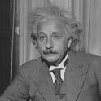
There are five houses:
The nationalities are norwegian, brit, swede, dane, german
The pets are dog, bird, zebra, cat, horse
The cigars are pallmall, winfield, dunhill, rothmans, marlboro
The beverages are tea, coffee, milk, water, beer
The house colors are red, green, yellow, blue, white
We know that
1) The Norwegian lives in the first house.
2) The person living in the center house drinks milk.
3) The Brit lives in a red house.
4) The Swede keeps dogs as pets.
5) The Dane drinks tea.
6) The Green house is next to, and on the left of the White house.
7) The owner of the Green house drinks coffee.
8) The person who smokes Pall Mall rears birds.
9) The owner of the Yellow house smokes Dunhill.
10) The man who smokes Marlboro lives next to the one who keeps cats.
11) The man who keeps horses lives next to the man who smokes Dunhill.
12) The man who smokes Winfields drinks beer.
13) The German smokes Rothmans.
14) The red house is to the right of the blue.
15) The Norwegian doesn't live by the red, white, or green houses
Who owns the zebra?
Einstein's Zebra puzzle: a logic challenge
(0) How do we represent the puzzle state?
(1) What relationships do we need?
(2) How do we encode the constraints?

