Slide 1
Joshua Eckroth
joshuaeckroth@gmail.com

Slide 2



Slide 3
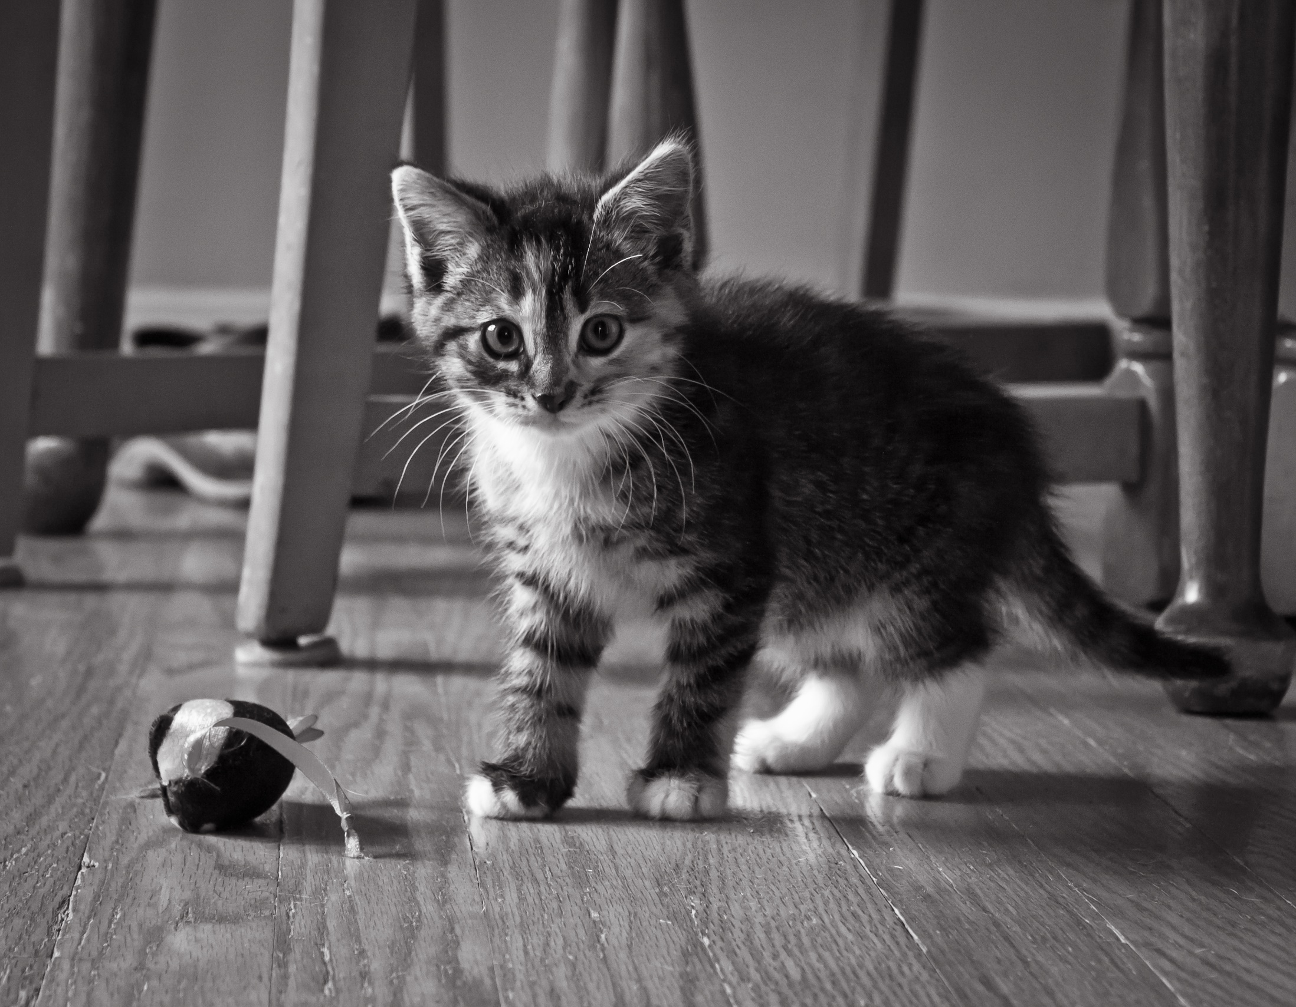
Notes:
About me

Slide 4
The Plan
Review some functions.
Write more functions.
Consider the nature of recursion.
Look at the call stack.
Discover tail-call optimization.

Slide 5
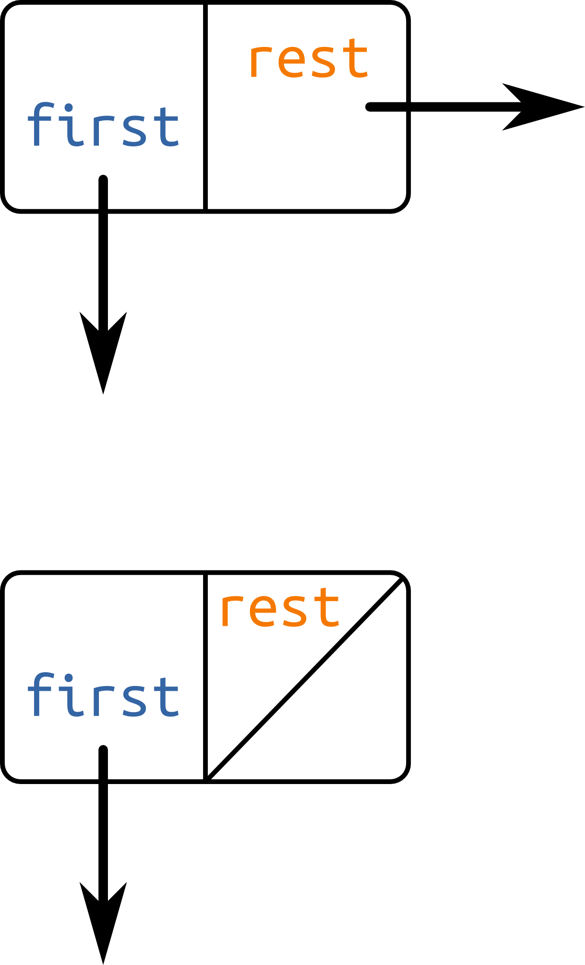
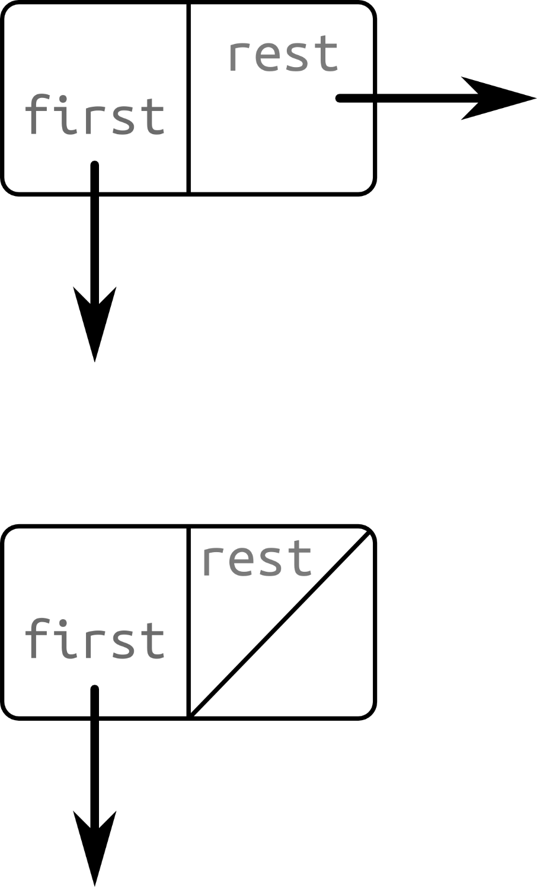
(rest L)
L =
(first L)

Slide 6
(cons 'a L)
L =
'a

Slide 7
Review: Length of L
(define (length L)
(cond [(null? L) 0]
[else (+ 1 (length (rest L)))]))

Slide 8
Review: Is e a member of L?
(define (member e L)
(cond [(null? L) #f]
[(equal? e (first L)) #t]
[else (member e (rest L))]))

Slide 9
Review: Remove first e from L
(define (remove e L)
(cond [(null? L) '()]
[(equal? e (first L)) (rest L)]
[else (cons (first L) (remove e (rest L)))]))

Slide 10
Task: Reverse L
(define (reverse L)
(cond [__________ __________]
[________ _______________________]))
Notes:
Remind that (if) can be used, too.
It’s my understanding you saw this last time, but it would be good to review.
Can’t just cons on to the back instead and be done with it (like copy) ☺

Slide 11
Task: Reverse L
(define (reverse L)
(cond [(null? L) '()]
[else (append (reverse (rest L))
(list (first L)))]))

Slide 12
Task: Write the “range” function
(define (range lo hi)
(cond [_________ ___________] [______ ___________________________]))
Notes:
Similar structure to reverse, isn’t it? That’s not shocking; often two concerns with recursive functions on lists: null?, and else

Slide 13
Task: Write the “range” function
(define (range lo hi)
(cond [(> lo hi) '()] ;; or >=
[else (cons lo (range (+ 1 lo) hi))]))
Notes:
Emphasize: cons only works on the front, can’t cons to the back!
(Why?! Because of its simplicity… doesn’t walk the whole list, too much work.)

Slide 14
Recursion in “nature.”

Slide 15
A list is the empty list (null),
OR,
a “first” value,
followed by a list (“rest”).
Notes:
Linked list structure

Slide 16
The Natural Numbers
0 = {}
n + 1 = n U {n}
1 = {0} = {{}}
2 = {0, 1} = {{}, {{}}}
3 = {0, 1, 2} = {{}, {{}}, {{}, {{}}}}
Notes:
Mathematical structure of an integer

Slide 17
Derivatives
Sum rule:
Product rule:
Chain rule:
If,
Then,
Notes:
One of earliest examples for Lisp; one of the reasons Lisp was created

Slide 18
Languages
def foobar(x):
if x < 10:
for y in baz:
while x > 0:
if z == y:
print “Too much nesting!”
(define (foobar x)
(if (< x 10)
(for ([y baz])
(do () (<= x 0)
(if (= z y)
(display “Too much nesting!”))))))
Notes:
Programming languages (recursive grammars)
Parsing will be recursive then.

Slide 19
I ate a banana.
I wish I ate a banana.
I know that I wish
I ate a banana.
Susan’s brother’s wife’s sister’s cat’s favorite toy…
Notes:
Keep consing it on

Slide 20
… language makes infinite use of finite means …
- Wilhelm von Humboldt
Notes:
Talking about language

Slide 21
“[T]he only reason language needs to be recursive is because its function is to express recursive thoughts. If there were not any recursive thoughts, the means of expression would not need recursion either.”
- Pinker & Jackendoff, “The faculty of language: What’s special about it?” Cognition, 2005, 95(2), pp. 201-236
Notes:
Human languages (recursive sentences)
Pinker & Jackendoff (jack-in-doff) argue that language is not simply recursive, but has a lot of extra non-recursive structure

Slide 22
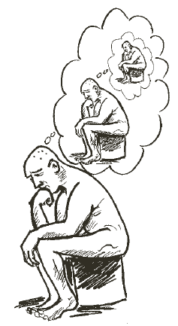
The thinker thinks of thinking of thinking.
Corballis, The Recursive Mind: The Origins of Human Language, Thought, and Civilization, Princeton University Press, 2011
Notes:
Thoughts (thinking about thinking, etc.)

Slide 23
Recursion is the root of computation since it trades description for time.
- Alan Perlis
More Perlisisms:
http://www.cs.yale.edu/quotes.html

Slide 24

Ackermann function
Looks harmless!

Slide 25
Ackermann function
(define (ackermann m n)
(cond [(= m 0) (+ 1 n)]
[(= n 0) (ackermann (- m 1) 1)]
[else (ackermann (- m 1) (ackermann m (- n 1)))]))

Slide 26
A(2, 2) =
Notes:
And this is the call tree:

Slide 27
A(2, 2) = 9
Notes:
And this is the call tree:

Slide 28
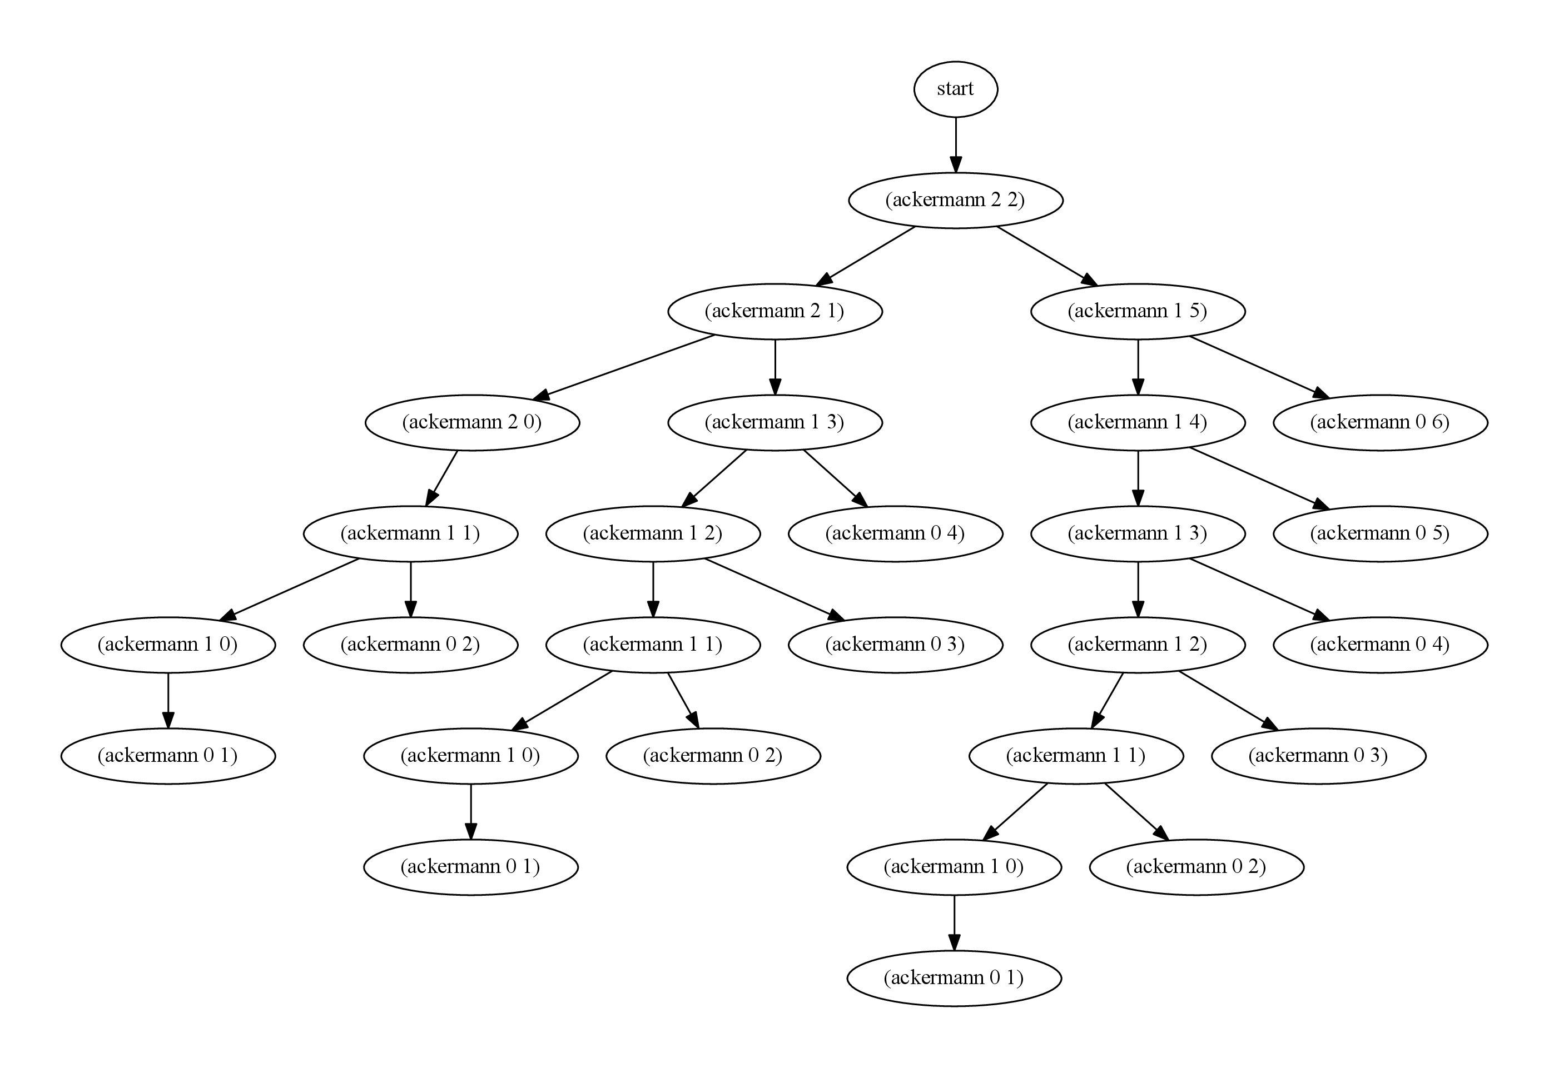
A(2, 2) = 9
I count 27 function calls.

Slide 29
A(3, 2) =

Slide 30
A(3, 2) = 29

Slide 31
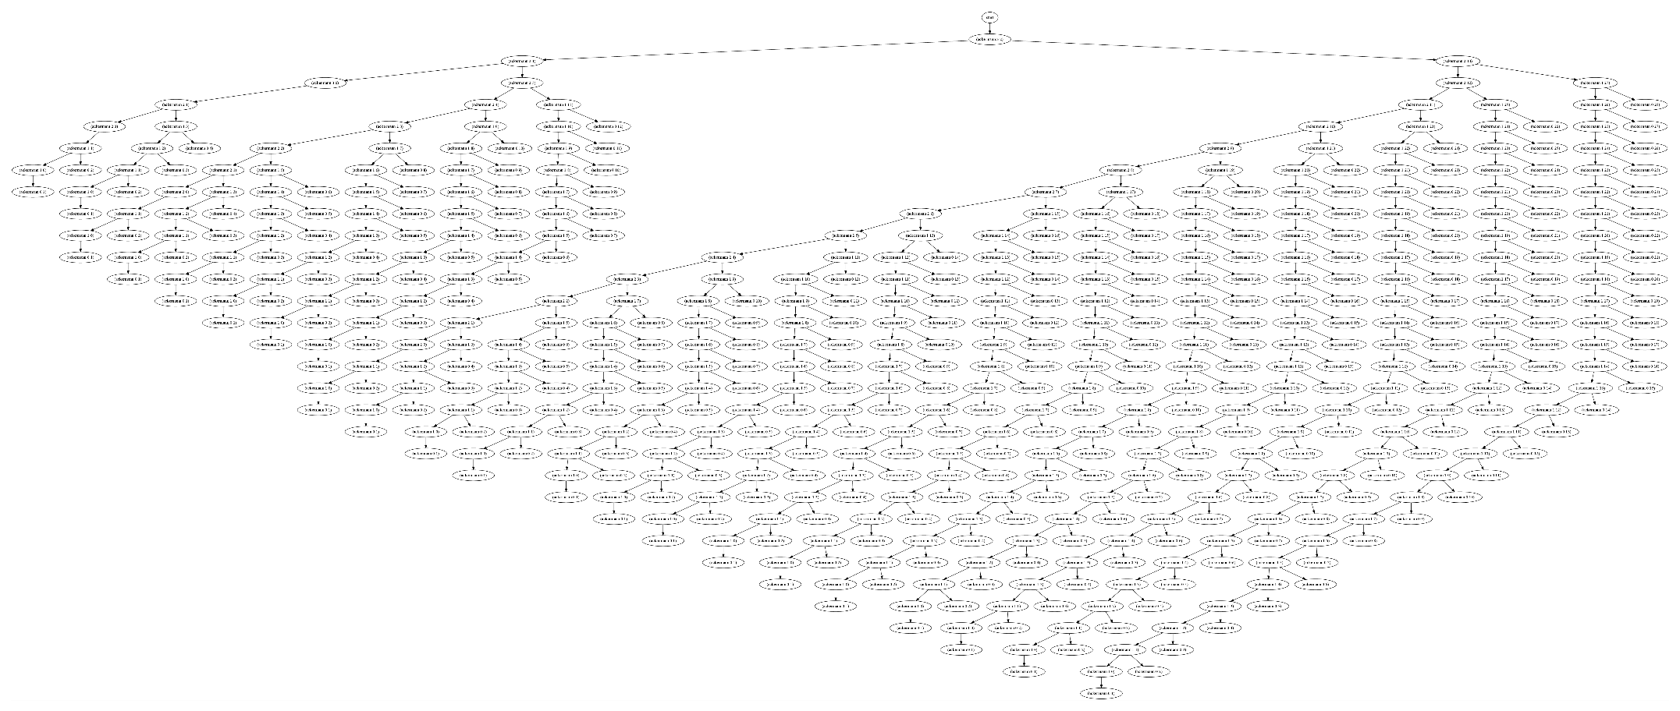

A(3, 2) = 29
540 calls!

Slide 32
A(4, 2) =
Notes:
19,729 digits
And this is the call tree:

Slide 33
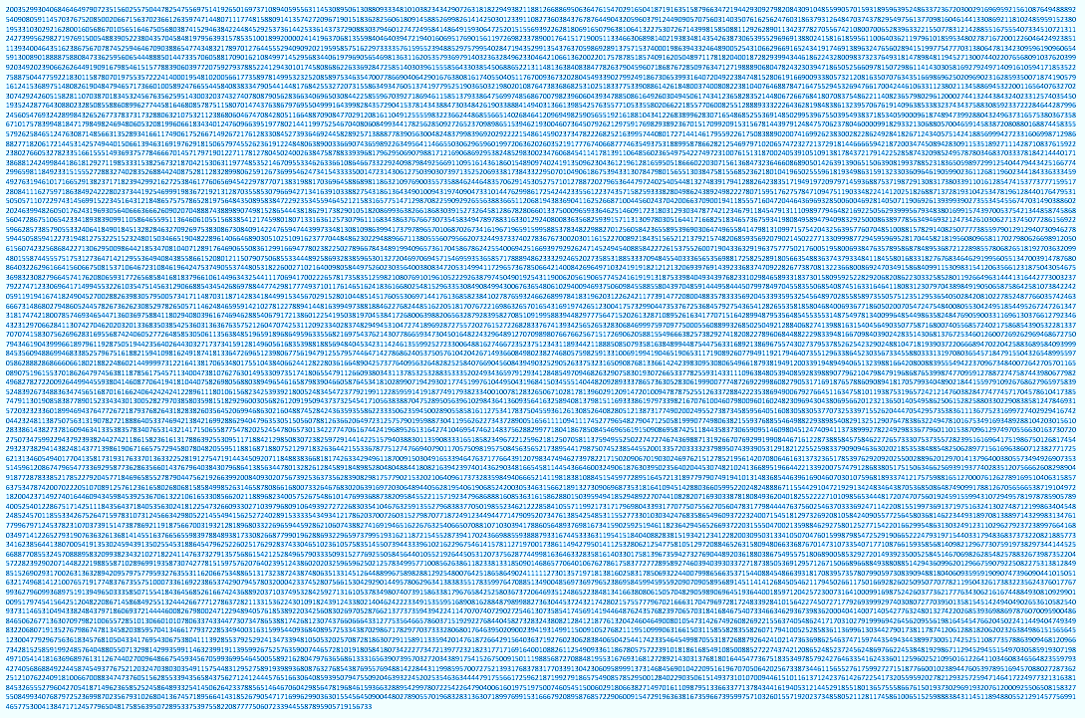
A(4, 2) =
20035299304068464649790723515602557504478254755693454734
Notes:
19,729 digits
And this is the call tree:

Slide 34

Notes:
Do we have to watch out? Is the lesson “bad stuff can happen!” even with very simple functions?
What’s the point of recursion, if there is so much computation? It must only have theoretical interest.

Slide 35
Why does recursion
get a bad rap?
Notes:
It’s slow, uses too much stack (too much memory), or even stack overflows

Slide 36
Stack frames
Notes:
In Racket, how are functions executed?

Slide 47
Task: “Flatten” L
(define (flatten L)
(cond [_________ ____]
[______________ (append ____________________
____________________)]
[______ ________________________________ ]))
Notes:
Emphasize: cons only works on the front, can’t cons to the back!

Slide 48
Task: “Flatten” L
(define (flatten L)
(cond [(null? L) '()]
[(list? (first L)) (append (flatten (first L))
(flatten (rest L)))]
[else (cons (first L) (flatten (rest L)))]))
Notes:
Emphasize: cons only works on the front, can’t cons to the back!

Slide 49
Quiz: Fill in details
for flatten’s call stack.
Notes:
Give return pointers on handout

Slide 72

Notes:
Do you feel this way after following that call stack?
I know I did after making all those slides.

Slide 73
Sometimes, recursion can be both fast and expressive.
Tail-recursion

Slide 74
Quiz: Identify tail-calls.
(define (example L)
(if (= 1 0) #f (example (rest L))))
(define (bloop a b c)
(cond [(bloop 1 2 3) (bloop 3 2 1)]
[else (rest (bloop 0 0 0))]))

Slide 75
Quiz: Identify tail-calls.
(define (example L)
(if (= 1 0) #f (example (rest L))))
(define (bloop a b c)
(cond [(bloop 1 2 3) (bloop 3 2 1)]
[else (rest (bloop 0 0 0))]))

Slide 76
Quiz: Identify tail-calls.
(define (example L)
(if (= 1 0) #f (example (rest L))))
(define (bloop a b c)
(cond [(bloop 1 2 3) (bloop 3 2 1)]
[else (rest (bloop 0 0 0))]))

Slide 77
Review: Length of L
(define (length L)
(cond [(null? L) 0]
[else (+ 1 (length (rest L)))]))

Slide 78
A tail-recursive length
(define (lengthT L Acc)
(cond [(null? L) ________]
[else (lengthT (rest L) ____________)]))

Slide 79
A tail-recursive length
(define (lengthT L Acc)
(cond [(null? L) Acc]
[else (lengthT (rest L) (+ 1 Acc)]))
(define (length L)
(length L 0))

Slide 82
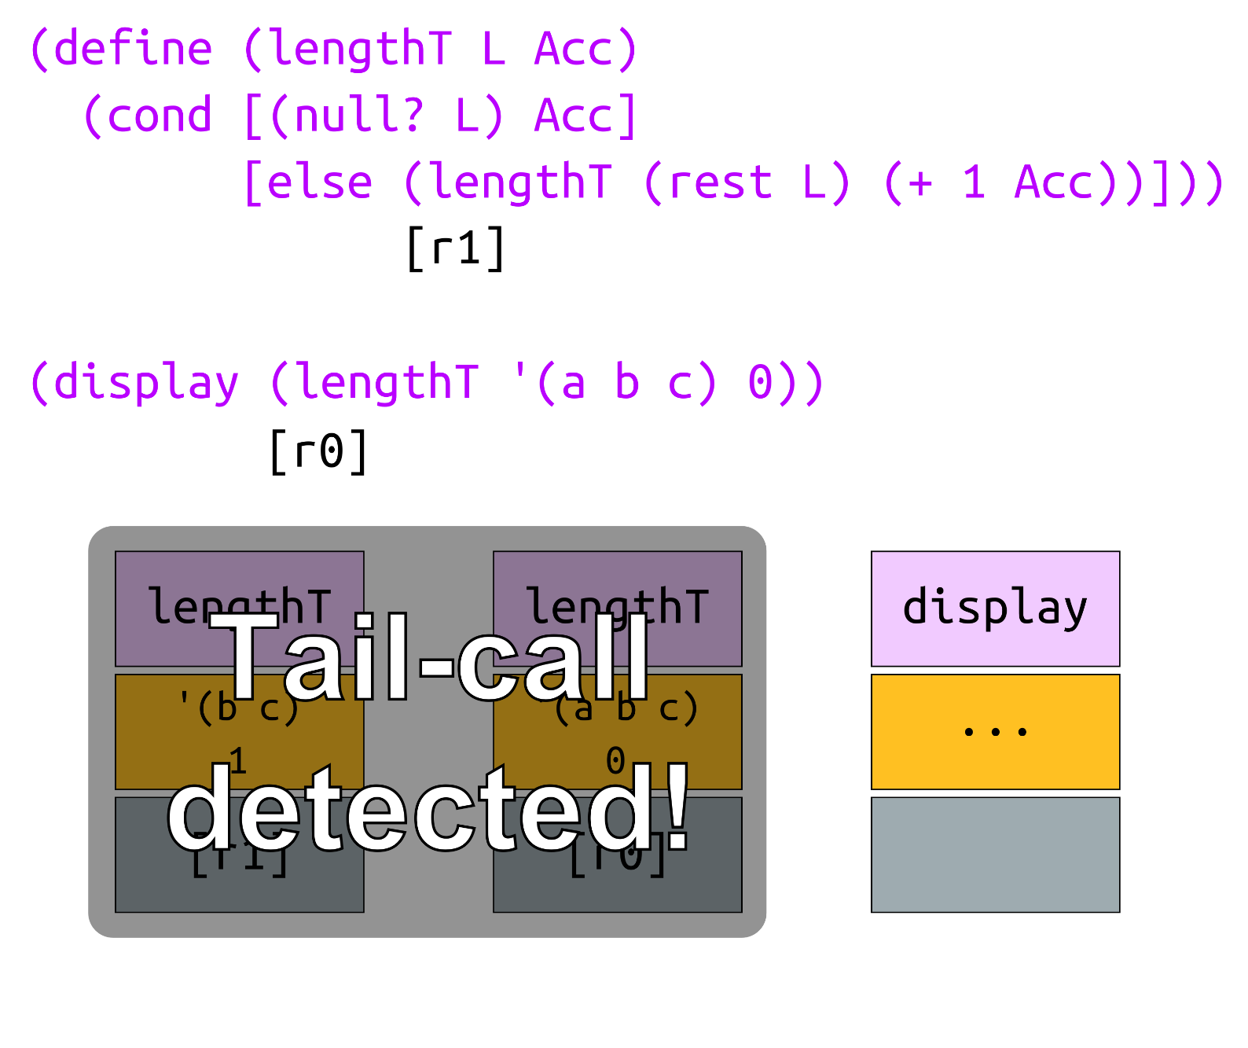

Slide 83
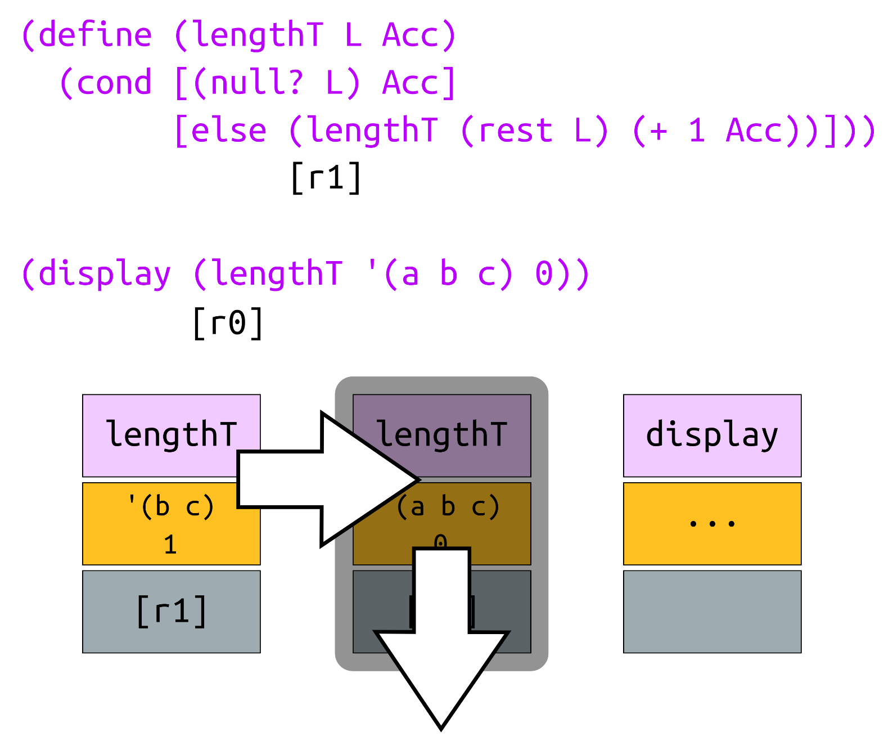

Slide 88
Review: Remove first e from L
(define (remove e L)
(cond [(null? L) '()]
[(equal? e (first L)) (rest L)]
[else (cons (first L) (remove e (rest L)))]))

Slide 89
A tail-recursive remove
(define (removeT e L Acc)
(cond [(null? L) _______]
[(equal? (first L) e)
__________________________]
[else (remove e (rest L) ______________________]))
(define (remove e L)
(remove e L '()))

Slide 90
A tail-recursive remove
(define (removeT e L Acc)
(cond [(null? L) Acc]
[(equal? (first L) e)
(append Acc (rest L))]
[else (remove e (rest L) (cons (first L) Acc))]))
(define (remove e L)
(remove e L '()))

Slide 91
Quiz: Write reverse and range with tail-recursion.

Slide 92

Tail-call optimization keeps a small stack.

Slide 93
Recursion is the root of computation since it trades description for time, but not necessarily.
Notes:
For what it’s worth, I believe GOTO + conditional branching is the root of computation.

