Slide 1
Final Exam ~ notes
3-hour take-home exam due Thursday at 5pm...
On the semester’s material, with an attempt at bridging different topics.
You may use two double-sided pages of notes (similar to before)…
Exam topics are available on the CS 60 website.
A practice exam is available on the CS 60 website, as well.
7+ problems
gratuitous backstories when possible
always good to keep in mind:
Partial credit is available -- more importantly, this can help you work out what needs to be done next!
You can jump away from the code and explain your approach (or what you want things to do…)
Notes:
extra credit for joining the spring cs talks…

Slide 2
6
Dynamic Programming
Consider the equal-sum subset problem.
2 7 6 7 13 6 6 13
How to divide the values into two subsets ~ as equally as possible?
use it or lose it! (for each item)

Slide 3
6
Dynamic Programming
Consider the equal-sum subset problem.
2 7 6 7 13 6 6 13
Just the make-change problem from Racket!
How to divide the values into two subsets ~ as equally as possible?
use it or lose it! (for each item)

Slide 4
6
Dynamic Programming
Consider the equal-sum subset problem.
2 7 6 7 13 6 6 13
Keep a table of all possible subset sums (so far)...
Sum
0 1 2 . 6 7 8 9 . 12 13 14 15 16
Element index

Slide 5
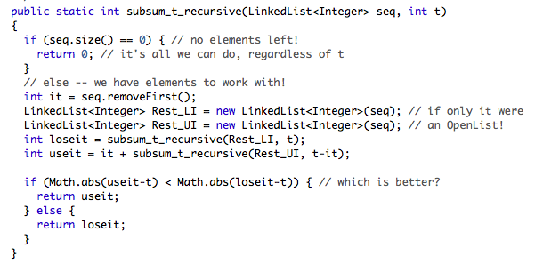
6
Dynamic Programming
Recursive version (in Java)
use it or lose it! (for each item)

Slide 6
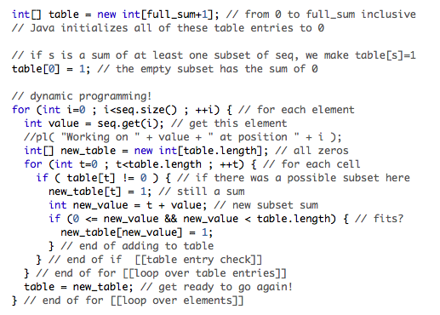
Dynamic programming solution:
6
Dynamic Programming

Slide 7
4
L
M
Prolog
subseq( [4,2], [5,4,3,2,1] ).
true.
true if L is a subsequence of M
Warm up:
subseq(
subseq( [F|R],
p( [0,0,1,1] ). p( [0,1,1] ).
true. false.
Another one:
p(
p( [0|R] ) :-
should accept 0^{k} followed by 1^{k} for any k >= 0

Slide 8
3
DFAs & Regex
input strings
results & explanation
0 0 1 0 0 0 0 0 1 0 (accepted -- considered transparent)
1 0 0 1 0 0 0 0 (rejected -- two 1's in a four-sensor span)
0 1 0 (accepted -- considered transparent)
0 0 0 (accepted -- considered transparent)
(accepted -- this piece is _really_ transparent!)
1 (accepted -- it does meet the definition: no more than one 1)
1 1 (rejected -- two 1's in a four- (or fewer) sensor span)
0 0 0 0 1 1 1 0 0 0 (rejected -- three 1's in a four-sensor span)
strings are rejected if there are two or more 1s in any four-bit span; otherwise accepted
Part A: Regular expression?
Part B: DFA?

Slide 9
class Transition
{
int sourceState; // ss
int destinationState; // ds
int transitionChar; // tc
}
class NFA
{
int numStates;
Transition[] T;
boolean[] A;
boolean run( Stack INPUT )
2
between 0 and numStates
Java
NFAs
between 0 and numStates
0, 1, or -1 (for λ)
Start state is #0
an array of all the machine's transitions
an array indicating whether each state accepts or rejects
Does it accept or reject?
Input is here

Slide 10
2-A
NFAs in Java
not 2B!
boolean run( Stack INPUT )

Slide 11
2-A
NFAs in Java
not 2B!
boolean run( Stack INPUT )
return run( INPUT, 0 ); // 0 is the start state!
}
boolean run( Stack INPUT, int curState )
{

Slide 12
2-A
NFAs in Java
not 2B!
boolean run( Stack INPUT )
return run( INPUT, 0 ); // 0 is the start state!
}
boolean run( Stack INPUT, int curState )
{
// ASSUMING NO LAMBDA TRANSITIONS
if (INPUT.isEmpty())

Slide 13
class Transition
{
int sourceState; // ss
int destinationState; // ds
int transitionChar; // tc
}
class NFA
{
int numStates;
Transition[] T;
boolean[] A;
boolean run( Stack INPUT )
2
between 0 and numStates
Java
NFAs
between 0 and numStates
0, 1, or -1 (for λ)
Start state is #0
an array of all the machine's transitions
an array indicating whether each state accepts or rejects
Does it accept or reject?
Input is here

Slide 14
2-A
NFAs in Java
not 2B!
boolean run( Stack INPUT )
return run( INPUT, 0 ); // 0 is the start state!
}
boolean run( Stack INPUT, int curState )
{
// ASSUMING NO LAMBDA TRANSITIONS
if (INPUT.isEmpty()) return A[curState];
int tc = INPUT.pop(); // next input character
for (int i=0 ; i<T.length ; ++i) { // check transitions…
if ( T[i].ss == __________
&& T[i].tc == __________ ) {

Slide 15
2-A
NFAs in Java
not 2B!
boolean run( Stack INPUT )
return run( INPUT, 0 ); // 0 is the start state!
}
boolean run( Stack INPUT, int curState )
{
// ASSUMING NO LAMBDA TRANSITIONS
if (INPUT.isEmpty()) return A[curState];
int tc = INPUT.pop(); // next input character
for (int i=0 ; i<T.length ; ++i) {
if (T[i].ss == curState && T[i].tc == tc) {
boolean result = run( copy(INPUT), T[i].ds );
if (result == true)
return true;
}
}
// none were true, return false
return false;
}

Slide 16
2-B
Java ~ inheritance
You'd like to create a NTM.
Should you make it a derived class from NFA?
Nondeterministic Turing machine
class NTM extends NFA
class Transition
{
int sourceState; // ss
int destinationState; // ds
int transitionChar; // tc
}
Transition?

Slide 17
1-A
Scheme
(define
returns #t if w appears at any level in list L
(waldo w L)
returns #f otherwise
(if (null? L)
null?
(if (equals?
equal?
first three cases!
list?
(if (list?
cons
list
append
review & include reminders…

Slide 18
1-B
Scheme
(lotto T LoT)
LoT is a list of tickets; T is the winning ticket
returns (name matches) for the best ticket in LoT
(("A" 2 10 12 14 16 18)
("B" 2 3 40 41 42 43)
("C" 1 2 3 5 15 19))
(1 2 3 4 5 6)

Slide 19
1-B
Scheme
(lotto T LoT)
LoT is a list of tickets; T is the winning ticket
returns (name matches) for the best ticket in LoT
(("A" 2 10 12 14 16 18)
("B" 2 3 40 41 42 43)
("C" 1 2 3 5 15 19))
(1 2 3 4 5 6)
(define (lotto T LoT)
(foldr compare '("no one" -1) (map (lambda (x) (score T x)) LoT)))
"pushes" a binary operation "through" a list
applies a unary operation to each element of a list

Slide 20
1-C
Scheme
(define (map f L)
(if (null? L)

Slide 21
1-C
"pushes" a binary operation f "through" a list L
Scheme
(define (foldr f e L)
(if (null? L)

Slide 22
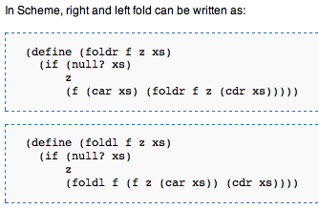
1-C
Scheme
first
rest
first
rest
Wikipedia!

Slide 23
0-A
Big-O
loops
for (int i=N ; i>1 ; i=i/2) // i goes down to 1
for (int j=0 ; j<i ; ++j) // j goes up to i
for (int k=0 ; k<i ; ++k) // k goes up to i
/* one operation here */

Slide 24
0-A
Big-O
loops
for (int i=N ; i>1 ; i=i/2) // i goes down to 1
for (int j=0 ; j<i ; ++j) // j goes up to i
for (int k=0 ; k<i ; ++k) // k goes up to i
/* one operation here */
i
i²

Slide 25
0-A
Big-O
loops
for (int i=N ; i>1 ; i=i/2) // i goes down to 1
for (int j=0 ; j<i ; ++j) // j goes up to i
for (int k=0 ; k<i ; ++k) // k goes up to i
/* one operation here */
i
OL
Work
i²
N
N/2
i
1
N²
(N/2)²
i²
1²
sum this column

Slide 26
0-B
Big-O
recurrence relations
T(1) = 1
T(N) = kN² + 2T(N/2)
"be kind; unwind"

Slide 27
0-B
Big-O
recurrence relations
T(1) = 1
T(N) = kN² + 2T(N/2)
"be kind; unwind"

Slide 28
Strategies?
(1) review pages
(2) slowed? use English
other languages welcome, too, though we readers are more limited...
(3) problem-solving more than memorization
don't remember a function? – make it up
just add a note to that effect...
don't remember some syntax? – make it up
Questions?

Slide 29
0-A
Big-O
loops
for (int i=N ; i>1 ; i=i/2) // i goes down to 1
for (int j=0 ; j<i ; ++j) // j goes up to i
for (int k=0 ; k<i ; ++k) // k goes up to i
/* one operation here */

Slide 30
0-A
Big-O
loops
for (int i=N ; i>1 ; i=i/2) // i goes down to 1
for (int j=0 ; j<i ; ++j) // j goes up to i
for (int k=0 ; k<i ; ++k) // k goes up to i
/* one operation here */
i
i²

Slide 31
0-A
Big-O
loops
for (int i=N ; i>1 ; i=i/2) // i goes down to 1
for (int j=0 ; j<i ; ++j) // j goes up to i
for (int k=0 ; k<i ; ++k) // k goes up to i
/* one operation here */
i
OL
Work
i²
N
N/2
i
1
N²
(N/2)²
i²
1²
sum this column

Slide 32
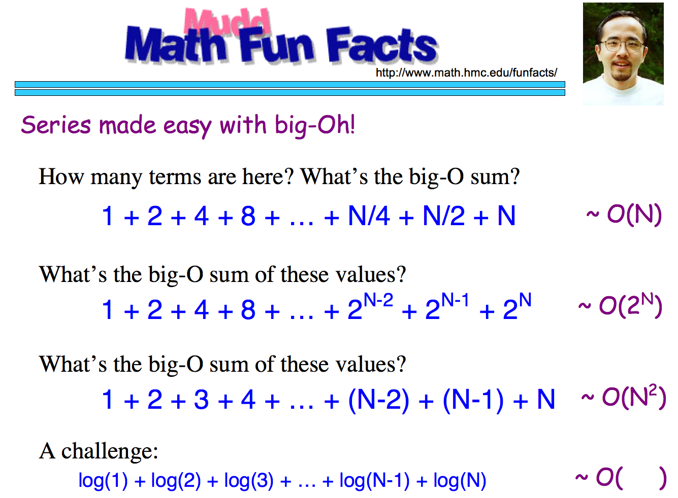

Slide 33
Good luck!
on all of this week's work…
See you M or F…

Slide 34
1-C
Rex
first
rest
first
rest
Wikipedia!

Slide 35
0-A
Big-O
loops
for (int i=N ; i>1 ; i=i/2) // i goes down to 1
for (int j=0 ; j<i ; ++j) // j goes up to i
for (int k=0 ; k<i ; ++k) // k goes up to i
/* one operation here */

Slide 36
0-A
Big-O
loops
for (int i=N ; i>1 ; i=i/2) // i goes down to 1
for (int j=0 ; j<i ; ++j) // j goes up to i
for (int k=0 ; k<i ; ++k) // k goes up to i
/* one operation here */
i
i²

Slide 37
0-A
Big-O
loops
for (int i=N ; i>1 ; i=i/2) // i goes down to 1
for (int j=0 ; j<i ; ++j) // j goes up to i
for (int k=0 ; k<i ; ++k) // k goes up to i
/* one operation here */
i
OL
Work
i²
N
N/2
i
1
N²
(N/2)²
i²
1²
sum this column

Slide 38
0-B
Big-O
recurrence relations
T(1) = 1
T(N) = kN² + 2T(N/2)
"be kind; unwind"

Slide 40
5
Uncomputability
The Regular Expression Checker is uncomputable.
YES, the input T's language of accepted strings is regular
INPUT: A turing machine T
REC
NO, the input T's language of accepted strings is not regular

Slide 41
4
Prolog
Warm up:
true if L is a subsequence of M
subseq( L, M ) :-
Another one:
0^{k} followed by 1^{k} for any k >= 0
p( R ) :-

Slide 42
3
DFAs & Regex
input strings
results & explanation
0 0 1 0 0 0 0 0 1 0 (accepted -- considered transparent)
1 0 0 1 0 0 0 0 (rejected -- two 1's in a four-sensor span)
0 1 0 (accepted -- considered transparent)
0 0 0 (accepted -- considered transparent)
(accepted -- this piece is _really_ transparent!)
1 (accepted -- it does meet the definition: no more than one 1)
1 1 (rejected -- two 1's in a four- (or fewer) sensor span)
0 0 0 0 1 1 1 0 0 0 (rejected -- three 1's in a four-sensor span)
Part A: Regular expression?
Part B: DFA?
strings are rejected if there are two or more 1s in any four-bit span; otherwise accepted

Slide 43
class Transition
{
int sourceState; // ss
int destinationState; // ds
int transitionChar; // tr
}
class NFA
{
int numStates;
Transition[] T;
boolean[] A;
boolean run( Stack INPUT )
2
between 0 and numStates
Java
NFAs
between 0 and numStates
0, 1, or -1 (for λ)
Start state is #0
an array of all the machine's transitions
an array indicating whether each state accepts or rejects
Does it accept or reject?
Input is here

Slide 44
2-B
Java ~ inheritance
You'd like to create a NTM.
Should you make it a derived class from NFA?
Nondeterministic Turing machine
Transition?

Slide 45
1-A
Rex
returns 1 if w appears at any level in list L
waldo(w,L)
returns 0 otherwise
Here is a list of some useful Rex functions (other languages, too!)
list(e,f,...) // makes a list from its inputs. [e,f,...] is often easier
cons(f,R) // the same as [f|R]
append(L,M) // concatenates two lists (inputs must be lists!)
member(e,L) // 0 if e is not in L; 1 if e is in L
reverse(L) // reverses L
rmv1(e,L) // not built-in; from class -- removes one e from L
removeAll(e,L) // not built-in; from hw#1 -- removes all e's from L
length(L) // returns the length of L
max(x,y) // returns the max of x and y -- does NOT take the max over a list
min(x,y) // returns the min of x and y -- does NOT take the min over a list
sort(L) // returns a sorted version of L
first(L) // returns the first of L (similarly, second, third...)
range(lo,hi) // returns [lo, lo+1, …, hi] (inclusive)
higher-order functions:
map(f,L) // applies f to each element of L. f takes one input.
reduce(f,e,L) // "pushes" the binary operator f "through" L, starting at e
keep(p,L) // retains those elements x in L that make p(x) true
drop(p,L) // drops those elements x from L that make p(x) true
some(p,L) // returns 1 iff there exists an x in L such that p(x) is true
all(p,L) // returns 1 iff p(x) is true for all x in L

Slide 46
1-B
Rex
[1, 2, 3, 4, 5, 6]
lotto(WT, LoT)
WT is the winning ticket; LoT is a list of tickets.
returns [name, matches] for the best ticket in LoT
[ ["A", 2, 10, 12, 14, 16, 18],
["B", 2, 3, 40, 41, 42, 43],
["C", 1, 2, 3, 5, 15, 19] ]

Slide 47
1-B
Rex
[1, 2, 3, 4, 5, 6]
lotto(WT, LoT)
WT is the winning ticket; LoT is a list of tickets.
returns [name, matches] for the best ticket in LoT
[ ["A", 2, 10, 12, 14, 16, 18],
["B", 2, 3, 40, 41, 42, 43],
["C", 1, 2, 3, 5, 15, 19] ]
lotto( WT, LoT ) =>
reduce( compare,
[ "no one", -1 ],
map( , LoT )
);
"pushes" a binary operation "through" a list
applies a unary operation to each element of a list

Slide 48
1-C
Rex
map( f, L )
map( f,
map( f,
reduce( f, e, L )
reduce( f, e,
reduce( f, e,

Slide 49
2-A
NFAs in Java
boolean run( Stack INPUT )

Slide 50
5
Uncomputability
The f(42) == 60 checker is uncomputable.
INPUT: A one-input function f
YES, f(42) == 60
Assume it is computable ~ i.e., assume it exists.
42CH( f )
OUTPUT:
NO, something (anything) else happens
def f₃( s ):
while True:
print 'hi'
def f₁( s ):
return 60
def f₂( s ):
return 17
42CH(f₁)
42CH(f₂)
42CH(f₃)

Slide 51
5
Uncomputability
Assume 42CH(f) exists.
checks if f(42) == 60
We write this function, fun:
def fun(P,w):
def f₄( s ):
P(w)
return 17
b = 42CH(f₄)
return b
If fun is a haltchecker, we're done!

Slide 52
5
Uncomputability
Assume 42CH(f) exists.
checks if f(42) == 60
We write this function, fun:
def fun(P,w):
def f₄( s ):
P(w)
return 60
b = 42CH(f₄)
return b
If fun is a haltchecker, we're done!

Slide 53
5
Uncomputability
The Regular Expression Checker is uncomputable.
INPUT: A one-input function f
YES, the input T's language of accepted strings is regular
Assume it is computable ~ i.e., assume it exists.
RC( f )
OUTPUT:
NO, the input T's language of accepted strings is not regular
def f₂( s ):
return
hw12pr1(s)
def f₃( s ):
while True:
pass
def f₁( s ):
return s==42
RC(f₁)
RC(f₂)
RC(f₃)

Slide 54
5
Uncomputability
Assume RC(f) exists.
checks if f accepts a regular language
We write this function, fun:
def fun(P,w):
def f₄( s ):
P(w)
run hw12pr1
b = RC(f₄)
return not b
If fun is a haltchecker, we're done!

