Slide 1
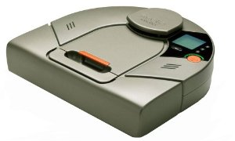
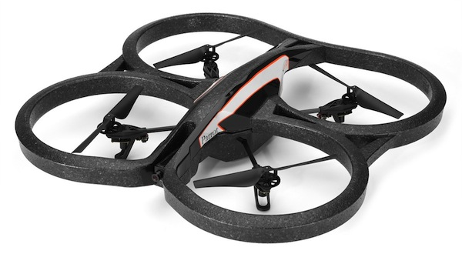
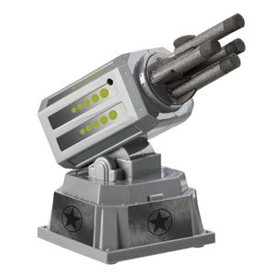
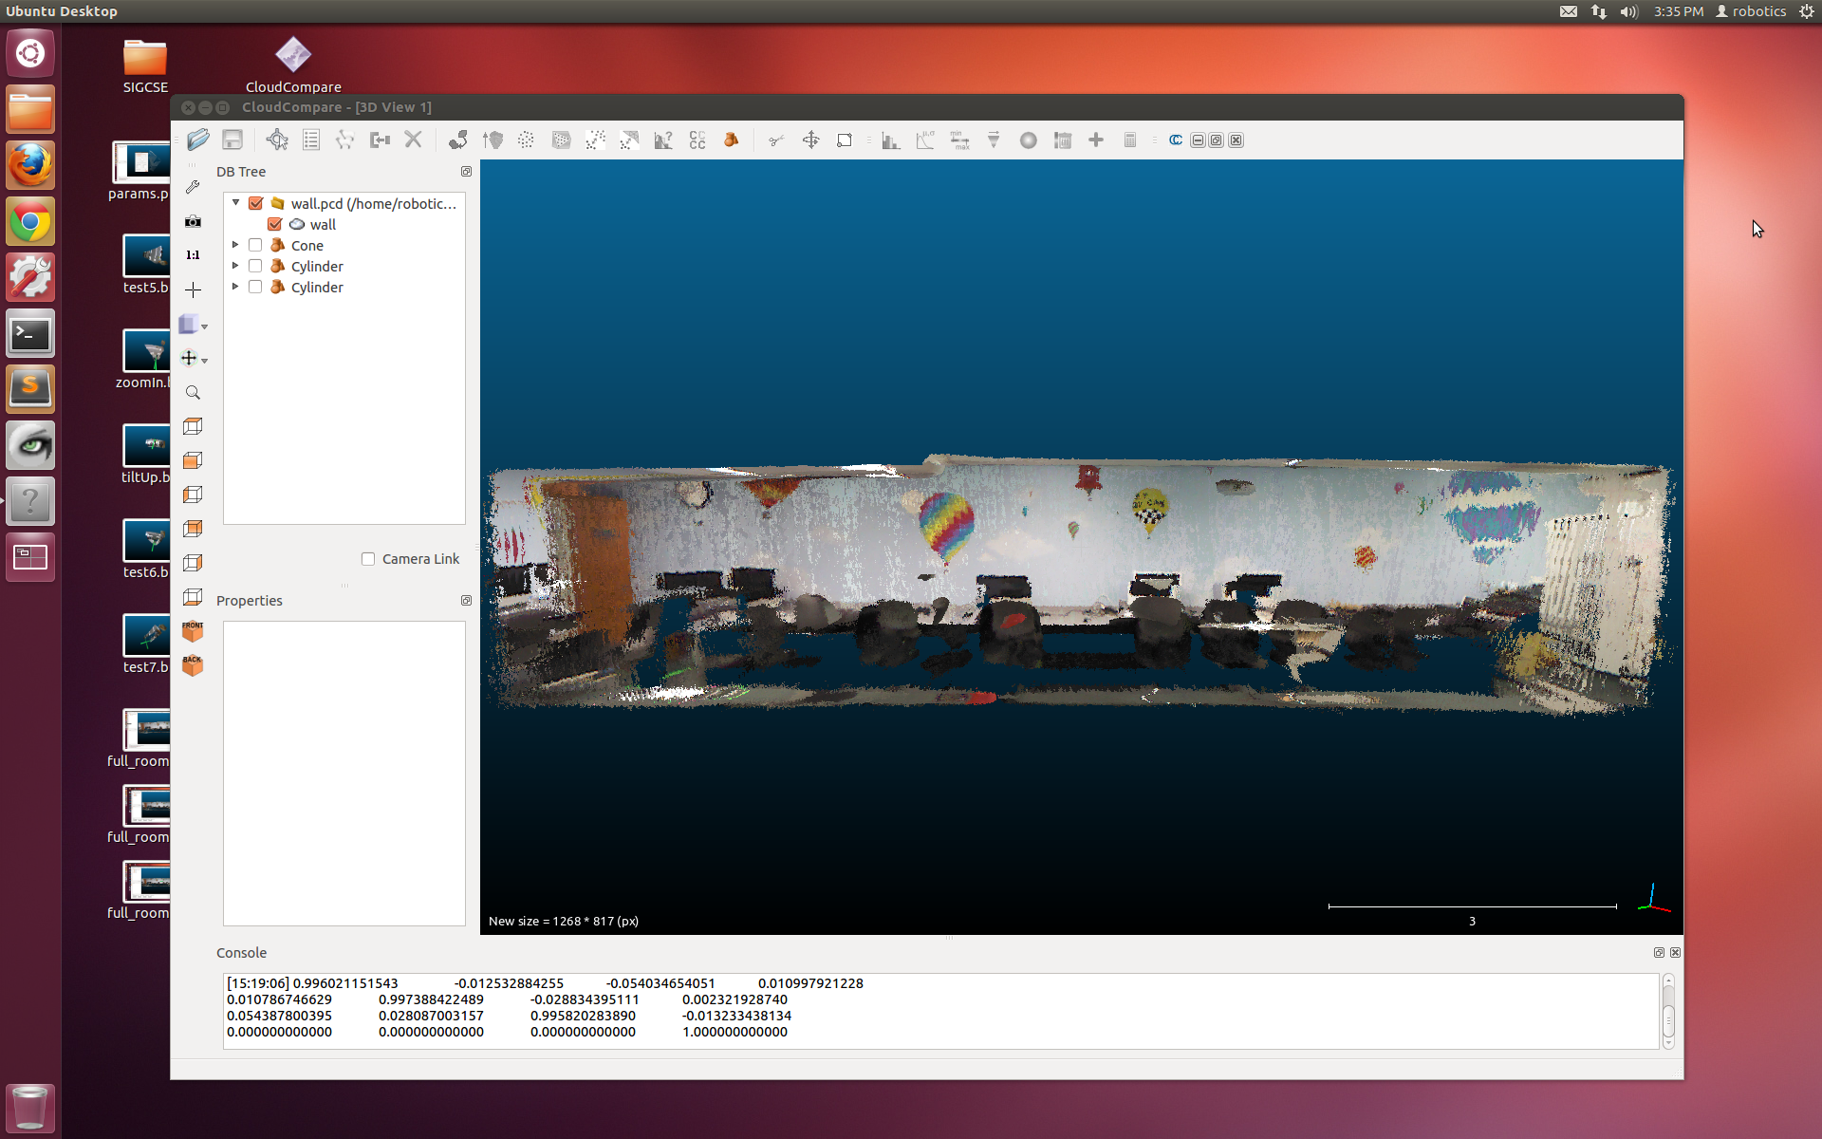
Interdimensional Robot Cooperation
Kristina Ming, Chris Eriksen, Graham Montgomery, Zach Dodds

Slide 2
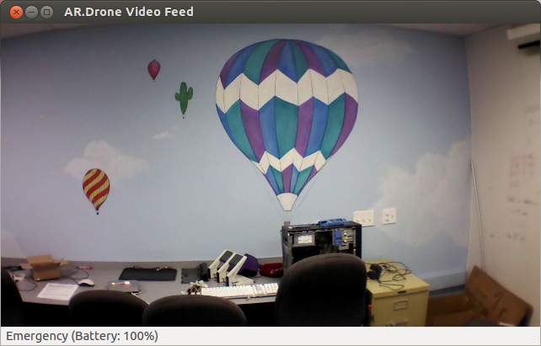
Now…
3d representations are a new standard for robot spatial reasoning
yet 2d image sensing is certainly still common – and will continue to be for a long time…
… vs. Then

Slide 3
Cooperating?!
2d sensors
3d models
Our goal: to investigate robot platforms, software, and algorithms for using 2d sensors amid 3d models of the world.

Slide 4
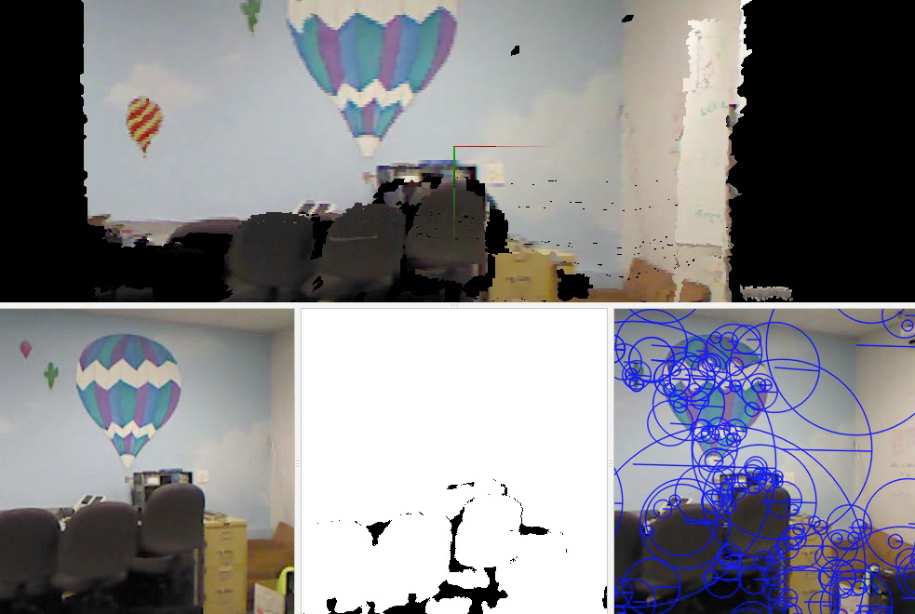
Now: 3d mapping
Demonstration of RGBD-SLAM

Slide 5
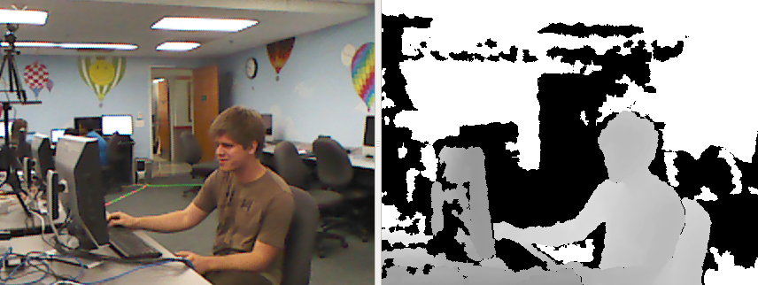
Accessing these 3d maps
saves each rgb image
and each depth image
Getting the data: by splicing into the code to extract the input images

Slide 6
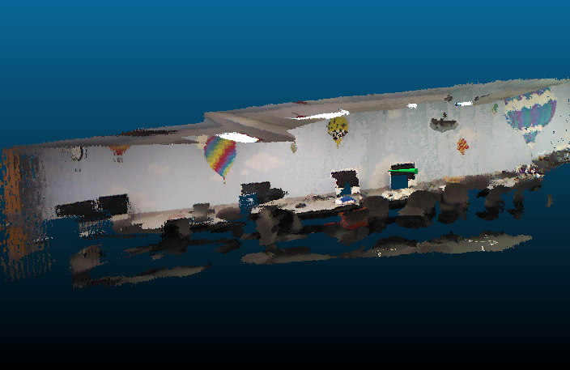
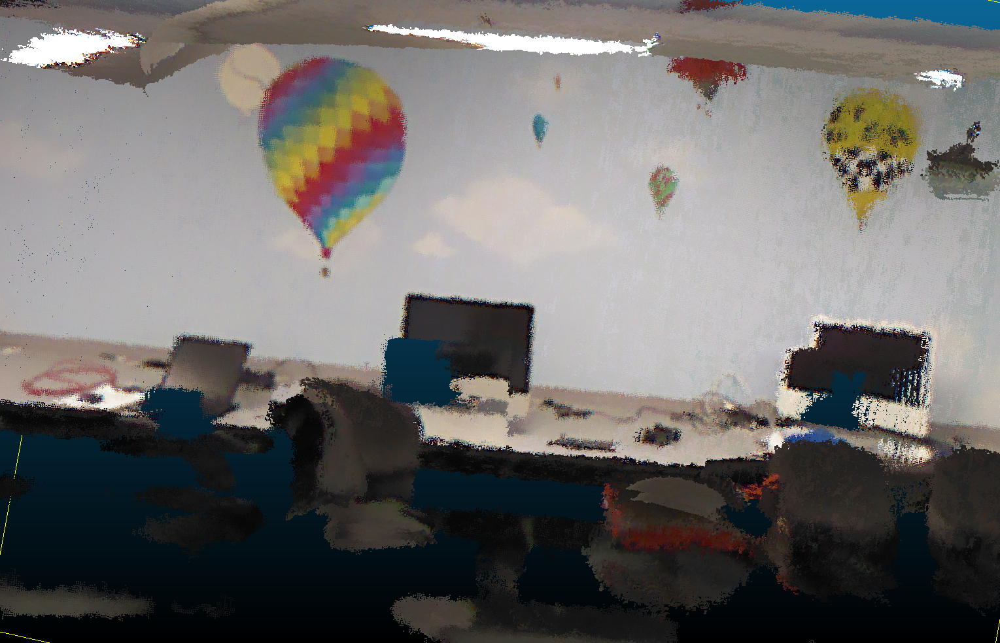
Accessing these models
3d lab model ~ with a surface added
the rendered view from that green cone

Slide 7
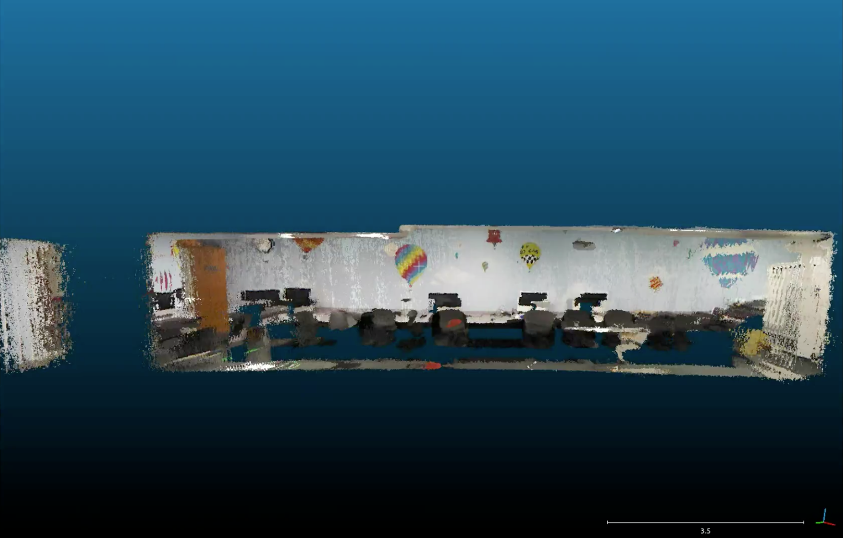
Accessing these models
Cloud Compare is a visualizer that can include our own “annotations” …

Slide 8
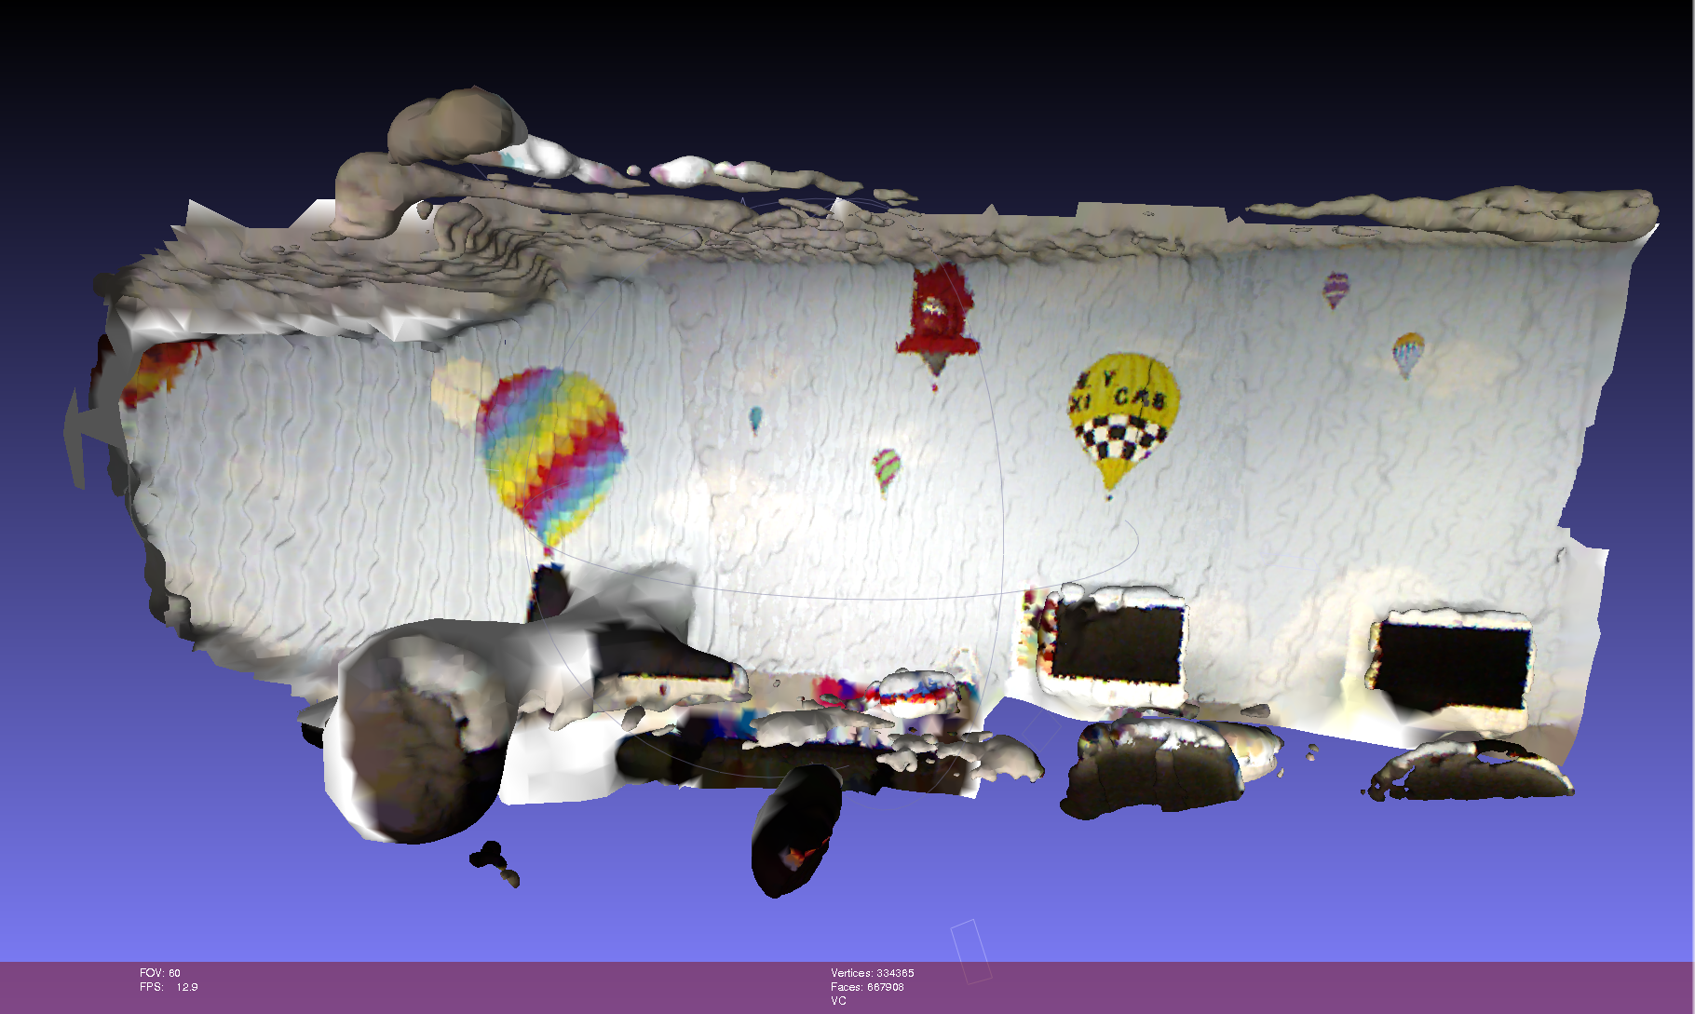
Accessing these models
We use Meshlab to display our model as a "mesh"

Slide 9
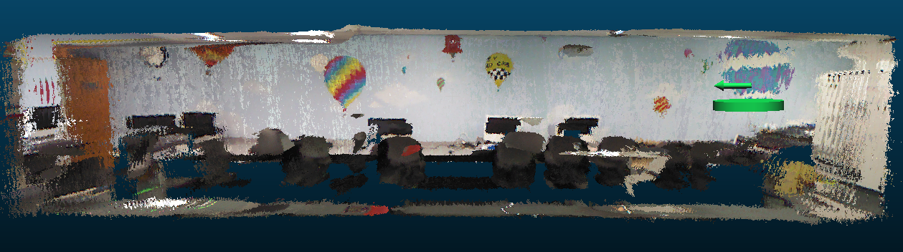

Goal: Escape from the lab!

Slide 10
Using these models
How might a robot with an ordinary camera, i.e., only 2d sensing, use these 3d models?
2d – 2d matching
3d – 3d matching
Ideally, a 2d sensing system could localize – and reason – within a 3d model

Slide 11
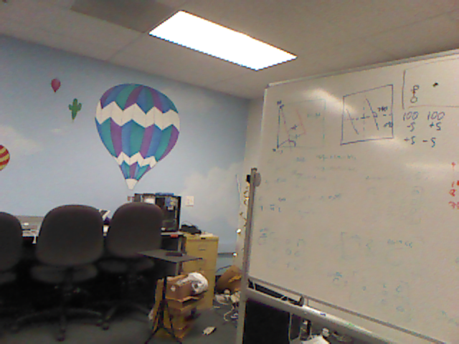
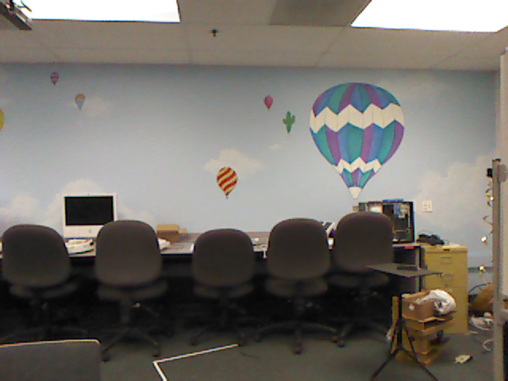
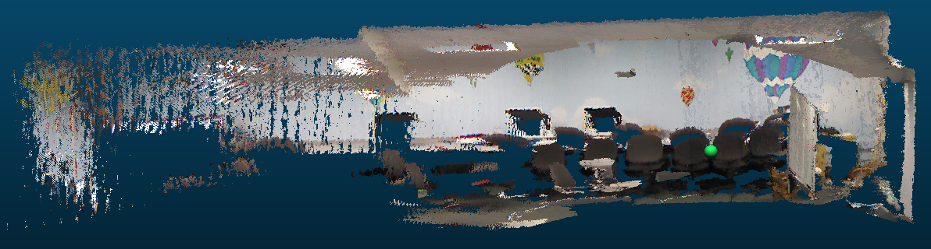
2d – 2d matching
with a new image from a robot (or other device)
we could compare
vs. original images
vs. rendered images
These are the images used to create the 3d model in the first place: fewer, higher-fidelity.
Images yielded by the 3d model: arbitrarily many, but lower-quality.

Slide 12
2d – 2d matching
with a new image from a robot (or other device)
we could compare
vs. original images
vs. rendered images
These are the images used to create the 3d model in the first place: fewer, higher-fidelity.
Images yielded by the 3d model: arbitrarily many, but lower-quality.

Slide 13
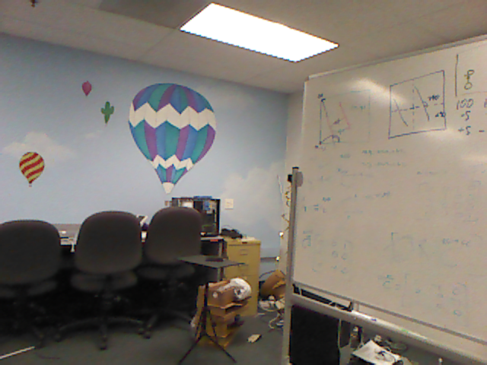
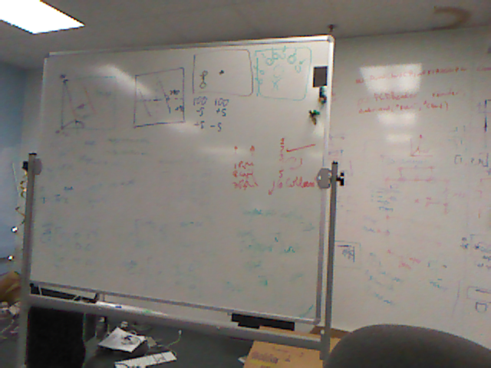
Matching?
new image
Our approach:
Find features in each (SIFT)
Consider all matches (FLANN)
Ensure bidirectional constraints
Consistency filtering (homography)
Best-matching by visual similarity metric
Tiebreaking by pixel distances
many original images

Slide 14
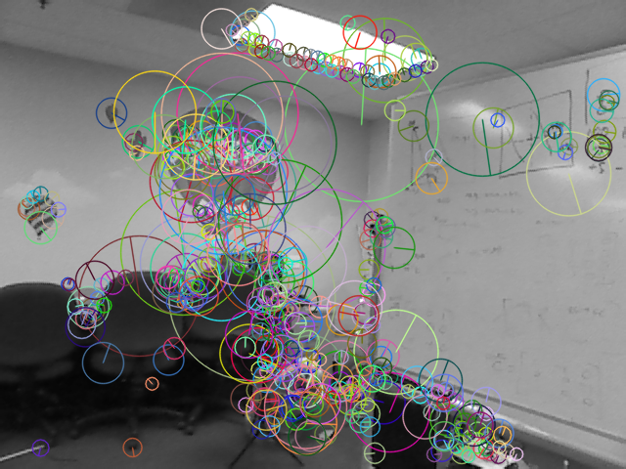
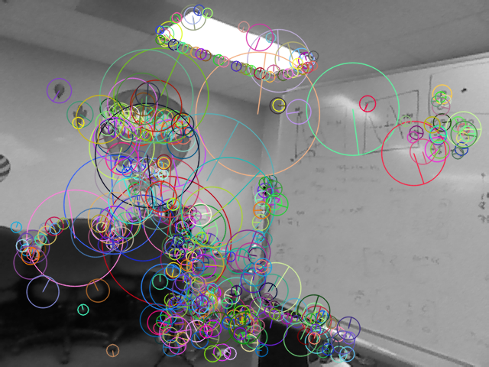
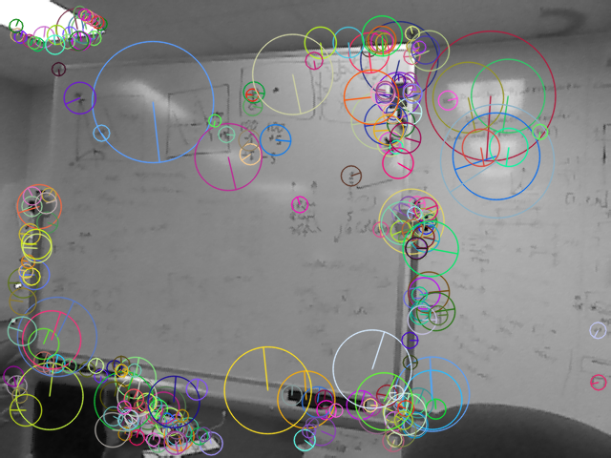
Features
Our approach:
Find features in each (SIFT)
Consider all matches (FLANN)
Ensure bidirectional constraints
Consistency filtering (homography)
Best-matching by visual similarity metric
Tiebreaking by pixel distances

Slide 15
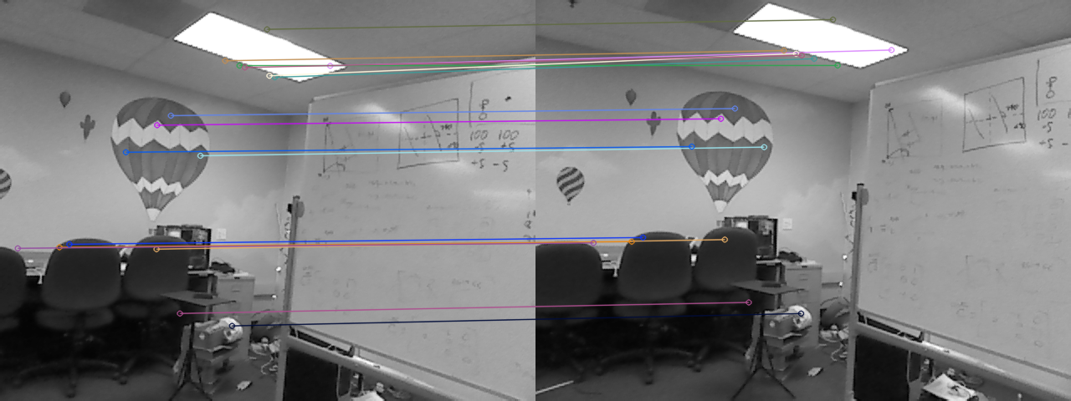
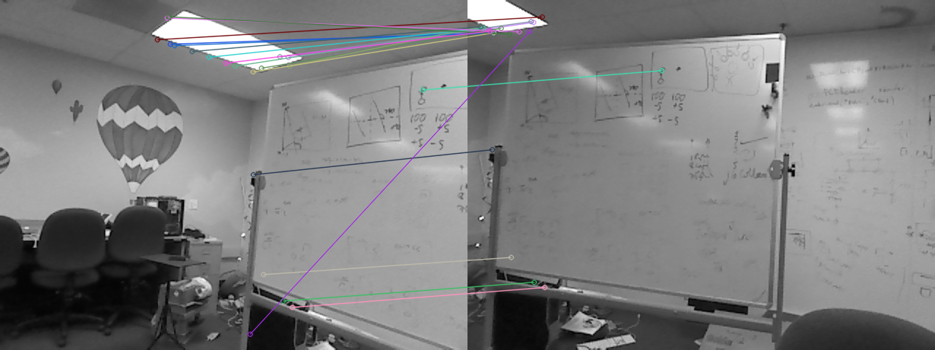
Our approach:
Find features in each (SIFT)
Consider all matches (FLANN)
Ensure bidirectional constraints
Consistency filtering (homography)
Best-matching by visual similarity metric
Tiebreaking by pixel distances
Nearest-neighbor matching

Slide 16
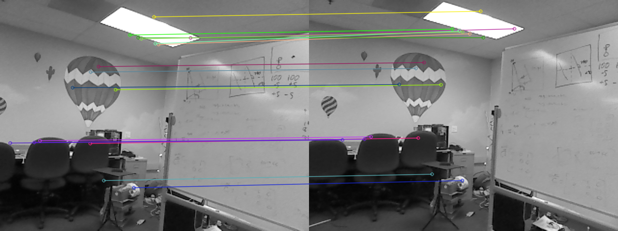
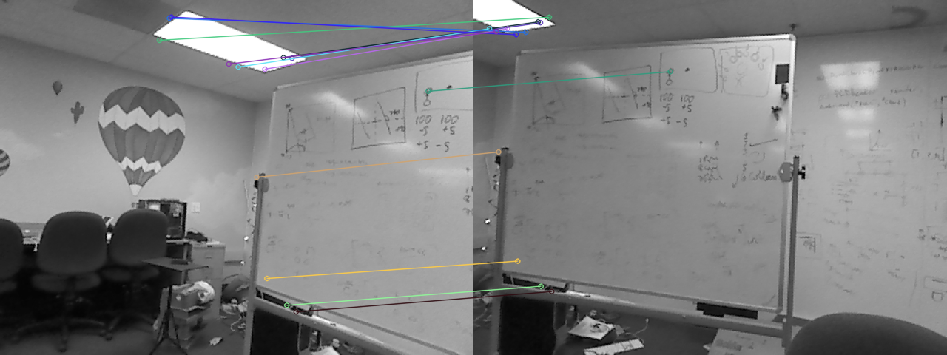
Our approach:
Find features in each (SIFT)
Consider all matches (FLANN)
Ensure bidirectional constraints
Consistency filtering (homography)
Best-matching by visual similarity metric
Tiebreaking by pixel distances
Keep only two-way best matches

Slide 17
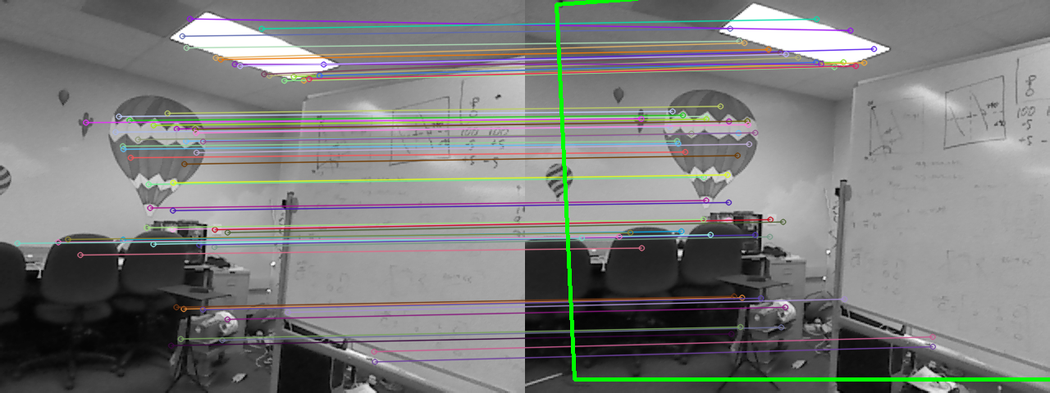
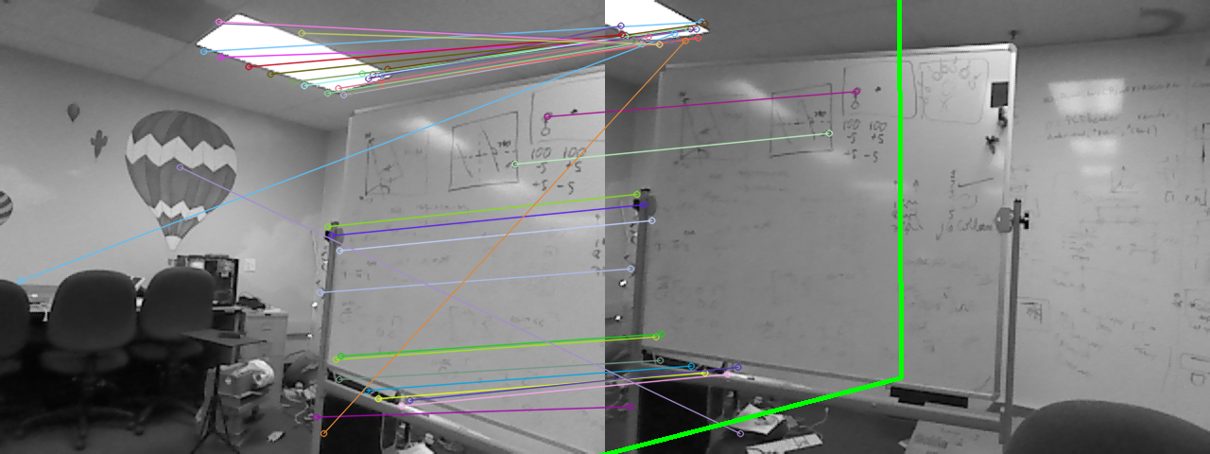
Our approach:
Find features in each (SIFT)
Consider all matches (FLANN)
Ensure bidirectional constraints
Consistency filtering (via homography)
Best-matching by visual similarity metric
Tiebreaking by pixel distances
Keep geometrically realistic matches

Slide 18
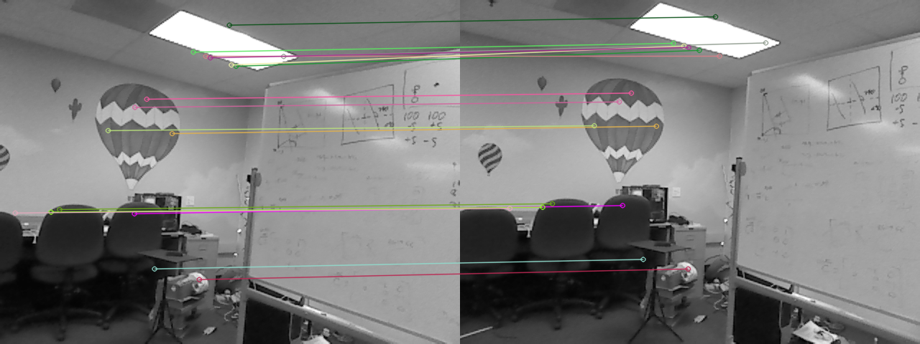
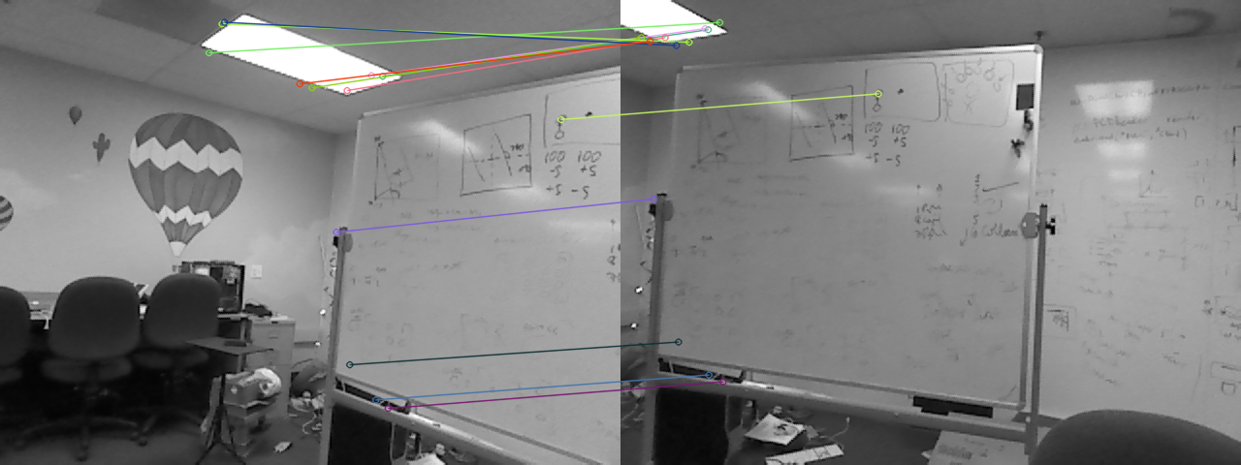
1st-best match
10th-best match
Our approach:
Find features in each (SIFT)
Consider all matches (FLANN)
Ensure bidirectional constraints
Consistency filtering (via homography)
Best-matching by visual similarity metric
Tiebreaking by pixel distances
Visual “closeness”

Slide 19
1st-best match
Average feature distance ~ 40 px
10th-best match
Average feature distance ~ 270 px
Our approach:
Find features in each (SIFT)
Consider all matches (FLANN)
Ensure bidirectional constraints
Consistency filtering (via homography)
Best-matching by visual similarity metric
Tiebreaking by pixel distances
Pixel “closeness”

Slide 20
2d – 2d matching
with a new image from a robot (or other device)
we could compare
vs. original images
vs. rendered images
These are the images used to create the 3d model in the first place: fewer, higher-fidelity.
Images yielded by the 3d model: arbitrarily many, but lower-quality.

Slide 21
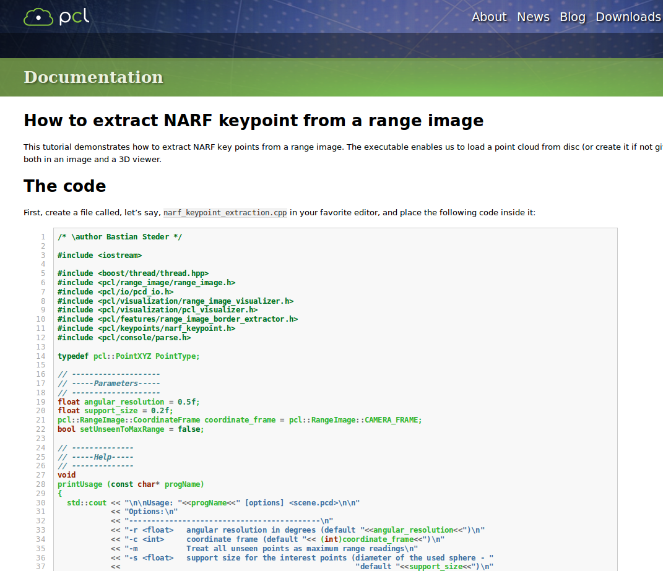

PCL: Point Cloud Library
3D-Reasoning
Easy point cloud access
Screenshot

Slide 22
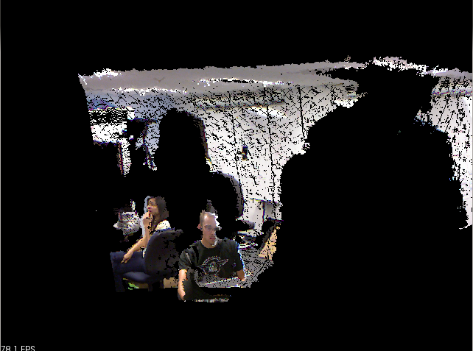
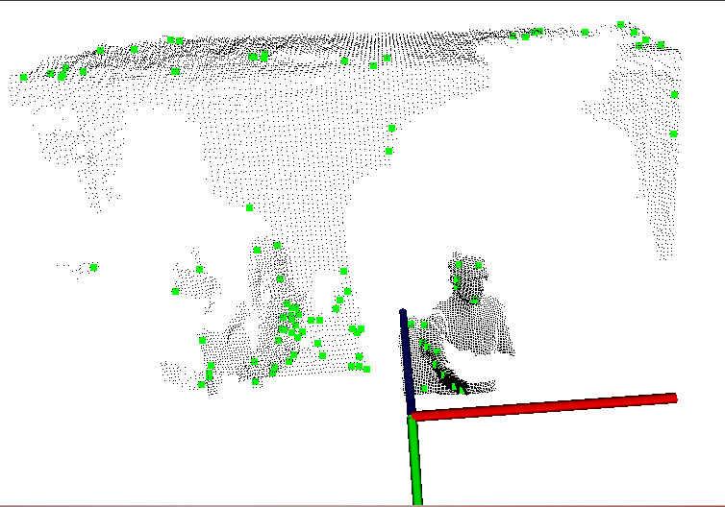
NARFs!
3d features: Normal Aligned Radial Features
picture of pt cloud
picture of NARFS
NARF features are purely based on the range image of a point cloud: its geometry, not its looks (SIFT)
They are based on the normals of the point cloud’s surfaces
They are places distinguishable from multiple perspectives.

Slide 23
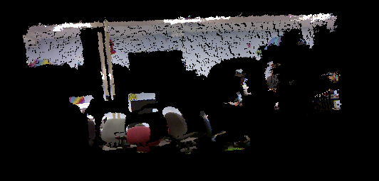
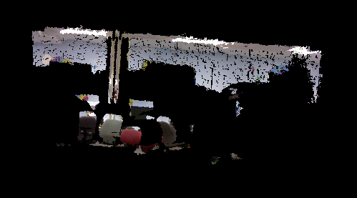
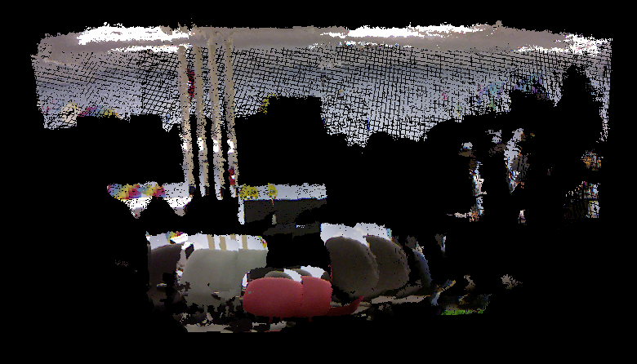
3d matching
picture of pt cloud w/NARFS
picture of pt cloud w/NARFS
Take two point clouds
Find NARFs
Match features and find transform
Make transform and combine
naive merging

Slide 24
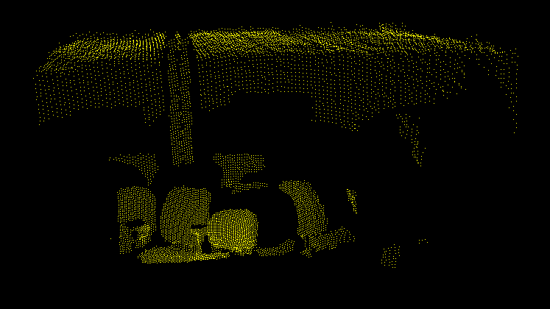
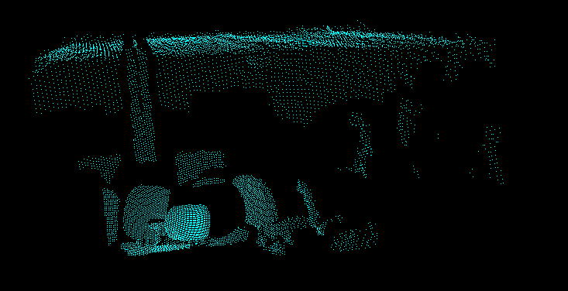
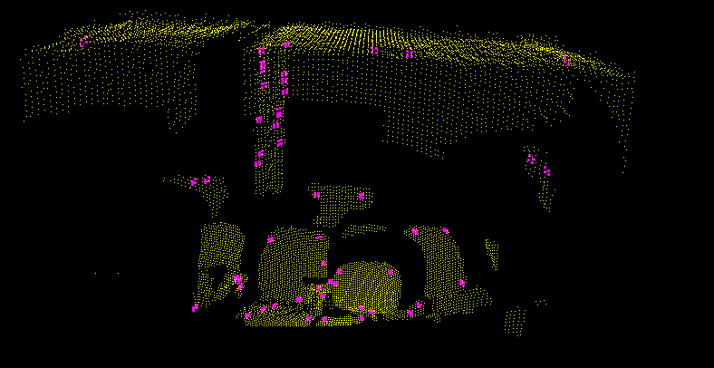
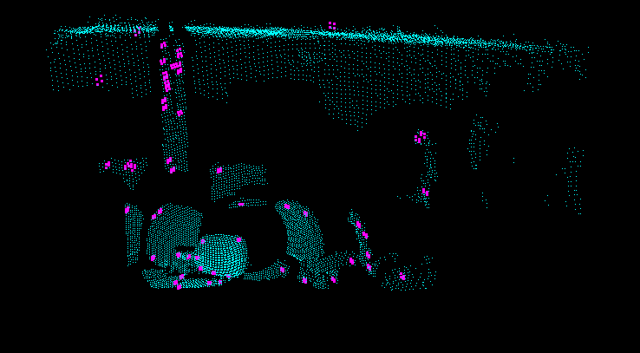
3d SLAM
Simultaneous Localization And Mapping
Take two point clouds
Find NARFs
Match features and find transform
Make transform and combine

Slide 25
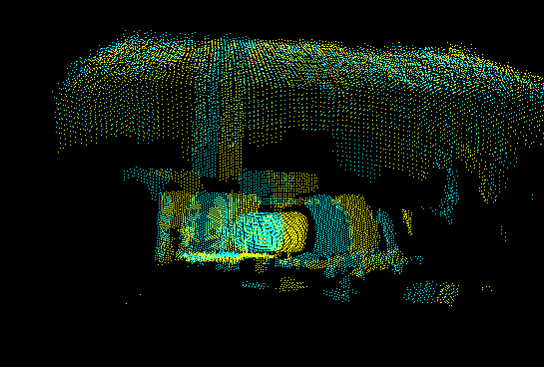
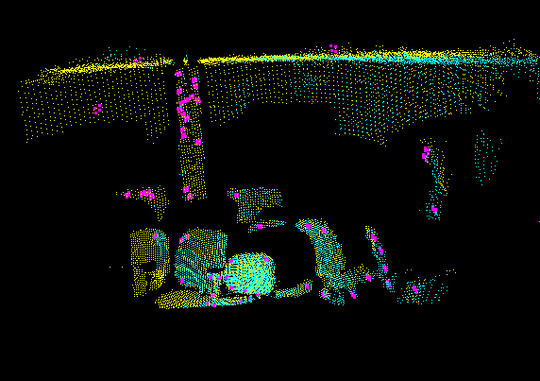
3d SLAM
Simultaneous Localization And Mapping
Take two point clouds
Find NARFs
Match features and find transform (ICP)
Make transform and combine

Slide 26
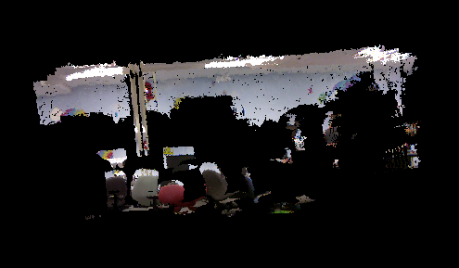
3d SLAM
Final point cloud map
Questions?
Future: using Neato to create 2.5d maps

Slide 27
New platform: Neato
Promise…
360° laser scanner
beautiful 2d sensing
inexpensive ($250)
serial interface
Unrealized…
forward
existing drivers slow
only runs tethered
no navigation routines
bump sensor

Slide 29
Kinect
Z.D. video
The Kinect estimates distance-to-camera by projecting a “star field” on the world.

Slide 30
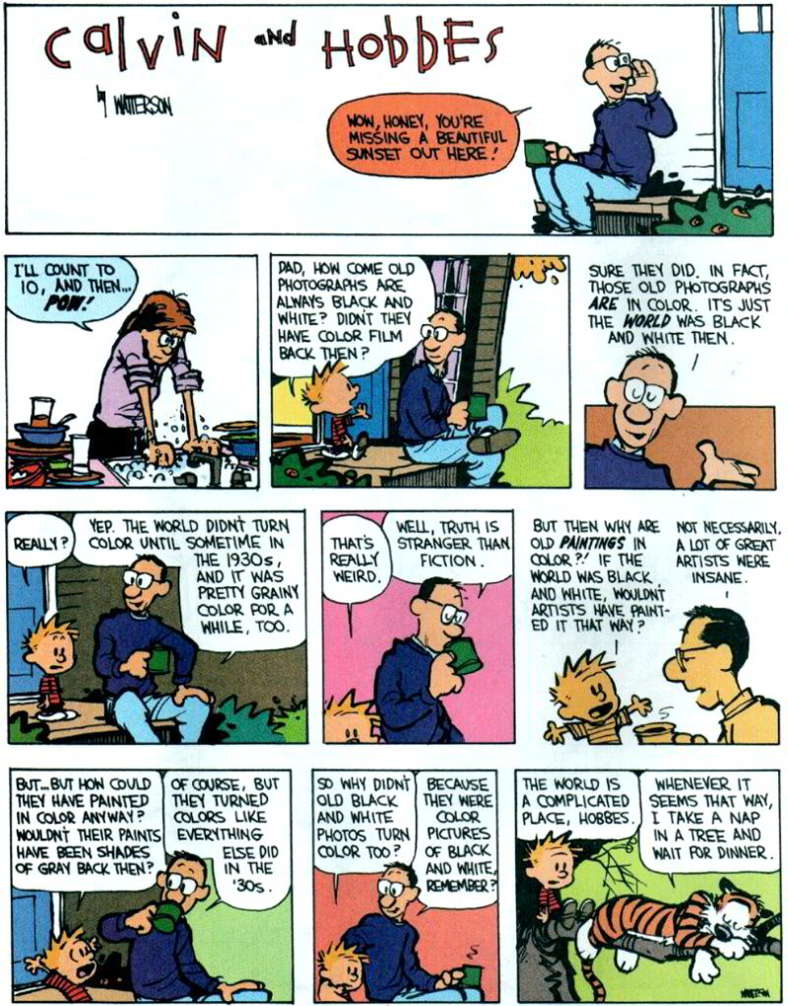
Now vs. Then

Slide 31
Title

Slide 32
Accessing these models
plane
other (sphere, cylinder, wavy,…)
K.M.
allows us to define the depth at each pixel

Slide 33
Ideally, a camera-only system could localize – and reason – within the 3d model
Ideally, a camera-only system could localize – and reason – within the 3d model

Slide 34
Accessing 3d models
RGB
Depth
splicing into the code…

Slide 35
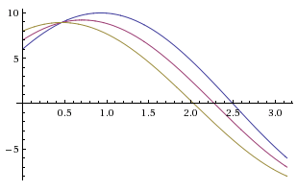
Hough transform
r
θ
Consider one point of a laser scan
These are all of the lines through it
http://gmarty.github.io/hough-transform-js/
http://liquify.eu/flash/HoughTransform

