Slide 1
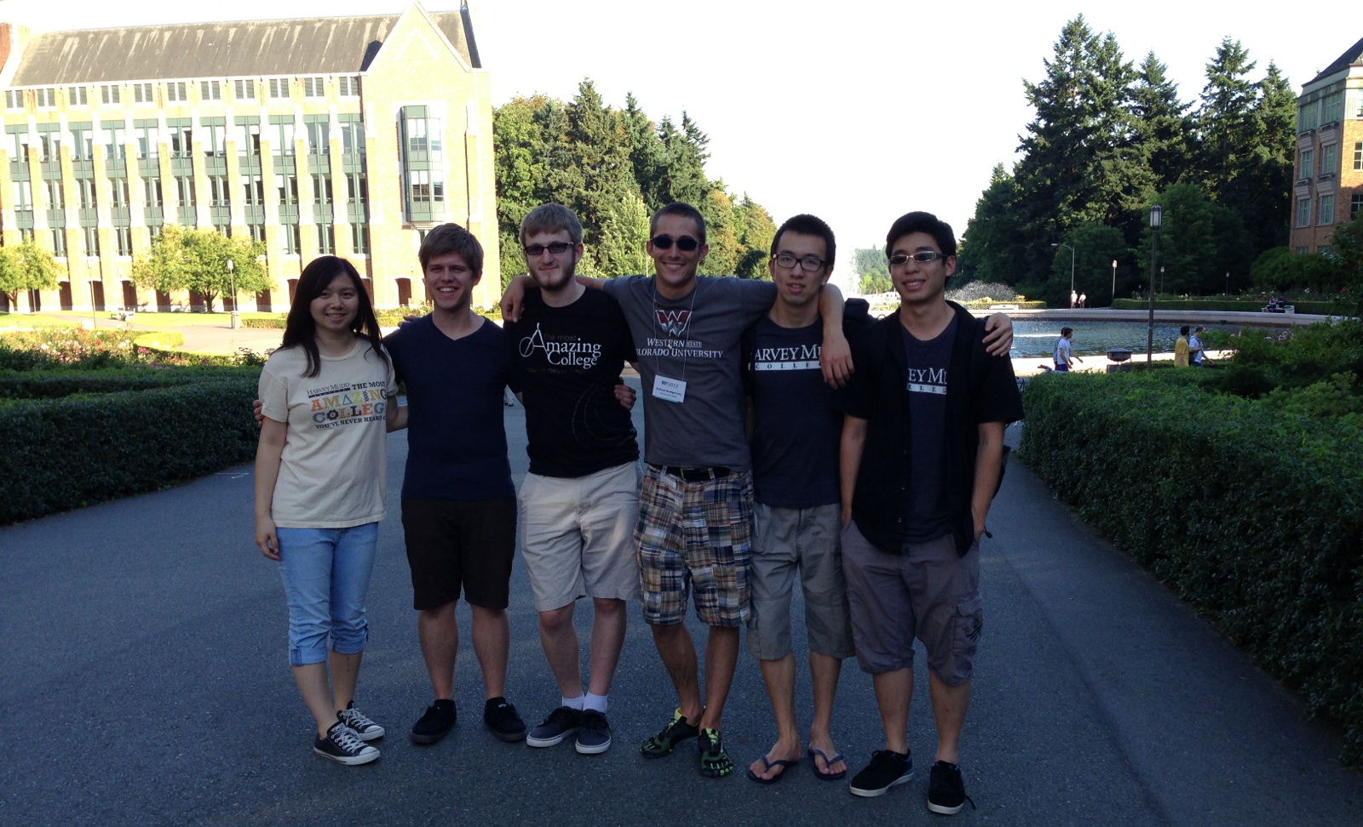
Interdimensional Robot Cooperation
Kristina Ming, Chris Eriksen, Graham Montgomery,
Jerry Hsiung, Cyrus Huang, Zakkai Davidson, and Zach Dodds

Slide 2
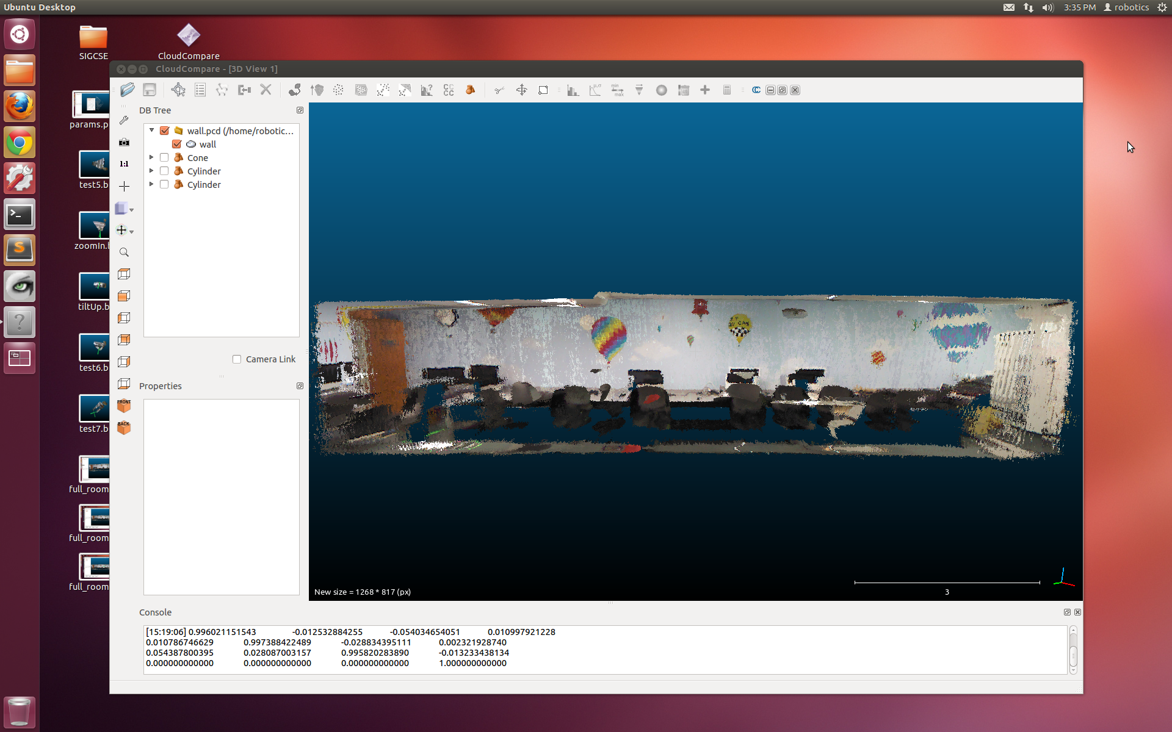
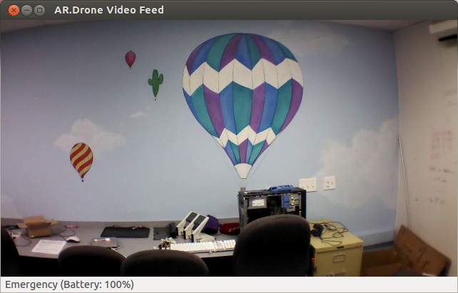
Now…
3d representations are a new standard for robot spatial reasoning, …
… yet 2d image sensing is still common – and will certainly continue to be for a long time.
… vs. Then

Slide 3
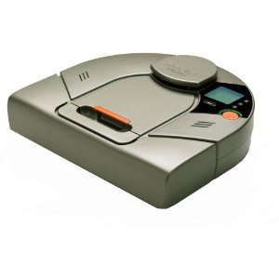
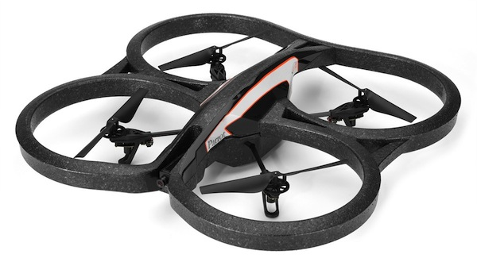
Cooperating?!
2d sensors
3d models
Our goal: to investigate robot platforms, software, and algorithms for using 2d sensors amid 3d models of the world.

Slide 4
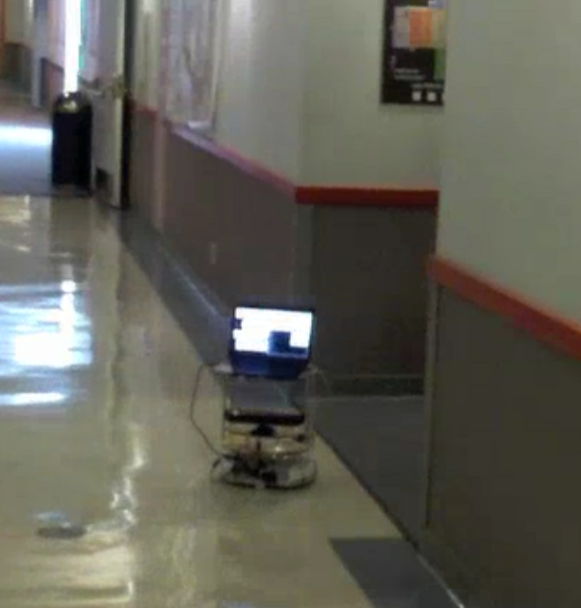
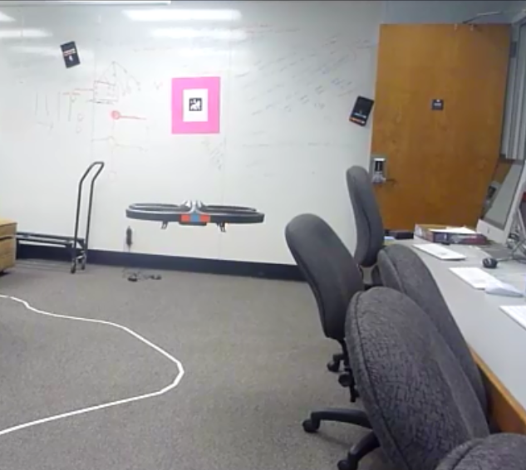
Two concrete challenges…
more robust navigation
more general "lab escape"
bridging 2d sensors with 3d spatial representations

Slide 5
Jerry, Cyrus, Zakkai

Slide 6
New platform: Neato
Initial tasks
learn ASCII API
write device drivers
interpret sensor data
follow corridors
detect intersections
AI Tasks
pt-to-pt navigating
localize and navigate
minimize ambiguity
navigate predictively
build 2d and 3d maps
Objective: to get this robot running and reasoning

Slide 7
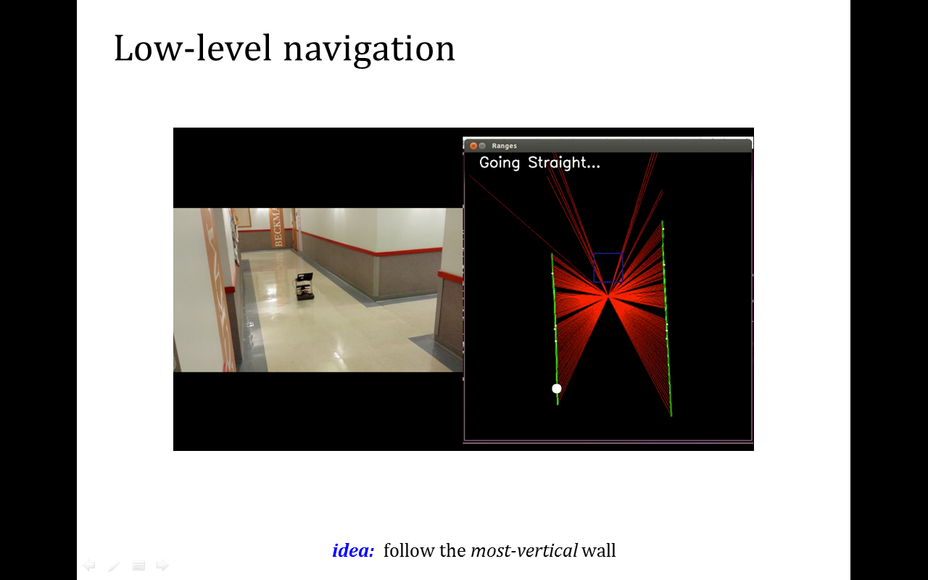
New platform: Neato
Initial tasks
learn ASCII API
write device drivers
interpret sensor data
follow corridors
detect intersections
laser-scan data, estimated walls, "aligning" wall

Slide 8
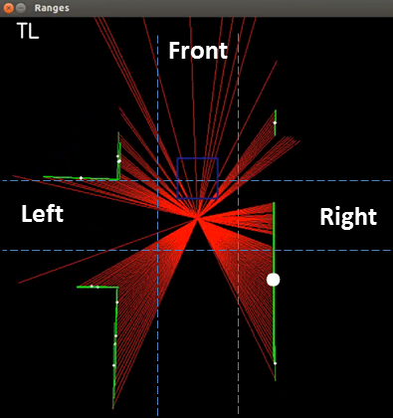
New platform: Neato
Initial tasks
learn ASCII API
write device drivers
interpret sensor data
follow corridors
detect intersections
This scan shows a "TL" intersection
wall-placement determines intersection type

Slide 9
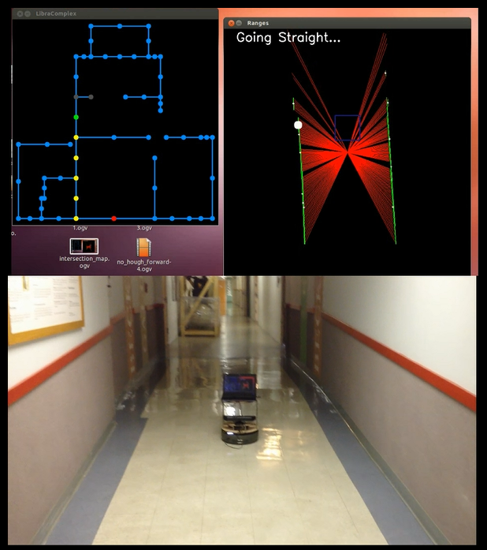
Neato navigation
robot_navigation_known_start
navigating the Libra complex, with the start node given
Notes:
goal node has to be given, too – though there's no avoiding that…!

Slide 10
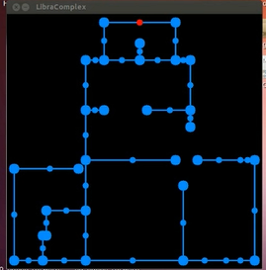
Localization
What if the robot doesn't know its starting pose?
?
Suppose the robot moves and sees
a "TL"
Which nodes remain?
Which are culled?
Don't worry about the goal.
Instead, make default motions…

Slide 11
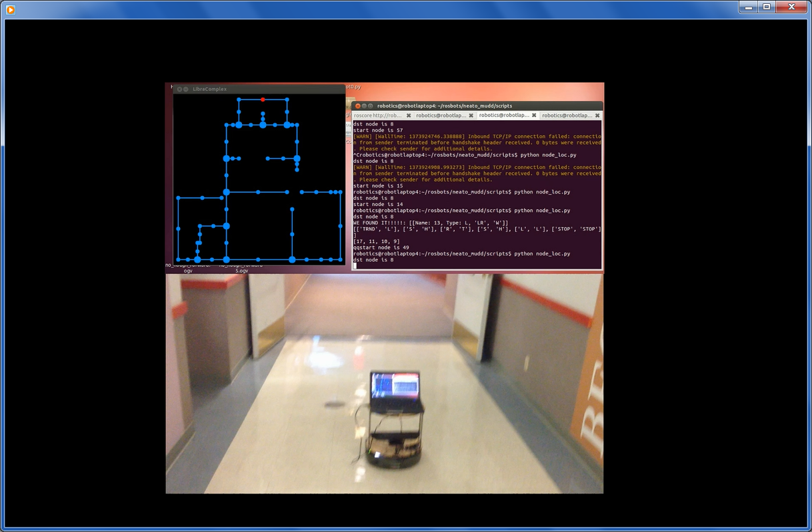
Localization
What if the robot doesn't know its starting pose?
TL
Don't worry about the goal.
Instead, make default motions…
With each observation, we
cull the robot's possible poses.
TL

Slide 12
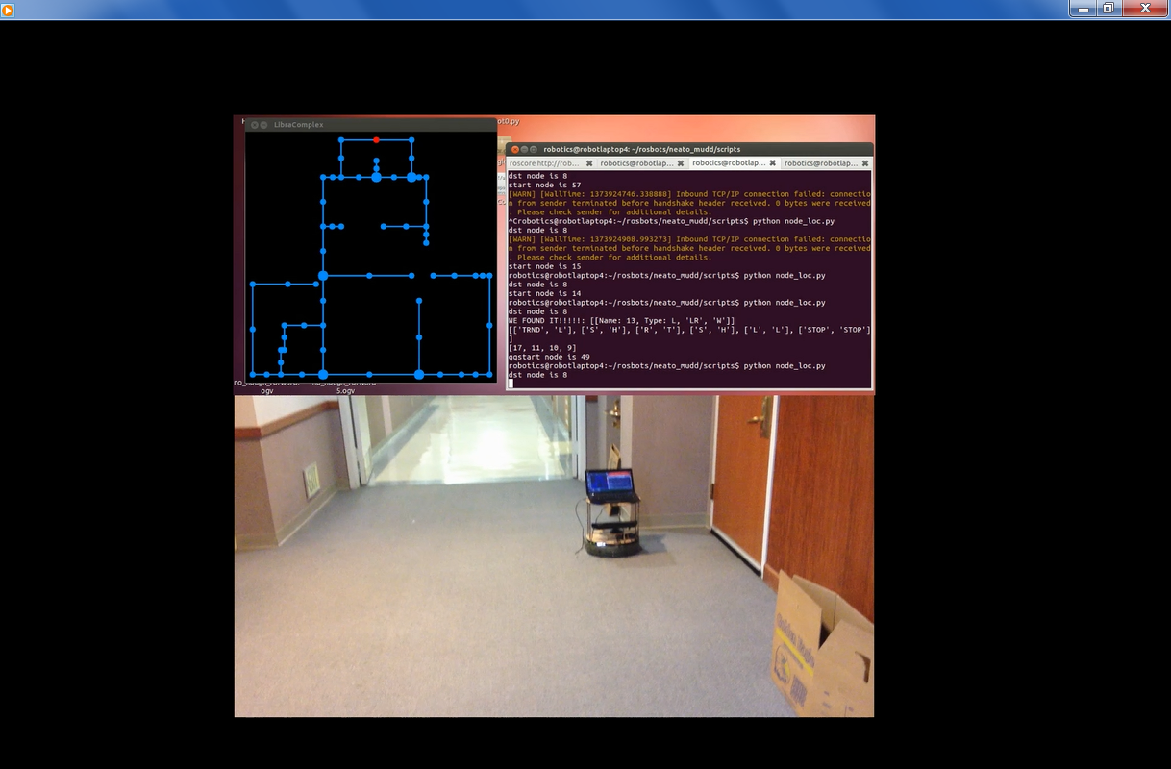
Localization
Keep going…
TL
previous distribution of poses
… cull again
TL

Slide 13
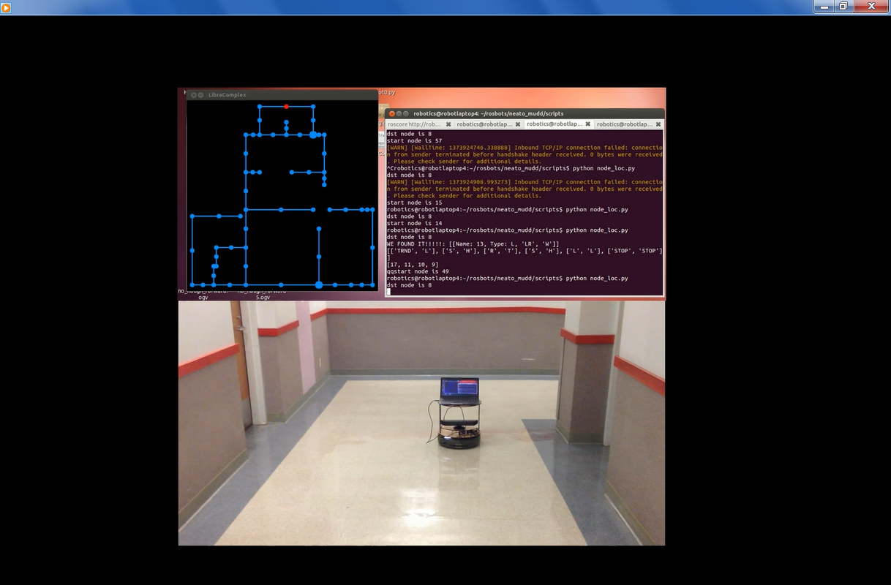
Localization
When it knows its location, head to the goal!
TL
previous distribution of poses
… cull again
TL

Slide 14
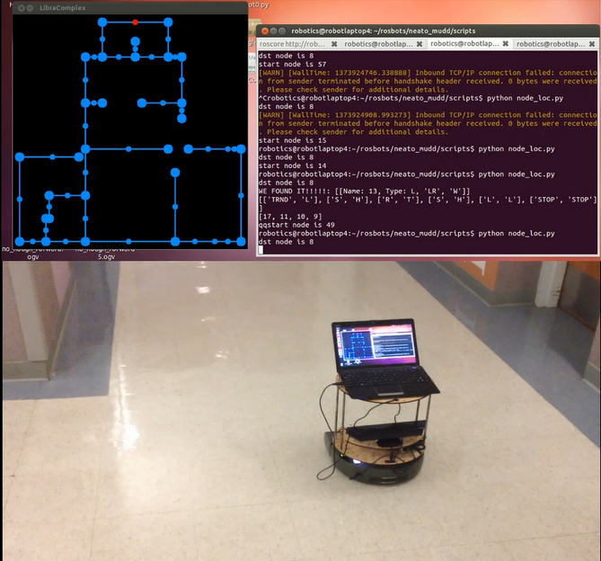
Markov localization
loc_short.mp4
navigating to a goal without the start node given

Slide 15
Can we be more deliberate?
Each intersection offers a choice:
Which turn to make, even if the robot isn't sure where it is?

Slide 16
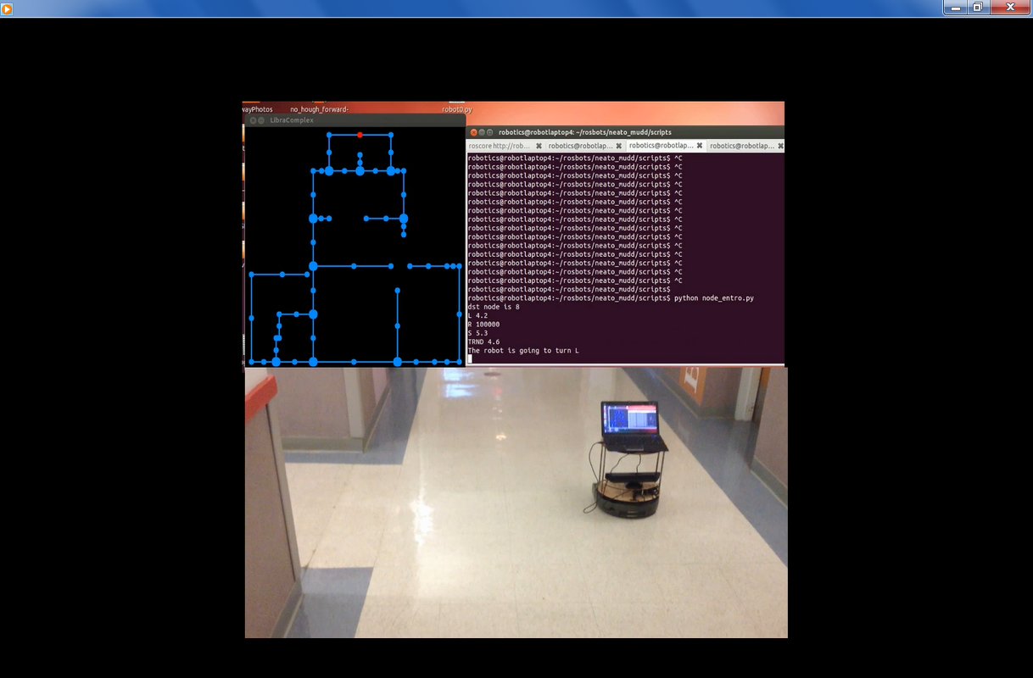
Can we be more deliberate?
Each intersection offers a choice:
Which turn to make, even if the robot isn't sure where it is?
We're at a TL…
Which way should we go?

Slide 17
Can we be more deliberate?
Suppose the robot goes left…
2 LR
2 LL
5 DE
1 TL
This is the distribution of possible next corners it could see.

Slide 18
Can we be more deliberate?
Suppose the robot goes left…
2 LR
2 LL
5 DE
1 TL

Slide 19
Can we be more deliberate?
Suppose the robot goes left…
2 LR
2 LL
5 DE
1 TL

Slide 20
Can we be more deliberate?
Suppose the robot goes left…
2 LR
2 LL
5 DE
1 TL

Slide 21
Can we be more deliberate?
Suppose the robot goes left…
2 LR
2 LL
5 DE
1 TL

Slide 22
Can we be more deliberate?
Suppose the robot goes straight…
1 LR
2 LL
1 TR
6 TL
2
2
the possibilities

Slide 23
Which possibilities are better?
left
straight
2 LR
2 LL
5 DE
1 TL
1 LR
2 LL
1 TR
6 TL
Which of these two possible actions (and their results) should we prefer?

Slide 24
Entropy
Suppose there were 8 possibilities to begin with…
2 A
2 B
2 C
2 D
4 A
4 B
0 C
0 D
8 A
0 B
0 C
0 D
2 possibilities will remain!
4 possibilities will remain!
8 possibilities will remain!
Flatter is better

Slide 25
Entropy
Suppose there were 8 possibilities to begin with…
2 A
2 B
2 C
2 D
4 A
4 B
0 C
0 D
8 A
0 B
0 C
0 D
2.00 bits
1.00 bit
0.0 bits
Entropy ~ expected information.
Entropy is the amount of uncertainty you expect to resolve by sampling a distribution.

Slide 26
Entropy
2 A
2 B
2 C
2 D
2 LR
2 LL
5 DE
1 TL
4 A
4 B
0 C
0 D
8 A
0 B
0 C
0 D
2.00 bits
1.76 bits
1.00 bit
0.0 bits
Flatter is better

Slide 27
Go left!
left
straight
2 LR
2 LL
5 DE
1 TL
1 LR
2 LL
1 TR
6 TL
1.76 bits
1.57 bits
Flatter is better

Slide 28
Entropy-based localization
entro_short.mp4

Slide 29
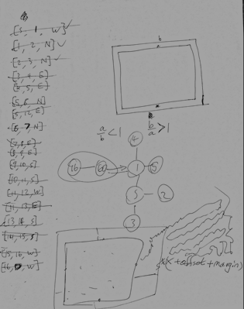
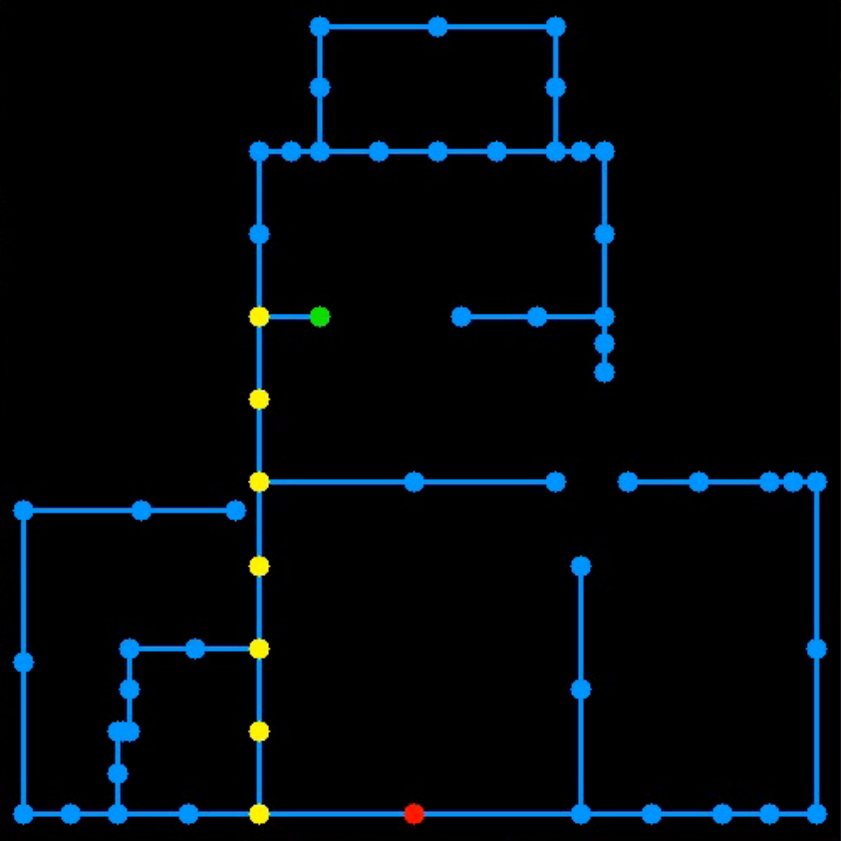
Map-building
Snapshot of Zakkai's brain while map-building…
Ideally, mapping would be automated, as well…

Slide 30
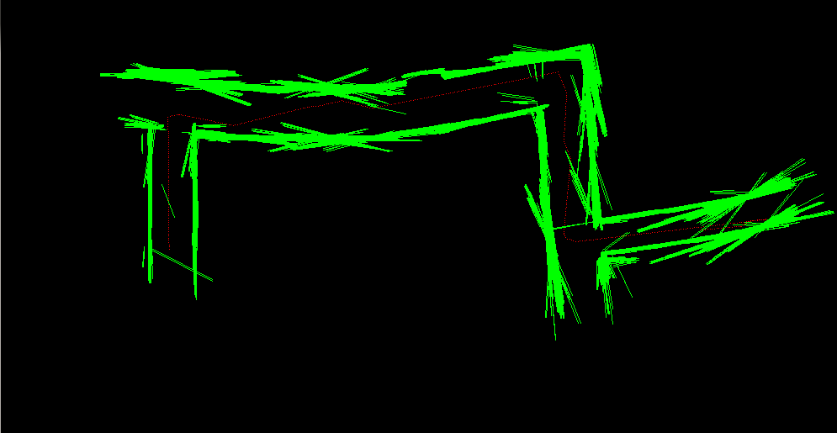
Autonomous Mapping
overlaying wall-lines using odometry
Notes:
Graham start

Slide 31
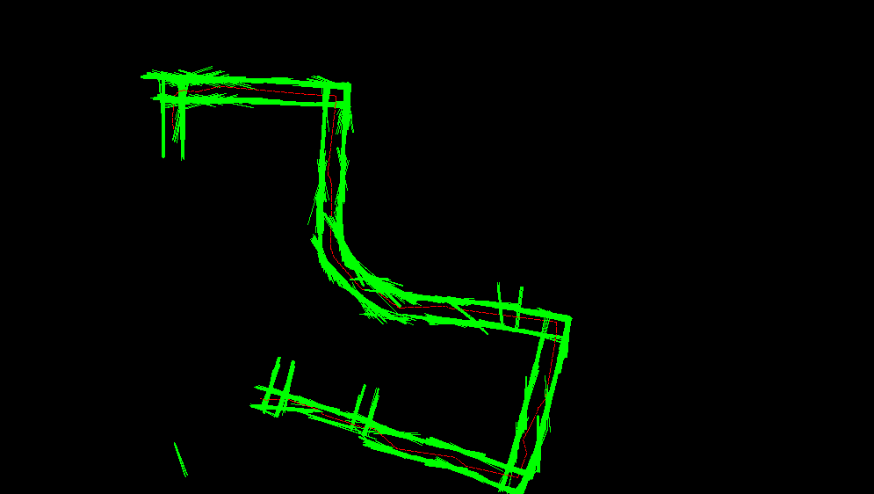
Mapping
slipping around the Olin Basement loop…

Slide 32
Graham + Jerry

Slide 33
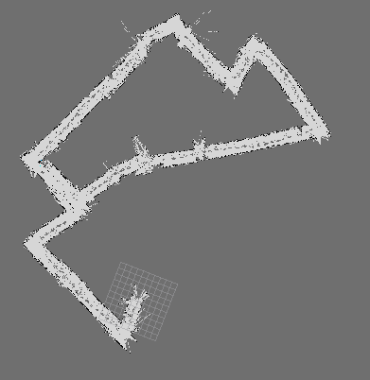
gmapping
an algorithm for autonomous laser-based mapping
(1) adjust each scan's pose to best-fit previous scans
Olin basement loop
straightens corridors
(2) search for distant-past similarities to "close loops"
Beckman hallway
corrects slippage?

Slide 34
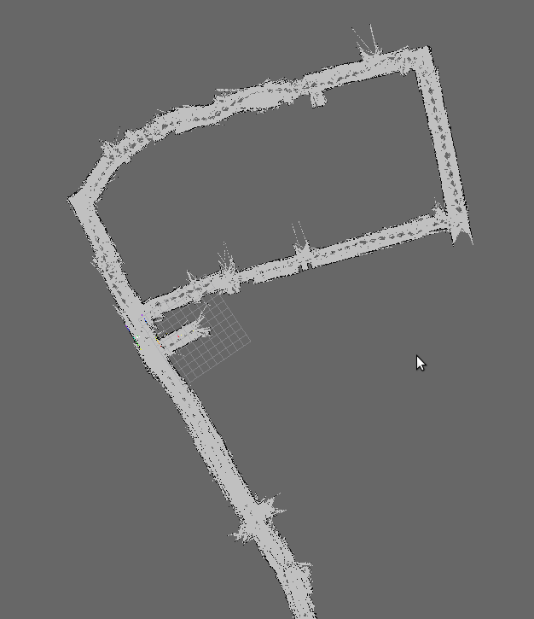
gmapping
… can miss "obvious" loops
Beckman CS loop
Laser scans aren't very distinctive
Jacobs hallway
Better landmarks?
… probably texture in 3d

Slide 35
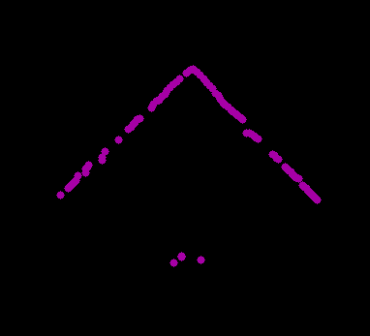
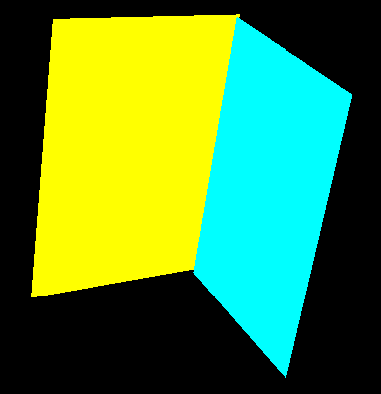
2½-d mapping
Assume wall-world: surfaces are vertical planes.
Create that "3d" representation
Texture it with the pixel colors ~ landmarks.
Idea:
Laser-scan of a corner
Now, as vertical planes

Slide 36
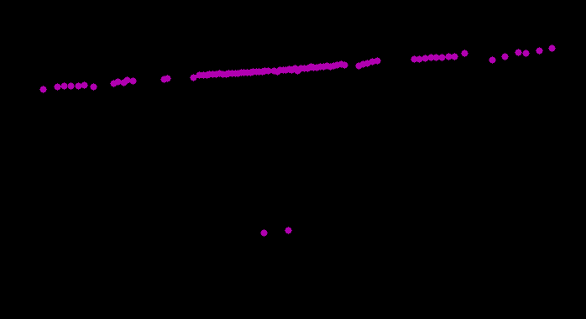
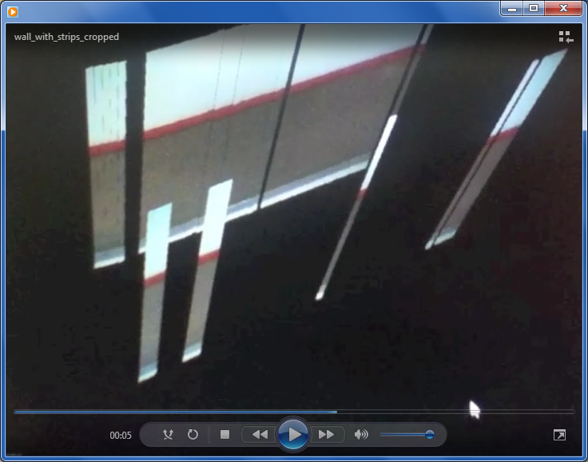

Painting the walls…
Laser-scan of a wall
laser scan of wall
+
image of wall
textured model
Image of the wall

Slide 37
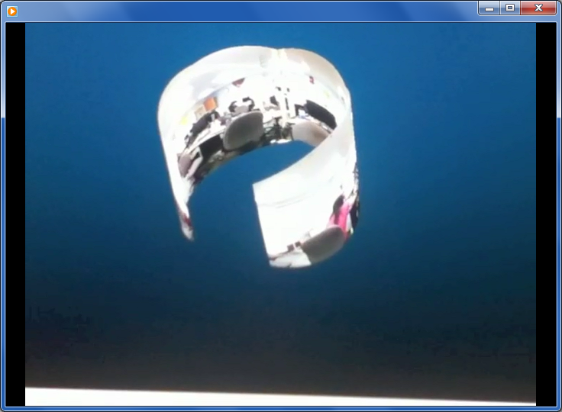
Painting the walls…
We can apply any geometry we like ~ here, a cylindrical panorama

Slide 38
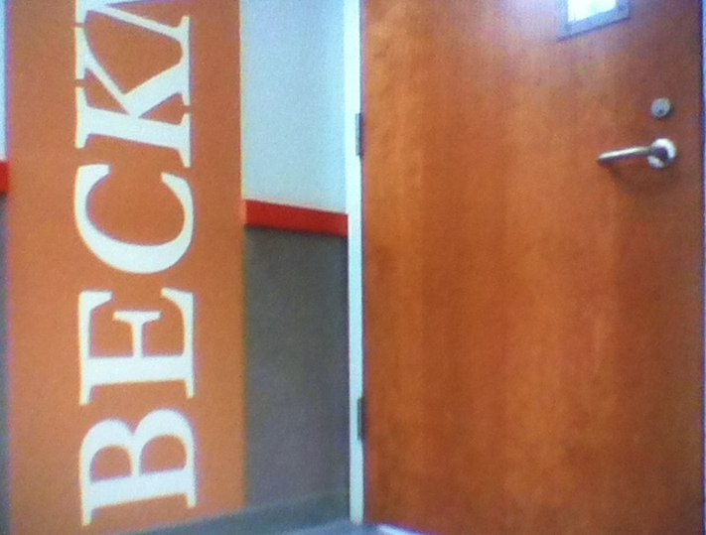
Where are the walls?
linked to raw_corner_cropped.m4v
Raw laser scans lead to artifacts ~ walls vs. ribbons

Slide 39
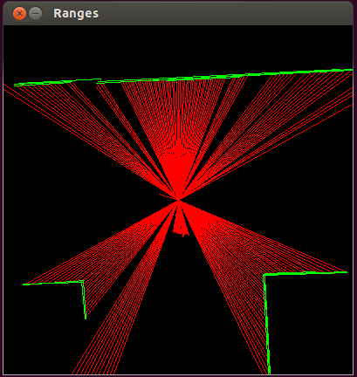
Finding the walls
via the Hough transform
~24 lines extracted
Extracting straight lines from laser scans yields too many of them

Slide 40
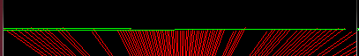
Selecting the best walls…
Use the Hough transform to find an initial set of wall segments
do
Compute the slope and position of each segment
Find a "close" pair of segments; remove them from set
Merge the pair into a single segment and add to set
until no more "close" pairs exist.
~12 Hough lines
with all but 2 merged

Slide 41
Better!
linked to hough_corner_3d_cropped.m4v
First, simplify the 3d structures, then paint them …

Slide 42
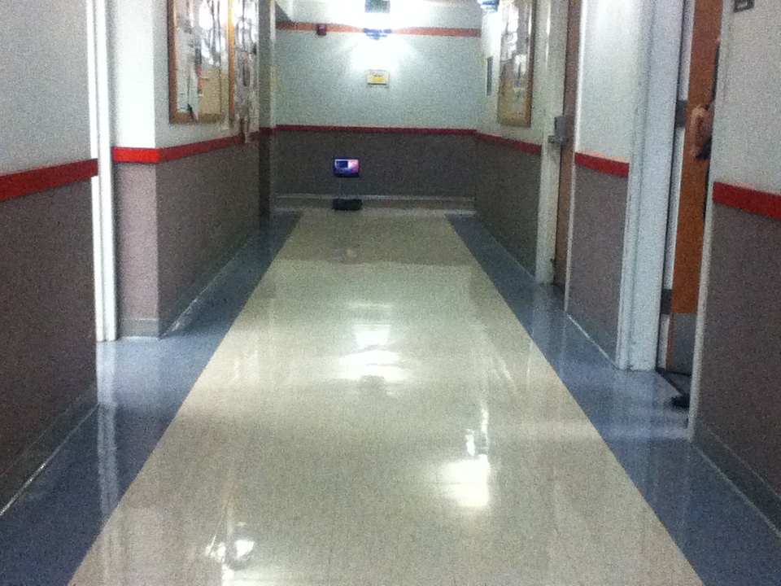
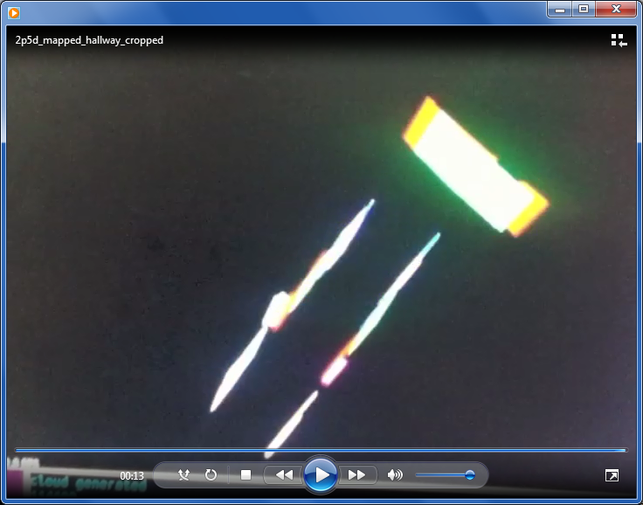
Building the map…
2p5d_mapped_hallway_cropped.m4v
the robot's final position…
… after creating its 2½-d map
Delegated to 2014: painting these walls in real time…

Slide 43
Chris + Kristina

Slide 44
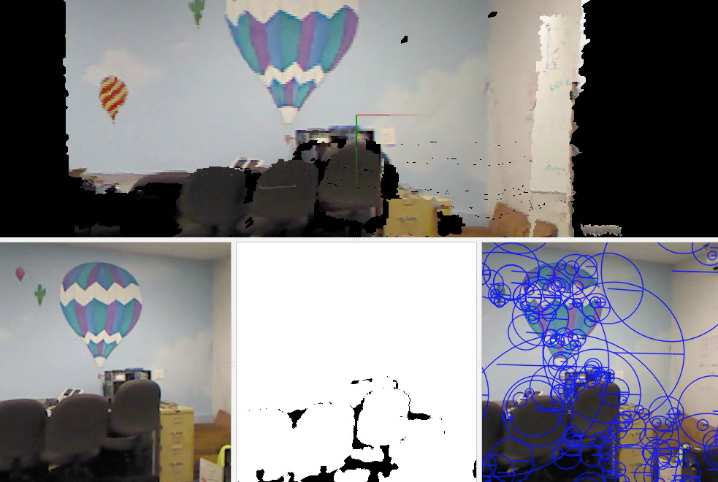
Or, use the Kinect: 3d mapping
Demonstration of RGBD-SLAM
SLAM ~ simultaneous localization and mapping

Slide 45
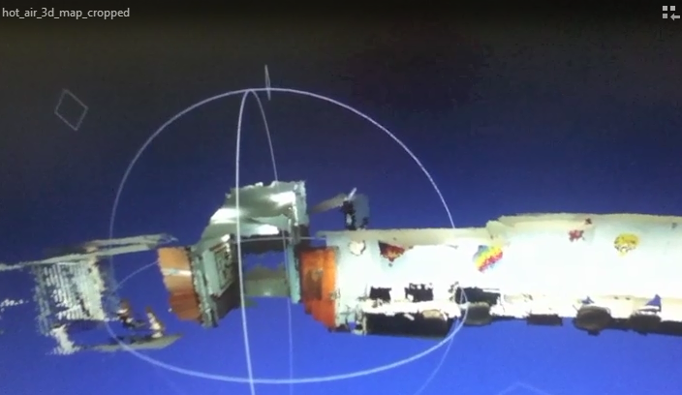
The hot-air lab's map
Example of lab and hallway map created by RGBD-SLAM

Slide 46
Two concrete challenges…
more robust navigation
more general "lab escape"
bridging 2d sensors with 3d spatial representations

Slide 47
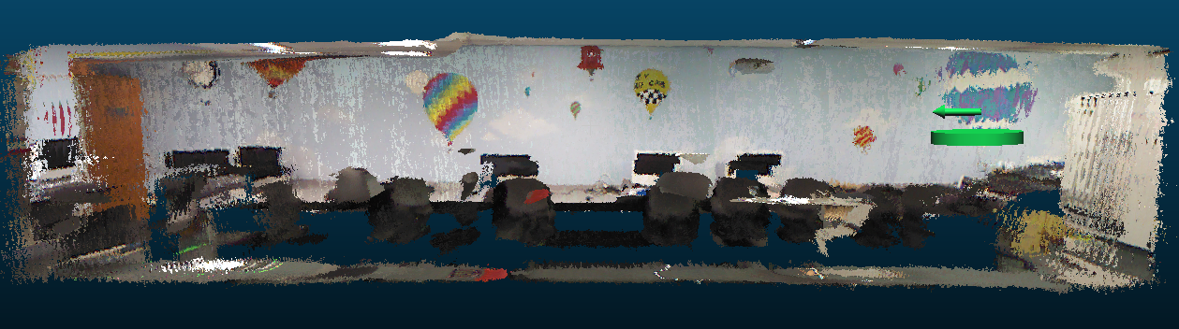
Escape the lab!
(1) the drone grabs a 2d image
(2) the system matches that image into the 3d map to locate the drone
(3) once located, the drone computes its desired velocity and applies it
(4) after two seconds, stop and goto (1)
Localization-based loop:
(given a known goal)

Slide 48
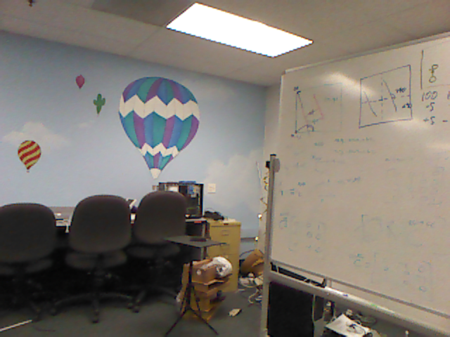
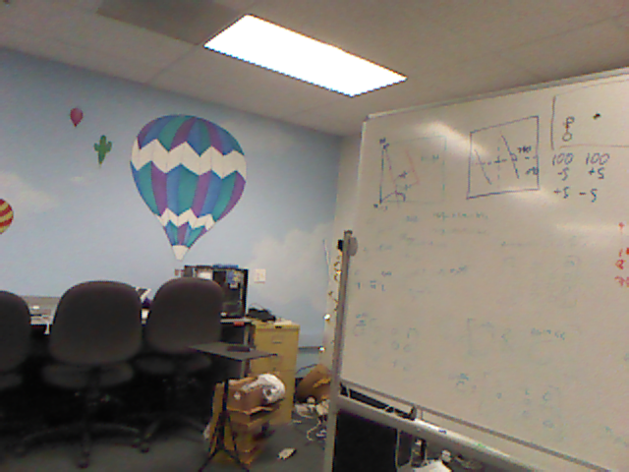
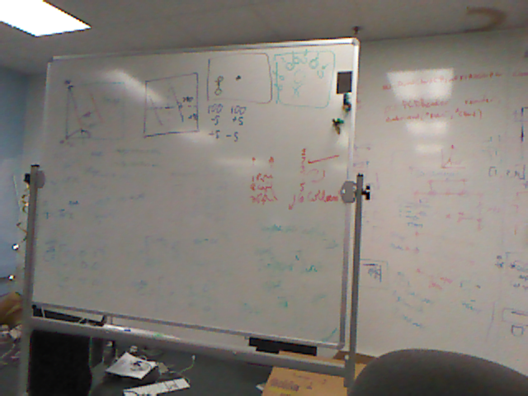
Image matching
new image (live)
Our approach (well, really Kristina's):
Find features in each (SIFT)
Consider all matches (FLANN)
Ensure bidirectional constraints
Consistency filtering (homography)
Best-matching by visual similarity metric
Tiebreaking by pixel distances
many original images (stored)

Slide 49
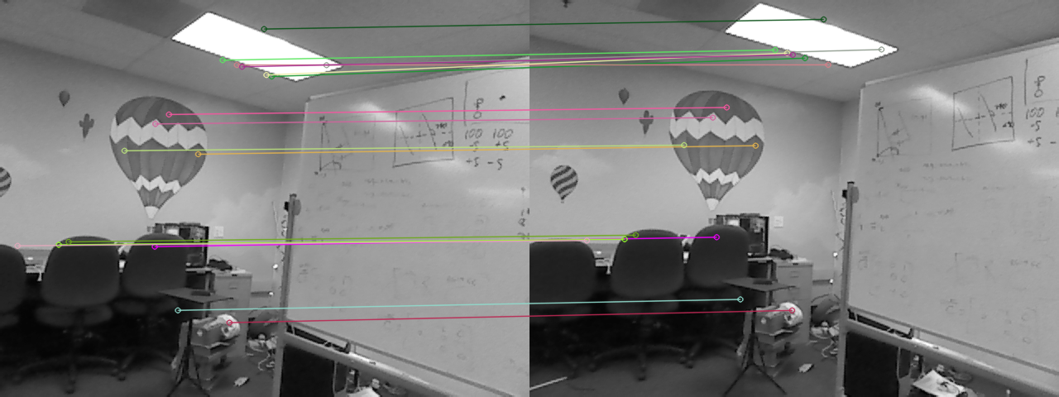
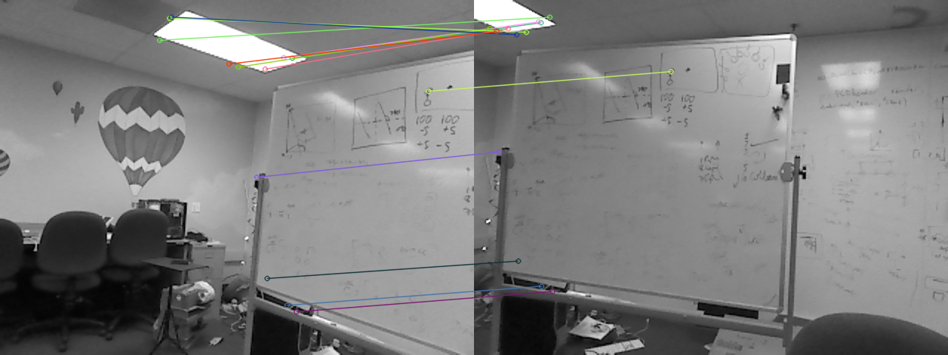
Image matching
1st-best match
new image (live)
many original images (stored)
10th-best match
for now, a linear search taking ~10 seconds for the hot-air map's 42 images

Slide 50
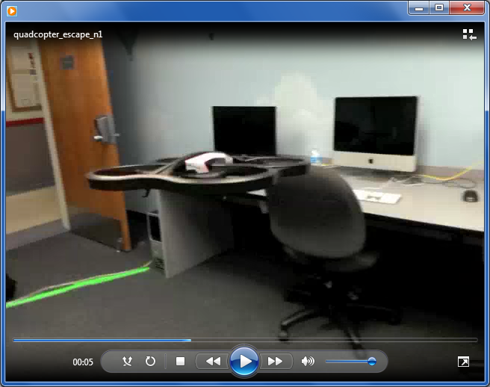
Results
One of the drone's escapes ~ 150 sec.

Slide 51
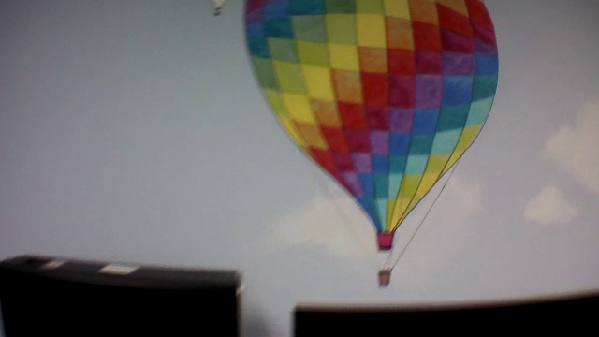
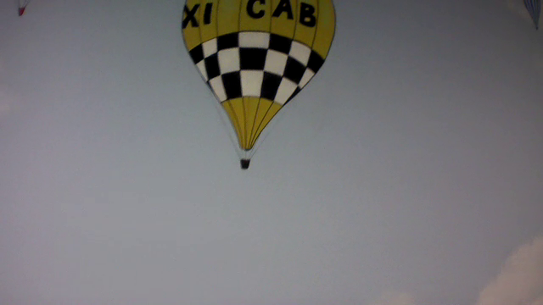
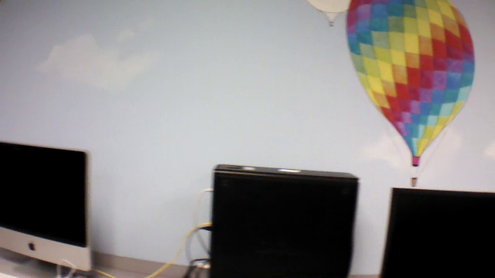
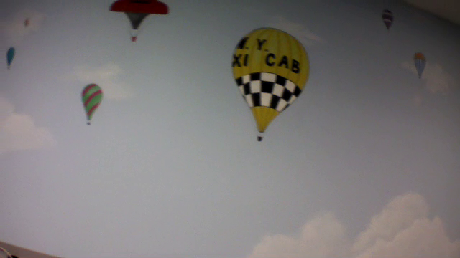
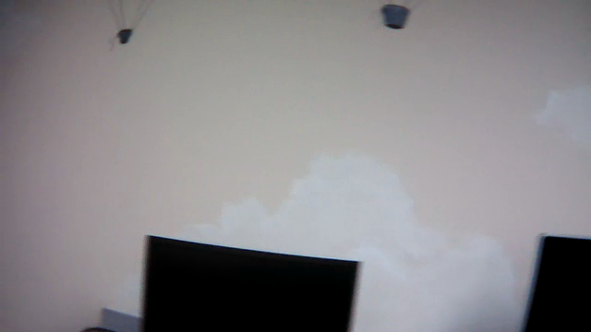
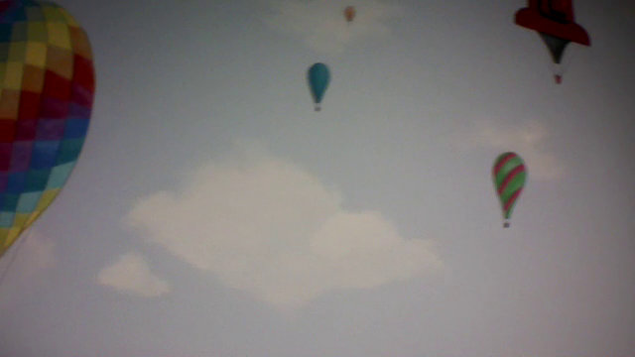
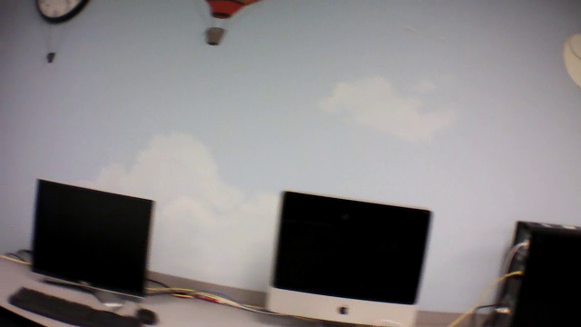
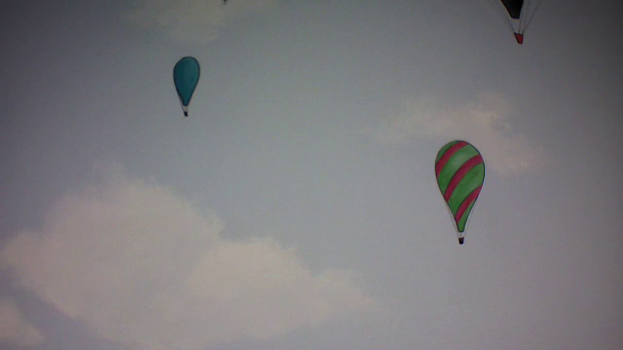
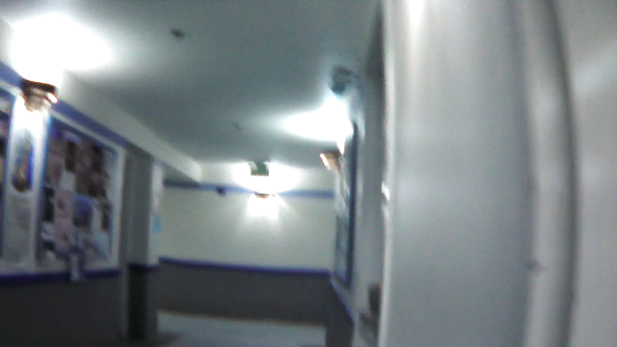
9 "landmarks"
4
0
5
1
6
2
7
3
8
live, novel images

Slide 52









Their matches
4
0
5
1
6
2
7
3
8
live, novel images
map matches

Slide 53

Model
Map-based localization of those 9 estimated positions

Slide 54


Other runs
Why not localize once and just go!?
A view from the back of the lab

Slide 55
Verdicts & insights
not perfect
not fast… yet
more geometry to exploit
surprisingly good!
2d matching?
don't use linear search!
do use multi-resolution search!!
use lack of features somehow
slowness?
opportunities!
accuracy?
use 3d model to get "exact" location
Skeleton of next summer's robotics agenda…
3d overall?
Yes!
What about next summer's robots?

Slide 56


New platforms…
Microdrone
"The Sofa"
Thoughts? Questions?
LeapMotion

Slide 57
This afternoon…
www.cs.hmc.edu/~cs5grad/survey/
(1) [anytime] Take our NSF research-finale survey!
(2) [afternoon] Create a slideshow of best summer images
-- it's great to have all of the images, but it's equally or more useful to have a slideshow of the highlights
(3) Let's show @ 4:30…
(4) [starting ~ 3:30] Save/archive your work
(5) Shutdown the HMC-owned computers
** Except in the games cubicle:
(6) Create lines of monitors, mice, cables, surge
protectors, computers, etc. along the back walls
(7) Clean/wipe off the workspace tabletops
(8) For kitchen, remove trash + clean surfaces/dishes

Slide 58

Contributions…

Slide 59


Slide 60


Slide 62


Slide 64

Accessing these 3d maps
our splicer
saves each rgb image
and each depth image
Getting the data: by splicing into the code to extract the input images

Slide 65
Neato reasoning
Initial tasks
learn ASCII API
write device drivers
interpret sensor data
follow corridors
detect intersections
AI Tasks
pt-to-pt navigating
localize and navigate
minimize ambiguity
navigate predictively
build 2d and 3d maps
wall placement determines each intersection type

Slide 66

Hough transform
Point space
Line space
y
r
θ
y = 8
x
x = 6
Consider one point of a laser scan
These are all of the lines through it

Slide 67
Hough transform
Point space
Line space
y
θ = 0
r
θ
x
r = 6
vertical line ~ θ = 0
The dot is the line r = 6, θ = 0

Slide 68
Hough transform
Point space
Line space
y
r
θ
r = 9.1
x
angled line ~ θ = 32°
The dot is the line r = 9.1, θ = 32°

Slide 69
Hough transform
Point space
Line space
y
r
θ
r = 8
x
angled line ~ θ = 90°
The dot is the line r = 8, θ = 90°

Slide 70

Hough transform
Point space
Line space
y
r
θ
x
three points of a laser scan
all the lines through all three
(horizontal lines are shown)
(dots ~ the shown horizontal lines)

Slide 71
Hough transform
Point space
Line space
y
r
θ
x
yield lines with substantial support in the original data
peaks here in line space

Slide 72
Image matching?
new image
Our approach:
Find features in each (SIFT)
Consider all matches (FLANN)
Ensure bidirectional constraints
Consistency filtering (homography)
Best-matching by visual similarity metric
Tiebreaking by pixel distances
many original images

Slide 73



matching?
Our approach:
Find features in each (SIFT)
Consider all matches (FLANN)
Ensure bidirectional constraints
Consistency filtering (homography)
Best-matching by visual similarity metric
Tiebreaking by pixel distances
Extract features

Slide 74


Our approach:
Find features in each (SIFT)
Consider all matches (FLANN)
Ensure bidirectional constraints
Consistency filtering (homography)
Best-matching by visual similarity metric
Tiebreaking by pixel distances
Nearest-neighbor matching

Slide 75


Our approach:
Find features in each (SIFT)
Consider all matches (FLANN)
Ensure bidirectional constraints
Consistency filtering (homography)
Best-matching by visual similarity metric
Tiebreaking by pixel distances
Keep only two-way best matches

Slide 76


Our approach:
Find features in each (SIFT)
Consider all matches (FLANN)
Ensure bidirectional constraints
Consistency filtering (via homography)
Best-matching by visual similarity metric
Tiebreaking by pixel distances
Keep geometrically realistic matches

Slide 77
1st-best match
10th-best match
Our approach:
Find features in each (SIFT)
Consider all matches (FLANN)
Ensure bidirectional constraints
Consistency filtering (via homography)
Best-matching by visual similarity metric
Tiebreaking by pixel distances
Visual “closeness”

Slide 78
1st-best match
Average feature distance ~ 40 px
10th-best match
Average feature distance ~ 270 px
Our approach:
Find features in each (SIFT)
Consider all matches (FLANN)
Ensure bidirectional constraints
Consistency filtering (via homography)
Best-matching by visual similarity metric
Tiebreaking by pixel distances
Pixel “closeness”

Slide 79

Map-based navigation…

Slide 80
Next: localization

Slide 81


Accessing these models
3d lab model ~ with a surface added
the rendered view from that green cone

Slide 82

Accessing these models
Cloud Compare is a visualizer that can include our own “annotations” …

Slide 83


Zooming vs. Moving
zooming in to the balloon…
CloudCompare
MeshLab
… vs. moving towards/past it

Slide 84
Using these models
How might a robot with an ordinary camera, i.e., only 2d sensing, use these 3d models?
2d – 2d matching
3d – 3d matching
Ideally, a 2d sensing system could localize – and reason – within a 3d model

Slide 85


2d – 2d matching
with a new image from a robot (or other device)
we could compare
vs. original images
vs. rendered images
These are the images used to create the 3d model in the first place: fewer, higher-fidelity.
Images yielded by the 3d model: arbitrarily many, but lower-quality.

Slide 86
2d – 2d matching
with a new image from a robot (or other device)
we could compare
vs. original images
vs. rendered images
These are the images used to create the 3d model in the first place: fewer, higher-fidelity.
Images yielded by the 3d model: arbitrarily many, but lower-quality.

Slide 87
Matching?
new image
Our approach:
Find features in each (SIFT)
Consider all matches (FLANN)
Ensure bidirectional constraints
Consistency filtering (homography)
Best-matching by visual similarity metric
Tiebreaking by pixel distances
many original images

Slide 88
Features
Our approach:
Find features in each (SIFT)
Consider all matches (FLANN)
Ensure bidirectional constraints
Consistency filtering (homography)
Best-matching by visual similarity metric
Tiebreaking by pixel distances

Slide 89
Our approach:
Find features in each (SIFT)
Consider all matches (FLANN)
Ensure bidirectional constraints
Consistency filtering (homography)
Best-matching by visual similarity metric
Tiebreaking by pixel distances
Nearest-neighbor matching

Slide 90
Our approach:
Find features in each (SIFT)
Consider all matches (FLANN)
Ensure bidirectional constraints
Consistency filtering (homography)
Best-matching by visual similarity metric
Tiebreaking by pixel distances
Keep only two-way best matches

Slide 91
Our approach:
Find features in each (SIFT)
Consider all matches (FLANN)
Ensure bidirectional constraints
Consistency filtering (via homography)
Best-matching by visual similarity metric
Tiebreaking by pixel distances
Keep geometrically realistic matches

Slide 92
1st-best match
10th-best match
Our approach:
Find features in each (SIFT)
Consider all matches (FLANN)
Ensure bidirectional constraints
Consistency filtering (via homography)
Best-matching by visual similarity metric
Tiebreaking by pixel distances
Visual “closeness”

Slide 93
1st-best match
Average feature distance ~ 40 px
10th-best match
Average feature distance ~ 270 px
Our approach:
Find features in each (SIFT)
Consider all matches (FLANN)
Ensure bidirectional constraints
Consistency filtering (via homography)
Best-matching by visual similarity metric
Tiebreaking by pixel distances
Pixel “closeness”

Slide 94


PCL: Point Cloud Library
3D-Reasoning
Easy point cloud access
Screenshot

Slide 95


NARFs!
3d features: Normal Aligned Radial Features
picture of pt cloud
picture of NARFS
NARF features are purely based on the range image of a point cloud: its geometry, not its looks (SIFT)
They are based on the normals of the point cloud’s surfaces
They are places distinguishable from multiple perspectives.

Slide 96



3d matching
picture of pt cloud w/NARFS
picture of pt cloud w/NARFS
Take two point clouds
Find NARFs
Match features and find transform
Make transform and combine
naive merging

Slide 97




3d SLAM
Simultaneous Localization And Mapping
Take two point clouds
Find NARFs
Match features and find transform
Make transform and combine

Slide 98


3d SLAM
Simultaneous Localization And Mapping
Take two point clouds
Find NARFs
Match features and find transform (ICP)
Make transform and combine

Slide 99

3d SLAM
Final point cloud map
Questions?
Future: using Neato to create 2.5d maps

Slide 101
Kinect
Z.D. video
The Kinect estimates distance-to-camera by projecting a “star field” on the world.

Slide 102

Now vs. Then

Slide 103
Title

Slide 104
Accessing these models
plane
other (sphere, cylinder, wavy,…)
K.M.
allows us to define the depth at each pixel

Slide 105
Ideally, a camera-only system could localize – and reason – within the 3d model
Ideally, a camera-only system could localize – and reason – within the 3d model

Slide 106

Intersection recognition
For each scan:
Front
Check for Front, Left, and Right obstacles
The number of obstacles determines the intersection type 3:D 2:L 1:T 0:+
Open space determines final label, e.g., TL
After 15 recognitions in a row, the robot checks the map (by broadcasting a message)
The robot does not broadcast again until it resets in a hallway: ST.
Left
still image
Right
ST
LL
LR
TL
TR
TD
D
+

Slide 107
Accessing 3d models
RGB
Depth
splicing into the code…

Slide 108
Hough transform
r
θ
Consider one point of a laser scan
These are all of the lines through it
http://gmarty.github.io/hough-transform-js/
http://liquify.eu/flash/HoughTransform

Slide 109
Can we be more deliberate?
Each intersection offers a choice:
Which turn to make, even if the robot isn't sure where it is?
Possible results if the robot heads straight
map of current knowledge…
Possible results if the robot turns the corner
Possible results if the robot reverses course
Consider all of the possible distributions of results…

Slide 110
~ the expected amount of information available from a distribution of possibilities.
Entropy
example 1 bit
example of 2 bits
example of 1.05 bits
in general

Slide 111
Entropy-based localization
Each intersection offers a choice:
Which turn to make, even if the robot isn't sure where it is?
Possible results if the robot heads straight
bits
map of current knowledge…
Possible results if the robot turns the corner
bits
Possible results if the robot reverses course
bits
We choose the action with the greatest expected information.

Slide 112
Entropy-based localization
entro_short.mp4

Slide 113

Could we be bolder?
Leap before you look.
~ W. H. Auden .
Just do it.
~ Nike .
… perhaps if robots felt more contemplative.

Slide 114


Predictive path planning
Given the same choice: Which turn to make?
map of current knowledge…
We could opt for the turn most likely to make progress toward the goal.

Slide 115
Predictive path planning
pre_short.mp4
more robust navigation ~ but all with a hand-built map

Slide 116


Localization
What if the robot doesn't know its starting pose?
map with all nodes large and the goal node in red
map with fewer nodes large and the goal node in red
move to the…?
Don't worry about the goal.
Instead, make default motions…
With each observation,
cull the robot's possible poses.

Slide 117
Localization
What if the robot doesn't know its starting pose?
map with fewer nodes large and the goal node in red
~ sees a TL ~ a T intersection open to the left
Don't worry about the goal.
Instead, make default motions…
With each observation,
cull the robot's possible poses.

Slide 118


Too many walls…
crazy image from uninitilized scans
"point fog" instead of "point cloud"
Uninitialized images ~ aargh!
More of a "point fog" than a point cloud

