Slide 1
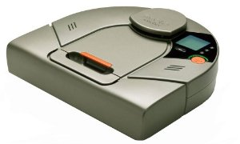
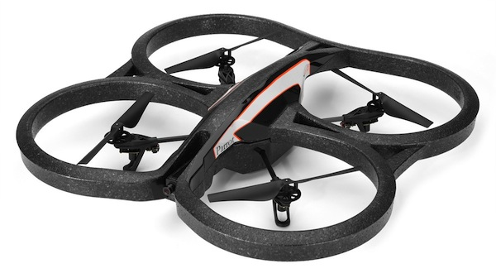
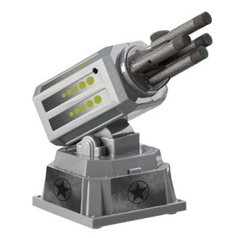
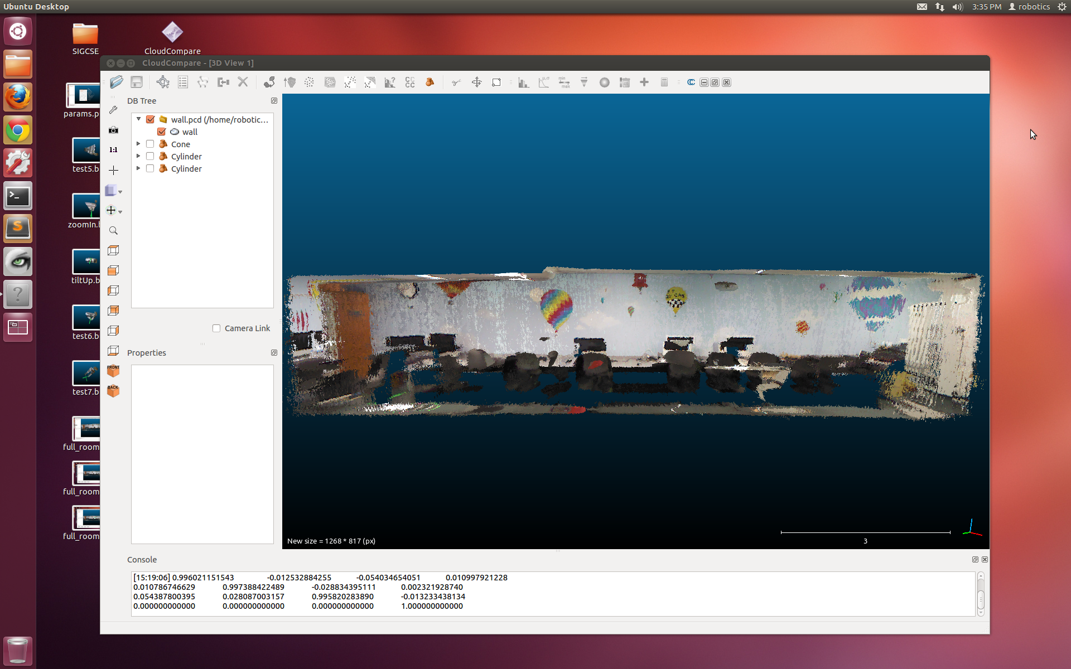
Interdimensional Robot Cooperation
Kristina Ming, Chris Eriksen, Graham Montgomery,
Jerry Hsiung, Cyrus Huang, Zakkai Davidson, and Zach Dodds

Slide 2
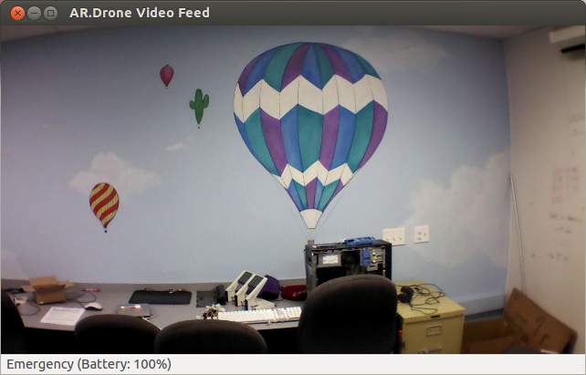
Now…
3d representations are a new standard for robot spatial reasoning, …
… yet 2d image sensing is still common – and will certainly continue to be for a long time.
… vs. Then

Slide 3
Cooperating?!
2d sensors
3d models
Our goal: to investigate robot platforms, software, and algorithms for using 2d sensors amid 3d models of the world.

Slide 4
New platform: Neato
Initial tasks
learn ASCII API
write device drivers
interpret sensor data
follow corridors
detect intersections
AI Tasks
pt-to-pt navigating
localize and navigate
minimize ambiguity
navigate predictively
build 2d and 3d maps
Objective: to get this robot running and reasoning

Slide 5
New platform: Neato
Initial tasks
learn ASCII API
write device drivers
interpret sensor data
follow corridors
detect intersections
laser scan image ~ with Hough walls
AI Tasks
pt-to-pt navigating
localize and navigate
minimize ambiguity
navigate predictively
build 2d and 3d maps
360° laser-scan data and Hough-extracted walls

Slide 6
New platform: Neato
Initial tasks
learn ASCII API
write device drivers
interpret sensor data
follow corridors
detect intersections
laser scan image ~ with Hough walls and big dot showing the "most vertical" (parallel) wall
AI Tasks
pt-to-pt navigating
localize and navigate
minimize ambiguity
navigate predictively
build 2d and 3d maps
the robot follows whichever wall is closest to parallel

Slide 7
New platform: Neato
Initial tasks
learn ASCII API
write device drivers
interpret sensor data
follow corridors
detect intersections
show a TL (with text and four-directions overlay)
AI Tasks
pt-to-pt navigating
localize and navigate
minimize ambiguity
navigate predictively
build 2d and 3d maps
wall-placement determines each intersection type

Slide 8
Neato navigation
Initial tasks
learn ASCII API
write device drivers
interpret sensor data
follow corridors
detect intersections
movie of point-to-point navigation – emphasize that the starting point had to be given… (of course, the goal has to be given, too – there's no avoiding that!!)
AI Tasks
pt-to-pt navigating
localize and navigate
minimize ambiguity
navigate predictively
build 2d and 3d maps
navigating the Libra complex, with the start node given

Slide 9
Neato localization
What if the robot does not know its starting pose?
map with all nodes large and the goal node in red
map with all nodes large and the goal node in red
Don't worry about the goal.
Instead, make default motions…
With each intersection,
cull the robot's possible poses.

Slide 10
Neato localization
movie of point-to-point navigation – emphasize that the starting point had to be given… (of course, the goal has to be given, too – there's no avoiding that!!)
navigating to a goal without the start node given

Slide 11
Neato reasoning
Initial tasks
learn ASCII API
write device drivers
interpret sensor data
follow corridors
detect intersections
AI Tasks
pt-to-pt navigating
localize and navigate
minimize ambiguity
navigate predictively
build 2d and 3d maps
wall placement determines each intersection type

Slide 12
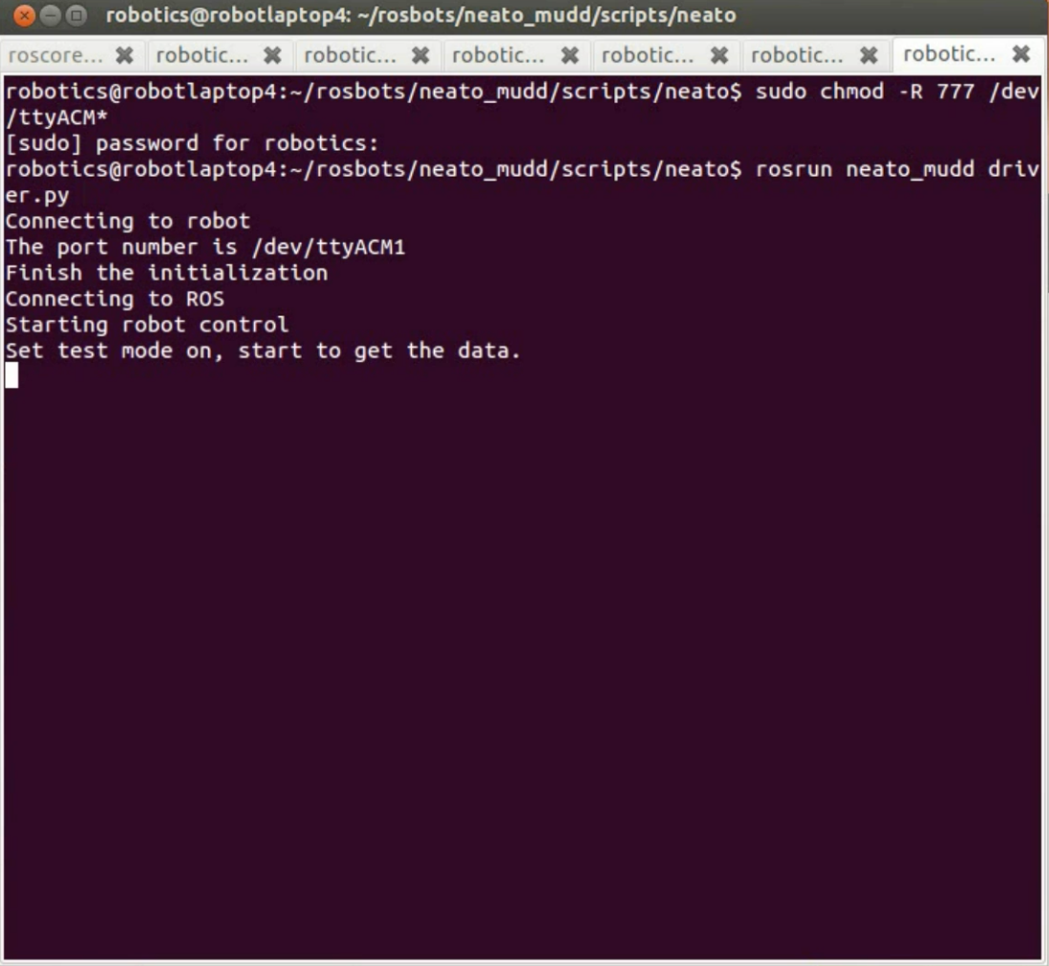
Neato drivers
Hurdles overcome:
driver crashes
- different Neatos!
unorganized data
multiple threads
Built: Robot Operating System (ROS) drivers w/full control

Slide 13
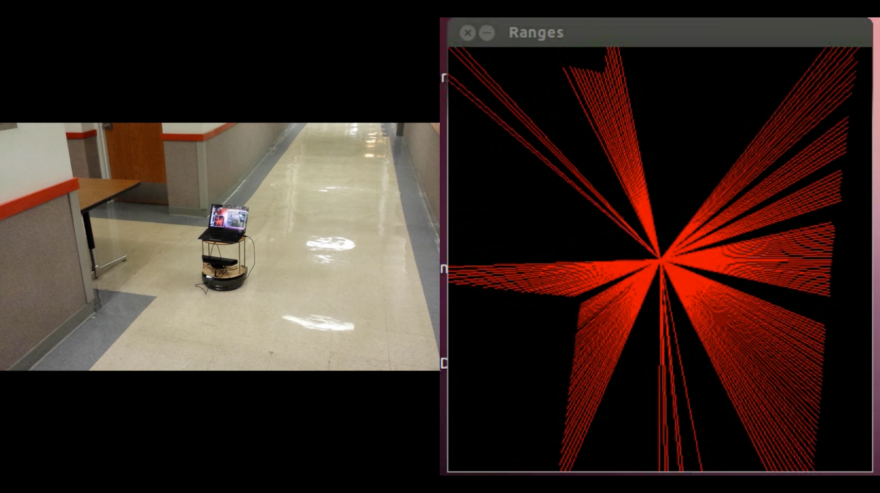
Visualizing
OpenCV interface
beautiful data!
how to navigate smoothly?
Objective: Find walls and navigate safely among them

Slide 14
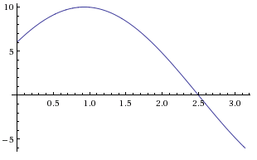
Hough transform
Point space
Line space
y
r
θ
y = 8
x
x = 6
Consider one point of a laser scan
These are all of the lines through it

Slide 15
Hough transform
Point space
Line space
y
θ = 0
r
θ
x
r = 6
vertical line ~ θ = 0
The dot is the line r = 6, θ = 0

Slide 16
Hough transform
Point space
Line space
y
r
θ
r = 9.1
x
angled line ~ θ = 32°
The dot is the line r = 9.1, θ = 32°

Slide 17
Hough transform
Point space
Line space
y
r
θ
r = 8
x
angled line ~ θ = 90°
The dot is the line r = 8, θ = 90°

Slide 18
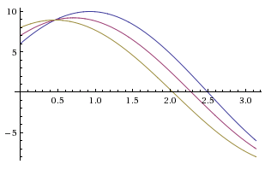
Hough transform
Point space
Line space
y
r
θ
x
three points of a laser scan
all the lines through all three
(horizontal lines are shown)
(dots ~ the shown horizontal lines)

Slide 19
Hough transform
Point space
Line space
y
r
θ
x
yield lines with substantial support in the original data
peaks here in line space

Slide 20
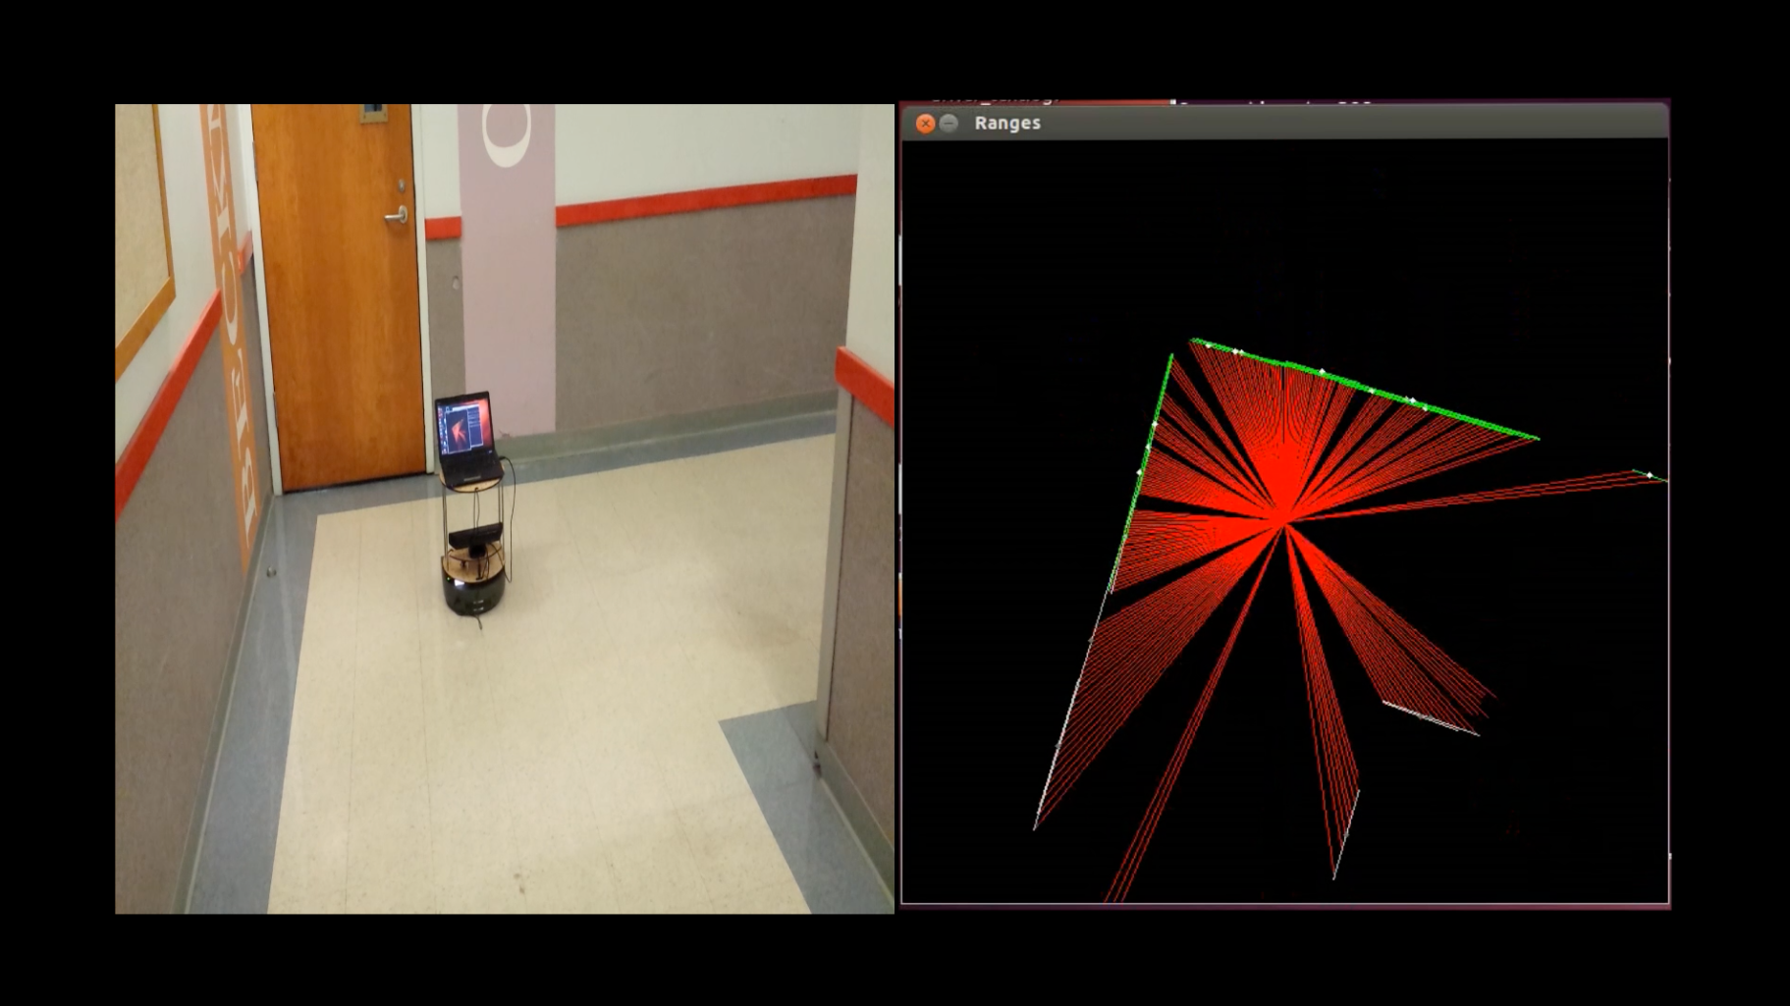
Hough in action
now… wall sensing

Slide 21
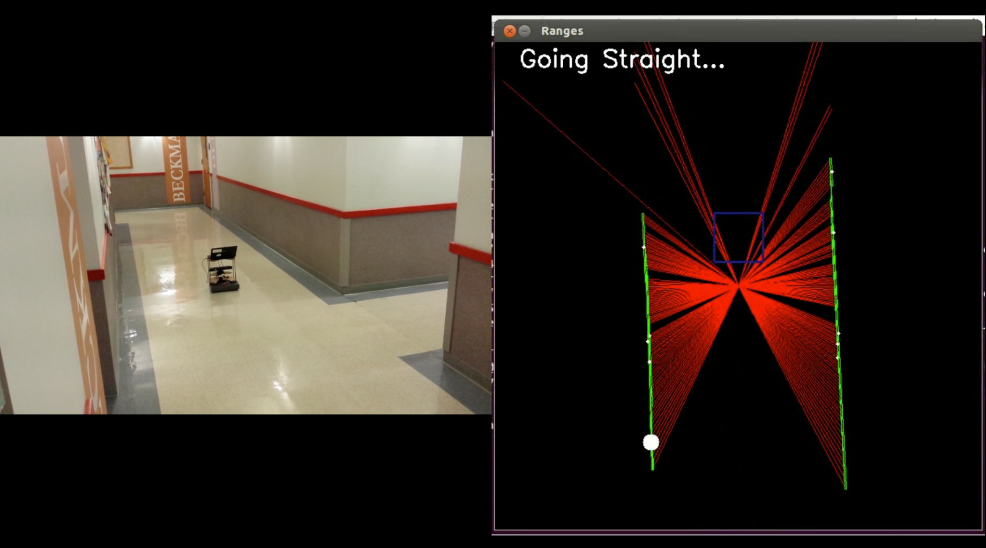
Low-level navigation
idea: follow the most-vertical wall

Slide 22
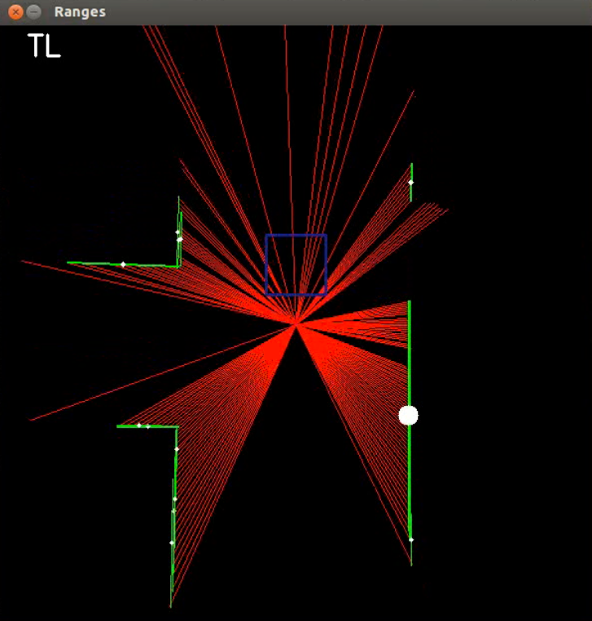
Intersection recognition
For each scan:
Front
Check for Front, Left, and Right obstacles
The number of obstacles determines the intersection type 3:D 2:L 1:T 0:+
Open space determines final label, e.g., TL
After 15 recognitions in a row, the robot checks the map (by broadcasting a message)
The robot does not broadcast again until it resets in a hallway: ST.
Left
still image
Right
ST
LL
LR
TL
TR
TD
D
+

Slide 23
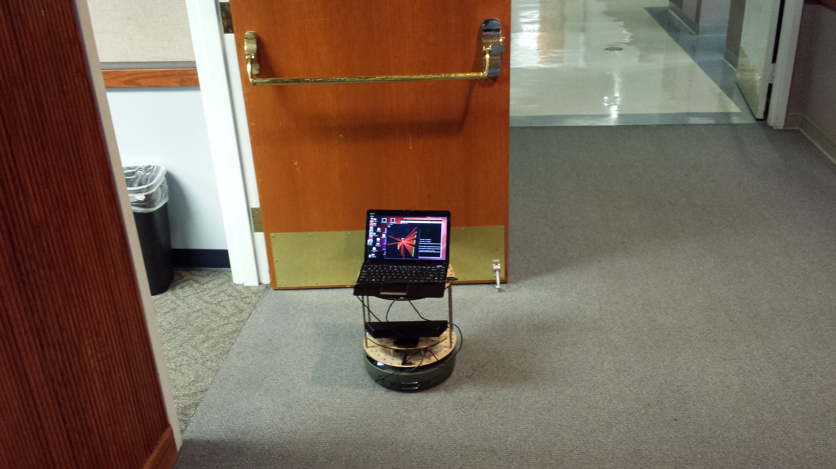
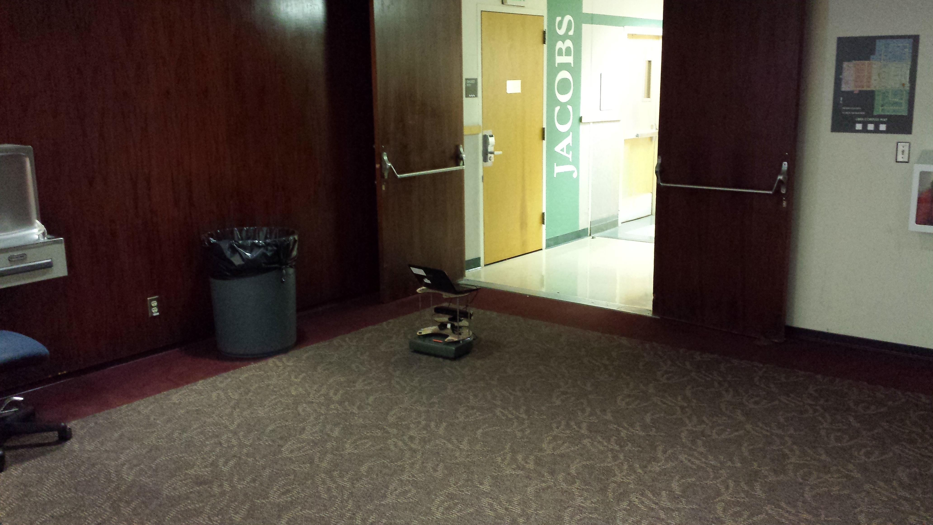
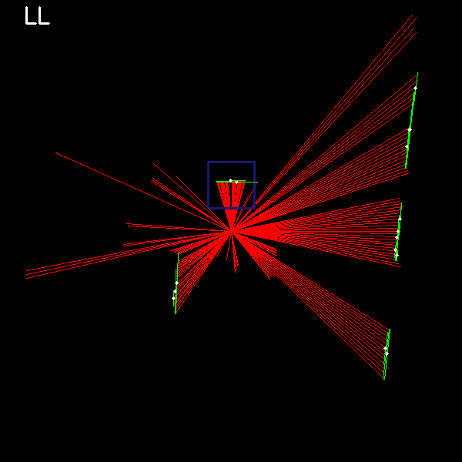
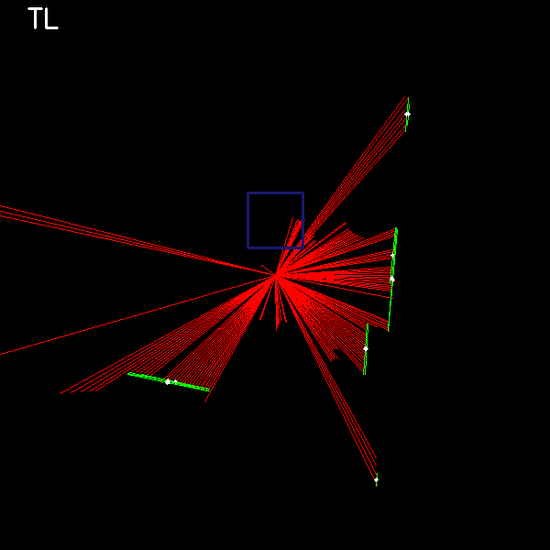
Recognition problems

Slide 24
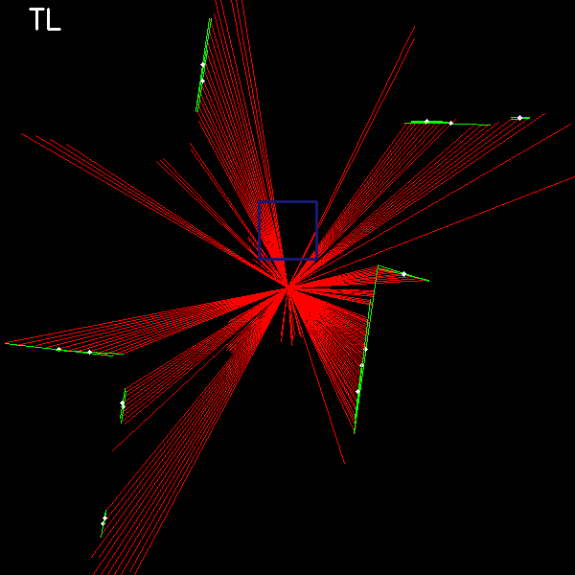
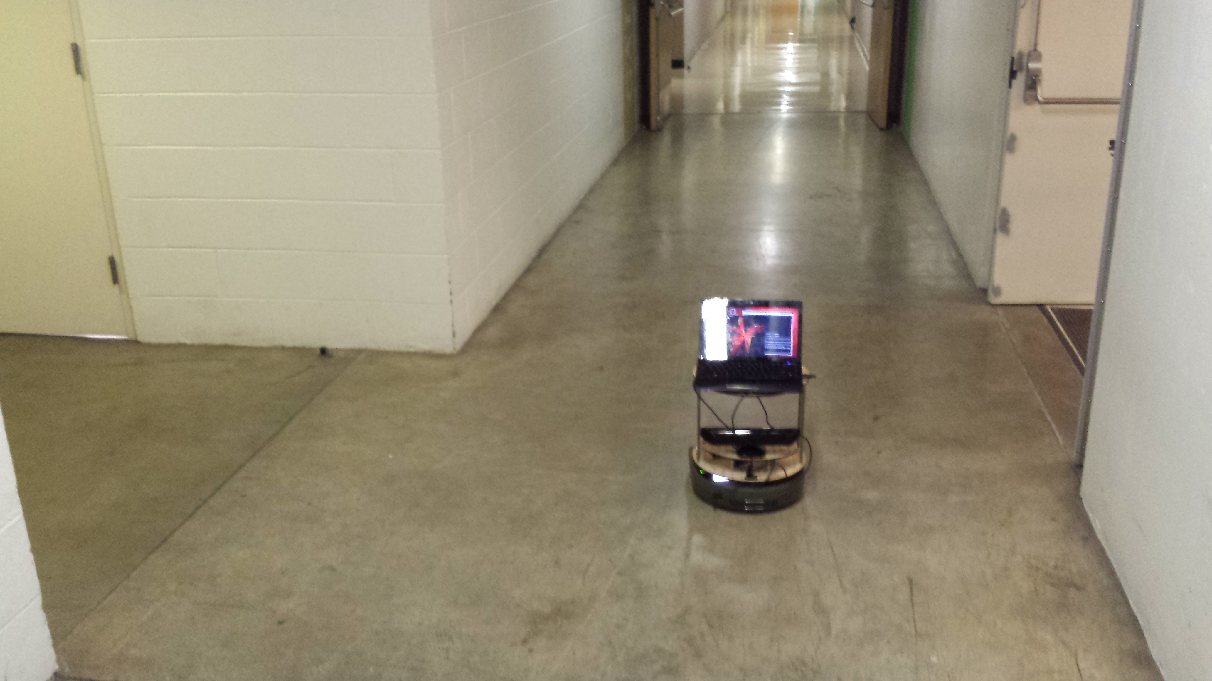
Recognition problems
Not really a +

Slide 25
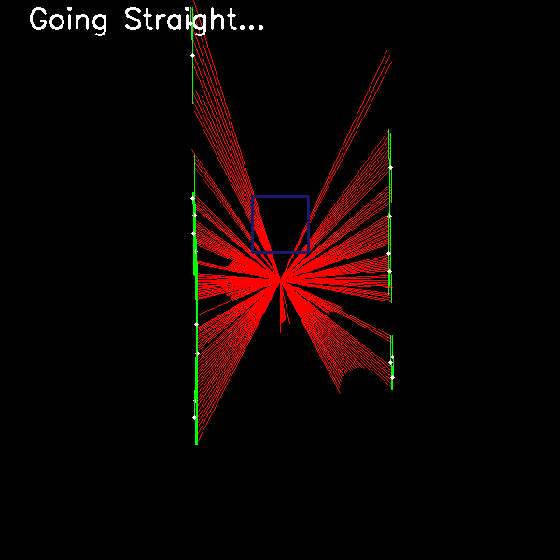
Recognition problems

Slide 26
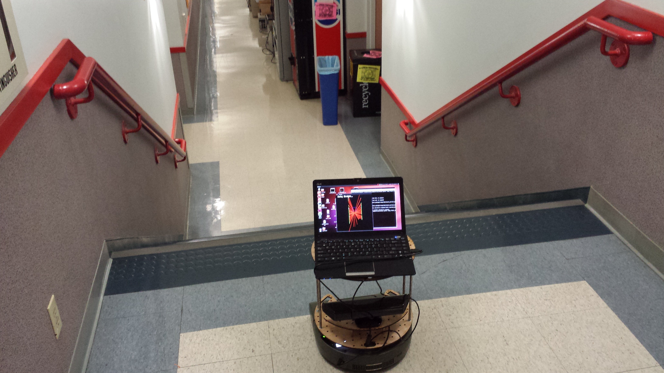
Recognition problems
Not really a hallway!

Slide 27
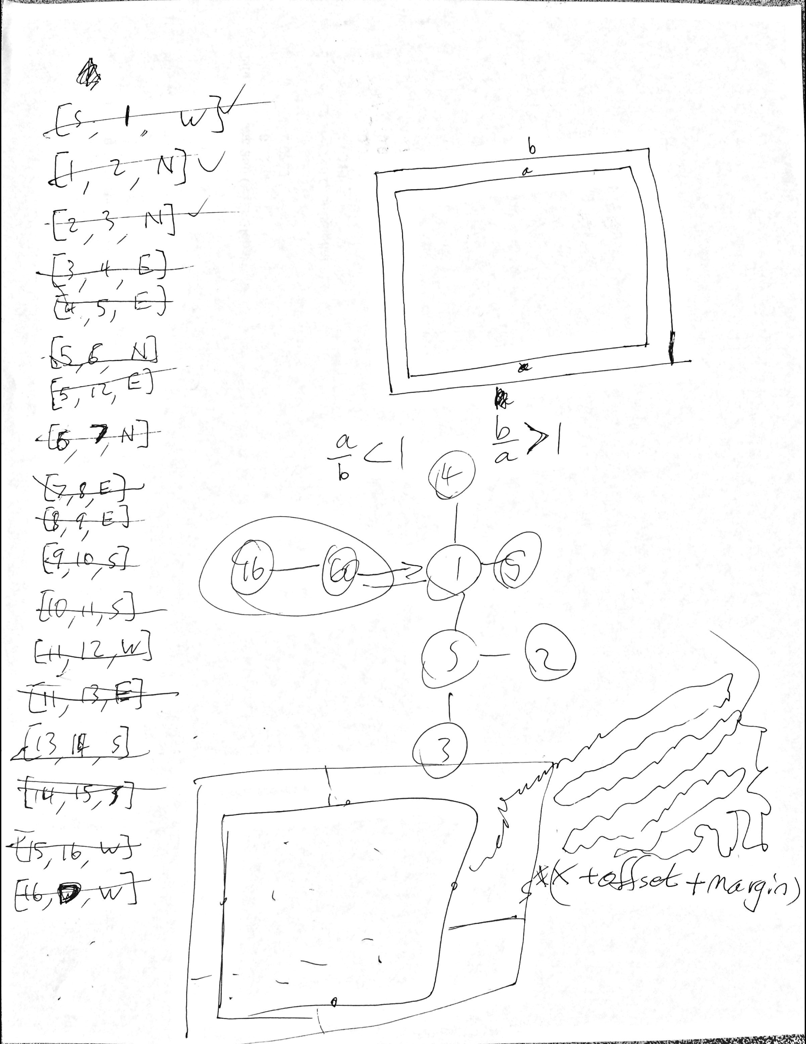
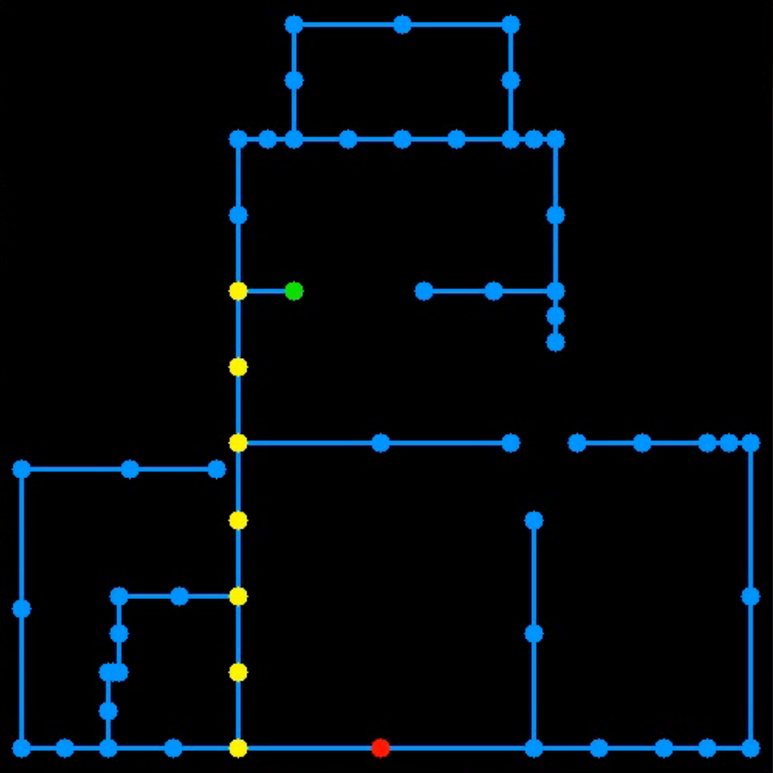
Map-building
Intersections and hallways make up the nodes and edges of our map

Slide 28
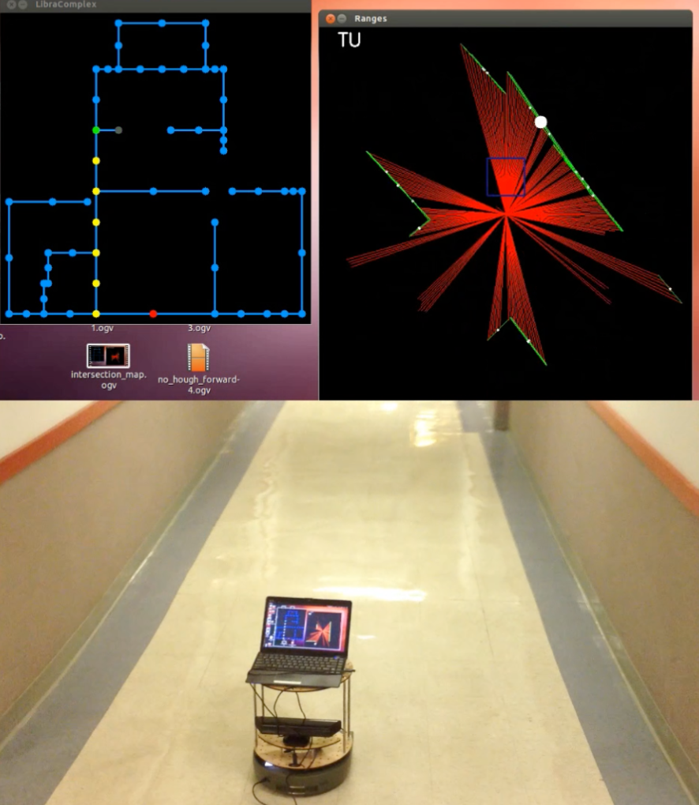
Map-based navigation…

Slide 29
Next: localization

Slide 30
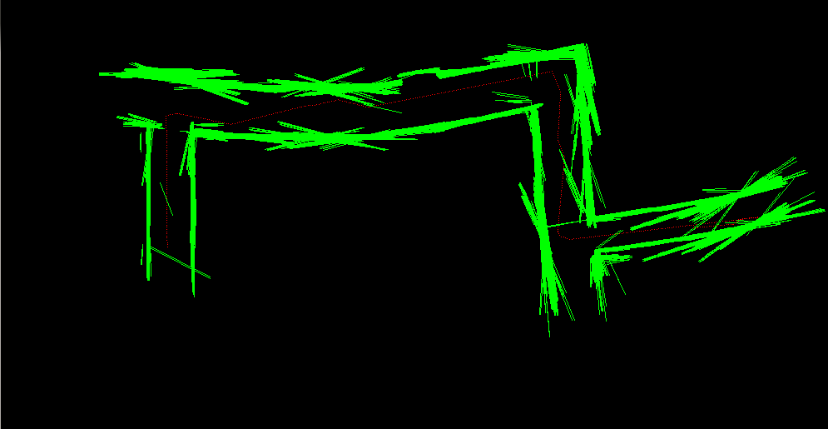
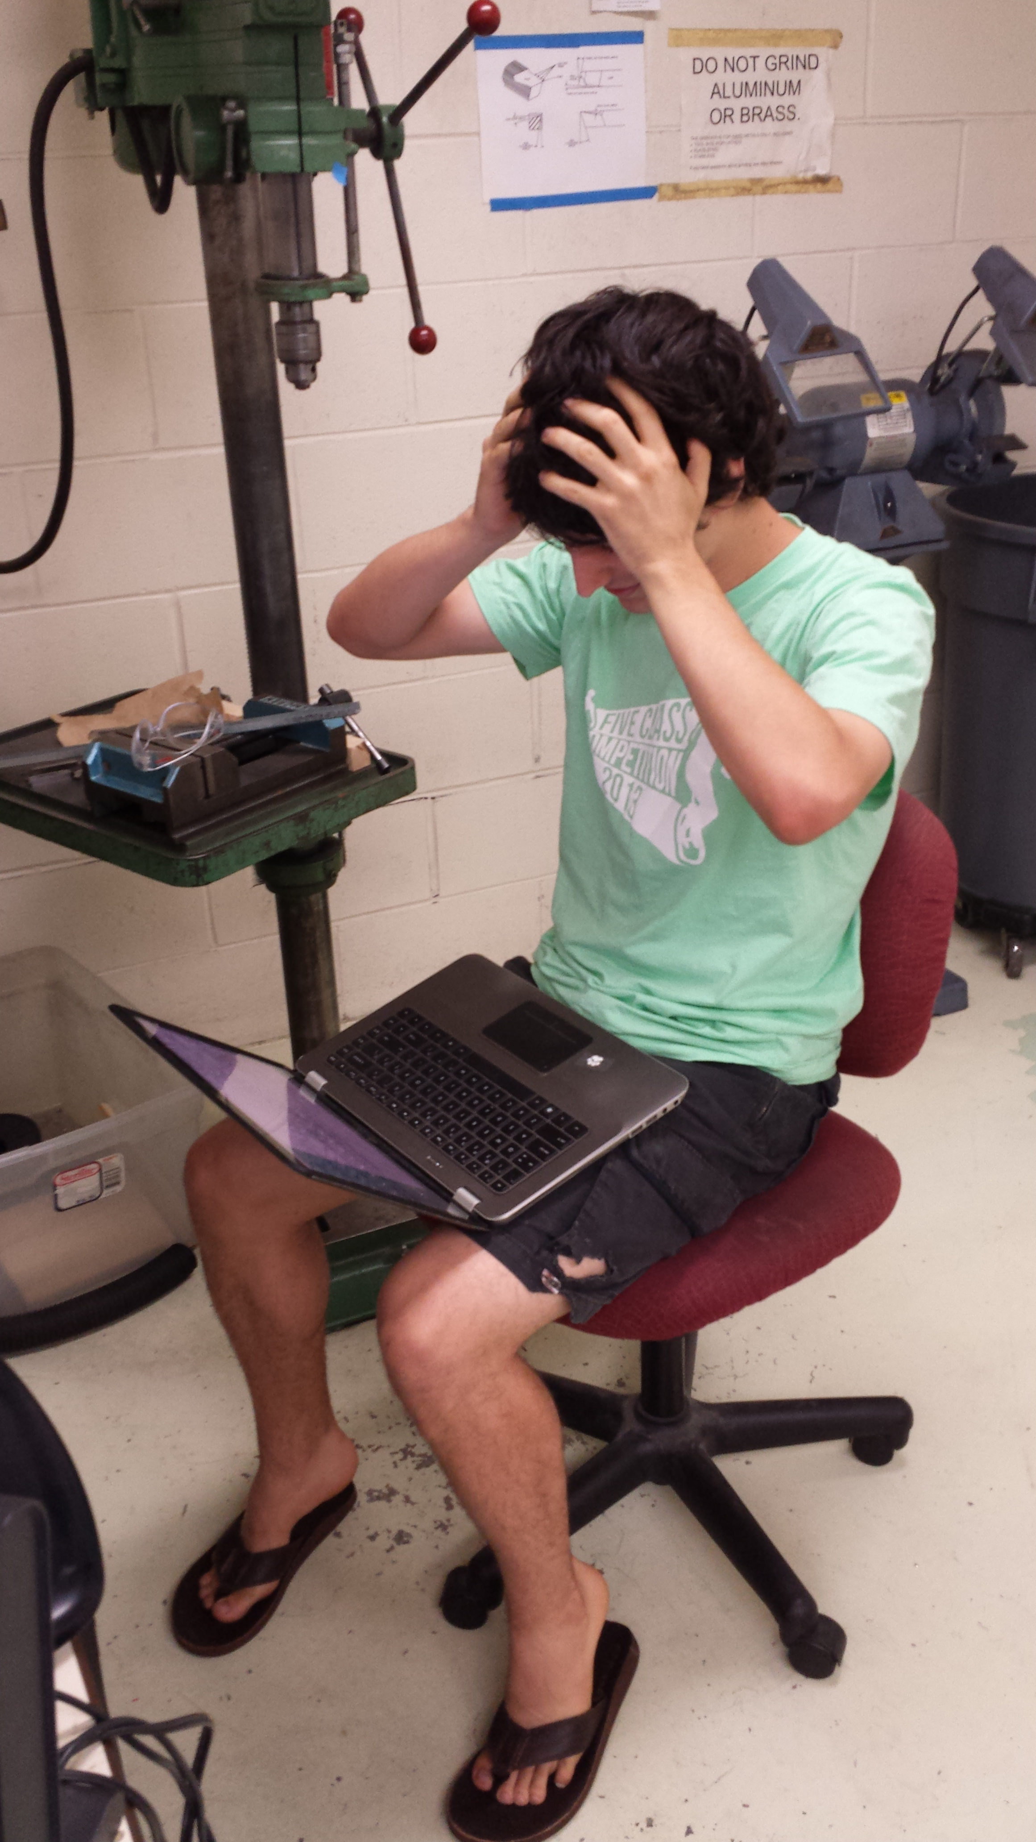
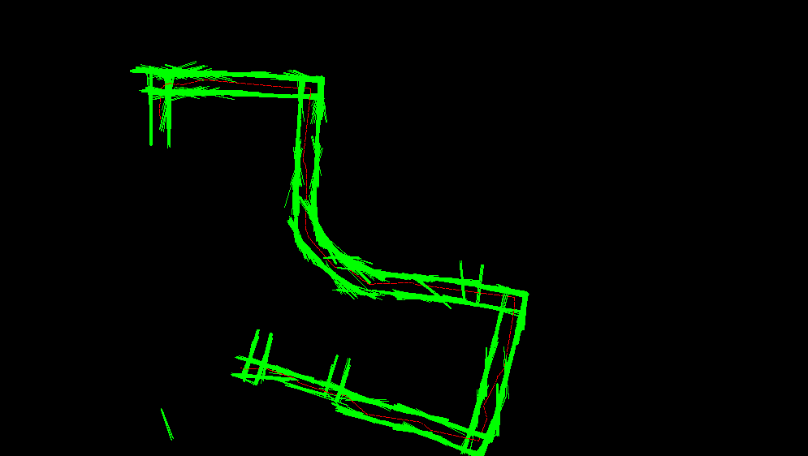
Next: 2d mapping
We plan to “borrow” Alistair’s efforts for this…
Pasting Hough lines together using odometry
Recognize this place?
from alistair import *

Slide 31
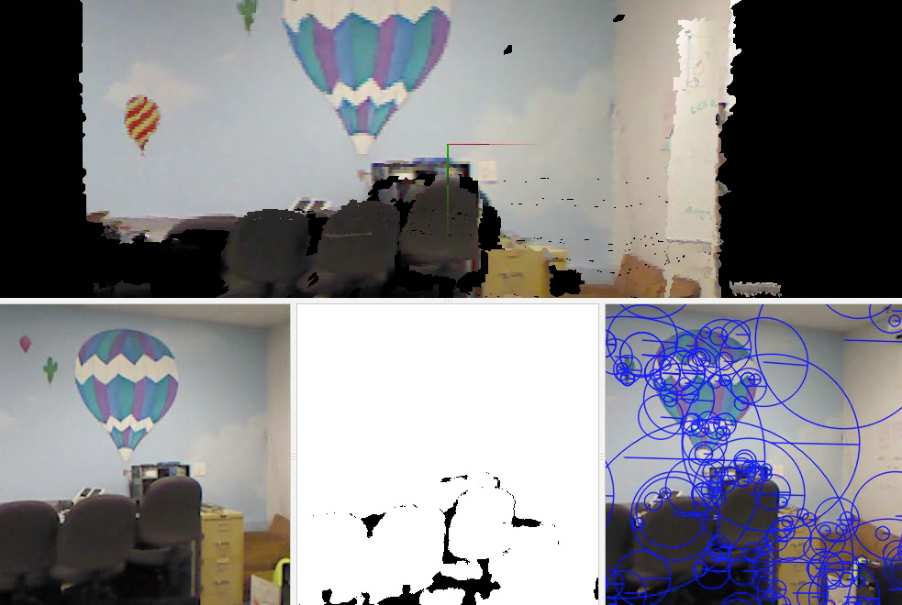
Now: 3d mapping
Demonstration of RGBD-SLAM

Slide 32
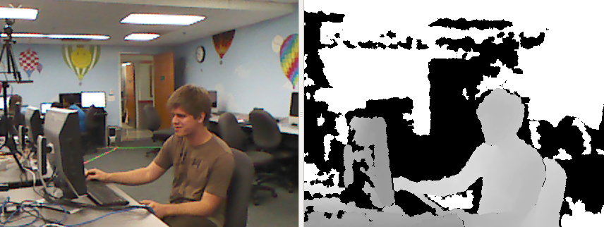
Accessing these 3d maps
our splicer
saves each rgb image
and each depth image
Getting the data: by splicing into the code to extract the input images

Slide 33
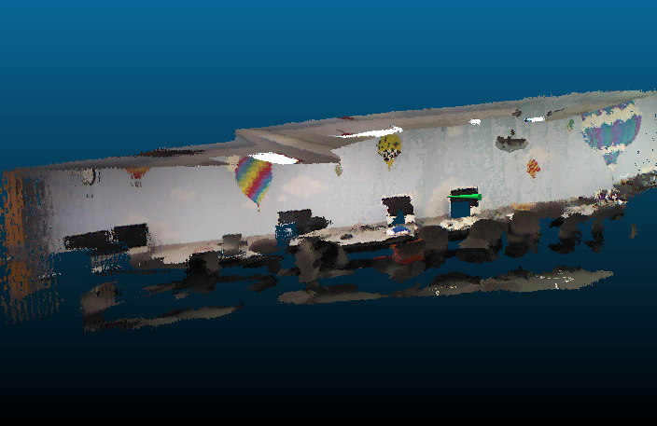
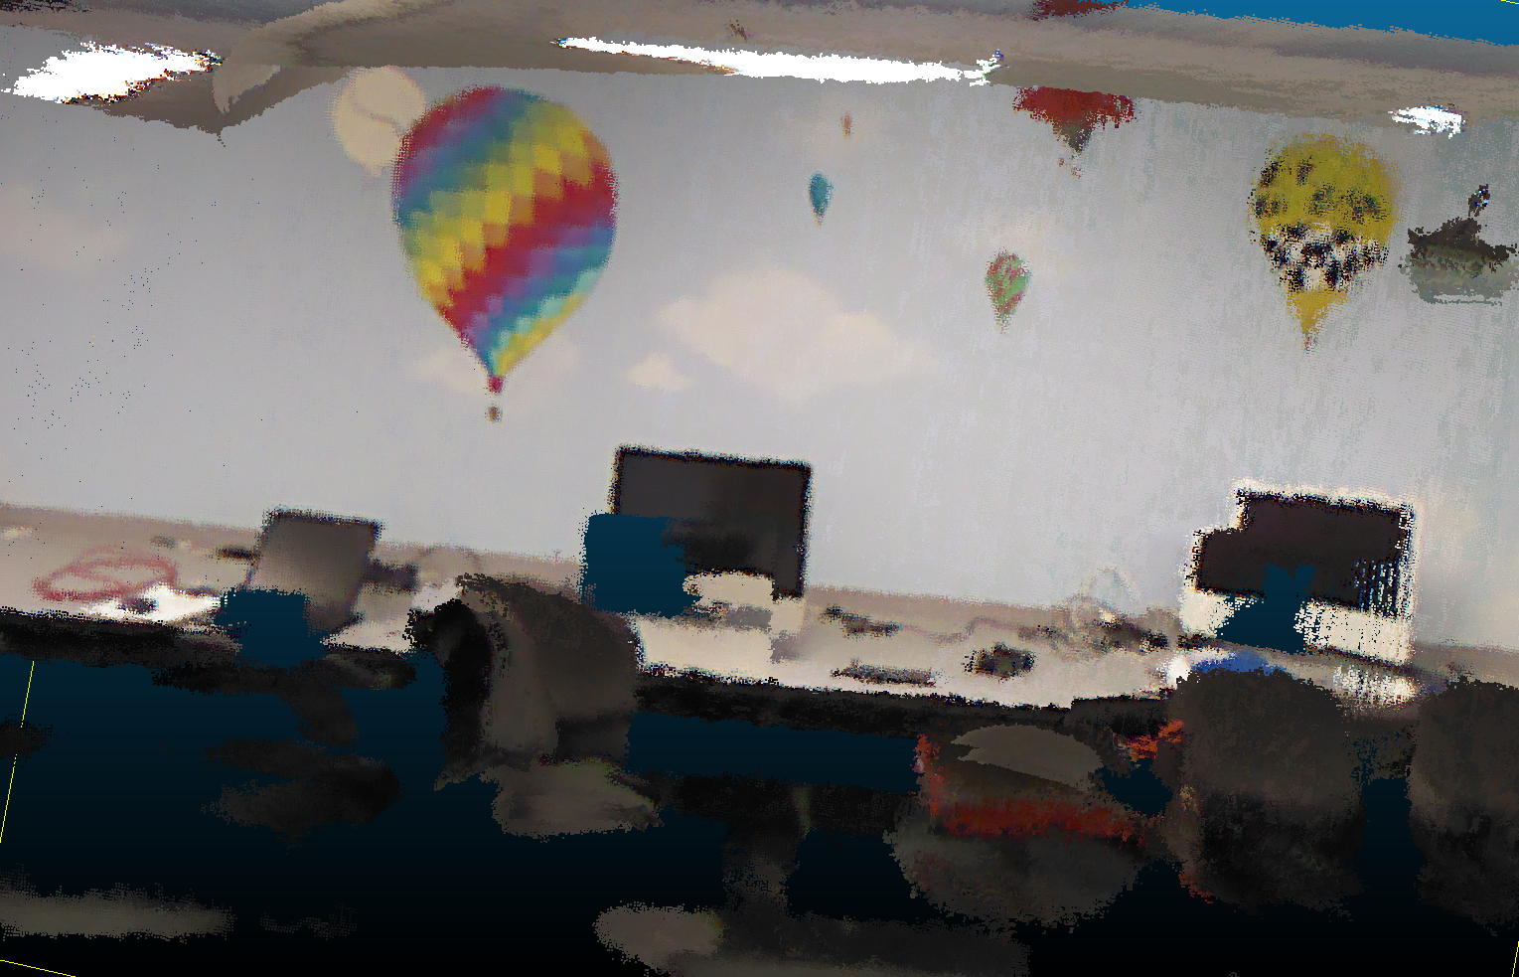
Accessing these models
3d lab model ~ with a surface added
the rendered view from that green cone

Slide 34
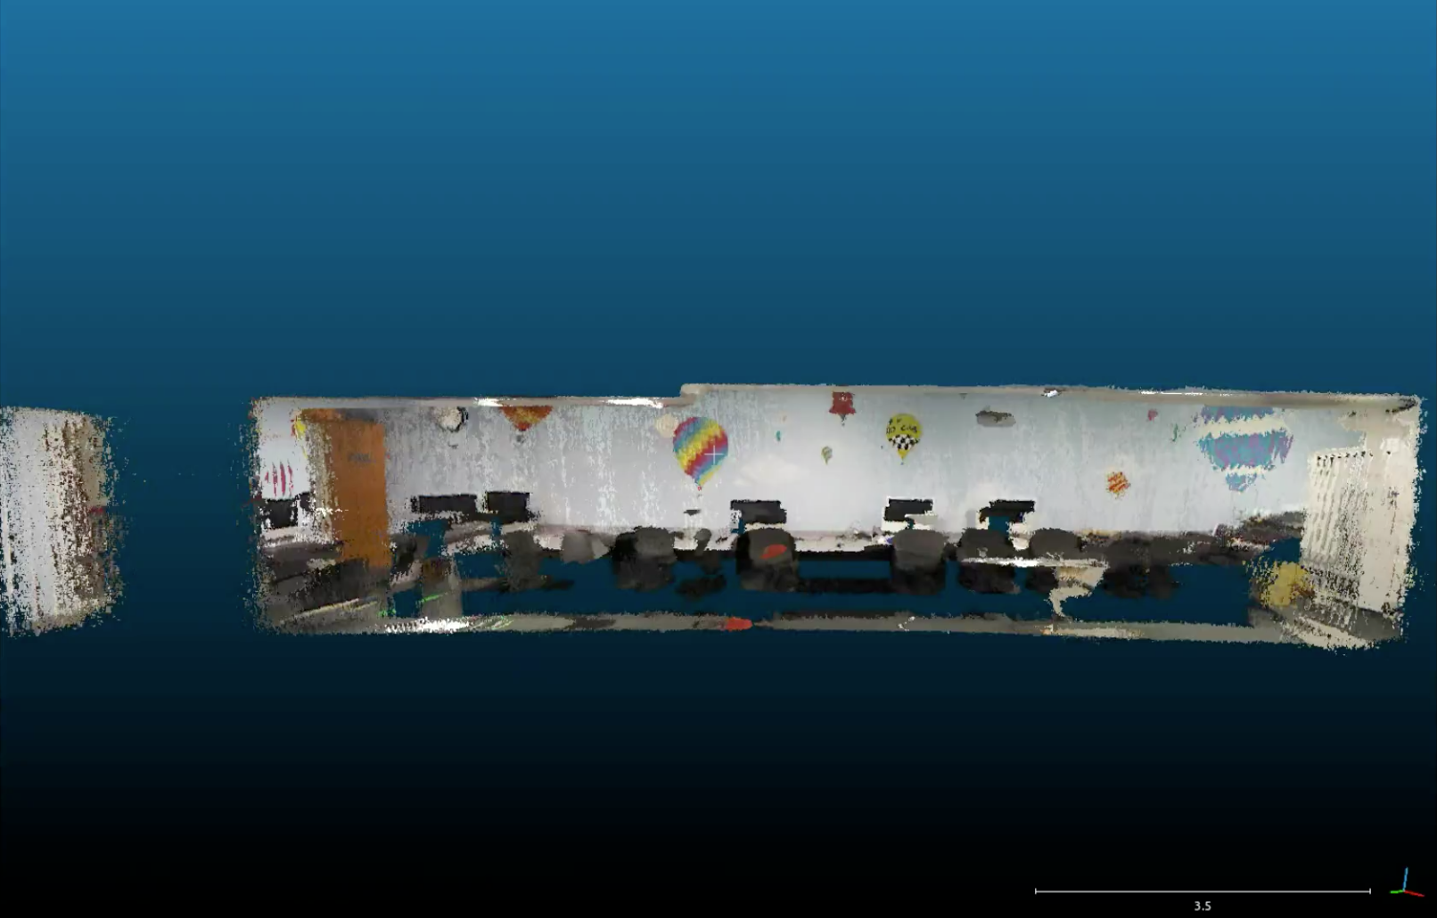
Accessing these models
Cloud Compare is a visualizer that can include our own “annotations” …

Slide 35
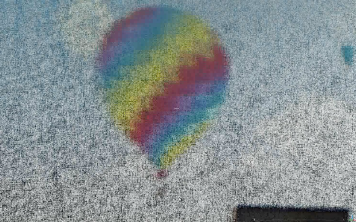
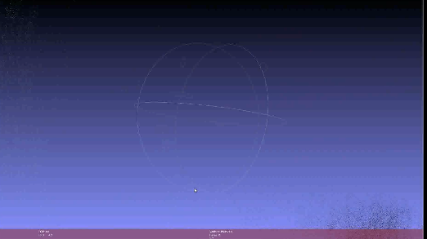
Zooming vs. Moving
zooming in to the balloon…
CloudCompare
MeshLab
… vs. moving towards/past it

Slide 36
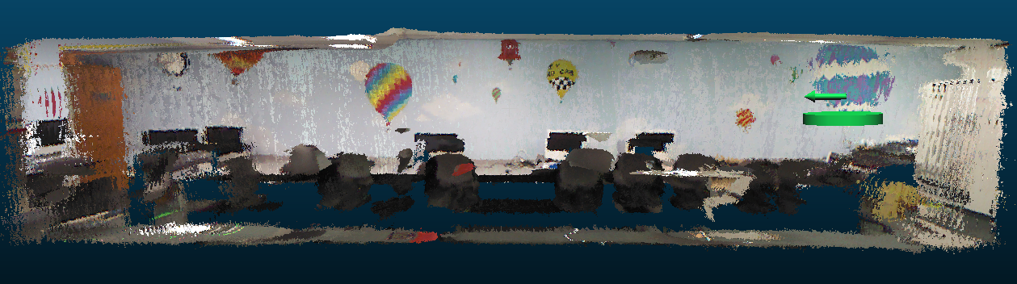

Goal: Escape from the lab!

Slide 37
Using these models
How might a robot with an ordinary camera, i.e., only 2d sensing, use these 3d models?
2d – 2d matching
3d – 3d matching
Ideally, a 2d sensing system could localize – and reason – within a 3d model

Slide 38
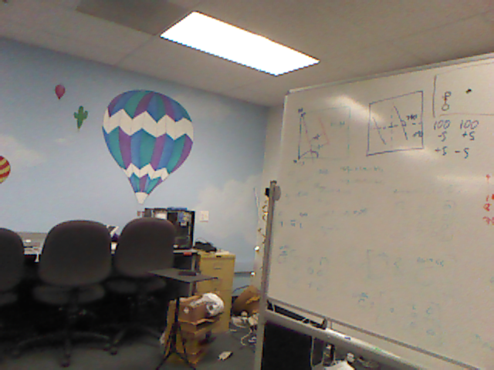
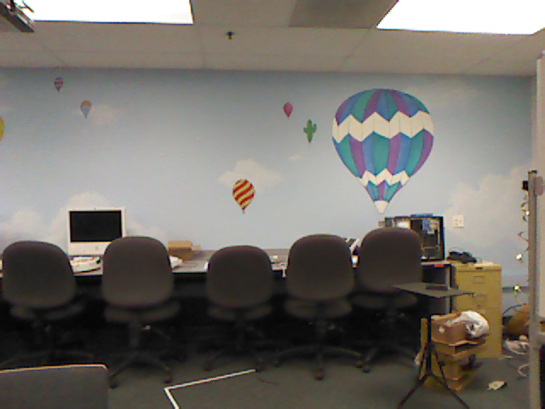
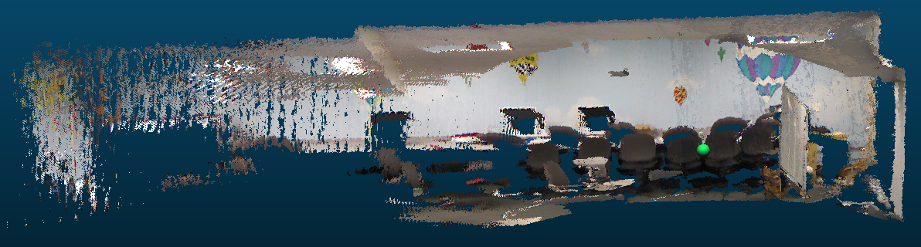
2d – 2d matching
with a new image from a robot (or other device)
we could compare
vs. original images
vs. rendered images
These are the images used to create the 3d model in the first place: fewer, higher-fidelity.
Images yielded by the 3d model: arbitrarily many, but lower-quality.

Slide 39
2d – 2d matching
with a new image from a robot (or other device)
we could compare
vs. original images
vs. rendered images
These are the images used to create the 3d model in the first place: fewer, higher-fidelity.
Images yielded by the 3d model: arbitrarily many, but lower-quality.

Slide 40
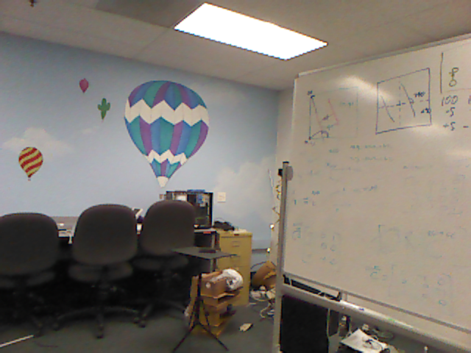
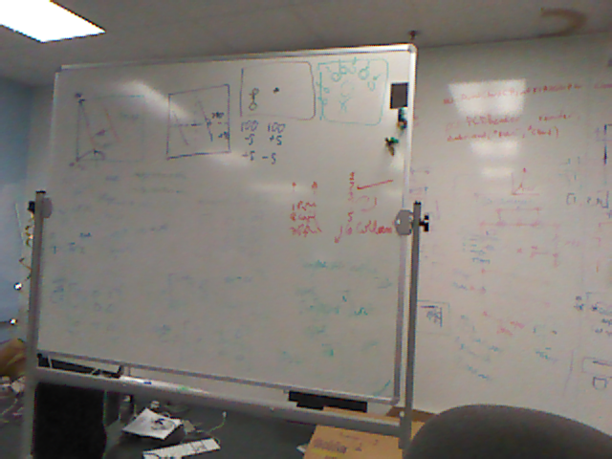
Matching?
new image
Our approach:
Find features in each (SIFT)
Consider all matches (FLANN)
Ensure bidirectional constraints
Consistency filtering (homography)
Best-matching by visual similarity metric
Tiebreaking by pixel distances
many original images

Slide 41
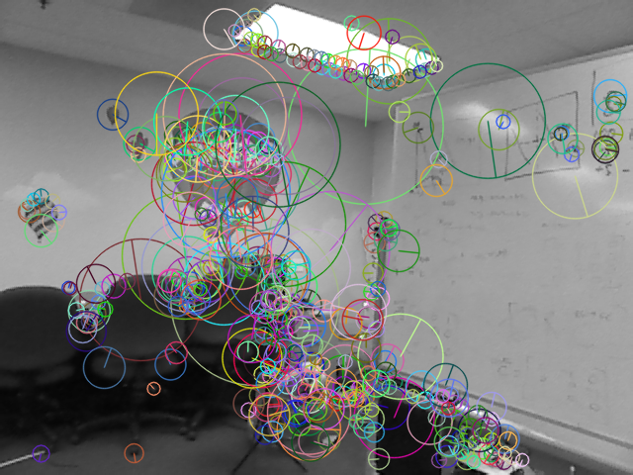
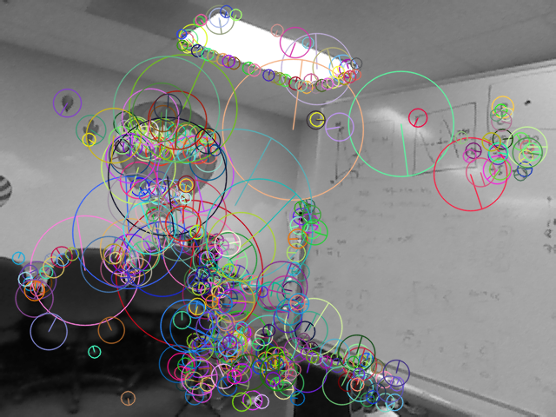
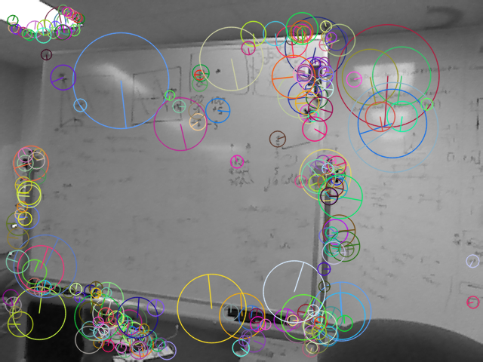
Features
Our approach:
Find features in each (SIFT)
Consider all matches (FLANN)
Ensure bidirectional constraints
Consistency filtering (homography)
Best-matching by visual similarity metric
Tiebreaking by pixel distances

Slide 42
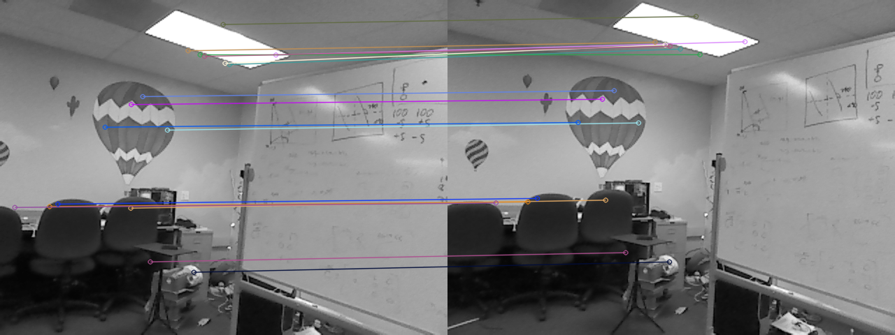
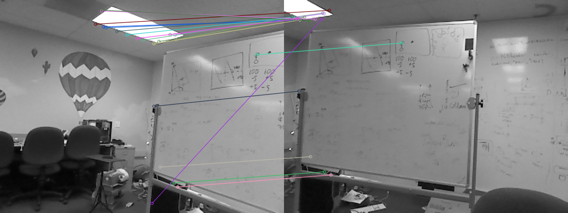
Our approach:
Find features in each (SIFT)
Consider all matches (FLANN)
Ensure bidirectional constraints
Consistency filtering (homography)
Best-matching by visual similarity metric
Tiebreaking by pixel distances
Nearest-neighbor matching

Slide 43
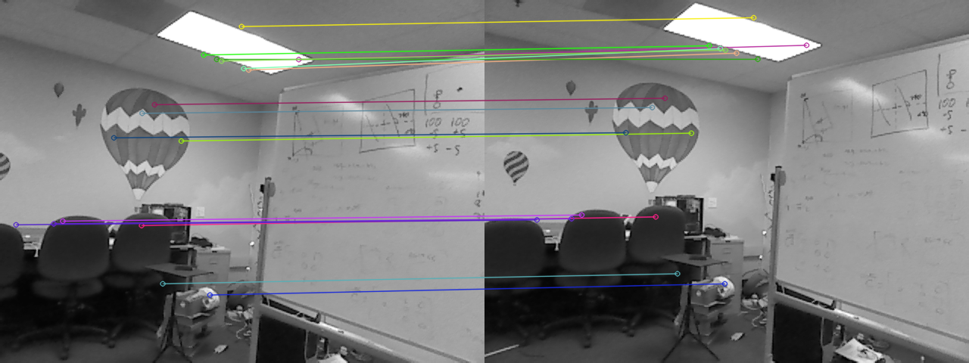
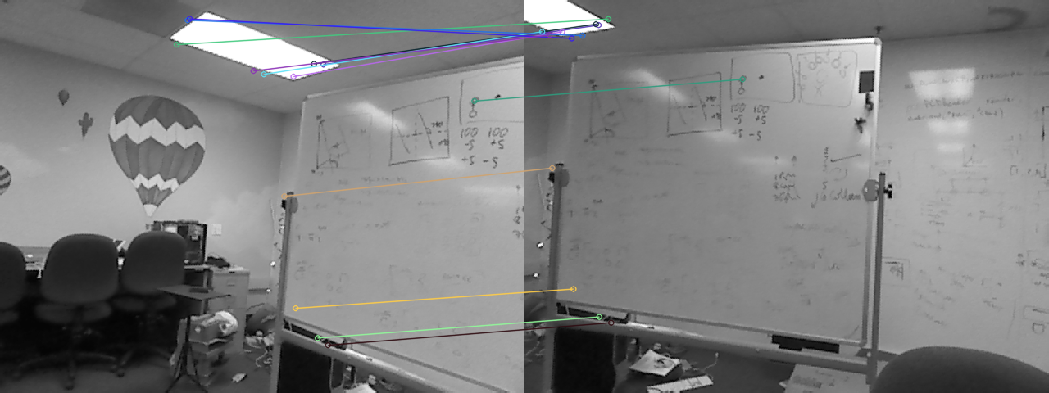
Our approach:
Find features in each (SIFT)
Consider all matches (FLANN)
Ensure bidirectional constraints
Consistency filtering (homography)
Best-matching by visual similarity metric
Tiebreaking by pixel distances
Keep only two-way best matches

Slide 44
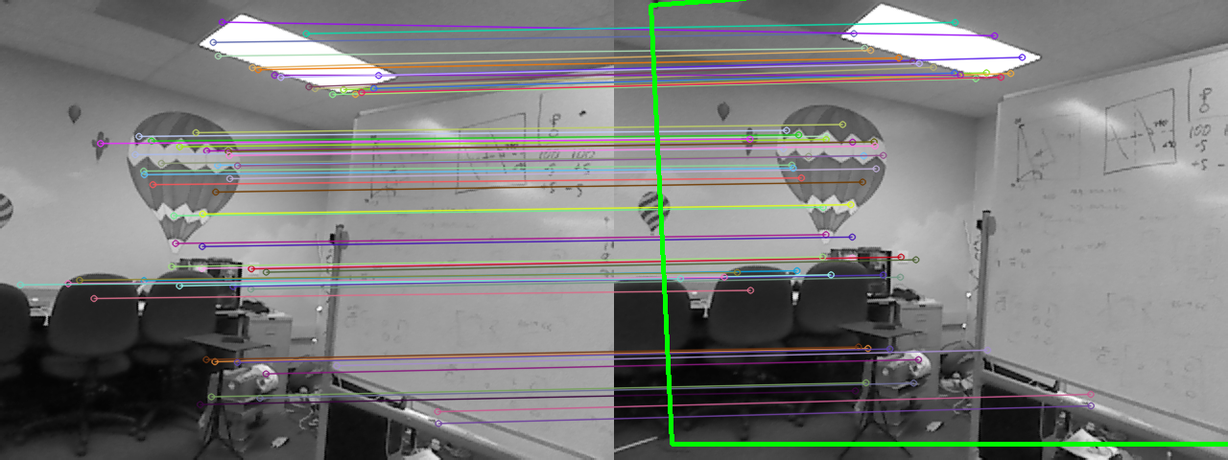
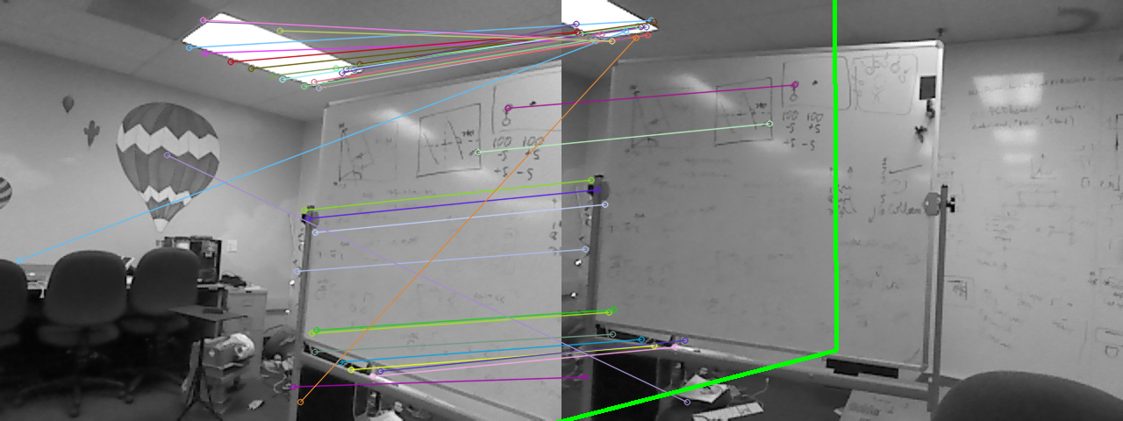
Our approach:
Find features in each (SIFT)
Consider all matches (FLANN)
Ensure bidirectional constraints
Consistency filtering (via homography)
Best-matching by visual similarity metric
Tiebreaking by pixel distances
Keep geometrically realistic matches

Slide 45
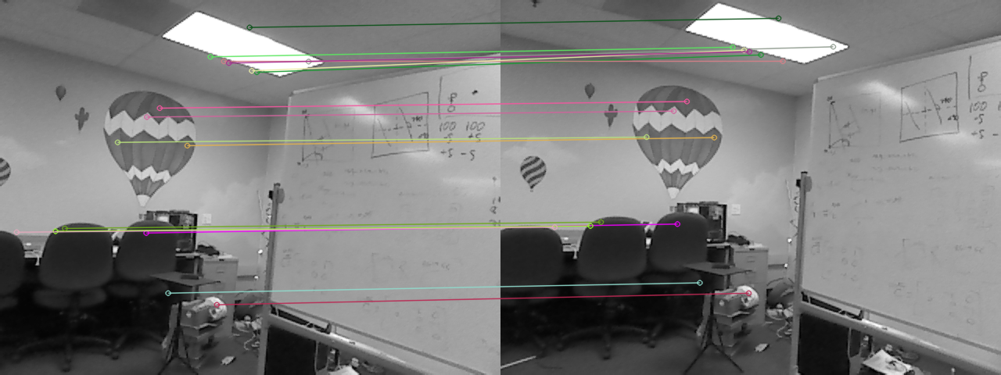
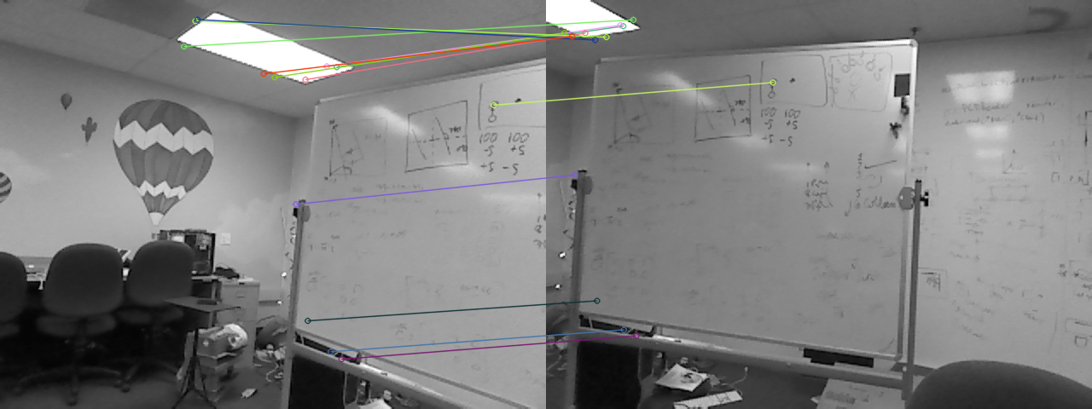
1st-best match
10th-best match
Our approach:
Find features in each (SIFT)
Consider all matches (FLANN)
Ensure bidirectional constraints
Consistency filtering (via homography)
Best-matching by visual similarity metric
Tiebreaking by pixel distances
Visual “closeness”

Slide 46
1st-best match
Average feature distance ~ 40 px
10th-best match
Average feature distance ~ 270 px
Our approach:
Find features in each (SIFT)
Consider all matches (FLANN)
Ensure bidirectional constraints
Consistency filtering (via homography)
Best-matching by visual similarity metric
Tiebreaking by pixel distances
Pixel “closeness”

Slide 47


PCL: Point Cloud Library
3D-Reasoning
Easy point cloud access
Screenshot

Slide 48


NARFs!
3d features: Normal Aligned Radial Features
picture of pt cloud
picture of NARFS
NARF features are purely based on the range image of a point cloud: its geometry, not its looks (SIFT)
They are based on the normals of the point cloud’s surfaces
They are places distinguishable from multiple perspectives.

Slide 49



3d matching
picture of pt cloud w/NARFS
picture of pt cloud w/NARFS
Take two point clouds
Find NARFs
Match features and find transform
Make transform and combine
naive merging

Slide 50




3d SLAM
Simultaneous Localization And Mapping
Take two point clouds
Find NARFs
Match features and find transform
Make transform and combine

Slide 51


3d SLAM
Simultaneous Localization And Mapping
Take two point clouds
Find NARFs
Match features and find transform (ICP)
Make transform and combine

Slide 52

3d SLAM
Final point cloud map
Questions?
Future: using Neato to create 2.5d maps

Slide 54
Kinect
Z.D. video
The Kinect estimates distance-to-camera by projecting a “star field” on the world.

Slide 55

Now vs. Then

Slide 56
Title

Slide 57
Accessing these models
plane
other (sphere, cylinder, wavy,…)
K.M.
allows us to define the depth at each pixel

Slide 58
Ideally, a camera-only system could localize – and reason – within the 3d model
Ideally, a camera-only system could localize – and reason – within the 3d model

Slide 59
Accessing 3d models
RGB
Depth
splicing into the code…

Slide 60
Hough transform
r
θ
Consider one point of a laser scan
These are all of the lines through it
http://gmarty.github.io/hough-transform-js/
http://liquify.eu/flash/HoughTransform

