Slide 1
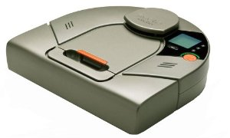
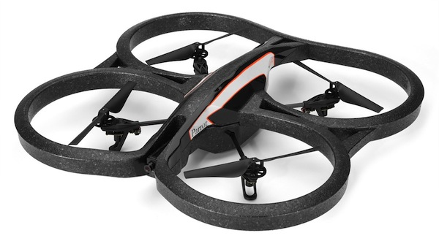
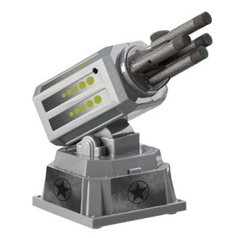
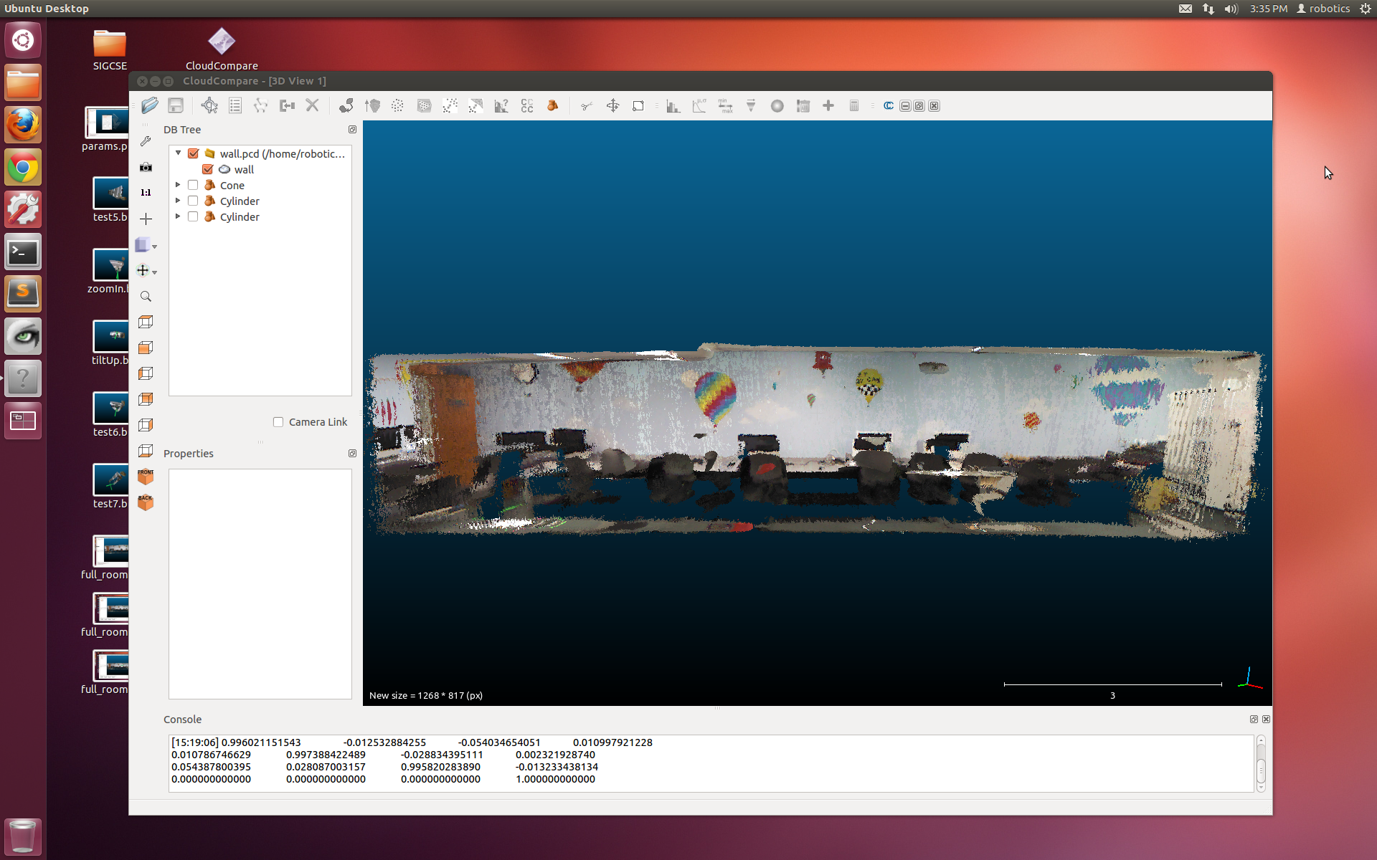
Interdimensional Robot Cooperation
Kristina Ming, Chris Eriksen, Graham Montgomery,
Jerry Hsiung, Cyrus Huang, Zakkai Davidson, and Zach Dodds

Slide 2
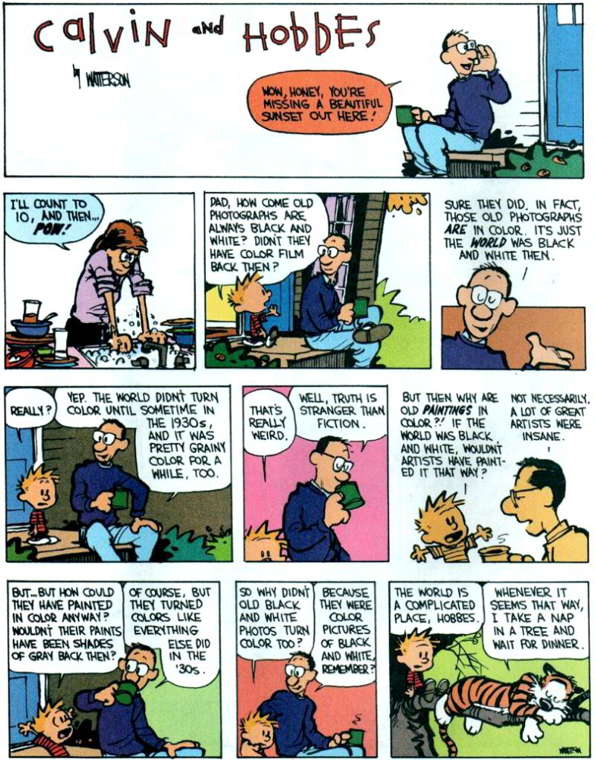
Now vs. Then

Slide 3
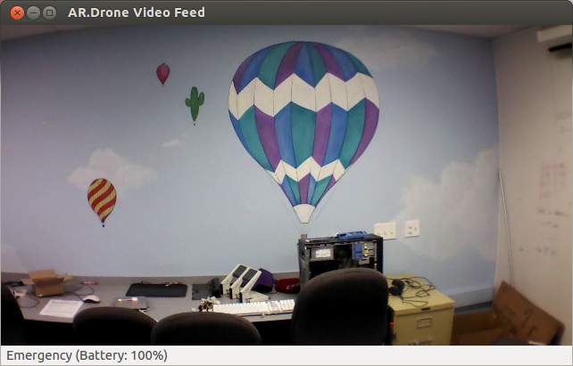
Now…
3d representations are a new standard for robot spatial reasoning
yet 2d image sensing is certainly still common – and will continue to be for a long time…
… vs. Then

Slide 4
Cooperating?!
2d sensors
3d models
Our goal: to investigate robot platforms, software, and algorithms for using 2d sensors amid 3d models of the world.

Slide 5
New platform: Neato
Promise…
360° laser scanner
beautiful 2d sensing
inexpensive ($250)
serial interface
Unrealized…
forward
existing drivers slow
only runs tethered
no navigation routines
bump sensor
Objective: to get this robot working well

Slide 6
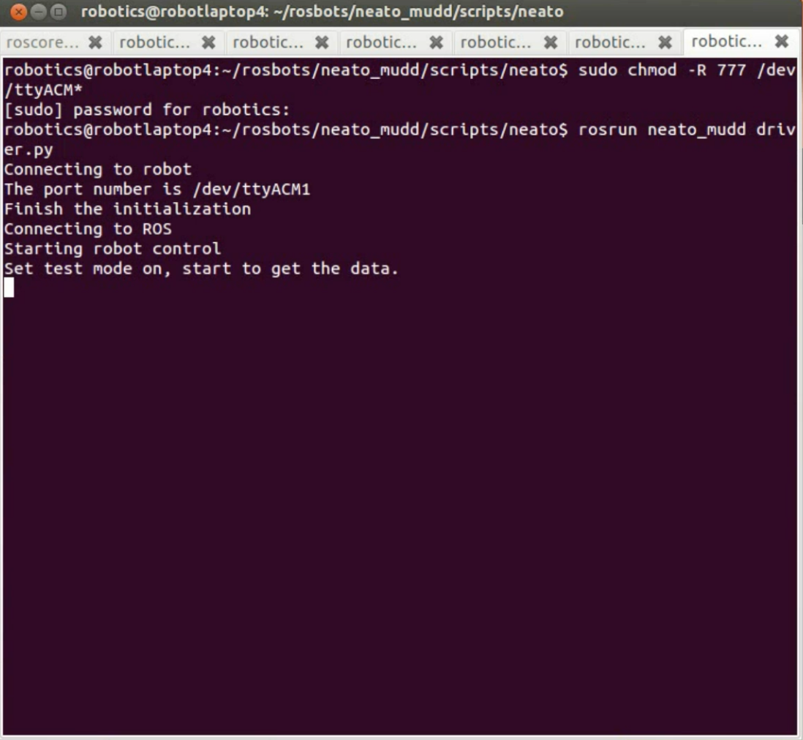
Neato drivers
Hurdles overcome:
driver crashes
- different Neatos!
unorganized data
multiple threads
Built: Robot Operating System (ROS) drivers w/full control

Slide 7
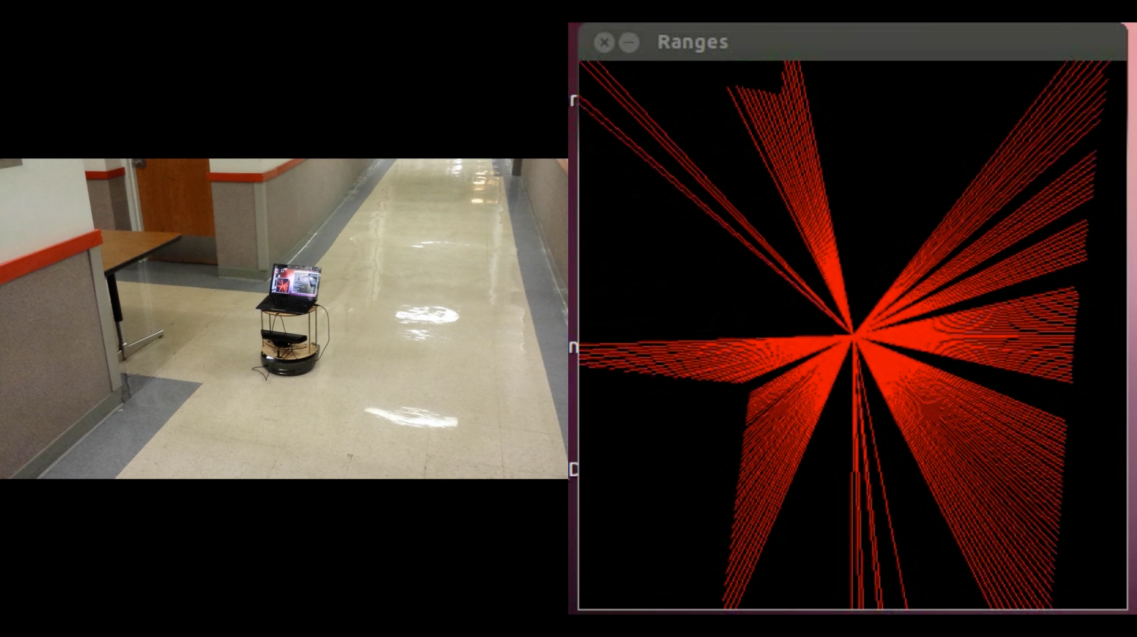
Visualizing
OpenCV interface
beautiful data!
how to navigate smoothly?
Objective: Find walls and navigate safely among them

Slide 8
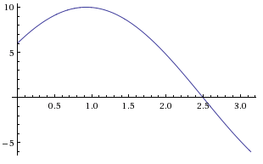
Hough transform
Point space
Line space
y
r
θ
y = 8
x
x = 6
Consider one point of a laser scan
These are all of the lines through it

Slide 9
Hough transform
Point space
Line space
y
θ = 0
r
θ
x
r = 6
vertical line ~ θ = 0
The dot is the line r = 6, θ = 0

Slide 10
Hough transform
Point space
Line space
y
r
θ
r = 9.1
x
angled line ~ θ = 32°
The dot is the line r = 9.1, θ = 32°

Slide 11
Hough transform
Point space
Line space
y
r
θ
r = 8
x
angled line ~ θ = 90°
The dot is the line r = 8, θ = 90°

Slide 12
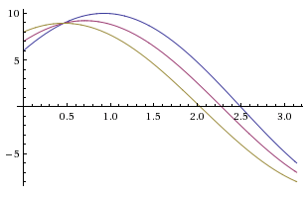
Hough transform
Point space
Line space
y
r
θ
x
three points of a laser scan
all the lines through all three
(horizontal lines are shown)
(dots ~ the shown horizontal lines)

Slide 13
Hough transform
Point space
Line space
y
r
θ
x
yield lines with substantial support in the original data
peaks here in line space

Slide 14
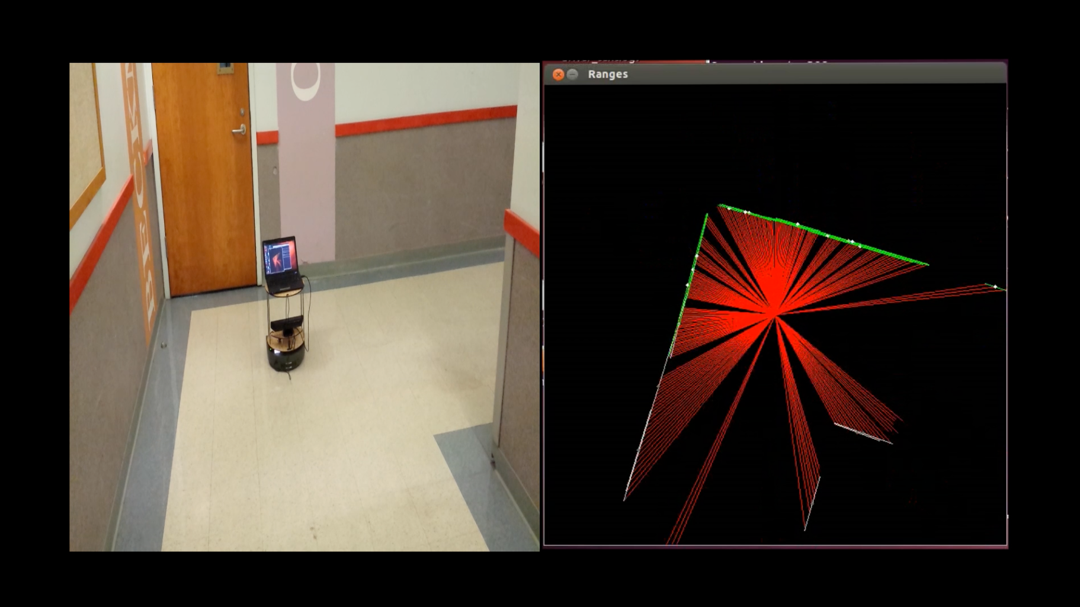
Hough in action
now… wall sensing

Slide 15
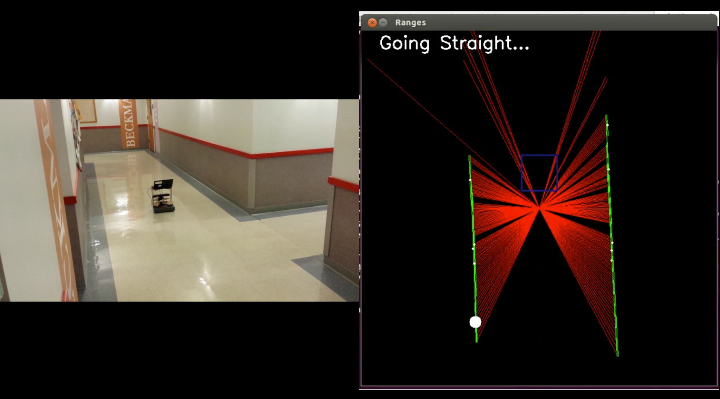
Low-level navigation
idea: follow the most-vertical wall

Slide 16
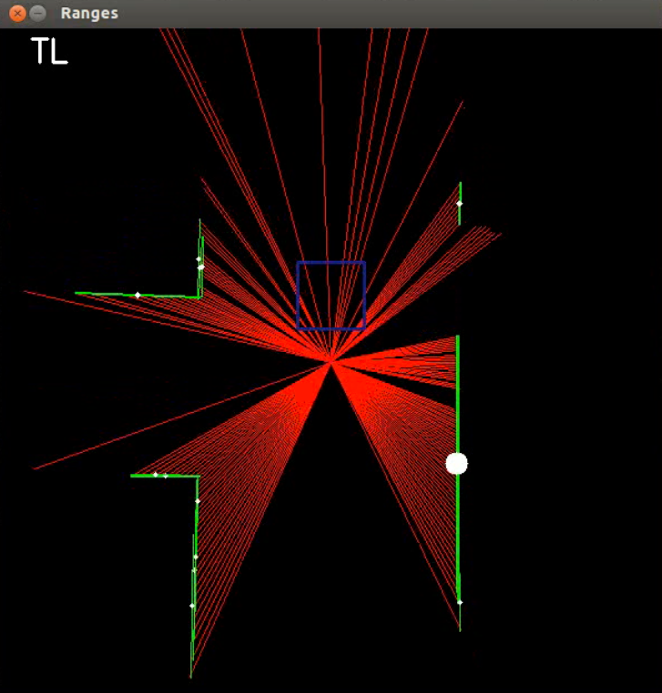
Intersection recognition
For each scan:
Front
Check for Front, Left, and Right obstacles
The number of obstacles determines the intersection type 3:D 2:L 1:T 0:+
Open space determines final label, e.g., TL
After 15 recognitions in a row, the robot checks the map (by broadcasting a message)
The robot does not broadcast again until it resets in a hallway: ST.
Left
still image
Right
ST
LL
LR
TL
TR
TD
D
+

Slide 17
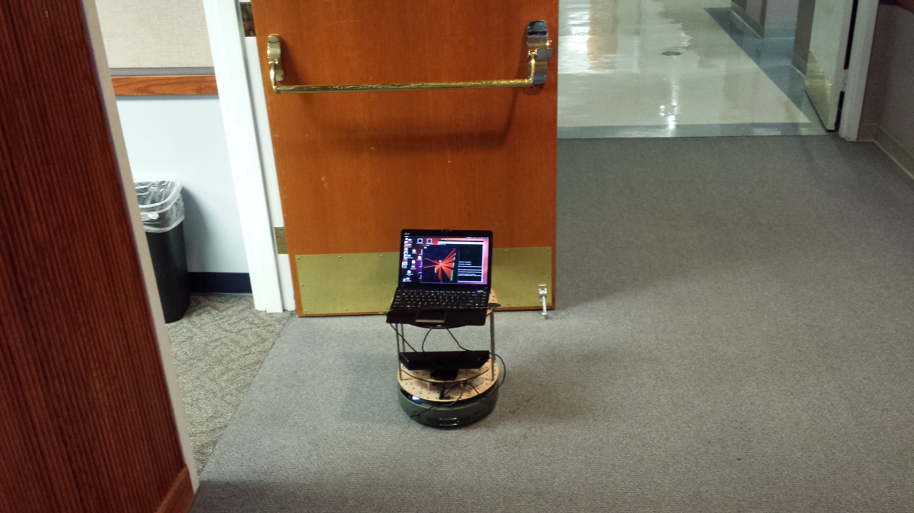
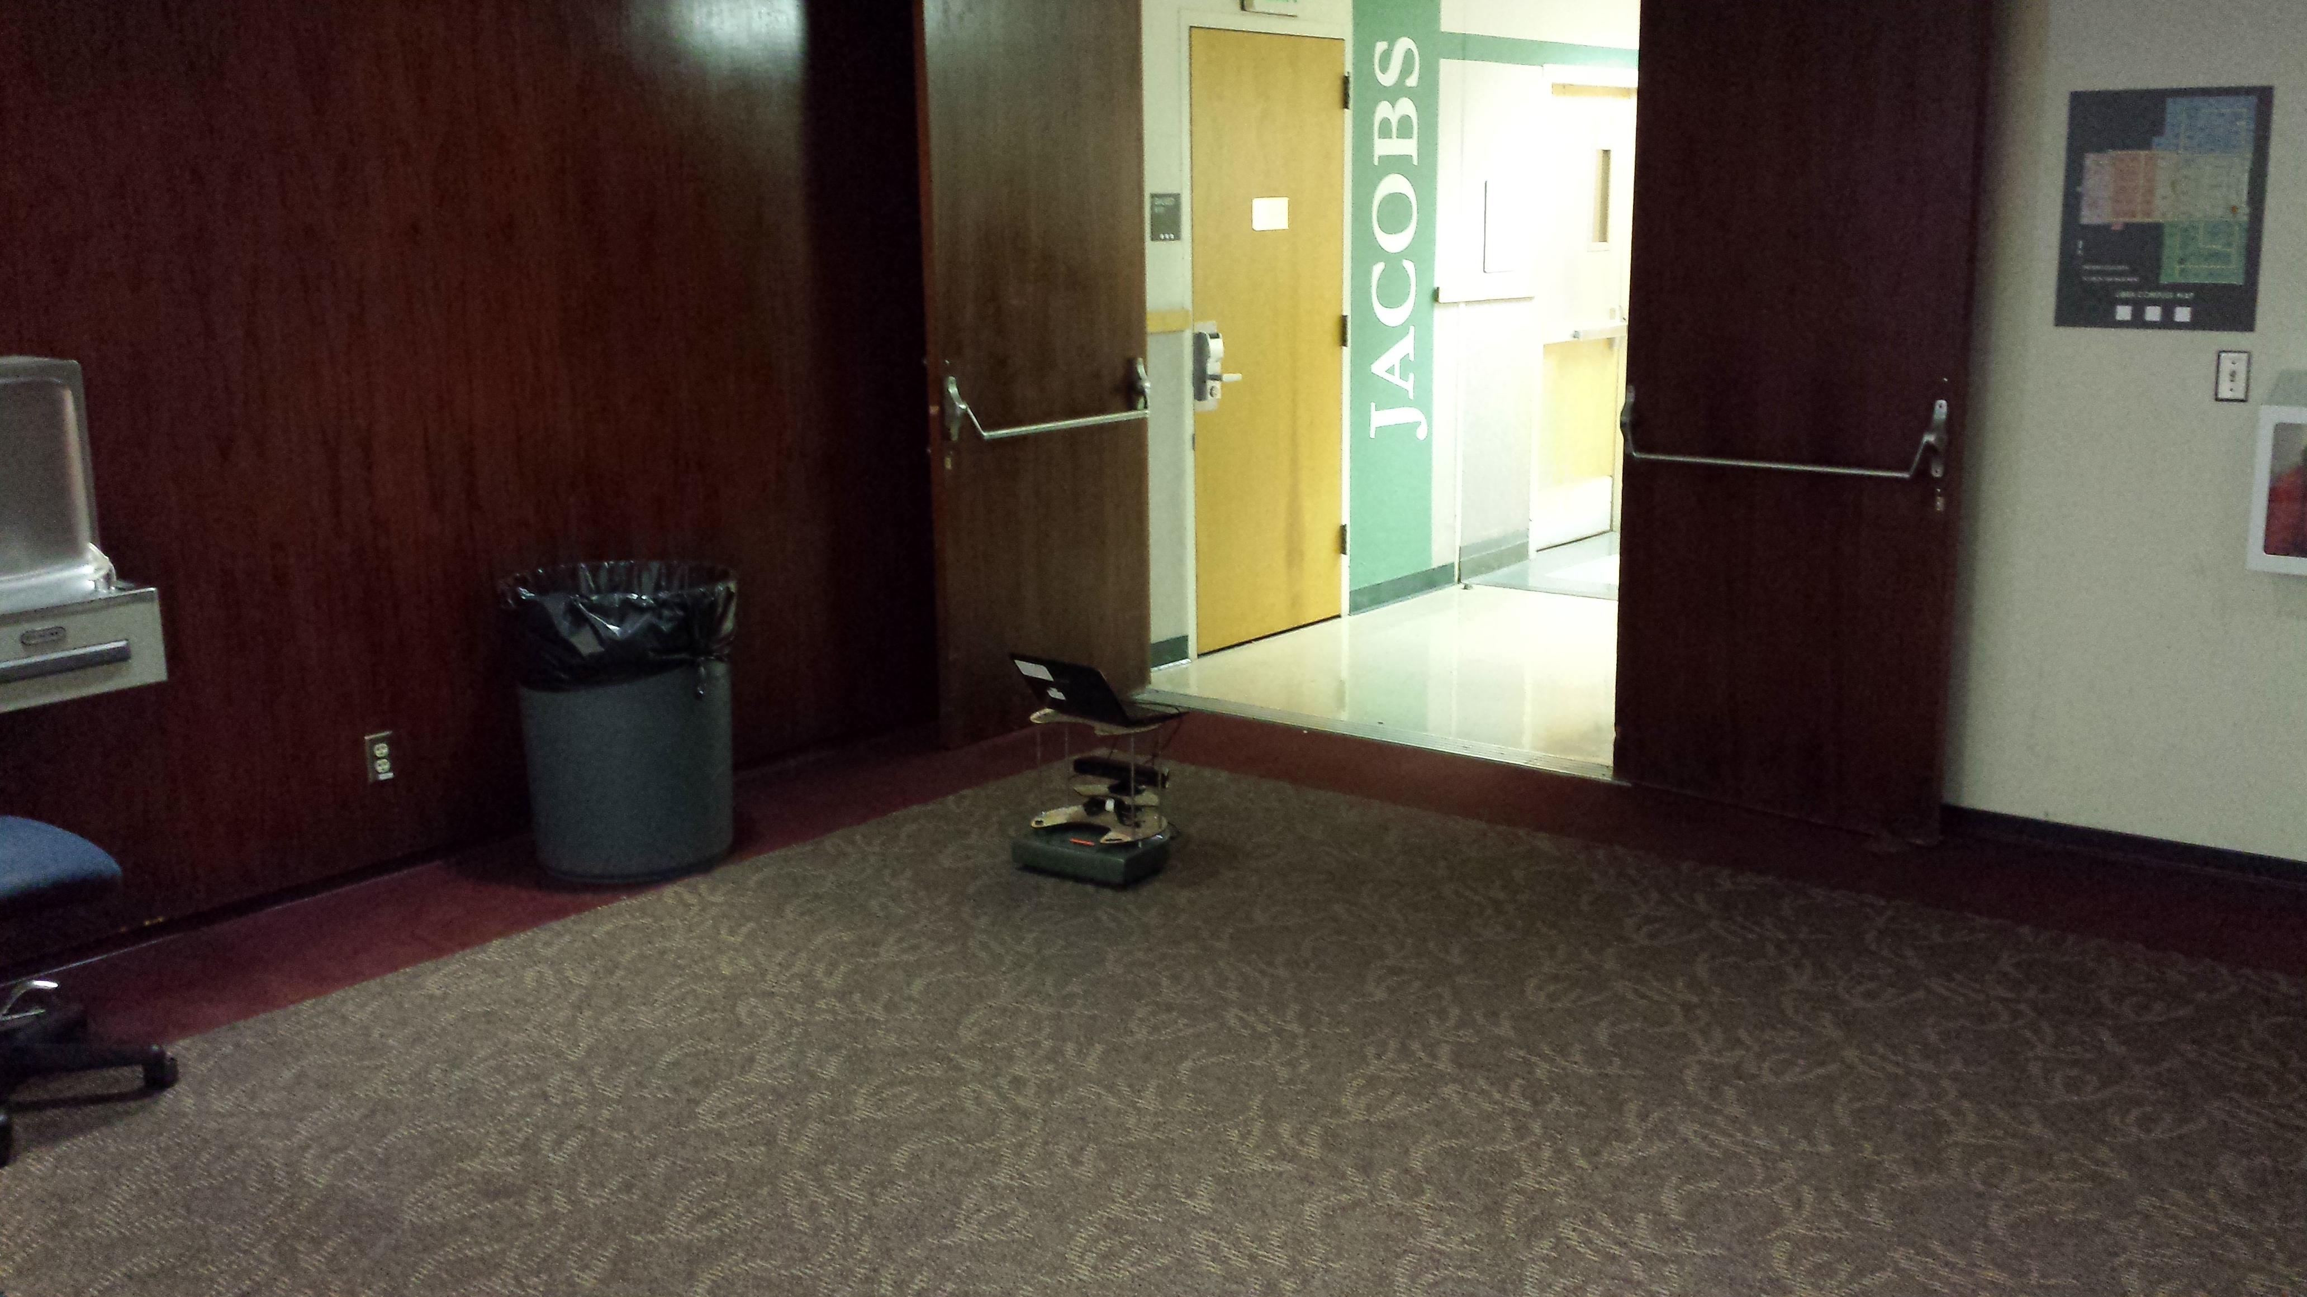
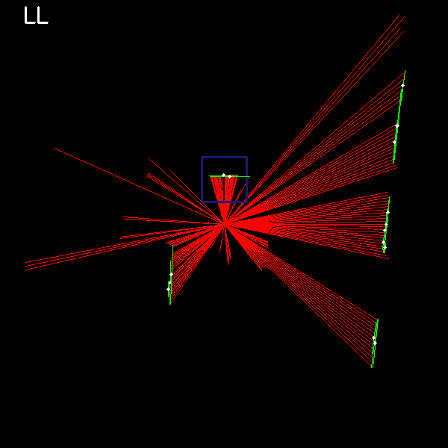
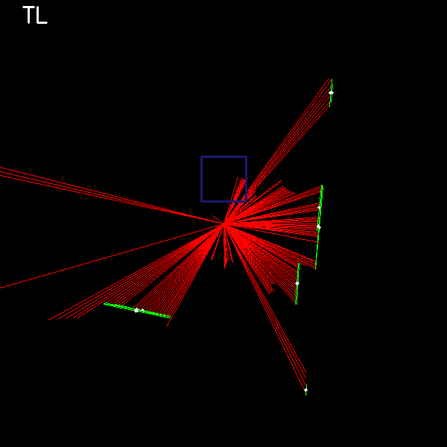
Recognition problems

Slide 18
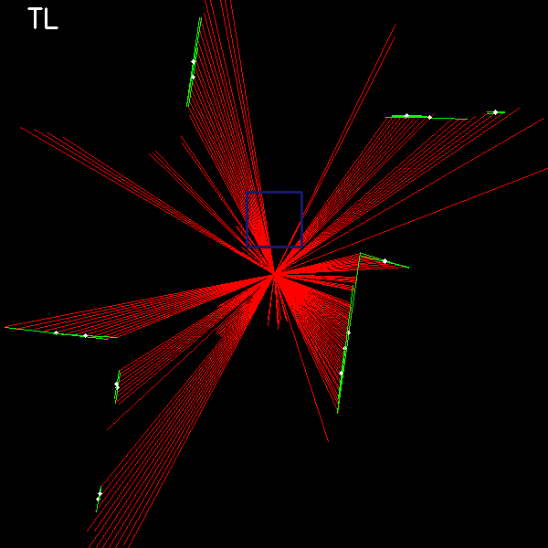
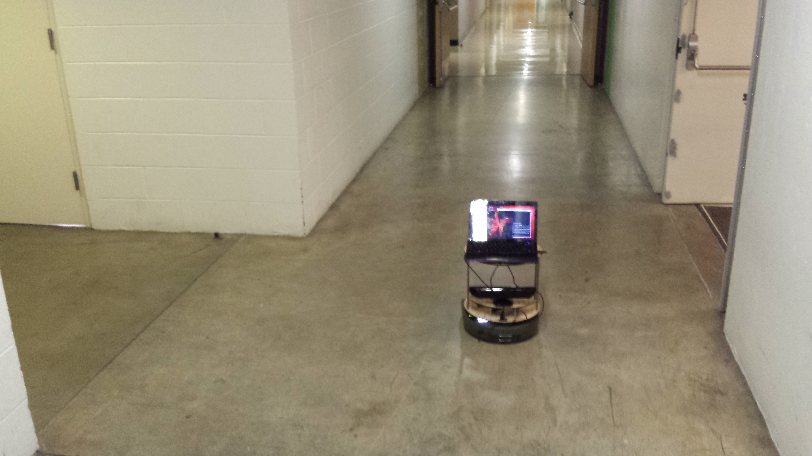
Recognition problems
Not really a +

Slide 19
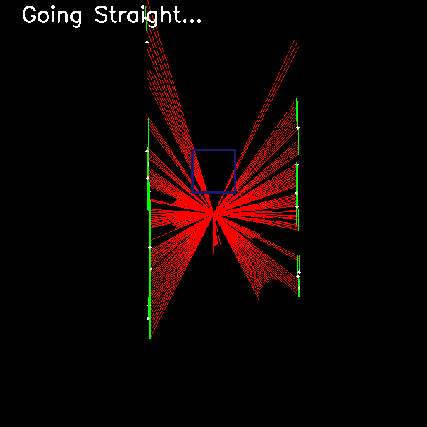
Recognition problems

Slide 20
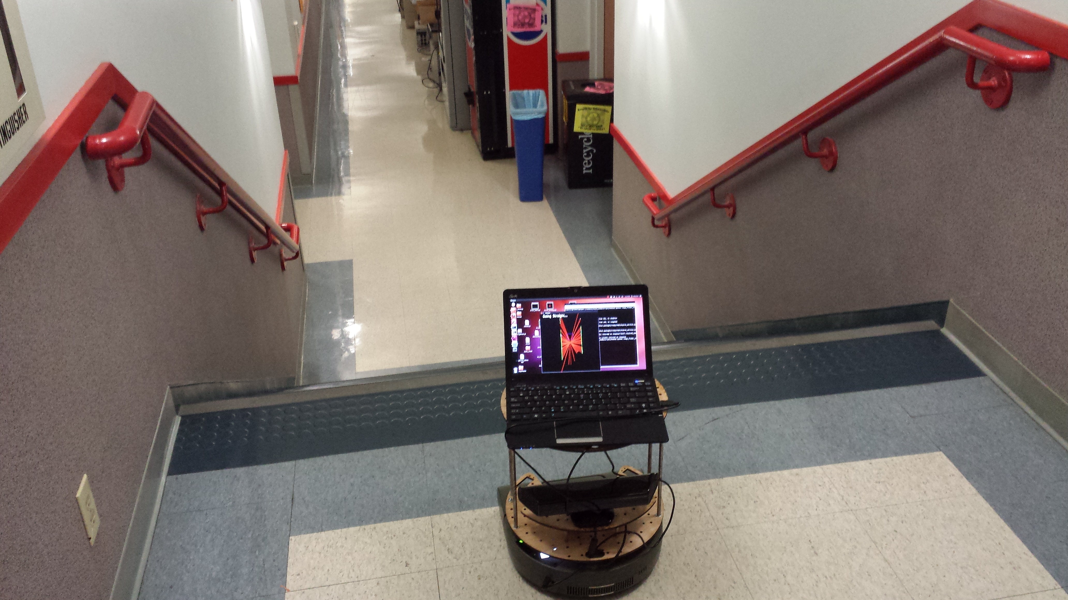
Recognition problems
Not really a hallway!

Slide 21
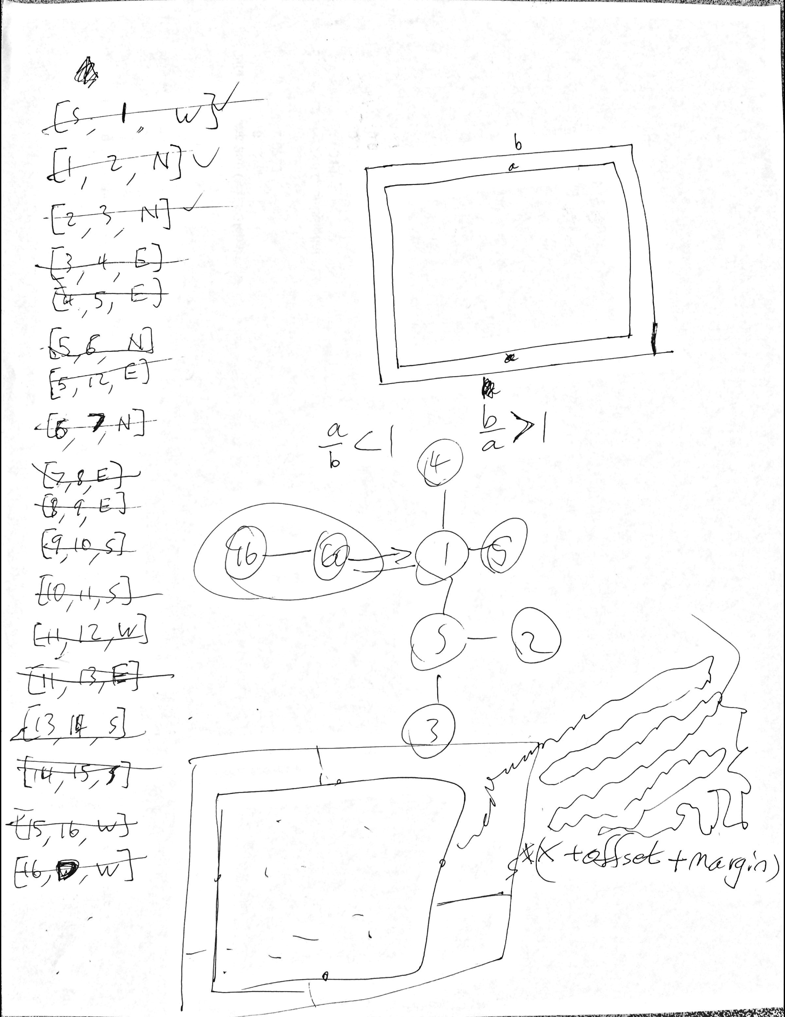
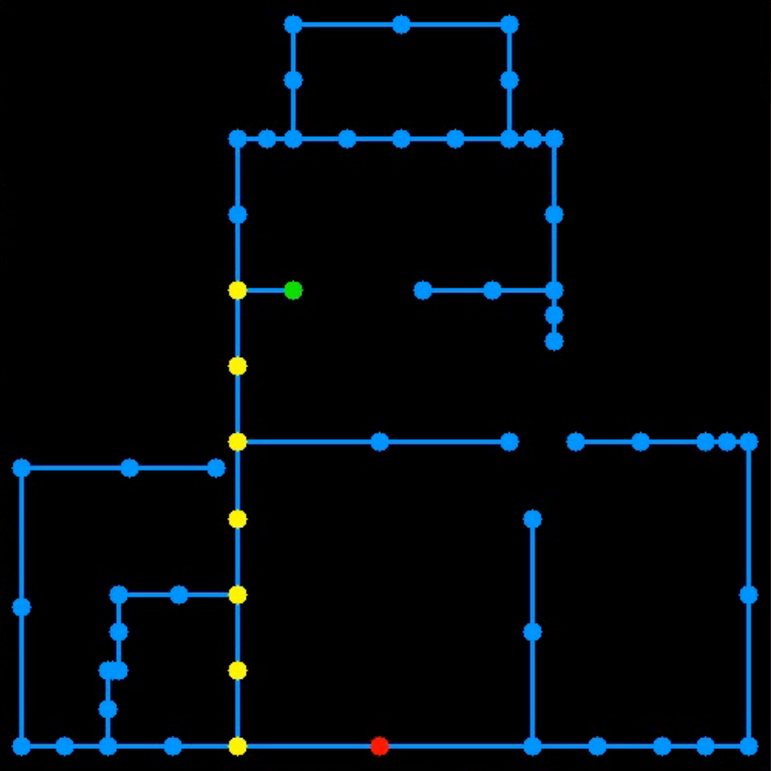
Map-building
Intersections and hallways make up the nodes and edges of our map

Slide 22
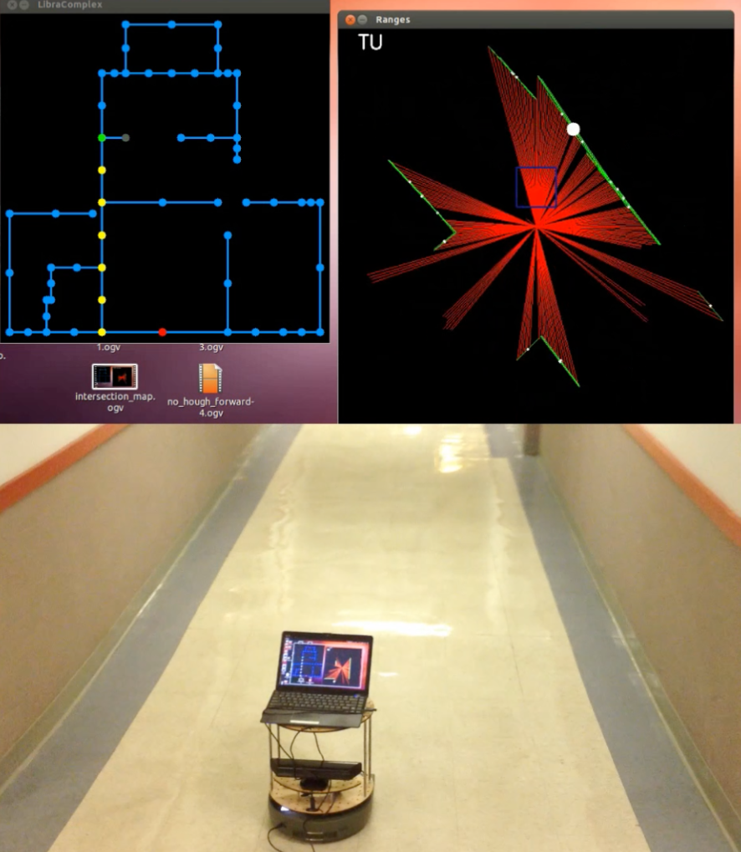
Map-based navigation…

Slide 23
Next: localization

Slide 24
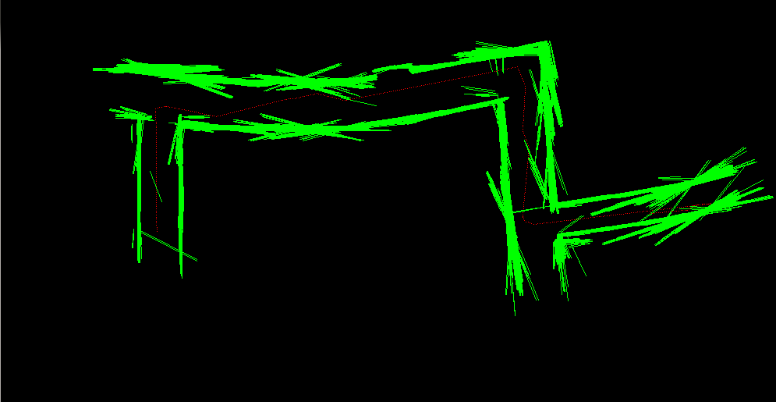
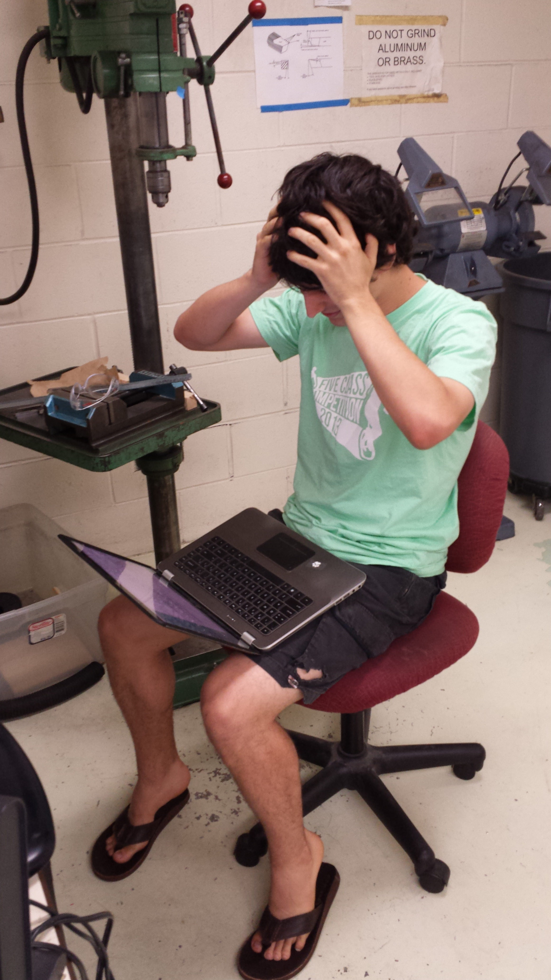
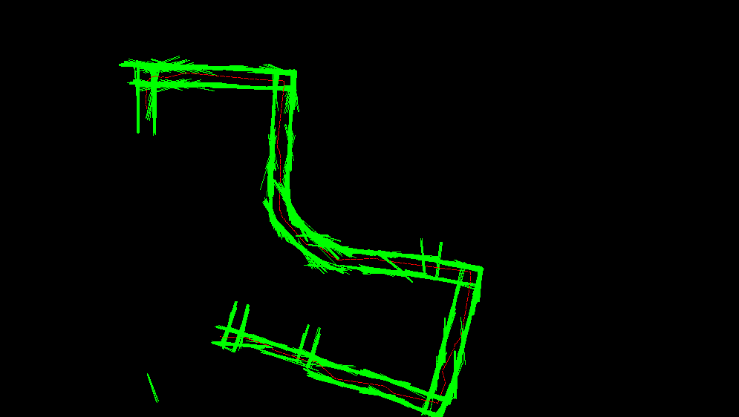
Next: 2d mapping
We plan to “borrow” Alistair’s efforts for this…
Pasting Hough lines together using odometry
Recognize this place?
from alistair import *

Slide 25
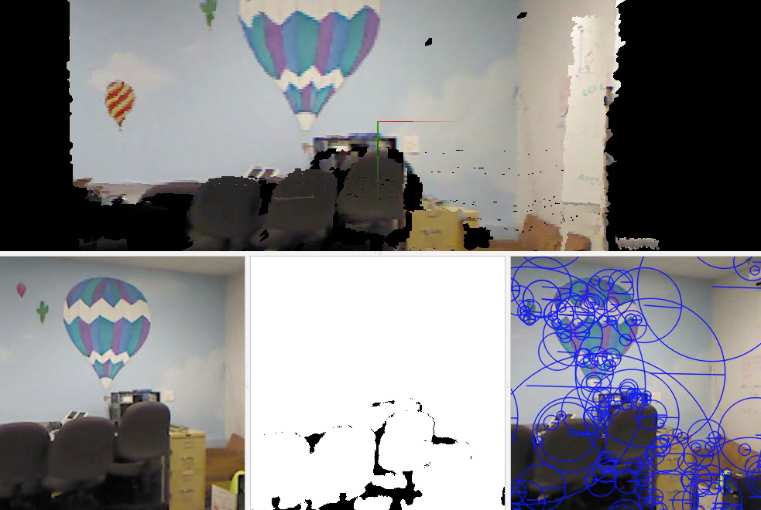
Now: 3d mapping
Demonstration of RGBD-SLAM

Slide 26
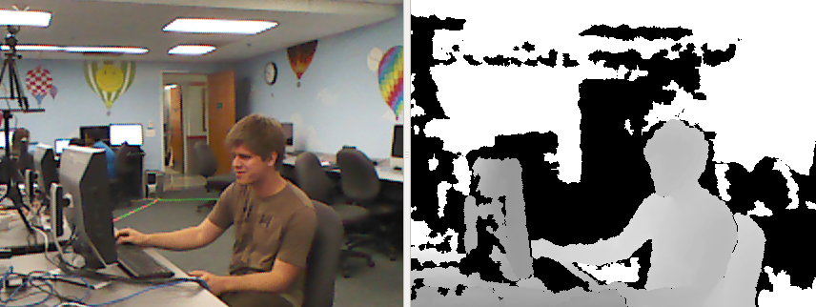
Accessing these 3d maps
our splicer
saves each rgb image
and each depth image
Getting the data: by splicing into the code to extract the input images

Slide 27
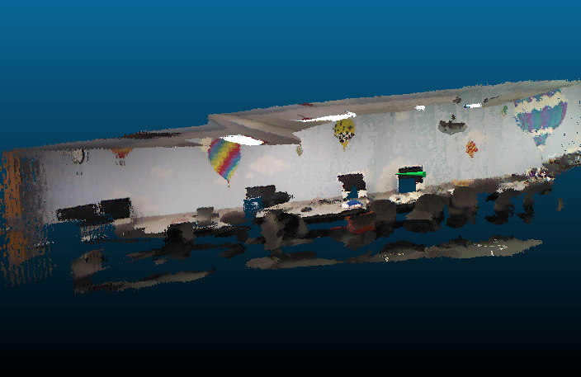
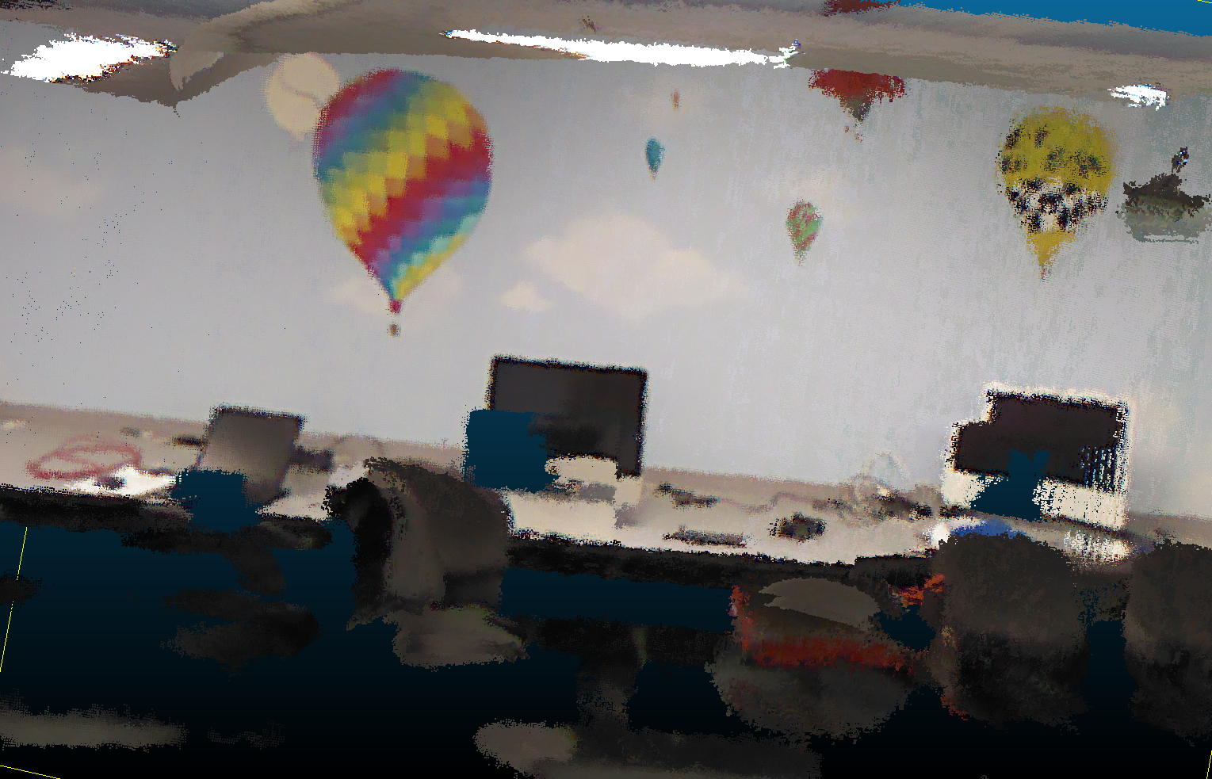
Accessing these models
3d lab model ~ with a surface added
the rendered view from that green cone

Slide 28
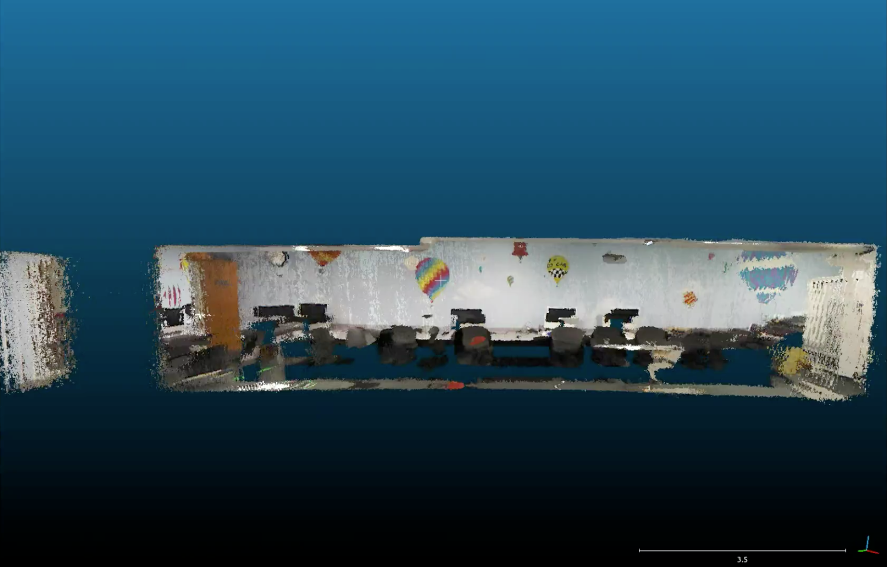
Accessing these models
Cloud Compare is a visualizer that can include our own “annotations” …

Slide 29
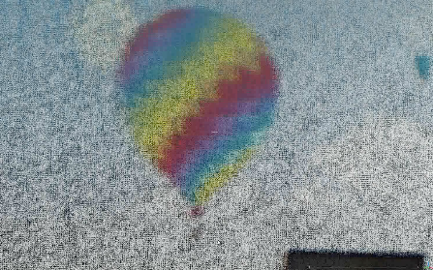
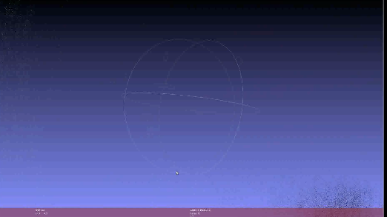
Zooming vs. Moving
zooming in to the balloon…
CloudCompare
MeshLab
… vs. moving towards/past it

Slide 30
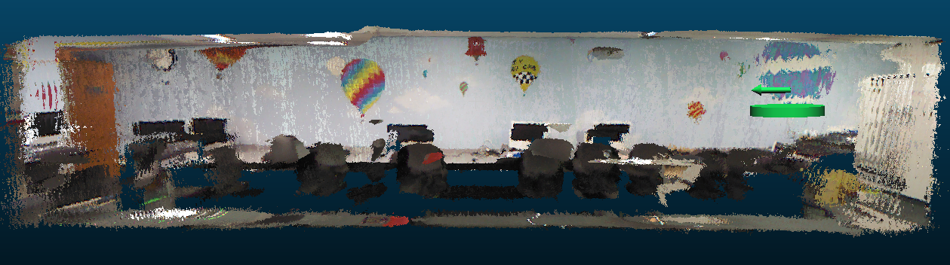

Goal: Escape from the lab!

Slide 31
Using these models
How might a robot with an ordinary camera, i.e., only 2d sensing, use these 3d models?
2d – 2d matching
3d – 3d matching
Ideally, a 2d sensing system could localize – and reason – within a 3d model

Slide 32
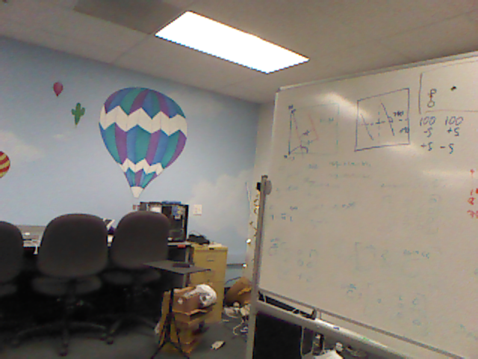
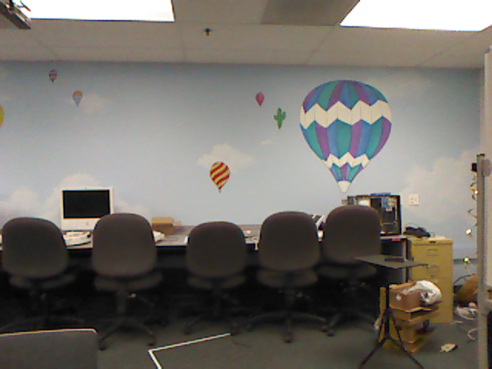
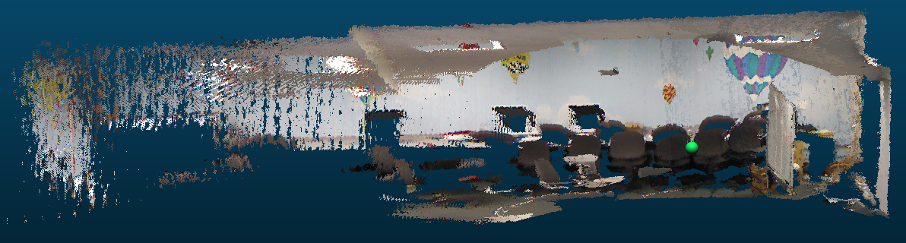
2d – 2d matching
with a new image from a robot (or other device)
we could compare
vs. original images
vs. rendered images
These are the images used to create the 3d model in the first place: fewer, higher-fidelity.
Images yielded by the 3d model: arbitrarily many, but lower-quality.

Slide 33
2d – 2d matching
with a new image from a robot (or other device)
we could compare
vs. original images
vs. rendered images
These are the images used to create the 3d model in the first place: fewer, higher-fidelity.
Images yielded by the 3d model: arbitrarily many, but lower-quality.

Slide 34
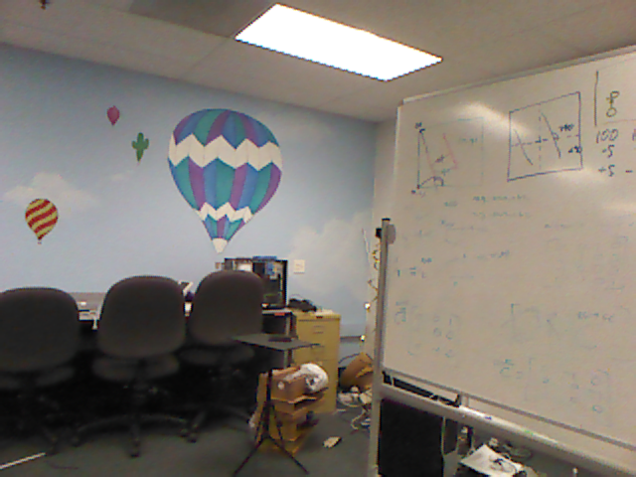
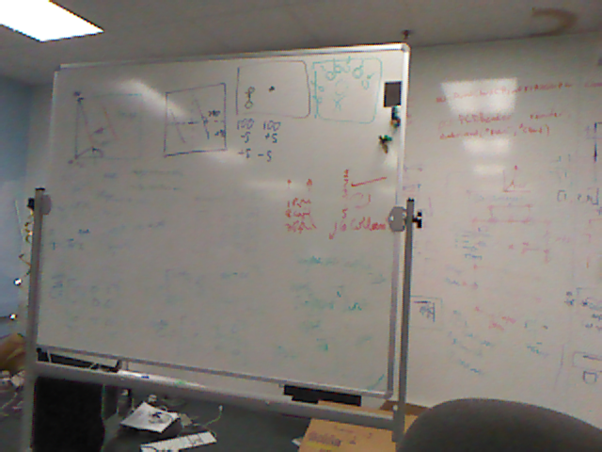
Matching?
new image
Our approach:
Find features in each (SIFT)
Consider all matches (FLANN)
Ensure bidirectional constraints
Consistency filtering (homography)
Best-matching by visual similarity metric
Tiebreaking by pixel distances
many original images

Slide 35
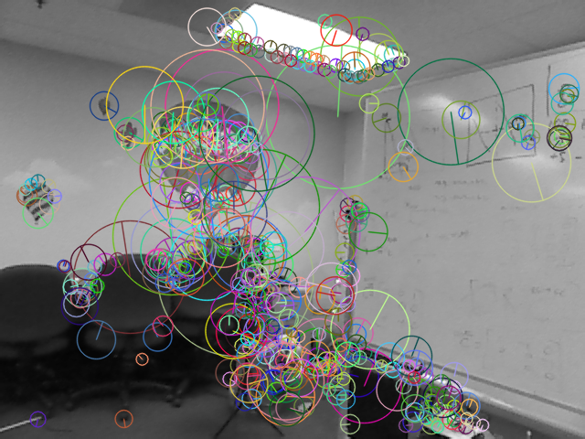
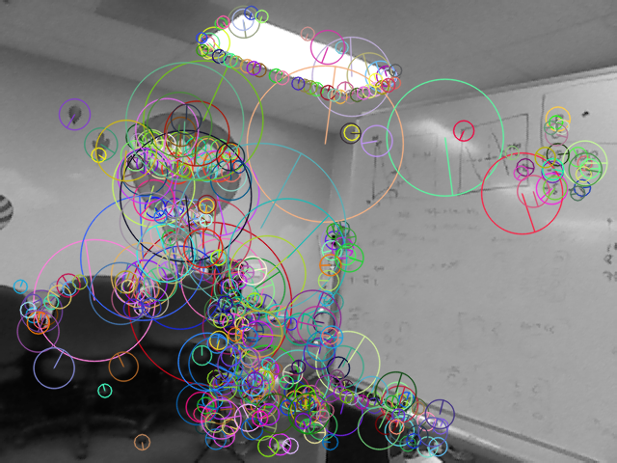
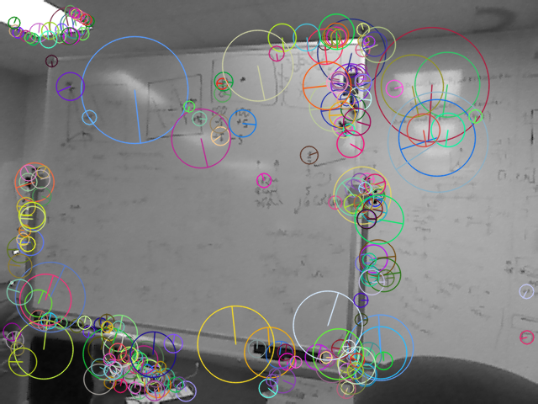
Features
Our approach:
Find features in each (SIFT)
Consider all matches (FLANN)
Ensure bidirectional constraints
Consistency filtering (homography)
Best-matching by visual similarity metric
Tiebreaking by pixel distances

Slide 36
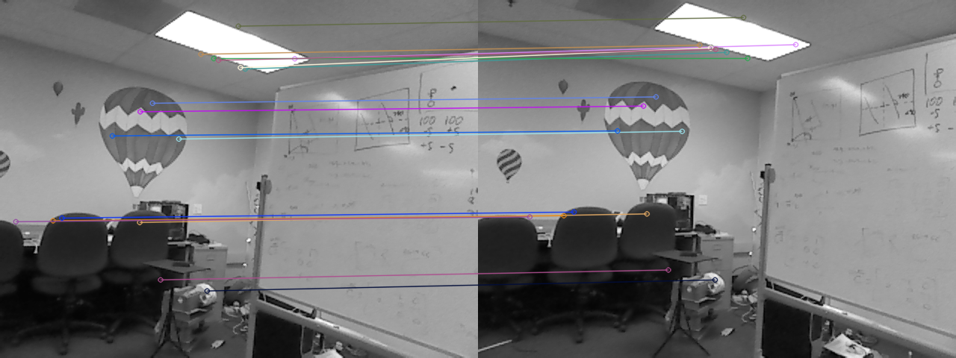
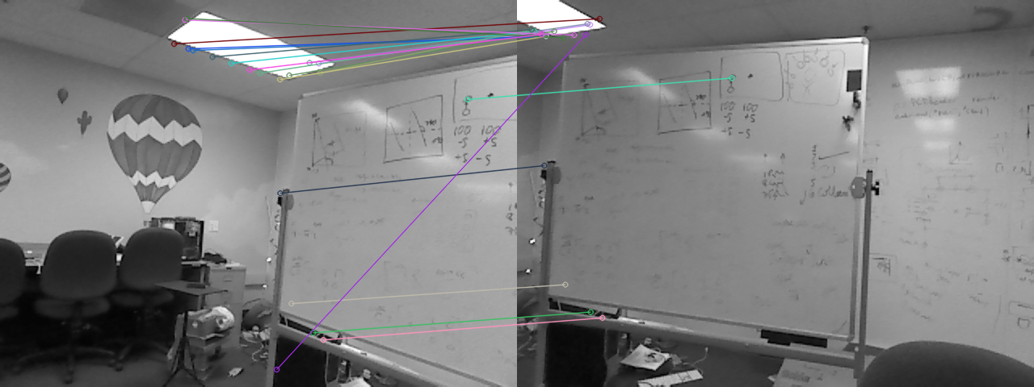
Our approach:
Find features in each (SIFT)
Consider all matches (FLANN)
Ensure bidirectional constraints
Consistency filtering (homography)
Best-matching by visual similarity metric
Tiebreaking by pixel distances
Nearest-neighbor matching

Slide 37
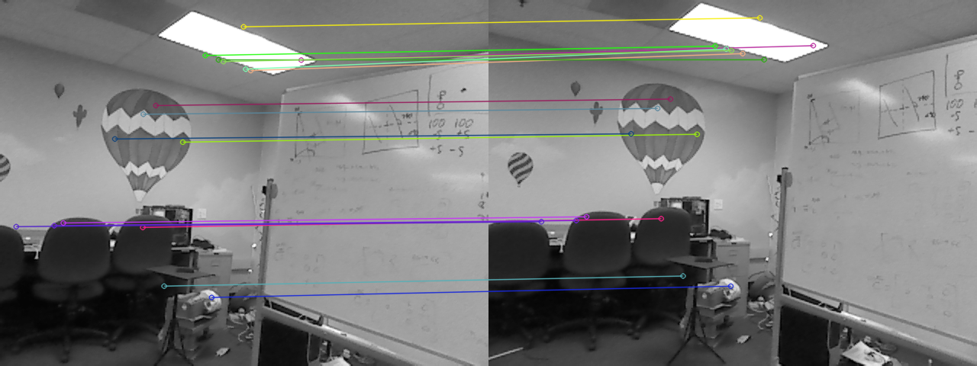
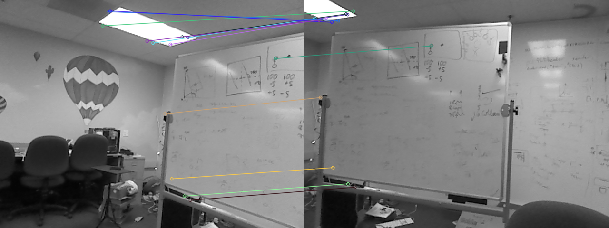
Our approach:
Find features in each (SIFT)
Consider all matches (FLANN)
Ensure bidirectional constraints
Consistency filtering (homography)
Best-matching by visual similarity metric
Tiebreaking by pixel distances
Keep only two-way best matches

Slide 38
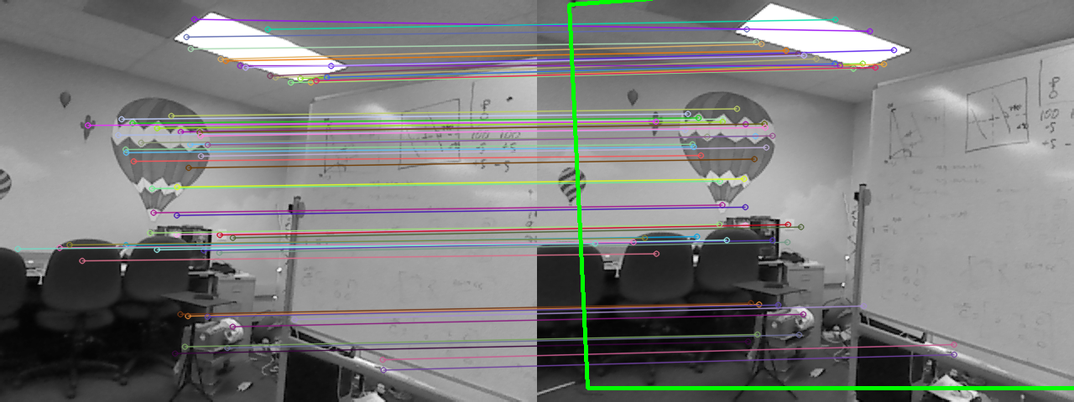
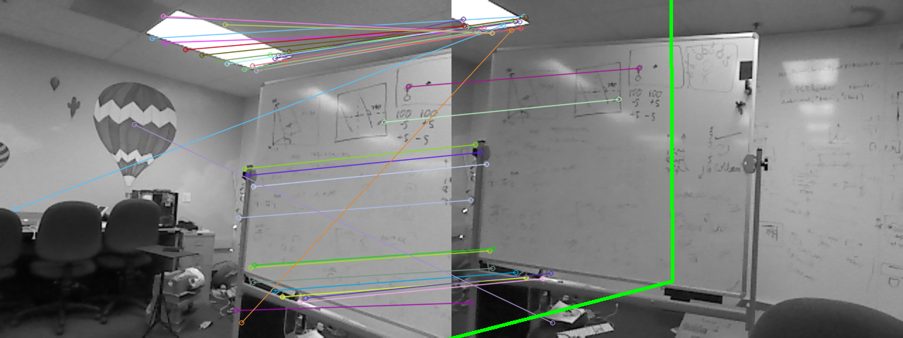
Our approach:
Find features in each (SIFT)
Consider all matches (FLANN)
Ensure bidirectional constraints
Consistency filtering (via homography)
Best-matching by visual similarity metric
Tiebreaking by pixel distances
Keep geometrically realistic matches

Slide 39
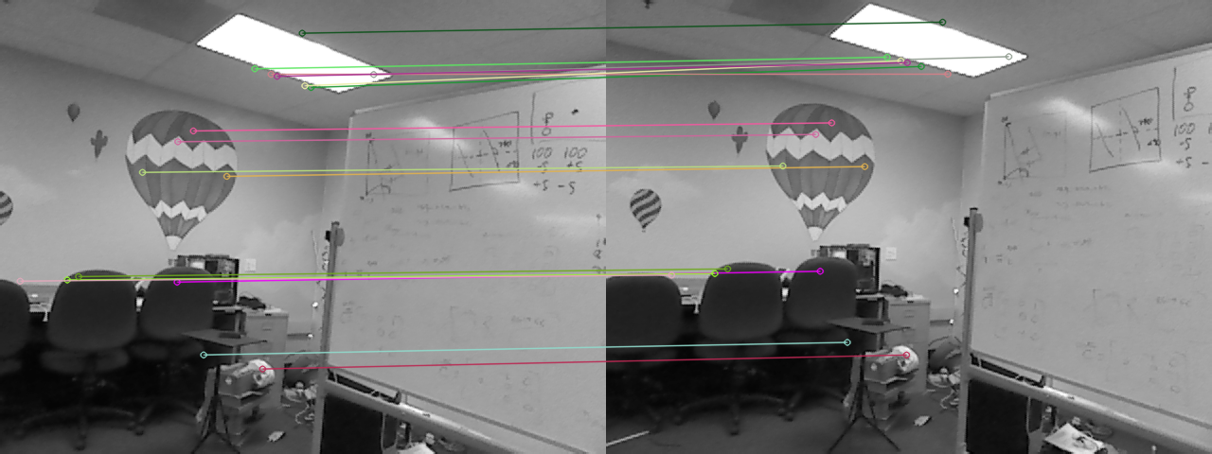

1st-best match
10th-best match
Our approach:
Find features in each (SIFT)
Consider all matches (FLANN)
Ensure bidirectional constraints
Consistency filtering (via homography)
Best-matching by visual similarity metric
Tiebreaking by pixel distances
Visual “closeness”

Slide 40
1st-best match
Average feature distance ~ 40 px
10th-best match
Average feature distance ~ 270 px
Our approach:
Find features in each (SIFT)
Consider all matches (FLANN)
Ensure bidirectional constraints
Consistency filtering (via homography)
Best-matching by visual similarity metric
Tiebreaking by pixel distances
Pixel “closeness”

Slide 41


PCL: Point Cloud Library
3D-Reasoning
Easy point cloud access
Screenshot

Slide 42


NARFs!
3d features: Normal Aligned Radial Features
picture of pt cloud
picture of NARFS
NARF features are purely based on the range image of a point cloud: its geometry, not its looks (SIFT)
They are based on the normals of the point cloud’s surfaces
They are places distinguishable from multiple perspectives.

Slide 43



3d matching
picture of pt cloud w/NARFS
picture of pt cloud w/NARFS
Take two point clouds
Find NARFs
Match features and find transform
Make transform and combine
naive merging

Slide 44




3d SLAM
Simultaneous Localization And Mapping
Take two point clouds
Find NARFs
Match features and find transform
Make transform and combine

Slide 45


3d SLAM
Simultaneous Localization And Mapping
Take two point clouds
Find NARFs
Match features and find transform (ICP)
Make transform and combine

Slide 46

3d SLAM
Final point cloud map
Questions?
Future: using Neato to create 2.5d maps

Slide 48
Kinect
Z.D. video
The Kinect estimates distance-to-camera by projecting a “star field” on the world.

Slide 49
Now vs. Then

Slide 50
Title

Slide 51
Accessing these models
plane
other (sphere, cylinder, wavy,…)
K.M.
allows us to define the depth at each pixel

Slide 52
Ideally, a camera-only system could localize – and reason – within the 3d model
Ideally, a camera-only system could localize – and reason – within the 3d model

Slide 53
Accessing 3d models
RGB
Depth
splicing into the code…

Slide 54
Hough transform
r
θ
Consider one point of a laser scan
These are all of the lines through it
http://gmarty.github.io/hough-transform-js/
http://liquify.eu/flash/HoughTransform

