Slide 1
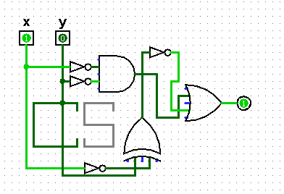
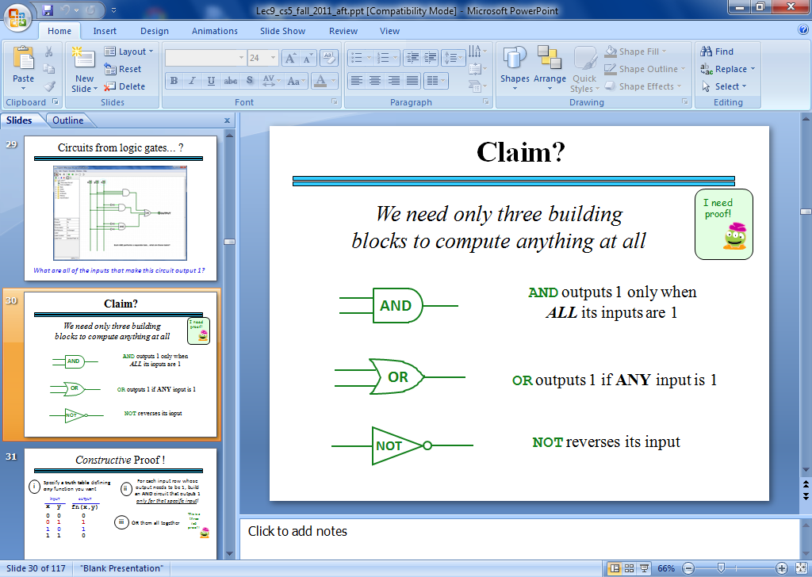
OK Recursing?
OKer than before?
Hw#4: binary + Python
Jotto Corner
Circuit design, part 1
1:15 guess
my guess
house: 1
alien: 2
?????: ?
?????: ?
diner: 0
savvy: 0
flock: ?
thumb: ?
This circuit was NOT, in fact, designed!
CS Today
A circuit for any function can be built from …
Minterm Expansion Principle
That's minterm, NOT midterm
… just these three logic gates!
Notes:
jazzy!

Slide 2
Creativity with Caesar...
def decipher( S ):
""" TESIJHYDW - je tusyfxuh
jxyi tesijhydw, zkij hkd
tusyfxuh ed yj. """
… code here …

Slide 3
Creativity with Caesar...
def decipher( S ):
""" DOCSTRING - to decipher
this docstring, just run
decipher on it. """
… code here …
… some other interesting decipher results

Slide 4
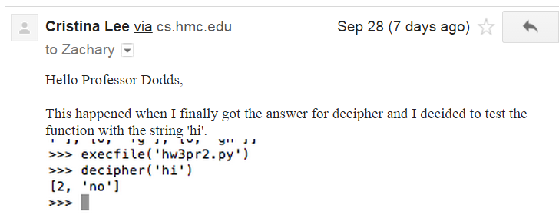
Caesar cipher, surprising...
my favorite not-fully-working decipher…

Slide 5
Creativity with Caesar...
def decipher( S ):
""" This works sometimes
"""
return encipher( S, 3 )
and the docstring is 100% correct!

Slide 6
This week
Circuits!
def decipher( S ):
""" This works sometimes
"""
return encipher( S, 3 )
Designing physical devices that work all the time!

Slide 7
In a computer, each bit is represented as a voltage (1 is +5v and 0 is 0v)
The big picture...
Computation is simply the deliberate combination of those voltages!
101010
42
(2) perform computation
(1) set input voltages
ADDER circuit
51
110011
(3) read output voltages
9
001001
What's in that green box?
Richard Feynman: "Computation is just a physics experiment that always works!"

Slide 8
Part 1: Represent your f'n as bits…
Any function can be represented using only bits…
IN
OUT
x
y
c
circuit output
0
0
0
0
0
0
1
1
0
1
0
1
This one is named the sum function
0
1
1
0
1
0
0
1
1
0
1
0
That's some function, all right!
1
1
0
0
1
1
1
1
three bits in...
...one bit out

Slide 9
Part 1: Represent your f'n as bits…
Any function can be represented using only bits…
IN
OUT
x
y
c
circuit output
0
0
0
0
0
0
1
0
0
1
0
1
0
1
1
0
another f'n!
1
0
0
0
fun!
1
0
1
0
1
1
0
1
1
1
1
1
three bits in...
...one bit out

Slide 10
All computations…
…are simply f'ns of bits
binary inputs A and B
output, A+B
A
B
add
You built this in Python last week as addB
00
00
000
00
01
001
You'll build this f'n in Logisim this week… !
00
10
010
00
11
011
01
00
001
01
01
010
01
10
011
01
11
bitwise
addition function
100
10
00
010
10
01
011
10
10
100
10
11
101
11
00
011
11
01
100
four bits in...
...three bits out
11
10
101
11
11
110
Each of these columns uses the sum function!

Slide 11
Part 2: Arrange logic gates to do the work…
input
output
input
output
x
y
AND(x,y)
x
y
OR(x,y)
input
output
x
NOT(x)
0
0
0
0
0
0
0
1
0
0
1
1
0
1
1
0
0
1
0
1
1
0
1
1
1
1
1
1
AND outputs 1 only if ALL inputs are 1
OR outputs 1 if ANY input is 1
NOT reverses its input
AND
OR
NOT
not just theoretical models!

Slide 12
Our building blocks: logic gates
AND outputs 1 only if ALL inputs are 1
OR outputs 1 if ANY input is 1
NOT reverses its input
AND
OR
NOT
These circuits are physical functions of bits…
not just theoretical models
… and all mathematical functions can be built from them!

Slide 13
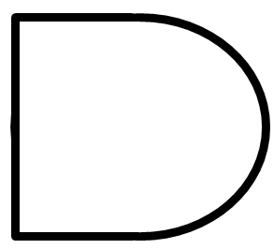
AND
drill sergeant metaphor?
Strict! Everything input must be True to output a True
inputs
AND
output
AND outputs 1 when ALL inputs are 1
otherwise it outputs 0

Slide 14
AND
Strict! Everything input must be True to output a True
x
inputs
AND
output
y
output
input
output
x
y
AND(x,y)
AND's function:
0
0
0
0
1
0
"Truth table"
1
0
0
1
1
1

Slide 15
AND
Strict! Everything input must be True to output a True
inputs
AND
output
How many different input combinations yield an output of 0 here?
AND outputs 1 when ALL inputs are 1
otherwise it outputs 0

Slide 16
AND
Strict! Everything input must be True to output a True
x
y
inputs
z
AND
output
output
w
input
output
x
y
z
w
AND(xyzw)
AND's function:
0
0
0
0
0
0
0
0
1
0
fifteen 0s
…12 more rows not shown…
0
1
1
1
0
0
1
1
1
1
1
one 1

Slide 17
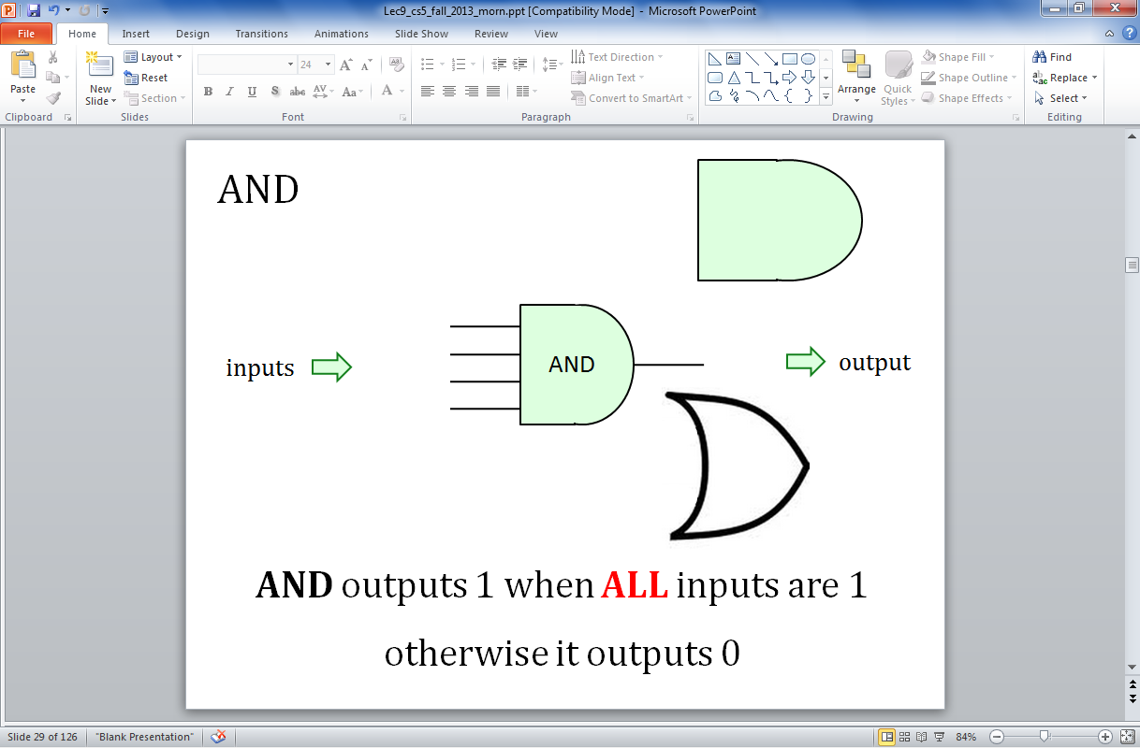
OR
camp counselor metaphor?
easy-going: if anything is OK, everything's OK
inputs
OR
output
OR outputs 1 when ANY input is 1
It outputs 0 only if all inputs are 0.

Slide 18
OR
easy-going: if anything is True, the output is True
x
inputs
OR
output
y
output
input
output
x
y
OR(x,y)
OR's function:
0
0
0
0
1
1
1
0
1
1
1
1

Slide 19
OR
easy-going: if anything is OK, everything's OK
inputs
OR
output
How many different 4-input combinations yield an output of 1?
OR outputs 1 when ANY input is 1
It outputs 0 only if all inputs are 0.

Slide 20
OR
easy-going: if anything is OK, everything's OK
x
y
inputs
z
OR
output
output
w
input
output
x
y
z
w
OR(xyzw)
OR's function:
0
0
0
0
0
one 0
0
0
0
1
1
…12 more rows not shown…
1
1
1
1
0
1
fifteen 1s
1
1
1
1
1

Slide 21
NOT
"NOT bubble" (optional – or the only thing needed!)
inputs
x
NOT
output
NOT's function:
input
output
x
NOT(x)
0
1
one 1
1
0
one 0

Slide 22
Our building blocks: logic gates
input
output
input
output
x
y
AND(x,y)
x
y
OR(x,y)
input
output
x
NOT(x)
0
0
0
0
0
0
0
1
0
0
1
1
0
1
1
0
0
1
0
1
1
0
1
1
1
1
1
1
AND outputs 1 only if ALL inputs are 1
OR outputs 1 if ANY input is 1
NOT reverses its input
AND
OR
NOT

Slide 23
Claim !?
We need only these three building blocks to compute anything at all
I need proof!
AND
AND outputs 1 iff ALL its inputs are 1
OR
OR outputs 1 iff ANY input is 1
NOT
NOT reverses its input

Slide 24
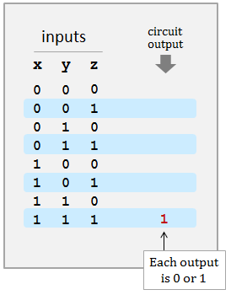
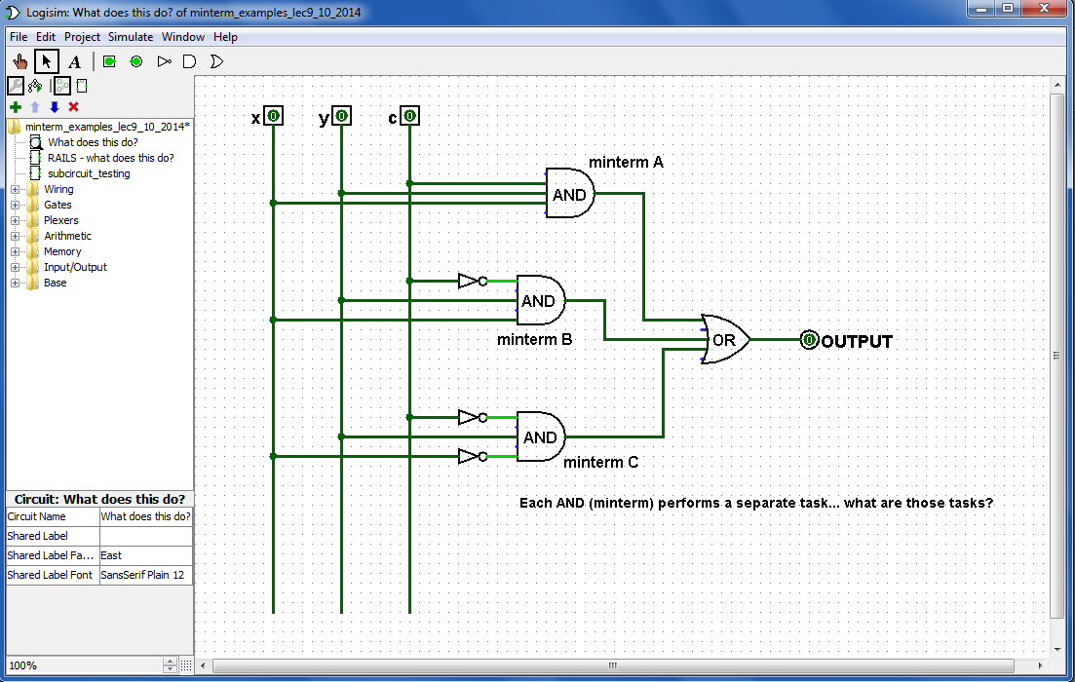
A circuit…
What are ALL its outputs?
c
What inputs make this circuit output 1?
Logisim
What inputs make this circuit output 0?

Slide 25
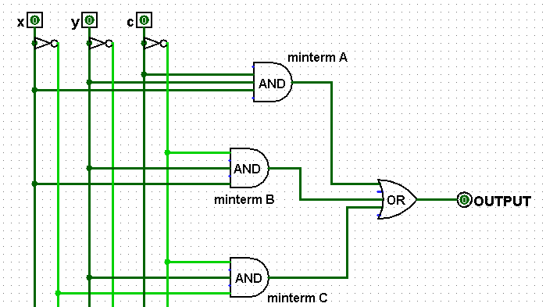
Rails
There is NO difference between these two circuits!
How?
using rails for not x, not y, not c
Any disadvantages of this "rails" approach?
Any advantages ?

Slide 26
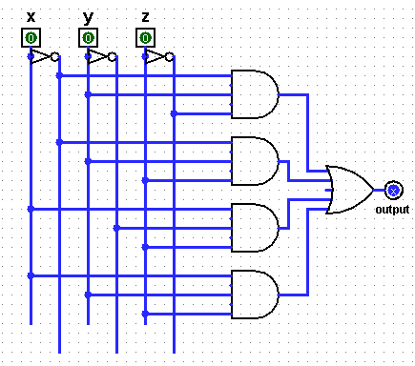
Quiz
Fill in the function values for this circuit (the truth table)
Name(s) ___________________________________
Each input x, y, and z can independently be 0 or 1, for eight total possible inputs:
inputs
circuit
output
x
y
z
A
0
0
0
0
0
1
0
1
0
B
0
1
1
1
0
0
C
1
0
1
1
1
0
1
1
1
1
D
Each output is 0 or 1
(1) This circuit uses 8 logic gates – how many of each? AND ___ OR ___ NOT ___
together
(2) Follow upstream from D. What x,y,z bits make D output 1 ? (and why is that all we need to know for D?)
(3) For each possible input, write the circuit output in the truth table above.
This circuit is prime!
(4) Could this circuit use fewer logic gates? If so, how?! If not, how do you know?!

Slide 27
Quiz
Fill in the function values for this circuit (the truth table)
Try this on the back page first…
Each input x, y, and z can independently be 0 or 1, for eight total possible inputs:
inputs
circuit
output
x
y
z
A
0
0
0
0
0
0
1
0
0
1
0
A
1
B
0
1
1
B
1
1
0
0
0
C
1
0
1
C
1
1
1
0
0
D
1
1
1
1
1
D
Each output is 0 or 1
4
1
3
(1) This circuit uses 8 logic gates – how many of each? AND ___ OR ___ NOT ___
together
(2) Follow upstream from D. What x,y,z bits make D output 1 ? (and why is that all we need to know for D?)
(3) For each possible input, write the circuit output in the truth table above.
This circuit is prime!
(4) Could this circuit use fewer logic gates? If so, how?! If not, how do you know?!
YES!

Slide 28
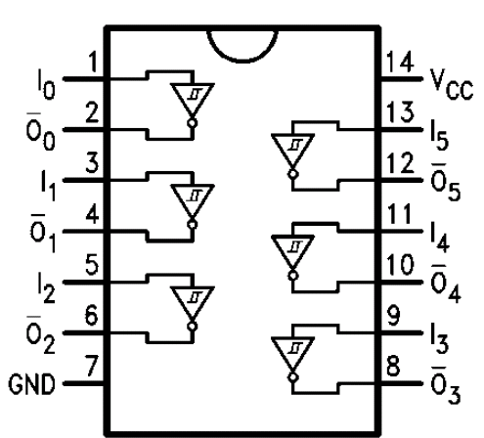
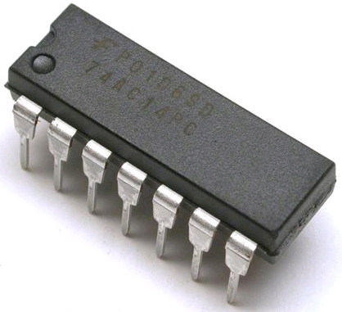
Real! logic gates...
Hex NOT gate
Notes:
these quotes are important to yahoo… !

Slide 29

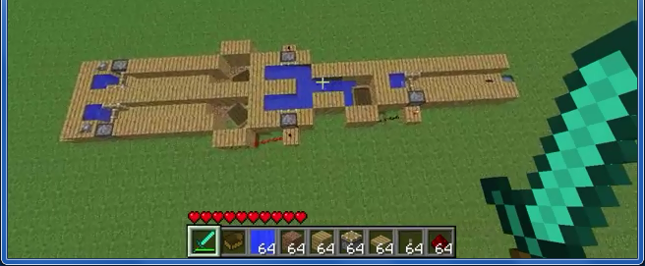
Real? logic gates
"It's not real unless it can be done in Minecraft."
1:11
https://www.youtube.com/watch?v=P7E4K5D834g "Minecraft Logi Gates"
https://www.youtube.com/watch?v=r7N3K8ulEEM "Minecraft Logic Gates Water"
:41
Notes:
these quotes are important to yahoo… !

Slide 30
The claim…
AND outputs 1 only if ALL its inputs are 1
AND
OR outputs 1 if ANY input is 1
OR
NOT
NOT reverses its input
We need only these three building blocks to compute anything at all
I need proof!

Slide 31
The proof… !
AND outputs 1 only if ALL its inputs are 1
AND
We prove this constructively using the minterm expansion principle.
OR outputs 1 if ANY input is 1
OR
NOT
NOT reverses its input
We need only these three building blocks to compute anything at all
I need proof!

Slide 32
A constructive proof…
i
Specify a truth table defining any function you want
For each input row whose output needs to be 1, build an AND circuit that outputs 1 only for that specific input!
ii
input
output
x
y
f(x,y)
0
0
0
Hey! This is a 3-i'ed proof!
0
1
1
iii
OR them all together
1
0
1
1
1
0

Slide 33
A constructive proof…
i
Specify a truth table defining any function you want
For each input row whose output needs to be 1, build an AND circuit that outputs 1 only for that specific input!
ii
input
output
x
y
f(x,y)
0
0
0
0
1
1
iii
OR them all together
1
0
1
1
1
0
We ensure this OR outputs zero by default.
x
y
The ZERO rows ALREADY work – with no connections at all !
0
OR
x
y

Slide 34
A constructive proof…
i
Specify a truth table defining any function you want
For each input row whose output needs to be 1, build an AND circuit that outputs 1 only for that specific input!
ii
input
output
x
y
f(x,y)
0
0
0
A
0
1
1
iii
OR them all together
1
0
1
1
1
0
x
y
NOT
AND
A
OR
Does this wire turn on for the red input row?
x
y
Does this wire turn on for any other input rows?

Slide 35
A constructive proof…
i
Specify a truth table defining any function you want
For each input row whose output needs to be 1, build an AND circuit that outputs 1 only for that specific input!
ii
input
output
x
y
f(x,y)
0
0
0
A
0
1
1
iii
OR them all together
B
1
0
1
1
1
0
x
y
NOT
AND
A
OR
AND
B
blue row?
other rows?
x
y
NOT

Slide 36
A constructive proof…
i
Specify a truth table defining any function you want
For each input row whose output needs to be 1, build an AND circuit that outputs 1 only for that specific input!
ii
input
output
x
y
This is a constructive proof that AND, OR, NOT suffice to build any function of bits!
f(x,y)
0
0
0
A
0
1
1
iii
OR them all together
B
1
0
1
1
1
0
x
y
NOT
AND
OR
AND
NOT
blue row?
other rows?
x
y

Slide 37
A constructive proof…
but ALL functions are just functions of bits !
i
Specify a truth table defining any function you want
For each input row whose output needs to be 1, build an AND circuit that outputs 1 only for that specific input!
ii
input
output
x
y
This is a constructive proof that AND, OR, NOT suffice to build any function of bits!
f(x,y)
0
0
0
0
1
1
iii
OR them all together
1
0
1
1
1
0
x
y
NOT
AND
OR
AND
NOT
blue row?
other rows?
x
y

Slide 38
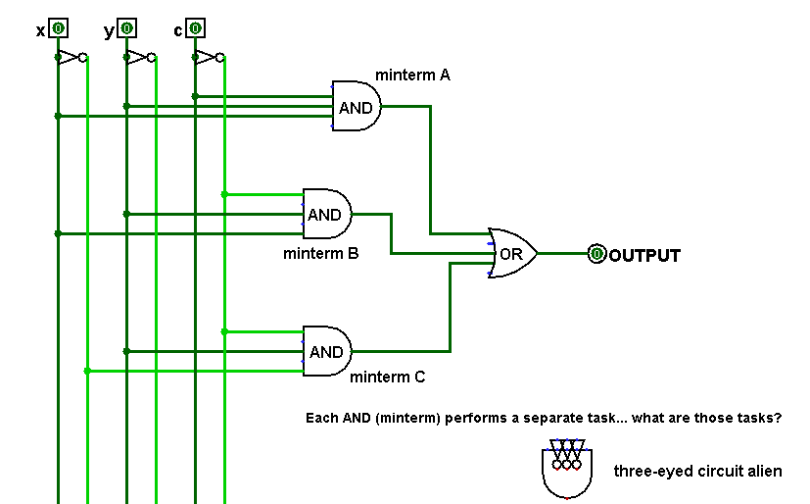
Minterm?
A minterm is an AND gate connected to all input bits - either directly or inverted
What input "activates" each of these minterms?
we did this before!
Minterm Expansion Principle

Slide 39
Each minterm selects one input:
a minterm is an AND gate that "selects" a single input row
x y c
111
the ONLY input to make this minterm output 1
x y c
110
the ONLY input to make this minterm output 1
x y c
010
the ONLY input to make this minterm output 1
Looks a little wiry to me!
Minterm Expansion Principle

Slide 40
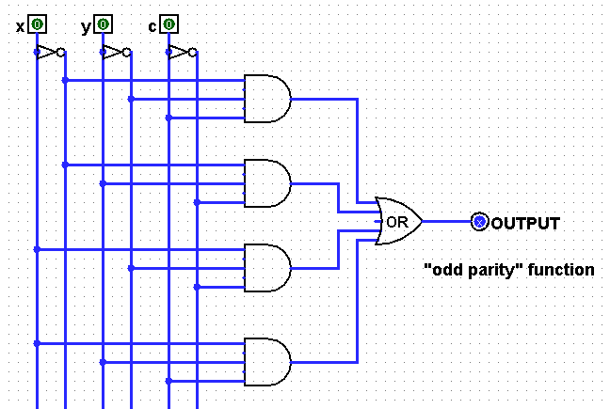
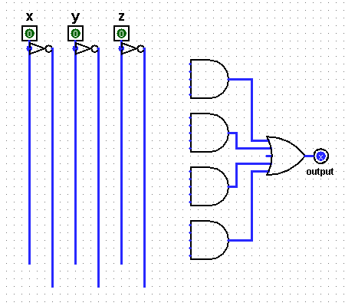
Take 2…
input
output
A
x
y
c
0
0
0
(1) Fill in the function values (the truth table) for this circuit…
0
0
1
B
0
1
0
0
1
1
1
0
0
Hint: Determine the input that turns each AND gate – each minterm -- to True
C
SUM
1
0
1
1
1
0
D
1
1
1
(2) Draw the upstream wires that will implement this function as a circuit.
(Extra #1) Any gates you can optimize away here?
c
input
output
(Extra #2) How could you replace the OR with only ANDs and NOTs – so ORs aren't needed !?
x
y
c
A
0
0
0
0
0
0
1
0
B
0
1
0
0
OR
(Extra #3) How do the two circuits on this page implement addition of any two binary #s!?
0
1
1
1
C
1
0
0
0
Carry_{Out}
1
0
1
1
1
1
0
1
D
1
1
1
x
1011
1
1
1
1
+
y
1111
11010

Slide 41
Take 2…
input
output
A
x
y
c
0
0
0
0
(1) Fill in the function values (the truth table) for this circuit…
0
0
A
1
1
B
0
1
B
1
0
0
1
1
0
1
0
C
Hint: Determine the input that turns each AND gate – each minterm -- to True
C
SUM
0
1
1
0
1
0
1
1
0
0
D
1
1
D
1
1
(2) Draw the upstream wires that will implement this function as a circuit.
(Extra #1) Any gates you can optimize away here?
c
input
output
(Extra #2) How could you replace the OR with only ANDs and NOTs – so ORs aren't needed !?
x
y
c
A
0
0
0
0
0
0
1
0
B
0
1
0
0
OR
(Extra #3) How do the two circuits on this page implement addition of any two binary #s!?
0
1
A
1
1
C
1
0
0
0
Carry_{Out}
1
0
B
1
1
1
1
C
D
1
0
1
1
1
Can combine D and ...
x
1011
1
1
D
+
1
1
y
1111
11010

Slide 42
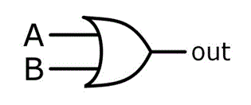
input
output
OR else ?!
x
y
OR(x,y)
0
0
0
0
1
1
Can you get rid of ORs by using only NOTs and ANDs?
1
0
1
1
1
1
x
x OR y
y
OR
Notes:
42

Slide 43
Lab5: adders!
A full adder sums three input bits to create a 2-bit binary output
x
y
c_{in}
c_{out} sum
0 0 0
0 0
0 0 1
0 1
the full adder
0 1 0
0 1
x
y
c_{in}
0 1 1
1 0
1 0 0
0 1
FA
c_{out}
1 0 1
1 0
sum
1 1 0
1 0
1 1 1
1 1
these columns look familiar!
Full Adder (FA)
3 bits of input
2 bits of output
(considered individually)
(considered a binary #)
Full Adder (FA)

Slide 44
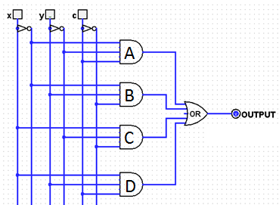
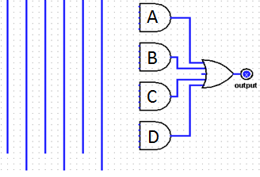
Lab5: adders!
A full adder sums three input bits to create a 2-bit binary output
x
y
c_{in}
Use this in lab this week!
the full adder
sum
x
y
c_{in}
FA
c_{out}
sum
connect these directly…
Full Adder (FA)
OR
carry_{out}
2 bits of output: a two-bit binary #
for this bottom-half circuit, you'll add the wires you designed a couple of minutes - and a couple of slides - ago…
3 individual bits of input

Slide 45
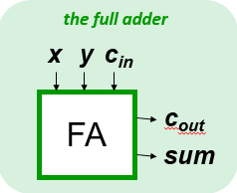
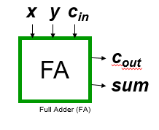
Compose!
Any binary addition at all?
carries…
Carry
X
0 1 1 1
1 1 0 1
X₃
X₂
X₁
X₀
8 bits in
Y
+
Y₃
Y₂
Y₁
Y₀
5 bits out
Do you see how you might use four Full Adders here?

Slide 46
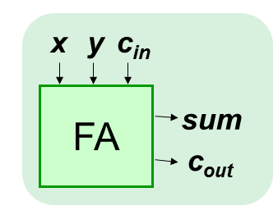
Compose!
Any binary addition at all?
carries…
Carry
Y
0 1 1 1
1 1 0 1
Y₃
Y₂
Y₁
Y₀
8 bits in
X
+
X₃
X₂
X₁
X₀
5 bits out
We've used four full adders here… .

Slide 47

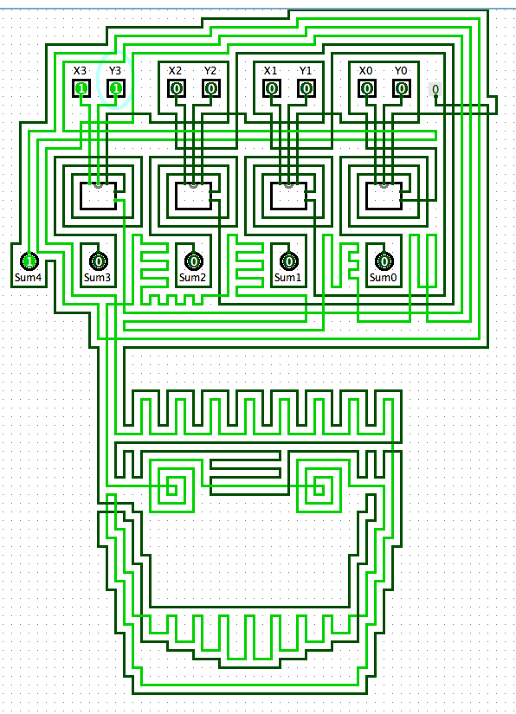

an "official" adder…
A zombie-themed ripple-carry adder
It looks just as wiry!

Slide 48
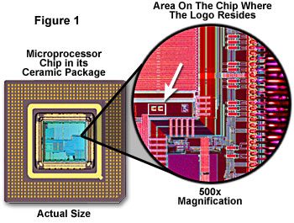
relative scale…

Slide 49
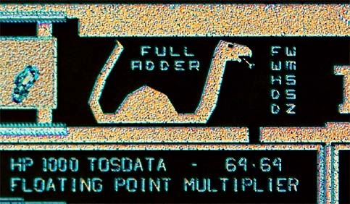
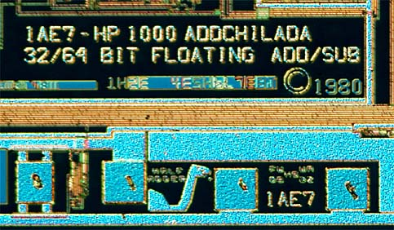
Many adders!
These aren't Easter Eggs, they're adder eggs!

Slide 50
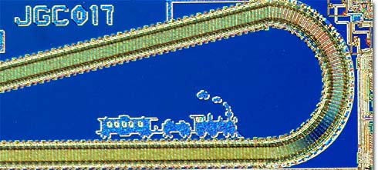
chugging right along…
Ridin' the Rails !

Slide 51
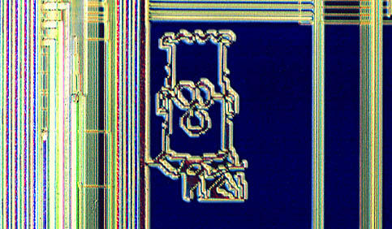
What to do with all that extra silicon?

Slide 52
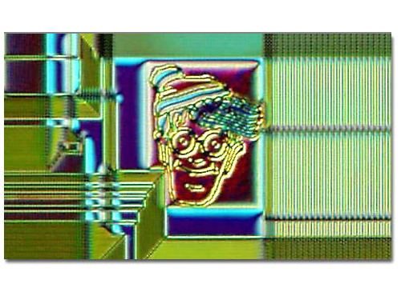
What to do with all that extra silicon?
The "silicon zoo": micro.magnet.fsu.edu/creatures/index.html

Slide 53
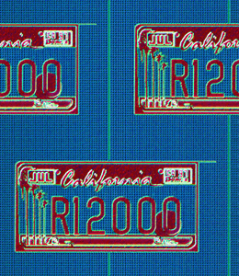
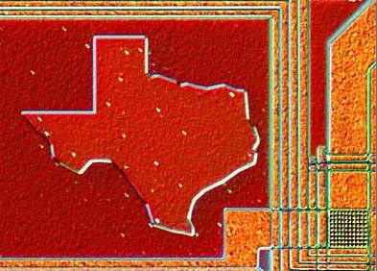
Homestate pride…

Slide 54
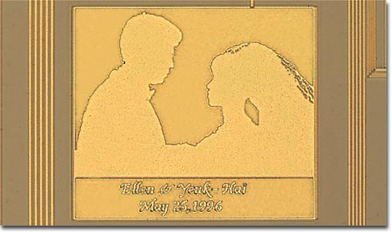
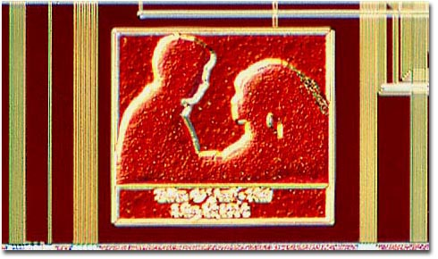
Marriage proposals?

Slide 55

and secret? messages…

Slide 56
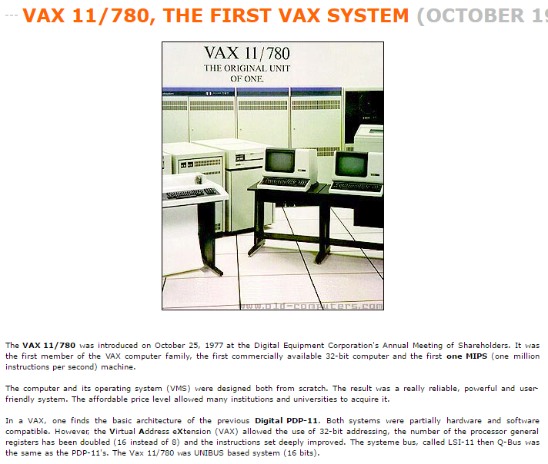
and secret? messages…
VAX c. 1977

Slide 57
and secret? messages…

Slide 58
and secret? messages!
VAX...
When you care enough to steal the very best

Slide 59
Composing circuits ~ hw5
4-bit "Ripple-Carry" Adder
4-bit Multiplier
3x2-bit Divider
extra credit
12 nGbits of memory (RAM)

Slide 60
Composing circuits
4-bit Ripple-Carry Adder
0 1 1 1
1 1 0 1
let's abstract these details away…
8 input bits
+
5 output bits

Slide 61
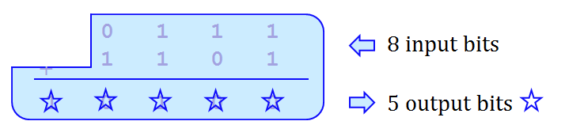
Composing circuits
4-bit Ripple-Carry Adder
0 1 1 1
1 1 0 1
8 input bits
+
1 0 1 0 0
5 output bits
Now let's make lots of them!!

Slide 62
hw5pr2: A 4-bit multiplier
1 1 0 1 Multiplicand
x 0 1 1 0 Multiplier
0 0 0 0 4 partial products
1 1 0 1
1 1 0 1
+ 0 0 0 0
1 0 0 1 1 1 0 Final answer…
0
(Q1) How could THREE 4-bit ripple-carry adders help here?
(Q2) What bit would be correct for the starred spot ?
(Q3) What circuits could you use to create the four "partial products" ??

Slide 63

hw5pr2: A 4-bit multiplier
1 1 0 1 Multiplicand
x 0 1 1 0 Multiplier
0 0 0 0 4 partial products
1 1 0 1
1 1 0 1
+ 0 0 0 0
1 0 0 1 1 1 0 Final answer…
0
(A3) Remember that the AND gate is single-bit multiplication.
(A2) Use a 4x1-bit helper circuit to find the four partial products…
(A1) You need three (3) ripple-carry adders to finish: see above…

Slide 64
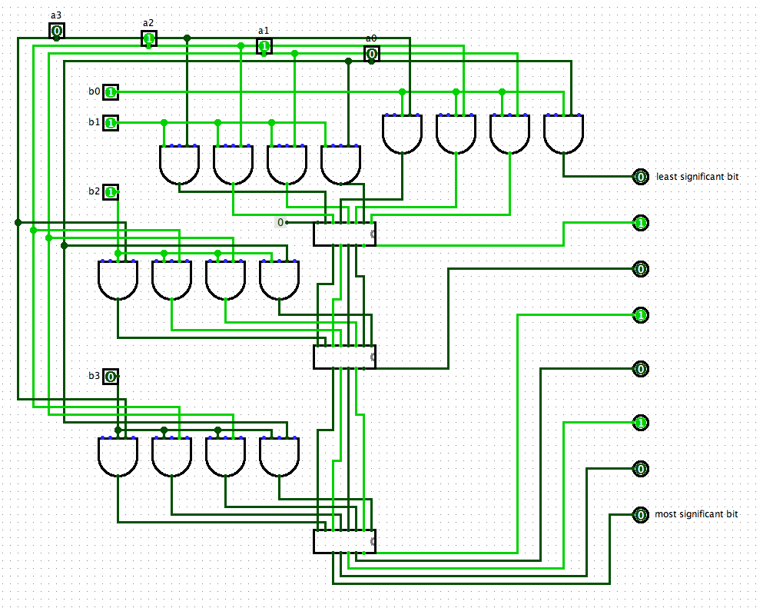
Logisim layout…
4-bit multiplier
one factor horizontal…
the 4-bit ripple-carry adder
the output
demo...
use labels!
6 x 7… what else?
one factor vertical…

Slide 65
Logisim layout…
4-bit multiplier
one factor horizontal…
the 4-bit ripple-carry adder
CS 5 lab: go forth + multiply!
Join us for Circuits Lab!
the output
demo...
use labels!
6 x 7… what else?
one factor vertical…

Slide 67
1:15 guess
my guess
house: 1
alien: 2
?????: ?
?????: ?
diner: 0
savvy: 0
flock: ?
thumb: ?
388
307
1:15 guess
ZD guess
2:45 guess
GK guess
words remaining
house: 1
alien: 2
?????: ?
?????: ?
diner: 0
savvy: 0
flock: ?
?????: ?
apple: 1
?????: ?
diner: 1
savvy: ?

Slide 68
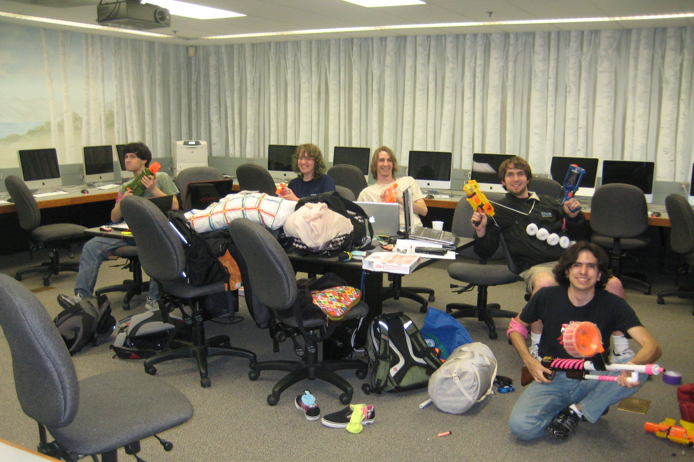
CS 5 lab: where the circuits, not the zombies, will be multiplying!
Join us for Lab!

Slide 69
Compose!
Any binary addition at all?
carries…
Carry
Y
0 1 1 1
1 1 0 1
Y₃
Y₂
Y₁
Y₀
8 bits in
X
+
X₃
X₂
X₁
X₀
5 bits out
Do you see how to use our Full Adders here?

Slide 70


dinner
Grading...

Slide 71

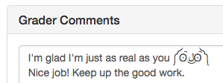

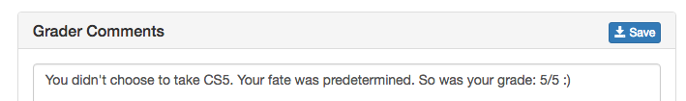
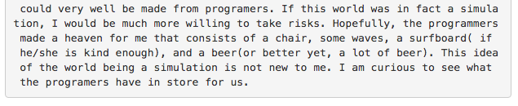
Last week's thoughts...
or worries... !

Slide 72
Quiz
Fill in the function values for this circuit (the truth table)
Name(s) ___________________________________
Each input x, y, and z can independently be 0 or 1, for eight total possible inputs:
inputs
circuit
output
x
y
z
A
0
0
0
0
0
1
0
1
0
B
0
1
1
1
0
0
C
1
0
1
1
1
0
1
1
1
1
D
Each output is 0 or 1
(1) This circuit uses 8 logic gates – how many of each? AND ___ OR ___ NOT ___
(2) Follow the inputs of x=1, y=1, z=1 and see why the overall output is 1 ... (already labeled)
(3) For each possible input, write the circuit output in the truth table above.
(4) Could this circuit use fewer logic gates? If so, how?! If not, how do you know?!

Slide 73
Take 2…
input
output
A
x
y
c
0
0
0
(1) Fill in the function values (the truth table) for this circuit…
0
0
1
B
0
1
0
0
1
1
(SUM)
1
0
0
Hint: Determine the input that turns each AND gate – each minterm -- to True
C
1
0
1
1
1
0
D
1
1
1
(2) Draw the upstream wires that will implement this function as a circuit.
c
input
output
(Extra #1) Could you replace the OR gate with ANDs and NOTs – so ORs aren't needed at all?!
x
y
c
A
0
0
0
0
0
0
1
0
B
0
1
0
0
(Extra #2) How could the two circuits on this page be used to implement any binary addition at all !?
0
1
1
1
C
1
0
0
0
(Carry_{Out})
1
0
1
1
1
1
0
1
D
1
1
1
1
… extras …

Slide 74
hw5pr2: A 4-bit multiplier
1 1 0 1 Multiplicand
x 0 1 1 0 Multiplier
0 0 0 0 4 partial products
1 1 0 1
1 1 0 1
+ 0 0 0 0
1 0 0 1 1 1 0 Final answer…
0
(A3) Remember that the AND gate is single-bit multiplication.
(A2) Use a 4x1-bit helper circuit to find the four partial products…
(A1) You need three (3) ripple-carry adders to finish: see above…

Slide 75
input
output
OR else ?!
x
y
OR(x,y)
0
0
0
0
1
1
Can you get rid of ORs by using only NOTs and ANDs?
1
0
1
1
1
1
x
x OR y
y
OR
Notes:
75

Slide 76

Celebrataing humanness…

Slide 77

Past zombie run-ins… Not sure about the tie?!

Slide 78
Celebrataing humanness…
CS 5 lab ~ a no-zombie zone!

Slide 79
CS 5 lab: where the circuits, not the zombies, will be multiplying!
Stay safe! Join us for Lab!

Slide 80
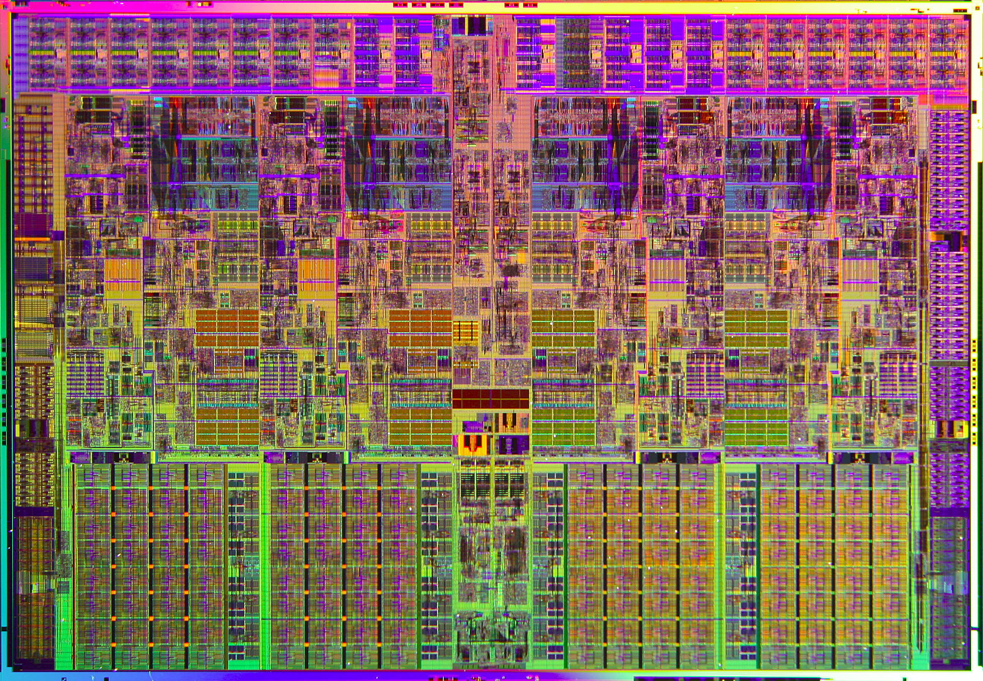
relative scale…

Slide 81
Compose!
Any binary addition at all?
0 1 1 1
1 1 0 1
8 bits in
+
5 bits out
Do you see how to use our Full Adders here?

Slide 82
Compose!
4-bit Ripple-Carry Adder
This may be less clear than before!
0 1 1 1
1 1 0 1
8 bits in
+
5 bits out
We've used four full adders here… .
(A 3-bit adder is a full adder)
(A 2-bit adder is a half adder)

Slide 83
Compose!
4-bit Ripple-Carry Adder
This may be less clear than before!
0 1 1 1
1 1 0 1
8 bits in
+
5 bits out
We've used four full adders here… .
(A 3-bit adder is a full adder)
(A 2-bit adder is a half adder)

Slide 84
Take 2…
input
output
A
x
y
c
0
0
0
(1) Fill in the function values (the truth table) for this circuit…
0
0
1
B
0
1
0
0
1
1
1
0
0
Hint: Determine the input that turns each AND gate – each minterm -- to True
C
1
0
1
1
1
0
D
1
1
1
(2) Draw the upstream wires that will implement this function as a circuit.
c
input
output
(Extra #1) Could you replace the OR gate with ANDs and NOTs – so ORs aren't needed at all?!
x
y
c
A
0
0
0
0
0
0
1
0
B
0
1
0
0
0
1
1
1
C
(Extra #2) How could these two circuits can implement any binary addition at all !?
1
0
0
0
1
0
1
1
1
1
0
1
D
1
1
1
1

Slide 85
input
output
OR else ?!
x
y
OR(x,y)
0
0
0
0
1
1
Can you get rid of ORs by using only NOTs and ANDs?
1
0
1
1
1
1
x
x OR y
y
OR
Notes:
85

Slide 86


MacGyver, back for 2016…
Thirty years ago, Angus MacGyver was the most iconic engineer hero on TV. In 2015, we’re looking for new engineering heroes.
The USC Viterbi School of Engineering and the National Academy of Engineering are partnering with Lee Zlotoff, creator of the MacGyver series to identify and develop the first great TV show featuring women engineers.
Five winners receive $5,000 each and be given the rare opportunity to be paired with top Hollywood mentors [to develop the show]. Please submit your ideas to www.thenextmacgyver.com
We’re looking for ideas only at this stage. No completed scripts necessary. All genres welcome.
We’re not looking to re-make MacGyver. We’re looking for that next show in the spirit of MacGyver, with a female protagonist who uses engineering to solve problems.
Who can submit: Anyone worldwide over 18. Screenwriters, engineers, students, non-students and essentially anyone who has a good idea and cares deeply about exciting young people to STEM fields.
Submission deadline: April 17

Slide 87
input
output
OR else ?!
x
y
OR(x,y)
0
0
0
0
1
1
Can you get rid of ORs by using only NOTs and ANDs?
1
0
1
1
1
1
x
x OR y
y
OR
Notes:
87

Slide 88
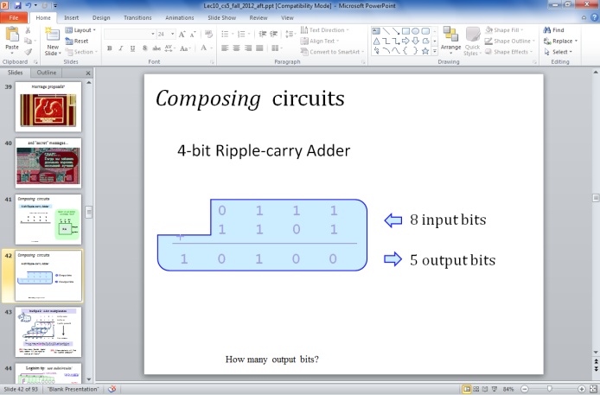
hw5pr2: A 4-bit multiplier
1 1 0 1 Multiplicand
x 0 1 1 0 Multiplier
0 0 0 0 4 partial products
1 1 0 1
1 1 0 1
+ 0 0 0 0
1 0 0 1 1 1 0 Final answer…
0
(Q1) How could you use 4-bit ripple-carry adders above?
(Q2) How many of them do you need? Where?
(Q3) What circuits can you use to yield the four "partial products" ??

Slide 89
A circuit…
What inputs make this circuit output 1?
Logisim
What inputs make this circuit output 0?

Slide 90
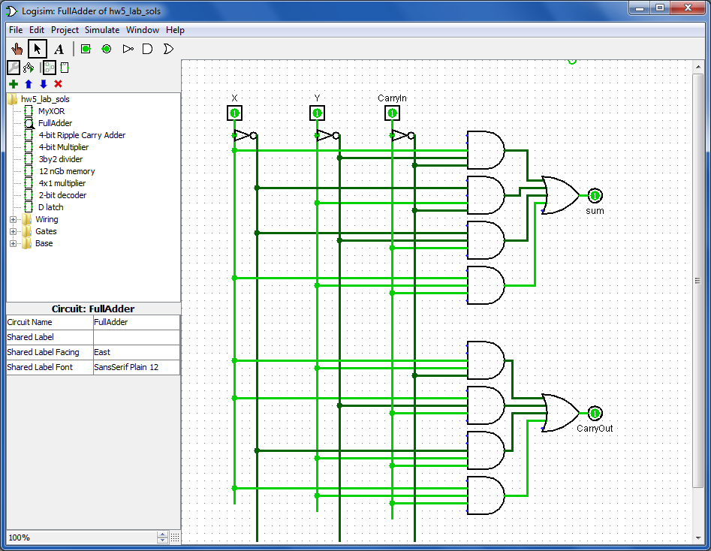
Building a Full Adder
A separate circuit for each output bit
3 input bits
Full Adder
input
output
x
y
c_{in}
x
y
c_{in}
c_{out} sum
0 0 0
0 0
0 0 1
0 1
sum output bit
0 1 0
0 1
0 1 1
1 0
1 0 0
0 1
2 output bits
1 0 1
1 0
1 1 0
1 0
You'll build both of these in Lab!
c_{out} output bit
1 1 1
1 1
"Carry-out" Circuit
"Rails" of each bit and its inverse

Slide 91
Quiz
input
output
A
x
y
c
0
0
0
0
B
0
0
1
1
0
1
0
1
C
0
1
1
0
1
0
0
1
1
0
1
0
D
1
1
0
0
1
1
1
1
(1) Fill in the function values (the truth table) for this circuit…
(2) Which truth-table line does each AND gate - i.e., each minterm A, B, C, and D - implement?

Slide 92

GHC!
… as these folks (and 40 other HMCers) did!
Needed: pictures from the 2014 GHC bus!

Slide 93
Name(s)
Quiz
input
output
A
x
y
z
0
0
0
(1) Fill in the function values (the truth table) for this circuit…
B
0
0
1
0
1
0
C
0
1
1
(2) Which line does each AND gate (each minterm) A, B, C, D - implement?
1
0
0
1
0
1
D
1
1
0
Let's go over these… in a moment
1
1
1
(3) Draw the upstream wires that will implement this function as a circuit.
(4) The second circuit has four ANDs (minterms). Could it use fewer ANDs?
input
output
x
y
z
A
0
0
0
0
(5) Could you replace the OR gate with ANDs and NOTs -- so ORs aren't needed at all?!
0
0
1
0
B
0
1
0
0
0
1
1
1
C
1
0
0
0
1
0
1
1
(EC) Do you see how these two circuits can implement all binary additions !?
1
1
0
1
D
1
1
1
1

Slide 94
Another example
Specify a truth table defining any function you want
For each input row whose output needs to be 1, build an AND circuit that outputs 1 only for that specific input!
1
2
input
output
x
y
fn(x,y)
0
0
1
3
OR them all together
0
1
0
1
0
0
1
1
1
x
y
1 OR
x
y
2 ANDs

Slide 95
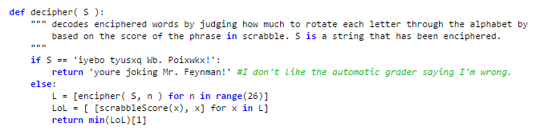
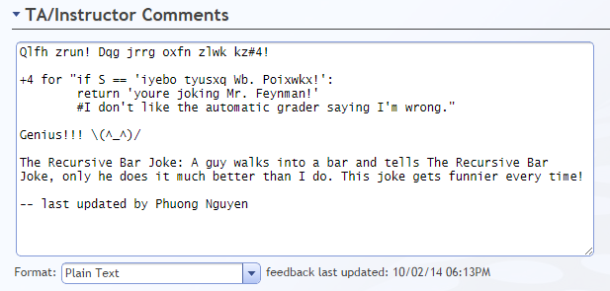
Creativity with Caesar...
def decipher( S ):

Slide 96
Composing circuits
4-bit Ripple-carry Adder
two 4-bit inputs
Could we use pieces we already have?
0 1 1 1
1 1 0 1
x
y
c_{in}
+
FA
sum
c_{out}
How many output bits?

Slide 97
hw5pr2: A 4-bit multiplier
1 1 0 1 Multiplicand
x 0 1 1 0 Multiplier
0 0 0 0 4 partial products
1 1 0 1
1 1 0 1
+ 0 0 0 0
1 0 0 1 1 1 0 Final answer…
0
(Q1) How could you use 4-bit ripple-carry adders above?
(Q2) How many of them do you need? Where?
(Q3) What circuits can you use to yield those four "partial products" ??

Slide 98
Name(s):
Quiz
Here are the truth table and circuit defining the odd parity f'n:
x
y
c
input
output
x
y
c
oddpar
Row 1
outputs 1 when xyc ==
001
0
0
0
0
Row 0
AND
0
0
1
1
Row 1
0
1
0
1
outputs 1 when xyc ==
Row 2
AND
0
1
1
0
Row 3
1
0
0
1
OR
Row 4
1
0
1
0
Row 5
AND
1
1
0
0
Row 6
outputs 1 when xyc ==
1
1
1
1
Row 7
AND
x
y
c
not
not
not
x
y
c
(1) Label the AND gates with the 3 input bits and row # that make it output 1. (They're not in order.)
(2) Which row does the unwired AND gate need to be? Draw the correct upstream wires for that one.
(3) When the input is from rows 0, 3, 5, or 6, what are the outputs of all the AND gates?
Notes:
98

Slide 99
Quiz, part 2
2
Sketch a circuit for this function using ANDs and NOTs, then combined with an OR.
1
Here's the truth table defining an "mj" function
x
y
c
input
output
x
y
c
mj
0
0
0
0
0
0
1
0
0
1
0
0
0
1
1
1
1
0
0
0
1
0
1
1
1
1
0
1
1
1
1
1
x
y
c
not
not
not
x
y
c
(4) Hmmm… Could this circuit be built without an OR gate at all by using only ANDs and NOTs? This is a thought experiment – not something to do on the circuit above…. .
(5) Wow! How could the the odd parity and mj circuits be replicated and combined in order to build a circuit that adds any two binary numbers at all!?!
Notes:
99

Slide 100
Name(s):
Quiz
Here are the truth table and circuit defining the odd parity f'n:
x
y
c
input
output
x
y
c
oddpar
Row 1
outputs 1 when xyc ==
001
0
0
0
0
Row 0
AND
0
0
1
1
Row 1
0
1
0
1
outputs 1 when xyc ==
Row 2
AND
0
1
1
0
Row 3
1
0
0
1
OR
Row 4
1
0
1
0
Row 5
AND
1
1
0
0
Row 6
outputs 1 when xyc ==
1
1
1
1
Row 7
AND
x
y
c
not
not
not
x
y
c
(1) Label the AND gates with the 3 input bits and row # that make it output 1. (They're not in order.)
(2) Which row does the unwired AND gate need to be? Draw the correct upstream wires for that one.
(3) When the input is from rows 0, 3, 5, or 6, what are the outputs of all the AND gates?
Notes:
100

Slide 101
Quiz, part 2
2
Sketch a circuit for this function using ANDs and NOTs, then combined with an OR.
1
Here's the truth table defining an "mj" function
x
y
c
input
output
x
y
c
mj
0
0
0
0
0
0
1
0
0
1
0
0
0
1
1
1
1
0
0
0
1
0
1
1
1
1
0
1
1
1
1
1
x
y
c
not
not
not
x
y
c
(4) Hmmm… Could this circuit be built without an OR gate at all by using only ANDs and NOTs? This is a thought experiment – not something to do on the circuit above…. .
(5) Wow! How could the the odd parity and mj circuits be replicated and combined in order to build a circuit that adds any two binary numbers at all!?!
Notes:
101

Slide 102
input
output
OR else ?!
x
y
OR(x,y)
0
0
0
0
1
1
Can you get rid of ORs by using only NOTs and ANDs?
1
0
1
1
1
1
x
x OR y
y
OR
Notes:
102

Slide 103
input
output
OR else ?!
x
y
OR(x,y)
0
0
0
0
1
1
Can you get rid of ORs by using only NOTs and ANDs?
1
0
1
1
1
1
x
x OR y
y
OR
Notes:
103

Slide 104
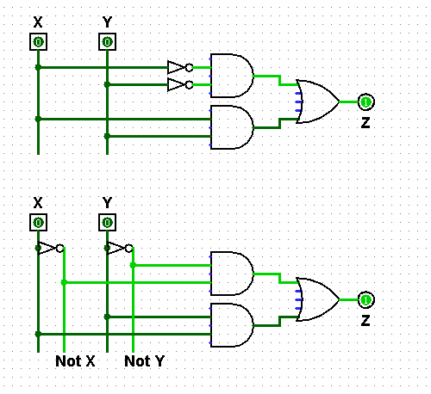
"Rails"
What are the differences between these two circuits?
Any advantages of the "rails" approach?
using rails for Not X and Not Y

Slide 105
Transistors, computationally
Transistors are current switches:
A low voltage here
allows current here
A high voltage here
allows current here

Slide 106
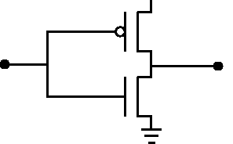
Transistors, computationally
POWER
Transistors are current switches:
+5 v power
A low voltage here
input (0 or 1)
allows current here
SIGNAL
Ground
A high voltage here
NOT
allows current here
input
output
Building a NOT gate from transistors…

Slide 107
Jotto: Word == ?????
Lani C.
am guess
bagel: 2
first: 0
hound: 2
bendy: 2
my guess
diner: 1
ghost: 2
plumb: 1
omega: 2
words remaining: 1771
2320 words remaining
words remaining: 433
761 words remaining
words remaining: 138
369 words remaining
sigma?
Madi M.
pm guess
alien: 0
slope: 2
truck: 2
shock: 1
my guess
diner: 2
sassy: 0
thumb: 1
cruel: 2
words remaining: 650
1917 words remaining
words remaining: 240
667 words remaining
words remaining: 72
310 words remaining
booed?

Slide 108
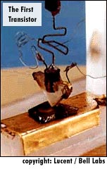
Transistors: a disruptive technology
point contact transistor
1947: Bell Labs
seeking cheaper amplifiers for phone lines
team of scientists: Walter Brattain, William Shockley, and John Bardeen
1948: junction transistor
much more robust design
1956: Shockley semiconductor corp.
the start of Silicon Valley…
1957: Fairchild semiconductor corp.
the "traitorous eight" - ICs

Slide 109
Quiz
Build separate circuits for each output-1 row using ANDs and NOTs
Name(s):
2
Combine them with an OR.
1
Here's the truth table defining a function
x
y
c
input
output
x
y
c
odd(x,y,c)
0
0
0
0
0
0
1
1
0
1
0
1
0
1
1
0
1
0
0
0
1
0
1
1
1
1
0
1
1
1
1
0
Create NOT "rails" ... if you want to...
Using multiplication for AND and addition for OR, what formula represents this circuit?
3
ExCr
Can you get rid of the ANDs by using only NOTs and ORs?
Notes:
109

Slide 110
input
output
Getting rid of ANDs ?
x
y
AND(x,y)
0
0
0
0
1
0
Can you get rid of the ANDs by using only NOTs and ORs?
1
0
0
1
1
1
x
xy
y
AND
Notes:
110

Slide 111
Jotto !
morning class's
our guesses
2047 words remaining
smile 2
bacon 1
2749 words remaining
938 words remaining
happy 1
shyly 2
630 words remaining
462 words remaining
tower 1
trump 1
285 words remaining
bunch 1
deify 1
afternoon class's
our guesses
1844 words remaining
hairy 2
wasps 2
1361 words remaining
784 words remaining
plane 1
credo 2
303 words remaining
339 words remaining
gumbo 1
thumb 0
206 words remaining
154 words remaining
front 1

Slide 112

The LogiSketch circuit simulator
http://www.cs.hmc.edu/~alvarado/research/sketch/release/LogiSketchFun2011.m4v

Slide 113
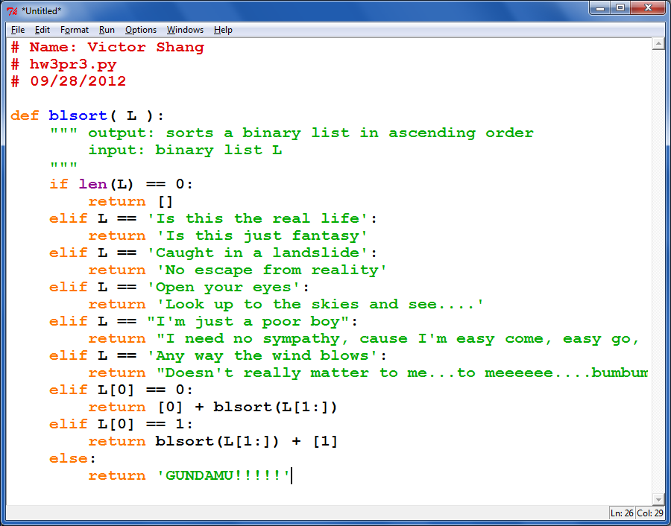
One sort of creativity…

Slide 114
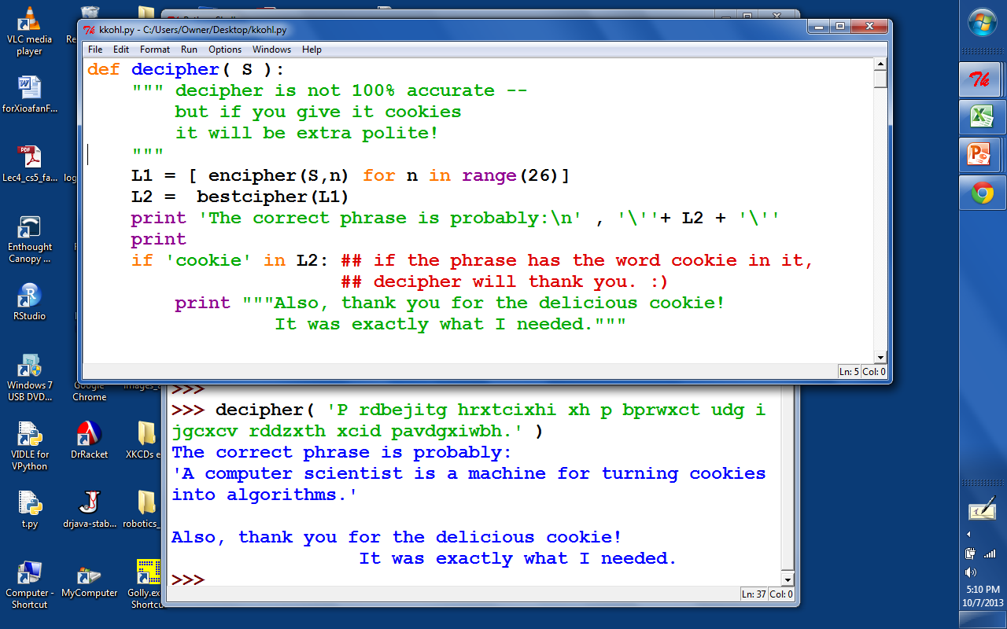
Cookies!

Slide 115
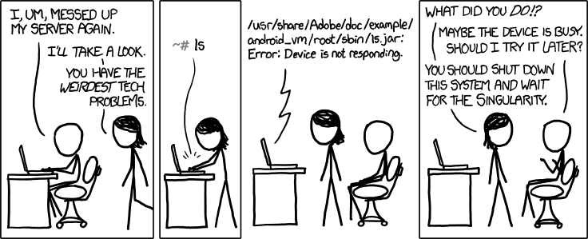

CS Today
recursion seems OK?
or more so than before?
Hw#5: Circuit design in Logisim
using the singularity as a problem-solving strategy
Sheldon-approved!
Minterm Expansion Principle
A circuit for any binary function can be built from
only these three logic gates
That's minterm, NOT midterm
Also:
on Th.: guest talk by Don Chamberlin HMC '66
Comparing types of programming languages

Slide 116

For systems, a face-lift is to add an edge that creates a cycle, not just an additional node.
input
output
S
Q
NOR
R
input
NOR's Truth Table

Slide 117
For systems, a face-lift is to add an edge that creates a cycle, not just an additional node.
input
output
S
Q
NOR
feedback loop

Slide 118
Take a look at this circuit.
If S is 1, what will Q be?
What happens if S becomes 0?
input
output
S
Q
NOR
feedback loop
Reminders
NOR outputs 1 only if both inputs are 0
NOR outputs 0 if either inputs is 1
NOR's Truth Table

Slide 119
The SR latch
Is it currently stable or oscillating?
SET
input
S
0
1
NOR
What will happen if input S is set to 1?
0
Follow how the signals will change…
1
output
input
0
Q
RESET
R
NOR
0
What will happen if input S is then set back to 0?
Which signals will change?
What will happen if input R is then set to 1?
how do R and S affect Q in general?
How could we change this circuit so that it takes 1 bit of DATA as input?
NOR's Truth Table

Slide 120
The D latch
The SR latch
D
data
S
0
1
NOR
inputs
0
1
output
0
Q
R
NOR
0
S sets Q to 1.
only one of S or R is high
R resets Q to 0.
How could we change this circuit so that it takes 1 bit of DATA as input?
We might want to deliberately trigger the memory of our 1 bit of data.

Slide 121
The D latch
The SR latch
D
data
inputs
S
0
AND
1
"strobe"
NOR
0
tells when to remember the data!
1
output
0
Q
R
NOR
AND
0
S sets Q to 1.
mutually exclusive ANDs
R resets Q to 0.
We might want to deliberately trigger the memory of our 1 bit of data.

Slide 122


The D latch
The SR latch
D
data
inputs
S
0
AND
1
"strobe"
NOR
0
The data can be ready any time (or NOT!) But nothing will happen until the strobe says so!
1
output
0
Q
R
NOR
AND
0
S sets Q to 1.
These ANDs ensure
R resets Q to 0.
if D == 1, S is 1
if D == 0, R is 1
1 bit of memory!
"flip-flop"

Slide 123
The D latch
The SR latch
D
data
inputs
0
AND
1
"strobe"
NOR
0
1
output
0
Q
NOR
AND
0
D
the circuit element
Q
1 bit of memory!
strobe
"flip-flop"

Slide 124

Random Access Memory
"on-chip"
We can use data latches to create a 12 nG bit RAM !
Inputs
Outputs
3 data input bits
Simplified
Prototype for
Accessing
Memory
3 data output bits
write enable line
read enable line
2 data address bits
12 bits of RAM
3 bits stored at location 00
3 bits stored at location 01
3 bits stored at location 10
3 bits stored at location 11

Slide 125
Random Access Memory
"on-chip"
We can use data latches to create a 12 nG bit RAM !
Inputs
Outputs
3 data input bits
Simplified
Prototype for
Accessing
Memory
3 data output bits
write enable line
read enable line
2 data address bits
12 bits of RAM
3 bits stored at location 00
3 bits stored at location 01
3 bits stored at location 10
3 bits stored at location 11

Slide 126


Creativity with Caesar...
def decipher( S ):
""" This works sometimes
"""
return encipher( S, 3 )
and the docstring is 100% correct!
MacGyver'ed!
solving with whatever resources are at hand

Slide 127
"QUIZ"
3 data input bits
STORE
5 into memory location #1
0. Make data input bits 101
1. Give 01 to the decoder (the 1 goes on)
2. Make the "Write Enable" high
3. How does it all work?
4. How do the * AND gates help?
D
Q
D
Q
D
Q
memory location
strobe
strobe
strobe
0
Address Decoder
*
D
Q
D
Q
D
Q
IN: data address, in binary
strobe
strobe
strobe
1
*
2
3
write enable line
OR
read enable line
OR
OR
two other memory lines and their flip-flops are not drawn
3 data output bits

Slide 128
"QUIZ"
3 data input bits
LOAD
data from mem. location #1
0. Suppose 101 is in Location #1
1. Give 01 to the decoder (the 1 goes on)
2. Make the "Read Enable" high
3. Which gates ensure data from memory location #1 is read?
4. Which gates ensure data from memory location #0 is not read?
memory location
D
Q
D
Q
D
Q
strobe
strobe
strobe
Address Decoder
0
D
Q
D
Q
D
Q
IN: data address, in binary
strobe
strobe
strobe
1
2
3
write enable line
OR
read enable line
OR
OR
two other memory lines and their flip-flops are not drawn
3 data output bits

Slide 129
See you in Lab…

Slide 130


What to do with all that extra silicon?
The "silicon zoo": micro.magnet.fsu.edu/creatures/index.html

Slide 131


Memorable media…
CPU = "on-chip"
Main Memory
(replaceable RAM)
Disk Drive
magnetic storage
Central Processing Unit
An 8-bit register: 8 flip-flops
D
Q
D
Q
D
Q
D
Q
D
Q
D
Q
D
Q
D
Q
s
s
s
s
s
s
s
s
50 Registers of 8-64 bits each
< 10,000 bits
~ 1 billion bits +
~1 trillion bits (or more)
120 gigabyte drive
"640K ought to be enough for anybody"
- not Bill Gates!

Slide 132
Memorable media…
CPU = "on-chip"
Main Memory
(replaceable RAM)
Disk Drive
magnetic storage
Central Processing Unit
An 8-bit register: 8 flip-flops
D
Q
D
Q
D
Q
D
Q
D
Q
D
Q
D
Q
D
Q
s
s
s
s
s
s
s
s
50 Registers of 8-64 bits each
< 10,000 bits
~ 1 billion bits +
~1 trillion bits (or more)
120 gigabyte drive
Not Bill Gates, Logic Gates!
"Leaky Bucket" capacitors
remagnetizing surfaces
strategies for storage

Slide 133
A Memorable Aside…
CPU = "on-chip"
Main Memory
("real" RAM)
Disk Drive
magnetic storage
Central Processing Unit
An 8-bit register: 8 flip-flops
D
Q
D
Q
D
Q
D
Q
D
Q
D
Q
D
Q
D
Q
s
s
s
s
s
s
s
s
~50 Registers of 8-32 bits each
8 billion bits
800 billion bits (or more)
1 billion bytes
100 billion bytes (or more)
Price
~$100
~$100
~$100

Slide 134
A Memorable Aside…
CPU = "on-chip"
Main Memory
("real" RAM)
Disk Drive
magnetic storage
Central Processing Unit
An 8-bit register: 8 flip-flops
D
Q
D
Q
D
Q
D
Q
D
Q
D
Q
D
Q
D
Q
s
s
s
s
s
s
s
s
~50 Registers of 8-32 bits each
8 billion bits
800 billion bits (or more)
1 billion bytes
100 billion bytes (or more)
Price
~$100
~$100
~$100
Time
1 clock cycle
100 cycles
10⁷ cycles

Slide 135
A Memorable Aside…
CPU = "on-chip"
Main Memory
("real" RAM)
Disk Drive
magnetic storage
Central Processing Unit
An 8-bit register: 8 flip-flops
D
Q
D
Q
D
Q
D
Q
D
Q
D
Q
D
Q
D
Q
s
s
s
s
s
s
s
s
~50 Registers of 8-32 bits each
8 billion bits
800 billion bits (or more)
1 billion bytes
100 billion bytes (or more)
Price
~$100
~$100
~$100
Time
1 clock cycle
100 cycles
10⁷ cycles
10⁻⁹ sec
10⁻⁷ sec
10⁻² sec
If “cycle”
were 1 min
1 min
1.5 hours
?

Slide 136
A Memorable Aside…
CPU = "on-chip"
Main Memory
("real" RAM)
Disk Drive
magnetic storage
Central Processing Unit
An 8-bit register: 8 flip-flops
D
Q
D
Q
D
Q
D
Q
D
Q
D
Q
D
Q
D
Q
s
s
s
s
s
s
s
s
~50 Registers of 8-32 bits each
8 billion bits
800 billion bits (or more)
1 billion bytes
100 billion bytes (or more)
Price
~$100
~$100
~$100
Time
1 clock cycle
100 cycles
10⁷ cycles
10⁻⁹ sec
10⁻⁷ sec
10⁻² sec
If “cycle”
were 1 min
1 min
1.5 hours
19 YEARS

Slide 137
See you in Lab!

Slide 138
Optimization hinders Evolution
- A Perlis

Slide 139


Integrated Circuits
3mm
http://personalpages.manchester.ac.uk/staff/p.dudek/projects/scamp
http://www.helicon.co.uk

Slide 140




Ouch!
The enemy ...
Keeping particles out of the fabrication process is paramount!
Pollen on a memory chip
A ruthless invader...
Nature still impresses...

Slide 141





It’s totally FAB
http://www.techfak.uni-kiel.de/matwis/amat/elmat_en/makeindex.html
How are all of these gates actually realized?
Layering
mask w/ circuit (or sailboat)
photoresist
conductor
silicon dioxide
silicon wafer
Cleaning
Lithography
Etching
x 200 or so

Slide 142




CS 101 Today
Welcome Back!
to all Grace Hopper-ers
Minterm Expansion Principle
Any circuit for any binary function can be built from three components:
Too many inputs !?
w
wxyz
x
y
AND
z
"w and x and y and z"
Gallery
w
w+x+y+z
x
OR
y
z
"w or x or y or z"
Hw #5:
due 10/11 @ 11:59 pm
Circuit design in Logisim
x
NOT
x
Extra credit: memory design
"not x"
start it in lab (perhaps finish!)

Slide 143

Logic Gates
input
output
input
output
x
y
AND(x,y)
x
y
OR(x,y)
input
output
0
0
0
0
0
0
x
NOT(x)
0
1
0
0
1
1
0
1
1
0
0
1
0
1
1
0
1
1
1
1
1
1
input
x
x
y
x
y
NOT
AND
OR
xy
x + y
x
output
"x and y"
"x or y"
"not x"

Slide 144

Universal set
input
output
Any function of bits can be built from these three gates:
AND
OR
NOT
“Hex NOT gate"
Notes:
these quotes are important to yahoo… !

Slide 145
Minterm Expansion
Truth Table
… is a proof that AND, OR, and NOT suffice to construct any function!
input
output
x
y
XOR(x,y)
0
0
0
0
1
1
1
0
1
1
1
0
Process
Build circuits of NOTs and AND that computes each "1" row.
OR them together.
Notes:
145

Slide 146
Minterm Expansion
1
Specify the Truth Table defining the function
2
Build separate circuits for each output-1 row using ANDs and NOTs
Combine them with OR.
input
output
x
y
XOR(x,y)
0
0
0
0
1
1
1
0
1
1
1
0
input x
KEY
AND
input y
This circuit always outputs 0 - except for the second row!
Notes:
146

Slide 147
Minterm Expansion
1
Specify the Truth Table defining the function
2
Build separate circuits for each output-1 row using ANDs and NOTs
Combine them with OR.
input
output
x
y
XOR(x,y)
0
0
0
0
1
1
1
0
1
1
1
0
input x
AND
KEY
input y
This circuit always outputs 0 - except for the third row!
AND
These are not bubbles, they’re NOT bubbles
Notes:
147

Slide 148
Minterm Expansion
1
Specify the Truth Table defining the function
2
Build separate circuits for each output-1 row using ANDs and NOTs
Combine them with OR.
input
output
x
y
XOR(x,y)
0
0
0
0
1
1
1
0
1
1
1
0
input x
AND
input y
output
OR
AND
These are not bubbles, they’re NOT bubbles
Notes:
148

Slide 149
Minterm Expansion
1
Specify the Truth Table defining the function
2
Build separate circuits for each output-1 row using ANDs and NOTs
Combine them with OR.
input
output
x
y
XOR(x,y)
Or you can start here…
0
0
0
0
1
1
"the formula"
1
0
1
3
xy + xy
1
1
0
input x
AND
input y
output
OR
AND
Notes:
149

Slide 150
"Rails"
1
Specify the Truth Table defining the function
2
Build separate circuits for each output-1 row using ANDs and NOTs
Combine them with OR.
input
output
x
y
x
y
XOR(x,y)
x
y
0
0
0
0
1
1
1
0
1
AND
1
1
0
OR
AND
This wire ("rail") carries x's value.
This wire ("rail") carries y's value.
Notes:
150

Slide 151
input
output
OR else ?!
x
y
OR(x,y)
0
0
0
0
1
1
Can you get rid of ORs by using only NOTs and ANDs?
1
0
1
1
1
1
x
x OR y
y
OR
Notes:
151

Slide 152

The Logisim circuit simulator
The XOR circuit in Logisim
Rails for circuit cleanliness!
http://ozark.hendrix.edu/~burch/logisim/
It's no coincidence that the "high-power" lines are lime green!

Slide 153
3
What is the "formula" for this boolean function?
1
Specify the Truth Table defining the function
2
Build separate circuits for each output-1 row using ANDs and NOTs
input
output
Combine them with OR.
x
y
<=(x,y)
How many ANDs will there be?
0
0
1
x
y
0
1
0
x
y
1
0
1
1
1
1
The "less than or equal to" function…
Use these "rails" to help draw your circuit
Notes:
153

Slide 154
I'm chomping at the bit to find out…
Minterm expansion proves that you need only AND, OR, and NOT gates in order to construct any boolean function.
Can we do without some of the 3? Which?
4
5
How could we create functions with two bits, or N bits, of output?

Slide 155

or maybe not so safe…

