Slide 1
CS5
Stylin' !

Slide 2
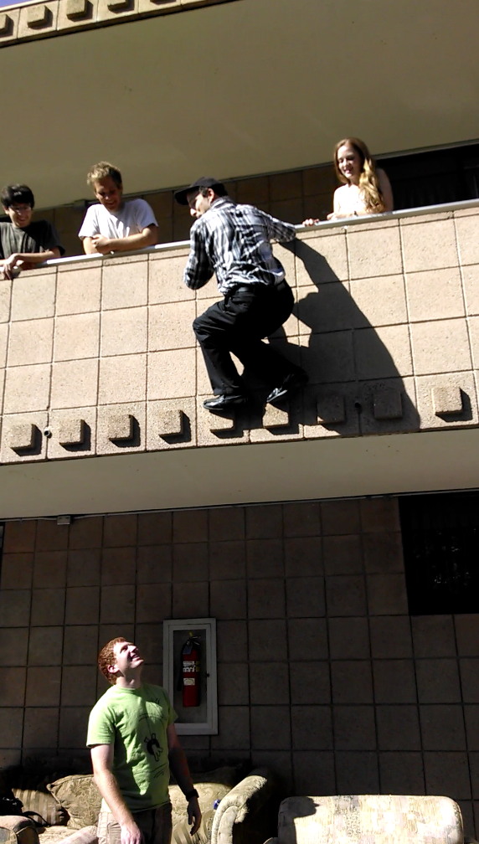
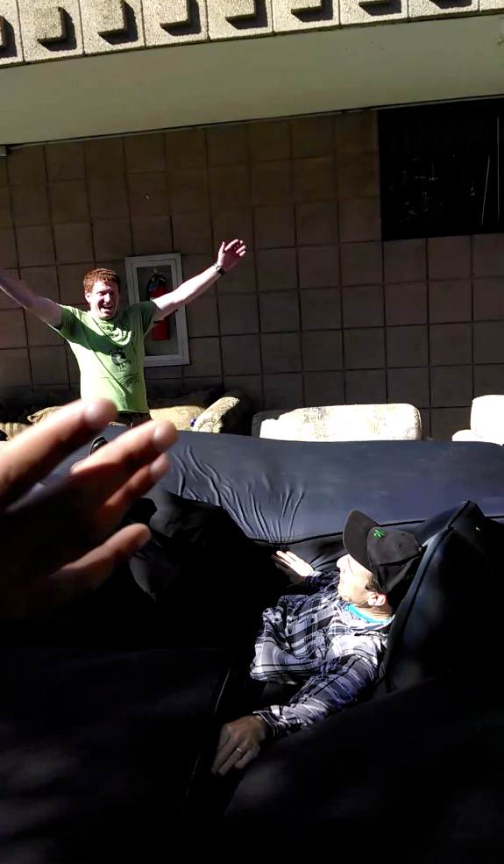
putting the fall into fall break...

Slide 3
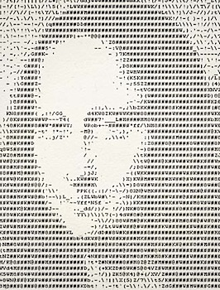
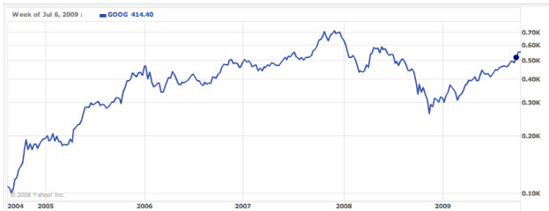
CS5
This week's HmmmWork #6 due Mon.
tutoring hours through the week(end)…
Coding in circles!
Office Hrs. Fri.
Thinking loopily and cumulatively
for a while
+=
sounds natural to me!
Today Loops have arrived…
This week + next: putting loops to good use:

Slide 4
... now, where were we ?

Slide 5
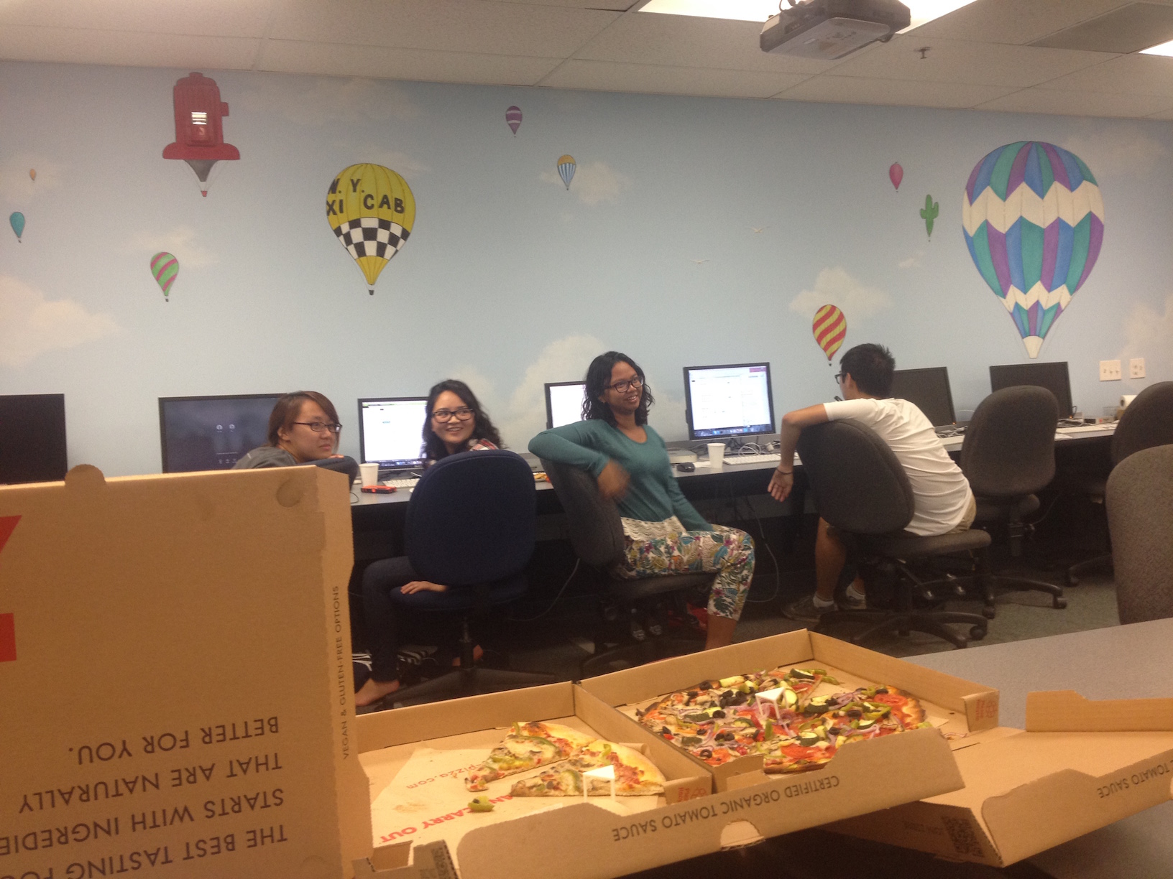
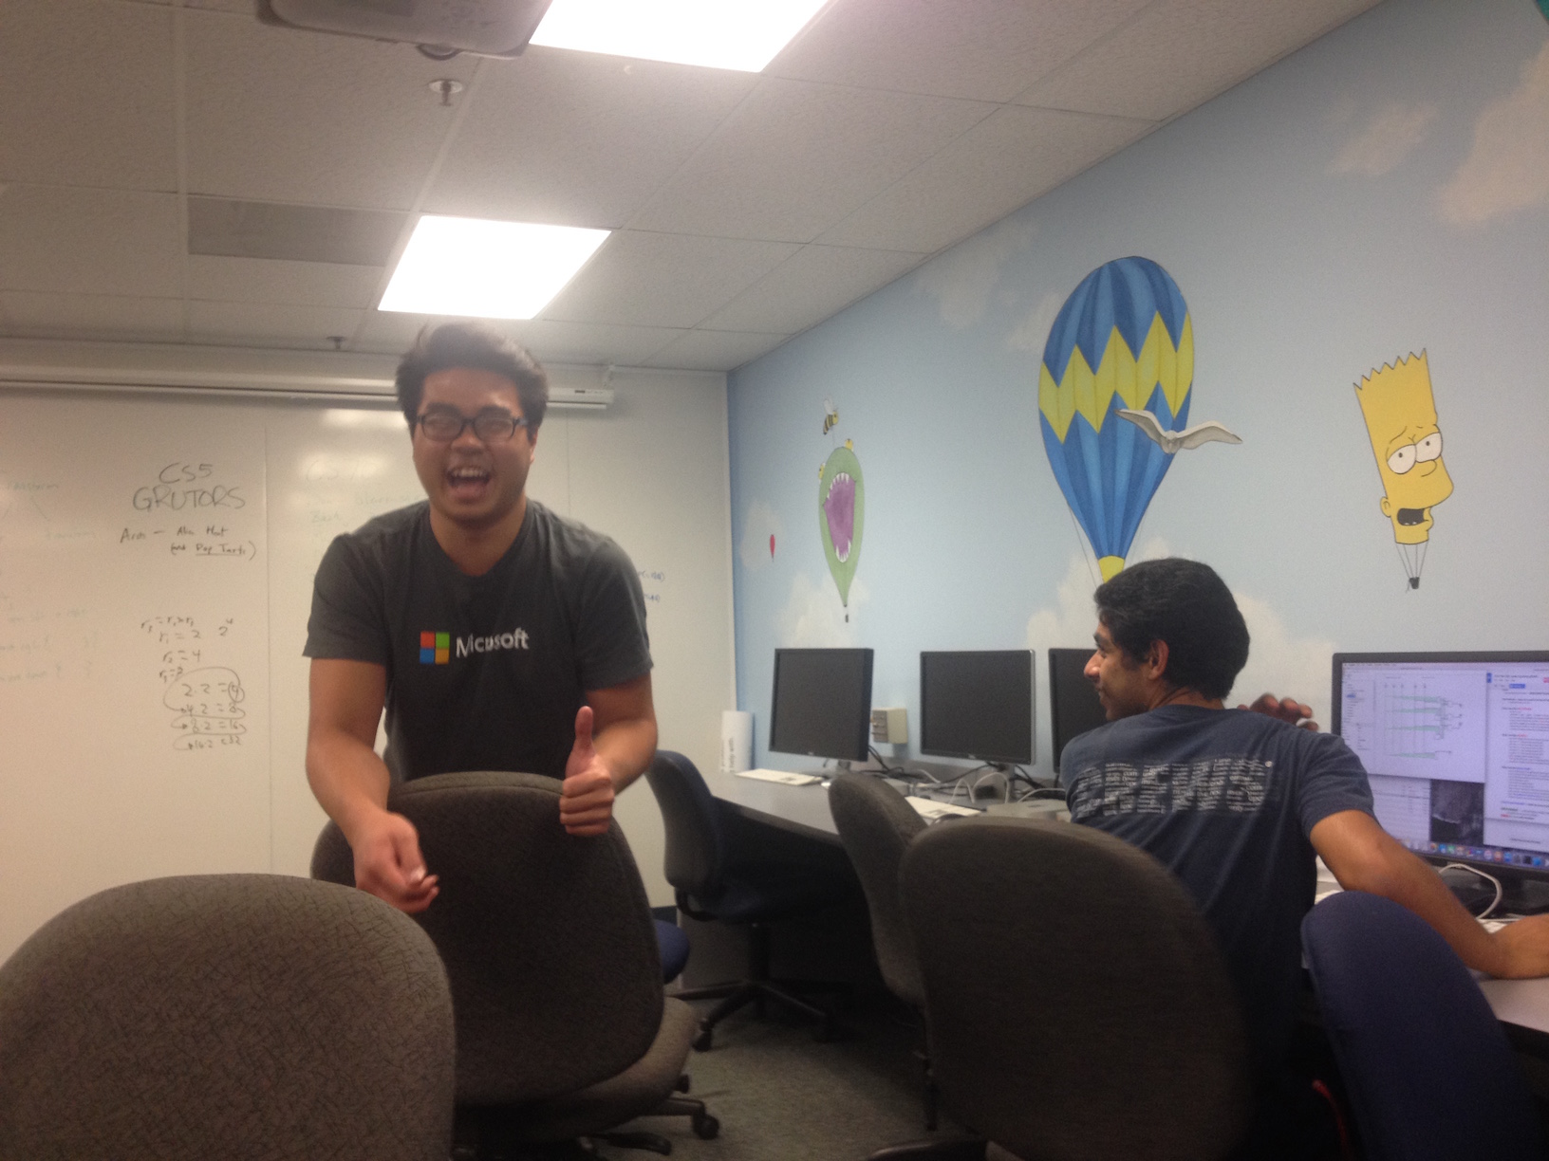
Circuit grading ~ this evening…

Slide 6
Lam: one of 22 c. fair t-shirts!

Slide 7
Wk 6: Assembly ~ why?
It's only the foolish who never climb Mt. Fuji -- or who climb it again.
some tasks are better left to machines…

Slide 8
Hmmm-thinking in Python
Loops in Python
Jumps in Hmmm
def fac(x):
result = 1
while x != 0:
result *= x
x -= 1
return result
00 read r1
01 setn r13 1
02 jeqzn r1 6
03 mul r13 r13 r1
04 addn r1 -1
05 jumpn 02
06 write r13
07 halt
It figures a Python would prefer looping to jumping!

Slide 9
Hmmm-thinking in Python
Loops in Python
Jumps in Hmmm
def fac(x):
result = 1
while x != 0:
result *= x
x -= 1
return result
00 read r1
01 setn r13 1
02 jeqzn r1 6
03 mul r13 r13 r1
04 addn r1 -1
05 jumpn 02
06 write r13
07 halt
It figures a Python would prefer looping to jumping!

Slide 10
Hmmm-thinking in Python
Loops in Python
Jumps in Hmmm
def fac(x):
result = 1
while x != 0:
result *= x
x -= 1
return result
00 read r1
01 setn r13 1
02 jeqzn r1 6
03 mul r13 r13 r1
04 addn r1 -1
05 jumpn 02
06 write r13
07 halt
It figures a Python would prefer looping to jumping!

Slide 11
Hmmm-thinking in Python
Loops in Python
Jumps in Hmmm
def fac(x):
result = 1
while x != 0:
result *= x
x -= 1
return result
00 read r1
01 setn r13 1
02 jeqzn r1 6
03 mul r13 r13 r1
04 addn r1 -1
05 jumpn 02
06 write r13
07 halt
It figures a Python would prefer looping to jumping!

Slide 12
Hmmm-thinking in Python
Loops in Python
Jumps in Hmmm
def fac(x):
result = 1
while x != 0:
result *= x
x -= 1
return result
00 read r1
01 setn r13 1
02 jeqzn r1 6
03 mul r13 r13 r1
04 addn r1 -1
05 jumpn 02
06 write r13
07 halt
It figures a Python would prefer looping to jumping!

Slide 13
Hmmm-thinking in Python
Loops in Python
Jumps in Hmmm
def fac(x):
result = 1
while x != 0:
result *= x
x -= 1
return result
00 read r1
01 setn r13 1
02 jeqzn r1 6
03 mul r13 r13 r1
04 addn r1 -1
05 jumpn 02
06 write r13
07 halt
It figures a Python would prefer looping to jumping!

Slide 14
Hmmm-thinking in Python
Loops in Python
Jumps in Hmmm
def fac(x):
result = 1
while x != 0:
result *= x
x -= 1
return result
00 read r1
01 setn r13 1
02 jeqzn r1 6
03 mul r13 r13 r1
04 addn r1 -1
05 jumpn 02
06 write r13
07 halt
It figures a Python would prefer looping to jumping!

Slide 15
Hmmm-thinking in Python
Loops in Python
def fac(x):
result = 1
while x != 0:
result *= x
x -= 1
return result
We get the advantages of explicit looping AND self-contained functions
All the advantages of Hmmm? I'm sold!

Slide 16
Hmmm
Recursive Hmmm factorial, hw6pr4
Looping Hmmm factorial, similar to hw6pr2 and pr3
00 read r1
01 setn r15 42
02 call r14 5
03 jump 21
04 nop
05 jnezn r1 8
06 setn r13 1
07 jumpr r14
08 storer r1 r15
09 addn r15 1
10 storer r14 r15
11 addn r15 1
12 addn r1 -1
13 call r14 5
14 addn r15 -1
15 loadr r14 r15
16 addn r15 -1
17 loadr r1 r15
18 mul r13 r13 r1
19 jumpr r14
20 nop
21 write r13
22 halt
00 read r1
01 setn r13 1
02 jeqzn r1 6
03 mul r13 r13 r1
04 addn r1 -1
05 jumpn 02
06 write r13
07 halt
Functional programming
Iterative programming
Hmmm… I think I'll take Python!

Slide 17
Iterative design in Python
for
for x in [40,41,42]:
print(x)
jumpn, jeqzn, …
x = 42
while x > 0:
print(x)
x -= 1
while
the initial value is often not the one we want in the end
x = 41
x += 1
addn r1 1
variables vary
a lot!
But we change it as we go…

Slide 18
for loops: examples…
This slide is four for for!
for x in [2,4,6,8]:
print(x)
for y in [7]*6:
print(y)
for c in 'down with loops!':
print(c)
How could we get this loop to run 42 times?
for i in
print(i)
There are a range of answers to this one…
Notes:
explain what's happening to x -- rather, as what's happening!!!
can take just the for part !!

Slide 19
for!
It's what the fox says: Duck!
1
x is assigned each value from this sequence
for x in [2,4,6,8]:
print('x is', x)
print('Done!')
3
LOOP back to the top for EACH value in the list
This is the #1 for-loop error! (what? why?)
2
the BODY or BLOCK of the for loop runs with that x
4
Code AFTER the loop will not run until the loop is finished.
anatomy?
empty?
x unused?
Notes:
the programmer takes on more responsibility -- for keeping track of what's happening to the variables
throughout the program's execution
part of the elegance of recursion is that you can specify how to obtain the result, and the machine will
make sure to change values as needed -- while storing and loading old values so that nothing is lost…

Slide 20
That's why they're called variables
Only in code can one's newer age be older than one's older age… !
age = 41
age = age + 1
The "old" value (41)
age += 1
The "new" value (42)
Echoes from Hmmm:
05 addn r1 1
Truth-in-powerpoint disclosure: all of this will be true soon, at least in base 12

Slide 21
That's why they're called variables
Only in code can one's newer age be older than one's older age… !
age = 41
age = age + 1
The "old" value (41)
age += 1
The "new" value (42)
Python shortcuts
hwToGo = 7
hwToGo = hwToGo - 1
amoebas = 100000
amoebas = amoebas * 2
u235 = 10000000000000;
u235 = u235 / 2
hwToGo -= 1
amoebas *= 2
u235 /= 2

Slide 22
four questions for for
for x in [1,2,3,4,5,6,7]:
print('x is', x)
avoid writing the whole list?
find the sum of the list?
showing partial sums?
factorial function?
Notes:
the programmer takes on more responsibility -- for keeping track of what's happening to the variables
throughout the program's execution
part of the elegance of recursion is that you can specify how to obtain the result, and the machine will
make sure to change values as needed -- while storing and loading old values so that nothing is lost…

Slide 23
fac with for
def fac( N ):
result = 1
for x in list(range(1,N+1)):
result = result * x
return result
Hey!? This is not the right answer… YET
Notes:
the programmer takes on more responsibility -- for keeping track of what's happening to the variables
throughout the program's execution
part of the elegance of recursion is that you can specify how to obtain the result, and the machine will
make sure to change values as needed -- while storing and loading old values so that nothing is lost…

Slide 24
Warning: no one else uses this term…
Laddering for loops
4
result
x
def fac( N ):
result = 1
for x in list(range(1,N+1)):
result = result * x
return result
meets up with Jacob's ladder
Notes:
the programmer takes on more responsibility -- for keeping track of what's happening to the variables
throughout the program's execution
part of the elegance of recursion is that you can specify how to obtain the result, and the machine will
make sure to change values as needed -- while storing and loading old values so that nothing is lost…

Slide 25
Warning: no one else uses this term…
Laddering for loops
result
x
def fac( N ):
result = 1
for x in list(range(1,N+1)):
result = result * x
return result
meets up with Jacob's ladder
Notes:
the programmer takes on more responsibility -- for keeping track of what's happening to the variables
throughout the program's execution
part of the elegance of recursion is that you can specify how to obtain the result, and the machine will
make sure to change values as needed -- while storing and loading old values so that nothing is lost…

Slide 26
Name(s): ________________
Quiz
Bday(s): ________________
What does the loop say?
mild
res.
x
mild-ish
x
i
result = 1
for x in [2,5,1,4]:
result *= x
print(result)
x = 0
for i in list(range(4)):
x += 10
print(x)
medium
spicy
L = ['golf','fore!','club','tee']
for i in list(range(len(L))):
if i%2 == 1:
print(L[i])
S = 'time to think this over! '
result = ''
for i in list(range(len(S))):
if S[i-1] == ' ':
result += S[i]
print(result)
25
i
i%2
L[i]
only ladder as needed...
These seem unexpected, but only at first… !?
Extra! How could you change one character above to yield
or another to yield
or another to yield
mns
etns!
eoks!
Notes:
the programmer takes on more responsibility -- for keeping track of what's happening to the variables
throughout the program's execution
part of the elegance of recursion is that you can specify how to obtain the result, and the machine will
make sure to change values as needed -- while storing and loading old values so that nothing is lost…

Slide 27
Quiz
What does the loop say?
result
x
result = 1
for x in [2,5,1,4]:
result *= x
print result
1
2
Notes:
the programmer takes on more responsibility -- for keeping track of what's happening to the variables
throughout the program's execution
part of the elegance of recursion is that you can specify how to obtain the result, and the machine will
make sure to change values as needed -- while storing and loading old values so that nothing is lost…

Slide 28
Quiz
What does the loop say?
result
x
result = 1
for x in [2,5,1,4]:
result *= x
print result
1
2
Notes:
the programmer takes on more responsibility -- for keeping track of what's happening to the variables
throughout the program's execution
part of the elegance of recursion is that you can specify how to obtain the result, and the machine will
make sure to change values as needed -- while storing and loading old values so that nothing is lost…

Slide 29
Quiz
What does the loop say?
[0,1,2,3]
x
i
x = 0
for i in list(range(4)):
x += 10
print(x)
0
0
Notes:
the programmer takes on more responsibility -- for keeping track of what's happening to the variables
throughout the program's execution
part of the elegance of recursion is that you can specify how to obtain the result, and the machine will
make sure to change values as needed -- while storing and loading old values so that nothing is lost…

Slide 30
Quiz
What does the loop say?
x
i
x = 0
for i in list(range(4)):
x += 10
print(x)
0
0
Notes:
the programmer takes on more responsibility -- for keeping track of what's happening to the variables
throughout the program's execution
part of the elegance of recursion is that you can specify how to obtain the result, and the machine will
make sure to change values as needed -- while storing and loading old values so that nothing is lost…

Slide 31
Quiz
What does the loop say?
L = ['golf','fore!','club','tee']
for i in list(range(len(L))):
if i%2 == 1:
print L[i]
L[i]
i%2
i
[0,1,2,3]
4
0
0
'golf'
1
1
'fore!'
0
2
'club'
1
3
'tee'
Notes:
the programmer takes on more responsibility -- for keeping track of what's happening to the variables
throughout the program's execution
part of the elegance of recursion is that you can specify how to obtain the result, and the machine will
make sure to change values as needed -- while storing and loading old values so that nothing is lost…

Slide 32
Quiz
What does the loop say?
res.
S[i-1]
S[i]
i
S = 'time to think this over! '
result = ''
for i in list(range(len(S))):
if S[i-1] == ' ':
result += S[i]
print result
' '
't'
0
[0,1,2,...,24]
't'
'i'
1
25
'i'
'm'
2
'm'
'e'
3
'e'
' '
4
' '
't'
5
't'
'o'
6
'o'
' '
7
' '
't'
8
Notes:
the programmer takes on more responsibility -- for keeping track of what's happening to the variables
throughout the program's execution
part of the elegance of recursion is that you can specify how to obtain the result, and the machine will
make sure to change values as needed -- while storing and loading old values so that nothing is lost…

Slide 33
Quiz
What does the loop say?
res.
S[i-1]
S[i]
i
S = 'time to think this over! '
result = ''
for i in list(range(len(S))):
if S[i-1] == ' ':
result += S[i]
print result
't'
' '
't'
0
[0,1,2,...,24]
't'
'i'
1
25
'i'
'm'
2
'm'
'e'
3
'e'
' '
4
'tttto'
'tt'
' '
't'
5
Looks like a four-'t' 'to' to me!
't'
'o'
6
'o'
' '
7
change ' ' to 'i'
change 1 to 4
change - to +
'ttt'
' '
't'
8
Extra! How could you change one character above to yield
or another to yield
or another to yield
mns
etns!
eoks!
Notes:
the programmer takes on more responsibility -- for keeping track of what's happening to the variables
throughout the program's execution
part of the elegance of recursion is that you can specify how to obtain the result, and the machine will
make sure to change values as needed -- while storing and loading old values so that nothing is lost…

Slide 34
Quiz
What does the loop say?
res.
S[i-1]
S[i]
i
S = 'time to think this over! '
result = ''
for i in list(range(len(S))):
if S[i-1] == ' ':
result += S[i]
print result
' '
't'
0
't'
'i'
1
'i'
'm'
2
'm'
'e'
3
'e'
' '
4
' '
't'
5
't'
'o'
6
'o'
' '
7
' '
't'
8
Notes:
the programmer takes on more responsibility -- for keeping track of what's happening to the variables
throughout the program's execution
part of the elegance of recursion is that you can specify how to obtain the result, and the machine will
make sure to change values as needed -- while storing and loading old values so that nothing is lost…

Slide 35
for: two types
L = [3, 15, 17, 7]
x
for x in L:
print(x)
element-based loops

Slide 36
for: two types
L[0]
L[1]
L[2]
L[3]
L = [3, 15, 17, 7]
0
1
2
3
i
for i in range(len(L)):
print(L[i])
list
index-based loops
for x in L:
print(x)
element-based loops

Slide 37
for: two types
L[0]
L[1]
L[2]
L[3]
L = [3, 15, 17, 7]
0
1
2
3
i
for i in range(len(L)):
print(L[i])
list
index-based loops
printing is NOT common in loops – these are just by way of example...
for x in L:
print(x)
element-based loops

Slide 38
simpler vs. flexibler
L = [3, 15, 17, 7]
x
def sum(L):
total = 0
for x in L:
total += x
return total
element-based loops

Slide 39
simpler vs. flexibler
L = [3, 15, 17, 7]
0
1
2
3
i
def sum(L):
total = 0
for x in L:
total += x
return total
def sum(L):
total = 0
for i in range(len(L))
total += _____
return total
list
element-based loops
index-based loops

Slide 40
for perspective
At the top of a CS5 project file …
// Author: Matt Beaumont-Gay
// Purpose: To get me out of CS5...
// ...no, really...
// Purpose: To create and maintain a list
// of films and directors
/* Notes:
* I haven't liked for-loops since the day I met them.
* They bother me for some reason. Hence, no for-loops…
*/
… and it is possible to avoid them entirely

Slide 41
Perspective on for loops
Barbara Usher (Google)
At the top of a CS5 project file …
CGU
// Author: Matt Beaumont
// Purpose: To get me out of CS5...
// ...no, really...
// Purpose: To create and maintain a list
// of films and directors
/* Notes:
* I haven't liked for-loops since the day I met them.
* They bother me for some reason. Hence, no for-loops…
*/

Slide 42
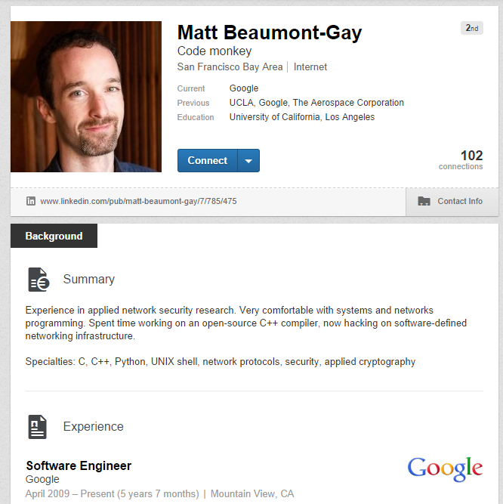
Perspective on for loops
Barbara Usher (Google)
At the top of a CS5 project file …
MBG, now willing to use for-loops...
// Author: Matt Beaumont
// Purpose: To get me out of CS5...
// ...no, really...
// Purpose: To create and maintain a list
// of films and directors
/* Notes:
* I haven't liked for-loops since the day I met them.
* They bother me for some reason. Hence, no for-loops…
*/
… and it is (temporarily) possible to avoid them entirely

Slide 43
Extreme Looping
What does this code do?
print('It keeps on')
while 41+1 == 42:
print('going and')
print('Phew! I\'m done!')
continuing if
I'm whiling away my time with this one!

Slide 44
Extreme Looping
Anatomy of a while
print('It keeps on')
while 41+1 == 42:
print('going and')
print('Phew! I\'m done!')
the loop keeps on running as long as the test is True
while loop body
other tests we could use here?
This won't print until the while loop finishes - In this case, it never prints!
I'm whiling away my time with this one!

Slide 45
Extreme Looping
lots of different tests…
print('It keeps on')
while 42 == 42:
print('going and')
print('Phew! I\'m done!')
others?
I'm whiling away my time with this one!

Slide 46
Extreme Looping
lots of different tests…
a "while True" loop
print('It keeps on')
while True:
print('going and')
print('Phew! I\'m done!')
I'm whiling away my time with this one!

Slide 47
Escape ?!
import random
escape = 0
while escape != 42:
print('Help! Let me out!')
escape = random.choice([41,42,43])
print('At last!')
starting value, not the final or desired value!
test to see if we keep looping
watch out for infinite loops!
after the loop ends
how could we count the number of loops we run?
how could we make it easier/harder to escape?
random.uniform!

Slide 48
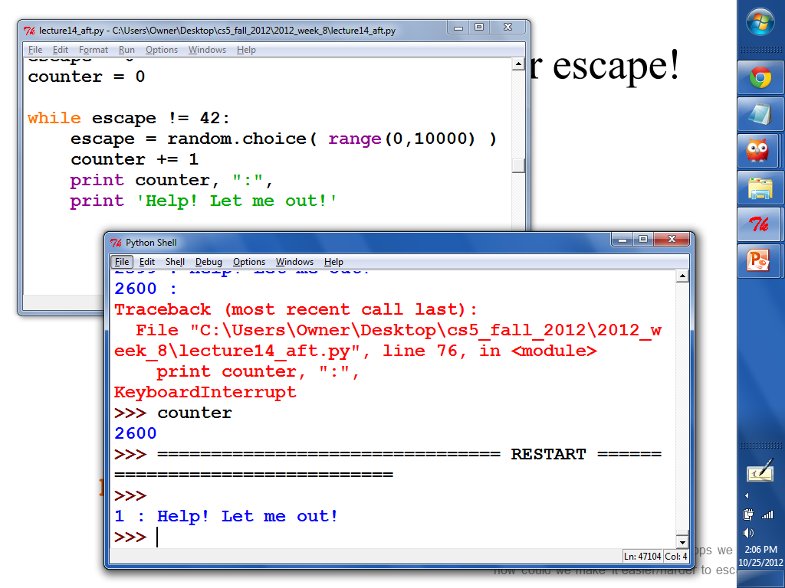
screenshot !!!

Slide 49
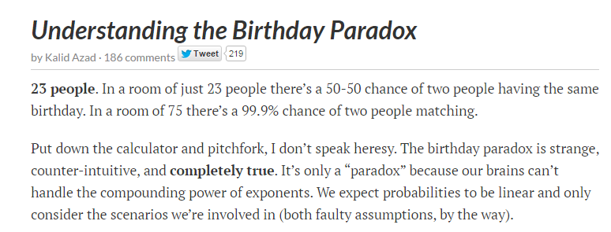
How long til a repeat?
Sooner than you might think…
http://betterexplained.com/articles/understanding-the-birthday-paradox/
birthday paradox!

Slide 50
How long til a repeat?
import random
LoBs = [] # List of BDays
while
b = random.choice( range(365))
LoBs += [b]
print("Repeat! # tries:", len(LoBs))
start w/ an empty list
What should this test be?
list
get a new birthday
add a new birthday – need to add list + list!
birthday paradox!

Slide 51
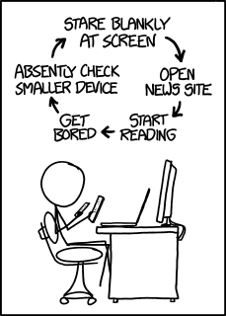
XKCD's loop
and this was before watches – or glasses...

Slide 52
Try these…
What do these two loops return?
Finish this loop to find and return the min of a list, L
L will be a non-empty list of numbers.
Let WORD = 'forty-two'
def min( L ):
result = L[0]
for x in L:
if
return result
What to check about x?
def count( WORD ):
n = 0
for c in WORD:
if c not in 'aeiou':
n += 1
return n
:
What to do?
Extra: Write a loop so that this function returns True if the input n is prime and False otherwise
Let n = 12
Let n = 8
def mystery( n ):
while n != 1:
if n%2 == 0:
n = n/2
else:
return False
return True
n will be a positive integer >= 2
12
8
def isPrime( n ):
Challenge: for what inputs n does mystery return True?
Hint: check all possible divisors to see if they "work"…

Slide 53
What do these two loops return?
Let n = 12 (then 8)
Let WORD = 'forty-two'
def mystery( n ):
while n != 1:
if n%2 == 0:
n = n/2
else:
return False
return True
def count( WORD ):
n = 0
for c in WORD:
if c not in 'aeiou':
n += 1
return n
n
c
0
12
8
'f'
1
'o'
1
6
4
'r'
2
't'
3
'y'
3
False
2
4
5
'-'
't'
1
True
6
7
'w'
7
'o'
Challenge: what are inputs for which mystery returns True?

Slide 54
L will be a non-empty list of numbers.
n will be a positive integer >= 2
def min( L ):
def isPrime( n ):
for d in range(2,n):
result = L[0]
for x in L:
if x < result:
return result
int(sqrt(n))
min so far
n/2
list
if n%d == 0:
return
min so far
return
min so far
[50,55,43,99,45,42]
An example list to consider…
Hint: check all possible divisors to see if they "work"…

Slide 55
Good luck with Hmmmwork #6!
Challenge:
use Hmmm code somewhere in your first Writ1 or SpecRel assignment…

Slide 57
Warning: no one else uses this term…
Laddering for loops
result
x
def fac( N ):
result = 1
for x in range(1,N+1):
result = result * x
return result
meets up with Jacob's ladder
Notes:
the programmer takes on more responsibility -- for keeping track of what's happening to the variables
throughout the program's execution
part of the elegance of recursion is that you can specify how to obtain the result, and the machine will
make sure to change values as needed -- while storing and loading old values so that nothing is lost…

Slide 58
Quiz
What does the loop say?
Name(s): __________________________
R
x
x
i
result = 1
for x in [2,5,1,4]:
result *= x
print result
x = 0
for i in range(4):
x += 10
print x
L = ['golf','fore!','club','tee']
for i in range(len(L)):
if i%2 == 1:
print L[i]
S = 'time to think this over! '
result = ''
for i in range(len(S)):
if S[i-1] == ' ':
result += S[i]
print result
i%2
i
make a better ladder!
These answers seem unexpected, but still somehow familiar… !?
Notes:
the programmer takes on more responsibility -- for keeping track of what's happening to the variables
throughout the program's execution
part of the elegance of recursion is that you can specify how to obtain the result, and the machine will
make sure to change values as needed -- while storing and loading old values so that nothing is lost…

Slide 59
Quiz
What does the loop say?
result
x
result = 1
for x in [2,5,1,4]:
result *= x
print result
1
2
Notes:
the programmer takes on more responsibility -- for keeping track of what's happening to the variables
throughout the program's execution
part of the elegance of recursion is that you can specify how to obtain the result, and the machine will
make sure to change values as needed -- while storing and loading old values so that nothing is lost…

Slide 60
Quiz
What does the loop say?
x
i
x = 0
for i in range(4):
x += 10
print x
0
0
Notes:
the programmer takes on more responsibility -- for keeping track of what's happening to the variables
throughout the program's execution
part of the elegance of recursion is that you can specify how to obtain the result, and the machine will
make sure to change values as needed -- while storing and loading old values so that nothing is lost…

Slide 61
Quiz
What does the loop say?
L = ['golf','fore!','club','tee']
for i in range(len(L)):
if i%2 == 1:
print L[i]
L[i]
i%2
i
0
1
2
3
Notes:
the programmer takes on more responsibility -- for keeping track of what's happening to the variables
throughout the program's execution
part of the elegance of recursion is that you can specify how to obtain the result, and the machine will
make sure to change values as needed -- while storing and loading old values so that nothing is lost…

Slide 62
Quiz
What does the loop say?
res
S[i-1]
S[i]
i
S = 'time to think this over! '
result = ''
for i in range(len(S)):
if S[i-1] == ' ':
result += S[i]
print result
' '
't'
0
't'
'i'
1
'i'
'm'
2
'm'
'e'
3
'e'
' '
4
' '
't'
5
't'
'o'
6
'o'
' '
7
' '
't'
8
Notes:
the programmer takes on more responsibility -- for keeping track of what's happening to the variables
throughout the program's execution
part of the elegance of recursion is that you can specify how to obtain the result, and the machine will
make sure to change values as needed -- while storing and loading old values so that nothing is lost…

Slide 63
What do these two loops return?
Let n = 12
Let WORD = 'forty-two'
def mystery( n ):
while n != 1:
if n%2 == 0:
n = n/2
else:
return False
return True
def count( WORD ):
n = 0
for c in WORD:
if c not in 'aeiou':
n += 1
return n
12
8
Challenge: what are inputs for which mystery returns True?

Slide 64
Quiz
What does the loop say?
result
x
result = 1
for x in [2,5,1,4]:
result *= x
print result
1
2
Notes:
the programmer takes on more responsibility -- for keeping track of what's happening to the variables
throughout the program's execution
part of the elegance of recursion is that you can specify how to obtain the result, and the machine will
make sure to change values as needed -- while storing and loading old values so that nothing is lost…

Slide 65
Quiz
What does the loop say?
x
i
x = 0
for i in range(4):
x += 10
print x
0
0
Notes:
the programmer takes on more responsibility -- for keeping track of what's happening to the variables
throughout the program's execution
part of the elegance of recursion is that you can specify how to obtain the result, and the machine will
make sure to change values as needed -- while storing and loading old values so that nothing is lost…

Slide 66
Quiz
What does the loop say?
L = ['golf','fore!','club','tee']
for i in range(len(L)):
if i%2 == 1:
print L[i]
i
0
1
2
3
Notes:
the programmer takes on more responsibility -- for keeping track of what's happening to the variables
throughout the program's execution
part of the elegance of recursion is that you can specify how to obtain the result, and the machine will
make sure to change values as needed -- while storing and loading old values so that nothing is lost…

Slide 67
Quiz
What does the loop say?
S = 'time to think this over! '
result = ''
for i in range(len(S)):
if S[i-1] == ' ':
result += S[i]
print result
S[i]
S[i-1]
i
't'
0
'i'
1
'm'
2
.
.
.
.
.
.
Notes:
the programmer takes on more responsibility -- for keeping track of what's happening to the variables
throughout the program's execution
part of the elegance of recursion is that you can specify how to obtain the result, and the machine will
make sure to change values as needed -- while storing and loading old values so that nothing is lost…

Slide 68
while power?
start the answer at a reasonable value
def pow( b, p ):
""" finds b**p """
result =
while
return result
create a loop that ACCUMULATES the correct answer
and return it...

Slide 69
What do these two loops return?
Let n = 12
Let WORD = 'forty-two'
def mystery( n ):
while n != 1:
if n%2 == 0:
n = n/2
else:
return False
return True
def count( WORD ):
n = 0
for c in WORD:
if c not in 'aeiou':
n += 1
return n
Challenge: what are inputs for which mystery returns True?

Slide 70
What do these two loops return?
Let n = 12
Let WORD = 'forty-two'
def mystery( n ):
while n != 1:
if n%2 == 0:
n = n/2
else:
return False
return True
def count( WORD ):
n = 0
for c in WORD:
if c not in 'aeiou':
n += 1
return n
Challenge: what are inputs for which mystery returns True?

Slide 71
L will be a non-empty list of numbers.
n will be a positive integer >= 2
def min( L ):
def isPrime( n ):
[50,55,43,99,45,42]
An example list to consider…
Hint: write a loop to check all possible divisors to see if they "work"…
index?

Slide 72
"Quiz"
in which you already know what all the correct answers will be…
Name(s): __________________________
result = 1
for x in [2,5,1,4]:
result *= x
print result
x = 0
for i in range(4):
x += 10
print x
L = ['golf','fore!','club','tee']
for i in range(len(L)):
if i%2 == 1:
print L[i]
S = 'time to think this over! '
result = ''
for i in range(len(S)):
if S[i-1] == ' ':
result += S[i]
print result
Extra: Use a loop to finish this sum function:
def sum( L ):
result = 0
for
result +=
return result
What do these four loops print out?
Notes:
the programmer takes on more responsibility -- for keeping track of what's happening to the variables
throughout the program's execution
part of the elegance of recursion is that you can specify how to obtain the result, and the machine will
make sure to change values as needed -- while storing and loading old values so that nothing is lost…

Slide 73
What do these two loops do?
Let n = 12
Let WORD = 'forty-two'
def mystery( n ):
while n != 1:
if n%2 == 0:
n = n/2
else:
return False
return True
def count( WORD ):
n = 0
for c in WORD:
if c not in 'aeiou':
n += 1
return n
Challenge: what are all the inputs for whch mystery returns True?

Slide 74
L will be a non-empty list of numbers.
n will be a positive integer > 1
def min( L ):
def isPrime( n ):
Challenge: how could you return the index (location) of the min instead?

Slide 75
which is more flexible?
L = [3, 15, 17, 7]
0
1
2
3
i
def sum(L):
total = 0
for x in L:
total += x
return total
def sum(L):
total = 0
for i in range(len(L))
total += _____
return total
element-based loops
index-based loops

Slide 76
while power?
start the answer at a reasonable value
def pow( b, p ):
result = 1
while
return
create a loop that ACCUMULATES the correct answer
and return it...

Slide 77
Looping over strings
for c in 'down with CS!':
print c

