Slide 1
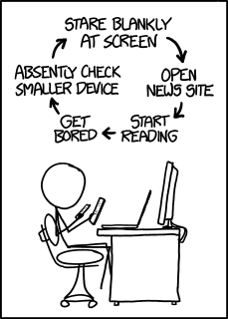
Loop of life, XKCD's take:
Challenge:
use Hmmm code somewhere in your first Writ1 or SpecRel assignment…
Next Tues
Guest Lecture ~ Tues. Prof. Julie Medero!
and this, before watches – or . glasses...

Slide 2
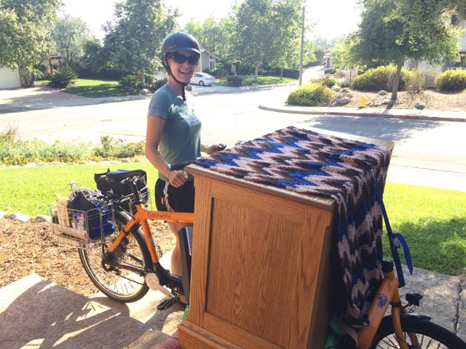
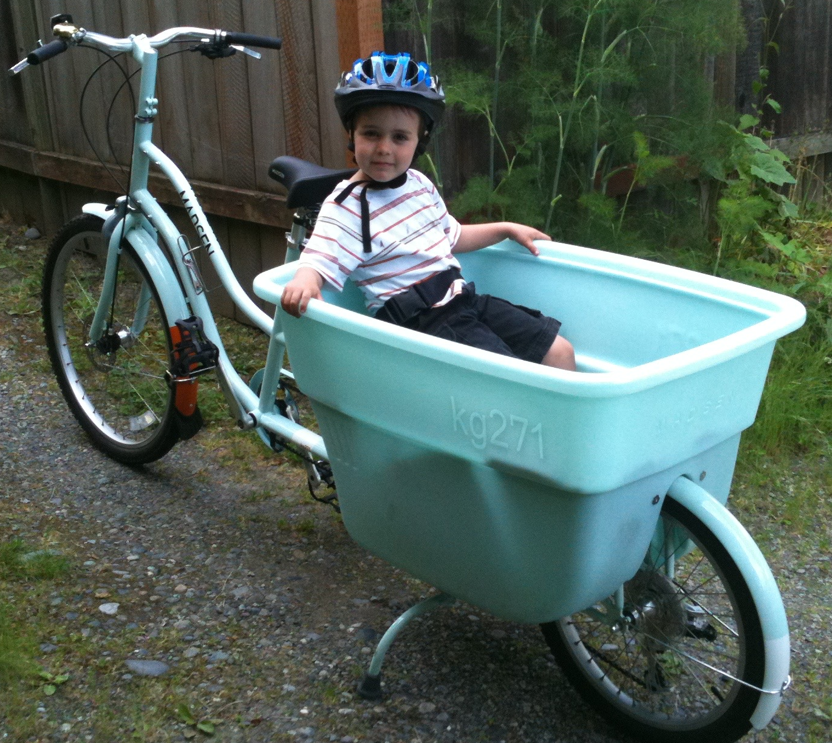
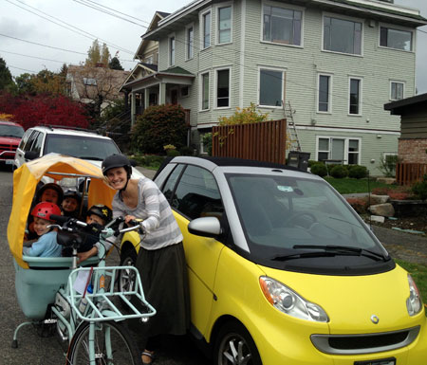
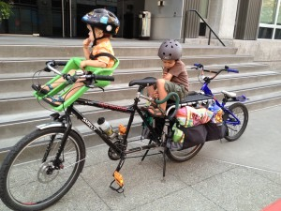
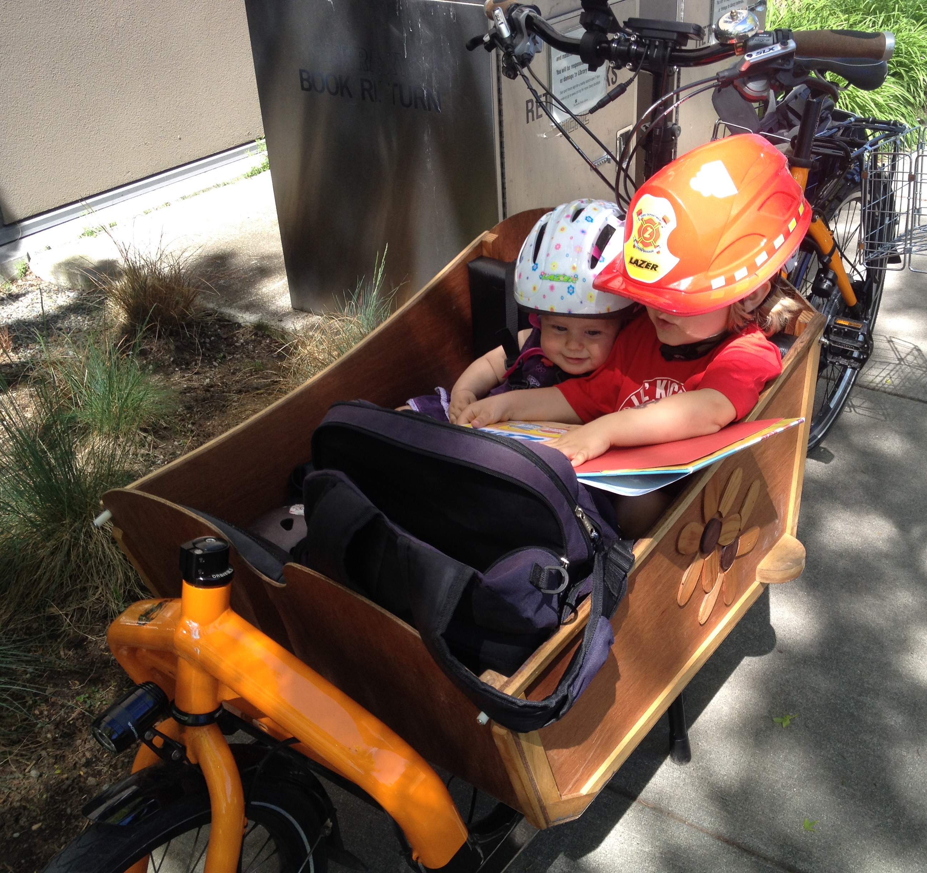
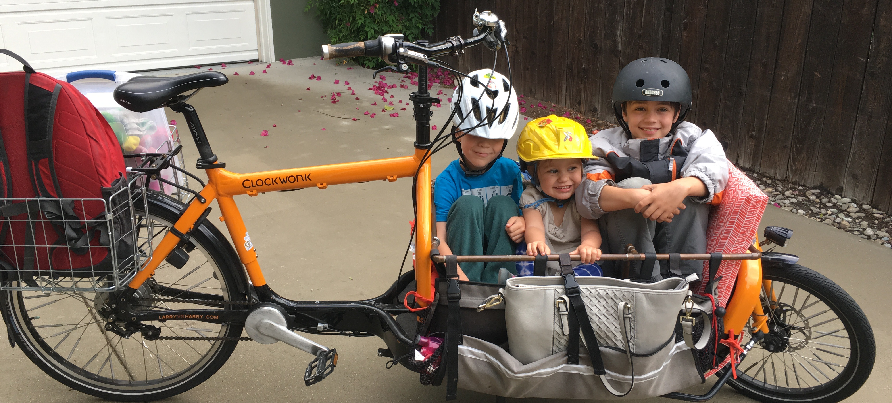
Loop of life, Prof. Medero's take:
Challenge:
use Hmmm code somewhere in your first Writ1 or SpecRel assignment…
Next Tues
Guest Lecture ~ Tues. Prof. Julie Medero!
and this, before watches – or . glasses...

Slide 3
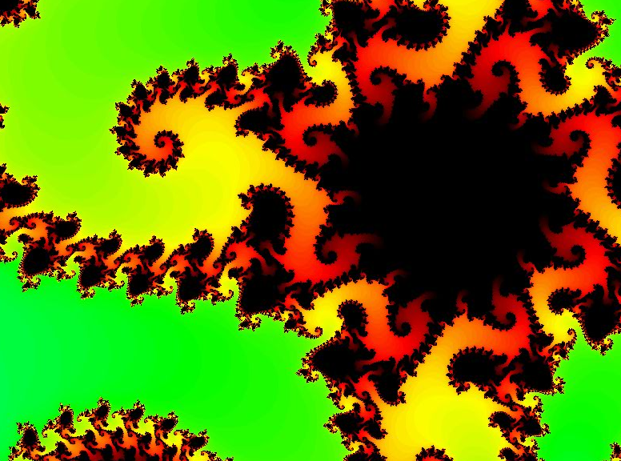
Seems more like two-thirds term to me...
CS 5 Today
infinitely nested structure…
CS Midterm
Thursday, Nov. 7
In-class, written
Page of notes is OK
Recursion in Python
Function composition
Circuit design
Hmmm assembly code
Loops in Python
Topics
from finitely nested loops
See online practice…
Homework 8 Loops! due Mon. 11/4
Accommodations...

Slide 4
Homework 8 preview
#0
When Algorithms Discriminate...
#1 ~ lab
The Mandelbrot Set
#2
Lots of loops!
#3
Pi from Pie
#4
TTS Securities
Thinking in Loops...
(Extra)
ASCII Art

Slide 5
Algorithms ~ better angels... ?
#0
When Algorithms Discriminate...
#1 ~ lab
The Mandelbrot Set
#2
Pi from Pie
TTS Securities
#3
Loopy thinking
(Extra)
ASCII Art

Slide 6
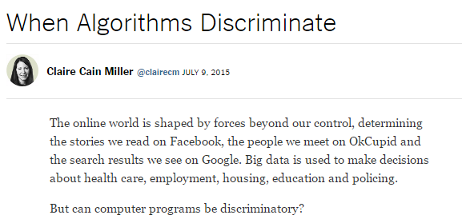
Or ~ louder angels of human nature... ?
#0
When Algorithms Discriminate...
#1 ~ lab
The Mandelbrot Set
#2
Pi from Pie
TTS Securities
#3
Loopy thinking
(Extra)
ASCII Art

Slide 7
Homework 8 preview
#0
When Algorithms Discriminate...
#1 ~ lab
The Mandelbrot Set
#2
Lots of loops!
#3
Pi from Pie
#4
TTS Securities
Thinking in Loops!
(Extra)
ASCII Art

Slide 8
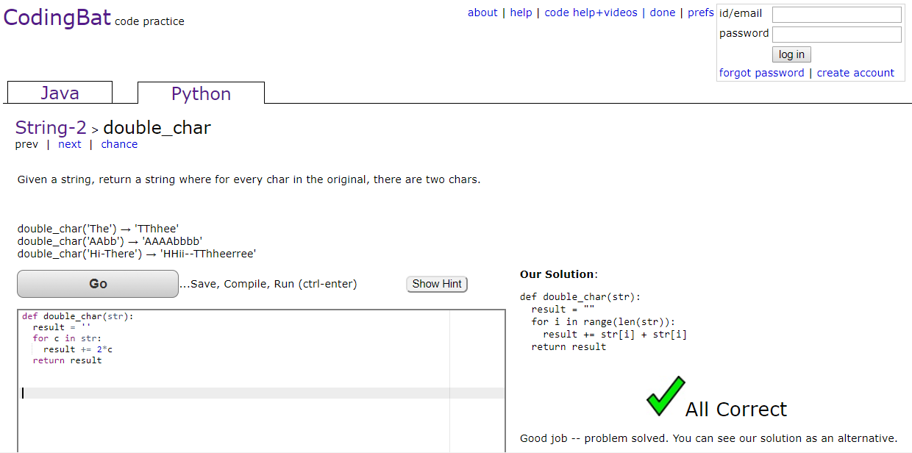
PythonBat loop practice...
google for "PythonBat" then...
5 points required, up to 11 points available...

Slide 9
Thinking in loops
for
while
x = 1
while x < 42:
print(x)
x *= 2
list
for x in range(42):
print(x)
What are the design differences between these two types of Python loops?

Slide 10
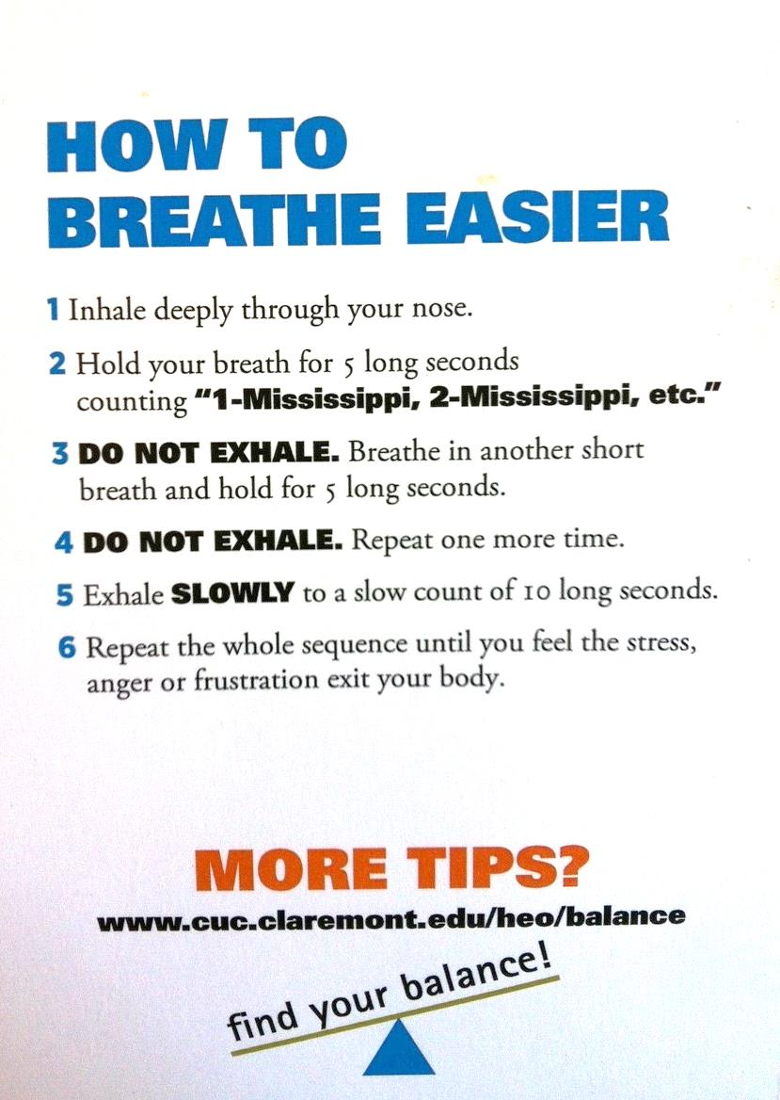
Loop design...
Is this a for or a while loop?
Careful here!
Table tent…

Slide 11
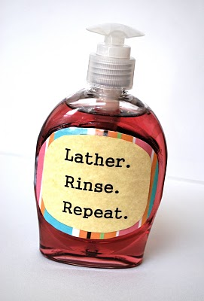
Loop design...
Is this a for or a while loop?

Slide 12
Thinking in loops
for
while
definite iteration
indefinite iteration
For a known list or # of iterations
For an unknown number of iterations

Slide 13
Homework 8 preview
#0
When Algorithms Discriminate...
#1 ~ lab
The Mandelbrot Set
#2
Lots of loops!
#3
Pi from Pie
#4
TTS Securities
Loopy thinking
(Extra)
ASCII Art
(Web extra)
CSS: Cascading Style Sheets

Slide 14
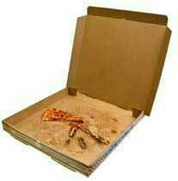
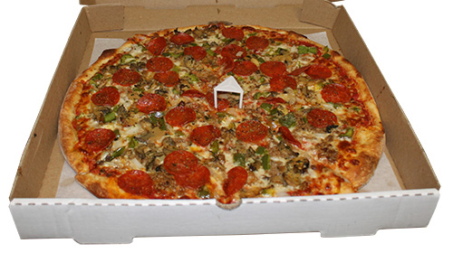
Hw8 Pr3
Pi from Pie?
π
Pizza is the universal constant, after all…

Slide 15
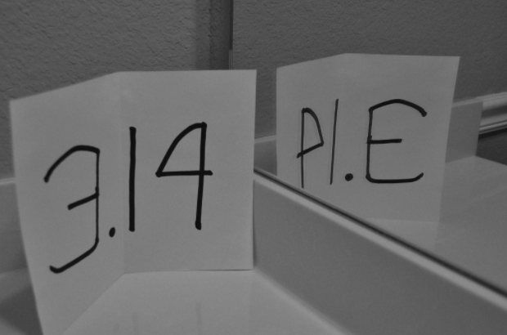
Hw8 Pr3
Pi from Pie?
π
This couldn't be just a coincidence!

Slide 16
Hw8 Pr3
(1,1)
Box
Estimating π from pie?
Pie
What if we just throw darts at this picture?
(0,0)
(-1,-1)

Slide 17
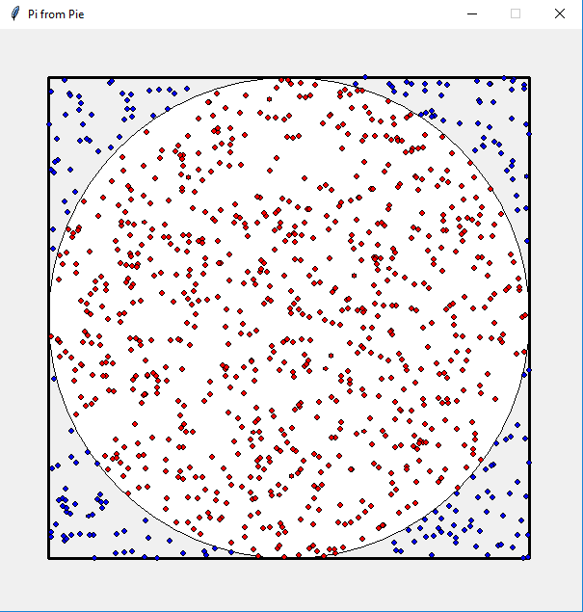
Pi-design challenge...
(1,1)
Estimating π from pie?
Box
(1) Suppose you throw 100 darts at the square (All of them hit the square)
(2) Suppose 80 of the 100 hit inside the circle.
(3) How could you estimate π from these throws?
Pie
Hints
How big is a side of the square? its area?
How big is the radius of the circle? its area?
How do these help!?
(-1,-1)

Slide 18
Pi-design challenge...
(1,1)
Estimating π from pie?
Box
π
area
=
4
area
Pie
4
*
hits
π
~
hits
(-1,-1)
Hw8 Pr3
Notes:
Run pi_darts

Slide 19
Loops: for or while?
pi_one(e)
e == how close to π we need to get
pi_two(n)
n == number of darts to throw
Which function will use which kind of loop?

Slide 20
Loops: for or while?
pi_one(e)
e == how close to π we need to get
while
pi_two(n)
n == number of darts to throw
for

Slide 21
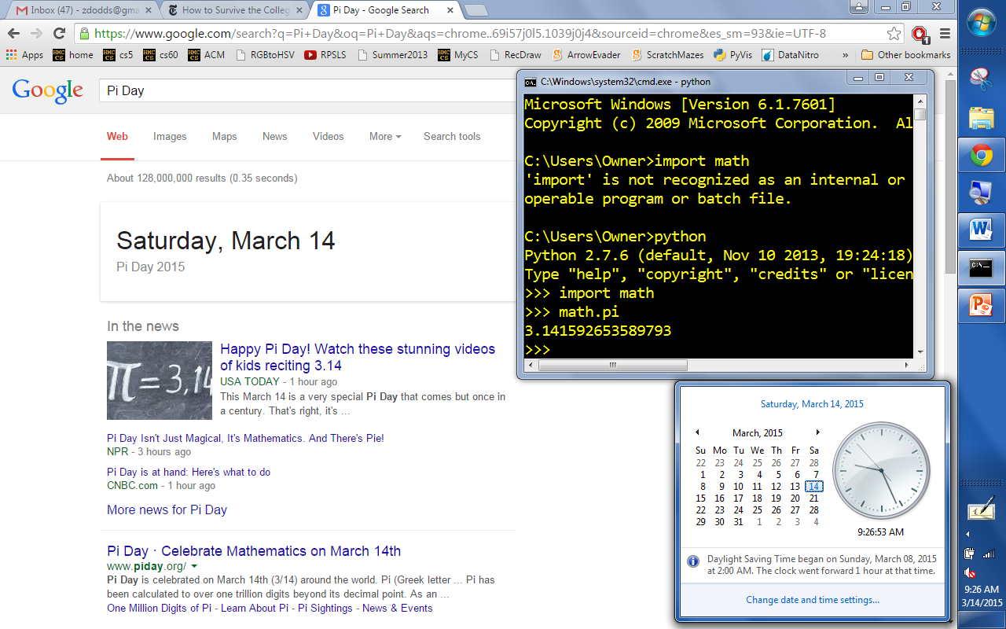
π day!
3/14/15 9:26:53

Slide 22
Homework 8 preview
#0
When Algorithms Discriminate...
#1 ~ lab
The Mandelbrot Set
#2
Lots of loops!
#3
Pi from Pie
#4
TTS Securities
Not just loops...
Nested loops
(Extra)
ASCII Art

Slide 23
Nested loops are familiar, too!
for mn in range(60):
for s in range(60):
tick()
list
list

Slide 24
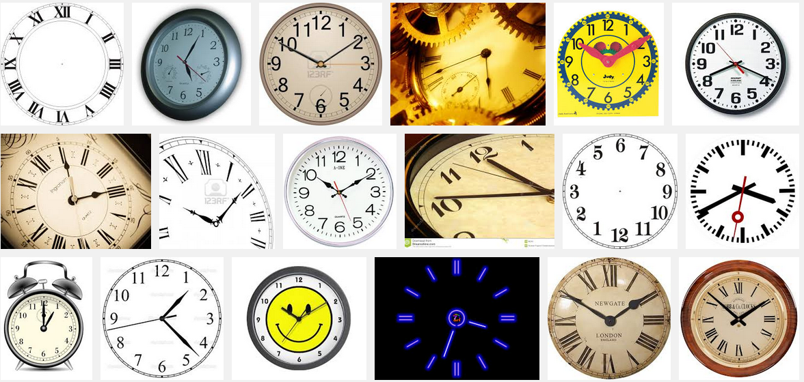
Nested loops are familiar, too!
So close!

Slide 25
Nested loops
Life clock
for y in range(84):
for m in range(12):
for d in range(f(m,y)):
for h in range(24):
for mn in range(60):
for s in range(60):
tick()
list
list
list
list
list
list

Slide 26
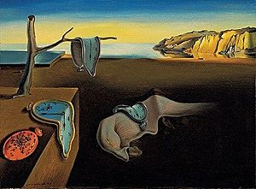
Nested loops!
for y in range(84):
for m in range(12):
for d in range(f(m,y)):
for h in range(24):
for mn in range(60):
for s in range(60):
tick()
How nested loops can feel ...
list
Persistence of Memory, S. Dali (MoMA)
list

Slide 27
s == 0
s == 59
mn == 0
Nested loops' 2d structure
One hour ~ 3600 seconds
mn == 42
42nd minute's
59th second
mn == 59
for mn in range(60):
for s in range(60):
tick()
list
list
hour()

Slide 28
Creating 2d structure ~ in ASCII
col
0
1
2
3
# # # #
# # # #
# # # #
0
row
1
2
for row in range(3):
for col in range(4):
print("#")
list
list
Wait! this needs something more…
Notes:
This is ex1()

Slide 29
Creating 2d structure
col
0
1
2
3
# # # #
# # # #
# # # #
0
row
1
2
for row in range(3):
for col in range(4):
print("#", end='')
list
list
Hmmm...
Notes:
This is ex2()

Slide 30
Creating 2d structure
[0,1,2]
for row in range(3):
for col in range(4):
print('#',end='')
print()
row =
[0,1,2,3]
col =
col =
col =
col =
row =
col
col =
col =
col =
col =
0
1
2
3
0
row =
row
1
col =
col =
col =
col =
2

Slide 31
Creating 2d structure
Let's take an alien's-eye view!
for row in range(3):
for col in range(4):
if col == row:
print('#',end='')
else:
print(' ',end='')
print()
0
row =
0
col =
col =
col =
col =
1
2
3
1
row =
0
col =
col =
col =
col =
1
col
2
3
0
1
2
3
2
row =
0
0
col =
col =
col =
col =
row
1
1
2
2
3
Notes:
This is ex3()

Slide 32
Match!
What code creates the fourth one?
Name(s) ______________________
* and ** are extra!
[0,1,2]
for r in range(3):
for c in range(6):
if c%2 == 1:
print('#',end='')
else:
print(' ',end='')
print()
for r in range(3):
for c in range(6):
if c%2 == r%2:
print('#',end='')
else:
print(' ',end='')
print()
for r in range(3):
for c in range(6):
if c >= r:
print('#',end='')
else:
print(' ',end='')
print()
[0,1,2,3,4,5]
A
B
C
1
cols
2
cols
*
cols
2
3
4
2
5
3
4
5
2
3
1
1
1
4
0
0
0
0
# # # # #
# # # #
# # #
0
# # #
# # #
# # #
0
# # # # #
# # #
#
1
1
1
2
2
2
rows
rows
3
cols
4
cols
**
cols
2
3
4
5
2
3
2
1
4
3
4
5
0
1
1
0
0
0
# # # # # #
# # # # #
# # # #
0
# # #
# # #
# # #
0
# # #
# # #
# # # #
1
1
1
2
2
2
rows
rows
Notes:
A 3
B 4
C 2
1: c+r <= 4

Slide 33
Match!
What code creates the fourth one?
answers...
* and ** are extra!
[0,1,2]
for r in range(3):
for c in range(6):
if c%2 == 1:
print('#',end='')
else:
print(' ',end='')
print()
for r in range(3):
for c in range(6):
if c%2 == r%2:
print('#',end='')
else:
print(' ',end='')
print()
for r in range(3):
for c in range(6):
if c >= r:
print('#',end='')
else:
print(' ',end='')
print()
[0,1,2,3,4,5]
A
B
C
1
cols
2
C
cols
*
cols
2
3
4
2
5
3
4
5
2
3
1
1
1
4
0
0
0
0
# # # # #
# # # #
# # #
0
# # #
# # #
# # #
0
# # # # #
# # #
#
1
1
1
2
2
2
rows
if c+r<=4
rows
if c+r<=4 and c>=r
3
A
4
B
cols
**
cols
cols
2
3
4
5
2
3
2
1
4
3
4
5
0
1
1
0
0
0
# # # # # #
# # # # #
# # # #
0
# # #
# # #
# # #
0
# # #
# # #
# # # #
1
1
1
2
2
2
rows
rows
if not (c==r or c+r==4)

Slide 34
Match!
What code creates the fourth one?
answers...
* and ** are extra!
[0,1,2]
for r in range(3):
for c in range(6):
if c%2 == 1:
print('#',end='')
else:
print(' ',end='')
print()
for r in range(3):
for c in range(6):
if c%2 == r%2:
print('#',end='')
else:
print(' ',end='')
print()
for r in range(3):
for c in range(6):
if c >= r:
print('#',end='')
else:
print(' ',end='')
print()
Pass those...
[0,1,2,3,4,5]
A
B
C
1
cols
2
C
cols
*
cols
2
3
4
2
5
3
4
5
2
3
1
1
1
4
0
0
0
# # # # #
# # # #
# # #
# # #
# # #
# # #
# # # # #
# # #
#
ashington-ward
0
0
0
1
1
1
2
2
2
rows
if c+r<=4
rows
if c+r<=4 and c>=r
3
A
4
B
cols
**
cols
cols
2
ouston-ward
3
4
5
2
3
2
1
4
3
4
5
0
1
1
0
0
0
# # # # # #
# # # # #
# # # #
0
# # #
# # #
# # #
0
# # #
# # #
# # # #
1
1
1
2
2
2
rows
rows
if not (c==r or c+r==4)

Slide 35
Nested loops' 2d structure
for d in range(f(m)):
for m in range(1,13):
num_bdays(m,d)
What trends appear in this birthday data?
How might we be suspicious of the fairness of this data?!
how many shared birthdays are in CS5?
vizwiz.blogspot.com/2012/05/how-common-is-your-birthday-find-out.html

Slide 36
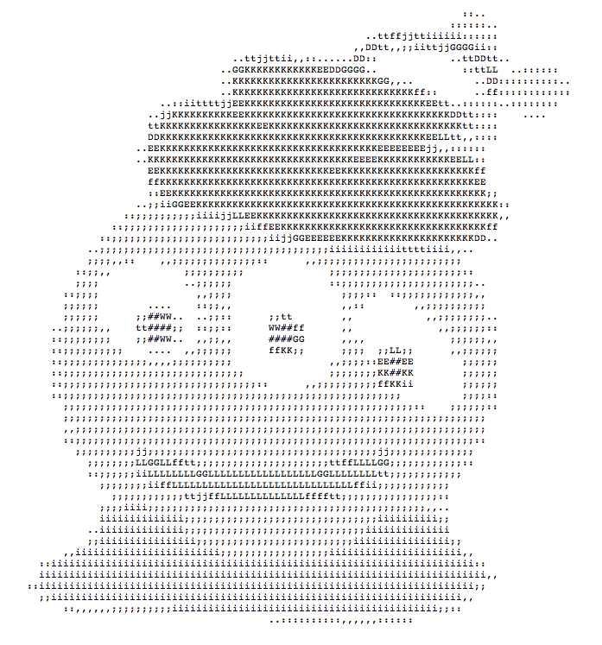
Nested loops: from ASCII Art
That's my type of alien!
... to "real" images!

Slide 37
Python and images
from cs5png import *
200
inputs are width and height
(10,100)
im = PNGImage( 300, 200 )
0
0
300
(0,0) is in the usual place!
im.plotPixel( 10, 100 )

Slide 38
Python and images
from cs5png import *
200
inputs are width and height
(10,100)
(42,42)
im = PNGImage( 300, 200 )
0
0
300
objects are variables that can contain their own functions, often called methods
im.plotPixel( 10, 100 )
im.plotPixel( 42, 42, (255,0,0) )
col x
row y
red
green
blue
im.saveFile( )
These functions are clearly plotting something – if only I knew what they were up to...

Slide 39
Imagining Images
from cs5png import *
def testImage():
""" image demonstration """
WD = 300
HT = 200
im = PNGImage( WD, HT )
for row in range(HT):
for col in range(WD):
if col == row:
im.plotPoint( col, row )
im.saveFile()
thicker line?
other diagonal?
stripes ?
thicker stripes?
thatching?

Slide 40
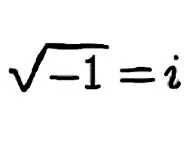
Nothing's too complex for Python!
Complex #s !
i
can't believe this!
1j * 1j == -1
(-1+0j)

Slide 41
Nothing's too complex for Python!
Complex #s !
i
can't believe this!
1j * 1j == -1
In[]: c = -2+1j
(-2+1j)*(-2+1j)
In[]: c**2
(3-4j)

Slide 42
Nothing's too complex for Python!
Complex #s !
i
can't believe this!
Imaginary axis
In[]: c = -2+1j
3j
2j
-2 + 1j
1j
Real axis
In[]: c**2
(3-4j)
-2
3
3 - 4j
-4j

Slide 43
Lab 8: the Mandelbrot Set
z₀ = 0
z_{n+1} = z_{n}² + c
Consider an update rule for all complex numbers c
.4j
c = .3 + .4j
.3
Real axis
z = z**2+c ; print(z)
Imaginary axis

Slide 44
Mandelbrot Definition
z₀ = 0
z_{n+1} = z_{n}² + c
Consider an update rule for all complex numbers c
Imaginary axis
c = .3 + .4j
Small values of c keep the sequence near the origin, 0+0j.
z₃
c
z₁
z₂
z₄
z₀
Real axis
z₅
some "stick around" ~ oscillate or converge
z = z**2+c ; print(z)
Notes:
Run mshow

Slide 45
Mandelbrot Definition
z₀ = 0
z_{n+1} = z_{n}² + c
Consider an update rule for all complex numbers c
Imaginary axis
Small values of c keep the sequence near the origin, 0+0j.
c
c = .3 + .4j
Real axis
Other values of c make the sequence head to infinity.
z = z**2+c ; print(z)
c
c = 3 - 4j

Slide 46
Mandelbrot Definition
z₀ = 0
z_{n+1} = z_{n}² + c
Consider an update rule for all complex numbers c
Imaginary axis
Which c's
stick around?
Small values of c keep the sequence near the origin, 0+0j.
Benoit B. Mandelbrot 1924 – 2010
c
c = .3 + .4j
Real axis
Other values of c make the sequence head to infinity.
z = z**2+c ; print(z)
c
c = 3 - 4j

Slide 47
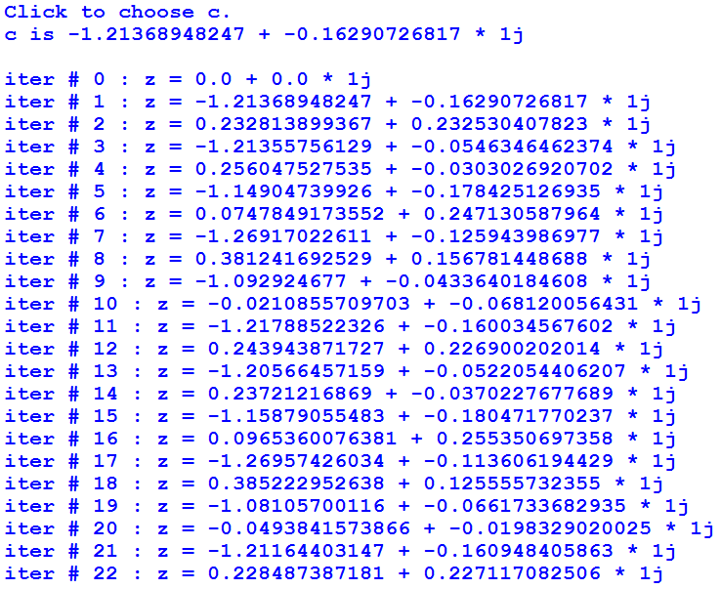
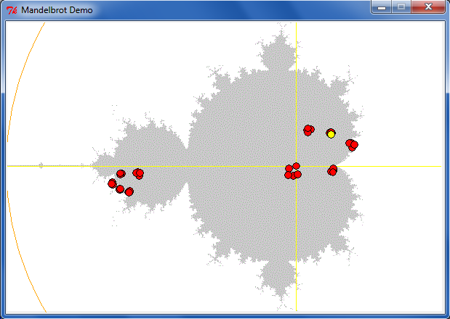
Lab 8: the Mandelbrot Set
z₀ = 0
z_{n+1} = z_{n}² + c
Consider an update rule for all complex numbers c
some c's stick around

Slide 48
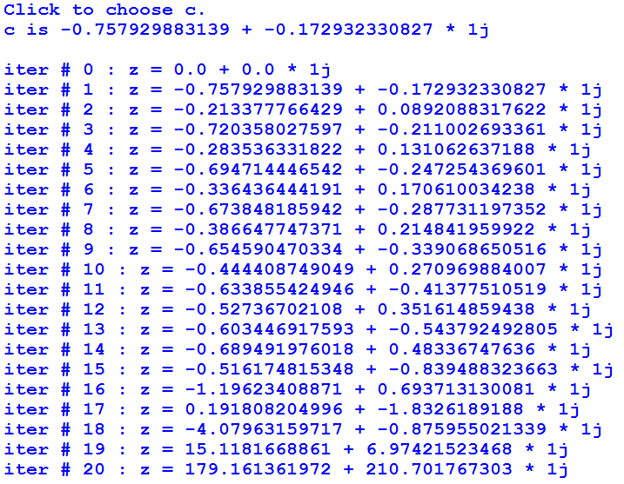
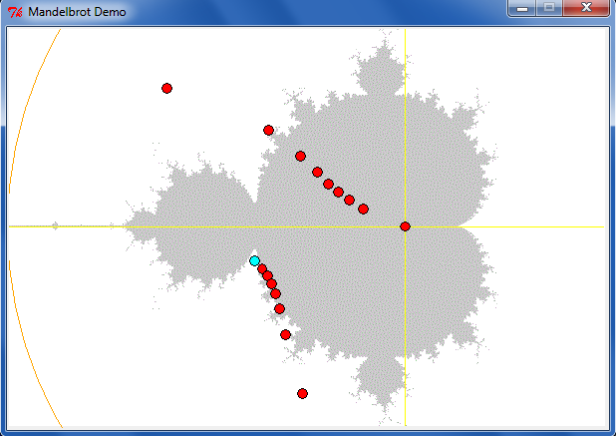
Lab 8: the Mandelbrot Set
z₀ = 0
z_{n+1} = z_{n}² + c
Consider an update rule for all complex numbers c
other c's diverge

Slide 49
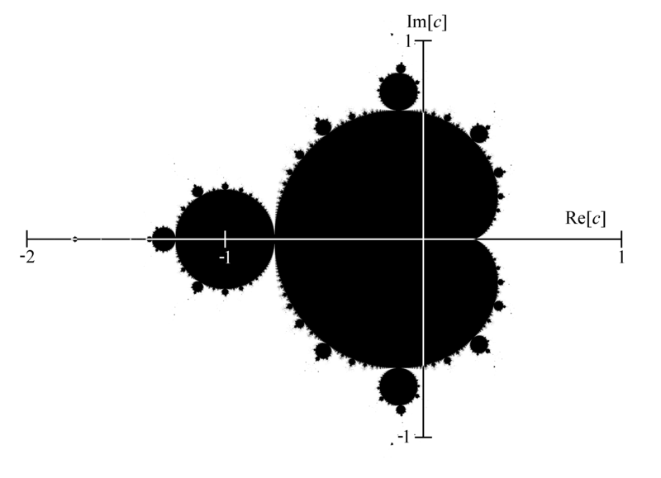
Mandelbrot Set ~ points that stick around
mid 70's resolution
The shaded area are points that do not diverge for z = z**2 + c

Slide 50
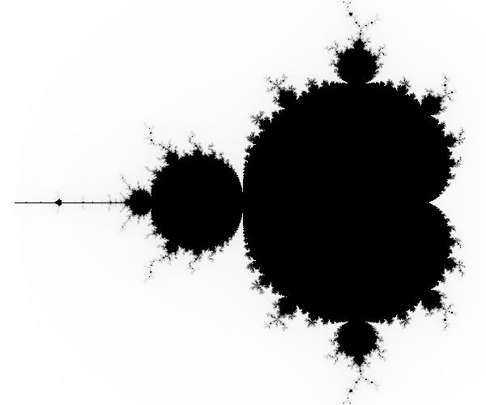
Higher-resolution M. Set
-2 + 1j
1 + 1j
connected
finite area
∞ perimeter!
-2 - 1j
1 - 1j
The black pixels are points that do not diverge for z = z**2 + c

Slide 51
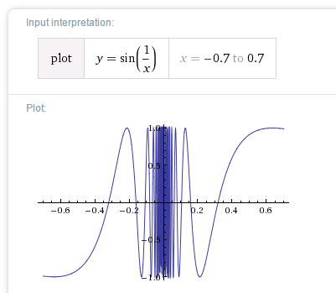
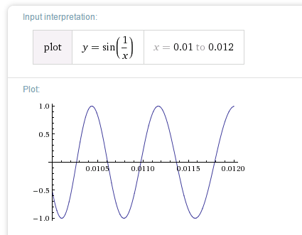
Chaos?
Complex things always consisted of simple parts…

Slide 52
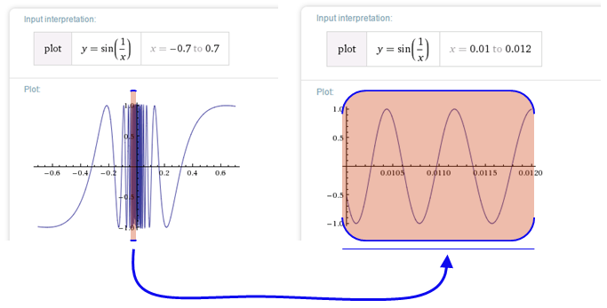
Before the M. Set, complex things were made of simple parts:
Chaos!
This was a "naturally occurring" object where zooming uncovers more detail, not less:
not self-similar but quasi-self-similar
http://www.youtube.com/watch?v=0jGaio87u3A

Slide 53
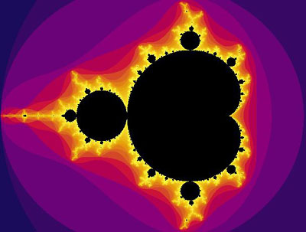
The black pixels are points that do not diverge for z = z**2 + c
escape velocities!
What are these colors?
??

Slide 54
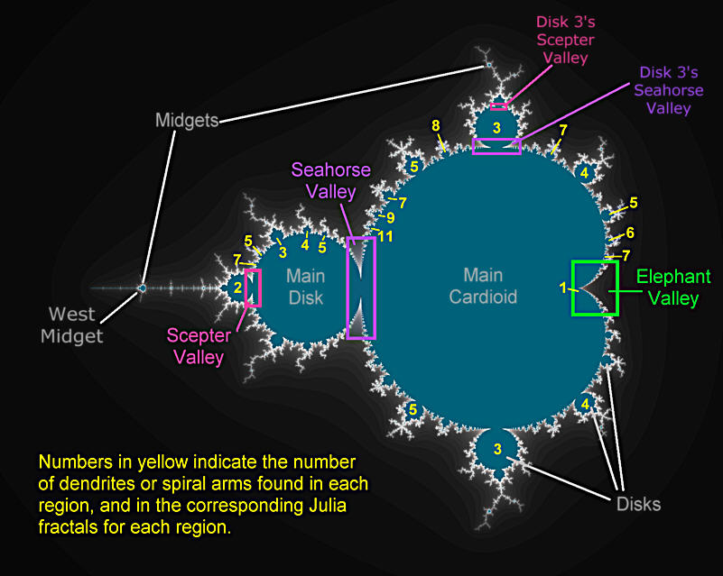
Atlas of the M. Set

Slide 55
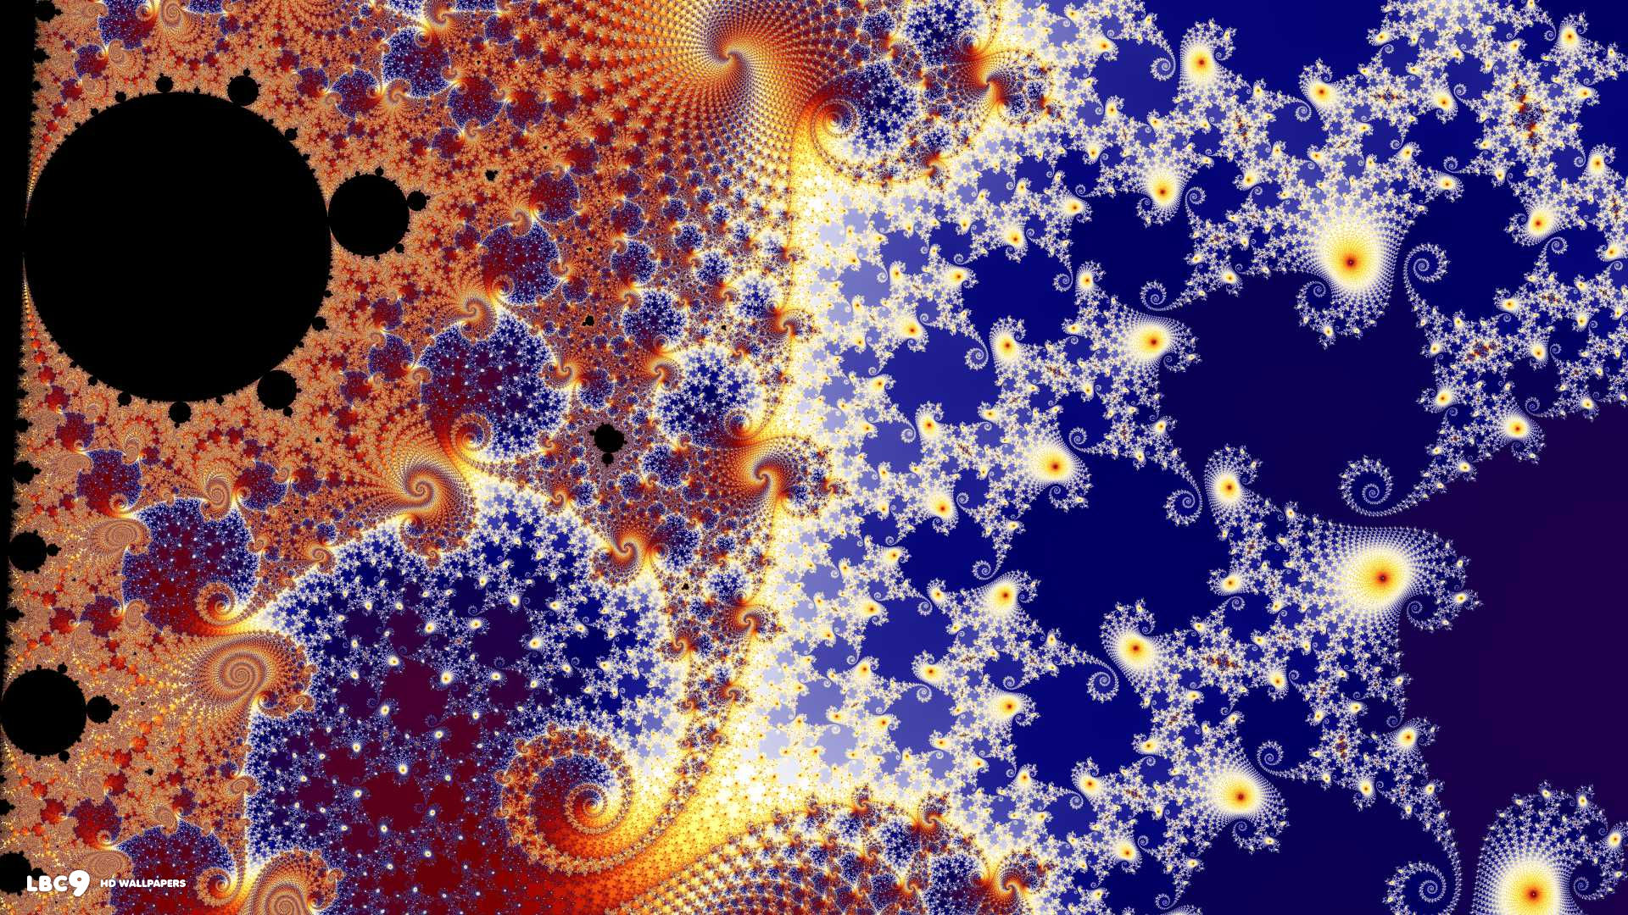
In the Seahorse Valley….

Slide 56
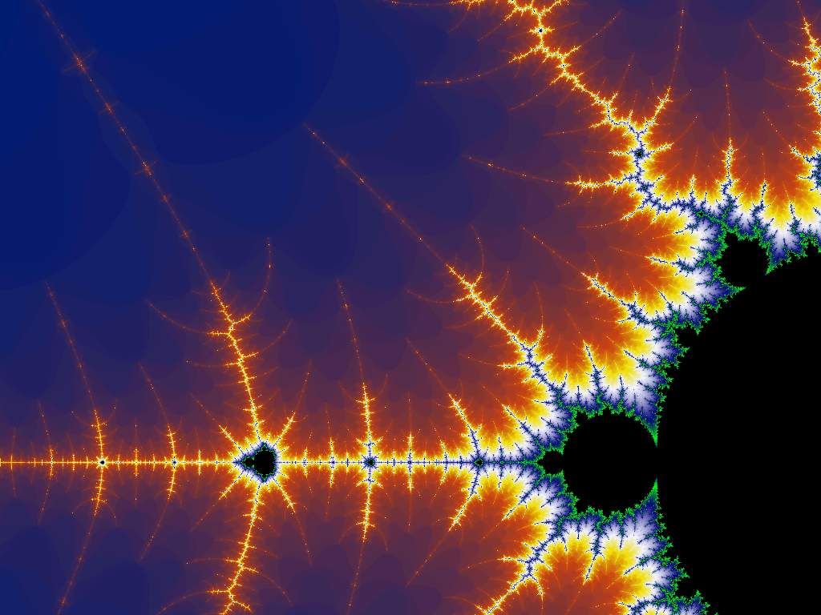
Happy Mandelbrotting!
www.cs.hmc.edu/~jgrasel/projects
http://www.youtube.com/watch?v=0jGaio87u3A

Slide 58
Have a great Hallo-week!

