Slide 1
CS 5 Today: Putting loops to work…
[ -35, -24, -13, -2, 9, 20, 31, ? ]
[ 26250, 5250, 1050, 210, ? ]
[ 90123241791111 , 93551622, 121074, 3111, ? ]
[ 1, 11, 21, 1211, 111221, ? ]
What's next?
I'm glad you asked!
Homework 8: due Mon., 11/4 by midnight
Office hrs. Sat.! + lots of tutoring, LAC & ...
Midterm on 11/7; review on CS5's homepage
... and in-class today

Slide 2

Happy 10/31!

Slide 3
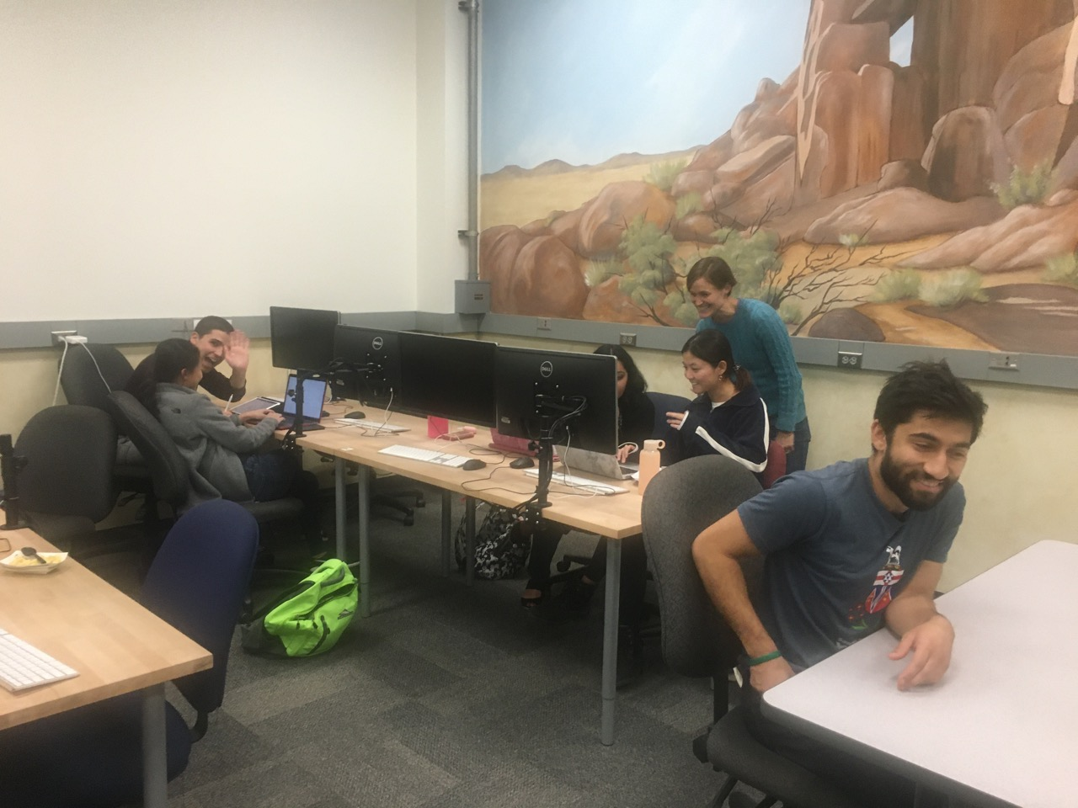
Thanks, Prof. Medero!

Slide 4
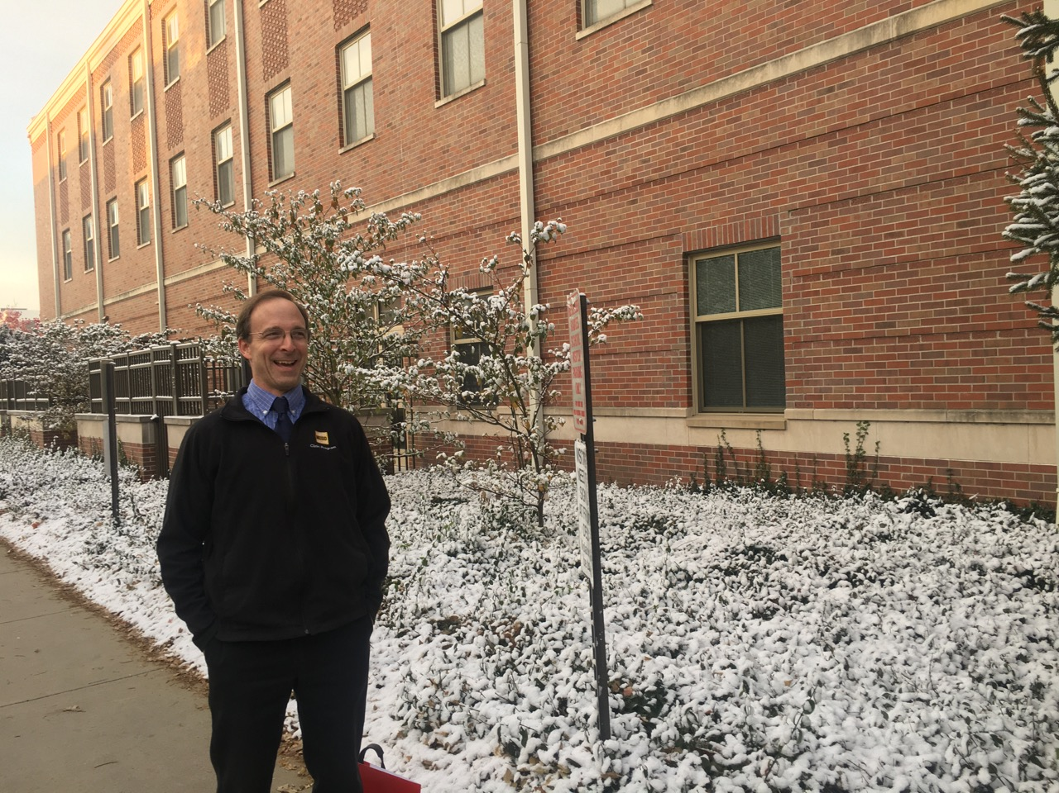

Slide 5
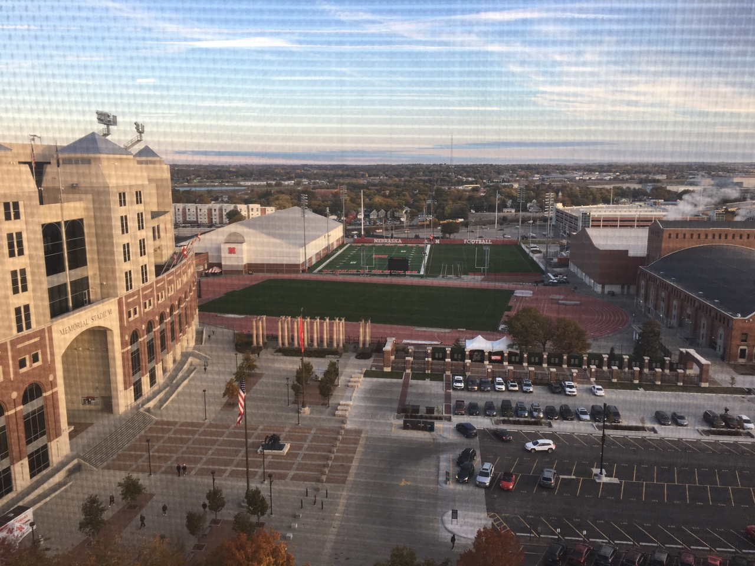

Slide 6


Slide 7
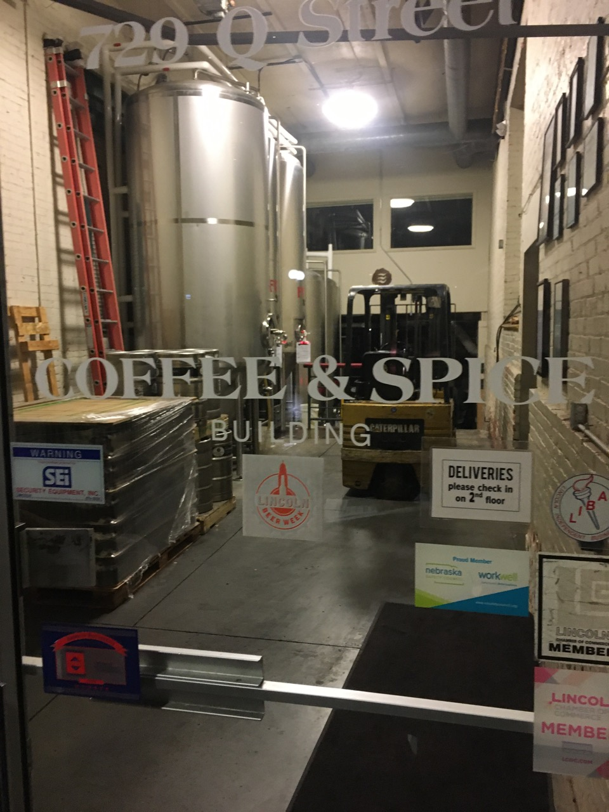

Slide 8
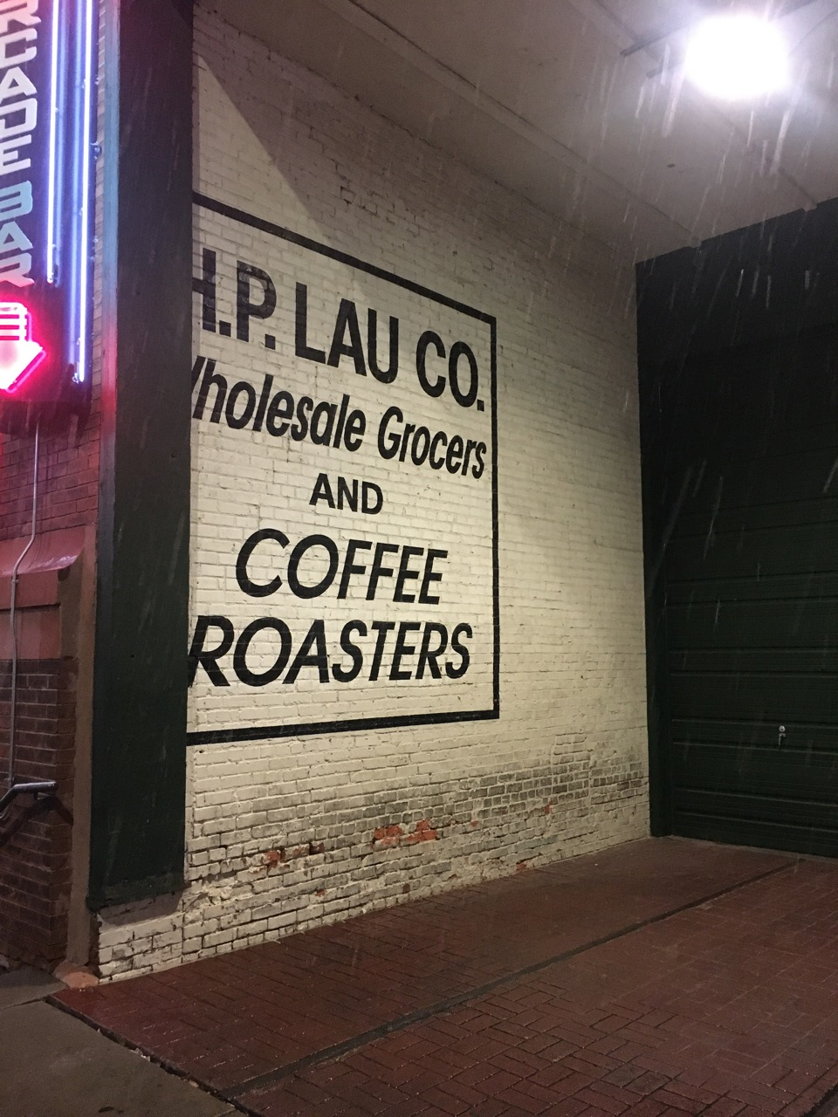

Slide 9
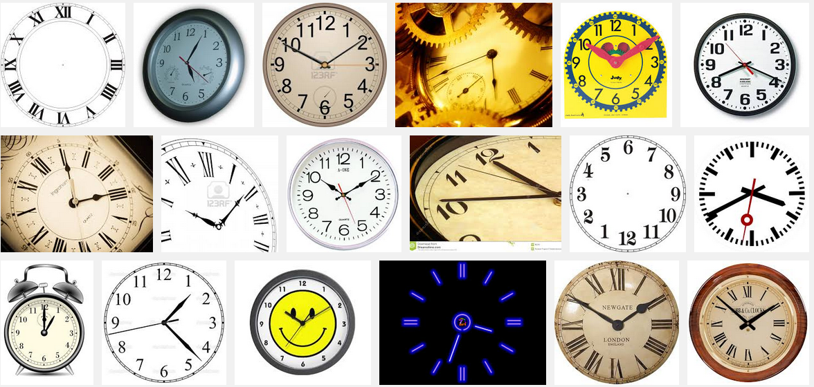
Nested loops are familiar, too!
So close!

Slide 10
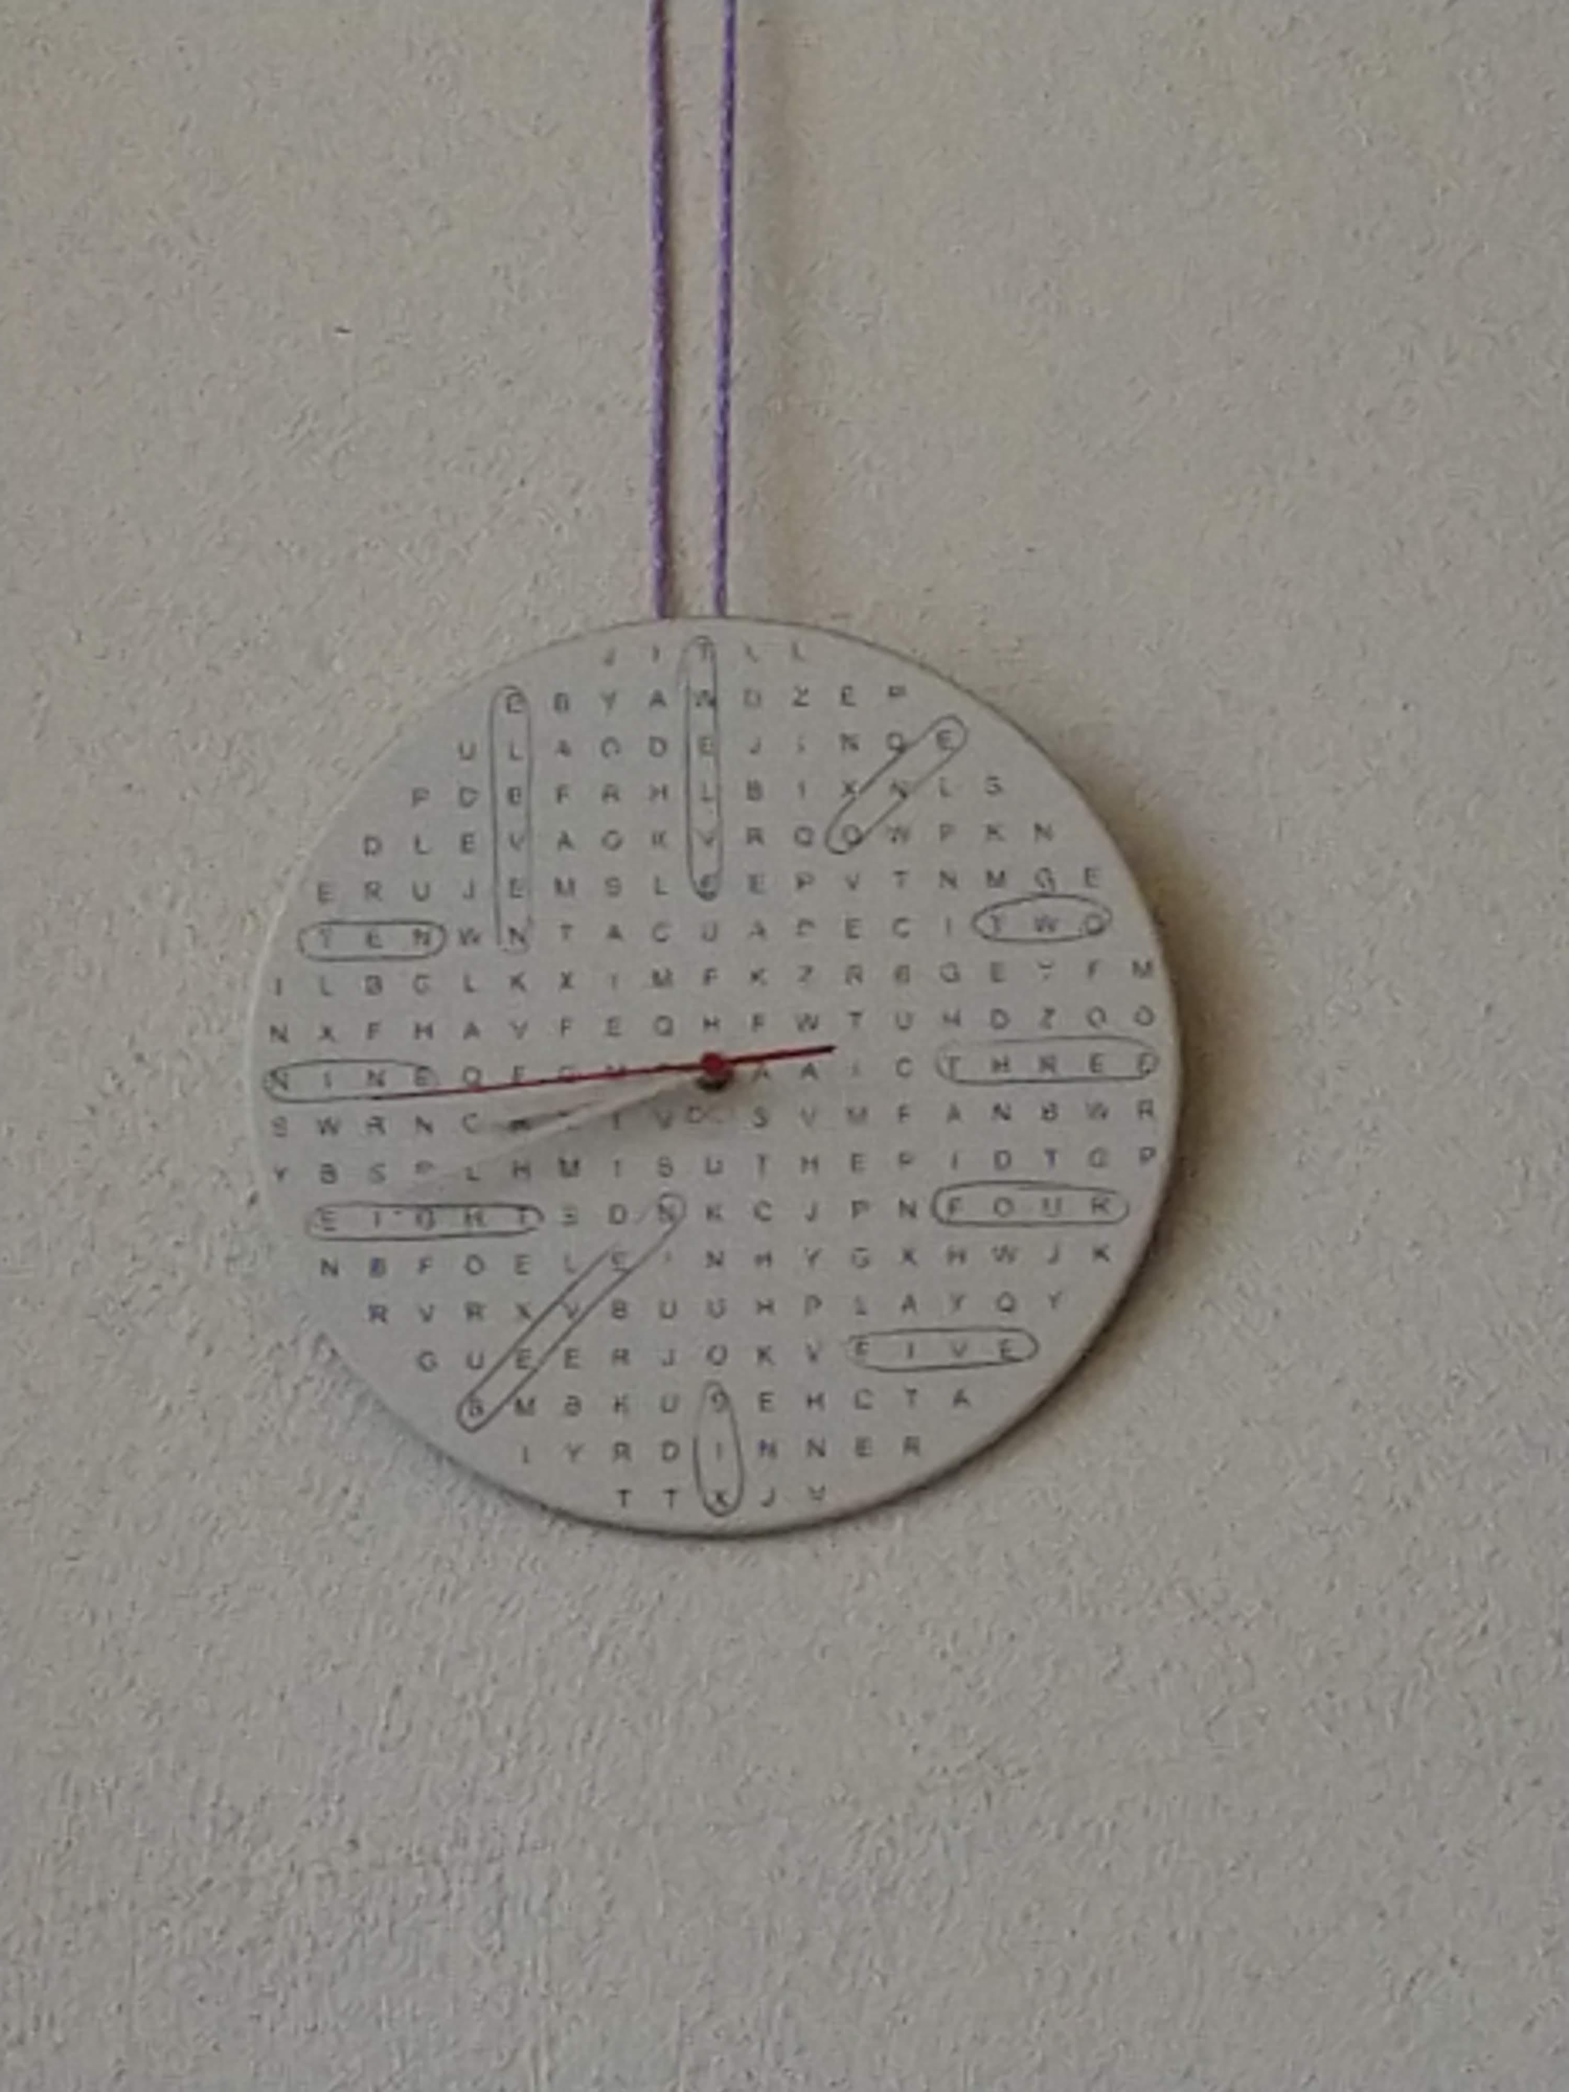
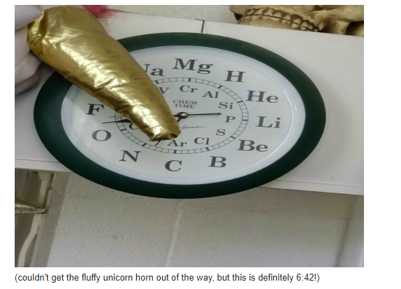
Clocks!!!

Slide 11
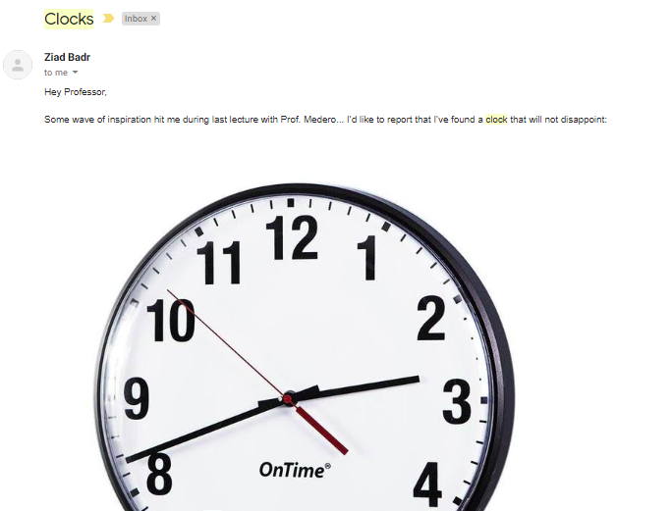

Slide 12
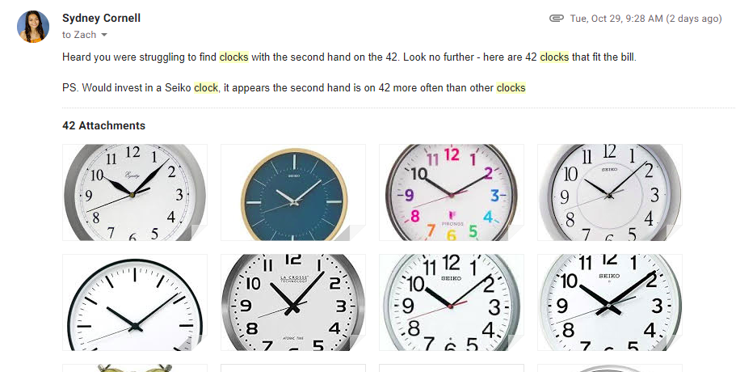

Slide 13
CS 5 Today: Putting loops to work…
[ -35, -24, -13, -2, 9, 20, 31, ? ]
[ 26250, 5250, 1050, 210, ? ]
[ 90123241791111 , 93551622, 121074, 3111, ? ]
[ 1, 11, 21, 1211, 111221, ? ]
What's next?
I'm glad you asked!
Homework 8: due Mon., 11/4 by midnight
Office hrs. Sat.! + lots of tutoring, LAC & ...
Midterm on 11/7; review on CS5's homepage
... and in-class today

Slide 14
The read it and weep sequence
1
11
21
1211
111221
312211
13112221
…
str vs. int
When does the first 4 appear?
How fast do these terms grow?
Extra extra credit: in wk9!
Notes:
Next is: 13112221

Slide 15
M.T. Review
(*) For up to two points! of extra credit on the midterm… Pair up with s/o and find something you have in common (that you didn't know before!)…
See review problems @ the cs5 site
Name + birthday:
Picobot! There are NO Picobot questions on the exam…
Recursion!!
You should feel confident you could create recursive functions to solve small problems, e.g., scrabble-scoring, finding sum or max or min, computing power or factorial (or variations)
You should be comfortable manipulating lists and strings (indexing, slicing, slicing with a "stride") What's s[1:-1:2]?
You should understand how to use, read, and compose list comprehensions , e.g., LC = [ x**2 for x in L ]
You should be able to design solutions using the "list of lists" technique (LoL), which uses list comprehensions, e.g., to find the highest scrabble-scoring word among a list or the lowest scrabble-scoring of a shifted string. Basic syntax: LoL = [ [sc(x),x] for x in L ]
You should understand the use-it-or-lose-it design strategy, e.g., the LCS, exact_change, jotto-score, and sort hw problems
Turtle graphics will not be on the exam. Nor will Yoda (audio).
Understand the difference between print and return
Look over how you composed larger programs out of smaller ones + how inputs and outputs are used, e.g., for Caesar Cipher
Representing Data!!!
Remind yourself of the various types of data (int, bool, str, float, list, etc.), how they're different, and how to convert among types
Know how characters are represented with chr and ord
Be comfortable with base-2 arithmetic (and base 10!), along with how to convert from base to base (no balanced ternary)
Remind yourself of how the bits of a base-2 number influence its value – what do right- and left-shifting do?
Thing in common:
Then, read these over & look for ones least familiar…
Circuits and Assembly!!!!
Know how the three basic logic gates operate: AND + OR, for any # of inputs; NOT, for 1 input. (No need to remember memory/flip-flops)
Know how minterm expansion works (answer: it's an OR of ANDs, each "selecting" one input) and how it enables the engineering of any circuit at all, given its truth-table specification
You should be comfortable going from a truth-table to a circuit (using minterm expansion) and going from a circuit to a truth-table (ditto)
You should be able to read and write simple looping programs in Hmmm, e.g., factorial, power, Fibonacci, …
You should know what the stack is, what it's used for conceptually (holding functions' variables and data) You should know that pushr and popr store and load data to the stack, but won't have to write code using them. More specifically, the exam will not ask you to implement recursion or stack-based functions in Hmmm. Hmmm code would only be looping (jumping) + conditional examples, e.g., jgtzn r2 42 etc.
The exam will have a full Hmmm reference (don't need your own)
Loops
You should feel comfortable with how for loops (both element-based and index-based) and while loops work – and be able to compose small functions that use them, e.g., ones similar to those in the pi-estimation and TT securities (statistics) problems.
You should understand how nested loops work and be able to read or compose examples (such as the TTS strategy or our in-class "quizzes")
I <3 three-eyed punctuation!
!
!
You may use functions from class and hw on the exam without reimplementing them. Here are some, but not all, of them:
removeOne( e, L ), removeAll( e, L ), removeUpto( e, L ), count( e, L ), ind( e, L ), frontNum( L ), binToNum( binstr ), numToBin( n ), …

Slide 16
hw8pr4: T. T. Securities (TTS)
Analyzes a sequence of "stock prices"
i
day
0
day
1
day
2
day
3
day
4
day
5
day
6
day
7
L = [ 40, 80, 10, 30, 27, 52, 5, 15 ]
x
(0) Input a new list
(1) Print the current list
(2) Find the average price
(3) Find the standard deviation
(4) Find the min and its day
(5) Find the max and its day
(6) Your TTS investment plan
(9) Quit
Enter your choice:
Implement a (text) menu:
webbrowser.open_new_tab(url)

Slide 17
What is the best TTS investment strategy here?
The TTS advantage!
L = [ 40, 80, 10, 30, 27, 52, 5, 15 ]
Your stock's prices:
Day Price
0 40.0
1 80.0
2 10.0
3 30.0
4 27.0
5 52.0
6 5.0
7 15.0
Important fine print:
To make our business plan realistic, however, we only allow selling after buying.

Slide 18
def fac( N ):
result = 1
for x in range(1,N+1):
result *= x
return result
Loops
Basic design strategies
Is one more reasonable than the other?
def fac( N ):
if N == 1:
return 1
else:
return N*fac(N-1)
Recursion

Slide 19
def fac( N ):
result = 1
for x in range(1,N+1):
result *= x
return result
Loops
Design strategy: look for repetition + describe it… .
Is one more reasonable than the other?
Design strategy: look for self-similarity + describe it… .
def fac( N ):
if N == 1:
return 1
else:
return N*fac(N-1)
Recursion

Slide 20
for: two types
L = [3, 15, 17, 7]
x
"deceptively easy"
for x in L:
print x
element-based loops

Slide 21
for: two types
L[0]
L[1]
L[2]
L[3]
L = [3, 15, 17, 7]
0
1
2
3
i
for i in range(len(L))
print L[i]
list
index-based loops
for x in L:
print x
element-based loops

Slide 22
for: two types
L[0]
L[1]
L[2]
L[3]
L = [3, 15, 17, 7]
0
1
2
3
x
i
for i in range(len(L))
print L[i]
list
index-based loops
Elements vs Indexes
Indices
for x in L:
print x
element-based loops

Slide 23
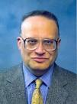
for: two types
L[0]
L[1]
L[2]
L[3]
L = [3, 15, 17, 7]
i
0
1
2
3
x
i
for i in range(len(L))
print L[i]
list
index-based loops
x
Elements vs Indexes
Indices
for x in L:
print x
element-based loops
"Get into a rut... and stay there!"

Slide 24
loops vs. return
L = [10, 3, 39]
def fun(L):
""" baddoc! """
result = 0
for x in L:
if x%2 == 1:
result += x
return result

Slide 25
loops vs. return
def summedOdds(L):
result = 0
for x in L:
if x%2 == 1:
result += x
return result
L = [10, 3, 39]
def summedOdds(L):
result = 0
for x in L:
if x%2 == 1:
result += x
return result
def summedOdds(L):
result = 0
for x in L:
if x%2 == 1:
result += x
return result

Slide 26
M.T. Review
(*) For up to two points! of extra credit on the midterm… Pair up with s/o and find something you have in common (that you didn't know before!)…
See review problems @ the cs5 site
Name + birthday:
Picobot! There are NO Picobot questions on the exam…
Recursion!!
You should feel confident you could create recursive functions to solve small problems, e.g., scrabble-scoring, finding sum or max or min, computing power or factorial (or variations)
You should be comfortable manipulating lists and strings (indexing, slicing, slicing with a "stride") What's s[1:-1:2]?
You should understand how to use, read, and compose list comprehensions , e.g., LC = [ x**2 for x in L ]
You should be able to design solutions using the "list of lists" technique (LoL), which uses list comprehensions, e.g., to find the highest scrabble-scoring word among a list or the lowest scrabble-scoring of a shifted string. Basic syntax: LoL = [ [sc(x),x] for x in L ]
You should understand the use-it-or-lose-it design strategy, e.g., the LCS, exact_change, jotto-score, and sort hw problems
Turtle graphics will not be on the exam. Nor will Yoda (audio).
Understand the difference between print and return
Look over how you composed larger programs out of smaller ones + how inputs and outputs are used, e.g., for Caesar Cipher
Representing Data!!!
Remind yourself of the various types of data (int, bool, str, float, list, etc.), how they're different, and how to convert among types
Know how characters are represented with chr and ord
Be comfortable with base-2 arithmetic (and base 10!), along with how to convert from base to base (no balanced ternary)
Remind yourself of how the bits of a base-2 number influence its value – what do right- and left-shifting do?
Thing in common:
Then, read these over & look for ones least familiar…
Circuits and Assembly!!!!
Know how the three basic logic gates operate: AND + OR, for any # of inputs; NOT, for 1 input. (No need to remember memory/flip-flops)
Know how minterm expansion works (answer: it's an OR of ANDs, each "selecting" one input) and how it enables the engineering of any circuit at all, given its truth-table specification
You should be comfortable going from a truth-table to a circuit (using minterm expansion) and going from a circuit to a truth-table (ditto)
You should be able to read and write simple looping programs in Hmmm, e.g., factorial, power, Fibonacci, …
You should know what the stack is, what it's used for conceptually (holding functions' variables and data) You should know that pushr and popr store and load data to the stack, but won't have to write code using them. More specifically, the exam will not ask you to implement recursion or stack-based functions in Hmmm. Hmmm code would only be looping (jumping) + conditional examples, e.g., jgtzn r2 42 etc.
The exam will have a full Hmmm reference (don't need your own)
Loops
You should feel comfortable with how for loops (both element-based and index-based) and while loops work – and be able to compose small functions that use them, e.g., ones similar to those in the pi-estimation and TT securities (statistics) problems.
You should understand how nested loops work and be able to read or compose examples (such as the TTS strategy or our in-class "quizzes")
I <3 three-eyed punctuation!
!
!
You may use functions from class and hw on the exam without reimplementing them. Here are some, but not all, of them:
removeOne( e, L ), removeAll( e, L ), removeUpto( e, L ), count( e, L ), ind( e, L ), frontNum( L ), binToNum( binstr ), numToBin( n ), …

Slide 27
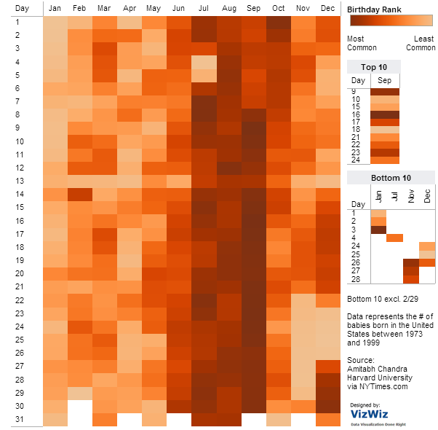
Nested loops' 2d structure
for d in range(f(m)):
for m in range(1,13):
num_bdays(m,d)
how many shared birthdays are in CS5?
vizwiz.blogspot.com/2012/05/how-common-is-your-birthday-find-out.html

Slide 28
M.T. Review
(*) For up to two points! of extra credit on the midterm… Pair up with s/o and find something you have in common (that you didn't know before!)…
See review problems @ the cs5 site
Name + birthday:
Picobot! There are NO Picobot questions on the exam…
Recursion!!
You should feel confident you could create recursive functions to solve small problems, e.g., scrabble-scoring, finding sum or max or min, computing power or factorial (or variations)
You should be comfortable manipulating lists and strings (indexing, slicing, slicing with a "stride") What's s[1:-1:2]?
You should understand how to use, read, and compose list comprehensions , e.g., LC = [ x**2 for x in L ]
You should be able to design solutions using the "list of lists" technique (LoL), which uses list comprehensions, e.g., to find the highest scrabble-scoring word among a list or the lowest scrabble-scoring of a shifted string. Basic syntax: LoL = [ [sc(x),x] for x in L ]
You should understand the use-it-or-lose-it design strategy, e.g., the LCS, exact_change, jotto-score, and sort hw problems
Turtle graphics will not be on the exam. Nor will Yoda (audio).
Understand the difference between print and return
Look over how you composed larger programs out of smaller ones + how inputs and outputs are used, e.g., for Caesar Cipher
Representing Data!!!
Remind yourself of the various types of data (int, bool, str, float, list, etc.), how they're different, and how to convert among types
Know how characters are represented with chr and ord
Be comfortable with base-2 arithmetic (and base 10!), along with how to convert from base to base (no balanced ternary)
Remind yourself of how the bits of a base-2 number influence its value – what do right- and left-shifting do?
Thing in common:
Then, read these over & look for ones least familiar…
Circuits and Assembly!!!!
Know how the three basic logic gates operate: AND + OR, for any # of inputs; NOT, for 1 input. (No need to remember memory/flip-flops)
Know how minterm expansion works (answer: it's an OR of ANDs, each "selecting" one input) and how it enables the engineering of any circuit at all, given its truth-table specification
You should be comfortable going from a truth-table to a circuit (using minterm expansion) and going from a circuit to a truth-table (ditto)
You should be able to read and write simple looping programs in Hmmm, e.g., factorial, power, Fibonacci, …
You should know what the stack is, what it's used for conceptually (holding functions' variables and data) You should know that pushr and popr store and load data to the stack, but won't have to write code using them. More specifically, the exam will not ask you to implement recursion or stack-based functions in Hmmm. Hmmm code would only be looping (jumping) + conditional examples, e.g., jgtzn r2 42 etc.
The exam will have a full Hmmm reference (don't need your own)
Loops
You should feel comfortable with how for loops (both element-based and index-based) and while loops work – and be able to compose small functions that use them, e.g., ones similar to those in the pi-estimation and TT securities (statistics) problems.
You should understand how nested loops work and be able to read or compose examples (such as the TTS strategy or our in-class "quizzes")
Take a picture, if you'd like!
Then, pass this page easterly...
I <3 three-eyed punctuation!
!
!
You may use functions from class and hw on the exam without reimplementing them. Here are some, but not all, of them:
removeOne( e, L ), removeAll( e, L ), removeUpto( e, L ), count( e, L ), ind( e, L ), frontNum( L ), binToNum( binstr ), numToBin( n ), …

Slide 29


Slide 30
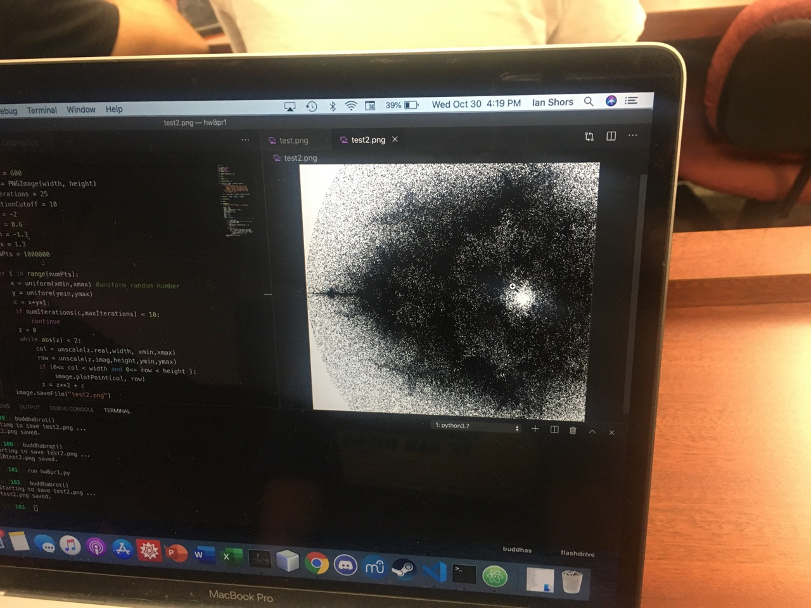

Slide 31


Slide 32
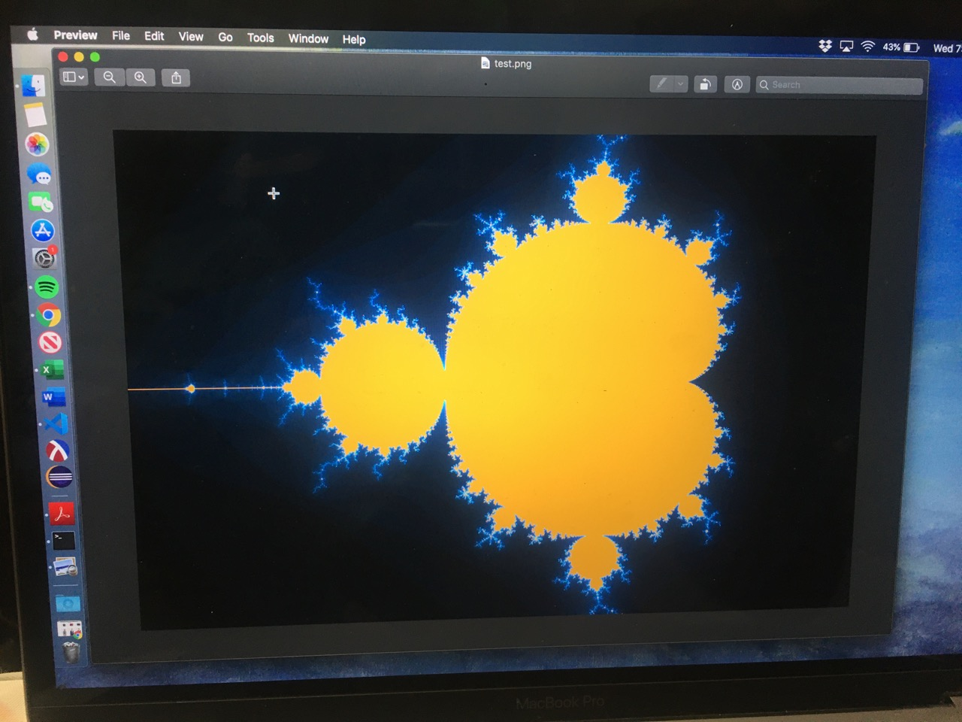

Slide 33
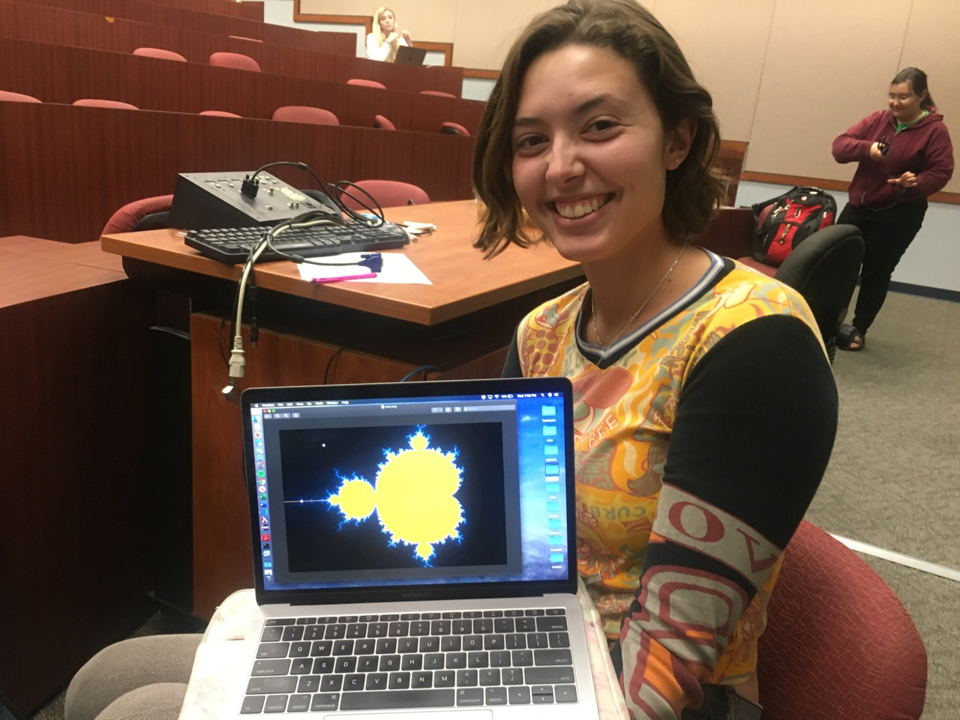

Slide 34

Cardi B rot

Slide 35

MandelbrAt!

Slide 36
hw8pr4: T. T. Securities (TTS)
Analyzes a sequence of "stock prices"
i
day
0
day
1
day
2
day
3
day
4
day
5
day
6
day
7
L = [ 40, 80, 10, 30, 27, 52, 5, 15 ]
x
(0) Input a new list
(1) Print the current list
(2) Find the average price
(3) Find the standard deviation
(4) Find the min and its day
(5) Find the max and its day
(6) Your TTS investment plan
(9) Quit
Enter your choice:
Implement a (text) menu:

Slide 37
User input…
meters = input('How many m? ')
cm = meters * 100
print("That's", cm, 'cm.')
What will Python think?
I think I like these units better than light years per year!

Slide 38
User input…
meters = input('How many m? ')
cm = meters * 100
print('That is', cm, 'cm.')
input ALWAYS returns a string – no matter what's typed!
What will Python think?
I think I like these units better than light years per year!

Slide 39
Fix #1: convert to the right type
m_str = input('How many m? ')
meters = float( m_str )
cm = meters * 100
print('That is', cm, 'cm.')
'42'
42.0
4200.0
name: m_str type: string
name: meters type: float
name: cm
type: float
... but crash-able
Notes:
Electric: from www.staticfreesoftware.com
My tutorial is at:
http://odin.ac.hmc.edu/~harris/class/chipdesign/electric.pdf
Lasergene (a molecular biology suite of programs for aligning and comparing
DNA sequences, etc.)
Statview (statistical analysis)
KaleidaGraph (plotting & graphing)
Populus (programs that simulate ecological and evolutionary processes)

Slide 40
Fix #2: convert and check
m_str = input('How many m? ')
try:
meters = float( m_str )
except:
print("What? Didn't compute!")
print("Setting meters = 42")
meters = 42.0
cm = meters * 100
print('That\'s', cm, 'cm.')
crash-able
try-except lets you try code and – if it crashes – catch an error and handle it
Notes:
Electric: from www.staticfreesoftware.com
My tutorial is at:
http://odin.ac.hmc.edu/~harris/class/chipdesign/electric.pdf
Lasergene (a molecular biology suite of programs for aligning and comparing
DNA sequences, etc.)
Statview (statistical analysis)
KaleidaGraph (plotting & graphing)
Populus (programs that simulate ecological and evolutionary processes)

Slide 41
Fix #2: convert and check
These errors are called exceptions.
This is exception handling.
m_str = input('How many m? ')
try:
meters = float( m_str )
except:
print("What? Didn't compute!")
print("Setting meters = 42")
meters = 42.0
cm = meters * 100
print('That\'s', cm, 'cm.')
crash-able
try-except lets you try code and – if it crashes – catch an error and handle it
Notes:
Electric: from www.staticfreesoftware.com
My tutorial is at:
http://odin.ac.hmc.edu/~harris/class/chipdesign/electric.pdf
Lasergene (a molecular biology suite of programs for aligning and comparing
DNA sequences, etc.)
Statview (statistical analysis)
KaleidaGraph (plotting & graphing)
Populus (programs that simulate ecological and evolutionary processes)

Slide 42
Fix #3: eval executes Python code!
m_str = input('How many m? ')
meters = eval( m_str )
cm = meters * 100
print('That is', cm, 'cm.')
What could go wrong here?
Notes:
Electric: from www.staticfreesoftware.com
My tutorial is at:
http://odin.ac.hmc.edu/~harris/class/chipdesign/electric.pdf
Lasergene (a molecular biology suite of programs for aligning and comparing
DNA sequences, etc.)
Statview (statistical analysis)
KaleidaGraph (plotting & graphing)
Populus (programs that simulate ecological and evolutionary processes)

Slide 43
Fix #3: eval executes Python code!
m_str = input('How many m? ')
try:
meters = eval( m_str )
except:
print("What? Didn't compute!")
print("Setting meters = 42")
meters = 42.0
cm = meters * 100
print('That is', cm, 'cm.')
What could REALLY go wrong here?
Notes:
Electric: from www.staticfreesoftware.com
My tutorial is at:
http://odin.ac.hmc.edu/~harris/class/chipdesign/electric.pdf
Lasergene (a molecular biology suite of programs for aligning and comparing
DNA sequences, etc.)
Statview (statistical analysis)
KaleidaGraph (plotting & graphing)
Populus (programs that simulate ecological and evolutionary processes)

Slide 44
A larger application
def menu():
""" prints our menu of options """
print("(0) Continue")
print("(1) Enter a new list")
print("(2) Analyze")
print("(9) Break (quit)")
def main():
""" handles user input for our menu """
while True:
menu()
uc = input('Which option? ')
try:
uc = int(uc) # was it an int?
except:
continue # back to the top!
Calls a helper function
Perhaps uc the reason for this?

Slide 45
def main():
""" handles user input for our menu """
L = [30,10,20] # a starting list
while True:
menu() # print menu
uc = input('Which option? ')
if uc == 9:
break
elif uc == 0:
continue
elif uc == 1:
... input ... eval ...
elif uc == 2:
(9) Quit
(0) Continue
(1) Get new list
(2) Analyze !
... and so on ...

Slide 46
def main():
""" handles user input for our menu """
L = [30,10,20] # a starting list
while True:
menu() # print menu
uc = input('Which option? ')
if uc == 9:
break
elif uc == 0:
continue
elif uc == 1:
... input ... eval ...
elif uc == 2:
(9) Quit
break jumps out of the loop
continue jumps back to the top
(0) Continue
uses eval (+check) for a new L
(1) Get new list
(2) Analyze !
other functions as needed...
... and so on ...

Slide 47
(A) Which block below handles an input of 5 ? of 7 ?
Big-picture view!
Full-program user-interaction example
(B) What does choice 3 print that 0 does not?
(D) What could you input for newL that would print this?
input
main function
(E) What could you input for newL that would print this?
secret_value
while True:
(C) Find the line of code that runs after this break!
(EC) How could a user learn the value of secret_value if they knew that variable name and could run the program -- but didn't have this source code?

Slide 48
Functions you'll write
All use loops…
Menu
def average( L )
def stdev( L )
(0) Input a new list
(1) Print the current list
(2) Find the average price
(3) Find the standard deviation
(4) Find the min and its day
(5) Find the max and its day
(6) Your TTS investment plan
(9) Quit
Enter your choice:
Σ
(L[i] - L_{av})²
i
len(L)
def minday( L )
def maxday( L )
webbrowser.open_new_tab(url)

Slide 49
hw8pr4: T. T. Securities (TTS)
Analyzes a sequence of "stock prices"
i
day
0
day
1
day
2
day
3
day
4
day
5
day
6
day
7
L = [ 40, 80, 10, 30, 27, 52, 5, 15 ]
x
(0) Input a new list
(1) Print the current list
(2) Find the average price
(3) Find the standard deviation
(4) Find the min and its day
(5) Find the max and its day
(6) Your TTS investment plan
(9) Quit
Enter your choice:
Implement a (text) menu:

Slide 50
Min price
Just call min ?
day
0
day
1
day
2
day
3
day
4
day
5
day
6
day
7
L = [ 40, 80, 10, 30, 27, 52, 5, 15 ]
m =
m is the "min so far"
What's the idea for finding the smallest (minimum) price?
track the value of the minimum so far as you loop over L

Slide 51
Min price vs. min day
day
0
day
1
day
2
day
3
day
4
day
5
day
6
day
7
L = [ 40, 80, 10, 30, 27, 52, 5, 15 ]
m = 40
m = 10
m = 5
5 is returned
def minprice( L ):
m = L[0]
for x in L:
if x < m:
m = x
return m
What about tracking BOTH the day of the minimum price and that min price?

Slide 52
6 is returned
minday
= 0
= 2
= 6
i
day
0
day
1
day
2
day
3
day
4
day
5
day
6
day
7
L = [ 40, 80, 10, 30, 27, 52, 5, 15 ]
= 40
= 10
= 5
minval
5 is returned
def min_prc_day( L ):
minprc = L[0]
minday = 0
for i in range(len(L)):
if
return minprc, minday
track price and day
loop over locs (i)
check one and update both
(as needed)
return both!

Slide 53
6 is returned
minday
= 0
= 2
= 6
i
day
0
day
1
day
2
day
3
day
4
day
5
day
6
day
7
L = [ 40, 80, 10, 30, 27, 52, 5, 15 ]
= 40
= 10
= 5
minval
5 is returned
def min_prc_day( L ):
minprc = L[0]
minday = 0
for i in range(len(L)):
if L[i] < minprc:
minprc = L[i]
minday = i
return minprc, minday
track price and day
loop over locs (i)
check one and update both
(as needed)
return both!

Slide 54
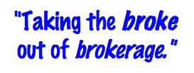
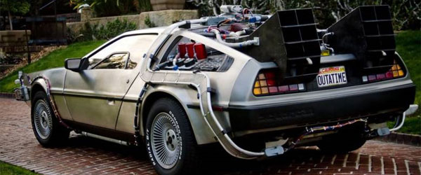

T. T. Securities
(0) Input a new list
(1) Print the current list
(2) Find the average price
(3) Find the standard deviation
(4) Find the min and its day
(5) Find the max and its day
(6) Your TTS investment plan
(9) Quit
Enter your choice:
Software side …
Hardware side…
Investment analysis for the 21st century … and beyond

Slide 55
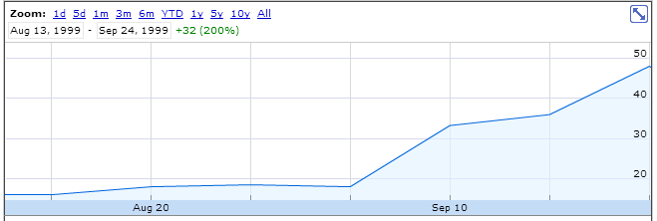
personal motivation for TT securities…
LightPath, Fall 1999 ~ wedding gift…

Slide 56
advice…?
LightPath, Fall 1999

Slide 57
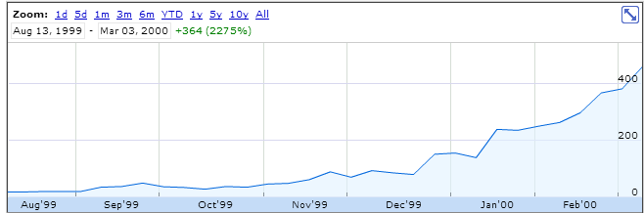
advice…?!
LightPath, Spring 2000

Slide 58
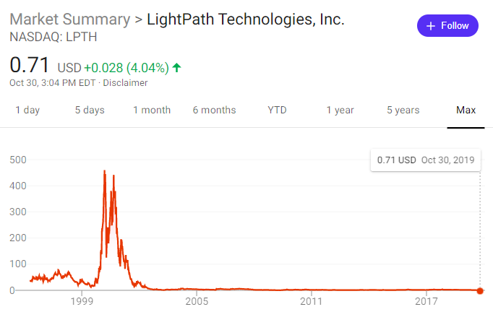
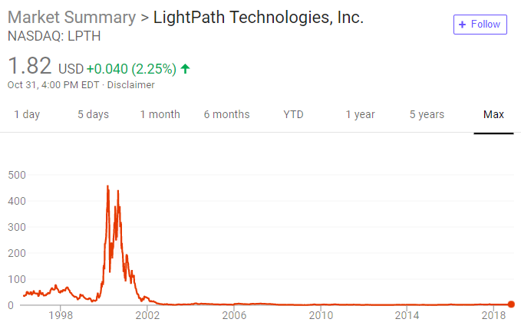
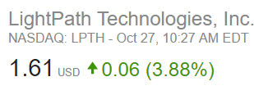
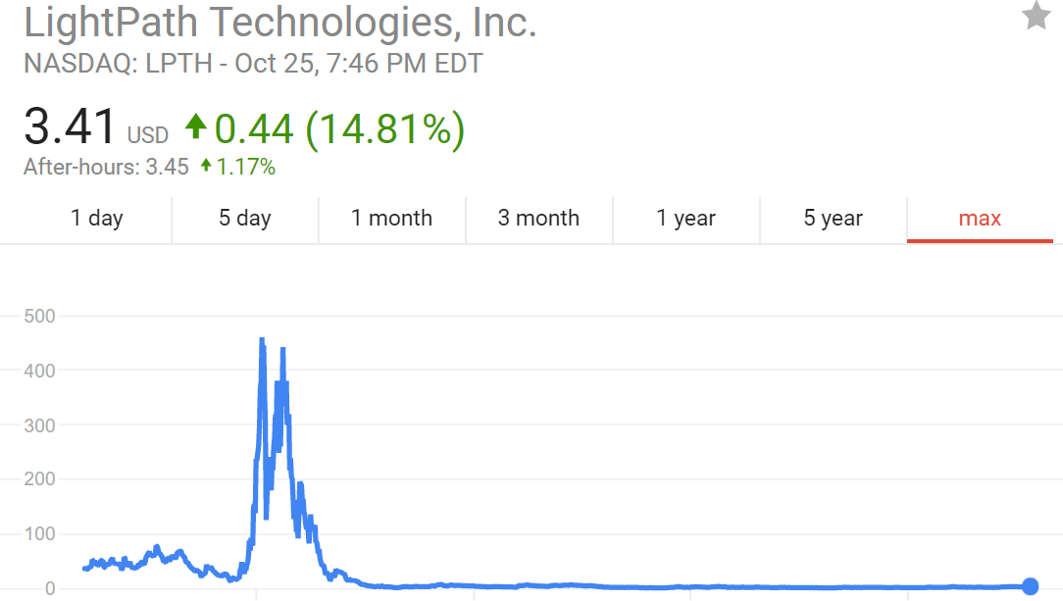
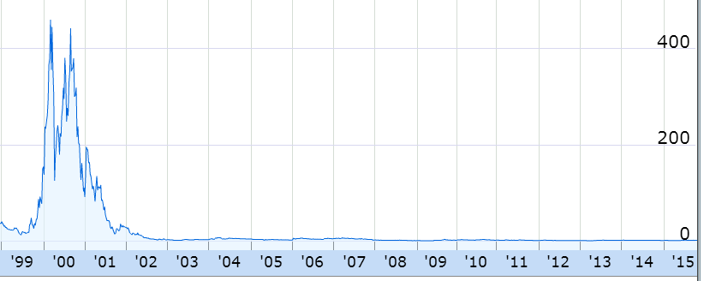
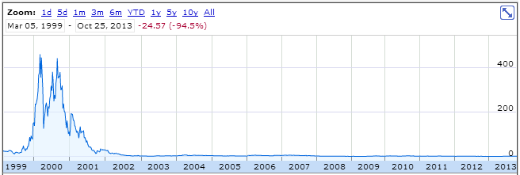
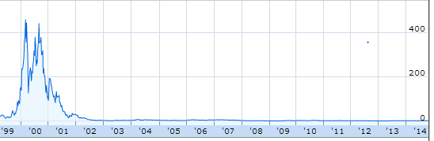
it's up!
LightPath, Fall 2019
inspiration…

Slide 59
What is the best TTS investment strategy here?
The TTS advantage!
L = [ 40, 80, 10, 30, 27, 52, 5, 15 ]
Your stock's prices:
Day Price
0 40.0
1 80.0
2 10.0
3 30.0
4 27.0
5 52.0
6 5.0
7 15.0
Important fine print:
To make our business plan realistic, however, we only allow selling after buying.

Slide 60
What is the best TTS investment strategy here?
The TTS advantage!
L = [ 40, 80, 10, 30, 27, 52, 5, 15 ]
Your stock's prices:
set max-so-far = 0
Day Price
0 40.0
1 80.0
2 10.0
3 30.0
4 27.0
5 52.0
6 5.0
7 15.0
for each buy-day, b:
for each sell-day, s:
compute the profit
if profit is > max-so-far:
remember it in a variable!
return profit, its b-day, and s-day
Important fine print:
To make our business plan realistic, however, we only allow selling after buying.

Slide 61
Write mindiff to return the smallest abs. diff. between any two elements from L.
mindiff( [42,3,100,-9,7] )
4
1
4
i
j
L
mindiff( [42,3,100,-9,7] )
4
Hint: Use nested loops:
for i in range(4):
for j in range(4):
Track the value of the minimum so far as you loop over L twice…

Slide 62
Write mindiff to return the smallest abs. diff. between any two elements from L.
mindiff( [42,3,100,-9,7] )
4
1
4
i
j
def mindiff( L ):
mdiff = abs(L[1]-L[0])
for i in range(len(L)):
for j in range( ,len(L)):
if
return mdiff
L
Hint: Use nested loops:
for i in range(4):
for j in range(4):
Track the value of the minimum so far as you loop over L twice…

Slide 63
Write mindiff to return the smallest abs. diff. between any two elements from L.
mindiff( [42,3,100,-9,7] )
4
1
4
i
j
def mindiff( L ):
mdiff = abs(L[1]-L[0])
for i in range(len(L)):
for j in range(i+1,len(L)):
if abs(L[j]-L[i]) < mdiff:
mdiff = abs(L[j]-L[i])
return mdiff
L
Hint: Use nested loops:
for i in range(4):
for j in range(4):
Track the value of the minimum so far as you loop over L twice…

Slide 64
What is the best TTS investment strategy here?
The TTS advantage!
L = [ 40, 80, 10, 30, 27, 52, 5, 15 ]
Your stock's prices:
CS5 wishes future you a thoroughly profit-filled weekend ...
set max-so-far = 0
Day Price
0 40.0
1 80.0
2 10.0
3 30.0
4 27.0
5 52.0
6 5.0
7 15.0
for each buy-day, b:
for each sell-day, s:
compute the profit
if profit is > max-so-far:
remember it in a variable!
return profit, its b-day, and s-day
... hw8 is ready to help!
Important fine print:
To make our business plan realistic, however, we only allow selling after buying.

Slide 65
Happy Halloween!

Slide 67
Mandelbrot!
Natalie K.

Slide 68
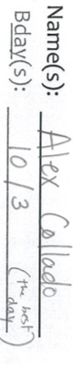


CS 5: Putting loops to work…
[ -35, -24, -13, -2, 9, 20, 31, ? ]
What's next?
I'm glad you asked!
[ 26250, 5250, 1050, 210, ? ]
[ 90123241791111 , 93551622, 121074, 3111, ? ]
[ 1, 11, 21, 1211, 111221, ? ]
Homework 8: due Mon., 11/5 by midnight
Office hrs. Fri! + lots of tutoring, LAC & ...
Midterm 11/8; review on the CS5 homepage

Slide 69
The read it and weep sequence
1
11
21
1211
111221
312211
13112221
…
str vs. int
When does the first 4 appear?
How fast do these terms grow?
Extra extra credit: in wk9!
Notes:
Next is: 13112221

Slide 70
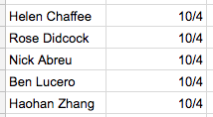
CS 5: Putting loops to work…
I'm glad you asked!
[ -35, -24, -13, -2, 9, 20, 31, ? ]
What's next?
[ 26250, 5250, 1050, 210, ? ]
[ 90123241791111 , 93551622, 121074, 3111, ? ]
[ 1, 11, 21, 1211, 111221, ? ]
Homework 8: due Mon., 11/5 by midnight
Office hrs. Fri! + lots of tutoring, LAC & ...
Midterm 11/8; review on the CS5 homepage

Slide 71
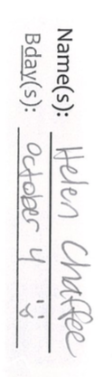

CS 5: Putting loops to work…
I'm glad you asked!
[ -35, -24, -13, -2, 9, 20, 31, ? ]
What's next?
[ 26250, 5250, 1050, 210, ? ]
[ 90123241791111 , 93551622, 121074, 3111, ? ]
[ 1, 11, 21, 1211, 111221, ? ]
Homework 8: due Mon., 11/5 by midnight
Office hrs. Fri! + lots of tutoring, LAC & ...
Midterm 11/8; review on the CS5 homepage
Yes!

Slide 72
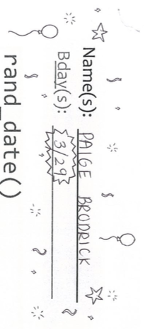
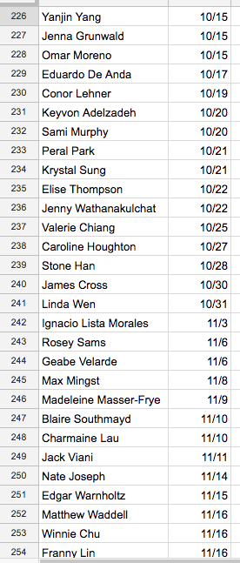
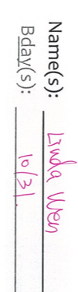
Happy birthday ~ and Halloween...!
birthdays

Slide 73
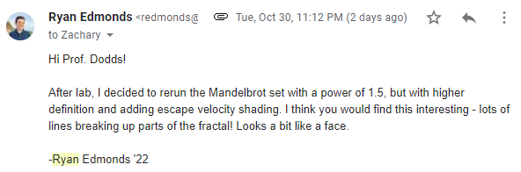
using **1.5

Slide 74

Mandelbrot!
Natalie K.

Slide 75
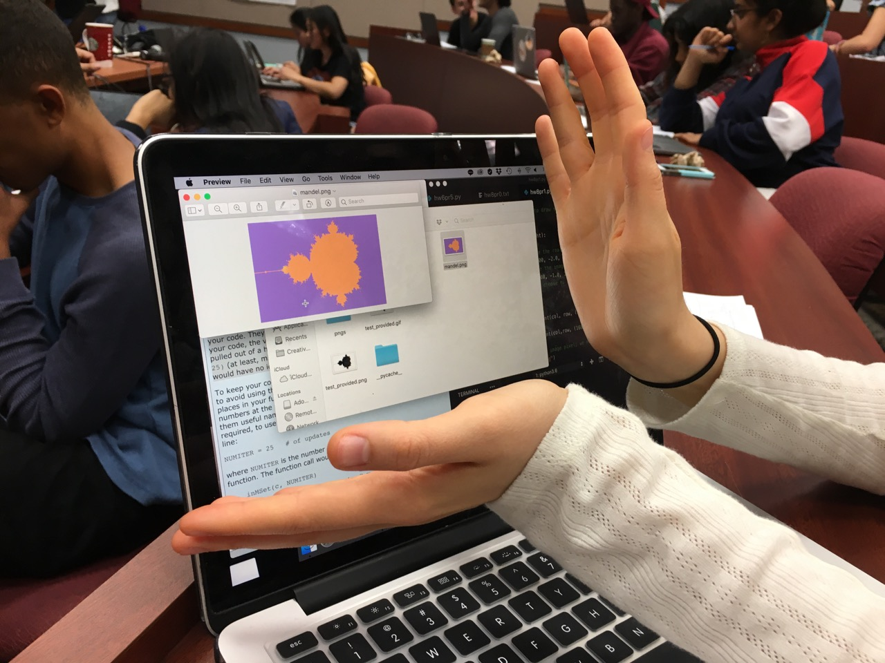
Mandelbrot!
Natalie K.

Slide 76
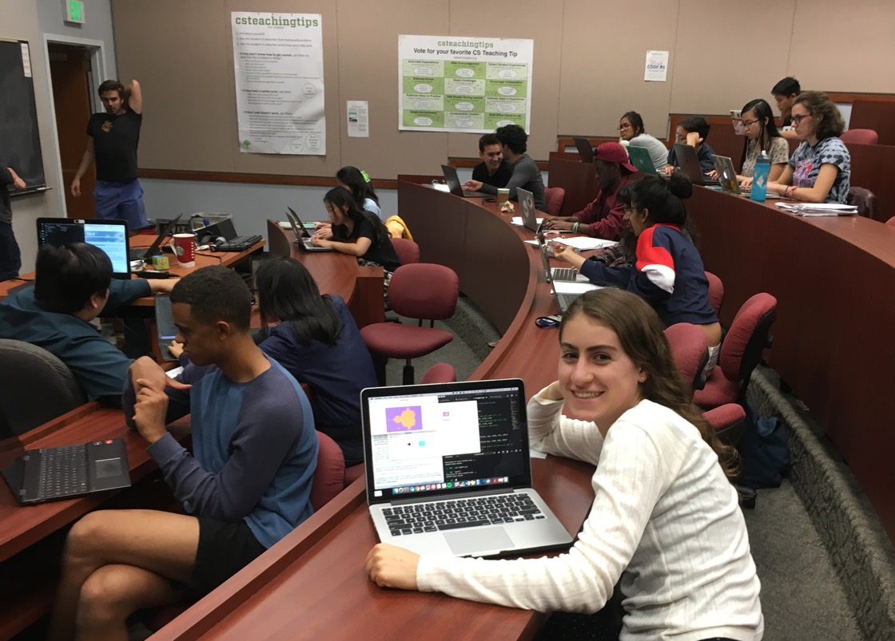
Mandelbrot!
Natalie K.

Slide 77
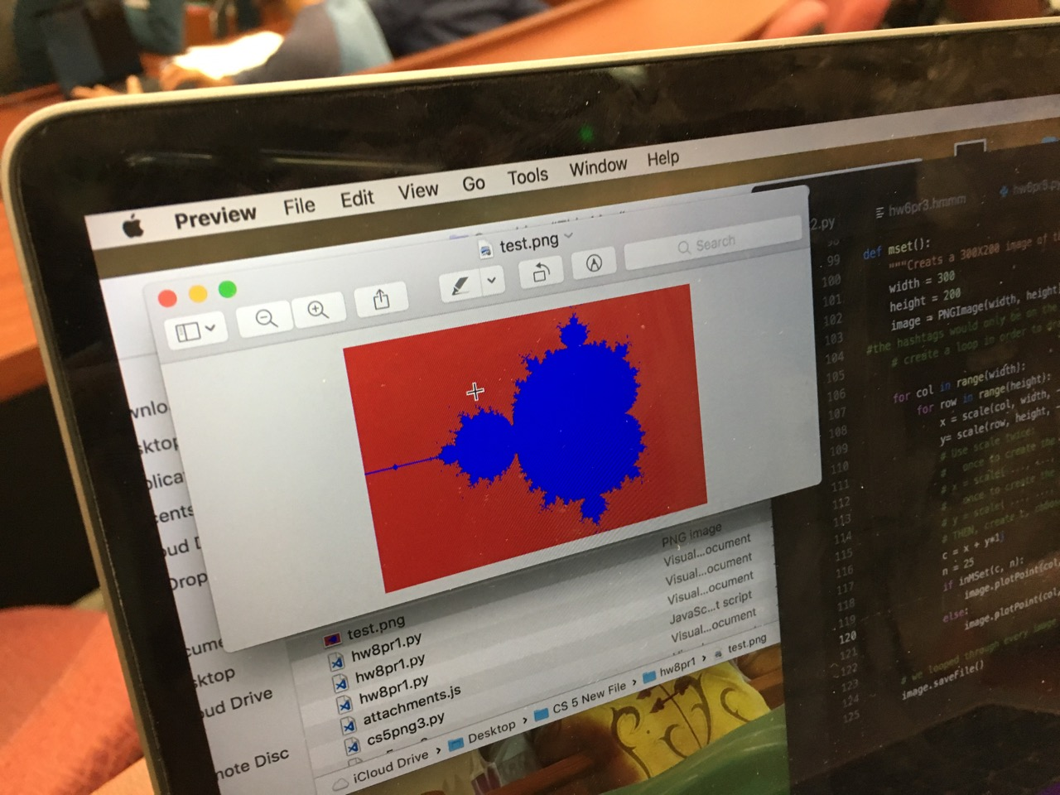
Mandelbrot!
Natalie K.

Slide 78

Mandelbrot?
Natalie K.

Slide 79
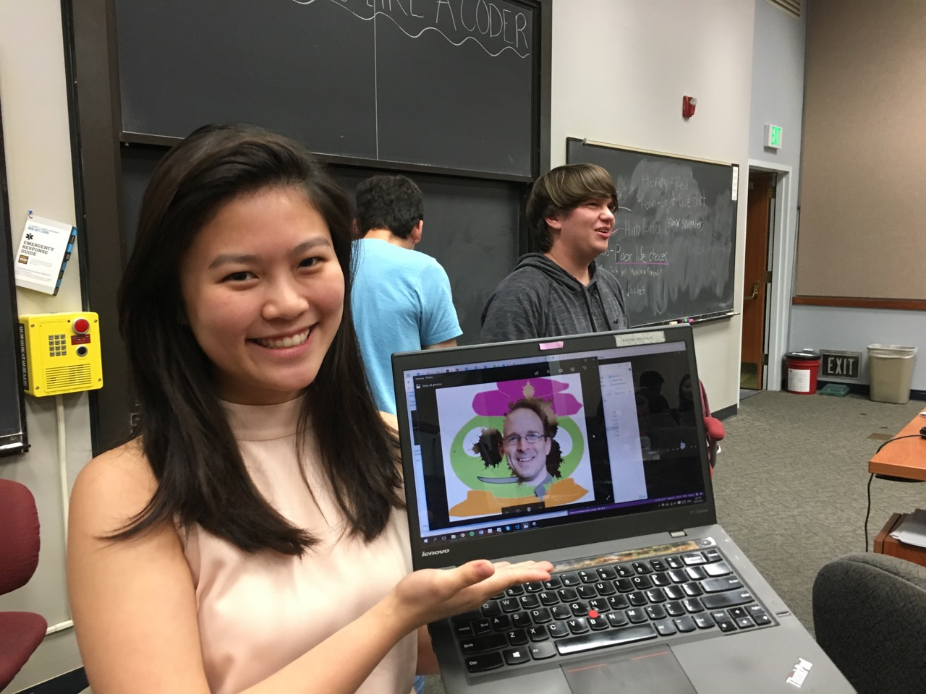
Mandelbrot!
Natalie K.

Slide 80


Mandelbrot!
Natalie K.

Slide 81
(A) Which code below handles an input of 5 ? of 7 ?
Try it!
Full program example of user-interactions
Name(s) ___________
(B) What does choice 3 print that 0 does not?
input
(D) What could you input for newL that would print this?
main function
(E) What could you type for newL that would print this?
secret_value
while True:
(EC) How could a user learn the value of secret_value if they knew that variable name and could run the program -- but didn't have this source code?
(C) What line of code runs after this break ?

Slide 82
Finish this code to return both the minprice and the minday of L!
Expand on the minprice example...
def min_prc_day( L ):
minprc = L[0]
minday = 0
for i in range(len(L)):
if
return minprc, minday
L
min_prc_day( [9, 8, 5, 7, 42] )
5, 2
0
1
2
3
4
Write mindiff to return the smallest absolute difference between any two elements from L.
def mindiff( L ):
mdiff = abs(L[1]-L[0])
for
for
if something here
return mdiff
mindiff( [42,3,100,-9,7] )
4
L
Try it!
Only consider abs differences.
L will be a list of 2 or more #s.
Hint: Use a nested loop!

Slide 83
Write mindiff to return the smallest abs. diff. between any two elements from L.
mindiff( [42,3,100,-9,7] )
4
1
4
i
j
def mindiff( L ):
mdiff = abs(L[1]-L[0])
for i in range(len(L)):
for j in range(i+1,len(L)):
if abs(L[j]-L[i]) < mdiff:
mdiff = abs(L[j]-L[i])
return mdiff
L
Hint: Use nested loops:
for i in range(4):
for j in range(4):
Track the value of the minimum so far as you loop over L twice…

Slide 84

Pause for Mandelbrot!
David T.

Slide 85
Min price
Just call min ?
day
0
day
1
day
2
day
3
day
4
day
5
day
6
day
7
L = [ 40, 80, 10, 30, 27, 52, 5, 15 ]
m =
m is the "min so far"
What's the idea for finding the smallest (minimum) price?
track the value of the minimum so far as you loop over L

Slide 86
Min price
Just call min ?
What's the idea for finding the smallest (minimum) price?
day
0
day
1
day
2
day
3
day
4
day
5
day
6
day
7
L = [ 40, 80, 10, 30, 27, 52, 5, 15 ]
m =
m is the "min so far"
track the value of the minimum so far as you loop over L

Slide 87
Min price vs. min day
day
0
day
1
day
2
day
3
day
4
day
5
day
6
day
7
L = [ 40, 80, 10, 30, 27, 52, 5, 15 ]
m = 40
m = 10
m = 5
5 is returned
def minprice( L ):
m = L[0]
for x in L:
if x < m:
m = x
return m
What about the day of the minimum price?

Slide 88
The TTS advantage!
Your stock's prices:
L = [ 40, 80, 10, 30, 27, 52, 5, 15 ]
The TTS investment strategy:
Day Price
0 40.0
1 80.0
2 10.0
3 30.0
4 27.0
5 52.0
6 5.0
7 15.0
to be realistic (for our VC backers), you must sell after you buy.

Slide 89
L
minday
return the index of L's minimum.
>>> minday( [9, 8, 5, 7, 42] )
2
0
1
2
3
4
index
def minday( L ):
m = L[0]
mndy = 0
for :
if < m:
m =
return mndy
How do we loop through the INDEX of each element?
How do we ensure m keeps track of the minimum?
How and where should we update mndy?
index-based loop

Slide 90
L
R
Write diff to return the smallest abs. diff. between any value from L and any value from R.
>>> diff( [42,3,7] , [6,0,-5] )
1
Only consider absolute differences.
L and R will be lists of numbers.
Hint: Adapt the nested loops below!
def diff( L, R ):
for x in range(3):
for y in range(3):
print x, y
Aha! Track the value of the minimum so far as you loop over L and R…

Slide 91
Min price
Just call min ?
What's the idea for finding the smallest (minimum) price?
day
0
day
1
day
2
day
3
day
4
day
5
day
6
day
7
L = [ 40, 80, 10, 30, 27, 52, 5, 15 ]
m =
m is the "min so far"
track the value of the minimum so far as you loop over L

Slide 92
Write mindiff to return the smallest abs. diff. between any two elements from L.
mindiff( [42,3,7,100,-9])
4
L
def diff( L, R ):
Hint: Use nested loops:
for x in range(4):
for y in range(4):
print abs(x-y),
Track the value of the minimum so far as you loop over L and R…

Slide 93
The read it and weep sequence
1
11
21
1211
111221
312211
??
str vs. int
When does the first 4 appear?
How fast do these terms grow?
Notes:
Next is: 13112221

Slide 94
Growth determined empirically…
1
11
21
1211
111221
312211
13112221
In the limit, the length of the Nth term of the read-it-and-weep sequence is
(1.303577...)
exponential growth
N
this base was found computationally by taking repeated ratios of term lengths...
Notes:
Next is: 13112221

Slide 95
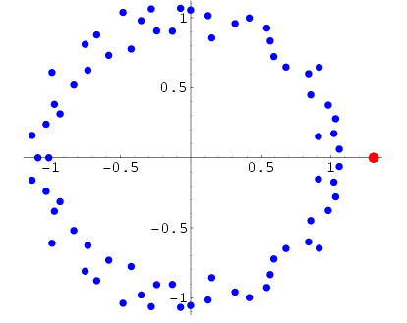
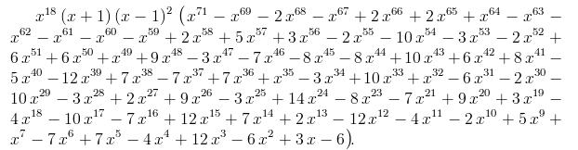
Growth determined analytically…
λ = 1.30357726034296…
"Conway’s Constant" has an analytic definition!
It is the largest real root of this 71st-degree polynomial !!
the 71 roots (in the complex plane)
Notes:
Next is: 13112221

Slide 96
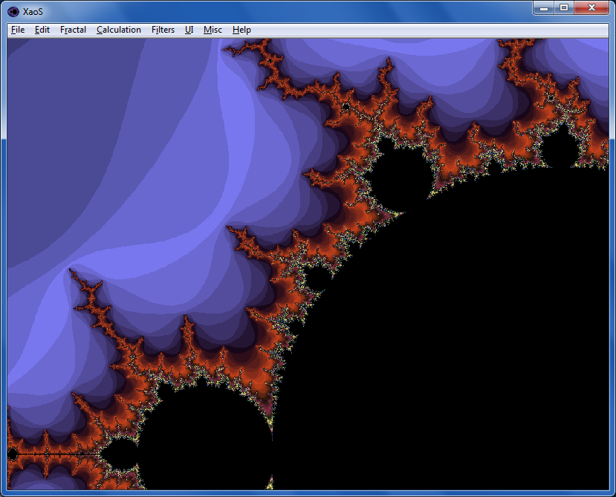

Fractals…
XaoS
fractal explorer
Python vs. C
Madi
Nova program on fractals:
Max

Slide 97

Google?

Slide 98
T. T. Securities (TTS)
Analyze a list of stock prices (given for a # of days in a row)
What's the idea for finding the smallest (minimum) price?
day
0
day
1
day
2
day
3
day
4
day
5
day
6
day
7
L = [ 40, 80, 10, 30, 27, 52, 5, 15 ]
m =
m is the "min so far"
track the value of the minimum so far as you loop over L

Slide 99
Just call min ?
Min price vs. min day
day
0
day
1
day
2
day
3
day
4
day
5
day
6
day
7
L = [ 40, 80, 10, 30, 27, 52, 5, 15 ]
def minprice( L ):
m = L[0]
for x in L:
if x < m:
m = x
return m
What about the day of the minimum price?

Slide 100
def main():
""" handles user input for our menu """
L = [30,10,20] # a starting list
while True:
menu() # print menu
uc = input('Which option? ')
if uc == 9:
elif uc == 1:
elif uc == 2:
#1 security "gotcha"
break exits the loop
(9) Quit!
use input to get a new L
(1) Get new list
(2) other…
other functions, as needed

Slide 101
Quiz
Return the smallest difference between one value from L and one value from R.
Alter this code to return the index of L's minimum.
Example:
L
Example:
L
R
>>> minday( [9,8,5,7,42] )
2
>>> diff( [7,3],[0,6] )
1
What does this code print?
HINT: track the day of the min in addition to the min value itself.
Only consider absolute differences.
for x in range(0,4):
for y in range(x,4):
print x, y
L and M will be lists of numbers
Hint: adapt the code at left...
def minday( L ):
m = L[0]
dom = 0 # day of min
for x in L:
if x < m:
m = x
return dom
def diff( L, R ):
You may want to change this loop!

Slide 102
>>> minday( [9,8,5,7,42] )
2
minday
def minday( L ):
m = L[0]
dom = 0
for x in L:
if x < m:
m = x
return dom
def minday( L ):
m = L[0]
dom = 0
for :
if < m:
m =
return dom
element-based loop
index-based loop

Slide 103
L
minday
return the index of L's minimum.
>>> minday( [9, 8, 5, 7, 42] )
2
0
1
2
3
4
index
def minday( L ):
minval = L[0]
minday = 0
RNG = range(len(L))
for i in RNG:
if < minval:
return minday
We loop through the INDEX of each element
How do we ensure minval tracks the minimum?
How and where should we update minday?
index-based loop

Slide 104
L
minday
return the index of L's minimum.
>>> minday( [9, 8, 5, 7, 42] )
2
0
1
2
3
4
index
Awkward!
def minday( L ):
mnvl = L[0]
mndy = 0
day = 0
for x in L:
if x < mnvl:
mnvl = x
mndy = day
day += 1
return mndy
Create a "counter" that will keep track of the current day.
IF we find a smaller min, save which day it was in mndy
Regardless, we add 1 to day so that we're keeping track!
element-based loop

Slide 105
What does this code print?
for x in range(0,4):
for y in range(x,4):
print x, y

Slide 106
for x in range(0,4):
for y in range(x,4):
print x, y
Example:
L
R
Hint: adapt this code
>>> diff( [7,3],[0,6] )
1
Return the minimum difference between one value from L and one value from M.
def diff( L, R ):
Only consider absolute differences.
L and M will be lists of numbers
SAME IDEA: track the value of the minimum so far as you loop over L

Slide 107
The TTS advantage!
Your stock's prices:
L = [ 40, 80, 10, 30, 27, 52, 5, 15 ]
The TTS investment strategy:
Day Price
0 40.0
1 80.0
2 10.0
3 30.0
4 27.0
5 52.0
6 5.0
7 15.0
to be realistic (for our VC backers), you must sell after you buy.

Slide 108
Have a great fall weekend!
extra_hour in [sleep,work,fun]:
True

Slide 109
T. T. Securities
(0) Input a new list
(1) Print the current list
(2) Find the average price
(3) Find the standard deviation
(4) Find the min and its day
(5) Find the max and its day
(6) Your TTS investment plan
(9) Quit
Enter your choice:
Software side …
Hardware side…
Investment analysis for the 21st century … and beyond!

Slide 110
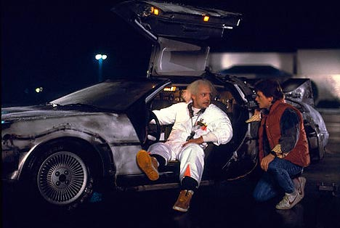
T. T. Securities
(0) Input a new list
(1) Print the current list
(2) Find the average price
(3) Find the standard deviation
(4) Find the min and its day
(5) Find the max and its day
(6) Your TTS investment plan
(9) Quit
Enter your choice:
Back to the future
Software side …
Hardware side…
Investment analysis for the 21st century … and beyond!

Slide 111

T. T. Securities
(0) Input a new list
(1) Print the current list
(2) Find the average price
(3) Find the standard deviation
(4) Find the min and its day
(5) Find the max and its day
(6) Your TTS investment plan
(9) Quit
Enter your choice:
Back to the future
Software side …
Hardware side…
Investment analysis for the 21st century … and beyond!

Slide 112
Mid-term feedback …
Don't put your name
I would love to know any thoughts you have about CS5 thus far in the term. In particular, how you feel about the time and effort CS5 requires…
On average, how much time per week do you spend on CS5 outside class + lab?
How does CS5's workload compare to other classes you're taking this term?
How would you judge the pace of CS5?
much lighter
about the same
much heavier
much too slow
about right
much too fast
Circle your year: First-year Sophomore Junior Senior Other
Later on today…
Something you'd keep about CS5 …?
Something you'd change about / get rid of / add to CS5 …?
Other thoughts optional, but 142% welcome:

Slide 113
feedback feedback
see 2012 feedback for a guide
Notes:
Next is: 13112221

Slide 114
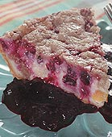

Homework 8
#2
Pi from Pie!
TT Securities Analysis, Inc.
#3
User-interaction
List-handling
Both for and while loops…
ASCII Art (extra)
#4

Slide 115
Extra (!) funky series
Harmonic Sequence:
1/1 + 1/2 + 1/3 + 1/4 + 1/5 + 1/6 + …
Without composites (primes only):
1/1 + 1/2 + 1/3 + 1/4 + 1/5 + 1/6 + 1/7 +…
Without 9’s…
1/1 + 1/2 + … + 1/8 + 1/9 + … +1/18 + 1/19 + … + 1/88 + 1/89 + 1/90 + 1/91 + …
Diverges!
???
???
Notes:
The harmonic series diverges (slowly); it's in today's lab. The primes-only series also diverges. But the no-9's series doesn't diverge. Why? Because as you get to big numbers, almost everything contains a 9, so the terms become sparse!

Slide 116
Quiz
Return the min difference between one value from X and one value from Y.
Alter this code to return the index of L's minimum.
Example:
Example:
>>> minday( [9,8,5,42] )
2
What does this code print?
>>> diff( [7,3],[0,6] )
1
HINT: track the index of the min in addition to the min value itself.
Only consider absolute differences.
for x in range(3):
for y in range(3):
print x, y
X and Y will be lists of numbers
Hint: adapt this code
def minday( L ):
min = L[0]
for x in L:
if x < min:
min = x
return
def diff( X, Y ):
You may want to change the loop!

Slide 117
Alter this code to return the index of L's minimum.
Example:
>>> mini( [9,8,1,7] )
2
def mini( L ):
min = L[0]
for x in L:
if x < min:
min = x
return
def mini( L ):
min = L[0]
for :
if < min:
min =
return
SAME LOOP
INDEX-BASED LOOP
returning both??

Slide 118
What does this code print?
for x in range(3):
for y in range(3):
print x, y

Slide 119
for x in range(3):
for y in range(3):
print x, y
Example:
Hint: adapt this code
>>> diff( [7,3],[0,6] )
1
Return the minimum difference between one value from X and one value from Y.
def diff( X, Y ):
Only consider absolute differences.
X and Y will be lists of numbers

Slide 120
“Quiz”
Finish these two methods…
This method returns the sum of the elements in the input array.
public static double sum(double[] A)
{
double s = 0.0;
for (
{
}
return s;
}
This method returns the average of the elements in the input array.
public static double average(double[] A)
“Extra Credit”: How concise can this method be?

Slide 121
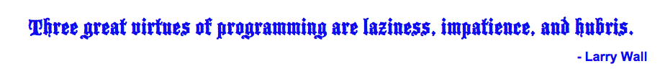
Procrastination Programming
Every while loop can be a while True: loop!
- just be sure to break!

Slide 122
Give me a break !
import random
escape = 0
while True:
print 'Help! Let me out!'
escape = random.choice([41,42,43])
if escape == 42:
break
print 'At last!'
I'll figure out later how to get out of this loop!
OK – I'll stop the loop now and continue with the code after the loop
compare return

Slide 123
This method returns the maximum element from the input array.
public static double max(double[] A)
Extra: What is something unusual and unrelated to CS 5 that you & the person next to you have in common ?!

Slide 124
Loopy thinking
0
1
2
3
4
5
6
7
8
9
10
11
12
13
14
15
16
17
18
s = 'gattacaaggtaaaatgca'
How could we find the number of 'a's ? How about 'a's and 't's?
How could we find the number of 'ta's ?
How could we find the longest sequence of 'a's ?
Notes:
ctg repeats…

Slide 125
Loopy thinking
0
1
2
3
4
5
6
7
8
9
10
11
12
13
14
15
16
17
18
s = 'gattacaaggtaaaatgca'
s = 'gattacaaggtaaaatgca'
N = 0
for i in range(0,len(s)):
if s[i] == 'a':
N = N + 1
print 'N is', N
How could we find the number of 'a's ? How about 'a's and 't's?
How could we find the number of 'ta's ?
How could we find the longest sequence of 'a's ?
Notes:
Electric: from www.staticfreesoftware.com
My tutorial is at:
http://odin.ac.hmc.edu/~harris/class/chipdesign/electric.pdf
Lasergene (a molecular biology suite of programs for aligning and comparing
DNA sequences, etc.)
Statview (statistical analysis)
KaleidaGraph (plotting & graphing)
Populus (programs that simulate ecological and evolutionary processes)

Slide 126
Loopy thinking
0
1
2
3
4
5
6
7
8
9
10
11
12
13
14
15
16
17
18
s = 'gattacaaggtaaaatgca'
s = 'gattacaaggtaaaatgca'
N = 0
for i in range(0,len(s)):
if s[i] == 'a' or s[i] == 't':
N = N + 1
print 'N is', N
How could we find the number of 'a's ? How about 'a's and 't's?
How could we find the number of 'ta's ?
How could we find the longest sequence of 'a's ?
Notes:
Electric: from www.staticfreesoftware.com
My tutorial is at:
http://odin.ac.hmc.edu/~harris/class/chipdesign/electric.pdf
Lasergene (a molecular biology suite of programs for aligning and comparing
DNA sequences, etc.)
Statview (statistical analysis)
KaleidaGraph (plotting & graphing)
Populus (programs that simulate ecological and evolutionary processes)

Slide 127
Loopy thinking
0
1
2
3
4
5
6
7
8
9
10
11
12
13
14
15
16
17
18
s = 'gattacaaggtaaaatgca'
s = 'gattacaaggtaaaatgca'
N = 0
for i in range(1,len(s)):
if s[i] == 'a' and s[i-1] == 't':
N = N + 1
print 'N is', N
How could we find the number of 'a's ? How about 'a's and 't's?
How could we find the number of 'ta's ?
How could we find the longest sequence of 'a's ?
Notes:
Electric: from www.staticfreesoftware.com
My tutorial is at:
http://odin.ac.hmc.edu/~harris/class/chipdesign/electric.pdf
Lasergene (a molecular biology suite of programs for aligning and comparing
DNA sequences, etc.)
Statview (statistical analysis)
KaleidaGraph (plotting & graphing)
Populus (programs that simulate ecological and evolutionary processes)

Slide 128
Loopy thinking
0
1
2
3
4
5
6
7
8
9
10
11
12
13
14
15
16
17
18
s = 'gattacaaggtaaaatgca'
How could we find the longest sequence of 'a's ?
Notes:
Electric: from www.staticfreesoftware.com
My tutorial is at:
http://odin.ac.hmc.edu/~harris/class/chipdesign/electric.pdf
Lasergene (a molecular biology suite of programs for aligning and comparing
DNA sequences, etc.)
Statview (statistical analysis)
KaleidaGraph (plotting & graphing)
Populus (programs that simulate ecological and evolutionary processes)

Slide 129
Planning in "pseudocode"
0
1
2
3
4
5
6
7
8
9
10
11
12
13
14
15
16
17
18
s = 'gattacaaggtaaaatgca'
Keep track of CurRun, MaxRun
Loop through the string:
if we do see an 'a'
if the PREVIOUS letter is NOT an 'a'
if the PREVIOUS letter IS an 'a'
Notes:
Electric: from www.staticfreesoftware.com
My tutorial is at:
http://odin.ac.hmc.edu/~harris/class/chipdesign/electric.pdf
Lasergene (a molecular biology suite of programs for aligning and comparing
DNA sequences, etc.)
Statview (statistical analysis)
KaleidaGraph (plotting & graphing)
Populus (programs that simulate ecological and evolutionary processes)

Slide 130
Planning in "pseudocode"
0
1
2
3
4
5
6
7
8
9
10
11
12
13
14
15
16
17
18
s = 'gattacaaggtaaaatgca'
Keep track of CurRun, MaxRun
Loop through the string:
if we do see an 'a'
if the PREVIOUS letter is NOT an 'a'
Start a Run! CurRun = 1
if the PREVIOUS letter IS an 'a'
Continue our run! CurRun = CurRun + 1
Check for a new maximum…
Notes:
Electric: from www.staticfreesoftware.com
My tutorial is at:
http://odin.ac.hmc.edu/~harris/class/chipdesign/electric.pdf
Lasergene (a molecular biology suite of programs for aligning and comparing
DNA sequences, etc.)
Statview (statistical analysis)
KaleidaGraph (plotting & graphing)
Populus (programs that simulate ecological and evolutionary processes)

Slide 131
Planning in "pseudocode"
0
1
2
3
4
5
6
7
8
9
10
11
12
13
14
15
16
17
18
s = 'gattacaaggtaaaatgca'
Keep track of CurRun, MaxRun
MAX = 0
cur = 0
for i in range(0,len(s)):
if s[i] == 'a':
if s[i-1] != 'a':
cur = 1
else:
cur = cur + 1
if cur > MAX:
MAX = cur
print 'Max is', MAX
Loop through the string:
if we do see an 'a'
if the PREVIOUS letter is NOT an 'a'
Start a Run!
if the PREVIOUS letter IS an 'a'
Continue our run!
Check for a new maximum…
Notes:
Electric: from www.staticfreesoftware.com
My tutorial is at:
http://odin.ac.hmc.edu/~harris/class/chipdesign/electric.pdf
Lasergene (a molecular biology suite of programs for aligning and comparing
DNA sequences, etc.)
Statview (statistical analysis)
KaleidaGraph (plotting & graphing)
Populus (programs that simulate ecological and evolutionary processes)

Slide 132
Challenge
Print the first N numbers in this series…
>>> fib(11)
Example:
1 1 2 3 5 8 13 21 34 55 89

Slide 133
Write an index-based loop to print the first N terms of
Write any loop to print the first N terms of
N terms total
N terms total
7 9 11 13 15 17 …
0 1 2 3 6 7 14 15 30
def seven(N):
for i in range(N):
feel free to add an accumulator, if you'd like!
Quiz, part 2

Slide 134

Looping inside loops!

Slide 135
input vs. raw_input
reply = raw_input('Enter a string and I\'ll tell you what I see.')
for c in reply:
print 'I see a(n) ', c
interprets what the user types as a string of characters
reply = input('Enter any list and I\'ll tell you what I see.')
for c in reply:
print 'I see a(n) ', c
processes what the user types just as python would

Slide 136
Monte Carlo π
Hw8 Pr3
A engineering challenge: to estimate π using everyday items...

Slide 137
Easy as π
(1,1)
Visualize:
(-1,-1)

Slide 138
CS 5: Putting Loops to Work
A
[ -35, -24, -13, -2, 9, 20, 31, ? ]
B
[ 26250, 5250, 1050, 210, ? ]
C
[ 1, 11, 21, 1211, 111221, ? ]
D
[ 2, 22, 222, ? ]
E
[ 90123241791111 , 93551622, 121074, 3111, ? ]
Which ? is unlike the others?

Slide 139
CS 5: Putting Loops to Work
A
[ -35, -24, -13, -2, 9, 20, 31, ? ]
B
[ 26250, 5250, 1050, 210, ? ]
C
[ 1, 11, 21, 1211, 111221, ? ]
D
[ 2, 22, 222, ? ]
E
[ 90123241791111 , 93551622, 121074, 3111, ? ]
Which sequences act numeric -- and which ones act like strings ?

Slide 140
User Input
meters = raw_input('How many m? ')
cm = meters * 100
print 'That is', cm, 'cm.'
If we type 42, what will python print for this # of cm ?
A
D
something < 0
something > 42
B
C
E
0
42
an error

Slide 141
Fix #2: use input instead
meters = input('How many m? ')
cm = meters * 100
print 'That is', cm, 'cm.'
input interprets its input
raw_input always returns a string
I always use input -- but don't "quote" me on that.

Slide 142


Brots… !
Will P.

Slide 143
Growth determined analytically…
λ = 1.30357726034296…
"Conway's Constant" has an analytic definition!
It is the largest real root of this 71st-degree polynomial !!
the 71 roots (complex plane)
This seems frightening...!
http://www.njohnston.ca/2010/10/a-derivation-of-conways-degree-71-look-and-say-polynomial/
Notes:
Next is: 13112221

Slide 144
Happy Oct 31!

Slide 145
elements vs. indices
L[0]
L[1]
L[2]
L[3]
L = [3, 15, 17, 7]
0
1
2
3
x
i
def sum(L):
total = 0
for x in L:
total += x
return total
def sum(L):
total = 0
for i in range(len(L))
total += L[i]
return total
list
element-based loops
index-based loops

Slide 146
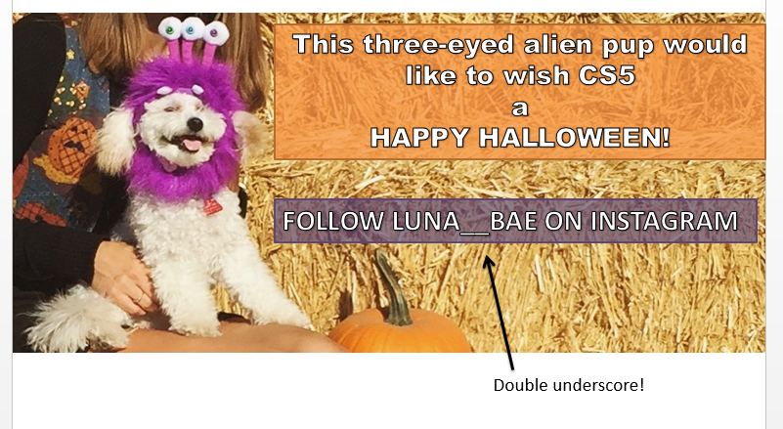
Luna_Bae…
see Stephanie, manager

Slide 147
j
0
1
2
3
Finish this code to return the index (location) of L's min.
What does this print?
0
L
list
for i in range(4):
for j in range(4):
print(abs(i-j),end='')
print()
1
>>> i_min( [9, 8, 5, 7, 42] )
2
list
0
1
2
3
4
2
def i_min( L ):
minval = L[0]
minloc = 0
for i in range(len(L)):
if :
minval =
minloc =
return minloc
3
i
Write mindiff to return the smallest absolute difference between any two elements from L.
Only consider abs differences.
L will be a list of numbers.
Hint: Use a nested loop!
list
>>> mindiff( [42,3,47,100,-9] )
5
def mindiff( L ):
Hints:
track of the minimum value in minval
track the location of the min inside minloc
Quiz, p.2

Slide 148
Nested loops...
[0,1,2,3]
j
list
for i in range(4):
for j in range(4):
print(abs(i-j),end='')
print()
i
0
1
2
3
list
0
0 1 2 3
1
1 0 1 2
2
2 1 0 1
3
3 2 1 0

Slide 149
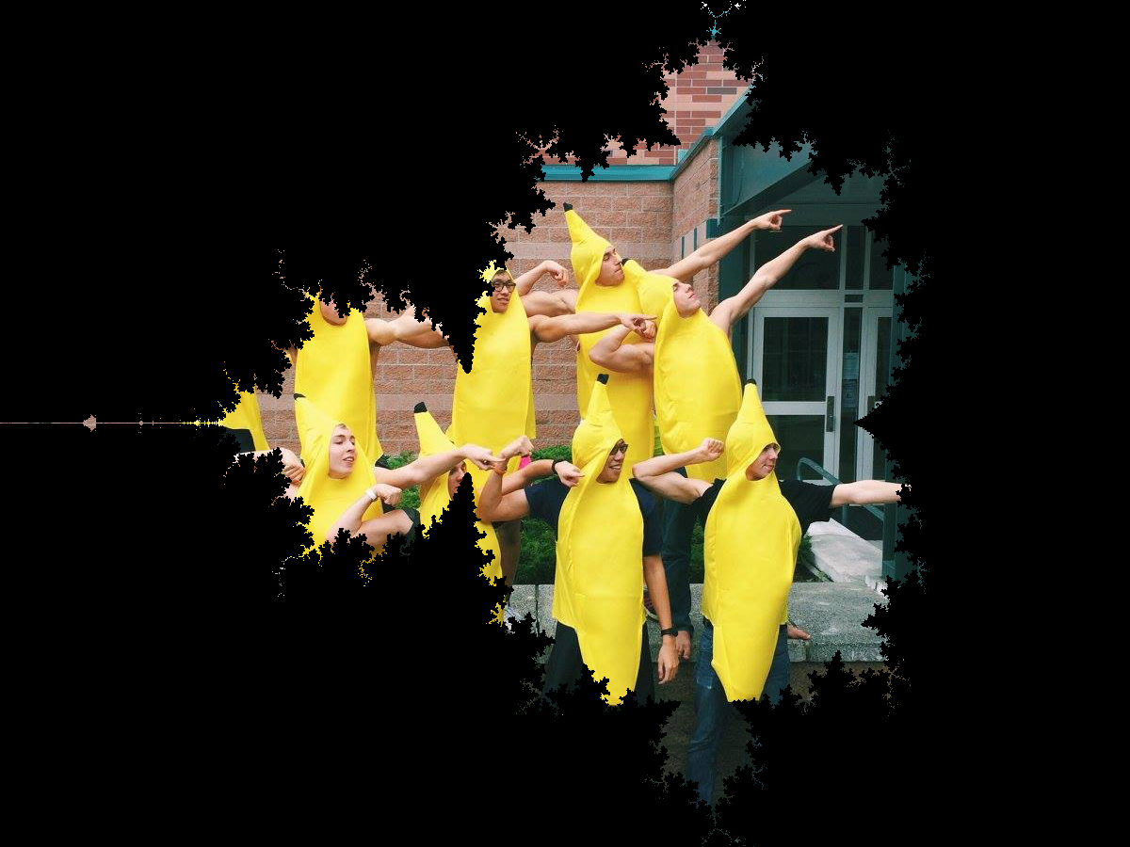
BananaBrot… !

Slide 150
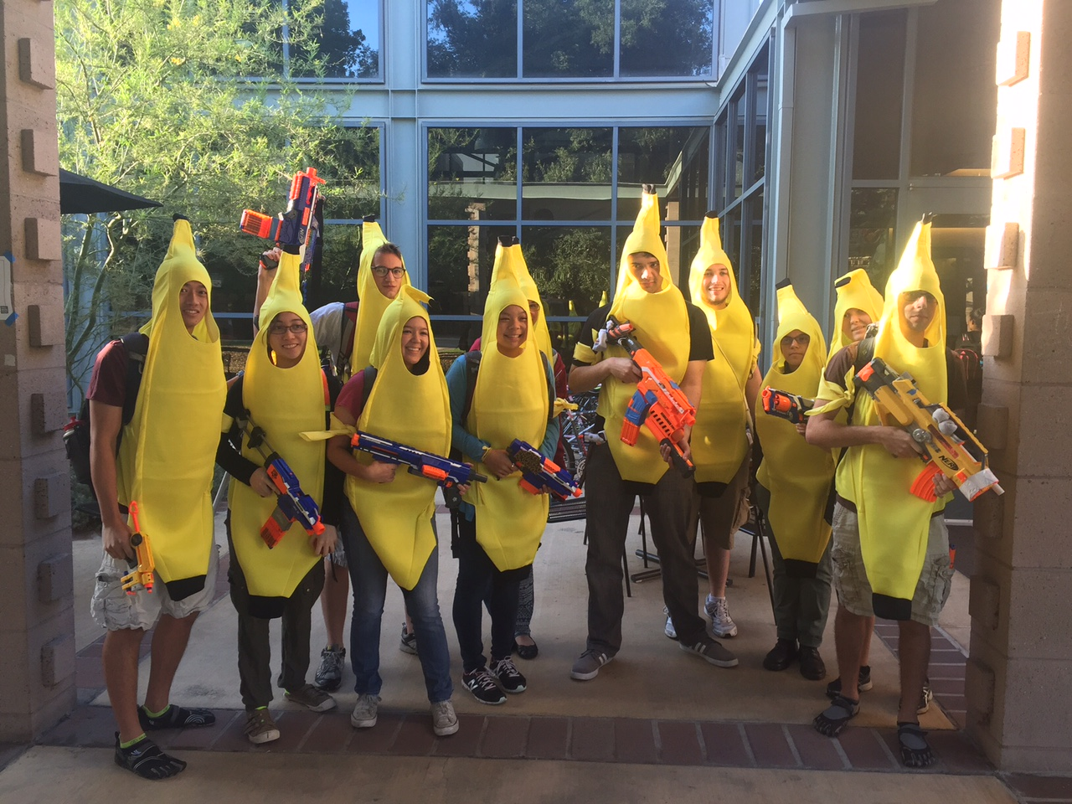
Celebrataing humanness…

Slide 151

Past zombie run-ins… Not sure about the tie?!

Slide 152
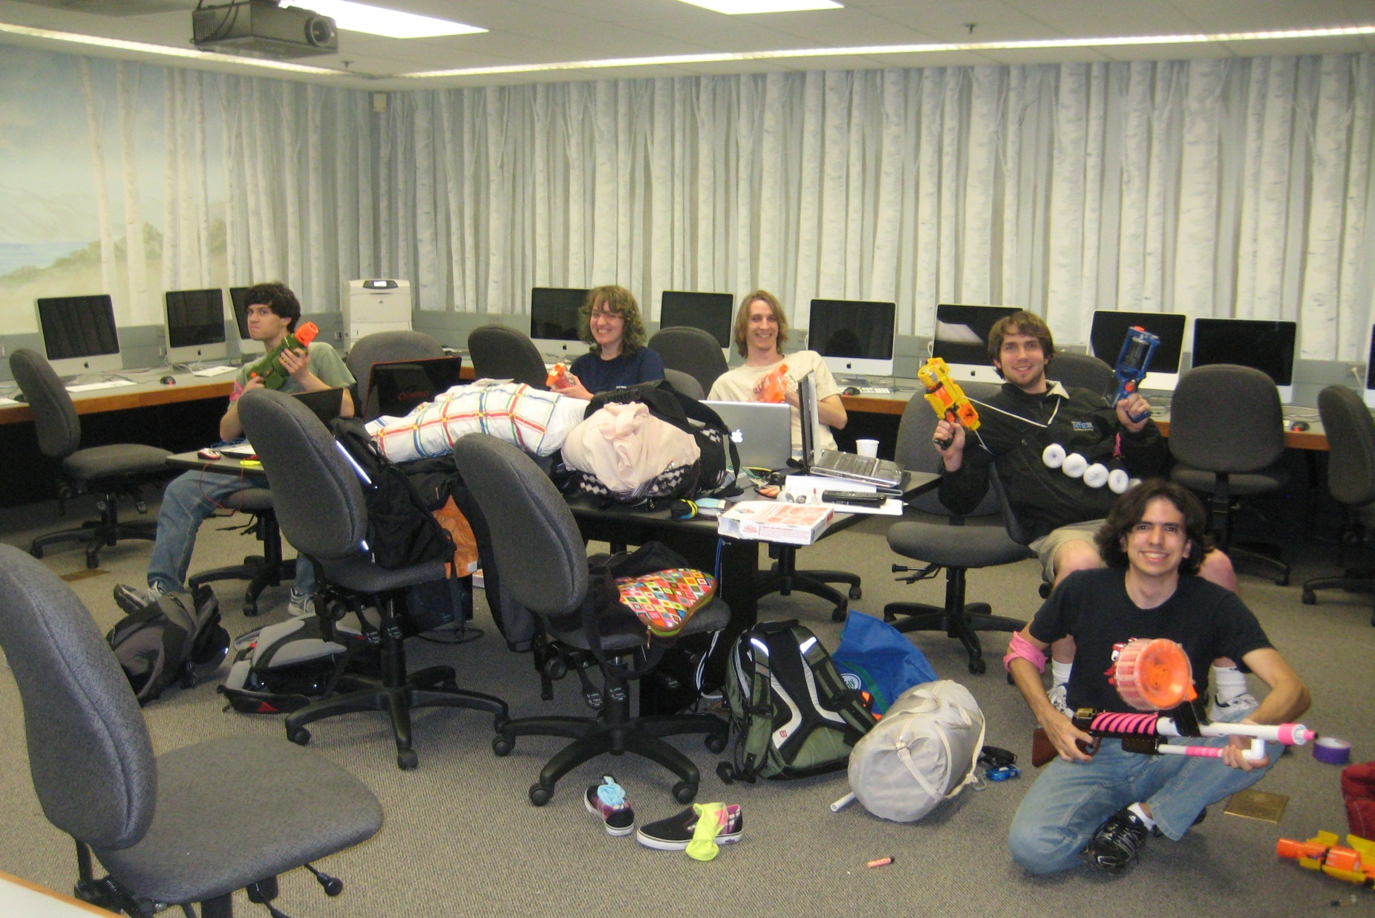
Celebrataing humanness…
CS 5 lab ~ a no-zombie zone!

Slide 153
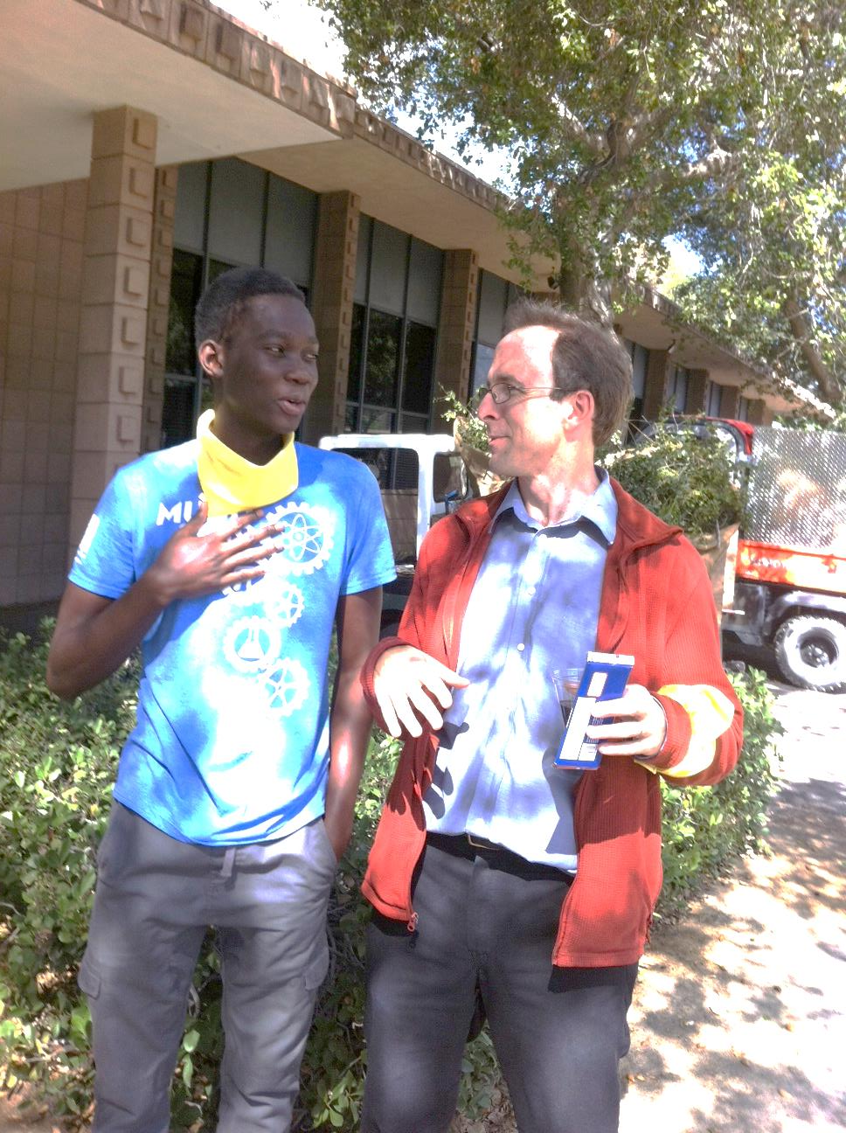
Farewell, humanness…

Slide 154
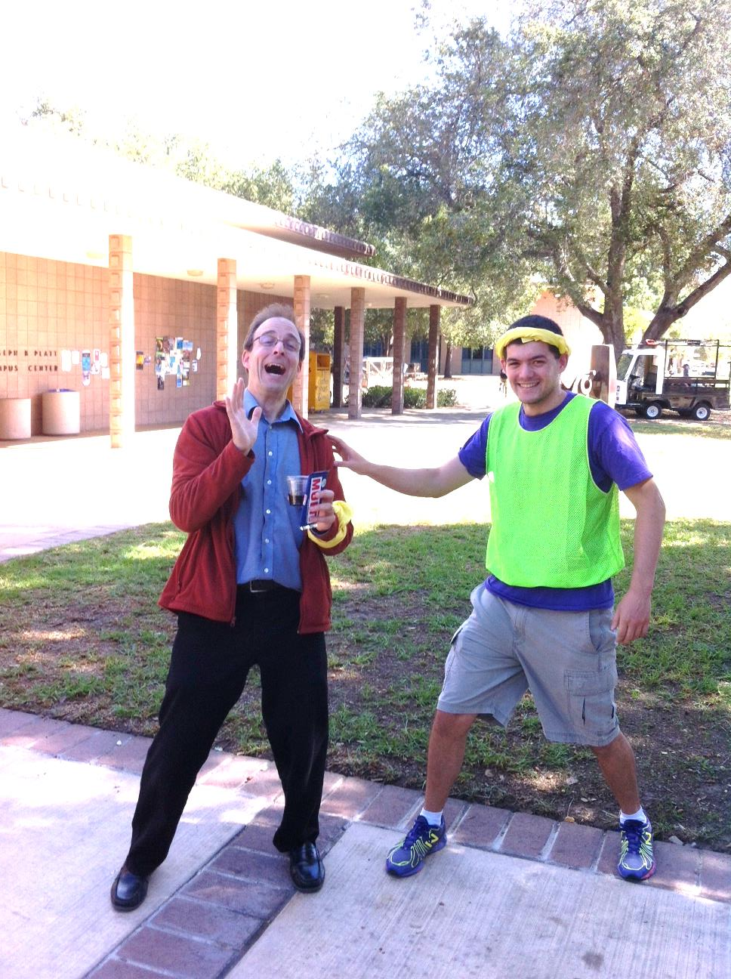
actual zombification…
Looks painful!
Past zombie run-ins… Not sure about the tie?!

Slide 155



Fire and Ice
or, just fire
Brots… !

Slide 156




Brots… !

Slide 157
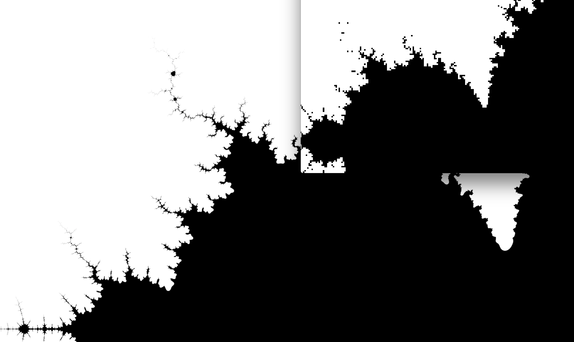
Brots… !
Nat E.-H.

Slide 158

Brots… !
Rui-Jie

Slide 159

Brots… !
Rui-Jie

Slide 160

Brots… !
Jimmy!

Slide 161

Brots… !
Jimmy!

Slide 162


Spaced Out
Brots… !

Slide 163
Spaced Out
Brots… !

Slide 164

Brots… !
Anna G. + Biggie S.

Slide 165

Brots… !
Henry D.R.

Slide 166

Brots… !
Henry D.R.

