Slide 1
CS 5 today! Putting loops to work…
[ -35, -24, -13, -2, 9, 20, 31, ? ]
[ 26250, 5250, 1050, 210, ? ]
[ 90123241791111 , 93551622, 121074, 3111, ? ]
What's next?
[ 1, 11, 21, 1211, 111221, ? ]
I'm glad you asked!
Homework 8: due Mon., 3/27 by midnight
"Office" hrs. Fri Sun! @ LAC, tutoring...
Midterm 3/30 ~ review on the CS5 homepage
Final Exam: choice of 5/9 or 5/12 @ 2pm
quizzes!

Slide 2
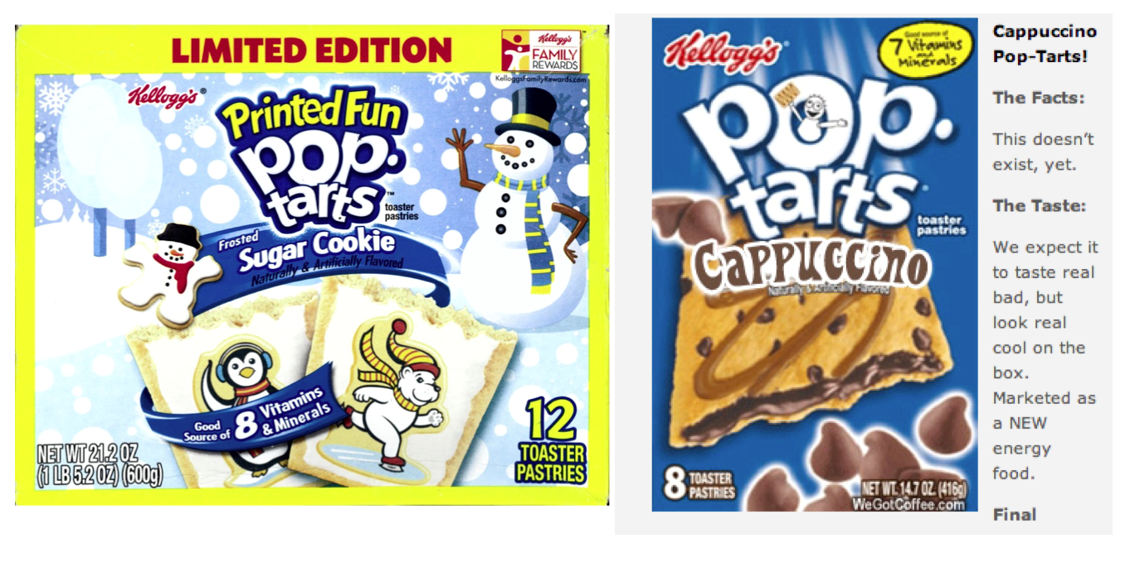
Pop tarts > candy
Official CS5 snack comparison
pop-tart recursion!
But this should exist!

Slide 3
Next Thursday will be the CS 5 in-class midterm
Un-warnings:
worries? concerns? See me…
five problems, written
worth 1 hw assignment
score worries? Extra extra-credit in hw9 and beyond
Suggestions:
go over in-class exercises and hwk problems
create a page of notes, 2-sided is OK
consider small variations of the problems – and how they would change the solutions…
only 5 minutes? Try list comprehensions & LoL!
all quizzes so far? they're posted!

Slide 4
M.T. Review
(*) For up to two points! of extra credit on the midterm… Pair up with s/o you don't know (or don't know well) and find something unusual you have in common…
See review problems @ the cs5 site
Names:
We'll do this next class!
Picobot! There are NO Picobot questions on the exam…
Recursion!!
You should feel confident you could create recursive functions to solve small problems, e.g., scrabble-scoring, finding sum or max or min, computing power or factorial (or variations)
You should be comfortable manipulating lists and strings (indexing, slicing, slicing with a "stride") What's s[1:-1:2]?
You should understand how to use, read, and compose list comprehensions , e.g., LC = [ x**2 for x in L ]
You should be able to design solutions using the "list of lists" technique (LoL), which uses list comprehensions, e.g., to find the highest scrabble-scoring word among a list or the lowest scrabble-scoring of a shifted string. Basic syntax: LoL = [ [sc(x),x] for x in L ]
You should understand the use-it-or-lose-it design strategy, e.g., the LCS, exact_change, jotto, and sort homework problems
Turtle graphics will not be on the exam
Know the difference between print and return !!
Look over how you composed larger programs out of smaller ones + how inputs and outputs are used, e.g., for Caesar Cipher
Representing Data!!!
Remind yourself of the various types of data (int, str, float, etc.), how they're different and how to convert between types
Know how characters are represented with chr and ord
Be comfortable with base-2 arithmetic (and base 10!), along with how to convert from base to base (no balanced ternary)
Remind yourself of how the bits of a base-2 number influence its value – what do right- and left-shifting do?
Thing in common:
Then, read over these & look for ones least familiar…
Circuits and Assembly!!!!
Know how the basic logic gates operate (AND and OR for any # of inputs , NOT for 1 input only)
Know how minterm expansion works (an OR of ANDs, each selecting one input) and how it enables the engineering of any circuit at all, given its truth-table specification
You should be comfortable using subcircuits (e.g., using the four-bit adders in the four-bit multiplier, or the individual pieces of the divider)
You should be able to write simple looping programs in Hmmm, e.g., factorial, power, Fibonacci, …
You should know what the stack is, what load and store do at the high-level (in Hmmm, they're named storer and loadr) - and why they're useful for implementing functions in Hmmm - broadly speaking
The exam will not ask you to implement recursion or stack-based functions in Hmmm: only looping + conditional examples.
It will have a full Hmmm reference (your don't need your own)
Loops
You should feel comfortable with how for loops (both element-based and index-based) and while loops work – and be able to compose small functions that use them, e.g., ones similar to those in the pi-estimation and TT securities (statistics) problems.
You should understand how nested loops work and be able to read or compose examples (such as the TTS strategy or our in-class problems)
I <3 three-eyed punctuation!
!
!
You may use functions from class and hw on the exam without reimplementing them. Here are some, but not all, of them:
removeOne( e, L ), removeAll( e, L ), removeUpto( e, L ), count( e, L ), ind( e, L ), frontNum( L ), binToNum( binstr ), numToBin( n ), …

Slide 5
Mid-term feedback…
Don't put your name
I would love to know any thoughts you have about CS5 thus far in the term. In particular, how you feel about the time and effort CS5 requires…
On average, how much time per week do you spend on CS5 outside class + lab?
How does CS5's workload compare to other classes you're taking this term?
How would you judge the pace of CS5?
much lighter
about the same
much heavier
much too slow
about right
much too fast
Circle your year: First-year Sophomore Junior Senior Other
Something you'd keep about CS5 …?
Later today
Something you'd change about / get rid of / add to CS5 …?
Other thoughts optional, but 142% welcome:

Slide 6
CS 5 today! Putting loops to work…
[ -35, -24, -13, -2, 9, 20, 31, ? ]
[ 26250, 5250, 1050, 210, ? ]
[ 90123241791111 , 93551622, 121074, 3111, ? ]
What's next?
[ 1, 11, 21, 1211, 111221, ? ]
I'm glad you asked!
Homework 8: due Mon., 3/27 by midnight
"Office" hrs. Fri Sun! @ LAC, tutoring...
Midterm 3/30 ~ review on the CS5 homepage
Final Exam: choice of 5/9 or 5/12 @ 2pm
quizzes!

Slide 7
The read it and weep sequence
1
11
21
1211
111221
312211
13112221
…
str vs. int
When does the first 4 appear?
How fast do these terms grow?
Extra credit ~ wk9!
Notes:
Next is: 13112221

Slide 8
Growth determined empirically…
1
11
21
1211
111221
312211
13112221
…
In the limit, the length of the Nth term of the read-it-and-weep sequence is
(1.303577...)
exponential growth
N
this base was found computationally by taking repeated ratios of term lengths...
Notes:
Next is: 13112221

Slide 9
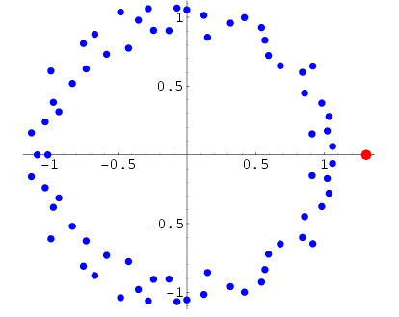
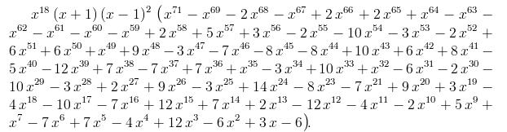
Growth determined analytically…
λ = 1.30357726034296…
"Conway's Constant" has an analytic definition!
It is the largest real root of this 71st-degree polynomial !!
the 71 roots (complex plane)
This seems frightening...!
http://www.njohnston.ca/2010/10/a-derivation-of-conways-degree-71-look-and-say-polynomial/
Notes:
Next is: 13112221

Slide 10
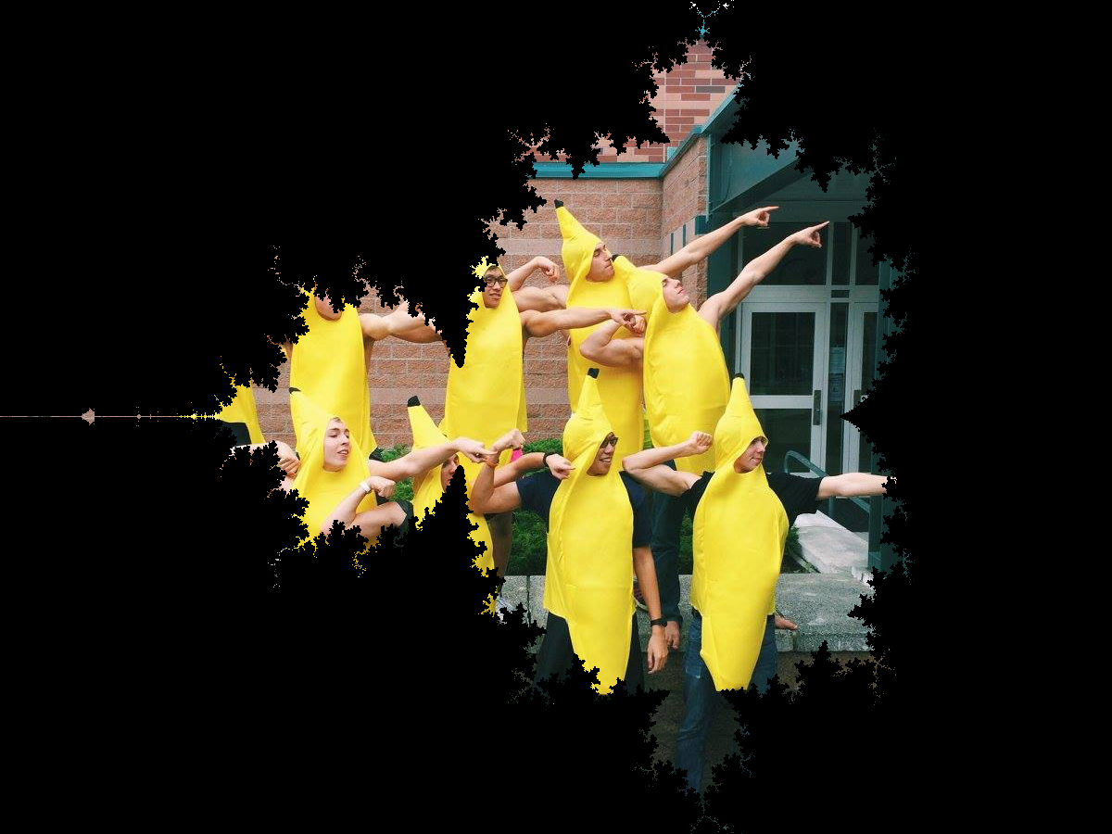
BananaBrot… !
even more frightening!

Slide 11
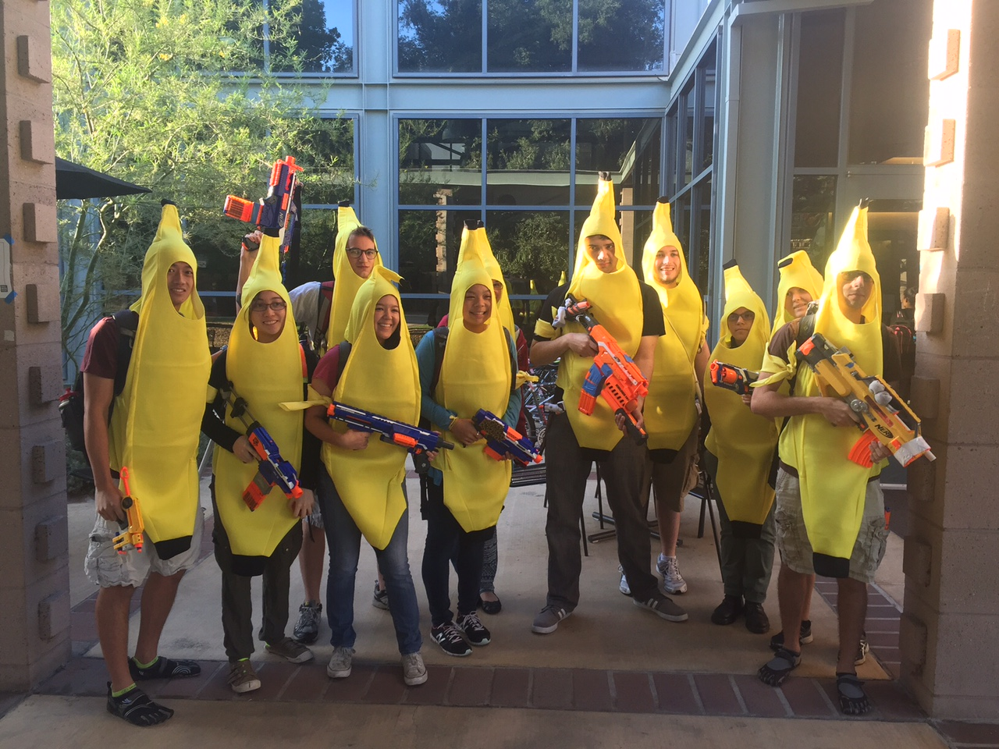
Celebrataing humanness…

Slide 12
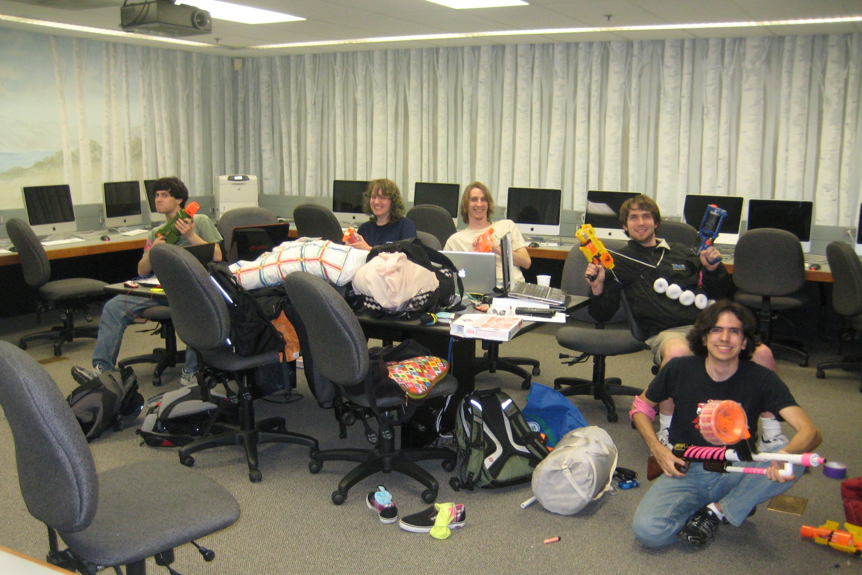
Celebrataing humanness…
CS 5 lab ~ a no-zombie zone!

Slide 13

Past zombie run-ins… Not sure about the tie?!

Slide 14
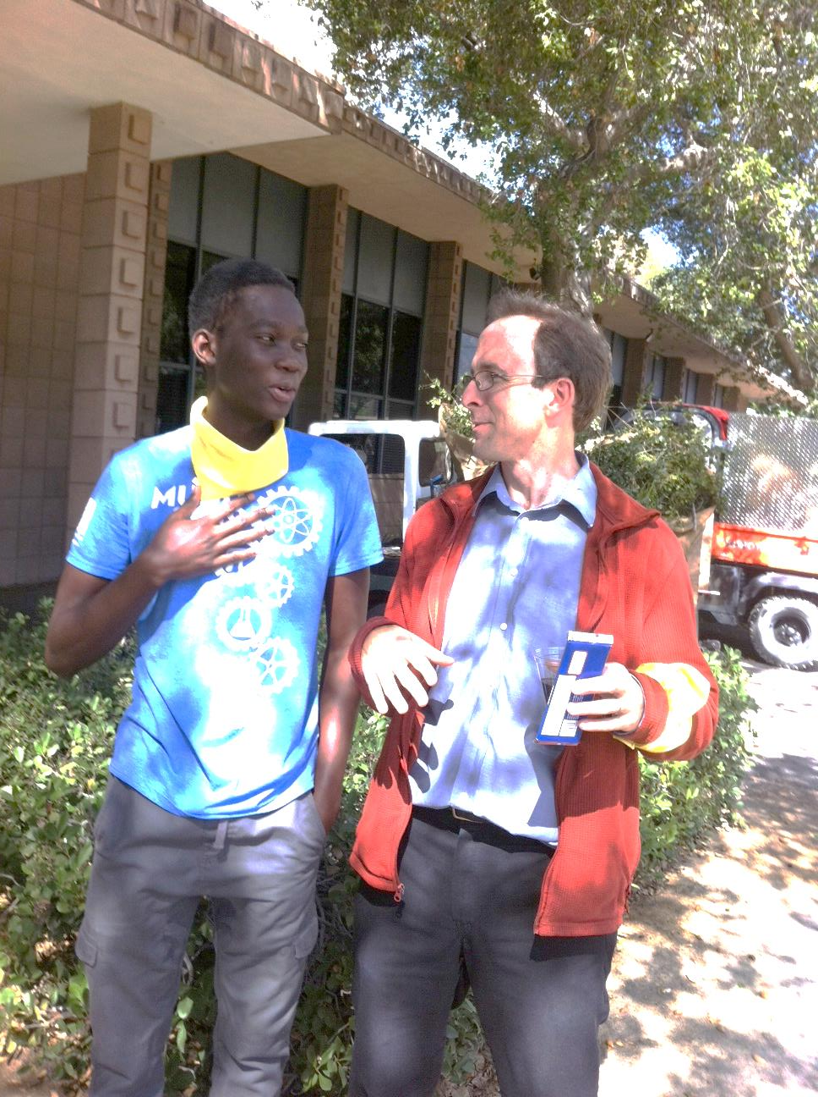

Farewell, humanness…

Slide 15

Spaced Out
Fall '16

Slide 16
def fac( N ):
result = 1
for x in range(1,N+1):
result *= x
return result
Loops
Is one more reasonable than the other?
Basic design strategies
def fac( N ):
if N == 1:
return 1
else:
return N*fac(N-1)
Recursion

Slide 17
def fac( N ):
result = 1
for x in range(1,N+1):
result *= x
return result
Loops
Design strategy: look for repetition + describe it… .
Basic design strategies
Design strategy: look for self-similarity + describe it… .
def fac( N ):
if N == 1:
return 1
else:
return N*fac(N-1)
Recursion

Slide 18
for: two types
L = [3, 15, 17, 7]
x
"deceptively easy"
for x in L:
print x
element-based loops

Slide 19
for: two types
L[0]
L[1]
L[2]
L[3]
L = [3, 15, 17, 7]
0
1
2
3
i
for i in range(len(L))
print L[i]
list
index-based loops
for x in L:
print x
element-based loops

Slide 20
elements vs. indices
L[0]
L[1]
L[2]
L[3]
L = [3, 15, 17, 7]
0
1
2
3
x
i
def sum(L):
total = 0
for x in L:
total += x
return total
def sum(L):
total = 0
for i in range(len(L))
total += L[i]
return total
list
element-based loops
index-based loops

Slide 21
hw8pr3: T. T. Securities (TTS)
Analyzes a sequence of stock prices
i
day
0
day
1
day
2
day
3
day
4
day
5
day
6
day
7
L = [ 40, 80, 10, 30, 27, 52, 5, 15 ]
x
(0) Input a new list
(1) Print the current list
(2) Find the average price
(3) Find the standard deviation
(4) Find the min and its day
(5) Find the max and its day
(6) Your TTS investment plan
(9) Quit
Enter your choice:
Implement a (text) menu:

Slide 22
User input…
meters = input('How many m? ')
cm = meters * 100
print('That is', cm, 'cm.')
What will Python think?
I think I like these units better than light years per year!

Slide 23
User input…
meters = input('How many m? ')
cm = meters * 100
print('That is', cm, 'cm.')
input ALWAYS returns a string – no matter what has been typed!
What will Python think?
I think I like these units better than light years per year!

Slide 24
Fix #1: convert to the right type
m_str = input('How many m? ')
meters = float( m_str )
cm = meters * 100
print('That is', cm, 'cm.')
'42'
42.0
4200.0
name: m_str type: string
name: meters type: float
name: cm
type: float
OK, but crash-able
Notes:
Electric: from www.staticfreesoftware.com
My tutorial is at:
http://odin.ac.hmc.edu/~harris/class/chipdesign/electric.pdf
Lasergene (a molecular biology suite of programs for aligning and comparing
DNA sequences, etc.)
Statview (statistical analysis)
KaleidaGraph (plotting & graphing)
Populus (programs that simulate ecological and evolutionary processes)

Slide 25
Fix #2: convert and check
m_str = input('How many m? ')
try:
meters = float( m_str )
except:
print("What? Does not compute!")
print("Setting meters = 42")
meters = 42.0
cm = meters * 100
print('That is', cm, 'cm.')
crash-able
try-except lets you try code and – if it crashes – catch an error and handle it
Notes:
Electric: from www.staticfreesoftware.com
My tutorial is at:
http://odin.ac.hmc.edu/~harris/class/chipdesign/electric.pdf
Lasergene (a molecular biology suite of programs for aligning and comparing
DNA sequences, etc.)
Statview (statistical analysis)
KaleidaGraph (plotting & graphing)
Populus (programs that simulate ecological and evolutionary processes)

Slide 26
Fix #2: convert and check
These errors are called exceptions.
This is exception handling.
m_str = input('How many m? ')
try:
meters = float( m_str )
except:
print("What? Does not compute!")
print("Setting meters = 42")
meters = 42.0
cm = meters * 100
print('That is', cm, 'cm.')
crash-able
try-except lets you try code and – if it crashes – catch an error and handle it
Notes:
Electric: from www.staticfreesoftware.com
My tutorial is at:
http://odin.ac.hmc.edu/~harris/class/chipdesign/electric.pdf
Lasergene (a molecular biology suite of programs for aligning and comparing
DNA sequences, etc.)
Statview (statistical analysis)
KaleidaGraph (plotting & graphing)
Populus (programs that simulate ecological and evolutionary processes)

Slide 27
Fix #3: eval executes Python code!
m_str = input('How many m? ')
meters = eval( m_str )
cm = meters * 100
print('That is', cm, 'cm.')
What could go wrong here?
Notes:
Electric: from www.staticfreesoftware.com
My tutorial is at:
http://odin.ac.hmc.edu/~harris/class/chipdesign/electric.pdf
Lasergene (a molecular biology suite of programs for aligning and comparing
DNA sequences, etc.)
Statview (statistical analysis)
KaleidaGraph (plotting & graphing)
Populus (programs that simulate ecological and evolutionary processes)

Slide 28
Fix #3: eval executes Python code!
m_str = input('How many m? ')
try:
meters = eval( m_str )
except:
print("What? Does not compute!")
print("Setting meters = 42")
meters = 42.0
cm = meters * 100
print('That is', cm, 'cm.')
What could STILL go wrong here?
Notes:
Electric: from www.staticfreesoftware.com
My tutorial is at:
http://odin.ac.hmc.edu/~harris/class/chipdesign/electric.pdf
Lasergene (a molecular biology suite of programs for aligning and comparing
DNA sequences, etc.)
Statview (statistical analysis)
KaleidaGraph (plotting & graphing)
Populus (programs that simulate ecological and evolutionary processes)

Slide 29
A larger application
def menu():
""" prints our menu of options """
print("(0) Continue")
print("(1) Enter a new list")
print("(2) Predict")
print("(9) Break (quit)")
def main():
""" handles user input for our menu """
while True:
menu()
uc = input('Which option? ')
try:
uc = int(uc) # was it an int?
except:
continue # back to the top!
Calls a helper function
Perhaps uc the reason for this?

Slide 30
def main():
""" handles user input for our menu """
L = [30,10,20] # a starting list
while True:
menu() # print menu
uc = input('Which option? ') ...
if uc == 9:
elif uc == 0:
elif uc == 1:
elif uc == 2:
(9) Quit
(0) Continue
(1) Get new list
(2) Predict !
... and so on ...

Slide 31
def main():
""" handles user input for our menu """
L = [30,10,20] # a starting list
while True:
menu() # print menu
uc = input('Which option? ')
if uc == 9:
break
elif uc == 0:
continue
elif uc == 1:
... input ... eval ...
elif uc == 2:
(9) Quit
break jumps out of the loop
continue jumps back to the top
(0) Continue
uses eval (+check) for a new L
(1) Get new list
(2) Predict !
other functions as needed...
... and so on ...

Slide 32
Full program example of user-interactions
(1) Which block below handles an input of 7 ?
(2) What does choice 0 not print that 3 does?
(4) What could you input for newL that would print this?
main function
(5) What could you type for newL that would print this?
while True:
(3) What line of code runs after this break ?
(6) predict is a function defined elsewhere (off this page) Find the two other functions called here, but defined elsewhere. Hint: they both include find in their names!
(EC) How could a user learn the value of secret_value if they guessed that variable name and could run the program – even if they couldn't see any of this code?!

Slide 33
Functions you'll write
All use loops…
Menu
def average( L )
def stdev( L )
(0) Input a new list
(1) Print the current list
(2) Find the average price
(3) Find the standard deviation
(4) Find the min and its day
(5) Find the max and its day
(6) Your TTS investment plan
(9) Quit
Enter your choice:
Σ
(L[i] - L_{av})²
i
len(L)
def minday( L )
def maxday( L )
webbrowser.open_new_tab(url)

Slide 34
Min price
Just call min ?
day
0
day
1
day
2
day
3
day
4
day
5
day
6
day
7
L = [ 40, 80, 10, 30, 27, 52, 5, 15 ]
m =
m is the "min so far"
What's the idea for finding the smallest (minimum) price?
track the value of the minimum so far as you loop over L

Slide 35
Min price vs. min day
day
0
day
1
day
2
day
3
day
4
day
5
day
6
day
7
L = [ 40, 80, 10, 30, 27, 52, 5, 15 ]
m = 40
m = 10
m = 5
5 is returned
def minprice( L ):
m = L[0]
for x in L:
if x < m:
m = x
return m
What about the day of the minimum price?

Slide 36
Mid-term feedback …
Don't put your name
I would love to know any thoughts you have about CS5 thus far in the term. In particular, how you feel about the time and effort CS5 requires…
On average, how much time per week do you spend on CS5 outside class + lab?
How does CS5's workload compare to other classes you're taking this term?
How would you judge the pace of CS5?
much lighter
about the same
much heavier
much too slow
about right
much too fast
Circle your year: First-year Sophomore Junior Senior Other
Something you'd keep about CS5 …?
Something you'd change about / get rid of / add to CS5 …?
Other thoughts optional, but 142% welcome:

Slide 37
j
0
1
2
3
Finish this code to return the index (location) of L's min.
What does this print?
0
L
list
for i in range(4):
for j in range(4):
print(abs(i-j),end='')
print()
1
>>> i_min( [9, 8, 5, 7, 42] )
2
list
0
1
2
3
4
2
def i_min( L ):
minval = L[0]
minloc = 0
for i in range(len(L)):
if :
minval =
minloc =
return minloc
3
i
Write mindiff to return the smallest absolute difference between any two elements from L.
Only consider abs differences.
L will be a list of numbers.
Hint: Use a nested loop!
list
>>> mindiff( [1,42,3,47,100,-9] )
5
def mindiff( L ):
m = abs( L[0]-L[1] )
for
for
return m
Hints:
track of the minimum value in minval
track the location of the min inside minloc
Quiz, p.2

Slide 38



Anya W
Fire and Ice
Danielle M.
or, just fire
Brots… !

Slide 39




Brots… !
Cameron K et al.

Slide 40


Brots… !
Hanna H

Slide 41

Brots… !
Richard Z.

Slide 42
6 is returned
minloc
= 0
= 2
= 6
i
day
0
day
1
day
2
day
3
day
4
day
5
day
6
day
7
L = [ 40, 80, 10, 30, 27, 52, 5, 15 ]
= 40
= 10
= 5
minval
def i_min( L ):
minval = L[0]
minloc = 0
for i in range(len(L)):
if
return minloc
track both day and price
loop!
update when needed

Slide 43
6 is returned
minloc
= 0
= 2
= 6
i
day
0
day
1
day
2
day
3
day
4
day
5
day
6
day
7
L = [ 40, 80, 10, 30, 27, 52, 5, 15 ]
= 40
= 10
= 5
minval
def i_min( L ):
minval = L[0]
minloc = 0
for i in range(len(L)):
if L[i] < minval:
minval = L[i]
minloc = i
return minloc
track both day and price
loop!
update when needed

Slide 44
Nested loops...
[0,1,2,3]
j
list
for i in range(4):
for j in range(4):
print(abs(i-j),end='')
print()
i
0
1
2
3
list
0
0 1 2 3
1
1 0 1 2
2
2 1 0 1
3
3 2 1 0

Slide 45
Write mindiff to return the smallest abs. diff. between any two elements from L.
mindiff( [1,42,3,47,100,-9] )
5
L
def mindiff( L ):
m = abs(L[1]-L[0])
for i in range(len(L)):
for j in range( ,len(L)):
if
return m
Hint: Use nested loops:
for i in range(4):
for j in range(4):
Track the value of the minimum so far as you loop over L twice…

Slide 46
Write mindiff to return the smallest abs. diff. between any two elements from L.
mindiff( [1,42,3,47,100,-9] )
5
L
def mindiff( L ):
m = abs(L[1]-L[0])
for i in range(len(L)):
for j in range(i+1,len(L)):
if abs(L[j]-L[i]) < m:
m = abs(L[j]-L[i])
return m
Hint: Use nested loops:
for i in range(4):
for j in range(4):
Track the value of the minimum so far as you loop over L twice…

Slide 47
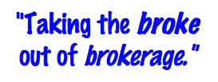
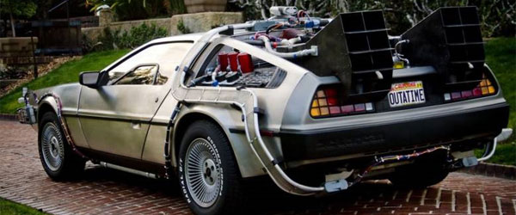
T. T. Securities
(0) Input a new list
(1) Print the current list
(2) Find the average price
(3) Find the standard deviation
(4) Find the min and its day
(5) Find the max and its day
(6) Your TTS investment plan
(9) Quit
Enter your choice:
Software side …
Hardware side…
Investment analysis for the 21st century … and beyond

Slide 48
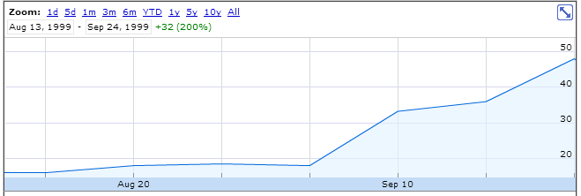
personal motivation for TT securities…
LightPath, Fall 1999 ~ wedding gift…

Slide 49
advice…?
LightPath, Fall 1999

Slide 50
What is the best TTS investment strategy here?
The TTS advantage!
L = [ 40, 80, 10, 30, 27, 52, 5, 15 ]
Your stock's prices:
Day Price
0 40.0
1 80.0
2 10.0
3 30.0
4 27.0
5 52.0
6 5.0
7 15.0
Important fine print:
To make our business plan realistic, however, we only allow selling after buying.

Slide 51
What is the best TTS investment strategy here?
The TTS advantage!
L = [ 40, 80, 10, 30, 27, 52, 5, 15 ]
Your stock's prices:
Day Price
0 40.0
1 80.0
2 10.0
3 30.0
4 27.0
5 52.0
6 5.0
7 15.0
for each buy-day, b:
for each sell-day, s:
compute the profit
if it's the max-so-far:
remember it in a variable!
Important fine print:
To make our business plan realistic, however, we only allow selling after buying.

Slide 52
What is the best TTS investment strategy here?
The TTS advantage!
L = [ 40, 80, 10, 30, 27, 52, 5, 15 ]
Your stock's prices:
Have a fantastic spring break, everyone!
Day Price
0 40.0
1 80.0
2 10.0
3 30.0
4 27.0
5 52.0
6 5.0
7 15.0
for each buy-day, b:
for each sell-day, s:
compute the profit
if it's the max-so-far:
remember it in a variable!
Tutoring hours are all the time... Plus, come to office hours: they're this upcoming SUNDAY – or any Friday in February!!
Important fine print:
To make our business plan realistic, however, we only allow selling after buying.

Slide 53
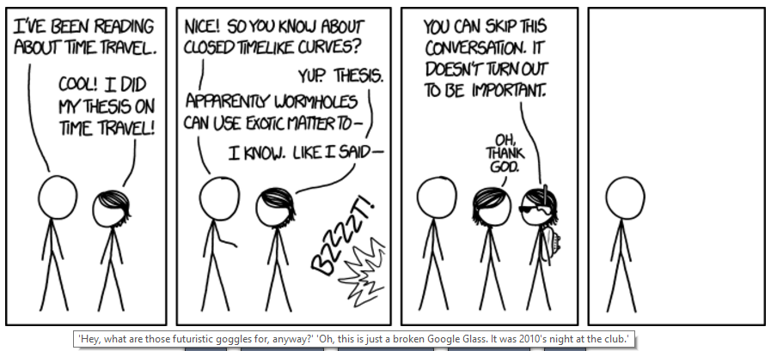
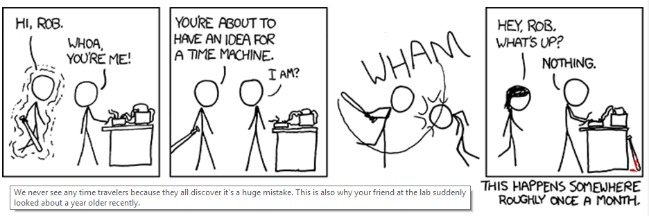

Slide 55
Halloween == pop-tarts!

Slide 56
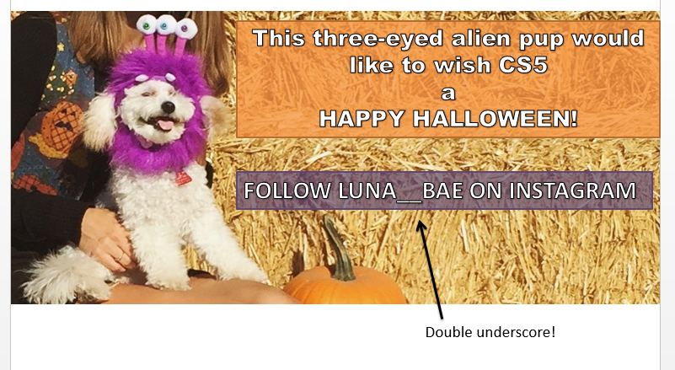
Luna_Bae…
see Stephanie, manager

Slide 57
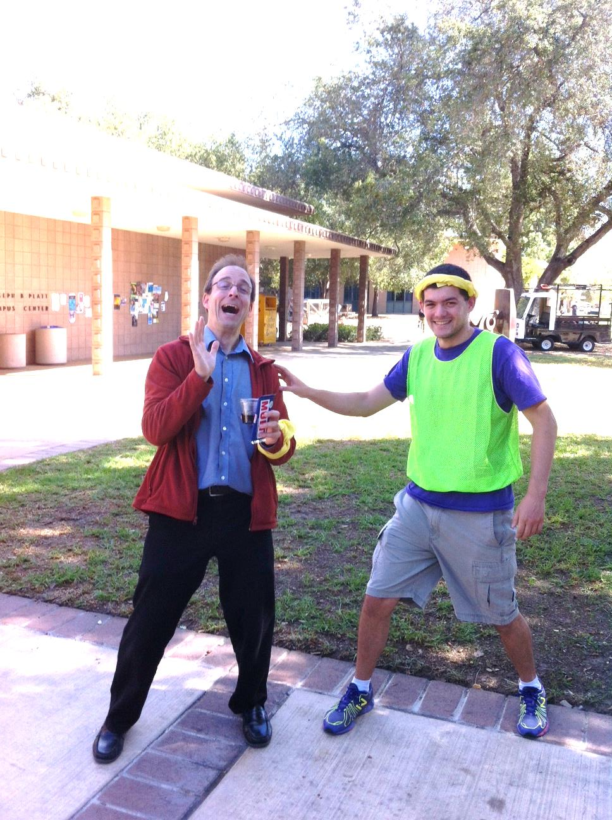
actual zombification…
Looks painful!
Past zombie run-ins… Not sure about the tie?!

Slide 58

Happy Oct 31!

Slide 59
Have a great Hallo-weekend!

Slide 60
Min price
Just call min ?
What's the idea for finding the smallest (minimum) price?
day
0
day
1
day
2
day
3
day
4
day
5
day
6
day
7
L = [ 40, 80, 10, 30, 27, 52, 5, 15 ]
m =
m is the "min so far"
track the value of the minimum so far as you loop over L

Slide 61
Min price vs. min day
day
0
day
1
day
2
day
3
day
4
day
5
day
6
day
7
L = [ 40, 80, 10, 30, 27, 52, 5, 15 ]
m = 40
m = 10
m = 5
5 is returned
def minprice( L ):
m = L[0]
for x in L:
if x < m:
m = x
return m
What about the day of the minimum price?

Slide 62
The TTS advantage!
Your stock's prices:
L = [ 40, 80, 10, 30, 27, 52, 5, 15 ]
The TTS investment strategy:
Day Price
0 40.0
1 80.0
2 10.0
3 30.0
4 27.0
5 52.0
6 5.0
7 15.0
to be realistic (for our VC backers), you must sell after you buy.

Slide 63
L
minday
return the index of L's minimum.
>>> minday( [9, 8, 5, 7, 42] )
2
0
1
2
3
4
index
def minday( L ):
m = L[0]
mndy = 0
for :
if < m:
m =
return mndy
How do we loop through the INDEX of each element?
How do we ensure m keeps track of the minimum?
How and where should we update mndy?
index-based loop

Slide 64
L
R
Write diff to return the smallest abs. diff. between any value from L and any value from R.
>>> diff( [42,3,7] , [6,0,-5] )
1
Only consider absolute differences.
L and R will be lists of numbers.
Hint: Adapt the nested loops below!
def diff( L, R ):
for x in range(3):
for y in range(3):
print x, y
Aha! Track the value of the minimum so far as you loop over L and R…

Slide 65
Min price
Just call min ?
What's the idea for finding the smallest (minimum) price?
day
0
day
1
day
2
day
3
day
4
day
5
day
6
day
7
L = [ 40, 80, 10, 30, 27, 52, 5, 15 ]
m =
m is the "min so far"
track the value of the minimum so far as you loop over L

Slide 66
Write mindiff to return the smallest abs. diff. between any two elements from L.
mindiff( [42,3,7,100,-9])
4
L
def diff( L, R ):
Hint: Use nested loops:
for x in range(4):
for y in range(4):
print abs(x-y),
Track the value of the minimum so far as you loop over L and R…

Slide 67
The read it and weep sequence
1
11
21
1211
111221
312211
??
str vs. int
When does the first 4 appear?
How fast do these terms grow?
Notes:
Next is: 13112221

Slide 68
Growth determined empirically…
1
11
21
1211
111221
312211
13112221
In the limit, the length of the Nth term of the read-it-and-weep sequence is
(1.303577...)
exponential growth
N
this base was found computationally by taking repeated ratios of term lengths...
Notes:
Next is: 13112221

Slide 69
Growth determined analytically…
λ = 1.30357726034296…
"Conway’s Constant" has an analytic definition!
It is the largest real root of this 71st-degree polynomial !!
the 71 roots (in the complex plane)
Notes:
Next is: 13112221

Slide 70
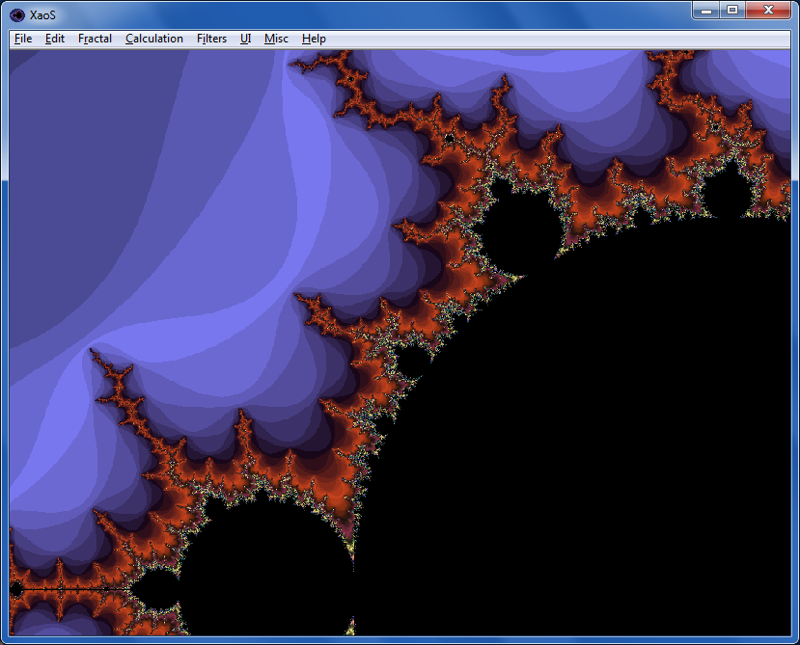

Fractals…
XaoS
fractal explorer
Python vs. C
Madi
Nova program on fractals:
Max

Slide 71

Google?

Slide 72
T. T. Securities (TTS)
Analyze a list of stock prices (given for a # of days in a row)
What's the idea for finding the smallest (minimum) price?
day
0
day
1
day
2
day
3
day
4
day
5
day
6
day
7
L = [ 40, 80, 10, 30, 27, 52, 5, 15 ]
m =
m is the "min so far"
track the value of the minimum so far as you loop over L

Slide 73
Just call min ?
Min price vs. min day
day
0
day
1
day
2
day
3
day
4
day
5
day
6
day
7
L = [ 40, 80, 10, 30, 27, 52, 5, 15 ]
def minprice( L ):
m = L[0]
for x in L:
if x < m:
m = x
return m
What about the day of the minimum price?

Slide 74
def main():
""" handles user input for our menu """
L = [30,10,20] # a starting list
while True:
menu() # print menu
uc = input('Which option? ')
if uc == 9:
elif uc == 1:
elif uc == 2:
#1 security "gotcha"
break exits the loop
(9) Quit!
use input to get a new L
(1) Get new list
(2) other…
other functions, as needed

Slide 75
Quiz
Return the smallest difference between one value from L and one value from R.
Alter this code to return the index of L's minimum.
Example:
L
Example:
L
R
>>> minday( [9,8,5,7,42] )
2
>>> diff( [7,3],[0,6] )
1
What does this code print?
HINT: track the day of the min in addition to the min value itself.
Only consider absolute differences.
for x in range(0,4):
for y in range(x,4):
print x, y
L and M will be lists of numbers
Hint: adapt the code at left...
def minday( L ):
m = L[0]
dom = 0 # day of min
for x in L:
if x < m:
m = x
return dom
def diff( L, R ):
You may want to change this loop!

Slide 76
>>> minday( [9,8,5,7,42] )
2
minday
def minday( L ):
m = L[0]
dom = 0
for x in L:
if x < m:
m = x
return dom
def minday( L ):
m = L[0]
dom = 0
for :
if < m:
m =
return dom
element-based loop
index-based loop

Slide 77
L
minday
return the index of L's minimum.
>>> minday( [9, 8, 5, 7, 42] )
2
0
1
2
3
4
index
def minday( L ):
minval = L[0]
minday = 0
RNG = range(len(L))
for i in RNG:
if < minval:
return minday
We loop through the INDEX of each element
How do we ensure minval tracks the minimum?
How and where should we update minday?
index-based loop

Slide 78
L
minday
return the index of L's minimum.
>>> minday( [9, 8, 5, 7, 42] )
2
0
1
2
3
4
index
Awkward!
def minday( L ):
mnvl = L[0]
mndy = 0
day = 0
for x in L:
if x < mnvl:
mnvl = x
mndy = day
day += 1
return mndy
Create a "counter" that will keep track of the current day.
IF we find a smaller min, save which day it was in mndy
Regardless, we add 1 to day so that we're keeping track!
element-based loop

Slide 79
What does this code print?
for x in range(0,4):
for y in range(x,4):
print x, y

Slide 80
for x in range(0,4):
for y in range(x,4):
print x, y
Example:
L
R
Hint: adapt this code
>>> diff( [7,3],[0,6] )
1
Return the minimum difference between one value from L and one value from M.
def diff( L, R ):
Only consider absolute differences.
L and M will be lists of numbers
SAME IDEA: track the value of the minimum so far as you loop over L

Slide 81
The TTS advantage!
Your stock's prices:
L = [ 40, 80, 10, 30, 27, 52, 5, 15 ]
The TTS investment strategy:
Day Price
0 40.0
1 80.0
2 10.0
3 30.0
4 27.0
5 52.0
6 5.0
7 15.0
to be realistic (for our VC backers), you must sell after you buy.

Slide 82
Have a great fall weekend!
extra_hour in [sleep,work,fun]:
True

Slide 83
T. T. Securities
(0) Input a new list
(1) Print the current list
(2) Find the average price
(3) Find the standard deviation
(4) Find the min and its day
(5) Find the max and its day
(6) Your TTS investment plan
(9) Quit
Enter your choice:
Software side …
Hardware side…
Investment analysis for the 21st century … and beyond!

Slide 84
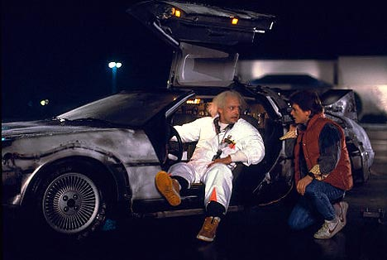
T. T. Securities
(0) Input a new list
(1) Print the current list
(2) Find the average price
(3) Find the standard deviation
(4) Find the min and its day
(5) Find the max and its day
(6) Your TTS investment plan
(9) Quit
Enter your choice:
Back to the future
Software side …
Hardware side…
Investment analysis for the 21st century … and beyond!

Slide 85

T. T. Securities
(0) Input a new list
(1) Print the current list
(2) Find the average price
(3) Find the standard deviation
(4) Find the min and its day
(5) Find the max and its day
(6) Your TTS investment plan
(9) Quit
Enter your choice:
Back to the future
Software side …
Hardware side…
Investment analysis for the 21st century … and beyond!

Slide 86
Mid-term feedback …
Don't put your name
I would love to know any thoughts you have about CS5 thus far in the term. In particular, how you feel about the time and effort CS5 requires…
On average, how much time per week do you spend on CS5 outside class + lab?
How does CS5's workload compare to other classes you're taking this term?
How would you judge the pace of CS5?
much lighter
about the same
much heavier
much too slow
about right
much too fast
Circle your year: First-year Sophomore Junior Senior Other
Later on today…
Something you'd keep about CS5 …?
Something you'd change about / get rid of / add to CS5 …?
Other thoughts optional, but 142% welcome:

Slide 87
feedback feedback
see 2012 feedback for a guide
Notes:
Next is: 13112221

Slide 88
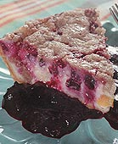

Homework 8
#2
Pi from Pie!
TT Securities Analysis, Inc.
#3
User-interaction
List-handling
Both for and while loops…
ASCII Art (extra)
#4

Slide 89
Extra (!) funky series
Harmonic Sequence:
1/1 + 1/2 + 1/3 + 1/4 + 1/5 + 1/6 + …
Without composites (primes only):
1/1 + 1/2 + 1/3 + 1/4 + 1/5 + 1/6 + 1/7 +…
Without 9’s…
1/1 + 1/2 + … + 1/8 + 1/9 + … +1/18 + 1/19 + … + 1/88 + 1/89 + 1/90 + 1/91 + …
Diverges!
???
???
Notes:
The harmonic series diverges (slowly); it's in today's lab. The primes-only series also diverges. But the no-9's series doesn't diverge. Why? Because as you get to big numbers, almost everything contains a 9, so the terms become sparse!

Slide 90
Quiz
Return the min difference between one value from X and one value from Y.
Alter this code to return the index of L's minimum.
Example:
Example:
>>> minday( [9,8,5,42] )
2
What does this code print?
>>> diff( [7,3],[0,6] )
1
HINT: track the index of the min in addition to the min value itself.
Only consider absolute differences.
for x in range(3):
for y in range(3):
print x, y
X and Y will be lists of numbers
Hint: adapt this code
def minday( L ):
min = L[0]
for x in L:
if x < min:
min = x
return
def diff( X, Y ):
You may want to change the loop!

Slide 91
Alter this code to return the index of L's minimum.
Example:
>>> mini( [9,8,1,7] )
2
def mini( L ):
min = L[0]
for x in L:
if x < min:
min = x
return
def mini( L ):
min = L[0]
for :
if < min:
min =
return
SAME LOOP
INDEX-BASED LOOP
returning both??

Slide 92
What does this code print?
for x in range(3):
for y in range(3):
print x, y

Slide 93
for x in range(3):
for y in range(3):
print x, y
Example:
Hint: adapt this code
>>> diff( [7,3],[0,6] )
1
Return the minimum difference between one value from X and one value from Y.
def diff( X, Y ):
Only consider absolute differences.
X and Y will be lists of numbers

Slide 94
“Quiz”
Finish these two methods…
This method returns the sum of the elements in the input array.
public static double sum(double[] A)
{
double s = 0.0;
for (
{
}
return s;
}
This method returns the average of the elements in the input array.
public static double average(double[] A)
“Extra Credit”: How concise can this method be?

Slide 95
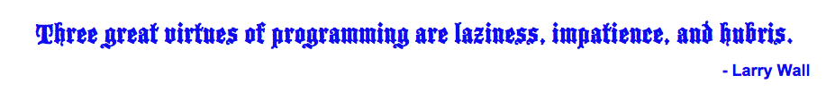
Procrastination Programming
Every while loop can be a while True: loop!
- just be sure to break!

Slide 96
Give me a break !
import random
escape = 0
while True:
print 'Help! Let me out!'
escape = random.choice([41,42,43])
if escape == 42:
break
print 'At last!'
I'll figure out later how to get out of this loop!
OK – I'll stop the loop now and continue with the code after the loop
compare return

Slide 97
This method returns the maximum element from the input array.
public static double max(double[] A)
Extra: What is something unusual and unrelated to CS 5 that you & the person next to you have in common ?!

Slide 98
Loopy thinking
0
1
2
3
4
5
6
7
8
9
10
11
12
13
14
15
16
17
18
s = 'gattacaaggtaaaatgca'
How could we find the number of 'a's ? How about 'a's and 't's?
How could we find the number of 'ta's ?
How could we find the longest sequence of 'a's ?
Notes:
ctg repeats…

Slide 99
Loopy thinking
0
1
2
3
4
5
6
7
8
9
10
11
12
13
14
15
16
17
18
s = 'gattacaaggtaaaatgca'
s = 'gattacaaggtaaaatgca'
N = 0
for i in range(0,len(s)):
if s[i] == 'a':
N = N + 1
print 'N is', N
How could we find the number of 'a's ? How about 'a's and 't's?
How could we find the number of 'ta's ?
How could we find the longest sequence of 'a's ?
Notes:
Electric: from www.staticfreesoftware.com
My tutorial is at:
http://odin.ac.hmc.edu/~harris/class/chipdesign/electric.pdf
Lasergene (a molecular biology suite of programs for aligning and comparing
DNA sequences, etc.)
Statview (statistical analysis)
KaleidaGraph (plotting & graphing)
Populus (programs that simulate ecological and evolutionary processes)

Slide 100
Loopy thinking
0
1
2
3
4
5
6
7
8
9
10
11
12
13
14
15
16
17
18
s = 'gattacaaggtaaaatgca'
s = 'gattacaaggtaaaatgca'
N = 0
for i in range(0,len(s)):
if s[i] == 'a' or s[i] == 't':
N = N + 1
print 'N is', N
How could we find the number of 'a's ? How about 'a's and 't's?
How could we find the number of 'ta's ?
How could we find the longest sequence of 'a's ?
Notes:
Electric: from www.staticfreesoftware.com
My tutorial is at:
http://odin.ac.hmc.edu/~harris/class/chipdesign/electric.pdf
Lasergene (a molecular biology suite of programs for aligning and comparing
DNA sequences, etc.)
Statview (statistical analysis)
KaleidaGraph (plotting & graphing)
Populus (programs that simulate ecological and evolutionary processes)

Slide 101
Loopy thinking
0
1
2
3
4
5
6
7
8
9
10
11
12
13
14
15
16
17
18
s = 'gattacaaggtaaaatgca'
s = 'gattacaaggtaaaatgca'
N = 0
for i in range(1,len(s)):
if s[i] == 'a' and s[i-1] == 't':
N = N + 1
print 'N is', N
How could we find the number of 'a's ? How about 'a's and 't's?
How could we find the number of 'ta's ?
How could we find the longest sequence of 'a's ?
Notes:
Electric: from www.staticfreesoftware.com
My tutorial is at:
http://odin.ac.hmc.edu/~harris/class/chipdesign/electric.pdf
Lasergene (a molecular biology suite of programs for aligning and comparing
DNA sequences, etc.)
Statview (statistical analysis)
KaleidaGraph (plotting & graphing)
Populus (programs that simulate ecological and evolutionary processes)

Slide 102
Loopy thinking
0
1
2
3
4
5
6
7
8
9
10
11
12
13
14
15
16
17
18
s = 'gattacaaggtaaaatgca'
How could we find the longest sequence of 'a's ?
Notes:
Electric: from www.staticfreesoftware.com
My tutorial is at:
http://odin.ac.hmc.edu/~harris/class/chipdesign/electric.pdf
Lasergene (a molecular biology suite of programs for aligning and comparing
DNA sequences, etc.)
Statview (statistical analysis)
KaleidaGraph (plotting & graphing)
Populus (programs that simulate ecological and evolutionary processes)

Slide 103
Planning in "pseudocode"
0
1
2
3
4
5
6
7
8
9
10
11
12
13
14
15
16
17
18
s = 'gattacaaggtaaaatgca'
Keep track of CurRun, MaxRun
Loop through the string:
if we do see an 'a'
if the PREVIOUS letter is NOT an 'a'
if the PREVIOUS letter IS an 'a'
Notes:
Electric: from www.staticfreesoftware.com
My tutorial is at:
http://odin.ac.hmc.edu/~harris/class/chipdesign/electric.pdf
Lasergene (a molecular biology suite of programs for aligning and comparing
DNA sequences, etc.)
Statview (statistical analysis)
KaleidaGraph (plotting & graphing)
Populus (programs that simulate ecological and evolutionary processes)

Slide 104
Planning in "pseudocode"
0
1
2
3
4
5
6
7
8
9
10
11
12
13
14
15
16
17
18
s = 'gattacaaggtaaaatgca'
Keep track of CurRun, MaxRun
Loop through the string:
if we do see an 'a'
if the PREVIOUS letter is NOT an 'a'
Start a Run! CurRun = 1
if the PREVIOUS letter IS an 'a'
Continue our run! CurRun = CurRun + 1
Check for a new maximum…
Notes:
Electric: from www.staticfreesoftware.com
My tutorial is at:
http://odin.ac.hmc.edu/~harris/class/chipdesign/electric.pdf
Lasergene (a molecular biology suite of programs for aligning and comparing
DNA sequences, etc.)
Statview (statistical analysis)
KaleidaGraph (plotting & graphing)
Populus (programs that simulate ecological and evolutionary processes)

Slide 105
Planning in "pseudocode"
0
1
2
3
4
5
6
7
8
9
10
11
12
13
14
15
16
17
18
s = 'gattacaaggtaaaatgca'
Keep track of CurRun, MaxRun
MAX = 0
cur = 0
for i in range(0,len(s)):
if s[i] == 'a':
if s[i-1] != 'a':
cur = 1
else:
cur = cur + 1
if cur > MAX:
MAX = cur
print 'Max is', MAX
Loop through the string:
if we do see an 'a'
if the PREVIOUS letter is NOT an 'a'
Start a Run!
if the PREVIOUS letter IS an 'a'
Continue our run!
Check for a new maximum…
Notes:
Electric: from www.staticfreesoftware.com
My tutorial is at:
http://odin.ac.hmc.edu/~harris/class/chipdesign/electric.pdf
Lasergene (a molecular biology suite of programs for aligning and comparing
DNA sequences, etc.)
Statview (statistical analysis)
KaleidaGraph (plotting & graphing)
Populus (programs that simulate ecological and evolutionary processes)

Slide 106
Challenge
Print the first N numbers in this series…
>>> fib(11)
Example:
1 1 2 3 5 8 13 21 34 55 89

Slide 107
Write an index-based loop to print the first N terms of
Write any loop to print the first N terms of
N terms total
N terms total
7 9 11 13 15 17 …
0 1 2 3 6 7 14 15 30
def seven(N):
for i in range(N):
feel free to add an accumulator, if you'd like!
Quiz, part 2

Slide 108

Looping inside loops!

Slide 109
input vs. raw_input
reply = raw_input('Enter a string and I\'ll tell you what I see.')
for c in reply:
print 'I see a(n) ', c
interprets what the user types as a string of characters
reply = input('Enter any list and I\'ll tell you what I see.')
for c in reply:
print 'I see a(n) ', c
processes what the user types just as python would

Slide 110
Monte Carlo π
Hw8 Pr3
A engineering challenge: to estimate π using everyday items...

Slide 111
Easy as π
(1,1)
Visualize:
(-1,-1)

Slide 112
CS 5: Putting Loops to Work
A
[ -35, -24, -13, -2, 9, 20, 31, ? ]
B
[ 26250, 5250, 1050, 210, ? ]
C
[ 1, 11, 21, 1211, 111221, ? ]
D
[ 2, 22, 222, ? ]
E
[ 90123241791111 , 93551622, 121074, 3111, ? ]
Which ? is unlike the others?

Slide 113
CS 5: Putting Loops to Work
A
[ -35, -24, -13, -2, 9, 20, 31, ? ]
B
[ 26250, 5250, 1050, 210, ? ]
C
[ 1, 11, 21, 1211, 111221, ? ]
D
[ 2, 22, 222, ? ]
E
[ 90123241791111 , 93551622, 121074, 3111, ? ]
Which sequences act numeric -- and which ones act like strings ?

Slide 114
User Input
meters = raw_input('How many m? ')
cm = meters * 100
print 'That is', cm, 'cm.'
If we type 42, what will python print for this # of cm ?
A
D
something < 0
something > 42
B
C
E
0
42
an error

Slide 115
Fix #2: use input instead
meters = input('How many m? ')
cm = meters * 100
print 'That is', cm, 'cm.'
input interprets its input
raw_input always returns a string
I always use input -- but don't "quote" me on that.

Slide 116


Brots… !
Will P.

