Slide 1
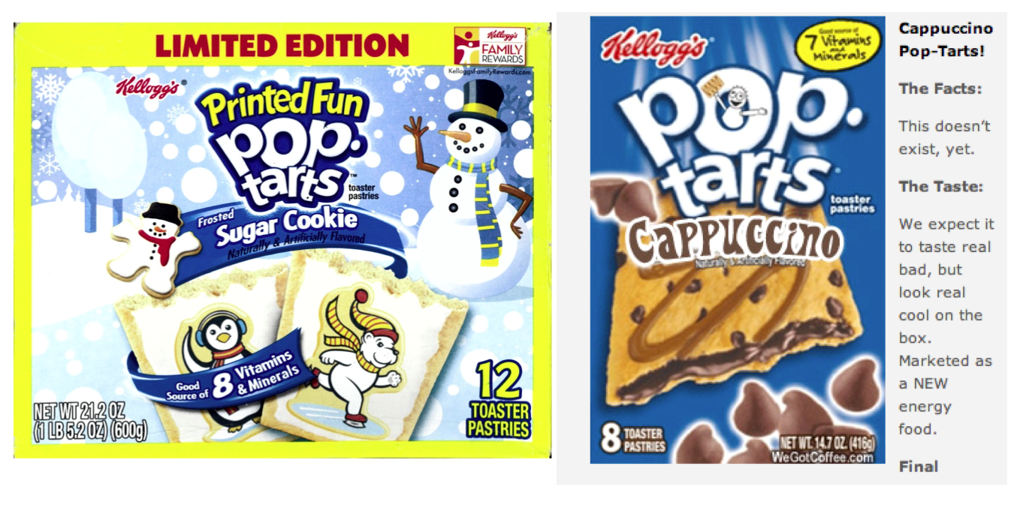
'pop tarts' > 'candy'
Official CS5 snack comparison
pop-tart recursion!
But this should exist!

Slide 2
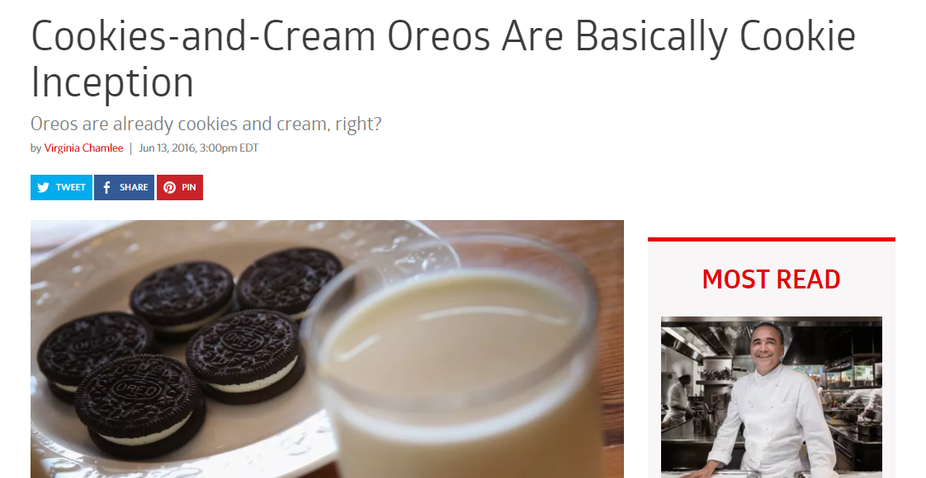
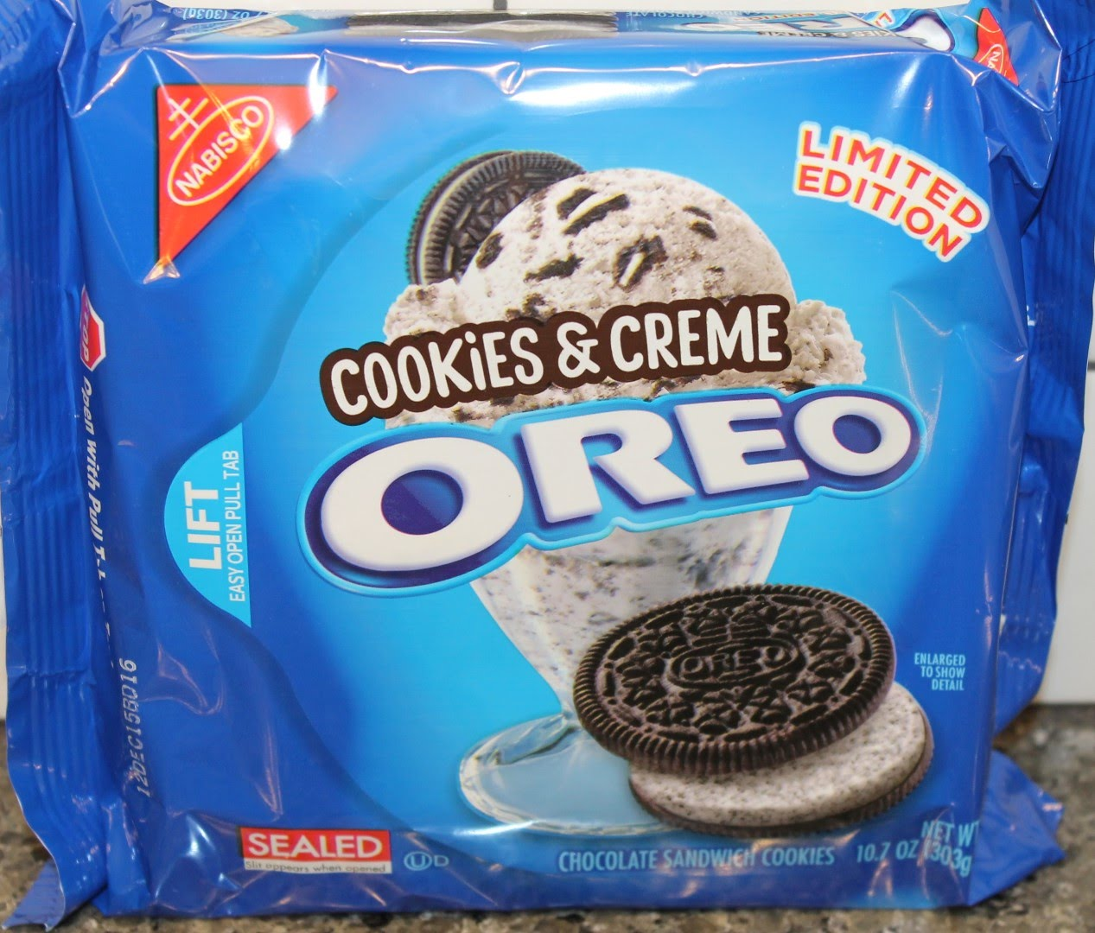
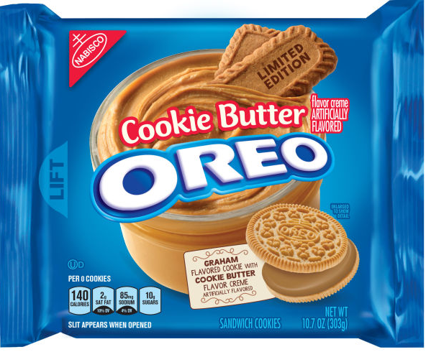
Recursive foods!
or, at least, cookies...

Slide 3
Mid-term feedback …
Don't put your name
I would love to know any thoughts you have about CS5 thus far in the term. In particular, how you feel about the time and effort CS5 requires…
On average, how much time per week do you spend on CS5 outside class + lab?
How does CS5's workload compare to other classes you're taking this term?
How would you judge the pace of CS5?
much lighter
about the same
much heavier
much too slow
about right
much too fast
Circle your year: First-year Sophomore Junior Senior Other
Something you'd keep about CS5 …?
Later today
Something you'd change about / get rid of / add to CS5 …?
Other thoughts optional, but 142% welcome:

Slide 4
Mid-term feedback …
Don't put your name
I would love to know any thoughts you have about CS5 thus far in the term. In particular, how you feel about the time and effort CS5 requires…
On average, how much time per week do you spend on CS5 outside class + lab?
How does CS5's workload compare to other classes you're taking this term?
How would you judge the pace of CS5?
much lighter
about the same
much heavier
much too slow
about right
much too fast
Circle your year: First-year Sophomore Junior Senior Other
Looking back...
Something you'd keep about CS5 …?
Looking forward...
Something you'd change about / get rid of / add to CS5 …?
Other thoughts optional, but 142% welcome:

Slide 5
This Thursday will be the CS 5 in-class midterm
Un-warnings:
accommodations? Edwards available, early + late ...
worries? concerns? See me…
five problems, written
worth 1 hw assignment
score worries? Extra extra-credit in hw9 and beyond
Suggestions:
go over in-class exercises and hwk problems
create a page of notes, 2-sided is OK
consider small variations of old problems – and how they would change the solutions…
only 5 minutes? Try list comprehensions & LoLs!

Slide 6
Ex. Cr. #1: Read-it-and-weep
1
11
21
1211
111221
312211
13112221
…
In the limit, the length of the Nth term of the read-it-and-weep sequence is
(1.303577...)
exponential growth
N
this base was found computationally by taking repeated ratios of term lengths...
growth determined empirically...
Notes:
Next is: 13112221

Slide 7
Growth determined analytically…
λ = 1.30357726034296…
"Conway's Constant" has an analytic definition!
It is the largest real root of this 71st-degree polynomial !!
the 71 roots (complex plane)
This seems frightening...!
http://www.njohnston.ca/2010/10/a-derivation-of-conways-degree-71-look-and-say-polynomial/
Notes:
Next is: 13112221

Slide 8
CS 60?
Same as CS5
2 x the work
Much harder
2+ languages
(define (whoami n)
(if (= n 0)
1
(* n (whoami (- n 1)))))
Racket
Who is whoami ?
public static int whoami(int n)
{
if (n<2) return 1;
else return n * whoami(n-1);
}
Java
O( N )
O( N² )
O( 2^{N} )
Runtime!
fast!
medium
slow...
How efficient is whoami ?

Slide 9
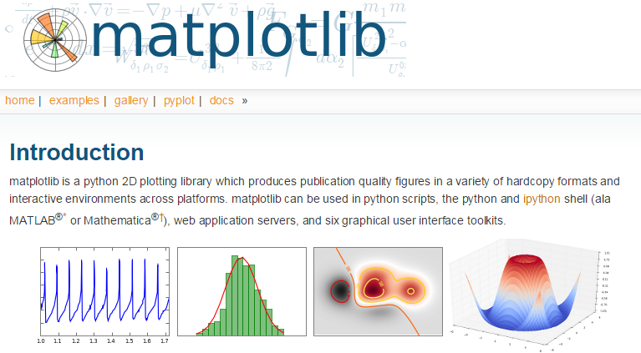
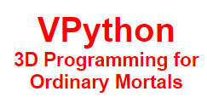
CS 35?
Same as CS5
2 x the work
Much harder
8-10 libraries

Slide 10
Other CS Courses @ HMC?
CS 60
CS, Principles and Practice
CS for Computer Scientists and/or Software Engineers...
vs. cs5?
CS 35
CS for Insight... i.e., insight toward non-CS disciplines
"Python Scripting for All"
vs. cs5?
Check out non-Mudd opportunities, as well...

Slide 11
CS5 Rules
z = z ² + c
Simple rules can yield complex results!
The rule: Don't follow this rule.
Midterm
review problems online
acc? we have add'l rooms for Thu. …
content? only through hw8

Slide 12
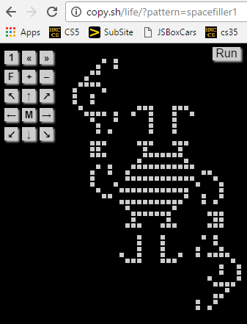
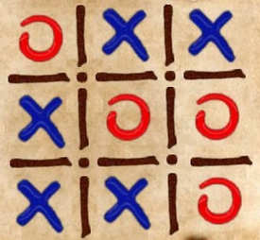
CS5 Rules
A "monster" of a game!
2D Data - but a zero-player game!
Run!
z = z ² + c
HW 9 (lab + #2 + #2b)
Simple rules can yield complex results!
due Mon. 11/11
The rule: Don't follow this rule.
Midterm
review problems online
acc? we have add'l rooms for Thu. …
content? only through hw8
Three-in-a-row? Aliens rule at this…

Slide 13
2D Data
DData!
Math + CS: shareful siblings!

Slide 14
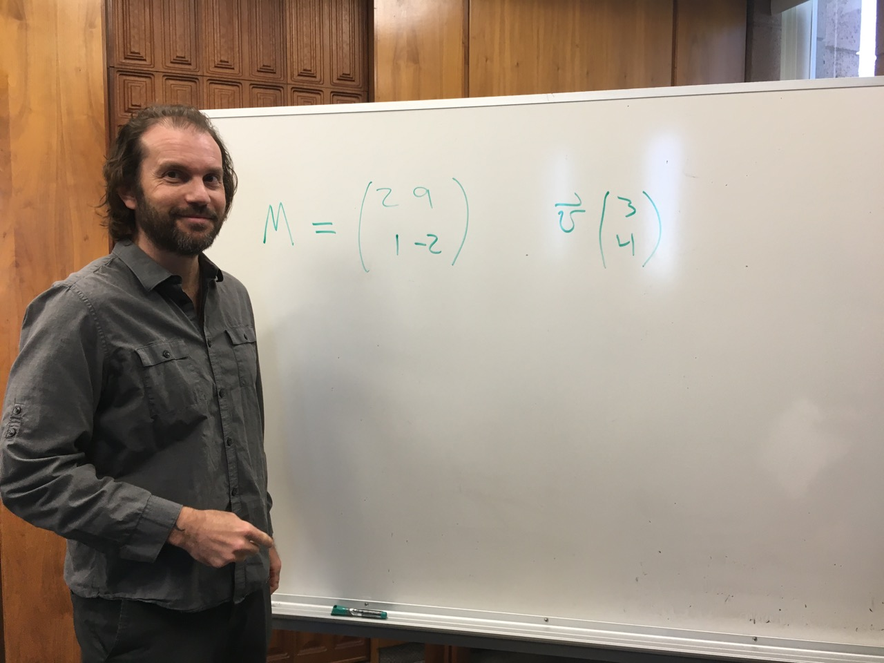
2D Data
DData!
Math + CS: shareful siblings!

Slide 15
2D Data
DData!
Math + CS: shareful siblings!

Slide 16
2D Data
DData!
Math + CS: shareful siblings!

Slide 17
2D data
ddata!
M[1][0]
M[0][0]
M[1][1]
M[0][1]
M = [[2,9], [1,-2]]
M[0]
M[1]
Math + CS: shareful siblings!

Slide 18
2D data
ddata!
M[1][0]
M[0][0]
M[1][1]
M[0][1]
M = [[2,9], [1,-2]]
M[0]
M[1]
Handling 2D data requires no new rules!
Math + CS: shareful siblings!

Slide 19
In CS, rules rule!
(1a) Lists are handled "by reference"
(1b) Numbers and strings are handled "by value"
(2) Functions receive inputs "by copy"
two rules,
"interesting" results!

Slide 20
In CS, rules rule!
(1a) Lists are handled "by reference"
"Reference"
"Pointer"
id
L = [5,42,'hi']
s = 'hi'
42,042
5
42
'hi'
'hi'
L
s
L[0]
L[1]
L[2]
(1b) Numbers and strings are handled "by value"
(2) Functions receive inputs "by copy"
The contents of the variable's "box" in memory are copied.
def main():
fav = 7
f(fav)
7
def f(x):
7
fav
x
x is a copy of fav

Slide 21
Reference vs. Value
Python's two methods for handling data
"Reference"
"Pointer"
id
s = 'hi'
x = 7
L = [5,42,'hi']
42,042
'hi'
7
5
42
'hi'
L
s
x
L[0]
L[1]
L[2]
Lists are handled by reference:
L really holds a memory address
Numeric data and strings are handled by value: imagine they hold the data
L = [5,42,'hi']; id(L) ...
s = 'hi'; id(s) ...
x = 7; id(x) ...

Slide 22
Shallow vs. Deep
Python's two methods for copying data
"Reference"
"Pointer"
id
L = [5,42,'hi']
L = [5,42,'hi']
42,042
5
42
'hi'
M = L
L
L[0]
L[1]
L[2]
M[0] = 60
What's L[0] ?!
M
= assignment is "shallow"

Slide 23
Shallow vs. Deep
Python's two methods for copying data
from copy import *
"Reference"
"Pointer"
id
L = [5,42,'hi']
L = [5,42,'hi']
42,042
5
42
'hi'
M = deepcopy(L)
L
L[0]
L[1]
L[2]
M[0] = 60
42,042
What's L[0] ?!
M
deepcopy is deep!

Slide 24
Shallow vs. Deep
Python's two methods for copying data
from copy import *
"Reference"
"Pointer"
id
L = [5,42,'hi']
L = [5,42,'hi']
42,042
5
42
'hi'
M = L[:]
L
L[0]
L[1]
L[2]
M[0] = 60
42,042
What's L[0] ?!
M
slicing is also deep!
but only one-level
import antigravity!

Slide 25
shallow
Python functions: pass by copy
^
def conform(fav)
fav = 42
return fav
fav
def main()
print(" Welcome! ")
fav = 7
fav = conform(fav)
print(" My favorite # is", fav)
7
fav

Slide 26
shallow
Python functions: pass by copy
^
def conform(fav)
fav = 42
return fav
7
fav
copy of fav
"pass by copy" means the contents of fav are copied to fav
def main()
print(" Welcome! ")
fav = 7
fav = conform(fav)
print(" My favorite # is", fav)
7
fav
But what if the underlined part were absent… ?

Slide 27
Try it!
Rules rule!?
Trace each f'n. What do main1, main2, and main3 print?
Numbers: by value.
Lists: by reference.
Function calls copy.
Thought experiments: Don't hand this in…
def conform1(fav)
fav = 42
return fav
def conform2(L)
L = [42,42]
return L
def conform3(L)
L[0] = 42
L[1] = 42
fav
L
L
7
7
11
7
11
fav
42042
42042
L
L[0]
L[1]
L
L[0]
L[1]
def main1()
fav = 7
conform1(fav)
print(fav)
def main2()
L = [7,11]
conform2(L)
print(L)
def main3()
L = [7,11]
conform3(L)
print(L)
Notice that there are NO assignment statements after these function calls! The return values aren't being used…

Slide 28
Lists are Mutable
You can change the contents of lists from within functions that take lists as input.
- Lists are MUTABLE objects
Those changes will be visible everywhere.
Numbers, strings, etc. are IMMUTABLE – they can't be changed, only reassigned.

Slide 29
Different approaches to "rules" …
Engineers
Physicists
Mathematicians
Different "rules"
mean
Different "worldviews…"
CS?

Slide 30
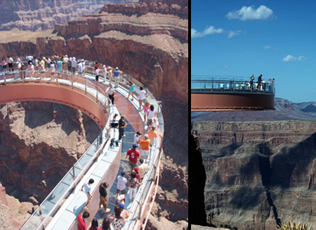
equations, relationships, formulas, etc.
Engineers believe their rules approximate reality;
Safety margins!
Grand Canyon Skywalk

Slide 31
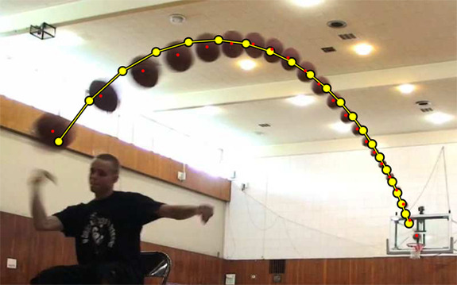
equations, relationships, formulas, etc.
Engineers believe their rules approximate reality;
Physicists believe reality approximates their rules…
^
measured
Image forensics' verdict:
Faked!
Not a parabola, so not a real shot!
http://www.youtube.com/watch?feature=player_embedded&v=WbaH52JI3So
http://www.fourandsix.com/blog/2011/8/29/seriously-amazing-beer-pong-shots.html

Slide 32
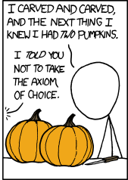
Engineers believe their rules approximate reality;
Physicists believe reality approximates their rules…
Mathematicians are happy either way!
A solid sphere can be split into 5 parts and rigidly reassembled into two solid spheres the same size as the original
Banach-Tarski paradox
Banach-Tarski XKCD
the parts are "clouds"
https://www.youtube.com/watch?v=s86-Z-CbaHA @ 18:49

Slide 33
Engineers believe equations approximate reality;
Physicists believe reality approximates equations…
Mathematics reasons about structural rules…
… CS reasons about procedural ones.
for
lists
Data
Data
while
variables
Axioms
arithmetic operations
Definitions
if/else
proofs
programs
Insights, tools, mathematical truths
Insights, tools, algorithms
Math worldview
CS worldview

Slide 34
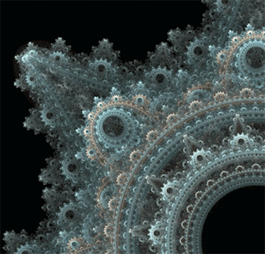
Engineers believe their rules approximate reality;
Physicists believe reality approximates their rules…
Mathematicians are happy either way!
CS?
Don't like your reality? Build a new one!
why settle for gears, when you could have fractal gears?
why settle for structured patterns? Self-propagating patterns!
https://en.wikipedia.org/wiki/File:Conways_game_of_life_breeder_animation.gif

Slide 35
2D data?
All and only the rules that govern 1D data apply here – no new rules to learn!
~ pure composition

Slide 36
Lists ~ 1D data
A = [ 42, 75, 70 ]
What does A "look like" ?
len(A) ?
id(A) ?
id(A[0]) ?
1D lists are familiar – but lists can hold ANY kind of data – including lists!

Slide 37
Lists ~ 1D data
A = [ 42, 75, 70 ]
42
75
70
list
int
int
int
A
len(A) ?
id(A) ?
id(A[0]) ?
1D lists are familiar – but lists can hold ANY kind of data – including lists!

Slide 38
2D data as lists of lists...
A = [ [1,2,3,4], [5,6], [7,8,9,10,11] ]
What does this A "look like" ?
Where's 3?
len(A)
len(A[0])
Replace 10 with 42.
len(A[1])

Slide 39
2D data as lists of lists...
A = [ [1,2,3,4], [5,6], [7,8,9,10,11] ]
1
2
3
4
list
list
A[0][0]
A[0][1]
A[0][3]
A
A[0]
A[0][2]
5
6
list
A[1][0]
A[1][1]
A[2][3] = 42
A[1]
7
8
9
10
11
list
A[2]
A[2][0]
A[2][1]
A[2][2]
A[2][3]
A[2][4]
4
Where's 3?
len(A)
len(A[0])
Replace 10 with 42.
3
len(A[1])
2

Slide 40
Rectangular 2D data
A = [ [0,0,0,0], [0,0,0,0], [0,0,0,0] ]
Original data...
0
0
0
0
list
list
A
A[0]
A[0][0]
0
0
42
0
list
A[1]
A[1][2]
row == 1
0
0
0
0
list
A[2]
col == 2
A[2][3]
A[1][2] = 42
row r
col c
A[r][c] = value
row == 1
col == 2

Slide 41
Rectangular 2D data
Original data...
A = [ [0,0,0,0], [0,0,0,0], [0,0,0,0] ]
0
0
0
0
list
list
A
A[0]
A[0][0]
0
0
0
0
list
A[1]
0
0
0
0
list
A[2]
A[2][3]
NROWS = len(A) # HEIGHT
NCOLS = len(A[0]) # WIDTH
for r in range( 0,NROWS ):
for c in range( 0,NCOLS ):
if r == c: A[r][c] = 4
else: A[r][c] = 2
Nested Loops ~ 2d Data

Slide 42
2 in-a-row ?
A = [ [4, 2, 2, 2],
[2, 2, 4, 4],
[2, 4, 4, 2] ]
def two_in_a_row(A):
""" what's happening ? """
NROWS = len(A)
NCOLS = len(A[0])
B = deepcopy( A )
for r in range( 0,NROWS ):
for c in range( 0,NCOLS ):
if c == NCOLS-1:
B[r][c] = False
elif A[r][c] == A[r][c+1]:
B[r][c] = True
else:
B[r][c] = False
A
row 0
4 2 2 2
2 2 4 4
2 4 4 2
row 1
row 2
col 0
col 1
col 2
col 3
B
After feedback...
Challenge:
How could we change the code above to check for two-in-a-row SOUTHWARD -- or DIAGONALLY !?
What does two_in_a_row(A) place into B?

Slide 43
Mid-term feedback …
Don't put your name
I would love to know any thoughts you have about CS5 thus far in the term. In particular, how you feel about the time and effort CS5 requires…
On average, how much time per week do you spend on CS5 outside class + lab?
How does CS5's workload compare to other classes you're taking this term?
How would you judge the pace of CS5?
much lighter
about the same
much heavier
much too slow
about right
much too fast
Circle your year: First-year Sophomore Junior Senior Other
Something you'd keep about CS5 …?
Start here...
Something you'd change about / get rid of / add to CS5 …?
Other thoughts optional, but 142% welcome:

Slide 44
Mid-term feedback …
Don't put your name
I would love to know any thoughts you have about CS5 thus far in the term. In particular, how you feel about the time and effort CS5 requires…
On average, how much time per week do you spend on CS5 outside class + lab?
How does CS5's workload compare to other classes you're taking this term?
How would you judge the pace of CS5?
much lighter
about the same
much heavier
much too slow
about right
much too fast
Circle your year: First-year Sophomore Junior Senior Other
Something you'd keep about CS5 …?
Something you'd change about / get rid of / add to CS5 …?
Other thoughts optional, but 142% welcome:

Slide 45
2 in-a-row ?
A = [ [4, 2, 2, 2],
[2, 2, 4, 4],
[2, 4, 4, 2] ]
def two_in_a_row(A):
""" what's happening ? """
NROWS = len(A)
NCOLS = len(A[0])
B = deepcopy( A )
for r in range( 0,NROWS ):
for c in range( 0,NCOLS ):
if c == NCOLS-1:
B[r][c] = False
elif A[r][c] == A[r][c+1]:
B[r][c] = True
else:
B[r][c] = False
A
row 0
4 2 2 2
2 2 4 4
2 4 4 2
row 1
row 2
col 0
col 1
col 2
col 3
B
Challenge:
How could we change the code above to check for two-in-a-row SOUTHWARD -- or DIAGONALLY !?
What does two_in_a_row(A) place into B?

Slide 46
hw9pr2…
A = [ [4, 2, 2, 2],
[2, 2, 4, 4],
[2, 4, 4, 2] ]
def two_in_a_row(A):
""" what happens here ? """
NROWS = len(A)
NCOLS = len(A[0])
B = deepcopy( A )
for r in range( 0,NROWS ):
for c in range( 0,NCOLS ):
if c == NCOLS-1:
B[r][c] = False
elif A[r][c] == A[r][c+1]:
B[r][c] = True
else:
B[r][c] = False
A
row 0
4 2 2 2
2 2 4 4
2 4 4 2
row 1
row 2
col 0
col 1
col 2
col 3
on the far edge!
2 in a row eastward – yes!
B
not 2 in a row
F T T F
T F T F
F T F F
Challenge:
How could we change the code above to check for two-in-a-row SOUTHWARD or DIAGONALLY !?!
What two_in_a_row(A) places into B...

Slide 47
hw9pr2…
A = [ [4, 2, 2, 2],
[2, 2, 4, 4],
[2, 4, 4, 2] ]
Use as your hw9pr2 starting point... !
def two_in_a_row(A):
""" what happens here ? """
NROWS = len(A)
NCOLS = len(A[0])
B = deepcopy( A )
for r in range( 0,NROWS ):
for c in range( 0,NCOLS ):
if c == NCOLS-1:
B[r][c] = False
elif A[r][c] == A[r][c+1]:
B[r][c] = True
else:
B[r][c] = False
A
row 0
4 2 2 2
2 2 4 4
2 4 4 2
row 1
row 2
col 0
col 1
col 2
col 3
on the far edge!
2 in a row eastward – yes!
B
not 2 in a row
F T T F
T F T F
F T F F
Challenge:
How could we change the code above to check for two-in-a-row SOUTHWARD or DIAGONALLY !?!
What two_in_a_row(A) places into B...

Slide 48
First, try it by eye…
… then, on hw9pr2, w/Python!
col 0
col 1
col 2
col 3
col 4
A = [ [' ','X','O',' ','O'],
['X','X','X','O','O'],
[' ','X','O','X','O'],
['X','O','O',' ','X'] ]
row 0
row 1
row 2
row 3
the data doesn't wrap around
start row
start col
checker
LoL
inarow_3east('X', 1, 0, A)
True
inarow_3south('O', 0, 4, A)
inarow_3southeast('X', 2, 3, A)
inarow_3northeast('X', 3, 1, A)

Slide 49
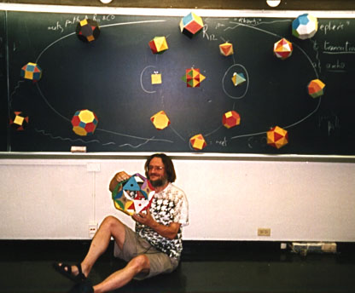
hw9pr1 (lab): Conway's Game of Life
1995
?
John Conway
20˚
10˚
Geometer @ Princeton
60˚
70˚
(no trig)
simple rules ~ surprising behavior
not really solitaire...
1970

Slide 50
Lab Problem: Conway's Game of Life
Grid World
Evolutionary rules
red cells are "alive"
Everything depends on a cell's eight neighbors
2
1
3
Exactly 3 neighbors give birth to a new, live cell.
4
5
6
7
8
Exactly 2 or 3 neighbors keep an existing cell alive.
Any other # of neighbors and the central cell dies…
Only 2 rules
white cells are empty

Slide 51
Lab Problem: Conway's Game of Life
"Parent generation"
Grid World
Evolutionary rules
red cells are "alive"
Everything depends on a cell's eight neighbors
Exactly 3 neighbors give birth to a new, live cell.
rule 1
Exactly 2 or 3 neighbors keep an existing cell alive.
Any other # of neighbors and the central cell dies…
white cells are empty

Slide 52
Lab Problem: Conway's Game of Life
"Child generation"
Grid World
Evolutionary rules
red cells are "alive"
Everything depends on a cell's eight neighbors
Exactly 3 neighbors give birth to a new, live cell.
Exactly 2 or 3 neighbors keep an existing cell alive.
Any other # of neighbors and the central cell dies…
white cells are empty
rule 2

Slide 53
Lab Problem: Conway's Game of Life
"Grandchild generation"
Grid World
Evolutionary rules
red cells are alive
Everything depends on a cell's eight neighbors
What's next?
Exactly 3 neighbors give birth to a new, live cell.
Exactly 2 or 3 neighbors keep an existing cell alive.
Any other # of neighbors and the central cell dies…
white cells are empty

Slide 54
Lab Problem: Creating life
next_life_generation( A )
For each cell…
3 live neighbors – life!
2 live neighbors – same
0, 1, 4, 5, 6, 7, or 8 live neighbors – death
computed all at once, not cell-by-cell, so the ? at left does NOT come to life, but ? does!
?
?
http://www.math.com/students/wonders/life/life.html

Slide 55
Lab Problem: Creating life
next_life_generation( A )
old generation is the input, A
returns the next generation
0
1
2
3
4
5
0
1
2
3
4
5
0
0
1
1
2
2
?
3
3
4
4
5
5

Slide 56
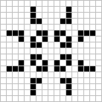
Lab Problem: Creating life
Stable configurations:
"rocks"
Periodic
"plants"
period 2
period 3
Self-propagating
"animals"
glider
Copperhead: 2016

Slide 57
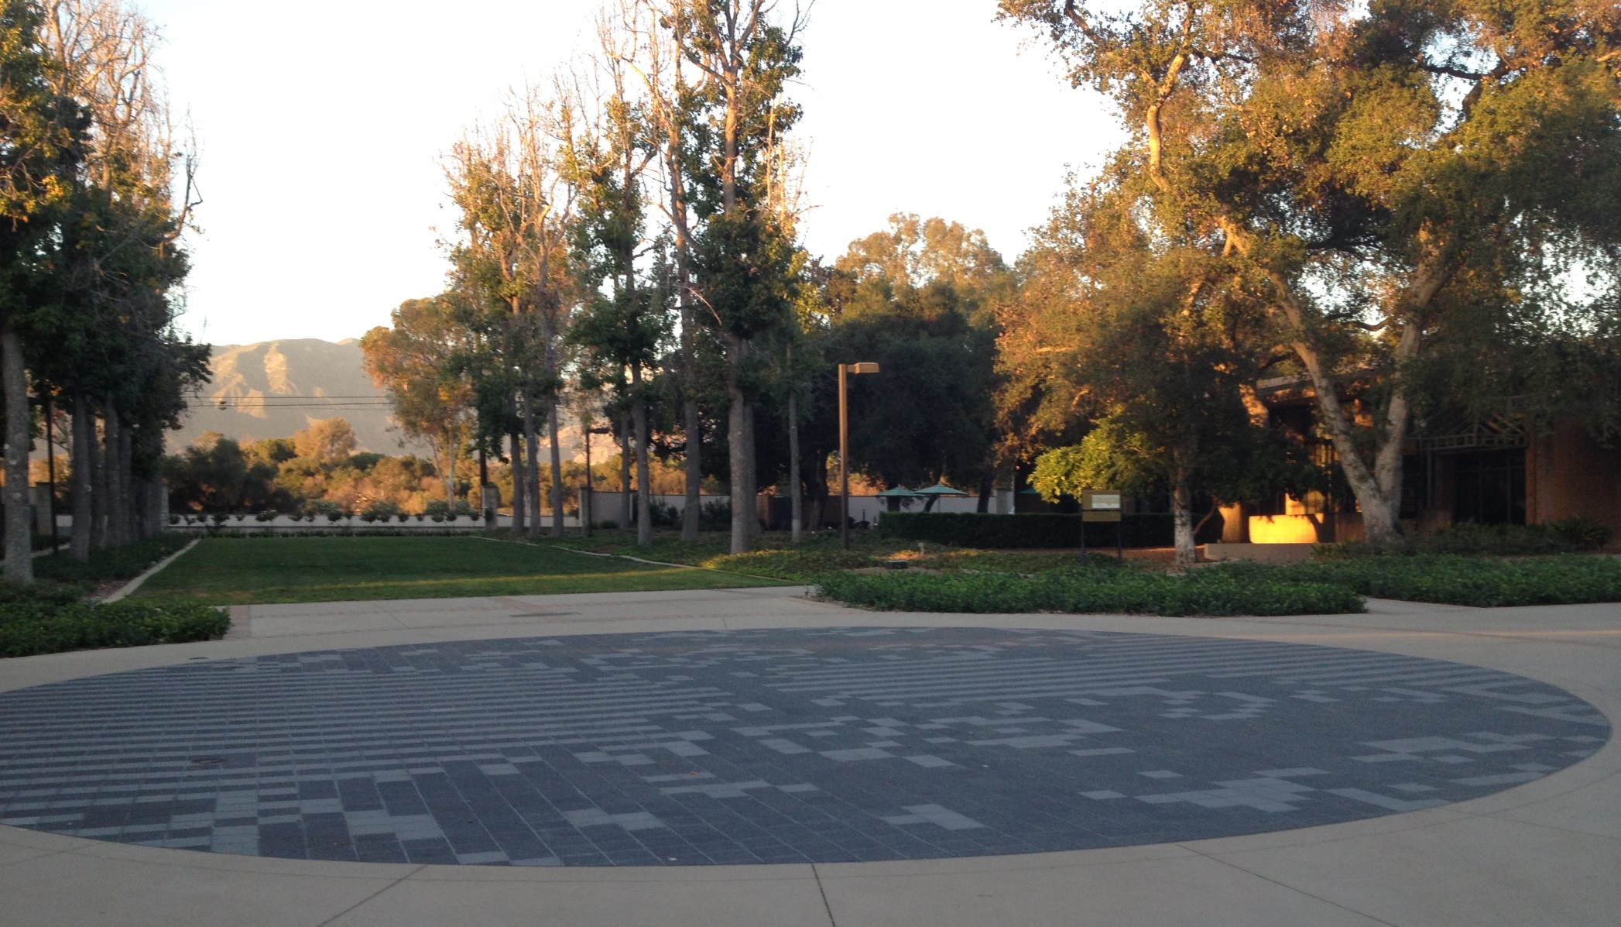
Life @ HMC?
Stable configurations:
"rocks"
Periodic
"plants"
period 2
period 3
Self-propagating
"animals"
glider
Copperhead: 2016

Slide 58
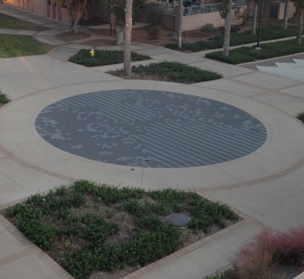
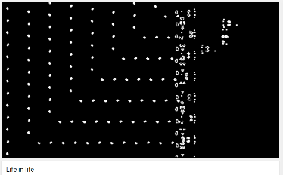
Life @ HMC!
Life, universally!
www.youtube.com/watch?v=xP5-iIeKXE8

Slide 59
Lab Problem: Creating life
Many life configurations expand forever…
"Gosper glider gun"
"glider"
What is the largest amount of the life universe that can be filled with cells?
How sophisticated can Life-structures get?
www.ibiblio.org/lifepatterns/

Slide 60
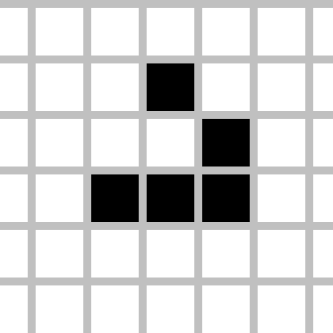
Today you'll be
Lifing it up
in lab!
so
on over…
glide

Slide 62
Try it!
Rules rule!?
Trace each f'n. What do main1, main2, and main3 print?
Numbers: by value.
Lists: by reference.
Function calls copy.
Thought experiments: Don't hand this in…
def conform1(fav)
fav = 42
return fav
def conform2(L)
L = [42,42]
return L
def conform3(L)
L[0] = 42
L[1] = 42
fav
L
L
7
7
11
7
11
fav
42042
42042
L
L[0]
L[1]
L
L[0]
L[1]
def main1()
fav = 7
conform1(fav)
print(fav)
def main2()
L = [7,11]
conform2(L)
print(L)
def main3()
L = [7,11]
conform3(L)
print(L)
Notice that there are NO assignment statements after these function calls! The return values aren't being used…

Slide 63
In CS, rules rule!
(1a) Lists are handled "by reference"
"Reference"
"Pointer"
id
L = [5,42,'hi']
s = 'hi'
42,000,042
5
42
'hi'
'hi'
L
s
L[0]
L[1]
L[2]
(1b) Numbers and strings are handled "by value"
The contents of the variable's "box" in memory are copied.
(2) Functions receive inputs "by copy"
in main:
fav = 7
f(fav)
7
def f(x):
7
fav
x
x is a copy of fav

Slide 64
Reference vs. Value
Python's two methods for handling data
"Reference"
"Pointer"
id
s = 'hi'
x = 7
L = [5,42,'hi']
42,000,042
'hi'
7
5
42
'hi'
L
s
x
L[0]
L[1]
L[2]
Lists are handled by reference:
L really holds a memory address
Numeric data and strings are handled by value: imagine they hold the data
L = [7,8,9]; id(L) ...
x = 9001; id(x) ...
s = 'wow!'; id(s) ...

Slide 65
Python functions: pass by copy
def conform(fav)
fav = 42
return fav
fav
def main()
print(" Welcome! ")
fav = 7
fav = conform(fav)
print(" My favorite # is", fav)
7
fav

Slide 66
Python functions: pass by copy
def conform(fav)
fav = 42
return fav
7
fav
copy of fav
"pass by copy" means the contents of fav are copied to fav
def main()
print(" Welcome! ")
fav = 7
fav = conform(fav)
print(" My favorite # is", fav)
7
fav
But what if the underlined part were absent… ?

Slide 67
Try it!
Rules rule!?
Trace each f'n. What do main1, main2, and main3 print?
Numbers: by value.
Lists: by reference.
Function calls copy.
Thought experiments: Don't hand this in…
def conform1(fav)
fav = 42
return fav
def conform2(L)
L = [42,42]
return L
def conform3(L)
L[0] = 42
L[1] = 42
fav
L
L
7
7
11
7
11
fav
L
L[0]
L[1]
L
L[0]
L[1]
def main1()
fav = 7
conform1(fav)
print(fav)
def main2()
L = [7,11]
conform2(L)
print(L)
def main3()
L = [7,11]
conform3(L)
print(L)
Notice that there are NO assignment statements after these function calls! The return values aren't being used…

Slide 68
Try it!
Rules rule!?
Just thought experiments: Don't hand this in…
Trace each f'n. What will main1, main2, and main3 print?
def conform1(fav)
fav = 42
return fav
def conform2(L)
L = [42,42]
return L
def conform3(L)
L[0] = 42
L[1] = 42
fav
L
L
7
7
11
7
11
fav
L
L[0]
L[1]
L
L[0]
L[1]
def main1()
fav = 7
conform1(fav)
print fav
def main2()
L = [7,11]
conform2(L)
print L
def main3()
L = [7,11]
conform3(L)
print L
Notice that there are NO assignment statements after these function calls! The return values aren't being used…

Slide 69
Lists are Mutable
You can change the contents of lists in functions that take those lists as input.
- Lists are MUTABLE objects
Those changes will be visible everywhere.
Numbers, strings, etc. are IMMUTABLE – they can't be changed, only reassigned.

Slide 70
Differing approaches to rules …
Engineers
Physicists
different worldviews…
Mathematicians
CS?

Slide 71
equations, relationships, formulas, etc.
Engineers believe their rules approximate reality;
Safety margins!
Grand Canyon Skywalk

Slide 72
equations, relationships, formulas, etc.
Engineers believe their rules approximate reality;
Physicists believe reality approximates their rules…
^
measured
Image forensics' verdict:
Fake!
Not a parabola, so not a real shot!
http://www.youtube.com/watch?feature=player_embedded&v=WbaH52JI3So
http://www.fourandsix.com/blog/2011/8/29/seriously-amazing-beer-pong-shots.html

Slide 73
Engineers believe their rules approximate reality;
Physicists believe reality approximates their rules…
Mathematicians don't care either way!
A solid sphere can be split into 5 parts and rigidly reassembled into two solid spheres the same size as the original
Banach-Tarski paradox
Banach-Tarski XKCD
the parts are "clouds"
https://www.youtube.com/watch?v=s86-Z-CbaHA @ 18:49

Slide 74
Engineers believe their rules approximate reality;
Physicists believe reality approximates their rules…
Mathematicians don't care either way!
CS?
Don't like your reality? Build a new one!
why settle for gears, when you could have fractal gears?
plain patterns? Self-propagating patterns!
https://en.wikipedia.org/wiki/File:Conways_game_of_life_breeder_animation.gif

Slide 75
Engineers believe equations approximate reality;
Physicists believe reality approximates equations…
Mathematics reason about structural rules…
… and CSers reason about procedural ones.
for
lists
Data
Data
while
variables
Axioms
arithmetic operations
Definitions
if/else
proofs
programs
Insights, tools, mathematical truths
Insights, tools, algorithms
math worldview
CS worldview

Slide 76
2D data!
All and only the rules that govern 1D data apply here – no new rules to learn!
~ pure composition

Slide 77
Lists ~ 2D data
A = [ 42, 75, 70 ]
42
75
70
list
int
int
int
A
1D lists are familiar – but lists can hold ANY kind of data – including lists!

Slide 78
Lists ~ 2D data
A = [ [1,2,3,4], [5,6], [7,8,9,10,11] ]
1
2
3
4
list
list
A[0][0]
A[0][1]
A[0][3]
A
A[0]
?
5
6
list
A[1][0]
A[1][1]
A[1]
7
8
9
10
11
list
A[2]
A[2][0]
A[2][1]
A[2][2]
A[2][3]
A[2][4]
Where's 3?
len(A[0])
len(A)
Replace 10 with 42.
len(A[1])

Slide 79
Rectangular 2D data
A = [ [0,0,0,0], [0,0,0,0], [0,0,0,0] ]
0
0
0
0
list
list
Original data...
A
A[0]
A[0][0]
0
0
0
0
list
A[1]
0
0
0
0
list
A[2]
A[2][3]
To try…
NROWS = len(A)
NCOLS = len(A[0])
for r in range( 0,NROWS ):
for c in range( 0,NCOLS ):
if r == c: A[r][c] = 4
else: A[r][c] = 2
What will this do?

Slide 80
(*) For up to two points! of extra credit on the midterm… Pair up with s/o you don't know (or not well) and find something you have in common…
after trying this, look over the midterm-review together!
A = [ [4, 2, 2, 2],
[2, 2, 4, 4],
[8, 3, 3, 1] ]
Names:
Thing in common:
def mystery(A):
""" what happens to A ? """
NROWS = len(A)
NCOLS = len(A[0])
for r in range( 0,NROWS ):
for c in range( 0,NCOLS ):
if r == c:
A[r][c] += 1
else:
A[r][c] *= 2
A
Before
row 0
4 2 2 2
2 2 4 4
8 3 3 1
row 1
row 2
col 0
col 1
col 2
col 3
A
After
Starting with the 2d array A above, write the values in A after running that code:
Above, write the resulting values in A
Challenge:
Then, how could you change the code above to create a True where the original value was equal to its neighbor to the right?! (False, if there's no neighbor or a different neighbor.)
F T T F
T F T F
F T F F

Slide 81
M.T. Review
(*) For up to two points! of extra credit on the midterm… Pair up with s/o you don't know (or don't know well) and find something unusual you have in common…
See also the gold review @ the cs5 site
Names:
Picobot! There are NO Picobot questions on the exam…
Recursion!!
You should feel confident you could create recursive functions to solve small problems, e.g., scrabble-scoring, finding a sum or a max or a min, computing power or factorial (or variations)
You should be comfortable manipulating lists and strings (indexing, slicing, slicing with a "stride")
You should understand how to use, read, and compose list comprehensions , e.g., LC = [ x**2 for x in L ]
You should be able to design solutions using the "list of lists" technique (LoL), which uses list comprehensions, e.g., to find the highest scrabble-scoring word among a list or the lowest scrabble-scoring of encipherings. Basic syntax: LoL = [ [sc(x),x] for x in L ]
You should understand the use-it-or-lose-it design strategy, e.g., the LCS, jotto, exact_change, and sort homework problems:
Turtle graphics will not be on the exam
Know the difference between print and return !!
Look over how you composed larger programs out of smaller ones + how inputs and outputs are used, e.g., for Caesar Cipher
Representing Data!!!
Remind yourself of the various types of data (int, str, float, etc.), how they're different and how to convert between types
Know how characters are represented with chr and ord
Be comfortable with base-2 arithmetic (and base 10!), along with how to convert from base to base (no balanced ternary)
Remind yourself of how the bits of a base-2 number influence its value – for example, what do right- and left-shifting do?
Thing in common:
Then, read over these & look for ones least familiar…
Circuits and Assembly!!!!
Know how the basic logic gates operate (AND and OR for any # of inputs , NOT for 1 input only)
Know how minterm expansion works (an OR of ANDs, each selecting one input) and how it enables the engineering of any circuit at all, given its truth-table specification
You should be comfortable using subcircuits (e.g., using the four-bit adders in the four-bit multiplier, or the individual pieces of the divider)
You should be able to write simple looping programs in Hmmm, e.g., factorial, power, Fibonacci, sum, max, min …
You should know what the stack is, what load and store do at the high-level (officially, they're named storer and loadr) - and why they're useful for implementing functions in Hmmm – only broadly speaking
The exam will not ask you to implement recursion or stack-based functions in Hmmm, however – only looping + conditional examples.
It will have a full Hmmm reference (your don't need your own)
Loops
You should feel comfortable with how for loops (both element-based and index-based) and while loops work – and be able to compose small functions that use them, e.g., ones similar to those in the pi-estimation and TT securities (statistics) problems.
You should understand what continue and break do within loops.
You should understand how nested loops work and be able to read or compose examples (such as the TTS strategy or our in-class problems)
I <3 three-eyed punctuation!
!
!
You may use functions from class and hw on the exam without reimplementing them. Here are some, but not all, of them:
removeOne( e, L ), removeAll( e, L ), removeUpto( e, L ), count( e, L ), ind( e, L ), frontNum( L ), binToNum( binstr ), numToBin( n ), …

Slide 82
hw9pr2…
A = [ [4, 2, 2, 2],
[2, 2, 4, 4],
[2, 4, 4, 2] ]
def inarow_2east(A):
""" what happens to A ? """
NROWS = len(A)
NCOLS = len(A[0])
for r in range( 0,NROWS ):
for c in range( 0,NCOLS ):
if c == NCOLS-1:
A[r][c] = False
elif A[r][c] == A[r][c+1]:
A[r][c] = True
else:
A[r][c] = False
A
Before
row 0
4 2 2 2
2 2 4 4
2 4 4 2
row 1
row 2
right edge!
col 0
col 1
col 2
col 3
2 in a row
not 2 in a row
F T T F
T F T F
F T F F
Challenge:
Then, how could you change the code above to create a True where the original value was equal to its neighbor to the right?! (False, if there's no neighbor or a different neighbor.)

Slide 83
First, try it by eye…
… then, on hw9pr2, by Python!
col 0
col 1
col 2
col 3
col 4
A = [ [' ','X','O',' ','O'],
['X','X','X','O','O'],
[' ','X','O','X','O'],
['X','O','O',' ','X'] ]
row 0
row 1
row 2
row 3
the data doesn't wrap around
start row
start col
checker
LoL
inarow_3east('X', 1, 0, A)

Slide 84
First, try it by eye…
… then, on hw9pr2, by Python!
col 0
col 1
col 2
col 3
col 4
A = [ [' ','X','O',' ','O'],
['X','X','X','O','O'],
[' ','X','O','X','O'],
['X','O','O',' ','X'] ]
row 0
row 1
row 2
row 3
the data doesn't wrap around
start row
start col
checker
LoL
inarow_3east('X', 1, 0, A)
True
inarow_3south('O', 0, 4, A)
inarow_3southeast('X', 2, 3, A)
inarow_3northeast('X', 3, 1, A)

Slide 85
hw9pr1 (lab): Conway's Game of Life
Geometer @ Princeton
1995
?
20˚
10˚
John Conway
60˚
70˚
(no trig)
simple rules ~ surprising behavior
1970

Slide 86
Lab Problem: Conway's Game of Life
Grid World
Evolutionary rules
red cells are "alive"
Everything depends on a cell's eight neighbors
2
1
3
Exactly 3 neighbors give birth to a new, live cell.
4
5
6
7
8
Exactly 2 or 3 neighbors keep an existing cell alive.
Only 3 rules
Any other # of neighbors and the central cell dies…
white cells are empty

Slide 87
Lab Problem: Conway's Game of Life
Grid World
Evolutionary rules
red cells are "alive"
Everything depends on a cell's eight neighbors
Exactly 3 neighbors give birth to a new, live cell.
Exactly 2 or 3 neighbors keep an existing cell alive.
Any other # of neighbors and the central cell dies…
white cells are empty

Slide 88
Lab Problem: Conway's Game of Life
Grid World
Evolutionary rules
red cells are "alive"
Everything depends on a cell's eight neighbors
Exactly 3 neighbors give birth to a new, live cell.
Exactly 2 or 3 neighbors keep an existing cell alive.
Any other # of neighbors and the central cell dies…
white cells are empty

Slide 89
Lab Problem: Conway's Game of Life
Grid World
Evolutionary rules
red cells are alive
Everything depends on a cell's eight neighbors
Exactly 3 neighbors give birth to a new, live cell.
Exactly 2 or 3 neighbors keep an existing cell alive.
What's next?
Any other # of neighbors and the central cell dies…
white cells are empty

Slide 90
Lab Problem: Creating life
next_life_generation( A )
For each cell…
3 live neighbors – life!
2 live neighbors – same
0, 1, 4, 5, 6, 7, or 8 live neighbors – death
computed all at once, not cell-by-cell, so the ? at left does NOT come to life!
?
http://www.math.com/students/wonders/life/life.html

Slide 91
Lab Problem: Creating life
next_life_generation( A )
old generation is the input, A
returns the next generation
0
1
2
3
4
5
0
1
2
3
4
5
0
0
1
1
2
2
?
3
3
4
4
5
5

Slide 92
Lab Problem: Creating life
Stable configurations:
"rocks"
Periodic
"plants"
period 2
period 3
Self-propagating
"animals"
glider
Copperhead: 2016

Slide 93
Lab Problem: Creating life
Many life configurations expand forever…
"Gosper glider gun"
"glider"
What is the largest amount of the life universe that can be filled with cells?
How sophisticated can Life-structures get?
www.ibiblio.org/lifepatterns/

Slide 94
Life @ HMC
Stable configurations:
"rocks"
Periodic
"plants"
period 2
period 3
Self-propagating
"animals"
glider

Slide 95
Life @ HMC
Life, universally!
www.youtube.com/watch?v=xP5-iIeKXE8

Slide 96
Today you'll be
Lifing it up
in lab!
so
on over…
glide

Slide 97
M.T. Review
(*) For up to two points! of extra credit on the midterm… Pair up with s/o you don't know (or don't know well) and find something unusual you have in common…
See also the gold review @ the cs5 site
Names:
Picobot! There are NO Picobot questions on the exam…
Recursion!!
You should feel confident you could create recursive functions to solve small problems, e.g., scrabble-scoring, finding sum or max or min, computing power or factorial (or variations)
You should be comfortable manipulating lists and strings (indexing, slicing, slicing with a "stride")
You should understand how to use, read, and compose list comprehensions , e.g., LC = [ x**2 for x in L ]
You should be able to design solutions using the "list of lists" technique (LoL), which uses list comprehensions, e.g., to find the highest scrabble-scoring word among a list or the lowest scrabble-scoring of a shifted string. Basic syntax: LoL = [ [sc(x),x] for x in L ]
You should understand the use-it-or-lose-it design strategy, e.g., the LCS, jotto, and sort homework problems:
Turtle graphics will not be on the exam
Do know the difference between print and return !!
Look over how you composed larger programs out of smaller ones + how inputs and outputs are used, e.g., for Caesar Cipher
Representing Data!!!
Remind yourself of the various types of data (int, str, float, etc.), how they're different and how to convert between types
Know how characters are represented with chr and ord
Be comfortable with base-2 arithmetic (and base 10!), along with how to convert from base to base (no balanced ternary)
Remind yourself of how the bits of a base-2 number influence its value – what do right- and left-shifting do?
Thing in common:
Then, read over these & look for ones least familiar…
Circuits and Assembly!!!!
Know how the basic logic gates operate (AND and OR for any # of inputs , NOT for 1 input only)
Know how minterm expansion works (an OR of ANDs, each selecting one input) and how it enables the engineering of any circuit at all, given its truth-table specification
You should be comfortable using subcircuits (e.g., using the four-bit adders in the four-bit multiplier, or the individual pieces of the divider)
You should be able to write simple looping programs in Hmmm, e.g., factorial, power, Fibonacci, …
You should know what the stack is, what load and store do at the high-level (officially, they're named storer and loadr) - and why they're useful for implementing functions in Hmmm - broadly speaking
The exam will not ask you to implement recursion or stack-based functions in Hmmm, however – only looping + conditional examples.
It will have a full Hmmm reference (your don't need your own)
Loops
You should feel comfortable with how for loops (both element-based and index-based) and while loops work – and be able to compose small functions that use them, e.g., ones similar to those in the pi-estimation and TT securities (statistics) problems.
You should understand how nested loops work and be able to read or compose examples (such as the TTS strategy or our in-class problems)
I <3 three-eyed punctuation!
!
!
You may use functions from class and hw on the exam without reimplementing them. Here are some, but not all, of them:
removeOne( e, L ), removeAll( e, L ), removeUpto( e, L ), count( e, L ), ind( e, L ), frontNum( L ), binToNum( binstr ), numToBin( n ), …

Slide 99
Try it!
Rules rule!?
Just thought experiments: Don't hand this in…
Trace each f'n. What will main1, main2, and main3 print?
def conform1(fav)
fav = 42
return fav
def conform2(L)
L = [42,42]
return L
def conform3(L)
L[0] = 42
L[1] = 42
fav
L
L
7
7
11
7
11
fav
L
L[0]
L[1]
L
L[0]
L[1]
def main1()
fav = 7
conform1(fav)
print fav
def main2()
L = [7,11]
conform2(L)
print L
def main3()
L = [7,11]
conform3(L)
print L
Notice that there are NO assignment statements after these function calls! The return values aren't being used…

Slide 100
Lists ~ 2D data
A = [ [1,2,3,4], [5,6], [7,8,9,10,11] ]
1
2
3
4
list
list
A[0][0]
A[0][1]
A[0][3]
A
A[0]
?
5
6
list
A[1][0]
A[1][1]
A[1]
7
8
9
10
11
list
A[2]
A[2][0]
A[2][1]
A[2][2]
A[2][3]
A[2][4]
Where's 3?
len(A[0])
len(A)
Replace 10 with 42.

Slide 101
Rectangular 2D data
A = [ [1,2,3,4], [5,6,7,8], [9,0,1,2] ]
1
2
3
4
list
list
A
A[0]
A[0][0]
5
6
7
8
list
A[1]
9
0
1
2
list
A[2]
A[2][3]
To try…
What is A[1][2]?
What does each component of A[1][2] mean ?
How many rows does A have, in general ?
How many columns does A have, in general ?

Slide 102
Try it…
A = [ [4, 2, 2, 2],
[2, 2, 4, 4],
[2, 4, 4, 2] ]
def mystery(A):
""" what happens to A ? """
NROWS = len(A)
NCOLS = len(A[0])
for r in range( 0,NROWS ):
for c in range( 0,NCOLS ):
if A[r][c]%4 == 0:
A[r][c] = 1
else:
A[r][c] += 1
A
Before
row 0
4 2 2 2
2 2 4 4
2 4 4 2
row 1
row 2
col 0
col 1
col 2
col 3
Starting with the 2d array A shown above, write the values in A after running the code?
Then, how would you change the code to produce a True where the original value is equal to its neighbor to the right?! (False, if no neighbor or a different neighbor.)
Write in the resulting values in A:
A
Challenge:
F T T F
T F T F
F T F F
After – with the code as written…

Slide 103
hw9pr2
A = [ [4, 2, 2, 2],
[2, 2, 4, 4],
[2, 4, 4, 2] ]
def inarow_2east(A):
""" what happens to A ? """
NROWS = len(A)
NCOLS = len(A[0])
for r in range( 0,NROWS ):
for c in range( 0,NCOLS ):
if c < NCOLS-1:
if A[r][c] == A[r][c+1]:
A[r][c] = True
else:
A[r][c] = False
A
Before
row 0
4 2 2 2
2 2 4 4
2 4 4 2
row 1
row 2
col 0
col 1
col 2
col 3
Challenge:
F T T F
T F T F
F T F F
How would you change the code to produce a True where the original value is equal to its neighbor to the right?!
(False, if no neighbor or a different neighbor.)

Slide 104
Differing approaches to rules …
Engineers
Physicists
different worldviews…
Mathematicians
CS?

Slide 105
"the rules"
Engineers believe equations approximate reality;
Safety margins!
Grand Canyon Skywalk

Slide 106
Engineers believe equations approximate reality;
Physicists believe reality approximates equations…
Image forensics' verdict:
Fake!
Not a parabola, so not a real shot!
http://www.youtube.com/watch?feature=player_embedded&v=WbaH52JI3So
http://www.fourandsix.com/blog/2011/8/29/seriously-amazing-beer-pong-shots.html

Slide 107
Engineers believe equations approximate reality;
Physicists believe reality approximates equations…
Mathematicians don't care either way!
A solid sphere can be split into 5 parts and rigidly reassembled into two solid spheres the same size as the original
Banach-Tarski paradox
Banach-Tarski XKCD
the parts are "clouds"

Slide 108
Engineers believe equations approximate reality;
Physicists believe reality approximates equations…
Mathematicians don't care either way!
CS?
Don't like your reality? Build a new one!
why settle for gears, when you could have fractal gears?

Slide 109
Engineers believe equations approximate reality;
Physicists believe reality approximates equations…
Mathematics reason about structural rules…
… and CSers reason about procedural ones.
for
lists
Data
Data
while
variables
Axioms
arithmetic operations
Definitions
if/else
proofs
programs
Insights, tools, mathematical truths
Insights, tools, algorithms
math worldview
CS worldview

Slide 110
First, try it by eye…
… then, on hw9pr2, by Python!
col 0
col 1
col 2
col 3
col 4
A = [ [' ','X','O',' ','O'],
['X','X','X','O','O'],
[' ','X','O','X','O'],
['X','O','O',' ','X'] ]
row 0
row 1
row 2
row 3
the data doesn't wrap around
start row
start col
checker
LoL
inarow_3east('X', 1, 0, A)

Slide 111
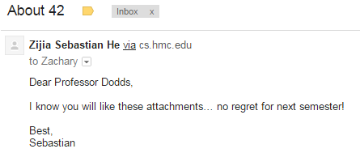
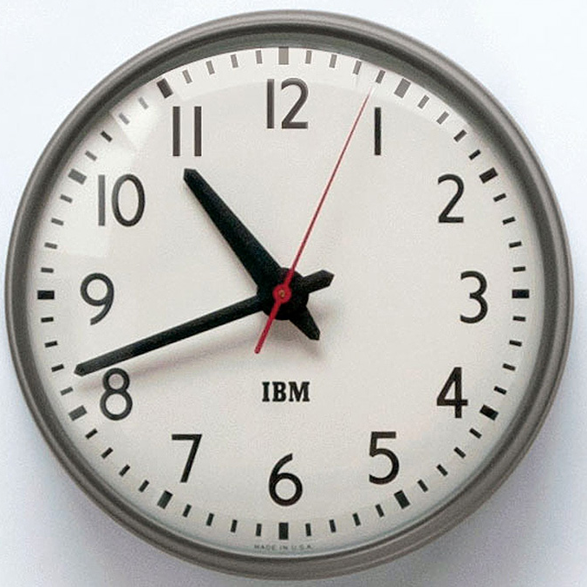
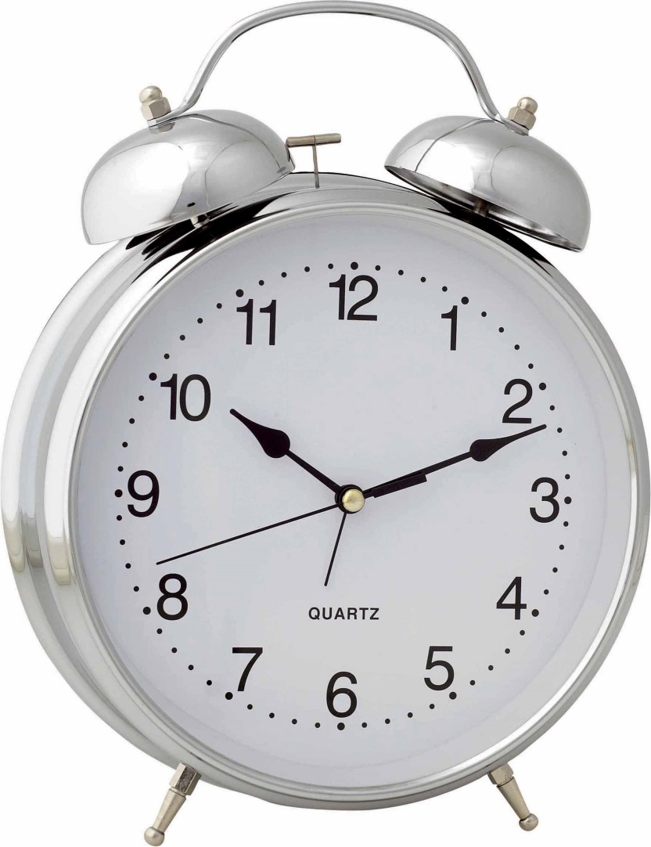
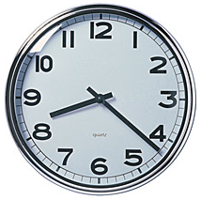

Slide 112
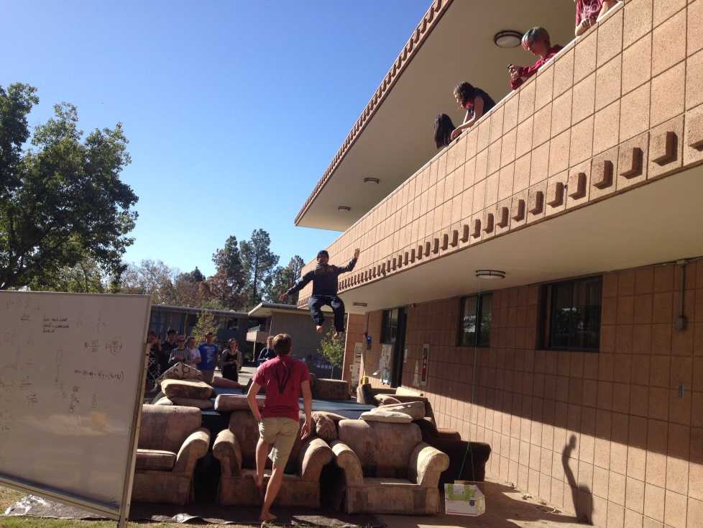
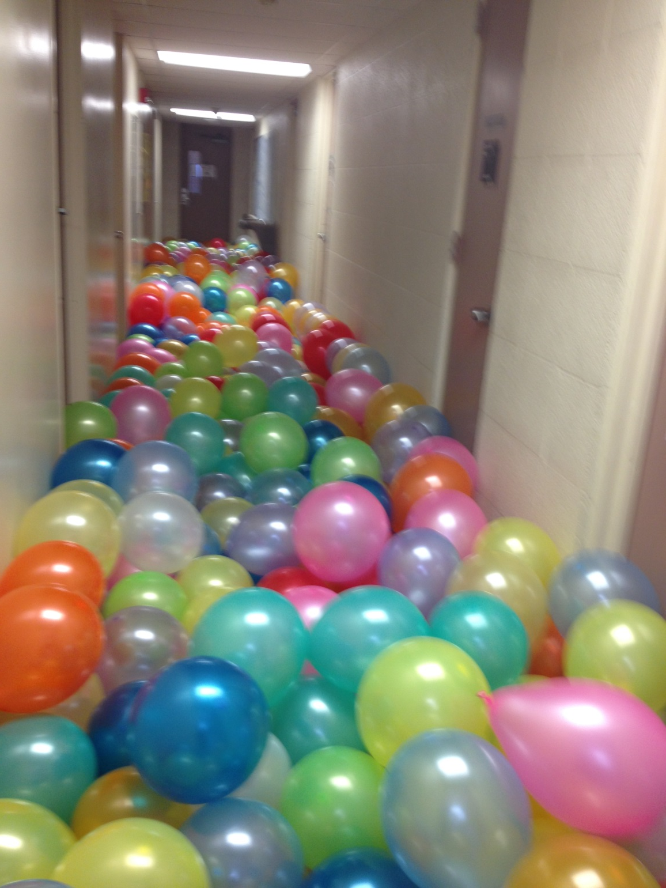
Other goings-on…

Slide 113
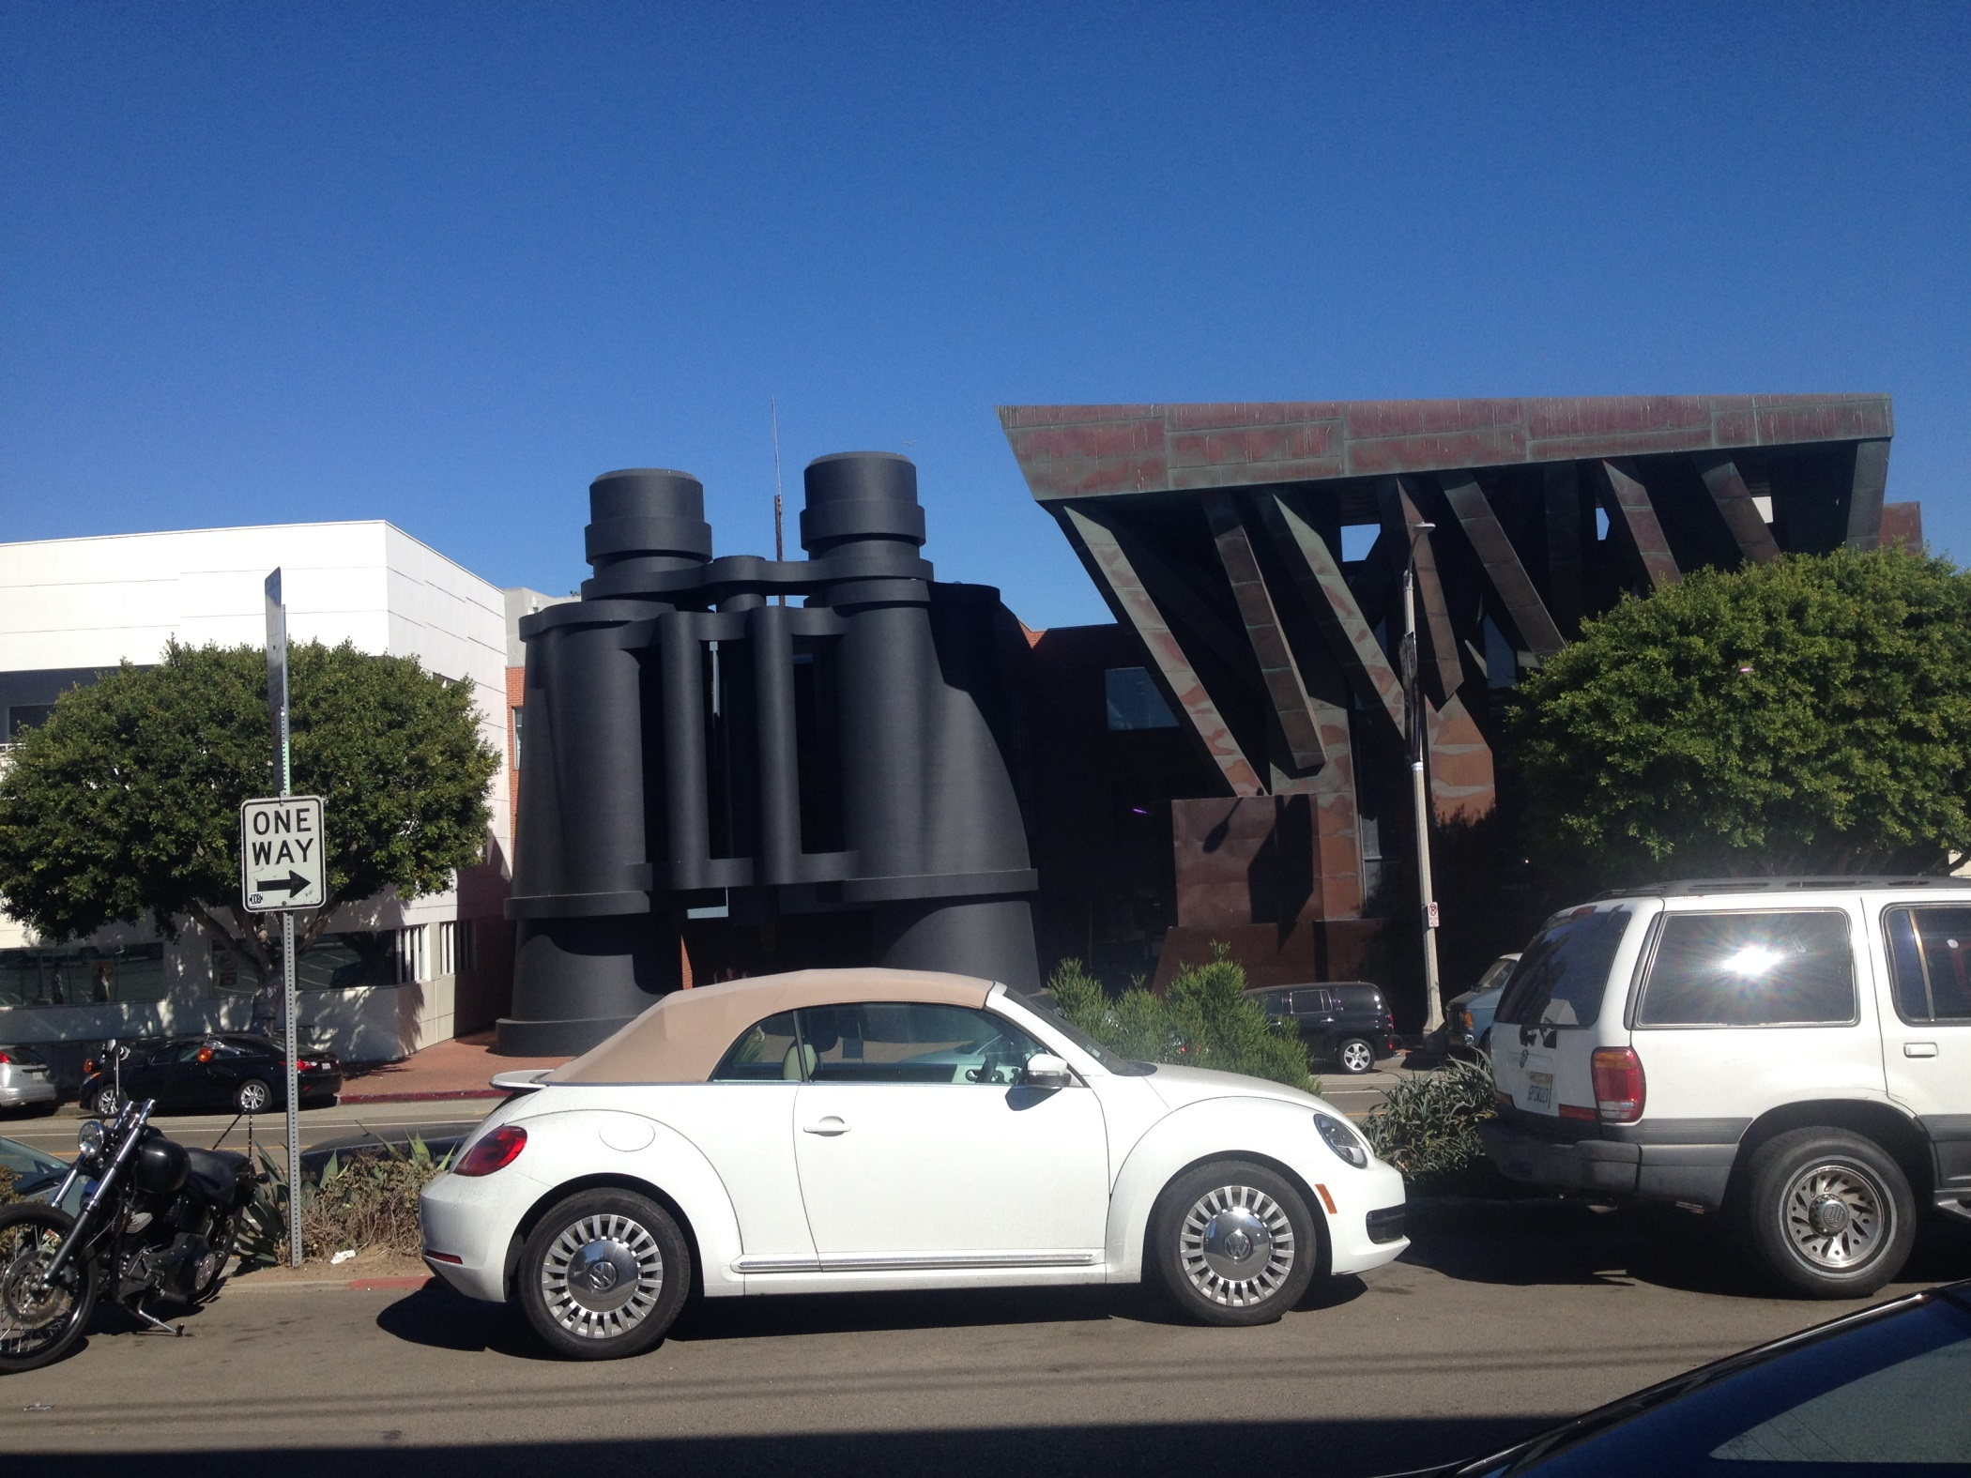
Other goings-on…

Slide 114
Other goings-on…

Slide 115
First, try it by eye…
… then, on hw9pr2, by Python!
col 0
col 1
col 2
col 3
col 4
A = [ [' ','X','O',' ','O'],
['X','X','X','O','O'],
[' ','X','O','X','O'],
['X','O','O',' ','X'] ]
row 0
row 1
row 2
row 3
the data doesn't wrap around
start row
start col
checker
LoL
inarow_3east('X', 1, 0, A)
True
inarow_3south('O', 0, 4, A)
inarow_3southeast('X', 2, 3, A)
inarow_3northeast('X', 3, 1, A)

Slide 116
Lab Problem: Conway's Game of Life
Grid World
Evolutionary rules
red cells are "alive"
Everything depends on a cell's eight neighbors
Exactly 3 neighbors give birth to a new, live cell.
Exactly 2 or 3 neighbors keep an existing cell alive.
Only 3 rules
Any other # of neighbors and the central cell dies…
white cells are empty

Slide 117
Lab Problem: Conway's Game of Life
Grid World
Evolutionary rules
red cells are "alive"
Everything depends on a cell's eight neighbors
Exactly 3 neighbors give birth to a new, live cell.
Exactly 2 or 3 neighbors keep an existing cell alive.
Any other # of neighbors and the central cell dies…
white cells are empty

Slide 118
Lab Problem: Conway's Game of Life
Grid World
Evolutionary rules
red cells are "alive"
Everything depends on a cell's eight neighbors
Exactly 3 neighbors give birth to a new, live cell.
Exactly 2 or 3 neighbors keep an existing cell alive.
Any other # of neighbors and the central cell dies…
white cells are empty

Slide 119
Lab Problem: Conway's Game of Life
Grid World
Evolutionary rules
red cells are alive
Everything depends on a cell's eight neighbors
Exactly 3 neighbors give birth to a new, live cell.
Exactly 2 or 3 neighbors keep an existing cell alive.
What's next?
Any other # of neighbors and the central cell dies…
white cells are empty

Slide 120
Lab Problem: Creating life
next_life_generation( A )
For each cell…
3 live neighbors – life!
2 live neighbors – same
0, 1, 4, 5, 6, 7, or 8 live neighbors – death
computed all at once, not cell-by-cell, so the ? at left does NOT come to life!
?
http://www.math.com/students/wonders/life/life.html

Slide 121
Lab Problem: Creating life
next_life_generation( A )
old generation is the input, A
returns the next generation
0
1
2
3
4
5
0
1
2
3
4
5
0
0
1
1
2
2
?
3
3
4
4
5
5

Slide 122
M.T. Review
(*) For up to two points! of extra credit on the midterm… Pair up with s/o you don't know (or don't know well) and find something unusual you have in common…
See also the gold review @ the cs5 site
Names:
Picobot! There are NO Picobot questions on the exam…
Recursion!!
You should feel confident you could create recursive functions to solve small problems, e.g., scrabble-scoring, finding sum or max or min, computing power or factorial (or variations)
You should be comfortable manipulating lists and strings (indexing, slicing, slicing with a "stride")
You should understand how to use, read, and compose list comprehensions , e.g., LC = [ x**2 for x in L ]
You should be able to design solutions using the "list of lists" technique (LoL), which uses list comprehensions, e.g., to find the highest scrabble-scoring word among a list or the lowest scrabble-scoring of a shifted string. Basic syntax: LoL = [ [sc(x),x] for x in L ]
You should understand the use-it-or-lose-it design strategy, e.g., the LCS, jotto, and sort homework problems:
Turtle graphics will not be emphasized (at most reading code)
Know the difference between print and return !!
Look over you composed larger programs out of smaller ones, how inputs and outputs are used, e.g., for Caesar Cipher
Representing Data!!!
Remind yourself of the various types of data (int, str, float, etc.), how they're different and how to convert between types
Know how characters are represented with chr and ord
Be comfortable with base-2 arithmetic (and base 10!), along with how to convert from base to base (no balanced ternary)
Remind yourself of how the bits of a base-2 number influence its value – what do right- and left-shifting do?
Thing in common:
Then, read over these & look for ones least familiar…
Circuits and Assembly!!!!
Know how the basic logic gates operate (AND and OR for any # of inputs , NOT for 1 input only)
Know how minterm expansion works (an OR of ANDs, each selecting one input) and how it enables the engineering of any circuit at all, given its truth-table specification
You should be comfortable using subcircuits (e.g., using the four-bit adders in the four-bit multiplier, or the individual pieces of the divider)
You should be able to write simple looping programs in Hmmm, e.g., factorial, power, Fibonacci, …
You should know what the stack is, what load and store do at the high-level (officially, they're named storer and loadr) - and why they're necessary for implementing functions in Hmmm (broadly speaking)
The exam will not ask you to implement recursion or stack-based functions in Hmmm, however.
The exam will contain Hmmm full reference sheet (you don't need it)
Loops
You should feel comfortable with how for loops (both element-based and index-based) and while loops work – and be able to compose small functions that use them, e.g., ones similar to those in the pi-estimation and TT securities (statistics) problems.
You should understand how nested loops work and be able to read or compose examples (such as in the TTS or our in-class problems)
I <3 punctuation with three eyes!
!
!
You may use functions from class and hw on the exam without reimplementing them. Here are some, but not all, of them:
removeOne( e, L ), removeAll( e, L ), removeUpto( e, L ), count( e, L ), ind( e, L ), frontNum( L ), binToNum( binstr ), numToBin( n ), …

Slide 123
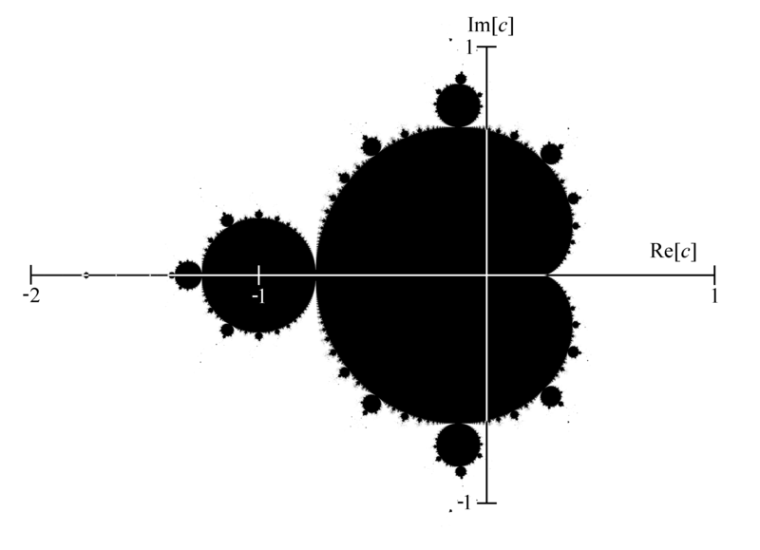
Mandelbrot Set ~ points that stick around
mid 70's resolution
The shaded area are points that do not diverge for z = z**2 + c

Slide 124
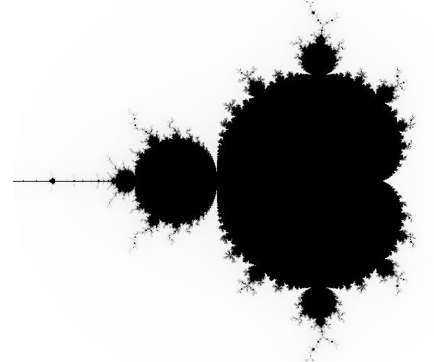
Higher-resolution M. Set
-2 + 1j
1 + 1j
connected
finite area
∞ perimeter!
-2 - 1j
1 - 1j
The black pixels are points that do not diverge for z = z**2 + c

Slide 125
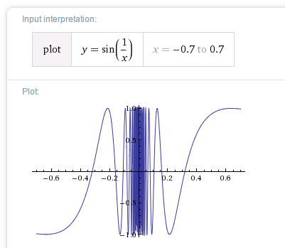
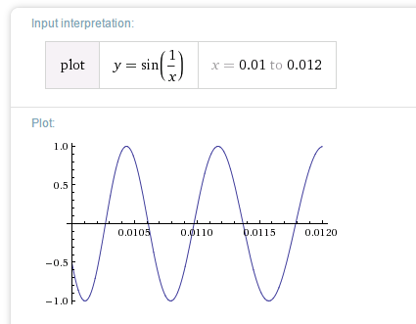
Chaos?
Complex things always consisted of simple parts…

Slide 126
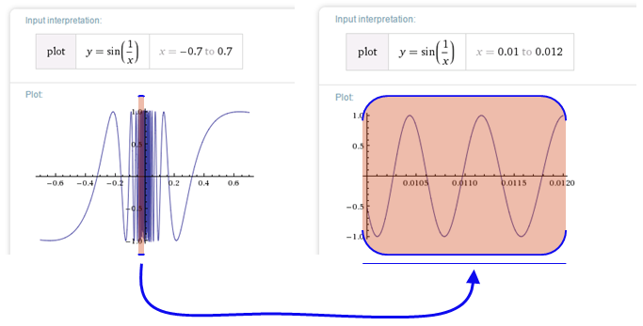
Before the M. Set, complex things were made of simple parts:
Chaos!
This was a "naturally occurring" object where zooming uncovers more detail, not less:
not self-similar but quasi-self-similar
http://www.youtube.com/watch?v=0jGaio87u3A

Slide 127
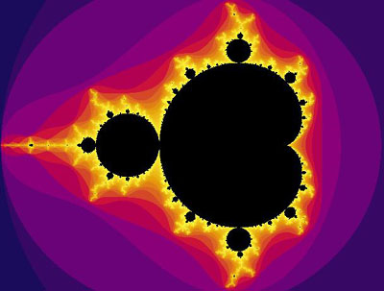
The black pixels are points that do not diverge for z = z**2 + c
What are these colors?

Slide 128
The black pixels are points that do not diverge for z = z**2 + c
escape velocities
What are these colors?

Slide 129
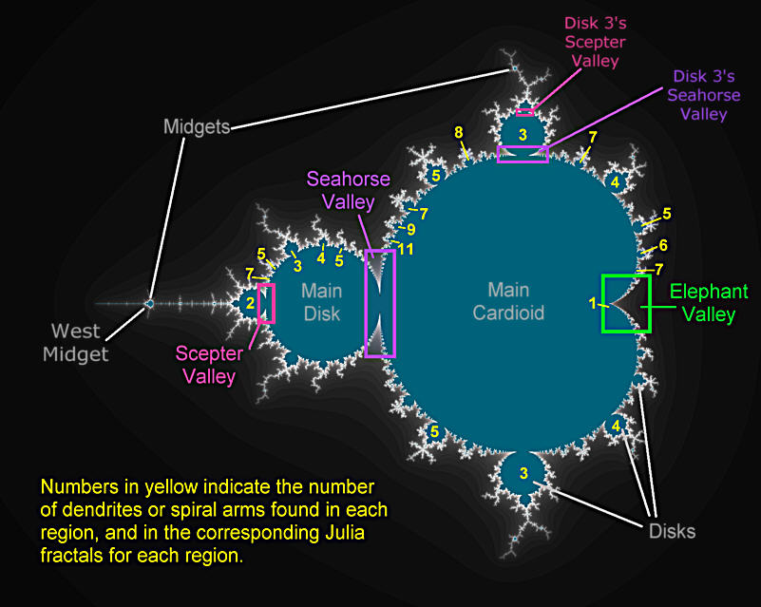
Atlas of the M. Set

Slide 130
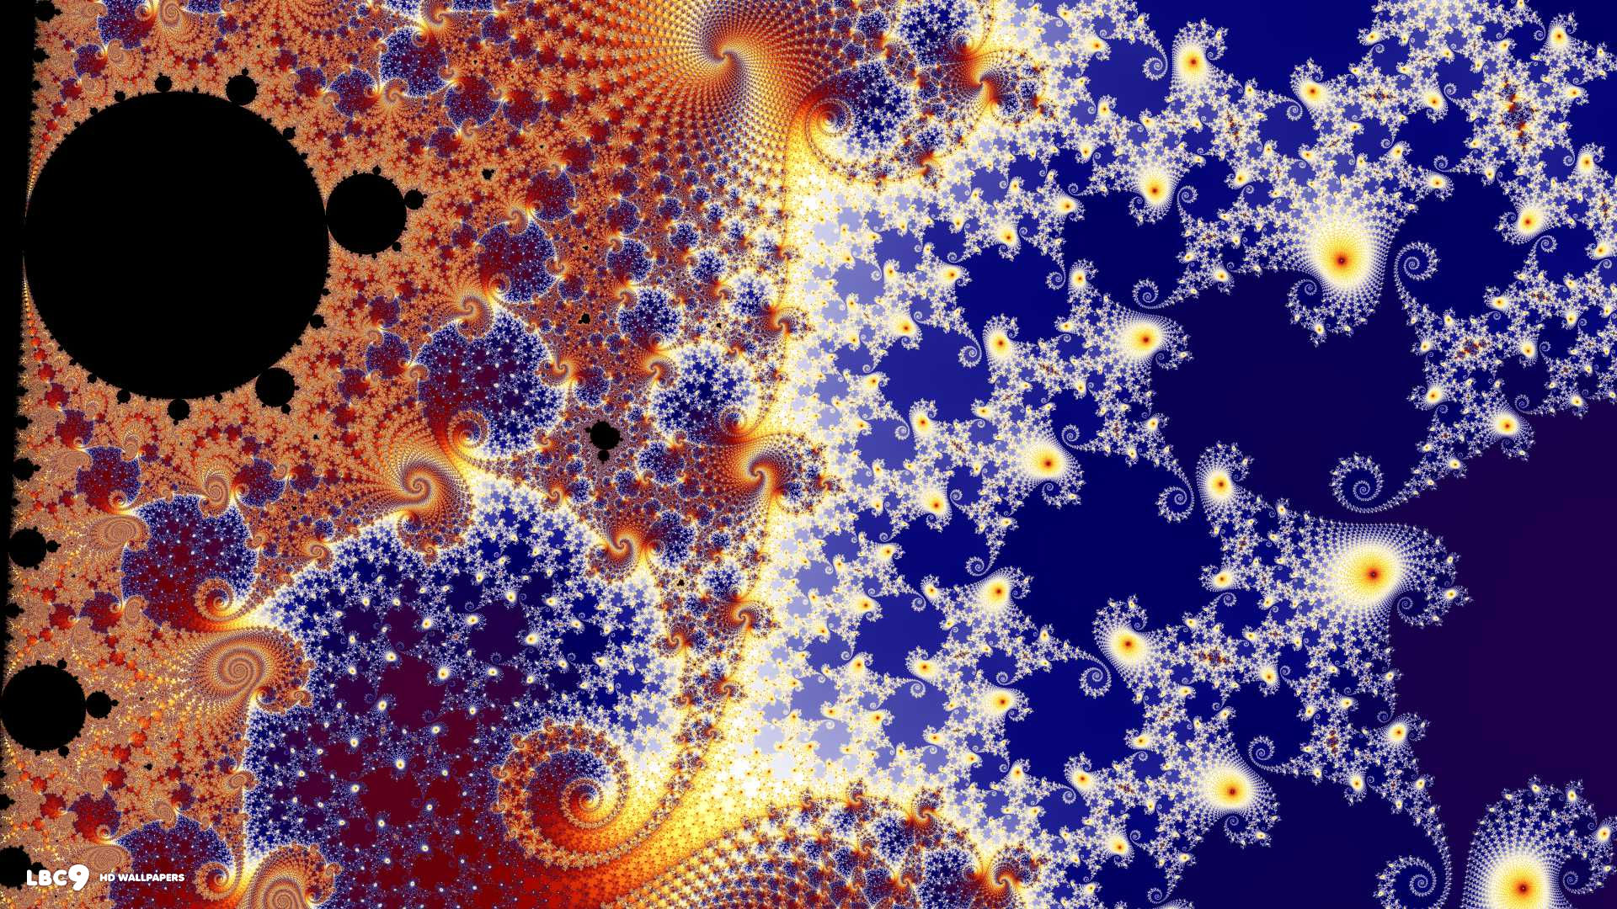
In the Seahorse Valley….

Slide 131
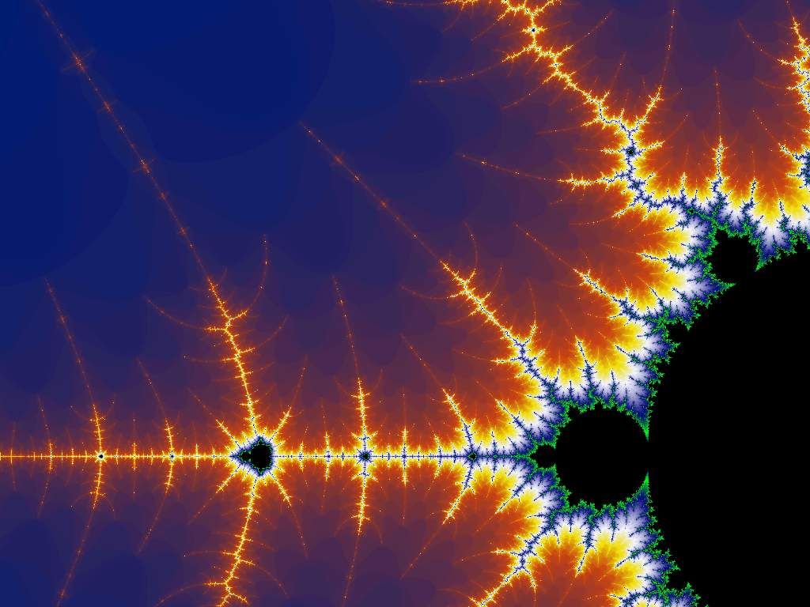
Happy Mandelbrotting!
www.cs.hmc.edu/~jgrasel/projects
http://www.youtube.com/watch?v=0jGaio87u3A

Slide 133
Quiz
Rules rule!?
Try this on the back page first…
Trace each f'n. What will main1, main2, and main3 print?
def conform1(fav)
fav = 42
return fav
def conform2(L)
L = [42,42]
return L
def conform3(L)
L[0] = 42
L[1] = 42
fav
L
L
7
7
11
7
11
fav
L
L[0]
L[1]
L
L[0]
L[1]
def main1()
fav = 7
conform1(fav)
print fav
def main2()
L = [7,11]
conform2(L)
print L
def main3()
L = [7,11]
conform3(L)
print L
Notice that there are NO assignment statements after these function calls! The return values aren't being used…

Slide 134
Part 2
A
before
Write a method that adds five times the values in row #1 into row #2.
row 0
0.00 1.00 0.00 1.00
3.00 0.50 0.50 3.00
10.00 20.00 30.00 27.00
row 1
row 2
The values in row 1
should not change
row 0
0.00 1.00 0.00 1.00
3.00 0.50 0.50 3.00
25.00 22.50 32.50 42.00
Only row 2's values change.
row 1
row 2
A
after
def add5ofRow1IntoRow2( A ):
for ____ in range( ):
+=
You need only one line in the loop!
What if 5, 1, and 2 were the variables: m, s, and d?

Slide 135
hw9pr2: 2D data
Menu
Functions
(1) Enter the size and values of an array
(2) Print the array
(3) Multiply an array row by a constant
(4) Add one row into another
(5) Add a multiple of one row to another
(6) Solve!
(9) Quit
Which choice would you like?
printMenu
enterValues
print
multRow
addRowSIntoRowD
addMofRowSIntoRowD
solve
S ~ source row index
D ~ destination row index
M ~ a multiplier

Slide 136
2.00 3.00 -1.00 -8.00
-3.00 -1.00 2.00 42.00
1.00 -9.00 4.00 56.00
First: fix A[0][0]
What row operation can we perform to make A[0][0], the upper-left entry, equal to 1.0 ?
Get 1's on the diagonal
Solve
Get 0's elsewhere
1.00 0.00 0.00 1.00
0.00 1.00 0.00 5.00
0.00 0.00 1.00 25.00
Goal

Slide 137
2.00 3.00 -1.00 -8.00
-3.00 -1.00 2.00 42.00
1.00 -9.00 4.00 56.00
First: fix A[0][0]
1.00 1.50 -0.50 -4.00
-3.00 -1.00 2.00 42.00
1.00 -9.00 4.00 56.00
fixed, by … multiplying Row 0 by 0.5
Get 1's on the diagonal
Solve
Get 0's elsewhere
1.00 0.00 0.00 1.00
0.00 1.00 0.00 5.00
0.00 0.00 1.00 25.00
Goal

Slide 138
Go one column at a time
1.00 1.50 -0.50 -4.00
-3.00 -1.00 2.00 42.00
1.00 -9.00 4.00 56.00
multiply Row 0 by 0.5
1.00 1.50 -0.50 -4.00
0.00 3.50 0.50 30.00
0.00 -10.50 4.50 44.00
add 3 times Row 0 to Row 1 add -1 times Row 0 to Row 2
1.00 0.00 -0.71 -16.85
0.00 1.00 0.14 30.00
0.00 0.00 6.00 150.00
multiply Row 1 by 1/3.5 add a multiple of Row 1 to Row 0 add a multiple of Row 1 to Row 2
1.00 0.00 0.00 1.00
0.00 1.00 0.00 5.00
0.00 0.00 1.00 25.00
same for other columns
as far as possible...

Slide 139
Gaussian Elimination
Goal: to find x, y, and z:
2x + 3y + -1z = -8
-3x + -1y + 2z = 42
1x + -9y + 4z = 56
Aargh!

Slide 140
Gaussian Elimination
Goal: to find x, y, and z:
2x + 3y + -1z = -8
-3x + -1y + 2z = 42
1x + -9y + 4z = 56
but some sets of equations are easier than others!
1x + 0y + 0z = 1
0x + 1y + 0z = 5
0x + 0y + 1z = 25
I like this one!

Slide 141
Gauss's idea
Goal: to find x, y, and z:
2x + 3y + -1z = -8
-3x + -1y + 2z = 42
1x + -9y + 4z = 56
multiply any row by a constant
nonzero
Use two rules:
add a multiple of any row to another
1x + 0y + 0z = 1
0x + 1y + 0z = 5
0x + 0y + 1z = 25
These rules don't change the solutions!
until it looks like:

Slide 142
hw9pr2: 2D data
Menu
Functions
(1) Enter the size and values of an array
(2) Print the array
(3) Multiply an array row by a constant
(4) Add one row into another
(5) Add a multiple of one row to another
(6) Solve!
(9) Quit
Which choice would you like?
printMenu
enterValues
print
multRow
addRowSIntoRowD
addMofRowSIntoRowD
solve
S ~ source row index
D ~ destination row index
M ~ a multiplier
Demo…

Slide 143
2D data!
Note that
2x + 3y + -1z = -8
-3x + -1y + 2z = 42
1x + -9y + 4z = 56
is really just the 2D matrix:
2 3 -1 -8
-3 -1 2 42
1 -9 4 56
…the variables aren't needed at all!

Slide 144
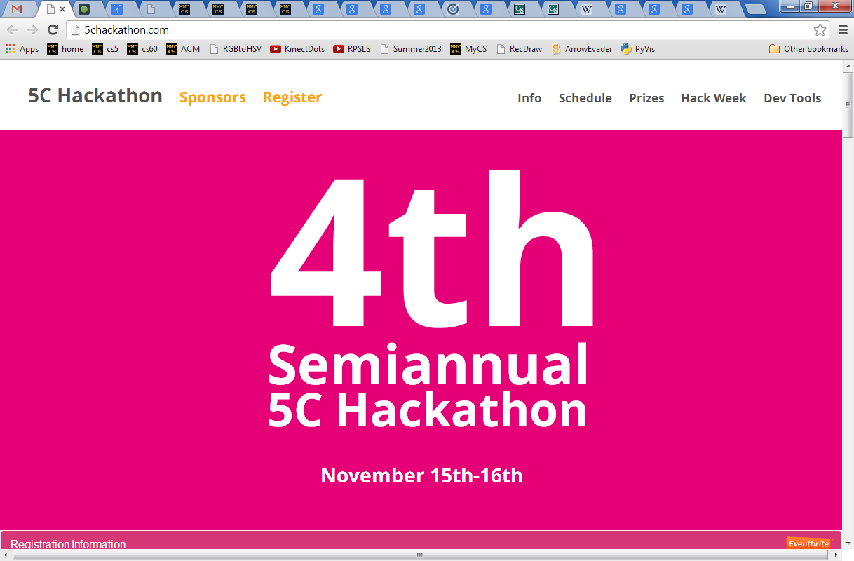
The 5C Hackathon is two weeks away and if possible I'd like to make an announcement in your two intro CS classes at the start of class Tuesday or later next week. In addition to the hackathon, we're holding an informal hack week series of tutorials that is designed to get beginners excited about CS and to introduce them to web programming! Thanks, Joe (jnewbry14@students.claremontmckenna.edu)

Slide 145
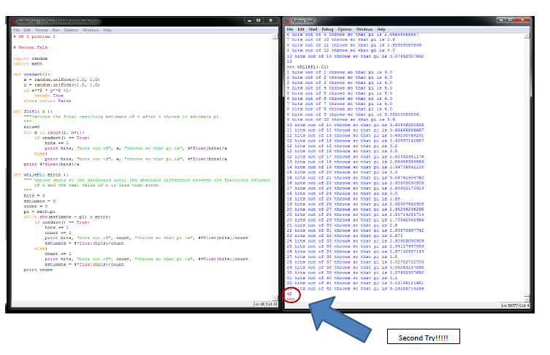
Nathan F. + Nicole A.
42 darts

Slide 146
Watch out!
How could we create this rectangular array of 0s?
[[0,0,0,0,0],
[0,0,0,0,0],
[0,0,0,0,0]]
A = 3*[ 5*[0] ]
or
A = 5*[ 3*[0] ]

Slide 147
Watch out!
inner = 5*[0]
A = 3*[ 5*[0] ]
A = 3*[inner]
list
list
A
inner
list
inner
list
inner
Inner-esting!
"shallow copy"
copies the list reference, not the list data

Slide 148
A
4
B
5
C
6
D
7
E
8
next_life_generation( A )
returns new generation or "array"
old generation or "array"
0
1
2
3
4
5
0
1
2
3
4
5
0
0
1
1
2
2
3
3
4
4
5
5
How many will there be?

Slide 149
Lab Problem: Creating life
next_life_generation( A )
returns new generation or "array"
old generation or "array"
0
1
2
3
4
5
0
1
2
3
4
5
0
0
42 darts!
1
1
2
2
3
3
4
4
5
5

Slide 150
Rectangular arrays
A[1][2] = 42
list
list
A
A[0]
A[0][0]
list
A[1]
list
A[2]
A[2][3]
What does each component of A[1][2] mean ?
How many rows does A have, in general ?
How many columns does A have, in general ?

Slide 151
Quiz
A = [ [1,2,3,4],
[5,6,7,8],
[9,10,11,12] ]
Starting with the 2d array A shown here, what are the values in A after running this code?
A
Before
def mystery(A):
""" what happens to A ? """
NUM_ROWS = len(A)
NUM_COLS = len(A[0])
for row in range( 0,NUM_ROWS ):
for col in range( 0,NUM_COLS ):
if row == col:
A[row][col] = 42
else:
A[row][col] += 1
row 0
1 2 3 4
5 6 7 8
9 10 11 12
row 1
row 2
col 0
col 1
col 2
col 3
A
After
What are the resulting values in A?

Slide 152
Quiz, part 2
A
before
five of row 1 will be added to row 2
row 0
0.00 1.00 0.00 1.00
3.00 0.50 0.50 3.00
10.00 20.00 30.00 27.00
Write a method that adds five times the values in row #1 into the values in row #2.
row 1
row 2
The values in row 1
should not change
row 0
0.00 1.00 0.00 1.00
3.00 0.50 0.50 3.00
25.00 22.50 32.50 42.00
You may assume that A has at least three rows!
row 1
Only row 2's values change.
row 2
A
after
def add5ofRow1IntoRow2( A ):
for ____ in range( ):
+=
Extra! How could you make the multipier, the source row number, and the destination row number into inputs to this function – and then use those inputs?

Slide 153
2.00 3.00 -1.00 -8.00
-3.00 -1.00 2.00 42.00
1.00 -9.00 4.00 56.00
ORIGINAL: fix A[0][0]
1.00 1.50 -0.50 -4.00
-3.00 -1.00 2.00 42.00
1.00 -9.00 4.00 56.00
by … multiplying Row 0 by 0.5
GOAL: to get this side to look like the identity matrix.
RESULT: this column will be our solution!
Which term should we fix next !?!

Slide 154
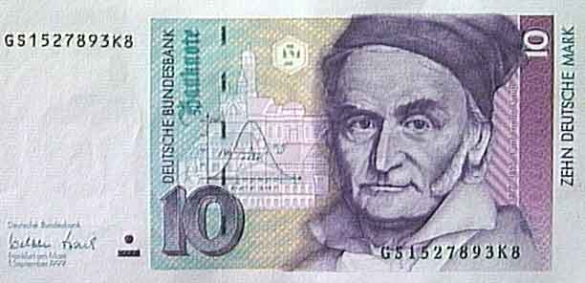
Gaussian Elimination
2p + 3n + -1q = -8.00
-3p + -1n + 2q = 42.00
1p + -9n + 4q = 56.00
Goal:
get 1s along the diagonal
Find p,n,q
get 0s elsewhere on the left
What rules can we use without changing the meaning of these equations?

Slide 155
Gaussian Elimination
2p + 3n + -1q = -8.00
-3p + -1n + 2q = 42.00
1p + -9n + 4q = 56.00
Goal:
get 1s along the diagonal
Find p,n,q
get 0s elsewhere on the left
1p + 0n + 0q = 1.00
0p + 1n + 0q = 5.00
0p + 0n + 1q = 25.00
Using only row operations (our methods) !
Just the array is necessary !
We can get rid of the variables...
where to start?

Slide 156
Gaussian Elimination
Goal: to find x, y, and z:
2x + 3y + -1z = -8.00
-3x + -1y + 2z = 42.00
1x + -9y + 4z = 56.00
Goal:
get 1s along the diagonal
Find p,n,q
get 0s elsewhere on the left
What rules can we use without changing the meaning of these equations?

Slide 157
Gaussian Elimination
2p + 3n + -1q = -8.00
-3p + -1n + 2q = 42.00
1p + -9n + 4q = 56.00
Goal:
get 1s along the diagonal
Find p,n,q
get 0s elsewhere on the left
1p + 0n + 0q = 1.00
0p + 1n + 0q = 5.00
0p + 0n + 1q = 25.00
Using only row operations (our methods) !
Just the array is necessary !
We can get rid of the variables...
where to start?

Slide 158
Lists ~ flexibility
Lists can hold ANY type of data
A = [ 42, 75, 70 ]
42
75
70
list
int
int
int
A
they don't have to be horizontal
It looks vertical to me!

Slide 159
Lists' flexibility
Lists can hold ANY type of data
A = [ 42, 75, 70 ]
42
75
70
list
int
int
int
A
We can equally well imagine them as vertical structures.
42
list
int
A
75
int
70
int

Slide 160
Lists' flexibility
Lists can hold ANY type of data
42.0
75.0
70.0
list
double
double
double
A
42
7
-11
list
int
int
int
A
“O”
“hi”
“O!”
list
String
String
String
A

Slide 161
2d lists or arrays
Lists can hold ANY type of data -- including lists !
A = [ [1,2,3,4], [5,6], [7,8,9,10,11] ]
list
A

Slide 162
2d arrays
Lists can hold ANY type of data -- including lists !
A = [ [1,2,3,4], [5,6], [7,8,9,10,11] ]
list
list
A
A[0]
list
A[1]
list
A[2]

Slide 163
Jagged arrays
Lists can hold ANY type of data -- including lists !
A = [ [1,2,3,4], [5,6], [7,8,9,10,11] ]
list
list
A
A[0]
list
A[1]
list
A[2]
Rows within 2d arrays need not be the same length…

Slide 164
No "jagged" arrays for us…
at least not in hw 9
A = [ [1,2,3,4], [5,6], [7,8,9,10,11] ]
May all your arrays be memory-aligned!
list
list
A
A[0]
list
A[1]
list
A[2]
Rows within 2d arrays need not be the same length…

Slide 165
Rectangular arrays
A = [ [1,2,3,4],
[5,6,7,8],
[9,0,1,2] ]
1
2
3
4
list
list
A
A[0]
A[0][0]
5
6
7
8
list
A[1]
9
0
1
2
list
A[2]
A[2][3]
To try…
Set A[1][2] = 42
What does each component of A[1][2] mean ?
How many rows does A have, in general ?
How many columns does A have, in general ?

Slide 166
Quiz
Rules rule!?
Name(s) ______________________________
def conform1(fav)
fav = 42
return fav
def main1()
fav = 7
conform1(fav)
print "Fave:", fav
def conform2(faves)
faves = [42,42]
return faves
def main2()
faves = [7,11]
conform2(faves)
print "Faves:", faves
def conform3(faves)
faves[0] = 42
faves[1] = 42
def main3()
faves = [7,11]
conform3(faves)
print "Faves:", faves
fav
faves
faves
fav
faves
faves
What will main1, main2, and main3 end up printing?

Slide 167
Sizing up arrays…
How could we create this rectangular array of 0s?
A = 3*[ 5*[0] ]
NEITHER ONE works!
[[0,0,0,0,0],
[0,0,0,0,0],
[0,0,0,0,0]]
or
because lists are handled by reference !
A = 5*[ 3*[0] ]

Slide 168
Safely creating arrays…
def createOneRow( width ):
""" does just that """
row = [] # start with nothing
for col in range( width ):
row = row + [0]
return row
# loop and add!
adding lists with lists!
So, how would you create a list of rows!?

Slide 169
Safely creating arrays…
def create2dArray( width, height ):
""" does just that """
A = [] # start with nothing
for row in range( height ):
row = createOneRow( width )
A = A + [row]
return A
the same approach as before; now, adding lists of rows with lists of rows!

Slide 170
hw9pr2: 2D data
Menu
Functions
(1) Enter the size and values of an array
(2) Print the array
(3) Multiply an array row by a constant
(4) Add one row into another
(5) Add a multiple of one row to another
(6) Solve!
(9) Quit
Which choice would you like?
printMenu
enterValues
print
multRow
addRowSIntoRowD
addMofRowSIntoRowD
solve
S ~ source row index
D ~ destination row index
M ~ a multiplier

Slide 171
Engineers believe equations approximate reality;
Physicists believe reality approximates equations…
Mathematics reasons about structural rules…
… and CS reasons about procedural ones.
(without using trig)
Creating structure from a few simple facts...
?
Axioms
Definitions
20˚
10˚
Proof
60˚
70˚
Solution and proof at http://www.cs.yale.edu/homes/toyama/tri/sol.htmll

Slide 172
A
John Conway's Challenge….
D
?
E
20˚
10˚
60˚
70˚
B
C
(without using trig)
Solution and proof at cs-www.cs.yale.edu/homes/toyama/tri/sol.html

Slide 173
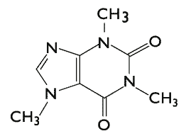
CS 5 Today
Rules: emphasize the elegance of 2 interacting rules…
2 rules: data by ref. vs. value: only show lists vs. ints
then, quiz
then, the advantage of ref. == lists' flexibility
2 rules: multiply by non-zero or add a multiple to another
2 rules: coming to life, staying alive
Coming up in CS 5:
Midterm exam
Anyone choose Gauss or Conway for Halloween?
Carl Gauss
in-class on Thu. 11/8
HW 9 (lab + 1 prob.)
due Monday, 11/12 at midnight
This week's credits:
I give you all the credit!
John Conway
Today's honorees: mathematicians…
Lecture 17

Slide 174
Halloween recursion!
taking OR too literally
(or too computationally!)

Slide 175
Halloween recursion!
taking OR too literally
(or too computationally!)

Slide 176
Halloween recursion!

Slide 177
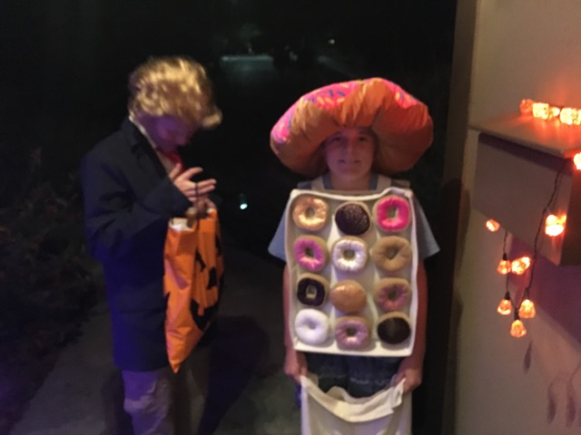
Costumes! '16...

Slide 178
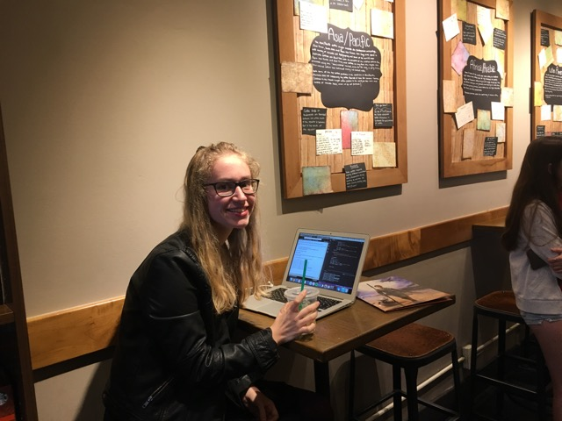
Hannah!

Slide 179
(*) For up to two points! of extra credit on the midterm… Pair up with s/o and find something you have in common (that you didn't know before!)…
after trying this, look over the midterm-review together!
A = [ [4, 2, 2, 2],
[2, 2, 4, 4],
[8, 3, 3, 1] ]
Names:
Thing in common:
def mystery(A):
""" what happens to A ? """
NROWS = len(A)
NCOLS = len(A[0])
for r in range( 0,NROWS ):
for c in range( 0,NCOLS ):
if r == c:
A[r][c] += 1
else:
A[r][c] *= 2
A
Before
row 0
4 2 2 2
2 2 4 4
8 3 3 1
row 1
row 2
col 0
col 1
col 2
col 3
A
After
Starting with the 2d array A above, write the values in A after running that code:
Above, write the resulting values in A
Challenge:
Then, how could you change the code above to create a True where the original value was equal to its neighbor to the right?! (False, if there's no neighbor or a different neighbor.)
F T T F
T F T F
F T F F

Slide 180
Mandelbrot!
Forest K.

Slide 181
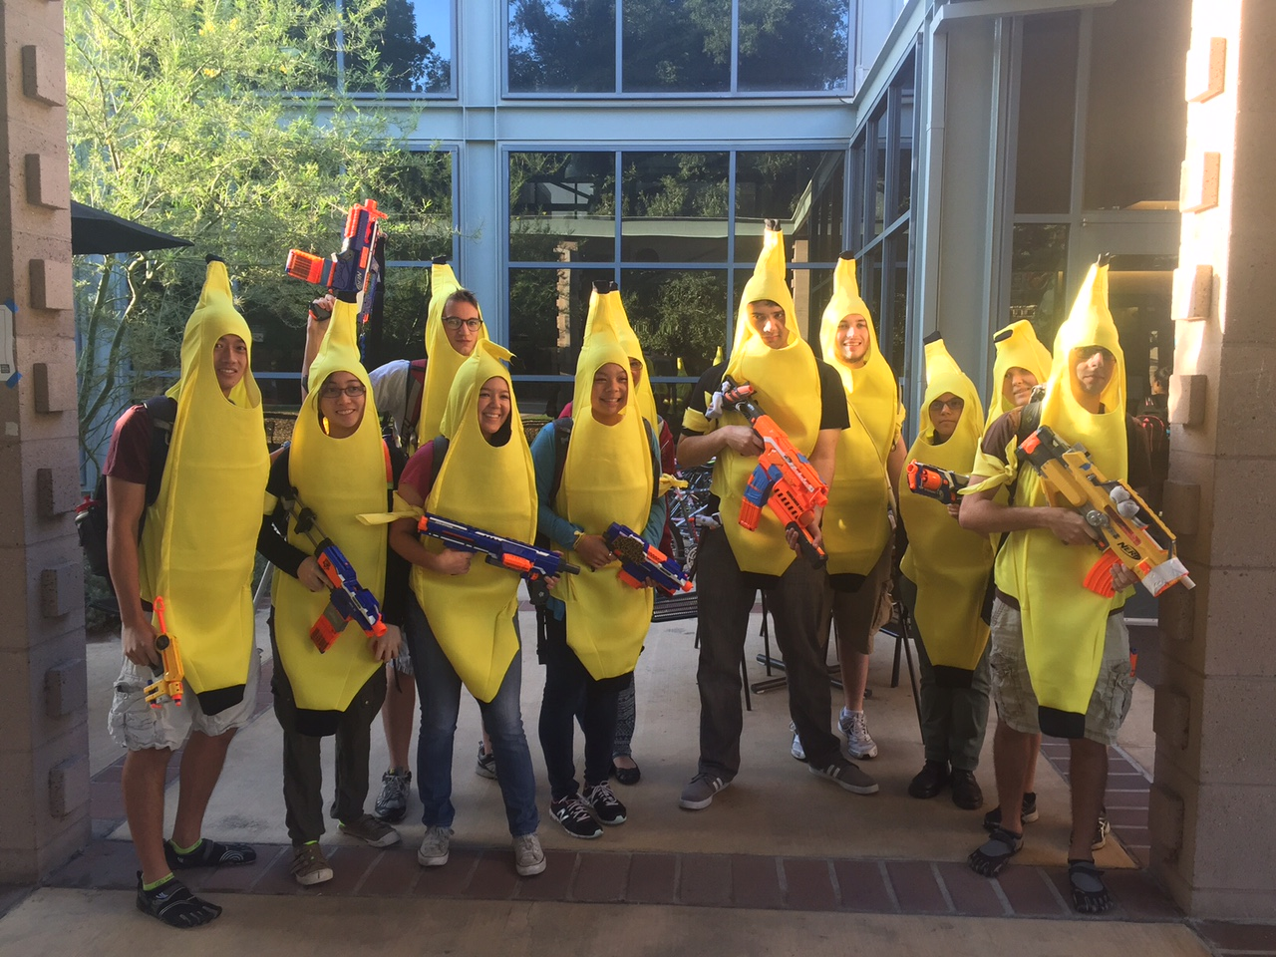
Celebrataing humanness…

Slide 182
Past zombie run-ins… Not sure about the tie?!

Slide 183
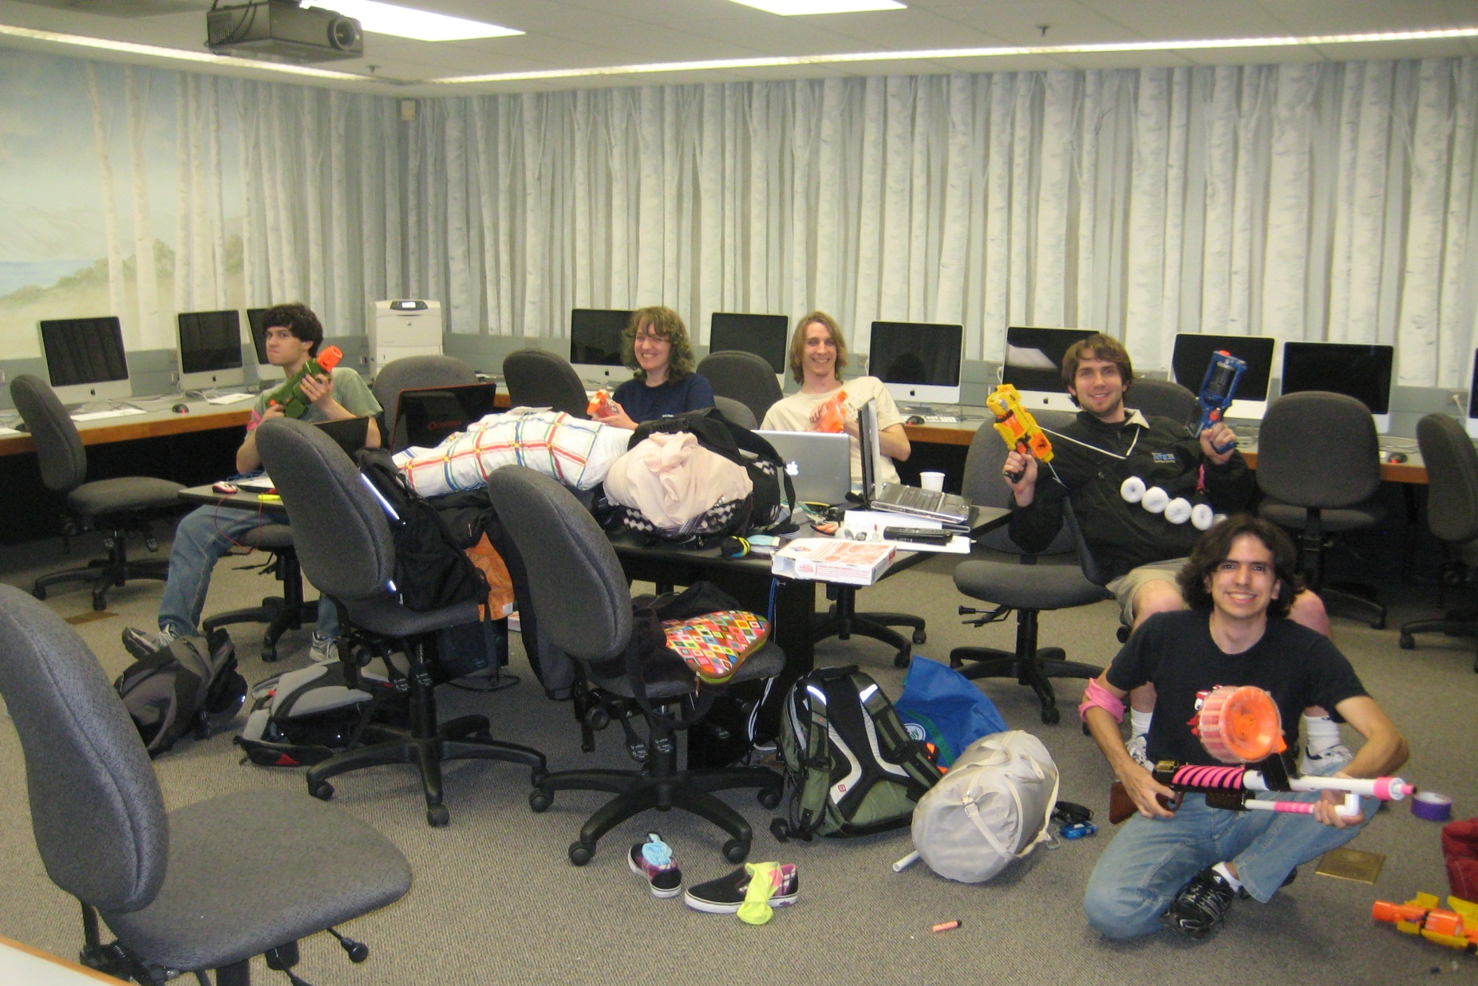
Celebrataing humanness…
CS 5 lab ~ a no-zombie zone!

Slide 184
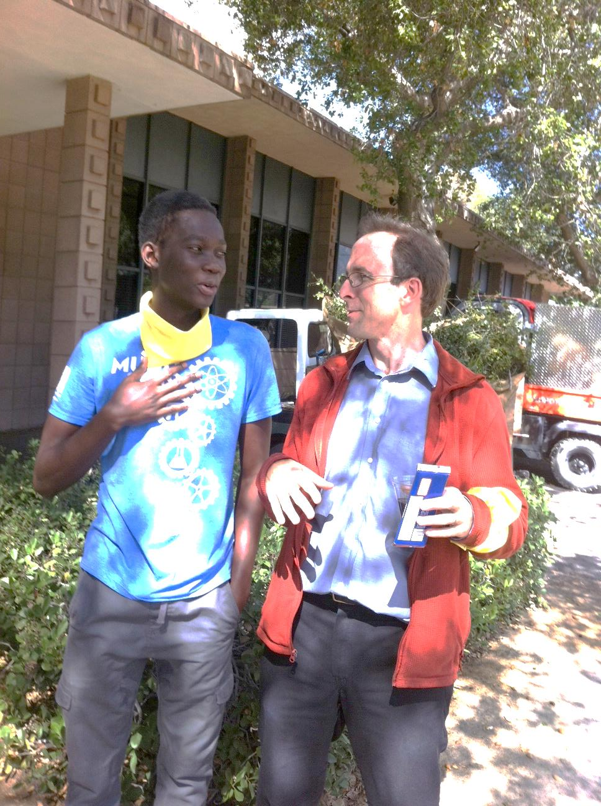
Farewell, humanness…

Slide 185
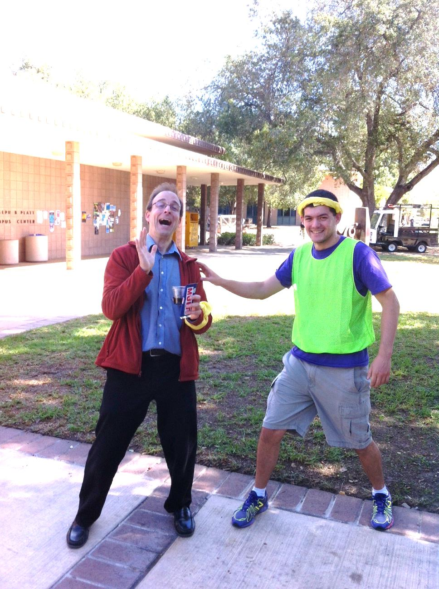
actual zombification…
Looks painful!
Past zombie run-ins… Not sure about the tie?!

Slide 186
CS5 Rules
A "monster" of a game!
A zero-player game?!
Run!
z = z ² + c
HW 9 (lab + prob #2)
Simple rules can yield complex results!
due Mon. 11/6
The rule: Don't follow this rule.
Midterm 11/2
review problems online
acc? we have add'l rooms for Thu. …
content? only through hw8
Three-in-a-row? Aliens rule at this…

Slide 187
M.T. Review
(*) For up to two points! of extra credit on the midterm… Pair up with s/o and find something you have in common (that you didn't know before!)…
See review problems @ the cs5 site
Names:
Put your names and thing-in-common on the OTHER page! Keep this page...
Picobot! There are NO Picobot questions on the exam…
Recursion!!
You should feel confident you could create recursive functions to solve small problems, e.g., scrabble-scoring, finding sum or max or min, computing power or factorial (or variations)
You should be comfortable manipulating lists and strings (indexing, slicing, slicing with a "stride") What's s[1:-1:2]?
You should understand how to use, read, and compose list comprehensions , e.g., LC = [ x**2 for x in L ]
You should be able to design solutions using the "list of lists" technique (LoL), which uses list comprehensions, e.g., to find the highest scrabble-scoring word among a list or the lowest scrabble-scoring of a shifted string. Basic syntax: LoL = [ [sc(x),x] for x in L ]
You should understand the use-it-or-lose-it design strategy, e.g., the LCS, exact_change, jotto, and sort homework problems
Turtle graphics will not be on the exam
Understand the difference between print and return...
Look over how you composed larger programs out of smaller ones + how inputs and outputs are used, e.g., for Caesar Cipher
Representing Data!!!
Remind yourself of the various types of data (int, str, float, etc.), how they're different and how to convert between types
Know how characters are represented with chr and ord
Be comfortable with base-2 arithmetic (and base 10!), along with how to convert from base to base (no balanced ternary)
Remind yourself of how the bits of a base-2 number influence its value – what do right- and left-shifting do?
Thing in common:
Then, read over these & look for ones least familiar…
Circuits and Assembly!!!!
Know how the basic logic gates operate (AND and OR for any # of inputs , NOT for 1 input only)
Know how minterm expansion works (an OR of ANDs, each selecting one input) and how it enables the engineering of any circuit at all, given its truth-table specification
You should be comfortable using subcircuits (e.g., using the four-bit adders in the four-bit multiplier, or the individual pieces of the divider)
You should be able to write simple looping programs in Hmmm, e.g., factorial, power, Fibonacci, …
You should know what the stack is, what load and store do at the high-level (in Hmmm, they're named storer and loadr) - and why they're useful for implementing functions in Hmmm - broadly speaking
The exam will not ask you to implement recursion or stack-based functions in Hmmm: only looping + conditional examples.
It will have a full Hmmm reference (your don't need your own)
Loops
You should feel comfortable with how for loops (both element-based and index-based) and while loops work – and be able to compose small functions that use them, e.g., ones similar to those in the pi-estimation and TT securities (statistics) problems.
You should understand how nested loops work and be able to read or compose examples (such as the TTS strategy or our in-class problems)
Later today…
I <3 three-eyed punctuation!
!
!
You may use functions from class and hw on the exam without reimplementing them. Here are some, but not all, of them:
removeOne( e, L ), removeAll( e, L ), removeUpto( e, L ), count( e, L ), ind( e, L ), frontNum( L ), binToNum( binstr ), numToBin( n ), …

Slide 188
Mid-term feedback…
Don't put your name
I would love to know any thoughts you have about CS5 thus far in the term. In particular, how you feel about the time and effort CS5 requires…
On average, how much time per week do you spend on CS5 outside class + lab?
How does CS5's workload compare to other classes you're taking this term?
How would you judge the pace of CS5?
much lighter
about the same
much heavier
much too slow
about right
much too fast
Circle your year: First-year Sophomore Junior Senior Other
Something you'd keep about CS5 …?
Later today
Something you'd change about / get rid of / add to CS5 …?
Other thoughts optional, but 142% welcome:

Slide 189
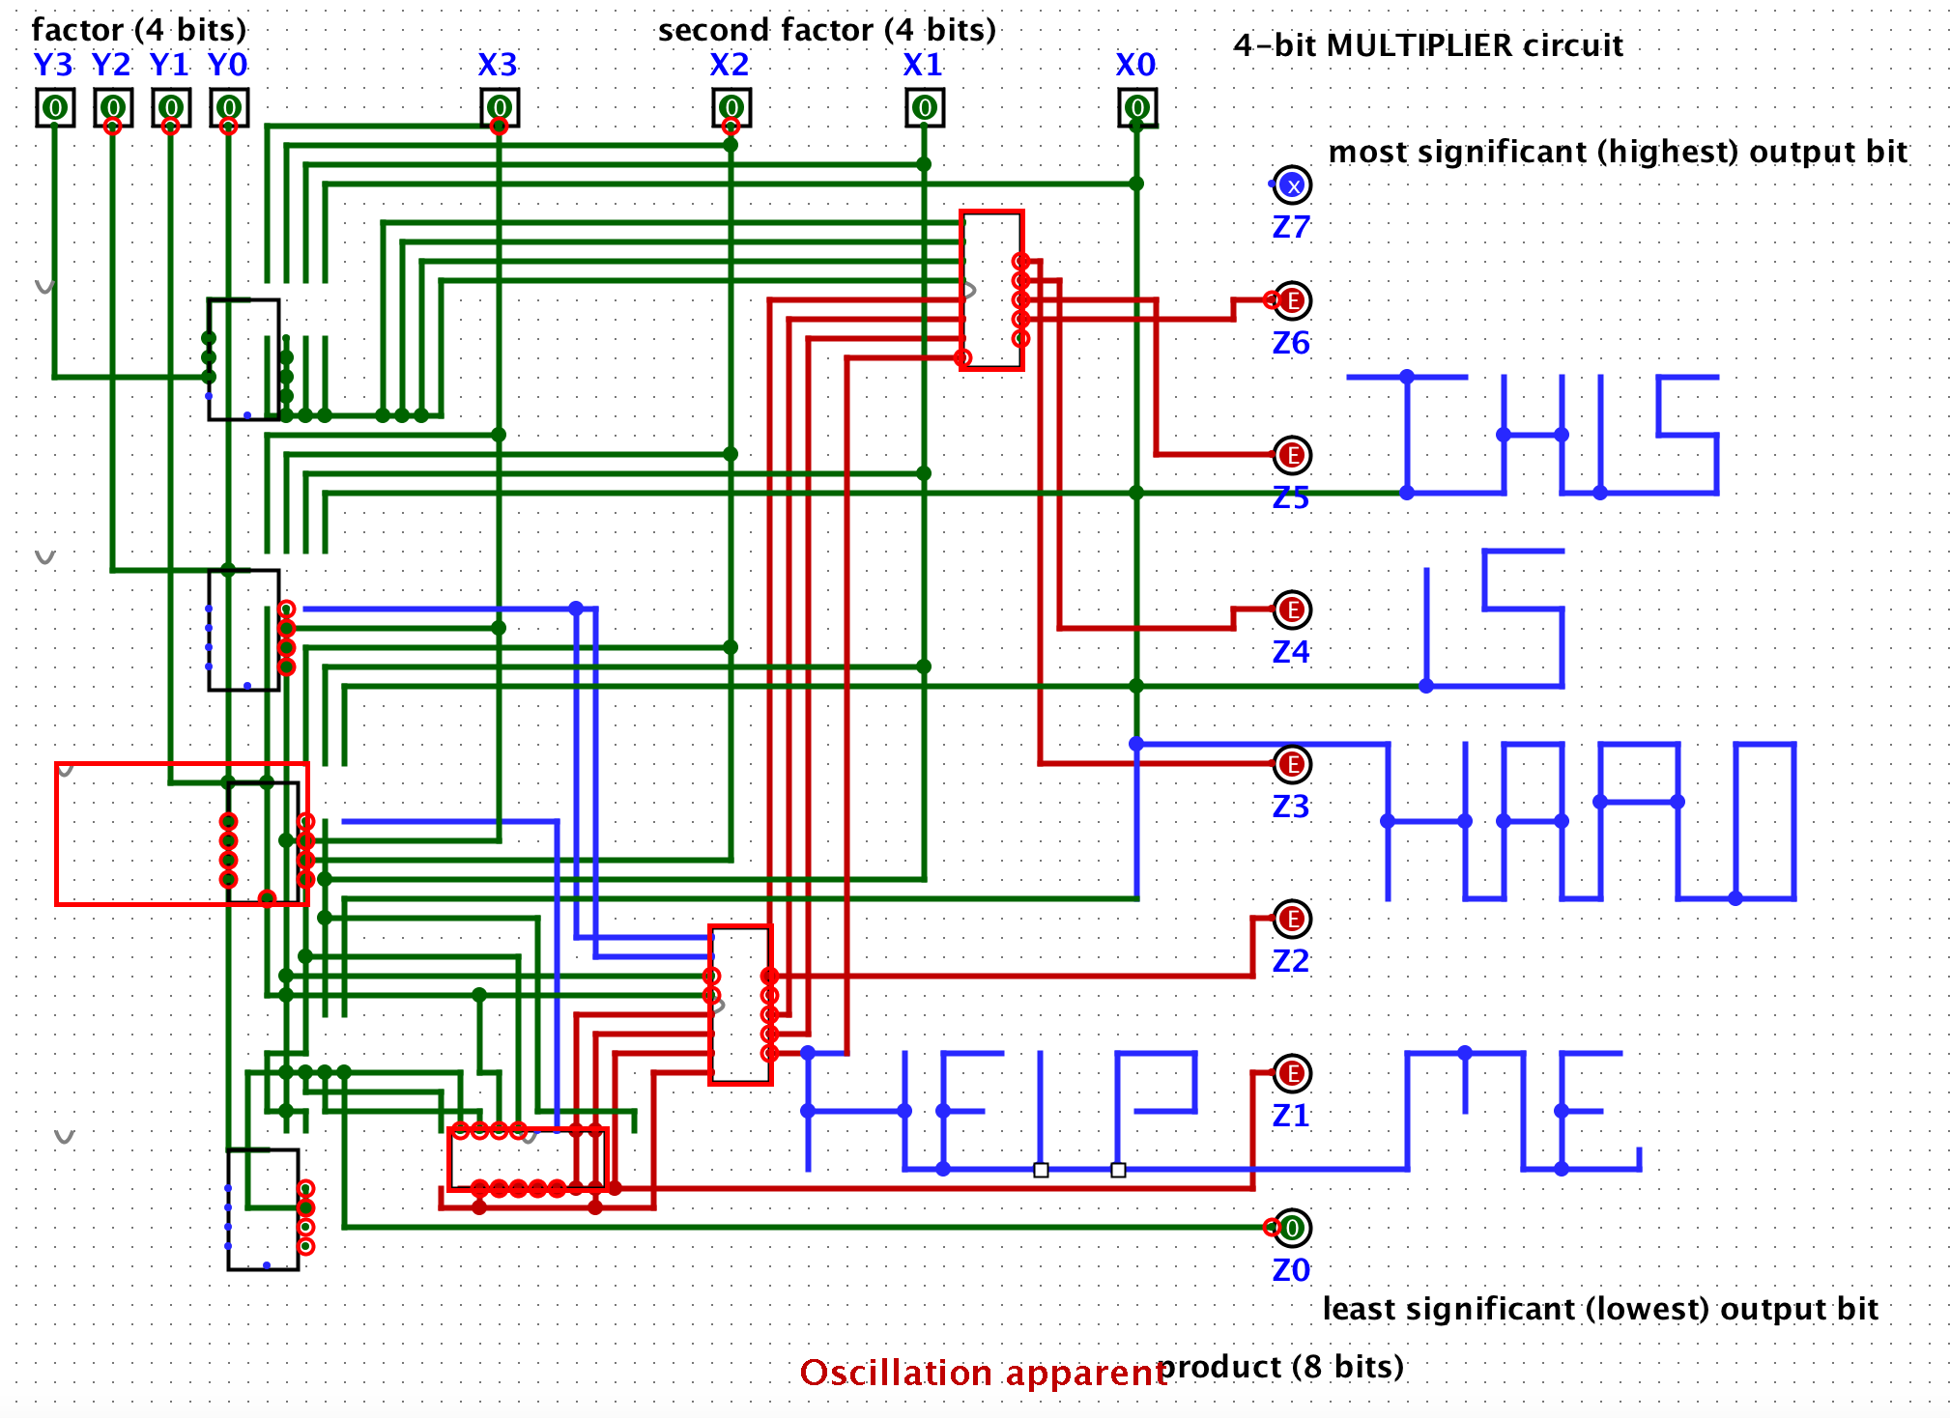
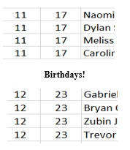
CS 5: Putting loops to work…
I'm glad you asked!
[ -35, -24, -13, -2, 9, 20, 31, ? ]
What's next?
[ 26250, 5250, 1050, 210, ? ]
[ 90123241791111 , 93551622, 121074, 3111, ? ]
[ 1, 11, 21, 1211, 111221, ? ]
Homework 8: due Mon., 10/30 by midnight
"Office" hrs. Fri! + lots of tutoring, LAC & ...
Midterm 11/2; review on the CS5 homepage
Final Exam choice: 12/13 @ 7pm or 12/14 @ 2pm

Slide 190
Mandelbrot!
David T.

Slide 191
Mandelbrot!
Natalie K.

Slide 192
Try it!
Rules rule!?
Trace each f'n. What do main1, main2, and main3 print?
Numbers: by value.
Lists: by reference.
Function calls copy.
Thought experiments: Don't hand this in…
def conform1(fav)
fav = 42
return fav
def conform2(L)
L = [42,42]
return L
def conform3(L)
L[0] = 42
L[1] = 42
fav
L
L
7
7
11
7
11
fav
42042
42042
L
L[0]
L[1]
L
L[0]
L[1]
def main1()
fav = 7
conform1(fav)
print(fav)
def main2()
L = [7,11]
conform2(L)
print(L)
def main3()
L = [7,11]
conform3(L)
print(L)
Notice that there are NO assignment statements after these function calls! The return values aren't being used…

Slide 193
Try it!
Rules rule!?
Trace each f'n. What do main1, main2, and main3 print?
Numbers: by value.
Lists: by reference.
Function calls copy.
Thought experiments: Don't hand this in…
def conform1(fav)
fav = 42
return fav
def conform2(L)
L = [42,42]
return L
def conform3(L)
L[0] = 42
L[1] = 42
fav
L
L
7
7
11
7
11
fav
L
L[0]
L[1]
L
L[0]
L[1]
def main1()
fav = 7
conform1(fav)
print(fav)
def main2()
L = [7,11]
conform2(L)
print(L)
def main3()
L = [7,11]
conform3(L)
print(L)
Notice that there are NO assignment statements after these function calls! The return values aren't being used…

Slide 194
Try it!
Rules rule!?
Just thought experiments: Don't hand this in…
Trace each f'n. What will main1, main2, and main3 print?
def conform1(fav)
fav = 42
return fav
def conform2(L)
L = [42,42]
return L
def conform3(L)
L[0] = 42
L[1] = 42
fav
L
L
7
7
11
7
11
fav
L
L[0]
L[1]
L
L[0]
L[1]
def main1()
fav = 7
conform1(fav)
print fav
def main2()
L = [7,11]
conform2(L)
print L
def main3()
L = [7,11]
conform3(L)
print L
Notice that there are NO assignment statements after these function calls! The return values aren't being used…

Slide 195
This week (not last week!)
or, at least, cookies...

Slide 196
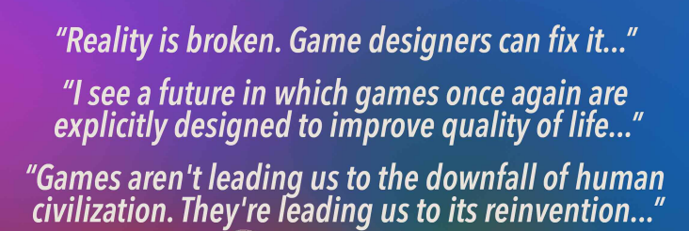
This week (Not last week!)
or, at least, cookies...

Slide 197
This week (CS, incarnate!)
or, at least, cookies...

Slide 198
Rectangular 2D data
A = [ [0,0,0,0], [0,0,0,0], [0,0,0,0] ]
Original data...
0
0
0
0
list
list
A
A[0]
A[0][0]
0
0
0
0
list
A[1]
0
0
0
0
list
A[2]
A[2][3]
A[1][2] = 42
A[r][c] = value

