Slide 1
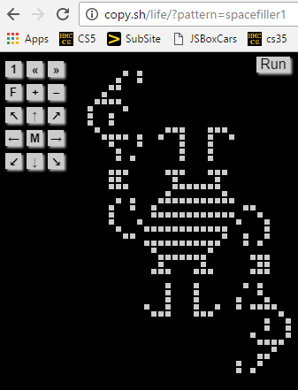

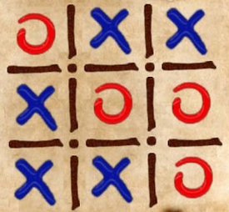
CS 5 Rules !
HW 8
Run!
z = z ² + c
A "monster" of a game! A zero-player game?!
Two problems - two rules each
HW 9 (lab + prob #2)
Simple rules can yield complex results!
due Mon. 4/3
The rule: Don't follow this rule.
Midterm
review problems online
acc? we have add'l space for Thu. …
content? only through hw8
Final ?!
Scheduled dates: 5/2 @ 2pm or 5/12 @ 2pm
Three-in-a-row? Aliens rule at this…

Slide 2
This Thursday will be the CS 5 in-class midterm
Un-warnings:
concerns? See me…
five problems, written
worth 1 hw assignment
score worries? Extra extra-credit in hw9 and beyond
Suggestions:
only 5 minutes? Try list comprehensions & LoL!
go over in-class exercises and hwk problems
create a page of notes, 2-sided is OK
code you understand is easiest to vary!
consider small variations of the problems – and how they would change the solutions…
that's our approach…

Slide 3
M.T. Review
(*) For up to two points! of extra credit on the midterm… Pair up with s/o you don't know (or don't know well) and find something unusual you have in common…
See also the gold review @ the cs5 site
Names:
Picobot! There are NO Picobot questions on the exam…
Recursion!!
You should feel confident you could create recursive functions to solve small problems, e.g., scrabble-scoring, finding sum or max or min, computing power or factorial (or variations)
You should be comfortable manipulating lists and strings (indexing, slicing, slicing with a "stride")
You should understand how to use, read, and compose list comprehensions , e.g., LC = [ x**2 for x in L ]
You should be able to design solutions using the "list of lists" technique (LoL), which uses list comprehensions, e.g., to find the highest scrabble-scoring word among a list or the lowest scrabble-scoring of a shifted string. Basic syntax: LoL = [ [sc(x),x] for x in L ]
You should understand the use-it-or-lose-it design strategy, e.g., the LCS, jotto, and sort homework problems:
Turtle graphics will not be emphasized (at most reading code)
Know the difference between print and return !!
Look over you composed larger programs out of smaller ones, how inputs and outputs are used, e.g., for Caesar Cipher
Representing Data!!!
Remind yourself of the various types of data (int, str, float, etc.), how they're different and how to convert between types
Know how characters are represented with chr and ord
Be comfortable with base-2 arithmetic (and base 10!), along with how to convert from base to base (no balanced ternary)
Remind yourself of how the bits of a base-2 number influence its value – what do right- and left-shifting do?
Thing in common:
Then, read over these & look for ones least familiar…
Circuits and Assembly!!!!
Know how the basic logic gates operate (AND and OR for any # of inputs , NOT for 1 input only)
Know how minterm expansion works (an OR of ANDs, each selecting one input) and how it enables the engineering of any circuit at all, given its truth-table specification
You should be comfortable using subcircuits (e.g., using the four-bit adders in the four-bit multiplier, or the individual pieces of the divider)
You should be able to write simple looping programs in Hmmm, e.g., factorial, power, Fibonacci, …
You should know what the stack is, what load and store do at the high-level (officially, they're named storer and loadr) - and why they're necessary for implementing functions in Hmmm (broadly speaking)
The exam will not ask you to implement recursion or stack-based functions in Hmmm, however – only looping + conditional examples.
The exam will have a full Hmmm reference sheet (you don't need it)
Loops
You should feel comfortable with how for loops (both element-based and index-based) and while loops work – and be able to compose small functions that use them, e.g., ones similar to those in the pi-estimation and TT securities (statistics) problems.
You should understand how nested loops work and be able to read or compose examples (such as the TTS strategy or our in-class problems)
Later today…
I <3 three-eyed punctuation!
!
!
You may use functions from class and hw on the exam without reimplementing them. Here are some, but not all, of them:
removeOne( e, L ), removeAll( e, L ), removeUpto( e, L ), count( e, L ), ind( e, L ), frontNum( L ), binToNum( binstr ), numToBin( n ), …

Slide 4
CS 5 Rules !
HW 8
Run!
z = z ² + c
A "monster" of a game! A zero-player game?!
Two problems - two rules each
HW 9 (lab + prob #2)
Simple rules can yield complex results!
due Mon. 4/3
The rule: Don't follow this rule.
Midterm
review problems online
acc? we have add'l space for Thu. …
content? only through hw8
Final ?!
Scheduled dates: 5/2 @ 2pm or 5/12 @ 2pm
Three-in-a-row? Aliens rule at this…

Slide 5
In CS, rules rule!
(1a) Lists are handled "by reference"
(1b) Numbers and strings are handled "by value"
(2) Functions receive inputs "by copy"
two rules,
"interesting" results!

Slide 6
In CS, rules rule!
(1a) Lists are handled "by reference"
"Reference"
"Pointer"
id
L = [5,42,'hi']
s = 'hi'
42,042
5
42
'hi'
'hi'
L
s
L[0]
L[1]
L[2]
(1b) Numbers and strings are handled "by value"
The contents of the variable's "box" in memory are copied.
(2) Functions receive inputs "by copy"
in main:
fav = 7
f(fav)
7
def f(x):
7
fav
x
x is a copy of fav

Slide 7
Reference vs. Value
Python's two methods for handling data
"Reference"
"Pointer"
id
s = 'hi'
x = 7
L = [5,42,'hi']
42,042
'hi'
7
5
42
'hi'
L
s
x
L[0]
L[1]
L[2]
Lists are handled by reference:
L really holds a memory address
Numeric data and strings are handled by value: imagine they hold the data
L = [7,8,9]; id(L) ...
x = 9001; id(x) ...
s = 'wow!'; id(s) ...

Slide 8
Shallow vs. Deep
Python's two methods for copying data
"Reference"
"Pointer"
id
L = [5,42,'hi']
L = [5,42,'hi']
42,042
5
42
'hi'
M = L
L
L[0]
L[1]
L[2]
M[0] = 60
What's L[0] ?!
M
= assignment is "shallow"

Slide 9
Shallow vs. Deep
Python's two methods for copying data
from copy import *
"Reference"
"Pointer"
id
L = [5,42,'hi']
L = [5,42,'hi']
42,042
5
42
'hi'
M = deepcopy(L)
L
L[0]
L[1]
L[2]
M[0] = 60
42,042
What's L[0] ?!
M
deepcopy is deep!
import antigravity!

Slide 10
shallow
Python functions: pass by copy
^
def conform(fav)
fav = 42
return fav
fav
def main()
print(" Welcome! ")
fav = 7
fav = conform(fav)
print(" My favorite # is", fav)
7
fav

Slide 11
shallow
Python functions: pass by copy
^
def conform(fav)
fav = 42
return fav
7
fav
copy of fav
"pass by copy" means the contents of fav are copied to fav
def main()
print(" Welcome! ")
fav = 7
fav = conform(fav)
print(" My favorite # is", fav)
7
fav
But what if the underlined part were absent… ?

Slide 12
Try it!
Rules rule!?
Trace each f'n. What do main1, main2, and main3 print?
Numbers: by value.
Lists: by reference.
Function calls copy.
Thought experiments: Don't hand this in…
def conform1(fav)
fav = 42
return fav
def conform2(L)
L = [42,42]
return L
def conform3(L)
L[0] = 42
L[1] = 42
fav
L
L
7
7
11
7
11
fav
42042
42042
L
L[0]
L[1]
L
L[0]
L[1]
def main1()
fav = 7
conform1(fav)
print(fav)
def main2()
L = [7,11]
conform2(L)
print(L)
def main3()
L = [7,11]
conform3(L)
print(L)
Notice that there are NO assignment statements after these function calls! The return values aren't being used…

Slide 13
Try it!
Rules rule!?
Trace each f'n. What do main1, main2, and main3 print?
Numbers: by value.
Lists: by reference.
Function calls copy.
Thought experiments: Don't hand this in…
def conform1(fav)
fav = 42
return fav
def conform2(L)
L = [42,42]
return L
def conform3(L)
L[0] = 42
L[1] = 42
fav
L
L
7
7
11
7
11
fav
L
L[0]
L[1]
L
L[0]
L[1]
def main1()
fav = 7
conform1(fav)
print(fav)
def main2()
L = [7,11]
conform2(L)
print(L)
def main3()
L = [7,11]
conform3(L)
print(L)
Notice that there are NO assignment statements after these function calls! The return values aren't being used…

Slide 14
Try it!
Rules rule!?
Just thought experiments: Don't hand this in…
Trace each f'n. What will main1, main2, and main3 print?
def conform1(fav)
fav = 42
return fav
def conform2(L)
L = [42,42]
return L
def conform3(L)
L[0] = 42
L[1] = 42
fav
L
L
7
7
11
7
11
fav
L
L[0]
L[1]
L
L[0]
L[1]
def main1()
fav = 7
conform1(fav)
print fav
def main2()
L = [7,11]
conform2(L)
print L
def main3()
L = [7,11]
conform3(L)
print L
Notice that there are NO assignment statements after these function calls! The return values aren't being used…

Slide 15
Lists are Mutable
You can change the contents of lists in functions that take those lists as input.
- Lists are MUTABLE objects
Those changes will be visible everywhere.
Numbers, strings, etc. are IMMUTABLE – they can't be changed, only reassigned.

Slide 16
Differing approaches to rules …
Engineers
Physicists
different worldviews…
Mathematicians
CS?

Slide 17
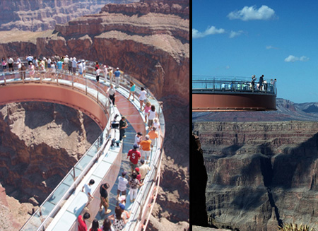
equations, relationships, formulas, etc.
Engineers believe their rules approximate reality;
Safety margins!
Grand Canyon Skywalk

Slide 18
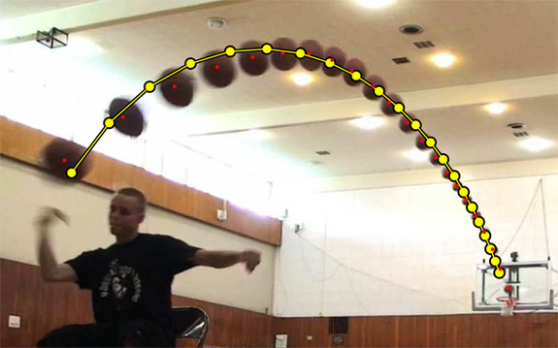
equations, relationships, formulas, etc.
Engineers believe their rules approximate reality;
Physicists believe reality approximates their rules…
^
measured
Image forensics' verdict:
Fake!
Not a parabola, so not a real shot!
http://www.youtube.com/watch?feature=player_embedded&v=WbaH52JI3So
http://www.fourandsix.com/blog/2011/8/29/seriously-amazing-beer-pong-shots.html

Slide 19
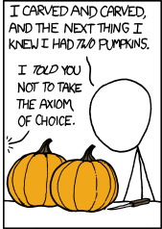
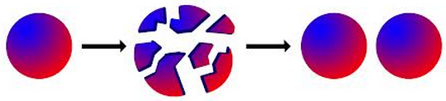
Engineers believe their rules approximate reality;
Physicists believe reality approximates their rules…
Mathematicians don't care either way!
A solid sphere can be split into 5 parts and rigidly reassembled into two solid spheres the same size as the original
Banach-Tarski paradox
Banach-Tarski XKCD
the parts are "clouds"
https://www.youtube.com/watch?v=s86-Z-CbaHA @ 18:49

Slide 20
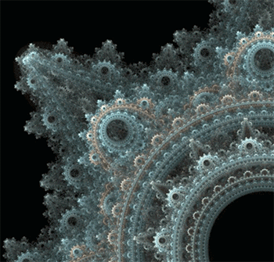
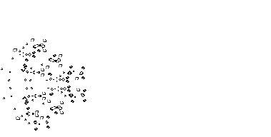
Engineers believe their rules approximate reality;
Physicists believe reality approximates their rules…
Mathematicians don't care either way!
CS?
Don't like your reality? Build a new one!
why settle for gears, when you could have fractal gears?
plain patterns? Self-propagating patterns!
https://en.wikipedia.org/wiki/File:Conways_game_of_life_breeder_animation.gif

Slide 21
Engineers believe equations approximate reality;
Physicists believe reality approximates equations…
Mathematics reason about structural rules…
… and CSers reason about procedural ones.
for
lists
Data
Data
while
variables
Axioms
arithmetic operations
Definitions
if/else
proofs
programs
Insights, tools, mathematical truths
Insights, tools, algorithms
math worldview
CS worldview

Slide 22
2D data!
All and only the rules that govern 1D data apply here – no new rules to learn!
~ pure composition

Slide 23
Lists ~ 1D data
A = [ 42, 75, 70 ]
Picture w/ A's reference?
len(A) ?
1D lists are familiar – but lists can hold ANY kind of data – including lists!

Slide 24
Lists ~ 1D data
A = [ 42, 75, 70 ]
42
75
70
list
int
int
int
A
len(A) ?
1D lists are familiar – but lists can hold ANY kind of data – including lists!

Slide 25
Lists ~ 2D data
A = [ [1,2,3,4], [5,6], [7,8,9,10,11] ]
Picture w/ A's references?
Where's 3?
len(A)
len(A[0])
Replace 10 with 42.
len(A[1])

Slide 26
Lists ~ 2D data
A = [ [1,2,3,4], [5,6], [7,8,9,10,11] ]
1
2
3
4
list
list
A[0][0]
A[0][1]
A[0][3]
A
A[0]
A[0][2]
5
6
list
A[1][0]
A[1][1]
A[2][3] = 42
A[1]
7
8
9
10
11
list
A[2]
A[2][0]
A[2][1]
A[2][2]
A[2][3]
A[2][4]
4
Where's 3?
len(A)
len(A[0])
Replace 10 with 42.
3
len(A[1])
2

Slide 27
Rectangular 2D data
A = [ [0,0,0,0], [0,0,0,0], [0,0,0,0] ]
Original data...
0
0
0
0
list
list
A
A[0]
A[0][0]
0
0
0
0
list
A[1]
0
0
0
0
list
A[2]
A[2][3]
To try…
NROWS = len(A) # HEIGHT
NCOLS = len(A[0]) # WIDTH
for r in range( 0,NROWS ):
for c in range( 0,NCOLS ):
if r == c: A[r][c] = 4
else: A[r][c] = 2
What will this do?

Slide 28
(*) For up to two points! of extra credit on the midterm… Pair up with s/o and find something you have in common (that you didn't know before!)…
after trying this, look over the midterm-review together!
A = [ [4, 2, 2, 2],
[2, 2, 4, 4],
[8, 3, 3, 1] ]
Names:
Thing in common:
def mystery(A):
""" what happens to A ? """
NROWS = len(A)
NCOLS = len(A[0])
for r in range( 0,NROWS ):
for c in range( 0,NCOLS ):
if r == c:
A[r][c] += 1
else:
A[r][c] *= 2
A
Before
row 0
4 2 2 2
2 2 4 4
8 3 3 1
row 1
row 2
col 0
col 1
col 2
col 3
A
After
Starting with the 2d array A above, write the values in A after running that code:
Above, write the resulting values in A
Challenge:
Then, how could you change the code above to create a True where the original value was equal to its neighbor to the right?! (False, if there's no neighbor or a different neighbor.)
F T T F
T F T F
F T F F

Slide 29
M.T. Review
(*) For up to two points! of extra credit on the midterm… Pair up with s/o and find something you have in common (that you didn't know before!)…
See review problems @ the cs5 site
Names:
Put your names and thing-in-common on the OTHER page! Keep this page...
Picobot! There are NO Picobot questions on the exam…
Recursion!!
You should feel confident you could create recursive functions to solve small problems, e.g., scrabble-scoring, finding sum or max or min, computing power or factorial (or variations)
You should be comfortable manipulating lists and strings (indexing, slicing, slicing with a "stride") What's s[1:-1:2]?
You should understand how to use, read, and compose list comprehensions , e.g., LC = [ x**2 for x in L ]
You should be able to design solutions using the "list of lists" technique (LoL), which uses list comprehensions, e.g., to find the highest scrabble-scoring word among a list or the lowest scrabble-scoring of a shifted string. Basic syntax: LoL = [ [sc(x),x] for x in L ]
You should understand the use-it-or-lose-it design strategy, e.g., the LCS, exact_change, jotto, and sort homework problems
Turtle graphics will not be on the exam
Know the difference between print and return !!
Look over how you composed larger programs out of smaller ones + how inputs and outputs are used, e.g., for Caesar Cipher
Representing Data!!!
Remind yourself of the various types of data (int, str, float, etc.), how they're different and how to convert between types
Know how characters are represented with chr and ord
Be comfortable with base-2 arithmetic (and base 10!), along with how to convert from base to base (no balanced ternary)
Remind yourself of how the bits of a base-2 number influence its value – what do right- and left-shifting do?
Thing in common:
Then, read over these & look for ones least familiar…
Circuits and Assembly!!!!
Know how the basic logic gates operate (AND and OR for any # of inputs , NOT for 1 input only)
Know how minterm expansion works (an OR of ANDs, each selecting one input) and how it enables the engineering of any circuit at all, given its truth-table specification
You should be comfortable using subcircuits (e.g., using the four-bit adders in the four-bit multiplier, or the individual pieces of the divider)
You should be able to write simple looping programs in Hmmm, e.g., factorial, power, Fibonacci, …
You should know what the stack is, what load and store do at the high-level (in Hmmm, they're named storer and loadr) - and why they're useful for implementing functions in Hmmm - broadly speaking
The exam will not ask you to implement recursion or stack-based functions in Hmmm: only looping + conditional examples.
It will have a full Hmmm reference (your don't need your own)
Loops
You should feel comfortable with how for loops (both element-based and index-based) and while loops work – and be able to compose small functions that use them, e.g., ones similar to those in the pi-estimation and TT securities (statistics) problems.
You should understand how nested loops work and be able to read or compose examples (such as the TTS strategy or our in-class problems)
I <3 three-eyed punctuation!
!
!
You may use functions from class and hw on the exam without reimplementing them. Here are some, but not all, of them:
removeOne( e, L ), removeAll( e, L ), removeUpto( e, L ), count( e, L ), ind( e, L ), frontNum( L ), binToNum( binstr ), numToBin( n ), …

Slide 30
hw9pr2…
A = [ [4, 2, 2, 2],
[2, 2, 4, 4],
[2, 4, 4, 2] ]
def inarow_2east(A):
""" what happens to A ? """
NROWS = len(A)
NCOLS = len(A[0])
for r in range( 0,NROWS ):
for c in range( 0,NCOLS ):
if c == NCOLS-1:
A[r][c] = False
elif A[r][c] == A[r][c+1]:
A[r][c] = True
else:
A[r][c] = False
A
Before
row 0
4 2 2 2
2 2 4 4
2 4 4 2
row 1
row 2
right edge!
col 0
col 1
col 2
col 3
2 in a row
not 2 in a row
F T T F
T F T F
F T F F
Challenge:
Then, how could you change the code above to create a True where the original value was equal to its neighbor to the right?! (False, if there's no neighbor or a different neighbor.)

Slide 31
First, try it by eye…
… then, on hw9pr2, by Python!
col 0
col 1
col 2
col 3
col 4
A = [ [' ','X','O',' ','O'],
['X','X','X','O','O'],
[' ','X','O','X','O'],
['X','O','O',' ','X'] ]
row 0
row 1
row 2
row 3
the data doesn't wrap around
start row
start col
checker
LoL
inarow_3east('X', 1, 0, A)

Slide 32
First, try it by eye…
… then, on hw9pr2, by Python!
col 0
col 1
col 2
col 3
col 4
A = [ [' ','X','O',' ','O'],
['X','X','X','O','O'],
[' ','X','O','X','O'],
['X','O','O',' ','X'] ]
row 0
row 1
row 2
row 3
the data doesn't wrap around
start row
start col
checker
LoL
inarow_3east('X', 1, 0, A)
True
inarow_3south('O', 0, 4, A)
inarow_3southeast('X', 2, 3, A)
inarow_3northeast('X', 3, 1, A)

Slide 33
hw9pr2…
A = [ [4, 2, 2, 2],
[2, 2, 4, 4],
[2, 4, 4, 2] ]
Use this as your starting point... !
def inarow_2east(A):
""" what happens to A ? """
NROWS = len(A)
NCOLS = len(A[0])
for r in range( 0,NROWS ):
for c in range( 0,NCOLS ):
if c == NCOLS-1:
A[r][c] = False
elif A[r][c] == A[r][c+1]:
A[r][c] = True
else:
A[r][c] = False
A
Before
row 0
4 2 2 2
2 2 4 4
2 4 4 2
row 1
row 2
right edge!
col 0
col 1
col 2
col 3
2 in a row
not 2 in a row
F T T F
T F T F
F T F F
Challenge:
Then, how could you change the code above to create a True where the original value was equal to its neighbor to the right?! (False, if there's no neighbor or a different neighbor.)

Slide 34
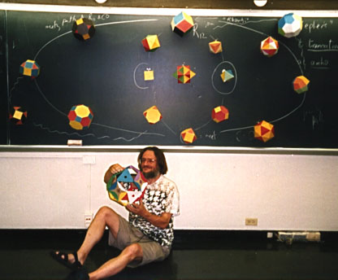
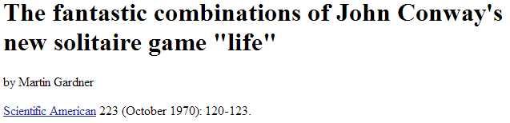
hw9pr1 (lab): Conway's Game of Life
1995
?
John Conway
20˚
10˚
Geometer @ Princeton
60˚
70˚
(no trig)
simple rules ~ surprising behavior
not really solitaire...
1970

Slide 35
Lab Problem: Conway's Game of Life
Grid World
Evolutionary rules
red cells are "alive"
Everything depends on a cell's eight neighbors
2
1
3
Exactly 3 neighbors give birth to a new, live cell.
4
5
6
7
8
Exactly 2 or 3 neighbors keep an existing cell alive.
Any other # of neighbors and the central cell dies…
Only 2 rules
white cells are empty

Slide 36
Lab Problem: Conway's Game of Life
"Parent generation"
Grid World
Evolutionary rules
red cells are "alive"
Everything depends on a cell's eight neighbors
Exactly 3 neighbors give birth to a new, live cell.
Exactly 2 or 3 neighbors keep an existing cell alive.
Any other # of neighbors and the central cell dies…
white cells are empty

Slide 37
Lab Problem: Conway's Game of Life
"Child generation"
Grid World
Evolutionary rules
red cells are "alive"
Everything depends on a cell's eight neighbors
Exactly 3 neighbors give birth to a new, live cell.
Exactly 2 or 3 neighbors keep an existing cell alive.
Any other # of neighbors and the central cell dies…
white cells are empty

Slide 38
Lab Problem: Conway's Game of Life
"Grandchild generation"
Grid World
Evolutionary rules
red cells are alive
Everything depends on a cell's eight neighbors
Exactly 3 neighbors give birth to a new, live cell.
Exactly 2 or 3 neighbors keep an existing cell alive.
What's next?
Any other # of neighbors and the central cell dies…
white cells are empty

Slide 39
Lab Problem: Creating life
next_life_generation( A )
For each cell…
3 live neighbors – life!
2 live neighbors – same
0, 1, 4, 5, 6, 7, or 8 live neighbors – death
computed all at once, not cell-by-cell, so the ? at left does NOT come to life, but ? does!
?
?
http://www.math.com/students/wonders/life/life.html

Slide 40
Lab Problem: Creating life
next_life_generation( A )
old generation is the input, A
returns the next generation
0
1
2
3
4
5
0
1
2
3
4
5
0
0
1
1
2
2
?
3
3
4
4
5
5

Slide 41


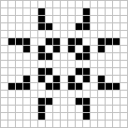


Lab Problem: Creating life
Stable configurations:
"rocks"
Periodic
"plants"
period 2
period 3
Self-propagating
"animals"
glider
Copperhead: 2016

Slide 42
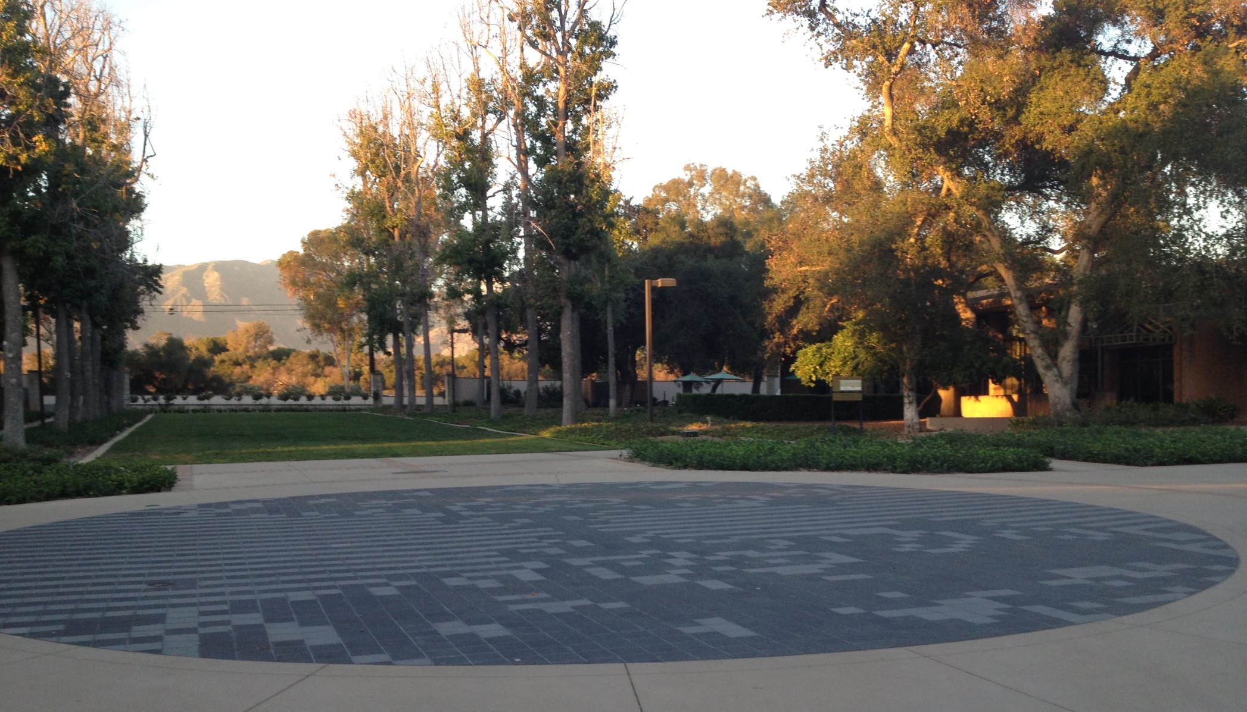
Life @ HMC
Stable configurations:
"rocks"
Periodic
"plants"
period 2
period 3
Self-propagating
"animals"
glider

Slide 43
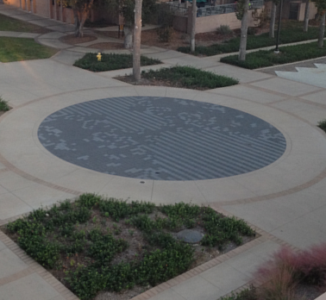
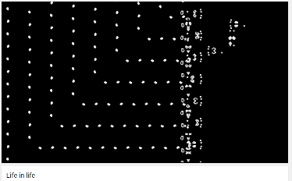
Life @ HMC
Life, universally!
www.youtube.com/watch?v=xP5-iIeKXE8

Slide 44
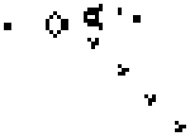
Lab Problem: Creating life
Many life configurations expand forever…
"Gosper glider gun"
"glider"
What is the largest amount of the life universe that can be filled with cells?
How sophisticated can Life-structures get?
www.ibiblio.org/lifepatterns/

Slide 45
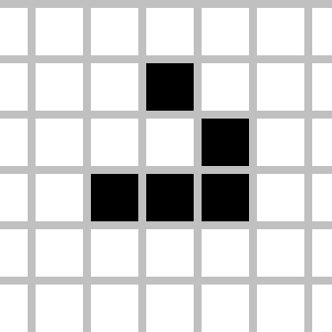
Today you'll be
Lifing it up
in lab!
so
on over…
glide

Slide 47
Try it!
Rules rule!?
Just thought experiments: Don't hand this in…
Trace each f'n. What will main1, main2, and main3 print?
def conform1(fav)
fav = 42
return fav
def conform2(L)
L = [42,42]
return L
def conform3(L)
L[0] = 42
L[1] = 42
fav
L
L
7
7
11
7
11
fav
L
L[0]
L[1]
L
L[0]
L[1]
def main1()
fav = 7
conform1(fav)
print fav
def main2()
L = [7,11]
conform2(L)
print L
def main3()
L = [7,11]
conform3(L)
print L
Notice that there are NO assignment statements after these function calls! The return values aren't being used…

Slide 48
Lists ~ 2D data
A = [ [1,2,3,4], [5,6], [7,8,9,10,11] ]
1
2
3
4
list
list
A[0][0]
A[0][1]
A[0][3]
A
A[0]
?
5
6
list
A[1][0]
A[1][1]
A[1]
7
8
9
10
11
list
A[2]
A[2][0]
A[2][1]
A[2][2]
A[2][3]
A[2][4]
Where's 3?
len(A[0])
len(A)
Replace 10 with 42.

Slide 49
Rectangular 2D data
A = [ [1,2,3,4], [5,6,7,8], [9,0,1,2] ]
1
2
3
4
list
list
A
A[0]
A[0][0]
5
6
7
8
list
A[1]
9
0
1
2
list
A[2]
A[2][3]
To try…
What is A[1][2]?
What does each component of A[1][2] mean ?
How many rows does A have, in general ?
How many columns does A have, in general ?

Slide 50
Try it…
A = [ [4, 2, 2, 2],
[2, 2, 4, 4],
[2, 4, 4, 2] ]
def mystery(A):
""" what happens to A ? """
NROWS = len(A)
NCOLS = len(A[0])
for r in range( 0,NROWS ):
for c in range( 0,NCOLS ):
if A[r][c]%4 == 0:
A[r][c] = 1
else:
A[r][c] += 1
A
Before
row 0
4 2 2 2
2 2 4 4
2 4 4 2
row 1
row 2
col 0
col 1
col 2
col 3
Starting with the 2d array A shown above, write the values in A after running the code?
Then, how would you change the code to produce a True where the original value is equal to its neighbor to the right?! (False, if no neighbor or a different neighbor.)
Write in the resulting values in A:
A
Challenge:
F T T F
T F T F
F T F F
After – with the code as written…

Slide 51
hw9pr2
A = [ [4, 2, 2, 2],
[2, 2, 4, 4],
[2, 4, 4, 2] ]
def inarow_2east(A):
""" what happens to A ? """
NROWS = len(A)
NCOLS = len(A[0])
for r in range( 0,NROWS ):
for c in range( 0,NCOLS ):
if c < NCOLS-1:
if A[r][c] == A[r][c+1]:
A[r][c] = True
else:
A[r][c] = False
A
Before
row 0
4 2 2 2
2 2 4 4
2 4 4 2
row 1
row 2
col 0
col 1
col 2
col 3
Challenge:
F T T F
T F T F
F T F F
How would you change the code to produce a True where the original value is equal to its neighbor to the right?!
(False, if no neighbor or a different neighbor.)

Slide 52
Differing approaches to rules …
Engineers
Physicists
different worldviews…
Mathematicians
CS?

Slide 53
"the rules"
Engineers believe equations approximate reality;
Safety margins!
Grand Canyon Skywalk

Slide 54
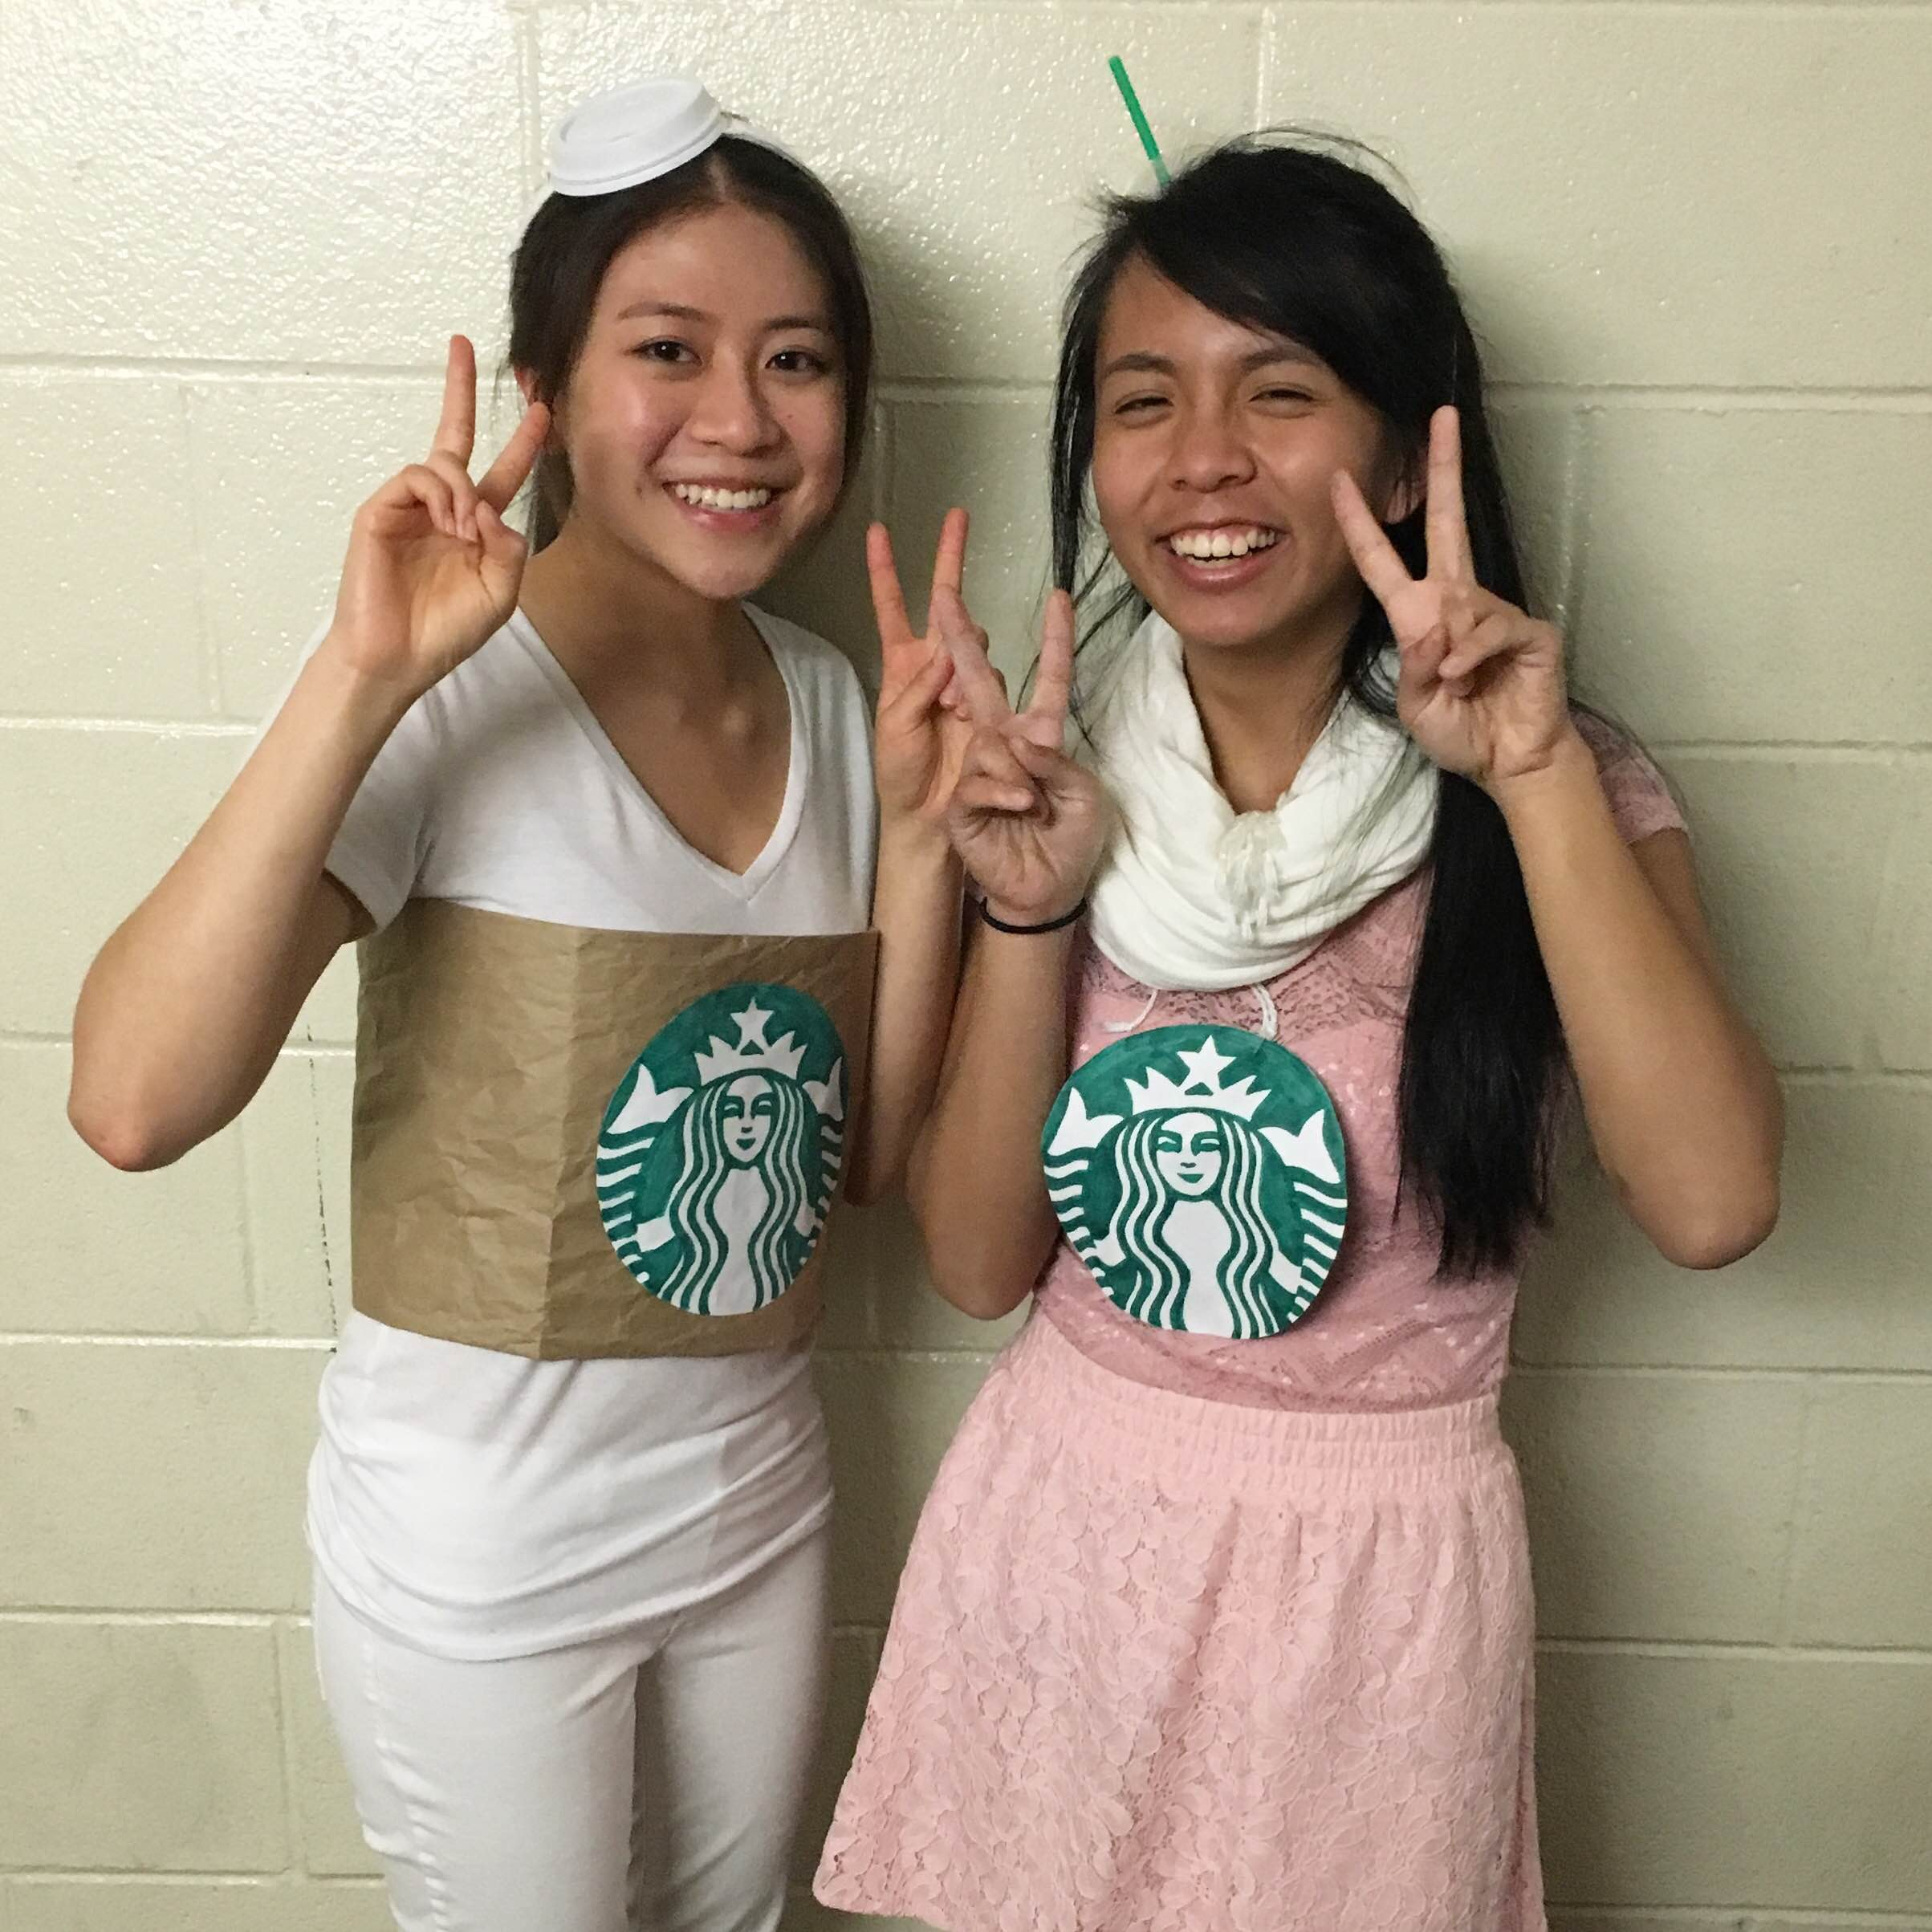
Costumes! '15
taking OR too literally
(or too computationally!)

Slide 55

Costumes! '16...

Slide 56
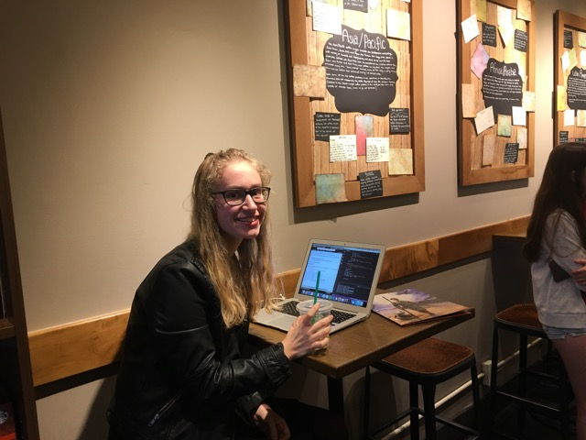
Hannah!

Slide 57

Mandelbrot!
Forest K.

Slide 58

Mandelbrot!
David T.

Slide 59
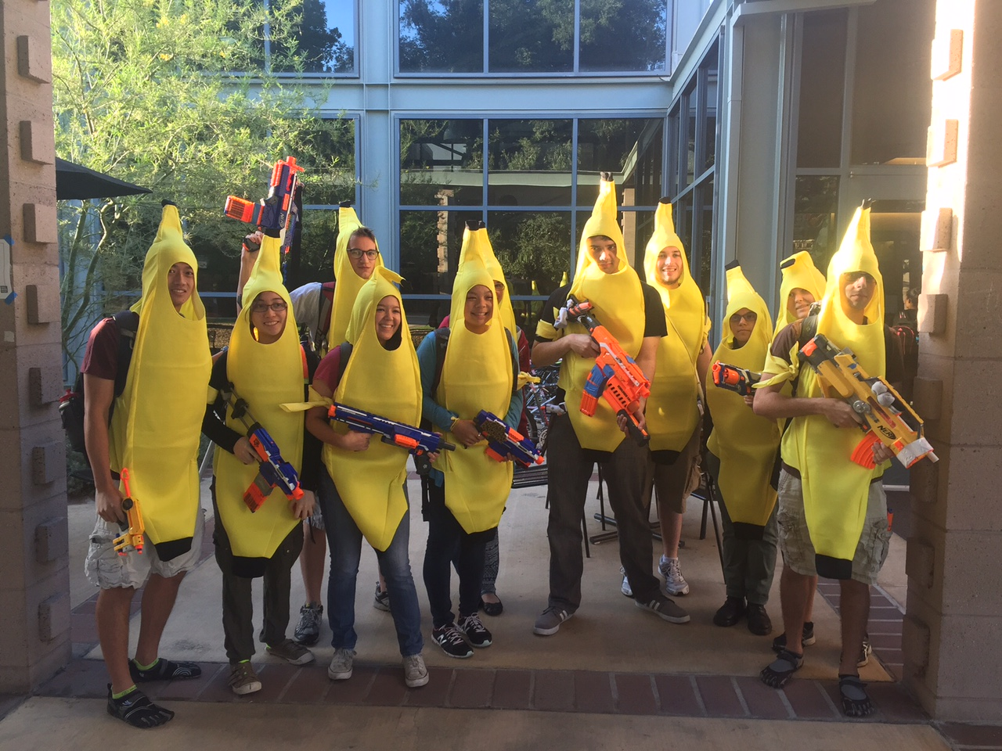
Celebrataing humanness…

Slide 60
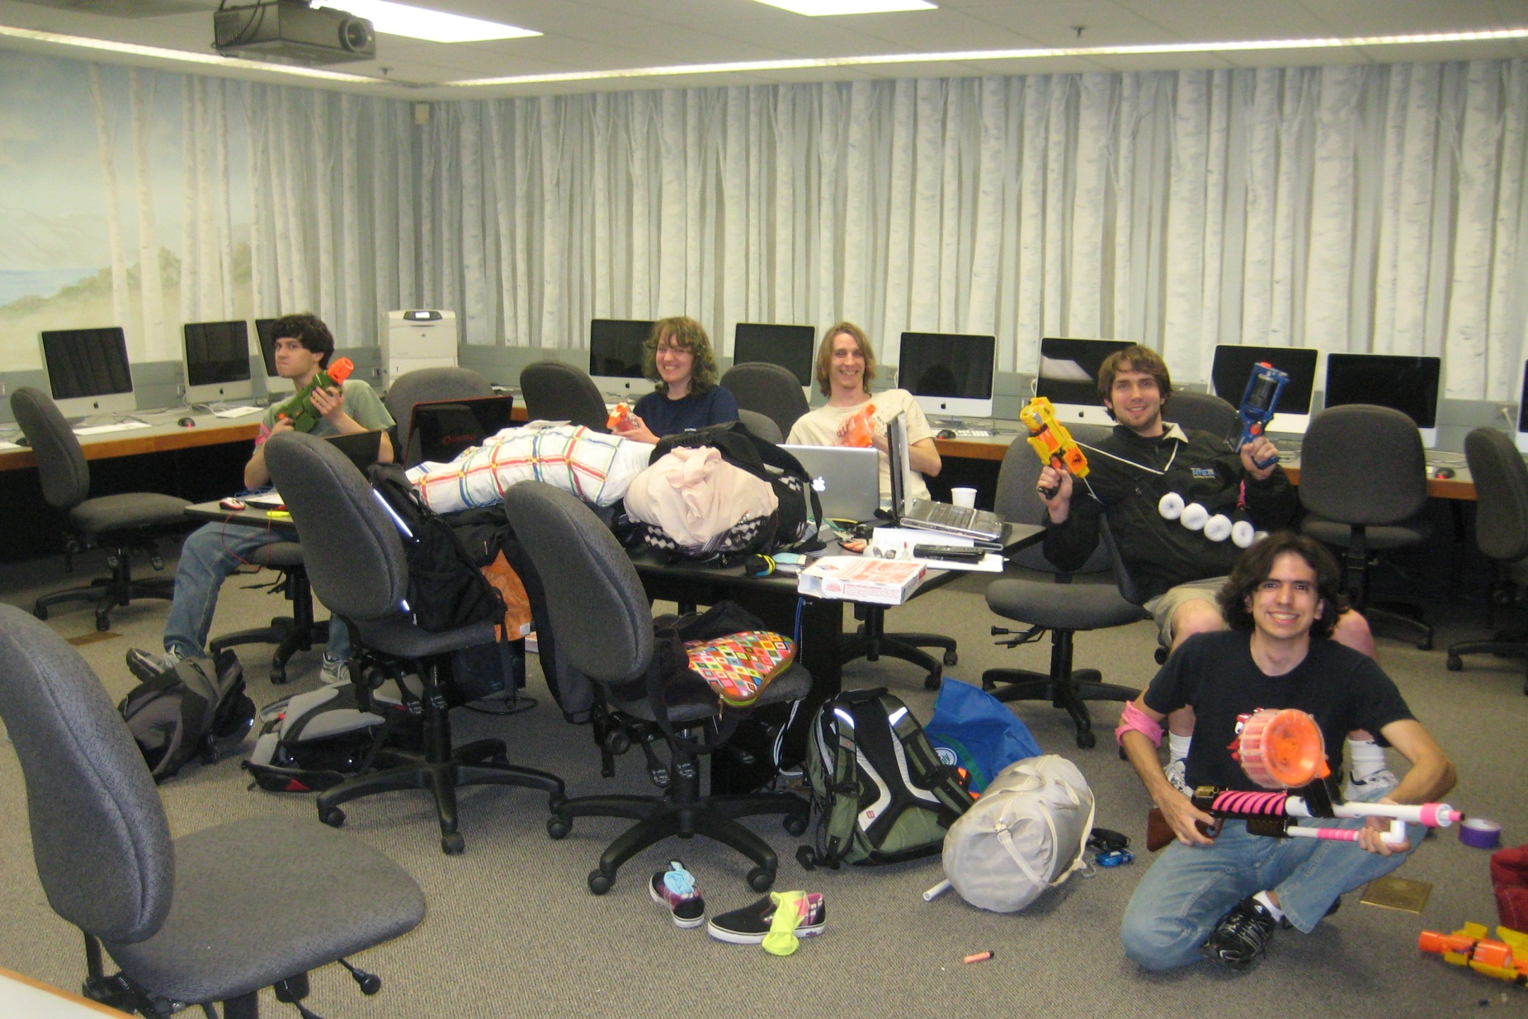
Celebrataing humanness…
CS 5 lab ~ a no-zombie zone!

Slide 61

Past zombie run-ins… Not sure about the tie?!

Slide 62
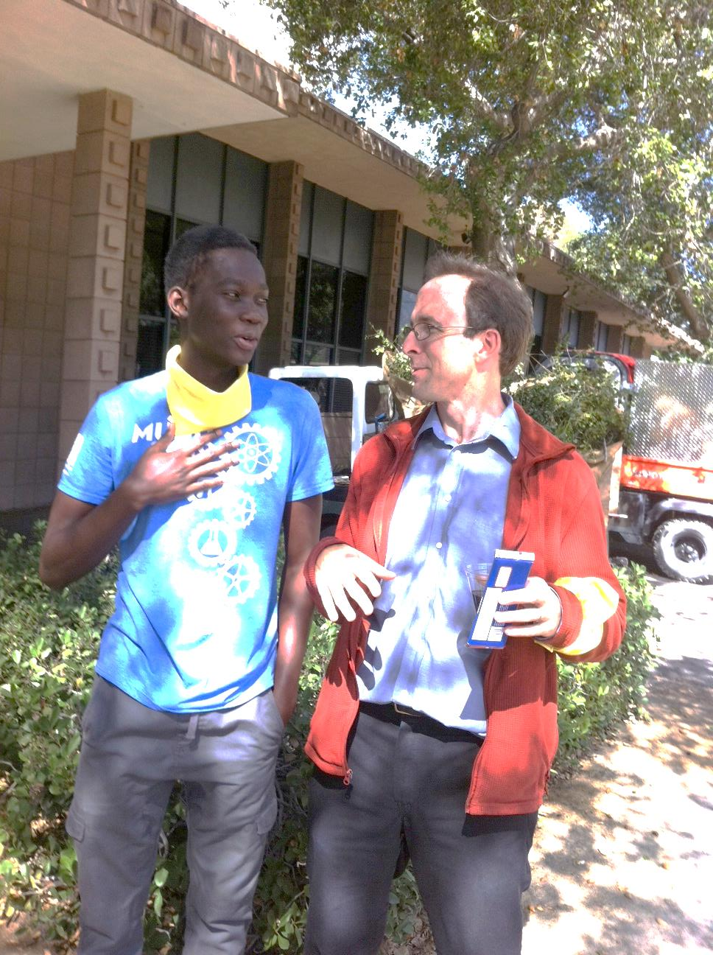
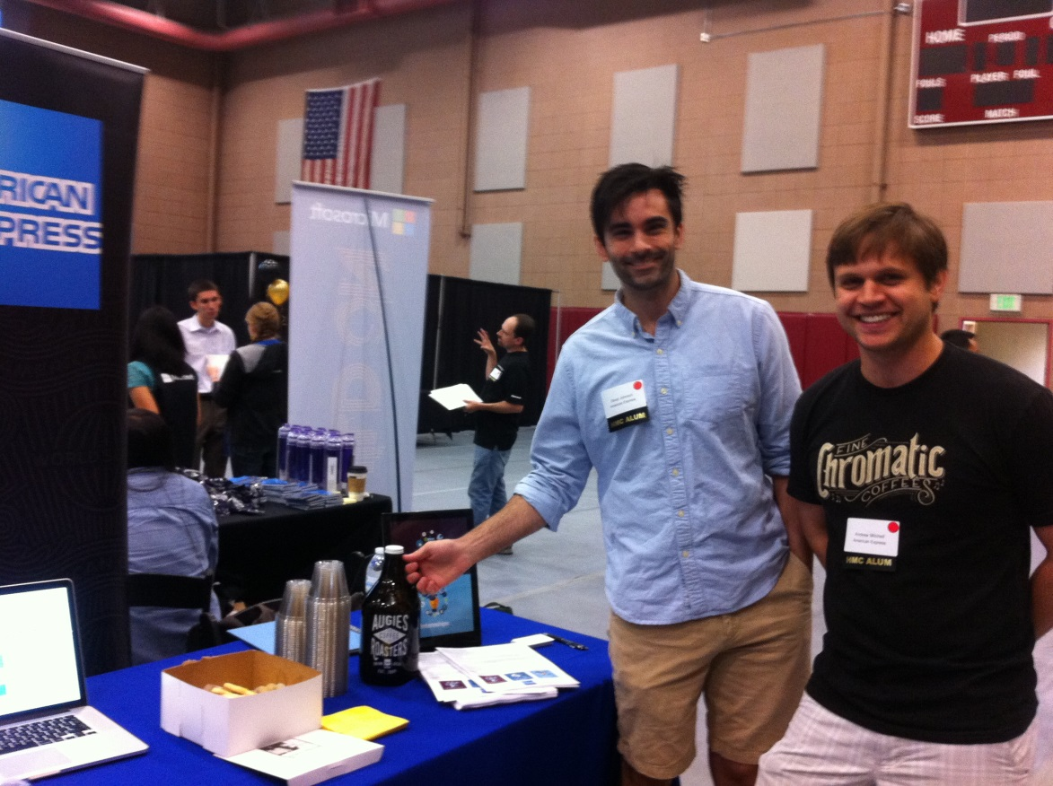
Farewell, humanness…

Slide 63
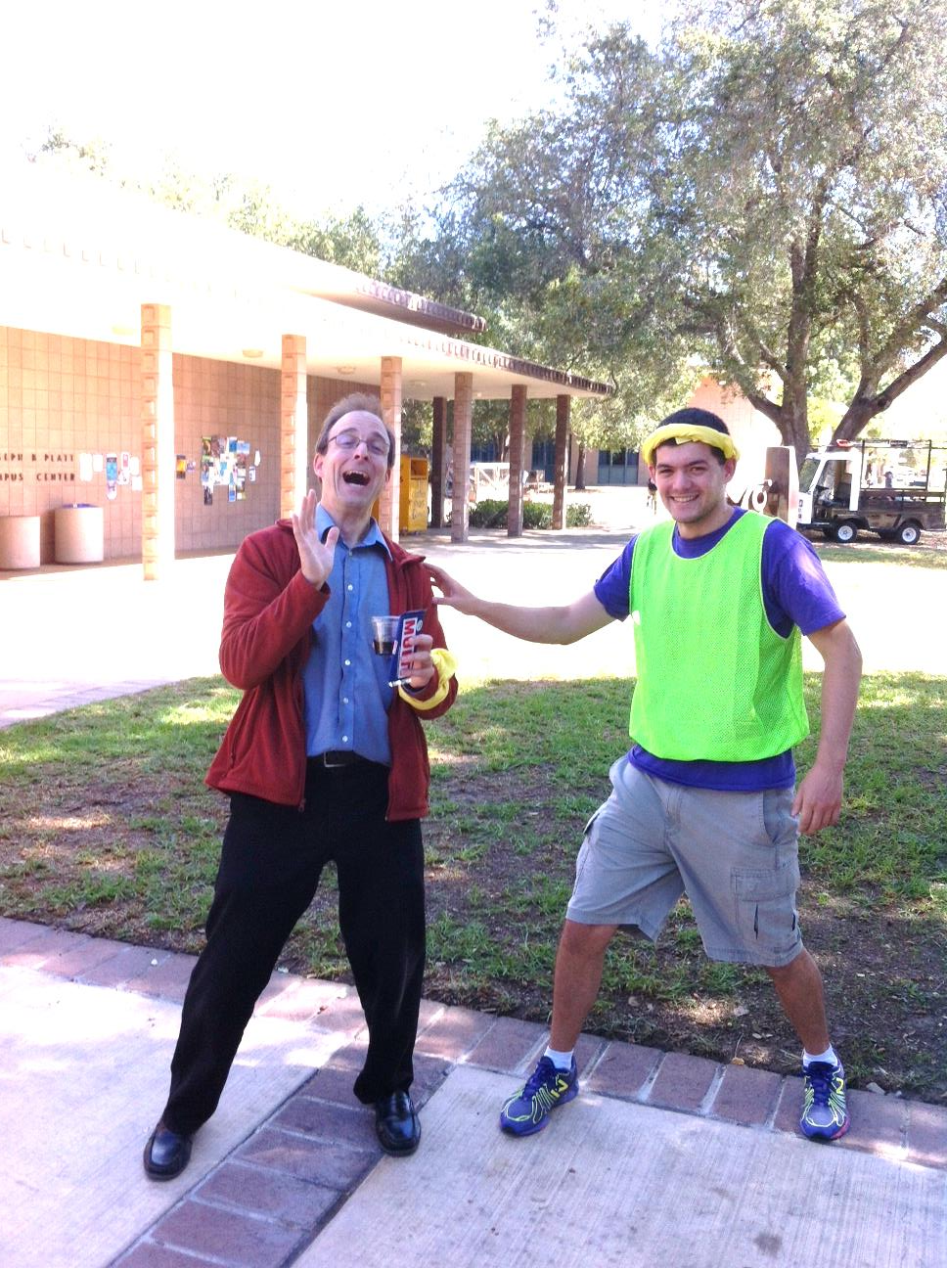
actual zombification…
Looks painful!
Past zombie run-ins… Not sure about the tie?!

Slide 64
Engineers believe equations approximate reality;
Physicists believe reality approximates equations…
Image forensics' verdict:
Fake!
Not a parabola, so not a real shot!
http://www.youtube.com/watch?feature=player_embedded&v=WbaH52JI3So
http://www.fourandsix.com/blog/2011/8/29/seriously-amazing-beer-pong-shots.html

Slide 65
Engineers believe equations approximate reality;
Physicists believe reality approximates equations…
Mathematicians don't care either way!
A solid sphere can be split into 5 parts and rigidly reassembled into two solid spheres the same size as the original
Banach-Tarski paradox
Banach-Tarski XKCD
the parts are "clouds"

Slide 66
Engineers believe equations approximate reality;
Physicists believe reality approximates equations…
Mathematicians don't care either way!
CS?
Don't like your reality? Build a new one!
why settle for gears, when you could have fractal gears?

Slide 67
Engineers believe equations approximate reality;
Physicists believe reality approximates equations…
Mathematics reason about structural rules…
… and CSers reason about procedural ones.
for
lists
Data
Data
while
variables
Axioms
arithmetic operations
Definitions
if/else
proofs
programs
Insights, tools, mathematical truths
Insights, tools, algorithms
math worldview
CS worldview

Slide 68
First, try it by eye…
… then, on hw9pr2, by Python!
col 0
col 1
col 2
col 3
col 4
A = [ [' ','X','O',' ','O'],
['X','X','X','O','O'],
[' ','X','O','X','O'],
['X','O','O',' ','X'] ]
row 0
row 1
row 2
row 3
the data doesn't wrap around
start row
start col
checker
LoL
inarow_3east('X', 1, 0, A)

Slide 69
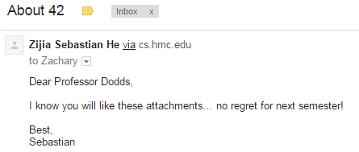
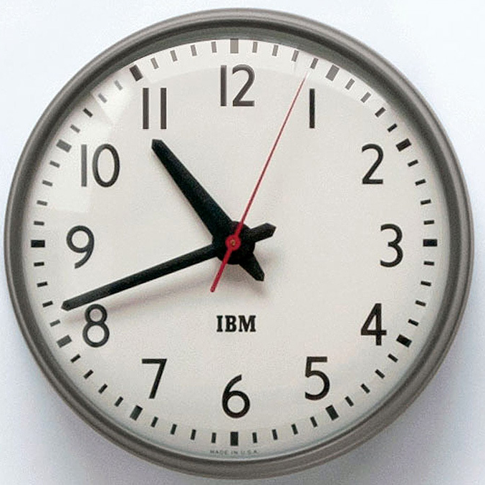
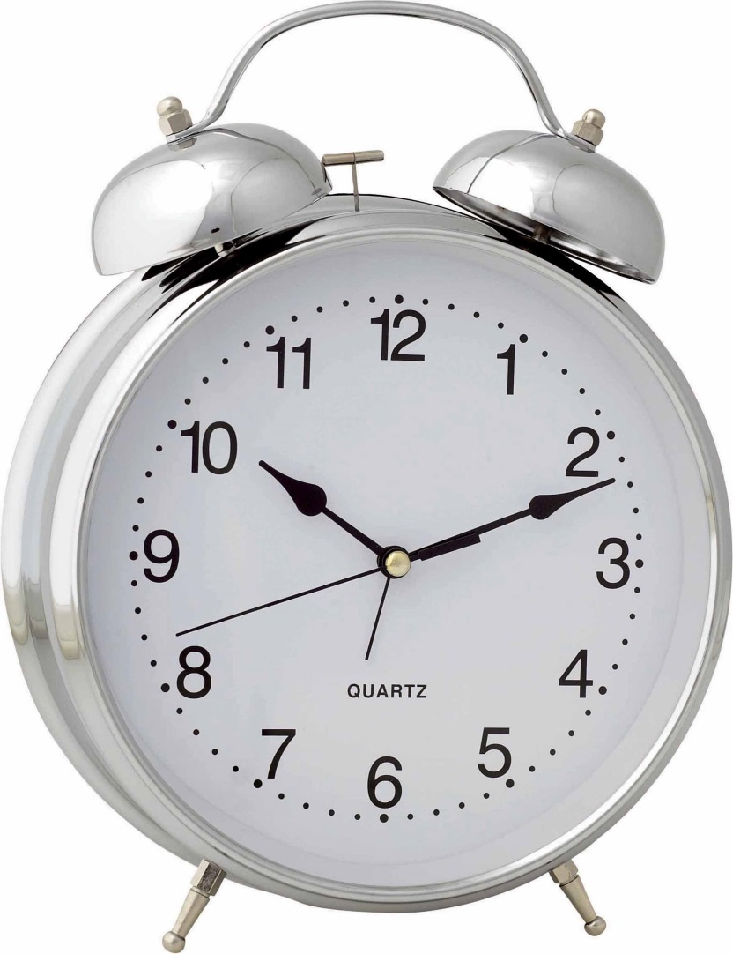
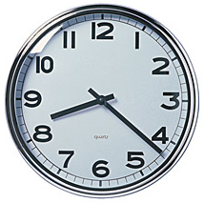


Slide 70
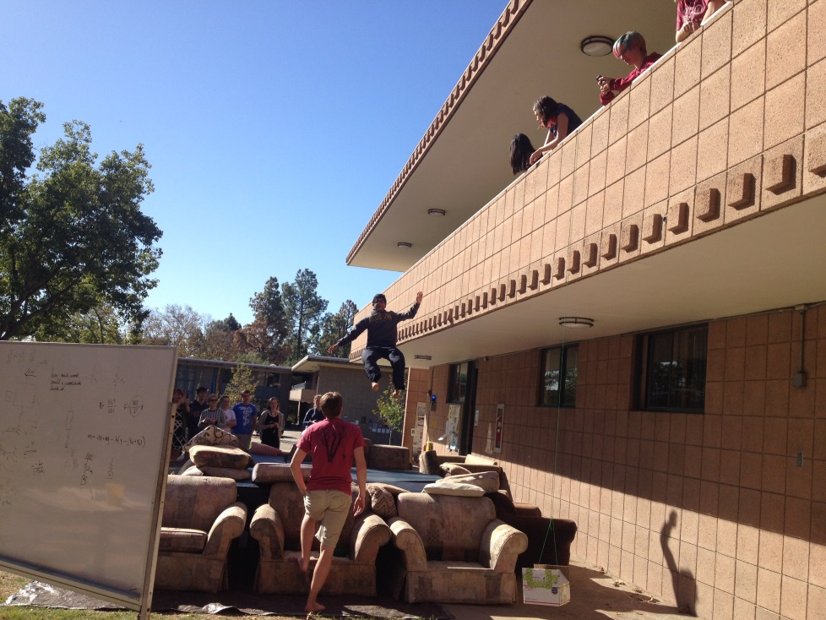
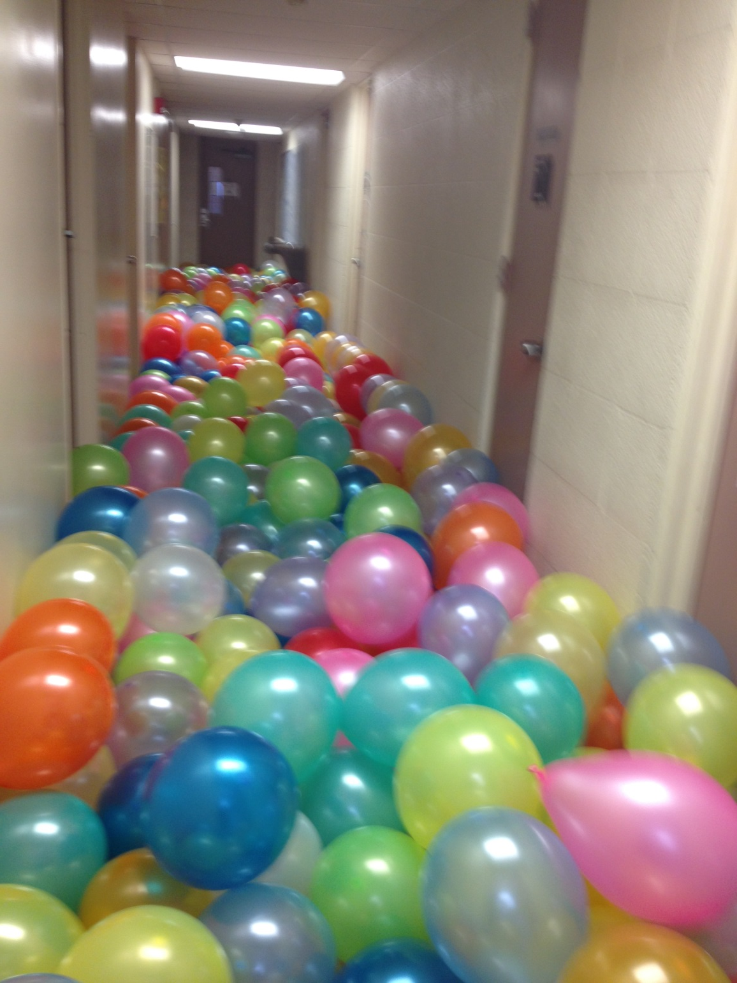
Other goings-on…

Slide 71

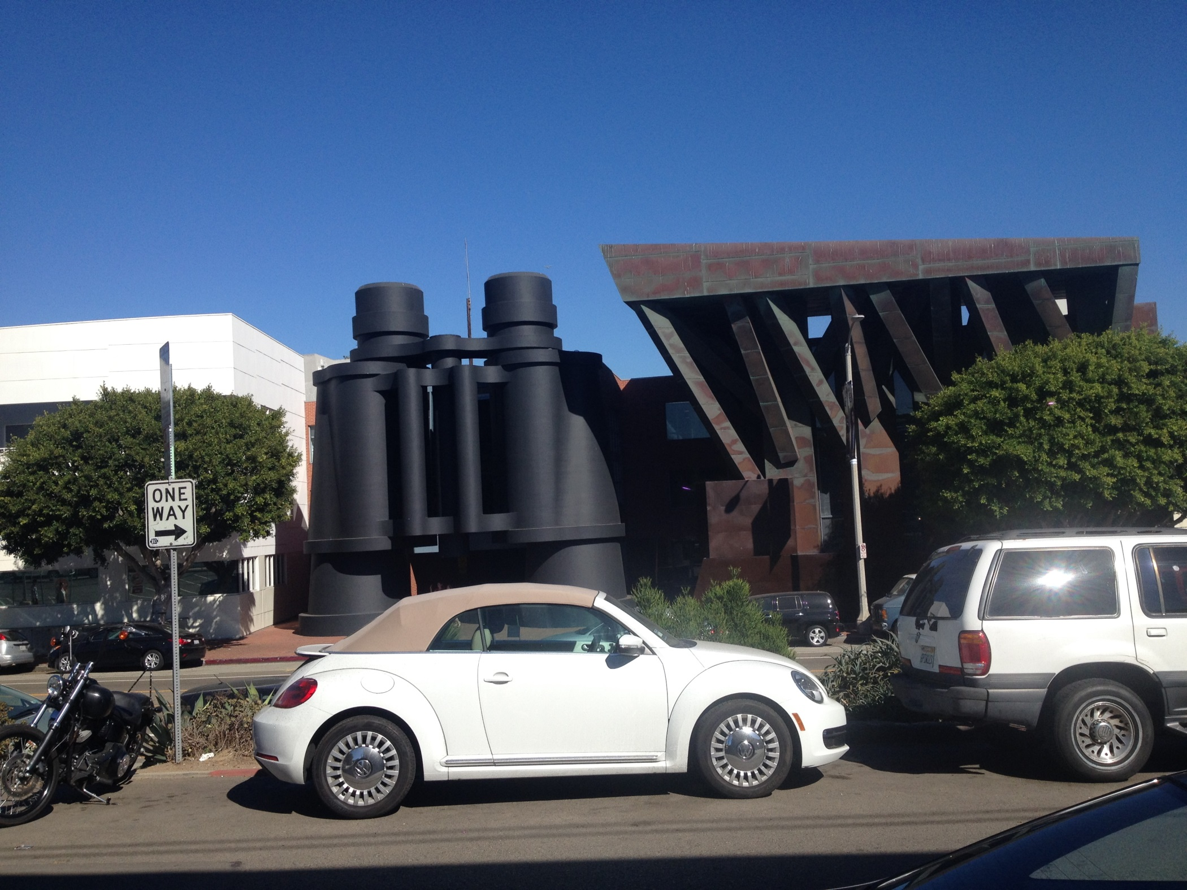
Other goings-on…

Slide 72
Other goings-on…

Slide 73
First, try it by eye…
… then, on hw9pr2, by Python!
col 0
col 1
col 2
col 3
col 4
A = [ [' ','X','O',' ','O'],
['X','X','X','O','O'],
[' ','X','O','X','O'],
['X','O','O',' ','X'] ]
row 0
row 1
row 2
row 3
the data doesn't wrap around
start row
start col
checker
LoL
inarow_3east('X', 1, 0, A)
True
inarow_3south('O', 0, 4, A)
inarow_3southeast('X', 2, 3, A)
inarow_3northeast('X', 3, 1, A)

Slide 74
Lab Problem: Conway's Game of Life
Grid World
Evolutionary rules
red cells are "alive"
Everything depends on a cell's eight neighbors
Exactly 3 neighbors give birth to a new, live cell.
Exactly 2 or 3 neighbors keep an existing cell alive.
Only 3 rules
Any other # of neighbors and the central cell dies…
white cells are empty

Slide 75
Lab Problem: Conway's Game of Life
Grid World
Evolutionary rules
red cells are "alive"
Everything depends on a cell's eight neighbors
Exactly 3 neighbors give birth to a new, live cell.
Exactly 2 or 3 neighbors keep an existing cell alive.
Any other # of neighbors and the central cell dies…
white cells are empty

Slide 76
Lab Problem: Conway's Game of Life
Grid World
Evolutionary rules
red cells are "alive"
Everything depends on a cell's eight neighbors
Exactly 3 neighbors give birth to a new, live cell.
Exactly 2 or 3 neighbors keep an existing cell alive.
Any other # of neighbors and the central cell dies…
white cells are empty

Slide 77
Lab Problem: Conway's Game of Life
Grid World
Evolutionary rules
red cells are alive
Everything depends on a cell's eight neighbors
Exactly 3 neighbors give birth to a new, live cell.
Exactly 2 or 3 neighbors keep an existing cell alive.
What's next?
Any other # of neighbors and the central cell dies…
white cells are empty

Slide 78
Lab Problem: Creating life
next_life_generation( A )
For each cell…
3 live neighbors – life!
2 live neighbors – same
0, 1, 4, 5, 6, 7, or 8 live neighbors – death
computed all at once, not cell-by-cell, so the ? at left does NOT come to life!
?
http://www.math.com/students/wonders/life/life.html

Slide 79
Lab Problem: Creating life
next_life_generation( A )
old generation is the input, A
returns the next generation
0
1
2
3
4
5
0
1
2
3
4
5
0
0
1
1
2
2
?
3
3
4
4
5
5

Slide 80
M.T. Review
(*) For up to two points! of extra credit on the midterm… Pair up with s/o you don't know (or don't know well) and find something unusual you have in common…
See also the gold review @ the cs5 site
Names:
Picobot! There are NO Picobot questions on the exam…
Recursion!!
You should feel confident you could create recursive functions to solve small problems, e.g., scrabble-scoring, finding sum or max or min, computing power or factorial (or variations)
You should be comfortable manipulating lists and strings (indexing, slicing, slicing with a "stride")
You should understand how to use, read, and compose list comprehensions , e.g., LC = [ x**2 for x in L ]
You should be able to design solutions using the "list of lists" technique (LoL), which uses list comprehensions, e.g., to find the highest scrabble-scoring word among a list or the lowest scrabble-scoring of a shifted string. Basic syntax: LoL = [ [sc(x),x] for x in L ]
You should understand the use-it-or-lose-it design strategy, e.g., the LCS, jotto, and sort homework problems:
Turtle graphics will not be emphasized (at most reading code)
Know the difference between print and return !!
Look over you composed larger programs out of smaller ones, how inputs and outputs are used, e.g., for Caesar Cipher
Representing Data!!!
Remind yourself of the various types of data (int, str, float, etc.), how they're different and how to convert between types
Know how characters are represented with chr and ord
Be comfortable with base-2 arithmetic (and base 10!), along with how to convert from base to base (no balanced ternary)
Remind yourself of how the bits of a base-2 number influence its value – what do right- and left-shifting do?
Thing in common:
Then, read over these & look for ones least familiar…
Circuits and Assembly!!!!
Know how the basic logic gates operate (AND and OR for any # of inputs , NOT for 1 input only)
Know how minterm expansion works (an OR of ANDs, each selecting one input) and how it enables the engineering of any circuit at all, given its truth-table specification
You should be comfortable using subcircuits (e.g., using the four-bit adders in the four-bit multiplier, or the individual pieces of the divider)
You should be able to write simple looping programs in Hmmm, e.g., factorial, power, Fibonacci, …
You should know what the stack is, what load and store do at the high-level (officially, they're named storer and loadr) - and why they're necessary for implementing functions in Hmmm (broadly speaking)
The exam will not ask you to implement recursion or stack-based functions in Hmmm, however.
The exam will contain Hmmm full reference sheet (you don't need it)
Loops
You should feel comfortable with how for loops (both element-based and index-based) and while loops work – and be able to compose small functions that use them, e.g., ones similar to those in the pi-estimation and TT securities (statistics) problems.
You should understand how nested loops work and be able to read or compose examples (such as in the TTS or our in-class problems)
I <3 punctuation with three eyes!
!
!
You may use functions from class and hw on the exam without reimplementing them. Here are some, but not all, of them:
removeOne( e, L ), removeAll( e, L ), removeUpto( e, L ), count( e, L ), ind( e, L ), frontNum( L ), binToNum( binstr ), numToBin( n ), …

Slide 81
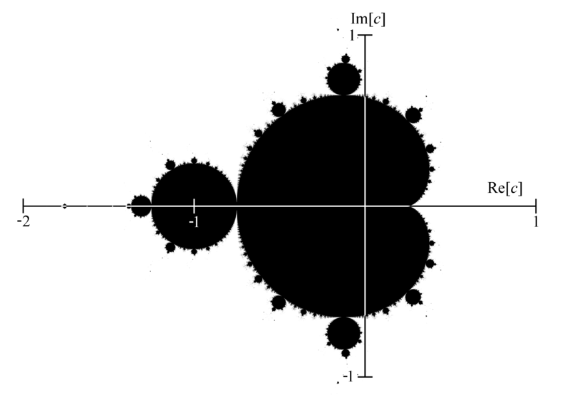
Mandelbrot Set ~ points that stick around
mid 70's resolution
The shaded area are points that do not diverge for z = z**2 + c

Slide 82
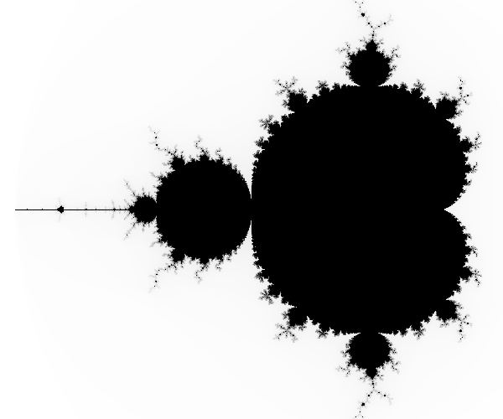
Higher-resolution M. Set
-2 + 1j
1 + 1j
connected
finite area
∞ perimeter!
-2 - 1j
1 - 1j
The black pixels are points that do not diverge for z = z**2 + c

Slide 83
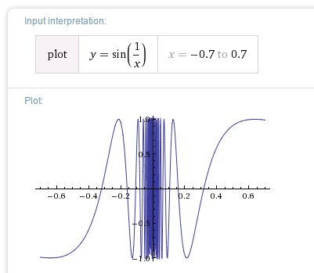
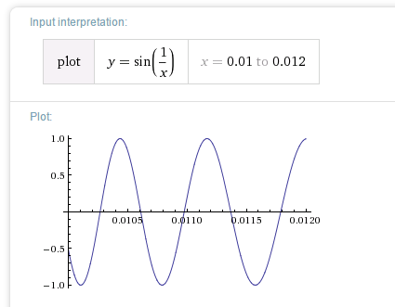
Chaos?
Complex things always consisted of simple parts…

Slide 84
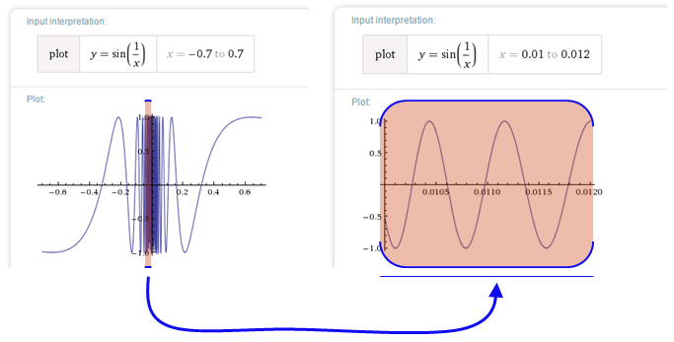

Before the M. Set, complex things were made of simple parts:
Chaos!
This was a "naturally occurring" object where zooming uncovers more detail, not less:
not self-similar but quasi-self-similar
http://www.youtube.com/watch?v=0jGaio87u3A

Slide 85
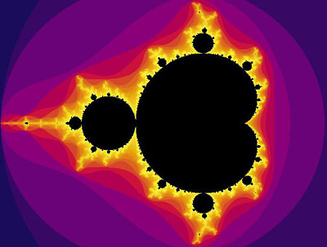
The black pixels are points that do not diverge for z = z**2 + c
What are these colors?

Slide 86
The black pixels are points that do not diverge for z = z**2 + c
escape velocities
What are these colors?

Slide 87
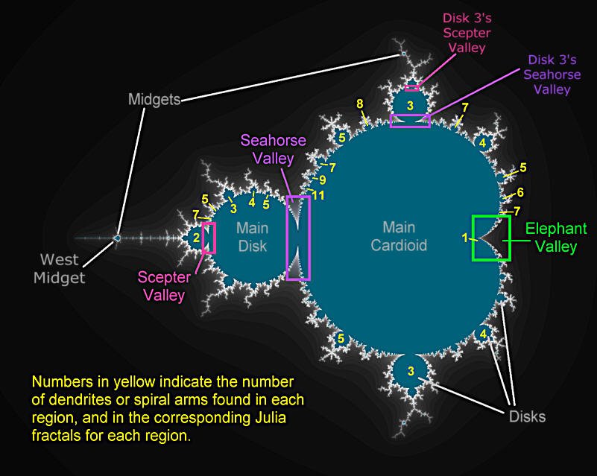
Atlas of the M. Set

Slide 88
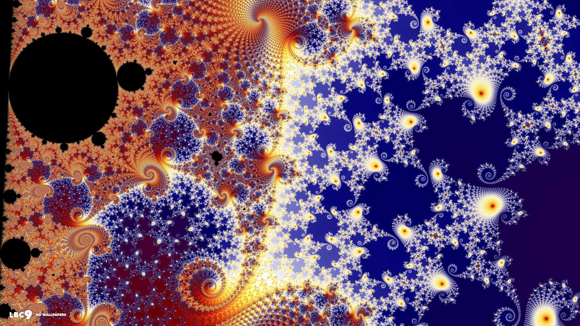
In the Seahorse Valley….

Slide 89
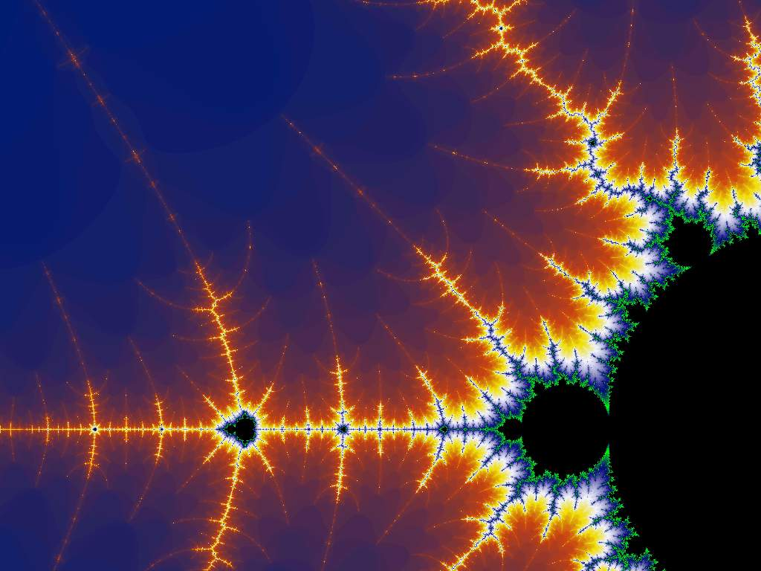
Happy Mandelbrotting!
www.cs.hmc.edu/~jgrasel/projects
http://www.youtube.com/watch?v=0jGaio87u3A

Slide 91
Quiz
Rules rule!?
Try this on the back page first…
Trace each f'n. What will main1, main2, and main3 print?
def conform1(fav)
fav = 42
return fav
def conform2(L)
L = [42,42]
return L
def conform3(L)
L[0] = 42
L[1] = 42
fav
L
L
7
7
11
7
11
fav
L
L[0]
L[1]
L
L[0]
L[1]
def main1()
fav = 7
conform1(fav)
print fav
def main2()
L = [7,11]
conform2(L)
print L
def main3()
L = [7,11]
conform3(L)
print L
Notice that there are NO assignment statements after these function calls! The return values aren't being used…

Slide 92
Part 2
A
before
Write a method that adds five times the values in row #1 into row #2.
row 0
0.00 1.00 0.00 1.00
3.00 0.50 0.50 3.00
10.00 20.00 30.00 27.00
row 1
row 2
The values in row 1
should not change
row 0
0.00 1.00 0.00 1.00
3.00 0.50 0.50 3.00
25.00 22.50 32.50 42.00
Only row 2's values change.
row 1
row 2
A
after
def add5ofRow1IntoRow2( A ):
for ____ in range( ):
+=
You need only one line in the loop!
What if 5, 1, and 2 were the variables: m, s, and d?

Slide 93
hw9pr2: 2D data
Menu
Functions
(1) Enter the size and values of an array
(2) Print the array
(3) Multiply an array row by a constant
(4) Add one row into another
(5) Add a multiple of one row to another
(6) Solve!
(9) Quit
Which choice would you like?
printMenu
enterValues
print
multRow
addRowSIntoRowD
addMofRowSIntoRowD
solve
S ~ source row index
D ~ destination row index
M ~ a multiplier

Slide 94
2.00 3.00 -1.00 -8.00
-3.00 -1.00 2.00 42.00
1.00 -9.00 4.00 56.00
First: fix A[0][0]
What row operation can we perform to make A[0][0], the upper-left entry, equal to 1.0 ?
Get 1's on the diagonal
Solve
Get 0's elsewhere
1.00 0.00 0.00 1.00
0.00 1.00 0.00 5.00
0.00 0.00 1.00 25.00
Goal

Slide 95
2.00 3.00 -1.00 -8.00
-3.00 -1.00 2.00 42.00
1.00 -9.00 4.00 56.00
First: fix A[0][0]
1.00 1.50 -0.50 -4.00
-3.00 -1.00 2.00 42.00
1.00 -9.00 4.00 56.00
fixed, by … multiplying Row 0 by 0.5
Get 1's on the diagonal
Solve
Get 0's elsewhere
1.00 0.00 0.00 1.00
0.00 1.00 0.00 5.00
0.00 0.00 1.00 25.00
Goal

Slide 96
Go one column at a time
1.00 1.50 -0.50 -4.00
-3.00 -1.00 2.00 42.00
1.00 -9.00 4.00 56.00
multiply Row 0 by 0.5
1.00 1.50 -0.50 -4.00
0.00 3.50 0.50 30.00
0.00 -10.50 4.50 44.00
add 3 times Row 0 to Row 1 add -1 times Row 0 to Row 2
1.00 0.00 -0.71 -16.85
0.00 1.00 0.14 30.00
0.00 0.00 6.00 150.00
multiply Row 1 by 1/3.5 add a multiple of Row 1 to Row 0 add a multiple of Row 1 to Row 2
1.00 0.00 0.00 1.00
0.00 1.00 0.00 5.00
0.00 0.00 1.00 25.00
same for other columns
as far as possible...

Slide 97
Gaussian Elimination
Goal: to find x, y, and z:
2x + 3y + -1z = -8
-3x + -1y + 2z = 42
1x + -9y + 4z = 56
Aargh!

Slide 98
Gaussian Elimination
Goal: to find x, y, and z:
2x + 3y + -1z = -8
-3x + -1y + 2z = 42
1x + -9y + 4z = 56
but some sets of equations are easier than others!
1x + 0y + 0z = 1
0x + 1y + 0z = 5
0x + 0y + 1z = 25
I like this one!

Slide 99
Gauss's idea
Goal: to find x, y, and z:
2x + 3y + -1z = -8
-3x + -1y + 2z = 42
1x + -9y + 4z = 56
multiply any row by a constant
nonzero
Use two rules:
add a multiple of any row to another
1x + 0y + 0z = 1
0x + 1y + 0z = 5
0x + 0y + 1z = 25
These rules don't change the solutions!
until it looks like:

Slide 100
hw9pr2: 2D data
Menu
Functions
(1) Enter the size and values of an array
(2) Print the array
(3) Multiply an array row by a constant
(4) Add one row into another
(5) Add a multiple of one row to another
(6) Solve!
(9) Quit
Which choice would you like?
printMenu
enterValues
print
multRow
addRowSIntoRowD
addMofRowSIntoRowD
solve
S ~ source row index
D ~ destination row index
M ~ a multiplier
Demo…

Slide 101
2D data!
Note that
2x + 3y + -1z = -8
-3x + -1y + 2z = 42
1x + -9y + 4z = 56
is really just the 2D matrix:
2 3 -1 -8
-3 -1 2 42
1 -9 4 56
…the variables aren't needed at all!

Slide 102
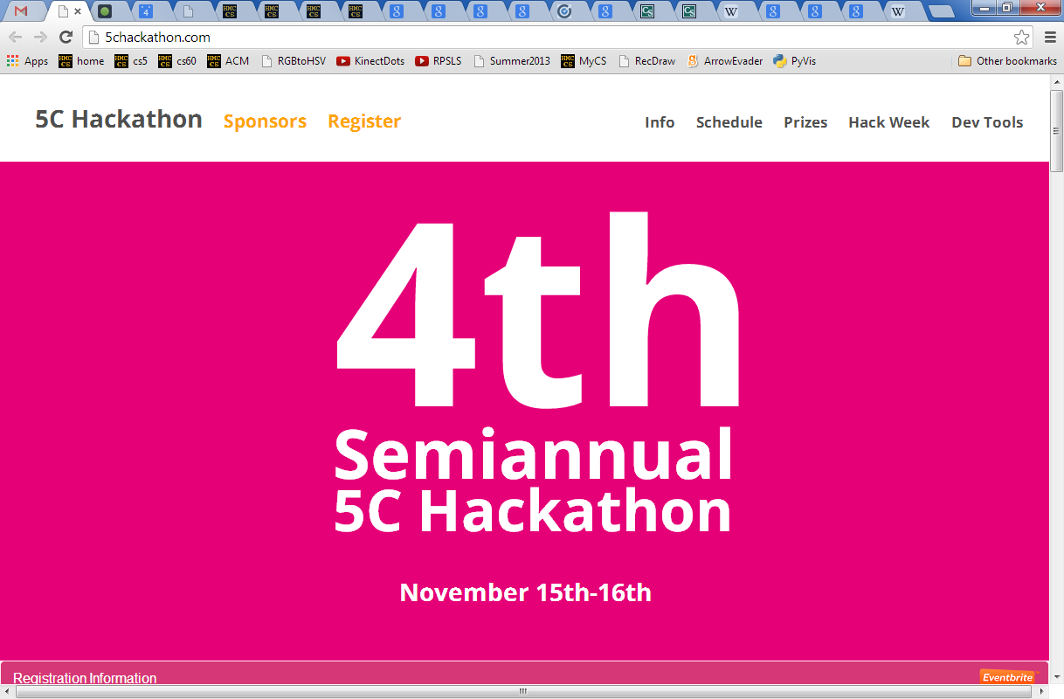
The 5C Hackathon is two weeks away and if possible I'd like to make an announcement in your two intro CS classes at the start of class Tuesday or later next week. In addition to the hackathon, we're holding an informal hack week series of tutorials that is designed to get beginners excited about CS and to introduce them to web programming! Thanks, Joe (jnewbry14@students.claremontmckenna.edu)

Slide 103
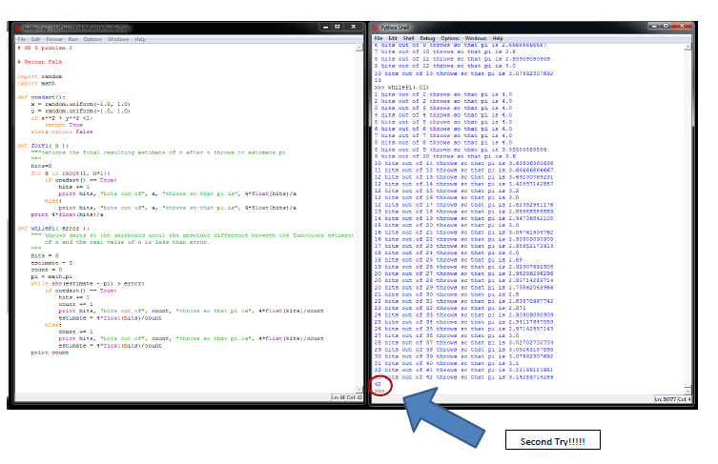
Nathan F. + Nicole A.
42 darts

Slide 104
Watch out!
How could we create this rectangular array of 0s?
[[0,0,0,0,0],
[0,0,0,0,0],
[0,0,0,0,0]]
A = 3*[ 5*[0] ]
or
A = 5*[ 3*[0] ]

Slide 105
Watch out!
inner = 5*[0]
A = 3*[ 5*[0] ]
A = 3*[inner]
list
list
A
inner
list
inner
list
inner
Inner-esting!
"shallow copy"
copies the list reference, not the list data

Slide 106
A
4
B
5
C
6
D
7
E
8
next_life_generation( A )
returns new generation or "array"
old generation or "array"
0
1
2
3
4
5
0
1
2
3
4
5
0
0
1
1
2
2
3
3
4
4
5
5
How many will there be?

Slide 107
Lab Problem: Creating life
next_life_generation( A )
returns new generation or "array"
old generation or "array"
0
1
2
3
4
5
0
1
2
3
4
5
0
0
42 darts!
1
1
2
2
3
3
4
4
5
5

Slide 108
Rectangular arrays
A[1][2] = 42
list
list
A
A[0]
A[0][0]
list
A[1]
list
A[2]
A[2][3]
What does each component of A[1][2] mean ?
How many rows does A have, in general ?
How many columns does A have, in general ?

Slide 109
Quiz
A = [ [1,2,3,4],
[5,6,7,8],
[9,10,11,12] ]
Starting with the 2d array A shown here, what are the values in A after running this code?
A
Before
def mystery(A):
""" what happens to A ? """
NUM_ROWS = len(A)
NUM_COLS = len(A[0])
for row in range( 0,NUM_ROWS ):
for col in range( 0,NUM_COLS ):
if row == col:
A[row][col] = 42
else:
A[row][col] += 1
row 0
1 2 3 4
5 6 7 8
9 10 11 12
row 1
row 2
col 0
col 1
col 2
col 3
A
After
What are the resulting values in A?

Slide 110
Quiz, part 2
A
before
five of row 1 will be added to row 2
row 0
0.00 1.00 0.00 1.00
3.00 0.50 0.50 3.00
10.00 20.00 30.00 27.00
Write a method that adds five times the values in row #1 into the values in row #2.
row 1
row 2
The values in row 1
should not change
row 0
0.00 1.00 0.00 1.00
3.00 0.50 0.50 3.00
25.00 22.50 32.50 42.00
You may assume that A has at least three rows!
row 1
Only row 2's values change.
row 2
A
after
def add5ofRow1IntoRow2( A ):
for ____ in range( ):
+=
Extra! How could you make the multipier, the source row number, and the destination row number into inputs to this function – and then use those inputs?

Slide 111
2.00 3.00 -1.00 -8.00
-3.00 -1.00 2.00 42.00
1.00 -9.00 4.00 56.00
ORIGINAL: fix A[0][0]
1.00 1.50 -0.50 -4.00
-3.00 -1.00 2.00 42.00
1.00 -9.00 4.00 56.00
by … multiplying Row 0 by 0.5
GOAL: to get this side to look like the identity matrix.
RESULT: this column will be our solution!
Which term should we fix next !?!

Slide 112
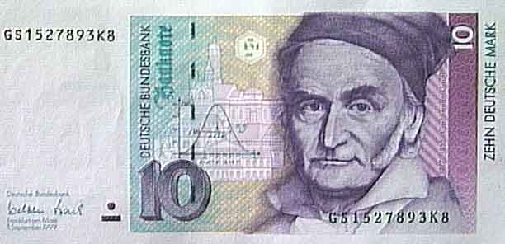
Gaussian Elimination
2p + 3n + -1q = -8.00
-3p + -1n + 2q = 42.00
1p + -9n + 4q = 56.00
Goal:
get 1s along the diagonal
Find p,n,q
get 0s elsewhere on the left
What rules can we use without changing the meaning of these equations?

Slide 113
Gaussian Elimination
2p + 3n + -1q = -8.00
-3p + -1n + 2q = 42.00
1p + -9n + 4q = 56.00
Goal:
get 1s along the diagonal
Find p,n,q
get 0s elsewhere on the left
1p + 0n + 0q = 1.00
0p + 1n + 0q = 5.00
0p + 0n + 1q = 25.00
Using only row operations (our methods) !
Just the array is necessary !
We can get rid of the variables...
where to start?

Slide 114
Gaussian Elimination
Goal: to find x, y, and z:
2x + 3y + -1z = -8.00
-3x + -1y + 2z = 42.00
1x + -9y + 4z = 56.00
Goal:
get 1s along the diagonal
Find p,n,q
get 0s elsewhere on the left
What rules can we use without changing the meaning of these equations?

Slide 115
Gaussian Elimination
2p + 3n + -1q = -8.00
-3p + -1n + 2q = 42.00
1p + -9n + 4q = 56.00
Goal:
get 1s along the diagonal
Find p,n,q
get 0s elsewhere on the left
1p + 0n + 0q = 1.00
0p + 1n + 0q = 5.00
0p + 0n + 1q = 25.00
Using only row operations (our methods) !
Just the array is necessary !
We can get rid of the variables...
where to start?

Slide 116
Lists ~ flexibility
Lists can hold ANY type of data
A = [ 42, 75, 70 ]
42
75
70
list
int
int
int
A
they don't have to be horizontal
It looks vertical to me!

Slide 117
Lists' flexibility
Lists can hold ANY type of data
A = [ 42, 75, 70 ]
42
75
70
list
int
int
int
A
We can equally well imagine them as vertical structures.
42
list
int
A
75
int
70
int
or diagonal...

Slide 118
Lists' flexibility
Lists can hold ANY type of data
42.0
75.0
70.0
list
double
double
double
A
42
7
-11
list
int
int
int
A
“O”
“hi”
“O!”
list
String
String
String
A

Slide 119
2d lists or arrays
Lists can hold ANY type of data -- including lists !
A = [ [1,2,3,4], [5,6], [7,8,9,10,11] ]
list
A

Slide 120
2d arrays
Lists can hold ANY type of data -- including lists !
A = [ [1,2,3,4], [5,6], [7,8,9,10,11] ]
list
list
A
A[0]
list
A[1]
list
A[2]

Slide 121
Jagged arrays
Lists can hold ANY type of data -- including lists !
A = [ [1,2,3,4], [5,6], [7,8,9,10,11] ]
list
list
A
A[0]
list
A[1]
list
A[2]
Rows within 2d arrays need not be the same length…

Slide 122
No "jagged" arrays for us…
at least not in hw 9
A = [ [1,2,3,4], [5,6], [7,8,9,10,11] ]
May all your arrays be memory-aligned!
list
list
A
A[0]
list
A[1]
list
A[2]
Rows within 2d arrays need not be the same length…

Slide 123
Rectangular arrays
A = [ [1,2,3,4],
[5,6,7,8],
[9,0,1,2] ]
1
2
3
4
list
list
A
A[0]
A[0][0]
5
6
7
8
list
A[1]
9
0
1
2
list
A[2]
A[2][3]
To try…
Set A[1][2] = 42
What does each component of A[1][2] mean ?
How many rows does A have, in general ?
How many columns does A have, in general ?

Slide 124
Quiz
Rules rule!?
Name(s) ______________________________
def conform1(fav)
fav = 42
return fav
def main1()
fav = 7
conform1(fav)
print "Fave:", fav
def conform2(faves)
faves = [42,42]
return faves
def main2()
faves = [7,11]
conform2(faves)
print "Faves:", faves
def conform3(faves)
faves[0] = 42
faves[1] = 42
def main3()
faves = [7,11]
conform3(faves)
print "Faves:", faves
fav
faves
faves
fav
faves
faves
What will main1, main2, and main3 end up printing?

Slide 125
Sizing up arrays…
How could we create this rectangular array of 0s?
A = 3*[ 5*[0] ]
NEITHER ONE works!
[[0,0,0,0,0],
[0,0,0,0,0],
[0,0,0,0,0]]
or
because lists are handled by reference !
A = 5*[ 3*[0] ]

Slide 126
Safely creating arrays…
def createOneRow( width ):
""" does just that """
row = [] # start with nothing
for col in range( width ):
row = row + [0]
return row
# loop and add!
adding lists with lists!
So, how would you create a list of rows!?

Slide 127
Safely creating arrays…
def create2dArray( width, height ):
""" does just that """
A = [] # start with nothing
for row in range( height ):
row = createOneRow( width )
A = A + [row]
return A
the same approach as before; now, adding lists of rows with lists of rows!

Slide 128
hw9pr2: 2D data
Menu
Functions
(1) Enter the size and values of an array
(2) Print the array
(3) Multiply an array row by a constant
(4) Add one row into another
(5) Add a multiple of one row to another
(6) Solve!
(9) Quit
Which choice would you like?
printMenu
enterValues
print
multRow
addRowSIntoRowD
addMofRowSIntoRowD
solve
S ~ source row index
D ~ destination row index
M ~ a multiplier

Slide 129
Engineers believe equations approximate reality;
Physicists believe reality approximates equations…
Mathematics reasons about structural rules…
… and CS reasons about procedural ones.
(without using trig)
Creating structure from a few simple facts...
?
Axioms
Definitions
20˚
10˚
Proof
60˚
70˚
Solution and proof at http://www.cs.yale.edu/homes/toyama/tri/sol.htmll

Slide 130
A
John Conway's Challenge….
D
?
E
20˚
10˚
60˚
70˚
B
C
(without using trig)
Solution and proof at cs-www.cs.yale.edu/homes/toyama/tri/sol.html

Slide 131
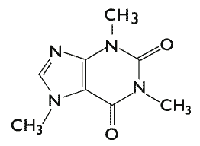
CS 5 Today
Rules: emphasize the elegance of 2 interacting rules…
2 rules: data by ref. vs. value: only show lists vs. ints
then, quiz
then, the advantage of ref. == lists' flexibility
2 rules: multiply by non-zero or add a multiple to another
2 rules: coming to life, staying alive
Coming up in CS 5:
Midterm exam
Anyone choose Gauss or Conway for Halloween?
Carl Gauss
in-class on Thu. 11/8
HW 9 (lab + 1 prob.)
due Monday, 11/12 at midnight
This week's credits:
I give you all the credit!
John Conway
Today's honorees: mathematicians…
Lecture 17

Slide 132
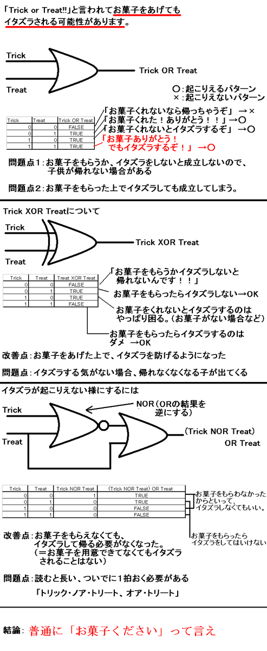
Halloween recursion!
taking OR too literally
(or too computationally!)

Slide 133
Halloween recursion!
taking OR too literally
(or too computationally!)

Slide 134

Halloween recursion!

