Slide 1
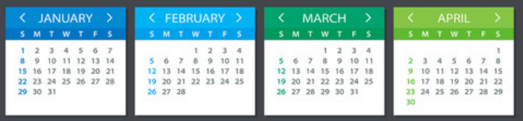
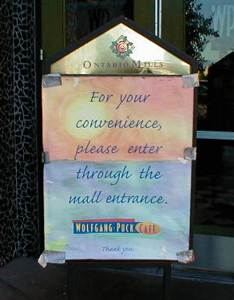

A whole new class of programming
CS5 overview
CS's building blocks: functions and composition
behind CS's curtain: circuits, assembly, loops
Designing Data!
The Date class
whose convenience?
CS: theory + practice
https://www.vecteezy.com/

Slide 2
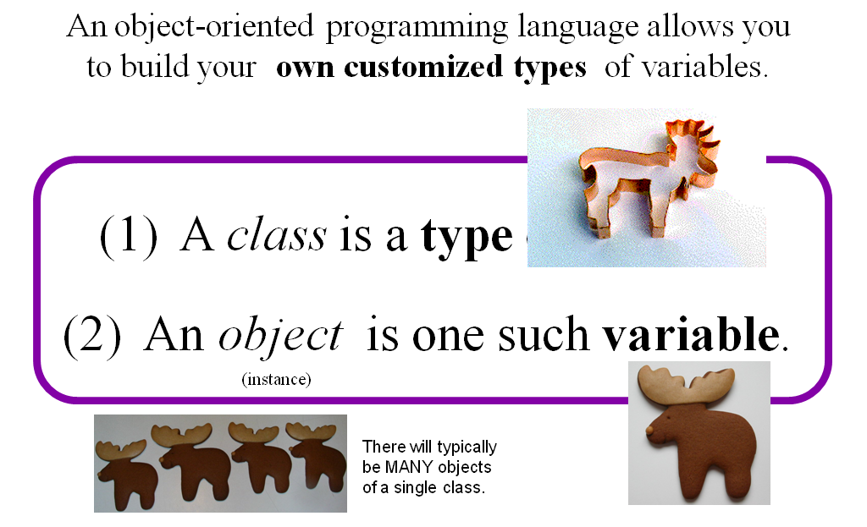
Classes and Objects

Slide 3
Classes and Objects
Customizing Python

Slide 4
Everything in Python is an object!
Its capabilities depend on its class.
functions
type
"methods"
what's more, you can build your own...

Slide 5
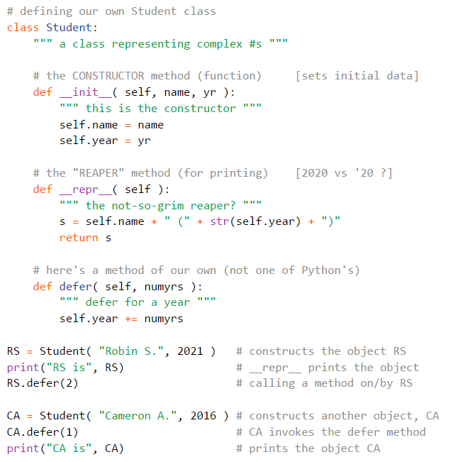
One-page example
Student is a class
1. construct an object
2. its string representation
3. change things
define
use
RS and CA are objects

Slide 6
Everything is an object!
Take strings, for example:
>>> s = str( 42 )
>>> type(s)
<type 'str'>
>>> dir(s)
['__add__', '__class__', '__contains__', '__delattr__', '__doc__', '__eq__', '__format__', '__ge__', '__getattribute__', '__getitem__', '__getnewargs__', '__getslice__', '__gt__', '__hash__', '__init__', '__le__', '__len__', '__lt__', '__mod__', '__mul__', '__ne__', '__new__', '__reduce__', '__reduce_ex__', '__repr__', '__rmod__', '__rmul__', '__setattr__', '__sizeof__', '__str__', '__subclasshook__', '_formatter_field_name_split', '_formatter_parser', 'capitalize', 'center', 'count', 'decode', 'encode', 'endswith', 'expandtabs', 'find', 'format', 'index', 'isalnum', 'isalpha', 'isdigit', 'islower', 'isspace', 'istitle', 'isupper', 'join', 'ljust', 'lower', 'lstrip', 'partition', 'replace', 'rfind', 'rindex', 'rjust', 'rpartition', 'rsplit', 'rstrip', 'split', 'splitlines', 'startswith', 'strip', 'swapcase', 'title', 'translate', 'upper', 'zfill']
This calls the str constructor.
Shows the type of s is str
Shows all of the methods (functions) of s
Let's try some!

Slide 7
Objects
Like a list, an object is a container, but much more customizable:
(1) Its data elements have names chosen by the programmer.
(2) An object contains its own functions, called methods
(3) In its methods, objects refer to themselves as self
(4) Python signals special methods with two underscores:
__init__ is called the constructor; it creates new objects
__repr__ tells Python how to print its objects
I guess we should doubly underscore these two methods!

Slide 8
A Date object, d
d
11
12
2013
month
day
year
memory location ~ 42042778

Slide 9
A Date object, d
d
11
12
2013
month
day
year
memory location ~ 42042778
It's an alien date!

Slide 10

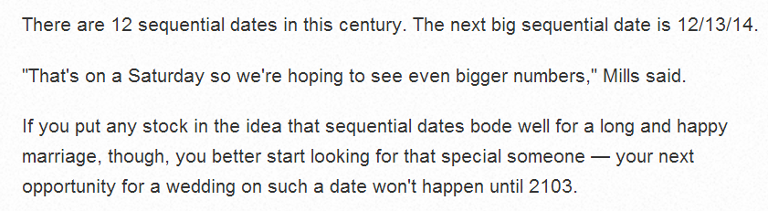
Special Dates?

Slide 11
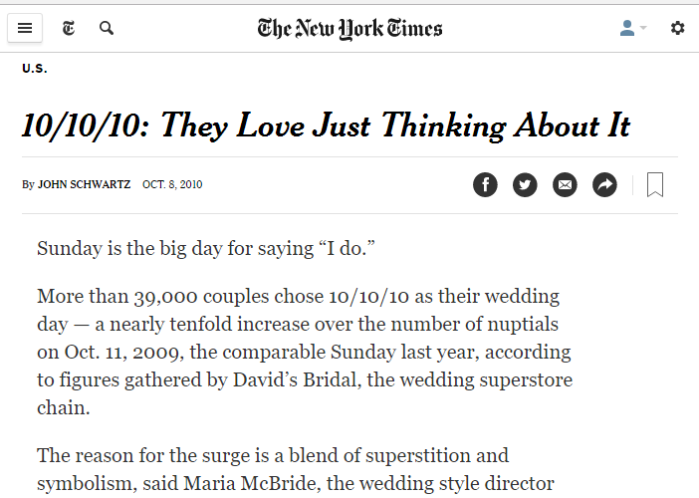
Special Dates?

Slide 12
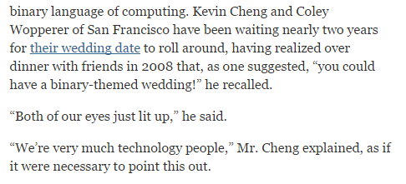
Special Dates?

Slide 13
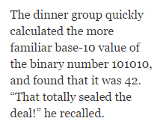
Special Dates?

Slide 14
class Date:
""" a blueprint (class) for objects
that represent calendar days
"""
def __init__( self, mo, dy, yr ):
""" the Date constructor """
self.month = mo
self.day = dy
self.year = yr
The Date class
This is the start of a new type called Date
It begins with the keyword class
This is the constructor for Date objects
As is typical, it assigns input data to the data members.
These are data members – they are the information inside every Date object.

Slide 15
Date
This is a class. It is a user-defined datatype that you'll build in Lab 10 this week…
>>> d = Date(11,12,2013)
>>> d.month
11
>>> d.day
12
add a print statement to see that this is OUR OWN code…
Constructor!
d contains data members named day, month, and year
>>> d
11/12/2013
The repr!
the representation of an object of type Date
The isLeapYear method returns True or False. How does it know what year to check?
>>> d.isLeapYear()
False

Slide 16
class Date:
""" a blueprint (class) for objects
that represent calendar days
"""
def __init__( self, mo, dy, yr ):
""" the Date constructor """
self.month = mo
self.day = dy
self.year = yr
def __repr__( self ):
""" used for printing Dates """
s = "%02d/%02d/%04d" % (self.month, self.day, self.year)
return s
The Date class
Why is everyone so far away?!
This is the repr for Date objects
It tells Python how to print these objects.
Why self instead of d ?

Slide 17
self
is the variable calling a method
>>> d = Date(11,12,2013)
>>> print d
11/12/2013
>>> d.isLeapYear()
False
These methods need access to the object that calls them: it's self
>>> ny = Date(1,1,2020)
>>> print ny
01/01/2020
>>> ny.isLeapYear()
True

Slide 18
class Date:
""" a blueprint (class) for objects
that represent calendar days
"""
def __init__( self, mo, dy, yr ):
""" the Date constructor """
self.month = mo
self.day = dy
self.year = yr
def __repr__( self ):
""" used for printing Dates """
s = "%02d/%02d/%04d" % (self.month, self.day, self.year)
return s
def isLeapYear( self ):
""" anyone know the rule? """
The Date class
Why is everyone so far away?!
which are leap years?

Slide 19
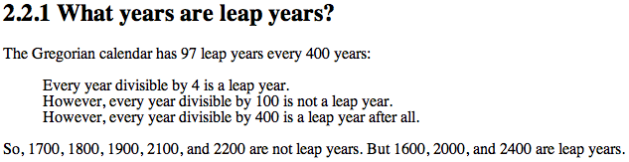
class Date:
def __init__( self, mo, dy, yr ): (constructor)
def __repr__(self): (for printing)
def isLeapYear( self ):
""" here it is """
if self.year%400 == 0: return True
if self.year%100 == 0: return False
if self.year%4 == 0: return True
return False

Slide 20
Problems with ==
>>> wd = Date(11,12,2013)
>>> wd
11/12/2013
>>> wd2 = Date(11,12,2013)
>>> wd2
11/12/2013
this constructs a different Date
Python objects are handled by reference…
== compares references!
>>> wd == wd2
False
How can this be False ?

Slide 21
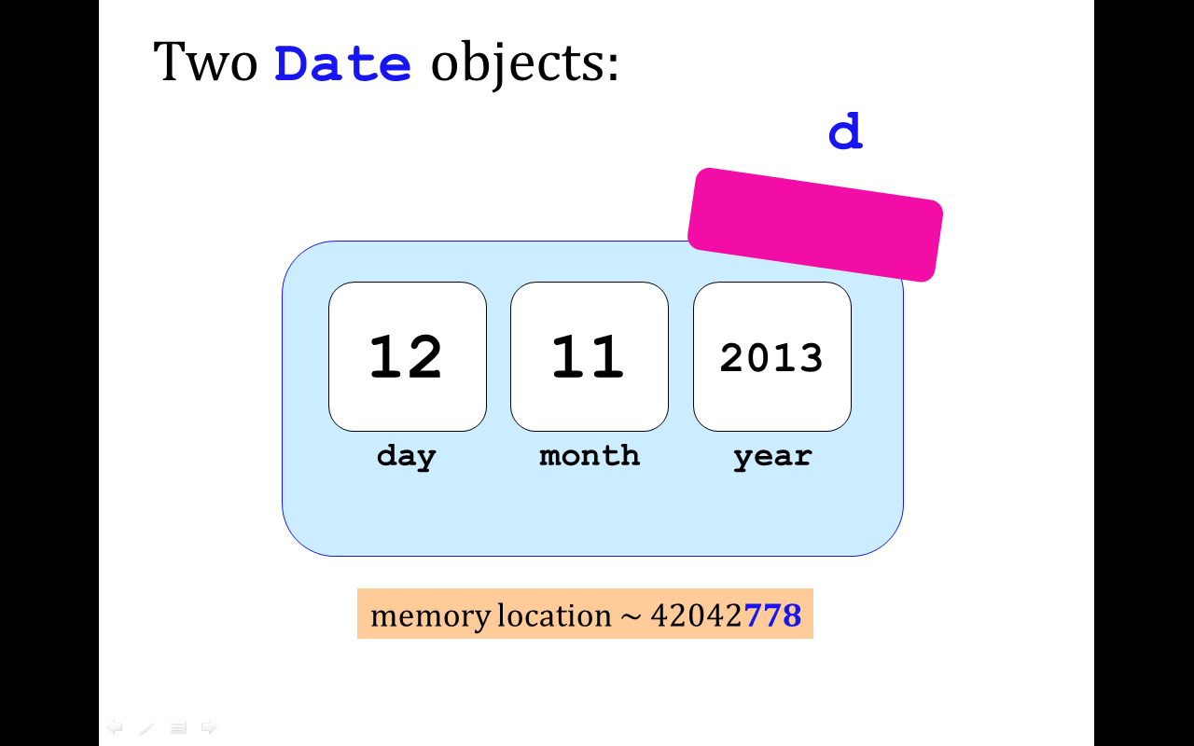

Two Date objects:
d
wd
wd2
12
11
2013
day
month
year
memory location ~ 42042778
== compares memory locations, not contents
originals underneath…

Slide 22
class Date:
def __init__( self, mo, dy, yr ):
def __repr__(self):
def isLeapYear(self):
def equals(self, d2):
""" returns True if they
represent the same date;
False otherwise
"""
if self.year == d2.year and \
self.month == d2.month and \
self.day == d2.day:
return True
else:
return False
equals
Let's write our own equality-tester
To use this, write wd.equals(wd2)
which goes where?

Slide 23
Solution: equals
>>> wd = Date(11,12,2013)
>>> wd
11/12/2013
>>> wd2 = Date(11,12,2013)
>>> wd2
11/12/2013
this constructs a different Date object, but with the same mo/dy/yr
.equals compares mo/dy/yr – because we asked it to!
>>> wd.equals(wd2)
True

Slide 24
class Date:
def __init__( self, mo, dy, yr ):
def __repr__(self):
def isLeapYear(self):
def __eq__(self, d2):
""" returns True if they
represent the same date;
False otherwise
"""
if self.year == d2.year and \
self.month == d2.month and \
self.day == d2.day:
return True
else:
return False
__eq__
L==k! This is T== C==L!
redefined for our convenience!
To use this, write d == d2

Slide 25
DIY operators …
__eq__(self, other) defines the equality operator, ==
__ne__(self, other) defines the inequality operator, !=
__lt__(self, other) defines the less-than operator, <
__gt__(self, other) defines the greater-than operator, >
__le__(self, other) defines the less-or-equal-to operator, <=
__ge__(self, other) defines the gr.-or-equal-to operator, >=
__add__(self, other) defines the addition operator, +
__sub__(self, other) defines the subtraction operator, -
… and many more! Use dir('')
there are two under-scores on each side here
I should underscore this unusual syntax!

Slide 26
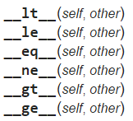
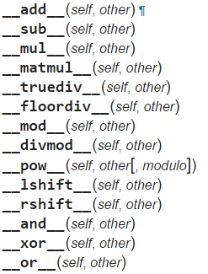
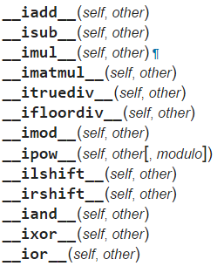
More operators!
Booleans
arithmetic
+
+=
-
-=
*
*=
@
@=
in-place arithmetic
https://docs.python.org/3/reference/datamodel.html#special-method-names

Slide 27
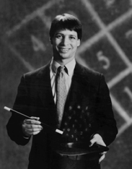
Lab today – or tomorrow
Add these to your Date class!
-= 1
yesterday(self)
tomorrow(self)
addNDays(self, N)
subNDays(self, N)
isBefore(self, d2)
isAfter(self, d2)
diff(self, d2)
dow(self)
+= 1
+= N
-= N
<
>
-
abs?
Prof. Benjamin !
no computer required…
and use your Date class to analyze our calendar a bit…

Slide 28
Quiz
Name(s) ______________________________
class Date:
def isBefore(self, d2):
""" True if self is before d2, else False """
if self.year < d2.year:
return True
if self.month < d2.month:
return True
if self.day < d2.day:
return True
return False
d prints as 4/1/2017
What does d.isBefore(d2) return?
Challenge #1
If
Which of the 4 return statements is used?
d2 prints as 4/4/2017
Is this the correct value?
Challenge #2
Find different dates, d and d2, for which d.isBefore(d2) returns an INCORRECT value...
Hint: change ONE of the two years!
Extra!
Above, how could the isBefore method be fixed...?

Slide 29
isBefore
I <3 Elf! But what about Elif?
class Date:
def isBefore(self, d2):
""" True if self is before d2, else False """
if self.year < d2.year:
return True
if self.month < d2.month and self.year == d2.year :
return True
if self.day < d2.day and self.year == d2.year \
and self.month == d2.month :
return True
return False

Slide 30
<
I want LESS !
__lt__
class Date:
def __lt__(self, d2):
""" if self is before d2, this should
return True; else False """
if self.isBefore(d2) == True:
return True
else:
return False

Slide 31
<
__lt__
LESS !
class Date:
def __lt__(self, d2):
""" this is less than most code! """
return self.isBefore(d2)

Slide 32
__lt__
LESS !
class Date:
def __lt__(self, d2):
""" this is less than most code! """
return self.isBefore(d2)
def __gt__(self, d2):
""" this is less than most code! """
return ____.isBefore(____)
>

Slide 33
Date's purpose…?!
>>> d = Date(11,12,2013)
>>> print d
11/12/2013
always create with the CONSTRUCTOR …
the tomorrow method returns nothing at all. Is it doing anything?
d += 1
>>> d.tomorrow()
>>> print d
11/13/2013
>>> d.addNDays(1238)
lots of printing, but no return value!
d has changed!
Why?
d += 1238
Some methods return a value; others change the object that call it!

Slide 34
class Date:
def tomorrow(self):
""" moves the self date ahead 1 day """
DIM = [0,31,28,31,30,31,30,31,31,30,31,30,31]
Don't hand this in... Use for hw10pr1 this week!
DIM looks pretty bright to me!
self.day += 1
first, add 1 to self.day
if
test if we have gone "out of bounds!"
then, adjust the month and year, only if needed
Don't return anything. This CHANGES the date object that calls it.
Extra how could we make this work for leap years, too?

Slide 35

class Date:
def tomorrow(self):
""" moves the self date ahead 1 day """
DIM = [0,31,fdays,31,30,31,30,31,31,30,31,30,31]
self.day += 1 # add 1 to the day!
if self.day > DIM[self.month]: # check day
self.month += 1
self.day = 1
if self.month > 12: # check month
self.year += 1
self.month = 1
better as a variable!

Slide 36
class Date:
def tomorrow(self):
""" moves the self date ahead 1 day """
if self.isLeapYear() == True: fdays = 29
else: fdays = 28
DIM = [0,31,fdays,31,30,31,30,31,31,30,31,30,31]
self.day += 1 # add 1 to the day!
if self.day > DIM[self.month]: # check day
self.month += 1
self.day = 1
if self.month > 12: # check month
self.year += 1
self.month = 1

Slide 37
class Date:
def tomorrow(self):
""" moves the self date ahead 1 day """
fdays = 28 + self.isLeapYear() # What ?!
DIM = [0,31,fdays,31,30,31,30,31,31,30,31,30,31]
self.day += 1 # add 1 to the day!
if self.day > DIM[self.month]: # check day
self.month += 1
self.day = 1
if self.month > 12: # check month
self.year += 1
self.month = 1
the "Luke trick"!

Slide 38
Don't hand this in... Use for hw10pr1 this week!
class Date:
def yesterday(self):
""" moves the self date backwards 1 day """
fdays = 28 + self.isLeapYear() # Yay!
DIM = [0,31,fdays,31,30,31,30,31,31,30,31,30,31]
For lab: how will "wrap-around" work in this case? What cases do we need to worry about?!

Slide 39
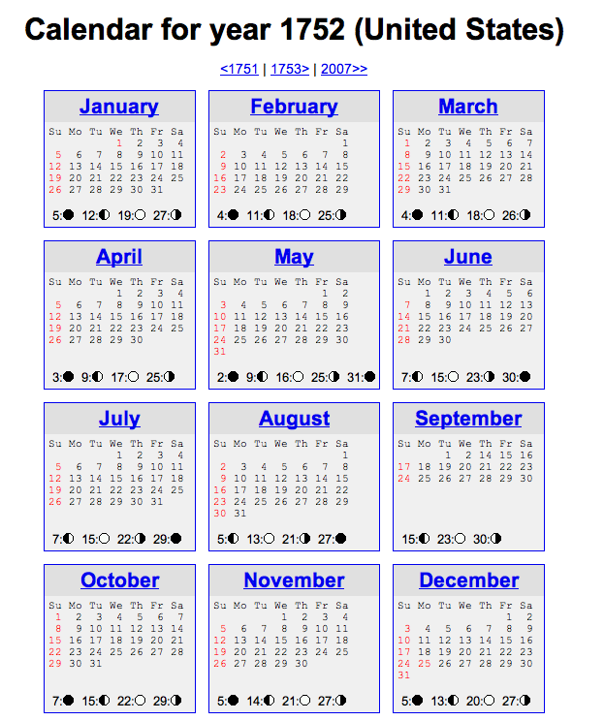
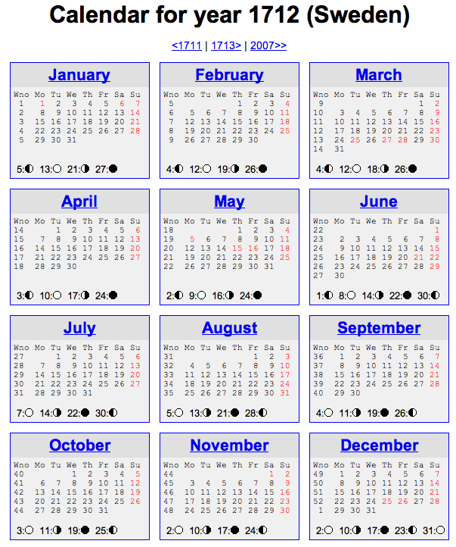
Not all years are the same!

Slide 40
See you @ this week's lab …
… it's a Date!
class-y
^

Slide 42
class Date:
def tomorrow(self):
""" moves the date ahead 1 day """
DIM = [0,31,28,31,30,31,30,31,31,30,31,30,31]
Let's write this one together...
Don't return anything. This CHANGES the date object that calls it.
DIM looks pretty bright to me!
self.day += 1
first, add 1 to self.day
if
test if we have gone "out of bounds!"
then, adjust the month and year, only if needed
Implement tomorrow !
Extra: how could you make this work for leap years, too?

Slide 43
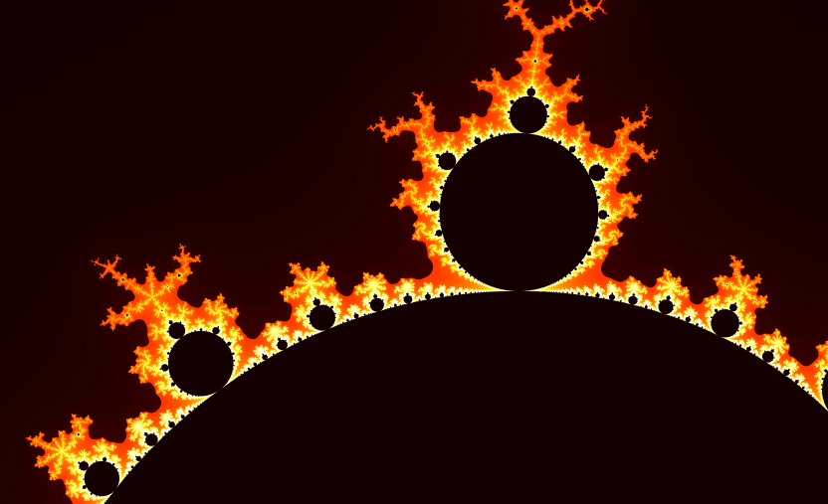
Mandelbrot + Life!
ex. cr. grading…
Infernalicious!
also: www.cs.hmc.edu/~jgrasel/

Slide 44
Life… with Life!

Slide 45
Quiz
class Date:
def tomorrow(self):
""" moves the date ahead 1 day """
DIM = [0,31,28,31,30,31,30,31,31,30,31,30,31]
self.day _________
if self.day > ____________:
Name(s) _____________________________
Don't return anything. This CHANGES the date object that calls it.
first, add 1 to self.day
DIM looks pretty bright to me!
then, adjust the month and year, but only if needed
Implement tomorrow !
Extra: how could you make this work for leap years, too?

Slide 46
Quiz
class Date:
def tomorrow(self):
""" moves the date ahead 1 day """
DIM = [0,31,28,31,30,31,30,31,31,30,31,30,31]
Name(s) _____________________________
Don't return anything. This CHANGES the date object that calls it.
first, add 1 to self.day
DIM looks pretty bright to me!
then, adjust the month and year, only if needed
Implement tomorrow !
Extra: how could you make this work for leap years, too?

Slide 47
class Date:
def tomorrow(self):
""" moves the date ahead 1 day """
DIM = [0,31,fdays,31,30,31,30,31,31,30,31,30,31]
self.day += 1 # add 1 to the day!
if self.day > DIM[self.month]: # check day
self.month += 1
self.day = 1
if self.month > 12: # check month
self.year += 1
self.month = 1
better as a variable!

Slide 48
class Date:
def tomorrow(self):
""" moves the date ahead 1 day """
if self.isLeapYear() == True: fdays = 29
else: fdays = 28
DIM = [0,31,fdays,31,30,31,30,31,31,30,31,30,31]
self.day += 1 # add 1 to the day!
if self.day > DIM[self.month]: # check day
self.month += 1
self.day = 1
if self.month > 12: # check month
self.year += 1
self.month = 1

Slide 49
class Date:
def tomorrow(self):
""" moves the date ahead 1 day """
fdays = 28 + self.isLeapYear() # What ?!
DIM = [0,31,fdays,31,30,31,30,31,31,30,31,30,31]
self.day += 1 # add 1 to the day!
if self.day > DIM[self.month]: # check day
self.month += 1
self.day = 1
if self.month > 12: # check month
self.year += 1
self.month = 1
the "Luke trick"!

Slide 50
class Date:
def __init__( self, mo, dy, yr ):
def __repr__(self):
def isLeapYear(self):
def equals(self, d2):
""" returns True if they represent
the same date; False otherwise
"""
if
return True
else:
return False
equals
How many Dates are here?
Which one is selfish?

Slide 51
class Date:
def tomorrow(self):
""" moves the date ahead 1 day """
DIM = [0,31,fdays,31,30,31,30,31,31,30,31,30,31]
self.day += 1 # add 1 to the day!
if self.day > DIM[self.month]: # check day
self.month += 1
self.day = 1
if self.month > 12: # check month
self.year += 1
self.month = 1
better as a variable!

Slide 52
class Date:
def tomorrow(self):
""" moves the date ahead 1 day """
fdays = 28 + self.isLeapYear() # What ?!
DIM = [0,31,fdays,31,30,31,30,31,31,30,31,30,31]
self.day += 1
if self.day > DIM[self.month]:
self.month += 1
self.day = 1
if self.month > 12:
self.year += 1
self.month = 1

Slide 53
Quiz
Name(s) _____________________________
class Date:
def isBefore(self, d2):
""" True if self is before d2, else False """
if self.year < d2.year:
return True
# what other
if self.month < d2.month:
return True
if self.day < d2.day:
return True
return False
(1) There's a bug here – what is it!?
Redo this somehow!
>>> d = Date(1,1,2014)
>>> d2 = Date(11,12,2013)
>>> d.isBefore( d2 )
True
(2) How could we fix it?
Bug!

Slide 54
class Date:
def tomorrow(self):
""" moves the date ahead 1 day """
fdays = 28 + self.isLeapYear() # What ?!
DIM = [0,31,fdays,31,30,31,30,31,31,30,31,30,31]

Slide 55
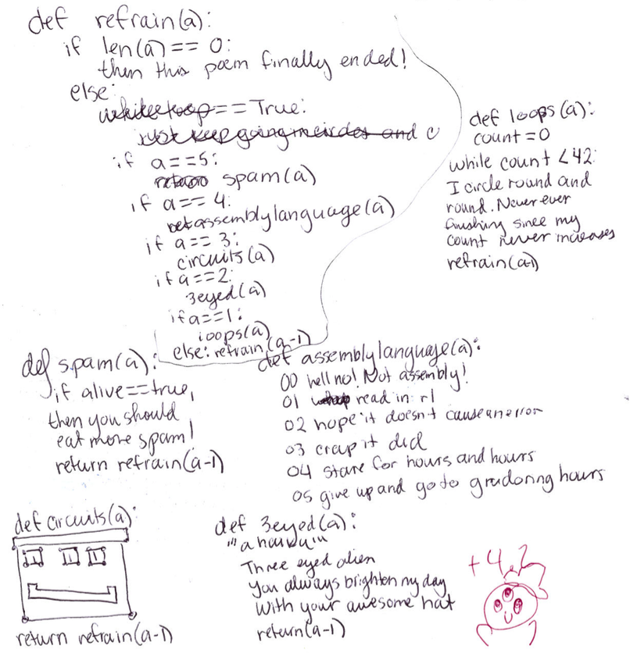
Cosette D

Slide 56
What's wrong?
d = Date(1,1,2012)
d2 = Date(11,8,2011)
d.isBefore( d2 )
True
class Date:
def isBefore(self, d2):
""" if self is before d2, this should
return True; else False """
if self.year < d2.year:
return True
if self.month < d2.month and
return True
if self.day < d2.day and
return True
return False

Slide 57
class Date:
def tomorrow(self):
""" moves the date that calls it ahead 1 day """
DIM = [0,31,28,31,30,31,30,31,31,30,31,30,31]

Slide 58
copy
class Date:
def __init__( self, mo, dy, yr ):
def __repr__(self):
def isLeapYear(self):
def equals(d,d2):
def copy(self):
""" returns a DIFFERENT object w/SAME date value! """
newd = Date( self.month, self.day, self.year )
return newd
Whenever you want to create a brand-new object, use the appropriate CONSTRUCTOR

Slide 59
Everything in Python is an object!

Slide 60
class Date:
""" a blueprint (class) for objects
that represent calendar days
"""
def __init__( self, mo, dy, yr ):
""" the Date constructor """
self.month = mo
self.day = dy
self.year = yr
def __repr__( self ):
""" used for printing Dates """
s = "%02d/%02d/%04d" % (self.month, self.day, self.year)
return s
def isLeapYear( self ):
""" anyone know the rule? """
The Date class
See docs.python.org/library/string.html
Why is everyone so far away?!

Slide 61
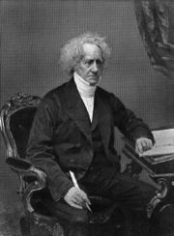
a Leap of faith….
class Date:
def __init__( self, mo, dy, yr ): (constructor)
def __repr__(self): (for printing)
def isLeapYear( self ):
""" here it is """
if self.year%400 == 0: return True
if self.year%100 == 0: return False
if self.year%4 == 0: return True
return False
How about a 4000-year rule?
John Herschel

Slide 62
More Date
class Date:
def __init__( self, mo, dy, yr ):
def __repr__(self):
def isLeapYear(self):
def copy(self):
""" returns a DIFFERENT object w/SAME date! """
def equals(self, d2):
""" returns True if they represent
the same date; False otherwise
"""
How many Dates are here?
Would two be selfish?

Slide 63
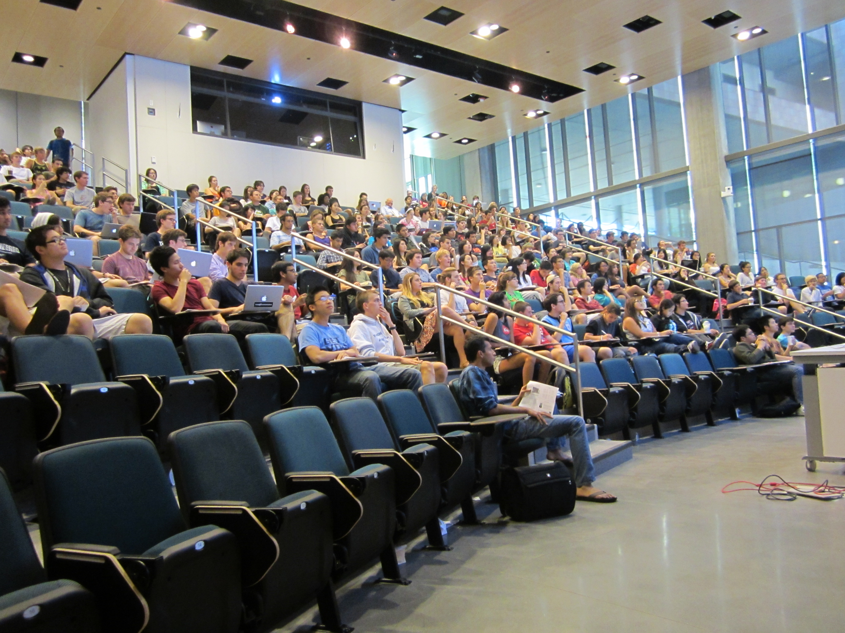
Thursday's AM class: in Shanahan
Lots of seats available!
Solutions… (Keep within this term's CS5)

Slide 64
class Date:
def isBefore(self, d2):
""" if self is before d2, this should
return True; else False """
if self.year < d2.year: return True
if self.month < d2.month: return True
if self.day < d2.day: return True
return False
def tomorrow(self):
""" moves the date that calls it ahead 1 day """
DIM = [0,31,28,31,30,31,30,31,31,30,31,30,31]
Quiz
Name: ______________
This method is WRONG! Find why … and suggest how you could fix it!
Hint:
d = Date(1,1,2012)
d2 = Date(11,8,2011)
d.isBefore( d2 )
True
DIM looks pretty bright to me!
Write this tomorrow method.
It does not return anything. It just CHANGES the date object that calls it.

Slide 65
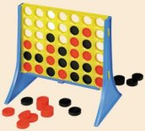
Designing classes
1) What data? (Data Members)
Not limited to 7x6!
2) What are the key capabilities? (Methods)

Slide 66
Connect Four: the object b
list
str
str
str
str
Board
b
data
str
str
str
str
?
str
str
str
str
4
int
width
3
int
height
Starting from b, how would you access the string marked by the ?

Slide 67
Object example: strings
Constructor!
s = str('harvey mudd college')
dir(s)
s.split()
s.__len__() # I should underscore this point!
s.title() # an entitlement?
20*'spam'.title() # how many capital S's?
('spam'*20).title()

Slide 68
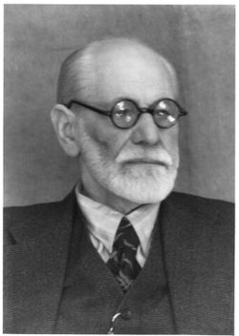

Everything in python is an object
Demo!
x = 20
y = 22
x.__add__(y) # either way!
# even this!
(19).__add__(23)
id(x)
id(y)
Hey! No other aliens allowed!
You mean superego?
My ego approves!

Slide 69
A complex object:
It seems clear enough to me!
>>> z = complex(3,4)
>>> z
(3+4j)
>>> dir(z)
all of the data members and methods of the complex class (and thus the object z !)
>>> z.imag
4.0
>>> z.conjugate()
3-4j
a data member of all objects of class complex
its value for this object, z
a method (function) within all objects of class complex
its return value for this object, z

Slide 70
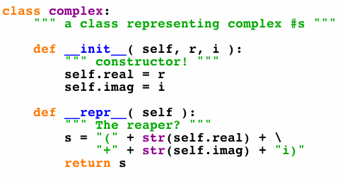
A complex class:
will have more methods (functions), too...
defines the type of our complex-number objects

Slide 71
Connect Four: constructor
class Board:
""" a datatype representing a C4 board
with an arbitrary number of rows and cols
"""
def __init__( self, width, height ):
""" the constructor for objects of type Board """
self.width = width
self.height = height
self.data = [] # this will be the board
self.data = [ [' ']*self.width for row in range(self.height) ]
What was this called again… ?
Notes:
71

Slide 72
Objects ~ DOTs !
Constructor!
s = str('harvey mudd college')
dir(s)
s.spit()
s.__len__() # I should underscore this point!
s.title() # an entitlement?
20*'spam'.title() # how many capital S's?
('spam'*20).title()
What, the L ?

Slide 73
Everything in python is an object
Demo!
x = 20
y = 22
x.__add__(y) # either way!
# even this!
(19).__add__(23)
id(x)
id(y)
Hey! No other aliens allowed!
You mean superego?
My ego approves!

Slide 74
dir and help !
provide all of the methods and data members available to an object
dir('any string')
help(''.count)
dir(42)
dir( [] )
No memorizing! Just use dir & help…
try sort!

Slide 75
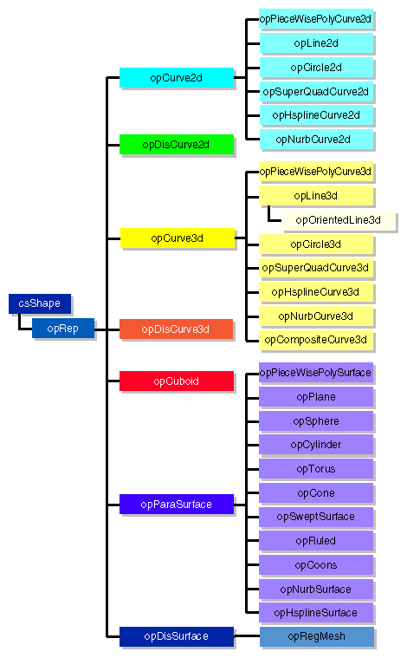
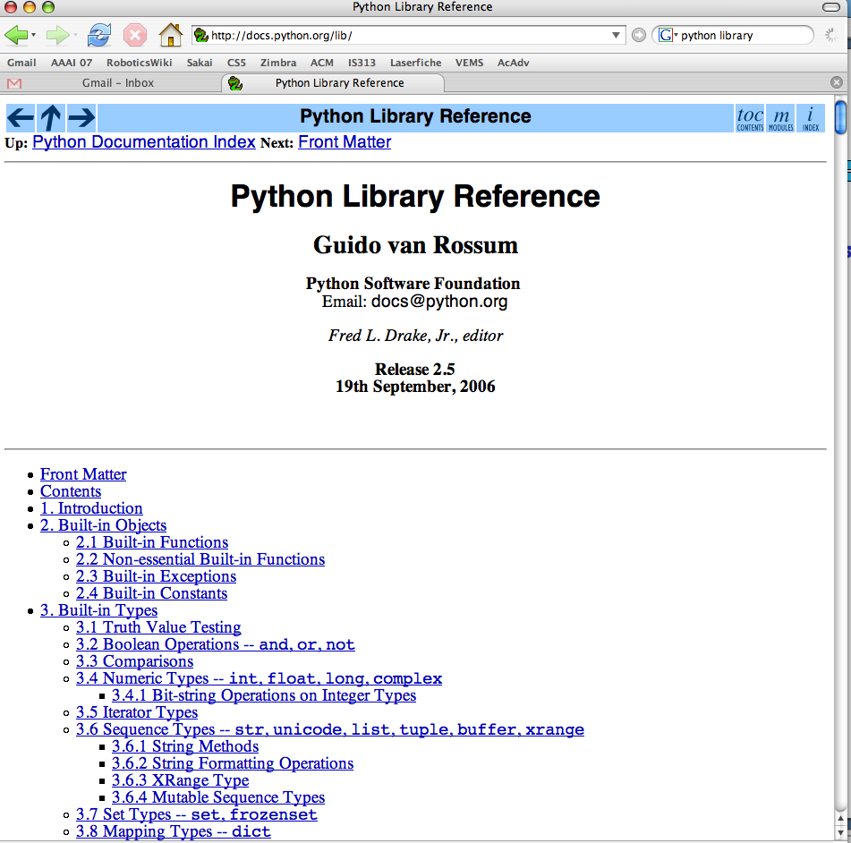
Examples…
Graphics libraries
Python's class libraries…
Do reference libraries have library references?
http://docs.python.org/lib/

Slide 76
Lists: the good and bad...
+
lots of computer work for little programmer work!
Here's a list for Feb. 29, 2010:
A = [ 2, 29, 2010 ]
2
29
2010
list
int
int
int
A
A[0]
A[1]
A[2]

Slide 77
Lists: the good and bad...
+
lots of computer work for little programmer work!
only generic capabilities, e.g., len, print
-
only square-bracket naming, e.g.,
A[i]
no data consistency checks
A = [ 2, 29, 2010 ]
2
29
Something is wrong with this date!
2010
list
int
int
int
A
A[0]
A[1]
A[2]
Classes and Objects take care of all 3 drawbacks...

Slide 78
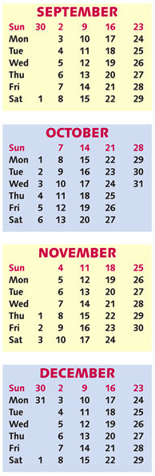
CS 5 today
A whole new class of programming
Composing functions
CS's building blocks
Designing Data!
The Date class
whose convenience?
Exams?

Slide 79
Objects ~ DOTs !
Constructor!
s = str('harvey mudd college')
dir(s)
s.spit()
s.__len__() # I should underscore this point!
s.title() # an entitlement?
20*'spam'.title() # how many capital S's?
('spam'*20).title()
What, the L ?

Slide 80
Everything in python is an object
Demo!
x = 20
y = 22
x.__add__(y) # either way!
# even this!
(19).__add__(23)
id(x)
id(y)
Hey! No other aliens allowed!
You mean superego?
My ego approves!

Slide 81
Lists: the good and bad...
+
lots of computer work for little programmer work!
only generic capabilities, e.g., len, print
-
only square-bracket naming, e.g.,
A[i]
no data consistency checks
A = [ 2, 29, 2010 ]
2
29
Something is wrong with this date!
2010
list
int
int
int
A
A[0]
A[1]
A[2]
Classes and Objects take care of all 3 drawbacks...

Slide 82
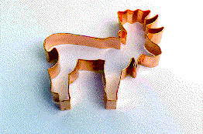

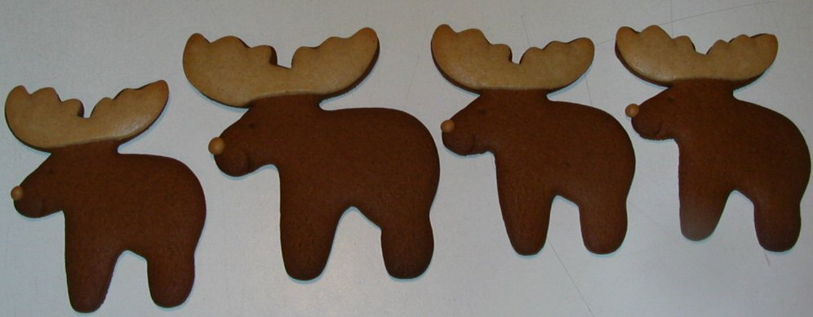
Classes & Objects
An object-oriented programming language allows you to build your own customized types of variables.
(1) A class is a type of variable.
(2) An object is one such variable.
(instance)
There will typically be MANY objects of a single class.

Slide 83
A complex object:
It seems clear enough to me!
>>> z = complex(3,4)
>>> z
(3+4j)
>>> dir(z)
all of the data members and methods of the complex class (and thus the object z !)
>>> z.imag
4.0
>>> z.conjugate()
3-4j
a data member of all objects of class complex
its value for this object, z
a method (function) within all objects of class complex
its return value for this object, z

Slide 84
A complex class:
will have more methods (functions), too...
defines the type of our complex-number objects

Slide 85
Objects
An object is a container data structure - like a list - except
(1) Its data elements have names chosen by the programmer.
(2) An object contains its own functions that it can call!
usually called "methods" instead of functions:
__init__
__repr__
the constructor
the repr (for printing)
(3) Thus, an object can take care of itself !
I guess he wants to underscore these two methods!

Slide 86
Date
This is a class. It is a user-defined datatype (that you'll build in Lab this week!)
>>> d = Date(10,9,2010)
>>> d
10/09/2010
this is a CONSTRUCTOR …
What does it do?
this is an object of type Date
the representation of a particular object of type Date
>>> d.isLeapYear()
False
the isLeapYear method returns True or False. How does it know what year to check?
>>> d2 = Date(1,1,2012)
>>> d2
01/01/2012
>>> d2.isLeapYear()
True
Another object of type Date - again, from the constructor.
How does it know to return True, instead of False in this case ??

Slide 87
class Date:
""" a blueprint (class) for objects
that represent calendar days
"""
def __init__( self, mo, dy, yr ):
""" the Date constructor """
self.month = mo
self.day = dy
self.year = yr
def __repr__( self ):
""" used for printing Dates """
s = "%02d/%02d/%04d" % (self.month, self.day, self.year)
return s
def isLeapYear( self ):
""" anyone know the rule? """
The Date class
See docs.python.org/library/string.html
Why is everyone so far away?!

Slide 88
self
is the specific OBJECT THAT CALLS A METHOD
>>> d = Date(11,9,2010)
>>> d
11/09/2010
These methods need access to the object that calls them
>>> d.isLeapYear()
True
>>> d2 = Date(1,1,2012)
>>> d2
12/31/2007
>>> d2.isLeapYear()
False
These methods need access to the object that calls them

Slide 89
a Leap of faith….
class Date:
def __init__( self, mo, dy, yr ): (constructor)
def __repr__(self): (for printing)
def isLeapYear( self ):
""" here it is """
if self.year%400 == 0: return True
if self.year%100 == 0: return False
if self.year%4 == 0: return True
return False
John Herschel
How about a 4000-year rule?

Slide 90
Date
>>> d = Date(1,1,2011)
>>> d
1/1/2011
always created with the CONSTRUCTOR …
>>> d.yesterday()
>>> d
12/31/2010
>>> d.subNDays(52)
lots of printing, but no return value!
>>> d
the yesterday method returns nothing at all. Is it doing anything?
d has changed!
Why is this important?
Some methods return a value; others change the object that call it!

Slide 91
Date ids
What date is on your id?
What id is on your Date?
UFO license
Area 51, CA
>>> d = Date(11,9,2010)
>>> d
11/09/2010
>>> d2 = Date(11,10,2010)
>>> d2
11/10/2010
this initializes a different Date!
>>> d == d2
?
>>> d2.yesterday()
>>> d == d2
?

Slide 92
Excuse me -- ids please!
Double Date
>>> d2 = d
>>> d
11/09/2010
>>> d.yesterday()
>>> d2
?
>>> d2 = d.copy()
>>> d2 == d
?
>>> d.equals(d2)
?
How many Dates are here?

Slide 93
More Date
class Date:
def __init__( self, mo, dy, yr ):
def __repr__(self):
def isLeapYear(self):
def copy(self):
""" returns a DIFFERENT object w/SAME date! """
def equals(self, d2):
""" returns True if they represent
the same date; False otherwise
"""
How many Dates are here?
Would two be selfish?

Slide 94
What's wrong?
d = Date(1,1,2011)
d2 = Date(11,9,2010)
d.isBefore( d2 )
True
class Date:
def isBefore(self, d2):
""" if self is before d2, this should
return True; else False """
if self.year < d2.year:
return True
if self.month < d2.month:
return True
if self.day < d2.day:
return True
return False

Slide 95
class Date:
def tomorrow(self):
""" moves the date that calls it ahead 1 day """
DIM = [0,31,28,31,30,31,30,31,31,30,31,30,31]

Slide 96
Lab today – or tomorrow
Add to Date these methods:
no computer required…
yesterday(self)
tomorrow(self)
addNDays(self, N)
subNDays(self, N)
isBefore(self, d2)
isAfter(self, d2)
diff(self, d2)
dow(self)
Prof. Art Benjamin
and use your Date class to analyze our calendar a bit…

Slide 97
Unusual calendar years…

Slide 98
Designing classes
1) What data? (Data Members)
Not limited to 7x6!
2) What are the key capabilities? (Methods)

Slide 99
Connect Four: the object b
list
str
str
str
str
Board
b
data
str
str
str
str
?
str
str
str
str
4
int
width
3
int
height
Starting from b, how would you access the string marked by the ?

Slide 100
Classes & Objects
An object-oriented programming language allows you to build your own customized types of variables.
(1) A class is a type of variable.
(2) An object is one such variable.
(instance)
There will typically be MANY objects of a single class.

Slide 101
Connect Four: constructor
class Board:
""" a datatype representing a C4 board
with an arbitrary number of rows and cols
"""
def __init__( self, width, height ):
""" the constructor for objects of type Board """
self.width = width
self.height = height
self.data = [] # this will be the board
self.data = [ [' ']*self.width for row in range(self.height) ]
What was this called again… ?
Notes:
101

Slide 102
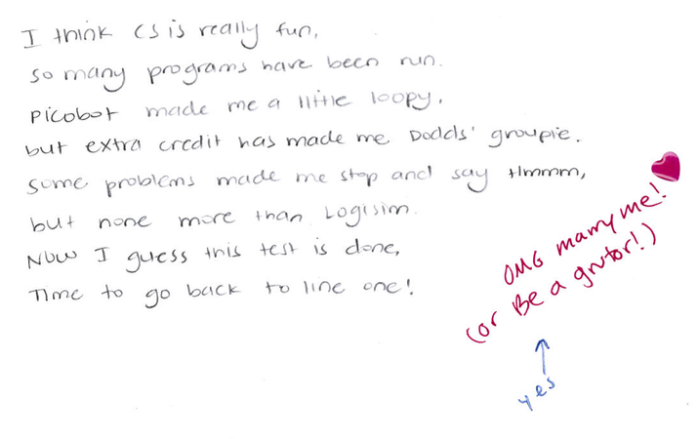

Slide 103
equals
This is Python's function name for the == operator!
class Date:
def __eq__(self, d2):
""" if self is the same Date as d2,
return True; else False """
if [self.year,self.month,self.day] ==
[ d2.year, d2.month, d2.day]
return True
else:
return False
Some == are more equal than others
To use this, write d == d2

Slide 104
I want even LESS !
isBefore
class Date:
def isBefore(self, d2):
""" if self is before d2, this should
return True; else False """
if [self.year,self.month,self.day] <
[ d2.year, d2.month, d2.day]
return True
else:
return False

