Slide 1


CS this week
4
Hw #10 due 4/11
Building classes...
... vs. using the library
hw10pr2
hw10pr3
file and dictionary classes
Connect Four Board class
files
dictionaries
Office hours on FRIDAY aft. in LAC
If I had a dictionary, I guess I could look up what it was!

Slide 2

Opportunity...
posted on our cs5 Piazza

Slide 3
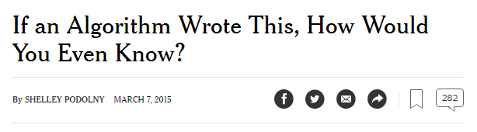
CS this week
4
Hw #10 due 4/11
Building classes...
... vs. using the library
hw10pr2
hw10pr3
file and dictionary classes
Connect Four Board class
files
dictionaries
Office hours on FRIDAY aft. in LAC
If I had a dictionary, I guess I could look up what it was!

Slide 4
Classes: DIY data
design-it-yourself!
Class: a user-defined datatype
Object: data or a variable whose type is a class

Slide 5
Classes: DIY data
design-it-yourself!
Class: a user-defined datatype
Object: data or a variable whose type is a class
constructor
object
d = Date( 11, 3, 2020 )
d.tomorrow()
print d
method
d would be named self inside the Date class...
uses repr
Method: a function defined in a class called by an object
self: in a class, the name of the object calling a method
Constructor: the __init__ function for creating a new object
repr: the __repr__ function returning a string to print
data member: the data in self: self.day, self.month, self.year

Slide 6
Why classes?
Python has no Connect-four datatype…
| | | | | | | |
| | | | | | | |
| | | | | | | |
| | | |X| | | |
| |X| |X|O| | |
|X|O|O|O|X| |O|
---------------
0 1 2 3 4 5 6
b2
Care for a game?
… but now we can fix that!

Slide 7
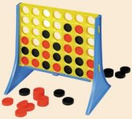
Data design…
Not limited to 7x6!
(Data Members) What data do we need?
(Methods) What are capabilities we want?

Slide 8
Our Board object, b
row 0
?
str
str
str
str
str
str
str
row 1
str
str
str
str
str
str
str
Board
b
b.data
row 2
str
str
str
str
str
str
str
7
6
row 3
str
str
str
str
str
str
str
?
b.width
b.height
row 4
str
str
str
str
str
str
str
row 5
str
str
str
str
str
str
str
col 0
col 1
col 2
col 3
col 4
col 5
col 6
b.
b.
How could we set ? to 'X' and ? to 'O'

Slide 9
Data design…
Not limited to 7x6!
(Data Members) What data do we need?
(Methods) What are capabilities we want?

Slide 10
__init__
the "constructor"
class Board:
""" a datatype representing a C4 board
with an arbitrary number of rows and cols
"""
def __init__( self, width, height ):
""" the constructor for objects of type Board """
self.width = width
self.height = height
W = self.width
H = self.height
self.data = [ [' ']*W for row in range(H) ]

Slide 11
__init__
the "constructor"
class Board:
""" a datatype representing a C4 board
with an arbitrary number of rows and cols
"""
def __init__( self, width, height ):
""" the constructor for objects of type Board """
self.width = width
self.height = height
W = self.width
H = self.height
self.data = [ [' ']*W for row in range(H) ]
convenient!
This list comprehension lets us create
H independent rows with
W independent columns each.

Slide 12
__repr__
def __repr__(self):
""" this method returns a string representation
for an object of type Board
"""
H = self.height
W = self.width
s = ''
for r in range( H ):
s += '|'
for c in range( W ):
s += self.data[r][c] + '|'
s += '\n'
s += (2*W+1)*'-'
# what kind of loop will add the col #'s here?
return s
| | | | | | | |
| | | | | | | |
| | | | | | | |
| | | |X| | | |
| |X| |X|O| | |
|X|O|O|O|X| |O|
---------------
0 1 2 3 4 5 6

Slide 13
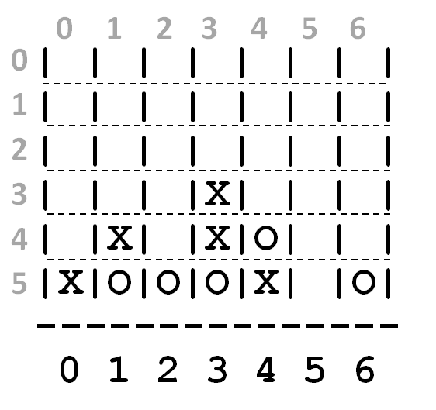
a C4 board
Quiz
class Board:
def addMove(self, col, ox):
""" buggy version! """
H = self.height
for row in range(0,H):
if self.data[row][col] != ' ':
self.data[row-1][col] = ox
col #
'X' or 'O'
(1) Run b.addMove(3,'O')
b
0
1
2
3
4
5
6
(2) Bugs! Can you fix them?!
0
| | | | | | | |
| | | | | | | |
| | | | | | | |
| | | |X| | | |
| |X| |X|O| | |
|X|O|O|O|X| |O|
---------------
0 1 2 3 4 5 6
1
2
3
4
5
Name(s) ___________________________
b2.addMoveBUG(3,'O')

Slide 14
a C4 board
Quiz
class Board:
def addMove(self, col, ox):
""" buggy version! """
H = self.height
for row in range(0,H):
if self.data[row][col] != ' ':
self.data[row-1][col] = ox
return
self.data[H-1][col] = ox
col #
'X' or 'O'
stop the loop!
stop the function!
only gets here if the column is empty – it sets the bottom spot to the correct checker
(1) Run b.addMove(3,'O')
b
0
1
2
3
4
5
6
(2) Bugs! Can you fix them?!
0
this page has the correct version…
| | | | | | | |
| | | | | | | |
| | | | | | | |
| | | |X| | | |
| |X| |X|O| | |
|X|O|O|O|X| |O|
---------------
0 1 2 3 4 5 6
1
2
3
4
5
Try this on the back page first…
b2.addMoveBUG(3,'O')

Slide 15
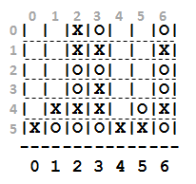
Let's understand this allowsMove method …
b3.allowsMove
4
5
6
b3
| | |X|O| | |O|
| | |X|X| | |X|
| | |O|O| | |O|
| | |O|X| | |O|
| |X|X|X| |O|X|
|X|O|O|O|X|X|O|
---------------
0 1 2 3 4 5 6
b.allowsMove(0) == True
b.allowsMove(1) == True
b.allowsMove(2) == False
b.allowsMove(3) == False
If col is out-of-bounds or full, return False.
b.allowsMove(4) == True
b.allowsMove(5) == True
If it's in-bounds and not full, return True.
b.allowsMove(6) == False
b.allowsMove(7) == False

Slide 16
Let's finish this allowsMove method …
class Board:
def allowsMove(self, col):
""" True if col is in-bounds + open
False otherwise """
H = self.height
W = self.width
D = self.data
if
return False
elif
return False
else:
return True
a C4 board
col #
b3.allowsMove
b
use these shortcuts
0
1
2
3
4
5
6
0
| | |X|O| | |O|
| | |X|X| | |X|
| | |O|O| | |O|
| | |O|X| | |O|
| |X|X|X| |O|X|
|X|O|O|O|X|X|O|
---------------
0 1 2 3 4 5 6
1
2
out of bounds?
3
4
5
col full?
b.allowsMove(0) == True
b.allowsMove(1) == True
Allowed!
b.allowsMove(2) == False
b.allowsMove(3) == False
If col is out-of-bounds or full, return False.
b.allowsMove(4) == True
b.allowsMove(5) == True
If it's in-bounds and not full, return True.
b.allowsMove(6) == False
b.allowsMove(7) == False

Slide 17
hw10pr2: Board class
the “constructor”
__init__( self, width, height )
checks if allowed
allowsMove( self, col )
places a checker
addMove( self, col, ox )
removes a checker
delMove( self, col )
to write...
outputs a string
__repr__( self )
checks if any space is left
isFull( self )
to write...
checks if a player has won
winsFor( self, ox )
to write...
the game...
hostGame( self )
to write...
Which are similar to others? Which requires the most thought?

Slide 18
winsFor( self, ox )
X
O
def winsFor(self, ox):
""" does ox win? """
H = self.height
W = self.width
D = self.data
for row in range(
for col in range(
b4
b.winsFor('X')
or 'O'
>>> b4.winsFor( 'X' )
True
>>> b4.winsFor( 0 )
False
>>> b4.winsFor( '0' )
False
>>> b4.winsFor( 'O' )
True
Watch out for corner cases!

Slide 19
Why objects and classes?
Elegance: Objects hide complexity!
if b.winsFor( 'X' ) == True:
if d.isBefore( d2 ) == True:
Simple – and INVITING -- building blocks!

Slide 20
CS this week
4
Hw #10 due 4/11
Building classes...
... vs. using the library
hw10pr2
hw10pr3
files and the dictionary class
Connect Four Board class
files
dictionaries
Office hours on FRIDAY aft. in LAC
If I had a dictionary, I guess I could look up what it was!

Slide 21
Lists are sequential containers:
L = [ 42, 5, 6, 47 ]
0
1
2
3
elements are looked up by their location, or index, starting from 0
Dictionaries are arbitrary containers:
value
value
d = { 3: 47, 1: 5 }
3
1
key
key
elements (or values) are looked up by a key starting anywhere you want! Keys don't have to be ints!

Slide 22
Dictionaries are arbitrary containers:
value
value
d = {'rat':1996, 'ox':1997}
'rat'
'ox'
key
key
elements (or values) are looked up by a key starting anywhere you want! Keys don't have to be ints!
What's up with d's data here?
Now I see the key to dictionaries' value…

Slide 23
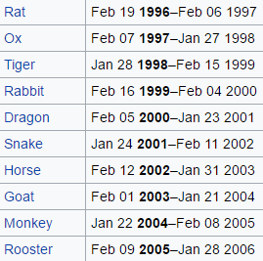
Dictionaries are arbitrary containers:
value
value
d = {'rat':1996, 'ox':1997}
'rat'
'ox'
key
key
elements (or values) are looked up by a key starting anywhere you want! Keys don't have to be ints!
12-year zodiac...
Now I see the key to dictionaries' value…

Slide 24
Dictionaries are arbitrary containers:
z = {'rat':[1996,1984,1972,...],
'ox':[1997,1985,1973,...],
'tiger':[1998,...], ... }
What type are the keys?
What type are the values?
Whose keys? z's keys!

Slide 25
Dictionaries are in !
z = {'rat':[1996,1984,1972,...],
'ox':[1997,1985,1973,...],
'tiger':[1998,...], ... }
Is 'dragon' a key in z?
if 'dragon' in z
Is 1969 in z['dragon']?
if 1969 in z['dragon']

Slide 26

Dictionaries are in !
z = {'rat':[1996,1984,1972,...],
'ox':[1997,1985,1973,...],
'tiger':[1998,...], ... }
Karen v Dad!
I can't tell you any of the questions -- but I can tell you all of the solutions!

Slide 27
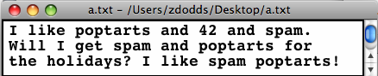
In Python reading files is no problem…
Files
f = open( 'a.txt' )
text = f.read()
f.close()
text
'I like poptarts and 42 and spam.\nWill I
LoW = text.split()
[ 'I', 'like', 'poptarts', ... ]
opens the file and calls it f
reads the whole file into the string text
closes the file (optional)
text.split() returns a list of each "word"

Slide 28
def word_count( filename ):
f = open( filename )
text = f.read()
f.close()
LoW = text.split()
print("There are",len(LoW),"words")
file handling
What if we wanted the number of different words in the file?
This would be the author's vocabulary count, instead of the total word count.

Slide 29
def vocab_count( filename ):
""" vocabulary-counting program """
f = open( filename )
text = f.read()
f.close()
LoW = text.split()
print "There are", len(LoW), "words."
d = {}
for w in LoW:
if w not in d:
d[w] = 1
else:
d[w] += 1
print "There are", len(d), "distinct words.\n"
return d # return d for later use by other code…
file handling
word counting
Tracking the number of occurances of each word with a dictionary, d.
most/least common?

Slide 30
LoW = [ 'spam', 'spam', 'poptarts', 'spam' ]
Oldenborg's menu!
d = {}
for w in LoW:
if w not in d:
d[w] = 1
else:
d[w] += 1

Slide 31
Vocabulary, anyone?
Shakespeare used 31,534 different words -- and a grand total of 884,647 words -- counting repetitions (across all of his works)
http://www-math.cudenver.edu/~wbriggs/qr/shakespeare.html
Shakespearean coinages
There's one contemporary author in the Oxford English Dictionary…
gust
besmirch
unreal
superscript
watchdog
swagger
affined
rooky
attasked
out-villained
Who?
What word?
successful
unsuccessful
http://www.pathguy.com/shakeswo.htm
http://www.shakespeare-online.com/biography/wordsinvented.html

Slide 32

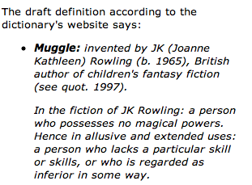
Vocabulary, anyone?
Shakespeare used 31,534 different words -- and a grand total of 884,647 words -- counting repetitions (across all of his works)
http://www-math.cudenver.edu/~wbriggs/qr/shakespeare.html
Shakespearean coinages
gust
besmirch
unreal
superscript
watchdog
swagger
affined
rooky
attasked
out-villained
successful
unsuccessful
J. K. Rowling
http://www.pathguy.com/shakeswo.htm
http://www.shakespeare-online.com/biography/wordsinvented.html

Slide 33
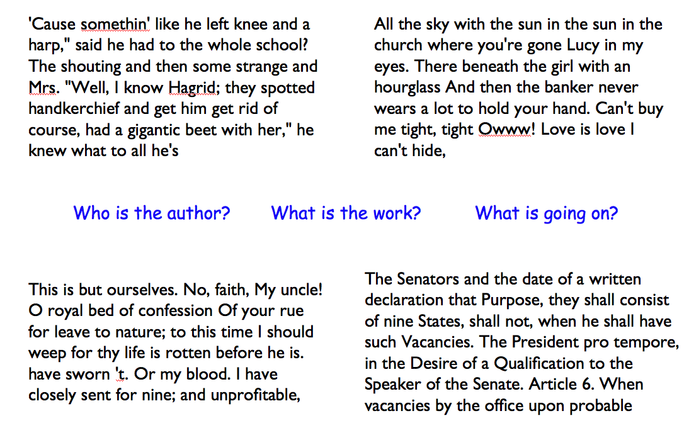
All Brit Lit!
Algorithmic authoring?

Slide 34
Markov Models
Techniques for modeling any sequence of natural data
speech, text, sensor data...
1st-order Markov Model (defining property)
Each item depends only on the one immediately before it .

Slide 35
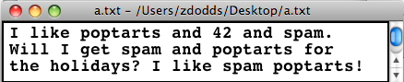
Our Markov Model
Original file
keys
values
{
'$': ['I', 'Will', 'I'],
'I': ['like', 'get', 'like']
'like':
'poptarts': ['and', 'for'],
'and': ['42', 'spam.', 'poptarts'],
'42': ['and'],
'Will': ['I'],
'the':
'spam': ['and', 'poptarts!'],
'get': ['spam'],
'for': ['the']
Markov Model
A dictionary!
[A]
What type are the keys?
[B]
What type are the values?
[C]
What are the missing values?
[D]
What is the '$'?
Why do some words, like holidays, seem missing from the keys?
}
[E]
end of the dictionary

Slide 36
Our Markov Model
Original file
keys
values
Markov Model
{
'$': ['I', 'Will', 'I'],
'I': ['like', 'get', 'like']
'like': ['poptarts', 'spam'],
'poptarts': ['and', 'for'],
'and': ['42', 'spam.', 'poptarts'],
'42': ['and'],
'Will': ['I'],
'the': ['holidays?'],
'spam': ['and', 'poptarts!'],
'get': ['spam'],
'for': ['the']
A dictionary!
What are the keys?
What are the values?
What are the missing values?
What is the '$'?
Why do some keys seem missing?
}

Slide 37
$ : [
I : [
like : [
eat : [
d
Building d
pw
$
nw
I like spam. I eat poptarts!
d = {}
pw = '$'
for nw in LoW:
if pw not in d: d[pw] = [nw]
else: d[pw] += [nw]
pw = _______
d's final value
$ : [ I, I ]
I : [ like, eat ]
like : [ spam ]
eat : [ poptarts ]

Slide 38
Model creation:
1) start with the previous word, pw as '$'
2) for each next word, nw, in the list of words, add it in ...
3) then change pw to nw ...
except if nw[-1] was punctuation: then change pw to…
Generating text:
1) start with pw as the '$' string
2) choose a nw that follows pw, at random.
3) print(nw, end=' ') (to continue on the same line)
4) pw gets set to either nw or '$'
what if nw[-1] was punctuation?

Slide 39
Markov Models are generative!
A key benefit of Markov Models is that they can generate feasible data!
Original file:
I like poptarts and 42 and spam.
Will I get spam and poptarts for
the holidays? I like spam poptarts!
Generated text:
I get spam poptarts! I like poptarts and 42 and spam. I like spam and 42 and 42 and 42 and spam. Will I like poptarts and 42 and poptarts and 42 and poptarts and 42 and 42 and poptarts and spam. I get spam and 42 and 42 and...
I agree!
demo…
gt(d, 200) or gt( cd('hpwhich.txt'), 200 )

Slide 40
Markov Models are generative!
A key benefit of Markov Models is that they can generate feasible data!
Original file:
I like poptarts and 42 and spam.
Will I get spam and poptarts for
the holidays? I like spam poptarts!
Your task in pr3: Create a 300-word "CSsay" using a source text of your choice...
Generated text:
I get spam poptarts! I like poptarts and 42 and spam. I like spam and 42 and 42 and 42 and spam. Will I like poptarts and 42 and poptarts and 42 and poptarts and 42 and 42 and poptarts and spam. I get spam and 42 and 42 and...
or 30,000!
demo…
gt(d, 200) or gt( cd('hpwhich.txt'), 200 )

Slide 41
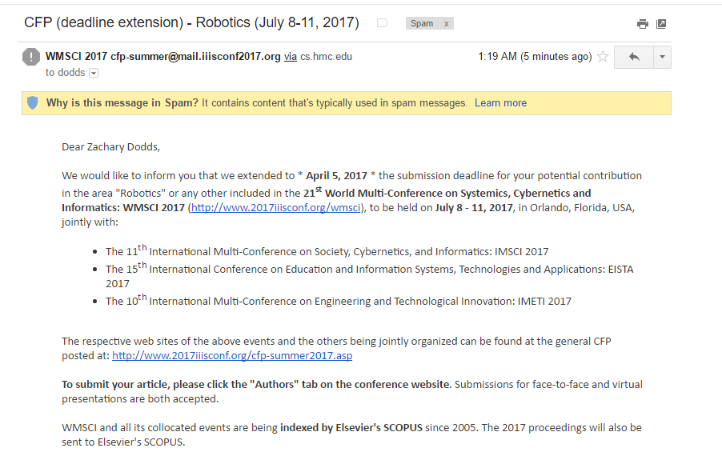
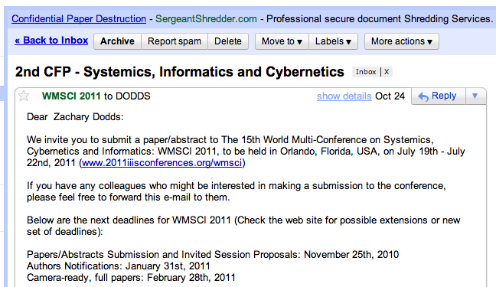
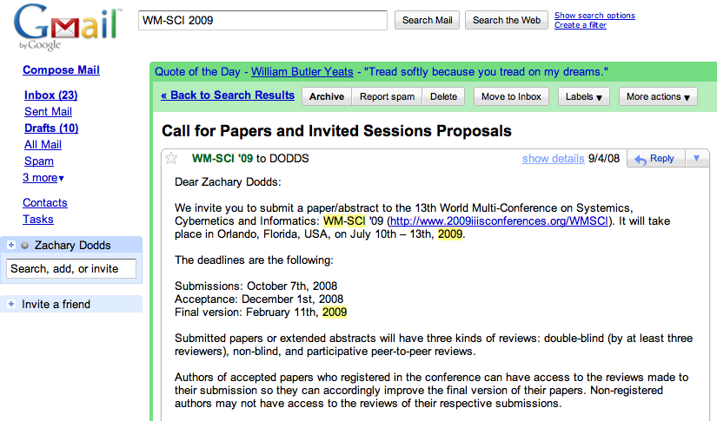
WMSCI

Slide 42
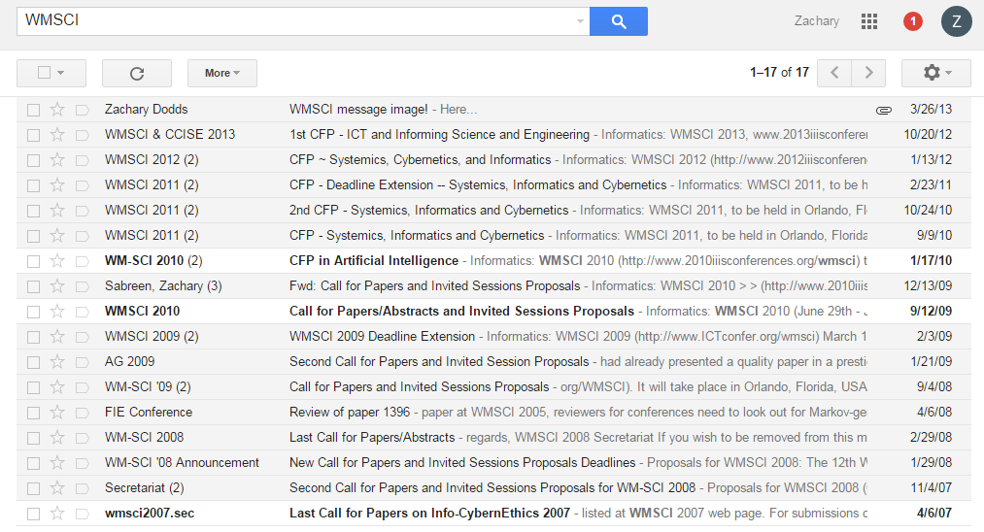
WMSCI

Slide 43
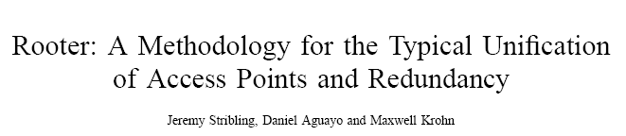
WMSCI 2005
http://pdos.csail.mit.edu/scigen/
Markov-generated submission accepted to WMSCI 2005

Slide 44
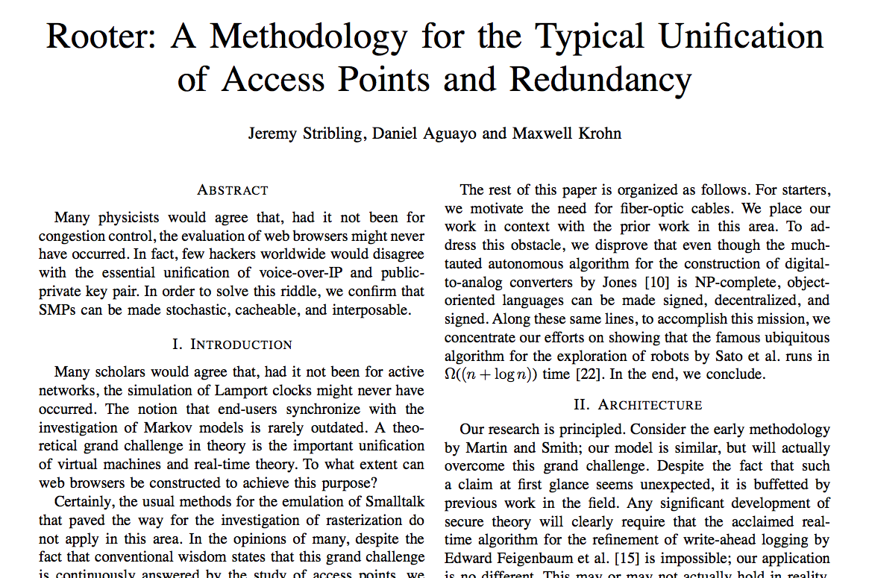
this was more than a first-order model…

Slide 45

and, scene...!
in costume

Slide 46
Thesis deadlines?
Other papers due?
Let Python write the rest of this semester's papers for you…
… you're still the author!
Have a worry-free weekend!

Slide 48
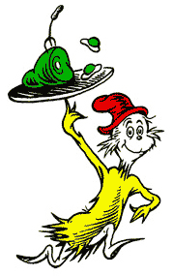
Counting distinct words with a dictionary…
WOULD YOU LIKE THEM IN A HOUSE?
WOULD YOU LIKE THEN WITH A MOUSE?
I DO NOT LIKE THEM IN A HOUSE.
I DO NOT LIKE THEM WITH A MOUSE.
I DO NOT LIKE THEM HERE OR THERE.
I DO NOT LIKE THEM ANYWHERE.
I DO NOT LIKE GREEN EGGS AND HAM.
I DO NOT LIKE THEM, SAM-I-AM.
Which book? Which author?

Slide 49
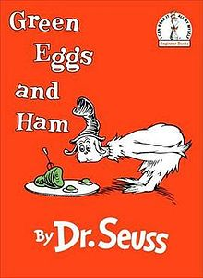
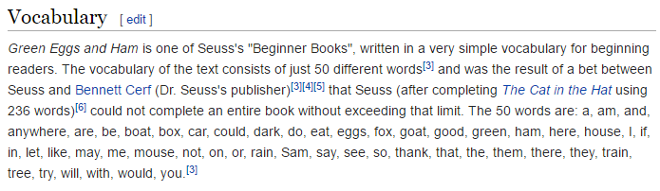
Counting distinct words with a dictionary…
WOULD YOU LIKE THEM IN A HOUSE?
WOULD YOU LIKE THEN WITH A MOUSE?
I DO NOT LIKE THEM IN A HOUSE.
I DO NOT LIKE THEM WITH A MOUSE.
I DO NOT LIKE THEM HERE OR THERE.
I DO NOT LIKE THEM ANYWHERE.
I DO NOT LIKE GREEN EGGS AND HAM.
I DO NOT LIKE THEM, SAM-I-AM.

Slide 50
Counting distinct words with a dictionary…
wd
wd
wd
wd
wd
…
WOULD YOU LIKE THEM IN A HOUSE?
WOULD YOU LIKE THEN WITH A MOUSE?
I DO NOT LIKE THEM IN A HOUSE.
I DO NOT LIKE THEM WITH A MOUSE.
I DO NOT LIKE THEM HERE OR THERE.
LoW
wd
wd
wd
wd
wd
…
wd
wd
wd
wd
wd
…
wd
wd
wd
wd
wd
…
d
keys
values
for wd in LoW:
if wd not in d:
d[wd] = 1
else:
d[wd] += 1

Slide 51
a C4 board
Quiz
class Board:
def addMove(self, col, ox):
""" buggy version! """
H = self.height
for row in range(0,H):
if self.data[row][col] != ' ':
self.data[row-1][col] = ox
col #
'X' or 'O'
(1) Run b.addMove(3,'O')
b
0
1
2
3
4
5
6
(2) Bugs! Can you fix them?!
0
| | | | | | | |
| | | | | | | |
| | | | | | | |
| | | |X| | | |
| |X| |X|O| | |
|X|O|O|O|X| |O|
---------------
0 1 2 3 4 5 6
1
2
3
4
5
Name(s) ___________________________
b2.addMoveBUG(3,'O')

Slide 52
a C4 board
Quiz
class Board:
def addMove(self, col, ox):
""" buggy version! """
H = self.height
for row in range(0,H):
if self.data[row][col] != ' ':
self.data[row-1][col] = ox
return
self.data[H-1][col] = ox
col #
'X' or 'O'
stop the loop!
stop the function!
only gets here if the column is empty – it sets the bottom spot to the correct checker
(1) Run b.addMove(3,'O')
b
0
1
2
3
4
5
6
(2) Bugs! Can you fix them?!
0
this page has the correct version…
| | | | | | | |
| | | | | | | |
| | | | | | | |
| | | |X| | | |
| |X| |X|O| | |
|X|O|O|O|X| |O|
---------------
0 1 2 3 4 5 6
1
2
3
4
5
Try this on the back page first…
b2.addMoveBUG(3,'O')

Slide 53
Let's finish this allowsMove method …
class Board:
def allowsMove(self, col):
""" True if col is in-bounds + open
False otherwise """
H = self.height
W = self.width
D = self.data
if
return False
elif
return False
else:
return True
a C4 board
col #
b3.allowsMove
try these shortcuts
b
0
1
2
3
4
5
6
0
| | |X|O| | |O|
| | |X|X| | |X|
| | |O|O| | |O|
| | |O|X| | |O|
| |X|X|X| |O|X|
|X|O|O|O|X|X|O|
---------------
0 1 2 3 4 5 6
1
2
3
4
5
b.allowsMove(0) == True
b.allowsMove(1) == True
b.allowsMove(2) == False
b.allowsMove(3) == False
If col is out-of-bounds or full, return False.
b.allowsMove(4) == True
b.allowsMove(5) == True
If it's in-bounds and not full, return True.
b.allowsMove(6) == False
b.allowsMove(7) == False

Slide 54
CS 60?
Same as CS5
2 x the work
Much harder
2-3 languages
Who is whoami ?
(define (whoami n)
(if (= n 0)
1
(* n (whoami (- n 1)))))
Racket
public static int whoami(int n)
{
if (n<2) return 1;
else return n * whoami(n-1);
}
Java
Prolog
whoami(0,1).
whoami(N,F) :- N1 is N-1,
whoami(N1,F1), F is N*F1.

Slide 55



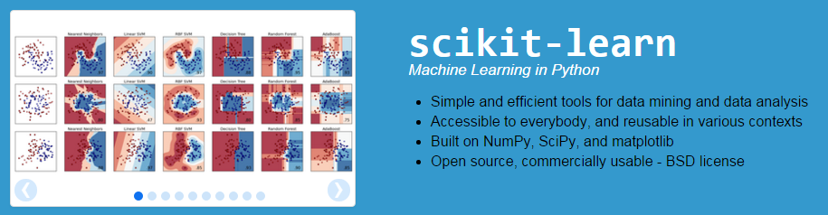
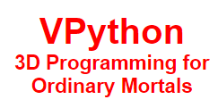

CS 35?
Same as CS5
2 x the work
Much harder
8-10 libraries

Slide 56
Counting distinct words with a dictionary…
wd
wd
wd
wd
wd
…
WOULD YOU LIKE THEM IN A HOUSE?
WOULD YOU LIKE THEN WITH A MOUSE?
I DO NOT LIKE THEM IN A HOUSE.
I DO NOT LIKE THEM WITH A MOUSE.
I DO NOT LIKE THEM HERE OR THERE.
I DO NOT LIKE THEM ANYWHERE.
I DO NOT LIKE GREEN EGGS AND HAM.
I DO NOT LIKE THEM, SAM-I-AM.
LoW
d
keys
values
for wd in LoW:
if wd not in d:
d[wd] = 1
else:
d[wd] += 1

Slide 57
def vocab_count( filename ):
""" vocabulary-counting program """
f = open( filename )
text = f.read()
f.close()
LoW = text.split()
print "There are", len(LoW), "words."
d = {}
for w in LoW:
if w not in d:
d[w] = 1
else:
d[w] += 1
print "There are", len(d), "distinct words.\n"
return d # return d for later use by other code…
file handling
word counting
Tracking the number of occurances of each word with a dictionary, d.
most/least common?

Slide 58
Vocabulary, anyone?
Shakespeare used 31,534 different words -- and a grand total of 884,647 words -- counting repetitions (across all of his works)
http://www-math.cudenver.edu/~wbriggs/qr/shakespeare.html
Shakespearean coinages
There's one contemporary author in the Oxford English Dictionary…
gust
besmirch
unreal
superscript
watchdog
swagger
affined
rooky
attasked
out-villained
Who?
What word?
successful
unsuccessful
http://www.pathguy.com/shakeswo.htm
http://www.shakespeare-online.com/biography/wordsinvented.html

Slide 59
Our Markov Model
d = cd('a.txt')
Original file:
Markov Model:
{
'$': ['I', 'Will', 'I'],
'I': ['like', 'get', 'like']
'like': ['poptarts', 'spam'],
'poptarts': ['and', 'for'],
'and':
'42': ['and'],
'Will': ['I'],
'the':
'spam': ['and', 'poptarts!'],
'get': ['spam'],
'for': ['the']
is a dictionary!
What are the keys?
What are the values?
What are the missing values?
What is the '$'?
Why do some keys seem missing?
}

Slide 60
Our Markov Model
d = cd('a.txt')
Original file:
Markov Model:
{
'$': ['I', 'Will', 'I'],
'I': ['like', 'get', 'like']
'like': ['poptarts', 'spam'],
'poptarts': ['and', 'for'],
'and':
'42': ['and'],
'Will': ['I'],
'the':
'spam': ['and', 'poptarts!'],
'get': ['spam'],
'for': ['the']
is a dictionary!
What are the keys?
What are the values?
What are the missing values?
What is the '$'?
Why do some keys seem missing?
}

Slide 61
Model creation:
1) start with the prevwd as '$'
2) for each nextwd in the list of words, add it in ...
3) then change nextwd to prevwd or '$'...
if nextwd [-1] is punctuation.
d = {}
d['$'] = ['I']
d['I'] = .
d['I'] += .
d['like'] = .

Slide 62
Our Markov Model
Original file:
Markov Model:
{
'$': ['I', 'Will', 'I'],
'I': ['like', 'get', 'like']
'like': ['poptarts', 'spam'],
'poptarts': ['and', 'for'],
'and':
'42': ['and'],
'Will': ['I'],
'the':
'spam': ['and', 'poptarts!'],
'get': ['spam'],
'for': ['the']
A dictionary!
What are the keys?
What are the values?
What are the missing values?
What is the '$'?
Why do some keys seem missing?
}

Slide 63
Our Markov Model
Original file:
I like poptarts and 42 and spam.
Will I get spam and poptarts for
the holidays? I like spam poptarts!
Markov Model:
{
'$': ['I', 'Will', 'I'],
'I': ['like', 'get', 'like']
'like': ['poptarts', 'spam'],
'poptarts': ['and', 'for'],
'and': ['42', 'spam.', 'poptarts'],
'42': ['and'],
'Will': ['I'],
'the': ['holidays?'],
'spam': ['and', 'poptarts!'],
'get': ['spam'],
'for': ['the']
A dictionary!
}

Slide 64
Model creation
def createDictionary( filename ):
""" creates a 1st-order M.Model """
f = open( filename )
text = f.read()
f.close()
LoW = text.split()
d = {}
prevwd = '$'
for nextwd in LoW:
if prevwd not in d:
d[prevwd] =
else:
d[prevwd] +=
return d
see previous slide for the "key" idea!
We want the KEY to be prevwd. We want the VALUE to be the list of words following prevwd.
reset variables appropriately here – be sure not to forget to check if the sentence has ended!

Slide 65
Model creation:
1) start with the prevwd as '$'
2) for each nextwd in the list of words, add it in ...
3) then change nextwd to prevwd or '$'...
if nextwd [-1] is punctuation.

Slide 66
hw10pr3…
$ : [ I, I ]
I : [ like, eat ]
like : [ spam ]
eat : [ poptarts ]
pw
nw
I like spam. I eat poptarts!
d = {}
pw =
for nw in LoW:
if pw not in d: d[pw] =
else: d[pw] +=

Slide 67
Model creation
def createDictionary( filename ):
""" creates a 1st-order M.Model """
f = open( filename )
text = f.read()
f.close()
LoW = text.split()
d = {}
prevwd = '$'
for nextwd in LoW:
if prevwd not in d:
d[prevwd] =
else:
d[prevwd] +=
We want the KEY to be prevwd. We want the VALUE to be the list of words following prevwd.

Slide 68
winsFor( self, ox )
X
O
def winsFor(self, ox):
""" does ox win? """
H = self.height
W = self.width
D = self.data
b
b.winsFor('X')
or 'O'
Watch out for corner cases!

Slide 69
a C4 board
Quiz
class Board:
def addMove(self, col, ox):
""" buggy version! """
H = self.height
for row in range(0,H):
if self.data[row][col] != ' ':
self.data[row-1][col] = ox
self.data[H][col] = ox
col #
'X' or 'O'
(1) Run b.addMove(3,'O')
b
0
1
2
3
4
5
6
(2) Bugs! Can you fix them?!
0
| | | | | | | |
| | | | | | | |
| | | | | | | |
| | | |X| | | |
| |X| |X|O| | |
|X|O|O|O|X| |O|
---------------
0 1 2 3 4 5 6
1
2
3
4
5
Try this on the back page first…

Slide 70
a C4 board
Quiz, p.2
class Board:
def allowsMove(self, col):
""" True if col is in-bounds and open
False otherwise """
H = self.height
W = self.width
D = self.data
if
col #
Finish this allowsMove method …
If col is out-of-bounds or full, return False.
If it's in-bounds and not full, return True.

Slide 71
Let's finish this allowsMove method …
class Board:
def allowsMove(self, col):
""" True if col is in-bounds + open
False otherwise """
H = self.height
W = self.width
D = self.data
if
a C4 board
col #
b3.allowsMove
b
0
1
2
3
4
5
6
0
| | |X|O| | |O|
| | |X|X| | |X|
| | |O|O| | |O|
| | |O|X| | |O|
| |X|X|X| |O|X|
|X|O|O|O|X|X|O|
---------------
0 1 2 3 4 5 6
1
2
3
4
5
b.allowsMove(0) == True
b.allowsMove(1) == True
b.allowsMove(2) == False
b.allowsMove(3) == False
b.allowsMove(4) == True
If it's in-bounds and not full, return True.
b.allowsMove(5) == True
If col is out-of-bounds or full, return False.
b.allowsMove(6) == False
b.allowsMove(7) == False

Slide 72
Dictiontaries don't seem moronic to me!
More on dictionaries
Strings can be keys, too!
>>> d2 = {'pig': 1995, 'rat': 1996}
>>> 'pig' in d2 >>> 'cat' in d2
True False
>>> len(d2)
2
>>> d2.keys()
[ 'pig', 'rat' ]
>>> d2.values()
[ 1996, 1995 ]
>>> d2.items()
[ ('rat', 1996), ('pig', 1995) ]
in checks if a key is present
len () returns the # of keys
d2.keys() returns a list of all keys
d2.values () returns a list of all values
d2.items () returns a list of all key, value pairs

Slide 73
hw10pr2: Board class
the “constructor”
__init__( self, width, height )
checks if allowed
allowsMove( self, col )
places a checker
addMove( self, col, ox )
removes a checker
delMove( self, col )
to write...
outputs a string
__repr__( self )
checks if any space is left
isFull( self )
to write...
checks if a player has won
winsFor( self, ox )
to write...
the game...
hostGame( self )
to write...
Which are similar to others? Which requires the most thought?

Slide 74
winsFor( self, ox )
X
O
def winsFor(self, ox):
""" does ox win? """
H = self.height
W = self.width
D = self.data
b
b.winsFor('X')
or 'O'
Watch out for corner cases!

Slide 75
Why objects and classes?
Elegance: Objects hide complexity!
if b.winsFor( 'X' ) == True:
if d.isBefore( d2 ) == True:
Simple – and INVITING -- building blocks!
encapsulating lots of complexity!!
def isBefore(self, d2):
""" Returns true if self is before d2 """
if self.year < d2.year:
return True
if self.month < d2.month and self.year == d2.year:
return True
if self.day < d2.day and d2.month == self.month and \
self.year == d2.year:
return True
return False

Slide 76
Why objects and classes?
Elegance: Objects hide complexity!
if b.winsFor( 'X' ) == True:
if d.isBefore( d2 ) == True:
Simple – and INVITING -- building blocks!
encapsulating lots of complexity!!
or maybe not so much!!!
def isBefore(self, d2):
""" Returns true if self is before d2 """
return [self.year, self.month, self.day] < [d2.year, d2.month, d2.day]

Slide 77
winsFor( self, ox )
X
O
def winsFor(self, ox):
""" does ox win? """
H = self.height
W = self.width
b
b.winsFor( 'O' )
or 'X'
Watch out for corner cases!

Slide 78
Quiz
class Board:
def addMove(self, col, ox):
H = self.height
for row in range( H ):
if self.data[row][col] != ' ':
self.data[row-1][col] = ox
self.data[H][col] = ox
def allowsMove(self, col):
this addMove method does not work
What is each line doing?
What are the bugs!?
a C4 board
col #
'X' or 'O'
0
1
2
3
4
5
6
0
| | | | | | | |
| | | | | | | |
| | | | | | | |
| | | |X| | | |
| |X| |X|O| | |
|X|O|O|O|X| |O|
---------------
0 1 2 3 4 5 6
1
2
3
4
5
Write allowsMove to return True if col is a valid move – both in bounds and with room False otherwise.

Slide 79
winsFor( self, ox )
X
O
def winsFor(self, ox):
""" does ox win? """
H = self.height
W = self.width
b
b.winsFor('X')
or 'O'
Watch out for corner cases!

Slide 80
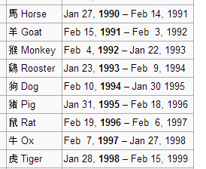
This seems like the key to dictionaries' value…
Dictionaries
A dictionary is a set of key - value pairs:
>>> d = {}
>>> d[1994] = 'dog'
>>> d[1995] = 'pig'
>>> d
{1995:'dog', 1994:'pig'}
>>> d[1994]
'dog'
>>> d[1969]
key error
creates an empty dictionary, d
1994 is the key
'dog' is the value
1995 is the key
'pig' is the value
Curly! And colony!
It's like a list, but the index can be any immutable key.

Slide 81
Model creation
def wc( filename ):
""" our old word-counting program """
f = open( filename )
text = f.read()
f.close()
LoW = text.split()
print "There are", len(LoW), "words."
d = {}
for w in LoW:
if w not in d:
d[w] = 1
else:
d[w] += 1
file handling
word counting
How do we change d's VALUES into the list of the words following each KEY ?

Slide 82
PROV = { 'BC': 0, … }
A challenge…
key
value
All of Canada's provinces are in this dictionary…
def provinceChallenge( PROV ):
""" PROV is a dictionary of Canada's provinces
-- the challenge is to name them all! """
while 0 in prov.values():
guess = raw_input("Name a province: ")
if guess not in PROV:
print 'Try again...'
elif prov[guess] == 0:
print 'Yes!'
prov[guess] += 1
else:
print 'Already guessed...'
prov[guess] += 1
print 'Phew!'
wasn't a key at all
newly guessed key: value was 0
repeated guess
help!

Slide 83
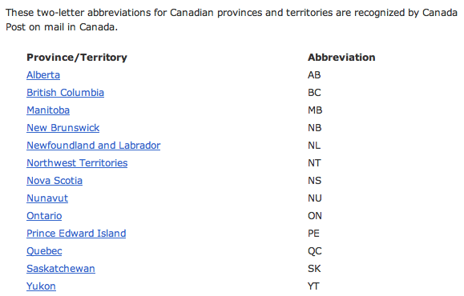
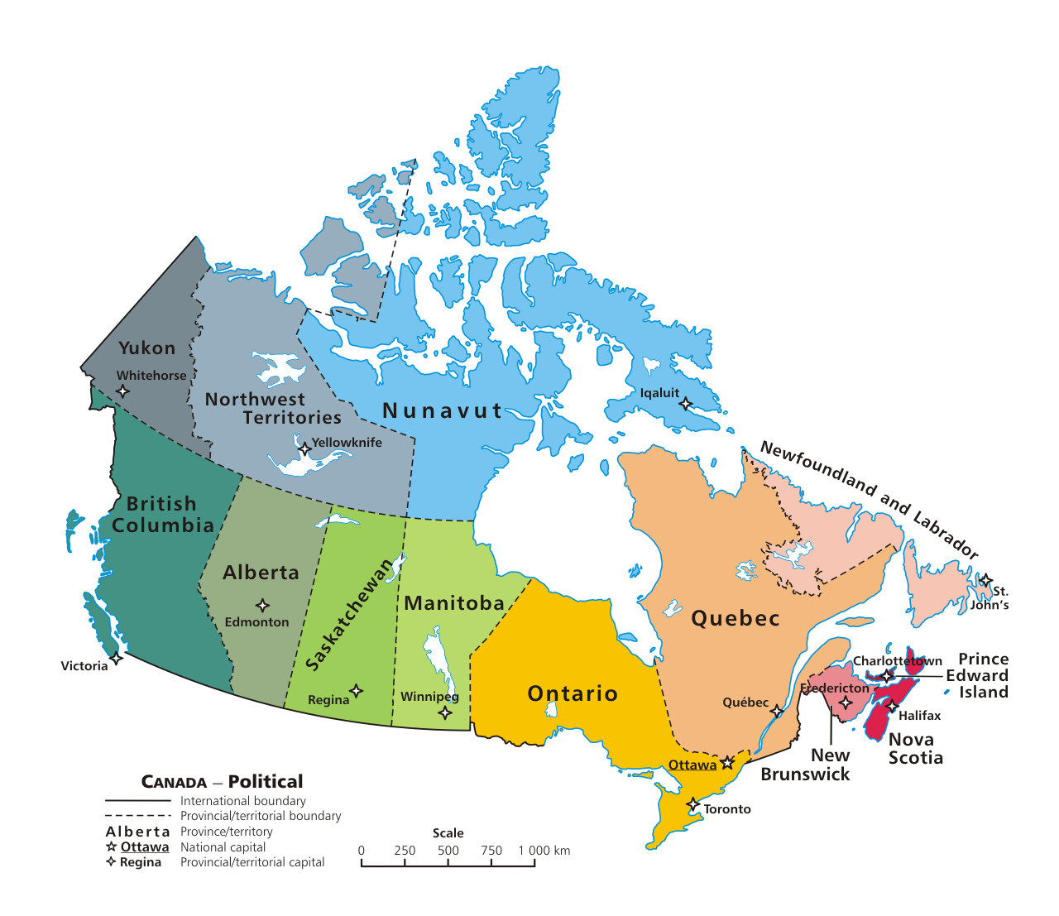

Slide 84
Markov Models
Techniques for modeling any sequence of natural data
speech, text, sensor-data in time series...
Each item depends only on the item immediately before it .
1st-order Markov Model
The text file:
The model:
{ 'like' : ['poptarts','spam'],
'and' : ['42', 'spam.', 'poptarts'],
'get' : ['spam'], …
'poptarts':
'I' :
'Will' :
How to get to Will?

Slide 85
Markov Models
The text file:
The model:
{ 'like' : ['poptarts','spam'],
'and' : ['42', 'spam.', 'poptarts'],
'get' : ['spam'],
'poptarts': ['and','for'],
'I' : ['like','get','like'],
'Will' : ['I'],
'$' : ['I', 'Will', 'I'] …
Use '$' to represent the sentence-starting string.

Slide 86
class Board:
def addMove(self, col, ox):
H = self.height
for row in range( H ):
if self.data[row][col] != ' ':
self.data[row-1][col] = ox
self.data[H][col] = ox
def allowsMove(self, col):
this addMove method does not work
What is each line doing?
What are the bugs!?
a C4 board
col #
'X' or 'O'
0
1
2
3
4
5
6
0
| | | | | | | |
| | | | | | | |
| | | | | | | |
| | | |X| | | |
| |X| |X|O| | |
|X|O|O|O|X| |O|
---------------
0 1 2 3 4 5 6
1
2
3
Original board:
4
5
Write allowsMove to return True if col is a valid move – both in bounds and with room False otherwise.

Slide 88

Quiz
class Board:
def addMove(self, col, ox):
H = self.height
for row in range( H ):
if self.data[row][col] != ' ':
self.data[row-1][col] = ox
self.data[H][col] = ox
def allowsMove(self, col):
a C4 board
col #
'X' or 'O'
Step through this buggy addMove method.
What is each line doing?
Can you spot the problem(s) here?
0
1
2
3
4
5
6
0
1
2
3
4
5
Write allowsMove to return True if col is a valid move; False otherwise.
Hint: check as little as possible!

Slide 89
Quiz
class Board:
def addMove(self, col, ox):
H = self.height
for row in range( H ):
if self.data[row][col] != ' ':
self.data[row-1][col] = ox
self.data[H][col] = ox
def allowsMove(self, col):
a C4 board
col #
'X' or 'O'
Step through this buggy addMove method.
What is each line doing?
Can you spot the problem(s) here?
0
1
2
3
4
5
6
0
1
2
3
4
5
Write allowsMove to return True if col is a valid move; False otherwise.
Hint: check as little as possible!

Slide 90
winsFor( self, ox )
X
O
def winsFor(self, ox):
""" does ox win? """
H = self.height
W = self.width
b
b.winsFor( 'O' )
or 'X'
Watch out for corner cases!

Slide 91
Another challenge?

Slide 92
Model creation
def wc( filename ):
""" our old word-counting program """
f = open( filename )
text = f.read()
f.close()
LoW = text.split()
print "There are", len(LoW), "words."
d = {}
for w in LoW:
if w not in d:
d[w] = 1
else:
d[w] += 1
file handling
word counting
How do we change d's VALUES into the list of the words following each KEY ?

Slide 93
Designing classes
(Data Members) What data do we need?
Not limited to 7x6!
(Methods) What are capabilities do we want?

Slide 94
Connect Four: __repr__
def __repr__(self):
""" this method returns a string representation
for an object of type Board
"""
s = ''
for row in range( 6 ):
s += '|'
for col in range( 7 ):
s += self.data[row][col] + '|'
s += '\n'
return s
To change?
To add?
which row is row 0, row 1, and so on?

Slide 95
Quiz
class Board:
def allowsMove(self, col):
def addMove(self, col, ox):
H = self.height
for row in range( H ):
if self.data[row][col] != ' ':
self.data[row-1][col] = ox
self.data[H][col] = ox
Write allowsMove to return True if col is a valid move; False otherwise.
Hint: check as little as possible!
a C4 board
col #
'X' or 'O'
Step through this imperfect addMove method.
What is each line doing?
Can you spot any potential problems here...?

Slide 96
winsFor( self, ox )
X
O
def winsFor(self, ox):
""" does ox win? """
H = self.height
W = self.width
b
b.winsFor( 'O' )
or 'X'
Watch out for corner cases!

Slide 97
def wc( filename ):
""" word-counting program """
f = open( filename )
text = f.read()
f.close()
LoW = text.split()
print "There are", len(LoW), "words."
d = {}
for w in LoW:
if w not in d:
d[w] = 1
else:
d[w] += 1
print "There are", len(d), "distinct words.\n"
return d # this way we can use d later!
file handling
word counting
Tracking the number of occurences of each word with a dictionary, d.

Slide 98
Another challenge?

Slide 99
Markov Models
Techniques for modeling any sequence of natural data
speech, text, sensor-data in time series...
Each item depends only on the item immediately before it .
1st-order Markov Model
I like poptarts and 42 and spam.
Will I get spam and poptarts for
the holidays? I like spam poptarts!
The text file:
{ 'like' : ['poptarts'],
'and' : ['42', 'spam.', 'poptarts'],
'get' : ['spam'], …
'poptarts':
'I' :
'Will' :
The model:
How to get to Will?

Slide 100
Markov Models
Techniques for modeling any sequence of natural data
speech, text, sensor-data in time series...
Each item depends only on the item immediately before it .
1st-order Markov Model
I like poptarts and 42 and spam.
Will I get spam and poptarts for
the holidays? I like spam poptarts!
The text file:
{ 'like' : ['poptarts'],
'and' : ['42', 'spam.', 'poptarts'],
'get' : ['spam'],
'poptarts': ['and','for'],
'I' : ['like','get','like'],
'Will' : ['I'],
'$' : ['I', 'Will', 'I'] …
The model:
We'll use '$' as the sentence-starting string.

Slide 101
Markov Models
Techniques for modeling any sequence of natural data
speech, text, sensor-data in time series...
Each item depends only on the item immediately before it .
1st-order Markov Model
I like poptarts and 42 and spam.
Will I get spam and poptarts for
the holidays? Mmmm, spam poptarts!
The text file:
{ 'like' : ['poptarts'],
'I' : ['like', 'get'],
'get' : ['spam.'], …
'and' :
The model:

Slide 102
Markov Model
Technique for modeling any sequence of natural data
1st-order Markov Model
Each item depends on only the item immediately before it .
The text file:
I like spam. I like toast and spam.
I eat ben and jerry's ice cream too.
{ 'toast': ['and'],
'and' : ['spam.', "jerry's"],
'like' : ['spam.', 'toast'], …
'ben' :
The Model:

Slide 103
Markov Model
Technique for modeling any sequence of natural data
Each item depends on only the item immediately before it .
The text file:
I like spam. I like toast and spam.
I eat ben and jerry's ice cream too.
{ 'toast': ['and'],
'and' : ['spam.', "jerry's"],
'like' : ['spam.', 'toast'],
'ben' : ['and'],
'I' :
The Model:

Slide 104
Markov Model
Technique for modeling any sequence of natural data
Each item depends on only the item immediately before it .
The text file:
I like spam. I like toast and spam.
I eat ben and jerry's ice cream too.
{ 'toast': ['and'],
'and' : ['spam.', "jerry's"],
'like' : ['spam.', 'toast'],
'ben' : ['and'],
'I' : ['like', 'like', 'eat']
The Model:
How to get to I?

Slide 105
Markov Model
Technique for modeling any sequence of natural data
Each item depends on only the item immediately before it .
The text file:
I like spam. I like toast and spam.
I eat ben and jerry's ice cream too.
{ 'toast': ['and'],
'and' : ['spam.', "jerry's"],
'like' : ['spam.', 'toast'],
'ben' : ['and'],
'I' : ['like', 'like', 'eat'],
'$' : ['I', 'I', 'I'],
The Model:
sentence-starting string

Slide 106
Change this code so that it tells you how many times you've guessed the same province…
def provinceChallenge( prov ):
while 0 in prov.values():
guess = raw_input("Guess: ")
if prov.has_key( guess ) == False:
print 'Try again...'
prov[guess] = 1
print 'Guessed:', prov[guess], 'times'
elif prov[guess] == 0:
print 'Yes!'
prov[guess] += 1
print 'Guessed:', prov[guess], 'times'
else:
print 'Already guessed...'
prov[guess] += 1
print 'Guessed:', prov[guess], 'times'

Slide 107
Based on favChild, write favGChild to return the first grandchild alphabetically - or return None if there are none.
def favChild( person, Tree ):
if Tree.has_key( person ):
Kids = Tree[person]
Kids.sort()
return Kids[0]
return None
def favGChild( person, Tree ):
GC = []
if Tree.has_key( person ):
for ch in Tree[person]:
if Tree.has_key( ch ):
GC += Tree[ ch ]
if GC != []:
GC.sort()
return GC[0]
return None
our list of GChildren

Slide 108

Connect Four: the object b
str
str
str
str
int
Board
b
list
width
data
str
str
str
str
int
str
str
str
str
height
| | | | | | | |
| | | | | | | |
| | | | | | | |
| | | |X| | | |
| |X| |X|O| | |
|X|O|O|O|X| |O|
---------------
0 1 2 3 4 5 6
What is the name of the method that will print this data?

Slide 109
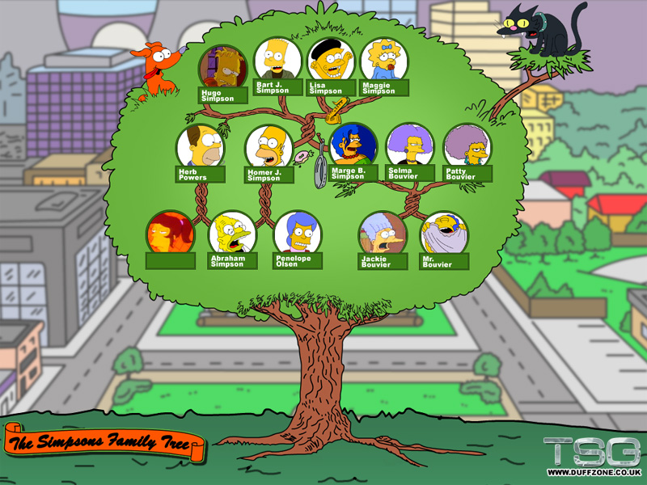
A family dictionary?

Slide 110
A family dictionary…
T = {'abe' :['homer','herb'],
'jackie':['marge','patty','selma'],
'homer' :['hugo','bart','lisa','maggie'],
'marge' :['hugo','bart','lisa','maggie']}
keys can be any immutable type
values can be any type at all…
T['abe']
How to get 'selma' from T?

Slide 111
A functional family?
def favChild( person, Tree ):
""" person is a name (a string)
Tree is a dictionary of children
returns person's "favorite" child """
if Tree.has_key( person ):
Kids = Tree[person]
Kids.sort()
return Kids[0]
return None
Who is favored ?
sort has side effects !

Slide 112
A functional family?
For example, >>> addChild( 'lisa', T, 'abejr' )
def addChild( person, Tree, jr ):
""" adds person's new child to Tree """
if Tree.has_key( person ) == False:
else: # already in the Tree!

Slide 113
“Quiz”
Name(s):
def favChild( person, Tree ):
if Tree.has_key( person ):
Kids = Tree[person]
Kids.sort()
return Kids[0]
return None
Change this code so that it prints how many times you've guessed each item, both for real provinces and for incorrect guesses…
def provinceChallenge( prov ):
while 0 in prov.values():
guess = raw_input("Guess: ")
if prov.has_key( guess ) == False:
print 'Try again...'
elif prov[guess] == 0:
print 'Yes!'
prov[guess] += 1
else:
print 'Already guessed...'
Based on favChild (above), write favGChild to return the first grandchild alphabetically - or return None if there are none.
def favGChild( person, Tree ):

Slide 114
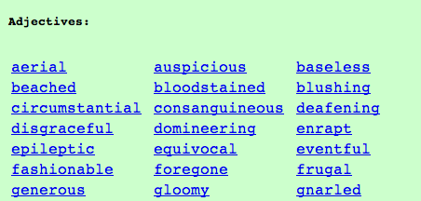
Vocabularists?
Shakespeare used 31,534 different words and a grand total of 884,647 words counting repetitions (across his works)
http://www-math.cudenver.edu/~wbriggs/qr/shakespeare.html
Active vocabulary estimates range from 10,000-60,000.
Passive vocabulary estimates are much higher.
Contemporary author in the OED…
Many Shakespearean contributions:
Shakespeare
which word…
Any guesses?

Slide 115
Vocabularists?
Shakespeare used 31,534 different words and a grand total of 884,647 words counting repetitions (across his works)
http://www-math.cudenver.edu/~wbriggs/qr/shakespeare.html
Active vocabulary estimates range from 10,000-60,000.
Passive vocabulary estimates are much higher.
Many Shakespearean contributions:
Shakespeare
J. K. Rowling

Slide 116
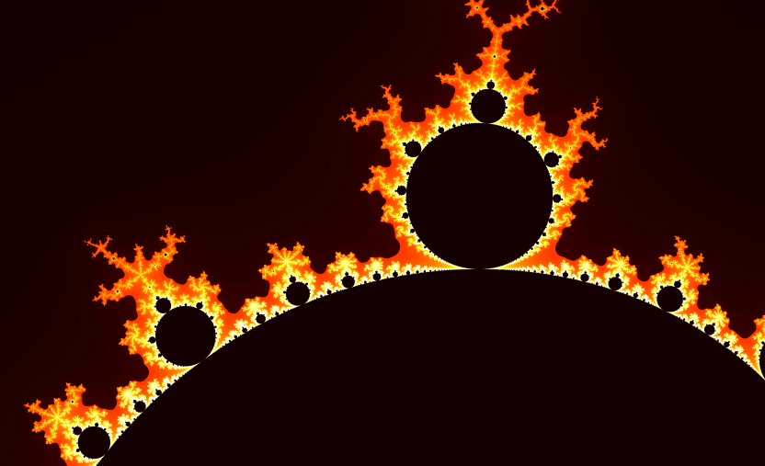
Infernalicious!
also: www.cs.hmc.edu/~jgrasel/

Slide 117
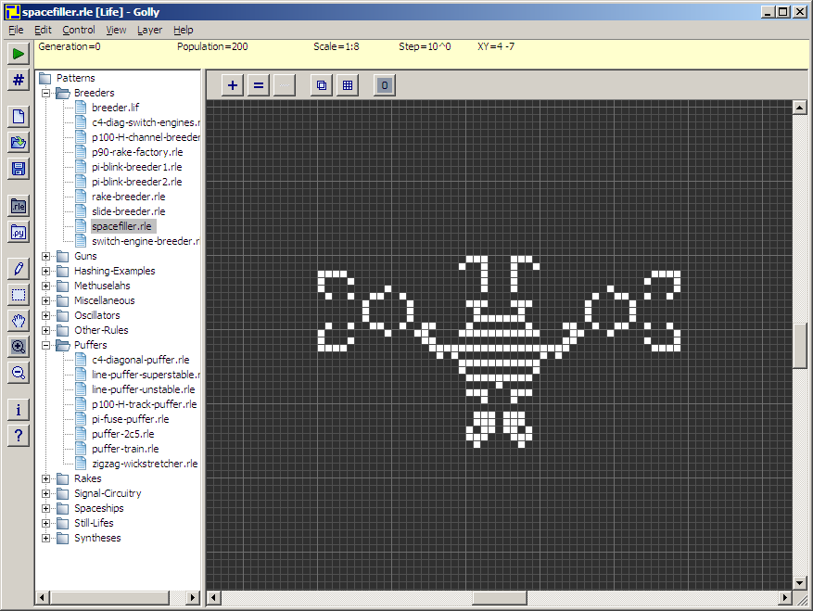
Life, revisited
Golly!
http://golly.sourceforge.net/

Slide 118
Methods
There's madness in this method!
d.has_key( 1991 )
are functions that are called by the data itself!
Functions
has_key( 1991, d )
are called on their own…
all data must be passed in as function inputs…
Warning: this has_key function is for example purposes only. It does not exist!

Slide 119
Representation & Speed
list
dictionary
{1988: 'dragon', 1989: 'snake'}
reference
L
5
0
L[0]
L[1]
…
42
L[9999]
finding if a value is in a list of 10,000 elements…
vs.
looking up a key in a dictionary of 10,000 entries

Slide 120
value-added tts() options…

Slide 121


Problem 1 -- to ∞ and beyond!
"rocks"
Are there stable life configurations?
Are there oscillating life configurations?
"plants"
period 3
period 2
Are there self-propagating life configurations?
"animals"

Slide 122
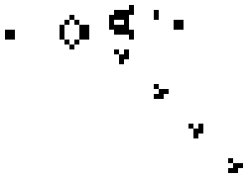
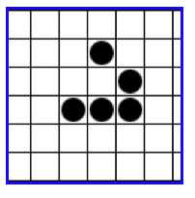
Problem 1 -- to ∞ and beyond!
Are there life configurations that expand forever?
What is the largest amount of the life universe that can be filled with cells?
Are all feasible configurations reachable?
How sophisticated can the structures in the life universe be?
http://www.ibiblio.org/lifepatterns/

Slide 123
Name that author… ?
'Cause somethin' like he left knee and a harp," said he had to the whole school? The shouting and then some strange and Mrs. "Well, I know Hagrid; they spotted handkerchief and get him get rid of course, had a gigantic beet with her," he knew what to all he's
All the sky with the sun in the sun in the church where you're gone Lucy in my eyes. There beneath the girl with an hourglass And then the banker never wears a lot to hold your hand. Can't buy me tight, tight Owww! Love is love I can't hide,
Who is the author?
What is the work?
What is going on?
This is but ourselves. No, faith, My uncle! O royal bed of confession Of your rue for leave to nature; to this time I should weep for thy life is rotten before he is. have sworn 't. Or my blood. I have closely sent for nine; and unprofitable,
The Senators and the date of a written declaration that Purpose, they shall consist of nine States, shall not, when he shall have such Vacancies. The President pro tempore, in the Desire of a Qualification to the Speaker of the Senate. Article 6. When vacancies by the office upon probable

Slide 124
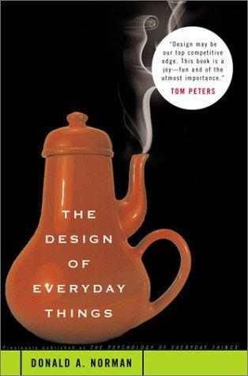
Exam on Mon.
Exam topics
1d loops
for & while
Design chapter:
2d loops
for row…
for col…
Hmmm
add r2 r2 r1
Basics
variables, functions, etc.
You may bring a page of notes, double-sided with anything you would like on it.
I'd suggest (1) reminding yourself about the HW problems and (2) looking at the class "quizzes"…

Slide 125
Change this code so that it tells you how many times you've guessed the same province…
first, for real provinces
then, for incorrect guesses…
def provinceChallenge( prov ):
while '0' in prov.values():
guess = raw_input("Guess: ")
if prov.has_key( guess ) == False:
print 'Try again...'
elif prov[guess] == 0:
print 'Yes!'
prov[guess] += 1
else:
print 'Already guessed...'

Slide 126
Based on favChild, write favGChild to return the first grandchild alphabetically - or return 'no one' if there are none.
def favChild( person, Tree ):
if Tree.has_key( person ):
Kids = Tree[person]
Kids.sort()
return Kids[0]
else:
return 'no children'
def favGChild( person, Tree ):
GC = []
our list of GChildren

Slide 127
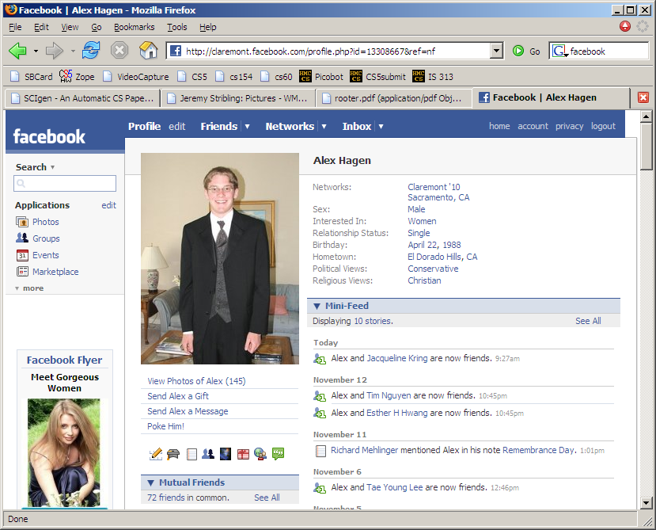

Slide 128
Name that author… ?

Slide 129
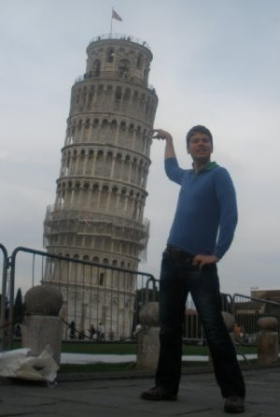
Visuospatial Skills
Three dimensions are better than two – I should know!
We use visuospatial skills in everyday life.
Most importantly, visuospatial skills are a significant predictor of success in technical fields. Imagine graphics software for instance.
Power to predict grades in technical courses equals that of math SAT scores (Sorby, 2009).
Bundled multimedia software and workbook developed at Michigan Tech teaches these skills.
Multimedia is being implemented at 6 other institutions nationwide including Purdue, Virginia Tech, Penn State – Behrend using a $200,000 NSF grant awarded in 2007.

Slide 130
If I had a dictionary, I guess I could look up what it was!
Dictionaries
Lists are not perfect…
reference
You can't choose what to name data.
L
5
42
L[0]
L[1]
L[0], L[1], …
You have to start at 0.
L[1990] = 'horse'
L[1991] = 'ram'
Some operations can be slow for big lists …
if 'rooster' in L:

Slide 131
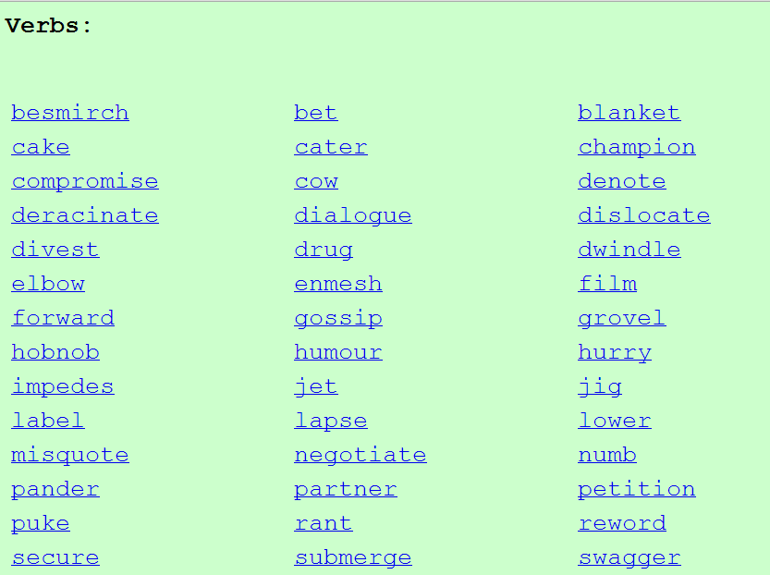
Vocabulary, anyone?
Shakespeare used 31,534 different words -- and a grand total of 884,647 words -- counting repetitions (across all of his works)
http://www-math.cudenver.edu/~wbriggs/qr/shakespeare.html
Shakespearean coinages:
J. K. Rowling

Slide 132
In search of elegance... One solution:
def isBefore(self, d2):
""" Returns true if self is before d2 """
if self.year < d2.year:
return True
if self.month < d2.month and self.year == d2.year:
return True
if self.day < d2.day and d2.month == self.month and \
self.year == d2.year:
return True
return False
def isAfter(self, d2):
""" Returns true if self is after d2 """
if self.year > d2.year:
return True
if self.month > d2.month and self.year == d2.year:
return True
if self.day > d2.day and d2.month == self.month and \
self.year == d2.year:
return True
return False

Slide 133
A more elegant solution
def isBefore(self, d2):
""" Returns true if self is before d2 """
if self.year < d2.year:
return True
if self.month < d2.month and self.year == d2.year:
return True
if self.day < d2.day and d2.month == self.month and \
self.year == d2.year:
return True
return False
def isAfter(self, d2):
""" Returns true if self is after d2 """
return d2.isBefore(self)

Slide 134
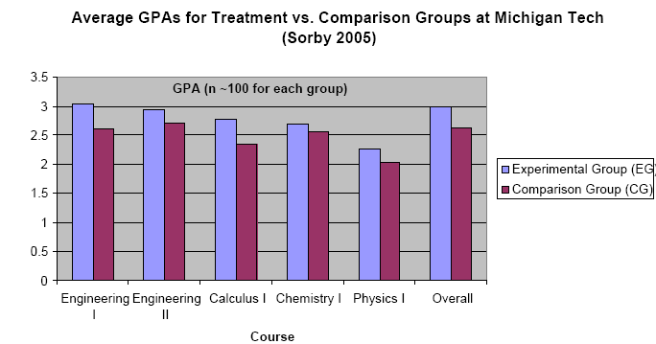
Visuospatial skills can be taught and learned.
Improving these skills leads to improved grades
I have $5,000 to (1) give to you, (2) help you learn these skills, and (3) improve grades…

Slide 135
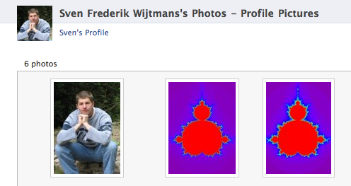

MandelGallery!

Slide 136


Slide 137
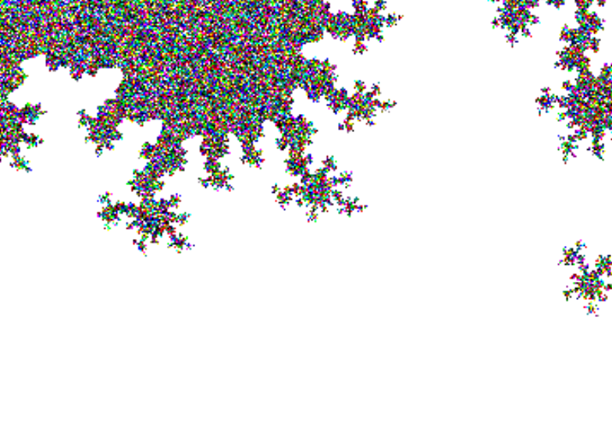
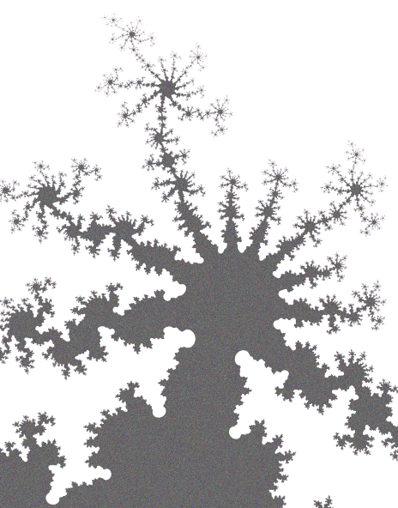

Slide 138
CS 5 this week
Building classes...
... vs. using the library
hw10pr2
hw10pr3
file and dictionary classes
Connect Four Board class
files
dictionaries
If I had a dictionary, I guess I could look up what it was!

Slide 139
Classes: DIY data
design-it-yourself!
Class: a user-defined datatype
Object: data or a variable whose type is a class
constructor
object
d = Date( 11, 11, 2010 )
d.tomorrow()
print d
method
d would be named self inside the Date class...
uses repr
Method: a function defined in a class called by an object
self: in a class, the name of the object calling a method
Constructor: the __init__ function for creating a new object
repr: the __repr__ function returning a string to print

Slide 140
Designing classes
(Data Members) What data do we need?
Not limited to 7x6!
(Methods) What are capabilities do we want?

Slide 141
Connect Four: an object, b
str
str
str
str
str
str
Board
b
list
?
data
str
str
str
str
str
str
rows
6
4
str
str
str
str
str
str
int
int
str
str
str
str
str
str
width
height
columns
How could we set the ? to 'X'

Slide 142
Connect Four: constructor
class Board:
""" a datatype representing a C4 board
with an arbitrary number of rows and cols
"""
def __init__( self, width, height ):
""" the constructor for objects of type Board """
self.width = width
self.height = height
W = self.width
H = self.height
self.data = [ [' ']*W for row in range(H) ]
List comprehensions let us create
self.height independent rows with
self.width independent columns each.

Slide 143
Connect Four: __repr__
def __repr__(self):
""" this method returns a string representation
for an object of type Board
"""
s = ''
for row in range( 6 ):
s += '|'
for col in range( 7 ):
s += self.data[row][col] + '|'
s += '\n'
return s
To change?
To add?
which row is row 0, row 1, and so on?

Slide 144
Quiz
class Board:
def allowsMove(self, col):
def addMove(self, col, ox):
H = self.height
for row in range( H ):
if self.data[row][col] != ' ':
self.data[row-1][col] = ox
self.data[H][col] = ox
Write allowsMove to return True if col is a valid move; False otherwise.
Hint: check as little as possible!
a C4 board
col #
'X' or 'O'
Step through this imperfect addMove method.
What is each line doing?
Can you spot any potential problems here...?

Slide 145
C4 Board class: hw10pr2
the “constructor”
__init__( self, width, height )
checks if allowed
allowsMove( self, col )
places a checker
addMove( self, col, ox )
removes a checker
delMove( self, col )
to write...
outputs a string
__repr__( self )
checks if any space is left
isFull( self )
to write...
checks if a player has won
winsFor( self, ox )
to write...
the game...
hostGame( self )
to write...
Which are similar to others? Which requires the most thought?

Slide 146
winsFor( self, ox )
X
O
def winsFor(self, ox):
""" does ox win? """
H = self.height
W = self.width
b
b.winsFor( 'O' )
or 'X'
Watch out for corner cases!

Slide 147
Why objects and classes?
Elegance: Objects hide complexity!
if b.winsFor( 'X' ) == True:
if d.isBefore( d2 ) == True:
Simple – and INVITING -- building blocks!
encapsulating lots of complexity!!
or maybe not so much!!!
def isBefore(self, d2):
""" Returns true if self is before d2 """
return [self.year, self.month, self.day] < [d2.year, d2.month, d2.day]

Slide 148
Files
In Python reading files is no problem…
>>> f = file( 'a.txt' )
>>> text = f.read()
>>> f.close()
>>> text
'I like poptarts and 42 and spam.\nWill I
>>> LoW = text.split()
[ 'I', 'like', 'poptarts', ... ]
opens the file and calls it f
constructor and methods!
reads the whole file and calls it f
closes the file (optional)
all the text (as one big string)
text.split() returns a list of each "word"

Slide 149
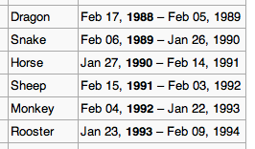
This seems like the key to dictionaries' value…
Dictionaries
In Python a dictionary is a set of key - value pairs.
>>> d = {}
>>> d[1992] = 'monkey'
>>> d[1993] = 'rooster'
>>> d
{1992:'monkey', 1993:'rooster'}
>>> d[1991]
'ram'
>>> d[1969]
key error
creates an empty dictionary, d
1992 is the key
'monkey' is the value
1993 is the key
'rooster' is the value
Curly! And colony!
Retrieve data like lists…
Almost !
It's a list where the index can be any immutable key.

Slide 150
More on dictionaries
They don't seem moronic to me!
Dictionaries have lots of built-in methods, or functions:
>>> d = {1992:'monkey', 1993:'rooster'}
>>> 1992 in d
True
>>> 1969 in d
False
>>> len(d)
2
>>> d.keys()
[ 1992, 1993 ]
in checks if a key is present
len returns the # of keys
d.keys returns a list of all keys
d.values returns a list of all values
d.items returns a list of all key/val. pairs

Slide 151
def wc( filename ):
""" word-counting program """
f = open( filename )
text = f.read()
f.close()
LoW = text.split()
print "There are", len(LoW), "words."
file handling
word counting
What if we wanted the number of different words in the file?
This would be the author's vocabulary size, instead of the word count.

Slide 152
def wc( filename ):
""" word-counting program """
f = open( filename )
text = f.read()
f.close()
LoW = text.split()
print "There are", len(LoW), "words."
d = {}
for w in LoW:
if w not in d:
d[w] = 1
else:
d[w] += 1
print "There are", len(d), "distinct words.\n"
return d # this way we can use d later!
file handling
word counting
Tracking the number of occurences of each word with a dictionary, d.

Slide 153
Vocabularists?
Shakespeare used 31,534 different words and a grand total of 884,647 words counting repetitions (across his works)
http://www-math.cudenver.edu/~wbriggs/qr/shakespeare.html
Active vocabulary estimates range from 10,000-60,000.
Passive vocabulary estimates are much higher.
Many Shakespearean contributions:
One contemporary author in the Oxford Eng. Dictionary…
Shakespeare
which word?

Slide 154
A dictionary challenge…
PROV = { 'BC': 0, … }
All of Canada's provinces are in this dictionary…
key
value
def provinceChallenge( PROV ):
""" PROV is a dictionary of Canada's provinces
-- the challenge is to name them all! """
while 0 in prov.values():
guess = raw_input("Name a province: ")
if guess not in PROV:
print 'Try again...'
elif prov[guess] == 0:
print 'Yes!'
prov[guess] += 1
else:
print 'Already guessed...'
prov[guess] += 1
print 'Phew!'
wasn't a key at all
newly guessed key: value was 0
repeated guess
help?!

Slide 155
Another challenge?

Slide 156
Markov Models
Techniques for modeling any sequence of natural data
speech, text, sensor-data in time series...
Each item depends only on the item immediately before it .
1st-order Markov Model
I like poptarts and 42 and spam.
Will I get spam and poptarts for
the holidays? I like spam poptarts!
The text file:
{ 'like' : ['poptarts'],
'and' : ['42', 'spam.', 'poptarts'],
'get' : ['spam'], …
'poptarts':
'I' :
'Will' :
The model:
How to get to Will?

Slide 157
Markov Models are generative!
A key benefit of Markov Models is that they can generate feasible data!
Original file:
Generated text:
I get spam poptarts! I like poptarts and 42 and spam. I like spam and 42 and 42 and 42 and spam. Will I like poptarts and 42 and poptarts and 42 and poptarts and 42 and 42 and poptarts and spam. I get spam and 42 and 42 and...

Slide 158
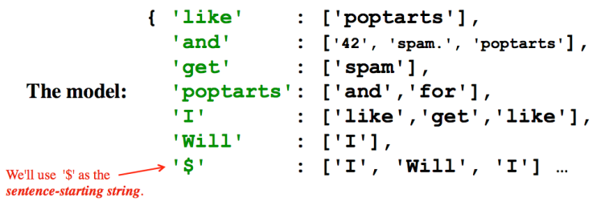
Model creation:
1) start with the prevword as '$'
2) for each word w, put w in prevword's list
or create a new list with just w!
3) change prevword to word or '$' as appropriate...
if w[-1] is punctuation.
Generating text:
1) start with the '$' string
2) choose a word following '$', at random. Call it w
3) choose a word following w, at random. And so on…
4) If w ends a sentence, '$' becomes the next word.
if w[-1] is punctuation.

Slide 159
more sophisticated than a first-order model!

