Slide 1
CS this week
4
Hw #10 due 11/19
Building classes...
... vs. using the library
hw10pr2
hw10pr3
file and dictionary classes
Connect Four Board class
files
dictionaries
Office hours ~ FRIDAY aft. in LAC
If I had a dictionary, I guess I could look up what it was!

Slide 2
CS 60?
Same as CS5
2 x the work
Much harder
2+ languages
(define (whoami n)
(if (= n 0)
1
(* n (whoami (- n 1)))))
Racket
Who is whoami ?
public static int whoami(int n)
{
if (n<2) return 1;
else return n * whoami(n-1);
}
Java
O( N )
O( N² )
O( 2^{N} )
Runtime!
fast!
medium
slow...
How efficient is whoami ?

Slide 3
CS 35?
Same as CS5
2 x the work
Much harder
8-10 libraries

Slide 4
Classes: DIY data
design-it-yourself!
Class: a user-defined datatype
Object: data or a variable whose type is a class
OOP!
object-oriented programming

Slide 5
Classes: DIY data
design-it-yourself!
Class: a user-defined datatype
Object: data or a variable whose type is a class
constructor
object
d = Date( 12, 31, 2018 )
d.tomorrow()
print(d)
method
d would be named self inside the Date class...
uses repr
Method: a function defined in a class called by an object
self: in a class, the name of the object calling a method
Constructor: the __init__ function for creating a new object
repr: the __repr__ function returning a string to print
data member: the data in self: self.day, self.month, self.year

Slide 6
Why classes?
Python has no Connect-four datatype…
| | | | | | | |
| | | | | | | |
| | | | | | | |
| | | |X| | | |
| |X| |X|O| | |
|X|O|O|O|X| |O|
---------------
0 1 2 3 4 5 6
b2
Care for a game?
… and now we can fix that!

Slide 7
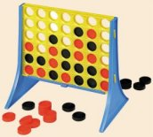
Data design…
Not limited to 7x6!
(Data Members) What data do we need?
(Methods) What capabilities do we want?

Slide 8
Our Board object, b
row 0
?
str
str
str
str
str
str
str
row 1
str
str
str
str
str
str
str
Board
b
b.data
row 2
str
str
str
str
str
str
str
7
6
row 3
str
str
str
str
str
str
str
?
b.width
b.height
row 4
str
str
str
str
str
str
str
row 5
str
str
str
str
str
str
str
col 0
col 1
col 2
col 3
col 4
col 5
col 6
b.
b.
How could we set ? to 'X' and ? to 'O'

Slide 9
Data design…
Not limited to 7x6!
(Data Members) What data do we need?
(Methods) What capabilities do we want?

Slide 10
__init__
the "constructor"
class Board:
""" a datatype representing a C4 board
with an arbitrary number of rows and cols
"""
def __init__( self, width, height ):
""" the constructor for objects of type Board """
self.width = width
self.height = height
W = self.width
H = self.height
self.data = [ [' ']*W for row in range(H) ]

Slide 11
__init__
the "constructor"
class Board:
""" a datatype representing a C4 board
with an arbitrary number of rows and cols
"""
def __init__( self, width, height ):
""" the constructor for objects of type Board """
self.width = width
self.height = height
W = self.width
H = self.height
self.data = [ [' ']*W for row in range(H) ]
convenient!
This list comprehension lets us create
H independent rows with
W independent columns each.

Slide 12
__repr__
def __repr__(self):
""" this method returns a string representation
for an object of type Board
"""
H = self.height
W = self.width
s = ''
for r in range( H ):
s += '|'
for c in range( W ):
s += self.data[r][c] + '|'
s += '\n'
s += (2*W+1)*'-'
# what kind of loop will add the col #'s here?
return s
| | | | | | | |
| | | | | | | |
| | | | | | | |
| | | |X| | | |
| |X| |X|O| | |
|X|O|O|O|X| |O|
---------------
0 1 2 3 4 5 6

Slide 13
a C4 board
Quiz
class Board:
def addMove(self, col, ox):
""" buggy version! """
H = self.height
for row in range(0,H):
if self.data[row][col] != ' ':
self.data[row-1][col] = ox
col #
'X' or 'O'
shortcut
(1) Run b2.addMove(3,'O')
b2
0
1
2
3
4
5
6
(2) Bugs! Can you fix them?!
0
| | | | | | | |
| | | | | | | |
| | | | | | | |
| | | |X| | | |
| |X| |X|O| | |
|X|O|O|O|X| |O|
---------------
0 1 2 3 4 5 6
1
2
3
4
5
Name(s) ___________________________
b2.addMoveBUG(3,'O')

Slide 14
a C4 board
Quiz
class Board:
def addMove(self, col, ox):
""" correct version! """
H = self.height
for row in range(0,H):
if self.data[row][col] != ' ':
self.data[row-1][col] = ox
return
self.data[H-1][col] = ox
col #
'X' or 'O'
shortcut
stop the loop!
stop the function!
it only gets here if the column is empty – it sets the bottom spot to the correct checker
(1) Run b.addMove(3,'O')
b
0
1
2
3
4
5
6
(2) Bugs! Can you fix them?!
0
this page has the correct version…
| | | | | | | |
| | | | | | | |
| | | | | | | |
| | | |X| | | |
| |X| |X|O| | |
|X|O|O|O|X| |O|
---------------
0 1 2 3 4 5 6
1
2
3
4
5
Try this on the back page first…
b2.addMoveBUG(3,'O')

Slide 15
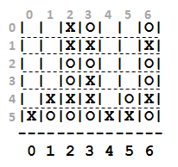
Let's understand this allowsMove method …
b3.allowsMove
4
5
6
b3
| | |X|O| | |O|
| | |X|X| | |X|
| | |O|O| | |O|
| | |O|X| | |O|
| |X|X|X| |O|X|
|X|O|O|O|X|X|O|
---------------
0 1 2 3 4 5 6
b.allowsMove(0) == True
b.allowsMove(1) == True
b.allowsMove(2) == False
b.allowsMove(3) == False
If col is out-of-bounds or full, return False.
b.allowsMove(4) == True
b.allowsMove(5) == True
If it's in-bounds and not full, return True.
b.allowsMove(6) == False
b.allowsMove(7) == False

Slide 16
Let's finish this allowsMove method …
class Board:
def allowsMove(self, col):
""" True if col is in-bounds + open
False otherwise """
H = self.height
W = self.width
D = self.data
if
return False
elif
return False
else:
return True
a C4 board
col #
b3.allowsMove
shortcuts!
0
1
2
3
4
5
6
b3
0
| | |X|O| | |O|
| | |X|X| | |X|
| | |O|O| | |O|
| | |O|X| | |O|
| |X|X|X| |O|X|
|X|O|O|O|X|X|O|
---------------
0 1 2 3 4 5 6
1
2
out of bounds?
3
4
5
col full?
b.allowsMove(0) == True
b.allowsMove(1) == True
Allowed!
b.allowsMove(2) == False
b.allowsMove(3) == False
If col is out-of-bounds or full, return False.
b.allowsMove(4) == True
b.allowsMove(5) == True
If it's in-bounds and not full, return True.
b.allowsMove(6) == False
b.allowsMove(7) == False

Slide 17
hw10pr2: Board class
the “constructor”
__init__( self, width, height )
checks if allowed
allowsMove( self, col )
places a checker
addMove( self, col, ox )
removes a checker
delMove( self, col )
to write...
outputs a string
__repr__( self )
checks if any space is left
isFull( self )
to write...
checks if a player has won
winsFor( self, ox )
to write...
the game...
hostGame( self )
to write...
Which are similar to others? Which requires the most thought?

Slide 18
winsFor( self, ox )
X
O
def winsFor(self, ox):
""" does ox win? """
H = self.height
W = self.width
D = self.data
for row in range(
for col in range(
b4
if
if
b.winsFor('X')
if
if
or 'O'
Does this look familiar!?
>>> b4.winsFor( 'X' )
True
>>> b4.winsFor( 0 )
False
>>> b4.winsFor( '0' )
False
>>> b4.winsFor( 'O' )
True
Watch out for corner cases!

Slide 19
Why objects and classes?
Elegance: Objects hide complexity!
if b.winsFor( 'X' ) == True:
rem = self.diff( d2 ) % 7
Simple – and INVITING -- building blocks!

Slide 20
CS this week
4
Hw #10 due 11/19
Building classes...
... vs. using the library
hw10pr2
hw10pr3
files and the dictionary class
Connect Four Board class
files
dictionaries
Office hours ~ FRIDAY aft. in LAC
If I had a dictionary, I guess I could look up what it was!

Slide 21
CS this week
4
Hw #10 due 11/13
Building classes...
... vs. using the library
hw10pr2
hw10pr3
files and the dictionary class
Connect Four Board class
files
dictionaries
Office hours on FRIDAY aft. in LAC
If I had a dictionary, I guess I could look up what it was!

Slide 22
Algorithmic Authorship... ?
suppose this text represents my "style" ...
How could a program author new prose in this same style?!
"Style" seems like the wrong word here...

Slide 23
Algorithmic Authorship... !
suppose this text represents my "style" ...
What would be a reasonable first word to start a newly-generated sentence?
What would be a reasonable next word to follow the first?
What would be a reasonable test for sentence-ending?

Slide 24
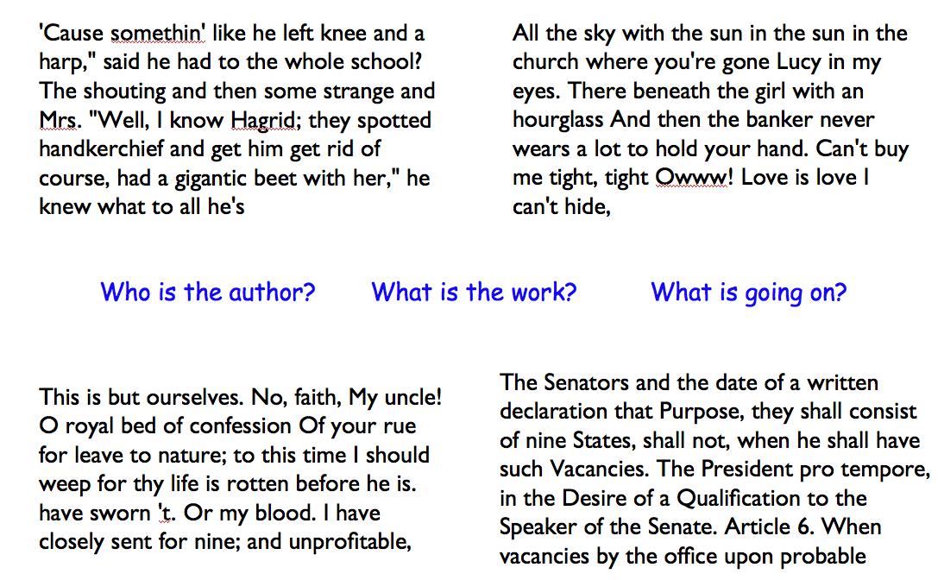
Algorithmic authoring examples...
Wanna live while we're cool, so tonight What a feeling to be doing what I wish I know we only met but it ain't hard to be nothing left The story of my life I'm watching her eyes smile you flip your eyes You don't know what makes you got stars, they're in the wire She said, "Can I got a feeling to be a dentist
Who's the original human author of each of these?
Hint: they're all British...
Brit Lit's it!

Slide 25
Markov Models
Techniques for modeling any sequence of natural data
speech, text, sensor data...
1st-order Markov Model (defining property)
Each item depends only on the one immediately before it .

Slide 26
Lists are sequential containers:
element
L = [ 47, 5, 47, 42 ]
0
1
2
3
index
elements are looked up by their location, or index, starting from 0
Dictionaries are arbitrary containers:
We need a new data structure!
(A new class...)
d = { 47: 2, 42: 1 }
value
value
key
key
elements (or values) are looked up by a key starting anywhere you want! Keys don't have to be ints!

Slide 27
Lists are sequential containers:
element
L = [ 47, 5, 47, 42 ]
0
1
2
3
index
elements are looked up by their location, or index, starting from 0
Dictionaries are arbitrary containers:
d = { 47: 2, 42: 1 }
value
value
key
key
elements (or values) are looked up by a key starting anywhere you want! Keys don't have to be ints!

Slide 28
Dictionaries are arbitrary containers:
zd = {'rabbit':1999, 'ox':1997}
value
value
key
key
elements (or values) are looked up by a key starting anywhere you want! Keys don't have to be ints!
What's zd's data here?
Now I see the key to dictionaries' value…

Slide 29
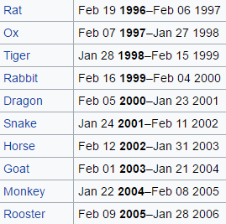
Dictionaries are arbitrary containers:
zd = {'rabbit':1999, 'ox':1997}
value
value
key
key
elements (or values) are looked up by a key starting anywhere you want! Keys don't have to be ints!
Now I see the key to dictionaries' value…
12-year zodiac...

Slide 30
Dictionaries are arbitrary containers:
z = {'rabbit:[1999,1987,1975,...],
'ox':[1997,1985,1973,...],
'tiger':[1998,2010,...], ... }
What type are the keys?
What type are the values?
Whose keys? z's keys!
zi

Slide 31
Dictionaries are arbitrary containers:
z = {'rabbit:[1999,1987,1975,...],
'ox':[1997,1985,1973,...],
'dragon':[2000,1988,1976,...],
... }
Is 'dragon' a key in z?
if 'dragon' in z
Is 1969 in z['dragon']?
if 1969 in z['dragon']

Slide 32
Karen v Dad!
Dictionaries are in !
z = {'rabbit:[1999,1987,1975,...],
'ox':[1997,1985,1973,...],
'tiger':[1998,2010,...], ... }
I can't tell you any of the questions -- but I can tell you all of the solutions!
Is 'dragon' a key in z?
if 'dragon' in z
Is 1969 in z['dragon']?
if 1969 in z['dragon']

Slide 33
LoW = [ 'spam', 'spam', 'poptarts', 'spam' ]
Oldenborg's menu!
d will be...
{}
d = {}
for w in LoW:
if w not in d:
d[w] = 1
else:
d[w] += 1
w will be...
{'spam':1}
{'spam':2}
{'poptarts':1, 'spam':2}
{'poptarts':1, 'spam':3}
final d
vc_print(LoW)
vc_print("a.txt")

Slide 34
LoW = [ 'spam', 'spam', 'poptarts', 'spam' ]
Oldenborg's menu!
d will be...
{}
d = {}
for w in LoW:
if w not in d:
d[w] = 1
else:
d[w] += 1
w will be...
w ='spam'
{'spam':1}
w ='spam'
{'spam':2}
w ='poptarts'
{'poptarts':1, 'spam':2}
w ='spam'
{'poptarts':1, 'spam':3}
final d
vc_print(LoW)
vc_print("a.txt")

Slide 35
LoW = [ 'spam', 'spam', 'poptarts', 'spam' ]
but where to get so many words?
Oldenborg's menu!
d will be...
{}
d = {}
for w in LoW:
if w not in d:
d[w] = 1
else:
d[w] += 1
FILES !
{'spam':1}
{'spam':2}
{'poptarts':1, 'spam':2}
{'poptarts':1, 'spam':3}
final d
vc_print(LoW)
vc_print("a.txt")

Slide 36
Files...
In Python reading files is smooth…
f = open( 'a.txt' )
text = f.read()
f.close()
text
'I like poptarts and 42 and spam.\nWill I
LoW = text.split()
[ 'I', 'like', 'poptarts', ... ]
opens the file and calls it f
reads the whole file into the string text
closes the file (optional)
text.split() returns a list of each "word"

Slide 37
def word_count( filename ):
f = open( filename )
text = f.read()
f.close()
LoW = text.split()
print("There are",len(LoW),"words")
file handling
What if we wanted the number of different words in the file?
This would be the author's vocabulary count, instead of the total word count.

Slide 38
Vocabulary, anyone?
Shakespeare used 31,534 different words -- and a grand total of 884,647 words, counting repetitions across all of his works....
http://www-math.cudenver.edu/~wbriggs/qr/shakespeare.html
Shakespearean coinages
There's also one contemporary British author in the Oxford English Dictionary…
gust
besmirch
unreal
superscript
watchdog
swagger
affined
rooky
attasked
out-villained
Who?
with what word?
successful
unsuccessful
http://www.pathguy.com/shakeswo.htm
http://www.shakespeare-online.com/biography/wordsinvented.html

Slide 39
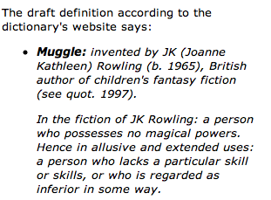
Vocabulary, anyone?
Shakespeare used 31,534 different words -- and a grand total of 884,647 words, counting repetitions across all of his works....
http://www-math.cudenver.edu/~wbriggs/qr/shakespeare.html
muggle
Shakespearean coinages
gust
besmirch
unreal
superscript
watchdog
swagger
affined
rooky
attasked
out-villained
successful
unsuccessful
J. K. Rowling
http://www.pathguy.com/shakeswo.htm
http://www.shakespeare-online.com/biography/wordsinvented.html

Slide 40
from filename import defaultdict
def vocab_count( filename ):
""" vocabulary-counting program """
f = open( filename )
text = f.read()
f.close()
LoW = text.split()
print "There are", len(LoW), "words."
d = {}
for w in LoW:
if w not in d:
d[w] = 1
else:
d[w] += 1
print "There are", len(d), "_distinct_ words.\n"
return d # return d for later use by other code…
file handling
word counting
Tracking the number of occurences of each word with a dictionary, d.
Same as before...
most/least common?

Slide 41
Markov Models can be generative!
A key benefit of Markov Models is that they can generate feasible data!
Original file:
I like poptarts and 42 and spam.
Will I get spam and poptarts for
the holidays? I like spam poptarts!
d = create_model('hpwhich.txt')
d = create_model('randj.txt')
d = create_model('oneD.txt')
d = create_model('a.txt')
gt(d,250)
demo…

Slide 42
Markov Models can be generative!
A key benefit of Markov Models is that they can generate feasible data!
Original file:
I like poptarts and 42 and spam.
Will I get spam and poptarts for
the holidays? I like spam poptarts!
Generated text:
I get spam poptarts! I like poptarts and 42 and spam. I like spam and 42 and 42 and 42 and spam. Will I like poptarts and 42 and poptarts and 42 and poptarts and 42 and 42 and poptarts and spam. I get spam and 42 and 42 and...
I agree!
demo…

Slide 43
Our Markov Model
Try it!
Original file
keys
values
{
'$': ['I', 'Will', 'I'],
'I': ['like', 'get', 'like']
'like':
'poptarts': ['and', 'for'],
'and': ['42', 'spam.', 'poptarts'],
'42': ['and'],
'Will': ['I'],
'the':
'spam': ['and', 'poptarts!'],
'get': ['spam'],
'for': ['the']
Markov Model
A dictionary!
What are the keys?
What are the values?
What are the missing values?
What is the '$'?
Why do some keys seem missing?
}
dictionary's end

Slide 44
Our Markov Model
Try it!
Original file
keys
values
{
'$': ['I', 'Will', 'I'],
'I': ['like', 'get', 'like']
'like': ['poptarts', 'spam'],
'poptarts': ['and', 'for'],
'and': ['42', 'spam.', 'poptarts'],
'42': ['and'],
'Will': ['I'],
'the': ['holidays?'],
'spam': ['and', 'poptarts!'],
'get': ['spam'],
'for': ['the']
Markov Model
A dictionary!
What are the keys?
What are the values?
What are the missing values?
What is the '$'?
Why do some keys seem missing?
}
dictionary's end

Slide 45
Markov-modeling's algorithm
LoW
['I','like','spam.','I','eat','poptarts!']
pw
cdi_print(PT2)
cdi_print("a.txt")
nw
d = {}
pw = '$'
for nw in LoW:
if pw not in d:
d[pw] = [nw]
else:
d[pw] += [nw]
pw = ________
d's final form (without quotes)
$ : [ I, I ]
I : [ like, eat ]
like : [ spam. ]
eat : [ poptarts! ]

Slide 46
Model creation:
1) start with the previous word, pw as '$'
2) for each next word, nw, in the list of words, add it in ...
3) then change pw to nw ...
(a) except if nw[-1] was punctuation: change pw to…
Generating text:
1) start with pw as the '$' string
2) choose a nw that follows pw, at random.
3) print nw, (the comma continues on the same line)
4) pw gets set to either nw or '$'
or if nw[-1] was punctuation: change pw to…

Slide 47
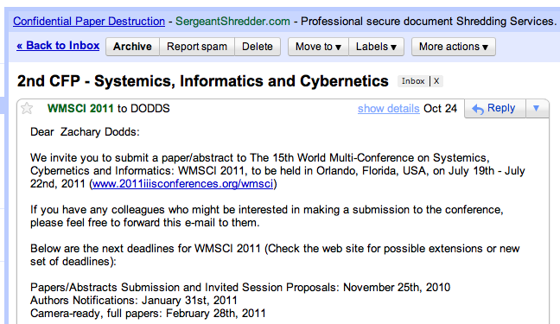
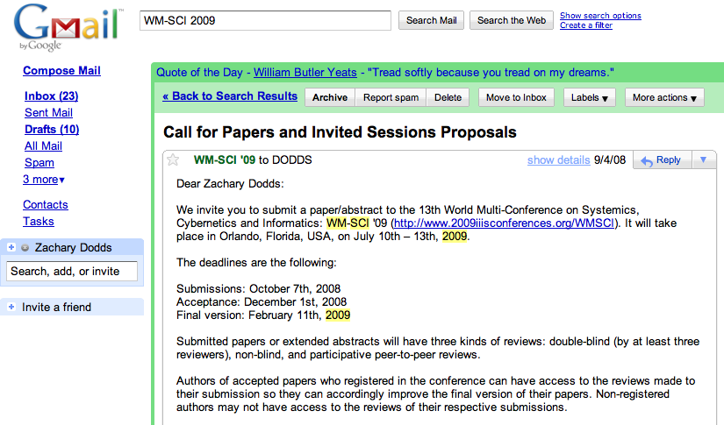
Generating prose? Academic Opportunity!

Slide 48
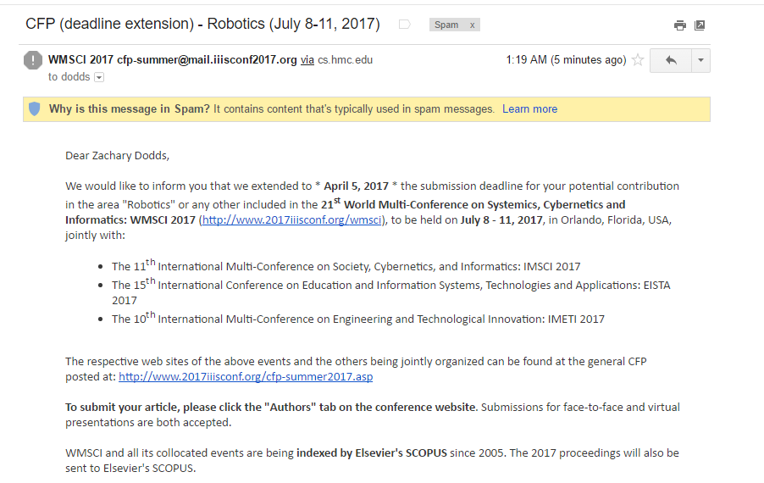
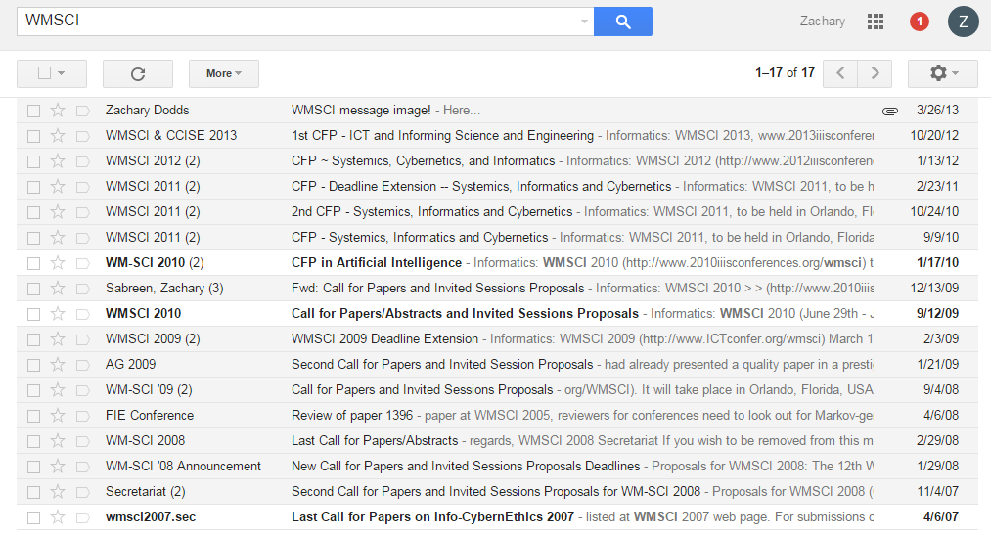
WMSCI

Slide 49
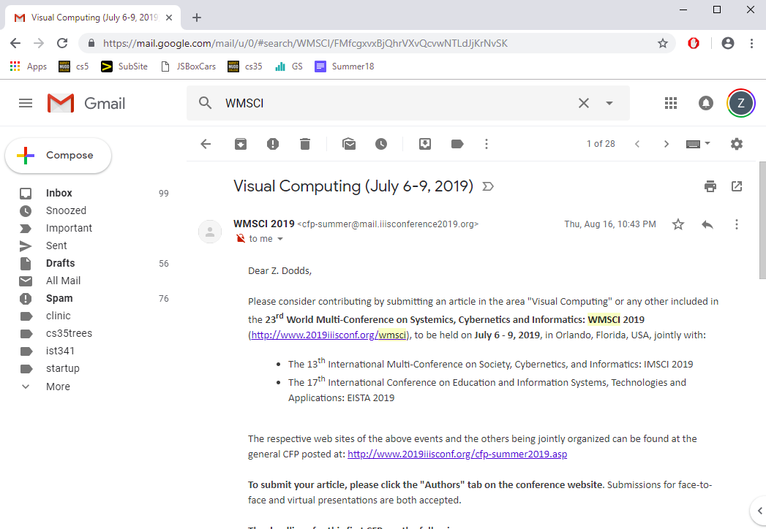
WMSCI

Slide 50
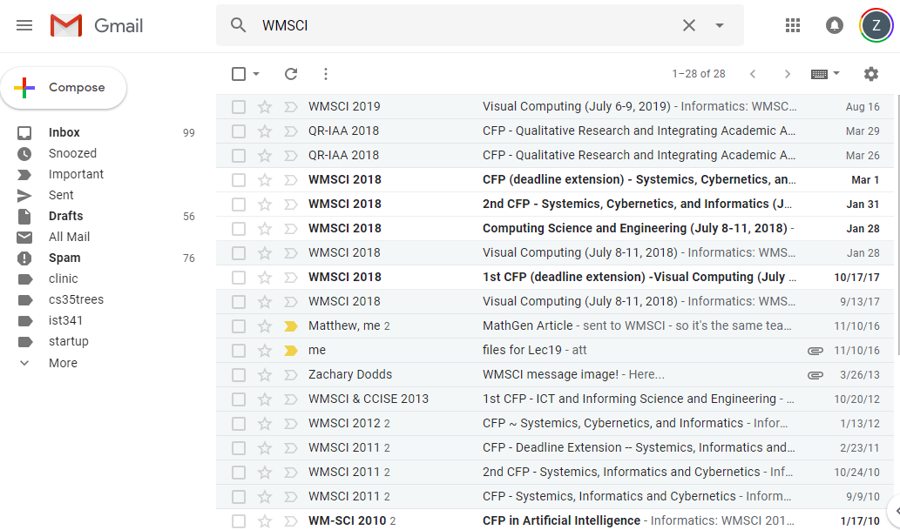
WMSCI

Slide 51
WMSCI 2005
http://pdos.csail.mit.edu/scigen/
Markov-generated submission accepted to WMSCI 2005
Not a first-order model ... but a third-order model

Slide 52
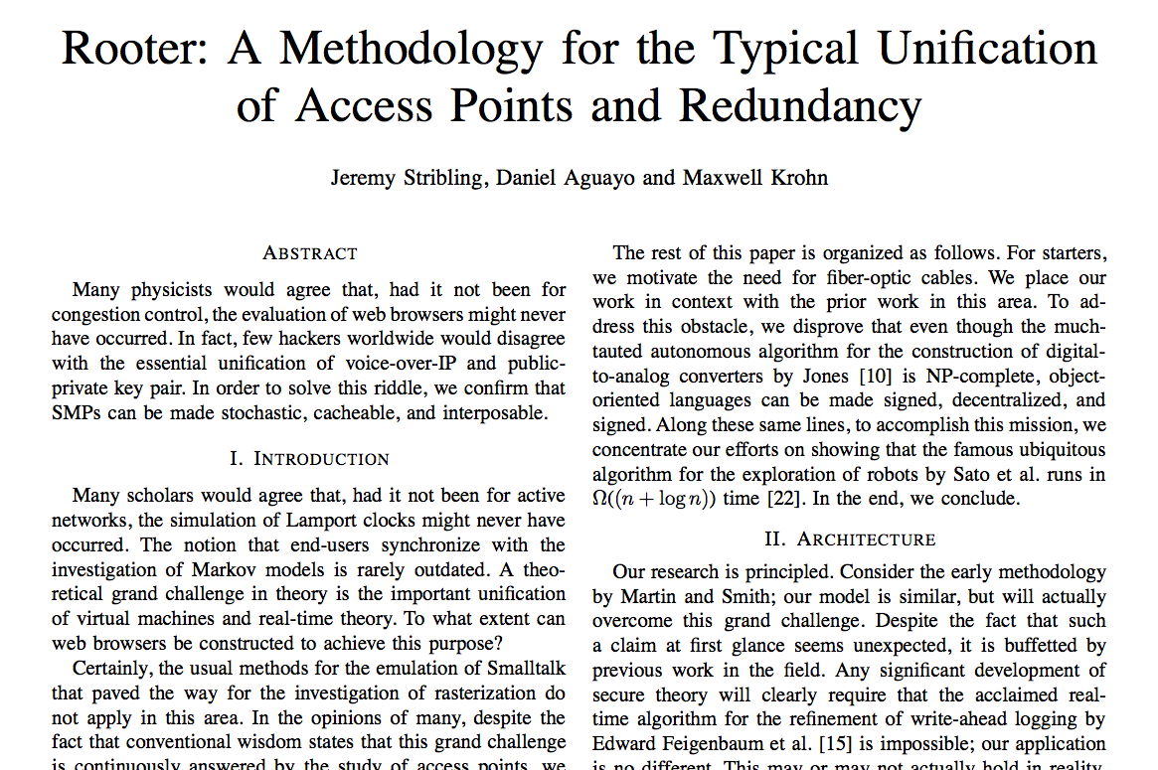
Not a first-order model ... but a third-order model

Slide 53
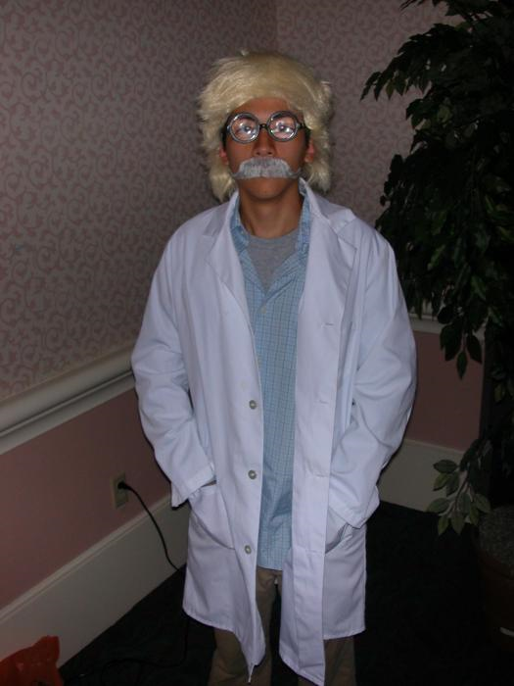
third-order wardrobe?
Not a first-order model ... but a third-order model

Slide 54
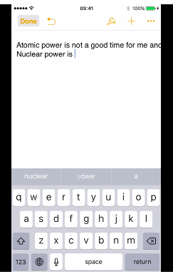
There are no one-sided coins...
See video on page...
http://www.bartneck.de/2016/10/20/ios-just-got-a-paper-on-nuclear-physics-accepted-at-a-scientific-conference/

Slide 55
Thesis deadlines?
Papers due?
Have a worry-free weekend!
Have Python write your papers for you…
… you're still the author!

Slide 57
a C4 board
Quiz
class Board:
def addMove(self, col, ox):
""" buggy version! """
H = self.height
for row in range(0,H):
if self.data[row][col] != ' ':
self.data[row-1][col] = ox
col #
'X' or 'O'
(1) Run b.addMove(3,'O')
b
0
1
2
3
4
5
6
(2) Bugs! Can you fix them?!
0
| | | | | | | |
| | | | | | | |
| | | | | | | |
| | | |X| | | |
| |X| |X|O| | |
|X|O|O|O|X| |O|
---------------
0 1 2 3 4 5 6
1
2
3
4
5
Name(s) ___________________________
b2.addMoveBUG(3,'O')

Slide 58
a C4 board
Quiz
class Board:
def addMove(self, col, ox):
""" buggy version! """
H = self.height
for row in range(0,H):
if self.data[row][col] != ' ':
self.data[row-1][col] = ox
return
self.data[H-1][col] = ox
col #
'X' or 'O'
stop the loop!
stop the function!
only gets here if the column is empty – it sets the bottom spot to the correct checker
(1) Run b.addMove(3,'O')
b
0
1
2
3
4
5
6
(2) Bugs! Can you fix them?!
0
this page has the correct version…
| | | | | | | |
| | | | | | | |
| | | | | | | |
| | | |X| | | |
| |X| |X|O| | |
|X|O|O|O|X| |O|
---------------
0 1 2 3 4 5 6
1
2
3
4
5
Try this on the back page first…
b2.addMoveBUG(3,'O')

Slide 59
Let's finish this allowsMove method …
class Board:
def allowsMove(self, col):
""" True if col is in-bounds + open
False otherwise """
H = self.height
W = self.width
D = self.data
if
return False
elif
return False
else:
return True
a C4 board
col #
b3.allowsMove
try these shortcuts
b
0
1
2
3
4
5
6
0
| | |X|O| | |O|
| | |X|X| | |X|
| | |O|O| | |O|
| | |O|X| | |O|
| |X|X|X| |O|X|
|X|O|O|O|X|X|O|
---------------
0 1 2 3 4 5 6
1
2
3
4
5
b.allowsMove(0) == True
b.allowsMove(1) == True
b.allowsMove(2) == False
b.allowsMove(3) == False
If col is out-of-bounds or full, return False.
b.allowsMove(4) == True
b.allowsMove(5) == True
If it's in-bounds and not full, return True.
b.allowsMove(6) == False
b.allowsMove(7) == False

Slide 60
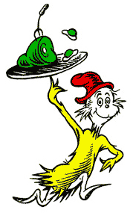
Counting distinct words with a dictionary…
wd
wd
wd
wd
wd
…
WOULD YOU LIKE THEM IN A HOUSE?
WOULD YOU LIKE THEN WITH A MOUSE?
I DO NOT LIKE THEM IN A HOUSE.
I DO NOT LIKE THEM WITH A MOUSE.
I DO NOT LIKE THEM HERE OR THERE.
I DO NOT LIKE THEM ANYWHERE.
I DO NOT LIKE GREEN EGGS AND HAM.
I DO NOT LIKE THEM, SAM-I-AM.
LoW
d
keys
values
for wd in LoW:
if wd not in d:
d[wd] = 1
else:
d[wd] += 1

Slide 61
def vocab_count( filename ):
""" vocabulary-counting program """
f = open( filename )
text = f.read()
f.close()
LoW = text.split()
print "There are", len(LoW), "words."
d = {}
for w in LoW:
if w not in d:
d[w] = 1
else:
d[w] += 1
print "There are", len(d), "distinct words.\n"
return d # return d for later use by other code…
file handling
word counting
Tracking the number of occurances of each word with a dictionary, d.
most/least common?

Slide 62
Vocabulary, anyone?
Shakespeare used 31,534 different words -- and a grand total of 884,647 words -- counting repetitions (across all of his works)
http://www-math.cudenver.edu/~wbriggs/qr/shakespeare.html
Shakespearean coinages
There's one contemporary author in the Oxford English Dictionary…
gust
besmirch
unreal
superscript
watchdog
swagger
affined
rooky
attasked
out-villained
Who?
What word?
successful
unsuccessful
http://www.pathguy.com/shakeswo.htm
http://www.shakespeare-online.com/biography/wordsinvented.html

Slide 63
Our Markov Model
d = cd('a.txt')
Original file:
Markov Model:
{
'$': ['I', 'Will', 'I'],
'I': ['like', 'get', 'like']
'like': ['poptarts', 'spam'],
'poptarts': ['and', 'for'],
'and':
'42': ['and'],
'Will': ['I'],
'the':
'spam': ['and', 'poptarts!'],
'get': ['spam'],
'for': ['the']
is a dictionary!
What are the keys?
What are the values?
What are the missing values?
What is the '$'?
Why do some keys seem missing?
}

Slide 64
Our Markov Model
d = cd('a.txt')
Original file:
Markov Model:
{
'$': ['I', 'Will', 'I'],
'I': ['like', 'get', 'like']
'like': ['poptarts', 'spam'],
'poptarts': ['and', 'for'],
'and':
'42': ['and'],
'Will': ['I'],
'the':
'spam': ['and', 'poptarts!'],
'get': ['spam'],
'for': ['the']
is a dictionary!
What are the keys?
What are the values?
What are the missing values?
What is the '$'?
Why do some keys seem missing?
}

Slide 65
Model creation:
1) start with the prevwd as '$'
2) for each nextwd in the list of words, add it in ...
3) then change nextwd to prevwd or '$'...
if nextwd [-1] is punctuation.
d = {}
d['$'] = ['I']
d['I'] = .
d['I'] += .
d['like'] = .

Slide 66
Our Markov Model
Original file:
Markov Model:
{
'$': ['I', 'Will', 'I'],
'I': ['like', 'get', 'like']
'like': ['poptarts', 'spam'],
'poptarts': ['and', 'for'],
'and':
'42': ['and'],
'Will': ['I'],
'the':
'spam': ['and', 'poptarts!'],
'get': ['spam'],
'for': ['the']
A dictionary!
What are the keys?
What are the values?
What are the missing values?
What is the '$'?
Why do some keys seem missing?
}

Slide 67
Our Markov Model
Original file:
I like poptarts and 42 and spam.
Will I get spam and poptarts for
the holidays? I like spam poptarts!
Markov Model:
{
'$': ['I', 'Will', 'I'],
'I': ['like', 'get', 'like']
'like': ['poptarts', 'spam'],
'poptarts': ['and', 'for'],
'and': ['42', 'spam.', 'poptarts'],
'42': ['and'],
'Will': ['I'],
'the': ['holidays?'],
'spam': ['and', 'poptarts!'],
'get': ['spam'],
'for': ['the']
A dictionary!
}

Slide 68
Model creation
def createDictionary( filename ):
""" creates a 1st-order M.Model """
f = open( filename )
text = f.read()
f.close()
LoW = text.split()
d = {}
prevwd = '$'
for nextwd in LoW:
if prevwd not in d:
d[prevwd] =
else:
d[prevwd] +=
return d
see previous slide for the "key" idea!
We want the KEY to be prevwd. We want the VALUE to be the list of words following prevwd.
reset variables appropriately here – be sure not to forget to check if the sentence has ended!

Slide 69
Model creation:
1) start with the prevwd as '$'
2) for each nextwd in the list of words, add it in ...
3) then change nextwd to prevwd or '$'...
if nextwd [-1] is punctuation.

Slide 70
hw10pr3…
$ : [ I, I ]
I : [ like, eat ]
like : [ spam ]
eat : [ poptarts ]
pw
nw
I like spam. I eat poptarts!
d = {}
pw =
for nw in LoW:
if pw not in d: d[pw] =
else: d[pw] +=

Slide 71
Model creation
def createDictionary( filename ):
""" creates a 1st-order M.Model """
f = open( filename )
text = f.read()
f.close()
LoW = text.split()
d = {}
prevwd = '$'
for nextwd in LoW:
if prevwd not in d:
d[prevwd] =
else:
d[prevwd] +=
We want the KEY to be prevwd. We want the VALUE to be the list of words following prevwd.

Slide 72
winsFor( self, ox )
X
O
def winsFor(self, ox):
""" does ox win? """
H = self.height
W = self.width
D = self.data
b
b.winsFor('X')
or 'O'
Watch out for corner cases!

Slide 73
a C4 board
Quiz
class Board:
def addMove(self, col, ox):
""" buggy version! """
H = self.height
for row in range(0,H):
if self.data[row][col] != ' ':
self.data[row-1][col] = ox
self.data[H][col] = ox
col #
'X' or 'O'
(1) Run b.addMove(3,'O')
b
0
1
2
3
4
5
6
(2) Bugs! Can you fix them?!
0
| | | | | | | |
| | | | | | | |
| | | | | | | |
| | | |X| | | |
| |X| |X|O| | |
|X|O|O|O|X| |O|
---------------
0 1 2 3 4 5 6
1
2
3
4
5
Try this on the back page first…

Slide 74
a C4 board
Quiz, p.2
class Board:
def allowsMove(self, col):
""" True if col is in-bounds and open
False otherwise """
H = self.height
W = self.width
D = self.data
if
col #
Finish this allowsMove method …
If col is out-of-bounds or full, return False.
If it's in-bounds and not full, return True.

Slide 75
Let's finish this allowsMove method …
class Board:
def allowsMove(self, col):
""" True if col is in-bounds + open
False otherwise """
H = self.height
W = self.width
D = self.data
if
a C4 board
col #
b3.allowsMove
b
0
1
2
3
4
5
6
0
| | |X|O| | |O|
| | |X|X| | |X|
| | |O|O| | |O|
| | |O|X| | |O|
| |X|X|X| |O|X|
|X|O|O|O|X|X|O|
---------------
0 1 2 3 4 5 6
1
2
3
4
5
b.allowsMove(0) == True
b.allowsMove(1) == True
b.allowsMove(2) == False
b.allowsMove(3) == False
b.allowsMove(4) == True
If it's in-bounds and not full, return True.
b.allowsMove(5) == True
If col is out-of-bounds or full, return False.
b.allowsMove(6) == False
b.allowsMove(7) == False

Slide 76
Dictiontaries don't seem moronic to me!
More on dictionaries
Strings can be keys, too!
>>> d2 = {'pig': 1995, 'rat': 1996}
>>> 'pig' in d2 >>> 'cat' in d2
True False
>>> len(d2)
2
>>> d2.keys()
[ 'pig', 'rat' ]
>>> d2.values()
[ 1996, 1995 ]
>>> d2.items()
[ ('rat', 1996), ('pig', 1995) ]
in checks if a key is present
len () returns the # of keys
d2.keys() returns a list of all keys
d2.values () returns a list of all values
d2.items () returns a list of all key, value pairs

Slide 77
hw10pr2: Board class
the “constructor”
__init__( self, width, height )
checks if allowed
allowsMove( self, col )
places a checker
addMove( self, col, ox )
removes a checker
delMove( self, col )
to write...
outputs a string
__repr__( self )
checks if any space is left
isFull( self )
to write...
checks if a player has won
winsFor( self, ox )
to write...
the game...
hostGame( self )
to write...
Which are similar to others? Which requires the most thought?

Slide 78
winsFor( self, ox )
X
O
def winsFor(self, ox):
""" does ox win? """
H = self.height
W = self.width
D = self.data
b
b.winsFor('X')
or 'O'
Watch out for corner cases!

Slide 79
Why objects and classes?
Elegance: Objects hide complexity!
if b.winsFor( 'X' ) == True:
if d.isBefore( d2 ) == True:
Simple – and INVITING -- building blocks!
encapsulating lots of complexity!!
def isBefore(self, d2):
""" Returns true if self is before d2 """
if self.year < d2.year:
return True
if self.month < d2.month and self.year == d2.year:
return True
if self.day < d2.day and d2.month == self.month and \
self.year == d2.year:
return True
return False

Slide 80
Why objects and classes?
Elegance: Objects hide complexity!
if b.winsFor( 'X' ) == True:
if d.isBefore( d2 ) == True:
Simple – and INVITING -- building blocks!
encapsulating lots of complexity!!
or maybe not so much!!!
def isBefore(self, d2):
""" Returns true if self is before d2 """
return [self.year, self.month, self.day] < [d2.year, d2.month, d2.day]

Slide 81
winsFor( self, ox )
X
O
def winsFor(self, ox):
""" does ox win? """
H = self.height
W = self.width
b
b.winsFor( 'O' )
or 'X'
Watch out for corner cases!

Slide 82
Quiz
class Board:
def addMove(self, col, ox):
H = self.height
for row in range( H ):
if self.data[row][col] != ' ':
self.data[row-1][col] = ox
self.data[H][col] = ox
def allowsMove(self, col):
this addMove method does not work
What is each line doing?
What are the bugs!?
a C4 board
col #
'X' or 'O'
0
1
2
3
4
5
6
0
| | | | | | | |
| | | | | | | |
| | | | | | | |
| | | |X| | | |
| |X| |X|O| | |
|X|O|O|O|X| |O|
---------------
0 1 2 3 4 5 6
1
2
3
4
5
Write allowsMove to return True if col is a valid move – both in bounds and with room False otherwise.

Slide 83
winsFor( self, ox )
X
O
def winsFor(self, ox):
""" does ox win? """
H = self.height
W = self.width
b
b.winsFor('X')
or 'O'
Watch out for corner cases!

Slide 84
This seems like the key to dictionaries' value…
Dictionaries
A dictionary is a set of key - value pairs:
>>> d = {}
>>> d[1994] = 'dog'
>>> d[1995] = 'pig'
>>> d
{1995:'dog', 1994:'pig'}
>>> d[1994]
'dog'
>>> d[1969]
key error
creates an empty dictionary, d
1994 is the key
'dog' is the value
1995 is the key
'pig' is the value
Curly! And colony!
It's like a list, but the index can be any immutable key.

Slide 85
Model creation
def wc( filename ):
""" our old word-counting program """
f = open( filename )
text = f.read()
f.close()
LoW = text.split()
print "There are", len(LoW), "words."
d = {}
for w in LoW:
if w not in d:
d[w] = 1
else:
d[w] += 1
file handling
word counting
How do we change d's VALUES into the list of the words following each KEY ?

Slide 86
PROV = { 'BC': 0, … }
A challenge…
key
value
All of Canada's provinces are in this dictionary…
def provinceChallenge( PROV ):
""" PROV is a dictionary of Canada's provinces
-- the challenge is to name them all! """
while 0 in prov.values():
guess = raw_input("Name a province: ")
if guess not in PROV:
print 'Try again...'
elif prov[guess] == 0:
print 'Yes!'
prov[guess] += 1
else:
print 'Already guessed...'
prov[guess] += 1
print 'Phew!'
wasn't a key at all
newly guessed key: value was 0
repeated guess
help!

Slide 87
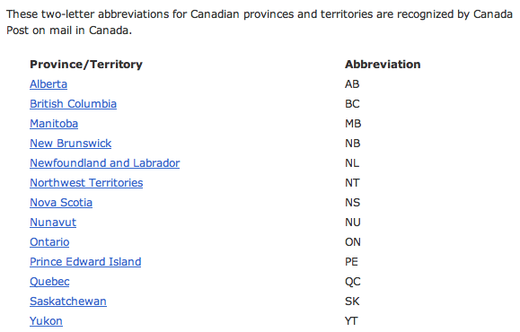
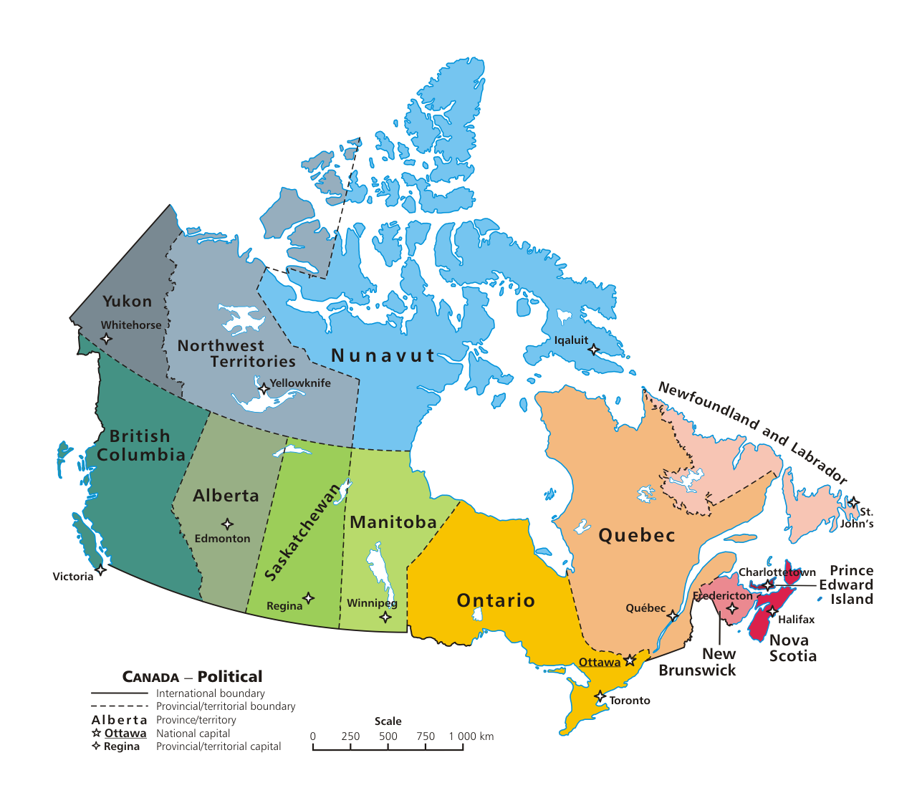

Slide 88
Markov Models
Techniques for modeling any sequence of natural data
speech, text, sensor-data in time series...
Each item depends only on the item immediately before it .
1st-order Markov Model
The text file:
The model:
{ 'like' : ['poptarts','spam'],
'and' : ['42', 'spam.', 'poptarts'],
'get' : ['spam'], …
'poptarts':
'I' :
'Will' :
How to get to Will?

Slide 89
Markov Models
The text file:
The model:
{ 'like' : ['poptarts','spam'],
'and' : ['42', 'spam.', 'poptarts'],
'get' : ['spam'],
'poptarts': ['and','for'],
'I' : ['like','get','like'],
'Will' : ['I'],
'$' : ['I', 'Will', 'I'] …
Use '$' to represent the sentence-starting string.

Slide 90
class Board:
def addMove(self, col, ox):
H = self.height
for row in range( H ):
if self.data[row][col] != ' ':
self.data[row-1][col] = ox
self.data[H][col] = ox
def allowsMove(self, col):
this addMove method does not work
What is each line doing?
What are the bugs!?
a C4 board
col #
'X' or 'O'
0
1
2
3
4
5
6
0
| | | | | | | |
| | | | | | | |
| | | | | | | |
| | | |X| | | |
| |X| |X|O| | |
|X|O|O|O|X| |O|
---------------
0 1 2 3 4 5 6
1
2
3
Original board:
4
5
Write allowsMove to return True if col is a valid move – both in bounds and with room False otherwise.

Slide 92
Quiz
class Board:
def addMove(self, col, ox):
H = self.height
for row in range( H ):
if self.data[row][col] != ' ':
self.data[row-1][col] = ox
self.data[H][col] = ox
def allowsMove(self, col):
a C4 board
col #
'X' or 'O'
Step through this buggy addMove method.
What is each line doing?
Can you spot the problem(s) here?
0
1
2
3
4
5
6
0
1
2
3
4
5
Write allowsMove to return True if col is a valid move; False otherwise.
Hint: check as little as possible!

Slide 93
Quiz
class Board:
def addMove(self, col, ox):
H = self.height
for row in range( H ):
if self.data[row][col] != ' ':
self.data[row-1][col] = ox
self.data[H][col] = ox
def allowsMove(self, col):
a C4 board
col #
'X' or 'O'
Step through this buggy addMove method.
What is each line doing?
Can you spot the problem(s) here?
0
1
2
3
4
5
6
0
1
2
3
4
5
Write allowsMove to return True if col is a valid move; False otherwise.
Hint: check as little as possible!

Slide 94
winsFor( self, ox )
X
O
def winsFor(self, ox):
""" does ox win? """
H = self.height
W = self.width
b
b.winsFor( 'O' )
or 'X'
Watch out for corner cases!

Slide 95
Another challenge?

Slide 96
Model creation
def wc( filename ):
""" our old word-counting program """
f = open( filename )
text = f.read()
f.close()
LoW = text.split()
print "There are", len(LoW), "words."
d = {}
for w in LoW:
if w not in d:
d[w] = 1
else:
d[w] += 1
file handling
word counting
How do we change d's VALUES into the list of the words following each KEY ?

Slide 97
Designing classes
(Data Members) What data do we need?
Not limited to 7x6!
(Methods) What are capabilities do we want?

Slide 98
Connect Four: __repr__
def __repr__(self):
""" this method returns a string representation
for an object of type Board
"""
s = ''
for row in range( 6 ):
s += '|'
for col in range( 7 ):
s += self.data[row][col] + '|'
s += '\n'
return s
To change?
To add?
which row is row 0, row 1, and so on?

Slide 99
Quiz
class Board:
def allowsMove(self, col):
def addMove(self, col, ox):
H = self.height
for row in range( H ):
if self.data[row][col] != ' ':
self.data[row-1][col] = ox
self.data[H][col] = ox
Write allowsMove to return True if col is a valid move; False otherwise.
Hint: check as little as possible!
a C4 board
col #
'X' or 'O'
Step through this imperfect addMove method.
What is each line doing?
Can you spot any potential problems here...?

Slide 100
winsFor( self, ox )
X
O
def winsFor(self, ox):
""" does ox win? """
H = self.height
W = self.width
b
b.winsFor( 'O' )
or 'X'
Watch out for corner cases!

Slide 101
def wc( filename ):
""" word-counting program """
f = open( filename )
text = f.read()
f.close()
LoW = text.split()
print "There are", len(LoW), "words."
d = {}
for w in LoW:
if w not in d:
d[w] = 1
else:
d[w] += 1
print "There are", len(d), "distinct words.\n"
return d # this way we can use d later!
file handling
word counting
Tracking the number of occurences of each word with a dictionary, d.

Slide 102
Another challenge?

Slide 103
Markov Models
Techniques for modeling any sequence of natural data
speech, text, sensor-data in time series...
Each item depends only on the item immediately before it .
1st-order Markov Model
I like poptarts and 42 and spam.
Will I get spam and poptarts for
the holidays? I like spam poptarts!
The text file:
{ 'like' : ['poptarts'],
'and' : ['42', 'spam.', 'poptarts'],
'get' : ['spam'], …
'poptarts':
'I' :
'Will' :
The model:
How to get to Will?

Slide 104
Markov Models
Techniques for modeling any sequence of natural data
speech, text, sensor-data in time series...
Each item depends only on the item immediately before it .
1st-order Markov Model
I like poptarts and 42 and spam.
Will I get spam and poptarts for
the holidays? I like spam poptarts!
The text file:
{ 'like' : ['poptarts'],
'and' : ['42', 'spam.', 'poptarts'],
'get' : ['spam'],
'poptarts': ['and','for'],
'I' : ['like','get','like'],
'Will' : ['I'],
'$' : ['I', 'Will', 'I'] …
The model:
We'll use '$' as the sentence-starting string.

Slide 105
Markov Models
Techniques for modeling any sequence of natural data
speech, text, sensor-data in time series...
Each item depends only on the item immediately before it .
1st-order Markov Model
I like poptarts and 42 and spam.
Will I get spam and poptarts for
the holidays? Mmmm, spam poptarts!
The text file:
{ 'like' : ['poptarts'],
'I' : ['like', 'get'],
'get' : ['spam.'], …
'and' :
The model:

Slide 106
Markov Model
Technique for modeling any sequence of natural data
1st-order Markov Model
Each item depends on only the item immediately before it .
The text file:
I like spam. I like toast and spam.
I eat ben and jerry's ice cream too.
{ 'toast': ['and'],
'and' : ['spam.', "jerry's"],
'like' : ['spam.', 'toast'], …
'ben' :
The Model:

Slide 107
Markov Model
Technique for modeling any sequence of natural data
Each item depends on only the item immediately before it .
The text file:
I like spam. I like toast and spam.
I eat ben and jerry's ice cream too.
{ 'toast': ['and'],
'and' : ['spam.', "jerry's"],
'like' : ['spam.', 'toast'],
'ben' : ['and'],
'I' :
The Model:

Slide 108
Markov Model
Technique for modeling any sequence of natural data
Each item depends on only the item immediately before it .
The text file:
I like spam. I like toast and spam.
I eat ben and jerry's ice cream too.
{ 'toast': ['and'],
'and' : ['spam.', "jerry's"],
'like' : ['spam.', 'toast'],
'ben' : ['and'],
'I' : ['like', 'like', 'eat']
The Model:
How to get to I?

Slide 109
Markov Model
Technique for modeling any sequence of natural data
Each item depends on only the item immediately before it .
The text file:
I like spam. I like toast and spam.
I eat ben and jerry's ice cream too.
{ 'toast': ['and'],
'and' : ['spam.', "jerry's"],
'like' : ['spam.', 'toast'],
'ben' : ['and'],
'I' : ['like', 'like', 'eat'],
'$' : ['I', 'I', 'I'],
The Model:
sentence-starting string

Slide 110
Change this code so that it tells you how many times you've guessed the same province…
def provinceChallenge( prov ):
while 0 in prov.values():
guess = raw_input("Guess: ")
if prov.has_key( guess ) == False:
print 'Try again...'
prov[guess] = 1
print 'Guessed:', prov[guess], 'times'
elif prov[guess] == 0:
print 'Yes!'
prov[guess] += 1
print 'Guessed:', prov[guess], 'times'
else:
print 'Already guessed...'
prov[guess] += 1
print 'Guessed:', prov[guess], 'times'

Slide 111
Based on favChild, write favGChild to return the first grandchild alphabetically - or return None if there are none.
def favChild( person, Tree ):
if Tree.has_key( person ):
Kids = Tree[person]
Kids.sort()
return Kids[0]
return None
def favGChild( person, Tree ):
GC = []
if Tree.has_key( person ):
for ch in Tree[person]:
if Tree.has_key( ch ):
GC += Tree[ ch ]
if GC != []:
GC.sort()
return GC[0]
return None
our list of GChildren

Slide 112
Connect Four: the object b
str
str
str
str
int
Board
b
list
width
data
str
str
str
str
int
str
str
str
str
height
| | | | | | | |
| | | | | | | |
| | | | | | | |
| | | |X| | | |
| |X| |X|O| | |
|X|O|O|O|X| |O|
---------------
0 1 2 3 4 5 6
What is the name of the method that will print this data?

Slide 113
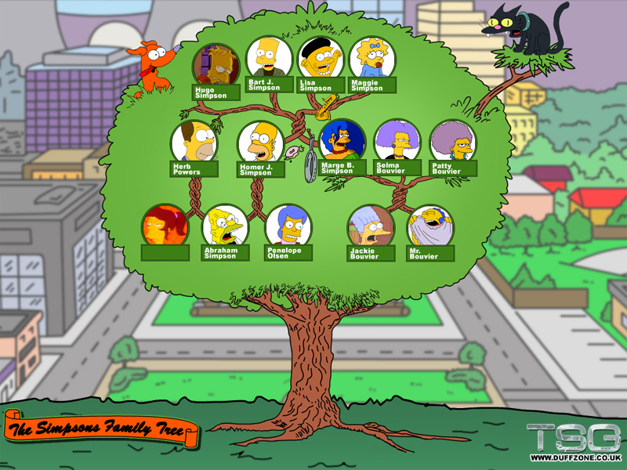
A family dictionary?

Slide 114
A family dictionary…
T = {'abe' :['homer','herb'],
'jackie':['marge','patty','selma'],
'homer' :['hugo','bart','lisa','maggie'],
'marge' :['hugo','bart','lisa','maggie']}
keys can be any immutable type
values can be any type at all…
T['abe']
How to get 'selma' from T?

Slide 115
A functional family?
def favChild( person, Tree ):
""" person is a name (a string)
Tree is a dictionary of children
returns person's "favorite" child """
if Tree.has_key( person ):
Kids = Tree[person]
Kids.sort()
return Kids[0]
return None
Who is favored ?
sort has side effects !

Slide 116
A functional family?
For example, >>> addChild( 'lisa', T, 'abejr' )
def addChild( person, Tree, jr ):
""" adds person's new child to Tree """
if Tree.has_key( person ) == False:
else: # already in the Tree!

Slide 117
“Quiz”
Name(s):
def favChild( person, Tree ):
if Tree.has_key( person ):
Kids = Tree[person]
Kids.sort()
return Kids[0]
return None
Change this code so that it prints how many times you've guessed each item, both for real provinces and for incorrect guesses…
def provinceChallenge( prov ):
while 0 in prov.values():
guess = raw_input("Guess: ")
if prov.has_key( guess ) == False:
print 'Try again...'
elif prov[guess] == 0:
print 'Yes!'
prov[guess] += 1
else:
print 'Already guessed...'
Based on favChild (above), write favGChild to return the first grandchild alphabetically - or return None if there are none.
def favGChild( person, Tree ):

Slide 118
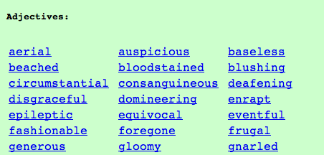
Vocabularists?
Shakespeare used 31,534 different words and a grand total of 884,647 words counting repetitions (across his works)
http://www-math.cudenver.edu/~wbriggs/qr/shakespeare.html
Active vocabulary estimates range from 10,000-60,000.
Passive vocabulary estimates are much higher.
Contemporary author in the OED…
Many Shakespearean contributions:
Shakespeare
which word…
Any guesses?

Slide 119
Vocabularists?
Shakespeare used 31,534 different words and a grand total of 884,647 words counting repetitions (across his works)
http://www-math.cudenver.edu/~wbriggs/qr/shakespeare.html
Active vocabulary estimates range from 10,000-60,000.
Passive vocabulary estimates are much higher.
Many Shakespearean contributions:
Shakespeare
J. K. Rowling

Slide 120
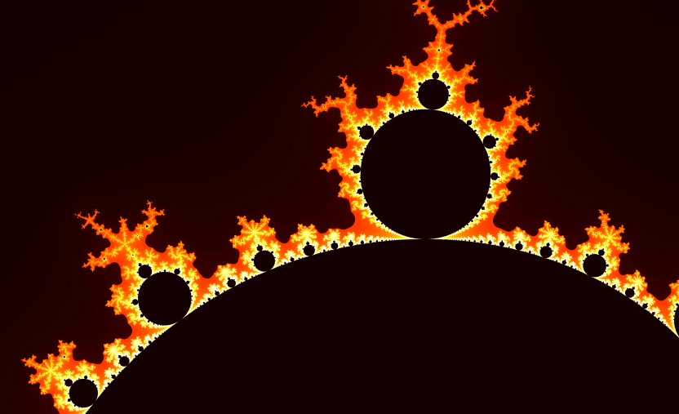
Infernalicious!
also: www.cs.hmc.edu/~jgrasel/

Slide 121
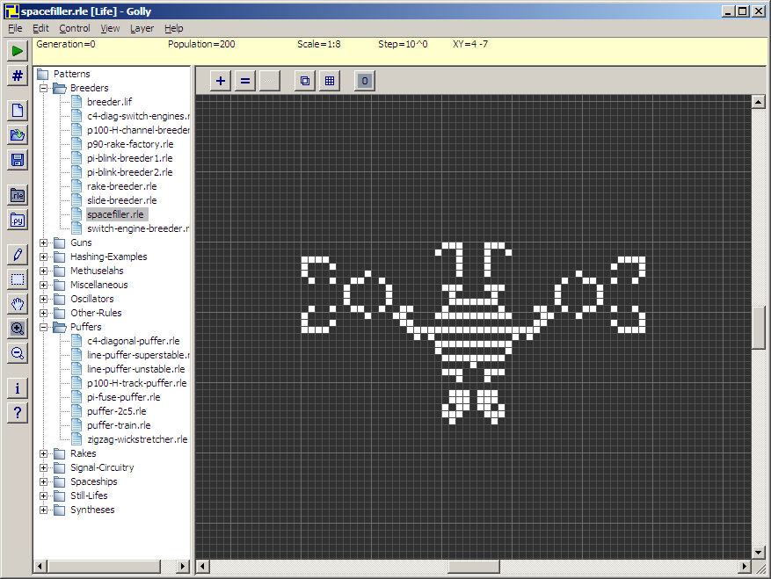
Life, revisited
Golly!
http://golly.sourceforge.net/

Slide 122
Methods
There's madness in this method!
d.has_key( 1991 )
are functions that are called by the data itself!
Functions
has_key( 1991, d )
are called on their own…
all data must be passed in as function inputs…
Warning: this has_key function is for example purposes only. It does not exist!

Slide 123
Representation & Speed
list
dictionary
{1988: 'dragon', 1989: 'snake'}
reference
L
5
0
L[0]
L[1]
…
42
L[9999]
finding if a value is in a list of 10,000 elements…
vs.
looking up a key in a dictionary of 10,000 entries

Slide 124
value-added tts() options…

Slide 125
Problem 1 -- to ∞ and beyond!
"rocks"
Are there stable life configurations?
Are there oscillating life configurations?
"plants"
period 3
period 2
Are there self-propagating life configurations?
"animals"

Slide 126
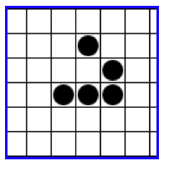
Problem 1 -- to ∞ and beyond!
Are there life configurations that expand forever?
What is the largest amount of the life universe that can be filled with cells?
Are all feasible configurations reachable?
How sophisticated can the structures in the life universe be?
http://www.ibiblio.org/lifepatterns/

Slide 127
Name that author… ?
'Cause somethin' like he left knee and a harp," said he had to the whole school? The shouting and then some strange and Mrs. "Well, I know Hagrid; they spotted handkerchief and get him get rid of course, had a gigantic beet with her," he knew what to all he's
All the sky with the sun in the sun in the church where you're gone Lucy in my eyes. There beneath the girl with an hourglass And then the banker never wears a lot to hold your hand. Can't buy me tight, tight Owww! Love is love I can't hide,
Who is the author?
What is the work?
What is going on?
This is but ourselves. No, faith, My uncle! O royal bed of confession Of your rue for leave to nature; to this time I should weep for thy life is rotten before he is. have sworn 't. Or my blood. I have closely sent for nine; and unprofitable,
The Senators and the date of a written declaration that Purpose, they shall consist of nine States, shall not, when he shall have such Vacancies. The President pro tempore, in the Desire of a Qualification to the Speaker of the Senate. Article 6. When vacancies by the office upon probable

Slide 128
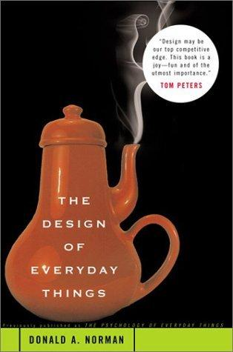
Exam on Mon.
Exam topics
1d loops
for & while
Design chapter:
2d loops
for row…
for col…
Hmmm
add r2 r2 r1
Basics
variables, functions, etc.
You may bring a page of notes, double-sided with anything you would like on it.
I'd suggest (1) reminding yourself about the HW problems and (2) looking at the class "quizzes"…

Slide 129
Change this code so that it tells you how many times you've guessed the same province…
first, for real provinces
then, for incorrect guesses…
def provinceChallenge( prov ):
while '0' in prov.values():
guess = raw_input("Guess: ")
if prov.has_key( guess ) == False:
print 'Try again...'
elif prov[guess] == 0:
print 'Yes!'
prov[guess] += 1
else:
print 'Already guessed...'

Slide 130
Based on favChild, write favGChild to return the first grandchild alphabetically - or return 'no one' if there are none.
def favChild( person, Tree ):
if Tree.has_key( person ):
Kids = Tree[person]
Kids.sort()
return Kids[0]
else:
return 'no children'
def favGChild( person, Tree ):
GC = []
our list of GChildren

Slide 131
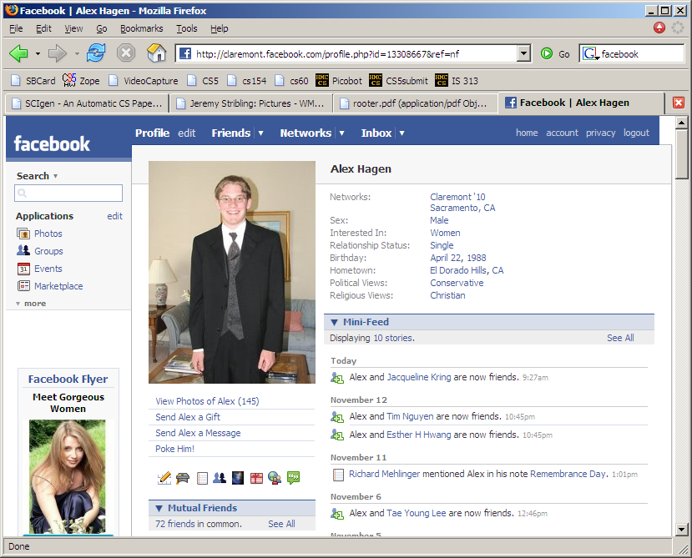

Slide 132
Name that author… ?

Slide 133
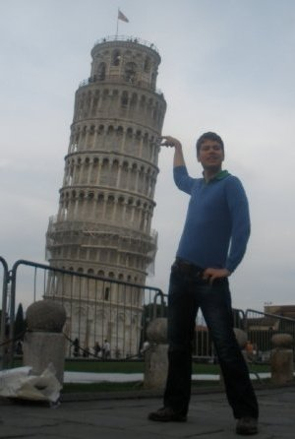
Visuospatial Skills
Three dimensions are better than two – I should know!
We use visuospatial skills in everyday life.
Most importantly, visuospatial skills are a significant predictor of success in technical fields. Imagine graphics software for instance.
Power to predict grades in technical courses equals that of math SAT scores (Sorby, 2009).
Bundled multimedia software and workbook developed at Michigan Tech teaches these skills.
Multimedia is being implemented at 6 other institutions nationwide including Purdue, Virginia Tech, Penn State – Behrend using a $200,000 NSF grant awarded in 2007.

Slide 134
If I had a dictionary, I guess I could look up what it was!
Dictionaries
Lists are not perfect…
reference
You can't choose what to name data.
L
5
42
L[0]
L[1]
L[0], L[1], …
You have to start at 0.
L[1990] = 'horse'
L[1991] = 'ram'
Some operations can be slow for big lists …
if 'rooster' in L:

Slide 135
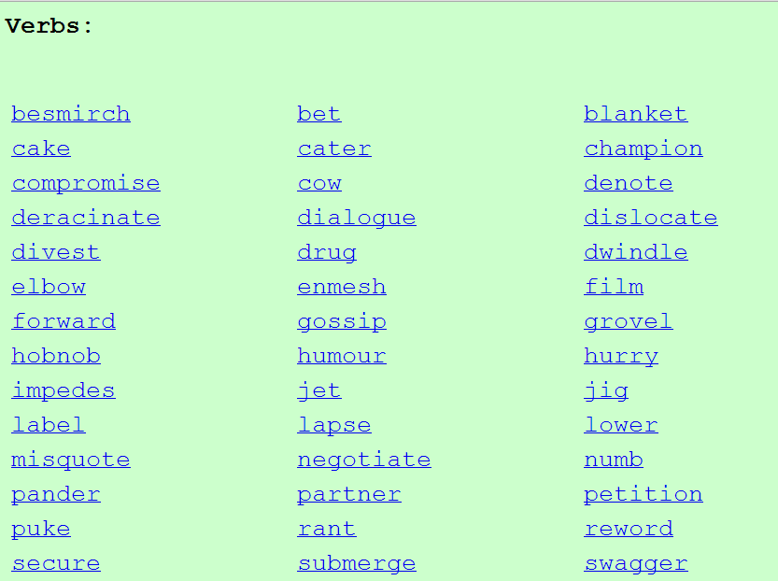
Vocabulary, anyone?
Shakespeare used 31,534 different words -- and a grand total of 884,647 words -- counting repetitions (across all of his works)
http://www-math.cudenver.edu/~wbriggs/qr/shakespeare.html
Shakespearean coinages:
J. K. Rowling

Slide 136
In search of elegance... One solution:
def isBefore(self, d2):
""" Returns true if self is before d2 """
if self.year < d2.year:
return True
if self.month < d2.month and self.year == d2.year:
return True
if self.day < d2.day and d2.month == self.month and \
self.year == d2.year:
return True
return False
def isAfter(self, d2):
""" Returns true if self is after d2 """
if self.year > d2.year:
return True
if self.month > d2.month and self.year == d2.year:
return True
if self.day > d2.day and d2.month == self.month and \
self.year == d2.year:
return True
return False

Slide 137
A more elegant solution
def isBefore(self, d2):
""" Returns true if self is before d2 """
if self.year < d2.year:
return True
if self.month < d2.month and self.year == d2.year:
return True
if self.day < d2.day and d2.month == self.month and \
self.year == d2.year:
return True
return False
def isAfter(self, d2):
""" Returns true if self is after d2 """
return d2.isBefore(self)

Slide 138
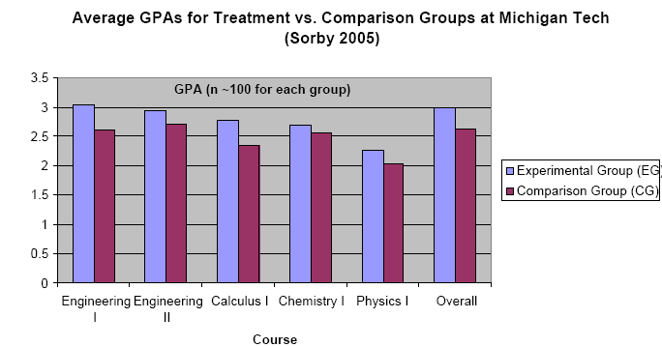
Visuospatial skills can be taught and learned.
Improving these skills leads to improved grades
I have $5,000 to (1) give to you, (2) help you learn these skills, and (3) improve grades…

Slide 139
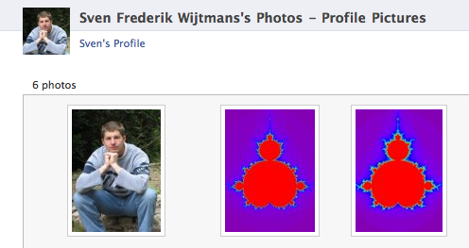
MandelGallery!

Slide 141
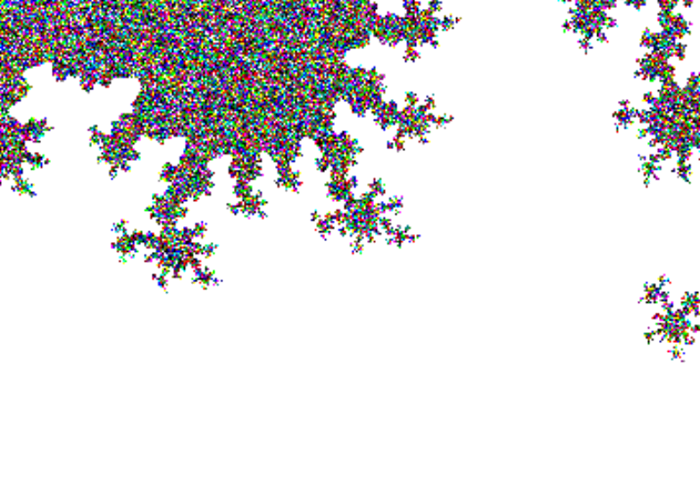

Slide 142
CS 5 this week
Building classes...
... vs. using the library
hw10pr2
hw10pr3
file and dictionary classes
Connect Four Board class
files
dictionaries
If I had a dictionary, I guess I could look up what it was!

Slide 143
Classes: DIY data
design-it-yourself!
Class: a user-defined datatype
Object: data or a variable whose type is a class
constructor
object
d = Date( 11, 11, 2010 )
d.tomorrow()
print d
method
d would be named self inside the Date class...
uses repr
Method: a function defined in a class called by an object
self: in a class, the name of the object calling a method
Constructor: the __init__ function for creating a new object
repr: the __repr__ function returning a string to print

Slide 144
Designing classes
(Data Members) What data do we need?
Not limited to 7x6!
(Methods) What are capabilities do we want?

Slide 145
Connect Four: an object, b
str
str
str
str
str
str
Board
b
list
?
data
str
str
str
str
str
str
rows
6
4
str
str
str
str
str
str
int
int
str
str
str
str
str
str
width
height
columns
How could we set the ? to 'X'

Slide 146
Connect Four: constructor
class Board:
""" a datatype representing a C4 board
with an arbitrary number of rows and cols
"""
def __init__( self, width, height ):
""" the constructor for objects of type Board """
self.width = width
self.height = height
W = self.width
H = self.height
self.data = [ [' ']*W for row in range(H) ]
List comprehensions let us create
self.height independent rows with
self.width independent columns each.

Slide 147
Connect Four: __repr__
def __repr__(self):
""" this method returns a string representation
for an object of type Board
"""
s = ''
for row in range( 6 ):
s += '|'
for col in range( 7 ):
s += self.data[row][col] + '|'
s += '\n'
return s
To change?
To add?
which row is row 0, row 1, and so on?

Slide 148
Quiz
class Board:
def allowsMove(self, col):
def addMove(self, col, ox):
H = self.height
for row in range( H ):
if self.data[row][col] != ' ':
self.data[row-1][col] = ox
self.data[H][col] = ox
Write allowsMove to return True if col is a valid move; False otherwise.
Hint: check as little as possible!
a C4 board
col #
'X' or 'O'
Step through this imperfect addMove method.
What is each line doing?
Can you spot any potential problems here...?

Slide 149
C4 Board class: hw10pr2
the “constructor”
__init__( self, width, height )
checks if allowed
allowsMove( self, col )
places a checker
addMove( self, col, ox )
removes a checker
delMove( self, col )
to write...
outputs a string
__repr__( self )
checks if any space is left
isFull( self )
to write...
checks if a player has won
winsFor( self, ox )
to write...
the game...
hostGame( self )
to write...
Which are similar to others? Which requires the most thought?

Slide 150
winsFor( self, ox )
X
O
def winsFor(self, ox):
""" does ox win? """
H = self.height
W = self.width
b
b.winsFor( 'O' )
or 'X'
Watch out for corner cases!

Slide 151
Why objects and classes?
Elegance: Objects hide complexity!
if b.winsFor( 'X' ) == True:
if d.isBefore( d2 ) == True:
Simple – and INVITING -- building blocks!
encapsulating lots of complexity!!
or maybe not so much!!!
def isBefore(self, d2):
""" Returns true if self is before d2 """
return [self.year, self.month, self.day] < [d2.year, d2.month, d2.day]

Slide 152
Files
In Python reading files is no problem…
>>> f = file( 'a.txt' )
>>> text = f.read()
>>> f.close()
>>> text
'I like poptarts and 42 and spam.\nWill I
>>> LoW = text.split()
[ 'I', 'like', 'poptarts', ... ]
opens the file and calls it f
constructor and methods!
reads the whole file and calls it f
closes the file (optional)
all the text (as one big string)
text.split() returns a list of each "word"

Slide 153
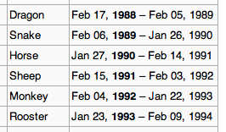
This seems like the key to dictionaries' value…
Dictionaries
In Python a dictionary is a set of key - value pairs.
>>> d = {}
>>> d[1992] = 'monkey'
>>> d[1993] = 'rooster'
>>> d
{1992:'monkey', 1993:'rooster'}
>>> d[1991]
'ram'
>>> d[1969]
key error
creates an empty dictionary, d
1992 is the key
'monkey' is the value
1993 is the key
'rooster' is the value
Curly! And colony!
Retrieve data like lists…
Almost !
It's a list where the index can be any immutable key.

Slide 154
More on dictionaries
They don't seem moronic to me!
Dictionaries have lots of built-in methods, or functions:
>>> d = {1992:'monkey', 1993:'rooster'}
>>> 1992 in d
True
>>> 1969 in d
False
>>> len(d)
2
>>> d.keys()
[ 1992, 1993 ]
in checks if a key is present
len returns the # of keys
d.keys returns a list of all keys
d.values returns a list of all values
d.items returns a list of all key/val. pairs

Slide 155
def wc( filename ):
""" word-counting program """
f = open( filename )
text = f.read()
f.close()
LoW = text.split()
print "There are", len(LoW), "words."
file handling
word counting
What if we wanted the number of different words in the file?
This would be the author's vocabulary size, instead of the word count.

Slide 156
def wc( filename ):
""" word-counting program """
f = open( filename )
text = f.read()
f.close()
LoW = text.split()
print "There are", len(LoW), "words."
d = {}
for w in LoW:
if w not in d:
d[w] = 1
else:
d[w] += 1
print "There are", len(d), "distinct words.\n"
return d # this way we can use d later!
file handling
word counting
Tracking the number of occurences of each word with a dictionary, d.

Slide 157
Vocabularists?
Shakespeare used 31,534 different words and a grand total of 884,647 words counting repetitions (across his works)
http://www-math.cudenver.edu/~wbriggs/qr/shakespeare.html
Active vocabulary estimates range from 10,000-60,000.
Passive vocabulary estimates are much higher.
Many Shakespearean contributions:
One contemporary author in the Oxford Eng. Dictionary…
Shakespeare
which word?

Slide 158
A dictionary challenge…
PROV = { 'BC': 0, … }
All of Canada's provinces are in this dictionary…
key
value
def provinceChallenge( PROV ):
""" PROV is a dictionary of Canada's provinces
-- the challenge is to name them all! """
while 0 in prov.values():
guess = raw_input("Name a province: ")
if guess not in PROV:
print 'Try again...'
elif prov[guess] == 0:
print 'Yes!'
prov[guess] += 1
else:
print 'Already guessed...'
prov[guess] += 1
print 'Phew!'
wasn't a key at all
newly guessed key: value was 0
repeated guess
help?!

Slide 159
Another challenge?

Slide 160
Markov Models
Techniques for modeling any sequence of natural data
speech, text, sensor-data in time series...
Each item depends only on the item immediately before it .
1st-order Markov Model
I like poptarts and 42 and spam.
Will I get spam and poptarts for
the holidays? I like spam poptarts!
The text file:
{ 'like' : ['poptarts'],
'and' : ['42', 'spam.', 'poptarts'],
'get' : ['spam'], …
'poptarts':
'I' :
'Will' :
The model:
How to get to Will?

Slide 161
Markov Models are generative!
A key benefit of Markov Models is that they can generate feasible data!
Original file:
Generated text:
I get spam poptarts! I like poptarts and 42 and spam. I like spam and 42 and 42 and 42 and spam. Will I like poptarts and 42 and poptarts and 42 and poptarts and 42 and 42 and poptarts and spam. I get spam and 42 and 42 and...

Slide 162
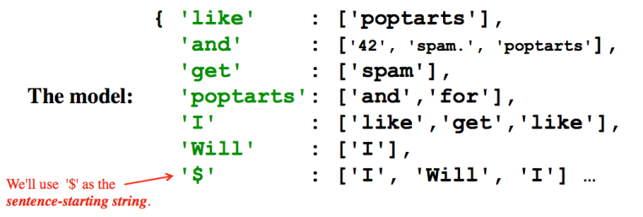
Model creation:
1) start with the prevword as '$'
2) for each word w, put w in prevword's list
or create a new list with just w!
3) change prevword to word or '$' as appropriate...
if w[-1] is punctuation.
Generating text:
1) start with the '$' string
2) choose a word following '$', at random. Call it w
3) choose a word following w, at random. And so on…
4) If w ends a sentence, '$' becomes the next word.
if w[-1] is punctuation.

Slide 163
more sophisticated than a first-order model!

Slide 164
Counting distinct words with a dictionary…
WOULD YOU LIKE THEM IN A HOUSE?
WOULD YOU LIKE THEN WITH A MOUSE?
I DO NOT LIKE THEM IN A HOUSE.
I DO NOT LIKE THEM WITH A MOUSE.
I DO NOT LIKE THEM HERE OR THERE.
I DO NOT LIKE THEM ANYWHERE.
I DO NOT LIKE GREEN EGGS AND HAM.
I DO NOT LIKE THEM, SAM-I-AM.
Which book? Which author?

Slide 165
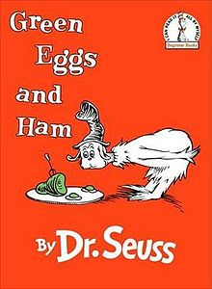
Counting distinct words with a dictionary…
WOULD YOU LIKE THEM IN A HOUSE?
WOULD YOU LIKE THEN WITH A MOUSE?
I DO NOT LIKE THEM IN A HOUSE.
I DO NOT LIKE THEM WITH A MOUSE.
I DO NOT LIKE THEM HERE OR THERE.
I DO NOT LIKE THEM ANYWHERE.
I DO NOT LIKE GREEN EGGS AND HAM.
I DO NOT LIKE THEM, SAM-I-AM.

Slide 166
Counting distinct words with a dictionary…
wd
wd
wd
wd
wd
…
WOULD YOU LIKE THEM IN A HOUSE?
WOULD YOU LIKE THEN WITH A MOUSE?
I DO NOT LIKE THEM IN A HOUSE.
I DO NOT LIKE THEM WITH A MOUSE.
I DO NOT LIKE THEM HERE OR THERE.
LoW
wd
wd
wd
wd
wd
…
wd
wd
wd
wd
wd
…
wd
wd
wd
wd
wd
…
d
keys
values
for wd in LoW:
if wd not in d:
d[wd] = 1
else:
d[wd] += 1

Slide 167
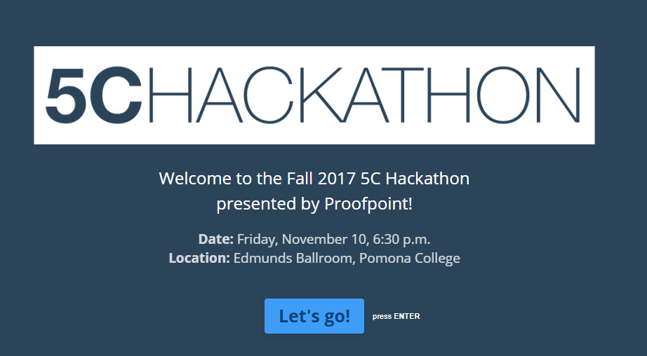
Opportunities...
... across space (the 5Cs)
and across time... !

Slide 168
Counting distinct words with a dictionary…
wd
wd
wd
wd
wd
…
WOULD YOU LIKE THEM IN A HOUSE?
WOULD YOU LIKE THEN WITH A MOUSE?
I DO NOT LIKE THEM IN A HOUSE.
I DO NOT LIKE THEM WITH A MOUSE.
I DO NOT LIKE THEM HERE OR THERE.
I DO NOT LIKE THEM ANYWHERE.
I DO NOT LIKE GREEN EGGS AND HAM.
I DO NOT LIKE THEM, SAM-I-AM.
LoW
d
keys
values
for w in LoW:
if w not in d:
d[w] = 1
else:
d[w] += 1

