Slide 1
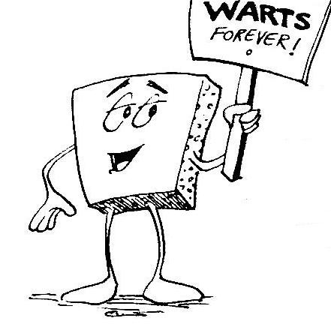
Welcome to CS 5 !
Grab these lecture notes…
Introduction to CS
Wally Wart, a protrusive advocate of concrete computing
We don't have words strong enough to describe this class.
- US News and Course Report
Everyone will get out of this course – a lot!
- NYTimes Review of Courses
1 handout…
We give this course two thumbs…
slides & syllabus
- Metametacritic

Slide 2
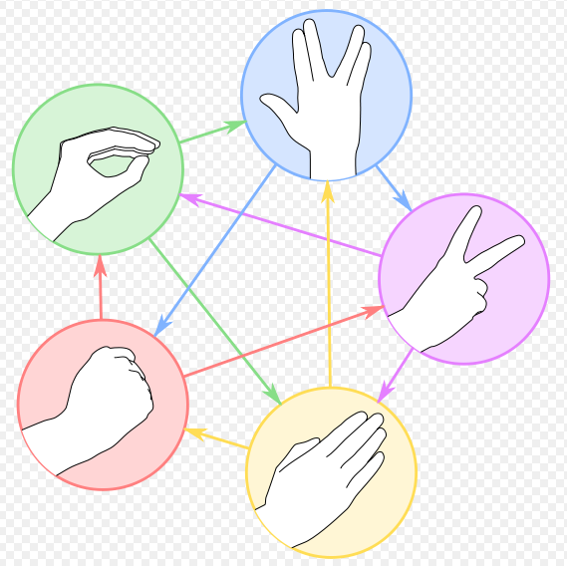





A word on 5 spots…
official alien of CS 5 Gold
negotiations afoot… these sections are first-years-only

Slide 3
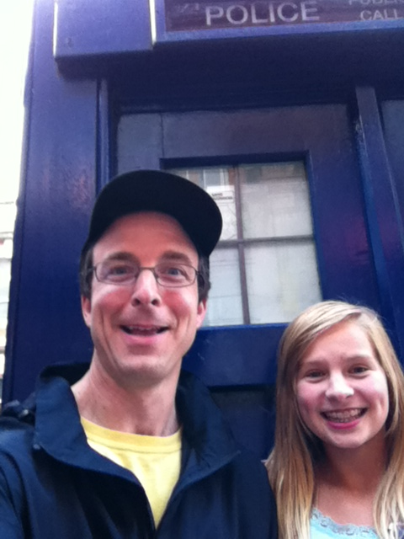
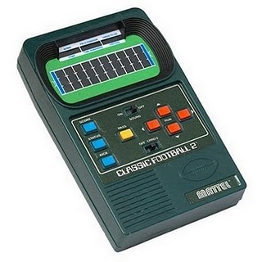
Introductions...
Zach Dodds
Olin B163 (HMC)
dodds@cs.hmc.edu
pursuer of low-level AI
taker of low-quality selfies
fan of low-tech games
and low-worry namecards!
Speaking of introductions

Slide 4
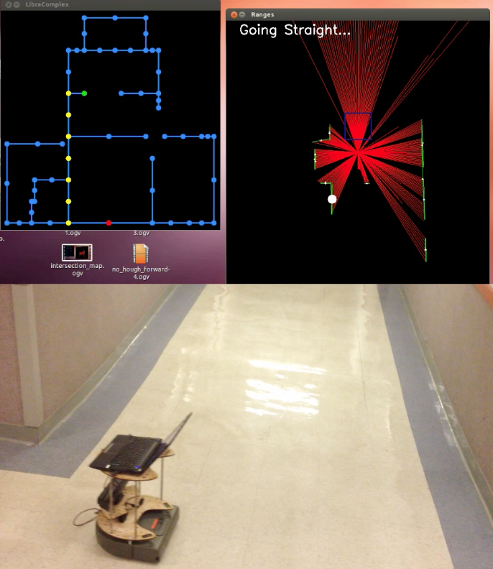
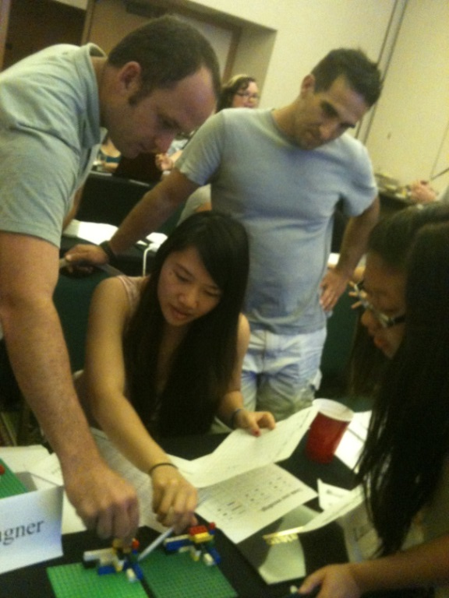
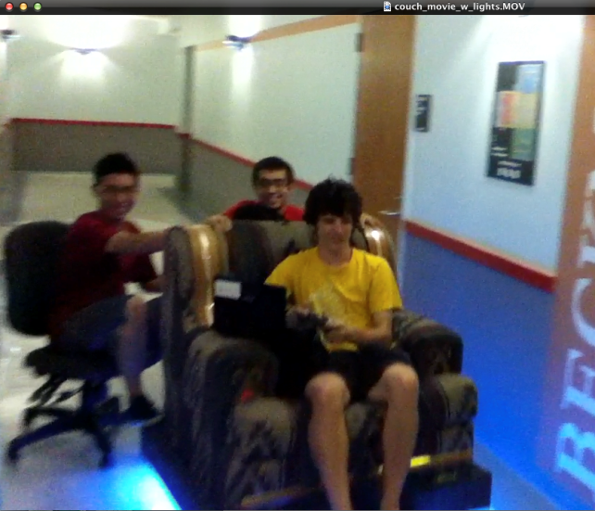
How I spend my non-CS5 time ...
actually, this "I" is not quite accurate…
Chairs?
Outreach
Robots

Slide 5
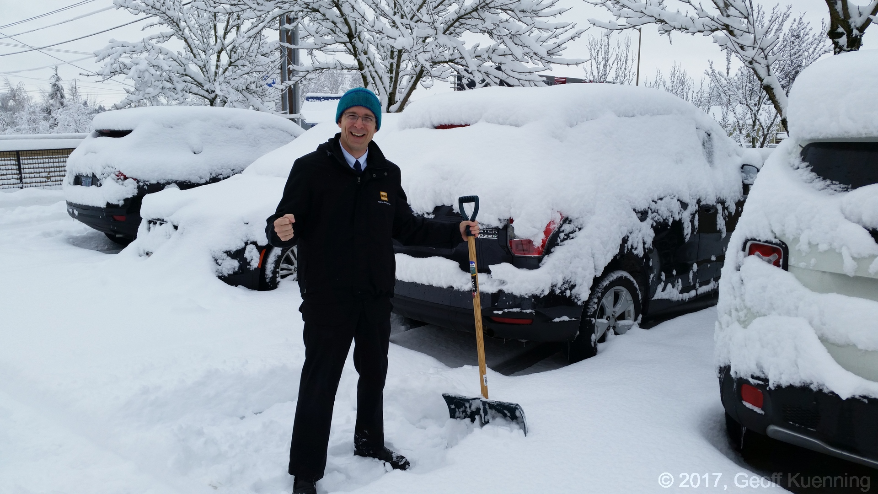
Winter!

Slide 6
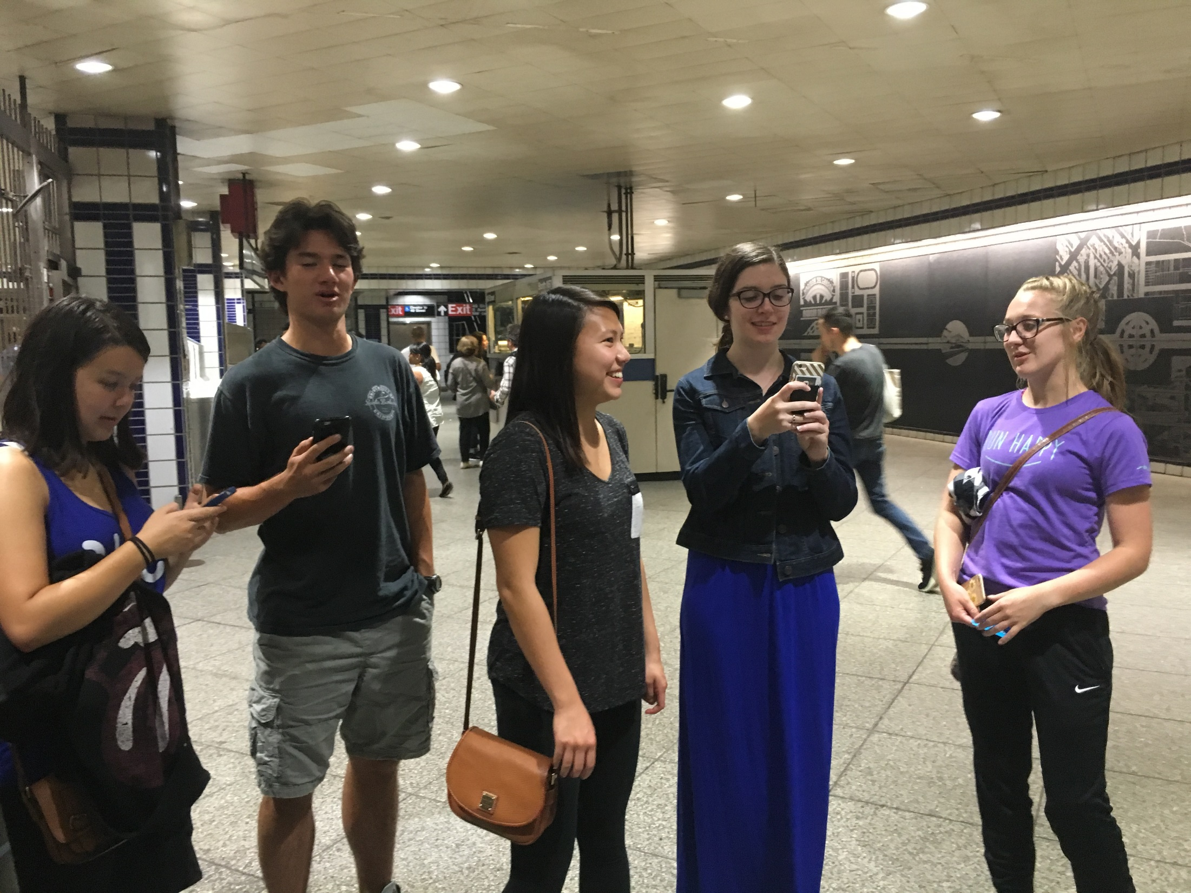
Poke-outreach!?

Slide 7
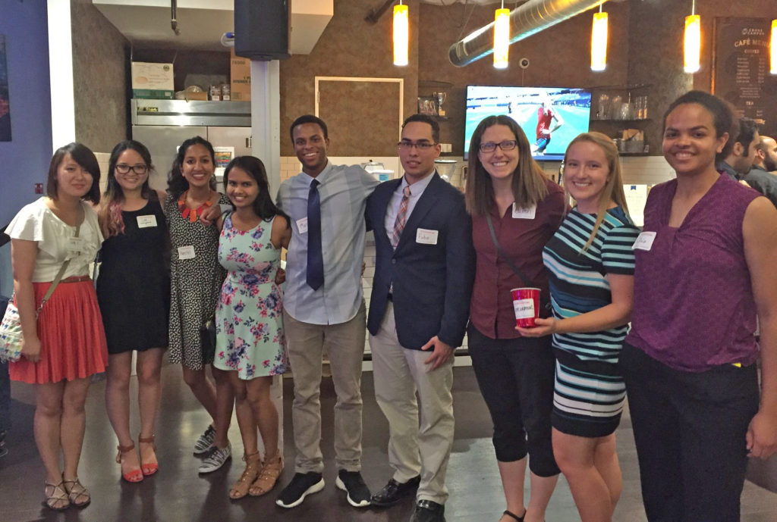
Summer start-up teams...

Slide 8
Summer start-up teams...
Lots of opportunities surrounding computing... (at the 5Cs and beyond)

Slide 9


Today in CS5…
2) How CS 5 runs…
3) Python?!
Shouldn’t there be an alien in this game?
CS is just programming, right?
1) What is CS?
I'm not so sure…
Whatever it is, it's definitely alien!

Slide 10
CS vs. programming ?

Slide 11
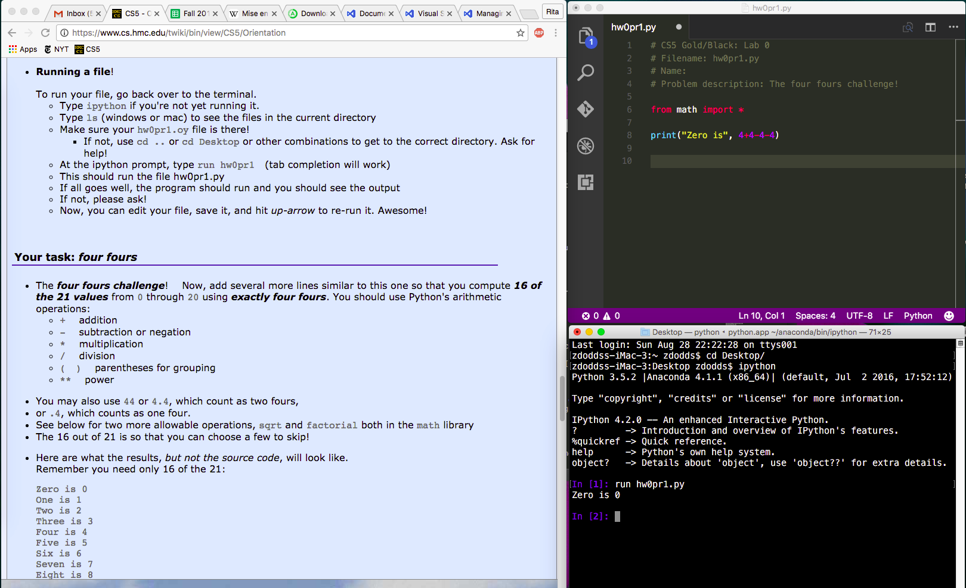
A minute of cs5 programming…
Python source code, a plain-text file
(here, edited by the VS Code text editor)
Demo
lab and hw instructions
shell or command-line or terminal
(the execution environment)
get everything running on your own machine

Slide 12
Spot the differences here?
print('hi')
print 'hi'
I could not – for days!

Slide 13
Spot the differences here?
print('hi')
print 'hi'
python 3
python 2
We will be using python 3 this term...

Slide 14
Spot the differences here?
print('hi')
print 'hi'
Syntax!
python 3
python 2
We will be using python 3 this term...

Slide 15
CS != programming
"not equal to"

Slide 16
CS != programming
So, what is CS?
Punctuation matters!
So what? is CS

Slide 17
CS != programming
programming : CS ::
longboards : HMC maybe 5Cs?
capital : business venture
equations : mathematics
CS
language : ideas
Programming
web search : knowledge
Tesla : Google
programs are a vehicle, not the destination

Slide 18
What is CS a science of ?
the study of complexity:
How can it be done?
it ~ information
How well can it be done?
Can it be done at all?
or, more precisely, a process transforming
information from one form to another
We'll look at 3 examples – each of which you'll construct in CS 5 …at least to some extent!
3 examples? That's it for me!
Notes:
creative side ~ dreamworks, game companies, google, microsoft, soc. networking <-- the design and creation of original algorithms and software
and a commodity side ~ application use, configuration, customization, certification, your favorite acronym here…
our department pays only about 5-10% of its attention to the commodity side
it pays 90-95% of its attention to the creative side… Why?
robotics? taught yourself to build or create something… game levels, etc.?

Slide 19
'HUMAN'
What is CS?
'CHIMPANZEE'
How can it be done?
What is the Longest Common Subsequence between 2 strings?
How well can it be done?
biology's string-matching problem, "LCS"
Can it be done at all?
'CGCTGAGCTAGGCC...'
Can you solve the problem?
'ATCCTAGGTAACTG...'
Can you create a process to solve such problems?
+10⁹more
Eye oneder if this haz othur aplications?
Notes:
creative side ~ dreamworks, game companies, google, microsoft, soc. networking <-- the design and creation of original algorithms and software
and a commodity side ~ application use, configuration, customization, certification, your favorite acronym here…
our department pays only about 5-10% of its attention to the commodity side
it pays 90-95% of its attention to the creative side… Why?
robotics? taught yourself to build or create something… game levels, etc.?

Slide 20
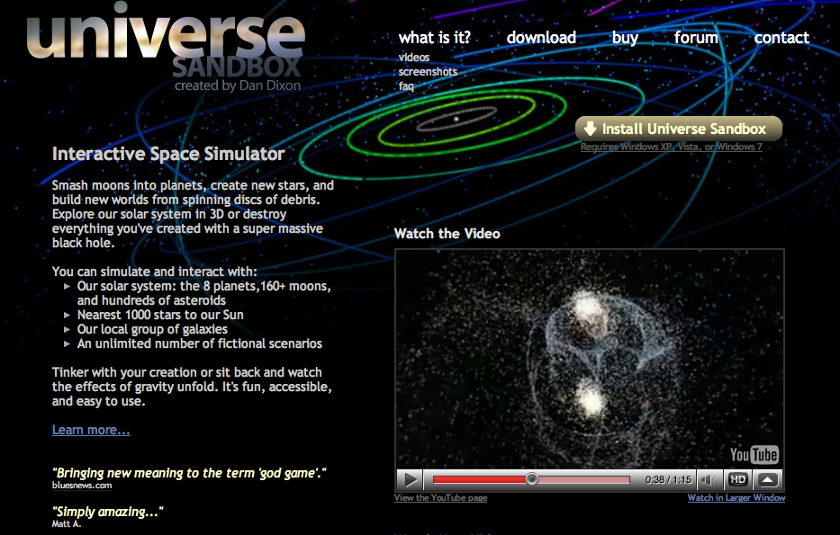
Feels like home!
What is CS?
How can it be done?
How well can it be done?
Can it be done at all?
How quickly can you find a solution?
How much work is needed to simulate N stars?
Is your solution the "best" possible?
chemistry's + physics's "N-body" problem
what if N is a million-and-one…?
Notes:
creative side ~ dreamworks, game companies, google, microsoft, soc. networking <-- the design and creation of original algorithms and software
and a commodity side ~ application use, configuration, customization, certification, your favorite acronym here…
our department pays only about 5-10% of its attention to the commodity side
it pays 90-95% of its attention to the creative side… Why?
robotics? taught yourself to build or create something… game levels, etc.?

Slide 21
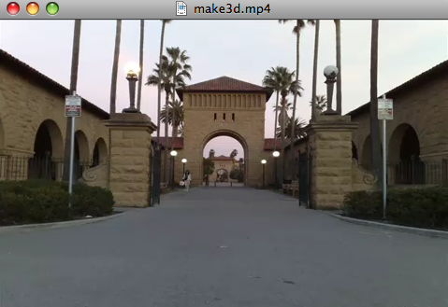
What is CS?
How can it be done?
How well can it be done?
Can it be done at all?
Can we build a 3d model from one 2d image?
Is your problem solvable?
Andrew Ng's "Make3d"
How can you tell !?
many problems are uncomputable… … and you'll prove this!
All three eyes tell me that Make3d has just failed ~ epically!
Notes:
creative side ~ dreamworks, game companies, google, microsoft, soc. networking <-- the design and creation of original algorithms and software
and a commodity side ~ application use, configuration, customization, certification, your favorite acronym here…
our department pays only about 5-10% of its attention to the commodity side
it pays 90-95% of its attention to the creative side… Why?
robotics? taught yourself to build or create something… game levels, etc.?

Slide 22
What is CS?
Can you solve this problem?
CS is the study of complexity
Can you create a process to solve such problems?
How can it be done?
How well can it be done?
How quickly can you find solutions?
Can it be done at all?
Do you have the “best” solution?
CS's six big questions are here.
Is every problem solvable?
But only one is
programming.
Do you see which?
Is there a way to tell?
There isn’t always!
Notes:
programming is only about 1/6th of computer science as a science – it is perhaps more of the commodity side of the field – but that’s a good thing!

Slide 23
What is CS?
CS
Can you solve this problem?
CS is the study of complexity
Can you create a process to solve such problems?
programming
+ CS
How can it be done?
How well can it be done?
How quickly can you find solutions?
CS
Can it be done at all?
Do you have the “best” solution?
CS
CS's six big questions are here.
CS
Is every problem solvable?
But only one is
programming.
Do you see which?
Is there a way to tell?
CS
There isn’t always!
Notes:
programming is only about 1/6th of computer science as a science – it is perhaps more of the commodity side of the field – but that’s a good thing!

Slide 24
CS’s – and CS5's – philosophy:
Whatever you are, be a good one.
- Abraham Lincoln
More and more, CS can help!

Slide 25
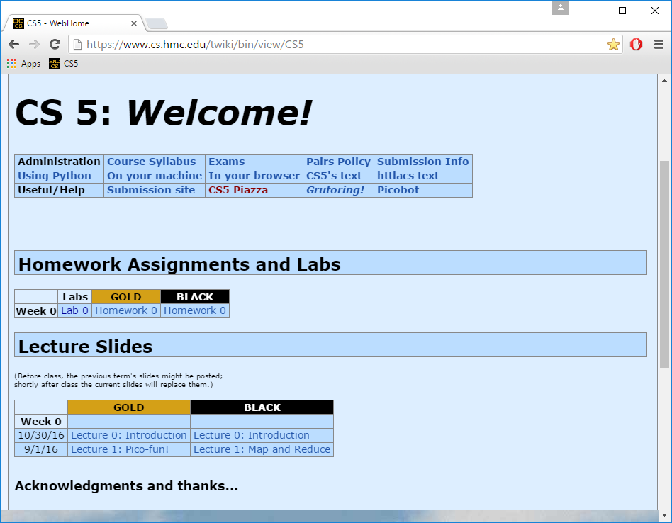
Take-home message…
depending on where "home" is, perhaps…
Now in 2017!
Just Google for
hmc cs5
www.cs.hmc.edu/cs5

Slide 26
You're here ~ what's next?
2) How CS 5 runs…
3) Python?!
Shouldn’t there be an alien in this game?
the first Python HW is choice!
CS is just programming, right?
1) What is CS?
I'm not so sure…
Whatever it is, it's definitely alien!

Slide 27
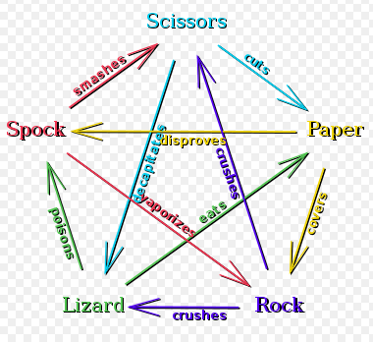

rock – paper – scissors – lizard – Spock!
Logically, I've got game!
http://www.youtube.com/watch?v=fqlDc2VICZ0 start at about :28

Slide 28
Syllabus, briefly
T and Th: 1:15-2:30pm and 2:45-4:00pm
Lectures
Key skills, topics, and their motivation
Come to Lectures!
Insight into the HW problems (what, why, how)
We’d like to see you! Let us know if you’ll be sick…
Lab
T or W: 6:00-8:00pm
recommended by 4 out of 5 CS5 alums!
Guided progress on the week's hw
Come to Labs!
Not required, but encouraged: full credit for lab
Will SAVE you time and effort in CS 5
Office hrs
F: 2:00-4:00 pm, Linde Activities Center lab
Lots of help is available!
feel free to work on HW, to just stop by,
or, come to any of the many tutoring hrs!
HW
Hw is due on Monday nights...
Monday nights: due by 11:59 pm
Notes:
still before the quiz… (syllabus is in the back of your handout…)

Slide 29
Syllabus, briefly
T and Th: 1:15-2:30pm and 2:45-4:00pm
Lectures
Key skills, topics, and their motivation
Insight into the HW problems (what, why, how)
We’d like to see you! Let us know if you’ll be sick…
Lab
T or W: 6:00-8:00pm
recommended by 4 out of 5 CS5 alums!
Guided progress on the week's hw
Not required, but encouraged: full credit for lab
Will SAVE you time and effort in CS 5
Office hrs
F: 2:00-4:00 pm, Linde Activities Center lab
feel free to work on HW, to just stop by,
or, come to any of the many tutoring hrs!
HW
Monday nights: due by 11:59 pm
Notes:
still before the quiz… (syllabus is in the back of your handout…)

Slide 30
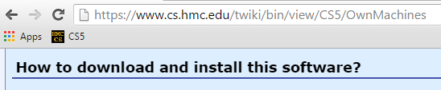
Each week's lab…
0) Find the lab! Sign in…
1) Get Python running…
download things now, perhaps!
2) Edit, run, + submit a file…
demo
Encouraged: bring your laptop

Slide 31
Each week's lab…
0) Find the lab! Sign in…
Labs are optional, but incentivized.
If you come to lab, give a good-faith effort, and please sign in, you'll receive all of the credit for the lab problems even if you don't finish
(you don't need to finish)
1) Get Python running…
download things now, perhaps!
2) Edit, run, + submit a file…
demo
Encouraged: bring your laptop

Slide 32
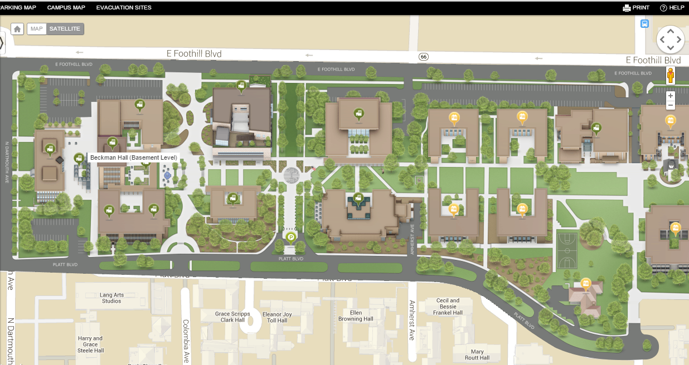
Evening lab?
Facilities and Maintenance
You can get your keycard activated @ F&M in Platt
you do need to show you're in cs5!
Enter through Olin building
We’re here!
the south door is open late!
Platt building. F&M is in the basement.
Beckman B102, B105, B126

Slide 33
Map to CS Lab
Shan
coffee
Koi
Edwards
Macalister
Pryne
Physicists, chemists & other parenthesis-needing individuals,
cool machines - drills, lathes, etc.
Your account for CS
submissions?
Laptop? Bring it!
Galileo
other keyboard-free machines
login:
B102
B100
Beckman
passwd:
CS Hallway and Labs
Big Beckman (B126)
B105
Biologists, bees, spiders and other arachnophiles
from Olin (Bio+CS)
South Olin Door

Slide 34
This week: Lab 0
Python source code, a plain-text file
(here, edited by the VS Code text editor)
lab and hw instructions
shell or command-line or terminal
(the execution environment)
get everything running on your own machine

Slide 35
Homework
Assignments
~ 5 problems/week
Due Monday evenings by 11:59 pm.
Eur-ollowed to use one Euro for up to three hwks.
No need to let us know, even.
Extra credit is usually available…
You have 3 CS 5 Euros to use…
"Late Days"
Some problems are specified “individual-only.”
Others offer the option of working as pairs/partners:
Collaborate!
You don’t have to work in pairs/partners (that said, it's fun!)
If you do, you must share the work equally - typing and coaching
Be sure to indicate who your partner was at the submission site!
Put your name(s) in the code, as well!

Slide 36

Pairs
Partners
one computer
two computers
tradeoff typing/debugging ~ about every 20 minutes
both partners type/debug ~ provide help as needed
Standard is the same either way:
After finishing the hw, (a) each person has contributed equally and (b) both could complete the problems on their own
Submit with a partner as full co-owners of the work.

Slide 37
Honor Code
You're encouraged to discuss problems with other students – or tutors - or any instructors.
You may not share written, electronic or verbal solutions with other students, present or past:
Even with three eyes, I need to borrow others' to find the syntax errors here!
Please do use the internet for Python language references.
Pleas do use other's eyes for finding syntax erorrs.
Do not use the internet (or intranet) to (try to) find solutions…
If you work as a pair/partners, the rules apply for the duo.
Sign & submit CS's honesty policy online in this week's lab.

Slide 38
Grading
if perc > .95:
print('A')
elif perc > .90:
print('A-')
elif perc > .70:
print('Pass')
~ 65% Assignments
~ 30% Exams
many take cs5 P/NC
~ 5% Participation/“quizzes”
see online syllabus for the full grade list...
Midterm? This feels more like a 3/4-term!
Exams
Midterm
Th, Mar. 30, in-class
Final
Tue, May 9 (2pm) or Fri, May 12 (2pm)
using a page of notes is OK on exams
the exams are written, not coded
the problems are modeled on the in-class "quizzes"
Notes:
homework really comprises the key skills I hope that everyone takes away from this class…
weighted accordingly!
if you never submit anything before 11:59pm on Wednesday – I have complete sympathy!

Slide 39
Choices, choices!
Let's set the value of perc to 0.91...
perc = 0.91
if perc > 0.95:
print 'A'
elif perc > 0.90:
print 'A-'
elif perc > 0.70:
print 'Pass'
else:
print 'Aargh!'
What will this program print, if perc is 0.91?
What's here?
First – who sees the syntax errors here !?
# of BLOCKS here:
# of TESTS here:
CONTROL STRUCTURES
# of here:
Notes:
Useful skill
Important tool
Window into corners of everyday life

Slide 40
Choices, choices!
Let's set the value of perc to 0.91...
perc = 0.91
if perc > 0.95:
print('A')
elif perc > 0.90:
print('A-')
elif perc > 0.70:
print('Pass')
else:
print('Aargh!')
What will this program print, if perc is 0.91?
Lots of Illuminating Solid Parentheses!
What's here?
# of BLOCKS here:
Aargh! ;-)
# of TESTS here:
CONTROL STRUCTURES
# of here:
Notes:
Useful skill
Important tool
Window into corners of everyday life

Slide 41
Choices, choices!
Let's set the value of perc to 0.91...
perc = 0.91
if perc > 0.95:
print('A')
elif perc > 0.90:
print('A-')
elif perc > 0.70:
print('Pass')
else:
print('Aargh!')
What will this program print, if perc is 0.91?
What's here?
# of BLOCKS here:
# of TESTS here:
CONTROL STRUCTURES
# of here:
Notes:
Useful skill
Important tool
Window into corners of everyday life

Slide 42
Choices, choices!
perc = 0.80
if perc > 0.95:
print('A')
elif perc > 0.90:
print('A-')
elif perc > 0.70:
print('Pass')
else:
print('Aargh!')
perc = 0.80
if perc > 0.00:
print('Aargh!')
elif perc > 0.70:
print('Pass')
elif perc > 0.90:
print('A-')
else:
print('A')
What does each of these programs print out, if perc is 0.8?
What value of perc gives an 'A-' on the right?
How can you get a better grade on the right than the left?
Notes:
Useful skill
Important tool
Window into corners of everyday life

Slide 43
Exclusive Choices
if ... elif ... else
perc = 0
if perc > 0.95:
print('A')
elif perc > 0.90:
print('A-')
elif perc > 0.70:
print('Pass')
else:
print('Aargh!')
4 mutually exclusive blocks
in a single control structure
When using
if . elif … . else
at most one block will run: the first whose test is True. If all fail, the else will run
elif and else are optional
Notes:
Useful skill
Important tool
Window into corners of everyday life

Slide 44
Exclusive Choices
if ... elif ... else
Every if starts a new control structure.
perc = 0
if perc > 0.95:
print('A')
elif perc > 0.90:
print('A-')
elif perc > 0.70:
print('Pass')
else:
print('Aargh!')
4 mutually exclusive blocks
Every elif and else continues an existing control structure.
in a single control structure
When using
if . elif … . else
at most one block will run: the first whose test is True. If all fail, the else will run
elif and else are optional
Notes:
Useful skill
Important tool
Window into corners of everyday life

Slide 45
What's the difference?
mutually exclusive blocks
nonexclusive blocks
perc
perc
if perc > .95:
print('A')
elif perc > .90:
print('A-')
elif perc > .70:
print('Pass')
if perc > .95:
print('A')
if perc > .90:
print('A-')
if perc > .70:
print('Pass')
What if perc == .99 ? (How would we set it?)
How many separate control structures does each side have?
Notes:
Useful skill
Important tool
Window into corners of everyday life

Slide 46
What's the difference?
mutually exclusive blocks
nonexclusive blocks
perc
perc
if perc > .95:
print('A')
elif perc > .90:
print('A-')
elif perc > .70:
print('Pass')
if perc > .95:
print('A')
if perc > .90:
print('A-')
if perc > .70:
print('Pass')
1
3
thing
things
What if perc == .99 ? (How would we set it?)
How many separate control structures does each side have?
Notes:
Useful skill
Important tool
Window into corners of everyday life

Slide 47
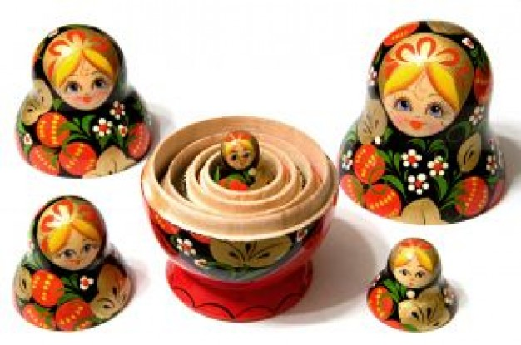
Nesting
for decision-making, we now have it all…
Notes:
Useful skill
Important tool
Window into corners of everyday life

Slide 48
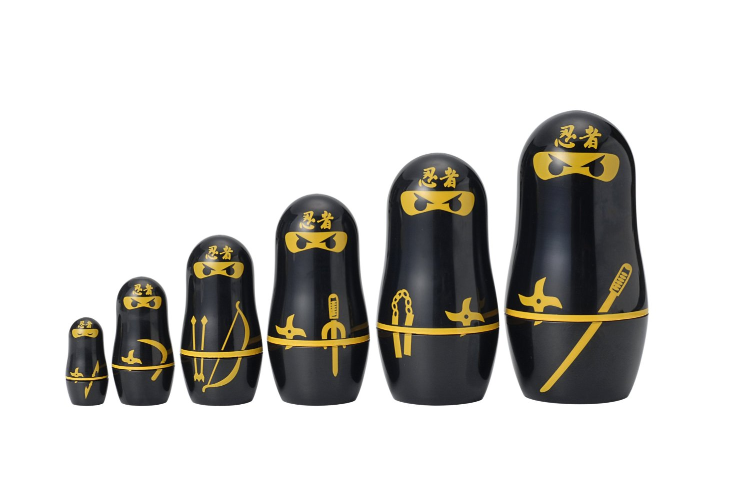
Nesting
for decision-making, we now have it all…
Notes:
Useful skill
Important tool
Window into corners of everyday life

Slide 49
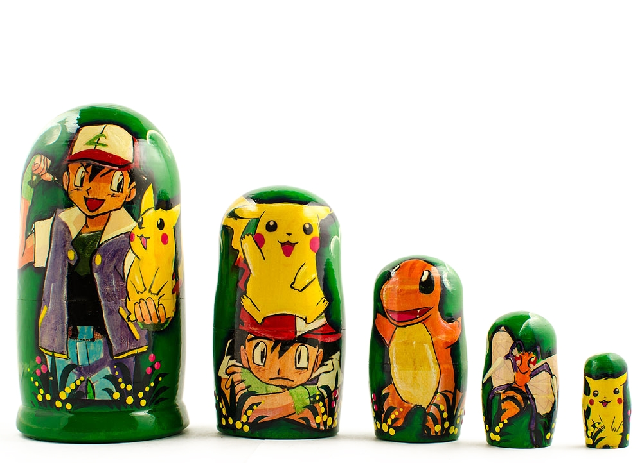
Nesting
for decision-making, we now have it all…
Notes:
Useful skill
Important tool
Window into corners of everyday life

Slide 50
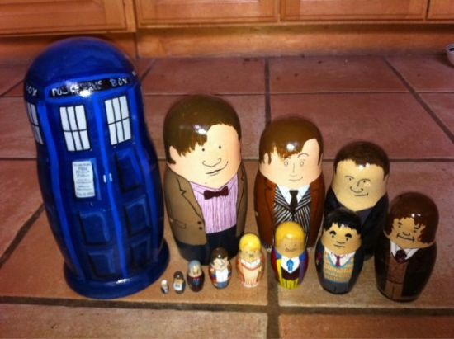
Nesting
for decision-making, we now have it all…
Notes:
Useful skill
Important tool
Window into corners of everyday life

Slide 51
Nesting
Does this program print the correct RPS result this time? Does it always?
comp = 'rock'
user = 'paper'
if comp == 'paper' and user == 'paper':
print('We tie. Try again?')
elif comp == 'rock':
if user == 'scissors':
print('I win! *_*')
else:
print('You win. Aargh!')
BLOCKS ?
TESTS ?
Control Structures ?
Notes:
Useful skill
Important tool
Window into corners of everyday life

Slide 52
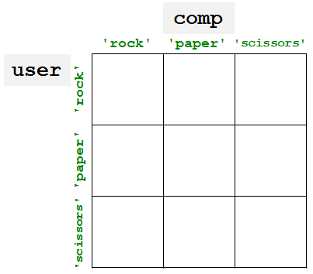
"Quiz"
Pair up with someone nearby – answer these questions together…
Name ______________________
Your favorite __________ is ____________.
Your least favorite ____________ is ____________.
Name ______________________
Your favorite __________ is ____________.
Your least favorite ____________ is ____________.
What is something non-Claremont-collegey you have in common?
Then, try these Python q's:
(2) As written, what output does this print?
(3) Change these inputs to produce a completely correct RPS output here.
(0) Find the 3 tests and 4 blocks here.
comp = 'rock'
user = 'rock'
if comp == 'rock':
print('I win *_*!')
if user == 'paper':
print('You win.')
else:
print('Tie.')
(1) What does this code print?
(4) How many of the 9 RPS input cases are fully correctly handled here?
comp = 'rock'
user = 'rock'
if comp == 'rock':
if user == 'paper':
print('I win *_*!')
elif user == 'scissors':
print('You win.')
else:
print('Tie.')
(5) What is the smallest number of blocks and tests you'd need for a full game of RPS?
(Extra) What if it were RPS-5, which includes Lizard and Spock? How about RPS-101?

Slide 53
"Quiz"
Pair up with someone nearby – answer these questions together…
Name ______________________
Your favorite __________ is ____________.
Your least favorite ____________ is ____________.
Name ______________________
Your favorite __________ is ____________.
Your least favorite ____________ is ____________.
People
Paper
What is something non-Claremont-collegey you have in common?
Then, try these Python q's:
(2) As written, what output does this print?
(3) Change these inputs to produce a completely correct RPS output here.
(0) Find the 3 tests and 4 blocks here.
comp = 'rock'
user = 'rock'
if comp == 'rock':
print('I win *_*!')
if user == 'paper':
print('You win.')
else:
print('Tie.')
(1) What does this code print?
(4) How many of the 9 RPS input cases are fully correctly handled here?
comp = 'rock'
user = 'rock'
if comp == 'rock':
if user == 'paper':
print('I win *_*!')
elif user == 'scissors':
print('You win.')
else:
print('Tie.')
Python
(5) What is the smallest number of blocks and tests you'd need for a full game of RPS?
(Extra) What if it were RPS-5, which includes Lizard and Spock? How about RPS-101?

Slide 54
"Quiz"
Pair up with someone nearby – answer these questions together…
Name ______________________
Your favorite __________ is ____________.
Your least favorite ____________ is ____________.
Name ______________________
Your favorite __________ is ____________.
Your least favorite ____________ is ____________.
What is something non-Claremont-collegey you have in common?
Then, try these Python q's:
(2) As written, what output does this print?
(3) Change these inputs to produce a completely correct RPS output here.
(0) Find the 3 tests and 4 blocks here.
comp = 'rock'
user = 'rock'
if comp == 'rock':
print('I win *_*!')
if user == 'paper':
print('You win.')
else:
print('Tie.')
(1) What does this code print?
(4) How many of the 9 RPS input cases are fully correctly handled here?
comp = 'rock'
user = 'rock'
if comp == 'rock':
if user == 'paper':
print('I win *_*!')
elif user == 'scissors':
print('You win.')
else:
print('Tie.')
(5) What is the smallest number of blocks and tests you'd need for a full game of RPS?
(Extra) What if it were RPS-5, which includes Lizard and Spock? How about RPS-101?

Slide 55
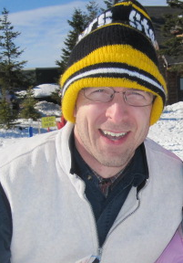
"Quiz"
Name
Your favorite _____ is ________________.
Your least favorite _______ is ______________.
Zach Dodds
tv show
Modern Family
(+ Dr. Who)
coffee
decaffeinated
Name
Your favorite _________ is _______.
Your least favorite _______ is ________.
T. E. Alien
canned-meat food product
spam
#
41.999
so close!
Something in common?
Our taste in hats!

Slide 56
"Quiz"
Pair up with someone nearby – answer these questions together…
Name ______________________
Your favorite __________ is ____________.
Your least favorite ____________ is ____________.
Name ______________________
Your favorite __________ is ____________.
Your least favorite ____________ is ____________.
Please pass these up the aisles…
(take a picture, if you'd like)
… then, turn back to the notes
What is something non-Claremont-collegey you have in common?
Then, try these Python q's:
(2) As written, what output does this print?
(3) Change these inputs to produce a completely correct RPS output here.
(0) Find the 3 tests and 4 blocks here.
comp = 'rock'
user = 'rock'
if comp == 'rock':
print('I win *_*!')
if user == 'paper':
print('You win.')
else:
print('Tie.')
(1) What does this code print?
(4) How many of the 9 RPS input cases are fully correctly handled here?
comp = 'rock'
user = 'rock'
if comp == 'rock':
if user == 'paper':
print('I win *_*!')
elif user == 'scissors':
print('You win.')
else:
print('Tie.')
(5) What is the smallest number of blocks and tests you'd need for a full game of RPS?
(Extra) What if it were RPS-5, which includes Lizard and Spock? How about RPS-101?

Slide 57
"Quiz" ~ problems 1+2
comp = 'rock'
user = 'rock'
if comp == 'rock':
if user == 'paper':
print('I win *_*!')
elif user == 'scissors':
print('You win.')
else:
print('Tie.')
print('Ties go to the runner.')
print(' - and I am running!')
... what if this else block were indented?

Slide 58
"Quiz" ~ problems 3-5
comp = 'rock'
user = 'rock'
if comp == 'rock':
print('I win *_*!')
if user == 'paper':
print('You win.')
else:
print('An awful tie')
What does this program print?

Slide 59
"Quiz" ~ problems 3-5
comp = 'rock'
user = 'rock'
if comp == 'rock':
print('I win *_*!')
if user == 'paper':
print('You win.')
else:
print('An awful tie')
comp
'rock'
'paper'
'scissors'
user
'rock'
'paper'
'scissors'
How many possible “input cases” are there?
How efficient can we be?
For RPS-3? RPS-5? RPS-101?
For how many is this program correct?

Slide 60
"Quiz" ~ problems 3-5
comp = 'rock'
user = 'rock'
if comp == 'rock':
print 'I win *_*!'
if user == 'paper':
print 'You win.'
else:
print 'An awful tie'
comp
'rock'
'paper'
'scissors'
user
'rock'
A correct RPS is possible with only if … elif … else !
'paper'
'scissors'
How many possible “input cases” are there?
How efficient can we be?
For RPS-3? RPS-5? RPS-101?
For how many is this program correct?

Slide 61
Remember ~ Lab this week
Tue. or Wed. ~ evening
Bring your laptop to Beckman B126 (here)
- or use one of the CS machines in B105
Get started with Python/text editor/cmdline…
See you in lab! (perhaps at 5:44:44 today…?)
though it's more than a few bits early!
Alien defeats everything – even Alien
How about a sneak peek at this week's HW… ?
… you must mean sneak Pic !

Slide 64
Choices, choices!
perc = 0.80
if perc > 0.95:
print 'A'
elif perc > 0.90:
print 'A-'
elif perc > 0.70:
print 'Pass'
else:
print 'Aargh!'
perc = 0.80
if perc > 0.00:
print 'Aargh!'
elif perc > 0.70:
print 'Pass'
elif perc > 0.90:
print 'A-'
else:
print 'A'
What does each of these programs print out, if perc is 0.8?
What value of perc gives an 'A-' on the right?
How can you get a better grade on the right than the left?
Notes:
Useful skill
Important tool
Window into corners of everyday life

Slide 65
What's the difference?
mutually exclusive blocks
nonexclusive blocks
perc
perc
if perc > .95:
print('A')
elif perc > .90:
print('A-')
elif perc > .70:
print('Pass')
if perc > .95:
print('A')
if perc > .90:
print('A-')
if perc > .70:
print('Pass')
What if perc == .99 ? (How would we set it?)
How many separate control structures does each side have?
Notes:
Useful skill
Important tool
Window into corners of everyday life

Slide 66
Nesting
Does this program print the correct RPS result this time? Does it always?
comp = 'rock'
user = 'paper'
if comp == 'paper' and user == 'paper':
print 'We tie. Try again?'
elif comp == 'rock':
if user == 'scissors':
print 'I win! *_*'
else:
print 'You win. Aargh!'
BLOCKS ?
TESTS ?
Control Structures ?
Notes:
Useful skill
Important tool
Window into corners of everyday life

Slide 67
"Quiz" ~ problems 1+2
comp = 'rock'
user = 'rock'
if comp == 'rock':
if user == 'paper':
print 'I win *_*!'
elif user == 'scissors':
print 'You win.'
else:
print 'Tie.'
print 'Ties go to the runner.'
print ' - and I am running!'
... what if this else block were indented?

Slide 68
"Quiz" ~ problems 3-5
comp = 'rock'
user = 'rock'
if comp == 'rock':
print 'I win *_*!'
if user == 'paper':
print 'You win.'
else:
print 'An awful tie'
What does this program print?

Slide 69
"Quiz" ~ problems 3-5
comp = 'rock'
user = 'rock'
if comp == 'rock':
print 'I win *_*!'
if user == 'paper':
print 'You win.'
else:
print 'An awful tie'
comp
'rock'
'paper'
'scissors'
user
'rock'
'paper'
'scissors'
How many possible “input cases” are there?
How efficient can we be?
For RPS-3? RPS-5? RPS-101?
For how many is this program correct?

Slide 70
Each week's lab…
0) Find the lab! Sign in…
1) Get Python running…
download things now, perhaps…
2) Run and submit a file…
demo
Encouraged: bring your laptop

Slide 71
This week's hw…
by next Monday night:
Get to the CS5 website and complete and submit hw0.
Make sure you can log into the submission system
Change your password + upload an image
Run and submit hw0pr0.py (provided!)
Extra: submit a rock-paper-scissors-playing program…
username = first initial + last name (most often)
password =
troubles? email me!
Extra! Extra! ~ if you do the extra credit this week, your first problem for next week is already complete!

Slide 72
This week's hw…
by Monday night:
Get to the CS5 website and hw0. Complete hw0pr0 - in brief,
Make sure you can log into the submission system
Change your password + upload an image
Run and submit hw0pr0.py (provided!)
Extra: submit a rock-paper-scissors-playing program…
Demo!
username = first initial + last name (most often)
troubles? email me!
password =
Extra! Extra! ~ if you do the extra credit this week, your first problem for next week is already complete!

Slide 73
in Platt
Evening lab? You can pickup a keycard from HMC's F&M dep't.
Shanahan
coffee
Koi
Map to CS Lab
Edwards
Macalister
Pryne
Physicists, chemists & other parenthesis-needing individuals,
Laptop? Bring it!
cool machines - drills, lathes, etc.
Galileo
other keyboard-free machines
Your account for
CS submissions:
B102
B100
Beckman
passwd:
CS Hallway and Labs
Big Beckman (B126)
B105
Biologists, bees, spiders and other arachnophiles
or Olin
to Olin (Bio + CS)

Slide 74
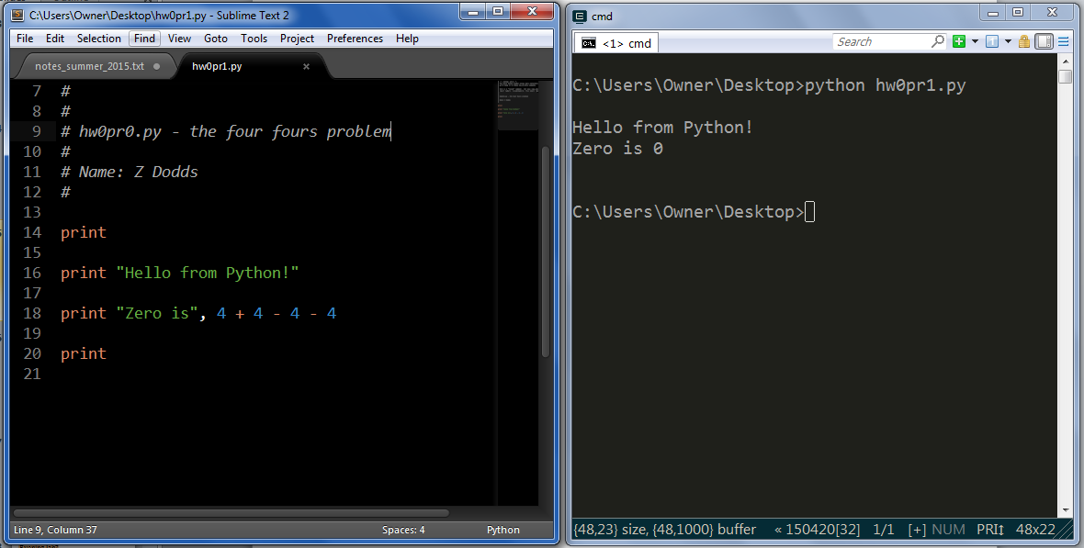
This week: Lab 0
shell prompt > or $
Python source code, a plain-text file
(here, edited by the Sublime text editor)
shell or command-line or terminal
(the execution environment)
get editor + Python running on your own machine

Slide 75
Choices, choices!
Suppose we set the value of perc to 0.91...
perc = 0.91
if perc > 0.95:
print 'A'
elif perc > 0.90:
print 'A-'
elif perc > 0.70:
print 'Pass'
else:
print 'Aargh!'
What will this program print, if perc is 0.91?
# of BLOCKS here:
# of TESTS here:
Notes:
Useful skill
Important tool
Window into corners of everyday life

Slide 76
Does this program print the correct RPS result this time? Does it always?
in a fiercely contested game of RPS...
comp = 'rock'
user = 'paper'
if comp == 'paper' and user == 'paper':
print 'We tie. Try again?'
elif comp == 'rock':
if user == 'scissors':
print 'I win! *_*'
else:
print 'You win. Aargh!'
# of BLOCKS here:
# of TESTS here:
Notes:
Useful skill
Important tool
Window into corners of everyday life

Slide 77
Choices, choices!
Suppose that the value of perc is 0.91...
perc = 0.91
if perc > 0.95:
print 'A'
elif perc > 0.90:
print 'A-'
elif perc > 0.70:
print 'Pass'
else:
print 'Aargh!'
What will this program print, if perc is 0.91?
# of BLOCKS here:
# of TESTS here:
Notes:
Useful skill
Important tool
Window into corners of everyday life

Slide 78
Choices, choices!
perc = 0.80
if perc > 0.95:
print 'A'
elif perc > 0.90:
print 'A-'
elif perc > 0.70:
print 'Pass'
else:
print 'Aargh!'
perc = 0.80
if perc > 0.00:
print 'Aargh!'
elif perc > 0.70:
print 'Pass'
elif perc > 0.90:
print 'A-'
else:
print 'A'
What does each of these programs print out, if perc is 0.8?
What value of perc gives an 'A-' on the right?
How can you get a better grade on the right than the left?
Notes:
Useful skill
Important tool
Window into corners of everyday life

Slide 79
What's the difference?
mutually exclusive blocks
nonexclusive blocks
if perc > .95:
print 'A'
elif perc > .90:
print 'A-'
elif perc > .70:
print 'Pass'
if perc > .95:
print 'A'
if perc > .90:
print 'A-'
if perc > .70:
print 'Pass'
What if perc == .99 ?
How many separate control structures does each side have?
Notes:
Useful skill
Important tool
Window into corners of everyday life

Slide 80
Does this program print the correct RPS result this time? Does it always?
in a fiercely contested game of RPS...
comp = 'rock'
user = 'paper'
if comp == 'paper' and user == 'paper':
print 'We tie. Try again?'
elif comp == 'rock':
if user == 'scissors':
print 'I win! *_*'
else:
print 'You win. Aargh!'
# of BLOCKS here:
# of TESTS here:
Notes:
Useful skill
Important tool
Window into corners of everyday life

Slide 81
First: Pick up your CS lab login + password and look up your submission-site login
"Quiz"
Pair up with someone nearby – and answer these questions together…
Name ______________________
Your favorite __________ is ____________.
Your least favorite ____________ is ____________.
Name ______________________
Your favorite __________ is ____________.
Your least favorite ____________ is ____________.
What is something non-Claremont-collegey you have in common?
Then, try these Python q's:
(2) As written, what output does this print?
(0) How many tests and blocks are here?
(1) What output does this code print?
(3) Change these inputs to produce a completely correct RPS output here.
comp = 'rock'
user = 'rock'
if comp == 'rock':
print 'I win *_*!'
if user == 'paper':
print 'You win.'
else:
print 'Tie.'
comp = 'rock'
user = 'rock'
if comp == 'rock':
if user == 'paper':
print 'I win *_*!'
elif user == 'scissors':
print 'You win.'
else:
print 'Tie.'
(4) How many RPS cases are there? How many of them does this code handle correctly?
(5) What is the smallest number of tests and blocks of code you'll need to correctly handle a full game of RPS?
(Extra) What if it were RPS-5, with Lizard and Spock? RPS-101?

Slide 82
Counting...
comp = 'rock'
user = 'rock'
if comp == 'rock':
if user == 'paper':
print 'I win *_*!'
elif user == 'scissors':
print 'You win.’
else:
print 'Tie.'
print 'Ties go to the runner!'
print ' - and I'm running.'
# of BLOCKS
# of TESTS
... what if the else were indented?

Slide 83
What does this print?
How many possible “inputs” are there?
For how many is this program correct?
comp = 'rock'
user = 'rock'
if comp == 'rock':
print 'I win *_*!‘
if user == 'paper':
print 'You win.‘
else:
print 'An awful tie'
… how efficiently can RPS be represented?
  Fewest number of blocks?
  Fewest number of tests?

Slide 84
'HUMAN'
What is CS?
'CHIMPANZEE'
How can it be done?
What is the Longest Common Subsequence between 2 strings?
How well can it be done?
biology's string-matching problem, "LCS"
Can it be done at all?
'CGCTGAGCTAGGCA...'
Can you solve the problem?
'ATCCTAGGTAACTG...'
Can you create a process to solve such problems?
+10⁹more
Eye oneder if this haz othur aplications?
Notes:
creative side ~ dreamworks, game companies, google, microsoft, soc. networking <-- the design and creation of original algorithms and software
and a commodity side ~ application use, configuration, customization, certification, your favorite acronym here…
our department pays only about 5-10% of its attention to the commodity side
it pays 90-95% of its attention to the creative side… Why?
robotics? taught yourself to build or create something… game levels, etc.?

Slide 85
Feels like home!
What is CS?
How can it be done?
How well can it be done?
Can it be done at all?
How quickly can you find a solution?
How much work is needed to simulate N stars?
Is your solution the "best" possible?
physics's "N-body" problem
Notes:
creative side ~ dreamworks, game companies, google, microsoft, soc. networking <-- the design and creation of original algorithms and software
and a commodity side ~ application use, configuration, customization, certification, your favorite acronym here…
our department pays only about 5-10% of its attention to the commodity side
it pays 90-95% of its attention to the creative side… Why?
robotics? taught yourself to build or create something… game levels, etc.?

Slide 86
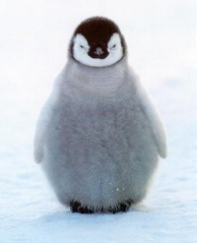
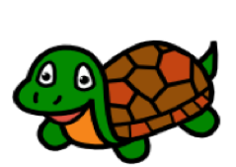

Why here?
official alien of CS 5 Gold
official mascot of CS 5 Black
Placement based on experience, not ability:
  Gold is for students mostly new to CS,
  Black for students with a good amount of previous CS
  Tradeoff: more careful coverage – a few more applications
  Green is for those who'd like biology-flavored CS!
  All of Gold Black and Green will prepare you well for
    CS 60
    Future computational work
    A happy and fulfilling life :-)
official turtle of CS 5 Green
switching?

Slide 87
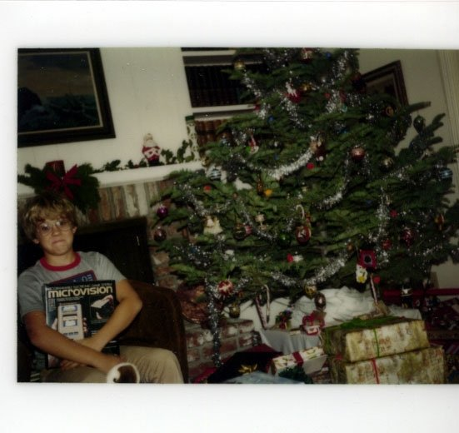
… and who is this Mudder, 35 years later?
Jon “Dean” Jacobsen, 1979

Slide 88
Notes:
my foreign language teachers always tried to convince me that the skill of speaking, reading and writing a foreign language…
I didn’t believe them then and I don’t believe them now -- but I do believe that reading and writing a computer language is the way to get a strong intuitive understanding of how machines think -- it’s also important for getting them to do what you want them to, but even if you forget everything this course (hopefully) teaches about Java (compiler, datatypes, Classes and Objects), the real goal is that you take away a deeper insight into how machines think
familiar and sometimes not so familiar… deceptively easy
you mean I have to type all that!!

Slide 89
What is programming ?
Programming as "recipe-writing"
vs.
Programming as learning a foreign language
Notes:
my foreign language teachers always tried to convince me that the skill of speaking, reading and writing a foreign language…
I didn’t believe them then and I don’t believe them now -- but I do believe that reading and writing a computer language is the way to get a strong intuitive understanding of how machines think -- it’s also important for getting them to do what you want them to, but even if you forget everything this course (hopefully) teaches about Java (compiler, datatypes, Classes and Objects), the real goal is that you take away a deeper insight into how machines think
familiar and sometimes not so familiar… deceptively easy
you mean I have to type all that!!

Slide 90
What is programming ?
Programming as "recipe-writing"
vs.
Programming as learning a foreign language
Baggage !
1) Expect it to be different!
2) Don’t feel you need to memorize it
3) Immersion == Experimentation
go/went
Notes:
my foreign language teachers always tried to convince me that the skill of speaking, reading and writing a foreign language…
I didn’t believe them then and I don’t believe them now -- but I do believe that reading and writing a computer language is the way to get a strong intuitive understanding of how machines think -- it’s also important for getting them to do what you want them to, but even if you forget everything this course (hopefully) teaches about Java (compiler, datatypes, Classes and Objects), the real goal is that you take away a deeper insight into how machines think
familiar and sometimes not so familiar… deceptively easy
you mean I have to type all that!!

Slide 91
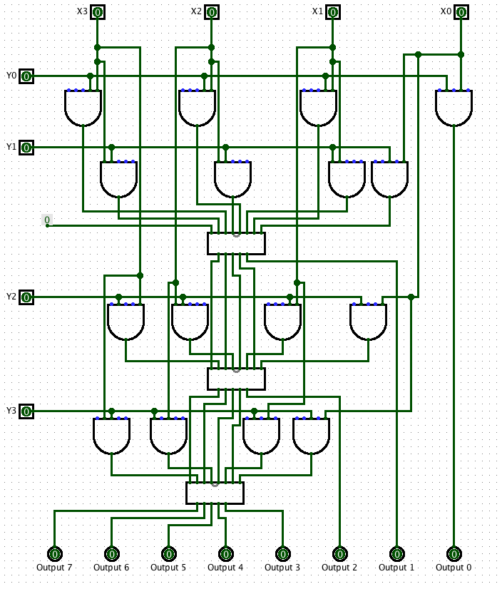
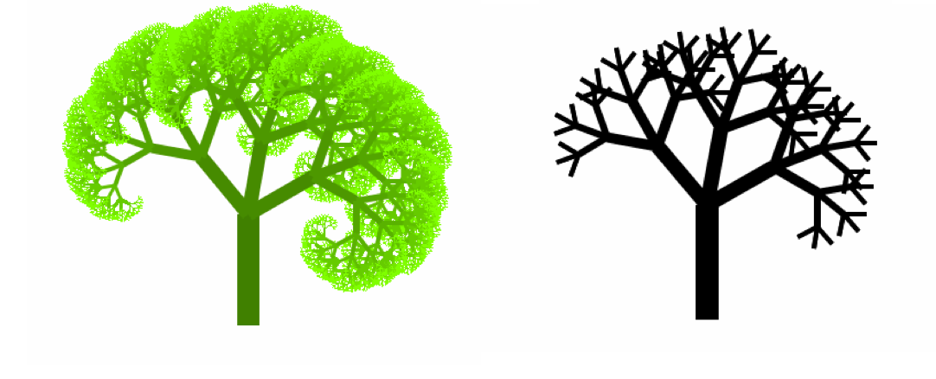
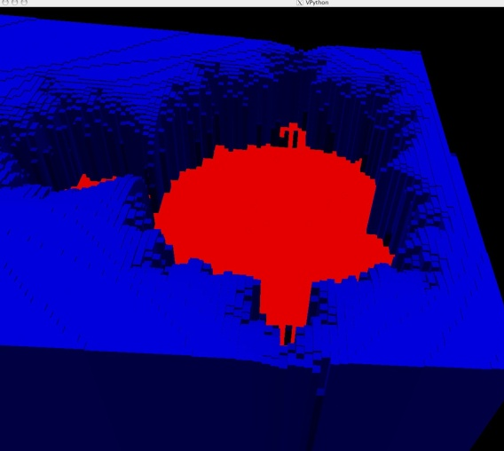
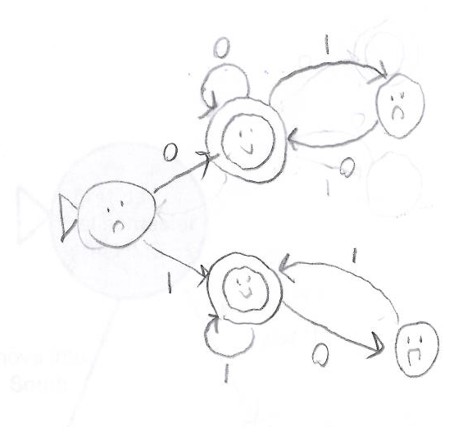
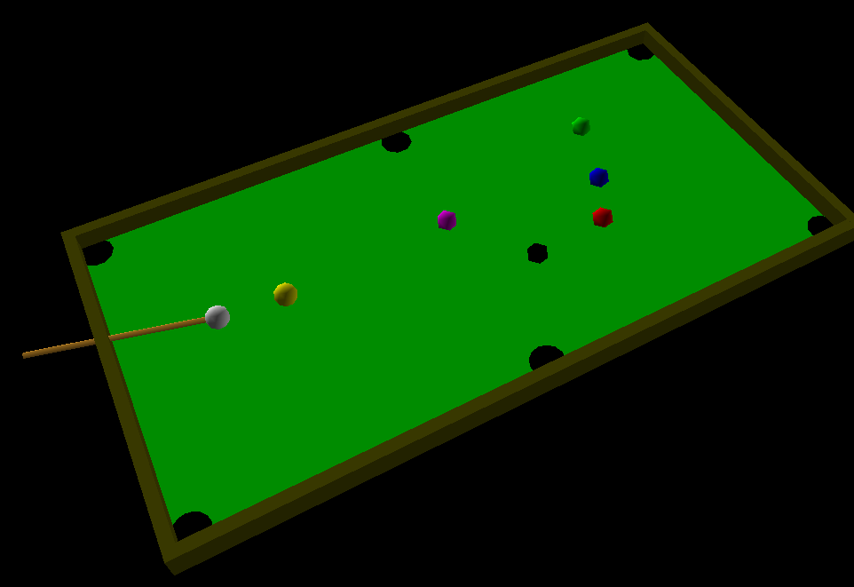
Why CS 5 ?
2
Broad, constructive tour in CS
semester abroad
1
design
recursion
simulation
3
5
4
Notes:
so, while this is an appealing argument to someone who is interested in AI

Slide 92
Python Programming?
in pictures?
Notes:
my foreign language teachers always tried to convince me that the skill of speaking, reading and writing a foreign language…
I didn’t believe them then and I don’t believe them now -- but I do believe that reading and writing a computer language is the way to get a strong intuitive understanding of how machines think -- it’s also important for getting them to do what you want them to, but even if you forget everything this course (hopefully) teaches about Java (compiler, datatypes, Classes and Objects), the real goal is that you take away a deeper insight into how machines think
familiar and sometimes not so familiar… deceptively easy
you mean I have to type all that!!

Slide 93
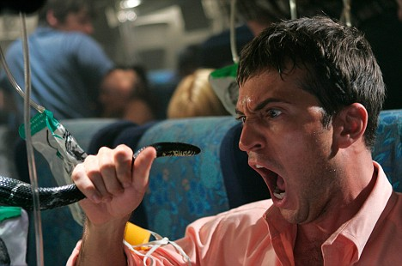
Python Programming?
One possibility...
Notes:
my foreign language teachers always tried to convince me that the skill of speaking, reading and writing a foreign language…
I didn’t believe them then and I don’t believe them now -- but I do believe that reading and writing a computer language is the way to get a strong intuitive understanding of how machines think -- it’s also important for getting them to do what you want them to, but even if you forget everything this course (hopefully) teaches about Java (compiler, datatypes, Classes and Objects), the real goal is that you take away a deeper insight into how machines think
familiar and sometimes not so familiar… deceptively easy
you mean I have to type all that!!

Slide 94
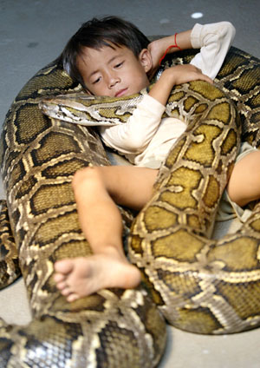
Python Programming?
One possibility...
Happy co-existence! It can even be comfy!
Notes:
my foreign language teachers always tried to convince me that the skill of speaking, reading and writing a foreign language…
I didn’t believe them then and I don’t believe them now -- but I do believe that reading and writing a computer language is the way to get a strong intuitive understanding of how machines think -- it’s also important for getting them to do what you want them to, but even if you forget everything this course (hopefully) teaches about Java (compiler, datatypes, Classes and Objects), the real goal is that you take away a deeper insight into how machines think
familiar and sometimes not so familiar… deceptively easy
you mean I have to type all that!!

Slide 95

Python Programming?
Python (language) and IDLE (editor)
open-source, free, powerful, and common
We will be using Python 2.7.3
~ the “Enthought” distribution
Plain old Python 2.7.x is certainly OK, too.
Don't get 3.1 or 3.x!
Notes:
my foreign language teachers always tried to convince me that the skill of speaking, reading and writing a foreign language…
I didn’t believe them then and I don’t believe them now -- but I do believe that reading and writing a computer language is the way to get a strong intuitive understanding of how machines think -- it’s also important for getting them to do what you want them to, but even if you forget everything this course (hopefully) teaches about Java (compiler, datatypes, Classes and Objects), the real goal is that you take away a deeper insight into how machines think
familiar and sometimes not so familiar… deceptively easy
you mean I have to type all that!!

Slide 96
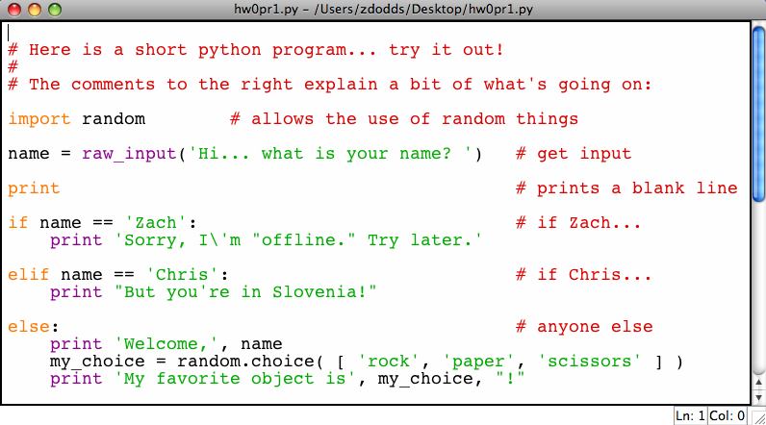
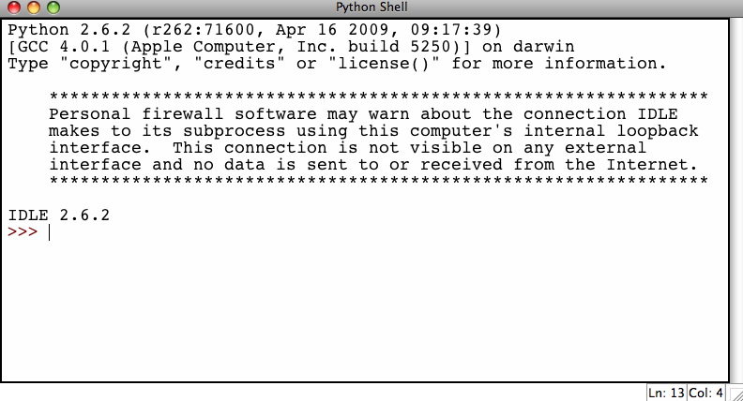
"Editor" and "Shell"
Editor (IDLE): typing code
Shell window: running code
Here, you can save and change programs. Hitting F5 runs your program over in the shell
Here, you can try things out at the command prompt >>>
Notes:
my foreign language teachers always tried to convince me that the skill of speaking, reading and writing a foreign language…
I didn’t believe them then and I don’t believe them now -- but I do believe that reading and writing a computer language is the way to get a strong intuitive understanding of how machines think -- it’s also important for getting them to do what you want them to, but even if you forget everything this course (hopefully) teaches about Java (compiler, datatypes, Classes and Objects), the real goal is that you take away a deeper insight into how machines think
familiar and sometimes not so familiar… deceptively easy
you mean I have to type all that!!

Slide 97
The foreign language of python…
name = raw_input('Hi... what is your name? ')
print # prints a blank line
if name == 'Eliot' or name == 'Ran':
print 'I\'m "offline." Try later.'
elif name == 'Zach': # is it Zach?
print 'Zach Quinto...?', 'No?', 'Oh.'
else: # in all other cases...
print 'Welcome', name, '!'
my_choice = random.choice( [ 'R','P','S' ] )
print 'My favorite object is', my_choice, "!"
Lab 0 – Tues. / Wed. is to run and submit “this” program
Notes:
my foreign language teachers always tried to convince me that the skill of speaking, reading and writing a foreign language…
I didn’t believe them then and I don’t believe them now -- but I do believe that reading and writing a computer language is the way to get a strong intuitive understanding of how machines think -- it’s also important for getting them to do what you want them to, but even if you forget everything this course (hopefully) teaches about Java (compiler, datatypes, Classes and Objects), the real goal is that you take away a deeper insight into how machines think
familiar and sometimes not so familiar… deceptively easy
you mean I have to type all that!!

Slide 98
The foreign language of python…
syntax
semantics
intent
How it looks
What it does
What it should do
name = raw_input('Hi... what is your name? ')
print # prints a blank line
if name == 'Eliot' or name == 'Ran':
print 'I\'m "offline." Try later.'
elif name == 'Zach': # is it Zach?
print 'Zach Quinto...?', 'No?', 'Oh.'
else: # in all other cases...
print 'Welcome', name, '!'
my_choice = random.choice( [ 'R','P','S' ] )
print 'My favorite object is', my_choice, "!"
Notes:
my foreign language teachers always tried to convince me that the skill of speaking, reading and writing a foreign language…
I didn’t believe them then and I don’t believe them now -- but I do believe that reading and writing a computer language is the way to get a strong intuitive understanding of how machines think -- it’s also important for getting them to do what you want them to, but even if you forget everything this course (hopefully) teaches about Java (compiler, datatypes, Classes and Objects), the real goal is that you take away a deeper insight into how machines think
familiar and sometimes not so familiar… deceptively easy
you mean I have to type all that!!

Slide 99
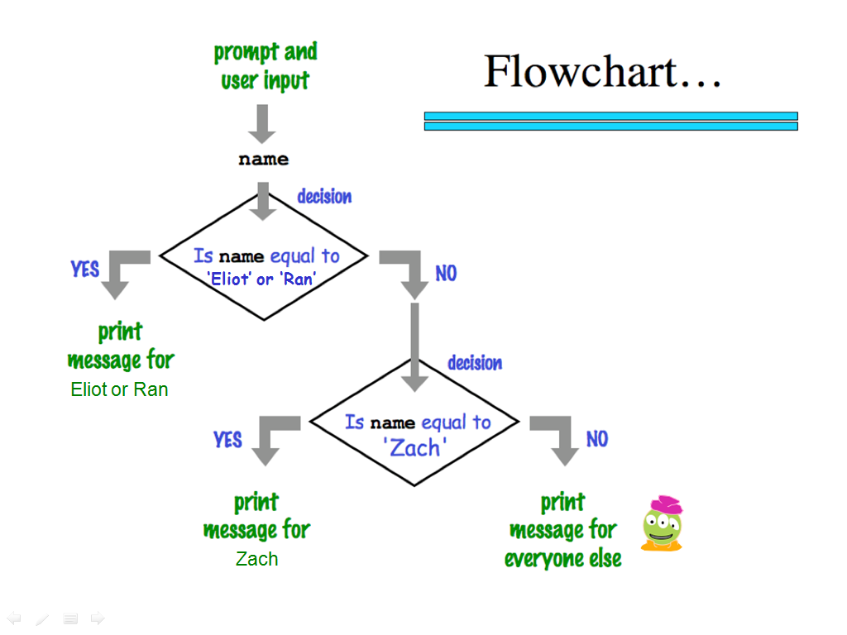
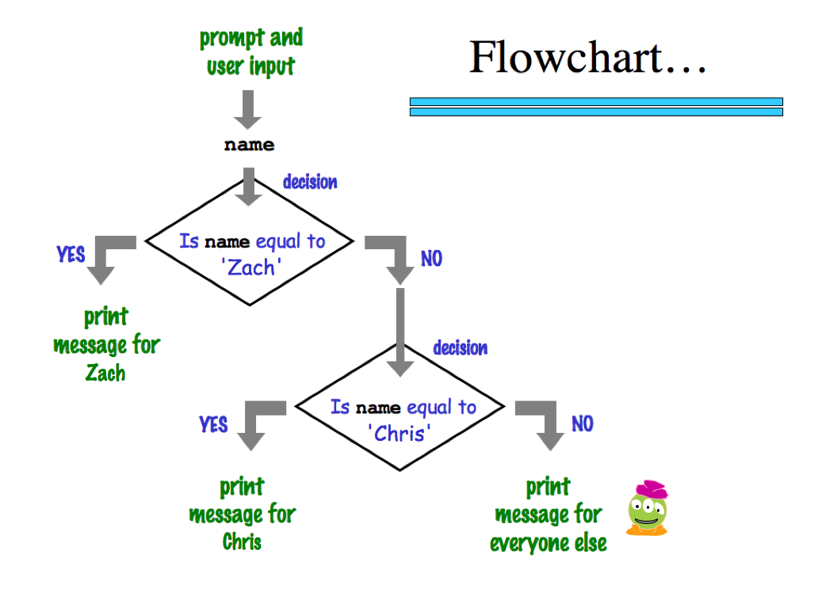
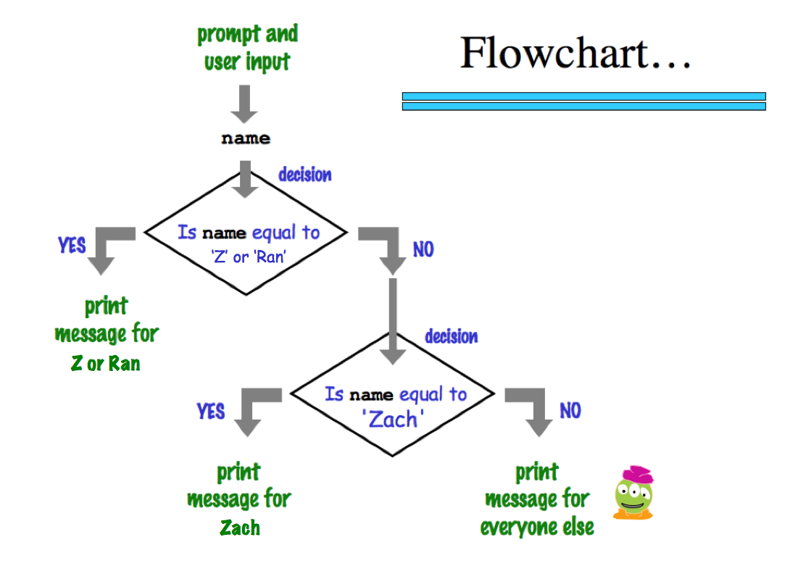
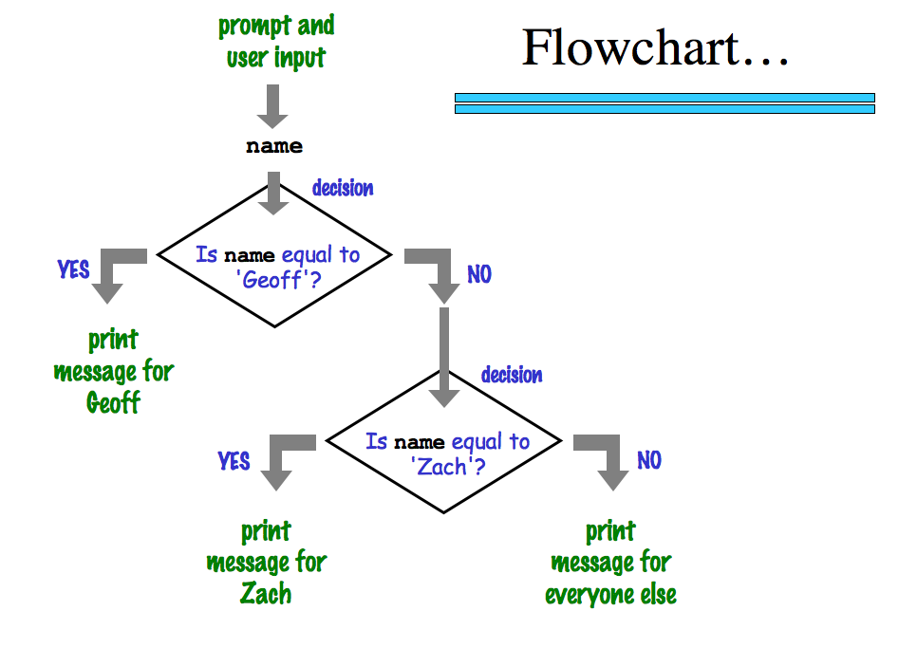

'Zach'
‘Eliot’ or ‘Ran’
Zach
Eliot or Ran
'Chris'
Chris
Zach
What about me?
Notes:
my foreign language teachers always tried to convince me that the skill of speaking, reading and writing a foreign language…
I didn’t believe them then and I don’t believe them now -- but I do believe that reading and writing a computer language is the way to get a strong intuitive understanding of how machines think -- it’s also important for getting them to do what you want them to, but even if you forget everything this course (hopefully) teaches about Java (compiler, datatypes, Classes and Objects), the real goal is that you take away a deeper insight into how machines think
familiar and sometimes not so familiar… deceptively easy
you mean I have to type all that!!

Slide 100
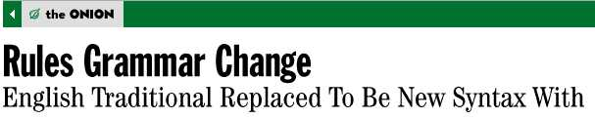
The foreign language of python…
syntax
semantics
intent
How it looks
What it does
What it should do
www.theonion.com
Syntax
how punctuation is used
the language keywords that are used
use of whitespace
peculiarities of formatting
how behavior is affected …
How Python looks!
Notes:
my foreign language teachers always tried to convince me that the skill of speaking, reading and writing a foreign language…
I didn’t believe them then and I don’t believe them now -- but I do believe that reading and writing a computer language is the way to get a strong intuitive understanding of how machines think -- it’s also important for getting them to do what you want them to, but even if you forget everything this course (hopefully) teaches about Java (compiler, datatypes, Classes and Objects), the real goal is that you take away a deeper insight into how machines think
familiar and sometimes not so familiar… deceptively easy
you mean I have to type all that!!

Slide 101
Language is language...?
Intercal
v
>v"Hello world!"0<
,:
^_25*,@
PLEASE DO ,1 <- #13
DO ,1 SUB #1 <- #238
DO ,1 SUB #2 <- #112
DO ,1 SUB #3 <- #112
DO ,1 SUB #4 <- #0
DO ,1 SUB #5 <- #64
DO ,1 SUB #6 <- #238
DO ,1 SUB #7 <- #26
DO ,1 SUB #8 <- #248
DO ,1 SUB #9 <- #168
DO ,1 SUB #10 <- #24
DO ,1 SUB #11 <- #16
DO ,1 SUB #12 <- #158
DO ,1 SUB #13 <- #52
PLEASE READ OUT ,1
PLEASE GIVE UP
Befunge
(DEFUN HELLO-WORLD ()
(PRINT (LIST 'HELLO 'WORLD)))
LISP
Scheme
int main()
{
printf("%s\n", "Hello, world!");
}
C
C++
HAI
CAN HAS STDIO?
VISIBLE "HAI WORLD!"
KTHXBYE
LOLCODE
print 'Hello, World!'
Python
Notes:
ZACH
my foreign language teachers always tried to convince me that the skill of speaking, reading and writing a foreign language…
I didn’t believe them then and I don’t believe them now -- but I do believe that reading and writing a computer language is the way to get a strong intuitive understanding of how machines think -- it’s also important for getting them to do what you want them to, but even if you forget everything this course (hopefully) teaches about any particular language, the real goal is that you take away a deeper insight into how machines think
really no scarier than being raised to learn English, Swedish, or whatever

Slide 102
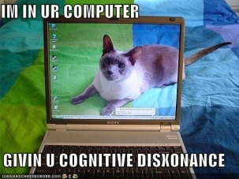

Language is language...?
Intercal
v
>v"Hello world!"0<
,:
^_25*,@
PLEASE DO ,1 <- #13
DO ,1 SUB #1 <- #238
DO ,1 SUB #2 <- #112
DO ,1 SUB #3 <- #112
DO ,1 SUB #4 <- #0
DO ,1 SUB #5 <- #64
DO ,1 SUB #6 <- #238
DO ,1 SUB #7 <- #26
DO ,1 SUB #8 <- #248
DO ,1 SUB #9 <- #168
DO ,1 SUB #10 <- #24
DO ,1 SUB #11 <- #16
DO ,1 SUB #12 <- #158
DO ,1 SUB #13 <- #52
PLEASE READ OUT ,1
PLEASE GIVE UP
Befunge
(DEFUN HELLO-WORLD ()
(PRINT (LIST 'HELLO 'WORLD)))
LISP
Scheme
int main()
{
printf("%s\n", "Hello, world!");
}
C
C++
HAI
CAN HAS STDIO?
VISIBLE "HAI WORLD!"
KTHXBYE
LOLCODE
print 'Hello, World!'
Python
Notes:
ZACH
my foreign language teachers always tried to convince me that the skill of speaking, reading and writing a foreign language…
I didn’t believe them then and I don’t believe them now -- but I do believe that reading and writing a computer language is the way to get a strong intuitive understanding of how machines think -- it’s also important for getting them to do what you want them to, but even if you forget everything this course (hopefully) teaches about any particular language, the real goal is that you take away a deeper insight into how machines think
really no scarier than being raised to learn English, Swedish, or whatever

Slide 103
Second looks?
name = raw_input('Hi... what is your name? ')
print # prints a blank line
if name == 'Eliot' or name == 'Ran':
print 'I\'m "offline." Try later.'
elif name == 'Zach': # is it Zach?
print 'Zach Quinto...?', 'No?', 'Oh.'
else: # in all other cases...
print 'Welcome', name, '!'
my_choice = random.choice( [ 'R','P','S' ] )
print 'My favorite object is', my_choice, "!"
Punctuation? Spacing? Color information? Strings? Variables?
Notes:
my foreign language teachers always tried to convince me that the skill of speaking, reading and writing a foreign language…
I didn’t believe them then and I don’t believe them now -- but I do believe that reading and writing a computer language is the way to get a strong intuitive understanding of how machines think -- it’s also important for getting them to do what you want them to, but even if you forget everything this course (hopefully) teaches about Java (compiler, datatypes, Classes and Objects), the real goal is that you take away a deeper insight into how machines think
familiar and sometimes not so familiar… deceptively easy
you mean I have to type all that!!

Slide 104
CS’s motto ?
details are temporary…
…but CS thinking isn’t !
print 'hv',
print 'dcle\naemdoe'
print 'ryu',
print 'lg!'
print 'whteo'
print 'aerub\nv',
print 'aeo\nyraoo'
print 'egdne'
Notes:
Useful skill
Important tool
Window into corners of everyday life

Slide 105
CS’s motto ?
details are temporary…
…but CS thinking isn’t !
hv dcle
aemdoe
ryu lg!
whteo
aerub
v aeo
yraoo
egdne
print 'hv',
print 'dcle\naemdoe'
print 'ryu',
print 'lg!'
print 'whteo'
print 'aerub\nv',
print 'aeo\nyraoo'
print 'egdne'
Notes:
Useful skill
Important tool
Window into corners of everyday life

Slide 106
We agree...
Whatever you are, be a good one.
- Abraham Lincoln
... more and more, CS can help!

Slide 107

(0) Be sure to sign in!
Lab 0!
(1) Pick up this page
(2) Login to your own laptop OR a CS machine
(with your CS account)
and open a browser, e.g., Safari
anything but IE
(3) Go to Lab 0 and work through it...
Google for "HMC CS" – click "Schedule" – then CS5 . Or, type www.cs.hmc.edu/twiki/bin/view/CS5/
(a) (or later) Change your CS password
(b) Try Python & its "shell"
(c) Submit hw0pr1 of the assignment
(d) Complete the CS policy forms
(e) Finish hw0pr2 (if you'd like...)
(4) Either before or after changing your CS password,
feel free to use your own laptop instead...
Questions? Ask us!

Slide 108
comp = 'rock'
user = 'rock'
if comp == 'rock':
if user == 'paper':
print 'I win *_*!'
elif user == 'scissors':
print 'You win.'
else:
print 'Tie.'
print 'Ties go to the runner!'
print 'I'm running - are you?'
What does this print?

Slide 109
How many RPS-legal inputs are there?
For how many is this program correct?
comp = ???
user = ???
if comp == 'rock':
print 'I win *_*!'
if user == 'paper':
print 'You win.'
else:
print 'Tie.'
print '-- a horrible tie!'
What does this print?

Slide 110
Why CS ?
Information is life’s fundamental building block.
Genetic Code: DNA
Our senses and experiences
GTAGCACAITTAGC…
More coffee required…
us
CS is a set of fundamental techniques for understanding and leveraging this information…
“constructing with”
Notes:
so, while this is an appealing argument to someone who is interested in AI

Slide 111
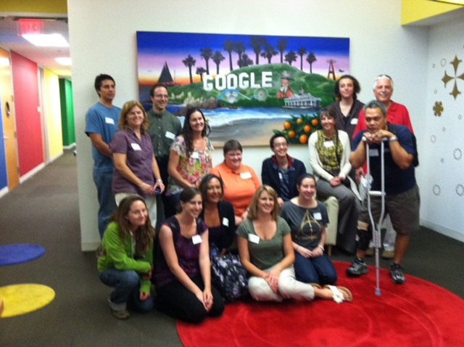
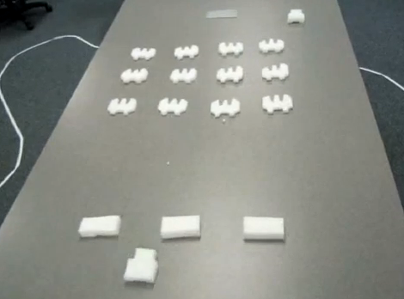
How I spent my summer vacation...
serving as a historical consultant!
visiting Google Irvine
... and programming flying robots, too...

Slide 112
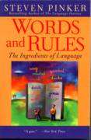
No worries...
CS is deceptively easy.

Slide 113
What is CS?
creativity / design
commodity skills
It's a big span
Notes:
creative side ~ dreamworks, game companies, google, microsoft, soc. networking <-- the design and creation of original algorithms and software
and a commodity side ~ application use, configuration, customization, certification, your favorite acronym here…
our department pays only about 5-10% of its attention to the commodity side
it pays 90-95% of its attention to the creative side… Why?
robotics? taught yourself to build or create something… game levels, etc.?

Slide 114
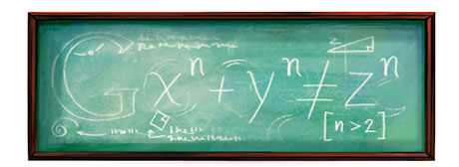

What is CS?
creativity / design
commodity skills
It's a big span
Notes:
creative side ~ dreamworks, game companies, google, microsoft, soc. networking <-- the design and creation of original algorithms and software
and a commodity side ~ application use, configuration, customization, certification, your favorite acronym here…
our department pays only about 5-10% of its attention to the commodity side
it pays 90-95% of its attention to the creative side… Why?
robotics? taught yourself to build or create something… game levels, etc.?

Slide 115
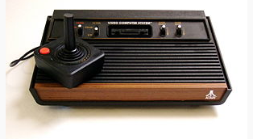

The Atari 2600 game, Adventure!

Slide 116
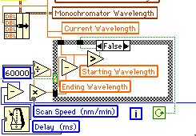
Why Python ?
Python is a general-purpose computer language
skills apply to all special-purpose languages
Physics: LabView
Biology: Lasergene, DNA*
Engineering: Matlab
Mathematics: Maple, Mathematica
ALL of these seem alien at first!
You’re telling me!
Notes:
Electric: from www.staticfreesoftware.com
My tutorial is at:
http://odin.ac.hmc.edu/~harris/class/chipdesign/electric.pdf
Lasergene (a molecular biology suite of programs for aligning and comparing
DNA sequences, etc.)
Statview (statistical analysis)
KaleidaGraph (plotting & graphing)
Populus (programs that simulate ecological and evolutionary processes)

Slide 117
Language is language ?
Perls of wisdom ?
eval evalq.q>trd!Uj:%L<061:%C<csnvo:%f<fsddo0:%c<cmtd:%x<xdmmnv:%I<011:%u<251:%bs<bsd`udSdbu`ofmd:%w<lnwd:%U<2:%t<L`hoVhoenv,?
odv),idhfiu<?314-,vheui<?254(:%b<%t,?B`ow`r:%b,?bnoghftsd),vheui<?%u-,idhfiu<?311(:%b,?q`bj)(:s)3-3-%u-001-%c(:s)3-081-%u-311
-%f(:s)3-001-%u-031-%f(:s)3-1-%u-34-%f(:gns)%{<1:%{=%u:%{*<71(zs)%{-01-%{*51-54-%f-%f(:|s)3-1-%u-04-cm`bj(:%b,?%bs)3-1-%u-311
(:%G<,041:v)1-%L-31-C-%x(:v)%G-%L-,021-C-%x(:%B<,91:v),31-041-,4-B-%c(:v),91-041-,74-B-%c(:%E<,%I:v)1-021-31-E-%x(:v),%I-021-,
91-E-%x(:%K<,231:v),71-81-,31-@-%C(:v),301-81-,%L-@-%C(:v),%u-81-,211-@-%C(:%M<,%u:v),51-61-1-F-%C(:v),%L-61-,021-F-%C(:v),%u
-61-,211-F-%C(:%J<%u:v)751-41-791-[-%C(:v)401-41-441-[-%C(:v)%u-41-291-[-%C(:%b,?bsd`udNw`m)063-080-091-088-,u`fr<?G-,ghmm<?f
sddo5(:S)1(:%b,?sdqd`u)%I-]'t(:%t,?choe)&=Envo?&<?rtczS),0(:'V:%b,?%w)G-1-31(hg)%x=081(:|(:%t,?choe)&=Tq?&<?rtczS)0(:%b,?%w)G
-1-,31(:|(:%t,?choe)&=Mdgu?&<?rtcz'V:%b,?%w)G-,31-1(hg)%y?31(:|(:%t,?choe)&=Shfiu?&<?rtcz'V:%b,?%w)G-31-1(hg)%Y=%u,31(:|(:L`h
oMnnq)(:dyhu:rtc!vz%b,?%bs)%^Z1\-%^Z0\-%^Z3\-%^Z0\*8-,u`fr<?%^Z2\-,ghmm<?%^Z5\(:|rtc!tzhg)%G?%u(z%G*<%L:%d<,%G:%G<,%L:|dmrdz%
G*<01:%d<01:|%b,?%w)C-%d-1(:hg)%B?%u(z%B*<%I:%d<,%B:%B<,%I:|dmrdz%B*<01:%d<01:|%b,?%w)B-%d-1(:hg)%E?%u(z%E*<031:%d<,%E:%E<,03
1:|dmrdz%E*<01:%d<01:|%b,?%w)E-%d-1(:hg)%K?%u(z%K*<229:%d<,%K:%K<,251:|dmrdz%K*<7:%d<7:|%b,?%w)@-%d-1(:hg)%M?%u(z%M*<271:%d<,
%M:%M<,271:|dmrdz%M*<9:%d<9:|%b,?%w)F-%d-1(:hg)%J=,%u(z%J,<%u:%d<,%J:%J<%u:|dmrdz%J,<7:%d<,7:|%b,?%w)[-%d-1(:'V:hg)%x=081(zhg
))%x?031(}})%x=001((zAn<%b,?ghoe)nwdsm`qqhof-%y-%x-%Y-%X(:hg)%x?031(zhg)%"n(z'R:||dmrdzhg)%x?58(zhg)%"n?0(z%n<7:%n*<3hg)%x=81
(:%n<,7hg)%x=61(:%b,?%w)G-%n-1(:|dmrdz'R:||dmrdzhg)%"n?0(z'R:|dmrdzS)00(:%U**:%O**:'R:v)%y-%x-%Y-Q-%f(:%b,?edmdud)&Q&(hg))%O$
4((:||||rmddq)4(''Uj;;dyhu)1(hg)%U=0(:||rtc!Rz%U,,:qshou#]`#:%b,?%w)G-063,%y-081,%x(:|rtc!SzP)cm`bj(:%R*<%^Z1\:P)sde(: |rtc!P
z%b,?bsd`udUdyu)%L-9,udyu<?%R/1-,ghmm<?%^Z1\(:|rtc!sz%b,?%bs)%^Z1\-%^Z0\-%^Z3\-%^Z2\-,ghmm<?%^Z5\-,ntumhod<?%^Z4\(:|rtc!Vz)%y
-%x-%Y-%X(<%b,?bnnser)G(:|>^chr($$/$$)x2016.
Perl might be a little bit TOO flexible a language!
Goal: expression, not language details.
Notes:
my foreign language teachers always tried to convince me that the skill of speaking, reading and writing a foreign language…
I didn’t believe them then and I don’t believe them now -- but I do believe that reading and writing a computer language is the way to get a strong intuitive understanding of how machines think -- it’s also important for getting them to do what you want them to, but even if you forget everything this course (hopefully) teaches about Java (compiler, datatypes, Classes and Objects), the real goal is that you take away a deeper insight into how machines think

Slide 118
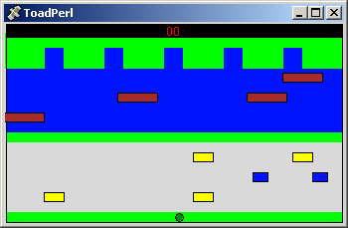
The results
back to Python
Notes:
my foreign language teachers always tried to convince me that the skill of speaking, reading and writing a foreign language…
I didn’t believe them then and I don’t believe them now -- but I do believe that reading and writing a computer language is the way to get a strong intuitive understanding of how machines think -- it’s also important for getting them to do what you want them to, but even if you forget everything this course (hopefully) teaches about Java (compiler, datatypes, Classes and Objects), the real goal is that you take away a deeper insight into how machines think

Slide 119
What Google thinks I look like
First 4 Google Image hits (8/29/10) for a search of
"Zach Dodds HMC"

Slide 120
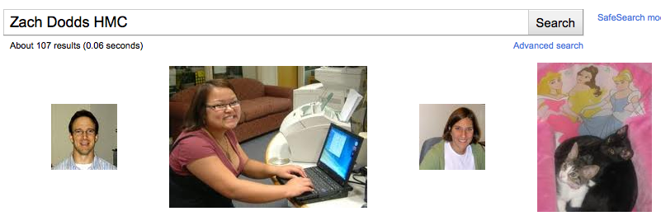
What Google thinks I look like
First 4 Google Image hits (8/29/10) for a search of
"Zach Dodds HMC"

Slide 121

What Google thought I looked like…
First Google Image hit (8/30/09) for a search of
"Zach Dodds"
Images are difficult!

Slide 122
coffee
See you in Lab!
CIS + Labs
Edwards
Macalister
Physicists and other parenthesis-needing individuals, e.g. chemists
Pryne
Parsons
cool machines - drills, lathes, etc.
Map to CS Labs
more cool, keyboardless machines
CS Hallway
B102
B100
B105
CS Hallway
Big Beckman (B126)
Beckman B102, B105
Get your CS account.
Laptop is OK, with wireless.
Olin (math, bio, CS)

Slide 123

CS? Not why...
Python is the ultimate programming language
Programming will solve problems for you
Programming will save
time and effort

Slide 126

Abstraction
Artists are mystics rather than rationalists. They leap to conclusions that logic cannot reach.
-- Sol LeWitt,
conceptual artist
Simplicity does not precede complexity, but follows it.
-- Alan Perlis, early CS-ist.
Notes:
dealing with code in which you don’t know everything that’s going on, you need to abstract away details and keep a bigger picture in mind

Slide 128


HW problems 3 and 4
walls
Picobot
Picobot
area not covered (yet!)
area already covered
Picobot
as envisioned by an HMC clinic
Goal: whole-environment coverage with only local sensing…
inspiration?

Slide 129

Picobot
walls
Picobot
area not covered (yet!)
area already covered
Goal: whole-environment coverage with only local sensing…
iRobot's Roomba vacuum
inspiration!

Slide 130
Surroundings
N
Picobot can only sense things directly to the N, E, W, and S
W
E
S
For example, here its surroundings are
NxWx
Surroundings are always in NEWS order.
N E W S

Slide 131
Surroundings
N
How many distinct surroundings are there?
W
E
S

Slide 132
Surroundings
N
How many distinct surroundings are there?
W
E
S
2⁴
== 16 possible …
xxxx
Nxxx
xExx
xxWx
xxxS
NExx
NxWx
NxxS
xEWx
xExS
xxWS
NEWx
NExS
NxWS
xEWS
NEWS
(won’t happen)

Slide 133
State
I am in state 0.
My surroundings
are xxWS.
Picobot's memory is a single number, called its state.
State is the internal context of computation.
Picobot always starts in state 0.
State and surroundings represent everything the robot knows about the world

Slide 134
Rules
I am in state 0.
My surroundings
are xxWS.
Aha!
I should move N.
I should enter state 0.
Picobot moves according to a set of rules:
state
surroundings
direction
new state
0
xxWS
N
0
If I'm in state 0 seeing xxWS,
Then I move North, and change to state 0.

Slide 135
Wildcards
I am in state 0.
My surroundings
are xxWS.
Aha! This matches x***
Asterisks * are wild cards. They match walls or empty space:
state
surroundings
direction
new state
0
x***
N
0
and EWS may be wall or empty space
N must be empty

Slide 136
What will this set of rules do to Picobot?
state
surroundings
direction
new state
0
x***
->
N
0
0
N***
->
X
0
how can we get back down the screen?
Picobot checks its rules from the top each time.
When it finds a matching rule, that rule runs.
Only one rule is allowed per state and surroundings.

Slide 137
What will this set of rules do to Picobot?
state
surroundings
direction
new state
0
x***
->
N
0
0
N***
->
X
1
1
***x
->
S
1
1
***S
->
X
0
Picobot checks its rules from the top each time.
When it finds a matching rule, that rule runs.
Only one rule is allowed per state and surroundings.

Slide 138


To do
Write rules that will always cover these two rooms.
(separate sets of rules are encouraged…)
hw0, Problem #3
hw0, Problem #4
but your rules should work regardless of Picobot's starting location

Slide 139

Alter these "up & down" rules so that Picobot will traverse the empty room…
"Quiz" #2
the empty room

Slide 140
Ideas for the maze?
the maze

Slide 141
Computer Science
Information is intrinsic to every system…
How can we benefit from this information?
“create with”
Representing it … Applying it … Measuring it
Efficiently? Effectively? Possibly?
Notes:
ZACH:
fundamentally creative

Slide 142
Computer Science
Information is intrinsic to every system…
How can we benefit from this information?
“create with”
Representing it … Applying it … Measuring it
Efficiently? Effectively? Possibly?
How to measure these rooms' complexity?
Notes:
ZACH:
fundamentally creative

Slide 143
Computer Science
Information is intrinsic to every system…
How can we benefit from this information?
“create with”
Representing it … Applying it … Measuring it
Efficiently? Effectively? Possibly?
How to measure these rooms' complexity?
How many states and rules are really necessary ?
How much information does each system contain ?
our best: 3 states, 7 rules
our best: 4 states, 8 rules
Notes:
ZACH:
information isn't just something that has appeared in the last 50 years as computers have become ubiquitous…
despite its name, computer science doesn't require a computer at all

Slide 144
Computer Science
Information is intrinsic to every system…
How can we benefit from this information?
“create with”
Representing it … Applying it … Measuring it
Efficiently? Effectively? Possibly?
How to measure these rooms' complexity?
How many states and rules are really necessary ?
How much information does each system contain ?
This image: 5 kilobytes
This image: 20 kilobytes!
Notes:
ZACH:
information isn't just something that has appeared in the last 50 years as computers have become ubiquitous…
despite its name, computer science doesn't require a computer at all

Slide 145
Happy Picobotting!
Remember
Office hours at the CS labs: Friday 2:00-4:00
Tutoring hours all weekend in LAC lab & CS labs…
Email me with any account/web/other problems.
dodds@cs.hmc.edu

Slide 147
Abstraction
Artists are mystics rather than rationalists. They leap to conclusions that logic cannot reach.
-- Sol LeWitt,
conceptual artist
Simplicity does not precede complexity, but follows it.
-- Alan Perlis,
creator of the first compiler
Notes:
dealing with code in which you don’t know everything that’s going on, you need to abstract away details and keep a bigger picture in mind

Slide 148
What is programming ?
Programming as "recipe-writing"
vs.
Programming as learning a foreign language
but ... let's start with the foundation!
What is CS?
Notes:
my foreign language teachers always tried to convince me that the skill of speaking, reading and writing a foreign language…
I didn’t believe them then and I don’t believe them now -- but I do believe that reading and writing a computer language is the way to get a strong intuitive understanding of how machines think -- it’s also important for getting them to do what you want them to, but even if you forget everything this course (hopefully) teaches about Java (compiler, datatypes, Classes and Objects), the real goal is that you take away a deeper insight into how machines think
familiar and sometimes not so familiar… deceptively easy
you mean I have to type all that!!

Slide 149
"Quiz"
Pair up with someone nearby – and answer these questions together…
Name ______________________
Birthday ____________
A place you considered home __________
Your favorite __________ is ____________.
Your least favorite ____________ is ____________.
Name ______________________
Birthday ____________
A place you considered home __________
Your favorite __________ is ____________.
Your least favorite ____________ is ____________.
What is something non-Claremont-collegey you have in common?
comp = 'rock'
user = 'rock'
if comp == 'rock':
if user == 'paper':
print 'I win *_*!'
elif user == 'scissors':
print 'You win.'
else:
print 'Tie.'
comp = 'rock'
user = 'rock'
if comp == 'rock':
print 'I win *_*!'
if user == 'paper':
print 'You win.'
else:
print 'Tie.'
(3) Change these inputs to produce a completely correct RPS output here.
(4) What is the smallest number of tests and blocks of code that are needed to play RPS?
(0) How many tests and blocks are here?
(2) As written, what output does this print?
Get your CS lab accounts, too!
(1) What output does this print?

Slide 150
'HUMAN'
What is CS?
'CHIMPANZEE'
the study of complexity
What is the longest common subsequence between 2 'strings'
How can it be done?
How well can it be done?
Can it be done at all?
'CGCTGAGCTAGGCA...'
Can you solve this problem?
'ATCCTAGGTAACTG...'
Can you create a process to solve such problems?
The "LCS" problem
Eye oneder if LCS haz othur aplications?
Notes:
creative side ~ dreamworks, game companies, google, microsoft, soc. networking <-- the design and creation of original algorithms and software
and a commodity side ~ application use, configuration, customization, certification, your favorite acronym here…
our department pays only about 5-10% of its attention to the commodity side
it pays 90-95% of its attention to the creative side… Why?
robotics? taught yourself to build or create something… game levels, etc.?

Slide 151
"Quiz"
Pair up with someone nearby – and answer these questions together…
Name ______________________
Your favorite __________ is ____________.
Your least favorite ____________ is ____________.
Name ______________________
Your favorite __________ is ____________.
Your least favorite ____________ is ____________.
What is something non-Claremont-collegey you have in common?
(0) How many tests and blocks are here?
(2) As written, what output does this print?
(1) What output does this code print?
comp = 'rock'
user = 'rock'
if comp == 'rock':
print 'I win *_*!'
if user == 'paper':
print 'You win.'
else:
print 'Tie.'
(3) Change these inputs to produce a completely correct RPS output here.
comp = 'rock'
user = 'rock'
if comp == 'rock':
if user == 'paper':
print 'I win *_*!'
elif user == 'scissors':
print 'You win.'
else:
print 'Tie.'
(4) What is the smallest number of tests and blocks of code you'll need to play full RPS?
Get your CS lab accounts, too!

