Slide 1
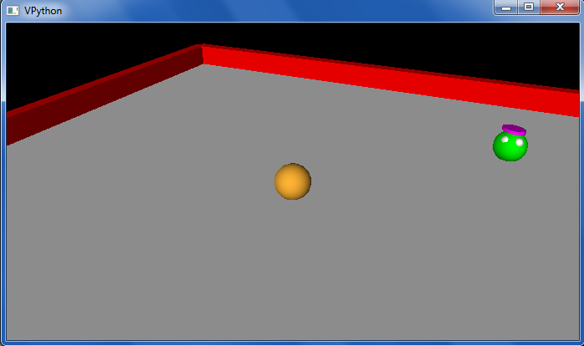
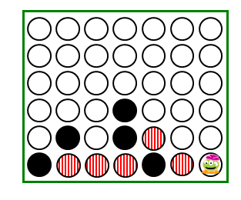
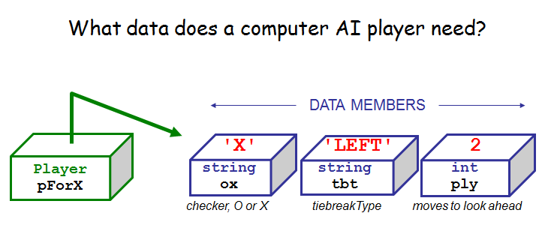
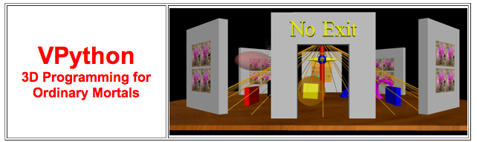
This week's classes
Homework #11, due 11/21
Notice that the value of (dimension + eyes) is conserved!
Three-eyed? This week, we're 3d'ed!
Connect 4 Player

Slide 2
Python objects + classes... used by VPython
Tuples are similar to lists, but they're parenthesized:
T = (4,2)
V = (1,0,0)
example of a two-element tuple named T and a three-element tuple named V

Slide 3
Tuples!
but what about that name?!
Lists that use parentheses are called tuples:
>>> T = ( 4, 2 )
>>> T
(4, 2)
>>> T[0]
4
>>> T[0] = 42
Error!
>>> T = ('a',2,'z')
>>>
Tuples are immutable lists: you can't change their elements...
...but you can always redefine the whole variable, if you want!
+ Tuples are more memory + time efficient
+ Tuples can be dictionary keys: lists can't

Slide 4
Tuple problems…
Creating 0- and 1-tuples would seem like a problem!
A bug from yesterday's Board class:
W = 4 # for example
s = ' ',
for col in range(W):
s += str(col), ' '
yields a surprising result for s:
Notes:
without the first comma, it's an error

Slide 5
Tuple problems…
Creating 0- and 1-tuples would seem like a problem!
A bug from yesterday's Board class:
W = 4 # for example
s = ' ',
for col in range(W):
s += str(col), ' '
yields a surprising result for s:
(' ', '0', ' ', '1', ' ', '2', ' ', '3', ' ')
starting value
Notes:
without the first comma, it's an error

Slide 6
Python details... (used, by, VPython)
Functions can have default input values and can take named inputs
def f(x=3, y=17):
return 10*x + y
example of default input values for x and y
f(x=4,y=2)
example of named input values for x and y
Function inputs look like tuples, but they're not exactly the same…

Slide 7
Python details in VPython…
Functions can have default input values and can take named inputs
def f(x=3, y=17):
return 10*x + y
example of an ordinary function call – totally OK
f(4,2)
example of two default inputs
f()
example using only one default input
f(1)
example of a named input
f(y=1)

Slide 8
Named inputs
def f(x=2, y=11):
return x + 3*y
Try this on the back page first…
f(3,1)
f()
f(3)
f(y=2,x=1)
What will these function calls to f return?
None of the above are 42!
What call to f returns the string 'Lalalalala' ?
These are tuples – they work like lists!
What is f( ( ), (1,0) ) ?
What is the shortest call to f returning 42?
it's only four characters!
Extra… what would this return? x=12; y=6; f(y=x,x=y)

Slide 9
Named inputs
def f(x=2, y=11):
return x + 3*y
Input your name(s) = ___________________________
f(3,1)
f()
f(3)
f(y=2,x=1)
What will these function calls to f return?
None of the above are 42!
What call to f returns the string 'Lalalalala' ?
These are tuples – they work like lists!
What is f( ( ), (1,0) ) ?
What is the shortest call to f returning 42?
it's only four characters!
Extra… what would this return? x=12; y=6; f(y=x,x=y)

Slide 10
feedback feedback
Notes:
Next is: 13112221

Slide 11
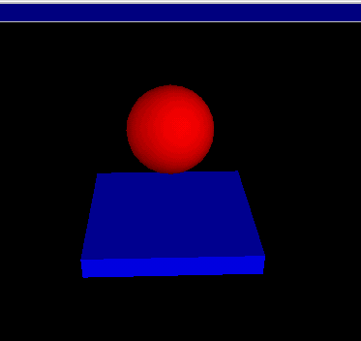
VPython
Where were we... ?
www.vpython.org
stonehenge.py
built by and for physicists to simplify 3d simulations
bounce.py
lots of available classes, objects and methods in its API
80-90% easily installable for windows and macs...?!

Slide 12
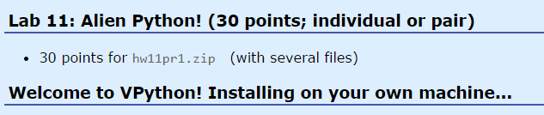
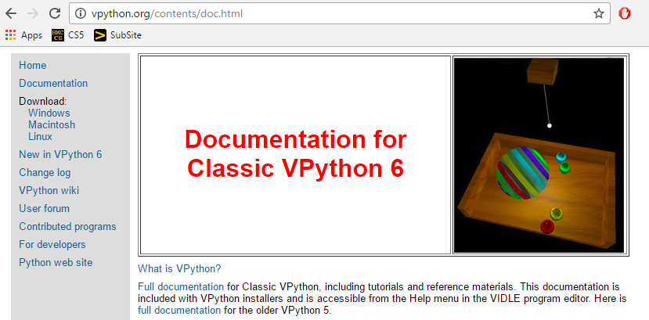
Installing VPython
or, use the lab's machines…
Windows & Mac OS
Tutorials and documentation…

Slide 13
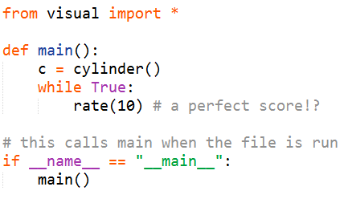
API
... stands for Application Programming Interface
a programming description of how to use a software library
A demo of VPython's API:
What's visual?
What's cylinder?
What's c?
What's main?
What's that last line?
at least it's not Visual C…
VPython example API calls: must be from a file

Slide 14
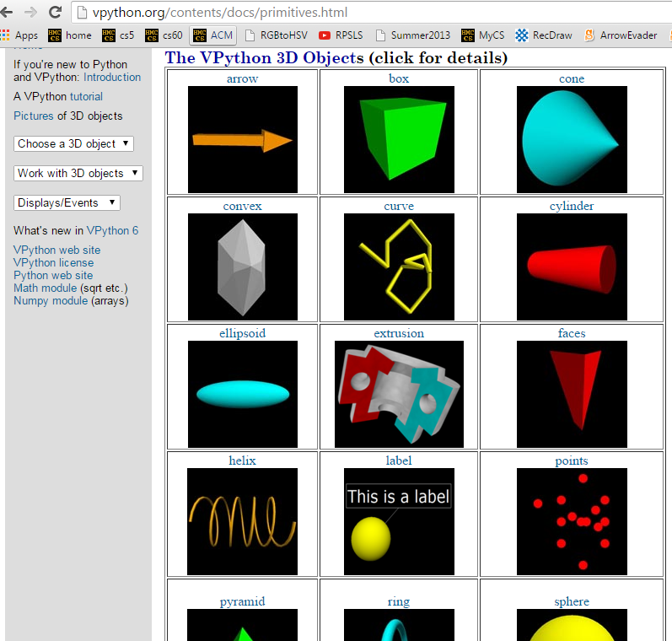
API
... stands for Application Programming Interface
constructors + methods!
shapes!

Slide 15
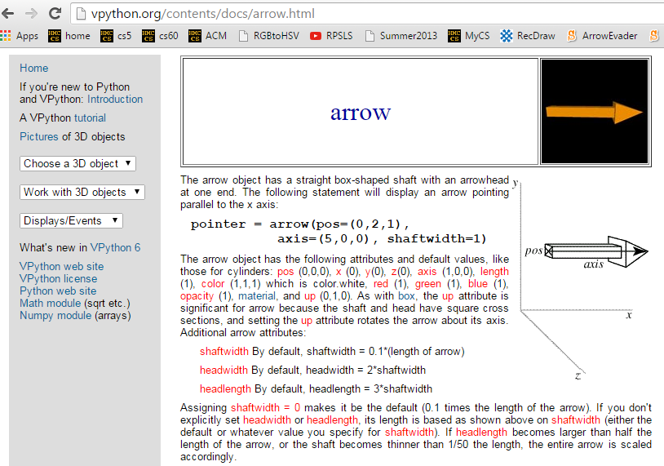
API
... stands for Application Programming Interface

Slide 16
VPython
Set up world with 3d objects…
b = box()
b.color = color.red
# 1: change colors…
color.red or a tuple
# 2: add objects
scene.autoscale = False
c = cylinder(pos=(4,0,0))
a = sphere(pos=(0,0,4))
Then, run a simulation using those objects…
more objects and API calls
while True:
rate(30) # times/sec
print "b.pos is", b.pos
# 3: change position
(most will be added before the while loop)
# 4: define velocity (above loop)
# 5: then, change pos (in loop)
if __name__ == "__main__":
main()

Slide 17
vectors
b.pos, b.vel,… are vectors
b.vel = vector(1,0,0)
vel.z
named components
vel.y
vel.x
b.pos = vector(0,0,0)
scalar multiplication
b.pos = b.pos + b.vel*0.2
component-by-component addition
let's compare with tuples…

Slide 18
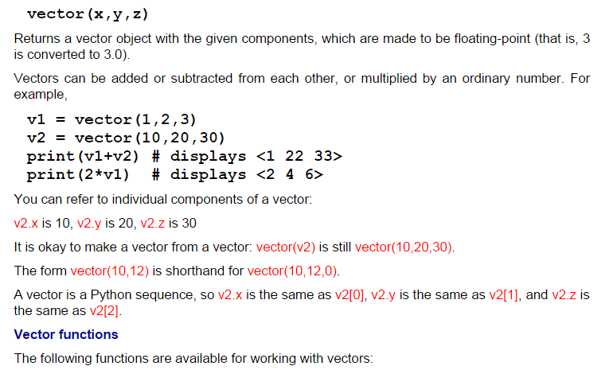
vectors
act like "arrows"
http://vpython.org/contents/docs/vector.html

Slide 19
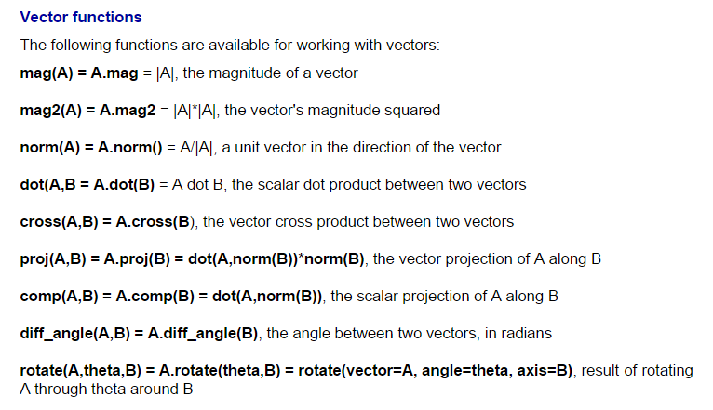
vectors
lots of support… (don't write your own)
http://vpython.org/contents/docs/vector.html

Slide 20
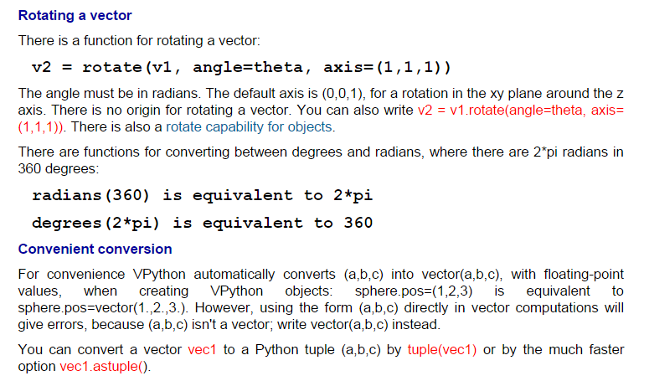
vpython.org/contents/docs
Documentation!

Slide 21


vPython!
(1) How many vPython classes are used in this code? ____
(2) How many vPython objects are used here? ________
(3) What line of code handles collisions ?
(4) How does physics work? Where is it?
(5) Tricky! How many tuples are here?
Look over this VPython program to determine
from visual import *
def main():
""" docstring! """
floor = box(length=4,width=4,height=0.5,color=(0,0,1))
ball = sphere(pos=(0,8,0),radius=1,color=color.red)
ball.vel = vector(0,-1,0)
RATE = 30
dt = 1.0/RATE
while True:
rate(RATE)
ball.pos += ball.vel*dt
if ball.pos.y < ball.radius:
ball.vel.y *= -1.0
else:
ball.vel.y += -9.8*dt
Physics is here.
Let's run it!
what is this += doing?
what is this if/else doing?

Slide 22
vPython!
(1) How many vPython classes are used in this code? ____
(2) How many vPython objects are used here? ________
(3) What line of code handles collisions ?
(4) How does physics work? Where is it?
(5) Tricky! How many tuples are here?
Look over this VPython program to determine
from visual import *
def main():
""" docstring! """
floor = box(length=4,width=4,height=0.5,color=(0,0,1))
ball = sphere(pos=(0,8,0),radius=1,color=color.red)
ball.vel = vector(0,-1,0)
RATE = 30
dt = 1.0/RATE
while True:
rate(RATE)
ball.pos += ball.vel*dt
if ball.pos.y < ball.radius:
ball.vel.y *= -1.0
else:
ball.vel.y += -9.8*dt
Physics is here.
what is this += doing?
what is this if/else doing?

Slide 23
Lab 11 goals
(0) Try out VPython!
(1) Make a few changes to the starter code
(2) Implement walls and wall-collisions…
(3) Improve your alien and world!
(Ex.) Add scoring, enemies, or a moving target, hoops, traps, holes, etc. ~ your own game…
(bounce.py + billiard_bounce.py)
final project option

Slide 24
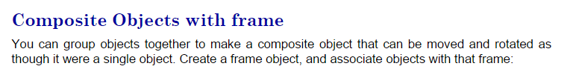
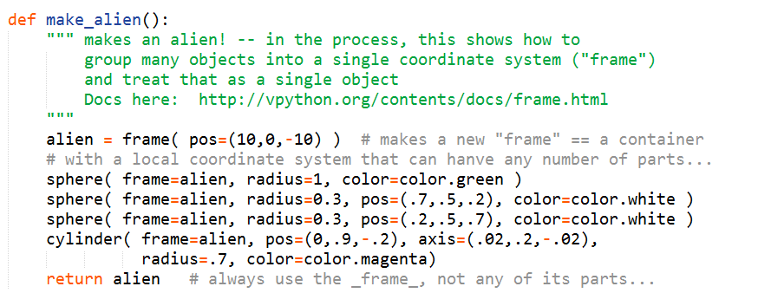
frames
What's what?

Slide 25
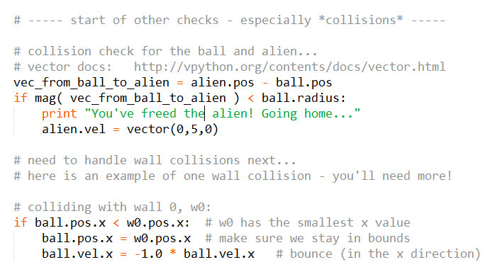
Collisions…
billiard_bounce.py

Slide 26
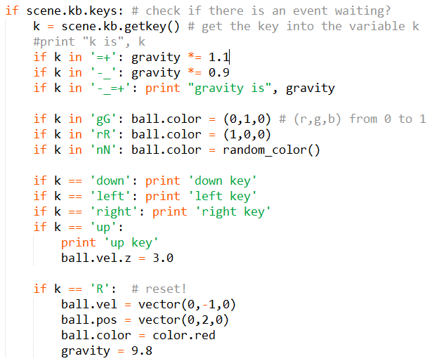
key presses…

Slide 27
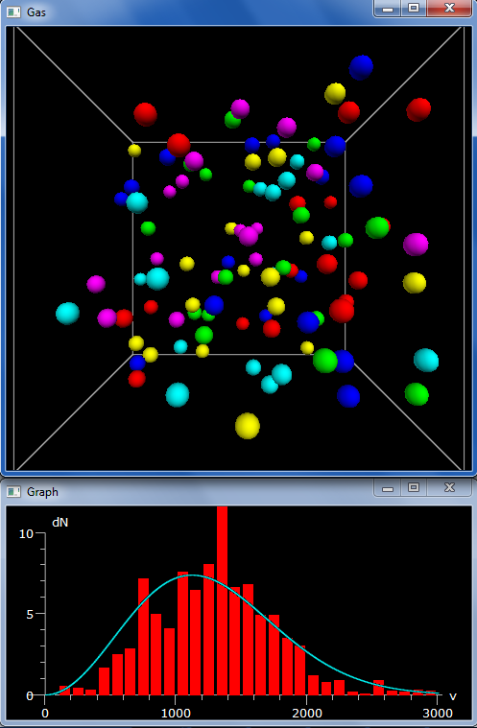
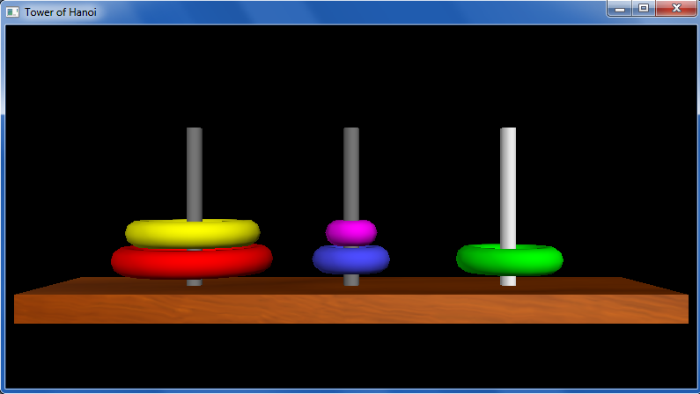
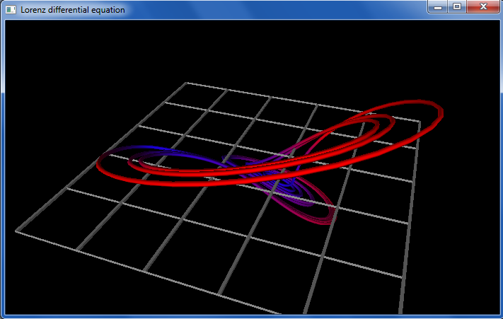
other vPython examples…

Slide 28
other vPython examples…
Try out vPython in lab this week!
~ if you enjoy it, consider it for a final project (next Tues. is the overview of the projects)

Slide 29
vPython!
(1) How many vPython classes are used in this code? ____
(2) How many vPython objects are used here? ________
(3) What line of code handles collisions ?
(4) How does physics work? Where is it?
(5) Tricky! How many tuples are here?
Look over this VPython program to determine
Physics is here.
from visual import *
def main():
""" docstring! """
floor = box(length=4,width=4,height=0.5,color=(0,0,1))
ball = sphere(pos=(0,8,0),radius=1,color=color.red)
ball.vel = vector(0,-1,0)
RATE = 30
dt = 1.0/RATE
while True:
rate(RATE)
ball.pos += ball.vel*dt
if ball.pos.y < ball.radius:
ball.vel.y *= -1.0
else:
ball.vel.y += -9.8*dt
what is this += doing?
what is this if/else doing?

Slide 30
Next time!
An AI for Connect Four

Slide 31
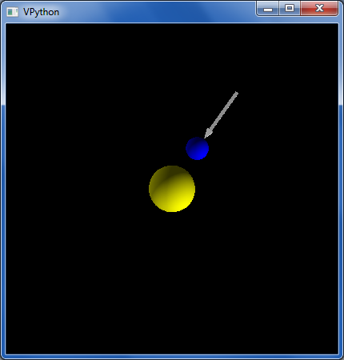
Orbiting example
"force arrow" in example code…
from visual import *
e = sphere(pos=(0,0,10),color=color.blue) #earth
s = sphere(color=color.yellow,radius=2) #sun
e.vel = vector(5,0,0) # initial velocity
RATE = 50
dt = 1.0/RATE
k = 70.0 # G!
while True:
rate(RATE)
diff = s.pos - e.pos # vector difference
force = k*diff/(mag(diff)**2) # mag
e.vel += dt*force # acceleration d.e.
e.pos += dt*e.vel # velocity d.e.
now, with vectors!

