Slide 1
This week's classes
You are on your shoes full of brains and your day. And you will say, I do not worry.
The Places you'll Go! Elise T.
Homework #11, due 11/25
Notice that the value of (dimension + eyes) is conserved ~ at 5!
Three-eyed? This week, we're 3d'ed!
Connect 4 aiMove
whether it's black's move or red's, they're eye-ing the same column!

Slide 2
Connect 4, Part 2
hw11pr2.py
what methods will help?
b
colsToWin( self, ox )
b.colsToWin('O')
b.colsToWin('X')
what methods will help?
aiMove( self, ox )
| | | | | | | |
| | | | | | | |
| | | | | | | |
| |X|O| | | | |
| |X|O| |X|X| |
|O|O|O| |X|O|X|
---------------
0 1 2 3 4 5 6
b.aiMove('O')
b.aiMove('X')
hostGame( self )

Slide 3
Connect 4, Part 2
hw11pr2.py
what methods will help?
b
colsToWin( self, ox )
b.colsToWin('O')
More C4 AI ~ and overall AI ~ this Thursday...
b.colsToWin('X')
what methods will help?
aiMove( self, ox )
| | | | | | | |
| | | | | | | |
| | | | | | | |
| |X|O| | | | |
| |X|O| |X|X| |
|O|O|O| |X|O|X|
---------------
0 1 2 3 4 5 6
b.aiMove('O')
b.aiMove('X')
hostGame( self )

Slide 4
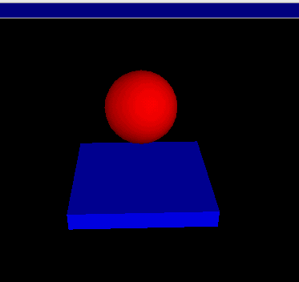
VPython ~ GlowScript!
www.glowscript.org/
Today's project option!
stonehenge.py
built by and for physicists to simplify 3d simulations
bounce.py
Try this out in lab today / tomorrow...

Slide 5
Python features, motivated by VPython…

Slide 6
Python features, motivated by VPython…
Tuples are similar to lists, but they're parenthesized:
T = (4,2)
x = (1,0,0)
example of a two-element tuple named T and a three-element tuple named x
not vectors!
examples of default and named inputs in a function definition
def f(x=3, y=17):
return 10*x + y

Slide 7
Python features, motivated by VPython…
Tuples are similar to lists, but they're parenthesized:
T = (4,2)
x = (1,0,0)
example of a two-element tuple named T and a three-element tuple named x
not vectors!
def f(x=3, y=17):
return 10*x + y
example of default inputs in a function definition

Slide 8
Tuples!
Lists that use parentheses are called tuples:
T = ( 4, 2 )
T
(4, 2)
T[0]
4
T[0] = 42
Error!
T = ('a',2,'z')
Tuples are immutable lists: you can't change their elements...
...but you can always redefine the whole variable, if you want!
+ Tuples are more memory + time efficient
+ Tuples can be dictionary keys: lists can't be
- But, you can't change tuples' elements!

Slide 9
Tuple surprises…
Creating 0- and 1-tuples would seem like a problem!
A bug from last week's Board class:
W = 4 # for example
s = " ",
for col in range(W):
s += str(col), " "
trying for
yields a surprising result for s
" 0 1 2 3 "
Notes:
without the first comma, it's an error

Slide 10
Tuple surprises…
Creating 0- and 1-tuples would seem like a problem!
A bug from last week's Board class:
W = 4 # for example
s = " ",
for col in range(W):
s += str(col), " "
trying for
yields a surprising result for s
" 0 1 2 3 "
actually creates a tuple:
(' ','0',' ','1',' ','2',' ','3',' ')
Notes:
without the first comma, it's an error

Slide 11
Default – and named – inputs!
Functions can have default input values and can take named inputs
function def'n
def f(x=3, y=17):
return 10*x + y
example of default input values for x and y

Slide 12
Default – and named – inputs!
Functions can have default input values and can take named inputs
function def'n
def f(x=3, y=17):
return 10*x + y
example of default input values for x and y
f(x=4,y=2)
example of named input values for x and y
function CALL
Function-call inputs look like tuples, but they're not quite the same…

Slide 13
Default – and named – inputs!
Functions can have default input values and can take named inputs
def f(x=3, y=17):
return 10*x + y
example of an ordinary function call – totally OK
f(4,2)
example of default inputs
f()
example using only one default input
f(1)
example of a named input
f(y=1)

Slide 14
Named inputs
def f(x=2, y=11):
return x + 3*y
Input your name(s) = ___________________________
f(3,1)
f()
f(3)
f(y=4,x=2)
What will these function calls to f return?
None of the above are 42!
but they all share a factor with it! - Eli B. '17
What call to f returns the string 'Lalalalala' ?
These are tuples – they work like lists!
What is f( ( ), (1,0) ) ?
What is the shortest call to f returning 42?
it's only four characters, too!
Extra… what does this return? y = 60; x = -6; f(y=x,x=y)
42

Slide 15
Named inputs
def f(x=2, y=11):
return x + 3*y
Try this on the back page first…
f(3,1)
f()
f(3)
f(y=4,x=2)
What will these function calls to f return?
None of the above are 42!
but they all share a factor with it! - Eli B. '17
What call to f returns the string 'Lalalalala' ?
These are tuples – they work like lists!
What is f( ( ), (1,0) ) ?
What is the shortest call to f returning 42?
it's only four characters, too!
Extra… what does this return? y = 60; x = -6; f(y=x,x=y)
42

Slide 16
Named inputs
def f(x=2, y=11):
return x + 3*y
Try this on the back page first…
6
35
f(3,1)
f()
36
14
f(3)
f(y=4,x=2)
What will these function calls to f return?
None of the above are 42!
but they all share a factor with it! - Eli B. '17
What call to f returns the string 'Lalalalala' ?
f('Lala','la')
These are tuples – they work like lists!
What is f( ( ), (1,0) ) ?
(1,0,1,0,1,0)
What is the shortest call to f returning 42?
14
it's only four characters, too!
Extra… what does this return? y = 60; x = -6; f(y=x,x=y)
42

Slide 17
Named inputs
def f(x=2, y=11):
return x + 3*y
Try this on the back page first…
6
35
f(3,1)
f()
36
14
f(3)
f(y=4,x=2)
Pass these Drinkwardward...
What will these function calls to f return?
None of the above are 42!
but they all share a factor with it! - Eli B. '17
What call to f returns the string 'Lalalalala' ?
f('Lala','la')
These are tuples – they work like lists!
What is f( ( ), (1,0) ) ?
(1,0,1,0,1,0)
What is the shortest call to f returning 42?
14
it's only four characters, too!
Extra… what does this return? y = 60; x = -6; f(y=x,x=y)
42

Slide 18
feedback feedback
Notes:
Next is: 13112221

Slide 19
feedback feedback
5.25 hrs.
3.41/5
3.17/5
2.3 st. dev.
0.8 st dev.
0.48 st dev.
min: 1.5 ~ max: 17.5
min: 1 ~ max: 5
min: 1 ~ max: 5
Notes:
Next is: 13112221

Slide 20
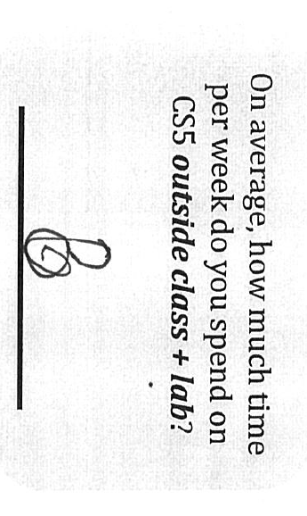
feedback feedback
5.25 hrs.
3.41/5
3.17/5
2.3 st. dev.
0.8 st dev.
0.48 st dev.
min: 1.5 ~ max: 17.5
min: 1 ~ max: 5
min: 1 ~ max: 5
Everything can be Alien'ed!
1
5
not sure about this one!
Notes:
Next is: 13112221

Slide 21
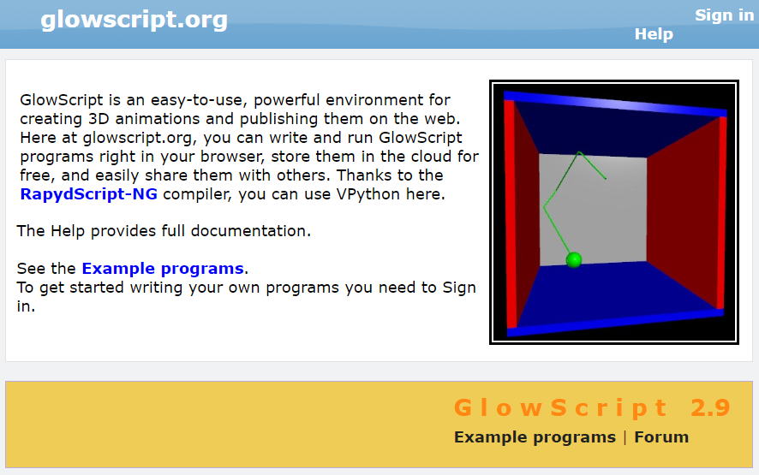
Using GlowScript / vPython...
www.glowscript.org/
Where were we... ?
examples...
documentation…

Slide 22
VPython ~ GlowScript!
www.glowscript.org/
stonehenge.py
built by and for physicists to simplify 3d simulations
bounce.py
lots of available classes, objects and methods in its API

Slide 23
API
... stands for Application Programming Interface
a programming description of how to use a software library
A demo of vPython's API:
What's box?
What's color?
What's vector?
Getting used to everything!
# the simplest possible vpython program:
box( color = vector(1, 0.5, 0) )
# try changing the color: the components are
# red, green, blue each from 0.0 to 1.0
# then, add a second parameter: size=vector(2.0,1.0,0.1)
# the order of those three #s: Length, Height, Width
# then, a third parameter: axis=vector(2,5,1)
# the order of those three #s: x, y, z
I'm hAPI about APIs!
vPython example API call(s)

Slide 24
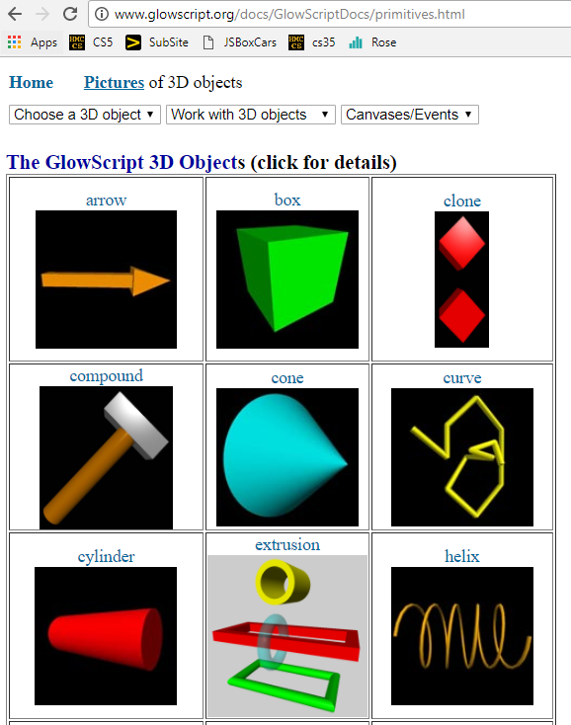
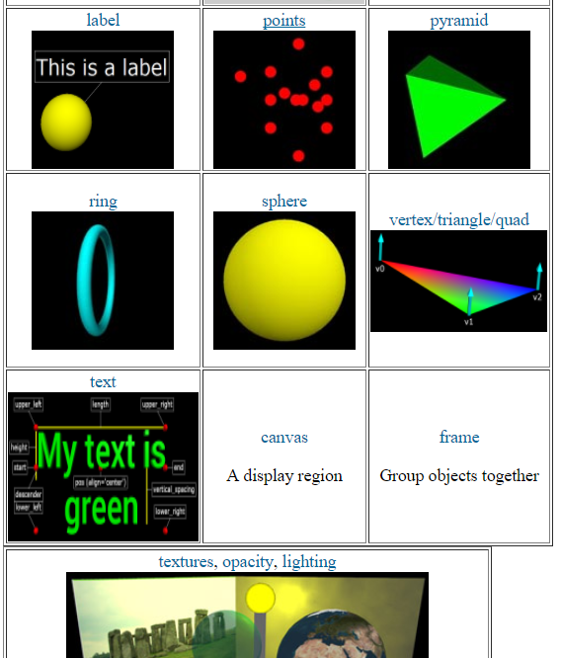
API
... stands for Application Programming Interface
constructors + methods!
shapes + docs!
cool stuff...

Slide 25
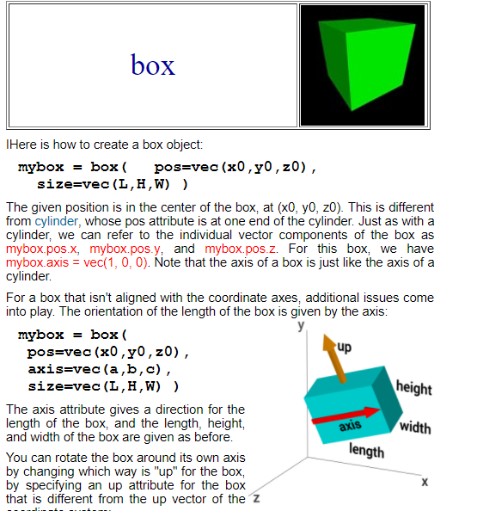
API
... stands for Application Programming Interface
constructor + default arguments; data!

Slide 26
vectors
b.pos, b.vel,… are vectors
b.vel = vector(1,0,0)
vel.z
named components
vel.y
vel.x
b.pos = vector(0,0,0)
scalar multiplication
b.pos = b.pos + b.vel*0.2
component-by-component addition
compare with tuples…

Slide 27
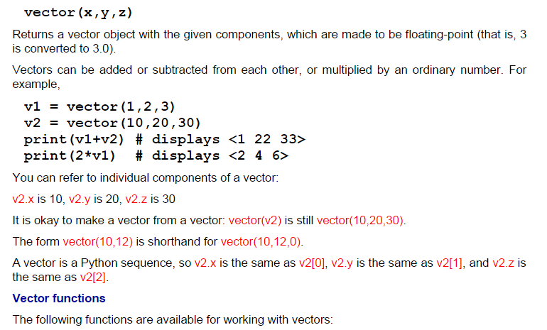
vectors
act like "arrows"
www.glowscript.org/docs/GlowScriptDocs/vector.html

Slide 28
vectors!
lots of support! (don't write your own)

Slide 29
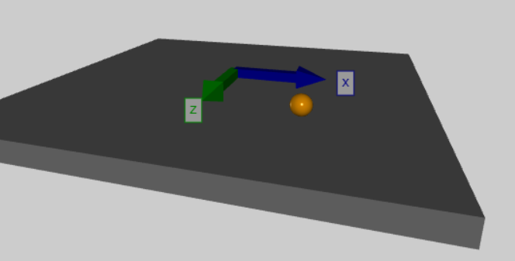
vectors
the shape
objects of this class
act like "arrows"
but arrows are arrows!
# if the ball ventures too far, restart with random velocity
if mag(ball.pos - origin) > 10.0: # mag finds magnitude of a vector
ball.pos = vector(0,0,0) # reset the ball.pos (position)
ball.vel = 4.2*vector.random() # set a random velocity
ball.vel.y = 0.0 # with no y component (no vertical)
print("velocity is now:", ball.vel)

Slide 30
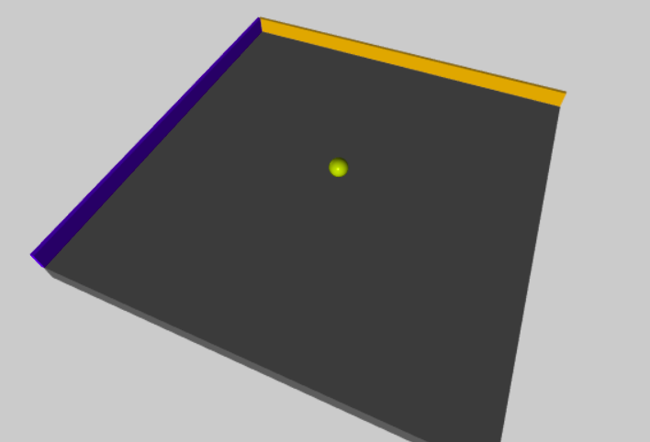
Axes!
(-10,0,-10)
line z = -10
(0,0,-10)
(-10,0,0)
(10,0,-10)
(0,0,0)
line x = -10
+X
(-10,0,10)
this "floor" is the X-Z plane
+Z
and the Y direction is "vertical" relative to the floor...
(10,0,10)

Slide 31
vPython!
(1) How many vPython classes/constructors are here? _____
(2) How many named inputs are here? _________________
(3) Tricky! How many vPython objects are here? ________
(4) What line of code handles collisions ?
(5) How does physics work? Where is it?
(6) Wind! How could we create a horizontal acceleration?
Look over this VPython program to determine
floor = box(length=4, width=4, height=0.5, color=vector(0,0,1))
ball = sphere(pos=vector(0,4.2,0), radius=1, color=vector(1,0,0))
ball.vel = vector(0,-1,0) # this is the velocity
RATE = 30
dt = 1.0/RATE
while True:
rate(RATE)
ball.pos = ball.pos + ball.vel*dt
if ball.pos.y < ball.radius:
ball.vel.y *= -1.0
else:
ball.vel.y += -9.8*dt
Let's run this first...
what is this doing?
what is the if doing?
what is the else doing?

Slide 32
vPython!
(1) How many vPython classes/constructors are here? _____
(2) How many named inputs are here? _________________
(3) Tricky! How many vPython objects are here? ________
(4) What line of code handles collisions ?
(5) How does physics work? Where is it?
(6) Wind! How could we create a horizontal acceleration?
Look over this VPython program to determine
floor = box(length=4, width=4, height=0.5, color=vector(0,0,1))
ball = sphere(pos=vector(0,4.2,0), radius=1, color=vector(1,0,0))
ball.vel = vector(0,-1,0) # this is the velocity
RATE = 30
dt = 1.0/RATE
while True:
rate(RATE)
ball.pos = ball.pos + ball.vel*dt
if ball.pos.y < ball.radius:
ball.vel.y *= -1.0
else:
ball.vel.y += -9.8*dt
what is this doing?
what is the if doing?
what is the else doing?
Physics is here and now!

Slide 33
vPython!
(1) How many vPython classes/constructors are here? _____
(2) How many named inputs are here? _________________
(3) Tricky! How many vPython objects are here? ________
(4) What line of code handles collisions ?
(5) How does physics work? Where is it?
(6) Wind! How could we create a horizontal acceleration?
Look over this VPython program to determine
floor = box(length=4, width=4, height=0.5, color=vector(0,0,1))
ball = sphere(pos=vector(0,4.2,0), radius=1, color=vector(1,0,0))
ball.vel = vector(0,-1,0) # this is the velocity
RATE = 30
dt = 1.0/RATE
while True:
rate(RATE)
ball.pos = ball.pos + ball.vel*dt
if ball.pos.y < ball.radius:
ball.vel.y *= -1.0
else:
ball.vel.y += -9.8*dt
what is this doing?
what is the if doing?
what is the else doing?
Physics is here and now!

Slide 34
vPython!
6
(1) How many vPython classes/constructors are here? _____
(2) How many named inputs are here? _________________
(3) Tricky! How many vPython objects are here? ________
(4) What line of code handles collisions ?
(5) How does physics work? Where is it?
(6) Wind! How could we create a horizontal acceleration?
7
4ish...
Look over this VPython program to determine
Physics is here, now.
floor = box(length=4, width=4, height=0.5, color=vector(0,0,1))
ball = sphere(pos=vector(0,4.2,0), radius=1, color=vector(1,0,0))
ball.vel = vector(0,-1,0) # this is the velocity
RATE = 30
dt = 1.0/RATE
while True:
rate(RATE)
ball.pos = ball.pos + ball.vel*dt
if ball.pos.y < ball.radius:
ball.vel.y *= -1.0
else:
ball.vel.y += -9.8*dt
objects
classes
PHYSICS!
COLLISIONS!
Wind!
ball.vel.x += .5*dt
GRAVITY!

Slide 35
Lab goals
(0) Try out VPython: Get your bearings (axes!)
(1) Make guided changes to the starter code...
(2) Expand your walls and wall-collisions…
(3) Improve your interaction/game!
(4) Optional: add scoring, enemies, or a moving target, hoops, traps, holes, etc. ~ final project…
one of the final project options

Slide 36
Collisions…
point-to-line collisions
# if the ball hits wallA
if ball.pos.z < wallA.pos.z: # hit - check for z
ball.pos.z = wallA.pos.z # bring back into bounds
ball.vel.z *= -1.0 # reverse the z velocity
# if the ball hits wallB
if ball.pos.x < wallB.pos.x: # hit - check for x
ball.pos.x = wallB.pos.x # bring back into bounds
ball.vel.x *= -1.0 # reverse the x velocity
# if the ball collides with the alien, give a vertical velocity
if mag( ball.pos - alien.pos ) < 1.0:
print("To infinity and beyond!")
alien.vel = vector(0,1,0)
point-to-point collisions

Slide 37
Demo!
point-to-line collisions
point-to-point collisions
only two eyes!

Slide 38
compound

Slide 39
compound
What's what here?
alien_body = sphere( size=1.0*vector(1,1,1), pos=vector(0,0,0), color=color.green )
alien_eye1 = sphere( size=0.3*vector(1,1,1), pos=.42*vector(.7,.5,.2), color=color.white )
alien_eye2 = sphere( size=0.3*vector(1,1,1), pos=.42*vector(.2,.5,.7), color=color.white )
alien_hat = cylinder( pos=0.42*vector(0,.9,-.2), axis=vector(.02,.2,-.02),
size=vector(0.2,0.7,0.7), color=color.magenta)
alien_objects = [alien_body, alien_eye1, alien_eye2, alien_hat]
com_alien = compound( alien_objects, pos=starting_position )

Slide 40
# +++ start of EVENT_HANDLING section - separate functions for
# keypresses and mouse clicks...
def keydown_fun(event):
""" function called with each key pressed """
ball.color = randcolor()
key = chr(event.which)
ri = randint( 0, 10 )
print("key:", key, ri) # prints the key pressed - caps only...
amt = 0.42 # "strength" of the keypress's velocity changes
if key in 'WI&': # all capitals!
ball.vel = ball.vel + vector(0,0,-amt)
if key in 'A%J':
ball.vel = ball.vel + vector(-amt,0,0)
if key in 'S(K':
ball.vel = ball.vel + vector(0,0,amt)
if key in "D'L":
ball.vel = ball.vel + vector(amt,0,0)
if key in " ":
ball.vel = vector(0,0,0) # reset! via the spacebar
ball.pos = vector(0,0,0)
random change of the sphere's color
printing is great for debugging!
variables make it easy to change behavior across many lines of code (here, all four motion directions)
key presses…
have shortcuts to make your game easier -- or to reset it!

Slide 41
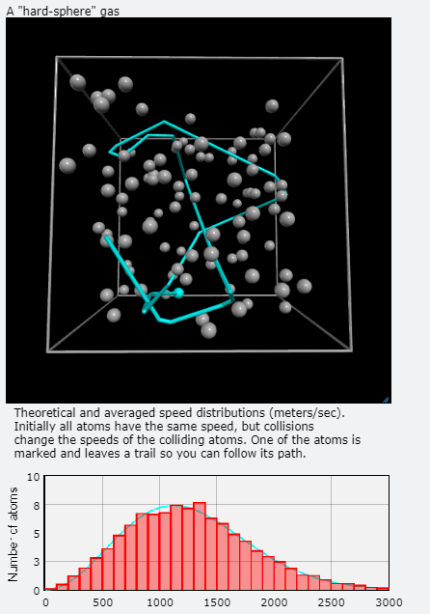
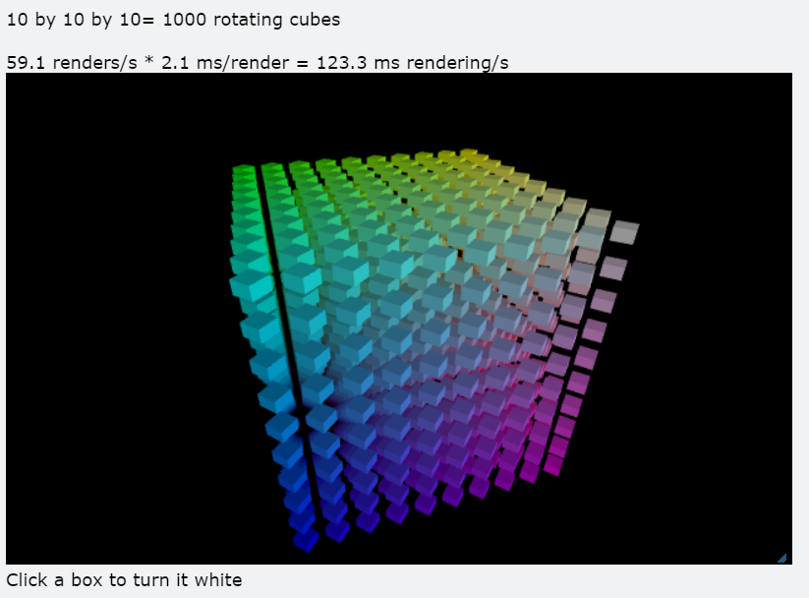
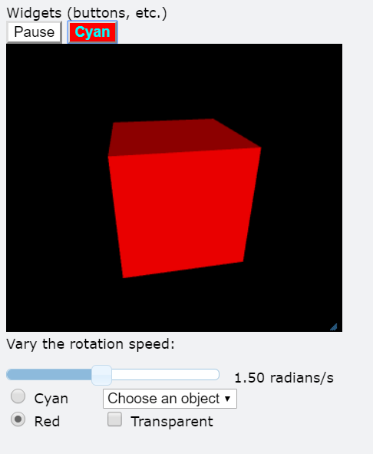
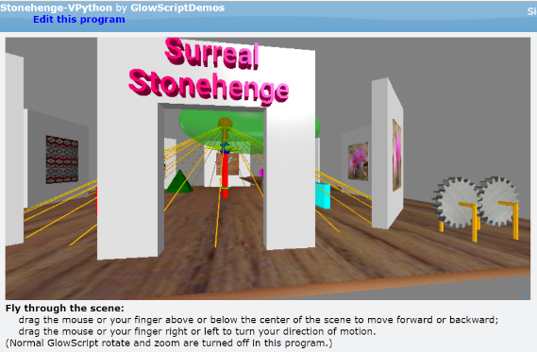
GlowScript / vPython examples…
Hey! I see what's happening here!

Slide 42
GlowScript / vPython examples…
Try out vPython in lab this week!
~ if you enjoy it, consider it for a final project
Full final-project pitch: Tuesday, 11/26
Hey! I see what's happening here!

Slide 44
Default – and named – inputs!
Functions can have default input values and can take named inputs
def f(x=3, y=17):
return 10*x + y
example of an ordinary function call – totally OK
f(4,2)
example of default inputs
f()
example using only one default input
f(1)
example of a named input
f(y=1)

Slide 45
Named inputs
def f(x=2, y=11):
return x + 3*y
Try this on the back page first…
6
35
f(3,1)
f()
36
14
f(3)
f(y=4,x=2)
What will these function calls to f return?
None of the above are 42!
but they all share a factor with it! - Eli B. '17
What call to f returns the string 'Lalalalala' ?
f('Lala','la')
These are tuples – they work like lists!
What is f( ( ), (1,0) ) ?
(1,0,1,0,1,0)
What is the shortest call to f returning 42?
14
it's only four characters, too!
Extra… what does this return? y = 60; x = -6; f(y=x,x=y)
42

Slide 46
vPython!
(1) How many vPython classes are used in this code? ____
(2) How many vPython objects are used here? ________
(3) What line of code handles collisions ?
(4) How does physics work? Where is it?
(5) Tricky! How many tuples are here?
Look over this VPython program to determine
from visual import *
def main():
""" docstring! """
floor = box(length=4,width=4,height=0.5,color=(0,0,1))
ball = sphere(pos=(0,8,0),radius=1,color=color.red)
ball.vel = vector(0,-1,0)
RATE = 30
dt = 1.0/RATE
while True:
rate(RATE)
ball.pos += ball.vel*dt
if ball.pos.y < ball.radius:
ball.vel.y *= -1.0
else:
ball.vel.y += -9.8*dt
Physics is here.
what is this += doing?
what is this if/else doing?

Slide 47
vPython!
(1) How many vPython classes are used in this code? ____
(2) How many vPython objects are used here? ________
(3) What line of code handles collisions ?
(4) How does physics work? Where is it?
(5) Tricky! How many tuples are here?
Look over this VPython program to determine
from visual import *
def main():
""" docstring! """
floor = box(length=4,width=4,height=0.5,color=(0,0,1))
ball = sphere(pos=(0,8,0),radius=1,color=color.red)
ball.vel = vector(0,-1,0)
RATE = 30
dt = 1.0/RATE
while True:
rate(RATE)
ball.pos += ball.vel*dt
if ball.pos.y < ball.radius:
ball.vel.y *= -1.0
else:
ball.vel.y += -9.8*dt
Physics is here.
what is this += doing?
what is this if/else doing?

Slide 48
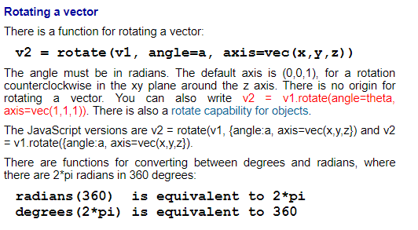
www.glowscript.org/docs/GlowScriptDocs/index.html
Documentation!

Slide 49
... back to vPython:
Libraries ~ Languages

Slide 50
Python details in VPython…
Functions can have default input values and can take named inputs
def f(x=3, y=17):
return 10*x + y
example of an ordinary function call – totally OK
f(4,2)
example of default inputs
f()
example using only one default input
f(1)
example of a named input
f(y=1)

Slide 51
Named inputs
def f(x=2, y=11):
return x + 3*y
Try this on the back page first…
f(3,1)
f()
f(3)
f(y=2,x=1)
What will these function calls to f return?
None of the above are 42!
What call to f returns the string 'Lalalalala' ?
These are tuples – they work like lists!
What is f( ( ), (1,0) ) ?
What is the shortest call to f returning 42?
it's only four characters!
Extra… what would this return? x=12; y=6; f(y=x,x=y)

Slide 53
vPython!
(1) How many vPython classes are used in this code? ____
(2) How many vPython objects are used here? ________
(3) What line of code handles collisions ?
(4) How does physics work? Where is it?
(5) Tricky! How many tuples are here?
Look over this VPython program to determine
Physics is here.
from visual import *
def main():
""" docstring! """
floor = box(length=4,width=4,height=0.5,color=(0,0,1))
ball = sphere(pos=(0,8,0),radius=1,color=color.red)
ball.vel = vector(0,-1,0)
RATE = 30
dt = 1.0/RATE
while True:
rate(RATE)
ball.pos += ball.vel*dt
if ball.pos.y < ball.radius:
ball.vel.y *= -1.0
else:
ball.vel.y += -9.8*dt
what is this += doing?
what is this if/else doing?

Slide 54
Next time!
An AI for Connect Four

Slide 55
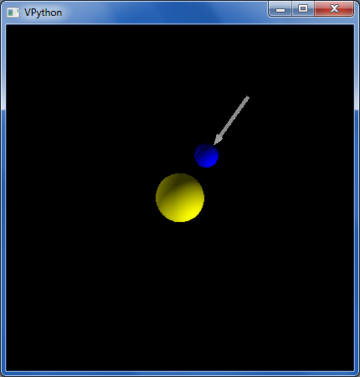
Orbiting example
"force arrow" in example code…
from visual import *
e = sphere(pos=(0,0,10),color=color.blue) #earth
s = sphere(color=color.yellow,radius=2) #sun
e.vel = vector(5,0,0) # initial velocity
RATE = 50
dt = 1.0/RATE
k = 70.0 # G!
while True:
rate(RATE)
diff = s.pos - e.pos # vector difference
force = k*diff/(mag(diff)**2) # mag
e.vel += dt*force # acceleration d.e.
e.pos += dt*e.vel # velocity d.e.
now, with vectors!

Slide 56
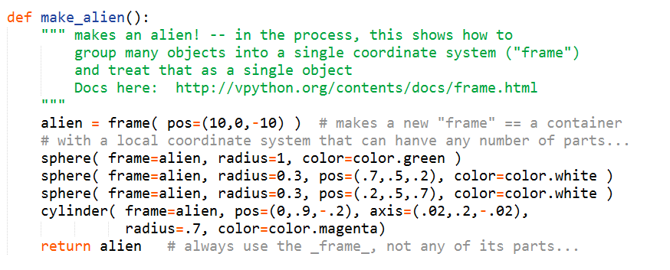
compound
What's what?

Slide 57
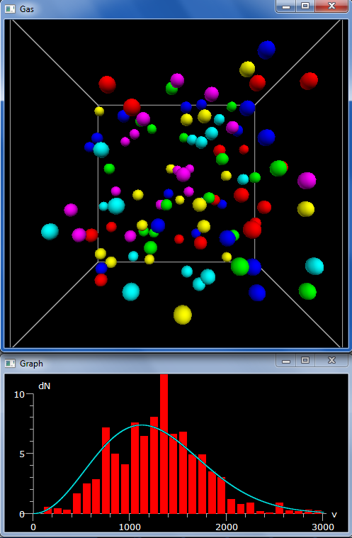
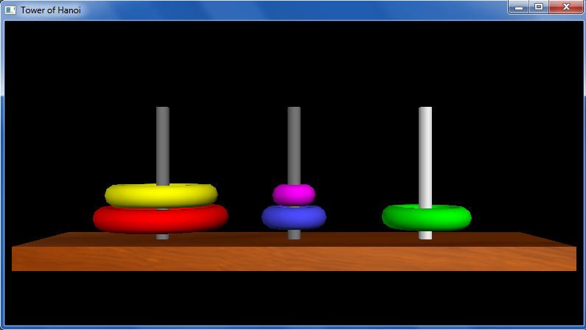
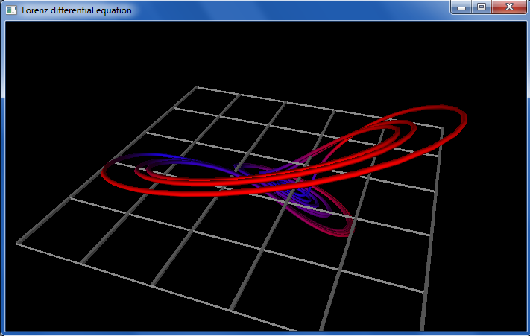
vPython examples…

Slide 58
vPython examples…
Try out vPython in lab this week!
~ if you enjoy it, consider it for a final project (Thurs./Tue. offer an overview of the projects)

Slide 59
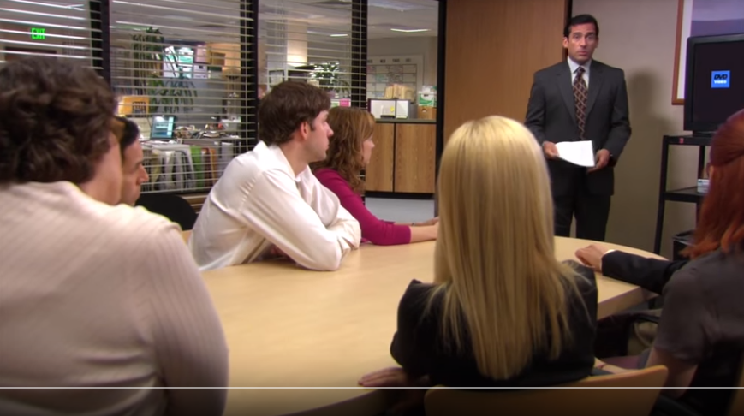
Enjoy the projects!
https://www.youtube.com/watch?v=QOtuX0jL85Y
Inspiration can come from almost anywhere...

Slide 60
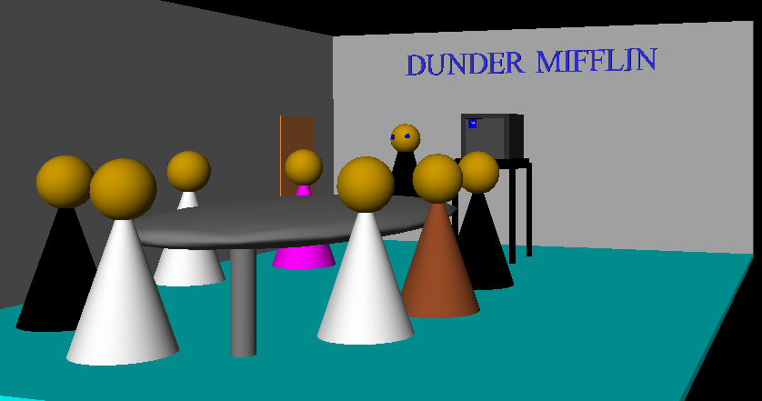
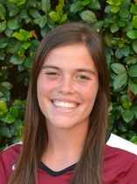
… the graders certainly do!
Enjoy the projects!
Have a relaxing November break!
Not sure what to do with all that free time over Thanksgiving break?
Jenna McCune

Slide 61
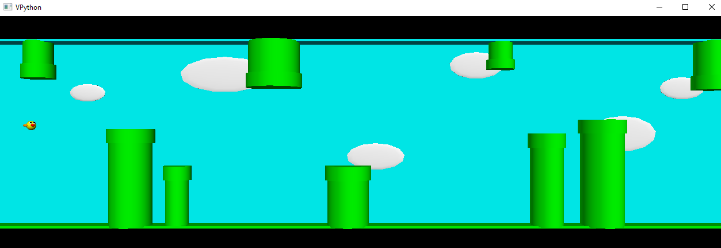
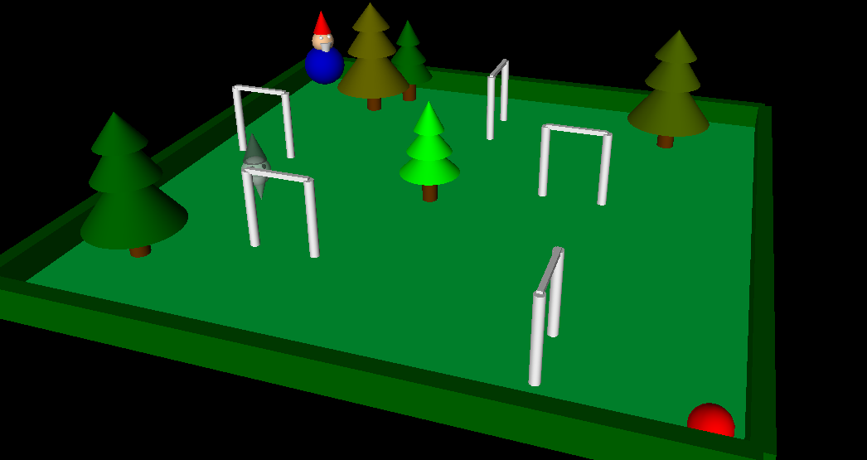
Example vProjects...
[3] bella lee
[6] mforssen
[4] lisa lam
shu!

Slide 62
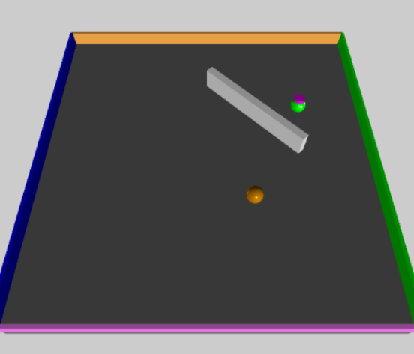
vPython: Linear + Spherical collisions...
At least some of the game needs to be about detecting collisions and changing velocities
x = 10
+x
Line ~ wall at x=10
How to bounce?
What else to do?

Slide 63
Spherical collisions
r.vel
0 Zeroth approximation:
Stop q. Undo any overlap.
Make r.vel = q.vel.
r
1 First approximation:
q
Stop q. Undo any overlap.
Compute d = r.pos – q.pos
Make r.vel = d
q.vel
2 Second approximation:
Same as first, but
Make q.vel = d ⊥ , at 90° from d
Reality is just three eyes away!

Slide 64
Spherical collisions
0 Zeroth approximation:
r.vel
Stop q. Undo any overlap.
Make r.vel = q.vel.
d
r
1 First approximation:
q
Stop q. Undo any overlap.
Compute d = r.pos – q.pos
Make r.vel = d
q.vel
2 Second approximation:
Same as first, but
Make q.vel = d ⊥ , at 90° from d
Reality is just two eyes away!

Slide 65
Spherical collisions
0 Zeroth approximation:
r.vel
new q.vel
Stop q. Undo any overlap.
Make r.vel = q.vel.
d⊥
d
r
1 First approximation:
q
Stop q. Undo any overlap.
Compute d = r.pos – q.pos
Make r.vel = d
old q.vel
2 Second approximation:
Same as first, but
Make q.vel = d ⊥ , at 90° from d
Reality is just one eye away!

Slide 66
vPool – physics?
http://en.wikipedia.org/wiki/Elastic_collision

Slide 67
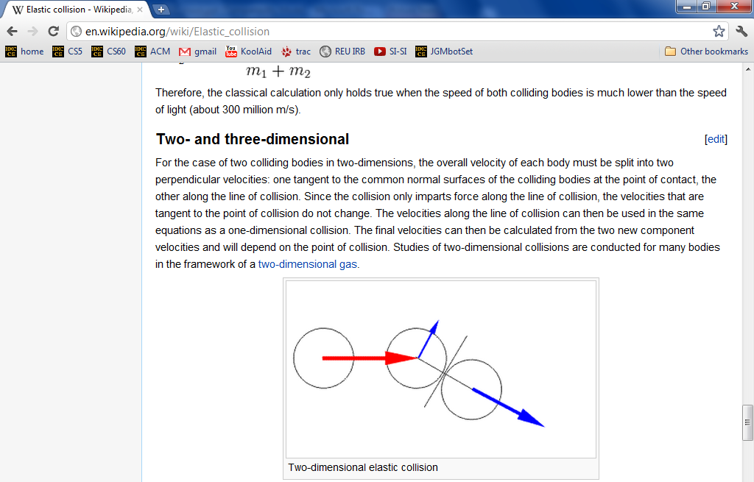
vPool – physics?
http://en.wikipedia.org/wiki/Elastic_collision
equations below...

