Slide 1
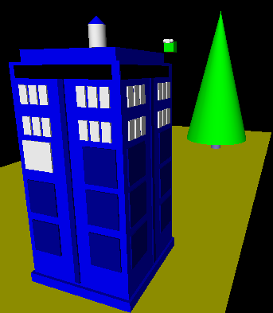
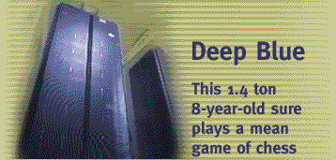
Intelligent CS 5 ?
Hw11 due Monday @ 11:59pm
No labs next week …
Fri: 2-4:30
An object is structured data that is alive, responsible, and intelligent.
Sound too friendly?
This week's objects will be more adversarial…
X to move.
Is there a way to ensure a win?
If so, how far ahead?
| | | | | | | |
| | | | | | | |
| | | | | | | |
| | | |X| | | |
| |X| |X|O| | |
|X|O|O|O|X|O| |
---------------
0 1 2 3 4 5 6
b0
x5.scoresFor( b0 )

Slide 2
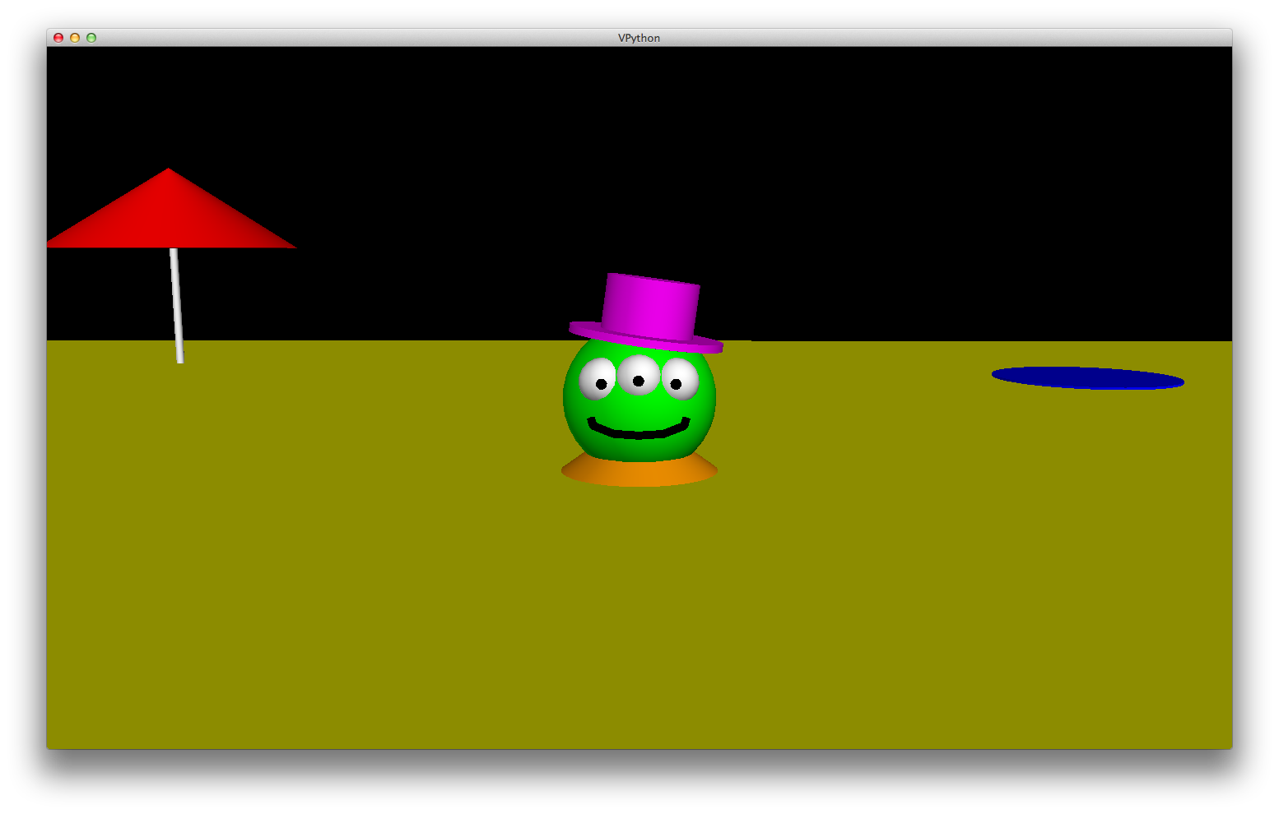
VPython is alien!
Help getting vPython to work on your machine? Come by…!

Slide 3
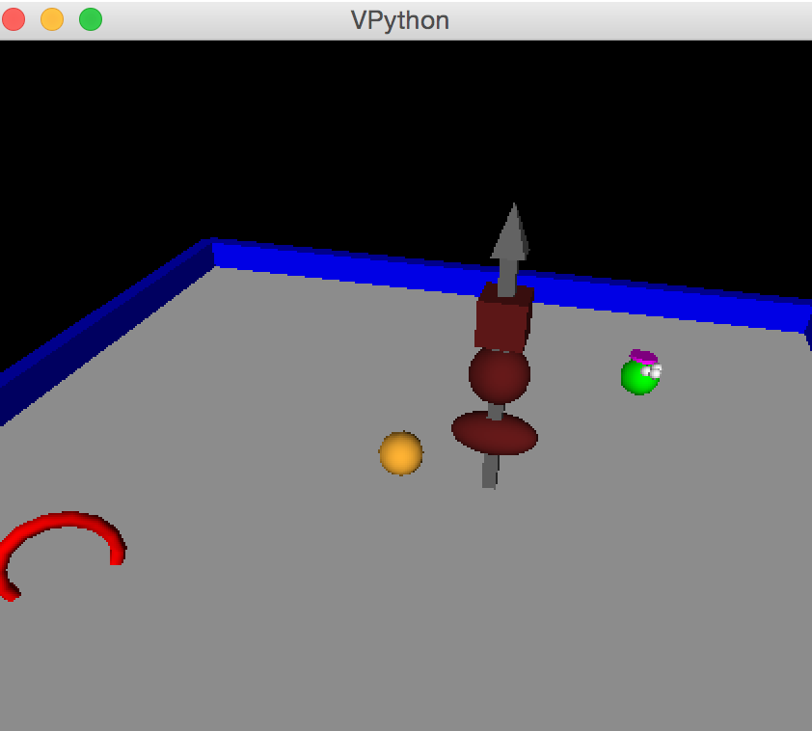
VPython is alien!
Help getting vPython to work on your machine? Come by…!

Slide 4
hw11: Strategic thinking!
Python had no Connect-four datatype…
I feel ahead of the game here...
| | | | | | | |
| | | | | | | |
| | | | | | | |
| | | |X| | | |
| |X| |X|O| | |
|X|O|O|O|X| |O|
---------------
0 1 2 3 4 5 6
How many moves ahead might we have to look?
… but you've already corrected that!
Now, may the best machine win!

Slide 5
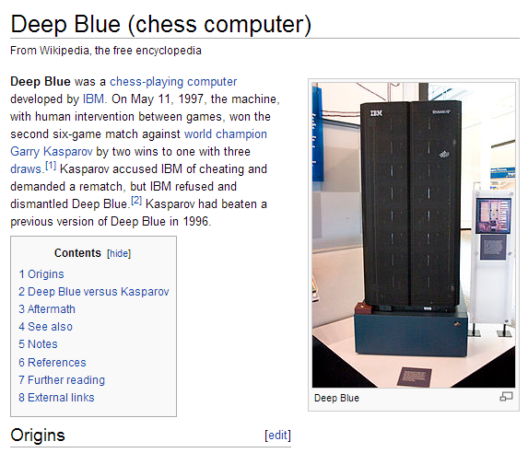

Slide 6
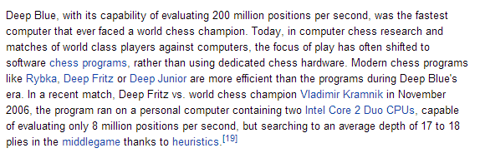

Slide 7

After Deep Blue…

Slide 8


Slide 9
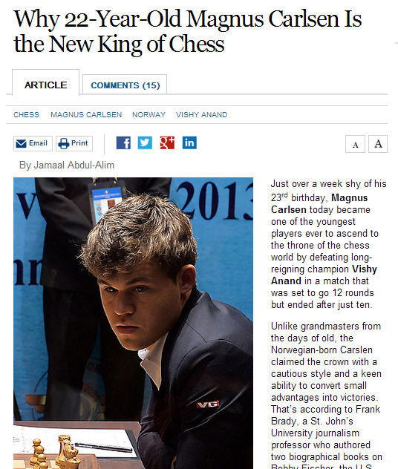
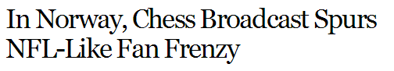
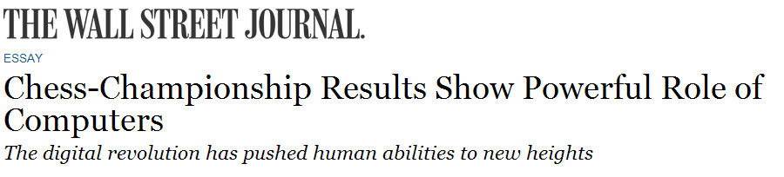
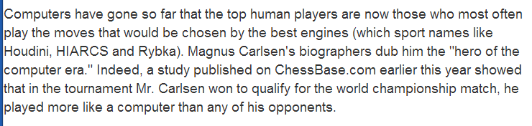
In reality?
Humans adapt!

Slide 10
The Player class
What data does a computer AI player need?
DATA MEMBERS
'X'
'LEFT'
2
Player
pForX
string
ox
string
tbt
int
ply
checker, O or X
tiebreakType
moves to look ahead
ox? tbt? ply?
x0
o0
b.playGame( x0, o0 )
… perhaps surprisingly, not so much.

Slide 11
Plying our intuitions…
In all 4 of these boards, X will move to col 3, even if both players have tbt = 'LEFT'
Circle the reason why 'X' moves to col. #3 in each case...
Try this on the back page first...
bC
bA
bD
bB
|X|O|O| | | | |
|X|X|X| | | | |
|O|X|O| | | | |
|O|X|X| | | | |
|O|O|O| | | | |
|X|X|O| | | | |
---------------
0 1 2 3 4 5 6
| | | | | | | |
| | | | | | | |
|O| | | | | | |
|X|O|X|O| | | |
|O|X|O|O| | | |
|X|X|O|X| | | |
---------------
0 1 2 3 4 5 6
| | | | | | | |
| | | | | | | |
|O|X| | | | | |
|X|X| | | | | |
|O|O|O| | | | |
|X|O|X|O| | | |
---------------
0 1 2 3 4 5 6
| | | | | | | |
| | | | | | | |
|X|O| | | | | |
|O|X| | | | | |
|O|O| | | | | |
|X|X| | | | | |
---------------
0 1 2 3 4 5 6
ply == 0
ply == 1
ply == 2
ply == 3
|O|O|O| | | | |
|X|X|X| | | | |
|O|O|O| | | | |
|X|X|X| | | | |
|O|O|O| | | | |
|X|X|X|X| | | |
---------------
0 1 2 3 4 5 6
Example
Challenge: What will happen if you run X at 1 ply and O at 1 ply, each tiebreaking LEFT?
|O|O| | | | | |
|X|X| | | | | |
|O|O| | | | | |
|X|X| | | | | |
|O|O| | | | | |
|X|X| | | | | |
---------------
0 1 2 3 4 5 6
X: ply == 0,
O: ply == 0,
both: tbt == 'LEFT'
b.playGame( x0, o0 )

Slide 12
Plying our intuitions…
In all 4 of these boards, X will move to col 3, even if both players have tbt = 'LEFT'
Circle the reason why 'X' moves to col. #3 in each case...
Name(s) _______________
bC
bA
bD
bB
|X|O|O| | | | |
|X|X|X| | | | |
|O|X|O| | | | |
|O|X|X| | | | |
|O|O|O| | | | |
|X|X|O| | | | |
---------------
0 1 2 3 4 5 6
| | | | | | | |
| | | | | | | |
|O| | | | | | |
|X|O|X|O| | | |
|O|X|O|O| | | |
|X|X|O|X| | | |
---------------
0 1 2 3 4 5 6
| | | | | | | |
| | | | | | | |
|O|X| | | | | |
|X|X| | | | | |
|O|O|O| | | | |
|X|O|X|O| | | |
---------------
0 1 2 3 4 5 6
| | | | | | | |
| | | | | | | |
|X|O| | | | | |
|O|X| | | | | |
|O|O| | | | | |
|X|X| | | | | |
---------------
0 1 2 3 4 5 6
ply == 0
ply == 1
ply == 2
ply == 3
|O|O|O| | | | |
|X|X|X| | | | |
|O|O|O| | | | |
|X|X|X| | | | |
|O|O|O| | | | |
|X|X|X|X| | | |
---------------
0 1 2 3 4 5 6
Example
Challenge: What will happen if you run X at 1 ply and O at 1 ply, each tiebreaking LEFT?
|O|O| | | | | |
|X|X| | | | | |
|O|O| | | | | |
|X|X| | | | | |
|O|O| | | | | |
|X|X| | | | | |
---------------
0 1 2 3 4 5 6
X: ply == 0,
O: ply == 0,
both: tbt == 'LEFT'
b.playGame( x0, o0 )

Slide 13
The Player class
Board
Player
__init__( self, width, height )
__init__(self, ox, tbt, ply)
allowsMove( self, col )
__repr__(self)
addMove( self, col, ox )
oppCh(self)
delMove( self, col )
Demos?
scoreBoard(self, b)
__repr__( self )
scoresFor(self, b)
isFull( self )
tiebreakMove(self, scores)
winsFor( self, ox )
nextMove(self, b)
hostGame( self )
playGame( self, pForX, pForO )

Slide 14
Why AI is challenging:
Make no mistake about it: computers process numbers - not symbols.
Computers can only help us to the extent that we can arithmetize an activity.
- paraphrasing Alan Perlis

Slide 15
scoreBoard(self,b)
‘X’
‘O’
Assigns a score to any board, b
A simple system:
100.0
50.0
0.0
for a win
for anything else
for a loss
Score for
Score for
Score for
Score for

Slide 16
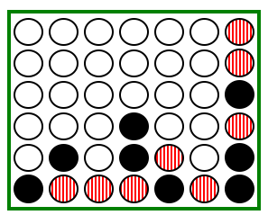
scoreBoard(self,b)
Assigns a score to any board, b
Our system:
100.0
50.0
0.0
for a win
for anything else
for a loss
Who's self?
def scoreBoard(self, b)
if b.winsFor( ): return
elif b.winsFor( ): return
else: return
How can there be no 'X' or 'O' input?
What methods that already exist will come in handy?
This isn't looking very far ahead !

Slide 17
Giving each board a score is useful, but …
possible moves for red
… ultimately, we want to give a score to each possible move.

Slide 18
scoreBoard vs. scoresFor
scoreBoard(self,b) looks ahead 0 moves
0-ply
only
it scores the board as it stands now
scoresFor(self,b) returns a LIST of scores: one for each column a player might move next…
0-ply
[ 50, 50, 50, 100, 50, 50, 50 ]
1-ply
example of an output from scoresFor
2-ply
it gives a separate score for each column, considering moves up to n-ply
any ply…

Slide 19
scoreBoard vs. scoresFor
scoreBoard(self,b) looks ahead 0 moves
0-ply
only
it scores the board as it stands now
scoresFor(self,b) returns a LIST of scores: one for each column a player might move next…
0-ply
[ 50, 50, 50, 100, 50, 50, 50 ]
1-ply
This is the AI.
example of an output from scoresFor
2-ply
it gives a separate score for each column, considering moves up to n-ply
any ply…

Slide 20
scoresFor at 0 ply…
0-ply scores for
What should scoresFor return for with ply == 0
x
x
x
x
x
x
x
0 ply is a Zen-like approach: exist only in the present
0-ply means 0 moves are made!
to move
We still use -1 as the score into a full column.
0 ply!
o0.scoreBoard( b42 )
o0.scoresFor( b42 )

Slide 21
scoresFor at 1 ply…
1-ply scores for
What should scoresFor return for with ply == 1
A 1-ply lookahead player will "see" an impending victory.
1-ply means 1 move is made!
"Gotcha!"
to move
I try 1 ply!
o1.scoresFor( b42 )

Slide 22
scoresFor at 2 ply…
2-ply scores for
What should scoresFor return for with ply == 2
A 2-ply lookahead player will see a way to win or block the opponent's win
2-ply means 2 moves are made!
"Gotcha!" + "Uh Oh…"
to move
What about 3-ply?

Slide 23
scoresFor at 2 ply for
2-ply scores for
What should scoresFor return for with ply == 2
A 2-ply lookahead player will see a way to win or block the opponent's win
2-ply means 2 moves are made!
"Gotcha!" + "Uh Oh…"
to move
What about 3-ply?

Slide 24
Quiz
So many ply!
b
Fill in the list of scores returned by scoresFor
'O'
The same move is evaluated at each ply... it's just evaluated farther into the future!
you, self, are playing 'O'
Each row is different in at least 1 score…
'X'
col 0
col 1
col 2
col 3
col 4
col 5
col 6
scoresFor(b)
ox == 'O' and ply == 0
col 0
col 1
col 2
col 3
col 4
col 5
col 6
scoresFor(b)
ox == 'O' and ply == 1
col 0
col 1
col 2
col 3
col 4
col 5
col 6
scoresFor(b)
ox == 'O' and ply == 2
col 0
col 1
col 2
col 3
col 4
col 5
col 6
scoresFor(b)
ox == 'O' and ply == 3

Slide 25
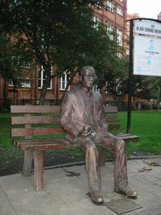
?
Strategic thinking == intelligence
Two-player games have been a key focus of AI as long as computers have been around…
In 1945, Alan Turing predicted that computers would be better chess players than people in ~ 50 years…
and thus would have achieved intelligence.
Alan Turing memorial Manchester, England

Slide 26
Strategic thinking != intelligence
computers
humans
good at looking to find winning combinations of moves
good at evaluating the strength of a board for a player
… humans and computers have different relative strengths in these games.

Slide 27
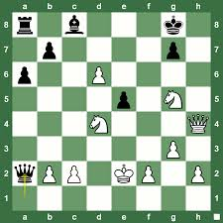
Humans play via "look-up"
An experiment (by A. deGroot) was performed in which chess positions were shown to novice and expert players…
- experts could reconstruct these perfectly
- novice players did far worse…
Adriaan de Groot

Slide 28
Humans play via "look-up"
An experiment (by A. deGroot) was performed in which chess positions were shown to novice and expert players…
- experts could reconstruct these perfectly
- novice players did far worse…
Random chess positions (not legal ones) were then shown to the two groups
- experts and novices did equally well/badly
at reconstructing them!
Adriaan de Groot

Slide 29
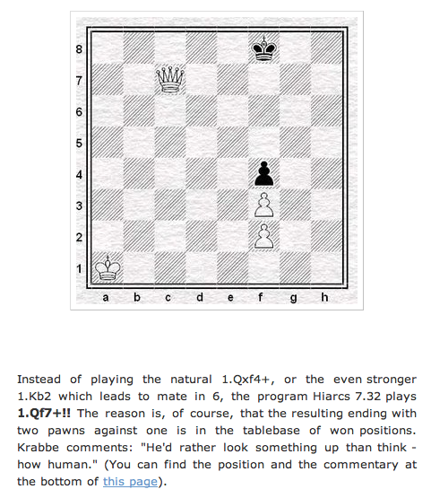
Computers can look up positions, too… !
sometimes w/ surprising results!

Slide 30
Extra this week
scoreBoard4Tourney
scoring like a human…
Idea: use more than only 0, 50, and 100
don't give this board a 50.0 !
We run a 2-ply round-robin tournament using these f'ns.
examples from prior years…

Slide 31
Extra this week
scoreBoard4Tourney
scoring like a human…
Possible ideas:
Give more value to central pieces
Give more value to unblocked 2-in-a-row and 3-in-a-row chains of pieces
Give more value to unblocked 2-out-of-four and 3-out-of-four sets of pcs.
Give less value when the opponent has any of these things!
0
15
42
47
50
52
75
99
100
There are numbers other than 50!

Slide 32
NOT extra this week
scoresFor
scoring like a machine…
Idea: Find the list of 7 scores – one for each column – at the current ply.
here, scoresFor returns
[ 50, 50, 50, 50, 50, 50, 50 ]
until ply 5 !

Slide 33
def scoresFor(self, b):
(0) Start all scores at 50.
(1) For each col to move:
(2a) If not possible…
(2b) If game already over…
(2c) Else add the move to b
(3) Ask an opponent (!!!) for its scoresFor at ply-1
(4) compute self's score
""" MUST return a list of 7 scores!!
"""
scores = [50,50,50,50,50,50,50]
for col in range( 0, 7 ):
What values will col take?
Needs to return a list of seven scores!
This is the AI.
return scores

Slide 34
scoresFor idea
(self) 'X'
(0) Suppose you're playing at 2 ply...
(1) Make ALL moves!
b

Slide 35
scoresFor idea
(self) 'X'
(0) Suppose you're playing at 2 ply...
(1) Make ALL moves!
(2) Ask OPPONENT its scoresFor at ply-1
(3) Compute which score the opp. will take
(4) Compute what score you get…
new 'X'
b
Opponent's scoresFor
[50,50,50,50,50,100,50]
[50,50,50,50,50,100,50]
Col 0
Col 6
Col 1
Col 5
Col 2
Col 3
Col 4
[50,50,50,50,50,100,50]
[50,50,50,50,50,50,50]
[50,50,50,50,50,100,50]
[50,50,50,50,50,100,50]
[ 0, 0, 0, 0, 0, 0, 0 ]

Slide 36
scoresFor idea
(self) 'X'
(0) Suppose you're playing at 2 ply...
(1) Make ALL moves!
(2) Ask OPPONENT its scoresFor at ply-1
(3) Compute which score the opp. will take
(4) Compute what score you get…
new 'X'
b
Which score will the opponent choose?
self gets the OPPOSITE score as a result!
Opponent's scoresFor
[50,50,50,50,50,100,50]
[50,50,50,50,50,100,50]
max(os) = 100
Col 0
Col 6
max(os) = 100
0
0
Col 1
Col 5
Col 2
max(os) = 100
Col 3
Col 4
max(os) = 100
max(os) = 50
0
max(os) = 100
max(os) = 0
50
0
0
100
[50,50,50,50,50,100,50]
[50,50,50,50,50,50,50]
[50,50,50,50,50,100,50]
[50,50,50,50,50,100,50]
[ 0, 0, 0, 0, 0, 0, 0 ]

Slide 37
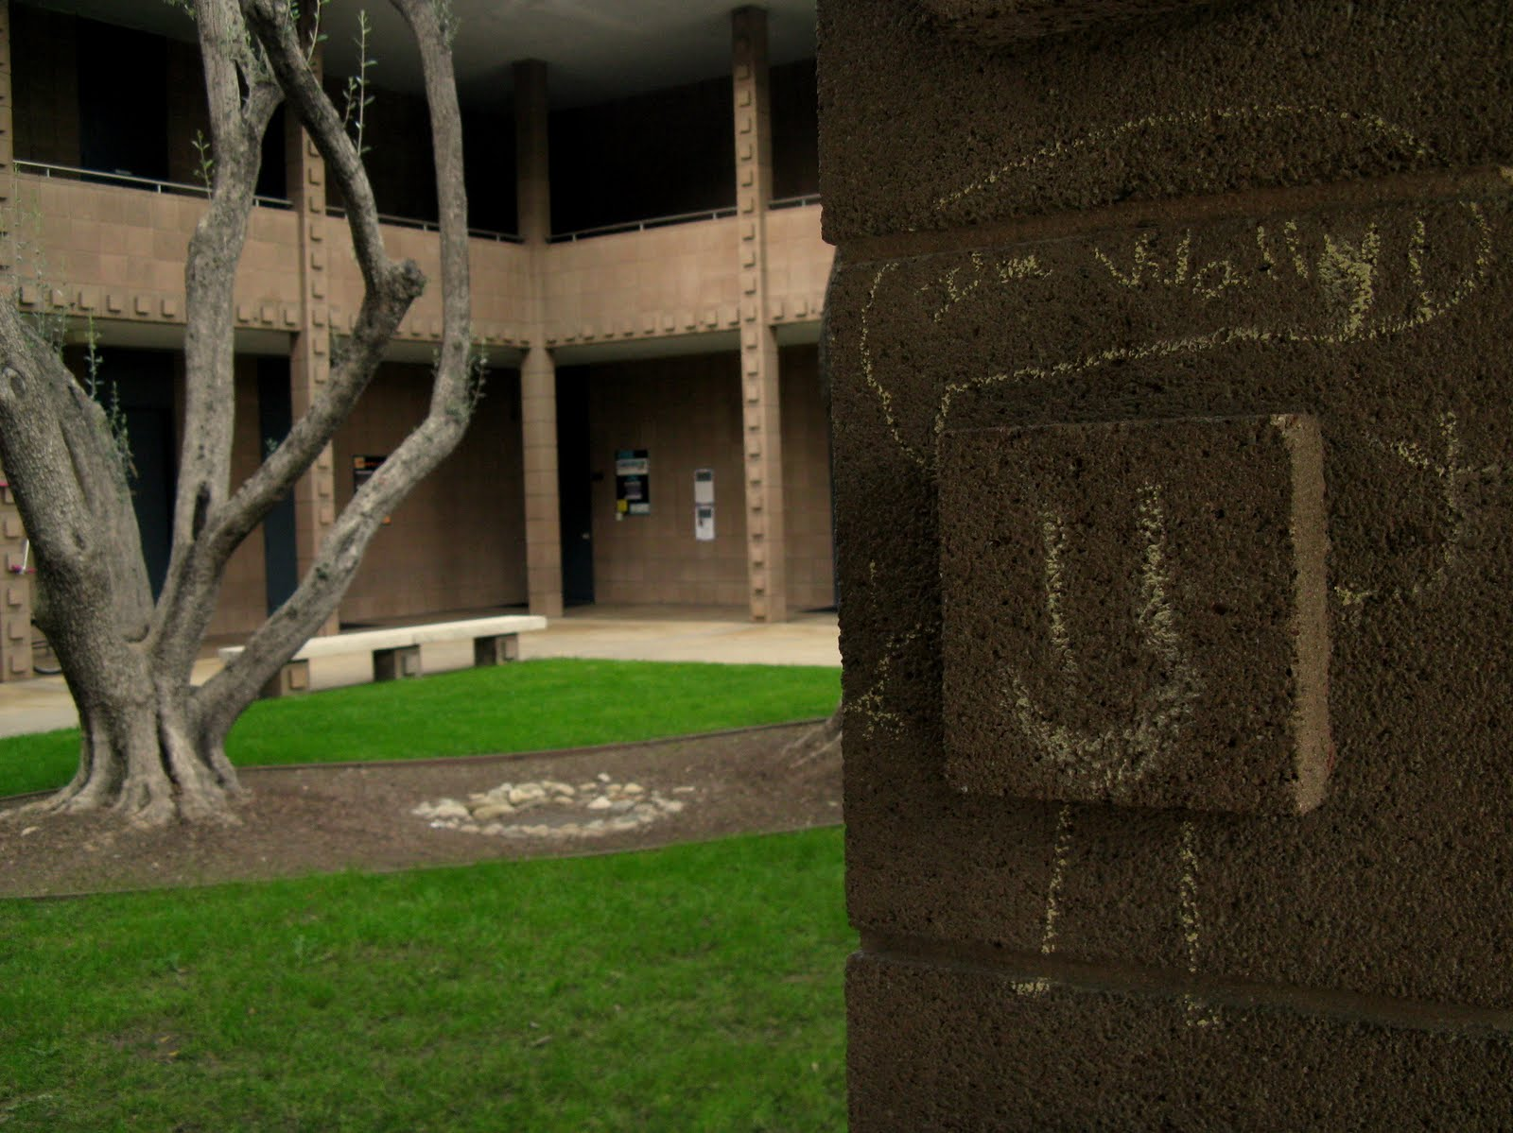
Less concept,
more concrete...

Slide 38
def scoresFor(self, b):
(0) Start all scores at 50.
(1) For each col to move:
(2a) If not possible…
(2b) If game already over…
(2c) Else add the move to b
(3) Ask an opponent (!!!) for its scoresFor at ply-1
(4) compute self's score
""" MUST return a list of 7 scores!!
"""
scores = [50,50,50,50,50,50,50]
for col in range( 0, 7 ):
return scores

Slide 39
def scoresFor(self, b):
(0) Start all scores at 50.
(1) For each col to move:
(2a) If not possible…
(2b) If game already over…
(2c) Else add the move to b
(3) Ask an opponent (!!!) for its scoresFor at ply-1
(4) compute self's score
""" MUST return a list of 7 scores!!
"""
scores = [50,50,50,50,50,50,50]
for col in range( 0, 7 ):
if
elif
...
Base cases
else:
Recursive case!
return scores

Slide 40
def scoresFor(self, b):
(0) Start all scores at 50.
(1) For each col to move:
(2a) If not possible…
(2b) If game already over…
(2c) Else add the move to b
(3) Ask an opponent (!!!) for its scoresFor at ply-1
(4) compute self's score
""" MUST return a list of 7 scores!!
"""
scores = [50,50,50,50,50,50,50]
for col in range( 0, 7 ):
if
elif
...
Base cases
else:
Recursive case!
return scores

Slide 41
Games' Branching Factors
0 Ply
On average, Connect 4 players have seven choices per move.
Chess players have more, perhaps around 40, possible choices in a given move.
1 Ply
2 Ply
Branching Factors
for different two-player games
“solved” games
Tic-tac-toe 4
Connect Four 7
Checkers 10
Othello 30
Chess 40
Go 300
Boundaries for qualitatively different games…
computer-dominated
human-dominated?
Arimaa 17000

Slide 42
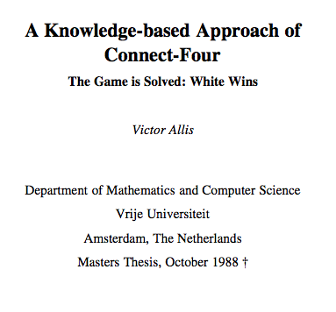
Connect 4 was solved in 1988.

Slide 43
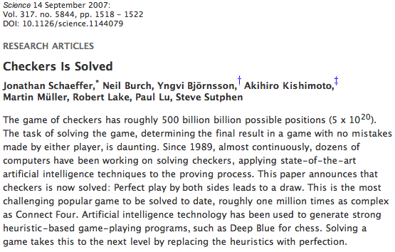
Checkers was solved in 2007.

Slide 44
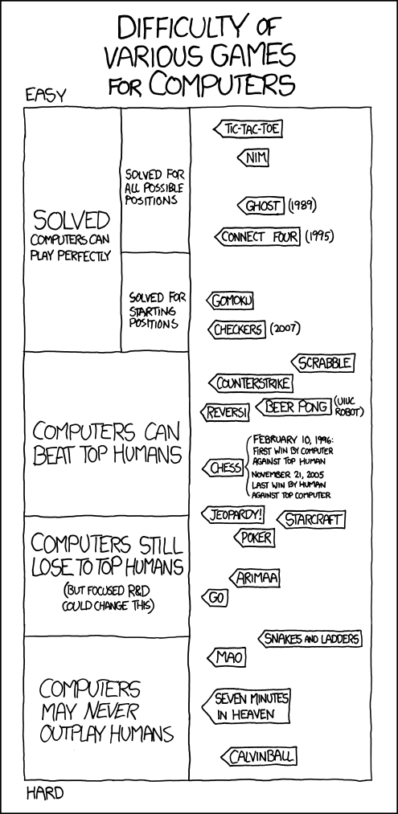
Games' Branching Factors

Slide 45
(Games' Branching Factors)

Slide 46
(Games' Branching Factors)

Slide 47
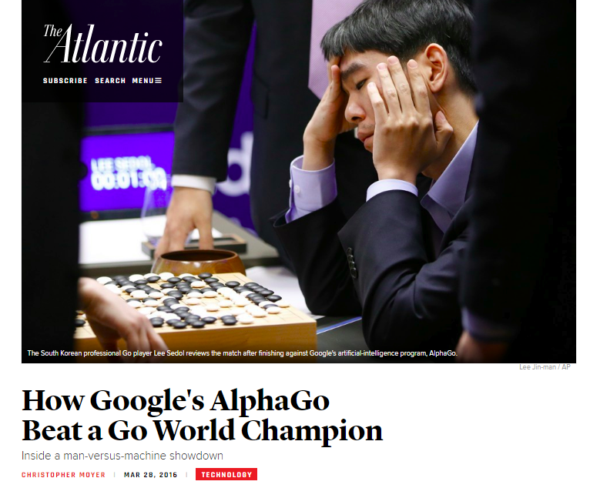
(Games' Branching Factors)

Slide 48
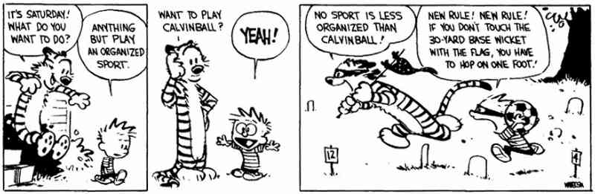
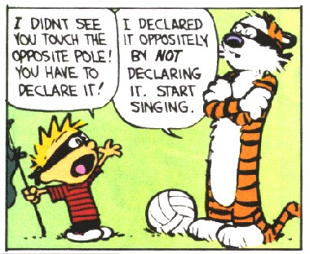

Slide 49
Suppose
def tiebreakMove(self, S):
if self.tbt == 'LEFT':
S = [-1,0,50,50,0,0,50]
col
0
1
2
3
4
5
6
best = max(S)
bestLocList = []
First, how could you create bestLocList, a list of all of the column #s (indices) of the highest score inside the list S
for
Hint: use a for or a LC!
Then, how could you return the leftmost out of all of those column numbers that are in bestLocList ?
How would 'RANDOM' and 'RIGHT' work differently?

Slide 50
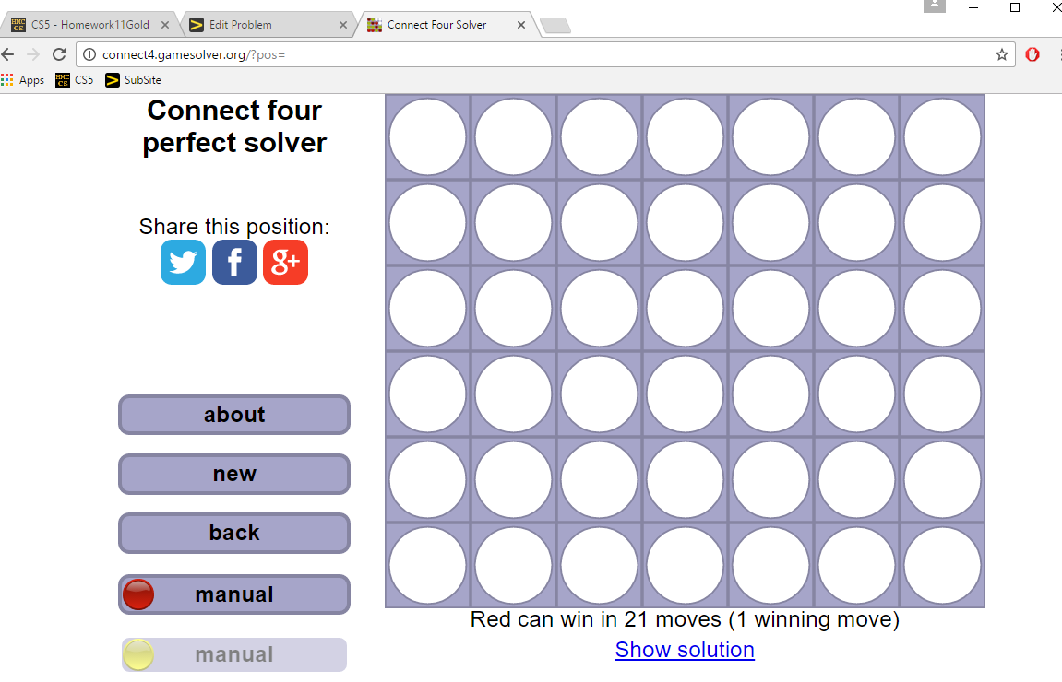
Good luck on hw#11 ~ against your own program

Slide 52
Quiz
Name(s) _______________________
b
Fill in the list of scores returned by scoresFor
'O'
The same move is evaluated at each ply... it's just evaluated farther into the future!
you, self, are playing 'O'
Each row is different in at least 1 score…
'X'
col 0
col 1
col 2
col 3
col 4
col 5
col 6
scoresFor(b)
ox == 'O' and ply == 0
col 0
col 1
col 2
col 3
col 4
col 5
col 6
scoresFor(b)
ox == 'O' and ply == 1
col 0
col 1
col 2
col 3
col 4
col 5
col 6
scoresFor(b)
ox == 'O' and ply == 2
col 0
col 1
col 2
col 3
col 4
col 5
col 6
scoresFor(b)
ox == 'O' and ply == 3

Slide 53
scoreBoard(self,b)
Assigns a score to any board, b
Our system:
100.0
50.0
0.0
for a win
for anything else
for a loss
Who's self?
def scoreBoard(self, b)
if b.winsFor( ): return
elif b.winsFor( ): return
else: return
How can there be no 'X' or 'O' input?
What methods that already exist will come in handy?
This isn't looking very far ahead !

Slide 54
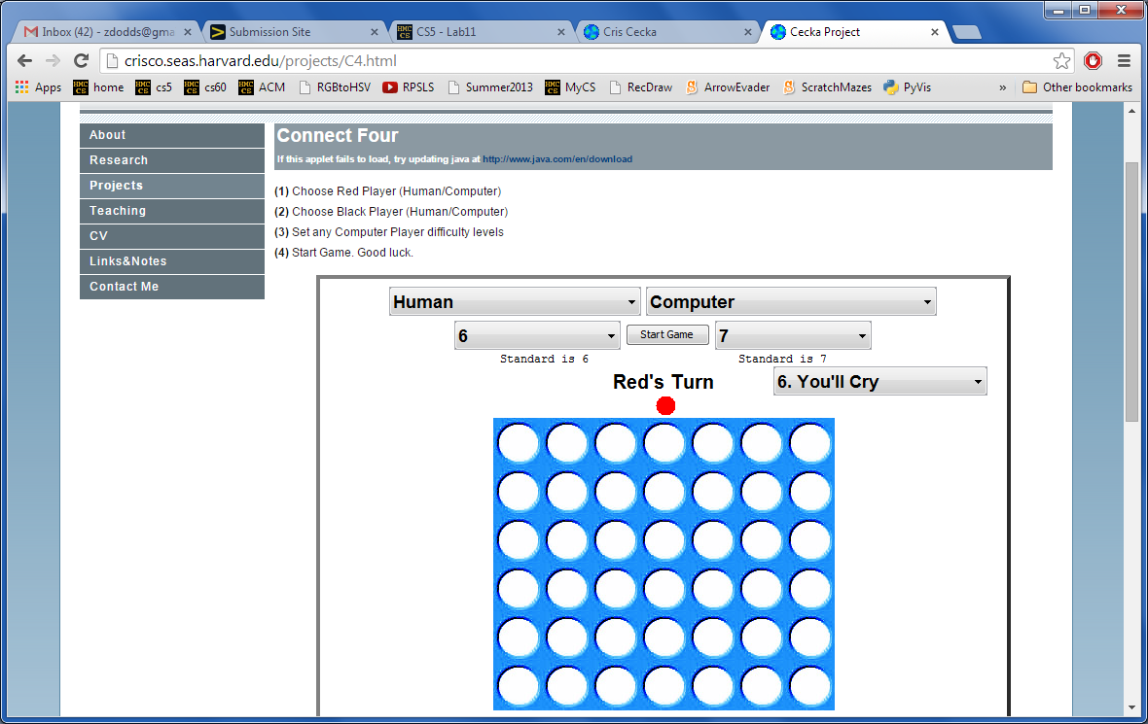
This game is tearing me up!
Looking for a game… ?
http://crisco.seas.harvard.edu/projects/C4.html
Good luck on hw#11 ~ against your own program

Slide 55
scoresFor at 0 ply…
0-ply scores for
What should scoresFor return for with ply == 0
x
x
x
x
x
x
x
0 ply is a Zen-like approach: exist only in the present
0-ply means 0 moves are made!
to move
We still use -1 as the score into a full column.
0 ply!
o0.scoreBoard( b42 )
o0.scoresFor( b42 )

Slide 56
scoresFor at 1 ply…
1-ply scores for
What should scoresFor return for with ply == 1
A 1-ply lookahead player will "see" an impending victory.
1-ply means 1 move is made!
"Gotcha!"
to move
I try 1 ply!
o1.scoresFor( b42 )

Slide 57
scoresFor at 2 ply…
2-ply scores for
What should scoresFor return for with ply == 2
A 2-ply lookahead player will see a way to win or block the opponent's win
2-ply means 2 moves are made!
"Gotcha!" + "Uh Oh…"
to move
What about 3-ply?

Slide 58
scoresFor at 2 ply for
2-ply scores for
What should scoresFor return for with ply == 2
A 2-ply lookahead player will see a way to win or block the opponent's win
2-ply means 2 moves are made!
"Gotcha!" + "Uh Oh…"
to move
What about 3-ply?

Slide 59
Quiz
Name(s) _______________________
b
Fill in the list of scores returned by scoresFor
'O'
The same move is evaluated at each ply... it's just evaluated farther into the future!
you, self, are playing 'O'
Each row is different in at least 1 score…
'X'
col 0
col 1
col 2
col 3
col 4
col 5
col 6
scoresFor(b)
ox == 'O' and ply == 0
col 0
col 1
col 2
col 3
col 4
col 5
col 6
scoresFor(b)
ox == 'O' and ply == 1
col 0
col 1
col 2
col 3
col 4
col 5
col 6
scoresFor(b)
ox == 'O' and ply == 2
col 0
col 1
col 2
col 3
col 4
col 5
col 6
scoresFor(b)
ox == 'O' and ply == 3

Slide 60
def scoresFor(self, b):
(0) Start all scores at 50.
(1) For each col to move:
(2a) If not possible…
(2b) If game already over…
(2c) Else add the move to b
(3) Ask an opponent (!!!) for its scoresFor at ply-1
(4) compute self's score
""" MUST return a list of 7 scores!!
"""
scores = [50,50,50,50,50,50,50]
for col in range( 0, 7 ):
if
elif
...
Base cases
else:
Recursive case!
return scores

Slide 61
def scoresFor(self, b):
(0) Start all scores at 50.
(1) For each col to move:
(2a) If not possible…
(2b) If game already over…
(2c) Else add the move to b
(3) Ask an opponent (!!!) for its scoresFor at ply-1
(4) compute self's score
""" MUST return a list of 7 scores!!
"""
scores = [50,50,50,50,50,50,50]
for col in range( 0, 7 ):
if
elif
...
Base cases
else:
Recursive case!
return scores

Slide 62
def scoresFor(self, b):
(0) Start all scores at 50.
(1) For each col to move:
(2a) If not possible…
(2b) If game already over…
(2c) Else add the move to b
(3) Ask an opponent (!!!) for its scoresFor at ply-1
(4) compute self's score
""" MUST return a list of 7 scores!!
"""
scores = [50,50,50,50,50,50,50]
for col in range( 0, 7 ):
return scores

Slide 63
def scoresFor(self, b):
(0) Start all scores at 50.
(1) For each col to move:
(2a) If not possible…
(2b) If game already over…
(2c) Else add the move to b
(3) Ask an opponent (!!!) for its scoresFor at ply-1
(4) compute self's score
""" MUST return a list of 7 scores!!
"""
scores = [50,50,50,50,50,50,50]
for col in range( 0, 7 ):
return scores

Slide 64
def scoresFor(self, b):
(0) Start all scores at 50.
(1) For each col to move:
(2a) If not possible…
(2b) If game already over…
(2c) Else add the move to b
(3) Ask an opponent (!!!) for its scoresFor at ply-1
(4) compute self's score
""" MUST return a list of 7 scores!!
"""
scores = [50,50,50,50,50,50,50]
for col in range( 0, 7 ):
return scores

Slide 65

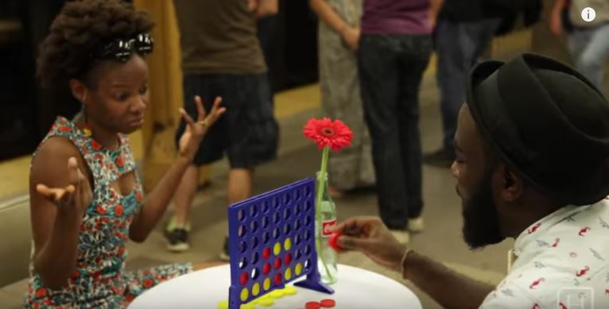

Slide 66
ox
tbt
ply
p = Player('X', 'LEFT', 3)
self
other
us
"them"

Slide 67
ox
tbt
ply
p = Player('X', 'LEFT', 3)
self
other
other = Player(…, …, …)
us
"them"

Slide 68

Connect Four lives on…

Slide 69
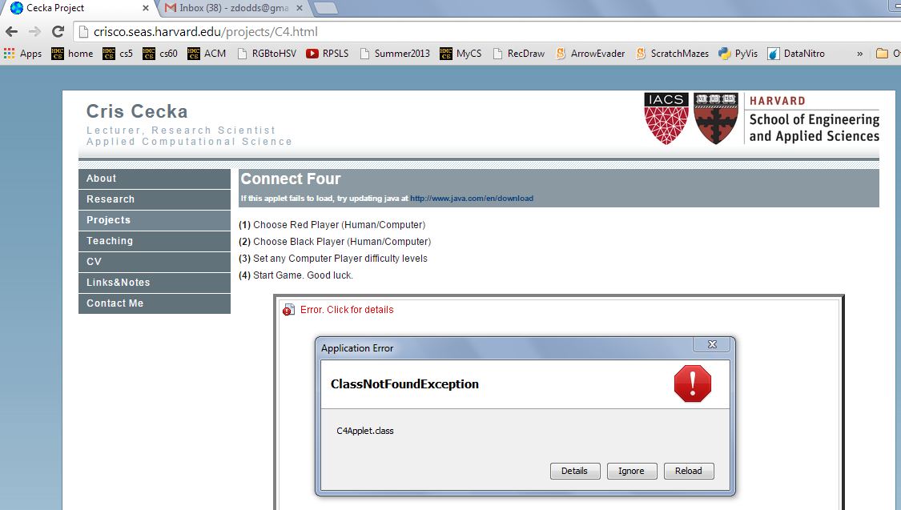
Aargh!

Slide 70
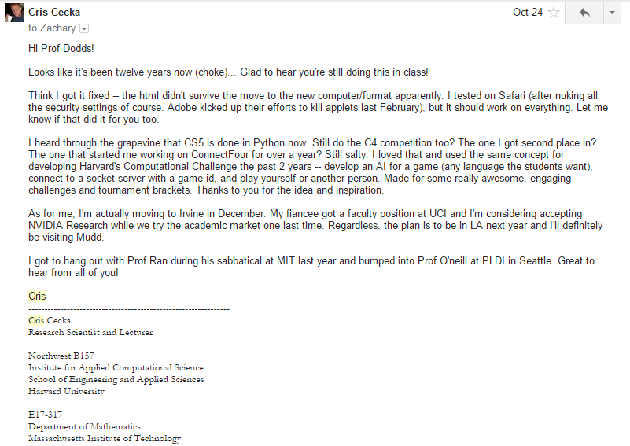
This year's Cris Cecka award…

Slide 71
Quiz
Name(s) _______________________
b
Fill in the score for each column at each ply up to 3.
'O'
The same move is evaluated at each ply... it's just evaluated farther into the future!
you - self - is playing 'O'
Each row is different in at least 1 score…
'X'
col 0
col 1
col 2
col 3
col 4
col 5
col 6
scoresFor 'O' at ply == 0
col 0
col 1
col 2
col 3
col 4
col 5
col 6
1-ply scores for 'O':
Looks 1 move into the future
col 0
col 1
col 2
col 3
col 4
col 5
col 6
2-ply scores for 'O':
Looks 2 moves into the future
col 0
col 1
col 2
col 3
col 4
col 5
col 6
3-ply scores for 'O':
Looks 3 moves into the future

Slide 72
Quiz
Try this on the back first!
b
Fill in the score for each column at each ply up to 3.
'O'
The same move is evaluated at each ply... it's just evaluated farther into the future!
you - self - is playing 'O'
Each row is different in at least 1 score…
'X'
col 0
col 1
col 2
col 3
col 4
col 5
col 6
0-ply scores for 'O':
Looks 0 moves into the future
col 0
col 1
col 2
col 3
col 4
col 5
col 6
1-ply scores for 'O':
Looks 1 move into the future
col 0
col 1
col 2
col 3
col 4
col 5
col 6
2-ply scores for 'O':
Looks 2 moves into the future
col 0
col 1
col 2
col 3
col 4
col 5
col 6
3-ply scores for 'O':
Looks 3 moves into the future

Slide 73
Quiz
Name(s) _______________________
b
Fill in the score for each column at each ply up to 3.
'O'
The same move is evaluated at each ply... it's just evaluated farther into the future!
you - self - is playing 'O'
Each row is different in at least 1 score…
'X'
col 0
col 1
col 2
col 3
col 4
col 5
col 6
0-ply scores for 'O':
Looks 0 moves into the future
col 0
col 1
col 2
col 3
col 4
col 5
col 6
1-ply scores for 'O':
Looks 1 move into the future
col 0
col 1
col 2
col 3
col 4
col 5
col 6
2-ply scores for 'O':
Looks 2 moves into the future
col 0
col 1
col 2
col 3
col 4
col 5
col 6
3-ply scores for 'O':
Looks 3 moves into the future

Slide 74
scoreBoard(self,b)
Assigns a score to any board, b
A simple system:
100.0
50.0
0.0
for a win
for anything else
for a loss
Implementing…
scoreBoard(self, b)
Who's this self?
How can there be no 'X' or 'O' input?
What methods that already exist will come in handy?
This isn't looking very far ahead !

Slide 75
Scoring moves at 0 ply
"Ply" is the number of moves to look ahead…
0-ply scores for
What would the 0-ply scores be for each column (move)?
x
x
x
x
x
x
x
0 ply is a Zen-like approach: exist only in the present
0-ply means 0 moves are made!
to move
We use -1 as the score into a full column.
0 ply!
o0.scoreBoard( b42 )
o0.scoresFor( b42 )

Slide 76
Scoring moves at 1 ply
1-ply scores for
What would the 1-ply scores be for each column (move)?
A 1-ply lookahead player will "see" an impending victory.
1-ply means 1 move is made!
"Gotcha!"
to move
I try 1 ply!
o1.scoresFor( b42 )

Slide 77
Scoring moves at 2 ply
2-ply scores for
What would the 2-ply scores be for each column (move)?
A 2-ply lookahead player will see a way to win or block the opponent's win
2-ply means 2 moves are made!
"Gotcha!" + "Uh Oh…"
to move
What about 3-ply?

Slide 78
Scoring moves at 2 ply for
2-ply scores for
What would the 2-ply scores be for each column (move)?
A 2-ply lookahead player will see a way to win or block the opponent's win
2-ply means 2 moves are made!
"Gotcha!" + "Uh Oh…"
to move
What about 3-ply?

Slide 79
Quiz
Name(s) _______________________
b
Fill in the score for each column at each ply up to 3.
'O'
The same move is evaluated at each ply... it's just evaluated farther into the future!
you - self - is playing 'O'
Each row is different in at least 1 score…
'X'
col 0
col 1
col 2
col 3
col 4
col 5
col 6
0-ply scores for 'O':
Looks 0 moves into the future
col 0
col 1
col 2
col 3
col 4
col 5
col 6
1-ply scores for 'O':
Looks 1 move into the future
col 0
col 1
col 2
col 3
col 4
col 5
col 6
2-ply scores for 'O':
Looks 2 moves into the future
col 0
col 1
col 2
col 3
col 4
col 5
col 6
3-ply scores for 'O':
Looks 3 moves into the future

Slide 80
def scoresFor(self, b):
(0) Start all scores at 50.
(1) For each col to move:
(2a) If not possible…
(2b) If game already over…
(2c) Else add the move to b
(3) Ask an opponent (!!!) for its scoresFor at ply-1
(4) compute self's score
""" MUST return a list of 7 scores!!
"""
scores = [50,50,50,50,50,50,50]
for col in range( 0, 7 ):
return scores

Slide 81
def scoresFor(self, b):
(0) Start all scores at 50.
(1) For each col to move:
(2a) If not possible…
(2b) If game already over…
(2c) Else add the move to b
(3) Ask an opponent (!!!) for its scoresFor at ply-1
(4) compute self's score
""" MUST return a list of 7 scores!!
"""
scores = [50,50,50,50,50,50,50]
for col in range( 0, 7 ):
return scores

Slide 82
scoreBoard(self,b)
Assigns a score to any board, b
A simple system:
100.0
50.0
0.0
for a win
for anything else
for a loss
Implementing…
scoreBoard(self, b)
How can there be no 'X' or 'O' input?
What methods that already exist will come in handy?
This isn't looking very far ahead !

Slide 83
Scoring moves at 0 ply
"Ply" is the number of moves to look ahead…
0-ply scores for
What would the 0-ply scores be for each column (move)?
x
x
x
x
x
x
x
0 ply is a Zen-like approach: exist only in the present
0-ply means 0 moves are made!
to move
We use -1 as the score into a full column.
0 ply!
o0.scoreBoard( b42 )
o0.scoresFor( b42 )

Slide 84
Scoring moves at 2 ply
2-ply scores for
What would the 2-ply scores be for each column (move)?
A 2-ply lookahead player will see a way to win or block the opponent's win
2-ply means 2 moves are made!
"Gotcha!" + "Uh Oh…"
to move
What about 3-ply?

Slide 85
Scoring moves at 2 ply for
2-ply scores for
What would the 2-ply scores be for each column (move)?
A 2-ply lookahead player will see a way to win or block the opponent's win
2-ply means 2 moves are made!
"Gotcha!" + "Uh Oh…"
to move
What about 3-ply?

Slide 86
Quiz
Name(s) _______________________
b
Fill in the score for each column at each ply up to 3.
'O'
you - self - is playing 'O'
The same move is evaluated at each ply... it's just evaluated farther into the future!
'X'
Each row is different in at least 1 score…
col 0
col 1
col 2
col 3
col 4
col 5
col 6
0-ply scores for 'O':
Looks 0 moves into the future
col 0
col 1
col 2
col 3
col 4
col 5
col 6
1-ply scores for 'O':
Looks 1 move into the future
col 0
col 1
col 2
col 3
col 4
col 5
col 6
2-ply scores for 'O':
Looks 2 moves into the future
col 0
col 1
col 2
col 3
col 4
col 5
col 6
3-ply scores for 'O':
Looks 3 moves into the future

Slide 87
def scoresFor(self, b):
""" MUST return a list of 7 scores!!
"""
scores = [50,50,50,50,50,50,50]
(0) Start all scores at 50.
(1) For each col to move:
(2a) If not possible…
(2b) If game already over…
(2c) Else add the move to b
(3) Ask an opponent (!!!) for its scoresFor at ply-1
(4) compute self's score
for col in range( 0, 7 ):
return scores

Slide 88
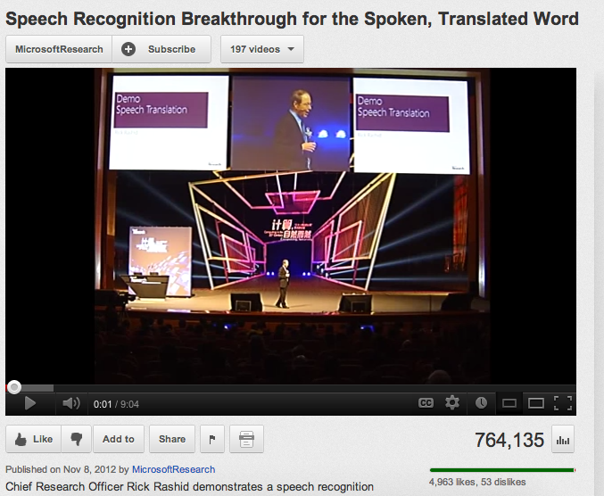
For example,
Computers can only help us to the extent that we can arithmetize an activity.
… Microsoft has tried arithmetizing both English and Chinese

Slide 89
scoreBoard(self,b)
‘X’
‘O’
Assigns a score to any board, b
A simple system:
100.0
50.0
0.0
for a win
for anything else
for a loss
Score for
Score for
Score for
Score for

Slide 90
scoreBoard
Assigns a score to any board, b
A simple system:
100.0
50.0
0.0
for a win
for anything else
for a loss
Implementation ideas…
Why do we need to pass in the board? We never had to do that before!
scoreBoard(self, b)
How can there be no 'X' or 'O' input?
What methods that already exist will come in handy?
This doesn't seem to be looking very far ahead !

Slide 91
Scoring moves, not boards...
scoresFor returns a list of 7 scores!
0-ply
What would the 0-ply scores be for each column (move)
scores
The "Zen" approach
The Player object's ply tells how far ahead to look.
to go
0 ply!
We will use -1 as the score for a full column.
o0.scoreBoard( b42 )
o0.scoresFor( b42 )

Slide 92
scoresFor at 1 ply
1-ply
What would the 1-ply scores be for each column (move)
scores
The "I win!" approach
A 1-ply lookahead player will "see" an impending victory.
to go
I try 1 ply!
o1.scoresFor( b42 )

Slide 93
Two moves ahead… ?
0-ply
-1
50
50
50
50
50
50
scores
What about 3-ply?
Try it!
's
turn
1-ply
scores
A 2-ply lookahead player can also "see" an opponent's impending victory.
2-ply
The "Uh Oh!" approach
scores

Slide 94
scoreBoard vs. scoresFor
scoreBoard(b) looks ahead 0 moves
The "Zen" approach -- we are excellent at this!
0-ply
only
it scores the board as it stands now
scoresFor( self, b ) returns a LIST of scores, one for each column you might choose to move next…
0-ply
it gives a separate score for each column and considers future moves up to n-ply
1-ply
2-ply
…

Slide 95
Name(s) _______________________
b
'X'
Quiz
Fill in the score for a move to each column.
'O'
you - self - is playing 'O'
The same move is evaluated at each ply... it's just evaluated farther into the future!
Each row is different in at least 1 score…
col 0
col 1
col 2
col 3
col 4
col 5
col 6
0-ply scores for 'O':
Looks 0 moves into the future
col 0
col 1
col 2
col 3
col 4
col 5
col 6
1-ply scores for 'O':
Looks 1 move into the future
col 0
col 1
col 2
col 3
col 4
col 5
col 6
2-ply scores for 'O':
Looks 2 moves into the future
col 0
col 1
col 2
col 3
col 4
col 5
col 6
3-ply scores for 'O':
Looks 3 moves into the future

Slide 96
Solutions
b
‘X’
‘O’
col 0
col 1
col 2
col 3
col 4
col 5
col 6
0-ply scores for O:
-1
50
50
50
50
50
50
col 0
col 1
col 2
col 3
col 4
col 5
col 6
1-ply scores for O:
-1
50
50
100
50
50
50
col 0
col 1
col 2
col 3
col 4
col 5
col 6
2-ply scores for O:
-1
0
0
100
0
0
50
col 0
col 1
col 2
col 3
col 4
col 5
col 6
3-ply scores for O:
-1
0
0
100
0
0
100

Slide 97
(0) Start all scores at 50.
(1) For each possible move
(2) If needed +possible, add the move to the board b
(3) Ask an OPPONENT its scoresFor at ply-1 (!!!)
(4) compute self's score
def scoresFor(self, b):
""" MUST return a list of 7 scores!!
"""
scores = [50,50,50,50,50,50,50]
for col in range( 0, 7 ):
return scores

Slide 98
(0) Start all scores at 50.
(1) For each possible move
(2) If needed +possible, add the move to the board b
(3) Ask an OPPONENT its scoresFor at ply-1 (!!!)
(4) compute self's score
def scoresFor(self, b):
""" MUST return a list of 7 scores!!
"""
scores = [50,50,50,50,50,50,50]
for col in range( 0, 7 ):

Slide 99
scoreBoard
Assigns a score to any board, b
A simple system:
100.0
50.0
0.0
for a win
for anything else
for a loss
Implementation ideas…
Why do we need to pass in the board? We never had to do that before!
scoreBoard(self, b)
How can there be no 'X' or 'O' input?
What methods that already exist will come in handy?
This doesn't seem to be looking very far ahead !

Slide 100
Scoring moves, not boards...
scoresFor returns a list of 7 scores!
0-ply
What would the 0-ply scores be for each column (move)
scores
The "Zen" approach
The Player object's ply tells how far ahead to look.
to go
0 ply!
We will use -1 as the score for a full column.
o0.scoreBoard( b42 )
o0.scoresFor( b42 )

Slide 101
scoresFor at 1 ply
1-ply
What would the 1-ply scores be for each column (move)
scores
The "I win!" approach
A 1-ply lookahead player will "see" an impending victory.
to go
I try 1 ply!
o1.scoresFor( b42 )

Slide 102
Two moves ahead… ?
0-ply
-1
50
50
50
50
50
50
scores
What about 3-ply?
Try it!
's
turn
1-ply
scores
A 2-ply lookahead player can also "see" an opponent's impending victory.
2-ply
The "Uh Oh!" approach
scores

Slide 103
scoreBoard vs. scoresFor
scoreBoard(b) looks ahead 0 moves
The "Zen" approach -- we are excellent at this!
0-ply
only
it scores the board as it stands now
scoresFor( self, b ) returns a LIST of scores, one for each column you might choose to move next…
0-ply
it gives a separate score for each column and considers future moves up to n-ply
1-ply
2-ply
…

Slide 104
Name(s) _______________________
b
'X'
Quiz
Fill in the score for a move to each column.
'O'
you - self - is playing 'O'
The same move is evaluated at each ply... it's just evaluated farther into the future!
Each row is different in at least 1 score…
col 0
col 1
col 2
col 3
col 4
col 5
col 6
0-ply scores for 'O':
Looks 0 moves into the future
col 0
col 1
col 2
col 3
col 4
col 5
col 6
1-ply scores for 'O':
Looks 1 move into the future
col 0
col 1
col 2
col 3
col 4
col 5
col 6
2-ply scores for 'O':
Looks 2 moves into the future
col 0
col 1
col 2
col 3
col 4
col 5
col 6
3-ply scores for 'O':
Looks 3 moves into the future

Slide 105
?
Strategic thinking == intelligence
Two-player games have been a key focus of AI as long as computers have been around…
computers
humans
good at looking ahead in the game to find winning combinations of moves
good at evaluating the strength of a board for a player
hw11 pr2
ex. credit
building a Connect 4 AI by looking ahead in the game
emulating a human by evaluating board positions
… humans and computers have different relative strengths in these games.

Slide 106
Extra examples: 1-ply and 2-ply scoresFor
It is O’s move. What scores does a 1-ply lookahead for O assign to each move?
|O| | | | | | |
|X| | | |O| |X|
|O| | | |X|O|X|
|X| | | |O|O|X|
|X| |X| |X|O|O|
|X| |O|O|O|X|X|
---------------
0 1 2 3 4 5 6
col 0
col 1
col 2
col 3
col 4
col 5
col 6
Which change at 2-ply?
| | | | | | |O|
| | | | | | |O|
| | | | | | |X|
|X| |X|O| | |O|
|X|O|O|X| |X|X|
|X|O|O|O| |O|X|
---------------
0 1 2 3 4 5 6
It is X’s move. What scores does a 2-ply lookahead for X assign to each move?
col 0
col 1
col 2
col 3
col 4
col 5
col 6
Which change at 3-ply?

Slide 107
Answers to example scoresFor scores
It is O’s move. What scores does a 1-ply lookahead for O assign to each move?
|O| | | | | | |
|X| | | |O| |X|
|O| | | |X|O|X|
|X| | | |O|O|X|
|X| |X| |X|O|O|
|X| |O|O|O|X|X|
---------------
0 1 2 3 4 5 6
col 0
col 1
col 2
col 3
col 4
col 5
col 6
-1
100
50
100
50
100
50
Which change at 2-ply?
0
0
| | | | | | |O|
| | | | | | |O|
| | | | | | |X|
|X| |X|O| | |O|
|X|O|O|X| |X|X|
|X|O|O|O| |O|X|
---------------
0 1 2 3 4 5 6
It is X’s move. What scores does a 2-ply lookahead for X assign to each move?
be careful!
col 0
col 1
col 2
col 3
col 4
col 5
col 6
100
0
0
0
50
0
-1
0
Which change at 3-ply?

Slide 108
Looking further ahead …
0 ply:
Zen choice of move: here and now
1 ply:
2 ply:
3 ply:
X’s move
X’s move
X‘s move
| | | | | | | |
| | | | | | | |
| | | | | | | |
| | | | | | | |
| |O|X| | | | |
|O|X|X|X| |O|O|
---------------
0 1 2 3 4 5 6
| | | | | | | |
| | | | | | | |
|O| | | | | | |
|X| | | | | | |
|X|O|O| | |X| |
|O|X|X|O|X|O| |
---------------
0 1 2 3 4 5 6
| | | | | | | |
| | | | | | | |
| | | | |X| | |
| | | | |O|O| |
| |X|X| |X|O| |
|O|X|O| |O|X| |
---------------
0 1 2 3 4 5 6
(1) Player will win
(2) Player will avoid losing
(3) Player will set up a win by forcing the opponent to avoid losing

Slide 109
It is O’s move. What scores does a 1-ply lookahead for O assign to each move?
|O| | | | | | |
|X| | | |O| |X|
|O| | | |X|O|X|
|X| | | |O|O|X|
|X| |X| |X|O|O|
|X| |O|O|O|X|X|
---------------
0 1 2 3 4 5 6
col 0
col 1
col 2
col 3
col 4
col 5
col 6
Which change at 2-ply?

Slide 110
‘X’
scoresFor each column
‘O’
new‘X’
b
(1) For each possible move
(2) Add it to the board
(3) Ask OPPONENT to score each board
(4) Which score will the opponent choose?
What, then, should assign for your score? (self's score)
0.0
50.0
Col 0
Col 6
Col 1
Col 5
Col 2
Col 3
Col 4
50.0
50.0
0.0
0.0
0.0

Slide 111
‘X’
Choosing the best move
‘O’
new‘X’
b
(1) For each possible move
(2) Add it to the board
(3) Ask OPPONENT to score each board - ply?
(4) Reverse the scores
100.0
50.0
Col 0
Col 6
Col 1
Col 5
Col 2
Col 3
Col 4
50.0
50.0
100.0
100.0
100.0

Slide 112
‘X’
Choosing the best move
‘O’
new‘X’
(1) For each possible move
(2) Add it to the board
(3) Ask OPPONENT to score each board - ply?
(4) Reverse the scores
(5) Find one max - that's it!
b
100.0
50.0
Col 0
Col 6
Col 1
Col 5
Col 2
Col 3
Col 4
50.0
50.0
100.0
100.0
100.0

Slide 113
Connect Four
For your convenience, the creators of Python’s library have included a Board class that can represent any size of Connect Four board... !
| | | | | | | |
| | | | | | | |
| | | | | | | |
| | | |X| | | |
| |X| |X|O| | |
|X|O|O|O|X| |O|
---------------
0 1 2 3 4 5 6
Suppose our Board class's 2d list of lists is named self.data. What is the name of this single spot?

Slide 114
Connect Four: the object b
This is true for sufficiently broad definitions of “the creators of Python’s library” ...
data members
int
list
char
char
char
char
NROWS
data
Board
b
char
char
char
char
int
NCOLS
char
char
char
char
What is player ?
def addMove(self, col, player)
def allowsMove(self, col)
def winsFor(self, player)
methods

Slide 115
Connect Four: the object b
This is true for sufficiently broad definitions of “the creators of Python’s library” ...
data members
int
list
char
char
char
char
NROWS
data
Board
b
char
char
char
char
int
NCOLS
char
char
char
char
def addMove(self, col, player)
Which methods will alter b? Which leave it alone?
def allowsMove(self, col)
def winsFor(self, player)
methods

Slide 116
Connect Four: Board
class Board:
def __init__( self, numRows, numCols ):
""" our Board's constructor """
self.NROWS = numRows
self.NCOLS = numCols
self.data = []
for r in range(self.NROWS):
onerow = [' ']*self.NCOLS
self.data += [onerow]
def __repr__(self):
""" thoughts? """
look familiar?
Starting code for the Board class

Slide 117
Connect Four: Board
class Board:
def __init__( self, numRows, numCols ):
""" our Board's constructor """
self.NROWS = numRows
self.NCOLS = numCols
self.data = []
for r in range(self.NR):
onerow = [' ']*self.NC
self.data += [onerow]
def __repr__(self):
""" thoughts? """
s = '\n'
for r in range(self.NROWS):
s += '|'
for c in range(self.NCOLS):
s += self.data[r][c] + '|'
return s
look familiar?
a bit more to go !

Slide 118
Problem 2
Hw11 Pr2: Connect Four Board
class Board
__init__
the “constructor”
allowsMove
checks if allowed
addMove
places a checker
__repr__
outputs to screen
isFull
checks if space left
winsFor
checks if a player has won
hostGame
play!
What's trickiest here?

Slide 119
Problem 2
Hw11 Pr2: Connect Four Board
class Board
__init__
the “constructor”
allowsMove
checks if allowed
addMove
places a checker
__repr__
outputs to screen
isFull
checks if space left
winsFor
checks if a player has won
hostGame
play!
What's trickiest here?

Slide 120
What's wrong here?
def winsForHoriz(self, player):
inarow = 0
for r in range(self.NROWS):
for c in range(self.NCOLS):
if self.data[r][c] == player:
inarow += 1
else:
inarow = 0
if inarow == 4:
return True
return False
| | | | | | | |
| | | | | | | |
| | | | | | | |
| | | |O|O| | |
|X|X| |O|X|X|X|
|X|O|O|O|O|X|X|
---------------
0 1 2 3 4 5 6

Slide 121
Strategies?
horizontals
verticals
diagonals ??
| | | | | | | |
| | | | | | | |
| | | | | | | |
| | | |O|O| | |
|X|X| |O|X|X|X|
|X|O|O|O|O|X|X|
---------------
0 1 2 3 4 5 6

Slide 122
class Board
{
# __init__ and __repr__ methods here…
# 3 data members:
# self.NR == number of rows
# self.NC == number of cols
# self.data == the 2d list of lists of chars
def mysteryMethod(self, col, ox):
r = 0
while r < self.NR and self.data[r][col] == ' ':
r += 1
self.data[r-1][col] = ox
def allowsMove(self, col):
}
“Quiz”
Briefly, what is each line of the mysteryMethod doing? Which method is it?
1
2
3
Could it go wrong?
Write allowsMove to return whether the input col is a valid column to move. (True or False)

Slide 123
Problem 2
Hw11 Pr2: Connect Four Board
class Board
__init__
the “constructor”
allowsMove
checks if allowed
addMove
places a checker
__repr__
outputs to screen
isFull
checks if space left
winsFor
checks if a player has won
hostGame
play!
What's trickiest here?

Slide 124
(1) For each possible move
(2) Add it to the board
(3) Ask OPPONENT to score each board at ply-1
(4) self's score is 100-max
def scoresFor(self, b):

Slide 125
Problem 2
Hw11 Pr2: Connect Four Board
class Board
__init__
the “constructor”
allowsMove
checks if allowed
addMove
places a checker
__repr__
outputs to screen
isFull
checks if space left
winsFor
checks if a player has won
hostGame
play!
What's trickiest here?

Slide 126
Strategies?
horizontals
verticals
diagonals ??
| | | | | | | |
| | | | | | | |
| | | | | | | |
| | | |X| | | |
| |X| |X|O| | |
|X|O|O|O|O| |O|
---------------
0 1 2 3 4 5 6

Slide 127
Example 1-ply and 2-ply lookahead scores
It is O’s move. What scores does a 1-ply lookahead for O assign to each move?
|O| | | | | | |
|X| | | |O| |X|
|O| | | |X|O|X|
|X| | | |O|O|X|
|X| |X| |X|O|O|
|X| |O|O|O|X|X|
---------------
0 1 2 3 4 5 6
col 0
col 1
col 2
col 3
col 4
col 5
col 6
Which change at 2-ply?

Slide 128
Solutions
b
‘X’
‘O’
col 0
col 1
col 2
col 3
col 4
col 5
col 6
0-ply scores for O:
-1
50
50
50
50
50
50
col 0
col 1
col 2
col 3
col 4
col 5
col 6
1-ply scores for O:
-1
50
50
100
50
50
50
col 0
col 1
col 2
col 3
col 4
col 5
col 6
2-ply scores for O:
-1
0
0
100
0
0
50
col 0
col 1
col 2
col 3
col 4
col 5
col 6
3-ply scores for O:
-1
0
0
100
0
0
100

Slide 129
(1) For each possible move
(2) Add it to the board b
(3) Ask OPPONENT its scoresFor each b at ply-1
(4) self's score is 100-max!
def scoresFor(self, b):
""" MUST return a 7-score list! """
S = 7*[50]
default values!
return S

Slide 130
Connect Four: the object b
str
str
str
str
int
Board
b
list
width
data
str
str
str
str
int
str
str
str
str
height
data
What is the name of the method that will construct this data?

Slide 131
Connect Four: constructor
class Board:
""" a datatype representing a C4 board
with an arbitrary number of rows and cols
"""
def __init__( self, width, height ):
""" the constructor for objects of type Board """
self.width = width
self.height = height
self.data = [] # this will be the board
for row in range( 6 ):
boardRow = []
for col in range( 7 ):
boardRow += [' '] # add a space to this row
self.data += [boardRow]
Bad magic?

Slide 132
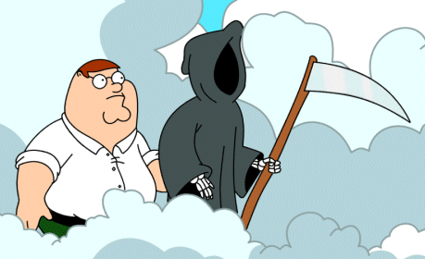
Connect Four: the object b
str
str
str
str
int
Board
b
list
width
data
str
str
str
str
int
str
str
str
str
height
| | | | | | | |
| | | | | | | |
| | | | | | | |
| | | |X| | | |
| |X| |X|O| | |
|X|O|O|O|X| |O|
---------------
0 1 2 3 4 5 6
What is the name of the method that will print this data?

Slide 133
Connect Four: __repr__
def __repr__(self):
""" this method returns a string representation
for an object of type Board
"""
s = ''
for row in range( 6 ):
s += '|'
for col in range( 7 ):
s += self.data[row][col] + '|'
s += '\n'
return s
which row is row 0, row 1, and so on?
To remove?
To add?

Slide 134
def addMove(self, col, ox):
row = self.height-1
while True:
if self.data[row][col] == ' ':
self.data[row][col] = ox
row -= 1
def allowsMove(self, col):
Examples
a C4 board
col #
'X' or 'O'
Step through this addMove method.
How does it work?
What's wrong?
allowsMove should return True if col is a valid move; False otherwise.

Slide 135
C4 Board class: methods
the “constructor”
__init__( self, width, height )
checks if allowed
allowsMove( self, col )
places a checker
addMove( self, col, ox )
removes a checker
delMove( self, col )
outputs a string
__repr__( self )
checks if any space is left
isFull( self )
checks if a player has won
winsFor( self, ox )
play!
hostGame( self )
Which is trickiest… ?

Slide 136
Checking wins… ?
b
X
O
Thoughts?
corner cases?

Slide 137
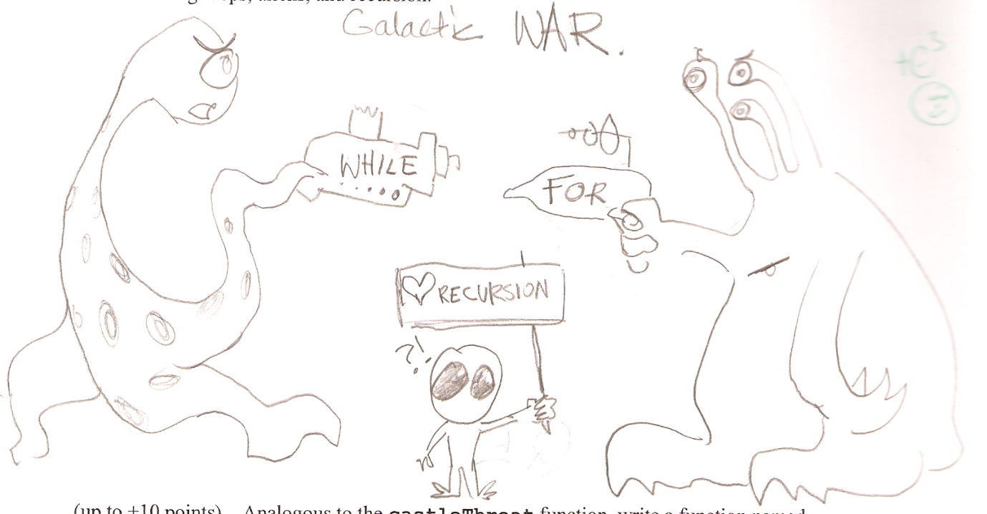
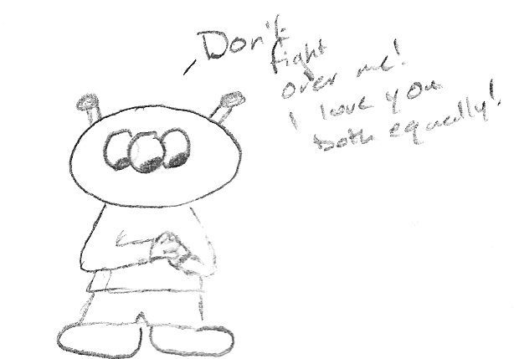
CS 5 today
A whole new class of programming
Choose your side…
Python's Date class
Lab and HW #11
Exam review
Hey! How did you get a body?
Software Engineering
Final projects
TheoComp !
Mon., 11/26
Wed., 12/5
Mon., 12/3
Wed., 11/28
Mon., 12/10

Slide 138
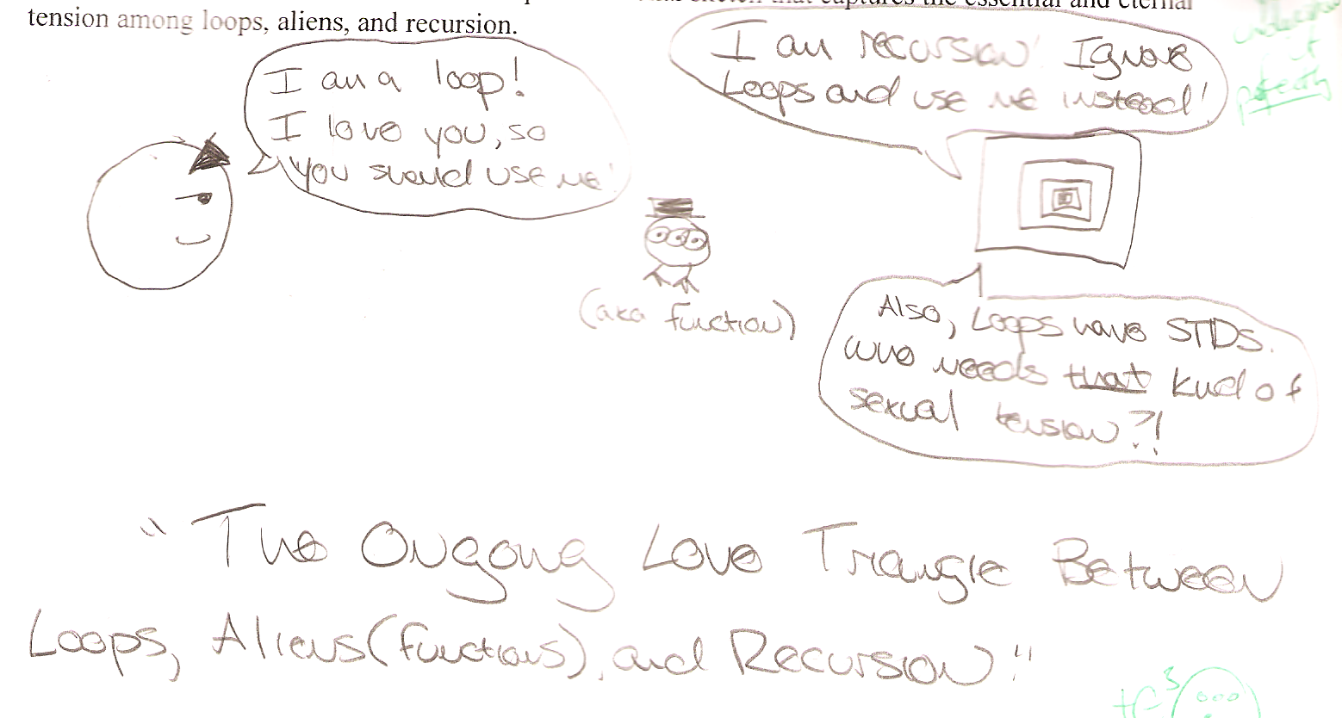
Exam 2

Slide 139
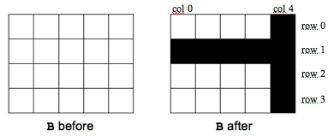
Exam 2
Problem 1b
Problem 2
def zerospan( L, hi, low ):
for i in range(len(L)):
if low <= L[i] <= hi:
L[i] = 0.0
def ROOKnotcastle( B, r, c ):
for row in range(len(B)):
for col in range(len(B[0])):
if row == r or col == c:
B[row][col] = 1
def zerospan( L, hi, low ):
for x in L:
if low <= x <= hi:
x = 0.0
This does not change L!

Slide 140
Sets values between low and hi to 0.0.
def zerospan( L, hi, low ):
for x in L:
if low <= x <= hi:
x = 0.0
CAUTION: This does not change L!

Slide 141
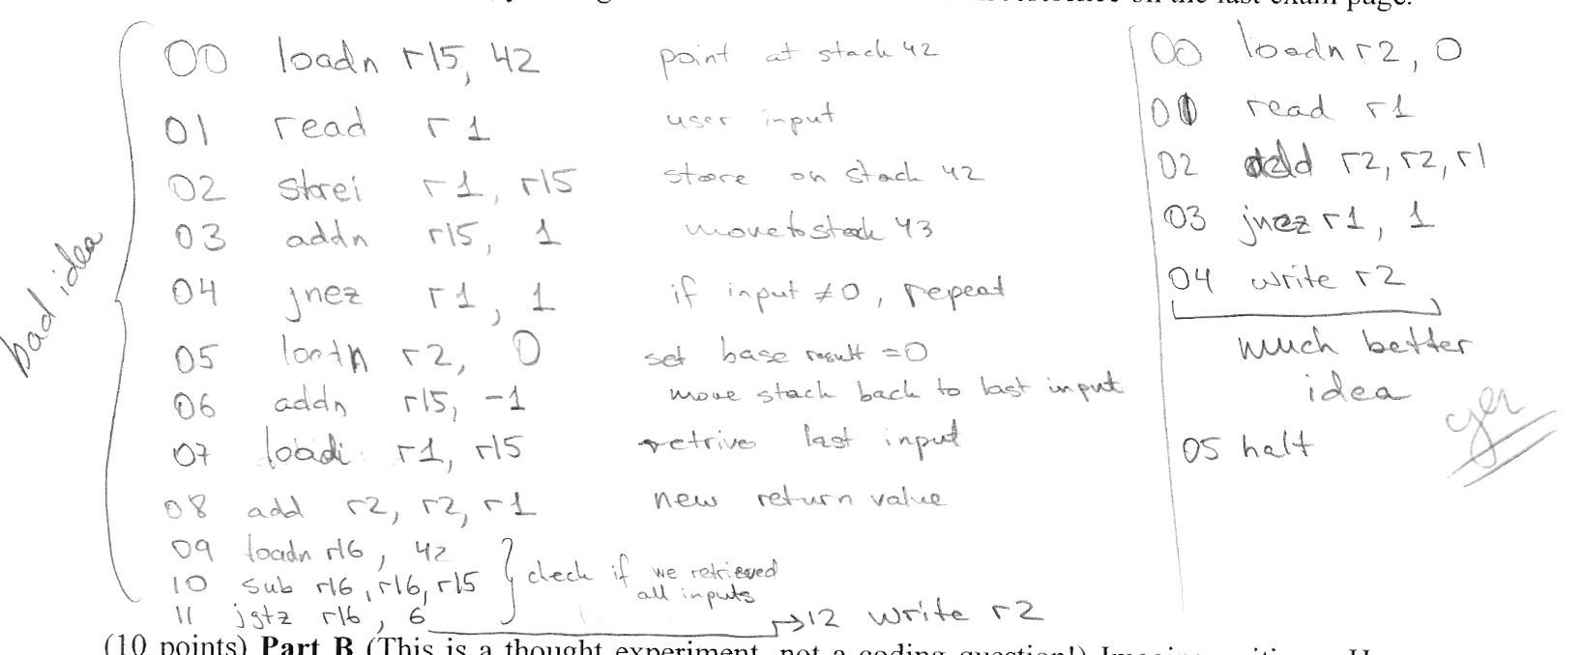
Exam 2
00 read r1 # input to r1
01 add r2 r2 r1 # add into r2
02 jnez r1 00 # if r1 != 0: goto 00
03 write r2 # else: write the sum
Problem 3
adding in place :-)
using the stack -- Aargh!

Slide 142
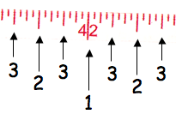
Exam 2
def ruler( n ):
s = ''
for i in range(n,0,-1):
s += str(i) + s
return s
Problem 5
ruler( 1 )
'1'
ruler( 2 )
'212'
ruler( 3 )
'3231323'
ruler( 4 )
'434243414342434'
s
s
i

Slide 143
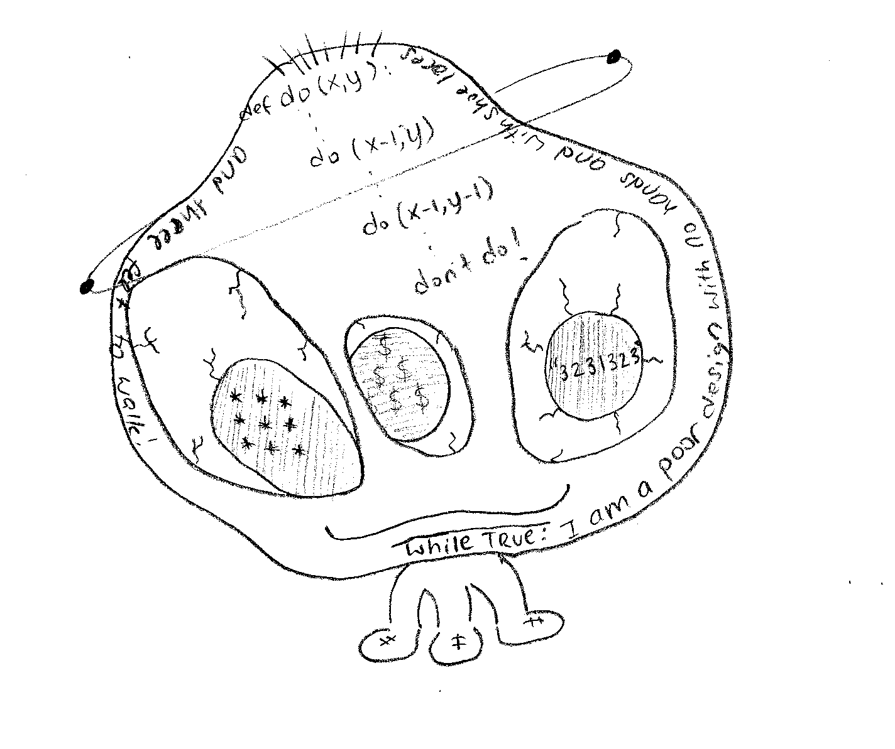
Exam 2

Slide 144
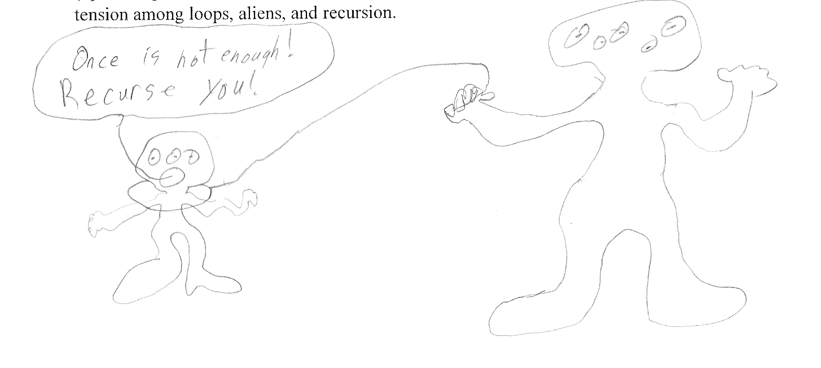
Exam 2

Slide 145
CS 5 today
A whole new class of programming
Choose your side…
Python's Date class
Lab and HW #11
Exam review
Hey! How did you get a body?
Software Engineering
Final projects
TheoComp !
Mon., 11/26
Wed., 12/5
Mon., 12/3
Wed., 11/28
Mon., 12/10

Slide 146
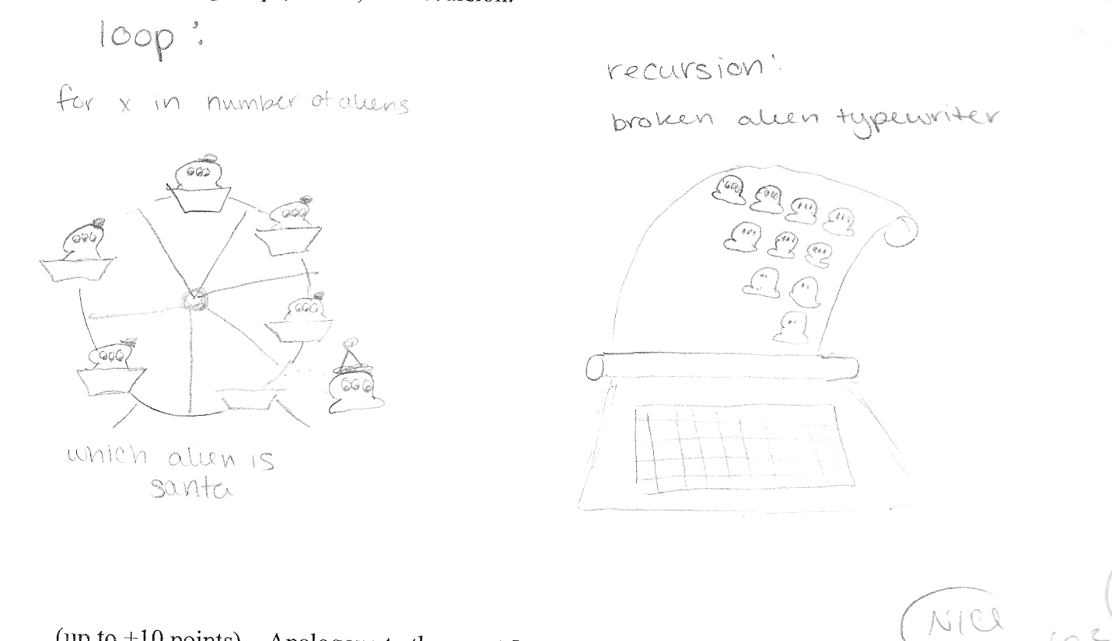
Exam 2

Slide 147
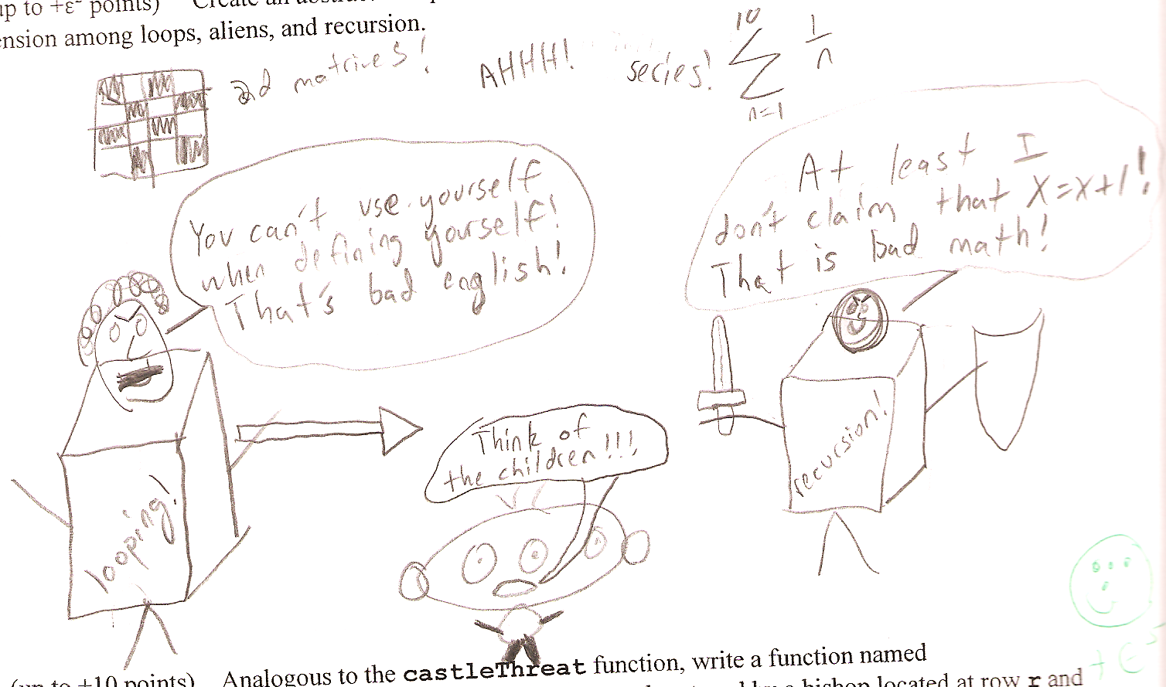
Exam 2

Slide 148
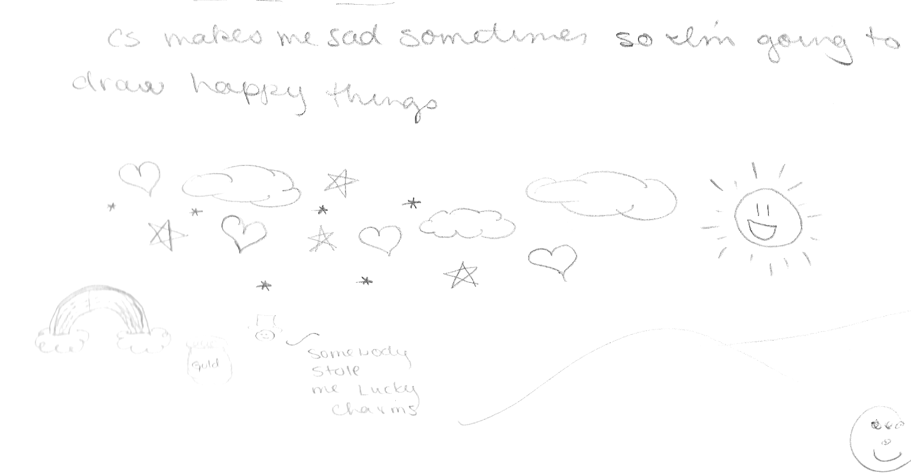
Exam 2

Slide 150
?
Strategic thinking == intelligence
Two-player games have been a key focus of AI as long as computers have been around…
computers
humans
good at looking ahead in the game to find winning combinations of moves
good at evaluating the strength of a board for a player
… humans and computers have different relative strengths in these games.

Slide 151
‘X’
scoresFor each column
‘O’
new‘X’
b
(1) For each possible move
(2) Add it to the board
Col 0
Col 6
Col 1
Col 5
Col 2
Col 3
Col 4

Slide 152
Friday 2-4, LAC
"Intelligent" CS 5 ?
Hw 11 due 11/22
office hours
An object is structured data that is alive, responsible, and intelligent.
Sound too friendly?
This week’s objects and classes will be the opposite ...
| | | | | | | |
| | | | | | | |
| | | | | | | |
| | | |X| | | |
| |X| |X|O| | |
|X|O|O|O|X|O| |
---------------
0 1 2 3 4 5 6
X to move.
Is there a way to win?

Slide 153
Player's methods
Board
Player
__init__( self, width, height )
allowsMove( self, col )
__init__(self, ox, tbt, ply)
addMove( self, col, ox )
__repr__(self)
delMove( self, col )
oppCh(self)
Demos?
__repr__( self )
scoreBoard(self, b)
isFull( self )
scoresFor(self, b)
winsFor( self, ox )
tiebreakMove(self, scores)
hostGame( self )
nextMove(self, b)
set( self, movestring )

Slide 154
Strategic thinking!
Python had no Connect-four datatype…
I feel ahead of the game here...
| | | | | | | |
| | | | | | | |
| | | | | | | |
| | | |X| | | |
| |X| |X|O| | |
|X|O|O|O|X| |O|
---------------
0 1 2 3 4 5 6
… but you've already corrected that!
Now, may the best machine win!

Slide 155
?
Strategic thinking == intelligence
Two-player games have been a key focus of AI as long as computers have been around…
In 1945, Alan Turing predicted that computers would be better chess players than people in ~ 50 years…
and thus would have achieved intelligence.
Alan Turing memorial Manchester, England

Slide 156
?
Strategic thinking == intelligence
Two-player games have been a key focus of AI as long as computers have been around…
computers
humans
good at looking ahead in the game to find winning combinations of moves
good at evaluating the strength of a board for a player
… humans and computers have different relative strengths in these games.

Slide 157
How humans play games…
An experiment (by A. deGroot) was performed in which chess positions were shown to novice and expert players…
- experts could reconstruct these perfectly
- novice players did far worse…
Random chess positions (not legal ones) were then shown to the two groups
- experts and novices did equally
well (badly) at reconstructing them!

Slide 158
Playing Chess like a computer…

Slide 159
The Player class
What data does a computer AI player need?
DATA MEMBERS
'X'
'LEFT'
0
Player
pForX
string
ox
string
tbt
int
ply
Ply?
checker, O or X
tiebreakType
moves to look ahead
surprisingly little!
How about knowledge about its opponent?

Slide 160
Why AI is challenging:
Make no mistake about it: computers process numbers - not symbols.
Computers can only help us to the extent that we can arithmetize an activity.
- paraphrasing Alan Perlis

Slide 161
scoreBoard(self,b)
‘X’
‘O’
Assigns a score to any board, b
A simple system:
100.0
50.0
0.0
for a win
for anything else
for a loss
Score for
Score for
Score for
Score for

Slide 162
scoreBoard
Assigns a score to any board, b
A simple system:
100.0
50.0
0.0
for a win
for anything else
for a loss
Implementation ideas…
scoreBoard(self, b)
How can there be no 'X' or 'O' input?
What methods that already exist will come in handy?
This doesn't seem to be looking very far ahead !
What class is this method in?

Slide 163
Scoring moves, not boards...
scoresFor returns a list of 7 scores!
0-ply
What would the 0-ply scores be for each column (move)
scores
The "Zen" approach
The Player object's ply tells how far ahead to look.
to go
0 ply!
We will use -1 as the score for a full column.
o0.scoreBoard( b42 )
o0.scoresFor( b42 )

Slide 164
scoresFor at 1 ply
1-ply
What would the 1-ply scores be for each column (move)
scores
The "Zen" approach
A 1-ply lookahead player will "see" an impending victory.
to go
I try 1 ply!
o1.scoresFor( b42 )

Slide 165
Two moves ahead… ?
0-ply
-1
50
50
50
50
50
50
A 2-ply lookahead player can also "see" an opponent's impending victory.
scores
's
turn
1-ply
scores
2-ply
What about 3-ply?
scores
Try it!

Slide 166
scoreBoard vs. scoresFor
scoreBoard looks ahead 0 moves
The "Zen" approach -- we are excellent at this!
0-ply
only
scoresFor( self, b ) returns a LIST of scores, one for each column you might choose to move next…
0-ply
1-ply
2-ply
…

Slide 167
"Quiz"
b
'X'
Fill in the score for a move to each column.
'O'
you - or self - is playing 'O'
The same move is evaluated at each ply... it's just evaluated farther into the future!
col 0
col 1
col 2
col 3
col 4
col 5
col 6
0-ply scores for 'O':
Looks 0 moves into the future
col 0
col 1
col 2
col 3
col 4
col 5
col 6
1-ply scores for 'O':
Looks 1 move into the future
col 0
col 1
col 2
col 3
col 4
col 5
col 6
2-ply scores for 'O':
Looks 2 moves into the future
col 0
col 1
col 2
col 3
col 4
col 5
col 6
3-ply scores for 'O':
Looks 3 moves into the future

Slide 168
Example 1-ply and 2-ply lookahead scores
It is O’s move. What scores does a 1-ply lookahead for O assign to each move?
|O| | | | | | |
|X| | | |O| |X|
|O| | | |X|O|X|
|X| | | |O|O|X|
|X| |X| |X|O|O|
|X| |O|O|O|X|X|
---------------
0 1 2 3 4 5 6
col 0
col 1
col 2
col 3
col 4
col 5
col 6
Which change at 2-ply?
| | | | | | |O|
| | | | | | |O|
| | | | | | |X|
|X| |X|O| | |O|
|X|O|O|X| |X|X|
|X|O|O|O| |O|X|
---------------
0 1 2 3 4 5 6
It is X’s move. What scores does a 2-ply lookahead for X assign to each move?
col 0
col 1
col 2
col 3
col 4
col 5
col 6
Which change at 3-ply?

Slide 169
Answers to example lookahead scores
It is O’s move. What scores does a 1-ply lookahead for O assign to each move?
|O| | | | | | |
|X| | | |O| |X|
|O| | | |X|O|X|
|X| | | |O|O|X|
|X| |X| |X|O|O|
|X| |O|O|O|X|X|
---------------
0 1 2 3 4 5 6
col 0
col 1
col 2
col 3
col 4
col 5
col 6
-1
100
50
100
50
100
50
Which change at 2-ply?
0
0
| | | | | | |O|
| | | | | | |O|
| | | | | | |X|
|X| |X|O| | |O|
|X|O|O|X| |X|X|
|X|O|O|O| |O|X|
---------------
0 1 2 3 4 5 6
It is X’s move. What scores does a 2-ply lookahead for X assign to each move?
be careful!
col 0
col 1
col 2
col 3
col 4
col 5
col 6
100
0
0
0
50
0
-1
0
Which change at 3-ply?

Slide 170
Looking further ahead …
0 ply:
Zen choice of move: here and now
1 ply:
2 ply:
3 ply:
X’s move
X’s move
X‘s move
| | | | | | | |
| | | | | | | |
| | | | | | | |
| | | | | | | |
| |O|X| | | | |
|O|X|X|X| |O|O|
---------------
0 1 2 3 4 5 6
| | | | | | | |
| | | | | | | |
|O| | | | | | |
|X| | | | | | |
|X|O|O| | |X| |
|O|X|X|O|X|O| |
---------------
0 1 2 3 4 5 6
| | | | | | | |
| | | | | | | |
| | | | |X| | |
| | | | |O|O| |
| |X|X| |X|O| |
|O|X|O| |O|X| |
---------------
0 1 2 3 4 5 6
(1) Player will win
(2) Player will avoid losing
(3) Player will set up a win by forcing the opponent to avoid losing

Slide 171
scoresFor's idea
(self) 'X'
(0) Suppose you're playing at 3 ply...
(1) For each of your possible moves
(2) Add it to the board
(3) Ask OPPONENT its scoresFor each board!
At what ply?
new 'X'
b
'O'
What score will the opponent give each?
[ 0, 0, 0, 0, 0, 0, 0 ]
[50,50,50,50,50,100,50]
Col 0
Col 6
Col 1
Col 5
Col 2
Col 3
Col 4
[50,50,50,50,50,100,50]
[50,50,50,50,50,50,50]
[ 0, 0, 0, 0, 0, 0, 0 ]
[ 0, 0, 0, 0, 0, 0, 0 ]
[ 0, 0, 0, 0, 0, 0, 0 ]
these are all of the opponent's calls to scoresFor !

Slide 172
scoresFor's idea
(self) 'X'
(0) Suppose you're playing at 3 ply...
(1) For each of your possible moves
(2) Add it to the board
(3) Ask OPPONENT its scoresFor each board!
At what ply?
new 'X'
b
'O'
What score will the opponent give each?
What score does self give each?
[ 0, 0, 0, 0, 0, 0, 0 ]
[50,50,50,50,50,100,50]
max(S) = 0
Col 0
Col 6
max(S) = 100
100
0
Col 1
Col 5
Col 2
max(S) = 100
Col 3
Col 4
max(S) = 0
max(S) = 50
0
max(S) = 0
max(S) = 0
50
100
100
100
[50,50,50,50,50,100,50]
[50,50,50,50,50,50,50]
[ 0, 0, 0, 0, 0, 0, 0 ]
[ 0, 0, 0, 0, 0, 0, 0 ]
[ 0, 0, 0, 0, 0, 0, 0 ]
these are all of the opponent's calls to scoresFor !

Slide 173
(0) Start all scores at 50.
(1) For each possible move
(2) If needed +possible, add the move to the board b
(3) Ask an OPPONENT its scoresFor at ply-1 (!)
(4) compute self's score
def scoresFor(self, b):
""" MUST return a list of 7 scores!!
"""
scores = [50,50,50,50,50,50,50]
for col in range( 0, 7 ):

Slide 174
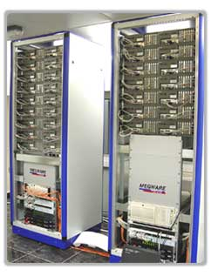
Game Difficulty == Branching Factor
On average, Connect 4 players have seven choices per move.
Chess players have more, perhaps around 40, possible choices in a given move.
0 Ply
1 Ply
2 Ply
Branching Factor Estimates
for different two-player games
Tic-tac-toe 4
Connect Four 7
Checkers 10
Othello 30
Chess 40
Go ?
Hydra looks
ahead 18 ply...
Hydra at home in the UAE…

Slide 175
Games’ Branching Factors
On average, Connect 4 players have seven choices per move.
Chess players have more, perhaps around 40, possible choices in a given move.
0 Ply
1 Ply
2 Ply
Branching Factor Estimates
for different two-player games
Tic-tac-toe 4
Connect Four 7
Checkers 10
Othello 30
Chess 40
Go ?
Boundaries for qualitatively different games…

Slide 176
Connect 4 was solved in 1988.

Slide 177
Checkers was solved in 2007.

Slide 178
Suppose
def tiebreakMove(self, S):
if self.tbt == 'LEFT':
S = [-1,0,50,50,0,0,50]
col
0
1
2
3
4
5
6
Write tiebreakMove to return the leftmost best score inside the list scores
How would 'RANDOM' and 'RIGHT' work differently?

Slide 179
Extra this week
scoreBoard4Tourney and a CS 5 C4 round-robin
Using more scores than 0, 50, and 100 !
don't give this board a 50.0 !
Good luck – against your own program!
http://www.stanford.edu/~ccecka/research/C4.html

