Slide 1
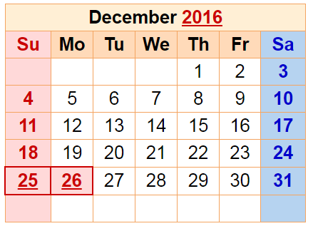
Dec. in CS 5
(0,0,0)
(110,102,0)
(220,205,0)
Mon., 12/5 – hw12+milestone due
Fri., 12/9 – 8pm: final proj. due
final project
Sun., 12/11 7 pm – review
Mon., 12/12 7 pm – final
Tue., 12/13 2 pm – final
Either exam is OK: you choose…
CS 5 black final exam 12/13 @ 2pm
final exam

Slide 2
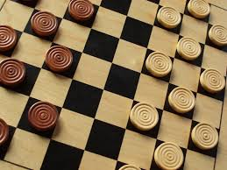
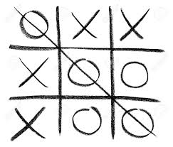
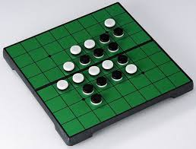
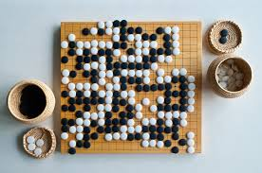
Connecting Connect Four ...
... to other strategy games.

Slide 3
Connecting Connect Four ...
tic-tac-toe
checkers
reversi
Go
How complex are these games, from least to most?
... to other strategy games.

Slide 4
Games' Branching Factors
0 Ply
On average, Connect 4 players have seven choices per move.
Chess players have more, perhaps around 40, possible choices in a given move.
1 Ply
2 Ply
Boundaries for qualitatively different games…
Branching Factors
for different two-player games
Tic-tac-toe 4
Connect Four 7
Checkers 10
Reversi 30
Chess 40
Go 300
Arimaa 17,000
“solved” games
computer-dominated
only 'til 2015-16
human-dominated

Slide 5
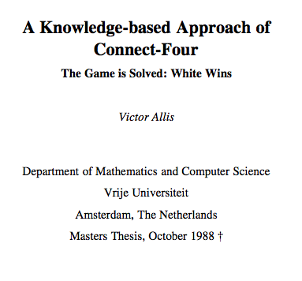
draw/tie with perfect play
first-player losses (with perfect play)
first-player win (with perfect play)
Connect 4 was solved in 1988.

Slide 6
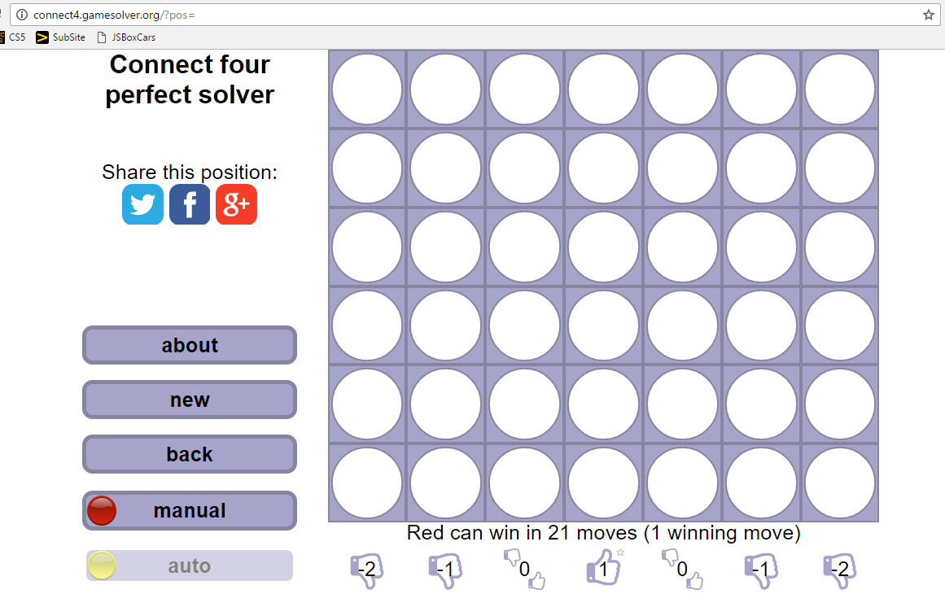
Nice site showing ideal play...
Connect 4 is solved ~ like tic-tac-toe

Slide 7
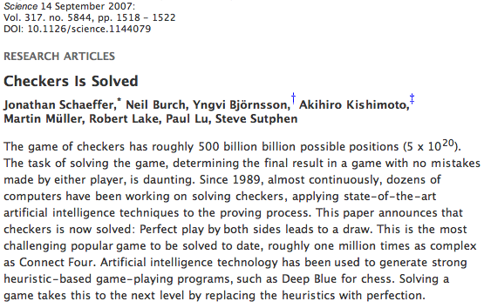
Checkers was solved in 2007.

Slide 8
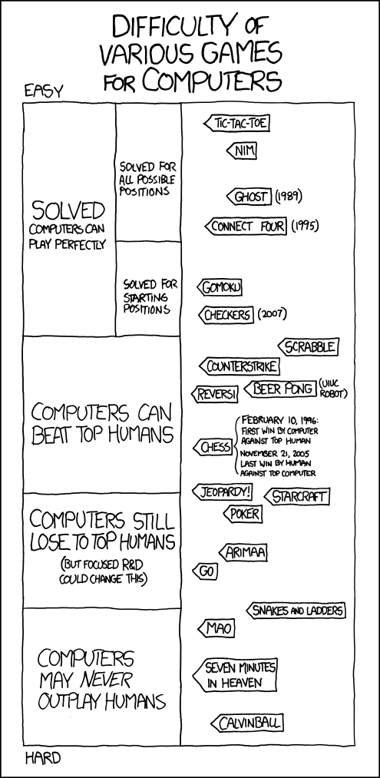
Games' Branching Factors

Slide 9
(Games' Branching Factors)

Slide 10
2015
2016
unlikely

Slide 11
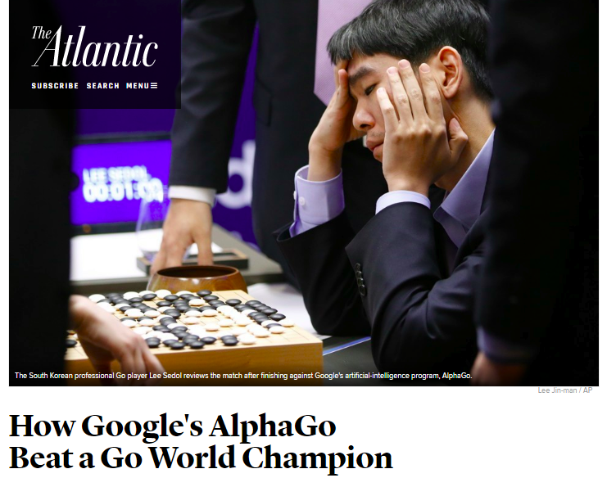
2015
2016
unlikely

Slide 12
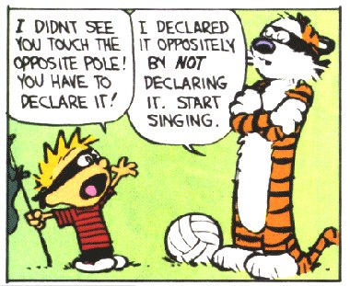

Slide 13
'tis the season for final projects…
Today is about the CS 5 final projects
+ it's a sales pitch for the three possible options:
vPool
TextID
Picobot
I've got my eyes on some of these projects!
Eye'll bet !

Slide 14
Final projects
open-ended
comprehensive
Final CS hw
same projects for black/gold
three choices…
Working in teams of 1-3 is OK
Eye, eye!
Teams need to work together - in the same place - and need to share the work equally...
Black/gold pairs are welcome...
Teaming is extra-encouraged on the final project!

Slide 15
Final lab days…
No lab meetings this week…
Labs will meet the first 2 weeks of Dec.
these lab meetings are extra-optional
final projects: get started and assistance
there are theocomp problems, too (hw12)…
no sign in
-2i
or two!
Now we're in a state!
+2i

Slide 16
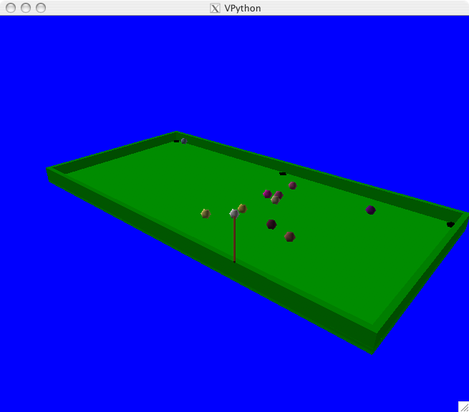
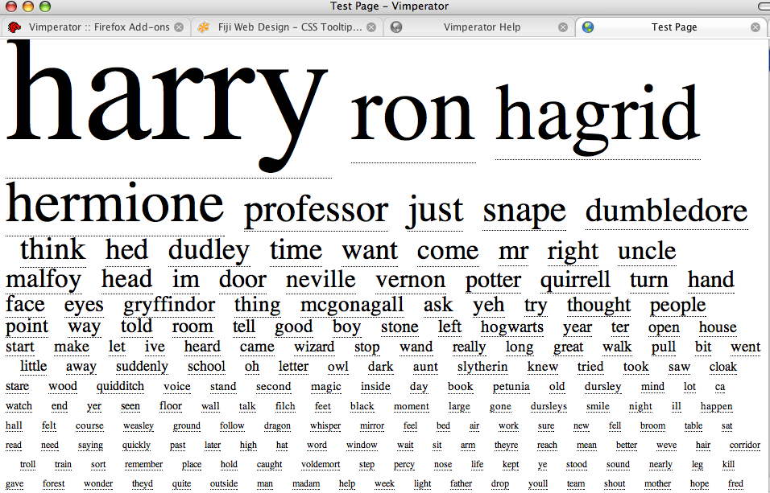
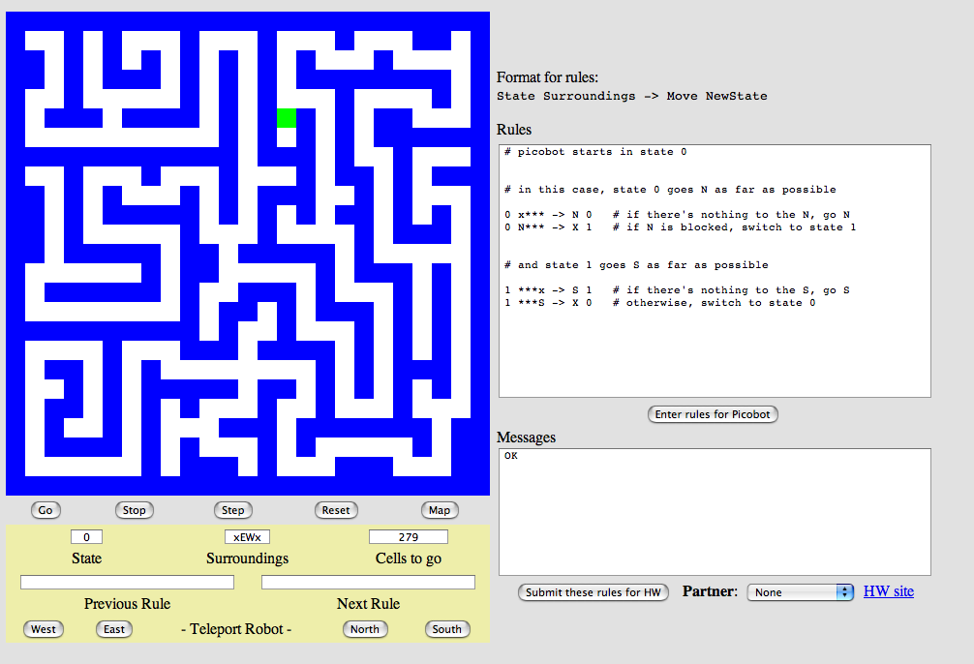
Project options…
VPool
…VPython
TextID
…Markov
Picobot!
…CFour

Slide 17
vProject inspiration...
Shruthi Michael Pinky

Slide 18
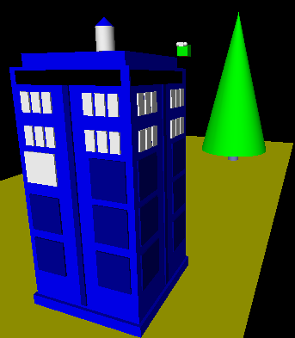
3d graphics-based game using VPython
vPool
I'll take your cue...
Let's play!
… it's not really very constrained at all!
A few constraints…
need ≥4 physically interacting objects
allow the user to direct 1+ objects, either by keyboard or mouse or both
needs a game goal + be winnable!
must detect some "linear" and some "spherical" collisions and implement their results on the motion of the objects

Slide 19
The vPool project
VPython was designed to make 3d physics simulations simpler to program – as a result, the library is physics-free!
⇒ Phunky Physics is welcome!
To now, VPython has eventually worked for everyone. See us for help!
Linear collisions should be somewhere ("walls")
Spherical collisions should be somewhere ("points")
You need "pockets" – or some other game objective
You need user control of at least one object (mouse/kbd)
A few examples to get you thinking…

Slide 20
What CSers "do"
^
or think as much...

Slide 21
What CSers "do"
^
or think as much...
final project algorithms...

Slide 22
Line-sphere colliding
wall.pos.x = 10
Program-composing
ball.vel = vector(1,0,1)
while True:
# this is the physics!
ball.pos += dt*ball.vel
if ball.pos.x > wall.pos.x:
ball.vel.x
ball.pos.x
How could you write a Python program to create a Picobot program that can solve this empty-room's challenge...
without simply giving the answer away...?
+ z
Final-project algorithms
What two lines above (ball.pos.x and ball.val.x) will ensure a successful bounce against the wall:
+ x
Name(s): _______________________________
Sphere-sphere colliding
Dictionary-comparing
Suppose these two Python dictionaries count words from various texts, e.g., by J.K. Rowling and W. Shakespeare. Which of these two text models does the third dictionary, at right – with unknown author -- better match? Why?
g
(stationary)
word-count dictionary for an unknown author
JKR
WS
{ "love": 25,
"spell": 275,
"potter": 700 }
{ "love": 50,
"spell": 8,
"thou": 42 }
{ "love": 3,
"thou": 1,
"potter": 2,
"spam": 4 }
Draw how these two balls should move when they collide offcenter. Extra: what are the collision results, in terms of b.vel ?
b.vel
word-count dictionary for J.K. Rowling
word-count dictionary for W. Shakespeare
does this better match JKR or WS? Why?

Slide 23
Line-sphere colliding
wall.pos.x = 10
4
Program-composing
ball.vel = vector(1,0,1)
while True:
# this is the physics!
ball.pos += dt*ball.vel
if ball.pos.x > wall.pos.x:
ball.vel.x
ball.pos.x
1
How could you write a Python program to create a Picobot program that can solve this empty-room's challenge...
without simply giving the answer away...?
+ z
Final-project algorithms
What two lines above (ball.pos.x and ball.val.x) will ensure a successful bounce against the wall:
+ x
Name(s): _______________________________
Sphere-sphere colliding
Dictionary-comparing
3
2
Suppose these two Python dictionaries count words from various texts, e.g., by J.K. Rowling and W. Shakespeare. Which of these two text models does the third dictionary, at right – with unknown author -- better match? Why?
g
(stationary)
word-count dictionary for an unknown author
JKR
WS
{ "love": 25,
"spell": 275,
"potter": 700 }
{ "love": 50,
"spell": 8,
"thou": 42 }
{ "love": 3,
"thou": 1,
"potter": 2,
"spam": 4 }
Draw how these two balls should move when they collide offcenter. Extra: what are the collision results, in terms of b.vel ?
b.vel
word-count dictionary for J.K. Rowling
word-count dictionary for W. Shakespeare
does this better match JKR or WS? Why?

Slide 24
Line-sphere colliding
wall.pos.x = 10
Program-composing
ball.vel = vector(1,0,1)
while True:
# this is the physics!
ball.pos += dt*ball.vel
if ball.pos.x > wall.pos.x:
ball.vel.x
ball.pos.x
How could you write a Python program to create a Picobot program that can solve this empty-room's challenge...
without simply giving the answer away...?
+ z
Final-project algorithms
What two lines above (ball.pos.x and ball.val.x) will ensure a successful bounce against the wall:
Try this on the back page first...
+ x
Sphere-sphere colliding
Dictionary-comparing
Suppose these two Python dictionaries count words from various texts, e.g., by J.K. Rowling and W. Shakespeare. Which of these two text models does the third dictionary, at right – with unknown author -- better match? Why?
g
(stationary)
word-count dictionary for an unknown author
JKR
WS
{ "love": 25,
"spell": 275,
"potter": 700 }
{ "love": 50,
"spell": 8,
"thou": 42 }
{ "love": 3,
"thou": 1,
"potter": 2,
"spam": 4 }
Draw how these two balls should move when they collide offcenter. Extra: what are the collision results, in terms of b.vel ?
b.vel
word-count dictionary for J.K. Rowling
word-count dictionary for W. Shakespeare
does this better match JKR or WS? Why?

Slide 25
vPython: Linear collisions
+z
x = 10
At least some of the game needs to be about detecting collisions and changing velocities
ball.vel = vector(1,0,1)
while True:
ball.pos += dt*ball.vel
if ball.pos.x > 10:
ball.vel.x
ball.pos.x
ball.pos += dt*ball.vel
+x
Line ~ wall at x=10
How to bounce?
What else to do?

Slide 26
Spherical collisions
r.vel
() Zeroth approximation:
Stop q. Undo any overlap.
Make r.vel = q.vel.
r
q
q.vel
Reality is just three eyes away!

Slide 27
Spherical collisions
() Zeroth approximation:
r.vel
Stop q. Undo any overlap.
Make r.vel = q.vel.
d
r
(i) First approximation:
q
Stop q. Undo any overlap.
Compute d = r.pos – q.pos
Make r.vel = d
q.vel
Reality is just two eyes away!

Slide 28
Spherical collisions
() Zeroth approximation:
r.vel
new q.vel
Stop q. Undo any overlap.
Make r.vel = q.vel.
d⊥
d
r
(i) First approximation:
q
Stop q. Undo any overlap.
Compute d = r.pos – q.pos
Make r.vel = d
old q.vel
(ii) Second approximation:
Same as first, but
Make q.vel = d ⊥ , at 90° from d
Reality is just one eye away!

Slide 29
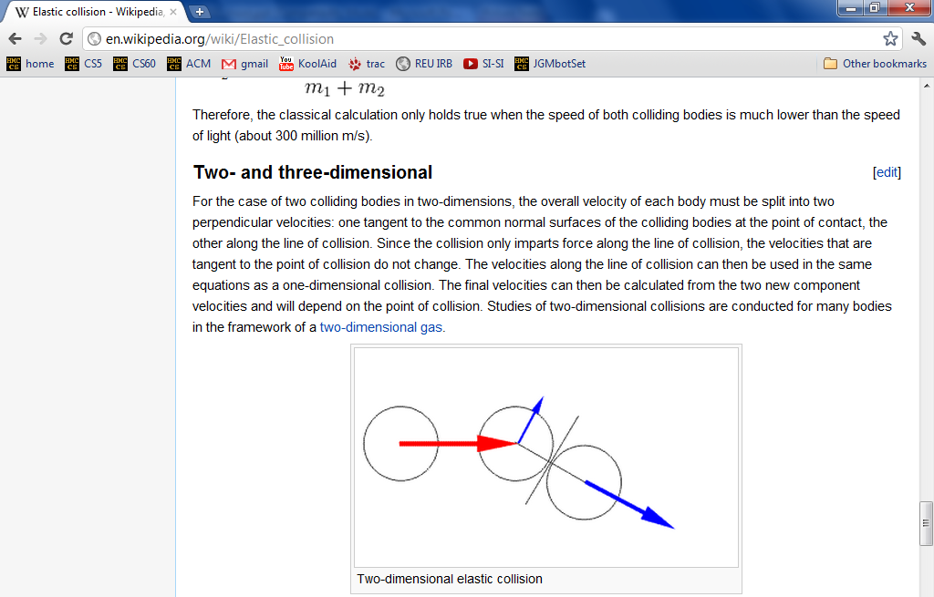
vPool – physics?
http://en.wikipedia.org/wiki/Elastic_collision
equations below...

Slide 30
vPool – physics?
http://en.wikipedia.org/wiki/Elastic_collision

Slide 31
vector library!
This is how I like my vectors: well done!
(or, at least, already done…)

Slide 32
Project options…
VPool
…VPython
TextID
…Markov
Picobot!
…CFour

Slide 33
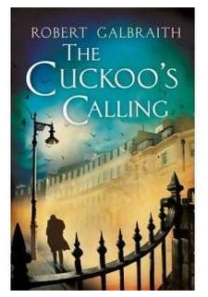
A couple of years ago...
Though Robin Ellacott’s twenty-five years of life had seen their moments of drama and incident, she had never before woken up in the certain knowledge that she would remember the coming day for as long as she lived.
April 4, 2013
First paragraph of The Cuckoo's Calling by R. Galbraith

Slide 34
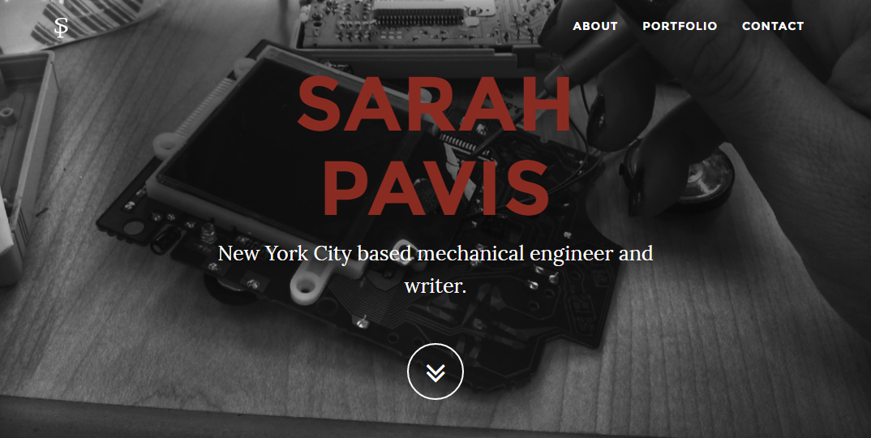
the TextID IDer...
Though Robin Ellacott’s twenty-five years of life had seen their moments of drama and incident, she had never before woken up in the certain knowledge that she would remember the coming day for as long as she lived.
April 4, 2013
First paragraph of The Cuckoo's Calling by R. Galbraith

Slide 35
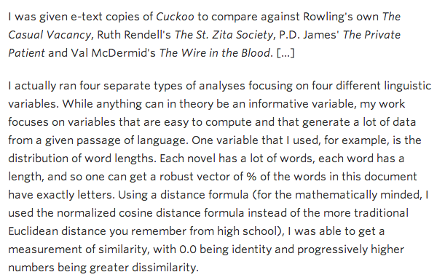
kottke.org/13/08/how-jk-rowling-was-found-to-be-robert-galbraith

Slide 36
the TextID project
Big ideas:
(1) Build lexical models of bodies of text…
(2) Use a similarity score to measure Rowlingness
vs.
Shakepearity
NYTimes-iness
vs.
WSJournalicity
Big Bang Theory
Modern Family
vs.
even better: your own choice of two or more comparisons…

Slide 37
I like poptarts and 42 and spam. Spamful poptarts are like poptartful spams -- and are liked by all!
Will _Thanksgiving_ bring spam poptarts?
File
class TextModel
... contains at least five Python dictionaries, e.g.,
count of each word
{'and': 3, 'poptartful': 1, 'liked': 1, 'spamful': 1, 'like': 2, '': 1, 'spam': 2, 'i': 1, '42': 1, 'all': 1, 'thanksgiving': 1, 'will': 1, 'bring': 1, 'poptarts': 3, 'spams': 1, 'by': 1, 'are': 2}
{0: 1, 1: 1, 2: 2, 3: 6, 4: 5, 5: 3, 7: 1, 8: 3, 10: 1, 12: 1}
{'and': 3, '': 1, 'all': 1, 'like': 3, 'thanksgiv': 1, 'spam': 4, 'i': 1, '42': 1, 'by': 1, 'will': 1, 'bring': 1, 'ar': 2, 'poptart': 4}
{12: 1, 5: 1, 7: 1}
{'!': 1, '-': 2, '?': 1, '_': 2, '.': 1}
???
???
???
???
What are these four other dictionaries counting?!

Slide 38
I like poptarts and 42 and spam. Spamful poptarts are like poptartful spams -- and are liked by all!
Will _Thanksgiving_ bring spam poptarts?
File
class TextModel
... contains at least five Python dictionaries, e.g.,
count of each word
{'and': 3, 'poptartful': 1, 'liked': 1, 'spamful': 1, 'like': 2, '': 1, 'spam': 2, 'i': 1, '42': 1, 'all': 1, 'thanksgiving': 1, 'will': 1, 'bring': 1, 'poptarts': 3, 'spams': 1, 'by': 1, 'are': 2}
{0: 1, 1: 1, 2: 2, 3: 6, 4: 5, 5: 3, 7: 1, 8: 3, 10: 1, 12: 1}
{'and': 3, '': 1, 'all': 1, 'like': 3, 'thanksgiv': 1, 'spam': 4, 'i': 1, '42': 1, 'by': 1, 'will': 1, 'bring': 1, 'ar': 2, 'poptart': 4}
{12: 1, 5: 1, 7: 1}
{'!': 1, '-': 2, '?': 1, '_': 2, '.': 1}
word lengths
stems
sentence lengths
punct
What are these four other dictionaries counting?!

Slide 39
TextID's building blocks…
This looks familiar...
(0) Get text from file…
(1) Split up the text into words (first pass)
(2) Model punctuation marks (optional)
(3) Model sentence lengths (using '.!?')
(4) Take a breather...
(5) Clean up the words (second pass)
(6) Model words and word lengths
(7) Stem words and model those stems
(8) You're ready to score against your model!
text with punctuation preserved
text with punctuation removed

Slide 40
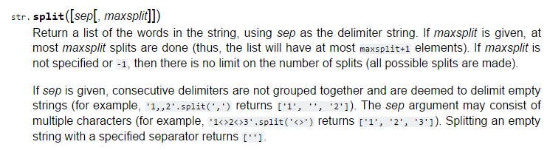
I bet they told you the age of the library was over…
but It's just begun!
TextID's library resources

Slide 41
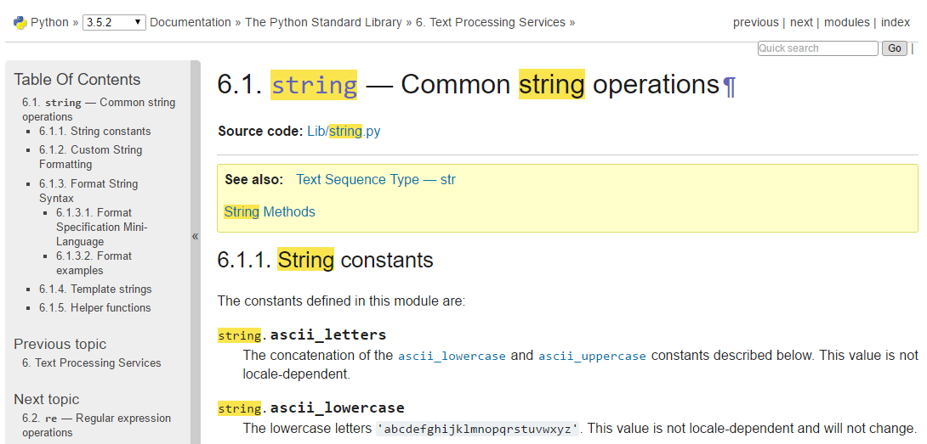
I bet they told you the age of the library was over…
but It's just begun!
TextID's library resources
string.ascii_lowercase

Slide 42
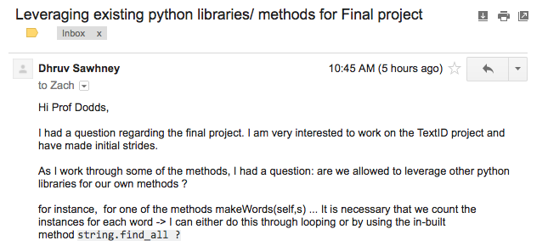
I bet they told you the age of the library was over…
but It's just begun!
TextID's library resources
Yes!

Slide 43
Stemming
An algorithm that outputs the root of the input word.
stem('parties')
'parti'
ends in ies
stem('love')
'lov'
these don't have to be words, just stems…
ends in vow + cons + e
stem('swerving')
'swerv'
ends in vow + cons + ing
stem('quickly')
'quick'
ends in vow + cons + ly
stem('slowest')
'slow'
ends in vow + cons + est
but, they can also be words
stem('stems')
'stem'
ends in cons + s
stem('stemming')
'stem'
ends in vow + 2*cons + ing
either way, they all have exceptions!

Slide 44
Stemming!
getting to the root of the problem…
def stem( w ):
exception
Find an English exception to each of these stemming patterns:
incorrect stem
π
pies
stem('parties')
'parti'
ends in ies
kite
stem('love')
'lov'
kit
ends in vow + cons + e
nothing
stem('swerving')
'swerv'
noth
ends in vow + cons + ing
ally
stem('quickly')
'quick'
al
ends in vow + cons + ly
interest
stem('slowest')
'slow'
inter
ends in vow + cons + est
princess
stem('stems')
'stem'
princes
ends in cons + s
lemming
stem('stemming')
'stem'
lem
ends in vow + 2*cons + ing
under
undo
do
der
stem(__________)
_______
create your own rule for stemming

Slide 45
Stemming!
getting to the root of the problem…
def stem( w ):
exception
Find an English exception to each of these stemming patterns:
incorrect stem
π
pies
stem('parties')
'parti'
ends in ies
kite
stem('love')
'lov'
kit
ends in vow + cons + e
nothing
stem('swerving')
'swerv'
noth
ends in vow + cons + ing
ally
stem('quickly')
'quick'
al
ends in vow + cons + ly
interest
stem('slowest')
'slow'
inter
ends in vow + cons + est
princess
stem('stems')
'stem'
princes
ends in cons + s
lemming
stem('stemming')
'stem'
lem
ends in vow + 2*cons + ing
under
undo
do
der
stem(__________)
_______
create your own rule for stemming

Slide 46
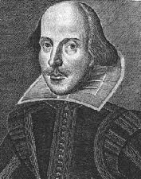
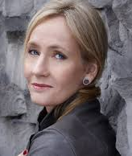
Model matching
Suppose we have two trained models:
WS: { "love": 50,
"spell": 8,
"thou": 42 }
JKR: { "love": 25,
"spell": 275,
"potter": 700 }
how do we handle different-sized texts?
Unknown text: { "love": 3,
"thou": 1,
"potter": 2,
"spam": 4 }
These must have been some really avant-garde texts!

Slide 47
Model matching
Suppose we have two trained models:
WS: { "love": 50,
"spell": 8,
"thou": 42 }
JKR: { "love": 25,
"spell": 275,
"potter": 700 }
normalize for size
WS: { "love": 0.50,
"spell": 0.08,
"thou": 0.42 }
JKR: { "love": 0.025,
"spell": 0.275,
"potter": 0.700 }
Unknown text: { "love": 3,
"thou": 1,
"potter": 2,
"spam": 4 }

Slide 48
Model matching
Suppose we have two normalized models:
WS: { "love": 0.50,
"spell": 0.08,
"thou": 0.42 }
JKR: { "love": 0.025,
"spell": 0.275,
"potter": 0.700 }
how do we compare the models with an unknown text?
What's the likelihood of the new model arising from each?
Unknown text: { "love": 3,
"thou": 1,
"potter": 2,
"spam": 4 }
There's probably a way to do this!

Slide 49
Model matching
Suppose we have two normalized models:
WS: { "love": 0.50,
"spell": 0.08,
"thou": 0.42 }
JKR: { "love": 0.025,
"spell": 0.275,
"potter": 0.700 }
how do we compare the models with an unknown text?
What's the likelihood of the new model arising from each?
Let's just pretend that the words are all independent of each other…
Unknown text: { "love": 3,
"thou": 1,
"potter": 2,
"spam": 4 }
There's probably a way to do this!

Slide 50
Model matching
Suppose we have two normalized models:
WS: { "love": 0.50,
"spell": 0.08,
"thou": 0.42 }
JKR: { "love": 0.025,
"spell": 0.275,
"potter": 0.700 }
the WS-based probability of each word in Unknown text
=
.50
.50
.50
_?_
?
?
?
?
?
?
???
love
love
love
thou
potter
potter
spam
spam
spam
spam
0? 1?
Unknown text: { "love": 3, "potter": 2,
"thou": 1, "spam": 4 }
I've got near-zero ideas on this one!

Slide 51
Model matching
Suppose we have two normalized models:
WS: { "love": 0.50,
"spell": 0.08,
"thou": 0.42 }
JKR: { "love": 0.025,
"spell": 0.275,
"potter": 0.700 }
the WS-based probability of each word in Unknown text
=
.50
.50
.50
.42
1
1
1
1
1
1
0.0525
love
love
love
thou
potter
potter
spam
spam
spam
spam
Why is this especially incorrect?
???
Unknown text: { "love": 3, "potter": 2,
"thou": 1, "spam": 4 }
I've got near-zero ideas on this one!

Slide 52
Model matching
Suppose we have two normalized models:
WS: { "love": 0.50,
"spell": 0.08,
"thou": 0.42 }
JKR: { "love": 0.025,
"spell": 0.275,
"potter": 0.700 }
the WS-based probability of each word in Unknown text
correct, but not helpful!
=
.50
.50
.50
.42
0
0
0
0
0
0
0.0
love
love
love
thou
potter
potter
spam
spam
spam
spam
???
Unknown text: { "love": 3, "potter": 2,
"thou": 1, "spam": 4 }
I've got near-zero ideas on this one!

Slide 53
Model matching
Suppose we have two normalized models:
WS: { "love": 0.50,
"spell": 0.08,
"thou": 0.42 }
JKR: { "love": 0.025,
"spell": 0.275,
"potter": 0.700 }
the WS-based probability of each word in Unknown text
for missing words, use half the smallest value – across both normalized models!
=
.50
.50
.50
.42
.012
.012
.012
.012
.012
.012
1.57e-13
love
love
love
thou
potter
potter
spam
spam
spam
spam
What?
3
1
2
4
Unknown text: { "love": 3, "potter": 2,
"thou": 1, "spam": 4 }
half of ϵ !

Slide 54
Model matching
Suppose we have two normalized models:
WS: { "love": 0.50,
"spell": 0.08,
"thou": 0.42 }
JKR: { "love": 0.025,
"spell": 0.275,
"potter": 0.700 }
the WS-based probability of each word in Unknown text
for missing words, use half the smallest value – across both normalized models!
=
.50
.50
.50
.42
.012
.012
.012
.012
.012
.012
1.57e-13
love
love
love
thou
potter
potter
spam
spam
spam
spam
too small!
3
1
2
4
take logs of everything!
Unknown text: { "love": 3, "potter": 2,
"thou": 1, "spam": 4 }
half of ϵ !

Slide 55
Model matching
Suppose we have two normalized models:
WS: { "love": 0.50,
"spell": 0.08,
"thou": 0.42 }
JKR: { "love": 0.025,
"spell": 0.275,
"potter": 0.700 }
the WS-based probability of each word in Unknown text
for missing words, use half the smallest value – across both normalized models!
=
3*log(.50)
+ log(.42)
+ 2*log(.012)
+ 4*log(.012)
-29.48
love
love
love
thou
potter
potter
spam
spam
spam
spam
OK!
3
1
2
4
take logs of everything!
Unknown text: { "love": 3, "potter": 2,
"thou": 1, "spam": 4 }
half of ϵ !

Slide 56
Model matching
Suppose we have two normalized models:
WS: { "love": 0.50,
"spell": 0.08,
"thou": 0.42 }
JKR: { "love": 0.025,
"spell": 0.275,
"potter": 0.700 }
the WS-based probability of each word in Unknown text
=
3*log(.025)
+ log(.012)
+ 2*log(.7)
+ 4*log(.012)
-33.89
love
love
love
thou
potter
potter
spam
spam
spam
spam
3
1
2
4
Unknown text: { "love": 3, "potter": 2,
"thou": 1, "spam": 4 }
this looks close…

Slide 57
Model matching
Suppose we have two normalized models:
WS: { "love": 0.50,
"spell": 0.08,
"thou": 0.42 }
JKR: { "love": 0.025,
"spell": 0.275,
"potter": 0.700 }
Unknown text:
{ "love": 3, "potter": 2,
"thou": 1, "spam": 4 }
-29.48
-33.89
the (much) better match…

Slide 58
Naïve Bayes classification
Don't take these formulas too seriously…
done!

Slide 59
Naïve Bayes classification
Don't take these formulas too seriously…
done!

Slide 60
Project options…
VPool
…VPython
TextID
…Markov
Picobot!
…CFour

Slide 61
The Picobot project
Big ideas
(1) Implement Picobot in Python
(2) Train Python to write successful Picobot programs!
talk about going full circle...

Slide 62
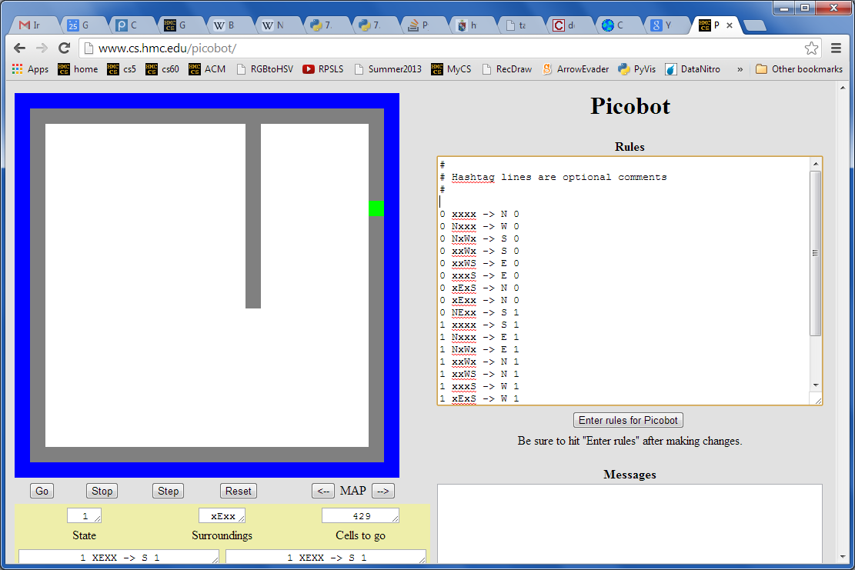
Picobot returns!
What data structures (classes) might be helpful in implementing Picobot?

Slide 63
Picobot's classes
0 xxxx -> N 0
0 Nxxx -> W 0
0 NxWx -> S 0
0 xxWx -> S 0
0 xxWS -> E 0
0 xxxS -> E 0
0 xExS -> N 0
0 xExx -> N 0
0 NExx -> S 1
1 xxxx -> S 1
1 Nxxx -> E 1
1 NxWx -> E 1
1 xxWx -> N 1
1 xxWS -> N 1
1 xxxS -> W 1
1 xExS -> W 1
1 xExx -> S 1
1 NExx -> W 0
class Program:
What in Python could most usefully hold all of these rules?
What type should self.rules be?

Slide 64
Picobot's classes
0 xxxx -> N 0
0 Nxxx -> W 0
0 NxWx -> S 0
0 xxWx -> S 0
0 xxWS -> E 0
0 xxxS -> E 0
0 xExS -> N 0
0 xExx -> N 0
0 NExx -> S 1
1 xxxx -> S 1
1 Nxxx -> E 1
1 NxWx -> E 1
1 xxWx -> N 1
1 xxWS -> N 1
1 xxxS -> W 1
1 xExS -> W 1
1 xExx -> S 1
1 NExx -> W 0
class Program:
What in Python could most usefully hold all of these rules?
What type should self.rules be?
both tuples
Python dictionary
key
value
self.rules[ (1,"NExx") ] = ("W",0)

Slide 65
Picobot's classes
+++++++++++++++++++++++++
+oooooPooooooooooooooooo+
+o o o+
+o o o+
+o o o+
+o o o+
+o o o+
+o o o+
+o o o+
+o o o+
+o o+
+o o+
+o o+
+o o+
+o o+
+o o+
+o o+
+o o+
+o o+
+o o+
+o o+
+o o+
+o o+
+ooooooooooooooooooooooo+
+++++++++++++++++++++++++
What type in Python could most usefully hold the environment?
class World:
What class that you've already written will be most similar to Picobot's World?
Wall:
+
What will self.room be?
o
Visited:
Picobot:
P

Slide 66
Picobot's classes
+++++++++++++++++++++++++
+oooooPooooooooooooooooo+
+o o o+
+o o o+
+o o o+
+o o o+
+o o o+
+o o o+
+o o o+
+o o o+
+o o+
+o o+
+o o+
+o o+
+o o+
+o o+
+o o+
+o o+
+o o+
+o o+
+o o+
+o o+
+o o+
+ooooooooooooooooooooooo+
+++++++++++++++++++++++++
What type in Python could most usefully hold the environment?
class World:
class Board
What class that you've already written will be most similar to Picobot's World?
Wall:
+
What will self.room be?
o
Visited:
The same as the Connect-Four board's self.data!
P
Picobot:
a list-of-lists-of-one-character-strings….

Slide 67
The Picobot project
Current State: 1
Current Rule: 1 N*W* -> X 2
++++++++++
+o++o+o+++
+oooooo ++
++++o++ +
+oooo+++++
++++o +
+oooo+++ +
++++o+++++
+Pooo +
++++++++++
First, build an ASCII simulation
Picobot started here…
and is now here…
Your actual ASCII is likely to be more monochromatic!
demo!

Slide 68
The Picobot project
Current State: 1
Current Rule: 1 N*W* -> X 2
++++++++++
+o++o+o+++
+oooooo ++
++++o++ +
+oooo+++++
++++o +
+oooo+++ +
++++o+++++
+Pooo +
++++++++++
First, build an ASCII simulation
Picobot started here…
then, evolve it…
with your own genetic algorithm
and is now here…
Your actual ASCII is likely to be more monochromatic!
http://rednuht.org/genetic_cars_2/ or http://boxcar2d.com/
Box2d: https://www.youtube.com/watch?v=uxourrlPlf8

Slide 69
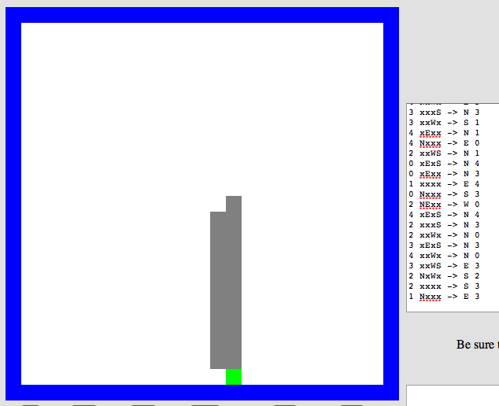
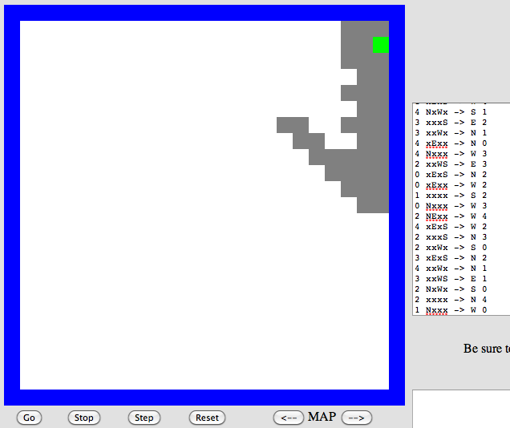
Program evolution
An example of genetic algorithms, which are used for optimizing hard-to-describe functions with easily-splittable solutions.
program p1
program p2
Start with a population of, say, ~200 random Picobot programs…

Slide 70
Program evolution
An example of genetic algorithms, which are used for optimizing hard-to-describe functions with easily-splittable solutions.
program p1
fitness = 0.03
program p2
fitness = 0.05
Then, measure the fitness of all of those programs
Measure? How??

Slide 71
program p1
fitness = 0.03
program p2
fitness = 0.05
mate + mutate the fittest rulesets
to create a new generation of ~200 programs…
program c1
fitness = 0.19
What the goal?

Slide 72
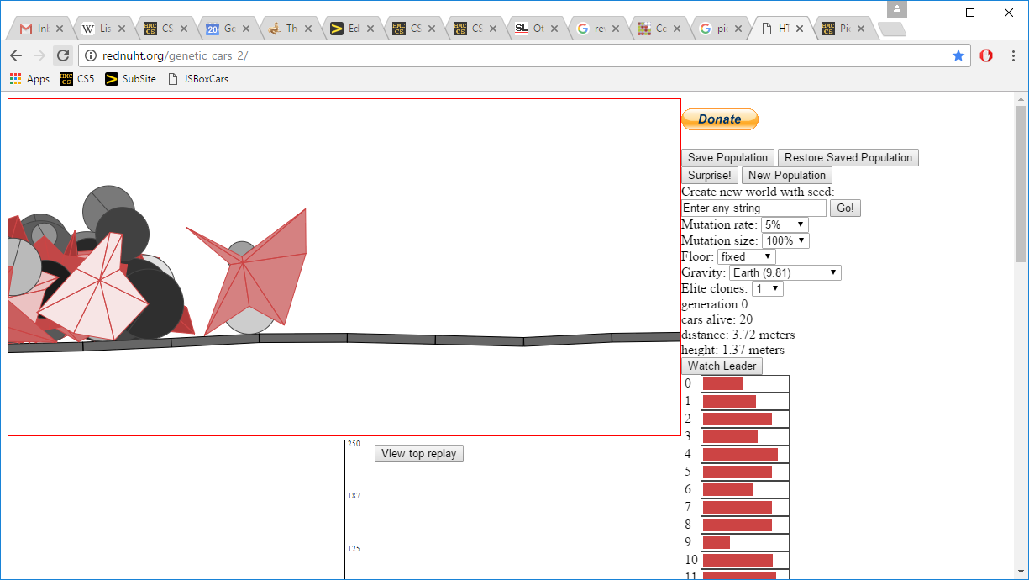
Genetic Algorithms...!
the current "fitness" leader
fitnesses!
the current "generation"
Rafael Matsunaga: rednuht.org/

Slide 73
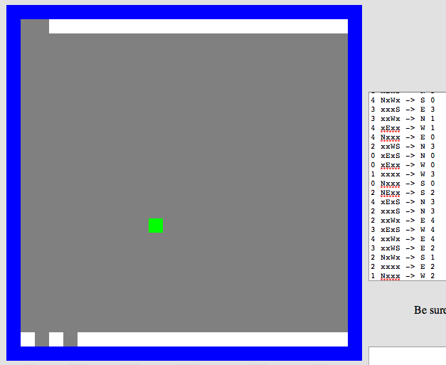
Repeat this "survival of the fittest" process for many generations…
… and by the end, your Python code should/will have evolved a much more capable Picobot program!
Solving hw0!
fitness = 0.90

Slide 74
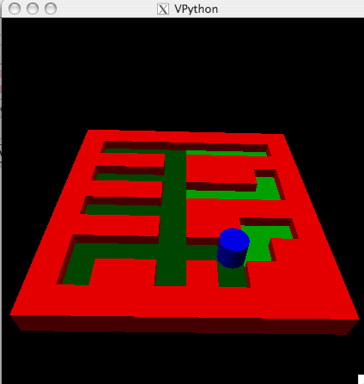
Extra: Picobot graphics…
Choice of graphical packages
2d: graphics.py from C4
3d: VPython
Mine's going to be in 5d!
or 3d …
2d should be enough for anybody
What? All the best stuff is 3d! Think coffee, poptarts, etc.
2d version…

Slide 75
Project options…
VPool
TextID
Picobot!

Slide 76
Project space…
algorithmic
Picobot!
VPool
open-ended (and 3d!)
TextID
practical + checkable

Slide 77
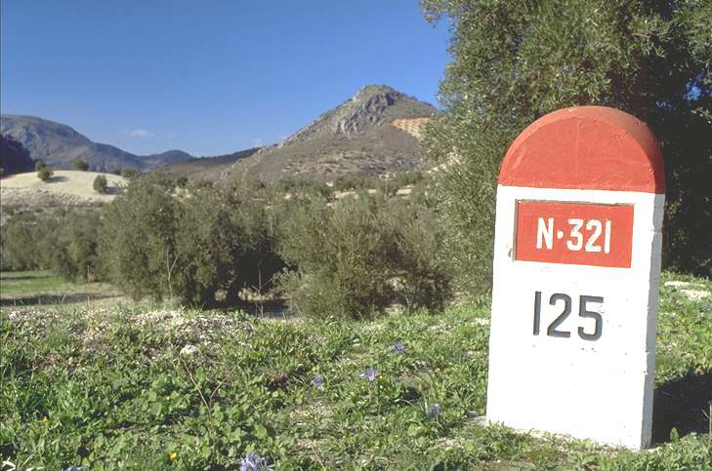
What's due?
Mon. 12/5
Fri. 12/9
The "milestone"
Final-project due date
project-specific tasks ~ to ensure that everyone has started!
(Note: we can't grade these in time)
A zip file with everything needed to run your final project and a .txt file describing how to do so!
Nice milestone!
It's a kilometer stone, actually!

Slide 78
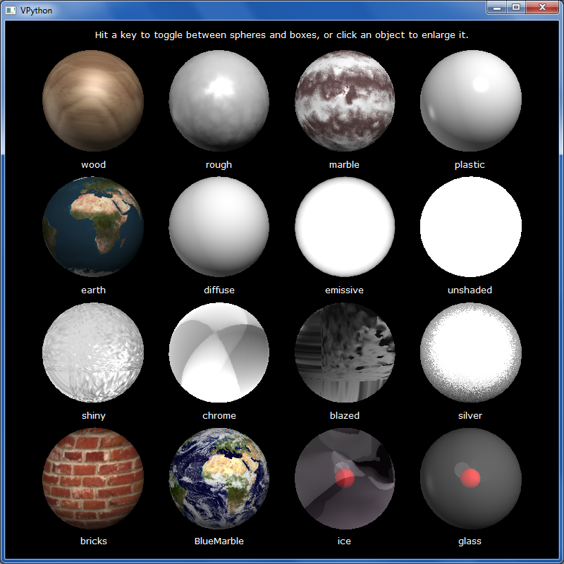
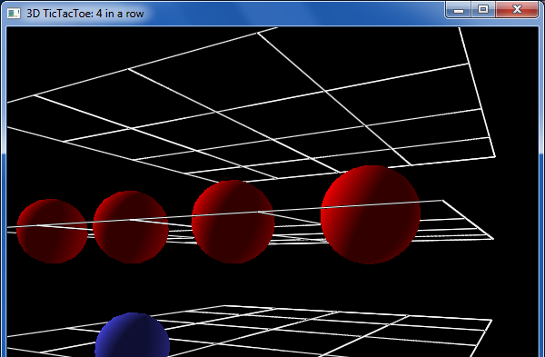
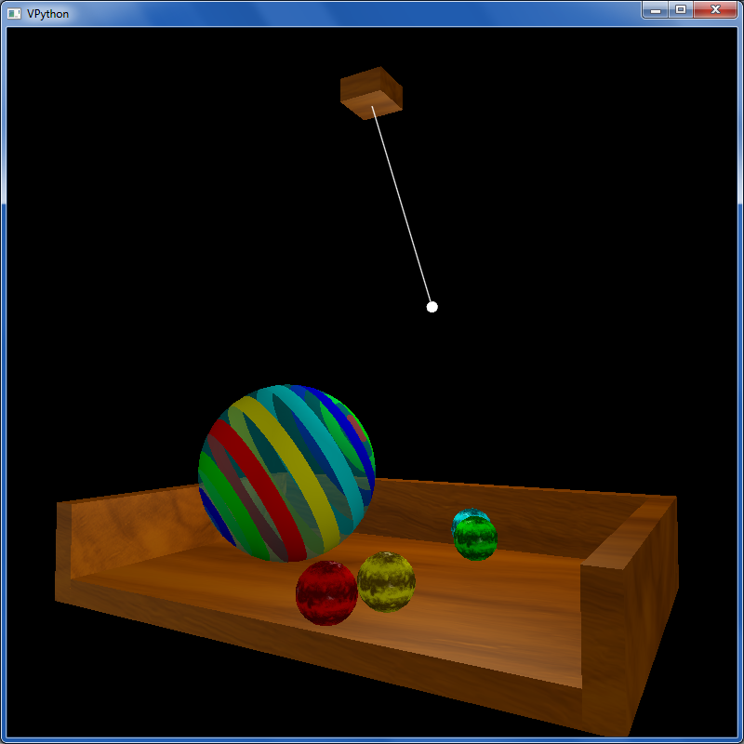
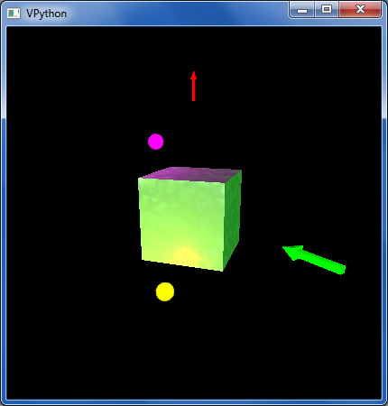
other VPython examples
tictac.py – a 3d game of tic-tac-toe
material_test.py – lots of materials
texture_and_lighting.py – fancier textures, opacity and a pendulum example
boxlighttest.py – very short + simple rotation and lighting example

Slide 79
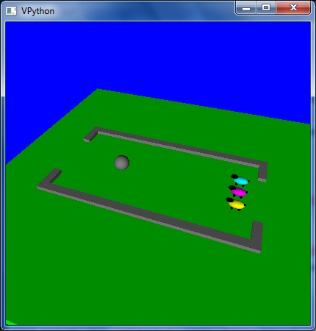
Enjoy the projects!
An unusual variation on VPool
… the graders certainly do!

Slide 80
Enjoy the projects!
An unusual variation on VPool
Have a relaxing long weekend!
… the graders certainly do!

Slide 82
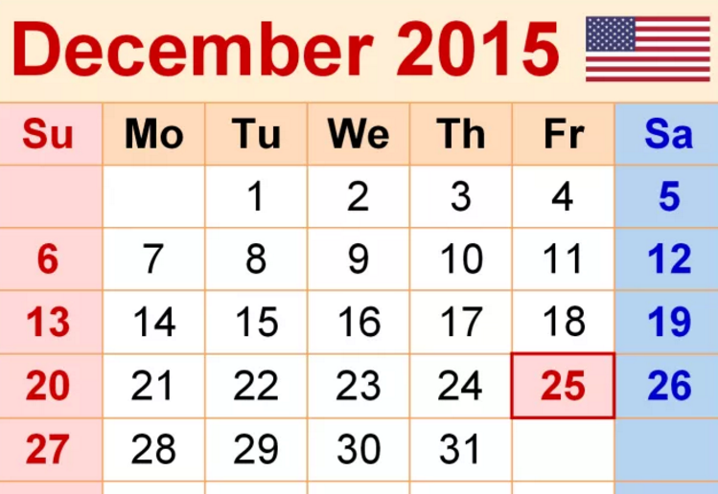
Dec. in CS 5
(0,0,0)
(110,102,0)
(220,205,0)
Tue., 12/8 – hw12 + milestone due
Fri., 12/11 – 8pm: final proj. due
final project
Tue., 12/15 7 pm – review
Wed., 12/16 7 pm – final
Thu., 12/17 7 pm – final
Either exam's OK: you choose…
final exam
CS 5 black final exam 12/17 @ 9am

Slide 83
Dec. in CS 5
(0,0,0)
(110,102,0)
(220,205,0)
Tue., 12/8 – hw12 + milestone due
Fri., 12/11 – 8pm: final proj. due
final project
Tue., 12/15 7 pm – review
Wed., 12/16 7 pm – final
Thu., 12/17 7 pm – final
Either exam's OK: you choose…
final exam
CS 5 black final exam 12/17 @ 9am

Slide 84
Connect Four continues…

Slide 85
Connect Four extra credit…

Slide 86
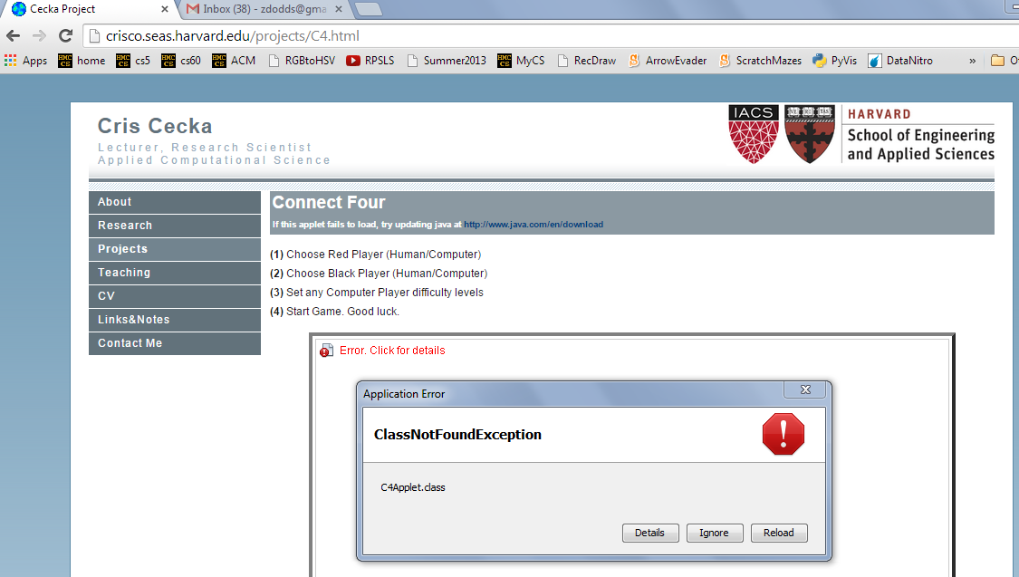
Aargh!

Slide 87
Aargh!

Slide 88
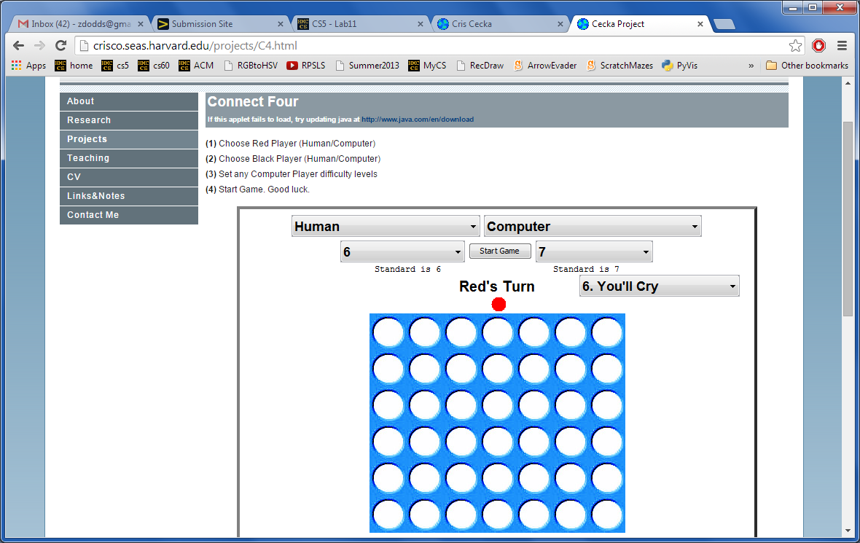
Give C4 a try… !
Looking for a game… ?
http://crisco.seas.harvard.edu/projects/C4.html

Slide 89
Connect-4 tiebreaking…
scoreBoard would give each of these 50.0
but which board is really better for black?
Ex. Cr.: write a scoreBoard4Tourney f'n.
taken beyond the extreme…

Slide 90
Quiz: better scoring!
Name(s): __________________________
scoreBoard would give both of these 50.0 for 'X' and 'O'
for 'X':
for 'X':
for 'O':
for 'O':
What values might a better scorer give to each board - for black and for red? Which side would get a higher score?

Slide 91
What's due?
Tue. 12/8
Fri. 12/11
The "milestone"
The "final" @ 8:00pm
project-specific tasks ~ ensuring that everyone has started!
(we can't grade these in time)
A zip file with everything needed to run your final project and a .txt file describing how to do so!
Nice milestone!
It's a kilometer stone, actually!

Slide 92
Stemming!
getting to the root of the problem…
def stem( w ):
Name(s): ______________________________
Find an English exception to each of these stemming patterns:
stem('parties')
'parti'
ends in ies
stem('party')
'parti'
ends in cons + y
stem('love')
'lov'
ends in vow + cons + e
stem('loving')
'lov'
ends in vow + cons + ing
stem('quickly')
'quick'
ends in ly
stem('quickest')
'quick'
ends in est
stem('stems')
'stem'
ends in s
stem('stemming')
'stem'
ends in vow + 2*cons + ing
stem(__________)
_______
create your own stemming rule

Slide 93
After Deep Blue…

Slide 94
In reality?
Xiaoyu Y.'s C4 game…
Humans adapt!

Slide 95
TextID model
class TextModel
Surely you're joking, Mr. Feynman! Aren't poptarts and spam always quantum-entangled? Dr. G. Kuenning jokes that spam poptarts don't exist. That's no joke!
file w/text:
algorithmic building blocks
{'and': 1, 'no': 1, 'jokes': 1, 'quantumentangled': 1, 'joking': 1, 'spam': 2, 'always': 1, 'youre': 1, 'g': 1, 'joke': 1, 'thats': 1, 'feynman': 1, 'that': 1, 'surely': 1, 'arent': 1, 'mr': 1, 'dont': 1, 'exist': 1, 'kuenning': 1, 'dr': 1, 'poptarts': 2}
{1: 1, 2: 3, 3: 1, 4: 5, 5: 5, 6: 3, 7: 1, 8: 3, 16: 1}
{'and': 1, 'alwai': 1, 'sure': 1, 'quantumentangl': 1, 'dont': 1, 'g': 1, 'spam': 2, 'joke': 3, 'that': 2, 'poptart': 2, 'feynman': 1, 'kuen': 1, 'arent': 1, 'mr': 1, 'no': 1, 'exist': 1, 'dr': 1, 'your': 1}
{9: 1, 3: 1, 5: 1, 6: 1}
{'!': 2, "'": 4, '-': 1, ',': 1, '.': 4, '?': 1}
the model!
at least 5 Python dictionaries…
here are the five for the above "Feynman" file:

Slide 96
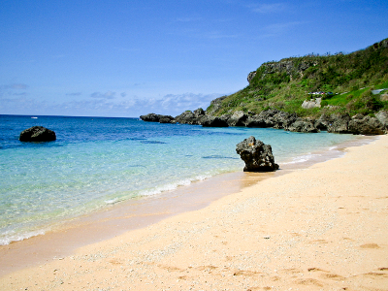
TextID's building blocks… ?
I don't see a difference!

Slide 97
Model matching
Suppose we have two dictionaries:
WS: { "love": 50,
"spell": 8,
"thou": 42 }
JKR: { "love": 25,
"spell": 275,
"potter": 700 }
"potter" is not here.
"thou" is not here.
New: { "love": 3, "thou": 1,
"potter": 2, "spam": 4 }
How could we give a match score for this New dictionary against each one above?

Slide 98
Stemming
getting to the root of the problem…
Name(s): ____________________
def stem( w ):
thought experiments…
if w[-3:] == 'ies':
return w[:-2]
This works for
parties -> parti
it fails for
elif w[-3:] == 'ing' and \
w[-4:-3] == w[-5:-4]:
return w[:-4]
What's this doing?
What's an example where it works?
What's an example where it fails?
elif
Write a rule to handle plurals ...
(1) What is a case where it will fail?
(2) How could you fix that case?
elif
Choose any other stemming rule and implement it here!

Slide 99
TextID's building blocks…
This looks familiar...
Get text from file…
You're ready to score against your model!

Slide 100
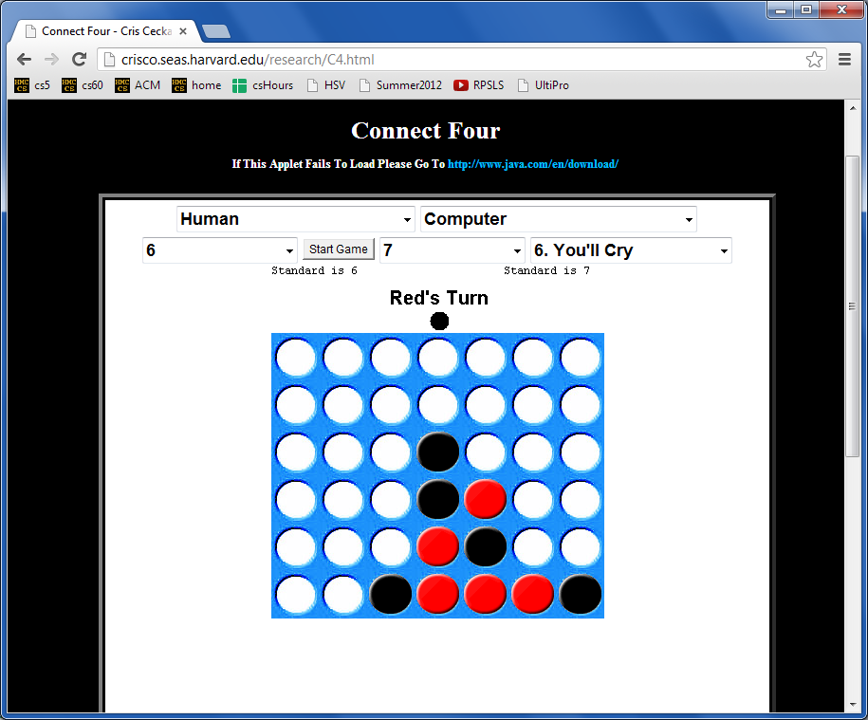
More Connect Four?
Looking for a game… ?
crisco.seas.harvard.edu/projects
Anyone defeated by their own program yet?

Slide 101
Naïve Bayes classification
multiply each word's probability as if they were all independent
WS: { "love": 50,
"spell": 8,
"thou": 42 }
JKR: { "love": 25,
"spell": 275,
"potter": 700 }
"potter" is not here.
"thou" is not here.
score vs. WS
score vs. JKR
50
50
50
42
0
25
25
25
0
700
100
100
100
100
100
1000
1000
1000
1000
1000
love
love
love
thou
potter
love
love
love
thou
potter
score = 0
score = 0
New: { "love": 3, "thou": 1,
"potter": 2, "spam": 4 }
problems?
solutions?

Slide 102
Naïve Bayes classification
multiply each word's probability as if they were all independent
WS: { "love": 50,
"spell": 8,
"thou": 42 }
JKR: { "love": 25,
"spell": 275,
"potter": 700 }
"potter" is not here.
"thou" is not here.
Ignore zeros!
score vs. WS
score vs. JKR
50
50
50
42
0
25
25
25
0
700
100
100
100
100
100
1000
1000
1000
1000
1000
love
love
love
thou
potter
love
love
love
thou
potter
score = 0.0525
score = 0.000011
New: { "love": 3, "thou": 1,
"potter": 2, "spam": 4 }
problems?
solutions?

Slide 103
Naïve Bayes classification
multiply each word's probability as if they were all independent
fix example to handle words that appear in one but not the other – give some low (non-zero) probability, e.g., the min frequency across all words in that model or all models (or just some small number)
WS: { "love": 50,
"spell": 8,
"thou": 42 }
JKR: { "love": 25,
"spell": 275,
"potter": 700 }
"potter" is not here.
"thou" is not here.
Ignore zeros!
score vs. WS
score vs. JKR
50
50
50
42
0
25
25
25
0
700
100
100
100
100
100
Use log!
1000
1000
1000
1000
1000
love
love
love
thou
potter
love
love
love
thou
potter
score = -1.27
score = -4.96
New: { "love": 3, "thou": 1,
"potter": 2, "spam": 4 }
problems?
solutions?

Slide 104
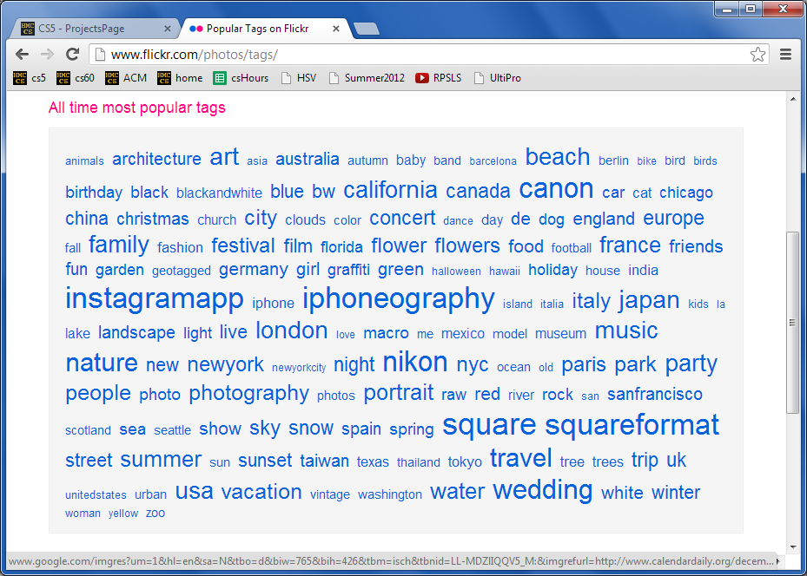
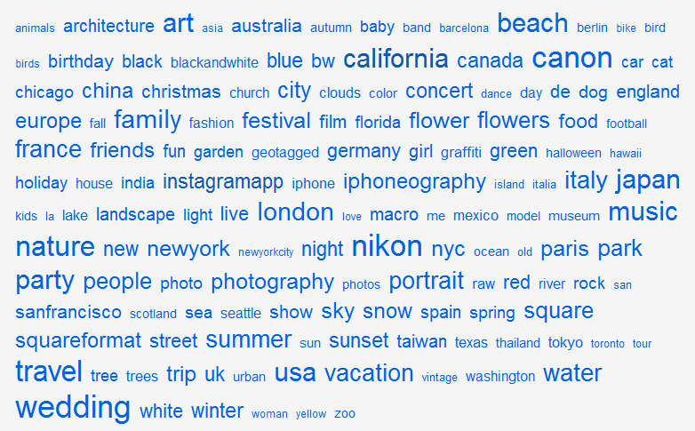
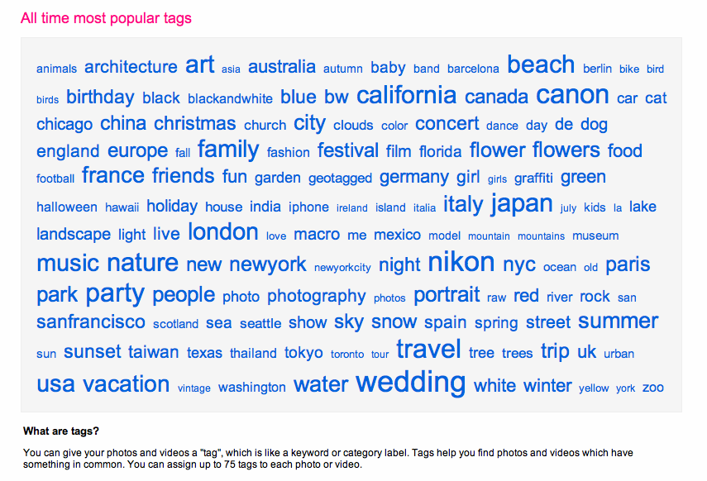
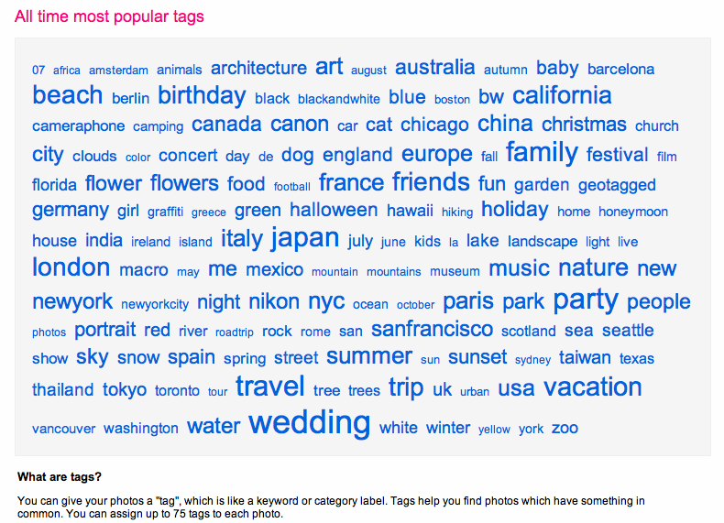
TextID project
2012
tag cloud
merges?

Slide 105
Text Clouds project
text cloud
this doesn't look nearly colorful enough…
Summary of the words in a body of text, sized according to their frequency.

Slide 106
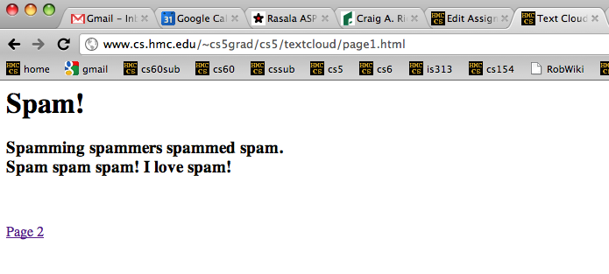
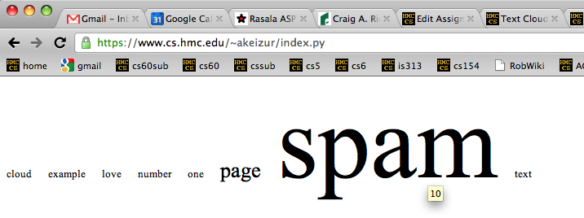
Text Clouds project
Input
http://www.cs.hmc.edu/~cs5grad/cs5/textcloud/page1.html
http://www.cs.hmc.edu/~cs5grad/cs5/textcloud/textcloud.html
Hey! Where did these come from?
Output
I think spam should go to 11!

Slide 107
Text Clouds project
http://www.cs.hmc.edu/~cs5grad/cs5/textcloud/page1.html
Spamming spammers spammed spam. Spam spam spam! I love spam!
['spamming', 'spammers', spammed', 'spam.', 'spam', 'spam', 'spam!',
'I', 'love', 'spam!', 'page', '2']
What happened here?
['spamming', 'spammers', spammed', 'spam', 'spam', 'spam', 'spam',
'love', 'spam', 'page', '2']
And here?
['spam', 'spam', spam', 'spam', 'spam', 'spam', 'spam',
'love', 'spam', 'page', '2']
What's next?

Slide 108
Text Clouds project
From text…
Start with text…
Split it into words…
With the list of words
Clean the words
Stem the words
Count the words
Return a string with frequencies
Add advanced features…
This looks familiar...
So does this!
… to cloud

Slide 109
What is a word for which each of these rules "works" and "fails." Then, add a new rule that handles one of the failures – or an entirely new case!
Stemming
def stem( w ):
if w[-3:] == 'ing':
w = w[:-4]
This works for
Stemming
it fails for _________
elif w[-3:] == 'ies':
w = w[:-3] + 'y'
This works for _________
it fails for _________
elif w[-2:] == 'er':
w = w[:-3]
This works for _________
it fails for _________
Write a rule to handle plurals ...
(1) What might go wrong?
(2) How might you fix it?
return w
It's easy to miss cases!

Slide 110
Text Clouds project
Develop the basic text-processing in Python+IDLE.
After that works, use a webpage to deploy it...
First:
Then:
Use the provided code to read HTML + process the results into ordered lists of words…
Once you have things working, move on to
writing HTML
following links beyond depth 1
Building a web crawler ...
Finally:
What will you need to look out for?
Personalize - There are lots of ways to do this!

Slide 111
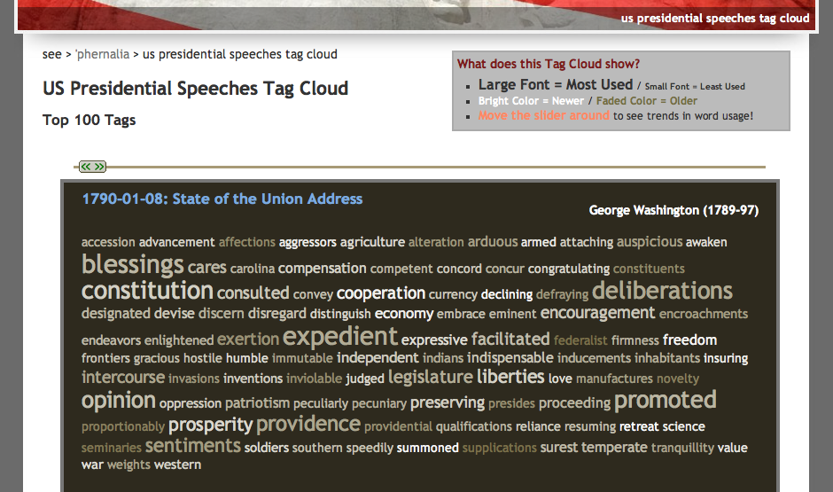
Text-cloud history
http://chir.ag/phernalia/preztags/

Slide 112
The pyRobot project
Robots typically cycle through several states :
States represent current subtasks
other keys...
Arrows represent transitions, through sensor or keybd feedback
KBD
FWD
keyboard control
's' key pressed
go forward
This triangle indicates the "start state"
How do we get out of FWD?
"a finite state machine"

Slide 113
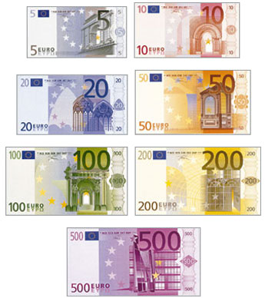
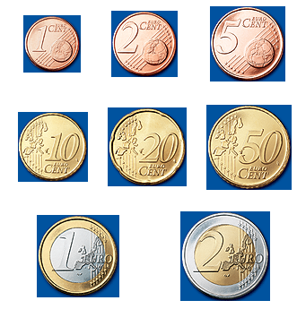
CS 5 currency…
Final project: 1 Euro for each deadline
as long as one partner has a Euro left....
Also ask about our Euro "buy-back" plan: convert your unused Euros to more valuable currency (like M&Ms)

Slide 114
Getting familiar with VPython's API...
(0) How many tuples appear in this code? ________
(1) How many classes are used here? ________
(2) How many objects are used here? ________
(3) How are the collisions working?
Look over this VPython program to determine
from visual import *
floor = box( pos=(0,0,0), length=4, height=0.5,
width=4, color=color.blue)
ball = sphere( pos=(0,4,0), radius=1, color=color.red)
ball.velocity = vector(0,-1,0)
dt = 0.01
while True:
rate(100)
ball.pos = ball.pos + ball.velocity*dt
if ball.pos.y < ball.radius:
ball.velocity.y = -ball.velocity.y
else:
ball.velocity.y = ball.velocity.y - 9.8*dt
What's this if/else doing?

Slide 115
What is a word for which each of these rules "works" and "fails." Then, add a new rule that handles one of the failures – or an entirely new case!
Stemming
def stem( wd ):
if wd[-3:] == 'ing':
wd = wd[:-3]
This works for _________
it fails for _________
elif wd[-3:] == 'ies':
wd = wd[:-3] + 'y'
This works for _________
it fails for _________
elif wd[-2:] == 'er':
wd = wd[:-3]
This works for _________
it fails for _________
Write a rule to handle plurals ...
(1) What might go wrong?
(2) How might you fix it?
return wd
It's easy to miss cases!

Slide 116
Extra: Text Clouds
text cloud
Summary of the words in a body of text, sized according to their frequency.
this doesn't look nearly colorful enough…
demos… ?

Slide 117
Text-cloud history
http://chir.ag/phernalia/preztags/

Slide 118
vPool collisions
I guess I'll watch out for VPython collisions...!
from visual import *
wall = box( ... )
ball = sphere( pos=(10,0,0), radius=1 )
ball.velocity = vector(-2,0,0)
RATE = 30
dt = 1/RATE
while True:
rate(RATE)
ball.pos += ball.velocity * dt
if ball.pos.x < 2.0:
print "Collide!"
ball.velocity = -ball.velocity
Start...
this is x == 2
Stuck!
What errors – in coding or logic or both – are here?

Slide 119
vPool collisions
I guess I'll watch out for VPython collisions...!
from visual import *
wall = box( ... )
ball = sphere( pos=(10,0,0), radius=1 )
ball.velocity = vector(-2,0,0)
RATE = 30
dt = 1/RATE
while True:
rate(RATE)
ball.pos += ball.velocity * dt
if ball.pos.x < 2.0:
print "Collide!"
ball.velocity = -ball.velocity
Start...
this is x == 2
Stuck!
What errors – in coding or logic or both – are here?

Slide 120
Labs?
(this week is VPython)
December's labs are final-project based:
optional, but helpful! (even more optional than usual...)
a natural opportunity to work in a pair
work on your laptop or the CS machines
easy access to help
and some of the CS machines do need work!
unspeakably fun!
Don't say it!

Slide 121
Is this a computer?
transition on 0
transition on 0
transition on 1
State 0
State 1
transition on 1
an input sequence
0010111
What does each state MEAN ?
always left-to-right
What does this FSM do overall?

Slide 122
Another example
0
1
s1
s0
0
1
s2
0,1
Specifically?
What inputs does this FSM accept?
Generally?
Fewer states?
What does each state MEAN ?

Slide 123
Project options...
VPool
TextClouds
PyRobot
Picobot!

Slide 124
Project options...
VPool
TextClouds
PyRobot
Picobot!

Slide 125
The pyRobot project
Hey! Watch where you're going!
Pt A
How do I control this robot !?!
2d simulator
Goal: get from Pt A to Pt B
Pt B

Slide 126
The pyRobot project
Robot control continuously loops through three things:
while True:
SENSE
PLAN
ACT
Sounds refreshing to me!
Robots almost always use the SPA approach!

Slide 127
The pyRobot project
Robots typically cycle through several states :
States represent current subtasks
other keys...
Arrows represent transitions, through sensor or keybd feedback
KBD
FWD
keyboard control
's' key pressed
go forward
This triangle indicates the "start state"
How do we get out of FWD?
"a finite state machine"

Slide 128
The pyRobot project
while True:
Robot control continuously runs three things:
SENSE
PLAN
ACT

Slide 129
Maps
are set by hitting the '8' key...
Required
Extra

Slide 131
The pyRobot project
Robots typically cycle through several states :
States represent current subtasks
other keys...
Arrows represent transitions, through sensor or keybd feedback
KBD
FWD
keyboard control
's' key pressed
go forward
This triangle indicates the "start state"
How do we get out of FWD?
"a two-state state machine"

Slide 132
What is a word for which each of these rules "works" and "fails." Then, add a new rule that handles one of the failures – or an entirely new case!
Stemming
def stem( wd ):
if wd[-3:] == 'ing':
wd = wd[:-3]
This works for _________
it fails for _________
elif wd[-3:] == 'ies':
wd = wd[:-3] + 'y'
This works for _________
it fails for _________
elif wd[-5:] == 'ement':
wd = wd[:-4]
This works for _________
it fails for _________
Fix one of these rules – or write another one... .
return wd
Maybe stemming stemming?

Slide 133
What will CS 5 be about... ?
What
Theoretical results in CS...

Slide 134
Picobot lives!
Your simulator will be able to run these rules just like any others!

Slide 135
Previously cool submissions...
You mean these no longer qualify as cool?
http://stanford.edu/~ccecka/research/C4.html
Creativity + Physics = vPool !

Slide 136
The pyRobot project ~ additions
Main
Goal: get from Pt A to Pt B
Optional
Start in an unknown location on the map…
Implement a niftier interface…
I'm lost!
vPython Robot?
Use only the bump sensors… (no range sensing)
Use noisy (realistic) data

Slide 137
The pyRobot project ~ additions
Main
Goal: get from Pt A to Pt B
Optional
Start in an unknown location on the map…
Implement a niftier interface…
I'm found!
vPython Robot?
Use only the bump sensors… (no range sensing)
Use noisy (realistic) data
Try your code for a "spin"…

Slide 138
More cool submissions?
Thanks, Alex!

Slide 139
Command-line commands
pwd
ls
cd
nano
cp
chmod
wc
prints the current directory
lists the current directory
changes directory
edits files
copies files
changes file permissions
Hey - that's me!
counts the words, lines, and characters

Slide 140
Design for software and beyond
Don Norman's key principles:
0. Conceptual models
1. Mapping
Visibility
Feedback
Affordances

Slide 141
Where do these go wrong?
Mapping
Visibility
Feedback
Affordances
Set to 5 minutes?
How to open this gas cap?
This handle unfastens the seat from the floor.
Win NT Dialog
How to turn on this stove?

Slide 142
CS 5 Mudd…
(0,0,0)
(110,102,0)
(220,205,0)
CS 5's winter weeks:
final project
computational models
uncomputability
No regular labs this week
Ex. Cr. labs are scheduled
Tue. (today): 2:45-4:45
Wed. (tomorrow): 2:45-4:45
Tue., 12/14 2 pm – Exam option #1
more later on, too ...
Thu., 12/16 9 am – Exam option #2

Slide 143
Final-project season
congratulations to all E11ers!
Today is about the CS 5 Term Projects
Sales pitch for the four possible options...
A sneak peek at "December in CS 5"
vPool
Picobot
pyRobot
Text Clouds
I’ve got my eyes on some of these projects!
Eye'll bet!

Slide 144
Final projects
open-ended
comprehensive
Final CS assignment
same projects for black/gold
several choices…
Working solo or duo is OK
Pairs need to work together (in the same place) and to share the work equally...
Eye, eye!

Slide 145
Cool submissions!
http://stanford.edu/~ccecka/research/C4.html
Room for creativity...

Slide 146
The vPool project
Phunky Fisicks is welcome!
VPython was designed to make 3d physics simulations simpler to program
Collisions with walls should be handled...
Collisions with other pool balls should be handled...
Pockets – or some other game objective
A few examples to get you thinking…
Linux users are welcome!
But they should use another OS…

Slide 147
Text Clouds project
2010
tag cloud
merges?

Slide 148
Text Clouds project
Input
http://www.cs.hmc.edu/~cs5grad/cs5/textcloud/page1.html
http://www.cs.hmc.edu/~akeizur/
Hey! Where did these come from?
Output
I think spam should go to 11!

Slide 149
Text Clouds project
http://www.cs.hmc.edu/~cs5grad/cs5/textcloud/page1.html
Spamming spammers spammed spam. Spam spam spam! I love spam!
['spamming', 'spammers', spammed', 'spam.', 'spam', 'spam', 'spam!',
'I', 'love', 'spam!', 'page', '2']
What happened here?
['spamming', 'spammers', spammed', 'spam', 'spam', 'spam', 'spam',
'love', 'spam', 'page', '2']
And here?
['spam', 'spam', spam', 'spam', 'spam', 'spam', 'spam',
'love', 'spam', 'page', '2']
What's next?

Slide 150
Text Clouds project
From text…
Start with a webpage (URL)
Read in text
Create a list of words
Clean the words
Stem the words
Count the words
Return a string with frequencies
Add advanced features…
This looks familiar...
So does this!
… to cloud

Slide 151
Text Clouds project
Develop the basic application using IDLE.
After it works, make it a webpage...
The Approach:
Use the provided code to read HTML
Make sure that you can process the files appropriately into ordered lists of words…
Once you have things working, move on to
writing HTML
following links beyond depth 1
Building a web crawler ...
Once you have everything working,
transfer your files to your webspace.
set up the HTML wrapper files & go…
What will you need to look out for?
Personalize - There are lots of ways to do this!
Alexa's ...

Slide 152
Text-cloud history
http://chir.ag/phernalia/preztags/

Slide 153
The pyRobot project
Robots typically cycle through several states :
States represent current subtasks
other keys...
Arrows represent transitions, through sensor or keybd feedback
KBD
FWD
keyboard control
's' key pressed
go forward
This triangle indicates the "start state"
How do we get out of FWD?
"a two-state state machine"

Slide 154
The pyRobot project
Robots typically cycle through several states :
other keys...
KBD
FWD
keyboard control
's' key pressed
go forward
Finish drawing the state machine for the random robot...

Slide 155
The pyRobot project
while True:
Robot control continuously runs three things:
SENSE
PLAN
ACT
[x,y,thd], bump = self.getData()
if bump[0] == True or bump[1] == True:
print 'BUMP!',
print ' [Left bump sensor:', bump[0], '] ',
print ' [Right bump sensor:', bump[1], '] '
robotTask = STOP
STOP is one of the robot's states. Every 40th of a second, the robot runs through this loop, sets the robot's state and sets the velocities accordingly. Don't sleep!
if robotTask == STOP:
self.setVels(0,0)
robotTask = KBD

Slide 156
Maps
are set at the very bottom of the main.py file:
Required
Extra

Slide 157
The Picobot project
Basic idea: implement Picobot (the hw problem from Week 1)
Picobot is also a finite-state machine!
talk about full circle...

Slide 158
The Picobot project
Basic idea: implement Picobot (the hw problem from Week 1)
Requirements:
Picobot is also a finite-state machine!
Text and graphical output
Read Picobot program from a file
Read maze description from a file
Keep track of visited/unvisited squares
Prohibit illegal moves – unless they're legal...

Slide 159
Picobot returns!
What data structures (classes) might be helpful in implementing Picobot?

Slide 160
The Picobot project
Current State: 1
Current Rule: 1 N*W* -> X 2
++++++++++
+o++o+o+++
+oooooo ++
++++o++ +
+oooo+++++
++++o +
+oooo+++ +
++++o+++++
+Rooo +
++++++++++
First, prototype it as ASCII-bot
Picobot started here…
and is now here…

Slide 161
The Picobot project
Graphical picobot:
turtle version…
Choice of graphical packages
VPython for 3d
turtle for 2d
Start/stop/step feature
Maze editing
Pebble dropping
Be inventive!
Lots of options…

Slide 162
What’s due?
Mon., 12/6 – Interim milestones due (11:59 pm)
milestone.txt
milestone.py
Name(s)
Project chosen
Your project description:
What is your plan.
What is your approach.
A start at an implementation.
Classes and functions
Docstrings
60-80+ lines of working, tested code
Nice milestone!
It’s actually a kilometer stone.

Slide 163
What’s due?
Fri., 12/10 – Final deliverables due (by 5:00 pm)
final.txt
final.py
Name(s)
Project chosen
Description of user interface:
How do we run / play your project.
What features did you implement.
What was your approach & plan.
Classes and functions with documentation/docstrings
Working, tested code
A final milestone?

Slide 164
CS 5 currency…
Final project: 1 Euro for each deadline
as long as one partner has a Euro left....
Ask Prof. Ran about his Euro "buy-back" plan!

Slide 165
Labs?
December's labs are final-project based:
optional, but helpful!
a natural opportunity to work in a pair
and some of the CS machines do need work!
work on your laptop or the CS machines
easy access to help
HTML set up for the TextClouds project
unspeakably fun!
Don't say it!
optional labs?

Slide 166
CS 5 Today
(0,0,0)
(110,102,0)
(220,205,0)
CS 5's final three weeks:
final project
w/Euro
CS labs this week: VPython
25
CS hwk this week: C4 AI
Hwk 11 due: Dec. 3
final exam
Mon., 12/17 2 pm – Exam option #1
Wed., 12/19 9 am – Exam option #2

Slide 167
def scoresFor(self, b):
""" MUST return a list of 7 scores!! """
scores = [50,50,50,50,50,50,50]
(0) Start all scores at 50.
(1) For each col to move:
(2a) If not possible…
(2b) If game already over…
(2c) Else add the move to b
(3) Ask an opponent (!!!) for its scoresFor at ply-1
(4) compute self's score
for col in range( 0, 7 ):
return scores

Slide 169
XKCD's take…

