Slide 1



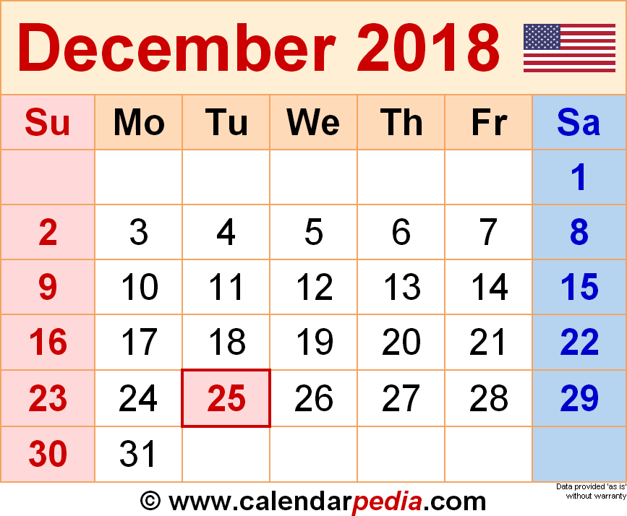
Dec. in CS 5
(0,0,0)
(110,102,0)
(220,205,0)
Mon., 12/3 – hw11 + project start due
Mon., 12/10 – hw12 + milestone due
Fri., 12/14 – 8pm: final proj. due
final project
Sun., 12/16 7 pm – review
Mon., 12/17 7 pm – final
gold final exam
Office hours this afternoon in office!
60?

Slide 2
Final-project preview!
Choices of final project:
TextID
this morning ~ overview
Picobot
vPython
next week ~ overview
Connect 4 AI
Labs do not meet this week...
Labs do meet the week after break...

Slide 3
Final 2 lab days…
Labs will meet the last 2 weeks of class, but...
they're "extra-optional" ~ no lab prob.
labtime: final projects ~ assistance + progress
there are theocomp problems, too (hw12)
Plus, hw12 has up to +50 pts of extra credit!
no sign in
-2i
or two!
Now we're in a state!
+2i

Slide 4
'tis the season for final projects…
  Today is about the CS 5 final projects
  + it's a sales pitch for the four possible options:
Picobot
C4 AI
TextID
vPool
I've got my eyes on some of these projects!
Eye'll bet !

Slide 5
Final projects
open-ended
comprehensive
Final CS hw
same projects across sections
several choices…
Working in teams of 1-3 is OK
Eye, eye!
Teams need to work together - in the same place - and need to share the work equally...
Pairs/trios are welcome (larger should split)
Teaming is extra-encouraged on the final project!

Slide 6
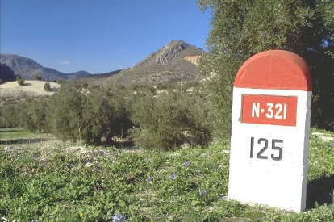
12/3
"Start" ~ part of hw11
When?!
Mon. 12/10
Fri. 12/14
"Milestone" ~ part of hw12
Final project & short reflection on how to run it and how it went.
project-specific tasks to help w/progress...
due at 8pm
Euros ok; grutoring tapers.
Nice milestone!
It's a kilometer stone, actually!

Slide 7
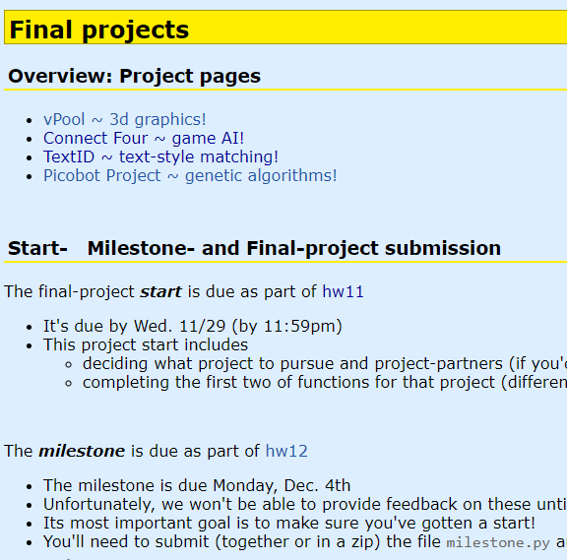
The project page...
Actually, a little later...

Slide 8
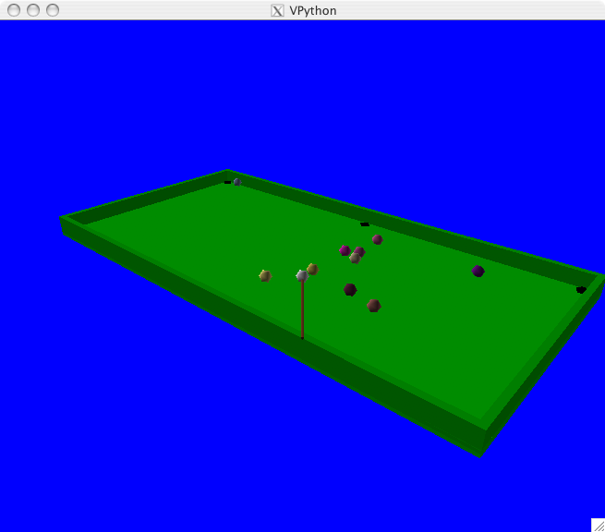
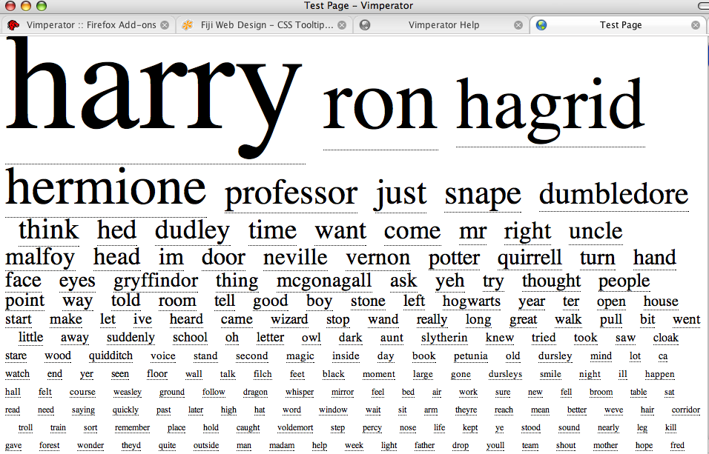
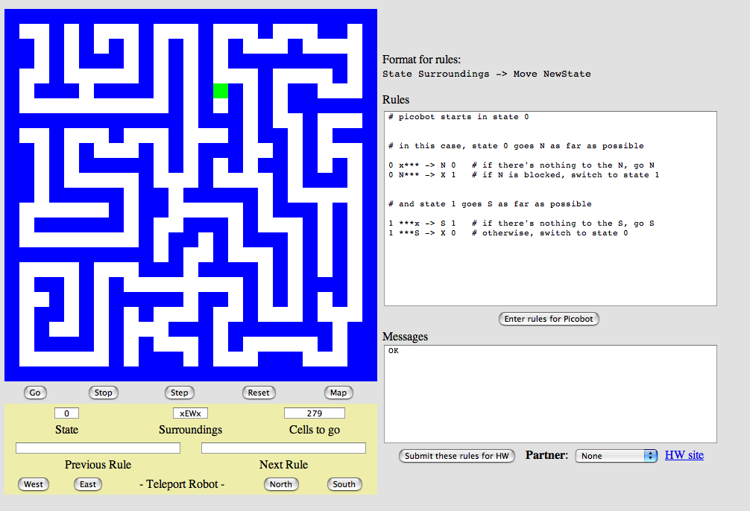
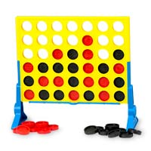
The projects...
VPool
TextID
C4 AI
Picobot!

Slide 9
VPool
TextID
Next week...
C4 AI
Picobot!

Slide 10
Next week's lab!
VPool
TextID
C4 AI
Not 3... but 4!
Picobot!

Slide 11
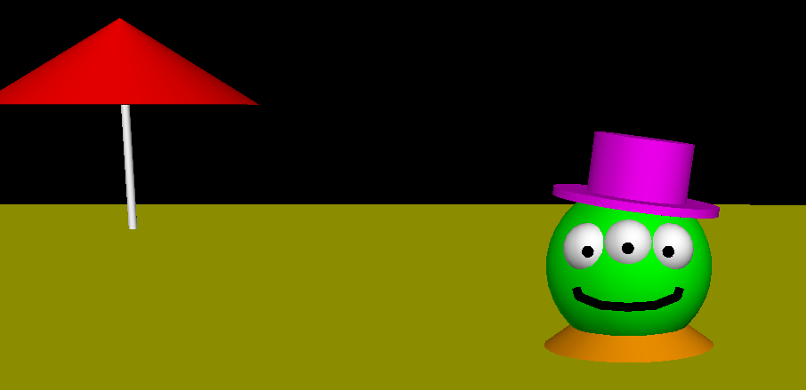
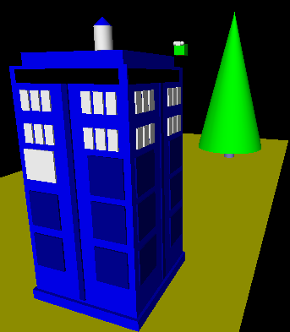
3d graphics-based game using VPython
Physics engine...
I'll take your cue...
Let's play!
… it's not really very constrained at all!
A few constraints…
need ≥4 physically interacting objects
allow the user to direct 1+ objects, either by keyboard or mouse or both
needs a game goal + be winnable!
must detect some "linear" and some "spherical" collisions and implement their results on the motion of the objects

Slide 12
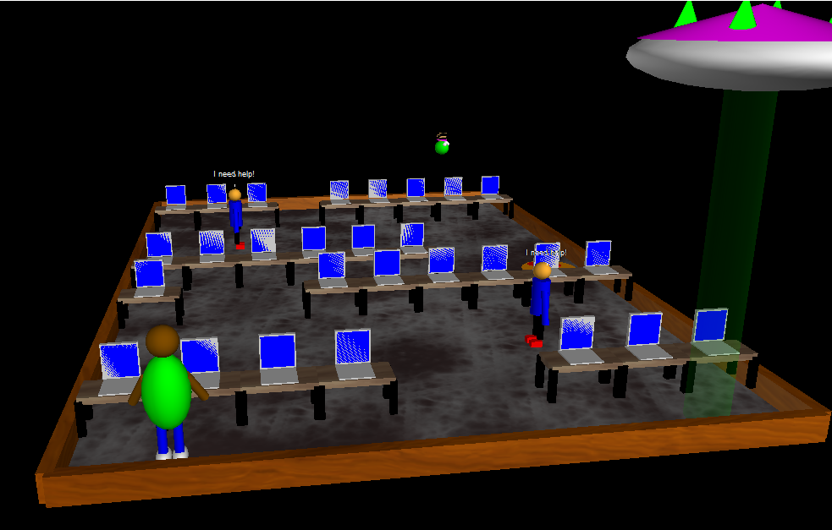
Example vProjects...
Do you see the pool table!? the pool balls? the alien?
lbrady, august t-y, [16] pking, [16] aserbent, [16] nami

Slide 13
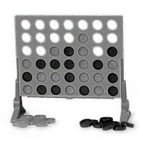
The projects...
VPool
TextID
C4 AI
Picobot!

Slide 14

The Picobot project
Big idea
(1) Implement Picobot in Python
(2) Train Python to write successful Picobot programs!
talk about going full circle...

Slide 15
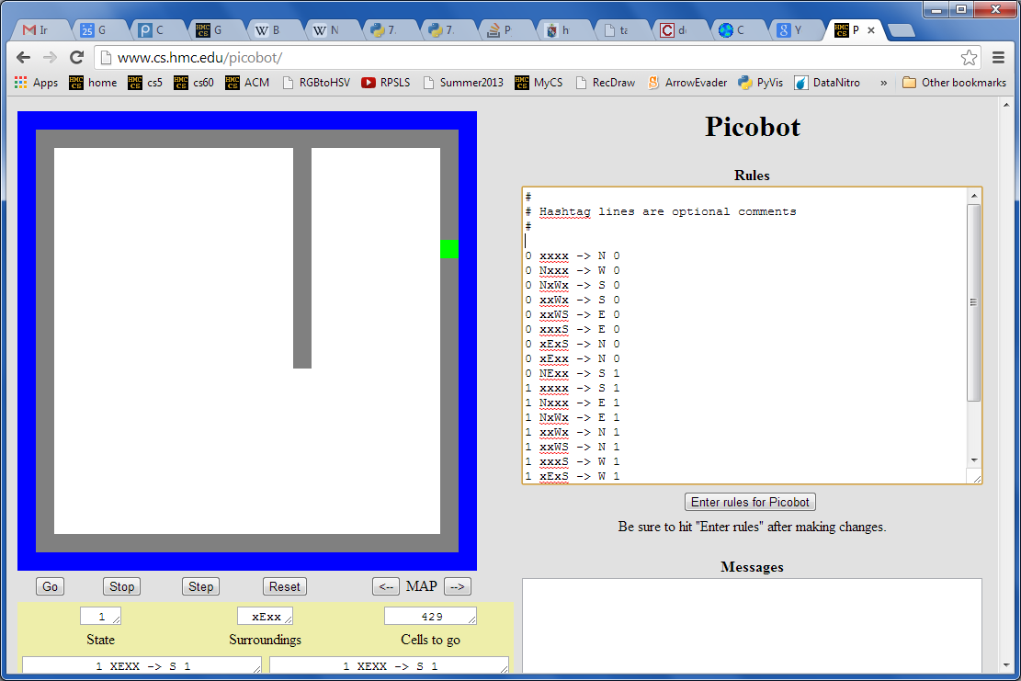
Picobot, behind the curtain...
What data structures (classes) might be helpful in implementing Picobot?

Slide 16
Picobot's classes
0 xxxx -> N 0
0 Nxxx -> W 0
0 NxWx -> S 0
0 xxWx -> S 0
0 xxWS -> E 0
0 xxxS -> E 0
0 xExS -> N 0
0 xExx -> N 0
0 NExx -> S 1
1 xxxx -> S 1
1 Nxxx -> E 1
1 NxWx -> E 1
1 xxWx -> N 1
1 xxWS -> N 1
1 xxxS -> W 1
1 xExS -> W 1
1 xExx -> S 1
1 NExx -> W 0
class Program:
What in Python could most usefully hold all of these rules?
What type should self.rules be?

Slide 17
Picobot's classes
0 xxxx -> N 0
0 Nxxx -> W 0
0 NxWx -> S 0
0 xxWx -> S 0
0 xxWS -> E 0
0 xxxS -> E 0
0 xExS -> N 0
0 xExx -> N 0
0 NExx -> S 1
1 xxxx -> S 1
1 Nxxx -> E 1
1 NxWx -> E 1
1 xxWx -> N 1
1 xxWS -> N 1
1 xxxS -> W 1
1 xExS -> W 1
1 xExx -> S 1
1 NExx -> W 0
class Program:
What in Python could most usefully hold all of these rules?
What type should self.rules be?
both tuples
Python dictionary
key
value
self.rules[ (1,"NExx") ] = ("W",0)

Slide 18
Picobot's classes
+++++++++++++++++++++++++
+oooooPooooooooooooooooo+
+o o o+
+o o o+
+o o o+
+o o o+
+o o o+
+o o o+
+o o o+
+o o o+
+o o+
+o o+
+o o+
+o o+
+o o+
+o o+
+o o+
+o o+
+o o+
+o o+
+o o+
+o o+
+o o+
+ooooooooooooooooooooooo+
+++++++++++++++++++++++++
What type in Python could most usefully hold the environment?
class World:
What class that you've already written will be most similar to Picobot's World?
Wall:
+
What will self.room be?
o
Visited:
Picobot:
P

Slide 19
Picobot's classes
+++++++++++++++++++++++++
+oooooPooooooooooooooooo+
+o o o+
+o o o+
+o o o+
+o o o+
+o o o+
+o o o+
+o o o+
+o o o+
+o o+
+o o+
+o o+
+o o+
+o o+
+o o+
+o o+
+o o+
+o o+
+o o+
+o o+
+o o+
+o o+
+ooooooooooooooooooooooo+
+++++++++++++++++++++++++
What type in Python could most usefully hold the environment?
class World:
class Board
What class that you've already written will be most similar to Picobot's World?
Wall:
+
What will self.room be?
o
Visited:
The same as the Connect-Four board's self.data!
P
Picobot:
a list-of-lists-of-one-character-strings….

Slide 20
Picobot's project
First, build an ASCII simulation
demo!
Current State: 1
Current Rule: 1 N*W* -> X 2
++++++++++
+o++o+o+++
+oooooo ++
++++o++ +
+oooo+++++
++++o +
+oooo+++ +
++++o+++++
+Pooo +
++++++++++
Picobot started here…
and is now here…
Your actual ASCII is likely to be more monochromatic!
http://rednuht.org/genetic_cars_2/ or http://boxcar2d.com/
Box2d: https://www.youtube.com/watch?v=uxourrlPlf8

Slide 21
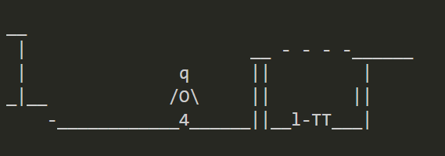
Picobot's project
First, build an ASCII simulation
demo!
Current State: 1
Current Rule: 1 N*W* -> X 2
++++++++++
+o++o+o+++
+oooooo ++
++++o++ +
+oooo+++++
++++o +
+oooo+++ +
++++o+++++
+Pooo +
++++++++++
Picobot started here…
and is now here…
Your actual ASCII is likely to be more monochromatic!
http://rednuht.org/genetic_cars_2/ or http://boxcar2d.com/
Box2d: https://www.youtube.com/watch?v=uxourrlPlf8

Slide 22
Picobot's project
First, build an ASCII simulation
demo!
Current State: 1
Current Rule: 1 N*W* -> X 2
++++++++++
+o++o+o+++
+oooooo ++
++++o++ +
+oooo+++++
++++o +
+oooo+++ +
++++o+++++
+Pooo +
++++++++++
then, evolve it…
Picobot started here…
with your own genetic algorithm
and is now here…
Your actual ASCII is likely to be more monochromatic!
http://rednuht.org/genetic_cars_2/ or http://boxcar2d.com/
Box2d: https://www.youtube.com/watch?v=uxourrlPlf8

Slide 23
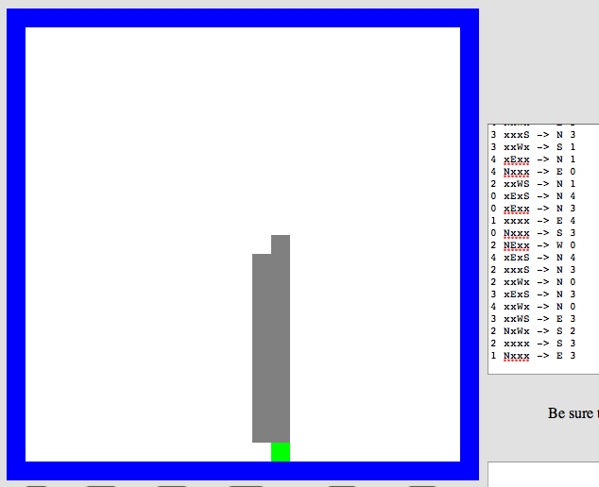
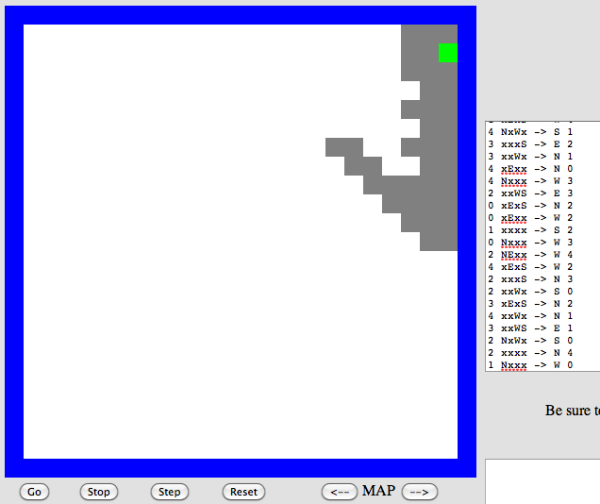
Program evolution
An example of genetic algorithms, which are used for optimizing hard-to-describe functions with easily-splittable solutions.
program p1
program p2
Start with a population of, say, ~200 random Picobot programs…

Slide 24
Program evolution
An example of genetic algorithms, which are used for optimizing hard-to-describe functions with easily-splittable solutions.
program p1
fitness = 0.03
program p2
fitness = 0.05
Then, measure the fitness of all of those programs
Measure? How??

Slide 25
program p1
fitness = 0.03
program p2
fitness = 0.05
mate + mutate the fittest rulesets
to create a new generation of ~200 programs…
program c1
fitness = 0.19
What the goal?

Slide 26
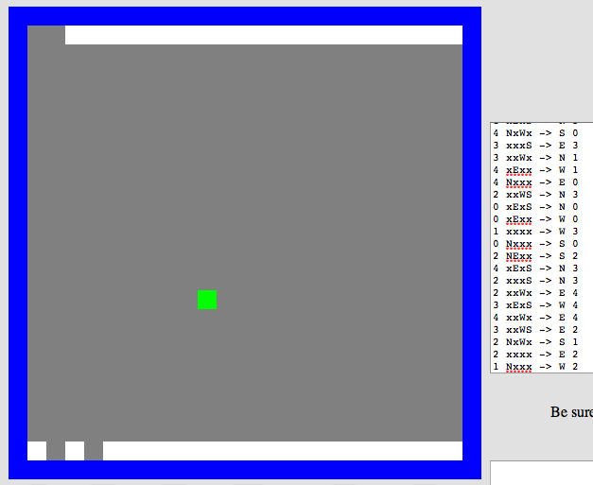
Repeat this "survival of the fittest" process for many generations…
… and by the end, your Python code should/will have evolved a much more capable Picobot program!
Solving hw0!
fitness = 0.90

Slide 27
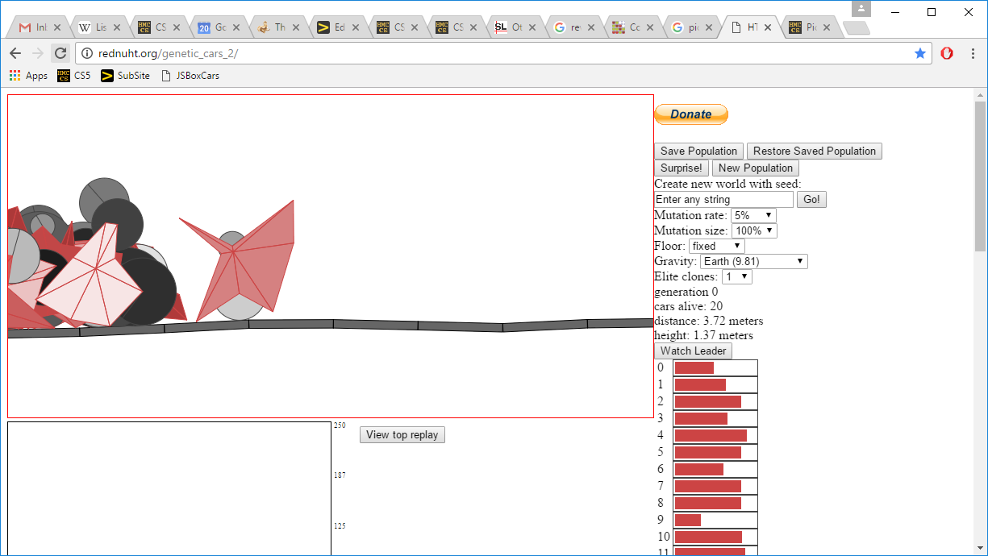
Genetic Algorithms ~ the 3rd way?!
the current "fitness" leader
fitnesses!
the current "generation"
Rafael Matsunaga: rednuht.org/
http://rednuht.org/genetic_cars_2/

Slide 28
The projects...
VPool
TextID
C4 AI
Picobot!

Slide 29
What CSers "do"
^
think they
or think as much...
final project algorithms...

Slide 30

A couple of years ago...
Though Robin Ellacott’s twenty-five years of life had seen their moments of drama and incident, she had never before woken up in the certain knowledge that she would remember the coming day for as long as she lived.
April 4, 2013
First paragraph of The Cuckoo's Calling by R. Galbraith

Slide 31
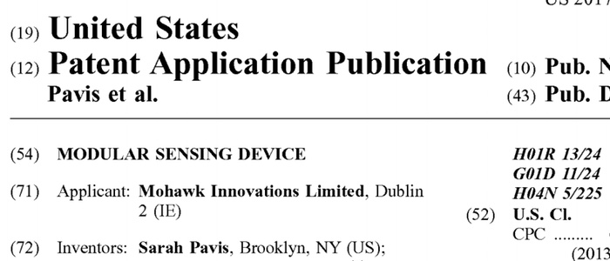

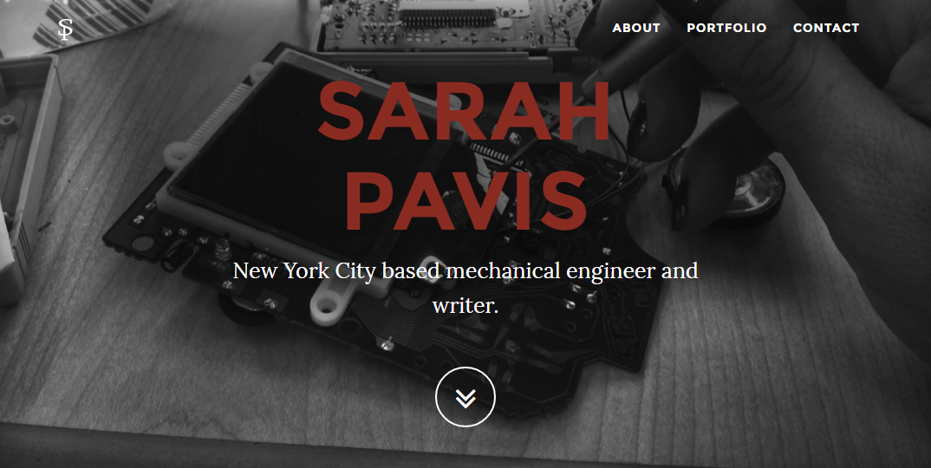
the TextID IDer...
Though Robin Ellacott’s twenty-five years of life had seen their moments of drama and incident, she had never before woken up in the certain knowledge that she would remember the coming day for as long as she lived.
April 4, 2013
First paragraph of The Cuckoo's Calling by R. Galbraith

Slide 32

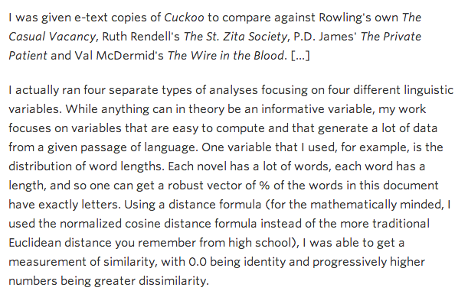
kottke.org/13/08/how-jk-rowling-was-found-to-be-robert-galbraith

Slide 33
I like poptarts and 42 and spam. Spamful poptarts are like poptartful spams -- and are liked by all!
Will _Thanksgiving_ bring spam poptarts?
File
TextModel
... will have at least five Python dictionaries, e.g.,
count of each word
{'and': 3, 'poptartful': 1, 'liked': 1, 'spamful': 1, 'like': 2, '': 1, 'spam': 2, 'i': 1, '42': 1, 'all': 1, 'thanksgiving': 1, 'will': 1, 'bring': 1, 'poptarts': 3, 'spams': 1, 'by': 1, 'are': 2}
{0: 1, 1: 1, 2: 2, 3: 6, 4: 5, 5: 3, 7: 1, 8: 3, 10: 1, 12: 1}
{'and': 3, '': 1, 'all': 1, 'like': 3, 'thanksgiv': 1, 'spam': 4, 'i': 1, '42': 1, 'by': 1, 'will': 1, 'bring': 1, 'ar': 2, 'poptart': 4}
{12: 1, 5: 1, 7: 1}
{'!': 1, '-': 2, '?': 1, '_': 2, '.': 1}
???
???
???
What are these four other dictionaries counting?!
???

Slide 34
I like poptarts and 42 and spam. Spamful poptarts are like poptartful spams -- and are liked by all!
Will _Thanksgiving_ bring spam poptarts?
File
TextModel
... will have at least five Python dictionaries, e.g.,
count of each word
{'and': 3, 'poptartful': 1, 'liked': 1, 'spamful': 1, 'like': 2, '': 1, 'spam': 2, 'i': 1, '42': 1, 'all': 1, 'thanksgiving': 1, 'will': 1, 'bring': 1, 'poptarts': 3, 'spams': 1, 'by': 1, 'are': 2}
{0: 1, 1: 1, 2: 2, 3: 6, 4: 5, 5: 3, 7: 1, 8: 3, 10: 1, 12: 1}
{'and': 3, '': 1, 'all': 1, 'like': 3, 'thanksgiv': 1, 'spam': 4, 'i': 1, '42': 1, 'by': 1, 'will': 1, 'bring': 1, 'ar': 2, 'poptart': 4}
{12: 1, 5: 1, 7: 1}
{'!': 1, '-': 2, '?': 1, '_': 2, '.': 1}
word lengths
stems
sentence lengths
punct
What are these four other dictionaries counting?!

Slide 35
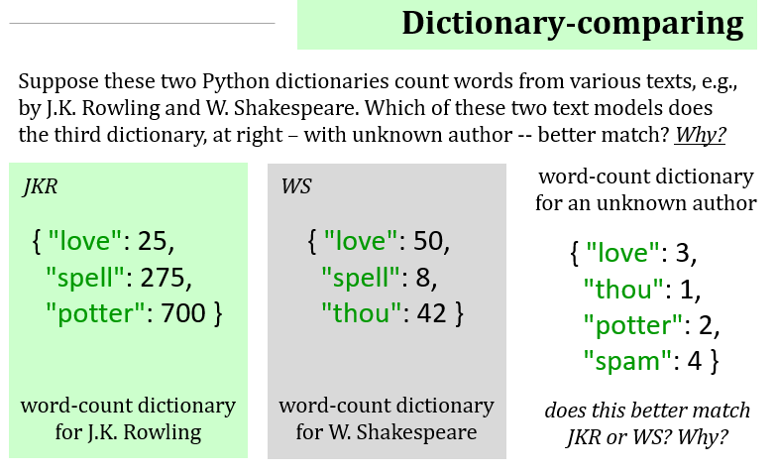
Quiz
Algorithmic Intuition...
Name(s) _________________________
Extra: what algorithm would you devise to quantify the two matches here?!?

Slide 36
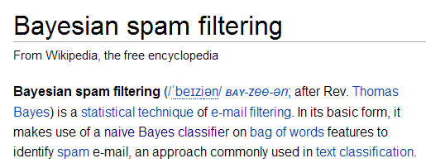
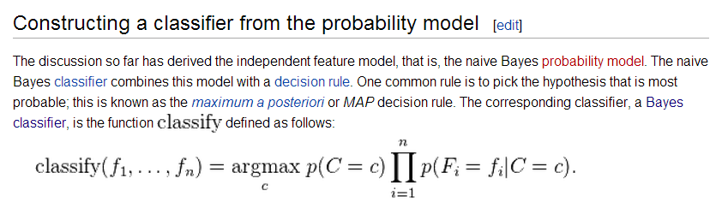
Naïve Bayes classification
Don't take these formulas too seriously…
what?!

Slide 37
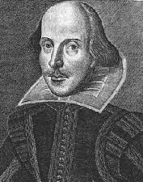
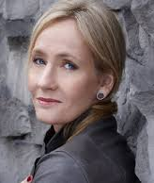
Model matching
Suppose we have two trained models:
WS: { "love": 50,
"spell": 8,
"thou": 42 }
JKR: { "love": 25,
"spell": 275,
"potter": 700 }
how do we handle different-sized texts?
Unknown text: { "love": 3,
"thou": 1,
"potter": 2,
"spam": 4 }
These must have been some really avant-garde texts!

Slide 38
Model matching
Suppose we have two trained models:
WS: { "love": 50,
"spell": 8,
"thou": 42 }
JKR: { "love": 25,
"spell": 275,
"potter": 700 }
normalize for size
WS: { "love": 0.50,
"spell": 0.08,
"thou": 0.42 }
JKR: { "love": 0.025,
"spell": 0.275,
"potter": 0.700 }
Unknown text: { "love": 3,
"thou": 1,
"potter": 2,
"spam": 4 }

Slide 39
Model matching
Suppose we have two normalized models:
WS: { "love": 0.50,
"spell": 0.08,
"thou": 0.42 }
JKR: { "love": 0.025,
"spell": 0.275,
"potter": 0.700 }
how do we compare the models with an unknown text?
What's the likelihood of the new model arising from each?
Unknown text: { "love": 3,
"thou": 1,
"potter": 2,
"spam": 4 }
Pretend the words are all independent
There's probably a way to do this!

Slide 40
Model matching
Suppose we have two normalized models:
WS: { "love": 0.50,
"spell": 0.08,
"thou": 0.42 }
JKR: { "love": 0.025,
"spell": 0.275,
"potter": 0.700 }
the WS-based probability of each word in Unknown text
=
.50
.50
.50
_?_
?
?
?
?
?
?
???
love
love
love
thou
potter
potter
spam
spam
spam
spam
0? 1?
Unknown text: { "love": 3, "potter": 2,
"thou": 1, "spam": 4 }
I've got near-zero ideas on this one!

Slide 41
Model matching
Suppose we have two normalized models:
WS: { "love": 0.50,
"spell": 0.08,
"thou": 0.42 }
JKR: { "love": 0.025,
"spell": 0.275,
"potter": 0.700 }
the WS-based probability of each word in Unknown text
correct, but not helpful!
=
.50
.50
.50
.42
0
0
0
0
0
0
0.0
love
love
love
thou
potter
potter
spam
spam
spam
spam
???
Unknown text: { "love": 3, "potter": 2,
"thou": 1, "spam": 4 }
I've got near-zero ideas on this one!

Slide 42
Model matching
Suppose we have two normalized models:
WS: { "love": 0.50,
"spell": 0.08,
"thou": 0.42 }
JKR: { "love": 0.025,
"spell": 0.275,
"potter": 0.700 }
the WS-based probability of each word in Unknown text
=
.50
.50
.50
.42
1
1
1
1
1
1
0.0525
love
love
love
thou
potter
potter
spam
spam
spam
spam
Why is this especially incorrect?
???
Unknown text: { "love": 3, "potter": 2,
"thou": 1, "spam": 4 }
I've got near-zero ideas on this one!

Slide 43
Model matching
Suppose we have two normalized models:
WS: { "love": 0.50,
"spell": 0.08,
"thou": 0.42 }
JKR: { "love": 0.025,
"spell": 0.275,
"potter": 0.700 }
the WS-based probability of each word in Unknown text
for missing words, use half the smallest value – across both normalized models!
=
.50
.50
.50
.42
.012
.012
.012
.012
.012
.012
1.57e-13
love
love
love
thou
potter
potter
spam
spam
spam
spam
What?
3
1
2
4
Unknown text: { "love": 3, "potter": 2,
"thou": 1, "spam": 4 }
half of ϵ !

Slide 44
Model matching
Suppose we have two normalized models:
WS: { "love": 0.50,
"spell": 0.08,
"thou": 0.42 }
JKR: { "love": 0.025,
"spell": 0.275,
"potter": 0.700 }
the WS-based probability of each word in Unknown text
for missing words, use half the smallest value – across both normalized models!
=
.50
.50
.50
.42
.012
.012
.012
.012
.012
.012
1.57e-13
love
love
love
thou
potter
potter
spam
spam
spam
spam
too small!
3
1
2
4
take logs of everything!
Unknown text: { "love": 3, "potter": 2,
"thou": 1, "spam": 4 }
half of ϵ !

Slide 45
Model matching
Suppose we have two normalized models:
WS: { "love": 0.50,
"spell": 0.08,
"thou": 0.42 }
JKR: { "love": 0.025,
"spell": 0.275,
"potter": 0.700 }
the WS-based probability of each word in Unknown text
for missing words, use half the smallest value – across both normalized models!
=
3*log(.50)
+ log(.42)
+ 2*log(.012)
+ 4*log(.012)
-29.48
love
love
love
thou
potter
potter
spam
spam
spam
spam
OK!
3
1
2
4
take logs of everything!
Unknown text: { "love": 3, "potter": 2,
"thou": 1, "spam": 4 }
half of ϵ !

Slide 46
Model matching
Suppose we have two normalized models:
WS: { "love": 0.50,
"spell": 0.08,
"thou": 0.42 }
JKR: { "love": 0.025,
"spell": 0.275,
"potter": 0.700 }
the WS-based probability of each word in Unknown text
=
3*log(.025)
+ log(.012)
+ 2*log(.7)
+ 4*log(.012)
-33.89
love
love
love
thou
potter
potter
spam
spam
spam
spam
3
1
2
4
Unknown text: { "love": 3, "potter": 2,
"thou": 1, "spam": 4 }
this looks close…

Slide 47
Model matching
Suppose we have two normalized models:
WS: { "love": 0.50,
"spell": 0.08,
"thou": 0.42 }
JKR: { "love": 0.025,
"spell": 0.275,
"potter": 0.700 }
Unknown text:
{ "love": 3, "potter": 2,
"thou": 1, "spam": 4 }
-29.48
-33.89
the (much) better match…

Slide 48
Naïve Bayes classification
Don't take these formulas too seriously…
done!

Slide 49
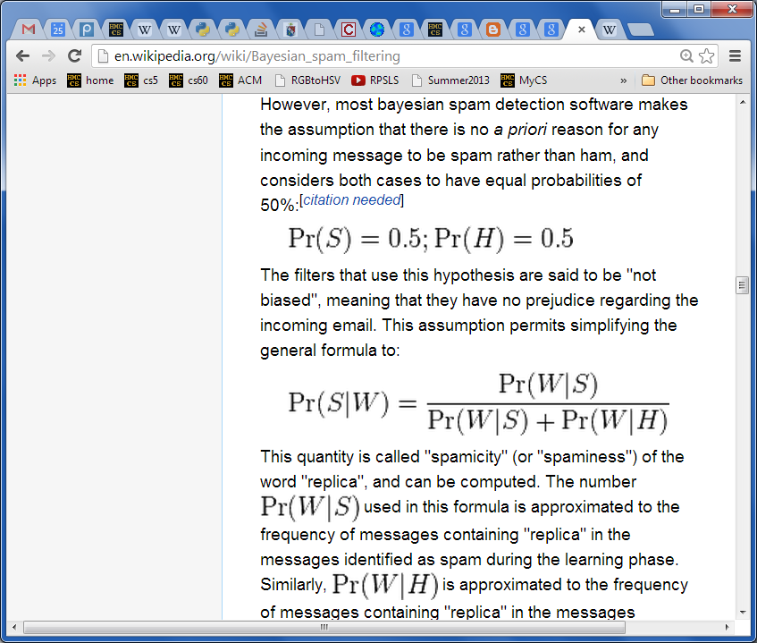
Naïve Bayes classification
Don't take these formulas too seriously…
done!

Slide 50
Project space…
algorithmic
Picobot!
C4
VPool
open-ended (and 3d!)
TextID
practical + checkable

Slide 51
The projects...
VPool
TextID
C4 AI
Not 3... but 4!
Picobot!

Slide 52
Python features, motivated by VPython…

Slide 53
Python features, motivated by VPython…
Tuples are similar to lists, but they're parenthesized:
T = (4,2)
x = (1,0,0)
example of a two-element tuple named T and a three-element tuple named x
not vectors!
examples of default and named inputs in a function definition
def f(x=3, y=17):
return 10*x + y

Slide 54
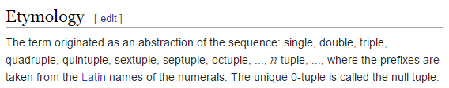
Python features, motivated by VPython…
Tuples are similar to lists, but they're parenthesized:
T = (4,2)
x = (1,0,0)
example of a two-element tuple named T and a three-element tuple named x
not vectors!
def f(x=3, y=17):
return 10*x + y
example of default inputs in a function definition

Slide 55
Tuples!
Lists that use parentheses are called tuples:
T = ( 4, 2 )
T
(4, 2)
T[0]
4
T[0] = 42
Error!
T = ('a',2,'z')
Tuples are immutable lists: you can't change their elements...
...but you can always redefine the whole variable, if you want!
+ Tuples are more memory + time efficient
+ Tuples can be dictionary keys: lists can't be
- But you can't change tuples' elements...

Slide 56
Tuple surprises…
Creating 0- and 1-tuples would seem like a problem!
A bug from last week's Board class:
W = 4 # for example
s = " ",
for col in range(W):
s += str(col), " "
trying for
" 0 1 2 3 "
yields a surprising result for s
Notes:
without the first comma, it's an error

Slide 57
Tuple surprises…
Creating 0- and 1-tuples would seem like a problem!
A bug from last week's Board class:
W = 4 # for example
s = " ",
for col in range(W):
s += str(col), " "
yields a surprising result for s
(' ', '0', ' ', '1', ' ', '2', ' ', '3', ' ')
starting value
Notes:
without the first comma, it's an error

Slide 58
Default – and named – inputs!
Functions can have default input values and can take named inputs
def f(x=3, y=17):
return 10*x + y
example of default input values for x and y
f(x=4,y=2)
example of named input values for x and y
Function inputs look like tuples, but they're not quite the same…

Slide 59
Default – and named – inputs!
Functions can have default input values and can take named inputs
def f(x=3, y=17):
return 10*x + y
example of an ordinary function call – totally OK
f(4,2)
example of default inputs
f()
example using only one default input
f(1)
example of a named input
f(y=1)

Slide 60
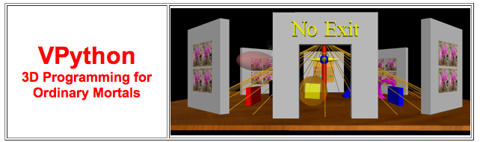
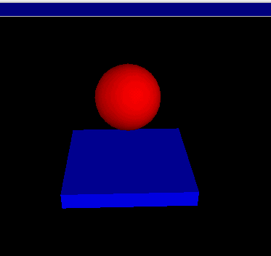
VPython ~ GlowScript!
www.glowscript.org/
Where were we... ?
stonehenge.py
built by and for physicists to simplify 3d simulations
bounce.py
lots of available classes, objects and methods in its API

Slide 61
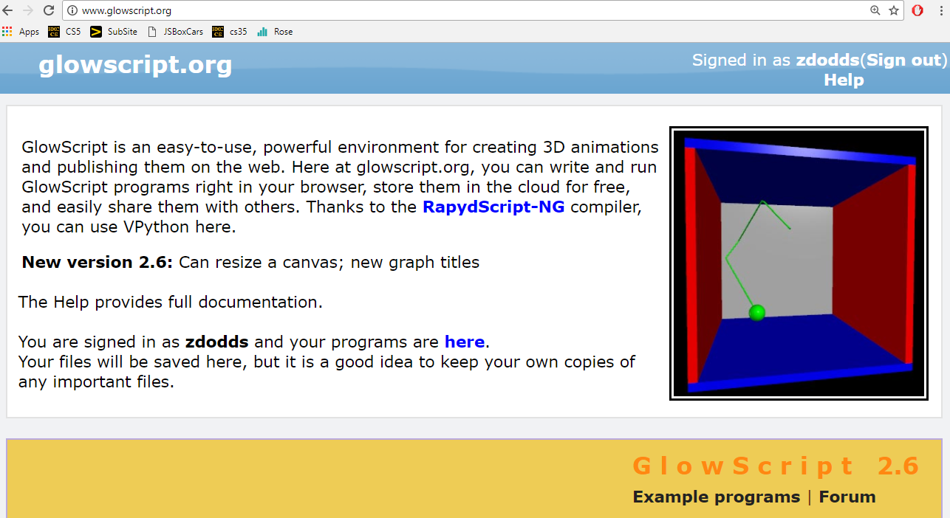
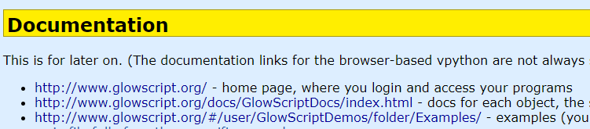
Using GlowScript / vPython...
examples...
documentation…

Slide 62
API
... stands for Application Programming Interface
a programming description of how to use a software library
A demo of vPython's API:
What's box?
What's color?
What's vector?
Getting used to everything!
# the simplest possible vpython program:
box( color = vector(1, 0.5, 0) )
# try changing the color: the components are
# red, green, blue each from 0.0 to 1.0
# then, add a second parameter: size=vector(2.0,1.0,0.1)
# the order of those three #s: Length, Height, Width
# then, a third parameter: axis=vector(2,5,1)
# the order of those three #s: x, y, z
I'm hAPI about APIs!
vPython example API call(s)

Slide 63
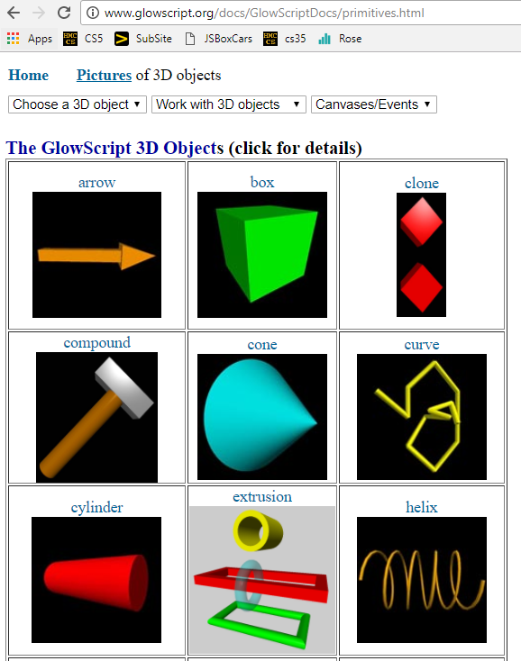
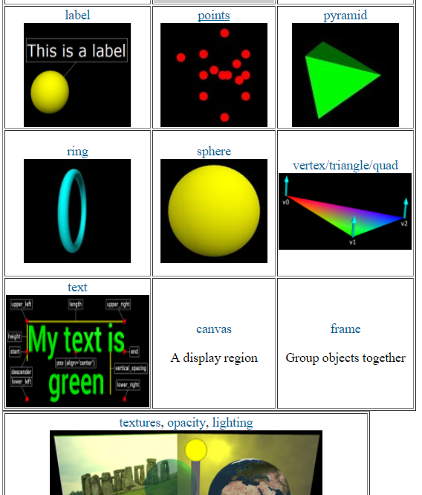
API
... stands for Application Programming Interface
constructors + methods!
shapes + docs!
cool stuff...

Slide 64
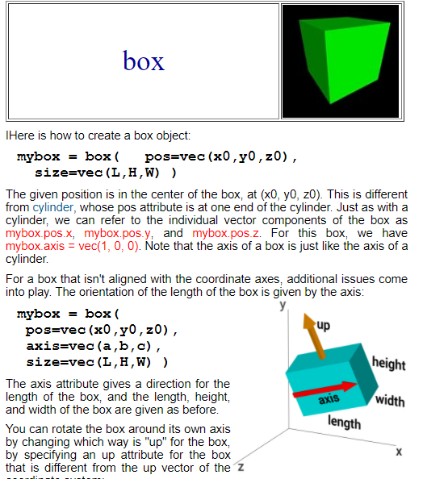
API
... stands for Application Programming Interface
constructor + default arguments; data!

Slide 65
vectors
b.pos, b.vel,… are vectors
b.vel = vector(1,0,0)
vel.z
named components
vel.y
vel.x
b.pos = vector(0,0,0)
scalar multiplication
b.pos = b.pos + b.vel*0.2
component-by-component addition
let's compare with tuples…

Slide 66
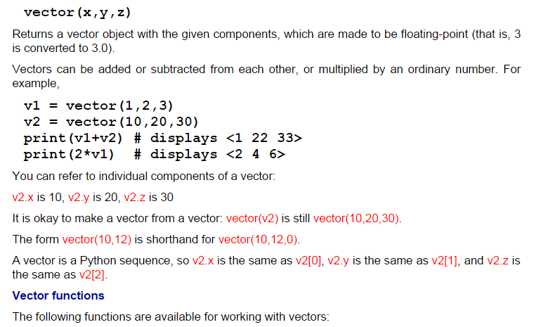
vectors
act like "arrows"
www.glowscript.org/docs/GlowScriptDocs/vector.html

Slide 67
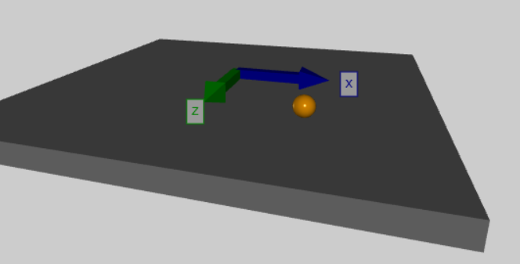
vectors
act like "arrows"
but arrows are arrows!
# if the ball ventures too far, restart with random velocity
if mag(ball.pos - origin) > 10.0: # mag finds magnitude of a vector
ball.pos = vector(0,0,0) # reset the ball.pos (position)
ball.vel = 4.2*vector.random() # set a random velocity
ball.vel.y = 0.0 # with no y component (no vertical)
print("velocity is now:", ball.vel)

Slide 68
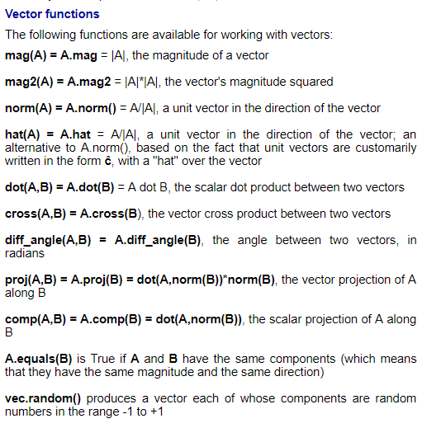
vectors!
lots of support… (don't write your own)

Slide 69
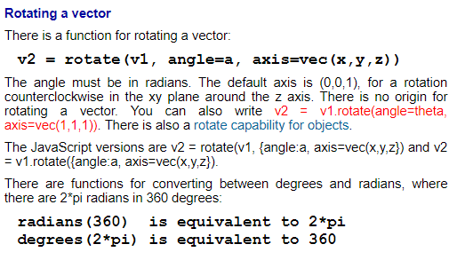
www.glowscript.org/docs/GlowScriptDocs/index.html
Documentation!

Slide 70

vPython!
(1) How many vPython classes/constructors are here? _____
(2) How many named inputs are here? _________________
(3) Tricky! How many vPython objects are here? ________
(4) What line of code handles collisions ?
(5) How does physics work? Where is it?
Look over this VPython program to determine
floor = box(length=4, width=4, height=0.5, color=vector(0,0,1))
ball = sphere(pos=vector(0,4.2,0), radius=1, color=vector(1,0,0))
ball.vel = vector(0,-1,0) # this is the velocity
RATE = 30
dt = 1.0/RATE
while True:
rate(RATE)
ball.pos += ball.vel*dt
if ball.pos.y < ball.radius:
ball.vel.y *= -1.0
else:
ball.vel.y += -9.8*dt
Let's run it first...
what is this += doing?
what is this if/else doing?

Slide 71
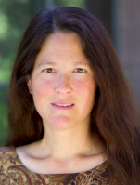

vPython!
(1) How many vPython classes/constructors are here? _____
(2) How many named inputs are here? _________________
(3) Tricky! How many vPython objects are here? ________
(4) What line of code handles collisions ?
(5) How does physics work? Where is it?
Look over this VPython program to determine
Physics is here, now.
floor = box(length=4, width=4, height=0.5, color=vector(0,0,1))
ball = sphere(pos=vector(0,4.2,0), radius=1, color=vector(1,0,0))
ball.vel = vector(0,-1,0) # this is the velocity
RATE = 30
dt = 1.0/RATE
while True:
rate(RATE)
ball.pos += ball.vel*dt
if ball.pos.y < ball.radius:
ball.vel.y *= -1.0
else:
ball.vel.y += -9.8*dt
what is this += doing?
what is this if/else doing?

Slide 72
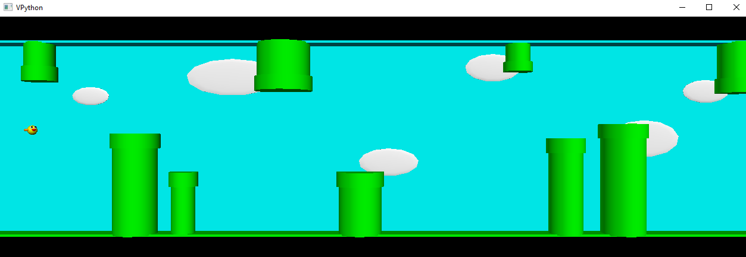
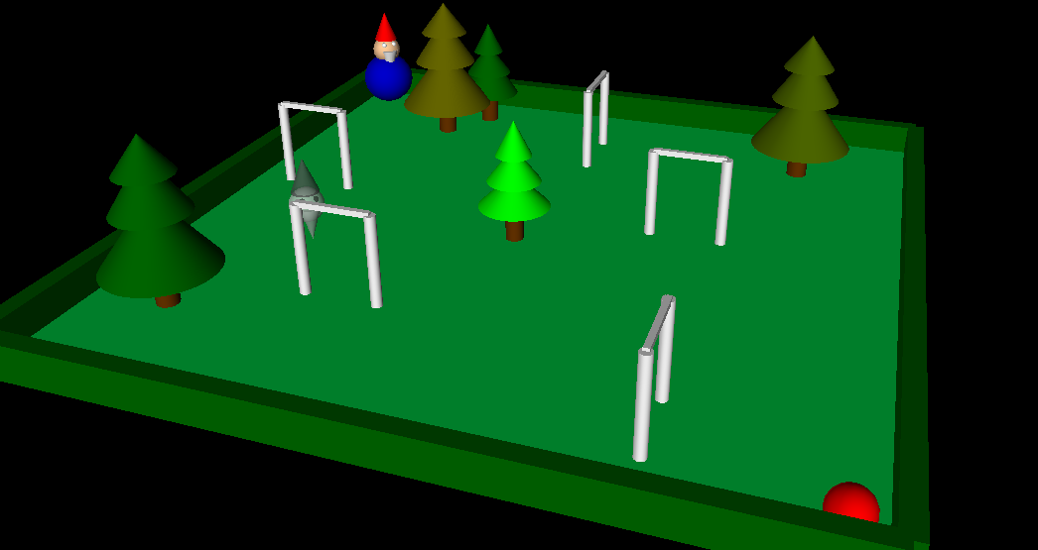
Example vProjects...
[3] bella lee
[6] mforssen
[4] lisa lam
shu!

Slide 73
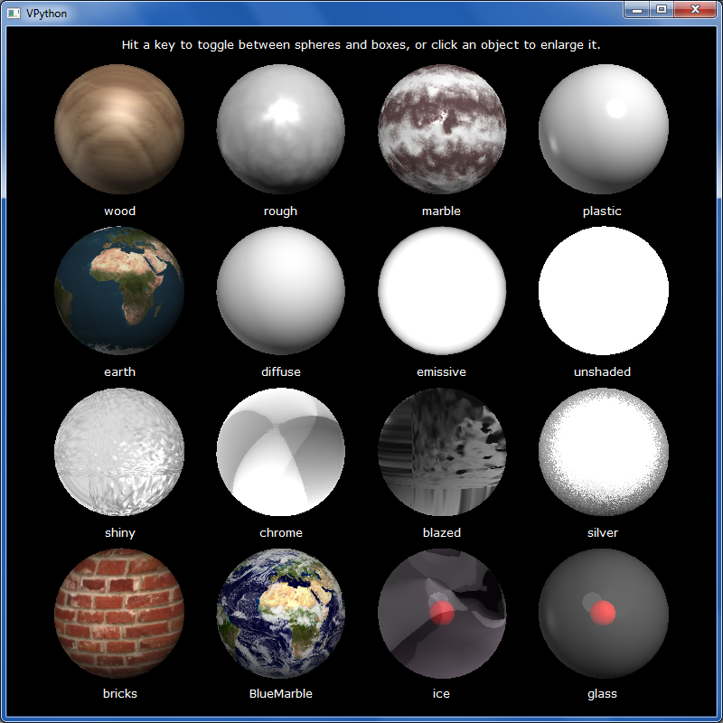
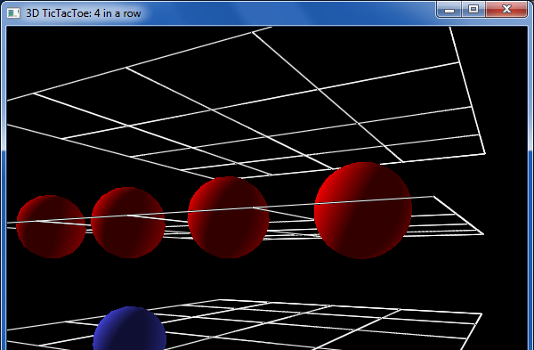
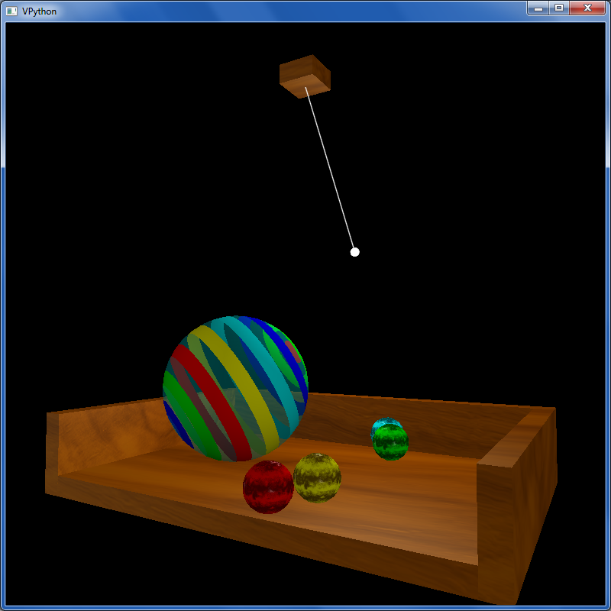
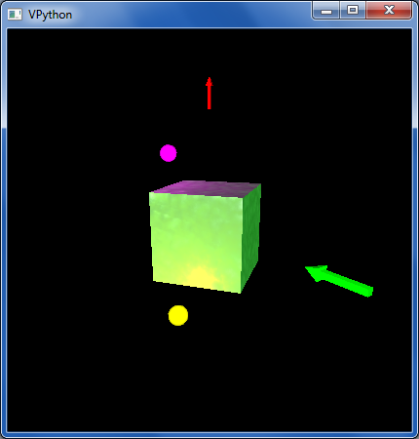
other VPython examples
tictac.py – a 3d game of tic-tac-toe
material_test.py – lots of materials
texture_and_lighting.py – fancier textures, opacity and a pendulum example
boxlighttest.py – very short + simple rotation and lighting example

Slide 74
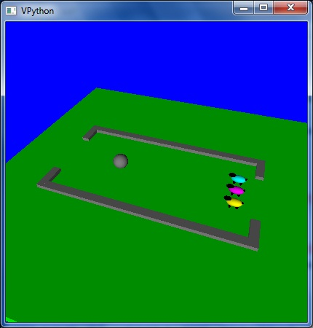
Enjoy the projects!
An unusual variation on VPool
… the graders certainly do!

Slide 75
Enjoy the projects!
Have a wonderful Thanksgiving break!
An unusual variation on VPool
… as relaxing as you want it to be!

Slide 76
The projects...
VPool
TextID
C4 AI
Picobot!

Slide 77
The projects...
VPool
TextID
C4 AI
Picobot!

Slide 78
Connect Four ...
Create an N-ply lookahead
Allow computer vs. computer and computer vs. human games of any difficulty...
Extend the game in some way:
(1) Change the rules!
(2) Graphics
Gravity
2d or 3d
Randomness
or, even, web...
WildCards
Tetris
(3) Tourney!

Slide 79
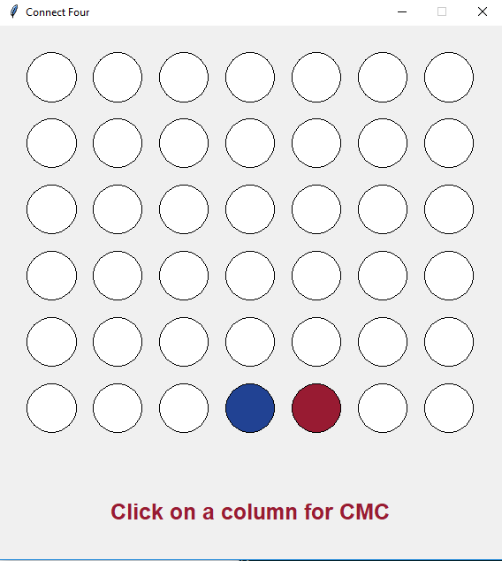
Creative connect fours...
5C C4?!

Slide 80
The projects...
VPool
TextID
C4 AI
Not 3... but 4!
Picobot!

Slide 81
3d graphics-based game using VPython
Physics engine...
I'll take your cue...
Let's play!
… it's not really very constrained at all!
A few constraints…
need ≥4 physically interacting objects
allow the user to direct 1+ objects, either by keyboard or mouse or both
needs a game goal + be winnable!
must detect some "linear" and some "spherical" collisions and implement their results on the motion of the objects

Slide 82
The vPool project
VPython was designed to make 3d physics simulations simpler to program – as a result, the library itself is physics-free!
⇒ Phunky Physics is welcome!
sounds like all physics to me!
Linear collisions should be somewhere ("walls")
Spherical collisions should be somewhere ("points")
You need "pockets" – or some other game objective
You need user control of at least one object (mouse/kbd)

Slide 83
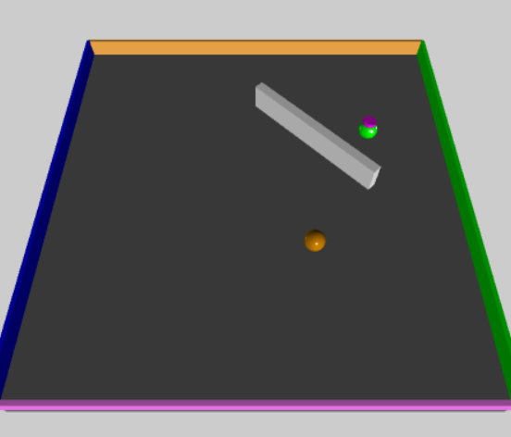
vPython: Linear + Spherical collisions...
At least some of the game needs to be about detecting collisions and changing velocities
x = 10
+x
Line ~ wall at x=10
How to bounce?
What else to do?

Slide 84
Spherical collisions
r.vel
0 Zeroth approximation:
Stop q. Undo any overlap.
Make r.vel = q.vel.
r
1 First approximation:
q
Stop q. Undo any overlap.
Compute d = r.pos – q.pos
Make r.vel = d
q.vel
2 Second approximation:
Same as first, but
Make q.vel = d ⊥ , at 90° from d
Reality is just three eyes away!

Slide 85
Spherical collisions
0 Zeroth approximation:
r.vel
Stop q. Undo any overlap.
Make r.vel = q.vel.
d
r
1 First approximation:
q
Stop q. Undo any overlap.
Compute d = r.pos – q.pos
Make r.vel = d
q.vel
2 Second approximation:
Same as first, but
Make q.vel = d ⊥ , at 90° from d
Reality is just two eyes away!

Slide 86
Spherical collisions
0 Zeroth approximation:
r.vel
new q.vel
Stop q. Undo any overlap.
Make r.vel = q.vel.
d⊥
d
r
1 First approximation:
q
Stop q. Undo any overlap.
Compute d = r.pos – q.pos
Make r.vel = d
old q.vel
2 Second approximation:
Same as first, but
Make q.vel = d ⊥ , at 90° from d
Reality is just one eye away!

Slide 87

vPool – physics?
http://en.wikipedia.org/wiki/Elastic_collision

Slide 88
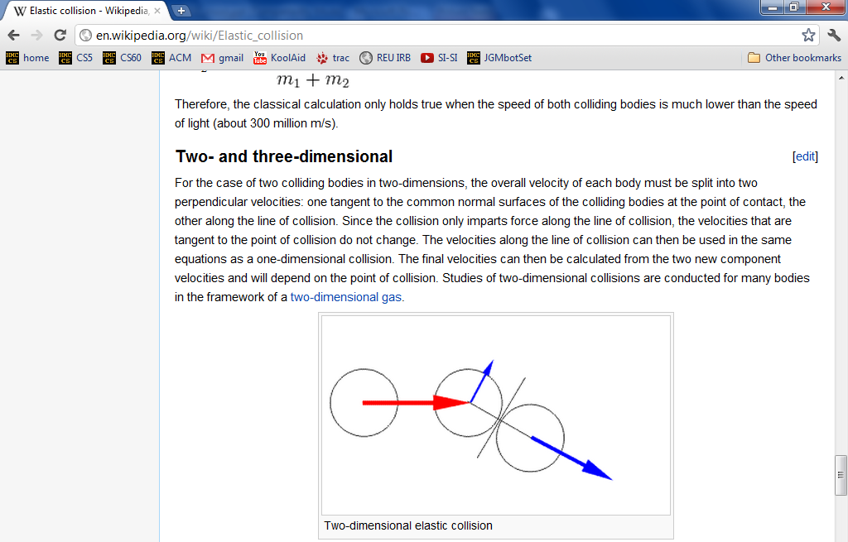
vPool – physics?
http://en.wikipedia.org/wiki/Elastic_collision
equations below...

Slide 89
Example vProjects...
lbrady, august t-y, [16] pking, [16] aserbent, [16] nami

Slide 90
The projects...
VPool
TextID
C4 AI
Picobot!

Slide 91
The Picobot project
Big idea
(1) Implement Picobot in Python
(2) Train Python to write successful Picobot programs!
talk about going full circle...

Slide 92
Picobot, behind the curtain...
What data structures (classes) might be helpful in implementing Picobot?

Slide 93
Picobot's classes
0 xxxx -> N 0
0 Nxxx -> W 0
0 NxWx -> S 0
0 xxWx -> S 0
0 xxWS -> E 0
0 xxxS -> E 0
0 xExS -> N 0
0 xExx -> N 0
0 NExx -> S 1
1 xxxx -> S 1
1 Nxxx -> E 1
1 NxWx -> E 1
1 xxWx -> N 1
1 xxWS -> N 1
1 xxxS -> W 1
1 xExS -> W 1
1 xExx -> S 1
1 NExx -> W 0
class Program:
What in Python could most usefully hold all of these rules?
What type should self.rules be?

Slide 94
Picobot's classes
0 xxxx -> N 0
0 Nxxx -> W 0
0 NxWx -> S 0
0 xxWx -> S 0
0 xxWS -> E 0
0 xxxS -> E 0
0 xExS -> N 0
0 xExx -> N 0
0 NExx -> S 1
1 xxxx -> S 1
1 Nxxx -> E 1
1 NxWx -> E 1
1 xxWx -> N 1
1 xxWS -> N 1
1 xxxS -> W 1
1 xExS -> W 1
1 xExx -> S 1
1 NExx -> W 0
class Program:
What in Python could most usefully hold all of these rules?
What type should self.rules be?
both tuples
Python dictionary
key
value
self.rules[ (1,"NExx") ] = ("W",0)

Slide 95
Picobot's classes
+++++++++++++++++++++++++
+oooooPooooooooooooooooo+
+o o o+
+o o o+
+o o o+
+o o o+
+o o o+
+o o o+
+o o o+
+o o o+
+o o+
+o o+
+o o+
+o o+
+o o+
+o o+
+o o+
+o o+
+o o+
+o o+
+o o+
+o o+
+o o+
+ooooooooooooooooooooooo+
+++++++++++++++++++++++++
What type in Python could most usefully hold the environment?
class World:
What class that you've already written will be most similar to Picobot's World?
Wall:
+
What will self.room be?
o
Visited:
Picobot:
P

Slide 96
Picobot's classes
+++++++++++++++++++++++++
+oooooPooooooooooooooooo+
+o o o+
+o o o+
+o o o+
+o o o+
+o o o+
+o o o+
+o o o+
+o o o+
+o o+
+o o+
+o o+
+o o+
+o o+
+o o+
+o o+
+o o+
+o o+
+o o+
+o o+
+o o+
+o o+
+ooooooooooooooooooooooo+
+++++++++++++++++++++++++
What type in Python could most usefully hold the environment?
class World:
class Board
What class that you've already written will be most similar to Picobot's World?
Wall:
+
What will self.room be?
o
Visited:
The same as the Connect-Four board's self.data!
P
Picobot:
a list-of-lists-of-one-character-strings….

Slide 97
Picobot's project
First, build an ASCII simulation
demo!
Current State: 1
Current Rule: 1 N*W* -> X 2
++++++++++
+o++o+o+++
+oooooo ++
++++o++ +
+oooo+++++
++++o +
+oooo+++ +
++++o+++++
+Pooo +
++++++++++
Picobot started here…
and is now here…
Your actual ASCII is likely to be more monochromatic!
http://rednuht.org/genetic_cars_2/ or http://boxcar2d.com/
Box2d: https://www.youtube.com/watch?v=uxourrlPlf8

Slide 98
Picobot's project
First, build an ASCII simulation
demo!
Current State: 1
Current Rule: 1 N*W* -> X 2
++++++++++
+o++o+o+++
+oooooo ++
++++o++ +
+oooo+++++
++++o +
+oooo+++ +
++++o+++++
+Pooo +
++++++++++
then, evolve it…
Picobot started here…
with your own genetic algorithm
and is now here…
Your actual ASCII is likely to be more monochromatic!
http://rednuht.org/genetic_cars_2/ or http://boxcar2d.com/
Box2d: https://www.youtube.com/watch?v=uxourrlPlf8

Slide 99
Program evolution
An example of genetic algorithms, which are used for optimizing hard-to-describe functions with easily-splittable solutions.
program p1
program p2
Start with a population of, say, ~200 random Picobot programs…

Slide 100
Program evolution
An example of genetic algorithms, which are used for optimizing hard-to-describe functions with easily-splittable solutions.
program p1
fitness = 0.03
program p2
fitness = 0.05
Then, measure the fitness of all of those programs
Measure? How??

Slide 101
program p1
fitness = 0.03
program p2
fitness = 0.05
mate + mutate the fittest rulesets
to create a new generation of ~200 programs…
program c1
fitness = 0.19
What the goal?

Slide 102
Repeat this "survival of the fittest" process for many generations…
… and by the end, your Python code should/will have evolved a much more capable Picobot program!
Solving hw0!
fitness = 0.90

Slide 103
Genetic Algorithms ~ the 3rd way?!
the current "fitness" leader
fitnesses!
the current "generation"
Rafael Matsunaga: rednuht.org/

Slide 104
The projects...
VPool
TextID
C4 AI
Picobot!

Slide 105
Example vProjects...
[3] bella lee
[6] mforssen
[4] lisa lam
shu!

Slide 106
What CSers "do"
^
think they
or think as much...
final project algorithms...

Slide 107
Quiz
Algorithmic Intuition...
Name(s) _________________________
Extra: what algorithm would you devise to quantify the two matches here?!?

Slide 108
A couple of years ago...
Though Robin Ellacott’s twenty-five years of life had seen their moments of drama and incident, she had never before woken up in the certain knowledge that she would remember the coming day for as long as she lived.
April 4, 2013
First paragraph of The Cuckoo's Calling by R. Galbraith

Slide 109
the TextID IDer...
Though Robin Ellacott’s twenty-five years of life had seen their moments of drama and incident, she had never before woken up in the certain knowledge that she would remember the coming day for as long as she lived.
April 4, 2013
First paragraph of The Cuckoo's Calling by R. Galbraith

Slide 110
kottke.org/13/08/how-jk-rowling-was-found-to-be-robert-galbraith

Slide 111
the TextID project
Big idea:
(1) Build models of bodies of text…
(2) Use a similarity score to measure Rowlingness
vs.
Shakepearity
NYTimes-iness
vs.
WSJournalicity
Big Bang Theory
Modern Family
vs.
or, even better: your own choice of two or more comparisons…

Slide 112
TextID's model…
This looks familiar...
(0) Get text from file…
(1) Split up the text into words (first pass)
(2) Model punctuation marks (optional)
(3) Model sentence lengths (using '.!?')
(4) Take a breather...
(5) Clean up the words (second pass)
(6) Model words and word lengths
(7) Stem words and model those stems
(8) You're ready to score against your model!
text with punctuation preserved
text with punctuation removed

Slide 113
I like poptarts and 42 and spam. Spamful poptarts are like poptartful spams -- and are liked by all!
Will _Thanksgiving_ bring spam poptarts?
File
class TextModel
... contains at least five Python dictionaries, e.g.,
count of each word
{'and': 3, 'poptartful': 1, 'liked': 1, 'spamful': 1, 'like': 2, '': 1, 'spam': 2, 'i': 1, '42': 1, 'all': 1, 'thanksgiving': 1, 'will': 1, 'bring': 1, 'poptarts': 3, 'spams': 1, 'by': 1, 'are': 2}
{0: 1, 1: 1, 2: 2, 3: 6, 4: 5, 5: 3, 7: 1, 8: 3, 10: 1, 12: 1}
{'and': 3, '': 1, 'all': 1, 'like': 3, 'thanksgiv': 1, 'spam': 4, 'i': 1, '42': 1, 'by': 1, 'will': 1, 'bring': 1, 'ar': 2, 'poptart': 4}
{12: 1, 5: 1, 7: 1}
{'!': 1, '-': 2, '?': 1, '_': 2, '.': 1}
???
???
???
What are these four other dictionaries counting?!
???

Slide 114
I like poptarts and 42 and spam. Spamful poptarts are like poptartful spams -- and are liked by all!
Will _Thanksgiving_ bring spam poptarts?
File
class TextModel
... contains at least five Python dictionaries, e.g.,
count of each word
{'and': 3, 'poptartful': 1, 'liked': 1, 'spamful': 1, 'like': 2, '': 1, 'spam': 2, 'i': 1, '42': 1, 'all': 1, 'thanksgiving': 1, 'will': 1, 'bring': 1, 'poptarts': 3, 'spams': 1, 'by': 1, 'are': 2}
{0: 1, 1: 1, 2: 2, 3: 6, 4: 5, 5: 3, 7: 1, 8: 3, 10: 1, 12: 1}
{'and': 3, '': 1, 'all': 1, 'like': 3, 'thanksgiv': 1, 'spam': 4, 'i': 1, '42': 1, 'by': 1, 'will': 1, 'bring': 1, 'ar': 2, 'poptart': 4}
{12: 1, 5: 1, 7: 1}
{'!': 1, '-': 2, '?': 1, '_': 2, '.': 1}
word lengths
stems
sentence lengths
punct
What are these four other dictionaries counting?!

Slide 115
Quiz
Try this on the back page first...
Algorithmic Intuition...
Extra: what algorithm would you devise to quantify the two matches here?!?

Slide 116
Naïve Bayes classification
Don't take these formulas too seriously…
what?!

Slide 117
Model matching
Suppose we have two trained models:
WS: { "love": 50,
"spell": 8,
"thou": 42 }
JKR: { "love": 25,
"spell": 275,
"potter": 700 }
how do we handle different-sized texts?
Unknown text: { "love": 3,
"thou": 1,
"potter": 2,
"spam": 4 }
These must have been some really avant-garde texts!

Slide 118
Model matching
Suppose we have two trained models:
WS: { "love": 50,
"spell": 8,
"thou": 42 }
JKR: { "love": 25,
"spell": 275,
"potter": 700 }
normalize for size
WS: { "love": 0.50,
"spell": 0.08,
"thou": 0.42 }
JKR: { "love": 0.025,
"spell": 0.275,
"potter": 0.700 }
Unknown text: { "love": 3,
"thou": 1,
"potter": 2,
"spam": 4 }

Slide 119
Model matching
Suppose we have two normalized models:
WS: { "love": 0.50,
"spell": 0.08,
"thou": 0.42 }
JKR: { "love": 0.025,
"spell": 0.275,
"potter": 0.700 }
how do we compare the models with an unknown text?
What's the likelihood of the new model arising from each?
Unknown text: { "love": 3,
"thou": 1,
"potter": 2,
"spam": 4 }
Pretend the words are all independent
There's probably a way to do this!

Slide 120
Model matching
Suppose we have two normalized models:
WS: { "love": 0.50,
"spell": 0.08,
"thou": 0.42 }
JKR: { "love": 0.025,
"spell": 0.275,
"potter": 0.700 }
the WS-based probability of each word in Unknown text
=
.50
.50
.50
_?_
?
?
?
?
?
?
???
love
love
love
thou
potter
potter
spam
spam
spam
spam
0? 1?
Unknown text: { "love": 3, "potter": 2,
"thou": 1, "spam": 4 }
I've got near-zero ideas on this one!

Slide 121
Model matching
Suppose we have two normalized models:
WS: { "love": 0.50,
"spell": 0.08,
"thou": 0.42 }
JKR: { "love": 0.025,
"spell": 0.275,
"potter": 0.700 }
the WS-based probability of each word in Unknown text
correct, but not helpful!
=
.50
.50
.50
.42
0
0
0
0
0
0
0.0
love
love
love
thou
potter
potter
spam
spam
spam
spam
???
Unknown text: { "love": 3, "potter": 2,
"thou": 1, "spam": 4 }
I've got near-zero ideas on this one!

Slide 122
Model matching
Suppose we have two normalized models:
WS: { "love": 0.50,
"spell": 0.08,
"thou": 0.42 }
JKR: { "love": 0.025,
"spell": 0.275,
"potter": 0.700 }
the WS-based probability of each word in Unknown text
=
.50
.50
.50
.42
1
1
1
1
1
1
0.0525
love
love
love
thou
potter
potter
spam
spam
spam
spam
Why is this especially incorrect?
???
Unknown text: { "love": 3, "potter": 2,
"thou": 1, "spam": 4 }
I've got near-zero ideas on this one!

Slide 123
Model matching
Suppose we have two normalized models:
WS: { "love": 0.50,
"spell": 0.08,
"thou": 0.42 }
JKR: { "love": 0.025,
"spell": 0.275,
"potter": 0.700 }
the WS-based probability of each word in Unknown text
for missing words, use half the smallest value – across both normalized models!
=
.50
.50
.50
.42
.012
.012
.012
.012
.012
.012
1.57e-13
love
love
love
thou
potter
potter
spam
spam
spam
spam
What?
3
1
2
4
Unknown text: { "love": 3, "potter": 2,
"thou": 1, "spam": 4 }
half of ϵ !

Slide 124
Model matching
Suppose we have two normalized models:
WS: { "love": 0.50,
"spell": 0.08,
"thou": 0.42 }
JKR: { "love": 0.025,
"spell": 0.275,
"potter": 0.700 }
the WS-based probability of each word in Unknown text
for missing words, use half the smallest value – across both normalized models!
=
.50
.50
.50
.42
.012
.012
.012
.012
.012
.012
1.57e-13
love
love
love
thou
potter
potter
spam
spam
spam
spam
too small!
3
1
2
4
take logs of everything!
Unknown text: { "love": 3, "potter": 2,
"thou": 1, "spam": 4 }
half of ϵ !

Slide 125
Model matching
Suppose we have two normalized models:
WS: { "love": 0.50,
"spell": 0.08,
"thou": 0.42 }
JKR: { "love": 0.025,
"spell": 0.275,
"potter": 0.700 }
the WS-based probability of each word in Unknown text
for missing words, use half the smallest value – across both normalized models!
=
3*log(.50)
+ log(.42)
+ 2*log(.012)
+ 4*log(.012)
-29.48
love
love
love
thou
potter
potter
spam
spam
spam
spam
OK!
3
1
2
4
take logs of everything!
Unknown text: { "love": 3, "potter": 2,
"thou": 1, "spam": 4 }
half of ϵ !

Slide 126
Model matching
Suppose we have two normalized models:
WS: { "love": 0.50,
"spell": 0.08,
"thou": 0.42 }
JKR: { "love": 0.025,
"spell": 0.275,
"potter": 0.700 }
the WS-based probability of each word in Unknown text
=
3*log(.025)
+ log(.012)
+ 2*log(.7)
+ 4*log(.012)
-33.89
love
love
love
thou
potter
potter
spam
spam
spam
spam
3
1
2
4
Unknown text: { "love": 3, "potter": 2,
"thou": 1, "spam": 4 }
this looks close…

Slide 127
Model matching
Suppose we have two normalized models:
WS: { "love": 0.50,
"spell": 0.08,
"thou": 0.42 }
JKR: { "love": 0.025,
"spell": 0.275,
"potter": 0.700 }
Unknown text:
{ "love": 3, "potter": 2,
"thou": 1, "spam": 4 }
-29.48
-33.89
the (much) better match…

Slide 128
Naïve Bayes classification
Don't take these formulas too seriously…
done!

Slide 129
Naïve Bayes classification
Don't take these formulas too seriously…
done!

Slide 130
Project space…
algorithmic
Picobot!
C4
VPool
open-ended (and 3d!)
TextID
practical + checkable

Slide 131
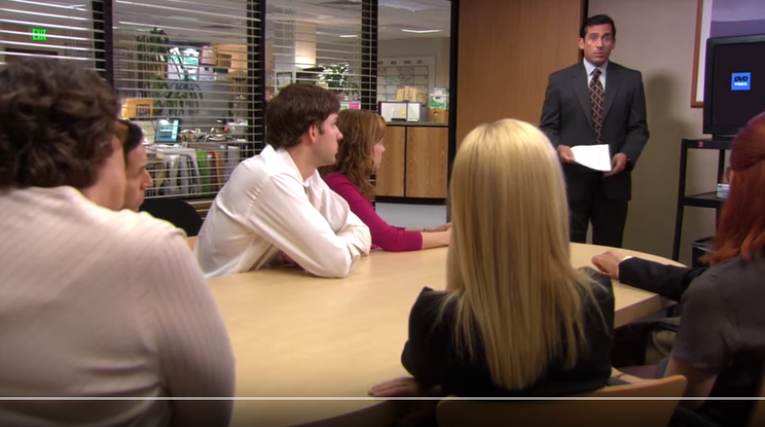
Enjoy the projects!
https://www.youtube.com/watch?v=QOtuX0jL85Y
Inspiration can come from almost anywhere...

Slide 132



… the graders certainly do!
Enjoy the projects!
Have a relaxing long weekend!
Not sure what to do with all that free time over Thanksgiving break?

Slide 134
The projects...
VPool
TextID
C4 AI
Picobot!

Slide 135

Dec. in CS 5
(0,0,0)
(110,102,0)
(220,205,0)
Tue., 12/8 – hw12 + milestone due
Fri., 12/11 – 8pm: final proj. due
final project
Tue., 12/15 7 pm – review
Wed., 12/16 7 pm – final
Thu., 12/17 7 pm – final
Either exam's OK: you choose…
final exam
CS 5 black final exam 12/17 @ 9am

Slide 136

Dec. in CS 5
(0,0,0)
(110,102,0)
(220,205,0)
Tue., 12/8 – hw12 + milestone due
Fri., 12/11 – 8pm: final proj. due
final project
Tue., 12/15 7 pm – review
Wed., 12/16 7 pm – final
Thu., 12/17 7 pm – final
Either exam's OK: you choose…
final exam
CS 5 black final exam 12/17 @ 9am

Slide 137

Connect Four continues…

Slide 138
Connect Four extra credit…

Slide 139

Aargh!

Slide 140

Aargh!

Slide 141

Give C4 a try… !
Looking for a game… ?
http://crisco.seas.harvard.edu/projects/C4.html

Slide 142
Connect-4 tiebreaking…
scoreBoard would give each of these 50.0
but which board is really better for black?
Ex. Cr.: write a scoreBoard4Tourney f'n.
taken beyond the extreme…

Slide 143
Quiz: better scoring!
Name(s): __________________________
scoreBoard would give both of these 50.0 for 'X' and 'O'
for 'X':
for 'X':
for 'O':
for 'O':
What values might a better scorer give to each board - for black and for red? Which side would get a higher score?

Slide 144

What's due?
Tue. 12/8
Fri. 12/11
The "milestone"
The "final" @ 8:00pm
project-specific tasks ~ ensuring that everyone has started!
(we can't grade these in time)
A zip file with everything needed to run your final project and a .txt file describing how to do so!
Nice milestone!
It's a kilometer stone, actually!

Slide 145
Stemming!
getting to the root of the problem…
def stem( w ):
Name(s): ______________________________
Find an English exception to each of these stemming patterns:
stem('parties')
'parti'
ends in ies
stem('party')
'parti'
ends in cons + y
stem('love')
'lov'
ends in vow + cons + e
stem('loving')
'lov'
ends in vow + cons + ing
stem('quickly')
'quick'
ends in ly
stem('quickest')
'quick'
ends in est
stem('stems')
'stem'
ends in s
stem('stemming')
'stem'
ends in vow + 2*cons + ing
stem(__________)
_______
create your own stemming rule

Slide 146

After Deep Blue…

Slide 147




In reality?
Xiaoyu Y.'s C4 game…
Humans adapt!

Slide 148
TextID model
class TextModel
Surely you're joking, Mr. Feynman! Aren't poptarts and spam always quantum-entangled? Dr. G. Kuenning jokes that spam poptarts don't exist. That's no joke!
file w/text:
algorithmic building blocks
{'and': 1, 'no': 1, 'jokes': 1, 'quantumentangled': 1, 'joking': 1, 'spam': 2, 'always': 1, 'youre': 1, 'g': 1, 'joke': 1, 'thats': 1, 'feynman': 1, 'that': 1, 'surely': 1, 'arent': 1, 'mr': 1, 'dont': 1, 'exist': 1, 'kuenning': 1, 'dr': 1, 'poptarts': 2}
{1: 1, 2: 3, 3: 1, 4: 5, 5: 5, 6: 3, 7: 1, 8: 3, 16: 1}
{'and': 1, 'alwai': 1, 'sure': 1, 'quantumentangl': 1, 'dont': 1, 'g': 1, 'spam': 2, 'joke': 3, 'that': 2, 'poptart': 2, 'feynman': 1, 'kuen': 1, 'arent': 1, 'mr': 1, 'no': 1, 'exist': 1, 'dr': 1, 'your': 1}
{9: 1, 3: 1, 5: 1, 6: 1}
{'!': 2, "'": 4, '-': 1, ',': 1, '.': 4, '?': 1}
the model!
at least 5 Python dictionaries…
here are the five for the above "Feynman" file:

Slide 149


TextID's building blocks… ?
I don't see a difference!

Slide 150
Model matching
Suppose we have two dictionaries:
WS: { "love": 50,
"spell": 8,
"thou": 42 }
JKR: { "love": 25,
"spell": 275,
"potter": 700 }
"potter" is not here.
"thou" is not here.
New: { "love": 3, "thou": 1,
"potter": 2, "spam": 4 }
How could we give a match score for this New dictionary against each one above?

Slide 151
Stemming
getting to the root of the problem…
Name(s): ____________________
def stem( w ):
thought experiments…
if w[-3:] == 'ies':
return w[:-2]
This works for
parties -> parti
it fails for
elif w[-3:] == 'ing' and \
w[-4:-3] == w[-5:-4]:
return w[:-4]
What's this doing?
What's an example where it works?
What's an example where it fails?
elif
Write a rule to handle plurals ...
(1) What is a case where it will fail?
(2) How could you fix that case?
elif
Choose any other stemming rule and implement it here!

Slide 152
TextID's building blocks…
This looks familiar...
Get text from file…
You're ready to score against your model!

Slide 153

More Connect Four?
Looking for a game… ?
crisco.seas.harvard.edu/projects
Anyone defeated by their own program yet?

Slide 154
Naïve Bayes classification
multiply each word's probability as if they were all independent
WS: { "love": 50,
"spell": 8,
"thou": 42 }
JKR: { "love": 25,
"spell": 275,
"potter": 700 }
"potter" is not here.
"thou" is not here.
score vs. WS
score vs. JKR
50
50
50
42
0
25
25
25
0
700
100
100
100
100
100
1000
1000
1000
1000
1000
love
love
love
thou
potter
love
love
love
thou
potter
score = 0
score = 0
New: { "love": 3, "thou": 1,
"potter": 2, "spam": 4 }
problems?
solutions?

Slide 155
Naïve Bayes classification
multiply each word's probability as if they were all independent
WS: { "love": 50,
"spell": 8,
"thou": 42 }
JKR: { "love": 25,
"spell": 275,
"potter": 700 }
"potter" is not here.
"thou" is not here.
Ignore zeros!
score vs. WS
score vs. JKR
50
50
50
42
0
25
25
25
0
700
100
100
100
100
100
1000
1000
1000
1000
1000
love
love
love
thou
potter
love
love
love
thou
potter
score = 0.0525
score = 0.000011
New: { "love": 3, "thou": 1,
"potter": 2, "spam": 4 }
problems?
solutions?

Slide 156
Naïve Bayes classification
multiply each word's probability as if they were all independent
fix example to handle words that appear in one but not the other – give some low (non-zero) probability, e.g., the min frequency across all words in that model or all models (or just some small number)
WS: { "love": 50,
"spell": 8,
"thou": 42 }
JKR: { "love": 25,
"spell": 275,
"potter": 700 }
"potter" is not here.
"thou" is not here.
Ignore zeros!
score vs. WS
score vs. JKR
50
50
50
42
0
25
25
25
0
700
100
100
100
100
100
Use log!
1000
1000
1000
1000
1000
love
love
love
thou
potter
love
love
love
thou
potter
score = -1.27
score = -4.96
New: { "love": 3, "thou": 1,
"potter": 2, "spam": 4 }
problems?
solutions?

Slide 157





TextID project
2012
tag cloud
merges?

Slide 158
Text Clouds project
text cloud
this doesn't look nearly colorful enough…
Summary of the words in a body of text, sized according to their frequency.

Slide 159


Text Clouds project
Input
http://www.cs.hmc.edu/~cs5grad/cs5/textcloud/page1.html
http://www.cs.hmc.edu/~cs5grad/cs5/textcloud/textcloud.html
Hey! Where did these come from?
Output
I think spam should go to 11!

Slide 160
Text Clouds project
http://www.cs.hmc.edu/~cs5grad/cs5/textcloud/page1.html
Spamming spammers spammed spam. Spam spam spam! I love spam!
['spamming', 'spammers', spammed', 'spam.', 'spam', 'spam', 'spam!',
'I', 'love', 'spam!', 'page', '2']
What happened here?
['spamming', 'spammers', spammed', 'spam', 'spam', 'spam', 'spam',
'love', 'spam', 'page', '2']
And here?
['spam', 'spam', spam', 'spam', 'spam', 'spam', 'spam',
'love', 'spam', 'page', '2']
What's next?

Slide 161
Text Clouds project
From text…
Start with text…
Split it into words…
With the list of words
Clean the words
Stem the words
Count the words
Return a string with frequencies
Add advanced features…
This looks familiar...
So does this!
… to cloud

Slide 162
What is a word for which each of these rules "works" and "fails." Then, add a new rule that handles one of the failures – or an entirely new case!
Stemming
def stem( w ):
if w[-3:] == 'ing':
w = w[:-4]
This works for
Stemming
it fails for _________
elif w[-3:] == 'ies':
w = w[:-3] + 'y'
This works for _________
it fails for _________
elif w[-2:] == 'er':
w = w[:-3]
This works for _________
it fails for _________
Write a rule to handle plurals ...
(1) What might go wrong?
(2) How might you fix it?
return w
It's easy to miss cases!

Slide 163
Text Clouds project
Develop the basic text-processing in Python+IDLE.
After that works, use a webpage to deploy it...
First:
Then:
Use the provided code to read HTML + process the results into ordered lists of words…
Once you have things working, move on to
writing HTML
following links beyond depth 1
Building a web crawler ...
Finally:
What will you need to look out for?
Personalize - There are lots of ways to do this!

Slide 164

Text-cloud history
http://chir.ag/phernalia/preztags/

Slide 165
The pyRobot project
Robots typically cycle through several states :
States represent current subtasks
other keys...
Arrows represent transitions, through sensor or keybd feedback
KBD
FWD
keyboard control
's' key pressed
go forward
This triangle indicates the "start state"
How do we get out of FWD?
"a finite state machine"

Slide 166





CS 5 currency…
Final project: 1 Euro for each deadline
as long as one partner has a Euro left....
Also ask about our Euro "buy-back" plan: convert your unused Euros to more valuable currency (like M&Ms)

Slide 167
Getting familiar with VPython's API...
(0) How many tuples appear in this code? ________
(1) How many classes are used here? ________
(2) How many objects are used here? ________
(3) How are the collisions working?
Look over this VPython program to determine
from visual import *
floor = box( pos=(0,0,0), length=4, height=0.5,
width=4, color=color.blue)
ball = sphere( pos=(0,4,0), radius=1, color=color.red)
ball.velocity = vector(0,-1,0)
dt = 0.01
while True:
rate(100)
ball.pos = ball.pos + ball.velocity*dt
if ball.pos.y < ball.radius:
ball.velocity.y = -ball.velocity.y
else:
ball.velocity.y = ball.velocity.y - 9.8*dt
What's this if/else doing?

Slide 168
What is a word for which each of these rules "works" and "fails." Then, add a new rule that handles one of the failures – or an entirely new case!
Stemming
def stem( wd ):
if wd[-3:] == 'ing':
wd = wd[:-3]
This works for _________
it fails for _________
elif wd[-3:] == 'ies':
wd = wd[:-3] + 'y'
This works for _________
it fails for _________
elif wd[-2:] == 'er':
wd = wd[:-3]
This works for _________
it fails for _________
Write a rule to handle plurals ...
(1) What might go wrong?
(2) How might you fix it?
return wd
It's easy to miss cases!

Slide 169
Extra: Text Clouds
text cloud
Summary of the words in a body of text, sized according to their frequency.
this doesn't look nearly colorful enough…
demos… ?

Slide 170
Text-cloud history
http://chir.ag/phernalia/preztags/

Slide 171


vPool collisions
I guess I'll watch out for VPython collisions...!
from visual import *
wall = box( ... )
ball = sphere( pos=(10,0,0), radius=1 )
ball.velocity = vector(-2,0,0)
RATE = 30
dt = 1/RATE
while True:
rate(RATE)
ball.pos += ball.velocity * dt
if ball.pos.x < 2.0:
print "Collide!"
ball.velocity = -ball.velocity
Start...
this is x == 2
Stuck!
What errors – in coding or logic or both – are here?

Slide 172
vPool collisions
I guess I'll watch out for VPython collisions...!
from visual import *
wall = box( ... )
ball = sphere( pos=(10,0,0), radius=1 )
ball.velocity = vector(-2,0,0)
RATE = 30
dt = 1/RATE
while True:
rate(RATE)
ball.pos += ball.velocity * dt
if ball.pos.x < 2.0:
print "Collide!"
ball.velocity = -ball.velocity
Start...
this is x == 2
Stuck!
What errors – in coding or logic or both – are here?

Slide 173
Labs?
(this week is VPython)
December's labs are final-project based:
optional, but helpful! (even more optional than usual...)
a natural opportunity to work in a pair
work on your laptop or the CS machines
easy access to help
and some of the CS machines do need work!
unspeakably fun!
Don't say it!

Slide 174
Is this a computer?
transition on 0
transition on 0
transition on 1
State 0
State 1
transition on 1
an input sequence
0010111
What does each state MEAN ?
always left-to-right
What does this FSM do overall?

Slide 175
Another example
0
1
s1
s0
0
1
s2
0,1
Specifically?
What inputs does this FSM accept?
Generally?
Fewer states?
What does each state MEAN ?

Slide 176

Project options...
VPool
TextClouds
PyRobot
Picobot!

Slide 177
Project options...
VPool
TextClouds
PyRobot
Picobot!

Slide 178

The pyRobot project
Hey! Watch where you're going!
Pt A
How do I control this robot !?!
2d simulator
Goal: get from Pt A to Pt B
Pt B

Slide 179

The pyRobot project
Robot control continuously loops through three things:
while True:
SENSE
PLAN
ACT
Sounds refreshing to me!
Robots almost always use the SPA approach!

Slide 180
The pyRobot project
Robots typically cycle through several states :
States represent current subtasks
other keys...
Arrows represent transitions, through sensor or keybd feedback
KBD
FWD
keyboard control
's' key pressed
go forward
This triangle indicates the "start state"
How do we get out of FWD?
"a finite state machine"

Slide 181

The pyRobot project
while True:
Robot control continuously runs three things:
SENSE
PLAN
ACT

Slide 182




Maps
are set by hitting the '8' key...
Required
Extra

Slide 184
The pyRobot project
Robots typically cycle through several states :
States represent current subtasks
other keys...
Arrows represent transitions, through sensor or keybd feedback
KBD
FWD
keyboard control
's' key pressed
go forward
This triangle indicates the "start state"
How do we get out of FWD?
"a two-state state machine"

Slide 185
What is a word for which each of these rules "works" and "fails." Then, add a new rule that handles one of the failures – or an entirely new case!
Stemming
def stem( wd ):
if wd[-3:] == 'ing':
wd = wd[:-3]
This works for _________
it fails for _________
elif wd[-3:] == 'ies':
wd = wd[:-3] + 'y'
This works for _________
it fails for _________
elif wd[-5:] == 'ement':
wd = wd[:-4]
This works for _________
it fails for _________
Fix one of these rules – or write another one... .
return wd
Maybe stemming stemming?

Slide 186
What will CS 5 be about... ?
What
Theoretical results in CS...

Slide 187

Picobot lives!
Your simulator will be able to run these rules just like any others!

Slide 188



Previously cool submissions...
You mean these no longer qualify as cool?
http://stanford.edu/~ccecka/research/C4.html
Creativity + Physics = vPool !

Slide 189
The pyRobot project ~ additions
Main
Goal: get from Pt A to Pt B
Optional
Start in an unknown location on the map…
Implement a niftier interface…
I'm lost!
vPython Robot?
Use only the bump sensors… (no range sensing)
Use noisy (realistic) data

Slide 190

The pyRobot project ~ additions
Main
Goal: get from Pt A to Pt B
Optional
Start in an unknown location on the map…
Implement a niftier interface…
I'm found!
vPython Robot?
Use only the bump sensors… (no range sensing)
Use noisy (realistic) data
Try your code for a "spin"…

Slide 191

More cool submissions?
Thanks, Alex!

Slide 192

Command-line commands
pwd
ls
cd
nano
cp
chmod
wc
prints the current directory
lists the current directory
changes directory
edits files
copies files
changes file permissions
Hey - that's me!
counts the words, lines, and characters

Slide 193

Design for software and beyond
Don Norman's key principles:
0. Conceptual models
1. Mapping
Visibility
Feedback
Affordances

Slide 194





Where do these go wrong?
Mapping
Visibility
Feedback
Affordances
Set to 5 minutes?
How to open this gas cap?
This handle unfastens the seat from the floor.
Win NT Dialog
How to turn on this stove?

Slide 195

CS 5 Mudd…
(0,0,0)
(110,102,0)
(220,205,0)
CS 5's winter weeks:
final project
computational models
uncomputability
No regular labs this week
Ex. Cr. labs are scheduled
Tue. (today): 2:45-4:45
Wed. (tomorrow): 2:45-4:45
Tue., 12/14 2 pm – Exam option #1
more later on, too ...
Thu., 12/16 9 am – Exam option #2

Slide 196
Final-project season
congratulations to all E11ers!
  Today is about the CS 5 Term Projects
  Sales pitch for the four possible options...
  A sneak peek at "December in CS 5"
vPool
Picobot
pyRobot
Text Clouds
I’ve got my eyes on some of these projects!
Eye'll bet!

Slide 197
Final projects
open-ended
comprehensive
Final CS assignment
same projects for black/gold
several choices…
Working solo or duo is OK
Pairs need to work together (in the same place) and to share the work equally...
Eye, eye!

Slide 198
Cool submissions!
http://stanford.edu/~ccecka/research/C4.html
Room for creativity...

Slide 199
The vPool project
Phunky Fisicks is welcome!
VPython was designed to make 3d physics simulations simpler to program
Collisions with walls should be handled...
Collisions with other pool balls should be handled...
Pockets – or some other game objective
A few examples to get you thinking…
Linux users are welcome!
But they should use another OS…

Slide 200
Text Clouds project
2010
tag cloud
merges?

Slide 201
Text Clouds project
Input
http://www.cs.hmc.edu/~cs5grad/cs5/textcloud/page1.html
http://www.cs.hmc.edu/~akeizur/
Hey! Where did these come from?
Output
I think spam should go to 11!

Slide 202
Text Clouds project
http://www.cs.hmc.edu/~cs5grad/cs5/textcloud/page1.html
Spamming spammers spammed spam. Spam spam spam! I love spam!
['spamming', 'spammers', spammed', 'spam.', 'spam', 'spam', 'spam!',
'I', 'love', 'spam!', 'page', '2']
What happened here?
['spamming', 'spammers', spammed', 'spam', 'spam', 'spam', 'spam',
'love', 'spam', 'page', '2']
And here?
['spam', 'spam', spam', 'spam', 'spam', 'spam', 'spam',
'love', 'spam', 'page', '2']
What's next?

Slide 203
Text Clouds project
From text…
Start with a webpage (URL)
Read in text
Create a list of words
Clean the words
Stem the words
Count the words
Return a string with frequencies
Add advanced features…
This looks familiar...
So does this!
… to cloud

Slide 204
Text Clouds project
Develop the basic application using IDLE.
After it works, make it a webpage...
The Approach:
Use the provided code to read HTML
Make sure that you can process the files appropriately into ordered lists of words…
Once you have things working, move on to
writing HTML
following links beyond depth 1
Building a web crawler ...
Once you have everything working,
  transfer your files to your webspace.
  set up the HTML wrapper files & go…
What will you need to look out for?
Personalize - There are lots of ways to do this!
Alexa's ...

Slide 205
Text-cloud history
http://chir.ag/phernalia/preztags/

Slide 206
The pyRobot project
Robots typically cycle through several states :
States represent current subtasks
other keys...
Arrows represent transitions, through sensor or keybd feedback
KBD
FWD
keyboard control
's' key pressed
go forward
This triangle indicates the "start state"
How do we get out of FWD?
"a two-state state machine"

Slide 207
The pyRobot project
Robots typically cycle through several states :
other keys...
KBD
FWD
keyboard control
's' key pressed
go forward
Finish drawing the state machine for the random robot...

Slide 208
The pyRobot project
while True:
Robot control continuously runs three things:
SENSE
PLAN
ACT
[x,y,thd], bump = self.getData()
if bump[0] == True or bump[1] == True:
print 'BUMP!',
print ' [Left bump sensor:', bump[0], '] ',
print ' [Right bump sensor:', bump[1], '] '
robotTask = STOP
STOP is one of the robot's states. Every 40th of a second, the robot runs through this loop, sets the robot's state and sets the velocities accordingly. Don't sleep!
if robotTask == STOP:
self.setVels(0,0)
robotTask = KBD

Slide 209
Maps
are set at the very bottom of the main.py file:
Required
Extra

Slide 210
The Picobot project
Basic idea: implement Picobot (the hw problem from Week 1)
Picobot is also a finite-state machine!
talk about full circle...

Slide 211
The Picobot project
Basic idea: implement Picobot (the hw problem from Week 1)
Requirements:
Picobot is also a finite-state machine!
Text and graphical output
Read Picobot program from a file
Read maze description from a file
Keep track of visited/unvisited squares
Prohibit illegal moves – unless they're legal...

Slide 212
Picobot returns!
What data structures (classes) might be helpful in implementing Picobot?

Slide 213
The Picobot project
Current State: 1
Current Rule: 1 N*W* -> X 2
++++++++++
+o++o+o+++
+oooooo ++
++++o++ +
+oooo+++++
++++o +
+oooo+++ +
++++o+++++
+Rooo +
++++++++++
First, prototype it as ASCII-bot
Picobot started here…
and is now here…

Slide 214

The Picobot project
Graphical picobot:
turtle version…
Choice of graphical packages
  VPython for 3d
  turtle for 2d
Start/stop/step feature
Maze editing
Pebble dropping
Be inventive!
Lots of options…

Slide 215
What’s due?
Mon., 12/6 – Interim milestones due (11:59 pm)
milestone.txt
milestone.py
Name(s)
Project chosen
Your project description:
What is your plan.
What is your approach.
A start at an implementation.
Classes and functions
Docstrings
60-80+ lines of working, tested code
Nice milestone!
It’s actually a kilometer stone.

Slide 216

What’s due?
Fri., 12/10 – Final deliverables due (by 5:00 pm)
final.txt
final.py
Name(s)
Project chosen
Description of user interface:
How do we run / play your project.
What features did you implement.
What was your approach & plan.
Classes and functions with documentation/docstrings
Working, tested code
A final milestone?

Slide 217
CS 5 currency…
Final project: 1 Euro for each deadline
as long as one partner has a Euro left....
Ask Prof. Ran about his Euro "buy-back" plan!

Slide 218
Labs?
December's labs are final-project based:
optional, but helpful!
a natural opportunity to work in a pair
and some of the CS machines do need work!
work on your laptop or the CS machines
easy access to help
HTML set up for the TextClouds project
unspeakably fun!
Don't say it!
optional labs?

Slide 219


CS 5 Today
(0,0,0)
(110,102,0)
(220,205,0)
CS 5's final three weeks:
final project
w/Euro
CS labs this week: VPython
25
CS hwk this week: C4 AI
Hwk 11 due: Dec. 3
final exam
Mon., 12/17 2 pm – Exam option #1
Wed., 12/19 9 am – Exam option #2

Slide 220
def scoresFor(self, b):
""" MUST return a list of 7 scores!! """
scores = [50,50,50,50,50,50,50]
(0) Start all scores at 50.
(1) For each col to move:
(2a) If not possible…
(2b) If game already over…
(2c) Else add the move to b
(3) Ask an opponent (!!!) for its scoresFor at ply-1
(4) compute self's score
for col in range( 0, 7 ):
return scores

Slide 221


Slide 222

XKCD's take…

Slide 223


Extra: Picobot graphics…
Choice of graphical packages
  2d: graphics.py from C4
  3d: VPython
Mine's going to be in 5d!
or 3d …
2d should be enough for anybody
What? All the best stuff is 3d! Think coffee, poptarts, etc.
2d version…

Slide 224
Give C4 a try… !
Looking for a game… ?
http://crisco.seas.harvard.edu/projects/C4.html

Slide 225

Nice site showing ideal play...
Connect 4 is solved ~ like tic-tac-toe

Slide 226
Project options…
VPool
…VPython
TextID
…Markov
Picobot!
…CFour

Slide 227



I bet they told you the age of the library was over…
but It's just begun!
TextID's library resources

Slide 228

I bet they told you the age of the library was over…
but It's just begun!
TextID's library resources
string.ascii_lowercase

Slide 229

I bet they told you the age of the library was over…
but It's just begun!
TextID's library resources
Yes!

Slide 230
Stemming
An algorithm that outputs the root of the input word.
stem('parties')
'parti'
ends in ies
stem('love')
'lov'
these don't have to be words, just stems…
ends in vow + cons + e
stem('swerving')
'swerv'
ends in vow + cons + ing
stem('quickly')
'quick'
ends in vow + cons + ly
stem('slowest')
'slow'
ends in vow + cons + est
but, they can also be words
stem('stems')
'stem'
ends in cons + s
stem('stemming')
'stem'
ends in vow + 2*cons + ing
either way, they all have exceptions!

Slide 231
Stemming!
getting to the root of the problem…
def stem( w ):
exception
Find an English exception to each of these stemming patterns:
incorrect stem
π
pies
stem('parties')
'parti'
ends in ies
kite
stem('love')
'lov'
kit
ends in vow + cons + e
nothing
stem('swerving')
'swerv'
noth
ends in vow + cons + ing
ally
stem('quickly')
'quick'
al
ends in vow + cons + ly
interest
stem('slowest')
'slow'
inter
ends in vow + cons + est
princess
stem('stems')
'stem'
princes
ends in cons + s
lemming
stem('stemming')
'stem'
lem
ends in vow + 2*cons + ing
under
undo
do
der
stem(__________)
_______
create your own rule for stemming

Slide 232
Stemming!
getting to the root of the problem…
def stem( w ):
exception
Find an English exception to each of these stemming patterns:
incorrect stem
π
pies
stem('parties')
'parti'
ends in ies
kite
stem('love')
'lov'
kit
ends in vow + cons + e
nothing
stem('swerving')
'swerv'
noth
ends in vow + cons + ing
ally
stem('quickly')
'quick'
al
ends in vow + cons + ly
interest
stem('slowest')
'slow'
inter
ends in vow + cons + est
princess
stem('stems')
'stem'
princes
ends in cons + s
lemming
stem('stemming')
'stem'
lem
ends in vow + 2*cons + ing
under
undo
do
der
stem(__________)
_______
create your own rule for stemming

Slide 233
Dec. in CS 5
(0,0,0)
(110,102,0)
(220,205,0)
get highlights from CS-says!

Slide 234
Quiz
Try this on the back page first...
Algorithmic Intuition...
Extra: what algorithm would you devise to quantify the two matches here?!?

Slide 235
TextID's model-building…
This looks familiar...
(0) Get text from file…
(1) Split up the text into words (first pass)
(2) Model punctuation marks (optional)
(3) Model sentence lengths (using '.!?')
(4) Take a breather...
(5) Clean up the words (second pass)
(6) Model words and word lengths
(7) Stem words and model those stems
(8) You're ready to score against your model!
text with punctuation preserved
text with punctuation removed

Slide 236
Named inputs
def f(x=2, y=11):
return x + 3*y
Input your name(s) = ___________________________
f(3,1)
f()
f(3)
f(y=4,x=2)
What will these function calls to f return?
None of the above are 42!
but they all share a factor with it! - Eli B. '17
What call to f returns the string 'Lalalalala' ?
These are tuples – they work like lists!
What is f( ( ), (1,0) ) ?
What is the shortest call to f returning 42?
it's only four characters, too!
Extra… what does this return? y = 60; x = -6; f(y=x,x=y)

Slide 237
Named inputs
def f(x=2, y=11):
return x + 3*y
Try this on the back page first…
f(3,1)
f()
f(3)
f(y=4,x=2)
What will these function calls to f return?
None of the above are 42!
but they all share a factor with it! - Eli B. '17
What call to f returns the string 'Lalalalala' ?
These are tuples – they work like lists!
What is f( ( ), (1,0) ) ?
What is the shortest call to f returning 42?
it's only four characters, too!
Extra… what does this return? y = 60; x = -6; f(y=x,x=y)

Slide 238
Named inputs
def f(x=2, y=11):
return x + 3*y
Try this on the back page first…
6
35
f(3,1)
f()
36
14
f(3)
f(y=4,x=2)
What will these function calls to f return?
None of the above are 42!
but they all share a factor with it! - Eli B. '17
What call to f returns the string 'Lalalalala' ?
f('Lala','la')
These are tuples – they work like lists!
What is f( ( ), (1,0) ) ?
(1,0,1,0,1,0)
What is the shortest call to f returning 42?
14
it's only four characters, too!
Extra… what does this return? y = 60; x = -6; f(y=x,x=y)
42

Slide 239
Named inputs
def f(x=2, y=11):
return x + 3*y
Try this on the back page first…
6
35
f(3,1)
f()
Pass those Eastward...
36
14
f(3)
f(y=4,x=2)
What will these function calls to f return?
None of the above are 42!
but they all share a factor with it! - Eli B. '17
What call to f returns the string 'Lalalalala' ?
f('Lala','la')
These are tuples – they work like lists!
What is f( ( ), (1,0) ) ?
(1,0,1,0,1,0)
What is the shortest call to f returning 42?
14
it's only four characters, too!
Extra… what does this return? y = 60; x = -6; f(y=x,x=y)
42

Slide 240
The vPool project
VPython was designed to make 3d physics simulations simpler to program – as a result, the library itself is physics-free!
⇒ Phunky Physics is welcome!
sounds like all physics to me!
Linear collisions should be somewhere ("walls")
Spherical collisions should be somewhere ("points")
You need "pockets" – or some other game objective
You need user control of at least one object (mouse/kbd)

Slide 241
vPython: Linear + Spherical collisions...
At least some of the game needs to be about detecting collisions and changing velocities
x = 10
+x
Line ~ wall at x=10
How to bounce?
What else to do?

Slide 242
Spherical collisions
r.vel
0 Zeroth approximation:
Stop q. Undo any overlap.
Make r.vel = q.vel.
r
1 First approximation:
q
Stop q. Undo any overlap.
Compute d = r.pos – q.pos
Make r.vel = d
q.vel
2 Second approximation:
Same as first, but
Make q.vel = d ⊥ , at 90° from d
Reality is just three eyes away!

Slide 243
Spherical collisions
0 Zeroth approximation:
r.vel
Stop q. Undo any overlap.
Make r.vel = q.vel.
d
r
1 First approximation:
q
Stop q. Undo any overlap.
Compute d = r.pos – q.pos
Make r.vel = d
q.vel
2 Second approximation:
Same as first, but
Make q.vel = d ⊥ , at 90° from d
Reality is just two eyes away!

Slide 244
Spherical collisions
0 Zeroth approximation:
r.vel
new q.vel
Stop q. Undo any overlap.
Make r.vel = q.vel.
d⊥
d
r
1 First approximation:
q
Stop q. Undo any overlap.
Compute d = r.pos – q.pos
Make r.vel = d
old q.vel
2 Second approximation:
Same as first, but
Make q.vel = d ⊥ , at 90° from d
Reality is just one eye away!

Slide 245
vPool – physics?
http://en.wikipedia.org/wiki/Elastic_collision

Slide 246
vPool – physics?
http://en.wikipedia.org/wiki/Elastic_collision
equations below...

Slide 247
Enjoy the projects!
https://www.youtube.com/watch?v=QOtuX0jL85Y
Inspiration can come from almost anywhere...

Slide 248
… the graders certainly do!
Enjoy the projects!
Have a relaxing November break!
Not sure what to do with all that free time over Thanksgiving break?
Jenna McCune

