Slide 1
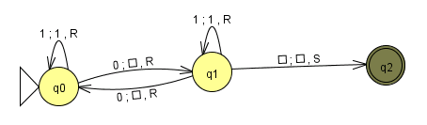
CS 5 today:
more machines!
Turing Machines and the MANY things computers can't compute... !
Final ideas...
This machine doesn't look all-powerful to me!
final tutoring hrs/labs meet this week + next
Final projects...
hw12 + milestone due on Monday, 12/5
5 finite-state machines due as part of hw12
Turing machines extra!

Slide 2
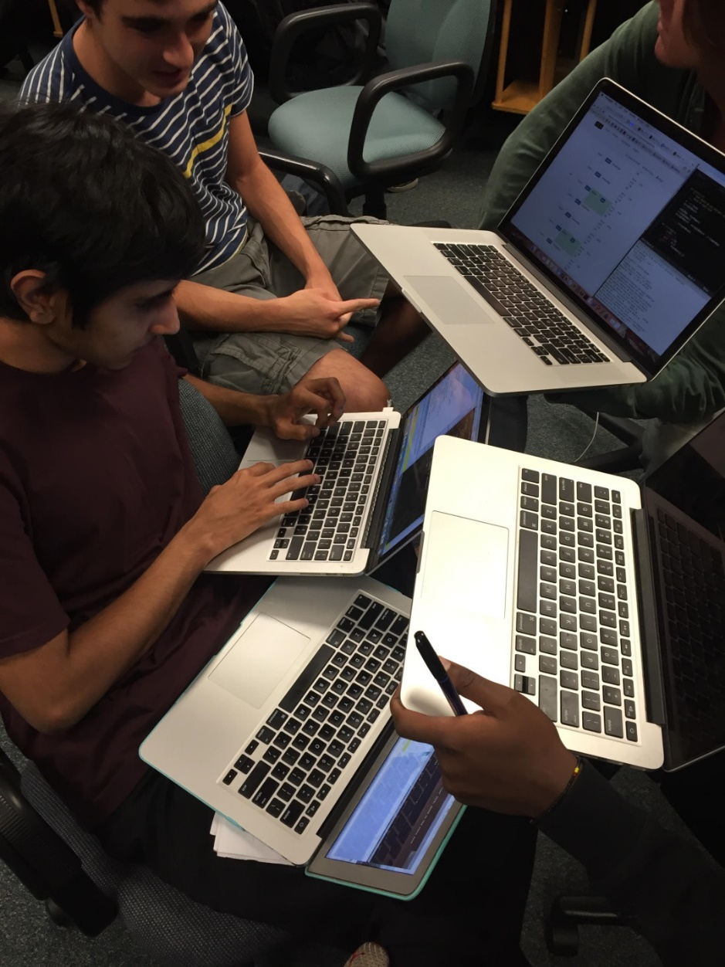
CS 5 today:
more machines!
Turing Machines and the MANY things computers can't compute... !
Final ideas...
This machine doesn't look all-powerful to me!
final tutoring hrs/labs meet this week + next
Final projects...
hw12 + milestone due on Monday, 12/5
5 finite-state machines due as part of hw12
Turing machines extra!

Slide 3
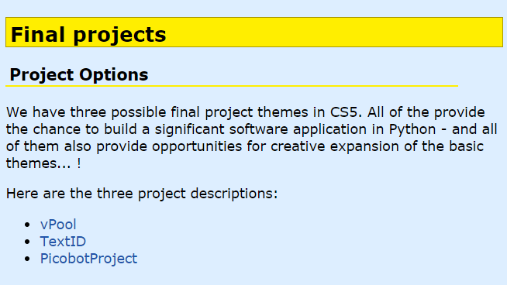
Final project help…
tutoring hours ~ guidance vs. problem-solving
be sure to read over these pages!
key piece of vPython advice... !
hw12 JFLAP ~ autograded

Slide 4
vPython's key-to-all-happiness
Make THE MOST BORING POSSIBLE version of your game…
… at first!
THEN... add more intricate models!

Slide 5
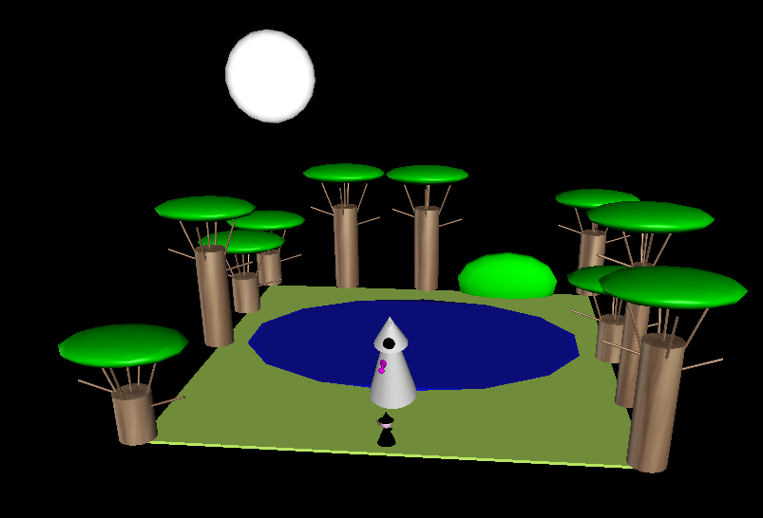
Recognize this scene?
OR ... at least develop in two different files!

Slide 6
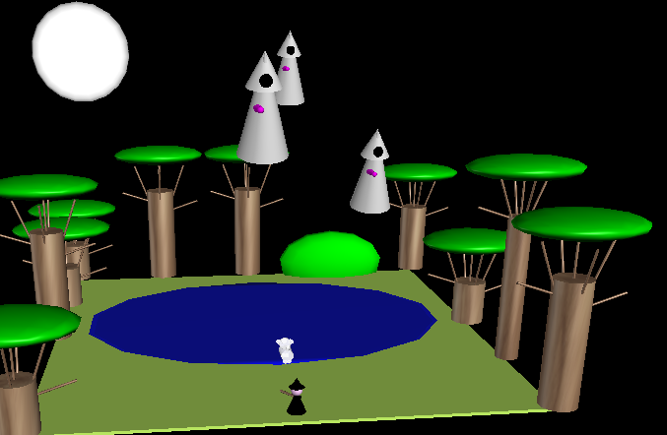
Any other approach & you may "lose your mind..." !
OR ... at least develop in two different files!

Slide 7
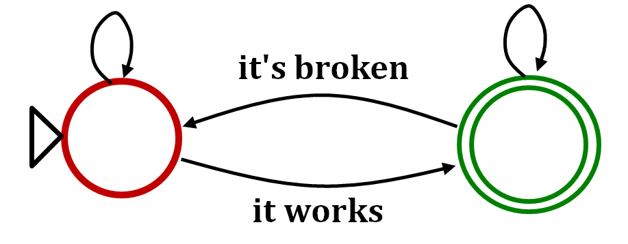
Final project state machine
still broken
still works
it's broken
stop adding features + start adding print statements
comment out print statements + start adding more features
it works
store a copy somewhere else!

Slide 8
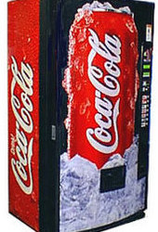
FSMs are everywhere!
penny, fifty cent piece,
silver dollar, Canadian
currency, CS 5 Euro, ….
q_{start}
nickel
dime
quarter
q_{5 cents}
q_{10 cents}
q_{25 cents}
nickel
mechanical
vending machine
dime
nickel
nickel
q_{15 cents}
q_{20 cents}
nickel
(some transitions not shown)
www.youtube.com/watch?v=85C4eh0mEJg @ 1:42 !

Slide 9
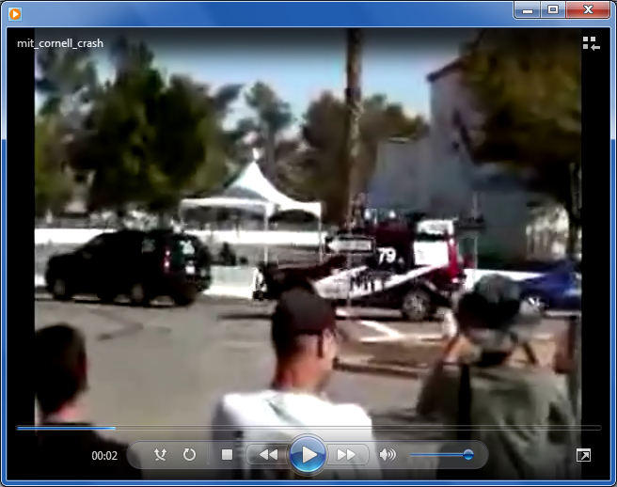
State-machine limits?
Are there limits to what FSMs can do?
they can't necessarily drive safely...
MIT's car, Talos

Slide 10
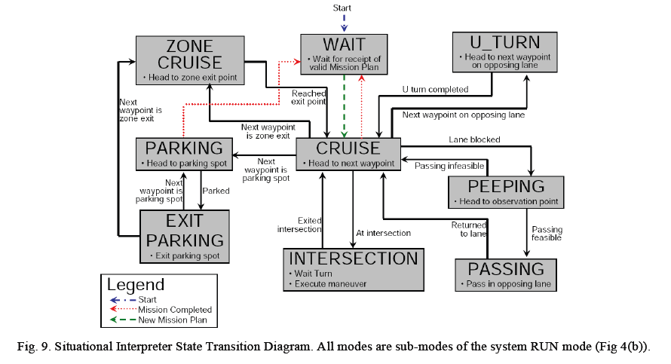
An autonomous vehicle's FSM

Slide 11
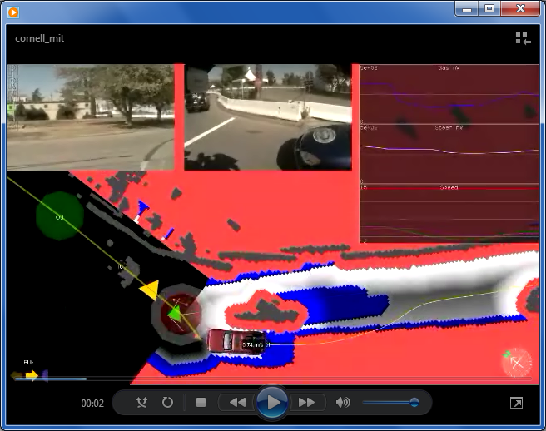
The data driving the state machine...
MIT's car, Talos - and its sensor suite
But are there any binary-string problems that FSMs can't solve?

Slide 12
State-machine limits?
You don't need three eyes to see some problems here!
accepting
0
0
0
zero 0s
one 0
two 0s
three 0s
1
1
1
Let's build a FSM that accepts strings with any # of 0s followed by the same #of 1s
rejected
accepted
011
000111
001
0011
11100
01
00110
λ

Slide 13
State-machine limits?
You don't need three eyes to see some problems here!
accepting
0
0
0
zero 0s
one 0
two 0s
three 0s
1
1
1
Let's build a FSM that accepts strings with any # of 0s followed by the same #of 1s
rejected
accepted
011
FSMs "can't count"
000111
001
0011
11100
at least, not arbitrarily high
01
00110
λ

Slide 14
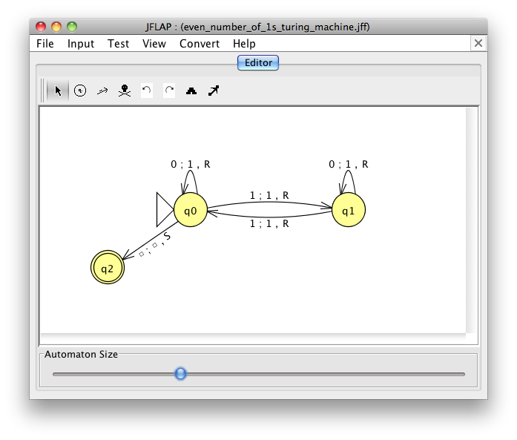
FSMs can't count...
So, let's build a better machine!
Shiny!
Turing Machine
Notes:
metric prefixes…

Slide 15
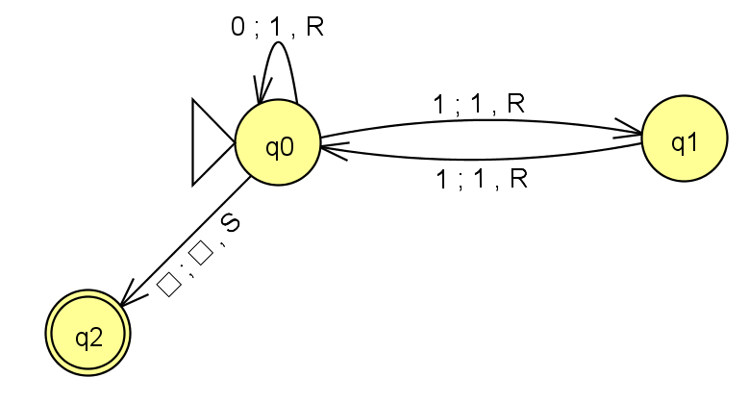
the input
the tape
R/W head
"blanks" are the default
an accepting state always halts -- then basks in its success!
if a transition is missing, the input FAILS!
0
;
1
,
a Turing Machine rule:
R
READ
WRITE
MOTION
try it in JFLAP...
Notes:
metric prefixes…

Slide 16
the input
0
1
1
the tape
R/W head
Accepted Input!
if a transition is missing, the input FAILS!
0
;
1
,
a Turing Machine rule:
R
READ
WRITE
MOTION
try it in JFLAP...
Notes:
metric prefixes…

Slide 17
the input
0
1
0
the tape
R/W head
Rejected Input.
an accepting state always halts -- then basks in its success!
if a transition is missing, the input FAILS!
0
;
1
,
a Turing Machine rule:
R
READ
WRITE
MOTION
try it in JFLAP...
Notes:
metric prefixes…

Slide 18
the input
0
1
1
0
0
the tape
R/W head
What happens here?
if it gets here, it succeeds.
if a transition is missing, the input FAILS!
0
;
1
,
a Turing Machine rule:
R
READ
WRITE
MOTION
try it in JFLAP...
Notes:
metric prefixes…

Slide 19
the input
0
1
1
0
0
the tape
R/W head
"blanks" are everywhere else
an accepting state always halts -- then basks in its success!
if a transition is missing, the input FAILS!
0
;
1
,
a Turing Machine rule:
R
READ
WRITE
MOTION
try it in JFLAP...
Notes:
metric prefixes…

Slide 20
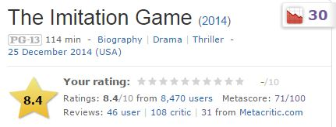
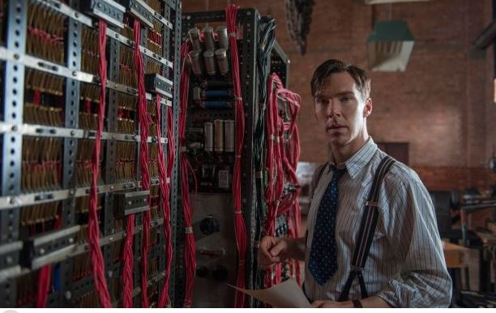
CS 5 spokesperson of the day!
Alan Turing
I want a 1950's network!

Slide 21
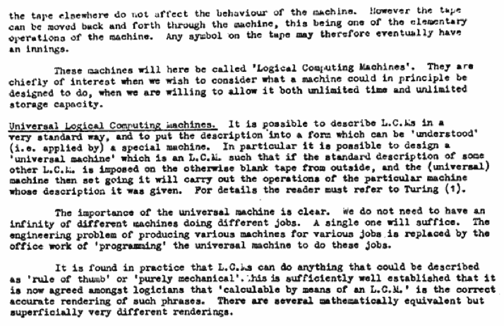
Can TMs compute everything?
Alan Turing says yes...
Turing called them Logical Computing Machines
Turing’s Intelligent Machines, 1948
http://www.alanturing.net/turing_archive/archive/l/l32/L32-005.html

Slide 22
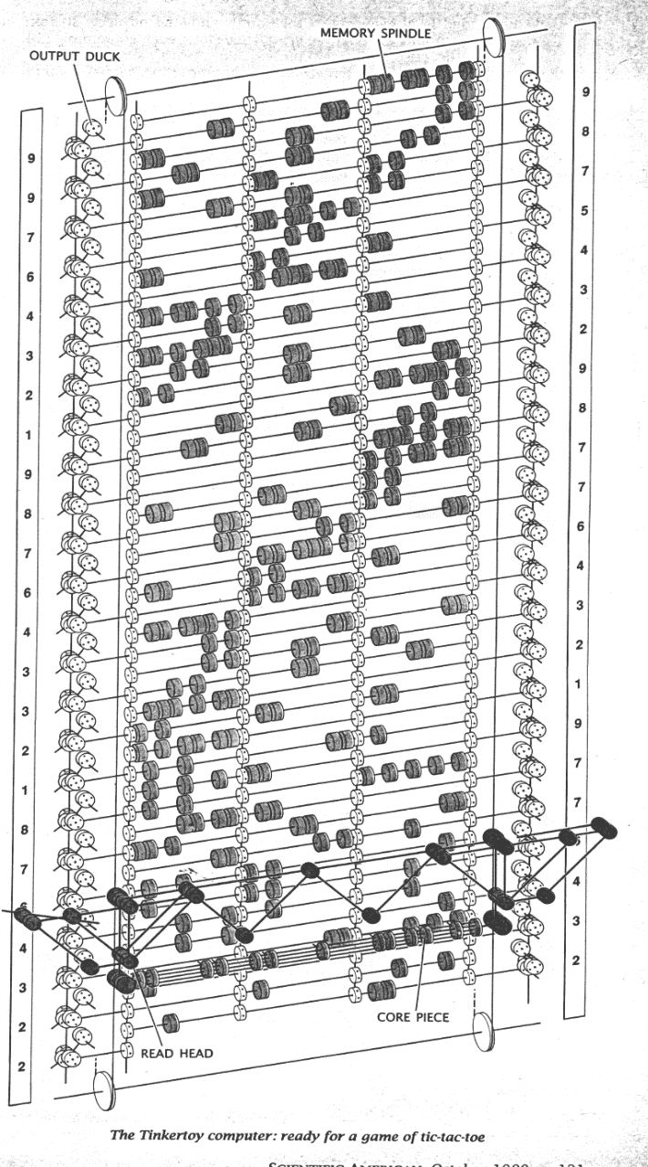

So far, all known computational devices can compute only what Turing Machines can...
some are faster than others…
Quantum computation
http://www.cs.virginia.edu/~robins/The_Limits_of_Quantum_Computers.pdf
Molecular computation
http://www.arstechnica.com/reviews/2q00/dna/dna-1.html
Parallel computers
Integrated circuits
Electromechanical computation
Water-based computation
Tinkertoy computation
Turing machine

Slide 23
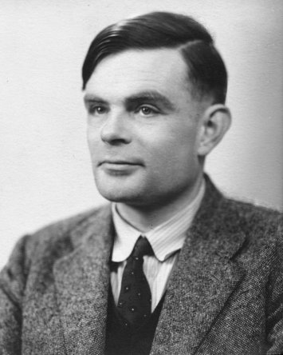
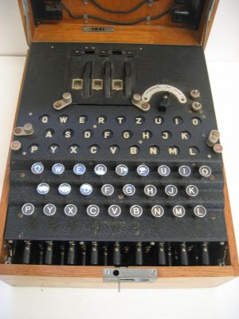
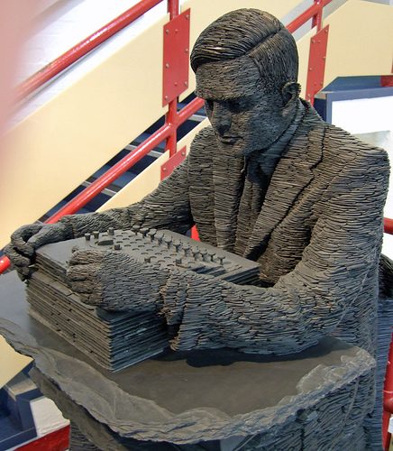
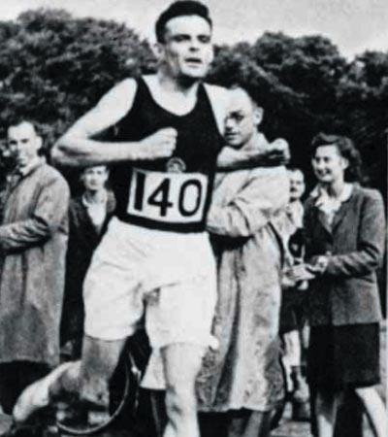
Alan Turing
AI!
1912-1954
WWII
Enigma machine ~ The axis's encryption engine
2007
1946
Bletchley Park

Slide 24
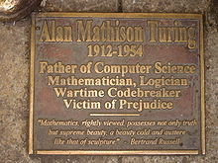
Alan Turing
AI!
1912-1954
WWII
Enigma machine ~ The axis's encryption engine
2007
1946
Bletchley Park

Slide 25
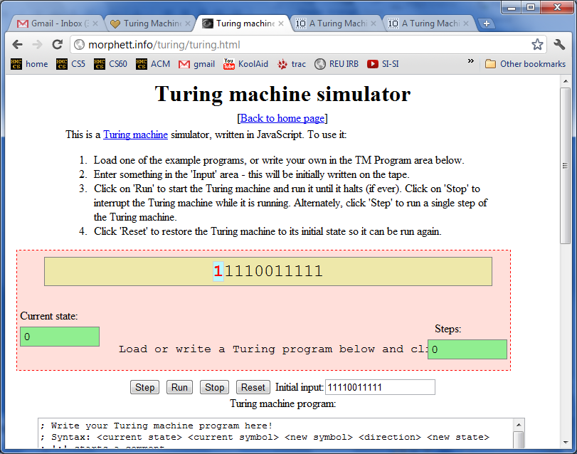
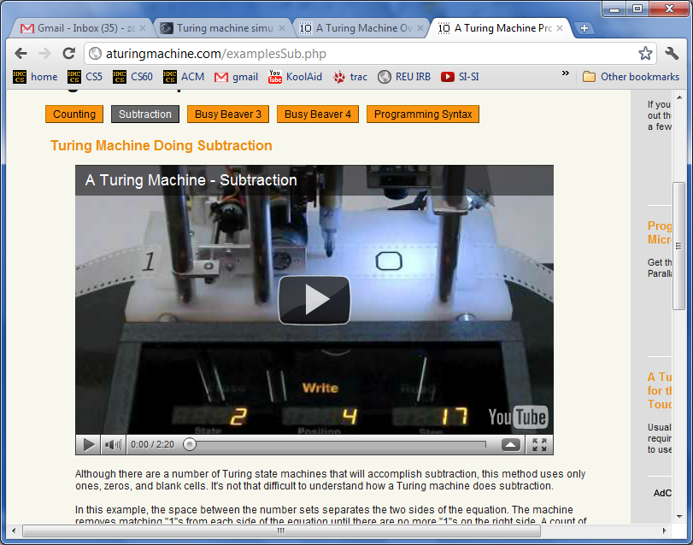
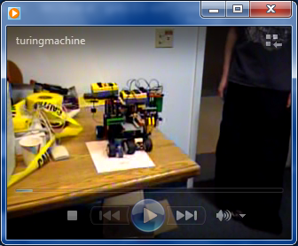
2012: Turing Celebration
http://aturingmachine.com/examplesSub.php
https://www.youtube.com/watch?v=aBToqFJLrl4

Slide 26
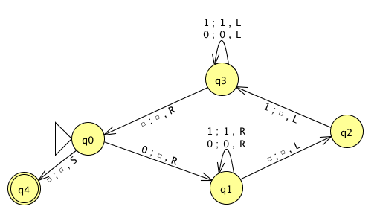
the tape
0
0
1
1
1
start
Is this input accepted or rejected by this TM?
Try it!
What does one "loop" of (q0-q1-q2-q3-q0) do?
What inputs are accepted in general?
Extra: How could you change this TM to accept palindromes?
(thought experiment and ex. cr.)
Notes:
metric prefixes…

Slide 27
the tape
0
0
1
1
1
start
with room to work...
Is this input accepted or rejected by this TM?
What does one "loop" of (q0-q1-q2-q3-q0) do?
What inputs are accepted in general?
Extra: How could you change this TM to accept palindromes?
(thought experiment and ex. cr.)
Notes:
metric prefixes…

Slide 28
Turing-Machine machines!
http://aturingmachine.com/examplesSub.php
http://aturingmachine.com/examplesSub.php

Slide 29
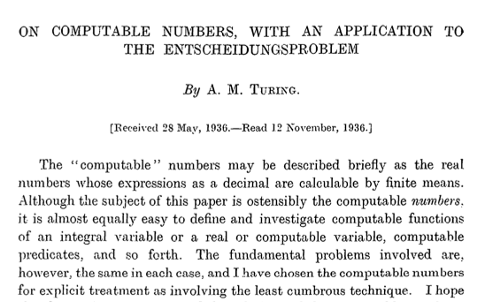
Can TMs compute everything?
computers
Alan Turing says No!
decision problems!
http://www.cs.virginia.edu/~robins/Turing_Paper_1936.pdf

Slide 30
There are many problems computers can't solve at all !
Perhaps this is not that surprising…
rising sea levels
What!?
disbelief in aliens
losing to your own Connect4 (at 0 ply!)
towel folding! (well, fast towel folding…)

Slide 31
Uncomputable functions?
well-defined mathematical functions
computer program
There are
that no
can compute
even with any amount of memory!
or TM
functions
programs
1 if x is odd
def prog1(x):
return x%2
f_{B}(x) =
0 if x is even

Slide 32
functions
int - bool
f_{A}(x) = 1
These are "int-bool" mathematical functions.
They're also sometimes called
"integer predicates."
Input is an integer, x >= 0
Output is 0/1 (boolean or bit)
1 if x is odd
f_{B}(x) =
0 if x is even
1 if x is 0, 1, or 2
f_{C}(x) =
0 otherwise

Slide 33
programs
int - bool
def prog1(x):
return x%2
all int inputs:
x >= 0
Example programs
Input is one integer, x >= 0
Output is 0/1 (boolean or bit)
If programs look different they are different – even if they compute the same function!
def prog2(x):
return x<3
def prog3(x):
return 1
def prog4(x):
return len(str(x+42))>1
Let's match!

Slide 34
functions
programs
def prog1(x):
return x%2
f_{A}(x) = 1
all int inputs:
x >= 0
1 if x is odd
def prog2(x):
return x<3
f_{B}(x) =
0 if x is even
def prog3(x):
return 1
1 if x is 0, 1, or 2
f_{C}(x) =
0 otherwise
def prog4(x):
return len(str(x+42))>1
def prog5(x):
return x in [0,1,2]
1. Match each program with the function it computes.
2. There are three different functions on the left side -- how many different programs are in the right side?
def prog6(x):
if x<2: return x
else: return prog6(x-2)
* Which set is larger: all functions or all programs
[int-bool in both cases] - or, are they the same size?
Quiz!
Name(s): _______________________

Slide 35
functions
programs
There are many more of these …
than these!
def prog1(x):
return x%2
f_{A}(x) = 1
all int inputs:
x >= 0
1 if x is odd
def prog2(x):
return x<3
f_{B}(x) =
programs
0 if x is even
mathematical functions
def prog3(x):
return 1
1 if x is 0, 1, or 2
f_{C}(x) =
0 otherwise
def prog4(x):
return len(str(x+42))>1
def prog5(x):
return x in [0,1,2]
1. Match each program with the function it computes.
2. There are three different functions on the left side -- how many different programs are in the right side?
def prog6(x):
if x<2: return x
else: return prog6(x-2)
* Which set is larger: all functions or all programs
[int-bool in both cases] - or, are they the same size?
Quiz!
Name(s): _______________________

Slide 36


Uncomputable functions?
well-defined mathematical functions
computer program
There are
that no
can compute
even with any amount of memory!
Why?
or TM
There are many more of these …
than these!
programs
mathematical functions
vs.

Slide 37
Programs are "like" integers…
def alien( x ):
if x == 42:
return True
else:
return not \ alien(x+1)
programs
For each program, there is an integer.
This is true: but how?
For each integer, there is a "program."
at least a string!
some have syntax errors...

Slide 38
Programs are integers (and vice-versa)
def alien( x ):
if x == 42:
return True
else:
return not \ alien(x+1)
programs
=
Positive integers
Every program is a string.
Every string is just a sequence of bits
Every sequence of bits is also an int!

Slide 39
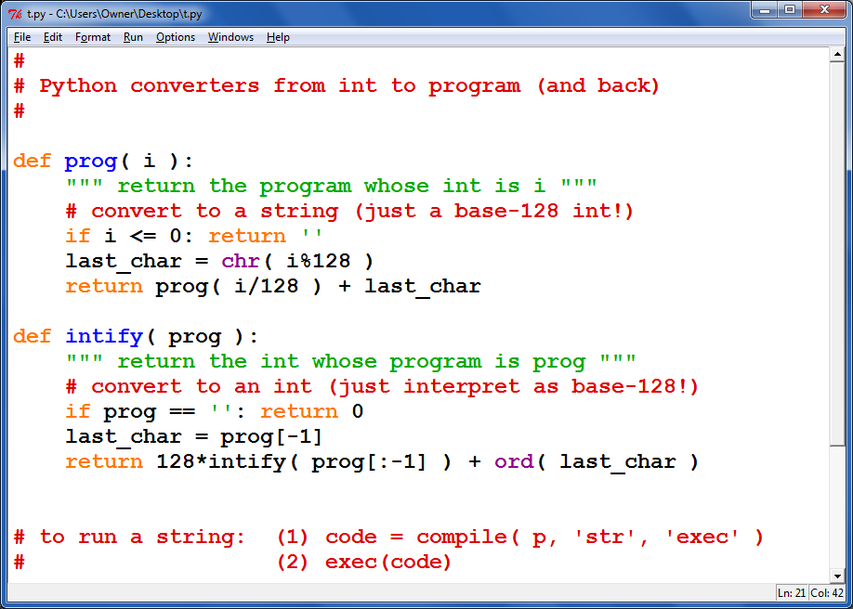
from progs to ints ~ and back...

Slide 40
functions vs. programs !
the Reals from 0 to 1
Positive integers
functions
programs
vs.

Slide 41
int-bool functions are real numbers!
(integer predicates)
This margin is too small to hold my marvelous proof!
the Reals from 0 to 1
=
functions
For each real #, there is a function.
This is true: but how?
For each function, there is a real #.

Slide 42
int-bool
for each real # …
there's a function
IN: a pos. integer x OUT: a 0/1 bool value
f₁(x) = 1
any real # from 0-1
one bit at a time...
1
2
3
4
5
6
7
8
1 if x is odd
f₂(x) =
r₁ = .11111111 ...
0 if x is even
r₂ = .10101010 ...
1 if x is 1 or 2
f₃(x) =
0 otherwise
r₃ = .11000000 ...
1 if x s prime
r₄ = .01101010 ...
f₄(x) =
0 otherwise
6 and 8 are not prime, so these digits are 0
2 and 3 are prime, so these digits are 1

Slide 43
for each real # …
there's a function
IN: a pos. integer x OUT: a 0/1 bool value
f₁(x) = 1
any real # from 0-1
one bit at a time...
1
2
3
4
5
6
7
8
1 if x is odd
f₂(x) =
r₁ = .11111111 ...
0 if x is even
r₂ = .10101010 ...
1 if x is 1 or 2
f₃(x) =
0 otherwise
r₃ = .11000000 ...
1 if x s prime
r₄ = .01101010 ...
f₄(x) =
0 otherwise
r₅ =
1 if x is div. by 3
f₅(x) =
r₆ = .00000000 ...
0 otherwise
f₆(x) =

Slide 44
for each real # …
there's a function
IN: a pos. integer x OUT: a 0/1 bool value
f₁(x) = 1
any real # from 0-1
one bit at a time...
1
2
3
4
5
6
7
8
1 if x is odd
f₂(x) =
r₁ = .11111111 ...
0 if x is even
For each real number, there's a different function – and vice-versa!
r₂ = .10101010 ...
1 if x is 1 or 2
f₃(x) =
0 otherwise
r₃ = .11000000 ...
1 if x s prime
r₄ = .01101010 ...
f₄(x) =
0 otherwise
r₅ = .00100100...
1 if x is div. by 3
f₅(x) =
r₆ = .00000000 ...
0 otherwise
f₆(x) =
0, except when x == 42

Slide 45
functions vs. programs !
the Reals from 0 to 1
Positive integers
?
functions
programs

Slide 46
functions vs. programs !
the Reals from 0 to 1
Positive integers
>
functions
programs

Slide 47
To infinity - and beyond
Pixar owes Cantor for this one!
strictly larger
>
the Reals from 0 to 1
Positive integers
Uncountably infinite
>
Countably infinite
>

Slide 48
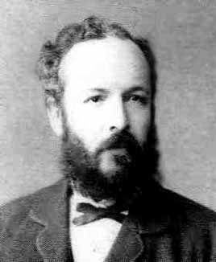
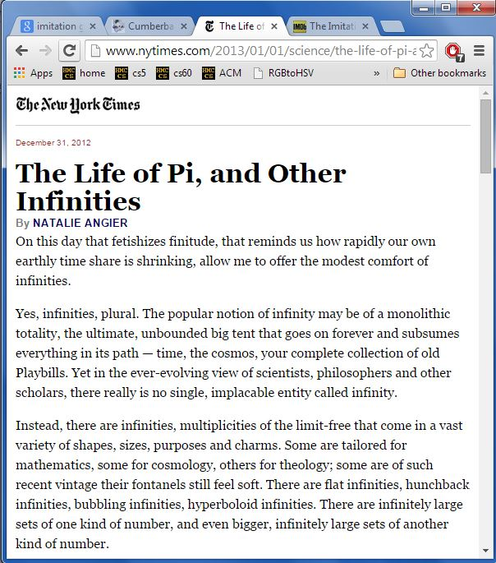
To infinity - and beyond
Pixar owes Cantor for this one!
strictly larger
G. Cantor
>
the Reals from 0 to 1
Positive integers
Uncountably infinite
>
Countably infinite
>

Slide 49
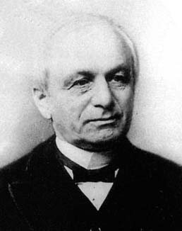
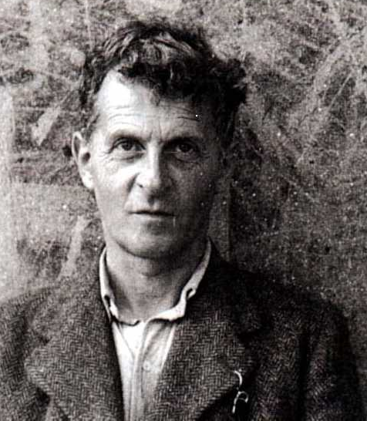
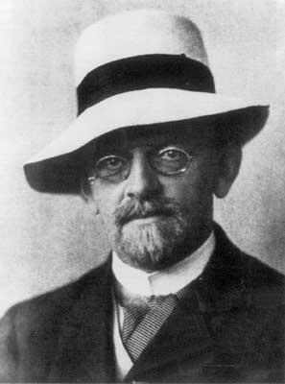
Cantor and "friends"
Georg Cantor
Whom would you trust?
Leopold Kronecker 1823-1891
Lugwig Wittgenstein
1889-1951
David Hilbert 1862-1943

Slide 50
Cantor and "friends"
"Charlatan"
"Renegade"
"Laughable and wrong"
"Utter nonsense"
No one shall expel us from the paradise that Cantor has created.
Ouch!
Leopold Kronecker 1823-1891
Lugwig Wittgenstein
1889-1951
David Hilbert 1862-1943

Slide 51
Cantor and "friends"
"Charlatan"
"Renegade"
"Corrupter of Youth"
"Laughable and wrong"
"Utter nonsense"
No one shall expel us from the paradise that Cantor has created.
And this was before 1900!
Leopold Kronecker 1823-1891
Lugwig Wittgenstein
1889-1951
David Hilbert 1862-1943

Slide 52

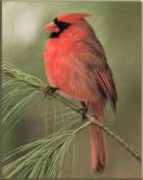

Different infinities !?
There are infinitely many functions + programs…
… but not all infinities are created equal!
{ , , }
{ 1 , 2 , 3 }
Two sets have equal size if
their elements have a
one-to-one matching
This matching is called a bijection.
These sets have the same cardinality

Slide 53

One-to-one mappings also define equal-sized infinite sets, but the results can be surprising!
Positive
evens
E = { 2, 4, 6, 8, 10, … }
Positive integers
N = { 1, 2, 3, 4, 5, … }
ALL
integers
Z = {…, -3, -2, -1, 0, 1, 2, 3, …}
With no negative repercussions!
E and N and Z all have the same size!

Slide 54
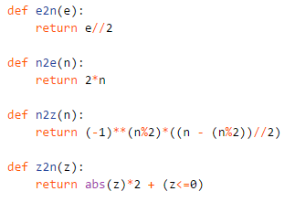
One-to-one mappings also define equal-sized infinite sets, but the results can be surprising!
Positive
evens
E = { 2, 4, 6, 8, 10, … }
Positive integers
N = { 1, 2, 3, 4, 5, … }
ALL
integers
Z = {…, -3, -2, -1, 0, 1, 2, 3, …}
With no negative repercussions!
E and N and Z all have the same size!

Slide 55
One-to-one mappings also define equal-sized infinite sets, but the results can be surprising!
Positive
evens
E = { 2, 4, 6, 8, 10, … }
Positive integers
N = { 1, 2, 3, 4, 5, … }
ALL
integers
Z = {…, -3, -2, -1, 0, 1, 2, 3, …}
With no negative repercussions!
E and N and Z all have the same size!

Slide 56
Let's get real
the reals (from 0 to 1)
the integers
(positive)
Are these sets equal-sized?
{ 0.0 <= r <= 1.0 }
{ 1, 2, 3, 4, 5, … }
.1
1
.2
2
.3
3
…
Why is this NOT a valid matching?
…
.11
11
.12
12
…
…
Notes:
Alien says: that's my .2!

Slide 57
Georg Cantor
1845-1918
Cantor Diagonalization
There are always real #s missing from any list!
the Reals from 0 to 1
Positive integers
real #s are always missing
r =
4 if r_{i}[i] != 4 else 2
0
regardless of the matching…
r = .333333333333333…
1
1
r = .424242424242424…
2
2
r = .314159426535897…
3
3
r = .090909090909090…
4
4
r = …
5
5

Slide 58
(Many) more functions than programs !
the Reals from 0 to 1
Positive integers
>
functions
programs
Uncountably infinite
Countably infinite

Slide 59
int-bool functions are uncountable
(integer predicates)
This margin is too small to hold my marvelous proof!
the Reals from 0 to 1
=
functions
For each real #, there is a function.
This is true: How? Why?
For each function, there is a real #.

Slide 60


There are lots of functions
uncountably many
Well-defined mathematical functions (uncountable)
What's swimming around out here?
Programs (countable)
There are "a few" programs
countably many

Slide 61
Philosophically thinking …
Human-describable things…
How big is the set of the human-describable things... ?
finite!
Well-defined mathematical functions
Programs
… and how does it overlap with all functions or all programs?

Slide 62
Do all HD things include all functions? (No…)
Well-defined mathematical functions
Programs
Human-describable things…
finite!

Slide 63
Do all HD things include all programs? (No…)
Well-defined mathematical functions
Programs
Human-describable things…
finite!

Slide 64
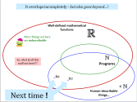
It overlaps incompletely – but also goes beyond... !
Well-defined mathematical functions
Wow! Things out here are indescribable
So, what is all this stuff out here?!?
Programs
kc
hc
Next time !
Human-describable things…

Slide 66
What about functions... and programs?
the Reals from 0 to 1
Positive integers
Uncountably infinite
>
Countably infinite
This is how many int-bool functions there are.
This is how many programs there are.

Slide 67
functions
programs
f_{A}(x) = 1
def prog1(x):
return x%2
all int inputs:
x >= 0
1 if x is odd
f_{B}(x) =
def prog2(x):
return x<3
0 if x is even
1 if x² < 8
def prog3(x):
return 1
f_{C}(x) =
0 otherwise
def prog4(x):
return len(str(x+42))>1
1 if x is 0, 1, or 2
f_{D}(x) =
0 otherwise
def prog5(x):
return x in [0,1,2]
1. Match each program with the function it computes.
2. How many different functions are one the left side?
def prog6(x):
if x<2: return x
else: return prog6(x-2)
3. How many different programs are in the right side?
4. Which set is larger: all functions or all programs ?
- or, are they the same size?
Quiz!
Name(s): _______________________

Slide 68
This seems irrational
They are the same size!
Q
Rational #s
Positive ints
N
1
84
22
13
{ … }
,
,
,
,
{ 1, 2, 3, 4, 5, … }
1
2
7
15
1/1
1/2
1/3
1/4
1/5
1/6
…
2/1
2/2
2/3
2/4
2/5
2/6
…
Numerator
3/1
3/2
3/3
3/4
3/5
3/6
…
4/1
4/2
4/3
4/4
4/5
4/6
…
…
Just make a list…
Denominator

Slide 69

Uncomputable functions?
well-defined computational problems
computer program
There are
that no
can solve
even with any amount of memory!
Pico-
bot
CS 5 homework
def is_odd(x):
return x%2
Video
games
Int-bool functions
def less_three(x):
return x < 3
Crossy Road
decision problems!
Well-defined computational tasks
Programs
These programs are both int-bool functions

Slide 70
One-to-one mappings also define equal-sized infinite sets, but the results can be surprising!
Positive
evens
E = { 2, 4, 6, 8, 10, … }
Positive integers
N = { 1, 2, 3, 4, 5, … }
ALL
integers
Z = {…, -3, -2, -1, 0, 1, 2, 3, …}
With no negative repercussions!
E and N and Z all have the same size!

Slide 71
the input
0
1
0
1
0
the tape
R/W head
"blanks" are everywhere else
an accepting state always halts -- then basks in its success!
if a transition is missing, the input FAILS!
0
;
1
,
a Turing Machine rule:
R
READ
WRITE
MOTION
try it in JFLAP...
Notes:
metric prefixes…

Slide 72
Run this TM on this input:
Try it!
0
0
1
1
1
Is this input accepted or rejected?
What inputs are accepted in general? How does it work?
Extra: How could you change this to accept palindromes?
(a thought experiment – and ex. cr.)
Notes:
metric prefixes…

Slide 73
the input
0
1
0
1
0
the tape
R/W head
"blanks" are everywhere else
an accepting state always halts -- then basks in its success!
if a transition is missing, the input FAILS!
0
;
1
,
a Turing Machine rule:
R
READ
WRITE
MOTION
try it in JFLAP...
Notes:
metric prefixes…

Slide 74
Run this TM on this input:
Try it!
0
0
1
1
1
Is this input accepted or rejected?
What inputs are accepted in general? How does it work?
Extra: How could you change this to accept palindromes?
(just a thought experiment)
Notes:
metric prefixes…

Slide 75
functions
programs
f₁(x) = 1
IN: a pos. integer x OUT: a 0/1 bool value
def prog1(x):
return x%2
1 if x is odd
f₂(x) =
def prog2(x):
return x<3
0 if x is even
1 if x is 1 or 2
def prog3(x):
return 1
f₃(x) =
0 otherwise
def prog4(x):
return len(str(x+42))>1
1 if x is < 3
f₄(x) =
0 otherwise
def prog5(x):
if x in [1,2]: return 1
else: return 0
1. Match each program with the function it computes.
2. How many different math. f'ns are in the left column?
def prog6(x):
if x<2: return x
else: return prog6(x-2)
3. How many different prog.s are in the right column?
4. Which (full) set is larger: functions or programs?
- or, are they the same size?
Try this on the back page first…

Slide 76
the input
0
1
0
1
0
the tape
R/W head
"blanks" are everywhere else
an accepting state always halts -- then basks in its success!
if a transition is missing, the input FAILS!
0
;
1
,
a Turing Machine rule:
R
READ
WRITE
MOTION
try it in JFLAP...
Notes:
metric prefixes…

Slide 77
functions
programs
There are many more of these …
than these!
f₁(x) = 1
IN: a pos. integer x OUT: a 0/1 bool value
def prog1(x):
return x%2
1 if x is odd
f₂(x) =
def prog2(x):
return x<3
0 if x is even
programs
1 if x is 1 or 2
def prog3(x):
return 1
mathematical functions
f₃(x) =
0 otherwise
def prog4(x):
return len(str(x+42))>1
1 if x is < 3
f₄(x) =
0 otherwise
def prog5(x):
if x in [1,2]: return 1
else: return 0
1. Match each program with the function it computes.
2. How many different math. f'ns are in the left column?
def prog6(x):
if x<2: return x
else: return prog6(x-2)
3. How many different prog.s are in the right column?
4. Which (full) set is larger: functions or programs?
- or, are they the same size?
Try this on the back page first…

Slide 78
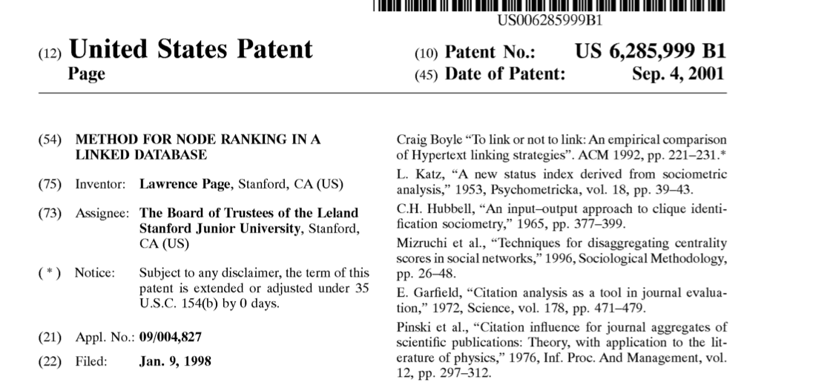
State-machine limits?
Are there limits to what FSMs can do?
PageRank
Robotics
they can't necessarily drive safely...
Page Rank
But are there any binary-string problems that FSMs can't solve?

Slide 79
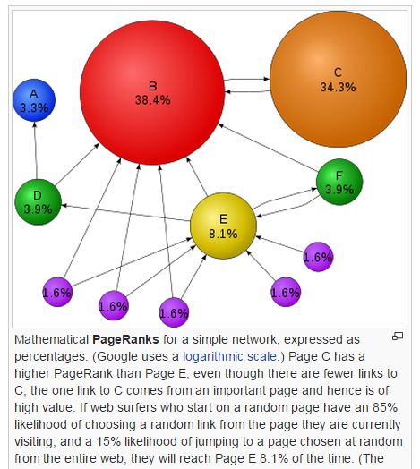
State-machine limits?
Are there limits to what FSMs can do?
PageRank
Robotics
they can't necessarily drive safely...
Page Rank
But are there any binary-string problems that FSMs can't solve?

Slide 80
That's my line!
This seems irrational
Are these sets equal-sized?
Q
Rational #s
Positive ints
N
1
84
22
13
{ … }
,
,
,
,
{ 1, 2, 3, 4, 5, … }
1
2
7
15

Slide 81
This seems irrational
They are the same size!
Q
Rational #s
Positive ints
N
1
84
22
13
{ … }
,
,
,
,
{ 1, 2, 3, 4, 5, … }
1
2
7
15
1/1
1/2
1/3
1/4
1/5
1/6
…
2/1
2/2
2/3
2/4
2/5
2/6
…
Numerator
3/1
3/2
3/3
3/4
3/5
3/6
…
4/1
4/2
4/3
4/4
4/5
4/6
…
…
Just make a list…
Denominator

Slide 82
State-machines are limited.
FSMs can't count
at least not arbitrarily high...
We need a more powerful model than FSMs...
What do we need to add?
so, "we" add memory !
where "we" == Turing

Slide 83
FSMs can't count...
Because they're finite, FSMs can only count finitely high !
They can handle modulo arithmetic.
Computable with FSMs
Uncomputable with FSMs
even/odd sums or differences
same # of 0s and 1s
multiples of other integers
are there more 0s than 1s?
finite input constraints:
infinite input constraints:
third digit is a 1
third-to-last digit is a 1
third digit == third-to-last digit
etc.
palindromes
anything modeled by an unknown-length while loop
Our computers should be able to handle while loops!
Notes:
metric prefixes…

Slide 84
State-machine limits?
Let's build a FSM that accepts bit strings with the SAME NUMBER of 0s as 1s
0
1
zero 0s
zero 1s

Slide 85
State-machine limits?
Let's build a FSM that accepts bit strings with the SAME NUMBER of 0s as 1s
0
0
1
1
one 0
zero 1s
zero 0s
zero 1s
zero 0s
one 1
1
1
0
0

Slide 86
State-machines are limited.
FSMs can't count
at least, not arbitrarily high...
We need a more powerful model than FSMs...
so, "we" add memory !
where "we" == Turing

Slide 87
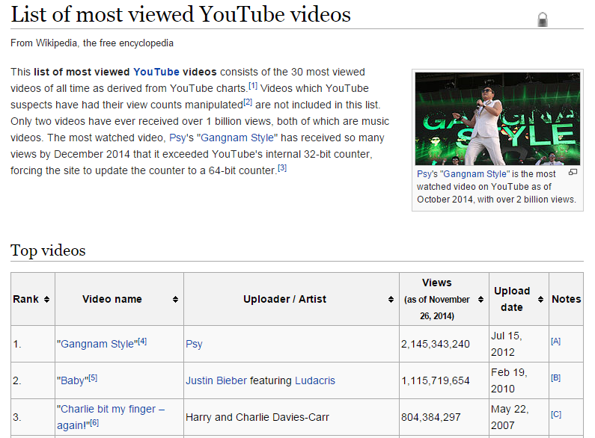
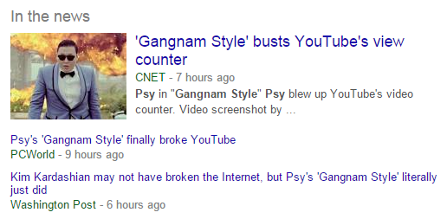
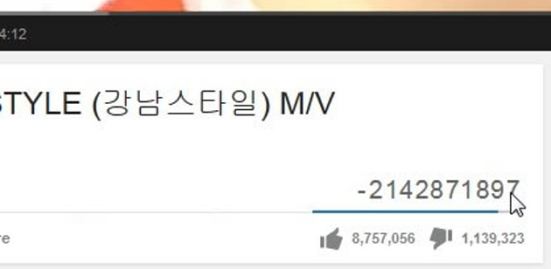
CS 5 spokessinger of the day!

Slide 88
the input
0
1
0
1
0
the tape
R/W head
"blanks" are everywhere else
an accepting state always halts -- then basks in its success!
if a transition is missing, the input FAILS!
0
;
1
,
a Turing Machine rule:
R
READ
WRITE
MOTION
try it in JFLAP...
Notes:
metric prefixes…

Slide 89
Name(s) __________________________________ Quiz
Run this TM on this input:
0
0
1
1
1
Is this input accepted or rejected?
What inputs are accepted in general? How does it work?
Extra: How could you change this to accept palindromes?
(just a thought experiment)
Notes:
metric prefixes…

Slide 90
the input
0
1
0
1
1
the tape
"blanks" are everywhere else
R/W head
an accepting state always halts and then basks in its success!
if a transition is missing, the input FAILS!
0
;
1
,
a Turing Machine rule:
R
READ SYMBOL
WRITE SYMBOL
MOTION
try it in JFLAP...
Notes:
metric prefixes…

Slide 91
functions
programs
def prog1(x):
return x%2
f_{A}(x) = 1
all int inputs:
x >= 0
1 if x is odd
def prog2(x):
return x<3
f_{B}(x) =
0 if x is even
def prog3(x):
return 1
1 if x is 0, 1, or 2
f_{C}(x) =
0 otherwise
def prog4(x):
return len(str(x+42))>1
def prog5(x):
return x in [0,1,2]
1. Match each program with the function it computes.
2. There are three different functions on the left side -- how many different programs are in the right side?
def prog6(x):
if x<2: return x
else: return prog6(x-2)
* Which set is larger: all functions or all programs
[int-bool in both cases] - or, are they the same size?
Quiz!
Name(s): _______________________

Slide 92
Bijections also define equal-sized infinite sets, but the results are surprising!
Positive
evens
E = { 2, 4, 6, 8, 10, … }
Positive integers
N = { 1, 2, 3, 4, 5, … }
ALL
integers
Z = {…, -3, -2, -1, 0, 1, 2, 3, …}
With no negative repercussions!
E and N and Z all have the same size!

Slide 93
That's my line!
This seems irrational
Are these sets equal-sized?
Positive integers
the Rationals
1
84
22
13
{ … }
,
,
,
,
{ 1, 2, 3, 4, 5, … }
1
2
7
15
1/1
1/2
1/3
1/4
1/5
1/6
…
2/1
2/2
2/3
2/4
2/5
2/6
…
Numerator
3/1
3/2
3/3
3/4
3/5
3/6
…
4/1
4/2
4/3
4/4
4/5
4/6
…
…
Denominator

Slide 94
IN: a pos. integer x OUT: a 0/1 bool value
functions
programs
f₁(x) = 1
def prog1(x):
return x%2
1 if x is odd
f₂(x) =
def prog2(x):
return x<3
0 if x is even
There are many more of these …
than these!
1 if x is 1 or 2
def prog3(x):
return 1
f₃(x) =
0 otherwise
def prog4(x):
return len(str(x+42))>1
1 if x is < 3
programs
f₄(x) =
mathematical functions
0 otherwise
def prog5(x):
if x in [1,2]: return 1
else: return 0
Match each program with the function it computes.
def prog6(x):
if x<2: return x
else: return prog2(x-2)
How many different math. functions are in the left column?
How many different programs are in the right column?
Which set has more different items: functions or programs? Or are there the same amount of each?

Slide 95
Georg Cantor
1845-1918
Cantor Diagonalization
There are always real #s missing from any list!
the Reals from 0 to 1
Positive integers
consider any matching…
r = .333333333333333…
1
1
r = .424242424242424…
2
2
r = .314159426535897…
3
3
r = .090909090909090…
4
4

Slide 96
functions are uncountable
mathematical
the Reals from 0 to 1
functions
input: int
output: T or F
any real # from 0-1
written out in binary
1 2 3 4 5 6 7 8 ...
r₁ = .01100000 ...
A(n): return isPrime(n)
r₂ = .10101010 ...
B(n): return n in [2, 3]
r₃ = .01101010 ...
C(n): return n >= 42
r₄ = .11010001 ...
D(n): return isPowerOf2(n)
r₅ = .00000000 ...
E(n): return True
r₆ =
Curse you, cursive!
F(n): return n%2 == 1

Slide 97
functions are uncountable
the Reals from 0 to 1
functions
input: int
output: T or F
any real # from 0-1
written out in binary
1 2 3 4 5 6 7 8 ...
r₁ = .01100000 ...
A(n): return isPrime(n)
r₂ = .10101010 ...
B(n): return n in [2, 3]
r₃ = .01101010 ...
C(n): return n >= 42
r₄ = .11010001 ...
D(n): return isPowerOf2(n)
r₅ = .00000000 ...
E(n): return True
r₆ = .11111111 ...
Curse you, cursive!
F(n): return n%2 == 1

Slide 98
functions are uncountable
the Reals from 0 to 1
functions
input: int
output: T or F
For each real number, there's a unique function!
any real # from 0-1
written out in binary
1 2 3 4 5 6 7 8 ...
r₁ = .01100000 ...
A(n): return isPrime(n)
r₂ = .10101010 ...
B(n): return n in [2, 3]
r₃ = .01101010 ...
C(n): return n >= 42
r₄ = .11010001 ...
D(n): return isPowerOf2(n)
r₅ = .00000000 ...
E(n): return True
r₆ = .11111111 ...
F(n): return n%2 == 1

Slide 99
There are lots of functions
uncountably many
Well-defined mathematical functions (uncountable)
What's swimming around out here?
Programs (countable)
There are "a few" programs
countably many

Slide 100
There are lots of functions
uncountably many
Well-defined mathematical functions (uncountable)
What's swimming around out here?
I can't even describe it!
Programs (countable)
kc
hc
Next time...
There are "a few" programs
countably many

Slide 101
How big is the set of the human-describable things... ?
Well-defined mathematical functions
Human-describable things…
Programs
<
Philosophical thinking…

Slide 102
Does it include all functions? (No…)
Well-defined mathematical functions
Programs
<
Human-describable things…

Slide 103
Does it include all programs? (No…)
Well-defined mathematical functions
Human-describable things…
Programs
<

Slide 104
It overlaps incompletely – and goes beyond... !
Well-defined mathematical functions
So, what is all this stuff out here?!?
Programs
kc
hc
<
Next time...
Human-describable things…

Slide 105
Uncomputable functions?
well-defined computational problems
computer program
can solve
There are
that no
even with ∞ memory!
There are more of these …
CS 5 homework
def is_even(x):
return x%2 == 0
than these!
Video
games
Pico-
bot
Int-bool functions
Team Fortress
Well-defined computational tasks
Programs
These programs are both int-bool functions

Slide 106
Or does it do something else?
Well-defined mathematical functions
Programs
Human-describable things…

Slide 107
How big is the set of the human-describable functions... ?
Well-defined mathematical functions (uncountable)
Human-describable functions…
Programs (countable)
(any method at all)

Slide 108
Blue set: human-describable functions
Well-defined computational functions (uncountable)
Describable functions (uncountable or countable?)
Programs (countable)
What is the size of the blue set?
What's an example in each piece?

Slide 109
functions are uncountable
the Reals from 0 to 1
functions
input: int
output: T or F
any real # from 0-1
written out in binary
1 2 3 4 5 6 7 8 ...
r₁ = .01100000 ...
A(n): return isPrime(n)
r₂ = .10101010 ...
B(n): return n in [2, 3]
r₃ = .01101010 ...
C(n): return n >= 42
r₄ = .11010001 ...
D(n): return isPowerOf2(n)
r₅ = .00000000 ...
E(n): return True
r₆ = .11111111 ...
Curse you, cursive!
F(n): return n%2 == 1

Slide 110
functions are uncountable
the Reals from 0 to 1
functions
input: int
output: T or F
For each real number, there's a unique function!
any real # from 0-1
written out in binary
1 2 3 4 5 6 7 8 ...
r₁ = .01100000 ...
A(n): return isPrime(n)
r₂ = .10101010 ...
B(n): return n in [2, 3]
r₃ = .01101010 ...
C(n): return n >= 42
r₄ = .11010001 ...
D(n): return isPowerOf2(n)
r₅ = .00000000 ...
E(n): return True
r₆ = .11111111 ...
F(n): return n%2 == 1

Slide 111
Well-defined computational functions (uncountable)
We can’t say!
Describable functions (countable)
All software
kc
Programs (countable)
hc
O
Today: Two describable, but uncomputable functions

Slide 112
int-bool functions are uncountable
Write your real number from 0 to 1 in binary :
What int-bool function could each number represent?
real number
index of each digit
1 2 3 4 5 6 7 8 9 10 11 12 13 14 15 …
r = .001000000000000...
r = .110110110110110...
What real number would represent is_even(x) ?

Slide 113
This proof seems disappointing…
There are strictly more int-bool functions than programs.
Thus, there are functions with no program to compute them!
Positive integers
the Reals
from 0 to 1
{ real numbers, 0-1 }
{ 1, 2, 3, 4, 5, … }
Uncountably infinite
>
Countably infinite
This is how many functions from integers to booleans there are.
This is how many programs there are.

Slide 114
There are lots of functions of integers
There are "a few" computer programs
(uncountably many ~ real #s)
(countably many ~ integers)
Well-defined computational functions
Programs
So this must be the seashore of uncomputability. Let's dive out!

Slide 115
There are lots of functions of integers
There are "a few" computer programs
(uncountably many ~ real #s)
(countably many ~ integers)
Well-defined computational functions
Describable
Programs
computational problems!
What are the sizes of these sets?
What's an example in each?
Consider the English-describable functions...

Slide 116
There are lots of functions of integers
There are "a few" computer programs
(uncountably many ~ real #s)
(countably many ~ integers)
Well-defined computational functions
I can’t say!
???
Describable
Programs
computational problems!
All software
O
except maybe IOCCC winners
This is indescribably odd...
What are the sizes of these sets?
What's an example in each?
Consider the English-describable functions...

Slide 117
There are lots of functions of integers
There are "a few" computer programs
Next time: some actual uncomputable functions…
(uncountably many ~ real #s)
(countably many ~ integers)
Well-defined computational functions
I can’t say!
???
Describable
Programs
computational problems!
All software
O
except maybe IOCCC winners
This is indescribably odd...
What are the sizes of these sets?
What's an example in each?
Consider the English-describable functions...

Slide 119
Georg Cantor
1845-1918
Cantor Diagonalization
There are always real #s missing from any list!
the Reals from 0 to 1
Positive integers
real #s are always missing
r =
0
regardless of the matching…
r = .333333333333333…
1
1
r = .424242424242424…
2
2
r = .314159426535897…
3
3
r = .090909090909090…
4
4

Slide 120
functions are uncountable
the Reals from 0 to 1
functions
input: int
output: T or F
For each real number, there's a unique function!
any real # from 0-1
written out in binary
1 2 3 4 5 6 7 8 ...
r₁ = .01100000 ...
A(n): return isPrime(n)
r₂ = .10101010 ...
B(n): return n in [2, 3]
r₃ = .01101010 ...
C(n): return n >= 42
r₄ = .11010001 ...
D(n): return isPowerOf2(n)
r₅ = .00000000 ...
E(n): return True
r₆ = .11111111 ...
F(n): return n%2 == 1

Slide 121
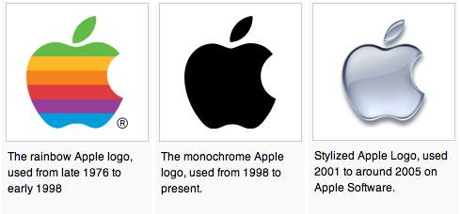
Alan Turing
AI !
1912-1954
WWII
Enigma machine ~ The axis's encryption engine
too neat, perhaps…?
2007
Bletchley Park
1946

Slide 122
Not being constructive…
One "failure" of this proof is that it doesn't construct a full example of an uncomputable problem!
But it's still useful!
What are the chances that a randomly-selected function will have a program that solves it?
functions are uncountable
(as numerous as the reals)
programs are countable
(as numerous as the integers)

Slide 123
A Strategy* for CS Programming HW**
or “How to succeed in CS 60 without programming at all !”
For each programming assignment, note that the desired program’s behavior can be rephrased as functions of integers by encoding the input and output appropriately.
1
2
Point out that with 100% probability a function of integers is not computable by any program at all.
3
Proceed to your choice of (A) Amnesia, (B) Breaking Bad, or (C) Writ1.
4
Consult fine print for disclaimers.
* Please do not cite Prof. Dodds when using this strategy
** This strategy not applicable for CS 5 assignments.

Slide 124
Describing "Complexity"
Consider two integers:
lots of zeros
100000000000000000000000000…00000
Each has 5001 digits
lots of digits
170117684200068728224888577…85601
Which "feels like" the more complex number... Why ?

Slide 125
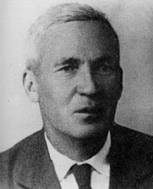
Kolmogorov Complexity
Andrei Kolmogorov
1903-1987
kcomp( k ) =
the length of the shortest zero-input program that produces k
k = 100000000000000000000000000…00000
A length-5017 program producing k:
def a(): return 10000…0000
k = 170117684200068728224888577…85601
A length-5017 program producing k:
def b(): return 17011…5601

Slide 126
Kolmogorov Complexity
Andrei Kolmogorov
1903-1987
kcomp( k ) =
the length of the shortest zero-input program that produces k
k = 100000000000000000000000000…00000
length of 24 !
def a(): return 10**5000
k = 170117684200068728224888577…85601
length of 5017 (or less)
def b(): return 17011…5601
Maybe we can do even better?

Slide 127
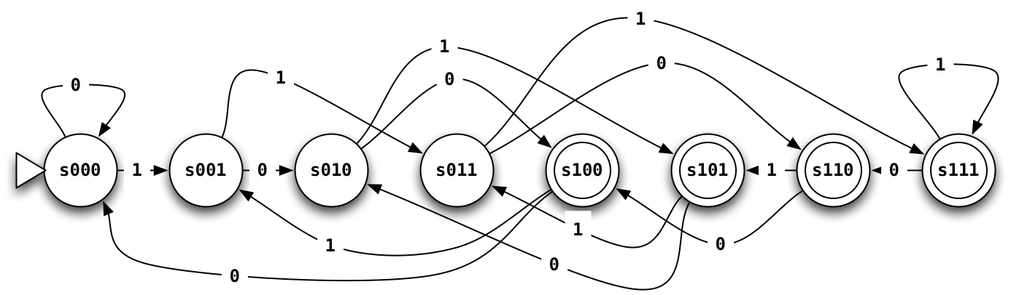
Third-to-last character is a 1
How many states would a 100th-to-last-character FSM have?

Slide 128
State-machine reminders...
Draw a FSM that accepts strings whose first bit is a 0 and whose last bit is a 1
01
01011
001011
0
00110
100111
101010
Accept:
Reject:
Draw a FSM that accepts strings that start with some number of 0s followed by the same number of 1s.
01
0011
000111
00110
011111
101010
Accept:
Reject:
42 is rejected?!
Notes:
metric prefixes…

Slide 129
State-machine reminders...
Draw a FSM that accepts strings whose first bit is a 0 and whose last bit is a 1
01
01011
001011
0
00110
100111
101010
Accept:
Reject:
can be done in four states...
Draw a FSM that accepts strings that start with some number of 0s followed by the same number of 1s.
01
0011
000111
00110
011111
101010
Accept:
Reject:
42 is rejected?!
Impossible to do with finite states!
Another impossible task:
detecting palindromes
Notes:
metric prefixes…

Slide 130
Kolmogorov Complexity
Andrei Kolmogorov
1903-1987
kcomp( k ) =
the length of the shortest zero-input program that produces k
For each input k, there is a well-defined, unambiguous value for kcomp(k).
k = 100000000000000000000000000…00000
kcomp( k ) = 24 or so
k = 170117684200068728224888577…85601
kcomp( k ) = some other integer
Does kcomp(k) always exist?

Slide 131
What are the uncomputable problems?
Here's an uncomputable function:
positive integer input, k
the positive integer output that is k's complexity
kcomp( k ) =
with a name like kcomp, this function was doomed !

Slide 132
Complexity isn't computable!
def kcomp( k ):
do stuff…
return answer
Proof strategy
I guess you'd call this part of the code a GRAY AREA…
proof by contradiction
(1) Presume that kcomp exists (as a program).
(2) We show this results in a contradiction…
(3) Thus, the presumption "kcomp exists" is false.
(4) So, the program/function kcomp can not exist!

Slide 133
def kcomp( k ):
do stuff…
return answer
Presume that kcomp exists, it works, and it's 42,000 characters long
Contradict!
def Ouch():
x = 0
while kcomp(x) < 50000:
x += 1
return x
def kcomp( k ):
do stuff…
return answer
Note:
it's OK to define a function inside another function – both theoretically and in real Python syntax
Will this loop stop when x is less than, equal to, or greater than 50,000?
Question 1:
Hey! That's not a question!
Question 2:
This function returns an integer.
Question 3:
If x is the integer returned, what is kcomp(x) (the K. complexity of x)?
Ouch hurts!
Question 4:
What is the contradiction here?

Slide 134
Others?
Where did kcomp go wrong?
They involve infinity.
Many potentially useful problems are impossible to compute!
They involve self-reference.
Or they can be interpreted as such.

Slide 135
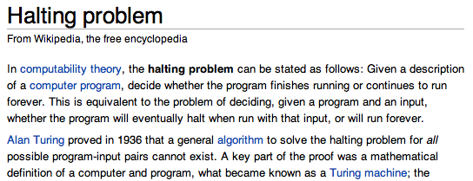
Others…? Haltchecking is impossible.
Any Python function
Any input at all!
def HC( f, inp ):
if f(inp) halts:
return True
else:
return False
This grey area is the tricky part!!
HC checks for infinite loops.
in finite time

Slide 136
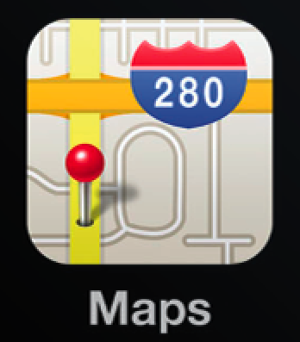
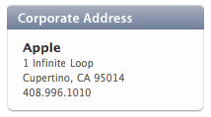
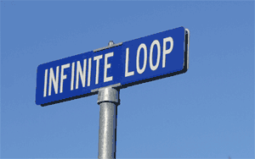
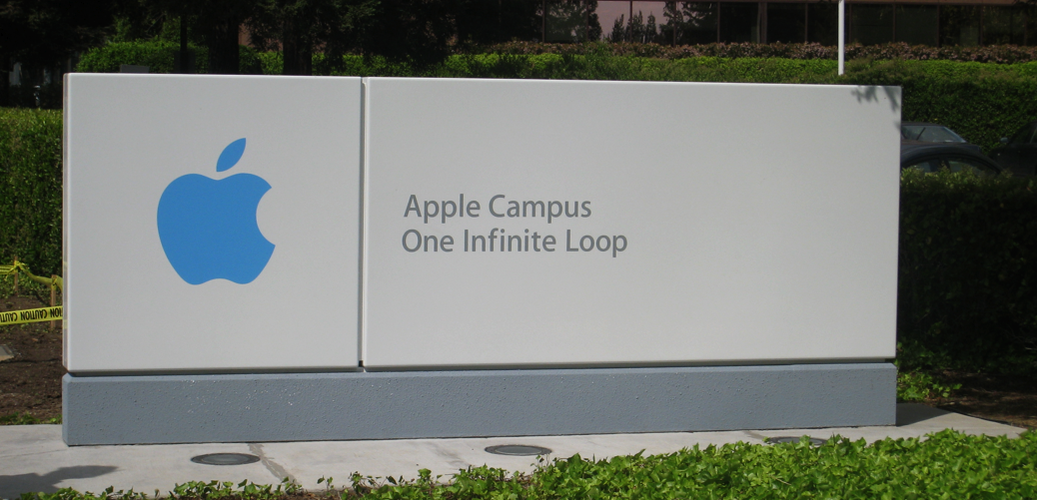
the iPhone's icon for Google Maps …

Slide 137
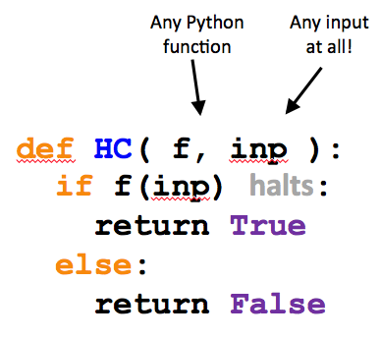
Examples of HC in action:
Here are two Python functions:
def g( x ):
if x == 42:
while True:
x += 0
else:
return 42
def h( x ):
if x == h:
while True:
print "Spam!"
else:
return g(x)
What does HC return in these calls?
HC(g, 41)
HC(g, 42)
HC(g, g)
HC(g, h)
HC(h, 41)
HC(h, 42)
HC(h, g)
HC(h, h)

Slide 138
Proof strategy: Assume HC exists
Any Python function
Any input at all!
We show that this results in a contradiction…
def HC( f, inp ):
if f(inp) halts:
return True
else:
return False
Thus, the presumption "HC exists" is false.
So, HC can not exist.
HC checks for infinite loops.
in finite time

Slide 139
Proof strategy: Assume HC exists
We build a new function, cant
Cant takes only one input, a function.
Does the following call halt or does it run forever?
Any Python function
cant( cant )
def cant( f ):
if HC(f,f):
while True:
print "Ha!"
else:
return 42
This name Cant be a coincidence!

Slide 140
Thus…
can not be programmed…
HC( f, inp )
can not be computed…
though, as a mathematical function, it does exist!
Haltchecking can not be done by computer.
The "Halting problem" is uncomputable.
or undecidable

Slide 141
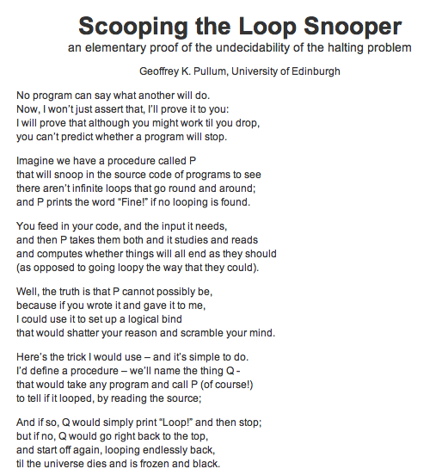



Slide 142
Cantor and "friends"
Who would you trust?
Leopold Kronecker 1823-1891
Lugwig Wittgenstein
1889-1951
David Hilbert 1862-1943

Slide 143
Cantor and "friends"
"Charlatan"
"Renegade"
No one shall expel us from the paradise that Cantor has created.
"Laughable and wrong"
"Utter nonsense"
And this was before 1900!
Leopold Kronecker 1823-1891
Lugwig Wittgenstein
1889-1951
David Hilbert 1862-1943

Slide 144
Cantor and "friends"
"Charlatan"
"Renegade"
"Corrupter of Youth"
No one shall expel us from the paradise that Cantor has created.
"Laughable and wrong"
"Utter nonsense"
And this was before 1900!
Leopold Kronecker 1823-1891
Lugwig Wittgenstein
1889-1951
David Hilbert 1862-1943

Slide 145
What about functions... and programs ?
Positive integers
the Reals
from 0 to 1
{ real numbers, 0-1 }
{ 1, 2, 3, 4, 5, … }
Uncountably infinite
>
Countably infinite
This is how many functions from integers to booleans there are.
This is how many programs there are.

Slide 146
What about functions... and programs ?
Uncountably infinite
Proof?
{ real numbers, 0-1 }
This is how many functions from integers to booleans there are.
Why are there more int-bool functions than real numbers from zero to one?
This margin looks better!

Slide 147
What about functions... and programs ?
Uncountably infinite
Proof?
{ real numbers, 0-1 }
This is how many functions from integers to booleans there are.
Why are there more int-bool functions than real numbers from zero to one?
(1) Choose any real x, 0-1
(2) Write it in binary
(3) The function that maps each positive integer k to the kth bit in x is unique to only that real number.
(4) QED!
* Technical note: some numbers x have more than one function...
real number
which bit?
1 2 3 4 5 6 7 ...
x = .0100000...
See, it worked!

Slide 148
What about functions... and programs ?
Uncountably infinite
Proof?
{ real numbers, 0-1 }
This is how many functions from integers to booleans there are.
Why are there more int-bool functions than real numbers from zero to one?
0.00000...
0.10000...
0.01000...
0.11000...
... all real #s from 0 to 1 ...
0.11111...
(1) Choose any real number, 0-1
(2) Write it in binary
(3)

Slide 149
well-defined computational problems
no computer program
can solve
There are
that
at any speed
Proof strategy
How many of each are there?
There are more of these …
Bio/CS 6 homework
def is_even(X):
return X%2 == 0
than these.
Video
games
Pico
bot
Positive Integer
Predicates ~ PIPs
def is_three(X):
return X == 3
Mario Kart
Well-defined computational tasks
Programs

Slide 150
well-defined computational problems
no computer program
can solve
There are
that
even with ∞ memory
Show that there are UNCOUNTABLY many of these!
Strategy?
Show that there are COUNTABLY many of these!
There are more of these …
Bio/CS 6 homework
def is_even(X):
return X%2 == 0
than these!
Video
games
String matching
Positive Integer
Predicates ~ PIPs
def is_three(X):
return X == 3
Mario Kart
Well-defined computational tasks
Programs
They look the same to me!

Slide 151
Programs are countable
There are as many programs as positive integers…
How to show this?
def is_even(X):
return X%2 == 0
def is_three(X):
return X == 3
Programs

Slide 152
Problems are uncountable
at least!
There are as many problems as real numbers from [0,1]…
How to show this?
CS 5 homework
Video
games
Pico
bot
Positive Integer
Predicates ~ PIPs
Mario Kart
Well-defined computational tasks

Slide 153
PIPs: Positive Integer Predicates
input
output
PIPs are functions mapping positive integers to boolean values
1,2,…
True or False
PIP
each PIP is a different computational "problem"
CS 5 homework
Video
games
Pico
bot
Positive Integer
Predicates ~ PIPs
Mario Kart
Well-defined computational tasks

Slide 154
PIPs: Positive Integer Predicates
input
output
PIPs are functions mapping positive integers to boolean values
1,2,…
True or False
PIP
each PIP is a different computational "problem"
Input
 | 1 | 2 | 3 | 4 | 5 | 6 | 7 | 8 | 9
A? | T | T | T | T | T | T | T | T | T
B? | F | T | F | T | F | T | F | T | F
C? | T | F | T | F | T | F | T | F | T
D? | F | T | T | F | T | F | T | F | F
E? | T | T | F | F | F | F | F | F | F
PIP
…

Slide 155
PIPs: Positive Integer Predicates
input
output
PIPs are functions mapping positive integers to boolean values
1,2,…
True or False
PIP
each PIP is a different computational "problem"
Input
 | 1 | 2 | 3 | 4 | 5 | 6 | 7 | 8 | 9
True | T | T | T | T | T | T | T | T | T
Even | F | T | F | T | F | T | F | T | F
Odd | T | F | T | F | T | F | T | F | T
Prime | F | T | T | F | T | F | T | F | F
<3 | T | T | F | F | F | F | F | F | F
PIP
…

Slide 156
PIPs are uncountable?
Input
 | 1 | 2 | 3 | 4 | 5 | 6 | 7 | 8 | 9
True | T | T | T | T | T | T | T | T | T
Even | F | T | F | T | F | T | F | T | F
Odd | T | F | T | F | T | F | T | F | T
Prime | F | T | T | F | T | F | T | F | F
<3 | T | T | F | F | F | F | F | F | F
PIP
…

Slide 157
Not being constructive…
One "failure" of this proof is that it doesn't construct a full example of an uncomputable problem!
So, where are all these uncomputable problems?
The problem is, most are indescribable…
(in English)
I guess that would be a problem!
... but a few can be described

Slide 158
Defining Complexity
Consider two integers:
lots of zeros
100000000000000000000000000…00000
Each has 5001 digits
lots of digits
170117684200068728224888577…85601
Which "feels like" the more complex number? Why?

Slide 159
Kolmogorov Complexity
Andrei Kolmogorov
1903-1987
Complexity( k ) =
the length of the shortest zero-input program that produces k
k = 100000000000000000000000000…00000
A length-5017 program producing k:
def a(): return 10000…0000
k = 170117684200068728224888577…85601
A length-5017 program producing k:
def b(): return 17011…5601

Slide 160
Kolmogorov Complexity
Andrei Kolmogorov
1903-1987
Complexity( k ) =
the length of the shortest zero-input program that produces k
k = 100000000000000000000000000…00000
length of 24 !
def a(): return 10**5000
k = 170117684200068728224888577…85601
length of 5017
def b(): return 17011…5601
Maybe we can do even better?

Slide 161
Kolmogorov Complexity
Andrei Kolmogorov
1903-1987
Complexity( k ) =
the length of the shortest zero-input program that produces k
For each input N, there is a well-defined, unambiguous value for Complexity(k).
N = 100000000000000000000000000…00000
Complexity( N ) = 24 or so
N = 170117684200068728224888577…85601
Complexity( N ) = some other integer
Does Complexity(N) always exist?

Slide 162
What are the uncomputable problems?
Here's an uncomputable function:
positive integer input, k
the positive integer output that is k's complexity
Complexity( k ) =
with a name like Complexity, this function was doomed !

Slide 163
Complexity isn't computable!
def Complexity( N ):
do stuff…
return answer
Proof strategy
I guess you'd call this part of the code a GRAY AREA…
proof by contradiction
(1) Presume that Complexity exists.
(2) We show this results in a contradiction…
(3) Thus, the presumption "Complexity exists" is false.
(4) So, the program/function Complexity can not exist!

Slide 164
Proof by contradiction?
(1) Presume something: there are a finite # of primes
(2) Show a contradiction…
(3) Thus, the something must have been false!
That's it!

Slide 165
def Complexity( N ):
do stuff…
return answer
Presume that Complexity exists, it works, and it's 42,000 characters long
Try it!
def Ouch():
k = 0
while Complexity(k) < 50000:
k += 1
return k
def Complexity( N ):
do stuff…
return answer
Note:
it's OK to define a function inside another function
Will this loop stop when k is less than, equal to, or greater than 50,000?
Question 1:
Hey! That's not a question!
Question 2:
This function returns an integer.
Question 3:
What is the Complexity of the integer returned?
Ouch hurts!
Question 4:
What is the contradiction here?

Slide 166
Others?
They involve infinity.
Many potentially useful problems are impossible to compute!
They involve self-reference.
Or they can be interpreted as such.
Where did Complexity go wrong?

Slide 167
Others?
They involve infinity.
Many potentially useful problems are impossible to compute!
They involve self-reference.
Or they can be interpreted as such.
A string containing a Python function
Any string
Inf checks for infinite loops.
def Inf( fs, input ):
if fs(inp) runs forever:
return True
else:
return False
in finite time

Slide 168
the iPhone's icon for Google Maps …

Slide 169

make_func ?
These Python strings look decidedly func-y
Strings and functions are one and the same…
Python creates Python!
What's this doing?
Python runs Python!
f is the function in fs
Let's test it!

Slide 170
A working Inf
Inf does exist - and does work - if given infinite time…
A string containing a Python function
Any string
def Inf( fs, inp ):
f = make_func(fs)
if f(inp) or not f(inp):
return False
else:
return True
This Inf checks for infinite loops.
but can use infinite time!
And, to be fair, it never really returns True !

Slide 171
Proof strategy
Presume that Inf exists.
A string containing a Python function
We show that this results in a contradiction…
Any string
def Inf( fs, inp ):
f = make_func(fs)
if f(inp) runs forever:
return True
else:
return False
Thus, the presumption "Inf exists" is false.
So, Inf can not exist.
Inf checks for infinite loops.
in finite time

Slide 172
Presume:
Inf( fs, inp ) works…
We build a new function, Cant
A string containing a Python function
def Cant( fs ):
if Inf(fs,fs):
return 42
else:
while True:
print "ha!"
Cant stubbornly reverses the predictive power of Inf !
Cant takes only one input, a string containing a Python function.
This name Cant be a coincidence!

Slide 173
Presume:
Inf( fs, inp ) works…
We build Cant:
Consider…
A string containing a Python function
fs2 = """
def Cant( fs ):
if Inf(fs,fs):
return 42
else:
while True:
print "ha!"
"""
def Cant( fs ):
if Inf(fs,fs):
return 42
else:
while True:
print "ha!"
>>> Cant( fs2 )

Slide 174
Thus…
can not exist…
Inf( fs, inp )
can not be written…
can not be programmed…
Infinite-loop checking can not be done by computer.
The "Halting problem" is uncomputable.
can it be done biologically?

Slide 175


Turing's proof
Alonzo Church, too
+ 36 more pages

Slide 176


Slide 177



Slide 178


Slide 179
Beyond computation
"All" problems are impossible to solve by computer program.
But "a few" are solvable by computer program.
(uncountably many)
(countably many)
Well-defined computational problems
Programs
So this must be the seashore of uncomputability. Let's dive in!

Slide 180
Beyond computation
"All" problems are impossible to solve by computer program.
But "a few" are solvable by computer program.
(uncountably many)
(countably many)
Well-defined computational problems
Programs
Describable computational problems!
This may seem indescribably odd...

Slide 181
All exam questions will be at most NP-complete.
(This is an advantage of paper coding!!)
Tell me about it!

Slide 182
Thus…
can not exist…
Inf( fs, inp )
can not be written…
can not be programmed…
Infinite-loop checking can not be done by computer.
The "Halting problem" is uncomputable.
can it be done biologically?

Slide 183
More computation?
well beyond the CS department…
E85 ~ digital electronics (probably E4 next term, however)
E155 ~ microp's
Math 55 ~ discrete mathematics
Physics 170 ~ computational physics (Phys 52 first)
Music 88 ~ computer music (HSA course)
CS 124a ~ user interfaces (any-major course)
CS 60 ~ principles of CS (a major course, nonmajors welcome)

Slide 184

CS 5 Today: Beyond FSMs
The review from here…
Final exam review
Review session
Monday, 12/13
7-8pm, here in Pryne
Questions + go over the CS 5 Gold practice exam
Project progress... ?
Milestone due last night (tonight with Euro)
Labs today and tomorrow for final project work/help
Friday hours in the CS labs, too
Final version due this Friday...
-- grading is scheduled for Monday!

Slide 185


What computers can't do !
In order to really examine this issue, we need to have a precise model of a computer…
Physics: Model of a particle in a potential field
Economics: Model of a rational consumer

Slide 186
Simplest model of computation: FSMs
Finite State Machines
Example:
0
0
1
s0
s1
1
start state
transitions
accepting states
“input funnel”
“where to go”
double circled
labeled by input !

Slide 187
Third-to-last character is a 1
How many states would a 100th-to-last-character FSM have?

Slide 188
FSMs can't count...
Because they're finite, FSMs can only count finitely high !
Computable with FSMs
Uncomputable with FSMs
even/odd sums or differences
equal numbers of two values
multiples of other integers
a specified difference between two values
finite constraints on the input:
palindromes
third digit is a 1
third-to-last digit is a 1
third digit == third-to-last digit
etc.
anything modeled by a potentially unbounded while loop
They can handle modulo, but not arbitrary, arithmetic
Can computers handle arbitrary arithmetic?
Notes:
metric prefixes…

Slide 189
Uncomputable problems?
There are many problems computers can't solve at all !
Perhaps this is not all that surprising…
losing to the Oakland Raiders
global warming
disbelief in aliens
Surely you jest!!!
anything, if using Vista
Warning: these problems may appear on the CS 5 final!

Slide 190
Proof strategy ?
well-defined computational problems
no computer program
can solve
There are
that
even with ∞ memory
There are more of these …
Bio/CS 6 homework
def is_even(X):
return X%2 == 0
than these!
Video
games
String matching
Positive Integer
Predicates ~ PIPs
def is_three(X):
return X == 3
Mario Kart
Well-defined computational tasks
Programs
They look the same to me!

Slide 191

equal-size sets
There are infinitely many of both….
…but not all infinities are created equal!
{ , , }
{ 1 , 2 , 3 }
Two sets have equal size if
their elements have a
one-to-one matching
This matching is called a bijection.
I'd say these sets share the same cardinality

Slide 192
Bijections define equality for infinite sets, too!
Positive
evens
E = { 2, 4, 6, 8, 10, … }
Positive integers
N = { 1, 2, 3, 4, 5, … }
ALL
integers
Z = {…, -3, -2, -1, 0, 1, 2, 3, …}
With no negative repercussions!
E and N and Z all have the same size!

Slide 193
This seems irrational !
That's my line!
the Rationals
Are these sets equal-sized?
Positive integers
1
84
22
13
{ … }
,
,
,
,
{ 1, 2, 3, 4, 5, … }
1
2
7
15

Slide 194
Georg Cantor
1845-1918
Cantor Diagonalization
There is NO matching from reals to integers!
Positive integers
the Reals
from 0 to 1
{ real numbers, 0-1 }
{ 1, 2, 3, 4, 5, … }

Slide 195
To infinity - and beyond
Pixar owes Cantor for this one!
Positive integers
the Reals
from 0 to 1
{ real numbers, 0-1 }
{ 1, 2, 3, 4, 5, … }
Uncountably infinite
>
Countably infinite
sets equal-sized with the real numbers
strictly larger
sets equal-sized with the positive integers

Slide 196
Cantor and "friends"
Who would you trust?
Leopold Kronecker 1823-1891
Lugwig Wittgenstein
1889-1951
David Hilbert 1862-1943

Slide 197
Programs are countable
There are as many programs as positive integers…
How to show this?
def is_even(X):
return X%2 == 0
def is_three(X):
return X == 3
Programs

Slide 198
PIPs: Positive Integer Predicates
input
output
PIPs are functions mapping positive integers to boolean values
1,2,…
True or False
PIP
each PIP is a different computational "problem"
Input
 | 1 | 2 | 3 | 4 | 5 | 6 | 7 | 8 | 9
A? | T | T | T | T | T | T | T | T | T
B? | F | T | F | T | F | T | F | T | F
C? | T | F | T | F | T | F | T | F | T
D? | F | T | T | F | T | F | T | F | F
E? | T | T | F | F | F | F | F | F | F
PIP
…

Slide 199
Not being constructive…
One "failure" of this proof is that it doesn't construct a full example of an uncomputable problem!
So, where are all these uncomputable problems?
The problem is, most are indescribable…
(in English)
I guess that would be a problem!
... but a few can be described

Slide 200
Defining Complexity
Consider two integers:
lots of zeros
100000000000000000000000000…00000
Each has 5001 digits
lots of digits
170117684200068728224888577…85601
Which "feels like" the more complex number? Why?

Slide 201
Kolmogorov Complexity
Andrei Kolmogorov
1903-1987
Complexity( k ) =
the length of the shortest zero-input program that produces k
k = 100000000000000000000000000…00000
A length-5017 program producing k:
def a(): return 10000…0000
k = 170117684200068728224888577…85601
A length-5017 program producing k:
def b(): return 17011…5601

Slide 202
Kolmogorov Complexity
Andrei Kolmogorov
1903-1987
Complexity( k ) =
the length of the shortest zero-input program that produces k
k = 100000000000000000000000000…00000
length of 24 !
def a(): return 10**5000
k = 170117684200068728224888577…85601
length of 5017
def b(): return 17011…5601
Maybe we can do even better?

Slide 203
Kolmogorov Complexity
Andrei Kolmogorov
1903-1987
Complexity( k ) =
the length of the shortest zero-input program that produces k
For each input N, there is a well-defined, unambiguous value for Complexity(k).
N = 100000000000000000000000000…00000
Complexity( N ) = 24 or so
N = 170117684200068728224888577…85601
Complexity( N ) = some other integer
Does Complexity(N) always exist?

Slide 204
What are the uncomputable problems?
Here's an uncomputable function:
positive integer input, k
the positive integer output that is k's complexity
Complexity( k ) =
with a name like Complexity, this function was doomed !

Slide 205
Complexity isn't computable!
def Complexity( N ):
do stuff…
return answer
Proof strategy
I guess you'd call this part of the code a GRAY AREA…
proof by contradiction
(1) Presume that Complexity exists.
(2) We show this results in a contradiction…
(3) Thus, the presumption "Complexity exists" is false.
(4) So, the program/function Complexity can not exist!

Slide 206
Proof by contradiction?
(1) Presume something: there are a finite # of primes
(2) Show a contradiction…
(3) Thus, the something must have been false!
That's it!

Slide 207
def Complexity( N ):
do stuff…
return answer
Presume that Complexity exists, it works, and it's 42,000 characters long
Try it!
def Ouch():
k = 0
while Complexity(k) < 50000:
k += 1
return k
def Complexity( N ):
do stuff…
return answer
Note:
it's OK to define a function inside another function
Will this loop stop when k is less than, equal to, or greater than 50,000?
Question 1:
Hey! That's not a question!
Question 2:
This function returns an integer.
Question 3:
What is the Complexity of the integer returned?
Ouch hurts!
Question 4:
What is the contradiction here?

Slide 208
Others?
They involve infinity.
Many potentially useful problems are impossible to compute!
They involve self-reference.
Or they can be interpreted as such.
Where did Complexity go wrong?

Slide 209
Others?
They involve infinity.
Many potentially useful problems are impossible to compute!
They involve self-reference.
Or they can be interpreted as such.
A string containing a Python function
Any string
Inf checks for infinite loops.
def Inf( fs, input ):
if fs(inp) runs forever:
return True
else:
return False
in finite time

Slide 210
vPython suggestion
Get ONE object working correctly.
q
q.vel

Slide 211
vPython suggestion
r.vel
Get ONE object working correctly.
r
q
q.vel
Get ONE interaction working correctly.
(two objects)

Slide 212
vPython suggestion
r.vel
Get ONE object working correctly.
r
q
q.vel
Get ONE interaction working correctly.
(two objects)
Milestone, complete!
Only then, expand further…

Slide 213

vPool – physics?
http://en.wikipedia.org/wiki/Elastic_collision
provided on the vPool project page…

Slide 214

vPool – physics?
http://en.wikipedia.org/wiki/Elastic_collision
equations below...

