Slide 1
CS 5 finale
Looking back! Evals, Ideas
Looking ahead? Options…
CS 5 Final Projects
Pick up ~
1. Eval form
2. CS5 Handout
CS 5: Final lecture
due this Fri. eve 12/8 @ 8 (Sat. w/ Euro)
now!
LAC hrs Fri. & tutoring hours through then...
I'll be back…
CS 5 Review Session
7-8 pm Tue., 12/12 in Galileo McAlister
- to go over the practice exam problems + q'ns
CS 5 Final Exam
that's my line!
comprehensive – some choice of problems
7pm Wed. 12/13 or 2pm Thu. 12/14
CS 5, on the verge of termination
Accommodations nearby rooms (next door)
Two pages of notes are OK…

Slide 2
CS 5 finale
Looking back! Evals, Ideas
Looking ahead? Options…
CS 5 Final Projects
CS 5: Final lecture
due this Fri. eve 12/13 @ 8 (Sat. w/ Euro)
now!
LAC hrs Fri. & tutoring hours through then...
I'll be back…
CS 5 Review Session
7-8 pm Tue., 12/17 in Galileo McAlister
- to go over the practice exam problems + q'ns
CS 5 Final Exam
that's my line!
comprehensive – seven problems + Ex. Cr.
7pm Wed. 12/18 (also: Sun + Tues @ 1...)
CS 5, on the verge of termination
Accommodations nearby room (next door)
Two pages of notes are OK…

Slide 3
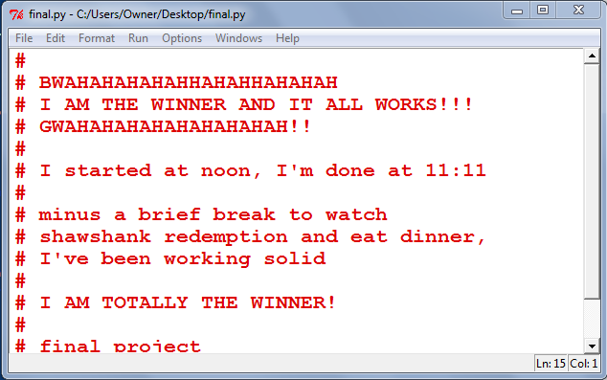
Final project ~ comments?!
one of many favorite grading - encountered comments
may you find equal success (and equal movie-watching time!)

Slide 4
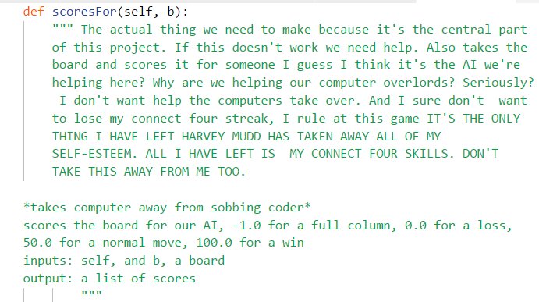
Final project ~ comments?!
one of many favorite grading - encountered comments
Thank you, Laura! (Fall '17)
Laura Gordon '21

Slide 5
The CS view of the world...
?
Input
Output
Algorithm
CS's challenge

Slide 6
Uncomputable functions
!
Input
Output
Algorithm
Sometimes an algorithm simply does not exist…
more precisely: every possible algorithm contains bugs!

Slide 7
Haltchecking is uncomputable.
Halt Checking
hc( f )
~ returns whether f() halts or not
hc always has a bug!

Slide 8
Haltchecking is uncomputable.
any Python function
def hc( f ):
It is impossible to write a (bug-free) function hc(f) that determines if a function f halts when run:
+ hc(f) returns True if f() halts and
+ hc(f) returns False if f() loops infinitely

Slide 9
Haltchecking is uncomputable.
Halt Checking
hc( f )
~ returns whether f() halts or not
def f1():
return 42
def f2():
while 1+1==2:
print('Ha')
return 42
def f3():
if f1() \
or f2():
return 5
hc(f1)
hc(f2)
hc(f3)
What should hc return for each of these?

Slide 10
Haltchecking is uncomputable.
Halt Checking
hc( f )
~ returns whether f() halts or not
def f1():
return 42
def f2():
while 1+1==2:
print('Ha')
return 42
def f3():
if f1() \
or f2():
return 5
hc(f1)
True
hc(f2)
False
hc(f3)
???
What should hc return for each of these?

Slide 11
Suppose hc(f) worked for all f
Create this BFF:
def BFF():
if hc(BFF) == True:
while 1+1==2: print 'Ha!'
else:
return # halt!
Is hc(BFF) == True ?
Is hc(BFF) == False ?
hc always has a bug
Proven!

Slide 12
And this is important because …
∞ loops are undetectable
some are detectable, but some are not – and there's no way to know!
bugs are inevitable
infinite loops are just one type of bug… In general, they're all undetectable
Rice's Theorem: CS81
programming is not automatable…
not perfect programming, at least

Slide 13
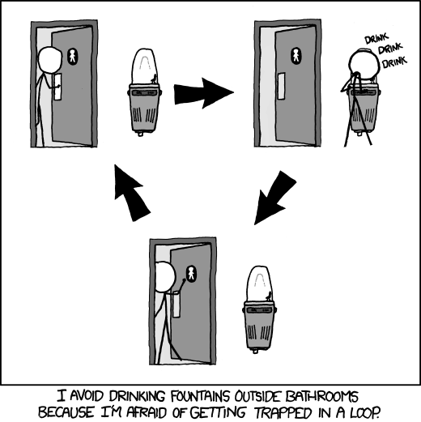
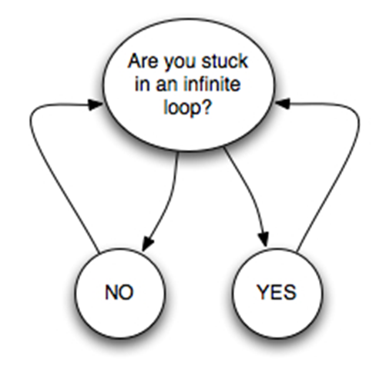
it's why CSers celebrate infinite loops !

Slide 14
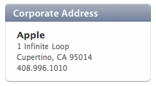
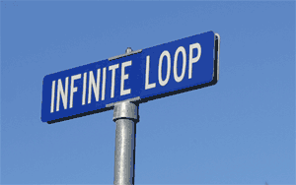
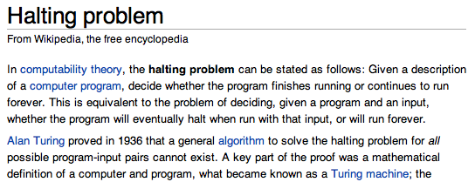
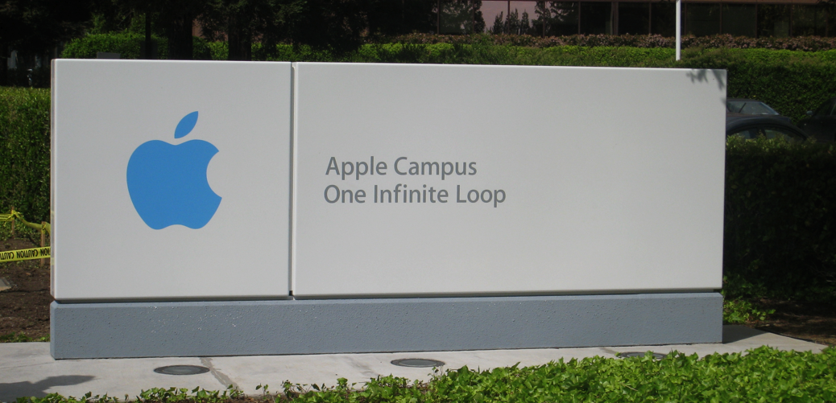
it's why CSers celebrate infinite loops !
the iPhone's icon for Google Maps …

Slide 15
original iPhone icon for Maps

Slide 16
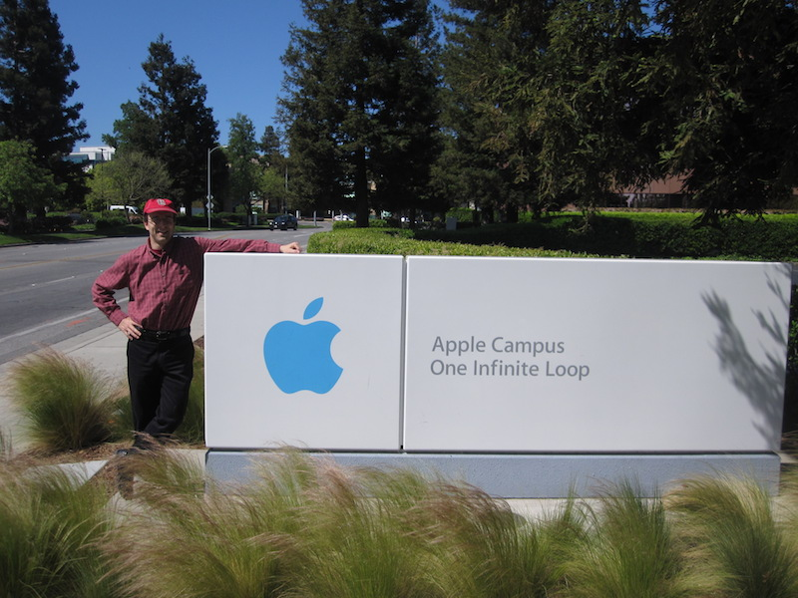
CS tourism !
the iPhone's icon for Google Maps …

Slide 17
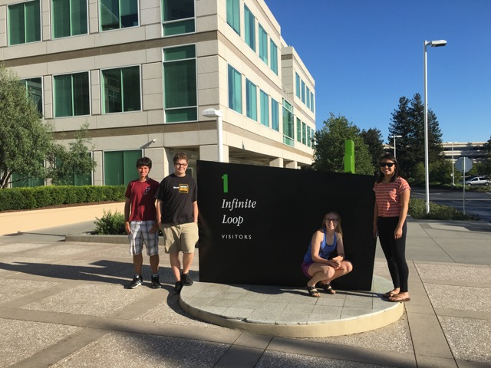
CS tourism !

Slide 18
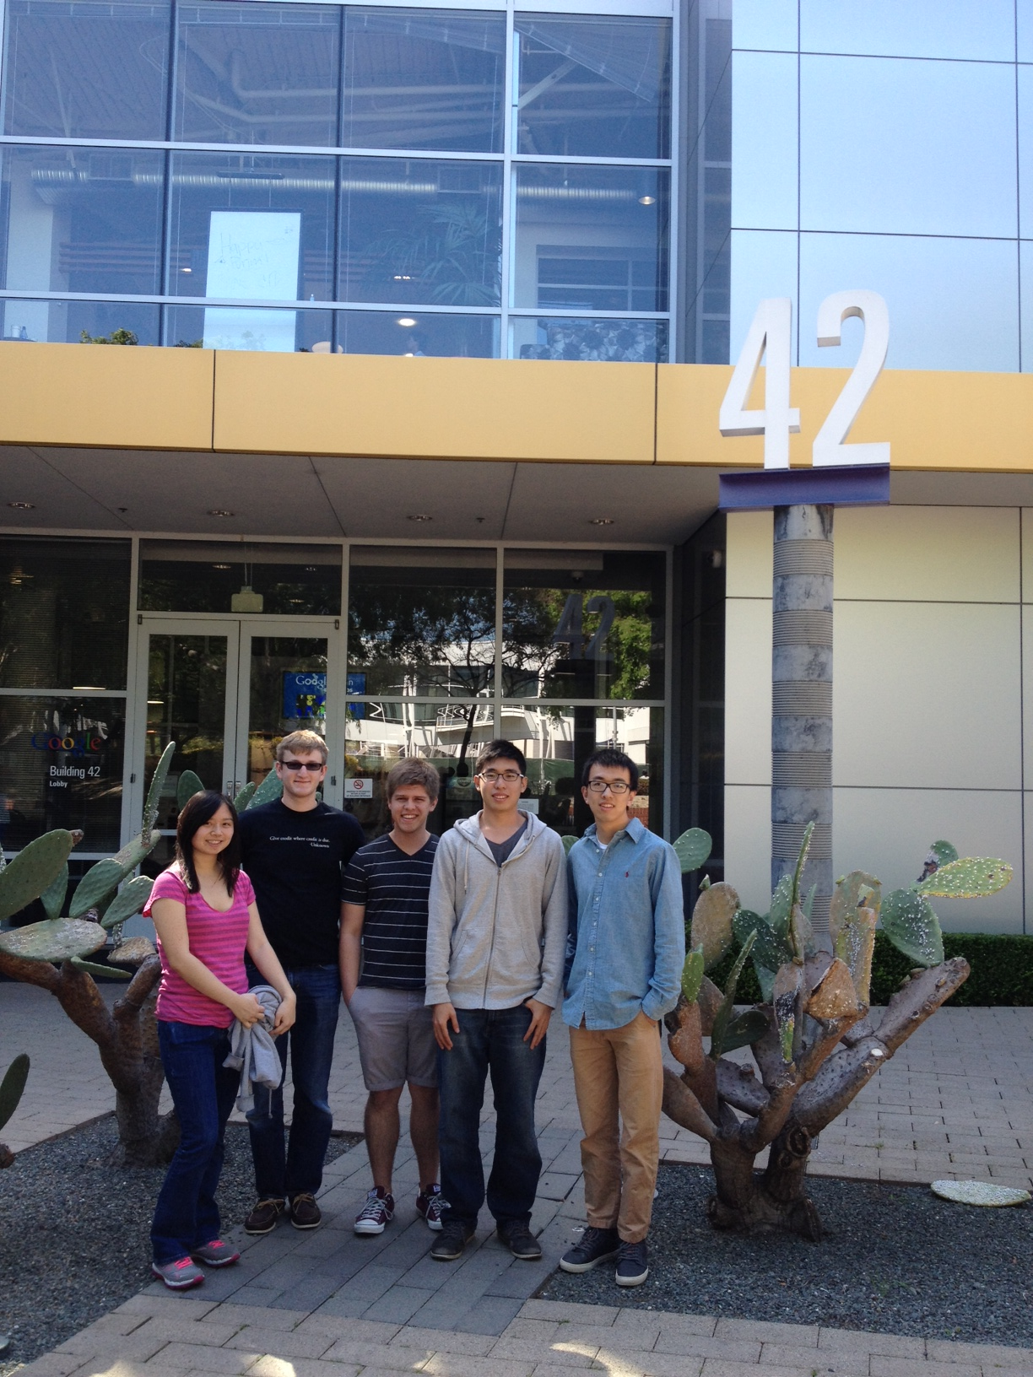
@ Google
the iPhone's icon for Google Maps …

Slide 19
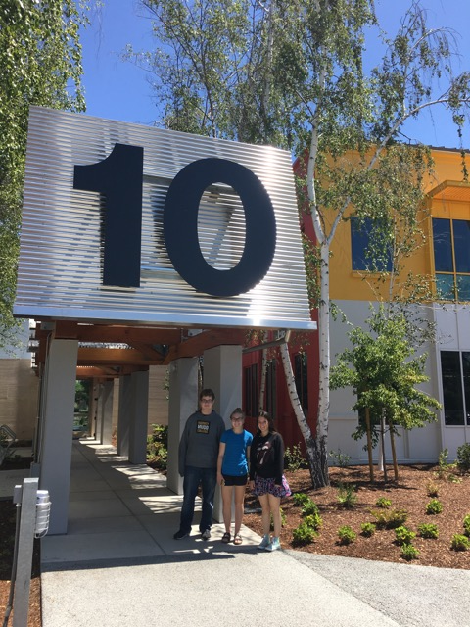
CS tourism @ ???...

Slide 20
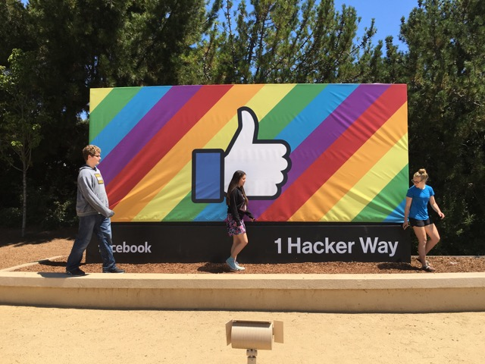
CS tourism @ FB...

Slide 21
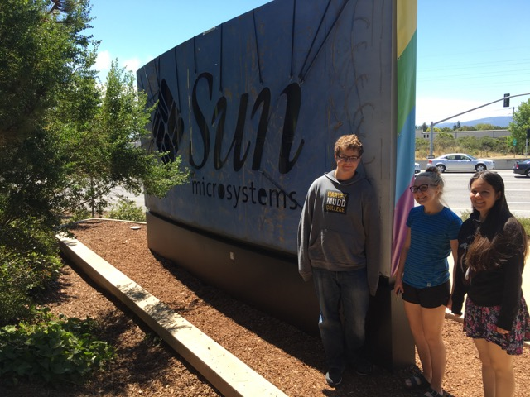
"Facebook is forever...!?"

Slide 22
Meaningful functions?
?
Input
Output
Algorithm
but, nearly all meaningful functions are computable…
the exception: functions that try to predict software behavior!

Slide 23
CS 5's examples…
?
Input
Output
Algorithm
Connect 4 Board
intelligent move
Input text
Markov model + new text
current gener. of “life” cells
next gener. of “life” cells

Slide 24
CS 5's examples…
?
Input
Output
Algorithm
Connect 4 Board
intelligent move
balance of utility & creativity / aesthetics?
Input text
Markov model + new text
current gener. of “life” cells
next gener. of “life” cells

Slide 25
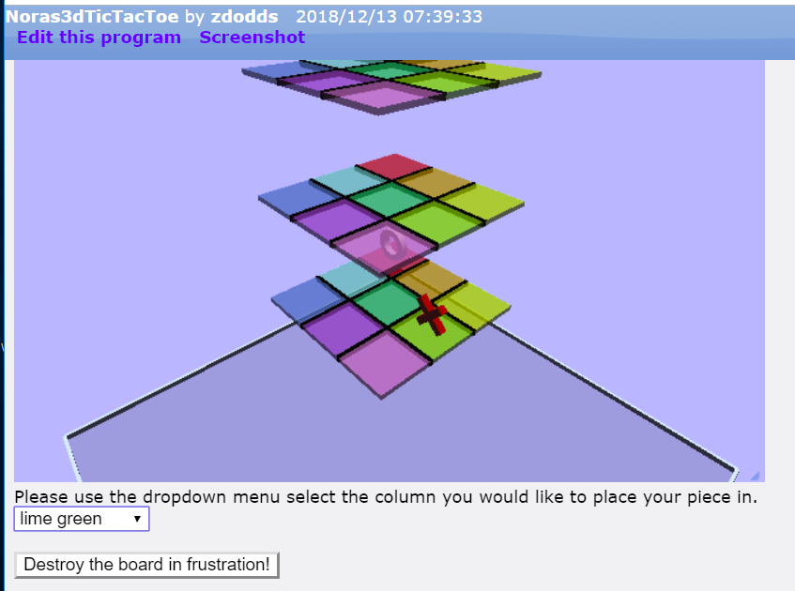
Utilitarian...
vs. Useful

Slide 26
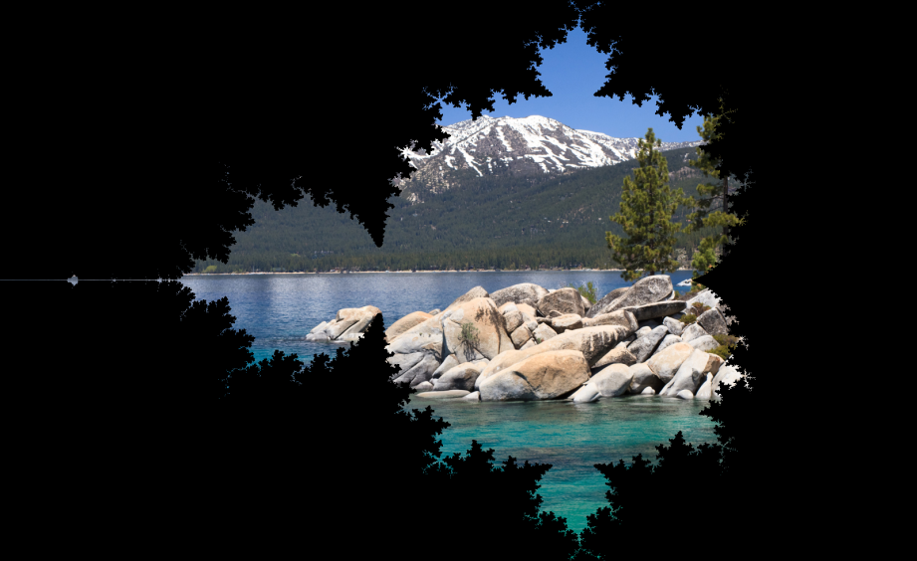
Mandelbrot Vistas!

Slide 27
Still Vaster!

Slide 28
"Science without religion is lame, religion without science is blind."
"Two things are infinite: the universe and human stupidity; and I'm not sure about the universe."
"Duct tape is like the force, it has a light side, a dark side, and it holds the world together"
"If you die in an elevator, be sure to push the Up button."
"All generalizations are false, including this one."
"Clearly you've never been to Singapore!"
"Luke, I am your father."
"To be, or not to be."
"You shall not pass!"
(… all with authors …)
INPUTS
Markov-generated wisdom!
OUTPUTS

Slide 29
"Science without religion is lame, religion without science is blind."
"Two things are infinite: the universe and human stupidity; and I'm not sure about the universe."
"Duct tape is like the force, it has a light side, a dark side, and it holds the world together"
"If you die in an elevator, be sure to push the Up button."
"All generalizations are false, including this one."
"Clearly you've never been to Singapore!"
"Luke, I am your father."
"To be, or not to be."
"You shall not pass!"
(… all with authors …)
INPUTS
Markov-generated wisdom!
"I have a dream! Duct tape is written on. Luke, I am your thoughts and what lies within us."
---- Audrey Rooney
"Your work is lame, religion is lame, religion is nearly the Up button."
---- Abraham Marx
OUTPUTS
"Two things are false, including this one."
---- Captain_Jack Truman

Slide 30
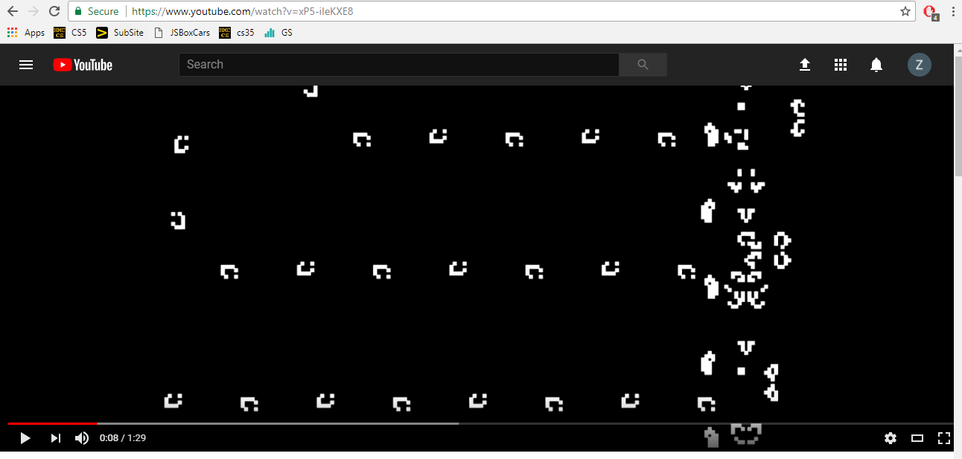
Compositional creativity
clay ~ computation...
Game of Life: GOL...!!!!

Slide 31
Connect-4 Creativity…
aiMove would give each of these 50.0
but which board is really better for black?
Round-robin of aiMove submissions...
taken beyond the extreme…

Slide 32
===== Results for hmc_5 =====
SaminZachariah_hmc_1951110 W: 303 L: 37 T: 0
MacyMills_hmc_1953547 W: 284 L: 56 T: 0
VeronicaShow_hmc_1718597 W: 279 L: 61 T: 0
SamanthaMarquez_hmc_1907922 W: 270 L: 69 T: 1
Congrats to each top 4!
===== Results for hmc_6 =====
WarrenChen_hmc_1914672 W: 246 L: 74 T: 0
JasonMisleh_hmc_1886352 W: 235 L: 84 T: 1
StephenMarzo_hmc_1903120 W: 228 L: 90 T: 2
MariesaTeo_hmc_1908100 W: 228 L: 92 T: 0
========== Final results ==========
StutiGrover_cmc_2002713 W: 1255 L: 0 T: 5
KeoChui_hmc_1710190 W: 1015 L: 241 T: 4
ShanniLam_hmc_1869141 W: 1002 L: 257 T: 1
AustinLong_cmc_1942664 W: 905 L: 348 T: 7
TristanSvenson_cmc_2003016 W: 891 L: 366 T: 3
AidanJohnson_cmc_2002797 W: 888 L: 369 T: 3
IgnacioListaRosales_hmc_1923302 W: 879 L: 358 T: 23
TennyLiu_pomona_1949756 W: 837 L: 410 T: 13
NicoleOberlag_hmc_1807785 W: 827 L: 422 T: 11
KaitlynPaulsen_hmc_1791839 W: 806 L: 442 T: 12
IlonaKariko_hmc_1952361 W: 755 L: 491 T: 14
HelenChaffee_hmc_1869042 W: 703 L: 519 T: 38
SaminZachariah_hmc_1951110 W: 671 L: 588 T: 1
NaseemNazari_cmc_1986487 W: 638 L: 621 T: 1
MaddieKauahi_hmc_1898208 W: 635 L: 619 T: 6
Fionna_hmc_1894718 W: 635 L: 622 T: 3
BrendanTerry_pomona_1957793 W: 631 L: 625 T: 4
DaniHonan_cmc_1964427 W: 628 L: 631 T: 1
JackieMcVay_scripps_1957121 W: 626 L: 629 T: 5
RomiElyashar_scripps_1955696 W: 624 L: 633 T: 3
EmilyKhouw_scripps_1937166 W: 622 L: 634 T: 4
RyanDrover_pitzer_1785920 W: 619 L: 639 T: 2
SafiaHassan_scripps_1849618 W: 614 L: 641 T: 5
AlexCollado_pomona_1980742 W: 613 L: 642 T: 5
VibhaRohilla_hmc_1957874 W: 609 L: 645 T: 6
AnyaZimmermanSmith_cmc_1902647 W: 608 L: 648 T: 4
FrannyLin_cmc_1900107 W: 608 L: 652 T: 0
ElizabethWickham_pomona_1952213 W: 606 L: 651 T: 3
KateLord_hmc_1923757 W: 606 L: 652 T: 2
AdrienneJo_cmc_1955108 W: 606 L: 652 T: 2
ColtonSmith_cmc_1958673 W: 605 L: 653 T: 2
Nicholas_hmc_1948873 W: 604 L: 653 T: 3
CharmaineLau_hmc_1919513 W: 603 L: 655 T: 2
HannahDorris_pomona_1895073 W: 601 L: 652 T: 7
David_webb_1954131 W: 574 L: 674 T: 12
Xin_pomona_1954924 W: 573 L: 644 T: 43
VeronicaShow_hmc_1718597 W: 563 L: 685 T: 12
MadeleineMasserFrye_hmc_1883259 W: 543 L: 701 T: 16
WarrenChen_hmc_1914672 W: 543 L: 715 T: 2
WingChow_webb_1958744 W: 541 L: 700 T: 19
AlfredSimetnal_hmc_2004489 W: 539 L: 721 T: 0
BrandonRuiz_cmc_1954433 W: 535 L: 723 T: 2
AndyYe_cmc_1892450 W: 534 L: 724 T: 2
JasonMisleh_hmc_1886352 W: 534 L: 724 T: 2
JasperTsai_pitzer_1945771 W: 532 L: 728 T: 0
MariesaTeo_hmc_1908100 W: 531 L: 726 T: 3
TiffanyTeng_cmc_1957275 W: 529 L: 730 T: 1
SamuelSoo_cmc_2004020 W: 525 L: 733 T: 2
JackViani_cmc_1957020 W: 525 L: 734 T: 1
JeffreyZhong_webb_1862980 W: 524 L: 734 T: 2
BenjaminLucero_pitzer_1848987 W: 522 L: 736 T: 2
BrandonTuckerMitchell_cmc_1895411 W: 522 L: 736 T: 2
SamanthaMarquez_hmc_1907922 W: 522 L: 738 T: 0
JenniferMace_cmc_1740743 W: 521 L: 733 T: 6
CarolineHoughton_cmc_1957184 W: 520 L: 739 T: 1
StephenMarzo_hmc_1903120 W: 517 L: 742 T: 1
PhousawanhPeaungvongpakdy_hmc_1909357 W: 512 L: 746 T: 2
FaustineShuFu_cmc_1901504 W: 510 L: 750 T: 0
DavenCrossland_pitzer_1956414 W: 510 L: 750 T: 0
WALTERBROSTROM_cmc_1957562 W: 506 L: 753 T: 1
MacyMills_hmc_1953547 W: 500 L: 755 T: 5
AnneLofgren_webb_1849208 W: 498 L: 746 T: 16
JennyThompson_pomona_1866357 W: 497 L: 745 T: 18
HayatRamzi_pomona_1960126 W: 445 L: 797 T: 18
===== Results for pomona_1 =====
TennyLiu_pomona_1949756 W: 191 L: 39 T: 10
HayatRamzi_pomona_1960126 W: 180 L: 50 T: 10
Xin_Zhang_pomona_1954924 W: 166 L: 54 T: 20
JennyThompson_pomona_1866357 W: 163 L: 74 T: 3
===== Results for cmc_4 =====
SamuelSoo_cmc_2004020 W: 259 L: 81 T: 0
FaustineShuFu_cmc_1901504 W: 255 L: 85 T: 0
JackViani_cmc_1957020 W: 252 L: 88 T: 0
WALTERBROSTROM_cmc_1957562 W: 252 L: 88 T: 0
SaviRathi_cmc_1819425 W: 251 L: 89 T: 0
CharlesMangum_cmc_1954851 W: 249 L: 91 T: 0
or so...
===== Results for hmc_2 =====
IgnacioListaRosales_hmc_1923302 W: 287 L: 52 T: 1
HelenChaffee_hmc_1869042 W: 247 L: 87 T: 6
Fionna_hmc_1894718 W: 238 L: 99 T: 3
IlonaKariko_hmc_1952361 W: 233 L: 104 T: 3
And, for the finals...
===== Results for pitzer =====
DavenCrossland_pitzer_1956414 W: 200 L: 60 T: 0
BenjaminLucero_pitzer_1848987 W: 199 L: 61 T: 0
RyanDrover_pitzer_1785920 W: 198 L: 62 T: 0
JasperTsai_pitzer_1945771 W: 198 L: 62 T: 0
EliFujita_pitzer_1849864 W: 196 L: 64 T: 0
===== Results for hmc_1 =====
VibhaRohilla_hmc_1957874 W: 260 L: 80 T: 0
KaitlynPaulsen_hmc_1791839 W: 252 L: 88 T: 0
SolomonValoreCaplan_hmc_1951493 W: 242 L: 98 T: 0
HugoSo_hmc_1876268 W: 230 L: 110 T: 0
StephenGross_hmc_1698315 W: 223 L: 114 T: 3
DelaneyCohn_hmc_1894260 W: 220 L: 119 T: 1
===== Results for scripps =====
RomiElyashar_scripps_1955696 W: 267 L: 111 T: 2
SafiaHassan_scripps_1849618 W: 261 L: 118 T: 1
EmilyKhouw_scripps_1937166 W: 261 L: 118 T: 1
JackieMcVay_scripps_1957121 W: 261 L: 119 T: 0
PaigeBrodrick_scripps_1954766 W: 260 L: 119 T: 1
C4 Tourney ~ 268 entries in fall 2018
===== Results for cmc_3 =====
TiffanyTeng_cmc_1957275 W: 248 L: 90 T: 2
BrandonRuiz_cmc_1954433 W: 246 L: 92 T: 2
NaseemNazari_cmc_1986487 W: 242 L: 98 T: 0
ColtonSmith_cmc_1958673 W: 241 L: 77 T: 22
SarahTritschler_cmc_1769389 W: 239 L: 100 T: 1
KaraSchachter_cmc_1901326 W: 237 L: 103 T: 0
===== Results for pomona_2 =====
HannahDorris_pomona_1895073 W: 177 L: 63 T: 0
AlexCollado_pomona_1980742 W: 174 L: 64 T: 2
ElizabethWickham_pomona_1952213 W: 171 L: 69 T: 0
BrendanTerry_pomona_1957793 W: 168 L: 72 T: 0
===== Results for hmc_3 =====
ShanniLam_hmc_1869141 W: 298 L: 42 T: 0
NicoleOberlag_hmc_1807785 W: 241 L: 99 T: 0
PhousawanhPeaungvongpakdy_hmc_1909357 W: 224 L: 116 T: 0
KateLord_hmc_1923757 W: 216 L: 124 T: 0
===== Results for cmc_5 =====
StutiGrover_cmc_2002713 W: 338 L: 2 T: 0
AndyYe_cmc_1892450 W: 218 L: 122 T: 0
AnyaZimmermanSmith_cmc_1902647 W: 217 L: 123 T: 0
AdrienneJo_cmc_1955108 W: 217 L: 123 T: 0
Others...

Slide 33
===== Results for hmc_5 =====
SaminZachariah_hmc_1951110 W: 303 L: 37 T: 0
MacyMills_hmc_1953547 W: 284 L: 56 T: 0
VeronicaShow_hmc_1718597 W: 279 L: 61 T: 0
SamanthaMarquez_hmc_1907922 W: 270 L: 69 T: 1
Congrats to each top 4!
===== Results for hmc_6 =====
WarrenChen_hmc_1914672 W: 246 L: 74 T: 0
JasonMisleh_hmc_1886352 W: 235 L: 84 T: 1
StephenMarzo_hmc_1903120 W: 228 L: 90 T: 2
MariesaTeo_hmc_1908100 W: 228 L: 92 T: 0
===== Results for pomona_1 =====
TennyLiu_pomona_1949756 W: 191 L: 39 T: 10
HayatRamzi_pomona_1960126 W: 180 L: 50 T: 10
Xin_Zhang_pomona_1954924 W: 166 L: 54 T: 20
JennyThompson_pomona_1866357 W: 163 L: 74 T: 3
===== Results for cmc_4 =====
SamuelSoo_cmc_2004020 W: 259 L: 81 T: 0
FaustineShuFu_cmc_1901504 W: 255 L: 85 T: 0
JackViani_cmc_1957020 W: 252 L: 88 T: 0
WALTERBROSTROM_cmc_1957562 W: 252 L: 88 T: 0
SaviRathi_cmc_1819425 W: 251 L: 89 T: 0
CharlesMangum_cmc_1954851 W: 249 L: 91 T: 0
or so...
===== Results for hmc_2 =====
IgnacioListaRosales_hmc_1923302 W: 287 L: 52 T: 1
HelenChaffee_hmc_1869042 W: 247 L: 87 T: 6
Fionna_hmc_1894718 W: 238 L: 99 T: 3
IlonaKariko_hmc_1952361 W: 233 L: 104 T: 3
And, for the finals...
===== Results for pitzer =====
DavenCrossland_pitzer_1956414 W: 200 L: 60 T: 0
BenjaminLucero_pitzer_1848987 W: 199 L: 61 T: 0
RyanDrover_pitzer_1785920 W: 198 L: 62 T: 0
JasperTsai_pitzer_1945771 W: 198 L: 62 T: 0
EliFujita_pitzer_1849864 W: 196 L: 64 T: 0
===== Results for hmc_1 =====
VibhaRohilla_hmc_1957874 W: 260 L: 80 T: 0
KaitlynPaulsen_hmc_1791839 W: 252 L: 88 T: 0
SolomonValoreCaplan_hmc_1951493 W: 242 L: 98 T: 0
HugoSo_hmc_1876268 W: 230 L: 110 T: 0
StephenGross_hmc_1698315 W: 223 L: 114 T: 3
DelaneyCohn_hmc_1894260 W: 220 L: 119 T: 1
===== Results for scripps =====
RomiElyashar_scripps_1955696 W: 267 L: 111 T: 2
SafiaHassan_scripps_1849618 W: 261 L: 118 T: 1
EmilyKhouw_scripps_1937166 W: 261 L: 118 T: 1
JackieMcVay_scripps_1957121 W: 261 L: 119 T: 0
PaigeBrodrick_scripps_1954766 W: 260 L: 119 T: 1
C4 Tourney ~ 268 entries in fall 2018
===== Results for cmc_3 =====
TiffanyTeng_cmc_1957275 W: 248 L: 90 T: 2
BrandonRuiz_cmc_1954433 W: 246 L: 92 T: 2
NaseemNazari_cmc_1986487 W: 242 L: 98 T: 0
ColtonSmith_cmc_1958673 W: 241 L: 77 T: 22
SarahTritschler_cmc_1769389 W: 239 L: 100 T: 1
KaraSchachter_cmc_1901326 W: 237 L: 103 T: 0
===== Results for pomona_2 =====
HannahDorris_pomona_1895073 W: 177 L: 63 T: 0
AlexCollado_pomona_1980742 W: 174 L: 64 T: 2
ElizabethWickham_pomona_1952213 W: 171 L: 69 T: 0
BrendanTerry_pomona_1957793 W: 168 L: 72 T: 0
===== Results for hmc_3 =====
ShanniLam_hmc_1869141 W: 298 L: 42 T: 0
NicoleOberlag_hmc_1807785 W: 241 L: 99 T: 0
PhousawanhPeaungvongpakdy_hmc_1909357 W: 224 L: 116 T: 0
KateLord_hmc_1923757 W: 216 L: 124 T: 0
===== Results for cmc_5 =====
StutiGrover_cmc_2002713 W: 338 L: 2 T: 0
AndyYe_cmc_1892450 W: 218 L: 122 T: 0
AnyaZimmermanSmith_cmc_1902647 W: 217 L: 123 T: 0
AdrienneJo_cmc_1955108 W: 217 L: 123 T: 0
Others...

Slide 34
===== Results for hmc_5 =====
SaminZachariah_hmc_1951110 W: 303 L: 37 T: 0
MacyMills_hmc_1953547 W: 284 L: 56 T: 0
VeronicaShow_hmc_1718597 W: 279 L: 61 T: 0
SamanthaMarquez_hmc_1907922 W: 270 L: 69 T: 1
Congrats to each top 4!
===== Results for hmc_6 =====
WarrenChen_hmc_1914672 W: 246 L: 74 T: 0
JasonMisleh_hmc_1886352 W: 235 L: 84 T: 1
StephenMarzo_hmc_1903120 W: 228 L: 90 T: 2
MariesaTeo_hmc_1908100 W: 228 L: 92 T: 0
===== Results for pomona_1 =====
TennyLiu_pomona_1949756 W: 191 L: 39 T: 10
HayatRamzi_pomona_1960126 W: 180 L: 50 T: 10
Xin_Zhang_pomona_1954924 W: 166 L: 54 T: 20
JennyThompson_pomona_1866357 W: 163 L: 74 T: 3
===== Results for cmc_4 =====
SamuelSoo_cmc_2004020 W: 259 L: 81 T: 0
FaustineShuFu_cmc_1901504 W: 255 L: 85 T: 0
JackViani_cmc_1957020 W: 252 L: 88 T: 0
WALTERBROSTROM_cmc_1957562 W: 252 L: 88 T: 0
SaviRathi_cmc_1819425 W: 251 L: 89 T: 0
CharlesMangum_cmc_1954851 W: 249 L: 91 T: 0
or so...
===== Results for hmc_2 =====
IgnacioListaRosales_hmc_1923302 W: 287 L: 52 T: 1
HelenChaffee_hmc_1869042 W: 247 L: 87 T: 6
Fionna_hmc_1894718 W: 238 L: 99 T: 3
IlonaKariko_hmc_1952361 W: 233 L: 104 T: 3
And, for the finals...
===== Results for pitzer =====
DavenCrossland_pitzer_1956414 W: 200 L: 60 T: 0
BenjaminLucero_pitzer_1848987 W: 199 L: 61 T: 0
RyanDrover_pitzer_1785920 W: 198 L: 62 T: 0
JasperTsai_pitzer_1945771 W: 198 L: 62 T: 0
EliFujita_pitzer_1849864 W: 196 L: 64 T: 0
===== Results for hmc_1 =====
VibhaRohilla_hmc_1957874 W: 260 L: 80 T: 0
KaitlynPaulsen_hmc_1791839 W: 252 L: 88 T: 0
SolomonValoreCaplan_hmc_1951493 W: 242 L: 98 T: 0
HugoSo_hmc_1876268 W: 230 L: 110 T: 0
StephenGross_hmc_1698315 W: 223 L: 114 T: 3
DelaneyCohn_hmc_1894260 W: 220 L: 119 T: 1
===== Results for scripps =====
RomiElyashar_scripps_1955696 W: 267 L: 111 T: 2
SafiaHassan_scripps_1849618 W: 261 L: 118 T: 1
EmilyKhouw_scripps_1937166 W: 261 L: 118 T: 1
JackieMcVay_scripps_1957121 W: 261 L: 119 T: 0
PaigeBrodrick_scripps_1954766 W: 260 L: 119 T: 1
========== Top results by school... ==========
StutiGrover_cmc_2002713 W: 1255 L: 0 T: 5
KeoChui_hmc_1710190 W: 1015 L: 241 T: 4
ShanniLam_hmc_1869141 W: 1002 L: 257 T: 1
TennyLiu_pomona_1949756 W: 837 L: 410 T: 13
JackieMcVay_scripps_1957121 W: 626 L: 629 T: 5
RomiElyashar_scripps_1955696 W: 624 L: 633 T: 3
RyanDrover_pitzer_1785920 W: 619 L: 639 T: 2
C4 Tourney ~ 268 entries in fall 2018
===== Results for cmc_3 =====
TiffanyTeng_cmc_1957275 W: 248 L: 90 T: 2
BrandonRuiz_cmc_1954433 W: 246 L: 92 T: 2
NaseemNazari_cmc_1986487 W: 242 L: 98 T: 0
ColtonSmith_cmc_1958673 W: 241 L: 77 T: 22
SarahTritschler_cmc_1769389 W: 239 L: 100 T: 1
KaraSchachter_cmc_1901326 W: 237 L: 103 T: 0
===== Results for pomona_2 =====
HannahDorris_pomona_1895073 W: 177 L: 63 T: 0
AlexCollado_pomona_1980742 W: 174 L: 64 T: 2
ElizabethWickham_pomona_1952213 W: 171 L: 69 T: 0
BrendanTerry_pomona_1957793 W: 168 L: 72 T: 0
===== Results for hmc_3 =====
ShanniLam_hmc_1869141 W: 298 L: 42 T: 0
NicoleOberlag_hmc_1807785 W: 241 L: 99 T: 0
PhousawanhPeaungvongpakdy_hmc_1909357 W: 224 L: 116 T: 0
KateLord_hmc_1923757 W: 216 L: 124 T: 0
===== Results for cmc_5 =====
StutiGrover_cmc_2002713 W: 338 L: 2 T: 0
AndyYe_cmc_1892450 W: 218 L: 122 T: 0
AnyaZimmermanSmith_cmc_1902647 W: 217 L: 123 T: 0
AdrienneJo_cmc_1955108 W: 217 L: 123 T: 0
Others...

Slide 35
===== Results for hmc_5 =====
SaminZachariah_hmc_1951110 W: 303 L: 37 T: 0
MacyMills_hmc_1953547 W: 284 L: 56 T: 0
VeronicaShow_hmc_1718597 W: 279 L: 61 T: 0
SamanthaMarquez_hmc_1907922 W: 270 L: 69 T: 1
Congrats to each top 4!
===== Results for hmc_6 =====
WarrenChen_hmc_1914672 W: 246 L: 74 T: 0
JasonMisleh_hmc_1886352 W: 235 L: 84 T: 1
StephenMarzo_hmc_1903120 W: 228 L: 90 T: 2
MariesaTeo_hmc_1908100 W: 228 L: 92 T: 0
===== Results for pomona_1 =====
TennyLiu_pomona_1949756 W: 191 L: 39 T: 10
HayatRamzi_pomona_1960126 W: 180 L: 50 T: 10
Xin_Zhang_pomona_1954924 W: 166 L: 54 T: 20
JennyThompson_pomona_1866357 W: 163 L: 74 T: 3
===== Results for cmc_4 =====
SamuelSoo_cmc_2004020 W: 259 L: 81 T: 0
FaustineShuFu_cmc_1901504 W: 255 L: 85 T: 0
JackViani_cmc_1957020 W: 252 L: 88 T: 0
WALTERBROSTROM_cmc_1957562 W: 252 L: 88 T: 0
SaviRathi_cmc_1819425 W: 251 L: 89 T: 0
CharlesMangum_cmc_1954851 W: 249 L: 91 T: 0
or so...
===== Results for hmc_2 =====
IgnacioListaRosales_hmc_1923302 W: 287 L: 52 T: 1
HelenChaffee_hmc_1869042 W: 247 L: 87 T: 6
Fionna_hmc_1894718 W: 238 L: 99 T: 3
IlonaKariko_hmc_1952361 W: 233 L: 104 T: 3
And, for the finals...
===== Results for pitzer =====
DavenCrossland_pitzer_1956414 W: 200 L: 60 T: 0
BenjaminLucero_pitzer_1848987 W: 199 L: 61 T: 0
RyanDrover_pitzer_1785920 W: 198 L: 62 T: 0
JasperTsai_pitzer_1945771 W: 198 L: 62 T: 0
EliFujita_pitzer_1849864 W: 196 L: 64 T: 0
===== Results for hmc_1 =====
VibhaRohilla_hmc_1957874 W: 260 L: 80 T: 0
KaitlynPaulsen_hmc_1791839 W: 252 L: 88 T: 0
SolomonValoreCaplan_hmc_1951493 W: 242 L: 98 T: 0
HugoSo_hmc_1876268 W: 230 L: 110 T: 0
StephenGross_hmc_1698315 W: 223 L: 114 T: 3
DelaneyCohn_hmc_1894260 W: 220 L: 119 T: 1
===== Results for scripps =====
RomiElyashar_scripps_1955696 W: 267 L: 111 T: 2
SafiaHassan_scripps_1849618 W: 261 L: 118 T: 1
EmilyKhouw_scripps_1937166 W: 261 L: 118 T: 1
JackieMcVay_scripps_1957121 W: 261 L: 119 T: 0
PaigeBrodrick_scripps_1954766 W: 260 L: 119 T: 1
C4 Tourney ~ 268 entries in fall 2018
===== Results for cmc_3 =====
TiffanyTeng_cmc_1957275 W: 248 L: 90 T: 2
BrandonRuiz_cmc_1954433 W: 246 L: 92 T: 2
NaseemNazari_cmc_1986487 W: 242 L: 98 T: 0
ColtonSmith_cmc_1958673 W: 241 L: 77 T: 22
SarahTritschler_cmc_1769389 W: 239 L: 100 T: 1
KaraSchachter_cmc_1901326 W: 237 L: 103 T: 0
===== Results for pomona_2 =====
HannahDorris_pomona_1895073 W: 177 L: 63 T: 0
AlexCollado_pomona_1980742 W: 174 L: 64 T: 2
ElizabethWickham_pomona_1952213 W: 171 L: 69 T: 0
BrendanTerry_pomona_1957793 W: 168 L: 72 T: 0
===== Results for hmc_3 =====
ShanniLam_hmc_1869141 W: 298 L: 42 T: 0
NicoleOberlag_hmc_1807785 W: 241 L: 99 T: 0
PhousawanhPeaungvongpakdy_hmc_1909357 W: 224 L: 116 T: 0
KateLord_hmc_1923757 W: 216 L: 124 T: 0
===== Results for cmc_5 =====
StutiGrover_cmc_2002713 W: 338 L: 2 T: 0
AndyYe_cmc_1892450 W: 218 L: 122 T: 0
AnyaZimmermanSmith_cmc_1902647 W: 217 L: 123 T: 0
AdrienneJo_cmc_1955108 W: 217 L: 123 T: 0
Others...

Slide 36
===== Results for hmc_5 =====
SaminZachariah_hmc_1951110 W: 303 L: 37 T: 0
MacyMills_hmc_1953547 W: 284 L: 56 T: 0
VeronicaShow_hmc_1718597 W: 279 L: 61 T: 0
SamanthaMarquez_hmc_1907922 W: 270 L: 69 T: 1
C4 Tourney ~ 268 entries in fall 2018!
Congrats to each top 4!
===== Results for pomona_1 =====
TennyLiu_pomona_1949756 W: 191 L: 39 T: 10
HayatRamzi_pomona_1960126 W: 180 L: 50 T: 10
Xin_Zhang_pomona_1954924 W: 166 L: 54 T: 20
JennyThompson_pomona_1866357 W: 163 L: 74 T: 3
===== Results for hmc_2 =====
IgnacioListaRosales_hmc_1923302 W: 287 L: 52 T: 1
HelenChaffee_hmc_1869042 W: 247 L: 87 T: 6
Fionna_hmc_1894718 W: 238 L: 99 T: 3
IlonaKariko_hmc_1952361 W: 233 L: 104 T: 3
===== Results for webb =====
JeffreyZhong_webb_1862980 W: 46 L: 34 T: 0
WingChow_webb_1958744 W: 41 L: 37 T: 2
AnneLofgren_webb_1849208 W: 36 L: 44 T: 0
LukeRaus_webb_1953497 W: 36 L: 44 T: 0
Now for the “final” matches...

Slide 37
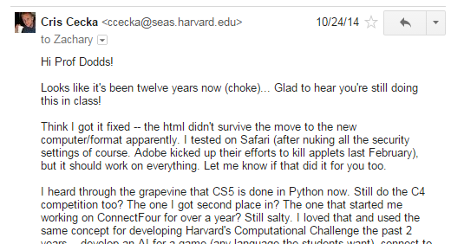
Fifth annual “Cris Cecka” award…

Slide 38
Fifth annual “Cris Cecka” award…
goes to…

Slide 39
?
Input
Output
Algorithm
Fortunately, nearly all meaningful functions are computable…
but this doesn't mean we know how to compute them - yet!
for example …

Slide 40
?
Input
Output
Algorithm
the computer vision problem

Slide 41
?
Input
Output
Algorithm
?
?
computer vision: what's the input and output?

Slide 42
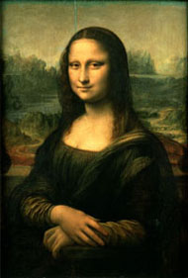
?
Input
Output
Algorithm
That's the Mona Lisa
020 067 073 058 055 076 069 050 074 064 065 066 066 059 023
047 109 107 118 107 115 110 120 120 124 120 128 124 132 131
047 125 130 130 122 121 117 142 131 133 134 141 149 144 135
051 139 143 139 147 134 149 069 127 144 139 144 150 161 149
054 136 161 148 147 158 055 052 034 030 158 156 165 163 156
043 144 165 159 154 171 224 191 047 030 171 165 175 164 163
025 161 174 172 167 049 200 193 112 028 120 169 173 177 173
011 091 101 105 177 039 078 060 041 026 073 102 167 208 121
011 091 094 066 094 033 199 184 139 024 060 094 125 152 134
009 068 072 072 065 031 151 171 075 028 035 072 083 109 063
013 068 074 059 057 037 161 129 062 028 035 071 072 078 056
012 042 063 055 072 033 020 067 031 022 027 082 070 073 060
011 037 064 094 091 026 025 080 066 026 023 071 070 080 060
011 060 077 082 037 023 024 147 140 038 023 037 043 076 037
013 049 076 059 032 028 174 197 182 060 021 021 121 101 062
013 059 111 072 020 078 200 211 182 061 069 059 043 086 106
007 053 057 092 023 105 189 230 210 084 034 021 017 033 091
011 061 072 018 027 054 069 068 062 023 045 011 016 042 044
014 041 047 025 018 040 065 039 024 021 036 041 013 030 022
013 093 106 017 019 027 030 042 012 021 043 013 014 020 027
019 040 029 023 016 024 015 026 011 010 026 017 012 013 014
022 042 030 040 019 015 016 011 012 009 008 012 009 017 019
022 026 018 030 020 012 017 010 008 011 007 015 008 016 034
019 018 048 029 012 054 012 008 008 009 008 012 007 016 005
022 015 057 043 126 135 122 006 005 008 007 019 010 011 008
018 008 009 019 023 093 109 128 063 052 031 010 012 009 006
017 010 010 007 067 054 106 116 067 056 011 028 005 009 006
015 010 012 014 062 076 057 055 019 024 020 006 005 013 004
016 010 008 011 039 025 020 016 011 007 008 007 006 010 003
015 009 010 010 012 011 014 009 008 007 007 005 005 008 002
014 007 008 011 007 012 010 009 007 008 007 005 005 007 003
020 011 015 019 013 017 017 013 019 013 012 013 011 009 005
020 067 073 058 055 076 069 050 074 064 065 066 066 059 023
025 161 174 172 167 049 200 193 112 028 120 169 173 177 173
(low difficulty)
2d array of ints
an image … of what?
That's a 16thc. woman, smiling (maybe…)
(high difficulty)

Slide 43
?
Input
Output
Algorithm
020 067 073 058 055 076 069 050 074 064 065 066 066 059 023
047 109 107 118 107 115 110 120 120 124 120 128 124 132 131
047 125 130 130 122 121 117 142 131 133 134 141 149 144 135
051 139 143 139 147 134 149 069 127 144 139 144 150 161 149
054 136 161 148 147 158 055 052 034 030 158 156 165 163 156
043 144 165 159 154 171 224 191 047 030 171 165 175 164 163
025 161 174 172 167 049 200 193 112 028 120 169 173 177 173
011 091 101 105 177 039 078 060 041 026 073 102 167 208 121
011 091 094 066 094 033 199 184 139 024 060 094 125 152 134
009 068 072 072 065 031 151 171 075 028 035 072 083 109 063
013 068 074 059 057 037 161 129 062 028 035 071 072 078 056
012 042 063 055 072 033 020 067 031 022 027 082 070 073 060
011 037 064 094 091 026 025 080 066 026 023 071 070 080 060
011 060 077 082 037 023 024 147 140 038 023 037 043 076 037
013 049 076 059 032 028 174 197 182 060 021 021 121 101 062
013 059 111 072 020 078 200 211 182 061 069 059 043 086 106
007 053 057 092 023 105 189 230 210 084 034 021 017 033 091
011 061 072 018 027 054 069 068 062 023 045 011 016 042 044
014 041 047 025 018 040 065 039 024 021 036 041 013 030 022
013 093 106 017 019 027 030 042 012 021 043 013 014 020 027
019 040 029 023 016 024 015 026 011 010 026 017 012 013 014
022 042 030 040 019 015 016 011 012 009 008 012 009 017 019
022 026 018 030 020 012 017 010 008 011 007 015 008 016 034
019 018 048 029 012 054 012 008 008 009 008 012 007 016 005
022 015 057 043 126 135 122 006 005 008 007 019 010 011 008
018 008 009 019 023 093 109 128 063 052 031 010 012 009 006
017 010 010 007 067 054 106 116 067 056 011 028 005 009 006
015 010 012 014 062 076 057 055 019 024 020 006 005 013 004
016 010 008 011 039 025 020 016 011 007 008 007 006 010 003
015 009 010 010 012 011 014 009 008 007 007 005 005 008 002
014 007 008 011 007 012 010 009 007 008 007 005 005 007 003
020 011 015 019 013 017 017 013 019 013 012 013 011 009 005
020 067 073 058 055 076 069 050 074 064 065 066 066 059 023
025 161 174 172 167 049 200 193 112 028 120 169 173 177 173
2d array of ints
btw, why is it clear these data/image examples definitely don't match?
an image … of what?

Slide 44
Actual image
Actual input: pixels
207 200 199 194 203 126 106 091 113 153 192 196 190 186 175
242 194 213 254 255 114 082 109 097 089 208 206 202 194 185
254 159 187 245 248 128 197 191 166 102 248 251 233 223 246
255 159 191 245 249 123 113 047 124 149 255 253 239 143 250
255 184 191 249 249 126 022 040 115 039 250 255 255 177 252
253 197 190 233 251 054 143 209 196 014 254 254 253 228 251
252 228 176 218 251 070 176 219 200 024 250 255 255 254 195
248 244 163 227 252 091 071 185 079 021 252 251 255 254 138
253 254 169 241 253 141 053 180 005 019 253 253 255 253 201
253 250 170 242 253 138 199 193 216 146 255 253 253 253 233
254 228 164 209 235 144 188 144 161 192 230 250 253 255 252
252 240 140 215 245 119 098 086 139 127 252 234 253 253 251
253 246 169 207 235 120 157 140 188 108 246 249 235 225 255
253 230 167 207 217 113 106 069 168 098 244 246 239 207 254
253 219 170 225 253 122 144 169 124 109 243 235 233 252 252
255 221 179 239 227 123 123 069 125 122 240 249 243 232 253
221 217 180 213 243 126 143 081 181 133 252 249 244 221 210
236 216 178 208 230 225 160 118 187 198 249 249 230 220 221
229 224 183 217 216 165 209 133 193 209 222 238 236 220 214
230 223 185 240 225 212 027 187 202 239 233 234 237 225 232
221 215 189 207 220 221 003 063 209 006 204 203 232 229 216
223 217 198 162 194 215 192 106 077 255 213 219 194 215 219
224 216 162 189 200 254 217 198 209 216 206 226 186 228 219
215 222 168 202 214 201 117 084 085 111 234 190 248 218 226
219 216 198 165 213 227 014 221 197 183 178 186 216 214 222
222 224 197 146 201 204 108 220 201 210 196 223 200 233 218
226 232 177 184 175 230 214 199 146 255 134 225 205 216 181
253 254 194 192 196 168 032 193 194 196 040 198 190 207 185
045 030 167 163 210 041 206 144 129 170 086 190 161 193 191
200 205 135 143 100 174 027 175 189 113 121 150 190 209 184
202 205 138 213 088 037 164 194 194 182 076 077 107 211 181
196 208 155 063 055 068 180 200 193 160 220 082 070 210 181
161 132 058 146 048 076 172 165 218 189 186 063 004 187 185
157 080 191 119 044 025 089 115 063 192 223 146 116 186 187
020 067 073 058 055 076 069 050 074 064 065 066 066 059 023
047 109 107 118 107 115 110 120 120 124 120 128 124 132 131
047 125 130 130 122 121 117 142 131 133 134 141 149 144 135
051 139 143 139 147 134 149 069 127 144 139 144 150 161 149
054 136 161 148 147 158 055 052 034 030 158 156 165 163 156
043 144 165 159 154 171 224 191 047 030 171 165 175 164 163
025 161 174 172 167 049 200 193 112 028 120 169 173 177 173
011 091 101 105 177 039 078 060 041 026 073 102 167 208 121
011 091 094 066 094 033 199 184 139 024 060 094 125 152 134
009 068 072 072 065 031 151 171 075 028 035 072 083 109 063
013 068 074 059 057 037 161 129 062 028 035 071 072 078 056
012 042 063 055 072 033 020 067 031 022 027 082 070 073 060
011 037 064 094 091 026 025 080 066 026 023 071 070 080 060
011 060 077 082 037 023 024 147 140 038 023 037 043 076 037
013 049 076 059 032 028 174 197 182 060 021 021 121 101 062
013 059 111 072 020 078 200 211 182 061 069 059 043 086 106
007 053 057 092 023 105 189 230 210 084 034 021 017 033 091
011 061 072 018 027 054 069 068 062 023 045 011 016 042 044
014 041 047 025 018 040 065 039 024 021 036 041 013 030 022
013 093 106 017 019 027 030 042 012 021 043 013 014 020 027
019 040 029 023 016 024 015 026 011 010 026 017 012 013 014
022 042 030 040 019 015 016 011 012 009 008 012 009 017 019
022 026 018 030 020 012 017 010 008 011 007 015 008 016 034
019 018 048 029 012 054 012 008 008 009 008 012 007 016 005
022 015 057 043 126 135 122 006 005 008 007 019 010 011 008
018 008 009 019 023 093 109 128 063 052 031 010 012 009 006
017 010 010 007 067 054 106 116 067 056 011 028 005 009 006
015 010 012 014 062 076 057 055 019 024 020 006 005 013 004
016 010 008 011 039 025 020 016 011 007 008 007 006 010 003
015 009 010 010 012 011 014 009 008 007 007 005 005 008 002
014 007 008 011 007 012 010 009 007 008 007 005 005 007 003
020 011 015 019 013 017 017 013 019 013 012 013 011 009 005
020 067 073 058 055 076 069 050 074 064 065 066 066 059 023
025 161 174 172 167 049 200 193 112 028 120 169 173 177 173
207 200 191 194 203 131 100 078 093 145 192 196 190 186 175
242 194 221 254 255 126 063 061 052 060 208 206 202 194 185
254 176 211 255 250 126 116 086 070 064 253 252 233 239 253
251 180 203 255 251 123 075 030 070 072 255 253 239 156 255
255 206 194 255 246 141 019 021 035 026 250 255 255 184 255
253 219 190 239 248 119 061 095 065 011 254 254 253 231 255
252 247 181 218 251 142 066 142 080 026 250 255 255 255 204
248 251 167 227 252 146 047 073 047 021 252 251 255 255 145
253 255 170 255 253 147 040 094 000 020 253 253 255 255 203
253 250 170 255 253 144 092 077 106 057 255 253 253 255 238
254 228 173 214 235 145 083 073 058 089 230 250 253 252 253
252 245 140 215 245 125 038 027 044 042 252 234 253 253 252
255 251 169 214 235 110 075 065 060 052 246 249 235 225 255
255 235 167 216 217 105 048 038 046 046 244 246 239 207 254
254 219 170 247 253 104 121 057 042 047 243 235 233 252 254
255 221 179 255 227 099 058 029 034 052 240 249 243 232 253
221 217 180 213 243 081 052 029 055 023 250 249 244 221 210
236 216 178 208 230 149 043 037 056 075 241 249 230 220 221
229 224 183 213 121 036 076 034 069 073 116 248 236 220 214
230 223 185 178 098 070 010 070 097 098 108 101 236 223 232
221 215 190 084 122 070 011 018 075 013 076 079 146 227 216
223 217 120 033 059 071 042 044 013 155 060 070 076 213 219
224 216 030 082 075 139 076 083 099 114 076 133 057 228 219
215 222 033 092 067 063 031 023 070 025 125 055 136 224 226
219 216 076 044 069 119 011 102 078 055 043 054 111 226 222
222 224 063 046 065 080 101 090 054 104 109 123 052 216 218
226 232 086 080 042 123 083 054 031 148 045 072 067 061 164
253 255 072 058 079 056 006 046 056 061 026 085 082 048 127
046 033 080 045 105 027 071 067 054 036 035 059 060 048 120
174 173 047 042 019 055 011 044 095 033 031 052 054 061 118
173 175 039 127 038 024 053 054 050 051 036 038 022 063 126
170 160 058 020 027 027 045 074 057 035 124 036 016 072 124
107 054 027 044 020 035 062 039 115 048 051 046 005 051 117
098 006 045 033 030 027 036 054 025 072 112 044 029 060 115
Actual output: contents
a woman, smiling?

Slide 45
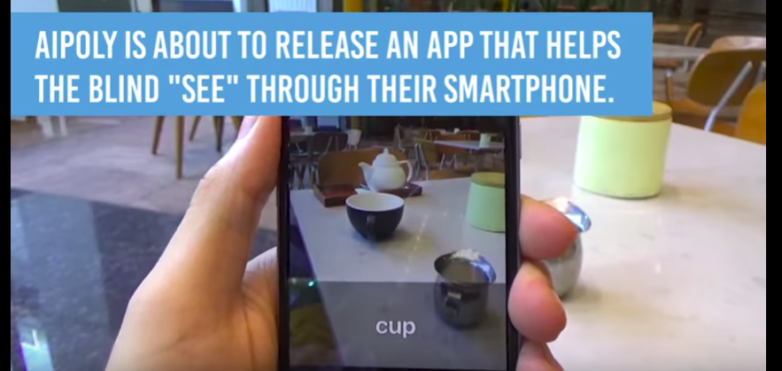
Actual image
Actual input: pixels
207 200 199 194 203 126 106 091 113 153 192 196 190 186 175
242 194 213 254 255 114 082 109 097 089 208 206 202 194 185
254 159 187 245 248 128 197 191 166 102 248 251 233 223 246
255 159 191 245 249 123 113 047 124 149 255 253 239 143 250
255 184 191 249 249 126 022 040 115 039 250 255 255 177 252
253 197 190 233 251 054 143 209 196 014 254 254 253 228 251
252 228 176 218 251 070 176 219 200 024 250 255 255 254 195
248 244 163 227 252 091 071 185 079 021 252 251 255 254 138
253 254 169 241 253 141 053 180 005 019 253 253 255 253 201
253 250 170 242 253 138 199 193 216 146 255 253 253 253 233
254 228 164 209 235 144 188 144 161 192 230 250 253 255 252
252 240 140 215 245 119 098 086 139 127 252 234 253 253 251
253 246 169 207 235 120 157 140 188 108 246 249 235 225 255
253 230 167 207 217 113 106 069 168 098 244 246 239 207 254
253 219 170 225 253 122 144 169 124 109 243 235 233 252 252
255 221 179 239 227 123 123 069 125 122 240 249 243 232 253
221 217 180 213 243 126 143 081 181 133 252 249 244 221 210
236 216 178 208 230 225 160 118 187 198 249 249 230 220 221
229 224 183 217 216 165 209 133 193 209 222 238 236 220 214
230 223 185 240 225 212 027 187 202 239 233 234 237 225 232
221 215 189 207 220 221 003 063 209 006 204 203 232 229 216
223 217 198 162 194 215 192 106 077 255 213 219 194 215 219
224 216 162 189 200 254 217 198 209 216 206 226 186 228 219
215 222 168 202 214 201 117 084 085 111 234 190 248 218 226
219 216 198 165 213 227 014 221 197 183 178 186 216 214 222
222 224 197 146 201 204 108 220 201 210 196 223 200 233 218
226 232 177 184 175 230 214 199 146 255 134 225 205 216 181
253 254 194 192 196 168 032 193 194 196 040 198 190 207 185
045 030 167 163 210 041 206 144 129 170 086 190 161 193 191
200 205 135 143 100 174 027 175 189 113 121 150 190 209 184
202 205 138 213 088 037 164 194 194 182 076 077 107 211 181
196 208 155 063 055 068 180 200 193 160 220 082 070 210 181
161 132 058 146 048 076 172 165 218 189 186 063 004 187 185
157 080 191 119 044 025 089 115 063 192 223 146 116 186 187
020 067 073 058 055 076 069 050 074 064 065 066 066 059 023
047 109 107 118 107 115 110 120 120 124 120 128 124 132 131
047 125 130 130 122 121 117 142 131 133 134 141 149 144 135
051 139 143 139 147 134 149 069 127 144 139 144 150 161 149
054 136 161 148 147 158 055 052 034 030 158 156 165 163 156
043 144 165 159 154 171 224 191 047 030 171 165 175 164 163
025 161 174 172 167 049 200 193 112 028 120 169 173 177 173
011 091 101 105 177 039 078 060 041 026 073 102 167 208 121
011 091 094 066 094 033 199 184 139 024 060 094 125 152 134
009 068 072 072 065 031 151 171 075 028 035 072 083 109 063
013 068 074 059 057 037 161 129 062 028 035 071 072 078 056
012 042 063 055 072 033 020 067 031 022 027 082 070 073 060
011 037 064 094 091 026 025 080 066 026 023 071 070 080 060
011 060 077 082 037 023 024 147 140 038 023 037 043 076 037
013 049 076 059 032 028 174 197 182 060 021 021 121 101 062
013 059 111 072 020 078 200 211 182 061 069 059 043 086 106
007 053 057 092 023 105 189 230 210 084 034 021 017 033 091
011 061 072 018 027 054 069 068 062 023 045 011 016 042 044
014 041 047 025 018 040 065 039 024 021 036 041 013 030 022
013 093 106 017 019 027 030 042 012 021 043 013 014 020 027
019 040 029 023 016 024 015 026 011 010 026 017 012 013 014
022 042 030 040 019 015 016 011 012 009 008 012 009 017 019
022 026 018 030 020 012 017 010 008 011 007 015 008 016 034
019 018 048 029 012 054 012 008 008 009 008 012 007 016 005
022 015 057 043 126 135 122 006 005 008 007 019 010 011 008
018 008 009 019 023 093 109 128 063 052 031 010 012 009 006
017 010 010 007 067 054 106 116 067 056 011 028 005 009 006
015 010 012 014 062 076 057 055 019 024 020 006 005 013 004
016 010 008 011 039 025 020 016 011 007 008 007 006 010 003
015 009 010 010 012 011 014 009 008 007 007 005 005 008 002
014 007 008 011 007 012 010 009 007 008 007 005 005 007 003
020 011 015 019 013 017 017 013 019 013 012 013 011 009 005
020 067 073 058 055 076 069 050 074 064 065 066 066 059 023
025 161 174 172 167 049 200 193 112 028 120 169 173 177 173
207 200 191 194 203 131 100 078 093 145 192 196 190 186 175
242 194 221 254 255 126 063 061 052 060 208 206 202 194 185
254 176 211 255 250 126 116 086 070 064 253 252 233 239 253
251 180 203 255 251 123 075 030 070 072 255 253 239 156 255
255 206 194 255 246 141 019 021 035 026 250 255 255 184 255
253 219 190 239 248 119 061 095 065 011 254 254 253 231 255
252 247 181 218 251 142 066 142 080 026 250 255 255 255 204
248 251 167 227 252 146 047 073 047 021 252 251 255 255 145
253 255 170 255 253 147 040 094 000 020 253 253 255 255 203
253 250 170 255 253 144 092 077 106 057 255 253 253 255 238
254 228 173 214 235 145 083 073 058 089 230 250 253 252 253
252 245 140 215 245 125 038 027 044 042 252 234 253 253 252
255 251 169 214 235 110 075 065 060 052 246 249 235 225 255
255 235 167 216 217 105 048 038 046 046 244 246 239 207 254
254 219 170 247 253 104 121 057 042 047 243 235 233 252 254
255 221 179 255 227 099 058 029 034 052 240 249 243 232 253
221 217 180 213 243 081 052 029 055 023 250 249 244 221 210
236 216 178 208 230 149 043 037 056 075 241 249 230 220 221
229 224 183 213 121 036 076 034 069 073 116 248 236 220 214
230 223 185 178 098 070 010 070 097 098 108 101 236 223 232
221 215 190 084 122 070 011 018 075 013 076 079 146 227 216
223 217 120 033 059 071 042 044 013 155 060 070 076 213 219
224 216 030 082 075 139 076 083 099 114 076 133 057 228 219
215 222 033 092 067 063 031 023 070 025 125 055 136 224 226
219 216 076 044 069 119 011 102 078 055 043 054 111 226 222
222 224 063 046 065 080 101 090 054 104 109 123 052 216 218
226 232 086 080 042 123 083 054 031 148 045 072 067 061 164
253 255 072 058 079 056 006 046 056 061 026 085 082 048 127
046 033 080 045 105 027 071 067 054 036 035 059 060 048 120
174 173 047 042 019 055 011 044 095 033 031 052 054 061 118
173 175 039 127 038 024 053 054 050 051 036 038 022 063 126
170 160 058 020 027 027 045 074 057 035 124 036 016 072 124
107 054 027 044 020 035 062 039 115 048 051 046 005 051 117
098 006 045 033 030 027 036 054 025 072 112 044 029 060 115
Happily, this problem is being solved…
but why is it so challenging?
Actual output: contents
a woman, smiling?
https://www.youtube.com/watch?time_continue=33&v=XMdct-5bERQ

Slide 46
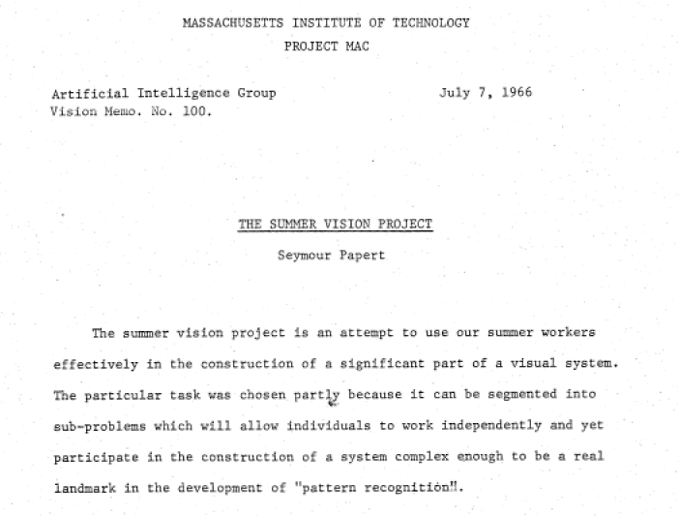
MIT AI Memo #100
- thanks to Rodney Brooks!

Slide 47
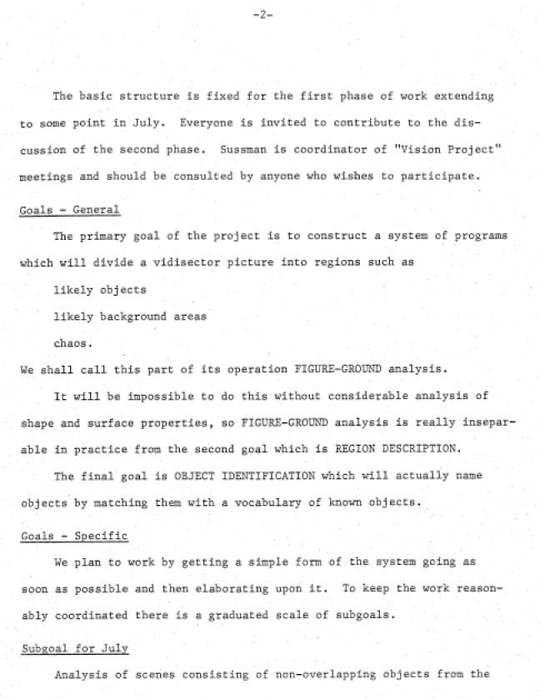
sophomore

Slide 48
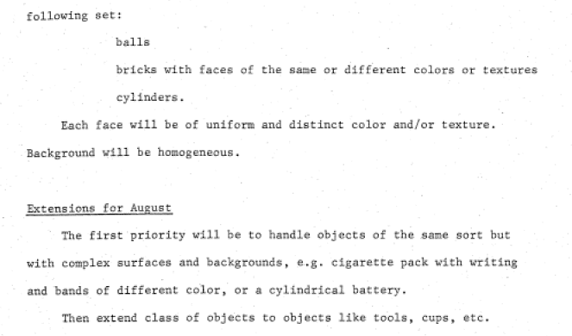

Slide 49
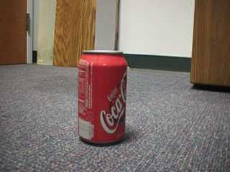
What's red?
Goal: a coke-can collecting robot…

Slide 50
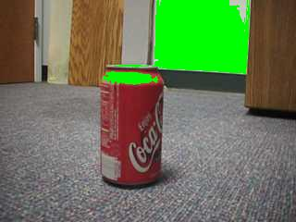
What's red?
red > 200
not good enough…

Slide 51
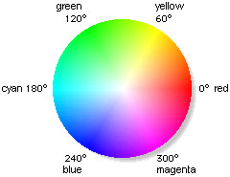
Idea: Use hue
Increasing
hue
hue = 25°
hue = -25°

Slide 52
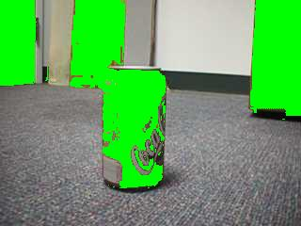
What's red?
-25 < hue < 25
hue's too much!

Slide 53
Idea: Use hue and saturation
Increasing
hue
hue = 25°
sat > 0.75
sat < 0.75
Increasing saturation
hue = -25°

Slide 54
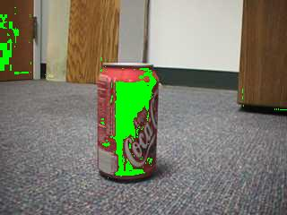
What's red?
Aargh!
-25 < hue < 25
saturation > 0.75
The door is still matched, too… why?

Slide 55
What's red?
Aargh!
-25 < hue < 25
in a sense, this is our own vision systems' fault…!
saturation > 0.75
The door is still matched, too… why?

Slide 56
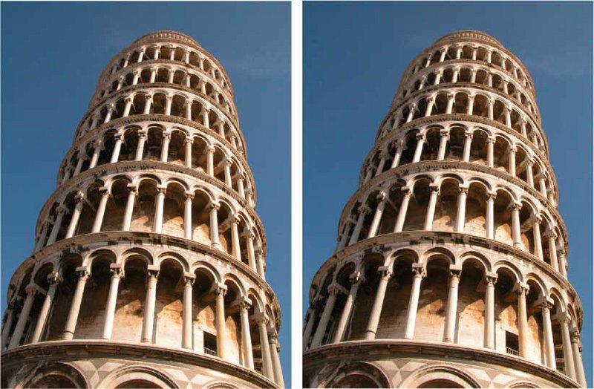
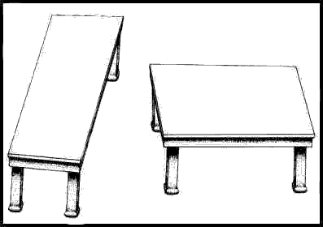
Try it!
Illusions? What computations is your brain doing to cause them? Why?
two tones
two towers
two segments
two tables

Slide 57
2 layers

Slide 58
2 layers

Slide 59
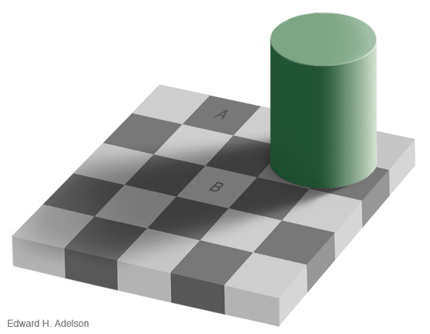
2 layers

Slide 60
2 layers

Slide 63
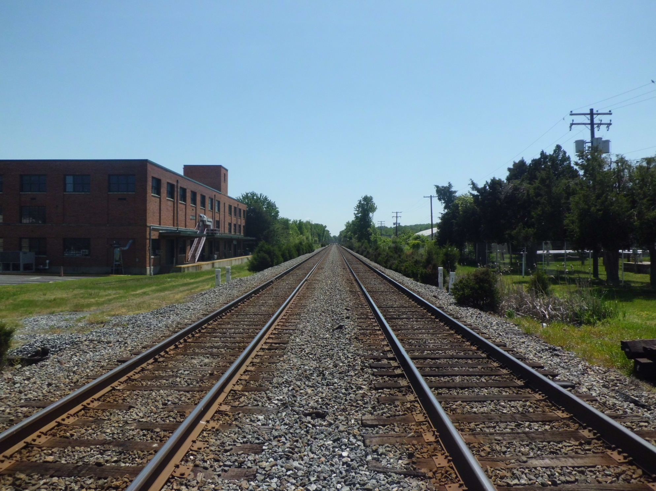
Are these four lines parallel?

Slide 64
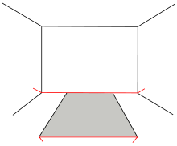

Slide 69
Try it!
Illusions? What computations is your brain doing to cause them? Why?
Vision is more challenging than it might seem on first "glance"!
two tones
two towers
two segments
two tables

Slide 70
we don't always give our own vision system credit for all the work it's doing…

Slide 71
we don't always give our own vision system credit for all the work it's doing…

Slide 72
we don't always give our own vision system credit for all the work it's doing…
Not a "real" example?
What's the most famous pattern like this?

Slide 73
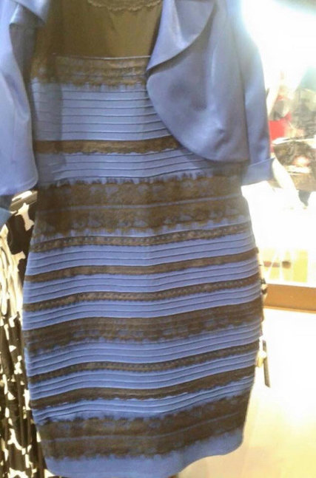
the now-familiar striped dress… !
blue + black
vs.
white + gold

Slide 74
NYT…

Slide 75
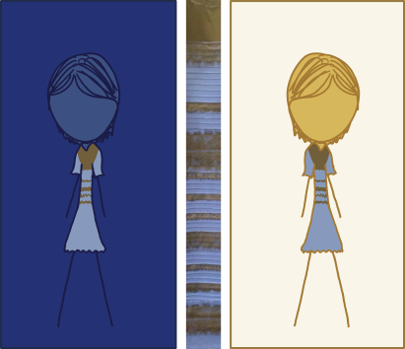
whether or not it can be explained in one picture... xkcd will try!

Slide 76
Let it go!
Aargh!
| hue | < 25
saturation > 0.75
Door == coke can? We'll work around it!

Slide 77
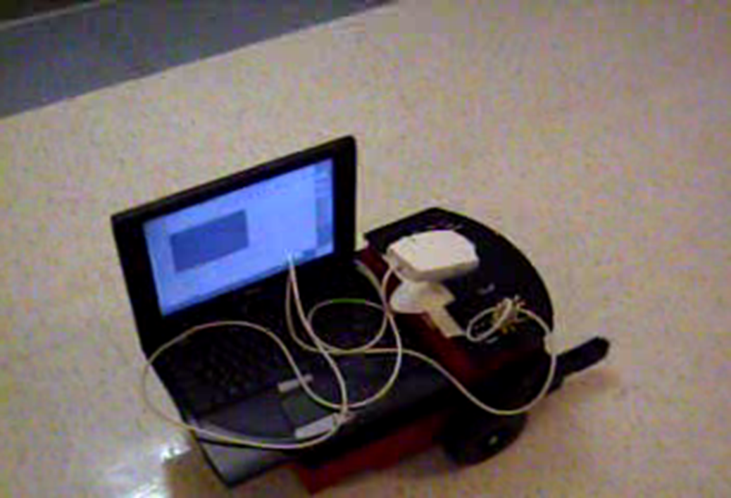
The coke-can collector: seeking…

Slide 78
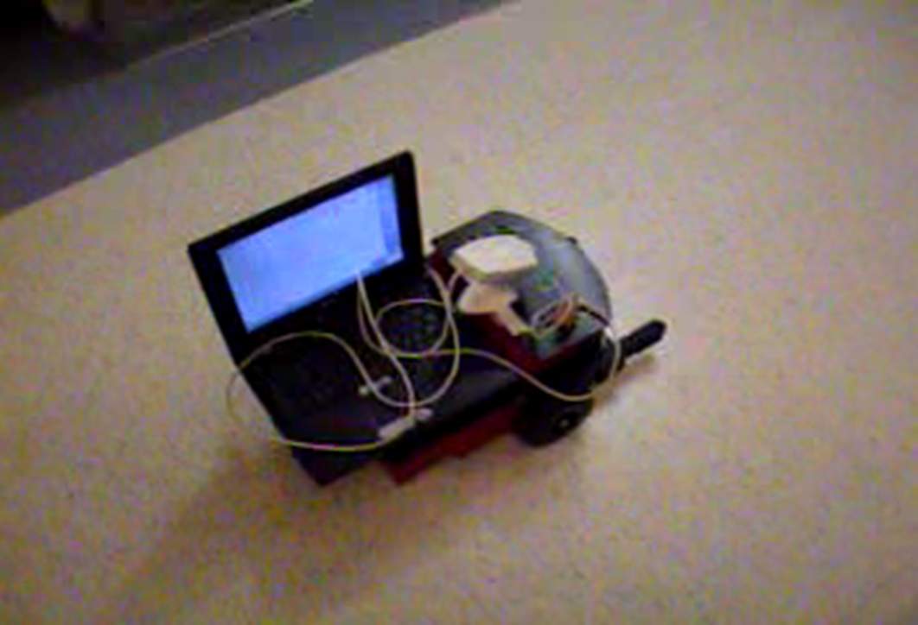
The coke-can collector: seeking…

Slide 79
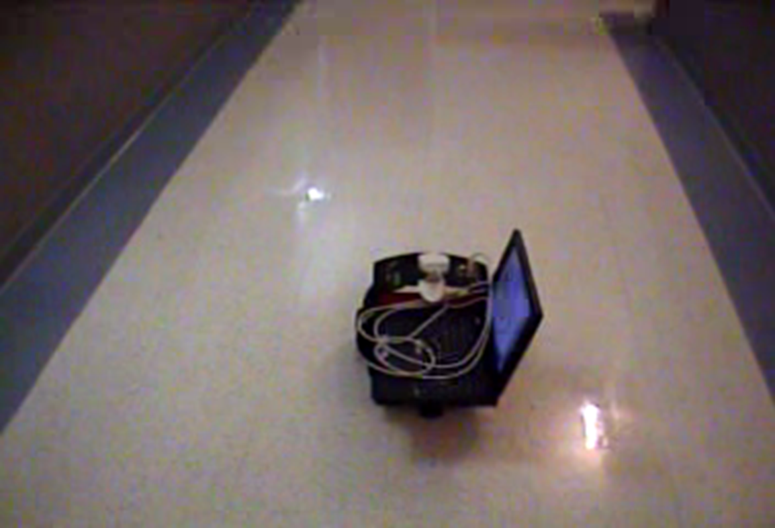
The coke-can collector: success!

Slide 80
How good is CV?
0:27 and 4:00
with human help, pretty good!

Slide 81
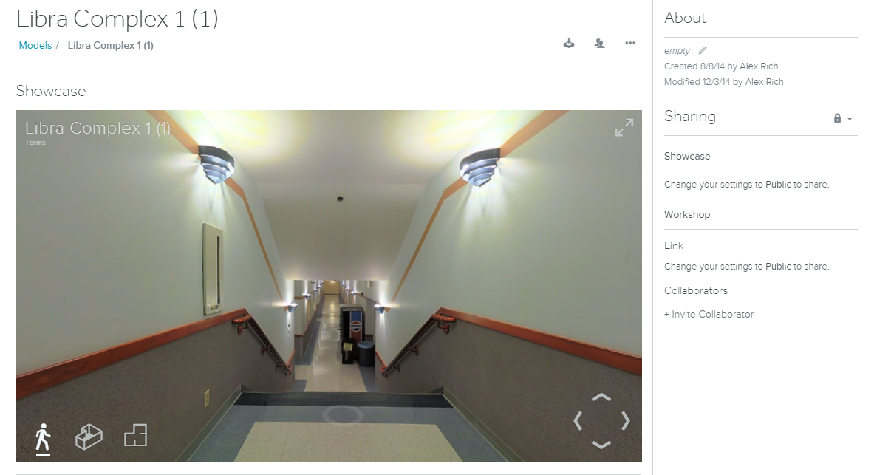
How good is CV on inanimate things?

Slide 82
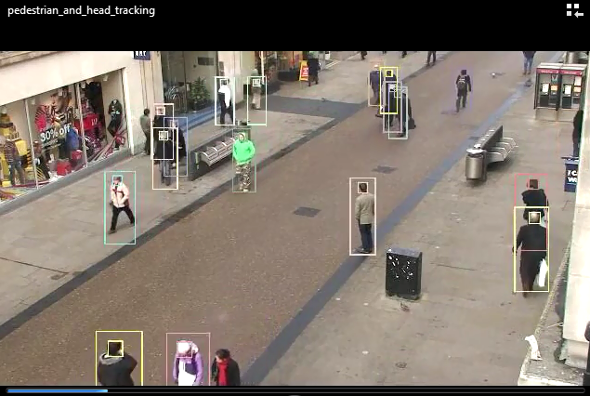
so many pixels!
Actual output: contents
people, walking…

Slide 83
CS 5: the past…
Functions & variables
growing trees
Recursion
looks like broccoli to me!
Representations (binary, ascii)
Caesar cipher
Circuit design & Hmmm
4-bit multiplier
Loops, 2d arrays
Mandelbrot, Life
Dictionaries
Markov Text Gen.
Objects and Classes
Date, C4, Project
Computability
Finite state machines
Uncomputable functions

Slide 84
CS 5: the past…
Functions & variables
growing trees
Recursion
looks like broccoli to me!
Representations (binary, ascii)
Caesar cipher
Future CS?
Circuit design & Hmmm
4-bit multiplier
Loops, 2d arrays
Mandelbrot, Life
Dictionaries
Markov Text Gen.
Objects and Classes
Date, C4, Project
Computability
Finite state machines
Uncomputable functions

Slide 85
Interfaces
User Interfaces, Graphics, Animation
Beyond classes?
CS 124, 155, 157
AI
AI, Neural Networks, Computer Vision, Robotics
CS 151, 152, 153, 154
Compilers, Programming Languages, Networking, Operating Systems, Computer Architecture
Systems
Eng 85, 155, 158 & CS 125, 131, 132, 134, 136
Other CS courses?
Theory
Theory of Computation, Advanced Algorithms
Math 167, 168 & CS 141, 142
SW Engineering &
Logic & Computability
Data structures
CS 81
CS 70, 121
Principles of CS
CS 60

Slide 86
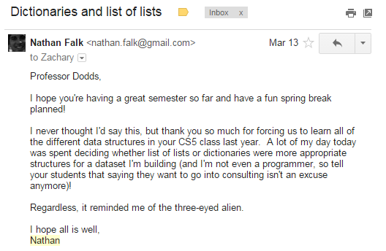
Interfaces
User Interfaces, Graphics, Animation
Beyond classes?
CS 124, 155, 157
AI
AI, Neural Networks, Computer Vision, Robotics
CS 151, 152, 153, 154
Compilers, Programming Languages, Networking, Operating Systems, Computer Architecture
Systems
Eng 85, 155, 158 & CS 125, 131, 132, 134, 136
Other CS courses?
Theory
Theory of Computation, Advanced Algorithms
Math 167, 168 & CS 141, 142
SW Engineering &
Logic & Computability
Data structures
CS 70, 121
Principles of CS
CS 60

Slide 87
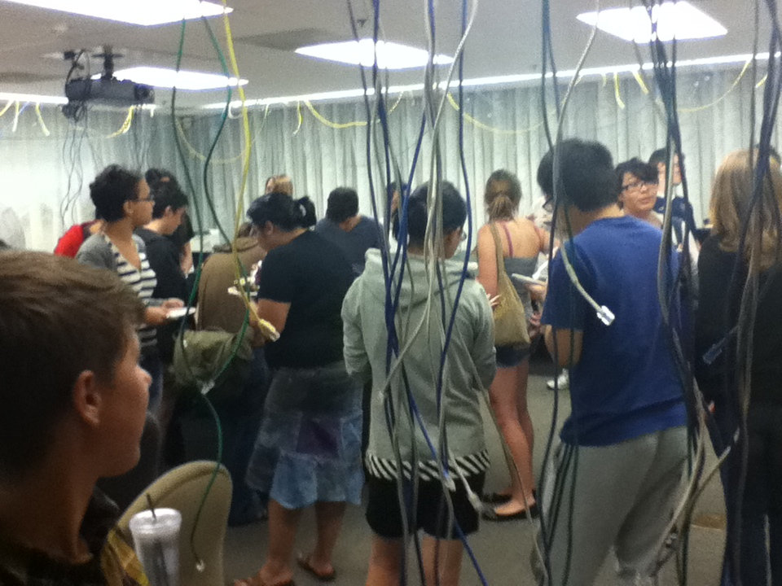
However you're CSing, enjoy!
but what if I'm nostalgic for CS 5 itself ?
6/28 3:18:53

Slide 88
However you're CSing, enjoy!
consider grutoring for CS5 next fall or beyond...
but what if I'm nostalgic for CS 5 itself ?
6/28 3:18:53

Slide 89
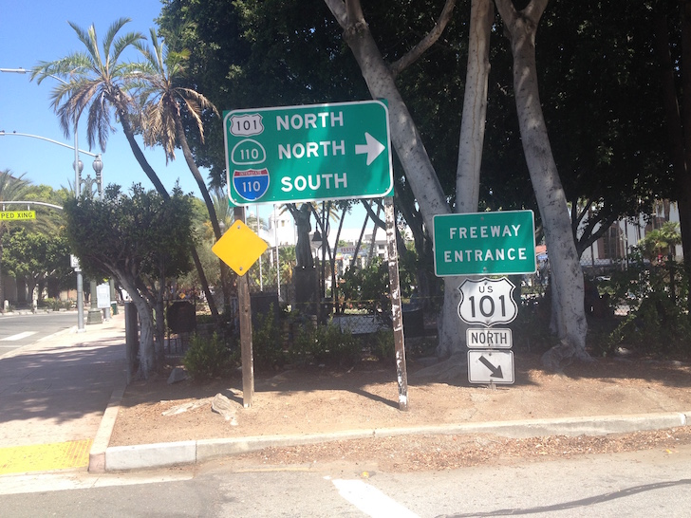
Parting thought:
No matter what road you choose, it's likely to be in binary…

Slide 90
Thank you for joining CS5!
Good luck on all finals (projects, exams, papers…)
Final Projects: due Friday evening…
Exam: Wed, 12/18 @ 7pm
Here in McAlister
Optional review session covering the practice final and any other questions…
REVIEW:
Tuesday evening, 12/17 7-8 pm McAlister (here!)

Slide 93
Fifth annual “Cris Cecka” award…

Slide 94
Fourth annual “Cris Cecka” award…
goes to…

Slide 95
How good is CV on inanimate things?

Slide 96
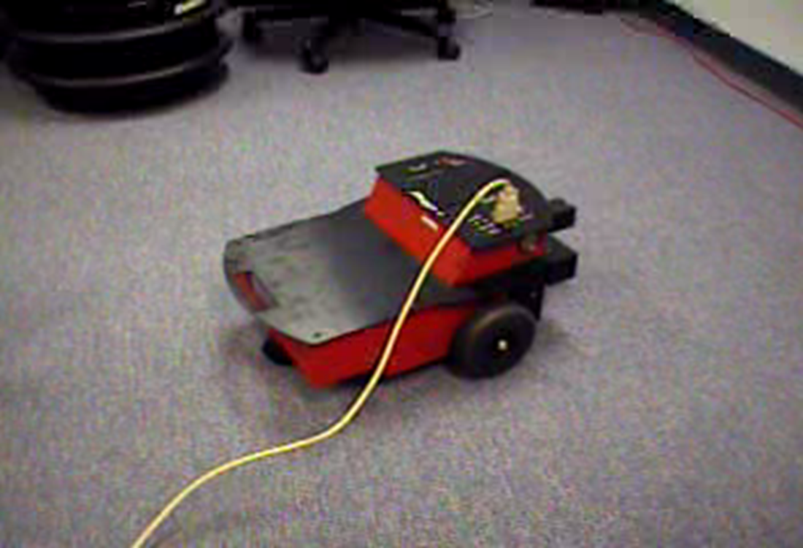
The coke-can collector: wall-avoidance

Slide 97
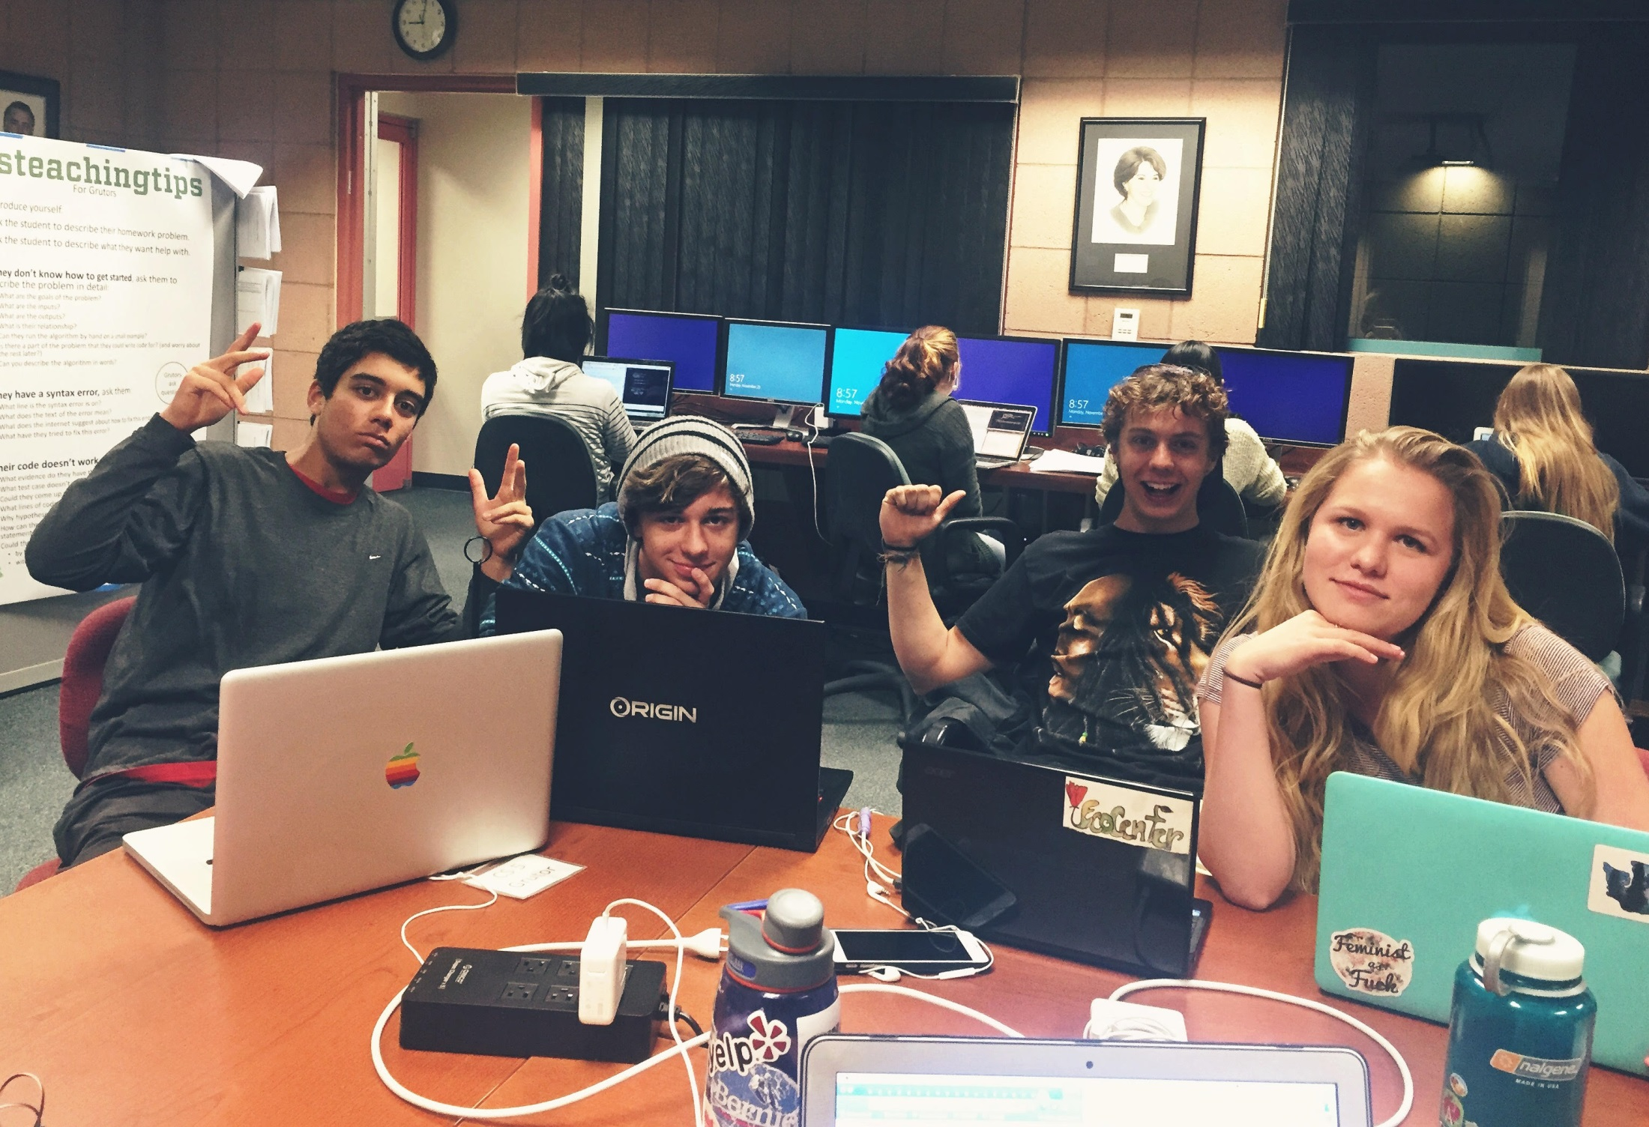
However you're CSing, have fun!
but what if I'm nostalgic for CS 5 itself ?
CS Squad

Slide 99
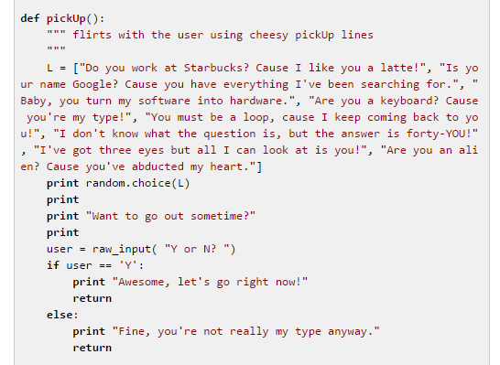
This term: Graders'-choice menu option: cheesy pickup lines
Rachel G.

Slide 100
CMC aschoff/mmenthen/hw11pr2 CMC (9 CMC)
mhafemeister/bjones /hw11pr2 CMC
eopperman/hw11pr2.py: CMC
fafanador/hw11pr2.py: CMC
she/hw11pr2.py: CMC
syerneni/hw11pr2.py: CMC
jwang/hw11pr2.py: CMC
vdhananjaya/hw11pr2.py: CMC
ywang/hw11pr2.py: (Danny) CMC
Pomona blee/hw11pr2.py: Pomona (4 Pomona)
bsangani/hw11pr2.py: Pomona
wachen/hw11pr2.py: Pomona
jle/hw11pr2.py: Pomona
Pitzer
cjackson/hw11pr2.py: Pitzer (1 Pitzer)
Scripps
kgrobeck/hw11pr2.py: Scripps (5 Scripps)
kkim/hw11pr2.py: Scripps
mkeckley/nvincent Scripps
tdinman/hw11pr2.py: Scripps
cdwyer/hw11pr2.py: Scripps
C4 Tourney ~ 19 entries in 2015!
jle:
W: 25 L: 15 T: 0
blee:
W: 24 L: 16 T: 0
wachen:
W: 11 L: 29 T: 0
definitely a record!

Slide 101
CMC aschoff/mmenthen/hw11pr2 CMC (9 CMC)
mhafemeister/bjones /hw11pr2 CMC
eopperman/hw11pr2.py: CMC
fafanador/hw11pr2.py: CMC
she/hw11pr2.py: CMC
syerneni/hw11pr2.py: CMC
jwang/hw11pr2.py: CMC
vdhananjaya/hw11pr2.py: CMC
ywang/hw11pr2.py: (Danny) CMC
Pomona blee/hw11pr2.py: Pomona (4 Pomona)
bsangani/hw11pr2.py: Pomona
wachen/hw11pr2.py: Pomona
jle/hw11pr2.py: Pomona
Pitzer
cjackson/hw11pr2.py: Pitzer (1 Pitzer)
Scripps
kgrobeck/hw11pr2.py: Scripps (5 Scripps)
kkim/hw11pr2.py: Scripps
mkeckley/nvincent Scripps
tdinman/hw11pr2.py: Scripps
cdwyer/hw11pr2.py: Scripps
C4 Tourney ~ 19 entries in 2015!
definitely a record!
cjackson … undefeated!

Slide 102
CMC aschoff/mmenthen/hw11pr2 CMC (9 CMC)
mhafemeister/bjones /hw11pr2 CMC
eopperman/hw11pr2.py: CMC
fafanador/hw11pr2.py: CMC
she/hw11pr2.py: CMC
syerneni/hw11pr2.py: CMC
jwang/hw11pr2.py: CMC
vdhananjaya/hw11pr2.py: CMC
ywang/hw11pr2.py: (Danny) CMC
Pomona blee/hw11pr2.py: Pomona (4 Pomona)
bsangani/hw11pr2.py: Pomona
wachen/hw11pr2.py: Pomona
jle/hw11pr2.py: Pomona
Pitzer
cjackson/hw11pr2.py: Pitzer (1 Pitzer)
Scripps
kgrobeck/hw11pr2.py: Scripps (5 Scripps)
kkim/hw11pr2.py: Scripps
mkeckley/nvincent Scripps
tdinman/hw11pr2.py: Scripps
cdwyer/hw11pr2.py: Scripps
C4 Tourney ~ 41 entries in 2015!
a record – by far!
cdwyer:
W: 13 L: 7 T: 0
tdinman:
W: 7 L: 13 T: 0

Slide 103
C4 Tourney ~ 41 entries in 2015!
vdhananjaya:
W: 76 L: 24 T: 0
jle:
W: 25 L: 15 T: 0
blee:
W: 24 L: 16 T: 0
Final four-ish…
cjackson
… undefeated!
cdwyer:
W: 13 L: 7 T: 0

Slide 104
C4 Tourney ~ 41 entries in 2015!
vdhananjaya:
W: 76 L: 24 T: 0
jle:
W: 25 L: 15 T: 0
blee:
W: 24 L: 16 T: 0
Final four-ish…
cjackson
… undefeated!
cdwyer:
W: 13 L: 7 T: 0

Slide 105
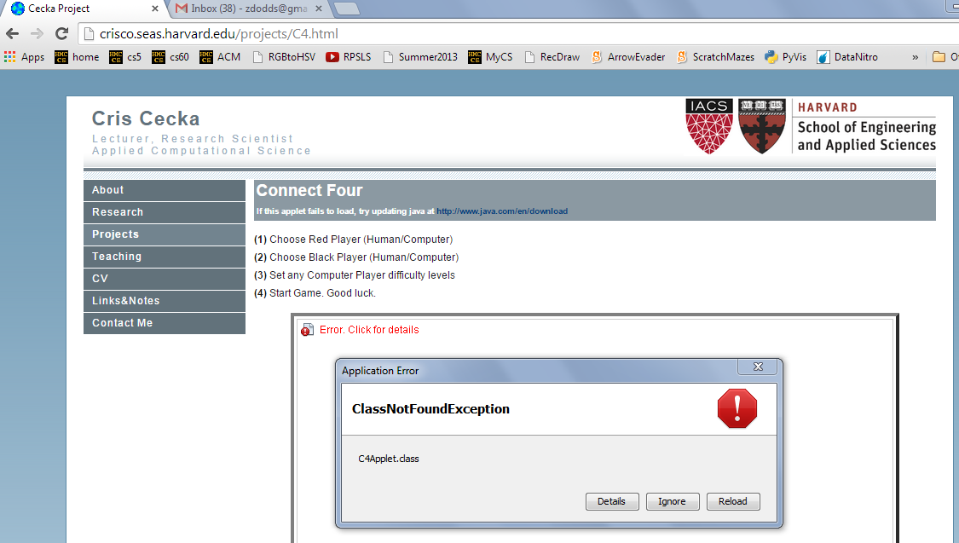
Aargh!

Slide 106
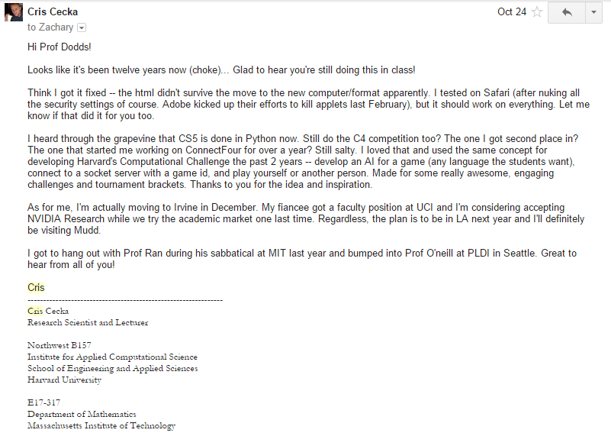
This year's Cris Cecka award…

Slide 107
motion, too!

Slide 108
Why are these uncomputable?
Where did kc and hc go wrong?
They involved computing what other programs were going to do…
useful – but impossible!
Rice's Theorem: Programs can not determine the behavior of other programs (in general). If they try, they always have bugs.

Slide 109
sbaron: W: 226 L: 14 T: 0
mirvine: W: 168 L: 72 T: 0
choyt: W: 165 L: 75 T: 0
kbae: W: 126 L: 114 T: 0
nfalk: W: 119 L: 121 T: 0
irisliu: W: 114 L: 126 T: 0
hyewonc: W: 108 L: 132 T: 0
nappleton: W: 105 L: 135 T: 0
gpaz: W: 81 L: 159 T: 0
briane: W: 77 L: 163 T: 0
jstevick: W: 40 L: 200 T: 0
cbernhardt: W: 40 L: 200 T: 0
C4 Tourney ~ across multiple years…
2014 and 2013 entries…

Slide 110
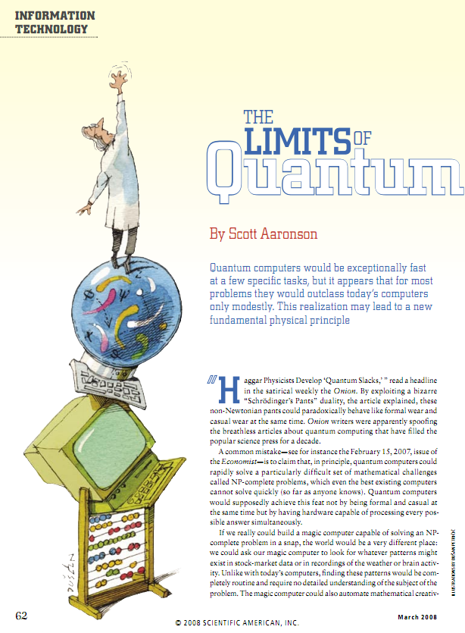
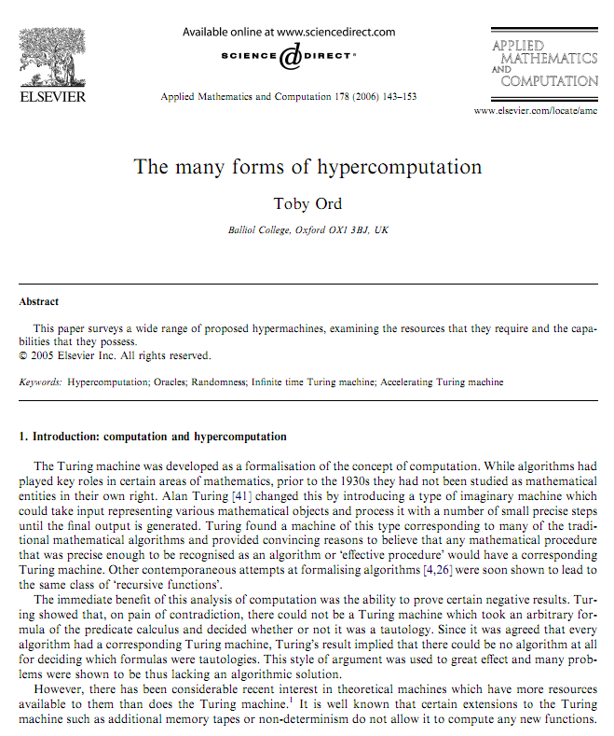
Hyper-turing computation?
HyperTuring computation is easy – just add coffee to your TM!
http://www.amirrorclear.net/academic/papers/many-forms.pdf
http://www.cs.virginia.edu/~robins/The_Limits_of_Quantum_Computers.pdf
Notes:
elementary proof: Mary Cartwright -- simplest proof, asked as a problem on an examination at Cambridge University… ~ 1947 (Girton College within Cambridge)

Slide 111
Hyper-turing computation?
HyperTuring computation is easy – just add coffee to your TM!
http://www.amirrorclear.net/academic/papers/many-forms.pdf
http://www.cs.virginia.edu/~robins/The_Limits_of_Quantum_Computers.pdf
Notes:
elementary proof: Mary Cartwright -- simplest proof, asked as a problem on an examination at Cambridge University… ~ 1947 (Girton College within Cambridge)

Slide 112
Hyper-turing computation?
HyperTuring computation is easy – just add coffee to your TM!
http://www.amirrorclear.net/academic/papers/many-forms.pdf
http://www.cs.virginia.edu/~robins/The_Limits_of_Quantum_Computers.pdf
Notes:
elementary proof: Mary Cartwright -- simplest proof, asked as a problem on an examination at Cambridge University… ~ 1947 (Girton College within Cambridge)

Slide 113
The early vision of vision
images hold great potential, but
complex contexts make vision surprisingly difficult!
The perfect ingredients for a research field…
G. Sussman

Slide 114
we don't always give our own vision system credit for everything it's doing…

Slide 115
human vision can be deceived, too!

Slide 116
3d modeling!
Incredibly, our vision systems can do this.
errors?

Slide 117
State of the "art" …
Actual output: contents
3d world model

Slide 118
Nearly there… ?
the Garage theme is a nice touch!

Slide 119
There recedes surprisingly quickly!
Automated Material Handling Order Fulfillment System
Kiva Systems, M. Mountz

Slide 120
An elegant example of the 2d and 3d geometry of vision

Slide 121
Fukuda's vision atop vision's geometry

Slide 122
Fukuda's vision atop vision's geometry

Slide 123
Life, in life!

Slide 124
Life, in life!
https://www.youtube.com/watch?v=xP5-iIeKXE8

Slide 125
It's easy to read this too fast…

Slide 127
3d reconstruction ?
Incredibly, our vision systems can do this.

Slide 128
BWAHAHAHAHAHHAHAHHAHAHAH
I AM THE WINNER AND IT ALL WORKS!!! GWAHAHAHAHAHAHAHAHAH!!
I started at noon, I'm done at 11:11
minus a brief break to watch shawshank redemption and eat dinner,
I've been working solid
I AM TOTALLY THE WINNER!
one of many favorite grading - encountered comments

Slide 129
2 layers

Slide 130
2 layers

Slide 131
2 layers

Slide 132
2 layers

Slide 136
Are these lines parallel?

Slide 141
Quiz
Illusions? What computations is your brain doing to cause them?
Vision is more challenging than it might seem on first "glance"!

Slide 143
Interfaces
User Interfaces, Graphics, Animation
CS 124, 155, 157
AI
AI, Neural Networks, Computer Vision, Robotics
CS 151, 152, 153, 154
Compilers, Programming Languages, Networking, Operating Systems, Computer Architecture
Systems
Eng 85, 155, 158 & CS 125, 131, 132, 134, 136
Theory
Theory of Computation, Advanced Algorithms
Math 167, 168 & CS 141, 142
SW Engineering &
Logic & Computability
Data structures
CS 81
CS 70, 121
Principles of CS
CS 60

Slide 144
CS60 ~ Other Languages
(define (whoami n)
(if (= n 0)
1
(* n (whoami (- n 1)))))
Racket
public static int whoami(int n)
{
if (n<2) return 1;
else return n* whoami(n-1);
}
Java
whoami(0,1).
whoami(N,F) :- N1 is N-1,
whoami(N1,F1), F is N*F1.
Prolog
Who is whoami ?

Slide 145
Algorithms & efficiency
Suppose your list has N elements…
L = [4, 7, 42, 1, …, 0, 14, -5, 5]
Find L's max
Sort L
Will sorting or max-finding take more work?

Slide 146
Algorithms & efficiency
Suppose your list has N elements…
L = [4, 7, 42, 1, …, 0, 14, -5, 5]
Find L's max
?
Find L's median
?
Sort L
How much work will median-finding take?

Slide 147
Hectare
Software Engineering
CS 121
'chunky'
Systems and Software
Data structures
CS 70
Principles of CS
CS 60

Slide 148
Summer CS
Project pitches: First Thursday of the spring term…
you might also consider grading for CS5 next fall – all schools welcome...
but what if I'm nostalgic for CS 5 itself ?

Slide 149
Summer CS
Project pitches: First Thursday of the spring term…
you might also consider grading for CS5 next fall – all schools welcome...
but what if I'm nostalgic for CS 5 itself ?

Slide 150
the iPhone's icon for Google Maps …

Slide 151
Future CS ?
but what if I'm nostalgic for CS 5 itself ?
CS's Summer projects colloquium
you might consider grading for CS5 next fall – all schools welcome...
Most likely:
Th., January 19, 2012 ~ place TBA
(probably right here)

Slide 152
CS 5 finale
I'll be back…
CS 5 Practice Exam
That's my line!
CS 5 Review Session
4-5pm Sunday, 12/16 here in Pryne
Rare photograph of CA governor before his morning make-up session.
CS 5 Final Exam
either day is OK!
2pm - on Thu. or Fri. 12/17-18 here in Pryne
2 pages of notes are OK
practice exam is a good review
CS 5 Final Projects
due Fri. 11:59 pm (or Sun. w/ Euro)
Looking back! evals, ideas
Looking ahead? Other options
Most creative pocket design…

Slide 153
CS in the next few years...
the long-awaited emergence of Artificial Intelligence?
Siri+ ?
Natural speech interactions
Google + facebook recognition
Interpretation of images
Physical interactions with the world...
autonomous cars?

Slide 154
Color Tracking
relying on our perceptions of color can be deceiving

Slide 160
Other Courses?
More Python ~ PyGame
CS 10
That's me!

Slide 161
Color definitions
matching based on pixel colors
red > 200
hue < 0.1
Color-based matching...
hue < 0.1
sat > 0.7

Slide 162
Future CS ?
Nostalgic for CS 5 itself ?
CS's Summer projects colloquium
Thursday, January 20, 2011 ~ place TBA
(but probably right here)

Slide 163
Sam
Grading CS5!
Sami

Slide 164
Summer CS
Missile launcher

Slide 165
Summer CS
Robots '11

Slide 166
Martin's Game of Life...

Slide 167
C4 Tourney ~ 277 entries in fall 2017!
Pomona:
({'T': 4, 'L': 101, 'W': 435}, 'LindseyMahomes_pomona_4870969')
({'T': 5, 'L': 117, 'W': 418}, 'PeterMellinger_pomona_4853449')
({'T': 9, 'L': 156, 'W': 375}, 'DanaiFlevaraki_pomona_4850074')
({'T': 2, 'L': 178, 'W': 360}, 'AndrewKim_pomona_4873791')
({'T': 11, 'L': 173, 'W': 356}, 'VedantVohra_pomona_4910425')
({'T': 8, 'L': 192, 'W': 340}, 'MuhammadChaudhry_pomona_4910383')
({'T': 10, 'L': 195, 'W': 335}, 'ElizabethRose_pomona_4828290')
Now for the “semi” and “final” matches...
Scripps
({'T': 2, 'W': 417, 'L': 121}, 'MariaWu_scripps_4843151')
({'T': 1, 'W': 403, 'L': 136}, 'SienaHacker_scripps_5036169')
({'T': 8, 'W': 378, 'L': 154}, 'IfunanyaOkeke_scripps_4863670')
({'T': 10, 'W': 371, 'L': 159}, 'RachelMatthews_scripps_4843741')
({'T': 8, 'W': 371, 'L': 161}, 'Emily_scripps_4843740')
({'T': 8, 'W': 366, 'L': 166}, 'ShannonSong_scripps_4831227')
({'T': 8, 'W': 366, 'L': 166}, 'NiaReneeCooper_scripps_4854344')
Congrats to each top 4:
or so…
CMC North
({'T': 5, 'L': 74, 'W': 621}, 'ShaneliJain_cmc_4861153')
({'T': 9, 'L': 166, 'W': 525}, 'KellyWatanabe_cmc_4861382')
({'T': 8, 'L': 172, 'W': 520}, 'KateLayman_cmc_4826773')
({'T': 5, 'L': 180, 'W': 515}, 'AhmedBilal_cmc_4897387')
({'T': 4, 'L': 182, 'W': 514}, 'KristaDeLaTorre_cmc_4879090')
Pitzer:
({'T': 1, 'W': 297, 'L': 22}, 'ZacharyVeitch_pitzer')
({'T': 3, 'W': 224, 'L': 93}, 'shihaolin_pitzer')
({'T': 0, 'W': 207, 'L': 113}, 'JohnGittens_pitzer')
({'T': 0, 'W': 195, 'L': 125}, 'HassanNasir_pitzer')
({'T': 0, 'W': 194, 'L': 126}, 'AndyParks_pitzer')
({'T': 0, 'W': 186, 'L': 134}, 'LindsayMooradian_pitzer')
({'T': 1, 'W': 185, 'L': 134}, 'TarenBouwman_pitzer')
({'T': 0, 'W': 185, 'L': 135}, 'ChavaRFriedman_pitzer')
CMCSouth
({'L': 128, 'W': 566, 'T': 6}, 'RoxannaKiessling_cmc_4847011')
({'L': 177, 'W': 517, 'T': 6}, 'JinyiJiang_cmc_4877028')
({'L': 212, 'W': 487, 'T': 1}, 'MohnishShah_cmc_4874469')
({'L': 210, 'W': 486, 'T': 4}, 'HenryMinervini_cmc_4900055')
({'L': 227, 'W': 470, 'T': 3}, 'JohannLim_cmc_4847689')
HMCWest
({'W': 667, 'T': 4, 'L': 189}, 'AdityaKetanKhant_hmc')
({'W': 663, 'T': 3, 'L': 194}, 'WingYeeAliciaLaw_hmc')
({'W': 657, 'T': 4, 'L': 199}, 'RakiaSegev_hmc')
({'W': 655, 'T': 1, 'L': 204}, 'JuliaVendemiatti_hmc')
({'W': 649, 'T': 4, 'L': 207}, 'SarahHalvorsen_hmc')
HMCEast
({'W': 654, 'T': 19, 'L': 187}, 'SydneySwanson_hmc_4950731')
({'W': 627, 'T': 12, 'L': 221}, 'Sik_yuPoon_hmc_4843763')
({'W': 618, 'T': 8, 'L': 234}, 'JuliaVendemiatti_hmc_4822934')
({'W': 611, 'T': 6, 'L': 243}, 'WingYeeAliciaLaw_hmc_4874048')

