Slide 1
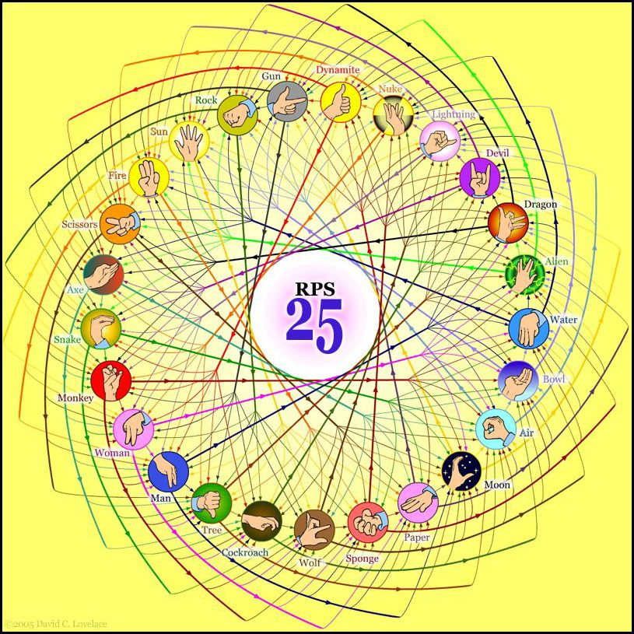
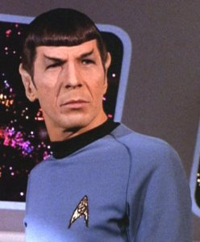
http://www.youtube.com/watch?v=iapcKVn7DdY
http://www.youtube.com/watch?v=yuEZEyDdmvQ
RPS-25 ?!
They call that an alien?
Spock mind-melds three-eyed aliens!
Provably.

Slide 2
Lab lookback…
Get things working
Lab's goal:
Complete 25-50% of the hw
Nick's rule…
Finished with lab? OK! No need to stay longer
print "Five is", (4**4)/44
Wow!?
Four fours is ~
sometimes too many…
othertimes too few…
and never enough! -- Prof. Su

Slide 5
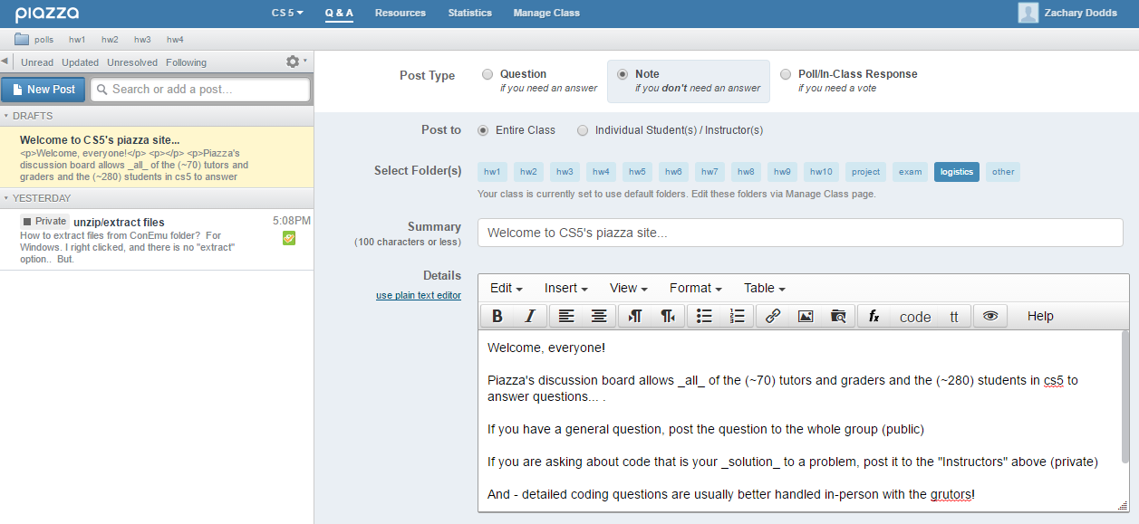
Help via email/Piazza...
for some questions, Piazza is a great resource:
this link:
this Q&Apage

Slide 6
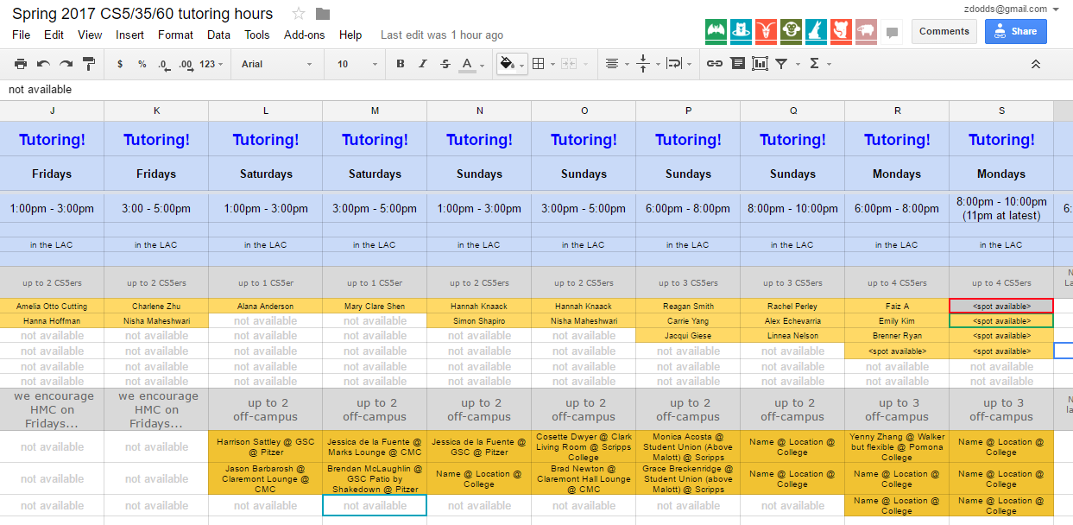
In-person help: "grutoring"
Linde Activities Center
every day there are tutoring hours in the LAC lab
many days there are tutoring hours at other campuses
this link:
this page

Slide 7
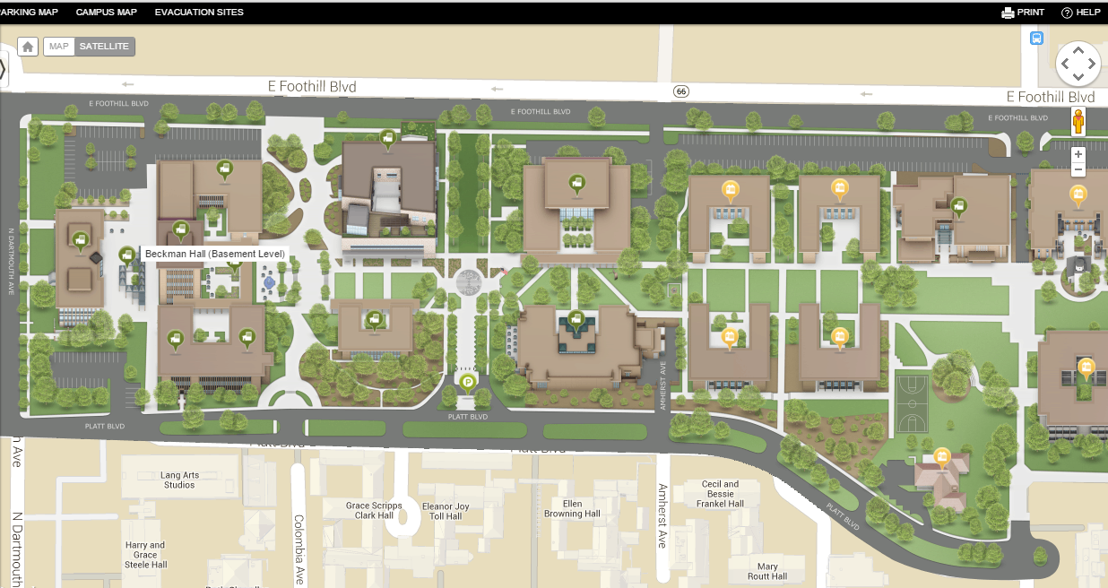
CS5 tutoring location: LAC
Tutoring hours are in the Linde Activities Center computer lab (LAC lab)
west-side entrance
Come by!
coffee
My office hours are Friday 2:00-4:00
LOTS of tutoring hours, as well…

Slide 8
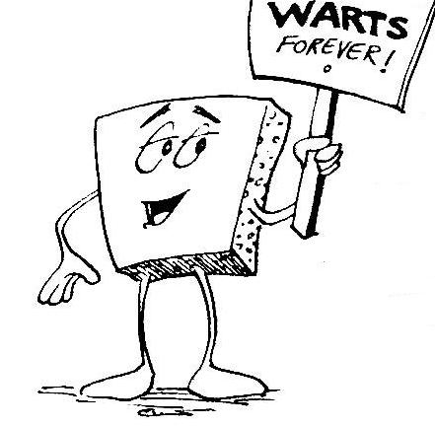
Welcome back to CS 5 !
Average of these two?
Alien
Wally
Problem 0: Reading + response…
Homework 0
Problem 1: Four-fours program: Can be done for lab...
due Mon. night (11:59pm)
Problem 2: Rock-paper-scissors program (Maybe done already!)
Problems 3-4: Picobot! empty room (3) maze (4)

Slide 9
Welcome back to CS 5 !
Yes! I see the resemblance
Picobot!
Alien
Wally
Problem 0: Reading + response…
Homework 0
Problem 1: Four-fours program: Can be done for lab...
due Mon. night (11:59pm)
Problem 2: Rock-paper-scissors program (Maybe done already!)
Problems 3-4: Picobot! empty room (3) maze (4)

Slide 10
Problem 0 ?
Typically an article on CS or an application...
A few sentences that raise or address questions, using the article as a guide.
Submit a one-paragraph response
5 – insightful, careful
4 – thoughtful
3 – complete, on topic
0-2 – less than complete
Small part (5 pts)
This week's article might not seem like CS at first…

Slide 11
and I thought my language was alien!
Seventy years ago, in 1940, a popular science magazine published a short article that set in motion one of the trendiest intellectual fads of the 20th century. At first glance, there seemed little about the article to augur its subsequent celebrity. Neither the title, “Science and Linguistics,” nor the magazine, M.I.T.’s Technology Review, was most people’s idea of glamour. And the author, a chemical engineer who worked for an insurance company and moonlighted as an anthropology lecturer at Yale University, was an unlikely candidate for international superstardom. And yet Benjamin Lee Whorf let loose an alluring idea about language’s power over the mind, and his stirring prose seduced a whole generation into believing that our mother tongue restricts what we are able to think.

Slide 12
and I thought my language was alien!
Seventy years ago, in 1940, a popular science magazine published a short article that set in motion one of the trendiest intellectual fads of the 20th century. At first glance, there seemed little about the article to augur its subsequent celebrity. Neither the title, “Science and Linguistics,” nor the magazine, M.I.T.’s Technology Review, was most people’s idea of glamour. And the author, a chemical engineer who worked for an insurance company and moonlighted as an anthropology lecturer at Yale University, was an unlikely candidate for international superstardom. And yet Benjamin Lee Whorf let loose an alluring idea about language’s power over the mind, and his stirring prose seduced a whole generation into believing that our mother tongue restricts what we are able to think.

Slide 13
Last time…
CS != Programming

Slide 14
What is programming ?
Programming as recipe-writing
vs.
Programming as learning a foreign language
Baggage!
1) Expect it to be different!
2) Don't memorize anything!
3) Immerse == Experiment!
ser/estar
go/went
Notes:
my foreign language teachers always tried to convince me that the skill of speaking, reading and writing a foreign language…
I didn’t believe them then and I don’t believe them now -- but I do believe that reading and writing a computer language is the way to get a strong intuitive understanding of how machines think -- it’s also important for getting them to do what you want them to, but even if you forget everything this course (hopefully) teaches about Java (compiler, datatypes, Classes and Objects), the real goal is that you take away a deeper insight into how machines think
familiar and sometimes not so familiar… deceptively easy
you mean I have to type all that!!

Slide 15
What about the Python programming language ?
Notes:
my foreign language teachers always tried to convince me that the skill of speaking, reading and writing a foreign language…
I didn’t believe them then and I don’t believe them now -- but I do believe that reading and writing a computer language is the way to get a strong intuitive understanding of how machines think -- it’s also important for getting them to do what you want them to, but even if you forget everything this course (hopefully) teaches about Java (compiler, datatypes, Classes and Objects), the real goal is that you take away a deeper insight into how machines think
familiar and sometimes not so familiar… deceptively easy
you mean I have to type all that!!

Slide 16
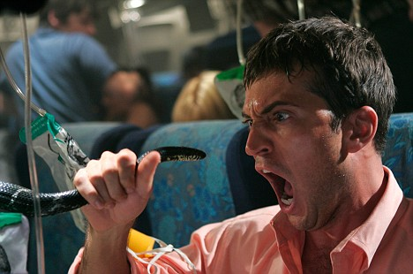
Python ?
One possible relationship...
Notes:
my foreign language teachers always tried to convince me that the skill of speaking, reading and writing a foreign language…
I didn’t believe them then and I don’t believe them now -- but I do believe that reading and writing a computer language is the way to get a strong intuitive understanding of how machines think -- it’s also important for getting them to do what you want them to, but even if you forget everything this course (hopefully) teaches about Java (compiler, datatypes, Classes and Objects), the real goal is that you take away a deeper insight into how machines think
familiar and sometimes not so familiar… deceptively easy
you mean I have to type all that!!

Slide 17
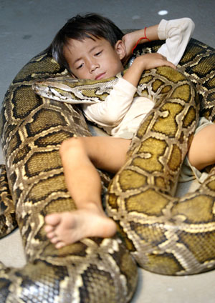
Python !
One possible relationship...
Happy co-existence… It can even be comfy!
Notes:
my foreign language teachers always tried to convince me that the skill of speaking, reading and writing a foreign language…
I didn’t believe them then and I don’t believe them now -- but I do believe that reading and writing a computer language is the way to get a strong intuitive understanding of how machines think -- it’s also important for getting them to do what you want them to, but even if you forget everything this course (hopefully) teaches about Java (compiler, datatypes, Classes and Objects), the real goal is that you take away a deeper insight into how machines think
familiar and sometimes not so familiar… deceptively easy
you mean I have to type all that!!

Slide 18
The foreign language of python…
syntax
semantics
intent
How it looks
What it does
What it should do
Notes:
my foreign language teachers always tried to convince me that the skill of speaking, reading and writing a foreign language…
I didn’t believe them then and I don’t believe them now -- but I do believe that reading and writing a computer language is the way to get a strong intuitive understanding of how machines think -- it’s also important for getting them to do what you want them to, but even if you forget everything this course (hopefully) teaches about Java (compiler, datatypes, Classes and Objects), the real goal is that you take away a deeper insight into how machines think
familiar and sometimes not so familiar… deceptively easy
you mean I have to type all that!!

Slide 19
The foreign language of python…
syntax
semantics
intent
How it looks
What it does
What it should do
name = raw_input('Hi... what is your name? ')
print # prints a blank line
if name == 'Eliot' or name == 'Ran':
print 'I\'m "offline." Try later.'
elif name == 'Zach': # is it Zach?
print 'Zach Quinto...?', 'No?', 'Oh.'
else: # in all other cases...
print 'Welcome', name, '!'
my_choice = random.choice( [ 'R','P','S' ] )
print 'My favorite object is', my_choice, "!"
This program should greet its user appropriately.
Notes:
my foreign language teachers always tried to convince me that the skill of speaking, reading and writing a foreign language…
I didn’t believe them then and I don’t believe them now -- but I do believe that reading and writing a computer language is the way to get a strong intuitive understanding of how machines think -- it’s also important for getting them to do what you want them to, but even if you forget everything this course (hopefully) teaches about Java (compiler, datatypes, Classes and Objects), the real goal is that you take away a deeper insight into how machines think
familiar and sometimes not so familiar… deceptively easy
you mean I have to type all that!!

Slide 20
The foreign language of python…
syntax
semantics
intent
How it looks
What it does
What it should do
name = raw_input('Hi... what is your name? ')
print # prints a blank line
if name == 'Eliot' or name == 'Ran':
print 'I\'m "offline." Try later.'
elif name == 'Zach': # is it Zach?
print 'Zach Quinto...?', 'No?', 'Oh.'
else: # in all other cases...
print 'Welcome', name, '!'
my_choice = random.choice( [ 'R','P','S' ] )
print 'My favorite object is', my_choice, "!"
This program should greet its user appropriately.
human-desired output
Notes:
my foreign language teachers always tried to convince me that the skill of speaking, reading and writing a foreign language…
I didn’t believe them then and I don’t believe them now -- but I do believe that reading and writing a computer language is the way to get a strong intuitive understanding of how machines think -- it’s also important for getting them to do what you want them to, but even if you forget everything this course (hopefully) teaches about Java (compiler, datatypes, Classes and Objects), the real goal is that you take away a deeper insight into how machines think
familiar and sometimes not so familiar… deceptively easy
you mean I have to type all that!!

Slide 21
The foreign language of python…
syntax
semantics
intent
How it looks
What it does
What it should do
name = raw_input('Hi... what is your name? ')
print # prints a blank line
if name == 'Eliot' or name == 'Ran':
print 'I\'m "offline." Try later.'
elif name == 'Zach': # is it Zach?
print 'Zach Quinto...?', 'No?', 'Oh.'
else: # in all other cases...
print 'Welcome', name, '!'
my_choice = random.choice( [ 'R','P','S' ] )
print 'My favorite object is', my_choice, "!"
Notes:
my foreign language teachers always tried to convince me that the skill of speaking, reading and writing a foreign language…
I didn’t believe them then and I don’t believe them now -- but I do believe that reading and writing a computer language is the way to get a strong intuitive understanding of how machines think -- it’s also important for getting them to do what you want them to, but even if you forget everything this course (hopefully) teaches about Java (compiler, datatypes, Classes and Objects), the real goal is that you take away a deeper insight into how machines think
familiar and sometimes not so familiar… deceptively easy
you mean I have to type all that!!

Slide 22
The foreign language of python…
syntax
semantics
intent
How it looks
What it does
What it should do
machine-producedoutput
name = raw_input('Hi... what is your name? ')
print # prints a blank line
if name == 'Eliot' or name == 'Ran':
print 'I\'m "offline." Try later.'
elif name == 'Zach': # is it Zach?
print 'Zach Quinto...?', 'No?', 'Oh.'
else: # in all other cases...
print 'Welcome', name, '!'
my_choice = random.choice( [ 'R','P','S' ] )
print 'My favorite object is', my_choice, "!"
Notes:
my foreign language teachers always tried to convince me that the skill of speaking, reading and writing a foreign language…
I didn’t believe them then and I don’t believe them now -- but I do believe that reading and writing a computer language is the way to get a strong intuitive understanding of how machines think -- it’s also important for getting them to do what you want them to, but even if you forget everything this course (hopefully) teaches about Java (compiler, datatypes, Classes and Objects), the real goal is that you take away a deeper insight into how machines think
familiar and sometimes not so familiar… deceptively easy
you mean I have to type all that!!

Slide 23
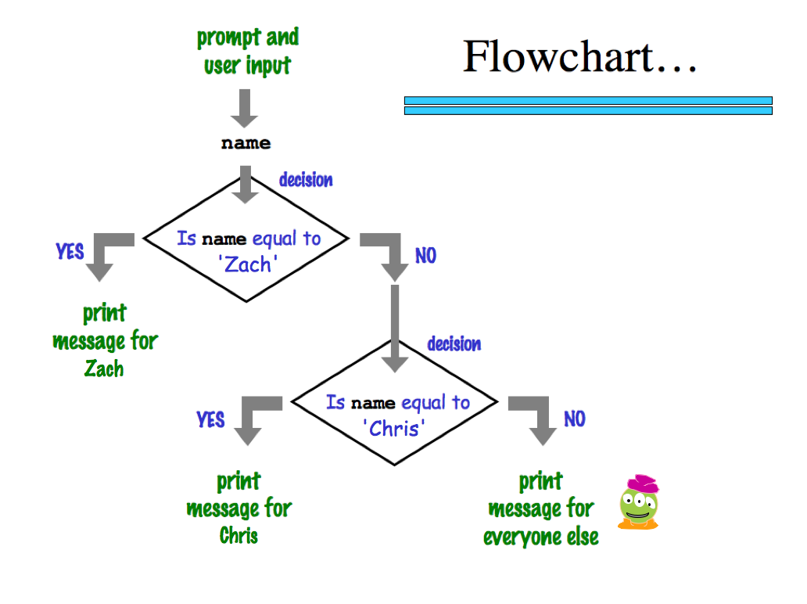
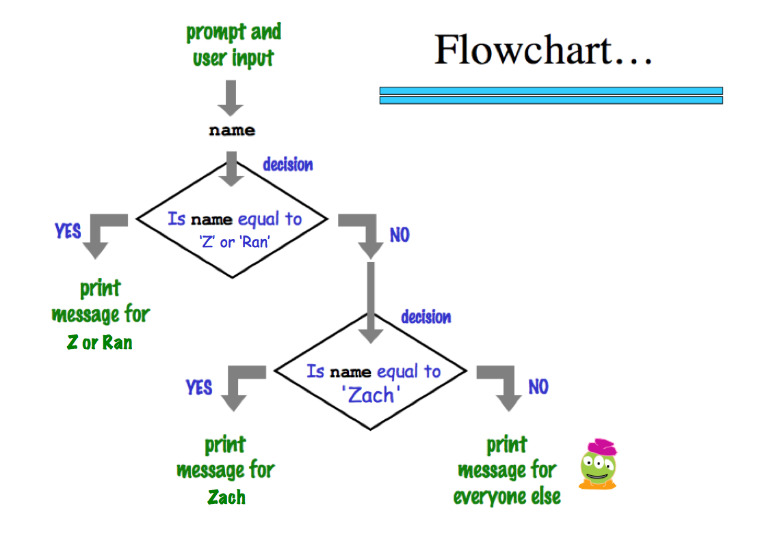
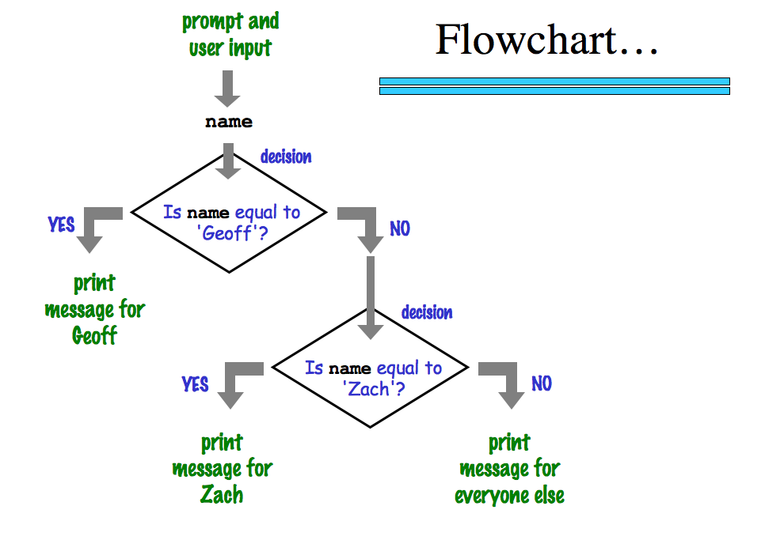
a graphical view of a program's semantics
'Zach'
machine-producedoutput
‘Eliot’ or ‘Ran’
Zach
Eliot or Ran
'Chris'
Chris
Zach
What about me?
Notes:
my foreign language teachers always tried to convince me that the skill of speaking, reading and writing a foreign language…
I didn’t believe them then and I don’t believe them now -- but I do believe that reading and writing a computer language is the way to get a strong intuitive understanding of how machines think -- it’s also important for getting them to do what you want them to, but even if you forget everything this course (hopefully) teaches about Java (compiler, datatypes, Classes and Objects), the real goal is that you take away a deeper insight into how machines think
familiar and sometimes not so familiar… deceptively easy
you mean I have to type all that!!

Slide 24
The foreign language of python…
syntax
semantics
intent
How it looks
What it does
What it should do
www.theonion.com
How Python looks!
how punctuation is used
the language keywords used
use of whitespace
peculiarities of formatting
how behavior is affected …
Notes:
my foreign language teachers always tried to convince me that the skill of speaking, reading and writing a foreign language…
I didn’t believe them then and I don’t believe them now -- but I do believe that reading and writing a computer language is the way to get a strong intuitive understanding of how machines think -- it’s also important for getting them to do what you want them to, but even if you forget everything this course (hopefully) teaches about Java (compiler, datatypes, Classes and Objects), the real goal is that you take away a deeper insight into how machines think
familiar and sometimes not so familiar… deceptively easy
you mean I have to type all that!!

Slide 25
The foreign language of python…
syntax
semantics
intent
How it looks
What it does
What it should do
human-typed input
www.theonion.com
How Python looks!
how punctuation is used
the language keywords used
use of whitespace
peculiarities of formatting
how behavior is affected …
Notes:
my foreign language teachers always tried to convince me that the skill of speaking, reading and writing a foreign language…
I didn’t believe them then and I don’t believe them now -- but I do believe that reading and writing a computer language is the way to get a strong intuitive understanding of how machines think -- it’s also important for getting them to do what you want them to, but even if you forget everything this course (hopefully) teaches about Java (compiler, datatypes, Classes and Objects), the real goal is that you take away a deeper insight into how machines think
familiar and sometimes not so familiar… deceptively easy
you mean I have to type all that!!

Slide 26
The challenge of programming…
syntax
semantics
intent
How it looks
What it does
What it should do
human-typed input
machine-producedoutput
human-desired output
?
Notes:
my foreign language teachers always tried to convince me that the skill of speaking, reading and writing a foreign language…
I didn’t believe them then and I don’t believe them now -- but I do believe that reading and writing a computer language is the way to get a strong intuitive understanding of how machines think -- it’s also important for getting them to do what you want them to, but even if you forget everything this course (hopefully) teaches about Java (compiler, datatypes, Classes and Objects), the real goal is that you take away a deeper insight into how machines think
familiar and sometimes not so familiar… deceptively easy
you mean I have to type all that!!

Slide 27
Name(s):
(1) Find and correct as many errors as you can in this code:
Syntax challenge!
import random
(2) This one line does three things… what are they?
user = input( "Choose your weapon! " )
comp = random.choice( ['rock','paper','scissors") ]
print('user (you) chose:', 'user')
print('comp (me!) chose:' comp)
if user == rock and comp = 'paper'
print('The result is, YOU LOSE.'
print('unless you're a CS 5 grader, then YOU WIN!')
(3) Extra! Can you find 7 punctuation marks used in more than one way here?

Slide 28
Name(s):
(1) Find and correct as many errors as you can in this code:
Syntax challenge!
import random
(2) This one line does three things… what are they?
user = input( "Choose your weapon! " )
comp = random.choice( ['rock','paper','scissors") ]
print('user (you) chose:', 'user')
print('comp (me!) chose:' comp)
if user == rock and comp = 'paper'
print('The result is, YOU LOSE.'
print('unless you're a CS 5 grader, then YOU WIN!')
(3) Extra! Can you find 7 punctuation marks used in more than one way here?

Slide 29
Syntax challenge!
(1) Find and correct as many errors as you can here…
(2) This line is doing three things… what are they?
import random
(1) prints the "weapon" prompt
(2) gets user's input from the kbd
(3) assigns that input to the variable user
set-equals always uses ONE equals sign
user = input( "Choose your weapon! " )
comp = random.choice( ['rock','paper','scissors'] )
print('user (you) chose:', user)
print('comp (me!) chose:', comp)
every block of code must line up!
match brackets and quotes !
test-equals uses TWO equals signs
The comma prints a space and does NOT go to the next line.
if user == rock and comp == 'paper':
print('The result is, YOU LOSE.')
print('unless you\'re a CS 5 grader, then YOU WIN!')
a colon starts a new block
every block of code must line up!
flattering - or flouting - graders is encouraged!
a backslash handles special characters
(3) Punctuation used in more than one way: ().'=,:

Slide 30
Include your full name
Tear off that page
Pass those to the aisles + Westward…
only 1 "quiz" is needed per pair
take a picture if you'd like to keep it
… then turn back into the packet

Slide 31
Another language!
Let's not only add another language…
… but also make it half the hw!
Even with three eyes, I must be misreading this!

Slide 32
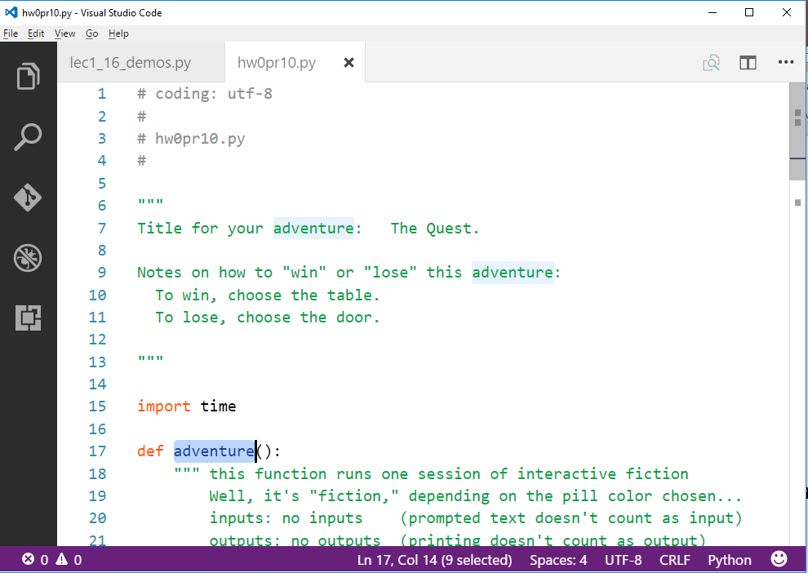
Your Quest!?
Create a short text-adventure in Python...
Use at least five control structures with decisions:
(if/elif/else)
We look forward to adventuring!

Slide 33
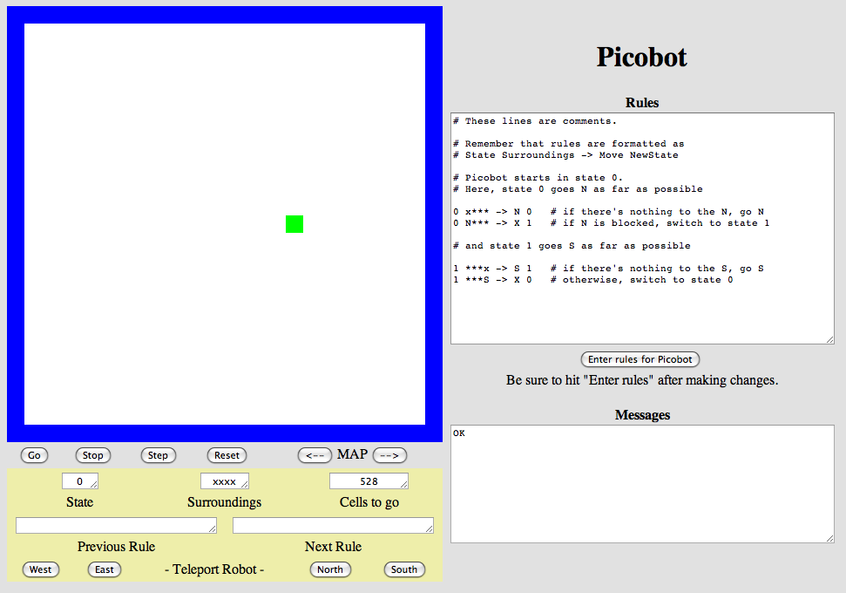
Another language already?
Picobot!
Python
General-purpose language
you might see 50% by the end of the term
even then, <1% of its libraries!
Picobot
Special-purpose language
you'll see 100% in the next 10 minutes
The Picobot simulator
www.cs.hmc.edu/picobot

Slide 34
HW problems 3 and 4: Picobot!
Goal: full-room coverage with only local sensing…
walls
Picobot
area not covered (yet!)
area already covered
Picobot can't tell…
Inspiration?

Slide 35
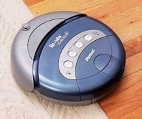
HW problems 3 and 4: Picobot!
Goal: full-room coverage with only local sensing…
walls
Picobot
area not covered (yet!)
area already covered
Picobot can't tell…
The Roomba!
can't tell "vacuumed" from "unvacuumed" area
Let's see it!

Slide 36
Surroundings
N
Picobot can only sense things directly to the N, E, W, and S
W
E
S
For example, here its surroundings are
NxWx
N E W S
Surroundings are always in NEWS order.

Slide 37
What are these surroundings?
Surroundings are always in NEWS order.
N E W S
NxWx
Wow - this one is disgusting!

Slide 38
Surroundings
N
How many distinct surroundings are there?
W
E
S

Slide 39
Surroundings
N
How many distinct surroundings are there?
W
E
2⁴
== 16 possible
S
xxxx
Nxxx
xExx
xxWx
xxxS
NExx
NxWx
NxxS
Aargh!
xEWx
xExS
xxWS
NEWx
NExS
NxWS
xEWS
NEWS
(won’t happen)

Slide 40
State
I am in state 0.
My surroundings
are xxWS.
Picobot's memory is a single number, called its state.
State is the internal context of a computation, i.e., its subtask.
0
Picobot always starts in state 0.
State and surroundings represent everything Picobot knows about the world
self-contained
but not simplistic

Slide 41
Picobot programming ~ rules
current state
surroundings
direction
new state
rule (A)
0
Nxxx
S
0
0
xxxx
N
0
rule (B)
these two rules are a complete Picobot program
Picobot checks its rules from the top each time.
Notes
When it finds a matching rule, that rule runs.
Start
Step 1
Step 2
Step 3
Step 4
…
?

Slide 42
Picobot programming ~ rules
current state
surroundings
direction
new state
rule (A)
0
Nxxx
S
0
0
xxxx
N
0
rule (B)
these two rules are a complete Picobot program
Picobot checks its rules from the top each time.
Notes
When it finds a matching rule, that rule runs.
Start
Step 1
Step 2
Step 3
Step 4
…
?

Slide 43
Picobot programming ~ rules
current state
surroundings
direction
new state
rule (A)
0
Nxxx
S
0
0
xxxx
N
0
rule (B)
these two rules are a complete Picobot program
Picobot checks its rules from the top each time.
Notes
When it finds a matching rule, that rule runs.
Start
Step 1
Step 2
Step 3
Step 4
…
?

Slide 44
Picobot programming ~ rules
current state
surroundings
direction
new state
rule (A)
0
Nxxx
S
0
0
xxxx
N
0
rule (B)
these two rules are a complete Picobot program
Picobot checks its rules from the top each time.
Notes
When it finds a matching rule, that rule runs.
Start
Step 1
Step 2
Step 3
Step 4
?

Slide 45
Picobot programming ~ rules
current state
surroundings
direction
new state
rule (A)
0
Nxxx
S
0
0
xxxx
N
0
rule (B)
these two rules are a complete Picobot program
Picobot checks its rules from the top each time.
Notes
When it finds a matching rule, that rule runs.
Start
Step 1
Step 2
Step 3
Step 4
…
?

Slide 46
Picobot programming ~ rules
current state
surroundings
direction
new state
rule (A)
0
Nxxx
S
0
0
xxxx
N
0
rule (B)
these two rules are a complete Picobot program
Picobot checks its rules from the top each time.
Notes
When it finds a matching rule, that rule runs.
Start
Step 1
Step 2
Step 3
Step 4
these cycle back and forth…

Slide 47
Rules
I am in state 0.
My surroundings
are xxWS.
Picobot acts through a set of rules
0
Each rule expresses your intent for Picobot!
current state
surroundings
direction
new state
0
xxWS
N
0
syntax
If Picobot's in state 0 seeing xxWS,
Then move North, and "change" to state 0.
semantics

Slide 48
Wildcards
I only care about NORTH being EMPTY
Asterisks * are wild cards. They match walls or empty space:
current state
surroundings
direction
new state
0
x***
N
0
EWS may be wall or empty space
N must be empty
8 surroundings in one rule
that's it!

Slide 49
The Rule is
One step per rule
One rule to rule them all?
That's precious!
state
surr.
move
new state
0 N*** -> W 1
0 x*** -> N 0
1 ***x -> S 1
rule (A)
rule (B)
P
rule (C)
more rules
Picobot's world
1. Run Picobot! Which rule A, B, or C runs first? ________
1a. How many times does rule (A) run? __________
1b. How many times does rule (B) run? __________
1c. How many times does rule (C) run? __________
Extra #1 Rule A has a bug! What is it?
Extra #2 Add rules to finish exploring the empty room from any starting point…
Extra #3 How to do this in only 6 rules total?!
2. Picobot stops when no rule matches. Where does it stop?
3. Add a rule so that Picobot continues back upward!

Slide 50
Warning! What's wrong here?
state
surroundings
direction
new state
0
x***
S
0
0
***x
N
0
these two rules are a broken Picobot program!
Picobot checks its rules from the top each time.
Notes
When it finds a matching rule, that rule runs.

Slide 51
Warning! What's wrong here?
state
surroundings
direction
new state
0
x***
S
0
These two situations COULD BE the same!
0
***x
N
0
these two rules are a broken Picobot program!
Picobot checks its rules from the top each time.
Notes
When it finds a matching rule, that rule runs.
There can only be ONE rule per situation!
and a "situation" is state and surroundings

Slide 52
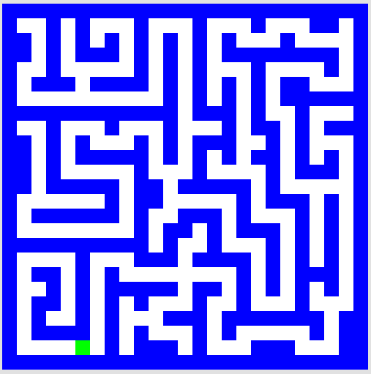
CS ~ Complexity Science
pr. 5 (extra!)
problem 3
problem 4
Shortest Picobot program:
6 rules
Shortest Picobot program:
8 rules
pr. 6 (extra!)

Slide 53
Maze strategies?

Slide 54
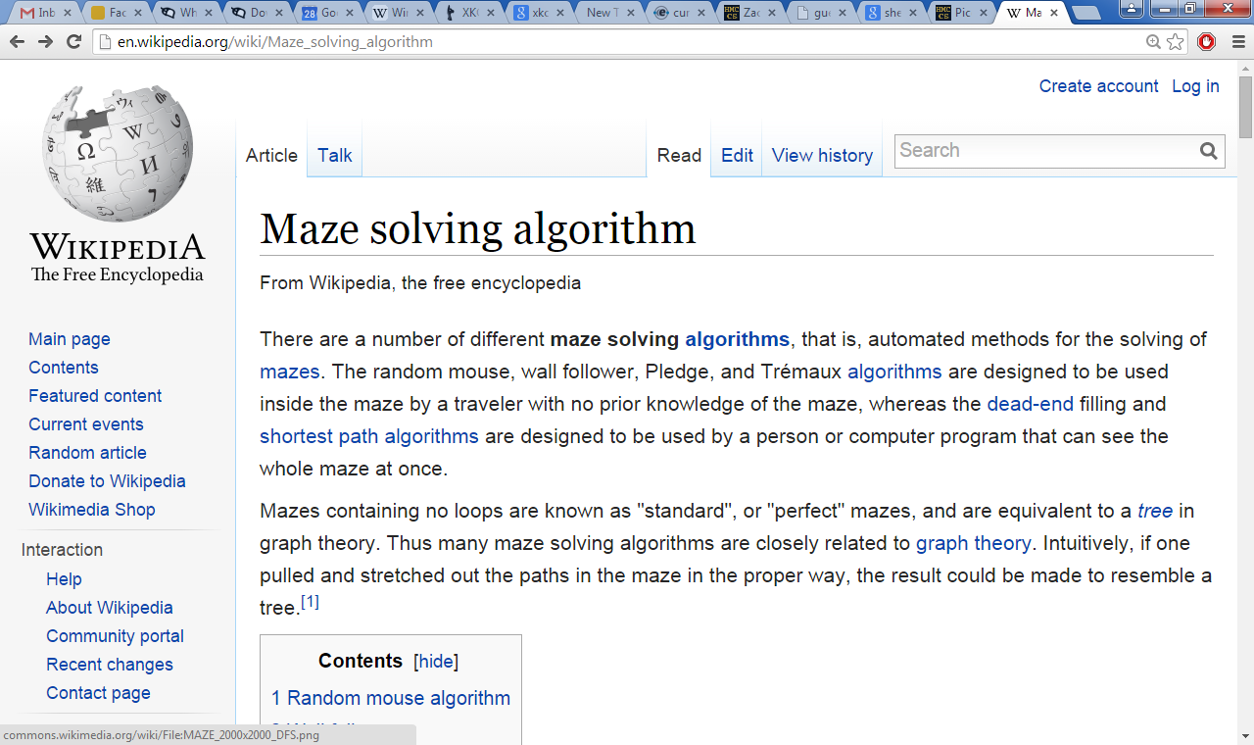
Right Hand Rule

Slide 55
Maze strategies?
Right Hand Rule
Keep your "right hand" on the wall, Picobot!
Why might this be difficult for Picobot?

Slide 56
Maze strategies?
Right Hand Rule
facing
on the right
Keep your "right hand" on the wall, Picobot!
State 0
State 1
State 2
State 3
We'll need to use state to represent the direction Picobot is facing.

Slide 57
Suppose Picobot wants to traverse a maze with its right hand always on the wall...
(A) CORRIDOR rule
If you're facing N with a wall at right and space ahead then go forward”
0
xE**
->
N
0
state 0 means "still facing north"
0
(A)
(B) INTERSECTION rule
“If you're facing North and lose the wall, then get over to the wall now!”
0
0
.
->
E
1
(B)
(C) DEAD END rule
Write 1 or 2 rules to tell Picobot to do the right thing if it hits a dead end.
0
(C)
Repeat this IDEA for all four states, representing all four facing directions.

Slide 58
Suppose Picobot wants to traverse a maze with its right hand always on the wall...
(A) CORRIDOR rule
If you're facing N with a wall at right and space ahead then go forward”
0
xE**
->
N
0
state 0 means "still facing north"
0
(A)
(B) INTERSECTION rule
“If you're facing North and lose the wall, then get over to the wall now!”
0
0
*x**
->
E
1
state 1 means "now facing east"
(B)
(C) DEAD END rule
Write 1 or 2 rules to tell Picobot to do the right thing if it hits a dead end.
0
NE**
->
X
2
state 2 means "now facing west"
0
(C)
Repeat this IDEA for all four states, representing all four facing directions.

Slide 59
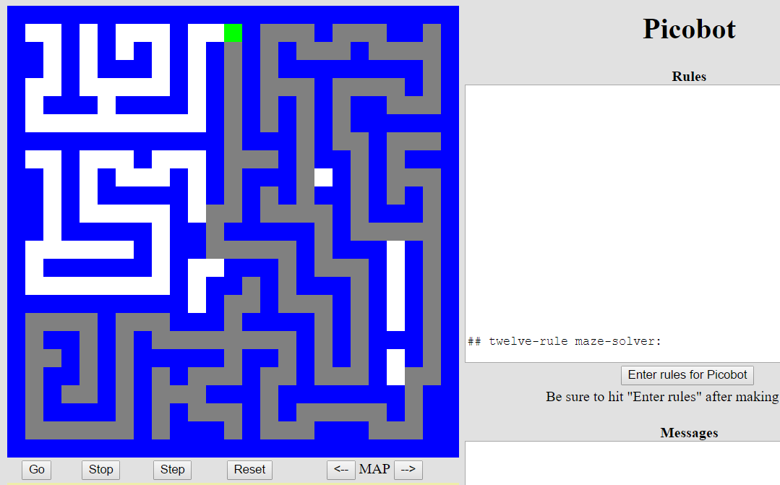
Hooray!?!
Is it working?

Slide 60
- Southward, Ahoy! -
Lab/hw
You are not alone!
Come to tutoring hours!
I can attest to that!
Post questions to piazza...
Lead on! I will follow.
Happy Picobotting!
And, good luck with the adventure of Python!

Slide 62
The Rule is
One step per rule
One rule to rule them all?
That's precious!
state
surr.
move
new state
0 N*** -> W 1
0 x*** -> N 0
1 ***x -> S 1
rule (A)
rule (B)
P
rule (C)
more rules
Picobot's world
1. Run Picobot! Which rule A, B, or C runs first? ________
1a. How many times does rule (A) run? __________
1b. How many times does rule (B) run? __________
1c. How many times does rule (C) run? __________
Extra #1 Rule A has a bug! What is it?
Extra #2 Add rules to finish exploring the empty room from any starting point…
Extra #3 How to do this in only 6 rules total?!
2. Picobot stops when no rule matches. Where does it stop?
3. Add a rule so that Picobot continues back upward!

Slide 63
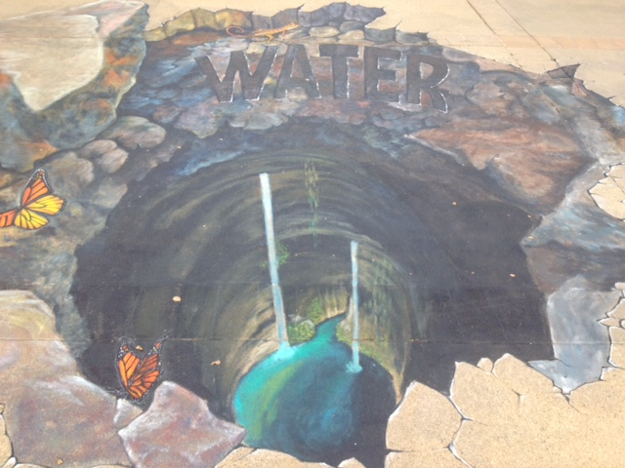
By the Koi pond!

Slide 64
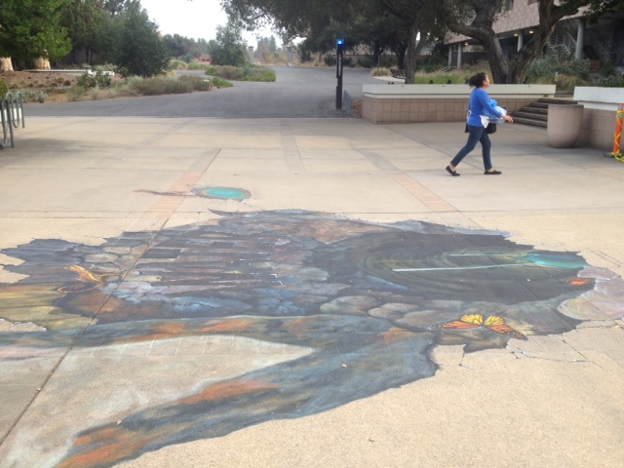
A different view…

Slide 65
Try it!
One rule to rule them all?
The Rule is
One step per rule
Do this together!
That's precious!
state
surr.
move
new state
0 N*** -> W 1
0 x*** -> N 0
1 ***x -> S 1
rule (A)
GO BACK UP – do not go W on 1!!!!!
rule (B)
P
rule (C)
more rules
Picobot's world
Ask how to extend + do it
- if get to the corner first, great!
- if get back across, great!
1. Which of the rules A, B, or C runs first? ______________
2. Picobot stops when no rule matches. Where does it stop?
3. How many times has rule (A) run? __________
Once Picobot stops,
4. How many times has rule (B) run? __________
5. How many times has rule (C) run? __________
Extra! Add rules to finish exploring the empty room… Can you do it in 6 rules total?
6. Add a 4th rule so that Picobot can continue westward.

Slide 66
Suppose Picobot wants to traverse a maze with its right hand always on the wall.
We use state 0 to represent that “Picobot is facing North”
(A) Here is a single rule that tells Picobot:
If you're facing N with a wall at right and space ahead then go forward”
0
xE**
->
N
0
state 0 means "still facing north"
0
(A)
(B) Let's write a single rule that tells Picobot:
“If you're facing North and lose the wall, then get over to the wall now!”
0
0
*x**
->
E
1
state 1 means "now facing east"
(B)
(C) (for HW) Write 1 or 2 rules to tell Picobot to do the right thing if it hits a dead end.
0
NE**
->
X
2
state 2 means "now facing west"
0
(C)
Repeat this IDEA for all four states, representing all four facing directions.

Slide 67
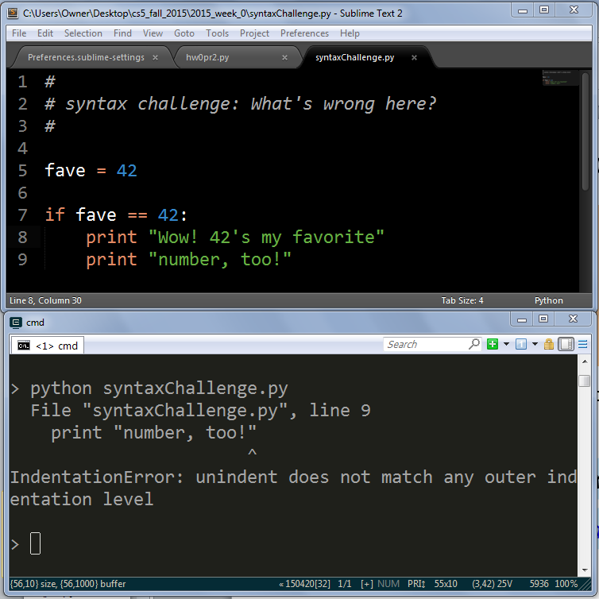
Syntax challenge!
3
1
2

Slide 68
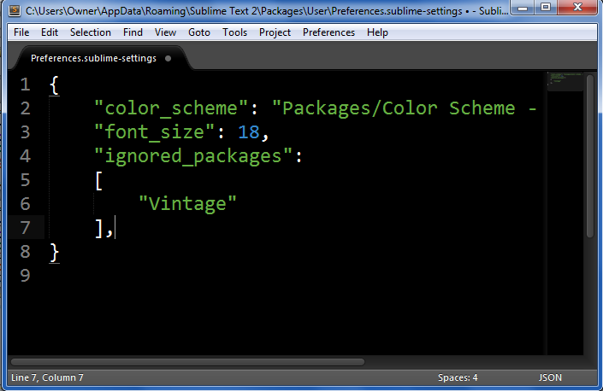
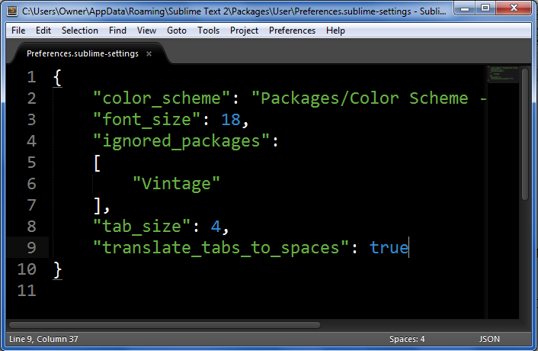
Go to the Preferences menu
Choose Settings - User
Add these two lines at the bottom
above the final closing curly brace:
"tab_size": 4,
"translate_tabs_to_spaces": true
Please do this!
so that tabs + spaces will always work correctly…
Convert to spaces…
Once & you're set!
Before
After

Slide 69
Quiz
One rule to rule them all?
Name(s):
The Rule is
One step per rule
This is precious!
state
surr.
move
new state
0 N*** -> W 1
0 x*** -> N 0
1 ***x -> S 1
rule (A)
rule (B)
P
rule (C)
more rules
Picobot's world
1. Which of the rules A, B, or C runs first? ______________
2. Picobot stops when no rule matches. Where does it stop?
3. How many times has rule (A) run? __________
Once Picobot stops,
4. How many times has rule (B) run? __________
5. How many times has rule (C) run? __________
Extra! Add rules to finish exploring the empty room… Can you do it in 6 rules total?
6. Add a 4th rule so that Picobot can continue westward.

Slide 70
Warning ~ what's wrong here?
state
surroundings
direction
new state
0
x***
S
0
0
***x
N
0
these two rules are a broken Picobot program!
Picobot checks its rules from the top each time.
Notes
When it finds a matching rule, that rule runs.

Slide 71
Warning ~ what's wrong here!
state
surroundings
direction
new state
0
x***
S
0
These two situations COULD BE the same!
0
***x
N
0
these two rules are a broken Picobot program!
Picobot checks its rules from the top each time.
Notes
When it finds a matching rule, that rule runs.
There can only be ONE rule per situation!
and a "situation" is state and surroundings

Slide 72
CS ~ Complexity Science
problem 3
problem 4
Extra! (5)
Shortest Picobot program:
6 rules
Shortest Picobot program:
8 rules
Shortest Picobot program:
? rules
Can it be done at all!?

Slide 73
CS ~ Complexity Science
problem 3
problem 4
Extra! (5)
Shortest Picobot program:
6 rules
Shortest Picobot program:
8 rules
Shortest Picobot program:
? rules
Can it be done at all!?

Slide 74
Maze strategies?

Slide 75
Right Hand Rule

Slide 76
Maze strategies?
Right Hand Rule
Keep your "right hand" on the wall, Picobot!
Why might this be difficult for Picobot?

Slide 77
Maze strategies?
Right Hand Rule
facing
Keep your "right hand" on the wall, Picobot!
State 0
State 1
State 2
State 3
We'll need to use state to represent the direction Picobot is facing.

Slide 78
Suppose Picobot wants to traverse a maze with its right hand always on the wall.
We use state 0 to represent that “Picobot is facing North”
(A) Here is a single rule that tells Picobot:
If you're facing N with a wall at right and space ahead then go forward”
0
xE**
->
N
0
0
(A)
(B) Let's write a single rule that tells Picobot:
“If you're facing North and lose the wall, then get over to the wall now!”
0
0
->
(B)
(C) (for HW) Write 1 or 2 rules to tell Picobot to do the right thing if it hits a dead end.
0
(C)
Repeat this IDEA for all four states, representing all four facing directions.

Slide 79
Suppose Picobot wants to traverse a maze with its right hand always on the wall.
We use state 0 to represent that “Picobot is facing North”
(A) Here is a single rule that tells Picobot:
If you're facing N with a wall at right and space ahead then go forward”
0
xE**
->
N
0
0
(A)
(B) Let's write a single rule that tells Picobot:
“If you're facing North and lose the wall, then get over to the wall now!”
0
0
->
(B)
(C) (for HW) Write 1 or 2 rules to tell Picobot to do the right thing if it hits a dead end.
0
(C)
Repeat this IDEA for all four states, representing all four facing directions.

Slide 80
and I thought my language was alien!
Seventy years ago, in 1940, a popular science magazine published a short article that set in motion one of the trendiest intellectual fads of the 20th century. At first glance, there seemed little about the article to augur its subsequent celebrity. Neither the title, “Science and Linguistics,” nor the magazine, M.I.T.’s Technology Review, was most people’s idea of glamour. And the author, a chemical engineer who worked for an insurance company and moonlighted as an anthropology lecturer at Yale University, was an unlikely candidate for international superstardom. And yet Benjamin Lee Whorf let loose an alluring idea about language’s power over the mind, and his stirring prose seduced a whole generation into believing that our mother tongue restricts what we are able to think.

Slide 81
and I thought my language was alien!
Seventy years ago, in 1940, a popular science magazine published a short article that set in motion one of the trendiest intellectual fads of the 20th century. At first glance, there seemed little about the article to augur its subsequent celebrity. Neither the title, “Science and Linguistics,” nor the magazine, M.I.T.’s Technology Review, was most people’s idea of glamour. And the author, a chemical engineer who worked for an insurance company and moonlighted as an anthropology lecturer at Yale University, was an unlikely candidate for international superstardom. And yet Benjamin Lee Whorf let loose an alluring idea about language’s power over the mind, and his stirring prose seduced a whole generation into believing that our mother tongue restricts what we are able to think.

Slide 82
As you head west-wards…
You are not alone!
I can attest to that!
Lead on! I will follow.
Office hours Fri. afternoon…
Tutoring hours all weekend + Monday evenings @ LAC lab and across all 5Cs…
Happy Picobotting!

Slide 84
The Rule: One step per rule
One rule to rule them all?
Using the ruleset above…
This is precious!
Picobot's world
How many times does rule (A) run? ___________________
How many times does rule (B) run? ___________________
How many times does rule (C) run? ___________________
How many times does rule (D) run? ___________________
P
In a phrase, what do state 0 and state 1 do?
Where does Picobot stop? Why?
Extra! What additional rules would be needed in order to ensure that Picobot fully explores the empty room (not this crazy room) from any starting spot? (this is problem 3…)
Quiz!
Name _________________
Name __________________

Slide 85
CS ~ complexity science
See you in lab… soon!
problem 3
problem 4
Extra! (5)
Shortest Picobot program:
6 rules
Shortest Picobot program:
8 rules
Shortest Picobot program:
? rules
Can it simply be done!?

Slide 86
Tear off that page
Pass those to the aisles + Southward…
only 1 "quiz" is needed per pair
… then turn back into the packet

Slide 87
The Rule: One step per rule
One rule to rule them all?
Using the ruleset above…
This is precious!
Picobot's world
How many times does rule (A) run? ___________________
How many times does rule (B) run? ___________________
How many times does rule (C) run? ___________________
How many times does rule (D) run? ___________________
P
In a phrase, what do state 0 and state 1 do?
Where does Picobot stop? Why?
Extra! What additional rules would be needed in order to ensure that Picobot fully explores the empty room (not this crazy room) from any starting spot? (this is problem 3…)
Quiz!
Solve this on the back page first…

Slide 88
Picobot hw problems
problem 3
problem 4
Extra! (#5)
Your rules must work regardless of Picobot's starting position… !

Slide 89
Picobot hw problems
problem 3
problem 4
Extra! (#5)
Your rules must work regardless of Picobot's starting position… !

Slide 90
Last time's quiz!?

Slide 91
Sign in…
Be sure to sign in to lab!

Slide 92
Lab rooms
Laptops encouraged!

Slide 93
Programming as recipe-writing
vs.
Programming as learning a foreign language
1) Expect it to be different!
2) Don’t feel you need to memorize it
3) Immersion ~ Experimentation ~ Mindset
go/went
Notes:
my foreign language teachers always tried to convince me that the skill of speaking, reading and writing a foreign language…
I didn’t believe them then and I don’t believe them now -- but I do believe that reading and writing a computer language is the way to get a strong intuitive understanding of how machines think -- it’s also important for getting them to do what you want them to, but even if you forget everything this course (hopefully) teaches about Java (compiler, datatypes, Classes and Objects), the real goal is that you take away a deeper insight into how machines think
familiar and sometimes not so familiar… deceptively easy
you mean I have to type all that!!

Slide 94
Problem 6 this week…
Typically an article on CS or an application...
A few sentences that raise or address questions, using the article as a guide.
Submit a one-paragraph response
5 – insightful, careful
4 – thoughtful
3 – complete, on topic
0-2 – less than complete
Small part (5 pts)
This week's article might not seem like CS at first…

Slide 95
and I thought my language was alien!
Seventy years ago, in 1940, a popular science magazine published a short article that set in motion one of the trendiest intellectual fads of the 20th century. At first glance, there seemed little about the article to augur its subsequent celebrity. Neither the title, “Science and Linguistics,” nor the magazine, M.I.T.’s Technology Review, was most people’s idea of glamour. And the author, a chemical engineer who worked for an insurance company and moonlighted as an anthropology lecturer at Yale University, was an unlikely candidate for international superstardom. And yet Benjamin Lee Whorf let loose an alluring idea about language’s power over the mind, and his stirring prose seduced a whole generation into believing that our mother tongue restricts what we are able to think.

Slide 96
and I thought my language was alien!
Seventy years ago, in 1940, a popular science magazine published a short article that set in motion one of the trendiest intellectual fads of the 20th century. At first glance, there seemed little about the article to augur its subsequent celebrity. Neither the title, “Science and Linguistics,” nor the magazine, M.I.T.’s Technology Review, was most people’s idea of glamour. And the author, a chemical engineer who worked for an insurance company and moonlighted as an anthropology lecturer at Yale University, was an unlikely candidate for international superstardom. And yet Benjamin Lee Whorf let loose an alluring idea about language’s power over the mind, and his stirring prose seduced a whole generation into believing that our mother tongue restricts what we are able to think.

Slide 97
Reminder
You are not alone!
I can attest to that!
Tutoring hours all weekend afternoons in the LAC lab -
also, Sunday and Monday evenings @ LAC lab.
My office hours: Wednesday 3-5pm
Lead on! I will follow.
Happy Picobotting!

Slide 98
Be Picobot!
(1) How many times does the 1st rule run? _________
(2) How many times does the 2nd rule run? _________
(3) How many times does the 3rd rule run? _________
(4) In English, what does state 0 do?
A different picobot world
(5) How could this help clear the empty room? … just a thought experiment
"Run" this Picobot program:
P
state
surr
dir
newstate
0
***x
->
S
0
1st rule
top of stalagmite
0
*x*S
->
E
0
2nd rule
0
*E*S
->
X
1
3rd rule
(6) Add 1 or 2 rules that will, in state 1, get Picobot to the top of the stalagmite, then stop.
(Extra!) What approach could get Picobot to travel around the whole outer edge?

Slide 99
Be Picobot!
(1) How many times does the 1st rule run? _________
(2) How many times does the 2nd rule run? _________
(3) How many times does the 3rd rule run? _________
(4) In English, what does state 0 do?
In this small world:
(5) How could this help clear the empty room? … just a thought experiment
"Run" this Picobot program:
state
surr
dir
newstate
P
0
***x
->
S
0
1st rule
0
*x*S
->
E
0
2nd rule
top of stalagmite
0
*E*S
->
X
1
3rd rule
(6) Add two rules that will, in state 1, get Picobot to the top of the stalagmite, then stop.
(Extra!) What approach could get Picobot to travel around the whole outer edge?

Slide 100
Maze strategies?

Slide 101
Maze strategies?
Right Hand Rule
Keep your "right hand" on the wall, Picobot!

Slide 102
Maze strategies?
Right Hand Rule
facing
Keep your "right hand" on the wall, Picobot!
State 0
State 1
State 2
State 3
We'll need to use state to represent the direction Picobot is facing.

Slide 103
Suppose Picobot wants to traverse a maze with its right hand always on the wall.
We use state 0 to represent that “Picobot is facing North”
(A) Here is a single rule that tells Picobot:
If you're facing N with a wall at right and space ahead then go forward”
0
xE**
->
N
0
0
(A)
(B) Let's write a single rule that tells Picobot:
“If you're facing North and lose the wall, then get over to the wall now!”
0
0
->
(B)
(C) (for HW) Write 1 or 2 rules to tell Picobot to do the right thing if it hits a dead end.
0
(C)
Repeat this IDEA for all four states, representing all four facing directions.

Slide 104
Reminder
You are not alone!
I can attest to that!
Tutoring hours all weekend afternoons in the LAC lab -
also, Sunday and Monday evenings @ LAC lab.
My office hours at the LAC lab: Wednesday 3-5pm
Piazza us with any account/web/other problems.
Lead on! I will follow.
Happy Picobotting!

Slide 105
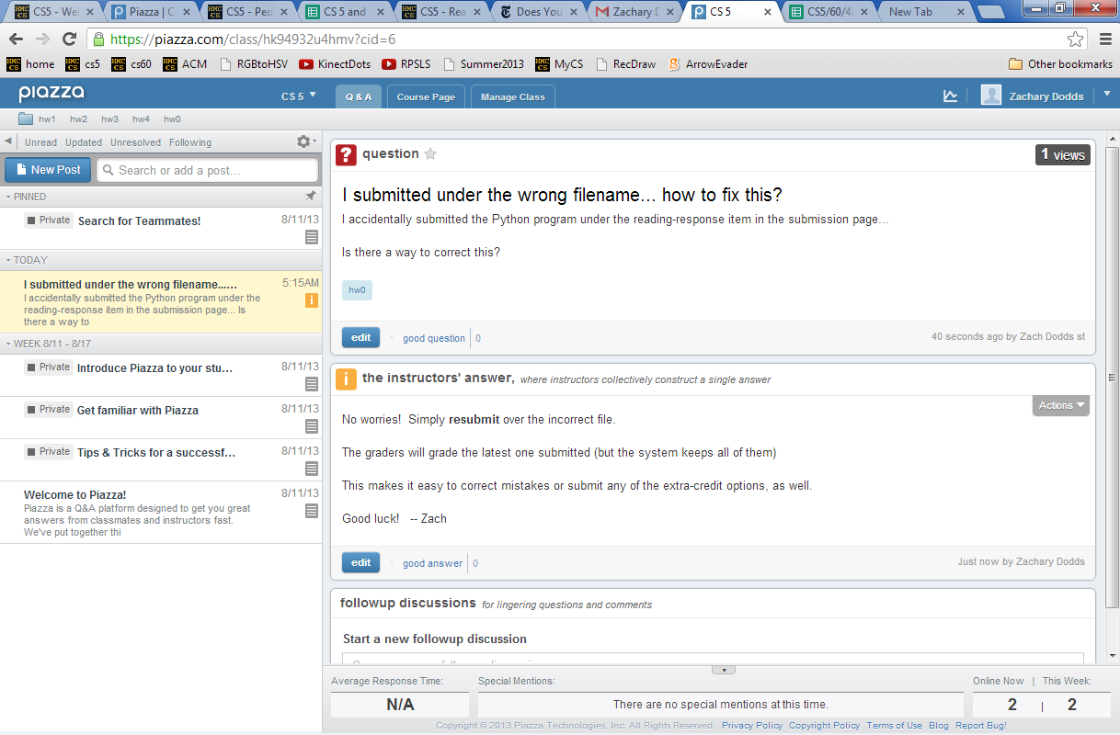
Piazza
for all CS5 concerns/questions
public: post to whole class

Slide 106
Piazza
you'll get a welcome email…
sign-in + choose your message frequency

Slide 107
Piazza
for all CS5 concerns/questions
individual concerns or your source code / bugs?
In-person + pair programming are better strategies for bugs.
But we'll try to take a look…
private: post to instructors
Account problems?
Piazza us!

Slide 108
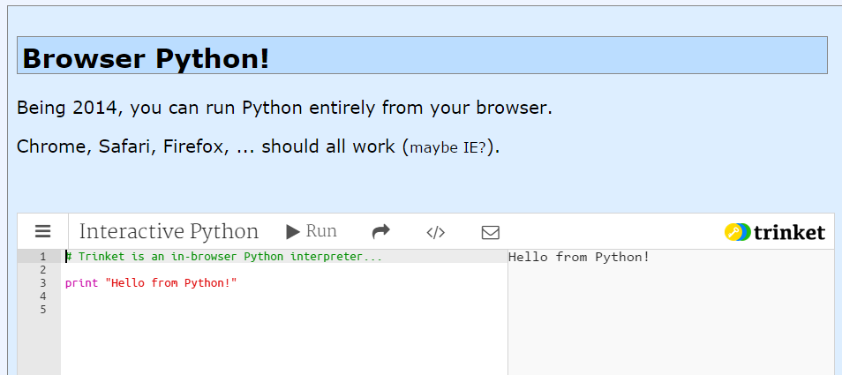
Online Python?
Several options
For text programs, trinket seems the easiest.

Slide 109
in Platt
Evening lab? You can pickup a keycard from HMC's F&M dep't.
Shanahan
coffee
Koi
Map to CS Lab
Edwards
Macalister
Pryne
Physicists, chemists & other parenthesis-needing individuals,
Laptop? Bring it!
cool machines - drills, lathes, etc.
Galileo
other keyboard-free machines
Your account for
CS submissions:
B102
B100
Beckman
passwd:
CS Hallway and Labs
Big Beckman (B126)
B105
Biologists, bees, spiders and other arachnophiles
or Olin
to Olin (Bio + CS)

Slide 110
Evening lab?
You can get a keycard from F&M in Platt
Enter through Olin building
Platt building. F&M is in the basement.
Beckman B102, B105, B126

Slide 111
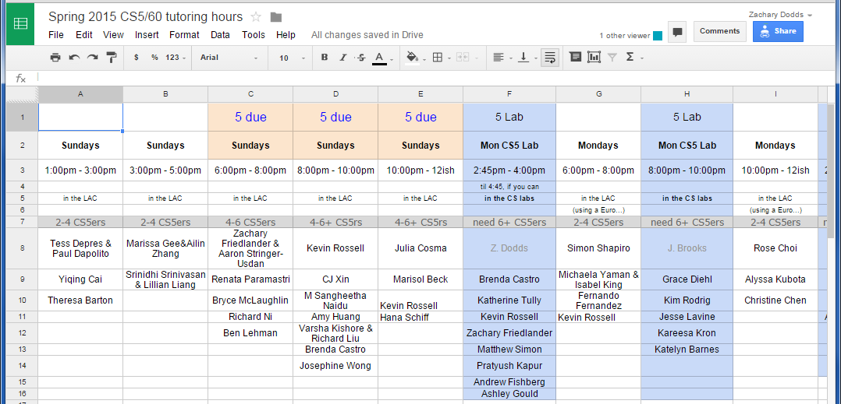
Graders + Tutors = Grutors
Ask for help…
see page
every day there are tutoring hours in the LAC computer lab
Linde Activities Center
Office hours: After class on Wed. (~3-5pm)
Piazza ~ next time

Slide 112
Quiz
Name ______________
Name ______________
(1) Find and correct as many errors as you can here…
(2) This line is doing three things… what are they?
import random
user = raw_input( "Choose your weapon! " )
comp = random.choice( ['rock','paper','scissors") ]
print 'user (you) chose:', 'user'
print 'comp (me!) chose:' comp
if user == rock and comp = 'paper'
print 'The result is, YOU LOSE!'
print 'unless you're a CS 5 grader, then YOU WIN!'
(3) How many different uses of punctuation can you find?

Slide 113
Quiz
Try the one on the back of these notes – with a partner – first…
(1) Find and correct as many errors as you can here…
(2) This line is doing three things… what are they?
import random
user = raw_input( "Choose your weapon! " )
comp = random.choice( ['rock','paper','scissors") ]
print 'user (you) chose:', 'user'
print 'comp (me!) chose:' comp
if user == rock and comp = 'paper'
print 'The result is, YOU LOSE.'
print 'unless you're a CS 5 grader, then YOU WIN!'
(3) I count ,()'=. : 6 or 7 punctuation characters which are being used in two different ways. Which ones are they? _____________________

Slide 114
Surroundings
N
Picobot can only sense things directly to the N, E, W, and S
W
E
S
For example, here its surroundings are
NxWx
N E W S
Surroundings are always in NEWS order.

Slide 115
What are these surroundings?
Surroundings are always in NEWS order.
N E W S
NxWx
Wow - this one is disgusting!

Slide 116
(A) A rule that sends Picobot to the North as far as it can go:
state
surroundings
direction
new state
0
x***
->
N
0
(B) What does this next rule do?
0
N***
->
W
1
(C) What about this one?
1
***x
->
S
1
(D) How could we stop at the bottom and return up through the same column?

Slide 117
Be Picobot!
(1) How many times does the 1st rule run? _________
(2) How many times does the 2nd rule run? _________
(3) How many times does the 3rd rule run? _________
(4) In English, what does state 0 do?
In this small world:
(5) How could this help clear the empty room? … just a thought experiment
"Run" this Picobot program:
state
surr
dir
newstate
P
0
***x
->
S
0
1st rule
0
*x*S
->
E
0
2nd rule
top of stalagmite
0
*E*S
->
X
1
3rd rule
(6) Add two rules that will, in state 1, get Picobot to the top of the stalagmite, then stop.
(Extra!) What approach could get Picobot to travel around the whole outer edge?

Slide 118
Maze strategies?
Right Hand Rule
facing
Keep your "right hand" on the wall, Picobot!
State 0
State 1
State 2
State 3
We'll need to use state to represent the direction Picobot is facing.

Slide 119
Suppose Picobot wants to traverse a maze with its right hand always on the wall.
We use state 0 to represent that “Picobot is facing North”
(A) Here is a single rule that tells Picobot:
If you're facing N using the RHR with space ahead then go forward”
0
xE**
->
N
0
0
(A)
(B) Let's write a single rule that tells Picobot:
“If you're facing North and lose the wall, then get over to the wall now!”
0
0
->
(B)
(C) (for HW) Write 1 or 2 rules to tell Picobot to do the right thing if it hits a dead end.
0
(C)
Repeat this IDEA for all four states, representing all four facing directions.

Slide 120
Pass those quizzes to the East... !
Turn back inside the packet...

Slide 121
For four 4's
0 = 4 + 4 - 4 - 4
1 = 44 / 44
2 = 4
...
8 = sqrt( .4 ) * (4+4+4)
...
19 = ???
20 = 4! + 4 - 4 - 4
4/(4+4)
Ask around the math department…

Slide 122
From lots of four-fours work in Prolog... !

Slide 123
I will be astonished to even cover up to this point…

Slide 124
Create a program that will get picobot to the SOUTHEAST corner of the empty room.
Your rules should work regardless of Picobot's starting position… !
How could you combine the previous example with this one to cover the whole room from any starting position?
How few states could be used?
How few total rules can be used?
How would you solve these rooms?

Slide 125
Quiz, continued…
What different set of rules would guide Picobot through this "maze" environment?
What algorithm will work?
What will each state mean?
How many states?
How many rules per state?
Thinking about the CS questions before diving into the programming will help!
Algorithm:
States:

Slide 126
Quiz
· Suppose Picobot want to traverse a maze with its right hand always on the wall.
· Suppose the starting state, state 0, will represent the fact that “Picobot is facing North”
part 2
(A) Write a single rule that tells Picobot:
“Continue North as long as there’s room to move and a wall on your right”
0
(A)
(B) Write a single rule that tells Picobot:
“If you lose the wall when facing North, return to it immediately!”
0
(B)
(C) Write 1-2 rules to tell Picobot to do the right thing if it hits a dead end.
0
(C)

Slide 127
Be Picobot!
(1) "Run" this Picobot program
Your rules should work regardless of Picobot's starting position… !
How could you combine the previous example with this one to cover the whole room from any starting position?
Extras!
How few states could be used?
Create a program that will initially get picobot to the SOUTHEAST corner of the empty room.
How few total rules can be used?
How would you solve these rooms?

Slide 128
CS is deceptively easy.

Slide 129
Python + Mac ==
Happy, even if alien…
Freezing Mac? Run with Shift-Command-F5
Thanks, Patrick!
Still freezing? Swim away with 2.7.2
Lion+ users: 2.7.2 is ok.

Slide 130
CS’s motto ?
details are temporary…
…but CS thinking isn’t !
print 'hv',
print 'dcle\naemdoe'
print 'ryu',
print 'lg!'
print 'whteo'
print 'aerub\nv',
print 'aeo\nyraoo'
print 'egdne'
Notes:
Useful skill
Important tool
Window into corners of everyday life

Slide 131
CS’s motto ?
details are temporary…
…but CS thinking isn’t !
hv dcle
aemdoe
ryu lg!
whteo
aerub
v aeo
yraoo
egdne
print 'hv',
print 'dcle\naemdoe'
print 'ryu',
print 'lg!'
print 'whteo'
print 'aerub\nv',
print 'aeo\nyraoo'
print 'egdne'
Notes:
Useful skill
Important tool
Window into corners of everyday life

Slide 132
Whatever you are, be a good one.
- Abraham Lincoln
… CS will help!

Slide 133
Ideas for the maze?
the maze
I need more Picobot!

Slide 134
Today's theme:
Models of Computation?

Slide 135
CS ~ complexity science
Information is intrinsic to every system…
How can we benefit from this information?
“construct with”
Representing it … Transforming it … Measuring it
efficiently? effectively? possibly?
How might we measure these rooms' complexity?
Notes:
ZACH:
information isn't just something that has appeared in the last 50 years as computers have become ubiquitous…
despite its name, computer science doesn't require a computer at all

Slide 136
CS ~ complexity science
Information is intrinsic to many systems…
CS analyzes, measures, and leverages it!
Representing it … Transforming it … Measuring it
efficiently? effectively? possibly?
How might we measure these rooms' complexity?
How many states and rules are necessary ?
How much information does each room contain ?
our best: 3 states, 6 rules
our best: 4 states, 8 rules
Notes:
ZACH:
information isn't just something that has appeared in the last 50 years as computers have become ubiquitous…
despite its name, computer science doesn't require a computer at all

Slide 137
CS ~ complexity science
Information is intrinsic to every system…
How can we benefit from this information?
“construct with”
Representing it … Transforming it … Measuring it
efficiently? effectively? possibly?
How might we measure these rooms' complexity?
How many states and rules are necessary ?
How much information does each room contain ?
As a file: ~5000 bytes
As a file: ~20,000 bytes!
Notes:
ZACH:
information isn't just something that has appeared in the last 50 years as computers have become ubiquitous…
despite its name, computer science doesn't require a computer at all

Slide 138
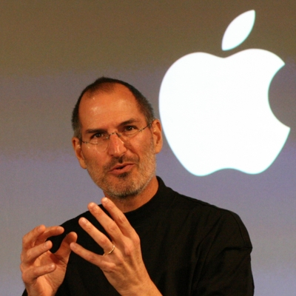
Models of Computation?

Slide 139
Models of Computation
A computational model is simply
"how a particular machine/language works"
or
"what the machine is thinking?!"
Some choice words might go here, at times.
This is the "baggage" of each foreign language...

Slide 140
Abstraction
Artists are mystics rather than rationalists. They leap to conclusions that logic cannot reach.
-- Sol LeWitt, conceptual artist
Simplicity does not precede complexity, but follows it.
-- Alan Perlis, early CS-ist.
Notes:
dealing with code in which you don’t know everything that’s going on, you need to abstract away details and keep a bigger picture in mind

Slide 141
Python syntax highlights
for homework 0
import random
assignment statements always read right-to-left and use ONE equals sign
user_choice = raw_input('Enter something: ')
every block of code must line up!!
comp_choice = random.choice( ['rock','paper','scissors'] )
comparisons use TWO equals signs
if user_choice == 'rock' and comp_choice == 'paper':
print 'You chose', user_choice
print 'I chose', comp_choice
print 'The result is',
print 'YOU LOSE!'
print 'unless you\'re a CS 5 grader,\n then YOU WIN!'
colons begin a new block!
The comma prints a space and does NOT go to the next line.
every block of code must line up!!
a backslash shows special cases or characters
flattering or flouting CS graders is encouraged!
elif test goes here:
else:
as many as you want – zero or more – all mutually exclusive
optional – NO test – still needs a colon

Slide 142
Computer Science
Information is intrinsic to every system…
How can we create with this information?
“benefit from”
Representing it...
What information will we need?
Interpreting it...
How will we know who won?
Evaluating it...
Is it as efficient as possible?
Notes:
ZACH:
fundamentally creative

Slide 143
Python's model?
How does this program execute?
import random
How many things is this line doing?
user_choice = raw_input('Enter something: ')
comp_choice = random.choice( ['rock','paper','scissors'] )
if user_choice == 'rock' and comp_choice == 'paper':
print 'You chose', user_choice
print 'I chose', comp_choice
print 'The result is',
print 'YOU LOSE!'
print 'unless you\'re a CS 5 grader,\n then YOU WIN!'
How many more if/elif/else blocks do we need?

Slide 144
Models of Computation
A computational model is simply
"how a particular machine/language works"
or
"what the machine is thinking?!"
sequential execution
variables store values
conditionals make decisions
loops loop
functions function
and so on...
GP language!

Slide 145
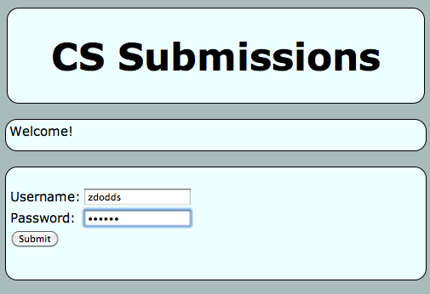
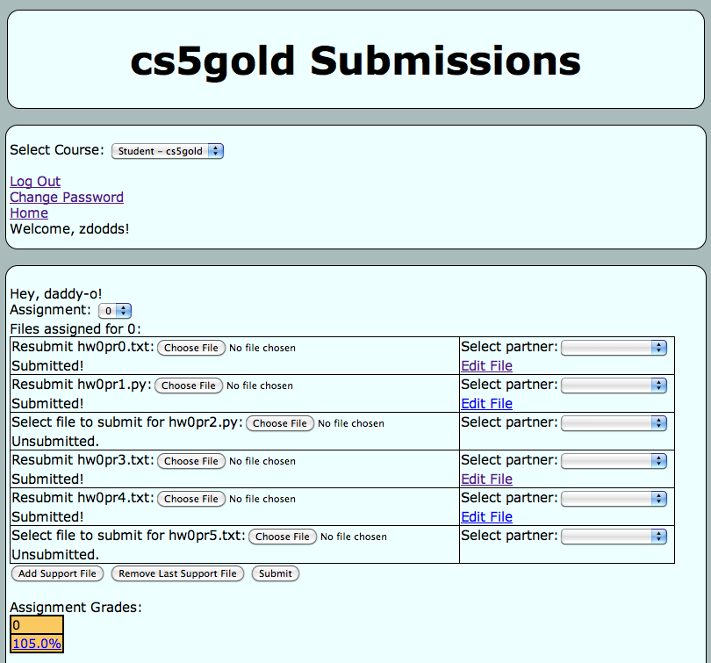
Submitting...
and transferring!
Sometimes I've needed to login twice…
One time, the browser needed to be restarted (or a different browser used)

Slide 146
Python's syntax?
(1) See if you can find and correct any errors here... !
import random
(2) This line is doing three things… what are they?
(1) prints the "weapon" prompt
(2) gets user's input from the kbd
(3) assigns that input to the variable user
assignment statements always use ONE equals sign – more on these next week
user = raw_input( 'Choose your weapon! ' )
every block of code must line up!!
comp = random.choice( ['rock','paper','scissors'] )
print '(You): user chose', user
print '(Me!): comp chose', comp
The comma prints a space and does NOT go to the next line.
comparisons use TWO equals signs
if user == 'rock' and comp == 'paper':
print 'The result is, YOU LOSE!'
print 'unless you\'re a CS 5 grader, then YOU WIN!'
a colon starts a new block
every block of code must line up!!
a backslash handles special cases or characters
flattering or flouting CS graders is encouraged!
quotes delimit text
(3) See how many different uses of punctuation you can find…

Slide 147
Language is language?
Intercal
v
>v"Hello world!"0<
,:
^_25*,@
PLEASE DO ,1 <- #13
DO ,1 SUB #1 <- #238
DO ,1 SUB #2 <- #112
DO ,1 SUB #3 <- #112
DO ,1 SUB #4 <- #0
DO ,1 SUB #5 <- #64
DO ,1 SUB #6 <- #238
DO ,1 SUB #7 <- #26
DO ,1 SUB #8 <- #248
DO ,1 SUB #9 <- #168
DO ,1 SUB #10 <- #24
DO ,1 SUB #11 <- #16
DO ,1 SUB #12 <- #158
DO ,1 SUB #13 <- #52
PLEASE READ OUT ,1
PLEASE GIVE UP
Befunge
(DEFUN HELLO-WORLD ()
(PRINT (LIST 'HELLO 'WORLD)))
LISP
Scheme
int main()
{
printf("%s\n", "Hello, world!");
}
C
C++
HAI
CAN HAS STDIO?
VISIBLE "HAI WORLD!"
KTHXBYE
LOLCODE
print 'Hello, World!'
Python
Notes:
ZACH
my foreign language teachers always tried to convince me that the skill of speaking, reading and writing a foreign language…
I didn’t believe them then and I don’t believe them now -- but I do believe that reading and writing a computer language is the way to get a strong intuitive understanding of how machines think -- it’s also important for getting them to do what you want them to, but even if you forget everything this course (hopefully) teaches about any particular language, the real goal is that you take away a deeper insight into how machines think
really no scarier than being raised to learn English, Swedish, or whatever

