Slide 1
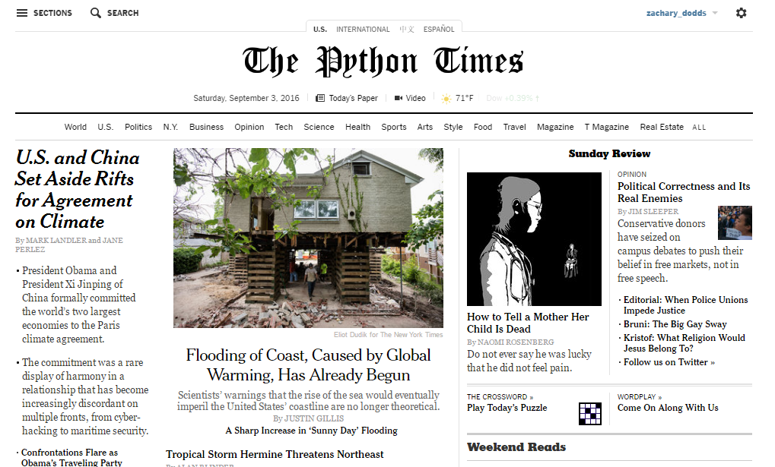
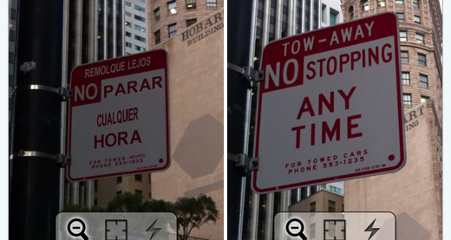
Today’s whether: if, elif, or else!
Three-eyed aliens causing most computer troubles...
Homework #1 Due Mon., 9/12
0) Reading + response
Alien Attack?! Picobot programmer Z. Dodds was subject of a bizarre encounter yesterday with three-eyed aliens. The trinocular tourists, it seems, were conducting experiments that would help them understand “how humans think.”
It seems the aliens used a shrinking ray, which let them enter the programmer’s head in order to see what was happening. A witness reports deeply disappointed voices emanating from within.
To escape the attack, Dodds had to turn the ray on himself – as he shrank, the aliens quickly flew off, departing so fast that he was unable to use the reverse ray before they left. “I don’t mind,” Dodds mused – in fact, this might help me tomorrow… ”
1) Lab: data
2) Lab: functions
Composite sketch of one of the attackers drawn from three-eyewitness accounts
3) The fun in functions!
(ExCr) HTMLanguage
Automatic translation: if it's possible for human languages... perhaps for CS, too?
see three-eyed alien attack, p. 42

Slide 2
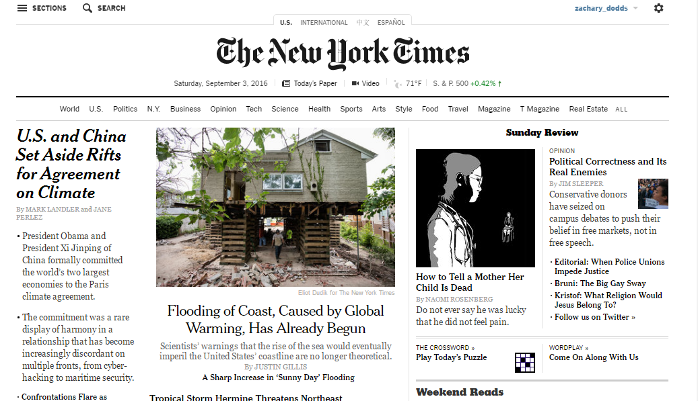
Extra Extra...! admittedly, for "comical" credit

Slide 3
Extra Extra...! admittedly, for "comical" credit

Slide 4
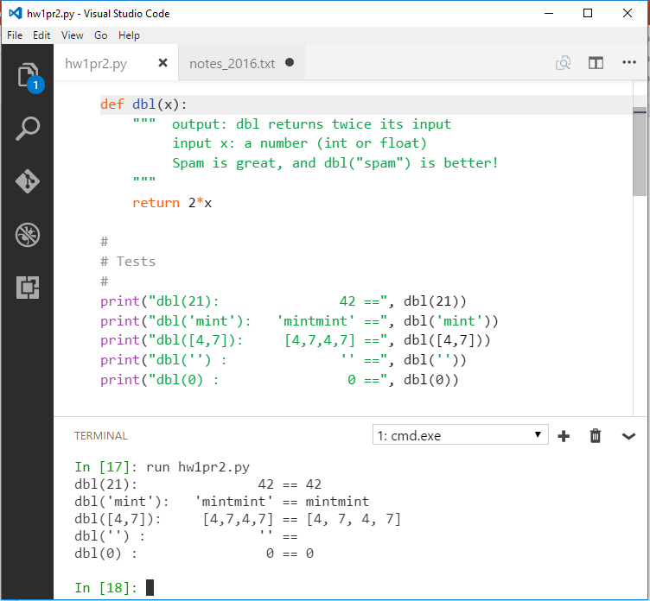
VS Code...
... now, with terminal
Notes:
my foreign language teachers always tried to convince me that the skill of speaking, reading and writing a foreign language…
I didn’t believe them then and I don’t believe them now -- but I do believe that reading and writing a computer language is the way to get a strong intuitive understanding of how machines think -- it’s also important for getting them to do what you want them to, but even if you forget everything this course (hopefully) teaches about Java (compiler, datatypes, Classes and Objects), the real goal is that you take away a deeper insight into how machines think
familiar and sometimes not so familiar… deceptively easy
you mean I have to type all that!!

Slide 5
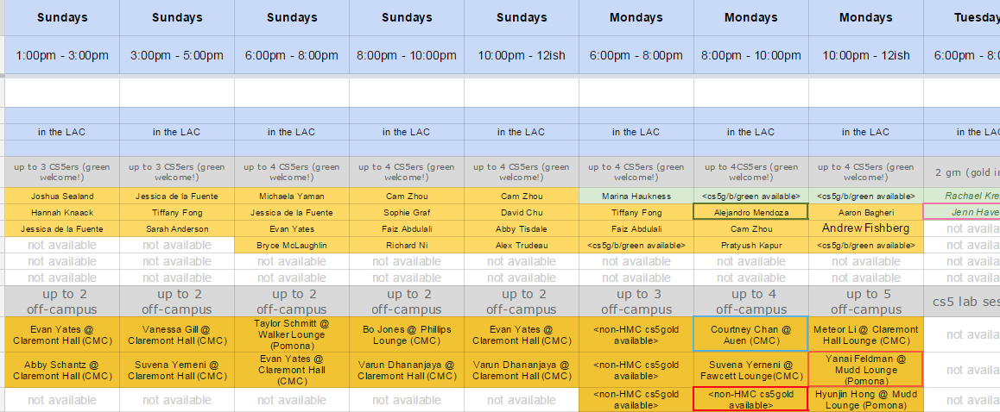
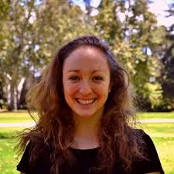

In-person help: Tutoring hours…
For information: Which tutors are where?!
(please don't edit or change this spreadsheet)
Yes, this spreadsheet is crazy (But join in…!)
Yes, we need more hrs. at Scripps!
Katherine T.

Slide 6
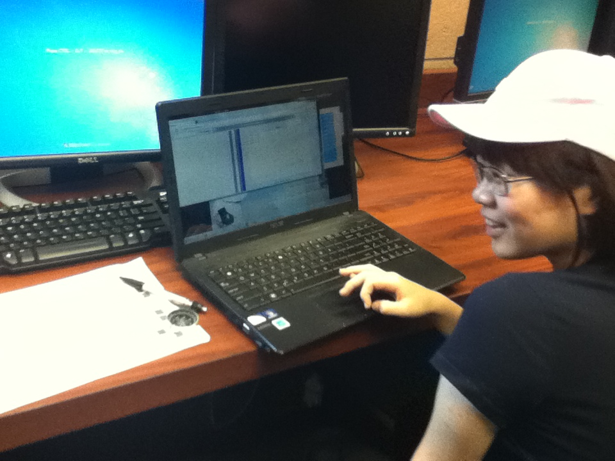
Tutoring hrs. @ Mudd…

Slide 7
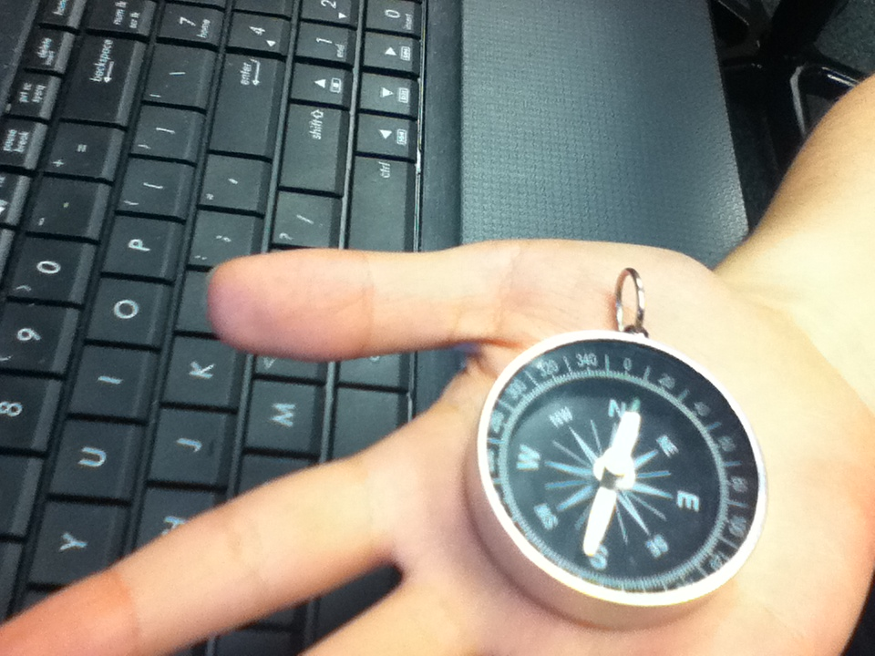
Picobot tutoring gets real!

Slide 8
The challenge of programming…
syntax
semantics
intent
How it looks
What it does
What it should do
human-typed input
machine-producedoutput
www.theonion.com
human-desired output
?
Notes:
my foreign language teachers always tried to convince me that the skill of speaking, reading and writing a foreign language…
I didn’t believe them then and I don’t believe them now -- but I do believe that reading and writing a computer language is the way to get a strong intuitive understanding of how machines think -- it’s also important for getting them to do what you want them to, but even if you forget everything this course (hopefully) teaches about Java (compiler, datatypes, Classes and Objects), the real goal is that you take away a deeper insight into how machines think
familiar and sometimes not so familiar… deceptively easy
you mean I have to type all that!!

Slide 9
learning a language ~ syntax
unavoidable, but not the point
… but learning CS ~ semantics
learning how machines think!
Notes:
Electric: from www.staticfreesoftware.com
My tutorial is at:
http://odin.ac.hmc.edu/~harris/class/chipdesign/electric.pdf
Lasergene (a molecular biology suite of programs for aligning and comparing
DNA sequences, etc.)
Statview (statistical analysis)
KaleidaGraph (plotting & graphing)
Populus (programs that simulate ecological and evolutionary processes)

Slide 10
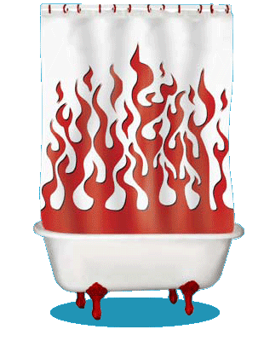
Inside the machine…
What's behind the scenes (processing + memory):
Computation
Data Storage
41
42
name: x
type: int
LOC: 312
name: y
type: int
LOC: 324
memory location 312
memory location 324
variables ~ boxes
id, del

Slide 11
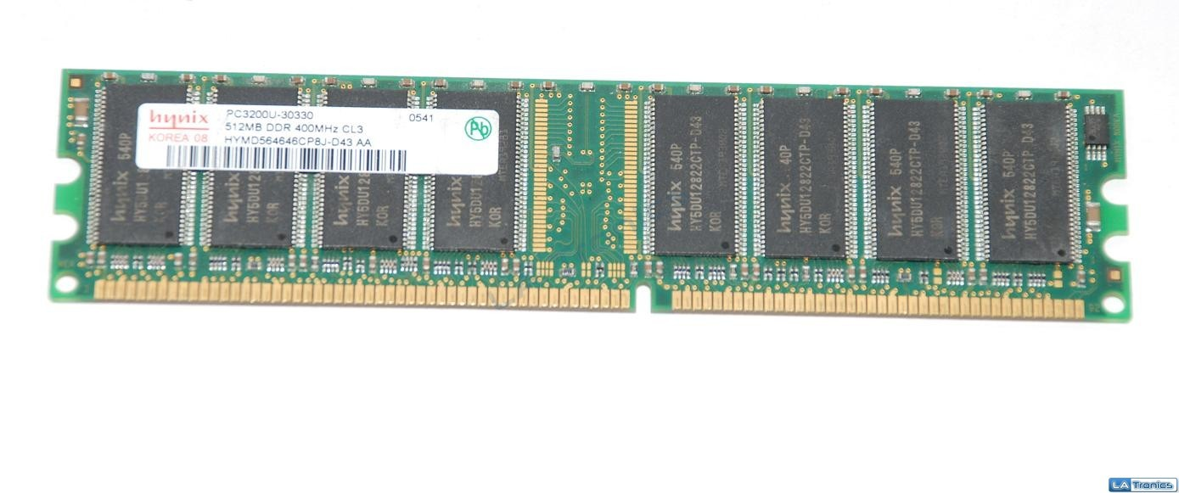
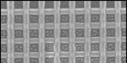
Memory!
Random Access Memory
41
42
83
83
name: x
type: int
LOC: 312
name: y
type: int
LOC: 324
name: z
type: int
LOC: 336
name:
type: int
LOC: 348
a big list of boxes, each with a name, type, location, and value
512 MB of memory
on or off
bit = smallest amt. of info.: 0 or 1
False
True
byte = 8 bits
word = 64 bits

Slide 12

All languages use datatypes
Type
Example
What is it?
numeric values with a fractional part, even if the fractional part is .0
float
3.14
or
3.0
int
42
10**100
integers – Python has infinite precision ints!
or
the T/F results from a test or comparison:
bool
True
or
False
==, !=, <, >, <=, >=
Hey! Someone can't spelle !
"Boolean values"
"Boolean oeprators"
George Boole
type( x )
Notes:
Electric: from www.staticfreesoftware.com
My tutorial is at:
http://odin.ac.hmc.edu/~harris/class/chipdesign/electric.pdf
Lasergene (a molecular biology suite of programs for aligning and comparing
DNA sequences, etc.)
Statview (statistical analysis)
KaleidaGraph (plotting & graphing)
Populus (programs that simulate ecological and evolutionary processes)

Slide 13
Operate!
higher precedence
( )
**
-
* / % //
+ -
> == <
=
Notes:
Electric: from www.staticfreesoftware.com
My tutorial is at:
http://odin.ac.hmc.edu/~harris/class/chipdesign/electric.pdf
Lasergene (a molecular biology suite of programs for aligning and comparing
DNA sequences, etc.)
Statview (statistical analysis)
KaleidaGraph (plotting & graphing)
Populus (programs that simulate ecological and evolutionary processes)

Slide 14

O-per-ate!
higher precedence
( )
**
-
* / % //
+ -
> == <
=
Notes:
Electric: from www.staticfreesoftware.com
My tutorial is at:
http://odin.ac.hmc.edu/~harris/class/chipdesign/electric.pdf
Lasergene (a molecular biology suite of programs for aligning and comparing
DNA sequences, etc.)
Statview (statistical analysis)
KaleidaGraph (plotting & graphing)
Populus (programs that simulate ecological and evolutionary processes)

Slide 15
Python operators
higher precedence
( )
parens
**
power
-
negate
* / % //
times, mod, divide
add, subtract
+ -
> == <
compare
=
assign
It's not worth remembering all these %+/* things! I’d recommend parentheses over precedence.
Notes:
Electric: from www.staticfreesoftware.com
My tutorial is at:
http://odin.ac.hmc.edu/~harris/class/chipdesign/electric.pdf
Lasergene (a molecular biology suite of programs for aligning and comparing
DNA sequences, etc.)
Statview (statistical analysis)
KaleidaGraph (plotting & graphing)
Populus (programs that simulate ecological and evolutionary processes)

Slide 16
% the mod operator
7 % 3
9 % 3
8 % 3
30 % 7
x%y is the remainder when x is divided by y
x%2 == 0
x%2 == 1
For what values of x are these True?
x%4 == 0
If x is a year, what happens on these years!?
x%4 == 3
What happens on these years, football-wise!?
Notes:
Electric: from www.staticfreesoftware.com
My tutorial is at:
http://odin.ac.hmc.edu/~harris/class/chipdesign/electric.pdf
Lasergene (a molecular biology suite of programs for aligning and comparing
DNA sequences, etc.)
Statview (statistical analysis)
KaleidaGraph (plotting & graphing)
Populus (programs that simulate ecological and evolutionary processes)

Slide 17
// integer division
7 // 3
8 // 3
9 // 3
30 // 7
x//y is x/y, rounded-down to an integer
x == (x//y)*y + (x%y)
But why?
# of full y's in x
remainder after "taking" all of the full y's in x
Notes:
Electric: from www.staticfreesoftware.com
My tutorial is at:
http://odin.ac.hmc.edu/~harris/class/chipdesign/electric.pdf
Lasergene (a molecular biology suite of programs for aligning and comparing
DNA sequences, etc.)
Statview (statistical analysis)
KaleidaGraph (plotting & graphing)
Populus (programs that simulate ecological and evolutionary processes)

Slide 18
the "equals" operators
= != ==
This is true – but what is it saying!?
Notes:
Electric: from www.staticfreesoftware.com
My tutorial is at:
http://odin.ac.hmc.edu/~harris/class/chipdesign/electric.pdf
Lasergene (a molecular biology suite of programs for aligning and comparing
DNA sequences, etc.)
Statview (statistical analysis)
KaleidaGraph (plotting & graphing)
Populus (programs that simulate ecological and evolutionary processes)

Slide 19
the "equals" operators
= != ==
SET equals
isn't equal to
TEST equals
I want === !
Notes:
Electric: from www.staticfreesoftware.com
My tutorial is at:
http://odin.ac.hmc.edu/~harris/class/chipdesign/electric.pdf
Lasergene (a molecular biology suite of programs for aligning and comparing
DNA sequences, etc.)
Statview (statistical analysis)
KaleidaGraph (plotting & graphing)
Populus (programs that simulate ecological and evolutionary processes)

Slide 20
how = works
"Quiz"
name(s)
x = 41
y = x + 1
z = x + y
Run
these lines
x
y
z
What are x, y, and z at this time?
Then run this line
x = x + y
x
y
z
What are x, y, and z at this time?
Extra!
a = 11//2
b = a%3
c = b** a+b *a
What are the values of a, b, and c after the 3 lines, at left, run?
a
b
c

Slide 21
Inside the machine…
x = 41
y = x + 1
z = x + y
x = x + y
What's happening in python:
What's happening behind the scenes (in memory):
Computation
Memory (Data Storage)
41
42
name: x
type: int
LOC: 312
name: y
type: int
LOC: 324
83
83
name: z
type: int
LOC: 312
name: x
type: int
LOC: 324
id, del

Slide 22
Are numbers enough for everything?
Yes and no…
You need lists of numbers, as well!
and strings - lists of characters - too.
Both of these are Python sequences…

Slide 23
Data, data everywhere…
Data

Slide 24
Data, data everywhere…
2015
2020
2011
1 Zettabyte
2009
44 ZB
1.8 ZB
8.0 ZB
800 EB
2002
Data produced each year
161 EB
2006
logarithmic scale
1 Exabyte
5 EB
100-years of HD video + audio
1 Petabyte
Human brain's capacity
60 PB
14 PB
1 Petabyte, PB == 1000 Terabytes, TB
1 Terabyte, TB == 1000 Gigabytes, GB
References
(2020) 44ZB: http://www.emc.com/leadership/digital-universe/2014iview/executive-summary.htm
(2015) 8 ZB: http://www.emc.com/collateral/analyst-reports/idc-extracting-value-from-chaos-ar.pdf
(2011) 1.8 ZB: http://www.emc.com/leadership/programs/digital-universe.htm
(2009) 800 EB: http://www.emc.com/collateral/analyst-reports/idc-digital-universe-are-you-ready.pdf
(2006) 161 EB: http://www.emc.com/collateral/analyst-reports/expanding-digital-idc-white-paper.pdf
(2002) 5 EB: http://www2.sims.berkeley.edu/research/projects/how-much-info-2003/execsum.htm
(life in video) 60 PB: in 4320p resolution, extrapolated from 16MB for 1:21 of 640x480 video (w/sound) – almost certainly a gross overestimate, as sleep can be compressed significantly!
(brain) 14 PB: http://www.quora.com/Neuroscience-1/How-much-data-can-the-human-brain-store

Slide 25

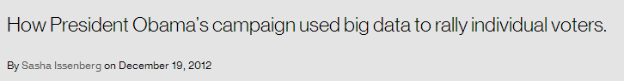
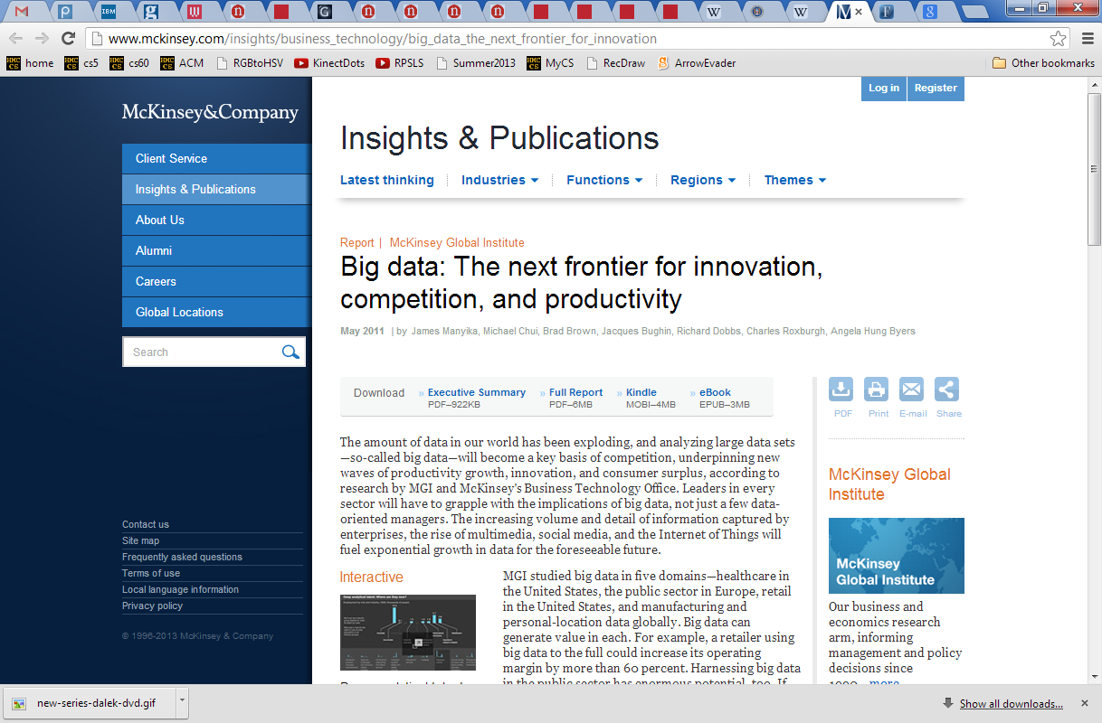
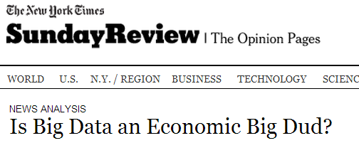
Big Data?
Notes:
Electric: from www.staticfreesoftware.com
My tutorial is at:
http://odin.ac.hmc.edu/~harris/class/chipdesign/electric.pdf
Lasergene (a molecular biology suite of programs for aligning and comparing
DNA sequences, etc.)
Statview (statistical analysis)
KaleidaGraph (plotting & graphing)
Populus (programs that simulate ecological and evolutionary processes)

Slide 26
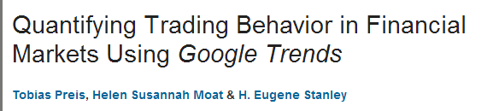
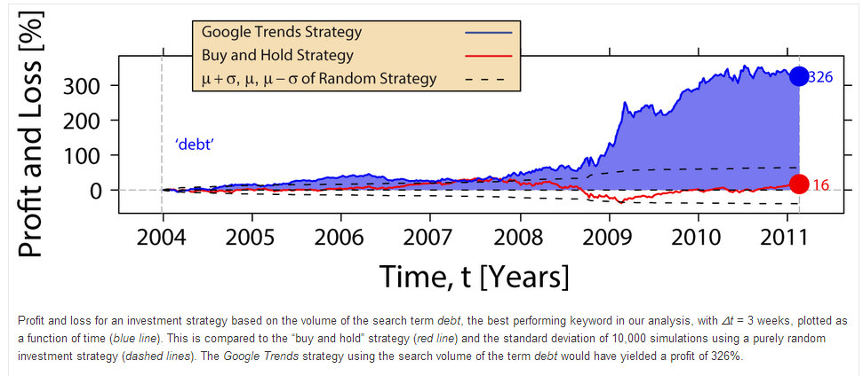
'debt'
more-than-average searches for debt: sell
around-average searches for debt: hold
fewer-than-average searches for debt: buy
strategy:
Notes:
Electric: from www.staticfreesoftware.com
My tutorial is at:
http://odin.ac.hmc.edu/~harris/class/chipdesign/electric.pdf
Lasergene (a molecular biology suite of programs for aligning and comparing
DNA sequences, etc.)
Statview (statistical analysis)
KaleidaGraph (plotting & graphing)
Populus (programs that simulate ecological and evolutionary processes)

Slide 27
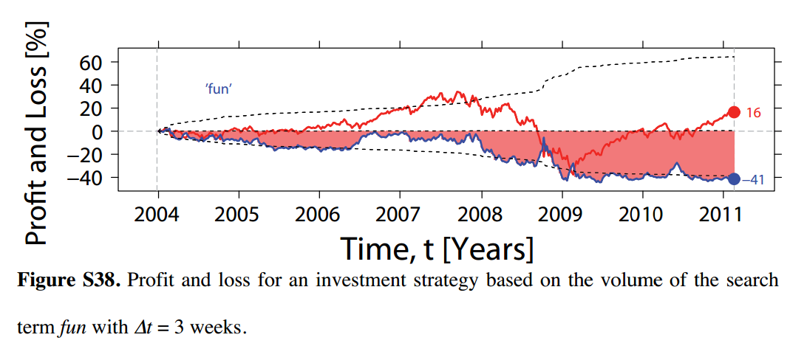
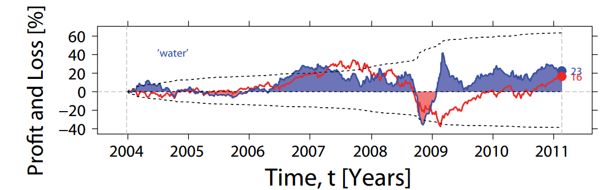
'fun'
'water'
Notes:
Electric: from www.staticfreesoftware.com
My tutorial is at:
http://odin.ac.hmc.edu/~harris/class/chipdesign/electric.pdf
Lasergene (a molecular biology suite of programs for aligning and comparing
DNA sequences, etc.)
Statview (statistical analysis)
KaleidaGraph (plotting & graphing)
Populus (programs that simulate ecological and evolutionary processes)

Slide 28
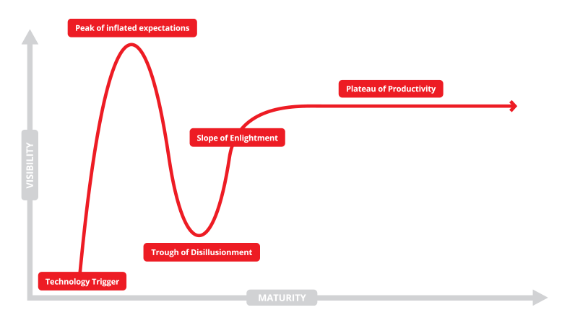
The Technology Hype Cycle…
not quite sure where we are right now…?
If you torture the data enough, it will confess.
- R. Coates, statistician
Notes:
Electric: from www.staticfreesoftware.com
My tutorial is at:
http://odin.ac.hmc.edu/~harris/class/chipdesign/electric.pdf
Lasergene (a molecular biology suite of programs for aligning and comparing
DNA sequences, etc.)
Statview (statistical analysis)
KaleidaGraph (plotting & graphing)
Populus (programs that simulate ecological and evolutionary processes)

Slide 29


wisdom
G.G.M, et al.
knowledge
G. Garcia Marquez
Google's users
Data's elevation?
information
Google
data
Notes:
Electric: from www.staticfreesoftware.com
My tutorial is at:
http://odin.ac.hmc.edu/~harris/class/chipdesign/electric.pdf
Lasergene (a molecular biology suite of programs for aligning and comparing
DNA sequences, etc.)
Statview (statistical analysis)
KaleidaGraph (plotting & graphing)
Populus (programs that simulate ecological and evolutionary processes)

Slide 30
strings: textual data
s = 'scripps'
strings
c = 'college'
type...
type(s)
len
len(s)
add!
s + c
multiply!!
2*s + 3*c
What did you say!?!

Slide 31
strings: textual data
s1 = 'ha'
Given
s2 = 't'
What are
s1 + s2
2*s1 + s2 + 2*(s1+s2)
What did you say!?!

Slide 32
Lists ~ collections of any data
M = [ 4, 7, 100, 42, 5, 47 ]
Notes:
Electric: from www.staticfreesoftware.com
My tutorial is at:
http://odin.ac.hmc.edu/~harris/class/chipdesign/electric.pdf
Lasergene (a molecular biology suite of programs for aligning and comparing
DNA sequences, etc.)
Statview (statistical analysis)
KaleidaGraph (plotting & graphing)
Populus (programs that simulate ecological and evolutionary processes)

Slide 33
Lists ~ collections of any data
Square brackets tell python you want a list.
Commas separate elements.
M = [ 4, 7, 100, 42, 5, 47 ]
len(M)
M[0]
M[0:3]
top-level length
indexing
slicing
Notes:
Electric: from www.staticfreesoftware.com
My tutorial is at:
http://odin.ac.hmc.edu/~harris/class/chipdesign/electric.pdf
Lasergene (a molecular biology suite of programs for aligning and comparing
DNA sequences, etc.)
Statview (statistical analysis)
KaleidaGraph (plotting & graphing)
Populus (programs that simulate ecological and evolutionary processes)

Slide 34
Lists ~ collections of any data
string
L = [ 3.14, [2,40], 'third', 42 ]
len(L)
L[0]
L[0:1]
top-level length
indexing
slicing
only counts top-level elements
could return a different type
always returns the same type, and always returns a substructure!
Notes:
Electric: from www.staticfreesoftware.com
My tutorial is at:
http://odin.ac.hmc.edu/~harris/class/chipdesign/electric.pdf
Lasergene (a molecular biology suite of programs for aligning and comparing
DNA sequences, etc.)
Statview (statistical analysis)
KaleidaGraph (plotting & graphing)
Populus (programs that simulate ecological and evolutionary processes)

Slide 35
Indexing uses [ ]
s = 'harvey mudd college'
0
1
2
3
4
5
6
7
8
9
10
11
12
13
14
15
16
17
18
index
Read as "s-of-zero" or "s-zero"
s[0]
'h'
is
s[17]
is
s[6]
is
s[ ]
'e'
is
Notes:
Selena's estoy contigo
Spanish was Selena's scond language

Slide 36
Negative indices…
In a negative mood ? Python's there for you !
0
1
2
3
4
5
6
7
8
9
10
11
12
13
14
15
16
17
18
s = 'harvey mudd college'
-19
-17
-15
-13
-11
-9
-7
-5
-3
-1
-18
-16
-14
-12
-10
-8
-6
-4
-2
Negative indices count backwards from the end!
s[-1]
'e'
is
s[-18]
is
s[-7]
is
s[-0]
is
Notes:
Selena's estoy contigo
Spanish was Selena's scond language

Slide 37
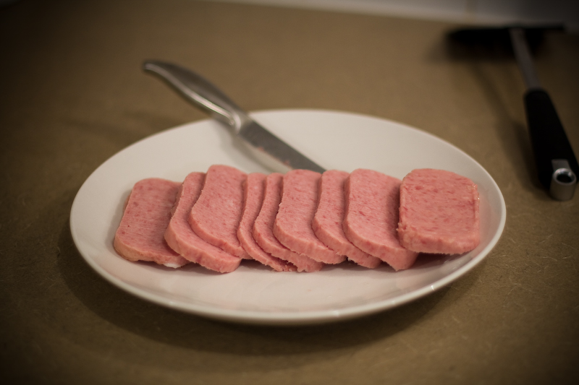
Slicing
s = 'harvey mudd college'
0
1
2
3
4
5
6
7
8
9
10
11
12
13
14
15
16
17
18
s[ : ]
slices the string, returning a substring
What's going on here?
s[0:6]
is
'harvey'
s[12:18]
is
'colleg'
s[17:]
is
'ge'
s[:]
is
'harvey mudd college'

Slide 38
Slicing
s = 'harvey mudd college'
0
1
2
3
4
5
6
7
8
9
10
11
12
13
14
15
16
17
18
start
end+1
s[ : ]
slices the string, returning a substring
first index is the first character
second index is ONE AFTER the last character
a missing index means that end of the string
s[0:6]
is
'harvey'
s[12:18]
is
'colleg'
s[17:]
is
'ge'
s[:]
is
'harvey mudd college'

Slide 39
Slicing
0
1
2
3
4
5
6
7
8
9
10
11
12
13
14
15
16
17
18
s = 'harvey mudd college'
-19
-18
-17
-16
-15
-14
-13
-12
-11
-10
-9
-8
-7
-6
-5
-4
-3
-2
-1
start
end+1
s[15:-1]
is
What are these slices?
s[:2]
is
is
'mud'
and these?
is
'e'
Don't wor'e'-
Be hap'e' !

Slide 40
Skip-Slicing
s[ : : ]
the third index is the stride length
default is +1
start
end+1
s = 'harvey mudd college'
0
1
2
3
4
5
6
7
8
9
10
11
12
13
14
15
16
17
18
s[0:8:2]
'hre '
is
s[17:12:-1]
is
s[::-1]
is
G. Garcia Marquez
is
'doe'
s[1::6]
is
I love this one.

Slide 41
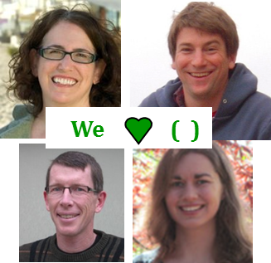
pi = [3,1,4,1,5,9]
Try it!
L = [ 'pi', "isn't", [4,2] ]
M = 'You need parentheses for chemistry !'
0
4
8
12
16
20
24
28
32
Part 1
Part 2
6
'pi'
What is len(pi)
What is L[0]
These three are all different
What is len(L)
What is L[0][1]
What is len(L[1])
What is L[0:1]
What slice of M is 'try'?
What is pi[2:4]
What slice of M is 'shoe'?
What slice of pi is [3,1,4]
pi[0:3]
What is M[9:15]
What slice of pi is [3,4,5]
What is M[::5]
Extra! Mind Muddler
What are pi[0]*(pi[1]+pi[2]) and pi[0]*(pi[1:2]+pi[2:3]) ?
These two are different!
Notes:
Prof. Aaron Laconte; Prof. Katie Purvis-Roberts

Slide 42




pi = [3,1,4,1,5,9]
Try it!
L = [ 'pi', "isn't", [4,2] ]
We ( )
M = 'You need parentheses for chemistry !'
0
4
8
12
16
20
24
28
32
Part 1
Part 2
6
'pi'
What is len(pi)
What is L[0]
These three are all different
3
'i'
What is len(L)
What is L[0][1]
['pi']
What is len(L[1])
What is L[0:1]
[4,1]
What slice of M is 'try'?
M[31:34]
or
M[-5:-2]
What is pi[2:4]
pi[:3]
What slice of M is 'shoe'?
What slice of pi is [3,1,4]
'parent'
What is M[9:15]
pi[::2]
What slice of pi is [3,4,5]
What is M[::5]
Extra! Mind Muddlers
What are pi[0]*(pi[1]+pi[2]) and pi[0]*(pi[1:2]+pi[2:3]) ?
These two are different!
15
[1,4,1,4,1,4]
Notes:
Prof. Aaron Laconte; Prof. Katie Purvis-Roberts

Slide 43
Python slices - it dices...
( data, at least )
… but wait, there's more!

Slide 44
Python slices - it dices...
( data, at least )
Python functions
… but wait, there's more!

Slide 45
Functioning in Python
# my own function!
def dbl( x ):
""" returns double its input, x """
return 2x
This doesn't look quite right…

Slide 46
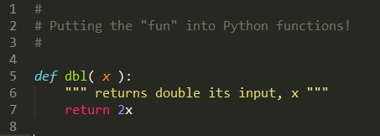
Functioning in Python
IDLE vs Monokai colorschemes
Still broken… !

Slide 47
Functioning in Python
comment for other coders
# my own function!
def dbl( x ):
""" returns double its input, x """
return 2*x
documentation string for all users
Python's keywords
Some of Python's baggage…

Slide 48
Function Fun !
def undo(s):
""" this "undoes" its input, s """
return 'de' + s
>>> undo('caf')
'decaf'
>>> undo(undo('caf'))
strings, lists, numbers … all data are fair game

Slide 49
Have a dedecaf-ternoon!
morning + evening, too
This week's lab ~ first two hw problems

Slide 51
Lists ~ collections of any data
L = [ 3.14, [2,40], 'third', 42 ]
len(L)
L[0]
L[0:1]
length
indexing
slicing
only counts top-level elements
could return a different type
always returns the same type, and always returns a substructure!
From L how could you get
'hi'
==
L[
Notes:
Electric: from www.staticfreesoftware.com
My tutorial is at:
http://odin.ac.hmc.edu/~harris/class/chipdesign/electric.pdf
Lasergene (a molecular biology suite of programs for aligning and comparing
DNA sequences, etc.)
Statview (statistical analysis)
KaleidaGraph (plotting & graphing)
Populus (programs that simulate ecological and evolutionary processes)

Slide 52
Lists ~ collections of any data
L = [ 3.14, [2,40], 'third', 42 ]
len(L)
L[0]
L[0:1]
length
indexing
slicing
only counts top-level elements
could return a different type
always returns the same type, and always returns a substructure!
From L how could you get
'hi'
==
L[
Notes:
Electric: from www.staticfreesoftware.com
My tutorial is at:
http://odin.ac.hmc.edu/~harris/class/chipdesign/electric.pdf
Lasergene (a molecular biology suite of programs for aligning and comparing
DNA sequences, etc.)
Statview (statistical analysis)
KaleidaGraph (plotting & graphing)
Populus (programs that simulate ecological and evolutionary processes)

Slide 53

Same message …
The PYTimes
Today’s whether: if, elif, or else!
… in any language?
Homework #1 Due Mon., 9/14
Alien Attack?! Picobot programmer Z. Dodds was subject of a bizarre encounter yesterday with three-eyed aliens. The trinocular tourists, it seems, were conducting experiments that would help them understand “how humans think.”
It seems the aliens used a shrinking ray, which let them enter the programmer’s head in order to see what was happening. A witness reports deeply disappointed voices emanating from within.
To escape the attack, Dodds had to turn the ray on himself – as he shrank, the aliens quickly flew off, departing so fast that he was unable to use the reverse ray before they left. “I don’t mind,” Dodds mused – in fact, this might help me tomorrow… ”
0) Reading/response
1) Lab: data
2) Lab: data + functions
Composite sketch of one of the attackers drawn from three-eyewitness accounts
3) Putting the fun into functions!
Automatic translation: if it's possible for human languages... perhaps for CS, too?
see three-eyed alien attack, p. 42

Slide 54
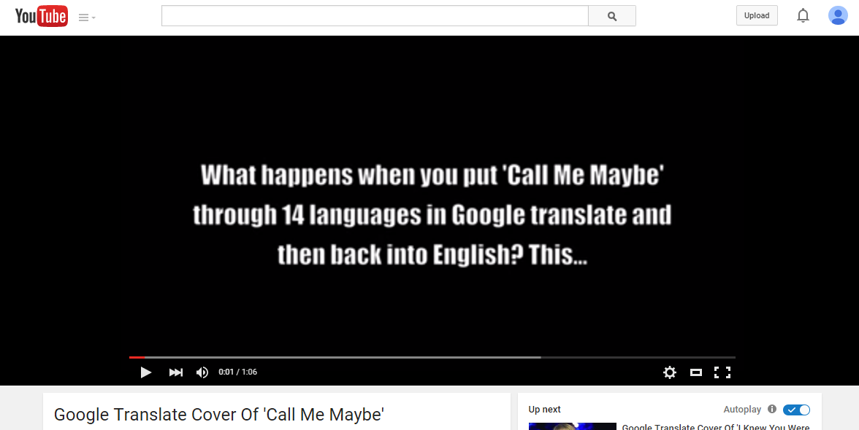
Same message …
The PYTimes
Today’s whether: if, elif, or else!
… in any language?
Homework #1 Due Mon., 9/14
Alien Attack?! Picobot programmer Z. Dodds was subject of a bizarre encounter yesterday with three-eyed aliens. The trinocular tourists, it seems, were conducting experiments that would help them understand “how humans think.”
It seems the aliens used a shrinking ray, which let them enter the programmer’s head in order to see what was happening. A witness reports deeply disappointed voices emanating from within.
To escape the attack, Dodds had to turn the ray on himself – as he shrank, the aliens quickly flew off, departing so fast that he was unable to use the reverse ray before they left. “I don’t mind,” Dodds mused – in fact, this might help me tomorrow… ”
0) Reading/response
1) Lab: data
2) Lab: data + functions
Composite sketch of one of the attackers drawn from three-eyewitness accounts
3) Putting the fun into functions!
Automatic translation: if it's possible for human languages... perhaps for CS, too?
see three-eyed alien attack, p. 42

Slide 55
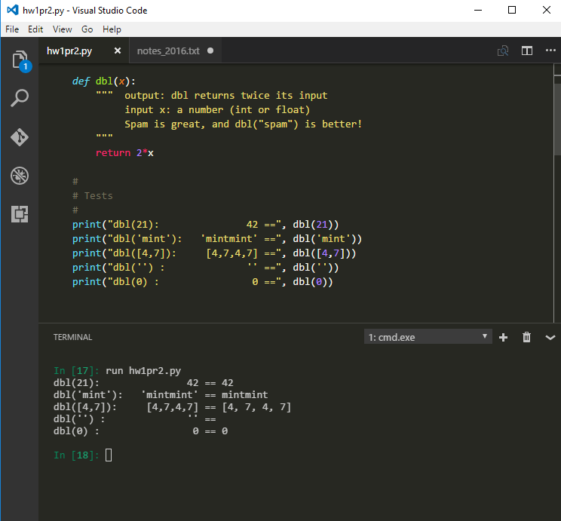
VS Code...
...with terminal
Notes:
my foreign language teachers always tried to convince me that the skill of speaking, reading and writing a foreign language…
I didn’t believe them then and I don’t believe them now -- but I do believe that reading and writing a computer language is the way to get a strong intuitive understanding of how machines think -- it’s also important for getting them to do what you want them to, but even if you forget everything this course (hopefully) teaches about Java (compiler, datatypes, Classes and Objects), the real goal is that you take away a deeper insight into how machines think
familiar and sometimes not so familiar… deceptively easy
you mean I have to type all that!!

Slide 56
% the mod operator
7 % 3
9 % 3
8 % 3
16 % 7
x%y returns the remainder when x is divided by y
x%2 == 0
x%2 == 1
For what values of x are these True?
x%4 == 0
What happens on these years?
x%4 == 3
Notes:
Electric: from www.staticfreesoftware.com
My tutorial is at:
http://odin.ac.hmc.edu/~harris/class/chipdesign/electric.pdf
Lasergene (a molecular biology suite of programs for aligning and comparing
DNA sequences, etc.)
Statview (statistical analysis)
KaleidaGraph (plotting & graphing)
Populus (programs that simulate ecological and evolutionary processes)

Slide 57
Quiz
how = works
name or names
x = 41
y = x + 1
z = x + y
Run
these lines
x
y
z
Extra!
What are x, y, and z at this time?
a = 11/2
b = a%3
c = b** a+b *a
Then run this
x = x + y
x
y
z
What are x, y, and z at this time?
What are the values of a, b, and c after these lines run?

Slide 58
Highlights from the first Quiz…

Slide 59
uses a "shell" language
Computer command-line
% cd Desktop
% ls or dir
% python
just about all we'll do…
% python hw1pr1.py
Python command-line
runs the Python language
>>> 6*7
>>> s = 'harvey mudd college'
>>> len(s)
this feels like CS5's primary topic!
>>> s.upper()

Slide 60
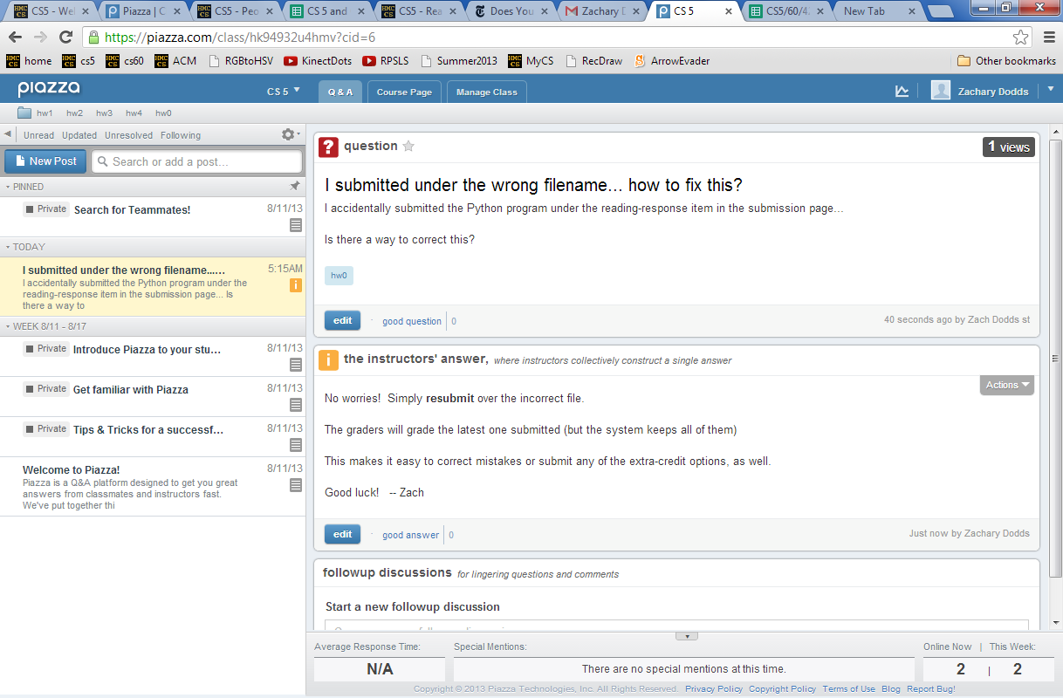
Piazza
for all CS5 concerns/questions
public: post to whole class

Slide 61
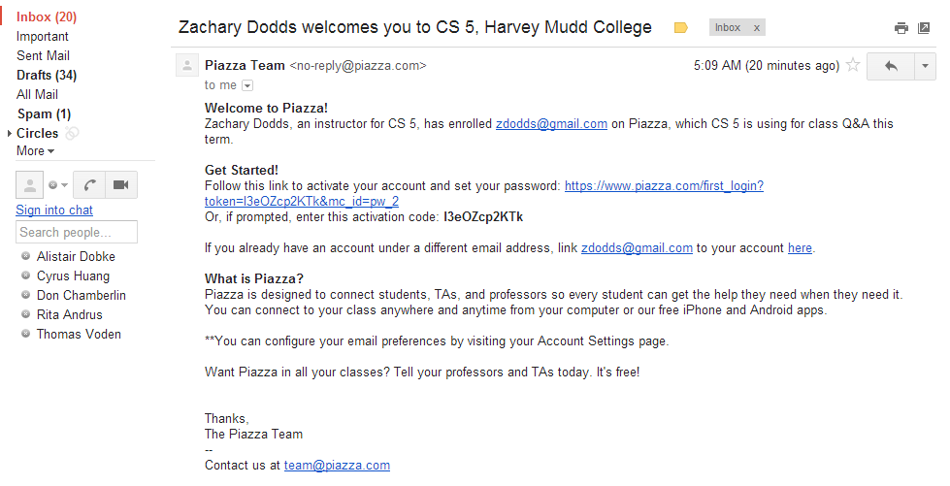
Piazza
you'll get a welcome email…
sign-in + choose your message frequency

Slide 62
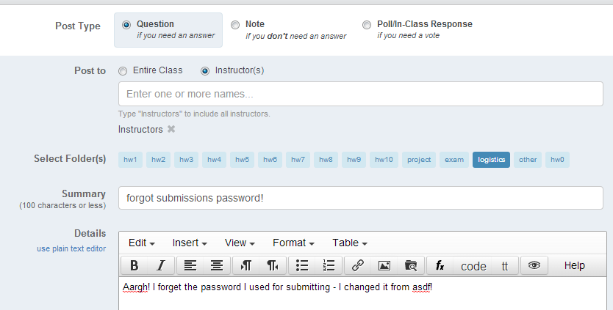
Piazza
for all CS5 concerns/questions
individual concerns or your source code / bugs?
In-person + pair programming are better strategies for bugs.
But we'll try to take a look…
private: post to instructors
Account problems?
Piazza us!

Slide 63
the "equals" operators
= != ==
SET equals
isn't equal to
TEST equals
I want === !
Notes:
Electric: from www.staticfreesoftware.com
My tutorial is at:
http://odin.ac.hmc.edu/~harris/class/chipdesign/electric.pdf
Lasergene (a molecular biology suite of programs for aligning and comparing
DNA sequences, etc.)
Statview (statistical analysis)
KaleidaGraph (plotting & graphing)
Populus (programs that simulate ecological and evolutionary processes)

Slide 64
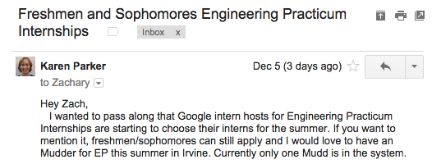

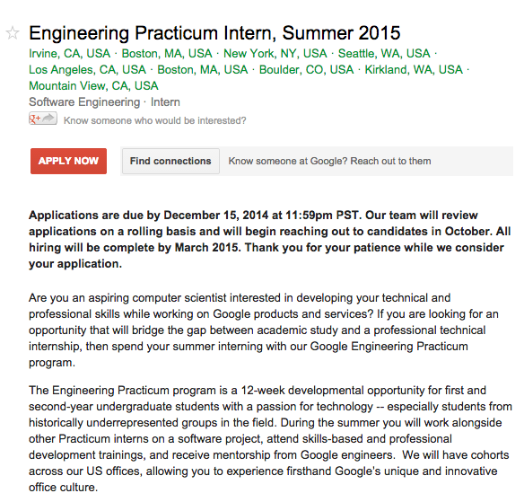
ask Karen about this now…

Slide 65
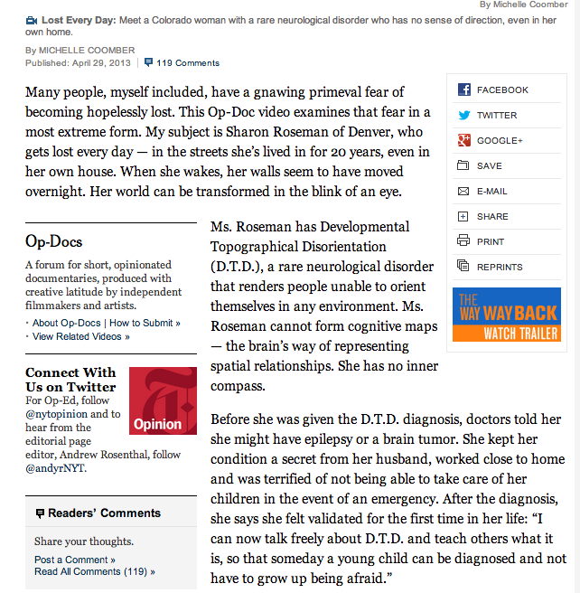
Piqued by Picobot?
for some, it's real…

Slide 66
Quiz
how = works
name or names
x = 41
y = x + 1
z = x + y
Run
these lines
What are the values of x, y, and z here?
x
y
z
extra!
a = 11/2
b = a%3
c = b** a+b *a
Then run this
x = x + y
x
y
z
What are the values of x, y, and z here?
What are the values of a, b, and c here?

Slide 67
= names data
extra!
a = 11/2
b = a%3
c = b** a+b *a
x = 41
y = x + 1
z = x + y
x
y
z
What are the values of a, b, and c here?
I see differences on the left and right – and with an eye to spare!
x = x + y
x
y
z

Slide 68
string functions
str(42) returns '42'
converts input to a string
len('42') returns 2
returns the string’s length
'XL' + 'II' returns 'XLII'
concatenates strings
'VI' * 7 returns 'VIVIVIVIVIVIVI'
repeats strings
s1 = 'ha'
Given these strings
s2 = 't'
s1 + s2
What are
2*s1 + s2 + 2*(s1+s2)
What did you say!?!

Slide 69
Indexing uses [ ]
s = 'harvey mudd college'
0
1
2
3
4
5
6
7
8
9
10
11
12
13
14
15
16
17
18
index
Read as "s-of-zero" or "s-zero"
s[0]
is
s[6]
is
s[ ]
'e'
is
Notes:
Selena's estoy contigo
Spanish was Selena's scond language

Slide 70
Negative indices…
In a negative mood ? Python's there for you !
0
1
2
3
4
5
6
7
8
9
10
11
12
13
14
15
16
17
18
s = 'harvey mudd college'
-19
-17
-15
-13
-11
-9
-7
-5
-3
-1
-18
-16
-14
-12
-10
-8
-6
-4
-2
Negative indices count backwards from the end!
s[-1]
is
s[-2]
is
s[-0]
is
Notes:
Selena's estoy contigo
Spanish was Selena's scond language

Slide 71
Slicing
s = 'harvey mudd college'
0
1
2
3
4
5
6
7
8
9
10
11
12
13
14
15
16
17
18
s[ : ]
slices the string, returning a substring
What's going on here?
s[0:6]
is
'harvey'
s[12:18]
is
'colleg'
s[17:]
is
'ge'
s[:]
is
'harvey mudd college'

Slide 72
Slicing
s = 'harvey mudd college'
0
1
2
3
4
5
6
7
8
9
10
11
12
13
14
15
16
17
18
s[15:-1]
is
What are these slices?
s[:2]
is
is
'mud'
and these?
is
'e'
Don't 'wor' 'e'-
Be 'hap' 'e' !

Slide 73
Skip-Slicing
s[ : : ]
the third index is the stride length
default is +1
s = 'harvey mudd college'
0
1
2
3
4
5
6
7
8
9
10
11
12
13
14
15
16
17
18
s[0:8:2]
'hre '
is
s[17:12:-1]
is
is
'doe'
G. Garcia Marquez
s[1::6]
is
I love this one.

Slide 74
Lists ~ collections of any data
L = [ 3.14, [2,40], 'third', 42 ]
len(L)
L[0]
L[0:1]
length
indexing
slicing
could return a different type
always returns the same type, and always returns a substructure!
From L how could you get
'hi'
Notes:
Electric: from www.staticfreesoftware.com
My tutorial is at:
http://odin.ac.hmc.edu/~harris/class/chipdesign/electric.pdf
Lasergene (a molecular biology suite of programs for aligning and comparing
DNA sequences, etc.)
Statview (statistical analysis)
KaleidaGraph (plotting & graphing)
Populus (programs that simulate ecological and evolutionary processes)

Slide 75
pi = [3,1,4,1,5,9]
Try it!
L = [ 'pi', "isn't", [4,2] ]
M = 'You need parentheses for chemistry !'
We ( )
0
4
8
12
16
20
24
28
32
Part 1
Part 2
What is len(pi)
What is L[0]
These two are different!
What is len(L)
What is L[0:1]
What is len(L[1])
What is L[0][1]
What is pi[2:4]
What slice of M is 'try'? is 'shoe'?
What slice of pi is [3,1,4]
What is M[9:15]
What slice of pi is [3,4,5]
What is M[::5]
Extra! Mind Muddlers
What are pi[0]*(pi[1] + pi[2]) and pi[0]*(pi[1:2] + pi[2:3]) ?
These two are different, too…

Slide 76
pi = [3,1,4,1,5,9]
L = [ 'pi', "isn't", [4,2] ]
M = 'You need parentheses for chemistry !'
We ( )
0
4
8
12
16
20
24
28
32
Part 1
Part 2
6
'pi'
What is len(pi)
What is L[0]
element
3
['pi']
sublist
What is len(L)
What is L[0:1]
What is len(L[1])
What is L[0][1]
[4,1]
What is pi[2:4]
What slice of M is 'try'? is 'shoe'?
M[31:34]
What slice of pi is [3,1,4]
pi[:3]
'parent'
What is M[9:15]
What slice of pi is [3,4,5]
pi[::2]
What is M[::5]
Extra! Mind Muddlers
What are pi[0]*(pi[1] + pi[2]) and pi[0]*(pi[1:2] + pi[2:3]) ?
15
[1,4,1,4,1,4]

Slide 77
pi = [3,1,4,1,5,9]
L = [ 'pi', "isn't", [4,2] ]
M = 'You need parentheses for chemistry !'
We ( )
0
4
8
12
16
20
24
28
32
Part 1
Part 2
6
'pi'
What is len(pi)
What is L[0]
element
3
['pi']
sublist
What is len(L)
What is L[0:1]
What is len(L[1])
What is L[0][1]
[4,1]
What is pi[2:4]
What slice of M is 'try'? is 'shoe'?
M[31:34]
What slice of pi is [3,1,4]
pi[:3]
'parent'
What is M[9:15]
What slice of pi is [3,4,5]
pi[::2]
What is M[::5]
Extra! Mind Muddlers
What are pi[0]*(pi[1] + pi[2]) and pi[0]*(pi[1:2] + pi[2:3]) ?
15
[1,4,1,4,1,4]

Slide 78
Functioning in Python
def undo(s):
""" this "undoes" its input, s """
return 'de' + s
>>> undo('caf')
'decaf'
>>> undo(undo('caf'))
strings, lists, numbers … all data are fair game

Slide 79
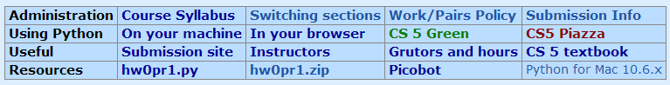
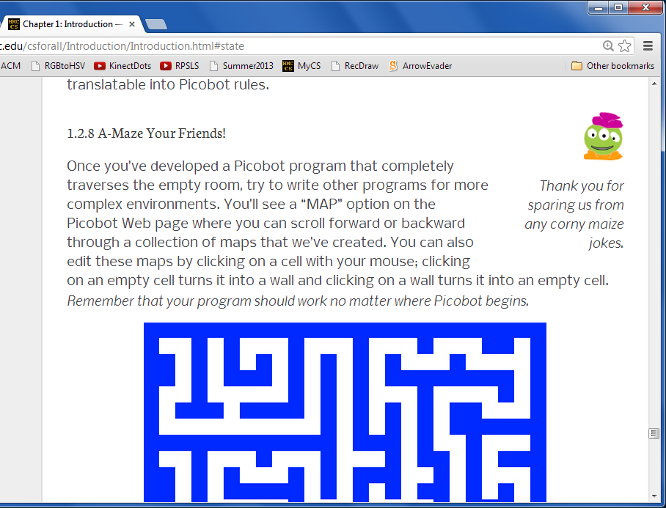
Textbook!
Notes:
recursion -- seems like magic
Gilderoy Lockhart

Slide 80
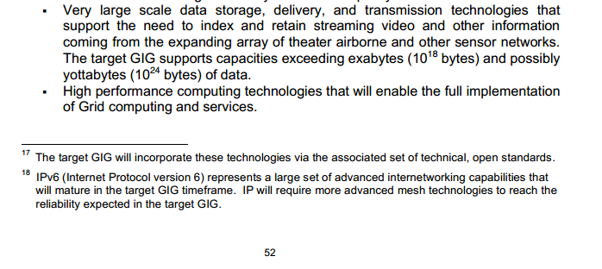
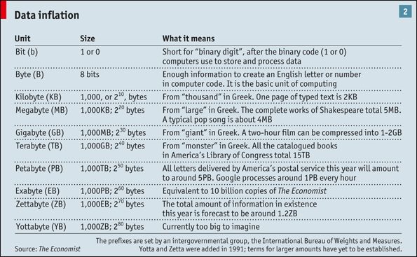
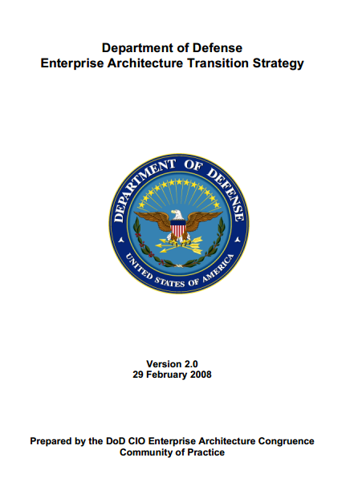
Notes:
Electric: from www.staticfreesoftware.com
My tutorial is at:
http://odin.ac.hmc.edu/~harris/class/chipdesign/electric.pdf
Lasergene (a molecular biology suite of programs for aligning and comparing
DNA sequences, etc.)
Statview (statistical analysis)
KaleidaGraph (plotting & graphing)
Populus (programs that simulate ecological and evolutionary processes)

Slide 81
1 Zettabyte
1.8 ZB
8.0 ZB
800 EB
Data produced each year
161 EB
1 Exabyte
5 EB
100-years of HD video + audio
1 Petabyte
Human brain's capacity
60 PB
2002
2006
2009
2011
2015
14 PB
1 Petabyte == 1000 TB
1 TB = 1000 GB
References
(2015) 8 ZB: http://www.emc.com/collateral/analyst-reports/idc-extracting-value-from-chaos-ar.pdf
(2002) 5 EB: http://www2.sims.berkeley.edu/research/projects/how-much-info-2003/execsum.htm
(2011) 1.8 ZB: http://www.emc.com/leadership/programs/digital-universe.htm
(life in video) 60 PB: in 4320p resolution, extrapolated from 16MB for 1:21 of 640x480 video (w/sound) – almost certainly a gross overestimate, as sleep can be compressed significantly!
(2009) 800 EB: http://www.emc.com/collateral/analyst-reports/idc-digital-universe-are-you-ready.pdf
(2006) 161 EB: http://www.emc.com/collateral/analyst-reports/expanding-digital-idc-white-paper.pdf
(brain) 14 PB: http://www.quora.com/Neuroscience-1/How-much-data-can-the-human-brain-store

Slide 82
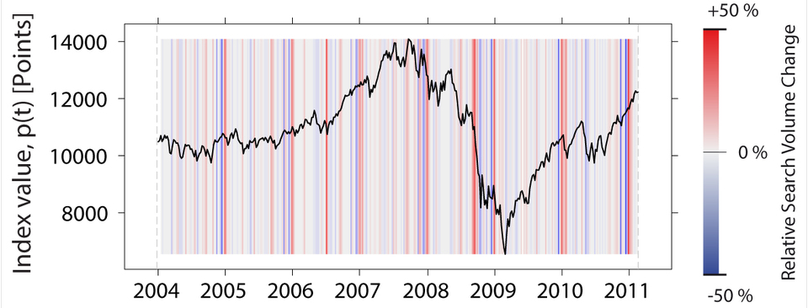
If you torture the data enough, it will confess.
- R. Coates, statistician
Notes:
Electric: from www.staticfreesoftware.com
My tutorial is at:
http://odin.ac.hmc.edu/~harris/class/chipdesign/electric.pdf
Lasergene (a molecular biology suite of programs for aligning and comparing
DNA sequences, etc.)
Statview (statistical analysis)
KaleidaGraph (plotting & graphing)
Populus (programs that simulate ecological and evolutionary processes)

Slide 83
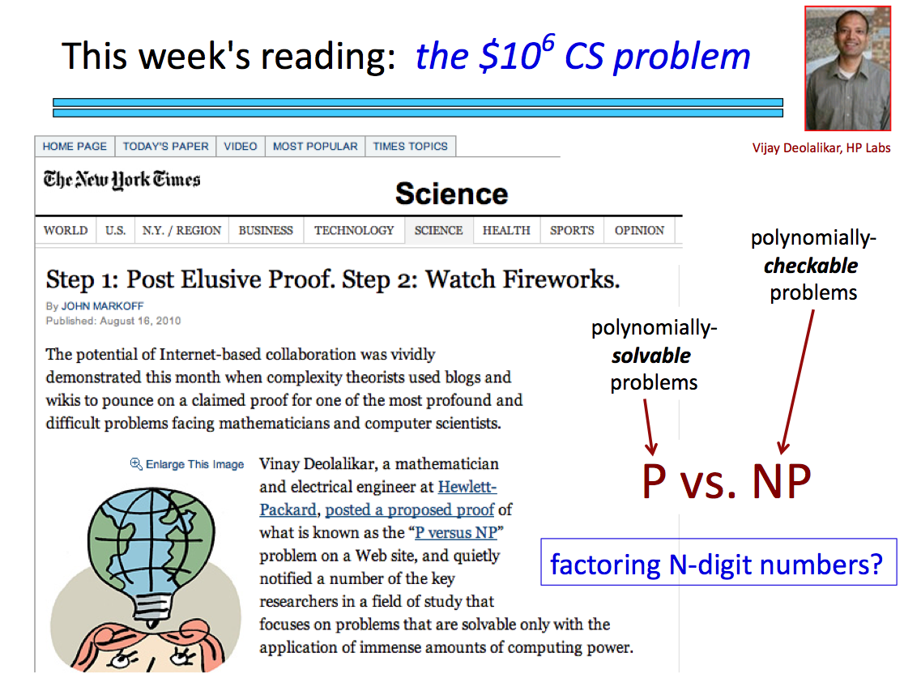

Slide 84

The in thing
>>> 3*'i' in 'alien'
False
python is badly confused here…
>>> 'i' in 'team'
False
but otherwise it seems pretty perceptive!
>>> 'cs' in 'physics'
True
What’s out here?
>>> 'sleep' not in 'CS 5'
True
>>> 42 in [41,42,43]
True
>>> 42 in [ [42], '42' ]
??
What will this be?

Slide 85

Raising and razing lists
"Quiz"
Name(s):
pi = [3,1,4,1,5,9]
Q = [ 'pi', "isn't", [4,2] ]
I ( )
message = 'You need parentheses for chemistry !'
0
4
8
12
16
20
24
28
32
Part 1
Part 2
What is len(pi)
What is Q[0]
What is len(Q)
What is Q[0:1]
Please hand these in (to your right)…
What is len(Q[1])
What is Q[0][1]
What is pi[2:4]
What slice of message is 'try'
What slice of pi is [3,1,4]
What is message[9:15]
What slice of pi is [3,4,5]
What is message[::5]
Extra! Mind Muddlers
What are pi[0]*(pi[1] + pi[2]) and pi[0]*(pi[1:2] + pi[2:3]) ?
They're different... !

Slide 86
Raising and razing lists
"Quiz"
Name(s):
pi = [3,1,4,1,5,9]
Q = [ 'pi', "isn't", [4,2] ]
We ( )
message = 'You need parentheses for chemistry !'
0
4
8
12
16
20
24
28
32
Part 1
Part 2
What is len(pi)
What is Q[0]
What is len(Q)
What is Q[0:1]
What is len(Q[1])
What is Q[0][1]
What is pi[2:4]
What slice of message is 'try'
What slice of pi is [3,1,4]
What is message[9:15]
What slice of pi is [3,4,5]
What is message[::5]
Extra! Mind Muddlers
What are pi[0]*(pi[1] + pi[2]) and pi[0]*(pi[1:2] + pi[2:3]) ?
They're different... !

Slide 87
Raising and razing lists
"Quiz"
Name(s):
pi = [3,1,4,1,5,9]
Q = [ 'pi', "isn't", [4,2] ]
We ( )
message = 'You need parentheses for chemistry !'
0
4
8
12
16
20
24
28
32
Part 1
Part 2
What is len(pi)
What is Q[0]
What is len(Q)
What is Q[0:1]
What is len(Q[1])
What is Q[0][1]
What is pi[2:4]
What slice of message is 'try'
What slice of pi is [3,1,4]
What is message[9:15]
What slice of pi is [3,4,5]
What is message[::5]
Extra! Mind Muddlers
What are pi[0]*(pi[1] + pi[2]) and pi[0]*(pi[1:2] + pi[2:3]) ?
They're different... !

Slide 88
Raising and razing lists
"Quiz"
Name(s):
pi = [3,1,4,1,5,9]
Q = [ 'pi', "isn't", [4,2] ]
I ( )
message = 'You need parentheses for chemistry !'
0
4
8
12
16
20
24
28
32
Part 1
Part 2
6
'pi'
What is len(pi)
What is Q[0]
3
['pi']
What is len(Q)
What is Q[0:1]
5
'i'
What is len(Q[1])
What is Q[0][1]
[4,1]
What is pi[2:4]
What slice of message is 'try'
message[31:34]
What slice of pi is [3,1,4]
pi[0:3]
What is message[9:15]
'parent'
What slice of pi is [3,4,5]
pi[::2]
What is message[::5]
Extra! Mind Muddlers
What are pi[0]*(pi[1] + pi[2]) and pi[0]*(pi[1:2] + pi[2:3]) ?
They're different... !
15
[1,4,1,4,1,4]

Slide 89
Functioning in Python
Some basic, built-in functions:
abs
max
min
sum
range
round
bool
float
int
long
list
str
absolute value
of lists
these change data from one type to another
creates lists
only as accurately as it can!
You call that a language?!
These are the most important:
help
dir

Slide 90
Functioning in Python
Far more are available in separate files, or modules:
import math
math.sqrt( 1764 )
dir(math)
accesses math.py's functions
lists all of math.py's functions
from math import *
pi
sin( pi/2 )
same, but without typing math. all of the time…
help()
help modules

Slide 91
Functioning in Python
# my own function!
def dbl( x ):
""" returns double its input, x """
return 2x
This doesn't look quite right…

Slide 92
% the "mod" operator
x%y returns the remainder when x is divided by y
7 % 3
8 % 3
9 % 3
16 % 7
x%2 == 0
For what values of x are these True?
x%2 == 1
x%4 == 0
What happens on these years?
Notes:
Electric: from www.staticfreesoftware.com
My tutorial is at:
http://odin.ac.hmc.edu/~harris/class/chipdesign/electric.pdf
Lasergene (a molecular biology suite of programs for aligning and comparing
DNA sequences, etc.)
Statview (statistical analysis)
KaleidaGraph (plotting & graphing)
Populus (programs that simulate ecological and evolutionary processes)

Slide 93
the "equals" operators
= != ==
What about === ?
Notes:
Electric: from www.staticfreesoftware.com
My tutorial is at:
http://odin.ac.hmc.edu/~harris/class/chipdesign/electric.pdf
Lasergene (a molecular biology suite of programs for aligning and comparing
DNA sequences, etc.)
Statview (statistical analysis)
KaleidaGraph (plotting & graphing)
Populus (programs that simulate ecological and evolutionary processes)

Slide 94
Slicing
s = 'harvey mudd college'
0
1
2
3
4
5
6
7
8
9
10
11
12
13
14
15
16
17
18
s[ : ]
slices the string, returning a substring
What are these slices?
s[15:-1]
s[:]
'mud'
How would you get
'e'
Don't 'wor' 'e'-
Be 'hap' 'e' !

Slide 95
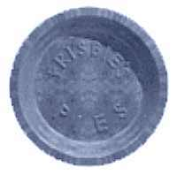
Skip-Slicing
if you don't want your neighbor to get any…
s = 'harvey mudd college'
0
1
2
3
4
5
6
7
8
9
10
11
12
13
14
15
16
17
18
s[ : : ]
skip-slices, returning a subsequence
the third index is the "stride" length
it defaults to 1
s[0:8:2] returns 'hre '
What skip-slice returns
'doe'
s[1::6]
I love this one.
What does this return?

Slide 96
Lists ~ Strings of anything
Commas separate elements.
L = [ 3.14, [2,40], 'third', 42 ]
Square brackets tell python you want a list.
len(L)
L[0]
Indexing:
could return a different type
L[0:1]
always returns the same type
Slicing:
always returns a substructure!
How could you extract from L
'hi'

Slide 98
See you in Lab !
Prof. Z @ 2:45pm and 6:00pm today
I'll be @ 2:45pm and 6:00pm tomorrow

Slide 99
while we're here…
import random
while True:
x = random.choice( range(0,100) )
print 'I got a', x
control-c is good to remember!

Slide 100
random thoughts
import random
random.choice( [41,42,43] )
random.choice( range(0,100) )
These are the most important:
help
dir

Slide 101

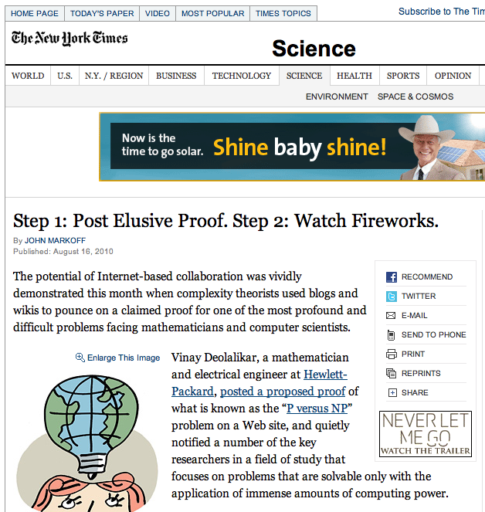
This week's reading: the $10⁶ CS problem
Vijay Deolalikar, HP Labs
polynomially-checkable problems
polynomially-solvable problems
P vs. NP
factoring N-digit numbers?

Slide 102
coffee
See you in Lab!
CIS + Labs
Edwards
Macalister
Physicists and other parenthesis-needing individuals (like chemists)
Pryne
Parsons
cool machines - drills, lathes, etc.
Map to CS Labs
more cool, keyboardless machines
CS Hallway
B102
B100
B105
CS Hallway
Big Beckman (B126)
Beckman B102, B105
Get your CS account.
Laptop OK, if you have wireless.
Olin (math, bio, CS)

Slide 104

Raising and razing lists
"Quiz"
Name(s):
pi = [3,1,4,1,5,9]
Q = [ 'pi', "isn't", [4,2] ]
message = 'You need parentheses for chemistry !'
Part 1
len(pi)
Part 2
Q[0]
What are
len(Q)
I ( )
Q[0:1]
len(Q[1])
What are
Q[0][1]
Q[1][0]
What slice of pi is [3,1,4]
What slice of pi is [3,4,5]
What is message[9:15]
What are
pi[0] * (pi[1] + pi[2])
and
pi[0] * (pi[1:2] + pi[2:3])
What is message[::5]
Extra! Mind Muddlers
What is pi[pi[2]]?
How many nested pi's before pi[…pi[0]…] produces an error?

Slide 105
Raising and razing lists
"Quiz"
Name(s):
pi = [3,1,4,1,5,9]
Q = [ 'pi', "isn't", [4,2] ]
message = 'You need parentheses for chemistry !'
Part 1
len(pi)
Part 2
Q[0]
What are
len(Q)
I ( )
Q[0:1]
len(Q[1])
What are
Q[0][1]
Q[1][0]
What slice of pi is [3,1,4]
Please hand these in (to your right)…
What slice of pi is [3,4,5]
What is message[9:15]
What are
pi[0] * (pi[1] + pi[2])
and
pi[0] * (pi[1:2] + pi[2:3])
What is message[::5]
Extra! Mind Muddlers
What is pi[pi[2]]?
How many nested pi's before pi[…pi[0]…] produces an error?

Slide 106
print vs. return
# is it dis-0 or dis-O, anyway?
def undo(s):
""" this "undoes" its string input, s """
return 'de' + s
>>> undo(undo('caf'))
# !?
def undopr(s):
""" hmmm """
print 'de' + s

Slide 107
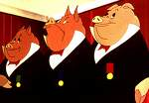
Any real computing with strings/lists?
Some strings are more equal than others…

Slide 108
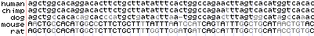
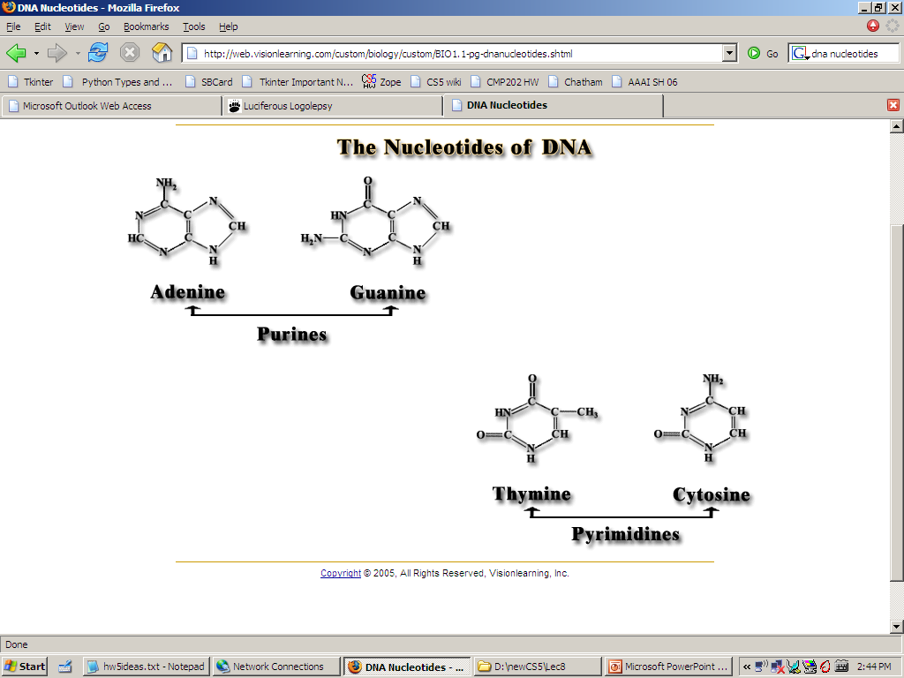
DNA
Our DNA's nucleotides:
http://genome.ucsc.edu/cgi-bin/hgGateway
AGCT
Notes:
building blocks!
Electric: from www.staticfreesoftware.com
My tutorial is at:
http://odin.ac.hmc.edu/~harris/class/chipdesign/electric.pdf
Lasergene (a molecular biology suite of programs for aligning and comparing
DNA sequences, etc.)
Statview (statistical analysis)
KaleidaGraph (plotting & graphing)
Populus (programs that simulate ecological and evolutionary processes)

Slide 109
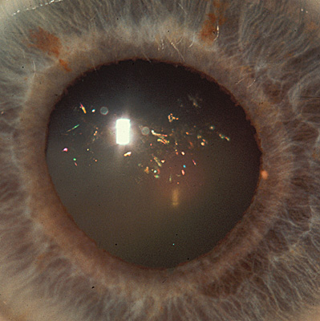
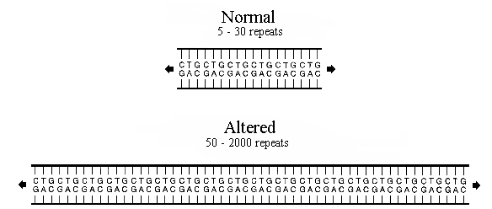
DNA
Genetic disease expression
Myotonic Dystrophy
neuromuscular weakness in the face/torso
"Christmas Tree cataracts"
www.neuro.wustl.edu/neuromuscular/musdist/pe-eom.html#myd
Its computational basis
CTG repeats
in the 3' UTR (three prime untranslated region), a particular section of messenger RNA
Notes:
http://www.neuro.wustl.edu/neuromuscular/musdist/pe-eom.html#myd
this is the link
Lasergene (a molecular biology suite of programs for aligning and comparing
DNA sequences, etc.)
Statview (statistical analysis)
KaleidaGraph (plotting & graphing)
Populus (programs that simulate ecological and evolutionary processes)

Slide 110
One sequence-checking algorithm…
def check(geneseq):
""" seeks evidence of Myo. Dys.
"""
if 'ctg'*50 in geneseq:
return True
else:
return False
checks if one string is contained in another
Can we make this algorithm more concise?
Why problems might this algorithm run into?
What information might we prefer to know?
What if we hadn't discovered the CTG-repeats yet?

Slide 111
The in thing
>>> 3*'i' in 'alien'
False
python is badly confused here…
>>> 'i' in 'team'
False
but otherwise it seems pretty perceptive!
>>> 'cs' in 'physics'
True
>>> 'sleep' not in 'harvey mudd'
True
>>> 42 in [41,42,43]
True
a little bit different for lists…
>>> 42 in [ [42], '42' ]
False

Slide 112
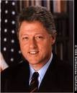
Do you remember?
This time…
strings
Way back in the '90s?!
lists
indexing
slicing
more on functions…
docstrings
comments
Next time…
Making up one's mind

Slide 113
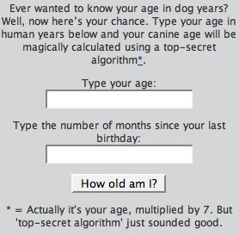
The in thing: compatibility?…
def compat( name, pso_name ):
""" top-secret compatibility algorithm!
returns whether the input pair is compatible
"""
n = len(name)%2
if name[n] in pso_name or pso_name[n+1] in name:
return True
else:
return False
zachary rita
angelina brad (now)
brad angelina (after split)
bill hillary
algorithm == function
past significant other
present significant other
possible significant other
www.neilturner.me.uk/resources/dogyears.php
Notes:
http://www.neilturner.me.uk/resources/dogyears.php

Slide 114
Are numbers enough?
No!
You need lists of numbers, as well!
list
and strings are helpful, too.
str

Slide 115
Precedence
Caution Level
( )
set equal to
=
Highest
divide
/
**
Python Operators
two views
remainder
%
-
power
**
*
/
%
is equal to
==
*
+
-
+
>
<
==
>
Not worth remembering all these %+/* things!
I’d suggest parentheses over precedence.
as usual
=
<
Lowest
-
( )
Notes:
Electric: from www.staticfreesoftware.com
My tutorial is at:
http://odin.ac.hmc.edu/~harris/class/chipdesign/electric.pdf
Lasergene (a molecular biology suite of programs for aligning and comparing
DNA sequences, etc.)
Statview (statistical analysis)
KaleidaGraph (plotting & graphing)
Populus (programs that simulate ecological and evolutionary processes)

Slide 116
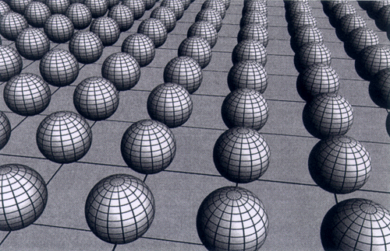
CS 5 Today: Data!
This stuff hurts my brane.
String theory
Now
To Do: Lists
when you learn string theory from google images…
Lab:
Why: hands-on, half of Hw1 !
Later
Bring your laptop, if you'd like… .
Notes:
thinking like a machine -- why??
thinking for a machine

Slide 117
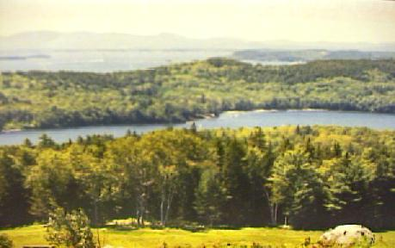
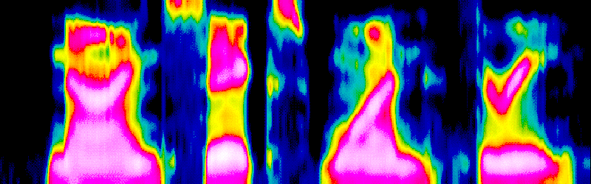
Do lists suffice?
‘Many years later, as he faced the firing squad, Colonel Aureliano Buendia was to remember that distant afternoon when his father took him to discover ice.’
{ 2, 3, 5, 7, 11 }
Sets
Can all information be represented using lists ?
Texts
Sounds/Speech
Graphs/Networks
Images/Video
Smells?
Ideas?
Notes:
homogeneous
inhomogeneous (diff eq class)
lists can contain lists as elements (associative list) --
talk about the possibility of a look up function
-- to arbitrary depth (ask length(list))
not the same as
flattened -- go get all of the atomic components and “leaves” leafcount()
steamroll the structure built around it

Slide 118
str(ing) fun(ctions)
str
len
+
*
str(42) returns '42'
converts input to a string
len('42') returns 2
returns the string’s length
'XL' + 'II' returns 'XLII'
concatenates strings
'VI'*7 returns 'VIVIVIVIVIVIVI'
repeats strings
composition / assembly

Slide 119
string surgery
decomposition / disassembly
s = 'harvey mudd college'
0
1
2
3
4
5
6
7
8
9
10
11
12
13
14
15
16
17
18
s[ ]
indexes into the string, returning a one-character string
len(s) returns 19
python != English
s[0] returns 'h'
'h' is the first character of s
s[6] returns ' '
' ' is the seventh character of s
s[4] returns 'e'
(or 16 or 18)
'e' is the nineteenth character of s
What index returns 'e'?
but python and English agree that s is 19 characters long
s[len(s)/2] returns 'd'
(the first)
What do these return?
s[len(s)-1] returns 'e'
(the last)
Soy aquí!
s[len(s)] returns and error!
Notes:
Selena's estoy contigo
Spanish was Selena's scond language

Slide 120
Lists ~ Strings of anything
L = [ 3.14, [2,40], 'third', 42 ]

Slide 121
Lists ~ Strings of anything
L = [ 3.14, [2,40], 'third', 42 ]
These square brackets tell python that you want a list.
Commas separate the elements.

Slide 122
"Quiz"
Name(s):
Raising and razing lists
pi = [3,1,4,1,5,9]
Q = [ 'pi', "isn't", [4,2] ]
message = 'You need parentheses for chemistry !'
Part 1
Part 2
What are len(pi), len(Q), len(Q[1])
Q[0]
Q[0:1]
What slice of pi is [3,1,4]
What are
Q[0][1]
What slice of pi is [9]
Q[1][0]
What slice of pi is [3,4,5]
What slice of message is 'parent'
What is the difference between
pi[0] * (pi[1] + pi[2])
and
pi[0] * (pi[1:2] + pi[2:3])
What is message[12:12]
What is message[::5]
How could you construct 'pint' using only Q, slicing, indexing, and + ?
Mind Muddlers
What is pi[pi[2]]?
How many nested pi's before pi[…pi[0]…] produces an error?

Slide 123
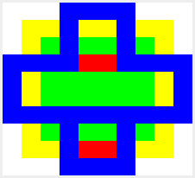
Homework 0
Problems with the submission system?
Use the submissions system to transfer files from computer to computer!
Submissions are time-stamped and all are preserved…
Only the last one before the deadline is graded!
def y():
return 1
def w(x):
return 3*(x+1)
def t(x):
return 3*x + 1
def r(x,y):
return ( x**2 % y ) + 2
def f(a,b):
if a < b:
return (b-1) * (b-2)
else:
return (a+42) * (b+42)
Problems with the problems?
Abstract art -- minimum number of Ls?
Arithmetic functions and composition
there are better ways, too!…
f(0,r(t(y()),t(w(0)))
4
10
8
42
Notes:
is there life beyond math?
fundamentally, yes, there are more things than numbers -- there are LISTS of numbers!

Slide 124
Solutions
"deQuiz"
pi = [3,1,4,1,5,9]
Q = [ 'pi', "isn't", [4,2] ]
message = 'You need parentheses for chemistry !'
Part 1
6
3
5
Part 2
Q[0]
'pi'
What are len(pi), len(Q), len(Q[1])
Q[0:1]
['pi']
What slice of pi is [3,1,4]
pi[0:3]
What are
'i'
Q[0][1]
Q[1][0]
'i'
What slice of pi is [3,4,5]
pi[0:5:2]
What slice of message is 'parent'
What is the difference between
pi[0] * (pi[1] + pi[2])
and
pi[0] * (pi[1:2] + pi[2:3])
message[9:15]
15
[1]
[4]
What is message[::5]
Yeah cs!
[1,4,1,4,1,4]
How could you construct 'pint' using only Q, slicing, indexing, and + ?
Mind Muddlers
Q[0] + Q[1][2::2]
What is pi[pi[2]]?
5
How many nested pi's before pi[…pi[0]…] produces an error?

Slide 125
Solutions
"deQuiz"
pi = [3,1,4,1,5,9]
Q = [ 'pi', "isn't", [4,2] ]
message = 'You need parentheses for chemistry !'
Part 1
6
3
5
Part 2
Q[0]
'pi'
What are len(pi), len(Q), len(Q[1])
Q[0:1]
['pi']
What slice of pi is [3,1,4]
pi[:3]
What are
'i'
Q[0][1]
What slice of pi is [9]
pi[-1:]
Q[1][0]
'i'
What slice of pi is [3,4,5]
pi[:5:2]
What slice of message is 'parent'
What is the difference between
pi[0] * (pi[1] + pi[2])
and
pi[0] * (pi[1:2] + pi[2:3])
message[9:15]
15
What is message[12:12]
'' - the empty string!
[1]
[4]
[1,4,1,4,1,4]
What is message[::5]
Yeah cs!
How could you construct 'pint' using only Q, slicing, indexing, and + ?
Mind Muddlers
Q[0] + Q[1][2::2]
What is pi[pi[2]]?
5
How many nested pi's before pi[…pi[0]…] produces an error?

Slide 126
What’s next?
[ -35, -24, -13, -2, 9, 20, 31 ]
[ 26250, 5250, 1050, 210 ]
4 lists
[ 90123241791111 , 93551622, 121074, 3111 ]
[ 2, 22, 222 ]
‘Guess how many characters this string has!’
2 strings
“Many years later, as he faced the firing squad, Colonel Aureliano Buendia was to remember that distant afternoon when his father took him to discover ice.”
Thinking like a machine
Thinking for a machine
len, max, min, sum
What’s next? What does it mean?

Slide 127
Computers think in lists…
What you type in python:
L = [ 42, 3.14159, 'hi' ]
These square brackets tell python that you want a list.
What is happening behind the scenes:
42
3.14159
‘a really long string’
name: L[0]
type: int
LOC: 300
name: L[1]
type: float
LOC: 304
name: L[2]
type: string
LOC: 308
?

Slide 128
To a computer, everything is a list.
What you type in python:
L = [ 42, 3.14159, 'a really long string' ]
These square brackets tell python that you want a list.
What is happening behind the scenes:
42
3.14159
‘a really long string’
name: L[0]
type: int
LOC: 300
name: L[1]
type: float
LOC: 304
name: L[2]
type: string
LOC: 308
'a'
' '
'r'
'g'
Strings are lists too!
308
309
310
327

Slide 129


Data types
Python maintains data by type :
Not enough snakes for my taste…
Numeric types
float
>>> type(3.14)
<type ‘float’>
long
int
bool
>>> type(True)
<type ‘bool’>
Sequence types
list
>>> type(‘writer’)
<type ‘str’>
str
?
( tuple )
>>> type([1,2,3])
<type ‘list’>
Notes:
python as a rather orwellian overlord…

Slide 130

str(ing)ing us along
typing strings from scratch
"double quotes"
'single quotes'
triple-quoted strings allow line breaks…
"""
triple
double
quotes!
"""
'''triple
single
quotes!'''
Give me a (line) break!
Why two types of quote character?

Slide 131
'something's wrong here!'

Slide 132
'something's wrong here!'
"but now we're all right…"

Slide 133

something appropriate… I hope!
This is all too relentlessly
glass-half-full-ish!
Notes:
This is a very funny German cartoon and I have no idea at all what it says.
http://www.weisheiten-der-welt.de/pics/optimist-pessimist-normal.jpg

Slide 134
I guess I'm the answer to nothing at all…
Hah! You think you got it bad… I'm the butt end of this slice!
That's what you think…
- Indices
s[ -42 : -5 : -1 ]
0
1
2
3
4
5
6
7
8
9
10
11
12
13
14
15
16
17
18
s = 'harvey mudd college'
-19
-17
-15
-13
-11
-9
-7
-5
-3
-1
-18
-16
-14
-12
-10
-8
-6
-4
-2
Negative indices count backwards from the end!
s[-1]
What do these return?
s[15:-1]
s[-7:1:-4]
can suit any mood…
Notes:
can mix and match negative and positive…

Slide 135
Skip-Slicing
if you don't want your neighbor to get any…
s = 'harvey mudd college'
0
1
2
3
4
5
6
7
8
9
10
11
12
13
14
15
16
17
18
s[ : : ]
skip-slices, returning a string subsequence
the third index is the stride length
it defaults to 1
I do this one…
s[1:5:2] returns
What slice returns
'doe'
What does this slice return?
s[1::6]
I love this one.

Slide 136
Inside the machine…
What's happening in python:
x = 41
x = x + 1
What is happening behind the scenes:

Slide 137

Inside the machine…
What's happening in python:
x = 41
x = x + 1
What is happening behind the scenes:
Happy Mathematicians!

Slide 138
coffee
CIS + Labs
Edwards
Macalister
Physicists and other parenthesis-needing individuals (like chemists)
Pryne
Parsons
cool machines - drills, lathes, etc.
Map to CS Labs
more cool, keyboardless machines
CS Hallway
B102
B100
B105
CS Hallway
Big Beckman (B126)
Beckman B102, B105
Get your CS account.
Laptop OK, if you have wireless.
Olin (math, bio, CS)

Slide 139
CS 5 Notes
Picobot!
Python!
Prof. Stone!
for content questions:
Please email…
cs5help@cs.hmc.edu
for administration:
dodds@cs.hmc.edu
stone@cs.hmc.edu
Notes:
thinking like a machine -- why??
thinking for a machine

Slide 140



The amount of data created per year (rough!)
(exabytes)
What type is this data?
Notes:
thinking like a machine -- why??
thinking for a machine

Slide 141
Operate!
( )
**
-
* % /
+ -
> == <
=
It's not worth remembering all these %+/* things! I’d recommend parentheses over precedence.
Notes:
Electric: from www.staticfreesoftware.com
My tutorial is at:
http://odin.ac.hmc.edu/~harris/class/chipdesign/electric.pdf
Lasergene (a molecular biology suite of programs for aligning and comparing
DNA sequences, etc.)
Statview (statistical analysis)
KaleidaGraph (plotting & graphing)
Populus (programs that simulate ecological and evolutionary processes)

