Slide 1
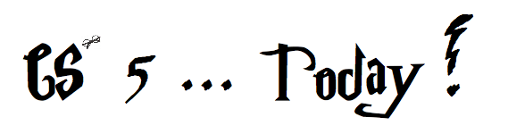

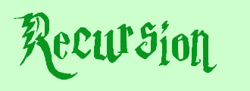

Jack Ma's Picobot "magic"
As close as CS gets to magic
a.k.a., CS's version of mathematical induction
Tutoring hours: LOTS!
Hw #1 due this Monday, 1/30, at 11:59 pm
This is the last CS 5 lecture you’ll ever "need"!*
HMC's legal counsel requires us to include these footnotes…
On Warner Brothers' insistence, we affirm that this 'C' does not stand for 'Chamber' and 'S' does not stand for 'Secrets.'
*
Caution: do not take this statement too literally or it is possible find yourself in twice as many CS 5 lectures as you need!
Notes:
recursion -- seems like magic
Gilderoy Lockhart

Slide 2

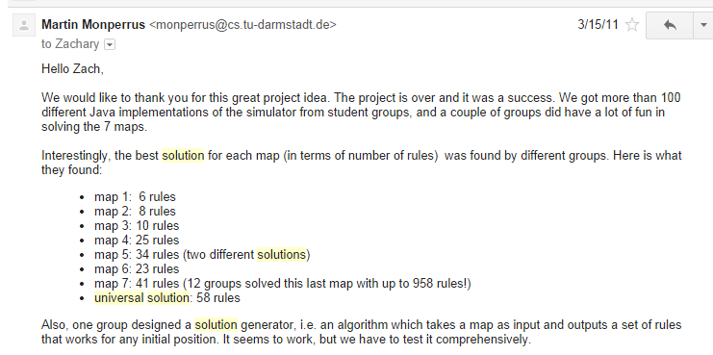
Picobot, Aargh!
+ "universal" solution…

Slide 3
MAGIC!?
As close as CS gets to magic
a.k.a., CS's version of mathematical induction
Tutoring hours: LOTS!
Hw #1 due this Monday, 1/30, at 11:59 pm
This is the last CS 5 lecture you’ll ever "need"!*
HMC's legal counsel requires us to include these footnotes…
On Warner Brothers' insistence, we affirm that this 'C' does not stand for 'Chamber' and 'S' does not stand for 'Secrets.'
*
Caution: do not take this statement too literally or it is possible find yourself in twice as many CS 5 lectures as you need!
Notes:
recursion -- seems like magic
Gilderoy Lockhart

Slide 4
Python is… in
MAGIC!
>>> 'i' in 'team'
False
>>> 'cs' in 'physics'
True
I guess Python's the in thing
>>> 'i' in 'alien'
True
>>> 3*'i' in 'alien'
False
>>> 42 in [41,42,43]
True
>>> 42 in [[42], '42']
False

Slide 5
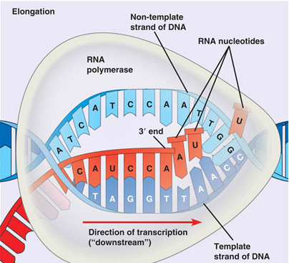
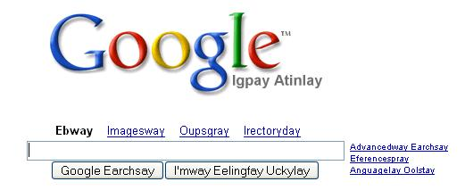
hw1
:
if you attended lab and submit pr1+pr2
you get full credit for hw1pr1 and hw1pr2
else
:
you should complete the two lab problems, pr1 + pr2
Is this Python??
either way: submit pr1 + pr2
complete and submit hw1pr3
Extra Credit: Pig Latin / CodingBat
DNA transcription

Slide 6
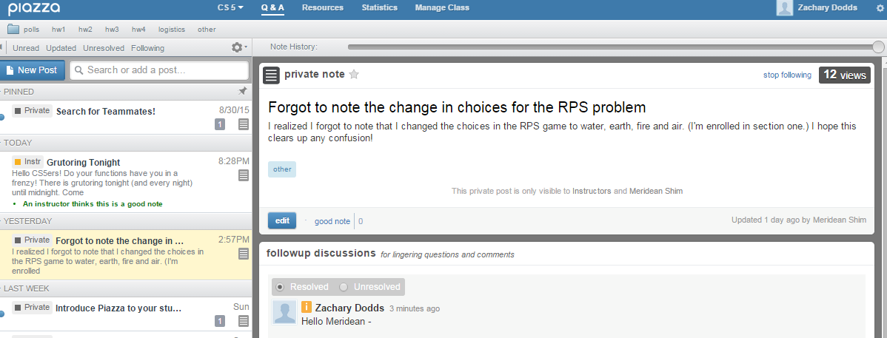

Piazza!
Questions?
+ add'l 4C grading
see online hours!

Slide 7
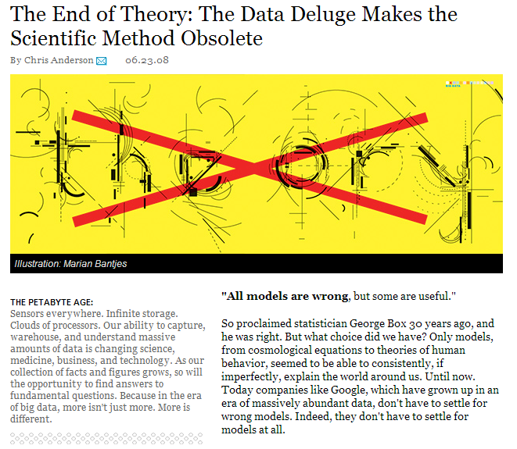
This week's reading on data…
Petabytes? This article is old-school!

Slide 8
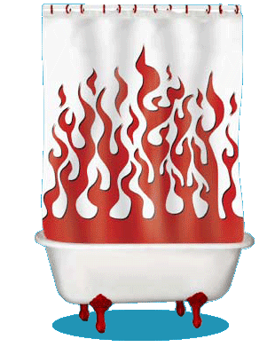
Computation's Dual Identity
Computation
Data Storage
41
42
name: x
type: int
LOC: 300
name: y
type: int
LOC: 304
memory location 300
memory location 304
variables ~ boxes
Last time
But what does the stuff on this side look like ?

Slide 9

Computation's Dual Identity
accessed through functions…
Computation
Data Storage
41
42
name: x
type: int
LOC: 300
name: y
type: int
LOC: 304
memory location 300
memory location 304
Functions!
variables ~ boxes
It's no coincidence this starts with fun!

Slide 10
Functioning across disciplines
procedure
structure
def g(x):
return x**100
g(x) = x¹⁰⁰
CS's googolizer
Math's googolizer
defined by what it does
defined by what it is
+ what follows behaviorally
+ what follows logically
Notes:
my foreign language teachers always tried to convince me that the skill of speaking, reading and writing a foreign language…
I didn’t believe them then and I don’t believe them now -- but I do believe that reading and writing a computer language is the way to get a strong intuitive understanding of how machines think -- it’s also important for getting them to do what you want them to, but even if you forget everything this course (hopefully) teaches about Java (compiler, datatypes, Classes and Objects), the real goal is that you take away a deeper insight into how machines think
familiar and sometimes not so familiar… deceptively easy
you mean I have to type all that!!

Slide 11
Giving names to data helps f'ns
def flipside(s):
""" flipside(s): swaps s's sides!
input s: a string
"""
x = len(s)//2
return s[x:] + s[:x]
This idea is the key to your happiness!
Notes:
show help!

Slide 12

Use variables!
I'm happy about this, too!
def flipside(s):
x = len(s)//2
return s[x:] + s[:x]
def flipside(s):
return s[len(s)//2:] + s[:len(s)//2]
Aargh!
Why would computers "prefer" the top version, too?
Notes:
show help!

Slide 13
Test!
def flipside(s):
""" flipside(s): swaps s's sides!
input s: a string
"""
x = len(s)/2
return s[x:] + s[:x]
#
# Tests!
#
print("workhome ~", flipside('homework'))
print(" petscar ~", flipside('carpets'))
print(" cs5! ~", flipside('5!cs'))
(1) function definition
(2) function tests
We provide tests (for now…)
Notes:
show help!

Slide 14
Using variables…
This program uses variables constantly!
def convertFromSeconds(s): # total seconds
""" convertFromSeconds(s): Converts an
integer # of seconds into a list of
[days, hours, minutes, seconds]
input s: an int
"""
days = s // (24*60*60) # total days
s = s % (24*60*60) # remainder s
hours = s // (60*60) # total hours
s = s % (60*60) # remainder s
minutes = s // 60 # total minutes
s = s % 60 # remainder s
return [days, hours, minutes, s]
Notes:
show help!

Slide 15
Using variables…
This program uses variables constantly!
name
signature line
def convertFromSeconds(s): # total seconds
""" convertFromSeconds(s): Converts an
integer # of seconds into a list of
[days, hours, minutes, seconds]
input s: an int
"""
days = s // (24*60*60) # total days
s = s % (24*60*60) # remainder s
hours = s // (60*60) # total hours
s = s % (60*60) # remainder s
minutes = s // 60 # total minutes
s = s % 60 # remainder s
return [days, hours, minutes, s]
docstring
comments –these are mostly optional in CS 5
code block
return statement
Notes:
show help!

Slide 16
return vs. print
def dbl(x):
""" dbls x? """
return 2*x
def dblPR(x):
""" dbls x? """
print(2*x)
In[1]: ans = dbl(20)
In[1]: ans = dblPR(20)
What's the difference ?!

Slide 17
return > print
def dbl(x):
""" dbls x? """
return 2*x
def dblPR(x):
""" dbls x? """
print(2*x)
>>> ans = dbl(20)+2
>>> ans = dblPR(20)+2
yes!
ouch!
print changes pixels on the screen...
… which the shell then prints!
return yields the function call's value …

Slide 18
Name(s):
Quiz
15
How f'ns work…
What is demo(15) here?
def demo(x):
y = x/3
z = g(y)
return z + y + x
def g(x):
result = 4*x + 2
return result
I might have a guess at both of these…
What is f(2) here?
def f(x):
if x == 0:
return 12
else:
return f(x-1) + 10*x
Notes:
vault 713?

Slide 19
How functions work…
15
"the stack"
def demo(x):
y = x/3
z = g(y)
return z + y + x
def g(x):
result = 4*x + 2
return result
they stack.
Notes:
vault 713?

Slide 20
How functions work…
15
"the stack"
def demo(x):
y = x/3
z = g(y)
return z + y + x
call: demo(15)
stack frame
local variables:
x = 15
y = 5
z = ?????
def g(x):
result = 4*x + 2
return result
they stack.
Notes:
vault 713?

Slide 21
How functions work…
15
"the stack"
def demo(x):
y = x/3
z = g(y)
return z + y + x
call: demo(15)
stack frame
local variables:
x = 15
y = 5
z = ?????
def g(x):
result = 4*x + 2
return result
call: g(5)
stack frame
local variables:
x = 5
result = 22
returns 22
they stack.
Notes:
vault 713?

Slide 22
How functions work…
15
"the stack"
def demo(x):
y = x/3
z = g(y)
return z + y + x
call: demo(15)
stack frame
local variables:
x = 15
y = 5
z = ?????
def g(x):
result = 4*x + 2
return result
call: g(5)
stack frame
local variables:
x = 5
result = 22
returns 22
they stack.
Notes:
vault 713?

Slide 23
How functions work…
15
"the stack"
def demo(x):
y = x/3
z = g(y)
return z + y + x
call: demo(15)
stack frame
local variables:
x = 15
y = 5
z = 22
def g(x):
result = 4*x + 2
return result
they stack.
Notes:
vault 713?

Slide 24
How functions work…
15
"the stack"
def demo(x):
y = x/3
z = g(y)
return z + y + x
call: demo(15)
stack frame
local variables:
x = 15
y = 5
z = 22
return 42
def g(x):
result = 4*x + 2
return result
they stack.
Notes:
vault 713?

Slide 25
How functions work…
15
"the stack"
42
def demo(x):
y = x/3
z = g(y)
return z + y + x
afterwards, the stack is empty…, but ready if another function is called
output
def g(x):
result = 4*x + 2
return result
they stack.
Notes:
vault 713?

Slide 26
How functions work…
2
what's f(2) ?
"the stack"
def f(x):
if x == 0:
return 12
else:
return f(x-1) + 10*x
Notes:
vault 713?

Slide 27
How functions work…
2
"the stack"
def f(x):
if x == 0:
return 12
else:
return f(x-1) + 10*x
call: f(2)
stack frame
local variables:
x = 2
need f(1)
Notes:
vault 713?

Slide 28
How functions work…
1
"the stack"
def f(x):
if x == 0:
return 12
else:
return f(x-1) + 10*x
call: f(2)
stack frame
local variables:
x = 2
need f(1)
call: f(1)
stack frame
local variables:
x = 1
need f(0)
Notes:
vault 713?

Slide 29
How functions work…
0
"the stack"
def f(x):
if x == 0:
return 12
else:
return f(x-1) + 10*x
call: f(2)
stack frame
local variables:
x = 2
need f(1)
call: f(1)
stack frame
local variables:
x = 1
need f(0)
call: f(0)
stack frame
local variables:
x = 0
returns 12
Notes:
vault 713?

Slide 30
How functions work…
0
"the stack"
def f(x):
if x == 0:
return 12
else:
return f(x-1) + 10*x
call: f(2)
stack frame
local variables:
x = 2
need f(1)
call: f(1)
stack frame
local variables:
x = 1
need f(0)
call: f(0)
stack frame
local variables:
x = 0
returns 12
Notes:
vault 713?

Slide 31
How functions work…
1
"the stack"
def f(x):
if x == 0:
return 12
else:
return f(x-1) + 10*x
call: f(2)
stack frame
local variables:
x = 2
need f(1)
call: f(1)
stack frame
local variables:
x = 1
f(0) = 12
result =
How do we compute the result?
Notes:
vault 713?

Slide 32
How functions work…
1
"the stack"
def f(x):
if x == 0:
return 12
else:
return f(x-1) + 10*x
call: f(2)
stack frame
local variables:
x = 2
need f(1)
call: f(1)
stack frame
local variables:
x = 1
f(0) = 12
result = 22
Where does that result go?
Notes:
vault 713?

Slide 33
How functions work…
1
"the stack"
def f(x):
if x == 0:
return 12
else:
return f(x-1) + 10*x
call: f(2)
stack frame
local variables:
x = 2
need f(1)
call: f(1)
stack frame
local variables:
x = 1
f(0) = 12
result = 22
Notes:
vault 713?

Slide 34
How functions work…
2
"the stack"
def f(x):
if x == 0:
return 12
else:
return f(x-1) + 10*x
call: f(2)
stack frame
local variables:
x = 2
f(1) = 22
result =
What's this return value?
Notes:
vault 713?

Slide 35
How functions work…
2
"the stack"
def f(x):
if x == 0:
return 12
else:
return f(x-1) + 10*x
call: f(2)
stack frame
local variables:
x = 2
f(1) = 22
result = 42
which then gets returned…
Notes:
vault 713?

Slide 36
How functions work…
2
"the stack"
def f(x):
if x == 0:
return 12
else:
return f(x-1) + 10*x
call: f(2)
stack frame
local variables:
x = 2
f(1) = 22
result = 42
the result then gets returned…
Notes:
vault 713?

Slide 37
How functions work…
2
42
"the stack"
def f(x):
if x == 0:
return 12
else:
return f(x-1) + 10*x
output
again, the stack is empty, but ready if another function is called…
functions stack.
Notes:
vault 713?

Slide 38
How functions work…
2
42
"the stack"
def f(x):
if x == 0:
return 12
else:
return f(x-1) + 10*x
output
again, the stack is empty, but ready if another function is called…
Functions are like cells, i.e., software's building blocks…
… each one, a self-contained computational unit!
functions stack.
Notes:
vault 713?

Slide 39
function design
Notes:
vault 713?

Slide 40
Thinking sequentially
factorial
5 ! = 120
math
fac(5) = 5*4*3*2*1
CS
fac(N) = N*(N-1)* … *3*2*1

Slide 41
Thinking sequentially
factorial
5 ! = 120
math
March + beyond…
fac(5) = 5*4*3*2*1
CS
fac(N) = N*(N-1)* … *3*2*1

Slide 42
Thinking recursively
factorial
5 ! = 120
fac(5) = 5*4*3*2*1
fac(5) =
can we express fac w/ a smaller version of itself?
fac(N) = N*(N-1)* … *3*2*1
fac(N) =

Slide 43
Thinking recursively
Recursion ~ self-similarity
factorial
5 ! = 120
fac(5) = 5*4*3*2*1
fac(5) = 5 * fac(4)
can we express fac w/ a smaller version of itself?
fac(N) = N*(N-1)* … *3*2*1
fac(N) = N * fac(N-1)

Slide 44
overall goal
fac(5)
output value of 5*4*3*2*1
Recursion, the process
fac(5)
starting from 5, decreasing to 1
5*4*3*2*1
integers from 5 down to 1, multiplied together
fac(5)
Notes:
recursion -- seems like magic
Gilderoy Lockhart

Slide 45
overall goal
fac(5)
output value of 5*4*3*2*1
is
fac(5)
overall goal
value of 5
output value of 4*3*2*1
*
combined with
fac(4)
one, small piece
self-similar "rest"
Recursion, the process
Notes:
recursion -- seems like magic
Gilderoy Lockhart

Slide 46
overall goal
fac(N)
output value of N*(N-1)*...*2*1
is
fac(N)
overall goal
value of N
output value of (N-1)*...*2*1
*
combined with
fac(N-1)
one, small piece
self-similar "rest"
Recursion, the process
Notes:
recursion -- seems like magic
Gilderoy Lockhart

Slide 47

Recursion's conceptual challenge?
You need to see BOTH the self-similar pieces AND the whole thing simultaneously!
Nature loves recursion!

Slide 48
overall goal
fac(N)
output value of N*(N-1)*...*2*1
is
fac(N)
overall goal
value of N
output value of (N-1)*...*2*1
*
combined with
fac(N-1)
one, small piece
self-similar "rest"
fac(N)
Recursion, the code!
Notes:
recursion -- seems like magic
Gilderoy Lockhart

Slide 49
Warning: this is legal!
def fac(N):
return N * fac(N-1)
I wonder how this code will STACK up!?
def facBad(N):
return N * facBad(N-1)
Notes:
Was that Gandalf or Dumbledore that "fell forever" ?

Slide 50
legal != recommended
def facBad(N):
return N * facBad(N-1)
calls to facBad will never stop: there's no BASE CASE
Make sure you have a base case
a.k.a. "escape hatch"
How about an escape from recursion itself!?!

Slide 51
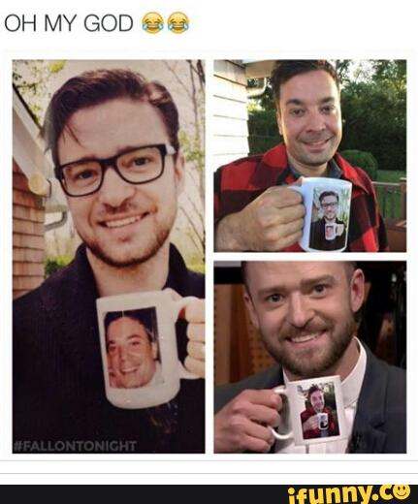
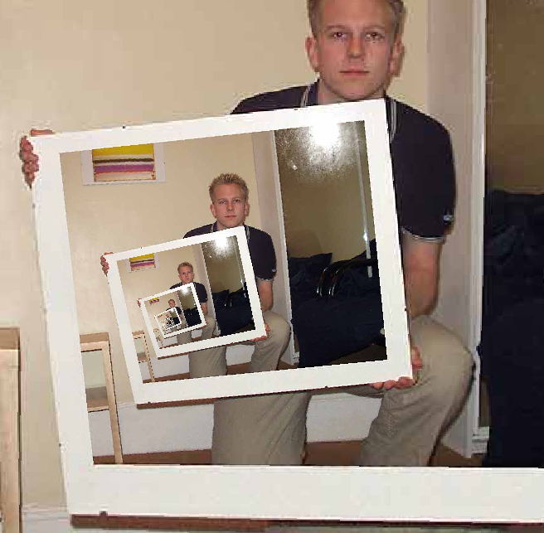
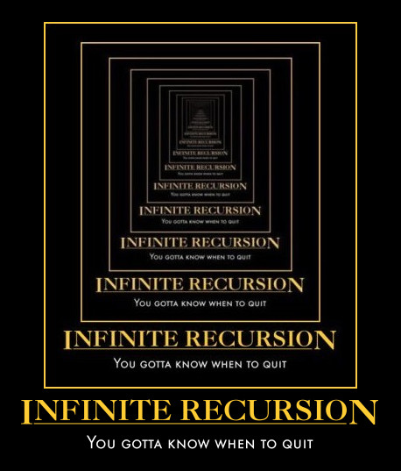
This "works" ~ but doesn't work!
def fac(N):
return fac(N)
Recursion
the dizzying dangers of having no base case!

Slide 52
This "works" ~ but doesn't work!
def fac(N):
return fac(N)
Recursion
the dizzying dangers of having no base case!

Slide 53
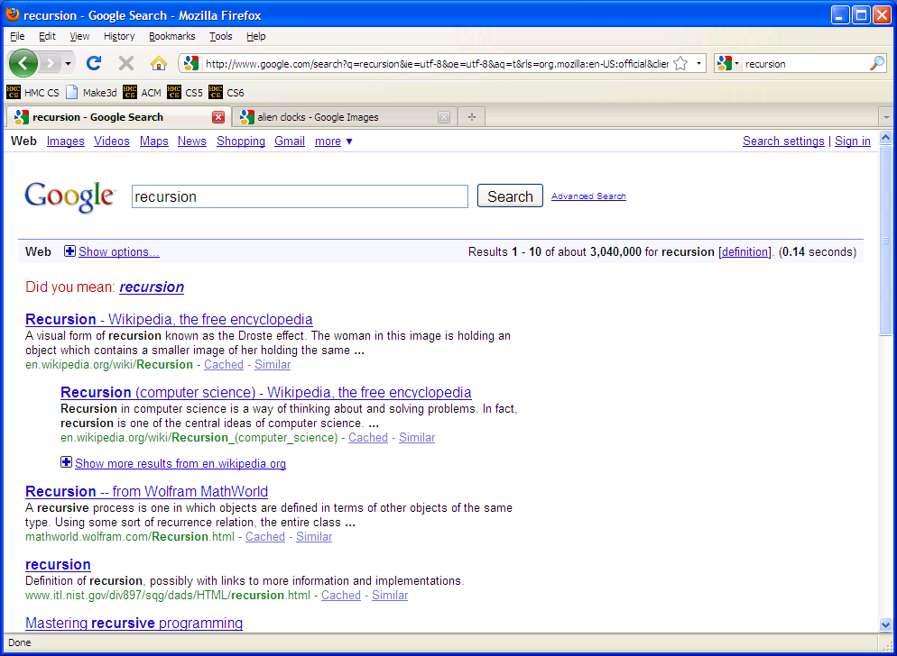

Slide 54
overall goal
fac(N)
output value of N*(N-1)*...*2*1
is
fac(N)
overall goal
value of N
output value of (N-1)*...*2*1
*
combined with
fac(N-1)
one, small piece
self-similar "rest"
fac(N)
base case:
output for fac(0) is 1
smallest possible input
its output
Notes:
recursion -- seems like magic
Gilderoy Lockhart

Slide 55
Thinking recursively...
def fac(N):
if N == 0:
return 1
else:
return N*fac(N-1)
Base case
Recursive case
(too short?)

Slide 56
Aside!
Acting recursively
def fac(N):
if N <= 1:
return 1
else:
return N*fac(N-1)
def fac(N):
if N <= 1:
return 1
else:
rest = fac(N-1)
return N*rest
this recursion happens first!
hooray for variables!
Conceptual
Actual

Slide 57
Behind the curtain:
how recursion works...
def fac(N):
if N <= 1:
return 1.0
else:
return N * fac(N-1)
fac(5)
5 * fac(4)
4 * fac(3)
3 * fac(2)
2 * fac(1)
1.0

Slide 58
Behind the curtain:
how recursion works...
def fac(N):
if N <= 1:
return 1.0
else:
return N * fac(N-1)
fac(5)
5 * fac(4)
stack frame with N = 5
4 * fac(3)
stack frame with N = 4
3 * fac(2)
stack frame with N = 3
2 * fac(1)
stack frame with N = 2
1.0
stack frame with N = 1

Slide 59
Behind the curtain:
how recursion works...
def fac(N):
if N <= 1:
return 1.0
else:
return N * fac(N-1)
fac(5)
5 * fac(4)
stack frame with N = 5
4 * fac(3)
stack frame with N = 4
3 * fac(2)
stack frame with N = 3
2 * 1.0
stack frame with N = 2

Slide 60
Behind the curtain:
how recursion works...
def fac(N):
if N <= 1:
return 1.0
else:
return N * fac(N-1)
fac(5)
5 * fac(4)
stack frame with N = 5
4 * fac(3)
stack frame with N = 4
3 * 2.0
stack frame with N = 3

Slide 61
Behind the curtain:
how recursion works...
def fac(N):
if N <= 1:
return 1.0
else:
return N * fac(N-1)
fac(5)
5 * fac(4)
stack frame with N = 5
4 * 6.0
stack frame with N = 4

Slide 62
Behind the curtain:
how recursion works...
def fac(N):
if N <= 1:
return 1.0
else:
return N * fac(N-1)
fac(5)
5 * 24.0
stack frame with N = 5

Slide 63
Behind the curtain:
how recursion works...
def fac(N):
if N <= 1:
return 1.0
else:
return N * fac(N-1)
fac(5)
complete!
120.0

Slide 64
Behind the curtain:
how recursion works...
def fac(N):
if N <= 1:
return 1.0
else:
return N * fac(N-1)
fac(5)
complete!
120.0
Recursion, the design process

Slide 65
Recursive Design: the 3 i's
Eye approve!
identify
self-similarities & base cases
intuition
implement

Slide 66
Recursive Design: the 3 i's
Eye approve!
What's the self-similarity?
Examples!
identify
self-similarities & base cases
Python...
intuition
implement

Slide 67
overall goal
fac(5)
output value of 5*4*3*2*1
fac(5)
starting from 5, decreasing to 1
Examples!
5*4*3*2*1
integers from 5 down to 1, multiplied together
fac(5)
Notes:
recursion -- seems like magic
Gilderoy Lockhart

Slide 68
overall goal
fac(5)
output value of 5*4*3*2*1
is
fac(5)
overall goal
value of 5
output value of 4*3*2*1
*
combined with
fac(4)
one, small piece
self-similar "rest"
Examples!
What's the self-similarity?
Notes:
recursion -- seems like magic
Gilderoy Lockhart

Slide 69
overall goal
fac(N)
output value of N*(N-1)*...*2*1
is
fac(N)
What's the self-similarity?
overall goal
value of N
output value of (N-1)*...*2*1
*
combined with
fac(N-1)
one, small piece
self-similar "rest"
What's the base case?
base case:
output for fac(0) is 1
smallest possible input
its output
Notes:
recursion -- seems like magic
Gilderoy Lockhart

Slide 70
Python...
def fac(N):
if N == 0:
return 1
else:
return N*fac(N-1)
Base case
Recursive case
(too short?)

Slide 71
Recursive Design: the 3 i's
Aye, aye, eye!
rec.
fac(5) is 5*4*3*2*1
fac(N) is
rec.
self-similarities
fac(4) is 4*3*2*1
fac(3) is 3*2*1
identify
base cases
base cases
self-similarities & base cases
fac(2) is 2*1
fac(1) is 1
base case
def fac(N):
if N <= 1:
return 1.0
else:
return N * fac(N-1)
fac(0) is 1
rec.
base case(s)
intuit
implement

Slide 72
Recursive Design: the 3 i's
rec.
fac(5) is 5*4*3*2*1
fac(N) is N*fac(N-1)
rec.
self-similarities
the order of base cases and recursive cases usually doesn't matter
fac(4) is 4*3*2*1
fac(3) = 3*2*1
identify
base cases
base cases
self-similarities & base cases
fac(2) = 2*1
fac(1) = 1
rec.
def fac(N):
if N > 0:
return N * fac(N-1)
else:
return 1.0
fac(0) is 1
base case(s)
base case
intuit
implement

Slide 73
Recursive Design: the 3 i's
rec.
fac(5) is 5*4*3*2*1
fac(N) is N*fac(N-1)
rec.
self-similarities
Let's try two more examples together – and then try 2-3 on your own...
fac(4) is 4*3*2*1
fac(3) = 3*2*1
identify
base cases
base cases
self-similarities & base cases
fac(2) = 2*1
fac(1) = 1
rec.
def fac(N):
if N > 0:
return N * fac(N-1)
else:
return 1.0
fac(0) is 1
base case(s)
base case
intuit
implement

Slide 74
Recursive Design: the 3 i's
rec.
plusone(4) is 1+1+1+1
plusone(N)
recursion?
self-similarities
plusone(3) is 1+1+1
plusone(2) is 1+1
identify
base cases
base cases
self-similarities & base cases
plusone(1) is 1
plusone(0) is 0
base case
def plusone(N):
if _______:
return ___
else:
return ______________
rec.
base case(s)
intuit
implement

Slide 75
overall goal
plusone(4)
output value of 1+1+1+1
plusone(4)
4 times
1+1+1+1
+1 added together, 4 times
plusone(4)
Notes:
recursion -- seems like magic
Gilderoy Lockhart

Slide 76
overall goal
plusone(4)
output value of 1+1+1+1
is
plusone(4)
overall goal
value of 1
output value of 1+1+1
+
combined with
plusone(3)
one, small piece
self-similar "rest"
example with concrete values
Notes:
recursion -- seems like magic
Gilderoy Lockhart

Slide 77
overall goal
plusone(N)
output value of 1+1+...+1
is
plusone(N)
overall goal
value of 1
output value of 1+...+1
+
combined with
plusone(N-1)
one, small piece
self-similar "rest"
base case:
output of plusone(0) is 0
smallest possible input
its output
Notes:
recursion -- seems like magic
Gilderoy Lockhart

Slide 78
Recursive Design: the 3 i's
rec.
plusone(4) is 1+1+1+1
plusone(N)
recursion?
self-similarities
plusone(3) is 1+1+1
plusone(2) is 1+1
identify
base cases
base cases
self-similarities & base cases
plusone(1) is 1
plusone(0) is 0
base case
def plusone(N):
if _______:
return ___
else:
return ______________
rec.
base case(s)
intuit
implement

Slide 79
Recursive Design: the 3 i's
rec.
plusone(4) is 1+1+1+1
plusone(N) is 1+plusone(N-1)
recursion?
self-similarities
plusone(3) is 1+1+1
plusone(0) is 0
plusone(2) is 1+1
identify
base cases
base cases
self-similarities & base cases
plusone(1) is 1
plusone(0) is 0
base case
def plusone(N):
if N == 0:
return 0
else:
return 1 + plusone(N-1)
rec.
base case(s)
intuit
implement

Slide 80
Recursive Design: leng(L)
rec.
leng( [5,42,7] ) is 3
leng(L)
recursion?
self-similarities
leng( [42,7] ) is 2
leng( [7] ) is 1
identify
base cases
base cases
self-similarities & base cases
leng( [ ] ) is 0
base case
def leng(L):
if ______________:
return ___
else:
return ______________
base case(s)
rec.
leng( 'and me?' )
intuit
implement

Slide 81
Recursive Design: leng(L)
rec.
leng( [5,42,7] ) is 3
leng(L) is 1+leng(L[1:])
recursion?
self-similarities
leng( [42,7] ) is 2
leng( [ ] ) is 0
leng( '' ) is 0
leng( [7] ) is 1
identify
base cases
base cases
self-similarities & base cases
leng( [ ] ) is 0
base case
def leng(L):
if L==[] or L=='':
return 0
else:
return 1 + leng(L[1:])
base case(s)
rec.
leng( 'and me?' )
intuit
implement

Slide 82
Design patterns…
Recursion's a design - not a formula, BUT, these pieces are common:
Handle base cases, with if …
Do one piece of work: L[0] or s[0]
Recurse with the rest: L[1:] or s[1:]
Combine + make sure the types match!

Slide 83

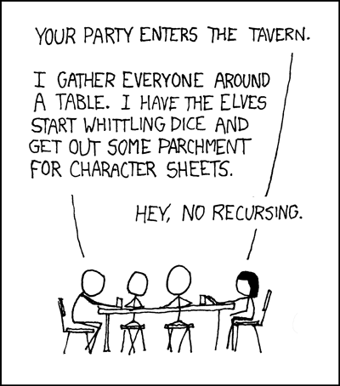

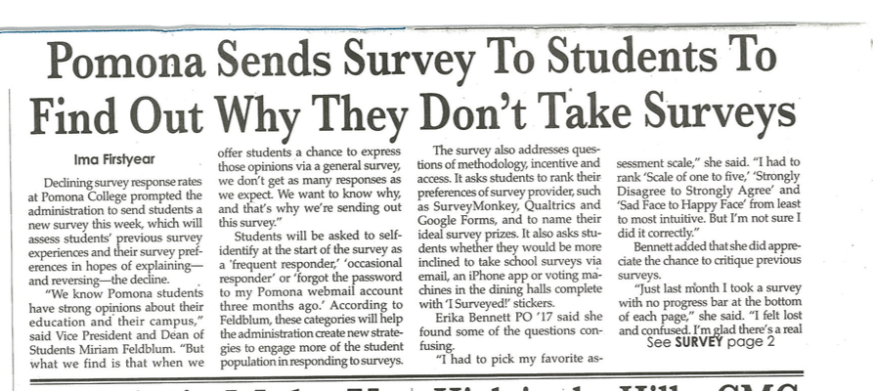
Recursion's advantage:
It handles arbitrary structural depth – all at once + on its own!
As a hat, I'm recursive, too!
https://www.youtube.com/watch?v=ybX9nVLtNi4 @ 0:08
https://www.youtube.com/watch?v=8PhiSSnaUKk @ 1:11
Notes:
I don’t know if this really works...

Slide 84
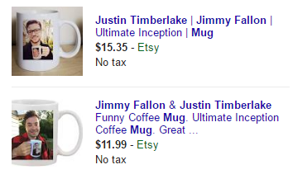
Recursion's advantage:
It handles arbitrary structural depth – all at once + on its own!
As a hat, I'm recursive, too!
Notes:
I don’t know if this really works...

Slide 85
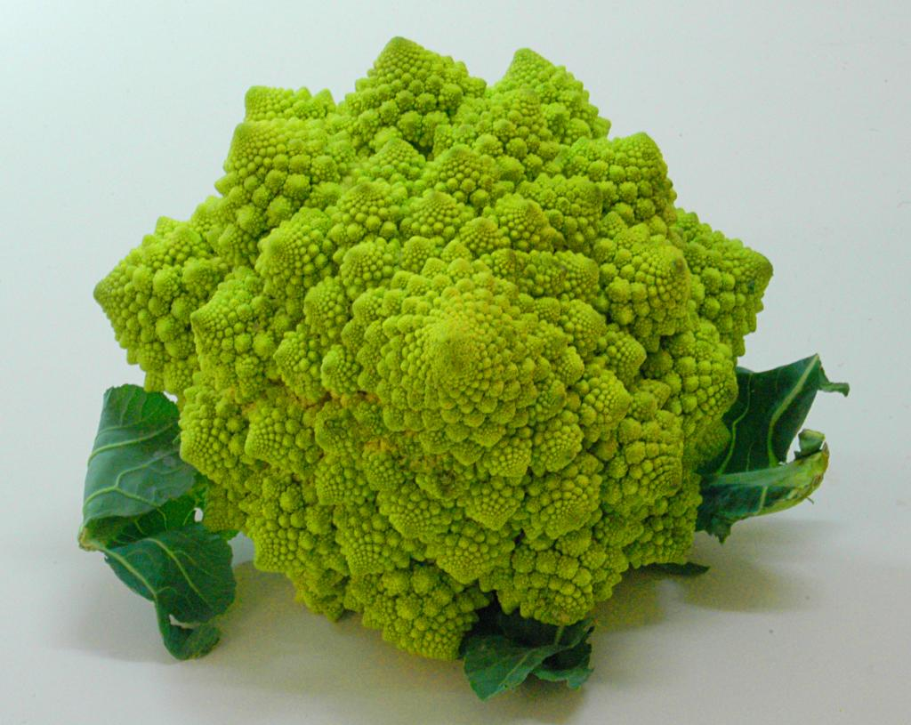
romanesco broccoli

Slide 86
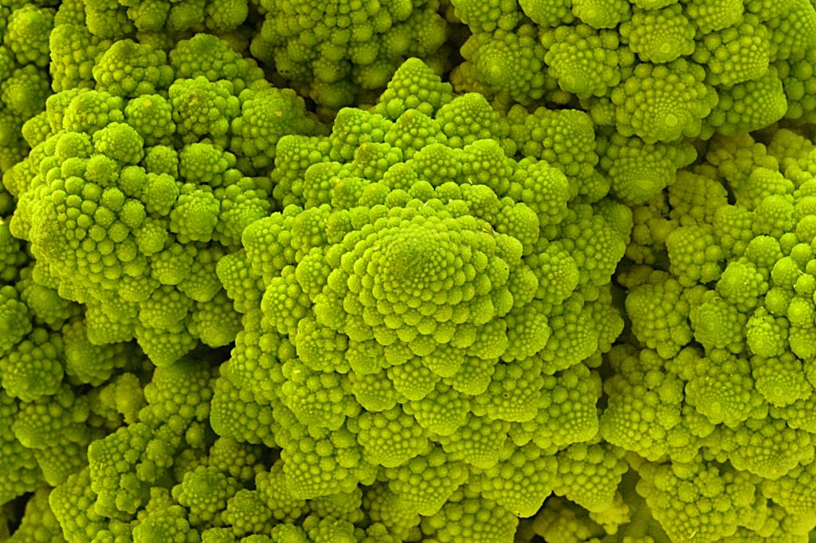
Are these rules for real?
Yes... and no.

Slide 87
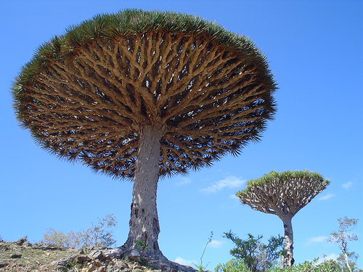
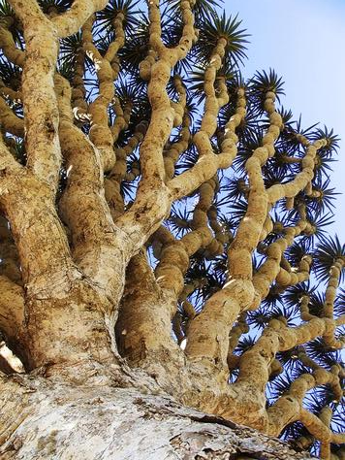
Dragon's-blood Tree

Slide 88

There still has to be a base case…

Slide 89
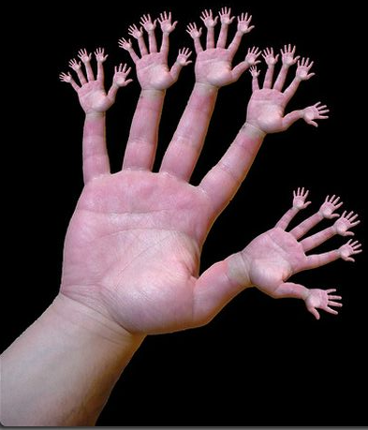
or else!

Slide 90
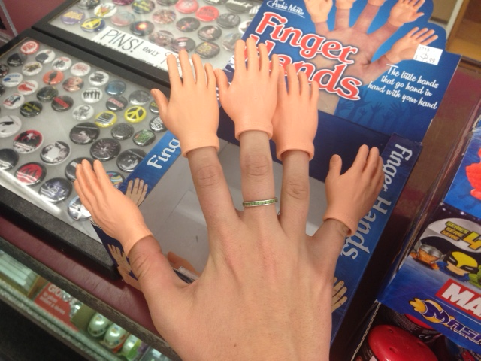
or one layer up!?

Slide 91

pow(b,p)
pow(b,p)
returns b**p, but using only multiplication times b
pow(2,4) ~ 2*2*2*2
pow(b,p)
= 16
self-similarities
pow(2,3) ~ 2*2*2
= 8
identify
base cases
self-similarities & base cases
pow(2,2) ~ 2*2
def pow(b,p):
if ________:
return ____
else:
return _____________
pow(2,1) ~ 2
pow(2,0) ~ 1
anything to the zero power is 1.0
intuit
Extra! See if you can also handle negative powers...
implement

Slide 92
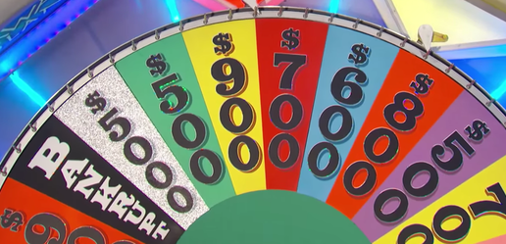
vwl(s)
vwl(s)
returns the number of vowels in the string s, s may or may not be empty.
let's count y!
vwl( 'crazy' ) ~ 2
IF
vwl(s)
vwl( 'razy' ) ~ 2
IF
self-similarities
vwl( 'azy' ) ~ 2
multiple possibilities!
identify
vwl( 'zy' ) ~ 1
base cases
self-similarities & base cases
vwl( 'y' ) ~ 1
def vwl(s):
if
elif
else:
vwl( '' ) ~ 0
What is the really simplest base case!?
intuit
Extra! What 7-letter English word maximizes vwl(s) ?
implement

Slide 93
Python is… in
I guess Python's the in thing
>>> 'i' in 'team'
False
>>> 'cs' in 'physics'
True
>>> 'i' in 'alien'
True
>>> 3*'i' in 'alien'
False
>>> 42 in [41,42,43]
True
>>> 42 in [[42], '42']
False

Slide 94
Answer: pow
pow(b,p)
return b**p, but using only multiplication times b
pow(2,4) ~ 2*2*2*2
pow(b,p) = pow(b,p-1) * b
= 16
self-similarities
pow(2,3) ~ 2*2*2
= 8
pow(b,0) = 1.0
identify
base cases
self-similarities & base cases
pow(2,2) ~ 2*2
def pow(b,p):
if p == 0:
return 1.0
else:
return pow(b,p-1) * b
pow(2,1) ~ 2
pow(2,0) ~ 1
anything to the zero power is 1.0
intuit
Extra! See if you can also handle negative powers...
implement

Slide 95
Answer: vwl
vwl(s)
return the number of vowels in the string s, s may or may not be empty.
let's count y!
vwl( 'crazy' ) ~ 2
vwl(s[1:]), if s[0] is not a vowel
1+vwl(s[1:]), if s[0] is a vowel
vwl(s) =
vwl( 'razy' ) ~ 2
self-similarities
vwl( 'azy' ) ~ 2
vwl( '' ) = 0
identify
vwl( 'zy' ) ~ 1
base cases
self-similarities & base cases
vwl( 'y' ) ~ 1
def vwl(s):
if s == '':
return 0
elif s[0] in 'aeiouy':
return 1+vwl(s[1:])
else:
return vwl(s[1:])
vwl( '' ) ~ 0
What is the really simplest base case!?
intuit
Extra! What 7-letter English word maximizes vwl(s) ?
implement

Slide 96
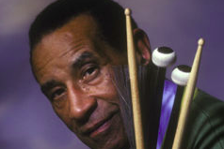
max( L )
max(L)
return the biggest element in L, given that L has at least one element!
max( [ 9,8,5 ] ) ~ 9
max(L)
max( [ 8,5 ] ) ~ 8
self-similarities
identify
base cases
self-similarities & base cases
max( [ 2,8,5 ] ) ~ 8
def max(L):
max( [ 8,5 ] ) ~ 8
max( [ 5 ] ) ~ 5
intuit
implement

Slide 97
Answer: max
max(L)
return the biggest element in L, given that L has at least one element!
max( [ 9,8,5 ] ) ~ 9
L[0], if L[0] > max(L[1:])
max(L[1:]), otherwise
max(L) is
max( [ 8,5 ] ) ~ 8
self-similarities
max( L ) is L[0]
identify
base cases
if len(L) == 1
self-similarities & base cases
max( [ 2,8,5 ] ) ~ 8
def max(L):
if len(L) == 1:
return L[0]
elif L[0] > max(L[1:])
return L[0]
else:
return max(L[1:])
max( [ 8,5 ] ) ~ 8
max( [ 5 ] ) ~ 5
intuit
implement

Slide 98
zeroest( L )
zeroest(L)
return the element of L closest to 0; L will have at least one element
Consider these examples:
zeroest(L)
zeroest( [4,-3,42] ) ~ -3
self-similarities
zeroest( [1,-3,42] ) ~ 1
identify
base cases
self-similarities & base cases
def zeroest(L):
zeroest( [-3,42] ) ~ -3
zeroest( [42] ) ~ 42
don't forget the base case!
intuit
Note: The function abs is built-in to Python….
implement

Slide 99
zeroest( L )
zeroest(L)
return the element of L closest to 0; L will have at least one element
Consider these examples:
L[0], if abs(L[0]) < abs(zeroest(L[1:]))
zeroest(L[1:]), otherwise
zeroest( [4,-3,42] ) ~ -3
zeroest(L)
self-similarities
self-similarities
zeroest( L ) is L[0]
zeroest( [1,-3,42] ) ~ 1
identify
base cases
if len(L) == 1
self-similarities & base cases
def zeroest(L):
if len(L) == 1:
return L[0]
rest = zeroest(L[1:])
if abs(L[0]) < abs(rest):
return L[0]
else:
return rest
zeroest( [-3,42] ) ~ -3
zeroest( [42] ) ~ 42
don't forget the base case!
intuit
Note: The function abs is built-in to Python….
implement

Slide 100
The key to understanding recursion is, first, to understand recursion.
- former CS 5 student
It's the eeriest!
Good luck with Homework #1
tutors @ LAC + 4C's Th/F/Sa/Su/Mon.

Slide 101
Notes:
recursion -- seems like magic
Gilderoy Lockhart

Slide 102
Recursive Design: the 3 i's
Aye, aye, eye!
rec.
fac(5) is 5*4*3*2*1
fac(N) is
rec.
self-similarities
fac(4) is 4*3*2*1
fac(3) is 3*2*1
identify
base cases
base cases
self-similarities & base cases
fac(2) is 2*1
fac(1) is 1
base case
def fac(N):
if N <= 1:
return 1.0
else:
return N * fac(N-1)
fac(0) is 1
rec.
base case(s)
intuit
implement

Slide 103
Recursive Design: leng(L)
rec.
leng( [5,42,7] ) is 3
leng(L)
recursion?
self-similarities
leng( [42,7] ) is 2
leng( [7] ) is 1
identify
base cases
base cases
self-similarities & base cases
leng( [ ] ) is 0
base case
def leng(L):
if ______________:
return ___
else:
return ______________
base case(s)
rec.
leng( 'and me?' )
intuit
implement

Slide 104
pow(b,p)
pow(b,p)
returns b**p, but using only multiplication times b
pow(2,4) ~ 2*2*2*2
pow(b,p)
= 16
self-similarities
pow(2,3) ~ 2*2*2
= 8
identify
base cases
self-similarities & base cases
pow(2,2) ~ 2*2
def pow(b,p):
if ________:
return ____
else:
return _____________
pow(2,1) ~ 2
pow(2,0) ~ 1
anything to the zero power is 1.0
intuit
Extra! See if you can also handle negative powers...
implement

Slide 105
vwl(s)
vwl(s)
returns the number of vowels in the string s, s may or may not be empty.
let's count y!
vwl( 'crazy' ) ~ 2
IF
vwl(s)
vwl( 'razy' ) ~ 2
IF
self-similarities
vwl( 'azy' ) ~ 2
multiple possibilities!
identify
vwl( 'zy' ) ~ 1
base cases
self-similarities & base cases
vwl( 'y' ) ~ 1
def vwl(s):
if
elif
else:
vwl( '' ) ~ 0
What is the really simplest base case!?
intuit
Extra! What 7-letter English word maximizes vwl(s) ?
implement

Slide 106
Recursion: the challenge
total # of vowels in 'college'
# of vowels in 'c'
total # of vowels in 'ollege'
+
Decompose
&
Recompose
Notes:
recursion -- seems like magic
Gilderoy Lockhart

Slide 107
Recursion: the big idea
value of 5*4*3*2*1
is
value of 4*3*2*1
value of 5
*
Decompose
&
Recompose
Notes:
recursion -- seems like magic
Gilderoy Lockhart

Slide 108
Big idea:
total # of vowels in s
# of vowels in s[0]
total # of vowels in s[1:]
Notes:
recursion -- seems like magic
Gilderoy Lockhart

Slide 109
overall goal
plusone(4)
output value of 1+1+1+1
plusone(4)
4 times
1+1+1+1
+1 added together, 4 times
plusone(4)
Notes:
recursion -- seems like magic
Gilderoy Lockhart

Slide 110
overall goal
plusone(4)
output value of 1+1+1+1
is
plusone(4)
overall goal
value of 1
output value of 1+1+1
+
combined with
plusone(3)
one, small piece
self-similar "rest"
example with concrete values
Notes:
recursion -- seems like magic
Gilderoy Lockhart

Slide 111
overall goal
plusone(N)
output value of 1+1+...+1
is
plusone(N)
overall goal
value of 1
output value of 1+...+1
+
combined with
plusone(N-1)
one, small piece
self-similar "rest"
base case:
output of plusone(0) is 0
smallest possible input
its output
Notes:
recursion -- seems like magic
Gilderoy Lockhart

Slide 112
Python function for plusone(N)
def plusone(N):
if _______:
return _______
else:
return _______________
Base case
Recursive case

Slide 113
Python function for plusone(N)
def plusone(N):
if N == 0:
return 0
else:
return 1 + plusone(N-1)
Base case
Recursive case

Slide 114
overall goal
pow(2,5)
output value of 2*2*2*2*2
pow(2,5)
5 times
2*2*2*2*2
five 2's multiplied together – 5 factors total
pow(2,5)
Notes:
recursion -- seems like magic
Gilderoy Lockhart

Slide 115
overall goal
pow(2,5)
output value of 2*2*2*2*2
pow(2,5)
overall goal
value of 2
output value of 2*2*2*2
*
combined with
pow(2,4)
one, small piece
self-similar "rest"
example with concrete values
Notes:
recursion -- seems like magic
Gilderoy Lockhart

Slide 116
overall goal
pow(b,p)
output value of b*b*...*b
p times
pow(b,p)
overall goal
value of b
output value of b*...*b
*
combined with
pow(b,p-1)
one, small piece
self-similar "rest"
base case:
output of pow(b,0) is 1
smallest possible input
its output
Notes:
recursion -- seems like magic
Gilderoy Lockhart

Slide 117
Python function for plusone(N)
def pow(b,p):
if _______:
return ______
else:
return _______________
Base case
Recursive case

Slide 118
Python function for plusone(N)
def pow(b,p):
if p == 0:
return 1.0
else:
return b*pow(b,p-1)
Base case
Recursive case

Slide 119
Python function for plusone(N)
def pow(b,p):
if p == 0:
return 1
elif p < 0:
return 1/pow(b,-p)
else:
return b*pow(b,p-1)
Base case
Recursive case
Recursive case

Slide 120
overall goal
leng( [7,42,9] )
output value for [7,42,9]
leng( [7,42,9] )
length is 3
[7,42,9]
3
this list has length of 3 – it has three top-level elements
leng( [7,42,9] )
Notes:
recursion -- seems like magic
Gilderoy Lockhart

Slide 121
overall goal
leng( [7,42,9] )
output value for [7,42,9]
leng( [7,42,9] )
overall goal
value of 1
output value for [42,9]
+
combined with
leng( [42,9] )
one, small piece
self-similar "rest"
example with concrete values
Notes:
recursion -- seems like magic
Gilderoy Lockhart

Slide 122
leng( L )
overall goal
output value for [7,42,...,9]
leng( [7,42,...,9] )
leng( L )
overall goal
value of 1
output value for [42,...,9]
+
combined with
leng( L[1:] )
one, small piece
self-similar "rest"
base case:
output of leng([]) is 0
smallest possible input
its output
Notes:
recursion -- seems like magic
Gilderoy Lockhart

Slide 123
Python function for plusone(N)
def leng( L ):
if _______:
return ______
else:
return _______________
Base case
Recursive case

Slide 124
Python function for leng( L )
def leng( L ):
if L == []:
return 0
else:
return 1 + leng(L[1:])
Base case
Recursive case

Slide 125
overall goal
has( 3, [4,5] )
output value for [7,42,9]
leng( [7,42,9] )
length is 3
[7,42,9]
3
this list has length of 3 – it has three top-level elements
leng( [7,42,9] )
Notes:
recursion -- seems like magic
Gilderoy Lockhart

Slide 126
overall goal
leng( [7,42,9] )
output value for [7,42,9]
leng( [7,42,9] )
overall goal
value of 1
output value for [42,9]
+
combined with
leng( [42,9] )
one, small piece
self-similar "rest"
example with concrete values
Notes:
recursion -- seems like magic
Gilderoy Lockhart

Slide 127
leng( L )
overall goal
output value for [7,42,...,9]
leng( [7,42,...,9] )
leng( L )
overall goal
value of 1
output value for [42,...,9]
+
combined with
leng( L[1:] )
one, small piece
self-similar "rest"
base case:
output of leng([]) is 0
smallest possible input
its output
Notes:
recursion -- seems like magic
Gilderoy Lockhart

Slide 128
Python function for plusone(N)
def leng( L ):
if _______:
return ______
else:
return _______________
Base case
Recursive case

Slide 129
Python function for leng( L )
def leng( L ):
if L == []:
return 0
else:
return 1 + leng(L[1:])
Base case
Recursive case

Slide 130
recursive design
Notes:
vault 713?

Slide 131
Recursive Design: the 3 i's
Eye approve!
identify
self-similarities & base cases
intuition
implement

Slide 132
Recursive Design: the 3 i's
fac(5) = 5*4*3*2*1
fac(4) = 4*3*2*1
fac(3) = 3*2*1
identify
self-similarities & base cases
fac(2) = 2*1
fac(1) = 1
fac(0) = 1
Examples!
intuition
implement

Slide 133
Recursive Design: the 3 i's
fac(5) = 5*4*3*2*1
fac(N) =
rec.
self-similarities
fac(4) = 4*3*2*1
fac(3) = 3*2*1
identify
base cases
self-similarities & base cases
fac(2) = 2*1
fac(1) = 1
fac(0) = 1
base cases
Examples!
intuit
implement

Slide 134
Recursive Design: the 3 i's
Eye approve!
fac(5) = 5*4*3*2*1
fac(N) =
rec.
self-similarities
fac(4) = 4*3*2*1
fac(3) = 3*2*1
identify
base cases
self-similarities & base cases
fac(2) = 2*1
fac(1) = 1
fac(0) = 1
base cases
intuit
implement

Slide 135
Recursive Design: the 3 i's
Eye approve!
rec.
fac(5) = 5*4*3*2*1
fac(N) =
rec.
self-similarities
fac(4) = 4*3*2*1
fac(3) = 3*2*1
identify
base cases
base cases
self-similarities & base cases
fac(2) = 2*1
fac(1) = 1
def fac(N):
if
return
else:
return
fac(0) = 1
base cases
intuit
implement

Slide 136
Recursive Design: the 3 i's
rec.
fac(5) = 5*4*3*2*1
fac(N) =
rec.
self-similarities
fac(4) = 4*3*2*1
fac(3) = 3*2*1
identify
base cases
base cases
self-similarities & base cases
fac(2) = 2*1
fac(1) = 1
base case
def fac(N):
if N <= 1:
return 1.0
else:
return N * fac(N-1)
fac(0) = 1
rec.
base cases
intuit
implement

Slide 137
Recursive Design: the 3 i's
rec.
fac(5) = 5*4*3*2*1
fac(N) =
the order of base cases and recursive cases usually does not matter!
rec.
self-similarities
fac(4) = 4*3*2*1
fac(3) = 3*2*1
identify
base cases
base cases
self-similarities & base cases
fac(2) = 2*1
fac(1) = 1
def fac(N):
if N > 1:
return N * fac(N-1)
else:
return 1.0
rec.
fac(0) = 1
base cases
base case
intuit
implement

Slide 138
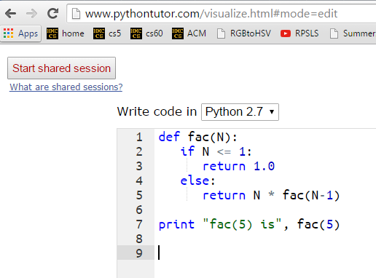
A look behind the curtain…
http://www.pythontutor.com/visualize.html

Slide 139

Recursive Design
add(m,n)
return m+n, but using only m and +1's …
m n
add(7,3) ~ 7+1+1+1
add(m,n) =
self-similarities
add(7,2) ~ 7+1+1
identify
add(7,1) ~ 7+1
base cases
self-similarities & base cases
def add(m,n):
if
return
else:
return
add(7,0) ~ 7
intuit
implement

Slide 140
def add(m,n):
if n == 0:
return m
else:
return 1 + add(m,n-1)
add(38,4)
1 + add(38,3)
stack frame with n = 4
1 + add(38,2)
stack frame with n = 3
1 + add(38,1)
stack frame with n = 2
1 + add(38,0)
stack frame with n = 1
stack frame with n = 0
38

Slide 141
Recursive Design
len(L)
return the length of the list or string L
len( [ 7,8,5 ] ) ~ 3
len(L) =
len( [ 8,5 ] ) ~ 2
self-similarities
len( [ 5 ] ) ~ 1
identify
len( [ ] ) ~ 0
base cases
self-similarities & base cases
lists
strings
def len(L):
if
return
else:
return
intuit
implement

Slide 142
def len(L):
if L == [] or L == '':
return 0
else:
return 1 + len(L[1:])
len('cs5!')
1 + len('s5!')
stack frame
1 + len('5!')
stack frame
1 + len('!')
stack frame
1 + len('')
stack frame
0
stack frame

Slide 143
Design patterns…
Recursion's a design - not a formula, BUT, these pieces are common:
Handle base cases, with if …
Do one piece of work: L[0] or s[0]
Recurse with the rest: L[1:] or s[1:]
Combine + make sure the types match!

Slide 144
Recursion's advantage:
It handles arbitrary structural depth – all at once + on its own!
As a hat, I'm recursive, too!
Notes:
I don’t know if this really works...

Slide 145
romanesco broccoli

Slide 146
Are these rules for real?
Yes... and no.

Slide 147
Dragon's-blood Tree

Slide 148
There still has to be a base case…

Slide 149
or else!

Slide 150
or else!

Slide 151
Recursive design…
fun! easy!?
(1) Program the base case.
(2) Find the self-similarity.
cool!
(3) Do one step!
indexing and slicing
(4) Delegate the rest to recursion…
Aha!

Slide 152
Try it!
pow(b,p)
return b**p, but using only multiplication times b
pow(2,4) ~ 2*2*2*2
pow(b,p) =
= 16
self-similarities
pow(2,3) ~ 2*2*2
= 8
identify
base cases
self-similarities & base cases
pow(2,2) ~ 2*2*1.0
def pow(b,p):
if
else:
pow(2,1) ~ 2*1.0
pow(2,0) ~ 1.0
anything to the zero power is 1.0
intuit
Extra! See if you can also handle negative powers...
implement

Slide 153
The key to understanding recursion is, first, to understand recursion.
- former CS 5 student
It's the eeriest!
Good luck with Homework #1
tutors @ LAC + 4C's Th/F/Sa/Su/Mon.

Slide 154
Notes:
I don’t know if this really works...

Slide 155
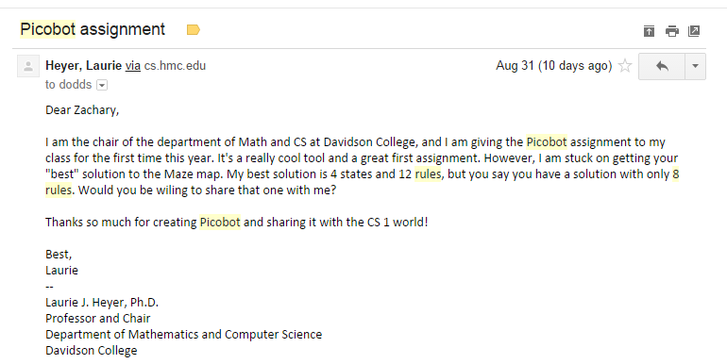
Picobot rules!
Eight rules?!
it's twice as slow!

Slide 156
Picobot, Aargh!
+ "universal" solution…

Slide 157
Jack Ma's Picobot "magic"
As close as CS gets to magic
a.k.a., CS's version of mathematical induction
Tutoring hours: LOTS!
Hw #1 due this Monday, 9/14, at 11:59 pm
This is the last CS 5 lecture you’ll ever need!*
HMC's legal counsel requires us to include these footnotes…
On Warner Brothers' insistence, we affirm that this 'C' does not stand for 'Chamber' and 'S' does not stand for 'Secrets.'
*
Caution: do not take this statement too literally or it is possible find yourself in twice as many CS 5 lectures as you need!
Notes:
recursion -- seems like magic
Gilderoy Lockhart

Slide 158
The dizzying dangers of having no base case!
Notes:
I don’t know if this really works...

Slide 159
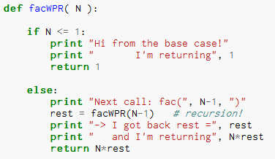
Thinking recursively…
What will print when facWPR(5) is called?

Slide 160
Let recursion do the work for you.
Exploit self-similarity
Less work !
Produce short, elegant code
You handle the base case – the easiest case!
def fac(N):
if N <= 1:
return 1
else:
rest = fac(N-1)
return rest * N
Recursion does almost all of the rest of the problem!
You specify one step at the end

Slide 161
Recursive design #1
'cs5'
def mylen(s):
""" input: any string, s
output: the number of characters in s
"""
if :
else:
base case test!
return
return
Ask yourself:
"How could I make use of the length of something smaller than s?" Then do!

Slide 162
… complete
def mylen(s):
""" input: any string, s
output: the number of characters in s
"""
if s == '':
return 0
else:
return 1 + mylen(s[1:])
There's not much len left here!

Slide 163
def mylen(s):
if s == '':
return 0
else:
return 1 + mylen(s[1:])
Behind the curtain:
how recursion works...
mylen('cs5')
1 + mylen('s5')
1 + 1 + mylen('5')
1 + 1 + 1 + mylen('')
1 + 1 + 1 + 0

Slide 164
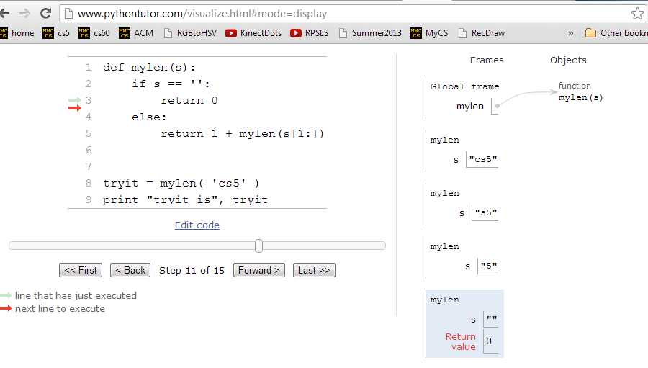
Looking behind the curtain…
http://www.pythontutor.com/visualize.html

Slide 165
Design #2
[1,4,3,42,-100,7]
def mymax(L):
""" input: a NONEMPTY list, L
output: L's maximum element
"""
if :
elif :
len(L)==1
base case test!
return
another case…
return
else:
return

Slide 166
Design #2
def mymax(L):
""" input: a NONEMPTY list, L
output: L's maximum element
"""
if len(L) == 1:
return L[0]
elif L[0] < L[1]:
return mymax( L[1:] )
else:
return mymax( L[0:1] + L[2:] )
Hey - do I get a slice?!

Slide 167
def mymax(L):
if len(L) == 1:
return L[0]
elif L[0] < L[1]:
return mymax( L[1:] )
else:
return mymax( L[0:1]+L[2:] )
base case
drop 1st
drop 2nd
mymax( [1,4,3,42,-100,7] )
mymax( [4,3,42,-100,7] )
mymax( [4,42,-100,7] )
mymax( [42,-100,7] )
mymax( [42,7] )
mymax( [42] )
42

Slide 168



power(2,5) == 32.0
Try it!
sajak('wheel of fortune') == 6
What about y? You decide…
in general:
def power(b,p):
def sajak(s):
""" returns b to the p power
Use recursion, not **
Inputs: int b, int p:
the base and the power
"""
""" returns the number of vowels
in the input string, s
"""
if s == '':
Base case test
p == 0
if :
Base case test
return
return
elif
elif
return
else:
else:
return
return
Want more power?
Handle negative values of p in an elif.
Want more Pat?
What 7-letter English word w maximizes sajak(w) ?
For example, power(5,-1) == 0.2

Slide 169
power( 2, 5 )
2* power( 2, 4 )
2* 2* power( 2, 3 )
2* 2* 2* power( 2, 2 )
2* 2* 2* 2* power( 2, 1 )
2* 2* 2* 2* 2* power( 2, 0 )
2* 2* 2* 2* 2* 1
32

Slide 170
sajak( 'eerier' )
1+ sajak( 'erier' )
1+ 1+ sajak( 'rier' )
1+ 1+ 0+ sajak( 'ier' )
1+ 1+ 0+ 1+ sajak( 'er' )
1+ 1+ 0+ 1+ 1+ sajak( 'r' )
1+ 1+ 0+ 1+ 1+ 0+ sajak( '' )
1+ 1+ 0+ 1+ 1+ 0+ 0
4

Slide 171
def power(b,p):
""" inputs: base b and power p (an int)
implements: b**p
"""
if p == 0:
return 1.0
elif p < 0:
return ____________________
else:
return b * power(b,p-1)
Recursion is power!

Slide 172
# of vowels in s
sajak(s):
D
E
S
I
G
N
When there are no letters, there are ZERO vowels
Base case?
Rec. step?
Look at the initial character.
if s[0] is NOT a vowel, the answer is
sajak( s[1:] )
if s[0] is a vowel, the answer is
1 + sajak( s[1:] )

Slide 173
def sajak(s):
if s == '':
return 0
elif s[0]=='a' or s[0]=='e' or…
Is s[0] a vowel?
but how to check for vowels?

Slide 174
Python is… in
I guess Python's the in thing
>>> 'i' in 'team'
False
>>> 'cs' in 'physics'
True
>>> 'i' in 'alien'
True
>>> 3*'i' in 'alien'
False
>>> 42 in [41,42,43]
True
>>> 42 in [[42], '42']
False

Slide 175
let's input 'eerier' for s
def sajak(s):
if len(s) == 0:
return 0
elif s[0] in 'aeiou':
return 1 + sajak(s[1:])
else:
return 0 + sajak(s[1:])
Base Case
if s[0] IS a vowel, the answer is
1 + the # of vowels in the rest of s
Recursive Cases
if s[0] is NOT a vowel, the answer is just
the number of vowels in the rest of s

Slide 176
How functions work…
2
"the stack"
def f(x):
if x == 0:
return 12
else:
return f(x-1) + 10*x
call: f(2)
stack frame
local variables:
x = 2
f(1) = 22
result = 42
the result then gets returned…
Notes:
vault 713?

Slide 177
How functions work…
"the stack"
def f(x):
if x == 0:
return 12
else:
return f(x-1) + 10*x
call: f(2)
stack frame
local variables:
x = 2
need f(1)
call: f(1)
stack frame
local variables:
x = 1
need f(0)
call: f(0)
stack frame
local variables:
x = 0
returns 12
they stack.
Notes:
vault 713?

Slide 179
def power(b,p):
""" inputs: base b and power p (an int)
implements: b**p
"""
if p == 0:
return 1.0
elif p < 0:
return ____________________
else:
return b * power(b,p-1)
Recursion is power!

Slide 180
Recursive design #1
'cs5'
def mylen(s):
""" input: any string, s
output: the number of characters in s
"""
if :
else:
base case test!
Ask yourself:
"How could I use the length of anything smaller than s?" Then do!

Slide 181
Design #2
[1,4,3,42,-100,7]
def mymax(L):
""" input: a NONEMPTY list, L
output: L's maximum element
"""
if :
elif :
else:
len(L)==1
base case test!
return
another case…
return

Slide 182
power(2,5) == 32.0
Try it!
sajak('wheel of fortune') == 6
p
p-1
2
==
2*
2
What about y? You decide…
def power(b,p):
def sajak(s):
""" returns b to the p power
Use recursion, not **
Inputs: int b, int p:
the base and the power
"""
""" returns the number of vowels
in the input string, s
"""
if s == '':
Base case test
p == 0
if :
Base case test
return
return
elif
elif
return
else:
else:
return
return
Want more power?
Handle negative values of p in an elif.
Want more Pat?
What 7-letter English word w maximizes sajak(w) ?
For example, power(5,-1) == 0.2

Slide 183





did somebody say induction?
Jack Ma's Picobot "magic"
a.k.a., CS's version of mathematical induction
Aye-Aye-Aye, Mateys!
As close as CS gets to magic
Tutoring hours: LOTS!
Hw #1 due this Sunday, 2/8, at 11:59 pm
This is the last CS 5 lecture you’ll ever need!*
HMC's legal counsel requires us to include these footnotes…
On Warner Brothers' insistence, we affirm that this 'C' does not stand for 'Chamber' and 'S' does not stand for 'Secrets.'
*
Caution: do not take this statement too literally or it is possible find yourself in twice as many CS 5 lectures as you need!
Notes:
recursion -- seems like magic
Gilderoy Lockhart

Slide 184
Overlay… Izzy; others
(1) function definition
def flipside(s):
""" flipside(s): swaps s's sides!
input s: a string
"""
x = len(s)/2
return s[x:] + s[:x]
#
# Tests!
#
print "flipside('carpets') ~", flipside('carpets')
print "flipside('carpets') ~", flipside('carpets')
print "flipside('carpets') ~", flipside('carpets')
print "flipside('carpets') ~", flipside('carpets')
print "flipside('carpets') ~", flipside('carpets')
(2) function tests
We provide these tests (for now…)
control-b in Sublime
Notes:
show help!

Slide 185
RPS results et al.
Notes:
recursion -- seems like magic
Gilderoy Lockhart

Slide 186


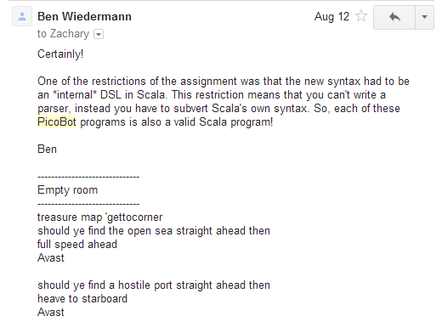
Aye-Aye-Aye, Mateys! 9/19
Pirate Picobot!
if open, go forth!
if blocked, go right!
this is a runnable program

Slide 187
Picobot rules!
Eight rules?!
it's twice as slow!

Slide 188
Picobot, Aargh!
show Porter's rules for this one!!
+ "universal" solution…

Slide 189
Quiz
First and last name(s):
-4
What is demo(-4) ?
def demo(x):
return x + f(x)
def f(x):
return 11*g(x) + g(x/2)
def g(x):
return -1 * x
I might have a guess…
How functions work…
Notes:
vault 713?

Slide 190
Thinking recursively
factorial
Recursion == self-reference!
5 ! = 120
5 ! = 5 * 4 * 3 * 2 * 1
5 ! =
N ! = N * (N-1) * (N-2) * … * 3 * 2 * 1
N ! =

Slide 191
Thinking recursively
def fac(N):
if N <= 1:
return 1
Base case
"How could I use the factorial of anything smaller than N?" Then do!
Ask yourself:

Slide 192
Recursive design #1
'cs5'
def mylen(s):
""" input: any string, s
output: the number of characters in s
"""
if :
else:
base case test!
Ask yourself:
"How could I use the length of anything smaller than s?" Then do!

Slide 193
Design #2
[1,4,3,42, 7,-100]
def mymax(L):
""" input: a NONEMPTY list, L
output: L's maximum element
"""
if :
elif :
else:
len(L)==1
base case test!
another case…

Slide 194
power(2,5) == 32.0
Try it!
sajak('wheel of fortune') == 6
5
4
2
==
2*
2
What about y? You decide…
def power(b,p):
def sajak(s):
""" returns b to the p power
Use recursion, not **
Inputs: int b, int p:
the base and the power
"""
""" returns the number of vowels
in the input string, s
"""
if s == '':
Base case test
p == 0
if :
Base case test
return
return
elif
return
else:
else:
return
return
Want more power?
Handle negative values of p, too.
Want more Pat?
What 7-letter English word w maximizes sajak(w) ?
For example, power(5,-1) == 0.2

Slide 197
def sajak(s):
if len(s) == 0:
return 0
elif s[0] in 'aeiou':
return 1 + sajak(s[1:])
else:
return sajak(s[1:])
Base Case
Rec. Steps
if it is NOT a vowel, the answer is just the number of vowels in the rest of s
if it IS a vowel, the answer is 1 + the number of vowels in the rest of s

Slide 198
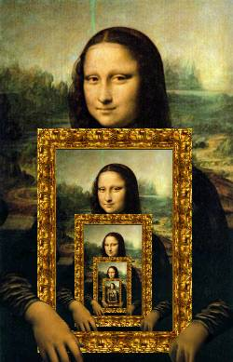

Recursion's Big Picture?
Need to see BOTH the self-similar piece AND the whole simultaneously!

Slide 199
behind the curtain
sajak('eerier')

Slide 200
behind the curtain
power(2,3)

Slide 201
def sajak(s):
when there are no letters, there are ZERO vowels
Base case?
Look at the initial character.
if s[0] is NOT a vowel, the answer is just the
number of vowels in the rest of s
Rec. step?
if s[0] is a vowel, the answer is
1 + the number of vowels in the rest of s

Slide 202

Recursion: not just numbers
Self-similarity elsewhere...
Natural phenomena
Relationships
how much here is leaf vs. stem?
What is an “ancestor” ?
Names / Acronyms
TTP == “The TTP Project”

Slide 203
Recursion: not just numbers
Self-similarity elsewhere...
Natural phenomena
Relationships
What is an “ancestor” ?
An ancestor is a parent OR an ancestor of a parent…
Names / Acronyms
TTP == “The TTP Project”
all stem!

Slide 204

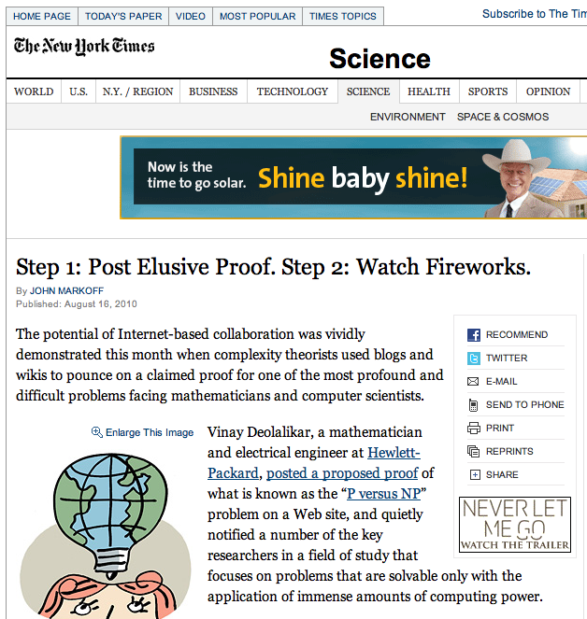
This week's reading: the $10⁶ problem
Vinay Deolalikar, HP Labs
polynomially-checkable problems
polynomially-solvable problems
P vs. NP
factoring N-digit numbers?

Slide 205
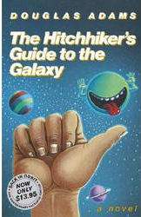
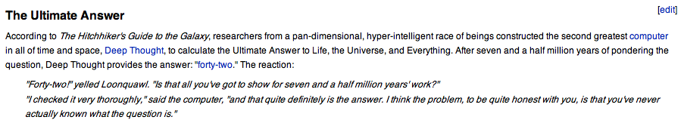
Douglas Adams's 42
Those zero-eyed aliens are a bit much…
answer: 42 question: unknown
Notes:
ZACH
show python in console

Slide 207
Recursion Examples
def mylen(s):
""" input: any string, s
output: the number of characters in s
"""
if :
else:
base case test!

Slide 208
Recursion Examples
def mymax(L):
""" input: a NONEMPTY list, L
output: L's maximum element
"""
if :
elif :
else:
base case test!
another case…

Slide 209

Try it!
Do not hand this one in…
def power(b,p):
def sajak(s):
""" returns b to the p power
using recursion, not **
inputs: int b, int p
output: a float
"""
""" returns the number of vowels
in the input string, s
"""
if :
if :
Base case test
Base case test
elif
else:
power(5,2) == 25.0
sajak('wheel of fortune') == 6
What about y? You decide…
Want more power?
Handle negative values of p, as well.
What seven-letter English word w maximizes sajak(w) ?
For example, power(5,-1) == 0.2 (or so)
Want more Pat?

Slide 210
Recursion is the root of all computation since it trades description for time.
- Alan Perlis
Recursion is the secret to all happiness in writing short, powerful functional programs!

Slide 211
while we're here…
import random
comp = random.choice( range(0,100) )
while True:
user = input('Your choice: ')
print user, '?'
if user == comp:
print 'Yes!'
break
else:
print 'No...'

Slide 212
"Quiz" on recursion
Names:
def sajak(s):
def power(b,p):
""" returns the number of vowels
in the input string, s
"""
""" returns b to the p power
using recursion and not **
inputs: b and p are ints
output: should be a float
"""
sajak('wheel of fortune') == 6
power(5,2) == 25.0
What about y? You decide…
What five-letter English word w maximizes sajak(w) ?
Want more power?
Handle negative values of p, as well.
Want more Pat?
For example, power(5,-1) == 0.2 (or so)

Slide 213
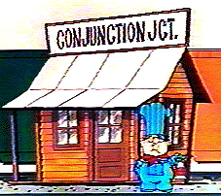
def sajak(s):
if s == '':
return 0
else:
Base Case
Checking for a vowel: Try #1
and
or
same as in English!
but each side has to be a complete boolean value!
not

Slide 214
def sajak(s):
if len(s) == 0:
return 0
else:
Base Case
if s[0] == 'a' or s[0] == 'e' or…
Checking for a vowel: Try #1
and
or
same as in English!
but each side has to be a complete boolean value!
not

Slide 215
def sajak(s):
if len(s) == 0:
return 0
else:
Base Case
Checking for a vowel: Try #2
in

