Slide 1
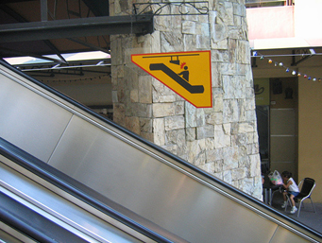
Welcome to CS 5! Be sure to watch your head…

Slide 2
Welcome to CS 5! Be sure to watch your head…

Slide 4
So many head-aching signs... !
def svtree( t, levels ):
if levels == 0: return
forward( t )
left(30)
svtree(t/2, levels-1 )
right(60)
svtree(t/2, levels-1 )
left(30)
backward( t )
1
1
2
1
4
3
2
1
3
2
1
The numbers show the value of N for each call ...
2
1
1
1
The colors show the entire stack of calls up to that branch!

Slide 5
STACK
levels = 4
t = 200, levels = 4
t = 100, levels = 3
levels = 3
levels = 2
t = 50, levels = 2
levels = 1
t = 25, levels = 1
def svtree( t, levels ):
if levels == 0: return
forward( t )
left(30)
svtree(t/2, levels-1 )
right(60)
svtree(t/2, levels-1 )
left(30)
backward( t )
1
1
2
1
4
3
2
1
3
2
1
The numbers show the value of N for each call ...
2
1
1
1
The colors show the entire stack of calls up to that branch!

Slide 6
STACK
levels = 4
t = 200, levels = 4
svtree(t/2, levels-1)
t = 100, levels = 3
levels = 3
svtree(t/2, levels-1)
levels = 2
t = 50, levels = 2
svtree(t/2, levels-1)
levels = 1
t = 25, levels = 1
forward(t)
def svtree( t, levels ):
if levels == 0: return
forward( t )
left(30)
svtree(t/2, levels-1 )
right(60)
svtree(t/2, levels-1 )
left(30)
backward( t )
1
1
2
1
4
3
2
1
3
2
1
The numbers show the value of N for each call ...
2
1
1
1
The colors show the entire stack of calls up to that branch!

Slide 7
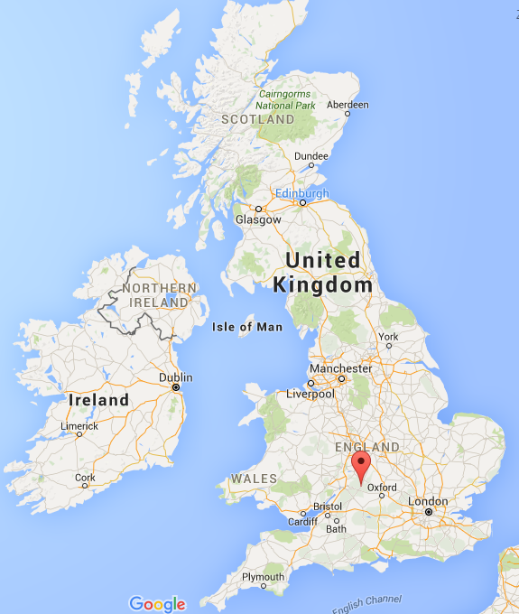
Bourton-on-the-water

Slide 8
Bourton-on-the-water

Slide 9
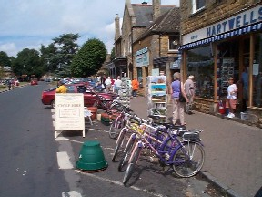
Bourton-on-the-water
town of 2000 people

Slide 10
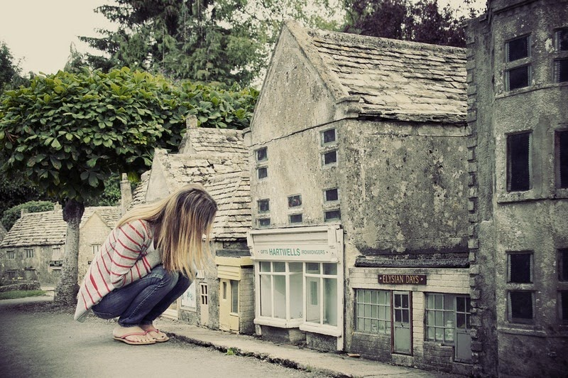
Bourton-on-the-water's 1/9 model

Slide 11
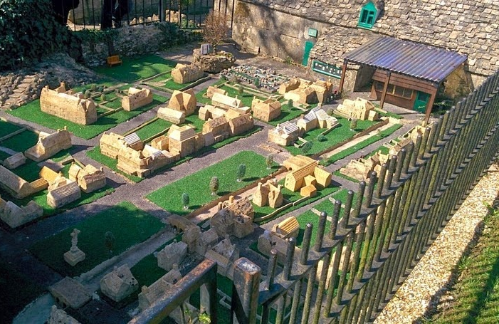
has a level-2 model…

Slide 12
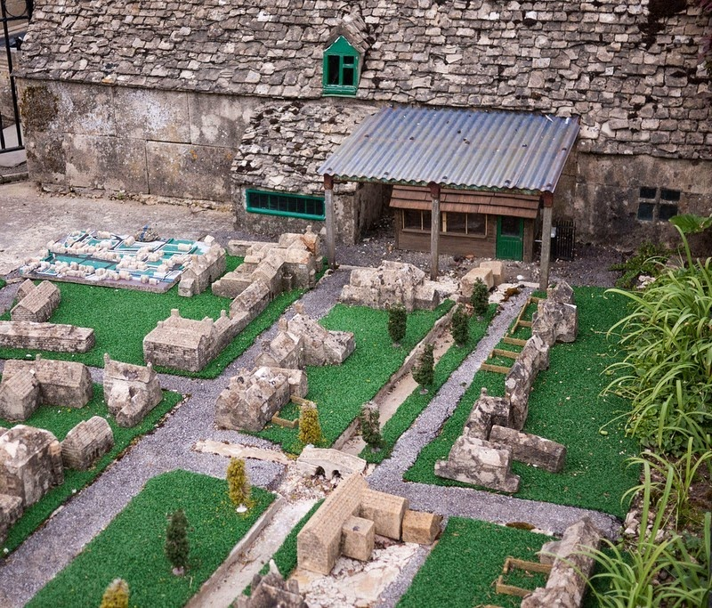
has a level-2 model…

Slide 13
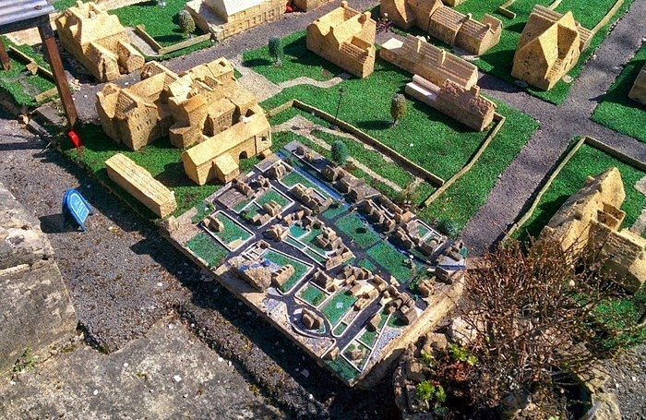
and a level-3 model…

Slide 14
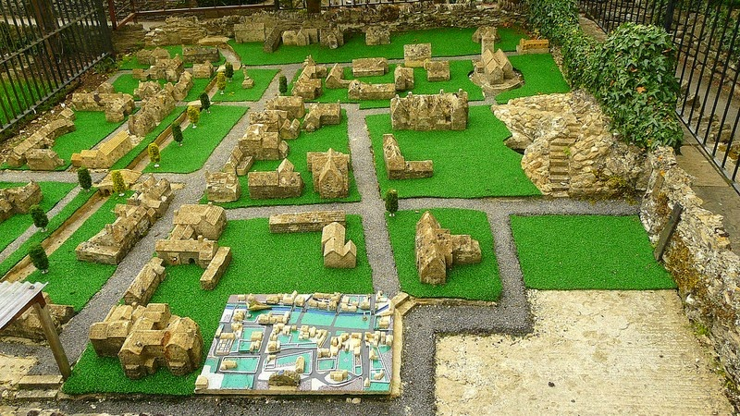
and a level-3 model…

Slide 15
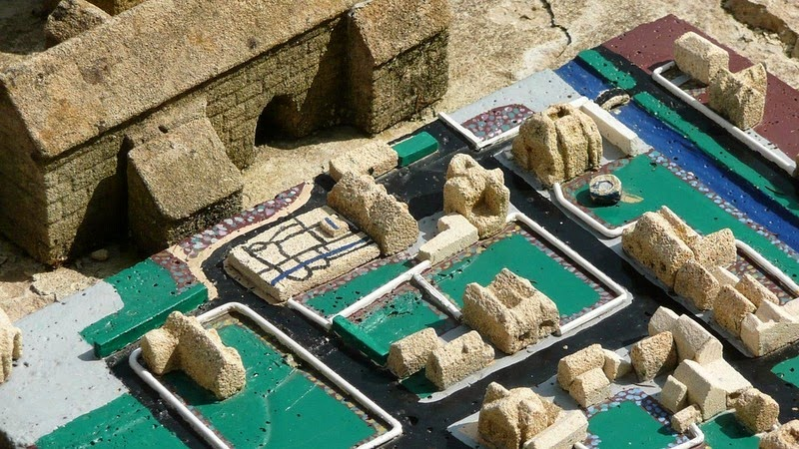
and even a (very small!) level-4 model

Slide 16
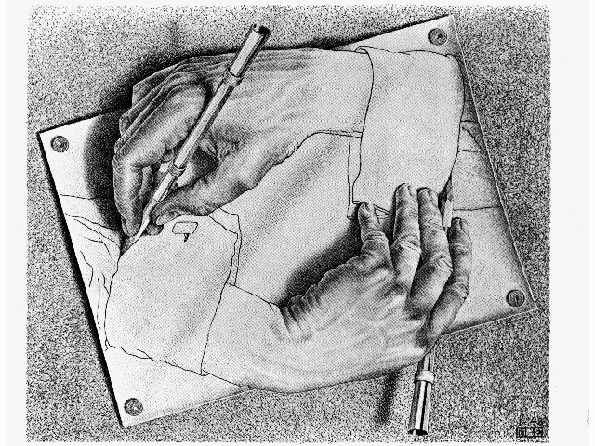
CS 5: now recursing…
Hw 2 – due Monday evening ~ usual time
Or re-cursing, depending on your feelings about recursion!
pr0 reading – Watson!
pr1 lab – Turtle!
pr2, pr3 - Python probs…
We're computationally complete!
pr4 – extra-credit turtle… !
What's next?
putting Python to work...
& adding building-blocks

Slide 17
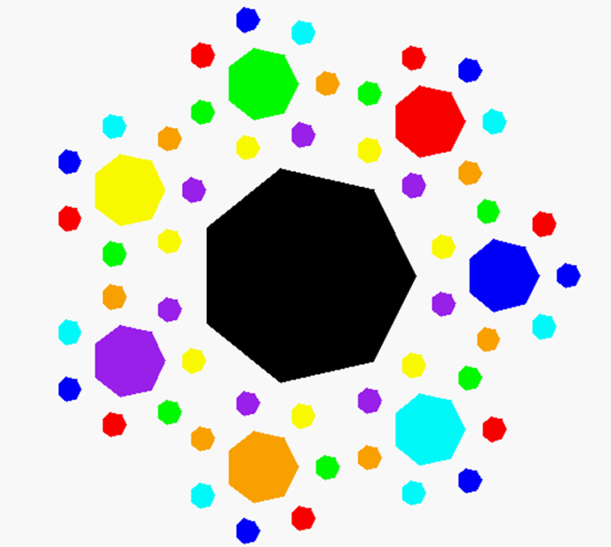
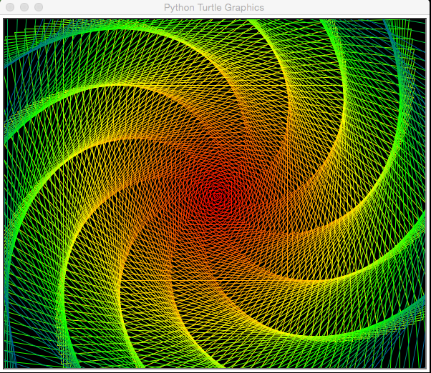
Recursive Art ~ hw2pr4
Submit things that work …
septagonal confetti
dramatic spiral!

Slide 18
Recursive Art Ex. Cr. ~ hw2pr4

Slide 19
Recursive Art Ex. Cr. ~ hw2pr4

Slide 20
Recursive Art Ex. Cr. ~ hw2pr4
"Icing Squeezer"

Slide 21
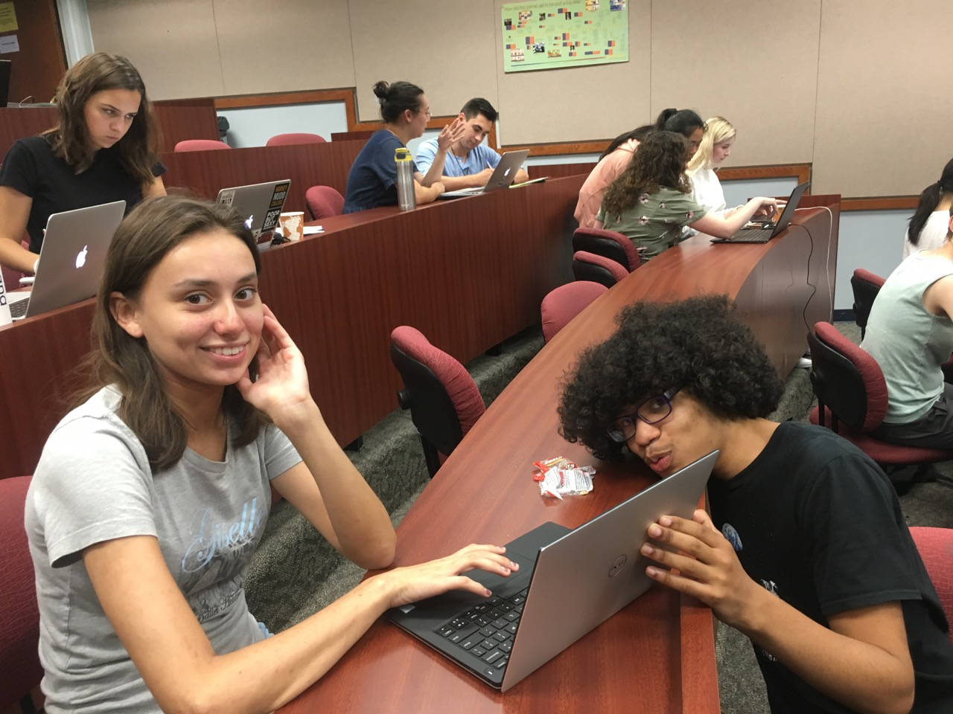
Recursive Art Ex. Cr. ~ hw2pr4

Slide 22
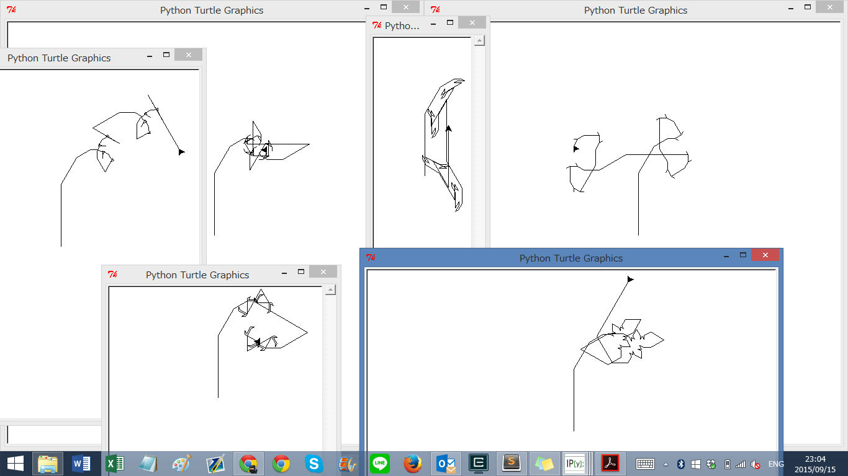
Recursive Art ~ hw2pr4
Submit things that work …
… and even things that "don't"!
"Cyriak's pet snake…"

Slide 23
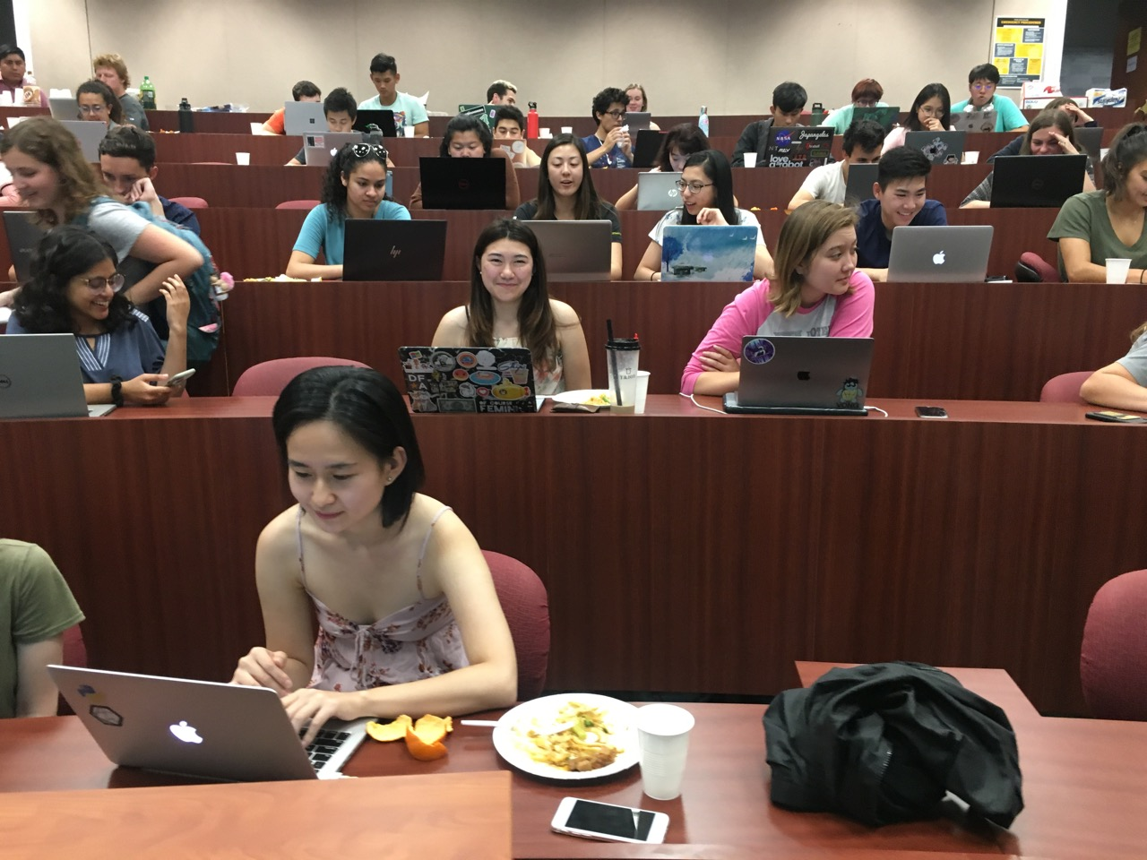
Graders!
Grading dinner

Slide 24
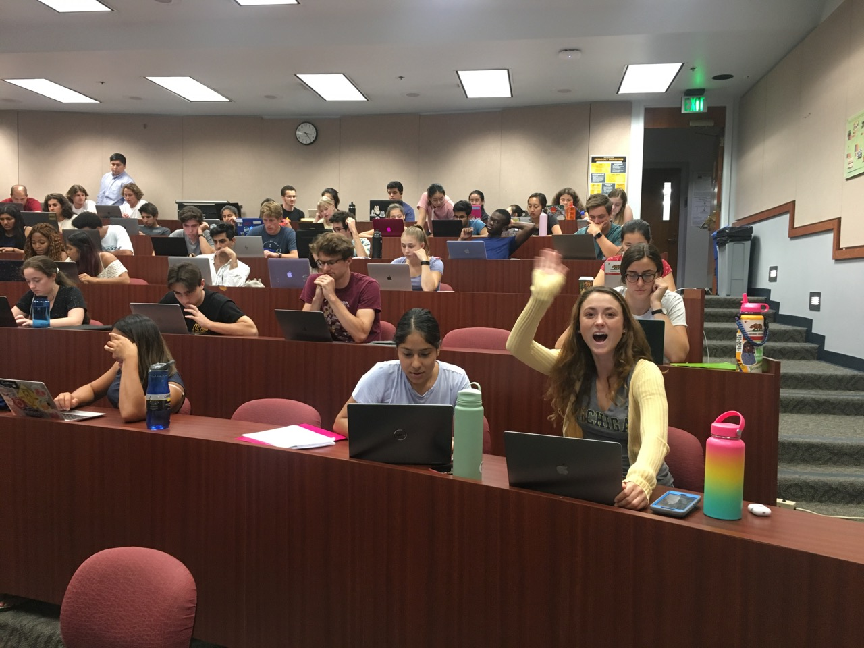
Highlights!
or ... Hi!-lights

Slide 25
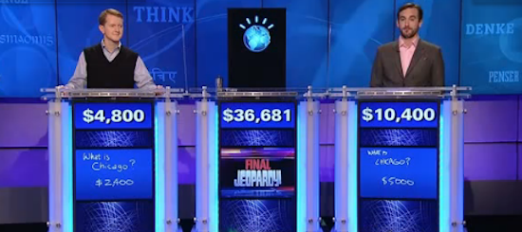
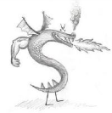
this week's hw2pr0
https://www.youtube.com/watch?v=lI-M7O_bRNg 3:00-3:42
Category: U.S. Cities. Clue: Its largest airport is named for a World War II hero, its second largest for a World War II battle.
Watson
Burninated by syntax!

Slide 26
functional programming
>>> 'fun' in 'functional'
True
representation via list structures (data)
leverage self-similarity (recursion)
create small building blocks (functions)
Composed together -- to solve/investigate problems.
Functional programming
conceptually concise
vs.
efficient for the computer…
functional
procedural or sequential

Slide 27
Data
[13,14,15]
[3,4,5,6,7,8,9]
Functions
sum( )
… and their compositions

Slide 28
sum range
def sum(L):
""" input: L, a list of #s
output: L's sum
"""
if len(L) == 0:
return 0.0
else:
return L[0] + sum(L[1:])
Base Case
Recursive Case

Slide 29
sum range
list
list(range(low,hi))
step?
what's cookin' here?
def range(low, hi ):
""" input: ints low and hi
output: int list from low to hi
"""
if low >= hi:
return
else:
return
excluding hi

Slide 30
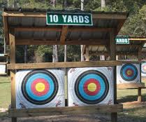
Recursion's range
Name(s): ______________
range(3,7)
[3,4,5,6]
range(3,7,2)
[3,5]
We're on target!
def range(low, hi ):
""" input: low and hi, integers
output: a list from low upto hi
"""
if low >= hi:
return
else:
return
, stride
but excluding hi
Base case: What if low is grater than or equal to hi?
Recursive case: How could we use another call to range to help us?!
Extra Extra!! What if stride were negative?
Extra! Take a (positive) third input in stride

Slide 31
Recursion's range
Name(s): ______________
range(3,7)
[3,4,5,6]
range(3,7,2)
[3,5]
We're on target!
def range(low, hi ):
""" input: low and hi, integers
output: a list from low upto hi
"""
if low >= hi:
return
else:
return
, stride
but excluding hi
[]
Allllllllllllmost...
Base case: What if low is grater than or equal to hi?
low + range(low+1,hi)
Recursive case: How could we use another call to range to help us?!
Extra! Take a (positive) third input in stride

Slide 32
Recursion's range
Name(s): ______________
Solution! Try on the back page first!
range(3,7)
[3,4,5,6]
range(3,7,2)
[3,5]
We're on target!
def range(low, hi ):
""" input: low and hi, integers
output: a list from low upto hi
"""
if low >= hi:
return
else:
return
, stride
but excluding hi
[]
Base case: What if low is grater than or equal to hi?
[low] + range(low+1,hi)
Recursive case: How could we use another call to range to help us?!
[low] + range(low+stride, hi, stride)
Extra! Take a (positive) third input in stride

Slide 33
Recursion's range
Name(s): ______________
range(3,7)
[3,4,5,6]
range(3,7,2)
[3,5]
We're on target!
def range(low, hi ):
""" input: low and hi, integers
output: a list from low upto hi
"""
if low >= hi:
return
else:
return
, stride
Pass these backward(42)
but excluding hi
Base case: What if low is grater than or equal to hi?
Recursive case: How could we use another call to range to help us?!
Extra Extra!! What if stride were negative?
Extra! Take a (positive) third input in stride

Slide 34
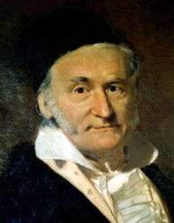
sum and range
1784
list
>>> sum(list(range(1,101)))
?
I'd bet you have a 50/50 chance on this one…
- Ben. L '14

Slide 35
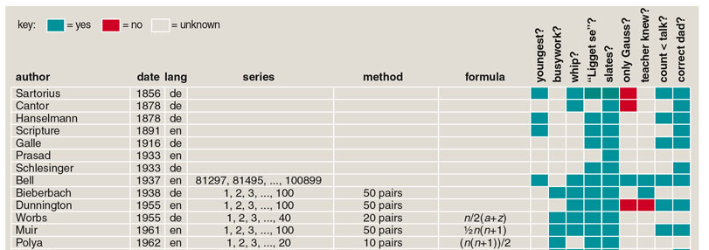
sum and range
1784
list
>>> sum(list(range(1,101)))
?
I'd bet you have a 50/50 chance on this one…
- Ben. L '14
Gauss's storied story…
and 100 more…
http://www.americanscientist.org/template/AssetDetail/assetid/50686

Slide 36
sum and range
1784
list
>>> sum(list(range(1,101)))
5050
Looks sort of scruffy for a 7-year old… !
1 + 2 + 3 + ... + 98 + 99 + 100
50+51
101
101
101
50 101's == 5050

Slide 37
Data
[8,9,10]
Functions
sq( )
[64,81,100]
[ sq(x) for x in [8,9,10] ]
…together

Slide 38
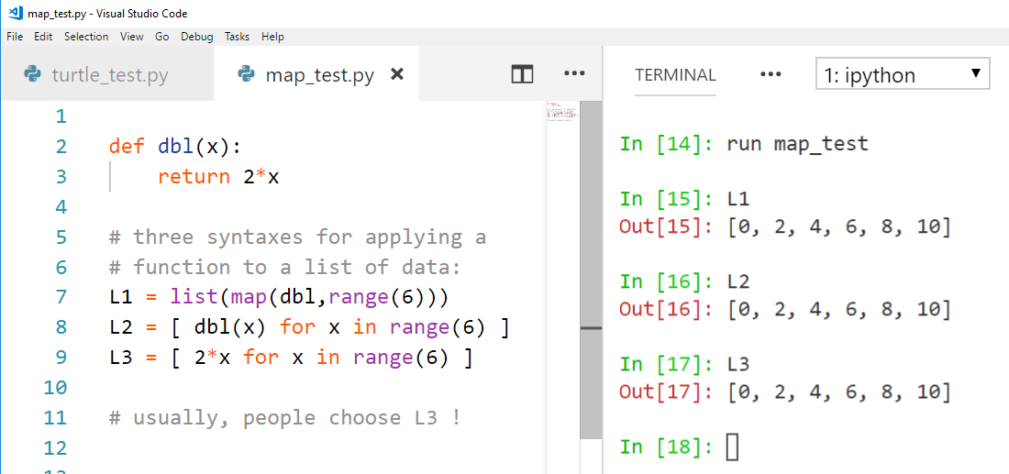
Various approaches...
many options for mapping a function onto a list:
Eye, Eye, Eye!

Slide 39
List Comprehensions
>>> [ 2*x for x in [0,1,2,3,4,5] ]
List Comprehenion
[0, 2, 4, 6, 8, 10]
result
What's the syntax saying here?

Slide 40
List Comprehensions
Expression to evaluate for each list element
Name for each list element
The list - or string to run
>>> [ 2*x for x in [0,1,2,3,4,5] ]
List Comprehenion
[0, 2, 4, 6, 8, 10]
result
What's the syntax saying here?

Slide 41
List Comprehensions
this "runner" variable can have any name...
x takes on each value
input
>>> [ 2*x for x in [0,1,2,3,4,5] ]
[0, 2, 4, 6, 8, 10]
and 2*x is output for each one
output

Slide 42
List Comprehensions
expression
iteration
condition
>>> [ 10*x for x in [0,1,2,3,4,5] if x%2==0]
result
>>> [ y*21 for y in list(range(0,3)) ]
result
>>> [ s[1] for s in ["hi", "5Cs!"] ]
result

Slide 43
Try it!
A range of list comprehensions...
Write Python's result for each L.C.:
[0,1,2,3,4]
[ n**2 for n in range(0,5) ]
list
[ 42 for z in [0,1,2] ]
[ z for z in [0,1,2] ]
[ s[1::2] for s in ['aces','451!'] ]
[ -7*b for b in range(-6,6) if abs(b)>4 ]
list
[ a*(a-1) for a in range(8) if a%2==1 ]
list
Got it! But what about that name?

Slide 44
Quiz!
A range of list comprehensions...
Write Python's result for each L.C.:
Join with a neighbor and try this on the back page first
[0,1,2,3,4]
[ n**2 for n in range(0,5) ]
list
[0,1,4,9,16]
[ 42 for z in [0,1,2] ]
[ z for z in [0,1,2] ]
[42,42,42]
[0,1,2]
[ s[1::2] for s in ['aces','451!'] ]
[ -7*b for b in range(-6,6) if abs(b)>4 ]
list
[ -6, -5, 5 ]
[ a*(a-1) for a in range(8) if a%2==1 ]
list
[ 1, 3, 5, 7 ]
[ 0, 6, 20, 42 ]
Got it! But what about that name?

Slide 45
>>> [ 2*x for x in [0,1,2,3,4,5] ]
[0, 2, 4, 6, 8, 10]
List Comprehensions?
Is this really the best name Guido Van Rossum could think of?

Slide 46
>>> [ 2*x for x in [0,1,2,3,4,5] ]
[0, 2, 4, 6, 8, 10]
A list comprehension by any other name would be even sweeter…
List Comprehensions?
Google maps?
Datafuncs?
FunLists!

Slide 47
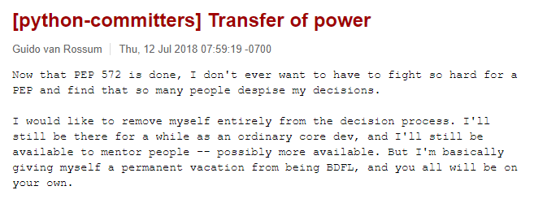
>>> [ 2*x for x in [0,1,2,3,4,5] ]
[0, 2, 4, 6, 8, 10]
A list comprehension by any other name would be even sweeter…
List Comprehensions?
Google maps?
Datafuncs?
FunLists!

Slide 48
Syntax ?!
>>> [ 2*x for x in [0,1,2,3,4,5] ]
[0, 2, 4, 6, 8, 10]
at first…
a jumble of characters and random other stuff
a (frustrated!) rendering of an unfamiliar math problem

Slide 49
Syntax ?!
>>> [ 2*x for x in [0,1,2,3,4,5] ]
[0, 2, 4, 6, 8, 10]
at first…
a jumble of characters and random other stuff
a (frustrated!) rendering of an unfamiliar math problem

Slide 50
Syntax ~ is CS's key resource!
Where'd the change happen?
a (frustrated!) rendering of an unfamiliar math problem
which was likely similar to these…
Notes:
change ~ internally to us
We see things not as they are but as we are…

Slide 51
LCs for Monte Carlo Analysis…
# this line runs guess(42) 1000 times
LC = [ guess_np(42) for x in range(1000) ]
# Let's look at the first 10 of them:
print(LC[0:10])
# Let's find the average:
print("av.#guesses:", sum(LC)/len(LC))
list
no printing version
Hah! Now I see why they told me I'd be making a zillion euros as spokesalien for this class!
a.k.a.
Run it a "zillion" times!

Slide 52
Zillion-times testing!
doubles-counting
# this runs the doubles-counter 600 times…
cd_np( 600 ) # np: no printing
# Run _that_ 1000 times (600,000 rolls total!)
LC = [ cd_np(600) for x in range(1000) ]
# Look at the first 10 of these
print(LC[0:10])
# Then, find the average:
print("av.dbls (/600):", sum(LC)/len(LC))
list
the average #doubles per 600 rolls
average == expected

Slide 53
Zillion-times testing!
Monte Carlo Monty Hall
# this runs the MCMH-counter 300 times…
MCMHnp( 1, 'switch', 300 ) # np: no printing
# Run _that_ 1000 times (300,000 games total!)
LC = [ MCMHnp(300) for x in range(1000) ]
# Look at the first 10 of these
print(LC[0:10])
# Let's find the average:
print("av. spams (/300):", sum(LC)/len(LC))
list
the average #wins per 300 games
Monagasques might use foie gras instead…

Slide 54
On balance?
or maybe lighter is better?

Slide 55
Designing with LCs
[0,1,2,3]
input
>>> [ _______ for x in range(4) ]
[0, 14, 28, 42]
list
output
input
>>> [ _____________ for c in 'igetthis' ]
[True, False, False, False, False, False, True, False]
output
... and what is the sum of this output?!

Slide 56
Using LCs
Short and sweet!
[7,8,9]
def
fun1(L):
LC = [1 for x in L]
return sum( LC )
def
letScore(c):
'twelve'
lots of ifs…
return score
def
fun2(S):
LC = [letScore(c) for c in S]
return sum( LC )
What fun are these?

Slide 57
Using LCs
[7,8,9]
But one-liners are my specialty…
def
len(L):
LC = [1 for x in L]
return sum( LC )
def
letScore(c):
'twelve'
lots of ifs…
return score
def
scrabbleScore(S):
LC = [letScore(c) for c in S]
return sum( LC )
What fun are these!

Slide 58
"One-line" LCs
'cs5'
def
len(L):
LC = [1 for x in L]
return sum( LC )
possible, but not recommendable!
I only ever get one line – who are the writers around here… ?
def
len(L):
return sum([1 for x in L])
Maybe too terse!

Slide 59
'sequoia'
if
# of vowels
def
vwl(s):
LC = [ 1 for c in s ]
return sum( LC )
if
42
[3,42,5,7,42]
# of times e is in L
def
count(e,L):
LC = [ 1 for x in L ]
return sum( LC )

Slide 60
Write each of these functions using list comprehensions…
input: L, any list of #s
output: the # of odd #s in L
First, demos()
def nodds(L):
example: nodds( [3,4,5,7,42] ) == 3
LC = [ for x in L ]
return sum(LC)
Y are your #s
W are the winning #s
inputs: Y and W, two lists of "lottery" numbers (ints)
output: the # of matches between Y & W
def lotto(Y,W):
example: lotto( [5,7,42,47] , [3,5,7,44,47] ) == 3
LC = [
return sum(LC)
input: N, an int >= 2
output: the # of positive divisors of N
def ndivs(N):
example: numdivs(12) == 6 (1,2,3,4,6,12)
LC = [
return sum(LC)
input: P, an int >= 2
output: the list of prime #s up to + incl. P
def primesUpTo(P):
example: primesUpTo(12) == [2,3,5,7,11]
Extra!
return LC

Slide 61
Write each of these functions using list comprehensions…
Go!
input: L, any list of #s
output: the # of odd #s in L
def nodds(L):
example: nodds( [3,4,5,7,42] ) == 3
LC = [ for x in L ]
return sum(LC)
Y are your #s
W are the winning #s
inputs: Y and W, two lists of "lottery" numbers (ints)
output: the # of matches between Y & W
def lotto(Y,W):
example: lotto( [5,7,42,47] , [3,5,7,44,47] ) == 3
LC = [
return sum(LC)
input: N, an int >= 2
output: the # of positive divisors of N
def ndivs(N):
example: numdivs(12) == 6 (1,2,3,4,6,12)
LC = [
return sum(LC)
input: P, an int >= 2
output: the list of prime #s up to + incl. P
def primesUpTo(P):
example: primesUpTo(12) == [2,3,5,7,11]
Extra!
return LC

Slide 62
Write each of these functions using list comprehensions…
Go!
def nodds(L):
LC = [ 1 for x in L if x%2 == 1 ]
return sum(LC)
too terse?
[ x%2 for x in L ]
def lotto(Y,W):
LC = [ ]
too terse?
return sum(LC)
[ ]
def ndivs(N):
LC = [ 1 for x in range(1,N+1) if N%x==0 ]
list
too terse?
return sum(LC)
[ N%x==0 for x in range(1,N+1) ]
def primesUpTo(P):
Extra!
LC = [ x for x in range(2,P+1) if ndivs(x)==2 ]
list
return LC

Slide 63
Write each of these functions using list comprehensions…
Go!
def nodds(L):
LC = [ 1 for x in L if x%2 == 1 ]
return sum(LC)
too terse?
[ x%2 for x in L ]
def lotto(Y,W):
LC = [ 1 for y in Y if y in W ]
too terse?
return sum(LC)
[ y in W for y in Y ]
def ndivs(N):
LC = [ 1 for x in range(1,N+1) if N%x==0 ]
list
too terse?
return sum(LC)
[ N%x==0 for x in range(1,N+1) ]
def primesUpTo(P):
Extra!
LC = [ x for x in range(2,P+1) if ndivs(x)==2 ]
list
return LC

Slide 64
hw2pr3: areas from rectangles
y = 2x
y = 2x
(7.5,15)
(7.5,15)
(5,10)
(5,10)
(2.5,5)
(2.5,5)
(0,0)
(0,0)
Areas of 4 rectangles
Areas of 8 rectangles

Slide 65
hw2pr3: areas from rectangles
y = 2x
(10,20)
y = 2x
y = 2x
(7.5,15)
(7.5,15)
(7.5,15)
(5,10)
(5,10)
(5,10)
(2.5,5)
(2.5,5)
(2.5,5)
(2.5,5)
(0,0)
(0,0)
(0,0)
(0,0)
Area of N rectangles in the limit

Slide 66
hw2pr3: Maya Lin, Architect…

Slide 67
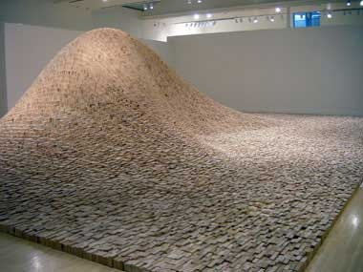
Maya Lin, Artist and Computer Scientist…
"two-by-four landscape"

Slide 68
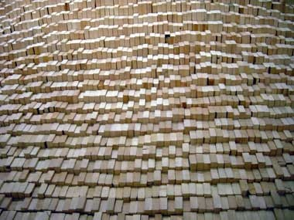
Maya Lin, Artist and Computer Scientist…
One building block, deliberately applied, over 50,000 times…

Slide 69
Building blocks == CS!
y = 2x
scaledfracs(low,hi,N)
(7.5,15)
f_of_fracs(f,low,hi,N)
(5,10)
integrate(f,low,hi,N)
(2.5,5)
only a few lines...
(0,0)
Where are the LCs?
Areas of 8 rectangles

Slide 70
Building blocks == CS!
Good luck with hw#2…
y = 2x
scaledfracs(low,hi,N)
(7.5,15)
f_of_fracs(f,low,hi,N)
(5,10)
integrate(f,low,hi,N)
... may this and all your weekends be syntactically smooth!
(2.5,5)
only a few lines...
(0,0)
Where are the LCs?
Areas of 8 rectangles

Slide 72
sword button?

Slide 73
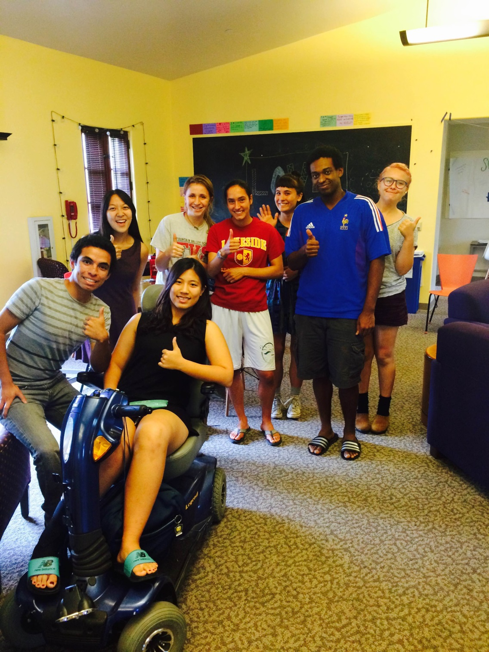
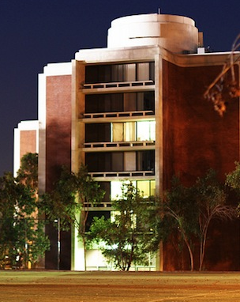
Tutoring hours ~ Scootering hours
Jasen Choi @ Fawcett Lounge
Monday evenings @ CMC…
Sat. 1-3pm @ Scripps S.U.

Slide 74
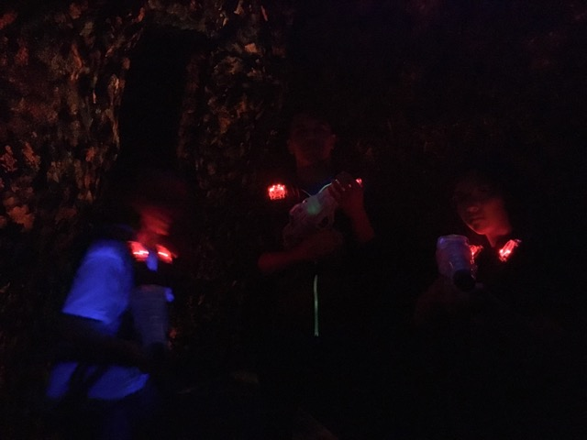
@ Laser Island...

Slide 75
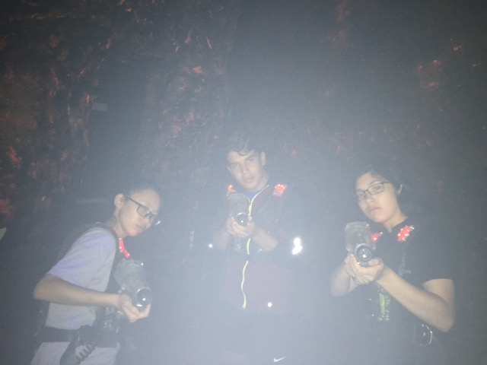
the team...

Slide 76
the mascots!

Slide 77
@ Laser Island...

Slide 78
the team...

Slide 79
the mascots!

Slide 80
@ Laser Island...

Slide 81
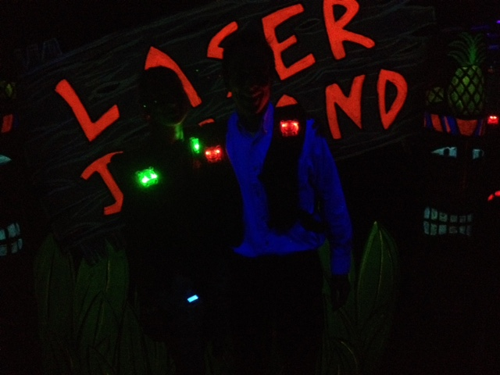
the universe whispers...

Slide 82
the universe whispers...

Slide 83
sword button?

Slide 84
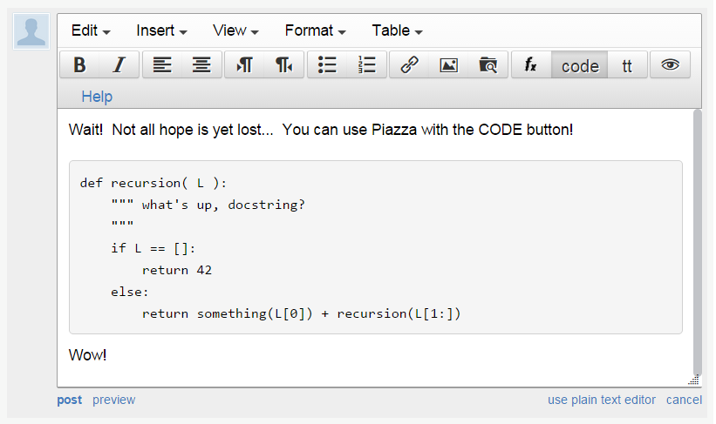
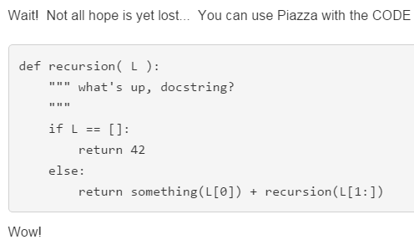
sword button?
code button!
creating a private post to Piazza because something is not working… ?
bugs, vanquished!
code button – then paste

Slide 85
sum range
step?
what's cookin' here?
def range(low,hi ):
""" input: ints low and hi
output: int list from low to hi
"""
if low >= hi:
return []
else:
return
excluding hi

Slide 86
sum and range
1784
>>> sum(range(1,101))
?
I'd bet you have a 50/50 chance on this one…
- Ben. L '14

Slide 87
List Comprehensions
LC
>>> [ 10*x for x in [0,1,2,3,4,5] if x%2==0]
result
>>> [ y*21 for y in range(0,3) ]
LC
result
>>> [ s[1] for s in ["hi", "5Cs!"] ]
LC
result
OK – got it. But what about that name?

Slide 88
Quiz!
A range of list comprehensions...
Write Python's result for each L.C.:
Join with a neighbor and try this on the back page first
[ n**2 for n in range(0,5) ]
[ 42 for z in [0,1,2] ]
[ z for z in [0,1,2] ]
[ s[1::2] for s in ['aces','451!'] ]
[ -7*b for b in range(-6,6) if abs(b)>4 ]
[ a*(a-1) for a in range(8) if a%2==1 ]
I wonder if these will be useful ?!

Slide 89
Designing with LCs
input
>>> [ _______ for x in range(4) ]
[0, 14, 28, 42]
[0,1,2,3]
output
input
>>> [ _____________ for c in 'igetthis' ]
[True, False, False, False, False, False, True, False]
[ 1, 0, 0, 0, 0, 0, 1, 0 ]
output
And what if we wanted these values in red…?

Slide 90
Using LCs
Sweet!
But one-liners are my specialty…
[7,8,9]
def
len(L):
LC = [1 for x in L]
return sum( LC )
def
letScore(c):
'twelve'
lots of ifs…
return score
def
scrabbleScore(S):
LC = [letScore(c) for c in S]
return sum( LC )

Slide 91
'sequoia'
Remember True == 1 and False == 0
# of vowels
def
sajak(s):
LC = [ for c in s]
return sum( LC )
42
[3,42,5,7,42]
# of times e is in L
def
count(e,L):
LC = [ for x in L ]
return sum( LC )
using if instead…
def
count(e,L):
LC = [ 1 for x in L if ]
return sum( LC )

Slide 92
Write each of these functions using list comprehensions…
Go!
input: L, any list of #s
output: the # of odd #s in L
def nodds(L):
example: nodds( [3,4,5,7,42] ) == 3
LC = [ for x in L ]
return sum(LC)
Y are your #s
W are the winning #s
inputs: Y and W, two lists of "lottery" numbers (ints)
output: the # of matches between Y & W
def lotto(Y,W):
example: lotto( [5,7,42,47] , [3,5,7,44,47] ) == 3
LC = [
input: N, an int >= 2
output: the # of positive divisors of N
def ndivs(N):
example: numdivs(12) == 6 (1,2,3,4,6,12)
LC = [
input: P, an int >= 2
output: the list of prime #s up to + incl. P
def primesUpTo(P):
example: primesUpTo(12) == [2,3,5,7,11]
Extra!

Slide 93
input: N, an int >= 2
output: the # of positive divisors of N
example: numdivs(12) == 6 (1,2,3,4,6,12)
def ndivs(N):
LC = [ for n in range(1,N+1)]
return sum(LC)
Extra! A list of all primes up to P…
def primesUpto( P ):

Slide 94
y = 2x
y = 2x
(7.5,15)
(7.5,15)
(5,10)
(5,10)
scaledfracs(low,hi,N)
step along x-axis
scaledfracs(low,hi,N)
step along x-axis
f_of_fracs(f,low,hi,N)
apply f to each
f_of_fracs(f,low,hi,N)
apply f to each
(2.5,5)
(2.5,5)
integrate(f,low,hi,N)
integrate!
integrate(f,low,hi,N)
integrate!
(0,0)
(0,0)
only a few lines...
Where are the LCs?
only a few lines...
Where are the LCs?
Areas of 4 rectangles
Areas of 8 rectangles

Slide 95
1
def recip(x): return 1.0/x
1
0.5
y =
x
area
0
1
2
3
4
5
6
7
8
9
10
hw2pr3
Integrating Python
1
0.5
0
low = 1.0
hi = 10.0

Slide 96
def recip(x): return 1.0/x
1
1
y =
0.5
x
area
0
1
2
3
4
5
6
7
8
9
10
scaledfracs(low,hi,N)
step along x-axis
f_of_fracs(f,low,hi,N)
apply f to each
integrate(f,low,hi,N)
integrate!
only a few lines...
Where are the LCs?

Slide 97
y = 2x
(7.5,15)
(5,10)
(2.5,5)
(0,0)
0x2.5
5x2.5
10x2.5
15x2.5
Areas of 4 rectangles

Slide 98
y = 2x
y = 2x
(7.5,15)
(7.5,15)
(5,10)
(5,10)
(2.5,5)
(2.5,5)
(0,0)
(0,0)
Areas of 4 rectangles
Areas of 8 rectangles

Slide 99
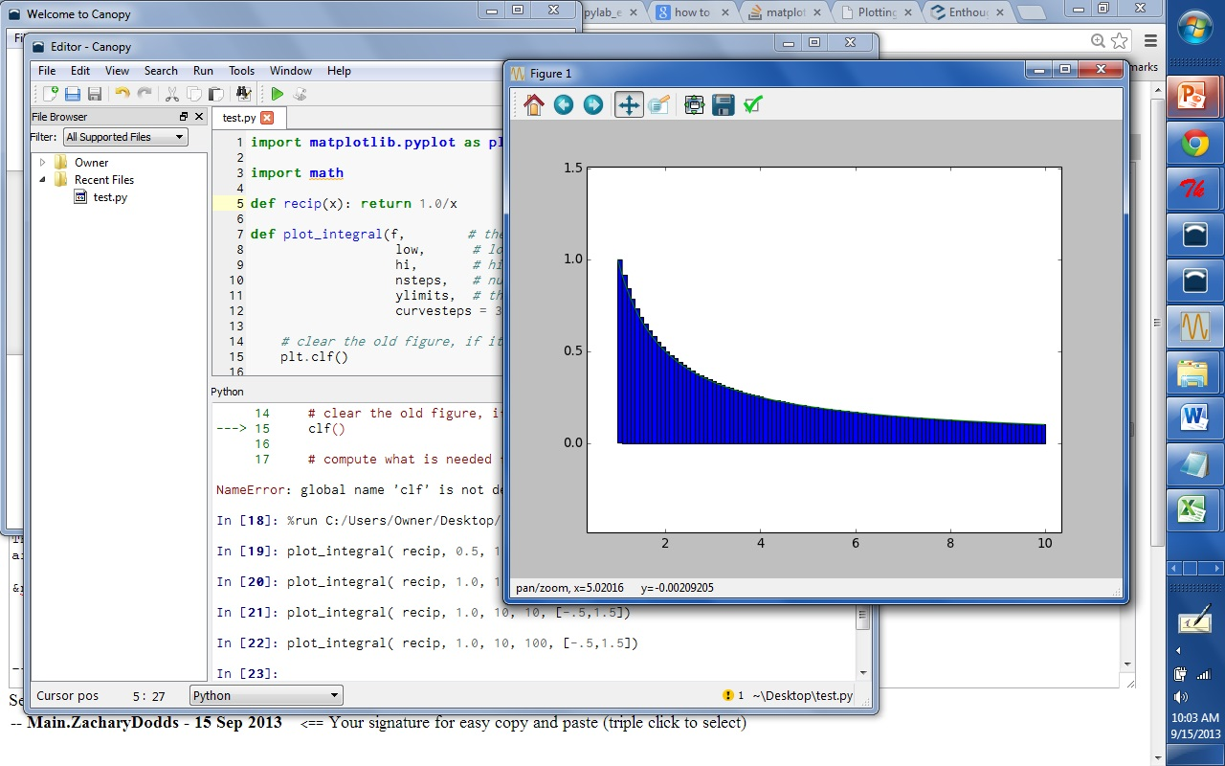
Canopy and matplotlib

Slide 100
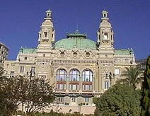
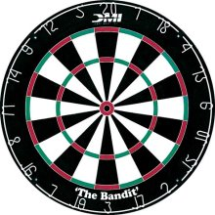
The two Monte Carlos
and their denizens…
Insights via random trials
Monte Carlo methods, Math/CS
Monte Carlo casino, Monaco

Slide 101
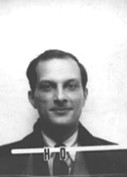
The two Monte Carlos
and their denizens…
Ulam, Stan Ulam
Stanislaw Ulam (Los Alamos badge)
Insights via random trials
Bond, James Bond
Monte Carlo methods, Math/CS
Monte Carlo casino, Monaco

Slide 102
Monte Carlo in action
How many doubles will you get in N rolls of 2 dice?
N is the total number of rolls
def countDoubles( N ):
""" input: the # of dice rolls to make
output: the # of doubles seen """
if N == 0:
return 0 # zero rolls, zero doubles…
else:
d1 = choice( [1,2,3,4,5,6] )
d2 = choice( range(1,7) )
if d1 != d2:
return countDoubles( N-1 ) # don't count it
else:
return 1+countDoubles( N-1 ) # COUNT IT!
two dice from 1-6 inclusive
where is the check for doubles?

Slide 103
See you in Lab 2 this week!
This must be a sine of what's to come, 'cos it'd be a real tangent otherwise...

Slide 104
sum range
step?
what's cookin' here?
def range(low,hi ):
""" input: ints low and hi
output: int list from low to hi
"""
if low >= hi:
return []
else:
return
excluding hi

Slide 105
I'll bet you have a 50/50 chance on this one…
- Ben. L '14
sum and range
>>> sum(range(1,101))
I'll bet you have a 50/50 chance on this one…
- Ben. L '14

Slide 106
Quiz!
A range of list comprehensions...
Write Python's result for each L.C.:
Join with a neighbor and try this on the back page first
[ n**2 for n in range(0,5) ]
[ 0, 1, 4, 9, 16 ]
[ 42 for z in [0,1,2] ]
[ z for z in [0,1,2] ]
[ 42, 42, 42 ]
[ 0, 1, 2 ]
[ s[1::2] for s in ['aces','451!'] ]
[ -7*b for b in range(-6,6) if abs(b)>4 ]
[ 42, 35, -35 ]
[ a*(a-1) for a in range(8) if a%2==1 ]
[ 0, 6, 20, 42 ]
I wonder if these will be useful ?!

Slide 107
Designing with LCs
input
>>> [ _______ for x in range(4) ]
[0, 14, 28, 42]
[0,1,2,3]
output
input
>>> [ _____________ for c in 'igotit' ]
[True, False, False, False, True, False]
[ 1, 0, 0, 0, 1, 0 ]
output
What about this?

Slide 108
LCs vs. raw recursion
def len(L):
if L == []:
return 0
else:
return 1 + len(L[1:])
len(L)
scrabble score!
def sScore(s):
if len(s) == 0:
return 0
else:
return letScore(s[0]) + \
sScore(s[1:])
sScore(s)
def sajak(s):
if len(s) == 0:
return 0
else:
if s[0] not in 'aeiou':
return sajak(s[1:])
else:
return 1+sajak(s[1:])
# of vowels
8 lines! Aargh!
sajak(s)

Slide 109
Map
def dbl(x):
return 2*x
>>> map(dbl, [0,1,2,3,4,5])
[0, 2, 4, 6, 8, 10]
def sq(x):
return x**2
>>> map(sq, range(6))
[0, 1, 4, 9, 16, 25]
def is_a(x):
return x == 'a'
>>> map(is_a, 'go away!')
[0, 0, 0, 1, 0, 1, 0, 0]
What does map do?
Hey… these look a bit False to me!

Slide 110
Map
def dbl(x):
return 2*x
>>> map(dbl, [0,1,2,3,4,5])
[0, 2, 4, 6, 8, 10]
def sq(x):
return x**2
>>> map(sq, range(6))
[0, 1, 4, 9, 16, 25]
def is_a(x):
return int(x=='a')
>>> map(is_a, 'go away!')
[0, 0, 0, 1, 0, 1, 0, 0]
Now I have 0 to complain about!
(1) map always returns a list
(2) map(f,L) calls f on each item in L

Slide 111
Map, managed!
input
>>> [ 2*x for x in [0,1,2,3,4,5] ]
[0, 2, 4, 6, 8, 10]
Looks natural to me!
output
Python has a "more natural" syntax for map…

Slide 112
Using a Euro, Yuan the deadline comes next time I'll try to make the Mark. I'm Pounding it into my brain, but I have to Peso much attention to other deadlines in the classes I Currency have - but if this keeps up, my grade will be demolished into Rubles.
hw0 highlights…
0 xE** -> N 0 # Once upon a time, there was
0 *x** -> E 1 # an extremely sad, lost Picobot. Ze
0 NEx* -> W 3 # traveled around a sad, dark maze
0 NEWx -> S 2 # in search of shelter and food.
# Finally, Picobot found a gingerbread
1 ***x -> S 2 # house deep in the corners of the maze.
1 *x*S -> E 1 # Though Picobot knew ze could never find
1 xE*S -> N 0 # zer way around the maze without keeping
1 NExS -> W 3 # zerself near the right-hand wall, ze
# decided the gingerbread house would be
2 **x* -> W 3 # worth disobeying zer program.
2 **Wx -> S 2 # Picobot thoroughly enjoyed zer
2 *xWS -> E 1 # gingerbread meal, but when ze tried to
2 xEWS -> N 0 # find zer way back to the maze, ze was so
# confused ze didn't know what to do.
3 x*** -> N 0 # Picobot began to sit in the corner,
3 N*x* -> W 3 # sighing in despair.
3 N*Wx -> S 2 # Suddenly came a noble grutor who
3 NxWS -> E 1 # showed Picobot the way through the maze.
# And there was much rejoicing. THE END
user = raw_input("Hello! This is Professor Oak. …")
comp = random.choice ( ['BULBASAUR!','CHARMANDER!','SQUIRTLE!'] )
cheesy =
random.choice ( ['Heh-you snooze you lose',
'I was here, and boy are you a loser!',
"You can't ignore my girth!",
"I'm Gary Oak! And I don't lose to chumps like you!",
'I would never lose to a loser like you. I have my own cheerleading squad!',
"I'll be waiting outside the Pokemon center just to battle you again!" ] )
if user == 'SQUIRTLE':
if comp == 'BULBASAUR!':
print 'Your SQUIRTLE used Water Gun!'
time.sleep(2)
print 'It was not very effective...'
time.sleep(2)
print "Gary's BULBASAUR used Vine Whip!"
time.sleep(2)
print 'It was super effective!'
time.sleep(2)
print 'Your Squirtle fainted!'
time.sleep(2)
print 'Gary is the winner!'
time.sleep(3)
print "Gary:", cheesy
elif user == 'HMC':
if comp == 'CMC':
print 'CMC is closer to all of the other 5 Cs. I win.'
elif comp == 'Pitzer':
print 'Pitzer is closer to Starbucks. I win.'
print 'Teeheehee! Looks like I won!'
answer = raw_input("Wait, are you a Grutor?!")
if answer == 'yes':
print 'I am so sorry! I mean YOU win!'
else:
print 'Then I DO win! Hahaha'
E.F.
full RPS-25

Slide 113
Designing with LCs
input
>>> [ _______ for x in range(4) ]
[0, 14, 28, 42]
[0,1,2,3]
output
input
>>> [ _____________ for c in 'igotit' ]
[True, False, False, False, True, False]
[ 1, 0, 0, 0, 1, 0 ]
output
What about this?

Slide 114
Using LCs
def
letScore(c):
stuff to get score…
return score
'twelve'
scrabble score!
def
sScore(s):
LC = [ for c in s]
return sum( LC )

Slide 115
'sequoia'
Remember True == 1 and False == 0
# of vowels
def
sajak(s):
LC = [ for c in s]
return sum( LC )
42
[3,42,5,7,42]
# of times e is in L
def
count(e,L):
LC = [ for x in L ]
return sum( LC )
using if instead…
def
count(e,L):
LC = [ 1 for x in L if ]
return sum( LC )

Slide 116
inputs: L, any list of #s
output: the # of odd #s in L
example: nodds( [3,4,5,7,42] ) == 3
def nodds(L):
LC = [ for x in L ]
return sum(LC)
def nodds(L):
LC = [ 1 for x in L ]
return sum(LC)

Slide 117
Y are your #s
W are the winning #s
inputs: Y and W, two lists of "lottery" numbers (ints)
output: the # of matches between Y & W
example: lotto( [5,7,42,47] , [3,5,7,44,47] ) == 3
def lotto(Y,W):
LC = [ for w in W ]
return sum(LC)
def lotto(Y,W):
LC = [ 1 for w in W ]
return sum(LC)
… could adapt to "y in Y", too.

Slide 118
input: N, an int >= 2
output: the # of positive divisors of N
example: numdivs(12) == 6 (1,2,3,4,6,12)
def ndivs(N):
LC = [ for n in range(1,N+1)]
return sum(LC)
Extra! A list of all primes up to P…
def primesUpto( P ):

Slide 119
input: Y and W, two lists of "lottery" numbers (ints)
W are the winning numbers
output: the # of matches between Y & W
Y are your numbers
example: lotto([5,7,42,47],[3,5,7,44,47]) == 3
def lotto(Y,W):
LC = [
return sum(LC)

Slide 120
input: N, an int >= 2
output: the number of positive divisors of N
Extra!
example: numdivs(12) == 6 (1,2,3,4,6,12)
def numdivs(N):
What if you want the divisors themselves? or prime #s?
def primesUpto( P ):
How could you use this to compute all of the prime numbers up to P?

Slide 121
sum and range
I've seen this before... ?
>>> sum(range(1,101))

Slide 122
List Comprehensions
The same as map, only better!
this "runner" variable can have any name...
input
>>> [ 2*x for x in [0,1,2,3,4,5] ]
[0, 2, 4, 6, 8, 10]
output
What is going on here?

Slide 123
List Comprehensions
The same as map, only better!
this "runner" variable can have any name...
input
>>> [ 2*x for x in [0,1,2,3,4,5] ]
[0, 2, 4, 6, 8, 10]
(1) x takes on each value in the list or string
(2) The operation 2*x happens for each x
output
So clear, I don't even NEED a map!

Slide 124
Map, managed!
Python has a "more natural" syntax for map…
What map could this refer to?
def map(f,L):
""" maps f onto the list L """
if L == []:
return []
else:
return
… and you don't even need the map!

Slide 125
Quiz!
A range of list comprehensions...
What's Python's result for each L.C.:
First/last name(s):_______________________
[ n**2 for n in range(0,5) ]
[ 42 for z in [0,1,2] ]
[ z for z in [0,1,2] ]
[ s[1::2] for s in ['aces','451!'] ]
[ -7*b for b in range(-6,6) if abs(b)>4 ]
[ a*(a-1) for a in range(8) if a%2==1 ]
I wonder if these will be useful?!

Slide 126
Create your own!
input
>>> [ _______ for y in range(6) ]
[0, 1, 4, 9, 16, 25]
output
input
>>> [ __________ for c in 'igotit' ]
[True, False, False, False, True, False]
[ 1, 0, 0, 0, 1, 0 ]
output
What about this?

Slide 127
Raw recursion vs. LCs ?
def
len(L):
LC = [1 for x in L]
return sum( LC )
scrabble score!
def
sScore(s):
LC = [ letScore(c) for c in s]
return sum( LC )
I prefer one-liners!

Slide 128
vs. List Comprehensions
# of vowels
def
sajak(s):
LC = [ for c in s]
return sum( LC )
Remember True == 1 and False == 0
# of odd elements
def
numOdds(L):
LC = [ for x in L]
return sum( LC )

Slide 129
Quiz
input: e, any element L, any list or string
Remember True == 1 and False == 0
output: the # of times L contains e
example: count('f', 'fluff') == 3
Write
def count(e,L):
LC = [ for x in L ]
return sum(LC)
don't use e here!
use e in here somehow…

Slide 130
Write
input: Y and W, two lists of lottery numbers (ints)
W are the winning numbers
output: the # of matches between Y & W
Y are your numbers
example: lotto([5,7,42,44],[3,5,7,44]) == 3
def lotto(Y,W):
LC = [ w in Y for w in W ]
return sum(LC)

Slide 131
Extra!
input: N, an int >= 2
output: the number of positive divisors of N
def numdivs(N):
example: numdivs(12) == 6 (1,2,3,4,6,12)
What if you want the divisors themselves? or prime #s?
def primesUpto( P ):
How could you use this to compute all of the prime numbers up to P?
return [ p in range(2,P+1) if numdivs(p)==2 ]

Slide 132
Recursion -- not just numbers
Self-similarity elsewhere...
Natural phenomena
Relationships
how much here is leaf vs. stem?
What is an “ancestor” ?
Names -- acronyms
The TTP Project

Slide 133
Recursion -- not just numbers
Self-similarity elsewhere...
Natural phenomena
Relationships
how much here is leaf vs. stem?
What is an “ancestor” ?
Names -- acronyms
The TTP Project

Slide 134
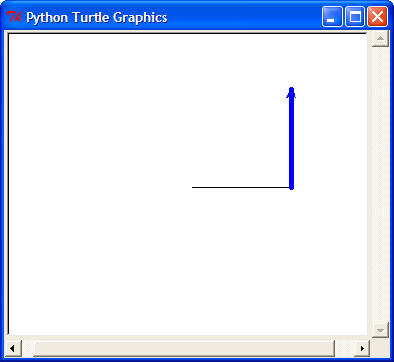
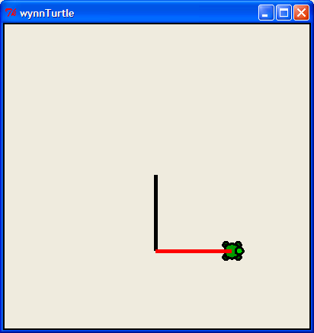
Next time: The Visual Arts ?
from turtle import *
reset()
left(90)
forward(50)
right(90)
backward(50)
down() or up()
color('green')
tracer(1) or tracer(0)
width(5)
and lots more!
www.cs.hmc.edu/twiki/bin/view/CS5/TurtleDirections
for turtle help
Basic turtle graphics
degrees!
states if the pen draws or not
states if the pen animates or not
More turtly turtle graphics

Slide 135
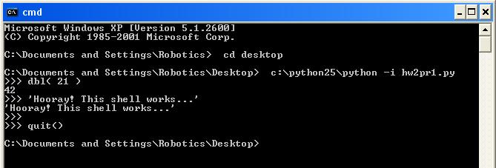
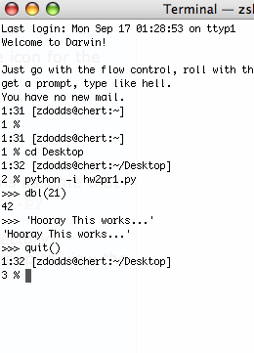
The Python shell
IDLE uses Python's graphics - but built-in shells do not
"command window"
"terminal window"
c:\python25\python -i hw2pr1.py
python -i hw2pr1.py

Slide 136
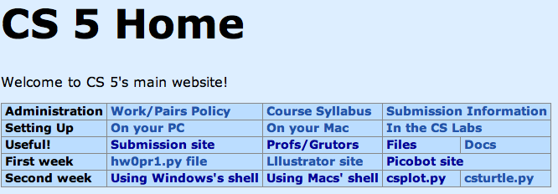
csplot.py
Links to pages with detailed instructions on opening a non-IDLE shell.
Links to two files providing graphics capabilities.
IDLE can still be used as your code editor!

Slide 137
A random aside…
import random
for more explanation, try dir(random) or help(random)
random.choice( L )
chooses 1 element from the list L
random.choice( ['north', 'case', 'west'] )
How would you get a random int from 0 to 9?
random.uniform(low,hi)
chooses a random float from low to hi
random.uniform(41.0, 43.0)
How likely is this to return 42 ?

Slide 138
Randomness vs. Determinism
Are there random numbers?
Can a computer generate them?
RNG
A “black box” model of a random number generator.
Output

Slide 139
Map: a higher-order function
def map( f, L ):
""" map returns a new list where each element of L has been f-efied
"""
if :
else:
test for base case
Key Idea
Functions are data!
Hey - I'm the only star allowed around here…
In Python, functions can take other functions as input…

Slide 140
List Comprehensions
The same as map, only better!
input
>>> [ 2*x for x in [0,1,2,3,4,5] ]
[0, 2, 4, 6, 8, 10]
output
What is going on here?
and the "running" variable can have any name...

Slide 141
List Comprehensions
The same as map, only better!
input
>>> [ 2*x for x in [0,1,2,3,4,5] ]
[0, 2, 4, 6, 8, 10]
(1) x takes on each value in the list or string
(2) The operation 2*x happens for each x
output
and the "running" variable can have any name...

Slide 142
List Comprehensions
The same as map, only better!
input
>>> [ _______ for y in range(6) ]
[0, 1, 4, 9, 16, 25]
output
input
>>> [ __________ for c in 'igotit' ]
[True, False, False, False, True, False]
output

Slide 143
vs. List Comprehensions
# of vowels
def
sajak(s):
LC = [ for c in s]
return sum( LC )
Remember True == 1 and False == 0
# of odd elements
def
numOdds(L):
LC = [ for x in L]
return sum( LC )

Slide 144
Quiz
Write each of these functions concisely using list comprehensions…
Name(s):
Write
input: e, any element L, any list or string
Remember True == 1 and False == 0
output: the # of times L contains e
def count(e,L):
example: count('f', 'fluff') == 3
LC = [ for x in L ]
return sum(LC)
don't use e here!
use e in here somehow…
Write
def lotto(Y,W):
input: Y and W, two lists of lottery numbers (ints)
W are the winning numbers
output: the # of matches between Y & W
Y are your numbers
example: lotto([5,7,42,44],[3,5,7,44]) == 3
Extra!
input: N, an int >= 2
def numdivs(N):
output: the number of positive divisors of N
example: numdivs(12) == 6 (1,2,3,4,6,12)
How could you use this to compute all of the prime numbers up to P?
def primesUpto( P ):

Slide 145
Quiz
input: e, any element L, any list or string
Remember True == 1 and False == 0
output: the # of times L contains e
example: count('f', 'fluff') == 3
Write
def count(e,L):
LC = [ for x in L ]
return sum(LC)
don't use e here!
use e in here somehow…

Slide 146
Write
input: Y and W, two lists of lottery numbers (ints)
W are the winning numbers
output: the # of matches between Y & W
Y are your numbers
example: lotto([5,7,42,44],[3,5,7,44]) == 3
def lotto(Y,W):

Slide 147
Extra!
input: N, an int >= 2
output: the number of positive divisors of N
def numdivs(N):
example: numdivs(12) == 6 (1,2,3,4,6,12)
What if you want the divisors themselves? or prime #s?
def primesUpto( P ):
How could you use this to compute all of the prime numbers up to P?

Slide 148
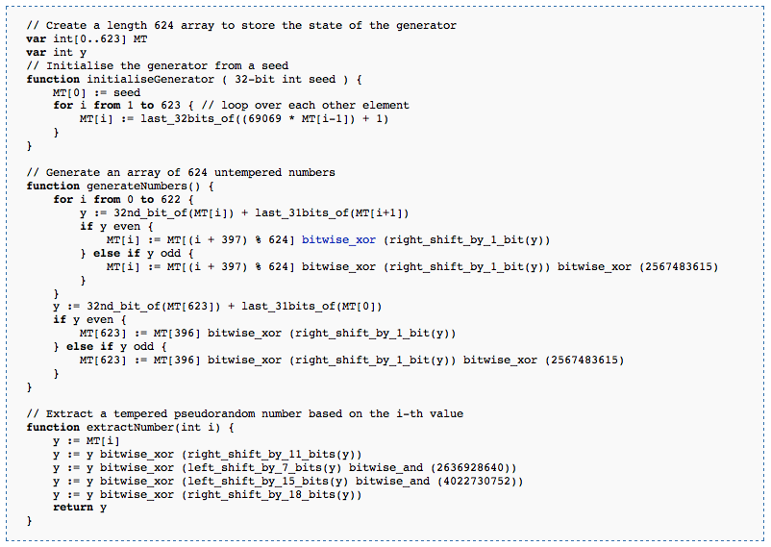
Randomness vs. Determinism
Are there random numbers?
Can a computer generate them?
Yes
Not without help!
The RNG revealed.
Periodic!
Output
p = 2¹⁹⁹³⁷-1
http://en.wikipedia.org/wiki/Mersenne_twister

Slide 149
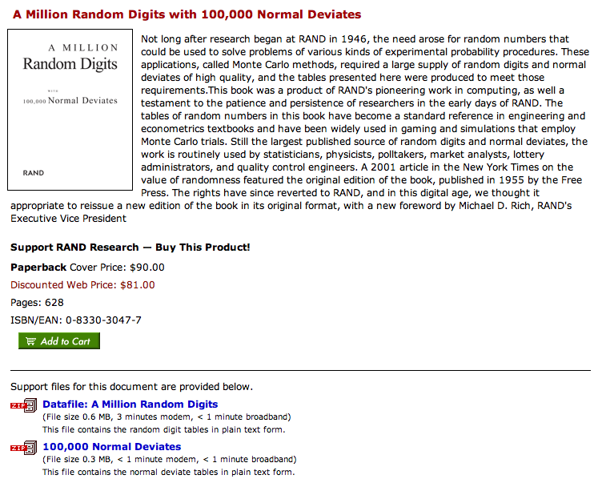
Some random history…
True randomness is valuable!
but not that valuable!
http://www.rand.org/pubs/monograph_reports/MR1418/index.html
Inevitable correlations among the published values

Slide 150
True Randomness !
http://www.leapzine.com/hr/
random, but not!
an enthusiastic endorser
LavaRnd’s lava lamps
using a chaotic physical system to seed random number generators
(Patent 5,732,138: "Method for seeding a pseudo-random number generator with a cryptographic hash of a digitization of a chaotic system.")
www.wired.com/wired/archive/11.08/random.html
This has since been “improved”…

Slide 151
A random program…
from random import *
def guess( hidden ):
""" guesses the user's #, "hidden" """
compguess = choice( range(100) )
if compguess == hidden: # at last!
print 'I got it!'
else:
guess( hidden )
This guesser is a bit suspicious…
print guesses ?
num guesses ?

Slide 152
The two Monte Carlos
Making random numbers work for you!
Monte Carlo casino, Monaco
Monte Carlo methods, Math/CS

Slide 153
Monte Carlo in action
Suppose you roll two dice.
What are the chances that you roll doubles?
input is the total number of rolls
def countDoubles( N ):
""" inputs a # of two-dice rolls
outputs the # of doubles """
if N == 0:
return 0
else:
d1 = choice( [1,2,3,4,5,6] )
d2 = choice( range(1,7) )
if d1 != d2:
return countDoubles( N - 1 )
else:
return
one roll of two dice
where is the doubles check?
what should the last line be?

Slide 154
1
def recip(x): return 1.0/x
0.5
1
y =
area
x
0
1
2
3
4
5
6
7
8
9
10
1
How might we find this area using Monte Carlo?
0.5
0
1
2
3
4
5
6
7
8
9
10
low = 1.0
hi = 10.0
N == 9 == total number of steps (rectangles)
steps(low,hi,N)
fsteps(recip,low,hi,N)
finteg(f,low,hi,N)

Slide 155
1
def recip(x): return 1.0/x
0.5
1
y =
area
x
0
1
2
3
4
5
6
7
8
9
10
Numerical Integration
Lab 2: Monday or Tuesday
steps(low,hi,N)
fsteps(recip,low,hi,N)
finteg(f,low,hi,N)

Slide 156
See you at Lab!

Slide 157
print: Making programs talk to you!
Debugging had to be discovered. I can remember the exact instant when I realized that a large part of my life from then on was going to be spent in finding mistakes in my own programs.
- Maurice Wilkes
Programming: the art of debugging an empty file.
- The Jargon File
http://www.tuxedo.org/~esr/jargon/

Slide 158
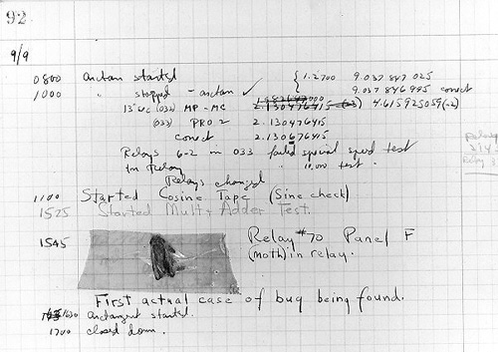
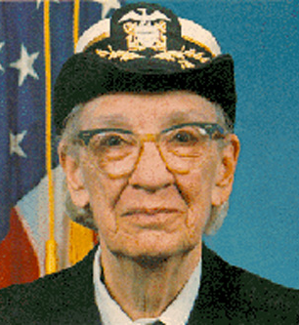
The first bug
Grace Hopper
from the UNIVAC 1
“In the days they used oxen for heavy pulling, when one ox couldn't budge a log, they didn't try to grow a larger ox. We shouldn't be trying for bigger and better computers, but for better systems of computers.”

Slide 159
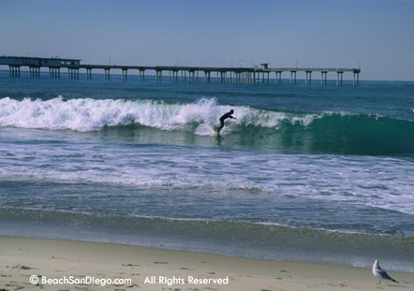
Top 5 reasons to sign up to come to the
Find out what CS is really all about
Meet other women (and a few men too) who do CS
Bond with your fellow Mudders (including Prof. Alvarado)
Helen Greiner (!) and Sally Ride are keynote speakers
Get a free trip to San Diego…

Slide 160
When is it?
October 4-7 (we’ll leave Wed. afternoon and return Sat. night)
Who can sign up?
Anyone! You don’t have to be a CS Major (or a woman)
How do I sign up?
Email Christine (alvarado@cs.hmc.edu) by Friday, Sept. 22
Where do I get more information?
http://www.cs.hmc.edu/~alvarado/ghc06.html
http://gracehopper.org/

Slide 161
Real visual recursion
How many times has the light bounced before reaching the camera from various items here??

Slide 162
Quiz
Write each of these two functions concisely using list comprehensions…
Write
input: s, a string
def countas(s):
output: the # of 'a' characters in s
example: countas('alphabet') == 2
return sum( [ x=='a' for x in s ] )
return sum( [ x=='ctg' for x in s ] )
return sum( [ s[i:i+3]=='ctg' for i in range(len(s)) ] )
Extra: How could this be modified to find the 'ctg' repeats that cause myotonic dystrophy?

Slide 163
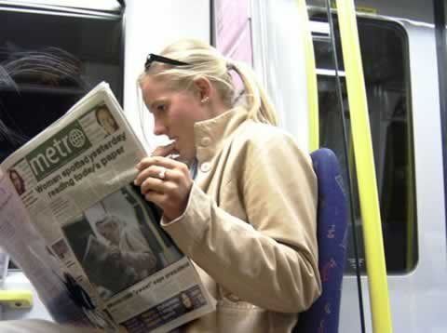

Slide 164
Solutions
Show a high-level (using map, reduce, etc.) solution for each and a low-level (raw recursion) for each.
The ascent - composing more sophisticated applications
The descent? - to deeper and deeper understandings of these things ("too deep" Fox Trot cartoon)

Slide 165
Syntax
Show the list comprehension syntax…
Do some examples & puzzles
Have a puzzle with if (used as a filter, too)
Try out the new syntax…

Slide 166
Specification:
Let W be a list of the six current winning lotto numbers (in order). A “ticket” is a list of six elements: [#1, #2, #3, #4, #5, #6 ], also in order. lottoScore(T) inputs a ticket and outputs its number of matches.
Examples:
W = [ 4, 8, 15, 29, 33, 47 ]; lottoScore([14, 15, 28, 30, 31, 42]); 1
lottoScore([4, 8, 15, 16, 32, 33]); 4
Code:
Notes:
I don’t know if this really works...

Slide 167
Specification:
lottoScore(W,T) takes both the winning numbers and a ticket as inputs and returns the number of matches... .
Example:
lottoScore( [4, 8, 15, 29, 33, 47], [4, 8, 15, 16, 32, 33] ); 4
Code:
“merge” technique ...
Notes:
I don’t know if this really works...

Slide 168
Today's forecast…
Specification:
dropGemini(L) takes in a list of birthdays (pairs like [6,5]) and returns an identical list w/o the Gemini.
US style
Example:
dropGemini([ [2,19], [3,13], [5,28], [6,11], [6,13], [7,29] ]); [ [2,19], [3,13], [7,29] ]
Code:
Notes:
I don’t know if this really works...

Slide 169
Applications
Lottery ticket applications - my favorite! with prizes for solvers

Slide 170
Do you remember…
That should do it… review slide.
Look ahead to lab.
Look ahead to Wed. :
revisiting randomness (lottery tie-in)
show a quick teaser example of the coolness of list comprehensions, e.g., analyze the primality instinct game by playing 1000000 times and counting the number of wins…

Slide 171
Recursion -- warning !
def fac(N):
return N * fac(N-1)
This is legal code!
try it out…
fall forever… was that Dumbledore or Gandalf?

Slide 172
Recursion Examples
def matchscore(a,b):
""" input: any two strings, a and b
output: the number of same characters in
the same location in both a and b
"""
This sentence is false.

Slide 173
CS 5 today
The building blocks of functional computing
data, sequences
We're computationally complete!
conditionals
recursion
So what now?
John Paul Jones, Paul McCartney, Flea (jazz Charles Mingus), Jakes: Phil Lesh
Living without a bass case!
http://www.stylusmagazine.com/articles/weekly_article/stylus-magazines-top-50-basslines-of-all-time.htm

Slide 174
1
0.5
1
y =
area
x
0
1
2
3
4
5
6
7
8
9
10
1
0.5
0
1
2
3
4
5
6
7
8
9
10
xmin = 1.0
xmax = 10.0
nsteps = 9

Slide 175
def sum(L):
""" input: a list of numbers, L
output: L's sum
"""
if len(L) == 0:
return 0.0
else:
return L[0] + sum(L[1:])
sum
sum([1,2,3,4])
L
>>> L = [1,2,3,4]
>>> sum(L)
L[0] + sum(L[1:])
1 + sum([2,3,4])

Slide 176
Depends what you mean by real …
(show recursion.swf)

Slide 178
sum, range
def range(low,hi):
""" input: two ints, low and hi
output: int list from low up to hi
"""
if hi <= low:
return []
else:
return
what's cookin' here?
excluding hi

Slide 179
sum and range
>>> sum(range(1,101))
I've seen this before... ?

Slide 180
A recursive spiral …

Slide 182
sum, range, max
max( [ 5, 42, 1, 7, 100 ] )
def max(L):
""" input: a nonempty sequence of values, L
output: L's maximum
"""
if len(L) == 1:
return L[0]
elif

Slide 183
sum, range, max
def max(L):
""" input: a nonempty sequence of values, L
output: L's maximum
"""
if len(L) == 1:
return L[0]
elif L[0] > L[1]:
return max( L[0:1] + L[2:] )
else:
return max( L[1:] )

Slide 184
max( [3, 7, 1, 42, -10, 1024, 55, 716] )
How many times does each block get called for this 8-element list?
def max(L):
""" docstring here """
if len(L) == 1:
return L[0]
elif L[0] > L[1]:
return max( L[0:1] + L[2:] )
else:
return max( L[1:] )
Base Case (if)
Second Case (elif)
Third Case (else)

Slide 185
max( [3, 7, 1, 42, -10, 1024, 55, 716] )
Third Case (else)
max( [7, 1, 42, -10, 1024, 55, 716] )
How many times does each block get called for this 8-element list?
def max(L):
""" docstring here """
if len(L) == 1:
return L[0]
elif L[0] > L[1]:
return max( L[0:1] + L[2:] )
else:
return max( L[1:] )
Base Case (if)
Second Case (elif)
Third Case (else)

Slide 186
max( [3, 7, 1, 42, -10, 1024, 55, 716] )
Third Case (else)
max( [7, 1, 42, -10, 1024, 55, 716] )
Second Case (elif)
max( [7, 42, -10, 1024, 55, 716] )
How many times does each block get called for this 8-element list?
def max(L):
""" docstring here """
if len(L) == 1:
return L[0]
elif L[0] > L[1]:
return max( L[0:1] + L[2:] )
else:
return max( L[1:] )
Base Case (if)
Second Case (elif)
Third Case (else)

Slide 187
max( [3, 7, 1, 42, -10, 1024, 55, 716] )
Third Case (else)
max( [7, 1, 42, -10, 1024, 55, 716] )
Second Case (elif)
max( [7, 42, -10, 1024, 55, 716] )
max( [42, -10, 1024, 55, 716] )
Third Case (else)
max( [42, 1024, 55, 716] )
Second Case (elif)
Third Case (else)
max( [1024, 55, 716] )
Second Case (elif)
max( [1024, 716] )
Second Case (elif)
max( [1024] )
Base Case (if)
1024
How many times does each block get called for this 8-element list?
def max(L):
""" docstring here """
if len(L) == 1:
return L[0]
elif L[0] > L[1]:
return max( L[0:1] + L[2:] )
else:
return max( L[1:] )
Base Case (if)
Second Case (elif)
Third Case (else)

Slide 188
Quiz
Write each of these two functions concisely using list comprehensions…
Name(s):
Write
input: s, a string
def countas(s):
output: the # of 'a' characters in s
Remember True == 1 and False == 0
example: countas('alphabet') == 2
Extra: How could this be modified to find the 'ctg' repeats that cause myotonic dystrophy?
Write
input: Y and W, two lists of ints (lottery numbers)
W are the winning numbers
def lottoScore(Y,W):
output: the # of matching numbers in Y & W
Y are your numbers
example: lottoScore([5,7,42,44],[3,5,7,44]) == 3

Slide 189
A list comprehension by any other name would be as sweet…
List Comprehensions
len
def len(L):
if L == []:
return 0
else:
return 1 + len(L[:])
Raw Recur-sion
last time
len
def len(L):
return sum( )
List Comp
this time

Slide 190
List Comprehensions
len
def len(L):
if L == []:
return 0
else:
return 1 + len(L[:])
Raw Recursion
def len(L):
return sum( [ 1 for x in L ] )
List Comp

Slide 191
List Comprehensions
scrabbleScore
def scrabbleScore(s):
if len(s) == 0:
return 0
else:
return recursive step
Raw Recursion
last time
def scrabbleScore(s):
return sum( )
List Comp
this time

Slide 192
List Comprehensions
scrabbleScore
def scrabbleScore(s):
if len(s) == 0:
return 0
else:
return recursive step
Raw Recursion
def scrabbleScore(s):
return sum( [ letScore(x) for x in s ] )
List Comp

Slide 193
Write
input: s, a string
def countas(s):
output: the # of 'a' characters in s
example: countas('alphabet') == 2

Slide 194
Write
input: Y and W, two lists of ints (lottery numbers)
W are the winning numbers
def lottoScore(Y,W):
output: the # of matching numbers in Y & W
Y are your numbers
example: lottoScore([5,7,42,44],[3,5,7,44]) == 3
Note: does this work for strings?

Slide 195
Write
input: s, a string
def countas(s):
output: the # of 'a' characters in s
example: countas('alphabet') == 2
return sum( [ x=='a' for x in s ] )
Extra: How could this be modified to find the 'ctg' repeats that cause myotonic dystrophy?

Slide 196
Write
input: s, a string
def countas(s):
output: the # of 'a' characters in s
example: countas('alphabet') == 2
return sum( [ x=='a' for x in s ] )
Extra: How could this be modified to find the 'ctg' repeats that cause myotonic dystrophy?
return sum( [ x=='ctg' for x in s ] )
Does this work?

Slide 197
Write
input: s, a string
def countas(s):
output: the # of 'a' characters in s
example: countas('alphabet') == 2
return sum( [ x=='a' for x in s ] )
Extra: How could this be modified to find the 'ctg' repeats that cause myotonic dystrophy?
return sum( [ x=='ctg' for x in s ] )
No!
return sum( [ s[i:i+3]=='ctg' for i in range( ) ] )
What range should this be?

Slide 198
Map, recursively
(1) map always returns a list
def map(f,L):
(2) map(f,L) calls f on each item in L

Slide 199
Summary of today…
>>> [ 2**x for x in range(10) ]
[1, 2, 4, 8, 16, 32, 64, 128, 256, 512]
list comprehensions
>>> map( math.sqrt, [0, 1, 4, 9] )
[0.0, 1.0, 2.0, 3.0]
map
building blocks…
max, min, range, sum, len, …

Slide 200
while we're here…
def rps():
""" plays rock-paper-scissors """
answer = 'yes'
while answer == 'yes':
#
# plays RPS one time
#
answer = raw_input('Again? ')
print 'Bye!'
test
loop while the test is true
outside of the loop
there's self-similarity here, for sure!

Slide 201
No while needed!
def rps():
""" plays rock-paper-scissors """
#
# plays RPS one time
#
answer = raw_input('Again? ')
if answer == 'yes':
rps() # recurse!
else:
print 'Bye!'

Slide 202
if name == 'Rock': # is it Rock?
print 'I too choose Rock! However, mine is larger. I win.'
elif name == 'Paper': # otherwise, is it Paper?
print 'I choose Rock! Rock can rip through Paper. I win.'
elif name == 'Scissors': # otherwise, is it Scissors?
print 'I choose Rock! Rock can smash Scissors. I win.'
else: # in the case of typos or silly choices...
print name, '????'
print 'Don\'t you know how to play Rock, Paper, Scissors?! NOTE: program is case-sensitive! Please capitalize all selections in the future. In the meantime...I win by default!'
One of the RPS programs…

Slide 203
A recursive spiral …

Slide 204
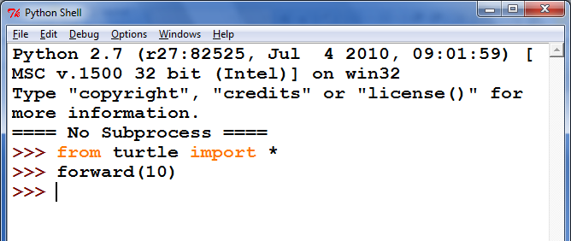
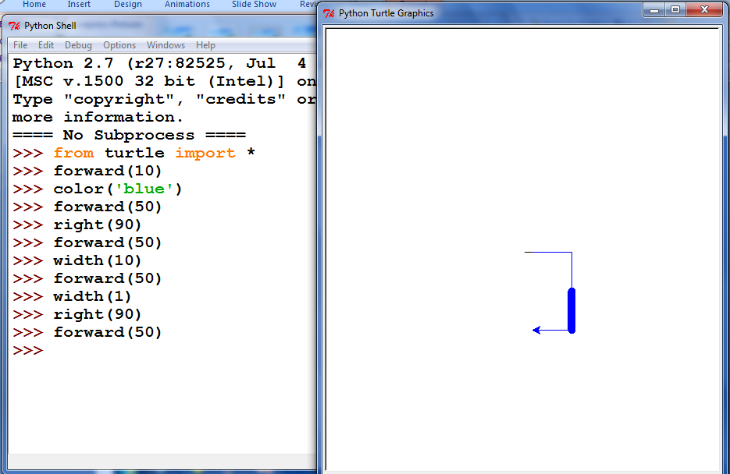

Slide 205
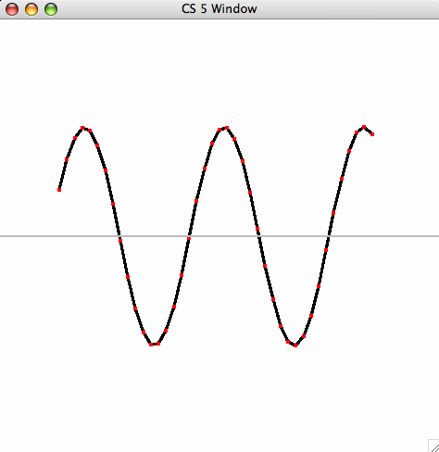
Lab 2: Integration
def unitfracs(N):
return [ float(x)/N for x in range(N) ]
fractional steps
0
1
41
42
42
42
def scaledfracs(low,hi,N):
return [ low + (hi-low)*x for x in unitfracs(N) ]
x values
0
1
6
10
10
15
7
7
7
def f_of_fracs(f,low,hi,N):
return [ f(x) for x in scaledfracs(low,hi,N) ]
y values
10
16
def integrate(f,low,hi,N):
return sum(f_of_fracs(f,low,hi,N))*(hi-low)/N
10
16
heights
width

Slide 206
hw2pr3: areas from rectangles
(10,20)
y = 2x
y = 2x
(7.5,15)
(7.5,15)
(5,10)
(5,10)
(2.5,5)
(2.5,5)
(2.5,5)
(0,0)
(0,0)
(0,0)
Area of N rectangles in the limit

Slide 207
Your Darth Vader proposes an alliance with the other Vader
The other Darth Vader agrees
Together the Darth Vaders over throw the sith lord and begin their own rein of horror
The Darth Vaders are victorious
The galaxy loses
I choose paper !
MMM MMMM
MM M
MM M
MM M
MMM M
MM M
MM M
MMM M
MMMMMM M
MM MMMMM M
MM MM MMM M
MMMMMMMMMMM MMM M
MM M MMMM MMM
M M MMMM MMM MM
M MM M MMM MM MM M
M M M M MMM MMM MMM M
M M MMM MM MMM MM
MMMM M M M M MMM MM MM MM
M M M M M M MM MM M MMMMMMMMM
M M M M M MM MMM M MMMM M
MM M M M M M MMM M MMM M
MM M M M M M MM MM MM
M M M M M M M M MMMMMMM M
M M M M M M MMMMM M
MM M M MM MMMM MMMMM MM
MM M M MMMM MMMM MM M MM
MMM MM M M MM MMMM MM MM MM MM
MM MMM M MMM MM MM MM MM
MM MM M MM M MMMM MM MM MM MMM
M M M MM M M M MM M M M
M M M MMM M M M MM M MMMMMMMMMMMMMM
MMM M M MM MM M M MMMMMMMM MM
MMMMMM M M MM MM M MMMMMMMM MMMMMMMMMM M
MMMMMM M M M M MM MMM MMMMMM MM
MM MMMM M M MMM MM MMM MMM MMMMMMMMM
MM MMM M MMM MM MMM MMMM MM MM M
MM MMM MM M M MMM MMMM MMM MM M
MM MMM MM MM MM M M MM MM
MM MM M MMMM MM MM M MM MM
MM MMM MM MMM MMM MM MMMM MMMM
MM MMMM MM MM MM M MM MMM MM MM MM
M M M M M MMM MMM M MM MM M
MM M M M MMM MM M MM M M
MMMMMM MM M M M MM MM MM M
MMM M M M M M MM MM MM MMM M
MMMM M MM M MM MM MM MMM
M MM M M M MM MM MM MM MMM MM
M MMM M M M M M M MM MM MM M
M M MMM M MMM MMM MM MMM
MM M M MMM M MM M M MM
MM M M MM M MMM MM MM M
M M M MM M MM MMMMMMMM
M MMMM MM M MM MM MMMMM MM
MMMMM M M M M MM MM MMM MMMM M MM
MMMMM MMMM M MM M MMMMMM MMMM MMMMMMMMM
MMMM MMM MM M MMMM MMMM MMMM M
MM MM M MMM M MMMM MMMM MMMM MMMMMMMMMM M
M M M MMMMMM MMM MMMM MMMMM MM MM M
MMMM M M MMMMMMM MM MMMMM MMM MM M
MMMMM MM M M M MMM MMM MM MM MM M MM
MM M MM M M MM MM MM MMM MM
MM M MMM M M M MM M MM MMM M
MM M M M M M MM M MM MMM MMMMMMMMM MM
MMM MM M M M M M M MM MMM MMMMM MMMMMMMMMMMMM
MMMMM M MM MM M M MMM M MMM MMMM MM
MMMM M M M M M M M M MMMMMM MMMM MMMM M
MMMMM M M M MM MMM MMMM MMMM MMM MMM MM
M MMMM MM M M MMMMM MM MMM MMM MMMM
M MMM MMMMM M MM MM MM MMM MMM M
M MMM MM MMMM M M M MM MMM MM
M M M M MMM MM MM MMMMMMMMMMMMMMMMMM
M MM M M M MM M MMMMMMMM MM MMMM
MM MMM M MM M MMMM MMM MM MMMMMM
M MM M M M MM MMM M MM
M M MM M MM M MM MM M
M M M MM MM M MM MM M
M M MMM M MM MM MM M MMMMMMMMMMMM
M M M MM MM M MMMMMM
MMM MM MM M
M MMM M M
MMM MM
M M
Hi... Let's play rock, paper, scissors! What do you choose?
>>>
Chooose your character (Obi-Wan, Anakin, Padme, Darth Vader) Darth Vader
user chose Darth Vader
comp chose Darth Vader
Darth Vader stumbles upon another Darth Vader
0 xE** -> N 0 # Once upon a time, there was
0 *x** -> E 1 # an extremely sad, lost Picobot. Ze
0 NEx* -> W 3 # traveled around a sad, dark maze
0 NEWx -> S 2 # in search of shelter and food.
# Finally, Picobot found a gingerbread
1 ***x -> S 2 # house deep in the corners of the maze.
1 *x*S -> E 1 # Though Picobot knew ze could never find
1 xE*S -> N 0 # zer way around the maze without keeping
1 NExS -> W 3 # zerself near the right-hand wall, ze
# decided the gingerbread house would be
2 **x* -> W 3 # worth disobeying zer program.
2 **Wx -> S 2 # Picobot thoroughly enjoyed zer
2 *xWS -> E 1 # gingerbread meal, but when ze tried to
2 xEWS -> N 0 # find zer way back to the maze, ze was so
# confused ze didn't know what to do.
3 x*** -> N 0 # Picobot began to sit in the corner,
3 N*x* -> W 3 # sighing in despair.
3 N*Wx -> S 2 # Suddenly, along came a noble grutor who
3 NxWS -> E 1 # showed Picobot the way through the maze.
# And there was much rejoicing. THE END

Slide 208
Syntax !?!
... unforgivingly literal ...

Slide 209
Syntax !?!
... unforgivingly literal ...

Slide 210
Syntax !?!
... unforgivingly literal ...

Slide 211
Syntax !?!
... unforgivingly literal ...

Slide 212
Celebrating syntax!
Thanks, Irene!

Slide 213
Syntax vs. Semantics
Come by the 5C Software Career Fair!
Thursday, September 21 at HMC's LAC, 1st floor

Slide 214
Career Fair'ers!

Slide 215
2017's Career Fair... (!)

Slide 216
Cyriak

Slide 217
Quiz!
A range of list comprehensions...
Write Python's result for each L.C.:
Join with a neighbor and try this on the back page first
[0,1,2,3,4]
[ n**2 for n in range(0,5) ]
list
[0,1,4,9,16]
[ 42 for z in [0,1,2] ]
[ z for z in [0,1,2] ]
Pass those easterly...
[42,42,42]
[0,1,2]
[ s[1::2] for s in ['aces','451!'] ]
[ -7*b for b in range(-6,6) if abs(b)>4 ]
list
[ -6, -5, 5 ]
[ a*(a-1) for a in range(8) if a%2==1 ]
list
[ 1, 3, 5, 7 ]
[ 0, 6, 20, 42 ]
Got it! But what about that name?

Slide 218
Recursive Art ~ hw2pr4

Slide 219
Recursive Art ~ hw2pr4

Slide 220
Recursive Art ~ hw2pr4

