Slide 1
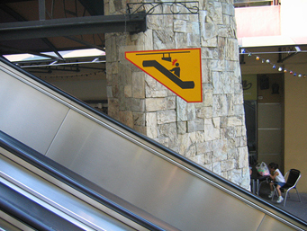
Welcome to CS 5! Be sure to watch your head…

Slide 2


Slide 3
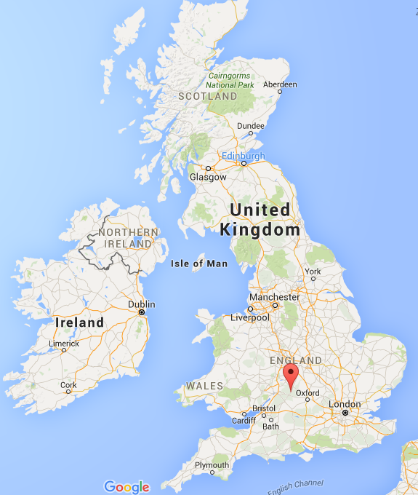
Bourton-on-the-water

Slide 4
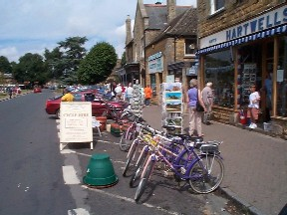
Bourton-on-the-water
town of 2000 people

Slide 5
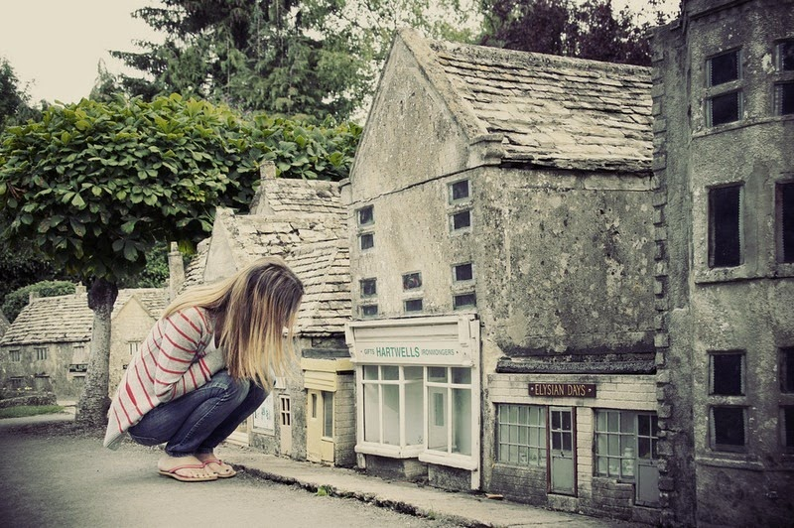
Bourton-on-the-water's 1/9 model

Slide 6
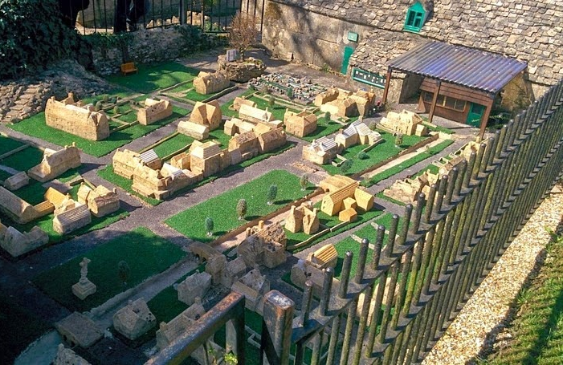
has a level-2 model…

Slide 7
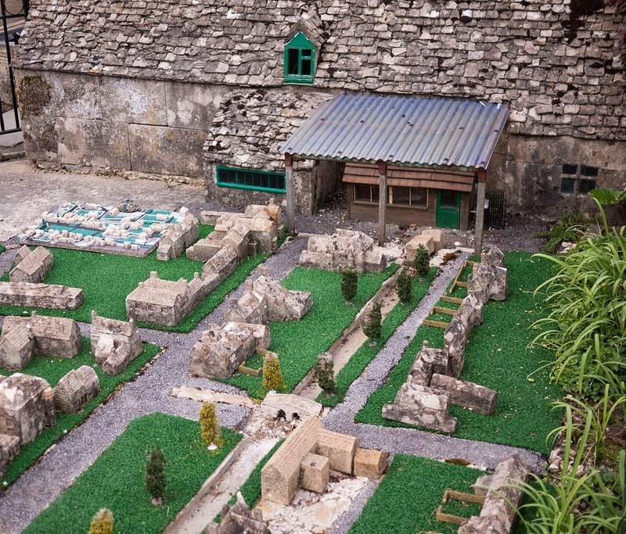
has a level-2 model…

Slide 8
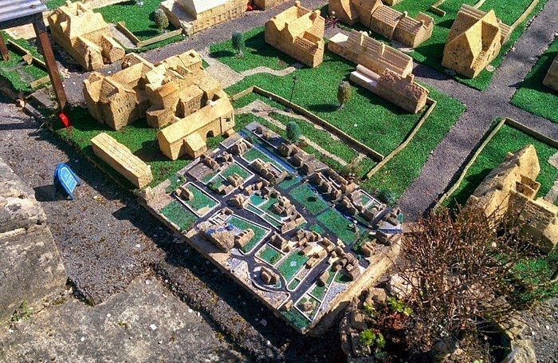
and a level-3 model…

Slide 9
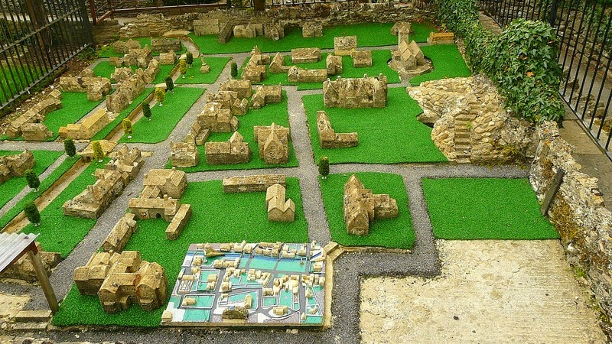
and a level-3 model…

Slide 10
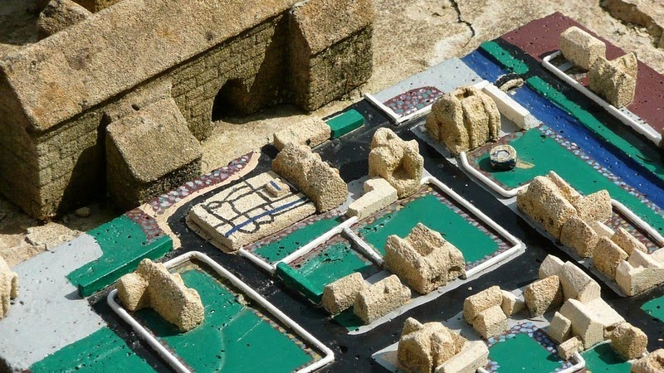
and even a (very small!) level-4 model

Slide 11
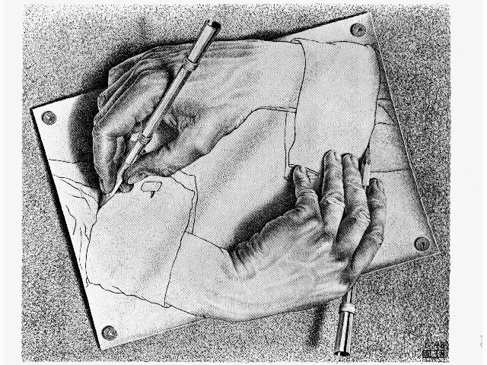
CS 5: now recursing…
Hw 2 – due Monday evening ~ usual time
Or re-cursing, depending on your feelings about recursion!
pr0 reading – Watson!
pr1 lab – Turtle!
pr2, pr3 - Python probs…
We're computationally complete!
pr4 – extra-credit turtle… !
What's next?
putting Python to work!
& adding building-blocks

Slide 12
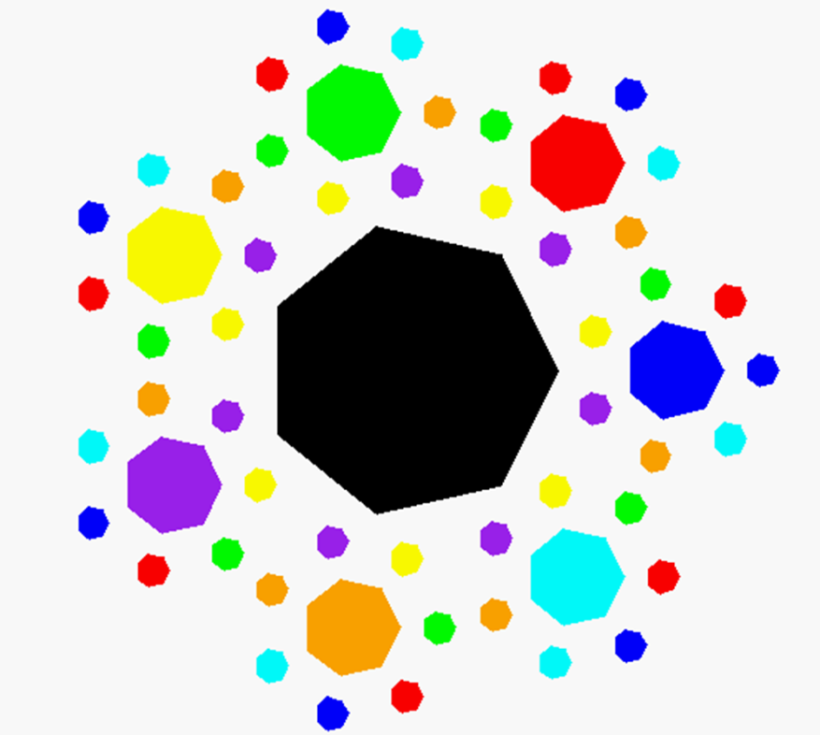
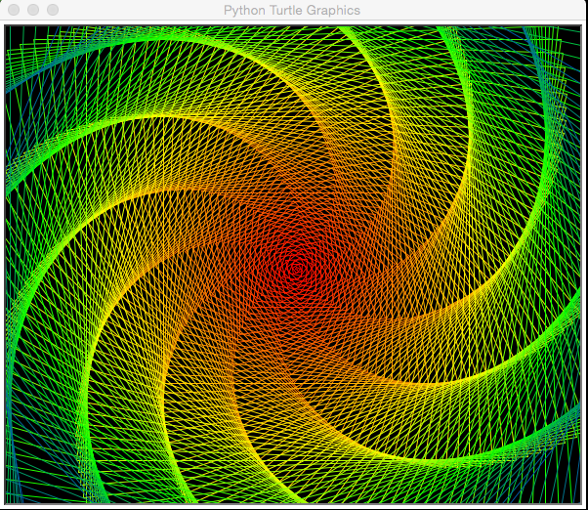
Recursive Art ~ hw2pr4
Tools for creative expression… ?
septagonal confetti
Submitting things that work …
dramatic spiral!
patrick kidwell

Slide 13
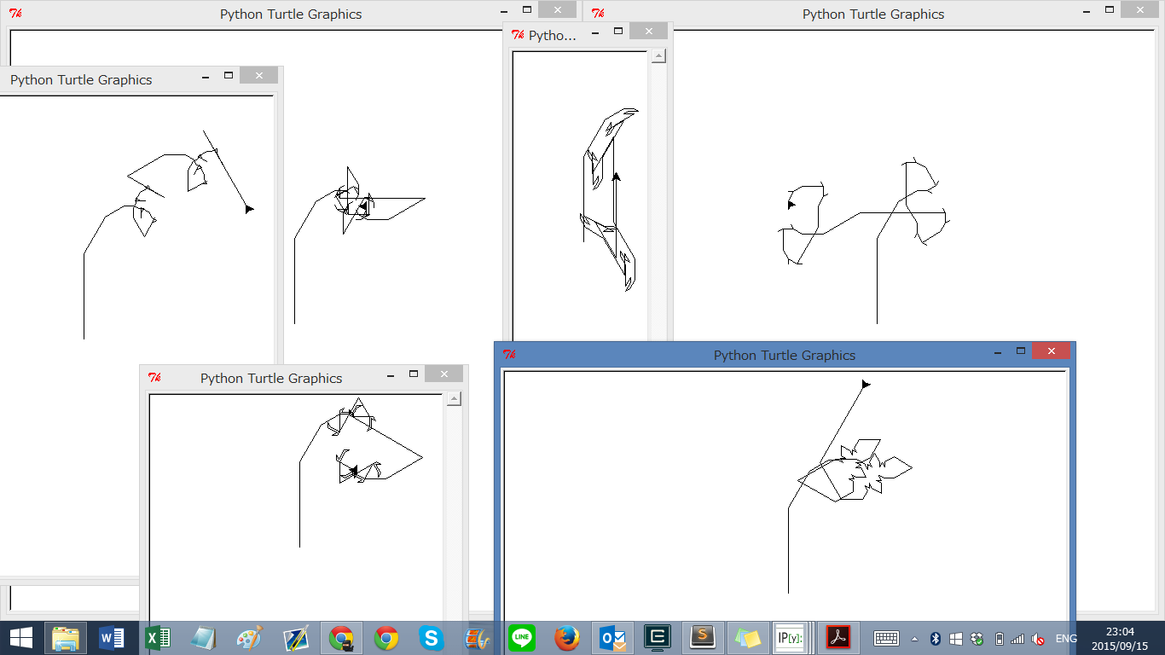
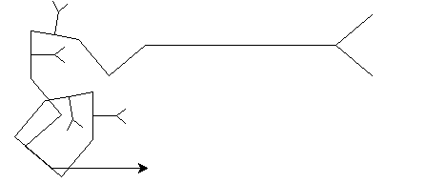
Recursive Art ~ hw2pr4
Submitting things that work …
… and even things that don't!
"Cyriak's pet snake…"

Slide 14
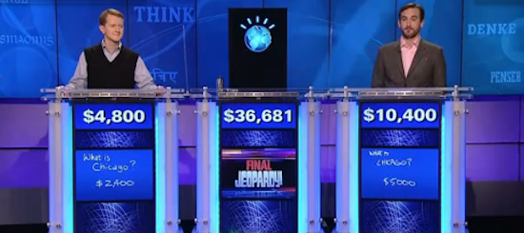
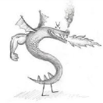
this week's hw2pr0
https://www.youtube.com/watch?v=lI-M7O_bRNg 3:00-3:42
Category: U.S. Cities. Clue: Its largest airport is named for a World War II hero, its second largest for a World War II battle.
Watson
Burninated by syntax!

Slide 15
functional programming
>>> 'fun' in 'functional'
True
representation via list structures (data)
leverage self-similarity (recursion)
create small building blocks (functions)
Composed together -- to solve/investigate problems.
Functional programming
conceptually concise
vs.
efficient for the computer…
functional
procedural or sequential

Slide 16
Data
[13,14,15]
[3,4,5,6,7,8,9]
Functions
sum( )
… and their compositions

Slide 17
sum range
def sum(L):
""" input: L, a list of #s
output: L's sum
"""
if len(L) == 0:
return 0.0
else:
return L[0] + sum(L[1:])
Base Case
Recursive Case
What's this saying?

Slide 18

sum range
list
list(range(low,hi))
step?
what's cookin' here?
def range(low, hi ):
""" input: ints low and hi
output: int list from low to hi
"""
if low >= hi:
return []
else:
return
excluding hi

Slide 19
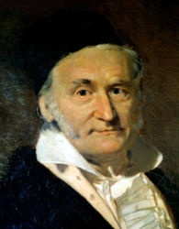
sum and range
1784
list
>>> sum(list(range(1,101)))
?
I'd bet you have a 50/50 chance on this one…
- Ben. L '14

Slide 20
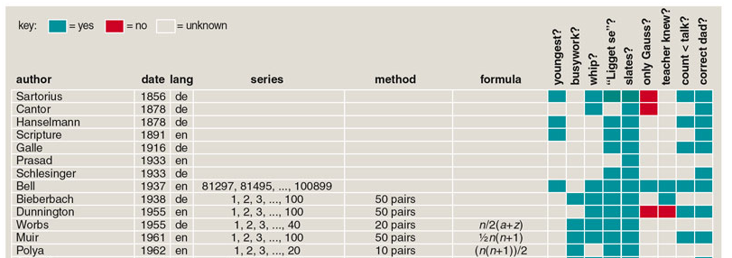
sum and range
1784
list
>>> sum(list(range(1,101)))
?
I'd bet you have a 50/50 chance on this one…
- Ben. L '14
Gauss's storied story…
and 100 more…
http://www.americanscientist.org/template/AssetDetail/assetid/50686

Slide 21
sum and range
1784
list
>>> sum(list(range(1,101)))
5050
Looks sort of scruffy for a 7-year old… !
1 + 2 + 3 + ... + 98 + 99 + 100
50+51
101
101
101
50 101's == 5050

Slide 22
Data
[8,9,10]
Functions
sq( )
[64,81,100]
[ sq(x) for x in [8,9,10] ]
…together

Slide 23
List Comprehensions
>>> [ 2*x for x in [0,1,2,3,4,5] ]
List Comprehenion
[0, 2, 4, 6, 8, 10]
result
What's the syntax saying here?

Slide 24
List Comprehensions
Expression to evaluate for each list element
Name for each list element
The list - or string to run
>>> [ 2*x for x in [0,1,2,3,4,5] ]
List Comprehenion
[0, 2, 4, 6, 8, 10]
result
What's the syntax saying here?

Slide 25
List Comprehensions
this "runner" variable can have any name...
x takes on each value
input
>>> [ 2*x for x in [0,1,2,3,4,5] ]
[0, 2, 4, 6, 8, 10]
and 2*x is output for each one
output

Slide 26
List Comprehensions
>>> [ 10*x for x in [0,1,2,3,4,5] if x%2==0]
result
>>> [ y*21 for y in list(range(0,3)) ]
result
>>> [ s[1] for s in ["hi", "5Cs!"] ]
result

Slide 27
Quiz!
A range of list comprehensions...
Write Python's result for each L.C.:
Name(s): ___________________________
[ n**2 for n in range(0,5) ]
list
Let's start this one together...
[ 42 for z in [0,1,2] ]
[ z for z in [0,1,2] ]
[ s[1::2] for s in ['aces','451!'] ]
[ -7*b for b in range(-6,6) if abs(b)>4 ]
list
[ a*(a-1) for a in range(8) if a%2==1 ]
list
Got it. But what about that name?

Slide 28
Quiz!
A range of list comprehensions...
Write Python's result for each L.C.:
Join with a neighbor and try this on the back page first
[ n**2 for n in range(0,5) ]
list
[0,1,4,9,16]
[ 42 for z in [0,1,2] ]
[ z for z in [0,1,2] ]
[42,42,42]
[0,1,2]
[ s[1::2] for s in ['aces','451!'] ]
[ -6, -5, -4, -3, -2, -1, 0, 1, 2, 3, 4, 5 ]
[ -7*b for b in range(-6,6) if abs(b)>4 ]
list
[ -6, -5, 5 ]
[ 0, 1, 2, 3, 4, 5, 6, 7 ]
[ a*(a-1) for a in range(8) if a%2==1 ]
list
[ 1, 3, 5, 7 ]
[ 0, 6, 20, 42 ]
Got it. But what about that name?

Slide 29
Quiz!
A range of list comprehensions...
Write Python's result for each L.C.:
Join with a neighbor and try this on the back page first
[ n**2 for n in range(0,5) ]
list
[0,1,4,9,16]
Pass those back...
[ 42 for z in [0,1,2] ]
[ z for z in [0,1,2] ]
[42,42,42]
[0,1,2]
[ s[1::2] for s in ['aces','451!'] ]
[ 'cs', '5!' ]
[ -6, -5, -4, -3, -2, -1, 0, 1, 2, 3, 4, 5 ]
[ -7*b for b in range(-6,6) if abs(b)>4 ]
list
[ 42, 35, -35 ]
[ -6, -5, 5 ]
[ 0, 1, 2, 3, 4, 5, 6, 7 ]
[ a*(a-1) for a in range(8) if a%2==1 ]
list
[ 1, 3, 5, 7 ]
[ 0, 6, 20, 42 ]
Got it. But what about that name?

Slide 30

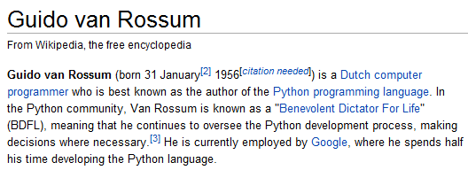
>>> [ 2*x for x in [0,1,2,3,4,5] ]
[0, 2, 4, 6, 8, 10]
List Comprehensions?
Is this really the best name Guido Van Rossum could think of?

Slide 31
>>> [ 2*x for x in [0,1,2,3,4,5] ]
[0, 2, 4, 6, 8, 10]
A list comprehension by any other name would be even sweeter…
List Comprehensions?
Google maps?
Datafuncs?
FunLists!

Slide 32
Syntax ?!
>>> [ 2*x for x in [0,1,2,3,4,5] ]
[0, 2, 4, 6, 8, 10]
at first…
a jumble of characters and random other stuff
a (frustrated!) rendering of an unfamiliar math problem

Slide 33
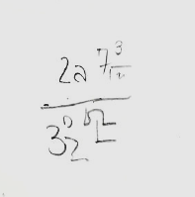
Syntax ?!
>>> [ 2*x for x in [0,1,2,3,4,5] ]
[0, 2, 4, 6, 8, 10]
at first…
a jumble of characters and random other stuff
a (frustrated!) rendering of an unfamiliar math problem

Slide 34
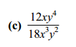
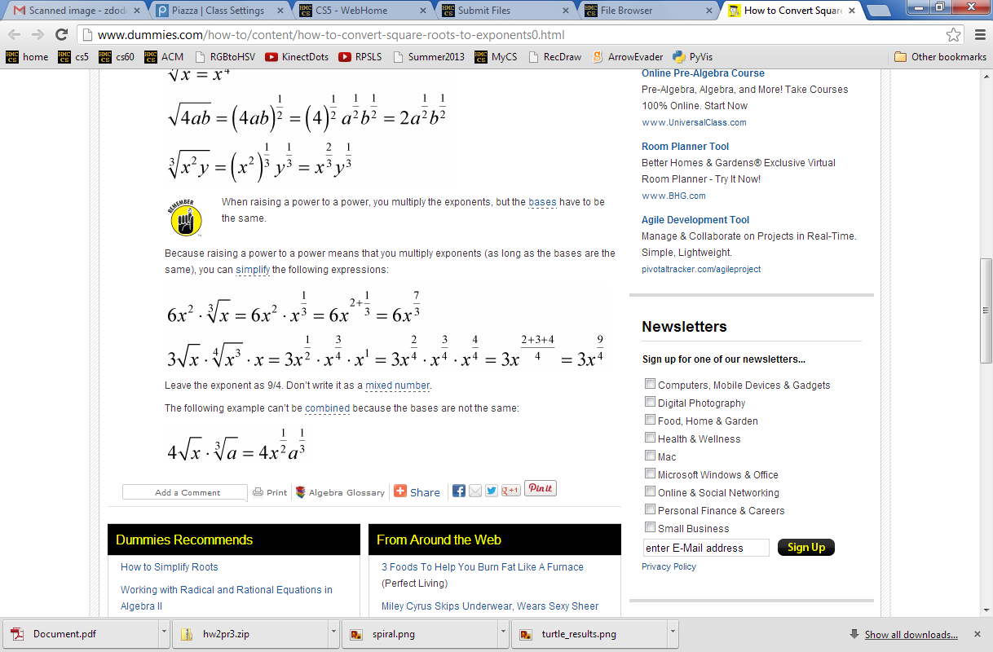
Syntax ~ is CS's key resource!
Where'd the change happen?
a (frustrated!) rendering of an unfamiliar math problem
which was likely similar to these…
Notes:
change ~ internally to us
We see things not as they are but as we are…

Slide 35

Syntax !?!
... unforgivingly literal ...

Slide 36
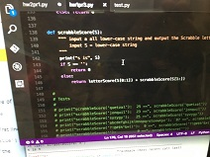
Syntax !?!
... unforgivingly literal ...

Slide 37

Syntax !?!
... unforgivingly literal ...

Slide 38

Syntax !?!
... unforgivingly literal ...

Slide 39
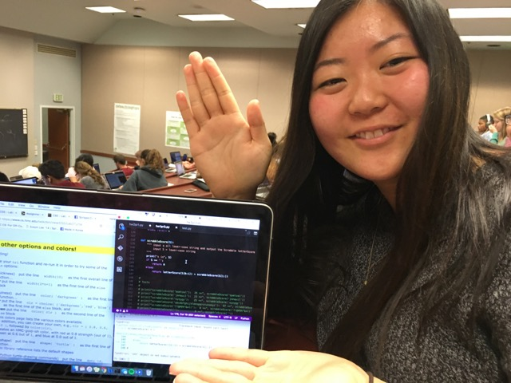
Celebrating syntax!
Thanks, Irene!

Slide 40
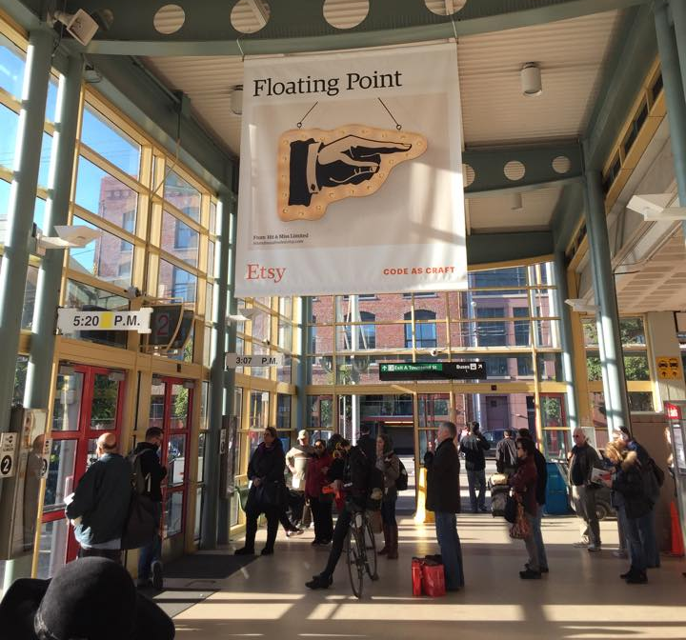
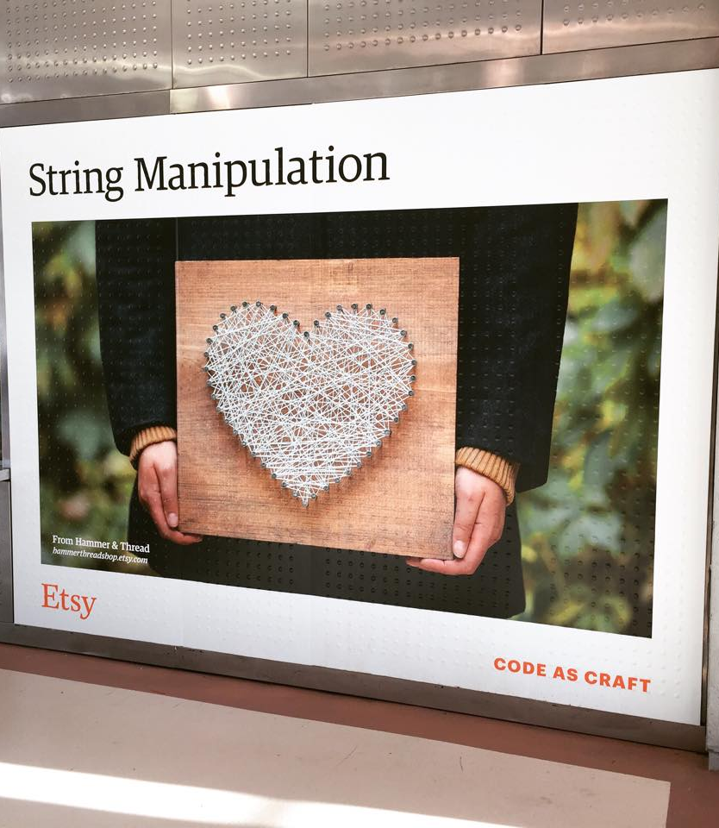
Syntax vs. Semantics
Come by the 5C Career Fair!
Feb 9th at HMC's LAC…

Slide 41
LCs for Monte Carlo Analysis…
# this line runs guess(42) 1000 times
LC = [ guess(42) for x in range(1000) ]
# Let's look at the first 10 of them:
print(LC[0:10])
# Let's find the average:
print("av.#guesses:", sum(LC)/len(LC))
# Other investigations? min? max?
list
Hah! Now I see why they told me I'd be making a zillion euros as spokesalien for this class!
a.k.a.
Run it a "zillion" times!

Slide 42
Zillion-times testing!
doubles-counting
# this runs the doubles-counter 600 times…
cd_np( 600 ) # np: no printing
# Run _that_ 1000 times (600,000 rolls total!)
LC = [ cd_np(600) for x in range(1000) ]
# Look at the first 10 of these
print(LC[0:10])
# Then, find the average:
print("av.dbls (/600):", sum(LC)/len(LC))
list
the average #doubles per 600 rolls

Slide 43
Zillion-times testing!
Monte Carlo Monty Hall
# this runs the MCMH-counter 300 times…
MCMHnp( 1, 'switch', 300 ) # np: no printing
# Run _that_ 1000 times (300,000 games total!)
LC = [ MCMHnp(300) for x in range(1000) ]
# Look at the first 10 of these
print(LC[0:10])
# Let's find the average:
print("av. spams (/300):", sum(LC)/len(LC))
list
the average #wins per 300 games
Monagasques might use foie gras instead…

Slide 44
If you win some SPAM… ? or pmfp... ?
What to do with it?

Slide 45
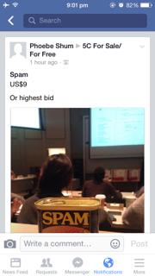
If you win some SPAM… ? or pmfp... ?

Slide 46
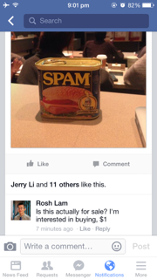
If you win some SPAM… ? or pmfp... ?

Slide 47
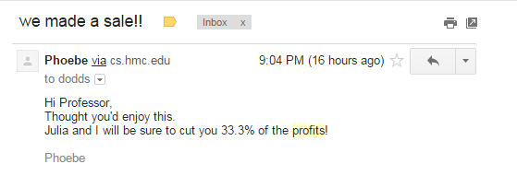
If you win some SPAM… ? or pmfp... ?

Slide 48
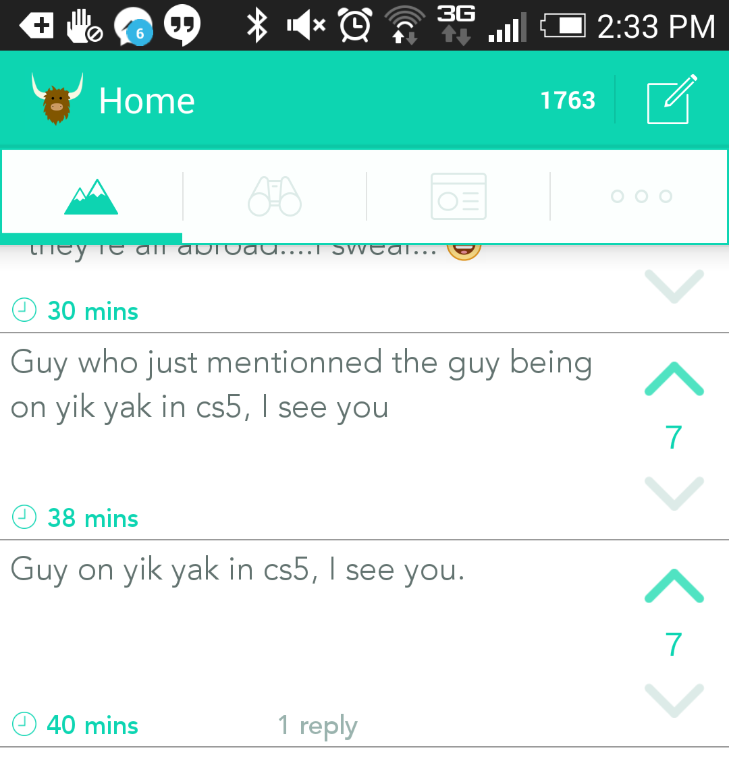
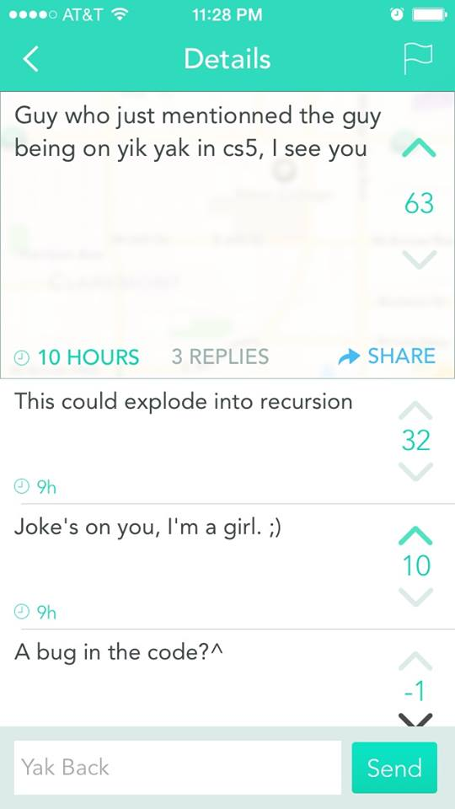
Another insight…
?

Slide 49
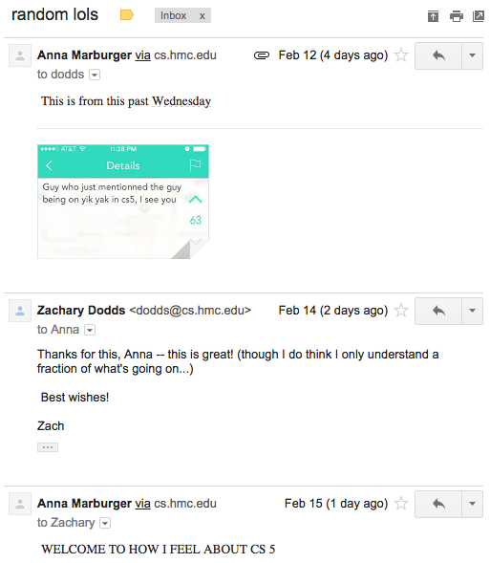
?

Slide 50
?

Slide 51


On balance?
or maybe lighter is better?

Slide 52
Designing with LCs
input
>>> [ _______ for x in range(4) ]
[0, 14, 28, 42]
list
[0,1,2,3]
output
input
>>> [ _____________ for c in 'igetthis' ]
[True, False, False, False, False, False, True, False]
[ 1, 0, 0, 0, 0, 0, 1, 0 ]
output
And if we wanted the ints (in red)…?

Slide 53
Using LCs
Short and sweet!
[7,8,9]
def
fun1(L):
LC = [1 for x in L]
return sum( LC )
def
letScore(c):
'twelve'
lots of ifs…
return score
def
fun2(S):
LC = [letScore(c) for c in S]
return sum( LC )

Slide 54
Using LCs
[7,8,9]
But one-liners are my specialty…
def
len(L):
LC = [1 for x in L]
return sum( LC )
def
letScore(c):
'twelve'
lots of ifs…
return score
def
scrabbleScore(S):
LC = [letScore(c) for c in S]
return sum( LC )

Slide 55
"One-line" LCs
'cs5'
def
len(L):
LC = [1 for x in L]
return sum( LC )
I only ever get one line – who are the writers around here… ?
possible, but not recommendable!
def
len(L):
return sum([1 for x in L])
Maybe too terse!

Slide 56
'sequoia'
if
# of vowels
def
vwl(s):
LC = [ for c in s ]
return sum( LC )
42
[3,42,5,7,42]
# of times e is in L
def
count(e,L):
LC = [ for x in L ]
return sum( LC )
the too-terse approaches to these...
LC = [ for c in s ]
top
remember True == 1 and False == 0
LC = [ for x in L ]
bottom

Slide 57
Write each of these functions using list comprehensions…
input: L, any list of #s
output: the # of odd #s in L
First, demos()
def nodds(L):
example: nodds( [3,4,5,7,42] ) == 3
LC = [ for x in L ]
return sum(LC)
Y are your #s
W are the winning #s
inputs: Y and W, two lists of "lottery" numbers (ints)
output: the # of matches between Y & W
def lotto(Y,W):
example: lotto( [5,7,42,47] , [3,5,7,44,47] ) == 3
LC = [
return sum(LC)
input: N, an int >= 2
output: the # of positive divisors of N
def ndivs(N):
example: numdivs(12) == 6 (1,2,3,4,6,12)
LC = [
return sum(LC)
input: P, an int >= 2
output: the list of prime #s up to + incl. P
def primesUpTo(P):
example: primesUpTo(12) == [2,3,5,7,11]
Extra!
return LC

Slide 58
Write each of these functions using list comprehensions…
Go!
input: L, any list of #s
output: the # of odd #s in L
def nodds(L):
example: nodds( [3,4,5,7,42] ) == 3
LC = [ for x in L ]
return sum(LC)
Y are your #s
W are the winning #s
inputs: Y and W, two lists of "lottery" numbers (ints)
output: the # of matches between Y & W
def lotto(Y,W):
example: lotto( [5,7,42,47] , [3,5,7,44,47] ) == 3
LC = [
return sum(LC)
input: N, an int >= 2
output: the # of positive divisors of N
def ndivs(N):
example: numdivs(12) == 6 (1,2,3,4,6,12)
LC = [
return sum(LC)
input: P, an int >= 2
output: the list of prime #s up to + incl. P
def primesUpTo(P):
example: primesUpTo(12) == [2,3,5,7,11]
Extra!
return LC

Slide 59
Write each of these functions using list comprehensions…
Go!
def nodds(L):
LC = [ 1 for x in L if x%2 == 1 ]
return sum(LC)
too terse?
[ x%2 for x in L ]
def lotto(Y,W):
LC = [ ]
too terse?
return sum(LC)
[ ]
def ndivs(N):
LC = [ 1 for x in range(1,N+1) if N%x==0 ]
list
too terse?
return sum(LC)
[ N%x==0 for x in range(1,N+1) ]
def primesUpTo(P):
Extra!
LC = [ x for x in range(2,P+1) if ndivs(x)==2 ]
list
return LC

Slide 60
Write each of these functions using list comprehensions…
Go!
def nodds(L):
LC = [ 1 for x in L if x%2 == 1 ]
return sum(LC)
too terse?
[ x%2 for x in L ]
def lotto(Y,W):
LC = [ 1 for y in Y if y in W ]
too terse?
return sum(LC)
[ y in W for y in Y ]
def ndivs(N):
LC = [ 1 for x in range(1,N+1) if N%x==0 ]
list
too terse?
return sum(LC)
[ N%x==0 for x in range(1,N+1) ]
def primesUpTo(P):
Extra!
LC = [ x for x in range(2,P+1) if ndivs(x)==2 ]
list
return LC

Slide 61
hw2pr3: areas from rectangles
y = 2x
y = 2x
(7.5,15)
(7.5,15)
(5,10)
(5,10)
(2.5,5)
(2.5,5)
(0,0)
(0,0)
Areas of 4 rectangles
Areas of 8 rectangles

Slide 62
hw2pr3: areas from rectangles
y = 2x
(10,20)
y = 2x
y = 2x
(7.5,15)
(7.5,15)
(7.5,15)
(5,10)
(5,10)
(5,10)
(2.5,5)
(2.5,5)
(2.5,5)
(2.5,5)
(0,0)
(0,0)
(0,0)
(0,0)
Area of N rectangles in the limit

Slide 63


hw2pr3: Maya Lin, Architect…

Slide 64
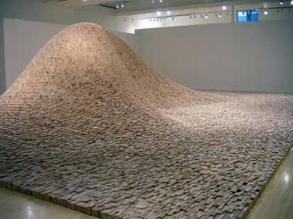
Maya Lin, Artist and Computer Scientist…
"two-by-four landscape"

Slide 65
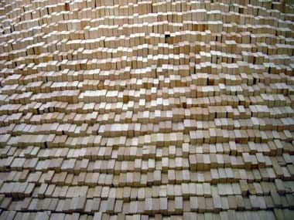
Maya Lin, Artist and Computer Scientist…
One building block, deliberately applied, over 50,000 times…

Slide 66
Building blocks == CS!
y = 2x
scaledfracs(low,hi,N)
(7.5,15)
f_of_fracs(f,low,hi,N)
(5,10)
integrate(f,low,hi,N)
(2.5,5)
only a few lines...
(0,0)
Where are the LCs?
Areas of 8 rectangles

Slide 67
Building blocks == CS!
y = 2x
Good luck with hw#2…
scaledfracs(low,hi,N)
(7.5,15)
f_of_fracs(f,low,hi,N)
(5,10)
integrate(f,low,hi,N)
... and may your weekend be syntactically smooth!
(2.5,5)
only a few lines...
(0,0)
Where are the LCs?
Areas of 8 rectangles

Slide 69
List Comprehensions
>>> [ 10*x for x in [0,1,2,3,4,5] if x%2==0]
result
>>> [ y*21 for y in list(range(0,3)) ]
result
>>> [ s[1] for s in ["hi", "5Cs!"] ]
result

Slide 70
Quiz!
A range of list comprehensions...
Write Python's result for each L.C.:
Name(s): ___________________________
[ n**2 for n in range(0,5) ]
list
[ 42 for z in [0,1,2] ]
[ z for z in [0,1,2] ]
[ s[1::2] for s in ['aces','451!'] ]
[ -7*b for b in range(-6,6) if abs(b)>4 ]
list
[ a*(a-1) for a in range(8) if a%2==1 ]
list
Got it. But what about that name?

Slide 71
Quiz!
A range of list comprehensions...
Write Python's result for each L.C.:
Join with a neighbor and try this on the back page first
[ n**2 for n in range(0,5) ]
list
[0,1,4,9,16]
[ 42 for z in [0,1,2] ]
[ z for z in [0,1,2] ]
[42,42,42]
[0,1,2]
[ s[1::2] for s in ['aces','451!'] ]
[ -6, -5, -4, -3, -2, -1, 0, 1, 2, 3, 4, 5 ]
[ -7*b for b in range(-6,6) if abs(b)>4 ]
list
[ -6, -5, 5 ]
[ 0, 1, 2, 3, 4, 5, 6, 7 ]
[ a*(a-1) for a in range(8) if a%2==1 ]
list
[ 1, 3, 5, 7 ]
[ 0, 6, 20, 42 ]
Got it. But what about that name?

Slide 72
Designing with LCs
input
>>> [ _______ for x in range(4) ]
[0, 14, 28, 42]
list
[0,1,2,3]
output
input
>>> [ _____________ for c in 'igetthis' ]
[True, False, False, False, False, False, True, False]
[ 1, 0, 0, 0, 0, 0, 1, 0 ]
output
And if we wanted the ints (in red)…?

Slide 73
Using LCs
Short and sweet!
[7,8,9]
def
fun1(L):
LC = [1 for x in L]
return sum( LC )
def
letScore(c):
'twelve'
lots of ifs…
return score
def
fun2(S):
LC = [letScore(c) for c in S]
return sum( LC )

Slide 74
'sequoia'
if
# of vowels
def
vwl(s):
LC = [ for c in s ]
return sum( LC )
42
[3,42,5,7,42]
# of times e is in L
def
count(e,L):
LC = [ for x in L ]
return sum( LC )
the too-terse approaches to these...
LC = [ for c in s ]
top
remember True == 1 and False == 0
LC = [ for x in L ]
bottom

Slide 75
Write each of these functions using list comprehensions…
Go!
def nodds(L):
LC = [ 1 for x in L if x%2 == 1 ]
return sum(LC)
too terse?
[ x%2 for x in L ]
def lotto(Y,W):
LC = [ ]
too terse?
return sum(LC)
[ ]
def ndivs(N):
LC = [ 1 for x in range(1,N+1) if N%x==0 ]
list
too terse?
return sum(LC)
[ N%x==0 for x in range(1,N+1) ]
def primesUpTo(P):
Extra!
LC = [ x for x in range(2,P+1) if ndivs(x)==2 ]
list
return LC

Slide 76
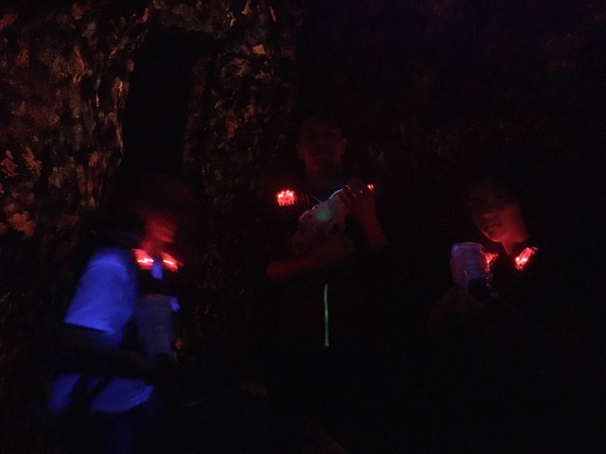
@ Laser Island...

Slide 77
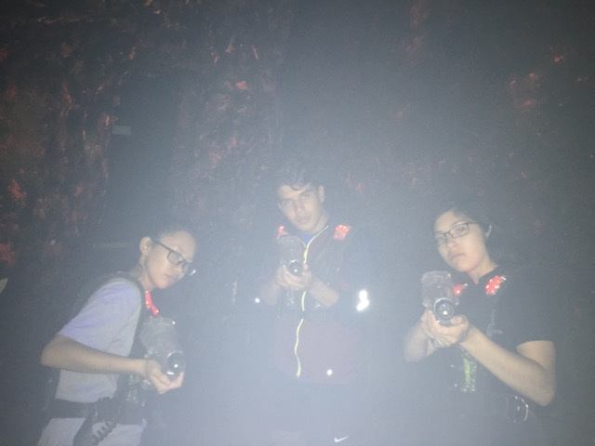
the team...

Slide 78
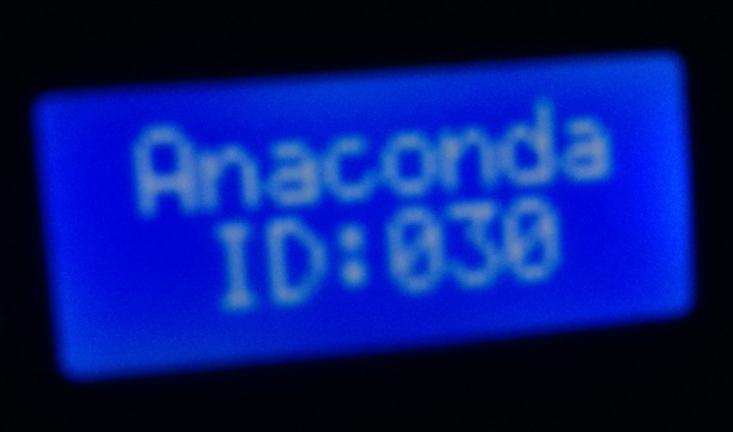
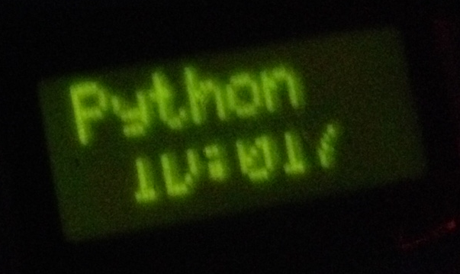
the mascots!

Slide 79
sword button?

Slide 80
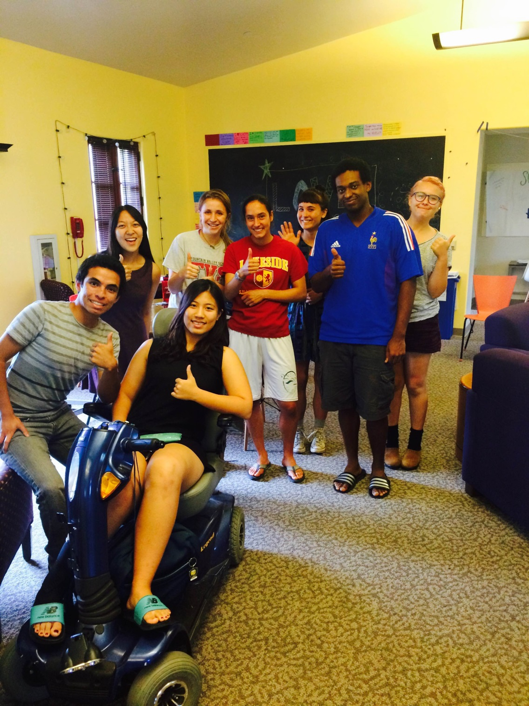
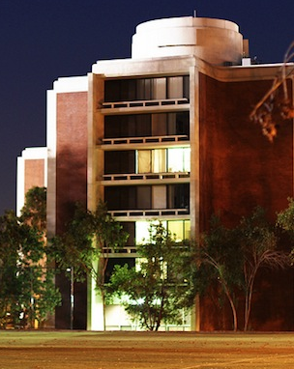
Tutoring hours ~ Scootering hours
Jasen Choi @ Fawcett Lounge
Monday evenings @ CMC…
Sat. 1-3pm @ Scripps S.U.

Slide 81
@ Laser Island...

Slide 82
the team...

Slide 83
the mascots!

Slide 84

@ Laser Island...

Slide 85
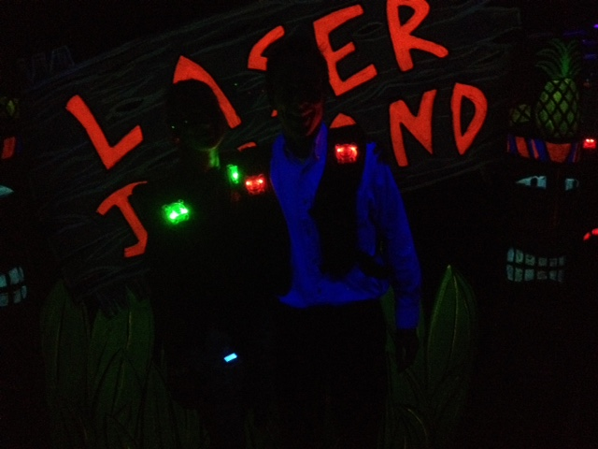
the universe whispers...

Slide 86
the universe whispers...

Slide 87


sword button?

Slide 88
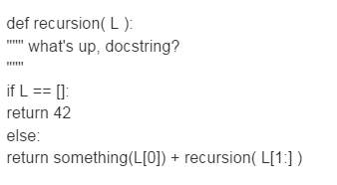
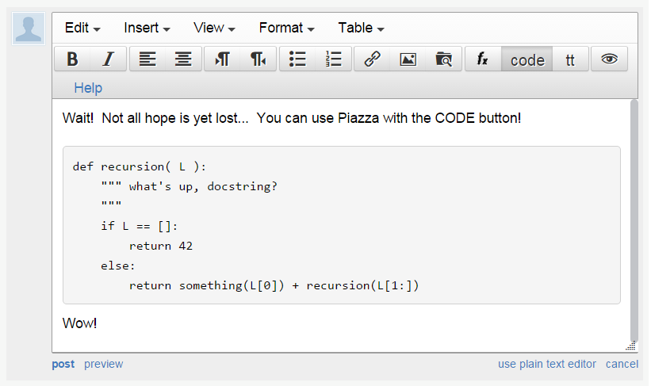
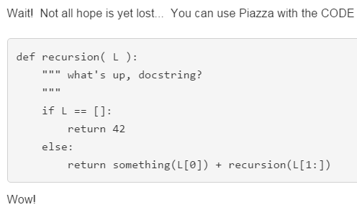
sword button?
code button!
creating a private post to Piazza because something is not working… ?
bugs, vanquished!
code button – then paste

Slide 89
sum range
step?
what's cookin' here?
def range(low,hi ):
""" input: ints low and hi
output: int list from low to hi
"""
if low >= hi:
return []
else:
return
excluding hi

Slide 90
sum and range
1784
>>> sum(range(1,101))
?
I'd bet you have a 50/50 chance on this one…
- Ben. L '14

Slide 91
List Comprehensions
LC
>>> [ 10*x for x in [0,1,2,3,4,5] if x%2==0]
result
>>> [ y*21 for y in range(0,3) ]
LC
result
>>> [ s[1] for s in ["hi", "5Cs!"] ]
LC
result
OK – got it. But what about that name?

Slide 92
Quiz!
A range of list comprehensions...
Write Python's result for each L.C.:
Join with a neighbor and try this on the back page first
[ n**2 for n in range(0,5) ]
[ 42 for z in [0,1,2] ]
[ z for z in [0,1,2] ]
[ s[1::2] for s in ['aces','451!'] ]
[ -7*b for b in range(-6,6) if abs(b)>4 ]
[ a*(a-1) for a in range(8) if a%2==1 ]
I wonder if these will be useful ?!

Slide 93
Designing with LCs
input
>>> [ _______ for x in range(4) ]
[0, 14, 28, 42]
[0,1,2,3]
output
input
>>> [ _____________ for c in 'igetthis' ]
[True, False, False, False, False, False, True, False]
[ 1, 0, 0, 0, 0, 0, 1, 0 ]
output
And what if we wanted these values in red…?

Slide 94
Using LCs
Sweet!
But one-liners are my specialty…
[7,8,9]
def
len(L):
LC = [1 for x in L]
return sum( LC )
def
letScore(c):
'twelve'
lots of ifs…
return score
def
scrabbleScore(S):
LC = [letScore(c) for c in S]
return sum( LC )

Slide 95
'sequoia'
Remember True == 1 and False == 0
# of vowels
def
sajak(s):
LC = [ for c in s]
return sum( LC )
42
[3,42,5,7,42]
# of times e is in L
def
count(e,L):
LC = [ for x in L ]
return sum( LC )
using if instead…
def
count(e,L):
LC = [ 1 for x in L if ]
return sum( LC )

Slide 96
Write each of these functions using list comprehensions…
Go!
input: L, any list of #s
output: the # of odd #s in L
def nodds(L):
example: nodds( [3,4,5,7,42] ) == 3
LC = [ for x in L ]
return sum(LC)
Y are your #s
W are the winning #s
inputs: Y and W, two lists of "lottery" numbers (ints)
output: the # of matches between Y & W
def lotto(Y,W):
example: lotto( [5,7,42,47] , [3,5,7,44,47] ) == 3
LC = [
input: N, an int >= 2
output: the # of positive divisors of N
def ndivs(N):
example: numdivs(12) == 6 (1,2,3,4,6,12)
LC = [
input: P, an int >= 2
output: the list of prime #s up to + incl. P
def primesUpTo(P):
example: primesUpTo(12) == [2,3,5,7,11]
Extra!

Slide 97
input: N, an int >= 2
output: the # of positive divisors of N
example: numdivs(12) == 6 (1,2,3,4,6,12)
def ndivs(N):
LC = [ for n in range(1,N+1)]
return sum(LC)
Extra! A list of all primes up to P…
def primesUpto( P ):

Slide 98
y = 2x
y = 2x
(7.5,15)
(7.5,15)
(5,10)
(5,10)
scaledfracs(low,hi,N)
step along x-axis
scaledfracs(low,hi,N)
step along x-axis
f_of_fracs(f,low,hi,N)
apply f to each
f_of_fracs(f,low,hi,N)
apply f to each
(2.5,5)
(2.5,5)
integrate(f,low,hi,N)
integrate!
integrate(f,low,hi,N)
integrate!
(0,0)
(0,0)
only a few lines...
Where are the LCs?
only a few lines...
Where are the LCs?
Areas of 4 rectangles
Areas of 8 rectangles

Slide 99
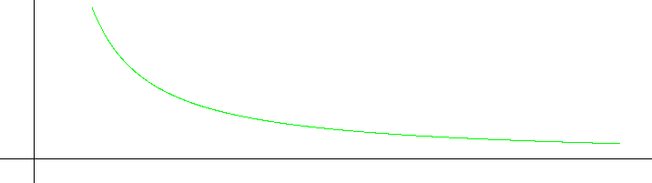
1
def recip(x): return 1.0/x
1
0.5
y =
x
area
0
1
2
3
4
5
6
7
8
9
10
hw2pr3
Integrating Python
1
0.5
0
low = 1.0
hi = 10.0

Slide 100
def recip(x): return 1.0/x
1
1
y =
0.5
x
area
0
1
2
3
4
5
6
7
8
9
10
scaledfracs(low,hi,N)
step along x-axis
f_of_fracs(f,low,hi,N)
apply f to each
integrate(f,low,hi,N)
integrate!
only a few lines...
Where are the LCs?

Slide 101
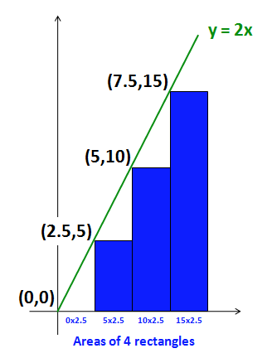
y = 2x
(7.5,15)
(5,10)
(2.5,5)
(0,0)
0x2.5
5x2.5
10x2.5
15x2.5
Areas of 4 rectangles

Slide 102
y = 2x
y = 2x
(7.5,15)
(7.5,15)
(5,10)
(5,10)
(2.5,5)
(2.5,5)
(0,0)
(0,0)
Areas of 4 rectangles
Areas of 8 rectangles

Slide 103
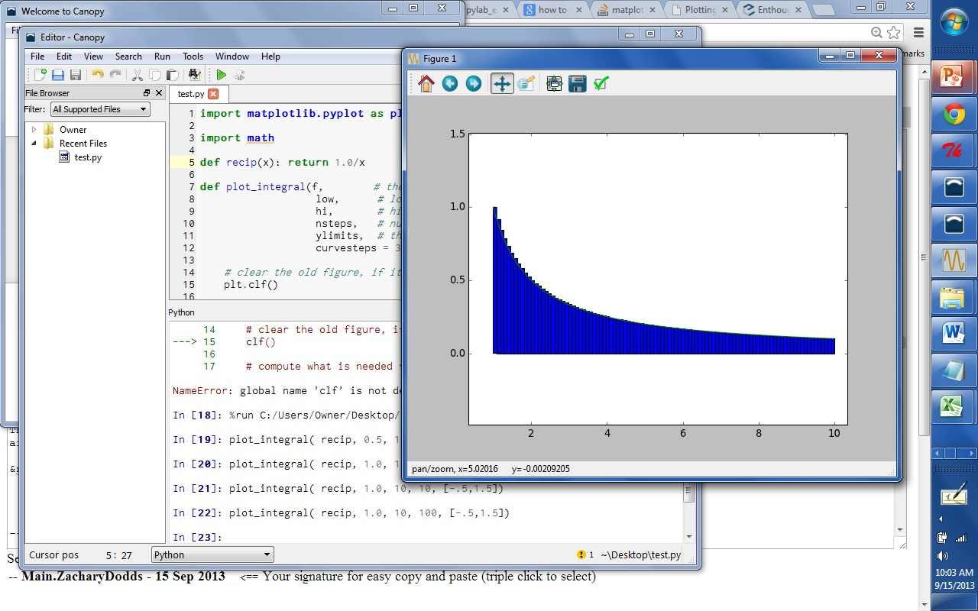
Canopy and matplotlib

Slide 104
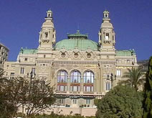
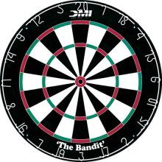
The two Monte Carlos
and their denizens…
Insights via random trials
Monte Carlo methods, Math/CS
Monte Carlo casino, Monaco

Slide 105
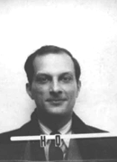

The two Monte Carlos
and their denizens…
Ulam, Stan Ulam
Stanislaw Ulam (Los Alamos badge)
Insights via random trials
Bond, James Bond
Monte Carlo methods, Math/CS
Monte Carlo casino, Monaco

Slide 106

Monte Carlo in action
How many doubles will you get in N rolls of 2 dice?
N is the total number of rolls
def countDoubles( N ):
""" input: the # of dice rolls to make
output: the # of doubles seen """
if N == 0:
return 0 # zero rolls, zero doubles…
else:
d1 = choice( [1,2,3,4,5,6] )
d2 = choice( range(1,7) )
if d1 != d2:
return countDoubles( N-1 ) # don't count it
else:
return 1+countDoubles( N-1 ) # COUNT IT!
two dice from 1-6 inclusive
where is the check for doubles?

Slide 107

See you in Lab 2 this week!
This must be a sine of what's to come, 'cos it'd be a real tangent otherwise...

Slide 108
sum range
step?
what's cookin' here?
def range(low,hi ):
""" input: ints low and hi
output: int list from low to hi
"""
if low >= hi:
return []
else:
return
excluding hi

Slide 109
I'll bet you have a 50/50 chance on this one…
- Ben. L '14
sum and range
>>> sum(range(1,101))
I'll bet you have a 50/50 chance on this one…
- Ben. L '14

Slide 110
Quiz!
A range of list comprehensions...
Write Python's result for each L.C.:
Join with a neighbor and try this on the back page first
[ n**2 for n in range(0,5) ]
[ 0, 1, 4, 9, 16 ]
[ 42 for z in [0,1,2] ]
[ z for z in [0,1,2] ]
[ 42, 42, 42 ]
[ 0, 1, 2 ]
[ s[1::2] for s in ['aces','451!'] ]
[ -7*b for b in range(-6,6) if abs(b)>4 ]
[ 42, 35, -35 ]
[ a*(a-1) for a in range(8) if a%2==1 ]
[ 0, 6, 20, 42 ]
I wonder if these will be useful ?!

Slide 111
Designing with LCs
input
>>> [ _______ for x in range(4) ]
[0, 14, 28, 42]
[0,1,2,3]
output
input
>>> [ _____________ for c in 'igotit' ]
[True, False, False, False, True, False]
[ 1, 0, 0, 0, 1, 0 ]
output
What about this?

Slide 112
LCs vs. raw recursion
def len(L):
if L == []:
return 0
else:
return 1 + len(L[1:])
len(L)
scrabble score!
def sScore(s):
if len(s) == 0:
return 0
else:
return letScore(s[0]) + \
sScore(s[1:])
sScore(s)
def sajak(s):
if len(s) == 0:
return 0
else:
if s[0] not in 'aeiou':
return sajak(s[1:])
else:
return 1+sajak(s[1:])
# of vowels
8 lines! Aargh!
sajak(s)

Slide 113
Map
def dbl(x):
return 2*x
>>> map(dbl, [0,1,2,3,4,5])
[0, 2, 4, 6, 8, 10]
def sq(x):
return x**2
>>> map(sq, range(6))
[0, 1, 4, 9, 16, 25]
def is_a(x):
return x == 'a'
>>> map(is_a, 'go away!')
[0, 0, 0, 1, 0, 1, 0, 0]
What does map do?
Hey… these look a bit False to me!

Slide 114
Map
def dbl(x):
return 2*x
>>> map(dbl, [0,1,2,3,4,5])
[0, 2, 4, 6, 8, 10]
def sq(x):
return x**2
>>> map(sq, range(6))
[0, 1, 4, 9, 16, 25]
def is_a(x):
return int(x=='a')
>>> map(is_a, 'go away!')
[0, 0, 0, 1, 0, 1, 0, 0]
Now I have 0 to complain about!
(1) map always returns a list
(2) map(f,L) calls f on each item in L

Slide 115

Map, managed!
input
>>> [ 2*x for x in [0,1,2,3,4,5] ]
[0, 2, 4, 6, 8, 10]
Looks natural to me!
output
Python has a "more natural" syntax for map…

Slide 116

Using a Euro, Yuan the deadline comes next time I'll try to make the Mark. I'm Pounding it into my brain, but I have to Peso much attention to other deadlines in the classes I Currency have - but if this keeps up, my grade will be demolished into Rubles.
hw0 highlights…
0 xE** -> N 0 # Once upon a time, there was
0 *x** -> E 1 # an extremely sad, lost Picobot. Ze
0 NEx* -> W 3 # traveled around a sad, dark maze
0 NEWx -> S 2 # in search of shelter and food.
# Finally, Picobot found a gingerbread
1 ***x -> S 2 # house deep in the corners of the maze.
1 *x*S -> E 1 # Though Picobot knew ze could never find
1 xE*S -> N 0 # zer way around the maze without keeping
1 NExS -> W 3 # zerself near the right-hand wall, ze
# decided the gingerbread house would be
2 **x* -> W 3 # worth disobeying zer program.
2 **Wx -> S 2 # Picobot thoroughly enjoyed zer
2 *xWS -> E 1 # gingerbread meal, but when ze tried to
2 xEWS -> N 0 # find zer way back to the maze, ze was so
# confused ze didn't know what to do.
3 x*** -> N 0 # Picobot began to sit in the corner,
3 N*x* -> W 3 # sighing in despair.
3 N*Wx -> S 2 # Suddenly came a noble grutor who
3 NxWS -> E 1 # showed Picobot the way through the maze.
# And there was much rejoicing. THE END
user = raw_input("Hello! This is Professor Oak. …")
comp = random.choice ( ['BULBASAUR!','CHARMANDER!','SQUIRTLE!'] )
cheesy =
random.choice ( ['Heh-you snooze you lose',
'I was here, and boy are you a loser!',
"You can't ignore my girth!",
"I'm Gary Oak! And I don't lose to chumps like you!",
'I would never lose to a loser like you. I have my own cheerleading squad!',
"I'll be waiting outside the Pokemon center just to battle you again!" ] )
if user == 'SQUIRTLE':
if comp == 'BULBASAUR!':
print 'Your SQUIRTLE used Water Gun!'
time.sleep(2)
print 'It was not very effective...'
time.sleep(2)
print "Gary's BULBASAUR used Vine Whip!"
time.sleep(2)
print 'It was super effective!'
time.sleep(2)
print 'Your Squirtle fainted!'
time.sleep(2)
print 'Gary is the winner!'
time.sleep(3)
print "Gary:", cheesy
elif user == 'HMC':
if comp == 'CMC':
print 'CMC is closer to all of the other 5 Cs. I win.'
elif comp == 'Pitzer':
print 'Pitzer is closer to Starbucks. I win.'
print 'Teeheehee! Looks like I won!'
answer = raw_input("Wait, are you a Grutor?!")
if answer == 'yes':
print 'I am so sorry! I mean YOU win!'
else:
print 'Then I DO win! Hahaha'
E.F.
full RPS-25

Slide 117
Designing with LCs
input
>>> [ _______ for x in range(4) ]
[0, 14, 28, 42]
[0,1,2,3]
output
input
>>> [ _____________ for c in 'igotit' ]
[True, False, False, False, True, False]
[ 1, 0, 0, 0, 1, 0 ]
output
What about this?

Slide 118
Using LCs
def
letScore(c):
stuff to get score…
return score
'twelve'
scrabble score!
def
sScore(s):
LC = [ for c in s]
return sum( LC )

Slide 119
'sequoia'
Remember True == 1 and False == 0
# of vowels
def
sajak(s):
LC = [ for c in s]
return sum( LC )
42
[3,42,5,7,42]
# of times e is in L
def
count(e,L):
LC = [ for x in L ]
return sum( LC )
using if instead…
def
count(e,L):
LC = [ 1 for x in L if ]
return sum( LC )

Slide 120
inputs: L, any list of #s
output: the # of odd #s in L
example: nodds( [3,4,5,7,42] ) == 3
def nodds(L):
LC = [ for x in L ]
return sum(LC)
def nodds(L):
LC = [ 1 for x in L ]
return sum(LC)

Slide 121
Y are your #s
W are the winning #s
inputs: Y and W, two lists of "lottery" numbers (ints)
output: the # of matches between Y & W
example: lotto( [5,7,42,47] , [3,5,7,44,47] ) == 3
def lotto(Y,W):
LC = [ for w in W ]
return sum(LC)
def lotto(Y,W):
LC = [ 1 for w in W ]
return sum(LC)
… could adapt to "y in Y", too.

Slide 122
input: N, an int >= 2
output: the # of positive divisors of N
example: numdivs(12) == 6 (1,2,3,4,6,12)
def ndivs(N):
LC = [ for n in range(1,N+1)]
return sum(LC)
Extra! A list of all primes up to P…
def primesUpto( P ):

Slide 123
input: Y and W, two lists of "lottery" numbers (ints)
W are the winning numbers
output: the # of matches between Y & W
Y are your numbers
example: lotto([5,7,42,47],[3,5,7,44,47]) == 3
def lotto(Y,W):
LC = [
return sum(LC)

Slide 124
input: N, an int >= 2
output: the number of positive divisors of N
Extra!
example: numdivs(12) == 6 (1,2,3,4,6,12)
def numdivs(N):
What if you want the divisors themselves? or prime #s?
def primesUpto( P ):
How could you use this to compute all of the prime numbers up to P?

Slide 125
sum and range
I've seen this before... ?
>>> sum(range(1,101))

Slide 126
List Comprehensions
The same as map, only better!
this "runner" variable can have any name...
input
>>> [ 2*x for x in [0,1,2,3,4,5] ]
[0, 2, 4, 6, 8, 10]
output
What is going on here?

Slide 127
List Comprehensions
The same as map, only better!
this "runner" variable can have any name...
input
>>> [ 2*x for x in [0,1,2,3,4,5] ]
[0, 2, 4, 6, 8, 10]
(1) x takes on each value in the list or string
(2) The operation 2*x happens for each x
output
So clear, I don't even NEED a map!

Slide 128
Map, managed!
Python has a "more natural" syntax for map…
What map could this refer to?
def map(f,L):
""" maps f onto the list L """
if L == []:
return []
else:
return
… and you don't even need the map!

Slide 129
Quiz!
A range of list comprehensions...
What's Python's result for each L.C.:
First/last name(s):_______________________
[ n**2 for n in range(0,5) ]
[ 42 for z in [0,1,2] ]
[ z for z in [0,1,2] ]
[ s[1::2] for s in ['aces','451!'] ]
[ -7*b for b in range(-6,6) if abs(b)>4 ]
[ a*(a-1) for a in range(8) if a%2==1 ]
I wonder if these will be useful?!

Slide 130
Create your own!
input
>>> [ _______ for y in range(6) ]
[0, 1, 4, 9, 16, 25]
output
input
>>> [ __________ for c in 'igotit' ]
[True, False, False, False, True, False]
[ 1, 0, 0, 0, 1, 0 ]
output
What about this?

Slide 131
Raw recursion vs. LCs ?
def
len(L):
LC = [1 for x in L]
return sum( LC )
scrabble score!
def
sScore(s):
LC = [ letScore(c) for c in s]
return sum( LC )
I prefer one-liners!

Slide 132
vs. List Comprehensions
# of vowels
def
sajak(s):
LC = [ for c in s]
return sum( LC )
Remember True == 1 and False == 0
# of odd elements
def
numOdds(L):
LC = [ for x in L]
return sum( LC )

Slide 133
Quiz
input: e, any element L, any list or string
Remember True == 1 and False == 0
output: the # of times L contains e
example: count('f', 'fluff') == 3
Write
def count(e,L):
LC = [ for x in L ]
return sum(LC)
don't use e here!
use e in here somehow…

Slide 134
Write
input: Y and W, two lists of lottery numbers (ints)
W are the winning numbers
output: the # of matches between Y & W
Y are your numbers
example: lotto([5,7,42,44],[3,5,7,44]) == 3
def lotto(Y,W):
LC = [ w in Y for w in W ]
return sum(LC)

Slide 135
Extra!
input: N, an int >= 2
output: the number of positive divisors of N
def numdivs(N):
example: numdivs(12) == 6 (1,2,3,4,6,12)
What if you want the divisors themselves? or prime #s?
def primesUpto( P ):
How could you use this to compute all of the prime numbers up to P?
return [ p in range(2,P+1) if numdivs(p)==2 ]

Slide 136

Recursion -- not just numbers
Self-similarity elsewhere...
Natural phenomena
Relationships
how much here is leaf vs. stem?
What is an “ancestor” ?
Names -- acronyms
The TTP Project

Slide 137

Recursion -- not just numbers
Self-similarity elsewhere...
Natural phenomena
Relationships
how much here is leaf vs. stem?
What is an “ancestor” ?
Names -- acronyms
The TTP Project

Slide 138


Next time: The Visual Arts ?
from turtle import *
reset()
left(90)
forward(50)
right(90)
backward(50)
down() or up()
color('green')
tracer(1) or tracer(0)
width(5)
and lots more!
www.cs.hmc.edu/twiki/bin/view/CS5/TurtleDirections
for turtle help
Basic turtle graphics
degrees!
states if the pen draws or not
states if the pen animates or not
More turtly turtle graphics

Slide 139




The Python shell
IDLE uses Python's graphics - but built-in shells do not
"command window"
"terminal window"
c:\python25\python -i hw2pr1.py
python -i hw2pr1.py

Slide 140

csplot.py
Links to pages with detailed instructions on opening a non-IDLE shell.
Links to two files providing graphics capabilities.
IDLE can still be used as your code editor!

Slide 141
A random aside…
import random
for more explanation, try dir(random) or help(random)
random.choice( L )
chooses 1 element from the list L
random.choice( ['north', 'case', 'west'] )
How would you get a random int from 0 to 9?
random.uniform(low,hi)
chooses a random float from low to hi
random.uniform(41.0, 43.0)
How likely is this to return 42 ?

Slide 142
Randomness vs. Determinism
Are there random numbers?
Can a computer generate them?
RNG
A “black box” model of a random number generator.
Output

Slide 143
Map: a higher-order function
def map( f, L ):
""" map returns a new list where each element of L has been f-efied
"""
if :
else:
test for base case
Key Idea
Functions are data!
Hey - I'm the only star allowed around here…
In Python, functions can take other functions as input…

Slide 144
List Comprehensions
The same as map, only better!
input
>>> [ 2*x for x in [0,1,2,3,4,5] ]
[0, 2, 4, 6, 8, 10]
output
What is going on here?
and the "running" variable can have any name...

Slide 145
List Comprehensions
The same as map, only better!
input
>>> [ 2*x for x in [0,1,2,3,4,5] ]
[0, 2, 4, 6, 8, 10]
(1) x takes on each value in the list or string
(2) The operation 2*x happens for each x
output
and the "running" variable can have any name...

Slide 146
List Comprehensions
The same as map, only better!
input
>>> [ _______ for y in range(6) ]
[0, 1, 4, 9, 16, 25]
output
input
>>> [ __________ for c in 'igotit' ]
[True, False, False, False, True, False]
output

Slide 147
vs. List Comprehensions
# of vowels
def
sajak(s):
LC = [ for c in s]
return sum( LC )
Remember True == 1 and False == 0
# of odd elements
def
numOdds(L):
LC = [ for x in L]
return sum( LC )

Slide 148
Quiz
Write each of these functions concisely using list comprehensions…
Name(s):
Write
input: e, any element L, any list or string
Remember True == 1 and False == 0
output: the # of times L contains e
def count(e,L):
example: count('f', 'fluff') == 3
LC = [ for x in L ]
return sum(LC)
don't use e here!
use e in here somehow…
Write
def lotto(Y,W):
input: Y and W, two lists of lottery numbers (ints)
W are the winning numbers
output: the # of matches between Y & W
Y are your numbers
example: lotto([5,7,42,44],[3,5,7,44]) == 3
Extra!
input: N, an int >= 2
def numdivs(N):
output: the number of positive divisors of N
example: numdivs(12) == 6 (1,2,3,4,6,12)
How could you use this to compute all of the prime numbers up to P?
def primesUpto( P ):

Slide 149
Quiz
input: e, any element L, any list or string
Remember True == 1 and False == 0
output: the # of times L contains e
example: count('f', 'fluff') == 3
Write
def count(e,L):
LC = [ for x in L ]
return sum(LC)
don't use e here!
use e in here somehow…

Slide 150
Write
input: Y and W, two lists of lottery numbers (ints)
W are the winning numbers
output: the # of matches between Y & W
Y are your numbers
example: lotto([5,7,42,44],[3,5,7,44]) == 3
def lotto(Y,W):

Slide 151
Extra!
input: N, an int >= 2
output: the number of positive divisors of N
def numdivs(N):
example: numdivs(12) == 6 (1,2,3,4,6,12)
What if you want the divisors themselves? or prime #s?
def primesUpto( P ):
How could you use this to compute all of the prime numbers up to P?

Slide 152

Randomness vs. Determinism
Are there random numbers?
Can a computer generate them?
Yes
Not without help!
The RNG revealed.
Periodic!
Output
p = 2¹⁹⁹³⁷-1
http://en.wikipedia.org/wiki/Mersenne_twister

Slide 153

Some random history…
True randomness is valuable!
but not that valuable!
http://www.rand.org/pubs/monograph_reports/MR1418/index.html
Inevitable correlations among the published values

Slide 154




True Randomness !
http://www.leapzine.com/hr/
random, but not!
an enthusiastic endorser
LavaRnd’s lava lamps
using a chaotic physical system to seed random number generators
(Patent 5,732,138: "Method for seeding a pseudo-random number generator with a cryptographic hash of a digitization of a chaotic system.")
www.wired.com/wired/archive/11.08/random.html
This has since been “improved”…

Slide 155
A random program…
from random import *
def guess( hidden ):
""" guesses the user's #, "hidden" """
compguess = choice( range(100) )
if compguess == hidden: # at last!
print 'I got it!'
else:
guess( hidden )
This guesser is a bit suspicious…
print guesses ?
num guesses ?

Slide 156
The two Monte Carlos
Making random numbers work for you!
Monte Carlo casino, Monaco
Monte Carlo methods, Math/CS

Slide 157
Monte Carlo in action
Suppose you roll two dice.
What are the chances that you roll doubles?
input is the total number of rolls
def countDoubles( N ):
""" inputs a # of two-dice rolls
outputs the # of doubles """
if N == 0:
return 0
else:
d1 = choice( [1,2,3,4,5,6] )
d2 = choice( range(1,7) )
if d1 != d2:
return countDoubles( N - 1 )
else:
return
one roll of two dice
where is the doubles check?
what should the last line be?

Slide 158
1
def recip(x): return 1.0/x
0.5
1
y =
area
x
0
1
2
3
4
5
6
7
8
9
10
1
How might we find this area using Monte Carlo?
0.5
0
1
2
3
4
5
6
7
8
9
10
low = 1.0
hi = 10.0
N == 9 == total number of steps (rectangles)
steps(low,hi,N)
fsteps(recip,low,hi,N)
finteg(f,low,hi,N)

Slide 159
1
def recip(x): return 1.0/x
0.5
1
y =
area
x
0
1
2
3
4
5
6
7
8
9
10
Numerical Integration
Lab 2: Monday or Tuesday
steps(low,hi,N)
fsteps(recip,low,hi,N)
finteg(f,low,hi,N)

Slide 160
See you at Lab!

Slide 161
print: Making programs talk to you!
Debugging had to be discovered. I can remember the exact instant when I realized that a large part of my life from then on was going to be spent in finding mistakes in my own programs.
- Maurice Wilkes
Programming: the art of debugging an empty file.
- The Jargon File
http://www.tuxedo.org/~esr/jargon/

Slide 162


The first bug
Grace Hopper
from the UNIVAC 1
“In the days they used oxen for heavy pulling, when one ox couldn't budge a log, they didn't try to grow a larger ox. We shouldn't be trying for bigger and better computers, but for better systems of computers.”

Slide 163



Top 5 reasons to sign up to come to the
Find out what CS is really all about
Meet other women (and a few men too) who do CS
Bond with your fellow Mudders (including Prof. Alvarado)
Helen Greiner (!) and Sally Ride are keynote speakers
Get a free trip to San Diego…

Slide 164
When is it?
October 4-7 (we’ll leave Wed. afternoon and return Sat. night)
Who can sign up?
Anyone! You don’t have to be a CS Major (or a woman)
How do I sign up?
Email Christine (alvarado@cs.hmc.edu) by Friday, Sept. 22
Where do I get more information?
http://www.cs.hmc.edu/~alvarado/ghc06.html
http://gracehopper.org/

Slide 165

Real visual recursion
How many times has the light bounced before reaching the camera from various items here??

Slide 166
Quiz
Write each of these two functions concisely using list comprehensions…
Write
input: s, a string
def countas(s):
output: the # of 'a' characters in s
example: countas('alphabet') == 2
return sum( [ x=='a' for x in s ] )
return sum( [ x=='ctg' for x in s ] )
return sum( [ s[i:i+3]=='ctg' for i in range(len(s)) ] )
Extra: How could this be modified to find the 'ctg' repeats that cause myotonic dystrophy?

Slide 167


Slide 168
Solutions
Show a high-level (using map, reduce, etc.) solution for each and a low-level (raw recursion) for each.
The ascent - composing more sophisticated applications
The descent? - to deeper and deeper understandings of these things ("too deep" Fox Trot cartoon)

Slide 169
Syntax
Show the list comprehension syntax…
Do some examples & puzzles
Have a puzzle with if (used as a filter, too)
Try out the new syntax…

Slide 170
Specification:
Let W be a list of the six current winning lotto numbers (in order). A “ticket” is a list of six elements: [#1, #2, #3, #4, #5, #6 ], also in order. lottoScore(T) inputs a ticket and outputs its number of matches.
Examples:
W = [ 4, 8, 15, 29, 33, 47 ]; lottoScore([14, 15, 28, 30, 31, 42]); 1
lottoScore([4, 8, 15, 16, 32, 33]); 4
Code:
Notes:
I don’t know if this really works...

Slide 171
Specification:
lottoScore(W,T) takes both the winning numbers and a ticket as inputs and returns the number of matches... .
Example:
lottoScore( [4, 8, 15, 29, 33, 47], [4, 8, 15, 16, 32, 33] ); 4
Code:
“merge” technique ...
Notes:
I don’t know if this really works...

Slide 172

Today's forecast…
Specification:
dropGemini(L) takes in a list of birthdays (pairs like [6,5]) and returns an identical list w/o the Gemini.
US style
Example:
dropGemini([ [2,19], [3,13], [5,28], [6,11], [6,13], [7,29] ]); [ [2,19], [3,13], [7,29] ]
Code:
Notes:
I don’t know if this really works...

Slide 173
Applications
Lottery ticket applications - my favorite! with prizes for solvers

Slide 174
Do you remember…
That should do it… review slide.
Look ahead to lab.
Look ahead to Wed. :
revisiting randomness (lottery tie-in)
show a quick teaser example of the coolness of list comprehensions, e.g., analyze the primality instinct game by playing 1000000 times and counting the number of wins…

Slide 175
Recursion -- warning !
def fac(N):
return N * fac(N-1)
This is legal code!
try it out…
fall forever… was that Dumbledore or Gandalf?

Slide 176

Recursion Examples
def matchscore(a,b):
""" input: any two strings, a and b
output: the number of same characters in
the same location in both a and b
"""
This sentence is false.

Slide 177


CS 5 today
The building blocks of functional computing
data, sequences
We're computationally complete!
conditionals
recursion
So what now?
John Paul Jones, Paul McCartney, Flea (jazz Charles Mingus), Jakes: Phil Lesh
Living without a bass case!
http://www.stylusmagazine.com/articles/weekly_article/stylus-magazines-top-50-basslines-of-all-time.htm

Slide 178
1
0.5
1
y =
area
x
0
1
2
3
4
5
6
7
8
9
10
1
0.5
0
1
2
3
4
5
6
7
8
9
10
xmin = 1.0
xmax = 10.0
nsteps = 9

Slide 179
def sum(L):
""" input: a list of numbers, L
output: L's sum
"""
if len(L) == 0:
return 0.0
else:
return L[0] + sum(L[1:])
sum
sum([1,2,3,4])
L
>>> L = [1,2,3,4]
>>> sum(L)
L[0] + sum(L[1:])
1 + sum([2,3,4])

Slide 180

Depends what you mean by real …
(show recursion.swf)

Slide 181


Slide 182
sum, range
def range(low,hi):
""" input: two ints, low and hi
output: int list from low up to hi
"""
if hi <= low:
return []
else:
return
what's cookin' here?
excluding hi

Slide 183
sum and range
>>> sum(range(1,101))
I've seen this before... ?

Slide 184
A recursive spiral …

Slide 186
sum, range, max
max( [ 5, 42, 1, 7, 100 ] )
def max(L):
""" input: a nonempty sequence of values, L
output: L's maximum
"""
if len(L) == 1:
return L[0]
elif

Slide 187
sum, range, max
def max(L):
""" input: a nonempty sequence of values, L
output: L's maximum
"""
if len(L) == 1:
return L[0]
elif L[0] > L[1]:
return max( L[0:1] + L[2:] )
else:
return max( L[1:] )

Slide 188
max( [3, 7, 1, 42, -10, 1024, 55, 716] )
How many times does each block get called for this 8-element list?
def max(L):
""" docstring here """
if len(L) == 1:
return L[0]
elif L[0] > L[1]:
return max( L[0:1] + L[2:] )
else:
return max( L[1:] )
Base Case (if)
Second Case (elif)
Third Case (else)

Slide 189
max( [3, 7, 1, 42, -10, 1024, 55, 716] )
Third Case (else)
max( [7, 1, 42, -10, 1024, 55, 716] )
How many times does each block get called for this 8-element list?
def max(L):
""" docstring here """
if len(L) == 1:
return L[0]
elif L[0] > L[1]:
return max( L[0:1] + L[2:] )
else:
return max( L[1:] )
Base Case (if)
Second Case (elif)
Third Case (else)

Slide 190
max( [3, 7, 1, 42, -10, 1024, 55, 716] )
Third Case (else)
max( [7, 1, 42, -10, 1024, 55, 716] )
Second Case (elif)
max( [7, 42, -10, 1024, 55, 716] )
How many times does each block get called for this 8-element list?
def max(L):
""" docstring here """
if len(L) == 1:
return L[0]
elif L[0] > L[1]:
return max( L[0:1] + L[2:] )
else:
return max( L[1:] )
Base Case (if)
Second Case (elif)
Third Case (else)

Slide 191
max( [3, 7, 1, 42, -10, 1024, 55, 716] )
Third Case (else)
max( [7, 1, 42, -10, 1024, 55, 716] )
Second Case (elif)
max( [7, 42, -10, 1024, 55, 716] )
max( [42, -10, 1024, 55, 716] )
Third Case (else)
max( [42, 1024, 55, 716] )
Second Case (elif)
Third Case (else)
max( [1024, 55, 716] )
Second Case (elif)
max( [1024, 716] )
Second Case (elif)
max( [1024] )
Base Case (if)
1024
How many times does each block get called for this 8-element list?
def max(L):
""" docstring here """
if len(L) == 1:
return L[0]
elif L[0] > L[1]:
return max( L[0:1] + L[2:] )
else:
return max( L[1:] )
Base Case (if)
Second Case (elif)
Third Case (else)

Slide 192
Quiz
Write each of these two functions concisely using list comprehensions…
Name(s):
Write
input: s, a string
def countas(s):
output: the # of 'a' characters in s
Remember True == 1 and False == 0
example: countas('alphabet') == 2
Extra: How could this be modified to find the 'ctg' repeats that cause myotonic dystrophy?
Write
input: Y and W, two lists of ints (lottery numbers)
W are the winning numbers
def lottoScore(Y,W):
output: the # of matching numbers in Y & W
Y are your numbers
example: lottoScore([5,7,42,44],[3,5,7,44]) == 3

Slide 193
A list comprehension by any other name would be as sweet…
List Comprehensions
len
def len(L):
if L == []:
return 0
else:
return 1 + len(L[:])
Raw Recur-sion
last time
len
def len(L):
return sum( )
List Comp
this time

Slide 194
List Comprehensions
len
def len(L):
if L == []:
return 0
else:
return 1 + len(L[:])
Raw Recursion
def len(L):
return sum( [ 1 for x in L ] )
List Comp

Slide 195
List Comprehensions
scrabbleScore
def scrabbleScore(s):
if len(s) == 0:
return 0
else:
return recursive step
Raw Recursion
last time
def scrabbleScore(s):
return sum( )
List Comp
this time

Slide 196
List Comprehensions
scrabbleScore
def scrabbleScore(s):
if len(s) == 0:
return 0
else:
return recursive step
Raw Recursion
def scrabbleScore(s):
return sum( [ letScore(x) for x in s ] )
List Comp

Slide 197
Write
input: s, a string
def countas(s):
output: the # of 'a' characters in s
example: countas('alphabet') == 2

Slide 198
Write
input: Y and W, two lists of ints (lottery numbers)
W are the winning numbers
def lottoScore(Y,W):
output: the # of matching numbers in Y & W
Y are your numbers
example: lottoScore([5,7,42,44],[3,5,7,44]) == 3
Note: does this work for strings?

Slide 199
Write
input: s, a string
def countas(s):
output: the # of 'a' characters in s
example: countas('alphabet') == 2
return sum( [ x=='a' for x in s ] )
Extra: How could this be modified to find the 'ctg' repeats that cause myotonic dystrophy?

Slide 200
Write
input: s, a string
def countas(s):
output: the # of 'a' characters in s
example: countas('alphabet') == 2
return sum( [ x=='a' for x in s ] )
Extra: How could this be modified to find the 'ctg' repeats that cause myotonic dystrophy?
return sum( [ x=='ctg' for x in s ] )
Does this work?

Slide 201
Write
input: s, a string
def countas(s):
output: the # of 'a' characters in s
example: countas('alphabet') == 2
return sum( [ x=='a' for x in s ] )
Extra: How could this be modified to find the 'ctg' repeats that cause myotonic dystrophy?
return sum( [ x=='ctg' for x in s ] )
No!
return sum( [ s[i:i+3]=='ctg' for i in range( ) ] )
What range should this be?

Slide 202
Map, recursively
(1) map always returns a list
def map(f,L):
(2) map(f,L) calls f on each item in L

Slide 203
Summary of today…
>>> [ 2**x for x in range(10) ]
[1, 2, 4, 8, 16, 32, 64, 128, 256, 512]
list comprehensions
>>> map( math.sqrt, [0, 1, 4, 9] )
[0.0, 1.0, 2.0, 3.0]
map
building blocks…
max, min, range, sum, len, …

Slide 204
while we're here…
def rps():
""" plays rock-paper-scissors """
answer = 'yes'
while answer == 'yes':
#
# plays RPS one time
#
answer = raw_input('Again? ')
print 'Bye!'
test
loop while the test is true
outside of the loop
there's self-similarity here, for sure!

Slide 205
No while needed!
def rps():
""" plays rock-paper-scissors """
#
# plays RPS one time
#
answer = raw_input('Again? ')
if answer == 'yes':
rps() # recurse!
else:
print 'Bye!'

Slide 206
if name == 'Rock': # is it Rock?
print 'I too choose Rock! However, mine is larger. I win.'
elif name == 'Paper': # otherwise, is it Paper?
print 'I choose Rock! Rock can rip through Paper. I win.'
elif name == 'Scissors': # otherwise, is it Scissors?
print 'I choose Rock! Rock can smash Scissors. I win.'
else: # in the case of typos or silly choices...
print name, '????'
print 'Don\'t you know how to play Rock, Paper, Scissors?! NOTE: program is case-sensitive! Please capitalize all selections in the future. In the meantime...I win by default!'
One of the RPS programs…

Slide 207
A recursive spiral …

Slide 208





Slide 209


Lab 2: Integration
def unitfracs(N):
return [ float(x)/N for x in range(N) ]
fractional steps
0
1
41
42
42
42
def scaledfracs(low,hi,N):
return [ low + (hi-low)*x for x in unitfracs(N) ]
x values
0
1
6
10
10
15
7
7
7
def f_of_fracs(f,low,hi,N):
return [ f(x) for x in scaledfracs(low,hi,N) ]
y values
10
16
def integrate(f,low,hi,N):
return sum(f_of_fracs(f,low,hi,N))*(hi-low)/N
10
16
heights
width

Slide 210
hw2pr3: areas from rectangles
(10,20)
y = 2x
y = 2x
(7.5,15)
(7.5,15)
(5,10)
(5,10)
(2.5,5)
(2.5,5)
(2.5,5)
(0,0)
(0,0)
(0,0)
Area of N rectangles in the limit

Slide 211
Your Darth Vader proposes an alliance with the other Vader
The other Darth Vader agrees
Together the Darth Vaders over throw the sith lord and begin their own rein of horror
The Darth Vaders are victorious
The galaxy loses
I choose paper !
MMM MMMM
MM M
MM M
MM M
MMM M
MM M
MM M
MMM M
MMMMMM M
MM MMMMM M
MM MM MMM M
MMMMMMMMMMM MMM M
MM M MMMM MMM
M M MMMM MMM MM
M MM M MMM MM MM M
M M M M MMM MMM MMM M
M M MMM MM MMM MM
MMMM M M M M MMM MM MM MM
M M M M M M MM MM M MMMMMMMMM
M M M M M MM MMM M MMMM M
MM M M M M M MMM M MMM M
MM M M M M M MM MM MM
M M M M M M M M MMMMMMM M
M M M M M M MMMMM M
MM M M MM MMMM MMMMM MM
MM M M MMMM MMMM MM M MM
MMM MM M M MM MMMM MM MM MM MM
MM MMM M MMM MM MM MM MM
MM MM M MM M MMMM MM MM MM MMM
M M M MM M M M MM M M M
M M M MMM M M M MM M MMMMMMMMMMMMMM
MMM M M MM MM M M MMMMMMMM MM
MMMMMM M M MM MM M MMMMMMMM MMMMMMMMMM M
MMMMMM M M M M MM MMM MMMMMM MM
MM MMMM M M MMM MM MMM MMM MMMMMMMMM
MM MMM M MMM MM MMM MMMM MM MM M
MM MMM MM M M MMM MMMM MMM MM M
MM MMM MM MM MM M M MM MM
MM MM M MMMM MM MM M MM MM
MM MMM MM MMM MMM MM MMMM MMMM
MM MMMM MM MM MM M MM MMM MM MM MM
M M M M M MMM MMM M MM MM M
MM M M M MMM MM M MM M M
MMMMMM MM M M M MM MM MM M
MMM M M M M M MM MM MM MMM M
MMMM M MM M MM MM MM MMM
M MM M M M MM MM MM MM MMM MM
M MMM M M M M M M MM MM MM M
M M MMM M MMM MMM MM MMM
MM M M MMM M MM M M MM
MM M M MM M MMM MM MM M
M M M MM M MM MMMMMMMM
M MMMM MM M MM MM MMMMM MM
MMMMM M M M M MM MM MMM MMMM M MM
MMMMM MMMM M MM M MMMMMM MMMM MMMMMMMMM
MMMM MMM MM M MMMM MMMM MMMM M
MM MM M MMM M MMMM MMMM MMMM MMMMMMMMMM M
M M M MMMMMM MMM MMMM MMMMM MM MM M
MMMM M M MMMMMMM MM MMMMM MMM MM M
MMMMM MM M M M MMM MMM MM MM MM M MM
MM M MM M M MM MM MM MMM MM
MM M MMM M M M MM M MM MMM M
MM M M M M M MM M MM MMM MMMMMMMMM MM
MMM MM M M M M M M MM MMM MMMMM MMMMMMMMMMMMM
MMMMM M MM MM M M MMM M MMM MMMM MM
MMMM M M M M M M M M MMMMMM MMMM MMMM M
MMMMM M M M MM MMM MMMM MMMM MMM MMM MM
M MMMM MM M M MMMMM MM MMM MMM MMMM
M MMM MMMMM M MM MM MM MMM MMM M
M MMM MM MMMM M M M MM MMM MM
M M M M MMM MM MM MMMMMMMMMMMMMMMMMM
M MM M M M MM M MMMMMMMM MM MMMM
MM MMM M MM M MMMM MMM MM MMMMMM
M MM M M M MM MMM M MM
M M MM M MM M MM MM M
M M M MM MM M MM MM M
M M MMM M MM MM MM M MMMMMMMMMMMM
M M M MM MM M MMMMMM
MMM MM MM M
M MMM M M
MMM MM
M M
Hi... Let's play rock, paper, scissors! What do you choose?
>>>
Chooose your character (Obi-Wan, Anakin, Padme, Darth Vader) Darth Vader
user chose Darth Vader
comp chose Darth Vader
Darth Vader stumbles upon another Darth Vader
0 xE** -> N 0 # Once upon a time, there was
0 *x** -> E 1 # an extremely sad, lost Picobot. Ze
0 NEx* -> W 3 # traveled around a sad, dark maze
0 NEWx -> S 2 # in search of shelter and food.
# Finally, Picobot found a gingerbread
1 ***x -> S 2 # house deep in the corners of the maze.
1 *x*S -> E 1 # Though Picobot knew ze could never find
1 xE*S -> N 0 # zer way around the maze without keeping
1 NExS -> W 3 # zerself near the right-hand wall, ze
# decided the gingerbread house would be
2 **x* -> W 3 # worth disobeying zer program.
2 **Wx -> S 2 # Picobot thoroughly enjoyed zer
2 *xWS -> E 1 # gingerbread meal, but when ze tried to
2 xEWS -> N 0 # find zer way back to the maze, ze was so
# confused ze didn't know what to do.
3 x*** -> N 0 # Picobot began to sit in the corner,
3 N*x* -> W 3 # sighing in despair.
3 N*Wx -> S 2 # Suddenly, along came a noble grutor who
3 NxWS -> E 1 # showed Picobot the way through the maze.
# And there was much rejoicing. THE END

