Slide 1

This would make me hungry… but I ate breakfast this morning!
Computing to the max
The not-so-subtle art of singling out the best (and worst) of anything…
Last hw?
N-step sleepwalking?
Turtle graphics??
a comparison comparison
Artistic renderings!!!
'm+ms'
'coffee'
[0, 42]
[4, 2]
This week!
[0, 'm+ms']
[4, 'coffee']
Hw #3 due next Monday…
> or <
pr0: Are we The Matrix?
pr1: Lab…
Computing with language
pr2: Sorting + Caesar!
What's in a Writ1 paper, anyway?
pr3: create a '90s webpage
Battle-tested ciphers & how to break them…

Slide 2
An Example of the Beauty of Algorithms
Adib Shaar, Bsc., MSc., PHd., Senior Member of IEEE
Harvey Mudd College
20-9-2016

Slide 3
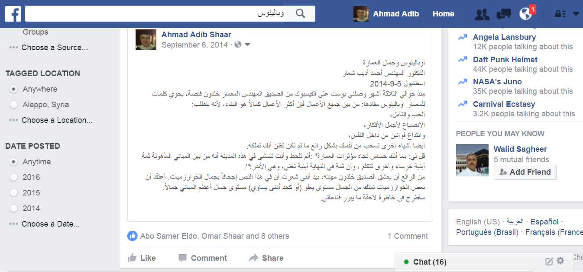
Outlines

Slide 4
My friend Khaldoun Fansa (a 70 years old architect), posted three months ago on Facebook: "buildings are the best example on (nonhuman) beauty: don't you notice that some of them nearly talk?".

Slide 5
I commented: I appreciate your faithfulness to your specialization, but I think algorithms (which are the main body of computer science) are the best example on beauty!
Give me some time to explain. After two months I posted the following article on Facebook.

Slide 6
There are several measures for beauty of nonhuman beings. One of the most important one is effectiveness (the cost). The following is a picture of one of Claremont University Consortium buildings, where effectiveness (cost) was one of the main factors in evaluating its architectural beauty.

Slide 7
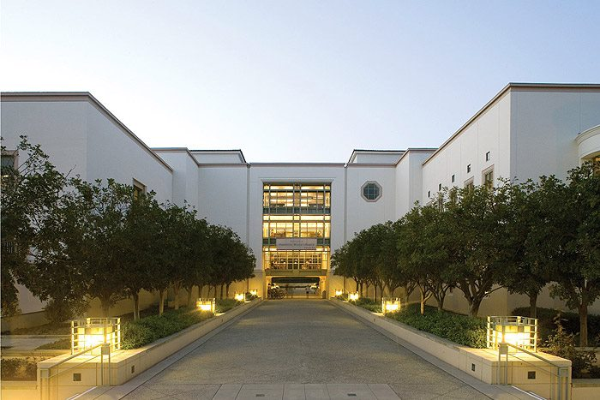

Slide 8
In order to imagine the effectiveness of this algorithm, I will compare its original, unimproved form, cost with the cost of building a bridge that costs 99 million Syrian Pounds.

Slide 9
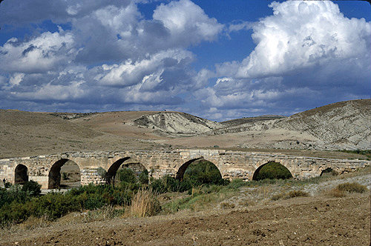
Roman bridge-countryside of Aleppo

Slide 10
The task: Design an algorithm to test whether the entered integer 101 is prime or not.

Slide 11
My student Sameer suggests Algorithm #1:
Relying on the definition of a prime number (a positive integer which can only be divided by itself and the number 1), this algorithm attempts dividing 101 by all numbers ranging between 2 and 100, in order.
If we don’t find a divisor we know 101 is a prime number. If we do find a divisor, we know it's not prime.

Slide 12
Check if 101 is prime by …
Beauty ~ efficiency
COST
(a) dividing by ALL values from 2 .. 100
99 £S
2, 3, 4, 5, …, 97, 98, 99, 100
insight: using the definition of "prime"

Slide 13
Then my student Zaid came and said: I have an algorithm which cuts the cost in half, Algorithm #2:
The same as algorithm #1, but without testing the division by even numbers, because of the simple fact that odd numbers (all prime numbers are odd with the exception of the number 2) are not divisible by any even number.

Slide 14
Check if 101 is prime by …
Beauty ~ efficiency
COST
(a) dividing by ALL values from 2 .. 100
99 £S
2, 3, 4, 5, …, 97, 98, 99, 100
insight: using the definition of "prime"
(b) dividing by ODD values from 2 .. 100
49 £S
2, 5, 7, 9, …, 93, 95, 97, 99
insight: 101 is odd, has no even divisors

Slide 15
Then my student Amr suggests an algorithm which cuts the cost to only 4 million Syrian Pounds. Algorithm #3:
The same as algorithm #2, but without trying to divide by numbers which are greater than 10,
relying on the fact that if no divisor is found for a number before its square root, then none will be found beyond it (here the square root is approximately 10).

Slide 16
Check if 101 is prime by …
Beauty ~ efficiency
COST
(a) dividing by ALL values from 2 .. 100
99 £S
2, 3, 4, 5, …, 97, 98, 99, 100
insight: using the definition of "prime"
(b) dividing by ODD values from 2 .. 100
49 £S
2, 5, 7, 9, …, 93, 95, 97, 99
insight: 101 is odd, has no even divisors
(c) dividing by ODD values from 2 .. 10
4 £S
3, 5, 7, 9
insight: only need to check upto sqrt(101)

Slide 17
My student Zaid, the designer of algorithm #2, laughs, saying: I have an even faster algorithm:

Slide 18
My student Zaid, the designer of algorithm #2, laughs, saying: I have an even faster algorithm:
The same as algorithm #3, but excluding dividing by 9,
because: we have already attempted dividing by 3, and since 9 is a multiple of 3, dividing by 9 would be redundant if we already tried division by 3
We only need prime divisors !

Slide 19
Check if 101 is prime by …
Beauty ~ efficiency
COST
(a) dividing by ALL values from 2 .. 100
99 £S
2, 3, 4, 5, …, 97, 98, 99, 100
insight: using the definition of "prime"
(b) dividing by ODD values from 2 .. 100
49 £S
2, 5, 7, 9, …, 93, 95, 97, 99
insight: 101 is odd, has no even divisors
(c) dividing by ODD values from 2 .. 10
4 £S
3, 5, 7, 9
insight: only need to check upto sqrt(101)
(d) dividing by PRIME values from 2 .. 10
3 £S
3, 5, 7
insight: only need to check prime factors!

Slide 20
Thank you
Comments and questions are welcomed

Slide 21
This would make me hungry… but I ate breakfast this morning!
Computing to the max
The not-so-subtle art of singling out the best (and worst) of anything…
Last hw?
N-step sleepwalking?
Turtle graphics??
a comparison comparison
Artistic renderings!!!
'm+ms'
'coffee'
[0, 42]
[4, 2]
This week!
[0, 'm+ms']
[4, 'coffee']
Hw #3 due next Monday…
> or <
pr0: Are we The Matrix?
pr1: Lab…
Computing with language
pr2: Sorting + Caesar!
What's in a Writ1 paper, anyway?
pr3: create a '90s webpage
Battle-tested ciphers & how to break them…

Slide 22
max
A recipe for life ?
and python already has it for us…
The real problem is knowing what we want to maximize!
... or minimize, with min

Slide 23
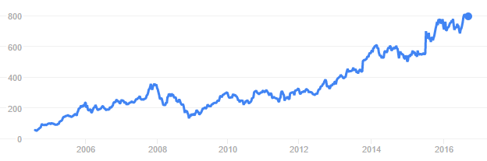
to the max
And I thought $100 was overpriced!
NASDAQ: GOOGL
Want the highest price?
max( [475.5, 458.0, 441.3, 470.8, 532.8, 520.9] )
ST
'nov'
'jan'
'mar'
'may'
'jul'
'sep'
What if the months are in there, as well?
max( [ [470.8,'may'], [532.8,'jul'], [520.9,'sep'] ] )
STm
max( [ ['may',470.8], ['jul',532.8], ['sep',520.9] ] )
mST

Slide 24
to the max
And I thought $100 was overpriced!
NASDAQ: GOOGL
Want the highest price?
max( [475.5, 458.0, 441.3, 470.8, 532.8, 520.9] )
ST
'nov'
'jan'
'mar'
'may'
'jul'
'sep'
What if the months are in there, as well?
max( [ [470.8,'may'], [532.8,'jul'], [520.9,'sep'] ] )
STm
max( [ ['may',470.8], ['jul',532.8], ['sep',520.9] ] )
mST
Mudd's max?
MSt
L = ['Harvey', 'Mudd', 'College', 'seeks', 'to', 'educate', 'engineers,', 'scientists', 'and', 'mathematicians', 'well-versed', 'in', 'all', 'of', 'these', 'areas', 'and', 'in', 'the', 'humanities', 'and', 'the', 'social', 'sciences', 'so', 'that', 'they', 'may', 'assume', 'leadership', 'in', 'their', 'fields', 'with', 'a', 'clear', 'understanding', 'of', 'the', 'impact', 'of', 'their', 'work', 'on', 'society']
max(MSt)
Or Mudd's min?
min(MSt)

Slide 25
recursive max
L
[ 7, 10, -2, 42, 15 ]
L = [ 'aliens', 'zap', 'hazy', 'code' ]
L[1:]
def max( L ):
""" returns the max element from L
input: L, a nonempty list
"""
if len(L) < 2: return L[0] # only 1 elem.
maxOfRest = max(L[1:]) # max of the rest
if L[0] > maxOfRest :
return L[0] # either L[0]
else:
return maxOfRest # or maxOfRest!
I love max rest!

Slide 26
max with scrabble-score
L = [ 'aliens', 'zap', 'hazy', 'code' ]
Which element has the highest scrabble score?
def maxSS( L ):
""" returns L's highest scrabble-scoring
element (input: L, a nonempty list)
"""
if len(L) < 2: return L[0] # only 1 elem.
maxOfRest = maxSS(L[1:]) # rest's max
if L[0] > maxOfRest :
return L[0] # either L[0]
else:
return maxOfRest # or maxOfRest!
Spacey! I like it!

Slide 27
max with scrabble-score
L = [ 'aliens', 'zap', 'hazy', 'code' ]
Which element has the highest scrabble score?
def maxSS( L ):
""" returns L's highest scrabble-scoring
element (input: L, a nonempty list)
"""
if len(L) < 2: return L[0] # only 1 elem.
maxOfRest = maxSS(L[1:]) # rest's max
if sScore(L[0]) > sScore(maxOfRest):
return L[0] # either L[0]
else:
return maxOfRest # or maxOfRest!
Spacey! I like it!

Slide 28
max with scrabble-score
L = [ 'aliens', 'zap', 'hazy', 'code' ]
Which element has the highest scrabble score?
def maxSS( L ):
""" returns L's highest scrabble-scoring
element (input: L, a nonempty list)
"""
if len(L) < 2: return L[0] # only 1 elem.
maxOfRest = maxSS(L[1:]) # rest's max
if sScore(L[0]) > sScore(maxOfRest):
return L[0] # either L[0]
else:
return maxOfRest # or maxOfRest!
Let's see if we can simplify this process... just for LoLs!
Spacey! I like it!

Slide 29
A more comprehensive solution: LoL
L = [ 'aliens', 'zap', 'hazy', 'code' ]
def maxSS( L ):
""" returns L's max-scrabble-score word
"""
LoL = [ [sScore(w), w] for w in L ]
bestpair = max( LoL )
return bestpair[1]
This does look funny!

Slide 30

A more comprehensive solution
L = [ 'aliens', 'zap', 'hazy', 'code' ]
def maxSS( L ):
""" returns L's max-scrabble-score word
"""
LoL = [ [sScore(w), w] for w in L ]
bestpair = max( LoL )
return bestpair[1]
This does look funny!

Slide 31
A more comprehensive solution
L = [ 'aliens', 'zap', 'hazy', 'code' ]
I loathe hazy code!
def maxSS( L ):
""" returns L's max-scrabble-score word
"""
LoL = [ [sScore(w), w] for w in L ]
bestpair = max( LoL )
return bestpair[1]
LoL = [ [6,'aliens'], [14,'zap'], [19,'hazy'], [7,'code'] ]
bestpair = [19,'hazy']
'hazy'

Slide 32
Everything … is a max problem?
I know the best word here… but does Python?
L = [ 'aliens', 'zap', 'hazy', 'code' ]
def revviestword( L ):
""" another example – what's returned?
"""
LoL = [ [w[::-1], w] for w in L ]
bestpair = max( LoL )
return bestpair[1]
LoL = [ [ 'sneila' ,'aliens'], [ 'paz' ,'zap'], [ 'yzah' ,'hazy'], [ 'edoc' ,'code'] ]
bestpair =

Slide 33
Other examples…
What is bestnumb ?
What is mostnumb ?
>>> bestnumb( [10,20,30,40,50,60,70] )
40
>>> bestnumb( [100,200,300,400] )
100
>>> bestnumb( [1,2,3,4,5,6,7,8,7] )
8
>>> mostnumb( [1,2,3,4,5,6,7,8,7] )
7
These functions have made me number

Slide 34
L = [ 'aliens', 'zap', 'hazy', 'code' ]
Name(s)
Quiz
def maxlen(L):
LoL = [ [len(s),s] for s in L ]
bstpr = max( LoL )
return bstpr[1]
1. What is LoL?
here is a start: LoL is [ [6,'aliens'], [3,'zap'], ___________, __________ ]
2. What is bstpr?
Extra!
Change exactly three characters in this code so that 3 is returned.
3. What is returned?
L = [ 30, 40, 50 ]
Use the LoL method to write these two functions
def bestnumb(L):
""" returns the # in L closest to 42 """
LoL = [ ]
bstpr =
return bstpr[1]
Hint: Python has abs(x) built-in
L = [ 3,4,5,7,6,7 ]
def mostnumb( L ):
""" returns the item most often in L """
LoL = [ ]
bstpr =
return bstpr[1]
Hint: Define a helper function!
def count(e,L):
""" return # of e's in L """

Slide 35
Quiz
L = [ 'aliens', 'zap', 'hazy', 'code' ]
Try this on the back page first!
def maxlen(L):
LoL = [ [len(s),s] for s in L ]
bstpr = max( LoL )
return bstpr[1]
1. What is LoL?
[ [6,'aliens'], [3,'zap'], [4,'hazy'], [4,'code'] ]
2. What is bstpr?
[6,'aliens']
Extra!
Change exactly three characters in this code so that 3 is returned.
3. What is returned?
'aliens'
L = [ 30, 40, 50 ]
def bestnumb(L):
""" returns the # in L closest to 42 """
LoL = [ [abs(x-42),x] for x in L ]
bstpr = min( LoL )
return bstpr[1]
Hint: Python has abs(x) built-in
L = [ 3,4,5,7,6,7 ]
def mostnumb( L ):
""" returns the item most often in L """
LoL = [ [count(e,L),e] for e in L ]
bstpr = max( LoL )
return bstpr[1]
Hint: Define a helper function!
def count(e,L):
LC = [1 for x in L \
if x==e]
return sum(LC)

Slide 36
L = [ 'aliens', 'zap', 'hazy', 'code' ]
def maxlen(L):
LoL = [ [len(s),s] for s in L ]
bstpr = max( LoL )
return bstpr[1]
1. What is LoL?
[ [6,'aliens'], [3,'zap'], [4,'hazy'], [4,'code'] ]
2. What is bstpr?
[6,'aliens']
'aliens'
3. What is returned?
Extra! Change exactly three characters in this code so that 3 is returned.

Slide 37
bestnumb
[30,40,50]
L
[[12,30],[2,40],[8,50]]
LoL
[2,40]
bstpr
[ 30, 40, 50 ]
40
bstpr[1]
def bestnumb( L ):
""" returns the # closest to 42 in L """
LoL = [ [abs(x-42),x] for x in L ]
bstpr = min( LoL )
return bstpr[1]

Slide 38
Helper function: count(e,L)
mostnumb
def count( e, L ):
""" returns the # of e's in L """
LC = [ 1 for x in L if x==e ]
return sum( LC )
L
[6,7,7,8]
LoL
[ [1,6], [2,7], [2,7], [1,8] ]
bstpr
[2,7]
[6,7,7,8]
bstpr[1]
7
def mostnumb( L ):
""" returns the item most often in L """
LoL = [ [count(e,L),e] for e in L ]
bstpr = max( LoL )
return bstpr[1]
Could you use x here instead of e?

Slide 39
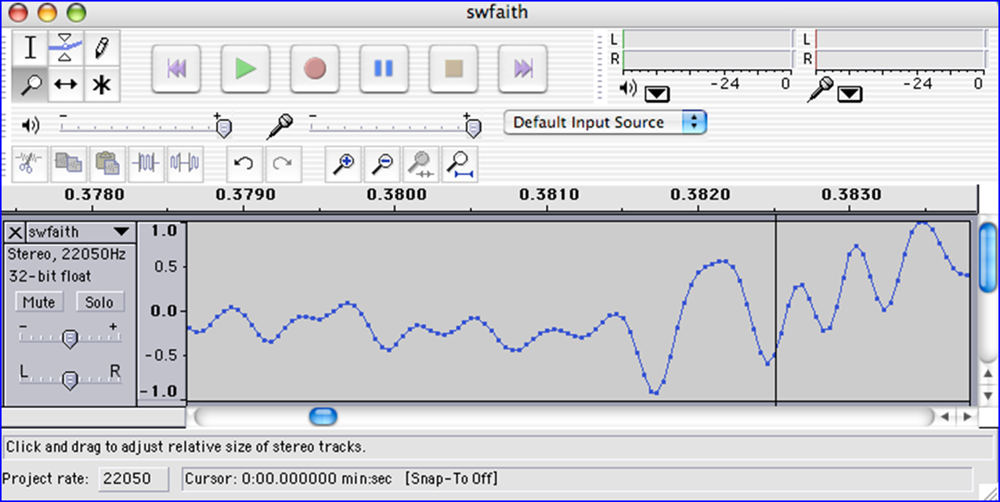
Today's lab: big data?
Any guesses as to what kind of data this is?
I find your lack of faith in this data disturbing.

Slide 40

Today's lab: sound data!
what are the vertical and horizontal axes here?

Slide 41
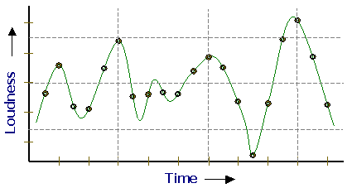
Lab3 ~ Sound
physics
continuous variation of air pressure vs. time
air pressure
sampling
samples taken every 1/22050th of a second (or some sampling rate)
time
quantization
Each sample is measured on a loudness scale from -32,768 to 32,767. (This fits into 2 bytes.)
storage
These two bytes are called a frame. Raw audio data - such as what is written to the surface of a CD - is simply a list of these frames.
pulse code modulation = PCM data
some examples...

Slide 42
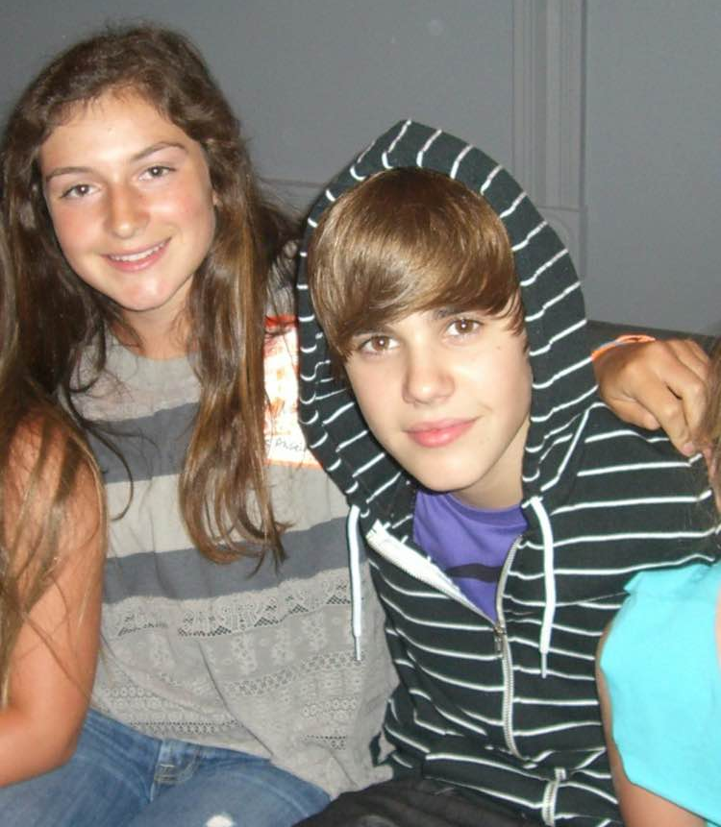
CS5 Beliebs!
physics
continuous variation of air pressure vs. time
air pressure
sampling
samples taken every 1/22050th of a second (or some sampling rate)
time
quantization
Each sample is measured on a loudness scale from -32,768 to 32,767. (This fits into 2 bytes.)
storage
These two bytes are called a frame. Raw audio data - such as what is written to the surface of a CD - is simply a list of these frames.
Thanks, Sarah!
pulse code modulation = PCM data
some examples...

Slide 43
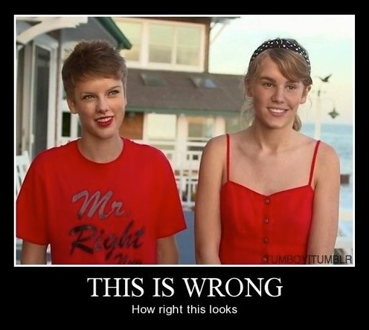
CS5 Beliebs...
in what!?
physics
continuous variation of air pressure vs. time
air pressure
sampling
samples taken every 1/22050th of a second (or some sampling rate)
time
quantization
Each sample is measured on a loudness scale from -32,768 to 32,767. (This fits into 2 bytes.)
storage
These two bytes are called a frame. Raw audio data - such as what is written to the surface of a CD - is simply a list of these frames.
Thanks, Sarah!
pulse code modulation = PCM data
some examples...
+ Merritt + Montana

Slide 44
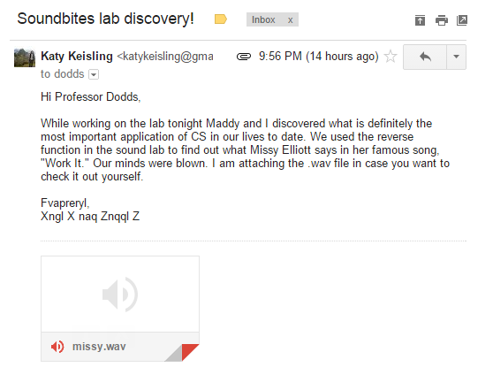
We saw you in Lab3…
heard

Slide 45

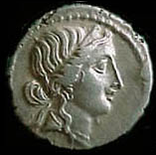


Computing with language
ideas / meaning
language / words / phrases
Python strings are here.
strings
numbers / bits

Slide 46
Computing with language
open questions in AI …
ideas / meaning
Eliza, Siri, Tay ... trouble?
language / words / phrases
This week…
processing language – how English-y is it?
strings
how strings are represented and stored
numbers / bits
Next week…

Slide 47
Caesar Cipher: encipher
What is it doing?
encipher(s,n)
encipher( 'I <3 Latin' , 0 )
'I <3 Latin'
'J <3 Mbujo'
'K <3 Ncvkp'
'L <3 Odwlq'
'M <3 Pexmr'
'N <3 Qfyns'
returns
encipher( 'I <3 Latin' , 1 )
returns
encipher( 'I <3 Latin' , 2 )
returns
encipher( 'I <3 Latin' , 3 )
returns
encipher( 'I <3 Latin' , 4 )
returns
encipher( 'I <3 Latin' , 5 )
returns
encipher( 'I <3 Latin' , 25 )
'H <3 Kzshm'
returns

Slide 48
Caesar Cipher: encipher
should return the string s with each alphabetic character shifted/wrapped by n places in the alphabet
encipher(s,n)
encipher( 'I <3 Latin' , 0 )
'I <3 Latin'
'J <3 Mbujo'
'K <3 Ncvkp'
'L <3 Odwlq'
'M <3 Pexmr'
'N <3 Qfyns'
CA
returns
encipher( 'I <3 Latin' , 1 )
returns
encipher( 'I <3 Latin' , 2 )
returns
encipher( 'I <3 Latin' , 3 )
returns
encipher( 'I <3 Latin' , 4 )
returns
encipher( 'I <3 Latin' , 5 )
returns
encipher( 'I <3 Latin' , 25 )
'H <3 Kzshm'
returns

Slide 49
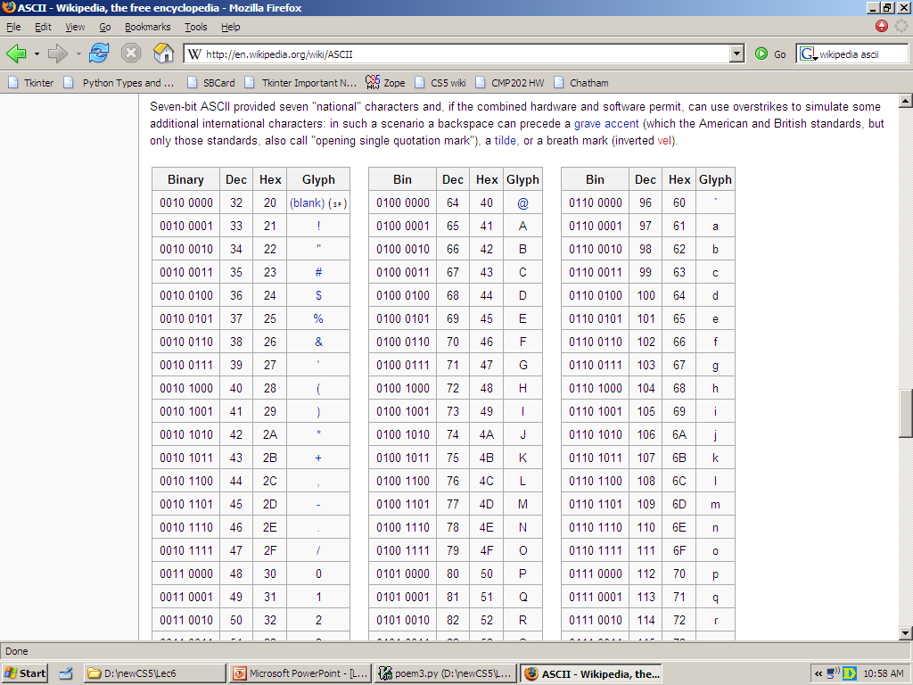
ASCII
American Standard Code for Information Interchange
convert # to char
chr
1 byte
ord
8 bits
convert char to #
The SAME bits represent an integer or a string, depending on type: int or str

Slide 50
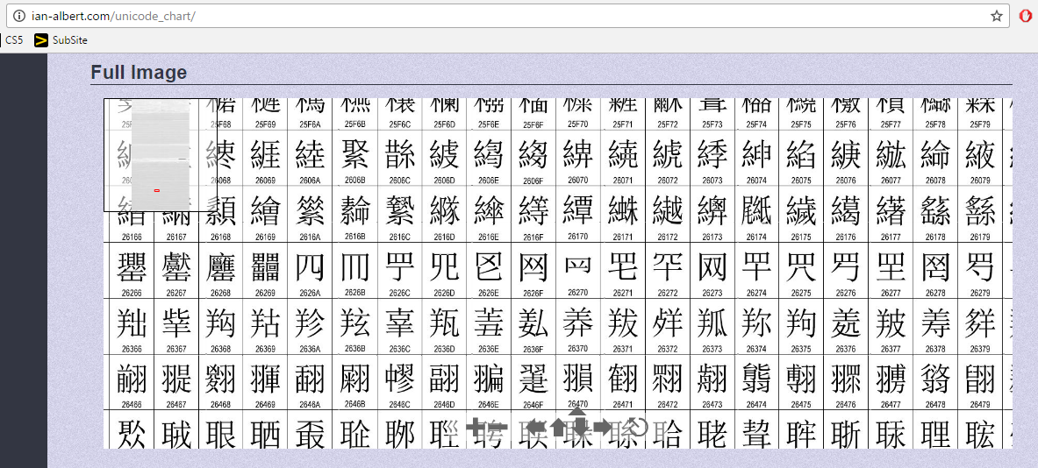
Unicode
Universal Character Encoding
!!!
http://ian-albert.com/unicode_chart/
Some fun characters...
chr(156265)
chr(9835)
chr(9731)
My favorite is chr(1661)
on Win10: chcp 65001

Slide 51
ASCII or Unicode...
value:
'/'
00101111
type: str
bits
name:
Identical bits are stored in each variable!
The types determine how to interpret the bits; the names don't matter at all…
1 byte
value:
47
8 bits
00101111
type: int
bits
name:
The SAME bits represent an integer or a string, depending on type: int or str
over in memory…

Slide 52
ASCII and Unicode
convert # to char
chr
ord
convert char to #
This is why 'CS' < 'clear' !
Julius spr'15

Slide 53
ASCII and Unicode
Ex1
convert # to char
[ [i,chr(i)] for i in range(128) ]
chr
Ex2
ord
[ ord(i) for i in '**** CS! ****' ]
convert char to #
This is why 'CS' < 'clear' !
Julius spr'15

Slide 54
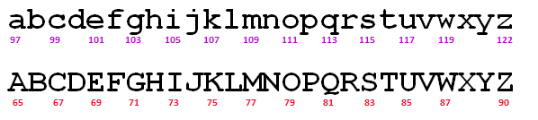
Rot13
a useful and illustrative starting point...
rot13('a') should output 'n'
adding 13
rot13('M') should output 'Z'
rot13('n') should output 'a'
wrapping
rot13('W') should output 'J'
rot13(' ') should output ' '
spaces + other characters
rot13('<') should output '<'

Slide 55
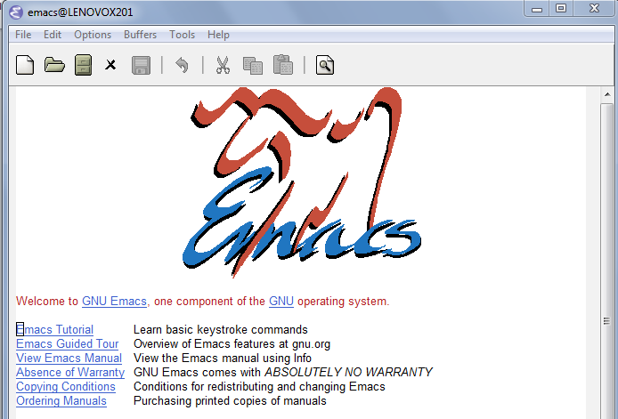
rot13's surprising history...

Slide 56
ASCII and Unicode
chr value
abcdefghijklmnopqrstuvwxyz
97
ord value
99
101
103
105
107
109
111
113
115
117
119
122
chr value
ABCDEFGHIJKLMNOPQRSTUVWXYZ
65
ord value
67
69
71
73
75
77
79
81
83
85
87
90
convert # to char
chr
What is ord('U')//2?
What is chr( ord('i')+13 )?
ord
What is chr( ord('W')+13 )?
convert char to #
how do we wrap?

Slide 57
any single character, c
Writing Rot13
def rot13( c ):
""" rotates c by 13 chars, "wrapping" as needed
NON-LETTERS don't change!
"""
if 'a' <= c <= 'z':
if ord(c)+13 <= ord('z'):
return chr( ord(c)+13 )
else:
return chr( )
elif 'A' <= c <= 'Z': # upper-case test!
else:
(0) What do these tests do?
(1) What code will "wrap" to the alphabet's other side?
(2) How will upper case change? Try noting only the code differences…
(3) What if c is not a letter at all?
Extra: How would you rotate n places, instead of 13?

Slide 58
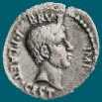
Caesar Cipher: encipher
Caesar
Brutus
>>> encipher('Bzdrzq bhogdq? H oqdedq Bzdrzq rzkzc.',25)
'Aycqyp agnfcp? G npcdcp Aycqyp qyjyb.'
S1
>>> encipher('Bzdrzq bhogdq? H oqdedq Bzdrzq rzkzc.',15)
'Qosgof qwdvsf? W dfstsf Qosgof gozor.'
>>> encipher('Bzdrzq bhogdq? H oqdedq Bzdrzq rzkzc.',4)
'Fdhvdu flskhu? L suhihu Fdhvdu vdodg.'
>>> encipher('Bzdrzq bhogdq? H oqdedq Bzdrzq rzkzc.',1)
'Caesar cipher? I prefer Caesar salad.'
>>> encipher('Hu lkbjhapvu pz doha ylthpuz hmaly dl mvynla '\
'lclyfaopun dl ohcl slhyulk.',19)
'An education is what remains after we forget everything we have learned.'
S2

Slide 59
Caesar Cipher: decipher
Caesar
Brutus
>>> decipher('Bzdrzq bhogdq? H oqdedq Bzdrzq rzkzc.')
'Caesar cipher? I prefer Caesar salad.'
S1
S2
>>> decipher('Hu lkbjhapvu pz doha ylthpuz hmaly dl mvynla '\
'lclyfaopun dl ohcl slhyulk.')
'An education is what remains after we forget everything we have learned.'
>>> decipher('Uifz xpsl ju pvu xjui b qfodjm!')
PL
LAT
>>> decipher('gv vw dtwvg')
How!?
Which is more difficult computationally?

Slide 60
Decipher?
Strategies?
Algorithms?

Slide 61
gv vw dtwvg
hw wx euxwh
ix xy fvyxi
jy yz gwzyj
kz za hxazk
la ab iybal
mb bc jzcbm
nc cd kadcn
od de lbedo
pe ef mcfep
qf fg ndgfq
rg gh oehgr
sh hi pfihs
ti ij qgjit
uj jk rhkju
vk kl silkv
wl lm tjmlw
xm mn uknmx
yn no vlony
zo op wmpoz
ap pq xnqpa
bq qr yorqb
cr rs zpsrc
ds st aqtsd
et tu brute
fu uv csvuf
Decipher?
All possible decipherings
Strategies?
Algorithms?

Slide 62
gv vw dtwvg
hw wx euxwh
ix xy fvyxi
jy yz gwzyj
kz za hxazk
la ab iybal
mb bc jzcbm
nc cd kadcn
od de lbedo
pe ef mcfep
qf fg ndgfq
rg gh oehgr
sh hi pfihs
ti ij qgjit
uj jk rhkju
vk kl silkv
wl lm tjmlw
xm mn uknmx
yn no vlony
zo op wmpoz
ap pq xnqpa
bq qr yorqb
cr rs zpsrc
ds st aqtsd
et tu brute
fu uv csvuf
[0, 'gv vw dtwvg'],
[2, 'hw wx euxwh'],
[2, 'ix xy fvyxi'],
[0, 'jy yz gwzyj'],
[2, 'kz za hxazk'],
[4, 'la ab iybal'],
[0, 'mb bc jzcbm'],
[1, 'nc cd kadcn'],
[4, 'od de lbedo'],
[3, 'pe ef mcfep'],
[0, 'qf fg ndgfq'],
[2, 'rg gh oehgr'],
[2, 'sh hi pfihs'],
[3, 'ti ij qgjit'],
[2, 'uj jk rhkju'],
[1, 'vk kl silkv'],
[0, 'wl lm tjmlw'],
[1, 'xm mn uknmx'],
[2, 'yn no vlony'],
[3, 'zo op wmpoz'],
[2, 'ap pq xnqpa'],
[1, 'bq qr yorqb'],
[0, 'cr rs zpsrc'],
[1, 'ds st aqtsd'],
[4, 'et tu brute'],
[3, 'fu uv csvuf']
Decipher?
All possible decipherings
Score them all
Strategies?
Algorithms?
quantifying Englishness?

Slide 63
gv vw dtwvg
hw wx euxwh
ix xy fvyxi
jy yz gwzyj
kz za hxazk
la ab iybal
mb bc jzcbm
nc cd kadcn
od de lbedo
pe ef mcfep
qf fg ndgfq
rg gh oehgr
sh hi pfihs
ti ij qgjit
uj jk rhkju
vk kl silkv
wl lm tjmlw
xm mn uknmx
yn no vlony
zo op wmpoz
ap pq xnqpa
bq qr yorqb
cr rs zpsrc
ds st aqtsd
et tu brute
fu uv csvuf
[0, 'gv vw dtwvg'],
[2, 'hw wx euxwh'],
[2, 'ix xy fvyxi'],
[0, 'jy yz gwzyj'],
[2, 'kz za hxazk'],
[4, 'la ab iybal'],
[0, 'mb bc jzcbm'],
[1, 'nc cd kadcn'],
[4, 'od de lbedo'],
[3, 'pe ef mcfep'],
[0, 'qf fg ndgfq'],
[2, 'rg gh oehgr'],
[2, 'sh hi pfihs'],
[3, 'ti ij qgjit'],
[2, 'uj jk rhkju'],
[1, 'vk kl silkv'],
[0, 'wl lm tjmlw'],
[1, 'xm mn uknmx'],
[2, 'yn no vlony'],
[3, 'zo op wmpoz'],
[2, 'ap pq xnqpa'],
[1, 'bq qr yorqb'],
[0, 'cr rs zpsrc'],
[1, 'ds st aqtsd'],
[4, 'et tu brute'],
[3, 'fu uv csvuf']
Decipher?
All possible decipherings
max!
Score them all
Strategies?
Algorithms?
yields the "most English" phrase

Slide 64
Measuring Englishness
Very English-y
"Call me Ishmael."
"Attack at dawn!"
"rainbow, table, candle"
higher scores
"Yow! Legally-imposed CULTURE-reduction
is CABBAGE-BRAINED!"
"quadruplicity drinks procrastination"
"Hold the newsreader's nose squarely, waiter, or
friendly milk will countermand my trousers."
quantifying Englishness?
"the gostak distims the doshes"
"hension, framble, bardle"
"jufict, stofwus, lictpub"
"itehbs, rsnevtr, khbsota"
lower scores
"epadxo, nojarpn, gdxokpw"
"h o q dedqBzdrzqrzkzc"
All of these sound
good to me!
Not English-y

Slide 65
gv vw dtwvg
hw wx euxwh
ix xy fvyxi
jy yz gwzyj
kz za hxazk
la ab iybal
mb bc jzcbm
nc cd kadcn
od de lbedo
pe ef mcfep
qf fg ndgfq
rg gh oehgr
sh hi pfihs
ti ij qgjit
uj jk rhkju
vk kl silkv
wl lm tjmlw
xm mn uknmx
yn no vlony
zo op wmpoz
ap pq xnqpa
bq qr yorqb
cr rs zpsrc
ds st aqtsd
et tu brute
fu uv csvuf
[0, 'gv vw dtwvg'],
[2, 'hw wx euxwh'],
[2, 'ix xy fvyxi'],
[0, 'jy yz gwzyj'],
[2, 'kz za hxazk'],
[4, 'la ab iybal'],
[0, 'mb bc jzcbm'],
[1, 'nc cd kadcn'],
[4, 'od de lbedo'],
[3, 'pe ef mcfep'],
[0, 'qf fg ndgfq'],
[2, 'rg gh oehgr'],
[2, 'sh hi pfihs'],
[3, 'ti ij qgjit'],
[2, 'uj jk rhkju'],
[1, 'vk kl silkv'],
[0, 'wl lm tjmlw'],
[1, 'xm mn uknmx'],
[2, 'yn no vlony'],
[3, 'zo op wmpoz'],
[2, 'ap pq xnqpa'],
[1, 'bq qr yorqb'],
[0, 'cr rs zpsrc'],
[1, 'ds st aqtsd'],
[4, 'et tu brute'],
[3, 'fu uv csvuf']
Decipher?
All possible decipherings
max!
Score them all
Strategies?
Algorithms?
"Englishness" score based on #-of-vowels

Slide 66
gv vw dtwvg
hw wx euxwh
ix xy fvyxi
jy yz gwzyj
kz za hxazk
la ab iybal
mb bc jzcbm
nc cd kadcn
od de lbedo
pe ef mcfep
qf fg ndgfq
rg gh oehgr
sh hi pfihs
ti ij qgjit
uj jk rhkju
vk kl silkv
wl lm tjmlw
xm mn uknmx
yn no vlony
zo op wmpoz
ap pq xnqpa
bq qr yorqb
cr rs zpsrc
ds st aqtsd
et tu brute
fu uv csvuf
[6.9e-05, 'gv vw dtwvg'],
[3.6e-05, 'hw wx euxwh'],
[1.4e-07, 'ix xy fvyxi'],
[8.8e-11, 'jy yz gwzyj'],
[7.2e-10, 'kz za hxazk'],
[0.01503, 'la ab iybal'],
[3.7e-08, 'mb bc jzcbm'],
[0.00524, 'nc cd kadcn'],
[0.29041, 'od de lbedo'],
[0.00874, 'pe ef mcfep'],
[7.3e-07, 'qf fg ndgfq'],
[0.06410, 'rg gh oehgr'],
[0.11955, 'sh hi pfihs'],
[3.1e-06, 'ti ij qgjit'],
[1.1e-08, 'uj jk rhkju'],
[2.6e-05, 'vk kl silkv'],
[0.00012, 'wl lm tjmlw'],
[3.1e-06, 'xm mn uknmx'],
[0.02011, 'yn no vlony'],
[1.5e-06, 'zo op wmpoz'],
[1.9e-07, 'ap pq xnqpa'],
[5.7e-08, 'bq qr yorqb'],
[0.00024, 'cr rs zpsrc'],
[0.02060, 'ds st aqtsd'],
[0.45555, 'et tu brute'],
[0.00011, 'fu uv csvuf']
Decipher?
All possible decipherings
S
c
o
r
e
s
Strategies?
Algorithms?
"Englishness" based on letter-probabilities
max!

Slide 67
We'll see you in Lab3 !
hear
Earbuds are helpful for lab - unless you really like Darth Vader!

Slide 69
This would make me hungry… but I ate breakfast this morning!
Computing to the max
The not-so-subtle art of singling out the best (and worst) of anything…
Last hw?
Adib, to start!
N-step sleepwalking?
a comparison comparison
Turtle graphics??
Artistic renderings!!!
'm+ms'
'coffee'
[ 0, 42 ]
[ 4, 2 ]
This week!
True
'True'
> or <
Hw #3 due next Monday…
pr0: Are we The Matrix?
Computing with language
pr1: Lab…
pr2: Sorting + Caesar!
What's in a Writ1 paper, anyway?
Battle-tested ciphers & how to break them…

Slide 70
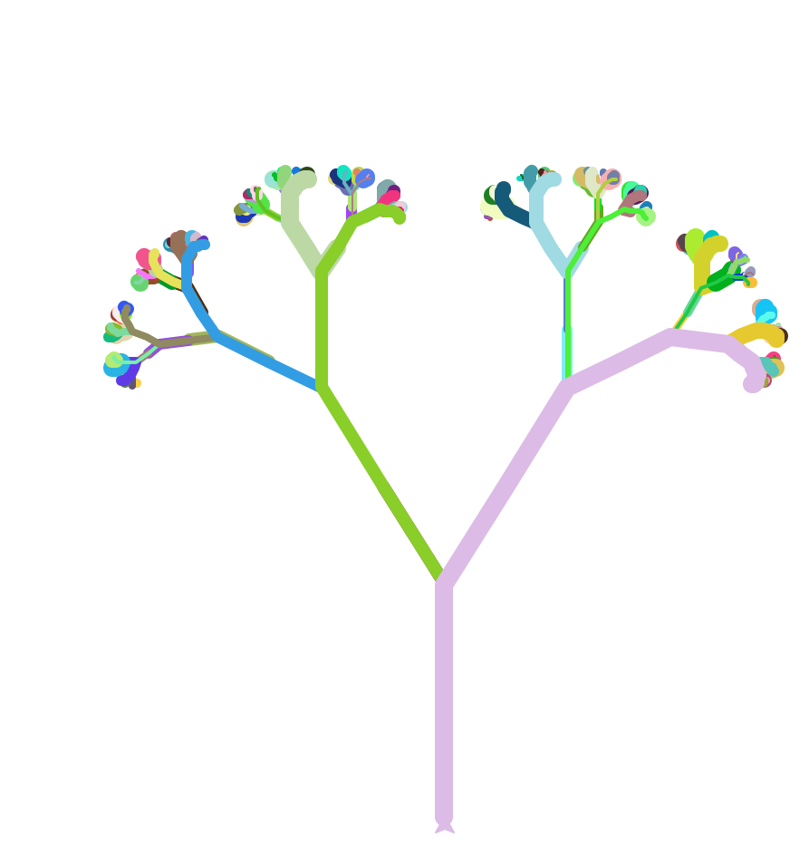
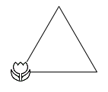
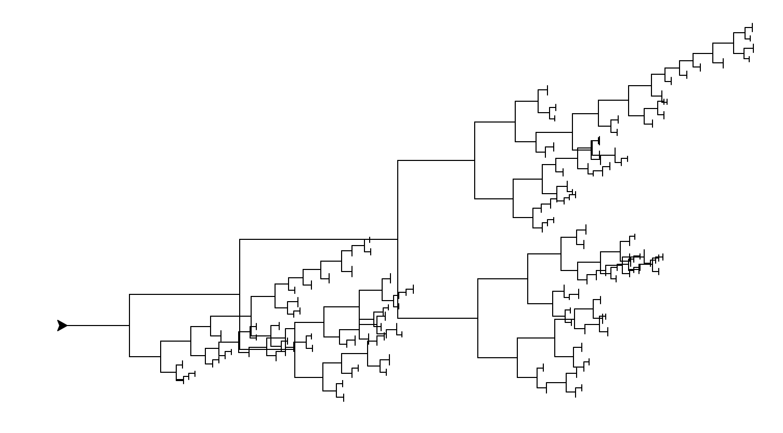
Extra-credit forest…
and Evy Larsen!
thank you to Flo Walsh!

Slide 71
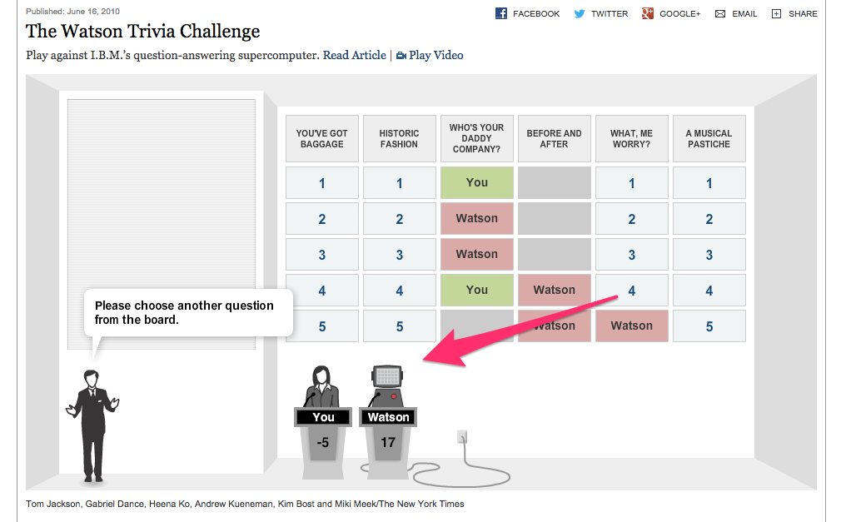
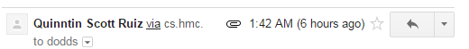
CS5 in the browser – sort of …
thanks to Quinn Ruiz for this!

Slide 72
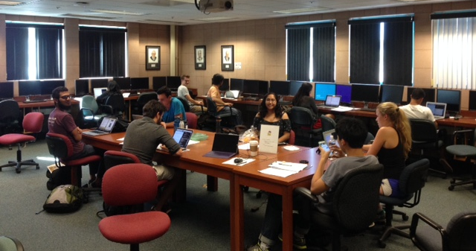
Notes from our amazing CS5 grutors…
Join in!
and/or join my office hours on Fridays, 2:30-4:30 or so @ the LAC lab
and others!

Slide 73
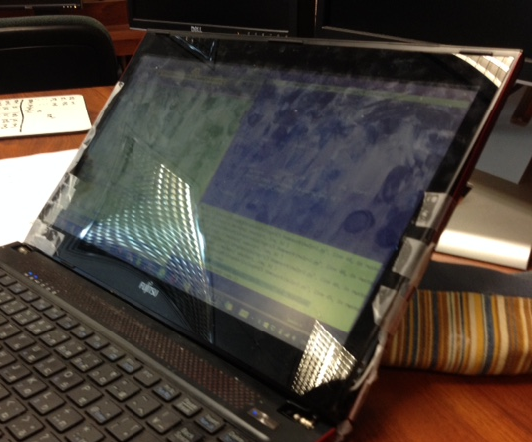
Notes from our amazing CS5 grutors…
Join in!
No matter what's holding your machine together!
and/or join my office hours on Fridays, 2:30-4:30 or so @ the LAC lab
and others!

Slide 74
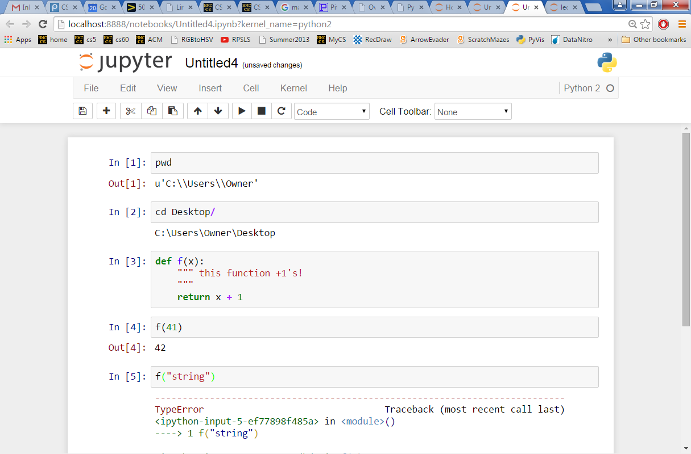
CS5 in the browser – yes …
try it out, maybe later this week…
instructions are at the start of this week's Lab…

Slide 75
scrabble-score max
['Harvey', 'Mudd', 'College', 'seeks', 'to', 'educate', … ]
def bestWord( L ):
""" returns L's max-scrabble-score word
input: L, a list of strings (words)
"""
if len(L) < 2: # one element is the max
return L[0]
elif L[0] < L[1] : #1 wins
return bestWord( L[1:] )
else: #0 wins
return bestWord( L[0:1] + L[2:] )
What do we need here?

Slide 76
A more comprehensive solution
L = [ 'aliens', 'zap', 'hazy', 'code' ]
I loathe hazy code!
def maxSS( L ):
""" returns L's max-scrabble-score word
"""
LoL = [ [sScore(w), w] for w in L ]
bestpair = max( LoL )
return bestpair[1]
LoL = [ [6,'aliens'], [14,'zap'], [19,'hazy'], [7,'code'] ]
bestpair = [19,'hazy']
'hazy'

Slide 77
variation: max
[ 7, 10, -2, 41, -46, 42, 15 ]
def max( L ):
""" returns the max element from L
input: L, a nonempty list
"""
if len(L) < 2: # one element is the max.
return L[0]
rest_max = max(L[1:]) # max of the rest
if L[0] > rest_max : # L[0]…
return L[0]
else:
return rest_max # … or rest_max wins!
Spacey! I like it!

Slide 78
general-purpose max
[ 7, 10, -2, 41, -46, 42, 15 ]
def max( L ):
""" returns the max element from L
input: L, a nonempty list
"""
if len(L) < 2: # one element is the max.
return L[0]
rest_max = max(L[1:]) # max of the rest
if L[0] > rest_max : # L[0]…
return L[0]
else:
return rest_max # … or rest_max wins!
Spacey! I like it!

Slide 79
general-purpose max
[ 7, 10, -2, 41, -46, 42, 15 ]
def max( L ):
""" returns the max element from L
input: L, a nonempty list
"""
if len(L) < 2: # one element is the max.
return L[0]
rest_max = max(L[1:]) # max of the rest
if sScore(L[0]) > sScore(rest_max): # L[0]…
return L[0]
else:
return rest_max # … or rest_max wins!

Slide 80
scrabble-score max
['Harvey', 'Mudd', 'College', 'seeks', 'to', 'educate', … ]
def bestWord( L ):
""" returns L's max-scrabble-score word
input: L, a list of strings (words)
"""
if len(L) < 2: # one element is the max
return L[0]
elif sScore(L[0]) < sScore(L[1]): #1 wins
return bestWord( L[1:] )
else: #0 wins
return bestWord( L[0:1] + L[2:] )
What do we need here?
What else might be nice to know ?

Slide 81
sword button?

Slide 82
chr and ord
abcdefghijklmnopqrstuvwxyz
ASCII values
97
ord value
99
101
103
105
107
109
111
113
115
117
119
122
ABCDEFGHIJKLMNOPQRSTUVWXYZ
65
ord value
67
69
71
73
75
77
79
81
83
85
87
90
ord( c )
Input: a string of one character, c
Conversion functions
Output: an integer, the ASCII value of c
chr( n )
Input: an integer in range(255)
Output: a one-char. string of that ASCII value

Slide 83
chr, ord,
and rot13
Finish rot13 to "shift" a letter, c, by 13 spots…
def rot13( c ):
""" rotate c by 13 chars, "wrapping" as needed; NON-LETTERS don't change """
if 'a' <= c <= 'z': # test if c is a lowercase letter
new_ord = ord(c) + 13 # if so, find the # 13 spots ahead
if new_ord <= ord('z'): # check if it's in bounds!
return chr(new_ord) # if so, return it
else: # otherwise
return # what to return?
elif # what test should go here?
# what would go here, if we had room?
else: # what should be done in the else?
How would this change if we wanted to rotate by n spots?

Slide 84


sword button?

Slide 85
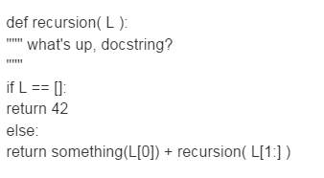
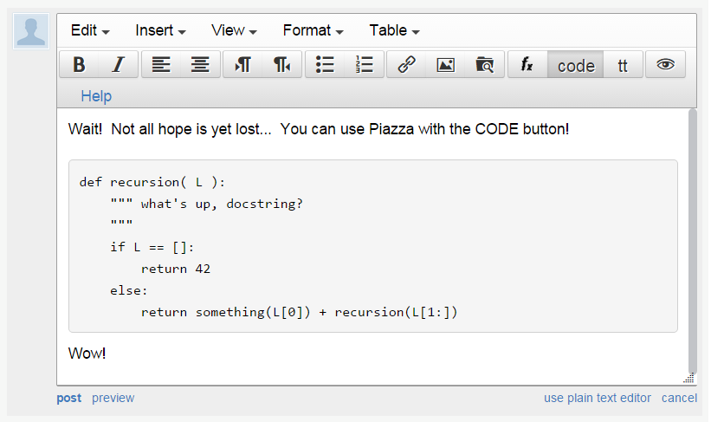
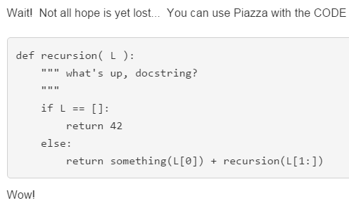
sword button?
code button!
creating a private post to Piazza because something is not working… ?
bugs, vanquished!
code button – then paste

Slide 86
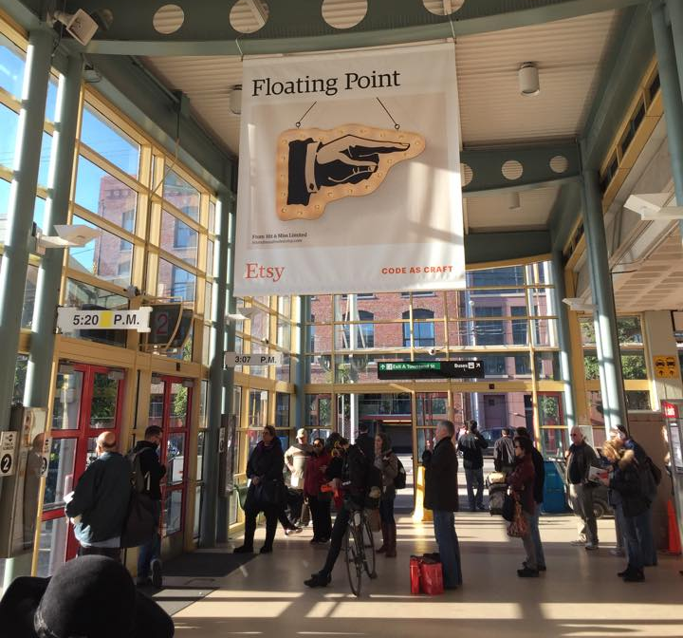
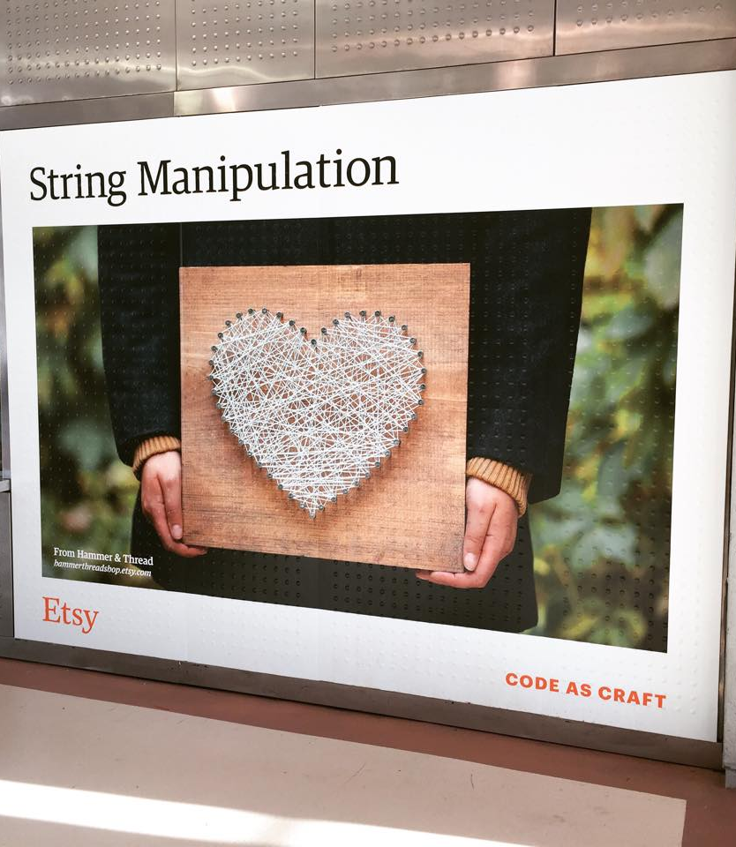
Syntax vs. Semantics
Karen and Erin!
Plus – you might consider coming to the Career Fair this Friday at HMC's LAC…

Slide 87
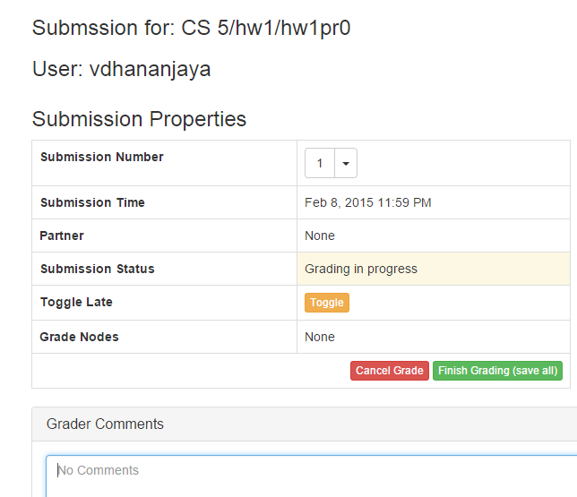
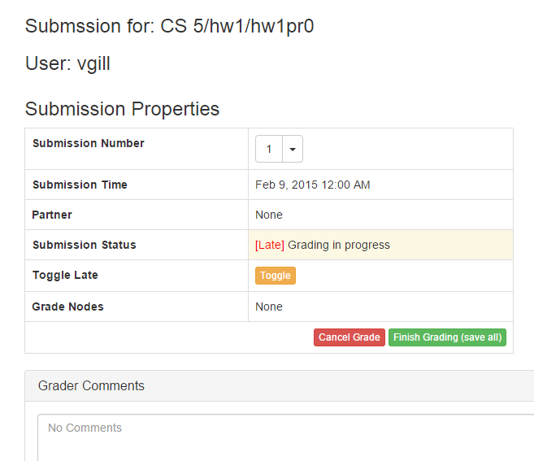
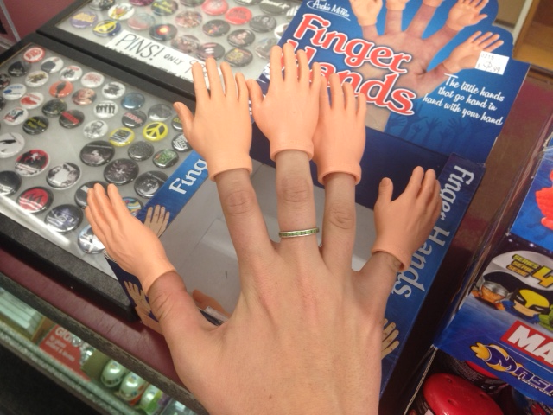
thanks, Nina!

Slide 88
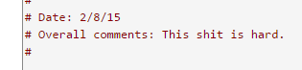
thanks, Nina!

Slide 89
Caesar Cipher: decipher
Caesar
Brutus
>>> decipher('Bzdrzq bhogdq? H oqdedq Bzdrzq rzkzc.')
'Caesar cipher? I prefer Caesar salad.'
S1
S2
Becca's connection with Islamic studies…
>>> decipher('Hu lkbjhapvu pz doha ylthpuz hmaly dl mvynla '\
'lclyfaopun dl ohcl slhyulk.')
'An education is what remains after we forget everything we have learned.'
>>> decipher('Uifz xpsl ju pvu xjui b qfodjm!')
PL
LAT
>>> decipher('gv vw dtwvg')
But how ?

Slide 90
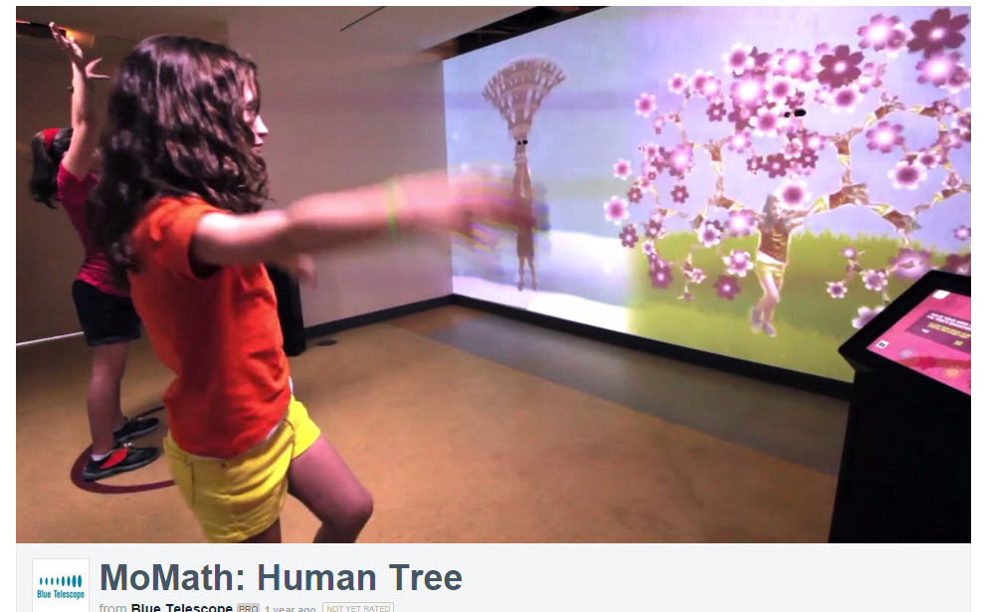


Slide 91
Rot 13
def rot13( c ):
""" rotates c by 13 chars, "wrapping" as needed
NON-LETTERS don't change!
"""
if 'a' <= c <= 'z':
new_ord = ord(c) + 13
if new_ord <= ord('z'):
return chr(new_ord)
else:
return chr( )
elif 'A' <= c <= 'Z': # upper-case test!
else:
Rotate n? Rotate an entire string?

Slide 92
Rot 13
def rot13( c ):
""" rotates c by 13 chars, "wrapping" as needed
NON-LETTERS don't change!
"""
if 'a' <= c <= 'z':
new_ord = ord(c) + 13
if new_ord <= ord('z'):
return chr(new_ord)
else:
return chr( )
elif 'A' <= c <= 'Z': # upper-case test!
else:
Rotate n? Rotate an entire string?

Slide 93
A more comprehensive solution
I loathe hazy code!
L = [ 'aliens', 'zap', 'hazy', 'code' ]
def bestWord( L ):
""" returns L's max-scrabble-score word
"""
LoL = [ [sScore(w), w] for w in L ]
bestpair = max( LoL )
return bestpair[1]
LoL = [ [6,'aliens'], [14,'zap'], [19,'hazy'], [7,'code'] ]
bestpair = [19,'hazy']
'hazy'

Slide 94
chr, ord,
and rot13
What is ord('U')/2?
What is chr( ord('i')+13 )?
What is chr( ord('W')+13 )?
Finish rot13 to "shift" letters by 13 spots…
def rot13( c ):
""" rotate c by 13 chars, "wrapping" as needed; NON-LETTERS don't change """
if 'a' <= c <= 'z': # test if c is a lowercase letter
new_ord = ord(c) + 13 # if so, find the # 13 spots ahead
if new_ord <= ord('z'): # check if it's in bounds!
return chr(new_ord) # if so, return it
else: # otherwise
return # what to return?
elif # what test should go here?
# what would go here, if we had room?
else: # what should be done in the else?
How would this change if we wanted to rotate by n spots?

Slide 95
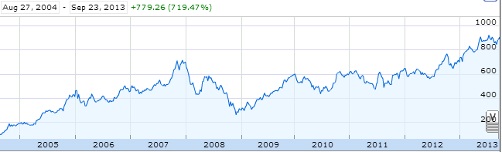
Aside: web scraping
How could we grab today's stock price via Python?

Slide 96
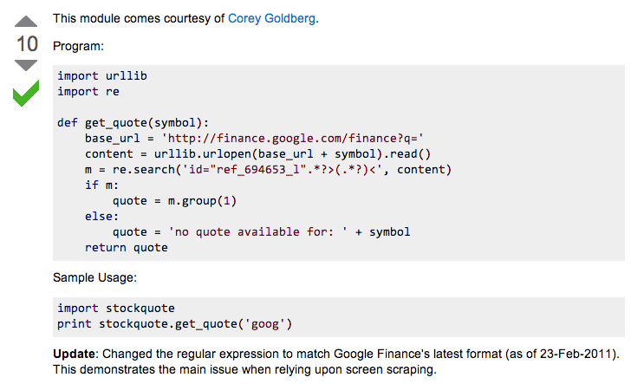
Example: web scraping
http://stackoverflow.com/questions/5081710/how-to-create-a-stock-quote-fetching-app-in-python

Slide 97
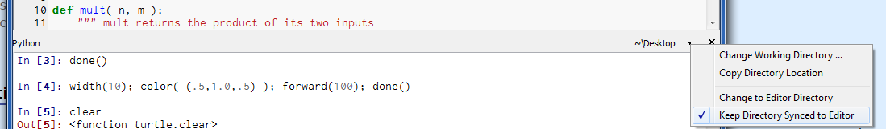

Slide 98
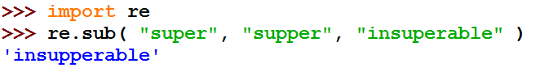
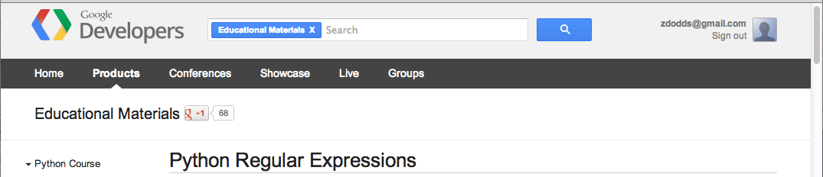
Regular Expressions
a huge string-processing library
many tutorials available…
developers.google.com/edu/python/regular-expressions?csw=1

Slide 99
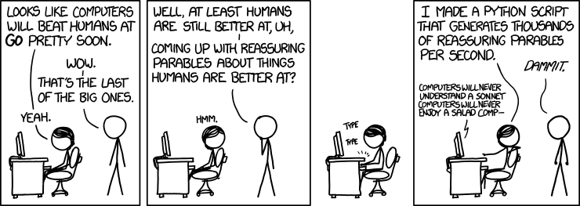
String-processing perspective…
with thanks to Jacquelyn Zehner!
http://stackoverflow.com/questions/5081710/how-to-create-a-stock-quote-fetching-app-in-python

Slide 101
Caesar Cipher: decipher
Caesar
[0, 'gv vw dtwvg'],
[2, 'hw wx euxwh'],
[2, 'ix xy fvyxi'],
[0, 'jy yz gwzyj'],
[2, 'kz za hxazk'],
[4, 'la ab iybal'],
[0, 'mb bc jzcbm'],
[1, 'nc cd kadcn'],
[4, 'od de lbedo'],
[3, 'pe ef mcfep'],
[0, 'qf fg ndgfq'],
[2, 'rg gh oehgr'],
[2, 'sh hi pfihs'],
[3, 'ti ij qgjit'],
[2, 'uj jk rhkju'],
[1, 'vk kl silkv'],
[0, 'wl lm tjmlw'],
[1, 'xm mn uknmx'],
[2, 'yn no vlony'],
[3, 'zo op wmpoz'],
[2, 'ap pq xnqpa'],
[1, 'bq qr yorqb'],
[0, 'cr rs zpsrc'],
[1, 'ds st aqtsd'],
[4, 'et tu brute'],
[3, 'fu uv csvuf']
Brutus
number-of-vowels score
max
won't always be correct!
all 26 possibilities

Slide 102
Caesar Cipher: decipher
Caesar
[6.9e-05, 'gv vw dtwvg'],
[3.6e-05, 'hw wx euxwh'],
[1.4e-07, 'ix xy fvyxi'],
[8.8e-11, 'jy yz gwzyj'],
[7.2e-10, 'kz za hxazk'],
[0.01503, 'la ab iybal'],
[3.7e-08, 'mb bc jzcbm'],
[0.00524, 'nc cd kadcn'],
[0.29041, 'od de lbedo'],
[0.00874, 'pe ef mcfep'],
[7.3e-07, 'qf fg ndgfq'],
[0.06410, 'rg gh oehgr'],
[0.11955, 'sh hi pfihs'],
[3.1e-06, 'ti ij qgjit'],
[1.1e-08, 'uj jk rhkju'],
[2.6e-05, 'vk kl silkv'],
[0.00012, 'wl lm tjmlw'],
[3.1e-06, 'xm mn uknmx'],
[0.02011, 'yn no vlony'],
[1.5e-06, 'zo op wmpoz'],
[1.9e-07, 'ap pq xnqpa'],
[5.7e-08, 'bq qr yorqb'],
[0.00024, 'cr rs zpsrc'],
[0.02060, 'ds st aqtsd'],
[0.45555, 'et tu brute'],
[0.00011, 'fu uv csvuf']
Brutus
letter-prob. score
max
not always correct, but better!
all 26 possibilities

Slide 103
Caesar Cipher: decipher
gv vw dtwvg
hw wx euxwh
ix xy fvyxi
jy yz gwzyj
kz za hxazk
la ab iybal
mb bc jzcbm
nc cd kadcn
od de lbedo
pe ef mcfep
qf fg ndgfq
rg gh oehgr
sh hi pfihs
ti ij qgjit
uj jk rhkju
vk kl silkv
wl lm tjmlw
xm mn uknmx
yn no vlony
zo op wmpoz
ap pq xnqpa
bq qr yorqb
cr rs zpsrc
ds st aqtsd
et tu brute
fu uv csvuf
Caesar
Brutus
decipher('gv vw dtwvg')
Strategy using max:
(1) consider all possible answers
(2) give them each a score
(3) use our techniques to get max
Score for "Englishness"?
up to you…
all 26 possibilities

Slide 104
Solutions…
Hints:
abs( x ) is built-in to Python
Use bestWord as a guide:
def bestWord( L ):
""" example code """
LOL = [ [scsc(w), w] for w in L ]
bestPair = max( LOL )
return bestPair[1]
L
def bestNumber( L ):
""" returns the # in
L closest to 42 """
LoL =
[30,40,50]
[[12,30],[2,40],[8,50]]
[2,40]
40

Slide 105
Solutions…
Hints:
abs( x ) is built-in to Python
Use bestWord as a guide:
def bestWord( L ):
""" example code """
LOL = [ [scsc(w), w] for w in L ]
bestPair = max( LOL )
return bestPair[1]
L
def bestNumber( L ):
""" returns the # in
L closest to 42 """
LoL =
[30,40,50]
[[12,30],[2,40],[8,50]]
[2,40]
40

Slide 106
Solutions…
def count( e, L ):
""" returns the # of e's in L """
return sum( [e==x for x in L] )
def mode( L ):
""" returns the element
appearing most often in L """

Slide 107
The last word on bestWord
def scrabbleScore(w):
# see homework #1!
Let's abbreviate this function as scsc(w)
using raw recursion
def bestWord( L ):
""" finds the "best" word from L, a list of words
here, "best" means highest scrabble score """
if len(L) < 2: return L[0]
elif scsc(L[0]) < scsc(L[1]): return bestWord( L[1:] )
else: return bestWord( L[0:1] + L[2:] )
using max
def bestWord( L ):
""" returns the word in L w/max scrabble score """
LoL = [ [scsc(w), w] for w in L ]
bestPair = max( LoL )
return bestPair

Slide 108
What is CS really about
thinking like a machine
thinking for a machine
variables
42
storage
int
guess
libraries
sequences
deciding how to use existing tools …
'w'
'a'
'r'
't'
str
s[0]
str
s[1]
str
s[2]
str
s[3]
functions
creating your own tools ...
if…elif…else
making decisions (conditionals)
classes
(later)
recursion
creating your own data structures ...
repeated, self-similar actions

Slide 109
Top-down program design
Given: a description of the problem
translation!
Wanted: a function that solves it

Slide 110
Top-down program design
Given: a description of the problem
translation!
Wanted: a function that solves it
with as much detail as possible
1. Visualize what the program will do
2. Break up the work into a set of smaller tasks
analysis
3. Compose solutions for these tasks (functions)
What do you need for each?
variables, lists, if…elif…else, recursion
synthesis
Are these tasks still too big? if so, go to step 1…
1. Visualize what the function will do ...

Slide 111
Top-down program design
Given: a description of the problem
translation!
Wanted: a function that solves it
with as much detail as possible
1. Visualize what the program will do
2. Break up the work into a set of smaller tasks
Examples...
3. Compose solutions for these tasks (functions)
What do you need for each?
variables, lists, if…elif…else, recursion
Are these tasks still too big? if so, go to step 1…
1. Visualize what the function will do ...

Slide 112
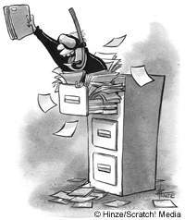
Files
Want to analyze your hum paper?
f becomes the "file object" representing humpaper.txt in this case.
Make sure you saved your paper as "plain text" (not .doc or .pdf) or else all sorts of weird formatting characters will show up!
f = file('humpaper.txt')
text = f.read()
words = text.split()
text is now one BIG string
words is now one BIG list of words (strings)
max(words)
or anything else you might want to investigate… !
min(words)
Two households, both alike in dignity,
In fair Verona, where we lay our scene,
From ancient grudge break to new mutiny,
Where civil blood makes civil hands unclean.
decode(text)

Slide 113
Representing Sound
physics
continuous plot of air pressure vs. time
sampling
samples taken every ~ 1/22050th of a second
quantization
Each sample is measured on a loudness scale from -32,768 to 32,767. (This fits into 2 bytes.)
storage
These two bytes are called a frame. Raw audio data - such as what is written to the surface of a CD - is simply a list of these frames.
pulse code modulation = PCM data

Slide 114
Break up
def remAll( e, L ):
""" this function removes all of the elements
e from the top level of the list L
"""
if len(L) == 0: # L is empty
return L
elif
else:
removeAll(42, [5,7,42,8,42])
[5,7,8]
removeAll('q', 'qaqqlqqiqeqqnqqqqs')
'aliens'

Slide 115
Warm up...
def removeAll( e, L ):
""" this function removes all of the elements
e from the top level of the list L
"""
if len(L) == 0:
return L # L is empty
elif
else:
removeAll(42, [5,7,42,8,42])
[5,7,8]
removeAll('q', 'qcqoqmqpqquqtqeqrq')
'computer'

Slide 116
Taking only one…
def removeAll( e, L ):
""" this function removes all of the elements
e from the top level of the list L
"""
if len(L) == 0:
return L # L is empty
elif e == L[0]:
return removeAll(e,L[1:]) # remove this one
# AND later ones…
else:
return L[0:1] + removeAll(e,L[1:])
# keep the non-e element and then keep going
How could we change this to removeOne?
removeOne(42, [5,7,42,8,42])
removeOne('p', 'computer programming')
[5,7,8,42]
'comuter programming'

Slide 117
"Best" word
def scrabbleScore(w):
# see homework #1!
Let's abbreviate this function as scsc(w)
def bestWord( L ):
""" finds the "best" word from L, a list of words
here, "best" means highest scrabble score """
if len(L) < 2:
return L[0]
elif
return
else:
return
What else might be nice to know ??

Slide 118
"Best" word
def scrabbleScore(w):
# see homework #1!
Let's abbreviate this function as scsc(w)
def bestWord( L ):
""" finds the "best" word from L, a list of words
here, "best" means highest scrabble score """
if len(L) < 2:
return L[0]
elif
return
else:
return
What else might be nice to know ??

Slide 119
A suggestion
def scrabbleScore(w):
# see homework #1!
Let's abbreviate this function as scsc(w)
def bestWord( L ):
""" returns the word in L w/maximum
scrabble score """
LOL = [ [scsc(w), w] for w in L ] # LOL!
bestPair = max( LOL )
return bestPair
What's so funny?

Slide 120
"Quiz"
Hints:
abs( x ) is built-in to Python
Solutions…
Use bestWord as a guide:
def bestWord( L ):
""" example code """
LOL = [ [scsc(w), w] for w in L ]
bestPair = max( LOL )
return bestPair[1]
Write this function using max:
def bestNumber( L ):
""" returns the # in L closest to 42 """
L
[30,40,50]
[[12,30],[2,40],[8,50]]
[2,40]
40

Slide 121
"Quiz"
Hint:
Solutions…
Consider defining a helper function !
Write this function however you like:
def mode( L ):
""" returns the element appearing most often in L """

Slide 122
"Quiz"
Nothing but the best!
Name(s):
Hints:
abs( x ) is built-in to Python
Write this function using max or recursively :
def bestNumber( L ):
""" returns the # in L closest to 42 """
Use bestWord as a guide:
def bestWord( L ):
""" example code """
LOL = [ [scsc(w), w] for w in L ]
bestPair = max( LOL )
return bestPair
Write this function however you like:
Hint:
Consider defining a helper function !
def mode( L ):
""" returns the element appearing most often in L """
Extra Credit: What four-letter word scores highest in scrabble?

Slide 123
"Quiz"
Hints:
abs( x ) is built-in to Python
Solutions…
Use bestWord as a guide:
def bestWord( L ):
""" example code """
LOL = [ [scsc(w), w] for w in L ]
bestPair = max( LOL )
return bestPair
Write this function using max:
def bestNumber( L ):
""" returns the # in L closest to 42 """

Slide 124
"Quiz"
Solutions…
Write this function however you like:
Hint:
Consider defining a helper function !
def mode( L ):
""" returns the element appearing most often in L """

Slide 125
chr and ord
abcdefghijklmnopqrstuvwxyz
ASCII VALUES
97
99
101
103
105
107
109
111
113
115
117
119
122
ABCDEFGHIJKLMNOPQRSTUVWXYZ
65
67
69
71
73
75
77
79
81
83
85
87
90
ord('a') is 97
chr(66) is 'B'
What is chr( ord('i')+13 ) ?
What is chr( ord('P')+13 ) ?
How can we wrap this around?

Slide 126
Rot 13
def rot13( c ):
""" rotates c by 13 chars, "wrapping" as needed
NON-LETTERS DO NOT CHANGE!
"""
if 'a' <= c <= 'z':
new_ord = ord(c) + 13
if new_ord <= ord('z'):
return chr(new_ord)
else:
return
elif
else:
How would you rotate an entire string?

Slide 127
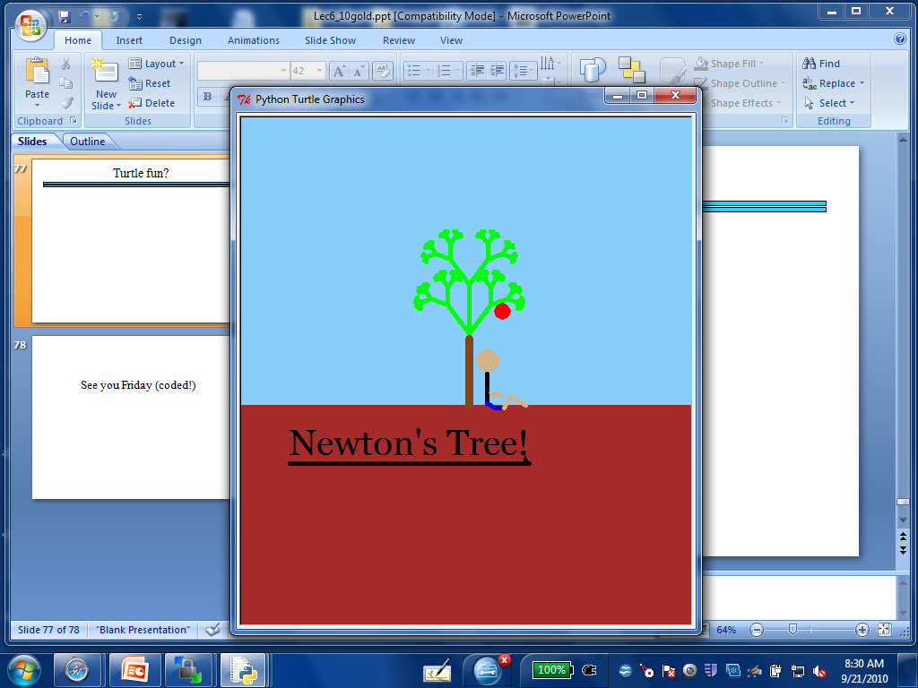
Turtle fun?

Slide 128
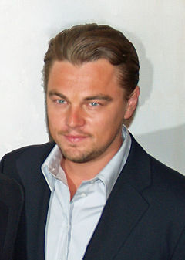
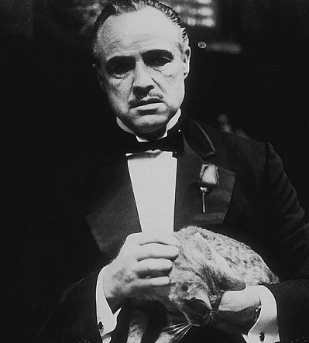
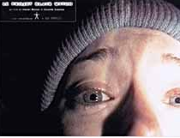
top N Lists
1. Titanic
2. Lord of the Rings 3
1. The Godfather
2. The Shawshank Redemption
1. The Blair Witch Project
2. Road to Ruin

Slide 129
top1List
def top1List( L ):
""" returns a list of the top element in L """
if len(L) < 1: return L
else: return [ max(L) ]

Slide 130
top2List
def top1List( L ):
""" returns a list of the top element in L """
if len(L) < 1: return L
else: return [ max(L) ]
def top2List( L ):
""" returns a list of the top 2 elements in L """
if len(L) < 2: return L
mx = max(L) # get the biggest element
newL = removeOne( mx, L ) # get rid of mx
return [ mx ] + top1List( newL )

Slide 131
top N List
def top3List( L ):
""" returns a list of the top 3 elements in L """
if len(L) < 3: return L
top N?

Slide 132
Files
Want to analyze your hum paper?
f becomes the "file object" representing humpaper.txt in this case.
You will first need to save your file as "plain text" or else all the special formatting characters will still be in there!
f = file('humpaper.txt')
text = f.read()
words = text.split()
text is now one BIG string
words is now one BIG list of words (strings)
max(words)
or anything else you might want to investigate… !
min(words)
Two households, both alike in dignity,
In fair Verona, where we lay our scene,
From ancient grudge break to new mutiny,
Where civil blood makes civil hands unclean.

Slide 133
Some legs to stand on…
It looks like I'm a head here!
decipher
max
encipher
score
adv(c,n)
creating more and more capable compositions
ord
chr

Slide 134
Some legs to stand on…
It looks like I'm a head here!
decipher
max
encipher
score
adv(c,n)
creating more and more capable compositions
ord
chr
computer organization
data representation
circuits
how are even these fundamentals physically realized ?!

Slide 135
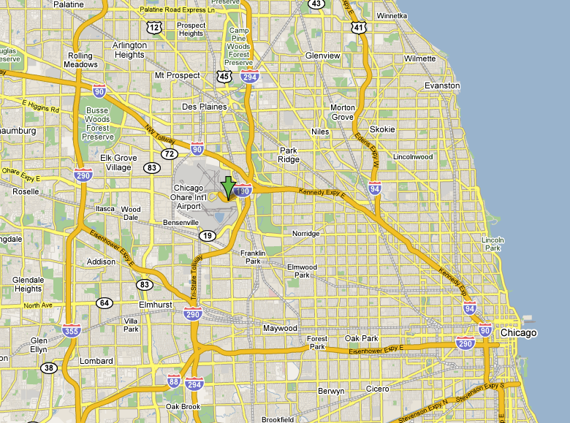
CHR and ORD
Orchard Field

Slide 136
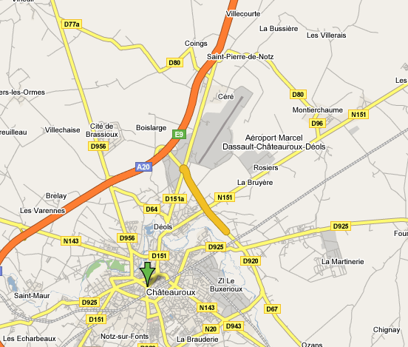
CHR and ORD
Chateauroux

Slide 137
ASCII
American Standard Code for Information Interchange
ASCII is a table that tells the computer how to represent characters as bits!
8 bits = 1 byte

Slide 138
chr and ord
abcdefghijklmnopqrstuvwxyz
functions for these conversions
97
122
ABCDEFGHIJKLMNOPQRSTUVWXYZ
65
90
ord( c )
Input: a string of one character, c
Output: an integer, the ASCII value of c
chr( n )
Input: an integer in range(255)
Output: a one-char. string of that ASCII value

Slide 139
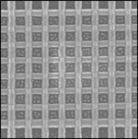
Binary Storage / Representation
8 bits = 1 byte = 1 box
The SAME bits represent integers, if the variable has type int instead of str
value:
'*'
00101010
type: str
bits
name:
Identical bits are stored in each variable!
1 bit
The types determine how to interpret the bits; the names don't matter at all…
value:
42
00101010
1 byte = 8 bits
type: int
bits
name:

Slide 140
chr and ord
abcdefghijklmnopqrstuvwxyz
functions for these conversions
97
122
ABCDEFGHIJKLMNOPQRSTUVWXYZ
65
90
ord( c )
Input: a string of one character, c
Output: an integer, the ASCII value of c
chr( n )
Input: an integer in range(255)
Output: a one-char. string of that ASCII value
[ [i,chr(i)] for i in range(128) ]
try these!
[ ord(i) for i in '**** CS! ****' ]

Slide 141
chr and ord
Orchard Field

Slide 142
chr and ord
Chateauroux

Slide 143
Caesar Cipher: encipher
encipher( 'gv vw dtwvg' , 0 )
'gv vw dtwvg'
'hw wx euxwh'
'ix xy fvyxi'
'jy yz gwzyj'
'kz za hxazk'
'la ab iybal'
returns
encipher( 'gv vw dtwvg' , 1 )
returns
encipher( 'gv vw dtwvg' , 2 )
returns
encipher( 'gv vw dtwvg' , 3 )
returns
encipher( 'gv vw dtwvg' , 4 )
returns
encipher( 'gv vw dtwvg' , 5 )
returns
encipher( 'gv vw dtwvg' , 25 )
'fu uv csvuf'
returns
Output

Slide 144
Caesar Cipher: encipher
gv vw dtwvg
hw wx euxwh
ix xy fvyxi
jy yz gwzyj
kz za hxazk
la ab iybal
mb bc jzcbm
nc cd kadcn
od de lbedo
pe ef mcfep
qf fg ndgfq
rg gh oehgr
sh hi pfihs
ti ij qgjit
uj jk rhkju
vk kl silkv
wl lm tjmlw
xm mn uknmx
yn no vlony
zo op wmpoz
ap pq xnqpa
bq qr yorqb
cr rs zpsrc
ds st aqtsd
et tu brute
fu uv csvuf
encipher( 'gv vw dtwvg' , 0 )
'gv vw dtwvg'
'hw wx euxwh'
'ix xy fvyxi'
'jy yz gwzyj'
'kz za hxazk'
'la ab iybal'
returns
encipher( 'gv vw dtwvg' , 1 )
returns
encipher( 'gv vw dtwvg' , 2 )
returns
encipher( 'gv vw dtwvg' , 3 )
returns
encipher( 'gv vw dtwvg' , 4 )
returns
encipher( 'gv vw dtwvg' , 5 )
returns
encipher( 'gv vw dtwvg' , 25 )
'fu uv csvuf'
returns
Output
decipher?
all 26 possibilities

Slide 145
Caesar Cipher: decipher
>>> decipher('Bzdrzq bhogdq? H oqdedq Bzdrzq rzkzc.')
'Caesar cipher? I prefer Caesar salad.'
>>> decipher('Hu lkbjhapvu pz doha ylthpuz hmaly dl mvynla '\
'lclyfaopun dl ohcl slhyulk.')
'An education is what remains after we forget everything we have learned.'
But how to do this… ?

Slide 146
Rot 13: characters
def rotc( c ):
""" rotates a single char. c ahead by n chars
'wrapping around' as needed """

Slide 147
Rot 13: strings
def rots( S ):
""" rotates a string ahead by 13 chars. """

Slide 148
Sorting
def sort(L)
returns a list which has the same elements as L, but in sorted order!

Slide 149
Computing with text
Bits/Numbers
Language
Ideas
Characters
Representation
Meaning

Slide 150
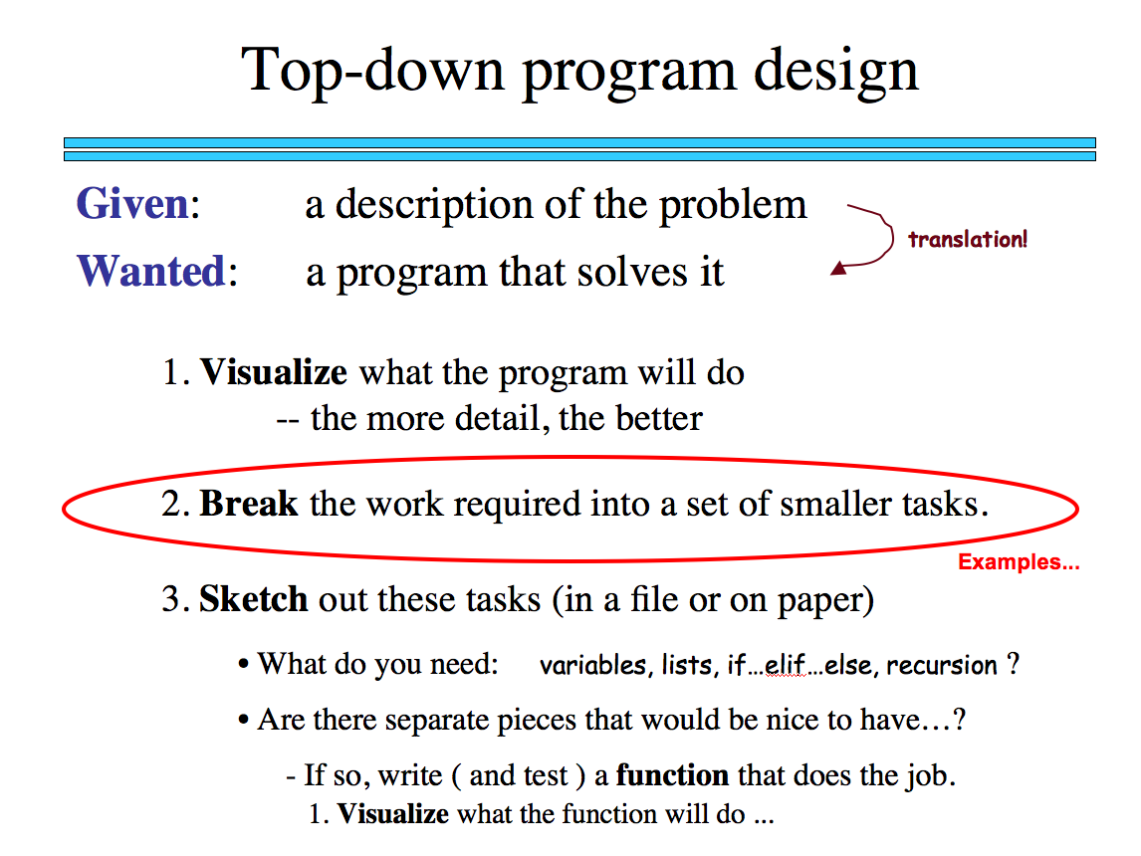
Sorting
def sort(L)
returns a list which has the same elements as L, but in sorted order!
What is sorting doing?
What is one piece?

Slide 151
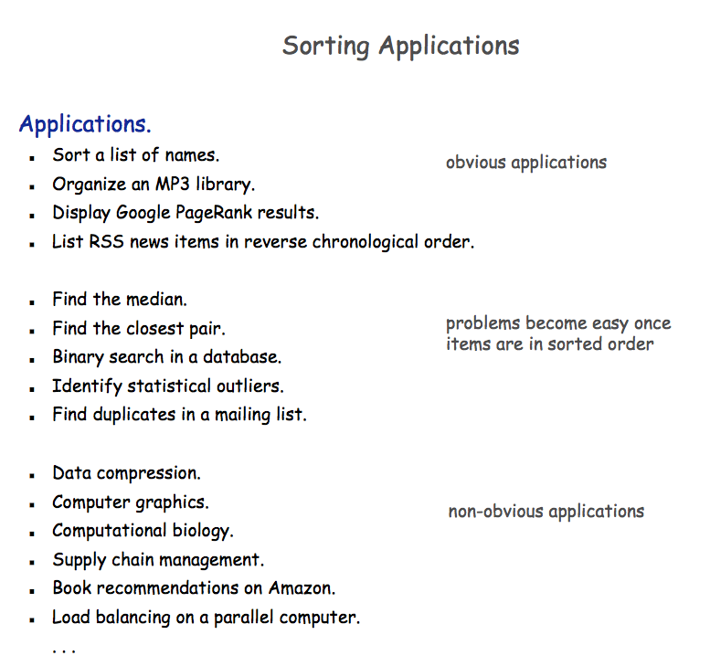

Slide 152

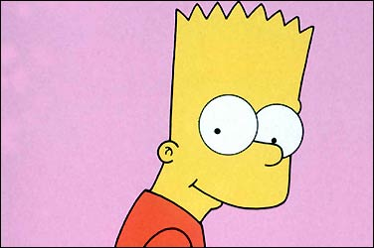
Random sorting…
def randSort( L ):
""" crazy sorting """
newL = random.sample( L, len(L) )
if isSorted(newL):
return newL
else:
return randSort(L) # try again…
A random permutation of L !
this function is totally random, dude!
Mmmm… sorting!

Slide 153

Random sorting…
def isSorted(s)
returns True if s is in order, False otherwise
isSorted('BART') returns False
isSorted('BERT') returns True
isSorted('BEGIN') returns True
isSorted([3,1,4]) returns False
isSorted([1,3,4]) returns True
ties?
isSorted('LOOPY') returns ??
Six-letter word?

Slide 154
Random sorting…
def isSorted(s):
returns True if s is in order, False otherwise
""" see the description in this box """
if len(s) < 2:
return
elif s[0] > s[1]:
return
else:
return
ties?
Six-letter word?

Slide 155
Random sorting…
def isSorted(s):
returns True if s is in order, False otherwise
""" see the description in this box """
if len(s) < 2:
return True
elif s[0] > s[1]:
return False
else:
return isSorted( s[1:] )
ties?
Six-letter word?

Slide 156
Almost the end…
def sort(L)
returns a list which has the same elements as L, but in sorted order!
Let e be the max element in L
Where should e go?
and what helper function might we want… ?

Slide 157
removeOne
def removeOne( e, L ):
""" this function removes one e from L
if L is a list, e is an element
if L is a string, e is a one-char. string
"""
if len(L) == 0:
return L # L is empty
elif e == L[0]:
return L[1:] # the element e is now gone
else:
return L[0:1] + removeOne( e, L[1:] ) # keep going

Slide 158
Computing with language
ideas / meaning
language / words / phrases
strings
numbers / bits

Slide 159
Computing with language
open questions in AI …
ideas / meaning
language / words / phrases
computing with language - recognizing English!
strings
how strings are represented and stored
numbers / bits

Slide 160
ASCII
American Standard Code for Information Interchange
ASCII is a table that tells the computer how to represent characters as bits!
8 bits = 1 byte

Slide 161
ASCII
American Standard Code for Information Interchange
ASCII is a table that tells the computer how to represent characters as bits!
value:
'*'
00101010
type: str
bits
name:
Identical bits are stored in each variable!
8 bits = 1 byte
The types determine how to interpret the bits; the names don't matter at all…
value:
42
00101010
The SAME bits represent integers, if the variable has type int instead of str
bits
type: int
name:

Slide 162
chr and ord
abcdefghijklmnopqrstuvwxyz
functions for these conversions
97
122
ABCDEFGHIJKLMNOPQRSTUVWXYZ
65
90
ord( c )
Input: a string of one character, c
Output: an integer, the ASCII value of c
chr( n )
Input: an integer in range(255)
Output: a one-char. string of that ASCII value

Slide 163
chr and ord
abcdefghijklmnopqrstuvwxyz
functions for these conversions
97
122
ABCDEFGHIJKLMNOPQRSTUVWXYZ
65
90
ord( c )
Input: a string of one character, c
Output: an integer, the ASCII value of c
chr( n )
Input: an integer in range(255)
Output: a one-char. string of that ASCII value
[ [i,chr(i)] for i in range(128) ]
try these!
[ ord(i) for i in '**** CS! ****' ]

Slide 164
chr and ord
Orchard Field

Slide 165
chr and ord
Chateauroux

Slide 166
Caesar Cipher: encipher
encipher( 'gv vw dtwvg' , 0 )
'gv vw dtwvg'
'hw wx euxwh'
'ix xy fvyxi'
'jy yz gwzyj'
'kz za hxazk'
'la ab iybal'
returns
encipher( 'gv vw dtwvg' , 1 )
returns
encipher( 'gv vw dtwvg' , 2 )
returns
encipher( 'gv vw dtwvg' , 3 )
returns
encipher( 'gv vw dtwvg' , 4 )
returns
encipher( 'gv vw dtwvg' , 5 )
returns
encipher( 'gv vw dtwvg' , 25 )
'fu uv csvuf'
returns
Output

Slide 167
Caesar Cipher: encipher
gv vw dtwvg
hw wx euxwh
ix xy fvyxi
jy yz gwzyj
kz za hxazk
la ab iybal
mb bc jzcbm
nc cd kadcn
od de lbedo
pe ef mcfep
qf fg ndgfq
rg gh oehgr
sh hi pfihs
ti ij qgjit
uj jk rhkju
vk kl silkv
wl lm tjmlw
xm mn uknmx
yn no vlony
zo op wmpoz
ap pq xnqpa
bq qr yorqb
cr rs zpsrc
ds st aqtsd
et tu brute
fu uv csvuf
encipher( 'gv vw dtwvg' , 0 )
'gv vw dtwvg'
'hw wx euxwh'
'ix xy fvyxi'
'jy yz gwzyj'
'kz za hxazk'
'la ab iybal'
returns
encipher( 'gv vw dtwvg' , 1 )
returns
encipher( 'gv vw dtwvg' , 2 )
returns
encipher( 'gv vw dtwvg' , 3 )
returns
encipher( 'gv vw dtwvg' , 4 )
returns
encipher( 'gv vw dtwvg' , 5 )
returns
encipher( 'gv vw dtwvg' , 25 )
'fu uv csvuf'
returns
Output
decipher?
all 26 possibilities

Slide 168
Caesar Cipher: decipher
>>> decipher('Bzdrzq bhogdq? H oqdedq Bzdrzq rzkzc.')
'Caesar cipher? I prefer Caesar salad.'
>>> decipher('Hu lkbjhapvu pz doha ylthpuz hmaly dl mvynla '\
'lclyfaopun dl ohcl slhyulk.')
'An education is what remains after we forget everything we have learned.'
But how to do this… ?

Slide 169
See you Friday (coded!)

Slide 170

Google at its public offering ~ $ 100

Slide 171


