Slide 1

This would make me hungry… but I ate breakfast this morning!
Computing to the max
The not-so-subtle art of singling out the best (and worst) of anything…
Last hw?
N-step sleepwalking?
Turtle graphics??
a comparison comparison
Artistic renderings!!!
'm+ms'
'coffee'
[0, 42]
[4, 2]
This week!
[0, 'm+ms']
[4, 'coffee']
Hw #3 due next Monday…
> or <
pr0: Are we The Matrix?
pr1: Lab…
Computing with language
pr2: Sorting + Caesar!
What's in a Writ1 paper, anyway?
Battle-tested ciphers & how to break them…
'CS' vs. 'clear'?

Slide 2
max
A recipe for life ?
and python already has it for us…
The real problem is knowing what we want to maximize!
... or minimize, with min

Slide 3
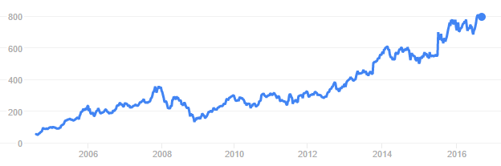
to the max
And I thought $100 was overpriced!
NASDAQ: GOOGL
Want the highest price?
max( [475.5, 458.0, 441.3, 470.8, 532.8, 520.9] )
ST
'nov'
'jan'
'mar'
'may'
'jul'
'sep'
What if the months are in there, as well?
max( [ [470.8,'may'], [532.8,'jul'], [520.9,'sep'] ] )
STm
max( [ ['may',470.8], ['jul',532.8], ['sep',520.9] ] )
mST

Slide 4
to the max
And I thought $100 was overpriced!
NASDAQ: GOOGL
Want the highest price?
max( [475.5, 458.0, 441.3, 470.8, 532.8, 520.9] )
ST
'nov'
'jan'
'mar'
'may'
'jul'
'sep'
What if the months are in there, as well?
max( [ [470.8,'may'], [532.8,'jul'], [520.9,'sep'] ] )
STm
max( [ ['may',470.8], ['jul',532.8], ['sep',520.9] ] )
mST
Mudd's max?
MSt
L = ['Harvey', 'Mudd', 'College', 'seeks', 'to', 'educate', 'engineers,', 'scientists', 'and', 'mathematicians', 'well-versed', 'in', 'all', 'of', 'these', 'areas', 'and', 'in', 'the', 'humanities', 'and', 'the', 'social', 'sciences', 'so', 'that', 'they', 'may', 'assume', 'leadership', 'in', 'their', 'fields', 'with', 'a', 'clear', 'understanding', 'of', 'the', 'impact', 'of', 'their', 'work', 'on', 'society']
max(MSt)
Or Mudd's min?
min(MSt)

Slide 5
4
recursive max
L
[ 7, 10, -2, 42, 15 ]
L = [ 'aliens', 'zap', 'hazy', 'code' ]
L[1:]
def max( L ):
""" returns the max element from L
input: L, a nonempty list
"""
if len(L) < 2: return L[0] # only 1 elem.
maxOfRest = max(L[1:]) # max of the rest
if L[0] > maxOfRest :
return L[0] # either L[0]
else:
return maxOfRest # or maxOfRest!
I love max rest!

Slide 6
recursive max
L
[ 7, 10, -2, 42, 15 ]
L = [ 'aliens', 'zap', 'hazy', 'code' ]
L[1:]
def max( L ):
""" returns the max element from L
input: L, a nonempty list
"""
if len(L) < 2: return L[0] # only 1 elem.
maxOfRest = max(L[1:]) # max of the rest
if L[0] > maxOfRest :
return L[0] # either L[0]
else:
return maxOfRest # or maxOfRest!
I love max rest!

Slide 7
max with scrabble-score
L = [ 'aliens', 'zap', 'hazy', 'code' ]
Which element has the highest scrabble score?
def maxSS( L ):
""" returns L's highest scrabble-scoring
element (input: L, a nonempty list)
"""
if len(L) < 2: return L[0] # only 1 elem.
maxOfRest = maxSS(L[1:]) # rest's max
if L[0] > maxOfRest :
return L[0] # either L[0]
else:
return maxOfRest # or maxOfRest!
Spacey! I like it!

Slide 8
max with scrabble-score
L = [ 'aliens', 'zap', 'hazy', 'code' ]
Which element has the highest scrabble score?
def maxSS( L ):
""" returns L's highest scrabble-scoring
element (input: L, a nonempty list)
"""
if len(L) < 2: return L[0] # only 1 elem.
maxOfRest = maxSS(L[1:]) # rest's max
if sScore(L[0]) > sScore(maxOfRest):
return L[0] # either L[0]
else:
return maxOfRest # or maxOfRest!
Spacey! I like it!

Slide 9
max with scrabble-score
L = [ 'aliens', 'zap', 'hazy', 'code' ]
Which element has the highest scrabble score?
def maxSS( L ):
""" returns L's highest scrabble-scoring
element (input: L, a nonempty list)
"""
if len(L) < 2: return L[0] # only 1 elem.
maxOfRest = maxSS(L[1:]) # rest's max
if sScore(L[0]) > sScore(maxOfRest):
return L[0] # either L[0]
else:
return maxOfRest # or maxOfRest!
Let's see if we can simplify this process... just for LoLs!
Spacey! I like it!

Slide 10
A more comprehensive solution: LoL
L = [ 'aliens', 'zap', 'hazy', 'code' ]
def maxSS( L ):
""" returns L's max-scrabble-score word
"""
LoL = [ [sScore(w), w] for w in L ]
bestpair = max( LoL )
return bestpair[1]
This does look funny!

Slide 11

A more comprehensive solution
L = [ 'aliens', 'zap', 'hazy', 'code' ]
def maxSS( L ):
""" returns L's max-scrabble-score word
"""
LoL = [ [sScore(w), w] for w in L ]
bestpair = max( LoL )
return bestpair[1]
This does look funny!
http://acronyms.thefreedictionary.com/LOL

Slide 12
A more comprehensive solution
L = [ 'aliens', 'zap', 'hazy', 'code' ]
I loathe hazy code!
def maxSS( L ):
""" returns L's max-scrabble-score word
"""
LoL = [ [sScore(w), w] for w in L ]
bestpair = max( LoL )
return bestpair[1]
LoL = [ [6,'aliens'], [14,'zap'], [19,'hazy'], [7,'code'] ]
bestpair = [19,'hazy']
'hazy'

Slide 13
Everything … is a max problem?
I know the best word here… but does Python?
L = [ 'aliens', 'zap', 'hazy', 'code' ]
def revviestword( L ):
""" another example – what's returned?
"""
LoL = [ [w[::-1], w] for w in L ]
bestpair = max( LoL )
return bestpair[1]
LoL = [ [ 'sneila' ,'aliens'], [ 'paz' ,'zap'], [ 'yzah' ,'hazy'], [ 'edoc' ,'code'] ]
bestpair =

Slide 14
Other examples…
What is bestnumb ?
What is mostnumb ?
>>> bestnumb( [10,20,30,40,50,60,70] )
40
>>> bestnumb( [100,200,300,400] )
100
>>> bestnumb( [1,2,3,4,5,6,7,8,7] )
8
>>> mostnumb( [1,2,3,4,5,6,7,8,7] )
7
These functions have made me number

Slide 15
L = [ 'aliens', 'zap', 'hazy', 'code' ]
Name(s)
Quiz
def maxlen(L):
LoL = [ [len(s),s] for s in L ]
bstpr = max( LoL )
return bstpr[1]
1. What is LoL?
here is a start: LoL is [ [6,'aliens'], [3,'zap'], ___________, __________ ]
2. What is bstpr?
Extra!
Change exactly three characters in this code so that 3 is returned.
3. What is returned?
L = [ 30, 40, 50 ]
Use the LoL method to write these two functions
def bestnumb(L):
""" returns the # in L closest to 42 """
LoL = [ ]
bstpr =
return bstpr[1]
Hint: Python has abs(x) built-in
L = [ 3,4,5,7,6,7 ]
def mostnumb( L ):
""" returns the item most often in L """
LoL = [ ]
bstpr =
return bstpr[1]
Hint: Define a helper function!
def count(e,L):
""" return # of e's in L """

Slide 16
Quiz
L = [ 'aliens', 'zap', 'hazy', 'code' ]
Try this on the back page first!
def maxlen(L):
LoL = [ [len(s),s] for s in L ]
bstpr = max( LoL )
return bstpr[1]
1. What is LoL?
[ [6,'aliens'], [3,'zap'], [4,'hazy'], [4,'code'] ]
2. What is bstpr?
[6,'aliens']
Extra!
Change exactly three characters in this code so that 3 is returned.
3. What is returned?
'aliens'
L = [ 30, 40, 50 ]
def bestnumb(L):
""" returns the # in L closest to 42 """
LoL = [ [abs(x-42),x] for x in L ]
bstpr = min( LoL )
return bstpr[1]
Hint: Python has abs(x) built-in
L = [ 3,4,5,7,6,7 ]
def mostnumb( L ):
""" returns the item most often in L """
LoL = [ [count(e,L),e] for e in L ]
bstpr = max( LoL )
return bstpr[1]
Hint: Define a helper function!
def count(e,L):
LC = [1 for x in L \
if x==e]
return sum(LC)

Slide 17
L = [ 'aliens', 'zap', 'hazy', 'code' ]
def maxlen(L):
LoL = [ [len(s),s] for s in L ]
bstpr = max( LoL )
return bstpr[1]
1. What is LoL?
[ [6,'aliens'], [3,'zap'], [4,'hazy'], [4,'code'] ]
2. What is bstpr?
[6,'aliens']
'aliens'
3. What is returned?
Extra! Change exactly three characters in this code so that 3 is returned.

Slide 18
bestnumb
[30,40,50]
L
[[12,30],[2,40],[8,50]]
LoL
[2,40]
bstpr
[ 30, 40, 50 ]
40
bstpr[1]
def bestnumb( L ):
""" returns the # closest to 42 in L """
LoL = [ [abs(x-42),x] for x in L ]
bstpr = min( LoL )
return bstpr[1]

Slide 19
Helper function: count(e,L)
mostnumb
def count( e, L ):
""" returns the # of e's in L """
LC = [ 1 for x in L if x==e ]
return sum( LC )
L
[6,7,7,8]
LoL
[ [1,6], [2,7], [2,7], [1,8] ]
bstpr
[2,7]
[6,7,7,8]
bstpr[1]
7
def mostnumb( L ):
""" returns the item most often in L """
LoL = [ [count(e,L),e] for e in L ]
bstpr = max( LoL )
return bstpr[1]
Could you use x here instead of e?

Slide 20
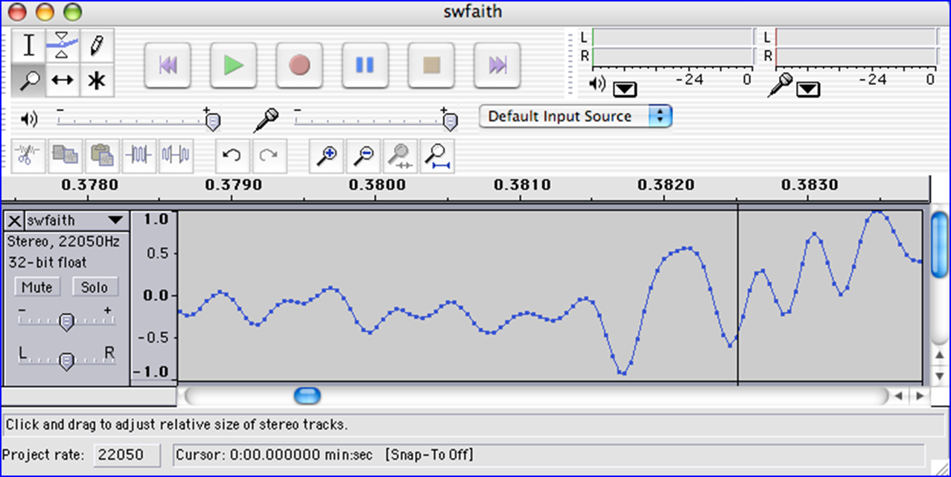
Today's lab: big data?
Any guesses as to what kind of data this is?
I find your lack of faith in this data disturbing.

Slide 21

Today's lab: sound data!
what are the vertical and horizontal axes here?

Slide 22
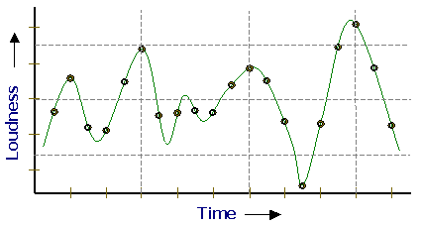
Lab3 ~ Sound
physics
continuous variation of air pressure vs. time
air pressure
sampling
samples taken every 1/22050th of a second (or some sampling rate)
time
quantization
Each sample is measured on a loudness scale from -32,768 to 32,767. (This fits into 2 bytes.)
storage
These two bytes are called a frame. Raw audio data - such as what is written to the surface of a CD - is simply a list of these frames.
pulse code modulation = PCM data
some examples...

Slide 23
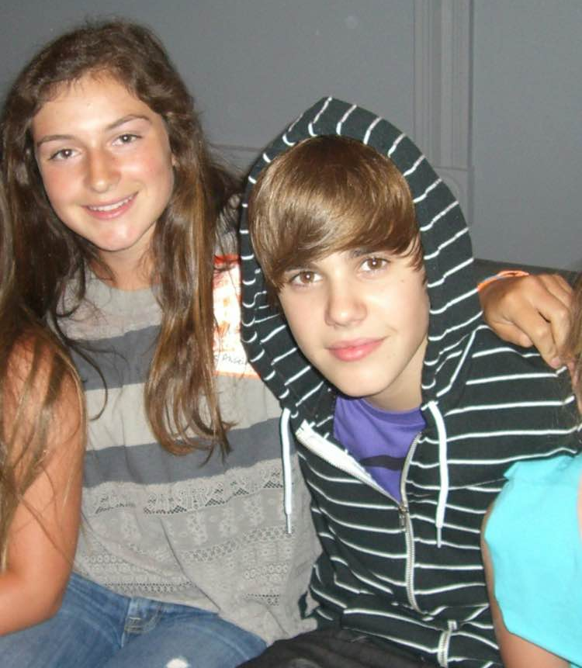
CS5 Beliebs!
physics
continuous variation of air pressure vs. time
air pressure
sampling
samples taken every 1/22050th of a second (or some sampling rate)
time
quantization
Each sample is measured on a loudness scale from -32,768 to 32,767. (This fits into 2 bytes.)
storage
These two bytes are called a frame. Raw audio data - such as what is written to the surface of a CD - is simply a list of these frames.
Thanks, Sarah!
pulse code modulation = PCM data
some examples...

Slide 24
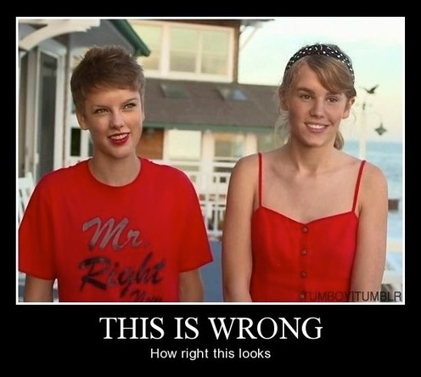
CS5 Beliebs...
in what!?
physics
continuous variation of air pressure vs. time
air pressure
sampling
samples taken every 1/22050th of a second (or some sampling rate)
time
quantization
Each sample is measured on a loudness scale from -32,768 to 32,767. (This fits into 2 bytes.)
storage
These two bytes are called a frame. Raw audio data - such as what is written to the surface of a CD - is simply a list of these frames.
Thanks, Sarah!
pulse code modulation = PCM data
some examples...
+ Merritt + Montana

Slide 25

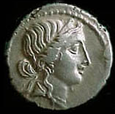


Computing with language
ideas / meaning
language / words / phrases
Python strings are here.
strings
numbers / bits

Slide 26
Computing with language
open questions in AI …
ideas / meaning
Eliza, Siri, Tay ... trouble?
language / words / phrases
This week…
processing language – how English-y is it?
strings
how strings are represented and stored
numbers / bits
Next week…

Slide 27
Caesar Cipher: encipher
What is it doing?
encipher(s,n)
encipher( 'I <3 Latin' , 0 )
'I <3 Latin'
'J <3 Mbujo'
'K <3 Ncvkp'
'L <3 Odwlq'
'M <3 Pexmr'
'N <3 Qfyns'
returns
encipher( 'I <3 Latin' , 1 )
returns
encipher( 'I <3 Latin' , 2 )
returns
encipher( 'I <3 Latin' , 3 )
returns
encipher( 'I <3 Latin' , 4 )
returns
encipher( 'I <3 Latin' , 5 )
returns
encipher( 'I <3 Latin' , 25 )
'H <3 Kzshm'
returns

Slide 28
Caesar Cipher: encipher
should return the string s with each alphabetic character shifted/wrapped by n places in the alphabet
encipher(s,n)
encipher( 'I <3 Latin' , 0 )
'I <3 Latin'
'J <3 Mbujo'
'K <3 Ncvkp'
'L <3 Odwlq'
'M <3 Pexmr'
'N <3 Qfyns'
CA
returns
encipher( 'I <3 Latin' , 1 )
returns
encipher( 'I <3 Latin' , 2 )
returns
encipher( 'I <3 Latin' , 3 )
returns
encipher( 'I <3 Latin' , 4 )
returns
encipher( 'I <3 Latin' , 5 )
returns
encipher( 'I <3 Latin' , 25 )
'H <3 Kzshm'
returns

Slide 29
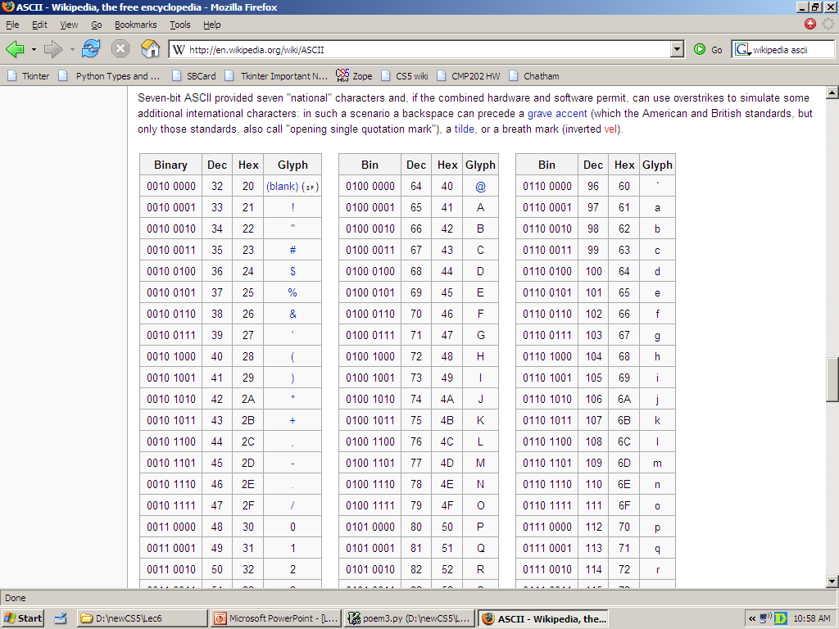
ASCII
American Standard Code for Information Interchange
convert # to char
chr
1 byte
ord
8 bits
convert char to #
The SAME bits represent an integer or a string, depending on type: int or str

Slide 30
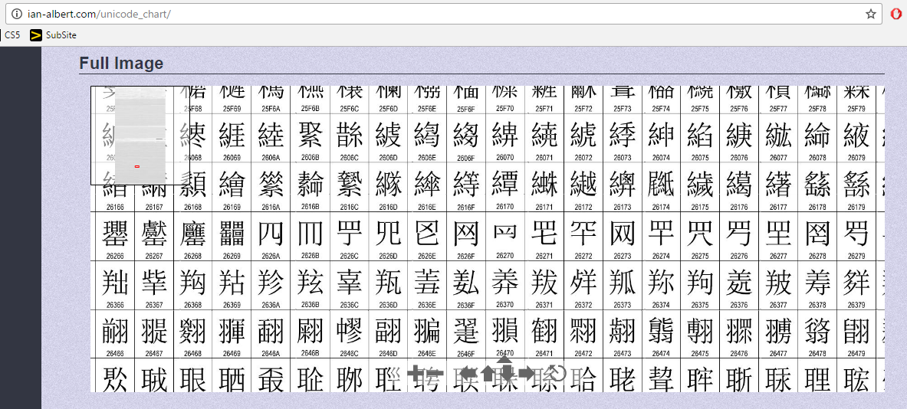
Unicode
Universal Character Encoding
!!!
http://ian-albert.com/unicode_chart/
Some fun characters...
chr(156265)
chr(9835)
chr(9731)
My favorite is chr(1661)
on Win10: chcp 65001

Slide 31
ASCII or Unicode...
value:
'/'
00101111
type: str
bits
name:
Identical bits are stored in each variable!
The types determine how to interpret the bits; the names don't matter at all…
1 byte
value:
47
8 bits
00101111
type: int
bits
name:
The SAME bits represent an integer or a string, depending on type: int or str
over in memory…

Slide 32
ASCII and Unicode
convert # to char
chr
ord
convert char to #
This is why 'CS' < 'clear' !
Julius spr'15

Slide 33
ASCII and Unicode
Ex1
convert # to char
[ [i,chr(i)] for i in range(128) ]
chr
Ex2
ord
[ ord(i) for i in '**** CS! ****' ]
convert char to #
This is why 'CS' < 'clear' !
Julius spr'15

Slide 34
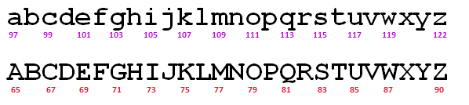
Rot13
a useful and illustrative starting point...
rot13('a') should output 'n'
adding 13
rot13('M') should output 'Z'
rot13('n') should output 'a'
wrapping
rot13('W') should output 'J'
rot13(' ') should output ' '
spaces + other characters
rot13('<') should output '<'

Slide 35
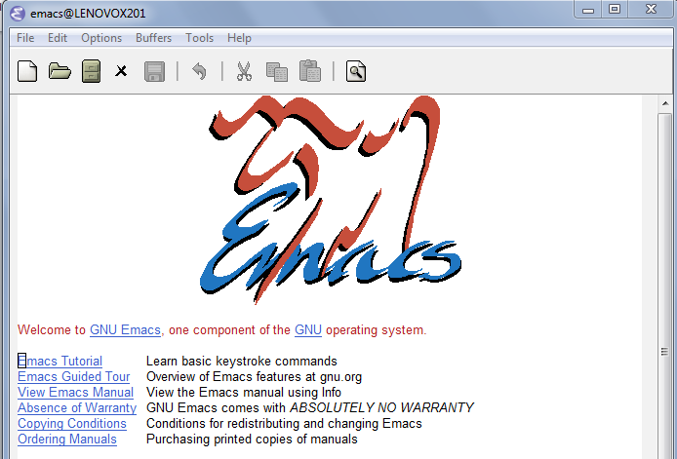
rot13's surprising history...

Slide 36
ASCII and Unicode
chr value
abcdefghijklmnopqrstuvwxyz
97
ord value
99
101
103
105
107
109
111
113
115
117
119
122
chr value
ABCDEFGHIJKLMNOPQRSTUVWXYZ
65
ord value
67
69
71
73
75
77
79
81
83
85
87
90
convert # to char
chr
What is ord('U')//2?
What is chr( ord('i')+13 )?
ord
What is chr( ord('W')+13 )?
convert char to #
how do we wrap?

Slide 37
any single character, c
Writing Rot13
def rot13( c ):
""" rotates c by 13 chars, "wrapping" as needed
NON-LETTERS don't change!
"""
if 'a' <= c <= 'z':
if ord(c)+13 <= ord('z'):
return chr( ord(c)+13 )
else:
return chr( )
elif 'A' <= c <= 'Z': # upper-case test!
else:
(0) What do these tests do?
(1) What code will "wrap" to the alphabet's other side?
(2) How will upper case change? Try noting only the code differences…
(3) What if c is not a letter at all?
Extra: How would you rotate n places, instead of 13?

Slide 38
any single character, c
Writing Rot13
def rot13( c ):
""" rotates c by 13 chars, "wrapping" as needed
NON-LETTERS don't change!
"""
if 'a' <= c <= 'z':
if ord(c)+13 <= ord('z'):
return chr( ord(c)+13 )
else:
return chr( ord(c)+13-26 )
elif 'A' <= c <= 'Z': # upper-case test!
else:
(0) What do these tests do?
(1) What code will "wrap" to the alphabet's other side?
same, but for 'Z'
(2) How will upper case change? Try noting only the code differences…
return c
(3) What if c is not a letter at all?
use n instead of 13
Extra: How would you rotate n places, instead of 13?

Slide 39
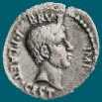
Caesar Cipher: encipher
Caesar
Brutus
>>> encipher('Bzdrzq bhogdq? H oqdedq Bzdrzq rzkzc.',25)
'Aycqyp agnfcp? G npcdcp Aycqyp qyjyb.'
S1
>>> encipher('Bzdrzq bhogdq? H oqdedq Bzdrzq rzkzc.',15)
'Qosgof qwdvsf? W dfstsf Qosgof gozor.'
>>> encipher('Bzdrzq bhogdq? H oqdedq Bzdrzq rzkzc.',4)
'Fdhvdu flskhu? L suhihu Fdhvdu vdodg.'
>>> encipher('Bzdrzq bhogdq? H oqdedq Bzdrzq rzkzc.',1)
'Caesar cipher? I prefer Caesar salad.'
>>> encipher('Hu lkbjhapvu pz doha ylthpuz hmaly dl mvynla '\
'lclyfaopun dl ohcl slhyulk.',19)
'An education is what remains after we forget everything we have learned.'
S2

Slide 40
Caesar Cipher: decipher
Caesar
Brutus
>>> decipher('Bzdrzq bhogdq? H oqdedq Bzdrzq rzkzc.')
'Caesar cipher? I prefer Caesar salad.'
S1
S2
>>> decipher('Hu lkbjhapvu pz doha ylthpuz hmaly dl mvynla '\
'lclyfaopun dl ohcl slhyulk.')
'An education is what remains after we forget everything we have learned.'
>>> decipher('Uifz xpsl ju pvu xjui b qfodjm!')
PL
LAT
>>> decipher('gv vw dtwvg')
How!?
Which is more difficult computationally?

Slide 41
Decipher?
Strategies?
Algorithms?

Slide 42
gv vw dtwvg
hw wx euxwh
ix xy fvyxi
jy yz gwzyj
kz za hxazk
la ab iybal
mb bc jzcbm
nc cd kadcn
od de lbedo
pe ef mcfep
qf fg ndgfq
rg gh oehgr
sh hi pfihs
ti ij qgjit
uj jk rhkju
vk kl silkv
wl lm tjmlw
xm mn uknmx
yn no vlony
zo op wmpoz
ap pq xnqpa
bq qr yorqb
cr rs zpsrc
ds st aqtsd
et tu brute
fu uv csvuf
Decipher?
All possible decipherings
Strategies?
Algorithms?

Slide 43
gv vw dtwvg
hw wx euxwh
ix xy fvyxi
jy yz gwzyj
kz za hxazk
la ab iybal
mb bc jzcbm
nc cd kadcn
od de lbedo
pe ef mcfep
qf fg ndgfq
rg gh oehgr
sh hi pfihs
ti ij qgjit
uj jk rhkju
vk kl silkv
wl lm tjmlw
xm mn uknmx
yn no vlony
zo op wmpoz
ap pq xnqpa
bq qr yorqb
cr rs zpsrc
ds st aqtsd
et tu brute
fu uv csvuf
[0, 'gv vw dtwvg'],
[2, 'hw wx euxwh'],
[2, 'ix xy fvyxi'],
[0, 'jy yz gwzyj'],
[2, 'kz za hxazk'],
[4, 'la ab iybal'],
[0, 'mb bc jzcbm'],
[1, 'nc cd kadcn'],
[4, 'od de lbedo'],
[3, 'pe ef mcfep'],
[0, 'qf fg ndgfq'],
[2, 'rg gh oehgr'],
[2, 'sh hi pfihs'],
[3, 'ti ij qgjit'],
[2, 'uj jk rhkju'],
[1, 'vk kl silkv'],
[0, 'wl lm tjmlw'],
[1, 'xm mn uknmx'],
[2, 'yn no vlony'],
[3, 'zo op wmpoz'],
[2, 'ap pq xnqpa'],
[1, 'bq qr yorqb'],
[0, 'cr rs zpsrc'],
[1, 'ds st aqtsd'],
[4, 'et tu brute'],
[3, 'fu uv csvuf']
Decipher?
All possible decipherings
Score them all
Strategies?
Algorithms?
quantifying Englishness?

Slide 44
gv vw dtwvg
hw wx euxwh
ix xy fvyxi
jy yz gwzyj
kz za hxazk
la ab iybal
mb bc jzcbm
nc cd kadcn
od de lbedo
pe ef mcfep
qf fg ndgfq
rg gh oehgr
sh hi pfihs
ti ij qgjit
uj jk rhkju
vk kl silkv
wl lm tjmlw
xm mn uknmx
yn no vlony
zo op wmpoz
ap pq xnqpa
bq qr yorqb
cr rs zpsrc
ds st aqtsd
et tu brute
fu uv csvuf
[0, 'gv vw dtwvg'],
[2, 'hw wx euxwh'],
[2, 'ix xy fvyxi'],
[0, 'jy yz gwzyj'],
[2, 'kz za hxazk'],
[4, 'la ab iybal'],
[0, 'mb bc jzcbm'],
[1, 'nc cd kadcn'],
[4, 'od de lbedo'],
[3, 'pe ef mcfep'],
[0, 'qf fg ndgfq'],
[2, 'rg gh oehgr'],
[2, 'sh hi pfihs'],
[3, 'ti ij qgjit'],
[2, 'uj jk rhkju'],
[1, 'vk kl silkv'],
[0, 'wl lm tjmlw'],
[1, 'xm mn uknmx'],
[2, 'yn no vlony'],
[3, 'zo op wmpoz'],
[2, 'ap pq xnqpa'],
[1, 'bq qr yorqb'],
[0, 'cr rs zpsrc'],
[1, 'ds st aqtsd'],
[4, 'et tu brute'],
[3, 'fu uv csvuf']
Decipher?
All possible decipherings
max!
Score them all
Strategies?
Algorithms?
yields the "most English" phrase

Slide 45
Measuring Englishness
Very English-y
"Call me Ishmael."
"Attack at dawn!"
"rainbow, table, candle"
higher scores
"Yow! Legally-imposed CULTURE-reduction
is CABBAGE-BRAINED!"
"quadruplicity drinks procrastination"
"Hold the newsreader's nose squarely, waiter, or
friendly milk will countermand my trousers."
quantifying Englishness?
"the gostak distims the doshes"
"hension, framble, bardle"
"jufict, stofwus, lictpub"
"itehbs, rsnevtr, khbsota"
lower scores
"epadxo, nojarpn, gdxokpw"
"h o q dedqBzdrzqrzkzc"
All of these sound
good to me!
Not English-y

Slide 46
gv vw dtwvg
hw wx euxwh
ix xy fvyxi
jy yz gwzyj
kz za hxazk
la ab iybal
mb bc jzcbm
nc cd kadcn
od de lbedo
pe ef mcfep
qf fg ndgfq
rg gh oehgr
sh hi pfihs
ti ij qgjit
uj jk rhkju
vk kl silkv
wl lm tjmlw
xm mn uknmx
yn no vlony
zo op wmpoz
ap pq xnqpa
bq qr yorqb
cr rs zpsrc
ds st aqtsd
et tu brute
fu uv csvuf
[0, 'gv vw dtwvg'],
[2, 'hw wx euxwh'],
[2, 'ix xy fvyxi'],
[0, 'jy yz gwzyj'],
[2, 'kz za hxazk'],
[4, 'la ab iybal'],
[0, 'mb bc jzcbm'],
[1, 'nc cd kadcn'],
[4, 'od de lbedo'],
[3, 'pe ef mcfep'],
[0, 'qf fg ndgfq'],
[2, 'rg gh oehgr'],
[2, 'sh hi pfihs'],
[3, 'ti ij qgjit'],
[2, 'uj jk rhkju'],
[1, 'vk kl silkv'],
[0, 'wl lm tjmlw'],
[1, 'xm mn uknmx'],
[2, 'yn no vlony'],
[3, 'zo op wmpoz'],
[2, 'ap pq xnqpa'],
[1, 'bq qr yorqb'],
[0, 'cr rs zpsrc'],
[1, 'ds st aqtsd'],
[4, 'et tu brute'],
[3, 'fu uv csvuf']
Decipher?
All possible decipherings
max!
Score them all
Strategies?
Algorithms?
"Englishness" score based on #-of-vowels

Slide 47
gv vw dtwvg
hw wx euxwh
ix xy fvyxi
jy yz gwzyj
kz za hxazk
la ab iybal
mb bc jzcbm
nc cd kadcn
od de lbedo
pe ef mcfep
qf fg ndgfq
rg gh oehgr
sh hi pfihs
ti ij qgjit
uj jk rhkju
vk kl silkv
wl lm tjmlw
xm mn uknmx
yn no vlony
zo op wmpoz
ap pq xnqpa
bq qr yorqb
cr rs zpsrc
ds st aqtsd
et tu brute
fu uv csvuf
[6.9e-05, 'gv vw dtwvg'],
[3.6e-05, 'hw wx euxwh'],
[1.4e-07, 'ix xy fvyxi'],
[8.8e-11, 'jy yz gwzyj'],
[7.2e-10, 'kz za hxazk'],
[0.01503, 'la ab iybal'],
[3.7e-08, 'mb bc jzcbm'],
[0.00524, 'nc cd kadcn'],
[0.29041, 'od de lbedo'],
[0.00874, 'pe ef mcfep'],
[7.3e-07, 'qf fg ndgfq'],
[0.06410, 'rg gh oehgr'],
[0.11955, 'sh hi pfihs'],
[3.1e-06, 'ti ij qgjit'],
[1.1e-08, 'uj jk rhkju'],
[2.6e-05, 'vk kl silkv'],
[0.00012, 'wl lm tjmlw'],
[3.1e-06, 'xm mn uknmx'],
[0.02011, 'yn no vlony'],
[1.5e-06, 'zo op wmpoz'],
[1.9e-07, 'ap pq xnqpa'],
[5.7e-08, 'bq qr yorqb'],
[0.00024, 'cr rs zpsrc'],
[0.02060, 'ds st aqtsd'],
[0.45555, 'et tu brute'],
[0.00011, 'fu uv csvuf']
Decipher?
All possible decipherings
S
c
o
r
e
s
Strategies?
Algorithms?
"Englishness" based on letter-probabilities
max!

Slide 48
We'll see you in Lab3 !
hear
Earbuds are helpful for lab - unless you really like Darth Vader!

Slide 50
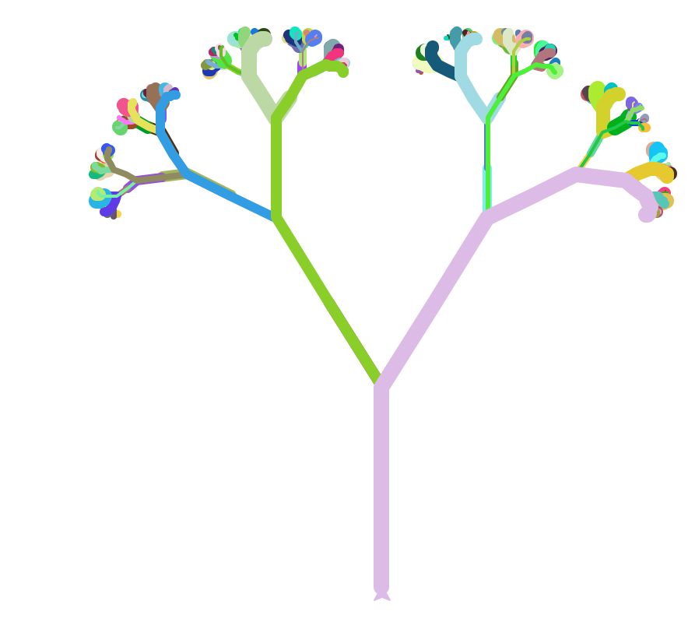

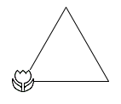
Turtle thoughts...
def flakeside(L,N):
if N==0: forward(L)
flakeside(L/3)
right(60)
flakeside(L/3)
left(120)
flakeside(L/3)
right(60)
flakeside(L/3)
and Flo Walsh!
Evy Larsen!
def svtree( L, N ):
if N==0: return
forward( L )
left(30)
svtree( L/2, N-1 )
right(60)
svtree( L/2, N-1 )
left(30)
backward( L )
1
1
2
1
4
3
2
1
3
2
1
The numbers show the value of N for each call ...
2
1
1
1
The colors show the entire stack of calls up to that branch!

Slide 51
This would make me hungry… but I ate breakfast this morning!
Computing to the max
The not-so-subtle art of singling out the best (and worst) of anything…
Last hw?
Adib, to start!
N-step sleepwalking?
a comparison comparison
Turtle graphics??
Artistic renderings!!!
'm+ms'
'coffee'
[ 0, 42 ]
[ 4, 2 ]
This week!
True
'True'
> or <
Hw #3 due next Monday…
pr0: Are we The Matrix?
Computing with language
pr1: Lab…
pr2: Sorting + Caesar!
What's in a Writ1 paper, anyway?
Battle-tested ciphers & how to break them…

Slide 52
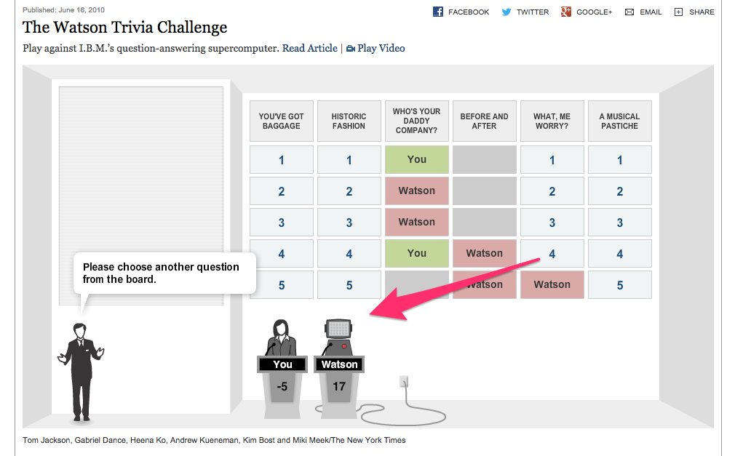
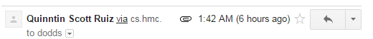
CS5 in the browser – sort of …
thanks to Quinn Ruiz for this!

Slide 53
recursive max
L
[ 7, 10, -2, 42, 15 ]
L = [ 'aliens', 'zap', 'hazy', 'code' ]
L[1:]
def max( L ):
""" returns the max element from L
input: L, a nonempty list
"""
if len(L) < 2: return L[0] # only 1 elem.
maxOfRest = max(L[1:]) # max of the rest
if L[0] > maxOfRest :
return L[0] # either L[0]
else:
return maxOfRest # or maxOfRest!
I love max rest!

Slide 54
max with scrabble-score
L = [ 'aliens', 'zap', 'hazy', 'code' ]
Which element has the highest scrabble score?
def maxSS( L ):
""" returns L's highest scrabble-scoring
element (input: L, a nonempty list)
"""
if len(L) < 2: return L[0] # only 1 elem.
maxOfRest = maxSS(L[1:]) # rest's max
if L[0] > maxOfRest :
return L[0] # either L[0]
else:
return maxOfRest # or maxOfRest!
Spacey! I like it!

Slide 55
A more comprehensive solution: LoL
L = [ 'aliens', 'zap', 'hazy', 'code' ]
def maxSS( L ):
""" returns L's max-scrabble-score word
"""
LoL = [ [sScore(w), w] for w in L ]
bestpair = max( LoL )
return bestpair[1]
This does look funny!

Slide 56
A more comprehensive solution
L = [ 'aliens', 'zap', 'hazy', 'code' ]
I loathe hazy code!
def maxSS( L ):
""" returns L's max-scrabble-score word
"""
LoL = [ [sScore(w), w] for w in L ]
bestpair = max( LoL )
return bestpair[1]
LoL = [ [6,'aliens'], [14,'zap'], [19,'hazy'], [7,'code'] ]
bestpair = [19,'hazy']
'hazy'

Slide 57
Everything … is a max problem?
I know the best word here… but does Python?
L = [ 'aliens', 'zap', 'hazy', 'code' ]
def revviestword( L ):
""" another example – what's returned?
"""
LoL = [ [w[::-1], w] for w in L ]
bestpair = max( LoL )
return bestpair[1]
LoL = [ [ 'sneila' ,'aliens'], [ 'paz' ,'zap'], [ 'yzah' ,'hazy'], [ 'edoc' ,'code'] ]
bestpair =

Slide 58
L = [ 'aliens', 'zap', 'hazy', 'code' ]
def maxlen(L):
LoL = [ [len(s),s] for s in L ]
bstpr = max( LoL )
return bstpr[1]
1. What is LoL?
[ [6,'aliens'], [3,'zap'], [4,'hazy'], [4,'code'] ]
2. What is bstpr?
[6,'aliens']
'aliens'
3. What is returned?
Extra! Change exactly three characters in this code so that 3 is returned.

Slide 59
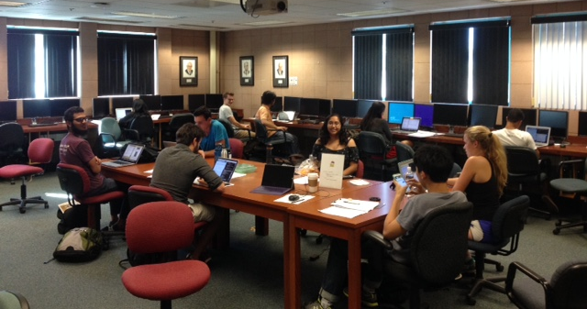
Notes from our amazing CS5 grutors…
Join in!
and/or join my office hours on Fridays, 2:30-4:30 or so @ the LAC lab
and others!

Slide 60
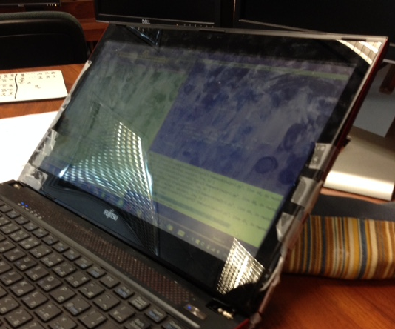
Notes from our amazing CS5 grutors…
Join in!
No matter what's holding your machine together!
and/or join my office hours on Fridays, 2:30-4:30 or so @ the LAC lab
and others!

Slide 61
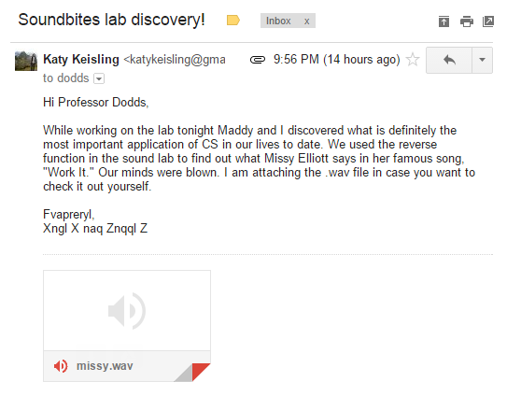
We saw you in Lab3…
heard

Slide 62
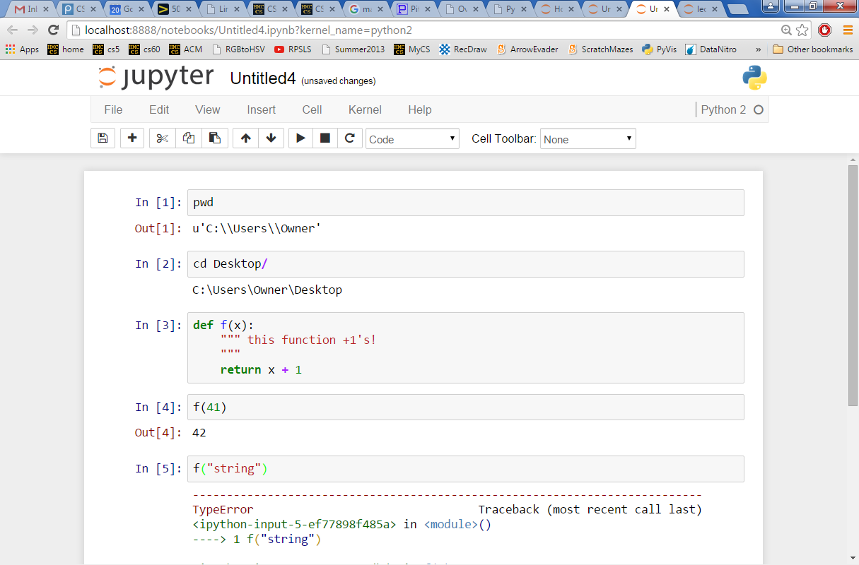
CS5 in the browser – yes …
try it out, maybe later this week…
instructions are at the start of this week's Lab…

Slide 63
scrabble-score max
['Harvey', 'Mudd', 'College', 'seeks', 'to', 'educate', … ]
def bestWord( L ):
""" returns L's max-scrabble-score word
input: L, a list of strings (words)
"""
if len(L) < 2: # one element is the max
return L[0]
elif L[0] < L[1] : #1 wins
return bestWord( L[1:] )
else: #0 wins
return bestWord( L[0:1] + L[2:] )
What do we need here?

Slide 64
A more comprehensive solution
L = [ 'aliens', 'zap', 'hazy', 'code' ]
I loathe hazy code!
def maxSS( L ):
""" returns L's max-scrabble-score word
"""
LoL = [ [sScore(w), w] for w in L ]
bestpair = max( LoL )
return bestpair[1]
LoL = [ [6,'aliens'], [14,'zap'], [19,'hazy'], [7,'code'] ]
bestpair = [19,'hazy']
'hazy'

Slide 65
variation: max
[ 7, 10, -2, 41, -46, 42, 15 ]
def max( L ):
""" returns the max element from L
input: L, a nonempty list
"""
if len(L) < 2: # one element is the max.
return L[0]
rest_max = max(L[1:]) # max of the rest
if L[0] > rest_max : # L[0]…
return L[0]
else:
return rest_max # … or rest_max wins!
Spacey! I like it!

Slide 66
general-purpose max
[ 7, 10, -2, 41, -46, 42, 15 ]
def max( L ):
""" returns the max element from L
input: L, a nonempty list
"""
if len(L) < 2: # one element is the max.
return L[0]
rest_max = max(L[1:]) # max of the rest
if L[0] > rest_max : # L[0]…
return L[0]
else:
return rest_max # … or rest_max wins!
Spacey! I like it!

Slide 67
general-purpose max
[ 7, 10, -2, 41, -46, 42, 15 ]
def max( L ):
""" returns the max element from L
input: L, a nonempty list
"""
if len(L) < 2: # one element is the max.
return L[0]
rest_max = max(L[1:]) # max of the rest
if sScore(L[0]) > sScore(rest_max): # L[0]…
return L[0]
else:
return rest_max # … or rest_max wins!

Slide 68
scrabble-score max
['Harvey', 'Mudd', 'College', 'seeks', 'to', 'educate', … ]
def bestWord( L ):
""" returns L's max-scrabble-score word
input: L, a list of strings (words)
"""
if len(L) < 2: # one element is the max
return L[0]
elif sScore(L[0]) < sScore(L[1]): #1 wins
return bestWord( L[1:] )
else: #0 wins
return bestWord( L[0:1] + L[2:] )
What do we need here?
What else might be nice to know ?

Slide 69
sword button?

Slide 70
chr and ord
abcdefghijklmnopqrstuvwxyz
ASCII values
97
ord value
99
101
103
105
107
109
111
113
115
117
119
122
ABCDEFGHIJKLMNOPQRSTUVWXYZ
65
ord value
67
69
71
73
75
77
79
81
83
85
87
90
ord( c )
Input: a string of one character, c
Conversion functions
Output: an integer, the ASCII value of c
chr( n )
Input: an integer in range(255)
Output: a one-char. string of that ASCII value

Slide 71
chr, ord,
and rot13
Finish rot13 to "shift" a letter, c, by 13 spots…
def rot13( c ):
""" rotate c by 13 chars, "wrapping" as needed; NON-LETTERS don't change """
if 'a' <= c <= 'z': # test if c is a lowercase letter
new_ord = ord(c) + 13 # if so, find the # 13 spots ahead
if new_ord <= ord('z'): # check if it's in bounds!
return chr(new_ord) # if so, return it
else: # otherwise
return # what to return?
elif # what test should go here?
# what would go here, if we had room?
else: # what should be done in the else?
How would this change if we wanted to rotate by n spots?

Slide 72


sword button?

Slide 73
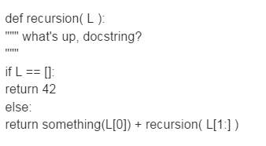
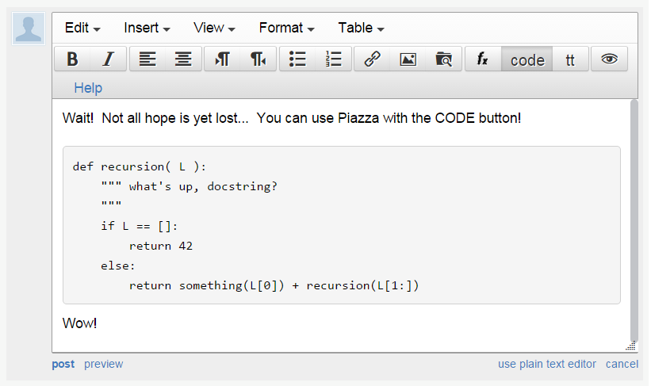
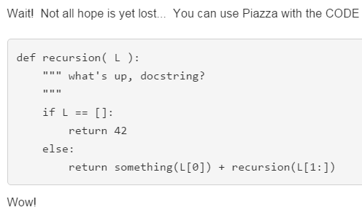
sword button?
code button!
creating a private post to Piazza because something is not working… ?
bugs, vanquished!
code button – then paste

Slide 74
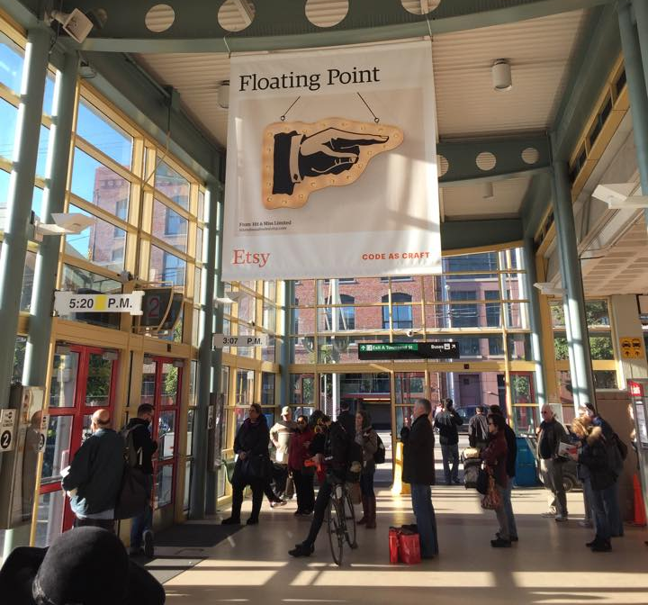
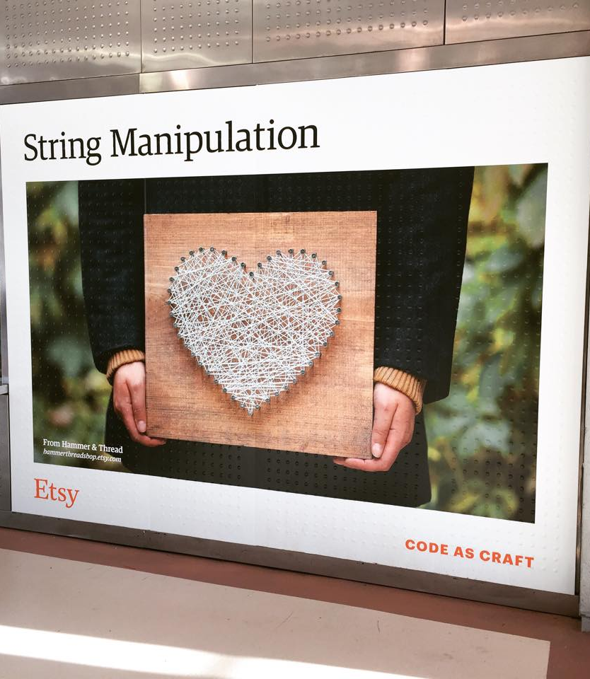
Syntax vs. Semantics
Karen and Erin!
Plus – you might consider coming to the Career Fair this Friday at HMC's LAC…

Slide 75
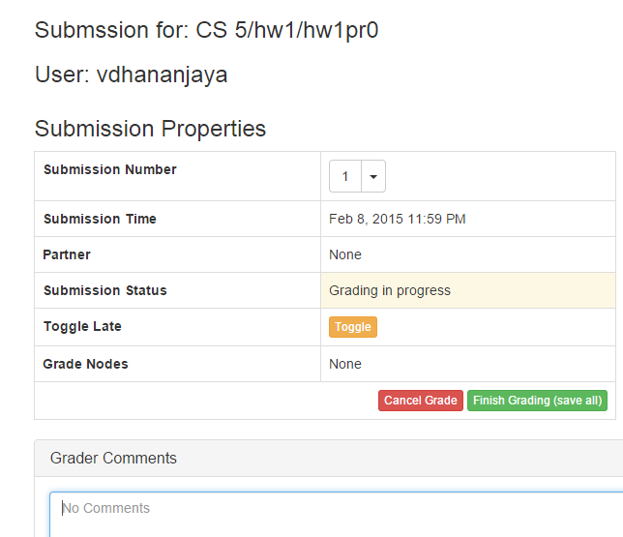
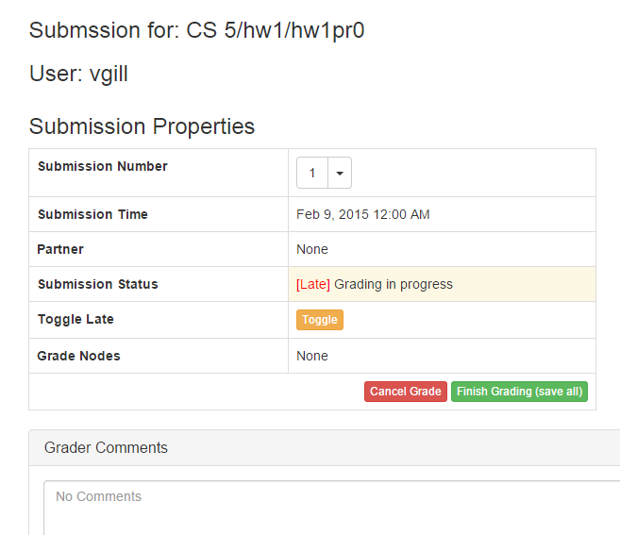
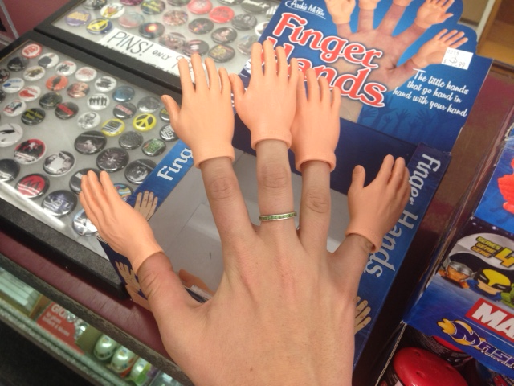
thanks, Nina!

Slide 76
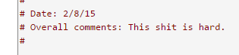
thanks, Nina!

Slide 77
Caesar Cipher: decipher
Caesar
Brutus
>>> decipher('Bzdrzq bhogdq? H oqdedq Bzdrzq rzkzc.')
'Caesar cipher? I prefer Caesar salad.'
S1
S2
Becca's connection with Islamic studies…
>>> decipher('Hu lkbjhapvu pz doha ylthpuz hmaly dl mvynla '\
'lclyfaopun dl ohcl slhyulk.')
'An education is what remains after we forget everything we have learned.'
>>> decipher('Uifz xpsl ju pvu xjui b qfodjm!')
PL
LAT
>>> decipher('gv vw dtwvg')
But how ?

Slide 78
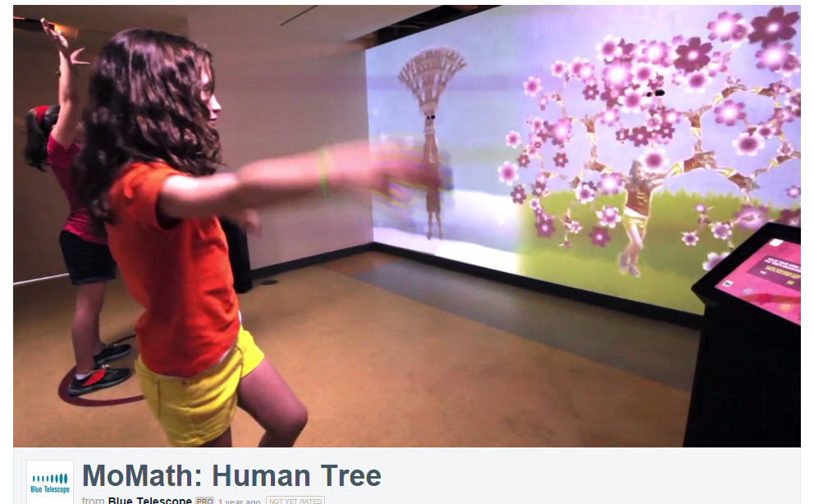


Slide 79
Rot 13
def rot13( c ):
""" rotates c by 13 chars, "wrapping" as needed
NON-LETTERS don't change!
"""
if 'a' <= c <= 'z':
new_ord = ord(c) + 13
if new_ord <= ord('z'):
return chr(new_ord)
else:
return chr( )
elif 'A' <= c <= 'Z': # upper-case test!
else:
Rotate n? Rotate an entire string?

Slide 80
Rot 13
def rot13( c ):
""" rotates c by 13 chars, "wrapping" as needed
NON-LETTERS don't change!
"""
if 'a' <= c <= 'z':
new_ord = ord(c) + 13
if new_ord <= ord('z'):
return chr(new_ord)
else:
return chr( )
elif 'A' <= c <= 'Z': # upper-case test!
else:
Rotate n? Rotate an entire string?

Slide 81
A more comprehensive solution
I loathe hazy code!
L = [ 'aliens', 'zap', 'hazy', 'code' ]
def bestWord( L ):
""" returns L's max-scrabble-score word
"""
LoL = [ [sScore(w), w] for w in L ]
bestpair = max( LoL )
return bestpair[1]
LoL = [ [6,'aliens'], [14,'zap'], [19,'hazy'], [7,'code'] ]
bestpair = [19,'hazy']
'hazy'

Slide 82
chr, ord,
and rot13
What is ord('U')/2?
What is chr( ord('i')+13 )?
What is chr( ord('W')+13 )?
Finish rot13 to "shift" letters by 13 spots…
def rot13( c ):
""" rotate c by 13 chars, "wrapping" as needed; NON-LETTERS don't change """
if 'a' <= c <= 'z': # test if c is a lowercase letter
new_ord = ord(c) + 13 # if so, find the # 13 spots ahead
if new_ord <= ord('z'): # check if it's in bounds!
return chr(new_ord) # if so, return it
else: # otherwise
return # what to return?
elif # what test should go here?
# what would go here, if we had room?
else: # what should be done in the else?
How would this change if we wanted to rotate by n spots?

Slide 83
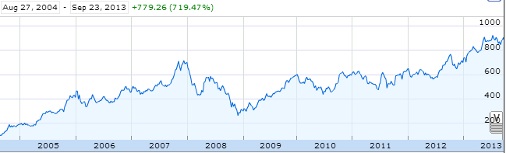
Aside: web scraping
How could we grab today's stock price via Python?

Slide 84
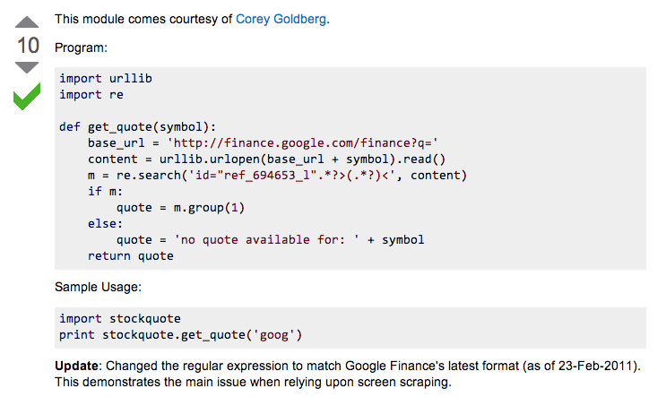
Example: web scraping
http://stackoverflow.com/questions/5081710/how-to-create-a-stock-quote-fetching-app-in-python

Slide 85
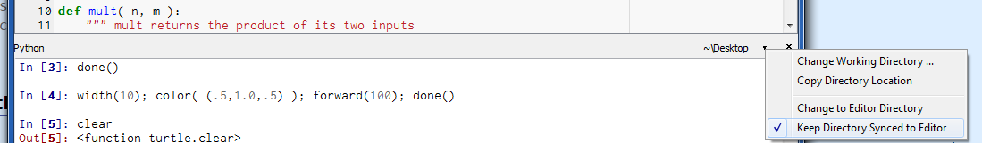

Slide 86
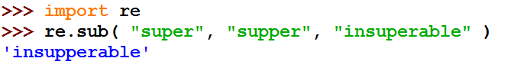
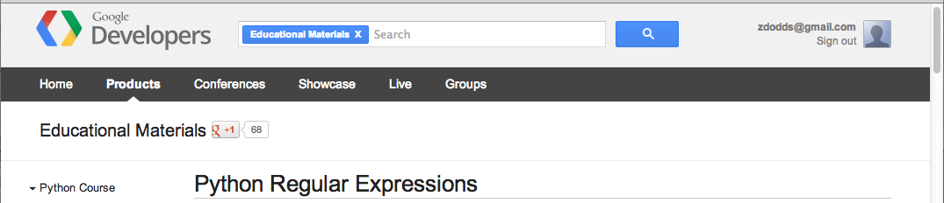
Regular Expressions
a huge string-processing library
many tutorials available…
developers.google.com/edu/python/regular-expressions?csw=1

Slide 87
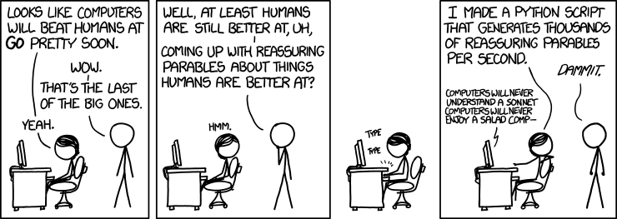
String-processing perspective…
with thanks to Jacquelyn Zehner!
http://stackoverflow.com/questions/5081710/how-to-create-a-stock-quote-fetching-app-in-python

Slide 89
Write each of these functions using list comprehensions…
Last Time...
def nodds(L):
LC = [ 1 for x in L if x%2 == 1 ]
return sum(LC)
too terse?
[ x%2 for x in L ]
def lotto(Y,W):
LC = [ ]
too terse?
return sum(LC)
[ ]
def ndivs(N):
LC = [ 1 for x in range(1,N+1) if N%x==0 ]
list
too terse?
return sum(LC)
[ N%x==0 for x in range(1,N+1) ]
def primesUpTo(P):
Extra!
LC = [ x for x in range(2,P+1) if ndivs(x)==2 ]
list
return LC

Slide 90
An Example of the Beauty of Algorithms
Adib Shaar, Bsc., MSc., PHd., Senior Member of IEEE
Harvey Mudd College
20-9-2016

Slide 91
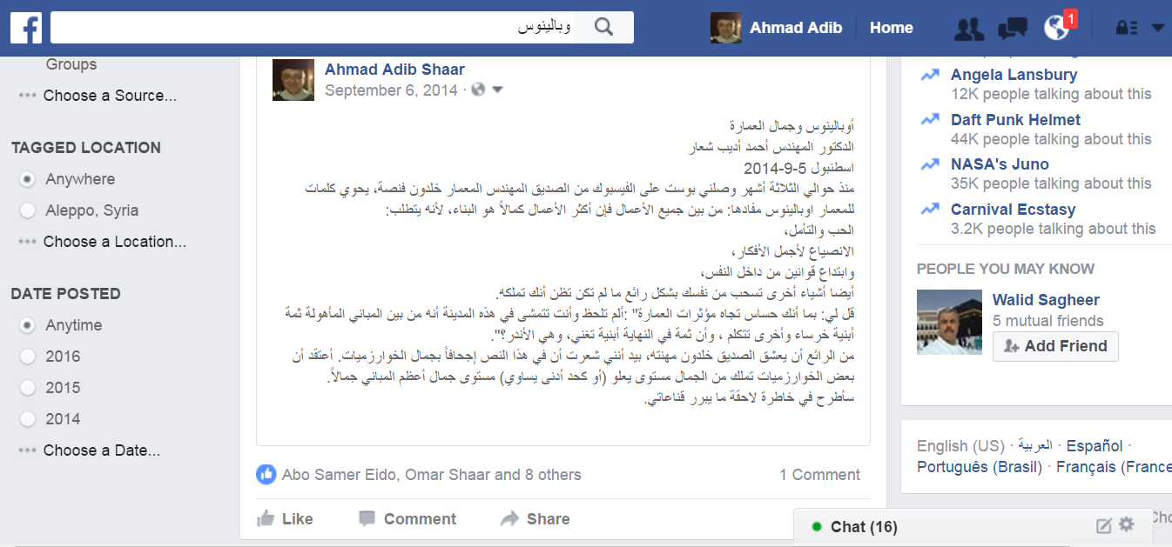
Outlines

Slide 92
My friend Khaldoun Fansa (a 70 years old architect), posted three months ago on Facebook: "buildings are the best example on (nonhuman) beauty: don't you notice that some of them nearly talk?".

Slide 93
I commented: I appreciate your faithfulness to your specialization, but I think algorithms (which are the main body of computer science) are the best example on beauty!
Give me some time to explain. After two months I posted the following article on Facebook.

Slide 94
There are several measures for beauty of nonhuman beings. One of the most important one is effectiveness (the cost). The following is a picture of one of Claremont University Consortium buildings, where effectiveness (cost) was one of the main factors in evaluating its architectural beauty.

Slide 95
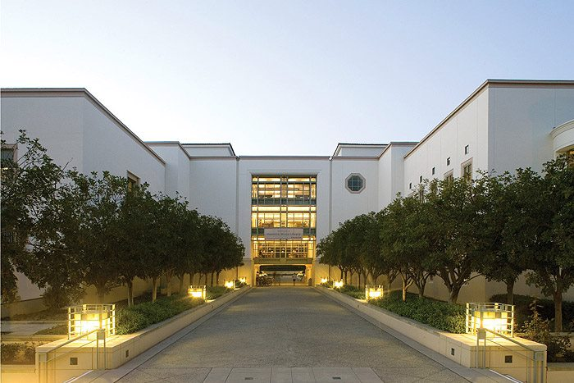

Slide 96
In order to imagine the effectiveness of this algorithm, I will compare its original, unimproved form, cost with the cost of building a bridge that costs 99 million Syrian Pounds.

Slide 97
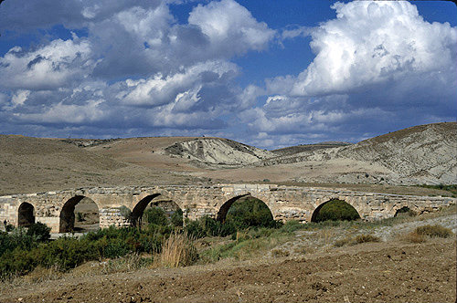
Roman bridge-countryside of Aleppo

Slide 98
The task: Design an algorithm to test whether the entered integer 101 is prime or not.

Slide 99
My student Sameer suggests Algorithm #1:
Relying on the definition of a prime number (a positive integer which can only be divided by itself and the number 1), this algorithm attempts dividing 101 by all numbers ranging between 2 and 100, in order.
If we don’t find a divisor we know 101 is a prime number. If we do find a divisor, we know it's not prime.

Slide 100
Check if 101 is prime by …
Beauty ~ efficiency
COST
(a) dividing by ALL values from 2 .. 100
99 £S
2, 3, 4, 5, …, 97, 98, 99, 100
insight: using the definition of "prime"

Slide 101
Then my student Zaid came and said: I have an algorithm which cuts the cost in half, Algorithm #2:
The same as algorithm #1, but without testing the division by even numbers, because of the simple fact that odd numbers (all prime numbers are odd with the exception of the number 2) are not divisible by any even number.

Slide 102
Check if 101 is prime by …
Beauty ~ efficiency
COST
(a) dividing by ALL values from 2 .. 100
99 £S
2, 3, 4, 5, …, 97, 98, 99, 100
insight: using the definition of "prime"
(b) dividing by ODD values from 2 .. 100
49 £S
2, 5, 7, 9, …, 93, 95, 97, 99
insight: 101 is odd, has no even divisors

Slide 103
Then my student Amr suggests an algorithm which cuts the cost to only 4 million Syrian Pounds. Algorithm #3:
The same as algorithm #2, but without trying to divide by numbers which are greater than 10,
relying on the fact that if no divisor is found for a number before its square root, then none will be found beyond it (here the square root is approximately 10).

Slide 104
Check if 101 is prime by …
Beauty ~ efficiency
COST
(a) dividing by ALL values from 2 .. 100
99 £S
2, 3, 4, 5, …, 97, 98, 99, 100
insight: using the definition of "prime"
(b) dividing by ODD values from 2 .. 100
49 £S
2, 5, 7, 9, …, 93, 95, 97, 99
insight: 101 is odd, has no even divisors
(c) dividing by ODD values from 2 .. 10
4 £S
3, 5, 7, 9
insight: only need to check upto sqrt(101)

Slide 105
My student Zaid, the designer of algorithm #2, laughs, saying: I have an even faster algorithm:

Slide 106
My student Zaid, the designer of algorithm #2, laughs, saying: I have an even faster algorithm:
The same as algorithm #3, but excluding dividing by 9,
because: we have already attempted dividing by 3, and since 9 is a multiple of 3, dividing by 9 would be redundant if we already tried division by 3
We only need prime divisors !

Slide 107
Check if 101 is prime by …
Beauty ~ efficiency
COST
(a) dividing by ALL values from 2 .. 100
99 £S
2, 3, 4, 5, …, 97, 98, 99, 100
insight: using the definition of "prime"
(b) dividing by ODD values from 2 .. 100
49 £S
2, 5, 7, 9, …, 93, 95, 97, 99
insight: 101 is odd, has no even divisors
(c) dividing by ODD values from 2 .. 10
4 £S
3, 5, 7, 9
insight: only need to check upto sqrt(101)
(d) dividing by PRIME values from 2 .. 10
3 £S
3, 5, 7
insight: only need to check prime factors!

Slide 108
Thank you
Comments and questions are welcomed

Slide 109
Caesar Cipher: decipher
Caesar
[0, 'gv vw dtwvg'],
[2, 'hw wx euxwh'],
[2, 'ix xy fvyxi'],
[0, 'jy yz gwzyj'],
[2, 'kz za hxazk'],
[4, 'la ab iybal'],
[0, 'mb bc jzcbm'],
[1, 'nc cd kadcn'],
[4, 'od de lbedo'],
[3, 'pe ef mcfep'],
[0, 'qf fg ndgfq'],
[2, 'rg gh oehgr'],
[2, 'sh hi pfihs'],
[3, 'ti ij qgjit'],
[2, 'uj jk rhkju'],
[1, 'vk kl silkv'],
[0, 'wl lm tjmlw'],
[1, 'xm mn uknmx'],
[2, 'yn no vlony'],
[3, 'zo op wmpoz'],
[2, 'ap pq xnqpa'],
[1, 'bq qr yorqb'],
[0, 'cr rs zpsrc'],
[1, 'ds st aqtsd'],
[4, 'et tu brute'],
[3, 'fu uv csvuf']
Brutus
number-of-vowels score
max
won't always be correct!
all 26 possibilities

Slide 110
Caesar Cipher: decipher
Caesar
[6.9e-05, 'gv vw dtwvg'],
[3.6e-05, 'hw wx euxwh'],
[1.4e-07, 'ix xy fvyxi'],
[8.8e-11, 'jy yz gwzyj'],
[7.2e-10, 'kz za hxazk'],
[0.01503, 'la ab iybal'],
[3.7e-08, 'mb bc jzcbm'],
[0.00524, 'nc cd kadcn'],
[0.29041, 'od de lbedo'],
[0.00874, 'pe ef mcfep'],
[7.3e-07, 'qf fg ndgfq'],
[0.06410, 'rg gh oehgr'],
[0.11955, 'sh hi pfihs'],
[3.1e-06, 'ti ij qgjit'],
[1.1e-08, 'uj jk rhkju'],
[2.6e-05, 'vk kl silkv'],
[0.00012, 'wl lm tjmlw'],
[3.1e-06, 'xm mn uknmx'],
[0.02011, 'yn no vlony'],
[1.5e-06, 'zo op wmpoz'],
[1.9e-07, 'ap pq xnqpa'],
[5.7e-08, 'bq qr yorqb'],
[0.00024, 'cr rs zpsrc'],
[0.02060, 'ds st aqtsd'],
[0.45555, 'et tu brute'],
[0.00011, 'fu uv csvuf']
Brutus
letter-prob. score
max
not always correct, but better!
all 26 possibilities

Slide 111
Caesar Cipher: decipher
gv vw dtwvg
hw wx euxwh
ix xy fvyxi
jy yz gwzyj
kz za hxazk
la ab iybal
mb bc jzcbm
nc cd kadcn
od de lbedo
pe ef mcfep
qf fg ndgfq
rg gh oehgr
sh hi pfihs
ti ij qgjit
uj jk rhkju
vk kl silkv
wl lm tjmlw
xm mn uknmx
yn no vlony
zo op wmpoz
ap pq xnqpa
bq qr yorqb
cr rs zpsrc
ds st aqtsd
et tu brute
fu uv csvuf
Caesar
Brutus
decipher('gv vw dtwvg')
Strategy using max:
(1) consider all possible answers
(2) give them each a score
(3) use our techniques to get max
Score for "Englishness"?
up to you…
all 26 possibilities

Slide 112
Solutions…
Hints:
abs( x ) is built-in to Python
Use bestWord as a guide:
def bestWord( L ):
""" example code """
LOL = [ [scsc(w), w] for w in L ]
bestPair = max( LOL )
return bestPair[1]
L
def bestNumber( L ):
""" returns the # in
L closest to 42 """
LoL =
[30,40,50]
[[12,30],[2,40],[8,50]]
[2,40]
40

Slide 113
Solutions…
Hints:
abs( x ) is built-in to Python
Use bestWord as a guide:
def bestWord( L ):
""" example code """
LOL = [ [scsc(w), w] for w in L ]
bestPair = max( LOL )
return bestPair[1]
L
def bestNumber( L ):
""" returns the # in
L closest to 42 """
LoL =
[30,40,50]
[[12,30],[2,40],[8,50]]
[2,40]
40

Slide 114
Solutions…
def count( e, L ):
""" returns the # of e's in L """
return sum( [e==x for x in L] )
def mode( L ):
""" returns the element
appearing most often in L """

Slide 115
The last word on bestWord
def scrabbleScore(w):
# see homework #1!
Let's abbreviate this function as scsc(w)
using raw recursion
def bestWord( L ):
""" finds the "best" word from L, a list of words
here, "best" means highest scrabble score """
if len(L) < 2: return L[0]
elif scsc(L[0]) < scsc(L[1]): return bestWord( L[1:] )
else: return bestWord( L[0:1] + L[2:] )
using max
def bestWord( L ):
""" returns the word in L w/max scrabble score """
LoL = [ [scsc(w), w] for w in L ]
bestPair = max( LoL )
return bestPair

Slide 116
What is CS really about
thinking like a machine
thinking for a machine
variables
42
storage
int
guess
libraries
sequences
deciding how to use existing tools …
'w'
'a'
'r'
't'
str
s[0]
str
s[1]
str
s[2]
str
s[3]
functions
creating your own tools ...
if…elif…else
making decisions (conditionals)
classes
(later)
recursion
creating your own data structures ...
repeated, self-similar actions

Slide 117
Top-down program design
Given: a description of the problem
translation!
Wanted: a function that solves it

Slide 118
Top-down program design
Given: a description of the problem
translation!
Wanted: a function that solves it
with as much detail as possible
1. Visualize what the program will do
2. Break up the work into a set of smaller tasks
analysis
3. Compose solutions for these tasks (functions)
What do you need for each?
variables, lists, if…elif…else, recursion
synthesis
Are these tasks still too big? if so, go to step 1…
1. Visualize what the function will do ...

Slide 119
Top-down program design
Given: a description of the problem
translation!
Wanted: a function that solves it
with as much detail as possible
1. Visualize what the program will do
2. Break up the work into a set of smaller tasks
Examples...
3. Compose solutions for these tasks (functions)
What do you need for each?
variables, lists, if…elif…else, recursion
Are these tasks still too big? if so, go to step 1…
1. Visualize what the function will do ...

Slide 120
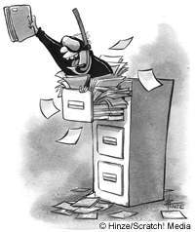
Files
Want to analyze your hum paper?
f becomes the "file object" representing humpaper.txt in this case.
Make sure you saved your paper as "plain text" (not .doc or .pdf) or else all sorts of weird formatting characters will show up!
f = file('humpaper.txt')
text = f.read()
words = text.split()
text is now one BIG string
words is now one BIG list of words (strings)
max(words)
or anything else you might want to investigate… !
min(words)
Two households, both alike in dignity,
In fair Verona, where we lay our scene,
From ancient grudge break to new mutiny,
Where civil blood makes civil hands unclean.
decode(text)

Slide 121
Representing Sound
physics
continuous plot of air pressure vs. time
sampling
samples taken every ~ 1/22050th of a second
quantization
Each sample is measured on a loudness scale from -32,768 to 32,767. (This fits into 2 bytes.)
storage
These two bytes are called a frame. Raw audio data - such as what is written to the surface of a CD - is simply a list of these frames.
pulse code modulation = PCM data

Slide 122
Break up
def remAll( e, L ):
""" this function removes all of the elements
e from the top level of the list L
"""
if len(L) == 0: # L is empty
return L
elif
else:
removeAll(42, [5,7,42,8,42])
[5,7,8]
removeAll('q', 'qaqqlqqiqeqqnqqqqs')
'aliens'

Slide 123
Warm up...
def removeAll( e, L ):
""" this function removes all of the elements
e from the top level of the list L
"""
if len(L) == 0:
return L # L is empty
elif
else:
removeAll(42, [5,7,42,8,42])
[5,7,8]
removeAll('q', 'qcqoqmqpqquqtqeqrq')
'computer'

Slide 124
Taking only one…
def removeAll( e, L ):
""" this function removes all of the elements
e from the top level of the list L
"""
if len(L) == 0:
return L # L is empty
elif e == L[0]:
return removeAll(e,L[1:]) # remove this one
# AND later ones…
else:
return L[0:1] + removeAll(e,L[1:])
# keep the non-e element and then keep going
How could we change this to removeOne?
removeOne(42, [5,7,42,8,42])
removeOne('p', 'computer programming')
[5,7,8,42]
'comuter programming'

Slide 125
"Best" word
def scrabbleScore(w):
# see homework #1!
Let's abbreviate this function as scsc(w)
def bestWord( L ):
""" finds the "best" word from L, a list of words
here, "best" means highest scrabble score """
if len(L) < 2:
return L[0]
elif
return
else:
return
What else might be nice to know ??

Slide 126
"Best" word
def scrabbleScore(w):
# see homework #1!
Let's abbreviate this function as scsc(w)
def bestWord( L ):
""" finds the "best" word from L, a list of words
here, "best" means highest scrabble score """
if len(L) < 2:
return L[0]
elif
return
else:
return
What else might be nice to know ??

Slide 127
A suggestion
def scrabbleScore(w):
# see homework #1!
Let's abbreviate this function as scsc(w)
def bestWord( L ):
""" returns the word in L w/maximum
scrabble score """
LOL = [ [scsc(w), w] for w in L ] # LOL!
bestPair = max( LOL )
return bestPair
What's so funny?

Slide 128
"Quiz"
Hints:
abs( x ) is built-in to Python
Solutions…
Use bestWord as a guide:
def bestWord( L ):
""" example code """
LOL = [ [scsc(w), w] for w in L ]
bestPair = max( LOL )
return bestPair[1]
Write this function using max:
def bestNumber( L ):
""" returns the # in L closest to 42 """
L
[30,40,50]
[[12,30],[2,40],[8,50]]
[2,40]
40

Slide 129
"Quiz"
Hint:
Solutions…
Consider defining a helper function !
Write this function however you like:
def mode( L ):
""" returns the element appearing most often in L """

Slide 130
"Quiz"
Nothing but the best!
Name(s):
Hints:
abs( x ) is built-in to Python
Write this function using max or recursively :
def bestNumber( L ):
""" returns the # in L closest to 42 """
Use bestWord as a guide:
def bestWord( L ):
""" example code """
LOL = [ [scsc(w), w] for w in L ]
bestPair = max( LOL )
return bestPair
Write this function however you like:
Hint:
Consider defining a helper function !
def mode( L ):
""" returns the element appearing most often in L """
Extra Credit: What four-letter word scores highest in scrabble?

Slide 131
"Quiz"
Hints:
abs( x ) is built-in to Python
Solutions…
Use bestWord as a guide:
def bestWord( L ):
""" example code """
LOL = [ [scsc(w), w] for w in L ]
bestPair = max( LOL )
return bestPair
Write this function using max:
def bestNumber( L ):
""" returns the # in L closest to 42 """

Slide 132
"Quiz"
Solutions…
Write this function however you like:
Hint:
Consider defining a helper function !
def mode( L ):
""" returns the element appearing most often in L """

Slide 133
chr and ord
abcdefghijklmnopqrstuvwxyz
ASCII VALUES
97
99
101
103
105
107
109
111
113
115
117
119
122
ABCDEFGHIJKLMNOPQRSTUVWXYZ
65
67
69
71
73
75
77
79
81
83
85
87
90
ord('a') is 97
chr(66) is 'B'
What is chr( ord('i')+13 ) ?
What is chr( ord('P')+13 ) ?
How can we wrap this around?

Slide 134
Rot 13
def rot13( c ):
""" rotates c by 13 chars, "wrapping" as needed
NON-LETTERS DO NOT CHANGE!
"""
if 'a' <= c <= 'z':
new_ord = ord(c) + 13
if new_ord <= ord('z'):
return chr(new_ord)
else:
return
elif
else:
How would you rotate an entire string?

Slide 135
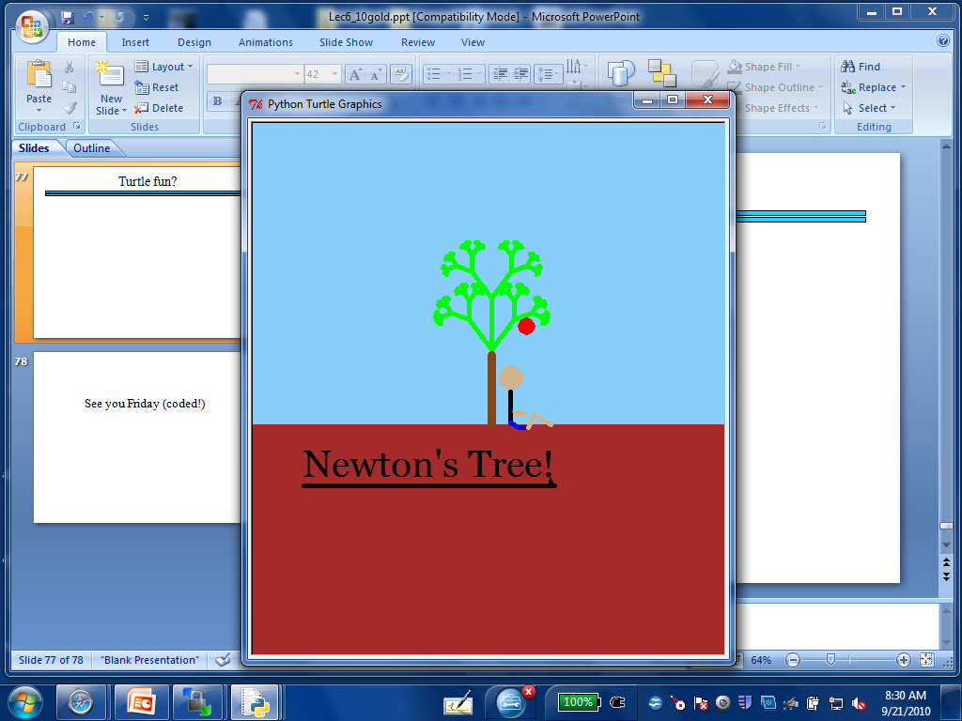
Turtle fun?

Slide 136
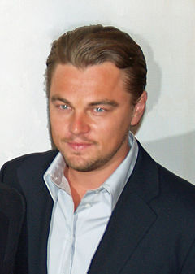
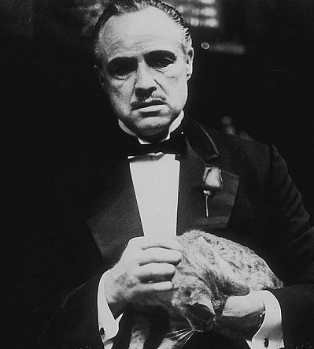
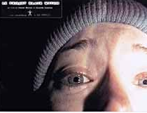
top N Lists
1. Titanic
2. Lord of the Rings 3
1. The Godfather
2. The Shawshank Redemption
1. The Blair Witch Project
2. Road to Ruin

Slide 137
top1List
def top1List( L ):
""" returns a list of the top element in L """
if len(L) < 1: return L
else: return [ max(L) ]

Slide 138
top2List
def top1List( L ):
""" returns a list of the top element in L """
if len(L) < 1: return L
else: return [ max(L) ]
def top2List( L ):
""" returns a list of the top 2 elements in L """
if len(L) < 2: return L
mx = max(L) # get the biggest element
newL = removeOne( mx, L ) # get rid of mx
return [ mx ] + top1List( newL )

Slide 139
top N List
def top3List( L ):
""" returns a list of the top 3 elements in L """
if len(L) < 3: return L
top N?

Slide 140
Files
Want to analyze your hum paper?
f becomes the "file object" representing humpaper.txt in this case.
You will first need to save your file as "plain text" or else all the special formatting characters will still be in there!
f = file('humpaper.txt')
text = f.read()
words = text.split()
text is now one BIG string
words is now one BIG list of words (strings)
max(words)
or anything else you might want to investigate… !
min(words)
Two households, both alike in dignity,
In fair Verona, where we lay our scene,
From ancient grudge break to new mutiny,
Where civil blood makes civil hands unclean.

Slide 141
Some legs to stand on…
It looks like I'm a head here!
decipher
max
encipher
score
adv(c,n)
creating more and more capable compositions
ord
chr

Slide 142
Some legs to stand on…
It looks like I'm a head here!
decipher
max
encipher
score
adv(c,n)
creating more and more capable compositions
ord
chr
computer organization
data representation
circuits
how are even these fundamentals physically realized ?!

Slide 143
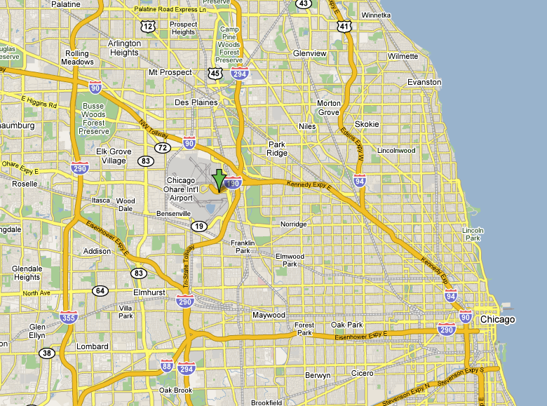
CHR and ORD
Orchard Field

Slide 144
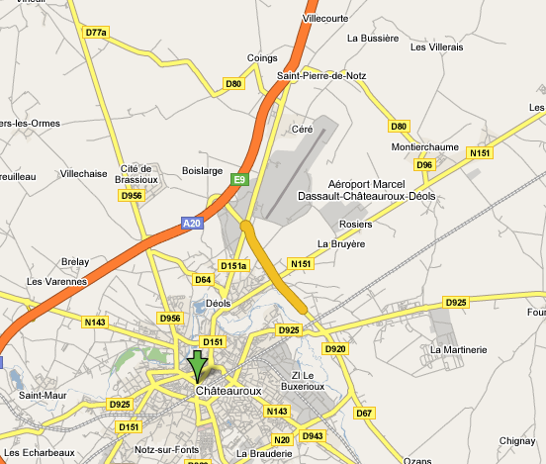
CHR and ORD
Chateauroux

Slide 145
ASCII
American Standard Code for Information Interchange
ASCII is a table that tells the computer how to represent characters as bits!
8 bits = 1 byte

Slide 146
chr and ord
abcdefghijklmnopqrstuvwxyz
functions for these conversions
97
122
ABCDEFGHIJKLMNOPQRSTUVWXYZ
65
90
ord( c )
Input: a string of one character, c
Output: an integer, the ASCII value of c
chr( n )
Input: an integer in range(255)
Output: a one-char. string of that ASCII value

Slide 147

Binary Storage / Representation
8 bits = 1 byte = 1 box
The SAME bits represent integers, if the variable has type int instead of str
value:
'*'
00101010
type: str
bits
name:
Identical bits are stored in each variable!
1 bit
The types determine how to interpret the bits; the names don't matter at all…
value:
42
00101010
1 byte = 8 bits
type: int
bits
name:

Slide 148
chr and ord
abcdefghijklmnopqrstuvwxyz
functions for these conversions
97
122
ABCDEFGHIJKLMNOPQRSTUVWXYZ
65
90
ord( c )
Input: a string of one character, c
Output: an integer, the ASCII value of c
chr( n )
Input: an integer in range(255)
Output: a one-char. string of that ASCII value
[ [i,chr(i)] for i in range(128) ]
try these!
[ ord(i) for i in '**** CS! ****' ]

Slide 149
chr and ord
Orchard Field

Slide 150
chr and ord
Chateauroux

Slide 151
Caesar Cipher: encipher
encipher( 'gv vw dtwvg' , 0 )
'gv vw dtwvg'
'hw wx euxwh'
'ix xy fvyxi'
'jy yz gwzyj'
'kz za hxazk'
'la ab iybal'
returns
encipher( 'gv vw dtwvg' , 1 )
returns
encipher( 'gv vw dtwvg' , 2 )
returns
encipher( 'gv vw dtwvg' , 3 )
returns
encipher( 'gv vw dtwvg' , 4 )
returns
encipher( 'gv vw dtwvg' , 5 )
returns
encipher( 'gv vw dtwvg' , 25 )
'fu uv csvuf'
returns
Output

Slide 152
Caesar Cipher: encipher
gv vw dtwvg
hw wx euxwh
ix xy fvyxi
jy yz gwzyj
kz za hxazk
la ab iybal
mb bc jzcbm
nc cd kadcn
od de lbedo
pe ef mcfep
qf fg ndgfq
rg gh oehgr
sh hi pfihs
ti ij qgjit
uj jk rhkju
vk kl silkv
wl lm tjmlw
xm mn uknmx
yn no vlony
zo op wmpoz
ap pq xnqpa
bq qr yorqb
cr rs zpsrc
ds st aqtsd
et tu brute
fu uv csvuf
encipher( 'gv vw dtwvg' , 0 )
'gv vw dtwvg'
'hw wx euxwh'
'ix xy fvyxi'
'jy yz gwzyj'
'kz za hxazk'
'la ab iybal'
returns
encipher( 'gv vw dtwvg' , 1 )
returns
encipher( 'gv vw dtwvg' , 2 )
returns
encipher( 'gv vw dtwvg' , 3 )
returns
encipher( 'gv vw dtwvg' , 4 )
returns
encipher( 'gv vw dtwvg' , 5 )
returns
encipher( 'gv vw dtwvg' , 25 )
'fu uv csvuf'
returns
Output
decipher?
all 26 possibilities

Slide 153
Caesar Cipher: decipher
>>> decipher('Bzdrzq bhogdq? H oqdedq Bzdrzq rzkzc.')
'Caesar cipher? I prefer Caesar salad.'
>>> decipher('Hu lkbjhapvu pz doha ylthpuz hmaly dl mvynla '\
'lclyfaopun dl ohcl slhyulk.')
'An education is what remains after we forget everything we have learned.'
But how to do this… ?

Slide 154
Rot 13: characters
def rotc( c ):
""" rotates a single char. c ahead by n chars
'wrapping around' as needed """

Slide 155
Rot 13: strings
def rots( S ):
""" rotates a string ahead by 13 chars. """

Slide 156
Sorting
def sort(L)
returns a list which has the same elements as L, but in sorted order!

Slide 157
Computing with text
Bits/Numbers
Language
Ideas
Characters
Representation
Meaning

Slide 158
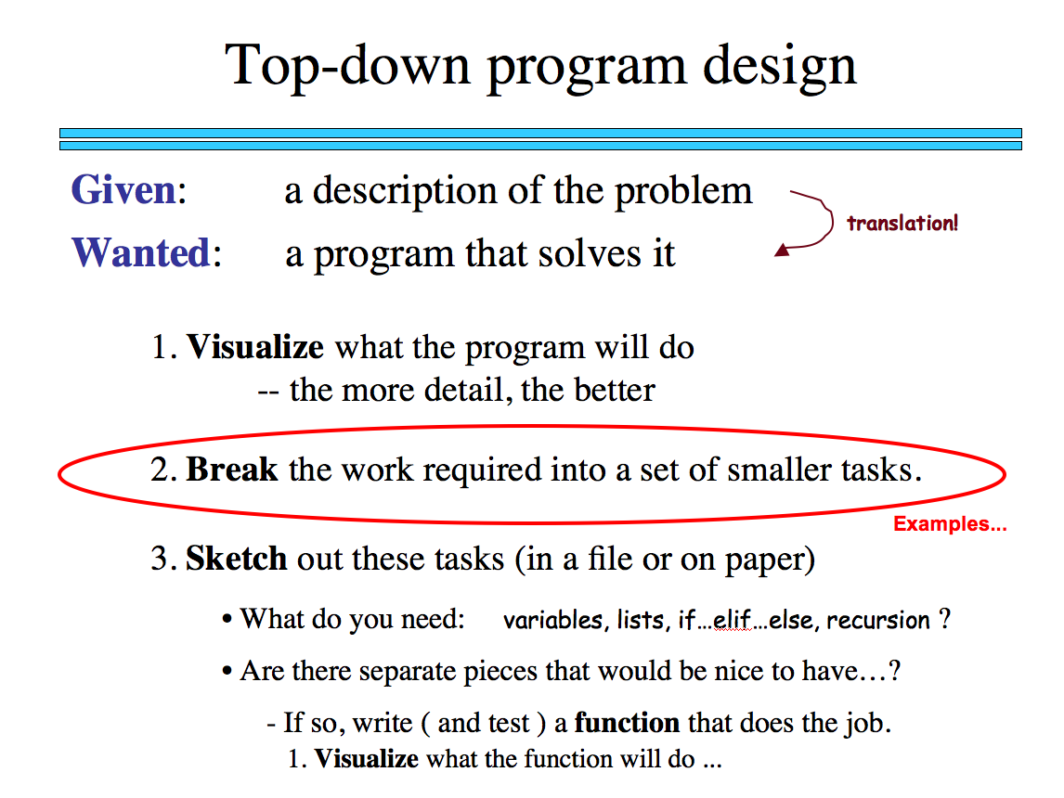
Sorting
def sort(L)
returns a list which has the same elements as L, but in sorted order!
What is sorting doing?
What is one piece?

Slide 159
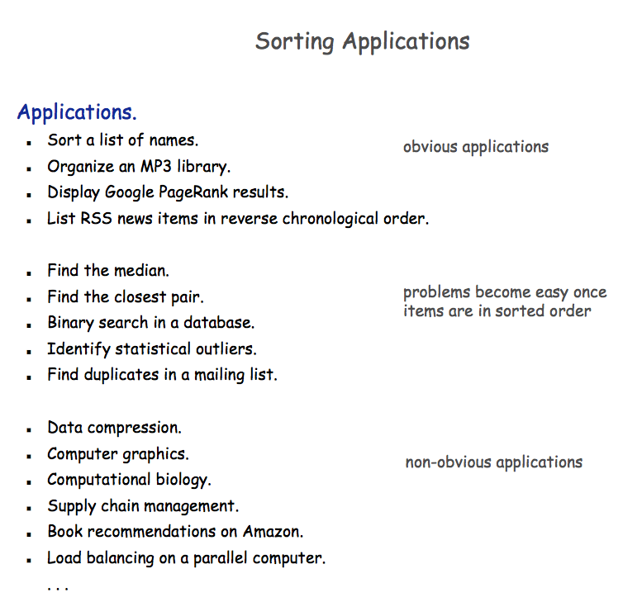

Slide 160

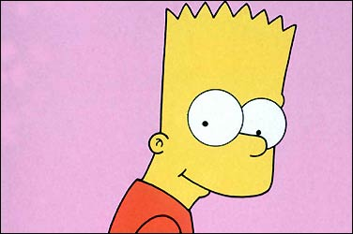
Random sorting…
def randSort( L ):
""" crazy sorting """
newL = random.sample( L, len(L) )
if isSorted(newL):
return newL
else:
return randSort(L) # try again…
A random permutation of L !
this function is totally random, dude!
Mmmm… sorting!

Slide 161

Random sorting…
def isSorted(s)
returns True if s is in order, False otherwise
isSorted('BART') returns False
isSorted('BERT') returns True
isSorted('BEGIN') returns True
isSorted([3,1,4]) returns False
isSorted([1,3,4]) returns True
ties?
isSorted('LOOPY') returns ??
Six-letter word?

Slide 162
Random sorting…
def isSorted(s):
returns True if s is in order, False otherwise
""" see the description in this box """
if len(s) < 2:
return
elif s[0] > s[1]:
return
else:
return
ties?
Six-letter word?

Slide 163
Random sorting…
def isSorted(s):
returns True if s is in order, False otherwise
""" see the description in this box """
if len(s) < 2:
return True
elif s[0] > s[1]:
return False
else:
return isSorted( s[1:] )
ties?
Six-letter word?

Slide 164
Almost the end…
def sort(L)
returns a list which has the same elements as L, but in sorted order!
Let e be the max element in L
Where should e go?
and what helper function might we want… ?

Slide 165
removeOne
def removeOne( e, L ):
""" this function removes one e from L
if L is a list, e is an element
if L is a string, e is a one-char. string
"""
if len(L) == 0:
return L # L is empty
elif e == L[0]:
return L[1:] # the element e is now gone
else:
return L[0:1] + removeOne( e, L[1:] ) # keep going

Slide 166
Computing with language
ideas / meaning
language / words / phrases
strings
numbers / bits

Slide 167
Computing with language
open questions in AI …
ideas / meaning
language / words / phrases
computing with language - recognizing English!
strings
how strings are represented and stored
numbers / bits

Slide 168
ASCII
American Standard Code for Information Interchange
ASCII is a table that tells the computer how to represent characters as bits!
8 bits = 1 byte

Slide 169
ASCII
American Standard Code for Information Interchange
ASCII is a table that tells the computer how to represent characters as bits!
value:
'*'
00101010
type: str
bits
name:
Identical bits are stored in each variable!
8 bits = 1 byte
The types determine how to interpret the bits; the names don't matter at all…
value:
42
00101010
The SAME bits represent integers, if the variable has type int instead of str
bits
type: int
name:

Slide 170
chr and ord
abcdefghijklmnopqrstuvwxyz
functions for these conversions
97
122
ABCDEFGHIJKLMNOPQRSTUVWXYZ
65
90
ord( c )
Input: a string of one character, c
Output: an integer, the ASCII value of c
chr( n )
Input: an integer in range(255)
Output: a one-char. string of that ASCII value

Slide 171
chr and ord
abcdefghijklmnopqrstuvwxyz
functions for these conversions
97
122
ABCDEFGHIJKLMNOPQRSTUVWXYZ
65
90
ord( c )
Input: a string of one character, c
Output: an integer, the ASCII value of c
chr( n )
Input: an integer in range(255)
Output: a one-char. string of that ASCII value
[ [i,chr(i)] for i in range(128) ]
try these!
[ ord(i) for i in '**** CS! ****' ]

Slide 172
chr and ord
Orchard Field

Slide 173
chr and ord
Chateauroux

Slide 174
Caesar Cipher: encipher
encipher( 'gv vw dtwvg' , 0 )
'gv vw dtwvg'
'hw wx euxwh'
'ix xy fvyxi'
'jy yz gwzyj'
'kz za hxazk'
'la ab iybal'
returns
encipher( 'gv vw dtwvg' , 1 )
returns
encipher( 'gv vw dtwvg' , 2 )
returns
encipher( 'gv vw dtwvg' , 3 )
returns
encipher( 'gv vw dtwvg' , 4 )
returns
encipher( 'gv vw dtwvg' , 5 )
returns
encipher( 'gv vw dtwvg' , 25 )
'fu uv csvuf'
returns
Output

Slide 175
Caesar Cipher: encipher
gv vw dtwvg
hw wx euxwh
ix xy fvyxi
jy yz gwzyj
kz za hxazk
la ab iybal
mb bc jzcbm
nc cd kadcn
od de lbedo
pe ef mcfep
qf fg ndgfq
rg gh oehgr
sh hi pfihs
ti ij qgjit
uj jk rhkju
vk kl silkv
wl lm tjmlw
xm mn uknmx
yn no vlony
zo op wmpoz
ap pq xnqpa
bq qr yorqb
cr rs zpsrc
ds st aqtsd
et tu brute
fu uv csvuf
encipher( 'gv vw dtwvg' , 0 )
'gv vw dtwvg'
'hw wx euxwh'
'ix xy fvyxi'
'jy yz gwzyj'
'kz za hxazk'
'la ab iybal'
returns
encipher( 'gv vw dtwvg' , 1 )
returns
encipher( 'gv vw dtwvg' , 2 )
returns
encipher( 'gv vw dtwvg' , 3 )
returns
encipher( 'gv vw dtwvg' , 4 )
returns
encipher( 'gv vw dtwvg' , 5 )
returns
encipher( 'gv vw dtwvg' , 25 )
'fu uv csvuf'
returns
Output
decipher?
all 26 possibilities

Slide 176
Caesar Cipher: decipher
>>> decipher('Bzdrzq bhogdq? H oqdedq Bzdrzq rzkzc.')
'Caesar cipher? I prefer Caesar salad.'
>>> decipher('Hu lkbjhapvu pz doha ylthpuz hmaly dl mvynla '\
'lclyfaopun dl ohcl slhyulk.')
'An education is what remains after we forget everything we have learned.'
But how to do this… ?

Slide 177
See you Friday (coded!)

Slide 178
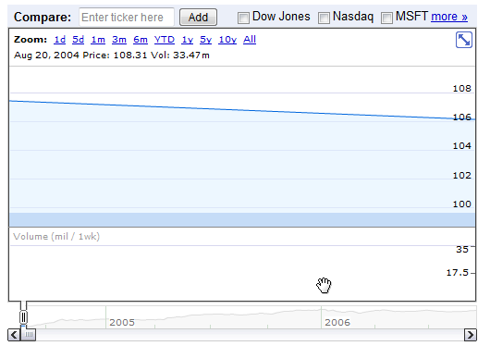
Google at its public offering ~ $ 100

Slide 179
