Slide 1
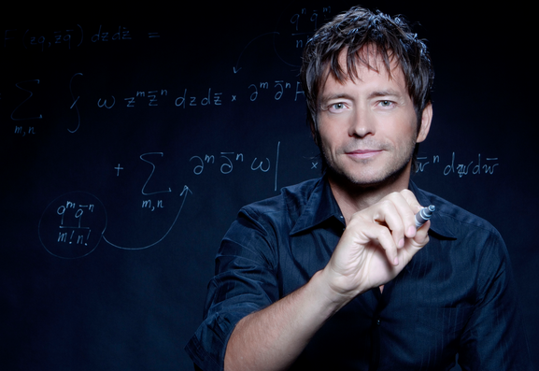
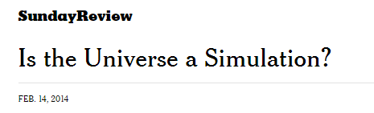
BR 5 Snczx
Gesundheit!
Algorithms
Edward Frenkel
Englishness...
Classifying life
Removing/Sorting
and Jotto!
HW 3
Hw #3 due Monday, 11:59
Sound Lab!
Several algorithms ...

Slide 2
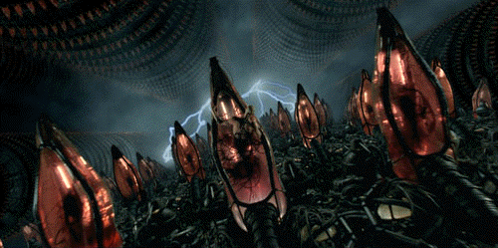
BR 5 Snczx
Gesundheit!
Algorithms
?
Edward Frenkel
Englishness...
Classifying life
Removing/Sorting
and Jotto!
HW 3
Hw #3 due Monday
"Office" hrs: Mon. 2-4pm
Weekend tutoring? yes!

Slide 3

BR 5 Snczx
Gesundheit!
Algorithms
!
Edward Frenkel
Englishness...
Classifying life
Removing/Sorting
and Jotto!
HW 3
Hw #3 due Monday
"Office" hrs: Mon. 2-4pm
Weekend tutoring? yes!

Slide 4
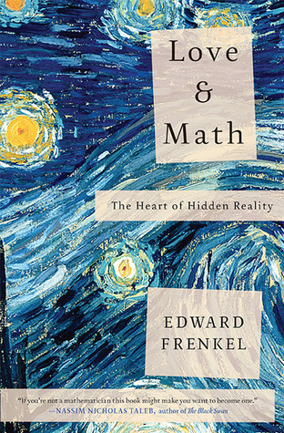
BR 5 Snczx
Gesundheit!
Algorithms
Edward Frenkel
Englishness...
Classifying life
Removing/Sorting
and Jotto!
HW 3
Hw #3 due Monday, 11:59
"Office" hrs: Fri. 2:30-4:30
Weekend tutoring? yes!

Slide 5
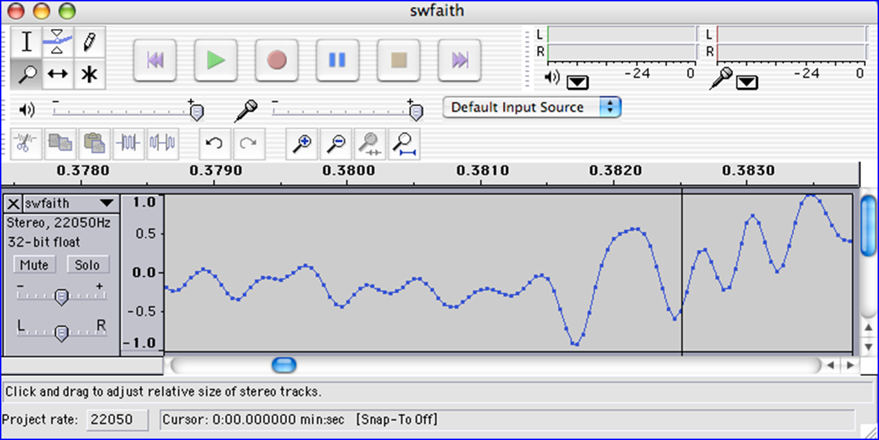
We saw you in Lab3…
heard

Slide 6
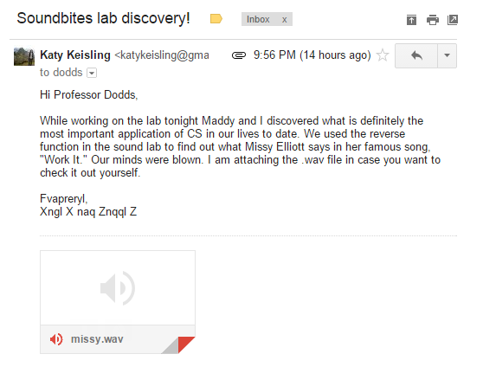
We saw you in Lab3…
heard

Slide 7
Today in CS5:
chr(9829)
The ♥ of CS (and CSers...)
We saw you in Lab3…
heard
Algorithms!

Slide 8
Caesar Cipher: encipher
should return the string s with each alphabetic character shifted/wrapped by n places in the alphabet
encipher(s,n)
encipher( 'I <3 Latin' , 0 )
'I <3 Latin'
'J <3 Mbujo'
'K <3 Ncvkp'
'L <3 Odwlq'
'M <3 Pexmr'
'N <3 Qfyns'
returns
encipher( 'I <3 Latin' , 1 )
returns
encipher( 'I <3 Latin' , 2 )
returns
encipher( 'I <3 Latin' , 3 )
returns
encipher( 'I <3 Latin' , 4 )
returns
encipher( 'I <3 Latin' , 5 )
returns
encipher( 'I <3 Latin' , 25 )
'H <3 Kzshm'
returns

Slide 9
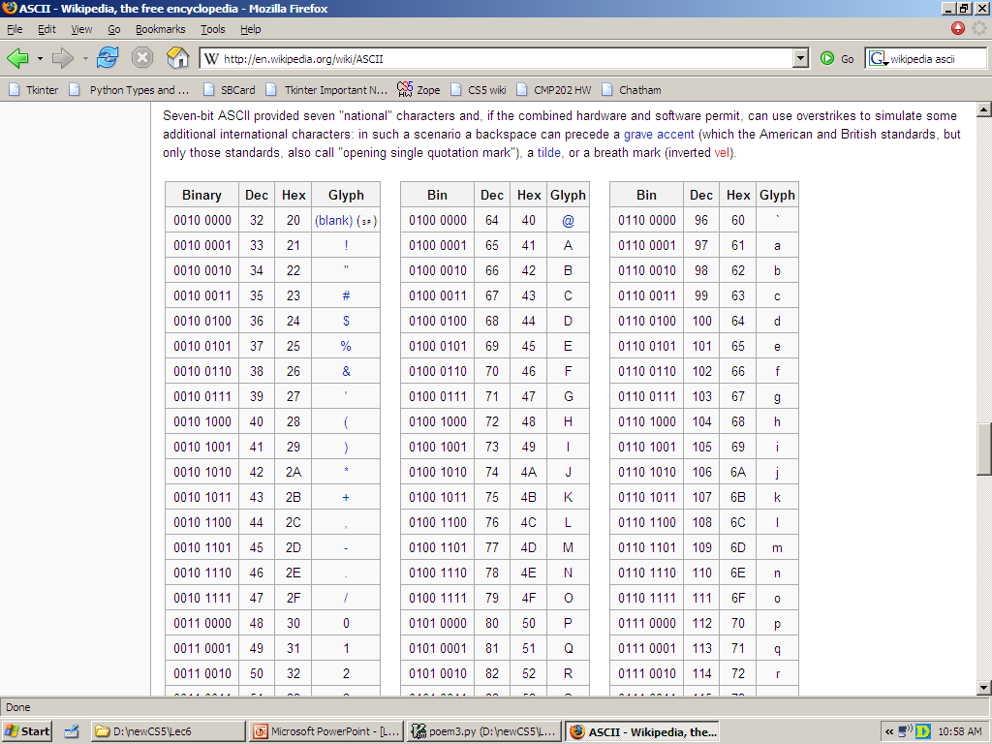
ASCII and Unicode
convert # to char
chr
ord
convert char to #
This is why 'CS' < 'clear' !
Julius spr'15

Slide 10
any single character, c
Writing Rot13
def rot13( c ):
""" rotates c by 13 chars, "wrapping" as needed
NON-LETTERS don't change!
"""
if 'a' <= c <= 'z':
if ord(c)+13 <= ord('z'):
return chr( ord(c)+13 )
else:
return chr( )
elif 'A' <= c <= 'Z': # upper-case test!
else:
(0) What do these tests do?
(1) What code will "wrap" to the alphabet's other side?
(2) How will upper case change? Try noting only the code differences…
(3) What if c is not a letter at all?
Extra: How would you rotate n places, instead of 13?

Slide 11
any single character, c
Writing Rot13
def rot13( c ):
""" rotates c by 13 chars, "wrapping" as needed
NON-LETTERS don't change!
"""
if 'a' <= c <= 'z':
if ord(c)+13 <= ord('z'):
return chr( ord(c)+13 )
else:
return chr( ord(c)+13-26 )
elif 'A' <= c <= 'Z': # upper-case test!
else:
(0) What do these tests do?
(1) What code will "wrap" to the alphabet's other side?
same, but for 'Z'
(2) How will upper case change? Try noting only the code differences…
return c
(3) What if c is not a letter at all?
use n instead of 13
Extra: How would you rotate n places, instead of 13?

Slide 12
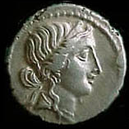
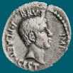
Caesar Cipher: encipher
Caesar
Brutus
>>> encipher('Bzdrzq bhogdq? H oqdedq Bzdrzq rzkzc.',25)
'Aycqyp agnfcp? G npcdcp Aycqyp qyjyb.'
S1
>>> encipher('Bzdrzq bhogdq? H oqdedq Bzdrzq rzkzc.',15)
'Qosgof qwdvsf? W dfstsf Qosgof gozor.'
>>> encipher('Bzdrzq bhogdq? H oqdedq Bzdrzq rzkzc.',4)
'Fdhvdu flskhu? L suhihu Fdhvdu vdodg.'
>>> encipher('Bzdrzq bhogdq? H oqdedq Bzdrzq rzkzc.',1)
'Caesar cipher? I prefer Caesar salad.'
>>> encipher('Hu lkbjhapvu pz doha ylthpuz hmaly dl mvynla '\
'lclyfaopun dl ohcl slhyulk.',19)
'An education is what remains after we forget everything we have learned.'
S2

Slide 13
Caesar Cipher: decipher
Caesar
Brutus
>>> decipher('Bzdrzq bhogdq? H oqdedq Bzdrzq rzkzc.')
'Caesar cipher? I prefer Caesar salad.'
S1
S2
>>> decipher('Hu lkbjhapvu pz doha ylthpuz hmaly dl mvynla '\
'lclyfaopun dl ohcl slhyulk.')
'An education is what remains after we forget everything we have learned.'
>>> decipher('Uifz xpsl ju pvu xjui b qfodjm!')
PL, PL2
>>> decipher('gv vw dtwvg')
LAT
But how ?

Slide 14
Decipher?
Strategies?
Algorithms?

Slide 15
gv vw dtwvg
hw wx euxwh
ix xy fvyxi
jy yz gwzyj
kz za hxazk
la ab iybal
mb bc jzcbm
nc cd kadcn
od de lbedo
pe ef mcfep
qf fg ndgfq
rg gh oehgr
sh hi pfihs
ti ij qgjit
uj jk rhkju
vk kl silkv
wl lm tjmlw
xm mn uknmx
yn no vlony
zo op wmpoz
ap pq xnqpa
bq qr yorqb
cr rs zpsrc
ds st aqtsd
et tu brute
fu uv csvuf
Decipher?
All possible decipherings
Strategies?
Algorithms?

Slide 16
gv vw dtwvg
hw wx euxwh
ix xy fvyxi
jy yz gwzyj
kz za hxazk
la ab iybal
mb bc jzcbm
nc cd kadcn
od de lbedo
pe ef mcfep
qf fg ndgfq
rg gh oehgr
sh hi pfihs
ti ij qgjit
uj jk rhkju
vk kl silkv
wl lm tjmlw
xm mn uknmx
yn no vlony
zo op wmpoz
ap pq xnqpa
bq qr yorqb
cr rs zpsrc
ds st aqtsd
et tu brute
fu uv csvuf
[0, 'gv vw dtwvg'],
[2, 'hw wx euxwh'],
[2, 'ix xy fvyxi'],
[0, 'jy yz gwzyj'],
[2, 'kz za hxazk'],
[4, 'la ab iybal'],
[0, 'mb bc jzcbm'],
[1, 'nc cd kadcn'],
[4, 'od de lbedo'],
[3, 'pe ef mcfep'],
[0, 'qf fg ndgfq'],
[2, 'rg gh oehgr'],
[2, 'sh hi pfihs'],
[3, 'ti ij qgjit'],
[2, 'uj jk rhkju'],
[1, 'vk kl silkv'],
[0, 'wl lm tjmlw'],
[1, 'xm mn uknmx'],
[2, 'yn no vlony'],
[3, 'zo op wmpoz'],
[2, 'ap pq xnqpa'],
[1, 'bq qr yorqb'],
[0, 'cr rs zpsrc'],
[1, 'ds st aqtsd'],
[4, 'et tu brute'],
[3, 'fu uv csvuf']
Decipher?
All possible decipherings
Score them all
Strategies?
Algorithms?
What strategy is this?

Slide 17
gv vw dtwvg
hw wx euxwh
ix xy fvyxi
jy yz gwzyj
kz za hxazk
la ab iybal
mb bc jzcbm
nc cd kadcn
od de lbedo
pe ef mcfep
qf fg ndgfq
rg gh oehgr
sh hi pfihs
ti ij qgjit
uj jk rhkju
vk kl silkv
wl lm tjmlw
xm mn uknmx
yn no vlony
zo op wmpoz
ap pq xnqpa
bq qr yorqb
cr rs zpsrc
ds st aqtsd
et tu brute
fu uv csvuf
[0, 'gv vw dtwvg'],
[2, 'hw wx euxwh'],
[2, 'ix xy fvyxi'],
[0, 'jy yz gwzyj'],
[2, 'kz za hxazk'],
[4, 'la ab iybal'],
[0, 'mb bc jzcbm'],
[1, 'nc cd kadcn'],
[4, 'od de lbedo'],
[3, 'pe ef mcfep'],
[0, 'qf fg ndgfq'],
[2, 'rg gh oehgr'],
[2, 'sh hi pfihs'],
[3, 'ti ij qgjit'],
[2, 'uj jk rhkju'],
[1, 'vk kl silkv'],
[0, 'wl lm tjmlw'],
[1, 'xm mn uknmx'],
[2, 'yn no vlony'],
[3, 'zo op wmpoz'],
[2, 'ap pq xnqpa'],
[1, 'bq qr yorqb'],
[0, 'cr rs zpsrc'],
[1, 'ds st aqtsd'],
[4, 'et tu brute'],
[3, 'fu uv csvuf']
Decipher?
All possible decipherings
max!
Score them all
Strategies?
Algorithms?
Using LoL to score each rotation's "Englishness"

Slide 18
Measuring Englishness
Very English-y
"Call me Ishmael."
"Attack at dawn!"
"rainbow, table, candle"
higher scores
"Yow! Legally-imposed CULTURE-reduction
is CABBAGE-BRAINED!"
"quadruplicity drinks procrastination"
"Hold the newsreader's nose squarely, waiter, or
friendly milk will countermand my trousers."
quantifying "Englishness"?
"the gostak distims the doshes"
"hension, framble, bardle"
"jufict, stofwus, lictpub"
"itehbs, rsnevtr, khbsota"
lower scores
"epadxo, nojarpn, gdxokpw"
"h o q dedqBzdrzqrzkzc"
All of these sound
good to me!
Not English-y

Slide 19
gv vw dtwvg
hw wx euxwh
ix xy fvyxi
jy yz gwzyj
kz za hxazk
la ab iybal
mb bc jzcbm
nc cd kadcn
od de lbedo
pe ef mcfep
qf fg ndgfq
rg gh oehgr
sh hi pfihs
ti ij qgjit
uj jk rhkju
vk kl silkv
wl lm tjmlw
xm mn uknmx
yn no vlony
zo op wmpoz
ap pq xnqpa
bq qr yorqb
cr rs zpsrc
ds st aqtsd
et tu brute
fu uv csvuf
[0, 'gv vw dtwvg'],
[2, 'hw wx euxwh'],
[2, 'ix xy fvyxi'],
[0, 'jy yz gwzyj'],
[2, 'kz za hxazk'],
[4, 'la ab iybal'],
[0, 'mb bc jzcbm'],
[1, 'nc cd kadcn'],
[4, 'od de lbedo'],
[3, 'pe ef mcfep'],
[0, 'qf fg ndgfq'],
[2, 'rg gh oehgr'],
[2, 'sh hi pfihs'],
[3, 'ti ij qgjit'],
[2, 'uj jk rhkju'],
[1, 'vk kl silkv'],
[0, 'wl lm tjmlw'],
[1, 'xm mn uknmx'],
[2, 'yn no vlony'],
[3, 'zo op wmpoz'],
[2, 'ap pq xnqpa'],
[1, 'bq qr yorqb'],
[0, 'cr rs zpsrc'],
[1, 'ds st aqtsd'],
[4, 'et tu brute'],
[3, 'fu uv csvuf']
Decipher?
All possible decipherings
max!
Score them all
Strategies?
Algorithms?
"Englishness" score ~ the #-of-vowels

Slide 20
gv vw dtwvg
hw wx euxwh
ix xy fvyxi
jy yz gwzyj
kz za hxazk
la ab iybal
mb bc jzcbm
nc cd kadcn
od de lbedo
pe ef mcfep
qf fg ndgfq
rg gh oehgr
sh hi pfihs
ti ij qgjit
uj jk rhkju
vk kl silkv
wl lm tjmlw
xm mn uknmx
yn no vlony
zo op wmpoz
ap pq xnqpa
bq qr yorqb
cr rs zpsrc
ds st aqtsd
et tu brute
fu uv csvuf
[6.9e-05, 'gv vw dtwvg'],
[3.6e-05, 'hw wx euxwh'],
[1.4e-07, 'ix xy fvyxi'],
[8.8e-11, 'jy yz gwzyj'],
[7.2e-10, 'kz za hxazk'],
[0.01503, 'la ab iybal'],
[3.7e-08, 'mb bc jzcbm'],
[0.00524, 'nc cd kadcn'],
[0.29041, 'od de lbedo'],
[0.00874, 'pe ef mcfep'],
[7.3e-07, 'qf fg ndgfq'],
[0.06410, 'rg gh oehgr'],
[0.11955, 'sh hi pfihs'],
[3.1e-06, 'ti ij qgjit'],
[1.1e-08, 'uj jk rhkju'],
[2.6e-05, 'vk kl silkv'],
[0.00012, 'wl lm tjmlw'],
[3.1e-06, 'xm mn uknmx'],
[0.02011, 'yn no vlony'],
[1.5e-06, 'zo op wmpoz'],
[1.9e-07, 'ap pq xnqpa'],
[5.7e-08, 'bq qr yorqb'],
[0.00024, 'cr rs zpsrc'],
[0.02060, 'ds st aqtsd'],
[0.45555, 'et tu brute'],
[0.00011, 'fu uv csvuf']
Decipher?
All possible decipherings
S
c
o
r
e
s
Strategies?
Algorithms?
"Englishness" based on letter-probabilities
max!

Slide 21
DIY Design…
remAll(e,L)
remove all e's from L

Slide 22
Design…
remAll(e,L)
remove all e's from L
Top-down design
remAll(42,[5,7,42,8,42])
Visualize
[5,7,8]
Split into parts
Build each part
Combine
remAll('q','qaqqlqqiqqiiqeqqnqs')
Test
'aliiiens'

Slide 23
Design…
remAll(e,L)
remove all e's from L
Top-down design
it
Use it!
'the rest'
remAll(42,[5,7,42,8,42])
Visualize
'it'
[5,7,8]
Split into parts
L[0] and L[1:]
'the rest'
Build each part
it
Combine
'the rest'
remAll('q','qaqqlqqiqqiiqeqqnqs')
Test
'aliiiens'
Lose it!

Slide 24
Design…
remAll(e,L)
remove all e's from L
Top-down design
it
Use it!
'the rest'
remAll(42,[5,7,42,8,42])
Visualize
keep L[0]
+ remove e from the rest
[5,7,8]
Split into parts
Build each part
it
Combine
'the rest'
remAll('q','qaqqlqqiqqiiqeqqnqs')
Test
drop L[0]
+ remove e from the rest
'aliiiens'
Lose it!

Slide 25
Design…
remAll(e,L)
remove all e's from L
Top-down design
it
Use it!
remAll(42,[5,7,42,8,42])
Use it!
Visualize
keep L[0]
+ remove e from the rest
[5,7,8]
Split into parts
- or -
Build each part
it
Combine
remAll('q','qaqqlqqiqqiiqeqqnqs')
Lose it.
Test
drop L[0]
+ remove e from the rest
'aliiiens'
Lose it!

Slide 26
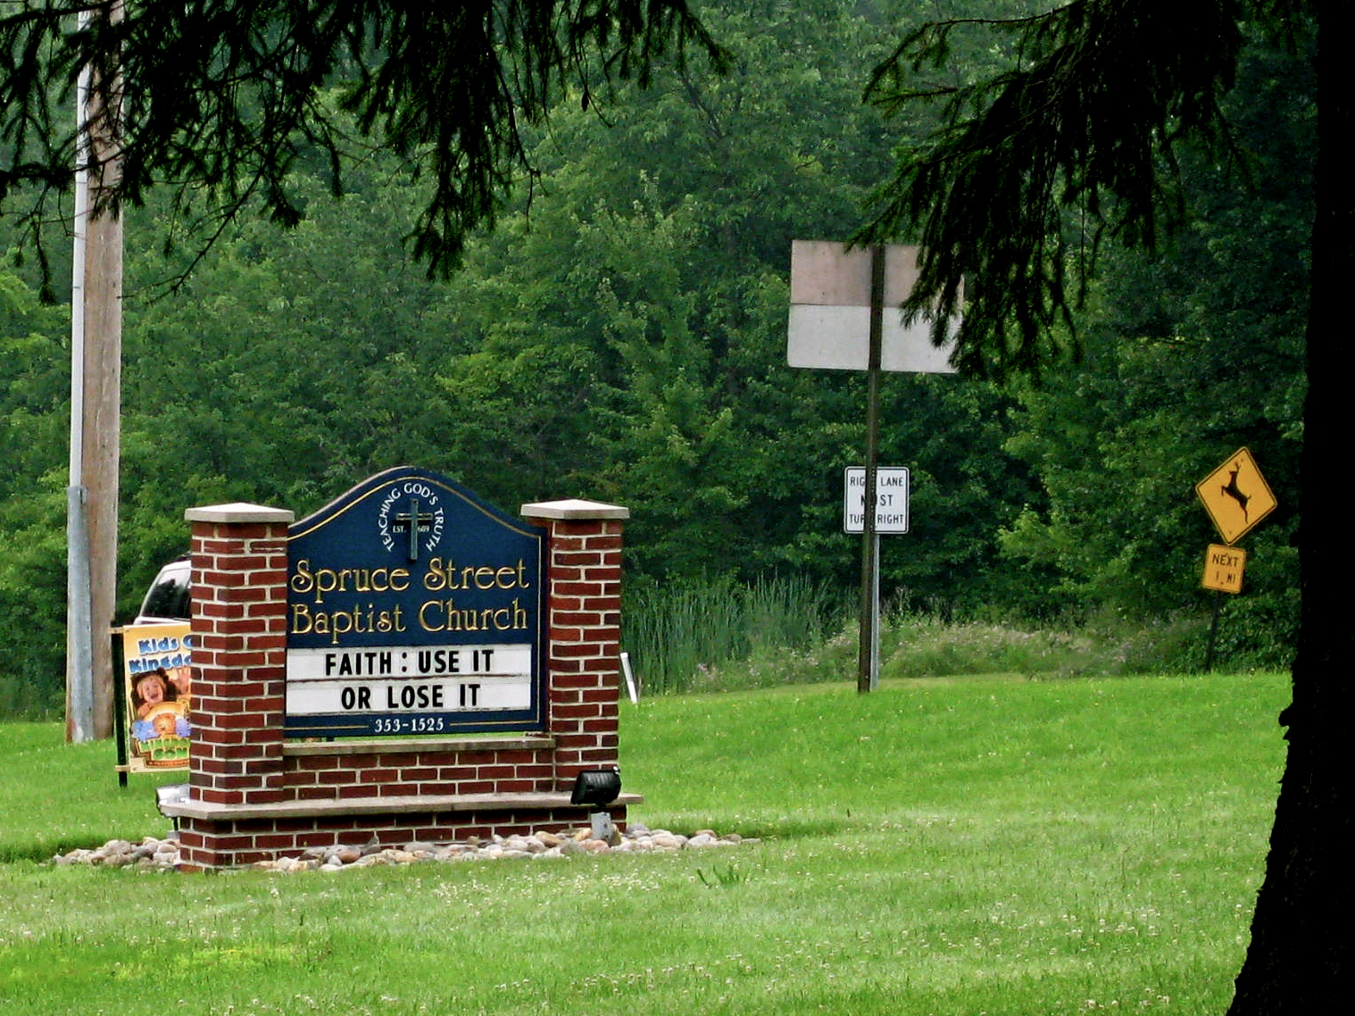
Allie Russell, '12
speaking of roadside church signs…

Slide 27
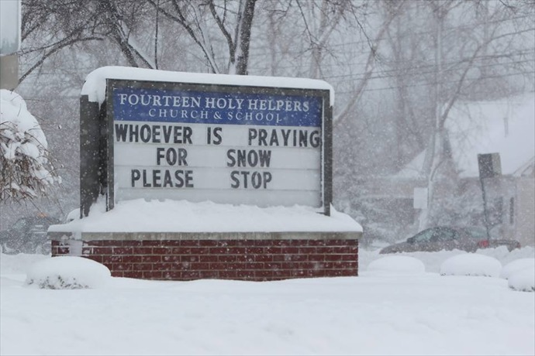
speaking of roadside church signs…

Slide 28
Design ~ code
remAll(e,L)
remove all e's from L
Top-down design
Visualize
def remAll( e, L ):
if len(L) == 0:
elif L[0] != e:
else:
L empty
Split into parts
it
Build each part
it wasn't e
Combine
it was e
Test

Slide 29
Design ~ code
remAll(e,L)
remove all e's from L
Top-down design
Visualize
def remAll( e, L ):
if len(L) == 0:
return L
elif L[0] != e:
return L[0:1] + remAll(e,L[1:])
else:
return remAll(e,L[1:])
Split into parts
Build each part
Use it!
Combine
Test
Lose it!

Slide 30
Teal… !
remAll(e,L)
remove all e's from L
Top-down design
Visualize
def remAll( e, L ):
if len(L) == 0:
return L
elif L[0] != e:
return L[0:1] + remAll(e,L[1:])
else:
return remAll(e,L[1:])
Split into parts
Build each part
Use it!
Combine
Test
Lose it!

Slide 31
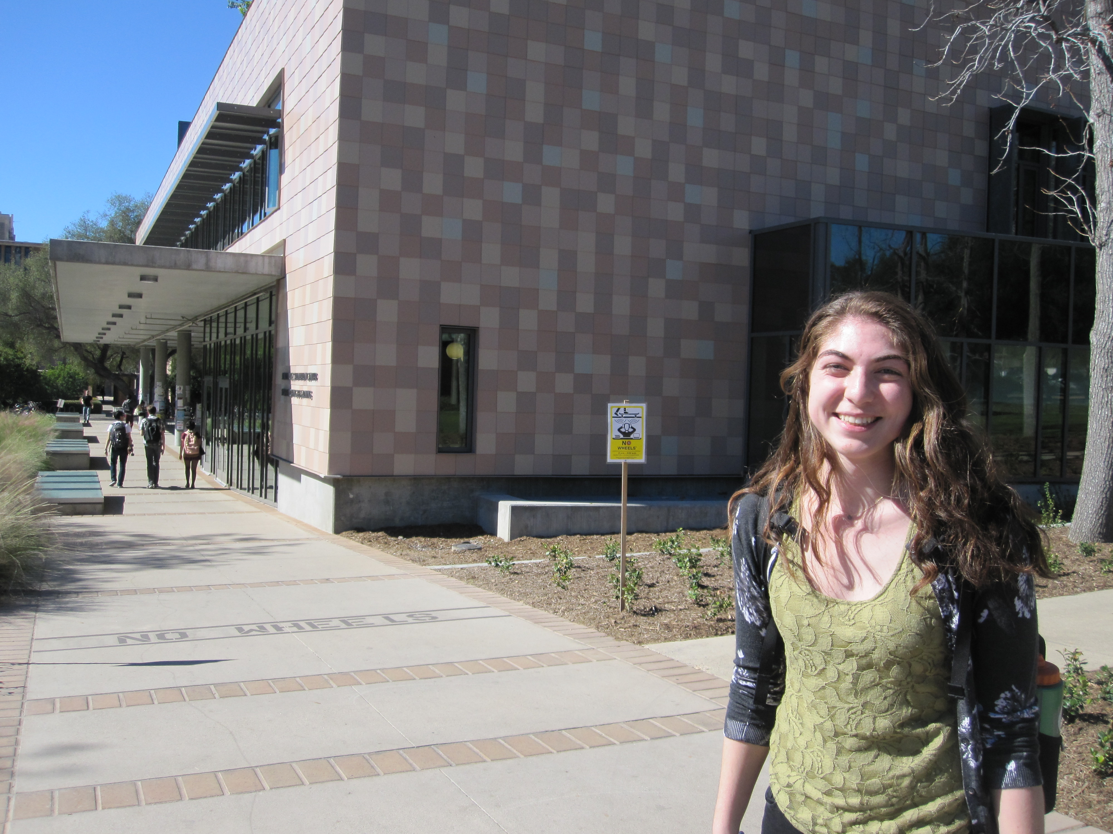
Teal… !
remAll(e,L)
remove all e's from L
Top-down design
Visualize
def remAll( e, L ):
if len(L) == 0:
return L
elif L[0] != e:
return L[0:1] + remAll(e,L[1:])
else:
return remAll(e,L[1:])
Split into parts
Build each part
Combine
Use it!
Test
Lose it!

Slide 32
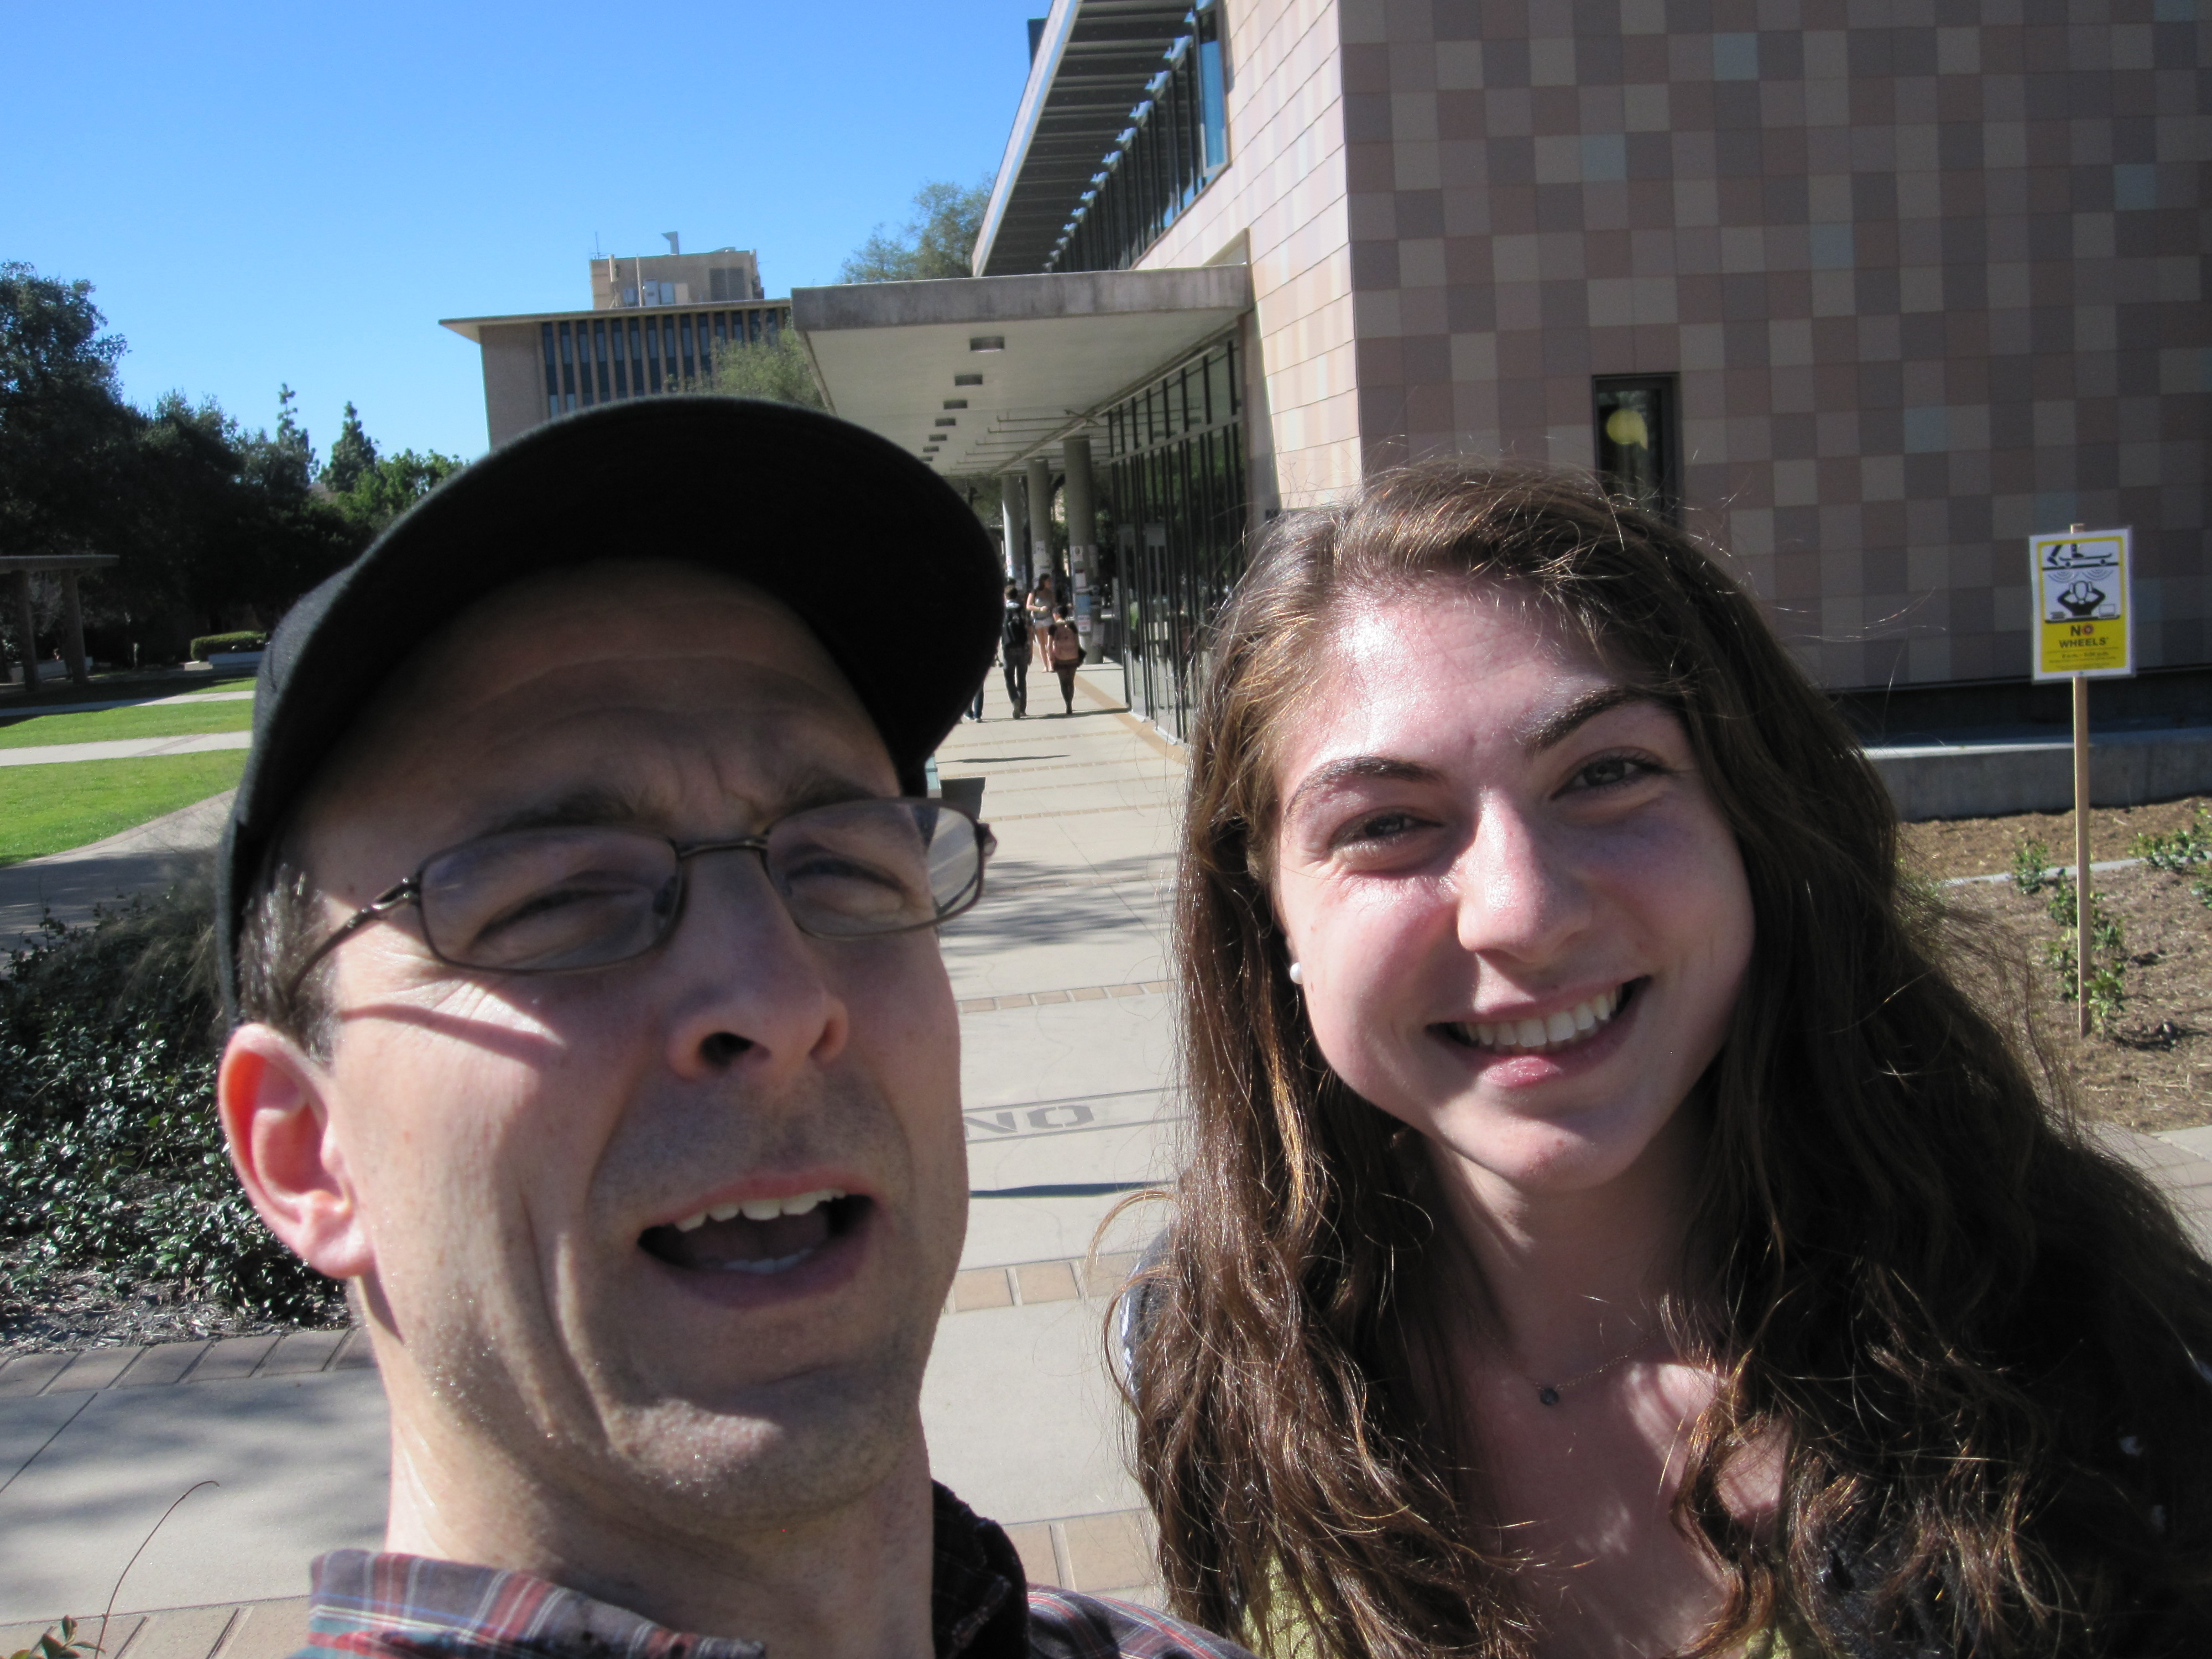
Teal… !
remAll(e,L)
remove all e's from L
A not-so-successful selfie!
Top-down design
Visualize
def remAll( e, L ):
if len(L) == 0:
return L
elif L[0] != e:
return L[0:1] + remAll(e,L[1:])
else:
return remAll(e,L[1:])
Split into parts
Build each part
Combine
Use it!
Test
Lose it!

Slide 33
Design…
design of what?
Code?
syntax

Slide 34
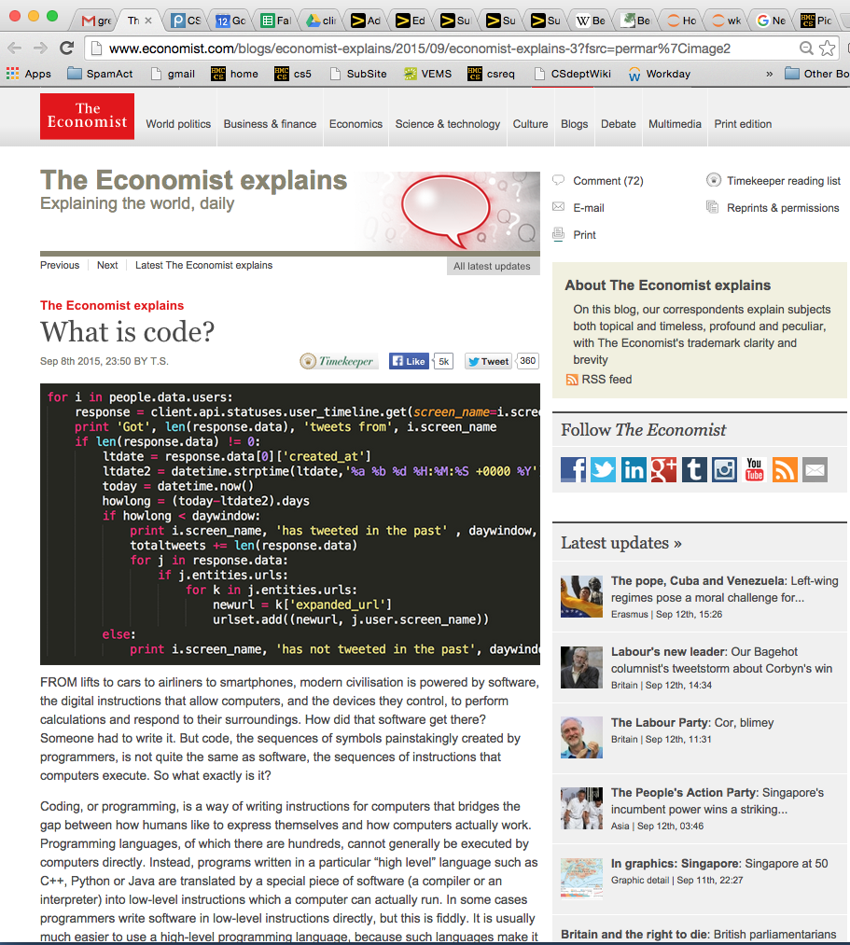
Design…
design of what?
Code?
syntax

Slide 35
Design…
design of what?
Code?
syntax
Algorithms!
ideas!

Slide 36
What's the problem?!
Top-down design
Visualize
Split into parts
Which one of these steps is the most important?
Build each part
Combine
Test

Slide 37
What's the problem?!
Top-down design
Visualize
understanding what the problem demands!!
Split into parts
Build each part
Combine
Test
I want some examples!

Slide 38
other rem examples…
remAll(8, [7,8,9,8]) [7,9]
remAll
remOne(8, [7,8,9,8]) [7,9,8]
remOne
remUpto(8,[7,8,9,8]) [9,8]
remUpto
remAll('d', 'coded') 'coe'
remAll
remOne('d', 'coded') 'coed'
remOne
remUpto('d','coded') 'ed'
remUpto
Notes:
def removeUpto( c, s ):
""" this function removes all of s up to and
including the first occurrence of c
s is any string, c is a 1-character string
"""
if len(s) == 0:
return s # s is empty
elif c == s[0]:
return s[1:] # the character c is now gone
else:
return removeUpto( c, s[1:] ) # keep going

Slide 39
Subsequences
in order, but not necessarily adjacent…
def subseq( s, sbig )
True or False?
s is the subsequence to find (or not)
sbig is the bigger string in which we are looking for s
T or F?
True
subseq('', 'cataga')
subseq('ctg', 'cataga')
True
subseq('ctg', 'tacggta')
False
True
subseq('aliens', 'always frighten dragons')
subseq('trogdor', 'that dragon is gone for good')
False
Here there be NO dragons!
Why are these True? or False?

Slide 40
Subsequences
in order, but not necessarily adjacent…
def subseq( s, sbig )
True or False?
s is the subsequence to find (or not)
sbig is the bigger string in which we are looking for s
T or F?
True
subseq('', 'cataga')
subseq('ctg', 'cataga')
True
False
subseq('ctg', 'tacggta')
False
True
True
subseq('aliens', 'always frighten dragons')
subseq('trogdor', 'that dragon is gone for good')
False
False
Here there be NO dragons!
Why are these True? or False?

Slide 41
Quiz
Algorithm design
Name(s):
1
Change remAll so that it removes only one e from L. (We could call it remOne.)
def remAll( e, L ):
""" removes all e's from L """
if len(L) == 0:
return L
elif L[0] != e:
return L[0:1] + remAll(e,L[1:])
else:
return remAll(e,L[1:])
remOne(8,[7,8,9,8])
[7,9,8]
2
Make more changes to remAll so that it removes all of the elements up to and including the first e in L.
(We could call it remUpto.)
remUpto('d','coded') 'ed'
If e is not in L, remUpto should remove everything...
Hint: In both cases, all that's needed is crossing stuff out! What stuff?
def subseq( s, sbig ):
""" returns True if s is a subseq. of sbig,
False otherwise. Both are strings.
"""
if s == '':
return True
elif
3
Challenge…
Write the other cases needed for subseq…
subseq('alg','magical')
False
subseq('alg','twasbrillig')
True
Notes:
def subseq( s, sbig ):
""" returns True if s is a subsequence of
sbig; False otherwise, both are strings
"""
if len(s) == 0:
return True
elif s[0] not in sbig:
return False
else:
restofsbig = removeUpto( s[0], sbig )
return subseq( s[1:], restofsbig )

Slide 42
Quiz
Algorithm design
Name(s):
1
Change remAll so that it removes only one e from L. (We could call it remOne.)
def remAll( e, L ):
""" removes all e's from L """
if len(L) == 0:
return L
elif L[0] != e:
return L[0:1] + remAll(e,L[1:])
else:
return remAll(e,L[1:])
Hint: remove one thing for remOne!
remOne(8,[7,8,9,8])
[7,9,8]
2
Make more changes to remAll so that it removes all of the elements up to and including the first e in L.
(We could call it remUpto.)
remUpto('d','coded') 'ed'
If e is not in L, remUpto should remove everything...
Hint: In both cases, all that's needed is crossing stuff out! What stuff?
Hint: remove one more thing for remUpto!
def subseq( s, sbig ):
""" returns True if s is a subseq. of sbig,
False otherwise. Both are strings.
"""
if s == '':
return True
elif
3
Challenge…
Write the other cases needed for subseq…
Hint: you'll need 3-4 cases total for subseq.
subseq('alg','magical')
False
subseq('alg','twasbrillig')
True
Notes:
def subseq( s, sbig ):
""" returns True if s is a subsequence of
sbig; False otherwise, both are strings
"""
if len(s) == 0:
return True
elif s[0] not in sbig:
return False
else:
restofsbig = removeUpto( s[0], sbig )
return subseq( s[1:], restofsbig )

Slide 43
from remAll to remOne
Hint: remove one thing for remOne!
def remAll( e, L ):
""" returns seq. L with all e's rmovd
"""
if len(L) == 0:
return L
elif L[0] != e:
return L[0:1] + remAll( e, L[1:] )
else:
return remAll( e, L[1:] )
remOne(8,[7,8,9,8])
[7,9,8]
remOne('d','coded')
'coed'
Notes:
def removeUpto( c, s ):
""" this function removes all of s up to and
including the first occurrence of c
s is any string, c is a 1-character string
"""
if len(s) == 0:
return s # s is empty
elif c == s[0]:
return s[1:] # the character c is now gone
else:
return removeUpto( c, s[1:] ) # keep going

Slide 44
from remOne to remUpto
Hint: remove one more thing for remUpto!
def remOne( e, L ):
""" returns seq. L with one e rmoved
"""
if len(L) == 0:
return L
elif L[0] != e:
return L[0:1] + remOne( e, L[1:] )
else:
return L[1:]
remUpto(8,[7,8,9,8])
[9,8]
remUpto('d','coded')
'ed'
Notes:
def removeUpto( c, s ):
""" this function removes all of s up to and
including the first occurrence of c
s is any string, c is a 1-character string
"""
if len(s) == 0:
return s # s is empty
elif c == s[0]:
return s[1:] # the character c is now gone
else:
return removeUpto( c, s[1:] ) # keep going

Slide 45

Subseq ~ trying (coding) it out…
Hint: you'll need 3-4 cases total for subseq.
def subseq( s, sbig ):
""" returns True if s is a subseq. of sbig;
False otherwise. Both are strings.
"""
if s == '': return True
Base case(s)
Recursive step(s)
subseq('alg','magical')
subseq('alg','twasbrillig')
False
True
Notes:
def subseq( s, sbig ):
""" returns True if s is a subsequence of
sbig; False otherwise, both are strings
"""
if len(s) == 0:
return True
elif s[0] not in sbig:
return False
else:
restofsbig = removeUpto( s[0], sbig )
return subseq( s[1:], restofsbig )

Slide 46
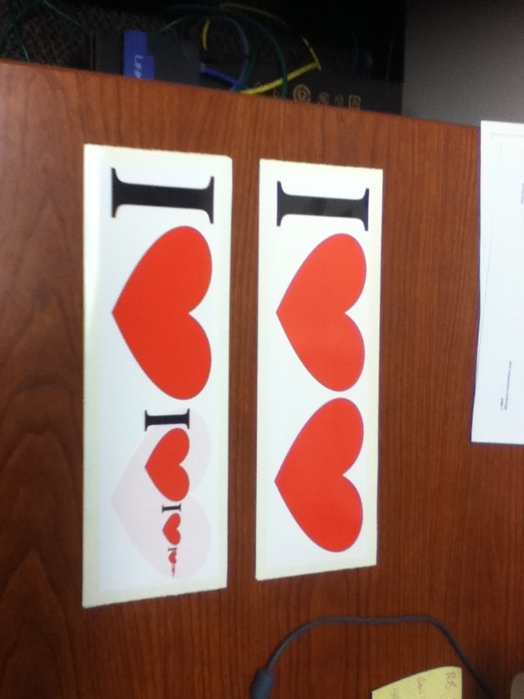
Notes:
def subseq( s, sbig ):
""" returns True if s is a subsequence of
sbig; False otherwise, both are strings
"""
if len(s) == 0:
return True
elif s[0] not in sbig:
return False
else:
restofsbig = removeUpto( s[0], sbig )
return subseq( s[1:], restofsbig )

Slide 47

Notes:
def subseq( s, sbig ):
""" returns True if s is a subsequence of
sbig; False otherwise, both are strings
"""
if len(s) == 0:
return True
elif s[0] not in sbig:
return False
else:
restofsbig = removeUpto( s[0], sbig )
return subseq( s[1:], restofsbig )

Slide 48
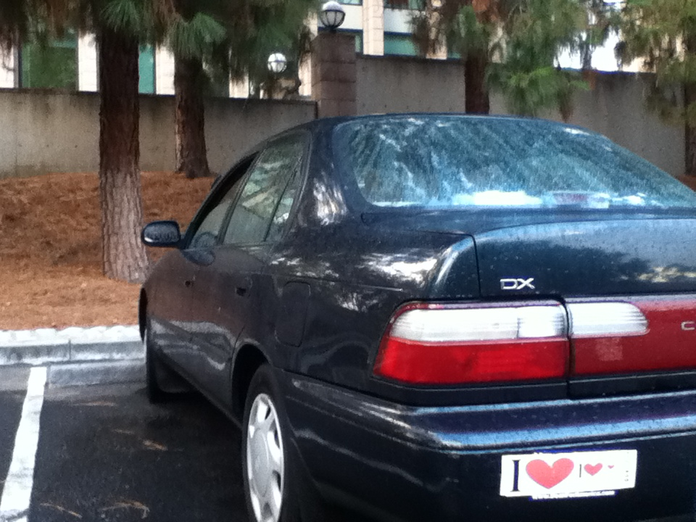
Notes:
def subseq( s, sbig ):
""" returns True if s is a subsequence of
sbig; False otherwise, both are strings
"""
if len(s) == 0:
return True
elif s[0] not in sbig:
return False
else:
restofsbig = removeUpto( s[0], sbig )
return subseq( s[1:], restofsbig )

Slide 49
Subseq ~ trying (coding) it out…
def subseq( s, sbig ):
""" returns True if s is a subseq. of sbig;
False otherwise. Both are strings.
"""
if s == '': return True
Base case(s)
Recursive step(s)
subseq('alg','magical')
subseq('alg','twasbrillig')
Let's try it!
False
True
Notes:
def subseq( s, sbig ):
""" returns True if s is a subsequence of
sbig; False otherwise, both are strings
"""
if len(s) == 0:
return True
elif s[0] not in sbig:
return False
else:
restofsbig = removeUpto( s[0], sbig )
return subseq( s[1:], restofsbig )

Slide 50
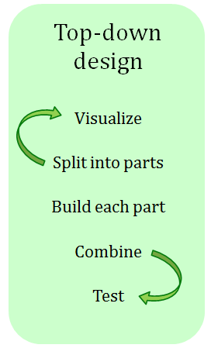
Subseq ~ thinking it out…
subseq( s, sbig )
subseq('ctg', 'tacggta')
What is a small (initial) piece of the problem?
Use it!
How would we describe it in terms of the inputs?
- or -
What is left after handling this piece?
Lose it!
Are there other functions we will need?

Slide 51
Subseq ~ trying (coding) it out…
def subseq( s, sbig ):
""" returns True if s is a subseq. of sbig;
False otherwise. Both are strings.
"""
if s == '':
return True
elif s[0] not in sbig:
return False
elif s[0] == sbig[0]:
return subseq( s[1:], sbig[1:] )
else:
return subseq( s[0:], sbig[1:] )
it
Base case(s)
Recursive step(s)
Where are the useit and loseit here?
Notes:
def subseq( s, sbig ):
""" returns True if s is a subsequence of
sbig; False otherwise, both are strings
"""
if len(s) == 0:
return True
elif s[0] not in sbig:
return False
else:
restofsbig = removeUpto( s[0], sbig )
return subseq( s[1:], restofsbig )

Slide 52
hw3pr2: use it or lose it
Longest Common Subsequence
LCS( S, T )
Jotto Score counting
jscore( s1, s2 )
binary list and general list sorting
blsort( L ), gensort( L )
exact_change making
exact_change( t, L )

Slide 53
hw3pr2: use it or lose it
Longest Common Subsequence
LCS( S, T )
'HUMAN'
'CGCTGAGCTAGGCA...'
'CHIMPANZEE'
'ATCCTAGGTAACTG...'
+10⁹more
Eye oneder if this haz other aplications?

Slide 54
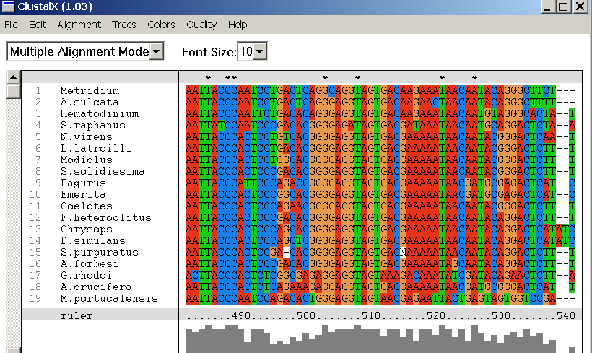

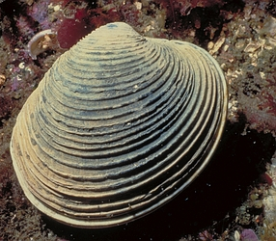
design of what? Code? Algorithms!
Why LCS?
Screenshot from the ClustalX multiple subsequence alignment tool...
Algorithmic challenge: How to find the best common subsequences among these very big genome strings ?!?

Slide 55
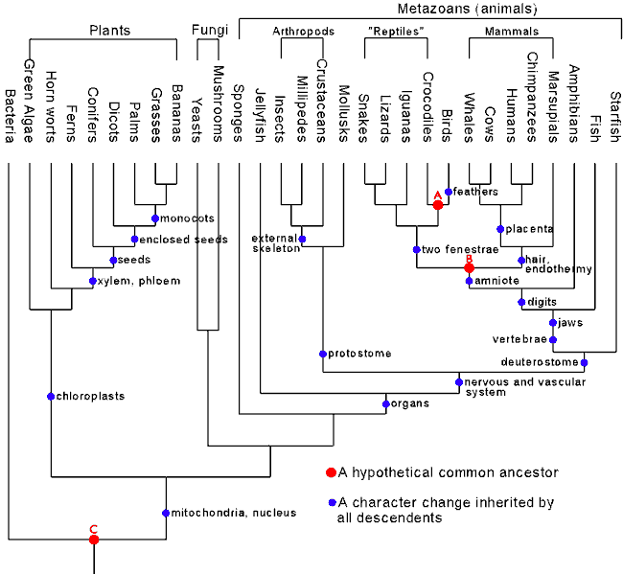
Hey!?
Trinocular aliens
?
Phylogeny
What was gained (or lost) here?

Slide 56
Hey!?
Trinocular aliens
?
The dark side!
Phylogeny
What was gained (or lost) here?
caffeine
cinema
chocolate
(poptarts!)

Slide 57

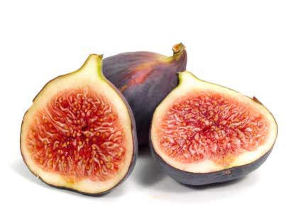
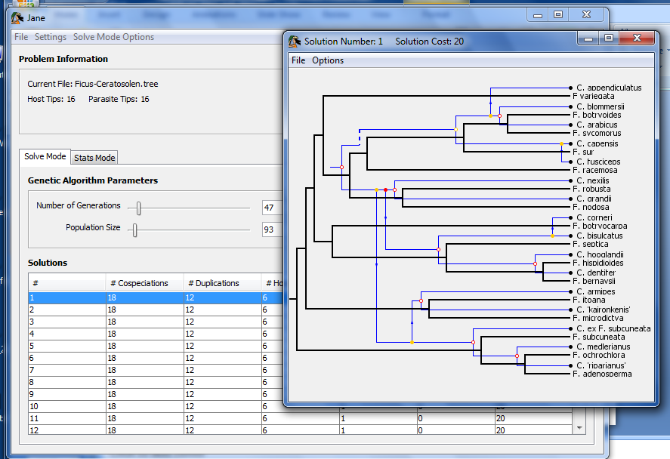
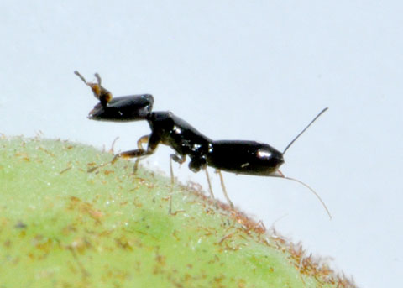
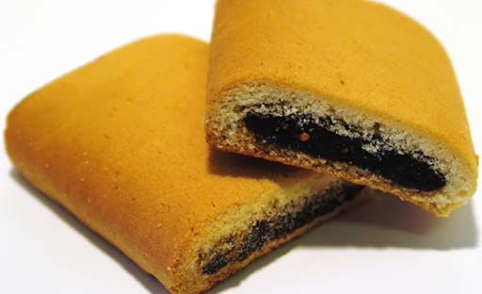
Jane
Subsequences @ HMC
host: figs
parasites: wasps
matching two phylogenies together
together!

Slide 58
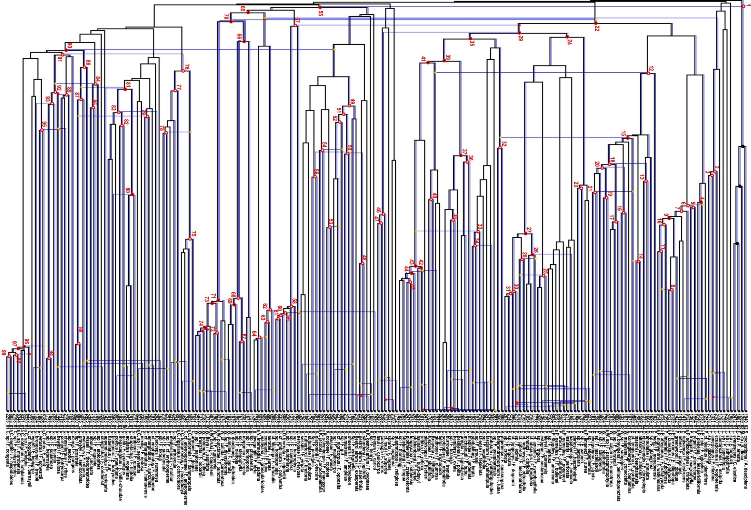
Complete!
Jane
Largest co-phylogeny ever computed (2012)

Slide 59
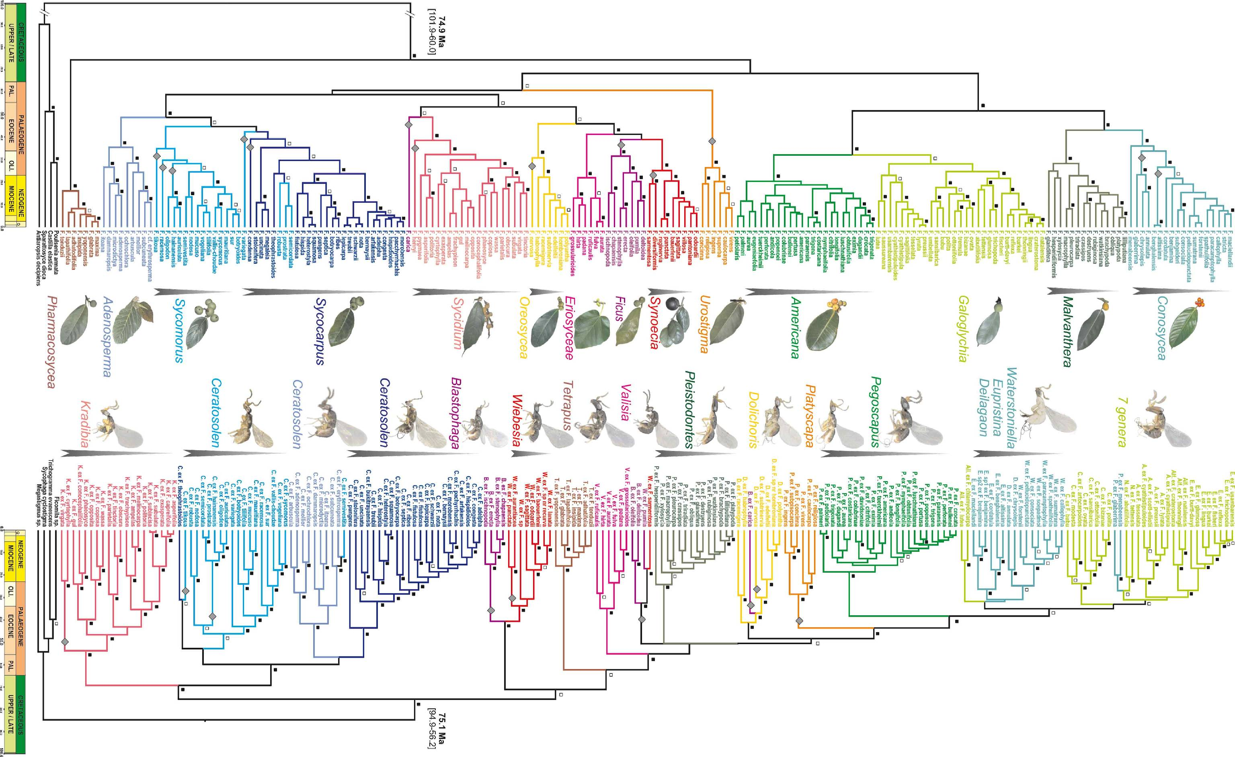
Jane's source data: 100s of species, 6 continents …

Slide 60
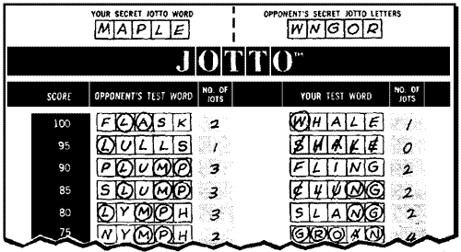
also in hw3pr2: Jotto !
a word-guessing game…
jscore( S, T )

Slide 61
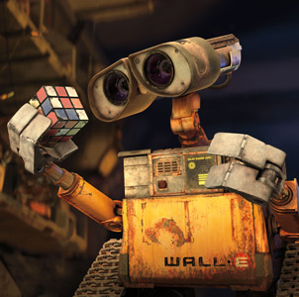

also in hw3pr2: Jotto !
a word-guessing game…
jscore( S, T )
'robot'
'otter'
These are two cute
jscore( 'robot', 'otter' )
Let's try it!

Slide 62
should return the jotto score for any strings s1 and s2
should return a new list that is the sorted version of the input L
should return the Longest Common Subsequence of strings S and T
jscore(s1,s2)
sort( L )
LCS(S,T)
jscore('robot', 'otter')
sort( [42,5,7] )
LCS( 'ctga', 'tagca' )
'tga'
3
[5,7,42]
jscore('geese', 'seems')
sort( [42,7] )
LCS( 'tga', 'taacg' )
jscore('fluff', 'lulls')
sort( [42] )
LCS( 'tga', 'a' )
jscore('pears', 'diner')
sort( [ ] )
LCS( 'gattaca', 'ctctgcgat')
jscore('xylyl', 'slyly')
blsort( [1,0,1] )
4 chars
Extra! Which of these 10 is the cruellest hidden jotto word?
binary-list sort: same as sort, but all of the #s are 0 or 1
don't write any code for these…
do try the examples + brainstorm
Brainstorm algorithms for these problems -- what helper functions might help each one?
exact_change( 42, [25,30,2,5] )
False
returns True if any subset of elements in L add up to t; returns False otherwise
exact_change( 42, [40,17,1,7] )
exact_change( 42, [18,21,22] )
exact_change(t,L)
exact_change( 42, [22,16,3,2,17] )
exact_change( 20, [16,3,2,17] )

Slide 63
should return the jotto score for any strings s1 and s2
should return a new list that is the sorted version of the input L
should return the Longest Common Subsequence of strings S and T
jscore(s1,s2)
sort( L )
LCS(S,T)
jscore('robot', 'otter')
sort( [42,5,7] )
LCS( 'ctga', 'tagca' )
'tga'
3
[5,7,42]
sort( [42,7] )
LCS( 'tga', 'taacg' )
'tga'
jscore('geese', 'seems')
3
[7,42]
sort( [42] )
LCS( 'tga', 'a' )
'a'
jscore('fluff', 'lulls')
2
[42]
jscore('pears', 'diner')
[ ]
LCS( 'gattaca', 'ctctgcgat')
2
sort( [ ] )
jscore('xylyl', 'slyly')
blsort( [1,0,1] )
'ttca'
4
[0,1,1]
4 chars
Extra! Which of these 10 is the cruellest hidden jotto word?
binary-list sort: same as sort, but all of the #s are 0 or 1
don't write any code for these…
do try the examples + brainstorm
Brainstorm algorithms for these problems -- what helper functions might help each one?
exact_change( 42, [25,30,2,5] )
False
returns True if any subset of elements in L add up to t; returns False otherwise
exact_change( 42, [40,17,1,7] )
False
exact_change( 42, [18,21,22] )
False
exact_change(t,L)
exact_change( 42, [22,16,3,2,17] )
True
exact_change( 20, [16,3,2,17] )
True

Slide 64
should return the jotto score for any strings s1 and s2
should return a new list that is the sorted version of the input L
should return the Longest Common Subsequence of strings S and T
jscore(s1,s2)
sort( L )
LCS(S,T)
jscore('robot', 'otter')
sort( [42,5,7] )
LCS( 'ctga', 'tagca' )
'tga'
3
[5,7,42]
sort( [42,7] )
LCS( 'tga', 'taacg' )
'ta' or 'tg'
jscore('geese', 'seems')
3
[7,42]
sort( [42] )
LCS( 'tga', 'a' )
'a'
jscore('fluff', 'lulls')
2
[42]
jscore('pears', 'diner')
[ ]
LCS( 'gattaca', 'ctctgcgat')
2
sort( [ ] )
jscore('xylyl', 'slyly')
blsort( [1,0,1] )
'ttca'
4
[0,1,1]
4 chars
Extra! Which of these 10 is the cruellest hidden jotto word?
binary-list sort: same as sort, but all of the #s are 0 or 1
Use it!
Lose it!
Lose it!
Use it!
don't write any code for these…
min
do try the examples + brainstorm
only recursion here…
remOne
Use it!
Lose it!
remOne
Brainstorm algorithms for these problems -- what helper functions might help each one?
exact_change( 42, [25,30,2,5] )
False
Use it!
exact_change( 42, [40,17,1,7] )
False
Lose it!
exact_change( 42, [18,21,22] )
False
exact_change(t,L)
exact_change( 42, [22,16,3,2,17] )
… and here
returns True if any subset of elements in L add up to t; returns False otherwise
True
exact_change( 20, [16,3,2,17] )
True

Slide 65
decipher( 'Weet bksa ed xecumeha 3!' )
kxn rkfo k qbokd goouoxn ...

Slide 66
decipher( 'Weet bksa ed xecumeha 3!' )
Good luck on homework 3!
kxn rkfo k qbokd goouoxn ...
and have a great weekend ...

Slide 68
Getting started...
What will each of these jotto-scoring examples return?
3
jotto('geese', 'seems')
jotto('fluff', 'lulls')
2
pears
2
jotto('pears', 'diner')
jotto('xylyl', 'slyly')
4
Extra! Which of these 8 is the cruellest hidden jotto word?
jotto(s1,s2)
sort( L )
LCS(s1,s2)
should return the jotto score for any strings s1 and s2
should return a new list that is the sorted version of the input L
should return the longest common subsequence of strings s1 and s2
Use it!
Use it!
don't need to write any code for these (yet...)
but think about how you'd approach them
Lose it!
min
Use it!
just recursion… but MORE of it!
remOne
remOne
Lose it!
Brainstorm algorithms for these problems -- what helper functions might help each one?

Slide 69
also in hw3pr2: Jotto !
a word-guessing game…
robot
otter
These are two cute

Slide 70
Getting started...
What will each of these jotto-scoring examples return?
jotto('geese', 'seems')
jotto('fluff', 'lulls')
jotto('pears', 'diner')
jotto('xylyl', 'slyly')
Extra! Which of these 8 is the cruellest hidden jotto word?
jotto(s1,s2)
sort( L )
LCS(s1,s2)
should return the jotto score for any strings s1 and s2
should return a new list that is the sorted version of the input L
should return the longest common subsequence of strings s1 and s2
don't need to write any code for these (yet...)
but think about how you'd approach them
Use it!
Lose it!
Brainstorm algorithms for these problems -- what helper functions might help each one?

Slide 71
from remAll to remOne
def remAll( e, L ):
""" returns seq. L with all e's rmovd
"""
if len(L) == 0:
return L
elif L[0] != e:
return L[0:1] + remAll( e, L[1:] )
else:
return remAll( e, L[1:] )
remOne(8,[7,8,9,8])
[7,9,8]
remOne('d','coded')
'coed'
Notes:
def removeUpto( c, s ):
""" this function removes all of s up to and
including the first occurrence of c
s is any string, c is a 1-character string
"""
if len(s) == 0:
return s # s is empty
elif c == s[0]:
return s[1:] # the character c is now gone
else:
return removeUpto( c, s[1:] ) # keep going

Slide 72
from remOne to remUpto
def remOne( e, L ):
""" returns seq. L with one e rmovd
"""
if len(L) == 0:
return L
elif L[0] != e:
return L[0:1] + remOne( e, L[1:] )
else:
return L[1:]
remUpto(8,[7,8,9,8])
[9,8]
remUpto('d','coded')
'ed'
Notes:
def removeUpto( c, s ):
""" this function removes all of s up to and
including the first occurrence of c
s is any string, c is a 1-character string
"""
if len(s) == 0:
return s # s is empty
elif c == s[0]:
return s[1:] # the character c is now gone
else:
return removeUpto( c, s[1:] ) # keep going

Slide 73
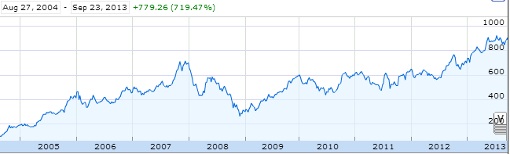
Aside: web scraping
How could we grab today's stock price via Python?

Slide 74
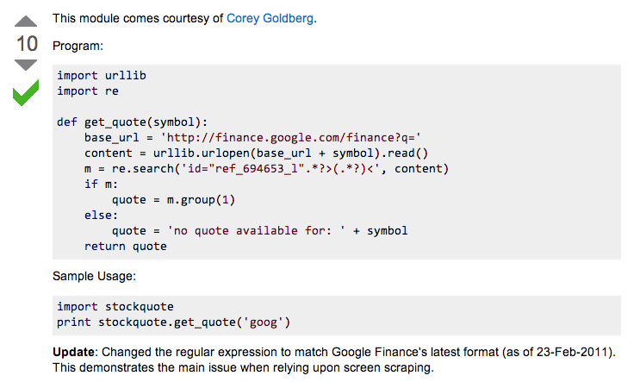
Example: web scraping
http://stackoverflow.com/questions/5081710/how-to-create-a-stock-quote-fetching-app-in-python

Slide 75
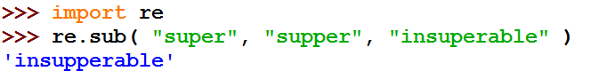
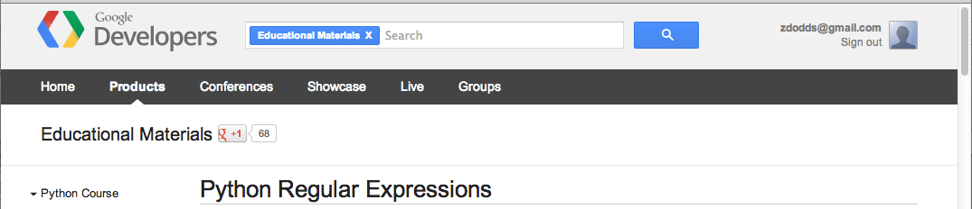
Regular Expressions
a huge string-processing library
a library for processing huge strings
many tutorials available…
developers.google.com/edu/python/regular-expressions?csw=1

Slide 76
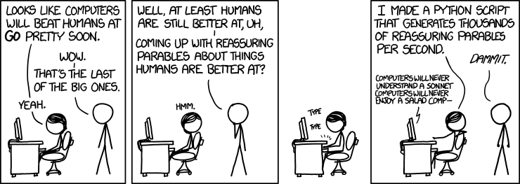
String-processing perspective…
with thanks to Jacquelyn Zehner!
http://stackoverflow.com/questions/5081710/how-to-create-a-stock-quote-fetching-app-in-python

Slide 77
Hey!?
Trinocular aliens
?
Phylogeny
What was gained (or lost) here?

Slide 78
What will each of these jotto-scoring examples return?
Thoughts?
3
jotto('geese', 'seems')
2
jotto('fluff', 'lulls')
2
pears
jotto('pears', 'diner')
4
Extra! Which of these 8 is the cruellest hidden jotto word?
jotto('xylyl', 'slyly')
jotto(s1,s2)
sort( L )
LCS(s1,s2)
should return the jotto score for any strings s1 and s2
should return a new list that is the sorted version of the input L
should return the longest common subsequence of strings s1 and s2
don't need to write any code for these (yet...)
but think about how you'd approach them
Brainstorm algorithms for these problems -- what helper functions might help each one?

Slide 79
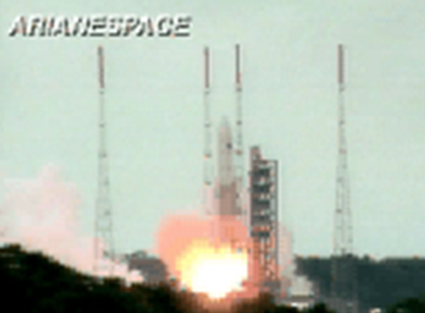
BR 5 Snczx
Gesundheit!
Algorithms
Englishness...
Classifying life
Removing/Sorting
and Jotto!
HW 3
Hw #3 due Monday
"Office" hrs: Fri. 2-4pm
Weekend tutoring? yes!
IndexError
TypeError
HumanError
This week's reading…

Slide 81
What's the problem?!
remove all e's from L
removes one e from L
remOne( e, L )
remAll( e, L )
removes upto the first e in L
sorts L (L is binary or L is general)
remUpto( e, L )
blsort( L )
gensort( L )
T or F: s is a subsequence of sbig?
returns # letters shared by s1, s2
subseq( s, sbig )
jscore( s1, s2 )
can_cancel( L )
exact_change( t, L )
T or F: a subset of L
T or F: a subset of L adds to t
LCS( S, T )

Slide 82
Subseq ~ trying (coding) it out…
def subseq( s, sbig ):
""" returns True if s is a subseq. of sbig;
False otherwise. Both are strings.
"""
if s == '':
return True
elif s[0] not in sbig:
return False
else:
sbigrest = remUpto( s[0], sbig )
return subseq( s[1:], sbigrest )
Lose it!
Base case(s)
it
Recursive step(s)
Use it!
Notes:
def subseq( s, sbig ):
""" returns True if s is a subsequence of
sbig; False otherwise, both are strings
"""
if len(s) == 0:
return True
elif s[0] not in sbig:
return False
else:
restofsbig = removeUpto( s[0], sbig )
return subseq( s[1:], restofsbig )

Slide 83
also in hw3pr2: Jotto !
a word-guessing game…
robot
otter
These are two cute

Slide 84
Getting started...
Thoughts?
jotto('geese', 'seems')
What will each of these jotto-scoring examples return?
jotto('fluff', 'lulls')
jotto('pears', 'diner')
Extra! Which of these 8 is the cruellest hidden jotto word?
jotto('xylyl', 'slyly')
jotto( s1, s2 )
should return the jotto score for any strings s1 and s2
sort( L )
should return a new list that is the sorted version of the input L
don't need to write code for these...
Brainstorm algorithms for these problems -- what helper functions might help each one?

Slide 85
Helper functions…
def remAll( e, L ):
""" this function removes all elements equal to
e from the top level of the list or string L
"""
# code written last time
def remOne( e, L ):
""" this function removes ONE element equal to
e from the top level of the list or string L,
as long as there is such an element
"""
# code written last time
Is either really what we want, or another variant?

Slide 86
Breaking down…
subseq( s, sbig )
subseq('ctg', 'tacggta')
What is a small (initial) piece of the problem?
How would we describe it in terms of the inputs?
What is left after handling this piece?
Are there other functions we will need?
Hey - I've seen something like this before!

Slide 87
Notes:
def subseq( s, sbig ):
""" returns True if s is a subsequence of
sbig; False otherwise, both are strings
"""
if len(s) == 0:
return True
elif s[0] not in sbig:
return False
else:
restofsbig = removeUpto( s[0], sbig )
return subseq( s[1:], restofsbig )

Slide 88
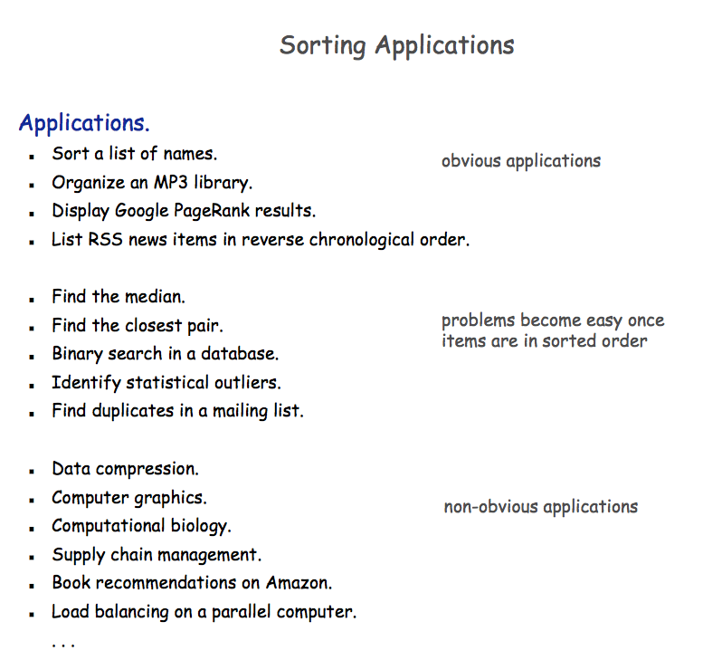

Slide 89


A sorting algorithm…
Input a list, L
Randomly permute L
Check if L is sorted
Repeat as necessary...
Mmmm… sorting!
in code:
How fast will this be?
from random import *
def randSort( L ):
""" crazy sorting """
newL = sample( L, len(L) )
if isSorted(newL):
return newL
else:
return randSort(L)
returns a random permutation of L
this function is totally random, dude!

Slide 90

checking if a list is sorted...
def isSorted(s):
returns True if s is in order, False otherwise
isSorted('BART') returns False
No way I'm False, man.
isSorted('BERT') returns True
isSorted('BEGIN') returns True
isSorted([3,1,4]) returns False
isSorted([1,3,4]) returns True
Too true!
isSorted('LOOPY') returns ??
Six-letter words?

Slide 91
checking if sorted...
def isSorted(s):
isSorted('BEGIN')
True
isSorted('END')
False
returns True if s is in order, False otherwise
if len(s) < 2:
return
elif s[0] < s[1]:
return
else:
return
six-letter word?

Slide 92
Algorithm Analysis
def isSorted(s):
""" True if s is sorted else False """
if len(s) < 2:
return True
elif s[0] < s[1]:
return isSorted( s[1:] )
else:
return False
If the original string had N chars, how many "steps" would it take to run isSorted ?
in the BEST case? in the WORST case?

Slide 93
Sorting out sorting
Theorem 1:
No sorting algorithm can sort n numbers in fewer than n steps.
Theorem 2:
No comparison-based sorting algorithm can sort n numbers asymptotically faster than n log₂ n.
Sorting Algorithm Worst-case Asymptotic Time
Insertion Sort n²
Bubble Sort n²
Quicksort n²
Mergesort n log₂ n
Heapsort n log₂ n

Slide 94

Does it matter?
Our "super"computer: 1 billion steps/second
Number of elements
Our algorithm's running time...
N steps
N² steps
N! steps
N = 10 el.
< 1sec.
< 1sec.
< 1sec.
N = 10³ el.
< 1sec.
< 1sec.
> lifespan
N = 10⁶ el.
< 1sec.
16.7 minutes
> lifespan
N = 10⁹ el.
1 sec.
31.7 years
> lifespan
total time to finish...

Slide 95
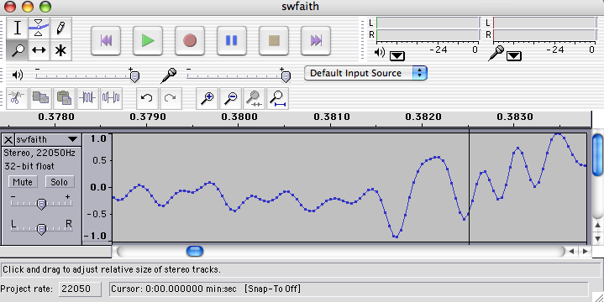
Do real data sets get so big?
Yes!

Slide 96
Weet bksa ed xecumeha 3!
and have a great weekend...

Slide 98
Phylogeny!
Hey!?
Trinocular aliens
?
What was gained (or lost) here?

Slide 99
from remAll to remOne
Hint: remove one thing for remOne!
def remAll( e, L ):
""" returns seq. L with all e's rmovd
"""
if len(L) == 0:
return L
elif L[0] != e:
return L[0:1] + remAll( e, L[1:] )
else:
return remAll( e, L[1:] )
remOne(8,[7,8,9,8])
[7,9,8]
remOne('d','coded')
'coed'
Notes:
def removeUpto( c, s ):
""" this function removes all of s up to and
including the first occurrence of c
s is any string, c is a 1-character string
"""
if len(s) == 0:
return s # s is empty
elif c == s[0]:
return s[1:] # the character c is now gone
else:
return removeUpto( c, s[1:] ) # keep going

Slide 100
from remOne to remUpto
Hint: remove one more thing for remUpto!
def remOne( e, L ):
""" returns seq. L with one e rmoved
"""
if len(L) == 0:
return L
elif L[0] != e:
return L[0:1] + remOne( e, L[1:] )
else:
return L[1:]
remUpto(8,[7,8,9,8])
[9,8]
remUpto('d','coded')
'ed'
Notes:
def removeUpto( c, s ):
""" this function removes all of s up to and
including the first occurrence of c
s is any string, c is a 1-character string
"""
if len(s) == 0:
return s # s is empty
elif c == s[0]:
return s[1:] # the character c is now gone
else:
return removeUpto( c, s[1:] ) # keep going

Slide 101
Visualize
def removeAll( e, L ):
""" this function removes all of the elements
e from the top level of the list L
"""
removeAll(42, [5,47,42,48,42])
removeAll('q', 'qaqqlqqiqqiiqeqqnqqqqs')
What are you trying to hide here... ?

Slide 102
removeOne
One
def removeAll( e, L ):
""" this function removes all of the elements
e from the top level of the list L
"""
if len(L) == 0:
return L
elif e == L[0]:
return removeAll(e,L[1:])
else:
return L[0:1] + removeAll(e,L[1:])
# keep the non-e element and going
How could we change this to removeOne?
removeOne(42, [5,7,42,8,42])
removeOne('p', 'computer programming')
[5,7,8,42]
'comuter programming'

Slide 103
Getting started...
Name(s): ____________________
jotto('geese', 'seems')
What will each of these jotto-scoring examples return?
jotto('fluff', 'lulls')
jotto('pears', 'diner')
Extra! Which of these 8 is the cruellest hidden jotto word?
jotto('xylyl', 'slyly')
jotto( s1, s2 )
should return the jotto score for any strings s1 and s2
sort( L )
should return a new list that is the sorted version of the input L
don't need to write code for these...
Brainstorm algorithms for these problems -- what helper functions might help each one?

Slide 104
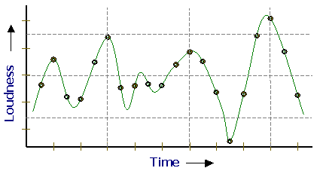
Representing Sound
physics
continuous plot of air pressure vs. time
sampling
samples taken every ~ 1/22050th of a second
quantization
Each sample is measured on a scale from -32,768 to 32,767.
(This fits into 2 bytes.)
storage
These two bytes are called a frame. Raw audio data - such as what is written to the surface of a CD - is simply a list of these frames.
This problem SOUNDS like fun!
pulse code modulation = PCM data

Slide 105
Subsequences: Sketching out…
def subseq( s, sbig ):
""" returns True if s is a subsequence of
sbig; False otherwise. Both are strings.
"""
Base Case(s)
Recursive Step(s)
Notes:
def subseq( s, sbig ):
""" returns True if s is a subsequence of
sbig; False otherwise, both are strings
"""
if len(s) == 0:
return True
elif s[0] not in sbig:
return False
else:
restofsbig = removeUpto( s[0], sbig )
return subseq( s[1:], restofsbig )

Slide 106
Asymptotic Analysis
3n + 42
“Asymptotic” is a fancy word!
42n+4242
“asymptotically linear”
100 n
(0.1)n² + n + 1
“asymptotically quadratic”
100 n²
n³ - 100n² + 2n + 42
2n³ + 10
1/5 n³
“asymptotically cubic”

Slide 107
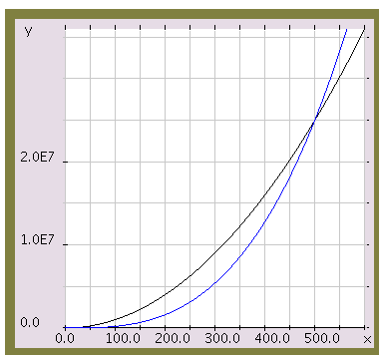
Asymptotic Analysis
Those look like two awesome water-slides!
100 n²
1/5 n³
n

Slide 108
Almost the end…
def sort(L)
returns a list which has the same elements as L, but in sorted order!
Let e be the max element in L
Where should e go?
and what helper function might we want… ?

Slide 109
Algorithm Analysis
def isSorted(s):
""" docstring! """
if L == []:
return 0
elif e == L[0]:
return 1 + count(e,L[1:])
else:
return count(e,L[1:])
If the original list had N elements, about how many "steps" would it take to run count(e,N)

Slide 110



Computing with text
open questions in AI …
ideas / meaning
language / words / phrases
computing with language - recognizing English!
strings
how strings are represented and stored
numbers / bits

Slide 111
Caesar Cipher: encipher
encipher( 'I <3 Latin' , 0 )
'I <3 Latin'
'J <3 Mbujo'
'K <3 Ncvkp'
'L <3 Odwlq'
'M <3 Pexmr'
'N <3 Qfyns'
returns
encipher( 'I <3 Latin' , 1 )
returns
encipher( 'I <3 Latin' , 2 )
returns
encipher( 'I <3 Latin' , 3 )
returns
encipher( 'I <3 Latin' , 4 )
returns
…
encipher( 'I <3 Latin' , 5 )
returns
encipher( 'I <3 Latin' , 25 )
'H <3 Kzshm'
returns
should return the string s with each alphabetic character shifted/wrapped by n places in the alphabet
encipher( s , n )
Historically bad decision #43:
Brutus won't mind if I use his salary to bring Skrillex to the Colosseum next month...

Slide 112
ASCII
American Standard Code for Information Interchange
value:
'/'
00101111
type: str
bits
name:
Identical bits are stored in each variable!
8 bits = 1 byte
The SAME bits represent integers, if the variable has type int instead of str
The types determine how to interpret the bits; the names don't matter at all…
value:
47
00101111
type: int
bits
name:

Slide 113
ASCII
American Standard Code for Information Interchange
convert # to char
chr
ord
convert char to #

Slide 114
chr and ord
abcdefghijklmnopqrstuvwxyz
ASCII VALUES
97
99
101
103
105
107
109
111
113
115
117
119
122
ABCDEFGHIJKLMNOPQRSTUVWXYZ
65
67
69
71
73
75
77
79
81
83
85
87
90
ord( c )
Input: a string of one character, c
Output: an integer, the ASCII value of c
CONVERTERS
chr( n )
Input: an integer in range(255)
Output: a one-char. string of that ASCII value
[ [i,chr(i)] for i in range(128) ]
Try these!
[ ord(i) for i in '**** CS! ****' ]

Slide 115
chr and ord
abcdefghijklmnopqrstuvwxyz
ASCII VALUES
97
99
101
103
105
107
109
111
113
115
117
119
122
ABCDEFGHIJKLMNOPQRSTUVWXYZ
65
67
69
71
73
75
77
79
81
83
85
87
90
ord('a') is 97
chr(66) is 'B'
What is chr( ord('i')+13 ) ?
What is chr( ord('P')+13 ) ?
How do we wrap?

Slide 116
Rot 13
def rot13( c ):
""" rotates c by 13 chars, "wrapping" as needed
NON-LETTERS DO NOT CHANGE!
"""
if 'a' <= c <= 'z':
new_ord = ord(c) + 13
if new_ord <= ord('z'):
return chr(new_ord)
else:
return
elif
else:
How would you rotate an entire string?

Slide 117
Caesar Cipher: decipher
>>> decipher('Bzdrzq bhogdq? H oqdedq Bzdrzq rzkzc.')
'Caesar cipher? I prefer Caesar salad.'
>>> decipher('Hu lkbjhapvu pz doha ylthpuz hmaly dl mvynla '\
'lclyfaopun dl ohcl slhyulk.')
'An education is what remains after we forget everything we have learned.'
>>> decipher('Uifz xpsl ju pvu xjui b qfodjm!')
>>> decipher('gv vw dtwvg')
But how ?

Slide 118
Caesar Cipher: decipher
gv vw dtwvg
hw wx euxwh
ix xy fvyxi
jy yz gwzyj
kz za hxazk
la ab iybal
mb bc jzcbm
nc cd kadcn
od de lbedo
pe ef mcfep
qf fg ndgfq
rg gh oehgr
sh hi pfihs
ti ij qgjit
uj jk rhkju
vk kl silkv
wl lm tjmlw
xm mn uknmx
yn no vlony
zo op wmpoz
ap pq xnqpa
bq qr yorqb
cr rs zpsrc
ds st aqtsd
et tu brute
fu uv csvuf
Caesar
Brutus
decipher('gv vw dtwvg')
Strategy using max:
(1) consider all possible answers
(2) give them each a score
(3) use our techniques to get max
Score for "Englishness"?
up to you…
all 26 possibilities

Slide 119
Caesar Cipher: Englishness
"call me Ishmael"
"attack at dawn"
A lot
"rainbow, table, candle"
"Yow! Legally-imposed CULTURE-reduction
is CABBAGE-BRAINED!"
"quadruplicity drinks procrastination"
"Hold the newsreader's nose squarely, waiter, or
friendly milk will countermand my trousers."
Where might you put "Twas brillig, and the slithy toves" ?
"the gostak distims the doshes"
"hension, framble, bardle"
They all sound
good to me!
"jufict, stofwus, lictpub"
"itehbs, rsnevtr, khbsota"
"epadxo, nojarpn, gdxokpw"
"h o q dedqBzdrzqrzkzc"
Not so much

Slide 120
Caesar Cipher: decipher
Caesar
[0, 'cr rs zpsrc']
[0, 'gv vw dtwvg']
[0, 'jy yz gwzyj']
[0, 'mb bc jzcbm']
[0, 'qf fg ndgfq']
[0, 'wl lm tjmlw']
[1, 'bq qr yorqb']
[1, 'ds st aqtsd']
[1, 'nc cd kadcn']
[1, 'vk kl silkv']
[1, 'xm mn uknmx']
[2, 'ap pq xnqpa']
[2, 'hw wx euxwh']
[2, 'ix xy fvyxi']
[2, 'kz za hxazk']
[2, 'rg gh oehgr']
[2, 'sh hi pfihs']
[2, 'uj jk rhkju']
[2, 'yn no vlony']
[3, 'fu uv csvuf']
[3, 'pe ef mcfep']
[3, 'ti ij qgjit']
[3, 'zo op wmpoz']
[4, 'et tu brute']
[4, 'la ab iybal']
[4, 'od de lbedo']
Brutus
number-of-vowels score
max
won't always be correct!
all 26 possibilities

Slide 121
Caesar Cipher: decipher
Caesar
[0.4680, 'jy yz gwzyj']
[0.4960, 'mb bc jzcbm']
[0.5420, 'uj jk rhkju']
[0.5567, 'ix xy fvyxi']
[0.5597, 'qf fg ndgfq']
[0.5718, 'fu uv csvuf']
[0.5753, 'bq qr yorqb']
[0.5833, 'kz za hxazk']
[0.5859, 'xm mn uknmx']
[0.5880, 'gv vw dtwvg']
[0.5902, 'vk kl silkv']
[0.6110, 'ap pq xnqpa']
[0.6304, 'zo op wmpoz']
[0.6318, 'wl lm tjmlw']
[0.6717, 'cr rs zpsrc']
[0.6735, 'hw wx euxwh']
[0.6963, 'nc cd kadcn']
[0.7153, 'ti ij qgjit']
[0.7398, 'la ab iybal']
[0.7442, 'yn no vlony']
[0.7867, 'pe ef mcfep']
[0.7880, 'sh hi pfihs']
[0.7918, 'rg gh oehgr']
[0.8213, 'ds st aqtsd']
[0.8609, 'od de lbedo']
[0.9082, 'et tu brute']
Brutus
letter-prob. score
max
not always correct, but better!
all 26 possibilities

Slide 122
Jotto scoring clicker trial
What is the score for jotto('geese','seems')
C
2
A
0
D
3
B
1
E
4

Slide 123
JOTTO clicker question
If you had to choose one of these, which helper function would you use for your jotto algorithm?
C
removeUpto
A
removeAll
D
B
remove these options from your selection!
removeOne
E

Slide 124
SORT clicker question
If you had to choose one of these, which helper function would you use for your sort algorithm?
C
removeUpto
A
removeAll
D
remove this question from the HW!
B
removeOne
E
Choose me!

Slide 125
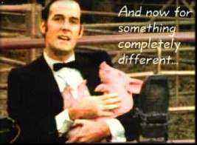
And now for something completely different…

Slide 126
top1List
def top1List( L ):
""" returns a list of the top element in L """
if len(L) < 1: return L
else: return [ max(L) ]

Slide 127
top2List
def top1List( L ):
""" returns a list of the top element in L """
if len(L) < 1: return L
else: return [ max(L) ]
def top2List( L ):
""" returns a list of the top 2 elements in L """
if len(L) < 2: return L
mx = max(L) # get the biggest element
newL = removeOne( mx, L ) # get rid of mx
return [ mx ] + top1List( newL )

Slide 128
top3List
def top3List( L ):
""" returns a list of the top 3 elements in L """
if len(L) < 3: return L
def topNList( n, L ):
""" returns a list of the top n elements in L """
top N?

Slide 129
Sorting
def sort(L)
returns a list which has the same elements as L, but in sorted order!

Slide 130

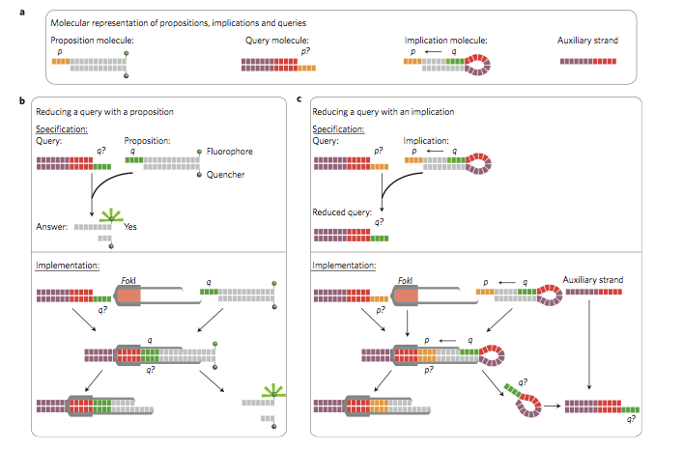
Reading this week: molecular computing
with robots...

Slide 131
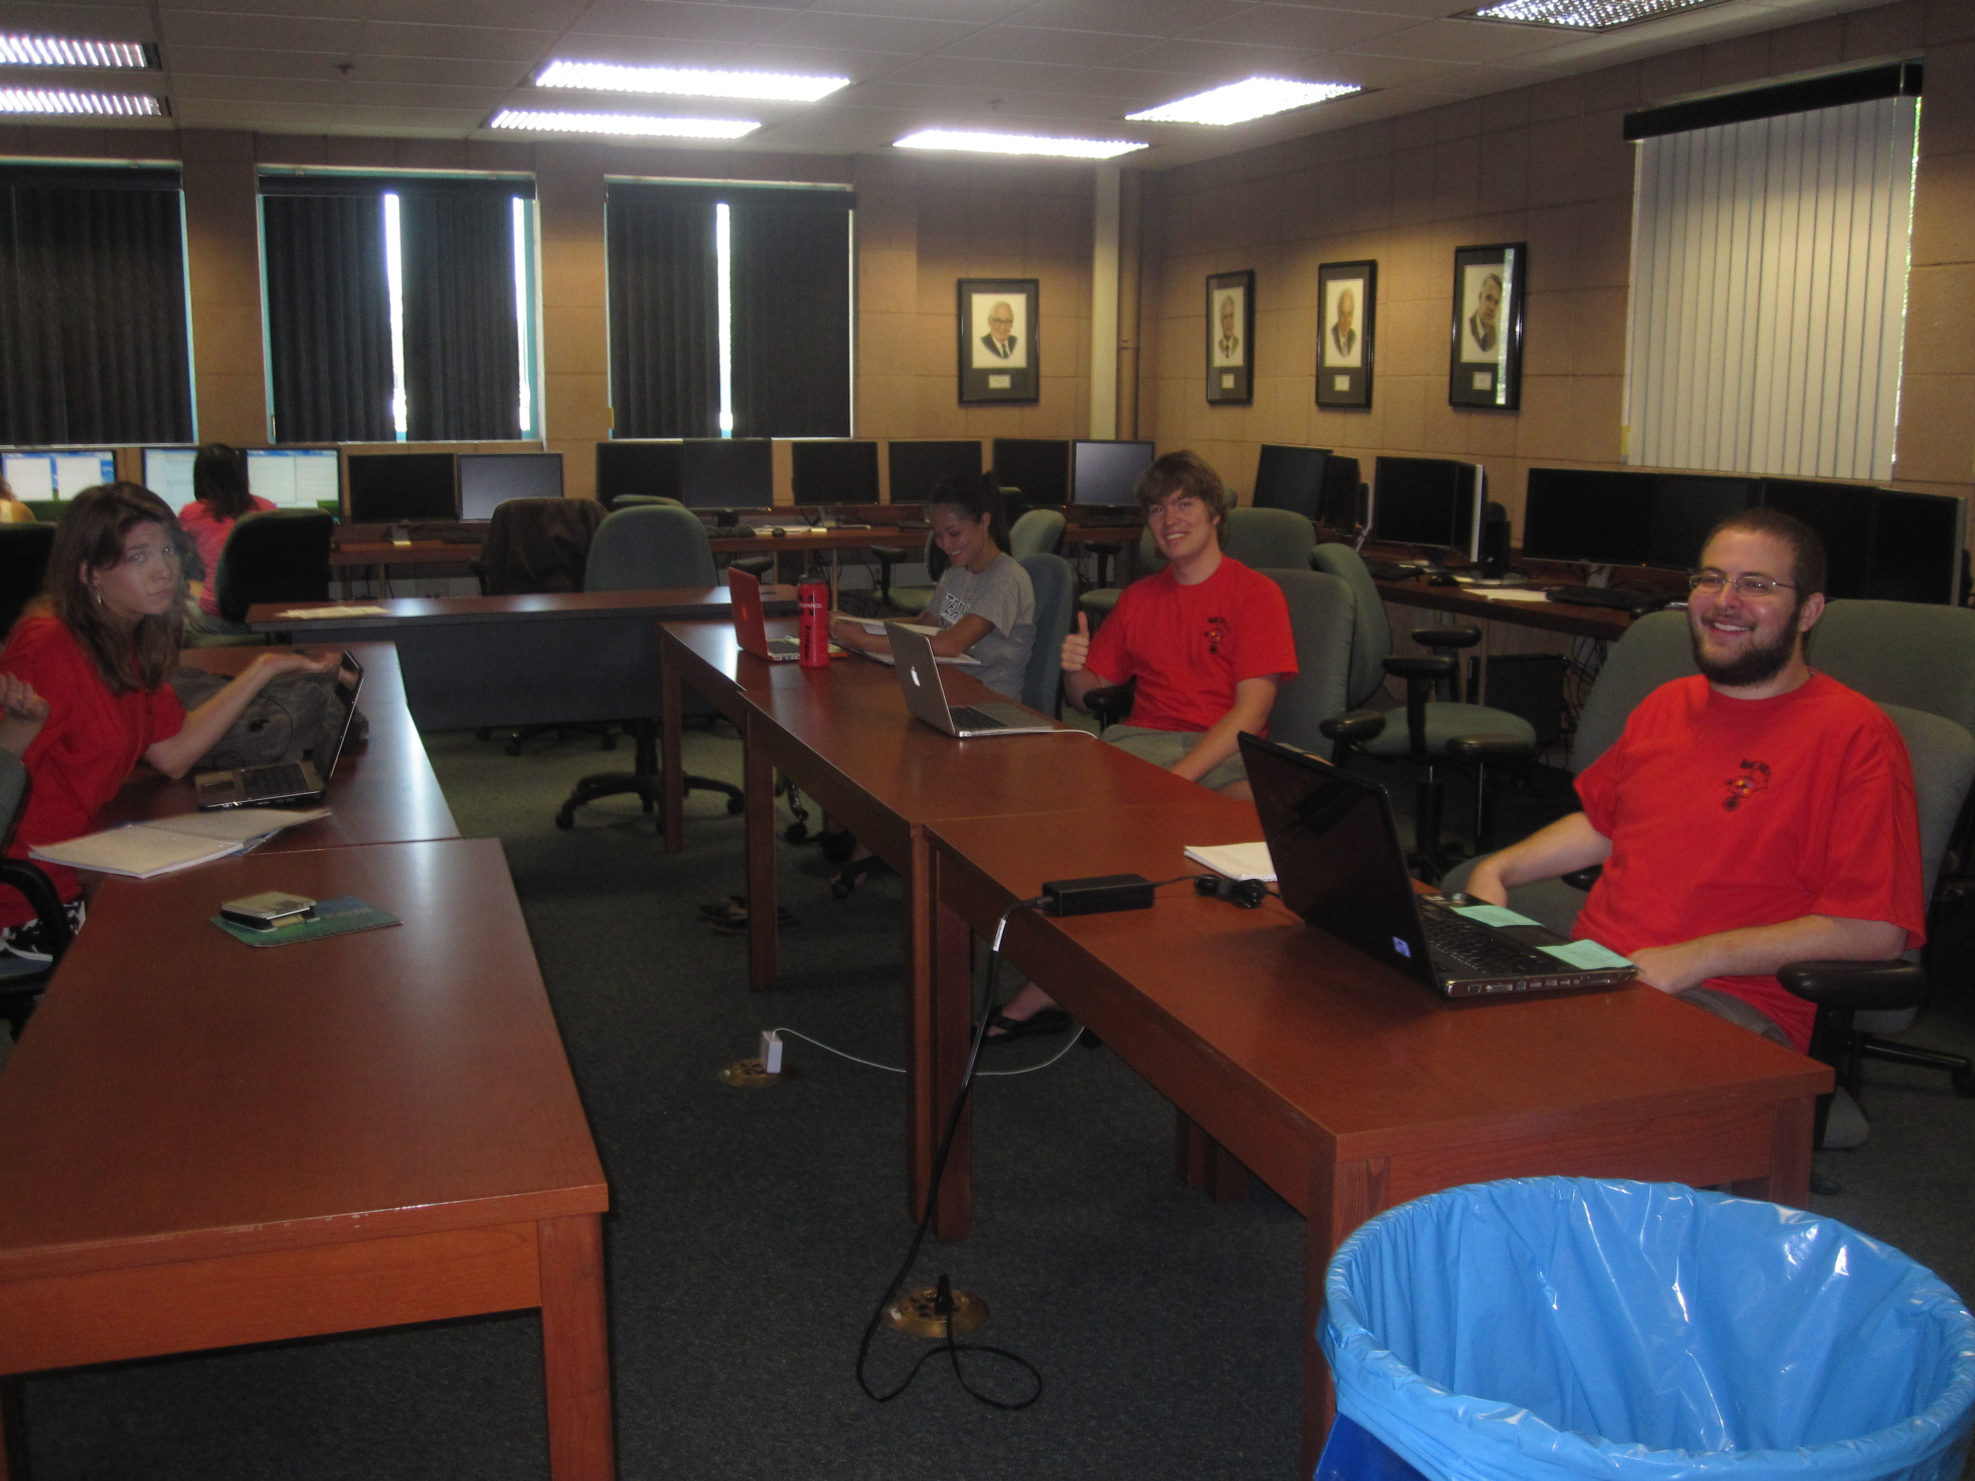
lonely on Friday afternoons... (not Monday evenings, however!)

Slide 132
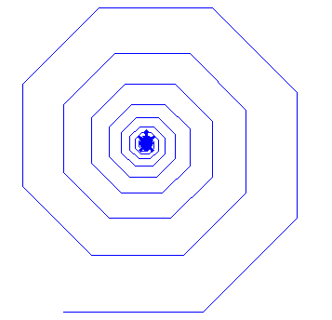
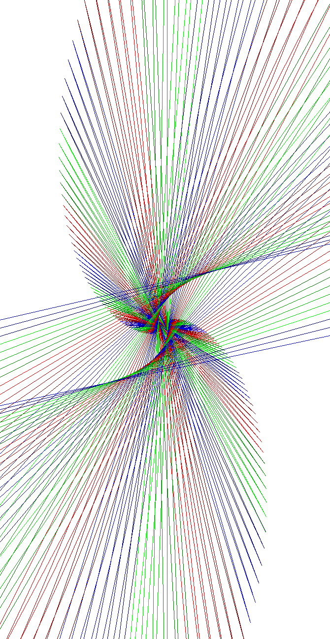

Spirals et al.
Jacob R.
Austin C.

Slide 133
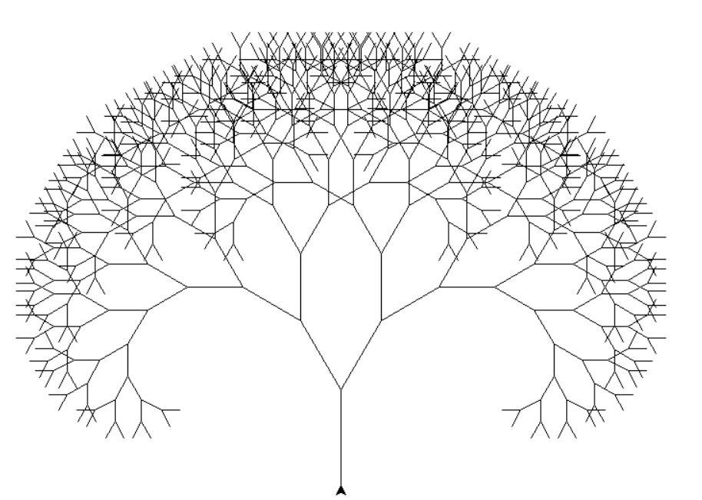
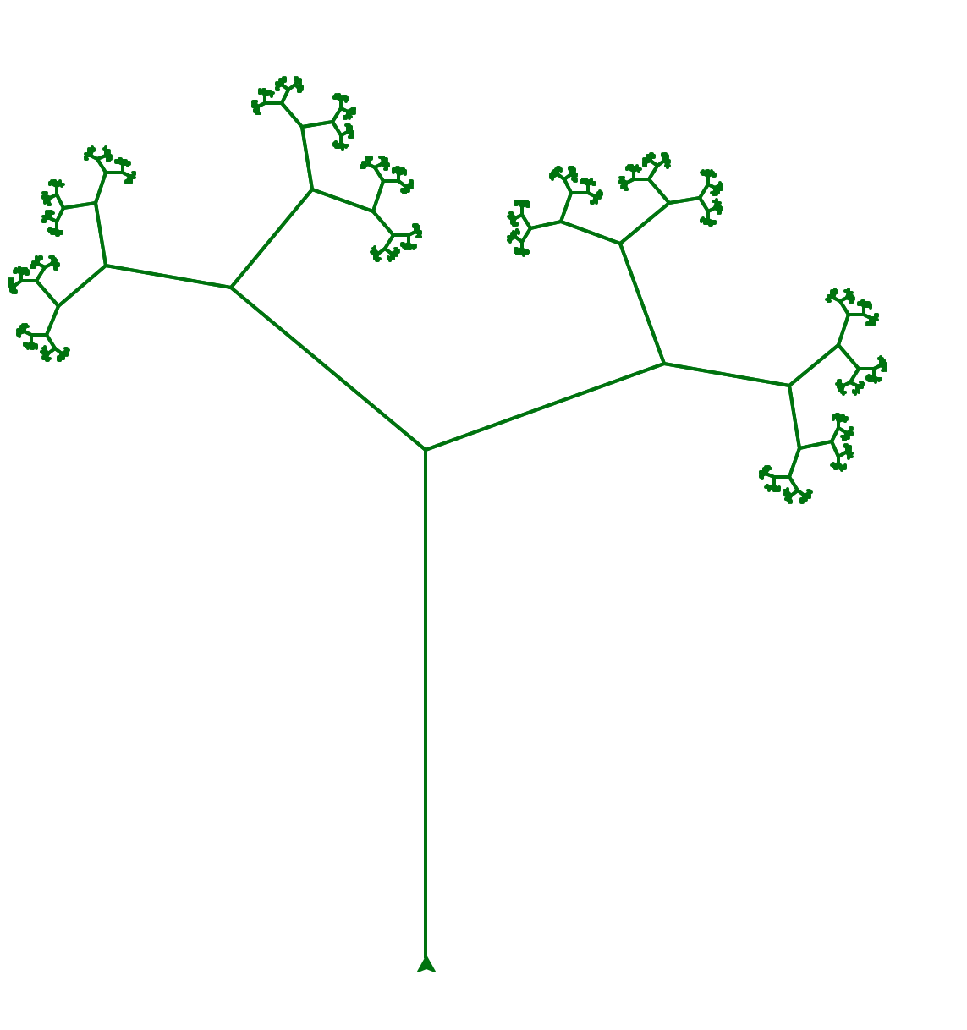
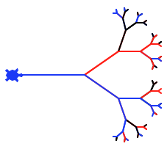
Trees
Errick Jackson
Katelyn B.

Slide 134
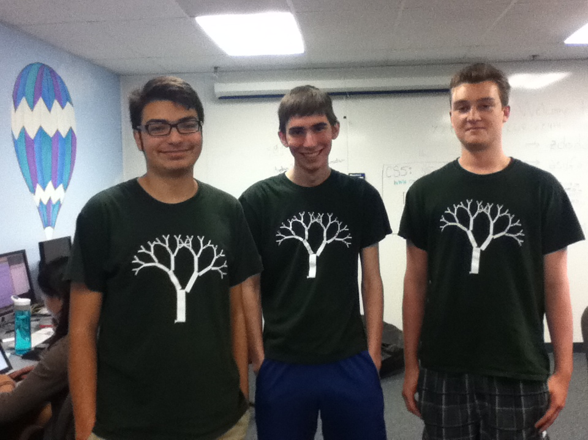
Trees

Slide 135
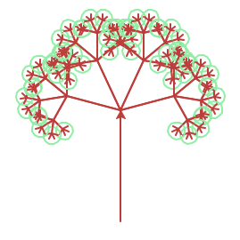

Trees
Marissa L.
and snowflakes…

Slide 136
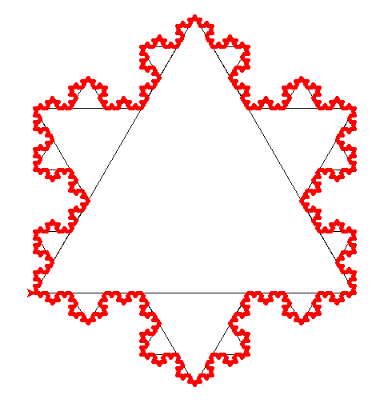
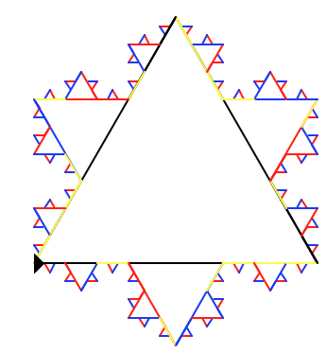
Kevin B.

Slide 137


Treeflakes?

Slide 138


Others… !
C. Hoyt
Annie Ludlow

Slide 139


Snowflake?
svtree?
It all depends on how you define success ...

Slide 140

treefail3.png
Snowflake?
svtree?
It all depends on how you define success ...

Slide 141

Snowflake?
svTree?
It all depends on how you define success ...
SNOWFLAKE?!

